Slide 1
Antibody-Drug Conjugates
Understanding the Current Paradigm and
New Approaches in the Care of Patients with Cancer
A Complimentary NCPD Hybrid Symposium Series Held During the 50th Annual ONS Congress
Wednesday, April 9, 2025
11:15 AM – 12:45 PM
Faculty
Marianne J Davies, DNP, ACNP, AOCNP, FAAN
Edward B Garon, MD, MS
Marissa Marti-Smith, DNP, APRN, AGNP-C, AOCNP
Tiffany A Traina, MD, FASCO
Moderator
Neil Love, MD

Slide 2




Faculty
Marianne J Davies, DNP, ACNP, AOCNP, FAAN
Program Manager, Care Signature
Oncology Service Line, Yale New Haven Health
Oncology Nurse Practitioner-Senior APP II
Yale Cancer Center
Smilow Cancer Hospital at Yale New Haven
Associate Professor
Yale University School of Nursing
New Haven, Connecticut
Edward B Garon, MD, MS
Professor
Director, Thoracic Oncology Program
Director, Signal Transduction and Therapeutics Research Program
David Geffen School of Medicine at UCLA
Jonsson Comprehensive Cancer Center
Los Angeles, California
Marissa Marti-Smith, DNP, APRN, AGNP-C, AOCNP
Nurse Practitioner
Texas Oncology-Baylor Charles A Sammons
Cancer Center
Dallas, Texas
Tiffany A Traina, MD, FASCO
Vice Chair, Department of Medicine
Section Head, Triple-Negative Breast Cancer Clinical Research Program
Associate Attending Physician
Breast Medicine Service
Memorial Sloan Kettering Cancer Center
Associate Professor
Weill Cornell Medical College
New York, New York

Slide 3
Ms Davies — Disclosures
No relevant conflicts of interest to disclose

Slide 4
Dr Garon — Disclosures
Advisory Committees and Consulting Agreements | AbbVie Inc, Arcus Biosciences, ArriVent Biopharma, AstraZeneca Pharmaceuticals LP, Atreca, Black Diamond Therapeutics Inc, BridgeBio, Bristol Myers Squibb, EMD Serono Inc, Gilead Sciences Inc, Hookipa Pharma Inc, I-Mab Biopharma, LianBio, Lilly, Merck, Merus, Novartis, Nuvalent, Pfizer Inc, Regeneron Pharmaceuticals Inc, Sanofi, Seagen Inc, Sensei Biotherapeutics, Strata Oncology, Sumitomo Dainippon Pharma Oncology Inc, Summit Therapeutics, Synthekine
Contracted Research | ABL Bio, ArriVent Biopharma, AstraZeneca Pharmaceuticals LP, BridgeBio, Bristol Myers Squibb, Daiichi Sankyo Inc, EMD Serono Inc, Genentech, a member of the Roche Group, Gilead Sciences Inc, Iovance Biotherapeutics, Lilly, Merck, Mirati Therapeutics Inc, Novartis, Prelude Therapeutics, Regeneron Pharmaceuticals Inc, Synthekine, TILT Biotherapeutics
Sponsored Independent Medical Education | Daiichi Sankyo Inc
Travel | A2 Bio, Novartis

Slide 5
Ms Marti-Smith — Disclosures
Speakers Bureaus | Biotheranostics Inc, Stemline Therapeutics Inc
Nonrelevant Financial Relationships | ASCO Advantage, Clinical Education Alliance

Slide 6
Dr Traina — Disclosures
Advisory Committees and Consulting Agreements | Aktis Oncology, AstraZeneca Pharmaceuticals LP, BioNTech SE, Daiichi Sankyo Inc, Ellipses Pharma, Exact Sciences Corporation, Genentech, a member of the Roche Group, Gilead Sciences Inc, GSK, Merck, Pfizer Inc, Stemline Therapeutics Inc, TerSera Therapeutics LLC, Veracyte Inc
Contracted Research | Astellas, AstraZeneca Pharmaceuticals LP, BioNTech SE, Daiichi Sankyo Inc, Genentech, a member of the Roche Group, Pfizer Inc

Slide 7
Commercial Support
This activity is supported by educational grants from AstraZeneca Pharmaceuticals LP and Daiichi Sankyo Inc.
Research To Practice NCPD Planning Committee Members,
Staff and Reviewers
Planners, scientific staff and independent reviewers for Research To Practice have no relevant conflicts of interest to disclose.

Slide 8
This educational activity contains discussion of
non-FDA-approved uses of agents and regimens. Please refer to official prescribing information for each product for approved indications.

Slide 9
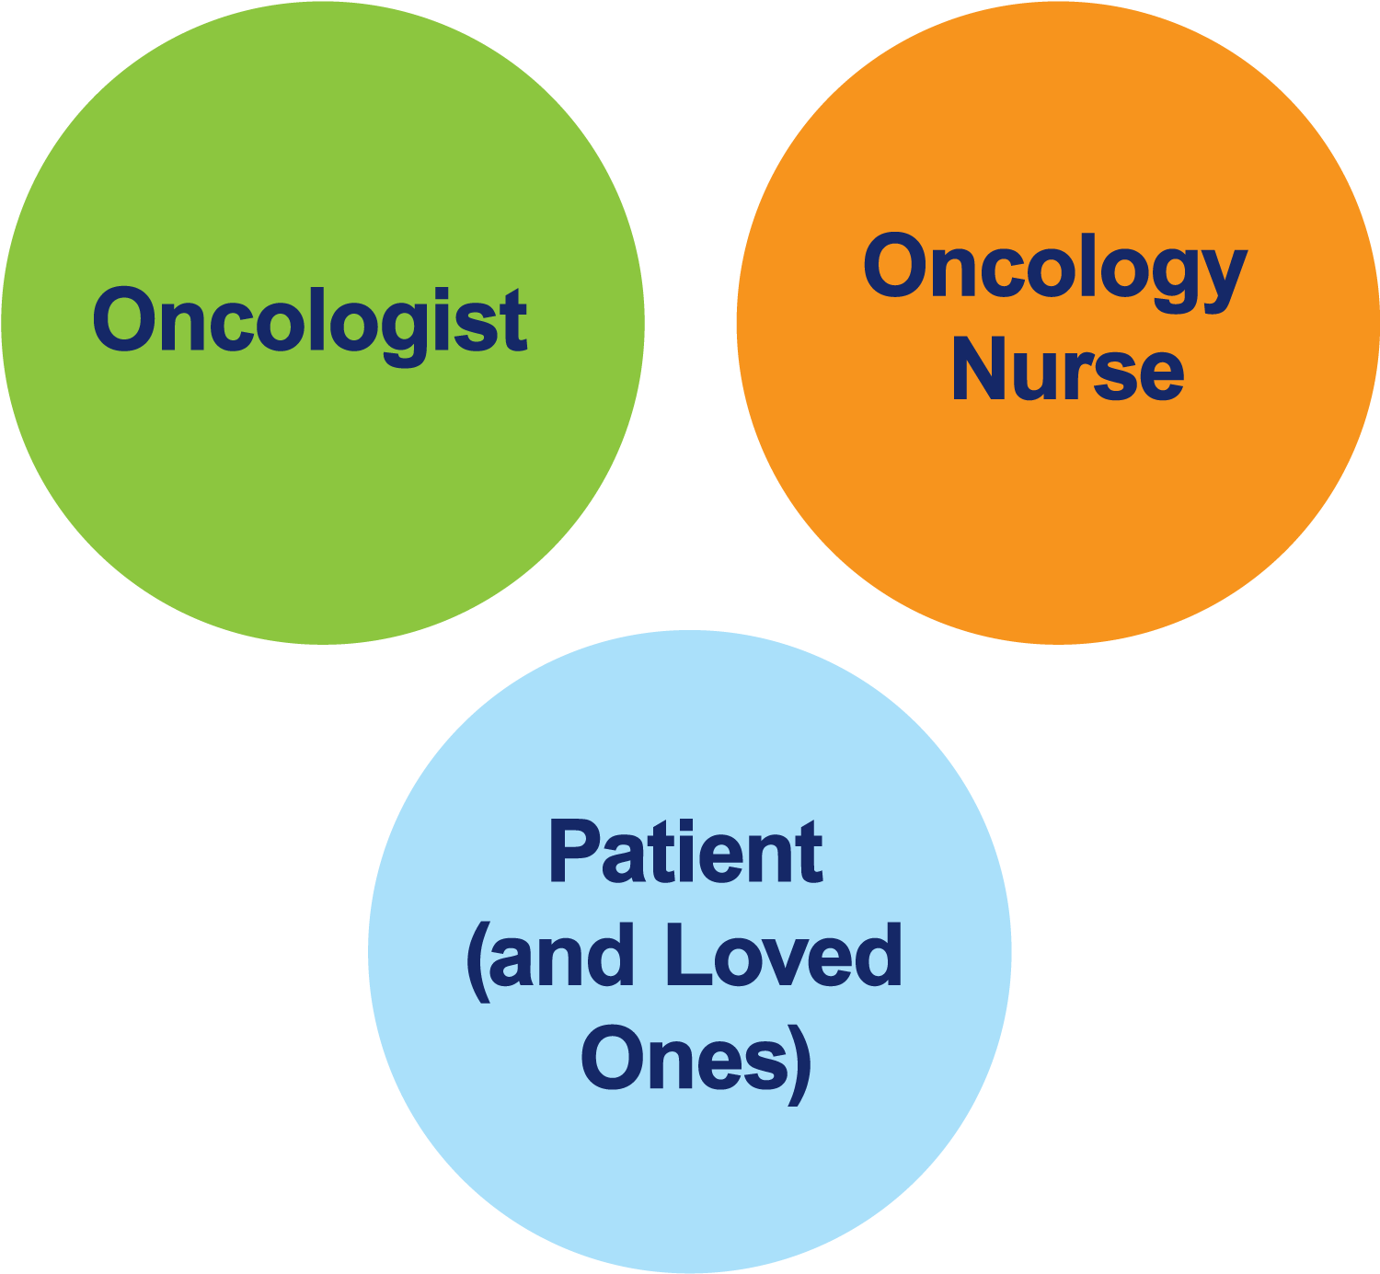
The Core Oncology Triad
Developing an Individualized Oncology Strategy

Slide 10
Understanding the Current Paradigm and New Approaches
Denver, Colorado
Symposia Themes
Personalized oncology: Implementing an individualized oncologic strategy
Tumor factors (eg, biomarkers, numeracy)
Biopsychosocial factors (eg, adherence, available family support, comorbidities, mood)
Novel agents and treatment strategies
The new-agents revolution (beginning of the end?)
The bond that heals (both ways)
Notes:
10
10
10
10
10

Slide 11
How was it different to take care of this patient
versus another patient in the same oncologic setting?
What unique biopsychosocial factors (eg, attitude, comorbidities, social support) were considered
in the overall management of this case?

Slide 12
Agenda
Module 1: Overview of Antibody-Drug Conjugates (ADCs)
Module 2: Trastuzumab Deruxtecan (T-DXd) in Patients with HER2-Positive Metastatic Breast Cancer (mBC) with and without Brain Metastases
Module 3: Role of ADCs for Patients with ER-Positive mBC
Module 4: T-DXd in Patients with Metastatic Non-Small Cell Lung Cancer (NSCLC) with HER2 Alterations
Module 5: Emerging Role of ADCs for Patients with Progressive EGFR-Mutant NSCLC

Slide 13
Agenda
Module 1: Overview of Antibody-Drug Conjugates (ADCs)
Module 2: Trastuzumab Deruxtecan (T-DXd) in Patients with HER2-Positive Metastatic Breast Cancer (mBC) with and without Brain Metastases
Module 3: Role of ADCs for Patients with ER-Positive mBC
Module 4: T-DXd in Patients with Metastatic Non-Small Cell Lung Cancer (NSCLC) with HER2 Alterations
Module 5: Emerging Role of ADCs for Patients with Progressive EGFR-Mutant NSCLC

Slide 14
Mechanism of ADCs: Multi-step Process
Teaching Point
Antibody-Drug Conjugate
Antibody
Antibody
Bystander effects
Cytotoxic payload
Cytotoxic payload
Linker
Cancer
cell
Linker
Targeted drug
delivery
ADC Components
Antibody specific for target antigen on cancer cells
High-potency cytotoxic payload
Cleavable or non-cleavable linker between antibody and payload
Cancer
cell
Effector cell
Apoptosis
Courtesy of Marianne J Davies, DNP, ACNP, AOCNP, FAAN
Notes:
Payload: Microtubule inhibitors: disrupt the cell’s ability to divide, leading to apoptosis (cell death)
Antigen: high expression on tumor cells; low or no expression onf healthy tissues
Antibody: high affinity for the antigen; either chimeric or humanized.
Target recognition: the monoclonal antibody component of the ADC specifically recognizes and binds to a target antigen. In this case it is the HER2 receptor; this selective binding ensures that the ADC delivers the cytotoxic drug to the cancer cell, minimizing “off target” effects on healthy tissues
Internalization: once th ADC binds to the target antigen, the entire complex is internalized into the cancer cell.
3. Release of the cytotoxic payload: : inside the cancer cell, the ADC is trafficked to a special compartment in the cell where enzymes degrade the ADC and cytotoxic drug is released.
Cell Death (cytotoxicity): once it is released, the cytotoxic payload exerts its lethal effect on the cancer cell. Leading to cell death.
Microtubule inhibitors: disrupt the cancer cells ability to divide, leading to apoptosis
DNA damaging agenets: directly damage the DNA of the cancer cels, preventing replication and triggering cell death.
This targeted approach helpt to ensure the cytotoxic effect is localized.

Slide 15
Current Approved ADCs in Oncology
Name | Year approved | Tumor type
Trastuzumab emtansine (T-DM1) | Adjuvant: 2019 Metastatic: 2013 | Breast
Sacituzumab govitecan | HR-positive: 2023 Triple-negative: 2021 (Traditional) Triple-negative: 2020 (Accelerated) | Breast
Datopotamab deruxtecan | 2025 | Breast
Trastuzumab deruxtecan | 2025 2024 2022 2022 2021 2019 (Accelerated) 2022 (Traditional) | HER2-low/ultralow breast HER2-positive solid tumors HER2-mutant lung HER2-low breast HER2-positive gastric HER2-positive mBC
https://www.fda.gov/drugs/resources-information-approved-drugs/oncology-cancer-hematologic-malignancies-approval-notifications

Slide 16
Current Approved ADCs in Oncology (Continued)
Name | Year approved | Tumor type
Mirvetuximab soravtansine | 2024 (Traditional) 2022 (Accelerated) | Ovarian
Tisotumab vedotin | 2021 | Cervical
Enfortumab vedotin (monotherapy) | 2021 (Traditional) 2019 (Accelerated) | Urothelial
Enfortumab vedotin (with pembrolizumab) | 2023 (Accelerated/Traditional) | Urothelial
Gemtuzumab ozogamicin | 2017 (Traditional) 2000 (Accelerated) | AML
Brentuximab vedotin | 2025 (Traditional) 2015 (Traditional) 2011 (Accelerated) | DLBCL Hodgkin lymphoma
Inotuzumab ozogamicin | 2017 | ALL
Polatuzumab vedotin | 2023 (Traditional) 2019 (Accelerated) | DLBCL
Loncastuximab tesirine | 2021 | LBCL
https://www.fda.gov/drugs/resources-information-approved-drugs/oncology-cancer-hematologic-malignancies-approval-notifications

Slide 17
Select Promising Investigational ADCs in Oncology
Name | Biological target | Tumor types under investigation
Ifinatamab Deruxtecan | B7-H3 | SCLC, ESCC, CRPC, NSCLC
Raludotatug Deruxtecan | CDH6 | Ovarian, RCC
Patritumab Deruxtecan | HER3 | Breast, NSCLC, melanoma, SCCHN, gastric
Sacituzumab Tirumotecan | TROP2 | Breast, NSCLC, cervical, endometrial, gastric, BTCs, CRC, pancreatic, malignant neoplasms
Telisotuzumab Vedotin | c-Met | NSCLC
Disitamab Vedotin | HER2 | Bladder, breast, GI cancers

Slide 18
Agenda
Module 1: Overview of Antibody-Drug Conjugates (ADCs)
Module 2: Trastuzumab Deruxtecan (T-DXd) in Patients with HER2-Positive Metastatic Breast Cancer (mBC) with and without Brain Metastases
Module 3: Role of ADCs for Patients with ER-Positive mBC
Module 4: T-DXd in Patients with Metastatic Non-Small Cell Lung Cancer (NSCLC) with HER2 Alterations
Module 5: Emerging Role of ADCs for Patients with Progressive EGFR-Mutant NSCLC

Slide 19
Clinical Scenario
A patient with HER2-positive mBC experiences disease progression, including new brain metastases, on first-line THP (docetaxel/trastuzumab/pertuzumab) and is about to begin treatment with T-DXd

Slide 20
ADCs @ ONS
Tiffany A. Traina, MD FASCO
Associate Attending, Breast Medicine Service
Vice Chair, Department of Medicine
Section Head, TNBC Clinical Research Program
Memorial Sloan Kettering Cancer Center
Associate Professor, Weill Cornell Medicine

Slide 21
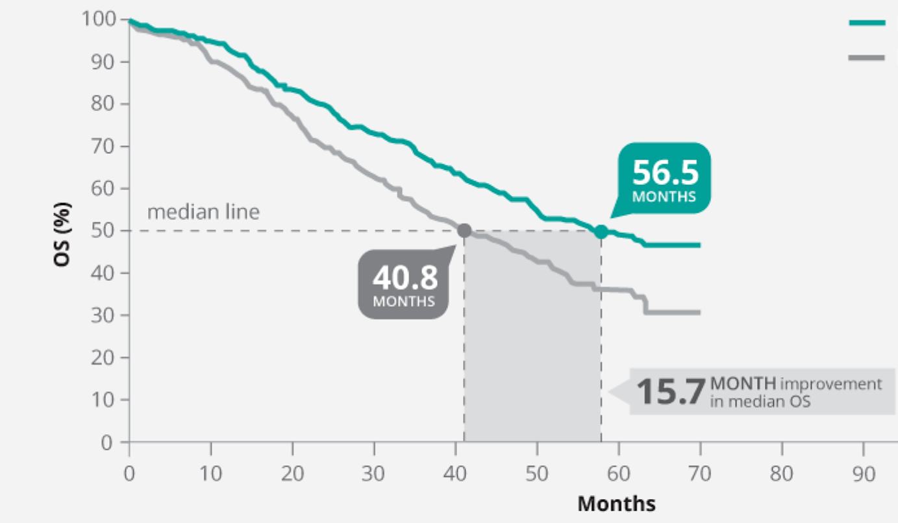
1L HER2+ MBC
THP is Standard of Care
Lingering Considerations
Often discontinue chemotherapy and continue maintenance HP
  Residual neuropathy from prolonged taxane
  High QoL with dual antibodies alone
Median Duration of Response ~ 2 years on 1L therapy
Significant ~16% absolute benefit in overall survival with docetaxel, trastuzumab and pertuzumab (“THP”)
Median OS 56.5mo vs. 40.8mo (HR 0.68, p=0.0002)
Swain et al 2020

Slide 22
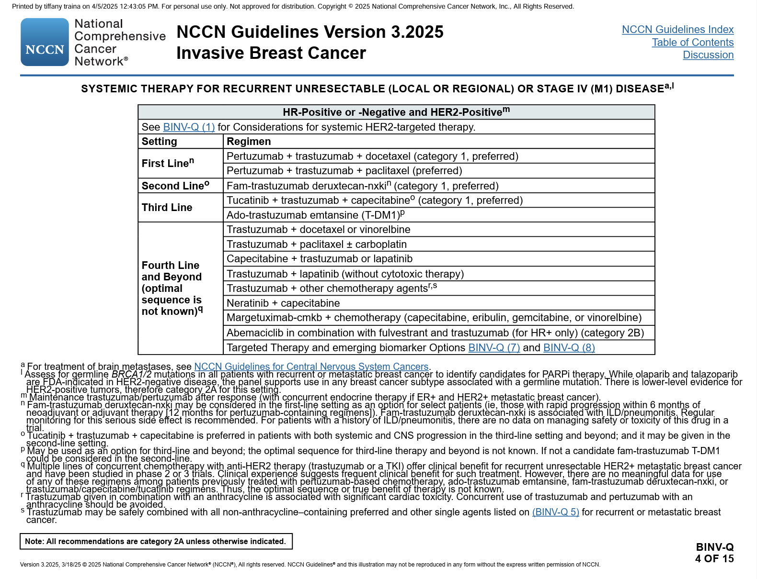
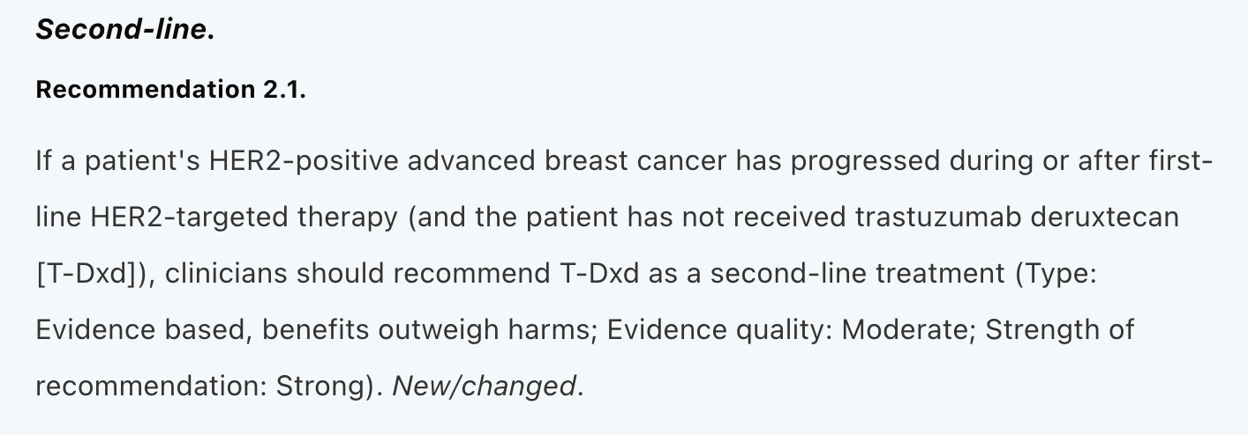
Guidelines support 2L T-DXd in HER2+ MBC
NCCN 3.2025
ASCO
NCCN Guidelines 3.2025; Giordano et al JCO 2022

Slide 23
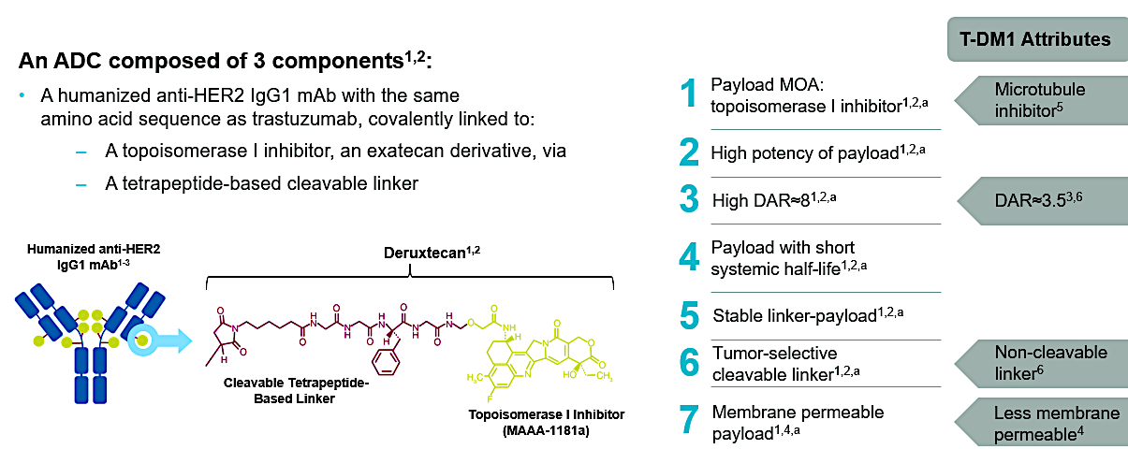
Trastuzumab Deruxtecan

Slide 24
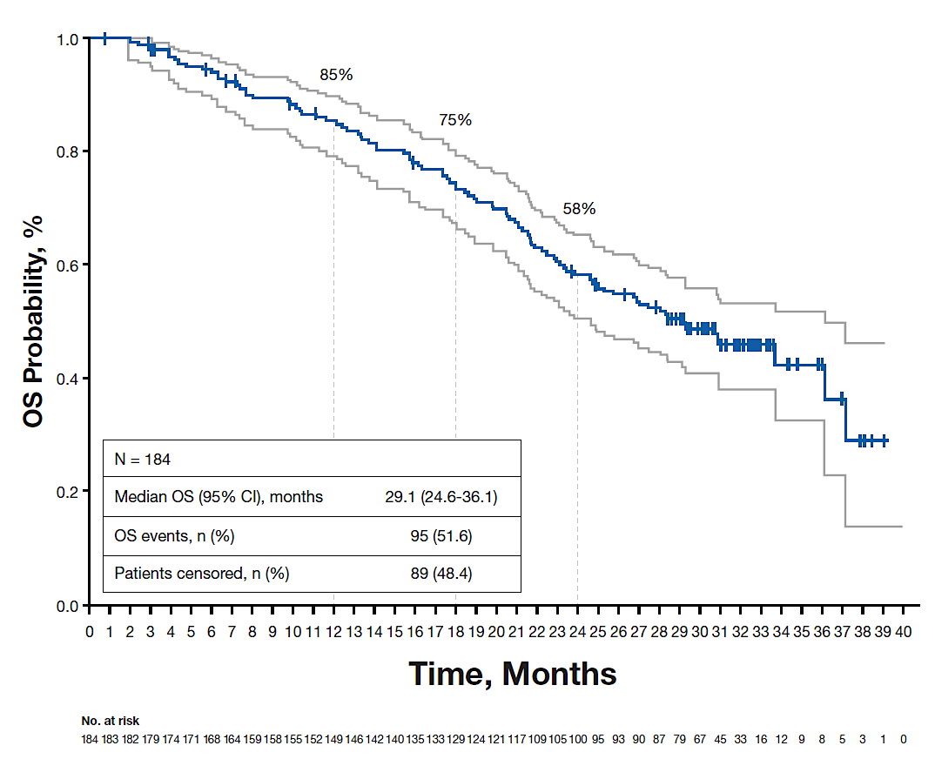
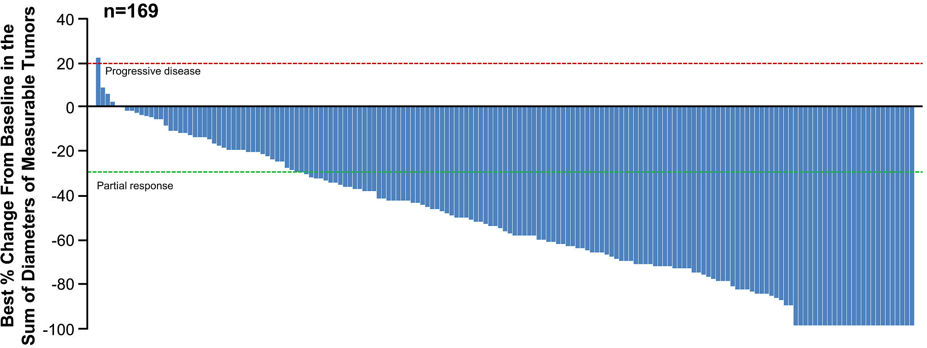
DESTINY-Breast01:
T-DXd is Highly Active in HER2+ MBC
Median Overall Survival = 29 months!
Best Percentage Change From Baseline in Tumor Size (by ICR)
Confirmed ORR: 62%
(95% CI, 54.5%–69.0%)
Modi et al Destiny Breast01; Saura C, et al. ESMO 2021. Abstract 279P; Saura C, et al.
Ann Oncol 2024 35(3):302-307.
Notes:
Adult patients with HER2+ unresectable and/or metastatic BC; prior T-DM1; ECOG PS 0/1; stable, treated brain metastases allowed; history of significant ILD excluded

Slide 25
DESTINY-Breast03: Phase 3 RCT
Patients
Unresectable or metastatic HER2-positiveª breast cancer
Previously treated with trastuzumab and taxane in advanced/metastatic setting^{b}
Could have clinically stable, treated brain metastases
Stratification factors
Hormone receptor status
Prior treatment with pertuzumab
History of visceral disease
Primary endpoint
PFS (BICR)
Key secondary endpoint
OS
Secondary endpoints
ORR (BICR and investigator)
DOR (BICR)
PFS (investigator)
Safety
T-DXd
5.4 mg/kg Q3W
(n = 261)
R
1:1
T-DM1
3.6 mg/kg Q3W
(n = 263)
Key Characteristics:
100% received prior trastuzumab
60% received prior pertuzumab
16% received HER2 TKI
50% were treated in the 2L setting, ~50% were 3L+
22% had brain metastases
Cortes, J et al. ESMO 2021
ªHER2 IHC3+ or IHC2+/ISH+ based on central confirmation. ^{b}Progression during or <6 months after completing adjuvant therapy involving trastuzumab and taxane

Slide 26
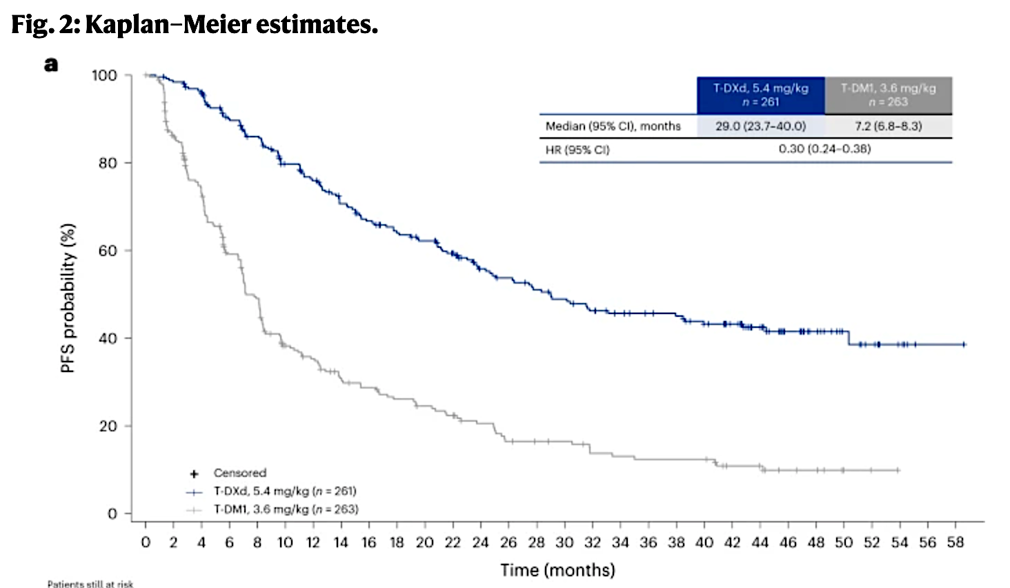
DESTINY-Breast03: Primary Endpoint - PFS
Median OS was 52.6 months (95% CI, 48.7 months to NE) with T-DXd vs. 42.7 months (95% CI, 35.4 months to NE) with T-DM1
(HR, 0.73; 95% CI, 0.56–0.94)
Cortes et al Nature Medicine June 2024; Hamilton et al. ASCO 2024;Abstract 1025.
Cortes, J et al. ESMO 2021
Notes:
@ what cost/consideration

Slide 27
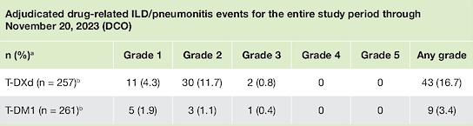
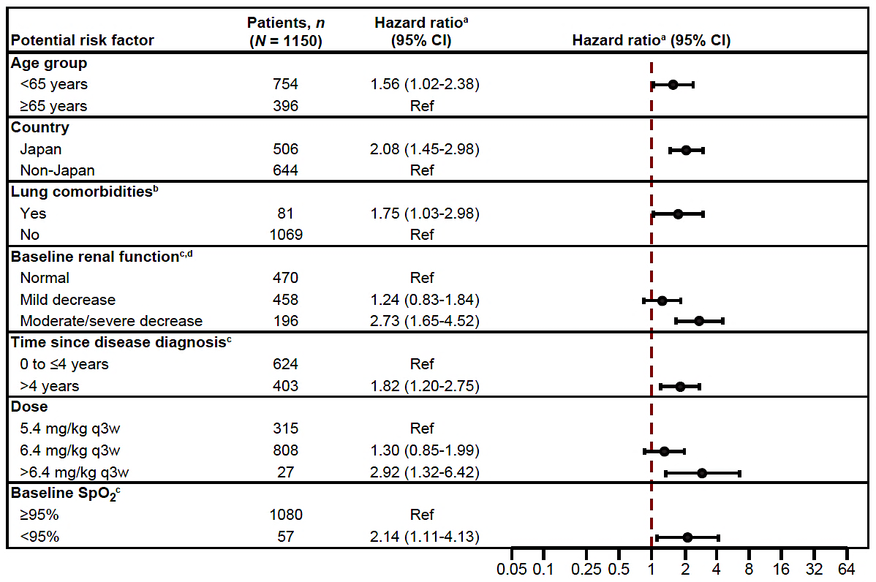
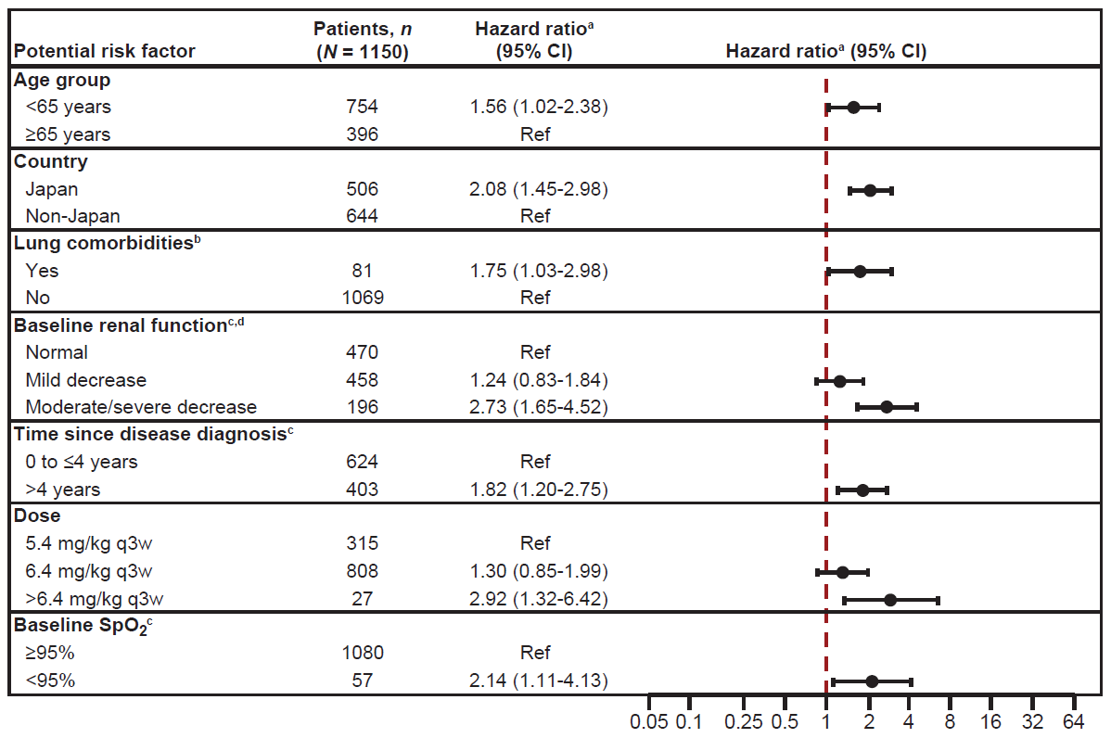
T-DXd Toxicity Considerations
>Gr 3
Nausea: 7% (all grade 77%)
Vomiting 2% (all grade 52%)
Thrombocytopenia 8% (25%)
Alopecia <1% (40%)
Don’t forget cardiac monitoring
Treatment related discontinuation for
T-DXd 20% vs T-DM1 6.5%
Median duration of treatment was
18.2 mo. vs. 6.9 mo
Hurvitz et al Lancet 2023; Powell et al ESMO Open 2022; Hamilton et al.
ASCO 2024;Abstract 1025.
Notes:
Talk about RC who wouldn’t start bc of alopecia and IV

Slide 28
Brain metastases: unmet need
17 studies with 5,971 patients reported a pooled cumulative incidence of brain metastases of 31% over a median follow-up of approximately 31 months.
Flatiron Health database ~17,000 patients: by 4L therapy the incidence of brain metastases is:​
  HR-/HER2+: 37.1%​
  HR+/HER2+: 26.1%
Median Overall Survival when diagnosed with breast cancer brain metastases (BCBM) ~ 6- 15 mo
Important considerations include symptom management, palliative goals, loss of function and independence, impact of local therapies (ie, RT), social supports, proxy designation
Kuksis et al Neuro Oncol 2020; Sammons et al SABCS 2023; Raghavendra et al JCO OP May 2024

Slide 29
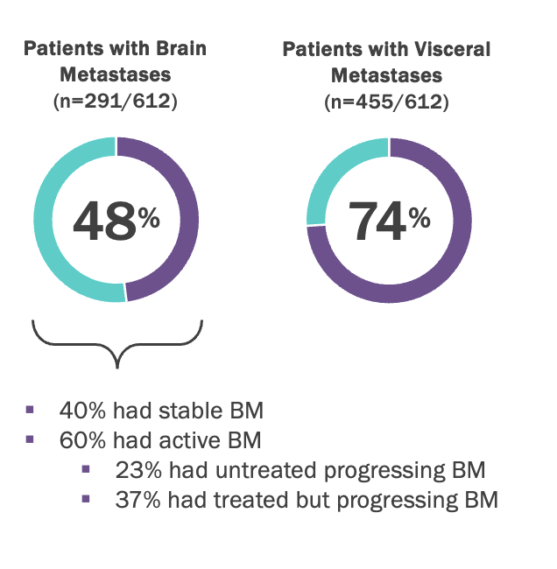
HER2CLIMB: Tucatinib, Trastuzumab and Capecitabine
Tucatinib is an oral, HER2 selective kinase inhibitor
Key characteristics:
All had prior trastuzumab, pertuzumab, T-DM1
75% had visceral disease
Brain metastases enrollment robust…
Murthy RK, et al. N Engl J Med. 2020;382:597-609.

Slide 30
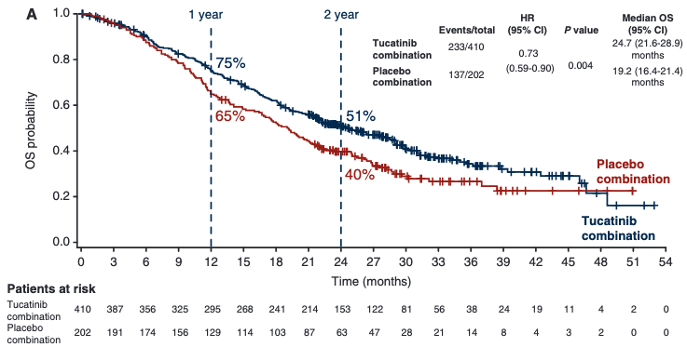
HER2CLIMB:
PFS and OS in Overall Population
Indication - “...metastatic HER2-positive breast cancer, including patients with brain metastases, who have received one or more prior anti-HER2-based regimens in the metastatic setting”.
Progression-Free Survival by BICR (N=480)
Overall Survival (N=612)
Murthy RK, et al. N Engl J Med. 2020;382:597-609; Curigliano G et al. Ann Oncol 2022;33(3):321-29.

Slide 31
HER2CLIMB:
Key Safety Event is Diarrhea
Most common AE in both arms (82% tucatinib arm vs 54% control arm);
Grade ≥3: 13% vs 9%
The median time to onset of any grade diarrhea was 12 days, and the median time to resolution was 8 days
Treatment discontinuation of tucatinib due to diarrhea occurred in 1%
of patients
Antidiarrheal prophylaxis:
  Antidiarrheals used in less than half of all cycles where diarrhea was reported
  When used, duration of antidiarrheal treatment was short (median of 3 days/cycle) and the same in both arms

Slide 32
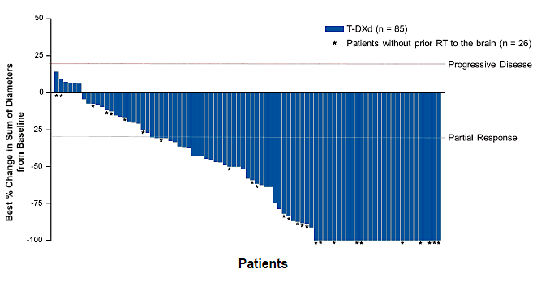

DESTINY-Breast01, -02, and -03 Pooled Analysis:
T-DXd in HER2+ MBC With Brain Metastases
T-DXd
Comparator
T-DXd (n=85)
T-DM1 (n=27)
Trastuzumab/capecitabine (n=13)
Lapatinib/capecitabine (n=16)
* Patients without prior RT to the brain (n=26)
* Patients without prior RT to the brain (n=18)
For patients with measurable brain lesion(s) at baseline and at least 1 postbaseline assessment.
Hurvitz SA, et al. ESMO 2023. Abstract 377O; Andes F Ann Oncol 2024;35(12):1169-80.

Slide 33
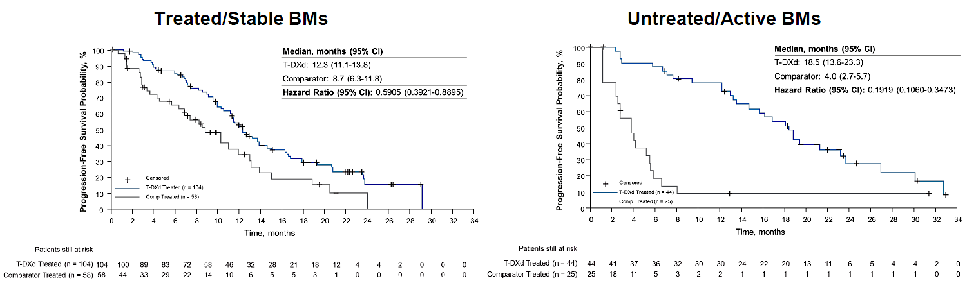
DESTINY-Breast01, -02, and -03 Pooled Analysis
Exploratory CNS-PFS
CNS-PFS in Treated/Stable BMs
CNS-PFS in Untreated/Active BMs
+
Censored
T-DXd Treated (n=104)
Comp Treated (n=58)
+
Censored
T-DXd Treated (n=44)
Comp Treated (n=25)
Treated/Stable BMs | T-DXd (n=104) | Comparator (n=58)
Median CNS-PFS, mo (95% CI) | 12.3 (11.1-13.8) | 8.7 (6.3-11.8)
HR (95% CI) | 0.59 (0.39-0.89)
Untreated/Active BMs | T-DXd (n=44) | Comparator (n=25)
Median CNS-PFS, mo (95% CI) | 18.5 (13.6-23.3) | 4.0 (2.7-5.7)
HR (95% CI) | 0.19 (0.11-0.35)
Treated/stable BMs: Patients have received prior CNS-directed therapy for their BMs, and their CNS disease is stable
Untreated/active BMs: Patients have new BMs or progressive BMs that have not been subjected to CNS-directed therapy since documented progression
Hurvitz SA, et al. ESMO 2023. Abstract 377O; Andes F Ann Oncol 2024;35(12):1169-80.

Slide 34
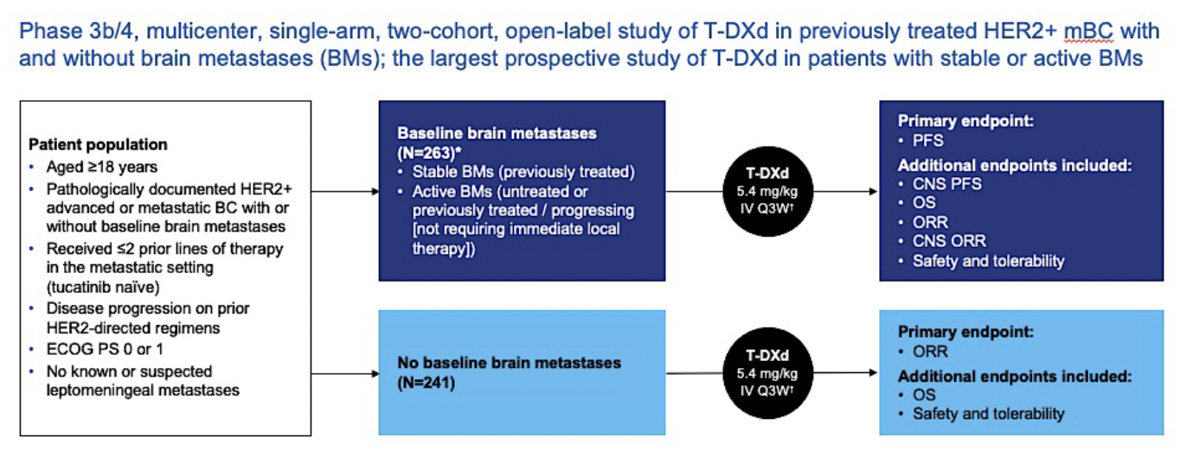
DESTINY-Breast12: T-DXd for HER2+ Brain Mets
Harbeck N et al. Nat Med 2024;30(12):3717-3727.

Slide 35
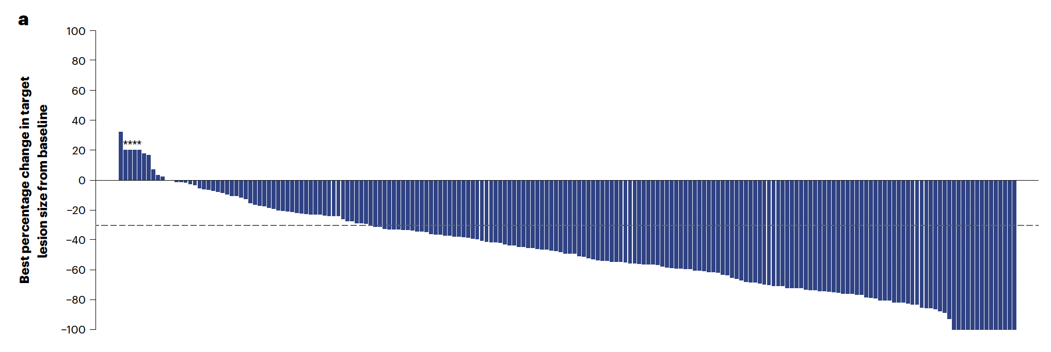
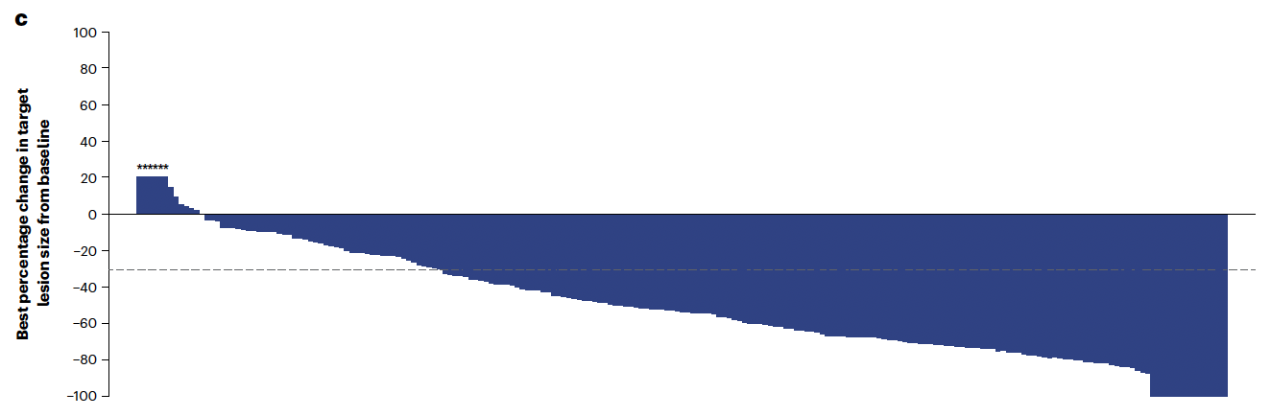
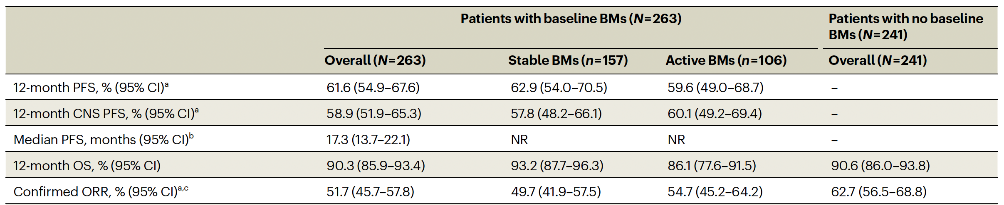
DESTINY-Breast12: T-DXd for HER2+ Brain Mets
With Baseline Brain Mets
No Baseline Brain Mets
Harbeck N et al. Nat Med 2024;30(12):3717-3727.

Slide 36
How do I choose in 2L?
Shared decision making
 | T-DXd | HER2Climb Regimen
PRO | Superiority in PFS/OS compared to prior 2L Standard of care Does have non-Ph 3 signs of activity in BCBM Convenient q3 week schedule | Impressive OS and activity in patients with BCBM and ITT All oral regimen No alopecia
CON | ILD risk is rare but non-trivial including Gr 5 events ~40% all grade alopecia with uncertain scalp cooling benefit IV therapy No randomized data for sequencing | Control arm not typical 2L SOC All oral regimen may be complicated for some Large pill burden Overlapping GI toxicity with cape and tucatinib Diarrhea No randomized data for sequencing

Slide 37
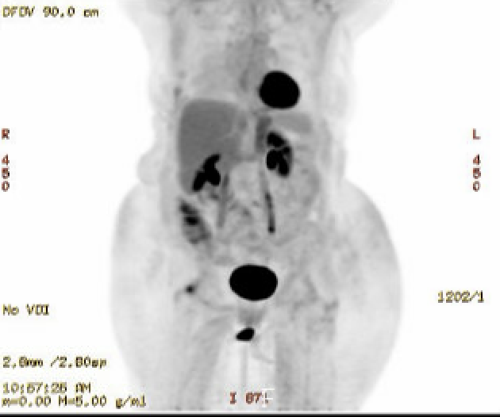
ER(-) HER2+ MBC
69 yo woman diagnosed with de novo MBC ER(-) HER2 3+ to brain, bone, liver in 3/2015
1L: weekly paclitaxel + HP x 6 mo with near CR → HP alone
3/2016 new brain lesions s/p WBXRT; continued HP
4/2024 LE weakness, spinal uptake on imaging, MRI concerning for LMD, LP cytology +
  T-DXd → improved MRI, cleared cytology, improved function but increasing fatigue/nausea
  Dose reduced x2 since
PET Feb 2025 NED

Slide 38
ER(-) HER2+ MBC
THP x4mo → HP + denosumab maintenance
NED by 8/2022
56 yo woman diagnosed with pT1N0 ER”+” HER2? in 2006. Declined therapy.
2008 Local recurrence s/p TM for ER+ HER2 3+ BC s/p ddAC-TH → Tam until self d/c in 2011
2012 Local rec s/p excision → OS/letrozole/H → pt self d/c’d 2012
Reestablished care 2013 and resumed letrozole
2019 Diagnosed with cervical cancer s/p Cis/RT
3/2022 CT CAP for cervical ca = liver & bone lesions
  Liver Bx metastatic breast ca ER+ HER2 3+
6/2023 POD in oligo bone
RT to humerus
8/2023 POD in bone and liver
Started T-DXd
8/2023 POD in bone and liver
Started T-DXd
Excellent response
1/2025 Inc SOB/dry cough
GGO, Pulm, Steroids
Holding T-DXd for ?ILD

Slide 39
Roundtable Discussion

Slide 40
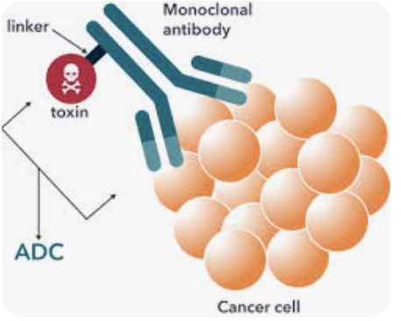
Antibody-Drug Conjugates
Marissa Marti-Smith
DNP, APRN, AGNP-C, AOCNP
Breast Oncology
Nurse Practitioner

Slide 41
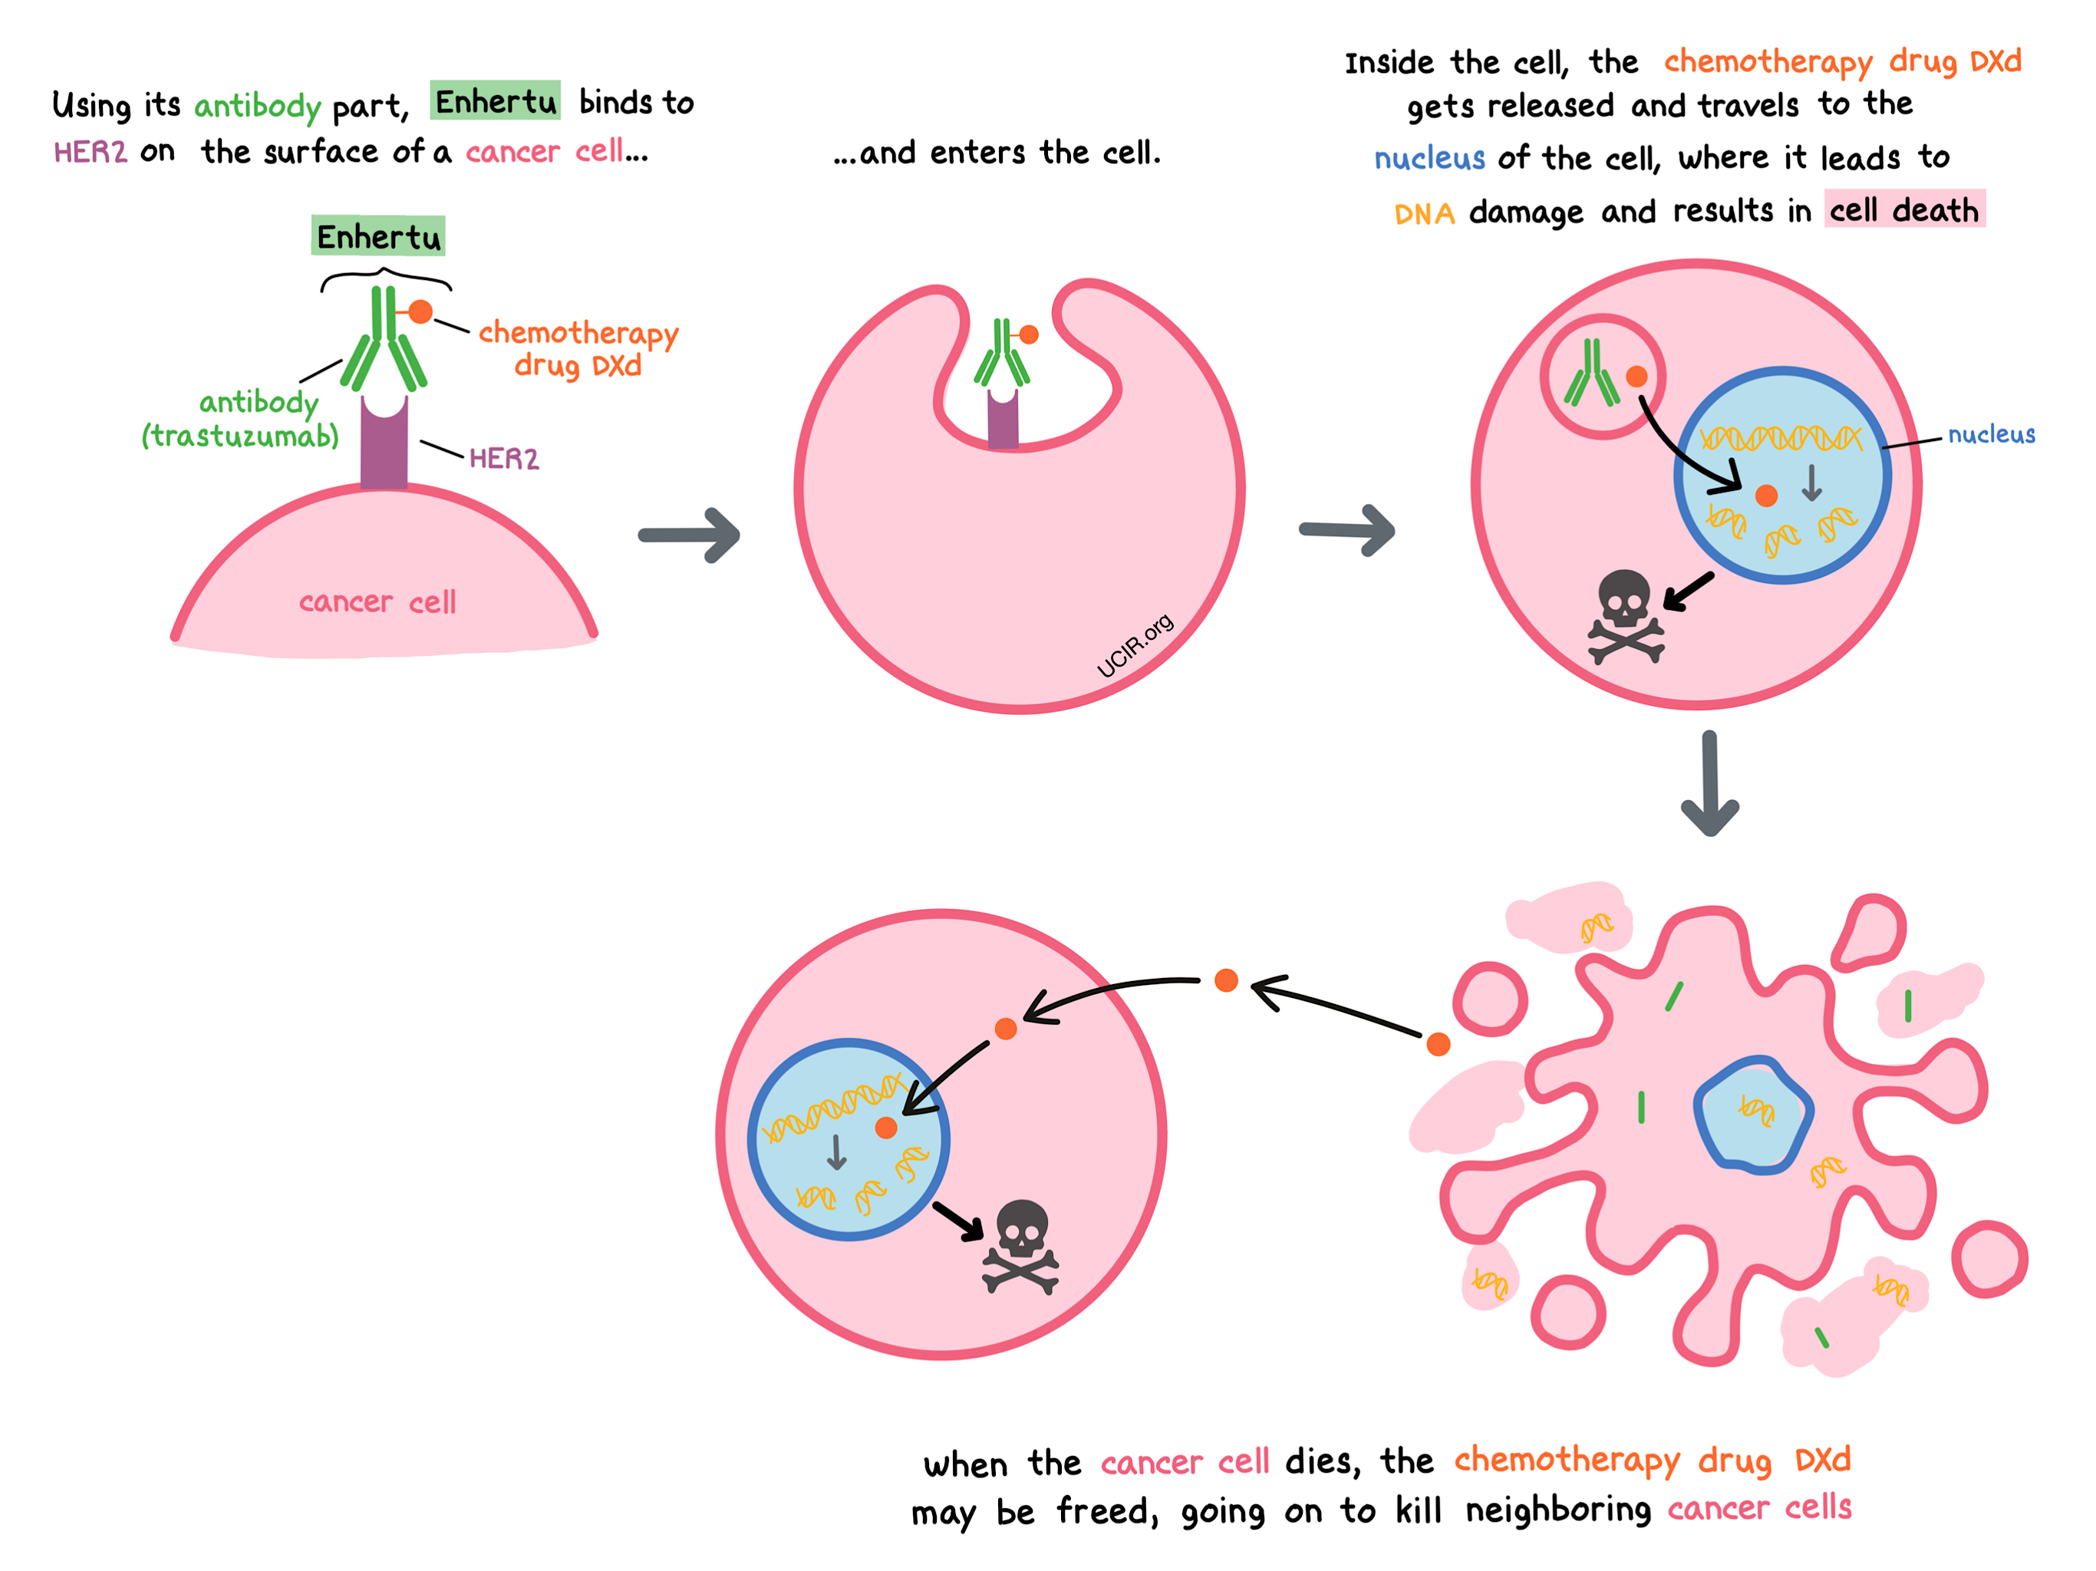
T-DXd (Trastuzumab deruxtecan)
T-DXd
T-DXd
https://www.ucir.org/immunotherapy-drugs/fam-trastuzumab-deruxtecan-nxki-enhertu

Slide 42

Patient Education
Her2+ target
Guided missile analogy
  Target > deliver > destroy
  Her2 antibody > linker > Deruxtecan
  Bystander antitumor effect
Positive data on longer PFS
(Rugo et al, 2023)

Slide 43

T-DXd toxicity monitoring
ILD
  Baseline O2 sats
  HRCT every 12 weeks
  (if higher risk q6-9 weeks)
  Consider PFTs
  Higher risk pts
    Pts with lower O2 levels
    Japanese ancestry
    Poor renal function
    Decreased lung function as baseline
(Rugo et al, 2023)

Slide 44
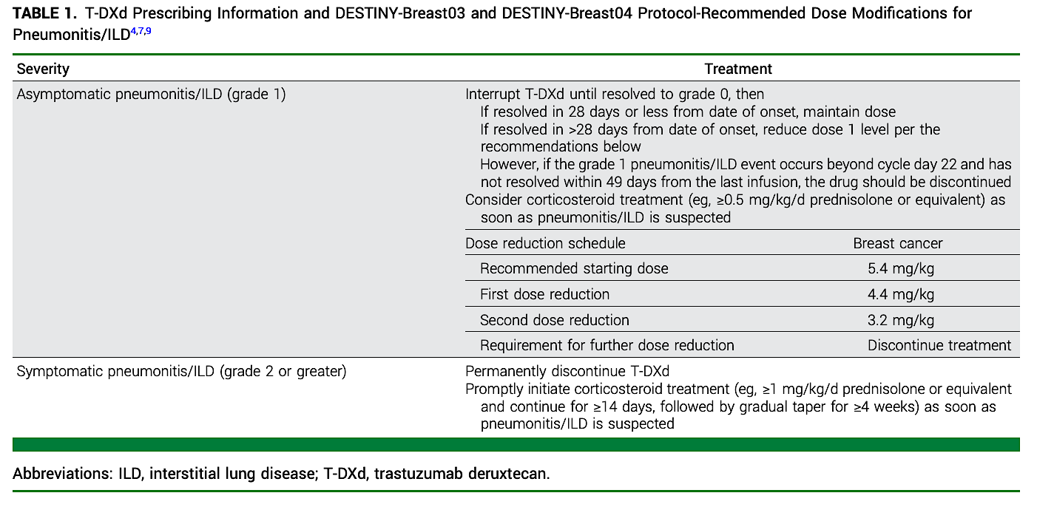
Management of ILD
(Rugo et al, 2023)

Slide 45
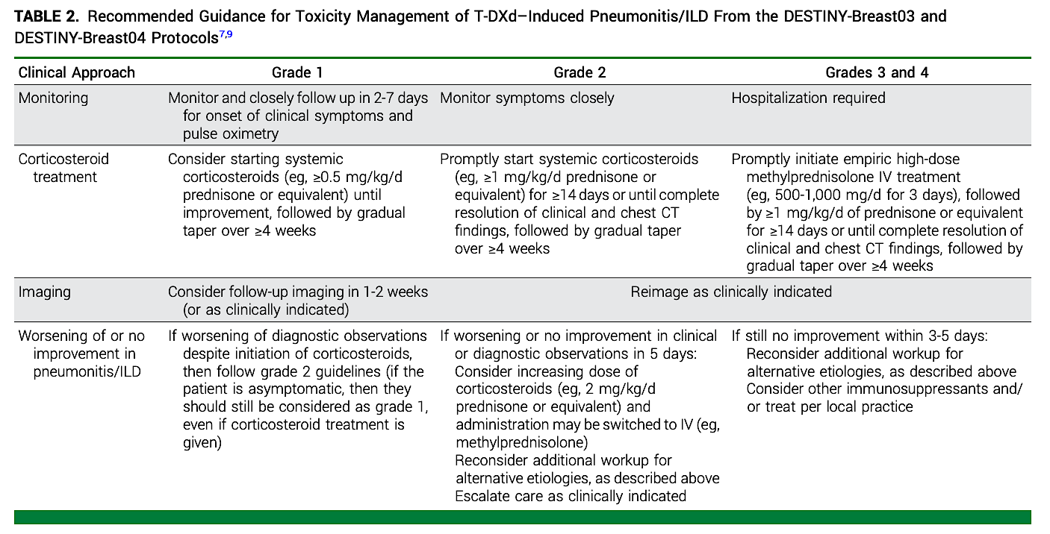
(Rugo et al, 2023)

Slide 46
T-DXd Patient Case Study
74-year-old female
4th line, mBC (bone), hx renal insufficiency
Cycle 4 (full dose 5.4 mg/kg)
AE: fatigue, nausea (x 8 days)
Routine CT chest showed ground glass changes upper lobes, pt asymptomatic
Prednisone taper, held treatment x 3-4 weeks, reimaged
Restarted, dose reduction 4.4 mg/kg
Continued until Cycle 21 (d/c’ed due to progressive disease)

Slide 47
Roundtable Discussion

Slide 48
Agenda
Module 1: Overview of Antibody-Drug Conjugates (ADCs)
Module 2: Trastuzumab Deruxtecan (T-DXd) in Patients with HER2-Positive Metastatic Breast Cancer (mBC) with and without Brain Metastases
Module 3: Role of ADCs for Patients with ER-Positive mBC
Module 4: T-DXd in Patients with Metastatic Non-Small Cell Lung Cancer (NSCLC) with HER2 Alterations
Module 5: Emerging Role of ADCs for Patients with Progressive EGFR-Mutant NSCLC

Slide 49
Clinical Scenario
A patient with ER-positive, HER2-low mBC who has received multiple lines of standard treatment, including endocrine therapy, capecitabine, T-DXd and sacituzumab govitecan, is about to start therapy with datopotamab deruxtecan

Slide 50
ADCs @ ONS
Tiffany A. Traina, MD FASCO
Associate Attending, Breast Medicine Service
Vice Chair, Department of Medicine
Section Head, TNBC Clinical Research Program
Memorial Sloan Kettering Cancer Center
Associate Professor, Weill Cornell Medicine

Slide 51
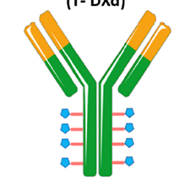

ADCs in ER+ MBC
 | T-DXd | Sacituzumab Govitecan | Dato-DXd
Monoclonal antibody | Trastuzumab | Sacituzumab | Datopotamab
Target antigen | HER2 | Trop2 | Trop2
Payload | Deruxtecan | SN-38 (irinotecan metabolite) | Deruxtecan
Payload class | Topo-I inhibitor | Topo-I inhibitor | Topo-I inhibitor
Bystander effect | Yes | Yes | Yes
Linker subtype | Cleavable | Cleavable | Cleavable
Drug:Antibody Ratio | ~8:1 | ~8:1 | 4:1
Half-life | ~7 days | ~15 hours | ~5 days

Slide 52
ADCs in ER+ MBC
 | T-DXd | Sacituzumab Govitecan | Dato-DXd
 | DB04, DB06 | Tropics02 | TROPION Breast01
Need testing for target expression? | Yes, HER2 low (1+, 2+) or Ultralow | No | No
FDA indication | HER2 low or UL after 1 or more endocrine tx HER2 low after 1 prior chemo | Endocrine tx and at least two additional systemic therapies in the metastatic setting | Endocrine tx and chemotherapy for metastatic disease
Main toxicity | Nausea, alopecia, ILD, LVEF | Diarrhea, neutropenia | Stomatitis, rare ocular events, rare ILD
Sequencing data | There are no prospective randomized sequencing data to guide decision-making
Notes:
ENHERTU is a HER2-directed antibody and topoisomerase inhibitor conjugate indicated for the treatment of adult patients with unresectable or metastatic:
Hormone receptor (HR)-positive, HER2-low (IHC 1+ or IHC 2+/ISH-) or HER2-ultralow (IHC 0 with membrane staining) breast cancer, as determined by an FDA-approved test, that has progressed on one or more endocrine therapies in the metastatic setting
HER2-low (IHC 1+ or IHC 2+/ISH-) breast cancer, as determined by an FDA-approved test, who have received a prior chemotherapy in the metastatic setting or developed disease recurrence during or within 6 months of completing adjuvant chemotherapy
TRODELVY® (sacituzumab govitecan-hziy) is a Trop-2-directed antibody and topoisomerase inhibitor conjugate indicated for the treatment of adult patients with unresectable locally advanced or metastatic hormone receptor (HR)-positive, human epidermal growth factor receptor 2 (HER2)-negative (IHC 0, IHC 1+ or IHC 2+/ISH–) breast cancer who have received endocrine-based therapy and at least two additional systemic therapies in the metastatic setting.
DATROWAY® is a Trop-2-directed antibody and topoisomerase inhibitor conjugate indicated for the treatment of adult patients with unresectable or metastatic, hormone receptor (HR)-positive, HER2-negative (IHC 0, IHC 1+, or IHC 2+/ISH−) breast cancer who have received prior endocrine-based therapy and chemotherapy for unresectable or metastatic disease.

Slide 53
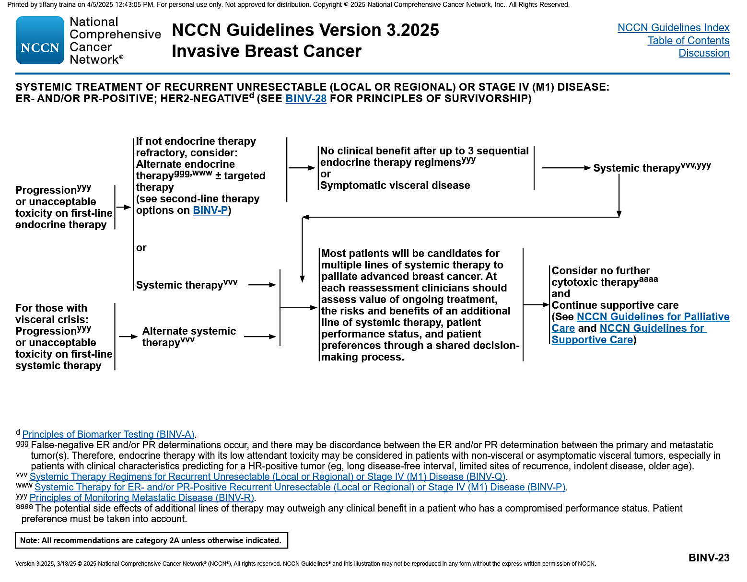
Approach to ER+ MBC before ADCs
Serial sequential endocrine therapies beginning with CDK4/6i
Biomarker driven targeted options to overcome endocrine resistance:
PI3K
AKT
PTEN
ESR1
BRCA1 or BRCA2
alpelisib
capivasertib
elacestrant
olaparib, talazoparib
Generally exhaust endocrine options and transition to ADCs or chemotherapy upon endocrine resistance

Slide 54
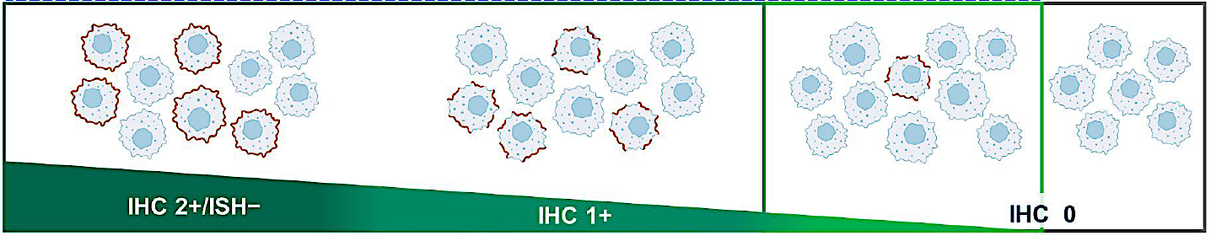
HER2 IHC Categories Within HR+/HER2– MBC
HER2-low
~60% to 65% of HR+/HER2– MBC
HER2-ultralow
~20% to 25% of HR+/HER2– MBC
Weak-to-moderate complete membrane staining in >10% cells
Faint, incomplete membrane staining in >10% tumor cells
Faint, incomplete membrane staining in ≤10% tumor cells
Absent/no observable membrane staining
Curigliano G, et al. ASCO 2024. Abstract LBA1000.

Slide 55
DESTINY-Breast04: T-DXd in HER2 low MBC
30% improvement in OS!
T-DXd
5.4 mg/kg q3w
(n=373)
Key Eligibility Criteria
HER2-low (IHC 1+ or IHC 2+/ISH–) unresectable and/or MBC
≥1 prior line of chemotherapy in the metastatic setting
≥1 line of ET if HR+ MBC
Primary endpoint:
PFS by BICR (HR+)
R
2:1
TPC
Capecitabine, eribulin, gemcitabine, paclitaxel, or nab-paclitaxelª
(n=184)
N=557
Key characteristics:
~90% of population had HR+ disease
Median 1 prior line of chemo
2% had 3 or more lines of chemo
Median 2 prior ET
 | PFS in HR+ Patients (by INV) |  | OS in HR+ Patients
 | T-DXd (n=331) | TPC (n=163) | T-DXd (n=331) | TPC (n=163)
Median, months | 9.6 (8.4-10.0) | 4.2 (3.4-4.9) | 23.9 (21.7-25.2) | 17.6 (15.1-20.2)
HR (95% CI) | 0.37 (0.30-0.46) |  | 0.69 (0.55-0.87)
Modi et al ESMO 2023
Notes:
Median 1 prior line of chemo (range 0-3)
2% had 3 or more lines of chemo
Median 2 prior ET

Slide 56
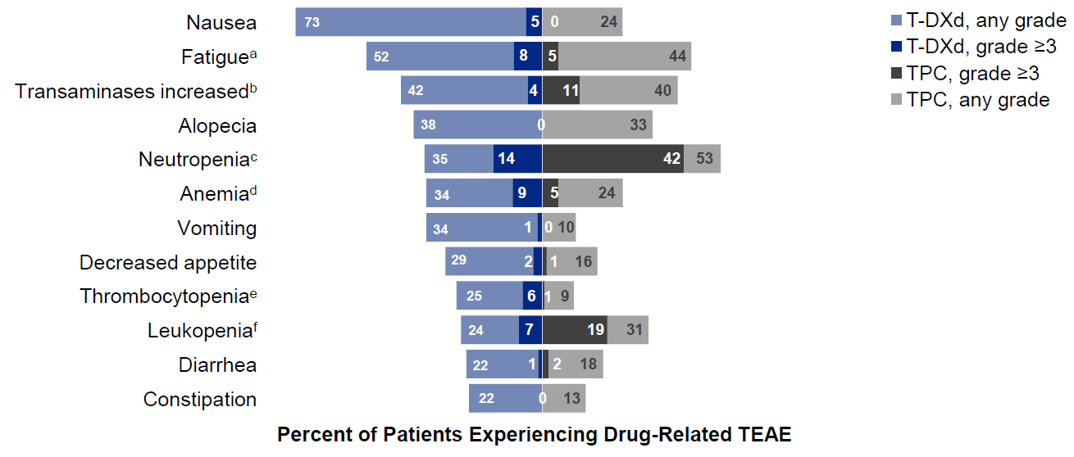
DESTINY-Breast04: Safety
Is the risk/benefit balance different in ER+ MBC?
Drug-Related TEAEs in ≥20% of Patients
Tx discontinuation 17%
54% Gr 3 or greater TEAEs
4% treatment related deaths (ILD)
AEs of Special Interest, n (%) |  | Grade 1 | Grade 2 | Grade 3 | Grade 4 | Grade 5 | Any Grade
Adjudicated as drug-related ILD/pneumonitis | T-DXd (n=371) | 13 (3.5) | 24 (6.5) | 4 (1.1)ª | 0 | 4 (1.1)ª | 45 (12.1)
 | TPC (n=172) | 1 (0.6) | 0 | 0 | 0 | 0 | 1 (0.6)
Modi S, et al. ESMO 2023. Abstract 376O.
Notes:
FDA indication
Bolstered by known efficacy in HER2+ MBC
Utilized in later line ER+ MBC for those with HER2 low disease
*** THINK ABOUT TRETTER

Slide 57
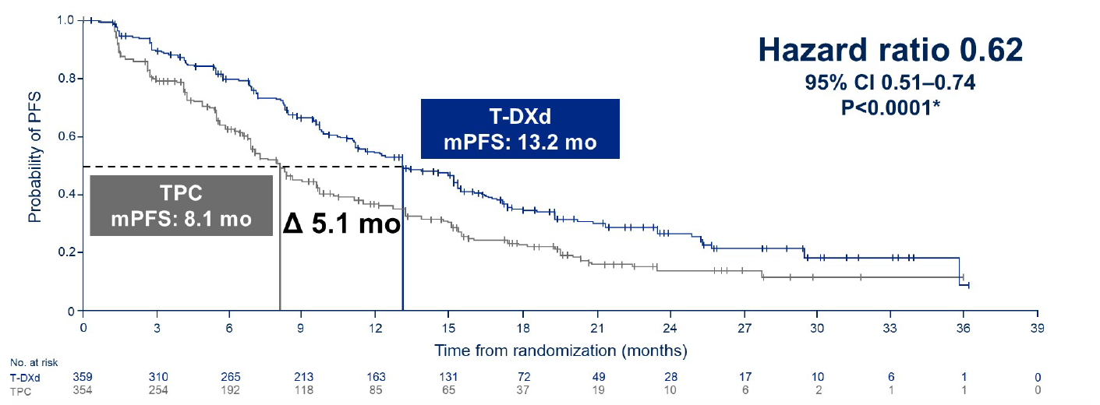
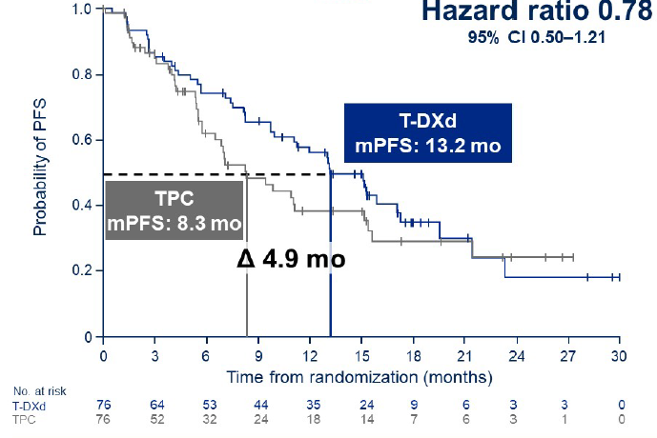
DESTINY-Breast06: T-DXd in HER2-Low/Ultralow MBC and in earlier line of therapy
Key Eligibility Criteria
HR+/HER2-low (IHC 1+ or IHC 2+/ISH–) or HR+/HER2-ultralow
(IHC 0 with membrane staining) MBC
Chemotherapy-naive in the MBC setting
≥2 lines of ET ± targeted therapy for MBC OR
1 line for MBC AND
  Progression ≤6 mo of starting 1L ET + CDK4/6i OR recurrence
  ≤24 mo of starting adjuvant ET
T-DXd (n=436)
5.4 mg/kg q3w
Stratification Factors
Prior CDK4/6i use (yes vs no)
HER2 expression (IHC 1+ vs IHC 2+/ISH– vs IHC 0 with membrane staining)
Prior taxane in nonmetastatic setting (yes vs no)
R
1:1
TPC (n=430)
Capecitabine, nab-paclitaxel, paclitaxel
ITT (N=866)
HER2-low (n=713)
HER2-ultralow (n=153)^{b}
Primary endpoint: PFS (BICR) in HER2-low
PFS (BICR) in HER2-Ultralow
(Prespecified Exploratory Analysis)
PFS (BICR) in HER2-Low
Curigliano G, et al. ASCO 2024. Abstract LBA1000; Bardia A et al. N Engl J Med 2024
Notes:
18% HER2 ultralow
30% considered to have primary endocrine resistance
median lines of ET in MBC 2
89% had prior CDK4/6i

Slide 58
How do you weigh safety & efficacy?
Sites of disease
Burden of disease
Underlying risks for ILD?
KPS, frailty
Cardiac comorbidities?
Psychosocial factors: IV vs oral, alopecia, q3 week travel to infusion
DB04 as salvage
AESI Adjudicated as Drug-Related ILD/Pneumonitis^{b}
n (%) | Any grade | Grade 1 | Grade 2 | Grade 3 | Grade 4 | Grade 5
T-DXd (n=434) | 49 (11.3) | 7 (1.6) | 36 (8.3) | 3 (0.7) | 0 | 3 (0.7)
TPC (n=417) | 1 (0.2) | 0 | 1 (0.2) | 0 | 0 | 0
In the T-DXd vs TPC arms, 35 (8.1%) vs 12 (2.9%) patients experienced any grade ejection fraction decreased, and 0 vs 3 (0.7%) patients experienced any grade cardiac failure

Slide 59
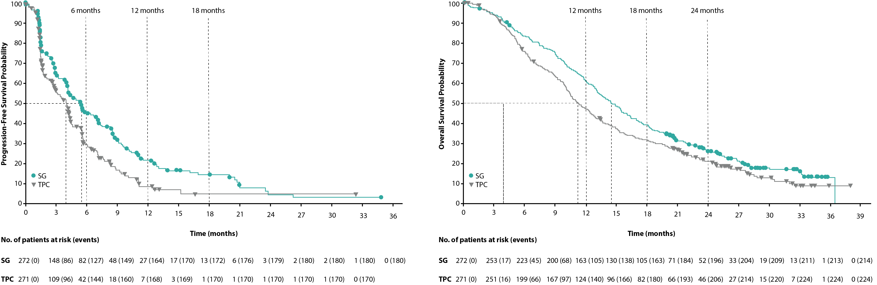
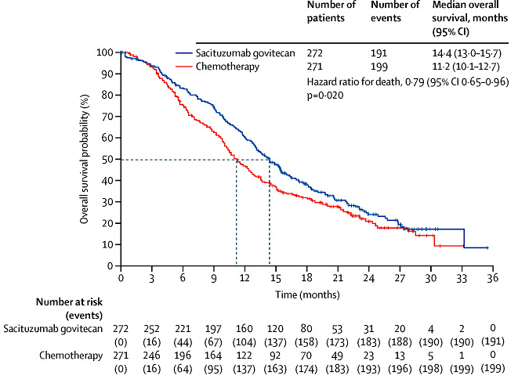
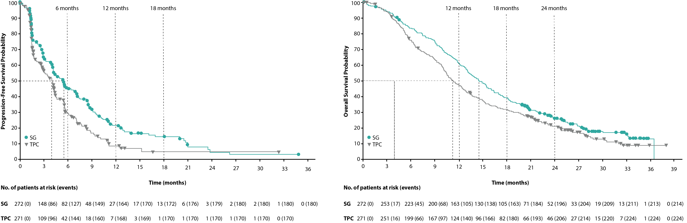
TROPiCS-02:
Sacituzumab in ER+ MBC
SG
10 mg/kg IV, days 1 and 8
every 21 days
(n=272)
Key Eligibility Criteria
HR+/HER2– MBC (or locally recurrent inoperable) with PD after:
  ≥1 ET, taxane, and CDK4/6i in any setting
  ≥2 to ≤4 lines of chemotherapy for metastatic disease
  Measurable disease by RECIST v1:1
Until PD or unacceptable toxicity
R
1:1
Physician’s choice (TPC)
Capecitabine, vinorelbine, gemcitabine, or eribulin
(n=271)
N=543
Primary endpoint: PFS by BICR
BICR-Assessed PFS in the ITT Population
OS in the ITT Population
Median PFS 5.5m v 4.0m
HR 0.65 (0.53-0.81)
P= 0.0001
Median OS 14.4m v 11.2m
HR 0.79 (0.65-0.96)
P=0.020
Rugo H, et al. ASCO 2022. Abstract LBA1001.; Tolaney S, et al. ASCO 2023. Abstract 1003. Rugo H, et al. Lancet 2023
Notes:
95% visceral mets
Prior CDK <12m 60%
Median prior chemo for MBC 3

Slide 60
TROPiCS-02: Safety
TEAEs (All Grade >20%), n (%) |  | SG (n=268) |  | TPC (n=249)
TRAE |  | All grade | Grade ≥3 | All grade | Grade ≥3
Hematologic | Neutropenia | 189 (71) | 140 (52) | 136 (55) | 97 (39)
 | Anemia | 98 (37) | 20 (7) | 69 (28) | 8 (3)
GI | Diarrhea | 166 (62) | 27 (10) | 57 (23) | 3 (1)
 | Nausea | 157 (59) | 3 (1) | 87 (35) | 7 (3)
 | Constipation | 93 (35) | 1 (<1) | 61 (24) | 0
 | Vomiting | 64 (24) | 3 (1) | 39 (16) | 4 (2)
 | Abdominal pain | 53 (20) | 10 (4) | 34 (14) | 2 (1)
Other | Alopecia | 128 (48) | 0 | 46 (18) | 0
Other | Fatigue | 105 (39) | 16 (6) | 82 (33) | 9 (4)
 | Asthenia | 62 (23) | 6 (2) | 50 (20) | 5 (2)
 | Decreased appetite | 57 (21) | 4 (1) | 52 (21) | 2 (1)
Treatment discontinuations due to AEs occurred in 17 patients (6%) receiving SG and 11 patients (4%) receiving TPC
Tolaney S, et al. ASCO 2023. Abstract 1003.

Slide 61
TROPION-Breast01: Dato-DXd in ER+ MBC
Dato-DXd
6 mg/kg IV day 1 q3w
n=365
Key Eligibility Criteria
HR+/HER2– MBC (HER2 IHC 0/1+/2+; ISH–)
Progressed on and not suitable for ET
1-2 prior lines of Chemo in inoperable/metastatic setting
ECOG PS 0-1
R
1:1
ICCª
(Eribulin, vinorelbine,
gemcitabine, capecitabine)
n=367
N=732
Dual primary endpoints: PFS by BICR per RECIST v1.1, OS
Bardia A, et al. ESMO 2023. Abstract LBA11.; Bardia A, et al. SABCS 2023. Abstract GS02-01.
Notes:
63% had 1 prior chemo; 37% had 2 prior
82% prior CDK
90% prior A+T

Slide 62
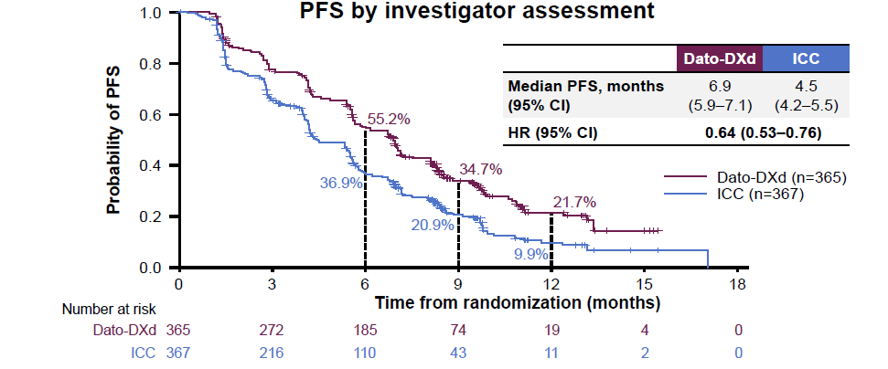

TROPION-Breast01: Dato-DXd Efficacy
PFS by Investigator | Dato-DXd (n=365) | ICC (n=367)
Median PFS, mo (95% CI) | 6.9 (5.9-7.1) | 4.5 (4.2-5.5)
HR (95% CI) | 0.64 (0.53-0.76)
PFS by Investigator Assessment
Median PFS by BICR (primary endpoint):
6.9 vs 4.9 mo;
HR=0.63 (95% CI: 0.52-0.76); P<0.0001
Bardia A, et al. ESMO 2023. Abstract LBA11.; Bardia A, et al. SABCS 2023. Abstract GS02-01.
Notes:
63% had 1 prior chemo; 37% had 2 prior
82% prior CDK
90% prior A+T

Slide 63
TROPION-Breast01: Dato-DXd Safety
TRAEs (in ≥15%), n (%) | Dato-DXd (n=360) |  | ICC (n=351)
 | Any grade | Grade ≥3 | Any grade | Grade ≥3
Anemia | 40 (11) | 4 (1) | 69 (20) | 7 (2)
Neutropenia | 39 (11) | 4 (1) | 149 (42) | 108 (31)
Dry eye | 78 (22) | 2 (1) | 27 (8) | 0
Nausea | 184 (51) | 5 (1) | 83 (24) | 2 (1)
Stomatitis | 180 (50) | 23 (6) | 46 (13) | 9 (3)
Vomiting | 71 (20) | 4 (1) | 27 (8) | 2 (1)
Constipation | 65 (18) | 0 | 32 (9) | 0
Fatigue | 85 (24) | 6 (2) | 64 (18) | 7 (2)
Alopecia | 131 (36) | 0 | 72 (21) | 0
Favorable toxicity profile, unlike T-DXd
Stomatitis prophylaxis successful with steroid rinse
Only 1 patient d/c Dato due to stomatitis
Most ocular events were dry eye and low grade
Only 1 patient d/c Dato due to ocular AE
ILD rare: 3% all grade
Bardia A, et al. ESMO 2023. Abstract LBA11.

Slide 64
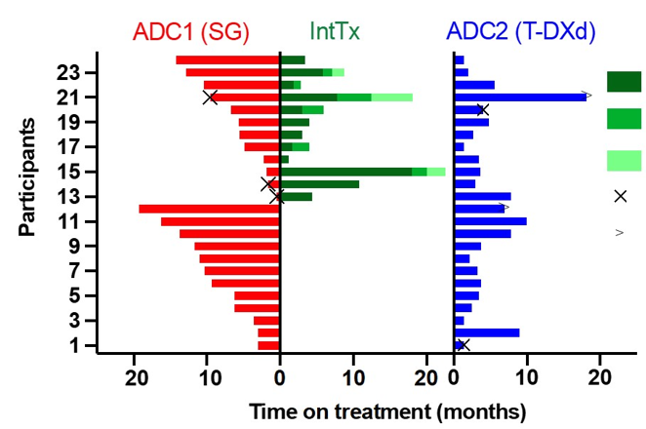
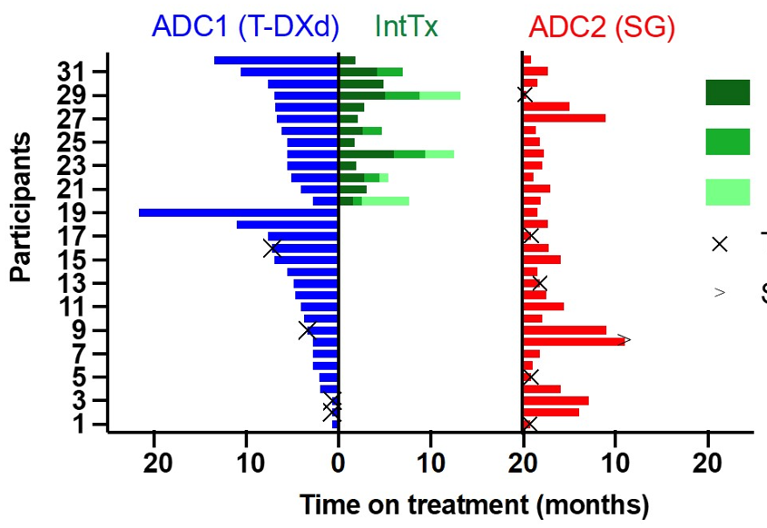
Sequential ADC Use?
No prospective data
HR+/HER2-Low (n=56)
SG→T-DXd (n=24)
T-DXd→SG (n=32)
1st ADC generally has longer time on tx
Intervening cytotoxic chemotherapy “sandwich” approach does not appear to be an advantage
What drives resistance?
  Target?
  Payload?
Where does Dato-DXd fit in?
n=24 | ADC1 (SG) | ADC2 (T-DXd)
mrwPFS, mo | 6.5 | 3.6
mrwOS, mo | 20.1 | 7.7
n=32 | ADC1 (T-DXd) | ADC2 (SG)
mrwPFS, mo | 5.3 | 2.1
mrwOS, mo | 15.1 | 5.6
Huppert L, et al. ASCO 2024. Abstract 1083.

Slide 65
ADCs in ER+ MBC
Bringing it together
 | T-DXd | Sacituzumab Govitecan | Dato-DXd
FDA indication | HER2 low or UL after 1 or more endocrine tx HER2 low after 1 prior chemo | Prior Endocrine tx and at least two additional systemic therapies in the metastatic setting | Prior Endocrine tx and chemotherapy for metastatic disease
1L
2L
3L
HER2 0
Chemotherapy
(ie, cape, taxane)
Dato or
Saci
Dato or
Saci or chemo
Endocrine resistant
s/p prior ET
(not candidate for PARPi)
Shared decision making essential!
T-DXd
Or
Chemotherapy
Dato or
Saci
Dato or
Saci or chemo
HER2 0+, 1+, 2+
T-DXd
Dato or
Saci or chemo
Notes:
ENHERTU is a HER2-directed antibody and topoisomerase inhibitor conjugate indicated for the treatment of adult patients with unresectable or metastatic:
Hormone receptor (HR)-positive, HER2-low (IHC 1+ or IHC 2+/ISH-) or HER2-ultralow (IHC 0 with membrane staining) breast cancer, as determined by an FDA-approved test, that has progressed on one or more endocrine therapies in the metastatic setting
HER2-low (IHC 1+ or IHC 2+/ISH-) breast cancer, as determined by an FDA-approved test, who have received a prior chemotherapy in the metastatic setting or developed disease recurrence during or within 6 months of completing adjuvant chemotherapy
TRODELVY® (sacituzumab govitecan-hziy) is a Trop-2-directed antibody and topoisomerase inhibitor conjugate indicated for the treatment of adult patients with unresectable locally advanced or metastatic hormone receptor (HR)-positive, human epidermal growth factor receptor 2 (HER2)-negative (IHC 0, IHC 1+ or IHC 2+/ISH–) breast cancer who have received endocrine-based therapy and at least two additional systemic therapies in the metastatic setting.
DATROWAY® is a Trop-2-directed antibody and topoisomerase inhibitor conjugate indicated for the treatment of adult patients with unresectable or metastatic, hormone receptor (HR)-positive, HER2-negative (IHC 0, IHC 1+, or IHC 2+/ISH−) breast cancer who have received prior endocrine-based therapy and chemotherapy for unresectable or metastatic disease.

Slide 66
ER(+) HER2 low MBC
MRI Brain & Spine 3/24/25:
Numerous subcm brain mets have contracted with a few resolved. Dominant parietal lesion decreased from ~2cm to 0.9cm. No new lesions. Decreased conspicuity of cauda equina lesions
71 yo pT1N2 ER >95% HER2 2+ FISH NA →PET/CT negative for MBC
  ddAC started but c/b anemia (hgb 4.6)
  Bone marrow bx = MBC ER+ HER2 3+ FISH amplified and low grade B cell lymphoma
1L anastrozole (9/2022) → added Palbociclib (11/2022) and HP w/ excellent clinical response and NED on scans
11/2024 Altered MS and seizure → MR w/ CNS metastases and LMD
s/p WBXRT, pCSI → 1/2025 Began T-DXd
PET 3/2025:
No new lesions. Stable treated bone lesions.
Notes:
KN
Q3w
Lepto data
Cape has CNS penetration but complicated oral regimen given poor cognition

Slide 67
ER low HER2 low MBC
70 yo pT2N0 ER low HER2 0 →ddAC-T; no ET (2014)
2018 Ipsilateral Ax recurrence ER 40% HER2 1+ s/p neo Gem/Carbo → AxD → RT → Anastrozole
2020 Unresectable Axillary and chest wall recurrence cw MBC ER 5-10% HER2 0 PDL1 1% → Capecitabine
2022 POD in chest wall, LN, ?lung → eribulin
3/2023 POD in lung; Bx MBC ER 5% HER2 0
  Started sacituzumab govitecan
PET 11/2024:
Stable subcm pulm nodules. Reactive marrow. No new sites of disease
Notes:
DT

Slide 68
Roundtable Discussion

Slide 69
Antibody-Drug Conjugates
Marissa Marti-Smith
DNP, APRN, AGNP-C, AOCNP
Breast Oncology
Nurse Practitioner

Slide 70

Dato DXd (Datopotamab Deruxtecan)
TROP2-directed ADC comprising a humanized anti-TROP2 immunoglobulin G1 monoclonal antibody covalently linked to a highly potent topoisomerase I (topo I) inhibitor, a derivative of exatecan, via a plasma-stable, tumor-selective, tetrapeptide-based cleavable linker, resulting in reduced systemic exposure and off-target adverse effects.
(Bardia et al, 2024)

Slide 71

Patient Education
Internalization of Dato-DXd into TROP2-expressing cells leads to death of target tumor cells and bystander killing of neighboring cells in the tumor microenvironment.
Guided missile analogy
Approved for mBC ER+ Her2-
(Bardia et al, 2024)

Slide 72
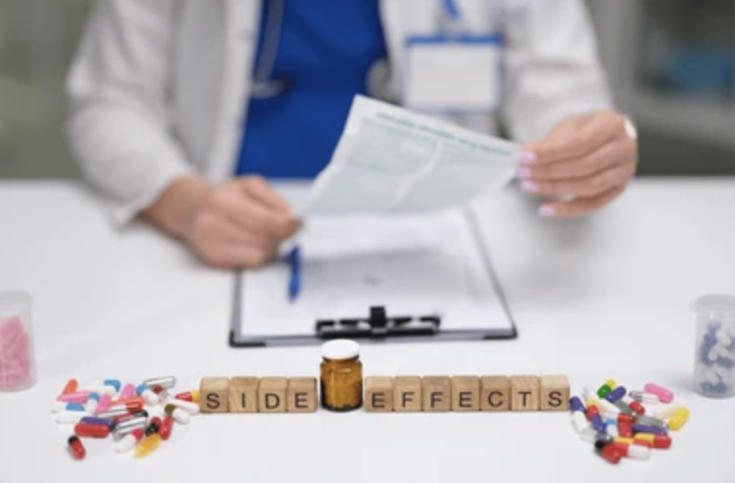
Dato DXd side effects
Stomatitis (59%; grades 3/4 7%)
Dry eyes (27%), Keratitis (24%)
Low blood counts (hgb, ANC, leukopenia)
Fatigue (44%)
Cough (15%)
GI (poor appetite, constipation, diarrhea, nausea (56%), vomiting
Decreased Ca+ (39%)
Alopecia (38%)
Rash (19%)
ILD/pneumonitis
Elevated LFTS (23%)
(UptoDate)

Slide 73
Dato-DXd Patient Case Study
68-year-old female
1st line, mBC (liver x 4 lesions, lymphatics, breast), Triple negative
On Trial: Durvalumab + Dato-DXd IV Q21D initiated 5/17/2022
AE: fatigue, mouth sores & dry mouth, poor appetite, watery eyes
C7: dose reduction 4 mg/kg (Dato-DXd) due to mucositis
C18: worsening inflammatory arthritis (HELD durvalumab)
Recently received C50: stability > almost 3 years
NED, other than new inflammatory lung nodule seen on scan
Notes:
A Phase IB/II, 2-Stage, Open-label, Multicenter Study to Determine the Efficacy and Safety of Durvalumab (MEDI4736) + Paclitaxel and Durvalumab (MEDI4736) in Combination With Novel Oncology Therapies With or Without Paclitaxel for First-line Metastatic Triple Negative Breast Cancer
negative for RA but has been treated symptomatically.
Rheumatology started leflunomide. (unable to receive hydroxychloroquine while on trial.) was on Cymbalta and Celebrex without relief – hands, wrists, knees, difficulty walking

Slide 74
Roundtable Discussion

Slide 75
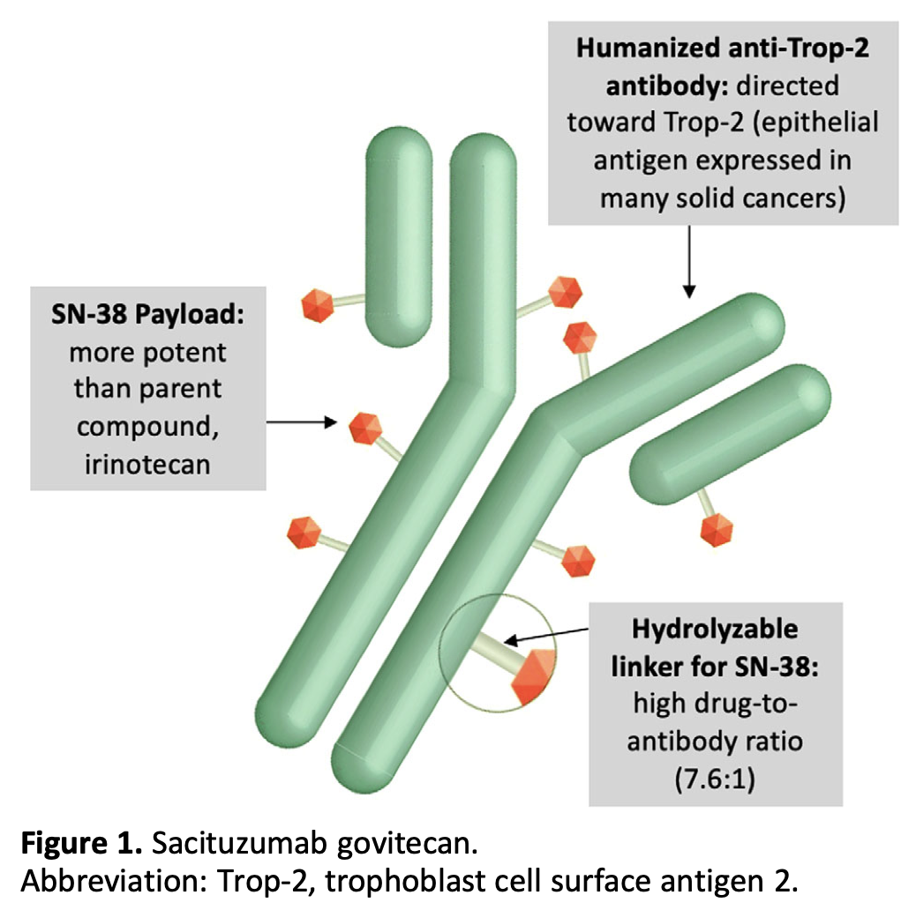
Sacituzumab Govitecan: TROP2-Targeting ADC
Spring LM et al. Oncologist 2021;26(10):827-834.

Slide 76
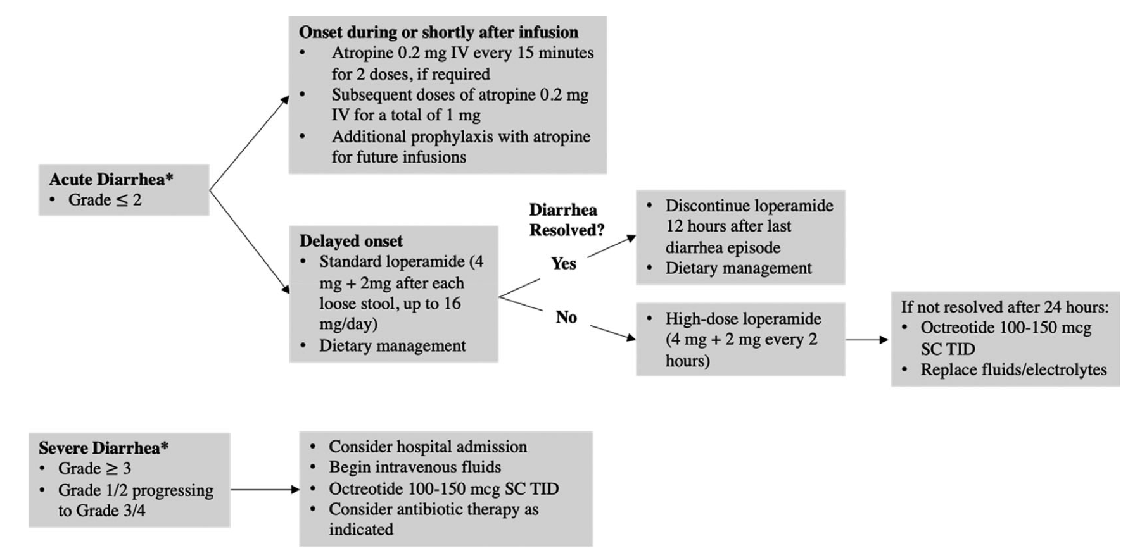
Management of Sacituzumab Govitecan–Induced Diarrhea
Spring LM et al. Oncologist 2021;26(10):827-834.

Slide 77
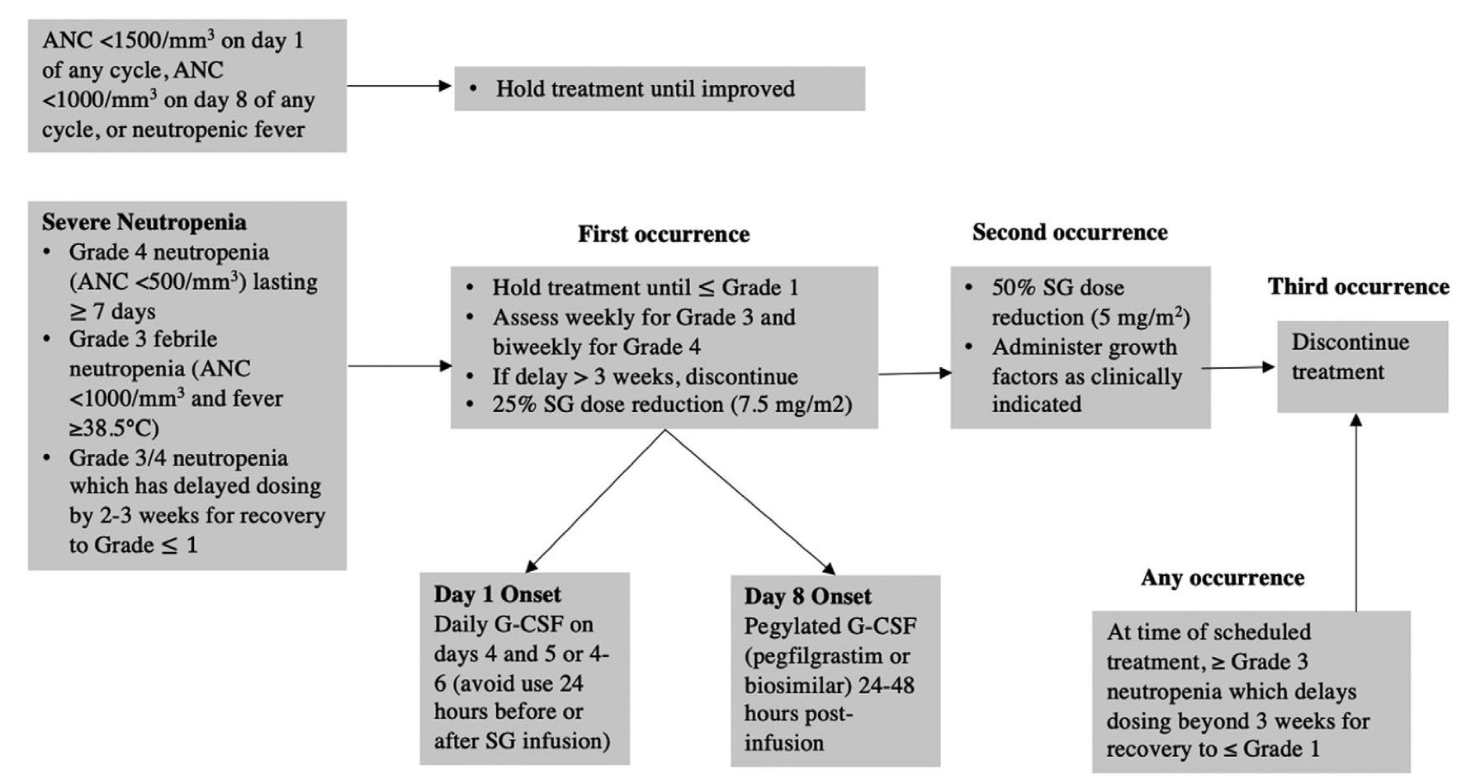
Management of Sacituzumab Govitecan–Induced Neutropenia
Spring LM et al. Oncologist 2021;26(10):827-834.

Slide 78
Agenda
Module 1: Overview of Antibody-Drug Conjugates (ADCs)
Module 2: Trastuzumab Deruxtecan (T-DXd) in Patients with HER2-Positive Metastatic Breast Cancer (mBC) with and without Brain Metastases
Module 3: Role of ADCs for Patients with ER-Positive mBC
Module 4: T-DXd in Patients with Metastatic Non-Small Cell Lung Cancer (NSCLC) with HER2 Alterations
Module 5: Emerging Role of ADCs for Patients with Progressive EGFR-Mutant NSCLC

Slide 79
Clinical Scenario
A patient with metastatic HER2-mutant NSCLC is about to start first-line therapy with T-DXd

Slide 80
Role of T-DXd in Patients with Metastatic NSCLC with HER2 Alterations
Edward B. Garon, MD, MS
Professor
David Geffen School of Medicine at UCLA
Los Angeles, CA

Slide 81
Case
63 year old woman with no smoking history presented when a chest X-ray obtained for work showed masses
Scans demonstrated bilateral lung lesions including three masses over 4 cm
Patient was without complaint
Biopsy demonstrated adenocarcinoma
Molecular studies showed ERBB2 (Her2/Neu) Exon 20 p.G778_P780dup

Slide 82
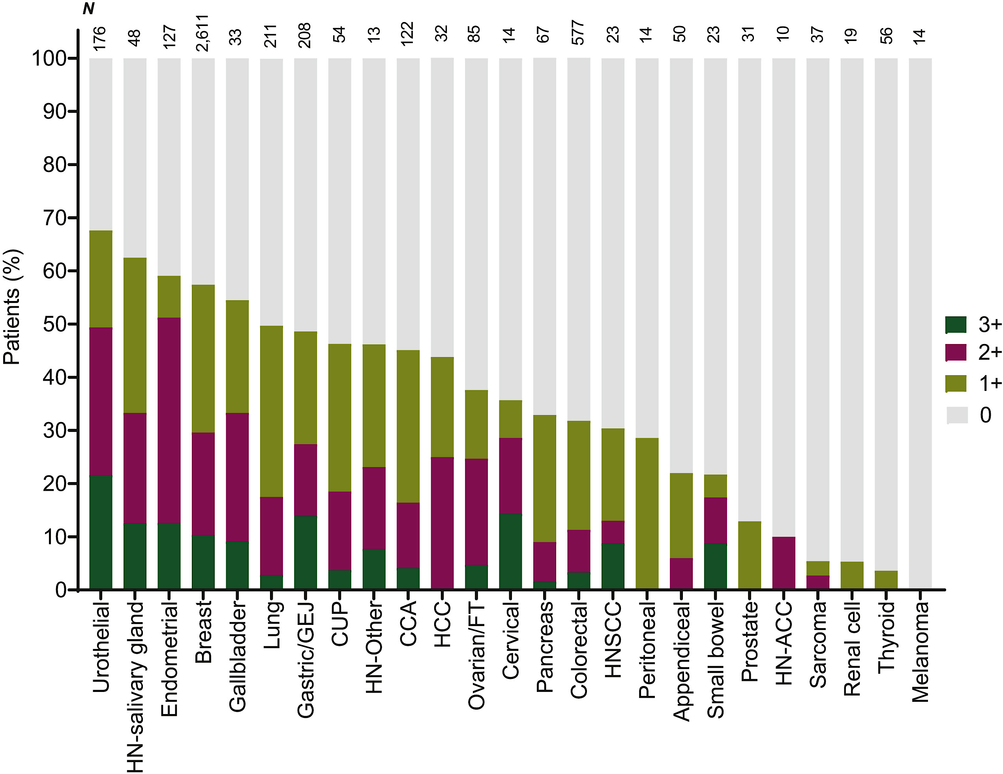
HER2 Abnormalities in NSCLC
HER2 mutations are seen in nearly 2% of NSCLC cases in US
HER2 3+ is seen in nearly 3% of NSCLC
High level HER2 amplification is seen in nearly 1% of NSCLC
Uzunparnak B. Annals of Oncology 2023
Waliany S. Cancer Med 2024
Odintsov I. Journal of Thoracic Oncology 2024

Slide 83
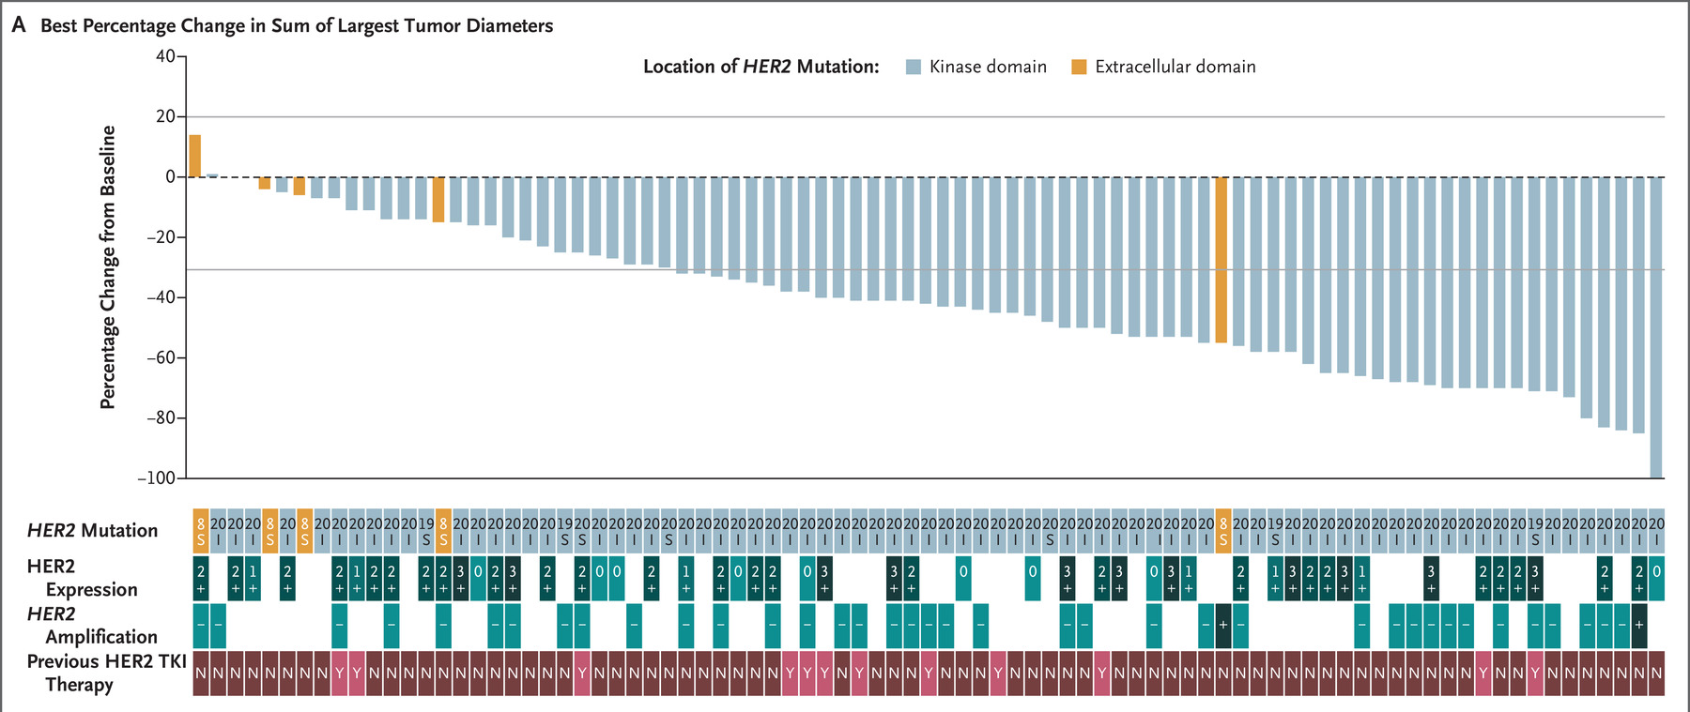
Trastuzumab Deruxtecan in HER2 Mutation Positive NSCLC
Li BT et al. N Engl J Med. 2022 Jan 20;386(3):241-251.

Slide 84
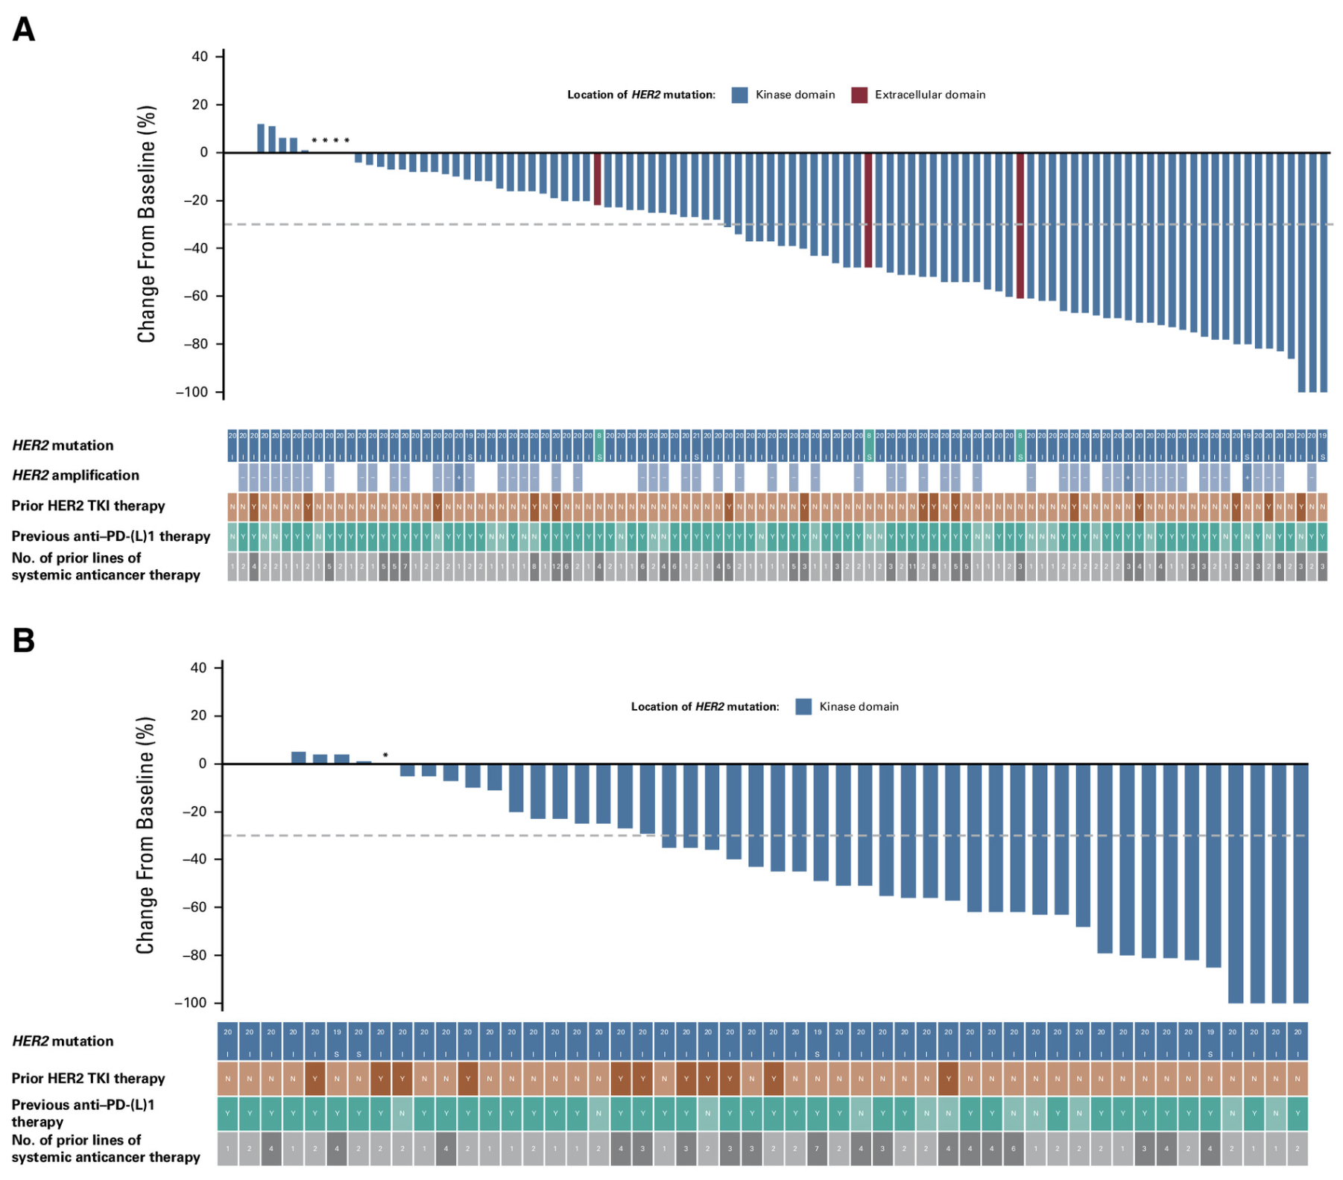
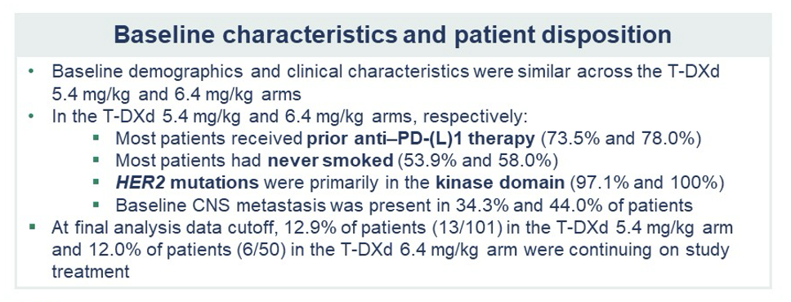
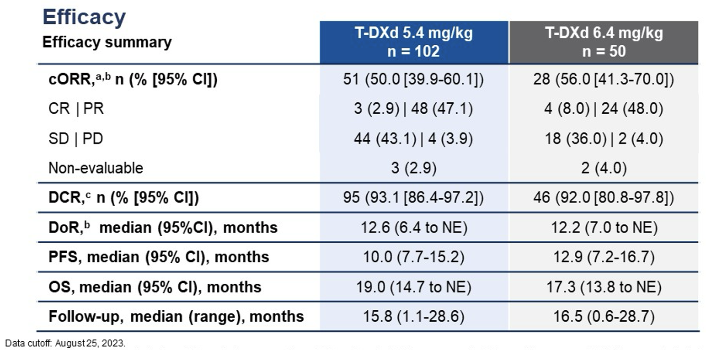
DESTINY-Lung02
5.4 mg/kg
6.4 mg/kg
Goto K et al. J Clin Oncol 2024;42(30):3635. Janne P et al. ASCO 2024;Abstract 8543.

Slide 85








T-DXd in HER2-overexpressing NSCLC: Best percentage change from baseline in target lesion size
40
Part 1: T-DXd monotherapy (arm 1D; N=36)*
20
HER2 IHC 3+
HER2 IHC 2+
PD-L1 <1%
PD-L1 1–49% PD-L1 ≥50%
Prior EGFR TKI§
Note: bars without symbols represent no prior EGFR TKI
Best change from baseline
in target lesion size (%)
0
−20
−40
‡
‡
−60
−80
−100
PD-L1
status†
Planchard D. WCLC 2024
Investigator assessed per RECIST v1.1. Best percentage change is the maximum reduction or minimum increase from baseline in the target lesion size; the dashed lines at −30% and 20% change in target lesion size indicate the thresholds for partial response and progressive disease, respectively. The study was not designed/powered to compare efficacy between subgroups.
*One patient was not evaluable; †patients with unknown PD-L1 status (n=12) are represented by white spaces; ‡unconfirmed response; §patients had HER2-OE (IHC 3+/2+) NSCLC
EGFR, epidermal growth factor receptor; HER2, human epidermal growth factor receptor 2; HER2-OE, HER2-overexpressing; IHC, immunohistochemistry; NSCLC, non-small cell lung cancer; PD-L1, programmed cell death ligand 1; RECIST v1.1, Response Evaluation Criteria in Solid Tumours version 1.1; T-DXd, trastuzumab deruxtecan; TKI, tyrosine kinase inhibitor

Slide 86
Trastuzumab Deruxtecan in HER2 3+
On April 5, 2024, the Food and Drug Administration granted accelerated approval to fam-trastuzumab deruxtecan-nxki for adult patients with unresectable or metastatic HER2-positive (IHC 3+) solid tumors who have received prior systemic treatment and have no satisfactory alternative treatment options.
ORR exceeded 50% and DOR exceeded a year (n = 16)
https://www.fda.gov/drugs/resources-information-approved-drugs/fda-grantsaccelerated-approval-fam-trastuzumab-deruxtecan-nxki-unresectable-or-metastatic-her2
Planchard D et al. WCLC 2024;Abstract OA16.05.

Slide 87
Case 1 Continued
Patient initially was treated with carboplatin/pemetrexed and pembrolizumab
She responded and tolerated it well, but progressed after approximately a year and a half
She switched to trastuzumab deruxtecan, and again responded but progressed after approximately a year and a half
She recently initiated therapy on a trial of zongertinib

Slide 88
Conclusions
Although there is no HER2 molecular abnormality with high prevalence, when combining HER2 mutant NSCLC and HER2 3+, HER2 is one of the more common molecular drivers
Trastuzumab deruxtecan is the only agent approved for treating HER2 driven NSCLC, although oral inhibitors are in development
HER2 amplification is rare in NSCLC, and the role of targeted agents in this context is not clear

Slide 89
Roundtable Discussion

Slide 90

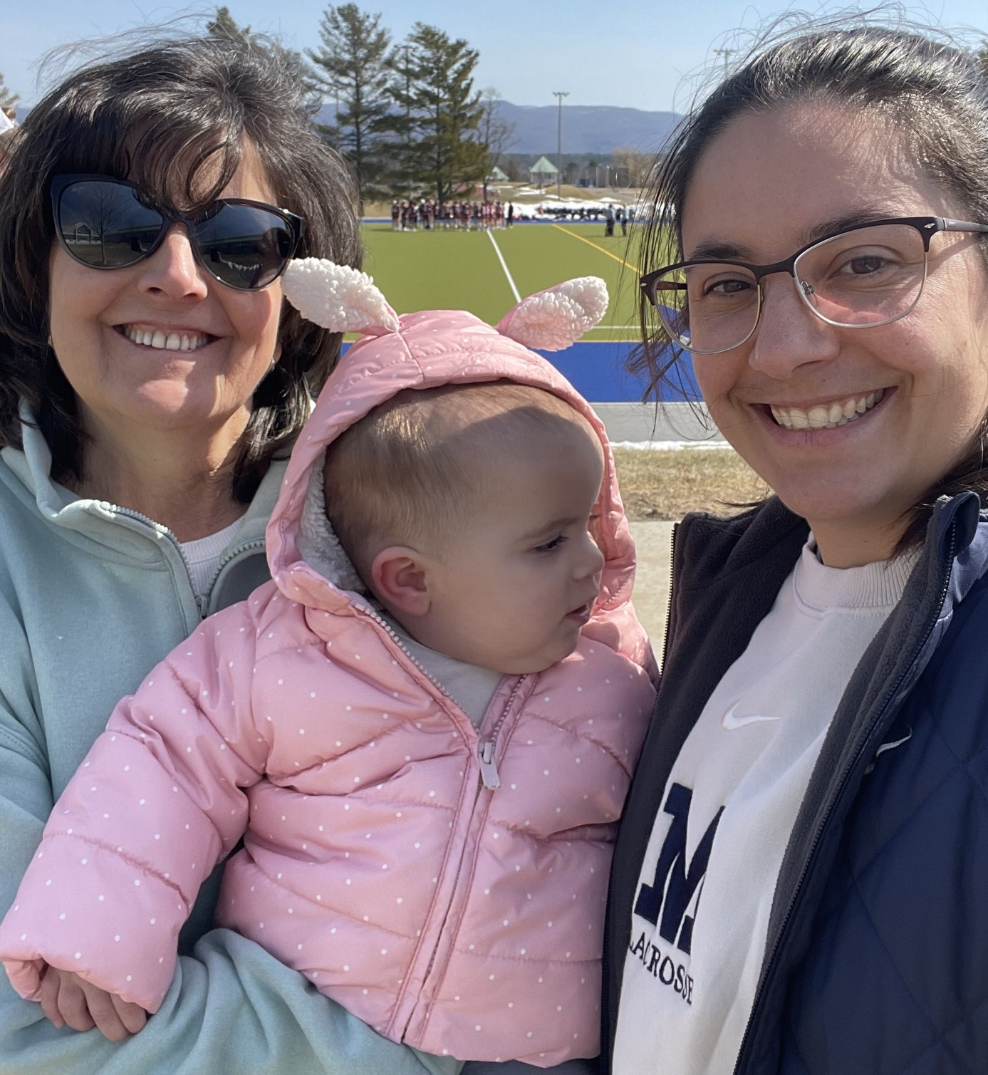
Understanding the Current Paradigm and New Approaches: The Optimal Implementation of Antibody-Drug Conjugates in the Care of Patients with Cancer
Research To Practice
Oncology Nursing Society Congress 2025
Marianne Davies, DNP, CNS-BC, ACNP-BC, AOCNP-BC, FAAN
Program Manager, Care Signature: Oncology Service Line
Thoracic Oncology Nurse Practitioner, Smilow Cancer Hospital
Associate Professor, Yale University School of Nursing

Slide 91


Scenario 3: Nursing Considerations for Patients with NSCLC Receiving T-DXd
62 yo male, married with two adult children and grandchildren; remote smoking history; works in sales; pizza aficionado; domestic bird owner.
Diagnosed with HER2-mutant (Exon 20 insertion) NSCLC
HER-2 mutant NSCLC:
More common in females, never smokers and younger age
2%-4% of NSCLC
Can also have HER-2 amplification +/or overexpression

Slide 92
Interstitial Lung Disease
Screen (History and Physical)
Rule out other causes
of ILD (other drugs
or RT tox)
Rule out infection, progression of disease,
or pulmonary embolism
Scan (Evaluation)
High-resolution CT scan, every 6-9 wks if s/s
Bronchoscopy and
BAL +/- biopsy
Synergy: Patient-MDT-Staff Triad
Based on severity
or grade of toxicity
Taper steroid based
on response
Suspend Treatment
Steroids
Radiology
Hold treatment during evaluation
Permanent discontinuation for unresolving ILD
Pulmonary function test
May consider dose reduction
Baseline SpO₂
Educate patients about signs & symptoms
to report
Pulmonary consult
GRADE Toxicity
Rule out: Bird Fancier’s Lung (Avian Hypersensitivity Pneumonitis)
Tarantino P. JAMA Oncol. 2021;7(12):1873-1881. doi:10.1001/jamaoncol.2021.3595
Tarantino P. JCO Oncol Pract. 2023;19(8):526-527. doi:10.1200/OP.23.00097
Notes:
Monitor for increase in cough, dyspnea, fever, worsening respritory symptoms
Questions to ask your patients:
Have you been coughing recently? Is it a dry cough?
Have you had any shortness of breath, especially during or after physical activity?
Have you experienced any new breathing or respiratory problems?
If you already have respiratory problems, have they gotten worse?
Fever? Fatigue? Weight loss?

Slide 93
T-DXd MOA & Approval
Trastuzumab Deruxtecan (T-DXd)
Trastuzumab: antibody that binds to HER2
Deruxtecan: chemotherapy
Irinotecan derivative: Topoisomerase 1 inhibitor
DESTINY-Lung01, DESTINY-Lung02
- Approved for treatment of patients with unresectable or metastatic NSCLC whose tumors have activating HER2 (ERBB2) mutations and who have received a prior line of therapy
- Approved for treatment of patients with unresectable or metastatic HER2-positive (IHC 3+) solid tumors who have received prior systemic treatment and have no satisfactory alternative treatment options
Patient enrolled on a First-Line Clinical Trial with T-DXd

Slide 94
Potential Toxicities & Monitoring
Factors influencing the side effects: T-DXd: has to do with the chemotherapy
  Diarrhea
  Neutropenia
  Thrombocytopenia
Rash
Interstitial Lung Disease (ILD)
Cardiac/ myocarditis: Left Ventricular Dysfunction: monitor LVEF at regular intervals;
if decreased by >10%;
  Need baseline Echocardiogram; If 40-45% and if decreased by 10-20%, hold tx and repeat ECHO at 3 weeks; if it does not recover to within 10%, then need to discontinue
Reproductive Considerations in those of child bearing years.
Embryo-Fetal toxicity

Slide 95
Cardiac Toxicity- Left Ventricular Dysfunction
Overall Incidence - 4.6% --- Grade 3 or worse - 0.6%
Assess LVEF prior to initiation of therapy and then every 3 months
Interrupt and consult Cardiology if
  IF LVEF 40%-45% and absolute decrease from 10-20%
  LVEF <40%
  Absolute decrease from baseline >20%
Courtesy of Jaclyn Shaver, MS, APRN, CNP, WHNP
Trastuzumab deruxtecan package insert.

Slide 96
Nausea and Vomiting Management
NCCN -Highly Emetogenic and includes delayed nausea and or vomiting. Administer prophylactic anti-emetics medications per institutional guidelines
At least D1-D4
NK1
5-HT3 antagonist
Olanzapine
Dexamethasone
Courtesy of Jaclyn Shaver, MS, APRN, CNP, WHNP

Slide 97
Nausea and Vomiting
Nonpharmacological Interventions
  Eat small frequent meals
  Avoid foods that cause nausea such as food with strong smells
  Sit upright or lie with head raised for 1 hour after eating
  Drink plenty of water throughout day – small sips
  Consult dietician
  Alternative Therapies – Relaxation Techniques, Acupuncture, hypnosis, music therapy
Courtesy of Jaclyn Shaver, MS, APRN, CNP, WHNP

Slide 98
Neutropenia Management
Monitor Complete Blood Counts prior to each infusion
Delay/Dose reduce for grade 3 / 4
Add G-CSF as needed based on patient risk factors
Patient education
  Reduce risk of infection by washing hands frequently, avoid being in contact with people who are sick. Avoid dental work while white count is low
  Immediately contact provider if fever occurs
Courtesy of Jaclyn Shaver, MS, APRN, CNP, WHNP

Slide 99
Fatigue Management
No Reliable laboratory test or objective measurements for cancer related fatigue
Rule out other causes – medication side effects, pain, anemia, emotional distress, sleep disturbances, nutritional deficiencies
Risk factors for cancer related fatigue- Pain, Nausea, pre-existing mental health disorders or stressors
Treatments- Physical Activity/Exercise, Cognitive Behavioral Therapy, mindfulness-based programs, Tai chi, Qigong, American Ginseng 2,000mg daily may also be recommended
Courtesy of Jaclyn Shaver, MS, APRN, CNP, WHNP

Slide 100
Alopecia
Typically manifests as thinning, rather than hair loss- best to be upfront with patients
  Consider scalp cooling
  Rule out other cause – can check TSH, Vit D, Zinc, and ferritin/iron levels
Patient counseling
  Can use wigs, caps, or head covering
  Protect scalp from heat, cold, and the sun
  Sleep on satin pillowcase, wrap hair at night
  Avoid excessive brushing, styling, or washing
Courtesy of Jaclyn Shaver, MS, APRN, CNP, WHNP

Slide 101
Roundtable Discussion

Slide 102
Agenda
Module 1: Overview of Antibody-Drug Conjugates (ADCs)
Module 2: Trastuzumab Deruxtecan (T-DXd) in Patients with HER2-Positive Metastatic Breast Cancer (mBC) with and without Brain Metastases
Module 3: Role of ADCs for Patients with ER-Positive mBC
Module 4: T-DXd in Patients with Metastatic Non-Small Cell Lung Cancer (NSCLC) with HER2 Alterations
Module 5: Emerging Role of ADCs for Patients with Progressive EGFR-Mutant NSCLC

Slide 103
Clinical Scenario
A patient with metastatic EGFR-mutant NSCLC has experienced disease progression on standard targeted therapy and is about to start treatment with Dato-DXd

Slide 104
Emerging Role of ADCs in Patients with Progressive EGFR-Mutant NSCLC
Edward B. Garon, MD, MS
Professor
David Geffen School of Medicine at UCLA
Los Angeles, CA

Slide 105
Case
77 year old woman presents after relocating to be closer to family
She was originally diagnosed 8 years earlier with Stage IB NSCLC with an EGFR L858R mutation for which resection was performed
First scan after 4 cycles of cisplatin/pemetrexed showed liver metastasis
Treated with gefitinib for 6 years
At progression, she initiated treatment with osimertinib
Symptomatically, she is a little worse, and there is evidence of progression on scans

Slide 106
TROPION-Lung01 Study Design
Randomized, Phase 3, Open-Label, Global Study (NCT04656652)
Key Eligibility Criteria
NSCLC (stage IIIB, IIIC, or IV)
ECOG PS of 0 or 1
No prior docetaxel
Without actionable genomic alterationsª
1 or 2 prior lines, including platinum CT and
anti–PD-(L)1 mAb therapy
With actionable genomic alterations
Positive for EGFR, ALK, NTRK, BRAF, ROS1,
MET exon 14 skipping, or RET
1 or 2 prior approved targeted therapies + platinum-based CT, and ≤1 anti–PD-(L)1 mAb
Dato-DXd
6 mg/kg Q3W
(N=299)
Dual Primary Endpoints
PFS by BICR
OS
Secondary Endpoints
ORR by BICR
DOR by BICR
Safety
R 1:1
Docetaxel
75 mg/m² Q3W
(N=305)
Stratified by: histology,^{b} actionable genomic alteration,^{c}
anti–PD-(L)1 mAb included in most recent prior therapy, geography^{d}
Enrollment period: 19 February 2021 to 7 November 2022.
BICR, blinded independent central review; CT, chemotherapy; DOR, duration of response; ECOG PS, Eastern Cooperative Oncology Group performance status; mAb, monoclonal antibody; NSCLC, non-small cell lung cancer; ORR, objective response rate; OS, overall survival; PD-(L)1, programmed cell death 1 (ligand 1); PFS, progression-free survival; Q3W, every 3 weeks; R, randomized.
ªPatients with KRAS mutations in the absence of known actionable genomic alterations are eligible; must meet prior therapy requirements for patients without actionable genomic alterations. ^{b}Squamous vs non-squamous. ^{c}Presence vs absence. ^{d}United States/Japan/Western Europe vs rest of world.
Aaron Lisberg
Lisberg A et al. ESMO 2023;Abstract LBA12.

Slide 107
PFS by Histology
Non-squamous
(with and without AGAs)
Squamous
(with and without AGAs)
100
100
Median (95% CI), months | Dato-DXd | Docetaxel
 | 5.6 (4.4-7.0) | 3.7 (2.9-4.2)
HR | 0.63 (0.51-0.78)
ORR, % | 31.2 | 12.8
DOR, months | 7.7 | 5.6
Median (95% CI), months | Dato-DXd | Docetaxel
 | 2.8 (1.9-4.0) | 3.9 (2.8-4.5)
HR | 1.38 (0.94-2.02)
ORR, % | 9.2 | 12.7
DOR, months | 5.9 | 8.1
80
80
60
60
PFS probability, %
PFS probability, %
40
40
20
20
+ Censored
+ Censored
0
0
0
2
4
6
8
10
12
14
16
18
0
2
4
6
8
10
12
14
16
18
No. at risk
Time since randomization, months
No. at risk
Time since randomization, months
Dato-DXd
229
178
134
86
68
41
20
7
1
0
Dato-DXd
70
38
22
10
6
5
4
3
1
0
Docetaxel
232
135
90
50
32
14
10
4
0
0
Docetaxel
73
51
30
13
10
5
4
3
0
0
PFS HR for non-squamous without AGAs: 0.71 (0.56, 0.91)
AGA, actionable genomic alteration; DOR, duration of response; HR, hazard ratio; ORR, objective response rate; PFS, progression-free survival.
Squamous subset included 3 patients with AGAs
Aaron Lisberg
Lisberg A et al. ESMO 2023;Abstract LBA12.

Slide 108
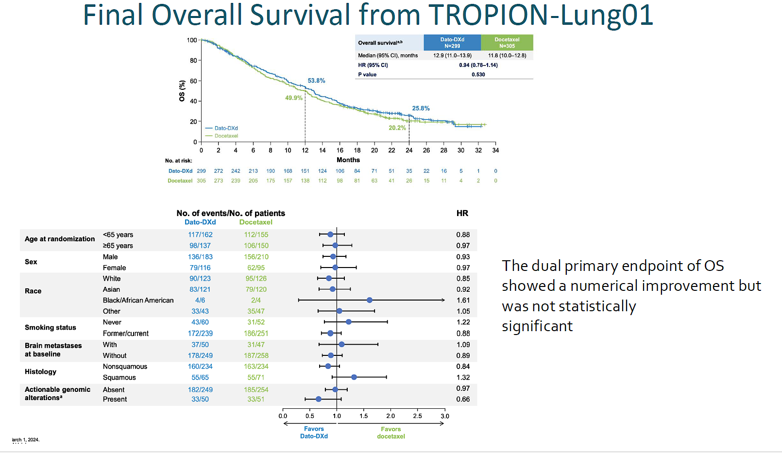
Sands et al, WCLC 2024

Slide 109
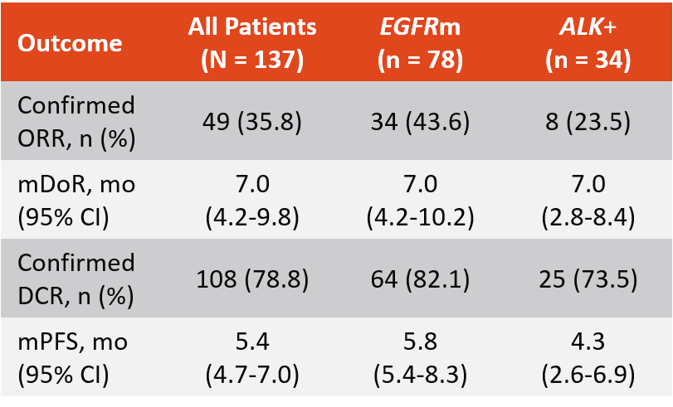
Phase II TROPION-Lung05: Dato-DXd in Previously Treated Advanced NSCLC With Actionable Genomic Alterations (AGAs)
Best overall response included CR in 4 patients (3%) and PR in 45 patients (33%)
Among 68 patients with EGFR sensitizing or T790M mutations, ORR was 49.1% among those with prior osimertinib
Paz-Ares. ESMO 2023. Abstr 1314MO.

Slide 110
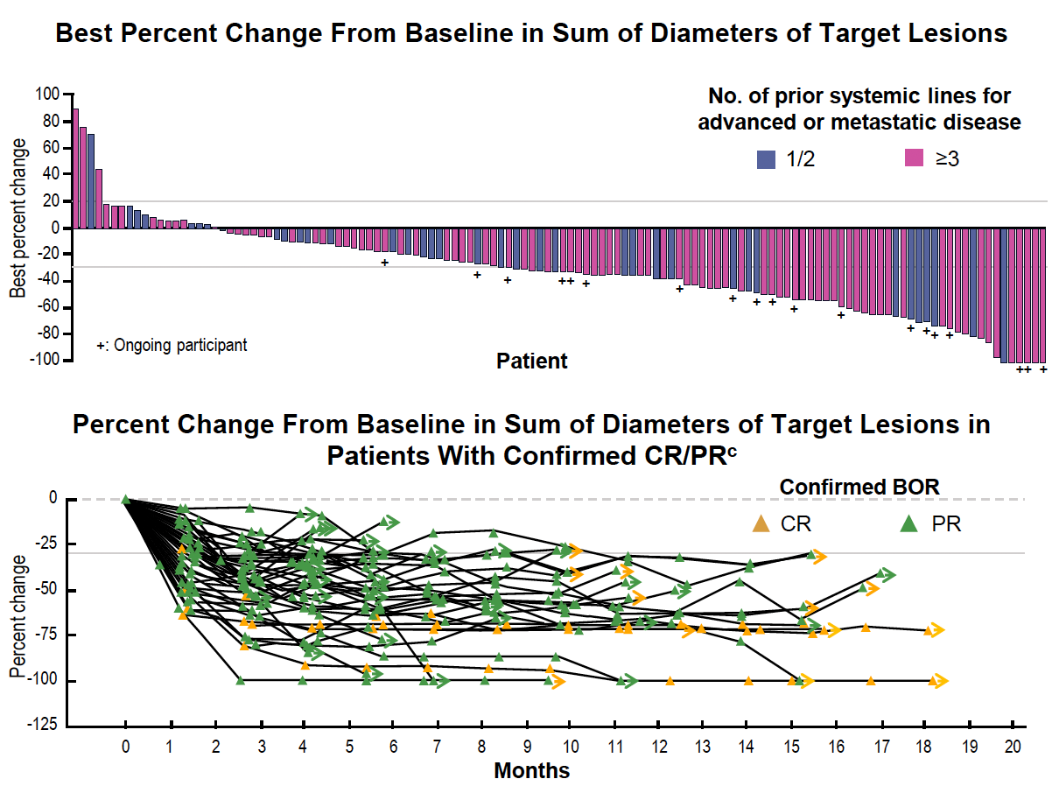
Phase II TROPION-Lung05: Dato-DXd in Previously Treated Advanced NSCLC With AGAs
Best overall response included CR in 4 patients (3%) and PR in 45 patients (33%)
Among 68 patients with EGFR sensitizing or T790M mutations, ORR was 49.1% among those with prior osimertinib
Paz-Ares. ESMO 2023. Abstr 1314MO.

Slide 111
Datopotamab deruxtecan granted Priority Review in the US for patients with previously treated advanced EGFR-mutated NSCLC
Press Release: January 13, 2025
The Biologics License Application (BLA) for datopotamab deruxtecan (Dato-DXd) has been accepted and granted Priority Review in the US for the treatment of adult patients with locally advanced or metastatic epidermal growth factor receptor-mutated (EGFRm) non-small cell lung cancer (NSCLC) who have received prior systemic therapies, including an EGFR-directed therapy.
In a pooled analysis of patients with previously treated advanced or metastatic EGFRm NSCLC in the TROPION-Lung05 and TROPION-Lung01 trials presented at the European Society for Medical Oncology (ESMO) Asia 2024 Congress, datopotamab deruxtecan demonstrated a confirmed objective response rate (ORR) of 42.7% (95% confidence interval [CI] 33.6-52.2) as assessed by blinded independent central review (BICR) and a median duration of response (DoR) of 7.0 months (95% CI 4.2-9.8). The safety profile of datopotamab deruxtecan was consistent with previous reports from the TROPION-Lung05 and TROPION-Lung01 trials, with no new safety concerns identified.
https://www.astrazeneca.com/media-centre/press-releases/2025/datopotamab-deruxtecan-granted-priority-review-in-the-us-for-patients-with-previously-treated-advanced-egfr-mutated-non-small-cell-lung-cancer.html#:~:text=AstraZeneca%20and%20Daiichi%20Sankyo's%20Biologics,small%20cell%20lung%20cancer%20(NSCLC)

Slide 112
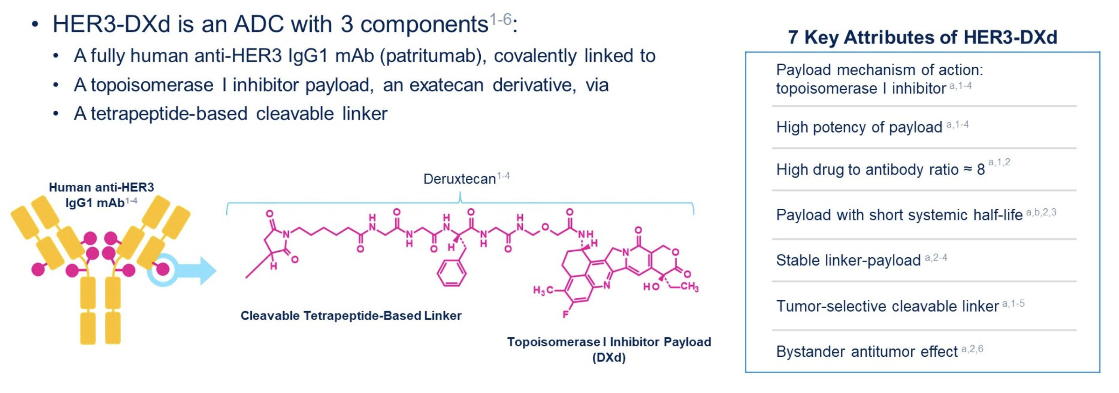
Patritumab Deruxtecan (HER3-DXd)
Krop IE et al. ASCO 2022;Abstract 1002.
Notes:
Eligible patients had EGFR-mutated NSCLC which had progressed after EGFR TKI and PBC, so HER3-DXd was the third or later line of therapy
Patients with clinically inactive or treated brain metastases (who were asymptomatic) were eligible
Primary endpoint was confirmed ORR by BICR
The initial study design was randomized across fixed-dose and uptitration cohorts
Soon after initiation, a benefit/risk analysis of Phase 1 study data supported continuing with the 5.6 mg/kg arm fixed-dose arm and closing the uptitration arm
The focus of this presentation is the 5.6 mg/kg fixed-dose arm
Information for possible questions:
Asymptomatic brain metastases?
This meant without neurologic signs or symptoms and not requiring treatment with corticosteroids or anticonvulsants
Patient disposition?
Treatment continued until disease progression, death, unacceptable toxicity, loss to follow-up, or withdrawal
At primary data cutoff:
Discontinued from study treatment: 197 (87.6)
Primary reason for discontinuation
Death: 14 (6.2)
Adverse event: 17 (7.6)
Progressive disease: 146 (64.9)
Clinical progression: 8 (3.6)
Withdrawal by patient: 11 (4.9)
Physician decision: 1 (0.4)

Slide 113
HERTHENA-Lung01 Study Design¹
HER3-DXd IV Q3W
Fixed dose
5.6 mg/kg
Enrollment continued
(N=225)^{b}
Patient population
Advanced EGFR-mutated NSCLC
Progression on most recent systemic therapy
Prior EGFR TKI and prior platinum-based chemotherapy (amended protocol required prior osimertinib)
Inactive or previously treated asymptomatic brain metastases allowed
Pretreatment tumor tissue required​ª
5.6 mg/kg
Primary endpoint
cORR by BICR​
Key secondary endpoint
DOR by BICR
February 18, 2021
February 18, 2022
R
1:1
Decision point
A benefit-risk assessment of phase 1 data supported the closure of the uptitration arm
Uptitration
C1D1: 3.2 mg/kg
C2D1: 4.8 mg/kg
C3D1 and later cycles: 6.4 mg/kg
Enrollment discontinued (N=50)^{c}
January 18, 2021
September 16, 2021
Primary data cutoff, 21 Nov 2022^{d}
Snapshot data cutoff, 18 May 2023 (additional 6 months follow-up)
Data are presented for the 5.6-mg/kg fixed-dose arm
Efficacy from snapshot data cutoff—median study follow-up, 18.9 (range, 14.9-27.5) months
Safety from primary data cutoff—median treatment duration, 5.5 (range, 0.7-18.2) months
BICR, blinded independent central review; C, cycle; cORR, confirmed objective response rate (complete or partial response confirmed ≥4 weeks after initial response [RECIST version 1.1]); D, day; DOR, duration of response; HER, human epidermal growth factor receptor; IV, intravenous; Q3W, every 3 weeks; RECIST, Response Evaluation Criteria in Solid Tumors; TKI, tyrosine kinase inhibitor.
ª Inclusion not based on detection of HER3 expression. ^{b} 226 patients were enrolled; 225 received ≥1 dose. ^{c} 51 patients were enrolled; 50 received ≥1 dose. ^{d} Data cutoff for the primary analysis occurred when all enrolled patients had either ≥9 months of follow-up or had discontinued from the study earlier.
1. Yu HA, et al. Future Oncol. 2023;19:1319-1329.
Yu HA et al. J Clin Oncol 2023;41(35):5363-5375.
Notes:
Eligible patients had EGFR-mutated NSCLC which had progressed after EGFR TKI and PBC, so HER3-DXd was the third or later line of therapy
Patients with clinically inactive or treated brain metastases (who were asymptomatic) were eligible
Primary endpoint was confirmed ORR by BICR
The initial study design was randomized across fixed-dose and uptitration cohorts
Soon after initiation, a benefit/risk analysis of Phase 1 study data supported continuing with the 5.6 mg/kg arm fixed-dose arm and closing the uptitration arm
The focus of this presentation is the 5.6 mg/kg fixed-dose arm
Information for possible questions:
Asymptomatic brain metastases?
This meant without neurologic signs or symptoms and not requiring treatment with corticosteroids or anticonvulsants
Patient disposition?
Treatment continued until disease progression, death, unacceptable toxicity, loss to follow-up, or withdrawal
At primary data cutoff:
Discontinued from study treatment: 197 (87.6)
Primary reason for discontinuation
Death: 14 (6.2)
Adverse event: 17 (7.6)
Progressive disease: 146 (64.9)
Clinical progression: 8 (3.6)
Withdrawal by patient: 11 (4.9)
Physician decision: 1 (0.4)

Slide 114

Tumor Reduction Across Diverse Mechanisms of EGFR TKI Resistance
HER3-DXd 5.6 mg/kg (N=225)ª
Snapshot data cutoff, 18 May 2023.
Median study follow-up, 18.9 (range, 14.9-27.5) months.
BICR, blinded independent central review; CR, complete response; HER, human epidermal growth factor receptor; IHC, immunohistochemistry; NE, not evaluable; PD, progressive disease; PR, partial response; SD, stable disease; TKI, tyrosine kinase inhibitor.
ª 210 patients had evaluable target lesion measurements at both baseline and post baseline and are included. ^{b} T790M was not included as an EGFR-dependent mechanism of EGFR TKI resistance.
Yu HA et al. J Clin Oncol 2023;41(35):5363-5375.
Notes:
This is waterfall plot showing the best change in the sum of target lesion diameters
Below is a table showing mutation status
The majority of patients had tumor shrinkage
We saw comparable responses in patients with diverse mechanisms of EGFR TKI resistance, including known EGFR-dependent and/or EGFR-independent mechanisms and unidentified mechanisms
25 patients had EGFR C797S mutations (11 PR [cORR, 44%], 7 SD) and 16 patients had MET amplifications (5 PR [cORR, 31%], 6 SD)
Confirmed ORR was 32.4% (11/34) in patients with only EGFR-dependent resistance mechanisms, 27.2% (22/81) in patients with only EGFR-independent resistance mechanisms, and 37.5% (12/32) in patients with both--In patients with no identified EGFR TKI resistance–associated genomic alterations, confirmed ORR was 27.3% (21/77)

Slide 115
Efficacy Observed Across a Broad Range of Pretreatment Tumor HER3 Membrane Expression Levels
Association of Baseline Tumor HER3 Membrane H-Score With Confirmed BOR by BICR
Following Treatment With HER3-DXd 5.6 mg/kg (N=225)ª
Baseline tumor HER3 membrane H-score
Confirmed BOR (BICR)
CR/PR
SD
PD
NE
Biomarker-evaluable patients, n/n
54/67
89/99
35/43
15/16
H-score, median
(range)
205
(0-300)
205
(0-300)
179
(0-300)
195
(15-295)
Response data are for the snapshot data cutoff, 18 May 2023.
Medians are indicated by horizontal lines; means are indicated by X.
BICR, blinded independent central review; BOR, best overall response; CR, complete response; HER, human epidermal growth factor receptor; NE, not evaluable; PD, progressive disease; PR, partial response; SD, stable disease.
ª 193 patients had tumor tissue evaluable for H-score. Baseline was the sample on or before the first dose date and not earlier than 90 days before the first dose date. Highest HER3 membrane H-score value was used if multiple records were available.
Yu HA et al. J Clin Oncol 2023;41(35):5363-5375.
Notes:
We observed no association between baseline tumor membrane HER3-expression and response to HER3-DXd

Slide 116


Intracranial Responses (by CNS BICR) Observed With HER3-DXd
Intracranial Efficacy of HER3-DXd in Patients With Brain Metastases at Baseline
Intracranial response by CNS BICR per CNS RECIST | Patients with brain metastasis at baseline and no prior radiotherapy (N=30)ª
Confirmed ORR (95% CI), % | 33.3 (17.3-52.8)
CR, n (%) | 9 (30.0)​^{b}
PR, n (%) | 1 (3.3)
SD, n (%)^{c} | 13 (43.3)
PD, n (%) | 4 (13.3)
NE, n (%) | 3 (10.0)
DCR (95% CI), % | 76.7 (57.7-90.1)
DOR, median (95% CI), mo | 8.4 (5.8-9.2)
Partial CNS Response in a Patient With a Measurable CNS BICR Target Lesion
Screening
Day 167
Snapshot data cutoff, 18 May 2023.
Median study follow-up, 18.9 (range, 14.9-27.5) months.
BICR, blinded independent central review; CNS, central nervous system; CR, complete response; DCR, disease control rate (CR+PR+SD); DOR, duration of response; MRI, magnetic resonance imaging; ORR, objective response rate; PD, progressive disease; PR, partial response; RECIST, Response Evaluation Criteria in Solid Tumors; SD, stable disease.
ª 7 patients had measurable target lesions; 23 patients had only nontarget lesions. ^{b} 8 patients had only nontarget lesions. ^{c} Includes non-CR/non-PD.
Yu HA et al. J Clin Oncol 2023;41(35):5363-5375.
Notes:
Because more than half of patients with EGFR-mutated NSCLC develop CNS metastases, we were interested in the intracranial efficacy of HER3-DXd
The intracranial imaging was reviewed by a group of neuroradiologists who implemented CNS BICR
Among patients that had brain lesions at baseline without prior radiotherapy
Intracranial cORR was 33.3%
Intracranial DCR was 76.7%
Intracranial DOR was 8.4 months
A more detailed analyses for brain metastases will be presented in the upcoming ESMO 2023
Information for possible questions:
What imaging was used to determine the responses (the slide shows contrast-enhanced CT scans)?
Responses were based on CT imaging alone (5 CRs and 1 PR), MRI alone (2 CRs), or CT imaging with MRI confirmation (2 CRs)
For the patient with CR in a measurable target lesion: CR confirmed by MRI at week 18; CNS PD at 31 weeks
What were the CNS RECIST criteria?
CNS RECIST (2 primary readers plus 1 adjudicator)
Lesion definition
Target Up to 5 lesions in CNS not previously irradiated or with progression following treatment.
Enhancing intraparenchymal brain metastases that can be measured in ≥1 dimension; minimum size of 10 mm or 2× the MRI slice thickness, whichever is larger.
Nontarget All others not selected as a target.
Response assessment
Complete response Disappearance of all target and nontarget lesions.
Partial response ≥30% decrease in sum of diameters of target lesions from baseline and no progression of target lesions.
Stable disease Non-PR/non-PD
Progressive disease Increase of 20% from nadir in target lesions, unequivocal progression in nontarget lesion, or unequivocal new lesion.

Slide 117
HERTHENA-Lung02
Patritumab deruxtecan demonstrated statistically significant improvement in progression-free survival versus doublet chemotherapy in patients with locally advanced or metastatic EGFR-mutated non-small cell lung cancer in HERTHENA-Lung02 phase 3 trial. News Release. September 17, 2024.

Slide 118
Conclusions
The greatest efficacy for datopotamab deruxtecan is among EGFR mutation positive patients
Patritumab deruxtecan has demonstrated efficacy among patients with EGFR mutations
The toxicity profile of the agents are somewhat unique
To date, we have not seen clear association of the target of the antibody and efficacy, although evaluation is ongoing

Slide 119
Roundtable Discussion

Slide 120
Understanding the Current Paradigm and New Approaches: The Optimal Implementation of Antibody-Drug Conjugates in the Care of Patients with Cancer
Research To Practice
Oncology Nursing Society Congress 2025
Marianne Davies, DNP, CNS-BC, ACNP-BC, AOCNP-BC, FAAN
Program Manager, Care Signature: Oncology Service Line
Thoracic Oncology Nurse Practitioner, Smilow Cancer Hospital
Associate Professor, Yale University School of Nursing

Slide 121

Scenario 4: EGFR-mutant NSCLC
55 yo woman, never smoker
  Married, Adult children & young grandchild
  Husband is ophthalmologist
  Volunteers in NICU, Community Dining Hall, Church
Diagnosed 2023 with EGFR-mutant NSCLC, L858R point mutation exon 21
Treated with 18 months on EGFR inhibitor therapy
Progression of disease on recent scans
About to start Datopotamab Deruxtecan (Dato-DXd)

Slide 122
Dato-DXd: Side Effect Reports on TROPION-Lung01
Nausea
Stomatitis/mucositis inflammation 55% all grade; 6% > grade 3
  TROP₂ expressed on mucosal surfaces
Ocular: 21% overall; Dry eye (7%) increased lacrimation (7%)
  Conjunctivitis, keratitis
ILD (9% all grade; 4% > grade 3; 2% death)
Hematologic toxicities: neutropenia, fever

Slide 123
Management of Ocular Surface Toxicities
Associated With Datopotamab Deruxtecan
Grade and Description | Protocol Management Recommendations
Grade 1: Asymptomatic; Nonconfluent superficial keratitis | Consider ophthalmology assessment Maintain dose
Grade 2: Symptomatic with moderate decrease in visual acuity; Confluent keratitis, cornea defect or 3-line or more loss of best corrected distance visual acuity. | Obtain ophthalmology assessment Delay dose until resolved to grade ≤1
Grade 3: Symptomatic limiting self-care ADLs; Corneal ulcer or stromal opacity or best corrected visual acuity <20/200 | Obtain ophthalmology assessment Delay dose until resolved to grade ≤1, then reduce by one dose level
Grade 4: Corneal Perforation | Obtain ophthalmology assessment Discontinue drug
Heist RS, et al. Cancer Treat Rev. 2024;125:102720.

Slide 124
Ocular Surface Events (OSE)
Prophylaxis
Management
Avoid contact lens use
Lubricating artificial tears
Ophthalmologic eye exam
  Other ADCs use prophylactic steroid, lubricant, vasoconstrictive drops. This has not so far been recommended for Dato-DXd given lower incidence
Use of eye cooling packs during infusion?

Slide 125
Management of Stomatitis/Mucositis
Associated With Datopotamab Deruxtecan
Grade | Protocol Management Recommendations
1 | Maintain dose
2 | Consider dose delay or reduction
3 | Delay dose until resolved to grade ≤1 or baseline Consider dose reduction by one level if supportive medications are already optimized
4 | Discontinue drug
Heist RS, et al. Cancer Treat Rev. 2024;125:102720.

Slide 126
Stomatitis
Prophylactic
Management
Educate patients on importance of oral hygiene, hydration and lubrication of oral mucosa
Gentle teeth brushing, soft toothbrush, bland fluoride-containing toothpaste
Daily flossing (stop if bleeding or painful)
Education about oral hygiene, hydration, lubrication
  What not to do or use
Steroid-containing mouthwash
  4 times a day, swish and spit 1 to 2 minutes
  Example is dexamethasone 0.1 mg/mL
Use bland mouthwashes every hour if needed
Pain management topical or systemic
  (doxepin 0.5%, viscous lidocaine 2%)
Referral to dentist or oral surgeon for further evaluation
Use of ice chips (cryotherapy) during infusions
  Held in mouth during the infusion
Heist RS, et al. Cancer Treat Rev. 2024;125:102720.

Slide 127
ILD Risk factors
Smoking
Previous ILD
ECOG PS >2
Preexisting lung disease
Patients with NSCLC are at higher risk due to underlying preexisting lung pathology and higher rates of smoking
EGFR-TKI, osimertinib, in first line setting (incidence of grade >3 ILD ranges from 0.9-3%)

Slide 128
Management of ILD Associated With Datopotamab Deruxtecan
Monitor
HOLD Dato-DXd for concerning new symptoms; Rule out other causes
Confirm
Evaluation with CT scan, Pulse oximetry, Pulmonology
Manage
Grade | Protocol Management Recommendations in Addition to Holding or Discontinuing Agent
1 | Monitor symptoms and closely follow up in 2-7 days for clinical onset of symptoms and SpO₂ Consider follow-up imaging in 1-2 weeks Consider starting systemic steroids (prednisone 0.5 mg/kg/day) Hold Dato-DXd until fully resolved ---If resolved in <28 days, maintain dose ---If resolved >28 days, reduce by one dose level ---If grade 1 ILD/pneumonitis does not resolve within 84 days, permanently discontinue Dato-DXd
2 | Permanently discontinue Dato-DXd Monitor and re-image Start systemic steroids (prednisone 1.0 mg/kg/day); increase steroid dose if worsening or no improvement in ≤5 days; duration until grade 1, then taper over > 4 weeks
3/4 | Permanently discontinue Dato-DXd Hospitalization Initiate high-dose systemic steroids (Methylprednisolone 500-1000 mg/day x 3 days) Re-image as clinically indicated If no improvement within 3-5 days, reconsider workup for alternative etiologies and consider other immunosuppressants and/or treat per local practice
SpO₂, oxygen saturation.
Heist RS, et al. Cancer Treat Rev. 2024;125:102720.

