Slide 1

Year in Review
Management of Metastatic EGFR Mutation-Positive Non-Small Cell Lung Cancer (NSCLC)
Helena Yu, MD

Slide 2
Jänne PA et al. Survival with Osimertinib plus Chemotherapy in EGFR-Mutated Advanced NSCLC. N Engl J Med 2026;394(1):27-38.
FLAURA2 survival

Slide 3
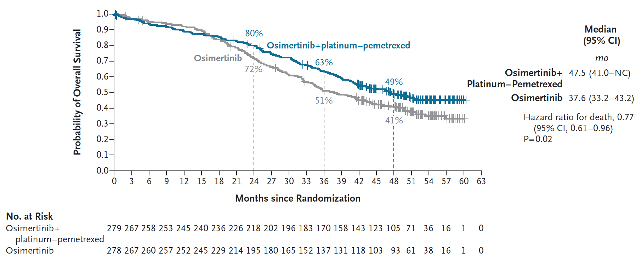
FLAURA2 Overall Survival
Jänne PA et al. N Engl J Med 2026;394(1):27-38.

Slide 4
FLAURA2 Overall Survival - Conclusions
Confirms the previous PFS benefit we saw with osimertinib + platinum chemotherapy compared to osimertinib alone
Reinforces that giving osimertinib + chemotherapy together upfront is better than sequencing. Natural history of cancer is altered with clear OS HR benefit with upfront combination therapy (HR 0.77)
Benefit maintained in various subgroups
Sets the standard of care upfront to be combination therapy. This is what convinced most providers to begin using combination therapy upfront for most patients. “Opt out” rather than “Opt in”
Changes standard of care for clinical research moving forward- need to allow for prior osimertinib and prior chemotherapy for all later-line drug development
Jänne PA et al. N Engl J Med 2026;394(1):27-38.

Slide 5
Jänne PA et al. FLAURA2: Exploratory overall survival (OS) analysis in patients (pts) with poorer prognostic factors treated with osimertinib (osi) ± platinum-pemetrexed chemotherapy (CTx) as first-line (1L) treatment (tx) for EGFR-mutated (EGFRm) advanced NSCLC. ESMO 2025;Abstract LBA77.
FLAURA2 survival – High risk subgroups

Slide 6
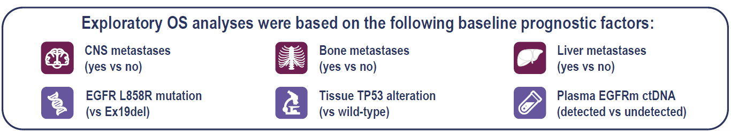
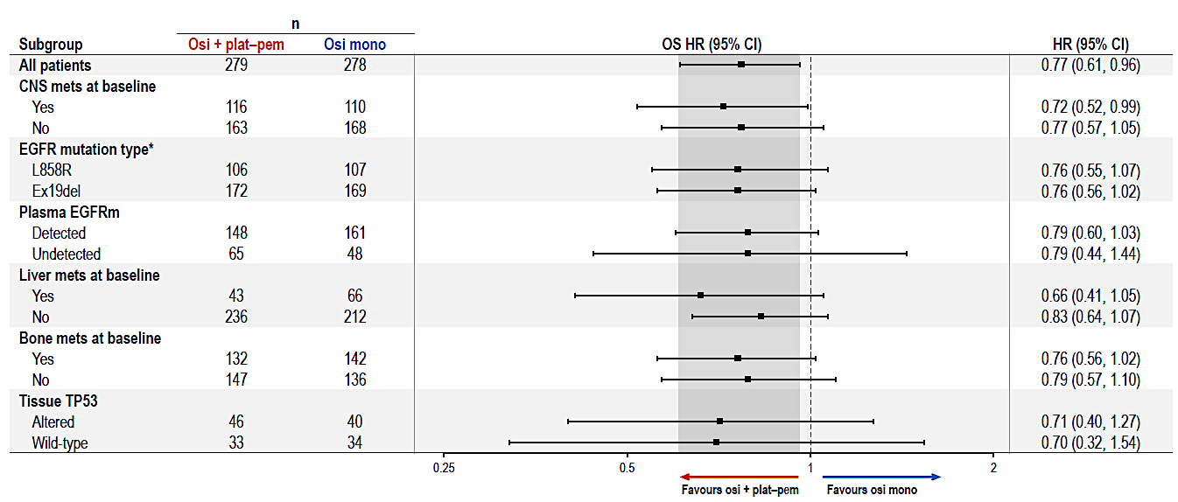
FLAURA2 Overall Survival – High risk subgroups
Jänne PA et al. ESMO 2025;Abstract LBA77.

Slide 7
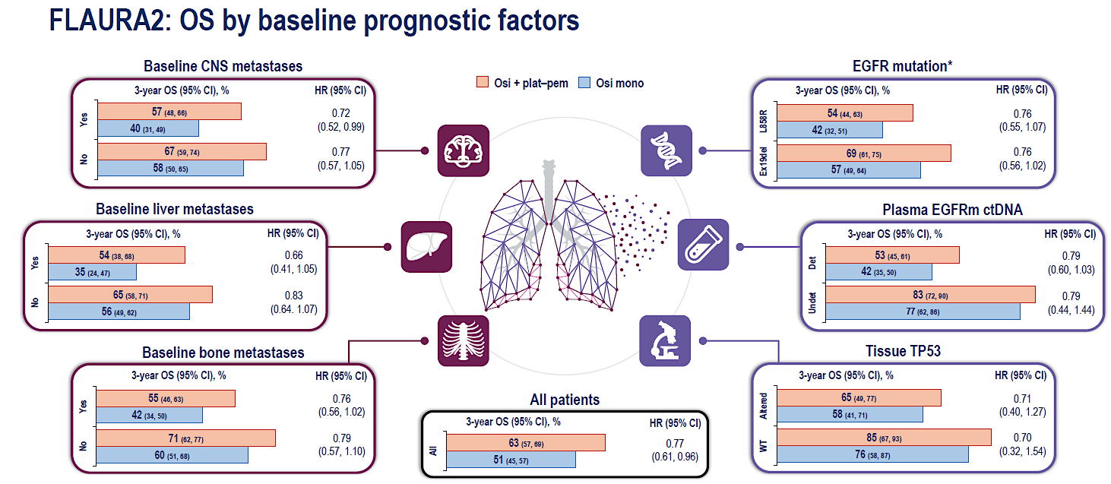
FLAURA2 Overall Survival – High risk subgroups
Jänne PA et al. ESMO 2025;Abstract LBA77.

Slide 8
FLAURA2 OS in high-risk subgroups- Conclusions
When looking at baseline-defined high-risk subgroups (CNS metastases, liver metastases, bone metastases, EGFR L858R, plasma EGFR ctDNA detection, TP53 comutation) – an OS benefit was maintained.
The majority of patients will have at least one high-risk feature in their lung cancer, so opt-out of combination therapy
Reinforces that high-risk cancers with poorer prognosis will still benefit from escalation of therapy
Jänne PA et al. ESMO 2025;Abstract LBA77.

Slide 9
Elamin YY et al. NorthStar: A phase II randomized study of osimertinib (OSI) with or without local consolidative therapy (LCT) for metastatic EGFR-mutant non-small cell lung cancer (NSCLC). ESMO 2025;Abstract LBA72.
Local consolidation for EGFR+ NSCLC

Slide 10
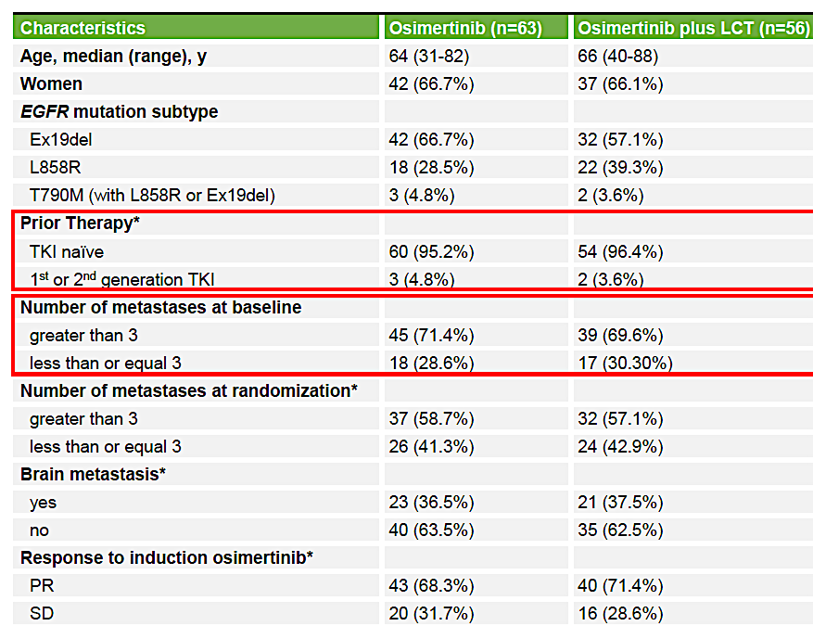
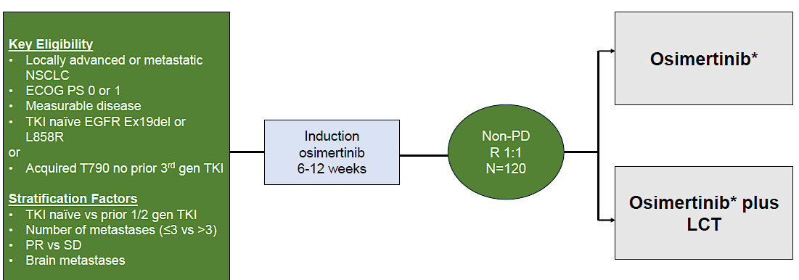
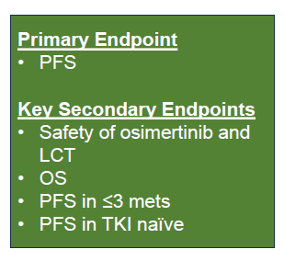
North Star study – Local consolidation for EGFR+ NSCLC
Elamin YY et al. ESMO 2025;Abstract LBA72.

Slide 11
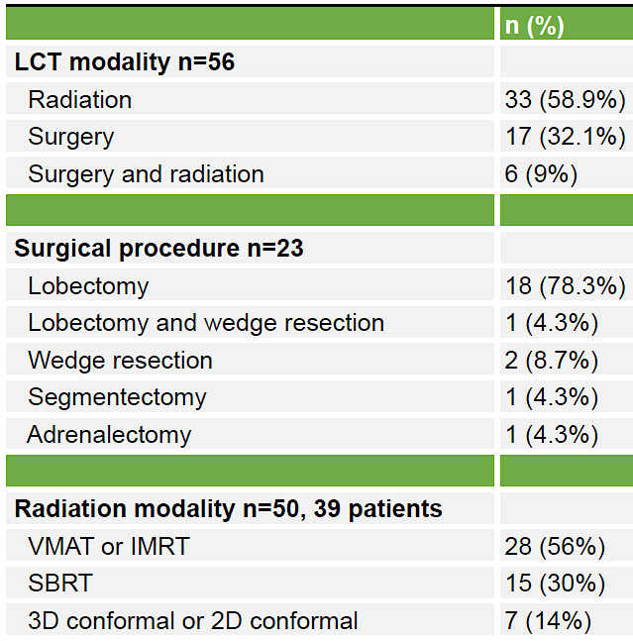

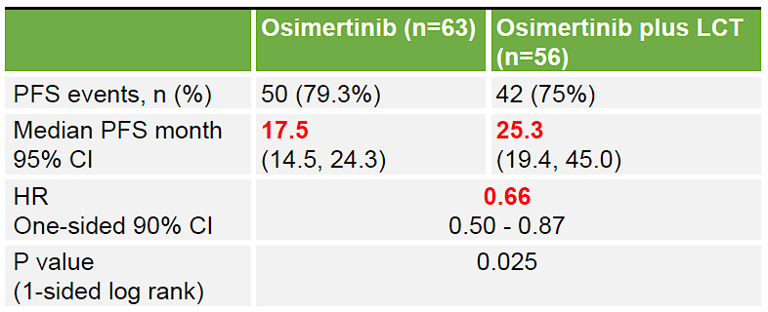
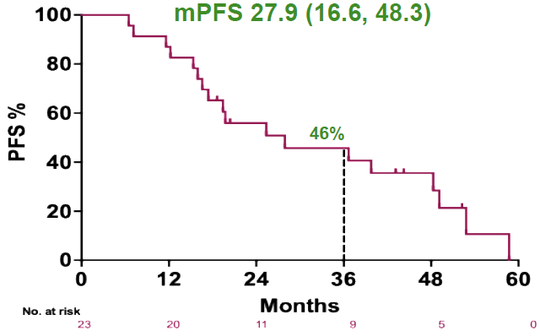
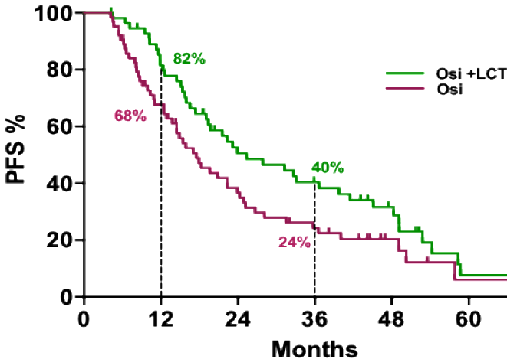

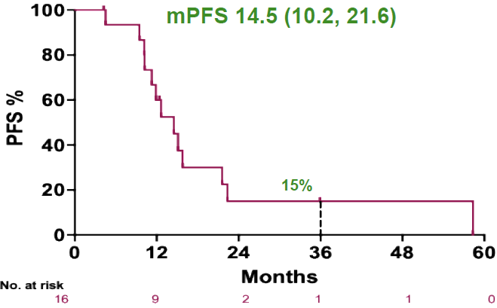
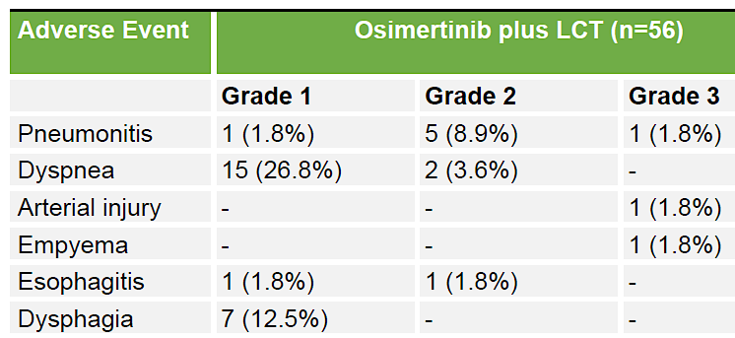
North Star study – Local consolidation for EGFR+ NSCLC
Elamin YY et al. ESMO 2025;Abstract LBA72.

Slide 12
Local consolidation for EGFR+ NSCLC - Conclusions
Local consolidation improves PFS compared to osimertinib alone (25.3 vs 17.5mo)
Patients with polymetastatic disease can be rendered oligometastatic (13%) and local therapy can be considered.
Even patients with polymetastatic disease can benefit from LCT if and only if complete LCT is done (i.e. local therapy to ALL sites of disease)
Elamin YY et al. ESMO 2025;Abstract LBA72.

Slide 13
Yang JC et al. Overall Survival with Amivantamab-Lazertinib in EGFR-Mutated Advanced NSCLC. N Engl J Med 2025;393(17):1681-93.
MARIPOSA - Overall Survival

Slide 14
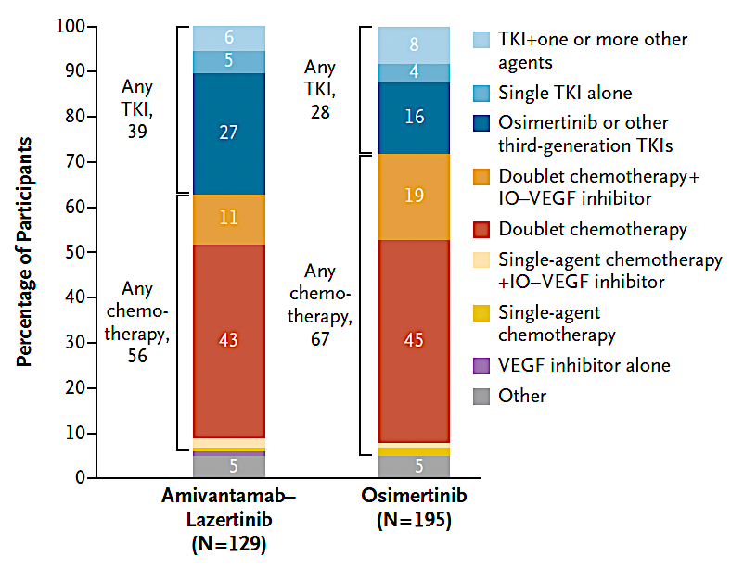
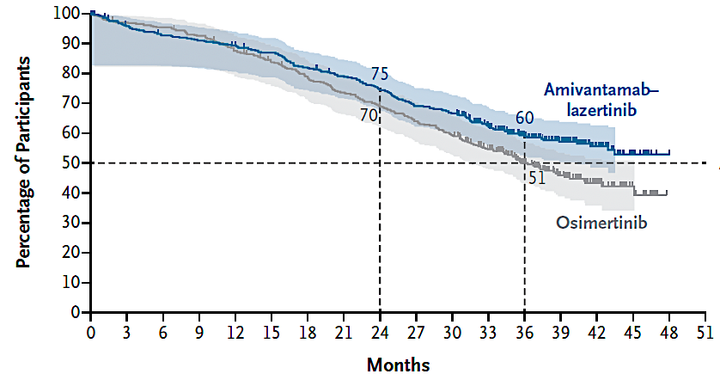
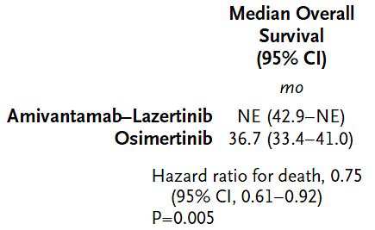
MARIPOSA - Overall Survival
On osimertinib arm, only 3 patients received subsequent amivantamab
Yang JC et al. N Engl J Med 2025;393(17):1681-93.

Slide 15
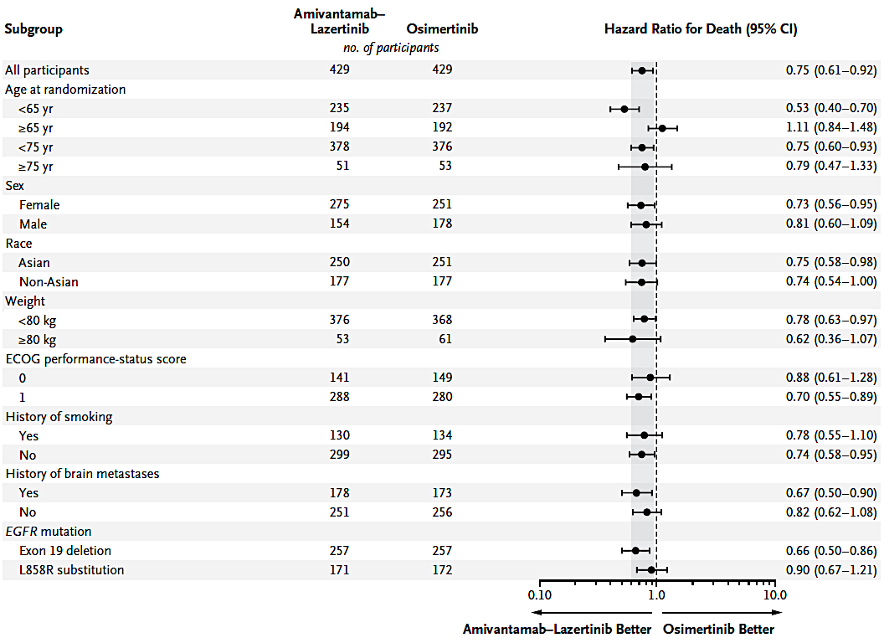
MARIPOSA - Overall Survival
Yang JC et al. N Engl J Med 2025;393(17):1681-93.

Slide 16
MARIPOSA - Overall Survival
Confirms the previous PFS benefit we saw with Amivantamab and lazertinib compared to osimertinib alone
Benefit maintained in various subgroups
Sets the standard of care upfront to be combination therapy. This is what convinced most providers to begin using combination therapy upfront for most patients. “Opt out” rather than “Opt in”
No question Amivantamab is an active drug- only question is whether to utilize in first-line or later-line
Yang JC et al. N Engl J Med 2025;393(17):1681-93.

Slide 17
Scott SC et al. PALOMA-2: Subcutaneous Amivantamab Administered Every 4 Weeks Plus Lazertinib in First-Line EGFR-Mutated Advanced NSCLC. WCLC 2025;Abstract MA08.05.
Subcutaneous amivantamab

Slide 18
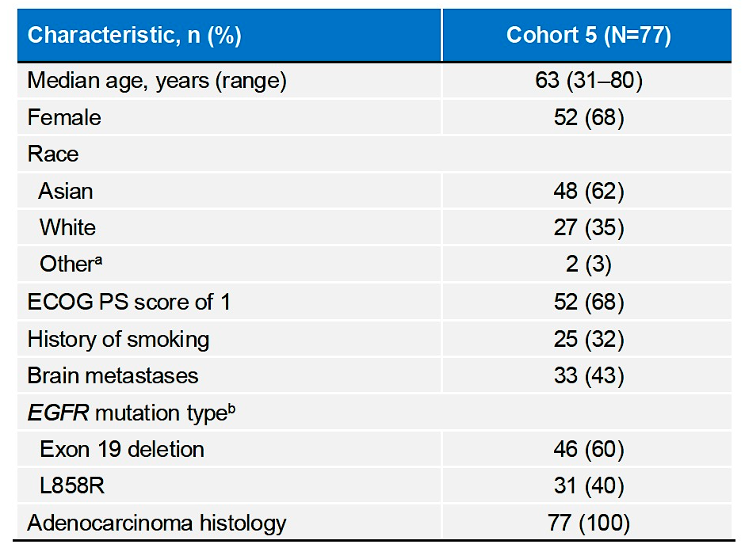
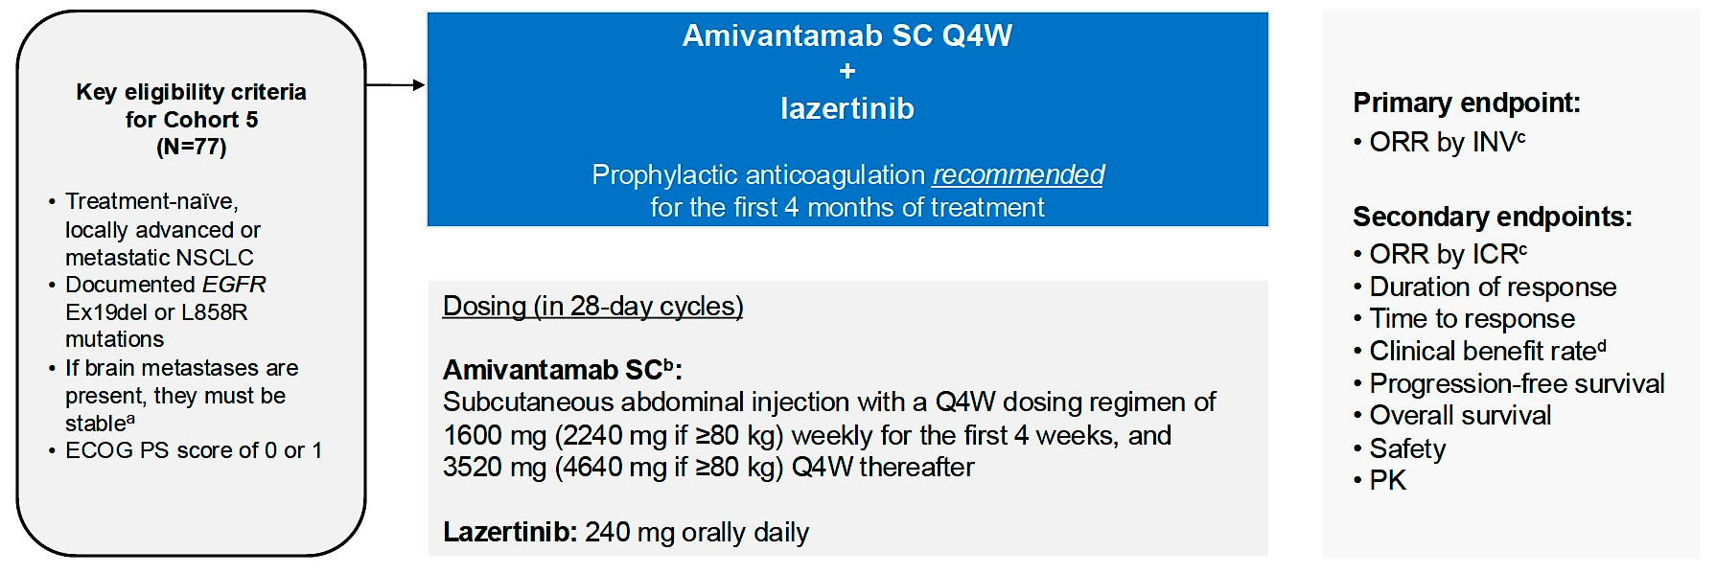
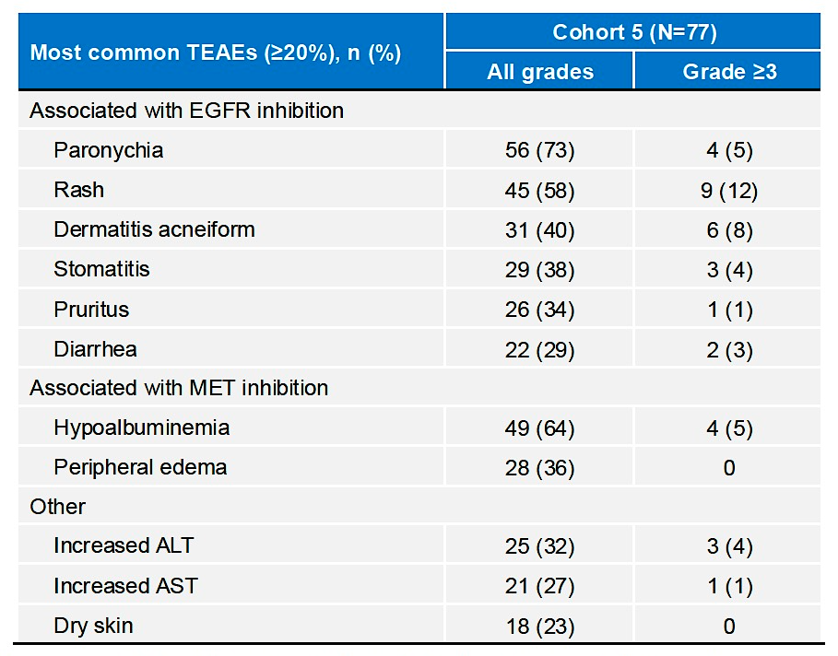
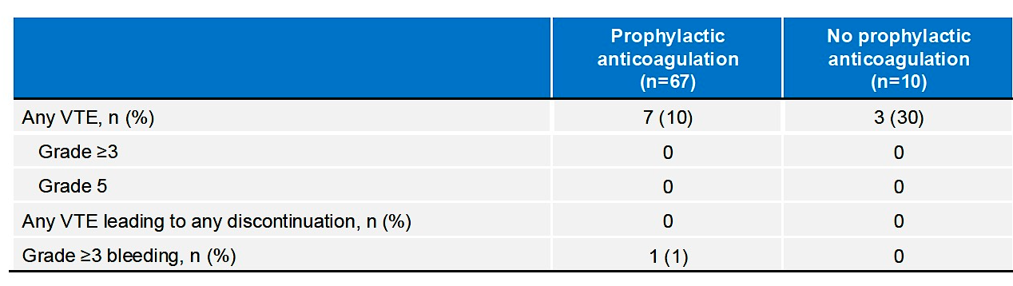
Subcutaneous amivantamab
Scott SC et al. WCLC 2025;Abstract MA08.05.

Slide 19
Subcutaneous amivantamab
Subcutaneous Amivantamab has significantly less infusion reactions, requires less chair time and comparable efficacy to intravenous formulation
Subcutaneous Amivantamab has similar EGFR and MET-directed cutaneous toxicities
Prophylactic anti-coagulation reduces rates of VTE
Scott SC et al. WCLC 2025;Abstract MA08.05.

Slide 20
Alexander M et al. Subcutaneous versus intravenous amivantamab, both in combination with lazertinib, in refractory EGFR-mutated non-small cell lung cancer: Patient satisfaction and resource utilization results from the PALOMA-3 study. Eur J Cancer 2025;227:115624.
Subcutaneous amivantamab

Slide 21
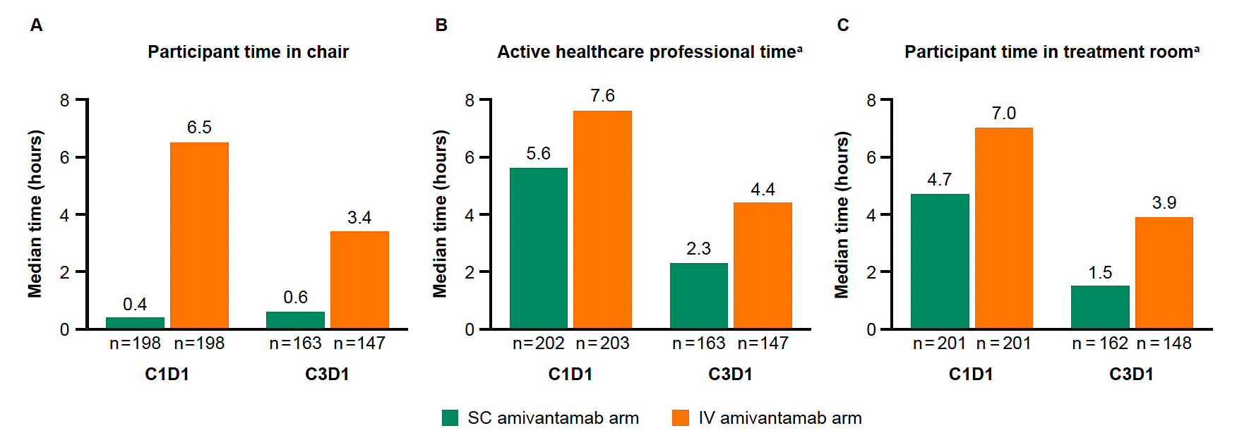
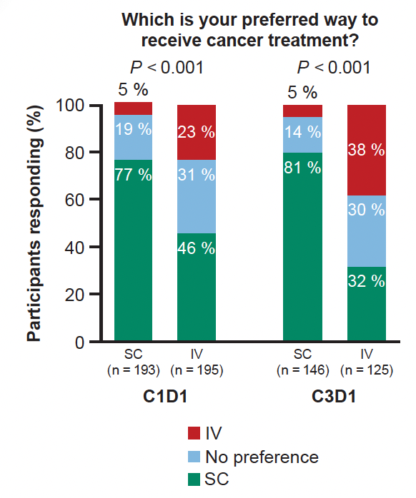
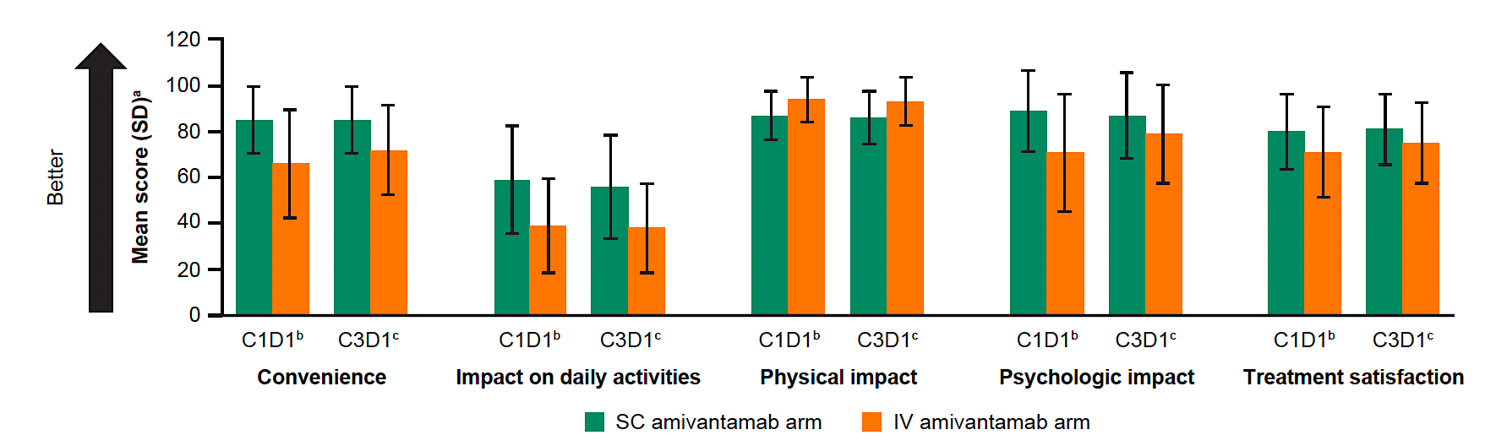
Subcutaneous Amivantamab – pt satisfaction PALOMA-3
Alexander M et al. Eur J Cancer 2025;227:115624.

Slide 22
Subcutaneous amivantamab
Subcutaneous Amivantamab results in shorter chair time, HCP time and patient time in room.
More patients who received subcutaneous Amivantamab were satisfied with its administration
Alexander M et al. Eur J Cancer 2025;227:115624.

Slide 23
Sands J et al. Datopotamab Deruxtecan in Advanced or Metastatic Non-Small Cell Lung Cancer With Actionable Genomic Alterations: Results From the Phase II TROPION-Lung05 Study. J Clin Oncol 2025;43(10):1254-65.
Datopotamab deruxtecan- TROPION Lung05

Slide 24
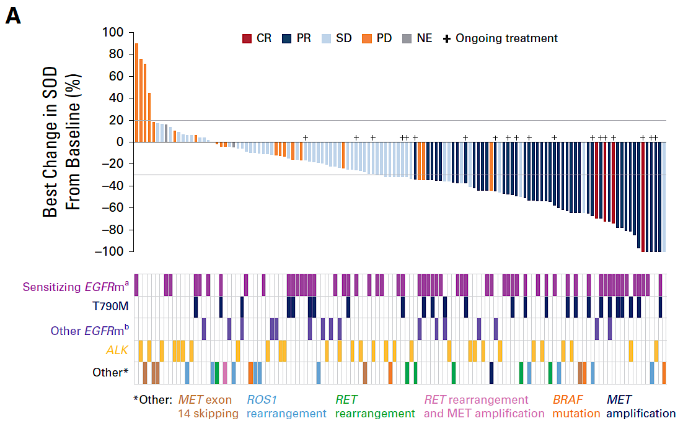
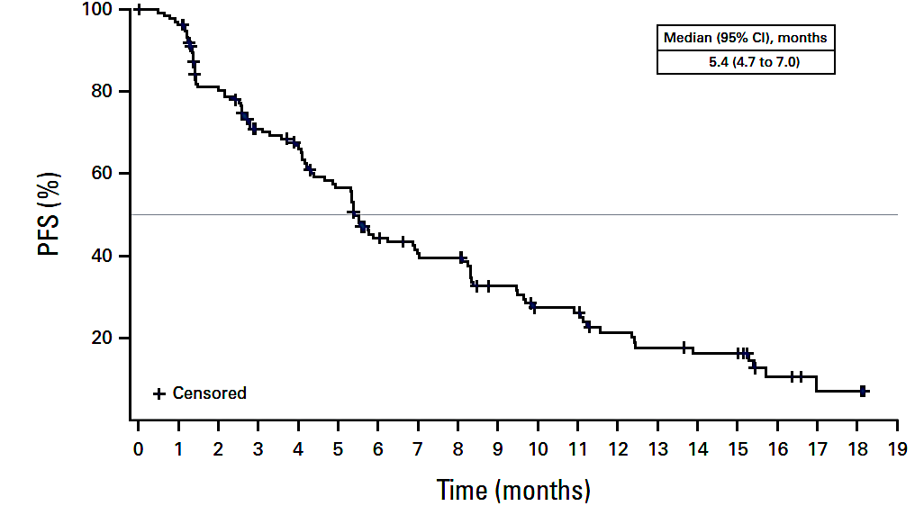
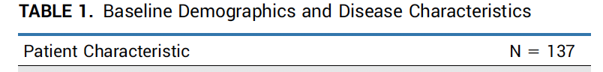
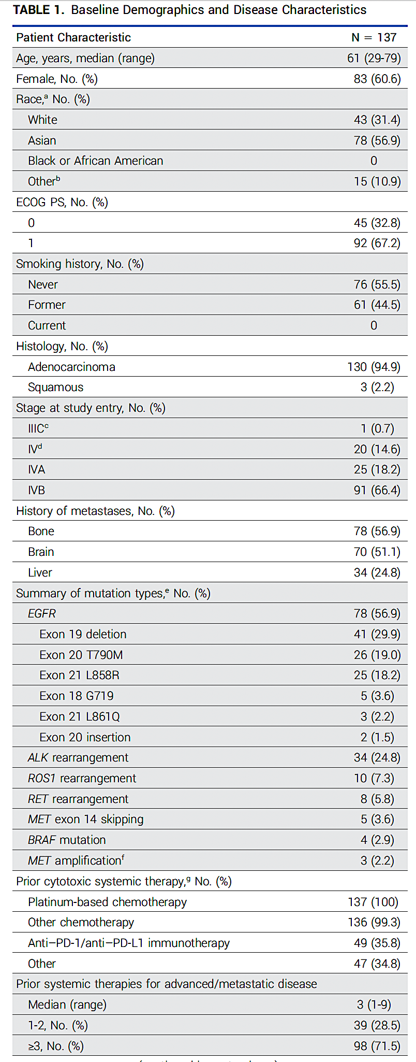
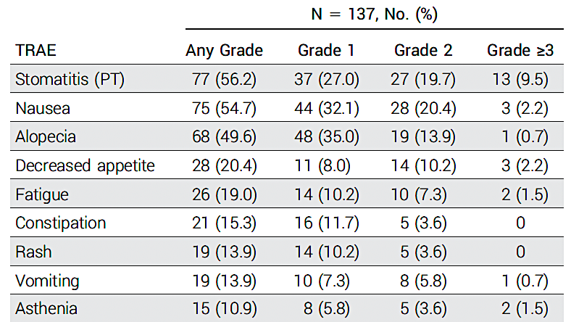
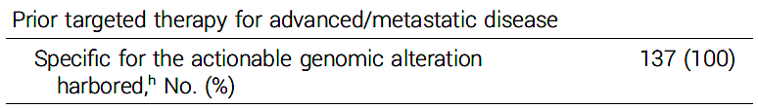
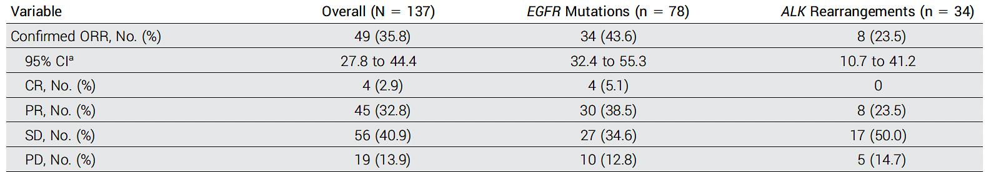
Datopotamab deruxtecan – TROPION-Lung05
Sands J et al. J Clin Oncol 2025;43(10):1254-65.

Slide 25
Datopotamab deruxtecan – TROPION-Lung05
TROPION-Lung05 focused on patients with AGA’s s/p chemotherapy and targeted therapy
More than half were patients with EGFR-mutant lung cancers. The highest efficacy was seen in these patients with an ORR of 44% and median PFS of 5.8 months
This study supported the accelerated approval of Datopotamab deruxtecan in patients with EGFR-mutant lung cancers after EGFR TKI and chemotherapy
Sands J et al. J Clin Oncol 2025;43(10):1254-65.

Slide 26
Ahn MJ et al. A Pooled Analysis of Datopotamab Deruxtecan in Patients With EGFR-Mutated NSCLC. J Thorac Oncol 2025;20(11):1669-82.
Pooled analysis of TL01 and TL05

Slide 27
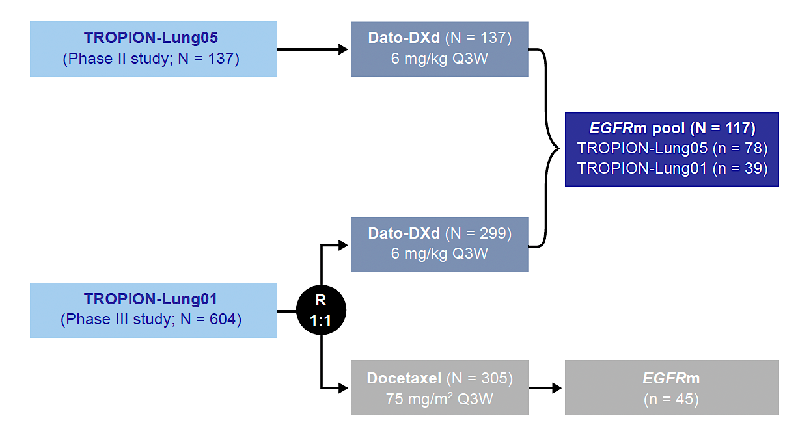
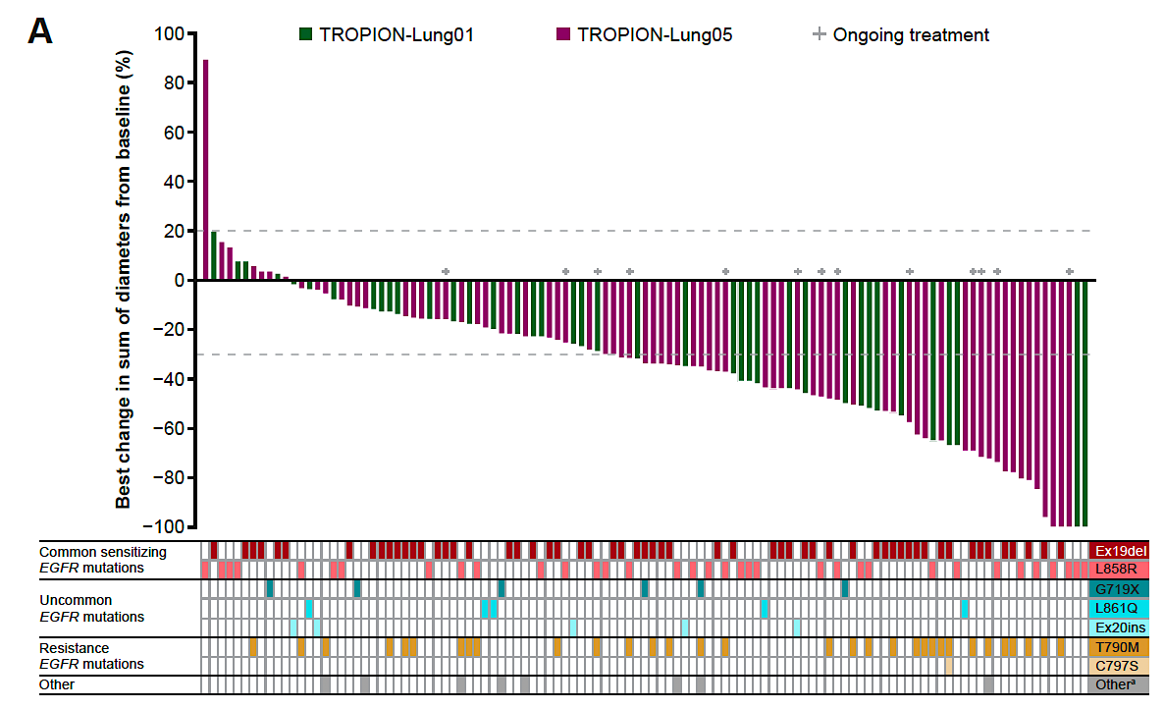
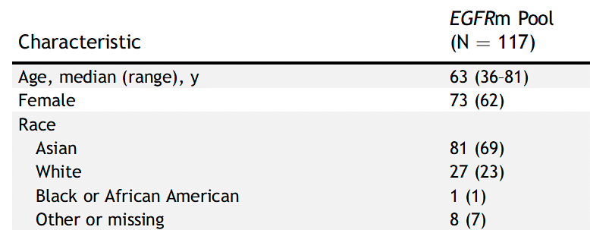
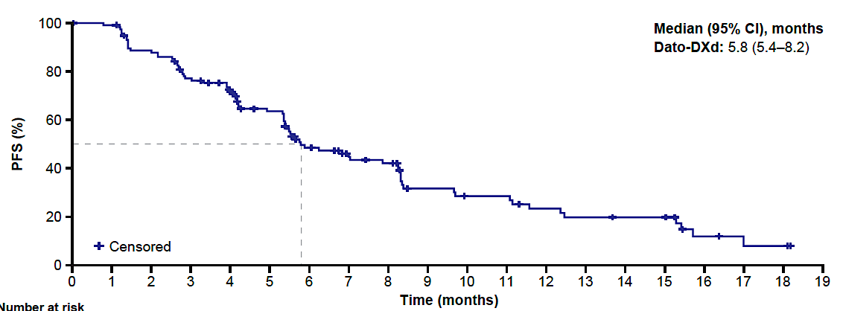
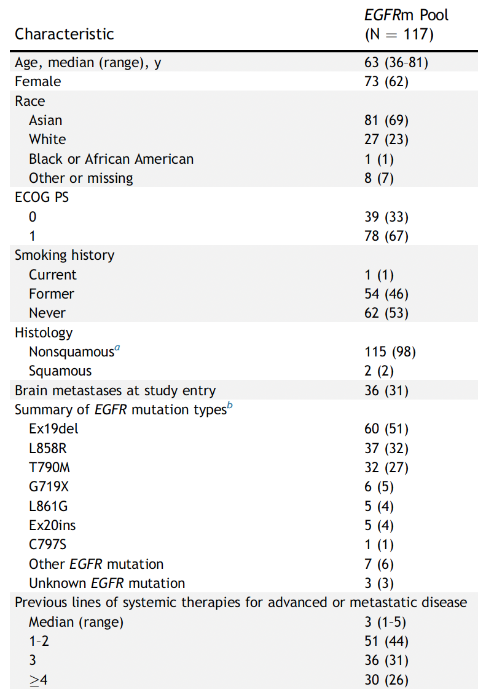
Datopotamab deruxtecan – TROPION-Lung01 and Lung05
Ahn MJ et al. J Thorac Oncol 2025;20(11):1669-82.

Slide 28
Datopotamab deruxtecan – TROPION-Lung01 and Lung05
Pooled analysis of TL01 and TL05 included 117 pts with EGFR-mutant lung cancer
Pooled ORR was 43% and median PFS was 5.8 months
This pooled analysis resulted in the accelerated approval of Datopotamab deruxtecan in patients with EGFR-mutant lung cancers after EGFR TKI and chemotherapy
Important to note approval also includes patients with uncommon EGFR mutations and Exon 20 insertions
Ahn MJ et al. J Thorac Oncol 2025;20(11):1669-82.

Slide 29
Peled N et al. COMPEL: Osimertinib plus platinum-based chemotherapy in patients with EGFR-mutated advanced NSCLC and progression on first-line osimertinib. ESMO Open 2025;10(10):105807.
COMPEL study – osimertinib with chemotherapy

Slide 30
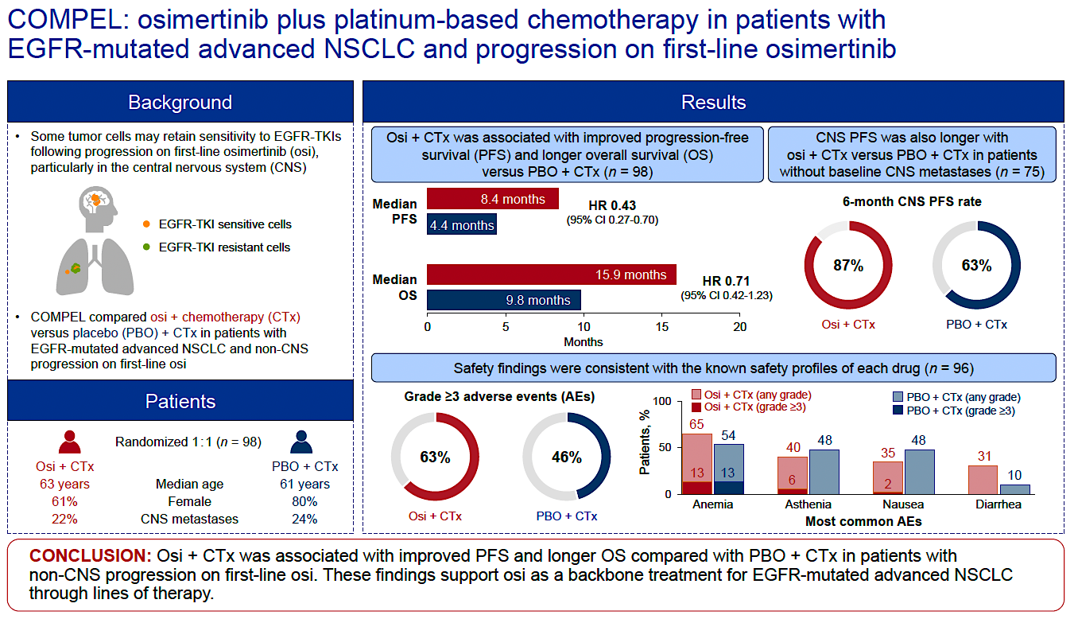
COMPEL study – osimertinib with chemotherapy
Peled N et al. ESMO Open 2025;10(10):105807.

Slide 31
COMPEL study – osimertinib with chemotherapy
Important study that assessed continuation of osimertinib with chemotherapy after non-CNS progression on osimertinib
Study was stopped early due to slow accrual
Median PFS 8.4 months in osimertinib/chemotherapy arm vs 5.5 months in the chemotherapy arm
Median CNS PFS was 15.9 months in osimertinib/chemotherapy arm and 8.6 months in the chemotherapy arm
Median non-CNS PFS was 8.4 months in osimertinib/chemotherapy arm and 5.2 months in the chemotherapy arm
Bottom line, if starting chemotherapy in the 2L setting, continuing osimertinib or adding Amivantamab is recommended. I would NOT proceed with chemotherapy alone
Continuing osimertinib with chemotherapy decreased the risk of CNS progression
Peled N et al. ESMO Open 2025;10(10):105807.

Slide 32
Le X et al. Osimertinib (osi) + datopotamab deruxtecan (Dato-DXd) in patients (pts) with EGFR-mutated (EGFRm) advanced NSCLC (aNSCLC) whose disease progressed on first-line (1L) osi: ORCHARD. ELCC 2025;Abstract 1O.
Datopotamab deruxtecan + osimertinib in the ORCHARD study

Slide 33
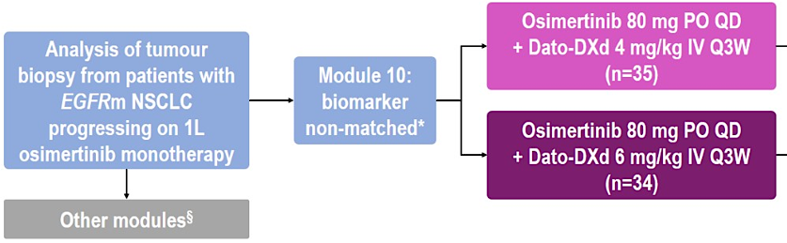
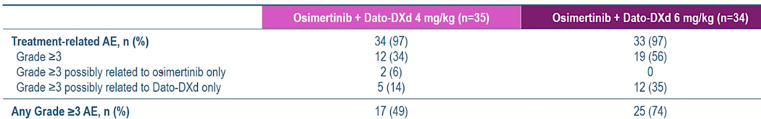
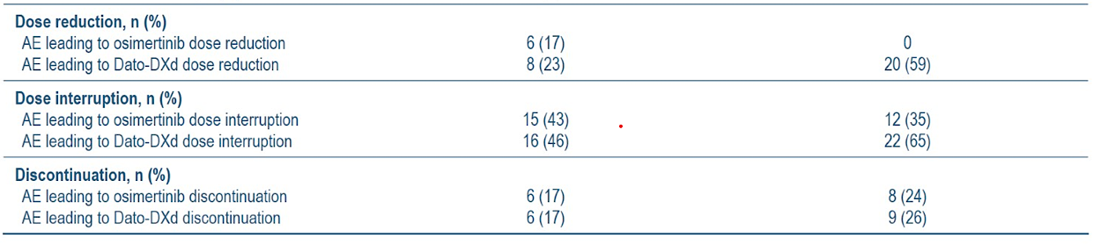
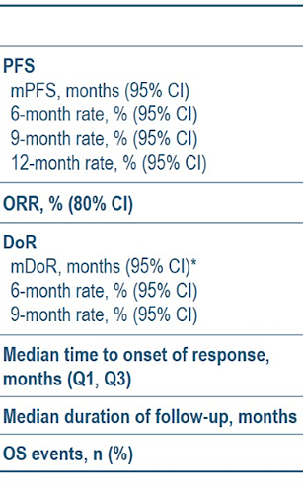
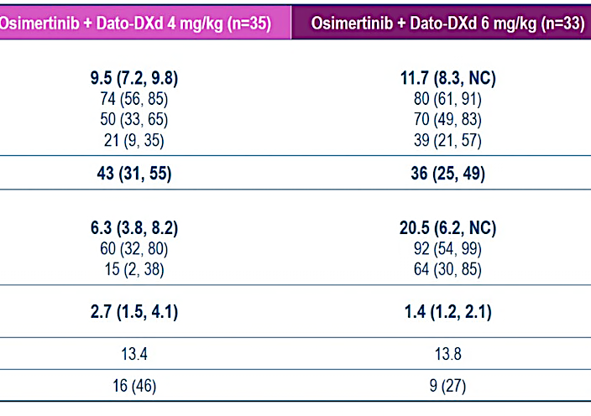
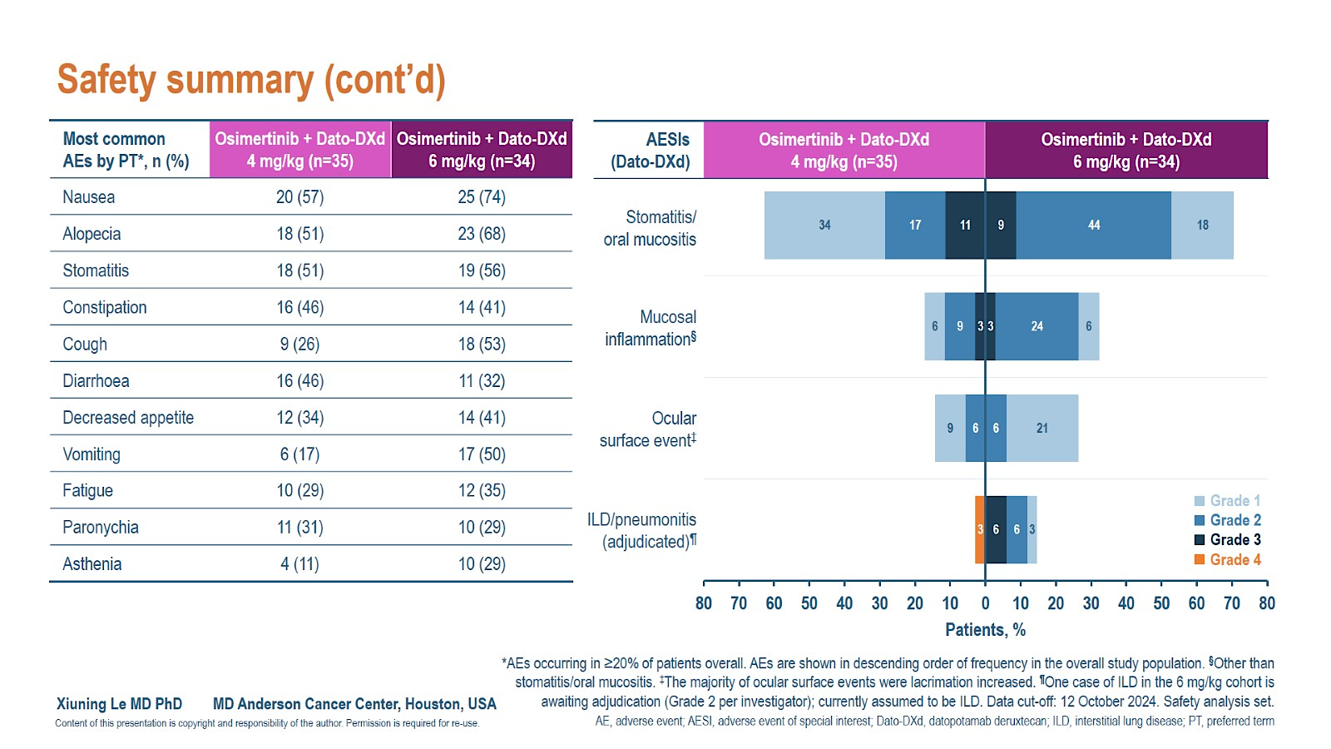
Datopotamab deruxtecan + osimertinib in ORCHARD
Le X et al. ELCC 2025;Abstract 1O.

Slide 34
Datopotamab deruxtecan + osimertinib in ORCHARD
Combination of Dato-DXd and osimertinib was doable but with additive toxicity
Better efficacy seen in Dato-DXd 6mg/kg compared to 4mg/kg
Ongoing studies looking at this combination in the first-line setting and after progression on osimertinib monotherapy
Le X et al. ELCC 2025;Abstract 1O.

Slide 35
Lu S et al. Savolitinib plus osimertinib versus chemotherapy for advanced, EGFR mutation-positive, MET-amplified non-small-cell lung cancer in China (SACHI): Interim analysis of a multicentre, open-label, phase 3 randomised controlled trial. Lancet 2026;407(10526):375-87.
SACHI study- Savolitinib + osimertinib

Slide 36
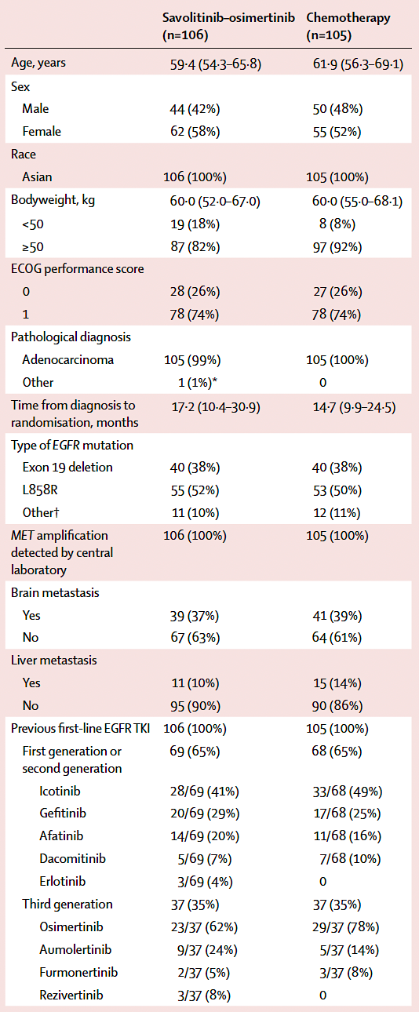
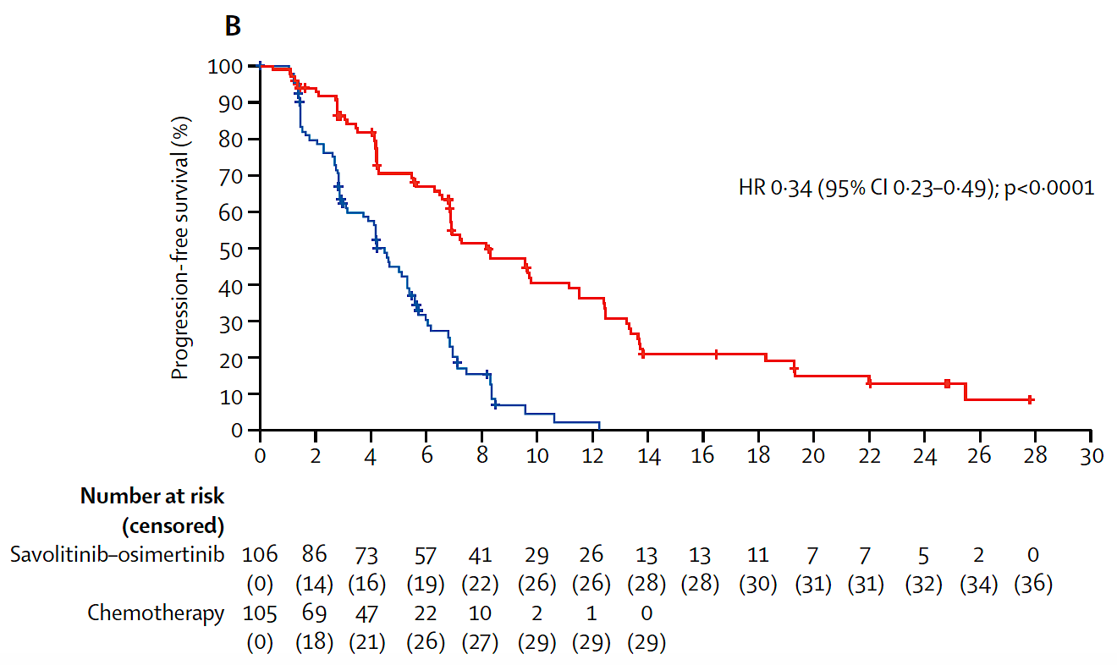
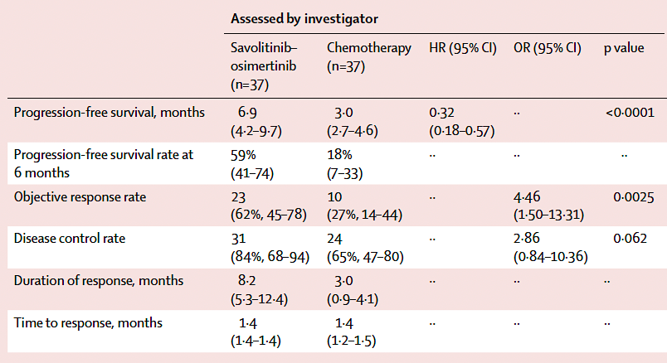
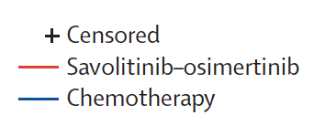
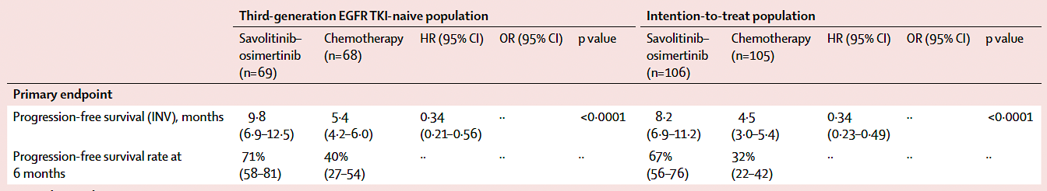
SACHI study- Savolitinib + osimertinib
MET amplification definition: MET copy number >5, MET to CEP7 ratio >2 after 1st/2nd gen EGFR TKI or MET copy number >10 after 3rd gen EGFR TKI
Lu S et al. Lancet 2026;407(10526):375-87.

Slide 37
SACHI study- Savolitinib + osimertinib
Unique study since 1/3 after 1st/2nd gen EGFR TKI, and randomized vs chemotherapy. All done in China.
Efficacy greater in 3rd gen EGFR TKI naïve- 9.8 vs 5.4 months (assume less heterogeneous disease)
In prior 3rd gen EGFR TKI treated, mPFS was 6.9 vs 3months
Treatment discontinuation due to AE in 8%
If MET amplification is identified after EGFR TKI, this is a viable biomarker for EGFR and MET directed therapy.
Lu S et al. Lancet 2026;407(10526):375-87.

Slide 38
de Marinis F et al. Savolitinib plus osimertinib in epidermal growth factor receptor (EGFR)-mutated advanced non-small cell lung cancer with MET overexpression and/or amplification following disease progression on osimertinib: Primary results from the phase II SAVANNAH study. Ann Oncol 2025;36(8):920-33.
SAVANNAH study- Savolitinib + osimertinib

Slide 39
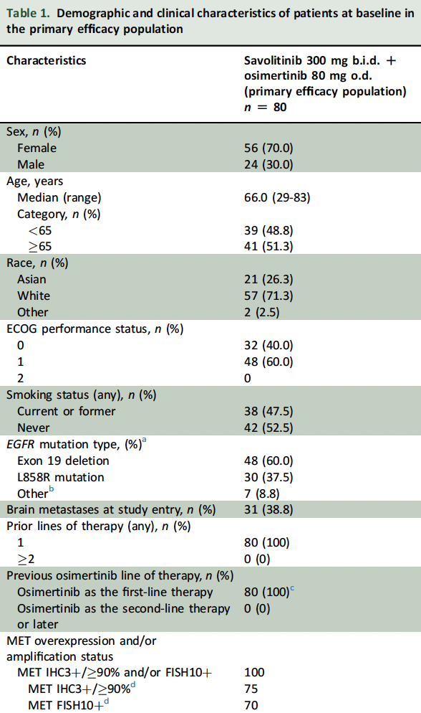
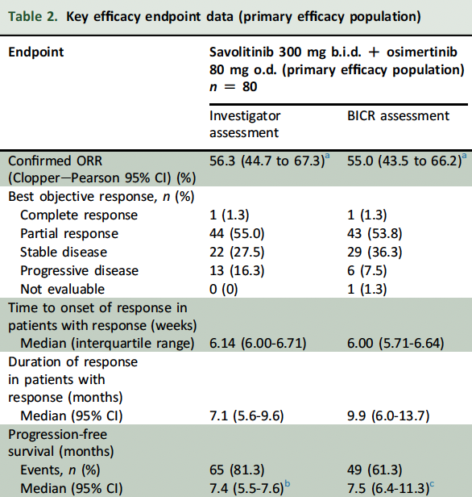

SAVANNAH study- Savolitinib + osimertinib
MET cut-offs initially MET IHC 3+/>50% and/or FISH5+ (>5 MET gene copies, MET/CEP7>2) and increased to MET IHC3+/>90% and FISH10+ after a preliminary analysis.
With lower cutoff, the mPFS was 2.8mo and ORR 9%
de Marinis F et al. Ann Oncol 2025;36(8):920-33.

Slide 40
SAVANNAH study- Savolitinib + osimertinib
Savolitinib and osimertinib is effective and tolerable for patients with MET amplification
A high cutoff for MET “positive” is needed, IHC3+/90% or FISH5+. With lower cutoffs, the efficacy was low and less than standard platinum-based chemotherapy. With the higher cutoff, identification is rarer.
Minimal activity with Savolitinib without osimertinib- must continue EGFR TKI
de Marinis F et al. Ann Oncol 2025;36(8):920-33.

