Slide 1
Year in Review: Advances in EGFR^{MT} NSCLC
Suresh S. Ramalingam, MD, FASCO
Executive Director, Emory Winship Cancer Institute
Professor of Hematology and Medical Oncology

Slide 2
Outline
EGFR TKI therapy for early stage NSCLC
Novel options to overcome acquired resistance to TKI
Emerging approaches for EGFR exon 20 mutation

Slide 3
NeoADAURA
Patients with completely resectable EGFRm stage II–IIIB NSCLC*
Osi 80 mg QD (≥9 weeks)§¶ + carboplatin AUC5 or cisplatin 75 mg/m² + pemetrexed 500 mg/m² (Q3W for 3 cycles)
Surgery
N=358
Key inclusion criteria:
Aged ≥18 years
Histologically / cytologically confirmed non-squamous NSCLC
Ex19del / L858R†
WHO PS 0 / 1
Investigator choice of adjuvant treatment
R 1:1:1
Osi mono 80 mg QD (≥9 weeks)¶#
Post-surgery follow-up visits**
Stratification by:
Stage II / III
Chinese‡ / other Asian
/ non-Asian
Ex19del / L858R
PBO QD (≥9 weeks)§¶ + carboplatin AUC5 or cisplatin 75 mg/m² + pemetrexed 500 mg/m² (Q3W for 3 cycles)
Sponsor-supplied adjuvant osi was available for eligible patients who completed surgery in all arms††
Endpoints:
Primary: major pathological response (MPR; by blinded central pathology review)
Secondary: event-free survival, pathological complete response, nodal downstaging and safety
Chaft J et al, ASCO 2025.

Slide 4
MPR
The MPR rate was statistically significantly higher with both osi-containing regimens
Difference, 24% (95% CI 15, 32);
OR, 19.8 (95.002% CI 4.6, 85.3); p<0.0001
Difference, 23% (95% CI 15, 32); OR, 19.3 (99.9% CI 1.7, 217.4); p<0.0001
MPR rate, %
Osi + CTx (n=121)
Osi mono (n=117)
PBO + CTx (n=120)
Chaft J et al, ASCO 2025.
CI, confidence interval; CTx, chemotherapy; EGFR, epidermal growth factor receptor; Ex19del, Exon 19 deletion; IASLC, International Association for the Study of Lung Cancer; mono, monotherapy; MPR, major pathological response; OR, odds ratio; osi, osimertinib; PBO, placebo

Slide 5
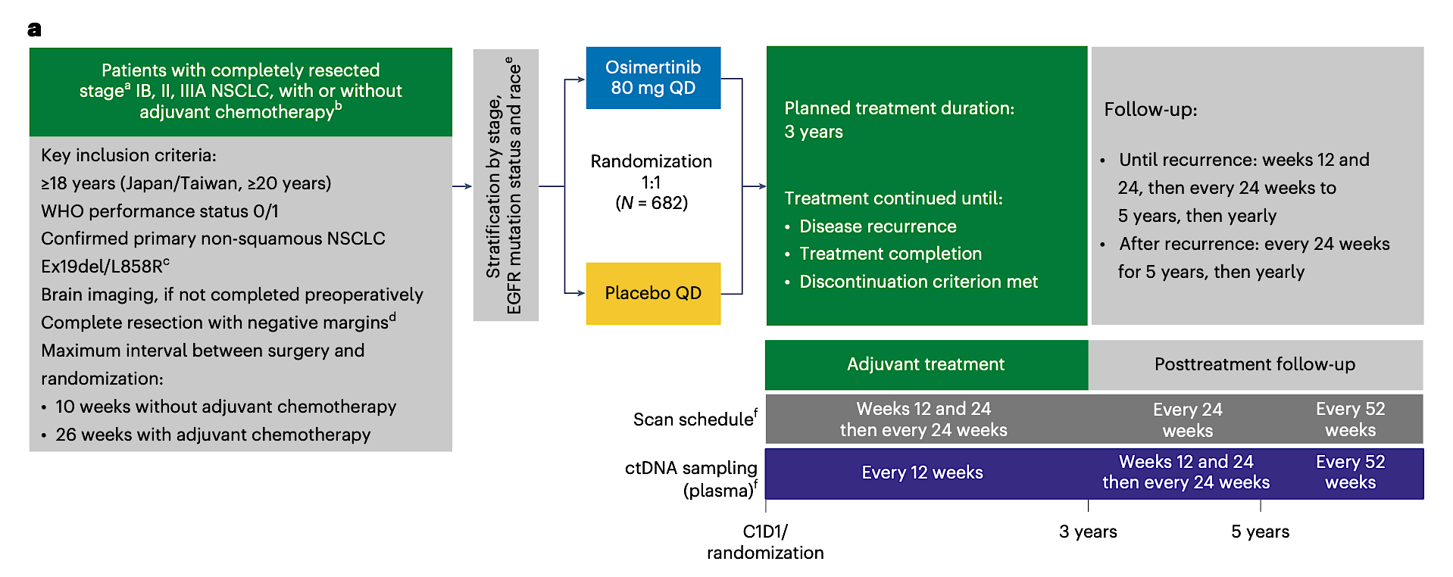
MRD Analysis in ADAURA Trial
Herbst R et al, Nat Med, 2025.

Slide 6
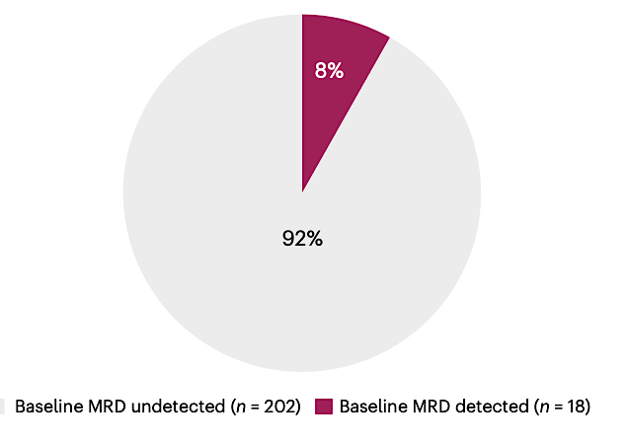
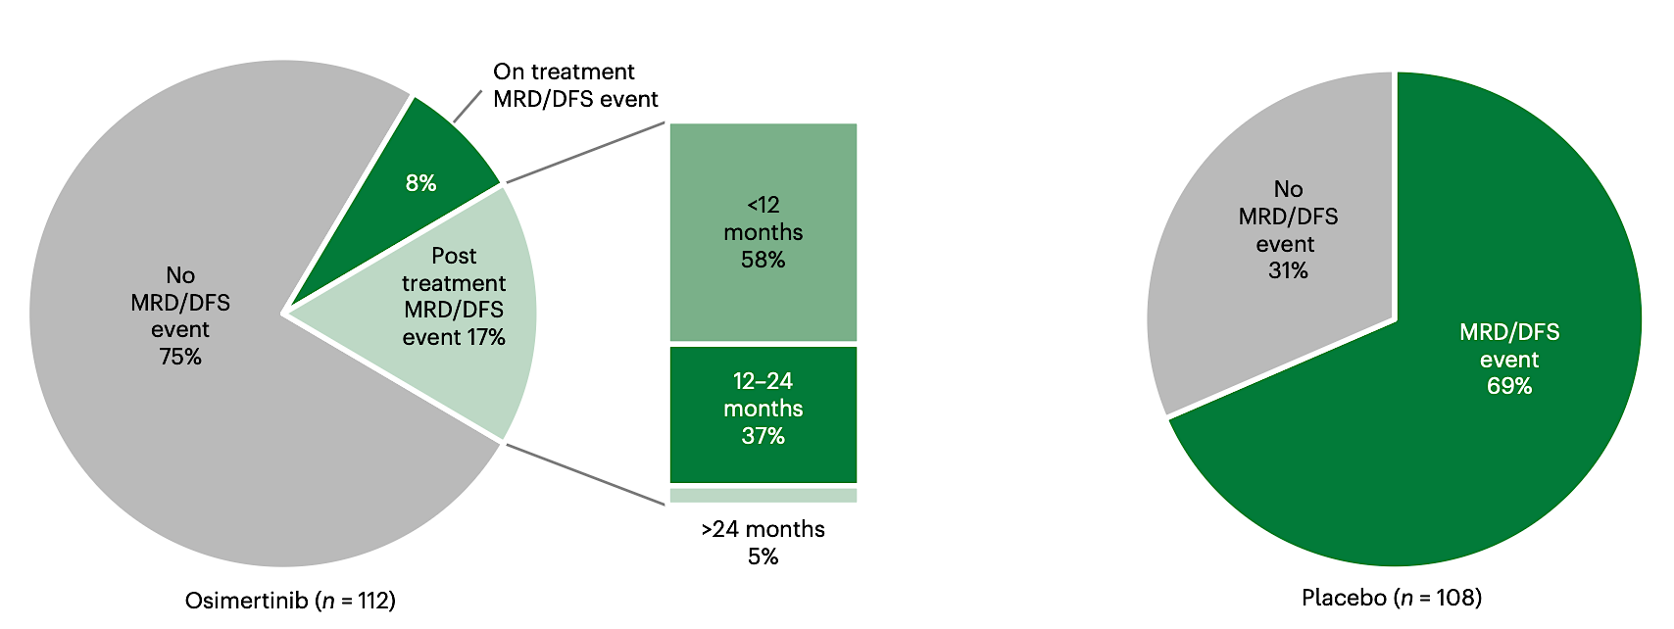
MRD Status at Baseline and with Therapy
Herbst R et al, Nat Med, 2025.

Slide 7
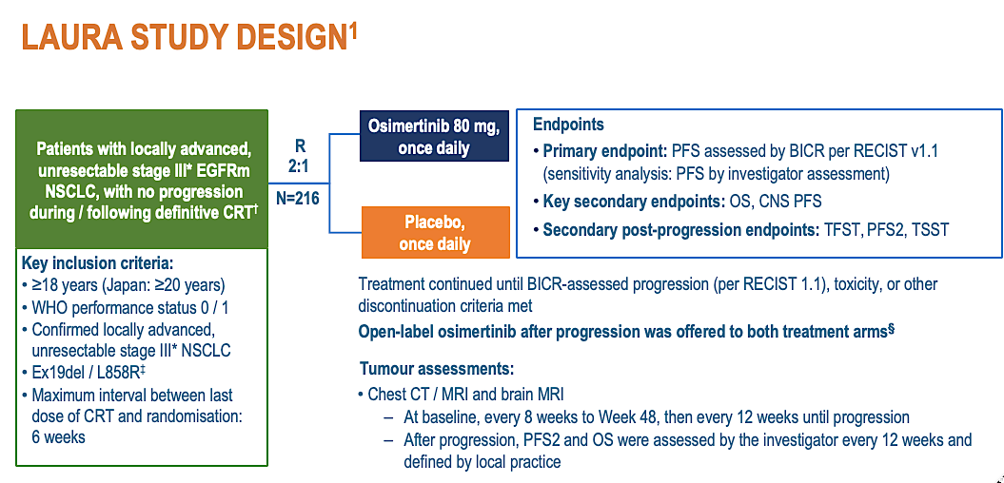
LAURA: updated overall survival results
Ramalingam S et al, ELCC 2025.

Slide 8
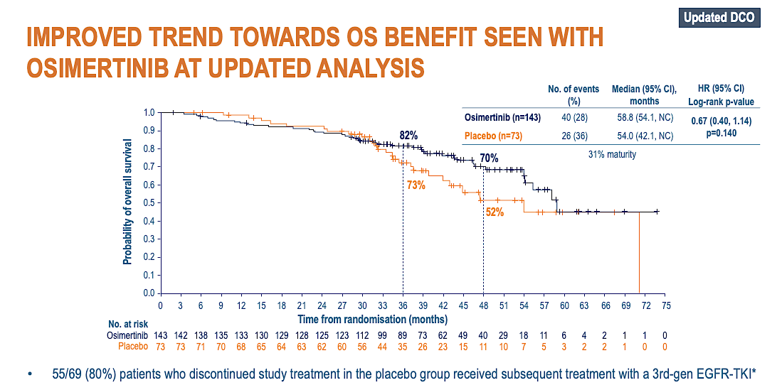
Ramalingam S et al, ELCC 2025.

Slide 9
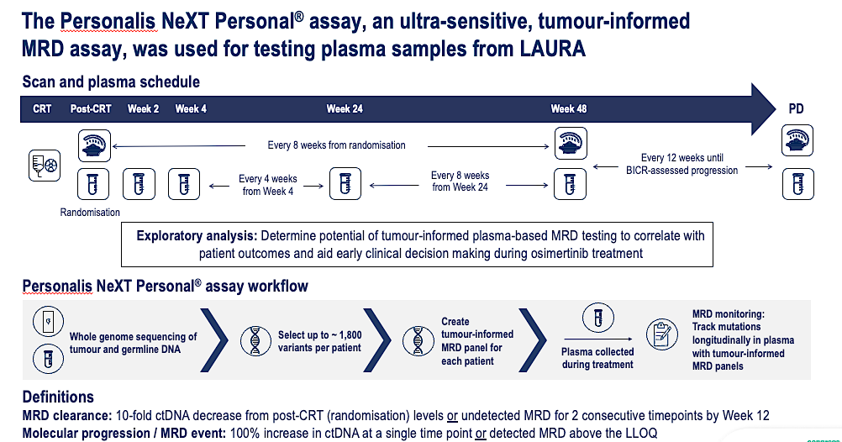
Arriola L et al, ESMO 2025.

Slide 10
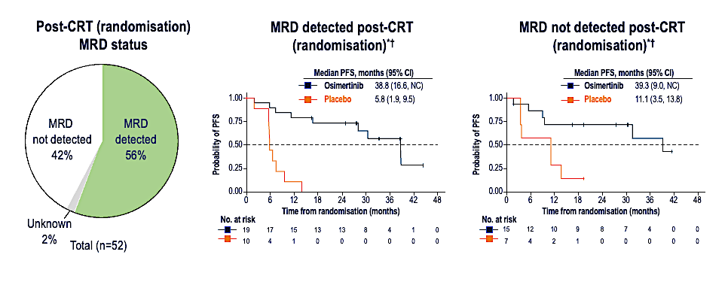
LAURA: Results by MRD Status
Arriola L et al, ESMO 2025.

Slide 11
Current approaches for Treatment of acquired resistance in EGFR^{MT} NSCLC
Acquired Resistance to TKI in EGFR^{MT} NSCLC
Mechanism-Based
4th Generation TKI
MET-targeted approaches
Targeting aberrant gene fusion
Mechanism-Agnostic
Chemotherapy
Chemo+ Amivantamab
Trop-2 ADCs
Chemo + Ivonescimab
Regardless of the strategy, median PFS is relatively modest
Relative merits of incremental efficacy versus toxicity should be contextualized to
individual patients

Slide 12
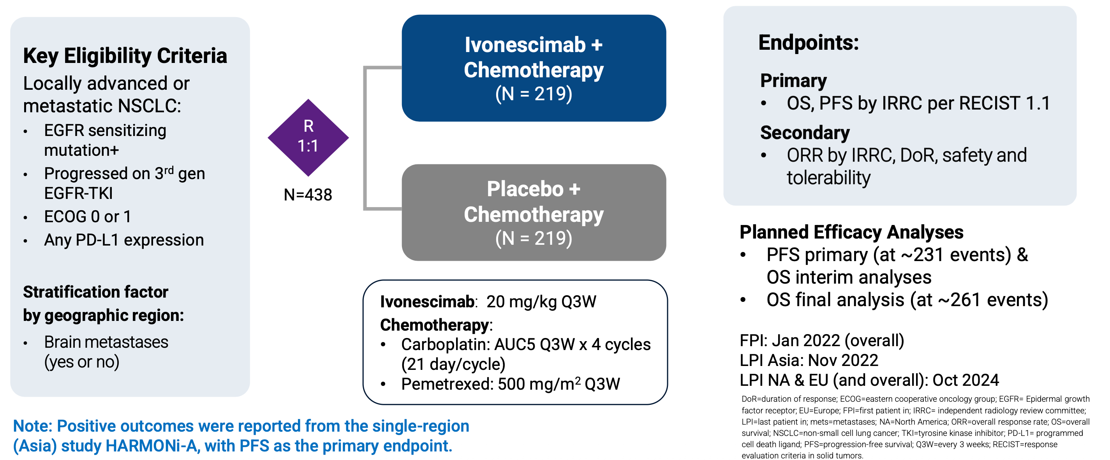
HARMONi Phase 3 Trial
Goldman J et al, WCLC 2025.

Slide 13
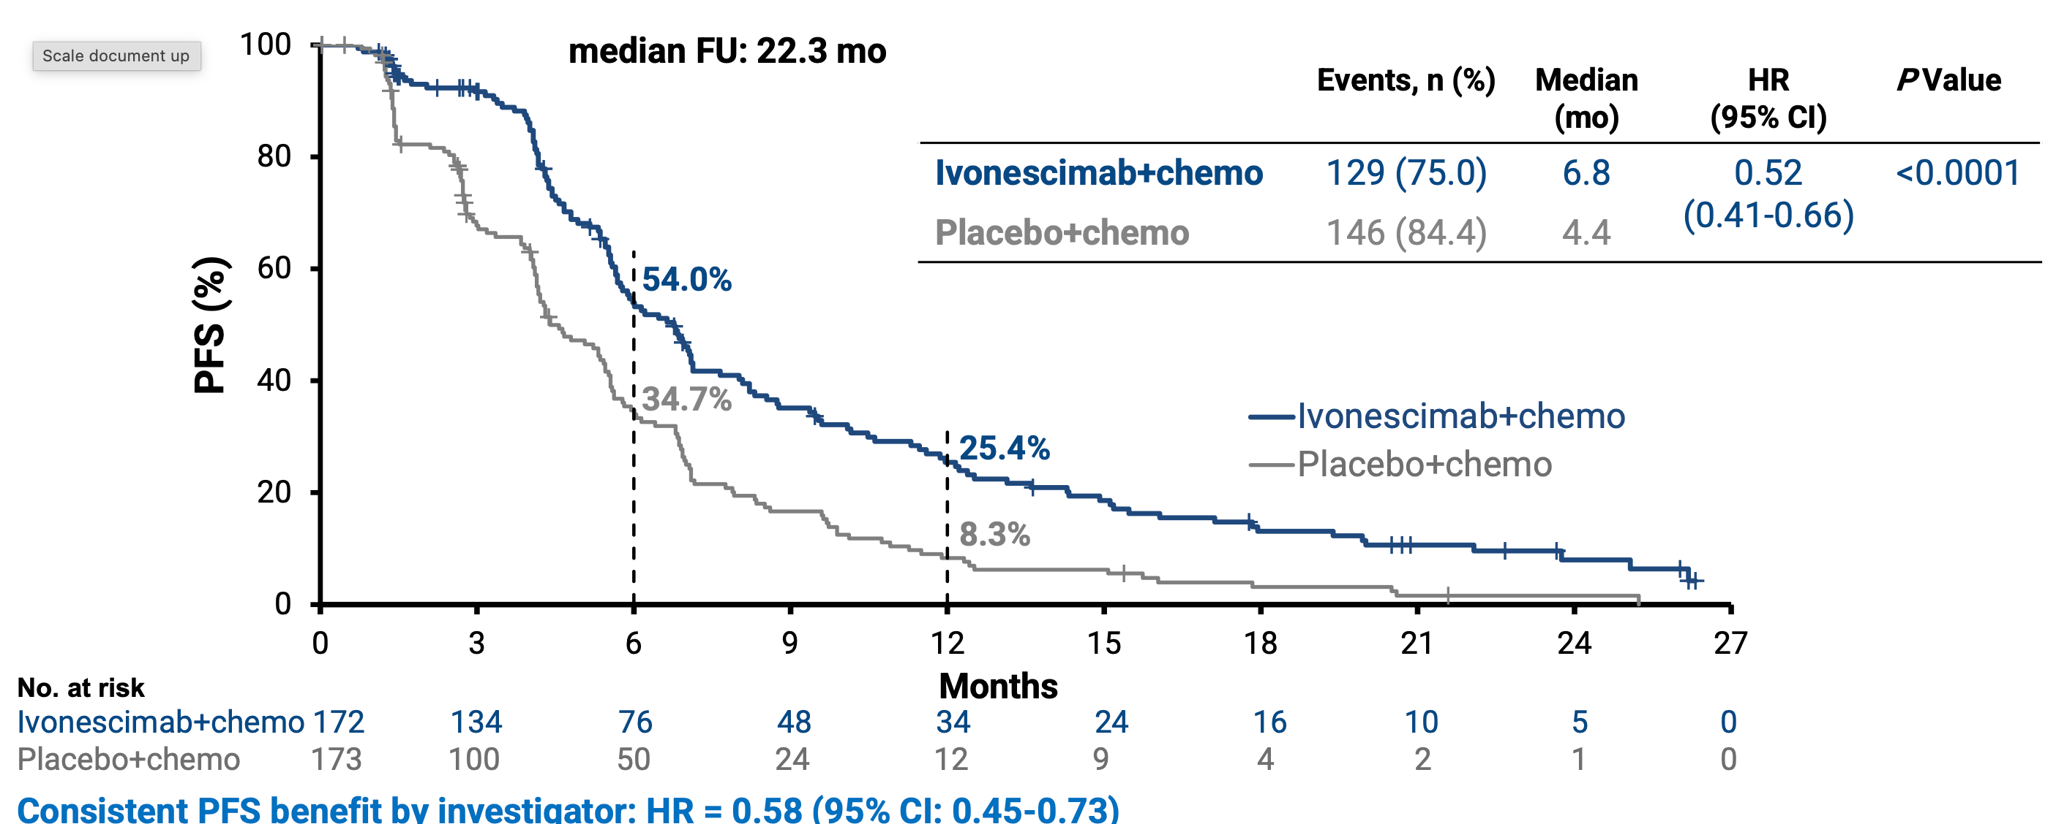
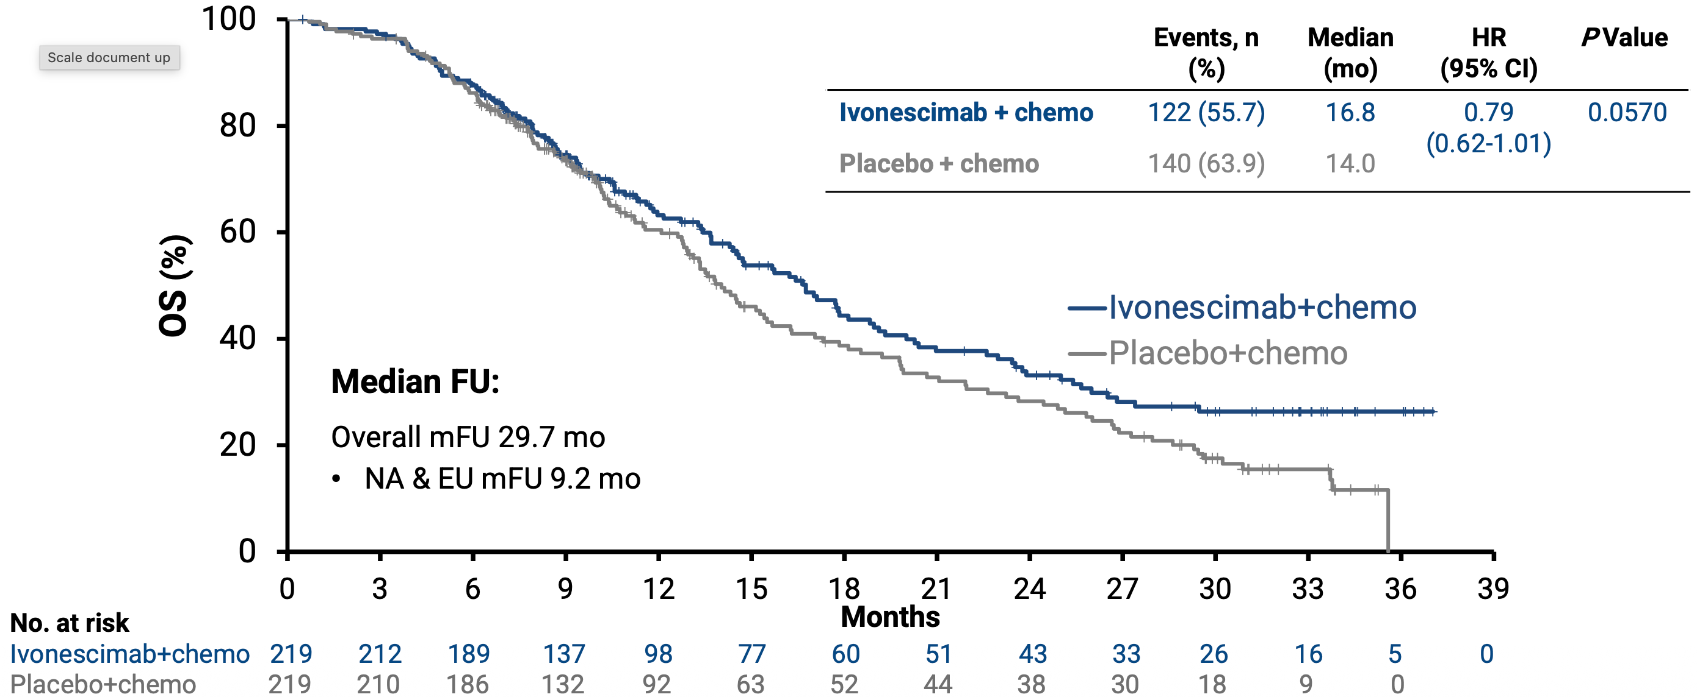
HARMONi: PFS & OS
Goldman J et al, WCLC 2025.

Slide 14
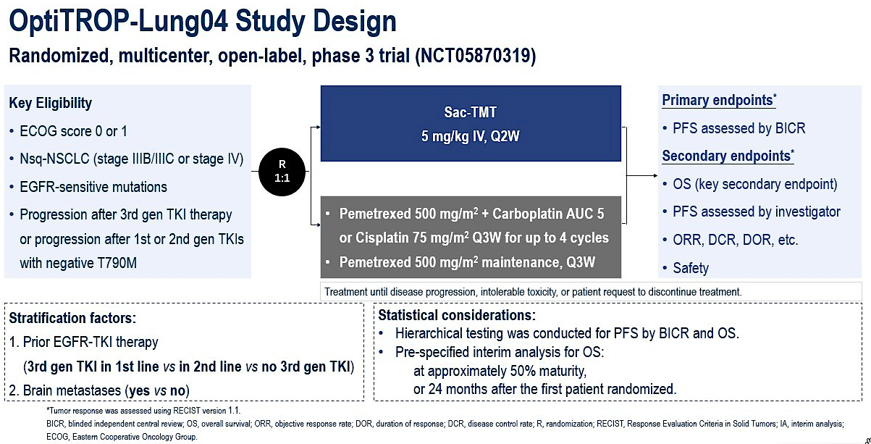
Limited to patients of age < 75 yrs
Fang W et al, NEJM, 2025; Zhang et al. ASCO 2025.

Slide 15
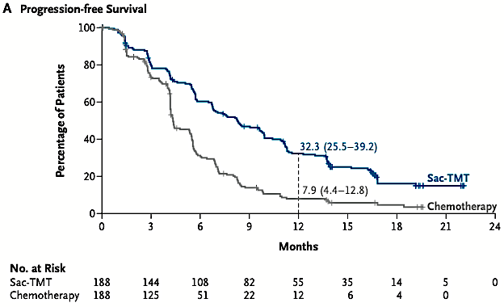
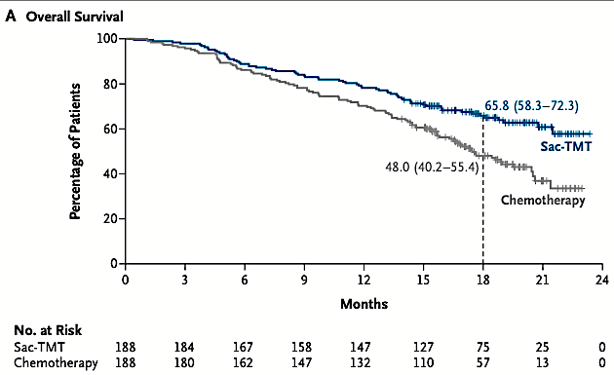
Optitrop-Lung04 trial
HR: 0.49; 8.3m vs. 4.3m
HR: 0.6; NE vs 17.4m
Salient AE with Sac-TMT:
Stomatitis; 64% (Gr 1 22%, Gr 2 37% & Gr 3 5%)
Fang W et al, NEJM, 2025.

Slide 16
EGFR Exon 20 Insertion Mutation: PAPILLON Study
Chemotherapy with amivantamab improves PFS
Median PFS improved from 6.7 m to 11.4 m
Approved by FDA for 1st line therapy
Report on patient reported outcomes by Paz-Ares L et al, Lung Cancer, 2025.
Physical functioning and global health status were maintained in both arms
77% of patients remained free of symptomatic progression with chemo-Ami compared at 60% with chemo at 12 months
Zhou C et al, NEJM, 2023; Paz-Ares L et al, Lung Cancer, 2025.

Slide 17
Sunvozertinib for EGFR Exon 20 Mutant NSCLC: WU-KONG1B
Sunvozertinib (DZD9008) is a rationally designed, potent, selective and irreversible EGFR inhibitor targeting EGFR exon 20 insertion mutations (exon20ins).
Locally advanced or metastatic NSCLC Confirmed EGFR exon20ins ECOG PS of 0 or 1 Prior treated with platinum-based chemotherapy
Cohort 1:
200 mg, QD
Continuous dosing until discontinuation criteria were met
Survival follow-up
R 1:1*
Cohort 2:
300 mg, QD
Primary Endpoint: ORR assessed by BICR# Key Secondary Endpoint: DoR by BICR
Yang J et al, ASCO 2025

Slide 18
Sunvozertinib: Summary of Anti-tumor Efficacy
Tumor Response Per BICR |  | 200 mg (N = 85) | 300 mg (N = 89)
Confirmed ORR |  | 46% | 47%
Disease Control Rate |  | 89% | 92%
Median DoR |  | 11.1 m | 13.8 m
Median PFS |  | 8.4 m | 7.7 m
Subgroup Analysis of Confirmed ORR
Prior Amivantamab Treatment | With | 25% | 42%
 | Without | 49% | 48%
Baseline Brain Metastasis | With | 29% | 52%
 | Without | 57% | 46%
The most common TRAEs with grade ≥3 included diarrhea, blood CPK increase
and anemia, generally did not lead to treatment discontinuation or dose reduction.
Yang J et al, ASCO 2024; Yang J et al, JCO 2025

Slide 19
Zipalertinib: REZILIENT1 Phase 2b study
REZILIENT1 is a phase 1/2, open-label, multicenter trial (NCT04036682)
Primary endpoint:
ORR and DOR as assessed by blinded ICR per RECIST v1.1
Secondary endpoints:
ORR and DOR by investigator
DCR
CBR
PFS by ICR and investigator
OS
Antitumor activity in patients with CNS disease
Safety
Key eligibility criteria
Age ≥18 years
Locally advanced or metastatic NSCLC
Documented EGFR exon 20 insertion
ECOG PS 0 or 1
Stable/asymptomatic CNS metastases allowed
Prior platinum-based chemotherapy without prior ex20ins-targeted therapy
Zipalertinib
100 mg PO BID
Prior platinum-based chemotherapy with prior amivantamab ± other ex20ins-targeted therapy
Safety analysis population: all patients who received ≥1 dose of zipalertinib 100 mg BID (N=244)
Primary efficacy population: all patients who received ≥1 dose of zipalertinib 100 mg BID with ~8 months of minimum follow-up before data cutoff (December 10, 2024) (N=176)
Patients were assigned to a cohort based on previous therapy (ie, platinum-based chemotherapy only or amivantamab)
BID, twice daily; CBR, clinical benefit rate; CNS, central nervous system; DCR, disease control rate; DOR, duration of response; ECOG PS, Eastern Cooperative Oncology Group performance status; EGFR, epidermal growth factor receptor; ex20ins, exon 20 insertions; ICR, independent central review; NSCLC, non-small cell lung cancer; ORR, objective response rate; OS, overall survival; PFS, progression-free survival; PO, orally; RECIST, Response Evaluation Criteria in Solid Tumors.
Yu H et al, ASCO 2025.

Slide 20
Zipalertinib Efficacy
Outcome | Primary efficacy population (N=176) | Platinum-based chemotherapy without ex20ins-targeted therapy (n=125) | Prior amivantamab ± other ex20ins-target therapy (n=51)ª
Confirmed ORR | 35% | 40% | 24%
Median DOR | 8.8 m | 8.8 m | 8.5 m
Any-grade TRAEs reported in ≥10% of patients, No. (%) | Any grade | Grade 3
Paronychia | 94 (38.5) | 0
Rash | 74 (30.3) | 6 (2.5)
Dermatitis acneiform | 60 (24.6) | 1 (0.4)
Dry skin | 60 (24.6) | 0
Diarrhea | 53 (21.7) | 5 (2.0)
Stomatitis | 49 (20.1) | 4 (1.6)
Anemia | 48 (19.7) | 17 (7.0)
Yu H et al, ASCO 2025.

