Slide 1
Subsequent to the recording of this interview, telisotuzumab vedotin received accelerated FDA approval on May 14, 2025, for the treatment of adults with locally advanced or metastatic, nonsquamous NSCLC with high c-Met protein overexpression [≥50% of tumor cells with strong (3+) staining], as determined by an FDA-approved test, and who have received a prior systemic therapy.

Slide 2
Lung Cancer Year In Review: Targeting HER2, MET, BRAF and KRAS
Joel Neal, MD, PhD
Professor of Medicine/Oncology
Stanford University

Slide 3
Agenda
HER2/ERBB2
Janne PA et al. Trastuzumab deruxtecan (T-DXd) in patients with HER2-mutant metastatic non–small cell lung cancer (mNSCLC): Final analysis results of DESTINY-Lung02. ASCO 2024;Abstract 8543.
Smit EF et al. Trastuzumab deruxtecan in patients with metastatic non-small-cell lung cancer (DESTINY-Lung01): Primary results of the HER2-overexpressing cohorts from a single-arm, phase 2 trial. Lancet Oncol 2024;25(4):439-54.
Planchard D et al. Trastuzumab Deruxtecan Monotherapy in Pretreated HER2-overexpressing Nonsquamous Non-Small Cell Lung Cancer: DESTINY-Lung03 Part 1. WCLC 2024;Abstract OA16.05.
Ruiter G et al. Primary Phase Ib Analysis of Beamion LUNG-1: Zongertinib (BI 1810631) in Patients with HER2 Mutation-Positive NSCLC. WCLC 2024;Abstract PL04.04. -> HEYMACH NEJM 2025
Le X et al. Safety and Efficacy of BAY 2927088 In Patients with HER2-Mutant NSCLC: Expansion Cohort from the Phase I/II SOHO-01 Study. WCLC 2024;Abstract PL04.03.
MET exon 14
Wolf J et al. Capmatinib in MET exon 14-mutated non-small-cell lung cancer: Final results from the open-label, phase 2 GEOMETRY mono-1 trial. Lancet Oncol 2024;25(10):1357-70.
Camidge DR et al. Telisotuzumab Vedotin Monotherapy in Patients With Previously Treated c-Met Protein-Overexpressing Advanced Nonsquamous EGFR-Wildtype Non-Small Cell Lung Cancer in the Phase II LUMINOSITY Trial. J Clin Oncol 2024;42(25):3000-11.
BRAF V600E
Riley GJ et al. Updated efficacy and safety from the phase II PHAROS study of encorafenib plus binimetinib in patients with BRAF V600E-mutant metastatic NSCLC (mNSCLC). ESMO 2024;Abstract LBA56.
KRAS G12C and G12D
Mok TSK et al. KRYSTAL-12: Phase 3 study of adagrasib versus docetaxel in patients with previously treated advanced/metastatic non-small cell lung cancer (NSCLC) harboring a KRASG12C mutation. ASCO 2024;Abstract LBA8509.
Waterhouse DM et al. Patient-reported outcomes in CodeBreaK 200: Sotorasib versus docetaxel for previously treated advanced NSCLC with KRAS G12C mutation. Lung Cancer 2024;196:107921.
Sacher A et al. Divarasib Single-Agent Long-Term Follow-up and Atezolizumab Combination Treatment in Patients with KRAS G12C-Positive NSCLC. WCLC 2024;Abstract OA14.06
Fujiwara Y et al. Efficacy and Safety of Olomorasib with Pembrolizumab + Chemotherapy as First-Line Treatment in Patients with KRAS G12C-Mutant Advanced NSCLC. WCLC 2024;Abstract OA14.04.
Arbour, KC Preliminary safety and antitumor activity of zoldonrasib (RMC-9805), an oral, RAS(ON) G12D-selective, tri-complex inhibitor in patients with KRAS G12D non-small cell lung cancer (NSCLC) from a phase 1 study in advanced solid tumors. AACR 2025

Slide 4
ERBB2 (HER2) mutations in NSCLC
Robichaux, et al. Cancer Cell 2019

Slide 5
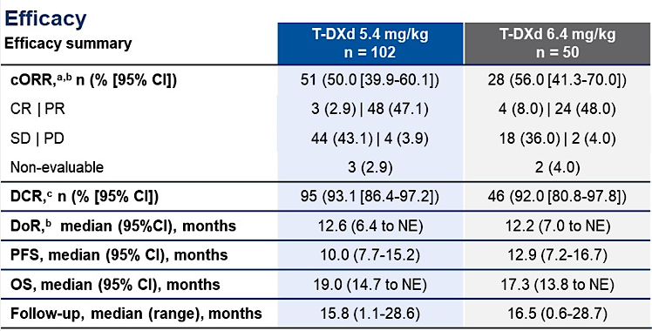
T-DXd for HER2-mutant (DESTINY-Lung02)
Janne ASCO 2024

Slide 6
HER2 immunohistochemistry in LUAD
Ref | N | 0 | 1+ | 2+ | 3+ | (2+ or 3+)
Hirsch et al, BJC 2002 | 125 | 62% | 8% | 23% | 7% | 30%
Yoshizawa et al, Lung Cancer 2014 | 243 | 42% | 42% | 13% | 3% | 16%
Reis et al Lung Cancer 2015 *(stage 3/4) | 176 | 42% | 28% | 23% | 7% | 30%
Kim et al PLoS One 2017 (0-3+) | 321 | 77% | 31% | 7% | 1% | 8%
Kim et al PLoS One 2017 (H-Score) | 321 | 60% | 15% | 8% | 2% | 10%
Tan et al, JCO Precision Oncol 2022

Slide 7
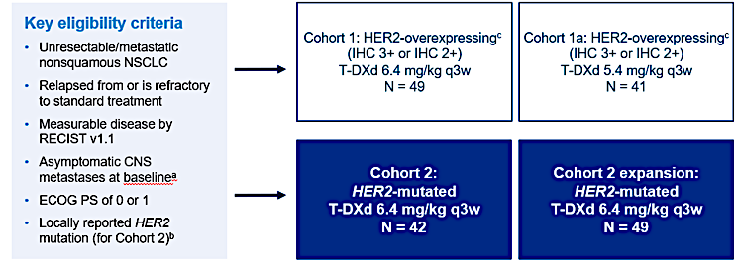
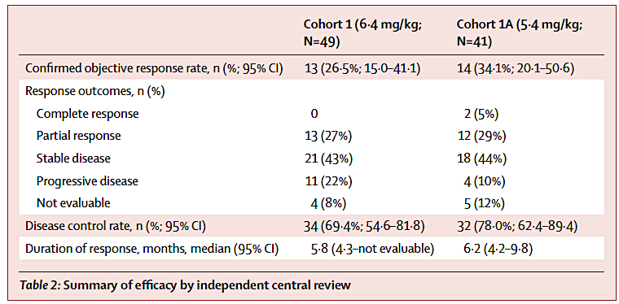
T-DXd for HER2-IHC+ (DESTINY-Lung01)
Smit Lancet Oncol 2024

Slide 8
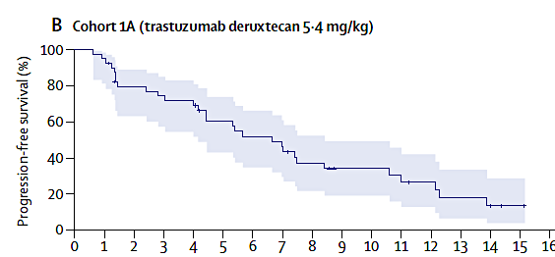
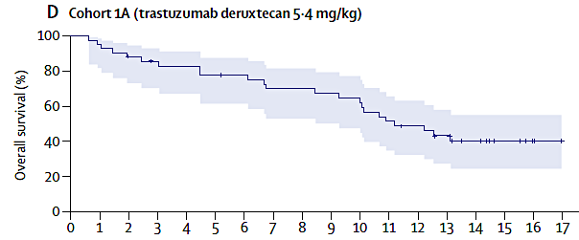
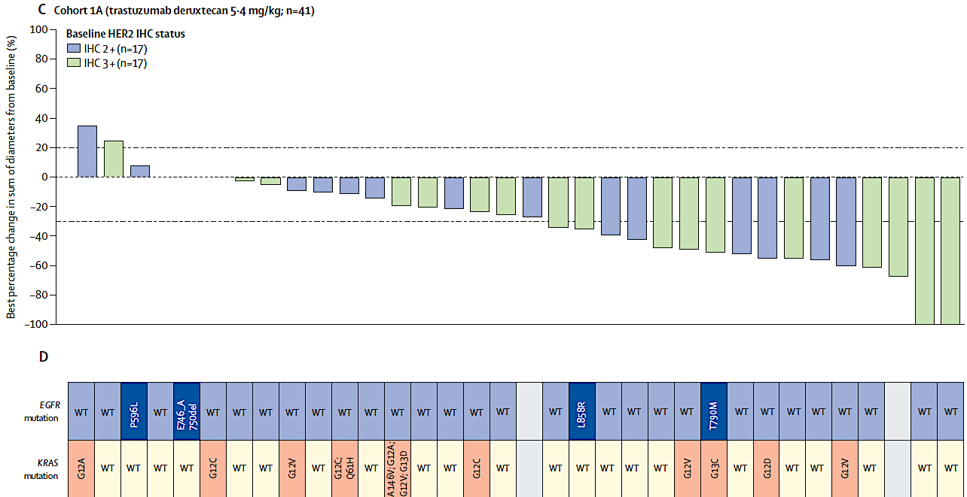
T-DXd for HER2-IHC+ (DESTINY-Lung01)
Smit Lancet Oncol 2024

Slide 9
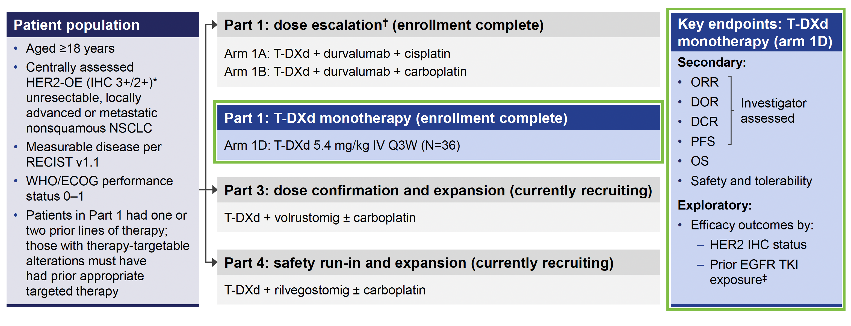
T-DXd for HER2 Overexpression (DESTINY-Lung03)
PLANCHARD WCLC 2024

Slide 10
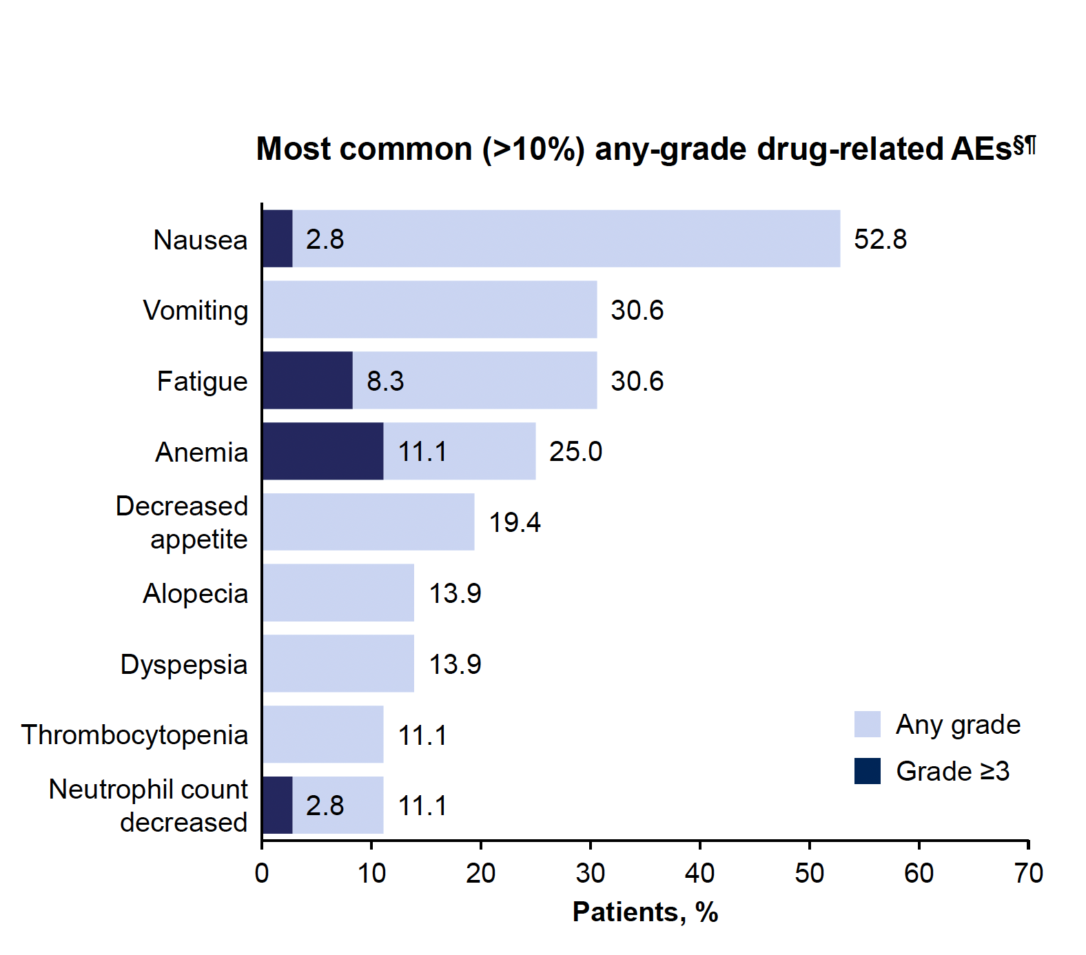
T-DXd for HER2 Overexpression (DESTINY-Lung03)
PLANCHARD WCLC 2024

Slide 11
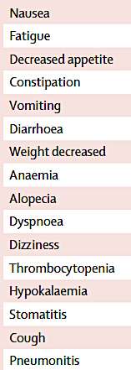
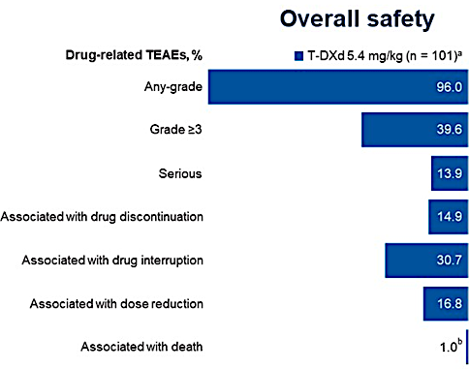
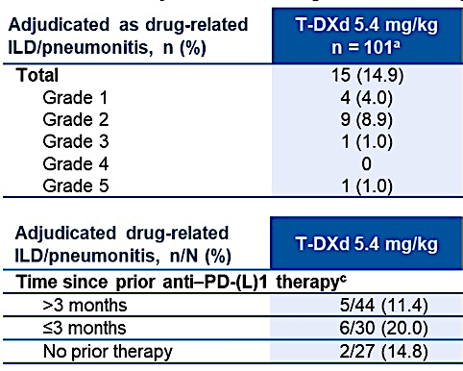
Trastuzumab deruxtecan (T-DXd) - Safety
~70%
~10%
Janne ASCO 2024 and Smit Lancet Oncol 2024

Slide 12
Zongertinib for HER2-mutant (Beamion LUNG-1)
 | RR (%) | DCR (%) | DOR (m) | PFS (m)
Cohort 1 | 71% | 96% | 14.1m | 12.4m
Cohort 5 | 48% | 97% | - | -
Cohort 3 | 30% | 65% | - | -
Heymach NEJM 2025

Slide 13
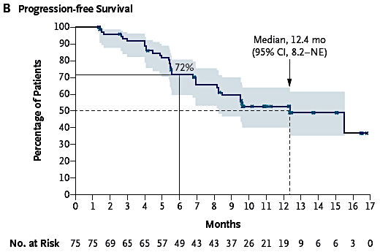
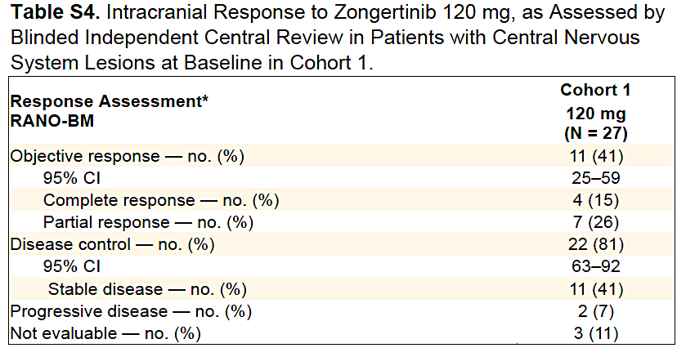
Zongertinib for HER2-mutant (Beamion LUNG-1)
Heymach NEJM 2025

Slide 14
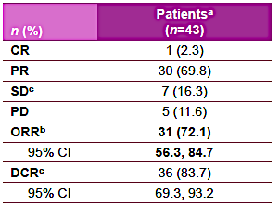
BAY2927088 for HER2-mutant (SOHO-01Cohort D, HER2-mutant, TKI/ADC naïve)
Le WCLC 2024

Slide 15
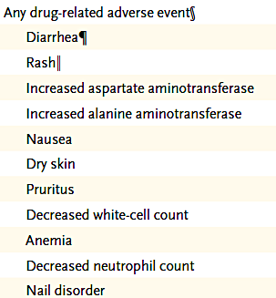
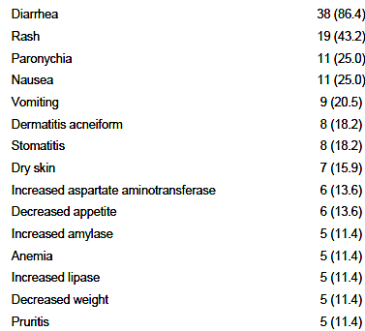
Safety and tolerability of new HER2-TKIs
BAY2927088
Zongertinib
~90%
~50%
~10%
~10%
16% Grade 3
7% dose reduction
3% discontinuation
43% Grade 3
32% dose reduction
7% discontinuation
Heymach NEJM 2025 and Le WCLC 2024

Slide 16
ERBB2/HER2 Conclusions:
Clinical Implications:
The ADC T-DXd is FDA-approved for ERBB2/HER2 mutant NSCLC after prior therapy
T-DXd works pan-tumor for HER2 IHC 2+/3+ (even in EGFR mutant NSCLC)
The HER2-TKIs are emerging - zongertinib appears most effective and tolerable --- so far
Future Directions:
Many other emerging HER2 TKIs are in development as well as bispecific antibodies and ADCs

Slide 17
MET exon 14 mutations in NSCLC
Normal Splicing
Aberrant Splicing and Exon 14 Skipping
Drilon A. Clin Cancer Res. 2016;22:2832-2834.

Slide 18
Capmatinib for MET ex14 NSCLC (GEOMETRY mono-1) First-line therapy
RR 68%
PFS 12.5 months
OS 21.4 months
Wolf Lancet Oncol 2024

Slide 19
Capmatinib for MET ex14 NSCLC (GEOMETRY mono-1) Subsequent therapy
RR 44%
PFS 5.5 months
OS 16.8 months
Wolf Lancet Oncol 2024

Slide 20
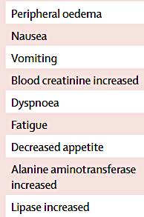
Capmatinib: GEOMETRY mono-1 final analysis: Tolerability
~65%
? Role of SGLT2 inhibitors?
58% Grade 3
48% dose reduction/interruption
12% discontinuation
~10%
Wolf Lancet Oncol 2024

Slide 21
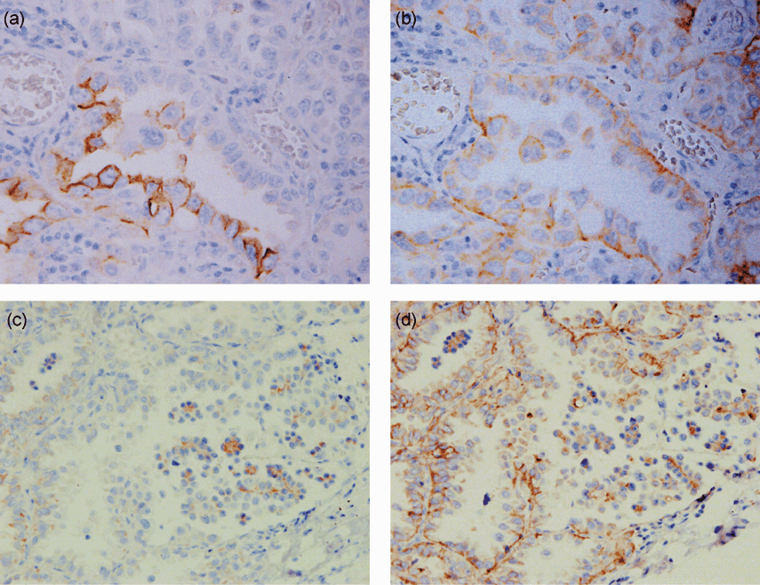
MET overexpression in NSCLC
MET Expression
Variable depending on antibody
25-75% of NSCLC maybe positive
MET Amplification
FISH testing for gene copy number (GCN) or MET/CEP7 ratio
NGS on tissue or ctDNA
Met probe (green), CEP7 probe (red).
a) High MET GCN; b) Cluster formation; c) Polysomy
Schubart C et al. Cancers 2021, 13(19), 5023
Nakamura Y et al. Cancer Sci. 2007;98:1006-1013.

Slide 22
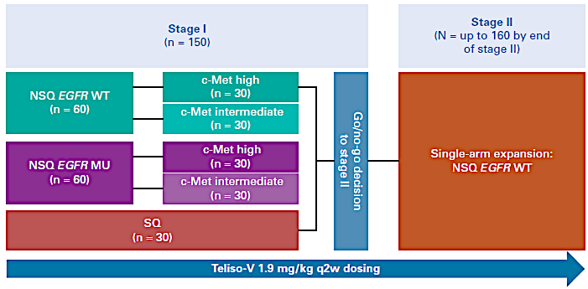
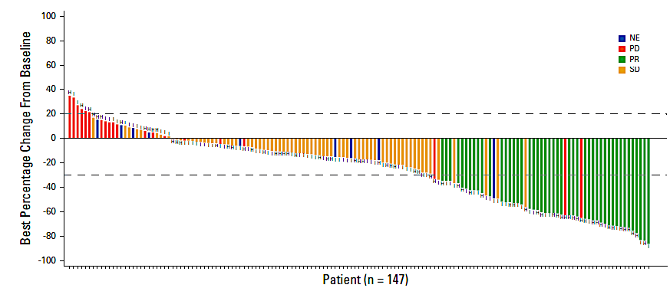
Telisotuzumab vedotin for MET Overexpression (LUMINOSITY)
Camidge J Clin Oncol 2024

Slide 23
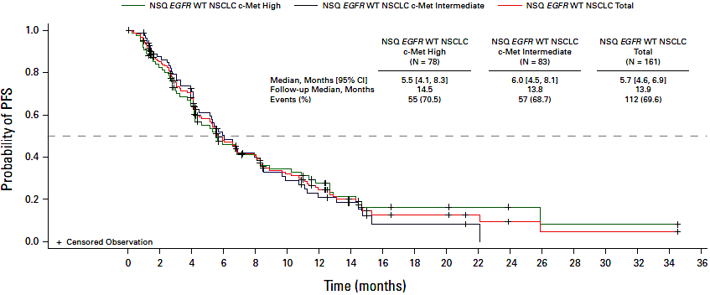
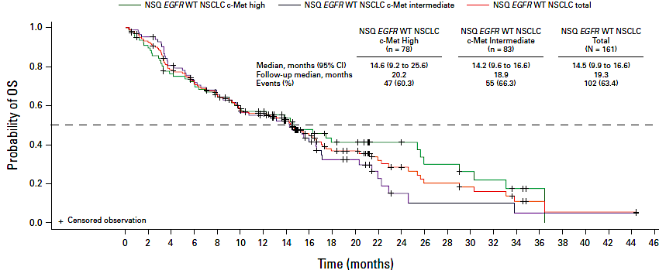
Telisotuzumab vedotin for MET Overexpression (LUMINOSITY)
Camidge J Clin Oncol 2024

Slide 24
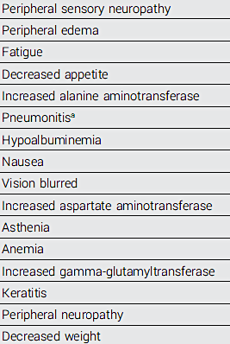
Telisotuzumab vedotin for MET Overexpression (LUMINOSITY)
~35%
~5%
Camidge J Clin Oncol 2024

Slide 25
MET NSCLC Conclusions:
Clinical Implications:
Capmatinib and tepotinib are approved preferred first line therapies for MET ex14 NSCLC
Teliso-V may have a role in MET overexpressed NSCLC
Future Directions:
Many other MET ADC’s and TKIs are in development

Slide 26
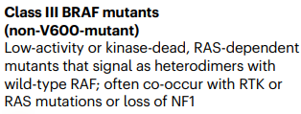
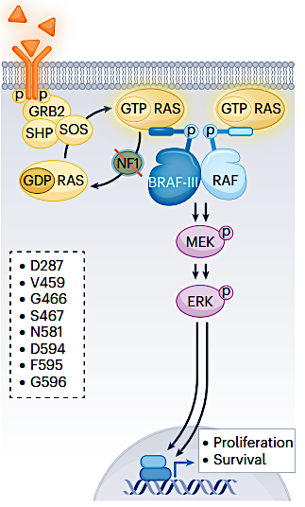
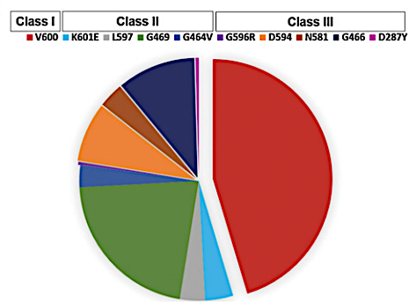
BRAF V600E mutations in NSCLC
Dagogo-Jack et al. CCR. 2018; Hanrahan et al. Nature Reviews Clinical Oncology. 2024

Slide 27
Encorafenib and binimetinib for BRAF V600E (PHAROS)
Riley ESMO 2024

Slide 28
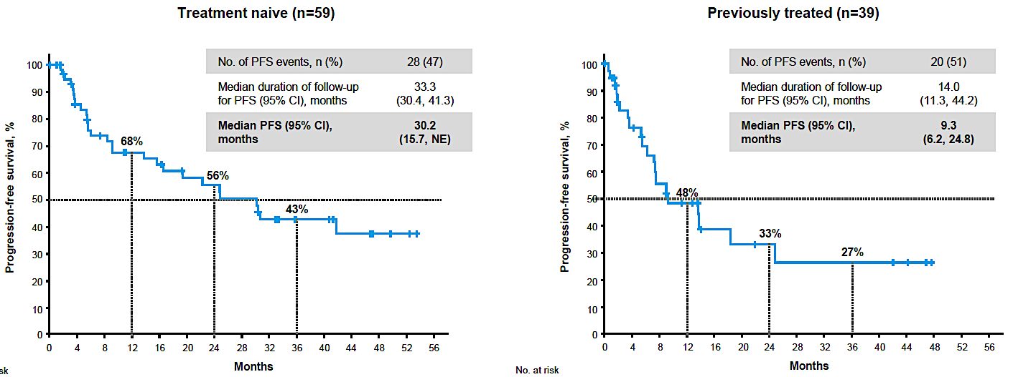
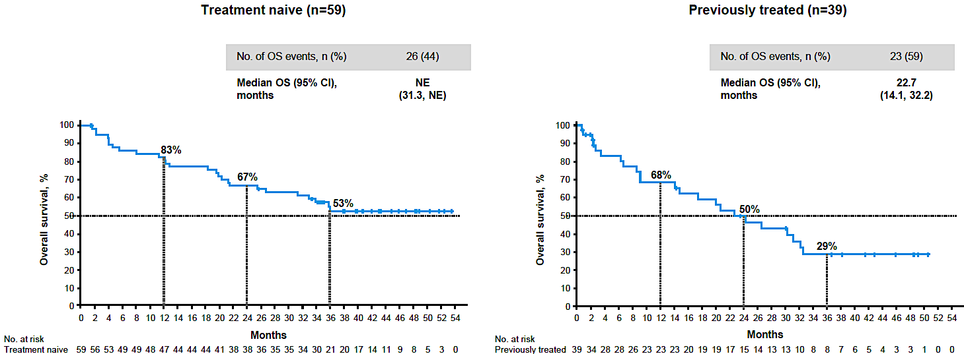
Encorafenib and binimetinib for BRAF V600E (PHAROS)
~52%
~10%
Riley ESMO 2024

Slide 29
BRAF Conclusions:
Clinical Implications:
Encorafenib and binimetinib is reasonable FDA approved option in BRAF V600E NSCLC (alternative to dabrafenib/trametinib)
Future Directions:
Type II and Type III BRAF mutations are currently not actionable with approved therapies, but options are in development

Slide 30
KRAS G12C mutations in NSCLC
Chen, Y., Liu, Qp., Xie, H. et al. Acta Pharmacol Sin (2023).

Slide 31
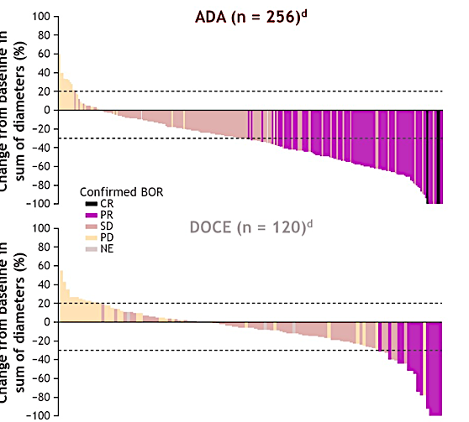
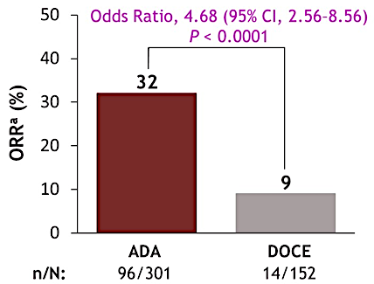
Adagrasib for KRAS G12C (KRYSTAL-12)
Change from baseline in sum of diameters (%)
Change from baseline in sum of diameters (%)
Mok ASCO 2024

Slide 32
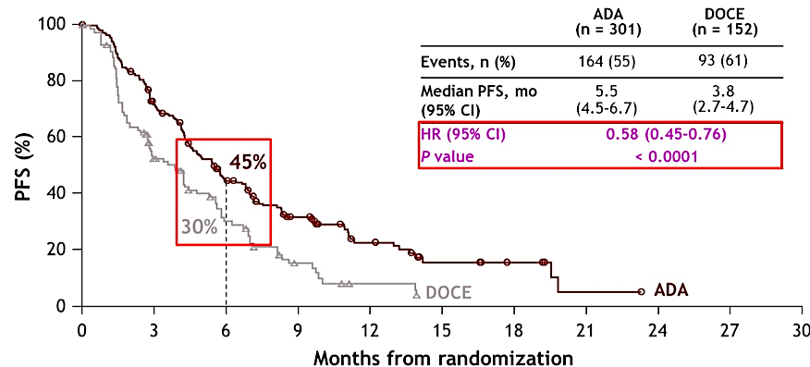
Adagrasib for KRAS G12C (KRYSTAL-12)
Mok ASCO 2024

Slide 33
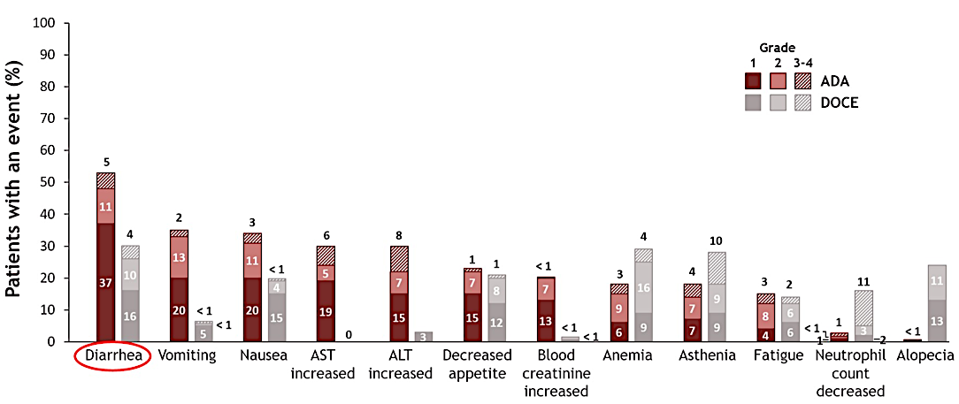
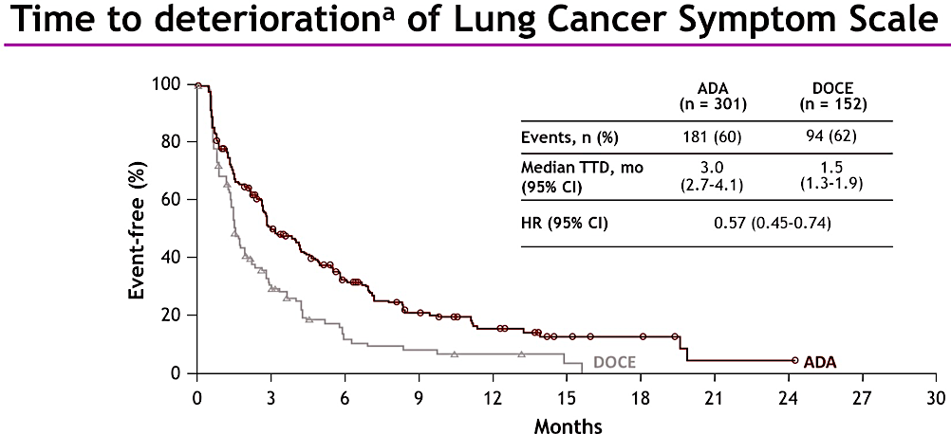
Adagrasib for KRAS G12C (KRYSTAL-12)
Mok ASCO 2024

Slide 34
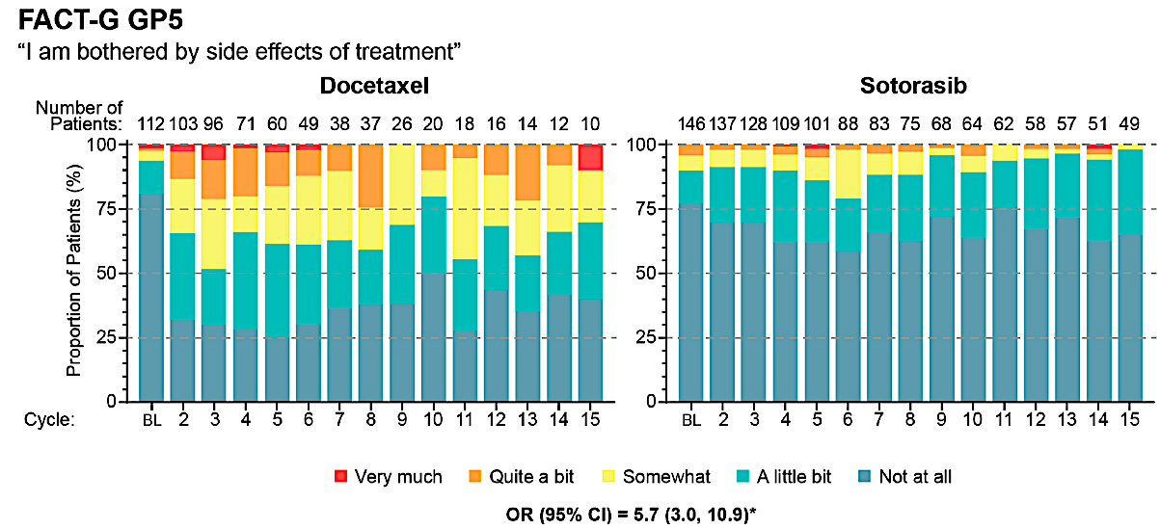
Sotorasib for KRAS G12C : PROs in CodeBreaK 200
Waterhouse Lung Cancer 2024

Slide 35
Divarasib for KRAS G12C
Sacher WCLC 2024

Slide 36
Divarasib for KRAS G12C
Sacher WCLC 2024

Slide 37
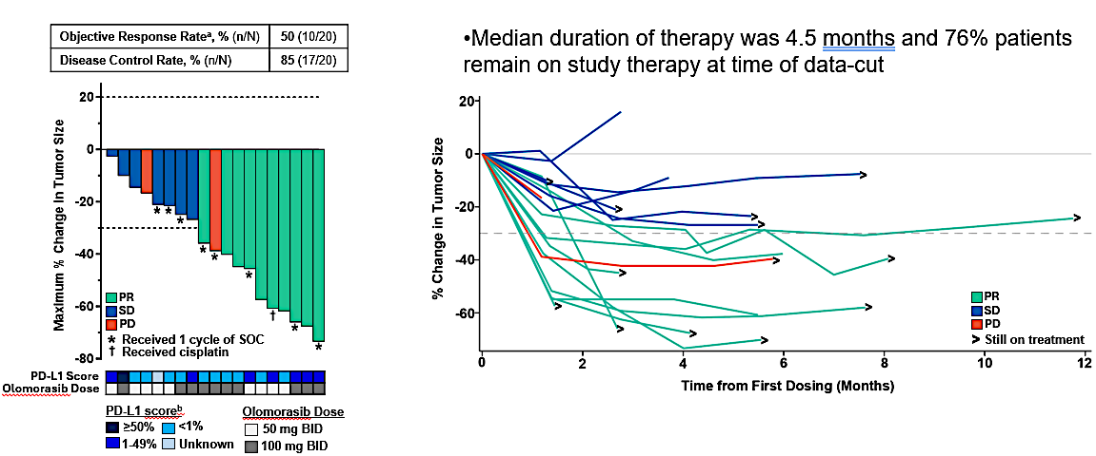
Olomorasib for KRAS G12C
Fujiwara WCLC 2024

Slide 38
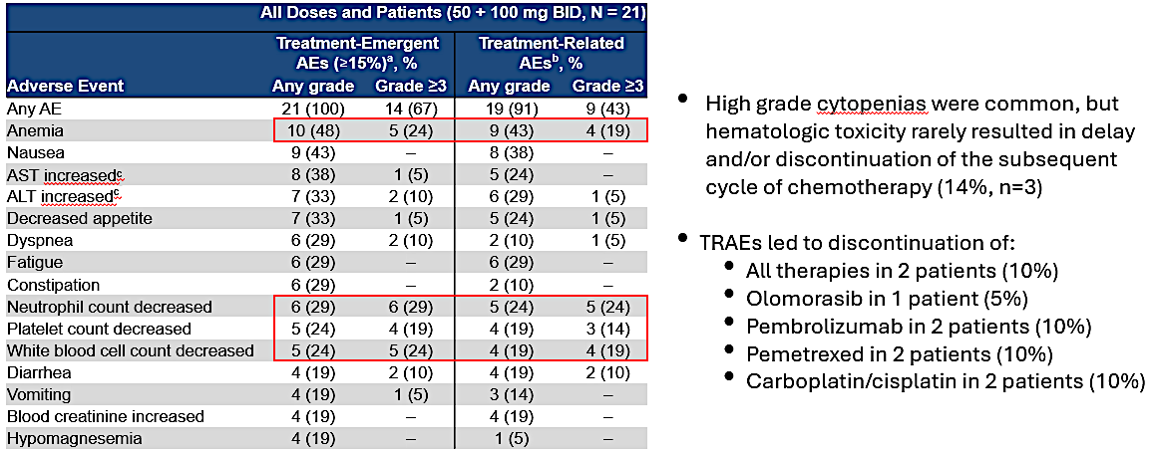
Olomorasib for KRAS G12C
Fujiwara WCLC 2024

Slide 39
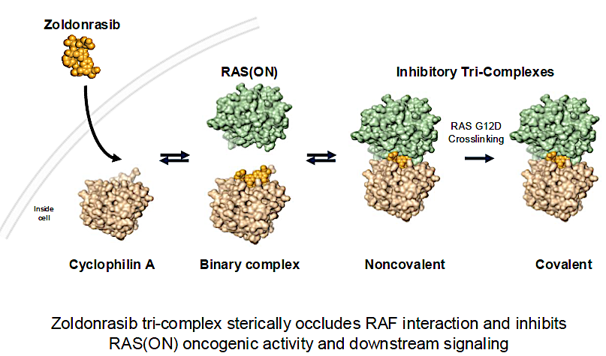
Zoldonrasib for KRAS G12D
Arbour AACR 2025

Slide 40
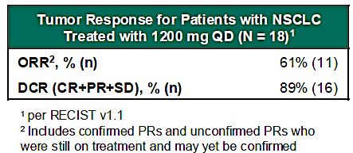
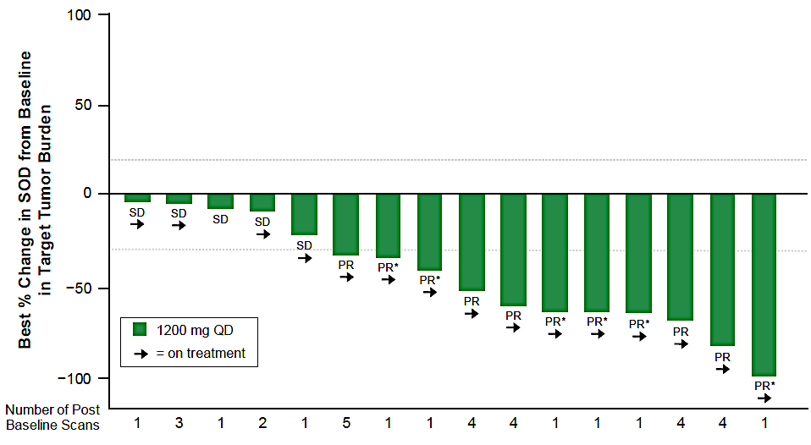
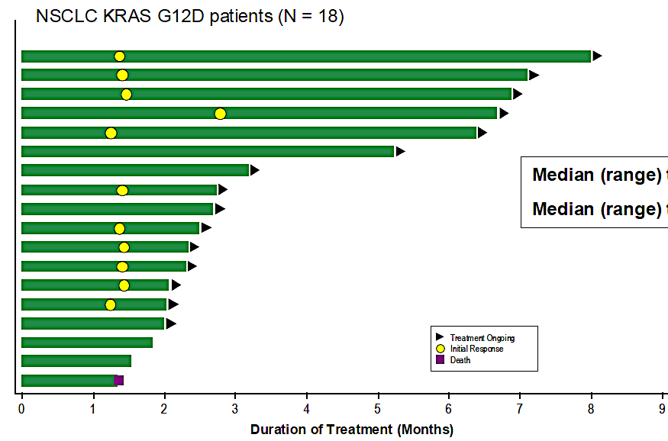
Zoldonrasib for KRAS G12D
Arbour AACR 2025

Slide 41
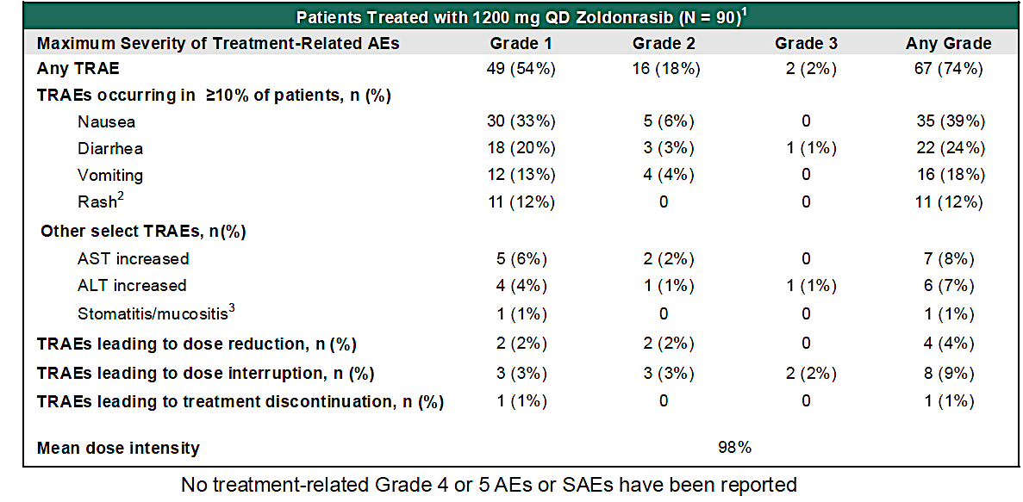
Zoldonrasib for KRAS G12D
Arbour AACR 2025

Slide 42
KRAS Conclusions:
Clinical Implications:
Adagrasib and sotorasib are FDA approved for KRAS G12C; adagrasib may be modestly more active
Divarasib and Olomorasib maybe more compatible with immunotherapy for 1L combinations
Zoldonrasib is a novel KRAS G12D inhibitor with promising efficacy
Future Directions:
Other Ras-ON inhibitors (for Pan-RAS, G12C, and G12D) are in development

Slide 43
Thank you!

