Slide 1
Year in Review: EGFR-Mutant
Non-Small Cell Lung Cancer
A CME/MOC-Accredited Live Webinar
Wednesday, January 15, 2025
5:00 PM – 6:00 PM ET
Faculty
Enriqueta Felip, MD, PhD
Helena Yu, MD
Moderator
Neil Love, MD

Slide 2



Faculty
Enriqueta Felip, MD, PhD
Head, Thoracic Oncology Unit
Vall d’Hebron University Hospital
Vall d’Hebron Institute of Oncology (VHIO)
Professor of Medicine, UAB
Barcelona, Spain
MODERATOR
Neil Love, MD
Research To Practice
Miami, Florida
Helena Yu, MD
Medical Oncologist
Associate Attending
Memorial Sloan Kettering Cancer Center
New York, New York

Slide 3
Commercial Support
This activity is supported by educational grants from AstraZeneca Pharmaceuticals LP, Daiichi Sankyo Inc, and Taiho Oncology Inc.
Research To Practice CME Planning Committee Members,
Staff and Reviewers
Planners, scientific staff and independent reviewers for Research To Practice have no relevant conflicts of interest to disclose.

Slide 4
Dr Felip — Disclosures
Advisory Boards | AbbVie Inc, Amgen Inc, AstraZeneca Pharmaceuticals LP, Bayer HealthCare Pharmaceuticals, Boehringer Ingelheim Pharmaceuticals Inc, Bristol Myers Squibb, Daiichi Sankyo Inc, F Hoffmann-La Roche Ltd, Gilead Sciences Inc, GSK, iTeos Therapeutics, Janssen Biotech Inc, Johnson & Johnson Pharmaceuticals, MSD, Novartis, Pfizer Inc, Pierre Fabre, Regeneron Pharmaceuticals Inc, Turning Point Therapeutics Inc
Independent Member of the Board | Grifols
Speakers Bureaus | Amgen Inc, AstraZeneca Pharmaceuticals LP, Bristol Myers Squibb, Daiichi Sankyo Inc, F Hoffmann-La Roche Ltd, Genentech, a member of the Roche Group, Gilead Sciences Inc, Janssen Biotech Inc, Johnson & Johnson Pharmaceuticals, Lilly, Merck Serono, MSD, Novartis, Pfizer Inc, Regeneron Pharmaceuticals Inc
Nonrelevant Financial Relationships | Medical Trends, Medscape, PeerVoice

Slide 5
Dr Yu — Disclosures
Consulting Agreements | AbbVie Inc, Amgen Inc, AstraZeneca Pharmaceuticals LP, Black Diamond Therapeutics Inc, Bristol Myers Squibb, Cullinan Therapeutics, Daiichi Sankyo Inc, Ipsen Biopharmaceuticals Inc, Janssen Biotech Inc, Pfizer Inc, Taiho Oncology Inc, Takeda Pharmaceuticals USA Inc
Contracted Research (To Institution) | AstraZeneca Pharmaceuticals LP, Black Diamond Therapeutics Inc, Cullinan Therapeutics, Daiichi Sankyo Inc, Janssen Biotech Inc, Kumquat Biosciences, SystImmune Inc, Taiho Oncology Inc
Data and Safety Monitoring Boards/Committees | Janssen Biotech Inc, Mythic Therapeutics

Slide 6
This educational activity contains discussion of
non-FDA-approved uses of agents and regimens. Please refer to official prescribing information for each product for approved indications.

Slide 7
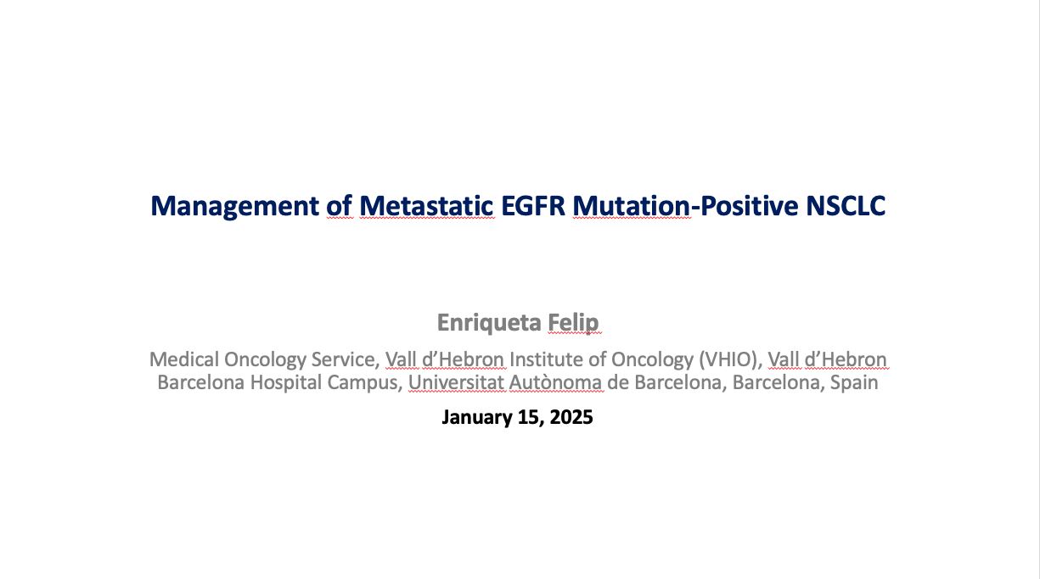
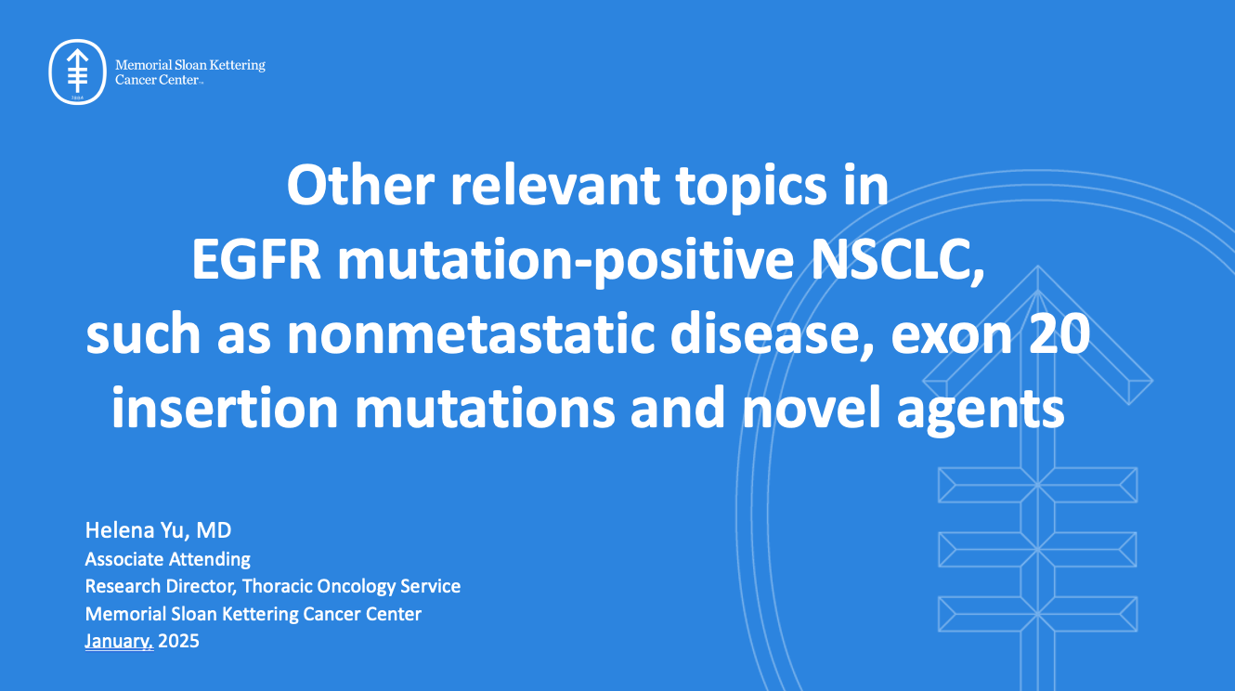

Slide 8
Key Data Sets
Enriqueta Felip, MD, PhD
Valdiviezo N et al. FLAURA2: Impact of Tumor Burden on Outcomes of 1L Osimertinib ± Chemotherapy in Patients with EGFR-Mutated Advanced NSCLC. WCLC 2024;Abstract MA12.04.
Valdiviezo N et al. First-Line (1L) Osimertinib (osi) ± Platinum-Pemetrexed in EGFR-Mutated (EGFRm) Advanced NSCLC: FLAURA2 Post-progression Outcomes. ELCC 2024;Abstract 4O.
Yang JC et al. FLAURA2: Resistance, and Impact of Baseline TP53 Alterations in Patients Treated with 1L Osimertinib ± Platinum-Pemetrexed. WCLC 2024;Abstract MA12.03.
Jänne PA et al. CNS Efficacy of Osimertinib with or without Chemotherapy in Epidermal Growth Factor Receptor-Mutated Advanced Non-Small-Cell Lung Cancer. J Clin Oncol 2024 March 1;42(7):808-20.
Park S et al. Phase II Efficacy and Safety of 80 mg Osimertinib in Patients with Leptomeningeal Metastases Associated with Epidermal Growth Factor Receptor Mutation-Positive Non-Small Cell Lung Cancer (BLOSSOM). J Clin Oncol 2024 August 10;42(23):2747-56.

Slide 9
Key Data Sets
Enriqueta Felip, MD, PhD (Continued)
Gadgeel S et al. Amivantamab plus Lazertinib vs Osimertinib in First-Line EGFR-Mutant Advanced NSCLC: Longer Follow-Up of the MARIPOSA Study. WCLC 2024;Abstract OA02.03.
Nguyen D et al. Amivantamab plus Lazertinib vs Osimertinib in First-Line, EGFR-Mutant Advanced NSCLC: Patient-Relevant Outcomes from MARIPOSA. WCLC 2024;Abstract MA12.07.
Felip E et al. Amivantamab plus Lazertinib versus Osimertinib in First-Line EGFR-Mutant Advanced Non-Small-Cell Lung Cancer with Biomarkers of High-Risk Disease: A Secondary Analysis from MARIPOSA. Ann Oncol 2024 September;35(9):805-16.
Besse B et al. Mechanisms of Acquired Resistance to 1L Amivantamab plus Lazertinib vs Osimertinib in Patients with EGFR-Mutant Advanced NSCLC: An Early Analysis from the Phase III MARIPOSA Study. ESMO 2024;Abstract LBA55.
Popat S et al. Amivantamab plus Chemotherapy vs Chemotherapy in EGFR-Mutated, Advanced Non-Small Cell Lung Cancer After Disease Progression on Osimertinib: Second Interim Overall Survival from MARIPOSA-2. ESMO 2024;Abstract LBA54.

Slide 10
Key Data Sets
Enriqueta Felip, MD, PhD (Continued)
Leighl NB et al. Subcutaneous versus Intravenous Amivantamab, Both in Combination with Lazertinib, in Refractory Epidermal Growth Factor Receptor-Mutated Non-Small Cell Lung Cancer: Primary Results from the Phase III PALOMA-3 Study. J Clin Oncol 2024 October 20;42(30):3593-605.
Mok T et al. Nivolumab plus Chemotherapy in Epidermal Growth Factor Receptor-Mutated Metastatic Non-Small-Cell Lung Cancer After Disease Progression on Epidermal Growth Factor Receptor Tyrosine Kinase Inhibitors: Final Results of CheckMate 722. J Clin Oncol 2024 April 10;42(11):1252-64.
Yang JC-H et al. Phase III KEYNOTE-789 Study of Pemetrexed and Platinum with or without Pembrolizumab for Tyrosine Kinase Inhibitor-Resistant, EGFR-Mutant, Metastatic Nonsquamous Non-Small Cell Lung Cancer. J Clin Oncol 2024 December;42(34):4029-39.

Slide 11
Key Data Sets
Helena Yu, MD
Blakely CM et al. Neoadjuvant Osimertinib for the Treatment of Stage I-IIIA Epidermal Growth Factor Receptor-Mutated Non-Small Cell Lung Cancer: A Phase II Multicenter Study. J Clin Oncol 2024 September 10;42(26):3105-14.
John T et al. Molecular Residual Disease (MRD) Analysis from the ADAURA Trial of Adjuvant (Adj) Osimertinib in Patients (pts) with Resected EGFR‑Mutated (EGFRm) Stage IB-IIIA Non-Small Cell Lung Cancer (NSCLC). ASCO 2024;Abstract 8005.
Lu S et al. Osimertinib After Chemoradiotherapy in Stage III EGFR-Mutated NSCLC. N Engl J Med 2024 August 15;391(7):585-97.
Lu S et al. Osimertinib After Definitive Chemoradiotherapy in Unresectable Stage III Epidermal Growth Factor Receptor-Mutated Non-Small-Cell Lung Cancer: Analyses of Central Nervous System Efficacy and Distant Progression from the Phase III LAURA Study. Ann Oncol 2024 December;35(12):1116-25.
Sands J et al. Datopotamab Deruxtecan in Advanced or Metastatic Non-Small Cell Lung Cancer with Actionable Genomic Alterations: Results from the Phase II TROPION-Lung05 Study. J Clin Oncol 2025 January 6;[Online ahead of print].

Slide 12
Key Data Sets
Helena Yu, MD (Continued)
Lisberg A et al. Intracranial Efficacy of Datopotamab Deruxtecan (Dato-DXd) in Patients (pts) with Previously Treated Advanced/Metastatic Non-Small Cell Lung Cancer (a/m NSCLC) with Actionable Genomic Alterations (AGA): Results from TROPION-Lung05. ASCO 2024;Abstract 8593.
Ahn M-J et al. Efficacy and Safety of Datopotamab Deruxtecan (Dato-DXd) in Patients (pts) with Previously-Treated EGFR-Mutated Advanced Non-Small Cell Lung Cancer (NSCLC): A Pooled Analysis of TROPION-Lung01 and TROPION-Lung05. ESMO Asia 2024;Abstract LBA7.
Yu HA et al. HERTHENA-Lung01, a Phase II Trial of Patritumab Deruxtecan (HER3-DXd) in Epidermal Growth Factor Receptor-Mutated Non-Small-Cell Lung Cancer After Epidermal Growth Factor Receptor Tyrosine Kinase Inhibitor Therapy and Platinum-Based Chemotherapy. J Clin Oncol 2023 December 10;41(35):5363-75.
Yu HA et al. Translational Insights and Overall Survival in the U31402-A-U102 Study of Patritumab Deruxtecan (HER3-DXd) in EGFR-Mutated NSCLC. Ann Oncol 2024 May;35(5):437-47.
Mok T et al. HERTHENA-Lung02: Phase III Study of Patritumab Deruxtecan in Advanced EGFR-Mutated NSCLC After a Third-Generation EGFR TKI. Future Oncol 2024 May;20(15):969-80.

Slide 13
Key Data Sets
Helena Yu, MD (Continued)
Garon EB et al. Phase 3 TroFuse-004 Study: Sac-TMT vs Chemotherapy for Previously Treated Advanced NSCLC with EGFR/Other Genomic Alterations. WCLC 2024;Abstract P2.10A.06.
Leighl NB et al. Trofuse-009: Phase 3 Study of Sac-TNT vs Platinum-Doublet Chemotherapy for Previously Treated EGFR-Mutated Advanced NSCLC. WCLC 2024;Abstract P2.10A.07.
Fang W et al. Updated Efficacy and Safety of Anti-TROP2 ADC SKB264 (MK-2870) for Previously Treated Advanced NSCLC in Phase 2 Study. AACR 2024;Abstract CT247.
Passaro A et al. Safety and Anti-tumour Activity of Zipalertinib in NSCLC Patients (pts) with EGFR Exon 20 Insertion (ex20ins) Mutations Who Received Prior Amivantamab. ESMO 2024;Abstract 1254MO.
Yu HA et al. REZILIENT2: Phase 2 Study of Zipalertinib in Patients with Advanced Non-Small Cell Lung Cancer (NSCLC) with Exon 20 Insertions (ex20ins) and Other Uncommon Epidermal Growth Factor Receptor (EGFR) Mutations. ASCO 2024;Abstract TPS8670.
Yu HA et al. REZILIENT3: Phase 3 Study of Zipalertinib plus Chemotherapy in Patients with Previously Untreated, Advanced Nonsquamous Non-Small Cell Lung Cancer (NSCLC) Harboring Epidermal Growth Factor Receptor (EGFR) Exon 20 Insertions (Ex20ins) Mutations. ASCO 2024;Abstract TPS8671.

Slide 14
AGENDA
Year in Review: EGFR-Mutant Non-Small Cell Lung Cancer
MODULE 1: First-Line Treatment of Metastatic Disease
MODULE 2: Adjuvant and Neoadjuvant Therapy
MODULE 3: EGFR Exon 20 Insertion Mutations
MODULE 4: Antibody-Drug Conjugates

Slide 15
AGENDA
Year in Review: EGFR-Mutant Non-Small Cell Lung Cancer
MODULE 1: First-Line Treatment of Metastatic Disease
MODULE 2: Adjuvant and Neoadjuvant Therapy
MODULE 3: EGFR Exon 20 Insertion Mutations
MODULE 4: Antibody-Drug Conjugates

Slide 16
First-Line Treatment of Metastatic Disease
Valdiviezo N et al. FLAURA2: Impact of Tumor Burden on Outcomes of 1L Osimertinib ± Chemotherapy in Patients with EGFR-Mutated Advanced NSCLC. WCLC 2024;Abstract MA12.04.
Valdiviezo N et al. First-Line (1L) Osimertinib (osi) ± Platinum-Pemetrexed in EGFR-Mutated (EGFRm) Advanced NSCLC: FLAURA2 Post-progression Outcomes. ELCC 2024;Abstract 4O.
Yang JC et al. FLAURA2: Resistance, and Impact of Baseline TP53 Alterations in Patients Treated with 1L Osimertinib ± Platinum-Pemetrexed. WCLC 2024;Abstract MA12.03.
Jänne PA et al. CNS Efficacy of Osimertinib with or without Chemotherapy in Epidermal Growth Factor Receptor-Mutated Advanced Non-Small-Cell Lung Cancer. J Clin Oncol 2024 March 1;42(7):808-20.
Park S et al. Phase II Efficacy and Safety of 80 mg Osimertinib in Patients with Leptomeningeal Metastases Associated with Epidermal Growth Factor Receptor Mutation-Positive Non-Small Cell Lung Cancer (BLOSSOM). J Clin Oncol 2024 August 10;42(23):2747-56.
Gadgeel S et al. Amivantamab plus Lazertinib vs Osimertinib in First-Line EGFR-Mutant Advanced NSCLC: Longer Follow-Up of the MARIPOSA Study. WCLC 2024;Abstract OA02.03.

Slide 17
First-Line Treatment of Metastatic Disease (Continued)
Nguyen D et al. Amivantamab plus Lazertinib vs Osimertinib in First-Line, EGFR-Mutant Advanced NSCLC: Patient-Relevant Outcomes from MARIPOSA. WCLC 2024;Abstract MA12.07.
Felip E et al. Amivantamab plus Lazertinib versus Osimertinib in First-Line EGFR-Mutant Advanced Non-Small-Cell Lung Cancer with Biomarkers of High-Risk Disease: A Secondary Analysis from MARIPOSA. Ann Oncol 2024 September;35(9):805-16.
Besse B et al. Mechanisms of Acquired Resistance to 1L Amivantamab plus Lazertinib vs Osimertinib in Patients with EGFR-Mutant Advanced NSCLC: An Early Analysis from the Phase III MARIPOSA Study. ESMO 2024;Abstract LBA55.
Popat S et al. Amivantamab plus Chemotherapy vs Chemotherapy in EGFR-Mutated, Advanced Non-Small Cell Lung Cancer After Disease Progression on Osimertinib: Second Interim Overall Survival from MARIPOSA-2. ESMO 2024;Abstract LBA54.
Leighl NB et al. Subcutaneous versus Intravenous Amivantamab, Both in Combination with Lazertinib, in Refractory Epidermal Growth Factor Receptor-Mutated Non-Small Cell Lung Cancer: Primary Results from the Phase III PALOMA-3 Study. J Clin Oncol 2024 October 20;42(30):3593-605.

Slide 18
Valdiviezo N et al. FLAURA2: Impact of Tumor Burden on Outcomes of 1L Osimertinib ± CT in Patients with EGFR-mutated Advanced NSCLC. WCLC 2024; Abstract MA12.04
My take home messages
The mechanisms for the observed clinical benefit with osimertinib+CT combination are not currently known
  It is possible that the combination overcomes intratumor heterogeneity
The PFS benefit appeared to be most pronounced among patients with BM at baseline
  Brain scans were performed at screening and at the time of PD in all patients. Patients with brain metastases at screening underwent brain scans at each tumor assessment
PFS benefit was observed with osimertinib+CT vs osimertinib alone in patients with high tumor burden
No PFS differences in patients with intra-thoracic disease (HR 0.97)
Courtesy of Enriqueta Felip, MD, PhD

Slide 19
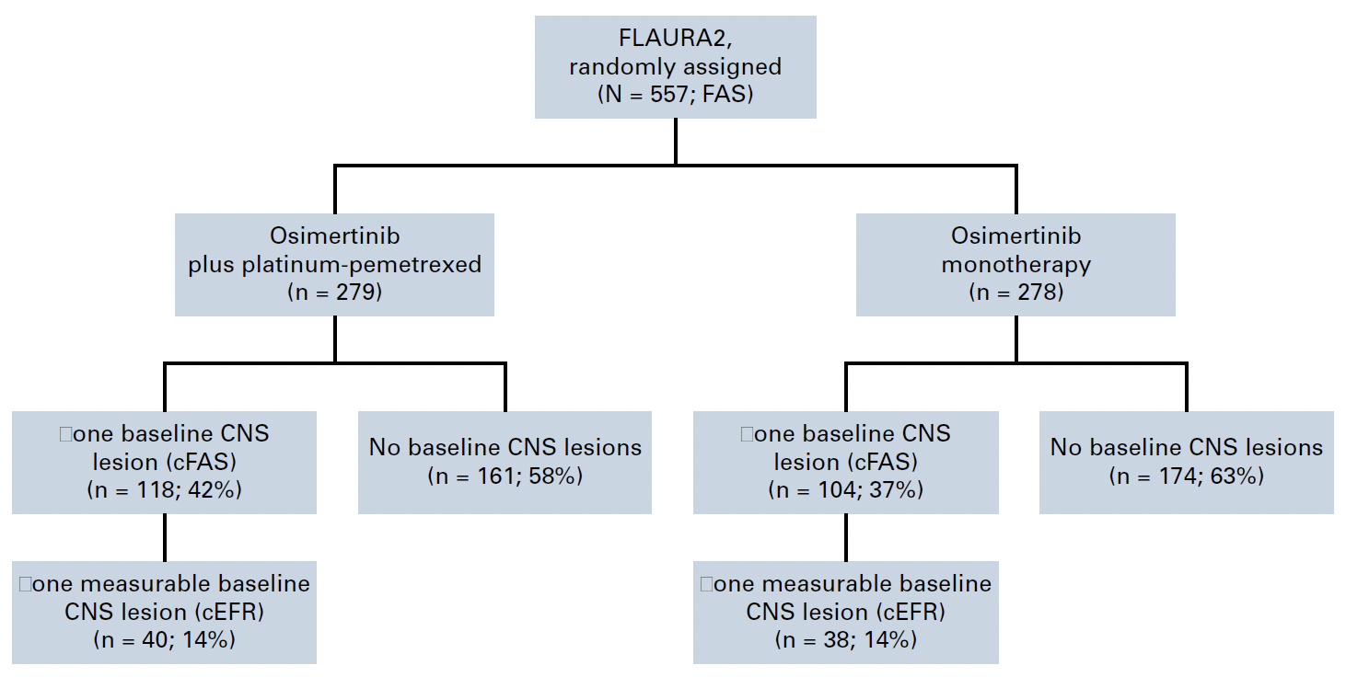
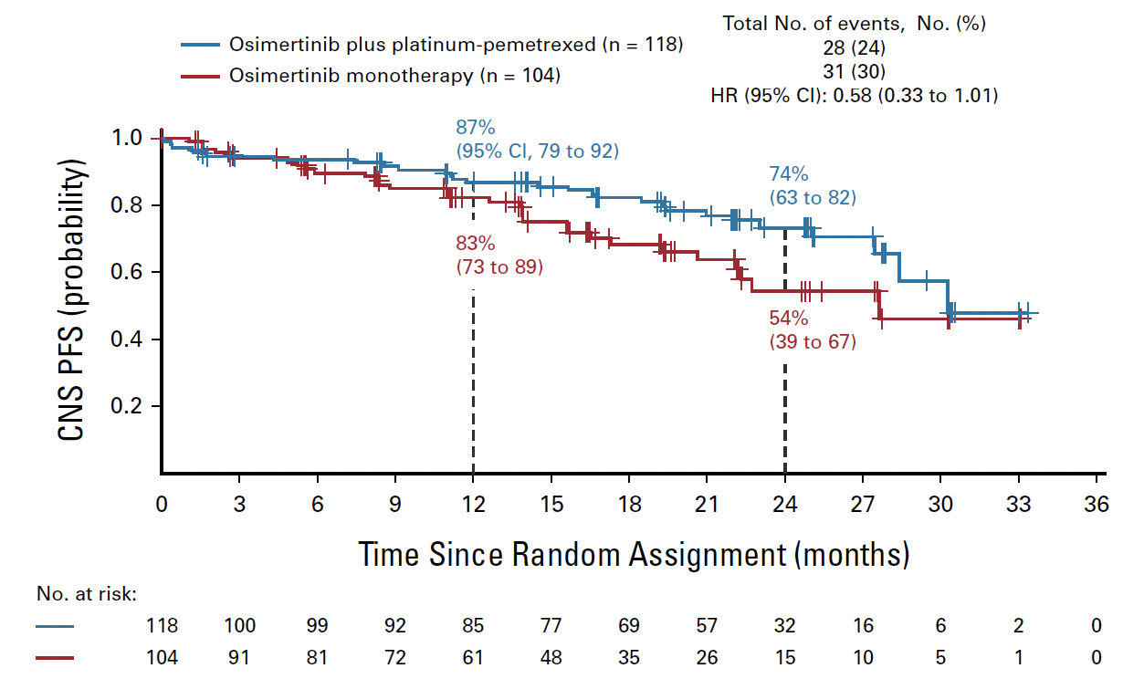
Jänne PA et al. CNS Efficacy of Osimertinib With or Without CT in EGFR-Mutated Advanced NSCLC. J Clin Oncol. 2024 Mar 1;42(7):808-820
FLAURA2: systemic PFS was improved with osimertinib+CT vs osimertinib monotherapy in the subgroup of patients with CNS metastases (mPFS 24.0 vs 13.8 mo; HR 0.47) and those without (27.6 vs 21.0 mo; HR 0.75)
The present study reports CNS efficacy (including CNS PFS) of osimertinib+CT vs osimertinib in patients from FLAURA2
Courtesy of Enriqueta Felip, MD, PhD
CNS PFS in CNS-full analysis set

Slide 20
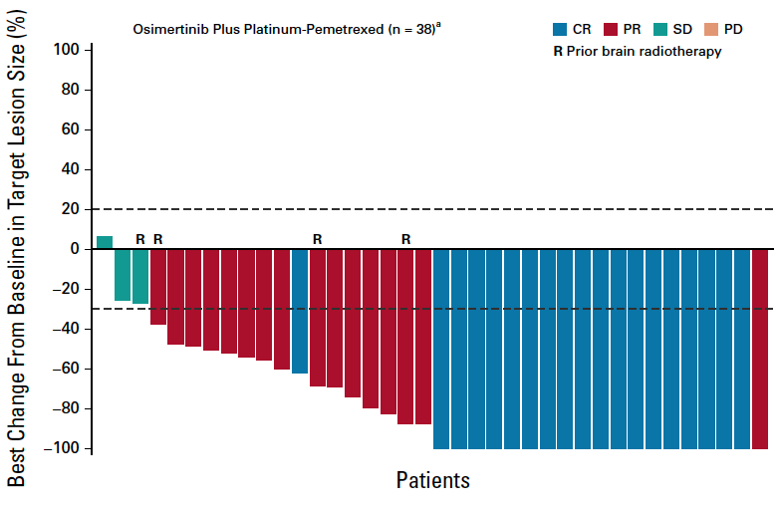
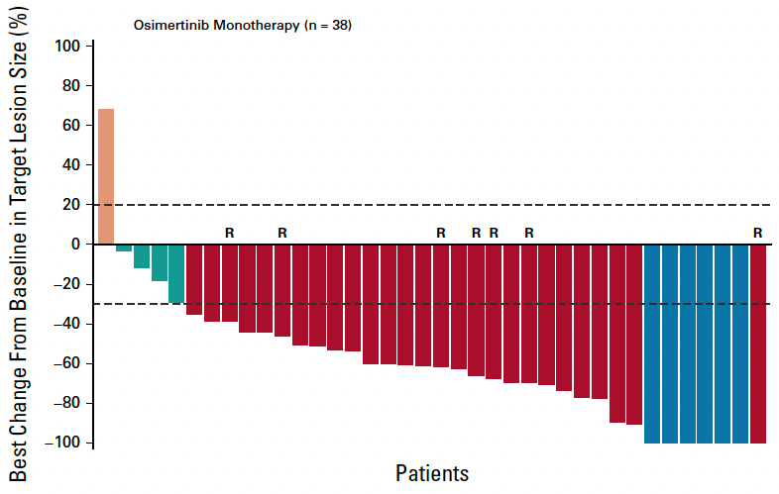
Jänne PA et al. CNS Efficacy of Osimertinib With or Without CT in EGFR-Mutated Advanced NSCLC. J Clin Oncol. 2024 Mar 1;42(7):808-820
Patients in the combination arm had a greater depth of response compared with those in the monotherapy arm
Courtesy of Enriqueta Felip, MD, PhD

Slide 21
Jänne PA et al. CNS Efficacy of Osimertinib With or Without CT in EGFR-Mutated Advanced NSCLC. J Clin Oncol. 2024 Mar 1;42(7):808-820
My take home messages
All randomly assigned patients in FLAURA2 had brain scans at baseline (MRI in 84%)
Scans were assessed by neuroradiologist BIRC
Among 222 patients with baseline CNS metastases, osimertinib+CT demonstrated a clinically and meaningful improvement in CNS PFS compared with osimertinib monotherapy
Data support the combination as 1L in patients with EGFR mutations and CNS disease at baseline
Courtesy of Enriqueta Felip, MD, PhD

Slide 22
Park S et al. Phase II Efficacy and Safety of 80 mg Osimertinib in Patients With Leptomeningeal Metastases Associated With EGFR Mutation-Positive NSCLC (BLOSSOM). J Clin Oncol. 2024 Aug 10;42(23):2747-2756
My take home messages
High efficacy of 80 mg once daily of osimertinib in patients with LMs
An important limitation (as recognized by the authors in the “Discussion”): the study includes patients initially treated with 1st and 2nd generation EGFR TKI
  The present SoC: 3rd generation EGFR TKI
The study supports the standard osimertinib dose (80 mg) vs double daily dose (160 mg) in patients with CNS disease
Courtesy of Enriqueta Felip, MD, PhD

Slide 23
Positive Topline OS Results from Pivotal Phase III MARIPOSA Study Announced
Press Release: January 7, 2025
“[Today were] announced positive topline results for the gold standard endpoint in cancer treatment of overall survival (OS) from the Phase 3 MARIPOSA study, evaluating amivantamab-vmjw plus lazertinib as a first-line therapy for patients with locally advanced or metastatic non-small cell lung cancer (NSCLC) with epidermal growth factor receptor (EGFR) exon 19 deletions (ex19del) or L858R substitution mutations. The chemotherapy-free combination regimen met the final pre-specified secondary endpoint of OS and demonstrated clinically meaningful and statistically significant improvement in OS versus the current standard of care osimertinib. Improvement in median OS is expected to exceed one year. Results from the final OS analysis build upon previously reported data from the interim analysis and positive results from the PFS analysis.
Due to the impact of these data on patient care, these OS results will be presented at an upcoming major medical meeting, and will be shared with global health authorities. Amivantamab combined with lazertinib is approved in the United States and Europe for the first-line treatment of patients with EGFR-mutated NSCLC based on the MARIPOSA Phase 3 study.”
https://finance.yahoo.com/news/rybrevant-amivantamab-vmjw-plus-lazcluze-130000654.html?guccounter=2

Slide 24
Gadgeel S et al. Amivantamab Plus Lazertinib vs Osimertinib in First-line EGFR-mutant Advanced NSCLC: Longer Follow-up of the MARIPOSA Study. WCLC 2024; Abstract OA02.03
My take home messages
After longer follow-up (median: 31.1 months), data continue to favor 1L amivantamab+lazertinib over osimertinib with a promising OS trend (HR, 0.77) in patients with EGFR-mutant advanced NSCLC​
OS curves separate early and widen over time, favoring amivantamab+lazertinib
Press release: positive and clinically meaningful OS benefit with the combination
A clear scientific rationale: “proactively address mechanisms of resistance to osimertinib blocking EGFR and MET”
High incidence of EGFR- and MET-related AEs; toxicity management is relevant
The data support the combination as 1L in patients with EGFR mutations
Courtesy of Enriqueta Felip, MD, PhD

Slide 25
Nguyen D et al. Amivantamab Plus Lazertinib vs Osimertinib in First-Line, EGFR-Mutant Advanced NSCLC: Patient-relevant Outcomes from MARIPOSA. WCLC 2024; Abstract MA12.07
My take home messages
Amivantamab + lazertinib combination therapy delayed symptomatic progression compared to osimertinib
  Symptomatic progression is a patient-relevant endpoint
QoL was maintained in both treatment arms
  The increased adverse events from amivantamab+ lazertinib did not meaningfully impact patients’ health-related QoL
Courtesy of Enriqueta Felip, MD, PhD

Slide 26
Felip E et al. Amivantamab plus lazertinib vs osimertinib in 1L EGFR-mutant advanced NSCLC with biomarkers of high-risk disease: a secondary analysis from MARIPOSA. Ann Oncol. 2024 Sep;35(9):805-816
My take home messages
Approx 50% of patients had TP53 co-mutations (detected by ctDNA NGS); 70% of patients had detectable EGFR mutations by ddPCR
Amivantamab+lazertinib significantly improved median PFS vs osimertinib in high-risk subgroups with:
    History of brain metastases (HR, 0.69; P=0.010)
    Baseline liver metastases (HR, 0.58; P=0.017)
    TP53 co-mutations (HR, 0.65; P=0.003)
    Detectable baseline EGFRm ctDNA^{b} (HR, 0.68; P=0.002)
    Without EGFRm ctDNA^{b} clearance at Week 9 (HR, 0.49; P=0.015)
Amivantamab+lazertinib effectively overcomes the effect of these negative prognostic factors
Among the corresponding subgroups without high-risk features, amivantamab+lazertinib showed a numerical PFS benefit over osimertinib
Courtesy of Enriqueta Felip, MD, PhD

Slide 27
Besse B et al. Mechanisms of acquired resistance to 1L amivantamab plus lazertinib vs osimertinib in patients with EGFR-mutant advanced NSCLC: An early analysis from the phase III MARIPOSA study. ESMO 2024; Abstract LBA55
My take home messages
Using ctDNA NGS analysis, amivantamab+lazertinib reduced the incidence of MET amplifications and EGFR resistance mutation vs osimertinib
Low rate (0.9%) of TP53/RB1 loss (associated with SCLC transformation)
Confirm the scientific rationale: proactively address mechanisms of resistance to osimertinib blocking EGFR and MET
Courtesy of Enriqueta Felip, MD, PhD

Slide 28
Popat S et al. Amivantamab plus CT vs CT in EGFR-mutated, advanced NSCLC after disease progression on osimertinib: Second interim overall survival from MARIPOSA-2. ESMO 2024;Abstract LBA54
My take home messages
At the 2nd interim analysis (median follow-up 18.1 mo), promising OS trend favoring amivantamab+CT in the post-osimertinib setting (OS HR 0.73)
Amivantamab+CT vs CT was associated with improvement in:
  Time to symptomatic progression
  Time to treatment discontinuation
  Time to subsequent therapy
  PFS2
An increasing number of treatment regimens will be available in this scenario: targeted combinations, ADC, CT+bispecifics antibody
Courtesy of Enriqueta Felip, MD, PhD

Slide 29
Leighl NB et al. Subcutaneous vs Intravenous Amivantamab, Both in Combination With Lazertinib, in Refractory EGFR-Mutated NSCLC: Primary Results From Phase III PALOMA-3 Study. J Clin Oncol. 2024 Oct 20;42(30):3593-3605
My take home messages
Adapted from Dr Jessica Lin’s Discussion at ASCO 2024
sc amivantamab demonstrated PK non-inferiority
sc amivantamab demonstrated advantage in safety
  Reduced rates of IRR and VTE
sc amivantamab demonstrated non-inferior efficacy
  Intriguing signal for improved efficacy (needs further investigation)
RARITAN, N.J., December 16, 2024 – The manufacturer today announced the U.S. Food and Drug Administration (FDA) has issued a Complete Response Letter (CRL) for the Biologics License Application (BLA) for a fixed combination of amivantamab and recombinant human hyaluronidase for subcutaneous administration (SC amivantamab) in patients with non-small cell lung cancer (NSCLC) with epidermal growth factor receptor (EGFR) mutations.
The CRL is related to observations as part of a standard pre-approval inspection at a manufacturing facility. The CRL is unrelated to the product formulation, or the efficacy and safety data submitted in the regulatory application, and the FDA has not requested any additional clinical studies. The currently approved intravenous (IV) formulation of amivantamab-vmjw is not impacted by the CRL.
The impact of sc administration on lymphatic absorption and immune stimulation is unknown but may also play a role in the OS results (????)
The sc formulation of amivantamab in combination with lazertinib may become a treatment option in the future
Courtesy of Enriqueta Felip, MD, PhD

Slide 30
AGENDA
Year in Review: EGFR-Mutant Non-Small Cell Lung Cancer
MODULE 1: First-Line Treatment of Metastatic Disease
MODULE 2: Adjuvant and Neoadjuvant Therapy
MODULE 3: EGFR Exon 20 Insertion Mutations
MODULE 4: Antibody-Drug Conjugates

Slide 31
(Neo)adjuvant or Consolidation Therapy
Blakely CM et al. Neoadjuvant Osimertinib for the Treatment of Stage I-IIIA Epidermal Growth Factor Receptor-Mutated Non-Small Cell Lung Cancer: A Phase II Multicenter Study. J Clin Oncol 2024 September 10;42(26):3105-14.
John T et al. Molecular Residual Disease (MRD) Analysis from the ADAURA Trial of Adjuvant (Adj) Osimertinib in Patients (pts) with Resected EGFR‑Mutated (EGFRm) Stage IB-IIIA Non-Small Cell Lung Cancer (NSCLC). ASCO 2024;Abstract 8005.
Lu S et al. Osimertinib After Chemoradiotherapy in Stage III EGFR-Mutated NSCLC. N Engl J Med 2024 August 15;391(7):585-97.
Lu S et al. Osimertinib After Definitive Chemoradiotherapy in Unresectable Stage III Epidermal Growth Factor Receptor-Mutated Non-Small-Cell Lung Cancer: Analyses of Central Nervous System Efficacy and Distant Progression from the Phase III LAURA Study. Ann Oncol 2024 December;35(12):1116-25.

Slide 32
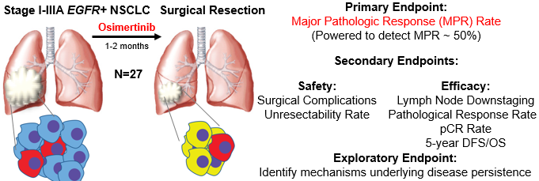
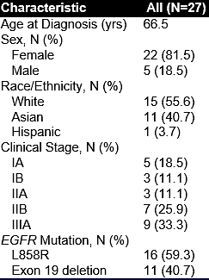
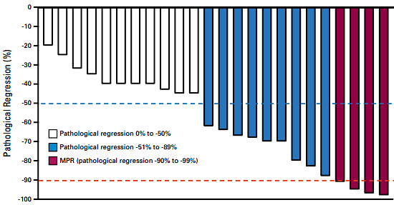
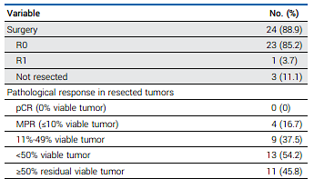
Neoadjuvant osimertinib for early stage
Primary Endpoint:
Major Pathologic Response Rate = 15%
Blakely J Clin Oncol. 2024
Courtesy of Helena Yu, MD

Slide 33
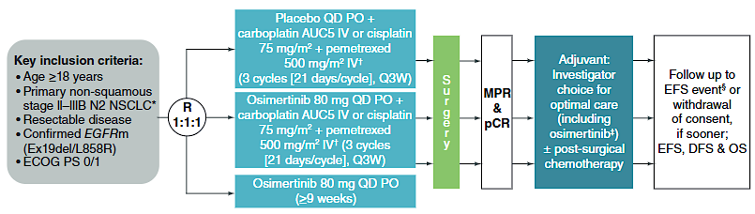
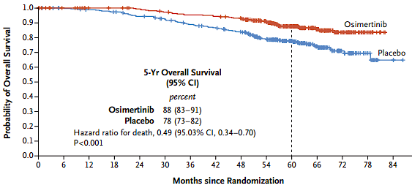
Neoadjuvant osimertinib for early stage
NeoADAURA study schema
OS benefit of adjuvant osimertinib
Lower than expected MPR and PCR rate
Possibly due to short treatment time (1-2 mo?)
Clear survival benefit of adjuvant osimertinib
Chemotherapy may be important for initial cytoreduction
Await NeoADAURA results
Courtesy of Helena Yu, MD
Blakely J Clin Oncol. 2024

Slide 34
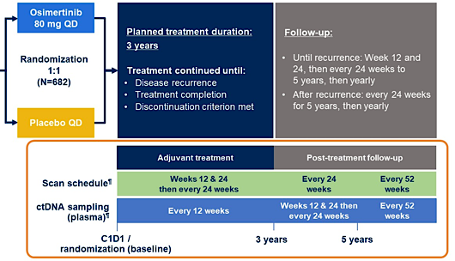
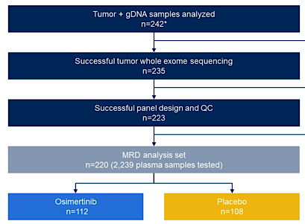
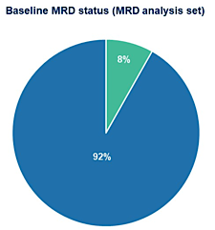
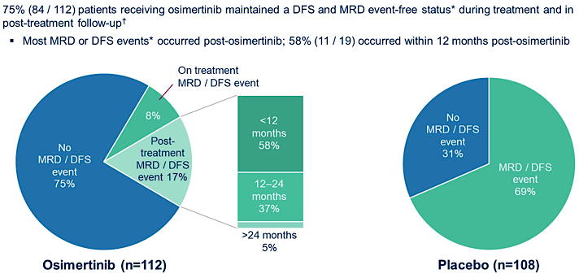
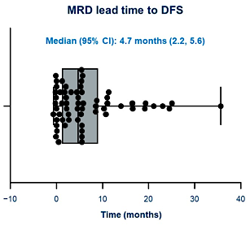
ADAURA MRD Analysis
Tumor-informed MRD testing feasible, with lead time of 4.7mo
DFS/MRD events often happened post-osimertinib in osi arm
Courtesy of Helena Yu, MD
John ASCO 2024; Abstract 800

Slide 35
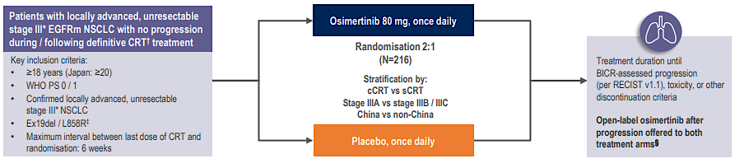
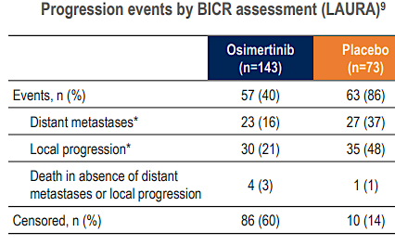
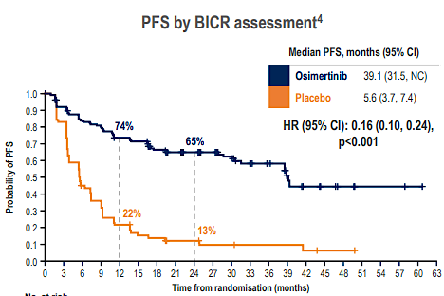
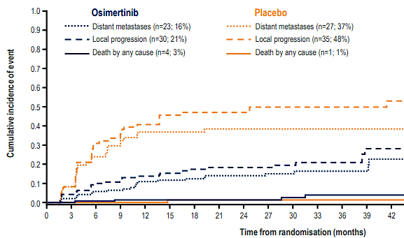
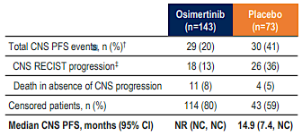

LAURA: Osimertinib after chemoradiation
Primary Endpoint:
PFS by BICR
Courtesy of Helena Yu, MD
Lu Ann Oncol 2024; Lu N Engl J Med 2024

Slide 36
Take home: LAURA: Osimertinib after chemoradiation
Adjuvant osimertinib after chemoradiation led to improved time to metastatic disease and CNS progression
High-risk group ~10% has baseline CNS metastases, ~50% no PET scan
INDEFINITE osimertinib until progression. Should this be standard of care in resected disease as well? Or is this just replicated osimertinib in (micro) metastatic disease?
TAKE HOME: Osimertinib is standard of care after definitive therapy for all locally advanced EGFR-mutant lung cancers
Courtesy of Helena Yu, MD
Lu Ann Oncol 2024; Lu N Engl J Med 2024

Slide 37
AGENDA
Year in Review: EGFR-Mutant Non-Small Cell Lung Cancer
MODULE 1: First-Line Treatment of Metastatic Disease
MODULE 2: Adjuvant and Neoadjuvant Therapy
MODULE 3: EGFR Exon 20 Insertion Mutations
MODULE 4: Antibody-Drug Conjugates

Slide 38
Zipalertinib for Patients with EGFR Exon 20 Insertion Mutations
Passaro A et al. Safety and Anti-tumour Activity of Zipalertinib in NSCLC Patients (pts) with EGFR Exon 20 Insertion (ex20ins) Mutations Who Received Prior Amivantamab. ESMO 2024;Abstract 1254MO.
Yu HA et al. REZILIENT2: Phase 2 Study of Zipalertinib in Patients with Advanced Non-Small Cell Lung Cancer (NSCLC) with Exon 20 Insertions (ex20ins) and Other Uncommon Epidermal Growth Factor Receptor (EGFR) Mutations. ASCO 2024;Abstract TPS8670.
Yu HA et al. REZILIENT3: Phase 3 Study of Zipalertinib plus Chemotherapy in Patients with Previously Untreated, Advanced Nonsquamous Non-Small Cell Lung Cancer (NSCLC) Harboring Epidermal Growth Factor Receptor (EGFR) Exon 20 Insertions (Ex20ins) Mutations. ASCO 2024;Abstract TPS8671.

Slide 39
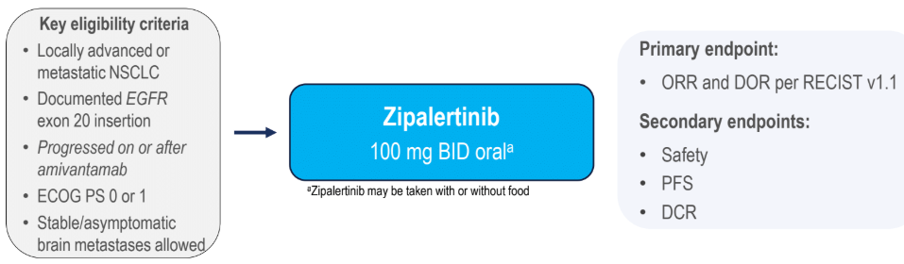
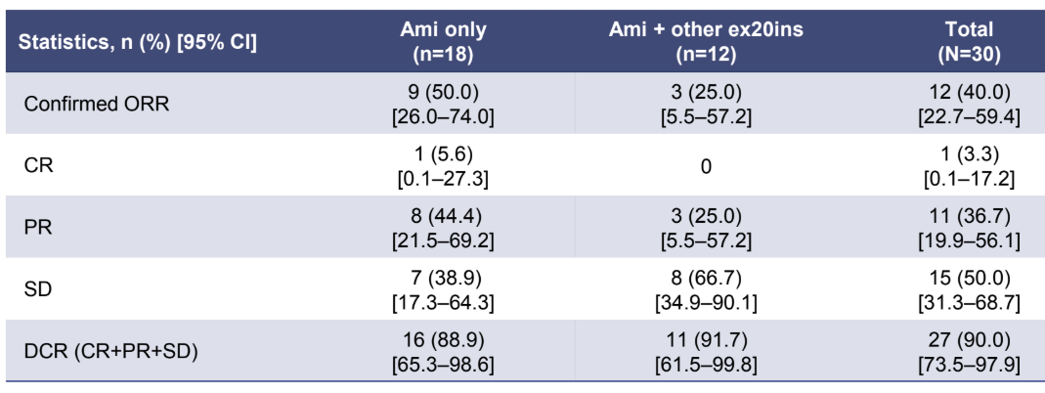
Zipalertinib after amivantamab
It was previously unknown whether there was cross-resistance between EGFR exon 20 directed antibodies versus tyrosine kinase inhibitors
Zipalertinib appears to be effective after amivantamab with an ORR of 50%
Zipalertinib is less effective (ORR 25%) after a different TKI (Poziotinib, mobocertinib, BLU-451)
Assessment of sequencing of TKI and antibody are needed
Courtesy of Helena Yu, MD
Passaro ESMO 2024; Abstract 1254MO

Slide 40
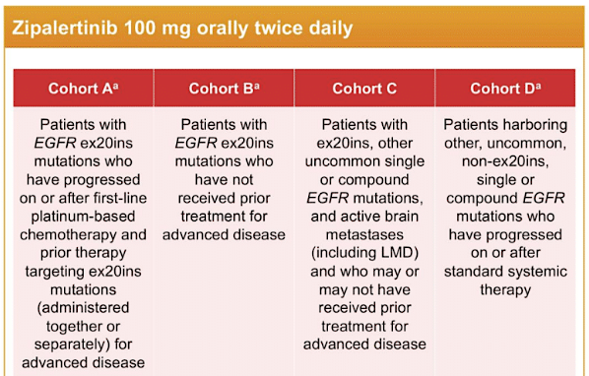
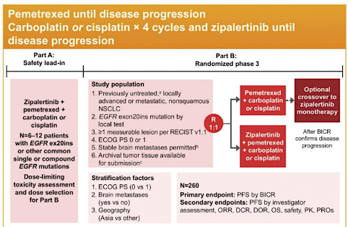
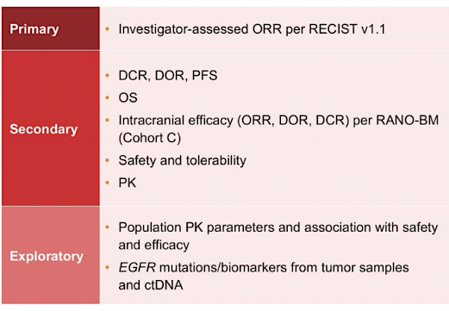
Ongoing zipalertinib trials
REZILIENT2: Zipalertinib in CNS, 1L, after other exon20 + uncommon mtns¹
REZILIENT3: Phase 3 of 1L Zipalertinib + chemo vs chemo²
REZILIENT2 will assess zipa in atypical EGFR, CNS disease and after other exon 20 treatments
REZILIENT3 is a registrational study to assess zipa + chemo as 1L treatment (similar to amivantamab + chemo)
1:Yu ASCO 2024;Abstract TPS8670
2:Yu ASCO 2024; Abstract TPS8671
Courtesy of Helena Yu, MD

Slide 41
AGENDA
Year in Review: EGFR-Mutant Non-Small Cell Lung Cancer
MODULE 1: First-Line Treatment of Metastatic Disease
MODULE 2: Adjuvant and Neoadjuvant Therapy
MODULE 3: EGFR Exon 20 Insertion Mutations
MODULE 4: Antibody-Drug Conjugates

Slide 42
Anti-PD-1 Immunotherapy in Combination with Chemotherapy for Tyrosine Kinase Inhibitor (TKI)-Resistant Metastatic NSCLC
Mok T et al. Nivolumab plus Chemotherapy in Epidermal Growth Factor Receptor-Mutated Metastatic Non-Small-Cell Lung Cancer After Disease Progression on Epidermal Growth Factor Receptor Tyrosine Kinase Inhibitors: Final Results of CheckMate 722. J Clin Oncol 2024 April 10;42(11):1252-64.
Yang JC-H et al. Phase III KEYNOTE-789 Study of Pemetrexed and Platinum with or without Pembrolizumab for Tyrosine Kinase Inhibitor-Resistant, EGFR-Mutant, Metastatic Nonsquamous Non-Small Cell Lung Cancer. J Clin Oncol 2024 December;42(34):4029-39.

Slide 43
Anti-PD-1 Immunotherapy in Combination with Chemotherapy for Tyrosine Kinase Inhibitor-Resistant, EGFR-Mutant Metastatic NSCLC
Outcome | KEYNOTE-789¹ |  | CheckMate 722²
 | Pembrolizumab + chemotherapy (n = 245) | Placebo + chemotherapy (n = 247) | Nivolumab + chemotherapy (n = 144) | Chemotherapy (n = 150)
Median progression-free survival (Hazard ratio; p-value) | 5.6 mo | 5.5 mo | 5.6 mo | 5.4 mo
 | 0.80 (0.0122) |  | 0.75 (0.0528)
Median overall survival (Hazard ratio; p-value) | 15.9 mo | 14.7 mo | 19.4 mo | 15.9 mo
 | 0.84 (0.0362) |  | 0.82 (not reported)
Overall response rate | 29.0% | 27.1% | 31% | 27%
Median duration of response | 6.3 mo | 5.6 mo | 6.7 mo | 5.6 mo
¹ Yang JC et al. J Clin Oncol 2024 Dec;42(34):4029-39;
² Mok T et al. J Clin Oncol 2024 Apr 10;42(11):1252-64.
Courtesy of Enriqueta Felip, MD, PhD

Slide 44
Antibody-Drug Conjugates for Advanced Disease
Sands J et al. Datopotamab Deruxtecan in Advanced or Metastatic Non-Small Cell Lung Cancer with Actionable Genomic Alterations: Results from the Phase II TROPION-Lung05 Study. J Clin Oncol 2025 January 6;[Online ahead of print].
Lisberg A et al. Intracranial Efficacy of Datopotamab Deruxtecan (Dato-DXd) in Patients (pts) with Previously Treated Advanced/Metastatic Non-Small Cell Lung Cancer (a/m NSCLC) with Actionable Genomic Alterations (AGA): Results from TROPION-Lung05. ASCO 2024;Abstract 8593
Ahn M-J et al. Efficacy and Safety of Datopotamab Deruxtecan (Dato-DXd) in Patients (pts) with Previously-Treated EGFR-Mutated Advanced Non-Small Cell Lung Cancer (NSCLC): A Pooled Analysis of TROPION-Lung01 and TROPION-Lung05. ESMO Asia 2024;Abstract LBA7.
Yu HA et al. HERTHENA-Lung01, a Phase II Trial of Patritumab Deruxtecan (HER3-DXd) in Epidermal Growth Factor Receptor-Mutated Non-Small-Cell Lung Cancer After Epidermal Growth Factor Receptor Tyrosine Kinase Inhibitor Therapy and Platinum-Based Chemotherapy. J Clin Oncol 2023 December 10;41(35):5363-75.
Yu HA et al. Translational Insights and Overall Survival in the U31402-A-U102 Study of Patritumab Deruxtecan (HER3-DXd) in EGFR-Mutated NSCLC. Ann Oncol 2024 May;35(5):437-47.

Slide 45
Antibody-Drug Conjugates for Advanced Disease (Continued)
Mok T et al. HERTHENA-Lung02: Phase III Study of Patritumab Deruxtecan in Advanced EGFR-Mutated NSCLC After a Third-Generation EGFR TKI. Future Oncol 2024 May;20(15):969-80.
Garon EB et al. Phase 3 TroFuse-004 Study: Sac-TMT vs Chemotherapy for Previously Treated Advanced NSCLC with EGFR/Other Genomic Alterations. WCLC 2024;Abstract P2.10A.06.
Leighl NB et al. Trofuse-009: Phase 3 Study of Sac-TNT vs Platinum-Doublet Chemotherapy for Previously Treated EGFR-Mutated Advanced NSCLC. WCLC 2024;Abstract P2.10A.07.
Fang W et al. Updated Efficacy and Safety of Anti-TROP2 ADC SKB264 (MK-2870) for Previously Treated Advanced NSCLC in Phase 2 Study. AACR 2024;Abstract CT247.

Slide 46
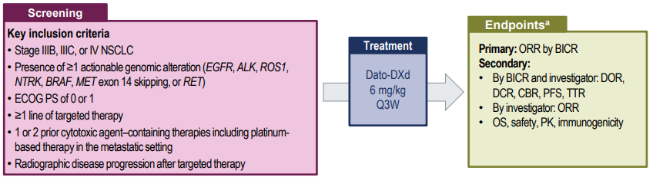
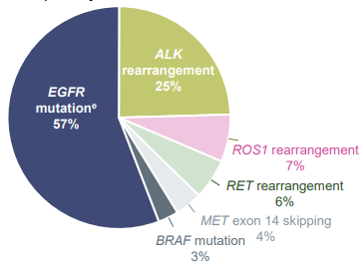
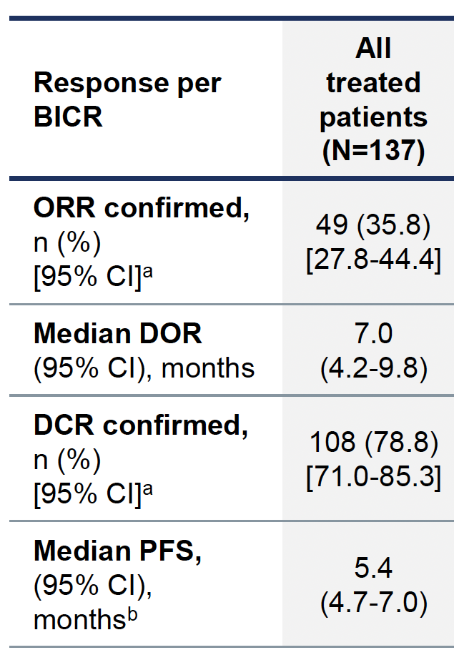
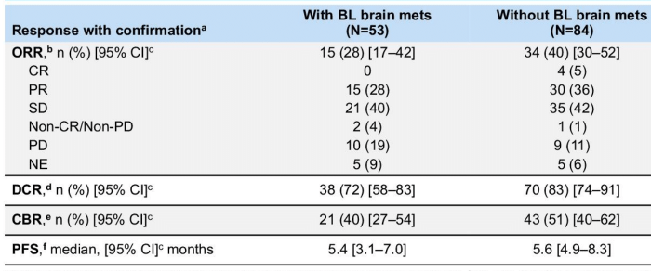
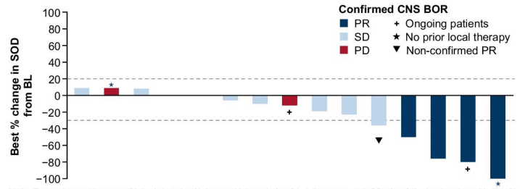

Datopotamab deruxtecan
TROPION-Lung05
Pts with measurable CNS disease
72% of pts with brain mets had prior local treatment
Courtesy of Helena Yu, MD
Sands J Clin Oncol 2025;Lisberg ASCO 2024;Abstract 8593

Slide 47
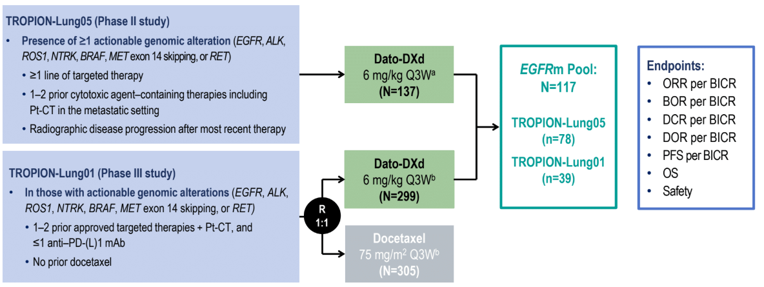
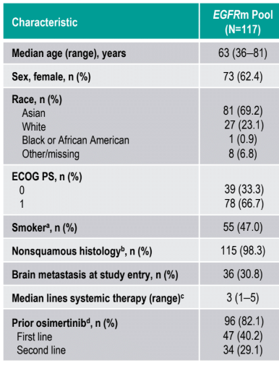
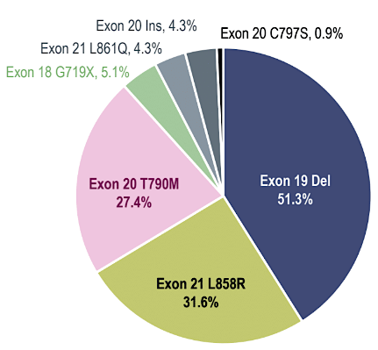
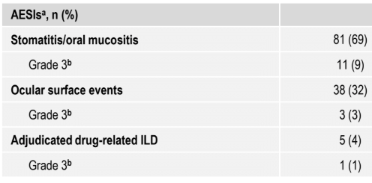
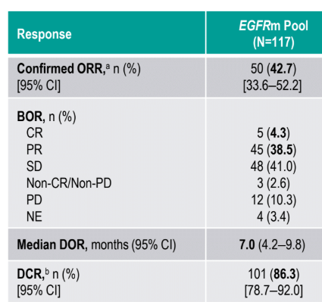
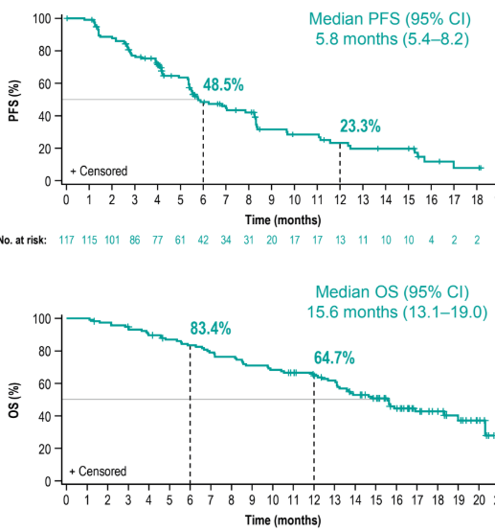
Datopotamab deruxtecan
EGFR+ NSCLC from TL1 and TL5
Ahn ESMO Asia; Abstract LBA7
Courtesy of Helena Yu, MD

Slide 48

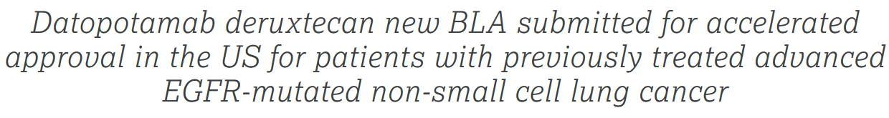

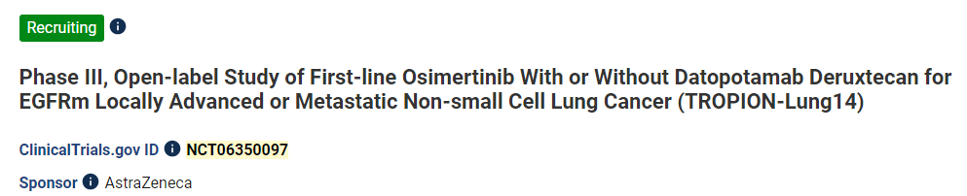
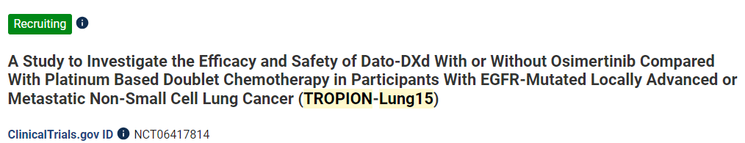
Datopotamab deruxtecan
Press release:
Biomarker for antibody drug conjugates may be driver oncogene – datopotamab and patritumab both seeking approval in EGFR+ lung cancer
ADCs initially thought too bulky and therefore with limited CNS penetration, but CNS efficacy is present
Efforts to combine ADCs with osimertinib are ongoing
Ahn ESMO Asia; Abstract LBA7
Courtesy of Helena Yu, MD

Slide 49
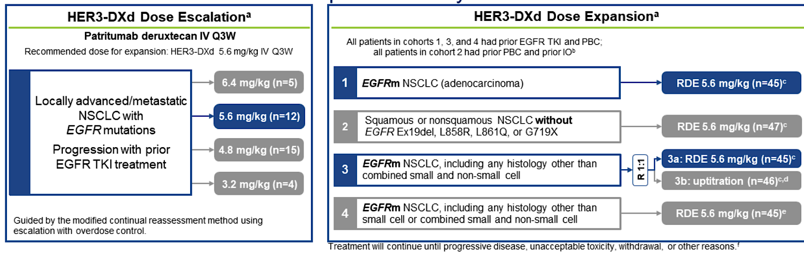
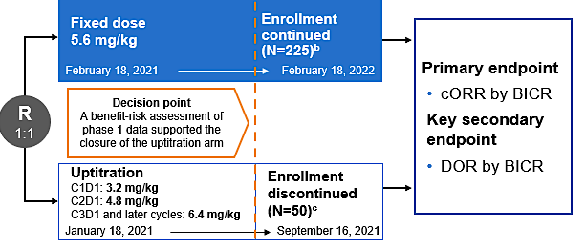
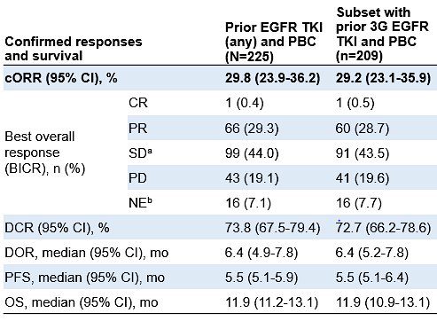
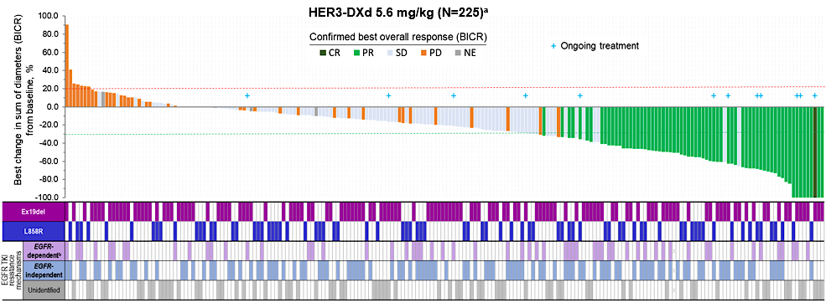
Patritumab deruxtecan
Phase 1 Dose escalation
HERTHENA-Lung01 Registrational phase 2
Courtesy of Helena Yu, MD
Yu J Clin Oncol 2023

Slide 50
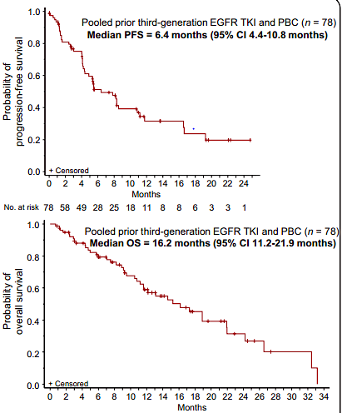
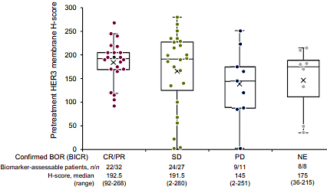
Patritumab deruxtecan
HER3 expression and response
PFS
Consistent updated PFS and OS
No new safety signals
Slightly higher ORR in pts with EGFR-independent resistance (30 vs 48%)
Acquired resistance mutations included a HER3 frameshift mutation, TOP1 mutation
HER3 expression did not select for response
OS
Courtesy of Helena Yu, MD
Yu Ann Oncol 2024

Slide 51
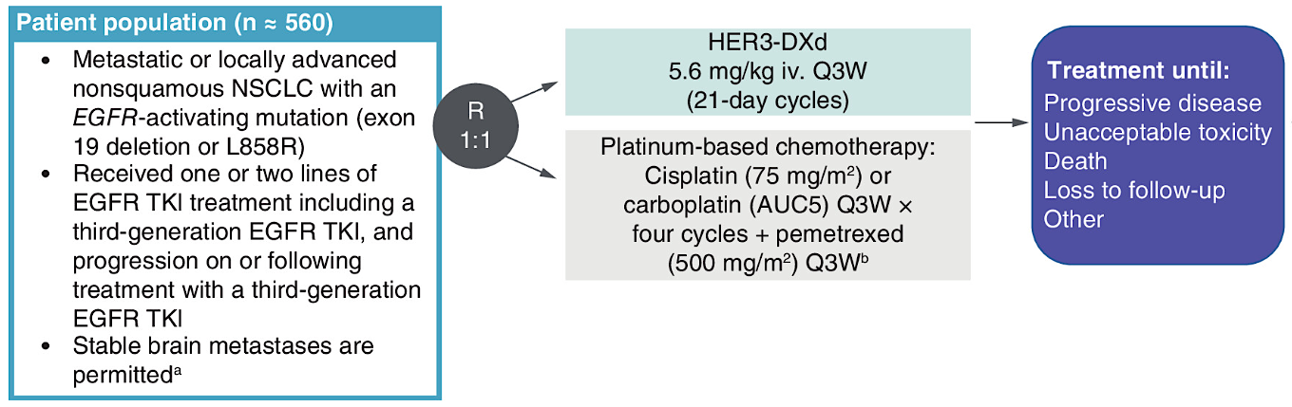


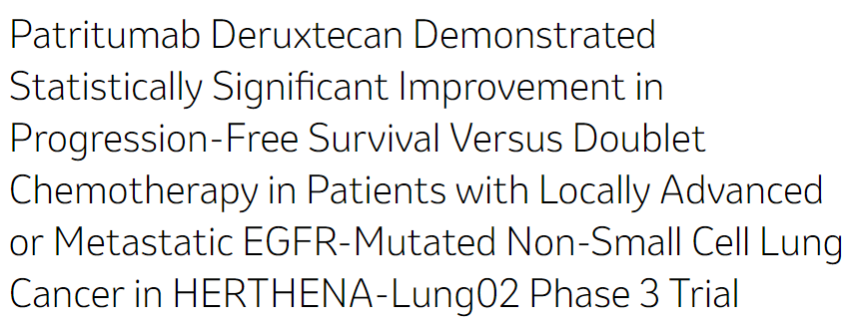

Patritumab deruxtecan
Primary endpoint: Progression-free survival by BICR
Press release:
Press release:
Courtesy of Helena Yu, MD
Mok Fut Med 2023

Slide 52
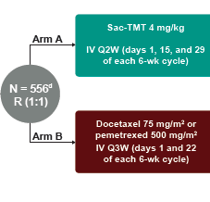


Sacituzumab tirumotecan
TroFuse-004¹
AGA: EGFR, ALK, ROS1, BRAF, NTRK, MET, RET
Primary endpoints: PFS and OS
Stratify by: brain mets, TROP2 expression, prior EGFR TKI
TroFuse-009²
Primary endpoints: PFS and OS
Stratify by: brain mets, TROP2 expression, prior EGFR TKI
1:Garon WCLC 2024;Abstract P2.10A.06.
2:Leighl WCLC 2024;Abstract P2.10A.07.
Courtesy of Helena Yu, MD

Slide 53



Sacituzumab tirumotecan
Press release:
- Several ADCs are looking at the AGA space as an entry point (enhanced efficacy in this population)
- Other studies are focused on combination therapies with immunotherapy for larger NSCLC populations
- Need biomarkers to select appropriate ADC for a pt
- We will hopefully have several ADC options for EGFR+ NSCLC in the near future
Fang AACR 2024;Abstract CT247
Courtesy of Helena Yu, MD

