Slide 1
Other relevant topics in
EGFR mutation-positive NSCLC, such as nonmetastatic disease, exon 20 insertion mutations and novel agents
Helena Yu, MD
Associate Attending
Research Director, Thoracic Oncology Service
Memorial Sloan Kettering Cancer Center
January, 2025

Slide 2
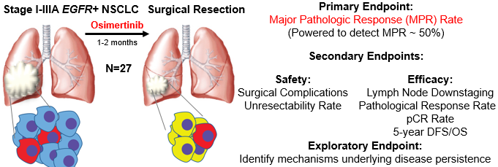
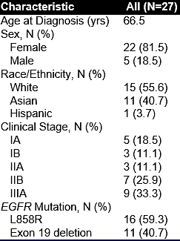
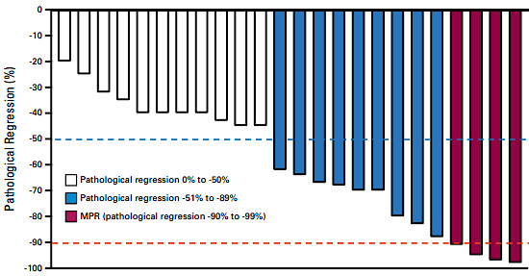
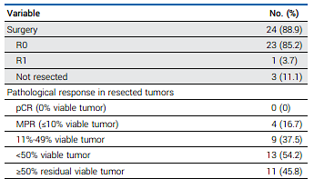
Neoadjuvant osimertinib for early stage
Primary Endpoint:
Major Pathologic Response Rate = 15%
Blakely J Clin Oncol. 2024

Slide 3
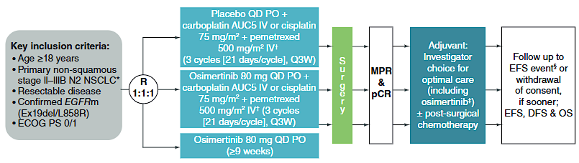
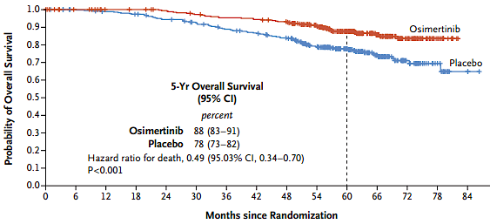
Neoadjuvant osimertinib for early stage
NeoADAURA study schema
OS benefit of adjuvant osimertinib
Lower than expected MPR and PCR rate
Possibly due to short treatment time (1-2 mo?)
Clear survival benefit of adjuvant osimertinib
Chemotherapy may be important for initial cytoreduction
Await NeoADAURA results
Blakely J Clin Oncol. 2024

Slide 4
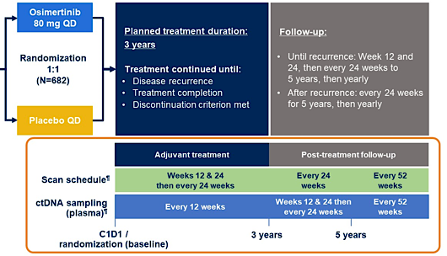
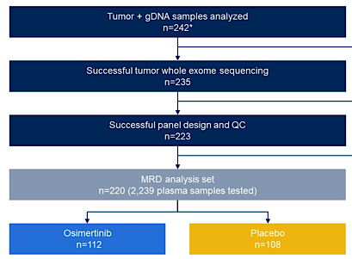
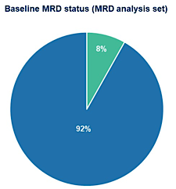
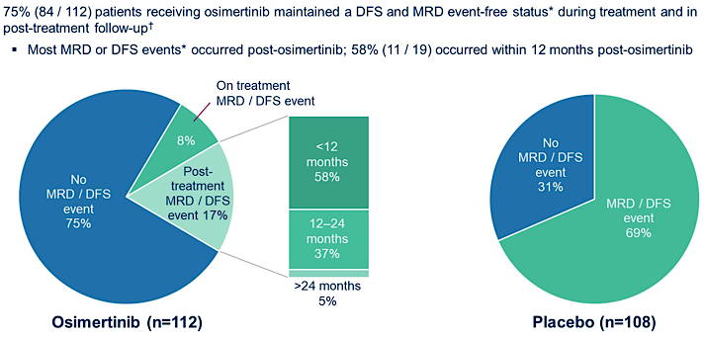
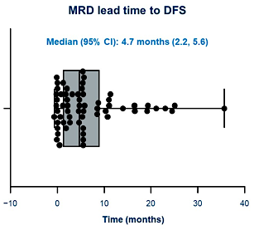
ADAURA MRD Analysis
Tumor-informed MRD testing feasible, with lead time of 4.7mo
DFS/MRD events often happened post-osimertinib in osi arm
John ASCO 2024; Abstract 800

Slide 5
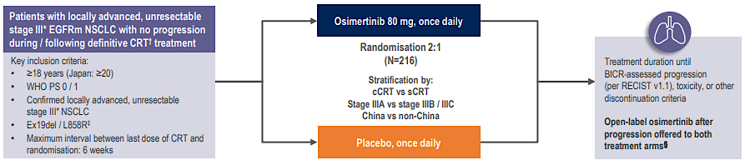
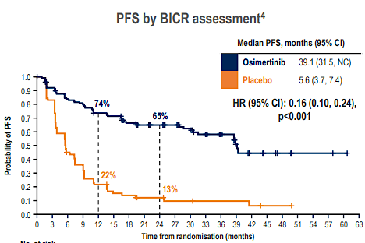
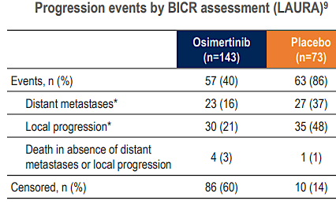
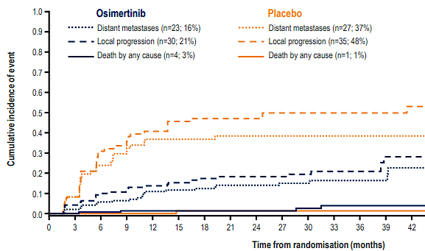
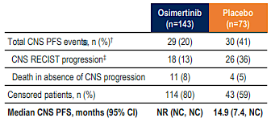

LAURA: Osimertinib after chemoradiation
Primary Endpoint:
PFS by BICR
Lu Ann Oncol 2024; Lu N Engl J Med 2024

Slide 6
Take home: LAURA: Osimertinib after chemoradiation
Adjuvant osimertinib after chemoradiation led to improved time to metastatic disease and CNS progression
High-risk group ~10% has baseline CNS metastases, ~50% no PET scan
INDEFINITE osimertinib until progression. Should this be standard of care in resected disease as well? Or is this just replicated osimertinib in (micro) metastatic disease?
TAKE HOME: Osimertinib is standard of care after definitive therapy for all locally advanced EGFR-mutant lung cancers
Lu Ann Oncol 2024; Lu N Engl J Med 2024

Slide 7
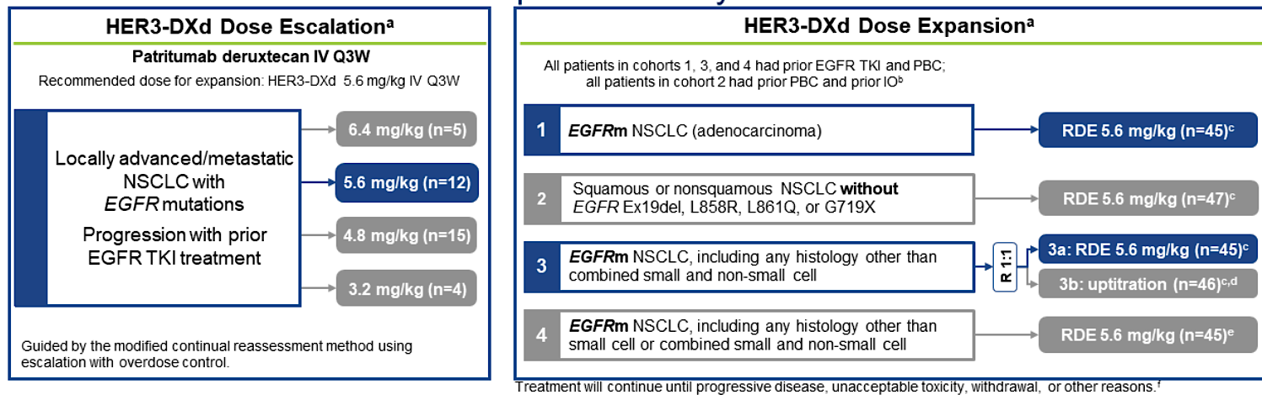
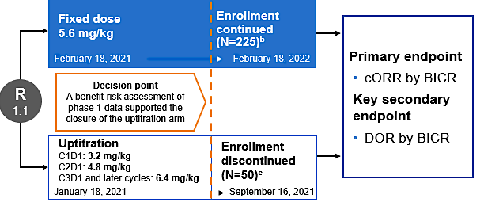
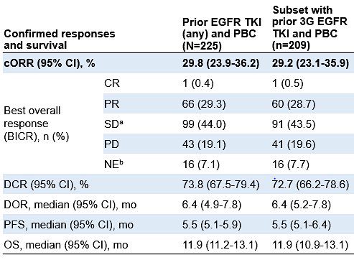
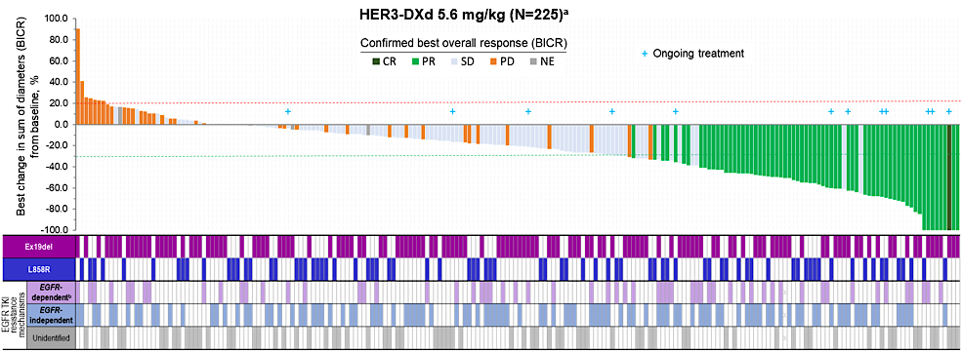
Patritumab deruxtecan
Phase 1 Dose escalation
HERTHENA-Lung01 Registrational phase 2
Yu J Clin Oncol 2023

Slide 8
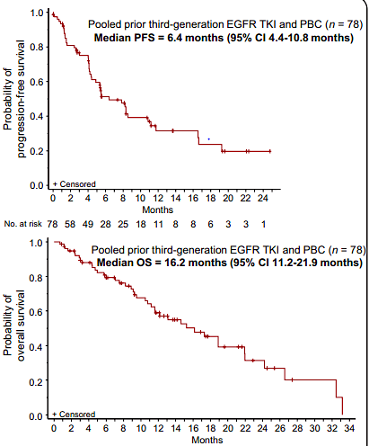
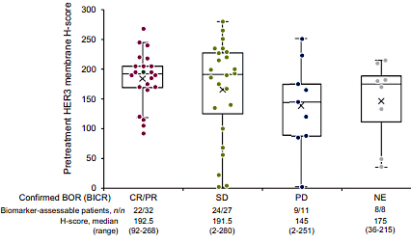
Patritumab deruxtecan
HER3 expression and response
PFS
OS
Consistent updated PFS and OS
No new safety signals
Slightly higher ORR in pts with EGFR-independent resistance (30 vs 48%)
Acquired resistance mutations included a HER3 frameshift mutation, TOP1 mutation
HER3 expression did not select for response
Yu Ann Oncol 2024

Slide 9
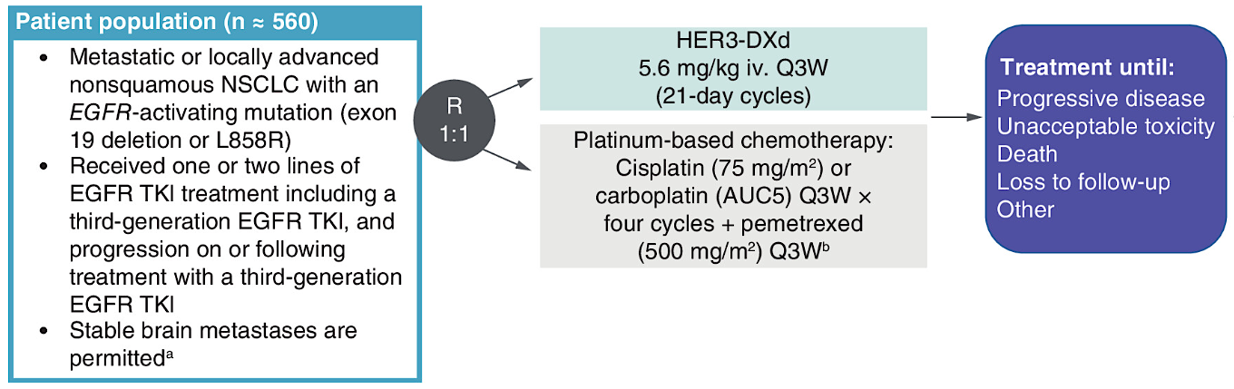


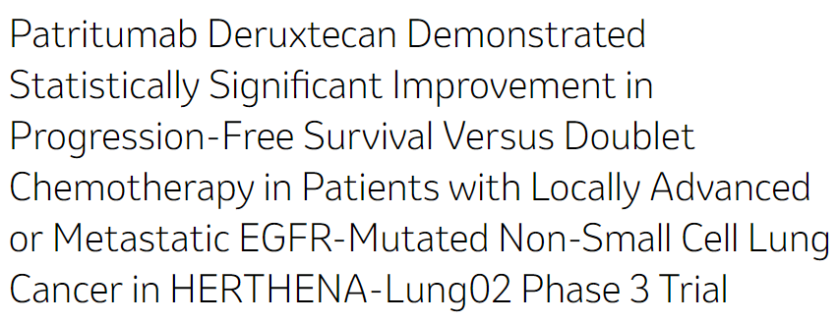
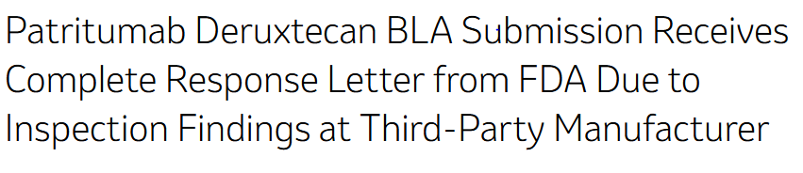
Patritumab deruxtecan
Primary endpoint: Progression-free survival by BICR
Press release:
Press release:
Mok Fut Med 2023

Slide 10
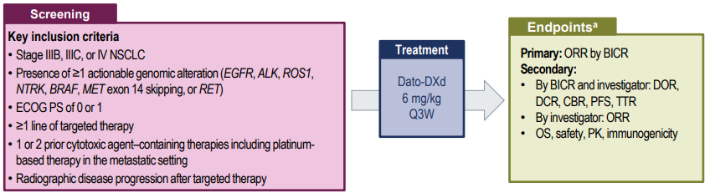
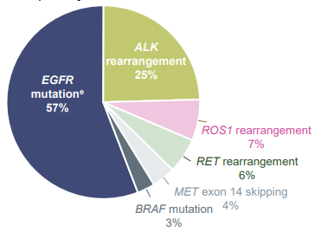
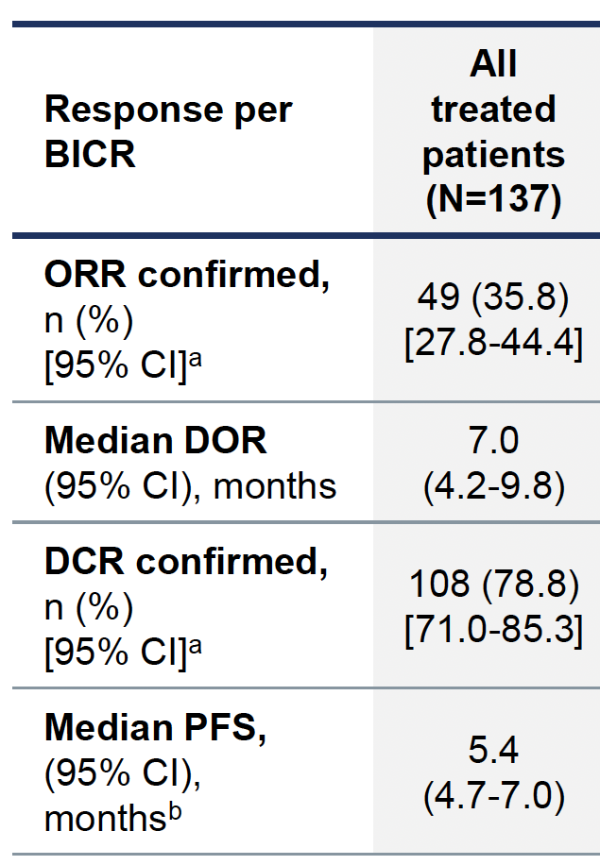
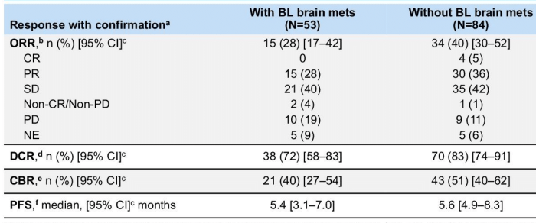
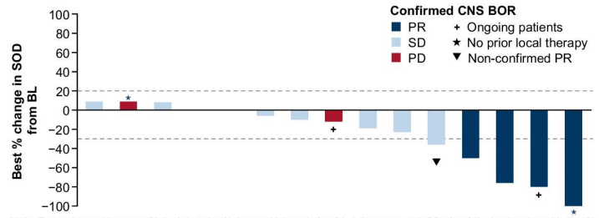

Datopotamab deruxtecan
TROPION-Lung05
Pts with measurable CNS disease
72% of pts with brain mets had prior local treatment
Sands J Clin Oncol 2025;Lisberg ASCO 2024;Abstract 8593

Slide 11
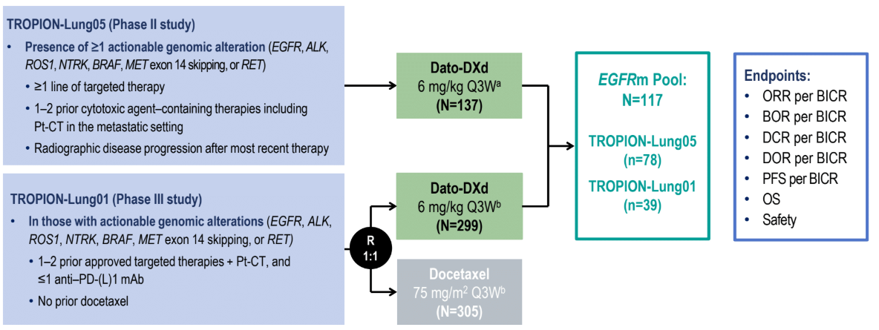
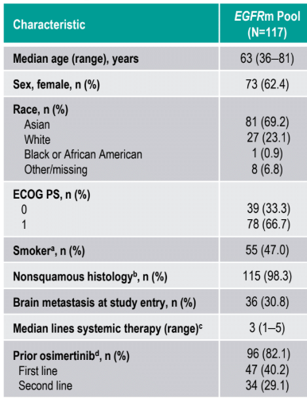
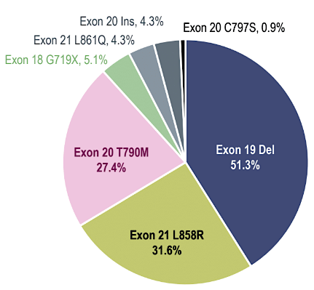
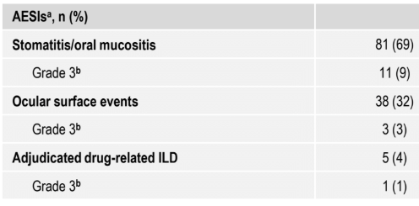
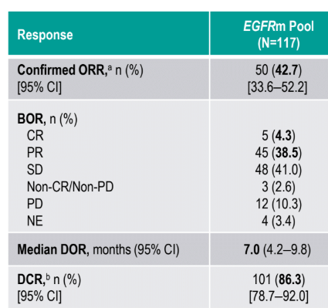
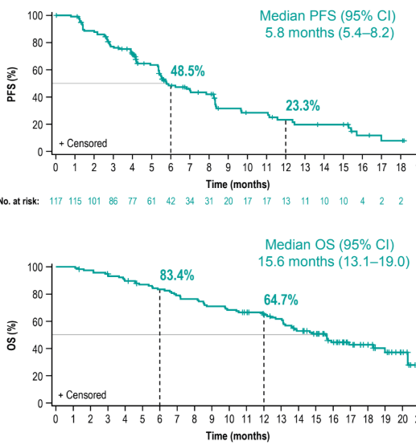
Datopotamab deruxtecan
EGFR+ NSCLC from TL1 and TL5
Ahn ESMO Asia; Abstract LBA7

Slide 12

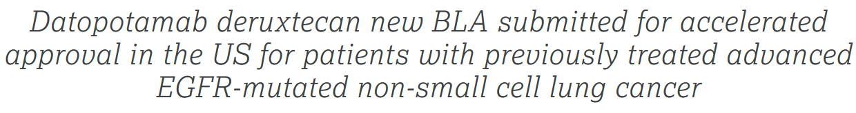

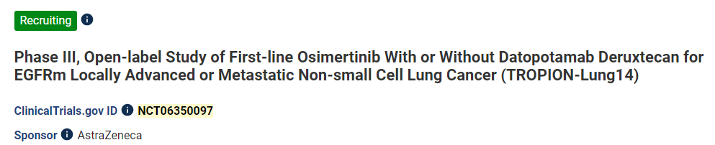
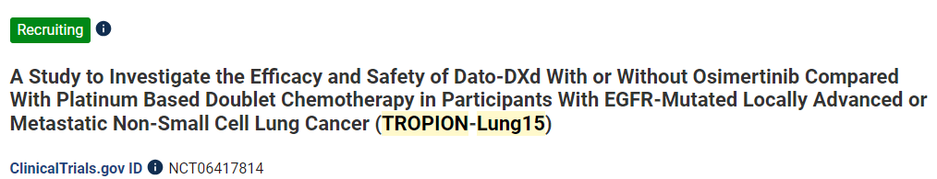
Datopotamab deruxtecan
Press release:
Biomarker for antibody drug conjugates may be driver oncogene – datopotamab and patritumab both seeking approval in EGFR+ lung cancer
ADCs initially thought too bulky and therefore with limited CNS penetration, but CNS efficacy is present
Efforts to combine ADCs with osimertinib are ongoing
Ahn ESMO Asia; Abstract LBA7

Slide 13
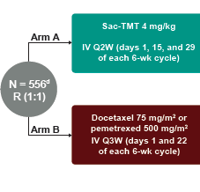

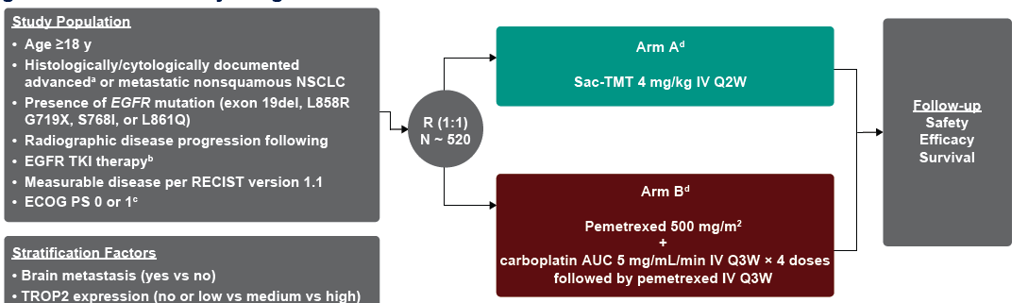
Sacituzumab tirumotecan
TroFuse-004¹
AGA: EGFR, ALK, ROS1, BRAF, NTRK, MET, RET
Primary endpoints: PFS and OS
Stratify by: brain mets, TROP2 expression, prior EGFR TKI
TroFuse-009²
Primary endpoints: PFS and OS
Stratify by: brain mets, TROP2 expression, prior EGFR TKI
1:Garon WCLC 2024;Abstract P2.10A.06.
2:Leighl WCLC 2024;Abstract P2.10A.07.

Slide 14

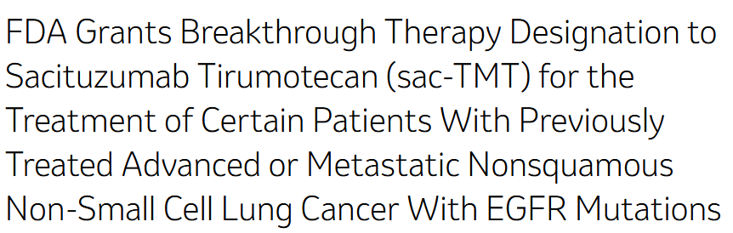
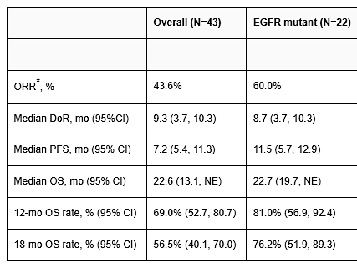
Sacituzumab tirumotecan
Press release:
- Several ADCs are looking at the AGA space as an entry point (enhanced efficacy in this population)
- Other studies are focused on combination therapies with immunotherapy for larger NSCLC populations
- Need biomarkers to select appropriate ADC for a pt
- We will hopefully have several ADC options for EGFR+ NSCLC in the near future
Fang AACR 2024;Abstract CT247

Slide 15
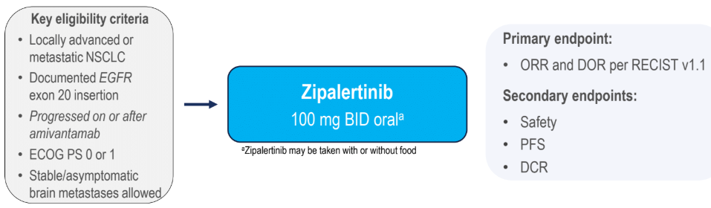
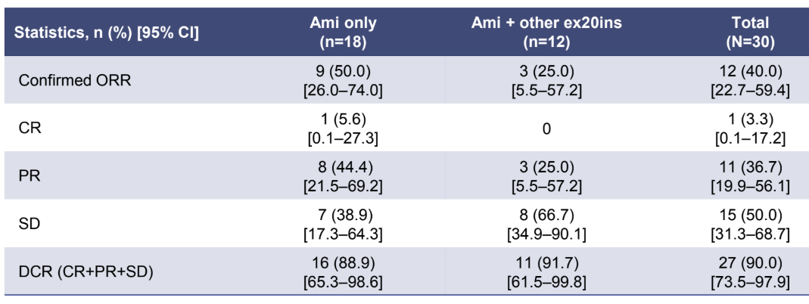
Zipalertinib after amivantamab
It was previously unknown whether there was cross-resistance between EGFR exon 20 directed antibodies versus tyrosine kinase inhibitors
Zipalertinib appears to be effective after amivantamab with an ORR of 50%
Zipalertinib is less effective (ORR 25%) after a different TKI (Poziotinib, mobocertinib, BLU-451)
Assessment of sequencing of TKI and antibody are needed
Passaro ESMO 2024; Abstract 1254MO

Slide 16
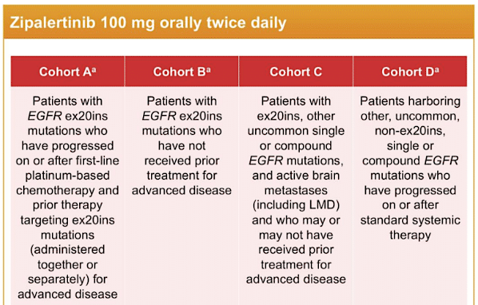
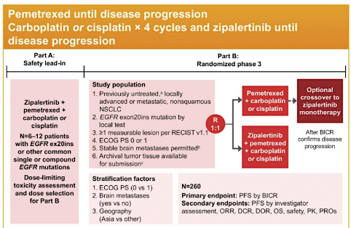
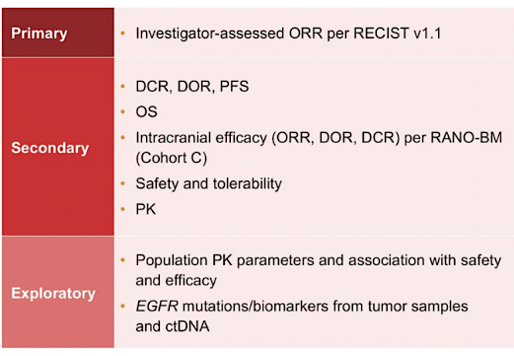
Ongoing zipalertinib trials
REZILIENT2: Zipalertinib in CNS, 1L, after other exon20 + uncommon mtns¹
REZILIENT3: Phase 3 of 1L Zipalertinib + chemo vs chemo²
REZILIENT2 will assess zipa in atypical EGFR, CNS disease and after other exon 20 treatments
REZILIENT3 is a registrational study to assess zipa + chemo as 1L treatment (similar to amivantamab + chemo)
1:Yu ASCO 2024;Abstract TPS8670
2:Yu ASCO 2024; Abstract TPS8671

