Slide 1
Management of Metastatic EGFR Mutation-Positive NSCLC
Enriqueta Felip
Medical Oncology Service, Vall d’Hebron Institute of Oncology (VHIO), Vall d’Hebron Barcelona Hospital Campus, Universitat Autònoma de Barcelona, Barcelona, Spain
January 15, 2025

Slide 2
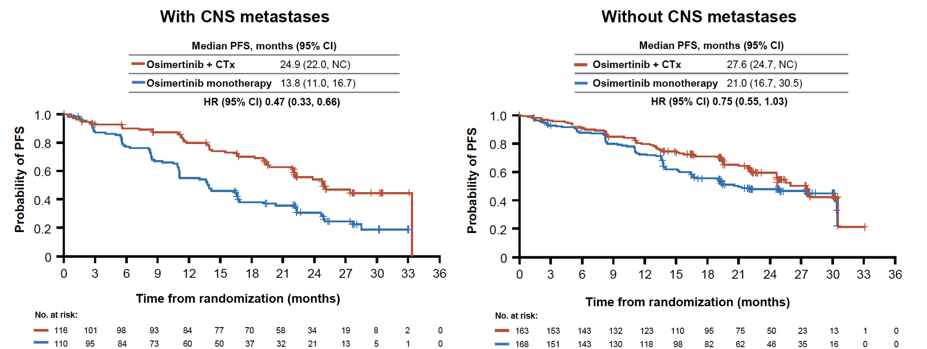
Valdiviezo N et al. FLAURA2: Impact of Tumor Burden on Outcomes of 1L Osimertinib ± CT in Patients with EGFR-mutated Advanced NSCLC. WCLC 2024; Abstract MA12.04
FLAURA2
PFS by INV 25.5 vs 16.7 mo; HR 0.62
Second OS interim analysis: HR 0.75
The present study reports the impact of baseline tumor burden (number of metastatic anatomical sites) on PFS in patients from FLAURA2

Slide 3
Valdiviezo N et al. FLAURA2: Impact of Tumor Burden on Outcomes of 1L Osimertinib ± CT in Patients with EGFR-mutated Advanced NSCLC. WCLC 2024; Abstract MA12.04

Slide 4
Valdiviezo N et al. FLAURA2: Impact of Tumor Burden on Outcomes of 1L Osimertinib ± CT in Patients with EGFR-mutated Advanced NSCLC. WCLC 2024; Abstract MA12.04 My take home messages
The mechanisms for the observed clinical benefit with osimertinib+CT combination are not currently known
It is possible that the combination overcomes intratumor heterogeneity
The PFS benefit appeared to be most pronounced among patients with BM at baseline
Brain scans were performed at screening and at the time of PD in all patients. Patients with brain metastases at screening underwent brain scans at each tumor assessment
PFS benefit was observed with osimertinib+CT vs osimertinib alone in patients with high tumor burden
No PFS differences in patients with intra-thoracic disease (HR 0.97)

Slide 5
Yang JC et al. FLAURA2: Resistance, and Impact of Baseline TP53 Alterations in Patients Treated With 1L Osimertinib ± Platinum-Pemetrexed. WCLC 2024; Abstract MA12.03

Slide 6
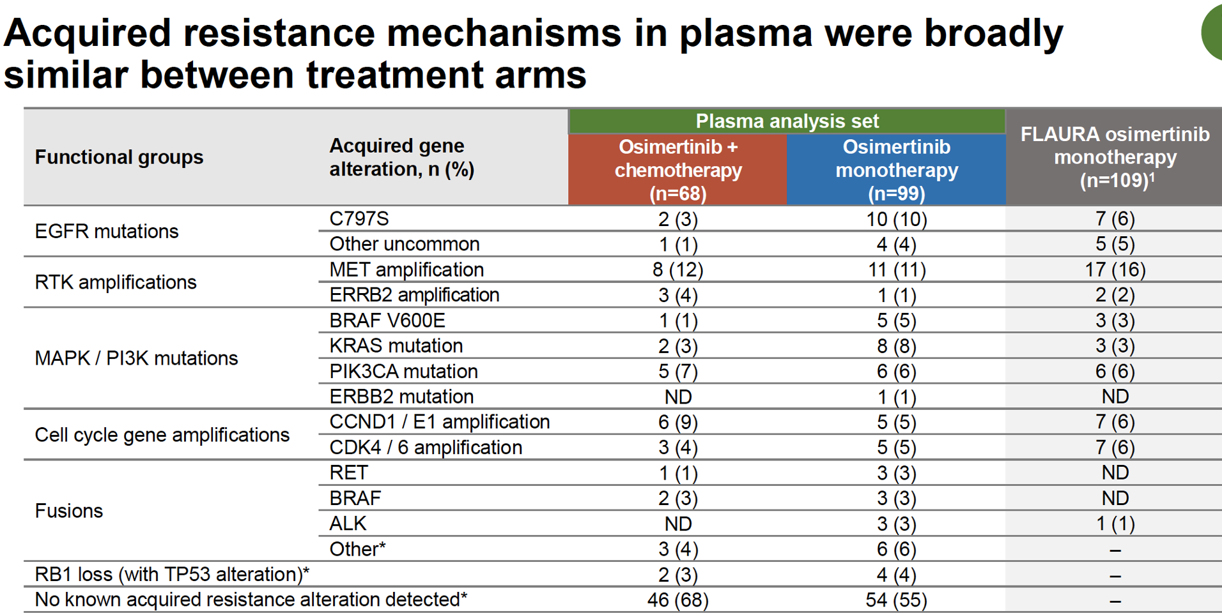
Yang JC et al. FLAURA2: Resistance, and Impact of Baseline TP53 Alterations in Patients Treated With 1L Osimertinib ± Platinum-Pemetrexed. WCLC 2024; Abstract MA12.03

Slide 7
Yang JC et al. FLAURA2: Resistance, and Impact of Baseline TP53 Alterations in Patients Treated With 1L Osimertinib ± Platinum-Pemetrexed. WCLC 2024; Abstract MA12.03

Slide 8
Yang JC et al. FLAURA2: Resistance, and Impact of Baseline TP53 Alterations in Patients Treated With 1L Osimertinib ± Platinum-Pemetrexed. WCLC 2024; Abstract MA12.03 My take home messages
In this updated plasma analysis, acquired resistance mechanisms remained similar between treatment arms
No new acquired resistance mechanisms were observed
TP53 alterations appear to be a prognostic factor for PFS across both treatment arms

Slide 9
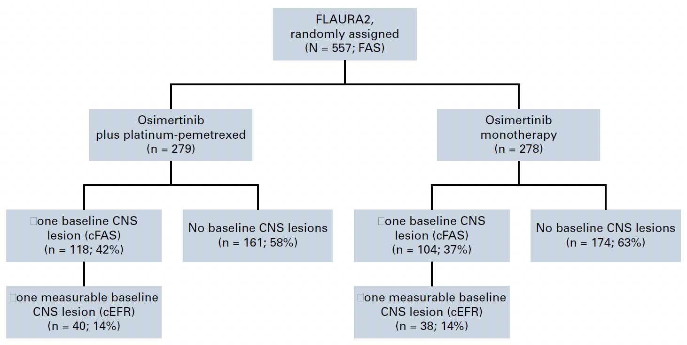
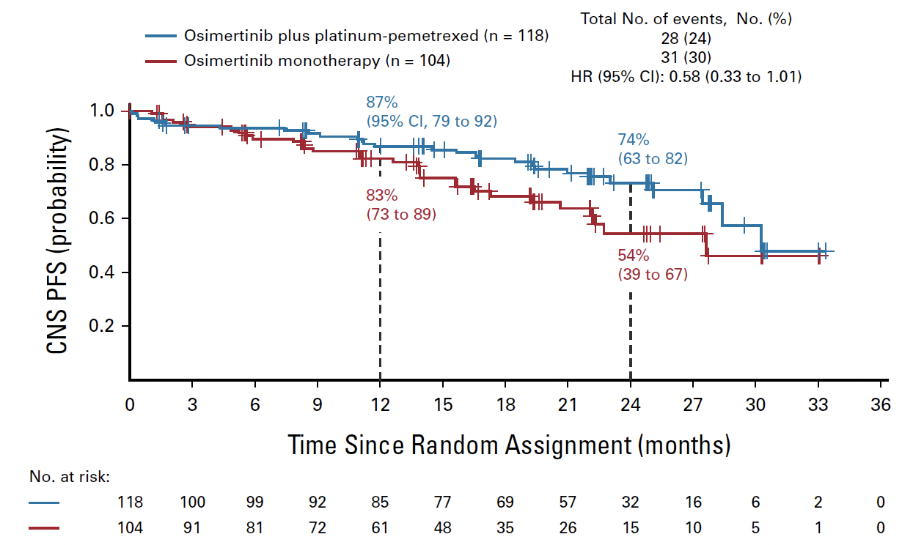
Jänne PA et al. CNS Efficacy of Osimertinib With or Without CT in EGFR-Mutated Advanced NSCLC. J Clin Oncol. 2024 Mar 1;42(7):808-820
FLAURA2: systemic PFS was improved with osimertinib+CT vs osimertinib monotherapy in the subgroup of patients with CNS metastases (mPFS 24.0 vs 13.8 mo; HR 0.47) and those without (27.6 vs 21.0 mo; HR 0.75)
The present study reports CNS efficacy (including CNS PFS) of osimertinib+CT vs osimertinib in patients from FLAURA2
CNS PFS in CNS-full analysis set

Slide 10
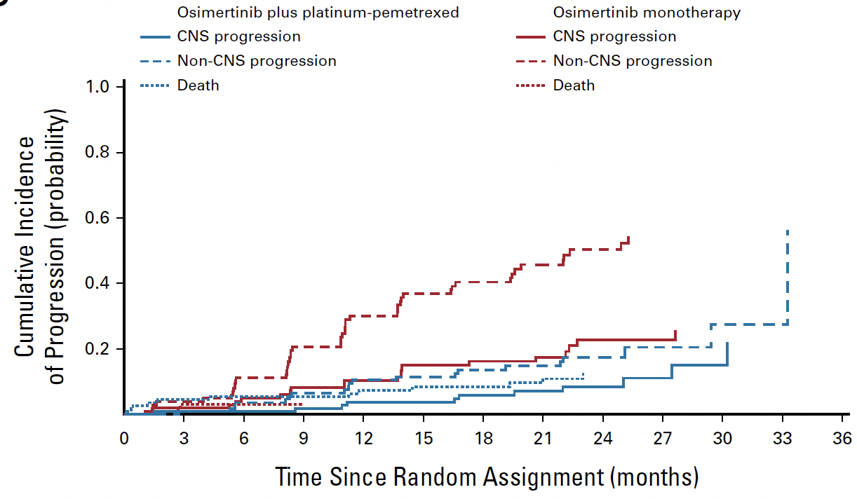
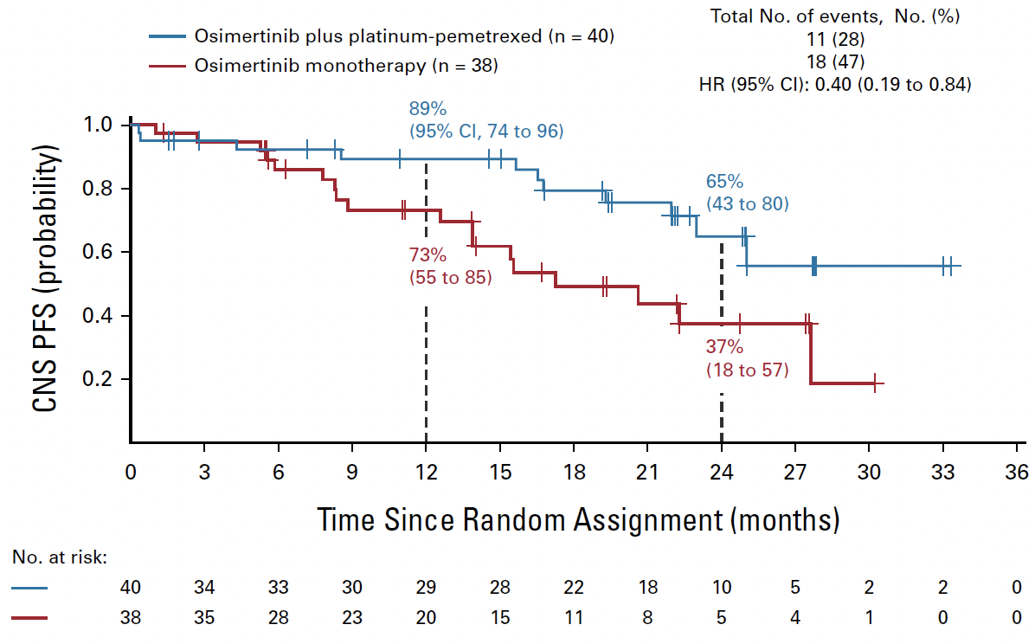
Jänne PA et al. CNS Efficacy of Osimertinib With or Without CT in EGFR-Mutated Advanced NSCLC. J Clin Oncol. 2024 Mar 1;42(7):808-820
CNS PFS in CNS-evaluable analysis set
Cumulative risk of CNS progression in CNS full analysis set

Slide 11
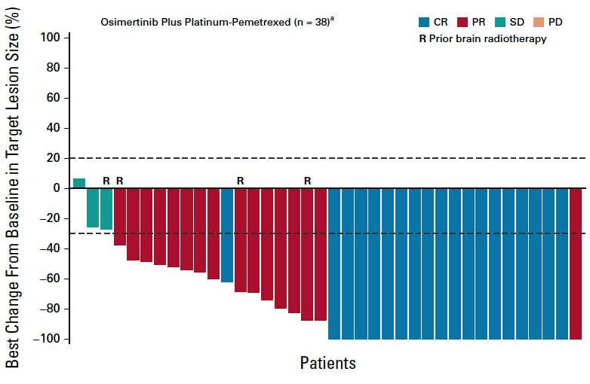
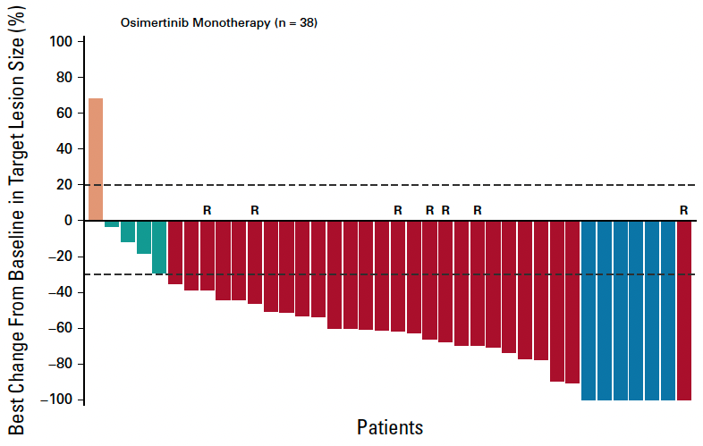
Jänne PA et al. CNS Efficacy of Osimertinib With or Without CT in EGFR-Mutated Advanced NSCLC. J Clin Oncol. 2024 Mar 1;42(7):808-820
Patients in the combination arm had a greater depth of response compared with those in the monotherapy arm

Slide 12
Jänne PA et al. CNS Efficacy of Osimertinib With or Without CT in EGFR-Mutated Advanced NSCLC. J Clin Oncol. 2024 Mar 1;42(7):808-820 My take home messages
All randomly assigned patients in FLAURA2 had brain scans at baseline (MRI in 84%)
Scans were assessed by neuroradiologist BIRC
Among 222 patients with baseline CNS metastases, osimertinib+CT demonstrated a clinically and meaningful improvement in CNS PFS compared with osimertinib monotherapy
Data support the combination as 1L in patients with EGFR mutations and CNS disease at baseline

Slide 13
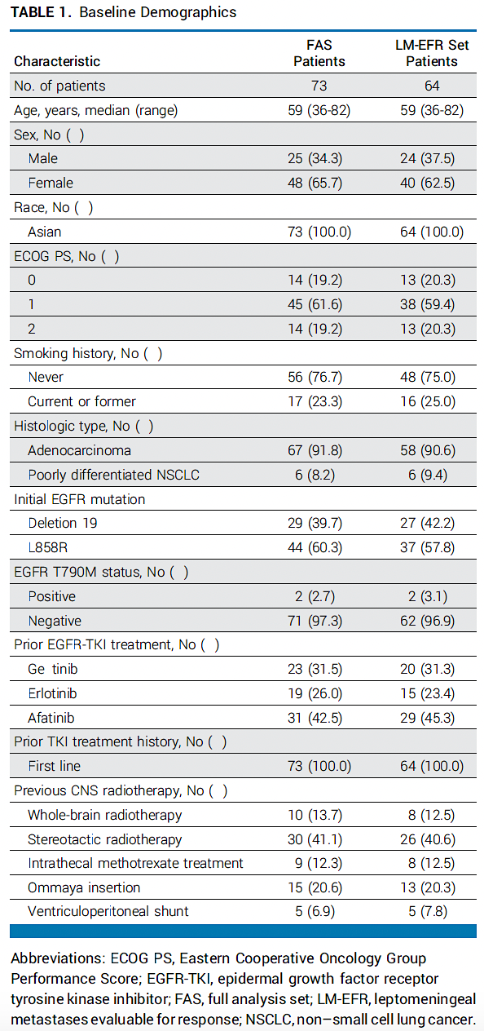
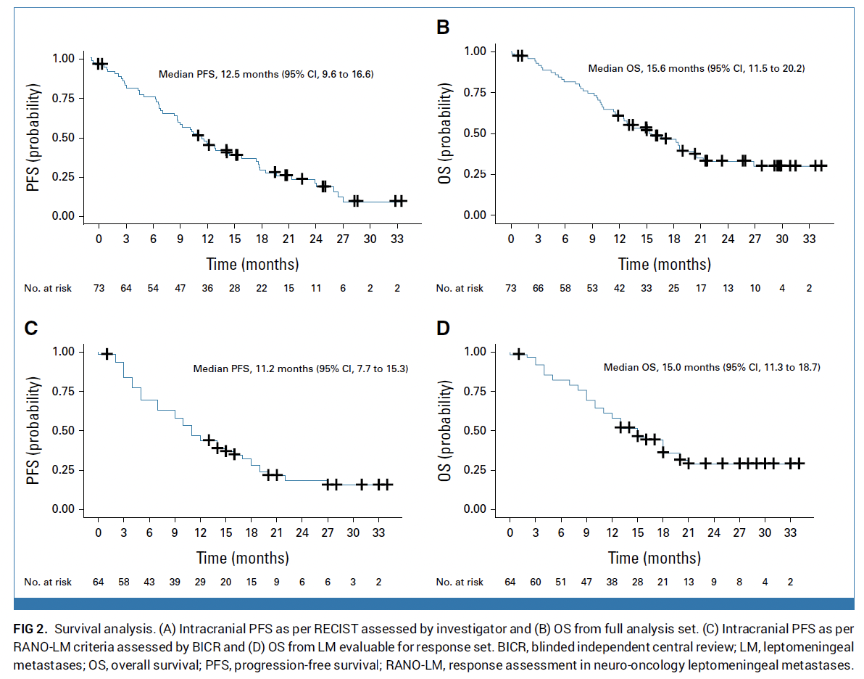
Park S et al. Phase II Efficacy and Safety of 80 mg Osimertinib in Patients With Leptomeningeal Metastases Associated With EGFR Mutation-Positive NSCLC (BLOSSOM). J Clin Oncol. 2024 Aug 10;42(23):2747-2756
To assess effectiveness of 80 mg osimertinib in patients with EGFR-mutant who developed LM disease after 1st or 2nd generation EGFR TKI treatment
Gefitinib

Slide 14
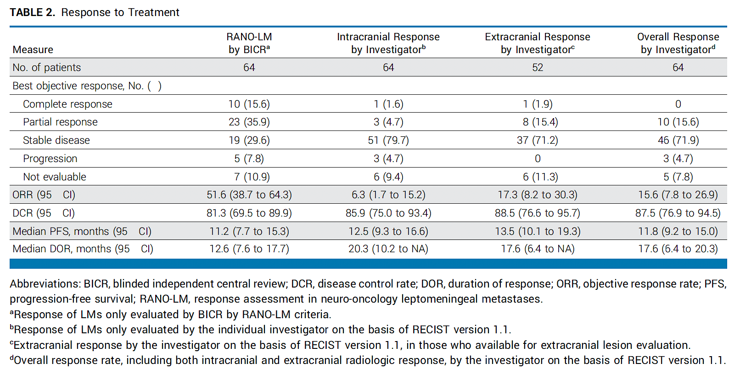
Park S et al. Phase II Efficacy and Safety of 80 mg Osimertinib in Patients With Leptomeningeal Metastases Associated With EGFR Mutation-Positive NSCLC (BLOSSOM). J Clin Oncol. 2024 Aug 10;42(23):2747-2756

Slide 15
Park S et al. Phase II Efficacy and Safety of 80 mg Osimertinib in Patients With Leptomeningeal Metastases Associated With EGFR Mutation-Positive NSCLC (BLOSSOM). J Clin Oncol. 2024 Aug 10;42(23):2747-2756 My take home messages
High efficacy of 80 mg once daily of osimertinib in patients with LMs
An important limitation (as recognized by the authors in the “Discussion”): the study includes patients initially treated with 1st and 2nd generation EGFR TKI
The present SoC: 3rd generation EGFR TKI
The study supports the standard osimertinib dose (80 mg) vs double daily dose (160 mg) in patients with CNS disease

Slide 16
Gadgeel S et al. Amivantamab Plus Lazertinib vs Osimertinib in First-line EGFR-mutant Advanced NSCLC: Longer Follow-up of the MARIPOSA Study. WCLC 2024; Abstract OA02.03

Slide 17
Gadgeel S et al. Amivantamab Plus Lazertinib vs Osimertinib in First-line EGFR-mutant Advanced NSCLC: Longer Follow-up of the MARIPOSA Study. WCLC 2024; Abstract OA02.03
RARITAN, N.J., January 7, 2025 – The manufacturer today announced positive topline results for the gold standard endpoint in cancer treatment of overall survival (OS) from the Phase 3 MARIPOSA study, evaluating amivantamab plus lazertinib as first-line therapy for patients with locally advanced or metastatic non-small cell lung cancer (NSCLC) with epidermal growth factor receptor (EGFR) exon 19 deletions (ex19del) or L858R substitution mutations. The chemotherapy-free combination regimen met the final pre-specified secondary endpoint of OS and demonstrated clinically meaningful and statistically significant improvement in OS versus the current standard of care osimertinib. Improvement in median OS is expected to exceed one year.

Slide 18
Gadgeel S et al. Amivantamab Plus Lazertinib vs Osimertinib in First-line EGFR-mutant Advanced NSCLC: Longer Follow-up of the MARIPOSA Study. WCLC 2024; Abstract OA02.03 My take home messages
After longer follow-up (median: 31.1 months), data continue to favor 1L amivantamab+lazertinib over osimertinib with a promising OS trend (HR, 0.77) in patients with EGFR-mutant advanced NSCLC​
OS curves separate early and widen over time, favoring amivantamab+lazertinib
Press release: positive and clinically meaningful OS benefit with the combination
A clear scientific rationale: “proactively address mechanisms of resistance to osimertinib blocking EGFR and MET”
High incidence of EGFR- and MET-related AEs; toxicity management is relevant
The data support the combination as 1L in patients with EGFR mutations

Slide 19
Nguyen D et al. Amivantamab Plus Lazertinib vs Osimertinib in First-Line, EGFR-Mutant Advanced NSCLC: Patient-relevant Outcomes from MARIPOSA. WCLC 2024; Abstract MA12.07

Slide 20
Nguyen D et al. Amivantamab Plus Lazertinib vs Osimertinib in First-Line, EGFR-Mutant Advanced NSCLC: Patient-relevant Outcomes from MARIPOSA. WCLC 2024; Abstract MA12.07 My take home messages
Amivantamab + lazertinib combination therapy delayed symptomatic progression compared to osimertinib
Symptomatic progression is a patient-relevant endpoint
QoL was maintained in both treatment arms
The increased adverse events from amivantamab+ lazertinib did not meaningfully impact patients’ health-related QoL

Slide 21
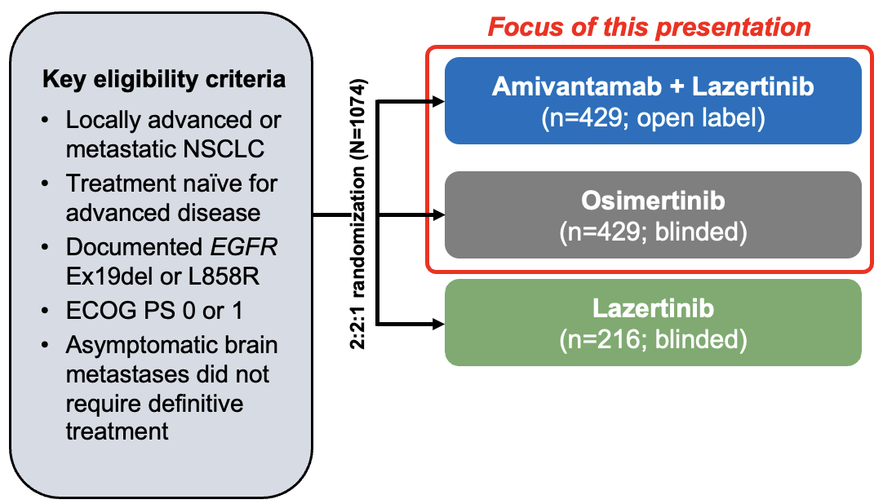
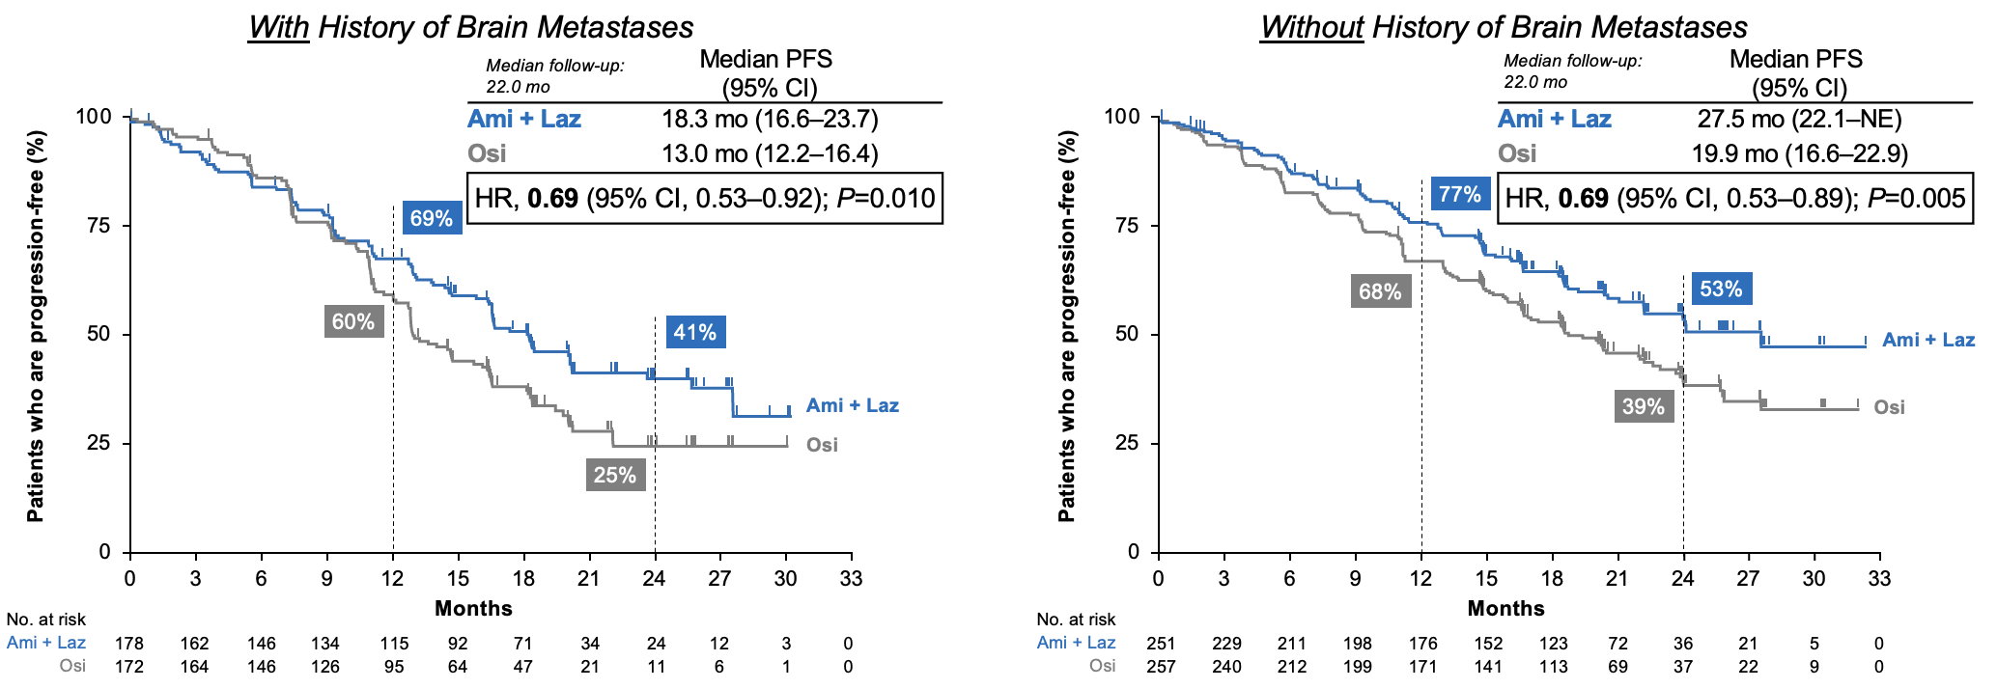
Felip E et al. Amivantamab plus lazertinib vs osimertinib in 1L EGFR-mutant advanced NSCLC with biomarkers of high-risk disease: a secondary analysis from MARIPOSA. Ann Oncol. 2024 Sep;35(9):805-816

Slide 22
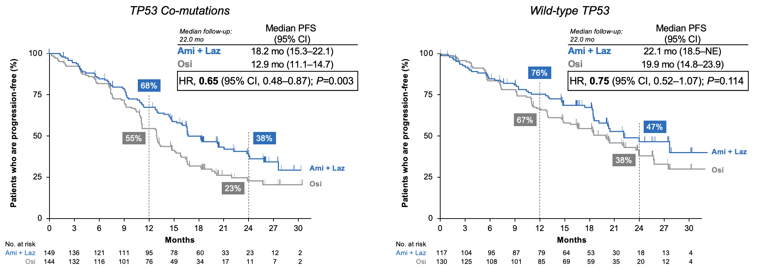
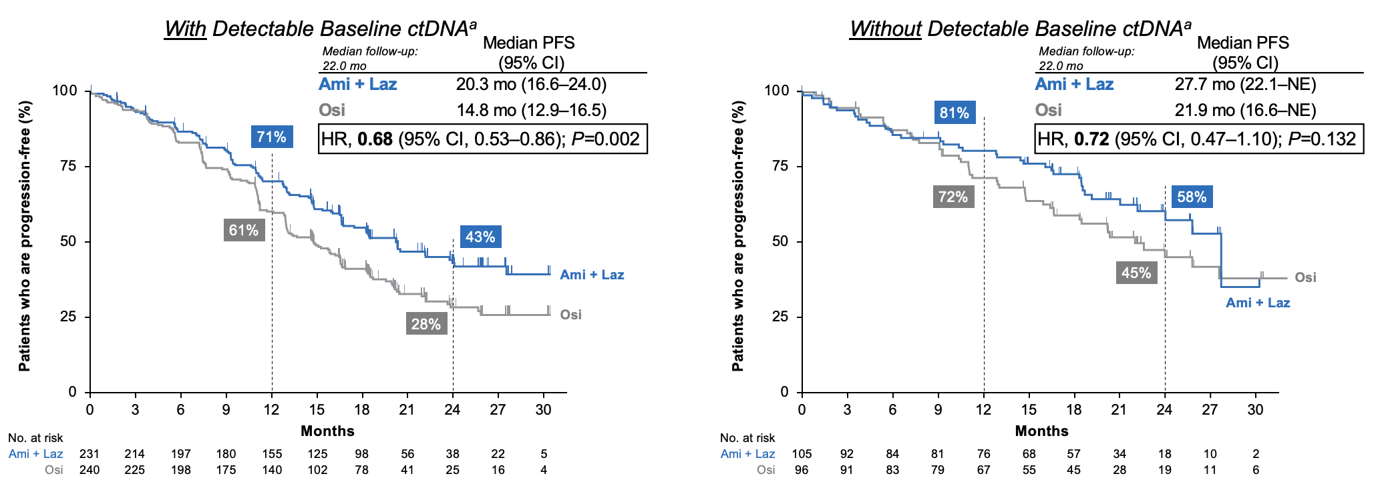
Felip E et al. Amivantamab plus lazertinib vs osimertinib in 1L EGFR-mutant advanced NSCLC with biomarkers of high-risk disease: a secondary analysis from MARIPOSA. Ann Oncol. 2024 Sep;35(9):805-816

Slide 23
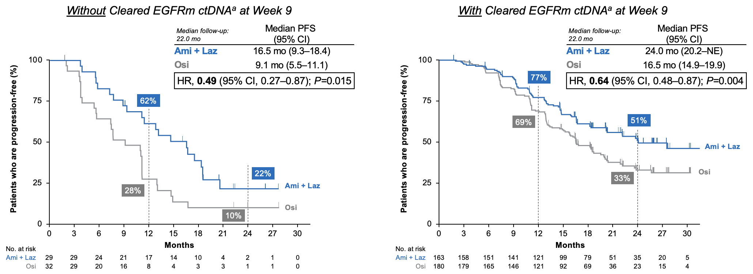
Felip E et al. Amivantamab plus lazertinib vs osimertinib in 1L EGFR-mutant advanced NSCLC with biomarkers of high-risk disease: a secondary analysis from MARIPOSA. Ann Oncol. 2024 Sep;35(9):805-816

Slide 24
Felip E et al. Amivantamab plus lazertinib vs osimertinib in 1L EGFR-mutant advanced NSCLC with biomarkers of high-risk disease: a secondary analysis from MARIPOSA. Ann Oncol. 2024 Sep;35(9):805-816 My take home messages
Approx 50% of patients had TP53 co-mutations (detected by ctDNA NGS); 70% of patients had detectable EGFR mutations by ddPCR
Amivantamab+lazertinib significantly improved median PFS vs osimertinib in high-risk subgroups with:
History of brain metastases (HR, 0.69; P=0.010)
Baseline liver metastases (HR, 0.58; P=0.017)
TP53 co-mutations (HR, 0.65; P=0.003)
Detectable baseline EGFRm ctDNA^{b} (HR, 0.68; P=0.002)
Without EGFRm ctDNA^{b} clearance at Week 9 (HR, 0.49; P=0.015)
Amivantamab+lazertinib effectively overcomes the effect of these negative prognostic factors
Among the corresponding subgroups without high-risk features, amivantamab+lazertinib showed a numerical PFS benefit over osimertinib

Slide 25
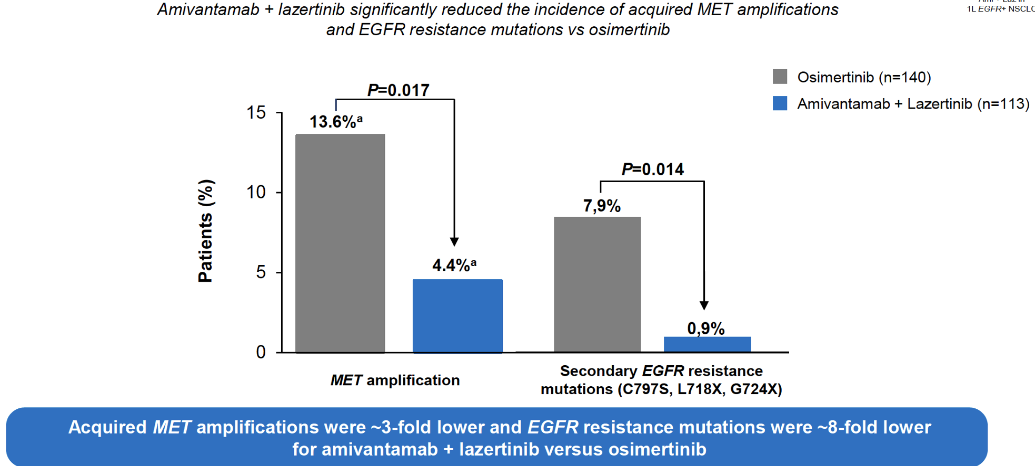
Besse B et al. Mechanisms of acquired resistance to 1L amivantamab plus lazertinib vs osimertinib in patients with EGFR-mutant advanced NSCLC: An early analysis from the phase III MARIPOSA study. ESMO 2024; Abstract LBA55

Slide 26
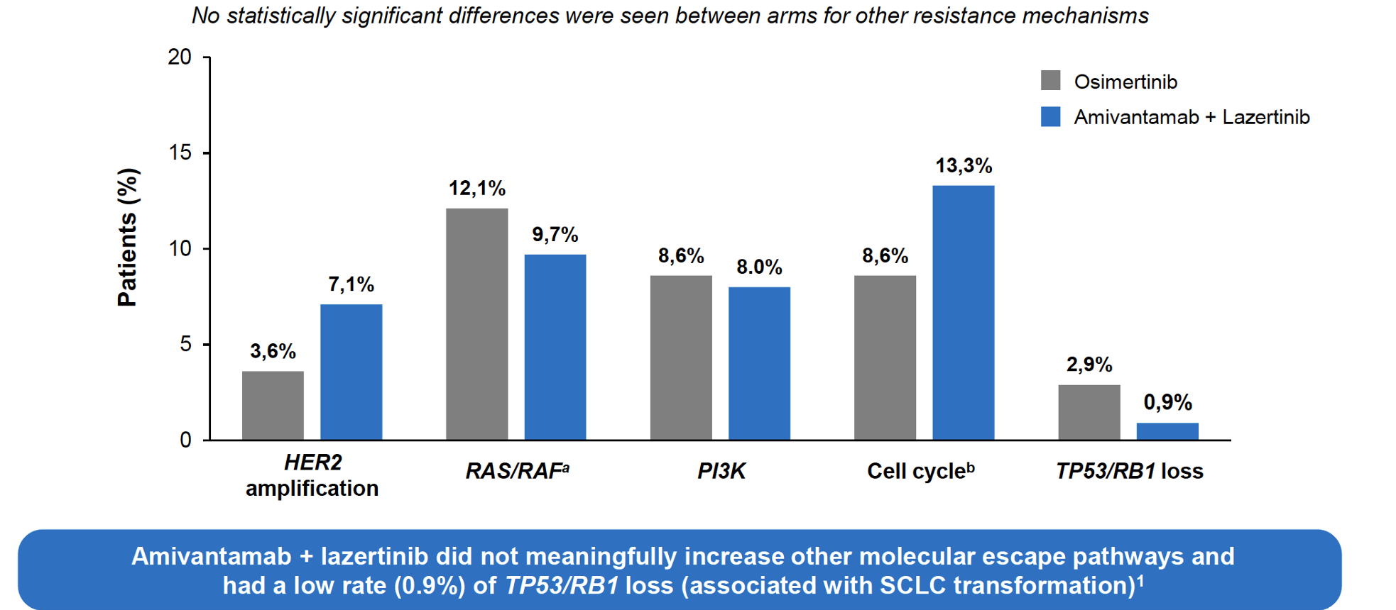
Besse B et al. Mechanisms of acquired resistance to 1L amivantamab plus lazertinib vs osimertinib in patients with EGFR-mutant advanced NSCLC: An early analysis from the phase III MARIPOSA study. ESMO 2024; Abstract LBA55

Slide 27
Besse B et al. Mechanisms of acquired resistance to 1L amivantamab plus lazertinib vs osimertinib in patients with EGFR-mutant advanced NSCLC: An early analysis from the phase III MARIPOSA study. ESMO 2024; Abstract LBA55 My take home messages
Using ctDNA NGS analysis, amivantamab+lazertinib reduced the incidence of MET amplifications and EGFR resistance mutation vs osimertinib
Low rate (0.9%) of TP53/RB1 loss (associated with SCLC transformation)
Confirm the scientific rationale: proactively address mechanisms of resistance to osimertinib blocking EGFR and MET

Slide 28
Popat S et al. Amivantamab plus CT vs CT in EGFR-mutated, advanced NSCLC after disease progression on osimertinib: Second interim overall survival from MARIPOSA-2. ESMO 2024;Abstract LBA54

Slide 29
Popat S et al. Amivantamab plus CT vs CT in EGFR-mutated, advanced NSCLC after disease progression on osimertinib: Second interim overall survival from MARIPOSA-2. ESMO 2024;Abstract LBA54

Slide 30
Popat S et al. Amivantamab plus CT vs CT in EGFR-mutated, advanced NSCLC after disease progression on osimertinib: Second interim overall survival from MARIPOSA-2. ESMO 2024;Abstract LBA54 My take home messages
At the 2nd interim analysis (median follow-up 18.1 mo), promising OS trend favoring amivantamab+CT in the post-osimertinib setting (OS HR 0.73)
Amivantamab+CT vs CT was associated with improvement in:
Time to symptomatic progression
Time to treatment discontinuation
Time to subsequent therapy
PFS2
An increasing number of treatment regimens will be available in this scenario: targeted combinations, ADC, CT+bispecifics antibody

Slide 31
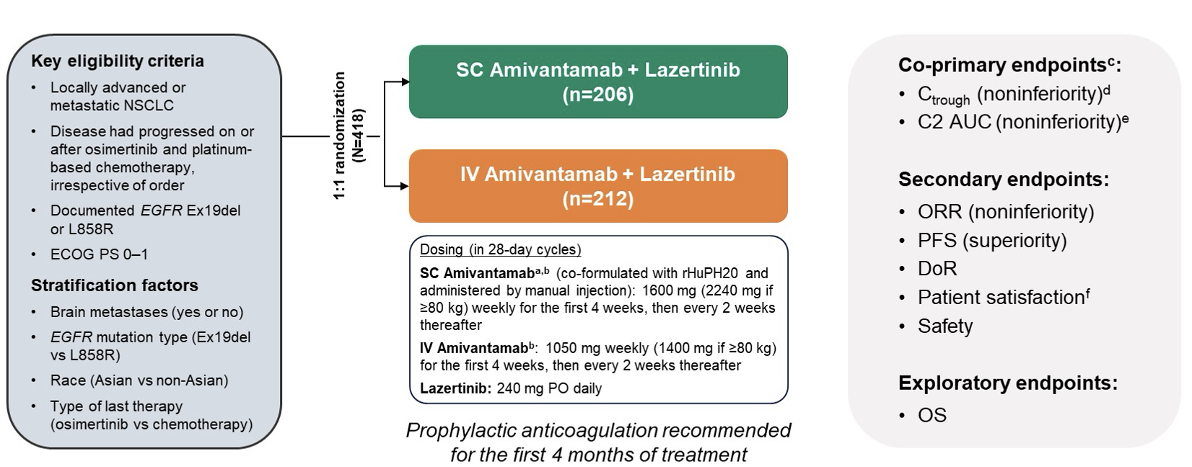
Leighl NB et al. Subcutaneous vs Intravenous Amivantamab, Both in Combination With Lazertinib, in Refractory EGFR-Mutated NSCLC: Primary Results From Phase III PALOMA-3 Study. J Clin Oncol. 2024 Oct 20;42(30):3593-3605
The coprimary pharmacokinetic outcomes for noninferiority were trough concentrations (Ctrough; either predose on cycle-2-day-1 and area under the curve from cycle-2-day-1 to day-15 (AUCD1-D15)
Noninferior trough concentrations were maintained with subcutaneous versus intravenous administration, although total systemic exposure (cycle-2 AUCD1-D15) remained similar between groups

Slide 32
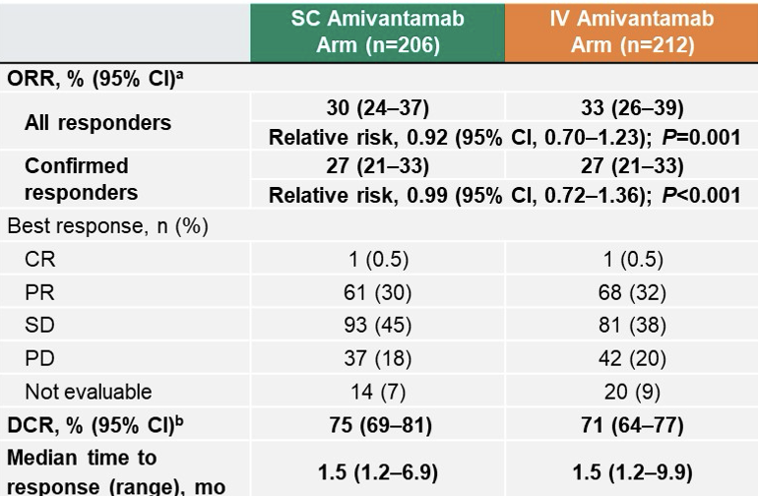
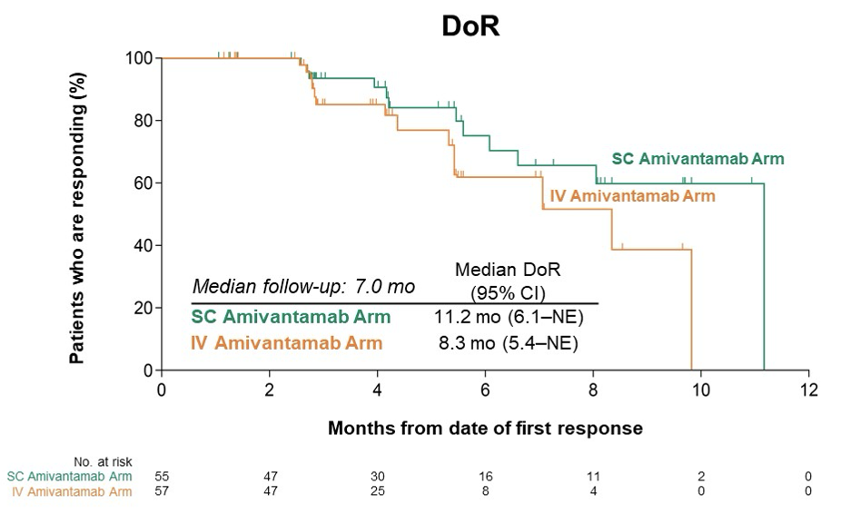
Leighl NB et al. Subcutaneous vs Intravenous Amivantamab, Both in Combination With Lazertinib, in Refractory EGFR-Mutated NSCLC: Primary Results From Phase III PALOMA-3 Study. J Clin Oncol. 2024 Oct 20;42(30):3593-3605

Slide 33
Leighl NB et al. Subcutaneous vs Intravenous Amivantamab, Both in Combination With Lazertinib, in Refractory EGFR-Mutated NSCLC: Primary Results From Phase III PALOMA-3 Study. J Clin Oncol. 2024 Oct 20;42(30):3593-3605

Slide 34
Leighl NB et al. Subcutaneous vs Intravenous Amivantamab, Both in Combination With Lazertinib, in Refractory EGFR-Mutated NSCLC: Primary Results From Phase III PALOMA-3 Study. J Clin Oncol. 2024 Oct 20;42(30):3593-3605 My take home messages
Adapted from Dr Jessica Lin’s Discussion at ASCO 2024
sc amivantamab demonstrated PK non-inferiority
sc amivantamab demonstrated advantage in safety
Reduced rates of IRR and VTE
sc amivantamab demonstrated non-inferior efficacy
Intriguing signal for improved efficacy (needs further investigation)
RARITAN, N.J., December 16, 2024 – The manufacturer today announced the U.S. Food and Drug Administration (FDA) has issued a Complete Response Letter (CRL) for the Biologics License Application (BLA) for a fixed combination of amivantamab and recombinant human hyaluronidase for subcutaneous administration (SC amivantamab) in patients with non-small cell lung cancer (NSCLC) with epidermal growth factor receptor (EGFR) mutations.
The CRL is related to observations as part of a standard pre-approval inspection at a manufacturing facility. The CRL is unrelated to the product formulation, or the efficacy and safety data submitted in the regulatory application, and the FDA has not requested any additional clinical studies. The currently approved intravenous (IV) formulation of amivantamab-vmjw is not impacted by the CRL.
The impact of sc administration on lymphatic absorption and immune stimulation is unknown but may also play a role in the OS results (????)
The sc formulation of amivantamab in combination with lazertinib may become a treatment option in the future

Slide 35
Anti-PD1 Immunotherapy in Combination with Chemotherapy for TKI-Resistant, EGFR-Mutant, Metastatic NSCLC
 | KEYNOTE-789¹ |  | CheckMate 722²
Outcome | Pembrolizumab + chemotherapy (n = 245) | Placebo + Chemotherapy (n = 247) | Nivolumab + chemotherapy (n = 144) | Chemotherapy (n = 150)
Median progression-free survival (Hazard ratio; p-value) | 5.6 mo | 5.5 mo | 5.6 mo | 5.4 mo
 | 0.80 (0.0122) |  | 0.75 (0.0528)
Median overall survival (Hazard ratio; p-value) | 15.9 mo | 14.7 mo | 19.4 mo | 15.9 mo
 | 0.84 (0.0362) |  | 0.82 (not reported)
Overall response rate | 29.0% | 27.1% | 31% | 27%
Median duration of response | 6.3 mo | 5.6 mo | 6.7 mo | 5.6 mo
¹ Yang JC et al. J Clin Oncol 2024 Dec;42(34):4029-39; ² Mok T et al. J Clin Oncol 2024 Apr 10;42(11):1252-64.

