Slide 1


2024 Lymphoma Year In Review
Brian Hill, MD, PhD
Director, Lymphoid Malignancies Program
April 16, 2025
*GELF = Groupe d'Etude des Lymphomes Folliculaires

Slide 2
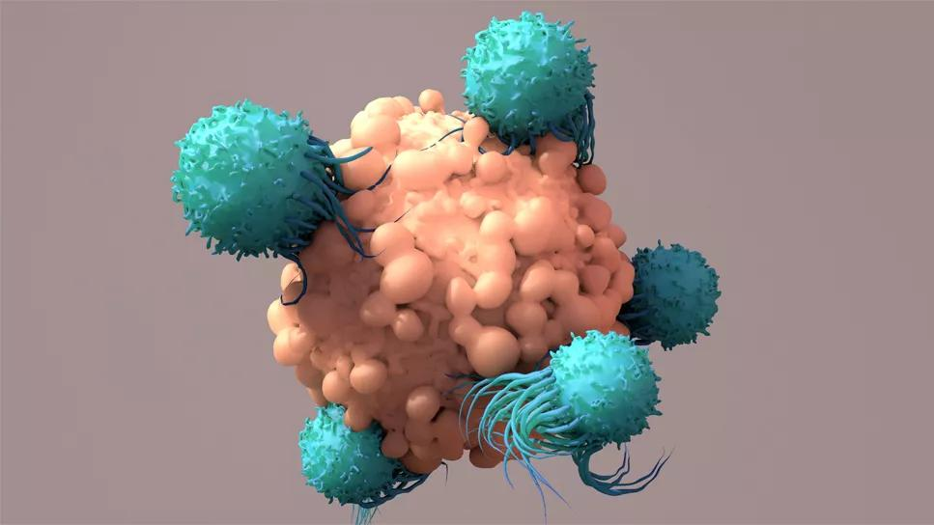
DLBCL: CAR-T
Liso-Cel
*GELF = Groupe d'Etude des Lymphomes Folliculaires

Slide 3
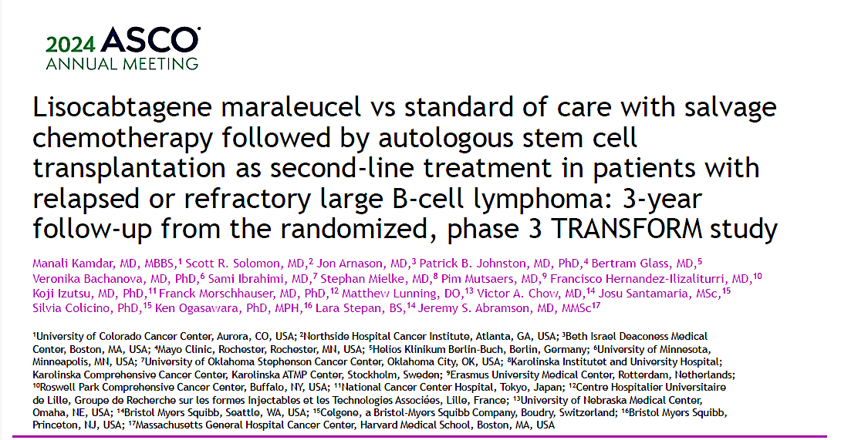
Kamdar MK et al. Lisocabtagene maraleucel (liso-cel) vs standard of care (SOC) with salvage chemotherapy (CT) followed by autologous stem cell transplantation (ASCT) as second-line (2L) treatment in patients (pt) with R/R large B-cell lymphoma (LBCL): 3-year follow-up (FU) from the randomized, phase 3 TRANSFORM study. ASCO 2024;Abstract 7013.

Slide 4
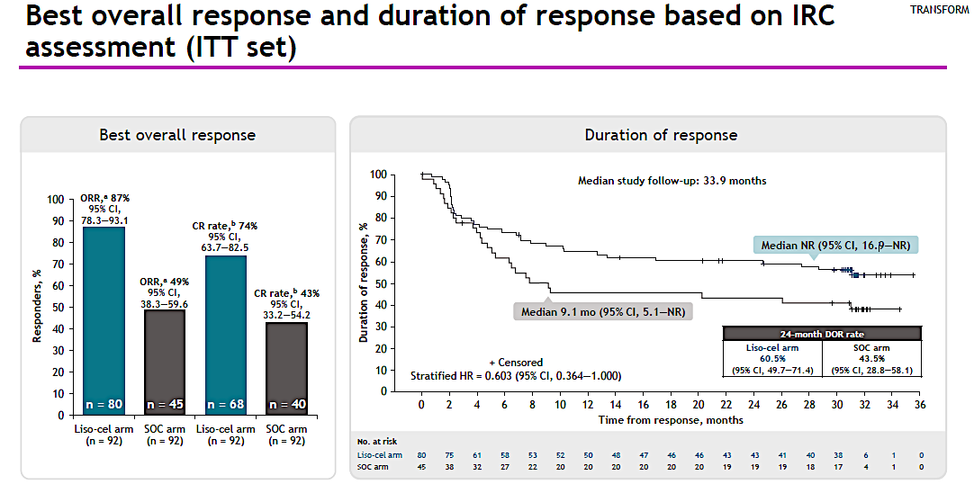

Slide 5
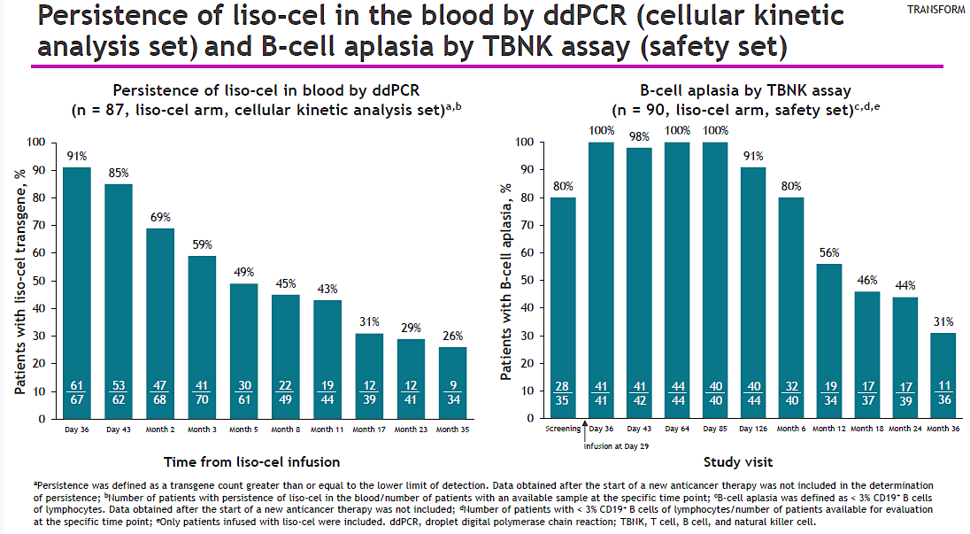

Slide 6
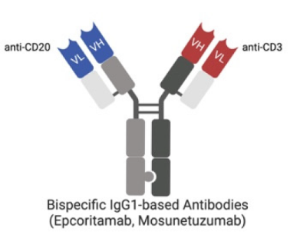

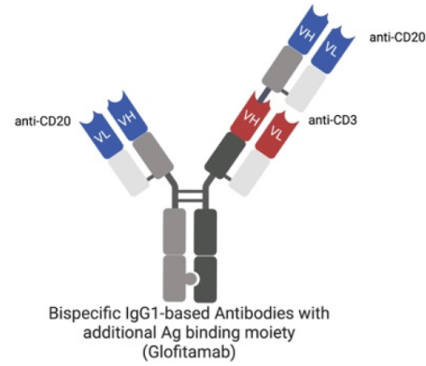


Epcoritamab q week until C3, then q14 days until C9, then monthly
DLBCL: Bispecifics
Epcoritamab
Ramp up
Is indefinite treatment better?
Glofitamab q21d x 1 year
Ramp up

Slide 7
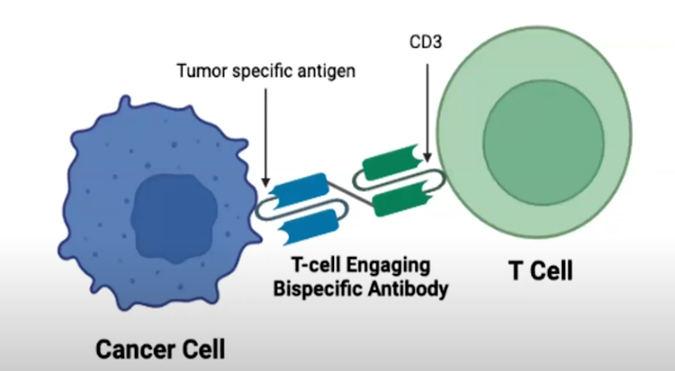
DLBCL: Bispecifics
Epcoritamab
*GELF = Groupe d'Etude des Lymphomes Folliculaires

Slide 8
3-Year Update from the EPCORE NHL-1 Trial: Epcoritamab Leads to Deep and Durable Responses in Relapsed or Refractory Large B-Cell Lymphoma
Julie M. Vose, MD, MBA,¹ Chan Y. Cheah, MBBS, DMSc,² Michael Roost Clausen, MD, PhD,³ David Cunningham, MD, FRCP, FMedSci,⁴
Umar Farooq, MD,⁵ Tatyana Feldman, MD,⁶ Herve Ghesquieres, MD, PhD,⁷ Wojciech Jurczak, MD, PhD,⁸ Kim M. Linton, MBChB, PhD,⁹ Catherine Thieblemont, MD, PhD,¹⁰ Tycel Phillips, MD,¹¹ Won Seog Kim, MD, PhD,¹² Pegah Jafarinasabian, MD, PhD,¹³ Barbara D'Angelo Månsson, PhD,¹⁴
David Soong, PhD,¹⁵ Andrew J. Steele, PhD,¹⁵ Zhu Li, MS,¹⁵ Christian W. Eskelund, MD, PhD,¹⁴ Martin Hutchings, MD, PhD,¹⁶ Yasmin H. Karimi, MD¹⁷
¹University of Nebraska Medical Center, Omaha, NE, USA; ²Sir Charles Gairdner Hospital and the University of Western Australia, Nedlands, Australia; ³Vejle Hospital, Vejle, Denmark; ⁴The Royal Marsden NHS Foundation Trust, Sutton, UK; ⁵University of Iowa, Iowa City, IA, USA; ⁶John Theurer Cancer Center at Hackensack Meridian Health, Hackensack Meridian Health School of Medicine, Hackensack, NJ, USA; ⁷Hospices Civils de Lyon, Centre Hospitalier Lyon Sud, Pierre-Bénite, France; ⁸MSC National Research Institute of Oncology, Kraków, Poland; ⁹The Christie NHS Foundation Trust, Manchester Cancer Research Centre, and Division of Cancer Sciences, University of Manchester, Manchester, UK; ¹⁰Assistance Publique & Hôpitaux de Paris (APHP), Hôpital Saint-Louis, Hémato-oncologie, Université de Paris, Paris, France; ¹¹University of Michigan Comprehensive Cancer Center, Ann Arbor, MI, USA (present affiliation: City of Hope, Duarte, CA, USA); ¹²Samsung Medical Center, Seoul, Republic of Korea; ¹³AbbVie, North Chicago, IL, USA; ¹⁴Genmab, Copenhagen, Denmark; ¹⁵Genmab, Plainsboro, NJ, USA; ¹⁶Rigshospitalet and University of Copenhagen, Copenhagen, Denmark; ¹⁷University of Michigan Division of Hematology/Oncology, Ann Arbor, MI, USA
Presented at the American Society of Hematology Annual Meeting; December 7–10, 2024; San Diego, CA
MED-GL-Epco-0000188

Slide 9
Baseline Characteristics and Prior Treatments
Baseline Characteristics | N=157
Median age (range), y | 64 (20–83)
Male sex at birth, n (%) | 94 (60)
Race, n (%)
White | 78 (50)
Asian | 30 (19)
Other | 6 (4)
Not reportedª | 43 (27)
Disease type
DLBCL, n (%)^{b,c} | 139 (89)
De novo, n/n (%) | 97/139 (70)
Transformed, n/n (%)^{d} | 40/139 (29)
From FL | 32/139 (23)
HGBCL, n (%) | 9 (6)
FL G3B, n (%) | 5 (3)
PMBCL, n (%) | 4 (3)
Prior Treatments | N=157
Median prior lines of therapy, n (range) | 3 (2–11)
Primary refractory disease, n (%)^{e,f} | 95 (61)
Refractory to ≥2 consecutive prior lines of therapy, n (%)^{f} | 118 (75)
Prior CAR T therapy, n (%) | 61 (39)
Additional demographics and baseline disease characteristics have been reported previously¹⁻³
ªDue to regional practices. ^{b}De novo versus transformed DLBCL was unknown in 2 patients. ^{c}Thirteen of 99 patients assessed by central FISH had double-hit/triple-hit lymphoma.^{1 d}Five patients had DLBCL transformed from MZL; 1 patient had DLBCL transformed from SLL; and 2 patients had DLBCL transformed from an unknown disease. ^{e}Primary refractory indicates refractoriness to first-line antilymphoma therapy. ^{f}Refractory indicates that patients experienced PD or SD as best response to antilymphoma therapy or experienced PD within 6 mo of therapy completion.
CAR T; chimeric antigen receptor T-cell; DLBCL, diffuse large B-cell lymphoma; FISH, fluorescence in-situ hybridization; FL, follicular lymphoma; G3B, grade 3B; HGBCL, high-grade B-cell lymphoma; mo, months; MZL, marginal zone lymphoma; PD, progressive disease; PMBCL, primary mediastinal large B-cell lymphoma; SD, stable disease; SLL, small lymphocytic lymphoma; y, years.
1. Thieblemont C, et al. J Clin Oncol. 2023;41:2238-47. 2. Thieblemont C, et al. Leukemia. 2024;DOI:10.1038/s41375-024-02410-8. 3. Karimi YH, et al. ASCO 2024. Abstract 7039.

Slide 10
Long-Term PFS and OS Benefits With Complete Response
Number at risk
65
65
63
61
59
55
54
50
48
48
45
42
27
13
5
60
60
58
56
54
51
50
46
44
44
41
38
27
13
5
58
58
56
54
52
49
48
44
42
42
39
37
26
12
5
14
14
14
14
14
13
12
11
11
11
11
10
8
4
2
Median PFS for the overall population (N=157) was 4.2 mo (95% CI, 2.8–5.5)
Among complete responders (n=65), median PFS was 37.3 mo (95% CI, 26.0–NR)
  36-mo PFS estimate was 53%
  Median OS for the overall population (N=157) was 18.5 mo (95% CI, 11.7–27.7); among complete responders, it was NR
  At 36 mo, an estimated 75% of complete responders had not initiated a new antilymphoma therapy
CI, confidence interval; CR, complete response; DLBCL, diffuse large B-cell lymphoma; LBCL, large B-cell lymphoma; mo, month(s); NR, not reached; OS, overall survival; PFS, progression-free survival.
Vose JM, et al. ASH 2024. Poster 4480.

Slide 11
Patient Disposition and Exposure
 | N=157
Median follow-up (range), moª | 37.1 (0.3–45.5)
Mean number of treatment cycles and doses administered | 12 and 22
Ongoing treatment with epcoritamab, n (%) | 19 (12)
Discontinued treatment, n (%) | 138 (88)
PD | 91 (58)
AE | 26 (17)
Decision to proceed with transplant | 7 (4)
Withdrawal by patient | 6 (4)
Death | 1 (1)
Maximum clinical benefit | 1 (1)
Other | 6 (4)
Few patients progressed after remaining on epcoritamab treatment beyond 1 y:
  5 of 47 patients treated from >12 to ≤24 mo
  2 of 29 patients treated beyond 24 mo
>12 to ≤24 mo
>24 mo
11% PD
7% PD
ªMedian (range) follow-up was 37.2 mo (0.3–45.5) for patients with DLBCL or HGBCL (n=148) and 37.2 mo (0.3–45.5) for patients with DLBCL (n=139). Among complete responders (n=65), median (range) follow-up was 37.4 mo (5.3–45.5).
AE, adverse event; DLBCL, diffuse large B-cell lymphoma; HGBCL, high-grade B-cell lymphoma; mo, months; PD, progressive disease.
Vose JM, et al. ASH 2024. Poster 4480.

Slide 12
DLBCL: Bispecifics
Glofitamab
*GELF = Groupe d'Etude des Lymphomes Folliculaires

Slide 13
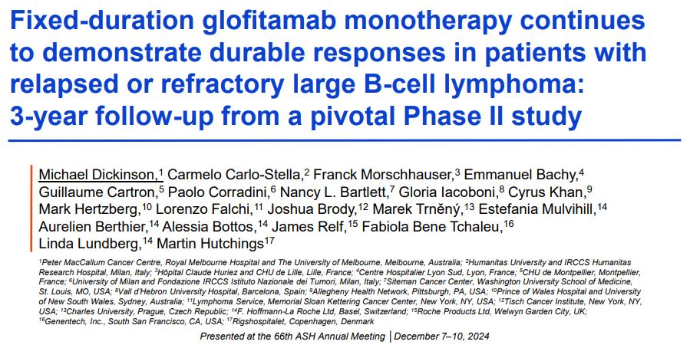
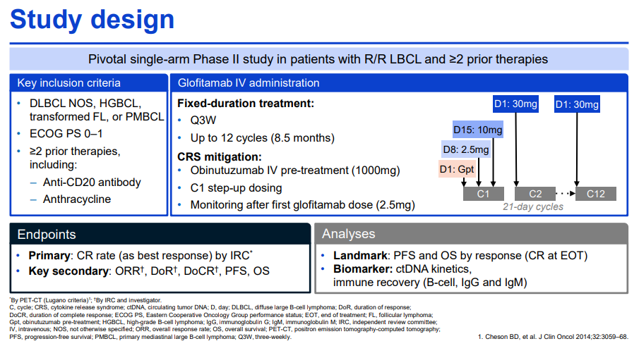

Slide 14
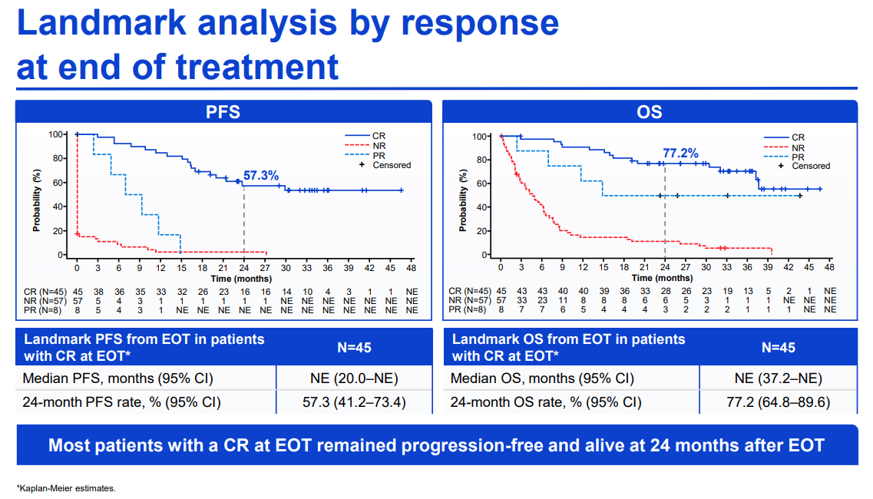
~20% dropoff

Slide 15
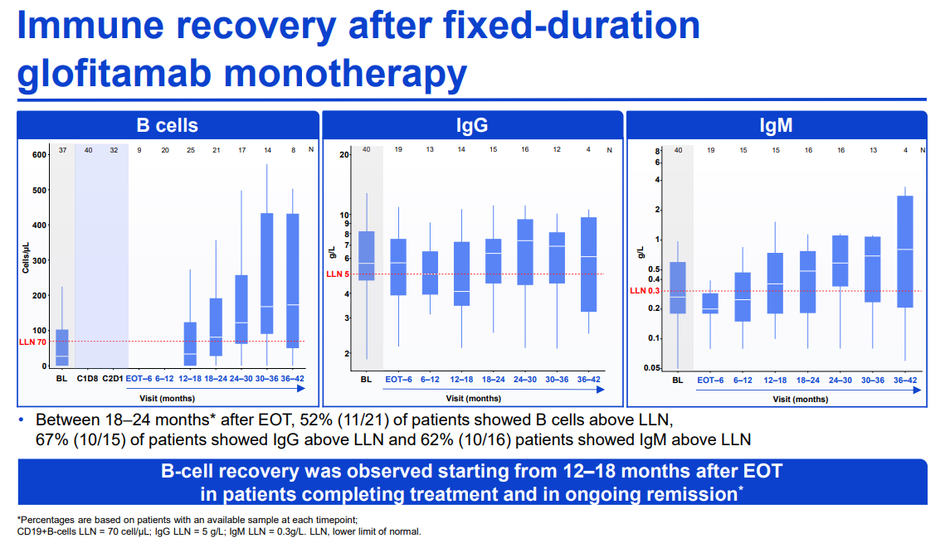

Slide 16
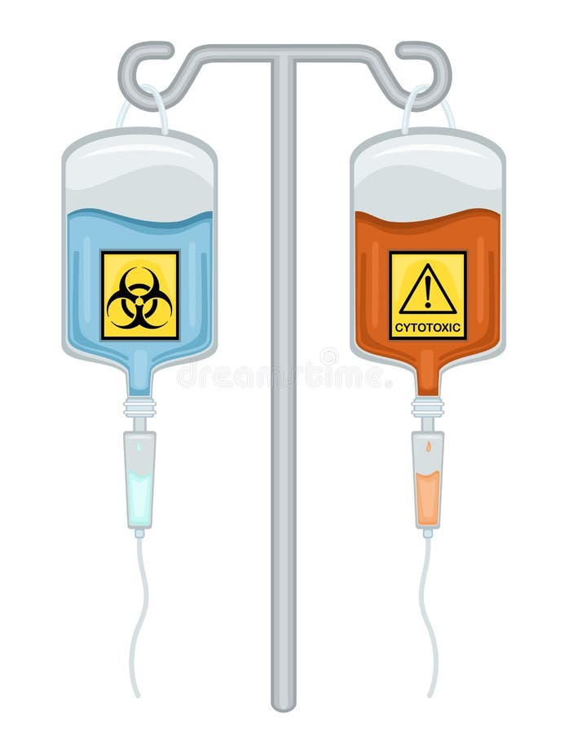
DLBCL: Bispecifics + Chemotherapy

Slide 17
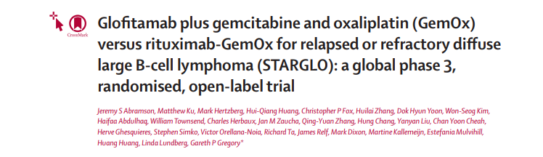
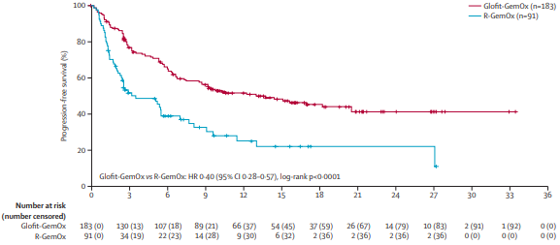
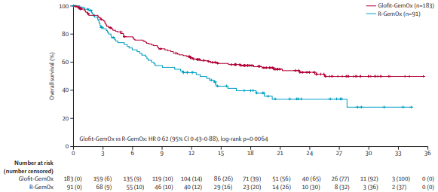
Global, randomized Phase 3: GemOx ± Glofitamab
Transplant ineligible r/r DLBCL
Median prior line of therapy = 1

Slide 18
Real-World Outcomes with Bispecific T-Cell Engagers (REALBiTE) for Relapsed or Refractory Large B-Cell Lymphoma: A Multi-Center, Retrospective Cohort Study
Taylor R. Brooks, MD, Emily C. Zabor, DrPH, Yohanna B. Bedelu, MPH, Nikita Dave, MD, Daniel J. Landsburg, MD, Adrienne N. Nedved, PharmD, RPh, Yucai Wang, MD, PhD, Catherine Reinert, RN, BSN, OCN, MBA, Ajay Major, MD, MBA, Megan Sears-Smith, DO, Nilanjan Ghosh, MD, PhD, Kiarash Salafian, MD, Emily Ayers, MD, Jordan Miller, PharmD, Natalie Grover, MD, Chelsea Peterson, DO, Cyrus Khan, MD, Sean P. Bliven, MD, Mayur Narkhede, MD, Carrie I. Ho, MD, Stephen D. Smith, MD, Alyssa Gibson, Justin Kline, MD, Suchitra Sundaram, MBBS, Joshua Brody, MD Kelsey Baron, MD, Boyu Hu, MD, Daniel C. Trotier, MD, Priyanka A Pophali, MBBS, Xi Yang, MD, Yasmin H. Karimi, MD, Marshall McKenna, MD, Claire Yun Kyoung Ryu Tiger, MD, PhD, Alex Niu, MD, Francisco Hernandez-Ilizaliturri, MD, Javier Munoz, MD, MBA, Rodolfo Garza-Morales, MD, Fadzai Chinyengetere, MD, Sandeep Dave, MD, Nayef Abdel-Razeq, MD, Muhamad Alhaj Moustafa, MD, MS, Paolo F. Caimi, MD, MBA, Brian T. Hill MD, PhD
Notes:
Good morning and thank you for joining. My name is Taylor Brooks and I am an associate staff physician in the lymphoid malignancies group at the Cleveland Clinic. I want to thank the American Society of Hematology and the session organizers for the opportunity to deliver this oral presentation.

Slide 19
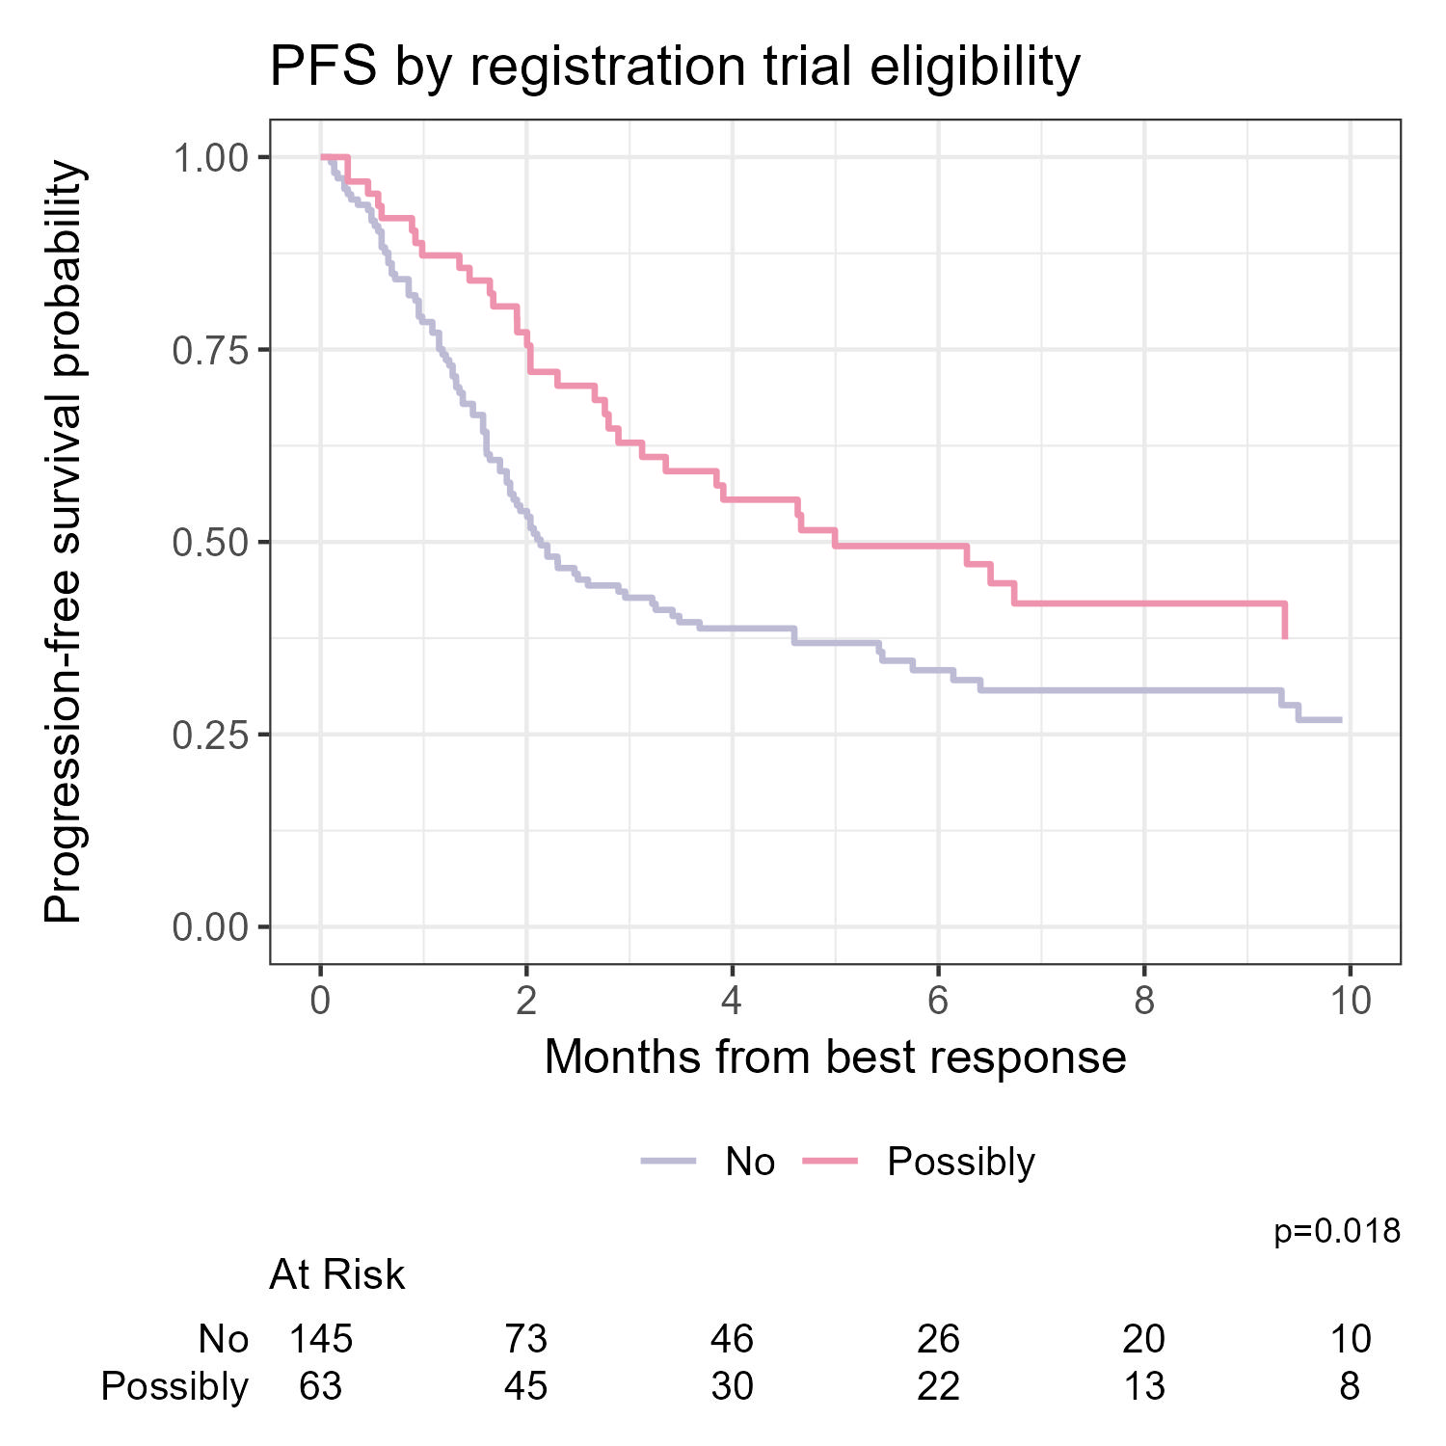
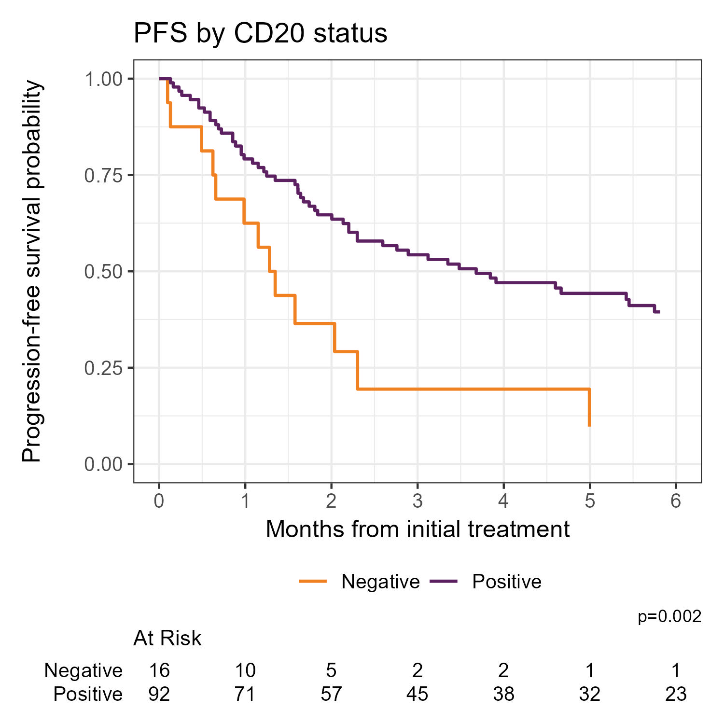
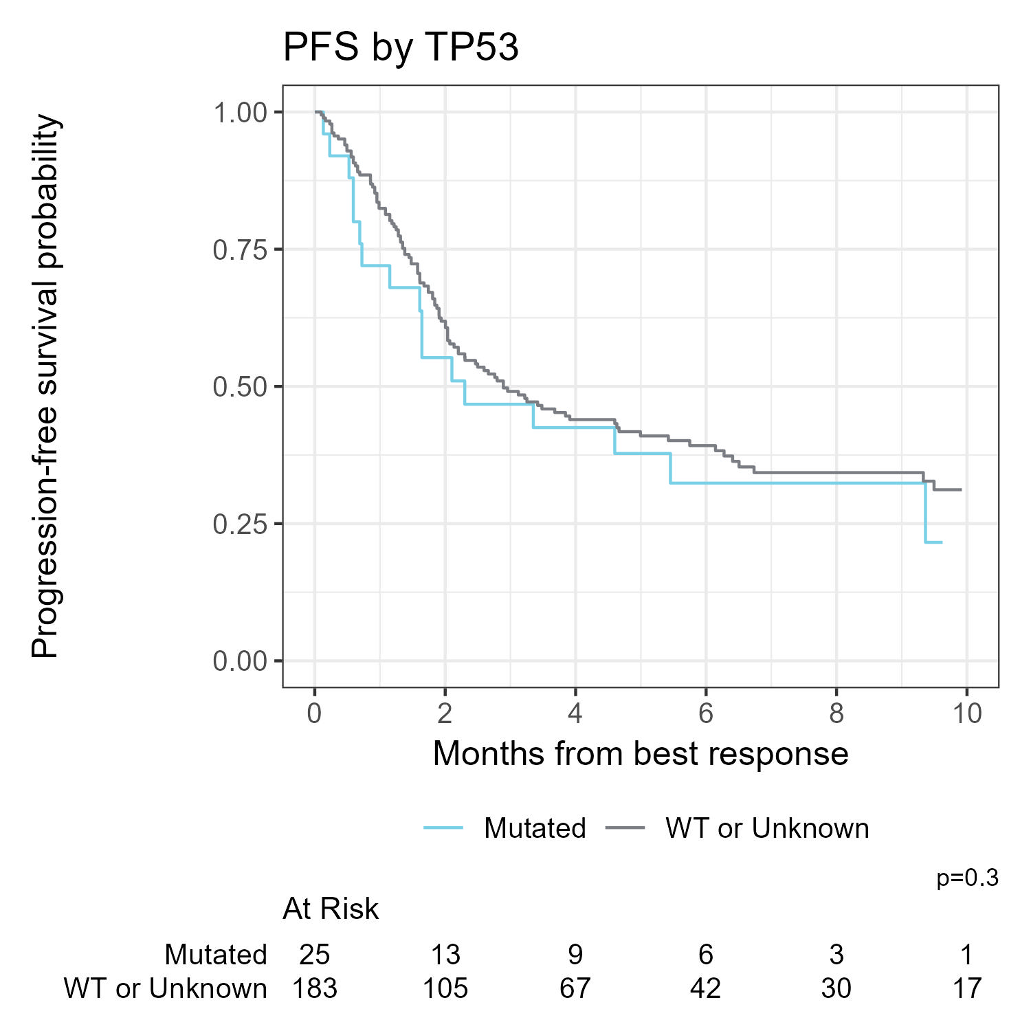
Progression-Free Survival of Subgroups
p =0.018
p = 0.002
p = 0.3
Brooks, et al. ASH 2024. Presentation #111
Notes:
(SLOWER) Individuals ineligible for the pivotal trials exhibited significantly shortened PFS compared to those who would have been included.
(ADVANCE) Patients who retained of CD20 prior to epco or glofit administration observed significantly longer PFS compared to those who lost CD20.
(ADVANCE) There was no difference in PFS among those with and without mutations in TP53.

Slide 20
Follicular Lymphoma: CAR-T
Liso-Cel
*GELF = Groupe d'Etude des Lymphomes Folliculaires

Slide 21
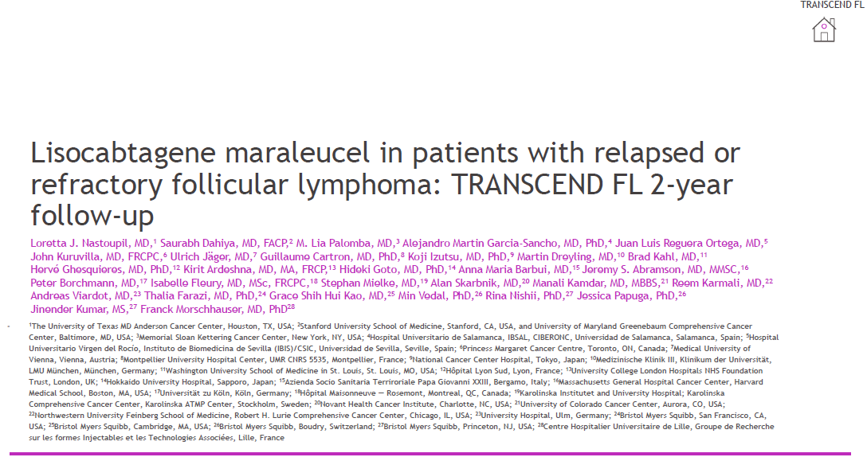

Slide 22
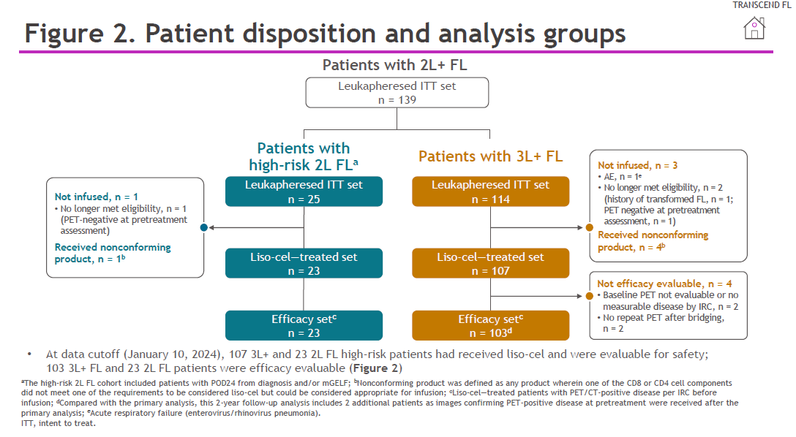

Slide 23
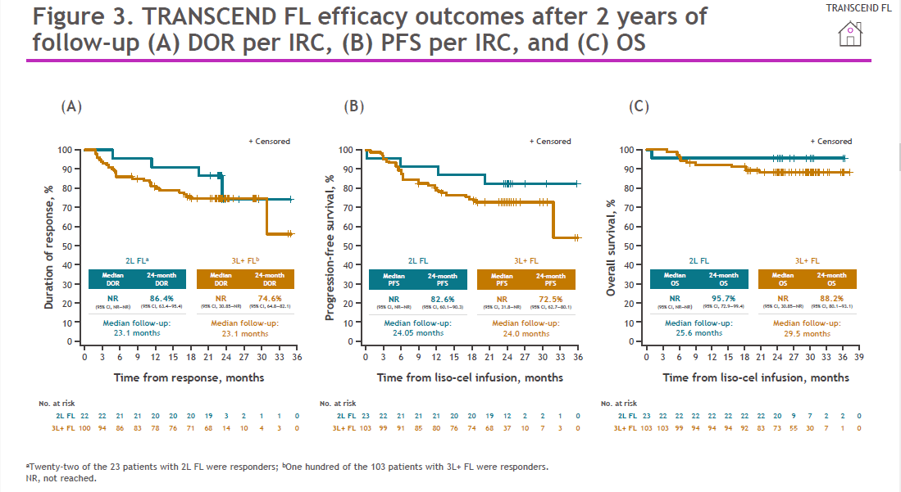

Slide 24
Follicular Lymphoma: CAR-T
Tisa-Cel
*GELF = Groupe d'Etude des Lymphomes Folliculaires

Slide 25
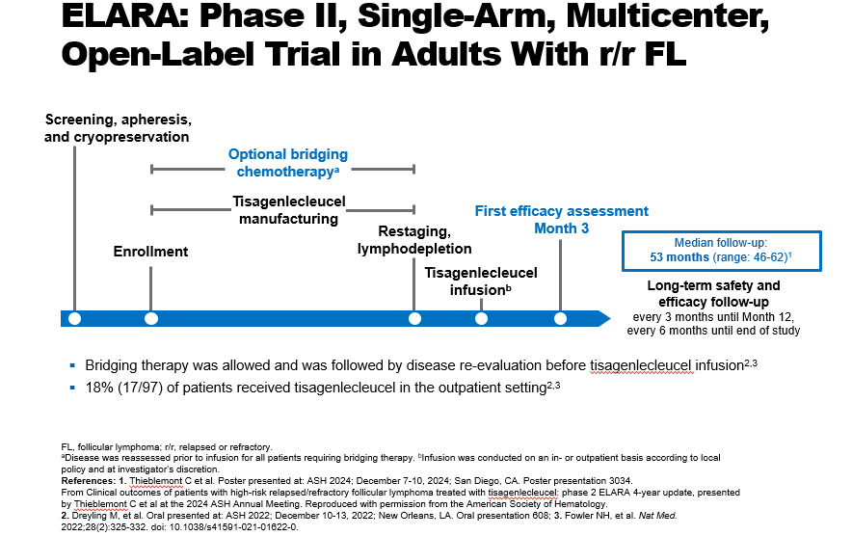

Slide 26
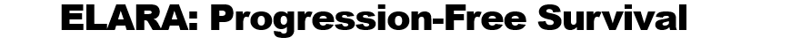
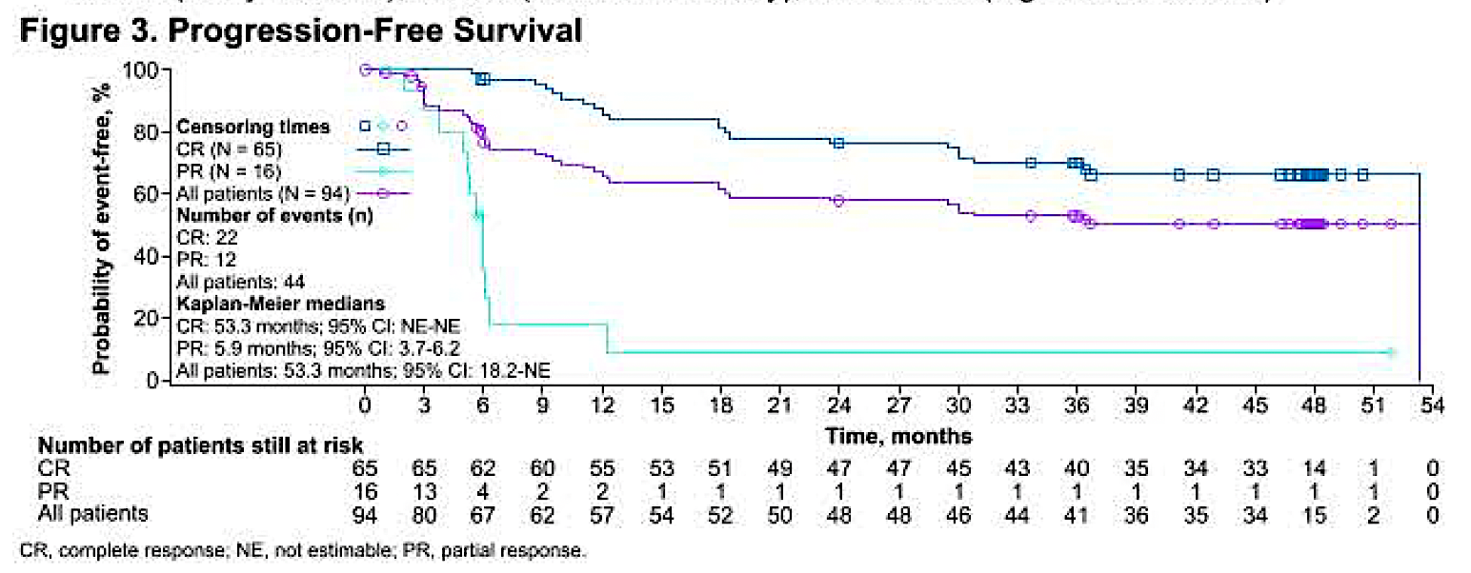
Thieblemont C et al. ASH 2024;Abstract 3034.

Slide 27
Follicular Lymphoma: CAR-T
Axi-Cel
*GELF = Groupe d'Etude des Lymphomes Folliculaires

Slide 28
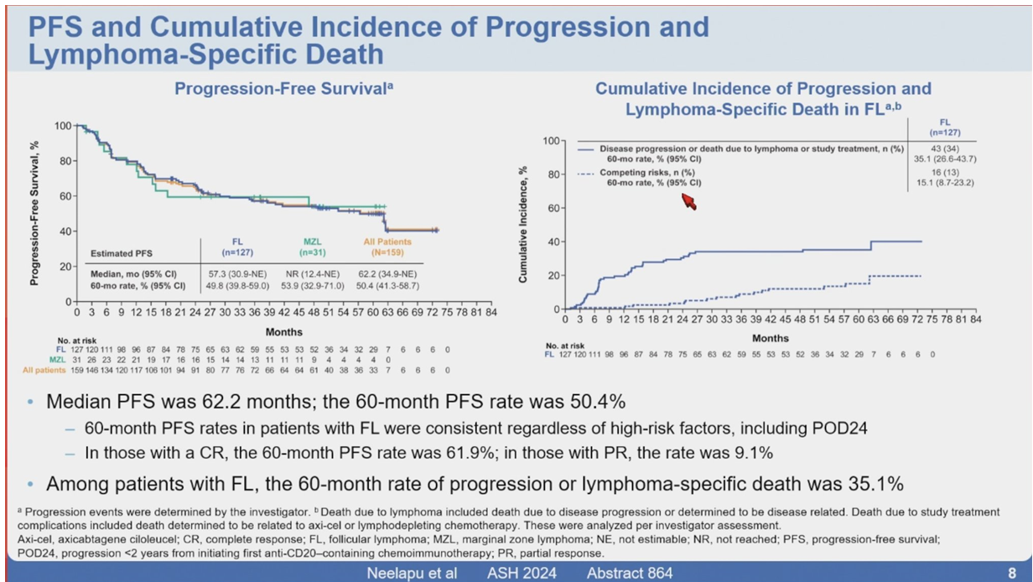
Neelapu S et al. 5-Year Follow-up Analysis from ZUMA-5: A Phase 2 Trial of Axicabtagene Ciloleucel (Axi-Cel) in Patients with Relapsed/Refractory Indolent Non-Hodgkin Lymphoma. ASH 2024;Abstract 864.

Slide 29
Follicular Lymphoma: Bispecifics
Mosunetuzumab
*GELF = Groupe d'Etude des Lymphomes Folliculaires

Slide 30
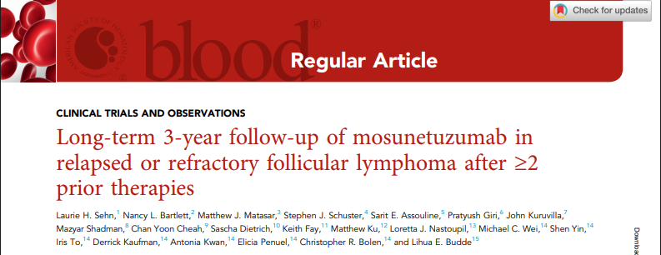

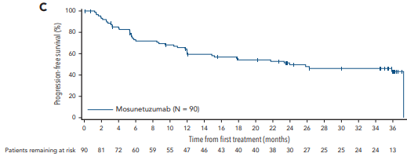

Slide 31
Follicular Lymphoma: Bispecifics
Epcoritamab
*GELF = Groupe d'Etude des Lymphomes Folliculaires

Slide 32
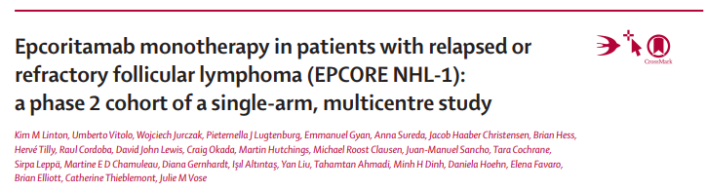

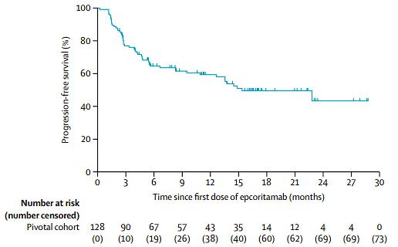
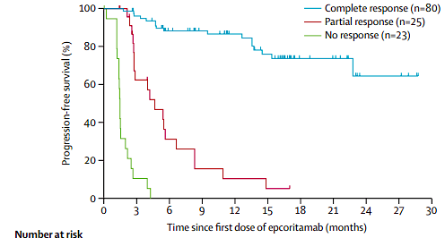
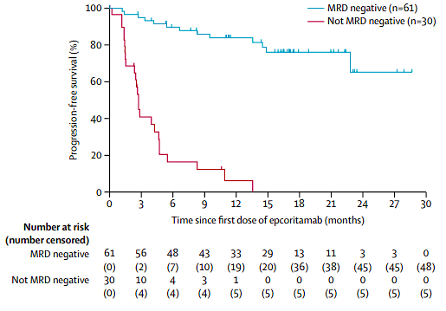

Slide 33
Mantle Cell Lymphoma: CAR-T
Liso-Cel
*GELF = Groupe d'Etude des Lymphomes Folliculaires

Slide 34
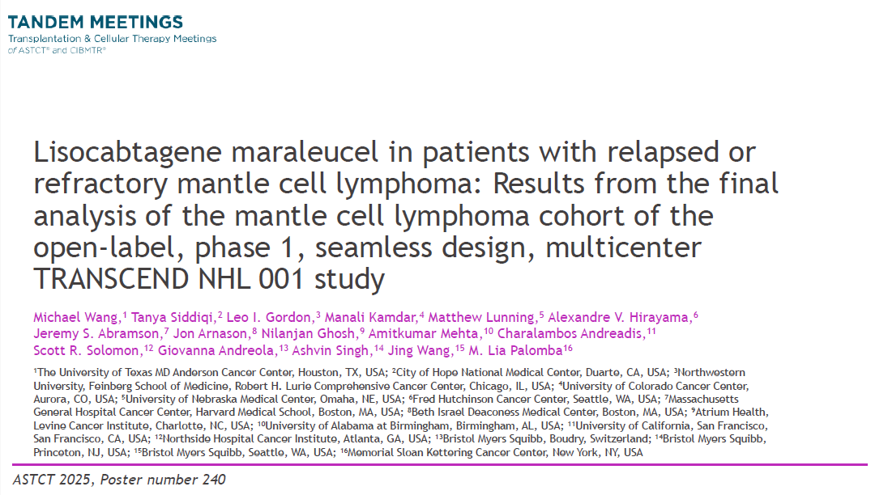

Slide 35
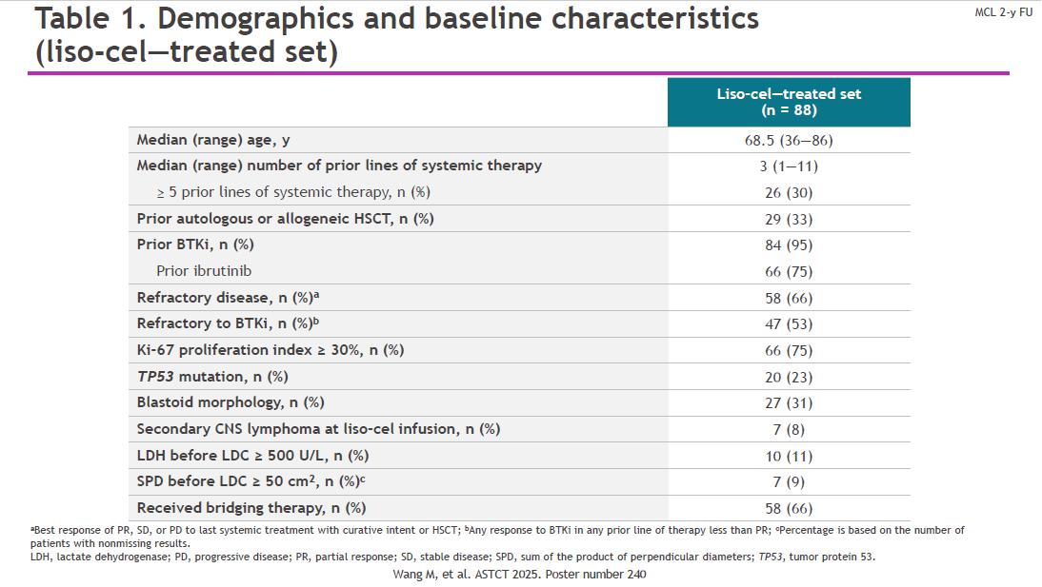

Slide 36
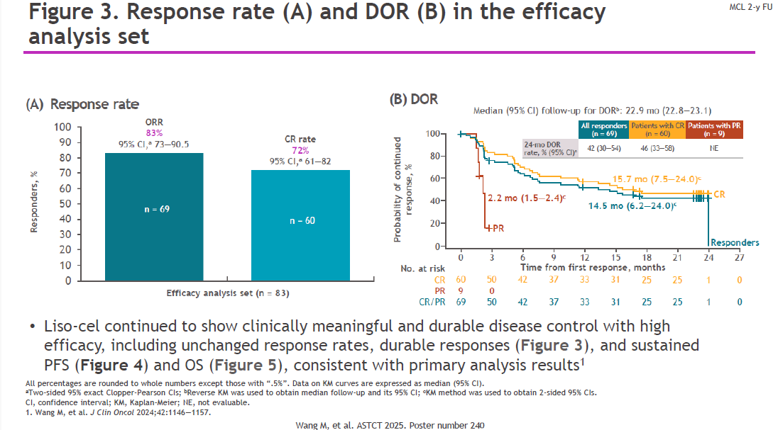

Slide 37
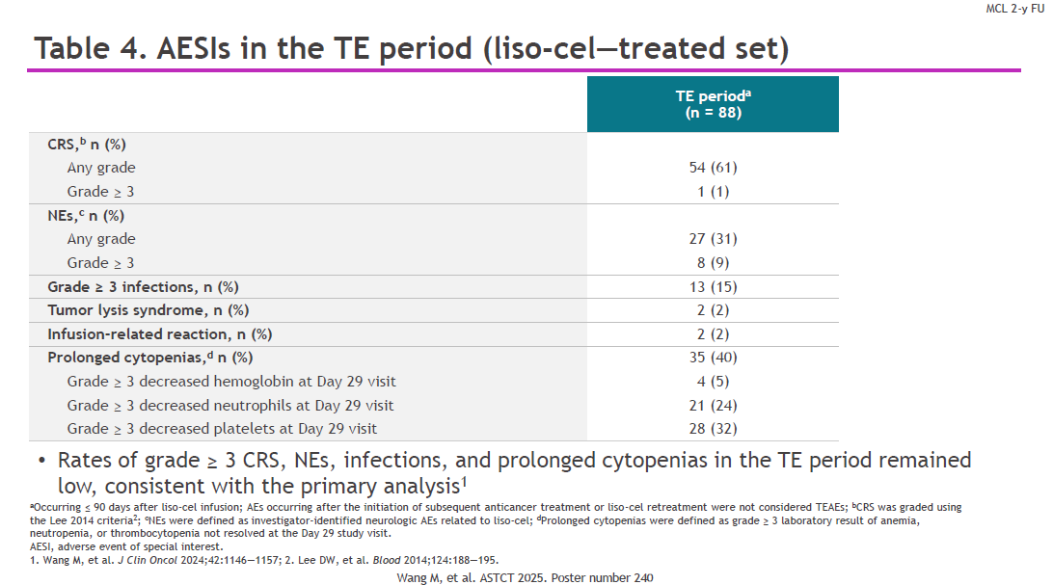

Slide 38
Mantle Cell Lymphoma: Bispecifics
Glofitamab
*GELF = Groupe d'Etude des Lymphomes Folliculaires

Slide 39
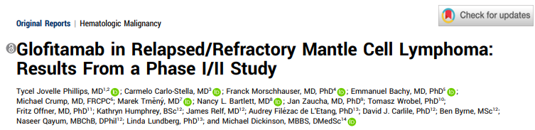
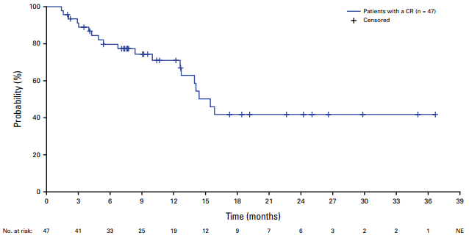
Phillips TJ et al. Glofitamab in Relapsed/Refractory Mantle Cell Lymphoma: Results From a Phase I/II Study. J Clin Oncol 2025;43(3):318-28.

Slide 40


Slide 41
Marginal Zone Lymphoma
*GELF = Groupe d'Etude des Lymphomes Folliculaires

Slide 42
Positive Topline Results for Lisocabtagene Maraleucel (Liso-cel) in Adult Patients with Relapsed or Refractory Marginal Zone Lymphoma
Press Release: February 10, 2025
“The Phase 2 TRANSCEND FL trial evaluating lisocabtagene maraleucel in adult patients with relapsed or refractory indolent B-cell non-Hodgkin lymphoma met its primary endpoint in the marginal zone lymphoma (MZL) cohort. Results showed lisocabtagene maraleucel demonstrated a statistically significant and clinically meaningful overall response rate (ORR) in these patients.
The study also met the key secondary endpoint of complete response rate (CRR). In the topline analysis, lisocabtagene maraleucel continued to demonstrate durable responses and a consistent safety profile with no new safety signals observed.”
https://news.bms.com/news/corporate-financial/2025/Bristol-Myers-Squibb-Announces-Positive-Topline-Results-for-Breyanzi-lisocabtagene-maraleucel-in-Adult-Patients-with-Relapsed-or-Refractory-Marginal-Zone-Lymphoma/default.aspx

Slide 43
Novel (not approved) Agent
*GELF = Groupe d'Etude des Lymphomes Folliculaires

Slide 44
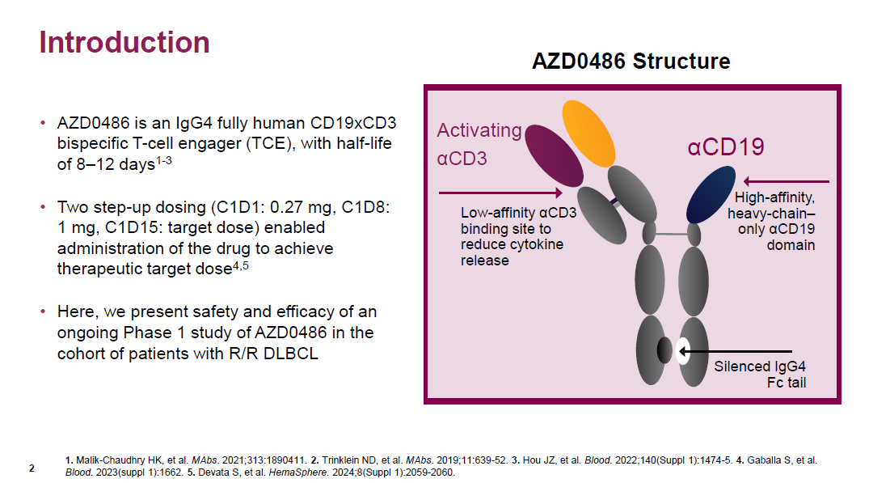

Slide 45
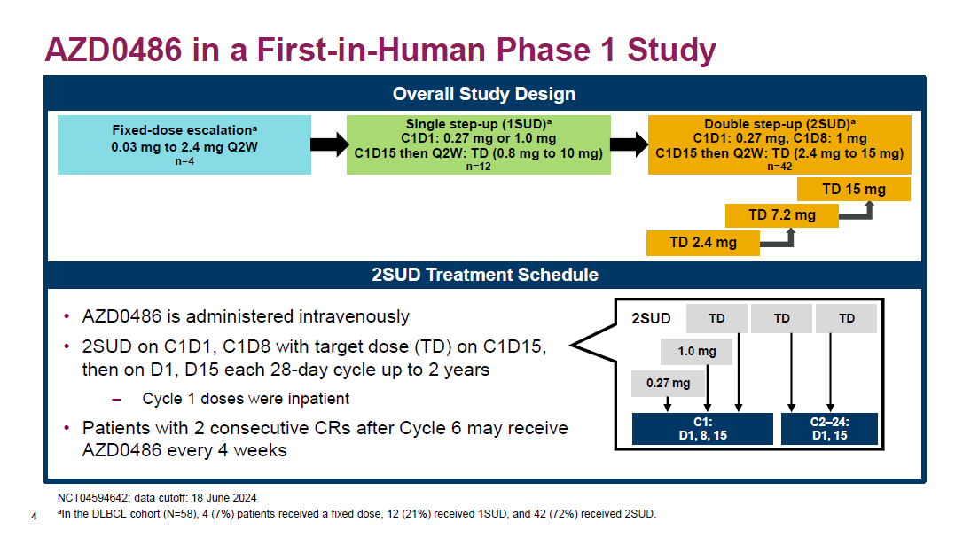

Slide 46
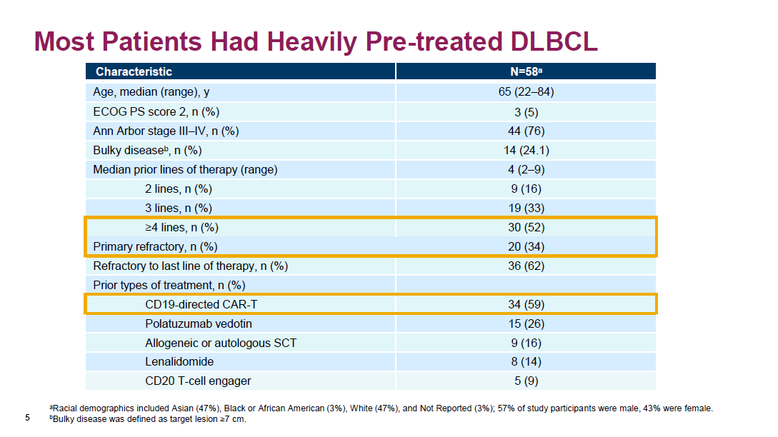

Slide 47
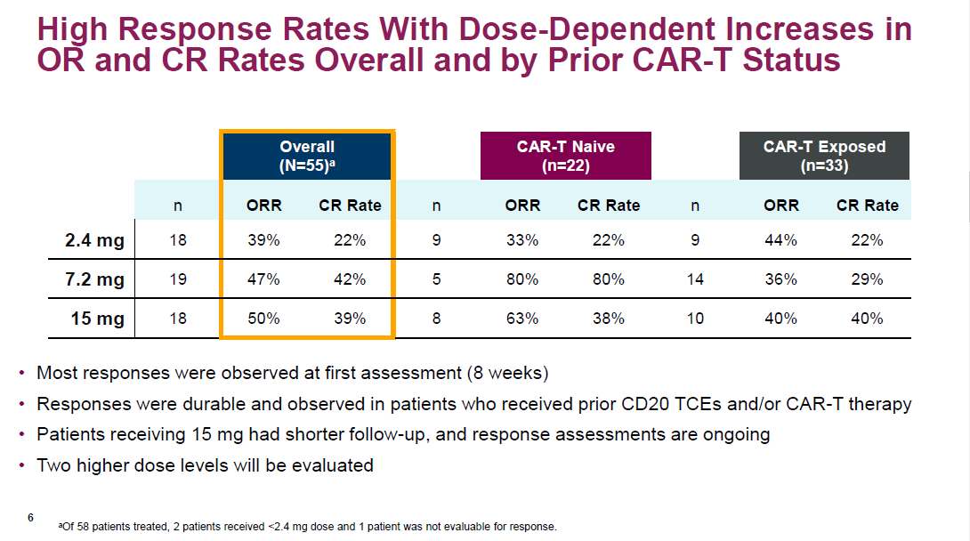

Slide 48
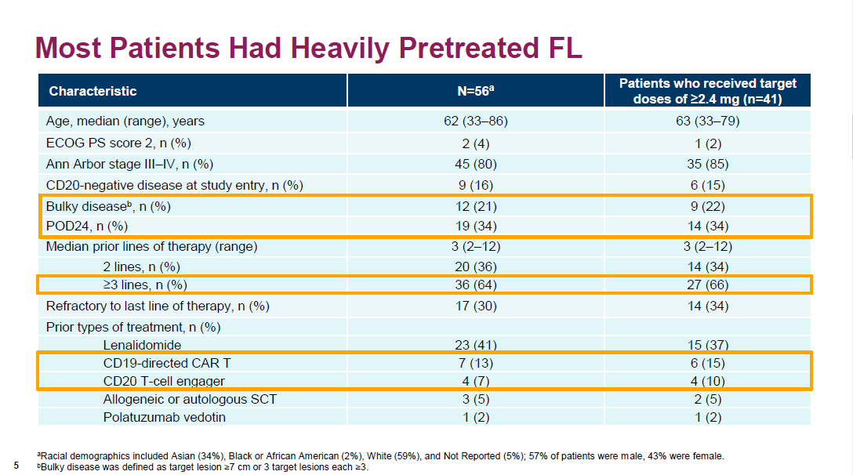

Slide 49
