Slide 1
Year in Review
Current Management of Myelofibrosis
Professor Claire Harrison
Deputy Chief Medical Officer — Research, Data and Analytics
Professor of Myeloproliferative Neoplasms
Guy’s and St Thomas’ NHS Foundation Trust
London, United Kingdom

Slide 2
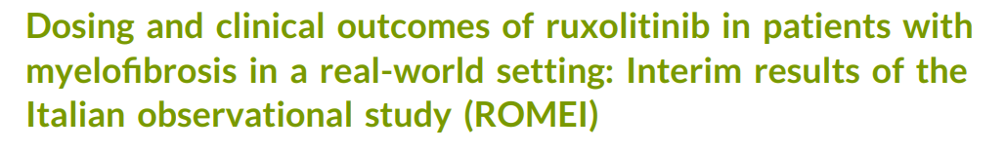
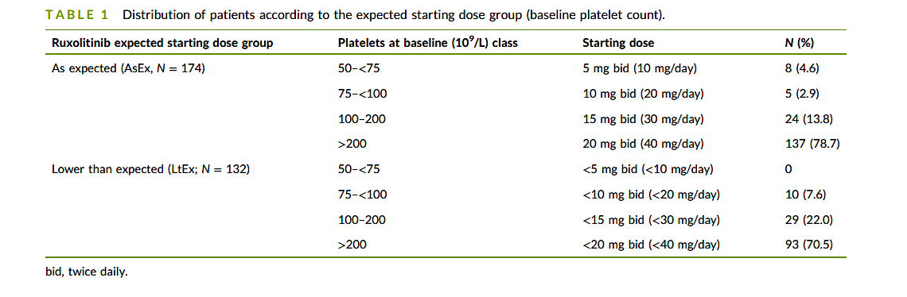
Breccia et al
Prospective multicentre study in Italy enrolling MF patients treated with ruxolitinib - 508 patients enrolled
Prior work from this study confirmed in its 24‐week findings, the beneficial effect of ruxolitinib in improving symptoms and QOL (primary endpoints) and reducing spleen size. A favorable safety profile was observed, consistent with results from clinical studies. The interim results in the ROMEI study indicated high adherence (60%–75%) to oral ruxolitinib at 24 weeks.
However, one third (25%–40%) of the patients receiving ruxolitinib may be undertreated owing to suboptimal adherence, potentially undermining disease control and survival outcomes.
This paper presents an interim analysis at 12 months based upon outcomes of patients according to starting dose of ruxolitinib.
AsEx – as expected for platelet count n = 174
LtEx – less than expected n= 132

Slide 3
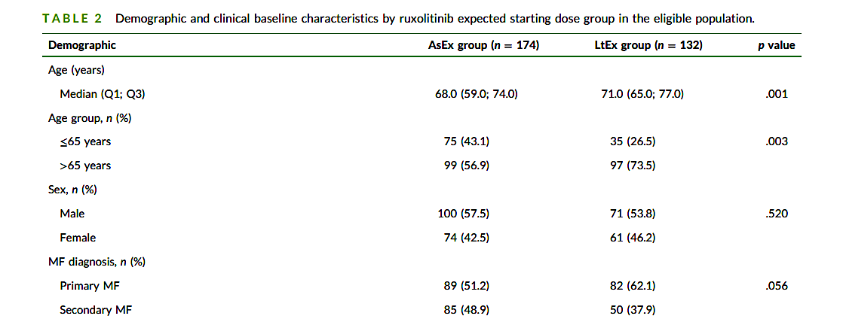
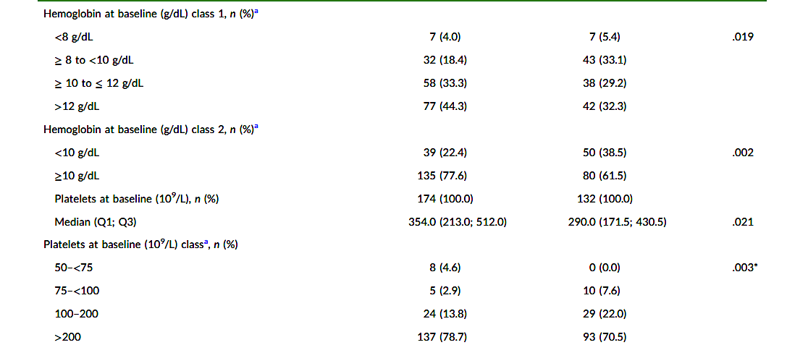
LtEx patients
Tended to be older with the phenotype of “cytopenic MF”
Breccia Cancer 2025

Slide 4
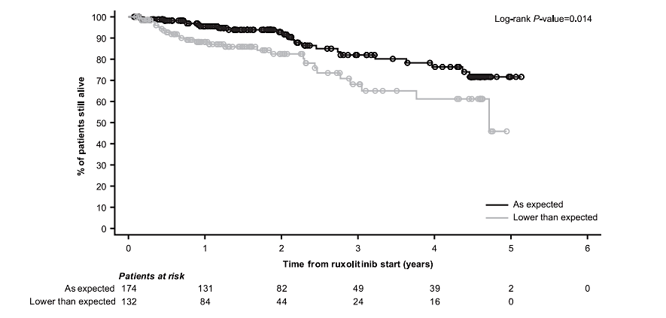
Symptoms
The proportion of patients with symptom response was higher in the AsEx group than in the LtEx group at 4 weeks (38.5% vs 27.3%) until 24 weeks (40.8% vs 39.4%), whereas at 48 weeks, the proportion of responders was similar between the groups (AsEx group, 40.8%; LtEx group, 40.9%).
Time to symptom response was faster in AsEx.
Spleen
Spleen response was achieved in a higher proportion of patients at both 24 weeks and 48 weeks in the AsEx group versus LtEx group (50.0% vs 30.2% and 57.7% vs 45.8%, respectively).
Median time to first spleen response was significantly shorter in the AsEx group versus LtEx group (3.3 months and 11.1 months; p = .019).
Among the patients eligible for spleen response evaluation, the first spleen response occurring anytime within the data cutoff was observed in 62.2% of patients in the AsEx group versus 52.3% in the LtEx group.
Survival
Was superior for AsEx median survival not reached vs 4.7 years in LtEx.
Conclusion
Initiation at the recommended dose maximizes the OS, as observed in patients of the AsEx starting dose group in which patients had a better OS than those in the LtEx group (median not reached vs 4.7 years; p = .014).
BUT other clinical features might influence OS such as older age, disease‐related anemia, and cytopenic phenotype that indeed in our study were unbalanced between the two starting dose groups.
Breccia Cancer 2025

Slide 5
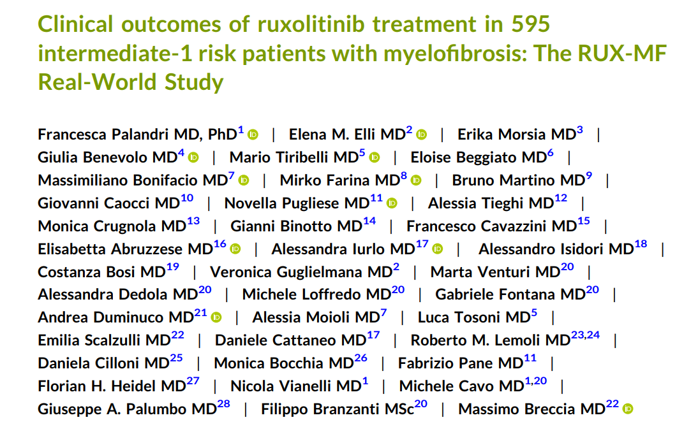

Slide 6
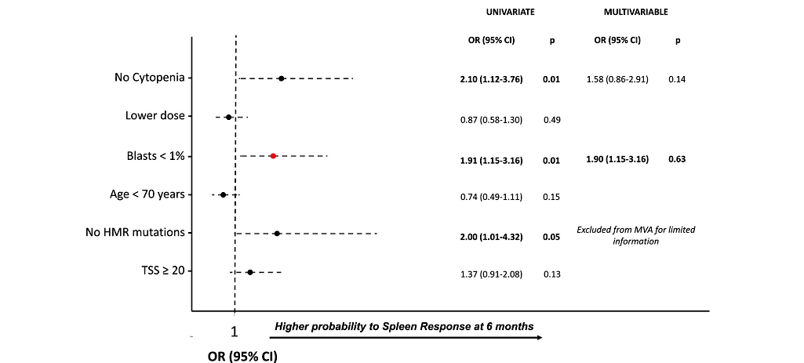
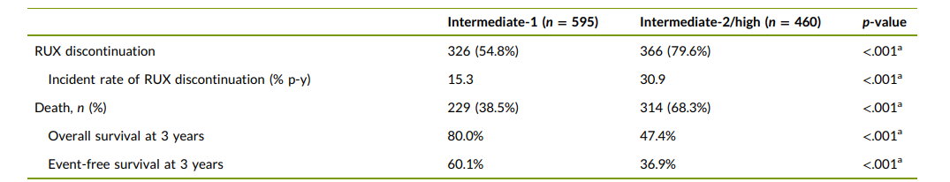
Analysis of factors associated with spleen response
Spleen and symptom responses
Were consistent with literature SVR 35 (26.8%) and TSS50 (67.9%)
Slightly low for spleen but questions validity of SVR35% and accuracy in RW
Rux discontinuation, OS and EFS
Were all superior for INT1 vs INT2/High
Palandri Cancer 2024

Slide 7
Conclusions
Outcome measures, including OS, EFS, and rates of ruxolitinib discontinuations were significantly better in intermediate‐1 patients, even after adjustment for age.
This may be mainly related to lower disease burden and better hematological status at baseline.
Overall, these data confirm the benefits of ruxolitinib in patients with less advanced disease.
Palandri Cancer 2024

Slide 8
Clinical Outcomes in Patients with Myelofibrosis Treated with Ruxolitinib and Anemia-Supporting Medications Vachhani ASH 2024; Abstract 4546
The large (N=2233), single-arm, phase 3b, expanded-access JUMP trial evaluated safety and efficacy of ruxolitinib treatment for patients with MF in a setting similar to routine clinical practice.
This post hoc analysis included patients with BL anemia (hemoglobin [Hb] <12.0 g/dL or Hb <10.0 g/dL) who were not receiving supportive care for anemia at enrollment but initiated an ESA or danazol within 3 months of enrollment and remained on that therapy for ≥3 months. Clinical outcomes evaluated were spleen length response.
101 (7.3%) initiated an ESA (n=98) or danazol (n=3) within 3 months of enrollment (52 [6.9%] with Hb<10.0g/dL) and were included in this analysis.
For the Hb<12.0 g/dL cohort, time from enrollment to first dose of an ESA or danazol was 43.0
(2–91) days.
For the Hb<10.0 g/dL subgroup, time to first dose of ESA or danazol was 34 (2–90) days.

Slide 9
Responses
SLR at Week 12 was achieved by 42 (42%) patients with Hb<12.0 g/dL and 22 (42%) with Hb<10.0 g/dL.
SLR at Week 24 was achieved by 34 (34%) patients with Hb<12.0 g/dL and 15 (29%) with Hb<10.0 g/dL.
Symptom response at Week 24 was achieved by 26 (26%) patients with Hb<12.0 g/dL and by 12 (23%) with Hb<10.0 g/dL.
These rates were similar to those previously reported for the entire JUMP population.
Vachhani ASH 2024; Abstract 4546

Slide 10
Conclusion
For patients with anemia at MF diagnosis who received ESA or danazol in combination with ruxolitinib, spleen and symptom responses were similar to those reported in the entire JUMP study population.
In addition, most patients tolerated doses of ruxolitinib >25 mg daily and post-enrollment maintained an Hb level within 1.0 g/dL of BL throughout the study period.
These results reinforce the use of supportive care for anemia with an ESA or danazol combined with ruxolitinib and may allow for maintenance of ruxolitinib dose intensity in MF patients with anemia.
Vachhani ASH 2024; Abstract 4546

Slide 11
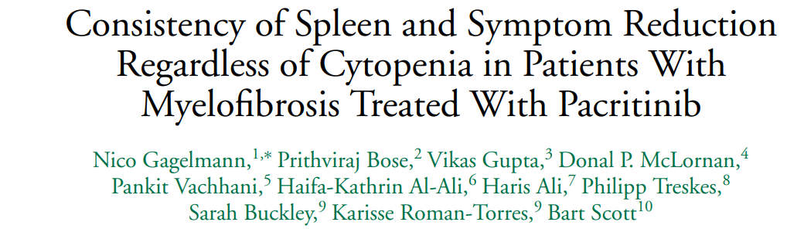
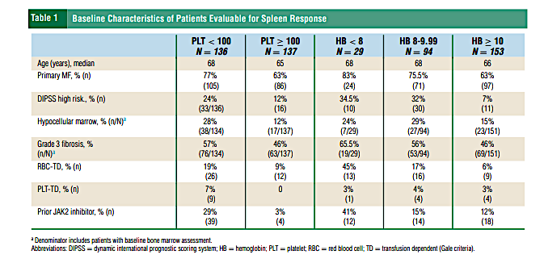
To assess the impact of baseline blood counts on pacritinib efficacy, an analysis of efficacy outcomes by baseline platelet and hemoglobin levels was performed using data pooled from 2 Phase 3 studies of pacritinib in patients with MF (PERSIST-1 and PERSIST-2).
Data from 276 evaluable patients were median patient age was 67 years, 51.5% had grade 3 fibrosis, 70% had primary MF, and 16% had prior JAK2 inhibitor exposure.
Equal numbers of patients had a baseline platelet count < 100 × 109/L (50%) or ≥ 100 × 109/L (50%).
But 29 (11%), 94 (34%) and 153 (55%) patients had a baseline hemoglobin count of < 8, 8 to < 10 or ≥ 10 g/dL, respectively.

Slide 12
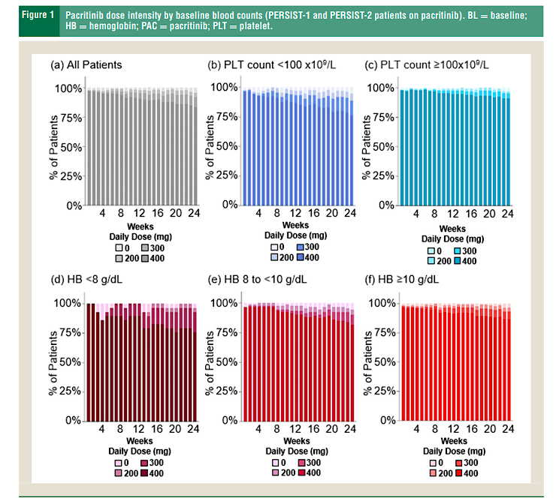
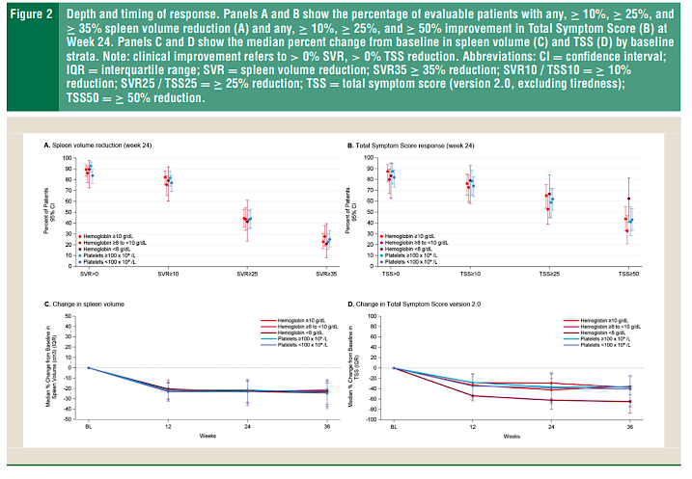
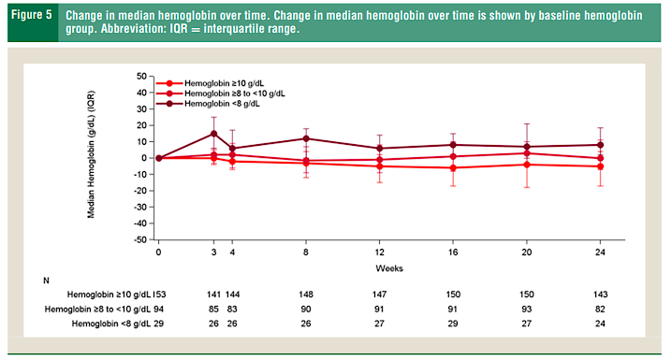
Dose intensity of pacritinib was almost 100% across all subgroups according to baseline haem parameters.
Spleen and symptom responses were consistent.
Of interest, pacritinib showed greater reduction in symptoms in patients with severe anemia at baseline, resulting in more rapid and deeper reductions in MF symptom burden compared with results in less severely anemic or nonanemic patients.
Hemoglobin remained stable slightly increased for those more anemic patients.
Gagelmann Clin Lymphoma Myeloma Leuk 2024

Slide 13
Conclusion
In this post-hoc analysis of data pooled from 2 Phase 3 studies, pacritinib demonstrated consistent efficacy in patients with MF regardless of baseline platelet and hemoglobin counts.
These findings suggest that pacritinib may be able to successfully improve underlying disease and general condition in severe cytopenic cases and potentially in pretransplant settings to avoid the risk of drug induced exacerbation of cytopenia associated with ruxolitinib and fedratinib.
Gagelmann Clin Lymphoma Myeloma Leuk 2024

Slide 14
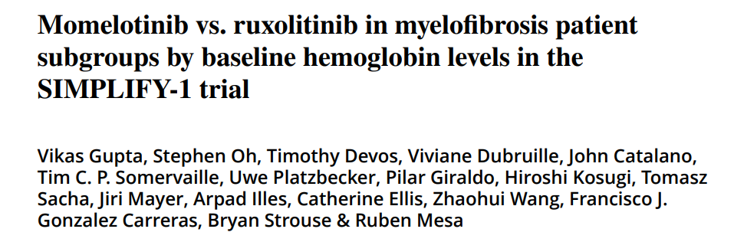
Anemia is a key hallmark of MF and often results in poor quality of life and under dosing of ruxolitinib. This is a post hoc analysis of the SIMPLIFY-1 study.
This study was the only trial to perform a head to head analysis of JAK inhibitors.

Slide 15
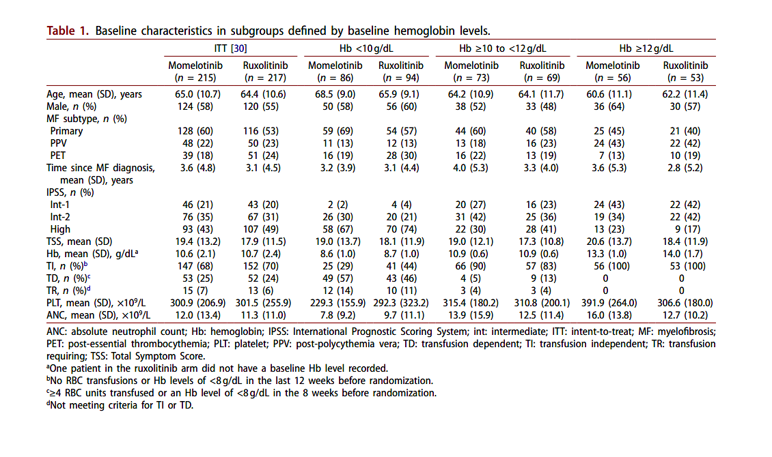
Gupta Leuk Lymphoma 2024

Slide 16
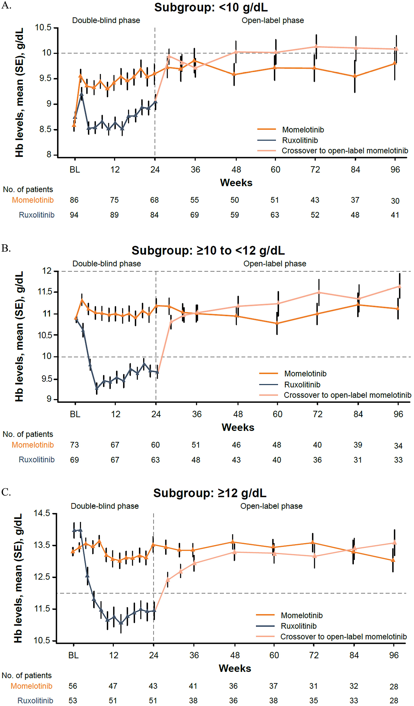
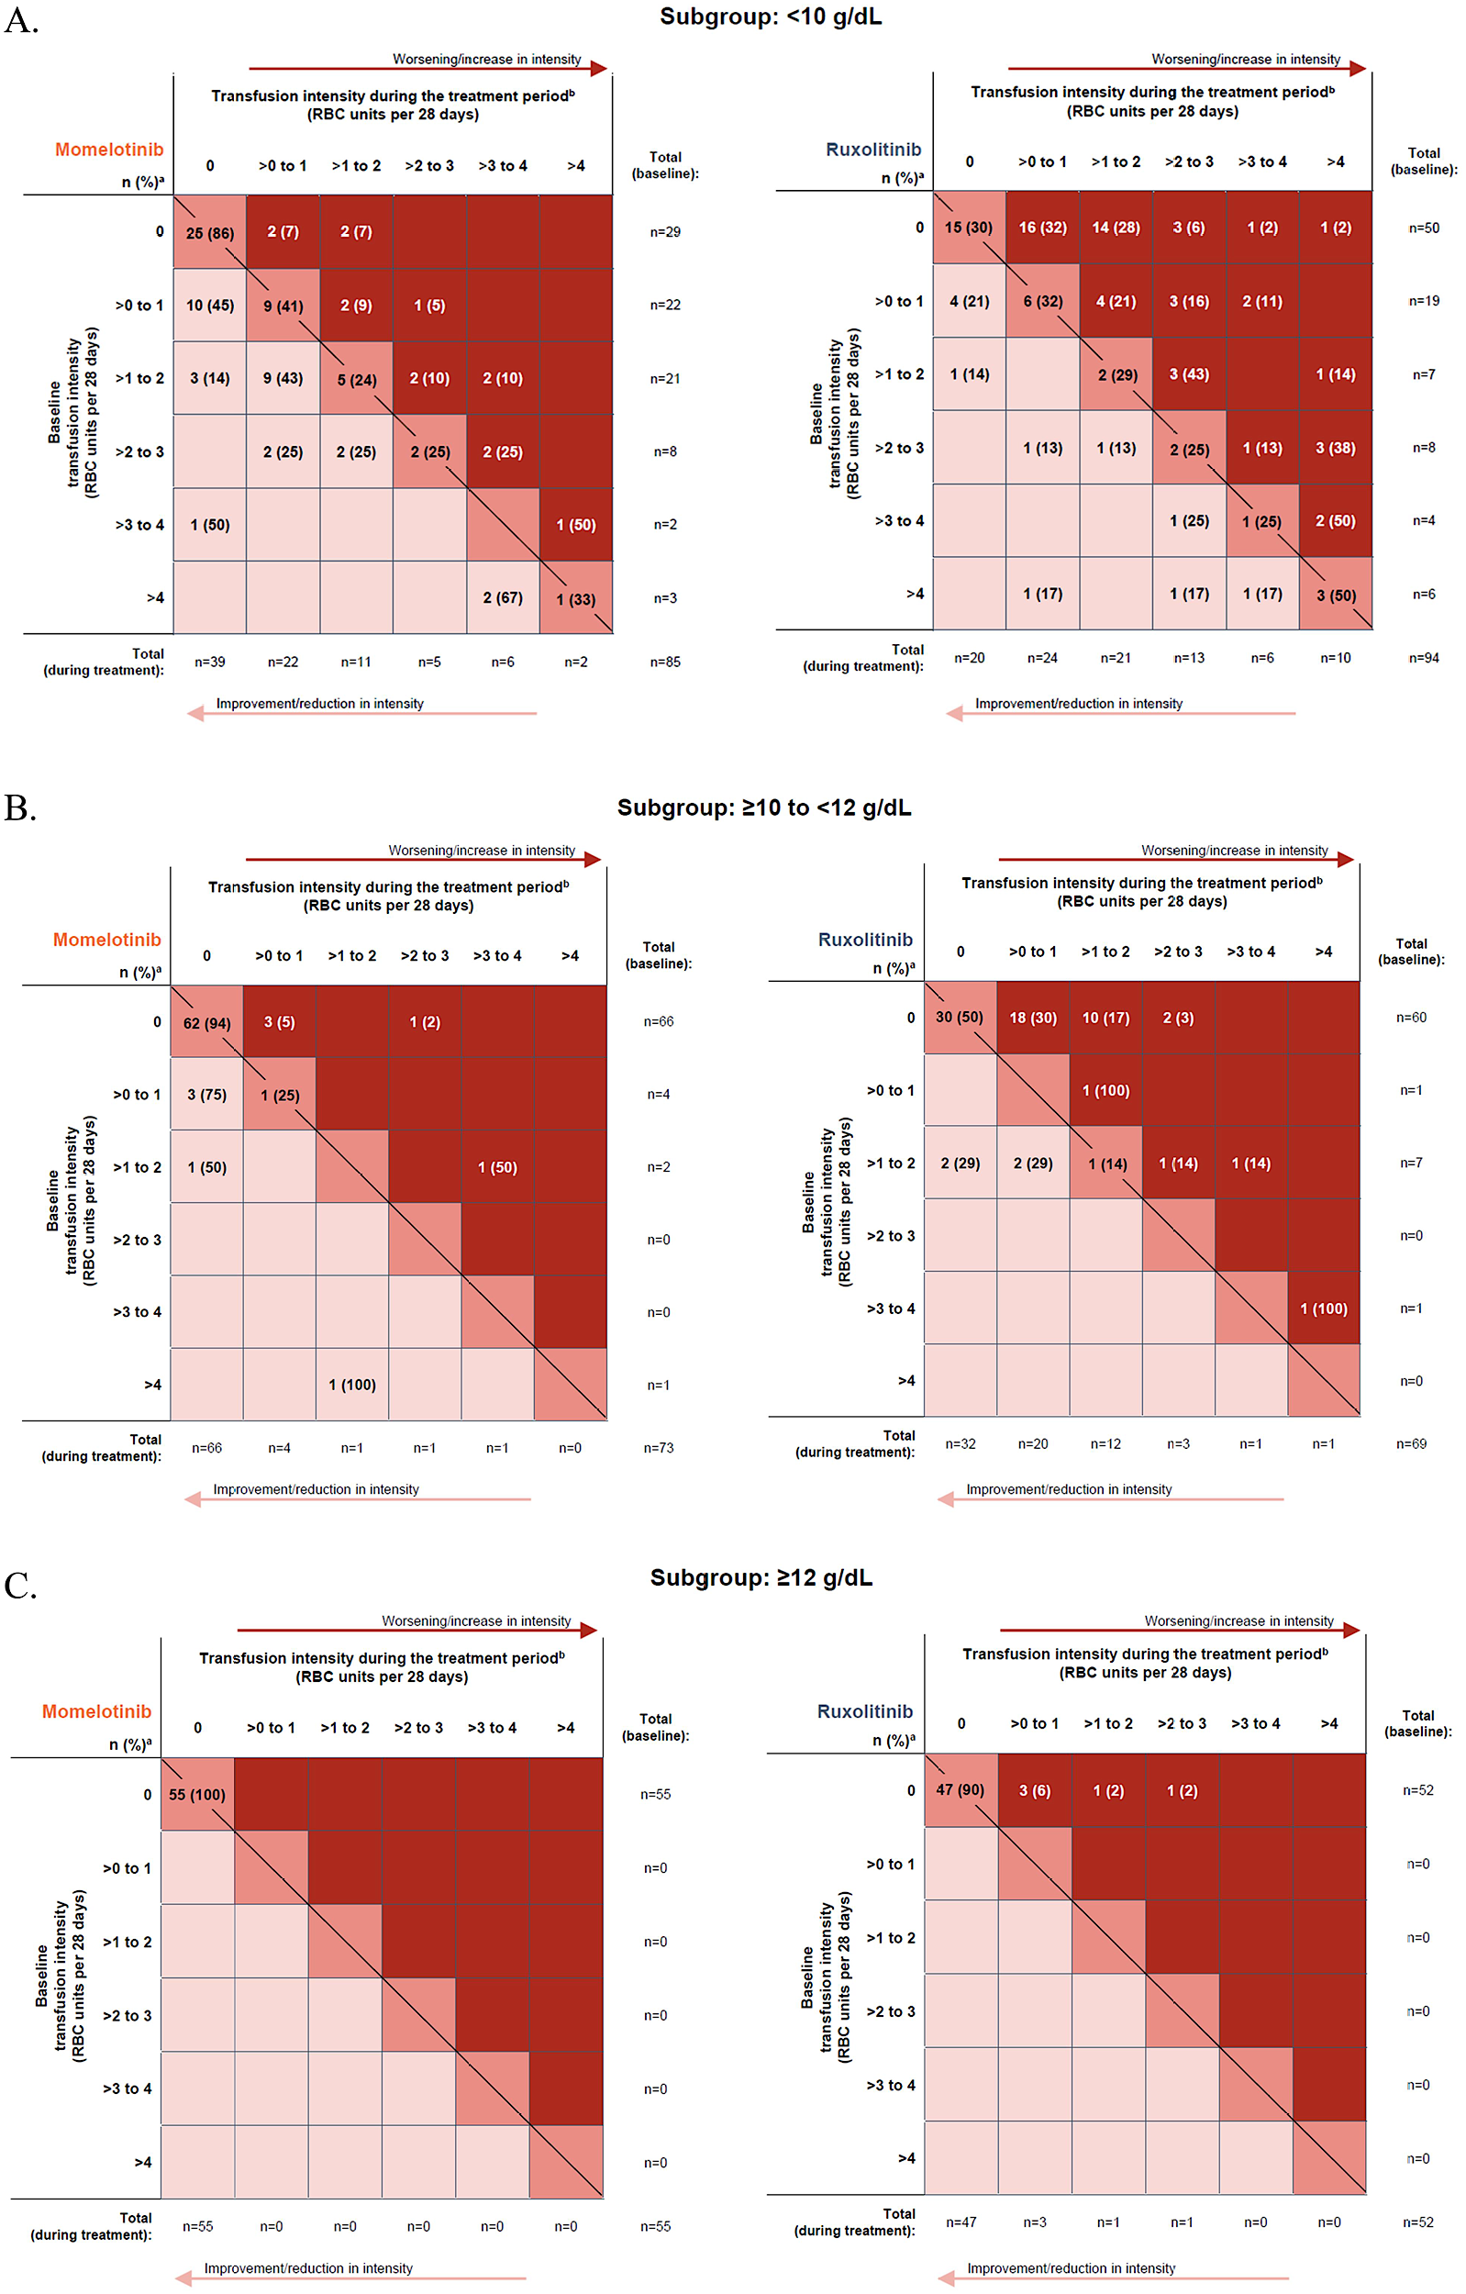
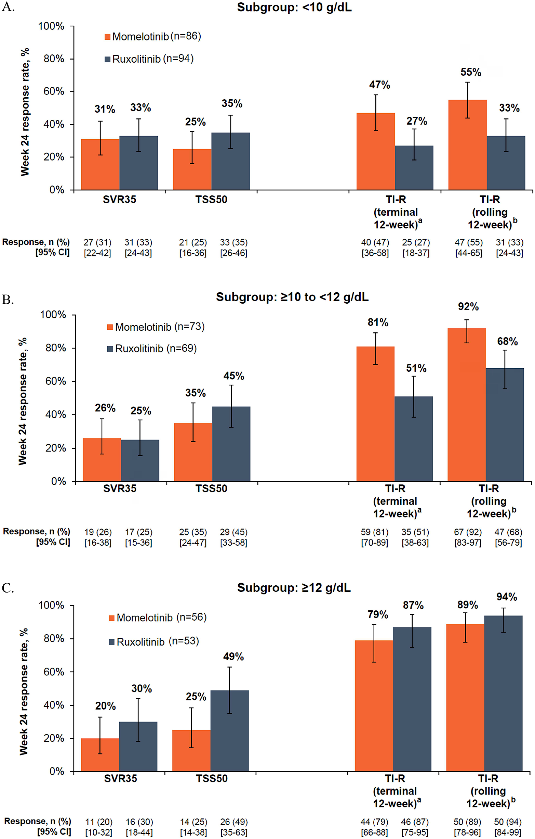
Gupta Leuk Lymphoma 2024

Slide 17
Conclusions
While momelotinib demonstrated benefits across anemic subgroups, the impact of momelotinib in nonanemic patients is less clear.
Across subgroups, no new momelotinib safety signals were identified. While grade ≥3 and serious treatment-emergent adverse events (TEAEs) were relatively more frequent in the Hb <10g groups this was consistent with both drugs.
As both momelotinib and ruxolitinib prescribing information require dose modification for thrombocytopenia, the stability of mean platelet counts over time with momelotinib across subgroups may support use at full dose in more patients vs. ruxolitinib.
Gupta Leuk Lymphoma 2024

Slide 18
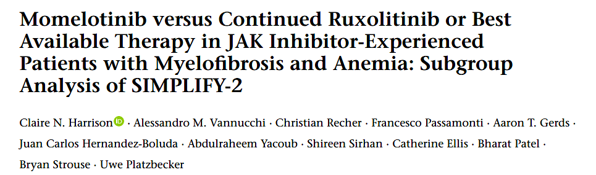
Post hoc analysis of SIMPLIFY 2
The patient subgroups for the present analysis were defined by either:
Hb of < 100 g/L
or transfusion status, ie all patients who were non-TI.
Transfusion independence is absence of RBC transfusions and no Hb of < 80 g/L in the 12 weeks before randomization.
As few patients received anemia supportive therapies other than RBC transfusions (e.g., ESAs), results in the small subgroup of the overall intent-to-treat (ITT) population who did were also summarized.

Slide 19
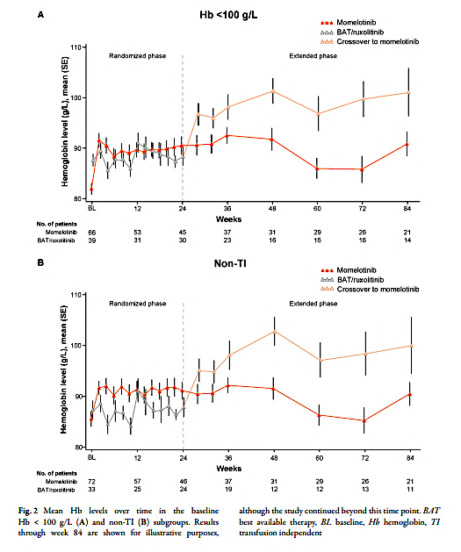
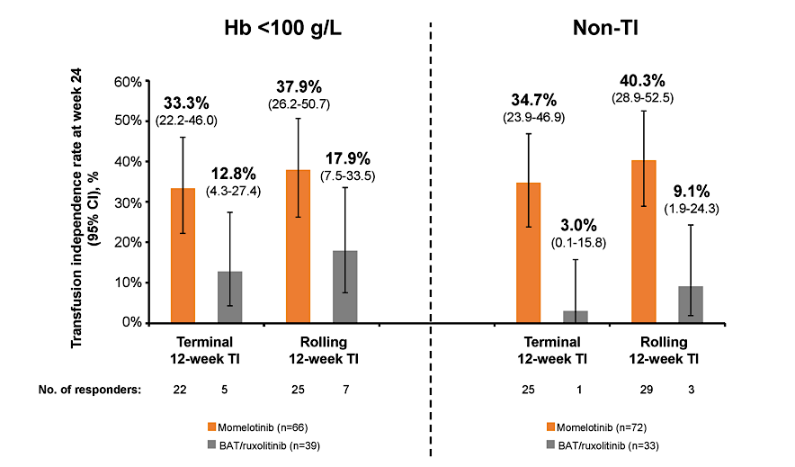
Hemoglobin and anemia responses
Harrison Adv Ther 2024

Slide 20
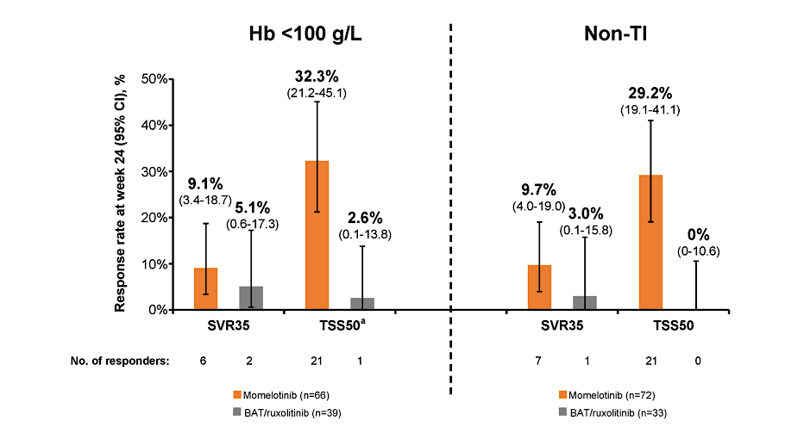
SVR and symptom responses were numerically superior for momelotinib
Harrison Adv Ther 2024

Slide 21
Conclusion
Momelotinib was associated with comprehensive anemia benefits, including higher mean Hb levels over time and increased rates of week 24 transfusion independence, versus BAT/ruxolitinib in both subgroups.
Anemia supportive therapies do not address the underlying mechanism of anemia in myelofbrosis and are unable to halt its progression; however, adding these supportive therapies to ongoing treatment with a JAK inhibitor such as ruxolitinib may be a preferred approach. Our analyses suggest that this approach provides not only limited anemia benefit but also lower symptom and spleen control compared with switching to momelotinib. But n = only 5
Safe to switch directly from ruxolitinib to momelotinib.
Limitations: post hoc analysis, suboptimal dosing of ruxolitinib.
Harrison Adv Ther 2024

Slide 22
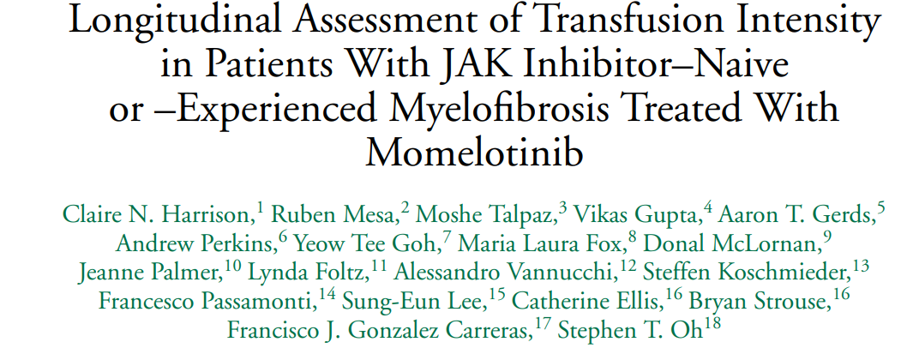
In this descriptive analysis, the impact of momelotinib on RBC transfusion burden over time was further characterized across JAK inhibitor–naive and –experienced patients.
To further visualize changes to RBC transfusion burden during treatment, patients were arrayed in ordinal bins jointly based on their baseline- and treatment-period intensities of RBC units per 28 days: exactly zero units, >0 to 1 unit, >1 to 2 units, >2 to 3 units, >3 to 4 units, and >4 units.

Slide 23
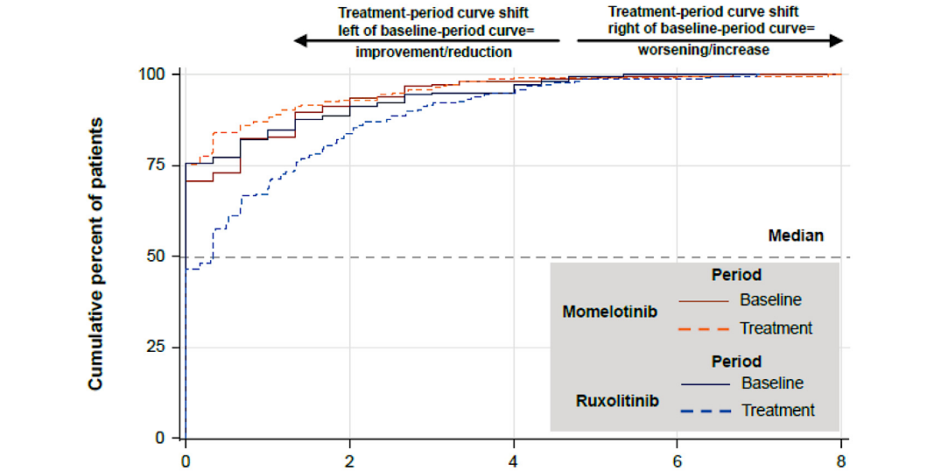
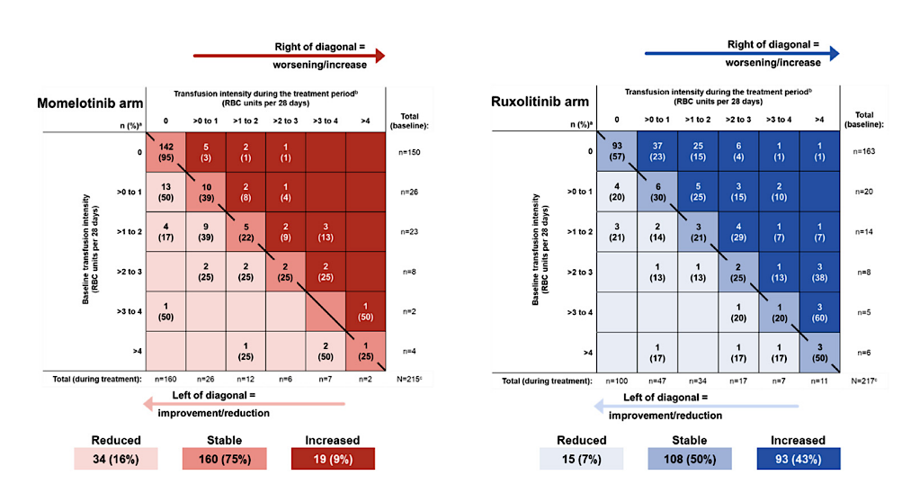
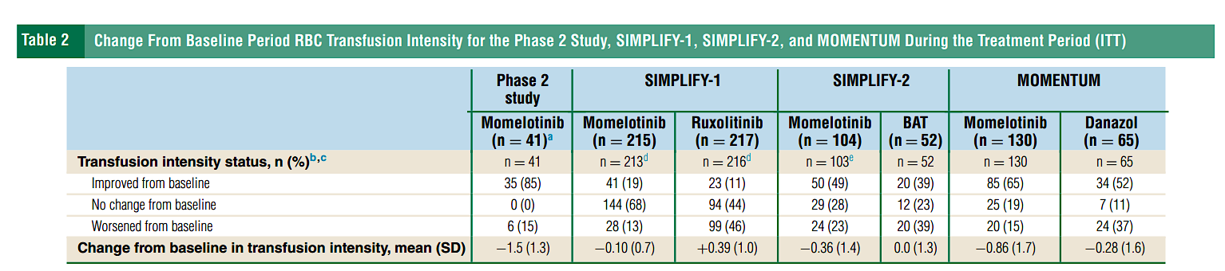
Example from SIMPLIFY 1
Harrison Clin Lymphoma Myeloma Leuk 2025

Slide 24
Clinical Practice Points
A novel transfusion burden analyses of JAK inhibitor–naïve and –experienced patients treated with momelotinib, ≥77% of patients achieved a numeric reduction in RBC transfusion requirements on treatment vs baseline.
Ordinal bin analyses, used to group patients showed that most patients experienced a decrease or stabilization of transfusion requirements on momelotinib treatment.
These data highlight that binary transfusion independence response/nonresponse may not fully capture the anemia benefits of momelotinib.
Harrison Clin Lymphoma Myeloma Leuk 2025

Slide 25
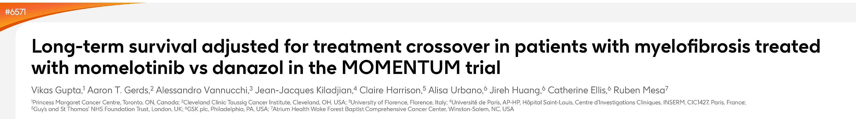
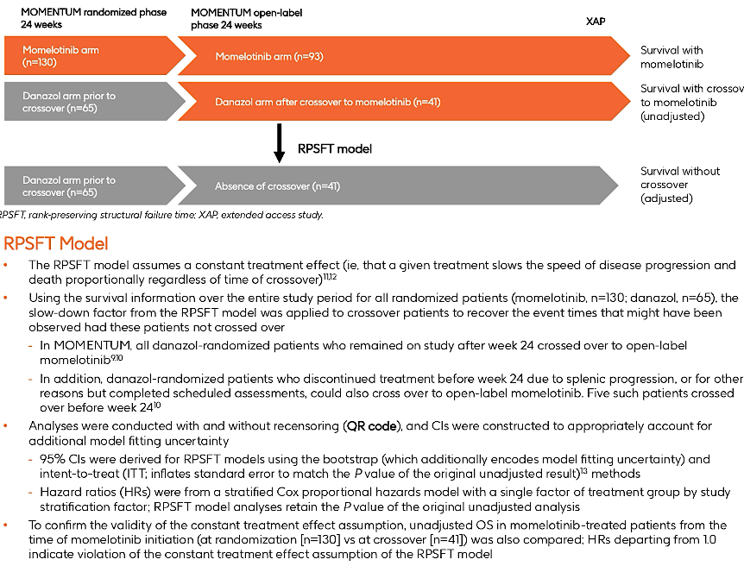

Slide 26
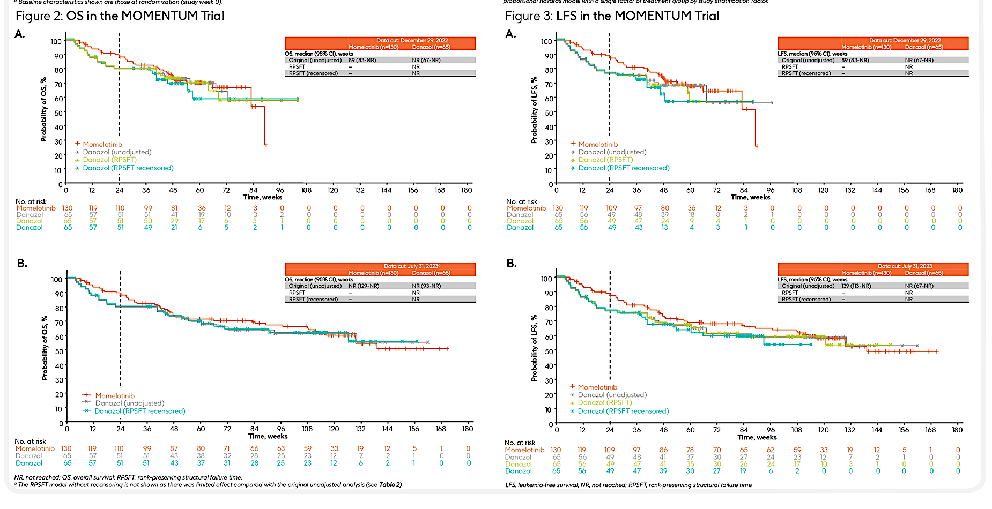
Gupta ASCO 2024; Abstract 6571

Slide 27
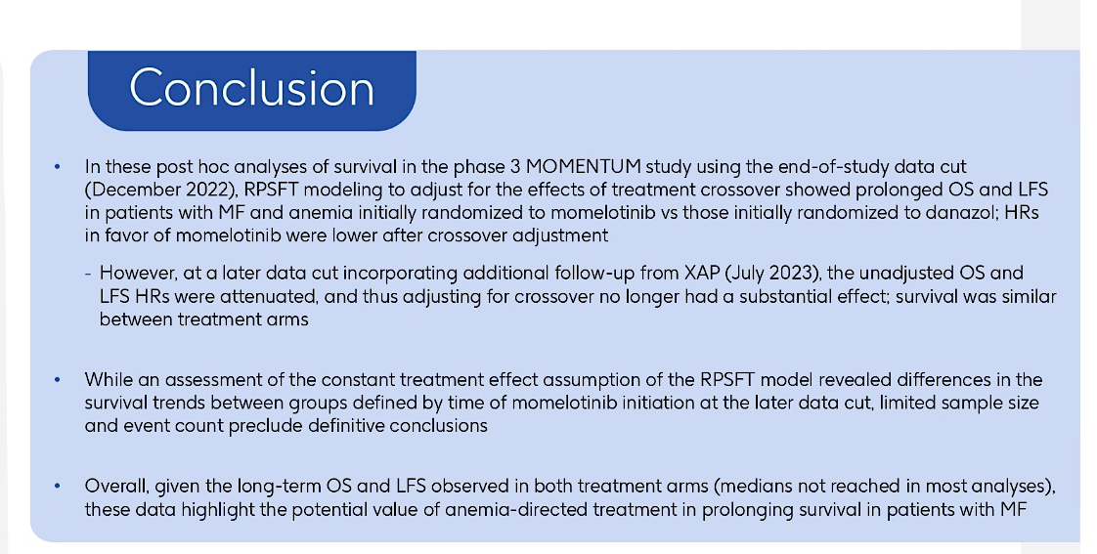
Gupta ASCO 2024; Abstract 6571

Slide 28
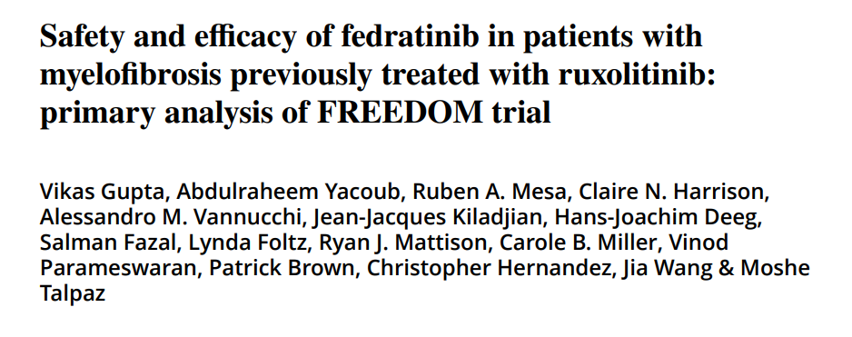
Due to COVID-19, accrual was cut short with 38 patients enrolled.
In the efficacy evaluable population (n = 35), nine (25.7%; 95% confidence interval 12.5–43.3) patients achieved primary endpoint of ≥35% spleen volume reduction (SVR) at end of cycle (EOC) 6; and 22 (62.9%) patients showed best overall response of ≥35% SVR up to end of treatment.
Sixteen (44.4%) patients showed ≥50% reduction in total symptom score at EOC6 (n = 36).
Compared to previously reported JAKARTA-2 trial, rates of GI AEs were lower, and no patient developed encephalopathy. Overall, FREEDOM study showed clinically relevant spleen and symptom responses with fedratinib, and effective mitigation of GI AEs.

Slide 29
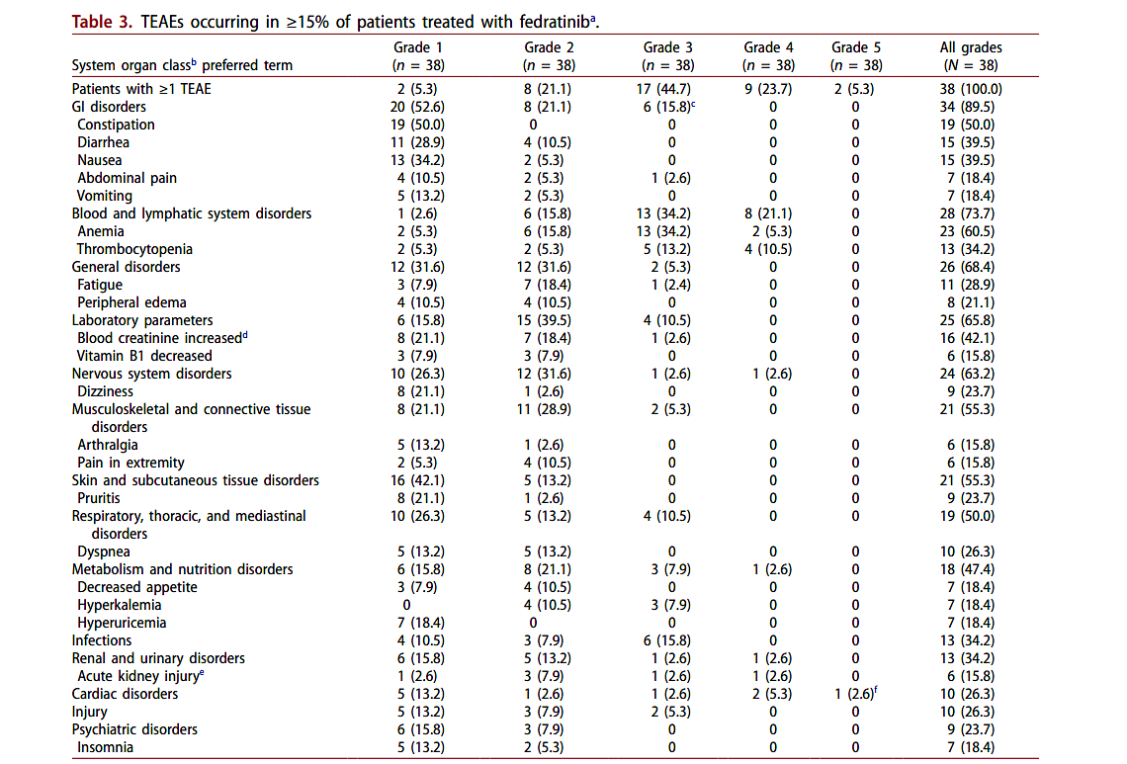
GI well managed
Some vitamin B1
decrease
Acute kidney injury
also reported
Gupta Leuk Lymphoma 2024

Slide 30
Conclusion
Small study supports efficacy of fedratinib
Emphasizes need for GI prophylaxis and thiamine monitoring. Some patients also received supplementation which was effective
Gupta Leuk Lymphoma 2024

Slide 31
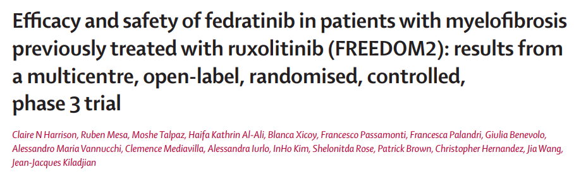

Slide 32
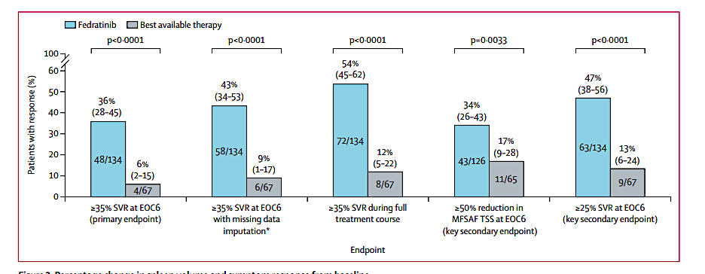
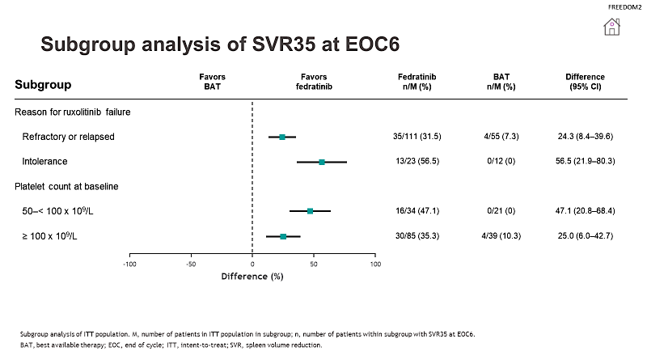
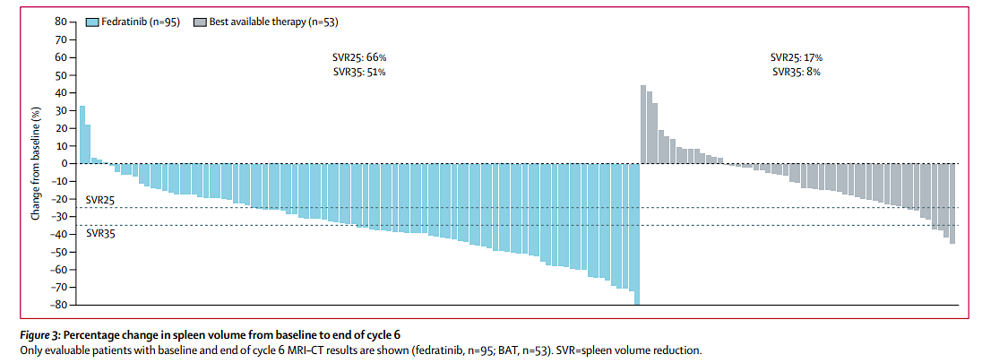
Efficacy results
Highly significant
Regardless of
refractory/
relapsed
vs intolerant
And for plts
50-100
vs >100
Harrison Lancet Haematol 2024

Slide 33
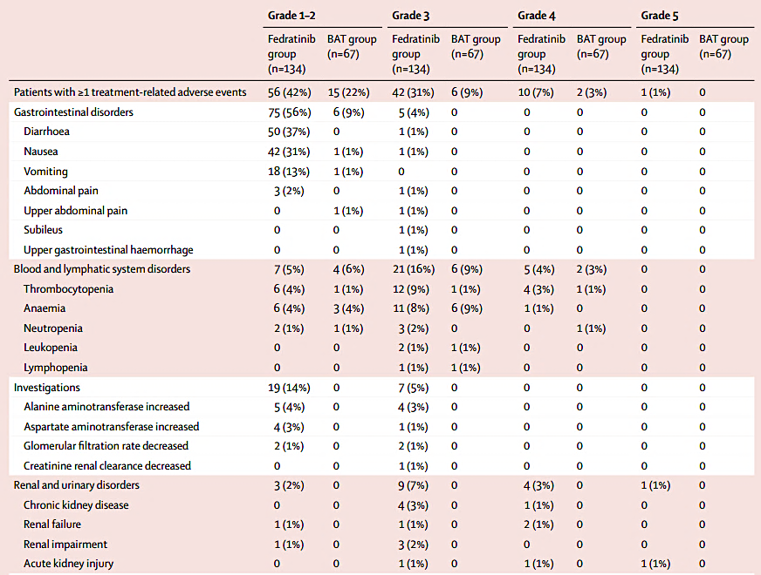
GI toxicity present but usually low grade
Note renal signal and
1 death
Harrison Lancet Haematol 2024

Slide 34
These data from the FREEDOM2 trial show the efficacy of fedratinib compared with BAT for the treatment of myeloproliferative neoplasm-related myelofibrosis, with superior SVR35, symptom response, and SVR25.
Adverse events-mitigation measures were effective in controlling gastrointestinal adverse events and decreases in thiamine concentrations, and the safety profile of fedratinib was consistent with previous trials.
Harrison Lancet Haematol 2024

Slide 35
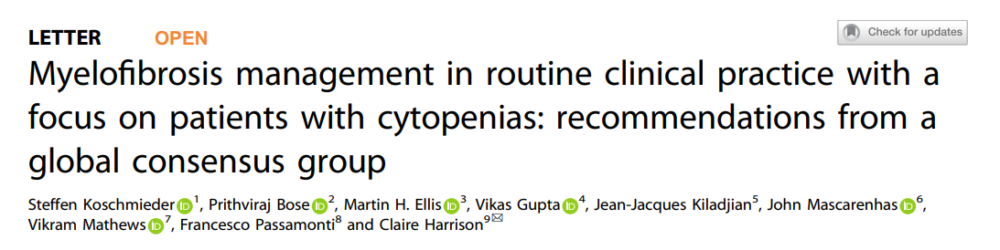
Aims to assess:
Defining the thresholds for anemia, and when to initiate/ modify treatment
Defining the threshold for thrombocytopenia and when to initiate/modify treatment
Defining JAKi failure and what would warrant switching treatment
How and when to determine prognosis in patients with MF
Unmet needs in MF clinical trials

Slide 36
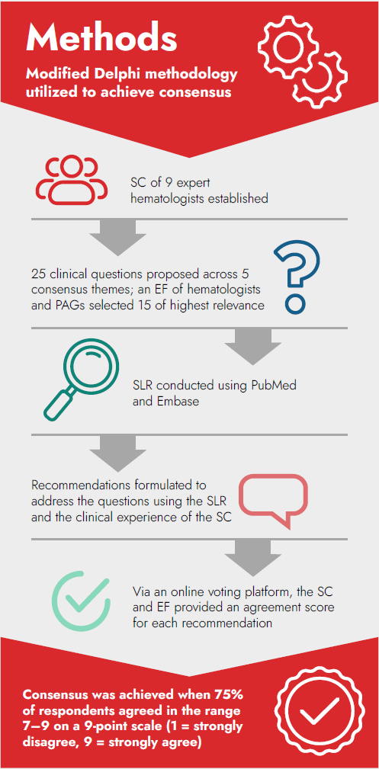






















Methods
STEERING COMMITTEE
EXTENDED FACULTY
Modified Delphi methodology utilized to achieve consensus
20 hematologists
SC of 9 expert hematologists established
Claire Harrison
Steffen Koschmieder
25 clinical questions proposed across 5 consensus themes; an EF of hematologists and PAGs selected 15 of highest relevance
1
10
3
1
Francesco Passamonti
Jean-Jacques
Kiladjian
SLR conducted using PubMed and Embase
1
2
2
9 patients
Recommendations formulated to address the questions using the SLR and the clinical experience of the SC
Vikram Mathews
John Mascarenhas
Via an online voting platform, the SC and EF provided an agreement score for each recommendation
3
3
3
Vikas Gupta
Prithviraj Bose
Consensus was achieved when 75% of respondents agreed in the range 7–9 on a 9-point scale
(1 = strongly disagree, 9 = strongly agree)
Martin H. Ellis
EF, Extended Faculty; PAG, patient advocacy group; SC, Steering Committee; SLR, systematic literature review.
Koschmieder Leukemia 2024

Slide 37

Question 3:
Which Current and Emerging Treatments to Improve Anemia Should be Considered for: • MF-Related Anemia? • Treatment-Related Anemia?
Theme 1: Defining the Thresholds for Anemia, and When to Initiate/Modify Treatment
Clinical Recommendation 3
Once other causes such as disease progression have been excluded: for MF-related anemia, JAK inhibition with momelotinib or pacritinib, danazol, luspatercept, ESAs, IMiD®, or conventional combination therapies, such as JAK inhibition plus ESAs, danazol, luspatercept, or IMiD®, may overcome the necessity of dose adjustments/interruptions, which may be associated with ruxolitinib or fedratinib*
In the future,
novel combination therapies may
deliver these benefits
Splenectomy can be considered as a last resort in select cases of refractory disease-related anemia.
For treatment-related anemia, consider dose reduction of current therapy for 4–6 weeks.
*Only ruxolitinib, fedratinib, pacritinib, and momelotinib are approved treatments for MF.
8
All current and emerging treatment options for
MF- and treatment-related anemia should be considered
100%
MEDIAN SCORE
CONSENSUS
ESA, erythropoietin-stimulating agent; Hb, hemoglobin; IMiD, immunomodulatory drugs; JAK, Janus kinase; MF, myelofibrosis.
Koschmieder Leukemia 2024

Slide 38




Question 4:
Aside From Access and Reimbursement, What Factors Guide Selection of JAK Inhibitor Therapy in Patients With MF and Anemia?
Theme 1: Defining the Thresholds for Anemia, and When to Initiate/Modify Treatment
Clinical Recommendation 4
    Factors guiding selection of JAK inhibitor monotherapy would include:
    For some agents, consideration of drug-specific adverse events (immunosuppression, skin cancer, infection risk, nutritional status, tolerance of GI toxicity, neurotoxicity, cardiovascular adverse events) is also a factor
      Baseline Hb
      Likely tolerance of anemia
      Baseline thrombocytopenia
      MF-related symptoms
8.5
92%
MEDIAN SCORE
CONSENSUS
GI, gastrointestinal; Hb, hemoglobin; JAK, Janus kinase; MF, myelofibrosis.
Koschmieder Leukemia 2024

Slide 39
Question 8:
What Criteria Should be Used to Define a Patient who is Relapsed, Refractory, or Intolerant to JAK Inhibitor Treatment?
Theme 3: Defining JAK Inhibitor Failure and What Would Warrant Switching Treatment
Clinical Recommendation 8
    There are existing criteria for ruxolitinib that are used in clinical trials to determine if a patient is relapsed, refractory, or intolerant to treatment (Table 2)
    However, in clinical practice, it may be difficult to distinguish exactly between ruxolitinib intolerance and relapse,
    as often these can coexist
    Criteria for other JAK inhibitors are likely to be similar
Table 2: Criteria for Ruxolitinib Failure Used in the Re-analysis of the JAKARTA-2, PAC203, and FREEDOM Trials (Adapted From Bose P, Verstovsek S. Hemasphere. 2020;4:e424)
Relapsed | Ruxolitinib for ≥3 months with spleen regrowth (defined as <10% SVR or <30% decrease in spleen size by palpation from baseline) following an initial response*
Refractory | Ruxolitinib for ≥3 months with <10% SVR or <30% decrease in spleen size by palpation from baseline
Intolerant | Ruxolitinib for ≥28 days complicated by development of RBC transfusion requirement (≥2 units/month for two consecutive months); or Grade ≥3 thrombocytopenia, anemia, hematoma/hemorrhage or other, non-hematologic adverse events while on ruxolitinib
8
94%
MEDIAN SCORE
CONSENSUS
*Response to ruxolitinib is defined as ≥35% reduction in spleen volume from baseline or ≥50% reduction in spleen size for baseline spleen sizes >10cm below LCM, a non-palpable spleen for baseline spleen sizes between 5–10cm below LCM, or not eligible for spleen response for baseline spleen <5cm below LCM (Harrison CN, et al. Am J Hematol. 2020;95:594–603).
JAK, Janus kinase; LCM, left costal margin; RBC, red blood cell; SVR, spleen volume reduction.
Koschmieder Leukemia 2024

Slide 40



Question 13:
Which Clinical Variables are Predictive of Long-Term Outcome or Survival Benefit in Patients Receiving JAK Inhibitor Therapy?
Theme 4: How and When to Determine Prognosis in Patients With MF
Clinical Recommendation 13
    The following variables may be useful in predicting the outcome for patients receiving JAK inhibitor therapy; however, it is important to consider the limitations of survival data and the fact that these variables are yet to be validated
    in large datasets:
      Spleen size reduction (for ruxolitinib, pacritinib, momelotinib, and fedratinib)
      Mutational complexity (for ruxolitinib)
      Transfusion independence
      (for momelotinib)
      Requirement for transfusion and dose of ruxolitinib <20mg BID (for patients who have been on RUX for ≥6 months) – in line with the RR6 prognostic score
      Emergence of clonal progression (following discontinuation
      of ruxolitinib) and specifically, clones such as RAS and TP53
8
100%
MEDIAN SCORE
CONSENSUS
BID, twice daily; JAK, Janus kinase; RR6, Response to Ruxolitinib After 6 Months; RUX, ruxolitinib.
Koschmieder Leukemia 2024

Slide 41



Question 14:
How can Broader Inclusion in Clinical Trials be Achieved?
Theme 5: Unmet Needs in MF Clinical Trials
Clinical Recommendation 14
    Attempts should be made to be fully inclusive in terms of diversity and disease-specific criteria
    Underserved patients include those listed below, and barriers to their inclusion should be identified and removed:
      Patients with low-risk disease
      Patients with
      accelerated-phase MPN
      Young and elderly patients
      Patients with well-controlled HIV/viral hepatitis
      Patients relapsing after allo-SCT
8
Comprehensive representation in MF clinical trials, with diversity
across disease-specific criteria and demographic backgrounds, is important to ensure generalizability of study findings in the real world
94%
MEDIAN SCORE
CONSENSUS
Allo-SCT, allogeneic stem cell transplantation; HIV, human immunodeficiency virus; MPN, myeloproliferative neoplasm.
Koschmieder Leukemia 2024

Slide 42




Question 15:
How can Clinical Trial Inclusion Criteria/Endpoints be Improved?
Theme 5: Unmet Needs in MF Clinical Trials
Clinical Recommendation 15
    Efforts should focus upon validation of endpoints other than spleen volume and symptoms, such as, but not limited to:
Overall survival
Progression-free survival
Leukemia-free survival
Event-free survival
Time to treatment failure
Transfusion independence
Reduction of driver and/or additional mutation variant
allele frequency
Artificial intelligence (AI)-based assessment
of marrow morphology response
Improvement of bone marrow fibrosis grade
Normalization of cytokine levels
    Furthermore, given MF is a rare disease, the development of real-world evidence controls should be considered
8.5
96%
MEDIAN SCORE
CONSENSUS
AI, artificial intelligence; MF, myelofibrosis.
Koschmieder Leukemia 2024

