Slide 1
Chronic Lymphocytic Leukemia
Understanding the Current Paradigm and
New Approaches in the Care of Patients with Cancer
A Complimentary NCPD Hybrid Symposium Series Held During the 50th Annual ONS Congress
Thursday, April 10, 2025
6:00 PM – 7:30 PM
Faculty
Jacqueline Broadway‑Duren, PhD, DNP, APRN, FNP-BC
Bita Fakhri, MD, MPH
Corinne Hoffman, MS, APRN-CNP, AOCNP
Jeff Sharman, MD
Moderator
Neil Love, MD

Slide 2

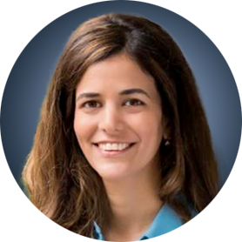
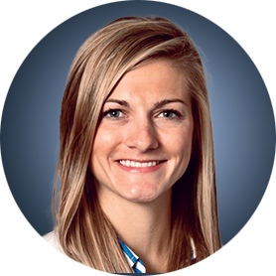

Faculty
Jacqueline Broadway-Duren, PhD, DNP, APRN, FNP-BC
Family Nurse Practitioner
Department of Leukemia
The University of Texas
MD Anderson Cancer Center
Houston, Texas
Bita Fakhri, MD, MPH
Assistant Professor of Medicine (Hematology)
Stanford University School of Medicine
Stanford, California
Corinne Hoffman, MS, APRN-CNP, AOCNP
Nurse Practitioner, Hematology
The James Comprehensive Cancer Center
The Ohio State University Wexner Medical Center
Columbus, Ohio
Jeff Sharman, MD
Medical Director of Hematology Research
Sarah Cannon Research Institute
at Willamette Valley Cancer Center
Eugene, Oregon

Slide 3
Dr Broadway-Duren — Disclosures
Advisory Committees | AbbVie Inc, BeiGene Ltd

Slide 4
Dr Fakhri — Disclosures
Advisory Committees | AbbVie Inc, AstraZeneca Pharmaceuticals LP, BeiGene Ltd, Bristol Myers Squibb, Genentech, a member of the Roche Group, Janssen Biotech Inc, Loxo Oncology Inc, a wholly owned subsidiary of Eli Lilly & Company, Pharmacyclics LLC, an AbbVie Company
Contracted Research | AbbVie Inc, BeiGene Ltd, Genmab US Inc, Loxo Oncology Inc, a wholly owned subsidiary of Eli Lilly & Company
Speakers Bureaus | AbbVie Inc, Loxo Oncology Inc, a wholly owned subsidiary of Eli Lilly & Company

Slide 5
Ms Hoffman — Disclosures
No relevant conflicts of interest to disclose.

Slide 6
Dr Sharman — Disclosures
Consulting Agreements and Contracted Research | AbbVie Inc, AstraZeneca Pharmaceuticals LP, BeiGene Ltd, Bristol Myers Squibb, Genentech, a member of the Roche Group, Lilly, Merck

Slide 7
Commercial Support
This activity is supported by educational grants from AstraZeneca Pharmaceuticals LP and Lilly.
Research To Practice NCPD Planning Committee Members,
Staff and Reviewers
Planners, scientific staff and independent reviewers for Research To Practice have no relevant conflicts of interest to disclose.

Slide 8
This educational activity contains discussion of
non-FDA-approved uses of agents and regimens. Please refer to official prescribing information for each product for approved indications.

Slide 9
Agenda
Introduction: Key Factors in the Management Patients with Chronic Lymphocytic Leukemia (CLL)
Module 1: Role of Covalent Bruton Tyrosine Kinase (BTK) Inhibitors for Newly Diagnosed CLL
Module 2: Role of Time-Limited Up-Front Treatment, Including Therapy Combining BTK Inhibitors and Venetoclax, for Newly Diagnosed CLL
Module 3: Role of Pirtobrutinib for Relapsed/Refractory (R/R) CLL
Module 4: CAR (Chimeric Antigen Receptor) T-Cell Therapy for R/R CLL

Slide 10
Agenda
Introduction: Key Factors in the Management Patients with Chronic Lymphocytic Leukemia (CLL)
Module 1: Role of Covalent Bruton Tyrosine Kinase (BTK) Inhibitors for Newly Diagnosed CLL
Module 2: Role of Time-Limited Up-Front Treatment, Including Therapy Combining BTK Inhibitors and Venetoclax, for Newly Diagnosed CLL
Module 3: Role of Pirtobrutinib for Relapsed/Refractory (R/R) CLL
Module 4: CAR (Chimeric Antigen Receptor) T-Cell Therapy for R/R CLL

Slide 11


Key Factors in Managing Patients With CLL
Timing of Therapy
Deciding when to
start therapy
  Many patients discovered incidentally; how to handle the “worried well”
  Comorbidities and fitness; where the patient is in their life cycle
Deciding when to
stop therapy
Key Prognostic Factors
The importance of
FISH, TP53, and mutational status of immunoglobulin genes
How to test for MRD
(ie, flow cytometry or molecular methods) and how to use it to guide clinical decision-making
Key Classes of Drugs
BTKi (eg, acalabrutinib, zanubrutinib, ibrutinib)
BCL2i (eg, venetoclax)
Anti-CD20 antibodies
(eg, rituximab, obinutuzumab)
Chemotherapy/
chemoimmunotherapy
(eg, chlorambucil, FCR, BR)
Courtesy of Bita Fakhri, MD, MPH

Slide 12
Agenda
Introduction: Key Factors in the Management Patients with Chronic Lymphocytic Leukemia (CLL)
Module 1: Role of Covalent Bruton Tyrosine Kinase (BTK) Inhibitors for Newly Diagnosed CLL
Module 2: Role of Time-Limited Up-Front Treatment, Including Therapy Combining BTK Inhibitors and Venetoclax, for Newly Diagnosed CLL
Module 3: Role of Pirtobrutinib for Relapsed/Refractory (R/R) CLL
Module 4: CAR (Chimeric Antigen Receptor) T-Cell Therapy for R/R CLL

Slide 13
Clinical Scenario
A patient with newly diagnosed CLL is about to start treatment with acalabrutinib or zanubrutinib

Slide 14
Considerations in CLL Treatment Choices
Jeff Sharman M.D.
Medical Director of Hematology Research
Willamette Valley Cancer Institute & Sarah Cannon

Slide 15
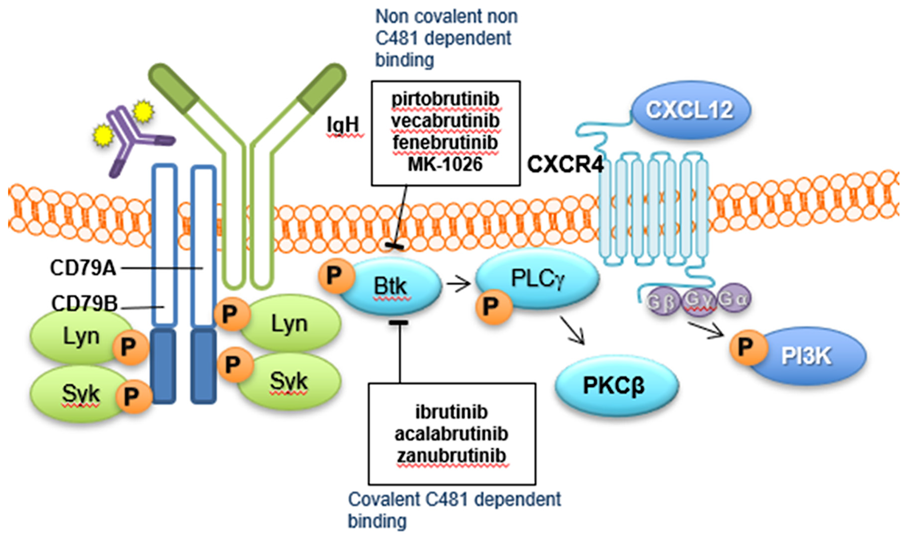

Slide 16
Treatment decisions in frontline CLL
78-year-old male
Known coronary artery disease, s/p two stents, on chronic aspirin
History of hypertension, well controlled on amlodipine, losartan, HCTZ
No known history of a. fib, but reports “heart occasionally skips a beat” when asked about palpitations.
Creatinine 1.5, GFR 50
Lives 50 miles away from cancer center and his daughter takes off of work to drive him to appointments

Slide 17
Treatment decisions in frontline CLL
Initially diagnosed 18 months ago, but now WBC rising to 180K, Hgb 10, Platelets 110. Has developed moderate adenopathy
IgHV unmutated, Trisomy 12, TP53 wild type
How do each of the above influence treatment decisions????

Slide 18
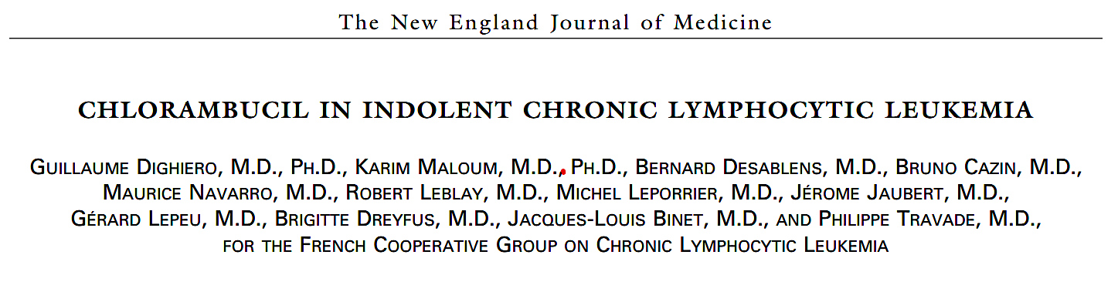
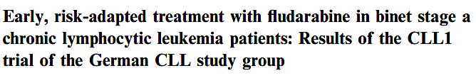


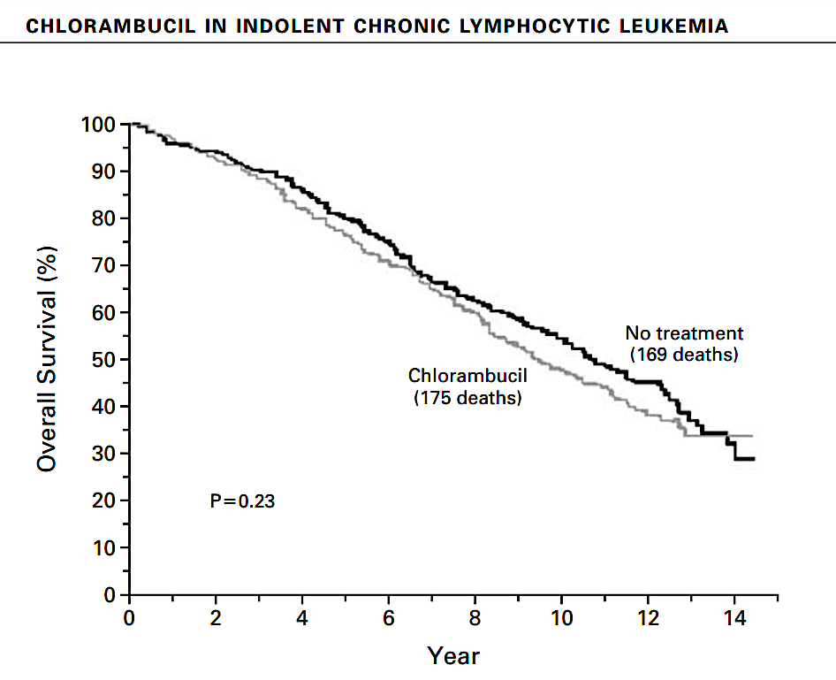
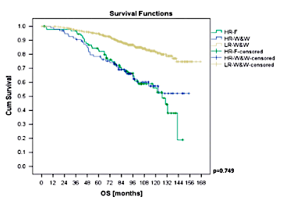
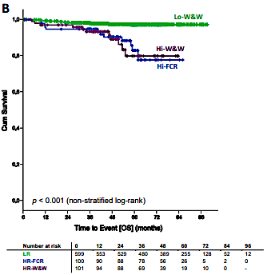
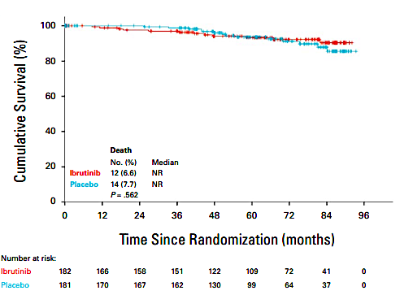
Watch and Wait… aka watch and freak out
Chlorambucil
Fludarabine
FCR
Ibrutinib

Slide 19
IWCLL Criteria to Initiate Treatment
Rapidly progressing ALC
Emergence of bone marrow dysfunction
Symptomatic adenopathy
“Other”

Slide 20
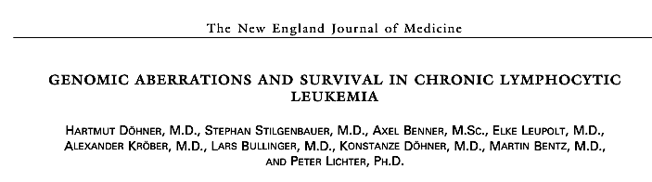
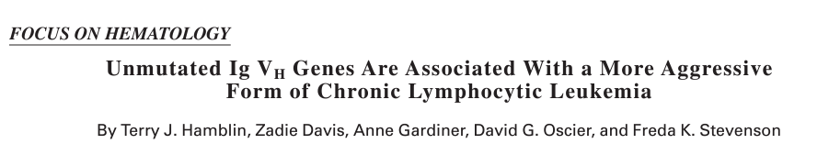
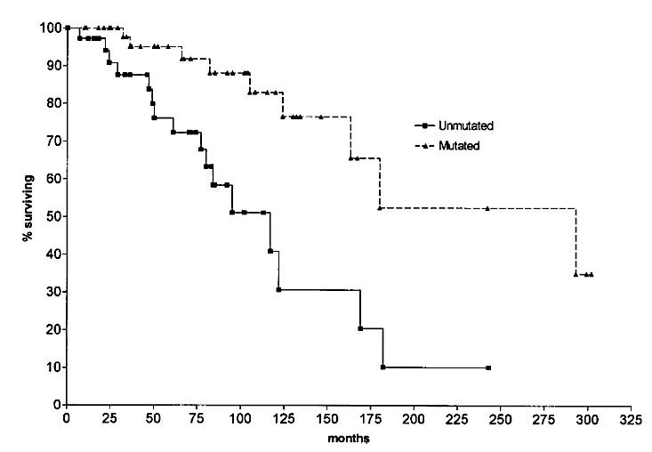
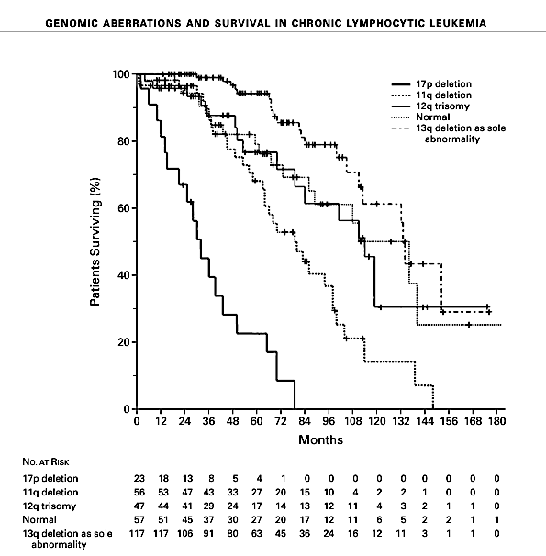
Key Biomarkers

Slide 21
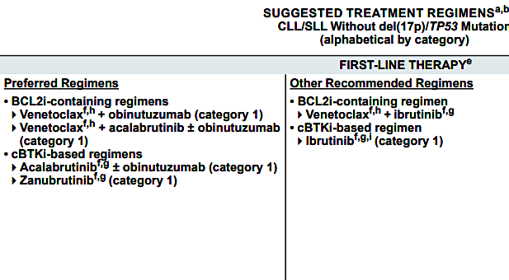
Current NCCN Guidance
SUGGESTED TREATMENT REGIMENS^{a,b}
CLL/SLL Without del(17p)ITP53 Mutation
(alphabetical by category)
NCCN Guidelines for CLL. V.3.2025.

Slide 22

Frontline BTKi vs. Ven + Obinutuzumab:
Factors to Consider
BTKi
Ven + Obin
Convenience (no infusions, TLS monitoring)
Long term efficacy data
Phase 3 data compared to FCR and BR
More data for efficacy of ven at time of BTKi progression
Potential for 1-year time-limited therapy
No known cardiac or bleeding risks
Less concern for long term adherence
Potential for cost-saving if 1-year of therapy is durable

Slide 23
BTK specific side effects
Cardiac Side Effects
  Atrial Fibrillation
  Hypertension
  Ventricular arrhythmias
Bruising / Bleeding
Arthralgias

Slide 24
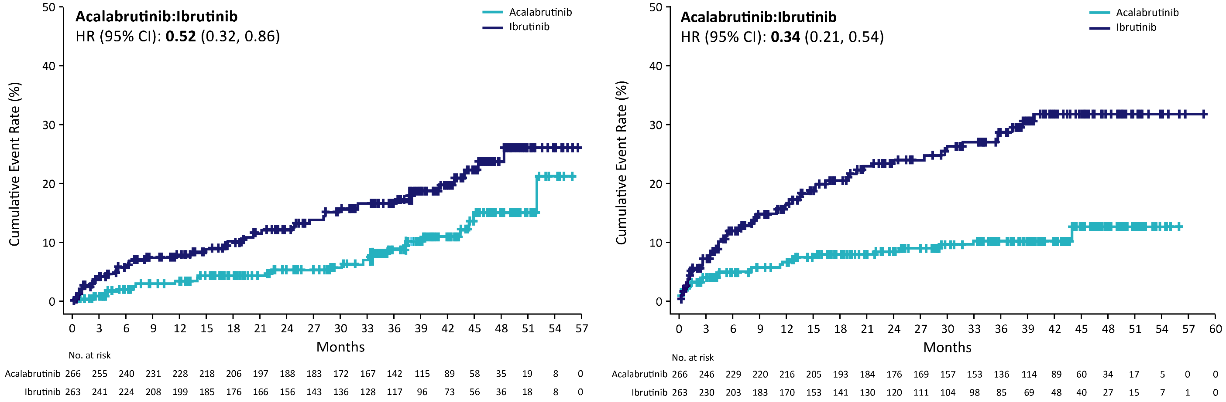
Lower Cumulative Incidences of Any Grade Atrial Fibrillation/Flutter and Hypertension With Acalabrutinib
Afib/Flutter
Hypertension
CI, confidence interval; HR, hazard ratio.
Byrd et al J Clin Oncol 2021 Nov 1;39(31):3441-3452.

Slide 25
Returning to the case above
Older, “typical” CLL patient with existing cardiac risk factors (hypertension/aspirin), but also some chronic kidney disease who needs therapy
Lives some distance away and relies on transportation
Indication for therapy
Mixed molecular features

Slide 26
Roundtable Discussion

Slide 27
BTK Inhibitors (Covalent)
Dr. Jackie Broadway-Duren

Slide 28
Nursing Considerations for Patients on BTKi
Patient conversations
  We discuss indications for the BTKi
  Discuss how it works and what to expect while receiving it

Slide 29
Laboratory data
WBC 52,000 with ALC 8.3
Hbg – 11.0 gm/dL, Plts – 110,000
Prognostic factors: mutated IgHV; FISH: 13q deletion; NGS: Negative
Symptoms: night sweats, increased fatigue 7/10 (MDASI scale)

Slide 30
Side Effects for BTKi Therapy (Covalent)
Ibrutinib (1st gen) | Acalabrutinib (2nd gen) | Zanubrutinib (2nd gen)
Atrial fibrillation (16%) Ventricular arrythmias (~10%) Sudden cardiac death Hypertension (23%) Arthralgias (40%) Muscle spasms/cramps (25%) Bleeding/bruising (51.3%) | Headache (~35%) Diarrhea (~35%) Cough/respiratory (~29%) Potential for bleeding/bruising arthralgias | A. Fib (2%) Hypertension (~11%) Neutropenia (34%) Upper respiratory infections (~24%) Low potential for bleeding
Cool, A., Nong, T., Montoya, S., & Taylor, J. (2024). BTK inhibitors: past, present, and future. Science Direct, 45(8), 691-707. https://doi.org/10.1016/j.tips.2024.06.006.

Slide 31
Start BTKi
  72 y/o female who was previously untreated who now presents for treatment recommendations due to progressing lymphadenopathy and WBC. PMH: hypertension, hypercholesterolemia
  After discussion of BTKi available, patient encouraged to start acalabrutinib
    Discuss possibility of headaches (usually transient with early weeks on therapy)
    Discussed minimal possibility of A. fib and management if occurs
  Patient developed a slight headache in 2nd week of therapy. HA resolved after a few days with a cup of coffee.
  Diarrhea – she developed “loose stools” for approximately 2-3 days of week 2, but symptoms resolved with loperamide.
  *Patient continues on Acala with further complaints of symptoms.

Slide 32
Advise on Toxicities with Initial Start of BTKi
WBC will increase initially due to mechanism of the drug – do not be alarmed with leukocytosis
Monitor blood pressure (keep log). Follow up with PCP or cardiologist
Muscle or joint pain
Be mindful of cardiac arrhythmias (A-fib)
  Report any heart palpitations, flutters, etc
  Report SOB

Slide 33
GI Toxicities with BTKis
Diarrhea – may be self-limiting
Loperamide – take as directed OTC
Avoid high fat diet
Avoid fruit and fruit juices
Encourage BRAT diet (bananas, rice, applesauce, toast)
Increase water intake to stay hydrated
Contact provider if diarrhea persists > 3 days

Slide 34
Management of BTKi Toxicity
Persistent, severe joint pains
  Stretching exercises
  Monitor and supplement potassium/magnesium (if indicated)
  Warm compresses
  Anecdotal: Apple cider vinegar (not a medical recommendation, but patients have had good results)
Atrial fibrillation – obtain baseline cardiac evaluation
  Beta blockers
  Monitor and record occurrences
  If A. fib persists despite β- blockers, may switch to another agent.

Slide 35
Neurological Toxicity
Headaches – primarily seen with Acalabrutinib
  Caffeine – coffee, coke, caffeine tablets (as indicated)
  Rest as needed and stay hydrated
  Cold compress to forehead
  Rule out other causes i.e., allergy related, sinusitis, head trauma, etc.

Slide 36
Changing BTKi(s)
Persistent A-fib (or other cardiac toxicity)
Progressive disease on BTKi
Persistent bleeding

Slide 37
Roundtable Discussion

Slide 38
Agenda
Introduction: Key Factors in the Management Patients with Chronic Lymphocytic Leukemia (CLL)
Module 1: Role of Covalent Bruton Tyrosine Kinase (BTK) Inhibitors for Newly Diagnosed CLL
Module 2: Role of Time-Limited Up-Front Treatment, Including Therapy Combining BTK Inhibitors and Venetoclax, for Newly Diagnosed CLL
Module 3: Role of Pirtobrutinib for Relapsed/Refractory (R/R) CLL
Module 4: CAR (Chimeric Antigen Receptor) T-Cell Therapy for R/R CLL

Slide 39
Clinical Scenario
A patient with newly diagnosed CLL is about to start treatment with a BTK inhibitor in combination with venetoclax

Slide 40
Considerations for the Treatment of Treatment-Naive CLL
Bita Fakhri, MD, MPH
Assistant Professor
Stanford University School of Medicine

Slide 41
Key Factors in Managing Patients With CLL
Timing of Therapy
Deciding when to
start therapy
  Many patients discovered incidentally; how to handle the “worried well”
  Comorbidities and fitness; where the patient is in their life cycle
Deciding when to
stop therapy
Key Prognostic Factors
The importance of
FISH, TP53, and mutational status of immunoglobulin genes
How to test for MRD
(ie, flow cytometry or molecular methods) and how to use it to guide clinical decision-making
Key Classes of Drugs
BTKi (eg, acalabrutinib, zanubrutinib, ibrutinib)
BCL2i (eg, venetoclax)
Anti-CD20 antibodies
(eg, rituximab, obinutuzumab)
Chemotherapy/
chemoimmunotherapy
(eg, chlorambucil, FCR, BR)

Slide 42
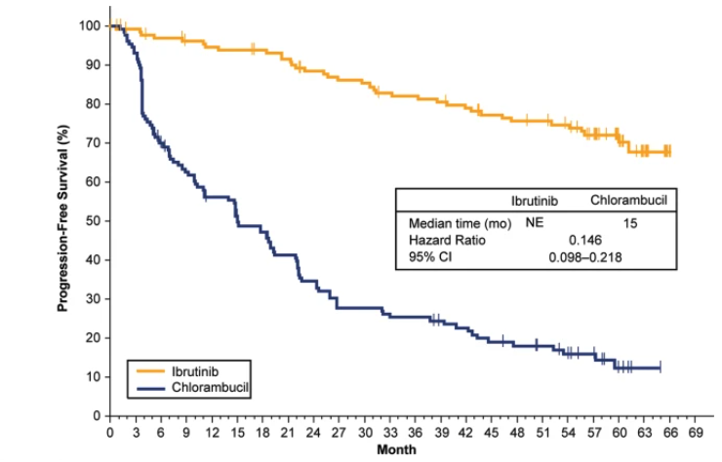
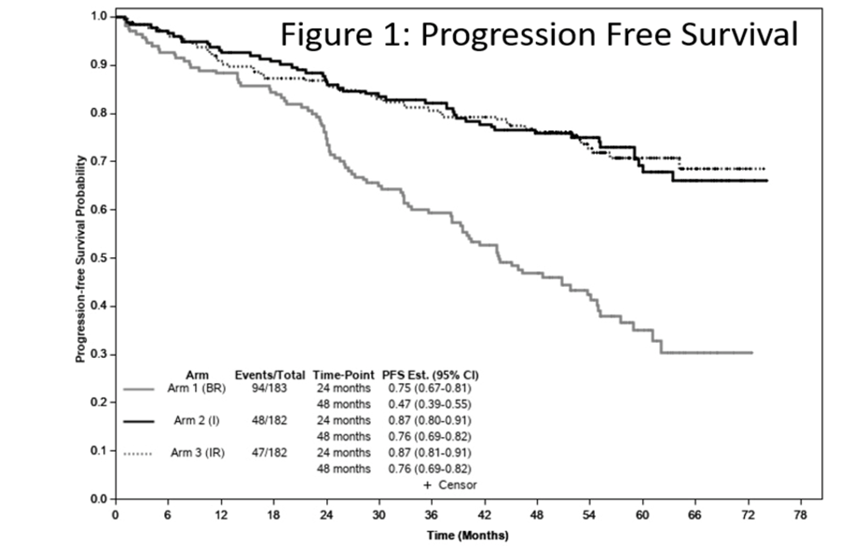
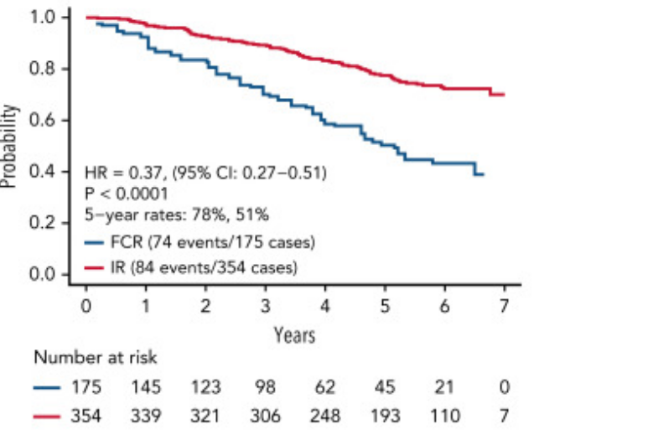
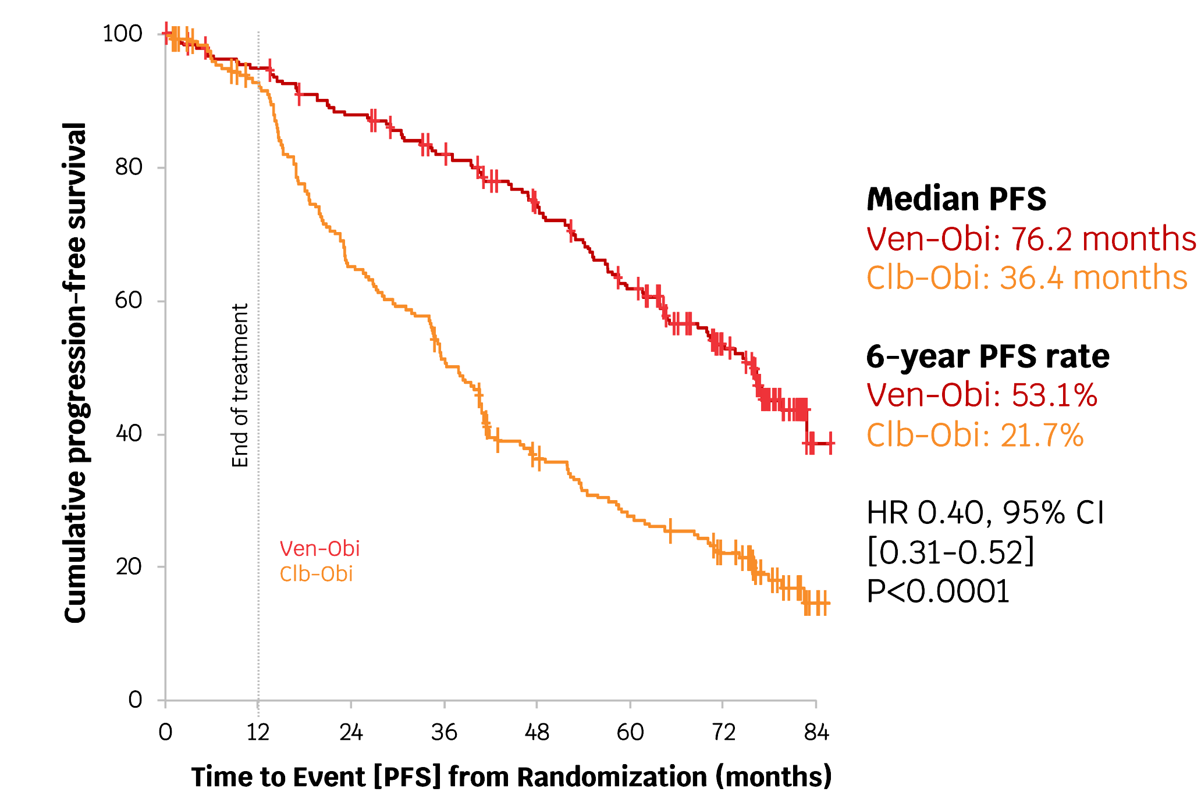
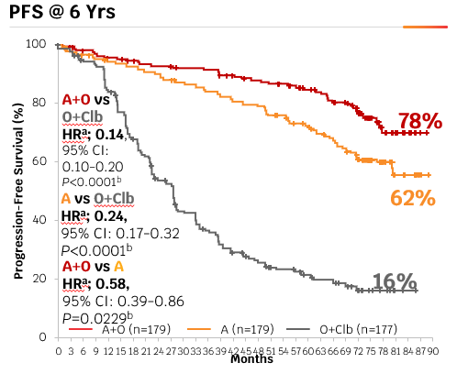
Background: Firstline chemotherapy is inferior to BTKis and Ven/Obi
RESONATE 2 (Ibrutinib v Chl) ALLIANCE (Ibrutinib vs Ibrutinib/rituximab v BR) E1912 (Ibrutinib/Rituximab v FCR)
CLL 14 (Ven-Obi vs Clb-Obi) ELEVATE – TN (Acala v Chl-Obin) SEQUOIA (Zanu v Benda-R)
80.1%
(74.3, 84.7)
75.8%
(69.0, 81.3)
PFS probability
BR
Zanubrutinib
Censored
44.6%
(37.6, 51.3)
40.1%
(32.7, 47.3)
Hazard ratio (95% CI): 0.29 (0.21, 0.40); P<.0001
1. Shanafelt. NEJM. 2019;381:432. 2. Woyach. NEJM. 2018;379:2517.
3. Burger. Leukemia. 2020 34:787

Slide 43
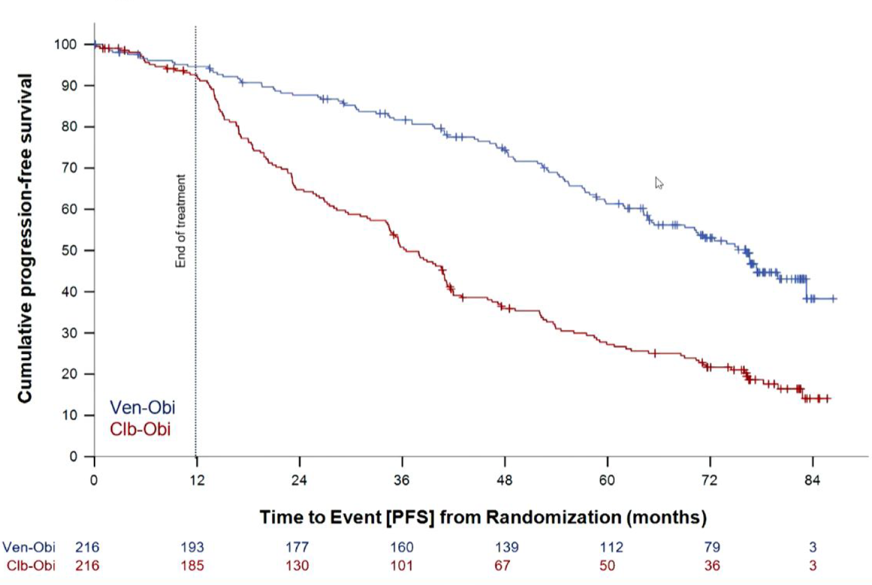
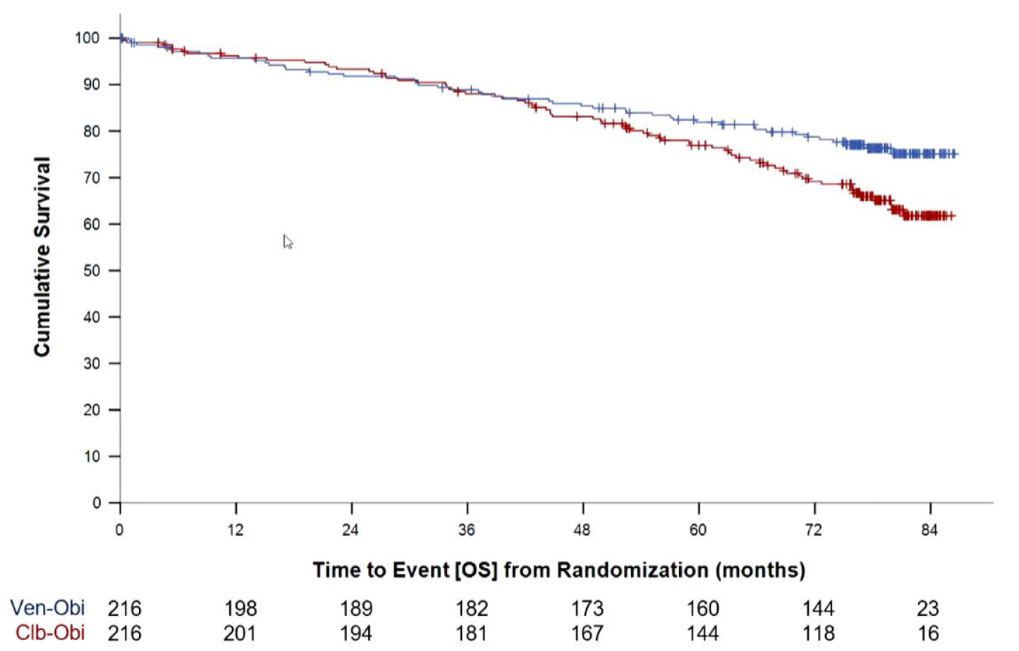

CLL14: 6-Year Follow-Up of Phase 3 Study of Venetoclax + Obinutuzumab vs Chlorambucil + Obinutuzumab – Study Design and Efficacy
Key Eligibility Criteria
Patients with TN CLL and coexisting
medical conditions
CIRS >6 and/or CrCl <70 mL/min
PFS
OS
End of treatment
RANDOMIZED
Venetoclax-Obinutuzumab (Ven-G)
(6 cycles) followed by
venetoclax (6 cycles)
Venetoclax-obinutuzumab
Chlorambucil-obinutuzumab
Venetoclax-obinutuzumab
Chlorambucil-obinutuzumab
1:1
Chlorambucil-Obinutuzumab (Clb-G)
(6 cycles) followed by
chlorambucil (6 cycles)
Median Follow-Up: 76.4 mo
Median PFS Ven-G: 76.2 months Clb-G: 36.4 months | 6-year PFS rate Ven-G: 53.1% Clb-G: 21.7%
HR 0.40 (95% Cl: 0.31-0.52) P<0.0001
Median OS Ven-G: not reached Clb-G: not reached | 5-year OS rate Ven-G: 78.7% Clb-G: 62.9%
HR 0.69 (95% Cl: 0.48-1.01) P=0.052
Primary endpoint PFS | Secondary endpoints Response MRD OS
Al-Sawaf O, et al. EHA 2023. Abstract S145.

Slide 44
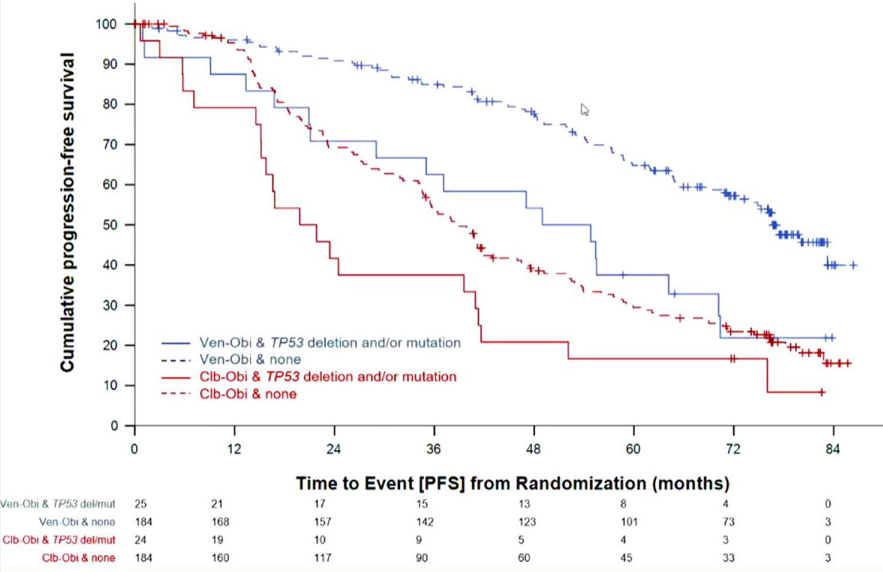
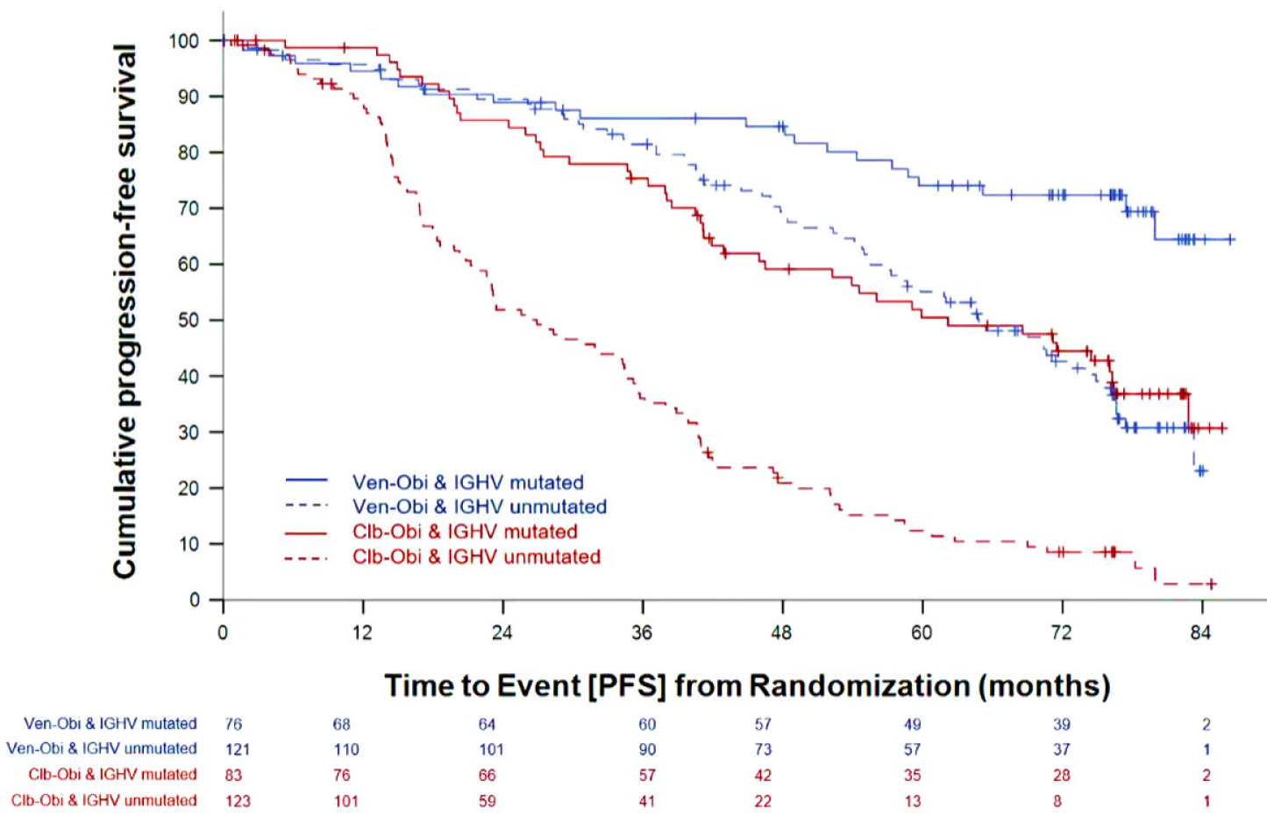
CLL14: 6-Year Follow-Up of Phase 3 Study of Venetoclax + Obinutuzumab vs Chlorambucil + Obinutuzumab – PFS by Mutational Status
PFS by TP53 Status
PFS by IGHV Status
Median PFS
Ven-G & no TP53 del/mut: 76.6 mo
Ven-G & TP53 del/mut: 51.9 mo
HR 2.29 (95% CI: 1.27-3.83), P=0.001
Clb-G & no TP53 del/mut: 38.9 mo
Clb-G & TP53 del/mut: 20.8 mo
HR 1.66 (95% CI: 1.05-2.63), P=0.03
Median PFS
Ven-G & IGHV-mut: NR
Ven-G & IGHV-unmut: 64.8 mo
HR 0.38 (95% CI: 0.23-0.61), P<0.001
Clb-G & IGHV-mut: 59.9 mo
Clb-G & IGHV-unmut: 26.9 mo
HR 0.33 (95% CI: 0.23-0.47), P<0.001
Al-Sawaf O, et al. EHA 2023. Abstract S145.

Slide 45
CLL14: 6-Year Follow-Up of Phase 3 Study of Venetoclax + Obinutuzumab vs Chlorambucil + Obinutuzumab – Safety
Most Frequent Grade ≥3 AEs,% | Ven-G (n=212) |  | Clb-G (n=214)
 | During treatment | After treatment | During treatment | After treatment
Neutropenia | 51.9 | 3.8 | 47.2 | 1.9
Thrombocytopenia | 14.2 | 0.5 | 15.0 | 0
Anemia | 7.5 | 1.9 | 6.1 | 0.5
Febrile neutropenia | 4.2 | 0.9 | 3.3 | 0.5
Leukopenia | 2.4 | 0 | 4.7 | 0
Pneumonia | 3.8 | 3.3 | 3.7 | 1.4
Infusion-related reaction | 9.0 | 0 | 9.8 | 0.5
TLS | 1.4 | 0 | 3.3 | 0
Secondary Primary Malignancies (SPM) | Ven-G (n=212) | Clb-G (n=214)
Overall total number of events,ª n | 31 | 20
Number of pts with ≥1 SPM, n (%) | 30 (14.2) | 18 (8.4)
Melanoma | 8 (3.8) | 4 (1.9)
Solid organ tumors | 17 (8.0) | 11 (5.1)
Hematological malignancies | 3 (1.4) | 2 (0.9)
Other | 2 (0.9) | 1 (0.5)
ª Excluding non-melanoma skin cancers.
Al-Sawaf O, et al. EHA 2023. Abstract S145.

Slide 46
Patient Case 1: 56-year-old Male with CLL
56-year-old male with CLL diagnosed 2 years ago (trisomy 12, unmutated IGHV) presents with 10% weight loss in six months, drenching night sweats and CBC showing continued decline in hemoglobin (10.2 – hemolysis labs negative) and platelet count of 73K. He currently experiences excessive fatigue to a level that has interfered with his activities of daily living.
No other comorbidities. He travels frequently and is interested in time-limited all-oral therapy.

Slide 47
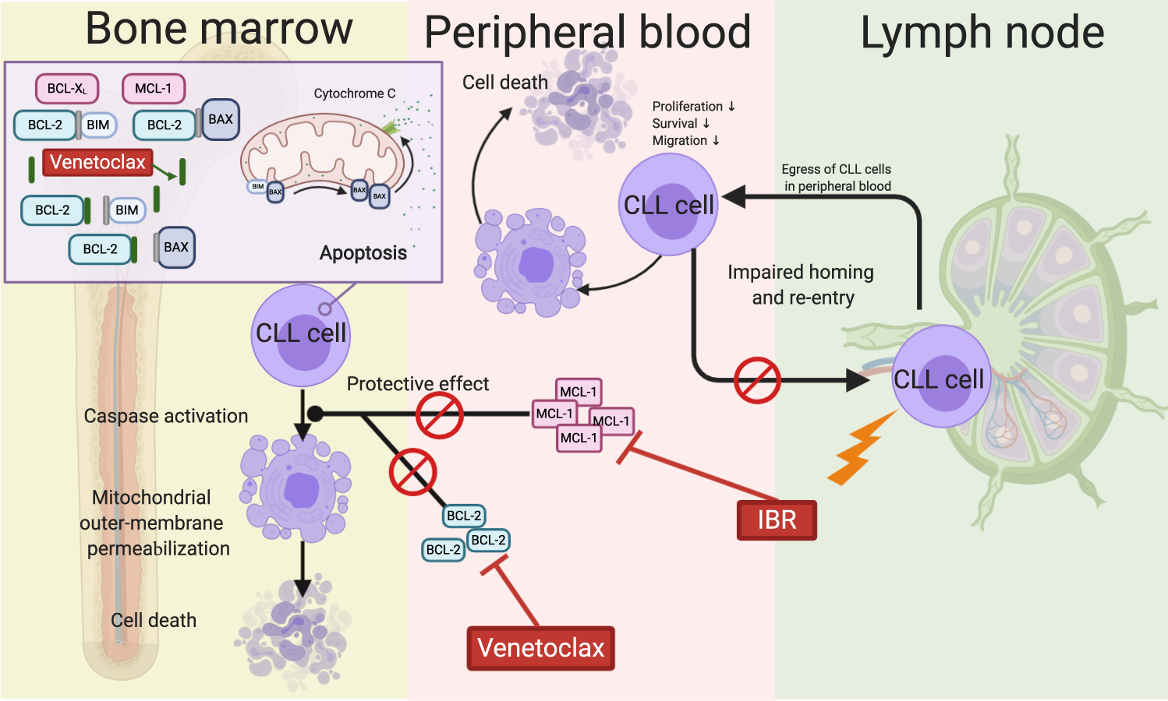
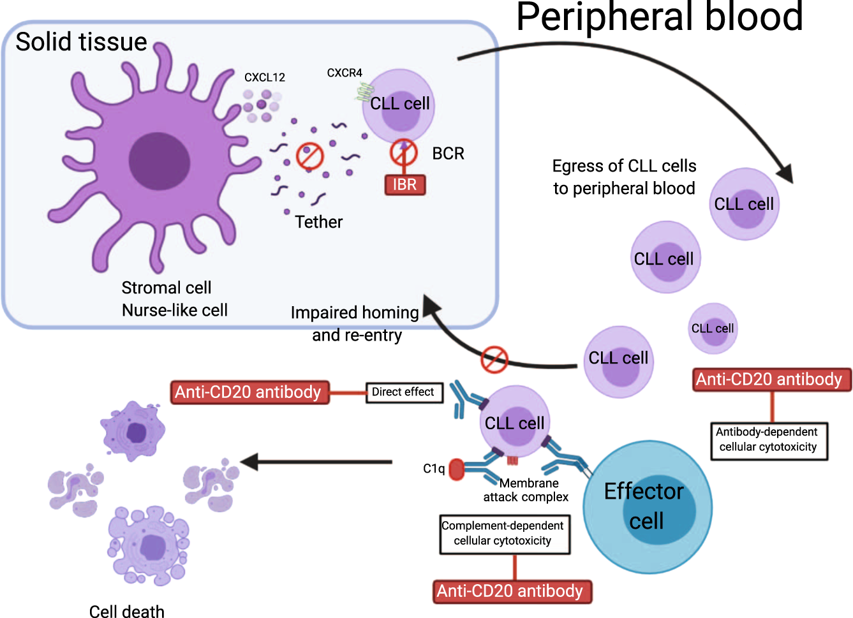
Combining Therapies: Rationale for Bruton Tyrosine Kinase Inhibitor (BTKi) and Venetoclax with or without Anti-CD20 Therapy
BTKi
BTKi
Timofeeva N, Gandhi V. Blood Cancer J 2021 April 29;11(4):79.

Slide 48
Combination cBTKi and BCL2i therapy in 1L CLL? AMPLIFY
AMPLIFY
Treatment-naive CLL
Age > 18y/o
ECOG: 0-2
Active disease per IWCLL 2018
criteria
Exclusion
del(17p), TP53
RANDOMIZE
1:1:1
Acalabrutinib + Venetoclax
Acalabrutinib + Venetoclax + Obinutuzumab
Chemo/IO (FCR or BR)
Primary endpoint: PFS (assessed by IRC)
AVO
83.1%
36-mo OS
94.1%
87.7%
85.9%
FCR/BR
AVO
AV
76.5%
FCR/BR
66.5%
AV
 | HR (95% CI) | P value
AV vs FCR/BR | 0.65 (0.49 to 0.87) | P = 0.0038
AVO vs FCR/BR | 0.42 (0.30 to 0.59) | P<0.0001
 | HR (95% CI) | P value
AV vs FCR/BR | 0.33 (0.18 to 0.56) | P<0.0001
AVO vs FCR/BR | 0.76 (0.49 to 1.18) | -
Patients at Risk
AV | 291 | 282 | 269 | 251 | 237 | 219 | 177 | 102 | 35 | 3 | 0
AVO | 286 | 272 | 258 | 237 | 225 | 219 | 191 | 116 | 51 | 7 | 0
FCR/BR | 290 | 236 | 208 | 189 | 170 | 154 | 127 | 66 | 28 | 6 | 0
Patients at Risk
AV | 291 | 286 | 281 | 277 | 275 | 270 | 233 | 142 | 58 | 10 | 0
AVO | 286 | 276 | 265 | 257 | 252 | 250 | 223 | 143 | 64 | 10 | 0
FCR/BR | 290 | 247 | 236 | 228 | 223 | 217 | 182 | 98 | 45 | 13 | 0
Median PFS was NR for AV and AVO, and was 47.6 mo for FCR/BR
Brown et. al. Fixed-Duration Acalabrutinib Plus Venetoclax with or without Obinutuzumab Versus Chemoimmunotherapy for First-Line Treatment of Chronic Lymphocytic Leukemia: Interim
Analysis of the Multicenter, Open-Label, Randomized, Phase 3 AMPLIFY Trial. ASH 2024; abstract 1009.

Slide 49
AMPLIFY: AEs of Clinical Interest
AV (n=291) |  |  | AVO (n=284) |  | FCR/BR (n=259)
 | Any Grade | Grade ≥3 | Any Grade | Grade ≥3 | Any Grade | Grade ≥3
Any ECI | 222 (76.3) | 136 (46.7) | 242 (85.2) | 188 (66.2) | 185 (71.4) | 141 (54.4)
Cardiac events | 27 (9.3) | 5 (1.7) | 34 (12.0) | 7 (2.5) | 9 (3.5) | 3 (1.2)
Atrial fibrillation | 2 (0.7) | 1 (0.3) | 6 (2.1) | 2 (0.7) | 2 (0.8) | 2 (0.8)
Ventricular tachyarrhythmiasª | 2 (0.7) | 0 | 3 (1.1) | 0 | 0 | 0
Hypertension | 12 (4.1) | 8 (2.7) | 11 (3.9) | 6 (2.1) | 7 (2.7) | 2 (0.8)
Hemorrhage | 94 (32.3) | 3 (1.0) | 86 (30.3) | 6 (2.1) | 11 (4.2) | 1 (0.4)
Major hemorrhage | 3 (1.0) | 3 (1.0) | 8 (2.8) | 6 (2.1) | 2 (0.8) | 1 (0.4)
Neutropenia (any)^{b} | 108 (37.1) | 94 (32.3) | 143 (50.4) | 131 (46.1) | 132 (51.0) | 112 (43.2)
Infections (any) | 148 (50.9) | 36 (12.4) | 153 (53.9) | 67 (23.6) | 82 (31.7) | 26 (10.0)
Second primary malignancies | 15 (5.2) | 5 (1.7) | 12 (4.2) | 5 (1.8) | 2 (0.8) | 0
Excl. non-melanoma skin | 8 (2.7) | 5 (1.7) | 7 (2.5) | 4 (1.4) | 1 (0.4) | 0
Tumor lysis syndrome | 1 (0.3) | 1 (0.3) | 1 (0.4) | 1 (0.4) | 8 (3.1) | 8 (3.1)
AV (n=291)
Brown et. al. Fixed-Duration Acalabrutinib Plus Venetoclax with or without Obinutuzumab Versus Chemoimmunotherapy for First-Line Treatment of Chronic Lymphocytic Leukemia: Interim Analysis of the Multicenter, Open-Label, Randomized, Phase 3 AMPLIFY Trial. ASH 2024; abstract 1009.

Slide 50
Comparison among Three Arms
 | A+V | AVO | FCR/BR
3-year PFS | 76% | 83% | 66%
ORR | 93% | 93% | 75%
Covid-19 deaths | 10 | 25 | 21
All deaths | 18 | 37 | 42
Brown et. al. Fixed-Duration Acalabrutinib Plus Venetoclax with or without Obinutuzumab Versus Chemoimmunotherapy for First-Line Treatment of Chronic Lymphocytic Leukemia: Interim Analysis of the Multicenter, Open-Label, Randomized, Phase 3 AMPLIFY Trial. ASH 2024; abstract 1009.

Slide 51
Key Conclusions from Amplify
Most likely AV will be FDA approved in the frontline setting.
Will FDA approve AVO based on mortality data??
Is AV better than OV? Majic trial will answer the question.

Slide 52
Future Directions in Upfront Therapy
Celestial-TN: OV vs Zanubrutinib and sonrotoclax
Majic trial: MRD-guided duration of therapy with OV vs AV

Slide 53
Roundtable Discussion

Slide 54
Nursing Considerations for Patients Receiving Time-Limited Up-Front Treatment
Corinne Hoffman, MS, APRN-CNP, AOCNP

Slide 55
Venetoclax + Obinutuzumab
Venetoclax:
  BCL-2 inhibitor
  Oral tablet
Obinutuzumab:
  Anti-CD20 antibody
  Intravenous infusion
Duration of therapy: 1 year
  Obinutuzumab, administered every 4 weeks, with the exception of the first cycle, for six cycles
  Venetoclax, 5-week dose ramp up followed by 400 mg daily through cycle 12
Venetoclax package insert, 7/2024

Slide 56
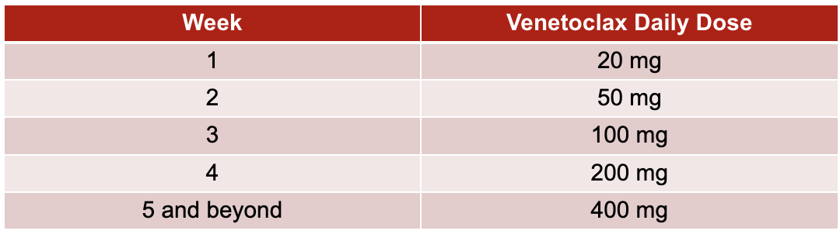
Venetoclax Dose Escalation
Venetoclax package insert, 7/2024

Slide 57

Venetoclax: Preparing to Start
Assess TLS risk
  Determine if inpatient or outpatient escalation
Hydration
Allopurinol
Consult with pharmacy, screen for medication interactions
  CYP3A interactions – Avoid strong and moderate inhibitors and inducers and determine if dose adjustments are needed
Venetoclax package insert, 7/2024

Slide 58
Assessing TLS Risk
Low
Lymph Nodes < 5 cm
AND
ALC <25 x 10⁹/L
Outpatient
High
Lymph Nodes ≥10 cm
OR
ALC ≥ 25 x 10⁹/L
and LN ≥ 5 cm
Inpatient for at least first two dose escalations
Medium
Lymph Nodes 5 cm
to < 10 cm
OR
ALC ≥ 25 x 10⁹/L
Outpatient
Venetoclax package insert, 7/2024

Slide 59
Venetoclax: Preparing to Start
Other factors that may impact in what setting medication is initiated:
  Tolerability of oral hydration
  Baseline renal function
  Baseline chemistry labs
Venetoclax package insert, 7/2024

Slide 60


Patient Education: Venetoclax + Obinutuzumab
Risk for infusion reaction (obinutuzumab)
  Pre-medications
Tumor Lysis Syndrome
  Explain rationale for 5-week dose ramp up
  Pre-dose labs, 6-8 hour and 24-hour post dose labs
  Stress importance of hydration
  Confirm patient is taking allopurinol or other antihyperuricemic

Slide 61

Patient Education: Venetoclax + Obinutuzumab
Diarrhea
  Loperamide as needed
  Grade severity, # stools/day
Nausea
  Antiemetic as needed
Neutropenia
  G-CSF support
  Dose interruption or reduction needed?
Fatigue
Infection
Thrombocytopenia
Venetoclax package insert, 7/2024

Slide 62
Patient Education: BTKi + Venetoclax
Discuss with patient the common of side effects of both BTKis and venetoclax
Potential for increased toxicities than with either agent alone but overall well tolerated
Neutropenia/infections
  Consider more frequent lab monitoring
  Consider prophylaxis
Potential for hold or dose reduction of one or both medications

Slide 63
Patient Case: BTKi + Venetoclax
58 year-old female
Treatment is recommended for her CLL due to progressive anemia and thrombocytopenia
Patient desires time-limited therapy
Has not historically been on many prescription medications and is anxious about starting therapy
Feels she can cope better knowing that treatment has an “end in sight”
Chooses an all oral approach with acalabrutinib + venetoclax over venetoclax + obinutuzumab (IV)
Patient is a caregiver for her mom who also has frequent medical appointments for a cancer diagnosis
Outside of the venetoclax ramp-up period, likes how this regimen will allow for shorter visits and potentially some more scheduling flexibility

Slide 64
Roundtable Discussion

Slide 65
Agenda
Introduction: Key Factors in the Management Patients with Chronic Lymphocytic Leukemia (CLL)
Module 1: Role of Covalent Bruton Tyrosine Kinase (BTK) Inhibitors for Newly Diagnosed CLL
Module 2: Role of Time-Limited Up-Front Treatment, Including Therapy Combining BTK Inhibitors and Venetoclax, for Newly Diagnosed CLL
Module 3: Role of Pirtobrutinib for Relapsed/Refractory (R/R) CLL
Module 4: CAR (Chimeric Antigen Receptor) T-Cell Therapy for R/R CLL

Slide 66
Clinical Scenario
A patient with CLL has experienced disease progression on a covalent BTK inhibitor and venetoclax and is about to start treatment with pirtobrutinib

Slide 67
Pirtobrutinib Data Review
Bita Fakhri, MD, MPH
Assistant Professor
Stanford University School of Medicine

Slide 68
Patient Case 2: 66 year old Male with CLL
66 year old male diagnosed with CLL in 2019 after being admitted with significant abdominal pain due to retroperitoneal lymphadenopathy. FISH: del(17p) and mutated IGHV.
2019 OV → median PFS 3.5 years with rapidly progressive lymphadenopathy.
2022-2025 → acalabrutinib with recent cervical lymphadenopathy.
Now at 72 years of age, he is interested in oral therapy.

Slide 69
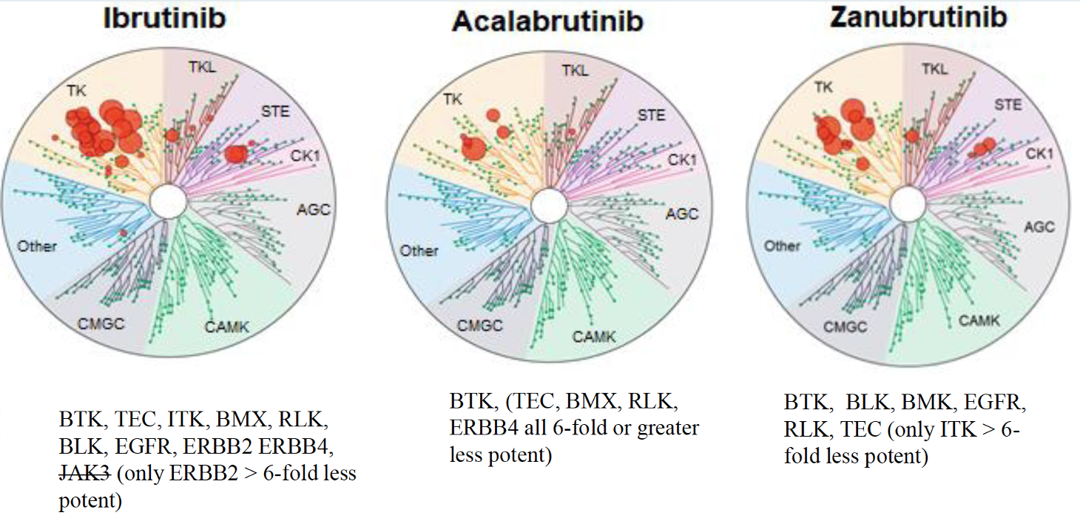
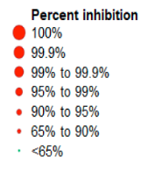
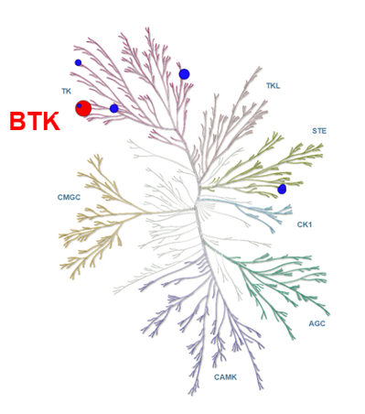
Irreversible and Reversible BTK Inhibitors for CLL
BTK inhibitor | Binding | T1/2 (hours) | IC50 (nM) | Dosing
Ibrutinib | Covalent irreversible C481 | 4-8 | 0.5 | 420 mg
Acalabrutinib | Covalent irreversible C481 | 0.9 | 5.1 | 100 mg BID
Zanubrutinib | Covalent irreversible C481 | 2-4 | 0.5 | 160 or 320 mg BID
Pirtobrutinib | Noncovalent reversible | Not available | 0.85 | 200 mg
Irreversible
Reversible
Pirtobrutinib (LOXO-305)
BID = twice a day
Robak T et al. Cancers 2022 February 2;14(3):771.

Slide 70
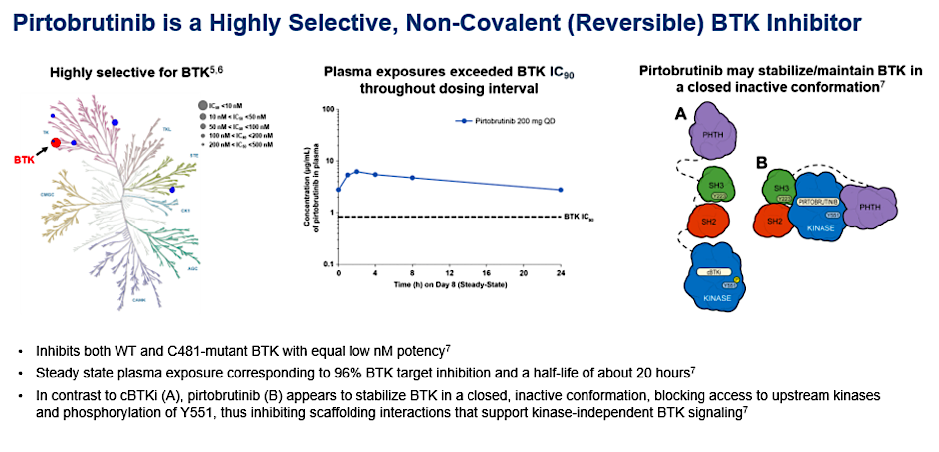
Woyach et al; ASH 2023

Slide 71
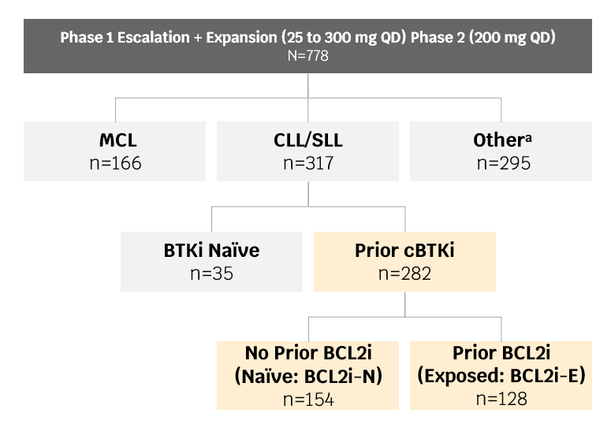

Pirtobrutinib currently approved post cBTKi and BCL2i based on BRUIN
ORR
Prior cBTKi | n=282^{b}
ORRª incl. PR-L, %(95% CI) | 81.6 (76.5-85.9)
Best Response, n (%)
CR | 5 (1.8)
nPR | 2 (0.7)
PR | 196 (69.5)
PR-L | 27 (9.6)
BRUIN Phase 1/2 Study Design
% Change in Sum of Products of Diameters from Baseline
Eligibility: Age ≥18, ECOG PS 0-2, Active disease and in need of treatment, Previously treated
PFS
PFS Probability (%)
84.9%
67.4%
Median | 95% CI
19.4 months | 16.6-22.1
52.8%
38.6%
Key endpoints: Safety/tolerability, Determine MTD and RP2D, Pharmacokinetics, Efficacy (ORR according to iwCLL 2018 criteria, DoR, PFS, and OS)
Months from first dose
Woyach et. al., Pirtobrutinib in Post-cBTKi CLL/SLL: ~30 Months Follow-up and Subgroup Analysis With/Without Prior BCL2i from the Phase 1/2 BRUIN Study. ASH 2023 Oral Presentation

Slide 72
BRUIN CLL-321 Study Design
Patients with
CLL/SLL previously treated with cBTKi
Stratified by:
17p deletion (yes/no) Prior venetoclax (yes/no)
Pirtobrutinib Monotherapy
200mg PO QD
R
1:1
Optional Crossover (PD confirmed by IRC)^{d}
IdelaR/BR
Idelalisib + Rituximabª
Bendamustine + Rituximab^{b,c}
Key Eligibility
Key Endpoints
Age ≥18
ECOG PS 0-2
Confirmed CLL/SLL requiring treatment per iwCLL 2018
Prior cBTKi required
No limit on prior lines of therapy
Prior history of atrial fibrillation allowed
Primary Endpoint: PFS assessed by IRC
PFS assessed by investigator
Event-Free Survival
Time to Next Treatment
Overall survival
Safety
Treatment was given in 28-day cycles. PFS assessed based on iwCLL2018. ªIdelalisib dosed at 150mg PO BID. Day 1 of cycle 1, first dose of rituximab at 375 mg/m², next 4 infusions at 500 mg/m² every 2 weeks, next 3 infusions at 500 mg/m² every 4 weeks. ^{b}Bendamustine (70 mg/m² ) administered IV D1, D2 of cycles 1-6. ^{c}Day 1 of cycle 1, first dose of rituximab at 375 mg/m², next 5 infusions day 1 of cycle 2 through cycle 6 at 500 mg/m². ^{d}Eligible patients receiving investigator’s choice of IdelaR/BR could crossover to receive pirtobrutinib monotherapy upon confirmation of PD by IRC per protocol. Abbreviations: BID, twice daily; BR, bendamustine + rituximab; cBTKi, covalent Bruton tyrosine kinase inhibitor; CLL, chronic lymphocytic leukemia; ECOG PS, Eastern Cooperative Oncology Group Performance Status; IdelaR, idelalisib + rituximab; IRC, Independent Review Committee; iwCLL, international workshop on chronic lymphocytic leukemia; mg, milligram; PD, progressive disease; PFS, progression-free survival; PO, by mouth; QD, once daily; R, randomized; SLL, small lymphocytic lymphoma.
Sharman et. al. ASH 2024. Abstract 886.

Slide 73
BRUIN CLL-321: IRC-Assessed Progression-free Survival
 | Pirtobrutinib n=119 | IdelaR/BR n=119
Number of Events, n (%) | 74 (62) | 79 (66)
Median PFS, mo (95% CI) | 14.0 (11.2-16.6) | 8.7 (8.1-10.4)
Median follow-up, mo | 19.4 | 17.7
Hazard ratio (95% CI) | 0.54 (0.39-0.75)
Stratified log-rank 2-sided p-value | 0.0002*
Pirtobrutinib
Study met primary endpoint at earlier data cut (Aug 2023) IRC HR=0.58
(95% CI 0.38-0.89); p=0.01
IdelaR/BR
Pirtobrutinib reduced risk of progression or death by 46% according to IRC assessment
Number at risk
 | 119 | 113 | 100 | 84 | 79 | 69 | 54 | 44 | 36 | 19 | 12 | 10 | 4 | 3 | 3 | 3 | 2 | 0
 | 119 | 92 | 73 | 60 | 57 | 37 | 25 | 18 | 16 | 10 | 7 | 5 | 3 | 1 | 0 | 0 | 0 | 0
*nominal p-value. Abbreviations: BR, bendamustine + rituximab; CI, confidence interval; HR, hazard ratio (pirtobrutinib vs. IdelaR/BR); IdelaR, idelalisib + rituximab; IRC, Independent Review Committee; mo, months; PFS, progression-free survival.
Sharman et. al. ASH 2024. Abstract 886.

Slide 74
BRUIN CLL-321: Key Secondary Endpoints
TTNT
OS
EFS
OS Probability (%)
EFS Probability (%)
Probability of Remaining
Free of Next Treatment (%)
Pirtobrutinib
Pirtobrutinib
Pirtobrutinib
IdelaR/BR
IdelaR/BR
IdelaR/BR
Crossover Rate: 76% (50/66ª)
 | Pirtobrutinib n=119 | IdelaR/BR n=119
Number of Events, n (%) | 77 (65) | 94 (79)
m EFS, mo (95% CI) | 14.1 (11.4-17.0) | 7.6 (4.8-8.8)
mfollow-up, mo | 19.4 | 18.7
Hazard ratio (95% CI) | 0.39 (0.28-0.53)
Stratified log-rank 2-sided p-value | <0.0001*
 | Pirtobrutinib n=119 | IdelaR/BR n=119
Number of Events, n (%) | 54 (45) | 82 (69)
mTTNT, mo (95% CI) | 24.0 (17.8-29.7) | 10.9 (8.7-12.5)
mfollow-up, mo | 20.0 | 20.2
Hazard ratio (95% CI) | 0.37 (0.25-0.52)
Stratified log-rank 2-sided p-value | <0.0001*
 | Pirtobrutinib n=119 | IdelaR/BR n=119
Number of Events, n (%) | 38 (32) | 32 (27)
18-mo OS rate, % (95% CI) | 73.4 (63.9-80.7) | 70.8 (60.9-78.7)
mfollow-up, mo | 20.4 | 19.2
Hazard ratio (95% CI) | 1.09 (0.68-1.75)
Stratified log-rank 2-sided p-value | 0.7202
Sharman et. al. ASH 2024. Abstract 886.

Slide 75
Adverse Events of Interest for Pirtobrutinib
Adverse Events of Interestª (AEI) | Pirtobrutinib (n=116)
 | Any grade n (%) | Grade 3+ n (%)
Bleeding | 25 (21.6) | 4 (3.4)
Bruising | 9 (7.8) | 1 (0.9)
Petechiae and purpura | 6 (5.2) | 1 (0.9)
Hemorrhage | 18 (15.5) | 3 (2.6)
Anemia | 24 (20.7) | 13 (11.2)
Neutropenia | 31 (26.7) | 24 (20.7)
Thrombocytopenia | 11 (9.5) | 9 (7.8)
Infection | 74 (63.8) | 34 (29.3)
Infection without Covid-19 | 67 (57.8) | 30 (25.9)
Atrial fibrillation and atrial flutter | 3 (2.6)ª | 2 (1.7)
Hypertension | 8 (6.9) | 3 (2.6)
ª2 of 3 patients with atrial fibrillation had a past medical history of atrial fibrillation
ªTreatment-emergent adverse events. ⁵Mato et al.NEJM 2023;389:33-44.
Sharman et. al. ASH 2024. Abstract 886.

Slide 76
Pirtobrutinib Clinical Development Plan in CLL
Previously Treated CLL/SLL or NHL
Previously Treated CLL/SLL
BTKi-Naïve CLL/SLL
Phase 1/2: BRUIN
Previously Treated CLL/SLL or NHL
Pirtobrutinib Monotherapy (Ph 1/2)
Pirtobrutinib + Venetoclax +/- Rituximab (Ph 1b)
• Estimated Enrollment: 860
• Identifier: NCT03740529
Phase 3: BRUIN CLL-321
Previously Treated (must include BTKi) CLL/SLL
Pirtobrutinib vs. Investigator’s Choice of Idelalisib + Rituximab or Bendamustine + Rituximab (Optional Crossover)
• Estimated Enrollment: 250
• Identifier: NCT04666038
Phase 3: BRUIN CLL-313
Previously Untreated CLL/SLL
Pirtobrutinib vs. Bendamustine + Rituximab
(Optional Crossover)
• Estimated Enrollment: 250
• Identifier: NCT05023980
Phase 3: BRUIN CLL-322
Previously Treated (may include BTKi) CLL/SLL
Fixed Duration Pirtobrutinib + Venetoclax + Rituximab vs. Venetoclax + Rituximab
• Estimated Enrollment: 600
• Identifier: NCT04965493
Phase 3: BRUIN CLL-314
Previously Untreated or Previously Treated (non-BTKi) CLL/SLL
Pirtobrutinib vs. Ibrutinib
• Estimated Enrollment: 650
• Identifier: NCT05254743
BTKi=Bruton tyrosine kinase inhibitor; CLL=chronic lymphocytic leukemia; NHL=non-Hodgkin lymphoma; Ph=phase; SLL= small lymphocytic lymphoma.
1. ClinicalTrials.gov identifier: NCT03740529. https://www.clinicaltrials.gov/ct2/show/NCT03740529.
2. ClinicalTrials.gov identifier: NCT04666038. https://www.clinicaltrials.gov/ct2/show/NCT04666038.
3. ClinicalTrials.gov identifier: NCT04965493. https://www.clinicaltrials.gov/ct2/show/NCT04965493.
4. ClinicalTrials.gov identifier: NCT04662255. https://www.clinicaltrials.gov/ct2/show/NCT04662255.
5. ClinicalTrials.gov identifier: NCT05023980. https://www.clinicaltrials.gov/ct2/show/NCT05023980.
6. ClinicalTrials.gov identifier: NCT05254743. https://www.clinicaltrials.gov/ct2/show/NCT05254743.

Slide 77
Roundtable Discussion

Slide 78
Nursing Considerations for Patients Receiving Pirtobrutinib
Corinne Hoffman, MS, APRN-CNP, AOCNP

Slide 79
Patient Education: Pirtobrutinib
Noncovalent (reversible) BTKi
  Explain that it binds BTK differently than the covalent BTKi they were previously taking, allowing it to have activity despite the presence of a known resistance mutation
Approved for adults who have been on two prior lines of CLL therapy, including BTKi and BCL-2 inhibitor
Overall similar side effect profile as BTKi they were previously taking but remind them of the most common adverse effects
Once daily dosing
Pirtobrutinib package insert, 6/2024

Slide 80
Patient Education: Pirtobrutinib
Bleeding
Atrial Fibrillation
Infection
Cytopenias
Musculoskeletal pain
Diarrhea
Fatigue

Slide 81
Pirtobrutinib: Side Effects
Bleeding
  Monitor patient for signs of bleeding, especially if on concurrent anticoagulation
  Instruct patient to inform provider about any upcoming procedures
  Consider hold of 3 to 7 days depending upon type of surgery and bleeding risk
Atrial fibrillation
  Monitor for and educate patient on signs and symptoms of arrhythmia
  3.6% incidence (all grade)
  New onset
    Cardiology consult
    Anticoagulation indicated?
    Rate and/or rhythm control
      Achieve prior to resuming treatment
Pirtobrutinib package insert, 6/2024

Slide 82
Pirtobrutinib: Side Effects
Infection
  Encourage patients to report fever and other signs and symptoms of infection promptly
  Consider prophylaxis in high-risk individuals
  Vaccination
Cytopenias
  Hold therapy or dose reduce depending on severity
Pirtobrutinib package insert, 6/2024

Slide 83
Pirtobrutinib: Side Effects
Diarrhea
  Usually self limited and manageable
  Loperamide PRN
Musculoskeletal Pain
  Acetaminophen
  Avoid NSAIDs when possible due to heightened bleeding risk

Slide 84
Roundtable Discussion

Slide 85
Agenda
Introduction: Key Factors in the Management Patients with Chronic Lymphocytic Leukemia (CLL)
Module 1: Role of Covalent Bruton Tyrosine Kinase (BTK) Inhibitors for Newly Diagnosed CLL
Module 2: Role of Time-Limited Up-Front Treatment, Including Therapy Combining BTK Inhibitors and Venetoclax, for Newly Diagnosed CLL
Module 3: Role of Pirtobrutinib for Relapsed/Refractory (R/R) CLL
Module 4: CAR (Chimeric Antigen Receptor) T-Cell Therapy for R/R CLL

Slide 86
Clinical Scenario
A patient with CLL has experienced disease progression on a covalent BTK inhibitor, venetoclax and pirtobrutinib and has recently been referred for CAR T-cell therapy

Slide 87
CLL: Other Treatment Options
Jeff Sharman M.D.
Medical Director of Hematology Research
Willamette Valley Cancer Institute & Sarah Cannon

Slide 88
CLL – Therapies in heavily pre-treated
67-year-old, diagnosed at age 60 with high-risk disease (IgHV unmutated, Del17P). Bulky nodes, initial presentation meeting indication for therapy
Initially treated with ibrutinib, 3.5 years later had PD
Treated at that time with rituximab / venetoclax – responded to treatment but then PD at two years.
Enrolled on pirtobrutinib study with reasonably controlled disease, but now progressing – now what?

Slide 89
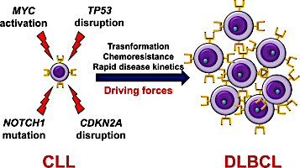
Richter’s Syndrome: What is it?

Slide 90
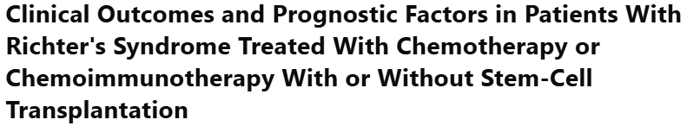
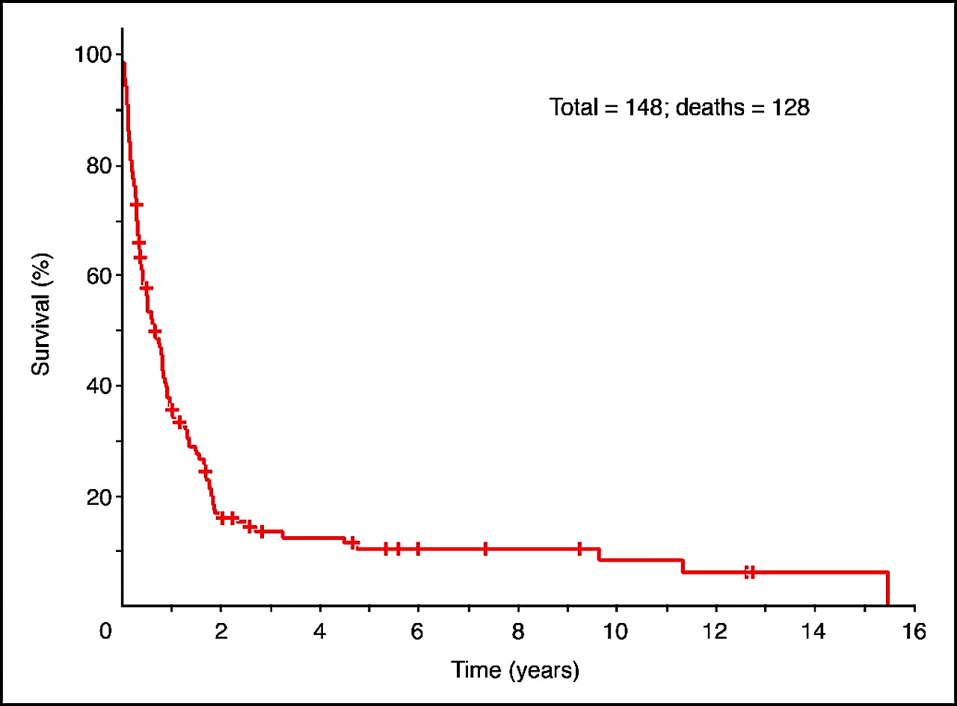
Richter’s Syndrome
R-CHOP
DA-R-EPOCH
Transplant
CAR-T

Slide 91
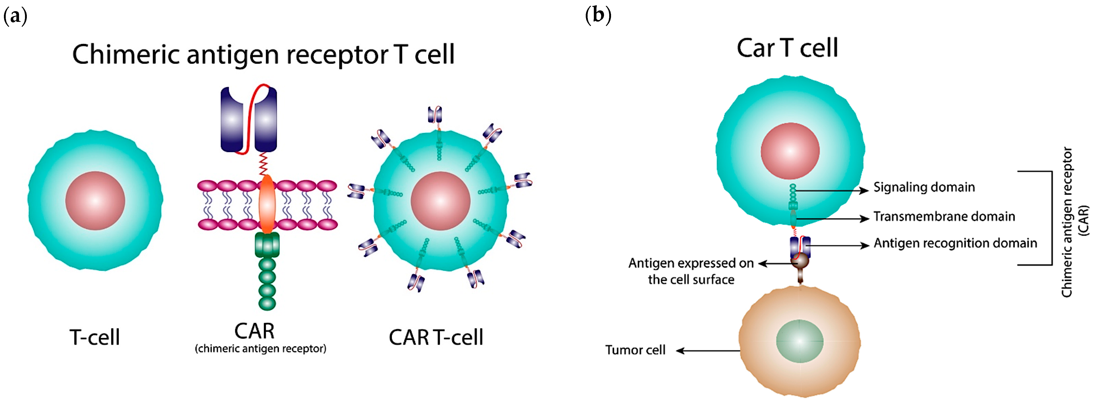
CAR-T: What is it?

Slide 92
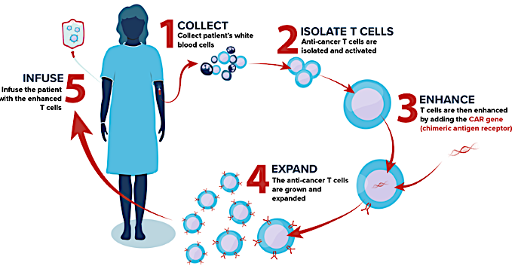
CAR-T: How do we do it?

Slide 93
CAR-T in CLL
FDA Approves Liso-Cel for Relapsed/Refractory CLL/SLL
March 14, 2024
The FDA has granted accelerated approval of lisocabtagene maraleucel (liso-cel), a CD19-directed chimeric antigen receptor (CAR) T cell therapy, for the treatment of adult patients with relapsed or refractory chronic lymphocytic leukemia (CLL) or small lymphocytic lymphoma (SLL) who have received at least two prior lines of therapy, including a Bruton tyrosine kinase (BTK) inhibitor and a B-cell lymphoma 2 (BCL-2) inhibitor.
This indication is approved under accelerated approval based on response rate and duration of response. Continued approval for this indication may be contingent upon verification and description of clinical benefit in confirmatory trial(s).
https://news.bms.com/news/details/2024/U.S.-FDA-Approves-Bristol-Myers-Squibbs-Breyanzi--as-the-First-and-Only-CAR-T-Cell-Therapy-for-Adults-with-Relapsed-or-Refractory-Chronic-Lymphocytic-Leukemia-CLL-or-Small-Lymphocytic-Lymphoma-SLL/default.aspx

Slide 94
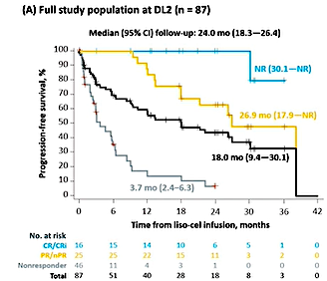
CAR-T in CLL: How well it works

Slide 95
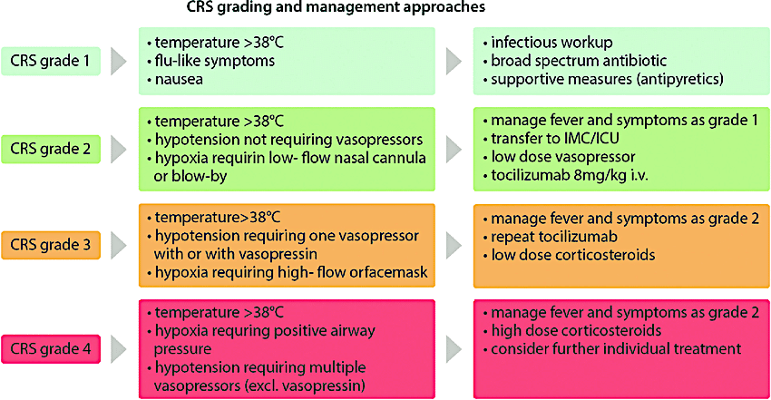
CRS
temperature >38˚C
hypotension not requiring vasopressors
hypoxia requiring low- flow nasal cannula or blow-by
temperature >38˚C
hypotension requiring one vasopressor with or without vasopressin
hypoxia requiring high- flow or facemask

Slide 96
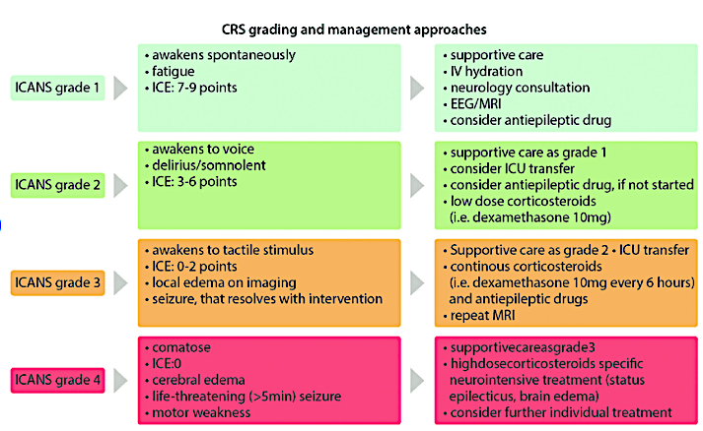
ICANS
ICANS grading and management approaches
supportive care as grade 3
high dose corticosteroids specific neurointensive treatments (status epilepticus, brain edema)
consider further individual treatment

Slide 97
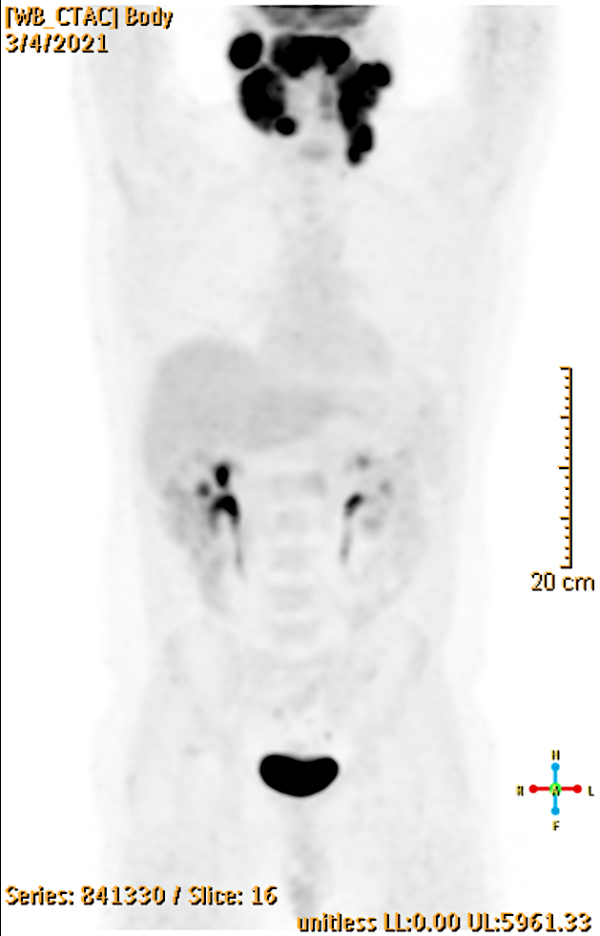
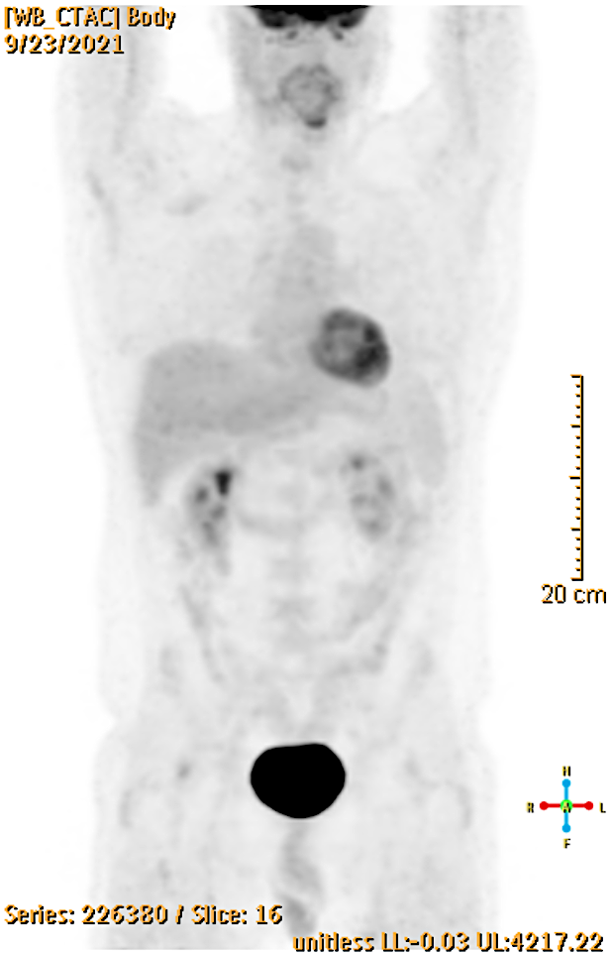
CLL with Richters: treated with CAR-T

Slide 98
CAR-T
When to refer?
What are the barriers?
Who are the patients?

Slide 99
Roundtable Discussion

Slide 100
CAR- T Cell Therapy in CLL
Dr. Jackie Broadway-Duren

Slide 101
Patient Education on CAR-T Cell Therapy
Discuss overview and mechanisms for CAR-T cell therapy
Process for CAR-T:
Chimeric Antigen Receptor (CAR) Modified T cells
Normal T cells are extracted from patients with indication for CART through process called leukopheresis.
T cells are then genetically engineered (in laboratory)
The altered T cells express an artificial receptor, CAR
The CAR-T cells are expanded to increase number of cells ~15 days
The patient receives chemotherapy to deplete lymphocytes
CAR-T cells are then infused into patient via IV infusion (inpt/outpt)

Slide 102
Patient Discussion
Patients are instructed on duration of hospitalization, usually 3-4 weeks
Patients instructed to plan to remain in close proximity to medical center for 2 weeks to 1 month

Slide 103
Adverse Effects with CAR-T cell Therapy
Cytokine release syndrome (CRS)
Myelosuppression
Fevers/Infections (20%-40%)
Risk of bleeding
Tumor Lysis Syndrome (TLS)
Mucositis
Skin rash
Hair loss
Nausea and vomiting
LLS, 2024

Slide 104
Neurotoxicity in CAR-T Cell Therapy
Immune Effector Cell-Associated Neurotoxicity Syndrome (ICANS) Language impairment (aphasia)
  Confusion
  Delirium
  Involuntary muscle twitching
  Hallucinations
  Unresponsiveness
  Seizures (cerebral edema)
  Neuro toxicity in most cases is reversible
  (LLS, 2024; Jain et al., 2023)

Slide 105
Management of CAR-T Cell Toxicities
CRS – may occur within 5 days
  Grade and manage accordingly
  Treatments for CRS:
    Toci – 80%
    Steroids – 75%
    Vasopressors – 40%
    Monoclonal antibody infusion (in extreme CRS).

Slide 106
Patient Case of Neurotoxicity/CRS Post CART
64 y/o female with refractory CLL s/p multiple lines of therapy.
Poor prognostic factors i.e, TP53
PMH: HTN, sarcoidosis
Admitted for CAR-T cell therapy
  Received lymphodepletion therapy with Fludarabine and Cyclophosphamide
  CAR-T cells infused on Day 1
    Developed fever and CRS within 5 days
    Treated for neutropenia
    Admitted to ICU due to grade 3 CRS – treated with Toci and high dose steroids
    Patient was hypotensive and received vasopressors
    Received rituximab on Day 10 due to prolonged neurotoxicity, etc

Slide 107
Monitoring Patients after CAR-T Therapy
In patient case, the CRS was reversed and the patient did well in the following weeks.
Patient remained in the medical center for next month with weekly follow up in outpatient clinic
Patient followed for 1-2 years depending on any neurological deficits.

