Slide 1
Cases from the Community: Investigators Discuss Available Research Guiding the Management of Relapsed/Refractory Multiple Myeloma — What Happened at ASH 2025?
A CME/MOC-Accredited Live Webinar
Monday, December 15, 2025 5:00 PM – 6:00 PM ET
Faculty
Sagar Lonial, MD, FACP, FASCO
María-Victoria Mateos, MD, PhD
Moderator
Neil Love, MD

Slide 2
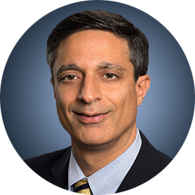
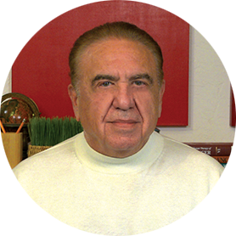
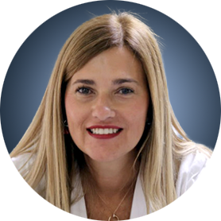
Faculty
Sagar Lonial, MD, FACP, FASCO
Chair and Professor
Department of Hematology and Medical Oncology
Chief Medical Officer
Winship Cancer Institute
Emory University School of Medicine
Atlanta, Georgia
MODERATOR
Neil Love, MD Research To Practice Miami, Florida
María-Victoria Mateos, MD, PhD
Consultant Physician in the Haematology Department
Associate Professor of Medicine
Director of the Myeloma Program
Clinical Trials Unit
University Hospital of Salamanca
Salamanca, Spain

Slide 3
Dr Lonial — Disclosures
Advisory Committees and Consulting Agreements | AbbVie Inc, Amgen Inc, Bristol Myers Squibb, Genentech, a member of the Roche Group, GSK, Janssen Biotech Inc, Novartis, Pfizer Inc, Regeneron Pharmaceuticals Inc, Takeda Pharmaceuticals USA Inc; Boards of Directors: TG Therapeutics Inc
Contracted Research | Bristol Myers Squibb, Janssen Biotech Inc, Novartis, Takeda Pharmaceuticals USA Inc
Stock Options/Stock — Public Companies | TG Therapeutics Inc

Slide 4
Dr Mateos — Disclosures
Advisory Committees and Speakers Bureaus | Amgen Inc, AstraZeneca Pharmaceuticals LP, Bristol Myers Squibb, GSK, Johnson & Johnson, Kite, A Gilead Company, Menarini Group, Oncopeptides, Pfizer Inc, Regeneron Pharmaceuticals Inc, Sanofi, Stemline Therapeutics Inc

Slide 5
Dr Love — Disclosures
Dr Love is president and CEO of Research To Practice. Research To Practice receives funds in the form of educational grants to develop CME activities from the following companies: Aadi Bioscience, AbbVie Inc, ADC Therapeutics, Agendia Inc, Alexion Pharmaceuticals, Amgen Inc, Array BioPharma Inc, a subsidiary of Pfizer Inc, Arvinas, Astellas, AstraZeneca Pharmaceuticals LP, Aveo Pharmaceuticals, Bayer HealthCare Pharmaceuticals, BeOne, Biotheranostics Inc, A Hologic Company, Black Diamond Therapeutics Inc, Blueprint Medicines, Boehringer Ingelheim Pharmaceuticals Inc, Bristol Myers Squibb, Celcuity, Clovis Oncology, Coherus BioSciences, Corcept Therapeutics Inc, CTI BioPharma, a Sobi Company, Daiichi Sankyo Inc, Eisai Inc, Elevation Oncology Inc, Exact Sciences Corporation, Exelixis Inc, Genentech, a member of the Roche Group, Genmab US Inc, Geron Corporation, Gilead Sciences Inc, GSK, Helsinn Therapeutics (US) Inc, ImmunoGen Inc, Incyte Corporation, Ipsen Biopharmaceuticals Inc, Jazz Pharmaceuticals Inc, Johnson & Johnson, Karyopharm Therapeutics, Kite, A Gilead Company, Kura Oncology, Legend Biotech, Lilly, MEI Pharma Inc, Merck, Mersana Therapeutics Inc, Mirati Therapeutics Inc, Mural Oncology Inc, Natera Inc, Novartis, Novartis Pharmaceuticals Corporation on behalf of Advanced Accelerator Applications, Novocure Inc, Nuvalent, Pfizer Inc, Pharmacyclics LLC, an AbbVie Company, Puma Biotechnology Inc, Regeneron Pharmaceuticals Inc, Rigel Pharmaceuticals Inc, R-Pharm US, Sanofi, Seagen Inc, Servier Pharmaceuticals LLC, SpringWorks Therapeutics Inc, Stemline Therapeutics Inc, Sumitomo Pharma America, Syndax Pharmaceuticals, Taiho Oncology Inc, Takeda Pharmaceuticals USA Inc, TerSera Therapeutics LLC, and Tesaro, A GSK Company.

Slide 6
Commercial Support
This activity is supported by an educational grant from GSK.
Research To Practice CME Planning Committee Members, Staff and Reviewers
Planners, scientific staff and independent reviewers for Research To Practice have no relevant conflicts of interest to disclose.

Slide 7
This educational activity contains discussion of non-FDA-approved uses of agents and regimens. Please refer to official prescribing information for each product for approved indications.

Slide 8
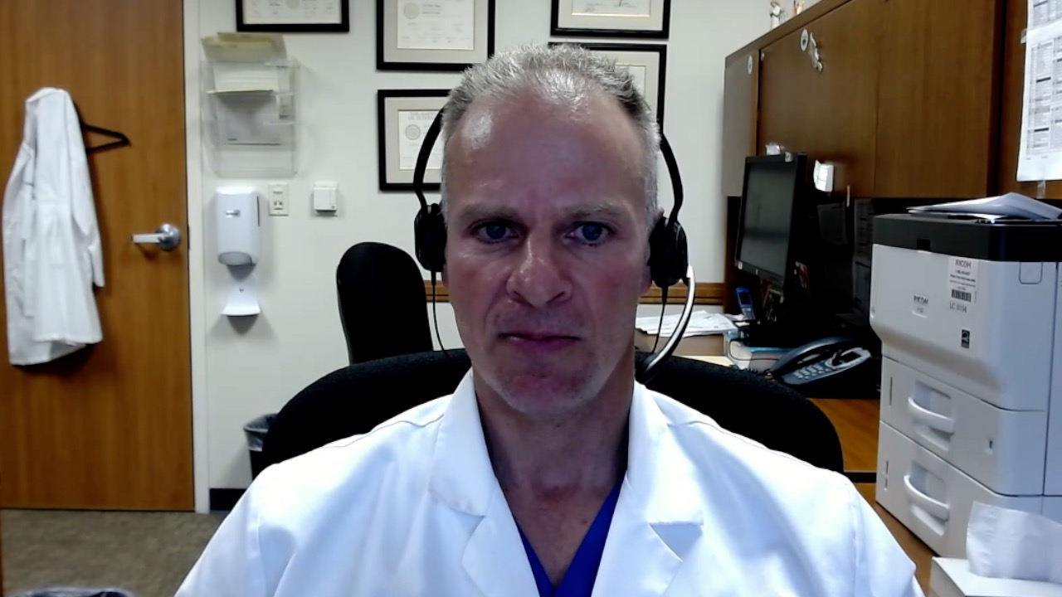
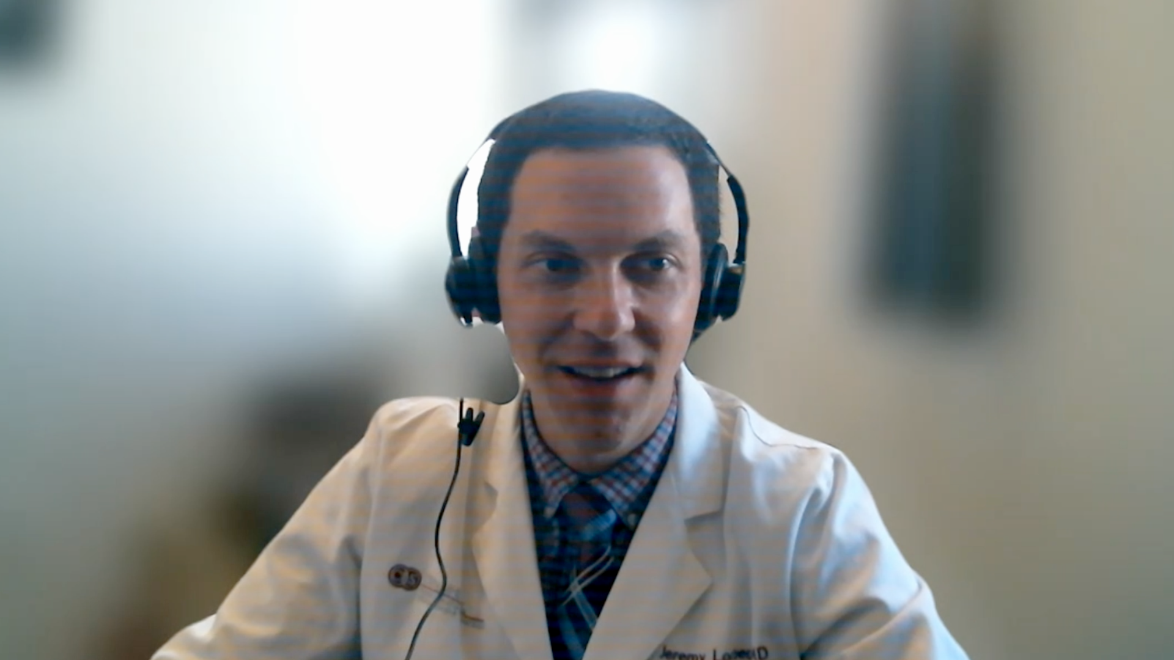
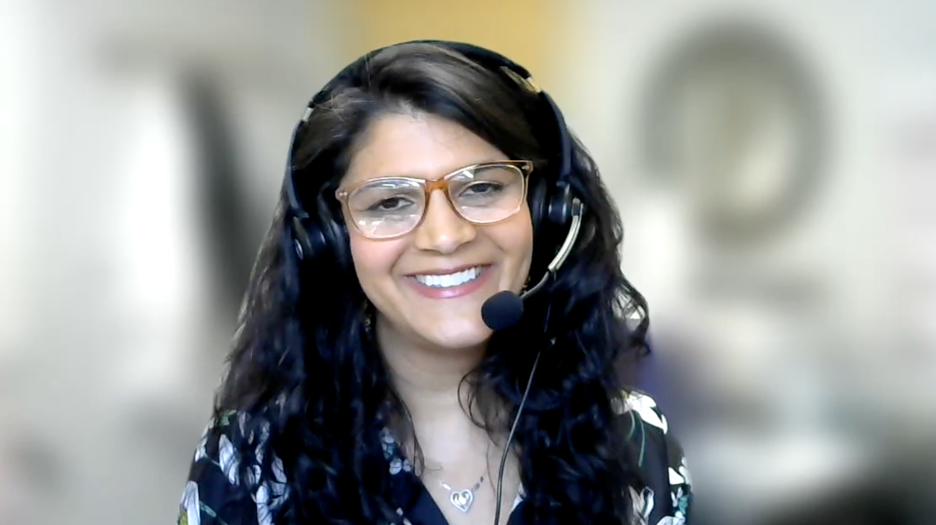
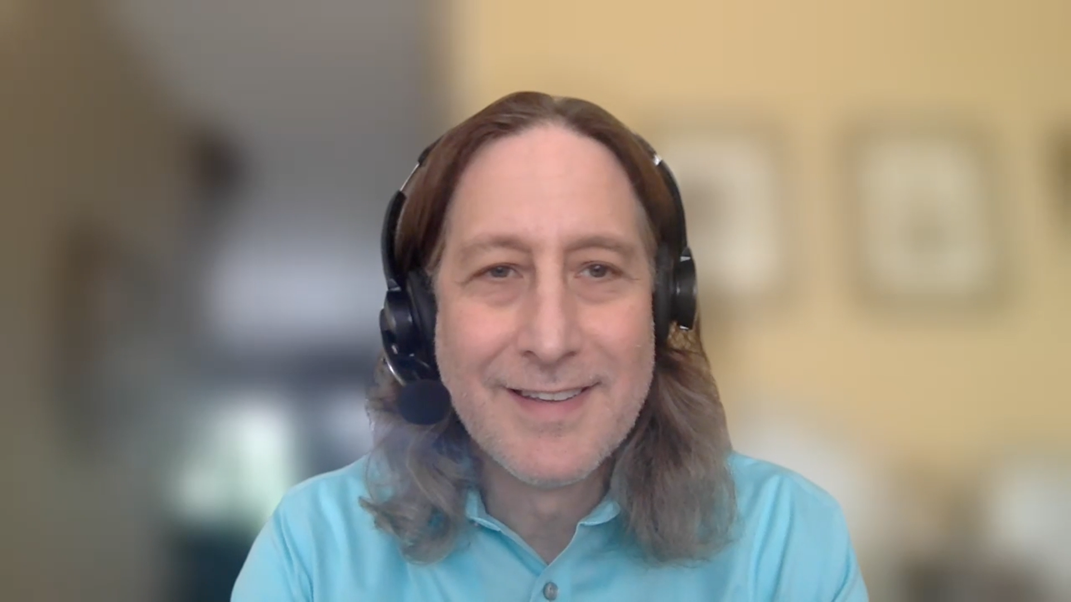
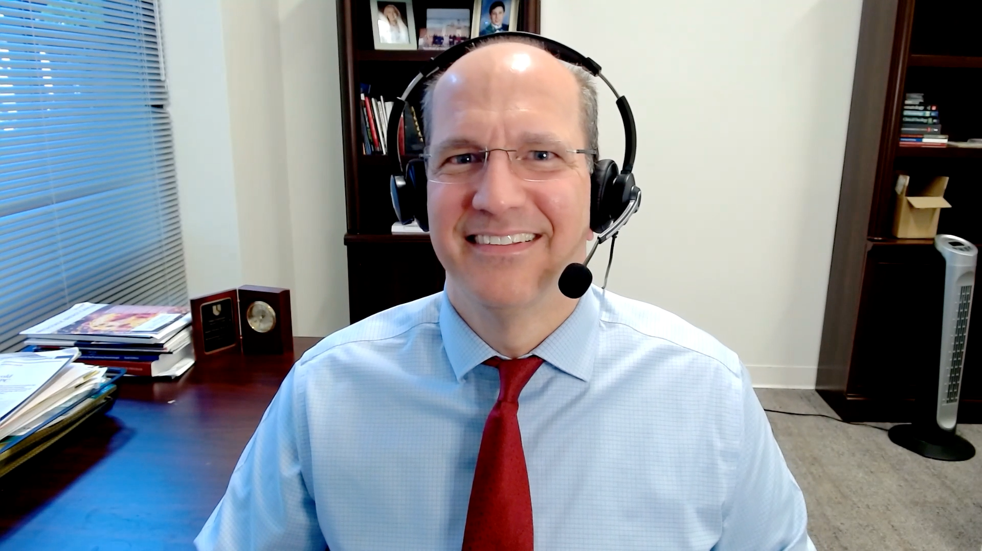
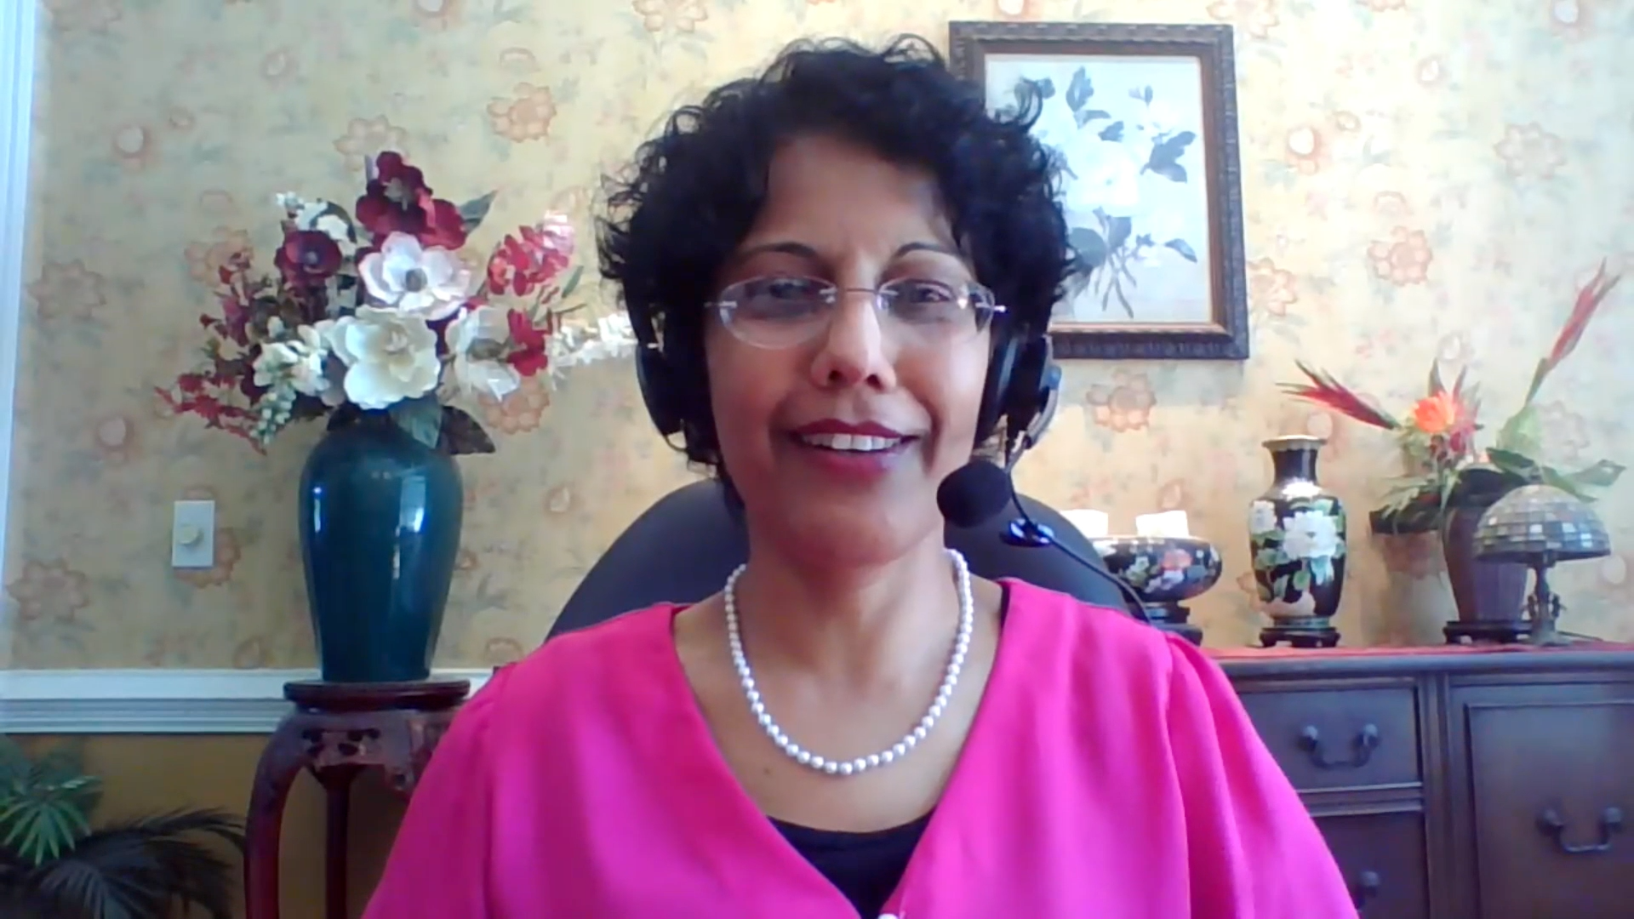
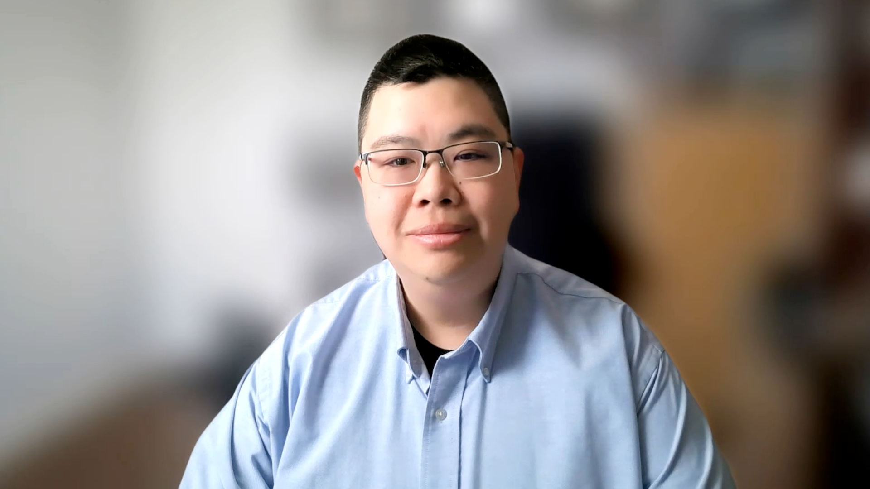
Contributing General Medical Oncologists
Warren S Brenner, MD
Lynn Cancer Institute
Boca Raton, Florida
Jeremy Lorber, MD
Cedars-Sinai Medical Center
Beverly Hills, California
Bhavana (Tina) Bhatnagar, DO WVU Cancer Institute
Wheeling, West Virginia
Neil Morganstein, MD
Atlantic Health System
Summit, New Jersey
Justin Favaro, MD, PhD
Oncology Specialists of Charlotte
Charlotte, North Carolina
Priya Rudolph, MD, PhD
Georgia Cancer Specialists
Athens, Georgia
Eric H Lee, MD, PhD
Los Angeles Cancer Network
Fountain Valley, California

Slide 9
Key Datasets
Sagar Lonial, MD
Hungria V et al. Long-term responders from the phase 3 DREAMM-7 study of belantamab mafodotin plus bortezomib and dexamethasone vs daratumumab plus bortezomib and dexamethasone in relapsed/refractory multiple myeloma. ASH 2025;Abstract 7236.
Trudel S et al. Deep responses and durable outcomes in patients treated with belantamab mafodotin plus pomalidomide and dexamethasone from long-term follow-up of the phase 3 DREAMM-8 study. ASH 2025;Abstract 7677.
Lonial S et al. Health-related quality of life with belantamab mafodotin in patients with relapsed or refractory multiple myeloma (RRMM): An exploratory analysis of overall quality of life in DREAMM-7. ASH 2025;Abstract 143.
Lonial S et al. Belantamab mafodotin (belamaf) ocular events are manageable and reversible with dose modifications guided by standard assessments. ASH 2025;Abstract 12045.
Usmani S et al. Belantamab mafodotin (belamaf) in combination with bortezomib, lenalidomide, and dexamethasone (VRd) for patients (pts) with transplant-ineligible (TI) newly diagnosed multiple myeloma (NDMM): A focus on treatment efficacy and management/resolution of ocular events in the phase 1 DREAMM-9 study. ASH 2025;Abstract 13646.

Slide 10
Key Datasets
Sagar Lonial, MD (continued)
Landgren O et al. A phase 2 trial of iberdomide, carfilzomib, daratumumab and dexamethasone quadruplet therapy for relapsed/refractory multiple myeloma: The ReKInDLE study. ASH 2025;Abstract 4108.
Sim S et al. Interim analysis of efficacy and safety for ALLG MM25 (Viber-M): A phase I b/II study of venetoclax, iberdomide and dexamethasone for patients in first or second relapse of multiple myeloma with t(11;14). ASH 2025;Abstract 7320.

Slide 11
Key Datasets
María-Victoria Mateos, MD, PhD
Costa L et al. Long-term progression-free survival benefit with ciltacabtagene autoleucel in standard-risk relapsed/refractory multiple myeloma. ASH 2025;Abstract 9129.
Parekh S et al. Earlier use of ciltacabtagene autoleucel (cilta-cel) is associated with better immune fitness and stronger immune effects as shown by correlative analysis of peripheral blood and the bone marrow tumor microenvironment (TME) from the CARTITUDE-4 study. ASH 2025;Abstract 8211.
Ailawadhi S et al. KarMMa-3 subgroup analysis in older patients with relapsed/refractory multiple myeloma treated with idecabtagene vicleucel. ASH 2025;Abstract 9044.
Patel K et al. Phase 2 registrational study of anitocabtagene autoleucel for the treatment of patients with relapsed and/or refractory multiple myeloma: Updated results from iMMagine-1. ASH 2025;Abstract 4541.
Harrison S et al. Minimal residual disease (MRD)-negative outcomes following a novel, in vivo gene therapy generating anti–B-cell maturation antigen (BCMA) chimeric antigen receptor (CAR)-T cells in patients with relapsed and refractory multiple myeloma (RRMM): Preliminary results from inMMyCAR, the first-in-human phase 1 study of KLN-1010. ASH 2025;Abstract LBA-1.

Slide 12
Key Datasets
María-Victoria Mateos, MD, PhD (continued)
Ho PJ et al. Subcutaneous cevostamab demonstrates manageable safety and clinically meaningful activity in relapsed/refractory multiple myeloma (RRMM): First results from the phase Ib CAMMA 3 study. ASH 2025;Abstract 8172.
Mateos M-V et al. Safety and efficacy of talquetamab + teclistamab in patients with relapsed/refractory multiple myeloma from Phase 1b of RedirecTT-1: Results with an extended median follow-up of 3 years. ASH 2025;Abstract 7712.
Mateos M-V et al. Phase 3 randomized study of teclistamab plus daratumumab versus investigator’s choice of daratumumab and dexamethasone with either pomalidomide or bortezomib (DPd/DVd) in patients (Pts) with relapsed refractory multiple myeloma (RRMM): Results of MajesTEC-3. ASH 2025;Abstract LBA-6.
Voorhees P et al. Etentamig plus pomalidomide-dexamethasone combination therapy in relapsed or refractory multiple myeloma: A phase 1b dose-escalation and safety expansion study. ASH 2025;Abstract 1875.
Hamadeh I et al. Low dose tocilizumab for mitigation of cytokine release syndrome with bispecific antibodies in relapsed/refractory multiple myeloma. ASH 2025;Abstract 7258.
Krishnan A et al. Updated efficacy and safety results of JNJ-5322, a novel, next-generation BCMA×GPRC5D×CD3 trispecific antibody, in patients with relapsed/refractory multiple myeloma. ASH 2025;Abstract 7875.

Slide 13
Agenda
Introduction | Dr Yannucci – 60-year-old man | Best of ASH Multiple Myeloma
Case 1 | Dr Morganstein – 62-year-old man | Dr Lorber – 59-year-old man
Faculty Presentation: Antibody-Drug Conjugates and Other Emerging Novel Therapies for Relapsed/Refractory (R/R) Multiple Myeloma (MM) — Dr Lonial
Case 2 | Dr Morganstein – 84-year-old man
Case 3 | Dr Favaro – 64-year-old man
Faculty Presentation: Integrating CAR T-Cell Therapy and Bispecific Antibodies into the Management of R/R MM — Dr Mateos
Case 4 | Dr Bhatnagar – 71-year-old man
Case 5 | Dr Rudolph – 56-year-old man

Slide 14
Agenda
Introduction | Dr Yannucci – 60-year-old man | Best of ASH Multiple Myeloma
Case 1 | Dr Morganstein – 62-year-old man | Dr Lorber – 59-year-old man
Faculty Presentation: Antibody-Drug Conjugates and Other Emerging Novel Therapies for Relapsed/Refractory (R/R) Multiple Myeloma (MM) — Dr Lonial
Case 2 | Dr Morganstein – 84-year-old man
Case 3 | Dr Favaro – 64-year-old man
Faculty Presentation: Integrating CAR T-Cell Therapy and Bispecific Antibodies into the Management of R/R MM — Dr Mateos
Case 4 | Dr Bhatnagar – 71-year-old man
Case 5 | Dr Rudolph – 56-year-old man

Slide 15

LBA-1
MRD-negative outcomes following a novel, in vivo gene therapy generating anti-BCMA CAR-T cells in patients with RRMM: Preliminary results from inMMyCAR, the first-in-human Phase 1 study of KLN-1010
Simon Harrison¹, P. Joy Ho², Sueh-li Lim³, Stephanie Talam², Hannah Pahl¹, Dharmesh Dingar⁴, Scott Currence⁴, Travis Quigley⁴, Andrew Spencer³
¹Peter MacCallum Cancer Centre, Melbourne, Victoria, Australia; ²Royal Prince Alfred Hospital, Sydney, New South Wales, Australia; ³The Alfred Hospital, Melbourne, Victoria, Australia; ⁴Kelonia Therapeutics, Inc., Boston, Massachusetts, United States.
Presented at the 67th ASH Annual Meeting and Exposition; December 6-9, 2025; Orlando, FL, USA.

Slide 16
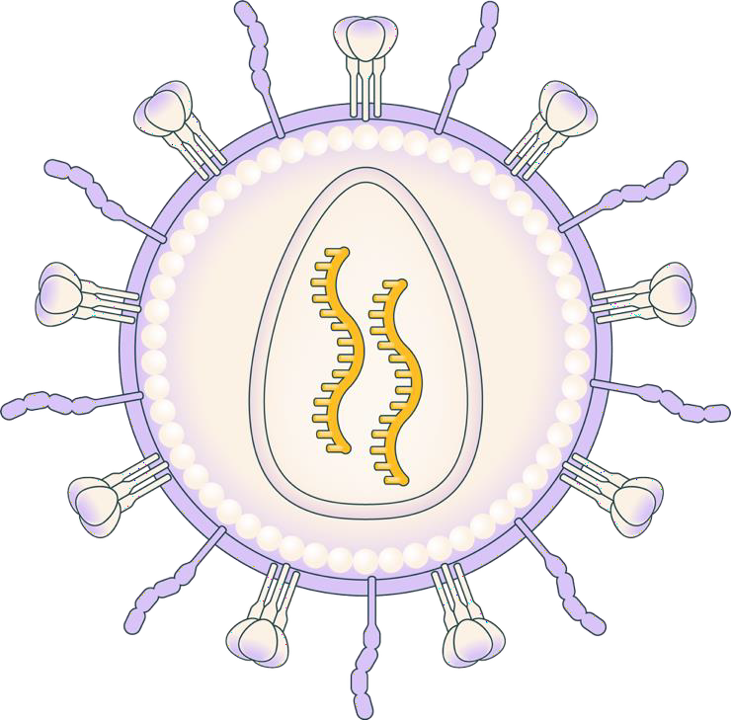


KLN-1010: a modified LVV generating anti-BCMA CAR-T cells
in vivo
Envelope-modified, replication-incompetent, self-inactivating lentiviral vector
De-targeted VSV-G fusogen avoids delivery to LDL-expressing cells while maintaining high transduction efficiency
Precise re-targeting to T cells with a CD3 scFv; avoids liver uptake and drug sinks
Anti-BCMA CAR was selected based on high levels of activity to BCMA-positive tumors
De-targeted fusogen,
VSV-G mutation
T cell re-targeting with CD3
tropism molecule
CAR molecule
Proprietary, fully-human BCMA scFv
4-1BB
CD3ζ
BCMA, anti–B-cell maturation antigen; CAR, chimeric antigen receptor; CD3, cluster of differentiation 3; CD3ζ, cluster of differentiation 3 zeta chain; LDL, low-density lipoprotein; LVV, lentiviral vector;scFv, single-chain variable fragment;
VSV-G, vesicular stomatitis virus glycoprotein.
Wood JT et al. Toward treatment with gene-modified B cells engineered in vivo using iGPS particles (abstract #1281). Poster presented at: ASGCT 28th Annual Meeting; May 13-17, 2025.

Slide 17



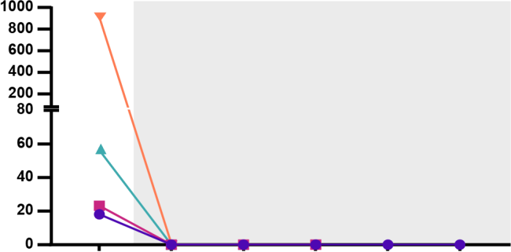
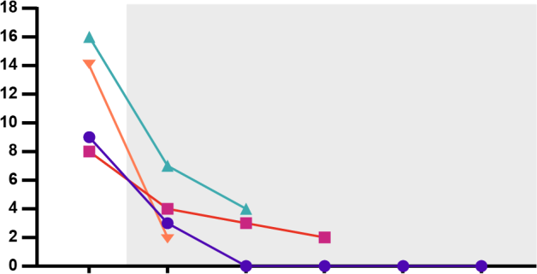
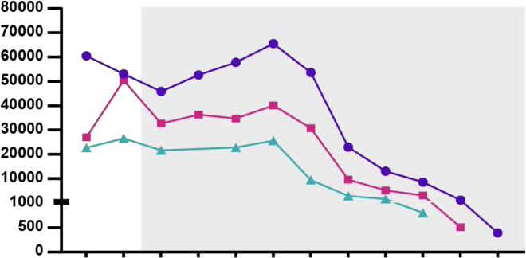


Deep, ongoing MRD-negative responses were observed across first 4 patients
Months post treatment
3 4
CR
1
2
5
6
VGPR
Patient 1
Patient 2
Patient 3
Patient 4
u
PR
MRD negative 10⁻⁶
MRD negative 10⁻⁵
*Most sensitive result from next
generation flow cytometry or sequencing
u
Involved sFLC
Post-infusion
M-spike levels
Post-infusion
Soluble BCMA
Post-infusion
M-spike (g/L)
sBCMA (pg/mL)
sFLC (mg/L)
Patient 1, DL1
Patient 2, DL1
Patient 3, DL1
Patient 4, DL-1
BCMA, B-cell maturation antigen; BL, baseline; CR, complete response; D, study day; M, study month; M-spike, monoclonal protein spike; MRD, minimal residual disease; PR, partial response; SCR, screening; sFLC, serum free light chain;
u, unconfirmed response; VGPR, very good partial response.

Slide 18
Favorable toxicity profile compared to ex vivo CAR T
Minimal events of cytopenia; only 1 case of Grade 4 (transient neutropenia related to margination)
Markedly lower number of events compared to ex vivo CAR-T therapies
TEAEs in >1 patient | Grade 1-2, n | Grade ≥3, n
IRR | 2 | 1 (DLT)
Lymphocytosis | 1 | 1
Hypomagnesemia | 2 | 0
Hypokalemia | 2 | 0
Cytopenia
 | Grade ≥3, n | Study day | Duration, days
Anemia | 1 | 15 | 2
Thrombocytopenia | 1 | 16 | 2
Neutropenia | 2 | 1, 15 | 2, 2
 |  | 14 | 3
TEAEs Grade ≥3 | Patients, n | Study day | Duration, days
Febrile neutropenia | 1 | 1 | 2
IRR | 1 | 1 | 3
Lymphopenia | 1 | 2, 8 | 2, 5
Lymphocytosis | 1 | 13 | 3
Anemia | 1 | 15 | 2
Vasovagal syncope | 1 | 27 | 1
Pneumonia | 1 | 86 | 8
Infusion-related reactions
 | Grade 1-2, n | Grade ≥3, n | Supportive care
Dose level 1 | 1 | 1 | Tocilizumab, steroid
Dose level -1 | 1 | 0 | Paracetamol
CAR, chimeric antigen receptor; DLT, dose-limiting toxicity; IRR, infusion-related reaction; TEAE, treatment-emergent adverse event.

Slide 19
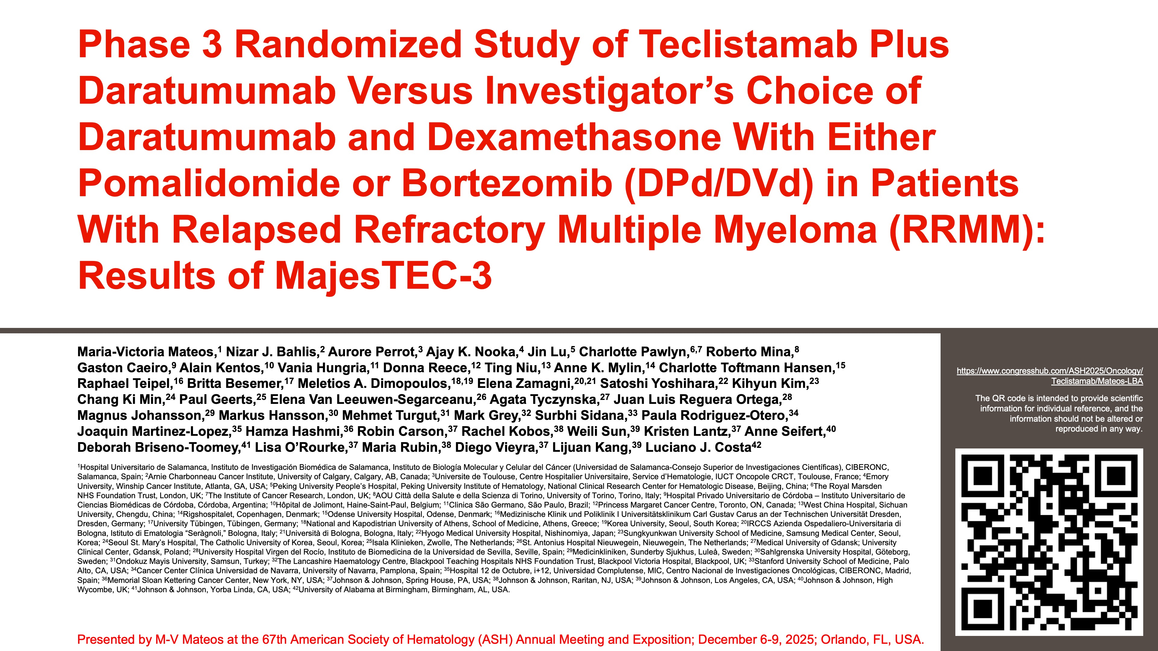

Slide 20
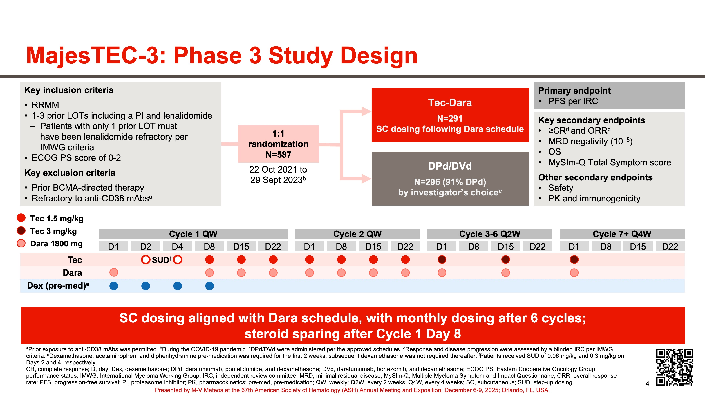

Slide 21
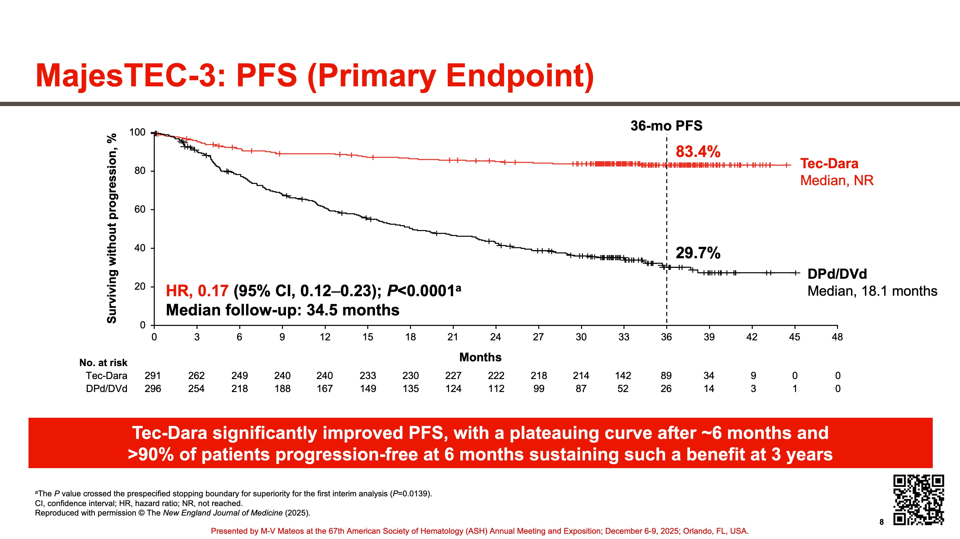

Slide 22
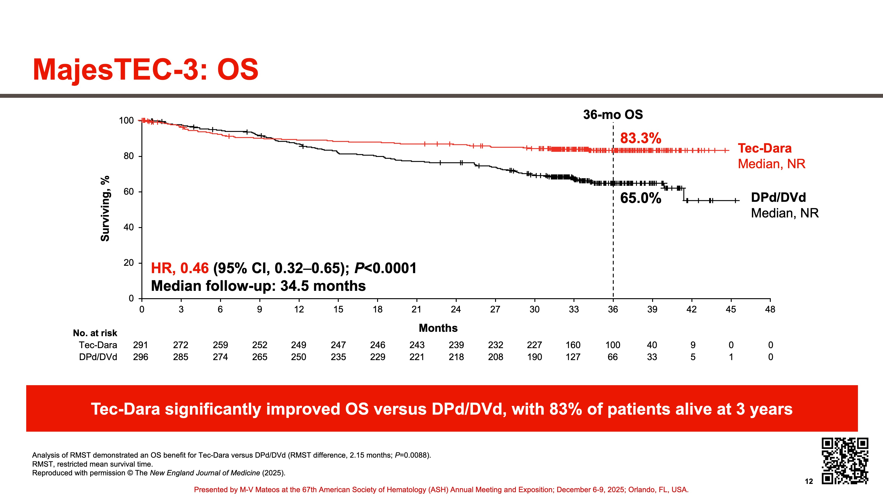

Slide 23
Agenda
Introduction | Dr Yannucci – 60-year-old man | Best of ASH Multiple Myeloma
Case 1 | Dr Morganstein – 62-year-old man | Dr Lorber – 59-year-old man
Faculty Presentation: Antibody-Drug Conjugates and Other Emerging Novel Therapies for Relapsed/Refractory (R/R) Multiple Myeloma (MM) — Dr Lonial
Case 2 | Dr Morganstein – 84-year-old man
Case 3 | Dr Favaro – 64-year-old man
Faculty Presentation: Integrating CAR T-Cell Therapy and Bispecific Antibodies into the Management of R/R MM — Dr Mateos
Case 4 | Dr Bhatnagar – 71-year-old man
Case 5 | Dr Rudolph – 56-year-old man

Slide 24
Case Presentation: 59-year-old man with t (11;14) IgA kappa myeloma discovered during workup for new Stage IV kidney disease. Chest wall plasmacytoma. Receives daratumumab with CyBorD and radiation therapy to the plasmacytoma with minimal response
Dr Jeremy Lorber
(Beverly Hills, California)
Questions for the faculty
Dr Warren Brenner
(Boca Raton, Florida)

Slide 25
Agenda
Introduction | Dr Yannucci – 60-year-old man | Best of ASH Multiple Myeloma
Case 1 | Dr Morganstein – 62-year-old man | Dr Lorber – 59-year-old man
Faculty Presentation: Antibody-Drug Conjugates and Other Emerging Novel Therapies for Relapsed/Refractory (R/R) Multiple Myeloma (MM) — Dr Lonial
Case 2 | Dr Morganstein – 84-year-old man
Case 3 | Dr Favaro – 64-year-old man
Faculty Presentation: Integrating CAR T-Cell Therapy and Bispecific Antibodies into the Management of R/R MM — Dr Mateos
Case 4 | Dr Bhatnagar – 71-year-old man
Case 5 | Dr Rudolph – 56-year-old man

Slide 26
FDA Approves Belantamab Mafodotin-blmf for Relapsed or Refractory Multiple Myeloma Press Release: October 23, 2025
“The Food and Drug Administration approved belantamab mafodotin-blmf, a B-cell maturation antigen (BCMA)-directed antibody and microtubule inhibitor conjugate, with bortezomib and dexamethasone for adults with relapsed or refractory multiple myeloma who have received at least two prior lines of therapy, including a proteasome inhibitor and an immunomodulatory agent.
Efficacy was evaluated in DREAMM-7 (NCT04246047), an open-label, randomized, multicenter trial in adults with relapsed or refractory multiple myeloma who had received at least one line of prior therapy. ... Patients were randomized (1:1) to receive either belantamab mafodotin-blmf, bortezomib, and dexamethasone (BVd) or daratumumab, bortezomib, and dexamethasone (DVd).
Efficacy was established based on progression-free survival (PFS) and overall survival (OS). The median PFS was 31.3 months (95% confidence interval [CI]: 23.5, not reached [NR]) in the BVd arm and 10.4 months (95% CI: 7, 13.4) in the DVd arm (hazard ratio [HR] 0.31, 95% CI: 0.21, 0.47). The median OS was NR and 35.7 months (95% CI: 21.1, NR) in respective arms (HR 0.49, 95% CI: 0.32, 0.76).”
https://www.fda.gov/drugs/resources-information-approved-drugs/fda-approves-belantamab-mafodotin-blmf-relapsed-or-refractory-multiple-myeloma

Slide 27

Antibody Drug Conjugates and Other Emerging Novel Therapies for R/R MM
Sagar Lonial, MD Professor and Chair
Department of Hematology and Medical Oncology
Anne and Bernard Gray Professor in Cancer
Chief Medical Officer, Winship Cancer Institute
Emory University School of Medicine

Slide 28
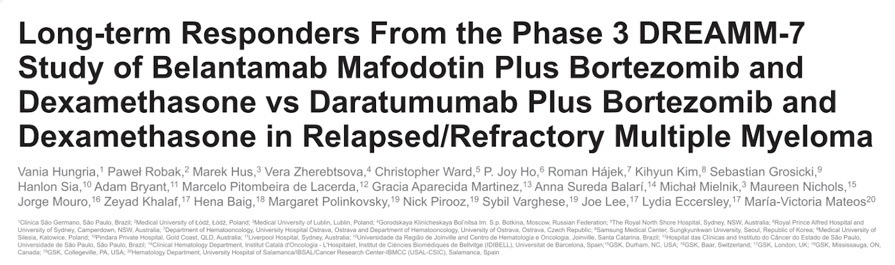
ASH 2025;Abstract 7236.

Slide 29
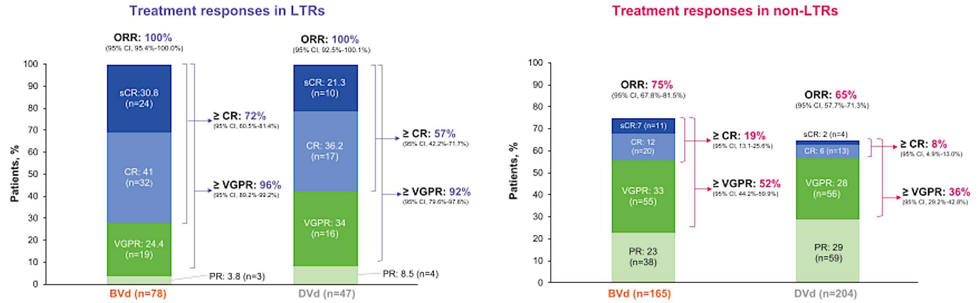
DREAMM-7: Responses in Long-Term Responders (LTRs) and Non-LTRs
ORR = overall response rate; CR = complete response; VGPR = very good partial response; PR = partial response; BVd = belantamab mafodotin/bortezomib/dexamethasone; DVd = daratumumab/bortezomib/dexamethasone
Hungria V et al. ASH 2025;Abstract 7236.

Slide 30
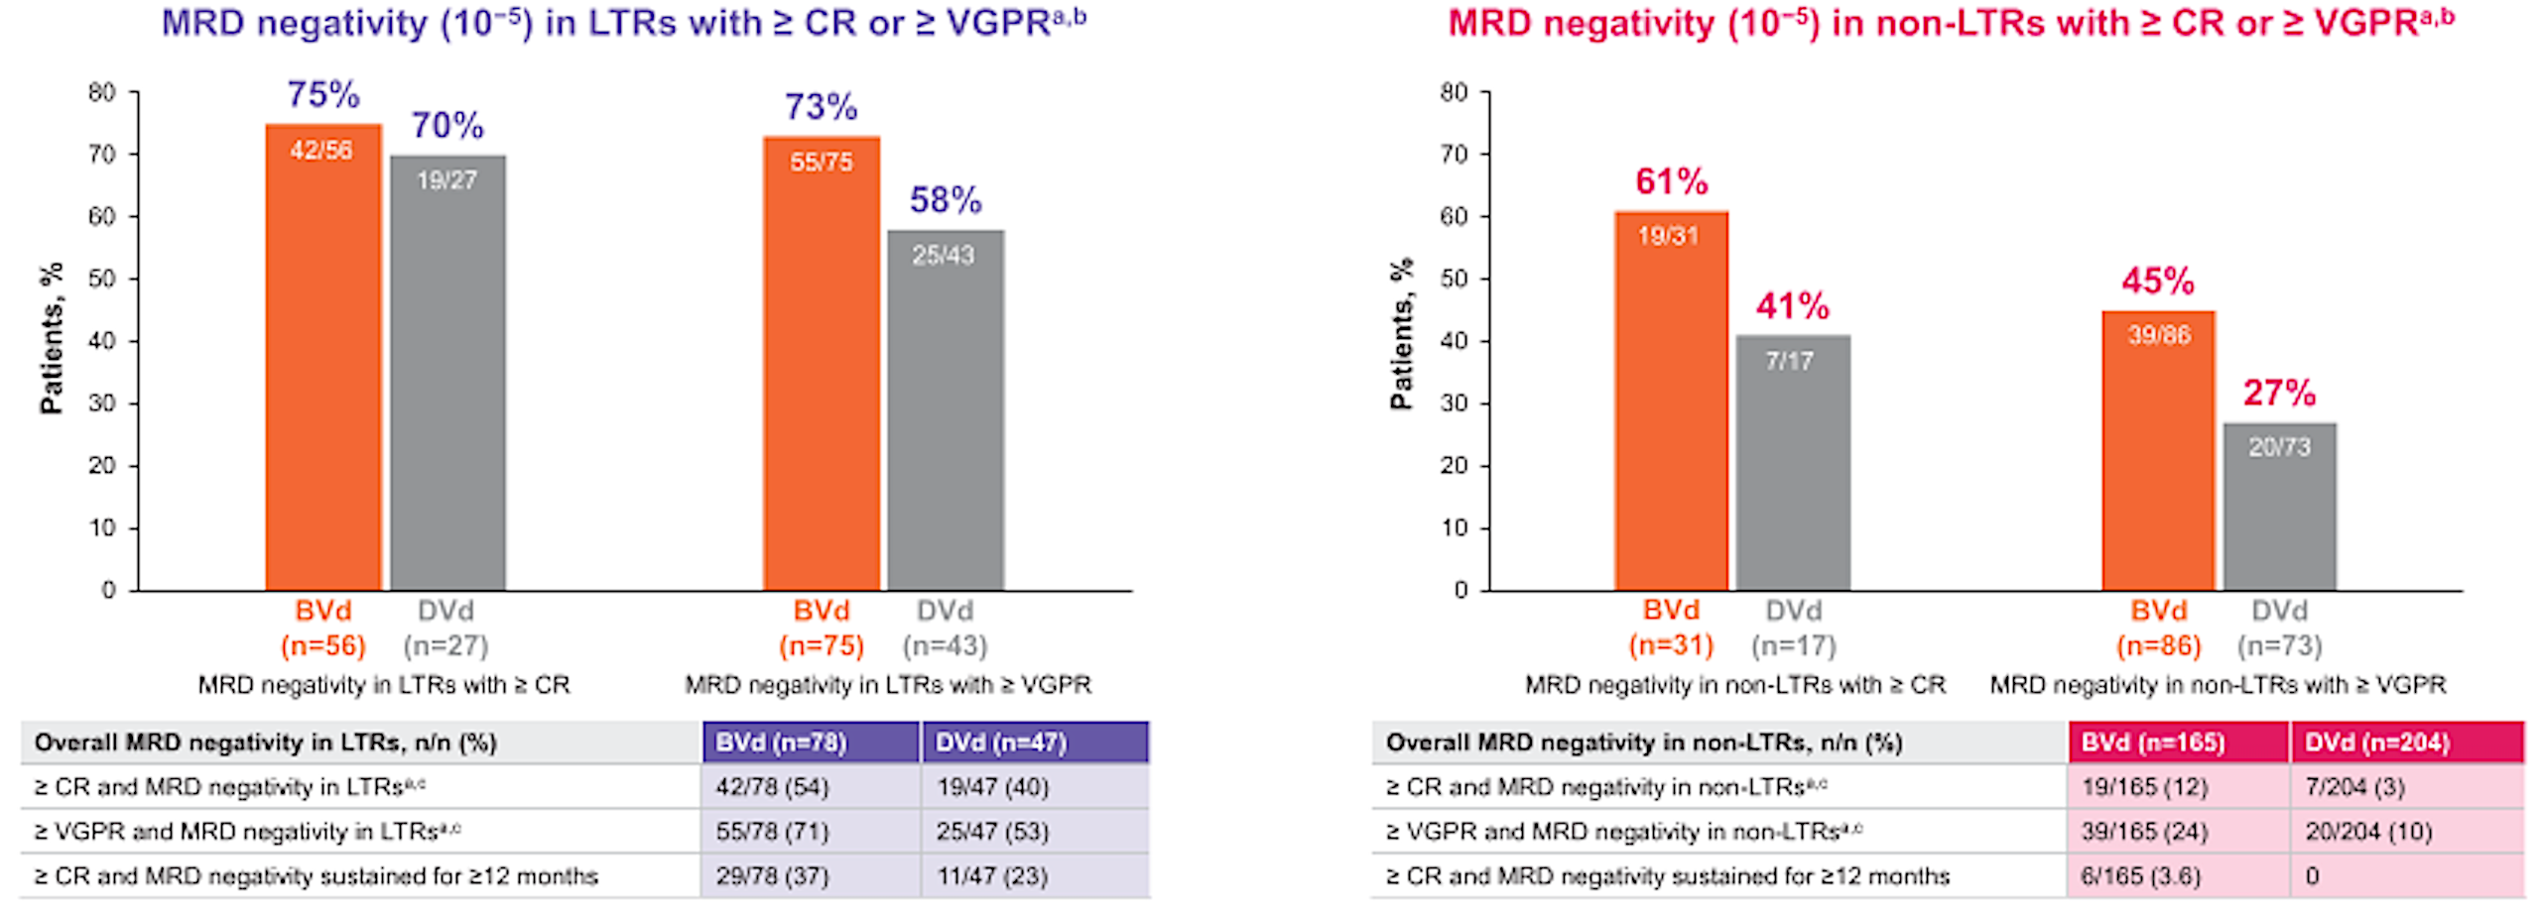
DREAMM-7: Minimal Residual Disease (MRD) Negativity in Long-Term Responders (LTRs) and Non-LTRs
Hungria V et al. ASH 2025;Abstract 7236.

Slide 31
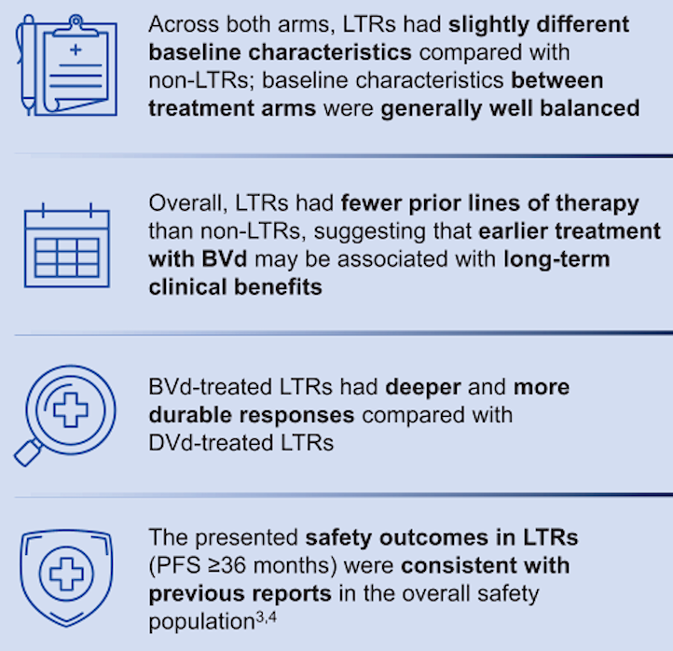
DREAMM-7: Authors’ Conclusions
Hungria V et al. ASH 2025;Abstract 7236.

Slide 32
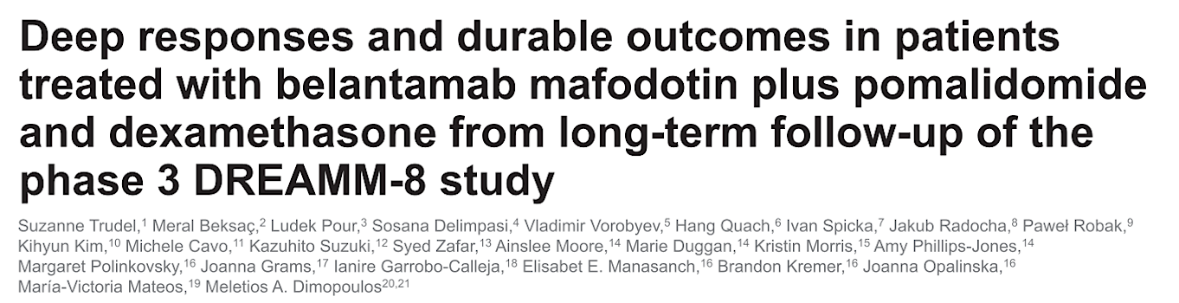
ASH 2025;Abstract 7677.

Slide 33
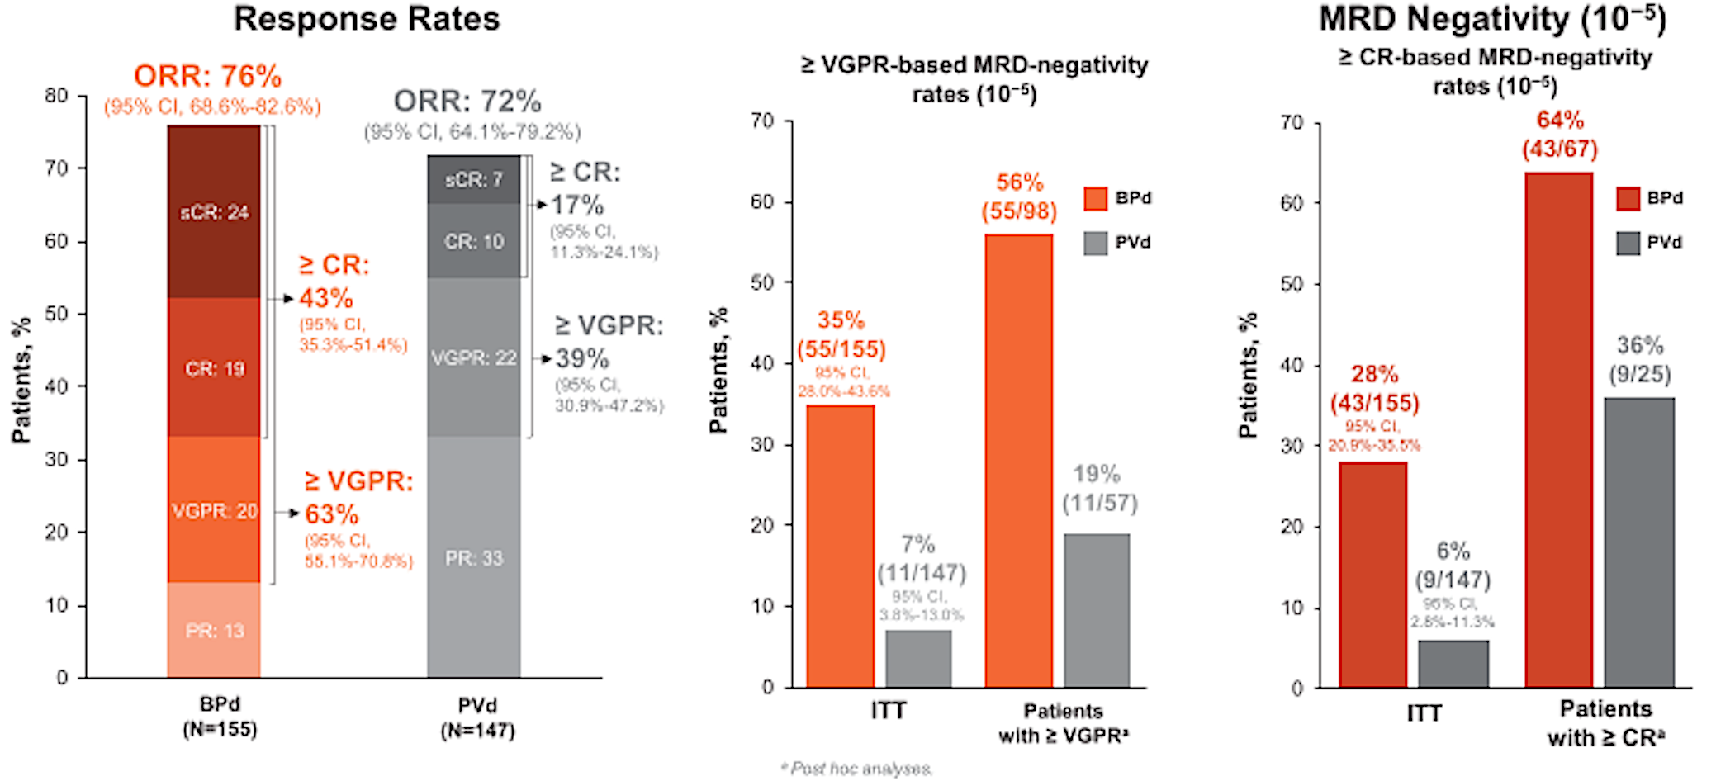
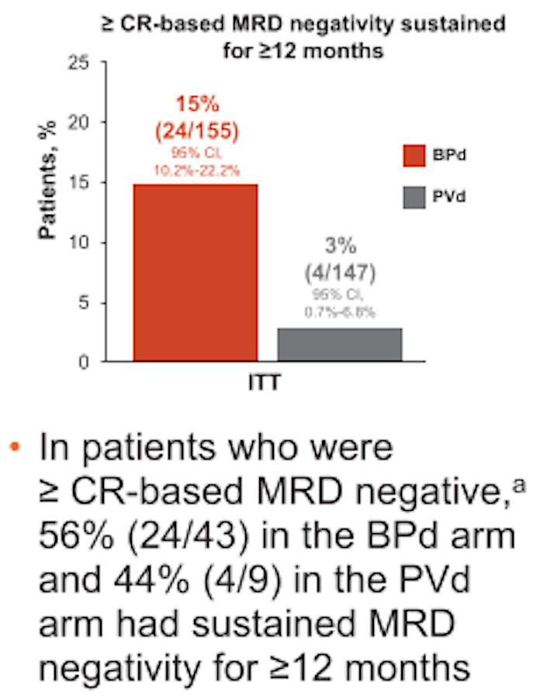
DREAMM-8 Long-Term Follow-Up: Response Rates and MRD Negativity
BPd = belantamab mafodotin/pomalidomide/dexamethasone; PVd = pomalidomide/bortezomib/dexamethasone; ITT = intent to treat
Trudel S et al. ASH 2025;Abstract 7677.

Slide 34
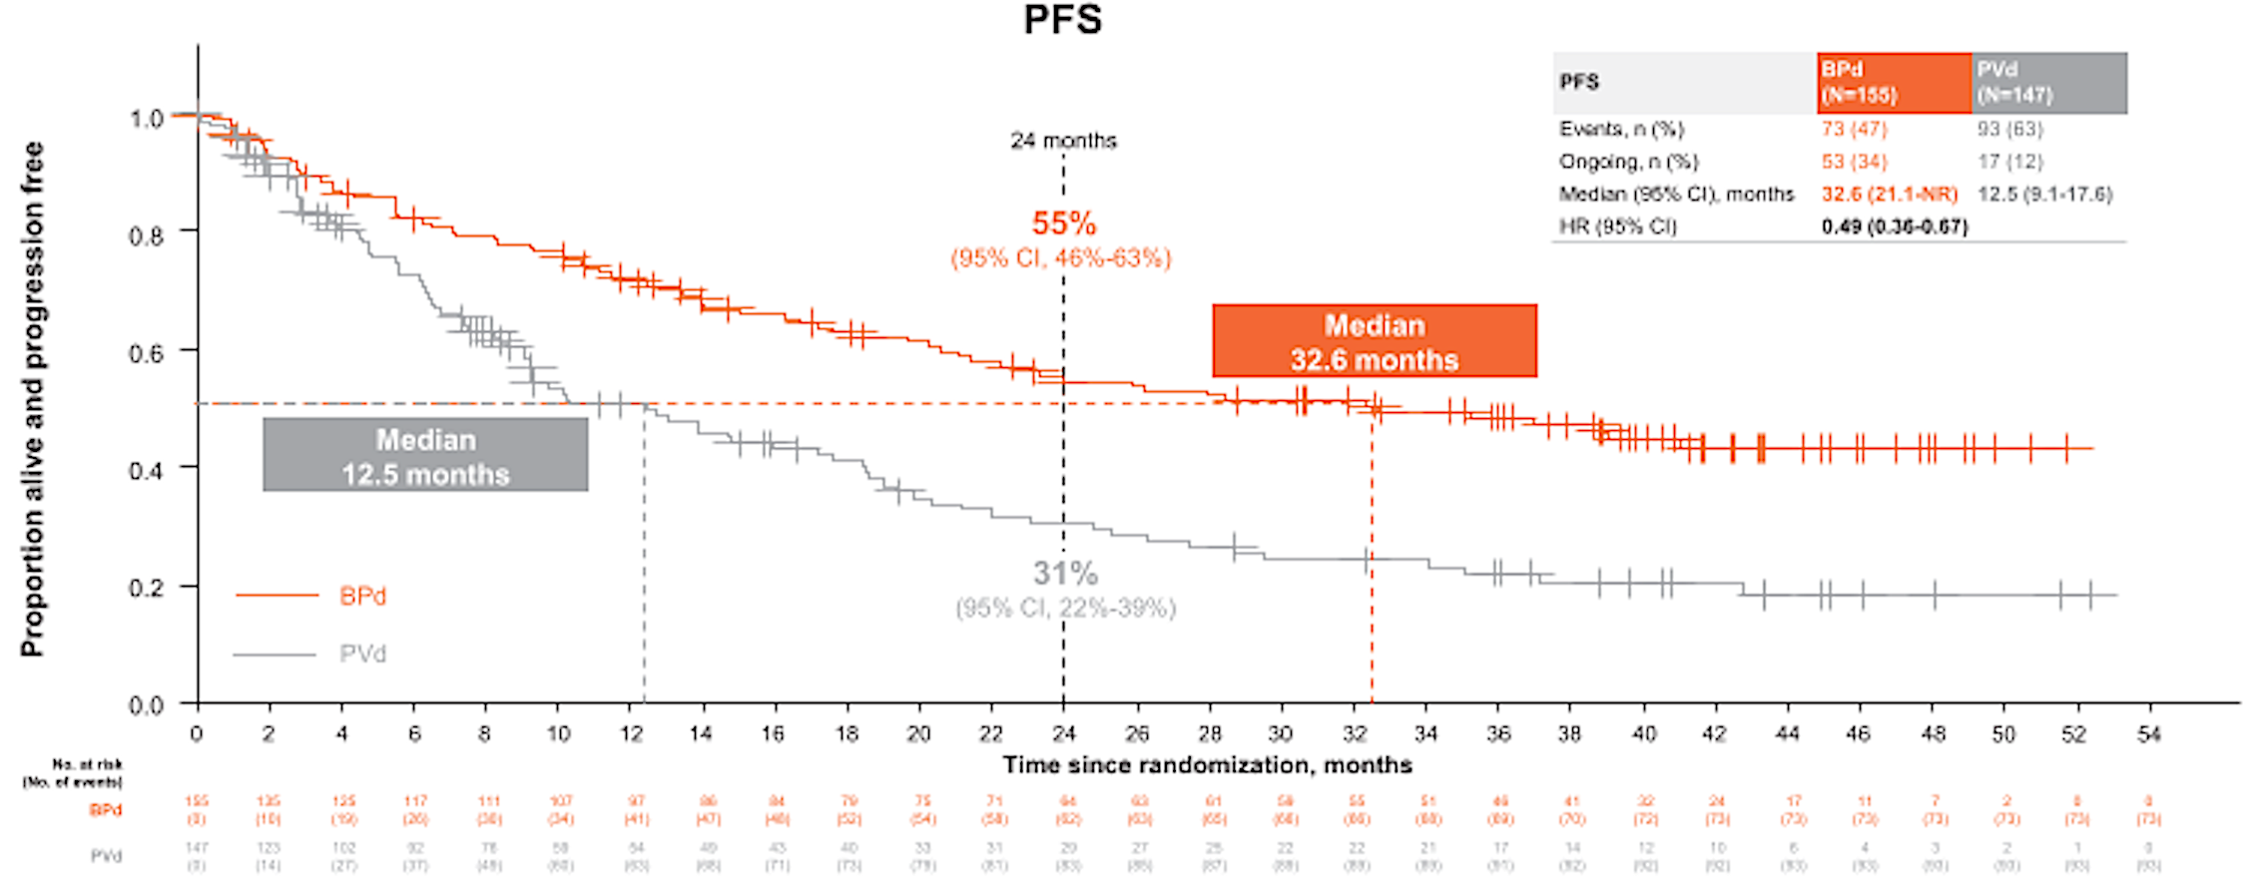
DREAMM-8 Long-Term Follow-Up: Progression-Free Survival (PFS)
Trudel S et al. ASH 2025;Abstract 7677.

Slide 35
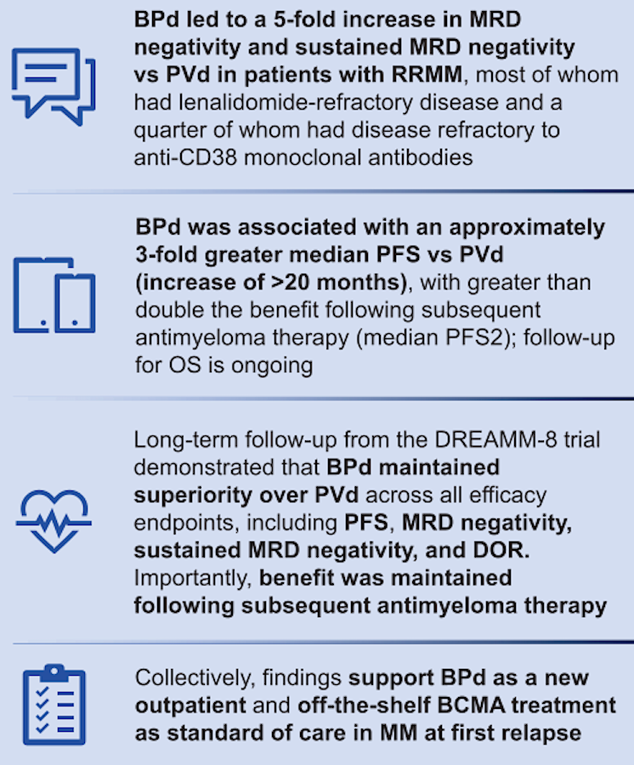
DREAMM-8: Authors’ Conclusions
DOR = duration of response
Trudel S et al. ASH 2025;Abstract 7677.

Slide 36
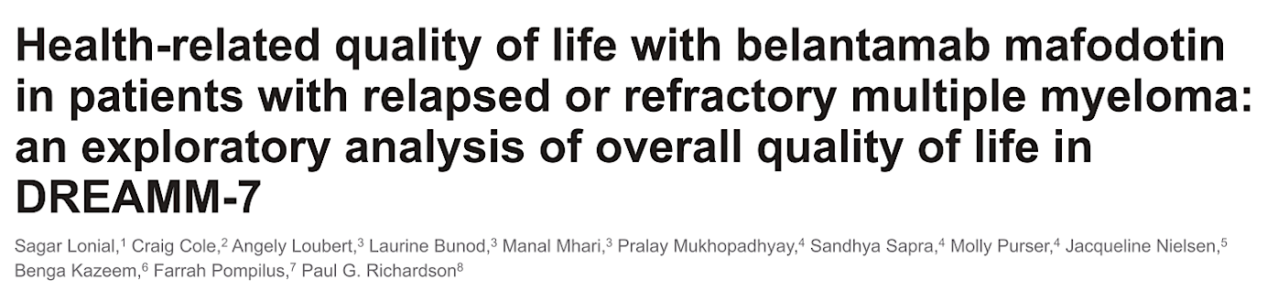
ASH 2025;Abstract 143.

Slide 37
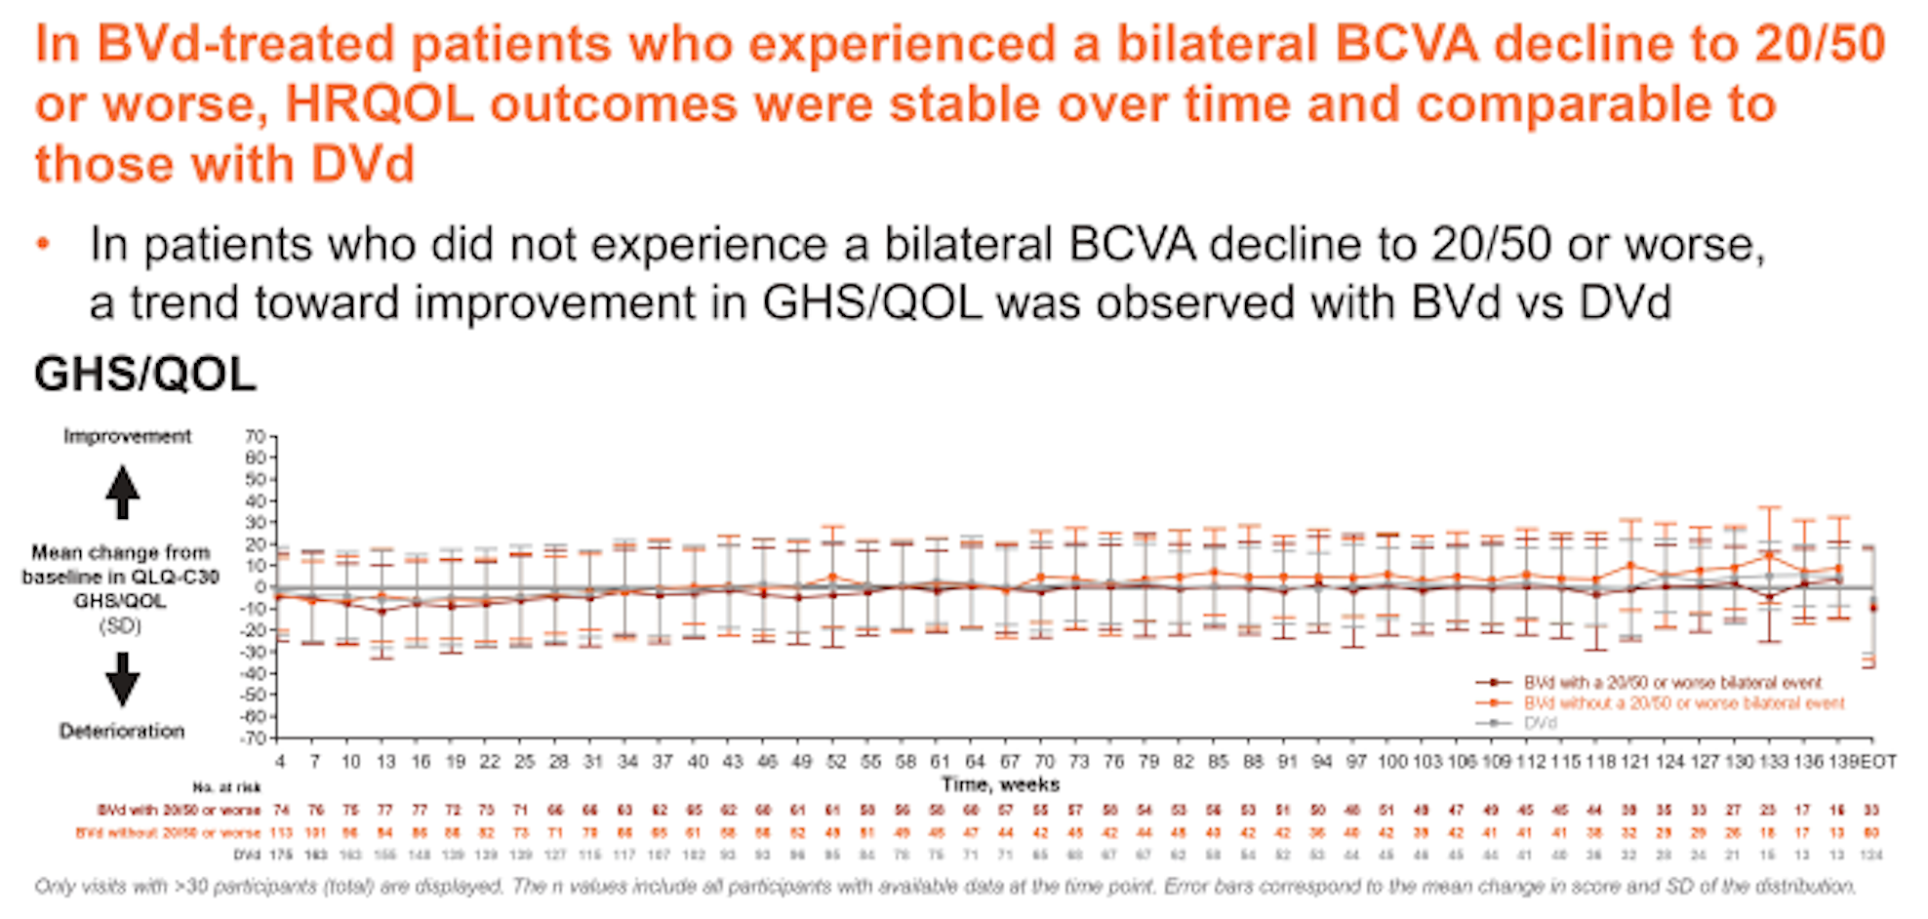
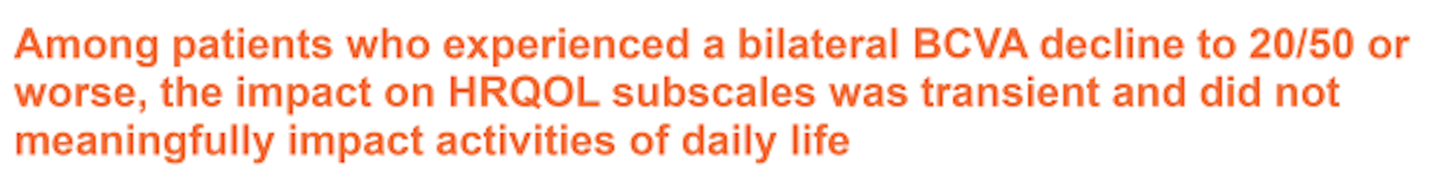
DREAMM-7 Exploratory Analysis: Global Health Status (GHS) and Quality of Life (QoL)
HRQOL = health-related quality of life; BCVA = best corrected visual acuity
Lonial S et al. ASH 2025;Abstract 143.

Slide 38
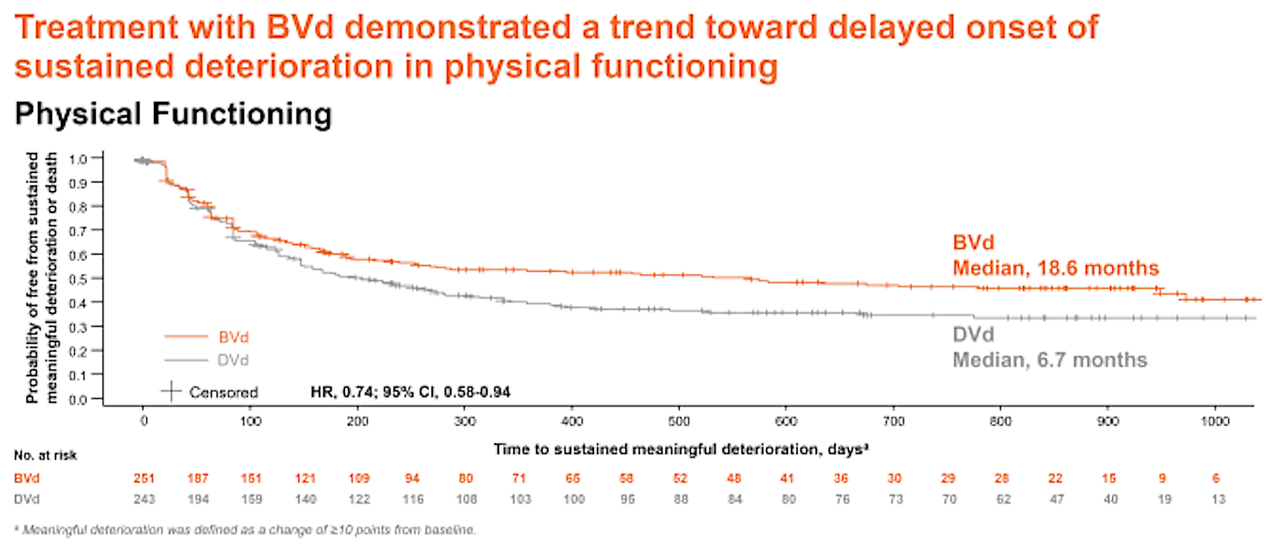
DREAMM-7 Exploratory Analysis: Treatment Benefit
A similar trend toward a delay in worsening of disease-specific symptoms was observed.
Lonial S et al. ASH 2025;Abstract 143.

Slide 39
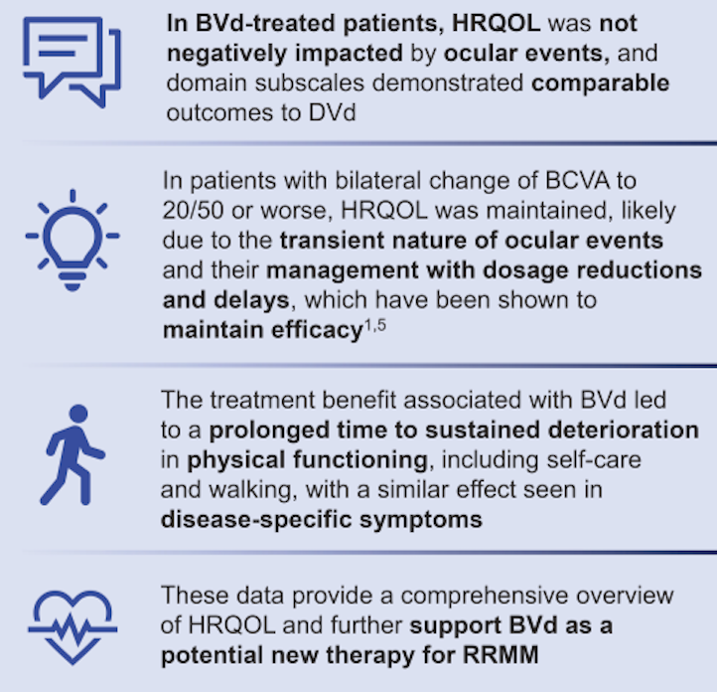
DREAMM-7 HRQoL: Authors’ Conclusions
NDMM = newly diagnosed multiple myeloma
Lonial S et al. ASH 2025;Abstract 143.

Slide 40
Belantamab Mafodotin (Belamaf) Ocular Events Are Manageable and Reversible With Dose Modifications Guided by Standard Assessments
Sagar Lonial,¹ Paul G. Richardson,² Craig E. Cole,³ Asim V. Farooq,⁴ Meghan Berkenstock,⁵ Julie Byrne,⁶ Sumita Roy-Ghanta,⁶ Rachel Rogers,⁶ Amy Phillips-Jones,⁷ Astrid McKeown,⁷ Natalie A. Afshari⁸
¹Winship Cancer Institute, Emory University Hospital, Atlanta, GA, USA; ²Dana-Farber Cancer Institute, Boston, MA, USA; ³Karmanos Cancer Institute, Wayne State University, Detroit, MI, USA, and Michigan State University, Lansing, MI, USA; ⁴University of Chicago Medical Center, Chicago, IL, USA; ⁵Johns Hopkins Wilmer Eye Institute, Baltimore, MD, USA; ⁶GSK, Collegeville, PA, USA; ⁷GSK, Stevenage, UK; ⁸ Shiley Eye Institute, Viterbi Family Department of Ophthalmology, University of California, San Diego, CA, USA
Corresponding author: Sagar Lonial, sloni01@emory.edu
Poster number 4055
Presented at 67th ASH Annual Meeting and Exposition | December 6-9, 2025 | Orlando, FL, USA

Slide 41
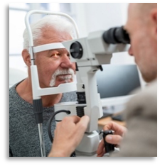
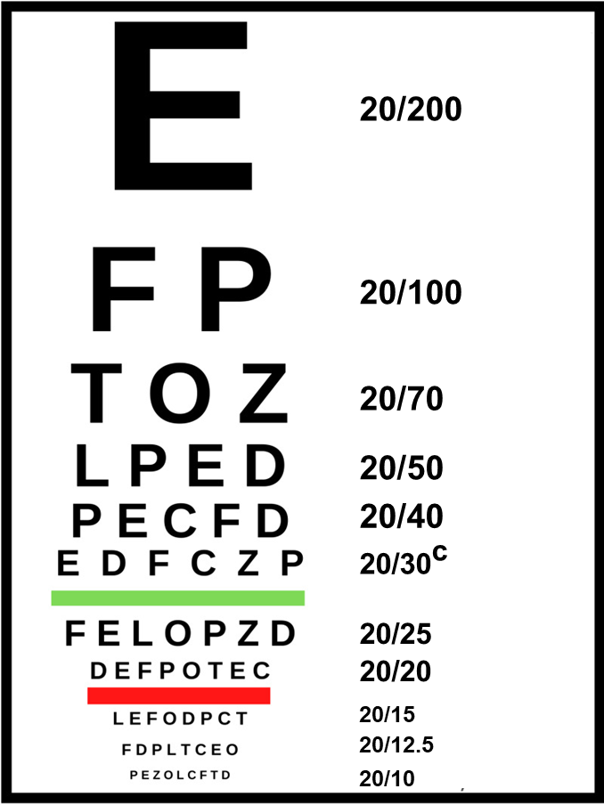
The KVA Scale Used to Grade OEFs Has a Sensitive Criteria for Belamaf Dose Modifications
Corneal exam finding
(slit lamp exam)ª
BCVA change
(Snellen or equivalent assessment)
Microcyst-like deposits
Representative Snellen Eye Chart^{b}
.
.
.
.
.
.
.
.
.
.
Grade 2 = eg, patchy microcyst-like deposits
Grade 2 = 2- or 3-line decrease in BCVA from baseline (eg, 20/20 to 20/30 or 20/40)
Dose delay until resolution to grade 1 or better^{d}
Dose delay until resolution to grade 1 or better^{e}
BCVA, best-corrected visual acuity; belamaf, belantamab mafodotin; KVA, Keratopathy and Visual Acuity; OEF, ocular exam finding.
ª The most common corneal exam findings in the trial were superficial punctate keratitis, microcyst-like changes, epithelial haze, and stromal opacity. ^{b} Not all distances are depicted here.
^{c} Included 20/30 or 20/32. ^{d} Mild superficial keratopathy. ^{e} Decline from baseline of 1 line on Snellen Visual Acuity.

Slide 42
Belamaf Dose Modifications Were Conservatively Guided by OEFs
Incidence and onset of events
DREAMM-7 (BVd, N=242)
Data cutoff: October 2, 2023
DREAMM-8 (BVd, N=150)
Data cutoff: January 29, 2024
OEF
Unilateral BCVAª
Bilateral BCVA
OEF
Unilateral BCVAª
Bilateral BCVA
n=209
n=131
Patients, %
n=166
Patients, %
n=108
n=82
n=51
Onset of the first event, median (range)
6 weeks
(2-87)
9 weeks
(2-132)
11 weeks
(2-108)
5 weeks
(3-76)
12 weeks
(3-109)
16 weeks
(4-109)
Last event resolved
42%
61%
83%
43%
60%
73%
Grade ≥2 OEFs had a higher incidence and earlier median time to onset than vision changes
BCVA, best-corrected visual acuity; belamaf, belantamab mafodotin; BVd, belantamab mafodotin, bortezomib, and dexamethasone; OEF, ocular exam finding.
ª Post hoc analyses.

Slide 43
Ocular Events Were Reversible in the Majority of Patients
Resolution of all occurrencesª
DREAMM-7 (BVd, N=242)
Data cutoff: October 2, 2023
DREAMM-8 (BVd, N=150)
Data cutoff: January 29, 2024
OEF
Unilateral BCVA
Bilateral BCVA
OEF
Unilateral BCVA
Bilateral BCVA
84%
607 of 724 occurrences resolved
84%
467 of 559 occurrences resolved^{b}
91%
137 of 151 occurrences resolved
76%
366 of 441
occurrences
resolved
81%
250 of 310
occurrences
resolved^{b}
83%
67 of 81 occurrences resolved
Time to resolution, median (range)
12 weeks
(0.7-116)
9 weeks
(0.4-129)
7 weeks
(1-130)
12 weeks
(2-107)
8 weeks
(0.7-124)
8 weeks
(2-64)
Improvement of
all events
94%
612 of 652 improved^{c}
96%
176 of 183 improved
91%
303 of 332 improved^{c}
89%
85 of 95 improved
NA
NA
Time to improvement, median (range)
3 weeks
(0.4-75)
3 weeks
(1-37)
4 weeks
(1-69)
4 weeks
(1-28)
NA
NA
Patients who experienced a bilateral worsening to 20/50 or worse did so for a median of 7% to 8% of their time on treatment
BCVA, best-corrected visual acuity; BVd, belantamab mafodotin, bortezomib, and dexamethasone; NA, not applicable; OEF, ocular exam finding.
ª Post hoc analysis. ^{b} For patients with baseline 20/50 or worse, resolution must additionally be better than 20/50. ^{c} Only patients with baseline visual acuity better than 20/50 in ≥1 eye are included.

Slide 44
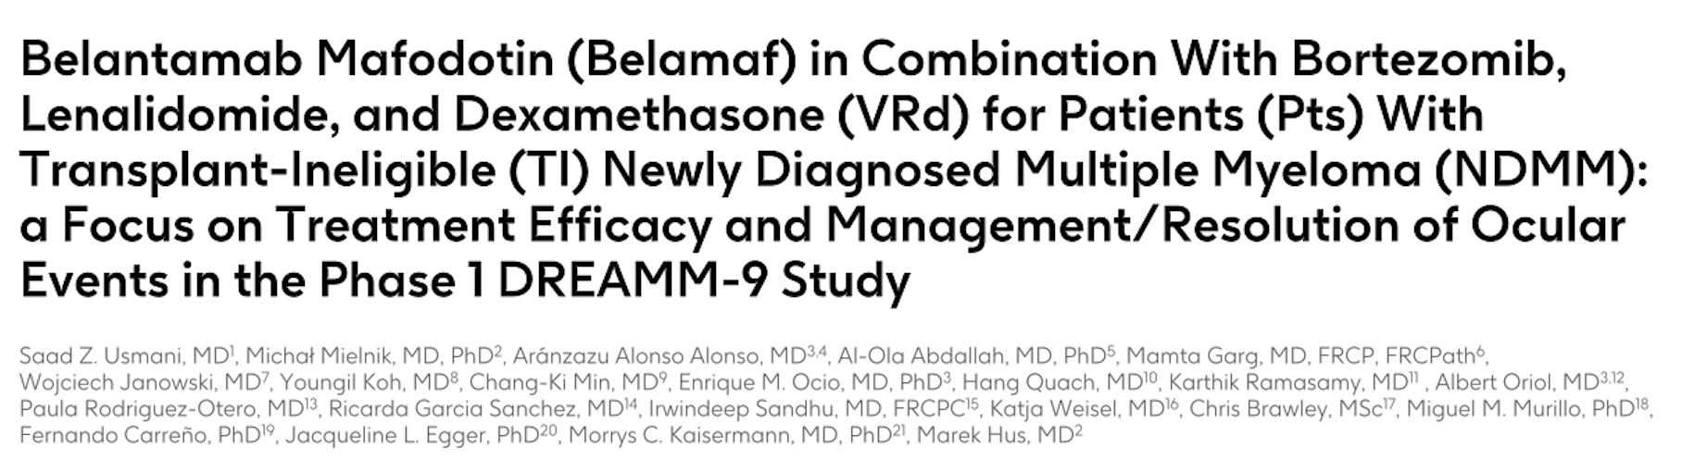
ASH 2025;Abstract 13646.

Slide 45
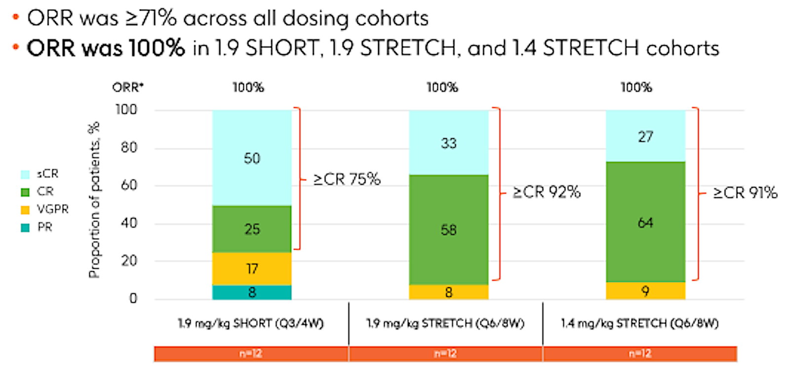
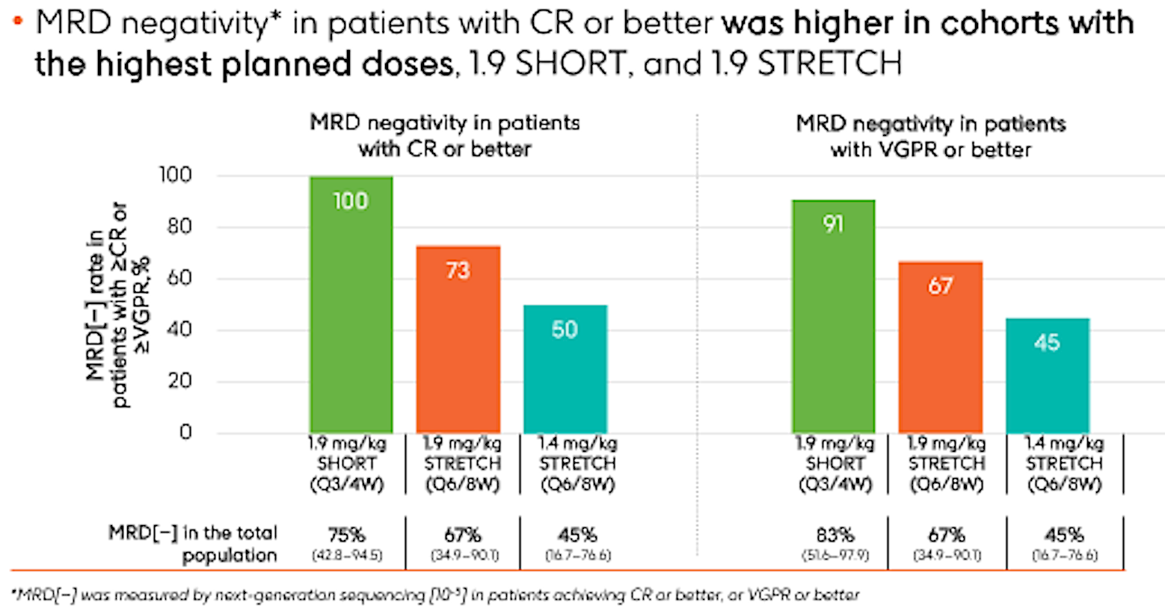
DREAMM-9 Efficacy: Overall Response Rate (ORR) and MRD Negativity Rates
Usmani SZ et al. ASH 2025;Abstract 13646.

Slide 46
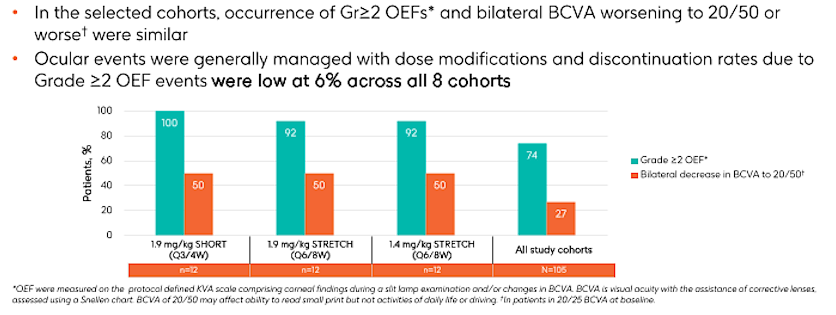
DREAMM-9 Efficacy: Ocular Event Findings (OEFs)
Usmani SZ et al. ASH 2025;Abstract 13646.

Slide 47
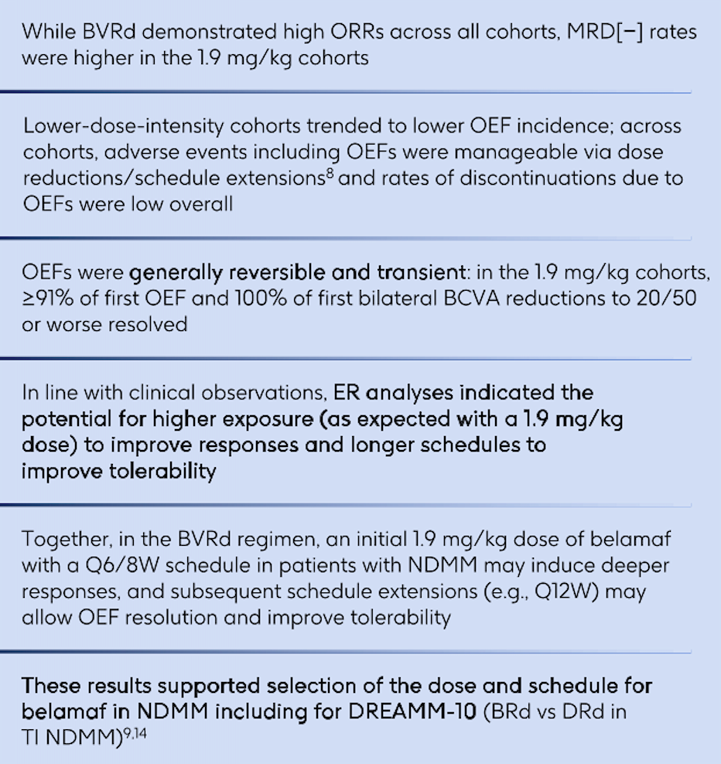
DREAMM-9: Authors’ Conclusions
NDMM = newly diagnosed multiple myeloma
Usmani SZ et al. ASH 2025;Abstract 13646.

Slide 48
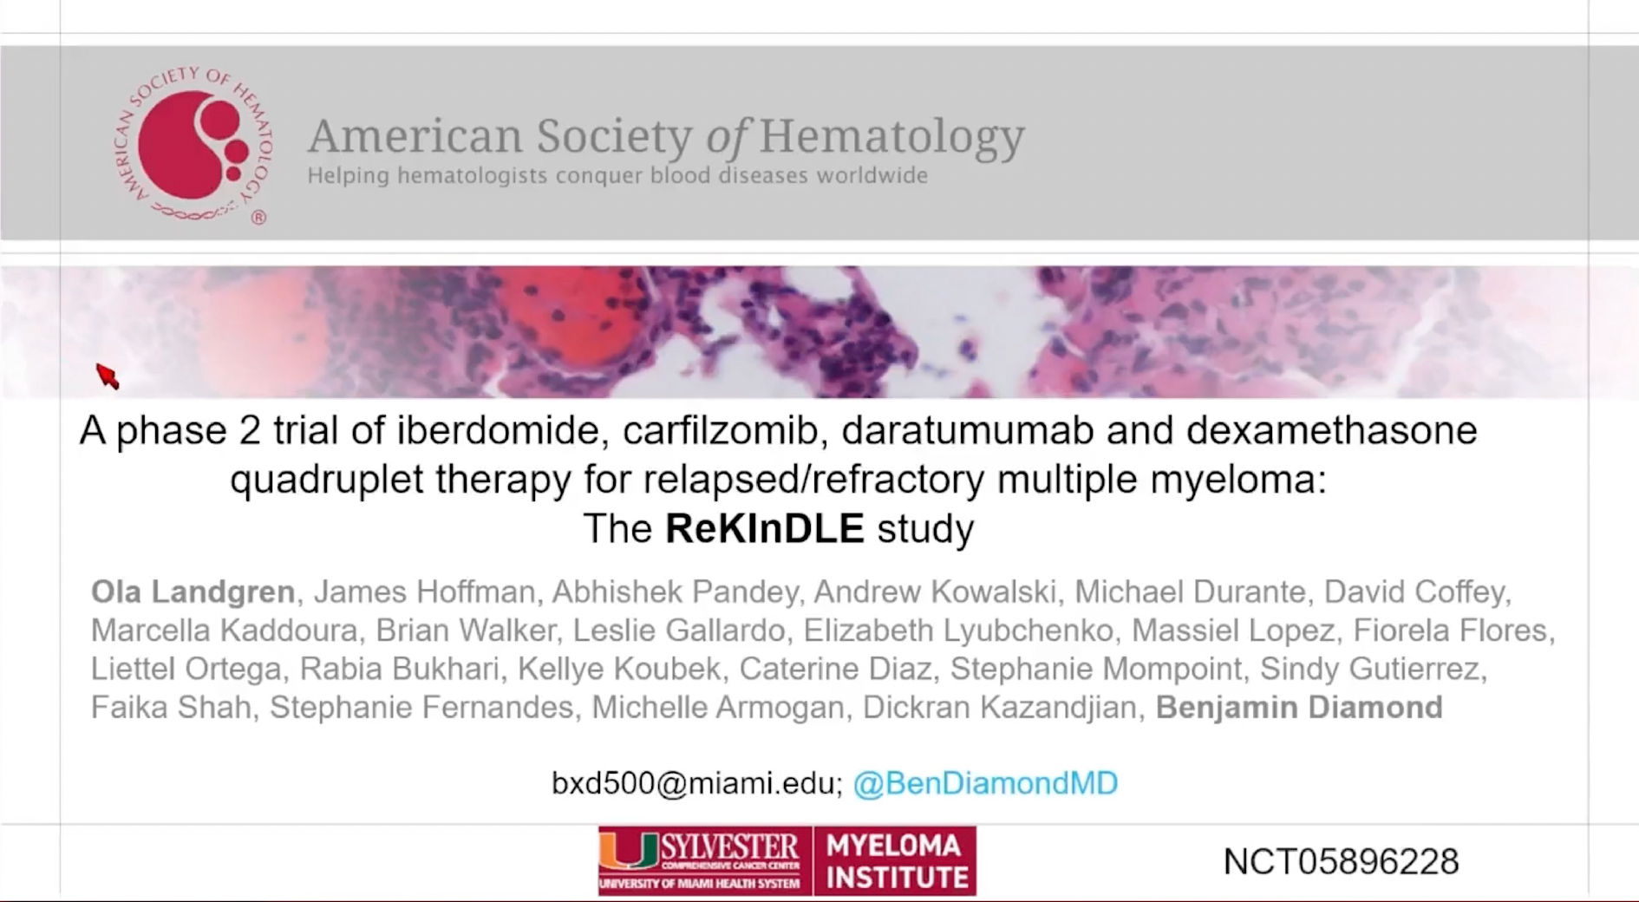
ASH 2025;Abstract 4108.

Slide 49
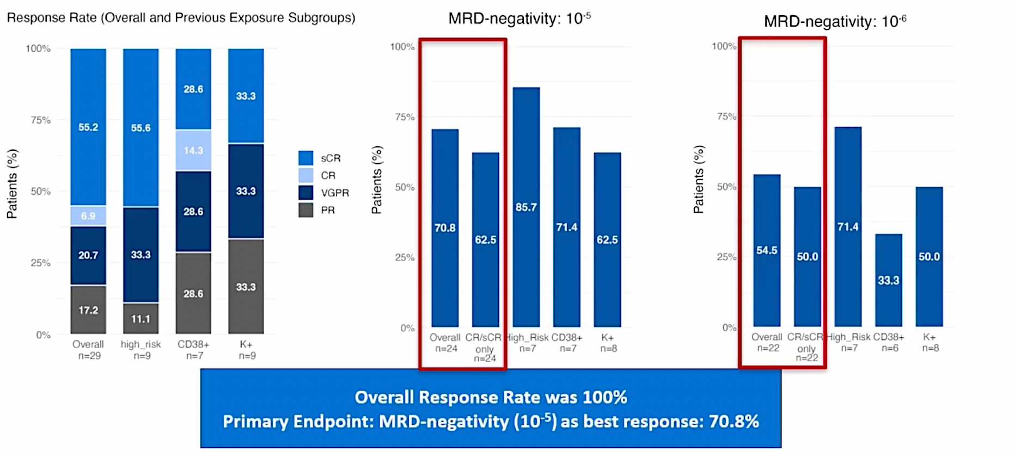
ReKInDLE: Response Rates and MRD Analysis
Landgren O et al. ASH 2025;Abstract 4108.

Slide 50
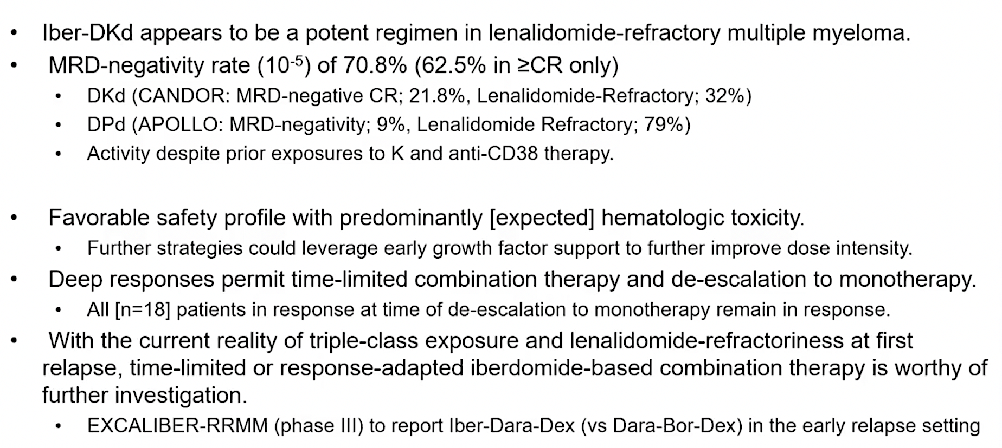
ReKInDLE: Authors’ Conclusions
DKd = daratumumab/carfilzomib/dexamethasone
Landgren O et al. ASH 2025;Abstract 4108.

Slide 51
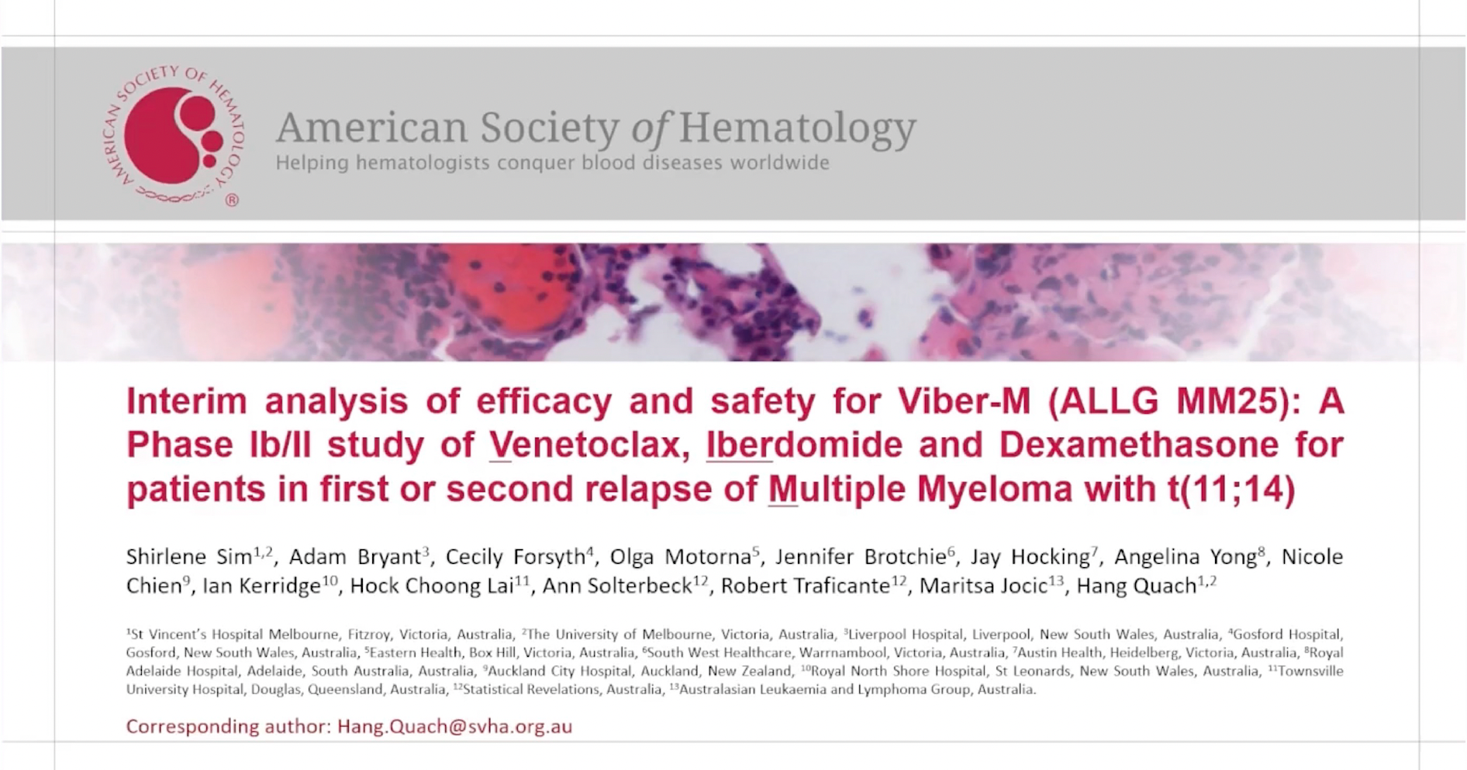
ASH 2025;Abstract 7320.

Slide 52
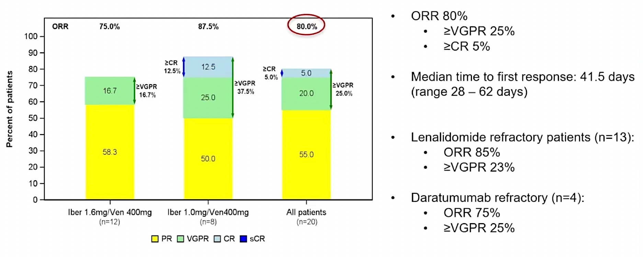
Viber-M (ALLG MM25): Response at the End of Cycle 3
Sim S et al. ASH 2025;Abstract 7320.

Slide 53
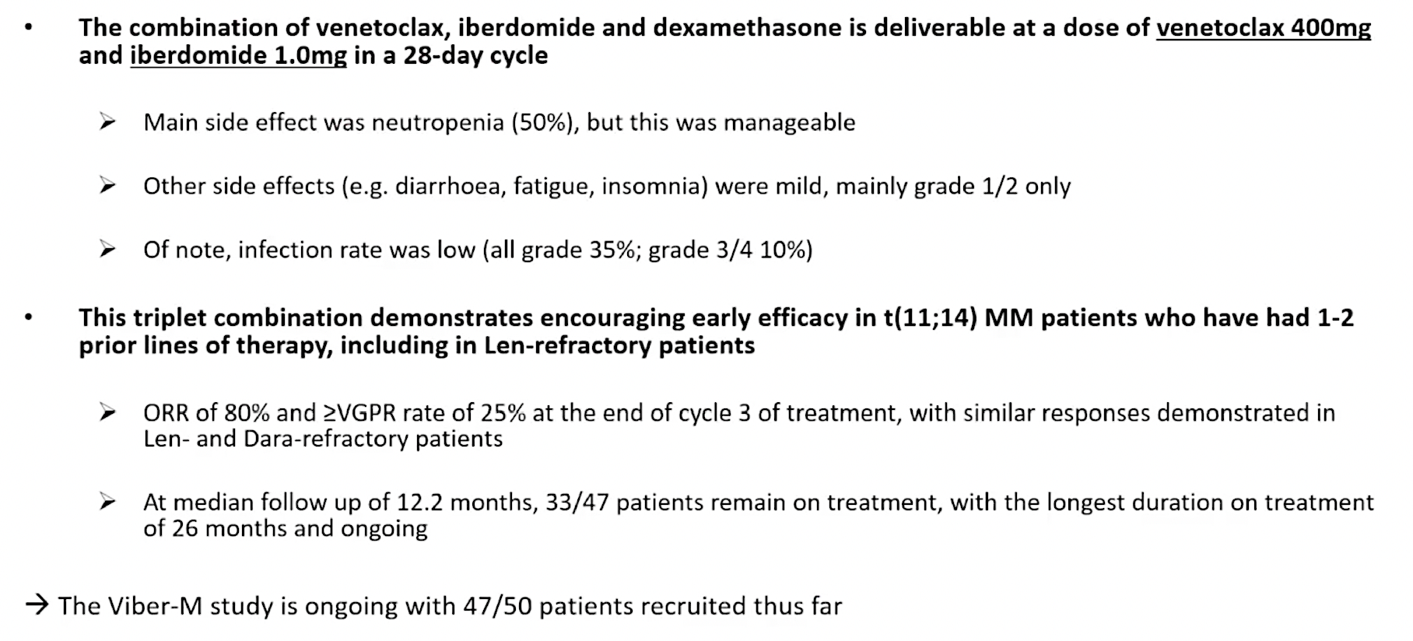
Viber-M (ALLG MM25): Authors’ Conclusions
Sim S et al. ASH 2025;Abstract 7320.

Slide 54
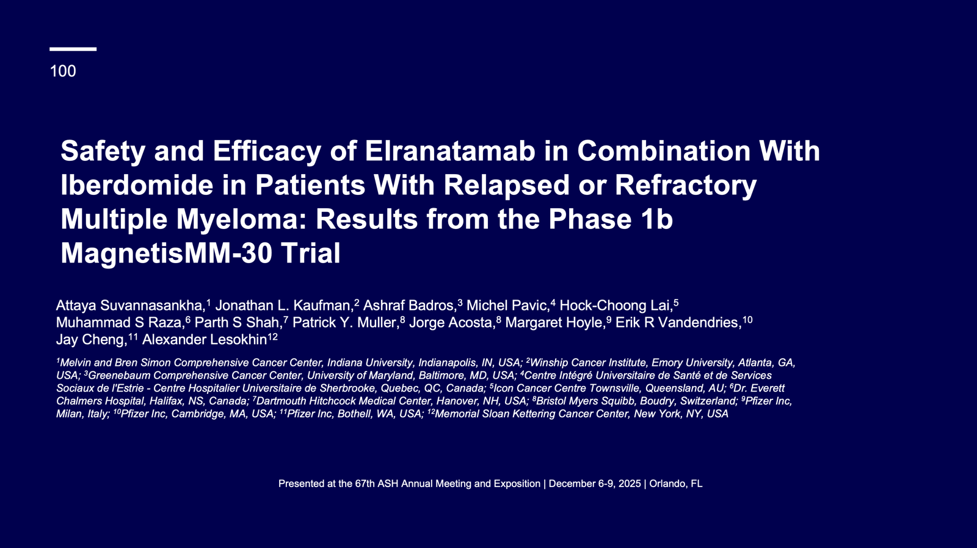

Slide 55
MagnetisMM-30 Study Design
MagnetisMM-30 (NCT06215118) is a phase 1b, open-label, multicenter, prospective study
Part 1 (dose escalation) primary objective was to assess the tolerability and safety of elranatamab in combination with iberdomide to determine the recommended doses of the combination for evaluation in Part 2 (randomized dose optimization)
A BOIN approach was used to guide dose escalation/de-escalation in Part 1
Patients with RRMM
Elranatamab 76 mg Q2W + iberdomide 1.3 mg QD
Elranatamab 76 mg QW + iberdomide 1.0 mg QD
Dose Level 2
Dose Level 1^{b}
Primary endpoint
Key inclusion criteria
Age ≥18 years with MM per IMWG criteria
ECOG PS 0-1
2-4 prior LOTs, including ≥1 IMiD and ≥1 PIª
Relapsed or refractory to last LOT
Key exclusion criterion
Stem cell transplant ≤12 weeks prior to enrollment or active GVHD
Ongoing grade ≥2 peripheral sensory or motor neuropathy; history of grade ≥3 peripheral motor polyneuropathy
DLTs during DLT observation period
Secondary endpoints
AEs and laboratory abnormalities
ORR^{c}
CR rate^{c}
Time-to-event endpoints^{c}
PK
MRD negativity rate^{c}
Immunogenicity
Elranatamab 76 mg Q2W + iberdomide 1.0 mg QD
Dose Level –1^{b}
Dose Level –2
Elranatamab 76 mg Q2W + iberdomide 0.75 mg QD
ª All patients must have received ≥2 consecutive cycles of an IMiD-containing regimen and ≥2 consecutive cycles of a PI or PI-containing regimen; ^{b} All patients received an initial 14-day cycle of elranatamab (12 mg on day 1, 32 mg on day 4, 76 mg on day 8) without iberdomide. Iberdomide was dosed at 21 out of 28 days for subsequent cycles; ^{c} Per IMWG criteria AE=adverse event; BOIN=Bayesian Optimal Interval Design; CR rate=complete response rate; DLT=dose-limiting toxicity; ECOG PS=Eastern Cooperative Oncology Group performance status; GVHD=graft vs host disease; IMiD=immunomodulatory drug; IMWG=International Myeloma Working Group; LOT=line of therapy; MM=multiple myeloma; MRD=minimal residual disease; ORR=objective response rate; PI=proteasome inhibitor; PK=pharmacokinetics; QD=once daily; QW=once weekly; Q2W=once every 2 weeks

Slide 56
ORR
 | DL1 76 mg ELRA QW + 1.0 mg IBER | DL–1 76 mg ELRA Q2W + 1.0 mg IBER | Overall
Median follow-upª | 9.4 months (range, 0.7-11.3) | 5.2 months (range, 4.5-6.4) | 7.8 months (range, 0.7-11.3)
Overall, the confirmed ORR by investigator was 95.5% (95% CI, 77.2-99.9)
Responses occurred early
Median time to response was 1.4 months (range, 0.5-2.7)
ORR, 100.0% (95% CI, 66.4-100.0)
ORR, 92.3% (95% CI, 64.0-99.8)
ORR, 95.5% (95% CI, 77.2-99.9)
≥CR:
44.4%
≥CR:
46.2%
≥CR:
45.5%
≥VGPR:
69.2%
≥VGPR:
88.9%
≥VGPR:
77.3%
ª Simple median of observation times. CR=complete response; DL=dose level; ELRA=elranatamab; IBER=iberdomide; ORR=objective response rate; PR=partial response; sCR=stringent complete response; VGPR=very good partial response

Slide 57
Swimmer Plot: Response and PFS per investigator
sCR
CR
DL1 (n=13)
DL–1 (n=9)
VGPR
Confirmed BOR (per IMWG)
PR
MR
SD
NE
NA
Ongoing treatment
Death
Time from initial dose, months
Time from initial dose, months
EOT due to AE
EOT due to PD
0
1
2
3
4
5
6
7
8
9
10
11
0
1
2
3
4
5
6
7
8
9
10
11
Grade 5 treatment-emergent adverse events were progressive disease and pancreatic cancer (patient died with VGPR). AE=adverse event; BOR=best overall response; CR=complete response; DL=dose level; IMWG=International Myeloma Working Group; EOT=end of treatment; MR=minimal response; NA=not assessed; NE=not evaluable; PD=progressive disease; PR=partial response; sCR=stringent complete response; SD=stable disease; VGPR=very good partial response

Slide 58
Agenda
Introduction | Dr Yannucci – 60-year-old man | Best of ASH Multiple Myeloma
Case 1 | Dr Morganstein – 62-year-old man | Dr Lorber – 59-year-old man
Faculty Presentation: Antibody-Drug Conjugates and Other Emerging Novel Therapies for Relapsed/Refractory (R/R) Multiple Myeloma (MM) — Dr Lonial
Case 2 | Dr Morganstein – 84-year-old man
Case 3 | Dr Favaro – 64-year-old man
Faculty Presentation: Integrating CAR T-Cell Therapy and Bispecific Antibodies into the Management of R/R MM — Dr Mateos
Case 4 | Dr Bhatnagar – 71-year-old man
Case 5 | Dr Rudolph – 56-year-old man

Slide 59
Case Presentation: 84-year-old man with severe obesity and coronary artery disease, chronic heart failure and sleep apnea receives belantamab mafodotin with low-dose pomalidomide for multiregimen-relapsed myeloma
Dr Neil Morganstein (Summit, New Jersey)

Slide 60
Agenda
Introduction | Dr Yannucci – 60-year-old man | Best of ASH Multiple Myeloma
Case 1 | Dr Morganstein – 62-year-old man | Dr Lorber – 59-year-old man
Faculty Presentation: Antibody-Drug Conjugates and Other Emerging Novel Therapies for Relapsed/Refractory (R/R) Multiple Myeloma (MM) — Dr Lonial
Case 2 | Dr Morganstein – 84-year-old man
Case 3 | Dr Favaro – 64-year-old man
Faculty Presentation: Integrating CAR T-Cell Therapy and Bispecific Antibodies into the Management of R/R MM — Dr Mateos
Case 4 | Dr Bhatnagar – 71-year-old man
Case 5 | Dr Rudolph – 56-year-old man

Slide 61
Case Presentation: 64-year-old man s/p CVA with aphasia who has multiregimen-relapsed MM after daratumumab, PIs, IMIDs and selinexor receives teclistamab
Dr Justin Favaro
(Charlotte, North Carolina)
Questions for the faculty
Dr Priya Rudolph
(Athens, Georgia)

Slide 62
Agenda
Introduction | Dr Yannucci – 60-year-old man | Best of ASH Multiple Myeloma
Case 1 | Dr Morganstein – 62-year-old man | Dr Lorber – 59-year-old man
Faculty Presentation: Antibody-Drug Conjugates and Other Emerging Novel Therapies for Relapsed/Refractory (R/R) Multiple Myeloma (MM) — Dr Lonial
Case 2 | Dr Morganstein – 84-year-old man
Case 3 | Dr Favaro – 64-year-old man
Faculty Presentation: Integrating CAR T-Cell Therapy and Bispecific Antibodies into the Management of R/R MM — Dr Mateos
Case 4 | Dr Bhatnagar – 71-year-old man
Case 5 | Dr Rudolph – 56-year-old man

Slide 63



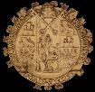
Integrating CAR-T cell therapy and BsAbs into the management of RRMM patients
University of Salamanca
María-Victoria Mateos
Salamanca, Spain

Slide 64
Treatment landscape in Multiple Myeloma today: realistic situation
1st line
ASCT eligible
ASCT ineligible
AntiCD38 + PI + IMiD + Dex
ASCT
Len/Dara-Len
Dara-Len-dex
Dara-VMP/RVd
AntiCD38 + PI + IMiD + Dex
2nd line
Based on sensitivity/refractoriness to Daratumumab and Lenalidomide
Anti-CD38 + Carfilzomib-dex
Anti-CD38 + Pomalidomide-dex
Pomalidomide-bortezomib-dex
Selinexor-bortezomib-dex
Carfilzomib-dex
3rd line
4th line
Anti-CD38 + Pomalidomide-dex
Elotuzumab-Pomalidomide-dex
Previous combos if pt eligible
BCMA-targeted therapy
GPRC5D-targeted therapy
Talquetamab
Ide-cel
Cilta-cel
BsAbs
CAR-T
The label is for RRMM after at least 4 PL of therapy
including PI, IMiD and antiCD38 and refractory
to the last line of therapy
Teclistamab, Elranatamab
Linvoseltamab
BsAbs
Mateos MV, personal communication. Dimopoulos MA et al. EHA/ESMO guidelines. Annals of Oncology 2021

Slide 65
Phase 2 Registrational Study of Anitocabtagene Autoleucel for the Treatment of Patients with (RRMM): Updated Results from iMMagine-1
Anito-cel is an autologous BCMA-directed CAR T-cell therapy using a novel D-Domain binder
117 TCE RRMM pts were dosed: median age 64; 18% EMD; 18% high tumor burden and 40% HRCA
Median number of PL: 3, TCR 87% and PCR 41%. 76% received bridging therapy. Median f/u: 16 months
Safety profile: CRS in 85% (G1 in 68% and G2 in 17); ICANS in 8%
No delayed NT; no SPM; no enterocolitis
G3-4 neutropenia: 70% and G3-4 infections: 9%
Patel K et al: ASH 2025: oral presentation. Abstract number 256

Slide 66
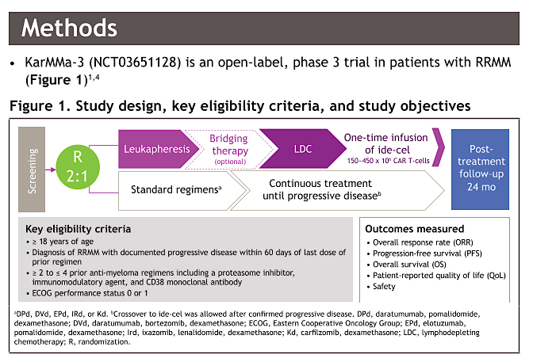
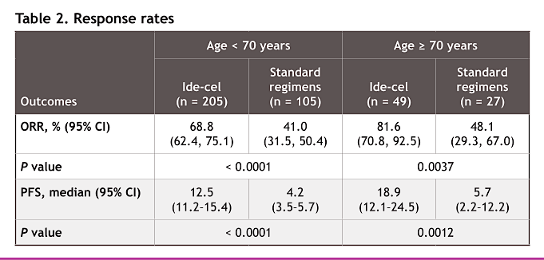
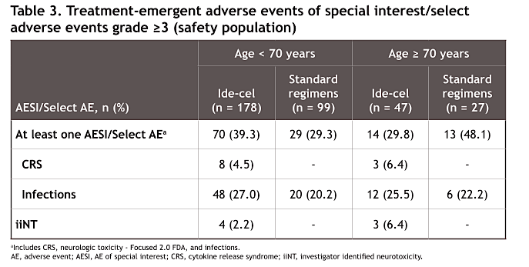
KarMMa-3: Ide-cel in RRMM after 2-4PL: outcomes in the older population
20% of pts approximately were older than 70 years
Patients older than 70 years were, overall: with less HRCA, less TCR and with longer time from the last line of therapy
Conclusions:
Patients aged ≥ 70 years from the KarMMa-3 trial experienced benefit from ide-cel treatment, as evidenced by a longer median PFS and notable ORR compared with patients treated with standard regimens
Ailawadhi S et al. ASH 2025: poster presentation number 9044

Slide 67
What is the subgroup of patients treated with Cilta-cel in C4 with better outcomes?
Safety profile of cilta-cel in standard-risk population was consistent with overall study population^{1,b}
Costa L et al. ASH 2025: oral presentation: abstract number 9129

Slide 68
The better outcomes for standard risk patients in C4 are applicable to C1
 | 30-month PFS rate, % | 30-month OS rate, %
CARTITUDE-4 (median 2 prior lines) 59.4% 76.4%
Cilta-cel Standard-risk cytogenetics per protocol | 80.5 | 87.3
Cilta-cel Standard-risk cytogenetics per protocol + gain/amp(1q) | 71.7 | 86.1
CARTITUDE-1 (median 6 prior lines) Median PFS 36 m and OS 60 m
Cilta-cel Standard-risk cytogenetics per protocol including gain/amp(1q) | 59.9 | 70.6
Costa L et al. ASH 2025: oral presentation: abstract number 9129

Slide 69


Earlier use of Cilta-cel is associated with better immune fitness and stronger immune effects
Cilta-cel in both C1 and C4 trials showed better outcomes in earlier lines of therapy (especially after 1 or 2 PL)
Evaluation included PB samples at D28 and M6: - Bulk RNA sequencing
- TCR repertoire in C-1
- Immunophenotyping by FCM
Cartitude-4
Parek S et al. ASH 2025: oral presentation. abstract number 8211

Slide 70



Earlier use of Cilta-cel is associated with better immune fitness and stronger immune effects
Cartitude-1: 33% of pts remain alive and progression-free at 5 years
Cartitude-4
Parek S et al. ASH 2025: oral presentation. abstract number 8211

Slide 71
Teclistamab-Talquetamab in RRMM patients: phase 1b of RedirecTT-1 trial
94 pts overall and 43 at the RP2R were included. Median number of PL: 4 (86% TCR and 46% with true EMD)
Safety profile: Infections are the most relevant ones (43% G3-4 at the RP2R); opportunistic infections in 17% of pts; any-grade infection risk peaked early and stabilized by ~6 months; grade ≥3 infection risk was highest in the first 6 months and decreased over time
On target off tumor toxicity related with GPRC5D are frequent but most are G1-2
Tec-Tal today has a role in patients with true EMD because this population has an unmet need.
MonumenTAL-9 study will confirm its role in all RRMM patients
Mateos MV et al. ASH 2025: oral presentation. Abstract number 7712

Slide 72


Subcutaneous Cevostamab (a novel FcRH5xCD3 bispecific T-cell engager — BiTE) in RRMM patients: Phase Ib CAMMA 3 study
58 pts included. Median number of PL: 5 (64% TCR and 48.3% BCMA-TT exposed including CAR-T, ADC and BsAbs)
Cevostamab was evaluated at different doses and dose > 120 mg is effective. Fixed duration: 13 c
Safety profile: Infections (44.8% and G3-4 12%); CRS in 69% and injection-site reaction in 58.6%; neutropenia in 31% (most G3-4)
The role of Cevostamab is interesting for the sequencing of T-cell redirecting therapies but.. more data are required and its role is maybe in combination
Ho PJ et al. ASH 2025: oral presentation: abstract number 8172

Slide 73


Etentamig (BCMAxCD3 BiTE) plus Pom-dex in RRMM patients: Cohort A of the clinical trial
85 pts included. Median number of PL: 4 (73% TCR and 51% refractory to pomalidomide)
Etentamig was given in this cohort with no SUD, no premedication and Q4W
Pom and dex at conventional doses from C1D1 and dose for etentamig was 20 or 40 mg
Safety profile: Infections (89% and G3-4 52%); CRS in 35% (no G3-4); neutropenia G3-4 in 78%. Hepatic toxicity in 25% (G3-4 in 8%)
Cohort E included some modifications: SUD 1 and Pom included at C2D1. Dose of etentamig 60 mg and less pretreated but the f/u was short
Voorhees P et al. ASH 2025: oral presentation: abstract number 1875

Slide 74



Ramantamig, BCMA-GPRC5D trispecific mAB in RRMM patients
36 pts received ramantamig at the RP2D (1 SUD followed by 100 mg flat dose Q4W). Median number of 4 PL (53% TCR and 25% previously exposed to BCMA/GPRc5D)
Ramantamig has a great efficacy in patients naïve to T-Cell Redirecting therapy similar to CAR-T
It is pending to know the activity in patients previously exposed as well as in specific populations like patients with EMD
Krishnan AY et al. ASH 2025: poster presentation. Abstract number 7875

Slide 75




Low dose Tocilizumab for mitigation of CRS with BsAbs in RRMM
Prophylactic single Toci-lo proved to be an effective strategy at reducing CRS incidence and severity during the SUD phase of BsAbs treatment. This low dose instead of the standard (8 mg/kg) may be a cost-effective strategy.
Hamadeh I et al. ASH 2025: poster presentation: abstract number 7258

Slide 76
Agenda
Introduction | Dr Yannucci – 60-year-old man | Best of ASH Multiple Myeloma
Case 1 | Dr Morganstein – 62-year-old man | Dr Lorber – 59-year-old man
Faculty Presentation: Antibody-Drug Conjugates and Other Emerging Novel Therapies for Relapsed/Refractory (R/R) Multiple Myeloma (MM) — Dr Lonial
Case 2 | Dr Morganstein – 84-year-old man
Case 3 | Dr Favaro – 64-year-old man
Faculty Presentation: Integrating CAR T-Cell Therapy and Bispecific Antibodies into the Management of R/R MM — Dr Mateos
Case 4 | Dr Bhatnagar – 71-year-old man
Case 5 | Dr Rudolph – 56-year-old man

Slide 77
Case Presentation: 71-year-old man with kappa light chain myeloma experiences CR on cilta-cel CAR T-cell therapy with hypogammaglobulinemia requiring IVIG, develops melanoma of the abdominal wall
Dr Tina Bhatnagar (Wheeling, West Virginia)

Slide 78
Agenda
Introduction | Dr Yannucci – 60-year-old man | Best of ASH Multiple Myeloma
Case 1 | Dr Morganstein – 62-year-old man | Dr Lorber – 59-year-old man
Faculty Presentation: Antibody-Drug Conjugates and Other Emerging Novel Therapies for Relapsed/Refractory (R/R) Multiple Myeloma (MM) — Dr Lonial
Case 2 | Dr Morganstein – 84-year-old man
Case 3 | Dr Favaro – 64-year-old man
Faculty Presentation: Integrating CAR T-Cell Therapy and Bispecific Antibodies into the Management of R/R MM — Dr Mateos
Case 4 | Dr Bhatnagar – 71-year-old man
Case 5 | Dr Rudolph – 56-year-old man

Slide 79
Case Presentation: 56-year-old man with heavily relapsed MM who received multiple prior lines of therapy, including CAR T-cell therapy, is now on talquetamab
Dr Priya Rudolph (Athens, Georgia)

Slide 80
Case Presentation: 71-year-old man with light chain MM receives daratumumab/RVd with VGPR, subsequently completes ASCT ➔ maintenance ixazomib and 2 years later is diagnosed with locally advanced prostate cancer treated with radiation therapy and ADT. Now with myeloma progression
Dr Eric Lee (Fountain Valley, California)

