Slide 1
Practical Perspectives on the Current and Future Management of Immune Thrombocytopenia — What Happened at ASH 2025?
A CME/MOC-Accredited Live Webinar
Tuesday, December 16, 2025
5:00 PM – 6:30 PM ET
Faculty
Hanny Al-Samkari, MD
Cindy Neunert, MD, MSCS
Professor Francesco Zaja
Moderator
Neil Love, MD

Slide 2

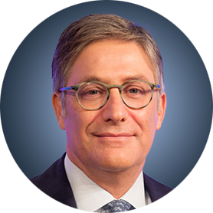
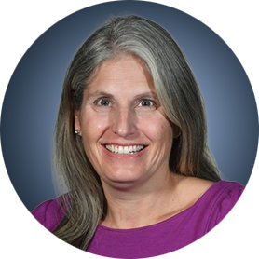
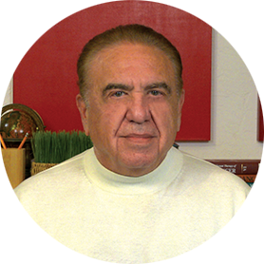
Faculty
Hanny Al-Samkari, MD
Classical Hematologist and Clinical Investigator
The Peggy S Blitz Endowed Chair
in Hematology/Oncology
Co-Director, Hereditary Hemorrhagic
Telangiectasia Center
Massachusetts General Hospital
Associate Professor of Medicine
Harvard Medical School
Boston, Massachusetts
Professor Francesco Zaja
DSM, University of Trieste
Director, Unit of Hematology
ASUGI
Trieste, Italy
Cindy Neunert, MD
Professor, Pediatrics
Columbia University Irving Medical Center
New York, New York
MODERATOR
Neil Love, MD
Research To Practice
Miami, Florida

Slide 3
Dr Al-Samkari — Disclosures
Consulting Agreements | Agios Pharmaceuticals Inc, Alnylam, Alpine Immune Sciences, Amgen Inc, Novartis, Pharmacosmos, Sanofi, Sobi, Takeda Pharmaceuticals USA Inc
Contracted Research | Agios Pharmaceuticals Inc, Amgen Inc, Novartis, Sobi, Vaderis Therapeutics AG

Slide 4
Dr Neunert — Disclosures
Advisory Committees | Novartis, Sanofi
Consulting Agreements | Janssen Biotech Inc
Contracted Research | Novartis
Data and Safety Monitoring Boards/Committees | Takeda Pharmaceuticals USA Inc

Slide 5
Prof Zaja — Disclosures
Advisory Committees | AbbVie Inc, Amgen Inc, argenx, AstraZeneca Pharmaceuticals LP, BeOne, Gilead Sciences Inc, Grifols, Incyte Corporation, Novartis, Sanofi, Takeda Pharmaceuticals USA Inc
Consulting Agreements | Amgen Inc, Grifols, Novartis
Contracted Research | Janssen Biotech Inc
Speakers Bureaus | AbbVie Inc, Amgen Inc, argenx, AstraZeneca Pharmaceuticals LP, Grifols, Novartis
Nonrelevant Financial Relationships (Educational Projects on Lymphomas and ITP) | AbbVie Inc, Amgen Inc, AstraZeneca Pharmaceuticals LP, BeOne, Grifols, Incyte Corporation, Kyowa Kirin Co Ltd, Sobi

Slide 6
Dr Love — Disclosures
Dr Love is president and CEO of Research To Practice. Research To Practice receives funds in the form of educational grants to develop CME activities from the following companies: Aadi Bioscience, AbbVie Inc, ADC Therapeutics, Agendia Inc, Alexion Pharmaceuticals, Amgen Inc, Array BioPharma Inc, a subsidiary of Pfizer Inc, Arvinas, Astellas, AstraZeneca Pharmaceuticals LP, Aveo Pharmaceuticals, Bayer HealthCare Pharmaceuticals, BeOne, Biotheranostics Inc, A Hologic Company, Black Diamond Therapeutics Inc, Blueprint Medicines, Boehringer Ingelheim Pharmaceuticals Inc, Bristol Myers Squibb, Celcuity, Clovis Oncology, Coherus BioSciences, Corcept Therapeutics Inc, CTI BioPharma, a Sobi Company, Daiichi Sankyo Inc, Eisai Inc, Elevation Oncology Inc, Exact Sciences Corporation, Exelixis Inc, Genentech, a member of the Roche Group, Genmab US Inc, Geron Corporation, Gilead Sciences Inc, GSK, Helsinn Therapeutics (US) Inc, ImmunoGen Inc, Incyte Corporation, Ipsen Biopharmaceuticals Inc, Jazz Pharmaceuticals Inc, Johnson & Johnson, Karyopharm Therapeutics, Kite, A Gilead Company, Kura Oncology, Legend Biotech, Lilly, MEI Pharma Inc, Merck, Mersana Therapeutics Inc, Mirati Therapeutics Inc, Mural Oncology Inc, Natera Inc, Novartis, Novartis Pharmaceuticals Corporation on behalf of Advanced Accelerator Applications, Novocure Inc, Nuvalent, Pfizer Inc, Pharmacyclics LLC, an AbbVie Company, Puma Biotechnology Inc, Regeneron Pharmaceuticals Inc, Rigel Pharmaceuticals Inc, R-Pharm US, Sanofi, Seagen Inc, Servier Pharmaceuticals LLC, SpringWorks Therapeutics Inc, Stemline Therapeutics Inc, Sumitomo Pharma America, Syndax Pharmaceuticals, Taiho Oncology Inc, Takeda Pharmaceuticals USA Inc, TerSera Therapeutics LLC, and Tesaro, A GSK Company.

Slide 7
Commercial Support
This activity is supported by an educational grant from Novartis.
Research To Practice CME Planning Committee Members,
Staff and Reviewers
Planners, scientific staff and independent reviewers for Research To Practice have no relevant conflicts of interest to disclose.

Slide 8
This educational activity contains discussion of
non-FDA-approved uses of agents and regimens. Please refer to official prescribing information for each product for approved indications.

Slide 9
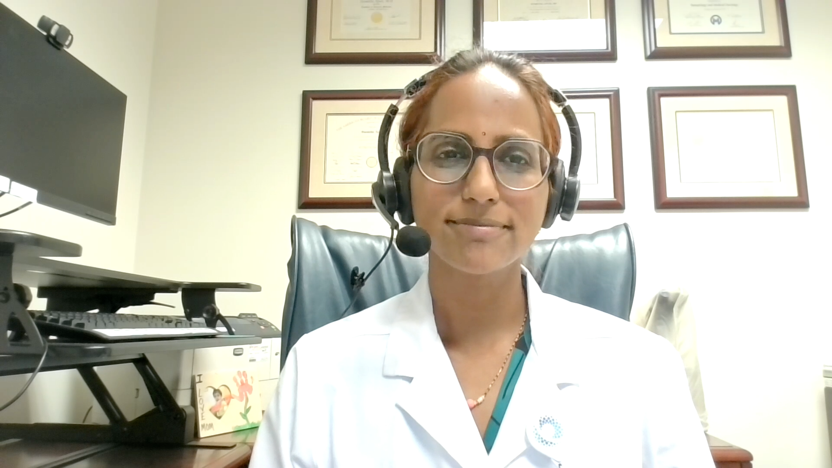
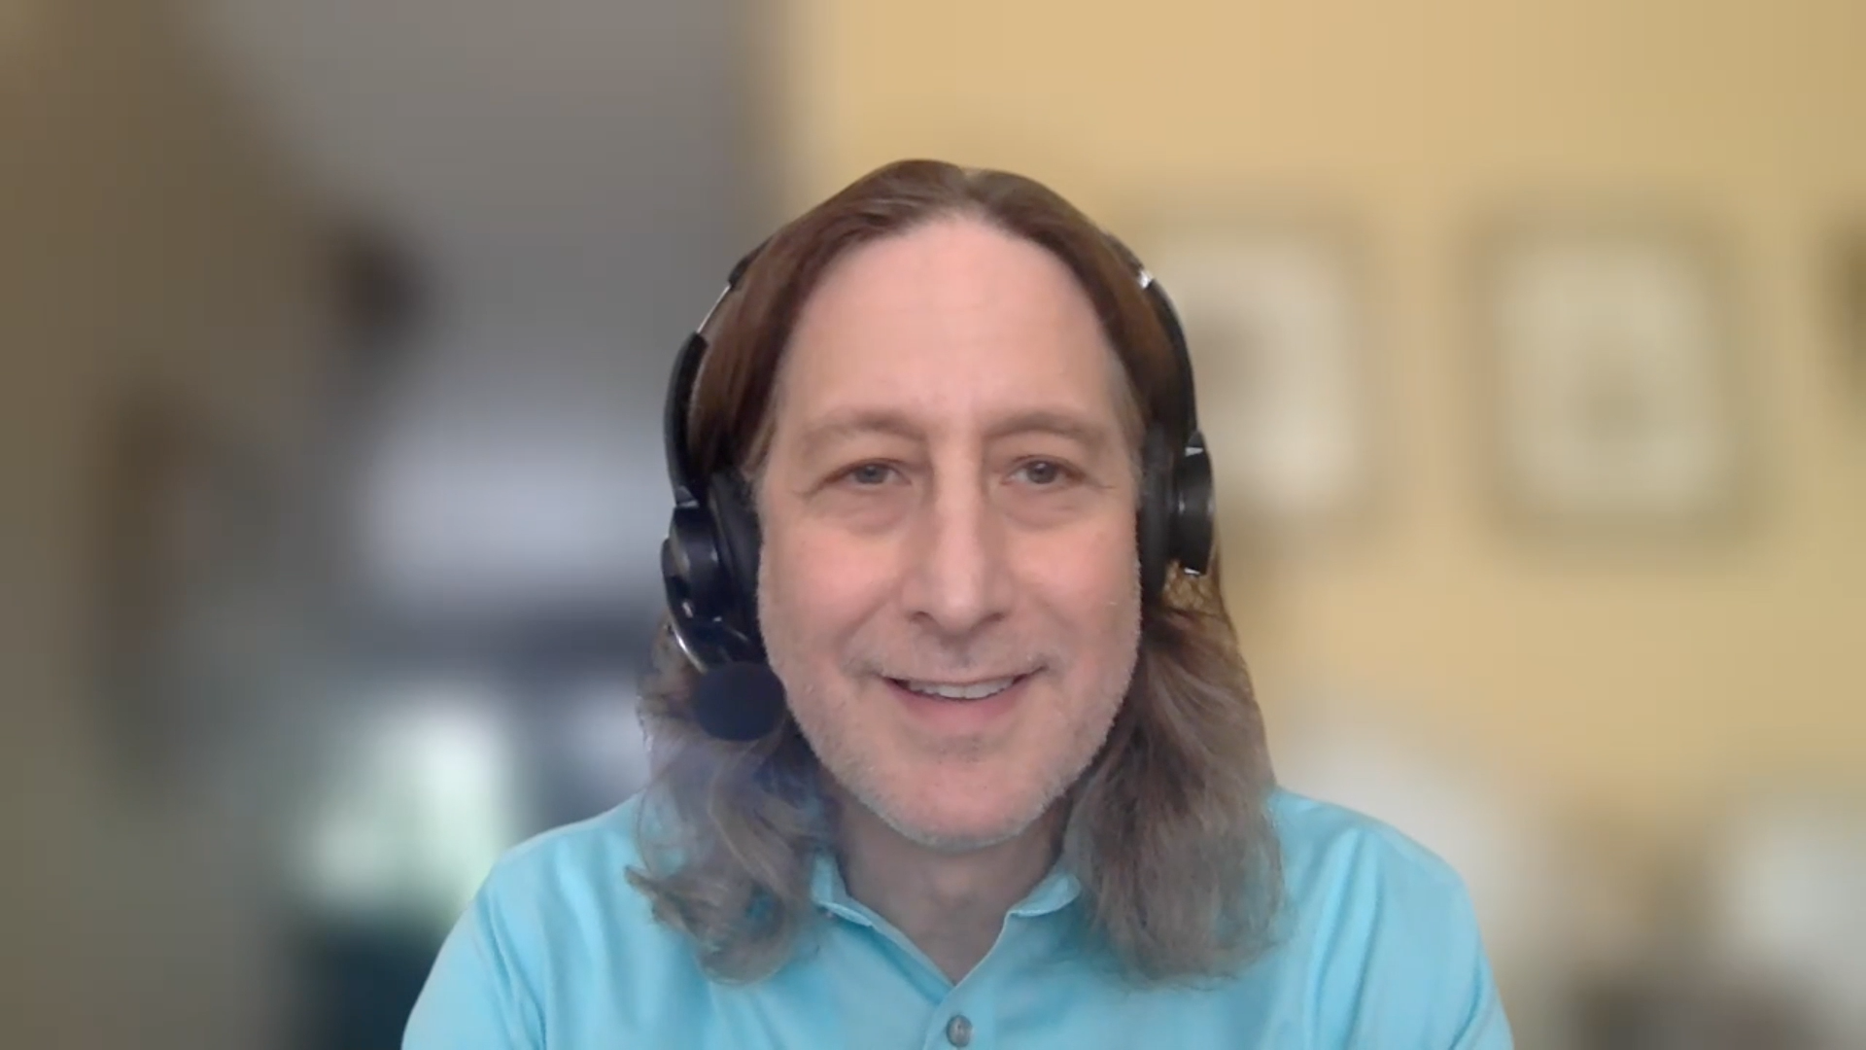
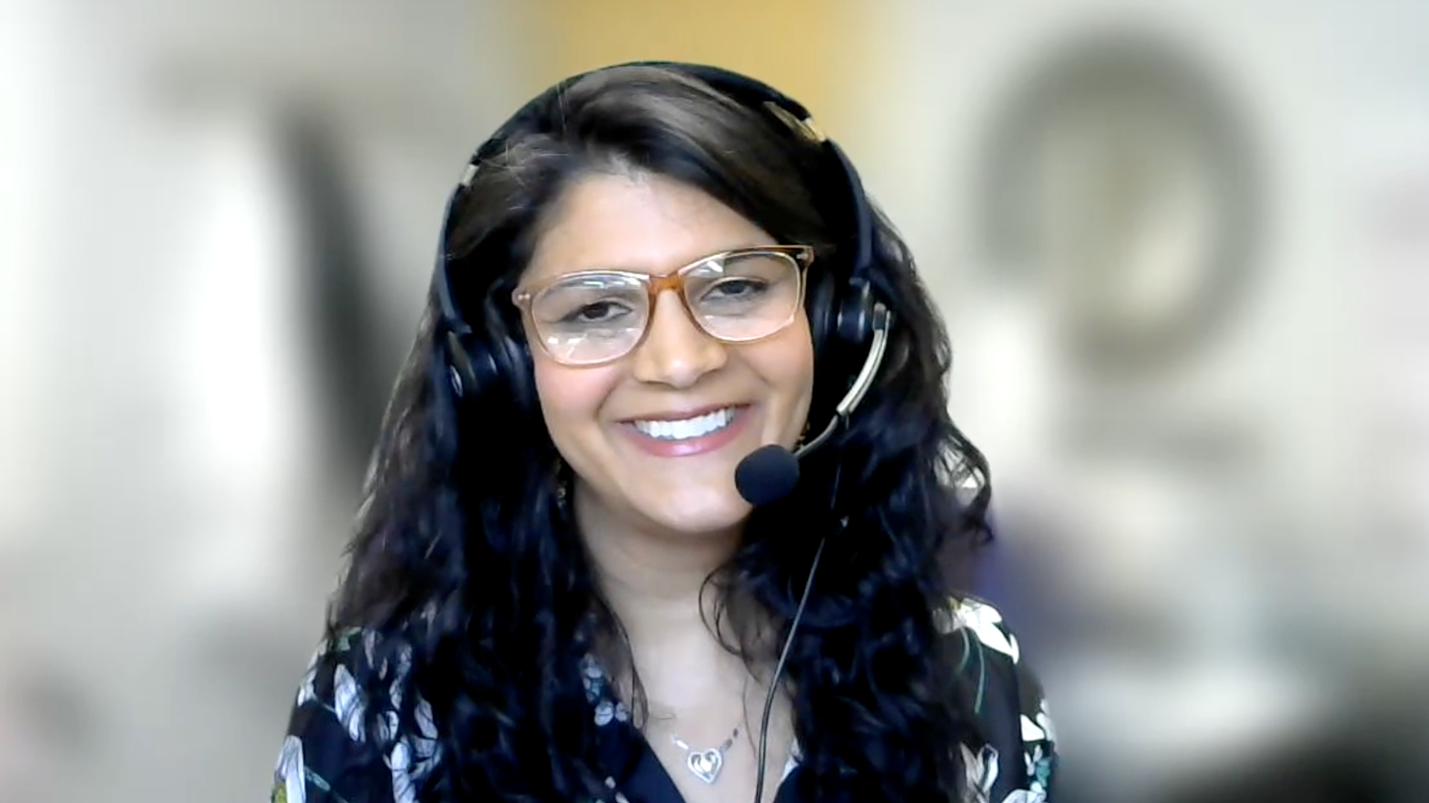
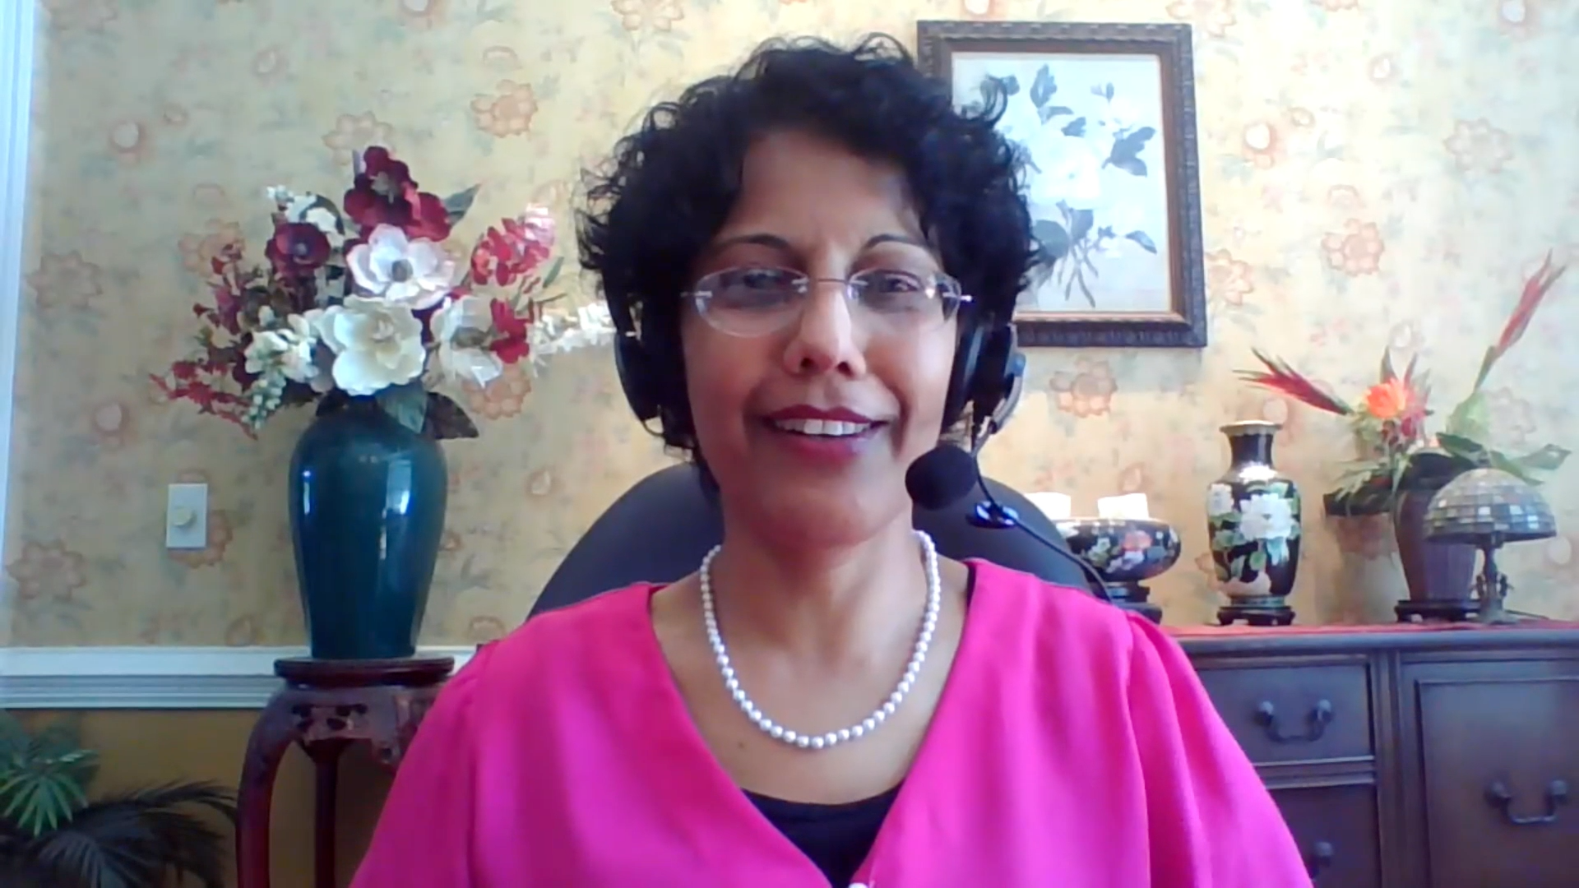
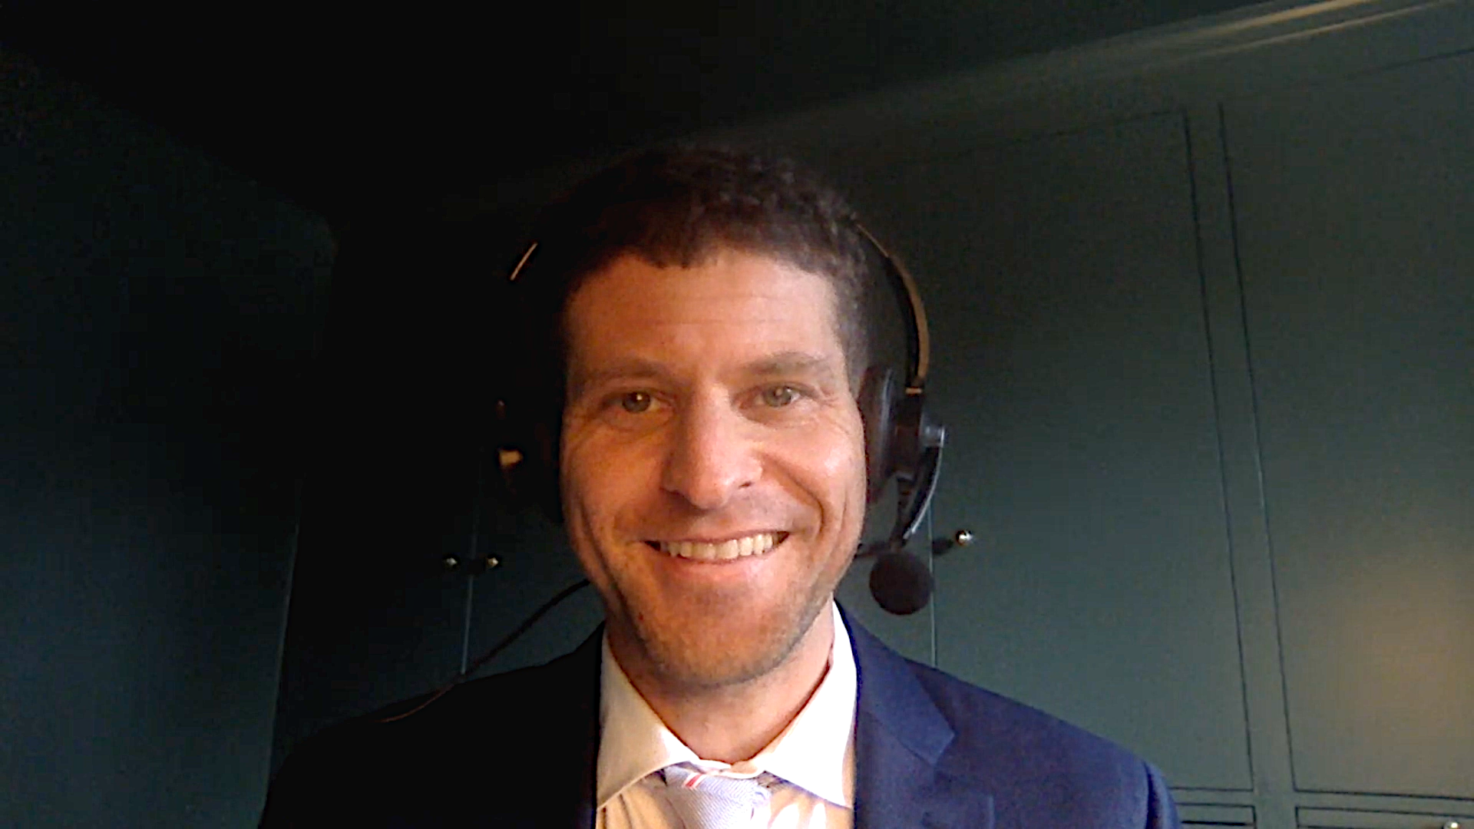
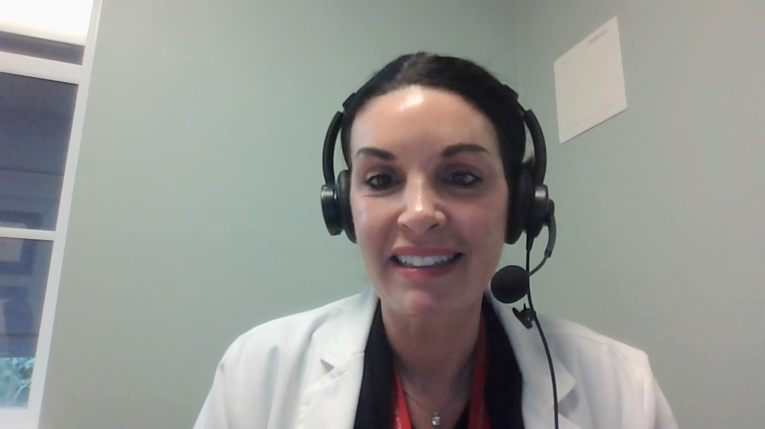
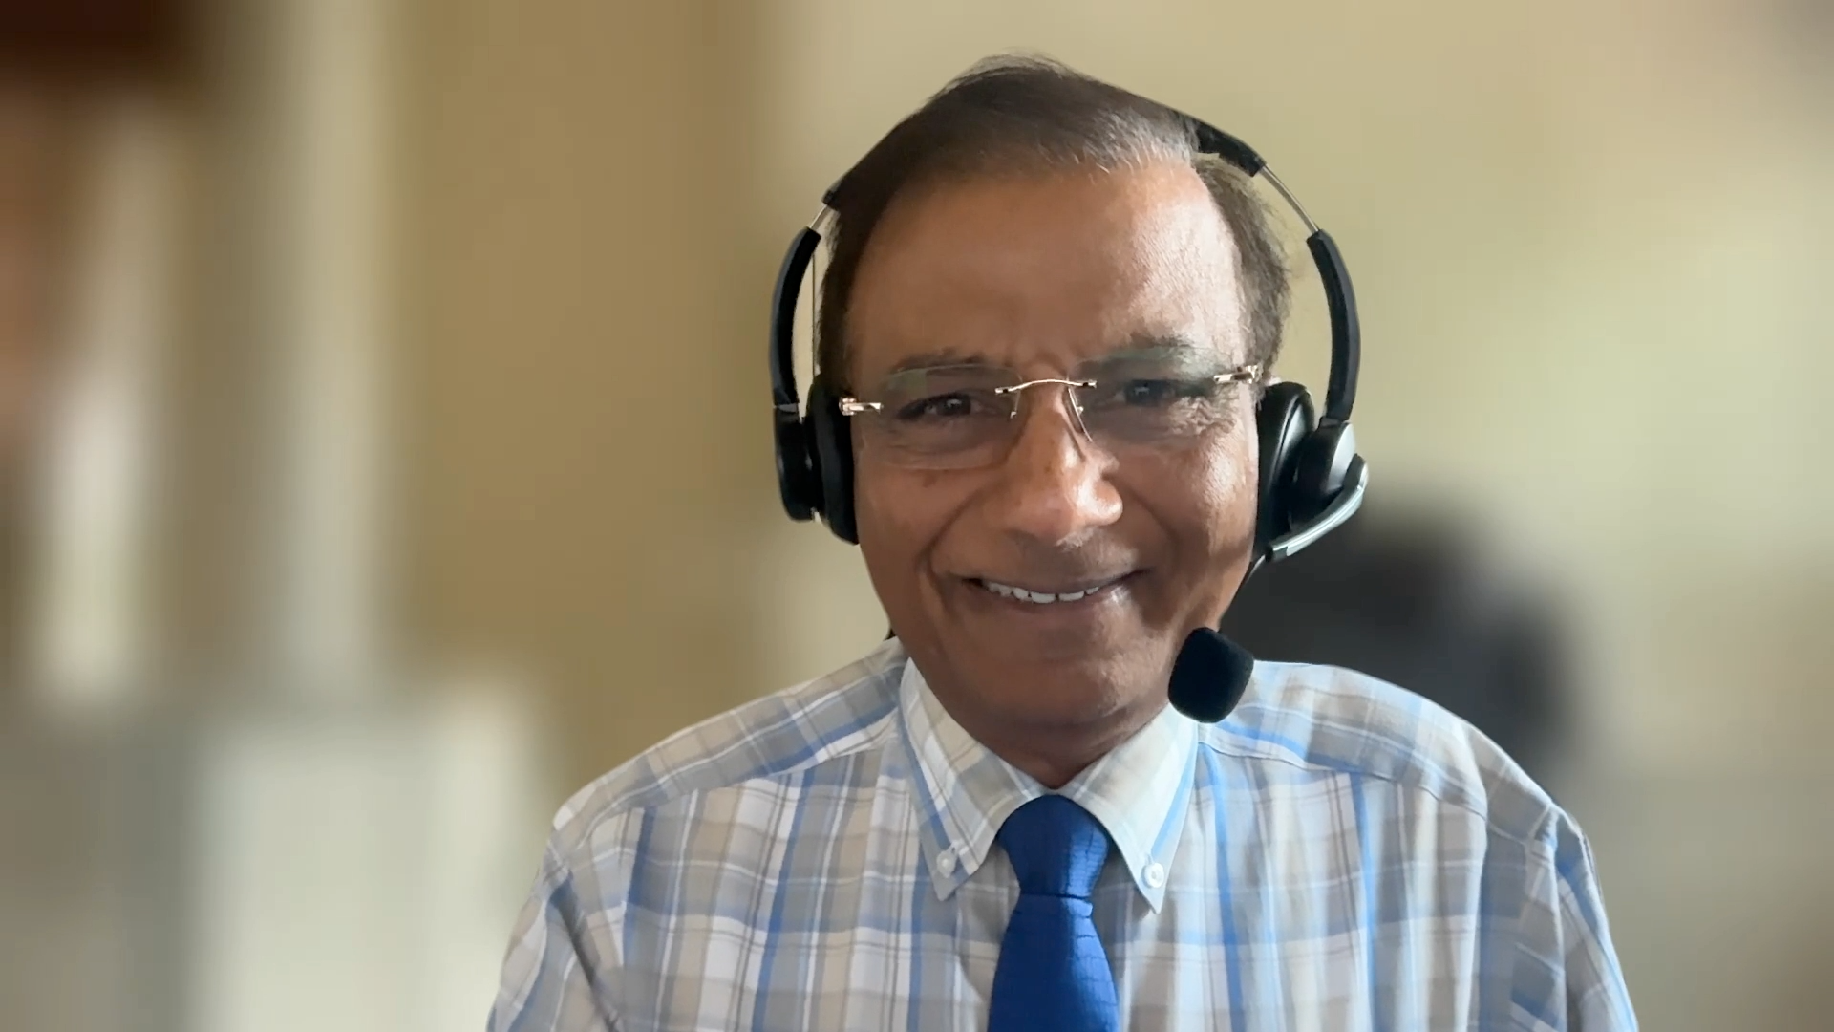
Contributing General Medical Oncologists
Susmitha Apuri, MD
Florida Cancer Specialists
& Research Institute
Lutz, Florida
Neil Morganstein, MD
Atlantic Health System
Summit, New Jersey
Bhavana (Tina) Bhatnagar, DO WVU Cancer Institute
Wheeling, West Virginia
Priya Rudolph, MD, PhD
Georgia Cancer Specialists
Athens, Georgia
Eric Fox, DO
Bryn Mawr Medical Specialists Association
Bryn Mawr, Pennsylvania
Jennifer Yannucci, MD
Low Country Cancer Care
Savannah, Georgia
Sunil Gandhi, MD
Florida Cancer Specialists
& Research Institute
Lecanto, Florida

Slide 10
ASH 2025 Key Datasets
Cindy Neunert, MD
Leaf R et al. Immune thrombocytopenia in patients treated with immune checkpoint inhibitors. ASH 2025; Abstract 841.
Professor Francesco Zaja
Ghanima W et al. The prolong trial: A two phase randomized placebo-controlled trial to optimize rituximab response with dexamethasone and maintenance therapy with low dose rituximab in immune thrombocytopenia (ITP) patients. ASH 2025;Abstract 736.
Mingot ME et al. A multicenter, randomized, open-label study of dexamethasone versus romiplostim plus dexamethasone as first line treatment in patients with newly diagnosed immune thrombocytopenia: Interim results of rodex study. ASH 2025;Abstract 733.

Slide 11
ASH 2025 Key Datasets
Hanny Al-Samkari, MD
Kuter D et al. Reduction in corticosteroid use with rilzabrutinib and sustained response in adults with persistent/chronic immune thrombocytopenia in the long-term extension period of the phase 3 LUNA3 study. ASH 2025;Abstract 1260.
Cooper N et al. Improved health-related quality of life (HRQoL) and bleeding scores with oral bruton tyrosine kinase (BTK) inhibitor rilzabrutinib in the open-label (OL) period of the multicenter phase 3 LUNA3 study in adults with immune thrombocytopenia (ITP). ASH 2025;Abstract 1254.
Al-Samkari H et al. Primary results from VAYHIT2, a randomized, double-blind, phase 3 trial of ianalumab plus eltrombopag versus placebo plus eltrombopag in patients with primary immune thrombocytopenia (ITP) who failed first-line corticosteroid treatment. ASH 2025;Abstract LBA-2.
Choi P et al. Secondary analysis results from VAYHIT3, a phase 2 study of ianalumab in patients with primary immune thrombocytopenia previously treated with at least two lines of therapy. ASH 2025;Abstract 844.

Slide 12
Agenda
Case 1 | Dr Yannucci – 60-year-old man | Dr Morganstein – 33-year-old woman
Case 2 | Dr Morganstein – 62-year-old man | Dr Bhatnagar – 68-year-old woman
Faculty Presentation: Clinical Manifestations and Initial Management of Immune Thrombocytopenia (ITP) — Dr Neunert
Case 3 | Dr Apuri – 81-year-old woman
Faculty Presentation: Incorporation of Thrombopoietin Receptor Agonists and Other Second-Line Therapies into ITP Management — Prof Zaja
Case 4 | Dr Fox – 69-year-old woman
Faculty Presentation: Current and Future Role of Novel Therapies in ITP — Dr Al-Samkari
Additional Case Presentations

Slide 13
Agenda
Case 1 | Dr Yannucci – 60-year-old man | Dr Morganstein – 33-year-old woman
Case 2 | Dr Morganstein – 62-year-old man | Dr Bhatnagar – 68-year-old woman
Faculty Presentation: Clinical Manifestations and Initial Management of Immune Thrombocytopenia (ITP) — Dr Neunert
Case 3 | Dr Apuri – 81-year-old woman
Faculty Presentation: Incorporation of Thrombopoietin Receptor Agonists and Other Second-Line Therapies into ITP Management — Prof Zaja
Case 4 | Dr Fox – 69-year-old woman
Faculty Presentation: Current and Future Role of Novel Therapies in ITP — Dr Al-Samkari
Additional Case Presentations

Slide 14
Case Presentation: 33-year-old woman with chronic relapsing ITP receives eltrombopag with ongoing stabilization of platelet counts
Dr Neil Morganstein (Summit, New Jersey)

Slide 15
Agenda
Case 1 | Dr Yannucci – 60-year-old man | Dr Morganstein – 33-year-old woman
Case 2 | Dr Morganstein – 62-year-old man | Dr Bhatnagar – 68-year-old woman
Faculty Presentation: Clinical Manifestations and Initial Management of Immune Thrombocytopenia (ITP) — Dr Neunert
Case 3 | Dr Apuri – 81-year-old woman
Faculty Presentation: Incorporation of Thrombopoietin Receptor Agonists and Other Second-Line Therapies into ITP Management — Prof Zaja
Case 4 | Dr Fox – 69-year-old woman
Faculty Presentation: Current and Future Role of Novel Therapies in ITP — Dr Al-Samkari
Additional Case Presentations

Slide 16
Case Presentation: 68-year-old woman has a long history of ITP controlled on eltrombopag but with acute exacerbations
Dr Tina Bhatnagar (Wheeling, West Virginia)

Slide 17
Agenda
Case 1 | Dr Yannucci – 60-year-old man | Dr Morganstein – 33-year-old woman
Case 2 | Dr Morganstein – 62-year-old man | Dr Bhatnagar – 68-year-old woman
Faculty Presentation: Clinical Manifestations and Initial Management of Immune Thrombocytopenia (ITP) — Dr Neunert
Case 3 | Dr Apuri – 81-year-old woman
Faculty Presentation: Incorporation of Thrombopoietin Receptor Agonists and Other Second-Line Therapies into ITP Management — Prof Zaja
Case 4 | Dr Fox – 69-year-old woman
Faculty Presentation: Current and Future Role of Novel Therapies in ITP — Dr Al-Samkari
Additional Case Presentations

Slide 18
Clinical Manifestations and Initial Management of Immune Thrombocytopenia (ITP)
Cindy Neunert, MD
Professor, Pediatrics
Columbia University Irving Medical Center
New York, New York

Slide 19
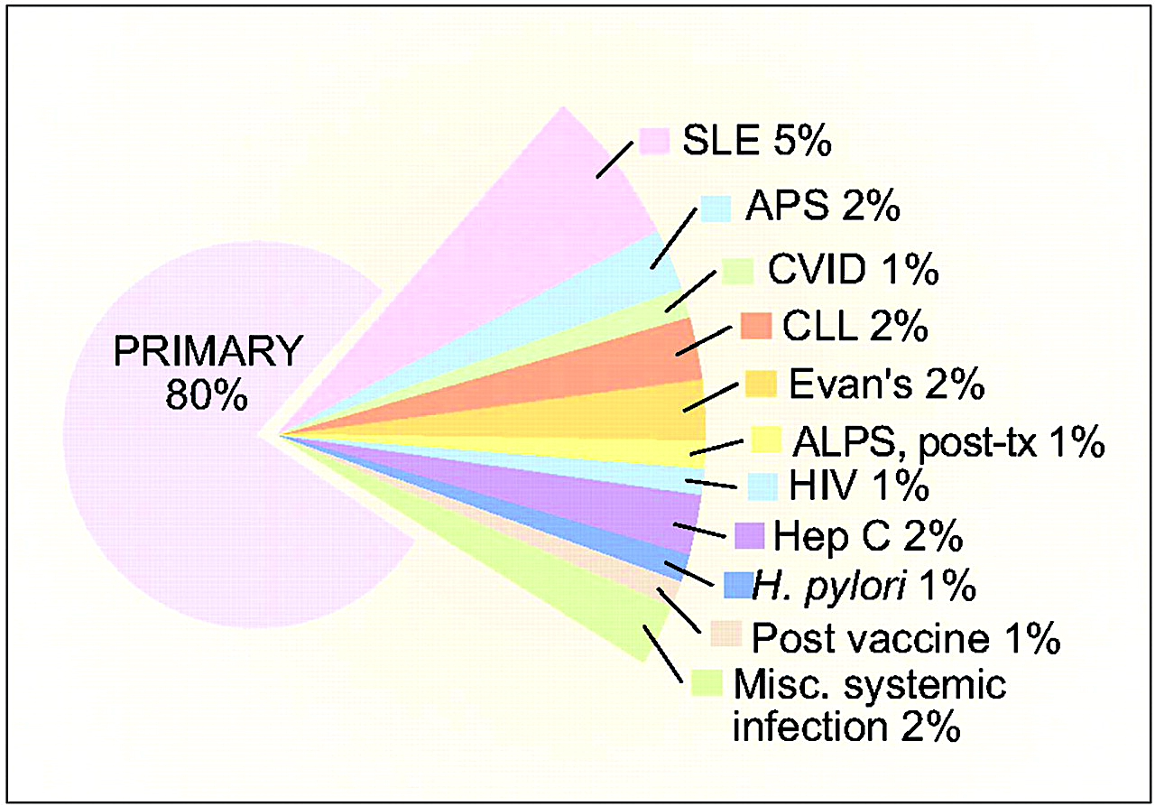
Immune Thrombocytopenia
An autoimmune disorder
  Isolated thrombocytopenia:
  platelet count < 100 × 10⁹/L
  The absence of other causes or disorders that may be associated with thrombocytopenia
  Remains a diagnosis of exclusion
Increased risk of bleeding
  Bleeding is very heterogeneous
Can be primary or secondary
SLE, systemic lupus erythematosus; APS, antiphospholipid syndrome; CVID, common variable immune deficiency; CLL, chronic lymphocytic leukemia; APLS, autoimmune lymphoproliferative syndrome; post-tx, post-bone marrow or solid organ transplantation
Cuker A. Hematology Am Soc Hematol Educ Program. 2010
Rodeghiero F, et al. Blood. 2009

Slide 20
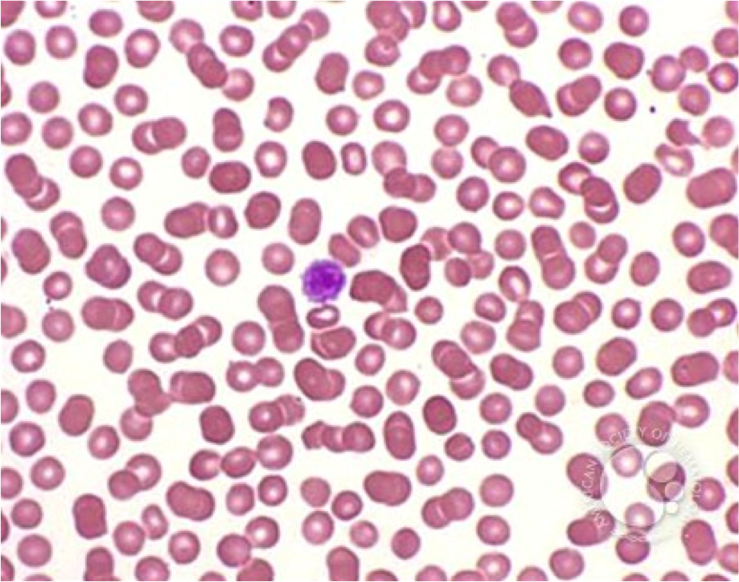
Diagnosis
A diagnosis of exclusion:
  Defined as a platelet count of less than 100 × 10⁹/L
  Absence of red and white cell abnormalities
    Anemia if significant bleeding present
    Pay attention to red cell indices
Peripheral blood smear
    Few large to normal platelets present
    No red or white cell abnormalities
HCV and HIV testing is recommended for all adult patients
Bone marrow examination
    Not necessary in patients presenting with typical ITP
    Age and failure of response to standard therapy are a debated factors

Slide 21
Diagnosis
The laboratory investigation of a suspected ITP patient³
ASH Guidelines⁴ | International Consensus Report⁵ | McMaster ITP Registry⁶
CBC | CBC, reticulocytes | CBC, reticulocytes
Blood film | Blood film | Blood film
HIV | HIV | HIV
HCV | HCV | HCV
HBV before rituximab | HBV before rituximab | HBV
Further tests depend on Hx, CBC | Quantitative immunoglobulins | Quantitative immunoglobulins
 | DAT | DAT
 | H pylori (in adults) | H pylori (in adults)
 | Bone marrow | Bone marrowª
 | Blood group (Rh) if considering anti-D | Platelet size
 | Further tests depend on Hx, CBC | Electrolytes
 |  | Creatinine
 |  | Liver enzymes
 |  | Serum protein electrophoresis
 |  | TSH
 |  | ANA
 |  | ACA
 |  | NSI
 |  | Abdominal ultrasound
A diagnosis of primary ITP relies on the exclusion of alternative etiologies of thrombocytopenia, as no robust clinical or laboratory parameters are available to establish a diagnosis.^{1,2}
ªA bone marrow test only if there are unexplained hematological findings, such as macrocytosis.
Note absence of Platelet antibody testing.
Footnotes are in the speaker notes.

Slide 22
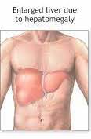
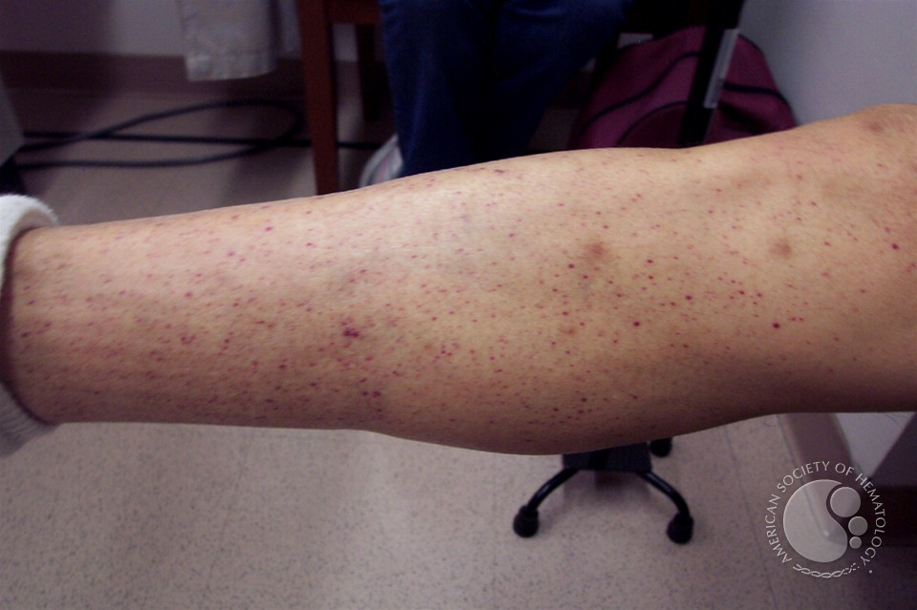
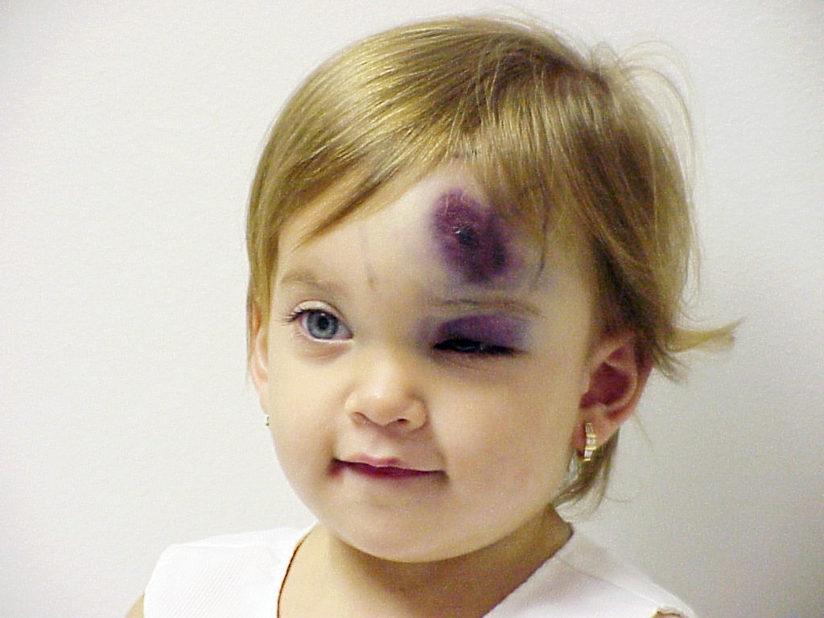
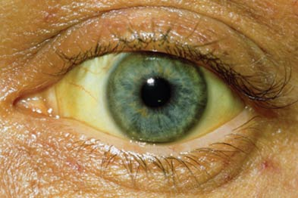
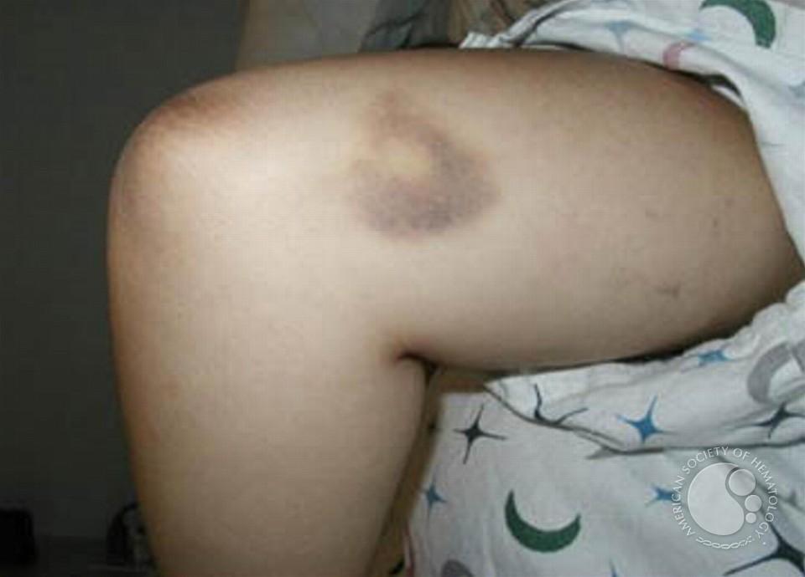
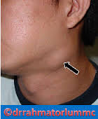
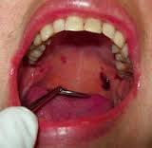
ITP Physical Examination

Slide 23
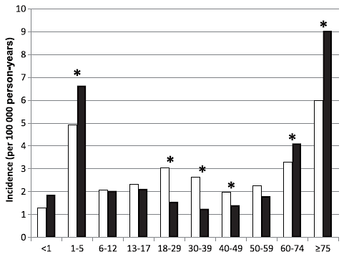
Epidemiology
Annual incidence: 1.6-3.9 per 100,000 person-years
= Females
= Males
*Statistically significant differences among males and females (α = 5%)
Moulis G, et al. Blood. 2014

Slide 24
ITP: Clinical Manifestations
Bleeding
  Substantial inter-individual variation in bleeding phenotype
  Mucocutaneous bleeding is most common manifestation
  Spontaneous intracranial hemorrhage (ICH) is rare, especially when platelet count is >20 x 10⁹/l
  Advanced age, prior bleeding, anti-platelet/anticoagulants are independent risk factors
Possible increase in thrombotic events

Slide 25
What the Platelet Count Doesn’t Tell Us
Therapy-related impact
Adverse effects of Treatment
Cost of Treatment
ITP Clinical Disease
Patient-related impact
Bleeding severity
Health related quality of life
Fatigue
Neurocognition
Patient’s treatment goals

Slide 26
Health-related Quality of Life
Multicenter observational Italian study (n=420)
  Lower HRQoL compared to the general population, except for Bodily Pain, Vitality, and Mental Health
US study (n=73)
  Lower HRQoL compared to the general US population, except for Mental Health
  Lower physical component scores compared to patients with hypertension
  (p <0.001), arthritis (p = 0.0014) and cancer (p=0.0003)
Web-based survey (n=1002)
  Lower HRQoL scores compared to controls, except for Bodily Pain and physical and mental component summary scores

Slide 27
Fatigue
Studies have shown fatigue to be a concern
  ITP Natural History (n=324): 89% reported fatigue, 81% bothered by fatigue
  iWISH study (n=1507): Most frequent (58%) and severe symptom (73%) associated with ITP at diagnosis
  ICON1 (n=54 children, n=42 adolescents): 54% and 62% had moderate to severe fatigue
Likely multifactorial
  Rule out organic causes: thyroid disease, iron deficiency
  Psychological impact
  Chronic inflammation

Slide 28
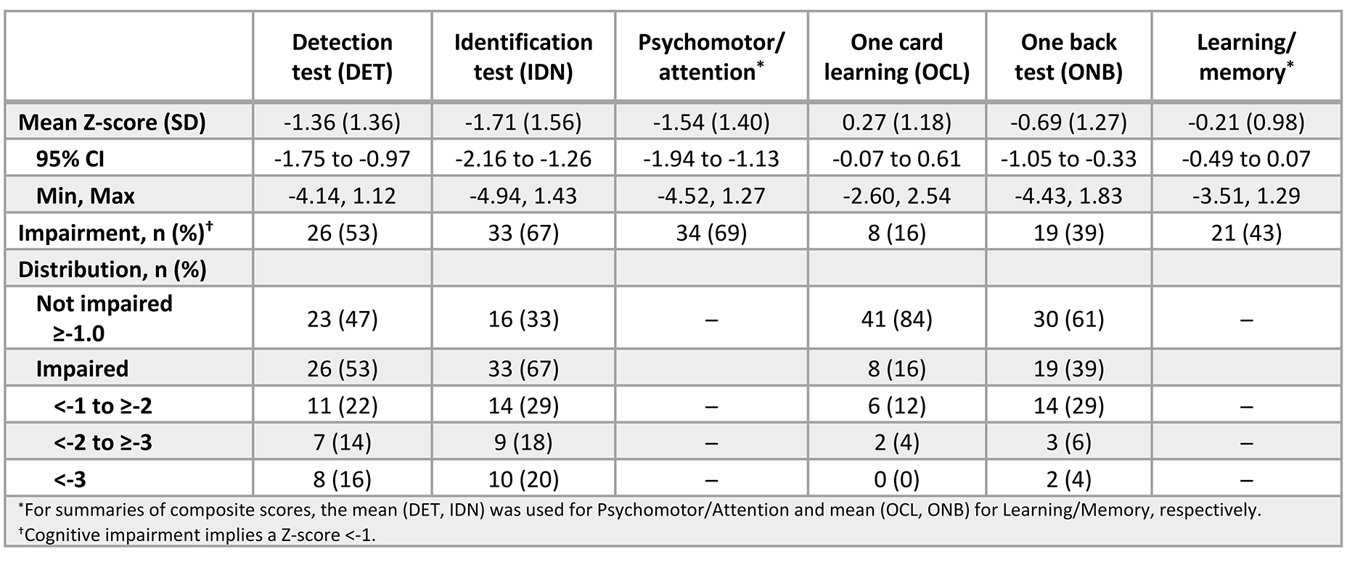
Cognitive Impairment in ITP
Psychomotor
Attention
Memory
Kuter et al. B J Hematol 2024; 205: 291-299

Slide 29
Upfront Management of ITP
 | Dose | Time to Response | Side Effects
Observation and Education | Time | 1 week - indefinite | Bleeding
Corticosteroids | Adults: Prednisone (0.5 to 2.0 mg/kg/day) or dexamethasone (40 mg/day for 4 days) Children: 2-4 mg/kg PO divided BID for 5-7 days | 3-4 days | Mood changes Hypertension Hyperglycemia Gastritis
IVIG | 0.8-1.0 gm/kg IV for one dose Up to 2gm/kg max | 24-48 hours | Infusion reaction Headache/Aseptic meningitis Thrombosis FDA Black box warning for renal failure
Anti-D Immunoglobulin (WinRho) | 50-75 mcg/kg IV for one dose | 24-48 hours | Hemolysis (2.0 gram decrease in Hgb) FDA Black box warning for fatal intravascular hemolysis

Slide 30
First-Line Treatment: Adults
Recommendation 1a: In adults with newly diagnosed ITP and a platelet count of <30 x 10⁹/L who are asymptomatic or have minor mucocutaneous bleeding, the panel suggests corticosteroids rather than management with observation (Conditional recommendation, Very low certainty in the evidence)
The platelet count threshold at which bleeding risk increases and the natural history of newly diagnosed ITP with a platelet count of <30 x10⁹/l managed with observation is not known.
At higher platelet counts within this population or in younger patients, observation may be reasonable.
Consideration should be given to additional comorbidities, use of anticoagulants or antiplatelet medications, need for upcoming procedures, and age of the patient.
Neunert et al. Blood Adv, 2019

Slide 31
Good Practice Statement
The treating physician should ensure the patient is adequately monitored for potential corticosteroid side effects regardless of the duration or type of corticosteroid selected. This includes close monitoring for hypertension, hyperglycemia, sleep and mood disturbances, gastric irritation or ulcer formation, glaucoma, myopathy, and osteoporosis.
Given the potential impact of corticosteroids on mental health, the treating physician should conduct an assessment of health-related quality of life (depression, fatigue, mental status, etc.) while patients are receiving corticosteroids.
Neunert et al. Blood Adv, 2019

Slide 32
First-Line Treatment: Adults
Recommendation 4: In adults with newly diagnosed ITP requiring corticosteroids, the panel suggests either prednisone (0.5 to 2.0 mg/kg/day) or dexamethasone (40 mg/day for 4 days) for initial therapy (Conditional recommendation, Very low certainty in the evidence)
If rapidity of platelet count response is important, an initial course of dexamethasone over prednisone may be preferred given that dexamethasone showed increased desirable effects with regards to response at 7 days.
Neunert et al. Blood Adv, 2019

Slide 33
Prednisone or High Dose Dexamethsone
Primary aim: 6-month response rates
Response at 6 months did not vary
  Overall response 54% vs 43%
  Complete response 37% vs 21%
Increase in OR by day 14 with dexamethasone
No effect of high cumulative dose
Adverse event rates:
  24 per 100 patients in the dexamethasone group
  46 per 100 patients in the prednisone group
Mithoowani et al. Lancet Haematolo 2016

Slide 34
Steroids…. a word of caution
Real-World Data
  Corticosteroids most common second- and third- line therapies in >80% of patients
  Spanish Registry:
    59.5% of patients received > 6 weeks
  Korean Insurance Review:
    75% of patients still on corticosteroids at 3 months
    50% of patients still on corticosteroids at 48 months

Slide 35
ASH Guidelines: Adult ITP Newly Diagnosed
Also carried forward recommendations from the 2011 ASH Guidelines:
  IVIG can be used with corticosteroids when a more rapid increase in platelet count is required (grade 2B)
  Either IVIG or anti-D (in appropriate patients) can be used as a first-line treatment if corticosteroids are contraindicated (grade 2C)
  If IVIG is used, the dose should initially be 1 g/kg as a 1-time dose; this dosage may be repeated if necessary (grade 2B)

Slide 36
Augmented First Line Therapy
Dexamethasone + Rituximab
Dexamethasone + TPO-RAs
  Mostly eltrombopag
  Mingot et al. (n=124)
    Dexamethasone with or without romiplostim
    SROT: 40.9% versus 52.6% (p=0.015)
Corticosteroids + MMF (FLIGHT trial)

Slide 37
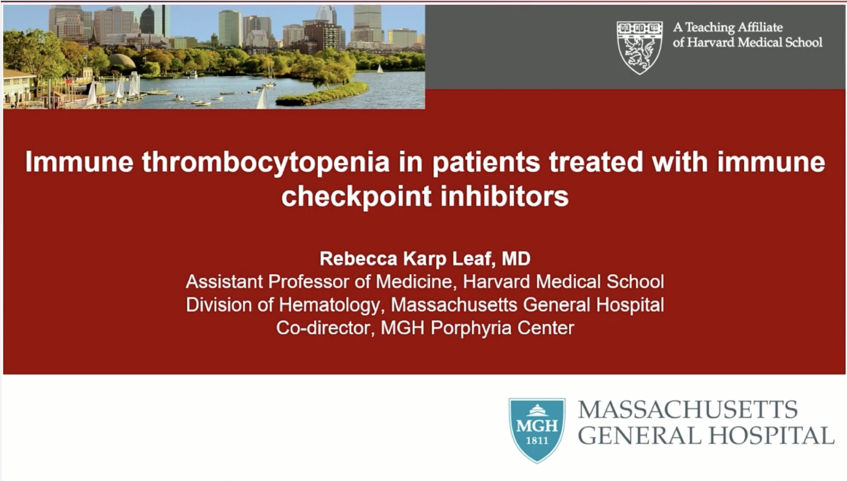
ASH 2025;Abstract 841

Slide 38
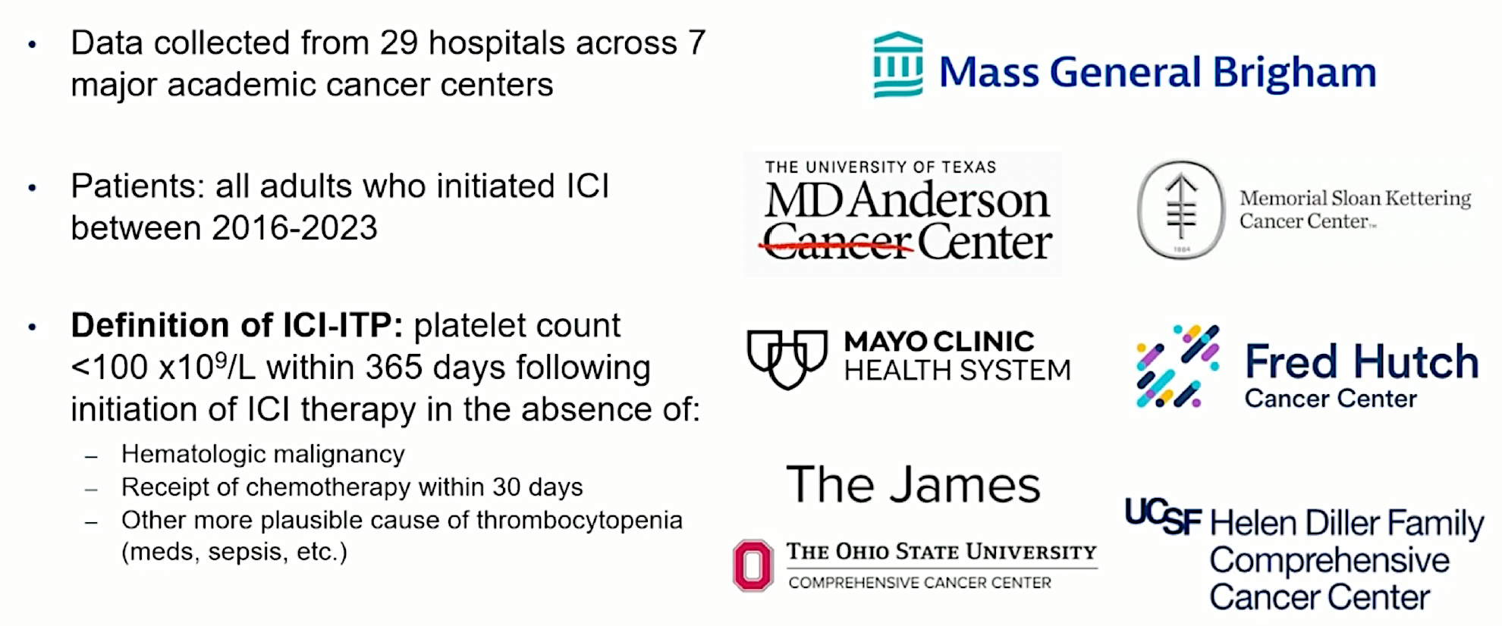
Study Design and Goals
Study Goals:
Identify incidence, risk factors, clinical characteristics, treatments and outcomes associated with immune checkpoint inhibitor (ICI)-ITP
Establish definitions for: diagnosis of ICI-ITP, treatment response, recurrent ICI-ITP
Improve recognition and management of ICI-ITP
Leaf R et al. ASH 2025;Abstract 841.

Slide 39
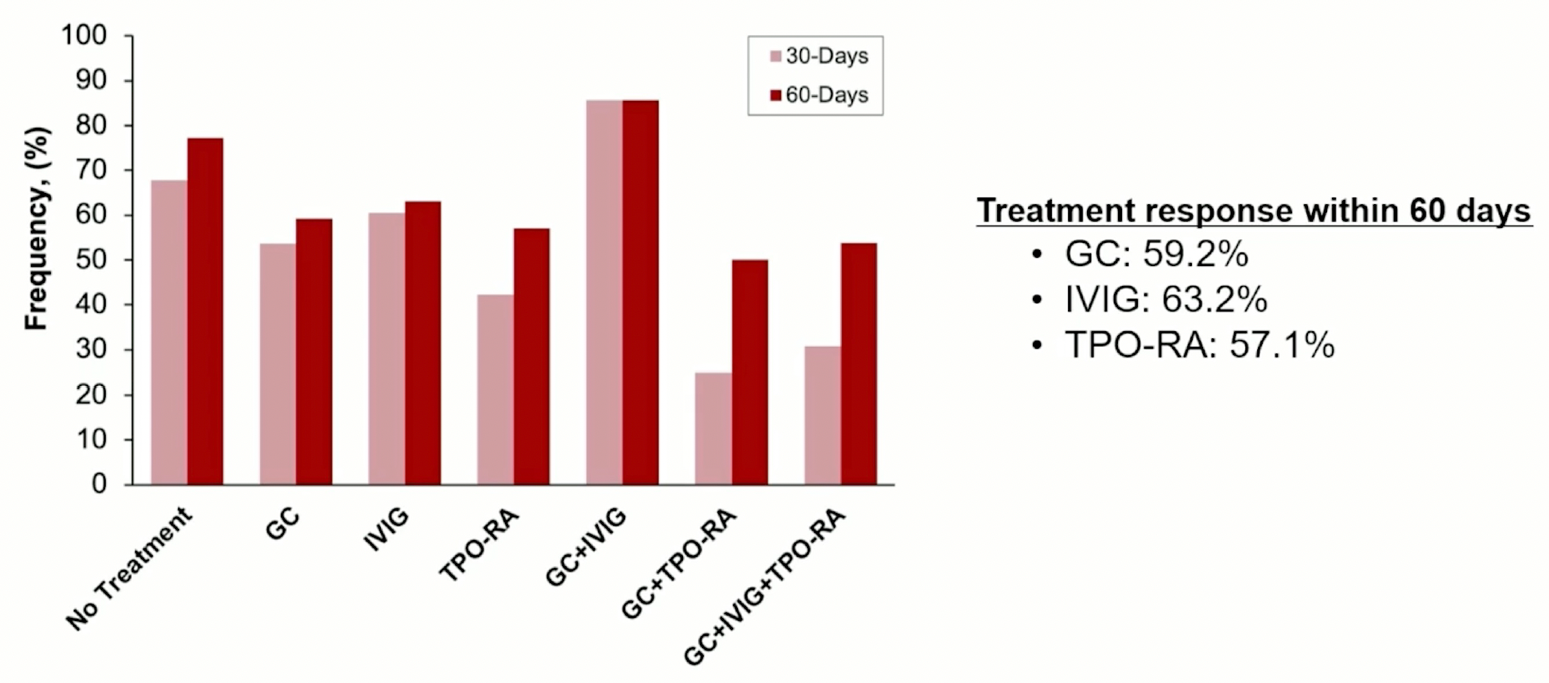
ICI-ITP Treatment Response
GC = glucocorticoid; IVIG = intravenous immunoglobulin; TPO-RA = thrombopoietin-receptor agonist
Leaf R et al. ASH 2025;Abstract 841.

Slide 40
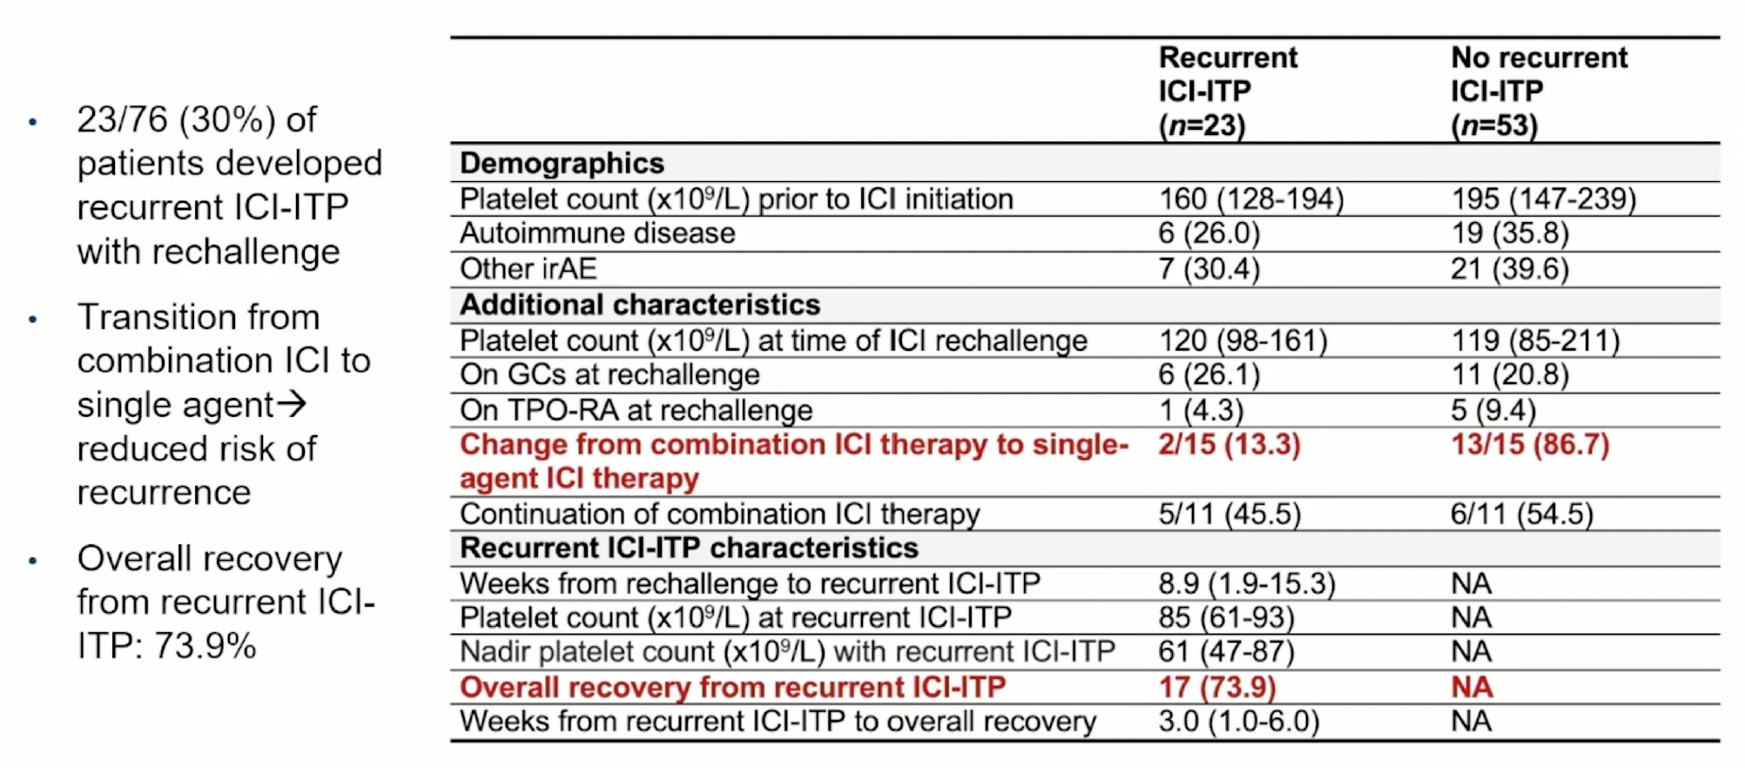
ICI-ITP Rechallenge and ITP
Leaf R et al. ASH 2025;Abstract 841.

Slide 41
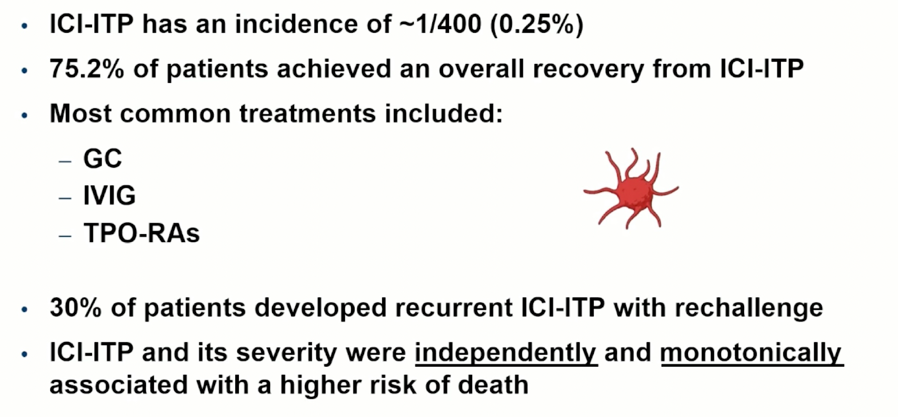
Authors’ Conclusions
Leaf R et al. ASH 2025;Abstract 841.

Slide 42
Agenda
Case 1 | Dr Yannucci – 60-year-old man | Dr Morganstein – 33-year-old woman
Case 2 | Dr Morganstein – 62-year-old man | Dr Bhatnagar – 68-year-old woman
Faculty Presentation: Clinical Manifestations and Initial Management of Immune Thrombocytopenia (ITP) — Dr Neunert
Case 3 | Dr Apuri – 81-year-old woman
Faculty Presentation: Incorporation of Thrombopoietin Receptor Agonists and Other Second-Line Therapies into ITP Management — Prof Zaja
Case 4 | Dr Fox – 69-year-old woman
Faculty Presentation: Current and Future Role of Novel Therapies in ITP — Dr Al-Samkari
Additional Case Presentations

Slide 43
Case Presentation: 81-year-old woman with metastatic adenocarcinoma of the lung responded to carboplatin/ pemetrexed/pembrolizumab but after 14 months of pembrolizumab maintenance presents with ITP
Dr Susmitha Apuri (Lutz, Florida)

Slide 44
Agenda
Case 1 | Dr Yannucci – 60-year-old man | Dr Morganstein – 33-year-old woman
Case 2 | Dr Morganstein – 62-year-old man | Dr Bhatnagar – 68-year-old woman
Faculty Presentation: Clinical Manifestations and Initial Management of Immune Thrombocytopenia (ITP) — Dr Neunert
Case 3 | Dr Apuri – 81-year-old woman
Faculty Presentation: Incorporation of Thrombopoietin Receptor Agonists and Other Second-Line Therapies into ITP Management — Prof Zaja
Case 4 | Dr Fox – 69-year-old woman
Faculty Presentation: Current and Future Role of Novel Therapies in ITP — Dr Al-Samkari
Additional Case Presentations

Slide 45
Incorporation of Thrombopoietin Receptor Agonists (TPO-RAs)
and Other Second-Line Therapies into ITP Management
December 16, 2025
Francesco Zaja – University of Trieste, Italy

Slide 46
Outcome with corticosteroids 1L therapy in adult ITP patients
 | Treatment | Initial R | TTR | SR | LTR
Prednisone | 1 mg/kg x 2-4 weeks max 8 weeks | 60-80% | 2-20 | ∼40% | ∼20%
Dexamethasone | 40 mg x 4 days 1-3 cycles | 60-90% | 1-10
R: response rate (i.e > 30 x 10⁹/L and doubling of baseline platelet count)
TTR: time to response (days)
SR: sustained response at 6 months
LTR: long-term response
1. Bae S, et al. Blood 2010; 2. Mashhadi MA, et al. Daru 2012; 3. Din B, et al. Acta Haematol 2015; 4. Wei Y, et al. Blood 2016.

Slide 47
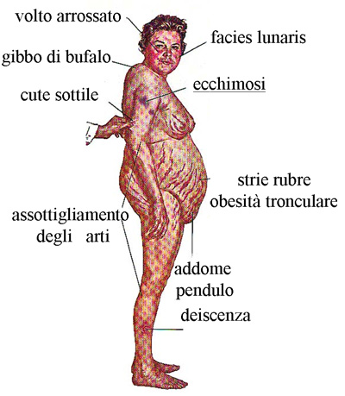

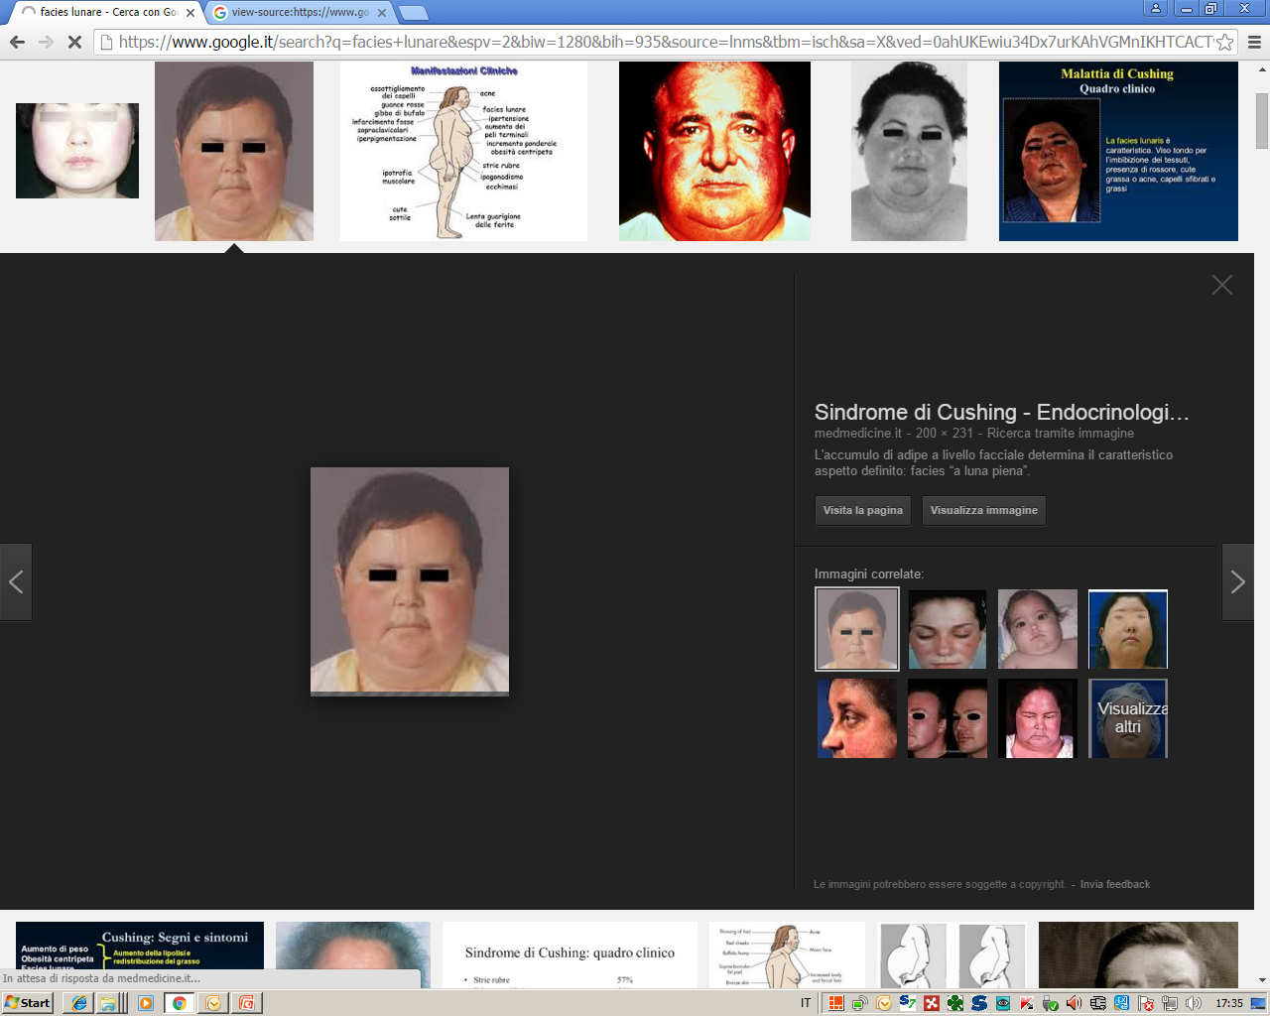
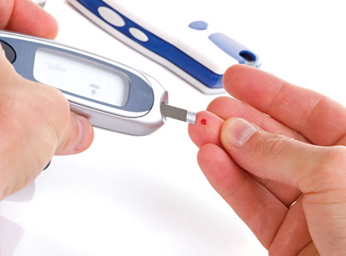
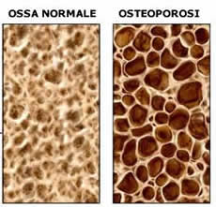
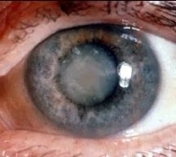
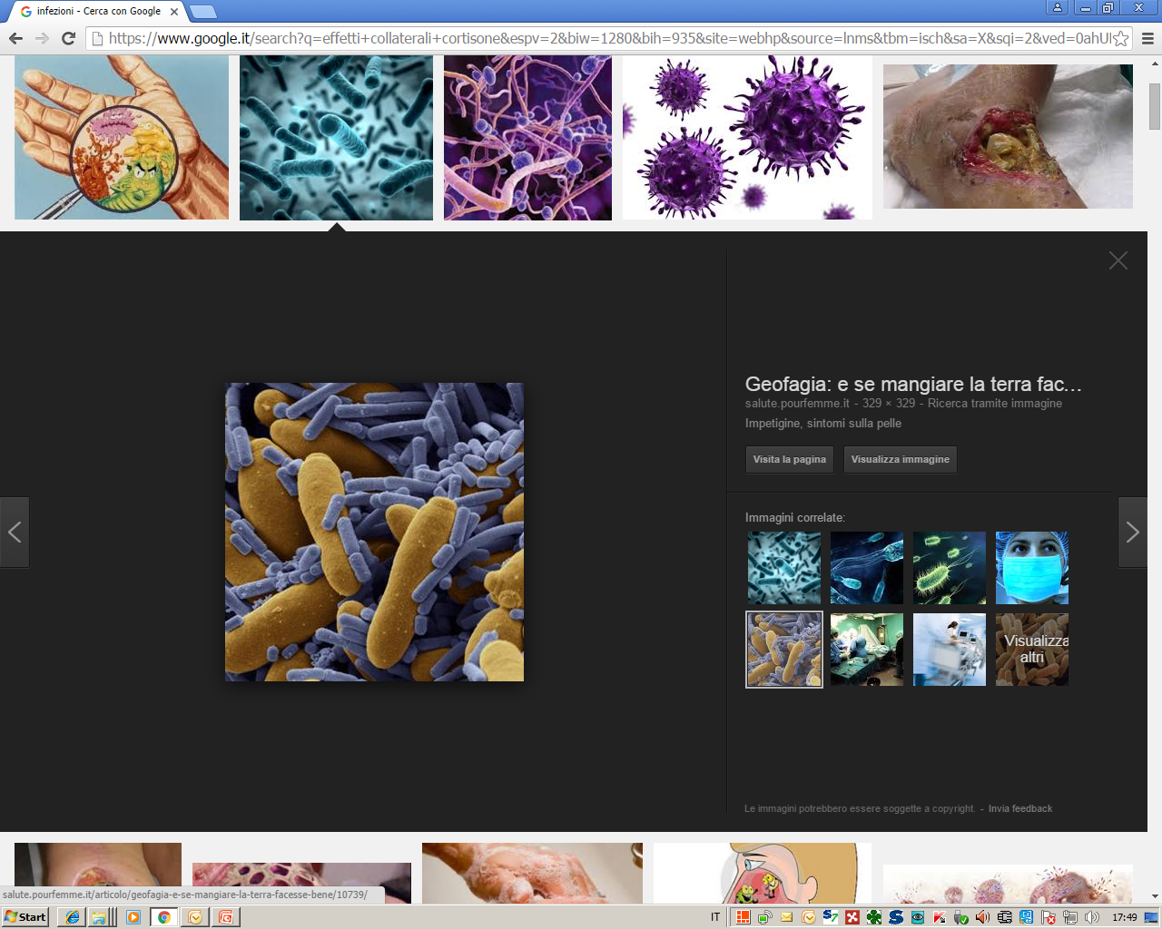
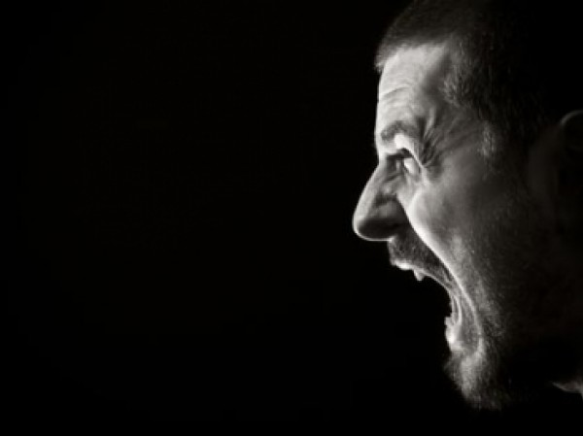
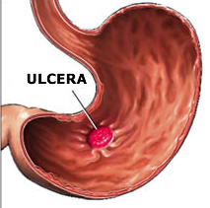
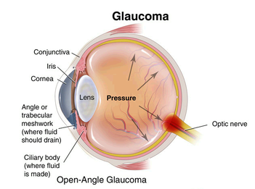
Side effects with long-term use of corticosteroids
Reddened face
Moon face
Buffalo hump
Truncal ecchymosis
Thin skin
Truncal obesity with red stretch marks
Normal bones
Osteoporosis
Thinning of limbs
Pendulous abdomen dehiscence
Ulcer

Slide 48
Subsequent treatments in ITP and goals of therapy
Sustained response off-treatment
Sustained response on-treatment
Rituximab
(20–40%)
TPO-RAs
(nearly30%)
Dapsone
Danazol
(30–40%)
CsA, MMF,
AZA (20–40%)
Fostamatinib
≥ 20%
Rilzabrutinib
≥ 20%
Splenectomy
( 60-70%)
TPO-RAs
(>60%)
Medical therapies with robust evidence Medical therapies with less robust evidence
TPO-RAs: thrombopoietin receptor agonists
AZA, azathioprine; CsA, cyclosporin A; MMF, mycophenolate mofetil.
Adapted from Provan D, et al. Blood Advances 2019;22:3780-3817

Slide 49
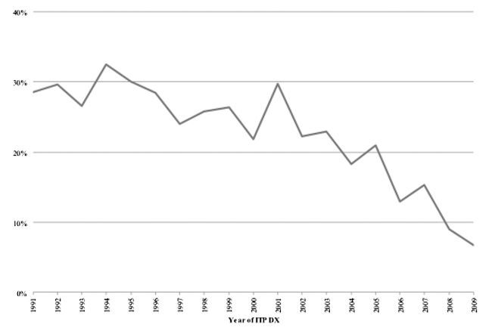
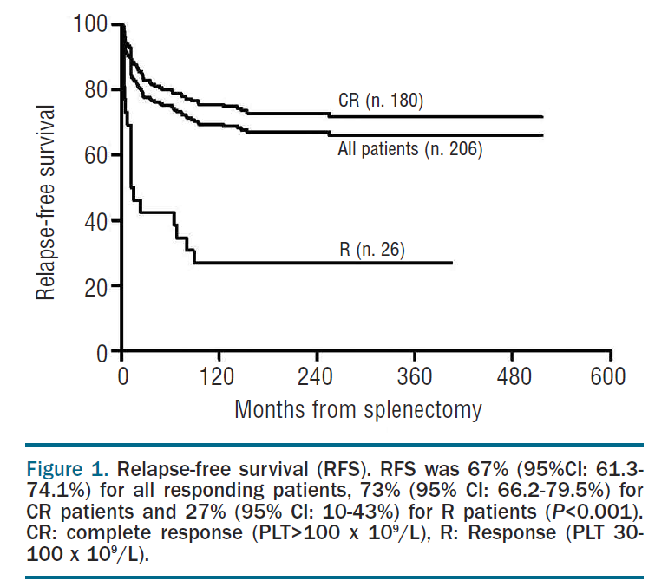
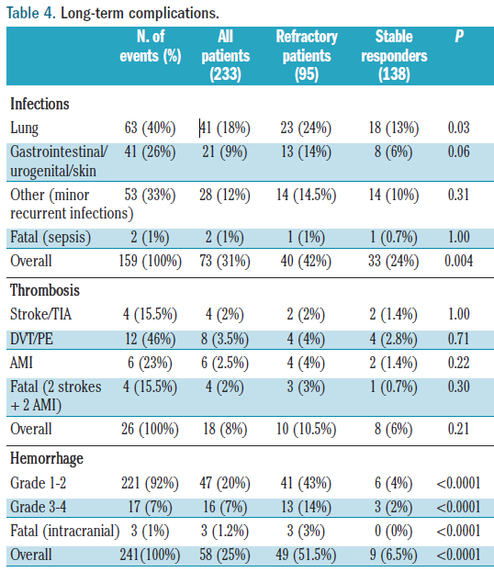
Splenectomy as a curative treatment for ITP
Vianelli N, et al. Haematologica 2013;98:875–80; Boyle S et al. BLOOD, 6 JUNE 2013
AMI, acute myocardial infarction; CR, complete response (PLT > 100 x 10⁹/L); DVT, deep vein thrombosis; PE, pulmonary embolism; PLT, platelet count; R, response (PLT 30–100 x 10⁹/L);
TIA, transient ischaemic attack.

Slide 50
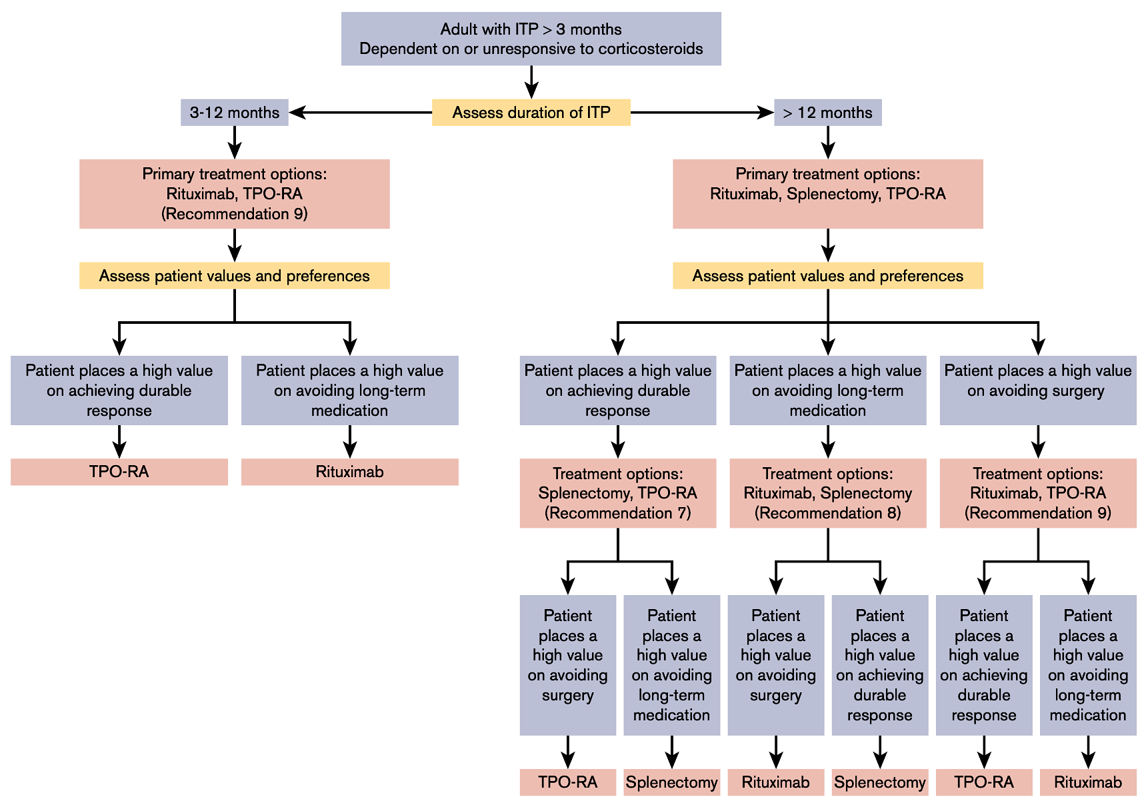
Splenectomy:
There is no rush to do it!
ASH guidelines 2019
The panel made a conditional recommendation in favor of TPO-RAs
International Consensus Report
Splenectomy recommended ≥12 to 24 months
from diagnosis after failure of medical therapies
and depending on patient age and comorbidities.
Neunert C, et al. Blood Advances. 2019;3:3829-3866.
Provan D, et al. Blood Advances 2019;22:3780-3817.
Conditional rec. for TPO-RAs
Conditional rec. for Rituximab
Conditional rec. for TPO-RAs

Slide 51
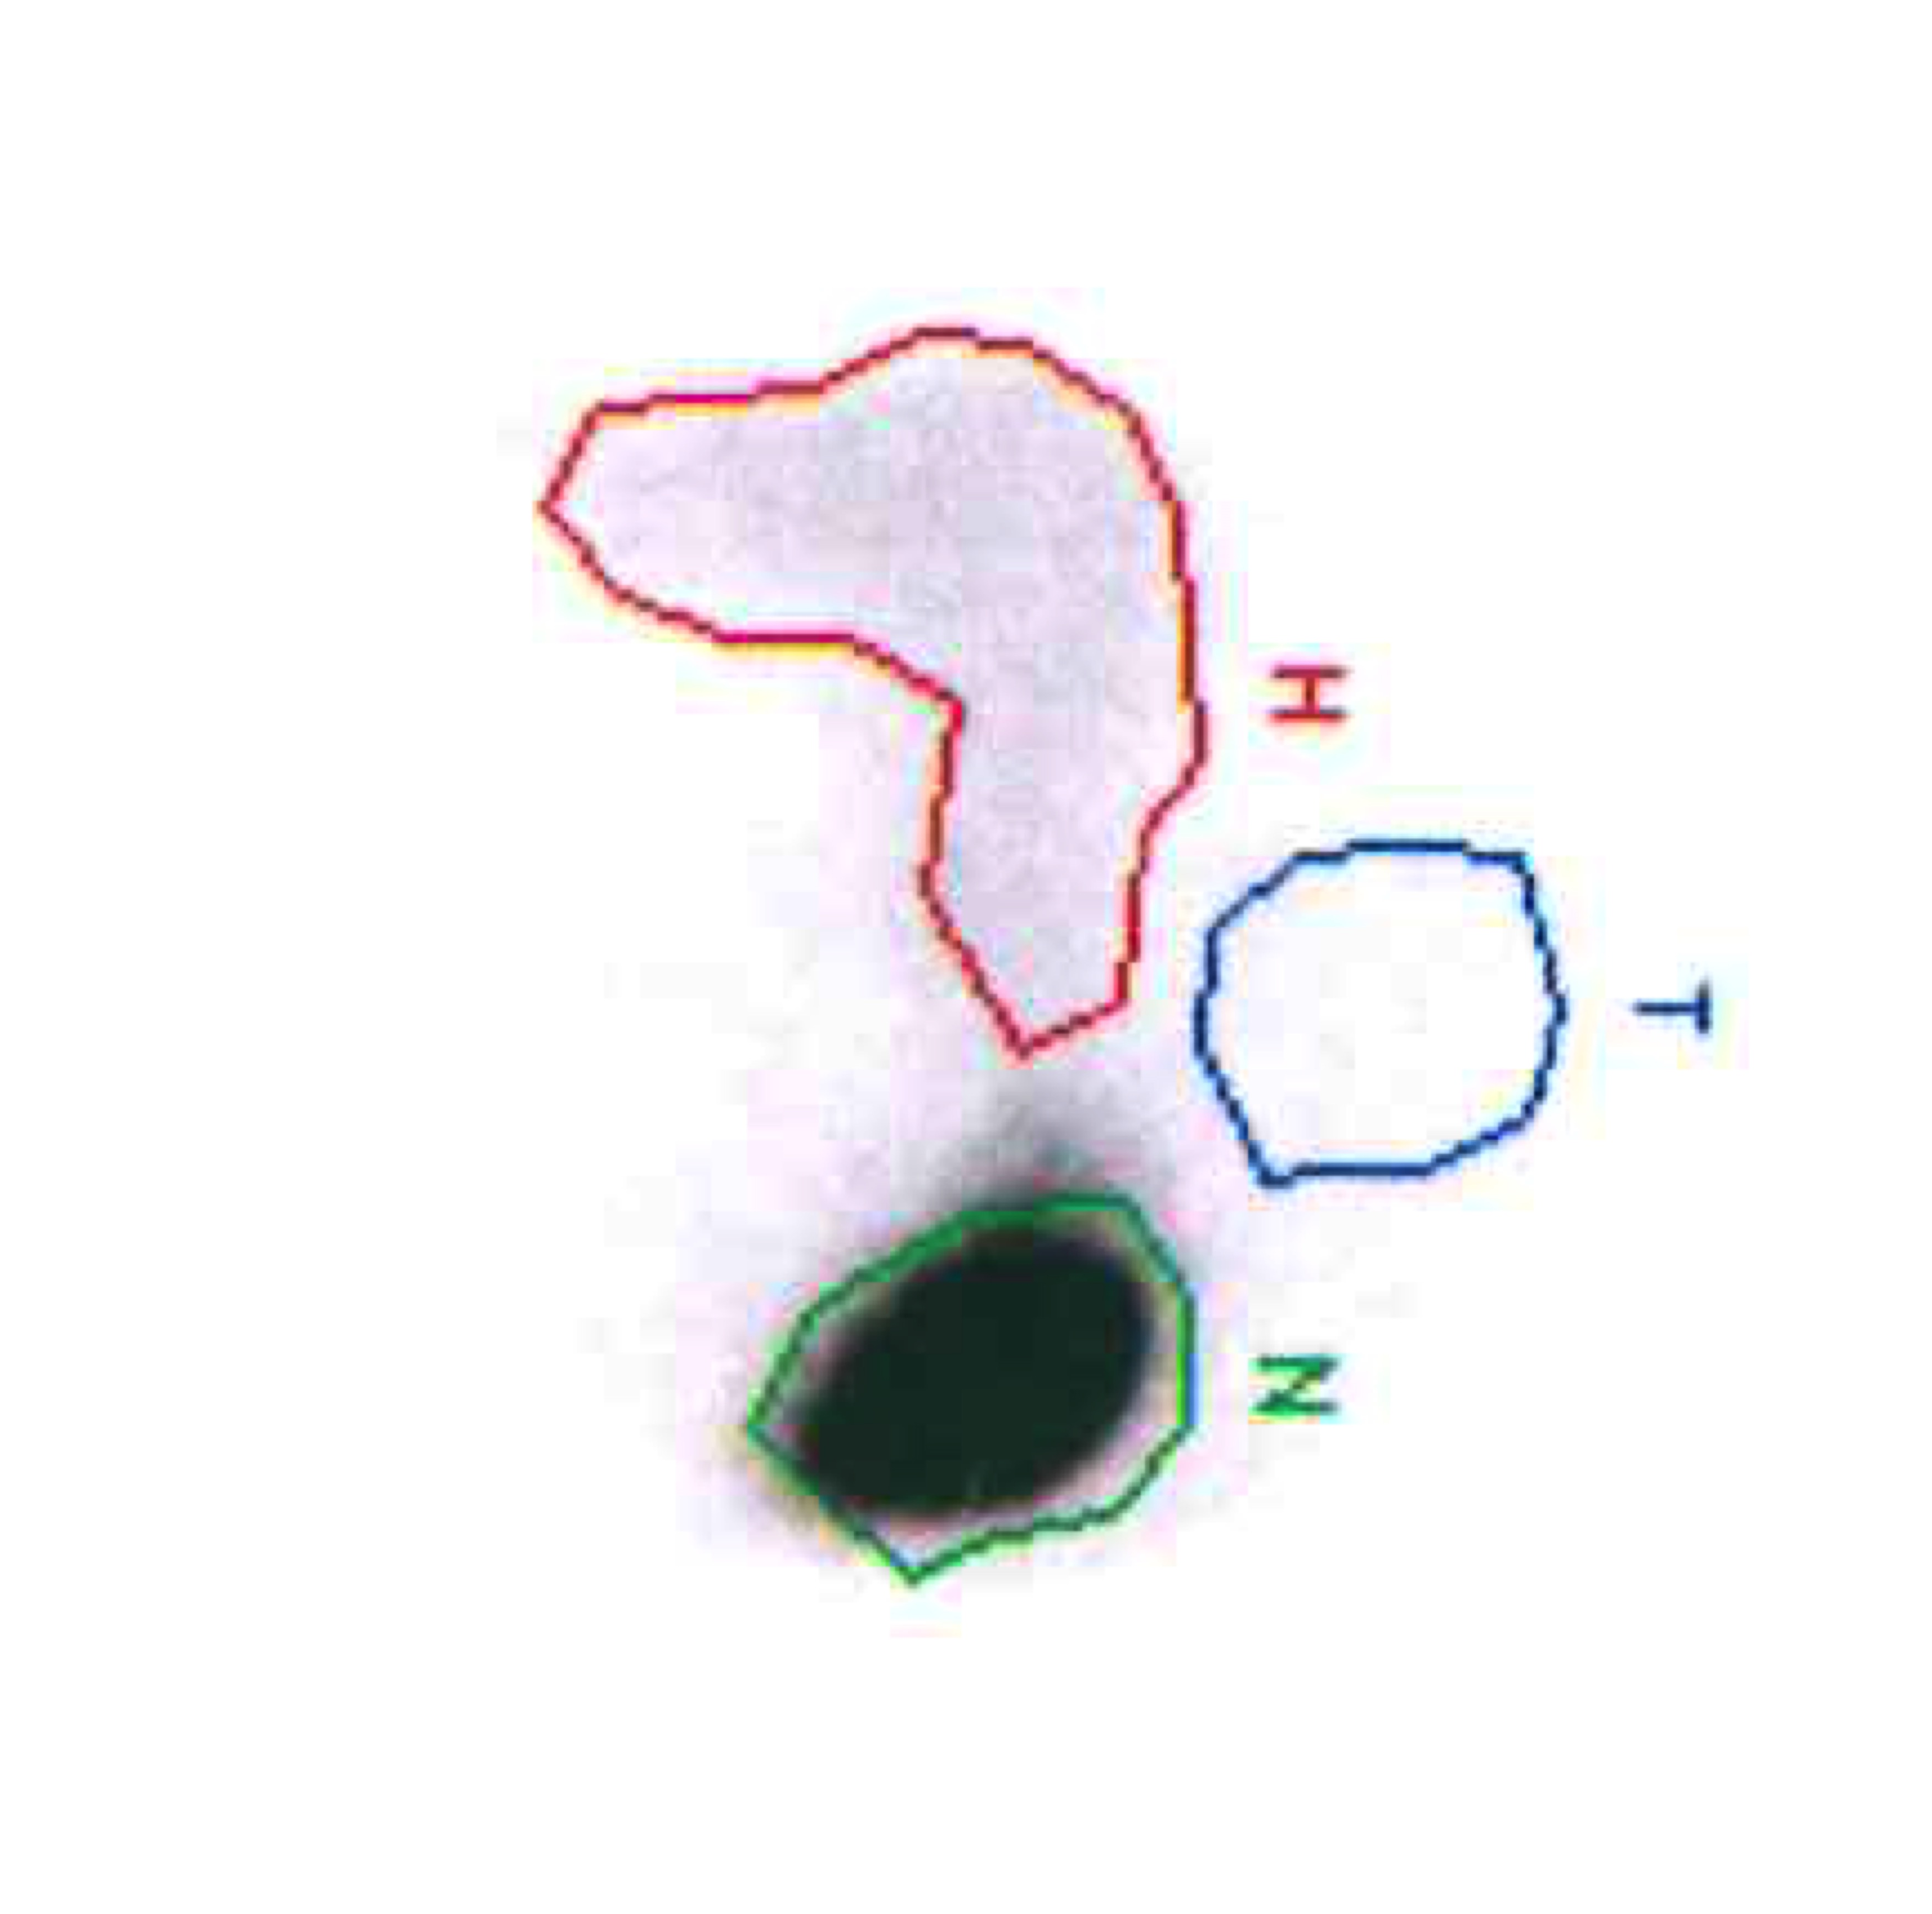
Use of splenectomy in ITP: predictors and recommendations
Retrospective analyses have reported no significant impact of baseline characteristics (including age, sex, and interval from diagnosis to splenectomy) on response to splenectomy
Predictors that have been associated with response to splenectomy
Response to high dose IVIG (Law, Kelton. N Engl J Med. 1997)
Younger age (Kojouri et al. Blood 2004)
Autoimmune comorbidities, daily steroid dose (Zoletto et al. J Clin Med. 2024)
Autologous platelet scintigraphy – splenic pattern (Amini et al. Crit Rev Oncol Hematol. 2020)
Recommendation before and after splenectomy
Ideally, platelet counts should be increased if possible to > 50x 10⁹/L prior to the procedure
Vaccinations (S pneumoniae, N meningitidis, and H influenzae)
Education regarding infection risk: prompt recognition and management of fever with antibiotics
Monitoring/Prophylaxis for perioperative splanchnic thrombosis
Splenic sequestration

Slide 52
Rituximab salvage therapy in adults with ITP
Response (platelet count) | Pooled estimate†
Response (>50 x 10⁹/L) | 63%
Complete response (>150 x 10⁹/L) | 46%
Deaths | 3%
†Data are from a pooled analysis of 19 uncontrolled studies investigating efficacy (313 patients) and safety (306 patients) of rituximab
Arnold et al. Ann Intern Med. 2007;146:25–33

Slide 53
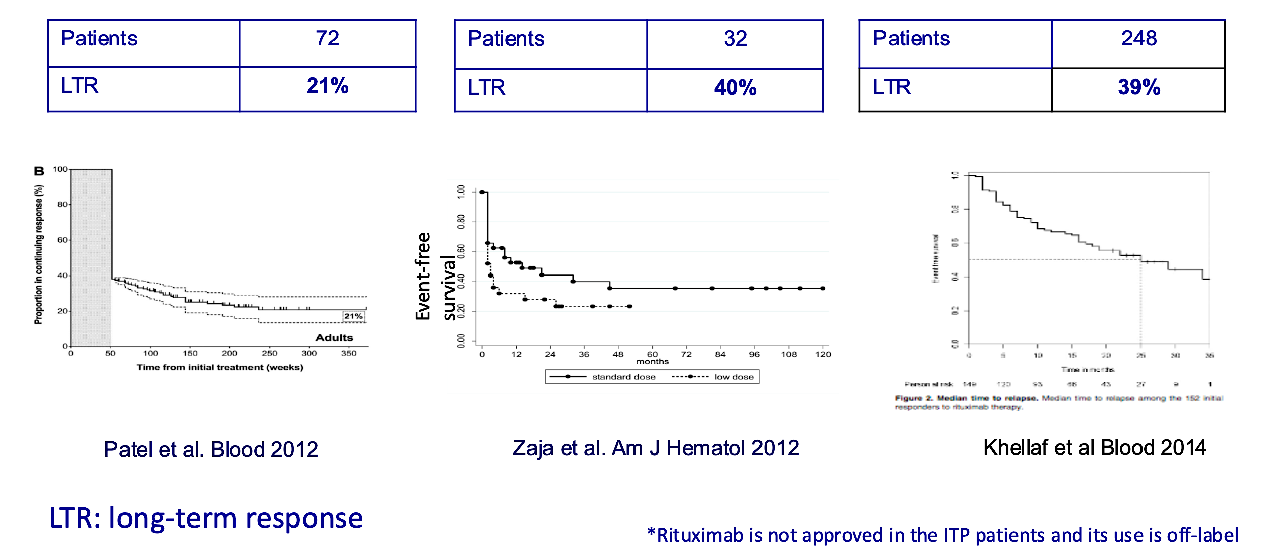
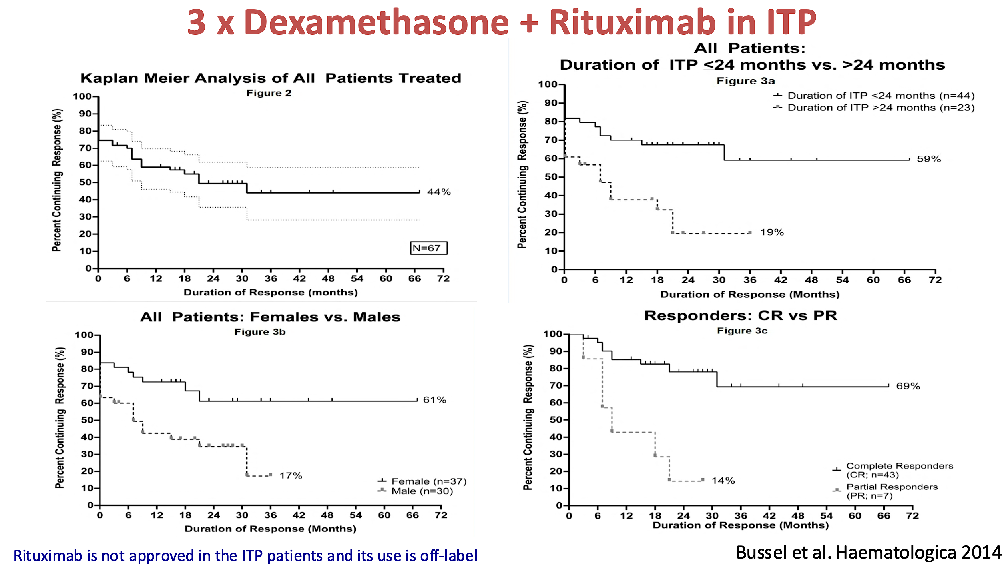
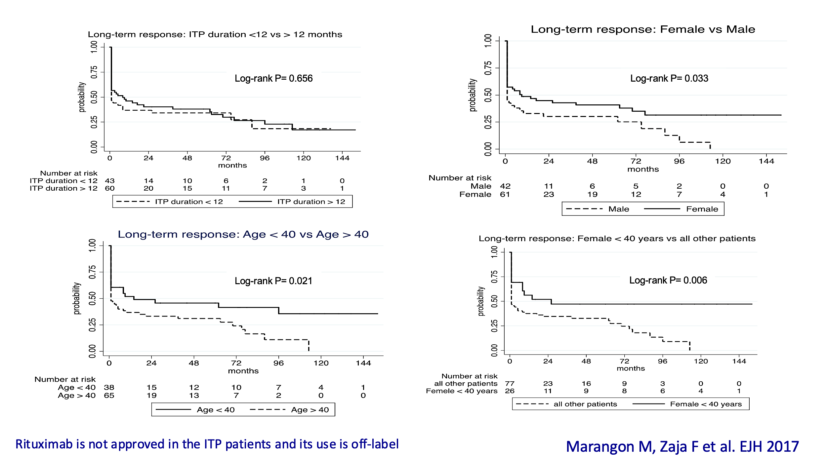
ITP: Rituximab:
Better early and in younger ?
Long-term effect of Rituximab
salvage therapy in adults with ITP
Rituximab single agent in ITP

Slide 54
TPO-RAs for adult patients with ITP
TPO-RAs in ITP
Short-term activity | 70–80%
Long-term activity | 60%
RAISE: a randomized, 6-month study
60
On
treatment
Post
treatment
Eltrombopag
50
Placebo
40
Is this always true?
Patients responding
to treatment (%)
30
20
10
0
0
1
2
3
4
5
6
10
14
18
22
26
1
2
4
Time (weeks)
Number of patients
Placebo
Eltrombopag
61
135
60
134
60
133
59
133
60
131
60
134
59
134
47
108
50
114
48
112
47
113
58
132
54
110
55
118
58
119
Cheng G, et al. Lancet. 2011;377:393-402.

Slide 55
ITP: TPO-RAs:
Not necessarily for chronic use!
Sustained response off treatment: analysis of 4 prospective studies
Study | Patients | ITP duration before starting TPO-RA | PLT count required to start tapering | Type of TPO-RA | Pts in sustained remission (n, % of all pts) | Median follow-up (months)
Newland et al BJH 2016 | 75 | < 6 months | ≥ 50 x 10⁹ | Romiplostim | 24 (32%) | 6
Lucchini et al BJH 2020 | 51 | ≤ 12 months ND 43%; P 57% | ≥ 30 x 10⁹ | Eltrombopag | 13 (25%) | 6
Guillet et al Blood 2023 | 48 | P 38%; C 62% | ≥ 100 x 10⁹ | Eltrombopag 83% Romiplostim 17% | 25 (52%) | 12
Cooper et al AJH 2023 | 105 | n/a | ≥ 70 x 10⁹ | Eltrombopag | 32 (30%) | 12
ND: newly diagnosed phase
P: persistent phase
C: chronic phase

Slide 56
Candidates for TPO-RAs tapering and withdrawal
Patients related | Disease related | Treatment related
Age Comorbidities Antiplatelet treatment Anticoagulant treatment | ITP duration Primary vs secondary Previous severe bleeding Platelet count (> 50-100 x 10⁹/L) | Quality of response to TPO-RAs Duration of treatment with TPO-RAs Dose of TPO-RAs Platelet count stability
Tapering can be performed if the following criteria are met:
Tapering is not advised if:
Stable platelet count/stable response (50 x 10⁹/L – 100x 10⁹/L)
Response maintained for at least 6 months without concomitant treatments and haemorrhagic events
Stable platelet count/stable response (50 x 10⁹/L – 100x 10⁹/L)
Response maintained for at least 6 months without concomitant treatments and haemorrhagic events
Zaja F et al. Blood Rev. 2020;41:100647.

Slide 57
Switching of TPO-R agonist in ITP
Romiplostim
Eltrombopag
Lack of efficacy
Platelet count fluctuations
Side effects
Patients’ preference

Slide 58
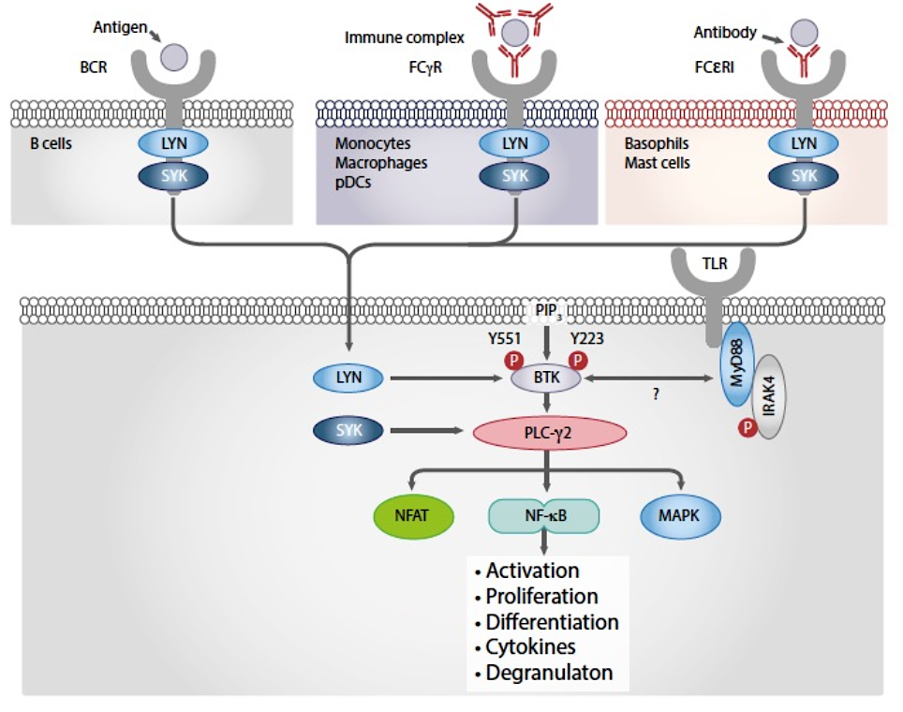
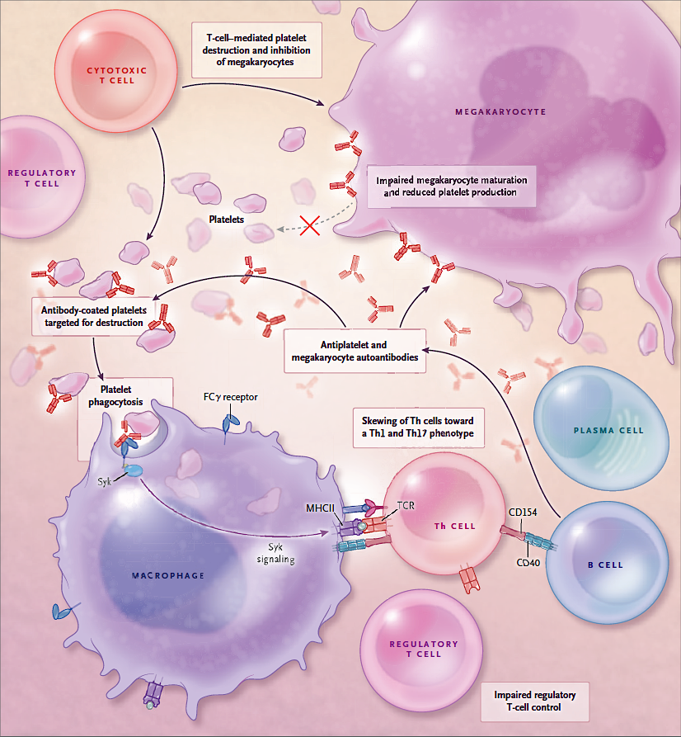
SYK inhibition in the management of ITP
Spleen tyrosine kinase (SYK)
SYK activity in ITP:
Phagocytosis of autoAb-PLT IC
Lymphocite B activation
Antibodies production
Y
FcγR activates SYK
Y
Syk
Macrophage
(APC)
Main targets of Fostamatinib
Zarrin AA, et al. Nat Rev Drug Discov. 2021; Liu D, et al. J Hematol Oncol. 2017; Cooper N and Ghanima W. NEJM 2019

Slide 59
Fostamatinib in adults with R/R cITP: results of the FIT program
Demographics and Baseline Patient Characteristics in FIT-1 and FIT-2
 | Placebo (n=49) | Fostamatinib (n=101)
Median time since diagnosis, years | 7.8 | 8.7
Median age (range), years | 53 (20-78) | 54 (20-88)
Mean baseline platelet count, x 10⁹/L | 19 | 16
Platelet count <15 × 10⁹/L, % | 57 | 54
Median number of unique prior therapies (%) | 3 | 3
Corticosteroids | 96 | 93
Immunoglobulins | 55 | 51
TPO-RAs | 51 | 47
Immunosuppressants | 45 | 44
Rituximab | 29 | 34
Splenectomy | 39 | 34
Bussel J et al. Am J Hematol. 2018;93:921-930

Slide 60
Fostamatinib in adults with R/R cITP: results of the FIT program
Efficacy assessment in FIT-1 and FIT-2
 | Placebo (n=49) | Fostamatinib (n=101) | P
Overall response | 7 (14%) | 43 (43%) | 0.0006
Stable response (primary endpoint*) | 1 (2%) | 18 (18%) | 0.0003
Median time to PLT > 50 x 10⁹/L in the Fostamatinib group: 15 days
Overall response achieved in 3/43 patients (7%) between week 10-12
88% of patients in Fostamatinib increased their dose to 150 mg BID at or after week 4
*Stable response (PLT>50 x 10⁹/L on at least 4 of the 6 clinic visits occurring every 2 weeks during weeks 14–24)
Bussel J et al. Am J Hematol. 2018;93:921-930

Slide 61
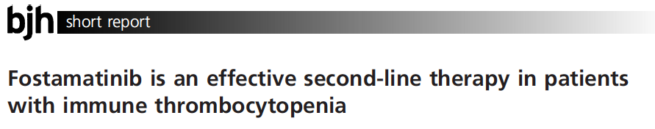
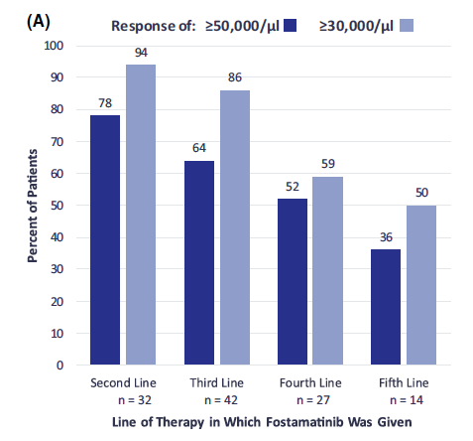
Baseline characteristics, lines of treatments, pattern of response and safety in FIT-1 and FIT-2
 | second-line (n= 32) | third-or-later (n=113)
Median time since diagnosis, years | 2.6 | 9.7
Median age, years | 50 | 54
Mean baseline PLT count, x 10⁹/L | 21 | 15
Chronic ITP | 84% | 96%
Response PLT ≥ 30 x 10⁹/L | 94% | 63%
Response PLT ≥ 50 x 10⁹/L | 78% | 48%
Adverse events | 72% | 94%
Responses once achieved tended to be durable in both groups
Most frequent prior treatments: Corticosteroids: 94% ; TPO-RAs: 47% ; Rituximab: 32%
Boccia et al. Br J Hematol. 2020;190:933-8

Slide 62
Fostamatinib: FIT 1-2 vs Real-life studies
 | FIT I-II² | FOSTAMES³ | FOSTASUR⁴ | ITP1122⁵
Patients | 146 | 138 | 44 | 95
Median ITP duration (years) | 8 | 4.3 | 2.6 | 7.7
ITP phase ND/P/C | 0%; 6%; 94% | 12%; 17%; 51% | 7%; 14%; 79% | 0%; 11%; 89%
ITP secondary | 0% | 12% | 0% | 6%
Median lines of pr. Tx | 5 | 4 | 4 | 5
Fostamatinib 150 mg BID | 88% | 61.5% | 50% | 78%
Concomitant therapy | 46% | 40% | 29.5% | 30%
ORR/CR | 43% | 79%/54% | 71%/39% (at 4 weeks) | 74%/31%
Median TTR (weeks) | 2 | 1,5 | 57% within 2 weeks | 4.6
ORR/CR at months 6 | SR 18% | 50% | 57%/36% at month 3 | 48%/24%
1-2. Bussel JB et al. AJH 2019; 3. Gonzalez-Lopez et al. Blood 2024; 4. Jimenez-Barcenas et al. BJH 2024; 5. Lucchini et al BJH 2025

Slide 63
Long-term analysis (5 years)- Safety (thromboembolic events)
SYK inhibition with fostamatinib may decrease the risk of thromboembolic events (TEE) in ITP patients
In FIT1, FIT2 and FIT3 1/146 (0.7%) patient had a transient ischemic attack with pre-existing
atherosclerosis, which resolved spontaneously (median number of TEE risk factors 2 (0–7).
The rate of TEEs reported in ITP patients receiving TPO-RAs in multiple studies ranged from 0 to 9%
In an acute stroke model, SYK inhibition/depletion:
    protected mice from aortic thrombosis and diminished brain infarction size
    without increasing hemorrhage risk
SYK is required for GPVI and CLEC-2 receptor signaling in mouse and human platelets. Both receptors are
involved in platelet activation and TEEs but are non essential for normal hemostasis in mice
R406 (active metabolite of fostamatinib) inhibits GPVI and CLEC-2 signaling in human platelets in vitro
Cooper et al. Ther Adv Hematol. 2021;12:20406207211010875

Slide 64
2 lines of treatment in ITP (with robust evidence)
Treatment option | Warning | Note
TPO-RAs | Patient with APS or high thrombotic risk | SROT Switch from one to another TPO-RA
Rituximab or Fostamatinib or Rilzabrutinib | Patients with immune depression, frail | 2L in young female ?
Fostamatinib | Patients with hypertension or GI symptoms | To be considered as alternative to TPO-RAs in patients with high thrombotic risk
Rilzabrutinib
Splenectomy | Secondary ITP, elderly, frail Perioperative and delayed thrombosis Sepsis | >12 months from diagnosis (if possible) Vaccinations Laparoscopic Platelet scintigraphy – splenic pattern
1
2
3

Slide 65
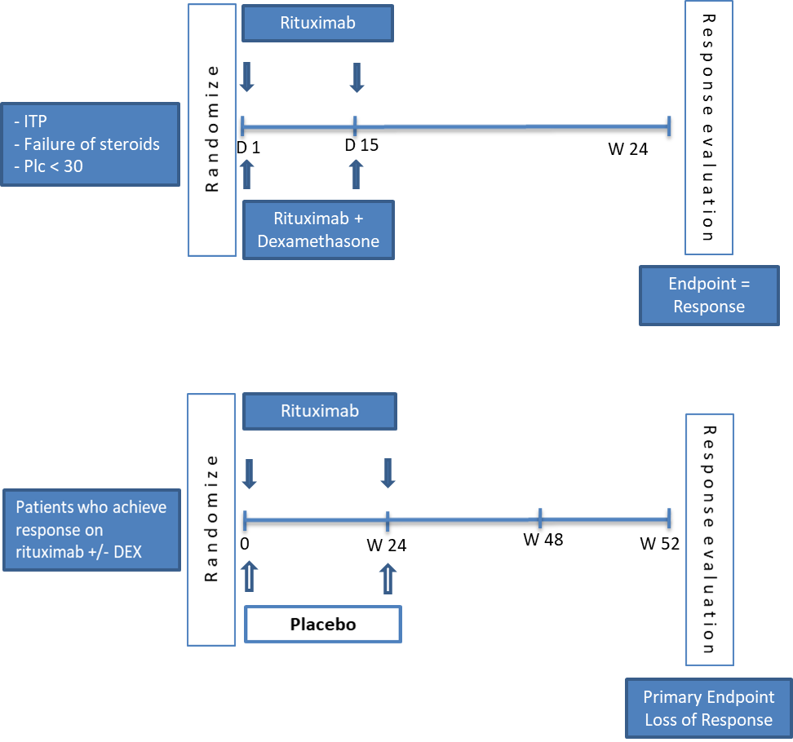
PROLONG: multi-center, international, randomized study
A two-phase randomized placebo-controlled trial to optimize rituximab response with dexamethasone and maintenance therapy with low dose rituximab in ITP patients
Phase 1 (induction):
Open-label,1:1 randomization into: Rituximab 1000 mg on day 1 and 15 vs Rituximab + 2 cycles of DXM (20 mg daily for 4 days) on days 1 and 15.
Phase 2 (maintenance):
Double-blind, 1:1 randomization of those who responded in the induction phase, into maintenance with rituximab 500 mg or placebo on weeks 0 and 24 after randomization.
DXM, Dexamethasone
Courtesy of Waleed Ghanima, oral presentation at ASH 2025

Slide 66
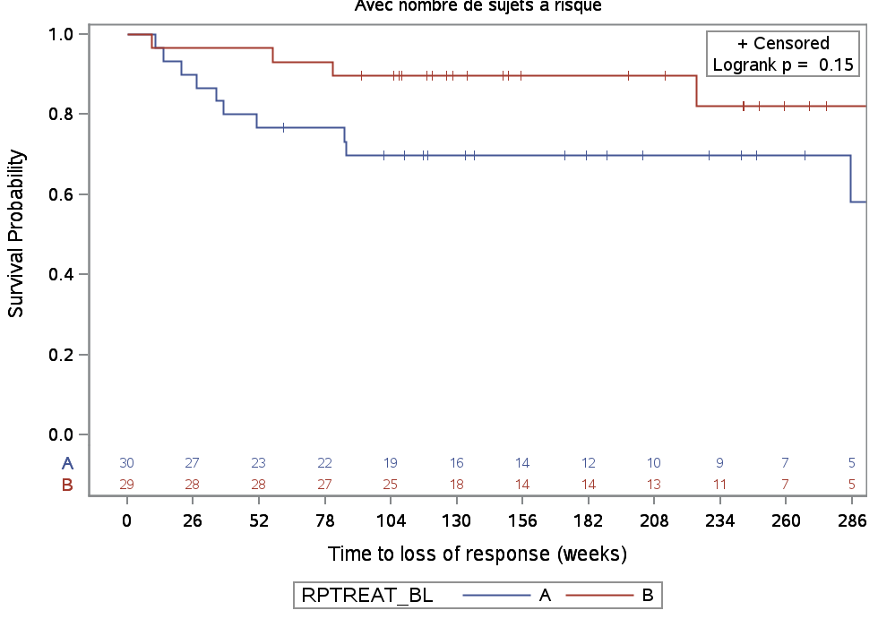
PROLONG study: results of the phase 1 and 2 of the study
Response at week 24 for ITT population
Time to loss of response
p=0.01
Response: mean platelet count >50 x10⁹/L at week 24 (± 2 weeks) after randomization without use of any other ITP-directed therapies after week 18
Loss of Response: 2 consecutive platelet counts <50 x10⁹/L at 1-8-week interval, and/or, use of any ITP-directed therapies for bleeding or thrombocytopenia
The addition of Dexamethasone to Rituximab and maintenance with low dose Rituximab:
Substantially improved the initial response compared to Rituximab alone without safety concerns
Reduced bleeding
Seems effective in preventing early relapses and prolonging remissions
Statistical significance was not reached likely due to limited study power
Courtesy of Waleed Ghanima, oral presentation at ASH 2025

Slide 67
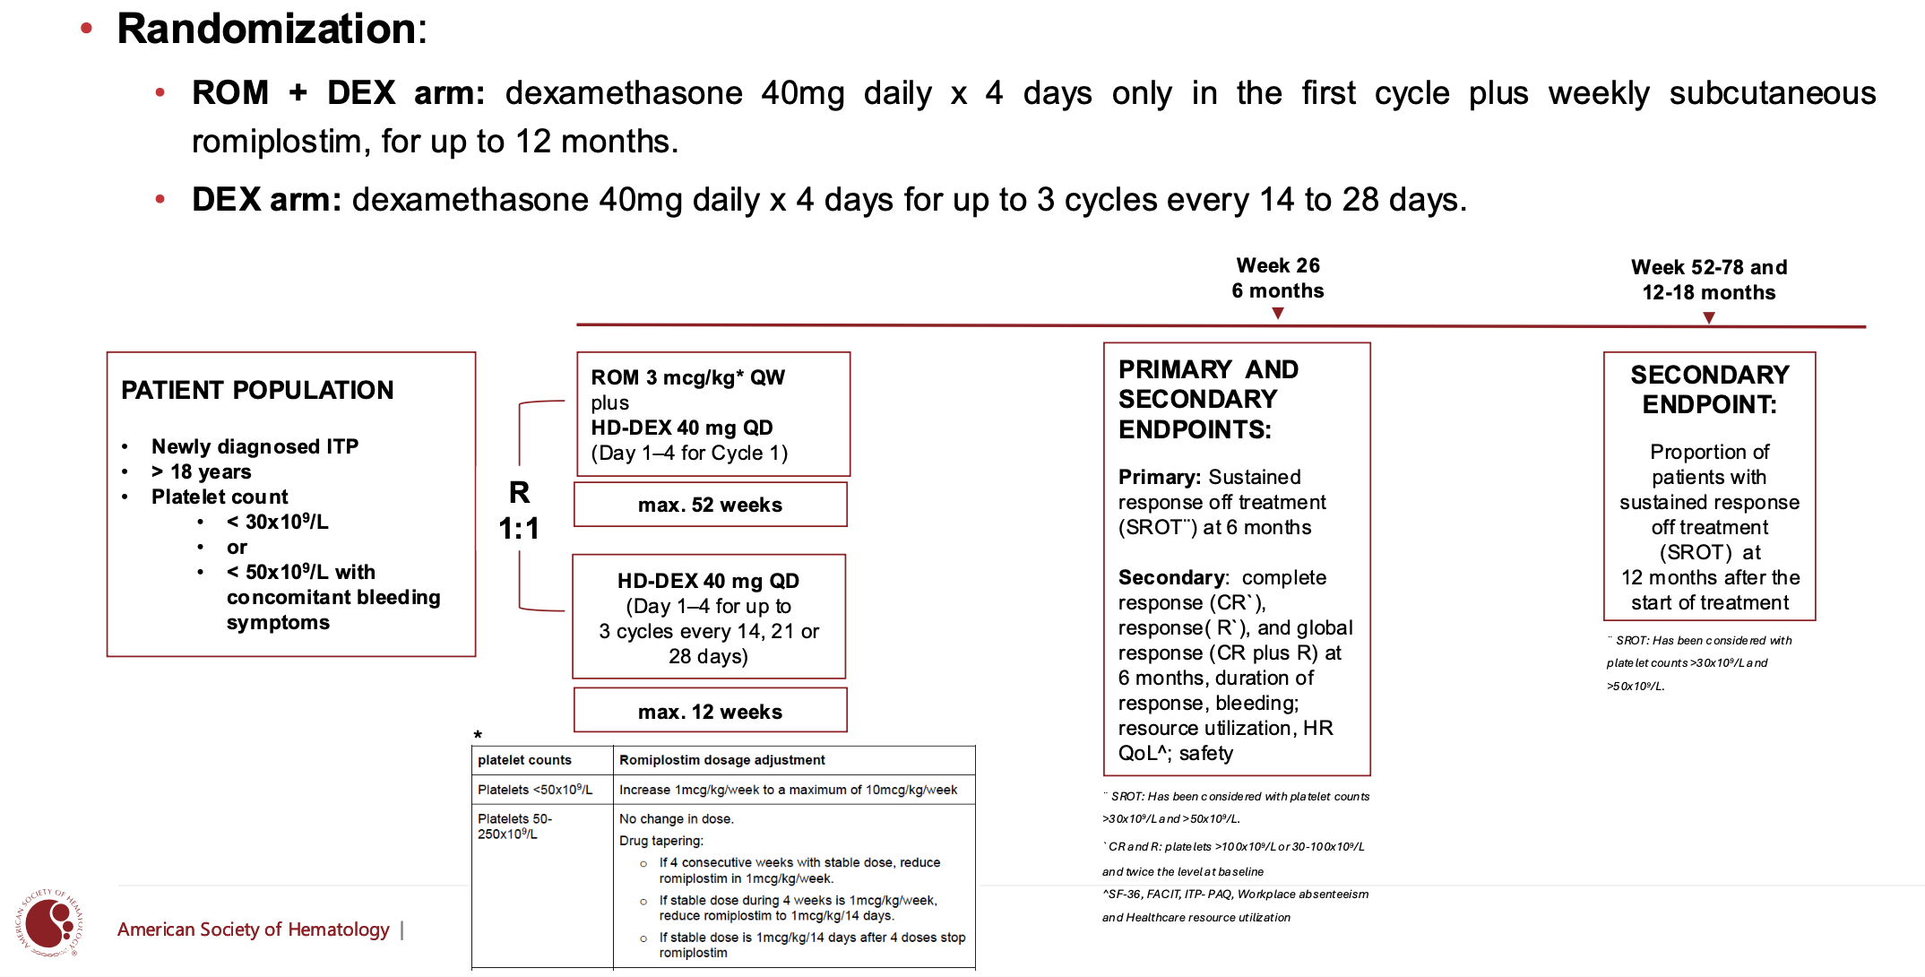
RODEX study. A multicenter, randomized, open-label study of romiplostim plus dexamethasone vs dexamethasone in newly diagnosed primary ITP
Courtesy of Maria Eva Mingot, oral presentation at ASH 2025

Slide 68

RODEX study: interim results of the study
The addition of Romiplostim to a single cycle of Dexamethasone:
SROT at 6 months was higher in patients treated with combination therapy
Responses occur with median maximum doses of 3 mcg/kg and a single cycle of dexamethasone
The addition of Romiplostim allowed to spare the total corticosteroids (1 vs 3 cycles)
Overall safety profiles were similar between regimens
Courtesy of Maria Eva Mingot, oral presentation at ASH 2025

Slide 69
Take home messages
New therapeutic opportunities to treat ITP patients
Different mechanisms of action
Individualization of treatment according to patients characteristics, comorbidities, expectations
Combinations appear to be a possible new strategy also in the early phases in selected patients

Slide 70
Agenda
Case 1 | Dr Yannucci – 60-year-old man | Dr Morganstein – 33-year-old woman
Case 2 | Dr Morganstein – 62-year-old man | Dr Bhatnagar – 68-year-old woman
Faculty Presentation: Clinical Manifestations and Initial Management of Immune Thrombocytopenia (ITP) — Dr Neunert
Case 3 | Dr Apuri – 81-year-old woman
Faculty Presentation: Incorporation of Thrombopoietin Receptor Agonists and Other Second-Line Therapies into ITP Management — Prof Zaja
Case 4 | Dr Fox – 69-year-old woman
Faculty Presentation: Current and Future Role of Novel Therapies in ITP — Dr Al-Samkari
Additional Case Presentations

Slide 71
Case Presentation: 69-year-old woman with stress cardiomyopathy and corticosteroid-refractory ITP receives rituximab followed by eltrombopag
Dr Eric Fox (Bryn Mawr, Pennsylvania)

Slide 72
Agenda
Case 1 | Dr Yannucci – 60-year-old man | Dr Morganstein – 33-year-old woman
Case 2 | Dr Morganstein – 62-year-old man | Dr Bhatnagar – 68-year-old woman
Faculty Presentation: Clinical Manifestations and Initial Management of Immune Thrombocytopenia (ITP) — Dr Neunert
Case 3 | Dr Apuri – 81-year-old woman
Faculty Presentation: Incorporation of Thrombopoietin Receptor Agonists and Other Second-Line Therapies into ITP Management — Prof Zaja
Case 4 | Dr Fox – 69-year-old woman
Faculty Presentation: Current and Future Role of Novel Therapies in ITP — Dr Al-Samkari
Additional Case Presentations

Slide 73


Current and Potential Future Role of Novel Therapeutics in Immune Thrombocytopenia
Hanny Al-Samkari, M.D.
The Peggy S. Blitz Endowed Chair in Hematology/Oncology
Classical Hematologist and Clinical Investigator
Co-Director, HHT Center of Excellence
Massachusetts General Hospital
Associate Professor of Medicine
Harvard Medical School

Slide 74

ITP: From Steroids, Splenectomy & Salvage to Numerous Targeted Therapies in Two Decades
Jiang, Al-Samkari and Panch, Transfusion Med Reviews 2022

Slide 75
Effects of BTK Inhibition
Pathophysiologic Mechanisms in ITP and AIHA
B cells, plasma cells | Monocyte, macrophage | Mast cells, basophils | Neutrophils | T cells
Blocks B-cell receptor Inhibits plasma cell differentiation and antibody production | Blocks IgG-mediated FcγR activation, phagocytosis, inflammatory mediators | Blocks IgE-mediated FcεR activation and degranulation | Inhibits activation, adhesion, recruitment, oxidative burst | No effect
BTK inhibition
Kuter et al., Blood 2019

Slide 76

BTK Inhibitor for ITP: Rilzabrutinib
Kuter et al., Blood 2019

Slide 77


BTK Inhibitor for ITP: Rilzabrutinib
1 µM Ibrutinib −
Healthy Volunteers
1 µM Rilzabrutinib −
Healthy Volunteers
1 µM Rilzabrutinib −
ITP Patients
Kuter et al., Blood 2019

Slide 78

BTK Inhibitor for ITP: Rilzabrutinib
Kuter et al., Blood 2021

Slide 79

Rilzabrutinib Phase 3 LUNA-3 Study: Platelet Counts are Significantly Higher on Rilzabrutinib
Kuter et al., Blood 2025

Slide 80

Rilzabrutinib Phase 3 LUNA-3 Study: Time to Platelet Count Response is Much Faster with Rilzabrutinib
Kuter et al., Blood 2025

Slide 81

Rilzabrutinib Phase 3 LUNA-3 Study: Much Less Rescue Therapy Required for Rilzabrutinib
Kuter et al., Blood 2025

Slide 82

Rilzabrutinib Phase 3 LUNA-3 Study: Dramatic Improvements in Fatigue in ITP-PAQ
Kuter et al., Blood 2025

Slide 83

Rilzabrutinib Phase 3 LUNA-3 Study: Safety
Kuter et al., Blood 2025

Slide 84

Ianalumab (VAY736) in ITP
Dual mechanism of action:
1) BAFF-R blockade
  Prevents activation and differentiation of B-cells and induction of long-lived plasma cells
  May overcome rebound/resistance mechanisms (including loss of CD20, BAFF-driven B-cell hyperactivation)
2) Enhanced ADCC-mediated
B-cell depletion
  Provides more potent, sustained
  B-cell depletion in blood and tissues

Slide 85

Ianalumab (VAY736) in ITP: VAYHIT2 Study
Al-Samkari et al., ASH LBA-2 2025; Cuker et al., NEJM 2025

Slide 86

Ianalumab (VAY736) in ITP: VAYHIT2 Study
Al-Samkari et al., ASH LBA-2 2025; Cuker et al., NEJM 2025

Slide 87

Ianalumab (VAY736) in ITP: VAYHIT2 Study
Al-Samkari et al., ASH LBA-2 2025; Cuker et al., NEJM 2025

Slide 88

Ianalumab (VAY736) in ITP: VAYHIT2 Study
Al-Samkari et al., ASH LBA-2 2025; Cuker et al., NEJM 2025

Slide 89

Ianalumab (VAY736) in ITP: VAYHIT2 Study
Ianalumab
Ianalumab
Al-Samkari et al., ASH LBA-2 2025; Cuker et al., NEJM 2025

Slide 90

Ianalumab (VAY736) in ITP: VAYHIT2 Study
Al-Samkari et al., ASH LBA-2 2025; Cuker et al., NEJM 2025

Slide 91

Ianalumab (VAY736) in ITP: VAYHIT2 Study
Al-Samkari et al., ASH LBA-2 2025; Cuker et al., NEJM 2025

Slide 92

Ianalumab (VAY736) in ITP: VAYHIT2 Study
Al-Samkari et al., ASH LBA-2 2025; Cuker et al., NEJM 2025

Slide 93

Ianalumab (VAY736) in ITP: VAYHIT2 Study
Al-Samkari et al., ASH LBA-2 2025; Cuker et al., NEJM 2025

Slide 94

Ianalumab (VAY736) in ITP: VAYHIT3 Study
VAYHIT3 Study Design
Choi et al., ASH Abstract 844 2025

Slide 95

Ianalumab (VAY736) in ITP: VAYHIT3 Study
Choi et al., ASH Abstract 844 2025

Slide 96

Ianalumab (VAY736) in ITP: VAYHIT3 Study
Choi et al., ASH Abstract 844 2025

Slide 97

Ianalumab (VAY736) in ITP: VAYHIT1 Study
Cooper et al. HemaSphere 2023

Slide 98





















Efgartigimod Competitively Inhibits FcRn
Endothelial Cell
IgG autoantibody
Endosome
IgG
antibody
FcRn
Lysosome
Efgartigimod alfa
Broome et al., Blood (2022) 140 (Supplement 1).
Notes:
Tags already in veeva
Figure
Wolfe 2021/pg2/Figure 1
Wolfe 2021/pg4/col1/P3/ln1-4
#1
Vaccaro 2005
p1283/ para1/L3‐4 (p.1)
p1284/Fig1 description/L1 (p.2)
Ulrichts 2018
Ulrichts et al_2018 J Clin Inves_Ph1_Pg4373_Col1_Para2_Efgartigimod description (p.3)
Vyvgart PI/pg8/P3 (Sec.12.1 Mechanism of Action)
#2
Vaccaro 2005
p1283/col1/para2/ L9‐12 (p.1)
Ulrichts 2018
p4372/col2/para2/ L5‐7 (p.2)
Ulrichts et al_2018 J Clin Inves_Ph1_Pg4379_Col2_Para1_Lines15-22 (p.9)
#3
Ulrichts 2018
p4379/col2/para1/ L9‐15 (p.9)
Ulrichts et al_2018 J Clin Inves_Ph1_Pg4379_Col2_Para1_Lines15-22 (p.9)
Vaccaro 2005
Vaccaro_Nat Biotech_2005_Pg1_Col2_Para2 (p.1)
p1283/col1/para2/L14-15 (p.1)
#4
Ulrichts 2018
p4372/col2/para2/ L3‐5 (p.2)
Note to reviewers: the efgartigimod icon has been updated to an antibody fragment (seen in commercial pieces) from the blue geometric shape. We removed the disclaimer that VYVGART is only approved from gMG, not other indications, as this talk is solely on gMG

Slide 99


Efgartigimod Phase 3 Study (ADVANCE IV) Platelet Counts
Platelet Counts Over Time
Broome et al., The Lancet 2023

Slide 100
Efgartigimod Phase 3 Study (ADVANCE IV) IgG Levels Fell 60%
Mean % Change from Baseline in Total IgG Levels over Time
Broome et al., The Lancet 2023

Slide 101

Mezagitamab (TAK-079) to Treat ITP

Slide 102

Mezagitamab (TAK-079) to Treat ITP: Dose-response for All 3 Mezagitamab Dose Groups Showed Rapid, Sustained Improvement in Platelet Counts that Persisted through Week 16
Kuter et al., RPTH 2024 LB 01.1

Slide 103

Mezagitamab (TAK-079) to Treat ITP: Fewer Patients with Bleeding Events in Mezagitamab Groups Versus Placebo
Kuter et al., RPTH 2024 LB 01.1

Slide 104
Agenda
Case 1 | Dr Yannucci – 60-year-old man | Dr Morganstein – 33-year-old woman
Case 2 | Dr Morganstein – 62-year-old man | Dr Bhatnagar – 68-year-old woman
Faculty Presentation: Clinical Manifestations and Initial Management of Immune Thrombocytopenia (ITP) — Dr Neunert
Case 3 | Dr Apuri – 81-year-old woman
Faculty Presentation: Incorporation of Thrombopoietin Receptor Agonists and Other Second-Line Therapies into ITP Management — Prof Zaja
Case 4 | Dr Fox – 69-year-old woman
Faculty Presentation: Current and Future Role of Novel Therapies in ITP — Dr Al-Samkari
Additional Case Presentations

Slide 105
Case Presentation: 57-year-old woman with symptomatic iron-deficiency anemia found to have ITP has received corticosteroids, rituximab and IVIG
Dr Jennifer Yannucci (Savannah, Georgia)

Slide 106
Case Presentation: 32-year-old woman received ABVD then ASCT for Hodgkin lymphoma and 5 years later experiences ITP refractory to high-dose prednisone, IVIG and rituximab, then romiplostim
Dr Priya Rudolph (Athens, Georgia)

Slide 107
Case Presentation: 70-year-old woman incidentally diagnosed with ITP experiences suboptimal response to prednisone and IVIG
Dr Tina Bhatnagar (Wheeling, West Virginia)

Slide 108
Case Presentation: 53-year-old man with long history of ITP undergoes splenectomy
Dr Neil Morganstein (Summit, New Jersey)

Slide 109
Case Presentation: 40-year-old man with chronic ITP receives romiplostim with rituximab
Dr Tina Bhatnagar (Wheeling, West Virginia)

Slide 110
Case Presentation: 78-year-old man with 30-year history of chronic ITP s/p corticosteroids and rituximab now receives avatrombopag
Dr Sunil Gandhi (Lecanto, Florida)

Slide 111
Case Presentation: 82-year-old woman with multiple comorbidities and long history of ITP presents with confusion and fluid retention due to CHF exacerbation and receives fostamatinib
Dr Tina Bhatnagar (Wheeling, West Virginia)

