Slide 1
Developments from ASH 2025 in Immune
Thrombocytopenia: BTK Inhibitors and
BAFF-R Antagonists — Microlearning Activity 2
Hanny Al-Samkari, MD
Classical Hematologist and Clinical Investigator
The Peggy S Blitz Endowed Chair in Hematology/Oncology
Co-Director, Hereditary Hemorrhagic Telangiectasia Center
Massachusetts General Hospital
Associate Professor of Medicine
Harvard Medical School
Boston, Massachusetts

Slide 2
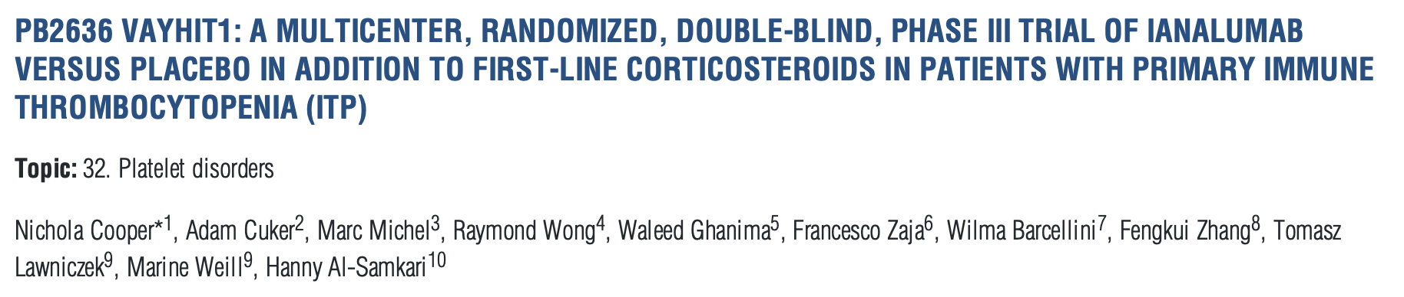
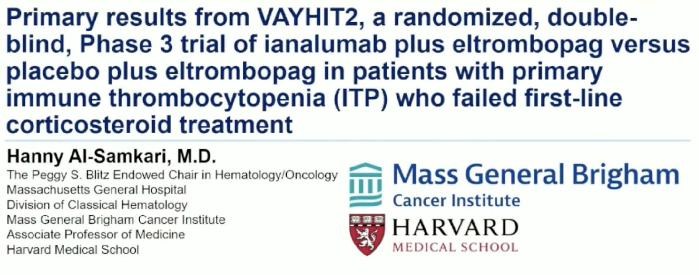
EHA 2023;Abstract PB2636.
ASH 2025; Abstract LBA-2.

Slide 3
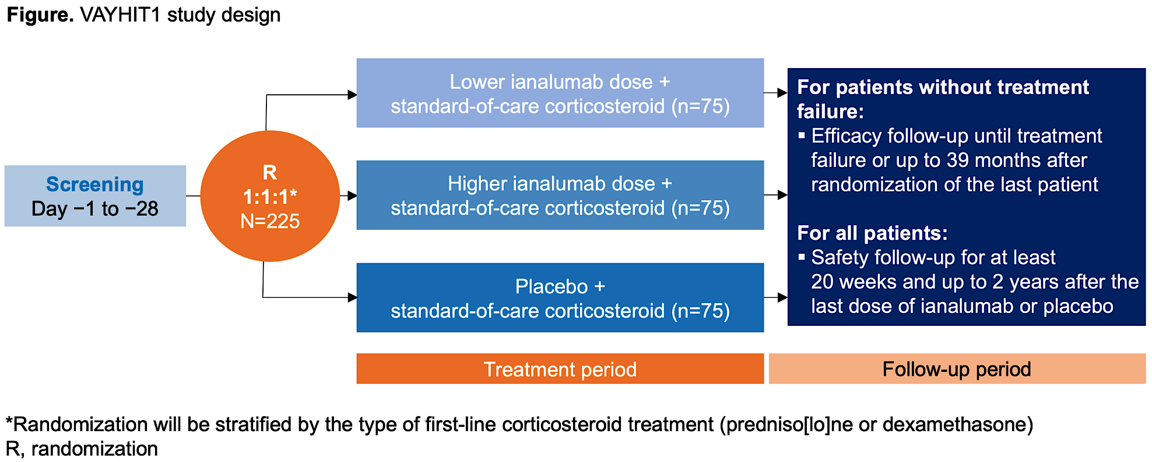
Ianalumab (VAY736) in ITP: VAYHIT1 Study
Cooper et al. HemaSphere 2023

Slide 4
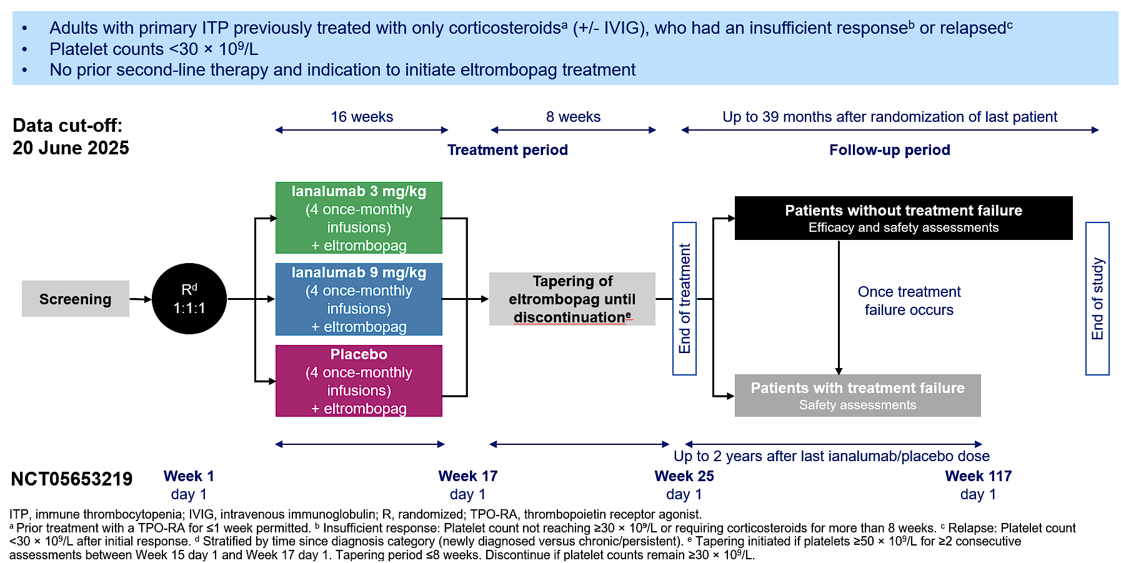
Ianalumab (VAY736) in ITP: VAYHIT2 Study
Al-Samkari et al., ASH LBA-2 2025; Cuker et al., NEJM 2025

Slide 5
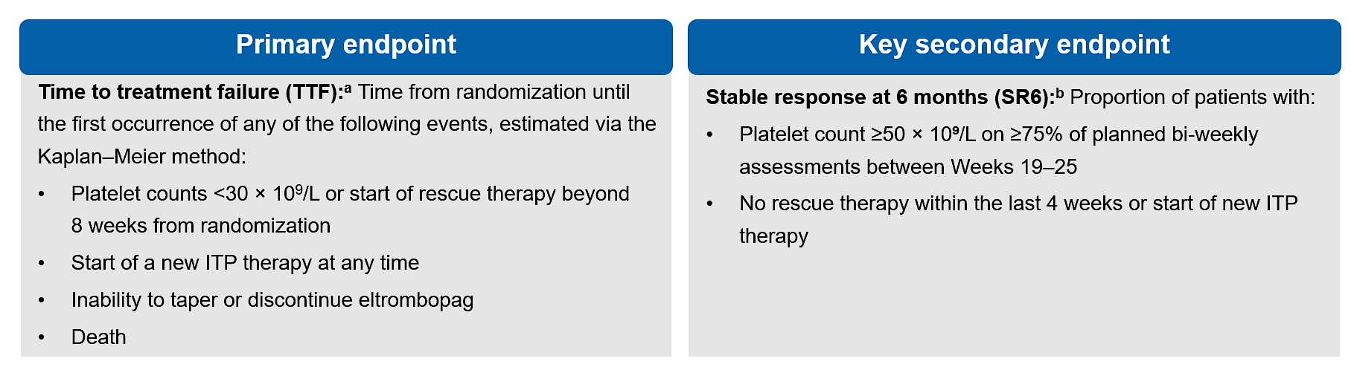
Ianalumab (VAY736) in ITP: VAYHIT2 Study
Al-Samkari et al., ASH LBA-2 2025; Cuker et al., NEJM 2025

Slide 6
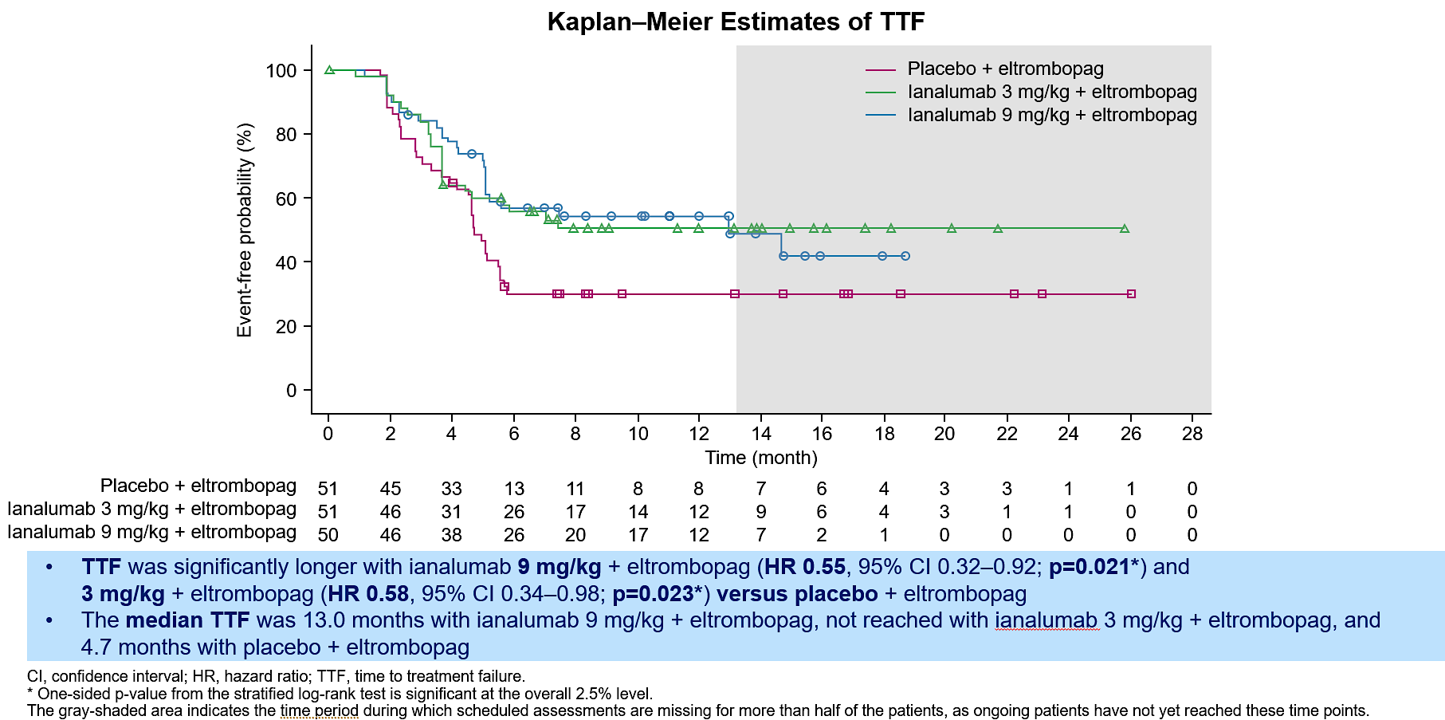
Ianalumab (VAY736) in ITP: VAYHIT2 Study
Al-Samkari et al., ASH LBA-2 2025; Cuker et al., NEJM 2025

Slide 7
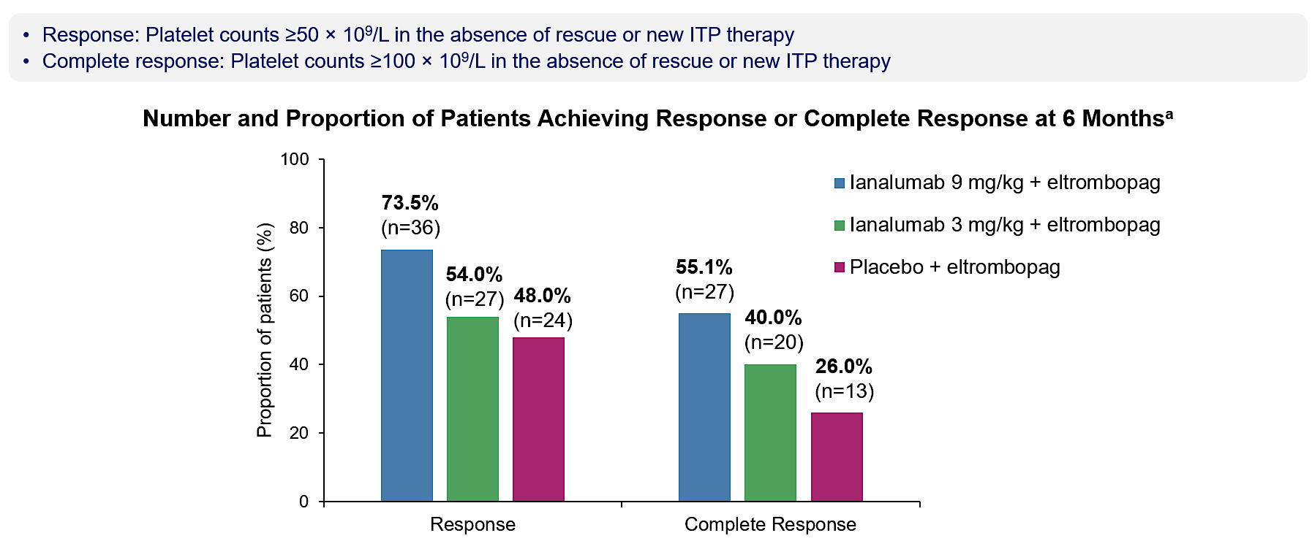
Ianalumab (VAY736) in ITP: VAYHIT2 Study
Al-Samkari et al., ASH LBA-2 2025; Cuker et al., NEJM 2025

Slide 8
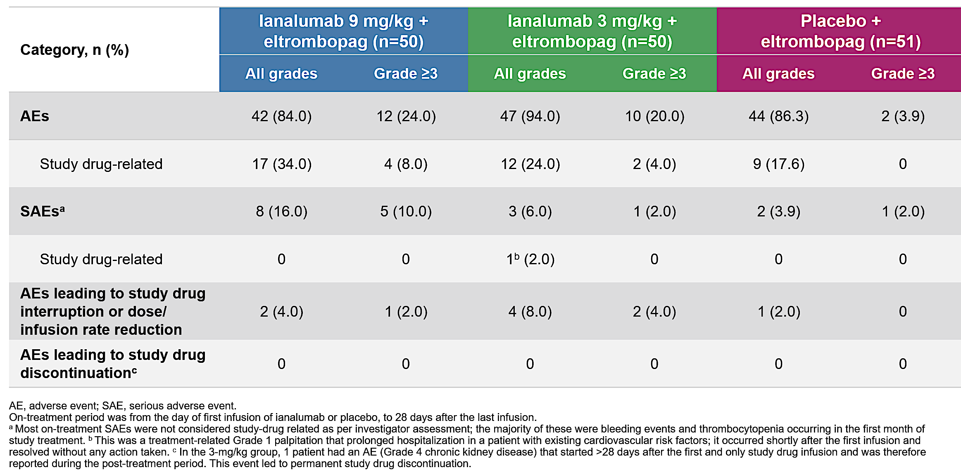
Ianalumab (VAY736) in ITP: VAYHIT2 Study
Al-Samkari et al., ASH LBA-2 2025; Cuker et al., NEJM 2025

Slide 9
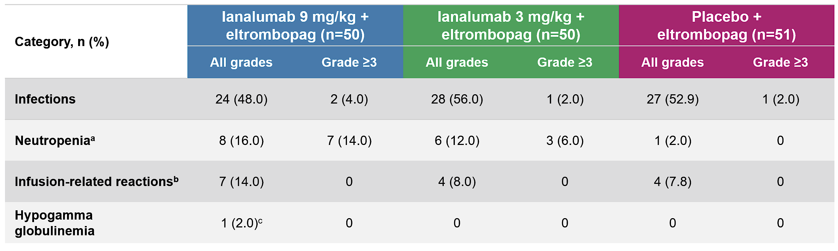
Ianalumab (VAY736) in ITP: VAYHIT2 Study
Al-Samkari et al., ASH LBA-2 2025; Cuker et al., NEJM 2025

Slide 10
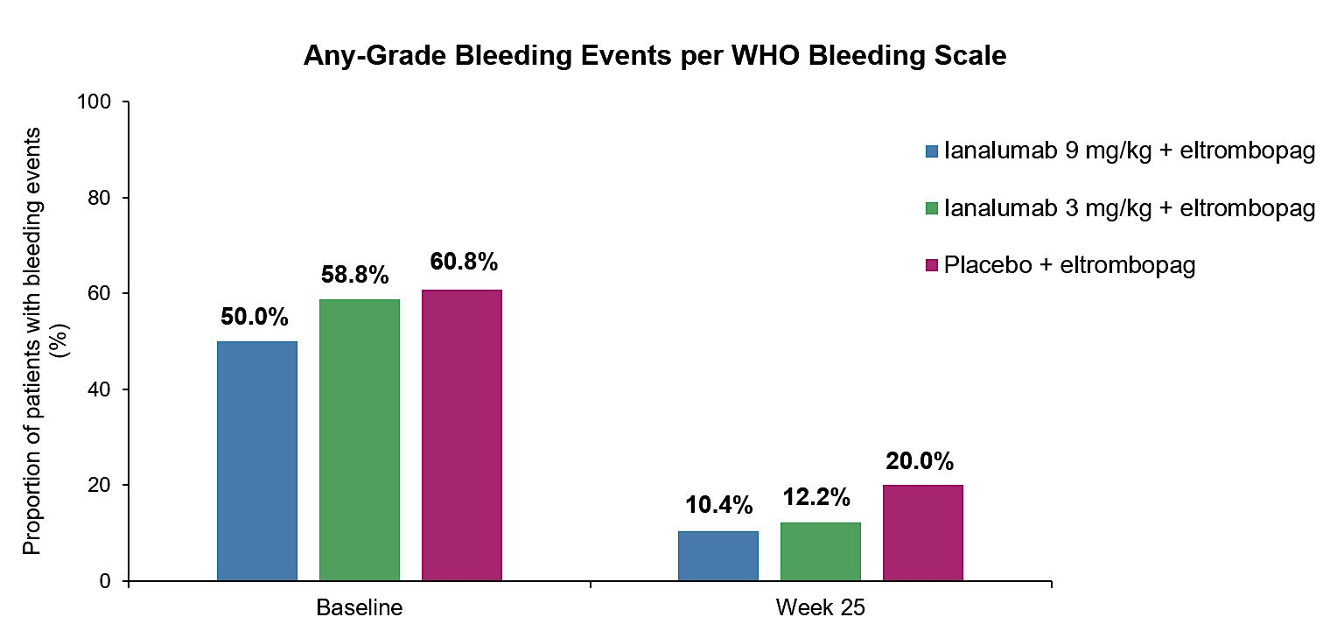
Ianalumab (VAY736) in ITP: VAYHIT2 Study
Al-Samkari et al., ASH LBA-2 2025; Cuker et al., NEJM 2025

Slide 11
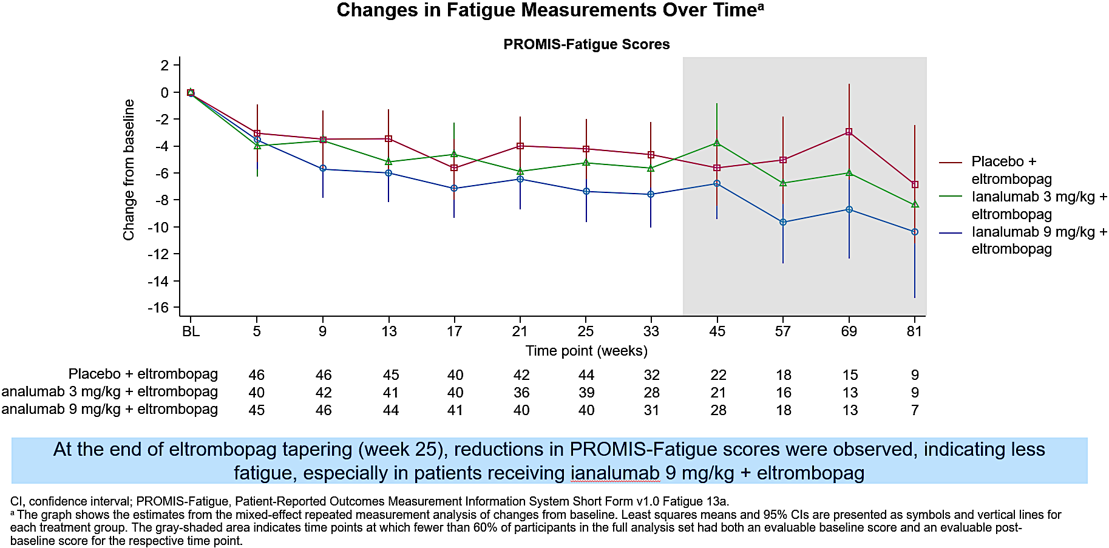
Ianalumab (VAY736) in ITP: VAYHIT2 Study
Ianalumab
Ianalumab
Al-Samkari et al., ASH LBA-2 2025; Cuker et al., NEJM 2025

Slide 12
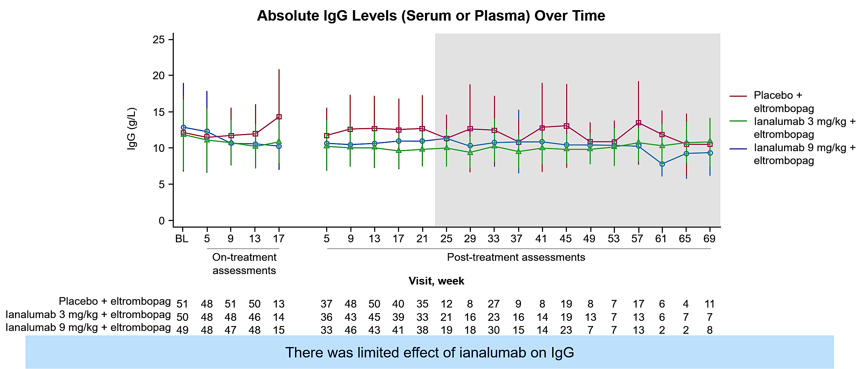
Ianalumab (VAY736) in ITP: VAYHIT2 Study
Al-Samkari et al., ASH LBA-2 2025; Cuker et al., NEJM 2025

Slide 13
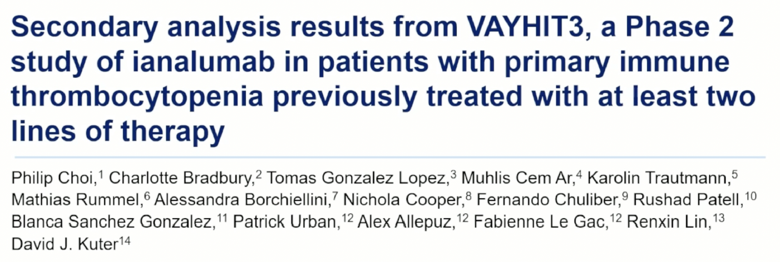
ASH 2025;Abstract 844.

Slide 14
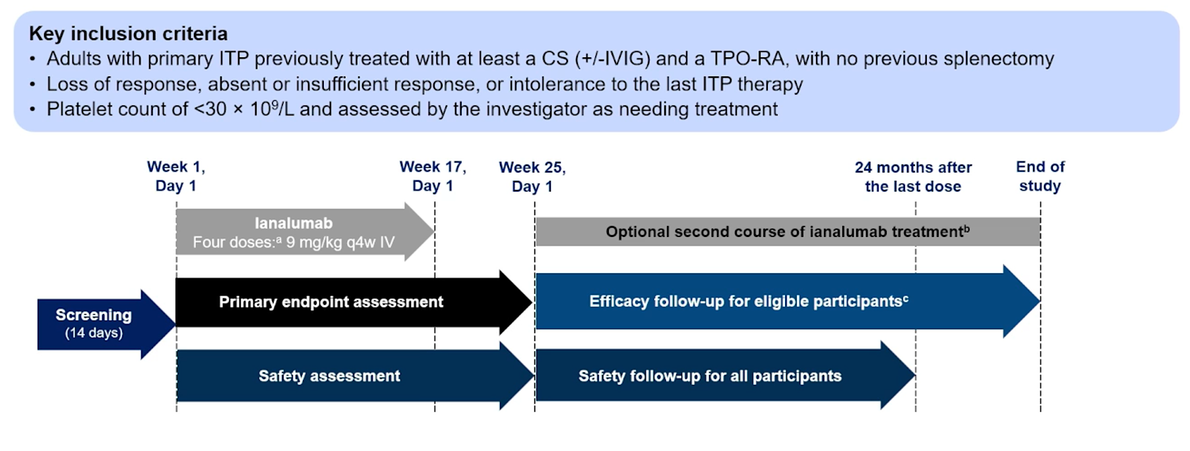
Ianalumab (VAY736) in ITP: VAYHIT3 Study
VAYHIT3 Study Design
Choi et al., ASH Abstract 844 2025

Slide 15
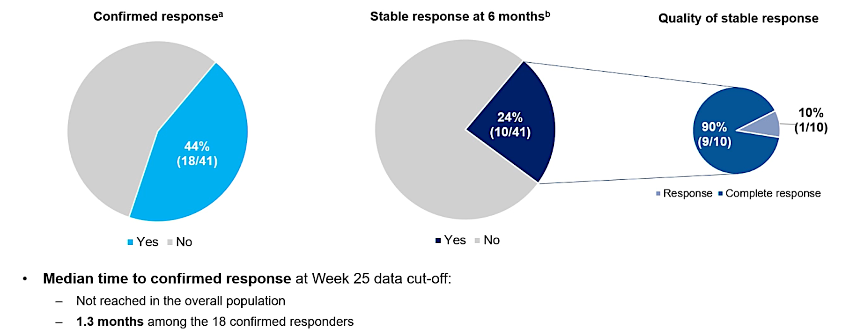
Ianalumab (VAY736) in ITP: VAYHIT3 Study
Choi et al., ASH Abstract 844 2025

Slide 16
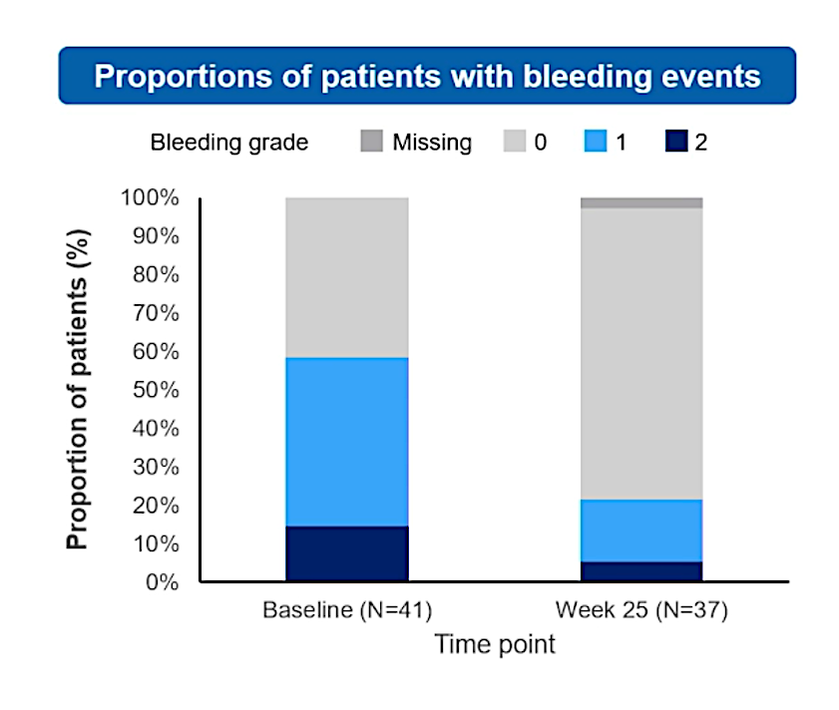
Ianalumab (VAY736) in ITP: VAYHIT3 Study
Choi et al., ASH Abstract 844 2025

Slide 17
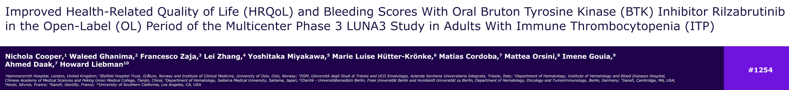
ASH 2025;Abstract 1254.

Slide 18
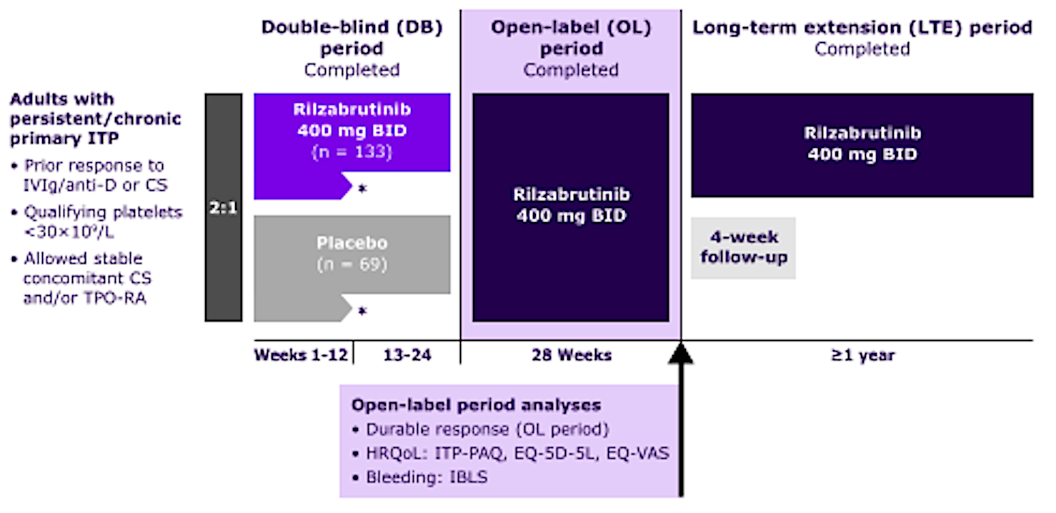
Rilzabrutinib Phase III LUNA-3 Study: 28-Week Open-Label Period
Cooper et al., ASH Abstract 1254 2025

Slide 19
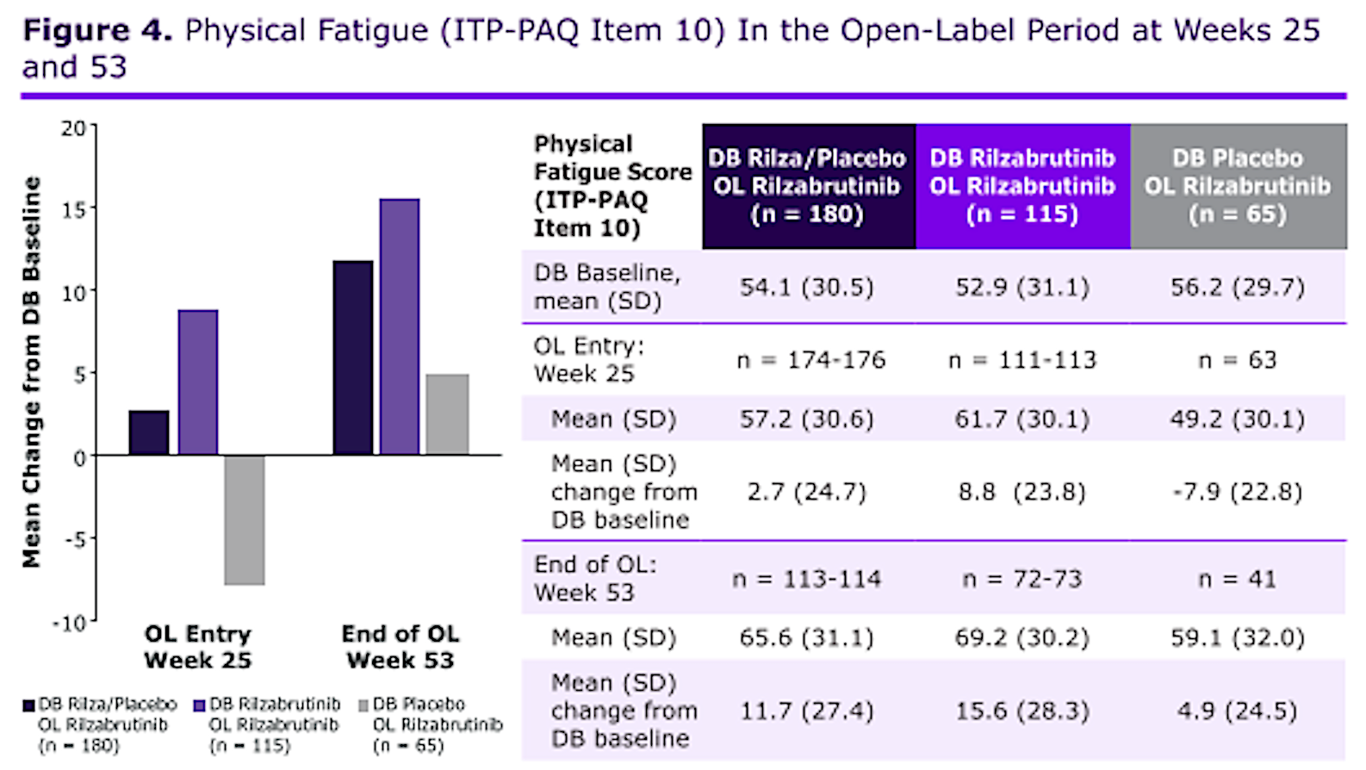
Rilzabrutinib Phase III LUNA-3 Study: Physical Fatigue
ITP-PAQ = Immune Thrombocytopenic Purpura-Patient Assessment Questionnaire
Cooper et al., ASH Abstract 1254 2025

Slide 20
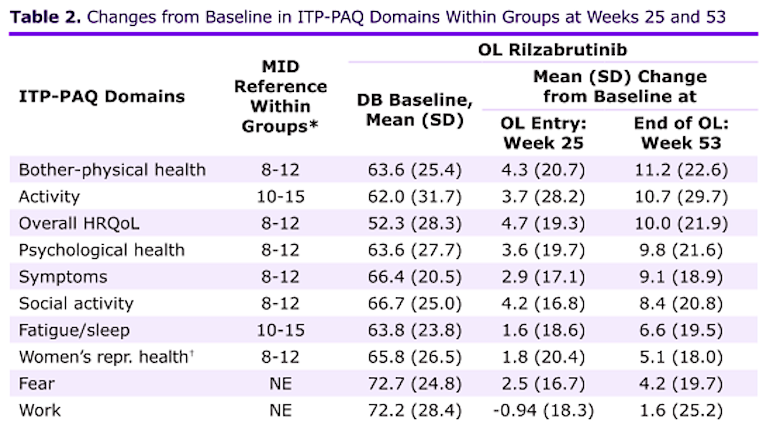
Rilzabrutinib Phase III LUNA-3 Study: ITP-PAQ Domains
Cooper et al., ASH Abstract 1254 2025

Slide 21
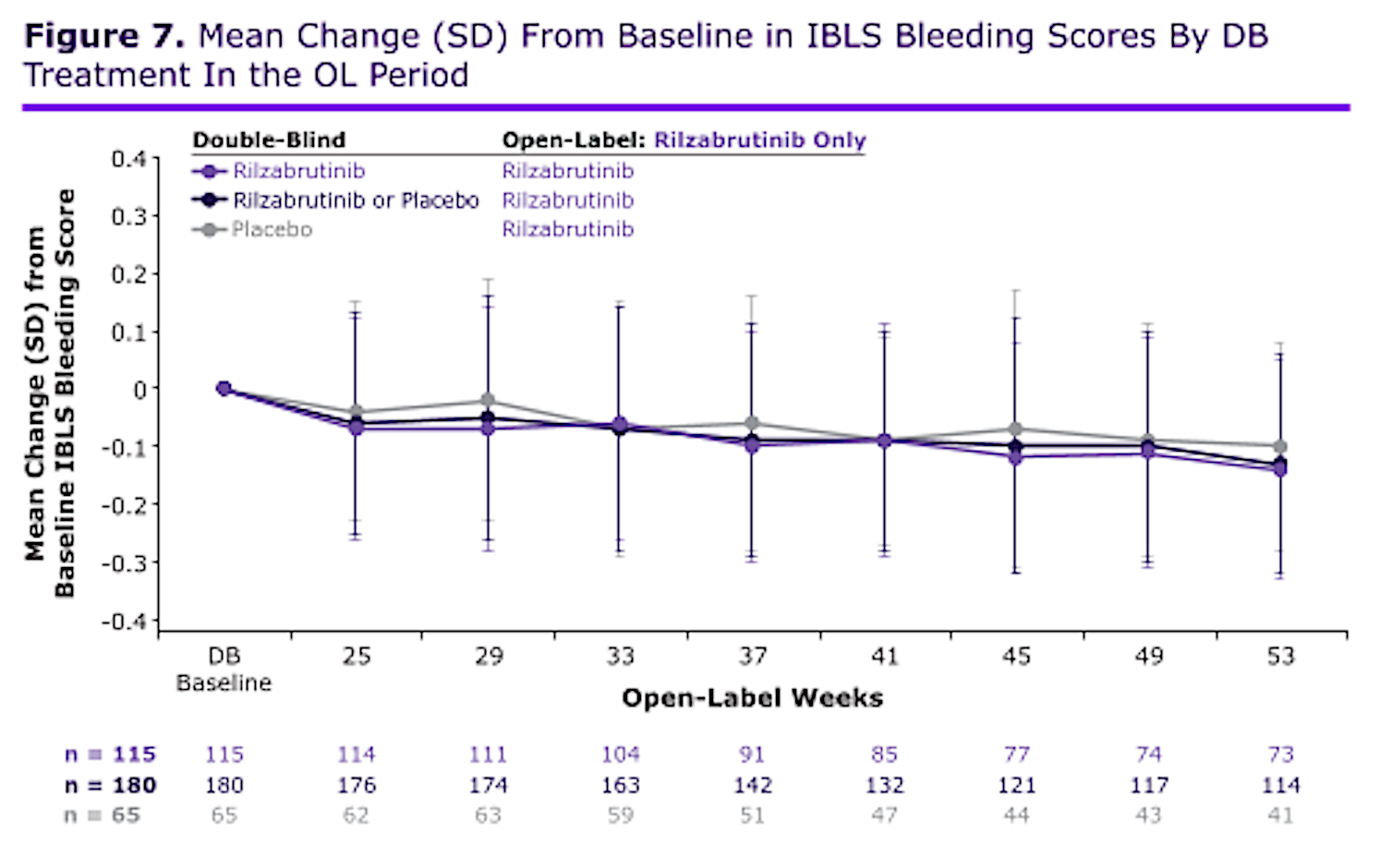
Rilzabrutinib Phase III LUNA-3 Study: Bleeding Scores
IBLS = ITP Bleeding Scale
Cooper et al., ASH Abstract 1254 2025
Notes:
Durable platelet responses seen, defined as platelet counts ≥ 50x10⁹/L for ≥ 2/3 of the last 16 of 28 OL weeks without rescue therapy

Slide 22
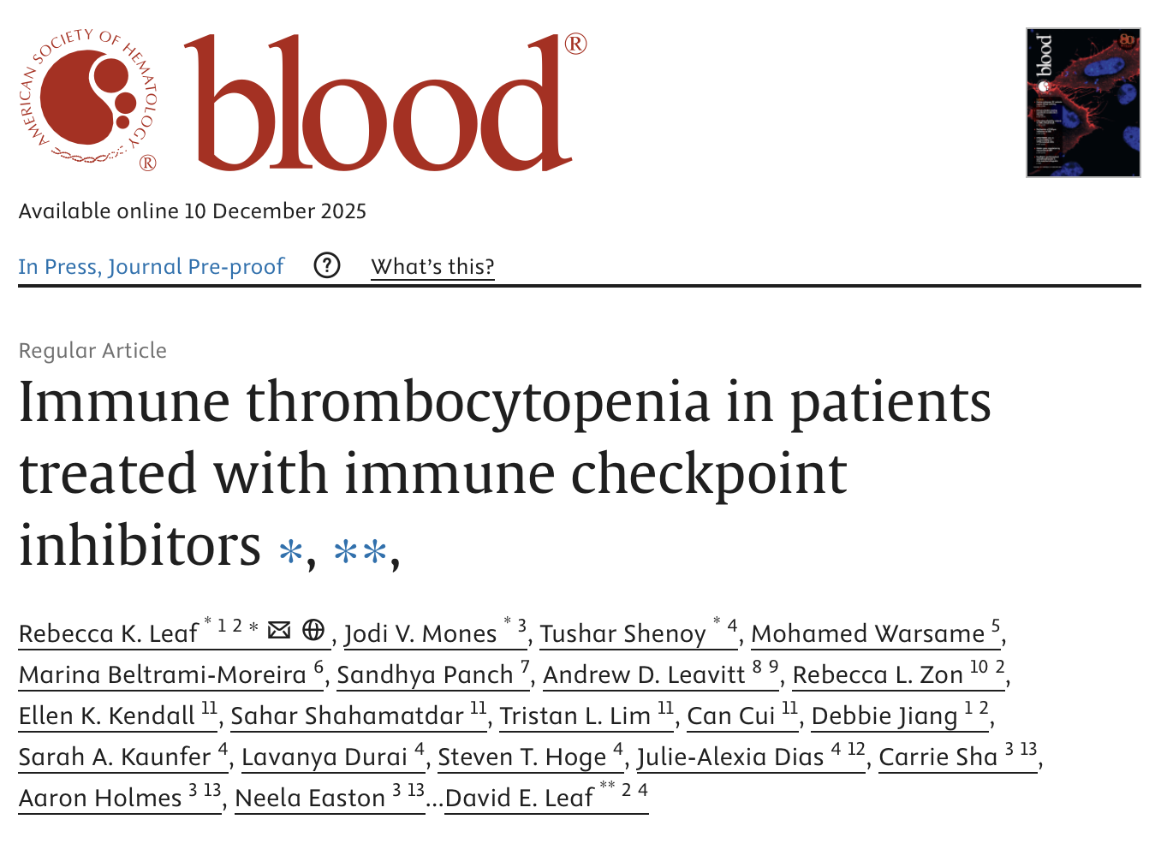
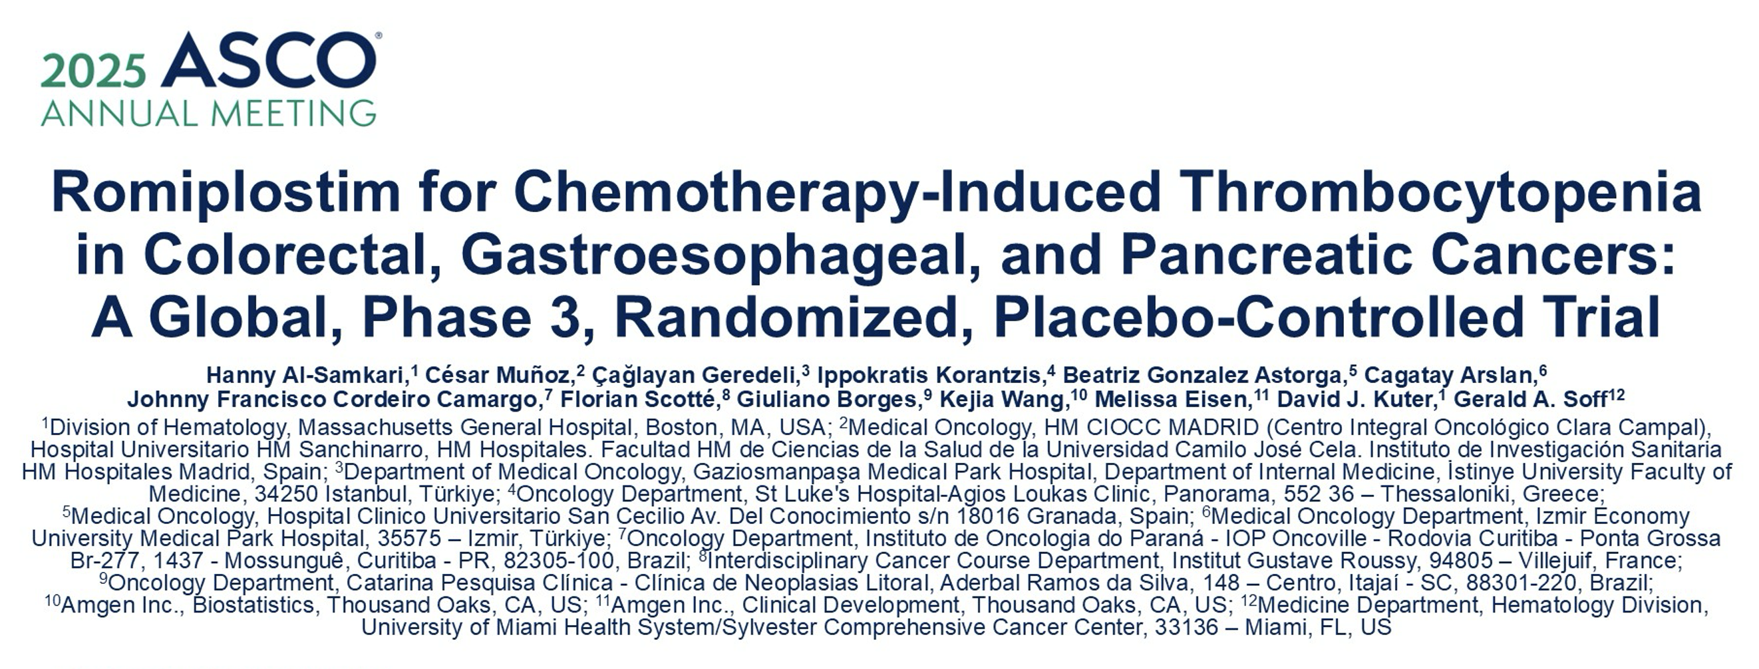
ASCO 2025;Abstract 12007.

Slide 23
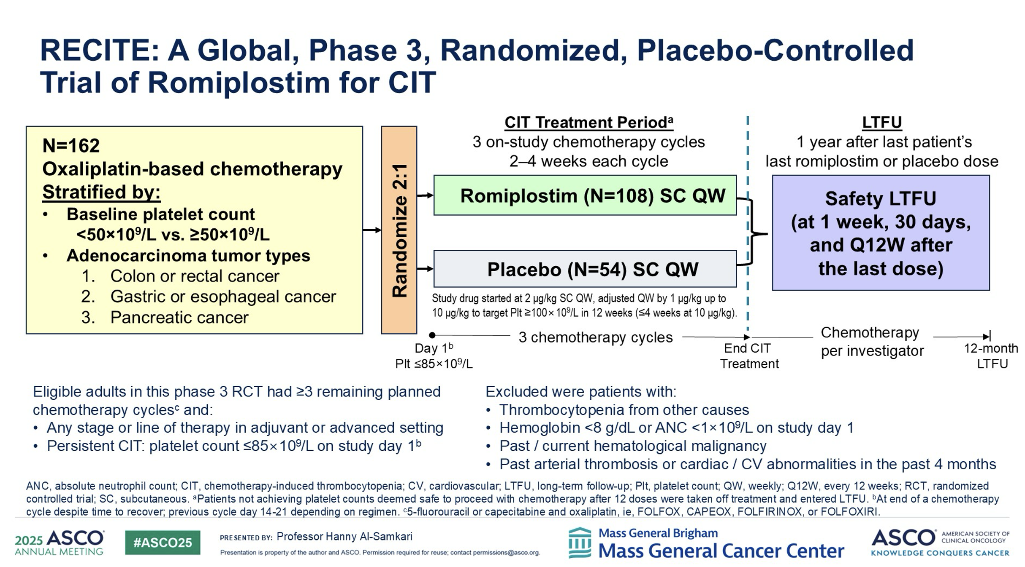

Slide 24
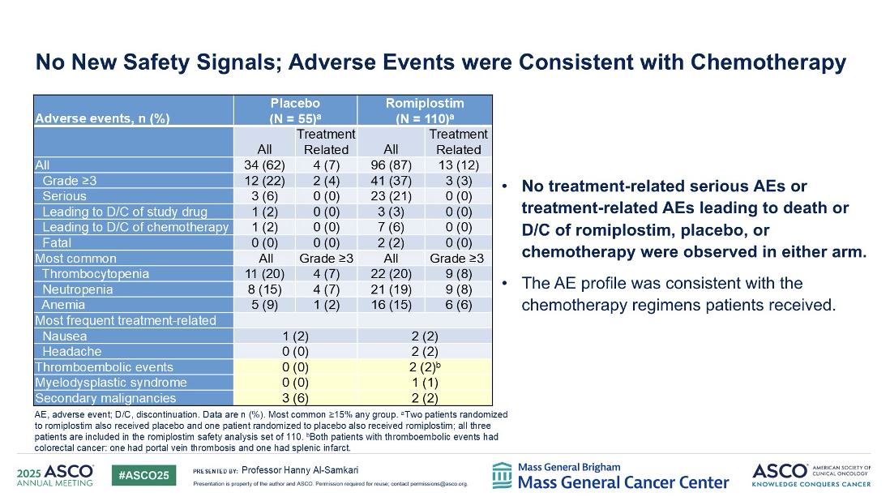

Slide 25
