Slide 1
Consensus or Controversy? Clinical Investigators
Provide Perspectives on the Current and Future Management of Acute Myeloid Leukemia
A CME-Accredited Friday Satellite Symposium Preceding the 67th ASH Annual Meeting
Friday, December 5, 2025
7:30 AM – 9:30 AM ET
Faculty
Harry Paul Erba, MD, PhD
Amir Fathi, MD
Tara L Lin, MD, MS
Alexander Perl, MD
Eytan M Stein, MD
Moderator
Neil Love, MD

Slide 2


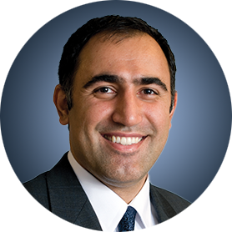

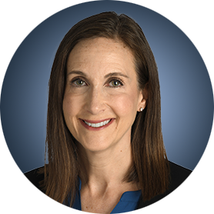

Faculty
Harry Paul Erba, MD, PhD
Director, Leukemia Program
Professor in the Department of Medicine
Member of the Duke Cancer Institute
Duke University School of Medicine
Durham, North Carolina
Alexander Perl, MD
Associate Professor of Medicine
Perelman School of Medicine
Member, Leukemia Program
Abramson Cancer Center
University of Pennsylvania
Philadelphia, Pennsylvania
Amir Fathi, MD
Director, Leukemia Program
Massachusetts General Hospital
Associate Professor of Medicine
Harvard Medical School
Boston, Massachusetts
Eytan M Stein, MD
Chief, Leukemia Service
Director, Program for Drug Development
in Leukemia
Associate Attending Physician
Leukemia Service, Department of Medicine
Memorial Sloan Kettering Cancer Center
New York, New York
Tara L Lin, MD, MS
Professor, Hematologic Malignancies
and Cellular Therapeutics
University of Kansas Medical Center
Kansas City, Kansas
Moderator
Neil Love, MD
Research To Practice
Miami, Florida

Slide 3



Contributing Clinical Investigators
Jorge Cortes, MD
Director, Georgia Cancer Center
Augusta University
Augusta, Georgia
Eunice S Wang, MD
Chief, Leukemia/Benign Hematology Service
Professor of Oncology, Department of Medicine
Roswell Park Comprehensive Cancer Center
Buffalo, New York
Courtney D DiNardo, MD, MSCE
Professor, Department of Leukemia
Division of Cancer Medicine
The University of Texas MD Anderson Cancer Center
Houston, Texas

Slide 4
Dr Erba — Disclosures
Faculty
Consulting Agreements | AbbVie Inc, Astellas, AstraZeneca Pharmaceuticals LP, Bristol Myers Squibb, Daiichi Sankyo Inc, Gilead Sciences Inc, GlycoMimetics Inc, Incyte Corporation, Jazz Pharmaceuticals Inc, Kura Oncology, Novartis, Pfizer Inc, Servier Pharmaceuticals LLC, Stemline Therapeutics Inc, Sumitomo Pharma America
Contracted Research | AbbVie Inc, Agios Pharmaceuticals Inc, ALX Oncology, Amgen Inc, Aptose Biosciences Inc, Ascentage Pharma, Daiichi Sankyo Inc, Forma Therapeutics, Gilead Sciences Inc, GlycoMimetics Inc, ImmunoGen Inc, Jazz Pharmaceuticals Inc, Kura Oncology, MacroGenics Inc, Novartis, Oryzon, PTC Therapeutics, Sumitomo Pharma America, Taiho Oncology Inc
Speakers Bureaus | AbbVie Inc, Bristol Myers Squibb, Incyte Corporation, Jazz Pharmaceuticals Inc, Servier Pharmaceuticals LLC, Syndax Pharmaceuticals
Study IRCs | AbbVie Inc (Chair, VIALE-A and VIALE-C)
Study Steering Committee Chairs | Bristol Myers Squibb (AML Registry), Daiichi Sankyo Inc (QuANTUM-First and QuANTUM-Wild)
Study Steering Committees | GlycoMimetics Inc, Kura Oncology, Sumitomo Pharma America
Nonrelevant Financial Relationships | Fortrea

Slide 5
Dr Fathi — Disclosures
Faculty
Consulting Agreements | AbbVie Inc, Astellas, AstraZeneca Pharmaceuticals LP, Autolus, Bristol Myers Squibb, Daiichi Sankyo Inc, Genentech, a member of the Roche Group, Genmab US Inc, Gilead Sciences Inc, Kura Oncology, Pfizer Inc, Prelude Therapeutics, Remix Therapeutics, Rigel Pharmaceuticals Inc, Schrödinger, Servier Pharmaceuticals LLC, Syndax Pharmaceuticals, Takeda Pharmaceuticals USA Inc, Thermo Fisher Scientific
Contracted Research | AbbVie Inc, Bristol Myers Squibb, Kura Oncology, Servier Pharmaceuticals LLC

Slide 6
Dr Lin — Disclosures
Faculty
Consulting Agreements | Daiichi Sankyo Inc, Jazz Pharmaceuticals Inc, Johnson & Johnson, Servier Pharmaceuticals LLC, Syndax Pharmaceuticals
Contracted Research | Aptevo Therapeutics, Bio-Path Holdings Inc, Cardiff Oncology, CicloMed, Cleave Biosciences, Jazz Pharmaceuticals Inc, Kura Oncology, Lin BioScience
Data and Safety Monitoring Boards/Committees | Sumitomo Pharma America

Slide 7
Dr Perl — Disclosures
Faculty
Advisory Committees | AbbVie Inc, Astellas, Daiichi Sankyo Inc, Johnson & Johnson, Rigel Pharmaceuticals Inc, Stemline Therapeutics Inc, Syndax Pharmaceuticals
Consulting Agreements | Astellas, Daiichi Sankyo Inc, Foghorn Therapeutics, Syndax Pharmaceuticals
Contracted Research | AbbVie Inc, Astellas, Daiichi Sankyo Inc, Syndax Pharmaceuticals
Data and Safety Monitoring Boards/Committees | Foghorn Therapeutics
Nonrelevant Financial Relationships | Beat AML LLC

Slide 8
Dr Stein — Disclosures
Faculty
Consulting Agreements | AbbVie Inc, Astellas, Cullinan Therapeutics, Daiichi Sankyo Inc, Genentech, a member of the Roche Group, Janssen Biotech Inc, Kura Oncology, Servier Pharmaceuticals LLC, Syndax Pharmaceuticals
Contracted Research | Astellas, Bristol Myers Squibb, Servier Pharmaceuticals LLC, Syndax Pharmaceuticals
Stock Options — Private Companies | Auron Therapeutics

Slide 9
Dr Cortes — Disclosures
Survey Participant
Consulting Agreements | Ascentage Pharma, Bio-Path Holdings Inc, Novartis, Pfizer Inc, Sun Pharmaceutical Industries Ltd, Syndax Pharmaceuticals, Takeda Pharmaceuticals USA Inc, Terns Pharmaceuticals
Contracted Research | Ascentage Pharma, Bio-Path Holdings Inc, CytoAgents, Kura Oncology, Novartis, Pfizer Inc, Sun Pharmaceutical Industries Ltd, Terns Pharmaceuticals
Stock Options/Stock — Public Companies | Bio-Path Holdings Inc

Slide 10
Dr DiNardo — Disclosures
Survey Participant
Advisory Committees | Astellas, Bristol Myers Squibb, Kura Oncology
Consulting Agreements | AbbVie Inc, AstraZeneca Pharmaceuticals LP, Bristol Myers Squibb, Genmab US Inc, Molecular Partners, Rigel Pharmaceuticals Inc, Servier Pharmaceuticals LLC
Contracted Research | AbbVie Inc, Astex Pharmaceuticals, Auron Therapeutics, Remix Therapeutics, Rigel Pharmaceuticals Inc, Servier Pharmaceuticals LLC, SillaJen, SystImmune Inc

Slide 11
Dr Wang — Disclosures
Survey Participant
Advisory Boards | AbbVie Inc, Blueprint Medicines, Cullinan Therapeutics, Daiichi Sankyo Inc, Dark Blue Therapeutics, Johnson & Johnson, Kite, A Gilead Company, Kura Oncology, Novartis, QIAGEN, Rigel Pharmaceuticals Inc, Ryvu Therapeutics, Schrödinger, Servier Pharmaceuticals LLC, Syndax Pharmaceuticals, Takeda Pharmaceuticals USA Inc
Consulting Agreements | Kura Oncology, Menarini Group
Data and Safety Monitoring Boards/Committees | AbbVie Inc, Gilead Sciences Inc
Speakers Bureaus | Astellas, Pfizer Inc
Nonrelevant Financial Relationships | UpToDate

Slide 12
Dr Love — Disclosures
Dr Love is president and CEO of Research To Practice. Research To Practice receives funds in the form of educational grants to develop CME activities from the following companies: Aadi Bioscience, AbbVie Inc, ADC Therapeutics, Agendia Inc, Alexion Pharmaceuticals, Amgen Inc, Array BioPharma Inc, a subsidiary of Pfizer Inc, Arvinas, Astellas, AstraZeneca Pharmaceuticals LP, Aveo Pharmaceuticals, Bayer HealthCare Pharmaceuticals, BeOne, Black Diamond Therapeutics Inc, Blueprint Medicines, Boehringer Ingelheim Pharmaceuticals Inc, Bristol Myers Squibb, Celcuity, Clovis Oncology, Coherus BioSciences, Corcept Therapeutics Inc, CTI BioPharma, a Sobi Company, Daiichi Sankyo Inc, Eisai Inc, Elevation Oncology Inc, Exact Sciences Corporation, Exelixis Inc, Genentech, a member of the Roche Group, Genmab US Inc, Geron Corporation, Gilead Sciences Inc, GSK, Helsinn Therapeutics (US) Inc, Hologic Inc, ImmunoGen Inc, Incyte Corporation, Ipsen Biopharmaceuticals Inc, Jazz Pharmaceuticals Inc, Johnson & Johnson, Karyopharm Therapeutics, Kite, A Gilead Company, Kura Oncology, Legend Biotech, Lilly, MEI Pharma Inc, Merck, Mersana Therapeutics Inc, Mirati Therapeutics Inc, Mural Oncology Inc, Natera Inc, Novartis, Novartis Pharmaceuticals Corporation on behalf of Advanced Accelerator Applications, Novocure Inc, Nuvalent, Pfizer Inc, Pharmacyclics LLC, an AbbVie Company, Puma Biotechnology Inc, Regeneron Pharmaceuticals Inc, Rigel Pharmaceuticals Inc, R-Pharm US, Sanofi, Seagen Inc, Servier Pharmaceuticals LLC, SpringWorks Therapeutics Inc, Stemline Therapeutics Inc, Sumitomo Pharma America, Syndax Pharmaceuticals, Taiho Oncology Inc, Takeda Pharmaceuticals USA Inc, TerSera Therapeutics LLC, and Tesaro, A GSK Company.

Slide 13
Commercial Support
This activity is supported by educational grants from AbbVie Inc, Astellas, Daiichi Sankyo Inc, Kura Oncology, and Rigel Pharmaceuticals Inc.
Research To Practice CME Planning Committee Members,
Staff and Reviewers
Planners, scientific staff and independent reviewers for Research To Practice have no relevant conflicts of interest to disclose.

Slide 14
This educational activity contains discussion of
non-FDA-approved uses of agents and regimens. Please refer to official prescribing information for each product for approved indications.

Slide 15
Agenda
Module 1: Up-Front Therapy for Older Patients with Acute Myeloid Leukemia (AML) — Dr Lin
Module 2: Selection of Therapy for Younger Patients with AML without a Targetable Mutation; Promising Investigational Strategies — Dr Perl
Module 3: Role of FLT3 Inhibitors in AML Management — Dr Erba
Module 4: Incorporation of IDH Inhibitors into the Care of Patients with AML — Dr Fathi
Module 5: Current and Future Role of Menin Inhibitors in the Treatment of AML — Dr Stein

Slide 16
Agenda
Module 1: Up-Front Therapy for Older Patients with Acute Myeloid Leukemia (AML) — Dr Lin
Module 2: Selection of Therapy for Younger Patients with AML without a Targetable Mutation; Promising Investigational Strategies — Dr Perl
Module 3: Role of FLT3 Inhibitors in AML Management — Dr Erba
Module 4: Incorporation of IDH Inhibitors into the Care of Patients with AML — Dr Fathi
Module 5: Current and Future Role of Menin Inhibitors in the Treatment of AML — Dr Stein

Slide 17
Up-Front Therapy for​
Older Patients with​
Acute Myeloid Leukemia
Tara L. Lin, MD
Professor of Medicine
Director, Acute Leukemia Program
Medical Director, Clinical Trials Office
Division of Hematologic Malignancies & Cellular Therapeutics

Slide 18
Treatment decision-making for older patients with AML
What is “old” for AML?
How do we determine fitness?
Disease biology to determine optimal treatment
Incorporation of targeted agents
Shared decision making with the patient
What if “intensive therapy” isn’t better than less intensive?
Clinical trial design less focused on age vs fitness

Slide 19
What is OLDER AML?
Latest ASH Guidelines for Older Adults – age 55+
Trials of less intensive therapy – age 75
Does AGE matter – or is age just one tool in assessing FITNESS?

Slide 20
Why fitness assessment is important
Guides treatment choice
Predicts treatment tolerance
Assessment of toxicity/tolerance/efficacy of new treatments
Encouraged to take the time to perform a comprehensive assessment

Slide 21
How do we assess fitness for intensive therapy?
Age
Performance status
Medical comorbidities

Slide 22
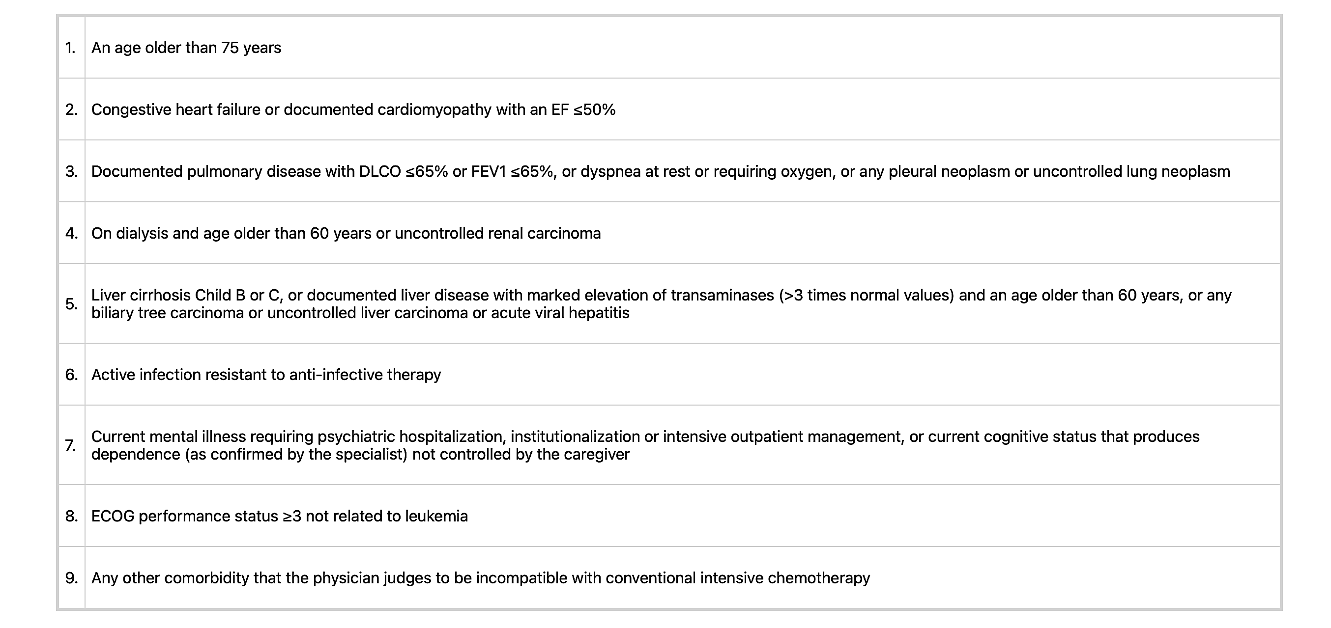
Ferrara Criteria
Leukemia volume 27, pages 997–999 (2013)

Slide 23
How should we assess fitness?
Age
Performance status
Medical comorbidities
Geriatric assessment
Comprehensive: age, PS, comorbidities AND functional capacity
Dynamic – at multiple stages of treatment
Specific – in the context of specific treatments
Not a binary FIT/UNFIT determination

Slide 24

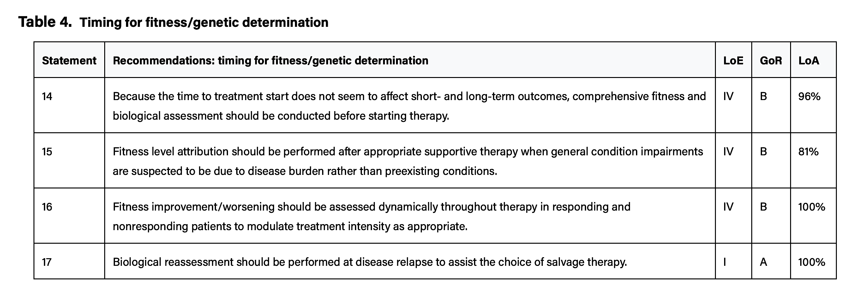
Blood Adv (2025) 9 (9): 2207–2220.

Slide 25
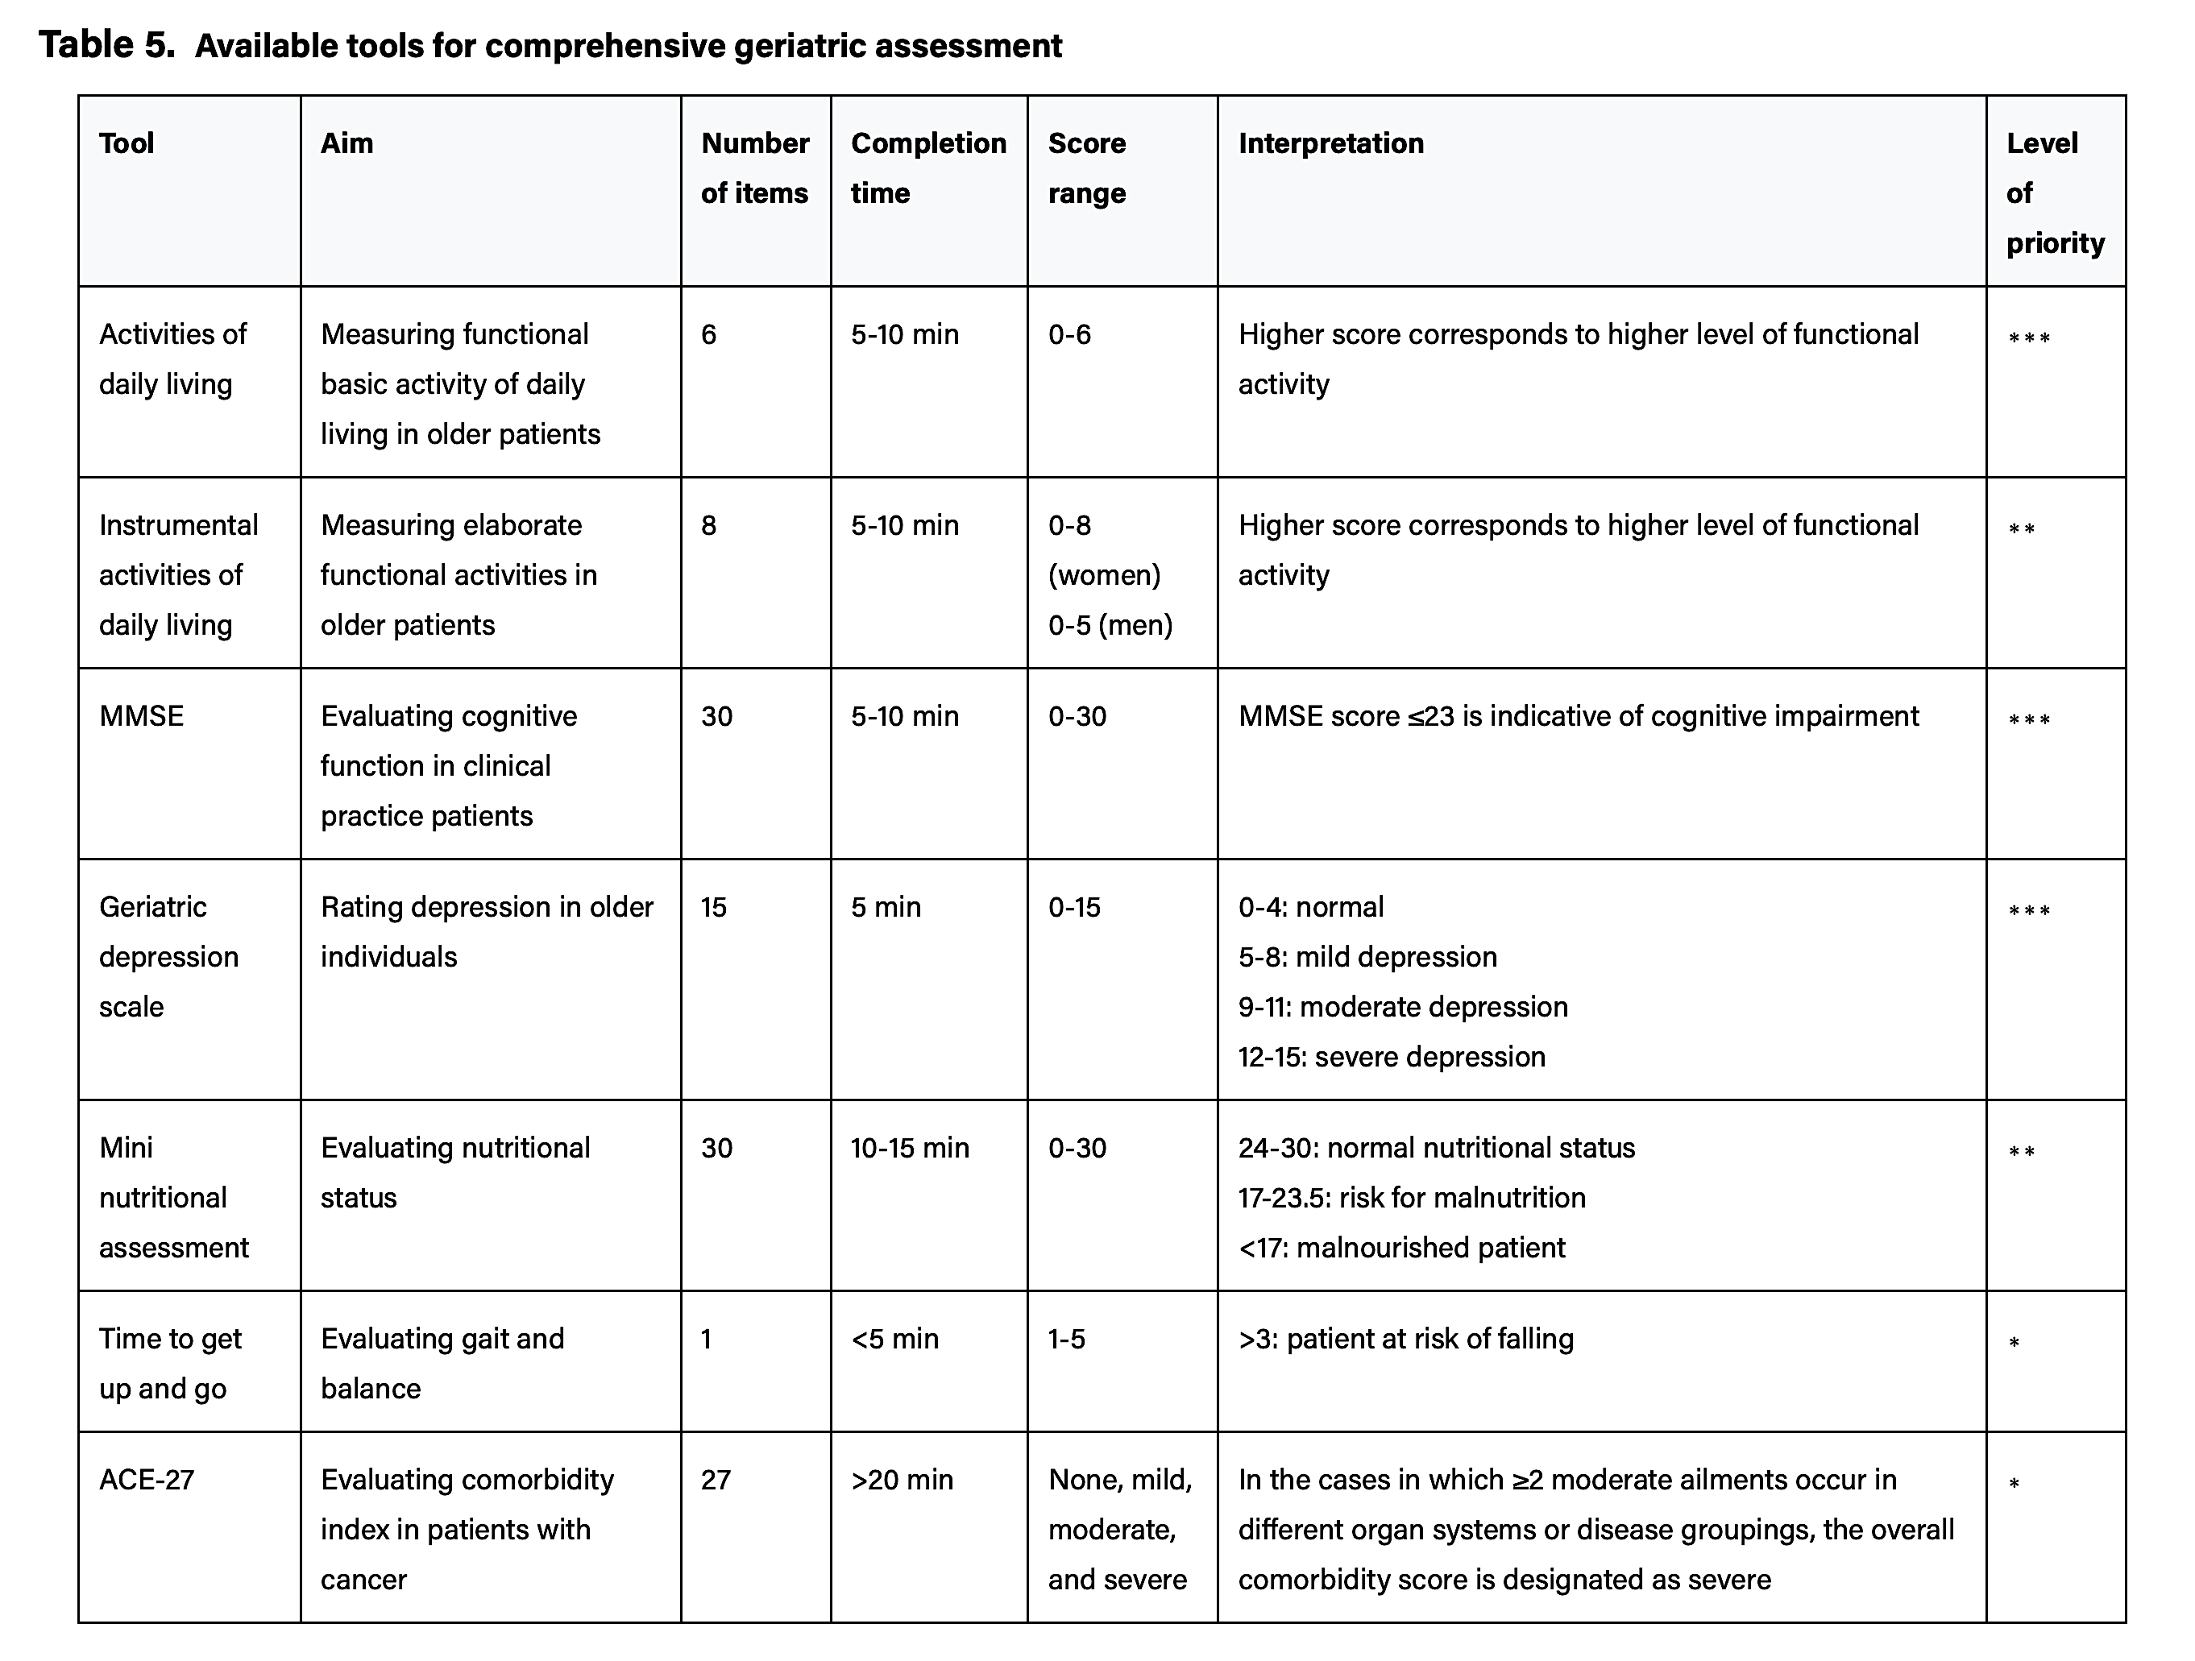
Blood Adv (2025) 9 (9): 2207–2220.

Slide 26
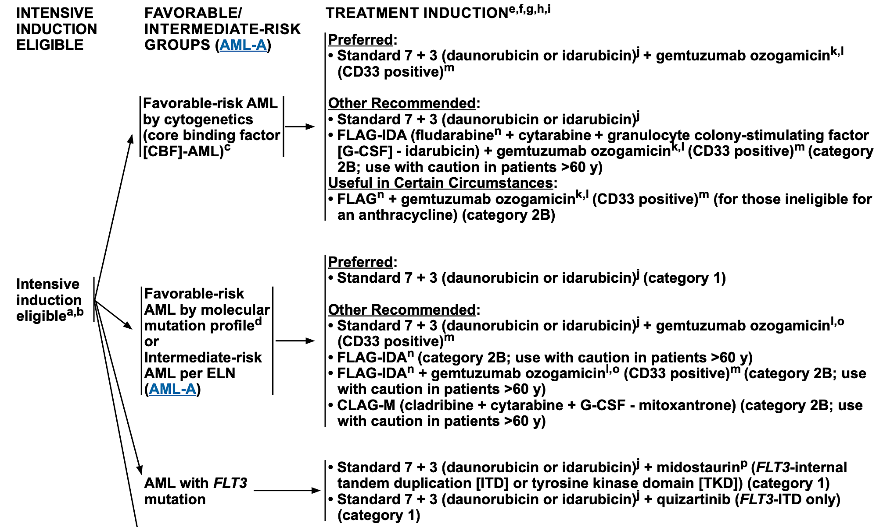
Disease Biology + Fitness to Guide Treatment
https://www.nccn.org

Slide 27
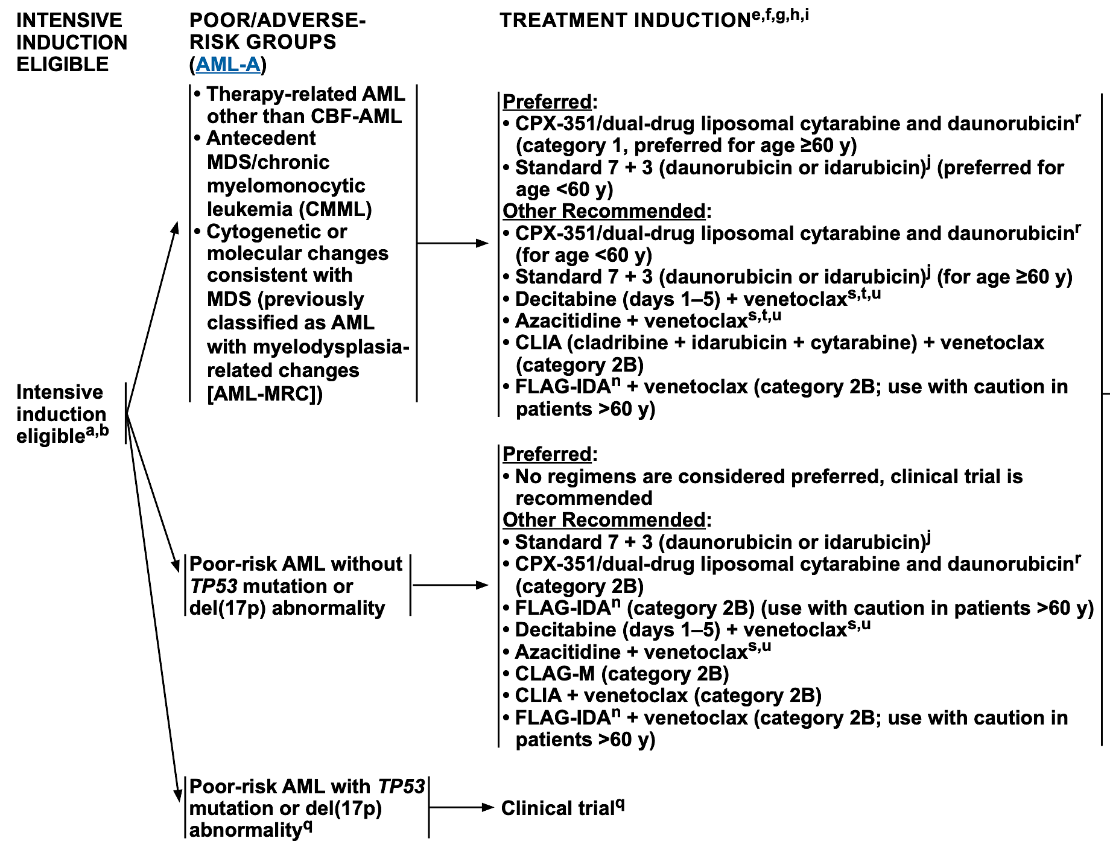
Disease Biology + Fitness to Guide Treatment
https://www.nccn.org

Slide 28
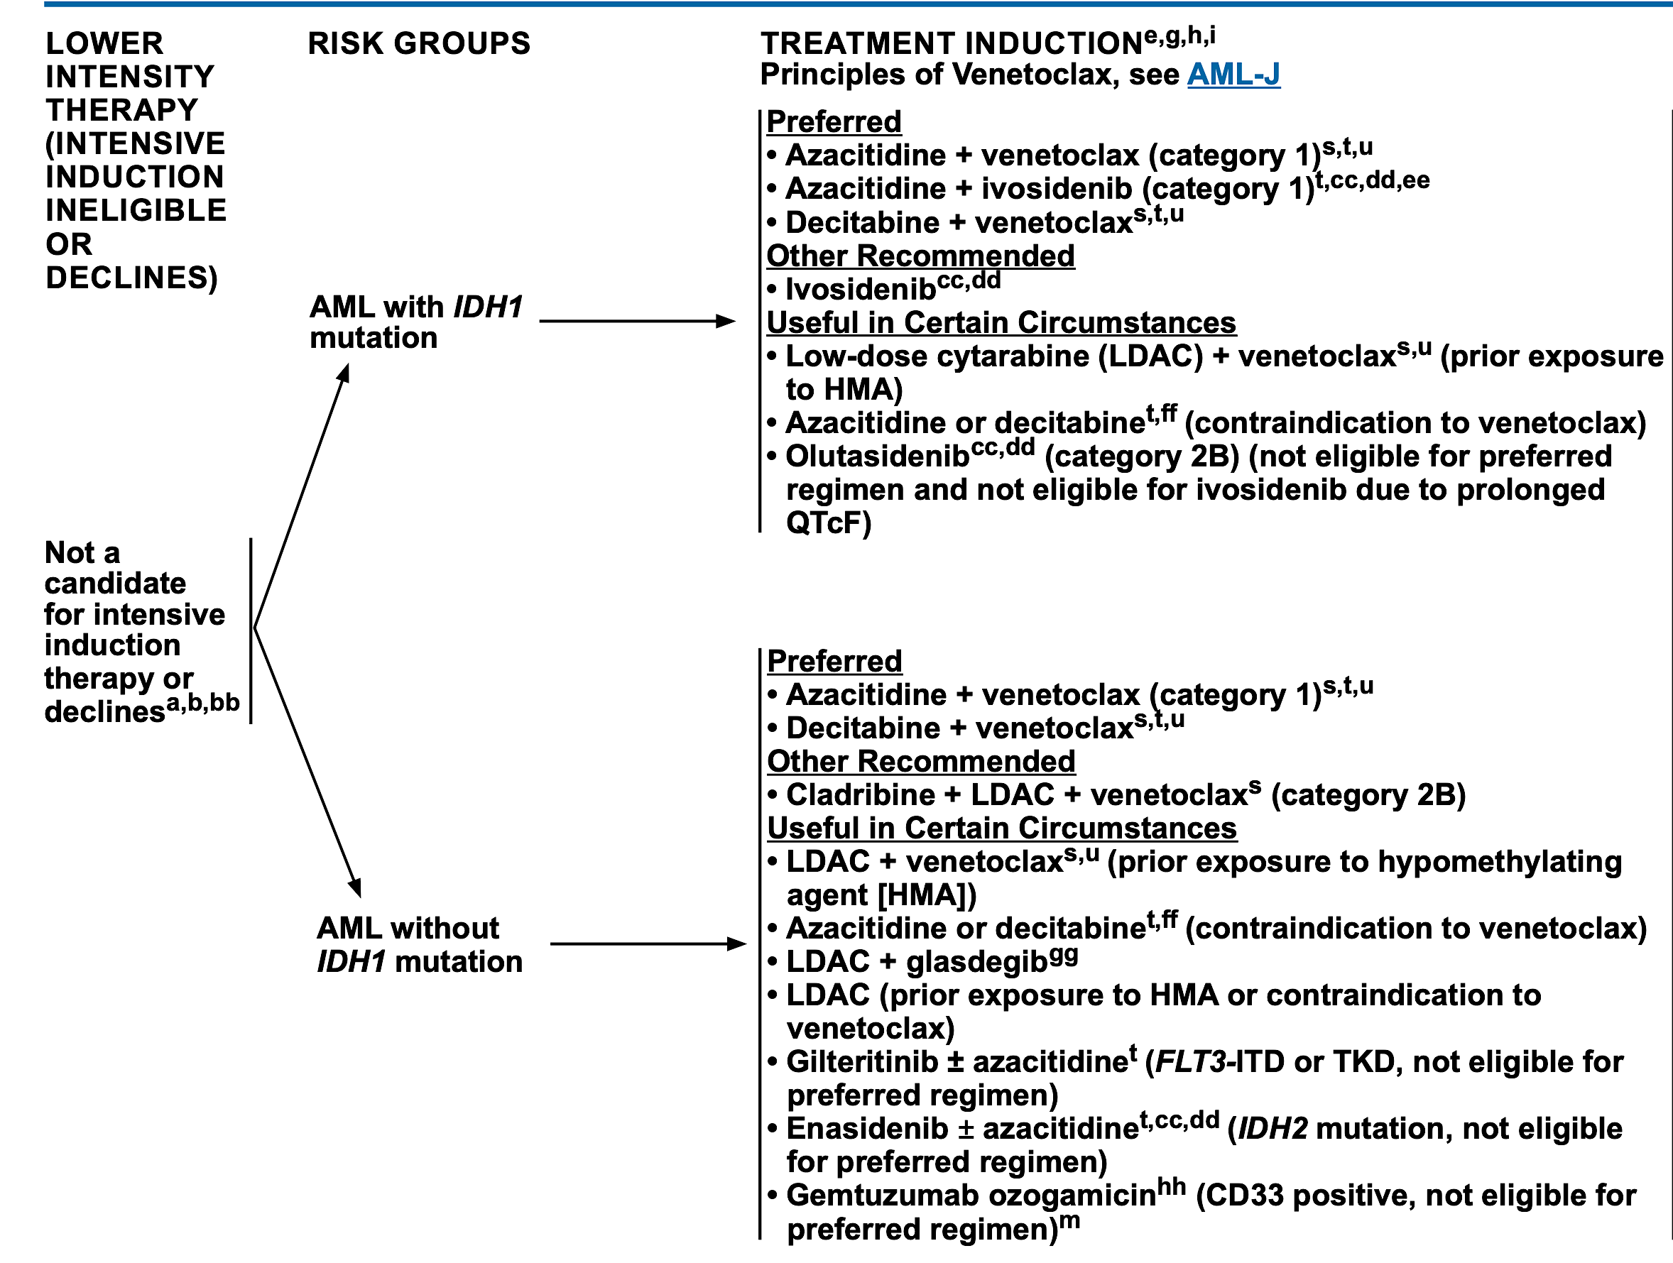
Disease Biology + Fitness to Guide Treatment
https://www.nccn.org

Slide 29
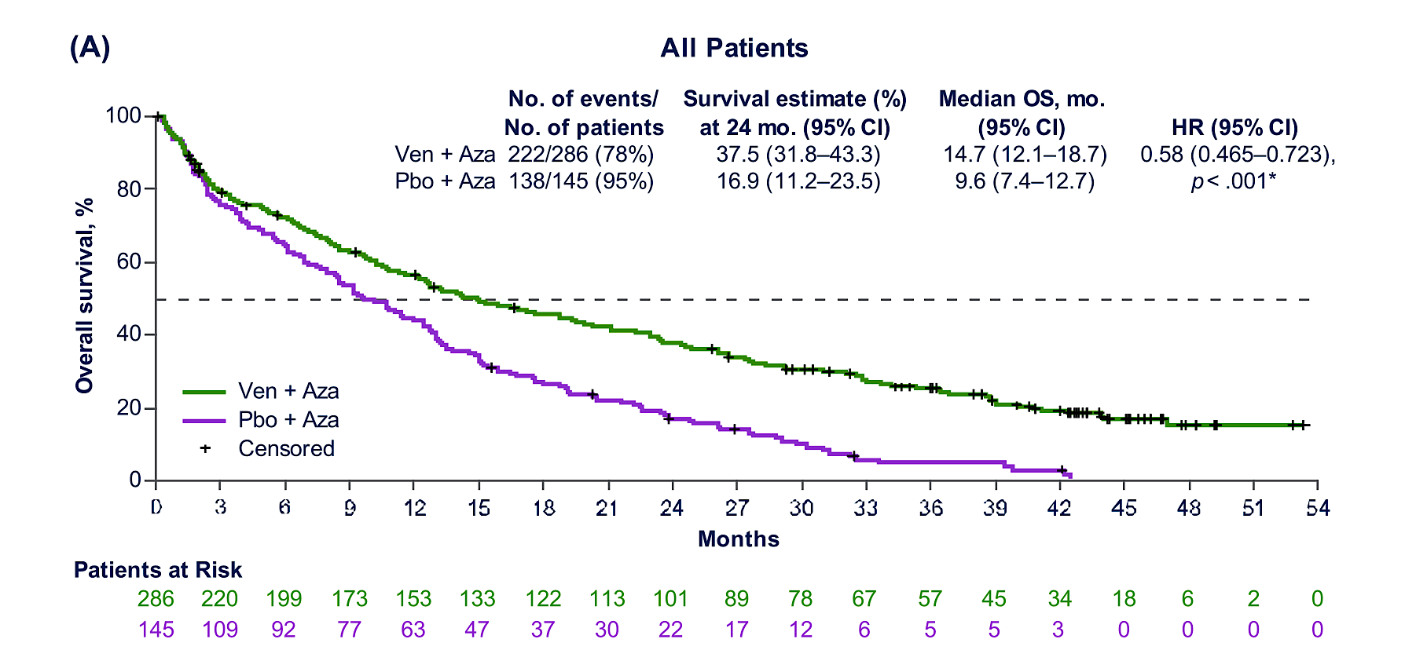
VIALE-A long-term follow-up
Pratz KW et al. Am J Hematol. 2024;99:615–624.

Slide 30
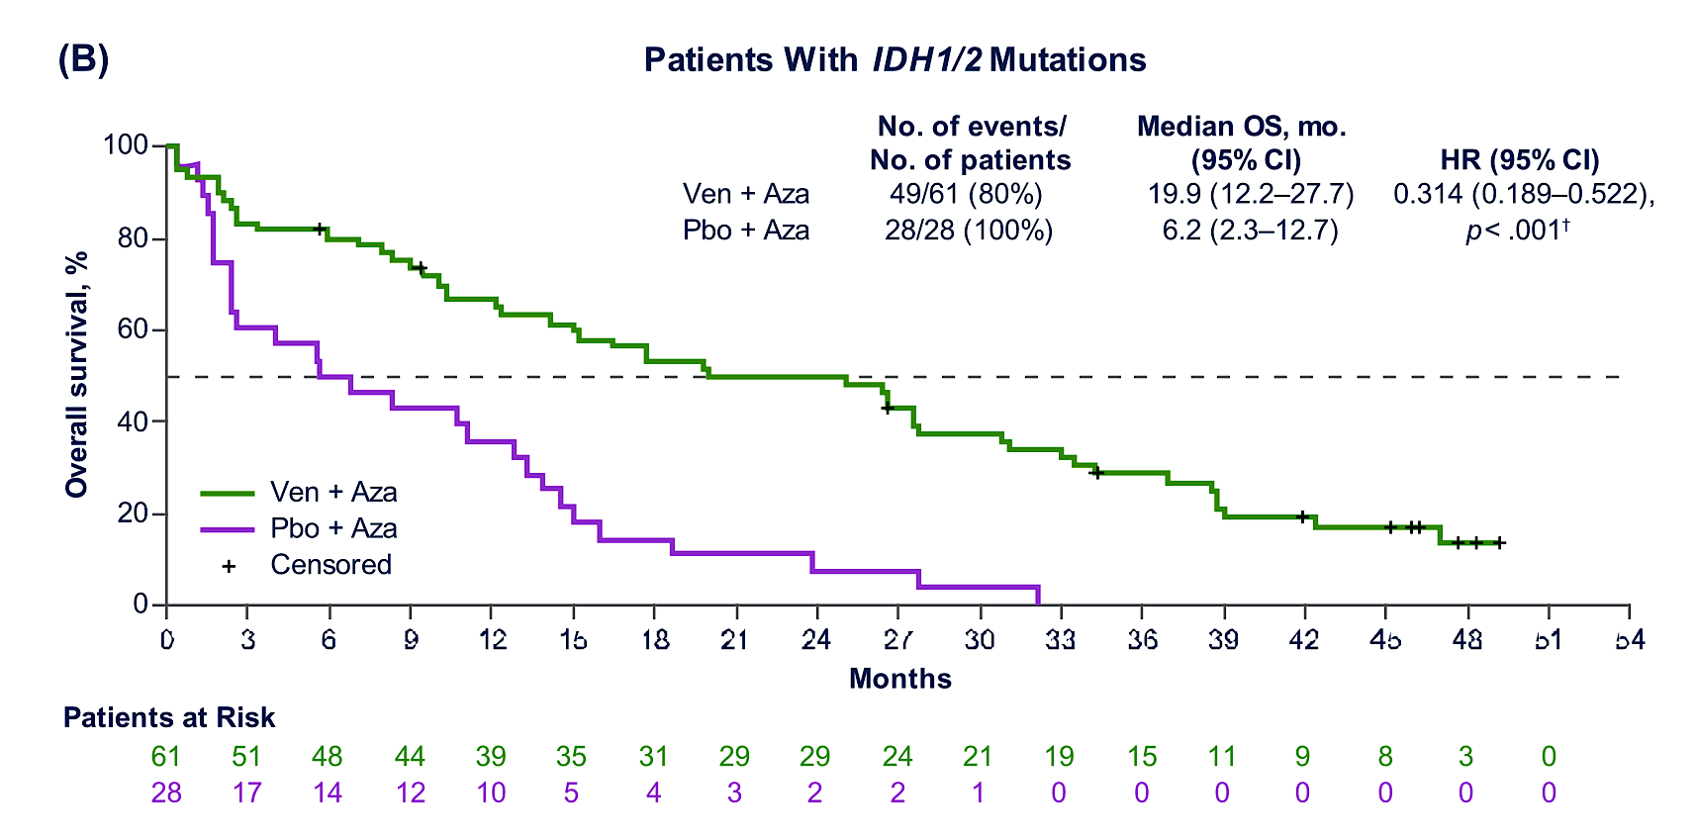
VIALE-A long-term follow-up
Pratz KW et al. Am J Hematol. 2024;99:615–624.

Slide 31
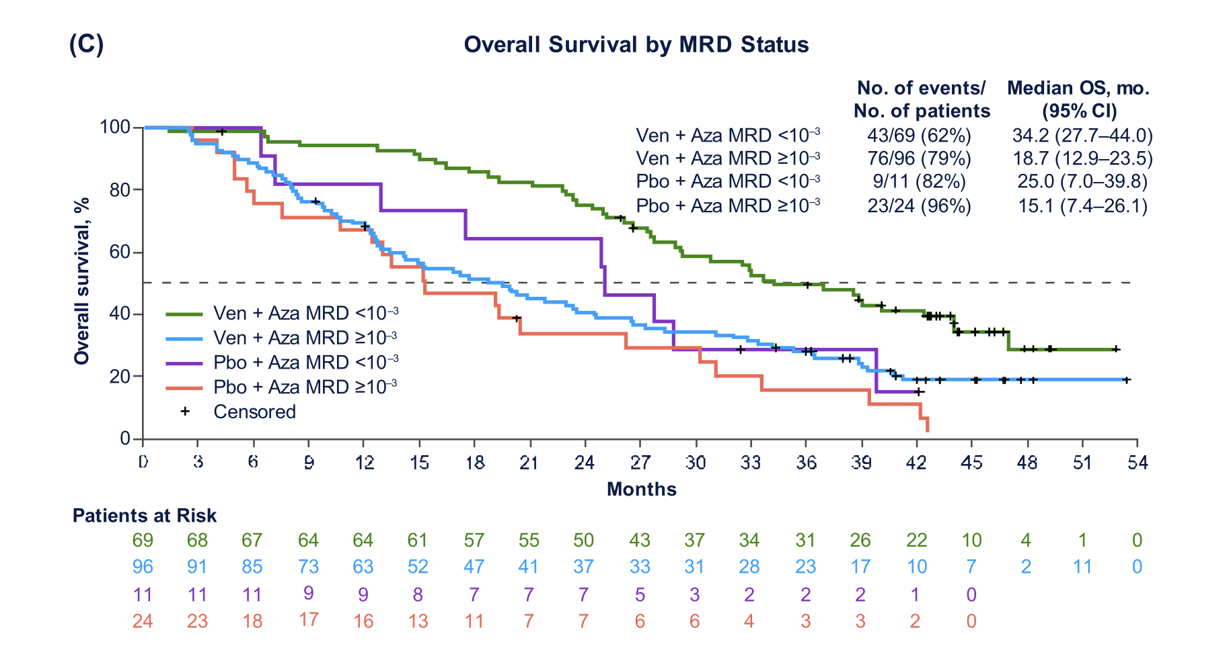
VIALE-A long-term follow-up
Pratz KW et al. Am J Hematol. 2024;99:615–624.

Slide 32
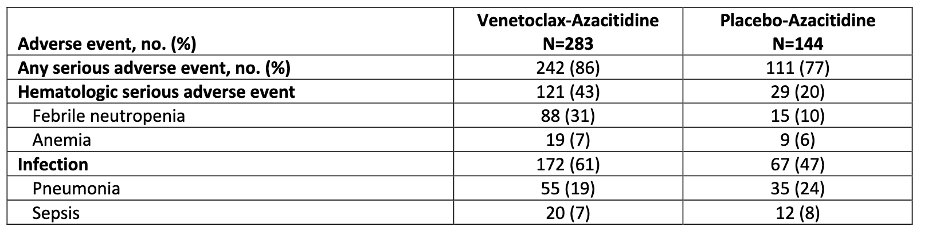
VIALE-A long-term follow-up
Pratz KW et al. Am J Hematol. 2024;99:615–624.

Slide 33
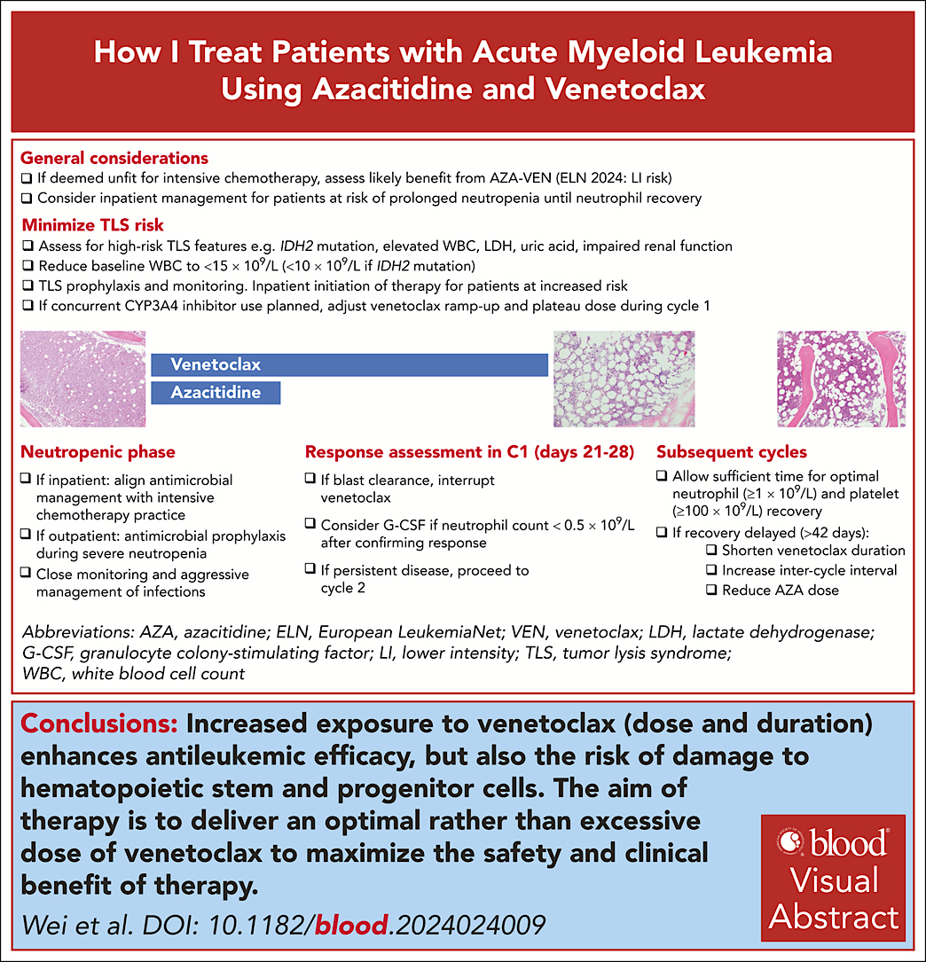
Blood (2025) 145 (12): 1237–1250.

Slide 34
Management of common toxicities
Tumor Lysis
  Prevention with IVF, allopurinol
  Electrolyte monitoring, telemetry as needed
Cytopenias
  Appropriate ven dose for anti-fungal
  G-CSF if blast clearance and delayed ANC recovery
  Start next cycle when ANC >1000 and platelets >50-100
  Reduce duration of ven
  Cycles q6 weeks
Febrile neutropenia/infections
  Appropriate prophylaxis
  Information for emergency management of fever
Blood (2025) 145 (12): 1237–1250.

Slide 35
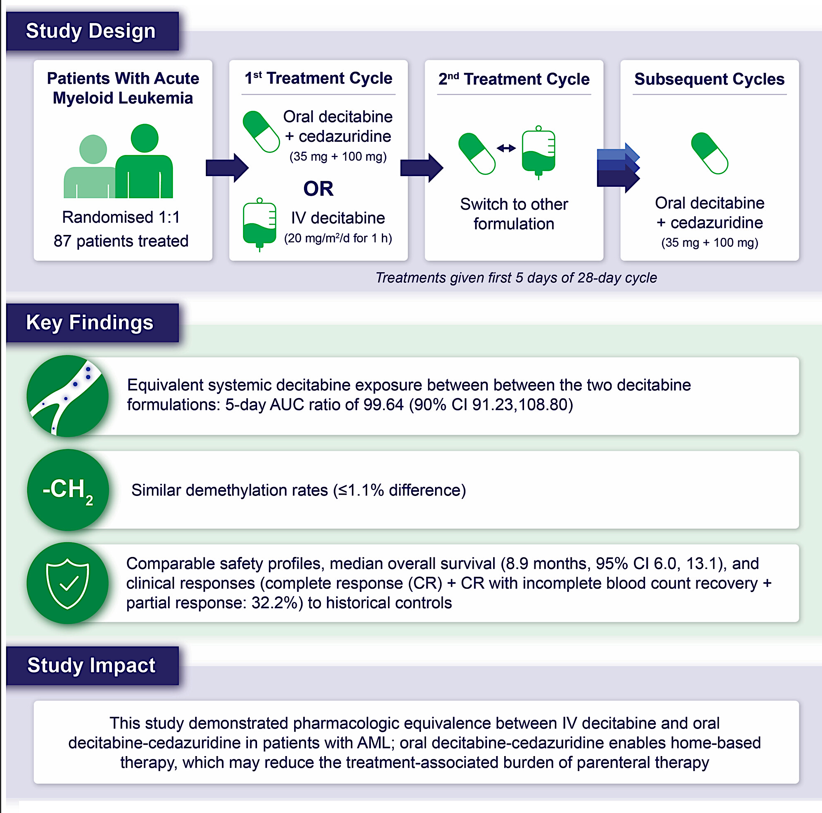
Phase III ASCERTAIN-AML
Equivalent systemic decitabine exposure between the two decitabine formulations: 5-day AUC ratio of 99.64 (90% Cl 91.23, 108.80)
Geissler K, et al. Br J Haematol. 2024;205(5):1734–1745.

Slide 36
An All-Oral Regimen of Decitabine-Cedazuridine
Plus Venetoclax in Patients With Newly Diagnosed Acute Myeloid Leukemia Ineligible for
Intensive Induction Chemotherapy:
Results From a Phase 2 Cohort of 101 Patients
#6504
Amer M. Zeidan,¹ Elizabeth A. Griffiths,² Courtney D. DiNardo,³ Gabriel N. Mannis,⁴ Pau Montesinos,⁵ Montserrat Arnan,⁶ Michael R. Savona,⁷ Olatoyosi Odenike,⁸ James K. McCloskey,⁹ Harsh V. Amin,¹⁰ Amir T. Fathi,¹¹ Teresa Bernal del Castillo,¹² Gabriela Rodríguez-Macías,¹³ Jane Liesveld,¹⁴ Annie P. Im,¹⁵ Aram Oganesian,¹⁶ Qing Xu,¹⁶ Margit Dijkstra,¹⁶ Harold Keer,¹⁶ Gail J. Roboz¹⁷
¹Yale University, New Haven, CT, USA; ²Roswell Park Comprehensive Cancer Center, Buffalo, NY, USA; ³The University of Texas MD Anderson Cancer Center, Houston, TX, USA;
⁴Stanford University School of Medicine, Stanford, CA, USA; ⁵Hospital Universitari i Politecnic La Fe, Valencia, Spain; ⁶ICO l'Hospitalet - Hospital Duran i Reynals, Barcelona, Spain; ⁷Vanderbilt-Ingram Cancer Center, Vanderbilt University School of Medicine, Nashville, TN, USA; ⁸The University of Chicago Medicine and Comprehensive Cancer Center, Chicago, IL, USA; ⁹John Theurer Cancer Center, Hackensack Medical Center, Hackensack, NJ, USA; ¹⁰Boca Raton Clinical Research, Boca Raton, FL, USA; ¹¹Massachusetts General Hospital Cancer Center, Boston, MA, USA; ¹²Hospital Universitario Central de Asturias/Instituto Universitario del Principado de Asturias (ISPA)/Instituo Universitario de Oncología del Principado de Asturias (IUOPA), Oviedo, Spain; ¹³Hospital General Universitario Gregorio Marañon, Madrid, Spain; ¹⁴University of Rochester Medical Center, Rochester, NY, USA; ¹⁵University of Pittsburgh/UPMC Hillman Cancer Center, Pittsburgh, PA, USA; ¹⁶Taiho Oncology, Inc., Pleasanton, CA, USA; ¹⁷Weill Cornell Medicine, New York-Presbyterian Hospital, New York, NY, USA
Amer Zeidan, MBBS, MHS

Slide 37
ASCERTAIN-V: Methods
Trial Schema: Phase 2 Part B
Cycle 1 (28-day cycle) | Patients (n=101)
Dosing
Day 1 | DEC-C + VEN 100 mg (ramp up)
Day 2 | DEC-C + VEN 200 mg (ramp up)
Days 3–5 | DEC-C + VEN 400 mg
Days 6–28 | VEN 400 mg
Cycle 1
Serial PK
Predose PK
Cycles
2 & 3 PK
Day 1
Day 2
Day 3
Day 4
Day 5
Day 6
Cycles 2 and 3 (28-day cycle) | Patients (n=101)
Dosing
Days 1–5 | DEC-C + VEN 400 mg
Days 6–28 | VEN 400 mg
Cycles 2 and 3
Serial PK in Cycle 2
Sparse PK in Cycle 3
Predose PK
(Cycle 2 only)
PK complete
Continue treatment until disease progression,
unacceptable toxicity, or patient is withdrawn from study
Day 1
Day 2
Day 3
Day 4
Day 5
Day 6
ASCERTAIN-V, AStx727-07: decitabine + CEdazuRidine TreAtment In Newly diagnosed AML adding Venetoclax; DEC-C, decitabine-cedazuridine; PK, pharmacokinetics; VEN, venetoclax.
DEC-C tablet
VEN 100 mg tablet
Amer Zeidan, MBBS, MHS

Slide 38
ASCERTAIN-V: Results
Patient Baseline Characteristics
Characteristic | Patients (n=101)
Median (range) age, years | 78 (63–88)
Patients aged ≥75 years, n (%) | 82 (81.2)
Male, n (%) | 61 (60.4)
ECOG PS,ª n (%)
0 | 27 (26.7)
1 | 52 (51.5)
≥2 | 21 (20.8)
Cytogenetic classification by ELN 2017, n (%)ª
Favorable | 32 (31.7)
Intermediate | 34 (33.7)
Adverse | 30 (29.7)
Mutation profiling (at baseline) by NGS, n (%)^{b}
TP53 | 17 (16.8)
IDH1 | 6 (5.9)
IDH2 | 12 (11.9)
FLT3 | 12 (11.9)
NPM1 | 13 (12.9)
ªExcludes patients with missing data. ^{b}NGS testing was performed for 96 patients in phase 2 Part B.
ASCERTAIN-V, AStx727-07: decitabine + CEdazuRidine TreAtment In Newly diagnosed AML adding Venetoclax; ECOG PS, Eastern Cooperative Oncology Group performance status; ELN, European Leukemia Net; NGS, next-generation sequencing.
Amer Zeidan, MBBS, MHS

Slide 39
ASCERTAIN-V: Results
Pharmacokinetics
PK data confirmed no drug-drug interactions between DEC-C and VEN
Decitabine (shown here) and cedazuridine PK were not affected by VEN
Drug-Drug Interaction Box Plots of Plasma Decitabine Parameters (AUC_{0–24} and C_{max}): Phase 2b
800
500
600
400
300
Plasma Decitabine AUC_{0–24} (h*ng/mL)
Plasma Decitabine
C_{max} (ng/mL)
400
200
200
100
0
0
DEC-C + VEN
(Cycle 1 Day 5) (n=92)
DEC-C alone
(Cycle 1 Day 5 or Cycle 2 Day 5) (n=75)
DEC-C + VEN
(Cycle 1 Day 5)
(n=94)
DEC-C alone
(Cycle 1 Day 5 or Cycle 2 Day 5) (n=76)
Open circles represent individual data. Line within the box represents the mean and the dotted line represents the median. The whiskers show the lowest data value still within 1.5 IQR of the lower quartile, and the highest value still within 1.5 IQR of the upper quartile, where IQR is the interquartile range (the difference between the third and first quartiles, the middle 50%).
ASCERTAIN-V, AStx727-07: decitabine + CEdazuRidine TreAtment In Newly diagnosed AML adding Venetoclax; AUC_{0–24}, area under the curve from 0 to 24 hours; C_{max}, maximum concentration; DEC-C, decitabine-cedazuridine; IQR, interquartile range; PK, pharmacokinetic; VEN, venetoclax.
Amer Zeidan, MBBS, MHS

Slide 40
ASCERTAIN-V: Results
Best Overall Response and Duration of Response
 | Patients (n=101)
Best overall response, %
CR,% (95% CI) | 46.5 (36.5, 56.7)
CRi, % | 16.8
CRh, % | 5.0
CR/CRi (95% CI) | 63.4 (53.2, 72.7)
CR/CRh (95% CI) | 51.5 (41.3, 61.6)
Median time to complete response, months | 2.4
CR duration, %ª
Responders continuing CR at 6 months | 80.0
Responders continuing CR at 12 months | 75.3
Median duration of follow-up, months | 11.2
Duration of Complete Responseª
1.0
Events
9
Censored
38
Median (95% CI)
NE (NE, NE)
Censored
0.8
0.6
Response Probability
0.4
0.2
0.0
0
1
2
3
4
5
6
7
8
9
10
11
12
13
14
15
16
17
At risk
47
42
38
35
33
31
26
24
22
17
12
9
7
5
2
1
1
0
Duration of Response (Months)
The clinical cutoff date for phase 2 was September 30, 2024.
ªMedian CR duration was not reached.
ASCERTAIN-V, AStx727-07: decitabine + CEdazuRidine TreAtment In Newly diagnosed AML adding Venetoclax; CI, confidence interval; CR, complete response; CRh, complete response with partial hematologic recovery; CRi, complete response with incomplete hematologic recovery; NE, not estimable.
Amer Zeidan, MBBS, MHS

Slide 41
ASCERTAIN-V: Results
Dose reductions in venetoclax were common in later cycles
Grade ≥3 AEs were reported in 98.0% of patients
  febrile neutropenia (49.5%)
  anemia (38.6%)
  neutropenia (35.6%)
Grade 2 nausea in 20%
30- and 60-day mortality rates were 3.0% and 9.9%, respectively

Slide 42
Conclusions
Rapidly changing AML treatment landscape
Traditional concepts of “fit” and ”unfit” are no longer appropriate
Intensive therapy may not always be the preferred treatment backbone
Comprehensive fitness assessment and disease biology should guide initial treatment decisions
Data of all oral therapy with decitabine-cedazuridine plus venetoclax is encouraging (although not without questions of compliance)
Personalized approach and shared decision-making with our patients is key to realizing the benefits of these newer therapies

Slide 43
Investigator
Survey Results

Slide 44
Regulatory and reimbursement issues aside, what initial treatment would you generally recommend for an 80-year-old patient with AML and no actionable mutations who was not eligible for intensive chemotherapy?
Azacitidine + venetoclax
HMA + venetoclax
Azacitidine + venetoclax
Azacitidine + venetoclax
Azacitidine + venetoclax
Azacitidine + venetoclax
HMA + venetoclax
Azacitidine + venetoclax
HMA = hypomethylating agent

Slide 45
In general, in what situations, if any, are you partnering oral decitabine (decitabine/cedazuridine) with venetoclax for patients with AML to whom you’ve decided to administer HMA/venetoclax as initial treatment?
Eligible for initial therapy as an outpatient, no infection or DIC, reliable/compliant
and able to rapidly obtain oral decitabine/cedazuridine
When more convenient, so often
Rarely used outside of a trial; patients who live far away, patients in remission with
stable counts/doses who want to travel or live part of the year away from the center
I am not generally recommending this off study due to lack of insurance
reimbursement and concern for dosing modification challenges in later cycles
I do this for cycle 2 and beyond in patients who have achieved a remission
Currently only in clinical trials
I think this should be the preferred approach. I typically start oral decitabine
with cycle #2 (due to reimbursement and obtainment purposes)
Achieving benefit from ven/aza but not able to continue to come daily for aza therapy
DIC = disseminated intravascular coagulation

Slide 46
In general, for a patient with AML who is receiving HMA/venetoclax, on how many days do you administer venetoclax during cycle 1 of therapy?
In general, for a patient with AML who is receiving HMA/venetoclax, when do you perform the first bone marrow biopsy?
Venetoclax administration
First bone marrow biopsy
21 days
Day 21
Plan for 28 days
Day 21-23
21 days
Day 21
21 days
Day 21
28 days
Day 21-28
Plan for 28 days
Day 21
21 days
Day 24-28
21 days
Day 21

Slide 47
What is a major toxicity other than cytopenias that you’ve observed in patients with AML receiving an HMA/venetoclax combination?
TLS, hypoxia with pulmonary infiltrates, fungal pneumonia
Not much. Some have GI toxicity. Heart toxicity can be seen but is quite rare
GI symptoms in about 30%; rarely joint pain requiring steroids
Myelosuppression, infection and GI toxicity; bleeding and mucositis are rare
Rarely, patients (often monocytic) can develop a CRS-like syndrome
Nothing of significance
Neutropenic infections — especially during the first 2 cycles
Not seeing any other significant toxicities
TLS = tumor lysis syndrome; CRS = cytokine release syndrome

Slide 48
In what situations, if any, would you currently offer venetoclax-based first-line therapy to a younger, fit patient with AML?
Adverse-risk AML as defined by ELN 2022
HMA and venetoclax is acceptable in younger, fit patients with
intermediate- or adverse-risk, FLT3-WT AML
Clinical trial or adverse-risk disease (eg, TP53, complex cytogenetics)
Adverse-risk AML as defined by ELN 2022
In a patient with adverse-risk genetics
On clinical trials only at the moment
ELN 2022 unfavorable disease (complex cytogenetics,
MDS-associated mutations, etc)
Adverse-risk cytogenetics and/or TP53-mut AML
ELN = European LeukemiaNet; WT = wild type; MDS = myelodysplastic syndromes

Slide 49
What effect, if any, do you expect the plenary presentation of the PARADIGM trial (azacitidine and venetoclax versus conventional induction chemotherapy for fit patients with newly diagnosed AML) will have on current clinical management?
More oncologists will adopt ven/HMA for ELN 2022 adverse-risk disease
HMA and venetoclax is acceptable in younger, fit patients with
intermediate- or adverse-risk, FLT3-WT AML
Many will adopt this, especially for intermediate/high-risk AML proceeding to transplant. This will impact ongoing/planned clinical trials and potentially adjust control arms away from 7 + 3
Much less 7 + 3 will be given for ELN 2022 adverse-risk AML
and perhaps generally in patients who plan to proceed to transplant in CR1
More physicians will use aza/ven for patients with adverse risk
around the age of 60-65 and above
I expect some use in general practice but not full adoption.
It may allow for more patients treated in the community
In the US, I think it will lead to a substantial increase in the number of patients “induced” with HMA + ven, often in their local community practice
May lead to clinicians offering fit patients with adverse-risk AML induction with
HMA/ven instead of SOC 7 + 3
SOC = standard of care

Slide 50
Agenda
Module 1: Up-Front Therapy for Older Patients with Acute Myeloid Leukemia (AML) — Dr Lin
Module 2: Selection of Therapy for Younger Patients with AML without a Targetable Mutation; Promising Investigational Strategies — Dr Perl
Module 3: Role of FLT3 Inhibitors in AML Management — Dr Erba
Module 4: Incorporation of IDH Inhibitors into the Care of Patients with AML — Dr Fathi
Module 5: Current and Future Role of Menin Inhibitors in the Treatment of AML — Dr Stein

Slide 51

Selection of Therapy for Younger Patients with AML without a Targetable Mutation; Promising Investigational Strategies
Alexander Perl, MD
Leukemia Program, Abramson Cancer Center
Associate Professor
University of Pennsylvania, Perelman School of Medicine
Research To Practice ASH Friday Satellite
December 5, 2025

Slide 52
The current treatment approach for AML
genetic risk profile
+
MRD
FLT3-ITD+ quizartinib (US, EU)
FLT3mut+ midostaurin (EU)
? oral azacitidine
lower risk
cytarabine-based consolidation (HiDAC)
+ TKI
cytarabine/anthracycline-based induction (7&3)
+ targeted agent
TKI
maintenance
fit
hematopoietic stem cell transplant (HSCT)
higher risk
MRD+
midostaurin (FLT3mut+)
quizartinib (FLT3-ITD+)
GO (CBF and ?non-adverse risk)
FLT3-ITD+ gilteritinib (off label)
AML diagnosis
relapse
or refractory
after response
unfit
low intensity
(VEN + HMA)
salvage chemotherapy,
gilteritinib (FLT3mut+),
or other targeted inhibitor*
*other approved targeted agents in R/R AML: enasidenib (IDH2+), ivosidenib or olutasidenib (IDH1+), revumenib or ziftomenib (KMT2A-R and/or NPM1+)

Slide 53
Marker Negative—how do we define this?!?
everyone
else
APL
everyone
else
CBF
FLT3mut+
everyone
else
mIDH1/2?
NPM1?
KMT2A-R?
TP53?

Slide 54
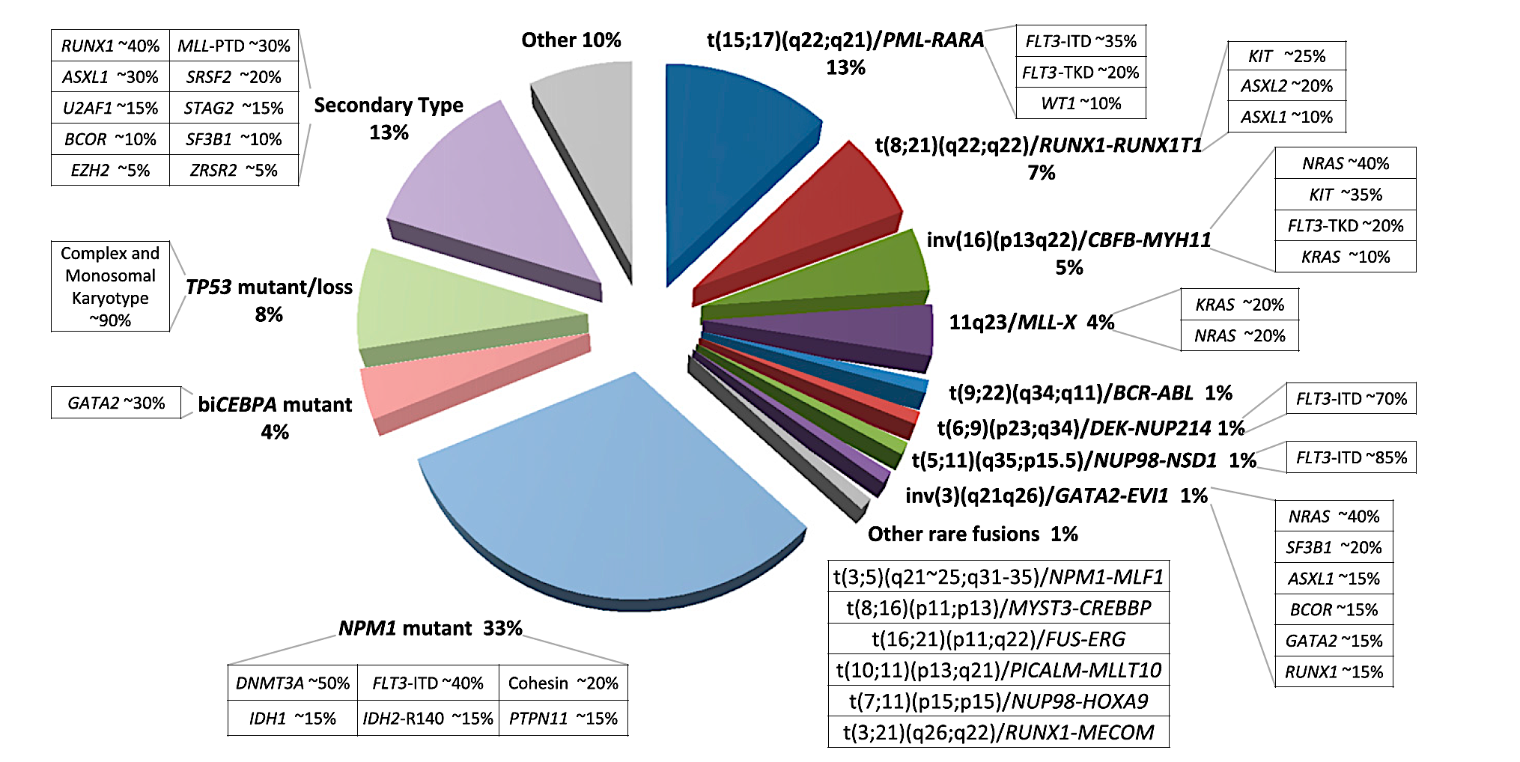
Which AML subsets really need 7&3 alone?
genetically similar to AML in older patients
ELN favorable
🦄
🦄
Grimwade D, et al. Blood. 2016 Jan 7;127(1):29-41

Slide 55
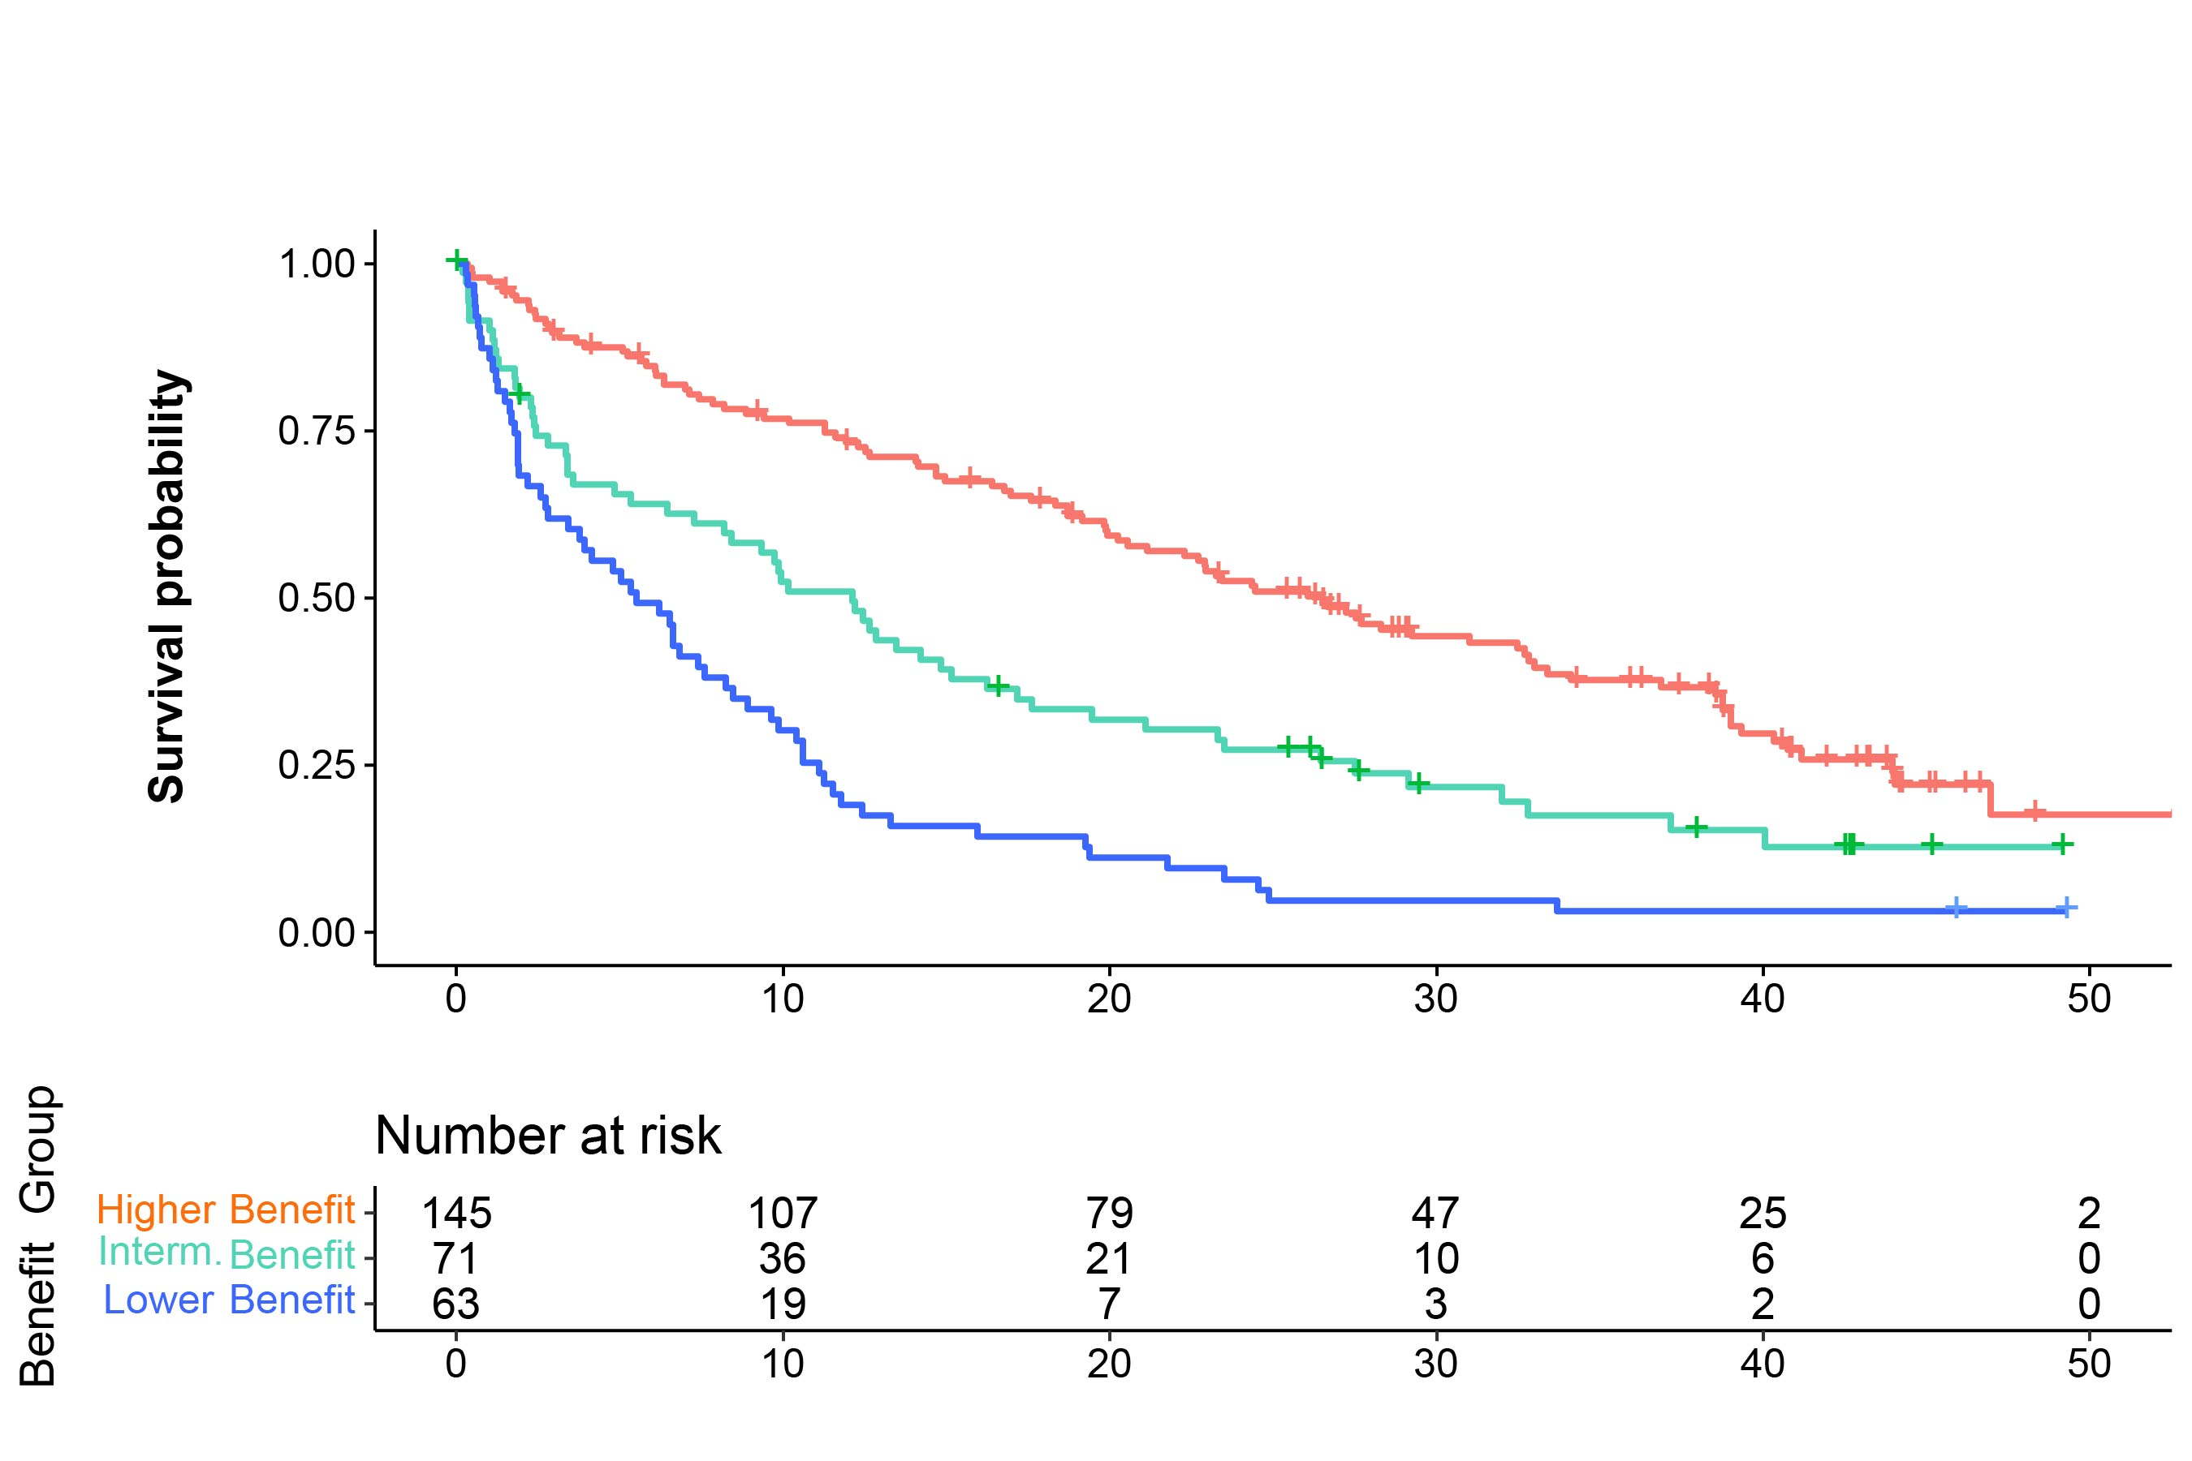
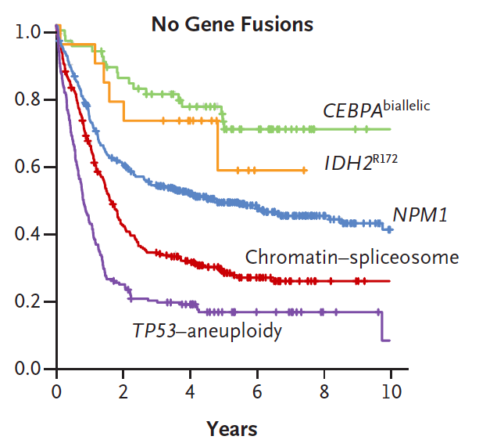
AML with mutated TP53
Intensive chemotherapy
Venetoclax + azacitidine
All others
FLT3-ITD, N-RAS, K-RAS
TP53
TP53
Patients at Risk
Most TP53 AML data come from older patients
  no satisfactory treatment approach has been identified
  TP53+ identifies patients with poor survival to 7&3 as well as ven/aza
  transplant for TP53 consistently shows poor LFS and OS
  no targeted agent has improved the OS of TP53+ AML
TP53mut+ AML has strong association with complex karyotype and autosomal monosomies, esp. Chr 5 & 7
  del5q and abnormal 17p also associated with TP53 mutation
  when the above karyotype is seen and/or if VAF is >25%, prognosis is even worse
Papaemmanuil E, et al. N Engl J Med. 2016 Jun 9;374(23):2209-2221.
Döhner H, et al. Blood. 2024 Nov 21;144(21):2211-2222

Slide 56
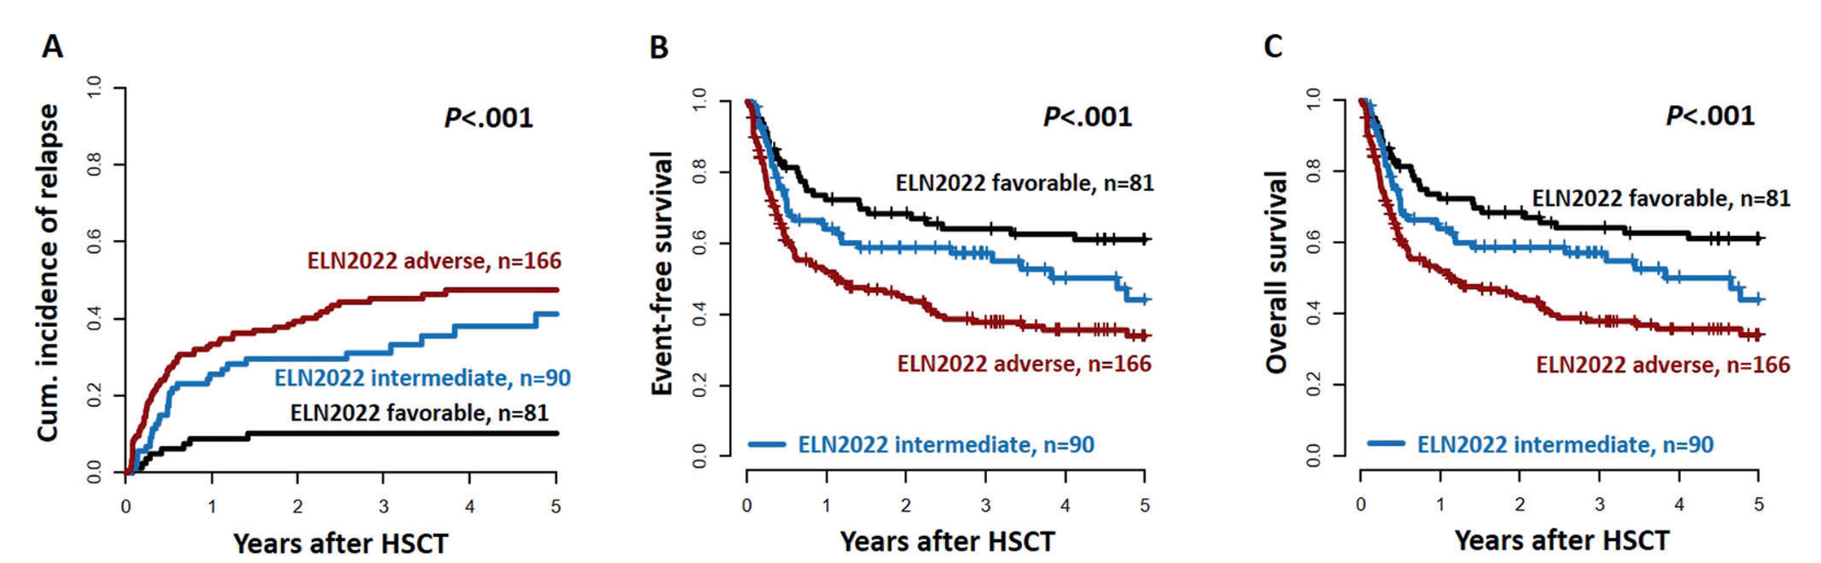
HSCT for Intermediate/Adverse Risk AML
Transplant is the preferred strategy for non-favorable risk AML
  widening donor options & improved GVHD prevention/treatment
  best frontline = whatever is most likely to bridge to HSCT
Recent EBMT retrospective registry (n=1735, median age 56) shows diverse outcomes of HSCT for ELN2022 adverse cytogenetic risk
  cure rate ~50% for most
  worse LFS/OS if complex karyotype or monosomal with del5q, -5, -7, or abnormal 17p
Data on HMA/VEN vs. IC prior to HSCT to be presented at ASH 2025 (Claiborne J, et al. Sat 12/6/25 #44 9:45-10AM)
Jentzch M, et al. Blood Cancer J. 2022 Dec 19;12(12):170
Bazarbachi A, et al. Am J Hematol. 2025 Aug;100(8):1374-1386.

Slide 57
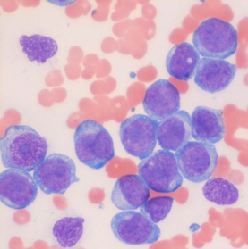
NCI Precision Medicine Initiative: MyeloMATCH
3-day genotyping/risk stratification
Rational allocation to randomized trial with novel agents
  targeted agent when present
  genetic risk-specific if not
Trial registration for all stages of therapy
Correlative science in top academic labs including flow MRD and Twinstrand NGS MRD
Newly diagnosed AML
Platform: Ion TorrentTM GenexusTM System
  45 DNA genes and 35 fusion driver genes
  Includes 28/30 (93.3%) genes mutated with >=3% frequency in AML.
  Includes 36/50 (72%) genes mutated with >1% frequency in AML.
  Includes 779 unique fusions reported in AML
  Can detect FLT3-ITD up to 120bp
Can detect all genetic alterations needed for
  WHO classification of AML, except inv 3
  NCCN/ELN risk stratification, except inv 3
http://imagebank.hematoloqv.org/image/61433/aml-circulating-blasts

Slide 58
Master Screening and Reassessment Protocol (MSRP)
Older Adult
MDS
Young Adult
High Disease Burden
Initial treatments for newly diagnosed patients
Tier 1 Treatment Trials
MSRP Reassessment 1
Trials designed to evaluate patients in CR using MRD-based assignments
or
Older Adult
MDS
Young Adult
Tier 2 Treatment Trials (MRD)
MSRP Reassessment 2
Trials designed to evaluate patients using MRD-based assignments
or
Tier 3 Treatment Trials (Transplant/Cellular Therapy)
Transplant/ Cellular Therapy
MSRP Reassessment 3
Participants with low disease burden states: trials designed to validate clinical utility of NGS and other assays
Low Disease Burden
Clinical Utility
Assay Validation studies
Tier 4 Treatment Trials (NGS)
Slide courtesy of Harry Erba, MD, PhD

Slide 59
Myelomatch “marker negative” studies
Intermediate Risk AML:
MM1YA-CTG01
High Risk AML:
MM1YA-S01
Study Chairs
Sarit Assouline
Lynn Savoie
Study Chairs
Paul Shami
Tara Lin
ASH 2025: first randomized study to compare IC to ven + IC or VEN + HMA: Fang Q, et al. #650 Sun. 12/7 4:45-5PM

Slide 60
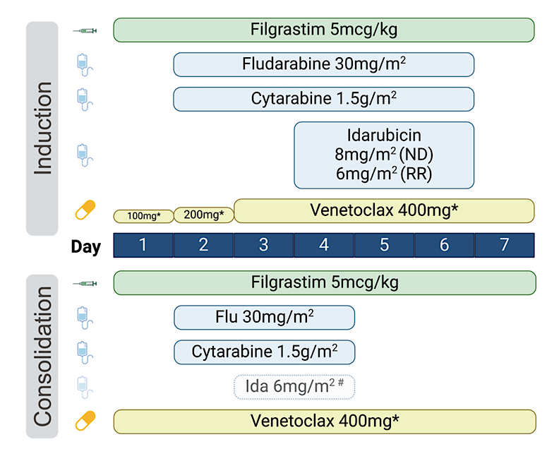
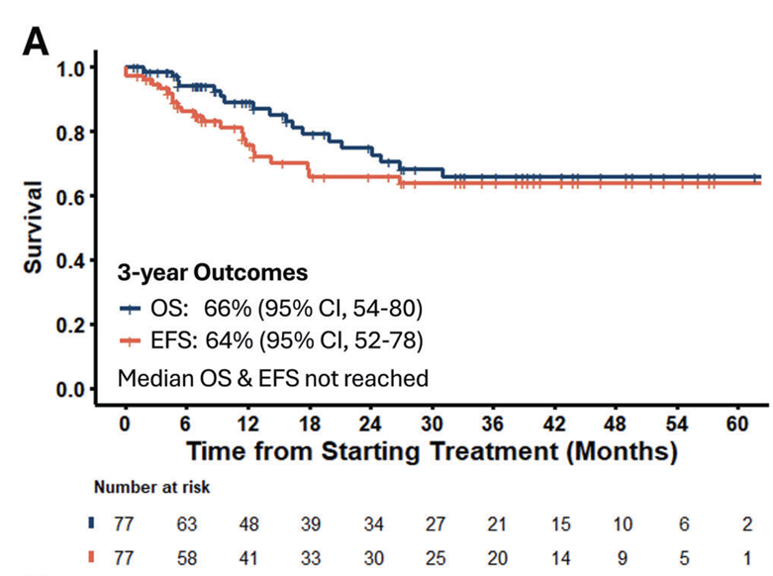
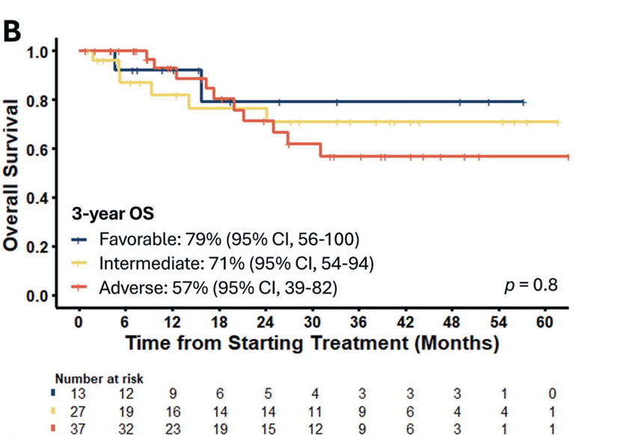
VEN-FLAG-IDA
Newly diagnosed AML
highly intensive regimen, best suited for younger adults
  e.g. age <40, very fit
Very high CRc (95%) and flow MRD(-) CR rates (90% of CRc) in ND AML
  prolonged thrombocytopenia very common (C2 and onward)
no obvious survival differences by ELN2022
  64% of patients transplanted in CR1
  but also no long-term survivors reported among TP53+ or MECOM-rearranged (combined n= 10)
DiNardo CD, et al. Leukemia 2025 Apr;39(4):854-863

Slide 61
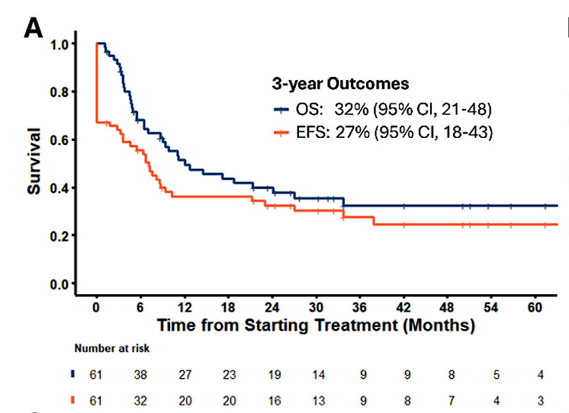
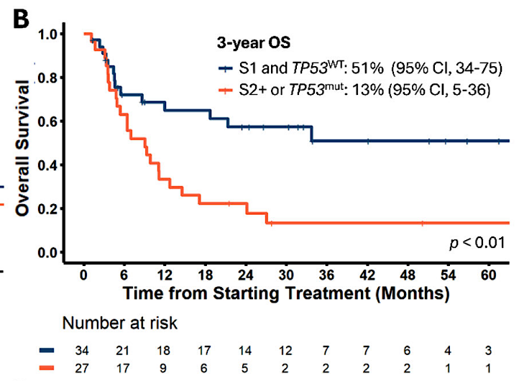
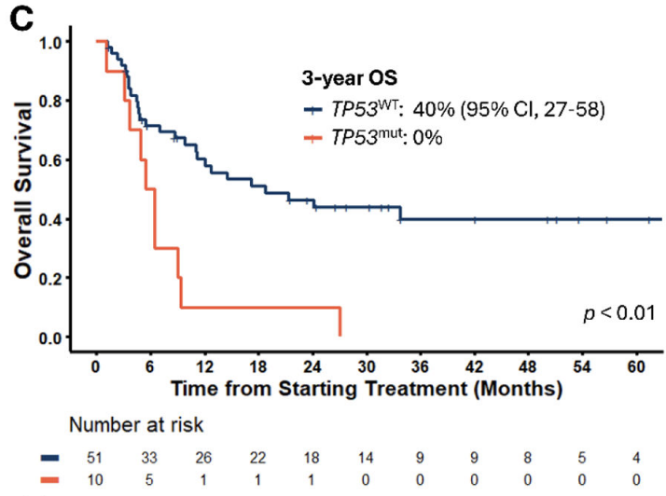
VEN-FLAG-IDA – R/R AML
All Patients
Salvage Number/TP53 Status
TP53^{WT}/TP53^{mut}
OS of first salvage TP53-WT was similar to frontline therapy
In the RR cohort, CRc=64%, and CRc=74% for first salvage TP53-WT patients
DiNardo CD, et al. Leukemia 2025 Apr;39(4):854-863

Slide 62
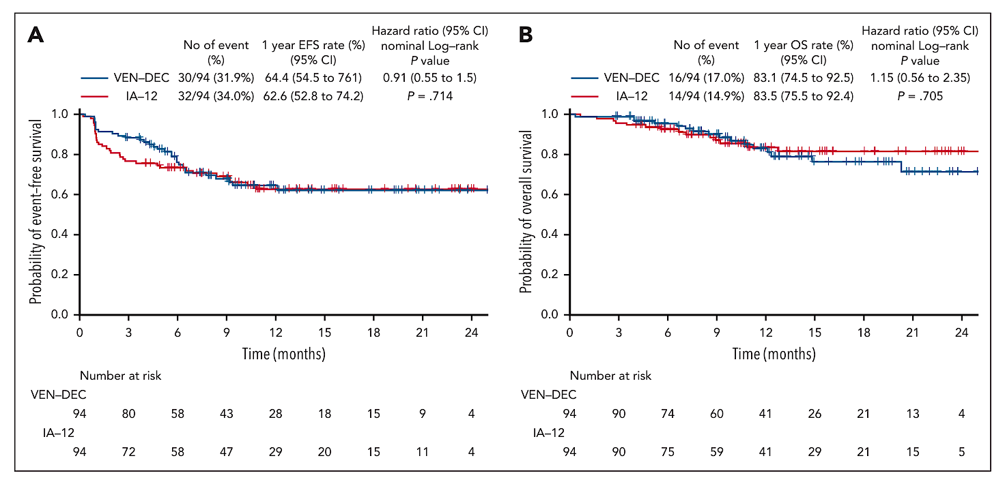
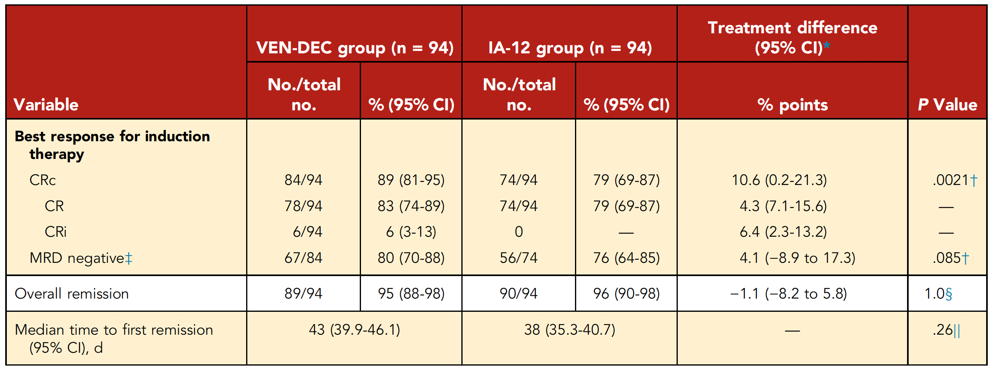
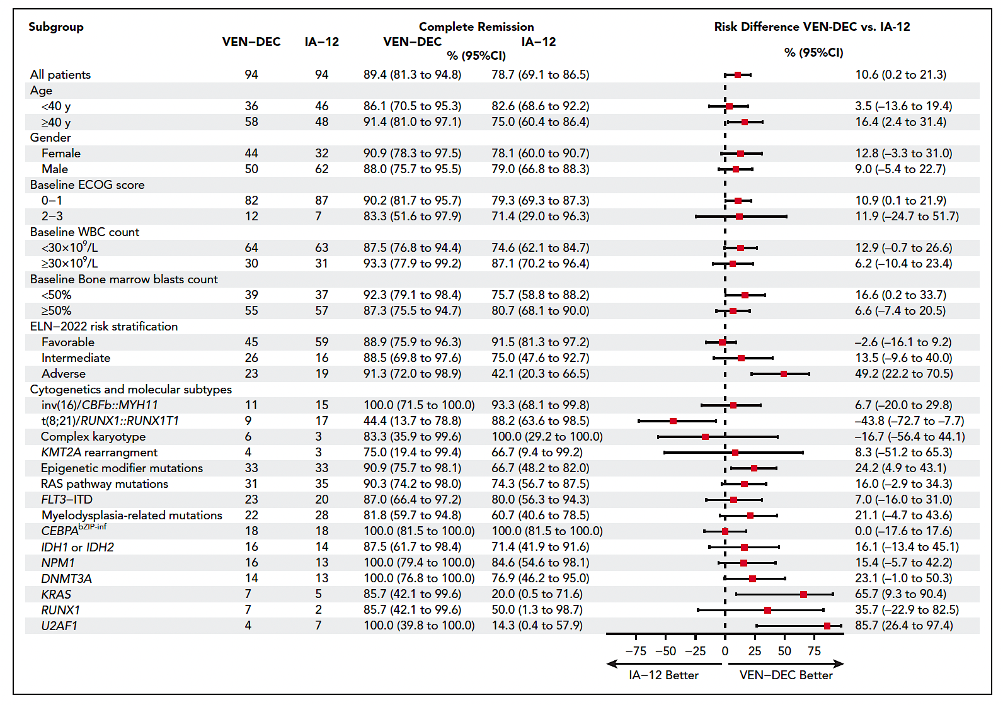
Prospective comparison of HMA-VEN and IC
188 fit adults with ND AML age 18-59 (all genotypes)
randomized 1:1 to ven + decitabine (5 days) x 1-2 cycles vs. 7&3 (ida/ara) x 1-2
  both arms consolidated with HiDAC (2 gm/m2 x 6 doses for 1-4 cycles)
Primary endpoint: CRc rate after induction (non-inferiority design)
  CRc rate higher with ven + decitabine (p=0.021);
  CR, MRD(-), and CR1 transplantation rates similar
Safety/tolerability favors ven-decitabine over IC
  early mortality (ven-dec 1% vs IC 4%)
  >Gr3 infections (ven-decitabine 30% vs IC 67%, p<0.01)
  less >Gr3 thrombocytopenia (13 vs. 19 days); similar days of >Gr3 neutropenia
Lu J, et al. Blood 2025 May 29;145(22):2645-2655

Slide 63
PARADIGM study design:
second induction
residual
disease
5+2 or
CPX-351
day 13-16
marrow
biopsy
7+3 or
CPX-351
consolidation
ablation
count recovery
marrow
biopsy
Response
cytarabine or CPX-351
ND AML
fit/IC eligible
age >18
R
C1
C2, ….
azacitidine +
venetoclax
day 21-31
marrow
biopsy
azacitidine +
venetoclax
Response
Exclusions:
t(15;17), PML-RARA
CBF alteration
FLT3 ITD/TKD (≥5% VAF) mutations
NPM1 mutations (if aged <60 years)
BCR::ABL1 fusion, MPAL
prior HMA
HCT
allowed at
any time following
disease response
ASH 2025 Plenary session, Fathi AT, et al. #6 12/7 3:45-4PM
NCT04801797

Slide 64
PARADIGM Results:
As of 7/25/2025, 172 patients (pts) at 9 US centers were randomized to aza-ven (n=86) or IC (n=86)
Intent-to-treat analysis:
  ORR (OR=CR+CRh+CRi+PR+MLFS) was significantly higher in the aza-ven arm (88% vs 62%; P<0.001)
  CCR (CR+CRh+CRi) was significantly higher in the aza-ven arm (81% vs 55%; p<0.001)
  CR rates for aza-ven and IC were not significantly different (59% vs 50%; p=.066)
Primary EFS endpoint (median follow-up 16 months):
  1-year EFS was 53% for the aza-ven arm and 39% for the IC arm (HR 0.61; p=0.017)
Procession to HCT following response from protocol therapy differed across arms (p=0.009)
  52 (61%) pts on aza-ven arm and 34 (40%) pts on IC arm
Grade 3/4 lung infections and sepsis occurred in 12% and 7% of aza-ven, and 15% and 11% of IC pts
30- and 60-day mortality rates on the aza-ven arm were both 0%, vs 3.5% and 4.7% in the IC arm, respectively
ASH 2025 Plenary session, Fathi AT, et al. #6 12/7 3:45-4PM

Slide 65
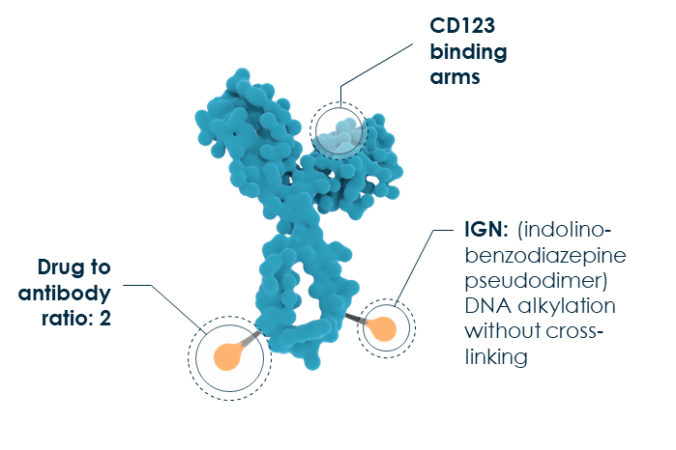
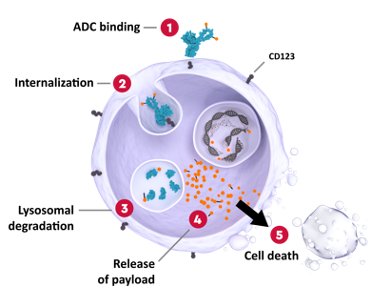
Pivekimab sunirine (PVEK) in AML
ADC binding
CD123
Internalization
Lysosomal degradation
Release
of payload
Cell death
ADC targeting CD123 (IL-3Rα)
>90% of AML samples overexpress CD123
single agent data in R/R AML show clinical activity without substantial myelosuppression (CR/CRi/CRp= 16%)
  thrombocytopenia was the only Gr>3 AE seen in >10% of patients
  small risk of VOD/SOS (2/68=3% during ph1)
  Gr1-2 peripheral edema common (25% in Ph1) but not capillary leak syndrome
Ongoing studies:
  ND unfit/older patients with VEN/AZA (Daver N, et al. ASH 2025 #651, Sunday 12/7 5-5:15PM)
  ND in fit adults with ELN 2022 adverse risk AML combined with FLAG-IDA (Appelbaum J, et al. ASH 2025 #3422 Sunday 12/7 poster session)
  frontline or R/R BPDCN (Pemmaraju N, et al. ASH 2025 #5195 Monday 12/8 poster session)
figure courtesy of Naval Daver
Daver NG, et al. Lancet Oncol. 2024 Mar;25(3):388-399.

Slide 66
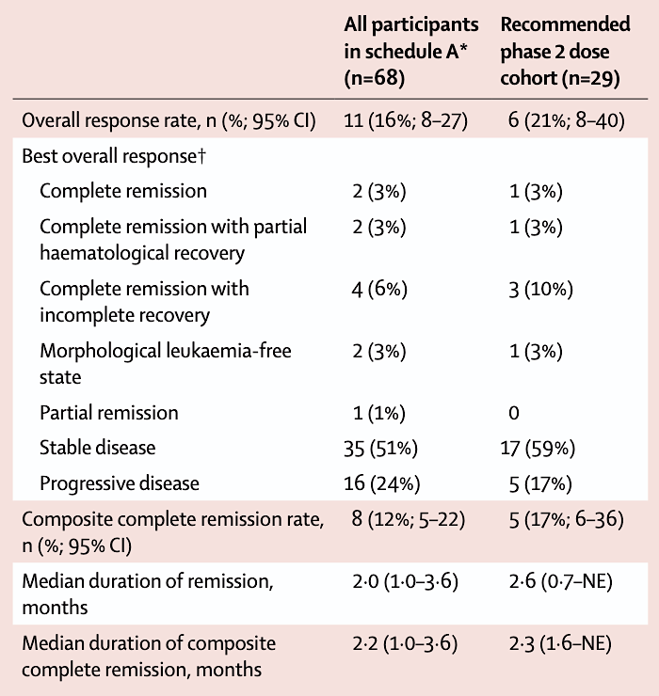
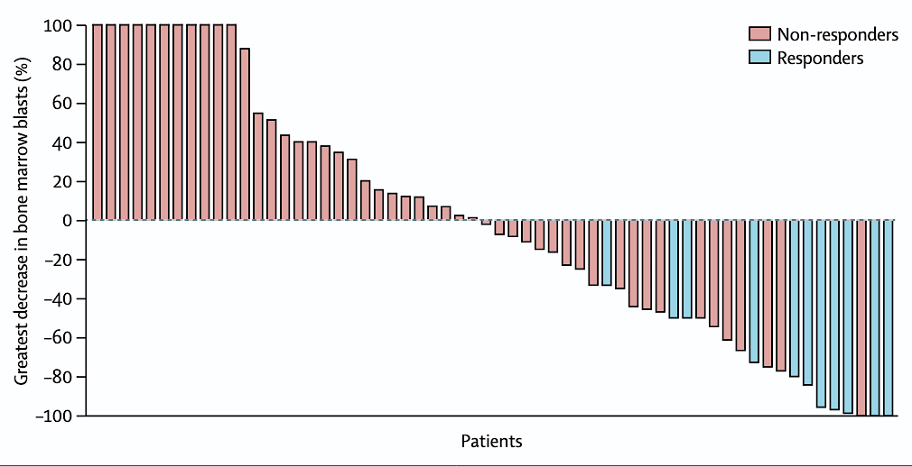
Pivekimab sunirine (PVEK) in AML
Response in Patients Receiving Schedule A
(once every 3 weeks, on day 1 of a 3-week cycle)
Daver NG, et al. Lancet Oncol. 2024 Mar;25(3):388-399.

Slide 67
Pivekimab sunirine (PVEK) with VEN/AZA in ND AML
Dose expansion phase of an ongoing, Phase 1b/2 study of 1L PVEK+VEN+AZA in unfit adults with AML deemed CD123-positive by investigator
Unfit pts were aged ≥75 years (yr), or aged <75 yr with ECOG PS score 2–3, or ≥1 defined comorbidity
Pts received PVEK (0.045 mg/kg, intravenous [IV]) on D7 and VEN (400 mg equivalent, oral) daily in a 28-D cycle (cohort 1 received ≥14 D of VEN; cohort 2 received 28 D of VEN) and AZA (up to 75 mg/m2, subcutaneous or IV) on D1–7
With a median follow-up of 10 mo:
  CR: 63.3%
  CR/CRi: 79.6%
  CR/CRh: 73.5%
Of pts who achieved CR or CR/CRi with an MRD-evaluable sample, 92% (23/25) and 90% (27/30) achieved flow cytometry MRD negativity (<0.1%) respectively
The most common (≥50% of pts) any grade treatment-emergent adverse events (AEs) were neutropenia/neutrophil count decreased and thrombocytopenia/platelet count decreased (both 69%); constipation (61%); and peripheral edema (51%)
Daver N, et al. ASH 2025 #651, Sunday 12/7 5-5:15PM

Slide 68
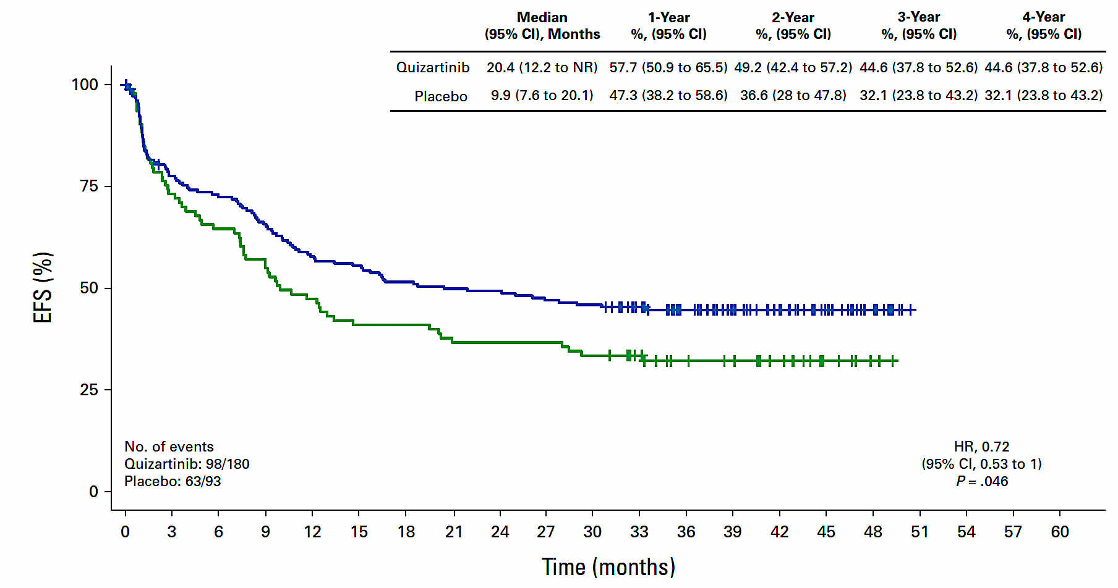
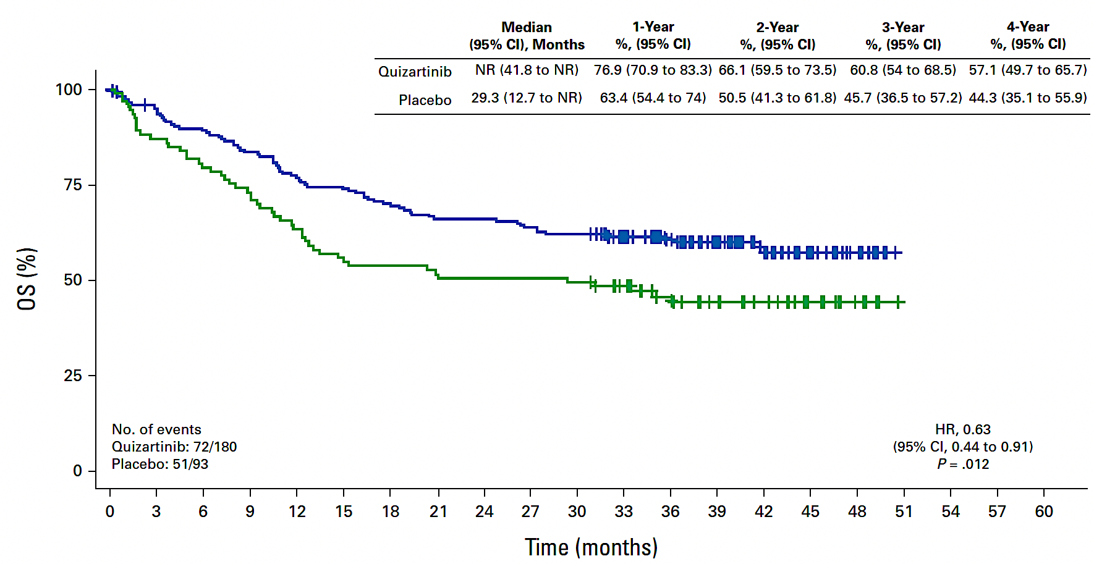
QuiWI study
median f/u= 39 months
EFS and OS significantly longer with quizartinib
  Principal group benefitted: NPM1+ (quiz 3-year OS = 90% vs. 71%)
  No survival benefit in ELN adverse group
  OS benefit over placebo maintained even among patients who did not receive HSCT
Phase 3 now underway (Quantum Wild, NCT06578247)
Montesinos P, et al. J Clin Oncol 2025 (epub, online)

Slide 69
Conclusions
Rapid integrated genomics now risk stratify patients within days
  NCI Myelomatch program brings this approach to the masses
If no molecular therapeutic target is found, prognosis is dependent upon:
  presence of favorable markers (e.g CEBPA bZIP in-frame indel mutations)
  absence of TP53 mutation
  The ultimate goal is HSCT for non-favorable risk patients and/or patients who remain MRD+ after 2 cycles of IC or up to 4 cycles of aza/ven
Several novel approaches show promise:
  adding venetoclax to HMA or intensive (or highly intensive) chemotherapy
  novel ADCs (PVEK) or signaling inhibitors (quizartinib) may achieve similar gains to much more intensive regimens and warrant prospective randomized comparisons

Slide 70
Investigator
Survey Results

Slide 71
Regulatory and reimbursement issues aside, which initial treatment would you generally recommend for a 35-year-old patient with AML and a TP53 mutation with a variant allele frequency (VAF) of 55% and complex karyotype who was eligible for intensive chemotherapy?
Decitabine + venetoclax
HMA + venetoclax (no preference for HMA)
Azacitidine + venetoclax
Azacitidine + venetoclax
Azacitidine + venetoclax
Azacitidine + venetoclax
Oral decitabine (decitabine/cedazuridine) + venetoclax
HMA + venetoclax (no preference for HMA)

Slide 72
Regulatory and reimbursement issues aside, what initial treatment would you generally recommend for a 55-year-old patient with intermediate-risk secondary AML and no actionable mutations who was eligible for intensive chemotherapy?
CPX-351
CPX-351 or HMA + venetoclax
CPX-351
Azacitidine + venetoclax
CPX-351
CPX-351
If this patient has not received a prior HMA or ven regimen, then I would prioritize oral decitabine (decitabine/cedazuridine) + ven, followed by ASCT
CPX-351

Slide 73
Would you use venetoclax-based therapy for a younger, fit patient whose disease had relapsed after 7+3 chemotherapy followed by ASCT?
If yes, what would you most likely combine with venetoclax?
Yes, azacitidine or FLAG-IDA
Yes, decitabine or oral decitabine (decitabine/cedazuridine)
Yes, azacitidine
Yes, azacitidine
Yes, azacitidine
Yes, HMA
Yes, oral decitabine (decitabine/cedazuridine)
Yes, azacitidine (+ targeted therapy if applicable)

Slide 74
What future role do you see for pivekimab sunirine in the management of AML?
As an option in relapsed disease unless survival benefit is demonstrated for
treatment-naïve disease in transplant-ineligible patients, then in combination with ven/HMA
Intriguing data with HMA/ven for intermediate,
adverse-risk, non-P53-mutated disease
Preliminary data in R/R setting are encouraging; it may be used in patients without an actionable mutation in combination with ven/aza
Early data suggest activity in patients with high CD123 expression. An advantage
of the drug appears to be its tolerability and lack of myelosuppression
None
It could be a valuable adjunct, but I expect the benefit to possibly be modest
Possibly in combination with HMA + ven for younger patients prior to ASCT
Up-front therapy with ven/aza

Slide 75
What future role do you see for chimeric antigen receptor T-cell therapy in the management of AML?
An option for relapsed/refractory disease only in clinical trials
Challenge remains overlapping targets between leukemic
and normal marrow precursors, and related toxicities
Still a significant challenge, not sure we have the right targets,
may need to be planned in tandem with alloSCT if CAR T is ablative
It is uncertain if it will ever be tolerable, safe, and active in AML. The biggest challenge
is finding a tumor-specific antigen that is not shared with normal hematopoietic elements
Minimal role in 2025
Good potential once an approach is identified with a more leukemia-specific target
As maintenance or MRD-directed therapy
Relapsed/refractory AML or MRD eradication maybe post-transplant (?)
alloSCT = allogeneic stem cell transplant

Slide 76
Agenda
Module 1: Up-Front Therapy for Older Patients with Acute Myeloid Leukemia (AML) — Dr Lin
Module 2: Selection of Therapy for Younger Patients with AML without a Targetable Mutation; Promising Investigational Strategies — Dr Perl
Module 3: Role of FLT3 Inhibitors in AML Management — Dr Erba
Module 4: Incorporation of IDH Inhibitors into the Care of Patients with AML — Dr Fathi
Module 5: Current and Future Role of Menin Inhibitors in the Treatment of AML — Dr Stein

Slide 77
FLT3 Inhibitors for Previously Untreated Acute Myeloid Leukemia
Harry P. Erba, MD, PhD
Professor, Department of Medicine
Director, Leukemia Program
Duke University
Durham, NC

Slide 78
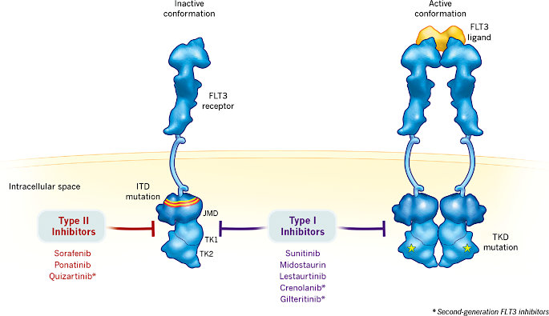
FLT3 Inhibitors: Mechanism of Action
ATP-binding site inhibition:
  FLT3 inhibitors competitively inhibit ATP binding to the FLT3 receptor, preventing its autophosphorylation and activation^{1,2}
Type I inhibitors (e.g., midostaurin, gilteritinib)
  Bind to both active and inactive conformations of the FLT3 receptor^{1,2}
  Active against ITD and TKD mutations³
Type II inhibitors (e.g., quizartinib, sorafenib)
  Bind specifically to the inactive FLT3 conformation^{1,2}
  Prevent activity of ITD mutations but do not target TKD mutations³
Mechanisms of Type I and Type II FLT3 Inhibitors in Targeting FLT3 Mutations³
1. Cerchione C, et al. Expert Rev Hematol. 2021;14:851-865. 2. Negotei C, et al. J Clin Med. 2023;12:6429.
3. Daver N, et al. Leukemia. 2019;33:299-312.

Slide 79
QuANTUM-First Primary Endpoint: Overall Survival
1.0
HR, 0.776 (95% CI, 0.615-0.979)
P=.0324 (2-sided)
0.8
Quizartinib
mOS: 31.9 mo
0.6
Overall survival probability
Placebo
mOS: 15.1 mo
0.4
∆mOS: 16.8 mo
0.2
0.0
0
3
6
9
12
15
18
21
24
27
30
33
36
39
42
45
48
51
54
57
60
No. at risk
Time, months
Quizartinib
268
233
216
195
176
162
153
145
139
126
110
96
83
68
53
36
24
8
4
1
0
Placebo
271
249
211
175
151
131
126
121
117
103
97
81
70
56
39
31
17
8
5
0
0
Erba HP, et al. Lancet 2023; 401(10388): 1571-1583

Slide 80
QuANTUM-First: Overall Survival in Patients Who Achieved CR
Patients With CR Who Received Allo-HCT in CR1
Patients With CR NOT Receiving Allo-HCT in CR1
1.0
1.0
Quizartinib
0.8
0.8
0.6
Placebo
0.6
Quizartinib
Overall survival probability
Overall survival probability
0.4
0.4
HR, 0.591 (95% CI, 0.330-1.059)
HR, 0.607 (95% CI, 0.387-0.954)
0.2
0.2
Placebo
0.0
0.0
0
3
6
9
12
15
18
21
24
27
30
33
36
39
42
45
48
51
54
57
60
0
3
6
9
12
15
18
21
24
27
30
33
36
39
42
45
48
51
54
57
60
No. at risk
Time, months
No. at risk
Time, months
Quizartinib
84
84
83
81
74
72
70
69
67
63
57
50
42
34
29
22
14
3
1
0
0
Quizartinib
63
60
54
51
48
44
41
37
35
30
25
21
17
15
9
5
3
1
0
0
0
Placebo
73
73
68
63
56
52
51
50
48
43
39
37
32
27
21
20
12
5
3
0
0
Placebo
77
76
61
50
42
33
31
30
30
25
22
17
14
10
7
4
2
1
0
0
0
Erba HP, et al. Lancet 2023; 401(10388): 1571-1583

Slide 81
Elimination of MRD by FLT3 ITD NGS MRD Assay
in QuANTUM-First Trial by Treatment Course
CRc After Induction
After 2 Cycles of CTx
After Last Consolidation Cycle
 | QUIZ | PLAC | QUIZ | PLAC | QUIZ | PLAC
Patients with non-detectable MRD, % | 22.8 | 11.9 | 31.7 | 21.7 | 55.8 | 41.2
Nominal P value | 0.0122 |  | 0.0609 |  | 0.0089
Perl A, et al. ASH 2023;Abstract 832

Slide 82
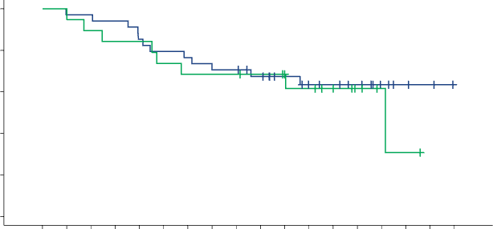
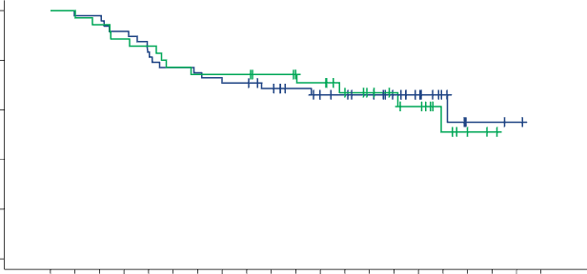
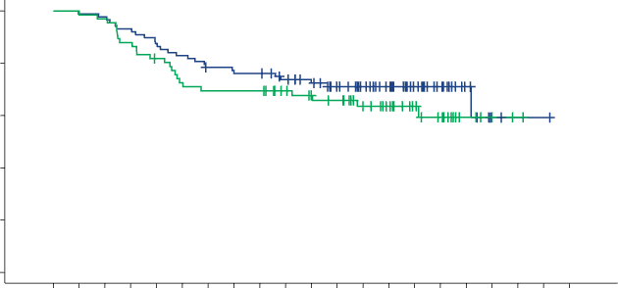
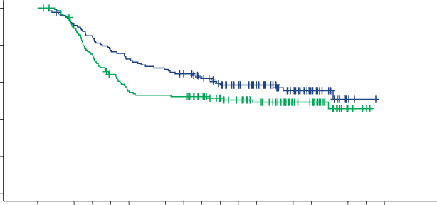
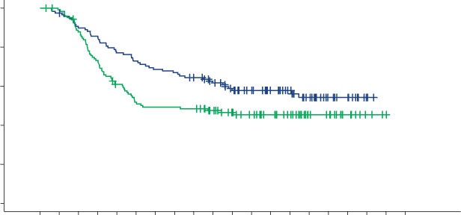
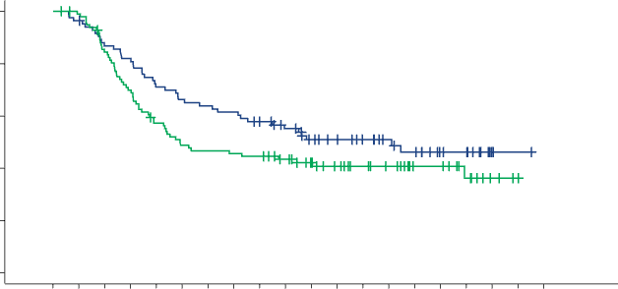
FLT3-ITD MRD Reduction Predicts Survival Across Therapy
CRc After Induction
(1 or 2 cycles)
After 2 Cycles of CTx
(CRc after induction × 2 cycles or
CRc after induction #1 + consolidation #1)
After Last Consolidation Cycle
(up to 4 cycles)
MRD− (n=53)
MRD− (n=83)
100
80
60
40
20
0
MRD− (n=154)
100
80
60
40
20
0
+ CENSORED
100
80
60
40
20
0
+ CENSORED
+ CENSORED
Quizartinib (n=88)
Quizartinib (n=34)
Quizartinib (n=48)
OS probability (%)
OS probability (%)
OS probability (%)
Placebo (n=66)
Placebo (n=19)
Placebo (n=35)
Median OS
Quizartinib: NR
Placebo: 42.5 months
HR=0.976
95% CI, 0.474-2.009
Median OS
Quizartinib: NR
Placebo: NR
HR=0.753
95% CI, 0.432-1.311
Median OS
Quizartinib: NR
Placebo: NR
HR=0.789
95% CI, 0.322-1.932
0 | 3 | 6 | 9 | 12 | 15 | 18 | 21 | 24 | 27 | 30 | 33 | 36 | 39 | 42 | 45 | 48 | 51
0 | 3 | 6 | 9 | 12 | 15 | 18 | 21 | 24 | 27 | 30 | 33 | 36 | 39 | 42 | 45 | 48 | 51 | 54 | 57 | 60
0 | 3 | 6 | 9 | 12 | 15 | 18 | 21 | 24 | 27 | 30 | 33 | 36 | 39 | 42 | 45 | 48 | 51 | 54 | 57 | 60
Time from randomization (months)
Quizartinib (n=34) Placebo (n=19)
Time from randomization (months)
Quizartinib (n=48) Placebo (n=35)
Time from randomization (months)
Quizartinib (n=88) Placebo (n=66)
No. at risk
Quizartinib
Placebo
34 | 33 | 33 | 32 | 29 | 27 | 26 | 24 | 24 | 21 | 17 | 13 | 12 | 10 | 6 | 3 | 2 | 0
19 | 19 | 17 | 16 | 16 | 14 | 13 | 13 | 13 | 12 | 10 | 9 | 7 | 4 | 2 | 1 | 0 | 0
No. at risk
Quizartinib
Placebo
48 | 47 | 47 | 44 | 40 | 37 | 36 | 34 | 34 | 31 | 27 | 23 | 22 | 20 | 16 | 12 | 7 | 2 | 2 | 1 | 0
35 | 35 | 33 | 31 | 30 | 27 | 26 | 26 | 26 | 24 | 22 | 21 | 17 | 14 | 12 | 10 | 5 | 2 | 1 | 0 | 0
No. at risk
Quizartinib
Placebo
88 | 87 | 86 | 82 | 77 | 73 | 68 | 66 | 66 | 61 | 55 | 47 | 41 | 34 | 24 | 15 | 7 | 2 | 1 | 1 | 0
66 | 66 | 64 | 58 | 53 | 47 | 45 | 45 | 45 | 40 | 36 | 34 | 28 | 22 | 16 | 12 | 5 | 2 | 1 | 0 | 0
100
80
60
40
20
0
MRD+ (n=268)
MRD+ (n=245)
100
80
60
40
20
0
MRD+ (n=183)
+ CENSORED
100
80
60
40
20
0
+ CENSORED
+ CENSORED
Quizartinib (n=128)
Quizartinib (n=119)
OS probability (%)
Quizartinib (n=84)
OS probability (%)
OS probability (%)
Placebo (n=140)
Placebo (n=126)
Placebo (n=99)
HR=0.749
95% CI, 0.526-1.069
Median OS
Quizartinib: NR
Placebo: 35.4 months
HR=0.670
95% CI, 0.465-0.967
Median OS
Quizartinib: NR
Placebo: 16.0 months
HR=0.725
95% CI, 0.487-1.082
Median OS
Quizartinib: 39.3 months
Placebo: 14.8 months
0 | 3 | 6 | 9 | 12 | 15 | 18 | 21 | 24 | 27 | 30 | 33 | 36 | 39 | 42 | 45 | 48 | 51 | 54 | 57
0 | 3 | 6 | 9 | 12 | 15 | 18 | 21 | 24 | 27 | 30 | 33 | 36 | 39 | 42 | 45 | 48 | 51 | 54 | 57
0 | 3 | 6 | 9 | 12 | 15 | 18 | 21 | 24 | 27 | 30 | 33 | 36 | 39 | 42 | 45 | 48 | 51 | 54 | 57
Time from randomization (months)
Quizartinib (n=128) Placebo (n=140)
Time from randomization (months)
Quizartinib (n=119) Placebo (n=126)
Time from randomization (months)
Quizartinib (n=84) Placebo (n=99)
No. at risk
Quizartinib
Placebo
128 | 125 | 115 | 108 | 98 | 92 | 87 | 85 | 80 | 73 | 64 | 58 | 49 | 41 | 32 | 20 | 14 | 3 | 1 | 0
140 | 137 | 122 | 103 | 86 | 74 | 71 | 71 | 70 | 62 | 55 | 50 | 42 | 37 | 27 | 24 | 13 | 5 | 2 | 0
No. at risk
Quizartinib
Placebo
119 | 116 | 106 | 101 | 91 | 86 | 81 | 79 | 74 | 67 | 58 | 52 | 43 | 35 | 26 | 15 | 12 | 2 | 0 | 0
126 | 123 | 108 | 90 | 73 | 62 | 59 | 59 | 58 | 50 | 43 | 38 | 32 | 27 | 17 | 15 | 8 | 3 | 1 | 0
No. at risk
Quizartinib
Placebo
84 | 81 | 72 | 68 | 59 | 55 | 53 | 51 | 46 | 41 | 34 | 31 | 26 | 22 | 19 | 13 | 12 | 2 | 1 | 0
99 | 96 | 81 | 67 | 54 | 46 | 44 | 43 | 42 | 37 | 31 | 26 | 22 | 19 | 13 | 13 | 8 | 3 | 1 | 0
Levis MJ, et al. Blood Adv. 2025;bloodadvances.2025016444; Perl A, et al. ASH 2023;Abstract 832

Slide 83
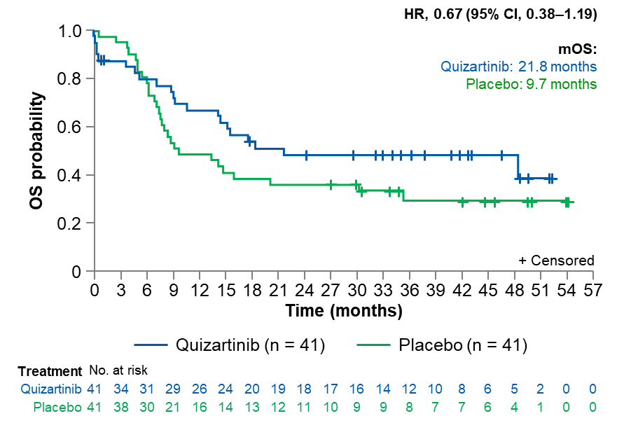
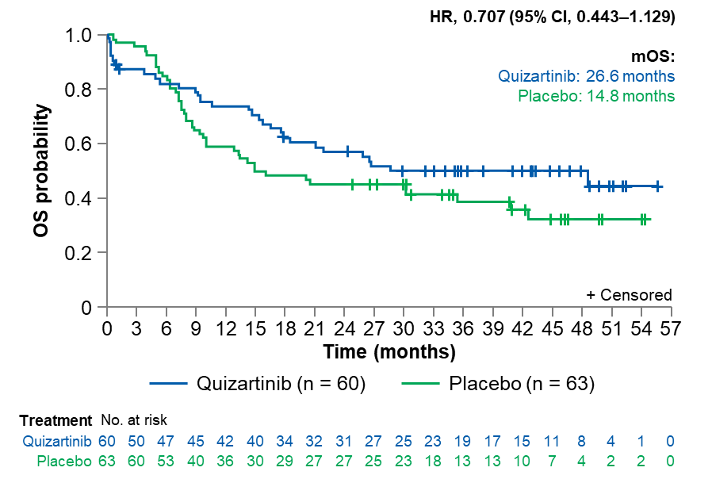
Effect of Co-mutations on Overall Survival of FLT3 ITD + AML Patients Age > 60 Years Treated with IC with Quizartinib vs Placebo
NPM1 and DNMT3A mutations
NPM1 and ≥ 1 mutation in DNMT3A, TET2, WT1, IDH1, or IDH2
Montesinos P and Levis M. Manuscript in Preparation, 2025; Levis M, et al. ASH 2024;Abstract 848

Slide 84
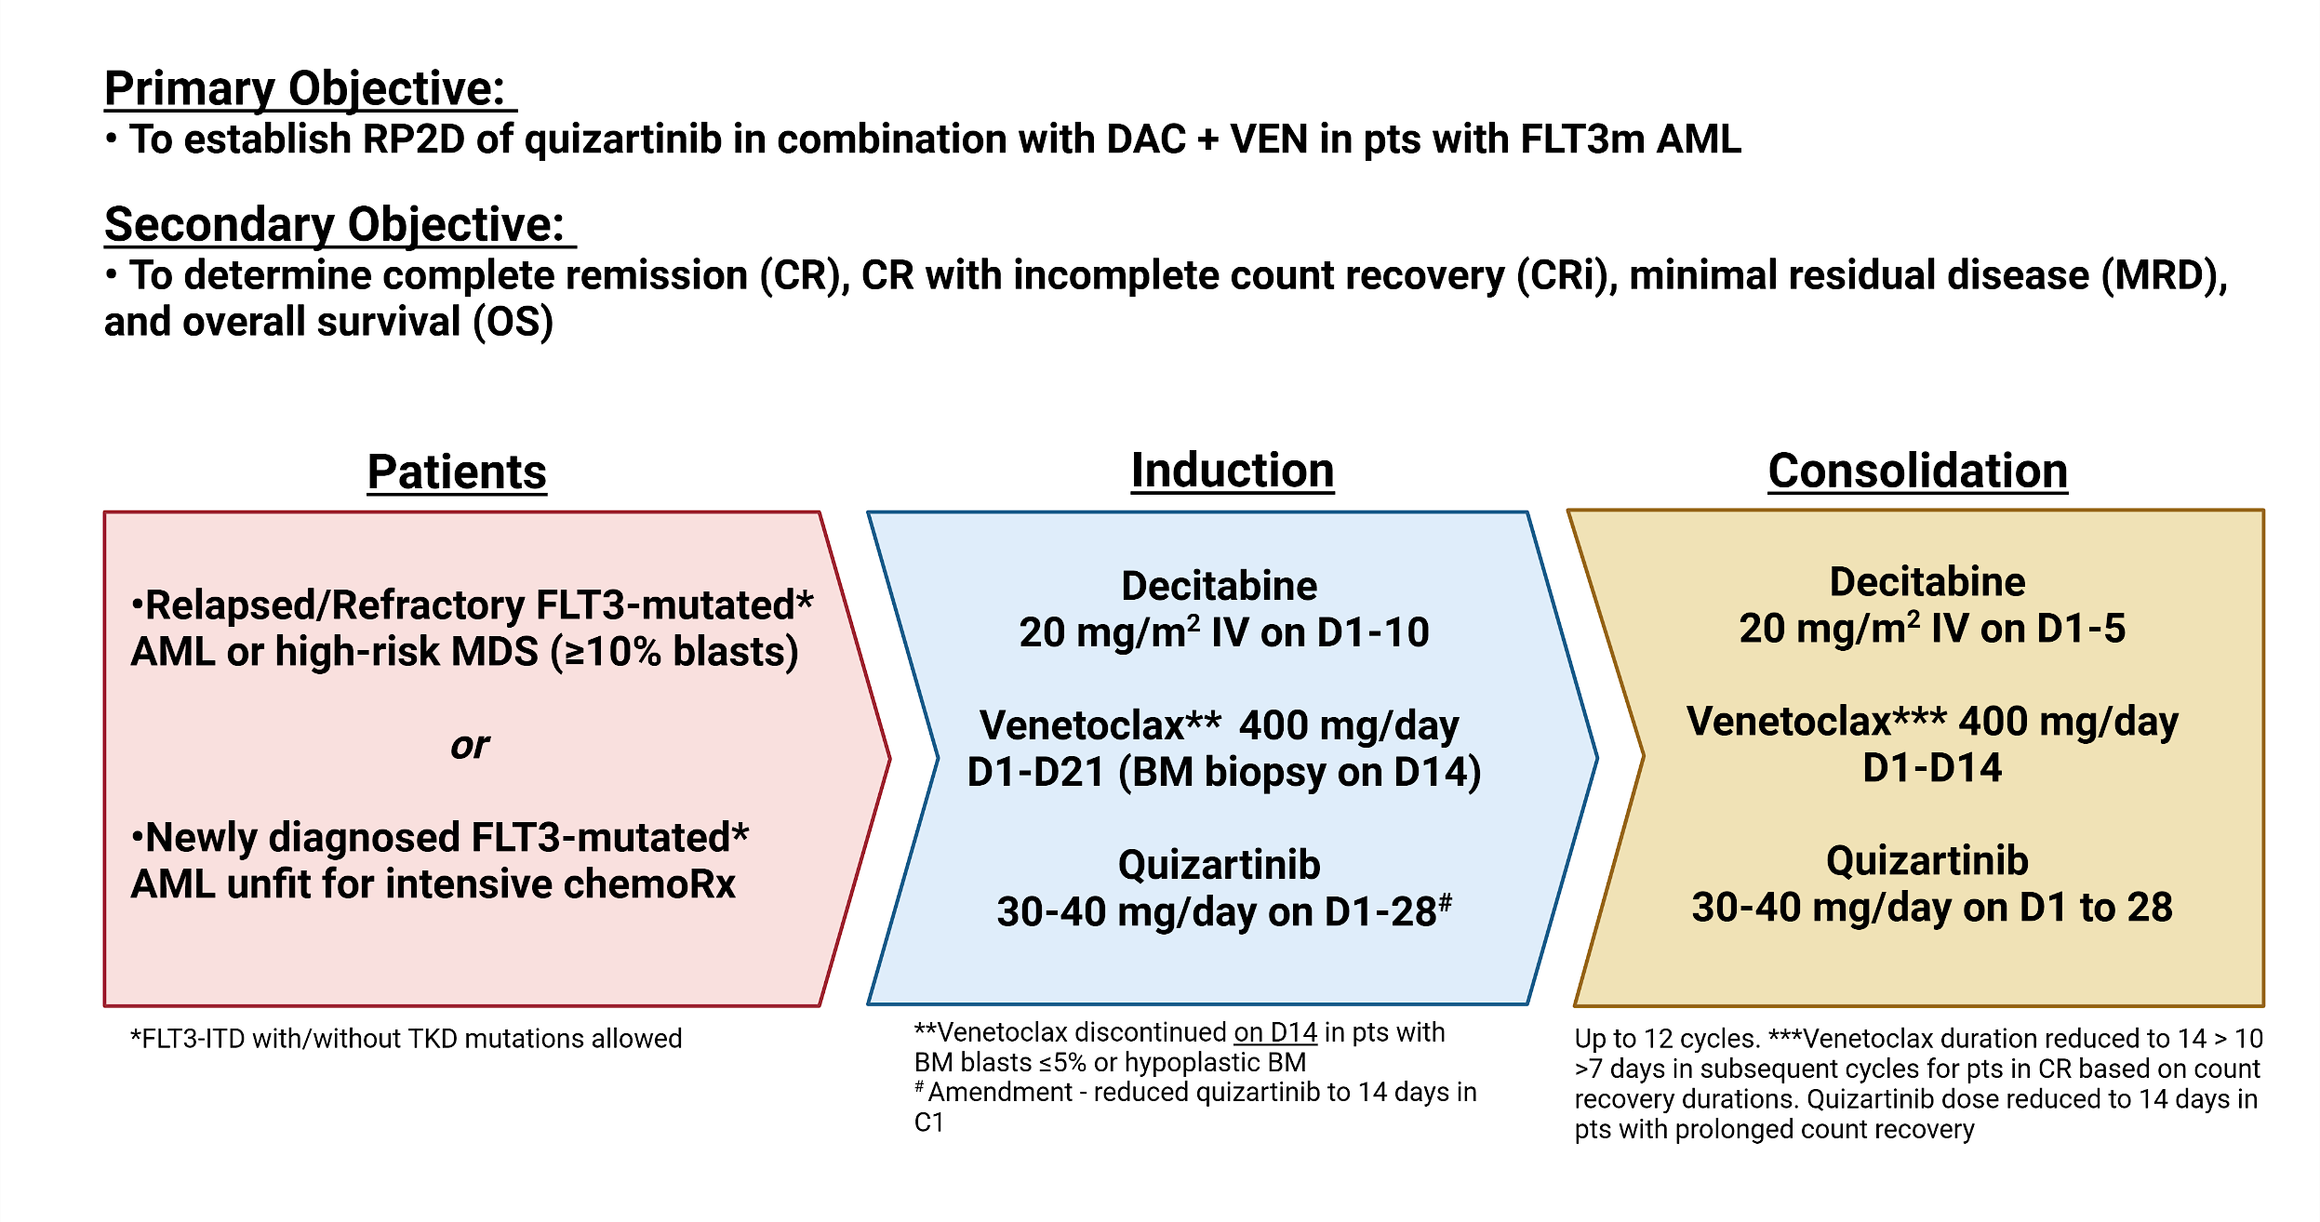
Decitabine + Venetoclax + Quizartinib for FLT3-ITD Mutated AML
*Amendment (November 2023): Decitabine 5 days in cycle 1, quizartinib D1-D21 (BM biopsy on day14)

Slide 85
Decitabine + Venetoclax + Quizartinib for FLT3-ITD Mutated AML
Response*, N (%) | Newly Diagnosed Cohort (N=30)
 | N (%), Median [Range]
Hematologic Response
CRc (composite CR) | 28 (94)
CR | 21 (70)
CRi | 7 (24)
MLFS | 0
No response | 1 (3)
Induction death | 1 (3)
MRD Response, EOC1, N (%)
Flow cytometry negative | 14/24 (58)
FLT3 PCR negative | 11/18 (61)
MRD Response, best, N (%)
Flow cytometry negative | 18/26 (69)
FLT3 PCR negative | 18/21 (86)
Bridge to ASCT | 9 (30)
Median time to ANC >500/mcL: 38 days [18-56]
Median time to ANC >1000/mcL: 40 days [19-67]
Median time to PLT >50,000/mcL: 35 days [16-71]
Median time to PLT >100,000/mcL: 39 days [18-105]
Yilmaz M, et al. EHA 2025;Abstract S142

Slide 86
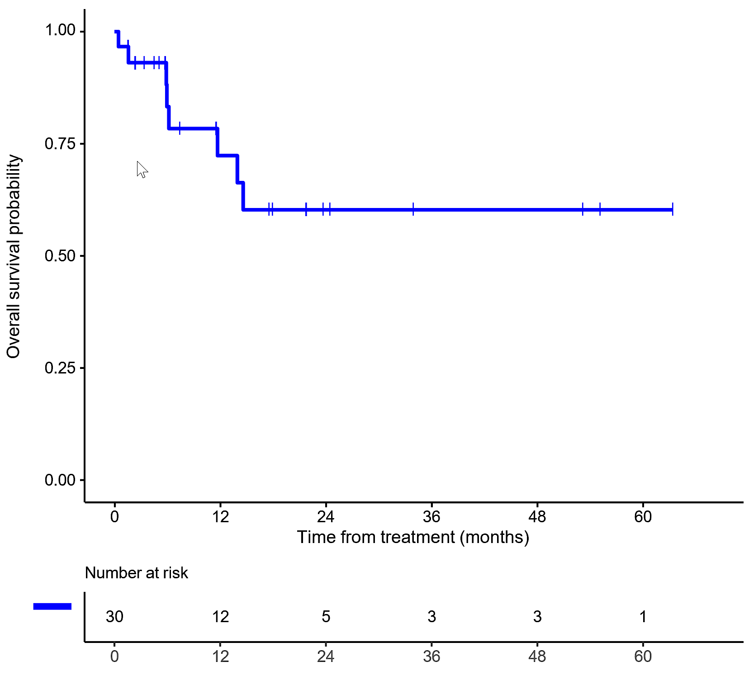
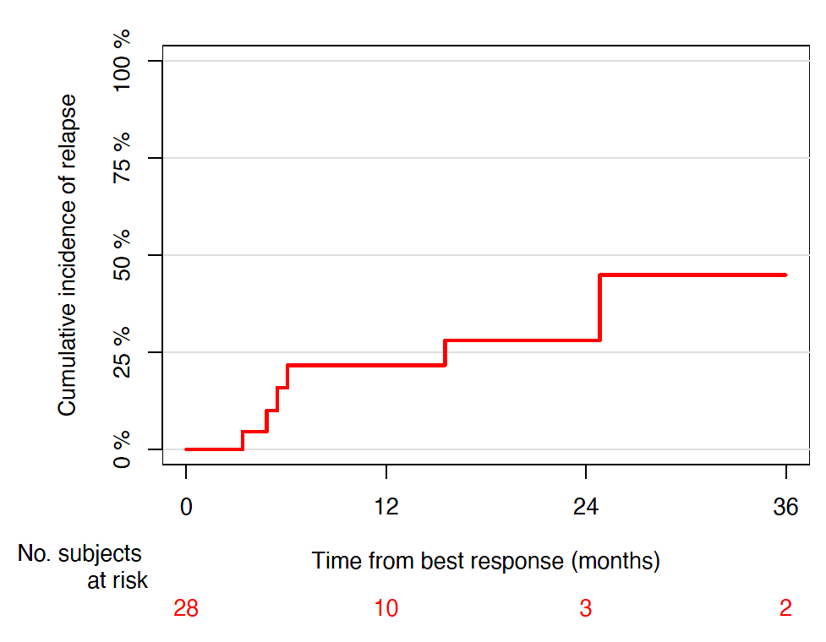
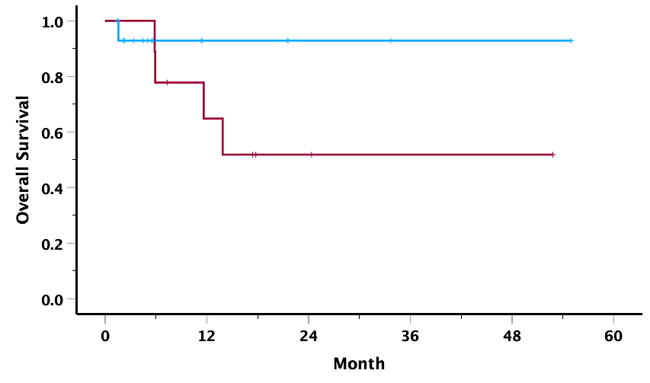
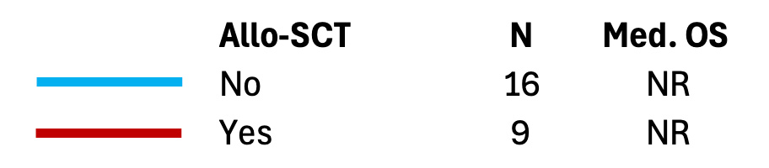
Decitabine + Venetoclax + Quizartinib for FLT3-ITD Mutated AML
Median OS: NR (median follow up 17 months)
1-yr OS: 72%, 2-yr OS: 60%
Yilmaz M, et al. EHA 2025;Abstract S142

Slide 87
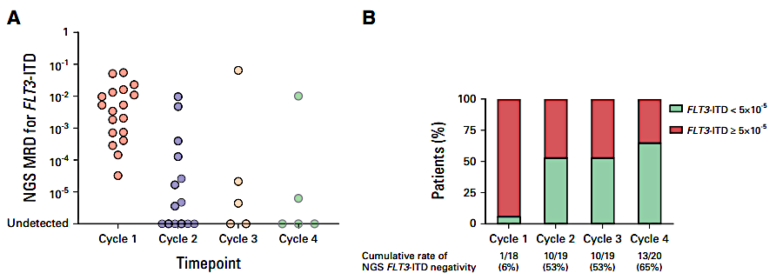
Phase II Study of AZA/VEN/GILT in ND FLT3m AML:
Response and Rate of FLT3-ITD Negativity Across Treatment Cycle
Hematologic Response | Frontline Cohort (n = 30)
mCRc (CR/Cri/MLFS), no. (%) | 30 (100)
CR | 27 (90)
CRi | 2 (6)
MLFS | 1 (4)
PR | 0
No response | 0
Short N, et al. J Clin Oncol. 2024;42:1499-1508

Slide 88
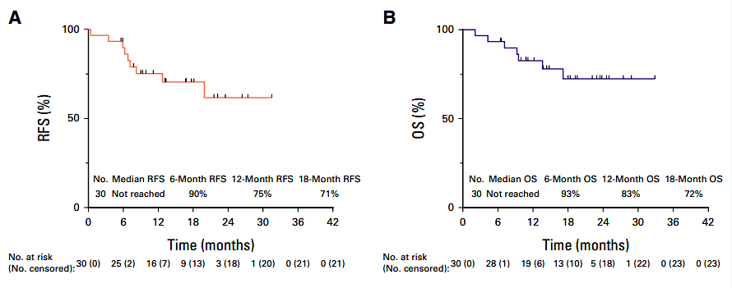
Azacitidine, Venetoclax, and Gilteritinib for FLT3 Mutated AML
(Median follow up 19 months)
Short N, et al. J Clin Oncol. 2024;42:1499-1508

Slide 89

Azacitidine, Venetoclax, and Gilteritinib for
Previously Untreated FLT3 Mutated AML
Short N, et al. J Clin Oncol. 2024;42:1499-1508

Slide 90

Quizartinib Monotherapy in Relapsed/Refractory AML
135 mg daily (men)
90 mg daily (women)
FLT3 ITD negative =
VAF < 10%
Cohort 1: > 60 years old, CR1 < 1 year or refractory to first line therapy
Cohort 2: > 18 years old, relapsed/refractory following one salvage or HSCT
Cortes J, et al. Lancet Oncol. 2018;19:889-903.

Slide 91

Quizartinib for Newly Diagnosed FLT3-ITD Negative AML: Phase II QUIWI Trial
Safety run-in phase: open-label cytarabine 200 mg/m² (days 1-7), Idarubicin 12 mg/m² (days 1-3) Quizartinib 60 mg/d x 14 days (30mg with strong CYP3A inhibitor)
Enrollment: September 2019 – November 2021
Age: 18-70 years of age
Performance status: ECOG <3
Newly diagnosed FLT3-ITD negative AML (ratio <0.03)
FLT3-ITD centrally screened (capillary electrophoresis)
Patients begin 7+3 chemotherapy during screening
Montesinos P, et al. J Clin Oncol. 2025 Oct 13:JCO2501841.

Slide 92
Quizartinib for Newly Diagnosed FLT3-ITD Negative AML:
Overall Survival by Age and Allo HSCT
Age < 60 years
Allo HCT
Age > 60 years
No Allo HCT
Montesinos P, et al. J Clin Oncol. 2025 Oct 13:JCO2501841.

Slide 93


Quizartinib for Newly Diagnosed FLT3-ITD Negative AML:
Overall Survival by Mutation and ELN 2022 Risk Stratification
ELN 2022 Favorable Risk
NPM1
DNMT3A
ELN 2022 Intermediate Risk
FLT3 TKD
ELN 2022 Adverse Risk
Montesinos P, et al. J Clin Oncol. 2025 Oct 13:JCO2501841.

Slide 94

Overview of the FLT3-like Clusters in QUIWI Trial
Overview of the FLT3-like signature
FLT3-like Cases:
Account for 49.67% of FLT3-ITD negative patients.
Characterized by a gene expression signature similar to FLT3-ITD positive cases.
Non-FLT3-like Cases:
Constitute 50.33% of FLT3-ITD negative patients lacking the FLT3-like gene expression signature.
Mosquera Orgueira A, et al. ASH 2023;Abstract 974.

Slide 95

Induction and Consolidation Chemotherapy with
Gilteritinib or Midostaurin
Gilteritinib 120 mg daily d 8-21
Midostaurin 50 mg BID d8-21
Luger S, et al. ASH 2024;Abstract 221.

Slide 96
PrECOG 0905: Induction and Response
177 newly diagnosed adults ages 18-70 years with, FLT3 ITD+ or TKD+ AML were eligible and treated
  Arm A (Gilteritinib) 90, Arm B (Midostaurin) 87
    5 (5.6%) vs 6 (6.9%) received 2 cycles induction
  CRc (Gilteritinib) 85.6% vs 72.4% (Midostaurin), p=0.042
  Allo HSCT in CR1: Gilteritinib Arm A 60.0% vs Midostaurin Arm B 45.9%
 | Arm A (Gilteritinib) N=90 | Arm B (Midostaurin) N=87 | Overall (N=177)
CR | 68 (75.6%) | 57 (65.5%) | 125 (70.6%)
CRi | 9 (10%) | 6 (6.9%) | 15 (8.5%)
CRc | 77 (85.6%) | 63 (72.4%) | 137 (79.3%)
No Response | 13 (14.4%) | 24 (27.6%) | 37 (20.9%)
Six color flow cytometry performed after induction to assess MRD negative remission (10⁻⁴)
FC MRD post induction | Arm A (Gilteritinib) N=90 | Arm B (Midostaurin) N=87 | Overall ( N=177)
MRD positive, not in CR or dropped out/unknown | 32 (35.6%) | 35 (40.2%) | 67 (37.9%)
MRD negative CRc | 58 (64.4%) | 52 (59.8%) | 110 (62.1%)
Luger S, et al. ASH 2024;Abstract 221.

Slide 97
PrECOG 0905: FLT3 Mutation MRD Post-induction
For ITD: LOD 10⁻⁴ by PCR followed by NGS
For TKD: LOD 10⁻² by PCR followed by capillary electrophoresis
MRD regardless of remission status | Arm A (Gilteritinib) N=90 | Arm B (Midostaurin) N=87 | Overall N=177
MRD negative | 36 (40.0%) | 46 (52.9%) | 82 (46.3%)
MRD positive | 39 (43.3%) | 28 (32.3%) | 67 (37.9%)
Dropped Out/Unknown | 15 (16.7%) | 13 (14.9%) | 28 (15.8%)
FLT3m negative CRc post induction
    40% Gilteritinib (A) vs 47.1% Midostaurin (B), p=0.366
Luger S, et al. ASH 2024;Abstract 221.

Slide 98



BMT-CTN 1506 (MORPHO): Efficacy Outcomes
Primary objective:
Relapse-free survival
HR = 0.679 (0.459-1.005)
P = 0.0518
Key secondary objective:
Overall survival
HR = 0.846 (0.554-1.293)
P = 0.4394
Levis MJ, et al. J Clin Oncol. 2024;42:1766-1775

Slide 99


MORPHO: Effect of detectable MRD6 on RFS by study arm
RFS
MRD+
RFS
MRD-
Levis MJ, et al. J Clin Oncol. 2024;42:1766-1775

Slide 100
MORPHO: Drug-related Grade 3 or higher
treatment emergent adverse events
Grade 3 or higher Adverse Event, n(%) | Gilteritinib (N=178) | Placebo (N=177)
Neutrophil count decreased | 44 (24.7%) | 14 (7.9%)
Platelet count decreased* | 27 (15.2%) | 10 (5.6%)
Anemia | 11 (6.2%) | 3 (1.7%)
Alanine aminotransferase (ALT) increased | 6 (3.4%) | 4 (2.2%)
Creatine phosphokinase increased | 12 (6.7%) | 0 (0%)
* Includes unique cases of platelet count decrease and thrombocytopenia
Levis MJ, et al. J Clin Oncol. 2024;42:1766-1775

Slide 101

Follow-up of Patients with Rel/Ref FLT3m AML
Treated with Gilteritinib in the Phase III Admiral Trial
26 gilteritinib treated patients alive for > 2 years without relapse
18 underwent allo HSCT; 16 restarted gilteritinib post allo HSCT
Perl AE, et al. Blood 2022;139:3366-3375.

Slide 102
Investigator
Survey Results

Slide 103
Regulatory and reimbursement issues aside, which initial treatment would you generally recommend for a 60-year-old patient with AML and a FLT3 mutation who was eligible for intensive chemotherapy?
FLT3-ITD
FLT3-TKD
7 + 3 + quizartinib
7 + 3 + midostaurin
7 + 3 + quizartinib
7 + 3 + midostaurin
7 + 3 + quizartinib
7 + 3 + midostaurin
7 + 3 + quizartinib
7 + 3 + midostaurin
7 + 3 + midostaurin
7 + 3 + midostaurin
7 + 3 + quizartinib
7 + 3 + gilteritinib
HMA + venetoclax + gilteritinib
or quizartinib
HMA + venetoclax + gilteritinib
7 + 3 + quizartinib
7 + 3 + midostaurin

Slide 104
Regulatory and reimbursement issues aside, which initial treatment would you generally recommend for an 80-year-old patient with AML and a FLT3 mutation who was not eligible for intensive chemotherapy?
FLT3-ITD
FLT3-TKD
Azacitidine + venetoclax
Azacitidine + venetoclax
Decitabine + venetoclax OR
HMA + venetoclax + gilteritinib
Decitabine + venetoclax
Azacitidine + venetoclax
Azacitidine + venetoclax
Azacitidine + venetoclax +/- gilteritinib
Azacitidine + venetoclax
Azacitidine + venetoclax
Azacitidine + venetoclax
Azacitidine + venetoclax + quizartinib
Azacitidine + venetoclax + gilteritinib
Azacitidine (5 days) + venetoclax + gilteritinib (80 mg)
Azacitidine (5 days) + venetoclax + gilteritinib (80 mg)
Azacitidine + venetoclax + gilteritinib
Azacitidine + venetoclax + gilteritinib

Slide 105
Based on available evidence, do you believe FLT3 inhibitors are likely to be used for patients without FLT3 mutations in the near future?
Yes
Too early to tell
Yes
Yes
No
Yes
No
No

Slide 106
A patient with AML and a FLT3-ITD mutation receives 7+3 chemotherapy and a FLT3 inhibitor, and an MRD assay ordered after the completion of induction therapy is negative. Would you proceed to ASCT? What would be your most likely approach to maintenance therapy?
Transplant
Maintenance
Yes
No maintenance therapy
Yes
No maintenance if MRD-negative,
FLT3 inhibitor if MRD-positive
Yes
No maintenance if MRD-negative,
FLT3 inhibitor if MRD-positive
Yes
Gilteritinib for 2 years if peri-HSCT
MRD-positive, otherwise no maintenance
Yes
No maintenance therapy
Yes
No maintenance therapy
Yes
FLT3 inhibitor maintenance
for 2-3 years
Yes
No maintenance therapy
HSCT = hematopoietic stem cell transplant

Slide 107
Regulatory and reimbursement issues aside, which treatment would you generally recommend next for a 60-year-old patient with AML and a FLT3-ITD mutation who experienced disease progression after 7 + 3 + quizartinib followed by ASCT?
Gilteritinib
HMA + venetoclax or HMA + venetoclax + gilteritinib
Azacitidine + venetoclax + gilteritinib
Gilteritinib-based therapy
Gilteritinib
Azacitidine + venetoclax + gilteritinib
HMA + venetoclax + gilteritinib
Azacitidine + venetoclax + gilteritinib

Slide 108
Regulatory and reimbursement issues aside, which treatment would you generally recommend next for an 80-year-old patient with AML and a FLT3-ITD mutation who experienced disease progression on azacitidine/venetoclax?
Gilteritinib
Gilteritinib or HMA + gilteritinib
Gilteritinib
Gilteritinib
Gilteritinib
Gilteritinib
Gilteritinib or HMA + gilteritinib
Gilteritinib

Slide 109
Agenda
Module 1: Up-Front Therapy for Older Patients with Acute Myeloid Leukemia (AML) — Dr Lin
Module 2: Selection of Therapy for Younger Patients with AML without a Targetable Mutation; Promising Investigational Strategies — Dr Perl
Module 3: Role of FLT3 Inhibitors in AML Management — Dr Erba
Module 4: Incorporation of IDH Inhibitors into the Care of Patients with AML — Dr Fathi
Module 5: Current and Future Role of Menin Inhibitors in the Treatment of AML — Dr Stein

Slide 110
Incorporation of IDH Inhibitors into the
Care of Patients with AML
Amir Fathi, MD
Director, Leukemia Program
MGH Brigham Cancer Institute

Slide 111


AML gets more complex!
Dohner H. et al. (Blood. 2017;129(4):424-447)
Brunner AM & Graubert TA

Slide 112

2025
Ziftomenib
Adapted from Zhang Z et al. Biomarker Research, 2024.

Slide 113

IDH1/2-mutant AML
Mardis et al, NEJM 2009: First description of IDH1 mutations in ~8% of patients with AML, associated with normal cytogenetic status (cn-AML).
Subsequent studies found a larger subset, ~15%, of patients with mutations in the IDH2 gene.
IDH proteins, essential to the Krebs Cycle, catalyze decarboxylation of isocitrate to α-ketoglutarate (α-KG) in cytoplasm (IDH1) and mitochondria (IDH2).
Mutant IDH enzymes catalyze an NADPH-dependent reduction of α-KG to 2-hydroxyglutarate (2-HG).
This leads to accumulation of 2-HG onco-metabolite in IDH-mutant tumors.
-Ward et al. Cancer cell, 2010
-Gross et al. J Exp Med 207:339-44, 2010.
-Dang et al. Nature 462:739-44, 2009.

Slide 114


Slide 115

Enasidenib - Responses in R/R AML
Stein et al. Blood 2017.

Slide 116

Enasidenib –
Survival in R/R AML
Stein et al. Blood 2017.

Slide 117


Slide 118

Ivosidenib – Responses in R/R AML
DiNardo et al. New Engl J Med, 2018.

Slide 119

Ivosidenib –
Survival in R/R AML
DiNardo et al. New Engl J Med, 2018.

Slide 120

Ivosidenib in R/R AML: Transfusion Independence
Transfusion independence was observed across all response categories at 500 mg among those dependent at baseline
DiNardo et al. New Engl J Med, 2018.

Slide 121


IDH-Differentiation Syndrome
respiratory
Fathi AT et al. JAMA Oncol. 2018;4:1106-10.

Slide 122

Acquired Resistance to IDH Inhibitors (enasidenib)
IDH2-mutated pts treated with enasidenib, with initial response, developed therapeutic resistance and a recurrent increase in circulating 2-HG.
Resistance was associated with the emergence of second-site IDH2 mutations in trans, occurring in the IDH2 allele without the neomorphic R140Q mutation.
Intlekofer, et al. Nature 2018
Kim A. Blood 2019
Chen J et al. Sci Rep. 2017

Slide 123

Acquired Resistance to IDH Inhibitors
Four other cases of therapeutic resistance mediated by mutant IDH “isoform switching”, from IDH1 to IDH2 or vice versa.
This isoform switch appeared to restore 2HG production by the tumor, and clinical progression on therapy.
Harding, et al. Cancer Discov 2018

Slide 124

Acquired Resistance to Ivosidenib
Choe S et al. Blood Adv 2020

Slide 125



Olutasidenib
Median DOR:
25.9 months
De Botton, et al. Blood Adv, 2023.

Slide 126

Olutasidenib –
Survival in R/R AML
Median OS:
11.6 months
De Botton, et al. Blood Adv, 2023.

Slide 127

Olutasidenib: Final 5-Year Results from the Pivotal Cohort — OS by Responder Status
Median OS:
11.5 months
CR/CRh
Other Responders
Non-Responders
Cortes J et al. J Hematol Oncol 2025 November 14;18:102.

Slide 128


Olutasidenib versus Ivosidenib
Ion abundance (2-HG)
Watts et al postulate that ivosidenib may bind the allosteric pocket longer in a more constant state, causing interaction with wildtype IDH1.
The smaller olutasidenib molecule has weaker binding affinity to wild-type IDH1, making it perhaps a more selective inhibitor of mutant IDH1.
Watts, et al. Curr Treat Options Oncol, 2024.

Slide 129



IDHi Combinations – With 7+3
The 30- and 60-day mortality was 5% and 10% in the ivosidenib, and 5% and 9% in the enasidenib cohorts.
Stein EM, et al. Blood, 2021.

Slide 130



Enasidenib + HMA
DiNardo CD, et al. Lancet Oncol, 2021.
DiNardo CD, et al. Blood, 2019

Slide 131



Ivosidenib + HMA
DiNardo CD, et al. J Clin Oncol, 2021.

Slide 132


IDHi – AGILE PH3 Clinical Trial in Older patients
Montesinos P, et al. N Eng L Med, 2022.
Montesinos P, et al. Blood Adv, 2025.

Slide 133




Cortes J, et al. J Hematol Oncol. 2025 Jan 16;18:7.

Slide 134



IDHi - Triplet
DiNardo CD, et al. J Clin Oncol, 2025.

Slide 135


IDHi - Triplet
The median ANC recovery (>500 cells/mL) by day 34 and platelet recovery (>50K/mL) by day 20.
Once in remission, transfusions were infrequent.
Early mortality was low, with 2% 60-day mortality and no 30-day mortality.
DiNardo CD, et al. J Clin Oncol, 2025.

Slide 136




How about Maintenance?
Fathi et al. Clin Cancer Res, 2023

Slide 137

Olutasidenib as Maintenance Therapy in IDH1-Mutated AML
RFS
OS
Wei AH et al. EHA 2025;Abstract PF530; Wei AH et al. SOHO 2025;Abstract AML-619.

Slide 138
Conclusions
IDH inhibitors are now key members of AML therapeutics, both in the R/R and upfront settings.
Ivosidenib is approved in combination with HMA for upfront AML.
Enasidenib, ivosidenib, and olutasidenib are approved for R/R AML.
Triplet therapies with IDH inhibitors are showing much promise in earlier phase trials, and they may soon compete with standard therapies.
IDH inhibitors may also have a role in the maintenance setting. Trials are ongoing.

Slide 139
Investigator
Survey Results

Slide 140
Regulatory and reimbursement issues aside, which initial treatment would you generally recommend for an 80-year-old patient with AML and an IDH mutation who was not eligible for intensive chemotherapy?
IDH1
IDH2
Azacitidine + ivosidenib
Azacitidine + venetoclax
HMA + ivosidenib
Decitabine + venetoclax ± enasidenib
Azacitidine + ivosidenib
Azacitidine + venetoclax
Azacitidine + ivosidenib
Azacitidine + venetoclax
HMA + ivosidenib
Azacitidine + venetoclax
Azacitidine + ivosidenib
Azacitidine + venetoclax + enasidenib
HMA + venetoclax + ivosidenib
HMA + venetoclax + enasidenib
Azacitidine + ivosidenib
Oral decitabine (decitabine/cedazuridine) + venetoclax

Slide 141
Regulatory and reimbursement issues aside, which treatment would you generally recommend next for a 60-year-old patient with AML and an IDH1 mutation who experienced disease progression after 7 + 3 followed by ASCT?
Ivosidenib + azacitidine
Ivosidenib or HMA + ivosidenib
Azacitidine + venetoclax
Azacitidine + venetoclax
Azacitidine + venetoclax
Olutasidenib
HMA + venetoclax + IDHi ( ivosidenib or olutasidenib)
Oral decitabine (decitabine/cedazuridine) + venetoclax + ivosidenib
IDHi = IDH inhibitor

Slide 142
Regulatory and reimbursement issues aside, which treatment would you generally recommend next for an 80-year-old patient with AML and an IDH1 mutation who experienced disease progression on azacitidine/venetoclax?
Olutasidenib
HMA + ivosidenib
Olutasidenib
Ivosidenib
Ivosidenib
Olutasidenib
Olutasidenib
Olutasidenib

Slide 143
In which situations, if any, would you use an IDH1 inhibitor for a patient with relapsed/refractory IDH1-mutant AML who had previously received an IDH1 inhibitor?
If there are no other options
One can use olutasidenib, if ivosidenib was used previously
Change of IDH1 inhibitor or prolonged time off IDH1 inhibitor
Relapse while not on an IDH1 inhibitor; IDH1 mutation present at relapse;
tolerability issues with prior IDH1 inhibitor
None
Frail patient unable to receive intensive chemo or combinations
Reasonable to try ivo or oluta if the other has failed — but would give in a combination with an HMA + ven at the time of relapse to improve synergy and response
All situations as my understanding is that olutasidenib
can work in patients treated with prior ivosidenib

Slide 144
Based on published research data and your own clinical experience, how would you indirectly compare the global efficacy and tolerability/toxicity of olutasidenib to that of ivosidenib for patients with relapsed/refractory AML and an IDH1 mutation?
Efficacy
Tolerability/toxicity
Efficacy is about the same
Ivosidenib is more tolerable
Efficacy is about the same
Ivosidenib is more tolerable
Olutasidenib is more efficacious
Tolerability is about the same
Efficacy is about the same
Tolerability is about the same
Efficacy is about the same
Tolerability is about the same
Olutasidenib is more efficacious
Ivosidenib is more tolerable
Efficacy is about the same
Tolerability is about the same
Olutasidenib is more efficacious
Tolerability is about the same

Slide 145
Based on published research data and your own clinical experience, how would you indirectly compare the risk of differentiation syndrome with olutasidenib to that with ivosidenib for patients with relapsed/refractory AML and an IDH1 mutation?
The risk is about the same
The risk is about the same
The risk is greater with ivosidenib
The risk is about the same
The risk is about the same
The risk is about the same
The risk is about the same
The risk is about the same

Slide 146
Agenda
Module 1: Up-Front Therapy for Older Patients with Acute Myeloid Leukemia (AML) — Dr Lin
Module 2: Selection of Therapy for Younger Patients with AML without a Targetable Mutation; Promising Investigational Strategies — Dr Perl
Module 3: Role of FLT3 Inhibitors in AML Management — Dr Erba
Module 4: Incorporation of IDH Inhibitors into the Care of Patients with AML — Dr Fathi
Module 5: Current and Future Role of Menin Inhibitors in the Treatment of AML — Dr Stein

Slide 147

Menin Inhibitors in Acute Myeloid Leukemia
Eytan M. Stein
Chief, Leukemia Service
Director, Program for Drug Development in Leukemia
Memorial Sloan Kettering Cancer Center
New York, New York

Slide 148
Pathogenesis of KMT2A-rearranged and NPM1-mutant Acute Leukemias
MLLr Acute Leukemias
Menin
MLL*
HOX
Menin
MLL*
Leukemia
MEIS
Gene transcription ON
MLL* = MLLr or MLL1 wildtype; Adopted from: Uckelmann HJ, et al. Presented at ASH Annual Meeting, 2018

Slide 149
Menin inhibitors turn off leukemic transcriptional programs
by binding to menin and displacing MLL complexes
MLLr Acute Leukemias
Menin Inhibitor
Menin Inhibitor
Menin
Menin
MLL*
MLL*
HOX
Menin
OFF
MLL*
HOX
Leukemia
MEIS
OFF
MEIS
Differentiation
/ Apoptosis
Gene transcription ON
Gene transcription OFF
MLL* = MLLr or MLL1 wildtype; Adopted from: Uckelmann HJ, et al. Presented at ASH Annual Meeting, 2018

Slide 150


Menin Inhibitors – Structures
Courtesy of Ghayas Issa, MD
Issa G et al. Blood Cancer Discov 2025;6(6):547-560.

Slide 151
AUGMENT-101: Phase 2 Trial of Revumenib in KMT2Ar or NPM1m R/R AML
Key Inclusion Criteria
Aged ≥30 days
R/R AML, ALL, or MPAL with KMT2Ar or NPM1m
Patients with primary refractory or relapsed refractory disease allowed
Key Exclusion Criteria
Active CNS disease
Revumenib RP2D
163 mg (95 mg/m² if <40 kg) q12h orally
+ strong CYP3A4i in 28-day cyclesª
Primary Endpoints
CR+CRh rate^{b}
Safety and tolerability
Key Secondary Endpoints
CRc (CR+CRh+CRi+CRp) rate
ORR (CRc+MLFS+PR)
DOR
Time to response
KMT2Ar
Acute Leukemia
NPM1m AML
(not included in this analysis)
ªTreatment continued until lack of at least MLFS after 4 cycles, disease progression, unacceptable toxicity, or withdrawal of consent. Maintenance therapy with revumenib after allogeneic hematopoietic stem cell transplant was allowed until disease progression or unacceptable toxicity.
^{b}CR+CRh rate >10% in evaluable population considered lower efficacy bound.
AML, acute myeloid leukemia; ALL, acute lymphoblastic leukemia; CNS, central nervous system CR, complete remission; CRc, CR composite (CR+CRh+CRp+CRi); CRh, CR with partial hematologic recovery; CRi, CR with incomplete hematologic recovery; CRp, CR with incomplete platelet recovery; CYP3A4i, cytochrome P450 3A4 inhibitor; DOR, duration of response; KMT2Ar, histone-lysine N-methyltransferase 2A rearrangements; MLFS, morphological leukemia-free state; NPM1m, nucleophosmin 1–mutated; ORR, overall response rate; PR, partial remission; q12h, every 12 hours; RP2D, recommended phase 2 dose; R/R, relapsed/refractory.

Slide 152


AUGMENT-101: Revumenib KMT2A R/R Acute Leukemia – Demographics
Revumenib
Revumenib USPI
1 One patient did not have a translocation type reported

Slide 153

AUGMENT-101: Revumenib KMT2Ar AML
Revumenib
Revumenib USPI

Slide 154

AUGMENT-101: Revumenib NPM1 Mutant R/R AML
Revumenib
Revumenib USPI

Slide 155
ASH 2025: Revumenib
Monday, December 8
04:30 PM - 06:00 PM EST
PRESENTATION ID 1001 (Oral)
OCCC - Chapin Theater (W320)
Revumenib for patients with relapsed or refractory (R/R) KMT2Ar acute leukemia: Outcomes by leukemia type in the phase 2 AUGMENT-101 study
Ibrahim Aldoss, MD
Abstract conclusions: Revumenib monotherapy provides clinically meaningful and durable responses, including high rates of MRD negativity, in heavily pretreated pts with R/R
KMT2Ar AL regardless of leukemia type: AML, ALL, or MPAL. The safety profile of revumenib is consistent with prior reports and is generally similar across acute leukemia subtypes.

Slide 156
FDA approves ziftomenib for relapsed or refractory AML with an NPM1 mutation
“On November 13, 2025, the Food and Drug Administration approved ziftomenib, a menin inhibitor, for adults with relapsed or refractory acute myeloid leukemia (AML) with a susceptible nucleophosmin 1 (NPM1) mutation who have no satisfactory alternative treatment options.
Efficacy was evaluated in KO-MEN-001 (NCT04067336), an open-label, single arm, multicenter trial in 112 adults with relapsed or refractory AML with an NPM1 mutation identified using next-generation sequencing or polymerase chain reaction. Patients with NPM1 mutations, including Type A, B, and D mutations and other NPM1 mutations likely to result in cytoplasmic localization of the NPM1 protein, were enrolled.”
“The prescribing information includes warnings and precautions for differentiation syndrome, QTc interval prolongation, and embryo-fetal toxicity.
The recommended ziftomenib dose is 600 mg taken orally once daily until disease progression or unacceptable toxicity.”
https://www.fda.gov/drugs/resources-information-approved-drugs/fda-approves-ziftomenib-relapsed-or-refractory-acute-myeloid-leukemia-npm1-mutation

Slide 157

KO-MEN-001: Ziftomenib R/R NPM1 Mutant AML – Demographics
Ziftomenib
Ziftomenib USPI

Slide 158

KO-MEN-001: Ziftomenib R/R NPM1 Mutant AML – Response
Ziftomenib
Ziftomenib USPI

Slide 159
Single Agent Menin Inhibitors for Relapsed and
Refractory Acute Leukemia
Name | Patient Population | Response Rates for KMT2Ar | Response Rates for NPM1 | Duration of CR/CRh (median) | Toxicity
Revumenib* | KMT2A NPM1 NUP98r | ORR – 63% CR/CRh – 21.2% - MRD neg 70% | ORR 48% CR/CRh (26%) - | KMT2A - 6.4 months NPM1 4.5 months | QT prolongation DS
Ziftomenib | NPM1 | ORR – 33% CR/CRh – 15% | ORR - 33% CR/CRh 22% MRD neg – 56%** | NPM1 5.0 months | DS Pruritus (23%)
Bleximenib | KMT2A NPM1 | CR/CRh – 33.3% | CR/CRh -33.3% | 6 months | DS
Enzomenib | KMT2A NPM1 | ORR – 65.2 CR/CRh – 30.4% | ORR – 58.8% CR/CRh - 47.1% | NPM1 - 7.0 months | DS (10.7%)
BN104 | KMT2A NPM1 | CR/CRh – 60.9% | CR/CRh – 40% | N/A | N/A
AZD3632 | KMT2A NPM1 Other HOX upregulated leukemias | N/A | N/A | N/A | N/A
*Approved
** NGS assay with level of detection of 0.34%
Issa et al, JCO 2025, Ziftomenib USPI, Revumenib USPI, Searle E, et al, ASH 2024, Zeidner, EHA 2024

Slide 160


Why do Patients Relapse – MEN1 Resistance Mutations
Perner F, Stein EM, et. al. Nature 2023

Slide 161

Menin Inhibitors in Combination with Other Agents
Issa G et al. Blood Cancer Discov 2025;6(6):547-560.

Slide 162

AZA/VEN/REVUMENIB: STUDY DESIGN
1 of induction
Zeidner J, et. al, EHA 2025

Slide 163
Clinical Outcomes of Aza/Ven/Revumenib
Clinical Outcomes | Dose Level 1 | Dose Level 2 | All
 | (n=21) | (n=22) | KMT2Ar (n=9) | NPM1m (n=34) | All (n=43)
Best Response, no. (%)
CR | 13 (61.9) | 16 (72.7) | 7 (77.8) | 22 (64.7) | 29 (67.4)
CRh | 0 (0.0) | 1 (4.5) | 0 (0.0) | 1 (2.9) | 1 (2.3)
CRi | 4 (19.0) | 1 (4.5) | 1 (11.1) | 4 (11.8) | 5 (11.6)
MLFS | 2 (9.5) | 1 (4.5) | 1 (11.1) | 2 (5.9) | 3 (7.0)
Not Evaluable¹ | 2 (9.5) | 3 (13.6) | 0 (0.0) | 5 (14.7) | 5 (11.6)
ORR (CR/CRh/CRi/MLFS) | 19 (90.5%) | 19 (86.4%) | 9 (100%) | 29 (85.3%) | 38 (88.4%)
CRc (CR/CRh/CRi) | 17 (81.0%) | 18 (81.8%) | 8 (88.9%) | 27 (79.4%) | 35 (81.4%)
No patient had refractory disease after 1-2 cycles
84% of evaluable patients achieved remission within 1st cycle of therapy
100% of evaluable pts achieved flow MRD-negative remission (sensitivity 0.02%)
  76% after cycle 1; 89% after cycle 2
31% achieved NPM1m NGS-negative remission (sensitivity 0.005%)
1 Not Evaluable = 5 pts had either early death (n=3) or withdrew from study (n=2) prior to end of cycle 1 BM Bx
Zeidner J, et. al, EHA 2025

Slide 164


Survival Outcomes of Aza/Ven/Revumenib
10 pts (23%) received an allogeneic stem cell transplant
4 pts relapsed (KMT2Ar: n=3; NPM1m: n=1)
Median F/U = 6.9 months
1 year OS = 63% (KMT2Ar: 83% vs. NPM1m: 55%)
Zeidner J, et. al, EHA 2025

Slide 165
ASH 2025: Revumenib
Saturday, December 6
09:30 AM - 11:00 AM EST
PRESENTATION ID 47 (Oral)
OCCC - Valencia Room W415A
Phase II Study of the all-oral combination of revumenib (SNDX-5613) with decitabine/cedazuridine (ASTX727) and venetoclax (SAVE) in newly diagnosed AML
Wei-Ying Jen, BM BCh, FRCPath
Abstract conclusions: SAVE, an all-oral combination, shows promising activity in older adults with ND NPM1m or KMT2Ar AML who are ineligible for intensive chemotherapy. Ongoing enrollment and longer follow-up are required to establish the durability of response.

Slide 166
KOMET-007: Ziftomenib Plus 7+3 in NPM1m or KMT2A-r ND AML
n (%) | NPM1-m | KMT2A-r | All Patients
 | 600 mg (n=44) | 600 mg (n=27) | 600 mg (N=71)
CRc | 41 (93) | 24 (89) | 65 (92)
ORR CR CRh CRi MLFS PR NR NE | 43 (98) 37 (84) 1 (2) 3 (7) 2 (5) 0 1 (2) 0 | 24 (89) 20 (74) 0 4 (15) 0 0 2 (7) 1 (4) | 67 (94) 57 (80) 1 (1) 7 (10) 2 (3) 0 3 (4) 1 (1)
CR MRD-negativity, n/N (%)^{b} CRc MRD-negativity, n/N (%)^{b} | 24/34 (71) 26/38 (68) | 14/16 (88) 15/18 (83) | 38/50 (76) 41/56 (73)
Median time to CR MRD-negativity, weeks (range) Median time to CRc MRD-negativity, weeks (range) | 4.7 (2–17) 4.7 (2–17) | 4.4 (3–12) 4.1 (3–12) | 4.5 (2–17) 4.3 (2–17)
Erba H et al. EHA 2025;Abstract S136.

Slide 167


KOMET-007: Ziftomenib in Combination with Aza/Ven in NPM1m or KMT2A-r R/R AML
Fathi AT et al. ASH 2024;Abstract 2880.

Slide 168
ASH 2025: Ziftomenib
Monday, December 8
10:30 AM - 12:00 PM EST
PRESENTATION ID 766 (Oral)
OCCC - Chapin Theater (W320)
Ziftomenib in combination with venetoclax and azacitidine in newly diagnosed NPM1-m acute myeloid leukemia: Phase 1b results from KOMET-007
Gail Roboz
Abstract conclusions: In the ongoing KOMET-007 study, ziftomenib RP2D of 600 mg once daily combined with Ven/Aza was well tolerated and demonstrated robust clinical activity in patients with newly diagnosed NPM1-m AML, including 84% CRc after a median of 3.5 weeks and 54% CRc MRD-negativity after a median of 8.4 weeks. Low rates of ziftomenib-related cytopenia and no additional myelosuppression were observed with this combination. One case each of differentiation syndrome (grade 2) and investigator-assessed QTc (grade 3) were successfully resolved. Taken together, these data support the RP2D determination and advancement of this ziftomenib-based combination in the KOMET-017 (NCT07007312) randomized phase 3 study in patients with newly diagnosed NPM1-m AML.

Slide 169
ASH 2025: Ziftomenib
Monday, December 8
10:30 AM - 12:00 PM EST
PRESENTATION ID 764 (Oral)
OCCC - Chapin Theater (W320)
Ziftomenib in combination with venetoclax and azacitidine in relapsed/refractory NPM1-m or KMT2A-r acute myeloid leukemia: Updated phase 1a/b safety and clinical activity results from KOMET-007
Amir Fathi, MD
Abstract conclusions: In the ongoing KOMET-007 study, ziftomenib RP2D of 600 mg QD + Ven/Aza was well tolerated with robust clinical activity in patients with R/R NPM1-m or
KMT2A-r AML. No ziftomenib-related QTc prolongation was reported. One case of DS (NPM1-m, Gr 3) successfully resolved with protocol-specified mitigation. These data support further investigation of ziftomenib-based combinations in R/R NPM1-m and KMT2A-r AML.

Slide 170
Adverse Events with Menin Inhibitors
On target (menin) effects
Reported in clinical trials:
Differentiation syndrome
Myelosuppression
Potential AEs (preclinical/animal studies):
MEN1 syndrome
Bone growth
Neurologic
Cardiac
Embryo-Fetal toxicity
Off target effects
QT prolongation (revumenib, 10% Gr 3)
DDI (CYP3A inhibitors or substrates)
Pruritus (ziftomenib, 13% Gr 1-2)
Courtesy of Ghayas Issa, MD

Slide 171


Phenotypes of Differentiation and Frequency of DS
Issa, Stein and Dinardo, Blood 2025

Slide 172

Treatment of DS
Issa, Stein and Dinardo, Blood 2025

Slide 173

Atypical Menin-DS?
A provocative case of steroid-refractory inflammation
Baseline
D16
D37
40F w prior Burkitt lymphoma and therapy-related AML with t(11;19) KMT2A:ELL and FLT3-ITD s/p alloHCT experiences relapse and starts revumenib 163 mg Q12H (12 months after alloHCT)
She’s admitted for fevers and hypoxia consistent with menin-DS, which responds to steroids and cytoreduction
She improves clinically and D37 BmBx shows MLFS (MRD indeterminate by flow)
D40+
Steroid-refractory fevers, hypoxemia, and hypotension with resumption of revumenib; marked elevated inflammatory markers (see next slide)
Unpublished Data, Do Not Distribute
Courtesy Chin KK

Slide 174

Markedly elevated inflammatory markers with MENINi
D59 Labs
WBC 0.1×10³/µL, HgB 8.6 g/dL, PLT 36×10³/µL
Ferritin 80,867 ng/mL
sCD25 (sIL2) 3,482 U/mL
Serum CXCL9 49,778 pg/mL (normal ≤669 pg/mL)
Serum IFNγ 2,069 pg/mL (normal ≤1.4)
Unpublished Data, Do Not Distribute

Slide 175

Evidence of hemophagocytosis in leukemia derived histiocytes
D64 BmBx
A. H&E section (x600) of bone marrow biopsy shows an increase in histiocytes including hemophagocytic histiocytes (inset).
B. Immunohistochemical staining for CD163 (brown, x400) highlights an increase in histiocytes on the bone marrow biopsy with strong membranous and cytoplasmic staining.
C. Combined immunophenotyping using CD163 (aqua), and FISH testing using KMT2A break-apart probes (5’MLL in green and 3’ MLL in orange, Abbott Molecular, Des Plaines, IL). Most CD163 positive cells are positive for KMT2A translocation, i.e., t(11;19).
D. A CD163 positive cells show KMT2A split signal pattern, with evidence of hemophagocytic feature, i.e., two red blood cells (white arrows) in the cytoplasm. Two CD163 negative cells (green arrows) are also positive for KMT2A translocation
Unpublished Data, Do Not Distribute

Slide 176
Concluding Thoughts
Menin inhibitors, overall, have high rates of overall response, moderate rates of CR/CRh and modest duration of response.
  BUT, all of the above is still generally better than what would be expected with other standard of care therapies for R/R disease.
  Prognostic impact of MRD eradication for single agent menin inhibitors in R/R leukemia with currently available diagnostics is unclear.
  Some resistance (up to 40% with revumenib?) mediated by MEN1 resistance mutations.
    Contribution of MEN1 mutations to relapse with other menin inhibitors in clinical development largely unknown.
  Outcomes after failure of menin inhibitors are poor. For patients who have not previously received ven, using a ven based strategy may be worthwhile.

Slide 177
Investigator
Survey Results

Slide 178
Regulatory and reimbursement issues aside, which treatment would you generally recommend next for a 60-year-old patient with AML and a KMT2A rearrangement who experienced disease progression after 7 + 3 followed by ASCT?
Revumenib
Revumenib
Azacitidine + venetoclax + revumenib
Azacitidine + venetoclax + revumenib
Revumenib
Revumenib-based combination, possibly with azacitidine + venetoclax
HMA + venetoclax + menin inhibitor
Revumenib

Slide 179
Regulatory and reimbursement issues aside, which treatment would you generally recommend next for an 80-year-old patient with AML and a KMT2A rearrangement who experienced disease progression on azacitidine/venetoclax?
Revumenib
Revumenib
Revumenib
Revumenib
Revumenib
Revumenib
Revumenib
Revumenib

Slide 180
Regulatory and reimbursement issues aside, which treatment would you generally recommend next for a 60-year-old patient with AML and an NPM1 mutation who experienced disease progression after 7 + 3 followed by ASCT?
Ziftomenib
HMA + venetoclax
Azacitidine + venetoclax + revumenib
Azacitidine + venetoclax + ziftomenib
Azacitidine + venetoclax
Ziftomenib-based combination, possibly with azacitidine + venetoclax
HMA + venetoclax
Ziftomenib

Slide 181
Regulatory and reimbursement issues aside, which treatment would you generally recommend next for an 80-year-old patient with AML and an NPM1 mutation who experienced disease progression on azacitidine/venetoclax?
Ziftomenib
Revumenib or ziftomenib
Revumenib or ziftomenib
Ziftomenib
Revumenib
Ziftomenib
Ziftomenib
Ziftomenib

Slide 182
Based on published research data and your own clinical experience, how would you indirectly compare the global efficacy and tolerability/toxicity of the available and investigational menin inhibitors for relapsed/refractory AML with an NPM1 mutation?
Efficacy
Tolerability/toxicity
Enzomenib is most efficacious
Enzomenib is the most tolerable
Efficacy is about the same
Tolerability is about the same
Efficacy is about the same
Tolerability is about the same
Efficacy is about the same
Enzomenib is the most tolerable
Efficacy is about the same
Tolerability is about the same
Efficacy is about the same
Tolerability is about the same
Efficacy is about the same
Tolerability is about the same
Efficacy is about the same
Enzomenib is the most tolerable

Slide 183
Based on published research data and your own clinical experience, how would you indirectly compare the risk of differentiation syndrome with the available and investigational menin inhibitors for relapsed/refractory AML?
The risk is about the same
Risk appears to vary a bit across agents, but head-to-head data are lacking
The risk is about the same
The risk is greater with ziftomenib
The risk is about the same
The risk is about the same
The risk is about the same
The risk is greater with bleximenib

Slide 184
Have you observed HLH-like syndrome in a patient with AML who was receiving a menin inhibitor?
No
Yes, a few times
No
No
Yes, 5 times
No
Yes, 3 times
No

