Slide 1
Research To Practice
June 2025
Ursula Matulonis, MD
Chief, Division of Gynecologic Oncology
Brock-Wilson Family Chair
Co-Leader, Ovarian Cancer SPORE grant
Co-Leader, Dana-Farber/Harvard Cancer Center GYN program
Dana-Farber Cancer Institute
Professor of Medicine
Harvard Medical School
Boston, MA

Slide 2
Newly diagnosed ovarian cancer
PRIMA OS results: ESMO 2024, Ann Onc 2024
FIRST PFS and OS results: ASCO 2025
ENGOT 0V43/GOG3036/KEYLYNK-001 PFS and OS results: ESGO and SGO 2025
PAOLA-1 updated PFS and final OS, based on risk, IJGC 2024

Slide 3

PRIMA: Niraparib as upfront maintenance for advanced high grade ovarian cancer
Patients
Newly diagnosed, stage III or IV
CR or PR to most recent platinum therapy
High grade ovarian cancer
Niraparib
2:1
Primary endpoint:
PFS
Placebo
After response to first-line chemotherapy, patients were randomized 2:1 to receive oral niraparib or placebo
733 pts enrolled
Subsequent PARPi therapy was received by:
Niraparib treated group:
11.7% overall population
15.8% of HRD pts
Placebo treated group:
37.8% in the overall population
48.4% of the HRD pts (in BRCAm group: 57% received a subsequent PARPi)
ESMO 2024, Monk et al, Annals of Oncology 2024
Graybill WS, et al. Int J Gynecol Cancer2024;34:1041–1050

Slide 4
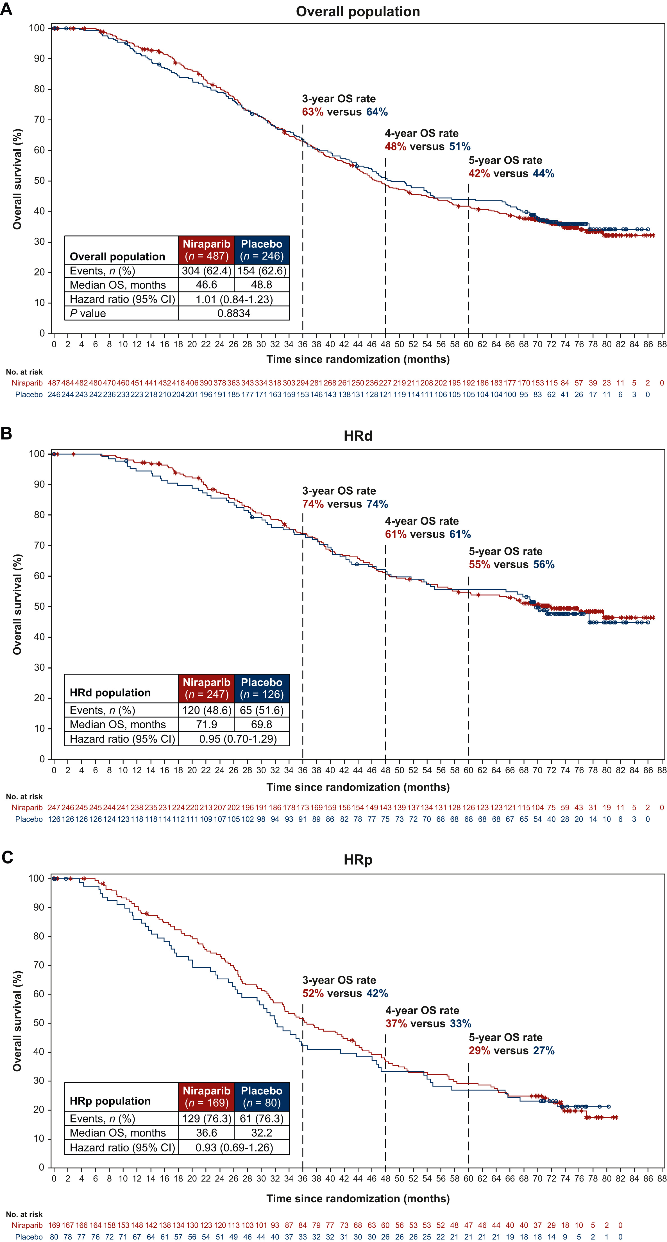
PRIMA
OS results
OS tested in the overall population: NS
So formal OS analysis of
HRD population did not occur
ESMO 2024, Monk et al, Annals of Oncology 2024

Slide 5
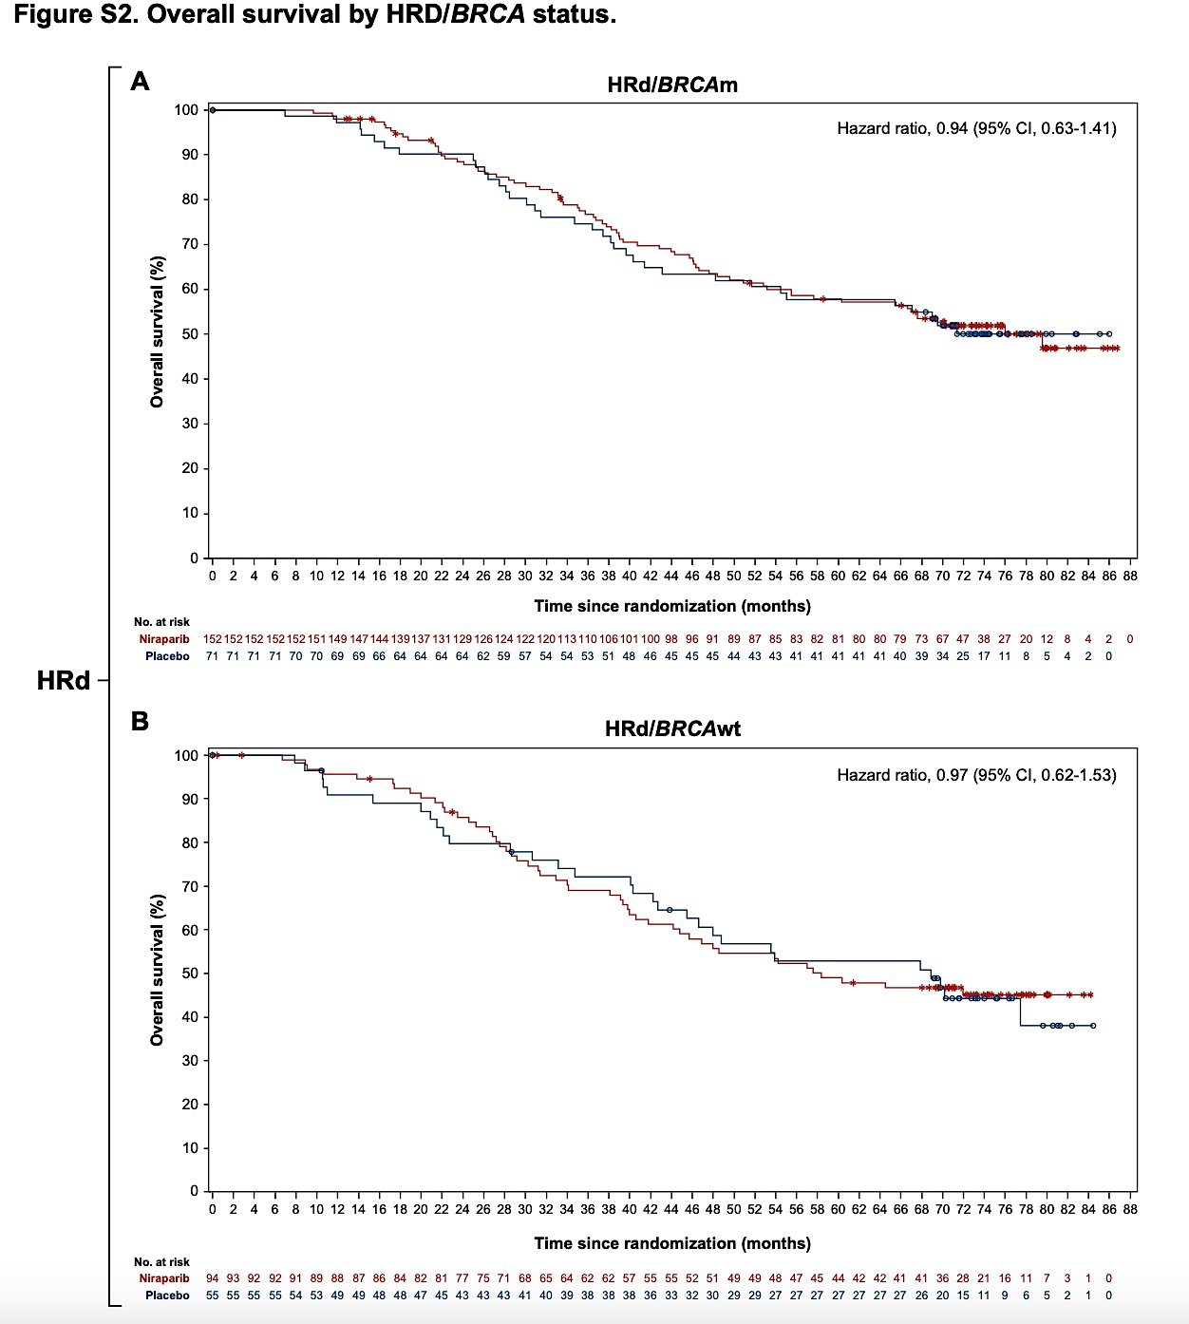
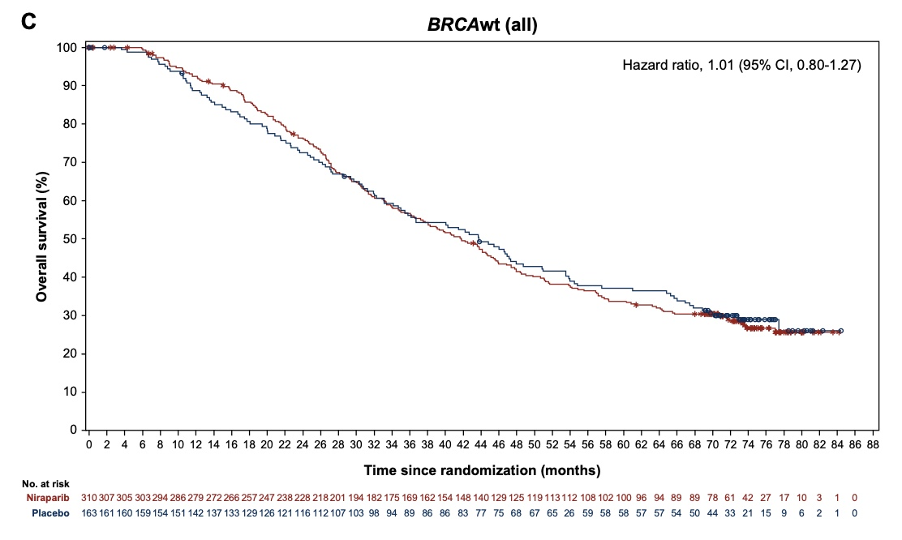
PRIMA OS results
ESMO 2024, Monk et al, Annals of Oncology 2024

Slide 6
FIRST study
Due to the approvals of PARP inhibitors in the first-line setting, Arm 1 (n=193) was closed and participants were subsequently randomized 1:2 to Arms 2 (n= 385) and 3 (n= 753) only.
Arm 1: SOC chemotherapy followed by placebo maintenance
Primary endpoint: investigator-assessed PFS in Arms 2 and 3. If PFS results were significant, then OS testing would continue
Secondary endpoints: OS, PFS2, time to first and second subsequent therapy.
Pts with PD-L1+ or HRD+ and those with concurrent bevacizumab were identified a priori as clinically “plausible” groups to have differentiated results
Patients with Stage III or IV nonmucinous ovarian
cancer.
Platinum/taxane +/- bev
1:2
Arm 2: SOC chemotherapy +/- bev followed by niraparib maintenance
1:1:2
1162 pts received
either Arm 2 or 3
Arm 3: SOC chemotherapy + dostarlimab +/-bev followed by niraparib and dostarlimab +/- bev maintenance
NCT03602859
ASCO 2025

Slide 7
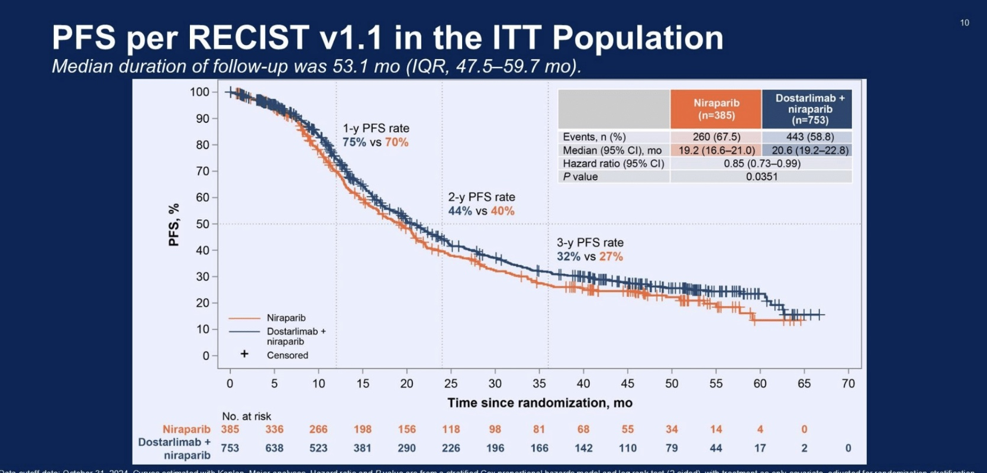
ASCO 2025

Slide 8
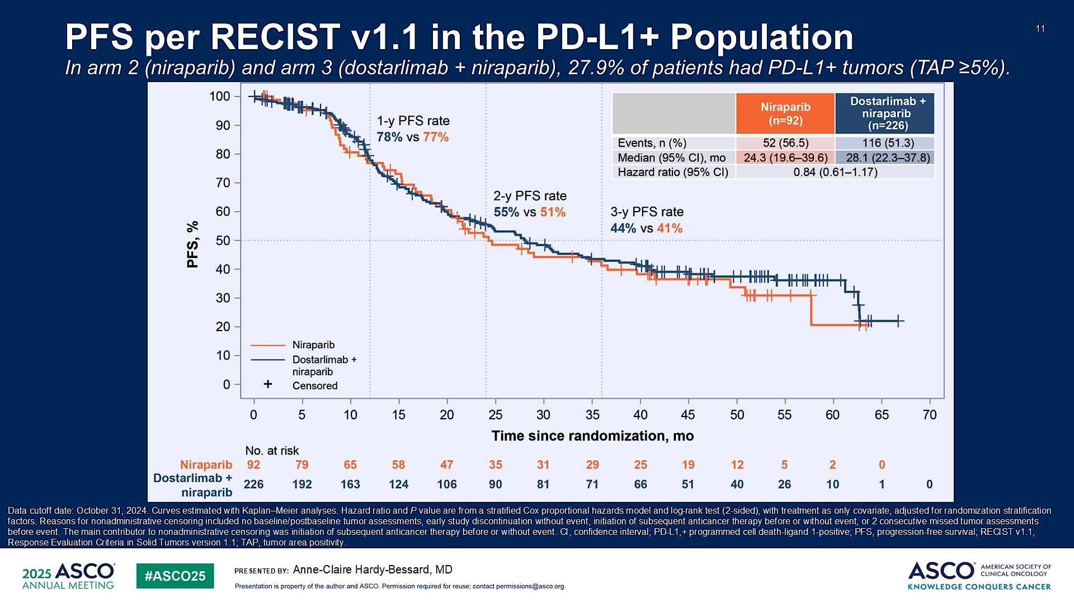
PFS per RECIST v1.1 in the PD-L1+ Population<br />In arm 2 (niraparib) and arm 3 (dostarlimab + niraparib), 27.9% of patients had PD-L1+ tumors (TAP ≥5%).<br />
Content of this presentation is the property of the author, licensed by ASCO. Permission required for reuse.

Slide 9
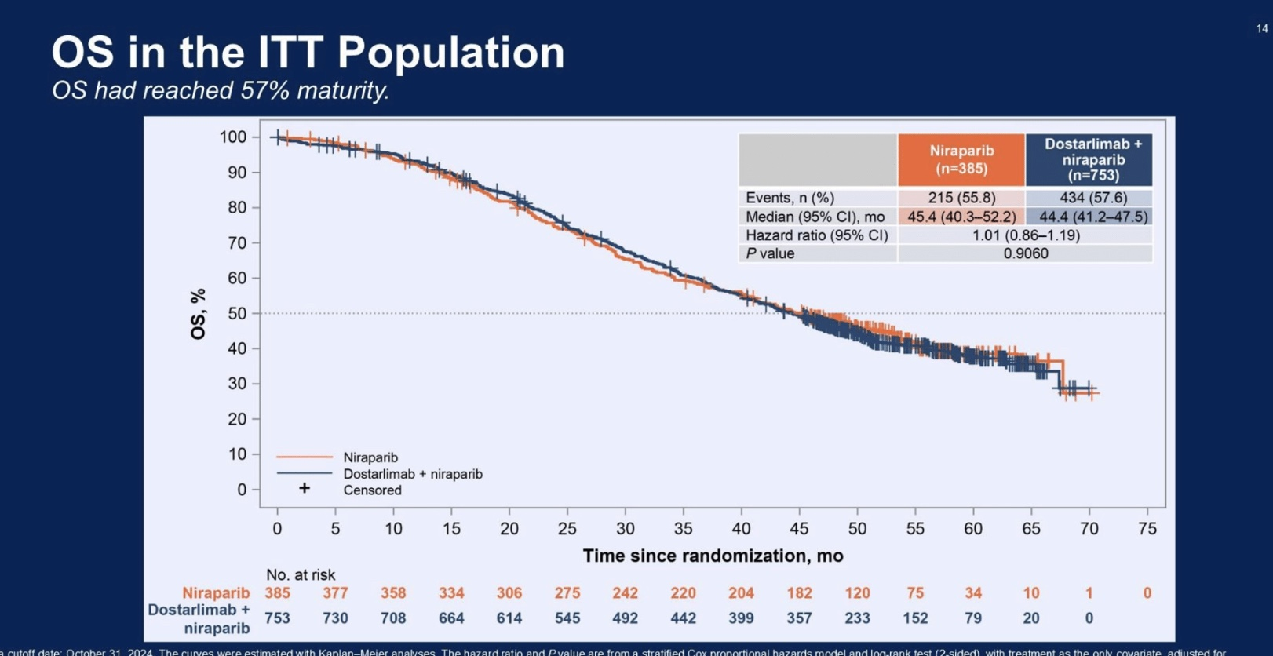
ASCO 2025

Slide 10
FIRST take away points
Essentially the same PFS benefit of adding dostarlimab:
1.4 months difference in median PFS
No overall survival benefit of adding dostarlimab to niraparib maintenance
PD-L1 biomarker did not predict impact of dostarlimab
~50% of patients received bevacizumab; how does receipt of bevacizumab influence therapy outcomes?

Slide 11
Graybill et al:
Post hoc analysis of PRIMA to determine the factors predictive of
long-term DFS
Performed a multivariate logistic regression model
Findings:
Characteristics associated with PFS ≥ 2 years included:
HRD+ cancers: BRCA1 and BRCA2-mutated/HRD tumors or
BRCAwt/not determined HRD tumor
FIGO stage III (vs stage IV) disease
0 or 1 baseline non-target lesions (vs ≥2 lesions)
Graybill et al, Int J Gyn Onc 2024

Slide 12
ENGOT 0V43/GOG3036/KEYLYNK-001
ESGO 2025, SGO 2025
Patient population: Advanced non-BRCA mutated newly diagnosed ovarian cancer
Treatment arms:
I) Carboplatin/Paclitaxel
II) Carboplatin/Paclitaxel/Pembrolizumab, followed by Pembrolizumab maintenance
III) Carboplatin/Paclitaxel/Pembrolizumab followed by Pembrolizumab/Olaparib
All arms with or without bevacizumab; no PARPi maintenance alone arm
ESGO 2025 and SGO 2025

Slide 13
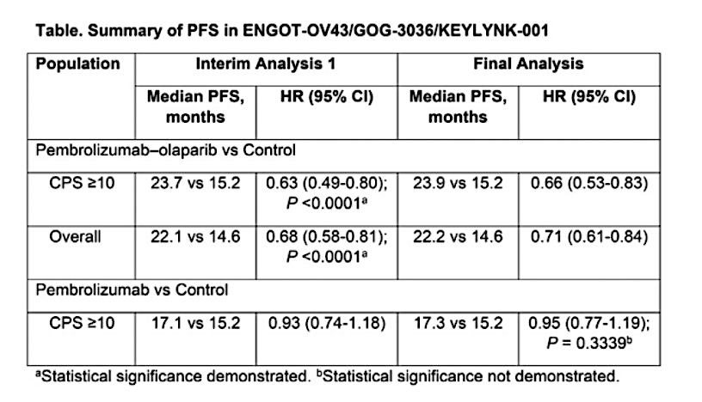
ENGOT 0V43/GOG3036/KEYLYNK-001: findings
PFS benefit for pembrolizumab/olaparib arm compared to chemotherapy alone
No OS benefit
Significance threshold of pembrolizumab versus control in the CPS10 population was not met: thus, formal testing of PFS in the overall population and OS was not performed
ESGO 2025 and SGO 2025

Slide 14
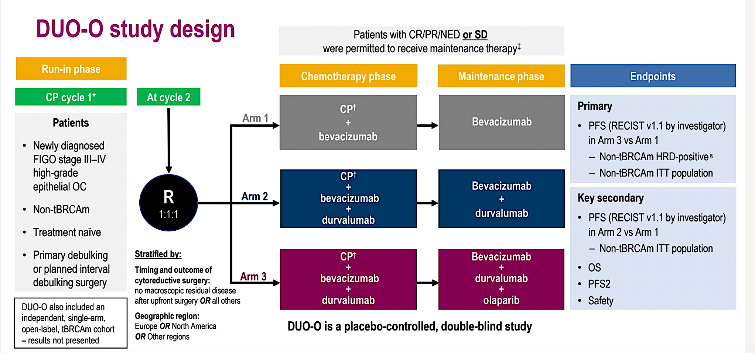

Slide 15
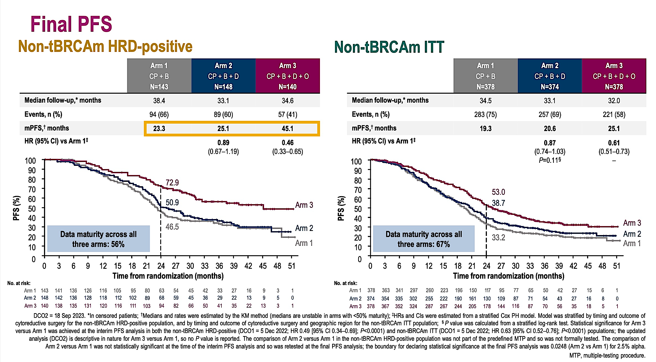

Slide 16
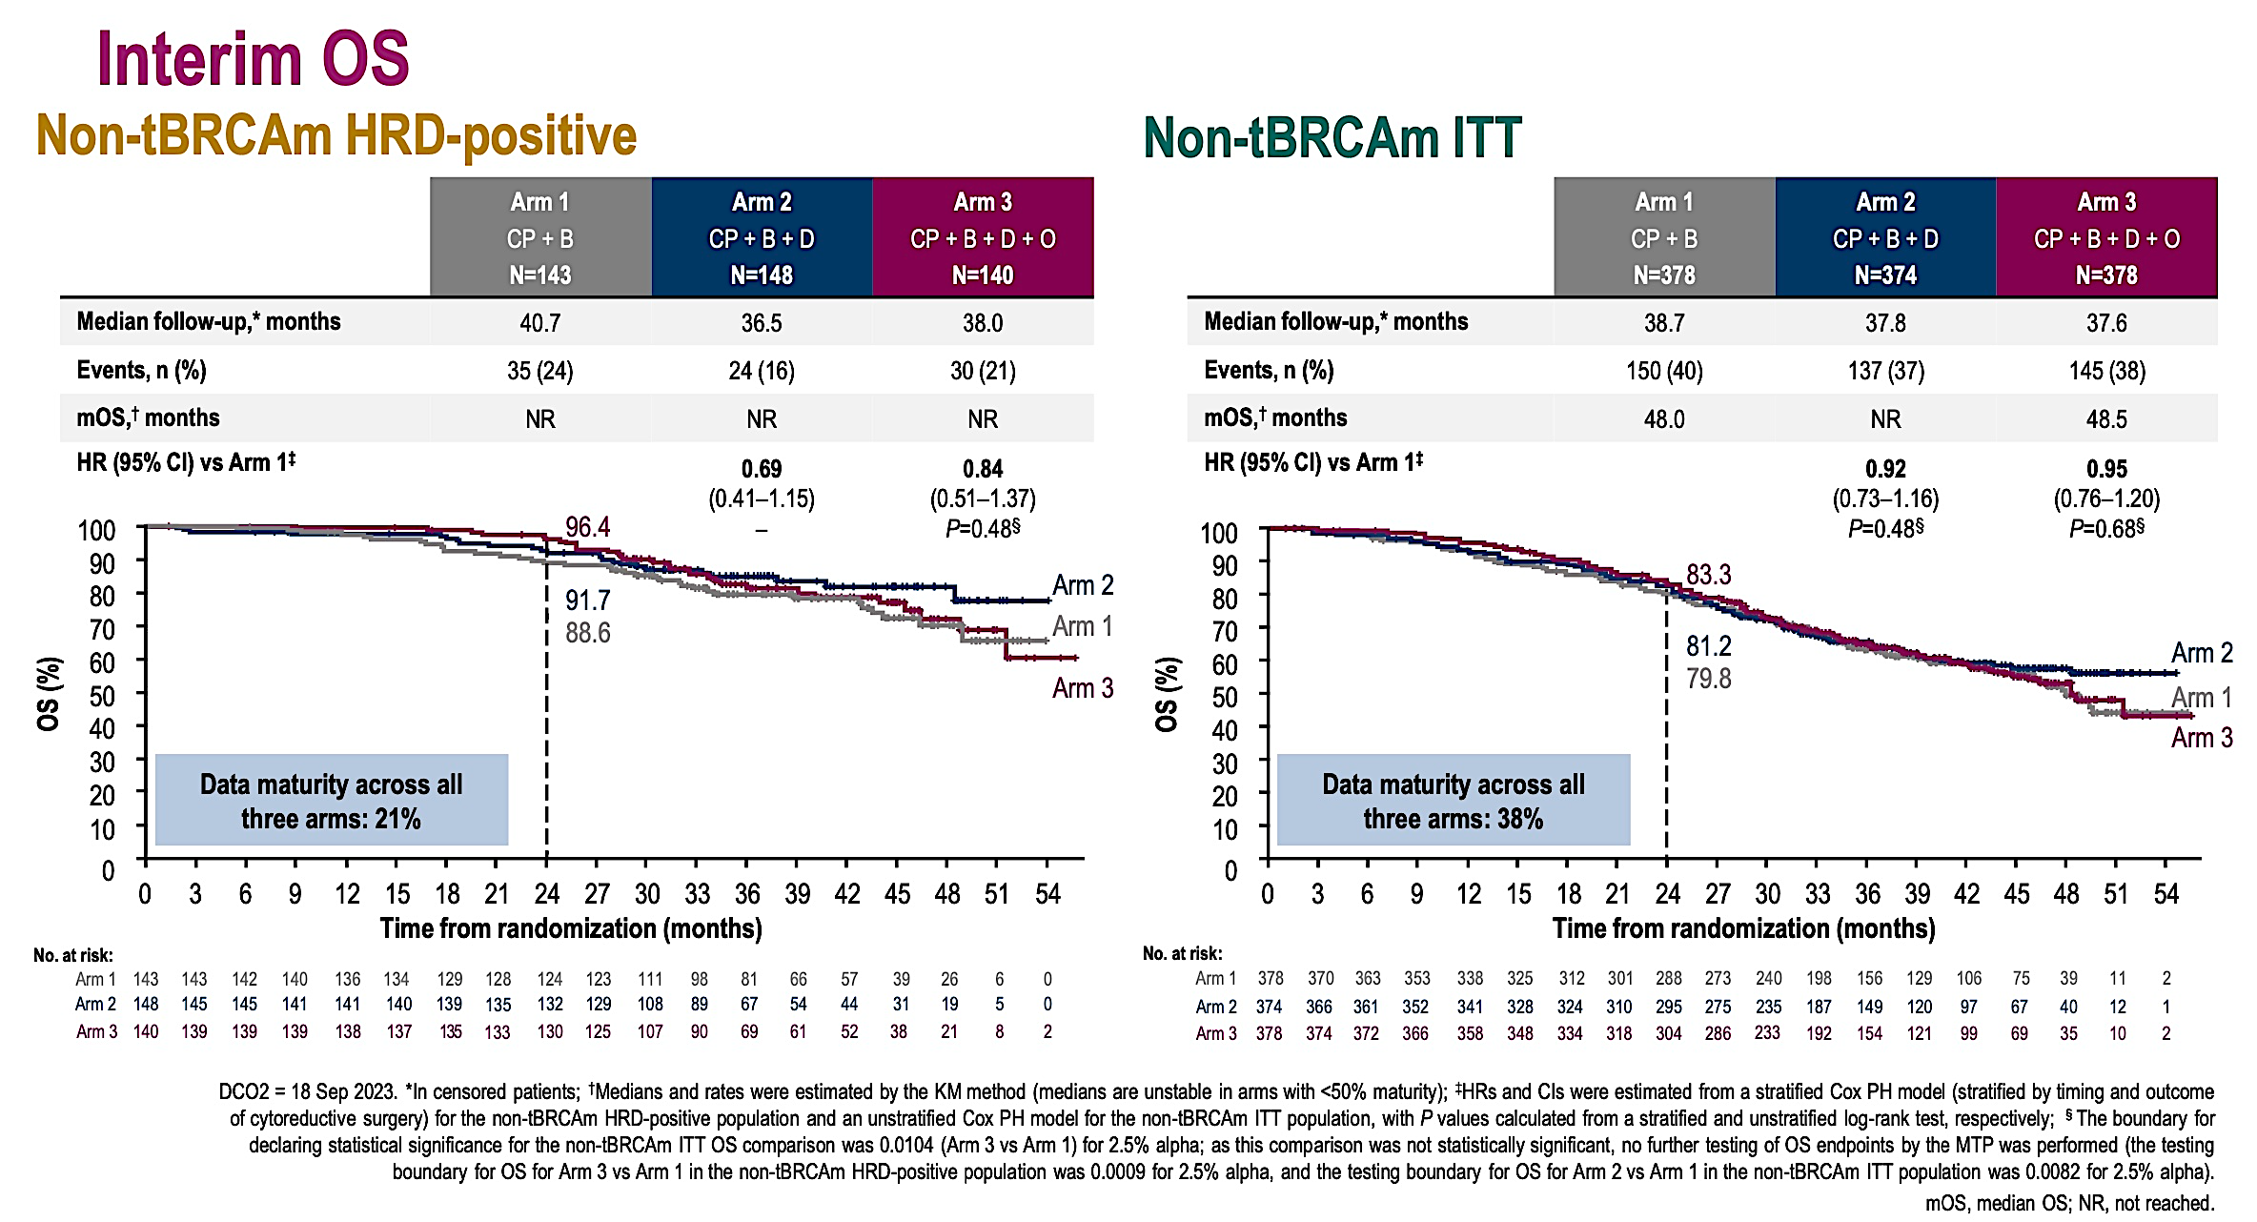

Slide 17
DUO-O and KEYLYNK studies
Both trials have no PARPi (+/- bev) arms as maintenance and cannot compare the experimental PARP/IO (+/-bev) to SOC PARPi maintenance
Based on these 3 studies – FIRST, DUO-O and KEYLYNK – data does not support adding an IO agent to a PARPi as maintenance nor justification for using an IO in the upfront setting

Slide 18
PAOLA-1: Updated PFS and final OS based on clinical risk and HRD status
Post-hoc analysis
PAOLA-1: 806 pts w/ advanced high grade ovarian cancer randomized after response to carbo/paclitaxel chemotherapy to Bevacizumab maintenance vs Bev + Olaparib
Risk definition:
Higher Risk: Pts with stage III disease who had upfront surgery/had residual disease, received neoadjuvant chemotherapy, or stage IV disease
Lower Risk: stage III pts who had upfront surgery and had complete resection
74% higher risk, 26% of pts were lower risk
Findings:
HRD+ pts
PFS: in higher risk pts, HR was 0.46 (0.34-0.61); in lower risk pts, HR 0.26 (0.15-0.45)
OS: in higher risk pts, HR 0.7 (0.5-1.0); in lower risk pts, HR 0.31 (HR 0.14-0.66)
HRP pts
No benefit of addition of olaparib to bev for PFS or OS was seen regardless of risk
Lorusso et al, Int J of Gyn Cancer 2024

Slide 19
Recurrent ovarian cancer
Avutometinib and defactinib: IGCS 2024, SGO 2025
ROSELLA ASCO 2025
KNB96: Press release May 2025
Raludotatug deruxtecan: SGO 2024
MIRASOL final OS results: SGO 2025

Slide 20
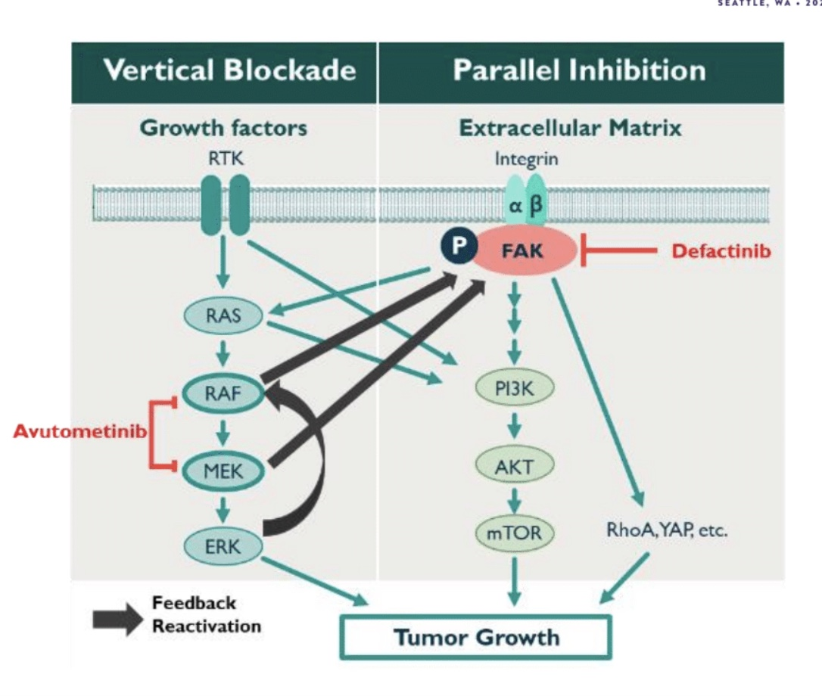
Avutometinib and defactinib for recurrent low grade serous cancer
Combination was granted FDA accelerated approval on
May 7, 2025 for recurrent KRAS mutated LGSC based on RAMP201

Slide 21
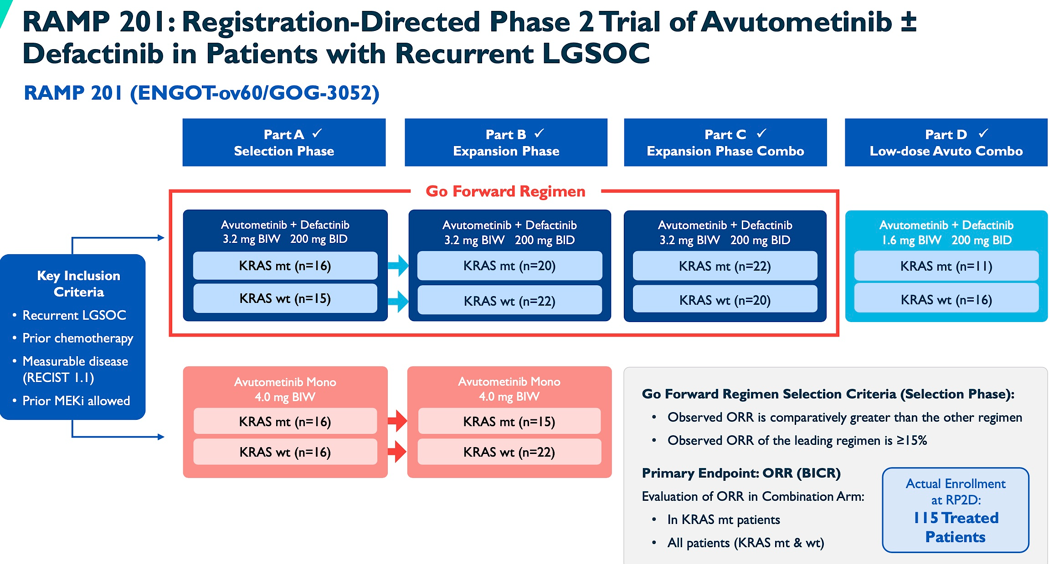
Avutometinib dose 3.2 mg (four
0.8 mg capsules) PO twice per week
(d 1,4). for the first 3 weeks of each
4 week cycle
Defactinib 200 BID PO for 3 weeks
out of 4 weeks
Phase 3 RAMP 301 trial is ongoing (NCT06072781) which is evaluating avutometinib plus defactinib vs investigator’s choice of treatment in patients with recurrent low-grade serous ovarian cancer
IGCS 2024, SGO 2025

Slide 22
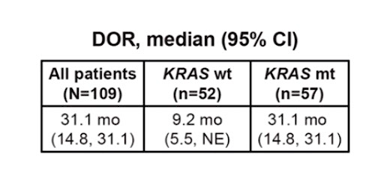
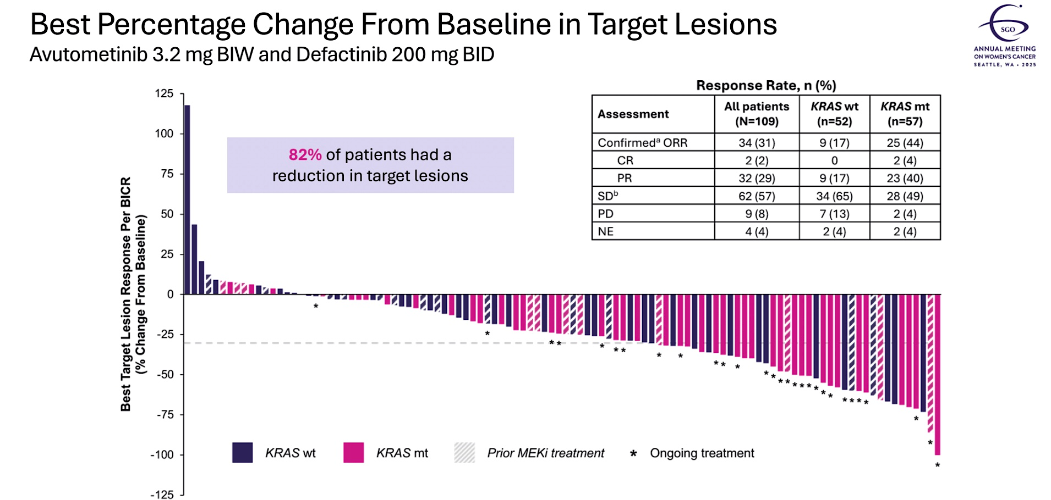
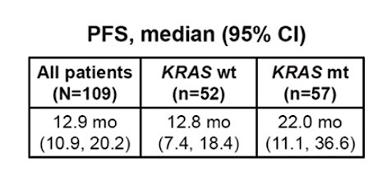
RAMP 201
Grisham et al, SGO 2025

Slide 23
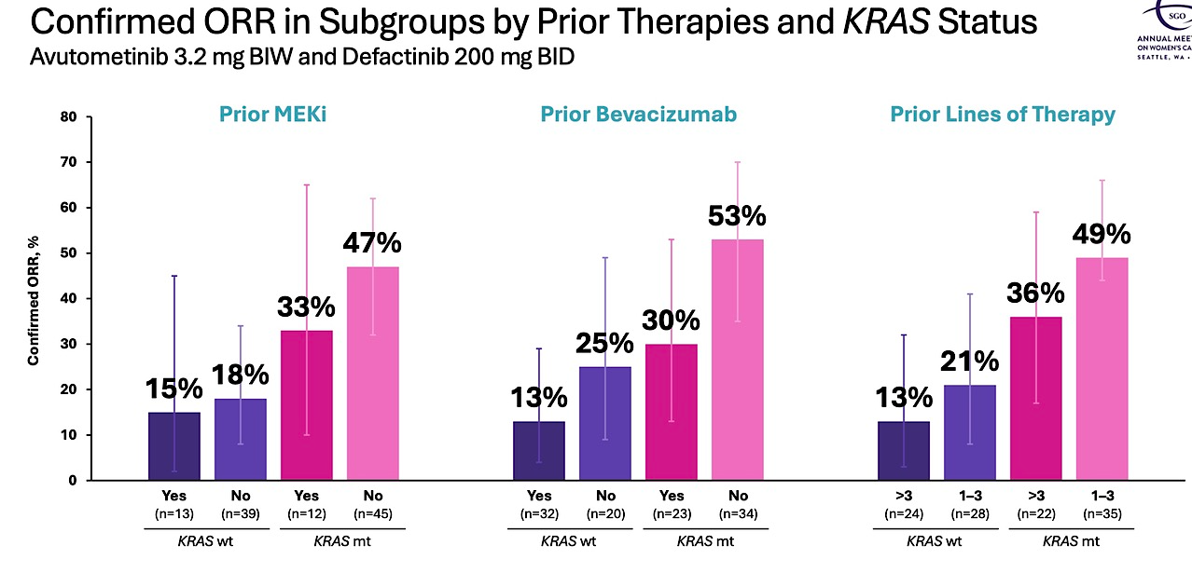
Grisham et al, SGO 2025

Slide 24
Toxicities
80% of pts had AE’s that led to dose interruption
37% of pts had AE’s that led to dose reduction
10% of pts discontinued treatment because of AE’s
--most common reason was for elevated CPK
Grisham et al, SGO 2025

Slide 25
ROSELLA study (ASCO 2025, Lancet 2025)
The glucocorticoid receptor (GR) is a nuclear hormone receptor and transcription factor activated by cortisol and glucocorticoid treatment.
Increased glucocorticoid receptor (GR) expression is associated with decreased overall survival in ovarian cancer patients (Veneris et al, 2017, 2019)
In vitro, GR activation inhibits chemotherapy-induced ovarian cancer cell killing in association – thought to occur because of transcriptional upregulation of anti-apoptotic genes.
Hypothesis: modulating/inhibiting GR activity in combination with chemotherapy may improve pt outcomes.
Relacorilant: selective GR modulator
RP2 study (JCO 2023):
Patients were randomly assigned 1:1:1 to:
(1) nab-paclitaxel (80 mg/m²) + intermittent relacorilant (150 mg the day before, of, and after nab-paclitaxel)
(2) nab-paclitaxel (80 mg/m²) + continuous relacorilant (100 mg once daily)
(3) nab-paclitaxel monotherapy (100 mg/m²)

Slide 26
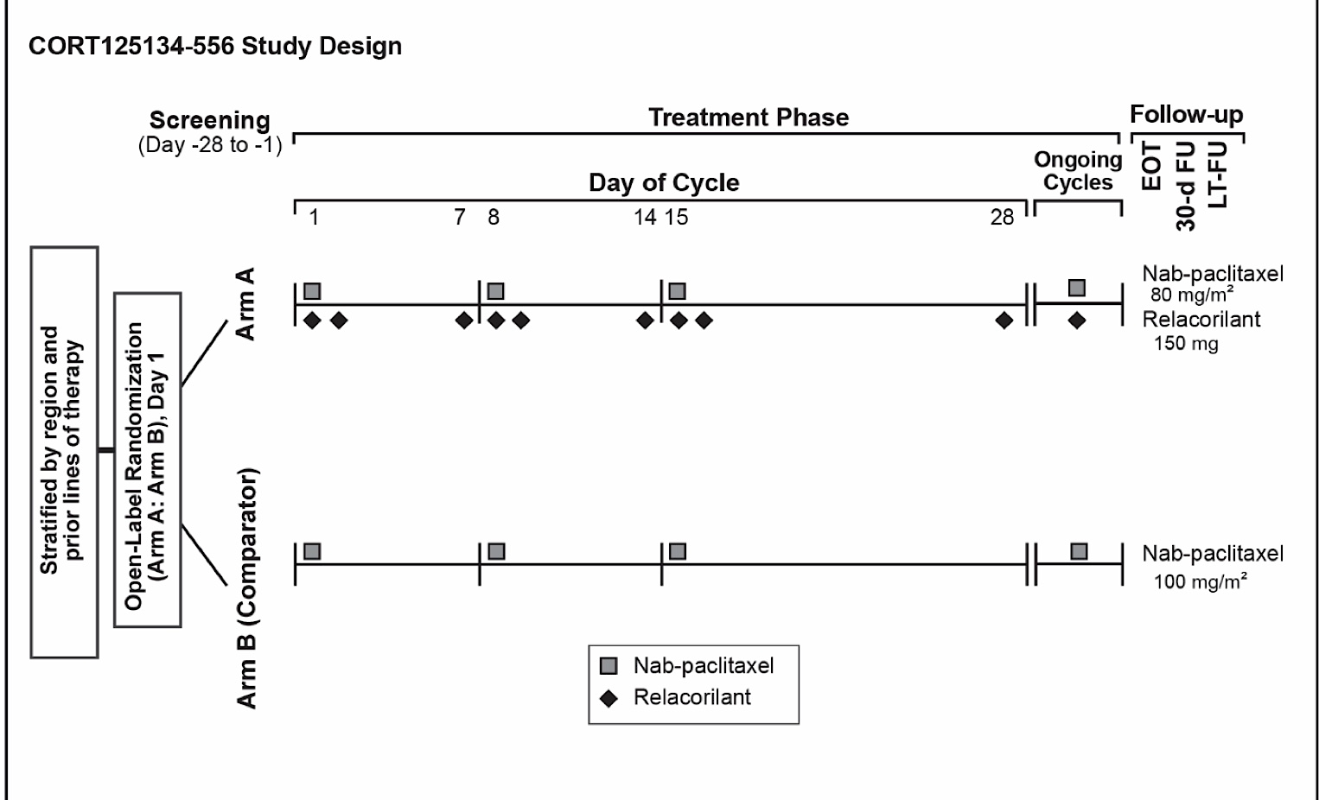
ROSELLA study design
Lancet 2025, suppl data

Slide 27
ROSELLA study statistics
PFS: with a 1:1 randomization, 230 events could show that the study had an 86.4% power to detect a 50% increase in PFS (HR 0.66) with a long rank test at a 2 sided 𝛂 = 0.04 significance.
OS: OS was allocated a 2 sided 𝛂 = 0.01 significance. If PFS null hypothesis is rejected, then OS would be tested at 𝛂 = 0.05
Interim analysis:
PFS performed per the statistical plan
OS was conducted at an 𝛂 = 0.0001 (constituted alpha spending)
Formal final OS analysis:
OS will be conducted at an 𝛂 = 0.0499 level because PFS as assessed by BICR was significant.
ASCO 2025, Lancet 2025

Slide 28
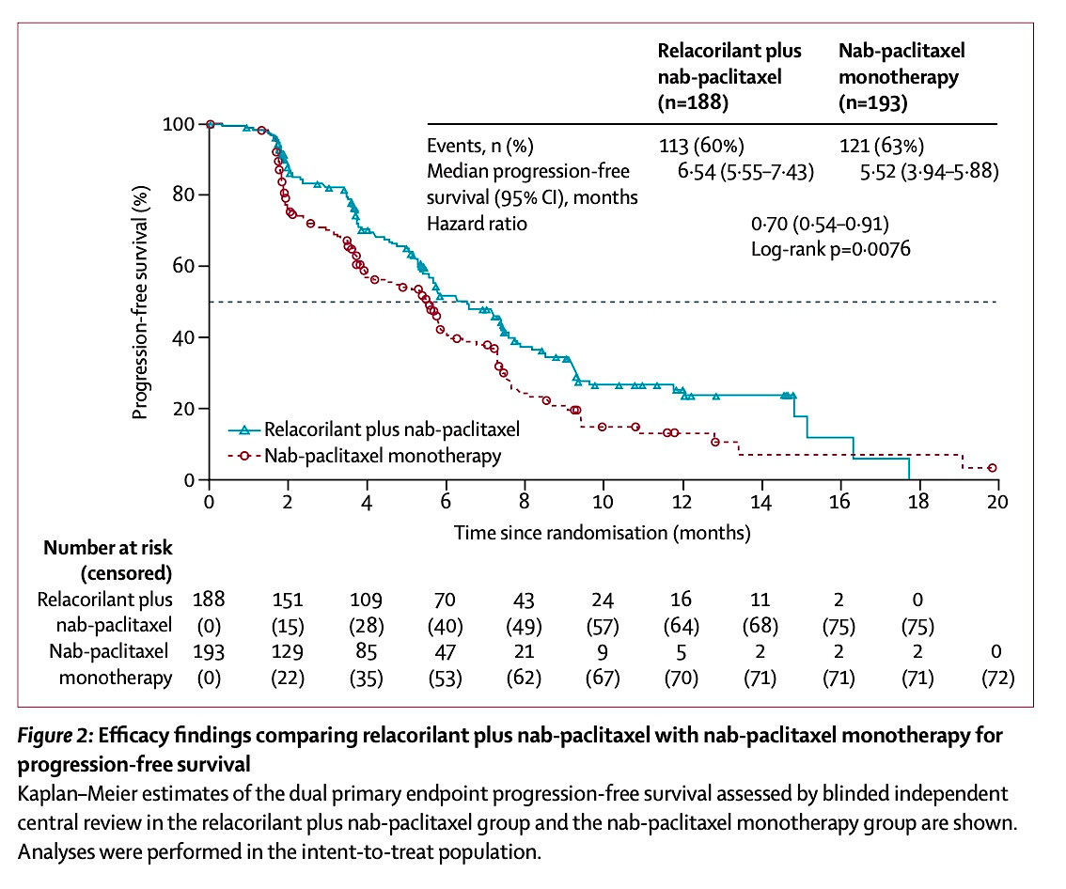
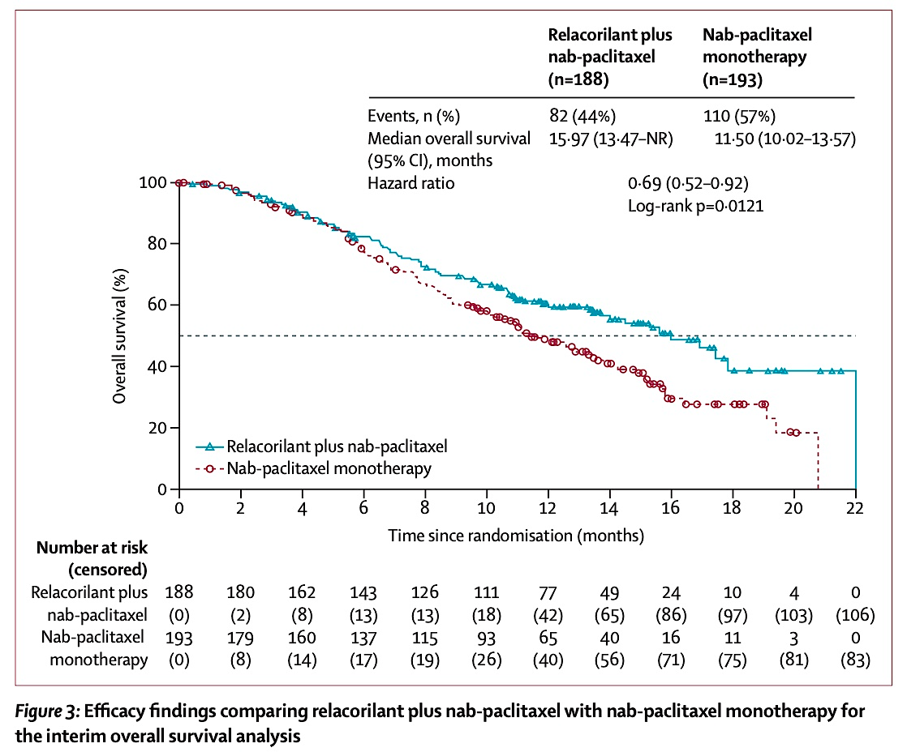
PFS OS

Slide 29
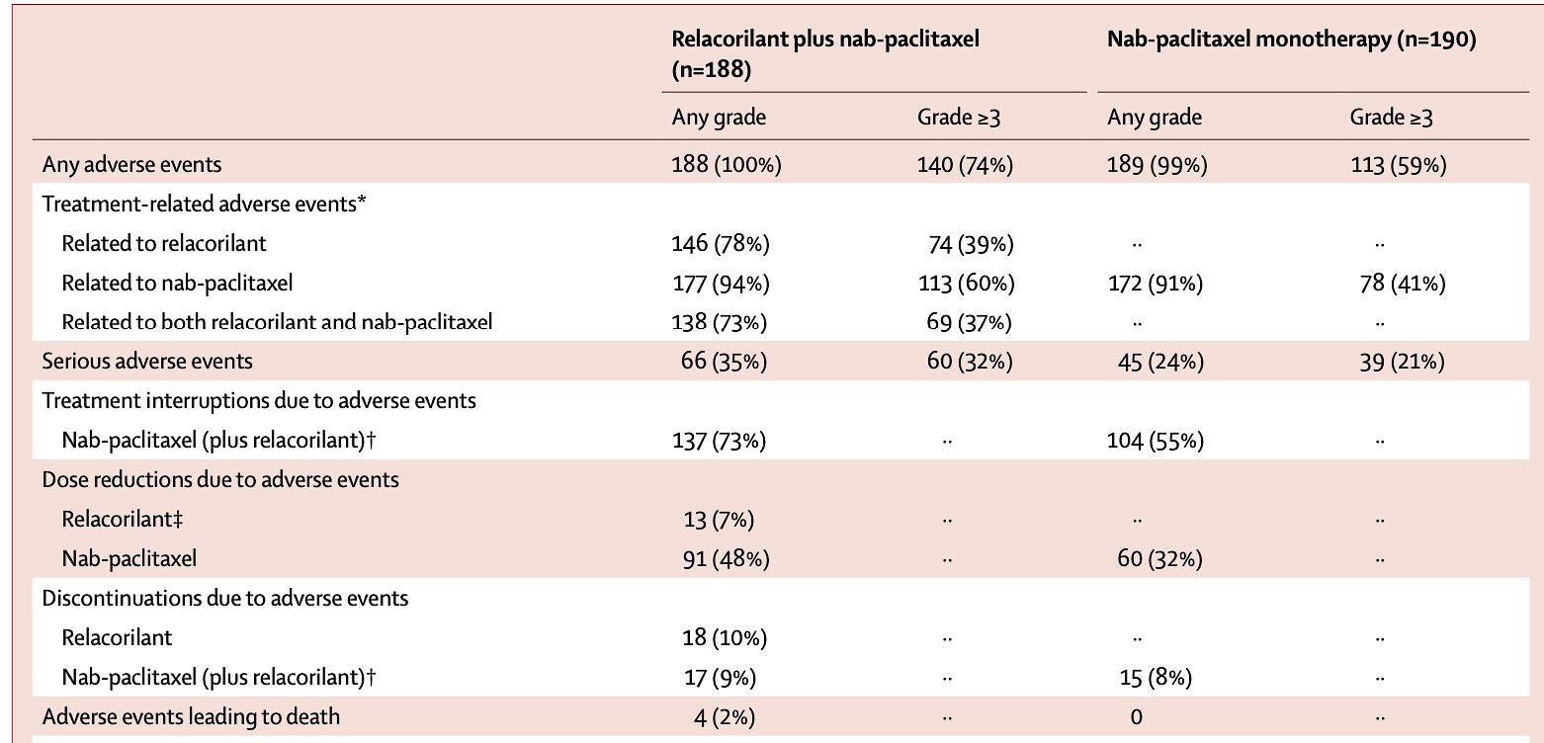
Toxicities
Higher rate of ≥ grade 3 neutropenia and anemia in the combination arm
Lancet 2025

Slide 30
Reservations about the ROSELLA study
Lancet paper and ASCO 2025 data represent an interim analysis:
OS benefit is not statistically significant
Very minimal PFS benefit for the experimental arm
Non-blinded study
Nab-paclitaxel is not used standardly
No control over what patients received post treatment
Mix of ovarian cancer histologies enrolled
No quantification of the glucocorticoid receptor
Higher rate of grade 3 or higher neutropenia and anemia in the combination arm
ASCO 2025, Lancet 2025

Slide 31
Phase 3, randomized, double-blind study of pembrolizumab versus placebo plus paclitaxel with optional bevacizumab for platinum-resistant recurrent ovarian KEYNOTE-B96
Study design:
Pembrolizumab + weekly paclitaxel ± bev vs placebo + weekly paclitaxel ± bev in pts with platinum resistant ovarian cancer
Eligibility:
Histologically confirmed recurrent platinum resistant epithelial ovarian cancer
Up to 1-2 prior lines of systemic therapy, including ≥1 prior platinum-based therapy with ≥4 cycles in first line
Randomization was stratified by:
Planned bev use (yes vs no)
Region (US vs Europe vs rest of world),
PD-L1 status (combined positive score [CPS] <1 vs CPS 1-<10 vs CPS ≥10).
Primary endpoint is PFS by investigator in pts with tumor PD-L1 CPS ≥1 and in all pts.
Secondary endpoints are OS in pts with tumor PD-L1 CPS ≥1 and in all pts, PFS per RECIST v1.1 by BICR in pts with tumor PD-L1 CPS ≥1 and in all pts,
safety and PROs

Slide 32
KEYNOTE-B96
Planned accrual was 643 pts
Pembro dose: 400 mg IV every 6 weeks
Paclitaxel dose/schedule: 80 mg/m2 per week on a 3 weekly schedule
Press release May 15th 2025:
Trial met its primary endpoint of PFS for platinum-resistant recurrent ovarian cancer whose tumors expressed PD-L1 and in all comers.
The study also met a secondary endpoint of OS in patients whose tumors express PD-L1.
KN100 (Ann Onc 2019)
Pembro alone in plat resistant ovarian cancer:
ORR based on CPS: 4.1% for CPS <1, 5.7% CPS ≥1, and 10.0% for CPS ≥10.
No additional molecular determinants identified for prediction of response (Gyn Onc 2023)

Slide 33
Final OS results of MIRASOL
Phase 3 randomized trial of mirvetuximab versus IC’s chemotherapy (weekly paclitaxel, PLD or topotecan)
Eligibility: PROC/high grade serous, FOLR1+, prior bev not mandated, up to 3 prior lines of treatment
Primary platinum refractory ovarian cancer excluded (Primary PFI < 3 months)
Pts randomized 1:1 to mirvetuximab vs IC chemotherapy
Primary endpoint: PFS by investigator
Key secondary endpoint: OS, ORR, mDOR, safety
Van Gorp et al, SGO 2024

Slide 34
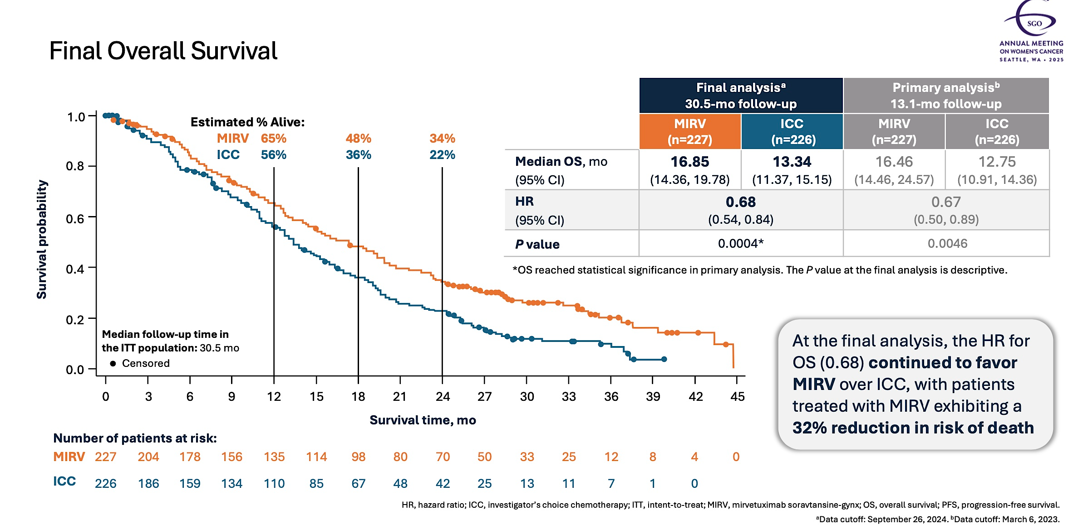
Final OS: First trial in platinum resistant OC to show an OS benefit
Van Gorp et al, SGO 2024

Slide 35
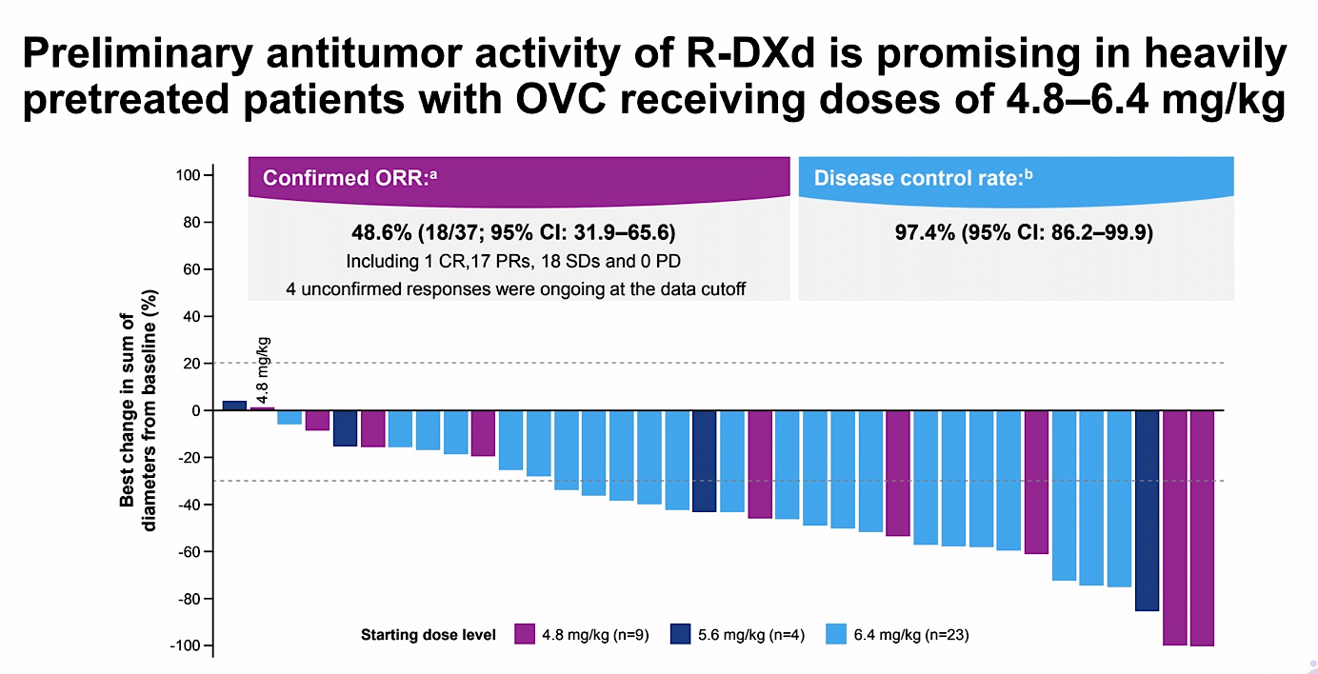
Raludotatug deruxtecan
DAR ~8
Anti-CDH6 ADC
Moore et al, SGO 2024

Slide 36
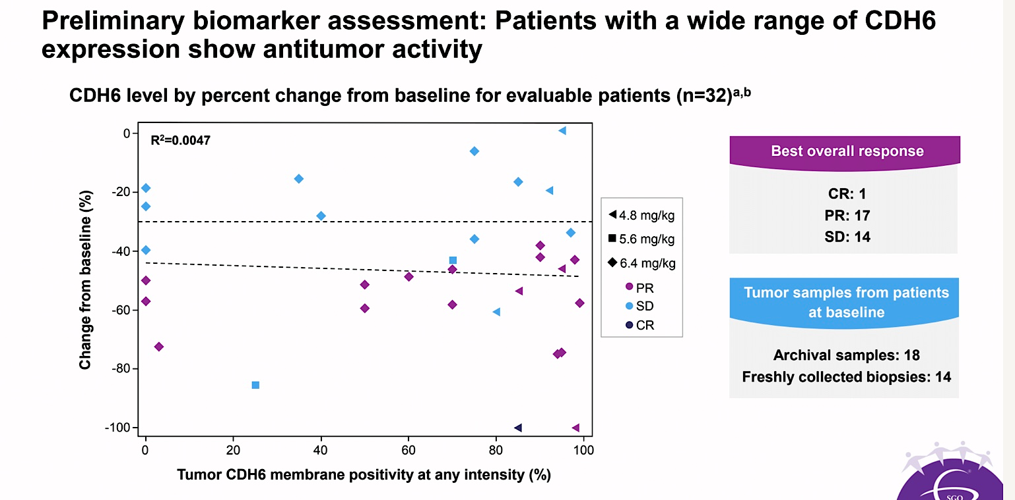
Moore et al, SGO 2024

Slide 37
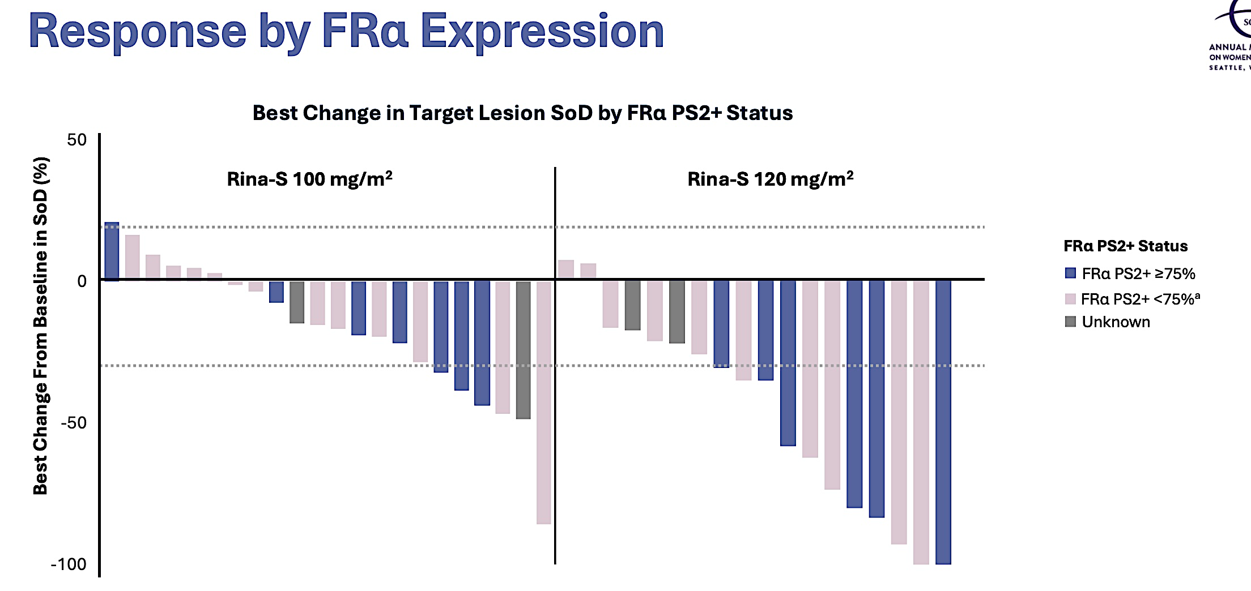
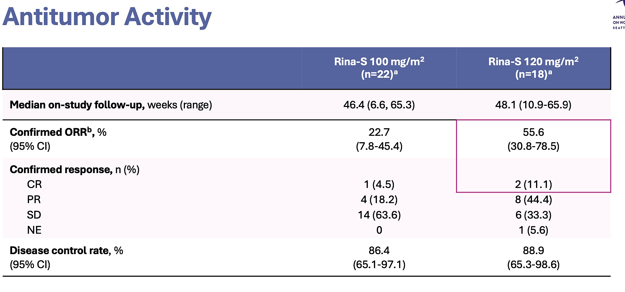
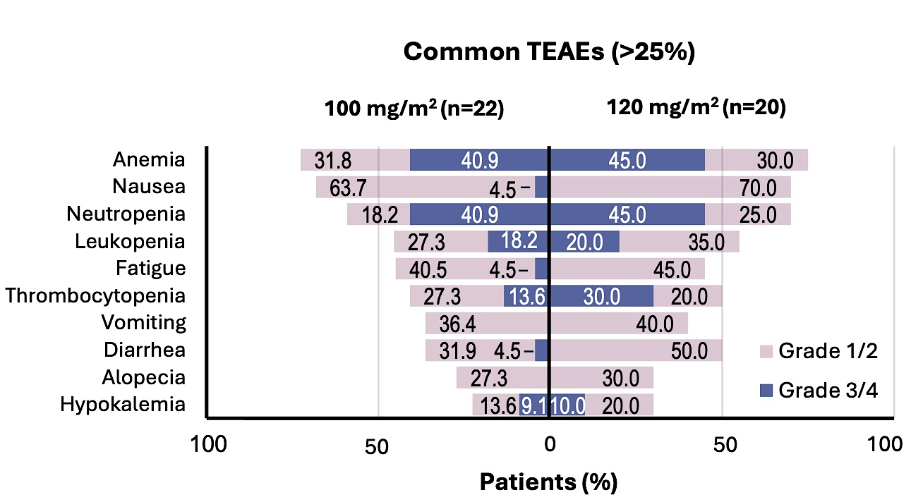
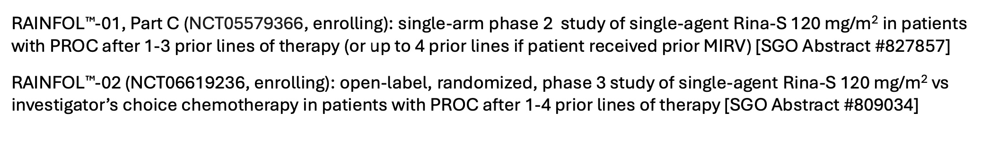
Rinatabart sesutecan
Lee et al, SGO 2025

Slide 38
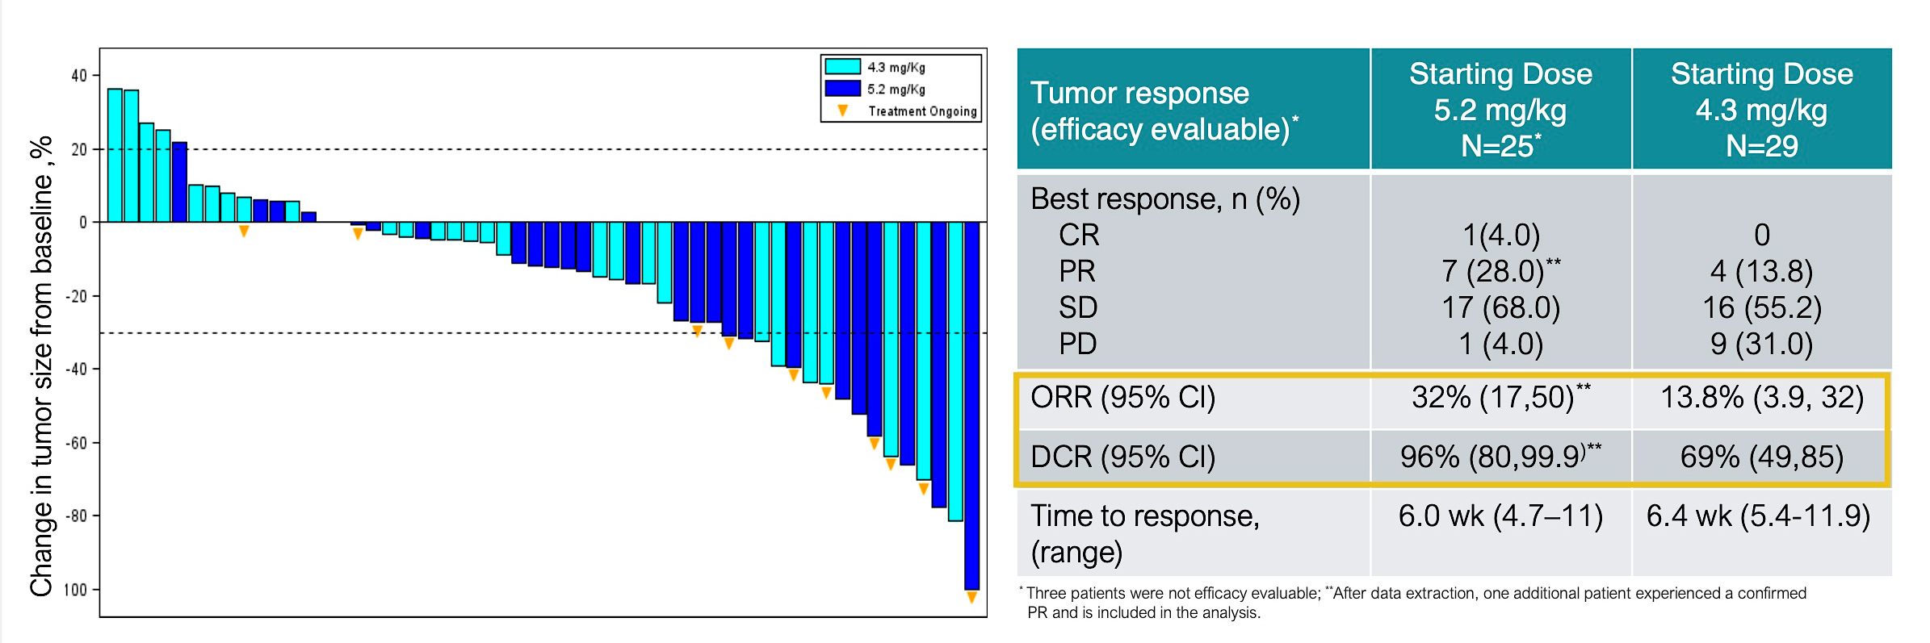
Luveltamab tazevibulin
March 13, 2025 press release:
-The pharmaceutical company will continue to advance exatecan and dual-payload ADC programs; luveltamab tazevibulin development will be deprioritized
March 15, 2025 SGO presentation
Lee et al, SGO 2025

Slide 39
Phase 2/3 ongoing or planned ADC studies in ovarian cancer
Line of therapy | Phase of trial | Year launched | ADC | Payload | Trial name | Trial design | NCT#
1st line | III | 2025 | Trastuzumab Deruxtecan (HER2) | Topo 1 | ENGOT-ov89/DESTINY-OV-01 | Maintenance HER2+ | NCT06819007
2nd line platinum sensitive | III | not yet | Sacituzumab-tirumotecan (Sac-TMT) (TROP-2) | Topo 1 | ENGOT-ov-84/GEICO141/MK-2870-022 | 2nd line Platinum sens Sac-TMT/bev vs SOC (no biomarker) | NCT06824467
 | III | 2022 | Mirvetuximab (FOLR1) | DM4 | GLORIOSA | Mirvetuximab/bev vs bev alone, as maintenance | NCT05445778
Platinum resistant | II/III | 2023 | Luveltamab tazevibulin (FOLR1) | Topo 1 | ENGOTov79/GEICO134-O/STRO-002-GM3 (REFRaME-01) | up to 4 previous lines, FR𝛂+ | NCT05870748
 | II/III | 2024 | Raludotatug-DXd (CDH6) | Topo 1 | REJOICE-Ovarian01 | up to 3 previous lines, high grade | NCT06161025
 | III | 2024 | Rinatabart sesutecan (FOLR1) | Topo 1 | ENGOT-ov86/GEICO152-O/RAINFOL-OV2 | up to 4 lines high grade | NCT06619236

