Slide 1
Ovarian Cancer
Understanding the Current Paradigm and
New Approaches in the Care of Patients with Cancer
A Complimentary NCPD Hybrid Symposium Series Held During the 50th Annual ONS Congress
Friday, April 11, 2025
12:15 PM – 1:45 PM
Faculty
Courtney Arn, CNP
Jennifer Filipi, MSN, NP
David M O’Malley, MD
Shannon N Westin, MD, MPH, FASCO, FACOG
Moderator
Neil Love, MD

Slide 2




Faculty
Courtney Arn, CNP
The James Cancer Hospital
and Solove Research Institute
The Ohio State University
Columbus, Ohio
David M O’Malley, MD
Director and Professor
Division of Gynecologic Oncology in Obstetrics
and Gynecology
John G Boutselis Chair in Gynecologic Oncology
The Ohio State University and The James Comprehensive Cancer Center
Columbus, Ohio
Jennifer Filipi, MSN, NP
Department of Gynecologic Oncology
Massachusetts General Hospital Cancer Center
Boston, Massachusetts
Shannon N Westin, MD, MPH, FASCO, FACOG
Professor
Medical Director, Gynecologic Oncology Center
Director, Early Drug Development
Department of Gynecologic Oncology and Reproductive Medicine
The University of Texas
MD Anderson Cancer Center
Houston, Texas

Slide 3
Ms Arn — Disclosures
Speakers Bureaus | AbbVie Inc, AstraZeneca Pharmaceuticals LP, Eisai Inc, Genmab US Inc, ImmunoGen Inc, Merck, Pfizer Inc

Slide 4
Ms Filipi — Disclosures
No relevant conflicts of interest to disclose.

Slide 5
Dr O’Malley — Disclosures
Advisory Committees and Consulting Agreements | AbbVie Inc, AstraZeneca Pharmaceuticals LP, Corcept Therapeutics, Duality Biologics, Genmab US Inc, GSK, Merck, MSD, Regeneron Pharmaceuticals Inc, Seagen Inc, Sumitomo Dainippon Pharma Oncology Inc, Sutro Biopharma, Verastem Inc
Contracted Research | AbbVie Inc, Adaptimmune, Advaxis Inc, Agenus Inc, Alkermes, Aravive Inc, Arcus Biosciences, Arquer Diagnostics, AstraZeneca Pharmaceuticals LP, Atossa Therapeutics, BeiGene Ltd, Bristol Myers Squibb, Cardiff Oncology, Celcuity, Clovis Oncology, Corcept Therapeutics, Deciphera Pharmaceuticals Inc, Duality Biologics, Eisai Inc, Elevar Therapeutics, EMD Serono Inc, Exelixis Inc, Genelux Corporation, Genentech, a member of the Roche Group, Genmab US Inc, GSK, ImmunoGen Inc, Imvax Inc, Incyte Corporation, InterVenn Biosciences, InxMed, Iovance Biotherapeutics, Janssen Biotech Inc, Jazz Pharmaceuticals Inc, Karyopharm Therapeutics, Laekna Therapeutics, Leap Therapeutics Inc, Luzsana Biotechnology, Merck, Mersana Therapeutics Inc, MSD, Myriad Genetic Laboratories Inc, Novartis, Novocure Inc, Onconova Therapeutics Inc, OncoQuest Inc, Pfizer Inc, Predictive Oncology Inc, Prelude Therapeutics, Regeneron Pharmaceuticals Inc, Replimune, Roche Laboratories Inc, R-Pharm US, Rubius Therapeutics, Seagen Inc, Sorrento Therapeutics, Sumitomo Dainippon Pharma Oncology Inc, Sutro Biopharma, Tarveda Therapeutics, Tesaro, A GSK Company, Toray Industries Inc, Trillium Therapeutics Inc, Umoja Biopharma, VBL Therapeutics, Verastem Inc, Vincerx Pharma, Xencor, Zentalis Pharmaceuticals
Nonrelevant Financial Relationships | Amarex Clinical Research, GOG Foundation, Ludwig Institute for Cancer Research Ltd, National Cancer Institute, NRG Oncology, RTOG Foundation, SWOG

Slide 6
Dr Westin — Disclosures
Consulting Agreements | AstraZeneca Pharmaceuticals LP, Bayer HealthCare Pharmaceuticals, Caris Life Sciences, Clovis Oncology, Corcept Therapeutics, Daiichi Sankyo Inc, Eisai Inc, EQRx, Genentech, a member of the Roche Group, Gilead Sciences Inc, GSK, Immunocore, ImmunoGen Inc, Incyte Corporation, Lilly, Loxo Oncology Inc, a wholly owned subsidiary of Eli Lilly & Company, Merck, Mereo BioPharma, Mersana Therapeutics Inc, NGM Biopharmaceuticals, Nuvectis Pharma Inc, Pfizer Inc, pharmaand GmbH, Seagen Inc, Verastem Inc, Vincerx Pharma, Zentalis Pharmaceuticals, ZielBio
Contracted Research (to Institution) | AstraZeneca Pharmaceuticals LP, Avenge Bio, Bayer HealthCare Pharmaceuticals, Bio-Path Holdings Inc, Clovis Oncology, Daiichi Sankyo Inc, Genentech, a member of the Roche Group, GSK, Jazz Pharmaceuticals Inc, Loxo Oncology Inc, a wholly owned subsidiary of Eli Lilly & Company, Mereo BioPharma, Novartis, Nuvectis Pharma Inc, Pfizer Inc, pharmaand GmbH, Zentalis Pharmaceuticals

Slide 7
Commercial Support
This activity is supported by educational grants from AstraZeneca Pharmaceuticals LP, GSK, and Merck.
Research To Practice NCPD Planning Committee Members,
Staff and Reviewers
Planners, scientific staff and independent reviewers for Research To Practice have no relevant conflicts of interest to disclose.

Slide 8
This educational activity contains discussion of
non-FDA-approved uses of agents and regimens. Please refer to official prescribing information for each product for approved indications.

Slide 9
Agenda
Introduction: Overview of Ovarian Cancer (OC) Management
Module 1: Genetic Testing for Newly Diagnosed Advanced OC
Module 2: Role of PARP Inhibitor Maintenance in Newly Diagnosed Advanced OC
Module 3: Other Available and Investigational Novel Strategies for OC
Module 4: Current and Future Role of Mirvetuximab Soravtansine in OC Treatment

Slide 10
Agenda
Introduction: Overview of Ovarian Cancer (OC) Management
Module 1: Genetic Testing for Newly Diagnosed Advanced OC
Module 2: Role of PARP Inhibitor Maintenance in Newly Diagnosed Advanced OC
Module 3: Other Available and Investigational Novel Strategies for OC
Module 4: Current and Future Role of Mirvetuximab Soravtansine in OC Treatment

Slide 11
Case study
Patient with history of IIIC high grade serous ovarian cancer
Initially presented with abdominal pain and was found to have bilateral pelvic masses and elevated CA-125
Underwent debulking surgery and 6 cycles of carboplatin/paclitaxel
Germline BRCA2 mutation
Counseled on parp inhibitors immediately
Completed 2 years of maintenance Olaparib 300 mg BID in 2022
Tolerated treatment well, currently has no evidence of disease
Biopsychosocial Issues: Adopted, good family support, history of stroke
Courtesy of Courtney Arn, CNP

Slide 12
Agenda
Introduction: Overview of Ovarian Cancer (OC) Management
Module 1: Genetic Testing for Newly Diagnosed Advanced OC
Module 2: Role of PARP Inhibitor Maintenance in Newly Diagnosed Advanced OC
Module 3: Other Available and Investigational Novel Strategies for OC
Module 4: Current and Future Role of Mirvetuximab Soravtansine in OC Treatment

Slide 13
Overview of Ovarian Cancer Management; Importance of Genetic Testing in Newly Diagnosed Advanced OC
Shannon N. Westin, MD, MPH
Professor
Department of Gynecologic Oncology and Reproductive Medicine

Slide 14
Typical Course of Advanced Ovarian Cancer
Surgery (primary or IDS)
+ primary or adjuvant chemotherapy carboplatin/paclitaxel
+/- bevacizumab
+/- PARPi
Platinum Sensitive
Progression >6 months after completion
of
platinum-based chemotherapy: Good Prognosis
First-Line
Treatment
Stage III, IV
First Response
70-80 %
Relapse/
Progression
(70%-80%)
Second
Response/
Disease Stabilization
Maintenance?
Relapse/
Progression
(100%)
GENETIC TESTING!!!!!
Surveillance every 3 months?
Maintenance Therapy?
Which Agent to Consider
Platinum Resistant
Progression <6 months after completion of platinum-based chemotherapy: Poor Prognosis
Ledermann JA, et al. Ann Oncol. 2013, Pignata S, et al. Ann Oncol. 2017; du Bois A, et al. Cancer 2009, Wilson MK, et al. Ann Oncol. 2017

Slide 15




Germline vs Somatic Mutations
Germline mutation
Somatic mutation
Parental gametes
Parental gametes
Embryo
Embryo
Entire organism carries mutation
Mutation only in affected area
©Medscape, LLC
©Medscape, LLC
Half of gametes carry mutation
No gametes carry mutation
Offspring gametes
Organism
Offspring gametes
Organism
Germline mutations are inherited and found in all cells – they are stable and do not change.
Somatic mutations are not inherited and are found within the tumor – they can change over time.
Both can impact cancer risk

Slide 16
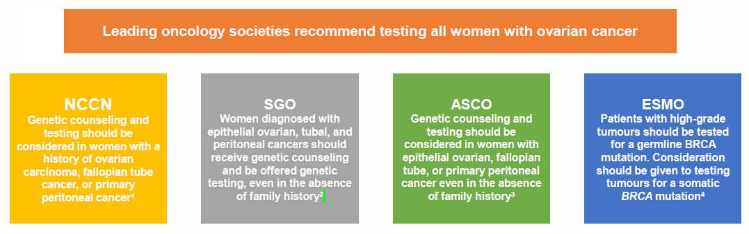
Which genes are associated with ovarian cancer risk and who should we test?
  BRCA1 and BRCA2
  RAD51C, RAD51D, BRIP1, PALB2
  Lynch syndrome (MLH1, MSH2, MSH6, PMS2, EPCAM)
Notes:
Add in pedigree example of family with unsolved genetics

Slide 17
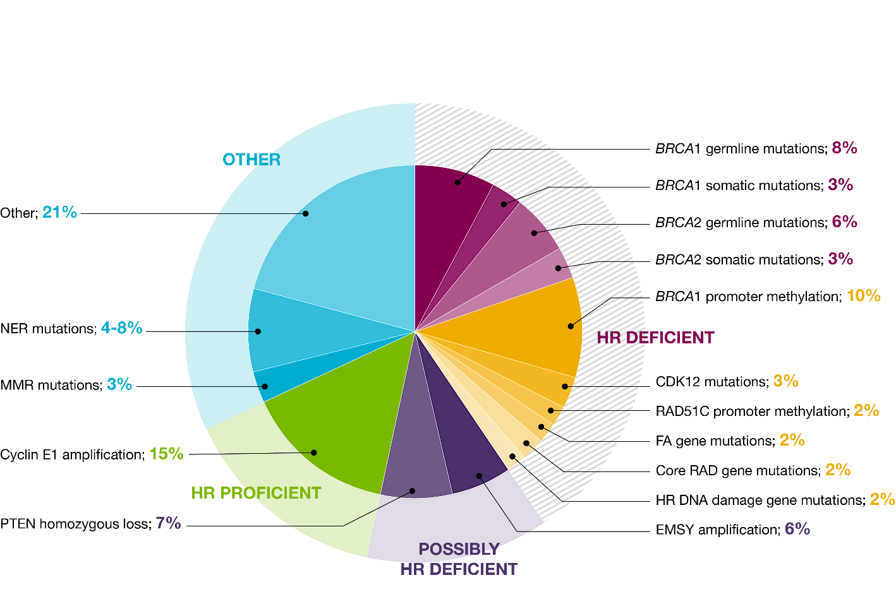
Clinical Implications:
Approximately 50% High Grade Epithelial Ovarian Cancers Characterized by HRD
Is this targetable in recurrent epithelial ovarian cancer?
Common Aberrations in Ovarian Cancer
These defects can be identified using different clinical and molecular biomarkers
Konstantinopoulos PA, et al. Cancer Discov. 2015
Notes:
Speaker notes are for internal use only and are not to be shown or disseminated outside of AstraZeneca

Slide 18
Importance of Cascade Testing
50/50 Risk for first degree relatives
Cancer Prevention
Screening for Early Detection

Slide 19
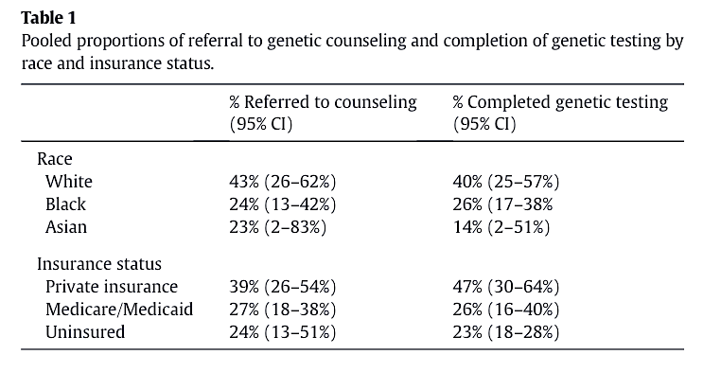
Universal Genetic Testing: Missed Opportunities
Meta-analysis (n=35 studies)
39% Referral to genetic counseling
30% Completion of genetic testing
Lin et al Gyn Onc 2021

Slide 20
New Testing Paradigm
DIAGNOSIS OF EPITHELIAL OVARIAN CANCER
PAIRED GERMLINE AND SOMATIC
TESTING
SOMATIC TESTING ALONE
GERMLINE TESTING ALONE
GERMLINE TESTING IF POSITIVE
SOMATIC TESTING IF NEGATIVE
HRD TESTING

Slide 21
Molecular Testing in Ovarian Cancer: Which Tests Should Be Used?
MyChoice®
(CDx olaparib, niraparib, veliparib)
FoundationOne®
(CDx rucaparib)
Caris®
Genomic scar score (LOH + LST)
HRD genes, including BRCA1 and BRCA2
=
MyChoice “GIS” Score
Loss of Heterozygosity
Telomeric Allelic Imbalance
Large-Scale State Transitions
Loss of Heterozygosity
Tempus®
BRCA LOH and somatic genome-wide LOH
HRD genes, including BRCA1 and BRCA2
Homologous recombination status is determined by genomic instability score:
HR-deficient tumors: tissue GIS ≥42 or a BRCA mutation
HR-proficient tumors: tissue GIS <42
HR not determined
HR-deficient tumors: LOH ≥16
ª Tests have not been compared head-to-head. Paired with development of respective drugs.

Slide 22
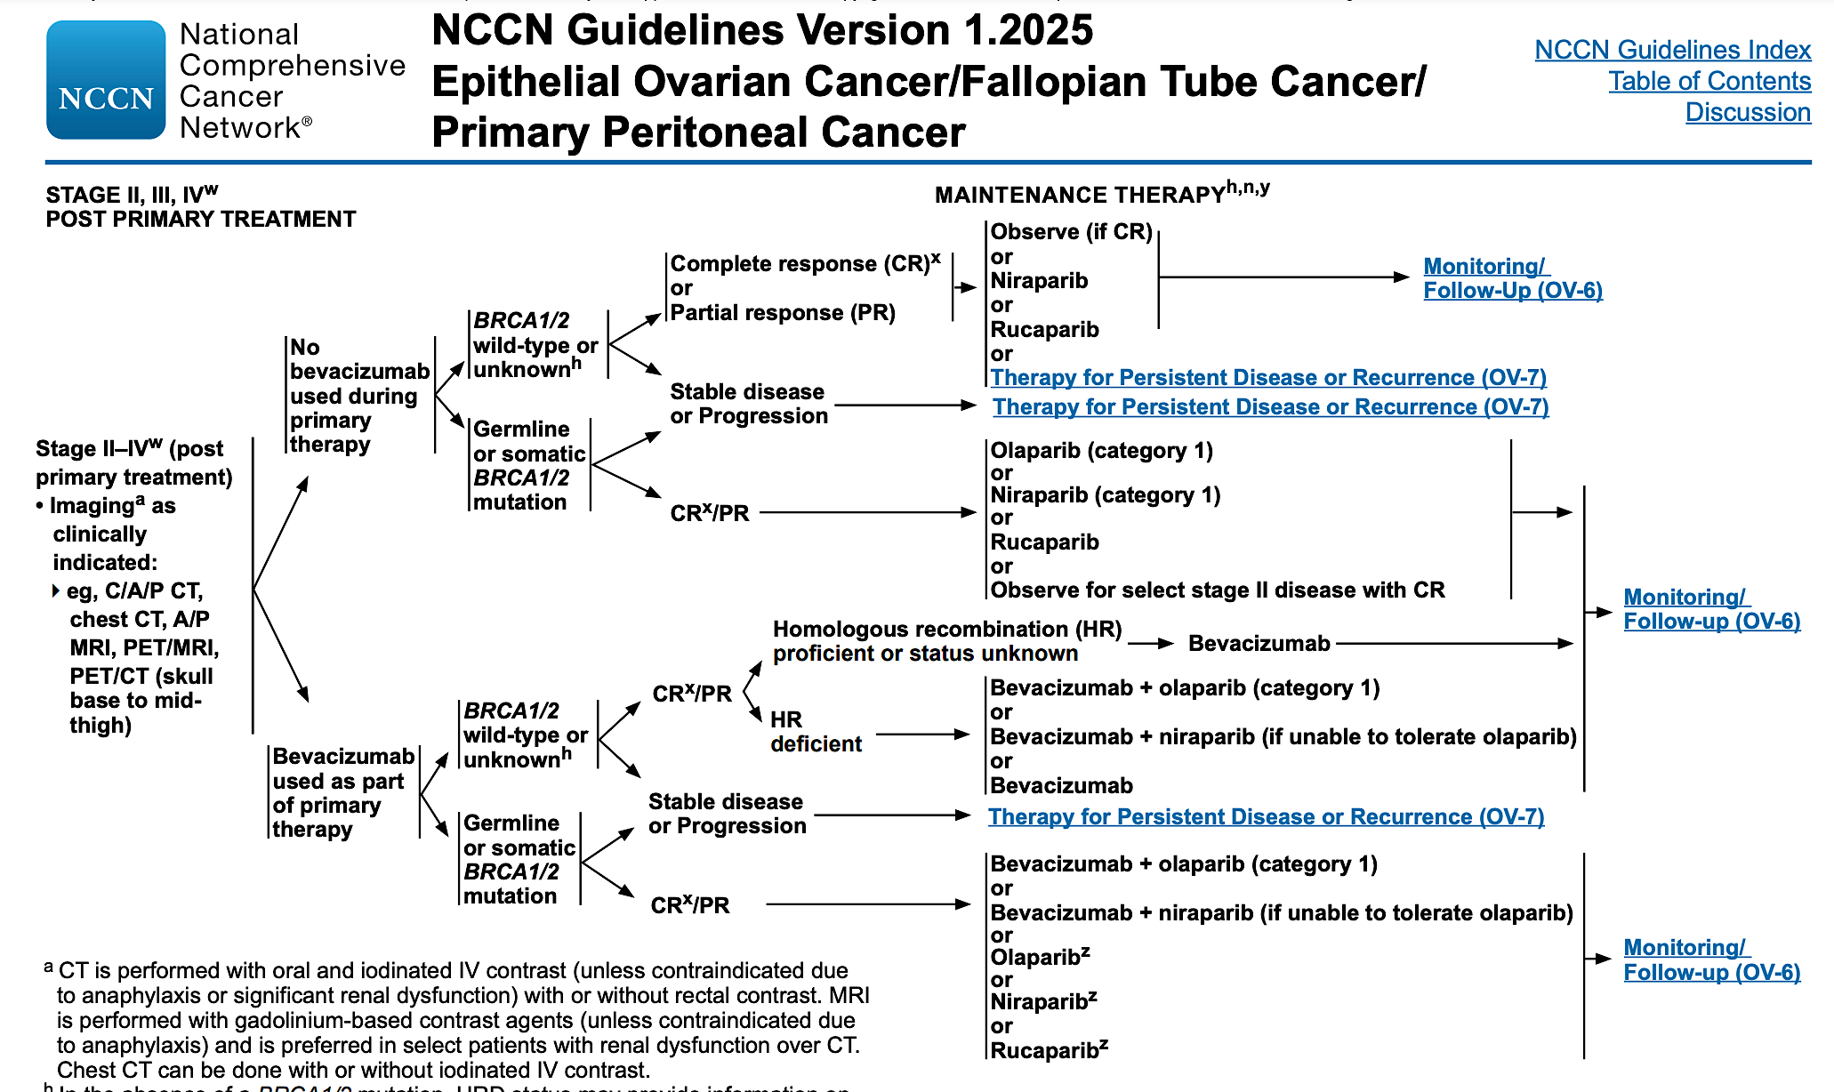

Slide 23
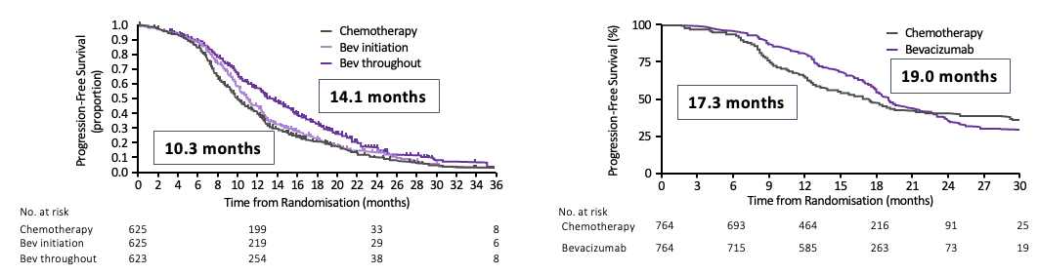
First-Line Chemotherapy Standard of Care:
Carboplatin, Paclitaxel & Bevacizumab + Maintenance
GOG-0218
ICON7
Paclitaxel + carboplatin + placebo
Placebo
Advanced epithelial ovarian cancer
Paclitaxel + carboplatin
Placebo
(Bev Initiation)
Advanced epithelial ovarian cancer
Paclitaxel + carboplatin + bevacizumab
Bevacizumab
(Bev throughout)
Paclitaxel + carboplatin + bevacizumab
Bevacizumab
Cycles 1–6;
+ bevacizumab at cycle 2
Until disease progression
or up to 22 cycles
Cycles 1–6
Until disease progression
or 12 cycles
Burger RA et al. N Engl J Med. 2011; Perren TJ et al. N Engl J Med. 2011

Slide 24
Roundtable Discussion

Slide 25
Agenda
Introduction: Overview of Ovarian Cancer (OC) Management
Module 1: Genetic Testing for Newly Diagnosed Advanced OC
Module 2: Role of PARP Inhibitor Maintenance in Newly Diagnosed Advanced OC
Module 3: Other Available and Investigational Novel Strategies for OC
Module 4: Current and Future Role of Mirvetuximab Soravtansine in OC Treatment

Slide 26
Clinical Scenario
A patient with newly diagnosed advanced OC with a germline BRCA2 mutation has undergone debulking surgery and 6 cycles of carboplatin/paclitaxel and is about to start PARP inhibitor maintenance

Slide 27
Advances in Ovarian Cancer
David O’Malley, MD
Professor
Division Director, Gynecologic Oncology
Co-Director, Gyn Oncology Phase I Program

Slide 28
PARPi in The First Line

Slide 29
Integrated Maintenance Treatment Paradigm for
Use in 1-L Ovarian Cancer ⁽²⁰²²⁾
Supporting Phase 3 trial
IV q 3 week carboplatin + paclitaxel
No bevacizumab
BRCA mut
HRD:
Add PARPi (preferred)
HRP:
Add PARPi
or
Observation
Bevacizumab during chemotherapy and in maintenance
BRCA mut
HRD:
Add PARPi (preferred)
HRP:
Continue bevacizumab
SOLO-1
PRIMA
ATHENA
Decision #1
NACT vs
Primary debulking
PRIMA
ATHENA
PAOLA
Decision #2
Bevacizumab Y/N
GOG 218
GOG 262
Decision #3
Add PARPi?
1. NCCN guidelines. Ovarian Cancer March, 2025.
Notes:
Key Points
Initial treatment for advanced ovarian cancer involves aggressive cytoreduction and platinum-based adjuvant chemotherapy
However, the majority of patients experience disease recurrence, resulting in a cycle of surgeries and additional rounds of chemotherapy
To improve outcomes, several treatment strategies are being tested; however, their role is presently unclear

Slide 30




PARP Inhibitors Yield Synthetic Lethality in Patients With HRD
PARP inhibitors prevent repair of single-strand breaks, which accumulate and generate double-strand breaks
People with HRD cannot repair double-strand breaks, which triggers cell death
PARP
Single-strand break
PARP inhibitors
Double-strand breaks
Normal Cell
Cell with HRD
Repair by
homologous recombination
No homologous
recombination or repair
Cell survival
Cell death
DNA repaired
HRD, homologous recombination deficiency
Sonnenblick A, et al. Nat Rev Clin Oncol. 2015;12(1):27-41.

Slide 31
SOLO-1: Phase III trial investigating maintenance therapy with a PARP inhibitor in newly diagnosed advanced BRCA^{mut} ovarian cancer
Primary endpoint
Newly diagnosed, FIGO
stage III–IV, high-grade serous or endometrioid ovarian, primary peritoneal or fallopian tube cancer
Germline or somatic BRCAm
ECOG performance status 0–1
Cytoreductive surgery*
In clinical complete response or partial response after platinum-based chemotherapy
Study treatment continued until disease progression
Patients with no evidence of disease at 2 years stopped treatment
Patients with a partial response at 2 years could continue treatment
Investigator-assessed PFS (modified RECIST 1.1)
Olaparib 300 mg bd
(N=260)
2:1 randomization
Secondary endpoints
Stratified by response to platinum-based chemotherapy
PFS using BICR
PFS2
Overall survival
Time from randomization to first subsequent therapy or death
Time from randomization to second subsequent therapy or death
HRQoL (FACT-O TOI score)
Placebo
(N=131)
2 years’ treatment if no evidence of disease
*Upfront or interval attempt at optimal cytoreductive surgery for stage III disease and either biopsy and/or upfront or interval cytoreductive surgery for stage IV disease. BICR, blinded independent central review; ECOG, Eastern Cooperative Oncology Group; FACT-O, Functional Assessment of Cancer Therapy –
Ovarian Cancer; FIGO, International Federation of Gynecology and Obstetrics; HRQoL, health-related quality of life; PFS, progression-free survival;
PFS2, time to second progression or death; RECIST, Response Evaluation Criteria in Solid Tumours; TOI, Trial Outcome Index
Moore et al ESMO 2018; NEJM 2018

Slide 32
SOLO-1 TFST substantially delayed by maintenance olaparib
 | Olaparib (N=260) | Placebo (N=131)
Events, n (%) | 135 (51.9) | 98 (74.8)
Median TFST, months | 64.0 | 15.1
 | HR 0.37 (95% CI 0.28–0.48)
100
90
80
70
60
51.2%
Patients free from first subsequent
therapy or death (%)
45.3%
50
40
Olaparib
30
20
22.5%
20.6%
Placebo
10
0
0
6
12
18
24
30
36
42
48
54
60
66
72
78
84
90
96
102
No. at risk
Months since randomization
Olaparib
260
240
223
203
190
160
147
141
132
125
119
115
111
102
75
31
5
0
Placebo
131
114
79
55
45
39
32
28
26
25
25
24
24
23
18
4
1
0
Paul DiSilvestro, et al ESMO 2022

Slide 33
PRIMA Trial Design
Patients with newly-diagnosed OC at high risk for recurrence after response to 1L platinum-based chemotherapy
Stratification Factors
Neoadjuvant chemotherapy administered: Yes or no
Best response to first platinum therapy: CR or PR
Tissue homologous recombination test status: deficient or proficient/not-determined
2:1 Randomization
Body weight ≥77 kg and platelets ≥150,000/μL started with 300 mg QD
Body weight <77 kg and/or platelets <150,000/μL started with 200 mg QD
Niraparib
Placebo
Endpoint assessment
Hierarchical PFS Testing
Primary Endpoint: Progression-free survival by BICR
Key Secondary Endpoint: Overall Survival
Secondary Endpoints: PFS2, TFST, PRO, Safety
Patients with homologous recombination deficient tumors, followed by the overall population.
Statistical assumption: a hazard ratio benefit in PFS of
  0.5 in homologous recombination deficient patients
  0.65 in the overall population
>90% statistical power and one-sided type I error of 0.025
Patients were treated with niraparib or placebo once daily for 36 months or until disease progression
1L, first-line; BICR, blinded independent central review; CR, complete response; OC, ovarian cancer;
PFS2, progression-free survival 2; PR partial response; PRO, patient-reported outcomes; TFST, time to first subsequent therapy.
Modified from González-Martín A, Presented at ESMO 2019, Barcelona, Spain
González‑Martín A, et al. N Engl J Med. 2019. doi:10.1056/NEJMoa1910962.

Slide 34
PRIMA Primary Endpoint, PFS Benefit in the HR-deficient Population
100
Hazard ratio: 0.43 (95% CI, 0.31–0.59)
p<0.001
57% reduction in hazard of relapse or death with niraparib
 | Niraparib (n=247) | Placebo (n=126)
Median PFS
months | 21.9 | 10.4
(95% CI) | (19.3–NE) | (8.1–12.1)
Patients without PD or death (%)
6 months | 86% | 68%
12 months | 72% | 42%
18 months | 59% | 35%
90
80
70
60
Niraparib
Progression-free Survival (%)
50
40
30
20
Placebo
10
0
0
2
4
6
8
10
12
14
16
18
20
22
24
26
28
Initiation of PRIMA
after completion of 1L CT
Months since Randomization
Niraparib
247
231
215
189
184
168
111
76
66
42
22
19
13
4
0
Placebo
126
117
99
79
70
57
34
21
21
11
5
5
4
1
0
1L, first-line; CI, confidence interval; CT, chemotherapy; HR, homologous recombination;
NE, not estimable; PD, progressive disease; PFS, progression-free survival.
Sensitivity analysis of PFS by the investigator was similar to and supported the BICR analysis.
Modified from González-Martín A, Presented at ESMO 2019, Barcelona, Spain
González‑Martín A, et al. N Engl J Med. 2019. doi:10.1056/NEJMoa1910962.

Slide 35
PRIMA PFS Benefit in Biomarker Subgroups
Homologous Recombination Deficient (HRd)
HRd/BRCAmut
HRd/BRCAwt
HR-proficient
100
Hazard ratio: 0.40 (95% CI, 0.27–0.62)
100
Hazard ratio: 0.50 (95% CI, 0.31–0.83)
100
Hazard ratio: 0.68 (95% CI, 0.49–0.94)
90
90
90
80
80
80
70
Niraparib
70
70
60
60
Niraparib
60
Progression-free Survival (%)
50
50
50
40
40
40
30
30
Placebo
30
Niraparib
20
Placebo
20
20
10
10
10
Placebo
0
0
2
4
6
8
10
12
14
16
18
20
22
24
26
28
0
0
2
4
6
8
10
12
14
16
18
20
22
24
26
28
0
0
2
4
6
8
10
12
14
16
18
20
22
24
26
28
Months since Randomization
Months since Randomization
Months since Randomization
Niraparib provided similar clinical benefit in the HRd subgroups (BRCAmut and BRCAwt)
Niraparib provide clinically significant benefit in the HR-proficient subgroup with a 32% risk reduction in progression or death
CI, confidence interval; HR, homologous recombination; mut, mutation; PFS, progression-free survival wt, wild-type.
Modified from González-Martín A, Presented at ESMO 2019, Barcelona, Spain
González‑Martín A, et al. N Engl J Med. 2019. doi:10.1056/NEJMoa1910962.

Slide 36
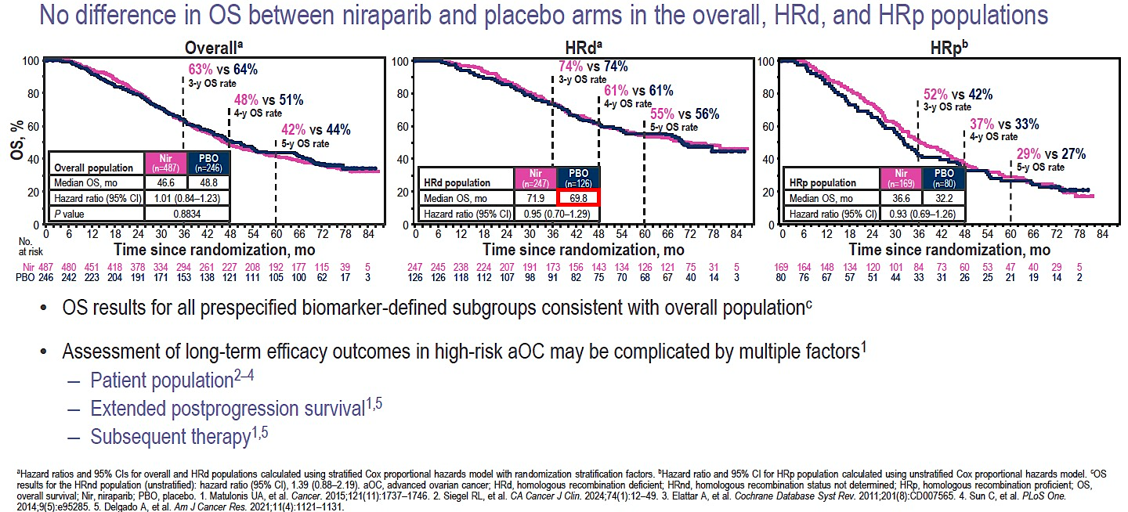
PRIMA/ENGOT-OV26/GOG-3012 Trial of Niraparib 1L Maintenance cont. Final OS (62.5% maturity in overall population)
NCT02655016

Slide 37
Phase III PAOLA-1/ENGOT-ov25: maintenance olaparib with bevacizumab in patients with newly diagnosed, advanced ovarian cancer treated with platinum-based chemotherapy and bevacizumab as standard of care
Newly diagnosed FIGO stage III–IV high-grade serous/endometrioid ovarian, fallopian tube or primary peritoneal cancer*
Maintenance therapy
N=806
Primary endpoint
Investigator-assessed PFS (RECIST v1.1)
Sensitivity analysis
PFS by BICR
Secondary endpoints
TFST
PFS2, TSST
OS
HRQoL
Safety and tolerability
FIRST LINE
Surgery
(upfront or interval)
Platinum–taxane based chemotherapy
≥3 cycles of bevacizumab†
Olaparib (300 mg BID) x2 years
NED/CR/PR
+ bevacizumab†
Randomization
2:1
Placebo x2 years
+ bevacizumab†
Stratification
Tumour BRCAm status‡
First-line treatment outcome¶
*Patients with other epithelial non-mucinous ovarian cancer were eligible if they had a germline BRCA1 and/or BRCA2 mutation
†Bevacizumab: 15 mg/kg, every 3 weeks for a total of 15 months, including when administered with chemotherapy; ‡By central labs; ¶According to timing of surgery and NED/CR/PR
BICR, blinded independent central review; HRQoL, health-related quality of life; PFS2, time to second progression or death; RECIST, Response Evaluation Criteria in Solid Tumours; TFST, time to first subsequent therapy or death; TSST, time to second subsequent therapy or death
Ray-Coquard IL, et al. Oral Presentation LBA2_PR at ESMO, September 27–October 1, 2019, Barcelona, Spain

Slide 38



Updated PFS: HRD-positive population*
100
 | Olaparib + bevacizumab (N=255) | Placebo + bevacizumab (N=132)
Events, n (%) | 136 (53.3) | 104 (78.8)
Median PFS, months | 46.8 | 17.6
5-year PFS rate, % | 46.1 | 19.2
 | HR 0.41 (95% CI 0.32–0.54)
90
80
70
60
5-year PFS rate
Patients free from disease progression and death (%)
46.1%
50
40
30
59% reduction in risk of disease progression or death for olaparib + bevacizumab vs bevacizumab alone
20
19.2%
10
Olaparib or placebo for up to 2 years
0
0
12
24
36
48
60
72
80
No. at risk
Olaparib + bevacizumab
Placebo + bevacizumab
Time from randomization (months)
255
132
252
129
242
118
236
103
223
91
214
79
194
62
183
52
165
41
162
37
147
34
143
30
138
29
127
25
123
24
119
24
117
21
112
20
103
19
79
15
63
13
40
8
31
6
8
2
5
0
3
0
*Descriptive analysis; PFS by investigator-assessment (modified RECIST v1.1).
Isabelle Ray-Coquard ESMO 2022

Slide 39
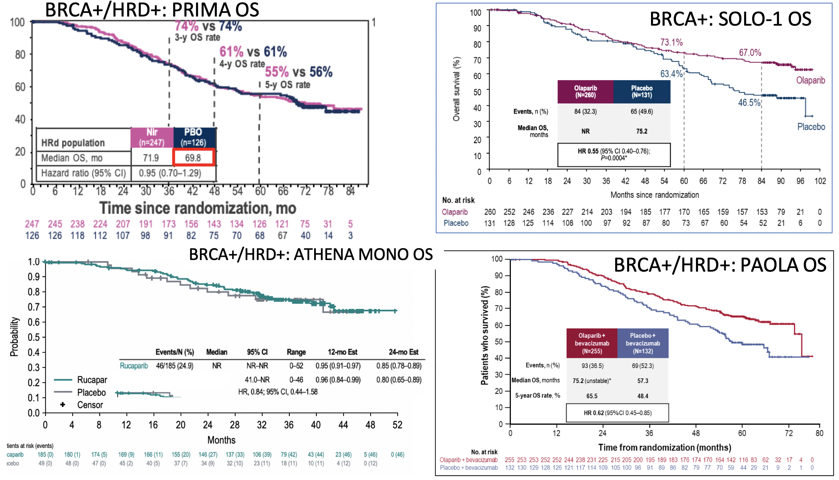
Updated OS – First Line Ovarian Cancer

Slide 40
Upfront Ovarian Cancer Maintenance Treatment
PARPi versus Bev versus Both
Curative intent is the goal
Biomarker derived therapy is now the standard.
Management of Toxicity is essential

Slide 41
PARPi + IO in Ovarian Cancer
Trial | Anti-angiogenic | PARPi | ICI | Median PFS | PFS HR
FIRST ENGOT OV-44 | + Bevacizumab | Niraparib | Dostarlimab | Statistically significant improvement (press release)
DUO-O ENGOT OV-46 | Bevacizumab | Olaparib | Durvalumab | 25.1 mo (ITT population) | 0.61 (0.51-0.73)
ATHENA GOG-3020 ENGOT OV-45 | - | Rucaparib | Nivolumab | 15.0 mo (ITT population) | 1.29 (1.08–1.53)
ENGOT OV-43 KEYLYNK-001 | + Bevacizumab | Olaparib | Pembrolizumab | 23.9 mo (CPS ≥10 population) | 0.66 (0.53-0.83)
Trillsch et al. ESMO GU 2024;Abstract 43O.
Monk et al. ESMO 2024;Abstract LBA30.
Vergote et al. ESGO 2025.
https://www.gsk.com/en-gb/media/press-releases/gsk-announces-first-trial-met-its-primary-endpoint-of-progression-free-survival-in-first-line-advanced-ovarian-cancer/

Slide 42
Recurrent Serous Carcinoma of the Ovary, Stage IIIC
BRCA1+, PD-L1+, FOLR1 negative (0%), Her2 negative (score=0)
Diagnosed in 2006 - TAH/BSO/LND/Omentectomy/Extensive TRS - Stage IIIC Ovarian Cancer
  Followed by Taxol/Carbo x 6 cycles
Recurred approximately 36 months later with GI symptoms (N/V with GERD), abdominal distention, elevated CA-125 (60)
Underwent TRS/Omentectomy/Splenectomy - positive for metastatic serous carcinoma
  Followed by Carbo/Gem/Bev x 6 cycles
Diagnosed with recurrence 13 years later
  Followed by Gem/Carboplatin/Bev
  Started maintenance Bev
  Started Olaparib, discontinued after 1 dose due to allergic reaction
  Switched to Niraparib Cycle 2
  Completed 5 cycles of maintenance Bev, discontinued Cycle 6 due to persistent hypertension.
  Continued Niraparib

Slide 43
Roundtable Discussion

Slide 44
Considerations for Patients Receiving a PARP Inhibitor
Courtney Arn, CNP
The Ohio State University
James Comprehensive Cancer Center
Columbus, Ohio

Slide 45
Initiation of parp inhibitors
Baseline Labs
Patient Education:
  MOA
  Indication
  Side effects/expectations
  Treatment Plan/Schedule
Supportive Care
Co-pay Evaluation/Financial Support

Slide 46
Mechanism of action
PARP inhibitors block the activity of PARP enzymes, disrupting the normal DNA repair process and ultimately causing cell death, particularly in cancer cells with impaired DNA repair mechanisms like BRCA mutations
Tumor cells carrying a BRCA mutation have been shown to be significantly more sensitive to PARP inhibition than tumors that do not carry a BRCA mutation

Slide 47
Side effects - Niraparib
Thrombocytopenia (66%)
Anemia (64%)
Nausea (57%)
Fatigue (51%)
Neutropenia (42%)
Constipation (40%)
Musculoskeletal pain (39%)
Hypertension (18%)
Warnings & Precautions: MDS/AML, Hematologic, Hypertension, PRES, Embryo-Fetal Toxicity
Niraparib prescribing information.

Slide 48
side effects – Olaparib
Nausea (77%)
Fatigue (67%)
Abdominal pain (45%)
Vomiting (40%)
Anemia (38%)
Diarrhea (37%)
Warnings & Precautions: MDS/AML, Pneumonitis, VTE, Embryo-Fetal Toxicity
Olaparib prescribing information.

Slide 49
Monitoring & Managing side effects
Nausea: Prophylactic anti-emetics 30-60 minutes prior to dosing and PRN
Constipation: Stool softeners, Laxatives, Diet, Physical Activity
Diarrhea: Anti-diarrheal, Diet, Fluids, Electrolytes
Fatigue: Hydration, Exercise, PT, consider stimulants
Hematologic: Plan for monitoring labs, transfuse as needed

Slide 50
Grade ≥3 AEs of Interest
PRIMA
PAOLA-1
SOLO-1
 | Niraparib | Placebo | Bevacizumab + Olaparib | Bevacizumab + Placebo | Olaparib | Placebo
n | 484 | 244 | 535 | 267 | 260 | 130
Anemia | 31% | 2% | 17% | <1% | 22% | 2%
Neutropenia | 13% | 1% | 6% | 3% | 9% | 5%
Thrombocytopenia | 29% | <1% | 2% | <1% | 1% | 2%
Fatigue | 2% | 1% | 5% | 1% | 4% | 2%
MDS/AML | Not reported | Not reported | 1% | <1% | 1% | 0
Nausea | 1% | 1% | 2% | 1% | 1% | 0%
Vomiting | 1% | 1% | 1% | 2% | <1% | 1%
Diarrhea | 1% | *********** | 2% | 2% | 3% | 0
Constipation | <1% | 0 | Not Reported | Not Reported | 0 | 0
Hypertension | 6% | 1% | 19% | 30% | Not Reported | Not Reported
Cross-trial comparisons are not head-to-head studies; varying study designs, methodology, and populations limit ability to draw conclusions of comparative efficacy and safety.
AE, adverse event; AML, acute myeloid leukemia; MDS, myelodysplastic syndrome; thrombo, thrombocytopenia; ↓plt, decreased platelets.
1. González‑Martín A, et al. N Engl J Med. 2019. doi:10.1056/NEJMoa1910962. 2. González‑Martín A, et al. Presented at: ESMO Congress; September 27-October 1, 2019; Barcelona, Spain. Abstract LBA1. 3. Ray-Coquard IL, et al. Presented at: ESMO Congress; September 27-October 1, 2019; Barcelona, Spain. Abstract LBA2. 4. Moore K, et al. N Engl J Med. 2018;27;379(26):2495-2505.

Slide 51
Aml/mds with PARP inhibitor Treatment
Trial | Placebo | Parp Inhibitor
SOLO-2 Olaparib | 4% | 8%
NOVA Niraparib | 1.7% (3.1% in BRCA) | 3.5% (6.6% in BRCA)
ARIEL3 Rucaparib | 3.2 | 3.8
Poveda A, Floquet A, Ledermann JA, et al. Olaparib tablets as maintenance therapy in patients with platinum-sensitive relapsed ovarian cancer and BRCA1/2 mutation (SOLO2/ENGOT-Ov21): a final analysis of a double-blind, randomised, placebo-controlled, phase 3 trial. Supplementary appendix [published online March 18, 2021]. Lancet Oncol.
Matulonis UA, Herrstedt J, Oza A, et al. Long-term safety and secondary efficacy endpoints in the ENGOT-OV16/NOVA phase 3 trial of niraparib in recurrent ovarian cancer. Presented at: Society of Gynecological Oncology 2021 Virtual Annual Meeting on Women’s Cancer; March 19-21, 2021; Virtual. Abstract 37
Coleman et al. Overall Survival Results From ARIEL3: A Phase 3 Randomized, Double-blind Study of Rucaparib vs Placebo Following Response to Platinum-Based Chemotherapy for Recurrent Ovarian Carcinoma. IGCS 2022

Slide 52
Aml/mds with PARP inhibitor Treatment
Trial | Placebo | Parp Inhibitor
SOLO-1 Olaparib | 0.8% | 1.5%
PRIMA Niraparib | 1.6% | 2.3%
PAOLA-1 Olaparib + bevacizumab | 2.2% | 1.7%
DiSilvestro P et al. J Clin Oncol 2022;41(3):609-17; Monk BJ et al. Ann Oncol 2024;35(11):981-92; Ray-Coquard I et al. Ann Oncol 2023;34(8):681-92.

Slide 53
Dosing & Administration
 | Olaparib | Niraparib
Dosage Forms | Tablets: 100 mg or 150 mg | Tablets: 100 mg
Dose | 300 mg bid | 300 mg daily
Starting Dose Modifications | Moderate renal impairment CYP3A inhibitor use | If baseline weight: <77 kg OR platelets: <150,000/uL
Monitor | CBC at baseline and monthly thereafter | CBC weekly for the first month, then monthly for the next 11 months, and then periodically BP monthly during the first year and periodically

Slide 54
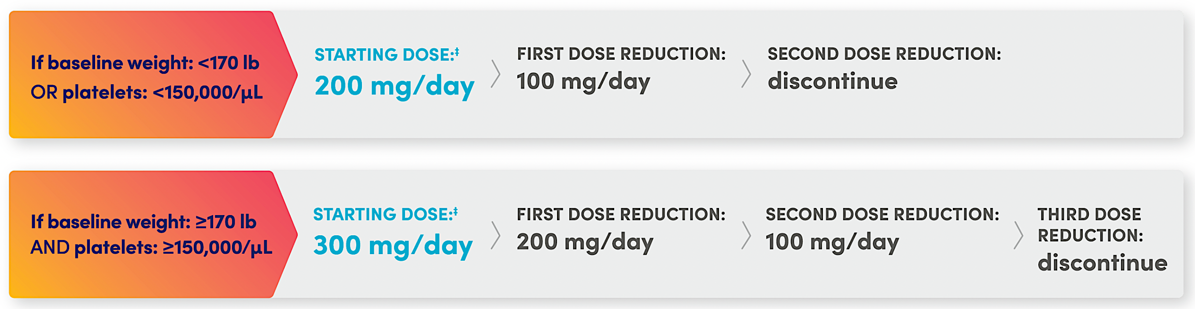
Niraparib individualized starting dose
Niraparib prescribing information. Accessed 4/2025.

Slide 55
Dose modification
PRIMA
PAOLA-1
SOLO-1
 | Niraparib | Placebo | Bevaci-zumab + Olaparib | Bevaci-zumab + Placebo | Olaparib | Placebo
n | 484 | 244 | 535 | 267 | 260 | 130
Dose reduction | 71% | 8% | 41% | 7% | 28% | 3%
Dose interruption | 80% | 18% | 54% | 24% | 52% | 17%
AE leading to discontinuation | 12% | 3% | 20% | 6% | 12% | 2%
Grade >/= 3 AEs | 71% | 19% | 57% | 51% | 39% | 18%
AE, adverse event.
1. González‑Martín A, et al. N Engl J Med. 2019. doi:10.1056/NEJMoa1910962. 2. González‑Martín A, et al. Presented at: ESMO Congress; September 27-October 1, 2019; Barcelona, Spain. Abstract LBA1. 3. Ray-Coquard IL, et al. Presented at: ESMO Congress; September 27-October 1, 2019; Barcelona, Spain. Abstract LBA2. 4. Moore K, et al. N Engl J Med. 2018;27;379(26):2495-2505.

Slide 56
Roundtable Discussion

Slide 57
Agenda
Introduction: Overview of Ovarian Cancer (OC) Management
Module 1: Genetic Testing for Newly Diagnosed Advanced OC
Module 2: Role of PARP Inhibitor Maintenance in Newly Diagnosed Advanced OC
Module 3: Other Available and Investigational Novel Strategies for OC
Module 4: Current and Future Role of Mirvetuximab Soravtansine in OC Treatment

Slide 58
Clinical Scenario
A patient with advanced OC undergoes resection, receives adjuvant carboplatin/paclitaxel and PARP inhibitor maintenance, experiences disease progression and then receives 2 subsequent lines of platinum-based chemotherapy. Her disease is now platinum resistant and is found to be HER2-positive, and she is about to start treatment with trastuzumab deruxtecan (T-DXd).

Slide 59
Targeted (ADCs) Therapy - Ovarian Cancer
David M O’Malley, MD
The Ohio State University and
The James Comprehensive Cancer Center
Columbus, Ohio

Slide 60
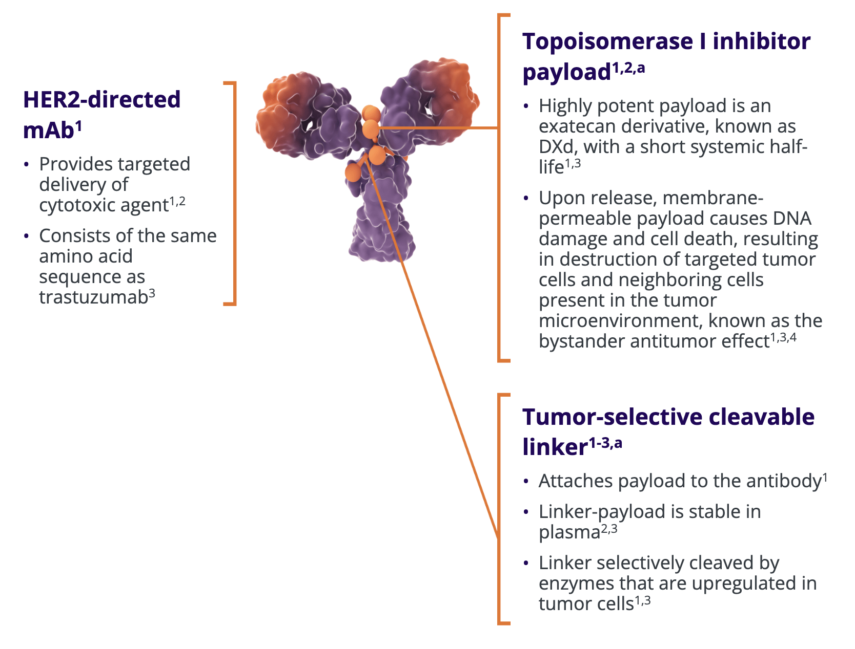
Trastuzumab Deruxtecan
1. Prescribing information. 2025.
2. Ogitani Y, Aida T, Hagihara K, et al. DS-8201a, a novel HER2-targeting ADC with a novel DNA topoisomerase I inhibitor, demonstrates a promising antitumor efficacy with differentiation from T-DM1. Clin Cancer Res. 2016;22(20):5097-5108.
3. Nakada T, Sugihara K, Jikoh T, Abe Y, Agatsuma T. The latest research and development into the antibody–drug conjugate, [fam-] trastuzumab deruxtecan (DS-8201a), for HER2 cancer therapy. Chem Pharm Bull (Tokyo). 2019;67(3):173-185.
ªBased on in vitro and in vivo non-clinical studies. The clinical relevance of these features is under investigation.
https://www.enhertuhcp.com/en/mechanism-of-action. accessed on 4/6/25

Slide 61
What Is the Incidence of HER2 Expression Across Solid Tumors?
Distribution of HER2 IHC expression levels across cancers
HER2 expression across solid tumors
Cancer types |  | Distribution of HER2 IHC scores across cancers
 |  | HER2 IHC expression levels, %
 |  | 0 | 1+ | 2+ | 3+ | Total, n
Breast Gastric/GEJ |  | 43 51 | 28 21 | 19 14 | 10 14 | 2611 208
Biliary tract | CCA Gallbladder Ampullary | 55 46 50 | 29 21 33 | 12 24 17 | 4 9 0 | 122 33 6
Gl—lower | Colorectal Appendiceal Small bowel Anal | 68 78 78 100 | 21 16 4 0 | 8 6 9 0 | 3 0 9 0 | 577 50 23 5
Gl—other | Pancreas HCC Mixed CCA and HCC | 67 56 67 | 24 19 33 | 8 25 0 | 2 0 0 | 67 32 6
Gynecological | Endometrial Ovarian/FT Peritoneal Cervical Vaginal Vulvar | 41 62 71 64 100 29 | 8 13 29 7 0 14 | 39 20 0 14 0 43 | 13 5 0 14 0 14 | 127 85 14 14 2 7
Head and neck | HN-ACC HN-Other HN-salivary gland HNSCC | 90 54 38 70 | 0 23 30 17 | 10 15 21 4 | 0 8 13 9 | 10 13 48 23
Genitourinary | Urothelial Prostate Renal cell Germ cell/testicular Penile | 32 87 95 100 100 | 18 13 5 0 0 | 28 0 0 0 0 | 21 0 0 0 0 | 176 31 19 3 1
Thoracic | Lung Thymic | 50 100 | 32 0 | 15 0 | 3 0 | 211 4
Skin | Melanoma Non-melanoma skin | 100 71 | 0 14 | 0 14 | 0 0 | 14 7
Other | Adrenal CUP CNS Sarcoma Thyroid | 67 54 50 95 96 | 0 28 50 3 4 | 33 15 0 3 0 | 0 4 0 0 0 | 3 54 2 37 56
Total |  | 2361 (50) | 1137 (24) | 796 (17) | 407 (9) | 4701
N
2,611
100
176
48
127
33
211
208
54
13
122
32
85
14
67
577
23
14
50
23
31
10
37
19
56
14
n 3+ n 2+ n 1+ n 0
80
Urothelial
HN-salivary gland
Endometrial
Breast
Gallbladder
Lung
Gastric/GEJ
CUP
HN-Other
CCA
HCC
Ovarian/FT
Cervical
Pancreas
Colorectal
HNSCC
Peritoneal
Appendicular
Small bowel
Prostate
HN-ACC
Sarcoma
Renal cell
Thyroid
Melanoma
60
Patients (%)
40
20
0
CCA = cholangiocarcinoma; CNS, central nervous system; CUP = cancer of unknown primary; FT = fallopian tube cancer; GEJ = gastroesophageal; GI = gastrointestinal; HCC = hepatocellular carcinoma; HER2 = human epidermal growth factor receptor 2; HN = head and neck; HN-ACC = head and neck-adenoid cystic carcinoma; HNSCC = head and neck squamous cell carcinoma; IHC = immunohistochemistry. *Row percentages were used in the construction of this table.
Uzunparmak B et al. Ann Oncol 2023;34:1035-46.

Slide 62
Does It Change With the Tissue Tested
(primary vs metastatic breast cancer)?
Across Time?
1st biopsy
2nd biopsy
3rd biopsy
HER2 0
HER2 0
HER2 0
HER2–
HER2–
HER2 1+
HER2 1+
HER2 1+
Primary
Metastatic
HER2-low
HER2-low
HER2 2+
HER2 2+
HER2 2+
HER2 3+
HER2 3+
HER2 3+
HER2+
HER2+
 |  | HER2 metastasis n, % |  |  | Total
 |  | HER2– | HER2-low | HER2+
HER2 primary n, % | HER2– | 157 (65.4) | 78 (32.5) | 5 (2.1) | 240
 | HER2-low | 96 (34.8) | 171 (62.0) | 9 (3.3) | 276
 | HER2+ | 4 (3.5) | 14 (12.4) | 95 (84.1) | 113
Total |  | 257 (40.9) | 263 (41.8) | 109 (17.3) | 629
 |  | HER2 secondary biopsy n, % |  |  |  | Total
 |  | HER2 0 | HER2 1+ | HER2 2+ | HER2 3+
HER2 first biopsy n, % | HER2 0 | 26 (57.8) | 9 (20.0) | 10 (22.2) | 0 (0) | 45
 | HER2 1+ | 14 (32.6) | 13 (30.2) | 15 (34.9) | 1 (2.3) | 43
 | HER2 2+ | 5 (19.2) | 6 (23.1) | 14 (53.8) | 1 (3.8) | 26
 | HER2 3+ | 1 (10.0) | 2 (20.0) | 0 (0) | 7 (70.0) | 10
Total |  | 46 (37.1) | 30 (24.2) | 39 (31.5) | 9 (7.3) | 124
Uzunparmak B et al. Ann Oncol 2023;34:1035-46.

Slide 63
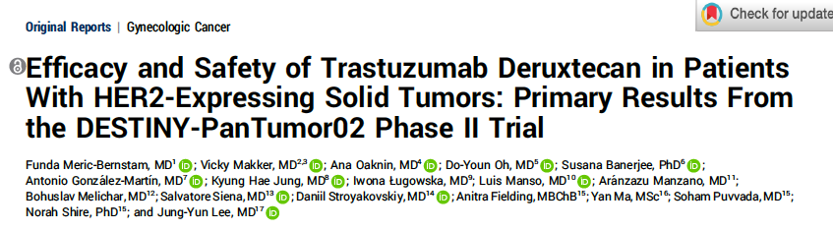
J Clin Oncol 2024;42(1):47-58.

Slide 64
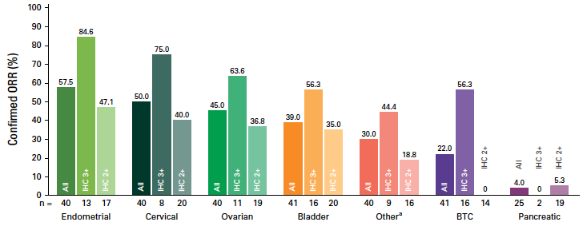
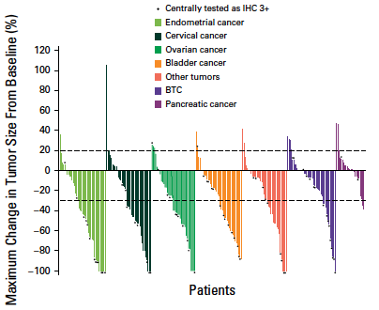
DESTINY-PanTumor02: Phase II Trial of Trastuzumab Deruxtecan in Patients with HER2-Expressing Solid Tumors
Meric-Bernstam F et al. J Clin Oncol 2024;42(1):47-58.

Slide 65
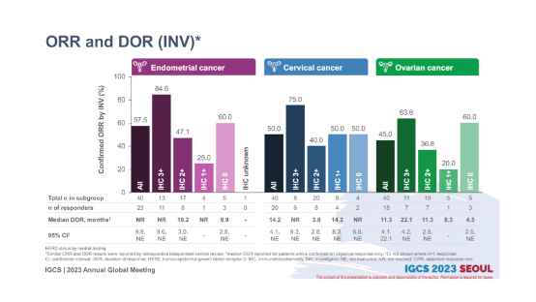
DESTINY-PanTumor02
Response by HER2 Expression Level (central)
Endometrial cancer
Ovarian cancer
Cervical cancer
Confirmed ORR by INV (%)
IHC Unknown
IHC 3+
IHC 2+
IHC 1+
IHC 0
IHC 3+
IHC 2+
IHC 1+
IHC 0
IHC 3+
IHC 2+
IHC 1+
IHC 0
All
All
All
Total n in subgroup 40 13 7 4 5 1 40 8 20 8 4 40 11 19 5 5
n of responders 23 11 8 1 3 0 20 6 8 4 2 18 7 7 1 3
Median DOR, months NR NR 18.2 NR 9.9 – 14.2 NR 3.8 14.2 NR 11.3 22.1 11.3 8.3 4.5
95% CR 9.9, 9.6, 3.0, – 2.8, – 4.1, 9.3, 2.8, 8.3, 6.8, 4.4, 4.2, 2.8, – 2.6,
NE NE NE NE NE NE NE NE NE 22.1 NE NE NE
GYN = gynecological; NE = not estimable; NR = not reached. Lee J-Y, et al. International Gynecological Cancer Society (IGCS) 2023.
Notes:
Trastuzumab deruxtecan (T-DXd) has demonstrated significant survival benefit for patients with HER2-expressing breast and gastric cancers. In DESTINY-PanTumor02, T-DXd demonstrated clinically meaningful response rates, progression-free survival (PFS), and overall survival (OS) in HER2-expressing tumors.
Methods
This open-label, Phase 2 study (NCT04482309) evaluated T-DXd (5.4 mg/kg Q3W) in patients across seven cohorts with HER2-expressing (immunohistochemistry [IHC] 3+/2+ by local [with retrospective central testing] or central testing) locally advanced/metastatic disease after ≥1 systemic treatment, or without alternative treatment. The primary endpoint was investigator-assessed confirmed objective response rate (ORR). Secondary endpoints included duration of response, PFS, OS, and safety. Exploratory endpoints included pharmacodynamic biomarkers.
Results
At data cutoff (June 2023), 120 patients in the endometrial, cervical, and ovarian cancer cohorts had received treatment (median follow-up [range]: 19.94 [0.8–31.1], 12.60 [0.9–31.0], and 13.13 [0.7–30.6] months, respectively). Overall, 80.8% received ≥2 prior lines of therapy. Table 1 shows efficacy outcomes by HER2 expression levels by cohort. Table 2 shows ORR by HER2 in situ hybridization (ISH) amplification and plasma HER2 amplification by cohort. Grade (G)≥3 drug-related adverse events occurred in 54/120 (45.0%) patients; adjudicated treatment-related interstitial lung disease/pneumonitis occurred in 13/120 (10.8%) patients (n=12 G≤2; n=1 G5).
Conclusion/Implications
T-DXd demonstrated clinically meaningful benefit, including responses across HER2 expression levels and in ISH+ or plasma ERBB2 amplified subgroups, and encouraging survival outcomes in patients with gynecological tumors. Safety was consistent with the known profile. These data support T-DXd as a potential treatment for patients with gynecological HER2-expressing tumors who progressed on prior therapy.
Lee J-Y, Makker V, Manso L, et al. Efficacy and safety of trastuzumab deruxtecan in patients with HER2-expressing solid tumors: results from the cervical, endometrial, and ovarian cancer cohorts of the DESTINY-PanTumor02 study. Presented at: Annual Global Meeting of the International Gynecological Cancer Society 2023; November 5-7, 2023; Seoul, North Korea.
https://cslide.ctimeetingtech.com/igcs23/attendee/confcal/session/calendar?q=makker
Slide courtesy D. O’Malley

Slide 66
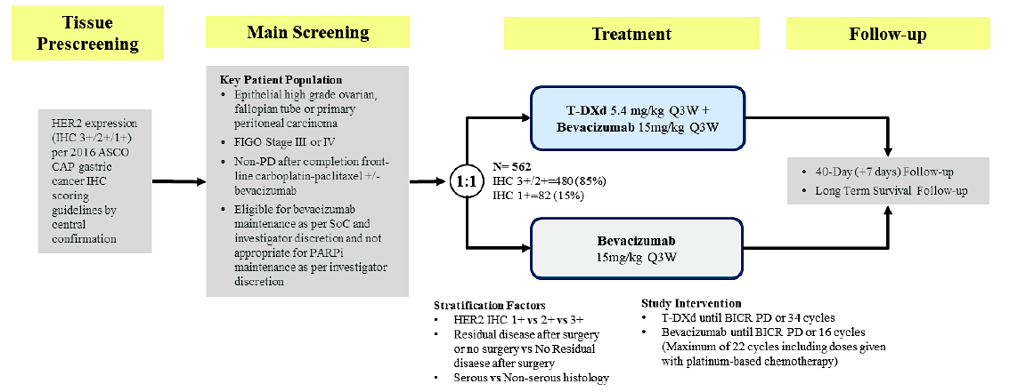
GOG 3112/ENGOT-ov89
Phase 3 DESTINY-Ovarian01: T-DXd + Bevacizumab as 1L Maintenance Therapy in HER2-Expressing Ovarian Cancer
PI: Joyce Liu
NCT06819007

Slide 67
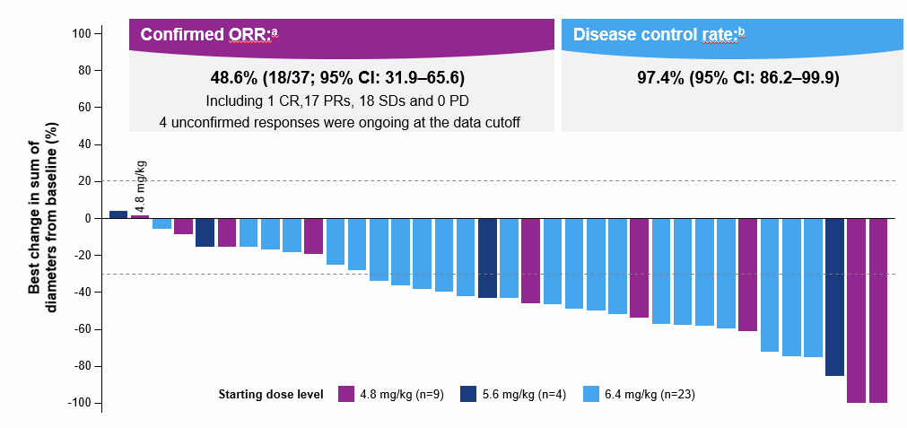
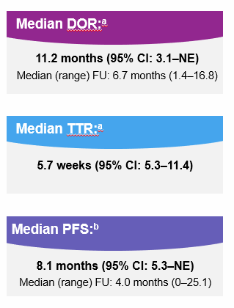
 | Raludotatug deruxtecan (DS-6000)^{1,2}
Payload | Topoisomerase 1 inhibitor (DXd)
DAR | 8
Linker | Cleavable tetrapeptide based linker
Trial | NCT04707248
Targeting CDH6
1. Moore K, et al. Presented at European Society for Medical Oncology (ESMO) Annual Meeting; 20-24 October 2023; Madrid, Spain.;
2. NCT04707248. Accessed from: https://clinicaltrials.gov/study/NCT04707248?cond=NCT04707248&rank=1.

Slide 68
REJOICE-Ovarian01/GOG-3096:
Phase 2/3 Randomized Study of R-DXd in Platinum-Resistant EOC
Key eligibility criteria:
High-grade serous or endometrioid ovarian, primary peritoneal, or fallopian tube cancer
1−3 prior LOT (inc. bevacizumab)
Platinum-resistant disease
Prior MIRV if high FRαª
ECOG PS 0−1
No prior CDH6-targeting agents or ADCs with linked TOPO I inhibitor
Patients with primary platinum-refractory disease are not eligible
40D
LTSFU Q3M
40D
LTSFU Q3M
Phase 2
Follow-up
Phase 3
Follow-up
R-DXd IV Q3W
R-DXd IV Q3W
4.8 mg/kg
R-DXd at RP3D
R
1:1:1
5.6 mg/kg
R
1:1
TPC
(gemcitabine, PLD, topotecan, paclitaxel)
6.4 mg/kg
Until PD,^{b} death, lost to FU, other reason
Until PD,^{b} death, lost to FU, other reason
Stratification:
Number of prior LOT (1 vs 2/3)
CDH6 expression (high vs low)
TPC (paclitaxel vs others; Ph 3 only)
Primary endpoints:
ORR per BICR^{b}
Key secondary endpoints:
ORR per inv^{b}
DOR
Primary endpoints:
ORR per BICR^{b}
PFS per BICR^{b}
Key secondary endpoints:
OS
QOL
NCT06161025
NCT06161025. Accessed from: https://clinicaltrials.gov/study/NCT06161025?term=NCT06161025&rank=1.

Slide 69
Key Takeaways
Phase 2 DESTINY-PanTumor02, led to tumor-agnostic indication
  April 5, 2024: FDA granted accelerated approval to T-DXd for unresectable/HER2+ (IHC3+) solid tumors after prior systemic treatment and no satisfactory alternative treatment options
  Greatest benefit in IHC 3+ population
Further exploration of T-DXd in HER2 IHC 1+/HER2-low is warranted
Multiple Trials are being initiated for HER2 expressing gyn cancer
Next Generation of ADCs is here

Slide 70
Case: Alex
Recurrent Endometrioid Ovarian Cancer
Line of therapy | Therapy
1 | Tumor Reductive Surgery + Carboplatin/paclitaxel x 6
2 | Carboplatin/paclitaxel x 6
3 | PD1i x 5 years
4 | Megestrol
5 | Letrozole + ribociclib
NGS Testing
  PTEN Mutation
HER2 IHC: 3+
Folate Receptor alpha: 0%
Started T-DXd
Reduced dose to 4.4 mg/kg Cycle 3 due to significant fatigue and diarrhea
Reduced dose to 3.2 mg/kg Cycle 9 due to persistent fatigue despite supportive care.
Has Received >20 cycles
TRS = tumor reductive surgery.
Notes:
1L (08/2009) PCS R0 (NGR) + Pac-Carbo x6
2L Carbo- PLD followed byIP catumoxamab
3L Secondary CS (MRD < 0.5 mm) + Carbo-Gem-Beva x6 followed by bev
4L Carboplatin-PLD folowed by
5L wPac-bevacizumab
6L EC BAY 94-9343/18326 (anetumab ravtansine + PLD)
7L pelvic irradiation of oligoprogression followed by oral cyclophosphamide
03/2021 Right iliac lymph node progression
HER2 testing: 3+ in 12% of cells.
Signed ICF for Destiny Pantumo-2 on 03/26/2021

Slide 71
Baseline
After 20 cycles — ongoing PR
Notes:
Alex

Slide 72
Roundtable Discussion

Slide 73
Nursing Considerations for Patients Receiving T-DXd
Courtney Arn, CNP
The Ohio State University
James Comprehensive Cancer Center
Columbus, Ohio

Slide 74
Patient Education
MOA/Indication
Potential Side Effects
Symptom Management
Treatment Plan/Schedule
Pre and post medications
Baseline labs and procedures (echo)

Slide 75

How does T-DXd work?
Topoisomerase I inhibitor payload
Highly potent payload is an exatecan derivative, known as DXd
Upon release, payload causes DNA damage and cell death, resulting in destruction of targeted tumor cells and neighboring cells present in the tumor microenvironment, known as the bystander antitumor effect
Tumor-selective cleavable linker
Attaches payload to the antibody
HER2-directed mAb
Provides targeted delivery of cytotoxic agent
Consists of the same amino acid sequence as trastuzumab
Trastuzumab deruxtecan prescribing information, accessed 4/2025.

Slide 76
Side Effects
Nausea (72%)
Fatigue (55%)
Vomiting (38%)
Alopecia (37%)
Constipation (32%)
Decreased appetite (31%)
Diarrhea (30%)
Musculoskeletal pain (24%).
Hematologic: Leukopenia (73%), Anemia (67%), Neutropenia (65%), decreased lymphocyte count (60%), Thrombocytopenia (48%), increased AST (46%), increased ALT (44%), increased alkaline phosphatase (39%), Hypokalemia (32%)
Trastuzumab deruxtecan prescribing information; accessed 4/2025

Slide 77
ILD/Pneumonitis Associated
With T-DXd
15% of patients receiving T-DXd
87.0% had their first event within 12 months
  Median: 5.4 months
  Range: <0.1-46.8 months
Median time to onset: 5-6 months
Most patients with ILD/pneumonitis experienced low-grade events (grade 1 or 2, 77.4%)
Overall rate of fatal events: 2.2%
Powell CA, et al. ESMO Open. 2022;7:100554.

Slide 78
5 “S” Rules
Five “S” strategies to help detect and manage ILD/pneumonitis
Screen
Scan
Synergy
Suspend treatment
Steroids
Careful patient selection
Optimize the monitoring strategies based on the baseline risk
Screening continues during treatment
Regular clinical assessments to exclude signs/symptoms
of ILD
Increased knowledge on the impact of prior ILD with other treatments on future risk of ILD
The fundamental diagnostic tools for ILD remain CT scans (high-resolution)
Baseline scan is recommended
Repeat scans to be performed every 6 to 12 weeks
Involves teamwork
Educating patients
Educate the entire the care team
Multidisciplinary management once ILD is suspected
  Pulmonologists
  Additional Testing
T-DXd should always be interrupted if ILD is suspected
Should only be restarted in the case of asymptomatic ILD that fully resolves
Mainstay for treating
are corticosteroids
Dose to be adapted to the toxicity grade
Tarantino P, Tolaney SM. J Oncol Practice. Trastuzumab deruxtecan prescribing information. Accessed 4/2025..

Slide 79
Interstitial Lung Disease: Recognition and Management
Advise patients of risks of ILD prior to start of treatment, as well as signs/symptoms of ILD
Monitor for new or worsening cough, dyspnea, or fever
Grade 1 (asymptomatic)
Hold T-DXd until resolved
May resume treatment once fully resolved by imaging
Consider starting systemic steroids (eg, 0.5 mg/kg/day of prednisone or equivalent) until improvement, followed by gradual taper over 4 weeks
If >28 days to resolve, reduce dose by
1 dose level
Grade 2+ (symptomatic)
Discontinue T-DXd permanently
Begin steroid treatment (eg, prednisone
≥1 mg/kg daily) with gradual taper
If ILD is suspected…
Exclude other etiologies, including infectious etiologies
Initiate evaluation without delay, which may include
  CT (High-resolution)
  Consultation with pulmonologist
  Infectious Workup
  Additional tests,
  as clinically indicated
Incidental findings on routine scan
Symptomatic findings
Trastuzumab deruxtecan prescribing information, Accessed 11/8/2024. Swain SM, et al. Cancer Treat Rev. 2022;106:102378.

Slide 80
Anemia/Neutropenia/Thrombocytopenia
  Dose reductions or delays
  Transfusion
  G-CSF for prevention and/or management of neutropenia
Left ventricular dysfunction
  Baseline LVEF and regular monitoring (every 3-4 months)
  Dose delay/discontinuations
Diarrhea
  Infectious workup
  Anti-diarrheal (Loperamide, Diphenoxylate/Atropine)
  Fluids/electrolytes
Nausea/Vomiting
  Moderate-High emetogenic risk
  Initiate tailored prophylactic antiemetic regimens (2-3 agents) before T-DXd infusion + home regimen for 3-4 days
Fatigue
  Assess/counsel
  Consider holding/dose reductions
  Rule out other causes
  Encourage exercise/physical activity/PT
Alopecia
  Patient counseling/education
  Wig prescription
  Scalp cooling

Slide 81
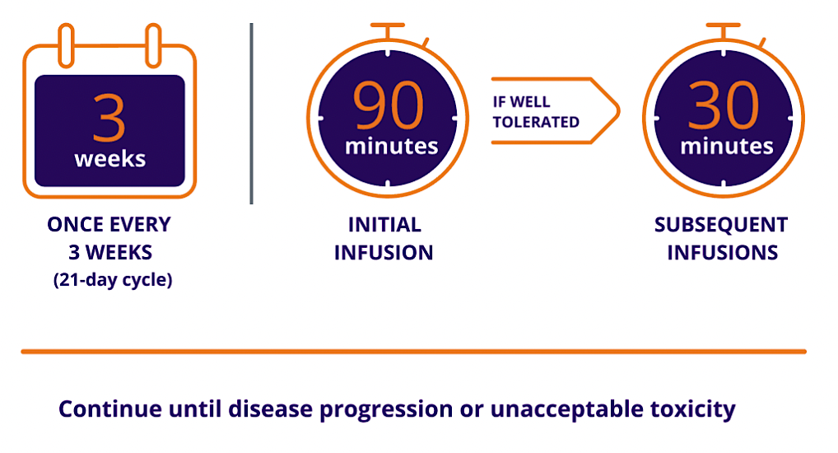
Trastuzumab deruxtecan official website. Accessed 4/2025.

Slide 82
Recommended Dose Reductions
Dose Reduction Schedule | 5.4 mg/kg starting dose
First Dose Reduction | 4.4 mg/kg
Second Dose Reduction | 3.2 mg/kg
Requirement for further dose reduction | Discontinue Treatment
Trastuzumab deruxtecan prescribing information. Accessed 4/2025.

Slide 83
T-DXd: Infusion-Related Reactions
Prompt recognition and treatment are important for reducing the risk of severe symptoms
  Signs of T-DXd-related IRRs include fever and chills, N/V, pain, headache, dizziness, dyspnea, and/or hypotension
Infusion 1 over 90 minutes → if well tolerated → subsequent infusions 30 minutes
  1% to 3% of patients receiving T-DXd experience an IRR with T-DXd 5.4 mg/kg
Grade 1: Reduce infusion rate to 50%
Grade 2: Temporarily stop infusion
Grade 3 or 4: Permanently stop
Keep resources to treat IRR readily on hand
Suspected anaphylaxis:
  Follow local management guidelines
  epinephrine (1 mg/mL IM every 5–15 minutes);
  normal saline (1–2 L at 5–10 ml/kg for first 5 minutes IV);
  H1/H2 antagonists
IRR = infusion-related reaction; N/V = nausea and/or vomiting.
Rugo HS, et al. ESMO Open. 2022;7:100553. Trastuzumab deruxtecan prescribing information.

Slide 84
CASE STUDY
Patient with recurrent high grade serous ovarian cancer (germline BRCA2+, HER2 IHC 3+, FOLR 0%)
2020: Diagnosed
2022: Completed adjuvant carboplatin and paclitaxel, followed by PARP maintenance
2023: Disease recurrence; Gem/Cis/Bev followed by maintenance Bev x 9 months
2024: Disease progression; Gem/Cis/Bev, progressed after 3 cycles of maintenance Bev
2025: Started treatment on trastuzumab deruxtecan (T-DXd)
Near CR after 3 cycles, side effects are well controlled with supportive care
Social History: 2 children in high school, enjoys traveling

Slide 85
Roundtable Discussion

Slide 86
Other Nursing Considerations Related to OC Management
Jennifer Filipi, MSN, NP
Department of Gynecologic Oncology
Massachusetts General Hospital Cancer Center
Boston, Massachusetts

Slide 87
Case Presentation
39 year old therapist, artist, and traveler with platinum resistant ovarian cancer, negative genetics, FOLR1 negative, HER2 negative.
Diagnosed in 2020, Stage III
  Complete cytoreductive surgery→ Carbo/paclitaxel
  2022: Carbo/PLD
  2023: platinum resistant→ bev/paclitaxel
  2023: clinical trial (ID + immunotherapy)

Slide 88
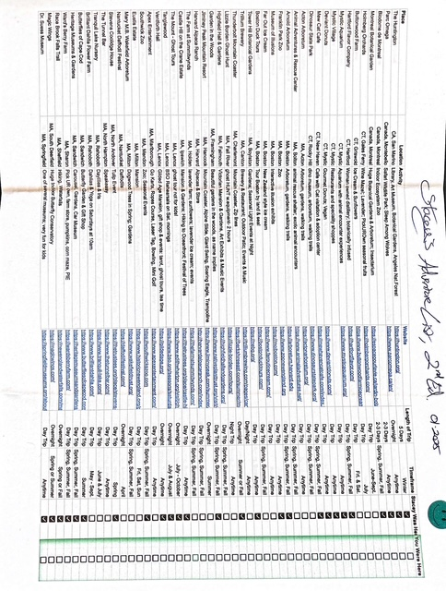



Slide 89
Clinical Trial Participation
Advantages: good potential for an active drug (several FDA approvals in last 5-10 years), clinical trial team, opportunity to contribute to the fight
Barriers: frequency of visits, live far from hospital (not available at satellite sites), eligibility requirements often strict
Communication: detailed explanations (don’t just assume), “I don’t want to be a guinea pig”- no placebos, will not affect overall care, clinical trial support from pharma company

Slide 90
Optimizing Oncology Nursing Care
Patient education and support
  Discuss goals of care with patient, what is important now, may change over time
    Introduce palliative care early
  Educate patients on disease and its management
    Including potential treatment-related adverse events
  Provide access to support and resources: support groups, social work, lifestyle medicine, nutrition
  Encourage ALL patients to participate in clinical trials, if available at your work site
  Be mindful of social and financial burdens, including oral adherence
  Helpful tips: bring a support person, give handouts for reference back, “never worry alone” motto
Multidisciplinary approach

Slide 91



Back to our case…
Patient in a PR (over a year on trial)

Slide 92
Roundtable Discussion

Slide 93
Agenda
Introduction: Overview of Ovarian Cancer (OC) Management
Module 1: Genetic Testing for Newly Diagnosed Advanced OC
Module 2: Role of PARP Inhibitor Maintenance in Newly Diagnosed Advanced OC
Module 3: Other Available and Investigational Novel Strategies for OC
Module 4: Current and Future Role of Mirvetuximab Soravtansine in OC Treatment

Slide 94
Clinical Scenario
A patient with advanced OC undergoes resection, receives adjuvant carboplatin/paclitaxel and PARP inhibitor maintenance, experiences disease progression and then receives 2 subsequent lines of platinum-based chemotherapy. Her disease is now platinum resistant and has
high FRα expression, and she is about to start treatment with mirvetuximab soravtansine.

Slide 95
Current and Potential Future Role of Mirvetuximab Soravtansine in Ovarian Cancer Treatment
Shannon N. Westin, MD, MPH
Professor
Department of Gynecologic Oncology and Reproductive Medicine

Slide 96
Typical Course of Advanced Ovarian Cancer
Surgery (primary or IDS)
+ primary or adjuvant chemotherapy carboplatin/paclitaxel
+/- bevacizumab
+/- PARPi
Platinum Sensitive
Progression >6 months after completion
of
platinum-based chemotherapy: Good Prognosis
First-Line
Treatment
Stage III, IV
First Response
70-80 %
Relapse/
Progression
(70%-80%)
Second
Response/
Disease Stabilization
Maintenance?
Relapse/
Progression
(100%)
Surveillance every 3 months?
Maintenance Therapy?
Which Agent to Consider
Platinum Resistant
Progression <6 months after completion of platinum-based chemotherapy: Poor Prognosis
Ledermann JA, et al. Ann Oncol. 2013, Pignata S, et al. Ann Oncol. 2017; du Bois A, et al. Cancer 2009, Wilson MK, et al. Ann Oncol. 2017

Slide 97
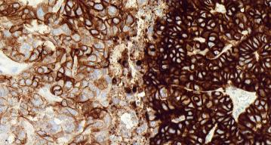
Targeting Folate Receptor Alpha
FRα is a cell surface folate receptor which mediates folate transport into epithelial cells.
FRα expression is limited on normal cells, but is upregulated on cancers, primarily ovarian, but also endometrial, and triple negative breast
FRα may be expressed on the alveoli of the lungs and on renal proximal tubules. However, these receptors are located on the surface of the cell facing the alveolar and tubular lumen, which reduces the exposure of the targets to circulating anti-folate agents
Expression in ovarian cancer varies by histology (80-90%)
  76% HGS
  50% LGS
  32% clear cell
Association with prognosis has been mixed
PS2+ Scoring
Determined by staining intensity and percentage of tumor cells staining at 0, 1+, 2+, or 3+
1+ intensity
2+ intensity
3+ intensity
PS2+ Scoring
Positive: ≥ 50% tumor cells with ≥ 2+ FRα membrane staining.
Kobel et al. Br. J Cancer (111); 2014; Moore KN et al. ESMO. 2019; Oaknin A et al. ASCO 2023; Chen YL, et al. Mol Oncol 2012

Slide 98
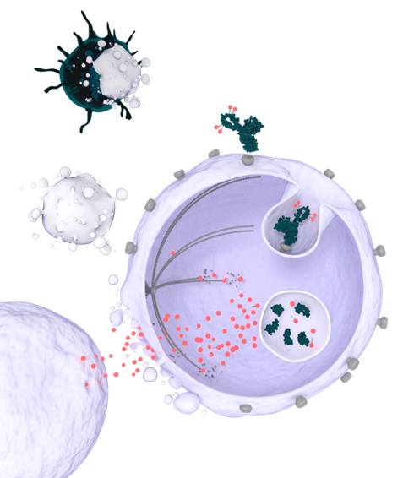
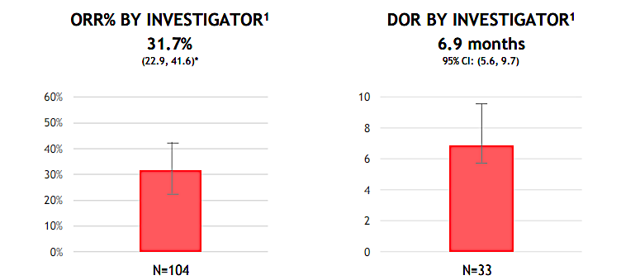
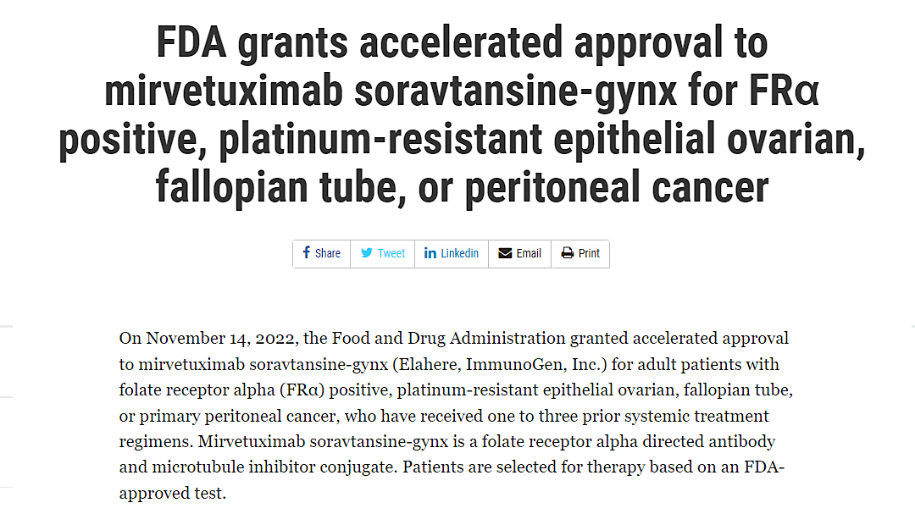
Mirvetuximab soravtansine, first FRα-targeted ADC approved for PROC
ADC Binding
Antibody-drug conjugate (ADC) comprising an FRα-binding antibody, cleavable linker, and a maytansinoid DM4 payload
Internalization
1
2
SORAYA (NCT04296890)
5
Cell Death
3
Lysosomal Degradation
4
Release of Payload
5
Bystander Killing
Mirvetuximab soravtansine (N=106)
6.0 mg/kg adjusted ideal body weight (AIBW) q3w
Key eligibility criteria
Platinum-resistant ovarian cancer
Prior bevacizumab required, prior PARPi allowed
1–3 prior lines of therapy
Patients with BRCA mutations allowed
FRα-positive (≥75% of cells staining positive with ≥2+ staining intensity)
Primary endpoint
ORR per Investigator
Secondary endpoints
DOR, PFS, OS, CA-125 response by GCIG criteria, safety
Moore KN et al. Cancer. 2017; Matulonis UA et al. J Clin Oncol. 2023

Slide 99
MIRASOL (NCT04209855): Randomized, phase 3 study of MIRV vs chemotherapy in FRα-high platinum–resistant ovarian cancer
Eligible patients:
PROC (PFI ≤6 mo)
FRα detected by IHC with PS2+ among ≥75% of viable tumor cells
High-grade serous histology
1–3 prior lines of therapy
Prior BEV and PARPi allowed
Participants with BRCA mutations allowed
Excluded patients:
1⁰ platinum-refractory disease (primary PFI <3 mo)
MIRV
6 mg/kg AIBW Q3W
Primary endpointª:
PFS by INV (BICR sensitivity analysis)
Select secondary endpoints:
ORR by INV (BICR sensitivity analysis)
OS OV28 abdominal/GI subscale^{b}
Safety and tolerability
DOR
CA-125 response^{c}
PFS2
Select exploratory:
Additional PRO assessments^{d}
R
1:1
(N=453)
IC Chemotherapy
Paclitaxel, PLD, or topotecan
Stratification:
IC chemotherapy: paclitaxel, PLD, or topotecan
Prior lines of therapy: 1 vs 2 vs 3
ITT population:
All randomized patients, regardless of receipt of assigned treatment
Safety population:
All randomized patients who received ≥1 dose of assigned treatment
Notes:
2024_24_48

Slide 100
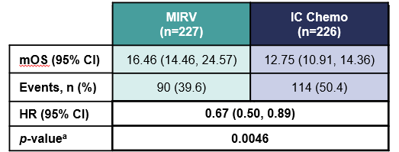
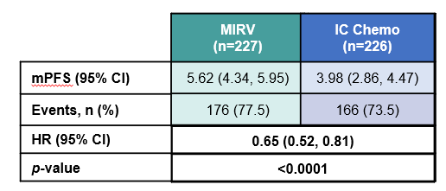
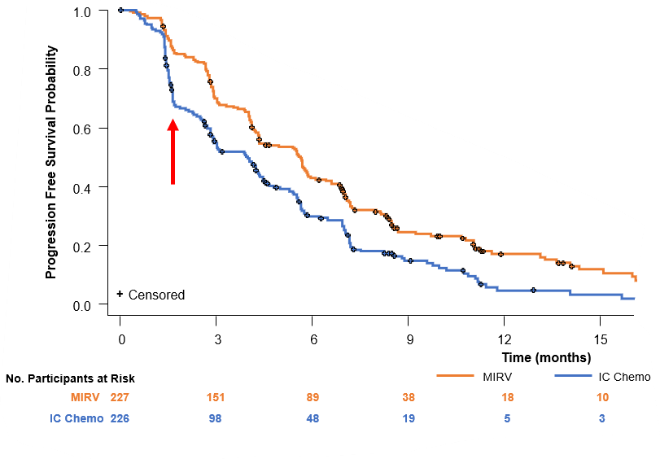
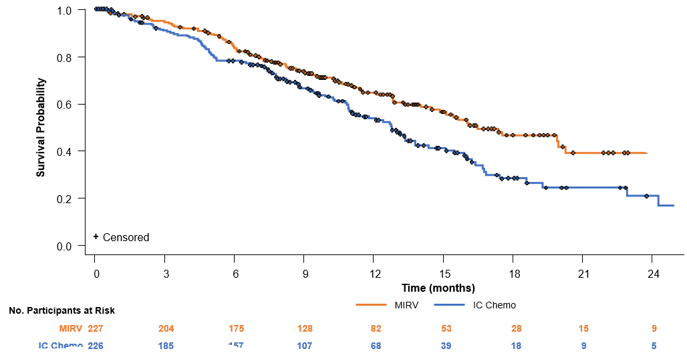
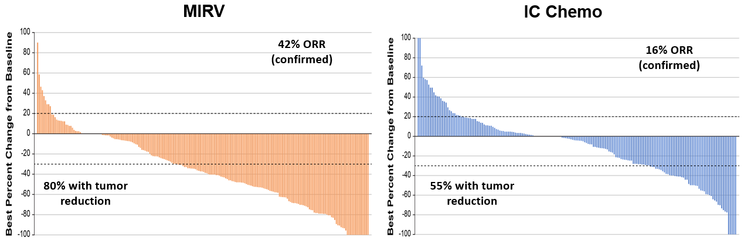
Confirmation of Superiority – OS Benefit!!!!
  Moore et al. NEJM 2023

Slide 101
PICCOLO: Mirvetuximab soravtansine in platinum sensitive ovarian cancer
100
80
Maximum Tumor % Change From Baseline
Characteristics | N=79
Age, median (range), years | 66 (41-84)
Race, n (%)
White | 65 (82.3)
Black or African American | 4 (5.1)
Asian | 1 (1.3)
# prior lines of systemic therapy, n (%)
1-2ª | 49 (62.0)
≥3 | 30 (37.9)
Prior exposure to taxanes, n (%), Yes | 77 (97.5)
Exposed in multiple lines | 20 (25.3)
60
40
20
Percentage change from baseline
0
-20
-40
-60
-80
100
Primary Endpoint | N=79
ORR, n (%) 95% CI | 41 (51.9) 40.4-63.3
Best Response, n (%)
CR | 6 (7.6)
PR | 35 (44.3)
SD | 29 (36.7)
PD | 7 (8.9)
Not evaluable | 2 (2.5)
Characteristics | N=79
Prior exposure to PARPi^{b},n (%), Yes | 64 (81.0)
Progression on PARPi^{c} | 59 (74.7)
Prior exposure to bev, n (%), Yes | 51 (64.6)
Most recent PFI (months)^{d}, n (%)
≤12 | 43 (54.4)
>12 | 34 (43.0)
Secondary Endpoints
Median DORª | n=41
Months (95% CI) | 8.25 (5.6-10.8)
Median PFS | N=79
Months (95% CI) | 6.93 (5.8-9.6)
Alvarez Secord; Ann Oncol 2025

Slide 102
PICCOLO: Subgroup Analyses
Exposure to PARPis | Median DOR months (95% CI)
Naïve | 8.8 (3.5-NR)
Treated | 8.3 (5.5-10.8)
PD with PARPiª | 7.3 (5.0-10.8)
No PD with PARPi | 8.4 (7.0-NR)
Total population ORR: 51.9% (95% CI, 40.4-63.3)
72.7%
49.8-89.3
75.0%
42.8-94.5
64.7%
46.5-80.3
60.0%
14.7-94.7
57.1%
37.2-75.5
55.1%
40.2-69.3
50.0%
29.1-70.9
49.0%
34.8-63.4
43.9%
30.7-57.6
46.9%
34.3-59.8
45.8%
32.7-59.2
43.9%
28.5-60.3
ORR
41.9%
27.0-57.9
33.3%
4.3-77.7
(n=49)
(n=24)
(n=6)
(n=22)
(n=57)
(n=12)
(n=64)
(n=59)
(n=5)
(n=28)
(n=51)
(n=41)
(n=43)
(n=34)
1 or 2
3
≥4
Positive
Negative/
Unknown
Naïve
Treated
PD with
PARPiª
No PD
with PARPi
Naïve
Treated
PARPi and BEV
≤12 mo
>12 mo
No. Prior Lines
of Therapy
BRCA Mutation
PARPi Exposure
BEV Exposure
Both PARPi & BEV Exposure
Most Recent
PFI^{b}
Alvarez Secord; Ann Oncol 2025

Slide 103
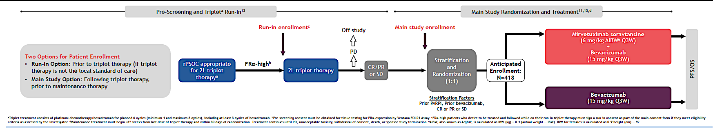




GOG-3078/IMGN853-0421/GLORIOSA
Randomized Phase 3 Trial for Mirvetuximab + Bevacizumab Maintenance in FRα-high Platinum Sensitive Ovarian Cancer
Key Eligibility Criteria:
Platinum-sensitive HGS ovarian cancer
1 prior platinum treatment
Prior PARPi required if BRCA+
CR, PR, or SD after treatment with platinum-based doublet + bevacizumab required
NCT05445778
Notes:
Sponsor approved
Pothuri to present
Need enrollments
N= 418
GOG Accrual: 17
GOG Activated Sites: 60
Recruitment
First site enrolled, Women’s Cancer Care Associates, PI: Joyce Barlin
Tips:
Please initiate early screening for FRα expression
Consider commercial FOLR1 testing on archival tissue at any time
Monitor for proteinuria early in bev tx (e.g.,after cycle 3) and modify treatment as needed
Response to platinum is SOC, not using RECIST
Submit eligibility forms early in advance for IMGN review

Slide 104
Roundtable Discussion

Slide 105
Nursing Considerations for Patients Receiving Mirvetuximab Soravtansine
Jennifer Filipi, MSN, NP
Department of Gynecologic Oncology
Massachusetts General Hospital Cancer Center
Boston, Massachusetts

Slide 106
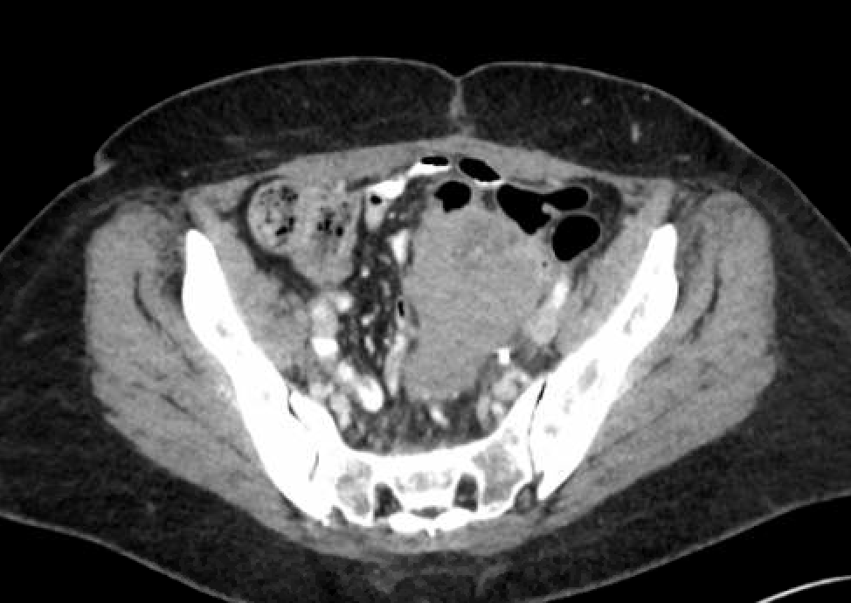
64-year-old new grandmother with platinum resistant ovarian cancer
Diagnosed in 2019
Negative genetics
C/T and cytoreductive surgery
Recurrence in 2021: C/PLD
Recurrence in 2023: C/Gem/Bev
Jan 2025: recurrence c/b rectal bleeding, hydronephrosis, significant pain

Slide 107
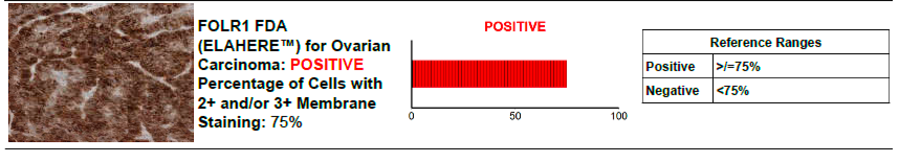
Molecular testing
Snapshot (in house molecular testing) with no actionable mutations
HER2 negative (0)
FOLR1 +
MIRV

Slide 108
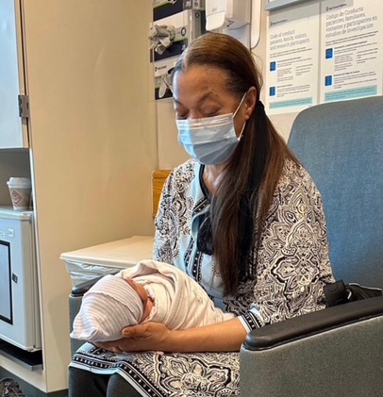


Slide 109
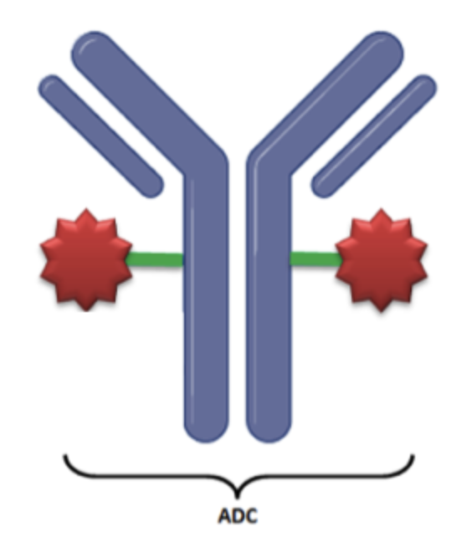
Mirvetuximab
Antibody drug conjugate
  3 components
    Antibody, linker,
    cytotoxic payload
Targets folate receptor 1 (FOLR1) on surface of cancer cells
  Often present in ov ca cells; limited expression in normal cells
Bystander effect
Approved for platinum resistant ovarian cancer
+ expression = 75% or greater

Slide 110
Mirvetuximab: Common Side Effects
Eye disorders: Blurry vision, dry eyes, eye irritation, eye redness
Low blood cell counts
Fatigue
Nausea, vomiting
    Most common on the day(s) of chemotherapy and for 2-3 days afterwards
Diarrhea, constipation
Liver enzyme elevations
Peripheral neuropathy:
    Numbness, tingling (“pins and needles”), or burning sensations in the hands and/or feet
        If you already have neuropathy when you start this treatment, it may get worse

Slide 111
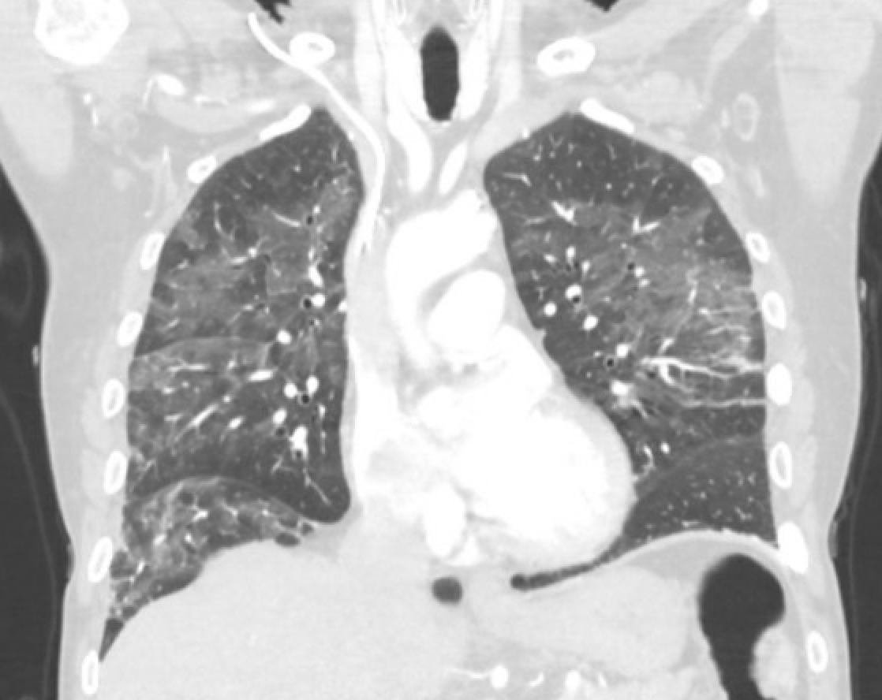
Mirvetuximab: Rare but Serious Side Effects
Infusion related/hypersensitivity reactions
    This reaction is most common with the first infusion and the risk for it after the first infusion significantly declines
Inflammation of the lungs
    If you experience unexplainable symptoms consisting of but not limited to dry cough, shortness of breath, or difficulty breathing then report it to your oncologist

Slide 112
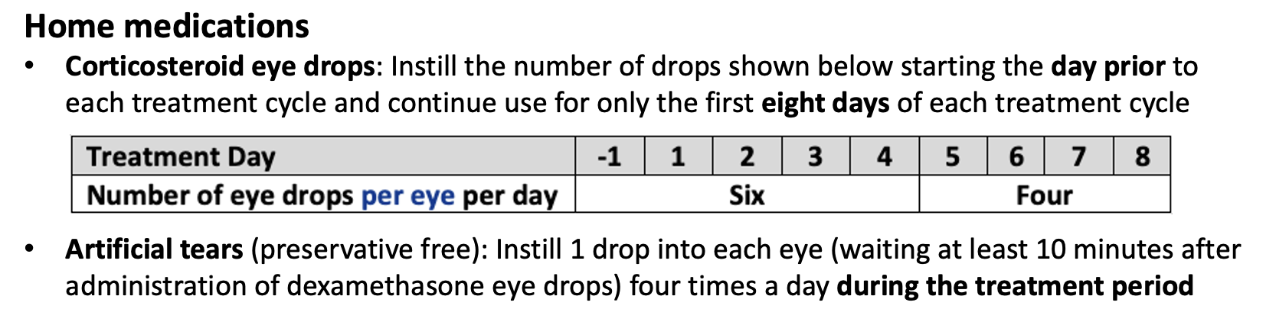
Eye Care During Treatment
To decrease risk of visual complications, you will be required to:
    Have an eye examination (visual acuity and slit lamp) done prior to your first infusion
    Have follow-up eye exams before every other dose of mirvetuximab soravtansine during the first 8 treatment cycles, then as directed by your provider
    Administer preservative free artificial tears in each eye at least four times a day, starting with the first treatment and continuing until the end of treatment
    Administer corticosteroid eye drops in each eye starting the day prior to and on days 1 to 8 of each treatment cycle, starting with the first cycle and continuing until the end of treatment
    Avoid the use of contact lenses
    Use caution when driving or operating heavy machinery
    Wear sunglasses when outdoors because your eyes may become more sensitive to sunlight during treatment with mirvetuximab soravtansine
    If you experience eye toxicity, your oncologist may hold (temporarily stop) this medication until your condition improves

Slide 113


Back to our case…
3 cycles later, complete resolution of rectal bleeding and pain
CA125 decreasing
Mild blurred vision with changes on eye exam.
  Management: ophthalmologist visit, held x1 week
  Lower dose by one dose level
Eye toxicity resolved
Continues to tolerate well

