Slide 1
Endometrial Cancer
Understanding the Current Paradigm and
New Approaches in the Care of Patients with Cancer
A Complimentary NCPD Hybrid Symposium Series Held During the 50th Annual ONS Congress
Saturday, April 12, 2025
6:00 AM – 7:30 AM
Faculty
Kathryn M Lyle, MSN, WHNP‑BC, AGNP‑C
Ritu Salani, MD, MBA
Jaclyn Shaver, MS, APRN, CNP, WHNP
Brian M Slomovitz, MD
Moderator
Neil Love, MD

Slide 2




Faculty
Kathryn M Lyle, MSN, WHNP-BC, AGNP-C
Nurse Practitioner
Division of Gynecologic Oncology
The University of Alabama at Birmingham
Birmingham, Alabama
Ritu Salani, MD, MBA
Director, Division of Gynecologic Oncology
Professor, Department of Obstetrics and Gynecology
David Geffen School of Medicine at UCLA
Los Angeles, California
Jaclyn Shaver, MS, APRN, CNP, WHNP
Section of Gynecologic Oncology
Stephenson Cancer Center
OU Health
Oklahoma City, Oklahoma
Brian M Slomovitz, MD
Professor, OB-GYN, Florida International University
Director, Gynecologic Oncology
Co-Chair, Cancer Research Committee
Mount Sinai Medical Center
Miami, Florida

Slide 3
Ms Lyle — Disclosures
No relevant conflicts of interest to disclose.

Slide 4
Dr Salani — Disclosures
Advisory Committees | AbbVie Inc, Daiichi Sankyo Inc, Eisai Inc, Genmab US Inc, GSK, Merck, Pfizer Inc
Nonrelevant Financial Relationships | Elsevier, UpToDate

Slide 5
Ms Shaver — Disclosures
No relevant conflicts of interest to disclose.

Slide 6
Dr Slomovitz — Disclosures
Consulting Agreements | Aadi Bioscience, AstraZeneca Pharmaceuticals LP, Eisai Inc, Genentech, a member of the Roche Group, Gilead Sciences Inc, GSK, Incyte Corporation, Merck, Novartis, Regeneron Pharmaceuticals Inc, Seagen Inc

Slide 7
Commercial Support
This activity is supported by an educational grant from GSK.
Research To Practice NCPD Planning Committee Members,
Staff and Reviewers
Planners, scientific staff and independent reviewers for Research To Practice have no relevant conflicts of interest to disclose.

Slide 8
This educational activity contains discussion of
non-FDA-approved uses of agents and regimens. Please refer to official prescribing information for each product for approved indications.

Slide 9
Agenda
Introduction: Overview of Endometrial Cancer (EC)
Module 1: First-Line Therapy for Advanced or Recurrent EC
Module 2: Role of Lenvatinib/Pembrolizumab in the Management of Progressive Advanced EC
Module 3: Novel Investigational Strategies for Newly Diagnosed Advanced EC
Module 4: Incidence and Management of HER2-Positive EC

Slide 10
Agenda
Introduction: Overview of Endometrial Cancer (EC)
Module 1: First-Line Therapy for Advanced or Recurrent EC
Module 2: Role of Lenvatinib/Pembrolizumab in the Management of Progressive Advanced EC
Module 3: Novel Investigational Strategies for Newly Diagnosed Advanced EC
Module 4: Incidence and Management of HER2-Positive EC

Slide 11
Overview of Endometrial Cancer
Cases by Stage
Estimated 69,120 new cases
  3.4% of all cancers
Estimated 13,860 deaths
Increasing incidence
5-Year Relative Survival by Stage
Increasing mortality
Siegel RL, et al. CA Cancer J Clin. 2025;75. https://seer.cancer.gov/statfacts/html/corp.html?statfacts_page=corp

Slide 12
Agenda
Introduction: Overview of Endometrial Cancer (EC)
Module 1: First-Line Therapy for Advanced or Recurrent EC
Module 2: Role of Lenvatinib/Pembrolizumab in the Management of Progressive Advanced EC
Module 3: Novel Investigational Strategies for Newly Diagnosed Advanced EC
Module 4: Incidence and Management of HER2-Positive EC

Slide 13
Clinical Scenario
A patient with newly diagnosed mismatch repair-deficient metastatic EC is about to start treatment with chemotherapy in combination with an anti-PD-1/PD-L1 antibody

Slide 14
Endometrial Cancer
First Line Therapy
Ritu Salani MD, MBA
Professor
UCLA

Slide 15
Molecular Profiling in Endometrial Cancer
POLE (ultramutated)
POLE: ultramutated, 100-500 mutations/Mb | 5%-10% of endometrial cancers High mutation burden leads to better immune response, excessive mutations lead to inability to proliferate
dMMR/MSI-H: 10-20 mutations/Mb | 20%-30% of endometrial cancers Hereditary (Lynch syndrome) or somatic
CN low/NSMP/TP53 WT/MSS: 2-3 mutations/Mb, endometrioid, G1 | Most common endometrial cancer Low-grade tumors Estrogen/progesterone positive PTEN, PIK3CA, ARID1A, and KRAS mutations
CN high/TP53 abn: 2-3 mutations/Mb, high grade | Often serous or mixed histology Poorest prognosis
+
+
+
+
+
+
+
+
+
+
+
+
+
+
+
+
+
+
+
+
+
+
+
+
+
+
+
+
+
+
+
+
PFS, %
+
+
+
+
+
+
+
+
+
+
+
Copy-number low (endometrioid)
+
+
+
+
+
+
+
+
+
+
+
+
+
+
+
+
+
+
+
+
+
+
+
+
+
+
+
+
+
+
+
+
+
+
+
+
+
+
+
+
+
+
+
+
+
+
+
+
+
+
+
+
+
+
+
+
+
+
+
+
+
+
+
+
+
+
+
+
+
+
+
+
+
+
+
+
+
+
+
+
+
+
+
+
+
+
+
+
+
+
+
+
+
MSI (hypermutated)
+
+
+
+
+
+
+
+
+
+
+
+
+
+
+
+
+
+
+
+
Copy-number high (serous like)
Log-rank P = .02
Time, months

Slide 16
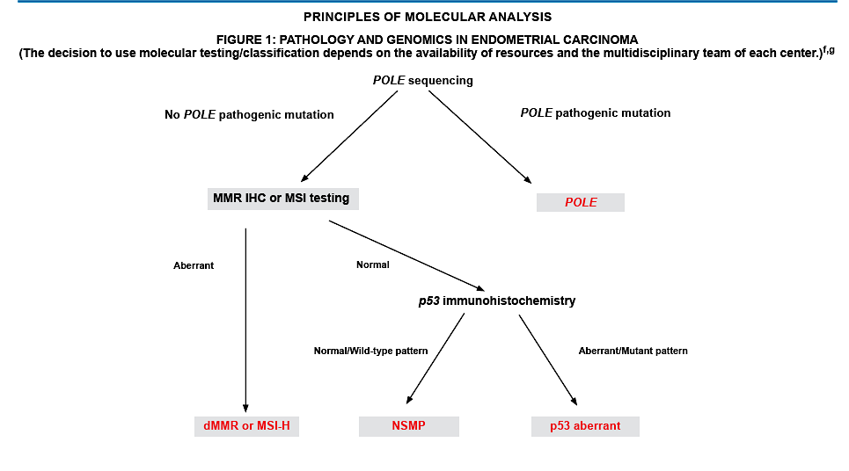
ProMisE Tool Classification of Endometrial Cancer
1
MMR deficiency evaluated by IHC
(MSH6 and PMS2)
2
POLE sequencing (exons 9-14)
3
p53 expression determined by IHC

Slide 17
Biomarker testing
MMR testing (IHC)
P53 (IHC)
HER2 (IHC)
ER/PR (IHC)
______________________________
POLE testing (NGS)
  Early stage, high risk factors
TMB (NGS)
MSI (NGS)
Other considerations
Primary or recurrent
Stage
  Surgical resection status
Comorbidities

Slide 18
Advanced Endometrial Cancer
Checkpoint inhibitors and Chemotherapy
Pembrolizumab +
carboplatin/paclitaxel
Q3W for up to 6 cycles
Pembrolizumab
Q6W for
up to 14 cycles
NRG-GY018
Key Eligibility Criteria
Advanced (III-IV) or recurrent EC
MMR status
No previous chemotherapy
for EC
previous adjuvant chemotherapy allowed if completed ≥6-12 mo ago
Dostarlimab 500 mg +
carboplatin/paclitaxel
Q3W for up to 6 cycles
Dostarlimab
1,000 mg
Q6W for up to 3 y
RUBY
R
Durvalumab 1120 mg +
carboplatin/paclitaxel
Q3W for up to 6 cycles
Durvalumab
1,500 mg
Q4W +/- olaparib
indefinitely
DUO-E
Placebo +
carboplatin/paclitaxel
Q3W for up to 6 cycles
Placebo

Slide 19
NRG-GY018: PFS
dMMR Cohort
pMMR Cohort
mPFS NR vs 7.7 mo
HR = 0.30 (95% CI, 0.19-0.48)
P < .001
mPFS 13.1 vs 8.7 mo
HR = 0.54 (95% CI, 0.41-0.71)
P < .001
+
+
+
+
+
+
+
+
+
+
+
+
+
+
+
+
+
+
+
1.0
+
1.0
+
+
+
+
+
+
+
+
+
+
+
+
+
+
+
+
+
+
+
+
+
+
+
+
+
+
+
+
+
+
+
+
+
+
+
+
+
+
+
+
+
+
+
+
+
+
+
+
+
+
+
+
+
+
+
+
+
+
+
+
+
+
+
+
+
+
+
+
+
+
+
+
+
+
+
+
+
+
+
+
+
+
+
+
+
+
+
+
+
+
+
+
+
+
+
+
+
+
+
+
+
+
+
+
+
+
+
+
+
+
+
+
+
+
+
+
+
+
+
+
+
+
+
+
+
+
+
+
+
+
+
+
+
+
+
+
+
+
+
+
+
+
+
+
+
+
+
+
+
+
+
+
+
+
+
+
+
+
+
+
+
+
+
PFS, Probability
+
+
+
Pembrolizumab + chemo
PFS, Probability
+
+
Pembrolizumab + chemo
+
+
+
+
+
+
+
+
+
+
+
+
+
+
+
+
+
+
+
+
+
+
+
+
+
+
+
+
+
+
+
+
+
+
+
+
+
+
+
+
+
+
+
+
+
+
+
+
+
+
+
+
+
+
+
+
Placebo + chemo
+
+
+
+
Placebo + chemo
+
+
+
+
Time, mo
Time, mo
Pembrolizumab improved INV PFS regardless of PD-L1 status for both the dMMR and pMMR populations

Slide 20
NRG-GY018: OS
dMMR EC
pMMR EC
I
I
I
I
I
I
I
I
I
I
I
I
I
I
I
I
I
I
I
I
I
I
I
I
I
I
I
I
I
I
I
I
I
I
I
I
I
I
I
I
I
I
I
I
I
I
I
I
I
I
I
I
I
I
I
I
I
I
I
I
I
I
I
I
I
I
I
I
I
I
I
I
I
I
I
I
I
I
I
I
I
I
I
I
I
I
Pembro + CT
I
I
I
I
I
I
I
I
I
I
I
I
I
I
I
I
I
I
I
I
I
I
I
I
I
I
I
I
I
I
I
I
I
I
I
I
I
I
I
I
I
I
I
I
I
I
I
I
I
I
I
I
I
I
I
I
I
I
I
I
I
I
I
I
I
I
I
I
I
I
I
I
I
I
I
I
I
I
I
I
I
I
I
I
I
I
I
I
I
I
I
I
I
I
I
I
I
I
I
I
I
I
I
I
I
I
I
I
I
I
I
I
I
I
I
I
I
I
I
I
I
I
I
I
I
I
I
I
I
I
I
I
I
I
I
I
I
I
I
I
I
I
I
I
I
I
I
I
I
I
I
I
I
I
I
I
I
I
I
I
I
I
I
I
I
I
I
I
I
I
I
I
I
I
I
I
I
I
I
I
I
I
I
I
I
I
I
I
I
I
I
I
I
I
I
I
I
I
I
I
I
I
I
I
I
I
I
I
I
I
I
I
I
I
I
I
I
I
I
I
I
I
I
I
I
I
I
Placebo + CT
OS, %
I
I
I
Pembro + CT
I
I
I
I
I
I
I
I
I
I
I
I
I
I
I
I
I
OS, %
I
Placebo + CT
I
Time Since Randomization, mo
Time Since Randomization, mo
 | Events, n/N | Follow-Up Duration, Median (range), mo | Median OS (95% CI), mo | HR (95% CI), P
Pembro + CT | 10/110 | 13.3 (0.6-39.4) | NR (NR-NR) | 0.55 (0.25-1.19) P = .0617
Placebo + CT | 17/112 | 13.7 (1.0-38.0) | NR (NR-NR)
 | Events, n/N | Follow-Up Duration, Median (range), mo | Median OS (95% CI), mo | HR (95% CI), P
Pembro + CT | 45/294 | 8.8 (0.1-37.0) | 27.96 (21.42-NR) | 0.79 (0.53-1.17) P = .1157
Placebo + CT | 54/294 | 8.4 (1.0-37.2) | 27.37 (19.52-NR)
Among those who discontinued treatment, more patients in the placebo + CT group vs the pembro + CT group received subsequent PD-1/PD-L1 inhibitors (54.5% vs 19.1%)
Among those who discontinued treatment, more patients in the placebo + CT group vs the pembro + CT group received subsequent PD-1/PD-L1 inhibitors (45.0% vs 19.3%)
June 17, 2024:
Pembrolizumab + chemotherapy followed by single-agent pembrolizumab approved by the FDA for patients with either dMMR or pMMR endometrial carcinoma

Slide 21
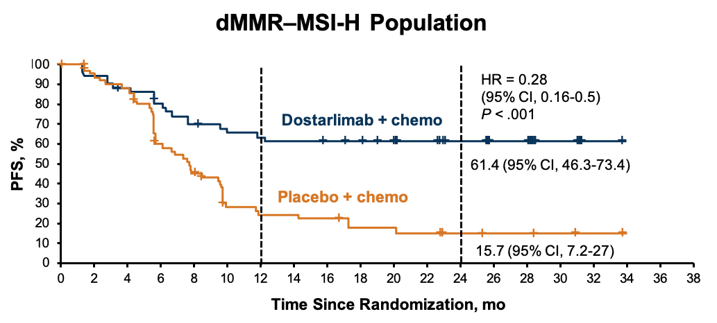
RUBY: PFS and OS in dMMR
PFS
OS
Median duration of follow-up, 36.6 mo^{b}
HR = 0.32
(95% CI, 0.17-0.63)
P = .0002
+
+
+
+
+
+
+
+
+
+
+
+
+
+
+
+
+
+
+
82.8
+
+
+
+
+
+
+
+
+
+
+
100
+
78.0
+
+
+
+
Dostarlimab + CP
+
+
+
+
Probability of Survival, %
57.5
+
+
+
+
+
+
+
+
+
+
+
+
+
+
46.0
+
+
+
+
+
+
 | Median (95% CI), mo | Events, n/N (%)
Dostarlimab + CP | NE (NE-NE) | 12/53 (22.6)
Placebo + CP | 31.4 (20.3-NE) | 35/65 (53.8)
OS maturity |  | 47/118 (39.8)
Placebo + CP
Time Since Randomization, mo
41.5% of patients in the placebo arm received subsequent immunotherapy
August 1, 2023
Expanded FDA approval of dostarlimab + chemotherapy followed by single-agent dostarlimab
for patients with either dMMR or pMMR endometrial carcinoma

Slide 22
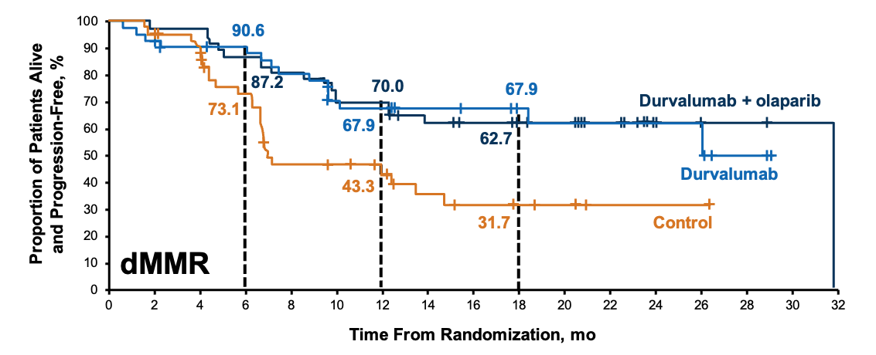
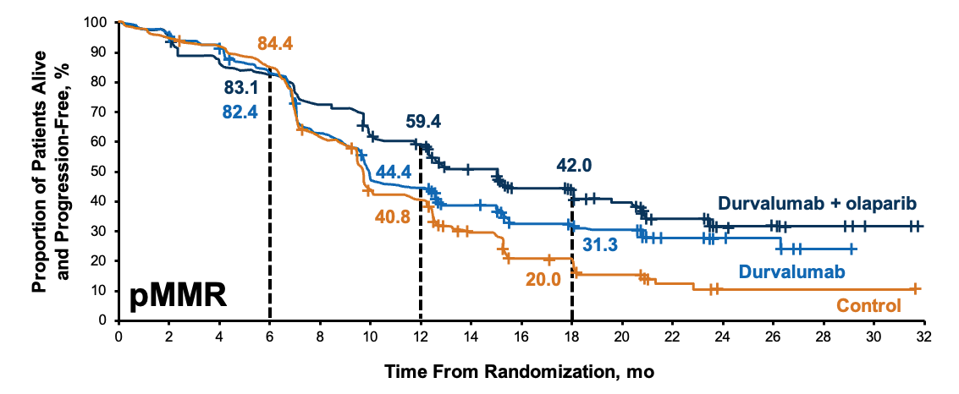
DUO-E: PFS by MMR Subgroups
 | Durvalumab + Olaparib Arm (n = 48) | Durvalumab Arm (n = 46) | Control Arm (n = 49)
Events, n (%) | 18 (37.5) | 15 (32.6) | 25 (51.0)
Median PFS (95% CI), mo | 31.8 (12.4-NR) | NR (NR-NR) | 7.0 (6.7-14.8)
HR (95% CI) vs control | 0.41 (0.21-0.75) | 0.42 (0.22-0.80) | –
 | Durvalumab + Olaparib Arm (n = 191) | Durvalumab Arm (n = 192) | Control Arm (n = 192)
Events, n (%) | 108 (56.5) | 124 (64.6) | 148 (77.1)
Median PFS (95% CI), mo | 15.0 (12.4-18.0) | 9.9 (9.4-12.5) | 9.7 (9.2-10.1)
HR (95% CI) vs control | 0.57 (0.44-0.73) | 0.77 (0.60-0.97) | –

Slide 23
DUO-E: OS
+
+
+
+
+
+
+
+
Durva + ola
+
+
+
+
+
+
+
+
+
+
+
+
+
+
+
+
+
+
+
+
+
+
+
+
+
+
+
+
+
+
+
+
+
+
+
+
+
+
+
+
+
+
+
+
+
+
+
+
+
+
+
+
+
+
+
+
+
+
+
+
+
+
+
+
+
+
+
+
+
+
+
+
+
+
+
+
+
+
+
+
+
+
+
+
+
+
+
+
+
+
+
+
+
+
+
+
+
+
+
+
+
+
+
+
+
+
+
+
+
+
+
+
+
+
+
+
+
+
+
+
+
+
+
+
+
+
+
+
+
+
+
+
+
+
+
+
+
+
+
+
+
+
+
+
+
+
+
+
+
+
+
+
+
+
+
+
+
+
+
+
+
+
+
+
+
+
+
+
+
+
+
+
+
+
+
+
+
+
Durva
+
+
+
+
+
+
+
+
+
+
+
+
+
Durva + ola
+
+
12 months
87.3
82.5
81.0
+
+
+
+
+
+
+
+
+
+
+
+
+
+
+
+
+
+
+
+
+
+
+
+
+
+
+
+
+
+
+
+
+
+
+
+
+
+
12 months
89.2
91.2
74.4
+
+
+
+
+
+
+
+
+
+
+
+
+
+
+
+
+
+
+
+
+
+
+
+
+
+
+
+
+
+
+
+
+
+
+
+
+
+
+
+
+
+
+
+
+
+
+
+
+
+
+
+
+
+
+
+
+
+
+
+
+
+
+
+
+
+
+
18 months
76.9
71.1
69.9
+
+
+
+
+
+
+
+
+
+
+
+
+
+
+
+
+
+
+
+
+
+
+
+
+
+
+
18 months
89.2
86.1
65.8
+
+
+
+
+
+
+
+
+
+
+
Durva
+
+
+
+
+
+
+
+
+
+
+
+
+
+
+
OS, %
OS, %
+
+
+
+
+
+
+
+
+
+
+
+
+
+
+
Control
+
+
+
+
Control
dMMR
pMMR
Time Since Randomization, mo
Time Since Randomization, mo
Durvalumab + C/P | 15.2 | NR (NR-NR)
Placebo + C/P | 36.7 | 23.7 (16.9-NR)
OS data maturity | 21.7%
Durvalumab + C/P | 30.2 | NR (NR-NR)
Placebo + C/P | 33.3 | 25.9 (25.1-NR)
OS data maturity | 29.2%
dMMR
HR = 0.28 (95% CI, 0.10-0.68); Durva + Ola + C/P arm
HR = 0.34 (95% CI, 0.13-0.79); Durva + C/P arm
pMMR
HR = 0.69 (95% CI, 0.47-1.00); Durva + Ola + C/P arm
HR = 0.91 (95% CI, 0.64-1.30); Durva + C/P arm
June 14, 2024: Durvalumab + chemotherapy followed by single-agent durvalumab
approved by the FDA for patients with dMMR endometrial carcinoma

Slide 24
Conclusions
Molecular testing is essential
  Most testing can be done with IHC
Endometrial Cancer with dMMR
  Improved outcomes with chemotherapy and checkpoint inhibitor
  FDA approval for pembrolizumab, dostarlimab and durvalumab
NGS may identify candidates for immunotherapy outside of dMMR
  POLE testing may allow for de-escalation of therapy

Slide 25
Roundtable Discussion

Slide 26
Endometrial Cancer Symposium
Research To Practice | ONS 2025
Kathryn Lyle, MSN, WHNP-BC, AGNP-C
Division of Gynecologic Oncology
University of Alabama at Birmingham

Slide 27
Nursing Considerations for
Patients Receiving an Anti-PD-1/PD-L1 Antibody

Slide 28
How does it work and why do we give it?
Endometrial cancer cells can express PD-L1, which is why it’s very important to order somatic testing on all patients with advanced or recurrent endometrial cancer.
Tumor cells have PD-L1 receptors and T cells have PD-1 receptors. If you can block that interaction where they bind together (which prevents the T cell from killing cancer cells and puts the brakes on the immune system), you can rev up the immune system and allow T cells to kill the tumor cells.
Immunotherapy can be used alone or in combination to treat endometrial cancer in certain circumstances.

Slide 29
How does it work and why do we give it?
Mechanism of Action:
  Immunotherapy uses the body’s immune system to attack and kill cancer cells.
Response time:
  It can take longer to see an initial response to treatment with immunotherapy compared to traditional chemotherapy because it takes time for the immune response to occur.
  Durable responses can occur even after discontinuation.
Pseudoprogression

Slide 30
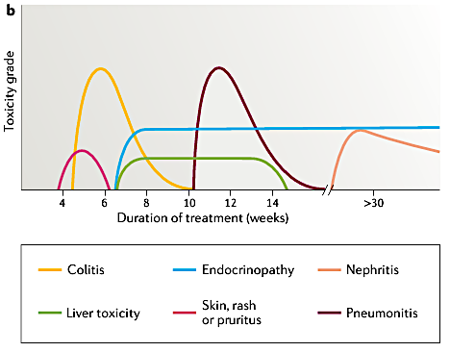
irAEs
Non-specific activation of the immune system by checkpoint inhibitors causes immune-related adverse events (irAEs)
The most common irAEs involve the skin, GI tract, endocrine system, and lungs (think *itis*)
Timing of onset and duration varies
Some toxicities can be reversible (GI, skin, pulmonary) while others may not be (endocrine)
Monitoring:
  Labs: TSH, FT4, LFTs (CBC, CMP, TSH)
  CXR, CT scans
  Closely monitor patients with pre-existing autoimmune disorders
Management: Dose delay +/- steroid taper vs drug discontinuation
Martins, F., Sofiya, L., Sykiotis, G.P. et al. Adverse effects of immune-checkpoint inhibitors: epidemiology, management and surveillance. Nat Rev Clin Oncol 16, 563–580 (2019).

Slide 31
irAEs
Patient education is key to early recognition
Consultation with other specialties may be needed (endocrinology, dermatology, etc)
Utilize guidelines for patient management (i.e. ASCO Clinical Practice Guidelines, NCCN Guidelines: Management of Immunotherapy-Related Toxicities)
Toxicity grading can vary some with each organ system, but in general:
  Grade 1: Continue therapy and closely monitor patient.
  Grade 2: Hold therapy. May consider steroid taper. Resume therapy once grade 1 or less.
  Grade 3: Hold therapy and start high-dose corticosteroids with taper.
  Grade 4: Typically permanently discontinue therapy.

Slide 32
Clinical Experience
I have a 38yo Spanish speaking patient who was receiving single agent Pembrolizumab. 5 months into treatment, her normal TSH became low for one cycle, and then started increasing each cycle after that. She was started on Levothyroxine. She has significant financial toxicity and a challenging social situation (no car, moves from house to house with friends and family, inconsistent work as a roofer). She was non-compliant with taking her Levothyroxine. At one point, she wasn't tolerating the higher dose and self discontinued. Other times, she did not have the money to pay for her medication at her local pharmacy. She ultimately presented after missing multiple infusion/clinic appts with a hoarse voice, swollen face and extremities, and severe fatigue. TSH was >100. We admitted her to the hospital and had to urgently consult endocrinology. She ultimately was stabilized but could not go back on Pembrolizumab due to drug induced hypothyroidism with poor medication compliance. She is much better controlled today (TSH still abnormal but very much improved) and medication compliance remains an issue.

Slide 33
Roundtable Discussion

Slide 34
Agenda
Introduction: Overview of Endometrial Cancer (EC)
Module 1: First-Line Therapy for Advanced or Recurrent EC
Module 2: Role of Lenvatinib/Pembrolizumab in the Management of Progressive Advanced EC
Module 3: Novel Investigational Strategies for Newly Diagnosed Advanced EC
Module 4: Incidence and Management of HER2-Positive EC

Slide 35
Clinical Scenario
A patient with mismatch repair-proficient metastatic EC has experienced disease progression on first-line chemotherapy and is about to start treatment with lenvatinib/pembrolizumab

Slide 36
Endometrial Cancer
Recurrence in pMMR EC
Ritu Salani MD, MBA
Professor
UCLA

Slide 37
KEYNOTE-775: Recurrent Endometrial Cancer
Key Eligibility Criteria
Advanced, metastatic, or recurrent EC
Measurable disease by BICR
1 prior platinum-based chemotherapy regimen
ECOG PS 0–1
Stratification Factors
MMR status (dMMR vs MMRp)
ECOG PS
Geographic region
Prior pelvic radiation
Lenvatinib
20 mg po qd
+
Pembrolizumab
200 mg IV q3w
Physician’s Choice:
Doxorubicin 60 mg/m² IV q3w
OR
Paclitaxel 80 mg IV mg/m² IV q1w
Primary Endpoints
PFS by BICR and OS
Makker V, et al. N Engl J Med. 2022;386:437-448.

Slide 38
Study 309/KEYNOTE 775:
Baseline Characteristics
Characteristic | LEN + PEMBRO (N=411) | CT (N=416)
Median age (years) | 64 | 65
Race, White/Black/Asian (%)† | 63.5 / 4.1 / 20.7 | 59.1 / 3.4 / 22.1
MMR status, pMMR/dMMR (%) | 84.2 / 15.8 | 84.4 / 15.6
ECOG PS, 0 or 1 (%)§ | 59.9 / 39.9 | 57.9 / 42.1
History of Pelvic Irradiation(%) | 42.3 | 44.7
Histologic Features at Initial Diagnosis, n (%)¶
Endometrioid carcinoma | 243 (59.1) | 254 (61.1)
High Grade | 94 (22.9) | 90 (21.6)
Low Grade | 59 (14.4) | 54 (13.0)
Not Specified ^{ǁ} | 90 (21.9) | 110 (26.4)
Serous Carcinoma | 103 (25.1) | 115 (27.6)
Clear-cell Carcinoma | 30 (7.3) | 17 (4.1)
Mixed Features | 22 (5.4) | 16 (3.8)
* Percentages may not total 100 because of rounding. The term dMMR denotes mismatch repair–deficient, MMR mismatch repair, and pMMR mismatch repair–proficient.
† Race was reported by the patient. Data on race were missing for 36 patients (8.8%) in the lenvatinib–pembrolizumab group and for 44 (10.6%) in the chemotherapy group.
Other races or ethnic groups (reported by 12 patients [2.9%] in the lenvatinib–pembrolizumab group and by 20 [4.8%] in the chemotherapy group) included American Indian or Alaska Native, Native Hawaiian, or Other Pacific Islander, and multiple.
§ Eastern Cooperative Oncology Group (ECOG) performance-status scores are assessed on a 5-point scale, with higher scores indicating greater disability.
One patient in the lenvatinib–pembrolizumab group had an ECOG performance status score of 3 (was enrolled in error).
¶ Information regarding histologic features at diagnosis for categories that included less than 5% of the patients is provided in Table S2.
‖ The “not specified” category included endometrioid carcinoma (grade not specified) and endometrioid carcinoma with squamous differentiation.
Adapted from: Makker V, et al. N Engl J Med. 2022;386:437-448.

Slide 39
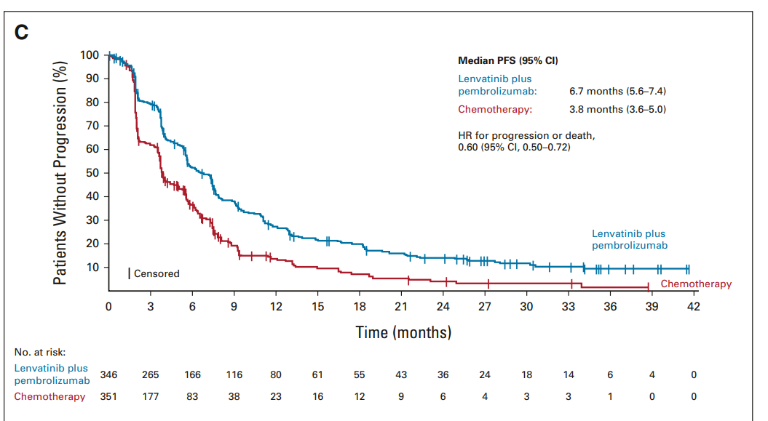
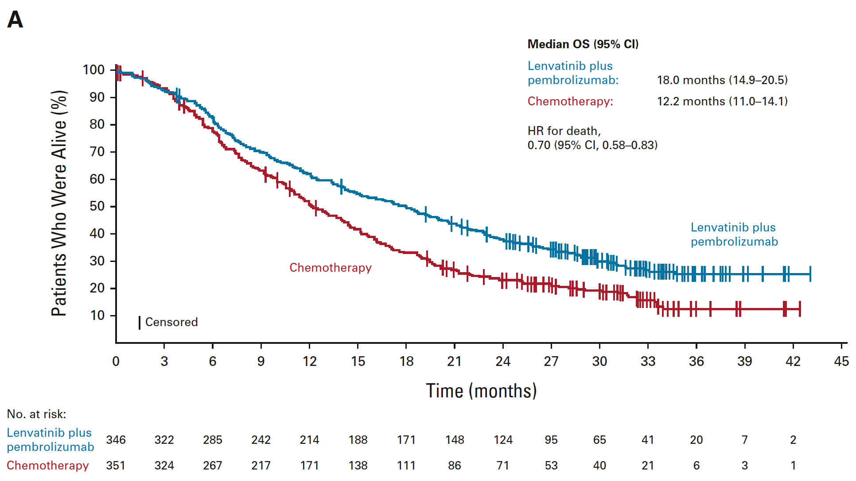
KEYNOTE-775: Survival Outcomes-pMMR
Progression Free Survival
Overall Survival
pMMR Population | ORR, % (95% CI) | mDOR, mo (range) | mOS, mo (95% CI) | HR
Len + Pem | 32.4 (27.5–37.6) | 9.3 (1.6+ to 39.5+) | 18.0 (14.2–19.9) | 0.70 (0.56–0.83)
Chemotherapy | 15.1 (11.5–19.3) | 5.7 (0.0+ to 37.1+) | 12.2 (11.0–14.1)
Makker V. J Clin Oncol. 2023;41:2904-2910.

Slide 40
Study 309/KEYNOTE-775: Response
 | pMMR Population |  | All Patients |  | dMMR Population
 | Lenvatinib + Pembrolizumab (N=346) | Chemotherapy (N=351) | Lenvatinib + Pembrolizumab (N=411) | Chemotherapy (N=416) | Lenvatinib + Pembrolizumab (N=65) | Chemotherapy (N=65)
Objective response, % | 30.3 | 15.1 | 31.9 | 14.7 | 40 | 12
CR | 5.2 | 2.6 | 6.6 | 2.6 | 14 | 3
PR | 25.1 | 12.5 | 25.3 | 12.0 | 26 | 9
SD | 48.6 | 39.6 | 47.0 | 40.1 | 38 | 43
PD | 15.6 | 30.8 | 14.8 | 29.6 | 11 | 23
Median DOR, months § | 9.2 | 5.7 | 14.4 | 5.7 | NR | 4.1
Median time to response, months | 2.1 | 3.5 | 2.1 | 2.1 | 2.9 | 1.9
Disease control ¶, % | 71.7 | 46.4 | 72 | 46.6 | 74 | 48
Subsequent Therapy
ITT: 28% in lenvatinib + pembrolizumab, 48.1% in chemotherapy group
pMMR: 9.1% in chemotherapy group received subsequent lenvatinib + pembrolizumab
dMMR: 16.9% received PD-1 pathway–targeting monotherapy or combination regimens as subsequent therapies
Makker V, et al. N Engl J Med. 2022;386:437-448.

Slide 41
KEYNOTE-775: Adverse Events
TEAE, % | Lenvatinib + Pembrolizumab (n = 406) |  | Doxorubicin or Paclitaxel (n = 388)
 | Any Grade | Grade ≥3 | Any Grade | Grade ≥3
Hypertension Hypothyroidism Diarrhea Nausea Decreased appetite Vomiting Weight decrease Fatigue Arthralgias | 65.0 58.9 55.7 51.7 46.6 37.7 35.5 34.0 32.3 | 39.2 1.5 8.1 3.4 7.6 3.0 10.8 5.4 1.7 | 5.2 0.8 20.4 46.4 21.4 21.1 5.9 27.6 8.0 | 2.6 0 2.1 1.3 0.5 2.6 0.3 3.1 0
TEAE, % | Lenvatinib + Pembrolizumab (n = 406) |  | Doxorubicin or Paclitaxel (n = 388)
 | Any Grade | Grade ≥3 | Any Grade | Grade ≥3
Proteinuria Constipation Anemia UTI Headache Neutropenia Alopecia | 30.5 28.3 28.1 27.6 26.4 9.1 5.9 | 5.2 0.7 6.9 4.2 0.5 2.0 0 | 3.4 24.5 48.7 10.3 9.0 34.0 30.9 | 0.3 0.5 15.5 1.0 0.3 26.0 0.3
*In the lenvatinib and pembrolizumab arm, 6.4% of patients suffered grade 5 AEs, and 5.2% of patients in the TPC arm suffered grade 5 AEs.
Dose reductions 66.5%
Dose interruptions 69.2%
Discontinuation secondary to AE 33.0%
Makker V, et al. N Engl J Med. 2022;386:437-448; Makker V, et al. J Clin Oncol. 2023;41:2904-2910.

Slide 42
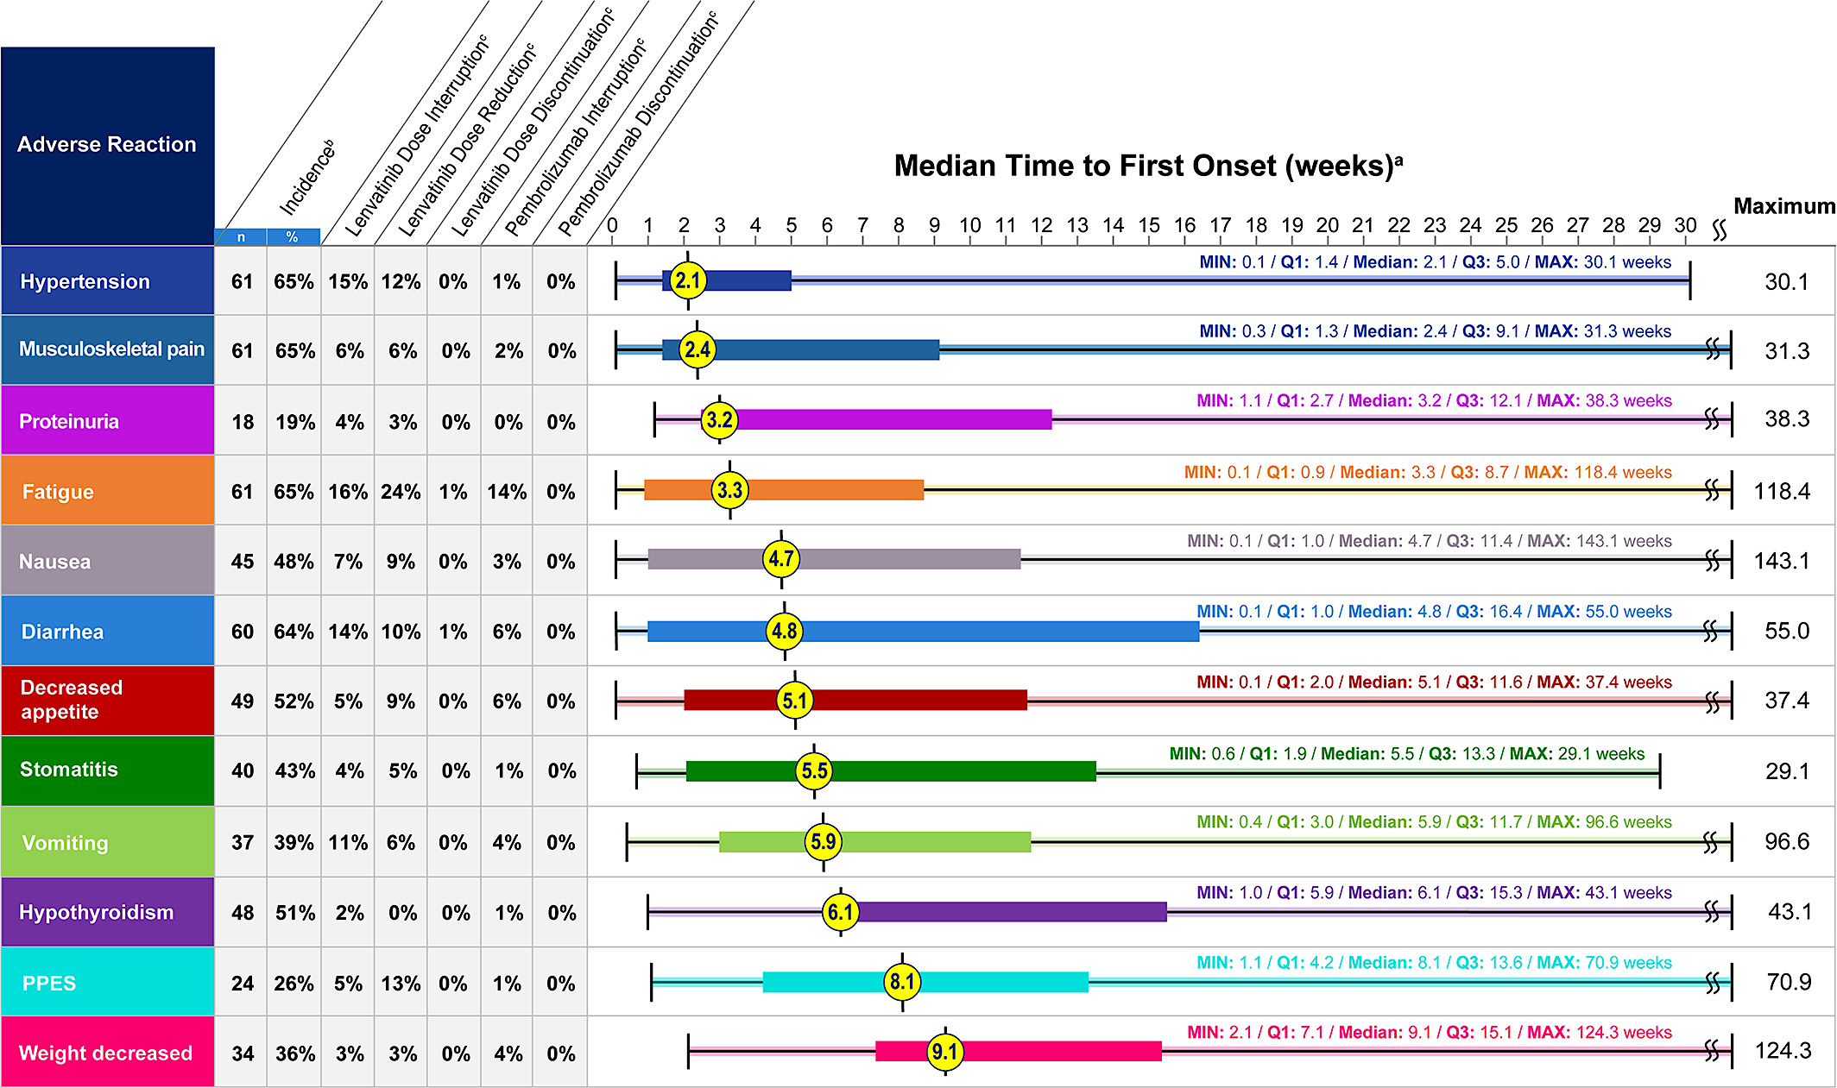
Lenvatinib and Pembrolizumab: Adverse Events
Makker V, et al. Oncologist. 2021;26:e1599-e1608.

Slide 43
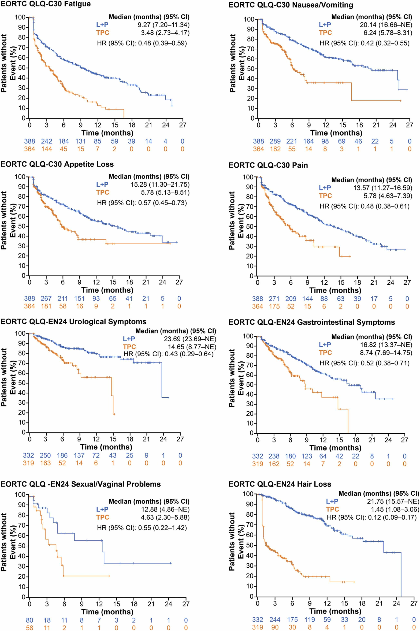
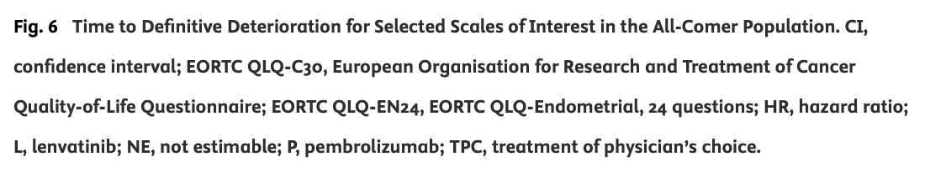
Lenvatinib and Pembrolizumab: Quality of Life
Len + Pem has survival and HRQOL benefit over TPC
Lorusso D, et al. Eur J Cancer. 2023;186:172-184.

Slide 44
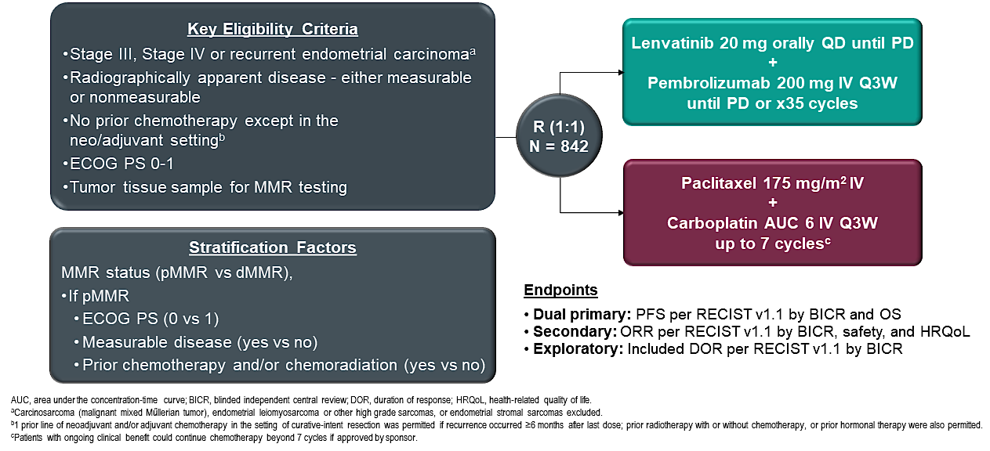
ENGOT-en9/LEAP-001: Study Design
Marth C, et al. ESGO 2024. Abstract 88.

Slide 45
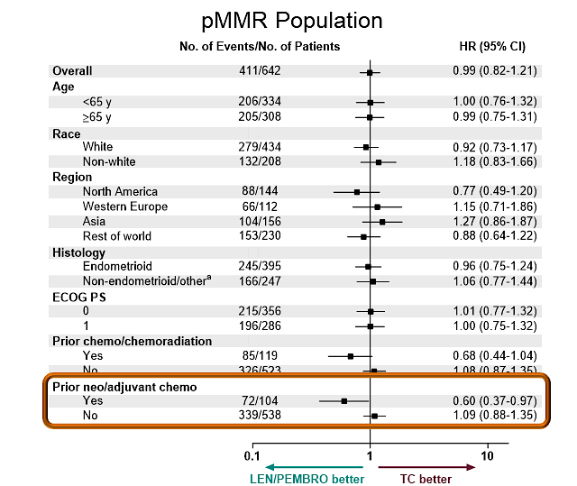
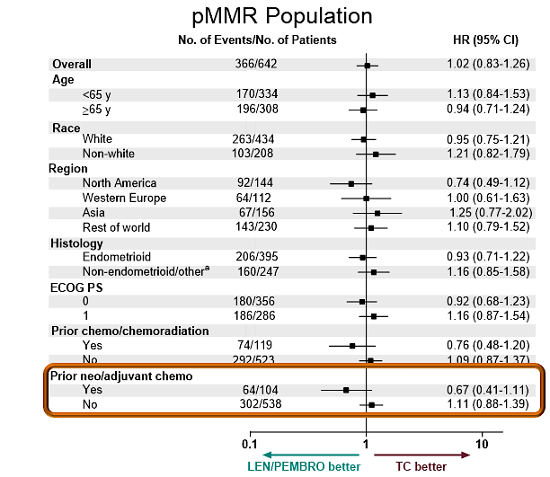
LEAP-001
Progression-Free Survival
Overall Survival
Marth C, et al. J Clin Oncol 2024.

Slide 46
Alternative options
Clinical trials
Targeted therapy
  Trastuzumab deruxtecan if HER2 2 or 3+ expression
Chemotherapy
  Platinum rechallenge
  Doxorubicin
  Weekly paclitaxel
Hormonal therapy

Slide 47
Conclusions
Molecular testing should be integrated into routine practice
  Prognostic and therapeutic implications in first line and recurrence
Lenvatinib and pembrolizumab is standard second line therapy in pMMR (ICI naïve patient population)
  Rechallenge with PD(L)-1 inhibitors has limited data
HER2 status may identify candidates for trastuzumab deruxtecan
Hormone therapy is an option
Future studies continue to exploit new targets!

Slide 48
Roundtable Discussion

Slide 49
Endometrial Cancer Symposium
Research To Practice | ONS 2025
Kathryn Lyle, MSN, WHNP-BC, AGNP-C
Division of Gynecologic Oncology
University of Alabama at Birmingham

Slide 50
Nursing Considerations for Patients Receiving Lenvatinib/Pembrolizumab

Slide 51
Lenvatinib/Pembrolizumab: Indication/Dosing
Indication: Advanced or recurrent endometrial cancer that is not MSI-H or dMMR following prior systemic therapy and not suitable for curative surgery or radiation
Mechanism of Action: Pembrolizumab and Lenvatinib have a synergistic effect. Lenvatinib is a tyrosine kinase inhibitor (prevents tumor growth and blood supply formation to the tumor). Pembrolizumab activates the body’s own immune system to attack and kill the cancer
Dosing:
  FDA-approved label indication: Lenvatinib 20mg daily + Pembrolizumab 200mg q21 days
  In practice, I start Lenvatinib at 12mg and dose reduce to 8mg if needed
  Tablets come in blister packets that vary based on the dose

Slide 52
Lenvatinib/Pembrolizumab: Side Effects
Lenvatinib AEs:
  Most common: HTN, diarrhea, fatigue, N/V, arthralgias/myalgias, and weight loss
  Other AEs include: PPE, stomatitis, proteinuria, decreased appetite, dry mouth, skin rash
Lenvatinib side effect profile can overlap with Pembrolizumab irAEs
  One strategy is to hold the Lenvatinib to see if the side effect improves
  If yes, we often restart at a reduced dose
Helpful medications to manage side effects:
  Dexamethasone oral rinse or MMW (mucositis), Urea cream (PPE), Loperamide - OTC or Diphenoxylate/Atropine – Rx (diarrhea), antihypertensive agents, topical steroid creams

Slide 53
Lenvatinib/Pembrolizumab: Monitoring/Education
Patient education:
  Ask patients to report any new side effects at the initial occurrence
  Keep loperamide on hand at home
  Review the differences in types of therapy as it relates to the SE profile
  Current therapy can exacerbate preexisting conditions
    Make PCP aware of new treatment
Monitoring:
  Keep a BP log at home
  Check urine protein levels monthly
  Ask about side effects at every visit

Slide 54
Clinical Experience
Multiple patients of mine have struggled with weight loss while on Len/Pem. We have worked with our nutritionists to try to increase protein intake. Oral mucositis and diarrhea can add to the weight loss.
I had a patient on Len/Pem (14mg daily Lenvatinib at the time) who developed PPE on the soles of her feet bilaterally. The PPE significantly impacted her mobility and ability to walk, wear shoes, etc. We had to hold Lenvatinib for >4 weeks. We prescribed urea cream and waited until her PPE was back to a grade 1. She was able to restart at a reduced dose of 10mg daily and was able to remain on therapy.

Slide 55
Roundtable Discussion

Slide 56
Agenda
Introduction: Overview of Endometrial Cancer (EC)
Module 1: First-Line Therapy for Advanced or Recurrent EC
Module 2: Role of Lenvatinib/Pembrolizumab in the Management of Progressive Advanced EC
Module 3: Novel Investigational Strategies for Newly Diagnosed Advanced EC
Module 4: Incidence and Management of HER2-Positive EC

Slide 57
Clinical Scenario
A patient with newly diagnosed metastatic EC is interested in learning about promising novel investigational strategies

Slide 58
Novel Investigational Strategies for
Newly Diagnosed Advanced EC
Brian M Slomovitz, MD
Professor, OB-GYN, Florida International University
Director, Gynecologic Oncology
Co-Chair, Cancer Research Committee
Mount Sinai Medical Center
Miami, Florida

Slide 59



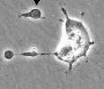
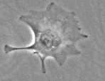
Mechanism of Action of PARP Inhibitors
DNA SSBs occur all the time in cells and PARP detects and repairs them
PARP
PARPi
During the replication process unrepaired SSBs are converted into DSBs
Replicating cells
Normal cell
Cancer cell with HRD
Repair by homologous recombination
No effective repair
(No HR pathway)
Survival
Tumor-specific killing by PARP inhibitors
Cell death
DSB, double-strand break; HR, homologous recombination; HRD, homologous recombination deficiency;
PARP, poly (ADP-ribose) polymerase; PARPi, PARP inhibitor; SSB, single-strand break.
O’Connor MJ, et al. Mol Cell. 2015;60:547-560.

Slide 60
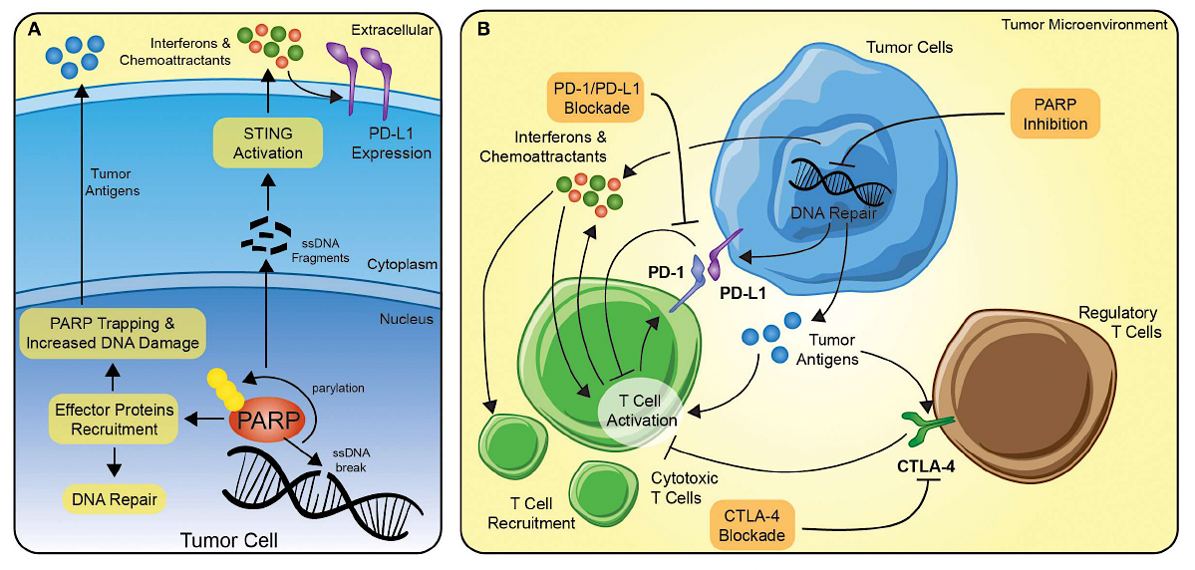
The Potential Synergy Between PARP Inhibition and Immune Checkpoint Blockade
Vikas P et al. Front Oncol 2020;10:570.

Slide 61
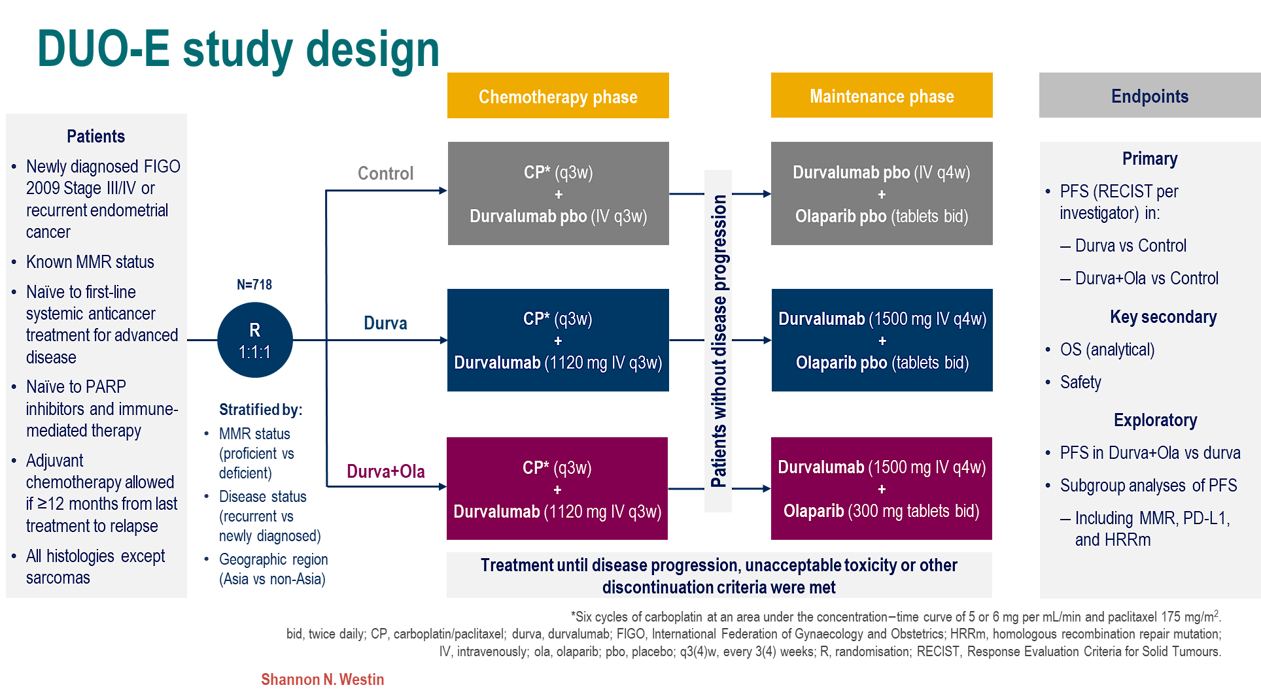

Slide 62
DUO-E: Maintenance Durvalumab ± Olaparib on PFS in ITT Population
PFS: ITT (Primary Endpoint)
 | Control (n = 241) | Durva (n = 238) | Durva + Ola (n = 239)
Events, n (%) | 173 (71.8) | 139 (58.4) | 126 (52.7)
Median PFS, mo (95% CI) | 9.6 (9.0-9.9) | 10.2 (9.7-14.7) | 15.1 (12.6-20.7)
HR (95% CI) vs control |  | 0.71 (0.57-0.89); P = .003 | 0.55 (0.43-0.69); P < .0001
HR (95% CI) vs durva |  |  | 0.78 (0.61-0.99)
100
90
Durva + Ola
Durva
Control
80
PFS, %
70
60
61.5%
Overall data maturity: 61%
50
48.5%
46.3%
40
37.8%
Durva + Ola
41.1%
Durva
30
20
21.7%
Placebo
10
0
0
3
6
9
12
15
18
21
24
27
30
33
Months From Randomization
ITT, intention to treat; Ola, olaparib.
Westin SN, et al. J Clin Oncol. 2024;42:283-299.

Slide 63
pMMR subpopulation: PFS by biomarker subgroup
CP + durvalumab + olaparib versus CP
Post hoc exploratory analysis
HR (95% CI)
All pMMR patients
PD-L1 expression*
POLEm and TP53m status†,‡
HRRm status†,§
BRCAm status†
Histology
Positive (TAP score ≥1%)
Negative (TAP score <1%)
Unknown
POLEm
TP53m
TP53 wt
Unknown
HRRm
Non-HRRm
Unknown
BRCAm
Non-BRCAm
Unknown
Endometrioid
Serous
Other¶
0.57 (0.44–0.73)
0.44 (0.31–0.61)
0.87 (0.59–1.28)
NC (NC–NC)§
NC (NC–NC)^{ǁ}
0.47 (0.32–0.67)
0.71 (0.47–1.07)
0.74 (0.37–1.45)
0.47 (0.26–0.86)
0.58 (0.43–0.78)
0.74 (0.37–1.45)
NC (NC–NC)^{ǁ}
0.57 (0.43–0.75)
0.74 (0.37–1.45)
0.60 (0.42–0.85)
0.46 (0.27–0.76)
0.64 (0.38–1.06)
0.25
0.5
1
2
Favours CP+D+O
Favours CP
DCO: 12 April 2023. *PD-L1 expression was evaluated using the VENTANA PD-L1 (SP263) assay. PD-L1 positive defined as TAP ≥1%, PD-L1 negative defined as TAP <1%, and unknown included patients who withdrew consent or due to sample unavailability; †Status determined retrospectively in two ways: from tissue samples (FoundationOne®CDx assay; Foundation Medicine, Inc.), and by molecular profiling of ctDNA (FoundationOne®Liquid CDx; Foundation Medicine, Inc.) from blood samples; ‡TP53m status defined as a sample with a deleterious or suspected deleterious mutation in TP53 excluding samples with a deleterious or suspected deleterious mutation in POLE; TP53 wt status defined as a sample with no deleterious or suspected deleterious mutation in TP53 excluding samples with a deleterious or suspected deleterious mutation in POLE; and unknown TP53m status included patients recruited in China, where TP53 and/or POLE testing was not performed, patients who withdrew consent and patients for whom no sample was available; §Positive HRRm status defined as a sample with a deleterious or suspected deleterious mutation in any of the following prespecified genes: ATM, BRCA1, BRCA2, BARD1, BRIP1, CDK12, CHEK1, CHEK2, FANCL, PALB2, RAD51B, RAD51C, RAD51D and RAD54L; negative HRRm status (non-HRRm) defined as a sample with no deleterious or suspected deleterious mutations in any of the prespecified genes; and unknown HRRm status included patients recruited in China, where HRR testing was not performed, patients who withdrew consent and patients for whom no sample was available; ^{ǁ}Not calculated due to low event numbers; ¶‘Other’ includes carcinosarcoma, mixed epithelial, clear cell, undifferentiated, mucinous, and other.
DCO, data cutoff; NC, not calculable.

Slide 64

ENGOT-EN6-NSGO/GOG-3031/RUBY Part 2
Eligible patients
Stage III/IV disease or first recurrent ECª
  All histologies except sarcomas^{b}
Naive to systemic anticancer therapy or had
a recurrence or PD ≥6 months after completing systemic anticancer therapy
Naive to PARP inhibitor therapy
Dostarlimab (500 mg IV Q3W)
+
CP^{d} (Q3W)
Dostarlimab
1000 mg IV Q6W up to 3 years^{e}
+
Niraparib
200 or 300 mg^{f} QD up to 3 years^{e}
Primary endpoint
PFS by INV
per RECIST v1.1
  Overall
  MMRp/MSS
Secondary endpoints
OS
PFS by BICR
ORR
DOR
DCR (BOR of CR, PR, or SD)
PFS2
HRQOL/PRO
PK
Safety
N=192
R 2:1
(6 cycles)
Follow-up
Placebo IV (Q3W)
+
CP^{d} (Q3W)
Placebo IV
Q6W up to 3 years^{e}
Placebo PO
QD up to 3 years^{e}
Stratification
  MMR/MSI status^{c}
    25% dMMR/MSI-H
    75% MMRp/MSS
    Prior external pelvic radiotherapy
  Disease status
N=99
(6 cycles)
On-study imaging assessments were performed Q6W (±7 days) from the randomization date until week 25 (cycle 8), followed by Q9W (±7 days) until week 52. Subsequent tumor imaging was performed every 12 weeks (±7 days) until radiographic PD was documented by investigator assessment per RECIST v1.1 followed by 1 additional imaging 4–6 weeks later, or subsequent anticancer therapy was started, whichever occurred first. Thereafter, scans were performed per standard of care.
ªHistologically/cytologically proven advanced or recurrent EC; stage III/IV disease or first recurrent EC with low potential for cure by radiation therapy or surgery alone or in combination. ^{b}Carcinosarcoma, clear cell, serous, or mixed histology permitted (mixed histology containing ≥10% carcinosarcoma, clear cell, or serous histology). ^{c}Patients were randomized based on either local or central MMR/MSI testing results. Central testing was used with local results were not available. For local determination of MMR/MSI status, IHC, next-generation sequencing, and polymerase chain reaction assays were accepted. For central determination of MMR/MSI status IHC per Ventana MMR RxDx panel was used. ^{d}Carboplatin AUC 5 mg/mL/min and paclitaxel 175 mg/m². ^{e}Treatment ends after 3 years, PD, toxicity, withdrawal of consent, investigator’s decision, or death, whichever occurs first. Continued treatment with dostarlimab or placebo beyond 3 years may be considered following discussion between the sponsor and the investigator. ^{f}Dose of 300 mg in patients with body weight ≥77 kg and platelet count ≥150,000/µL and 200 mg in patients with body weight <77 kg or platelet count <150,000/µL or both. AUC, area under the plasma or serum concentration-time curve; BICR, blinded independent central review; BOR, best overall response; CP, carboplatin-paclitaxel; CR, complete response; DCR, disease control rate; dMMR, MMR deficient; DOR, duration of response; EC, endometrial cancer; HRQOL, health-related quality of life; IHC, immunohistochemistry; INV, investigator assessment; MMR, mismatch repair; MMRp, MMR proficient; MSI, microsatellite instability; MSI-H, MSI high; MSS, microsatellite stable; ORR, objective response rate; OS, overall survival; PARP, poly(ADP-ribose) polymerase; PD, progressive disease; PFS, progression-free survival; PK, pharmacokinetic; PO, by mouth; PR, partial response; PRO, patient-reported outcome; Q3W, every 3 weeks; Q6W, every 6 weeks; Q9W, every 9 weeks; QD, once daily; R, randomization; RECIST v1.1, Response Evaluation Criteria in Solid Tumors version 1.1; SD, stable disease.
1. Mirza M, et al. Presented at SGO 2024, San Diego, USA; 2. Westin SH, et al. Presented at ESMO 2023, Madrid, Spain

Slide 65
RUBY Part 2: Maintenance Dostarlimab ± Niraparib on
PFS in Overall and pMMR Populations
Overall
pMMR
 | Median (95% CI), mo | Events, n/N (%)
Dosta + nira + CP | 14.5 (11.8–17.4) | 95/192 (49.5)
Placebo + CP | 8.3 (7.6–9.8) | 69/99 (69.7)
PFS maturity |  | 164/291 (56.4)
 | Median (95%CI), mo | Events, n/N (%)
Dosta + nira + CP | 14.3 (9.7–16.9) | 79/142 (55.6)
Placebo + CP | 8.3 (7.6–9.8) | 53/74 (71.6)
PFS maturity |  | 132/216 (61.1)
Median duration of
follow-up, 19.0 months*
100
100
80
80
60
57.0%
60
54.7%
Probability of PFS, %
Probability of PFS, %
40
40
HR, 0.60
(95% CI, 0.43–0.82)
P=.0007
33.7%
Dosta + nira + CP
HR, 0.63
(95% CI, 0.44–0.91)
P=.0060
31.1%
Dosta + nira + CP
20
Placebo IV +
Placebo oral + CP
20
Placebo IV +
Placebo oral + CP
0
0
0
2
4
6
8
10
12
14
16
18
20
22
24
26
28
30
0
2
4
6
8
10
12
14
16
18
20
22
24
26
28
30
Chemotherapy
period
Chemotherapy
period
Maintenance dostarlimab + niraparib resulted in a statistically significant improvement in PFS
in the overall and pMMR populations
*Median expected duration of follow-up.
Nira, niraparib.
Mirza MR, et al. Presented at: 2024 ESMO Gynecological Cancers Congress; June 20-22, 2024; Florence, Italy. Oral abstract 38M0.

Slide 66
Selecting Which Patient May Benefit From Addition of PARPi
RUBY Part 2 ITT
 | Dostarlimab + niraparib + CP N=192 | Placebo IV + placebo oral + CP N=99 | HR (95% CI) | HR (95% CI)
All patients | 95/192 | 69/99 |  | 0.59 (0.43–0.81)
PD-L1 statusª
PD-L1+ | 56/123 | 43/62 |  | 0.56 (0.37–0.83)
PD-L1- | 37/64 | 24/31 |  | 0.67 (0.40–1.12)
Not evaluable^{b} | 2/5 | 2/6 |  | NA
BRCA mutation status
Positive | 1/6 | 3/4 |  | NA
Negative | 75/148 | 49/71 |  | 0.61 (0.43–0.88)
Not evaluable^{b} | 19/38 | 17/24 |  | 0.71 (0.37–1.37)
HRR mutation status^{c}
Positive | 3/20 | 10/14 |  | NA
Negative | 73/134 | 42/62 |  | 0.69 (0.47–1.01)
Not evaluable^{b} | 19/38 | 17/24 |  | 0.71 (0.37–1.37)
 | Dostarlimab + niraparib + CP N=192 | Placebo IV + placebo oral + CP N=99 | HR (95% CI) | HR (95% CI)
All patients | 95/192 | 69/99 |  | 0.59 (0.43–0.81)
Molecular subgroupª
POLEmut | 0/3 | 1/2 |  | NA
dMMR/MSI-H | 12/37 | 10/17 |  | 0.45 (0.20–1.05)
TP53mut | 27/39 | 10/10 |  | 0.29 (0.13–0.63)
NSMP | 37/75 | 31/46 |  | 0.61 (0.38–0.99)
Not evaluable^{b} | 19/38 | 17/24 |  | 0.71 (0.37–1.37)
No. of patients with events/No. of patients
←Dostar + Nira + CP better
Placebo + CP better→
←Dostar + Nira + CP better
Placebo + CP better→
0.0156
0.0313
0.0625
0.125
0.25
0.5
1
2
4
8
16
0.0156
0.0313
0.0625
0.125
0.25
0.5
1
2
4
8
16

Slide 67
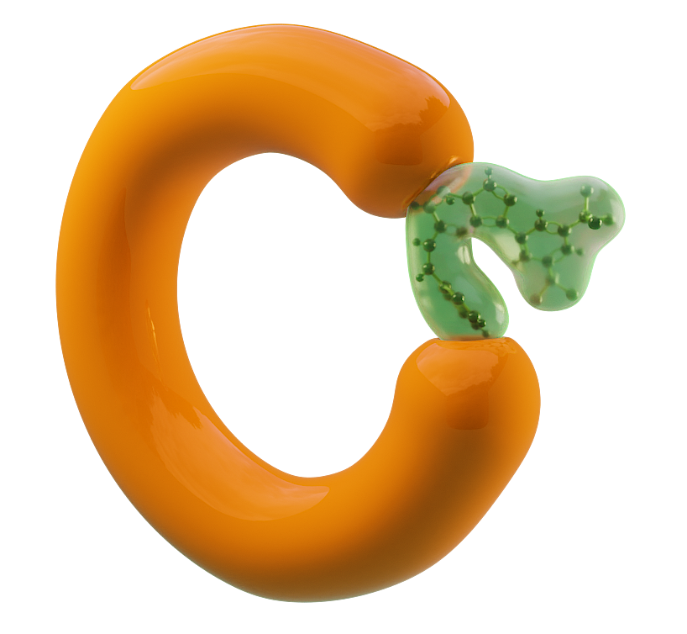







Selinexor Is a Targeted Oral XPO1 Inhibitor
Nucleus
XPO1 inhibition by selinexor results in:
Nuclear retention and functional reactivation of TSPs (eg, p53), which selectively kills cancer cells and largely spares normal cells
Inhibition of mRNA export of select oncogenes, thus decreasing subsequent translation and synthesis of oncoproteins
Simultaneous targeting of several oncogenic pathways involved in
cancer development, maintenance,
and progression
XPO1
(nuclear export)
Selinexor
Oncoproteins and growth regulators
BCR-ABL
PI3K/AKT
Wnt/β-catenin
AP-1
NF-kB
eIF4E
Nuclear pore complex
Tumor suppressor proteins (TSPs)
p53
p21
p27
FOXO
Cytoplasm
Tai Y-T, et al. Leukemia. 2014;28:155-165; Gandhi UH, et al. Clin Lymphoma Myeloma Leuk. 2018;18:335-345; Sun Q, et al. Signal Transduct Target Ther. 2016;1:16010.

Slide 68
ENGOT-EN5/GOG-3055/SIENDO: PFS in ITT Population
Probability of Progression-Free Survival
1.00
72.4%
vs
66.4%
Selinexor
Placebo
Censored
Median PFS
Selinexor (n = 174): 5.7 mo (95% CI, 3.81-9.20)
Placebo (n = 89): 3.8 mo (95% CI, 3.68-7.39)
Audited* (by electronic case report form)
  HR = 0.71 (95% CI, 0.50-0.99)
  Two-sided P-value = .05
Unaudited* (by interactive response technology)
  HR = 0.76 (95% CI, 0.54-1.08)
  Two-sided P-value = .13
0.75
48.2%
vs
40.9%
41.7%
vs
34.1%
35.3%
vs
25.8%
0.50
0.25
0.00
0
3
6
9
12
15
18
Time (Months)
Median follow-up: 10.2 months (95% CI 8.97, 13.57)
*In 7 patients (2.7% of 263), the stratification factor of CR/PR was incorrect and was corrected by the investigators prior to database lock and unblinding. The statistical analysis was validated by the independent ENGOT statistician and approved by the IDMC.
CR, complete response; IDMC, independent data safety monitoring committee; PR, partial response.
Vergote I, et al. J Clin Oncol. 2023;41:5400-5410.

Slide 69
ENGOT-EN5/GOG-3055/SIENDO: Long-Term Follow-Up of PFS in Prespecified Exploratory TP53^{WT} and TP53^{mut/abn} Subgroups
TP53^{WT}
TP53^{mut/abn}
Selinexor
Placebo
Censored
Selinexor
Placebo
Censored
Progression-Free Survival
1.00
Progression-Free Survival
1.00
Selinexor (n = 77): 28.4 mo (95% CI, 13.1-NR)
Placebo (n = 36): 5.2 mo (95% CI, 2.0-13.1)
HR: 0.44 (95% CI, 0.27-0.73)
One-sided nominal P-value = .0005
Selinexor (n = 79): 4.2 mo (95% CI, 3.6-5.6)
Placebo (n = 47): 5.4 mo (95% CI, 3.7-7.2)
HR: 1.34 (95% CI, 0.89-2.02)
One-sided nominal P-value = .9202
0.75
0.75
0.50
0.50
0.25
0.25
0.00
0.00
0
3
6
9
12
15
18
21
24
27
30
33
36
0
3
6
9
12
15
18
21
24
27
30
33
36
Months
Months
Median follow-up: 36.8 months
Median follow-up: 22.9 months
Makker V, et al. Gynecol Oncol. 2024;185:202-211; Slomovitz BM, et al. J Clin Oncol. 2023;41(suppl 36):427956.

Slide 70
XPORT-EC-042 (NCT05611931): A Phase 3, Randomized, Placebo-Controlled, Double-Blind, Multicenter Trial of Selinexor in Maintenance Therapy After Systemic Therapy for Patients With TP53 Wild-type, Advanced, or Recurrent EC
Prescreening Consent Tissue sent to Foundation
Study
Consent
Primary Endpoint
PFS assessed by Investigator
Key Secondary Endpoint
OS
Secondary Endpoints
Safety
TFST
TSST
PFS2
PFS as assessed by BICR
HR-QoL
Exploratory Endpoints
PFS per histology subtypes
PFS per other molecular features
CR rate among patients with PR as best response
Duration of CR among patients who enter study as PR and achieve CR during study
analysis of tumor biomarkers
PK analysis
Key Eligibility
TP53 wild-type endometrial cancer testing by FMI
Primary stage IV or first recurrent EC
Received at least 12 weeks of platinum-based chemotherapy +/- immunotherapy
Carcinosarcomas allowed; clear cell/small cell carcinoma excluded
N=220
Selinexor 60mg PO QW until PD n = 110
PR/CR
per RECIST v1.1
R
1:1
Treat until progression or intolerability
Placebo weekly until PD
n = 110
Stratification:
Primary Stage IV vs recurrent disease after platinum-based treatment
PR vs CR
*118 PFS events needed to provide 90% power to detect a HR of 0.55 with a 2-sided alpha of 0.05.
EC, endometrial cancer; FMI, Foundation Medicine; BICR, blinded independent central review; CR, complete response; DCR, disease control rate; EC, endometrial cancer; HR-QoL, health-related quality of life; HR, hazard ratio; OS, overall survival; PFS, progression-free survival; PFS2, time from randomization until the second progression event; PD, progressive disease; PK, pharmacokinetics; PR, partial response; R, randomized; RECIST, Response Evaluation Criterial in Solid Tumors; TFST, time to first subsequent treatment; TSST, time to second subsequent treatment; QW, every week.

Slide 71
Roundtable Discussion

Slide 72
Nursing Considerations for Patients Receiving Selinexor
Jaclyn Shaver, MS, APRN, CNP, WHNP

Slide 73
Selinexor: TP53 Wild Type- What I tell my patients
TP53 wild –type (Normal Functioning Gene)
  Tumor suppressor gene – crucial role in maintaining genomic stability and preventing cancer
  It detects DNA damage and triggers – repair, cell death of damage or cancerous cells, stop cell division
Studies have shown Selinexor works better in patients with a normal functioning gene like yours.
  Clinical Trial GOG-3083/XPORT- Phase 3 randomized placebo controlled double-blind multicenter trial of Selinexor in Maintenance Therapy after systemic therapy for patient with P53 wild type, advanced or recurrent endometrial carcinoma
Vergote I et al. Int J Gynecol Cancer 2024;34(8):1283-1289.

Slide 74
Selinexor: Common Side Effects
GI
  Nausea -#1, Vomiting, Constipation, Diarrhea, and Abdominal Pain
Nutrition
  Decreased Appetite/Weight loss -#1, Hyponatremia, Hypokalemia, Hyperglycemia
Blood
  Thrombocytopenia- #1, Anemia, Neutropenia, Leukopenia
Nervous System
  Altered Taste- #1, Dizziness, Headache
Eye
  Blurred Vision
General
  Fatigue-#1, Weakness, Feet/Ankle Swelling, Fever

Slide 75
Selinexor: Common Side Effects
Respiratory
  Cough -#1, Dyspnea, Pneumonia
Musculoskeletal
  Back Pain/Myalgias

Slide 76
Selinexor: Less Common Side Effects
Cataract, Visual Disturbance, and Dry Eye
Mucositis, Dry Mouth
Low Blood Pressure
Neuropathy
URI/UTI, Sepsis
Mental Status Changes- Confusion, Delirium
Tumor Lysis Syndrome

Slide 77
Administration- GOG-3083/XPORT
Oral Medication- with 4 oz of water, take whole- to avoid contact with skin
  Same time each day, with or without food- No diet restrictions. Maintain adequate hydration and oral intake
Weekly
28 day cycle
Dosed at 60mg on D1, 8, 15, 22
Dose missed – take next day
2 anti-nausea meds to prevent nausea at least first 2 cycles
  Ondansetron and aprepitant, if needed can add olanzapine and dexamethasone
Vergote I et al. Int J Gynecol Cancer 2024;34(8):1283-1289.

Slide 78
Clinic Scenario
49 y/o stage IA grade 1, S/p RA-TLH, BSO with mini laparotomy on 6/13/19.
No LVSI, No Myometrial Invasion- No adjuvant therapy
Uncontrolled DM with baseline neuropathy, CHF, Afib, morbidly obese
Recurrent disease to vaginal apex and mass with transmural colonic involvement (biopsy +5/18/20 of vaginal cuff and colonoscopy biopsies positive 6/30/20)
S/p Carboplatin/Paclitaxel x 6 cycles (completed 11/11/20).
  CT scan 9/24/20 with CR
SIENDO/3055 maintenance study, enrolled 12/2020.
  Discontinued after C1 due to intolerable side effects, primarily nausea.
  Patient was noncompliant with anti-emetics
Continues to be NED..? No showed her last surveillance visit on 4/1/25.

Slide 79
Roundtable Discussion

Slide 80
Agenda
Introduction: Overview of Endometrial Cancer (EC)
Module 1: First-Line Therapy for Advanced or Recurrent EC
Module 2: Role of Lenvatinib/Pembrolizumab in the Management of Progressive Advanced EC
Module 3: Novel Investigational Strategies for Newly Diagnosed Advanced EC
Module 4: Incidence and Management of HER2-Positive EC

Slide 81
Clinical Scenario
A patient with HER2-positive advanced EC has experienced disease progression on first-line carboplatin/paclitaxel/trastuzumab and second-line lenvatinib/pembrolizumab and is about to start treatment with trastuzumab deruxtecan

Slide 82
Incidence and Management of HER2-Positive EC
Brian M Slomovitz, MD
Professor, OB-GYN, Florida International University
Director, Gynecologic Oncology
Co-Chair, Cancer Research Committee
Mount Sinai Medical Center
Miami, Florida

Slide 83
What is HER2?
(Human Epidermal Growth Factor Receptor 2)
Promotes cell growth and division
Commonly overexpressed in breast and gastric cancers
Endometrial Cancer
  HER2 overexpression mainly in serous carcinoma (25-30%)
  Rare in endometrioid (<5%) and other histologies (carcinosarcoma: 16%)
  Associated with aggressive tumor behavior

Slide 84
Mechanism of ADC
Antibody-Drug Conjugate
Antibody
Bystander effects
Cytotoxic payload
Linker
Cancer
cell
ADC Components
Antibody specific for target antigen on cancer cells
High potency cytotoxic payload
Cleavable or non-cleavable linker between antibody and payload
Targeted drug delivery
Cancer
cell
Effector cell
Apoptosis
Fu Z, et al. Signal Transduct Target Ther. 2022;7:93.

Slide 85
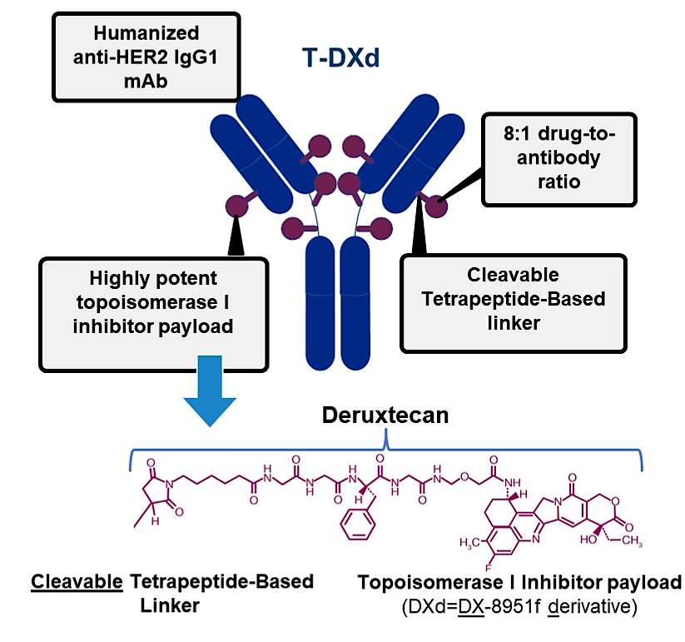
Trastuzumab Deruxtecan (T-DXd): an anti-Her2 ADC
Seven Key Attributes^{a,1–5}
Payload mechanism of action: topoisomerase I inhibitor
High potency of payload
High drug-to-antibody ratio ≈8
Payload with short systemic half-life
Stable linker payload
Tumor-selective cleavable linker
Bystander antitumor effect
Nakada T, et al. Chem Pharm Bull (Tokyo). 2019;67(3):173–185. 2. Ogitani Y, et al. Clin Cancer Res. 2016;22(20):5097–5108. 3. Trail PA, et al. Pharmacol Ther. 2018;181:126–142.
4. Okamoto H, et al. Xenobiotica. 2020;50(10):1242–1250. 5. Nagai Y, et al. Xenobiotica. 2019;49(9):1086–1096.

Slide 86
Open-Label, Phase 2 DESTINY-PanTumor02 Study of T-DXd for
HER2-Expressing Solid Tumors
Tumor types were selected based on epidemiological frequency,
prevalence of HER2 expression, and unmet medical need.
Advanced solid tumors not eligible for curative therapy
2L+ patient population
HER2 expression (IHC 3+ or 2+)
  Local test or central test by Hercep Test if local test not feasible (ASCO/CAP gastric cancer guidelines)
Prior HER2-targeting therapy
ECOG/WHO PS 0–1 restricted
in strenuous activity
Cervical cancer
Primary endpoint
Confirmed ORR (investigator)
Secondary endpoints
DOR
DCR
PFS
OS
Safety
Data cutoff for analysis
June 8, 2023
Endometrial cancer
T-DXd
5.4 mg/kg
Q3W
Ovarian cancer
Biliary tract cancer
n = 40 per
cohort planned
(Cohorts with no
objective responses in
the first 15 patients
were to be closed.)
Pancreatic cancer
Bladder cancer
Other tumorsª
ªOther tumors cohort: Salivary gland cancer (n = 19), malignant neoplasm of unknown primary site (n = 5), extramammary Paget disease (n = 3), cutaneous melanoma (n = 2), oropharyngeal neoplasm (n = 2), adenoid cystic carcinoma, head and neck cancer, lip and/or oral cavity cancer, esophageal adenocarcinoma, intestinal adenocarcinoma, appendiceal adenocarcinoma, esophageal squamous cell carcinoma, testicular cancer, and vulvar carcinoma (all n = 1).
2L+ = second-line or beyond; ASCO/CAP = American Society of Clinical Oncology/College of American Pathologists; DCR = disease control rate; DOR = duration of response; ECOG = Eastern Cooperative Oncology Group; IHC = immunohistochemistry; ORR = objective response rate; OS = overall survival; PFS = progression-free survival; PS = performance status; Q3W = every 3 weeks; T-DXd = trastuzumab deruxtecan; WHO = World Health Organization.
Meric-Bernstam F, et al. J Clin Oncol. 2024;42:47-58. Clinicaltrials.gov. NCT04482309 (https://clinicaltrials.gov/study/NCT04482309). Accessed 11/8/2024.

Slide 87
DESTINY-PanTumor02: Trastuzumab Deruxtecan Efficacy by HER2 Expression
PFS - All Cohorts
All Cohorts
Probability of PFS
1.0
Median PFS in Months (95% CI)
0.8
All cohorts: IHC 3+ 11.9 (8.2, 13.0)
All cohorts: IHC 2+ 5.4 (4.2, 6.0)
0.6
All cohorts: Total 6.9 (5.6, 8.0)
0.4
0.2
0.0
FDA granted accelerated approval to trastuzumab deruxtecan for unresectable or metastatic HER2-positive solid tumors in April 2024.
0
3
6
9
12
15
18
21
24
27
30
33
Time From First Dose (Months)
PFS - Endometrial Cancer
1.0
Median PFS in Months (95% CI)
Endometrial Cancer
Probability of PFS
Endometrial cancer: IHC 3+ NR (7.3, NR)
0.8
Endometrial cancer: IHC 2+ 8.5 (4.6, 15.1)
Endometrial cancer: Total 11.1 (7.1, NR)
0.6
0.4
0.2
n =
40 | 13 | 17
0.0
0
3
6
9
12
15
18
21
24
27
30
33
Time From First Dose (Months)
Meric-Bernstam F, et al. J Clin Oncol. 2024;42:47-58;
National Comprehensive Cancer Network. https://www.nccn.org/professionals/physician_gls/pdf/uterine.pdf. Accessed September 23, 2024.

Slide 88
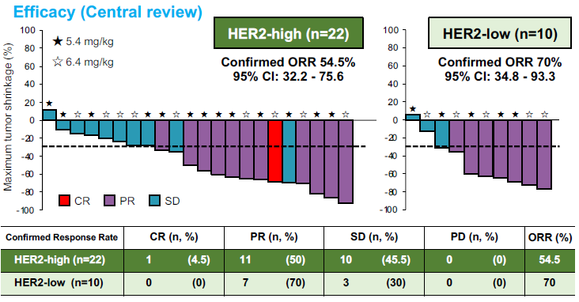
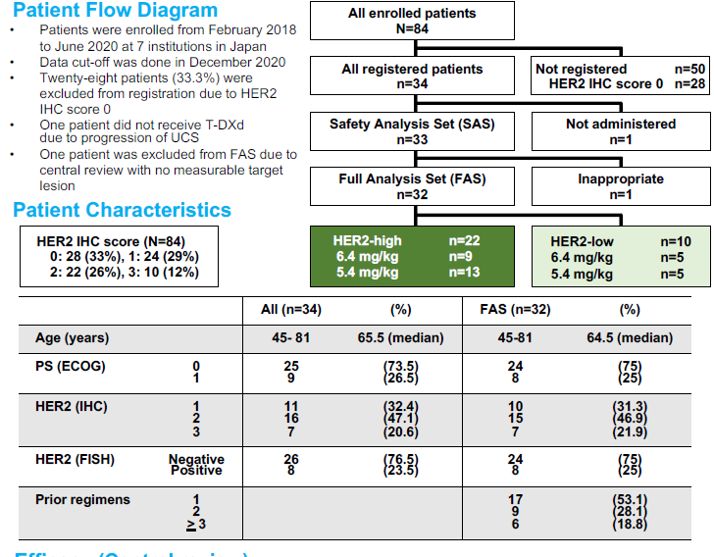
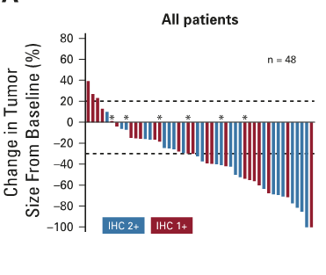
Clinical Data for Efficacy in HER2+ Uterine Carcinosarcoma
T-DXd in heavily
pretreated HER2-low MBC
ORR = 37%
mPFS = 11.1 months
Hasegawa K et al. ESMO 2021 poster 813p.
Nishikawa T et al. J Clin Oncol 2023.
Modi S et al JCO 2020

Slide 89
Clinical Case
A 62-year-old woman with HER2+ recurrent EC

Slide 90
Case: Presentation & Workup
  A 62 yo postmenopausal woman presents to her gyn/onc with vaginal bleeding
  in 2020
  Pelvic US: endometrial thickness 2 mm
  CT CAP: no evidence of metastatic disease
  Endometrial biopsy shows high-grade serous adenocarcinoma. IHC +p53, -ER, pMMR
  Surgery: Robotic hysterectomy, BSO, omental biopsy
  Pathology: endometrial serous carcinoma with microscopic metastases to bilateral ovaries, negative omentum, + pelvic nodes
  Adjuvant therapy: Post-operative carboplatin + paclitaxel chemotherapy x 6 cycles, along with vaginal cuff brachytherapy
  Germline genetic testing: no BRCAm, VUS in ATM gene

Slide 91
Case: (cont.)
  1.5 years after completion of initial carboplatin and paclitaxel, she developed a recurrence with retroperitoneal adenopathy and mesenteric masses
  Treatment:
    Lenvatinib/pembrolizumab, develops PD
  Molecular testing: HER2 IHC 3+

Slide 92
Case: (cont.)
Trastuzumab deruxtecan 5.4 mg/kg was initiated
  LVEF 65% pre—T-DXd
  CAP CT scans were done every 2 cycles
  Improvement in measurable cancer after 2 cycles
  Because of grade 3 fatigue and grade 2 diarrhea, dose was dropped to 4.4 mg/kg and then again to 3.2 mg/kg because of persistent fatigue, diarrhea

Slide 93
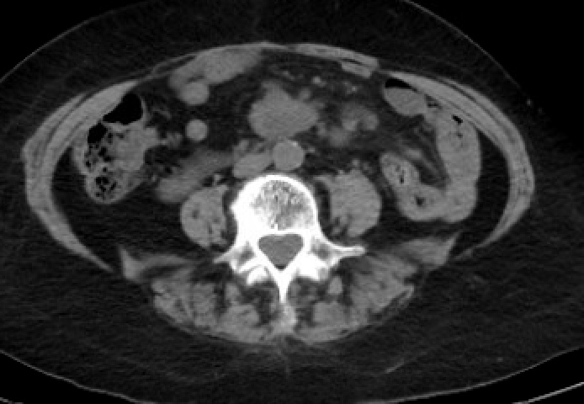
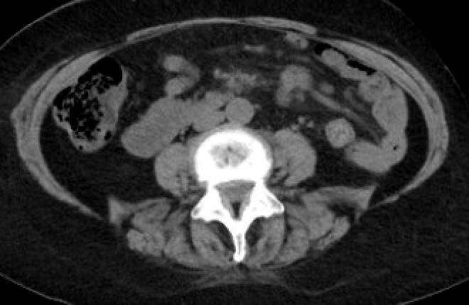
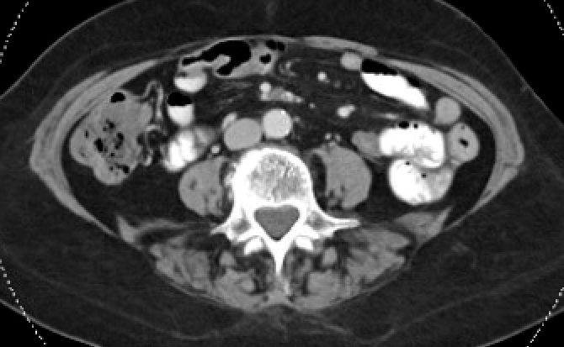
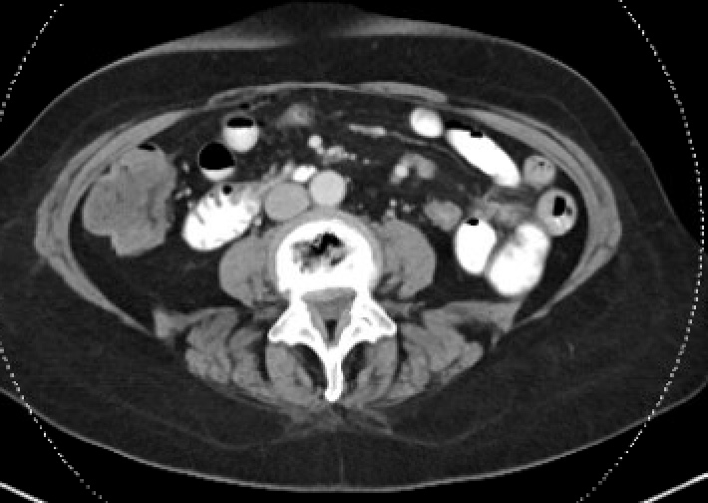
Case: Radiology
Start of
T-DXd
She remains
on T-DXd
After 8
cycles

Slide 94
Roundtable Discussion

Slide 95
Nursing Considerations for Patients Receiving HER2-Targeted Therapy
Jaclyn Shaver, MS, APRN, CNP, WHNP

Slide 96
Fam-Trastuzumab Deruxtecan (T-DXd)
NCCN Guidelines – at least 2nd line therapy
  HER2-positive tumors IHC 3+

Slide 97
T-DXd – Indications/Administration
Unresectable or Metastatic HER2 – positive (IHC 3+) solid tumors who have received prior systemic therapy and have no satisfactory alternative treatment options.
Administration – 5.4mg/kg every 3 weeks.
First dose over 90 minutes, second and subsequent doses over 30 minutes
Until disease progression or unacceptable toxicities.
1st dose reduction – 4.4mg/kg, 2nd dose reduction 3.2mg/kg
Trastuzumab deruxtecan package insert.

Slide 98
Boxed Warning
ILD and pneumonitis, including fatal cases have been reported
Using 5.4mg/kg
  Overall Incidence - 12.3%. Median time to first onset of ILD - 5.5 months.
  Death occurred in 0.9%
Monitor for and promptly investigate signs and symptoms including, cough, dyspnea, fever, or other new or worsening respiratory symptoms.
Permanently discontinue in all patients with Grade 2 or higher ILD/pneumonitis
Advise patient of risk and the need to immediately report symptoms
  Early detection is key, know patient baseline
Higher incidence with patients who have moderate renal impairment
CT at baseline and then at least every 12 weeks or 6-9 if baseline symptoms are present.
Trastuzumab deruxtecan package insert.

Slide 99
Suspect ILD/Pneumonitis
Patient develops radiographic changes potentially consistent with ILD/pneumonitis or develops acute onset of new or worsening respiratory symptoms.
  High Resolution Chest CT
  Pulmonology Referral- Bronchoscopy/PFT’s
  R/o other causes – viral panel, CBC, blood cultures, etc.
Grade 1 – Interrupt until resolved and grade 0, consider starting systemic steroids 0.5mg/kg/day prednisone with gradual taper. Close follow up – 1-2 weeks
  <28 days maintain dose
  >28 days reduce dose 1 level
Grade 2 – Discontinue, start systemic steroids 1mg/kg/day with gradual taper, close follow up 1-2 weeks
Grade 3-4 – Hospitalization with IV high dose methylprednisolone
Trastuzumab deruxtecan package insert.

Slide 100
Cardiac Toxicity- Left Ventricular Dysfunction
Overall Incidence - 4.6% --- Grade 3 or worse - 0.6%
Assess LVEF prior to initiation of therapy and then every 3 months
Interrupt and consult Cardiology if
  IF LVEF 40%-45% and absolute decrease from 10-20%
  LVEF <40%
  Absolute decrease from baseline >20%
Trastuzumab deruxtecan package insert.

Slide 101
Common Side Effects
GI – Nausea - #1, vomiting, diarrhea, constipation, stomatitis, abdominal pain, dyspepsia
General – Fatigue - #1, fever, edema
Metabolism/Nutrition - #1 Decreased appetite, loss of weight
Skin – Alopecia #1, and rash
Infections – URI- #1, and pneumonia
Musculoskeletal – Musculoskeletal Pain
Respiratory- Cough #1, ILD, Dyspnea
Nervous System - Headache

Slide 102
Clinical Example
74 y/o Recurrent Stage IV Serous Carcinoma of the Uterus
  s/p RATLH/BSO/right pelvic peritonectomy on 11/29/21
  Residual Disease on small bowel mesentery <1cm
  HER2 – 3+, P53 mutated, ER/ER+, pMMR, 100% invasion, + LVSI, + met to vagina
Enrolled in DUO-E 6 cycles carboplatin/paclitaxel +/- durvalumab, followed by Durvalumab or placebo maintenance. CR after cycle #12
7/12/23- Mesenteric nodes started to increase in size, but not measurable.
  3/21/24- CT measurable at 1.8cm
HER 2- 3+ -> ECHO- 55-65%→Started on fam-trastuzumab deruxtecan on 5/8/24
  D1 – Aprepitant, Palonosetron, and Dexamethasone; Olanzapine D2-4
  Now s/p cycle # 16 on 3/20/25, CT 3/14/25- node now 0.9cm.
Tolerated well with no dose reductions, no signs of ILD/pneumonitis, ECHO remains 55-65% on 3/14/25

