Slide 1
Available and Emerging Therapeutic Approaches for Metastatic CRPC
Research To Practice
April 7, 2025
Emmanuel S. Antonarakis, M.D.
Clark Endowed Professor of Medicine
Division of Hematology/Oncology & Transplantation, University of Minnesota
Associate Director of Translation, Masonic Cancer Center

Slide 2
Saad F et al. Efficacy of olaparib (ola) plus abiraterone (abi) versus placebo (pbo) plus abi in patients (pts) with metastatic castration-resistant prostate cancer (mCRPC) with a germline or somatic BRCA mutation in the PROpel trial. ASCO Genitourinary Cancers Symposium 2025;Abstract 219.

Slide 3
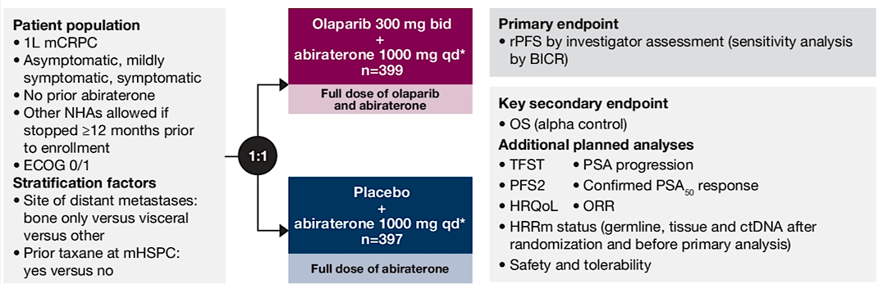
Olap + Abi: Phase 3 PROpel trial design
Saad F, et al. ASCO GU Symposium 2025; Abstract 219.

Slide 4
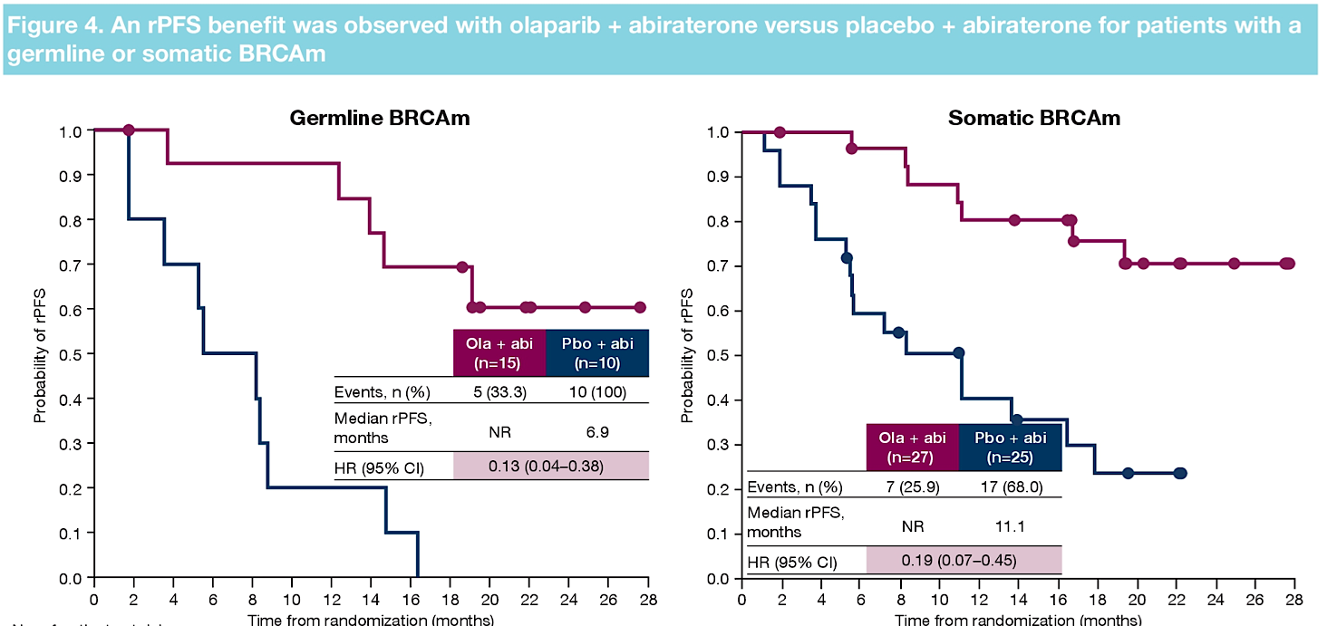
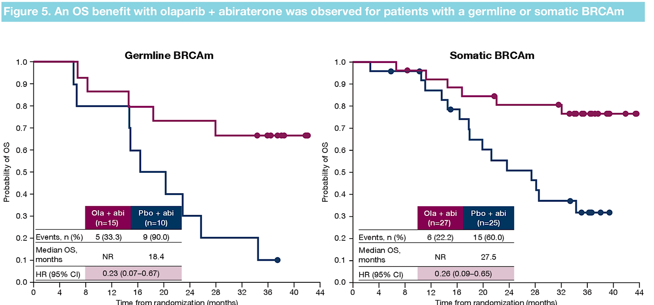
PFS/OS results by germline or somatic BRCAm
Saad F, et al. ASCO GU Symposium 2025; Abstract 219.

Slide 5
Conclusions
In first-line mCRPC patients with BRCAm, both germline and somatic muts derive similar benefit to olaparib + abiraterone
The natural history of germline BRCAm may be worse than somatic BRCAm in terms of PFS and OS
Since about 50% of BRCA mutations are of somatic-only origin, relying on germline testing alone will miss half of BRCAm cases
Germline and somatic testing are needed for all mCRPC patients
Somatic testing: tissue biopsy (primary, mets) or ctDNA assay

Slide 6
Roubaud G et al. Adjustment for imbalances in baseline characteristics in the MAGNITUDE phase 3 study confirms the clinical benefit of niraparib in combination with abiraterone acetate plus prednisone in patients with metastatic prostate cancer. Eur J Cancer 2024; 209:114183.

Slide 7
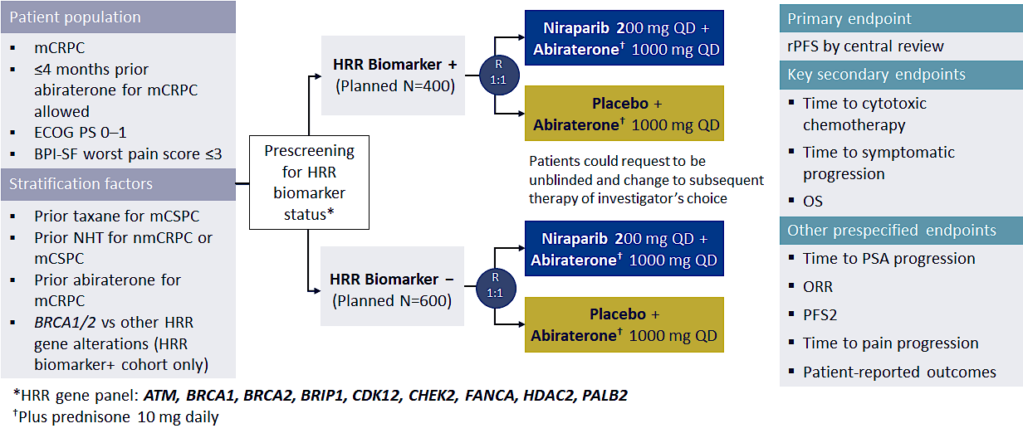
Magnitude: Phase III Trial of Abi +/- Niraparib
Chi KN et al. ASCO GU 2022; abstract 12; NCT03748641.

Slide 8
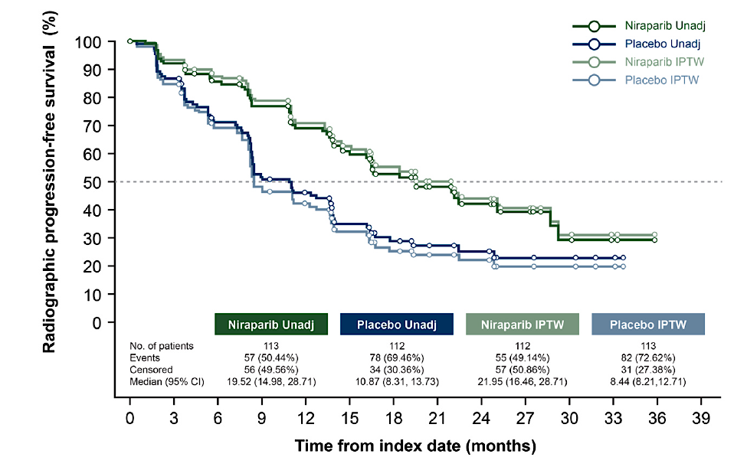
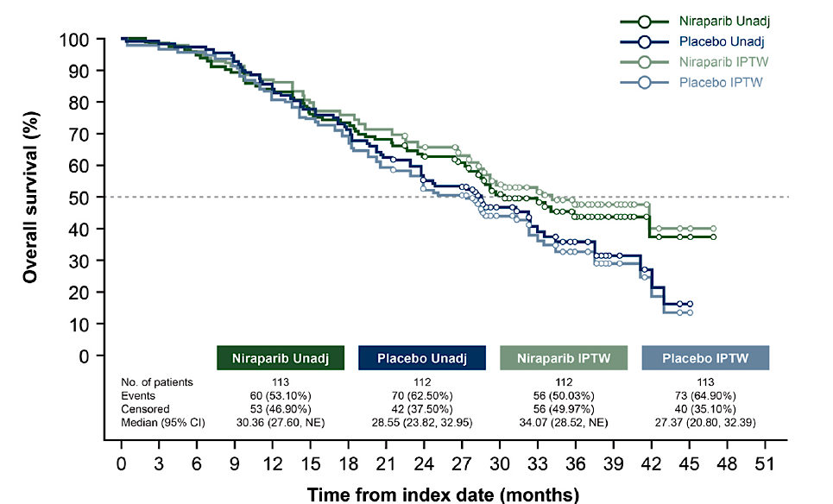
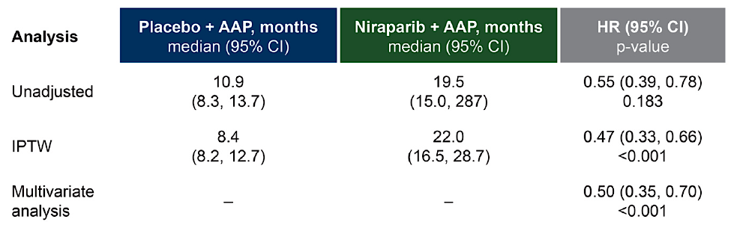

Unadjusted vs. Adjusted analyses of PFS/OS
Roubaud G, et al. Eur J Cancer 2024; 209: 114183.

Slide 9
Conclusions
MAGNITUDE was a randomized phase 3 trial in first-line mCRPC testing abiraterone +/- niraparib in HRRm and BRCAm patients
There were baseline prognostic imbalances in the MAGNITUDE trial potentially favoring the control group
After adjusting for these baseline imbalances (IPTW method), the degree of PFS and OS benefit was further enhanced
But… the combination of niraparib/abiraterone is less favored than other PARPi/ARPI combos due to lower perceived efficacy

Slide 10
Agarwal N et al. Final overall survival (OS) with talazoparib (TALA) + enzalutamide (ENZA) as first-line treatment in unselected patients with metastatic castration-resistant prostate cancer (mCRPC) in the phase 3 TALAPRO-2 trial. ASCO Genitourinary Cancers Symposium 2025;Abstract LBA18.

Slide 11
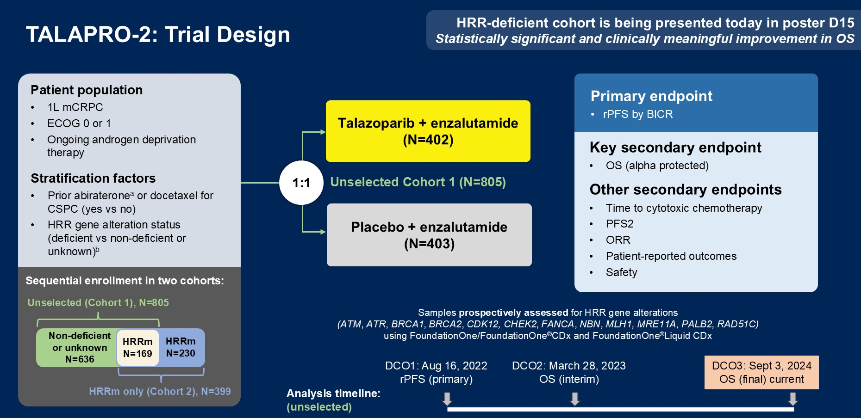
Talazop + Enza: Phase 3 TALAPRO-2 trial
Agarwal N, et al. ASCO GU Symposium 2025; Abstract LBA18.

Slide 12
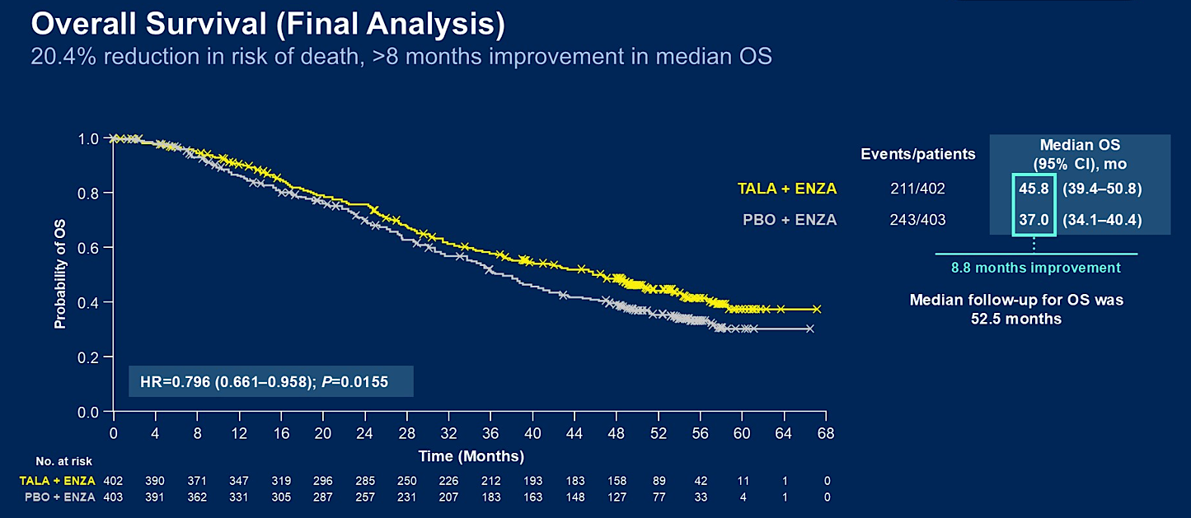
Phase 3 TALAPRO-2 trial: OS in unselected
Agarwal N, et al. ASCO GU Symposium 2025; Abstract LBA18.

Slide 13
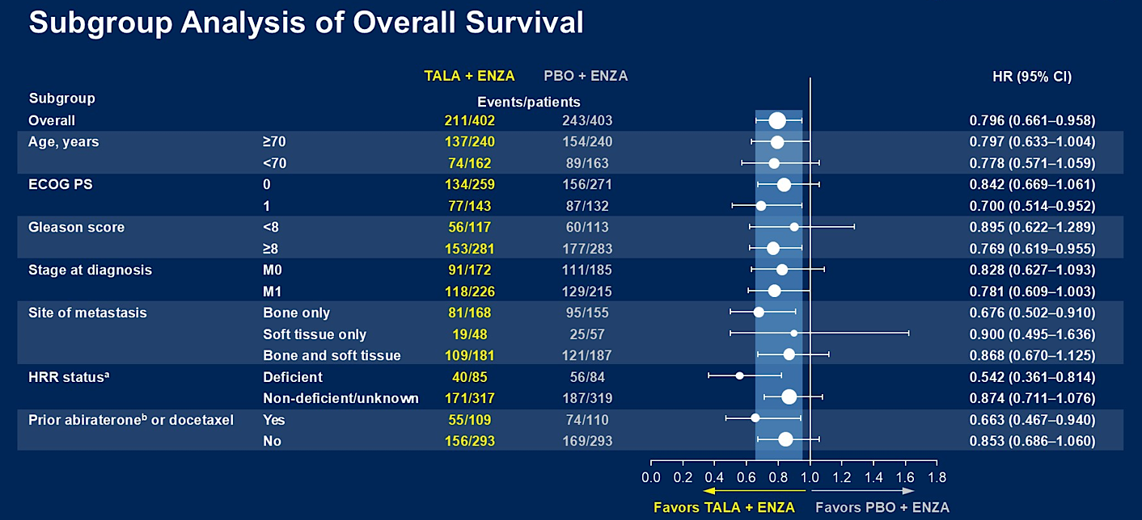
Phase 3 TALAPRO-2 trial: OS in unselected
Agarwal N, et al. ASCO GU Symposium 2025; Abstract LBA18.

Slide 14
Conclusions
TALAPRO-2 was a randomized phase 3 trial of enza +/- talazop in both unselected and HRRm first-line mCRPC patients
The primary PFS endpoint in unselected pts was met (HR 0.63, P<0.001) and was previously reported
Here, we see that OS is also significantly improved with enza/ talazoparib in unselected first-line mCRPC pts
Although this combo regimen is currently only FDA approved for HRR-altered mCRPC, expanded FDA approval will likely be sought

Slide 15
Hussain MH et al. Abiraterone, Olaparib, or Abiraterone + Olaparib in First-Line Metastatic Castration-Resistant Prostate Cancer with DNA Repair Defects (BRCAAway). Clin Cancer Res 2024;30(19):4318-28.

Slide 16
BRCAaway trial: Abi vs. Olap vs. Abi/Olap
Hussain M, et al. Clin Cancer Res 2024; 30: 4318-28. www.clinicaltrials.gov: (NCT03012321)

Slide 17
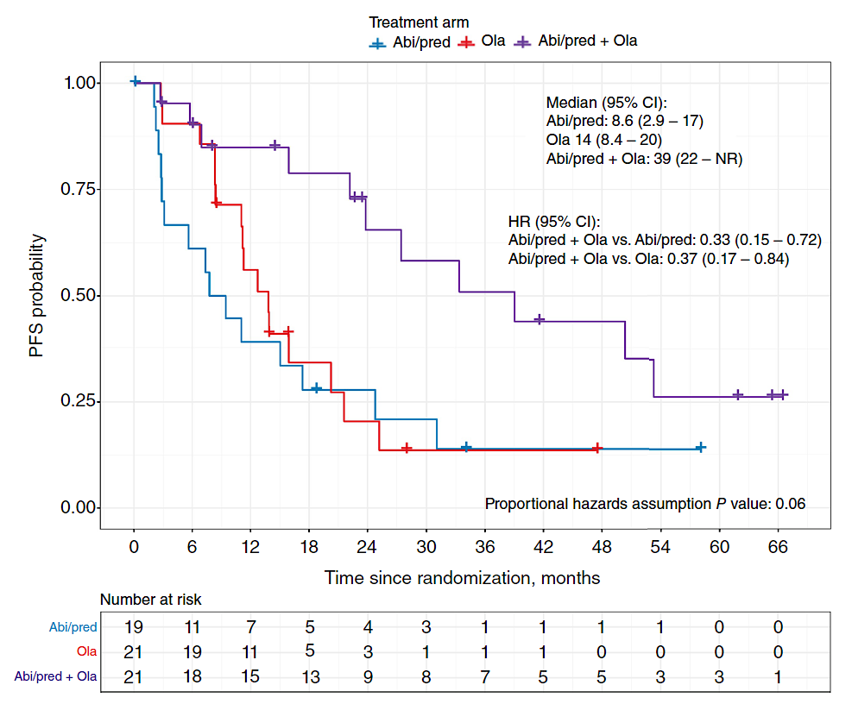
BRCAaway trial: Abi vs. Olap vs. Abi/Olap
Hussain M, et al. Clin Cancer Res 2024; 30: 4318-28.

Slide 18
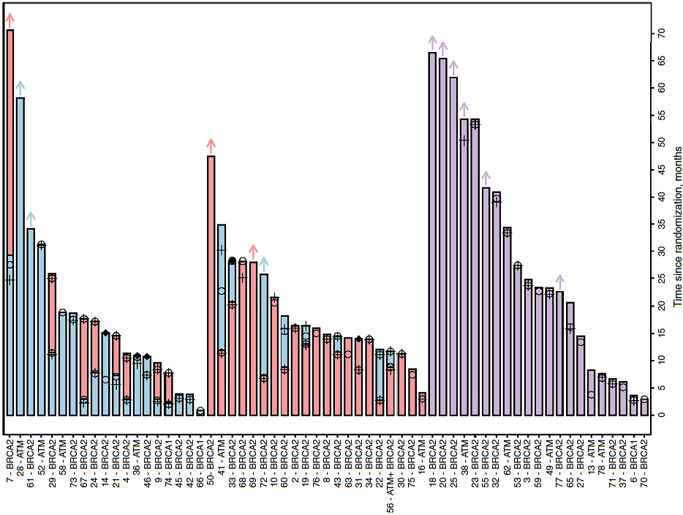
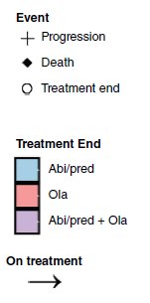
BRCAaway trial: Abi vs. Olap vs. Abi/Olap
Abi --> Olap
Olap --> Abi
Abi + Olap
Hussain M, et al. Clin Cancer Res 2024; 30: 4318-28.

Slide 19
Conclusions
BRCAaway is the only PARPi/ARPI randomized trial with two control arms: Olaparib alone and Abiraterone alone
The trial had a built-in crossover design for Arm A (abiraterone
--> olaparib) and Arm B (olaparib --> abiraterone)
Even accounting for crossover, the combo of olap/abi produced better PFS than sequential abi --> olap or olap --> abi
Albeit a small trial, this is the best evidence that combination PARPi/ARPI therapy may be superior to sequential treatment

Slide 20
Azad A et al. Phase III, double-blind, placebo-controlled, 2-cohort, randomized study of saruparib (AZD5305) in combination with androgen receptor pathway inhibitors in patients with metastatic hormone-sensitive prostate cancer with and without homologous recombination repair mutation (EvoPAR-Prostate01). ASCO GU Cancers Symposium 2025;Abstract TPS279.

Slide 21
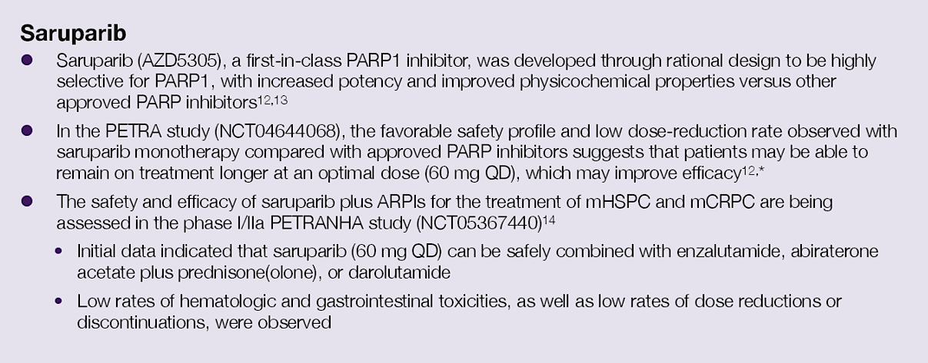
Saruparib: PARP1-selective inhibitor
Azad A, et al. ASCO GU Symposium 2025; Abstract TPS279.

Slide 22
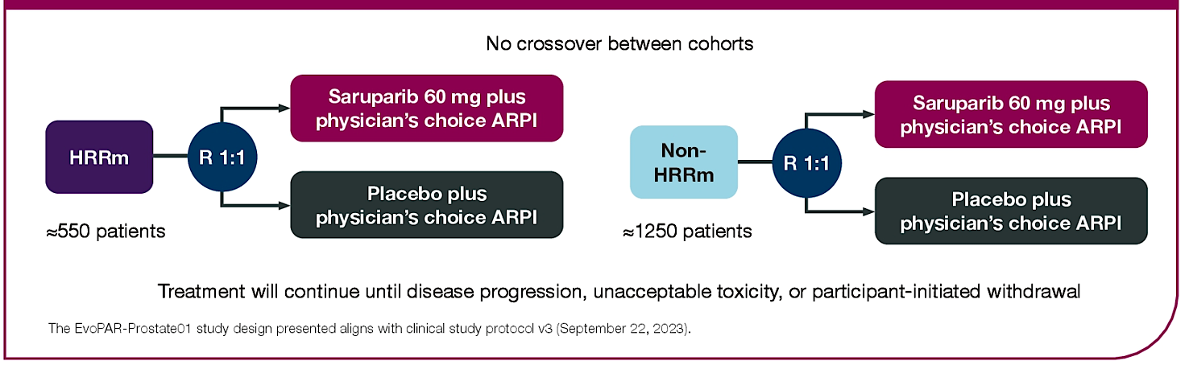
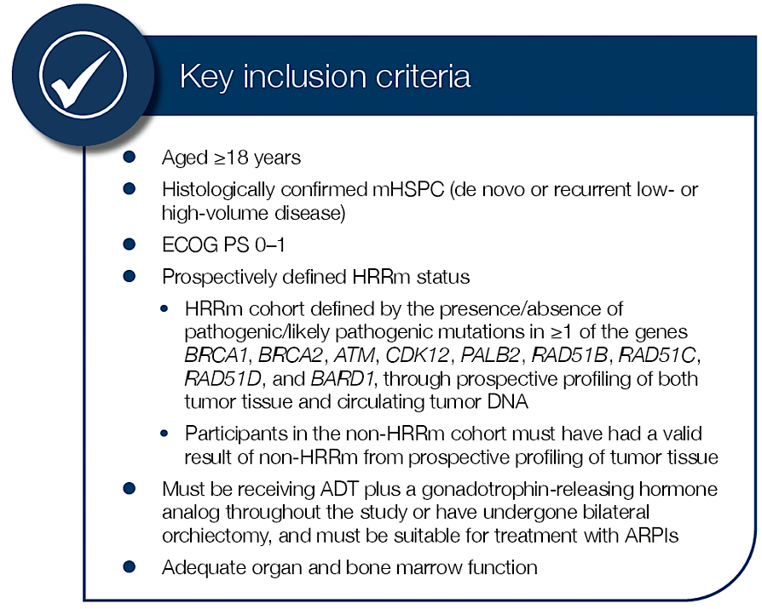
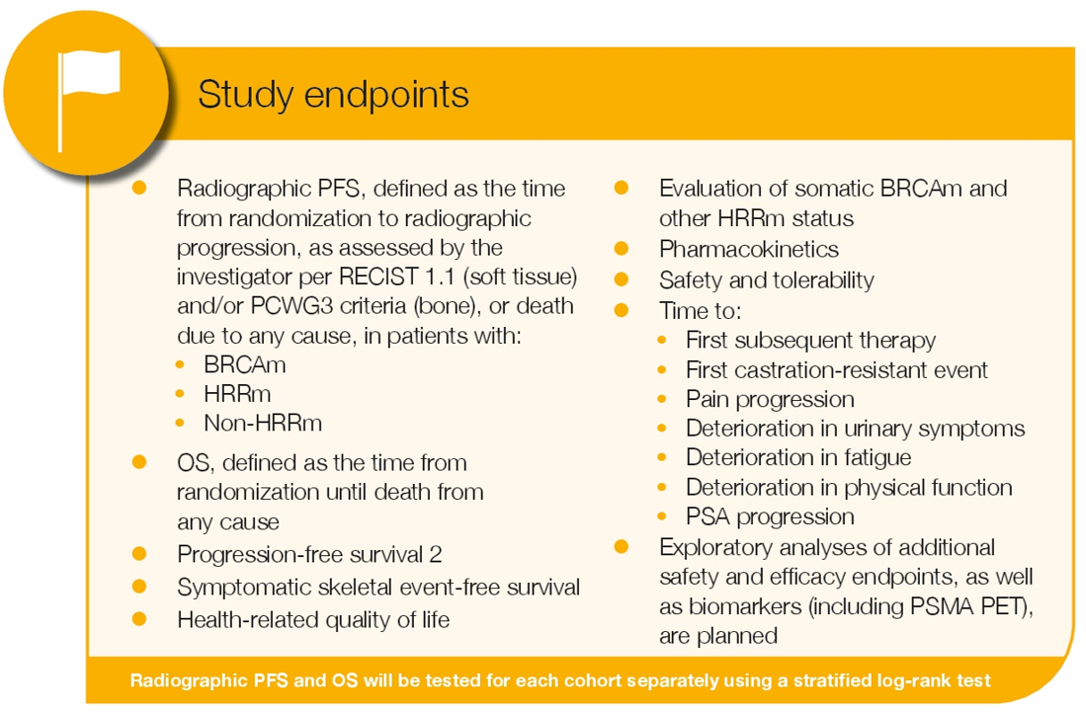
EvoPAR-01 trial: ARPI +/- Saruparib in mHSPC
Azad A, et al. ASCO GU Symposium 2025; Abstract TPS279.

Slide 23
Conclusions
Saruparib is the first PARP1-selective inhibitor
EvoPAR-01 is a Phase 3 randomized trial of ADT/ARPI +/- saruparib in mHSPC patients both with/without HRR muts
Other PARPi trials in mHSPC: TALAPRO-3 (ADT/ARPI +/- Talazop), and AMPLITUDE (ADT/ARPI +/- Nirap)
No indication currently for PARPi in mHSPC space, even for BRCA1/2-altered patients

Slide 24
Gillessen S et al. A randomized multicenter open label phase III trial comparing enzalutamide vs a combination of Radium-223 (Ra223) and enzalutamide in asymptomatic or mildly symptomatic patients with bone metastatic castration-resistant prostate cancer (mCRPC): First results of EORTC-GUCG 1333/PEACE-3. ESMO 2024;Abstract LBA1.

Slide 25
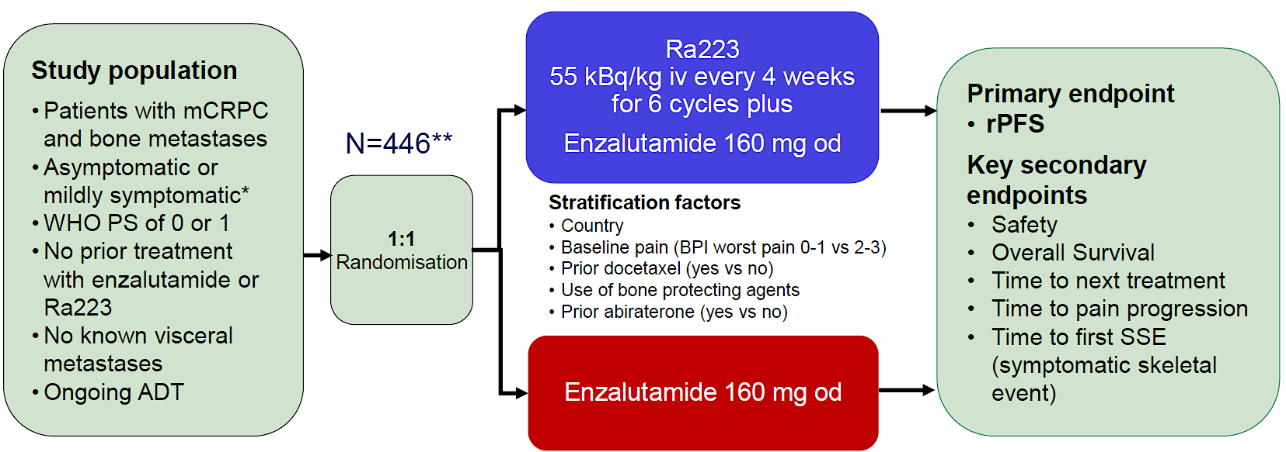
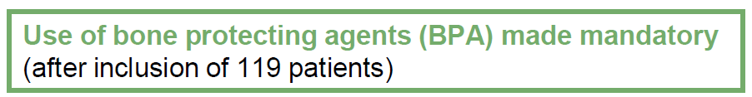
PEACE-3 trial: Enza +/- Radium²²³ in mCRPC
Gillessen S, et al. ESMO 2024; Abstract LBA1.

Slide 26
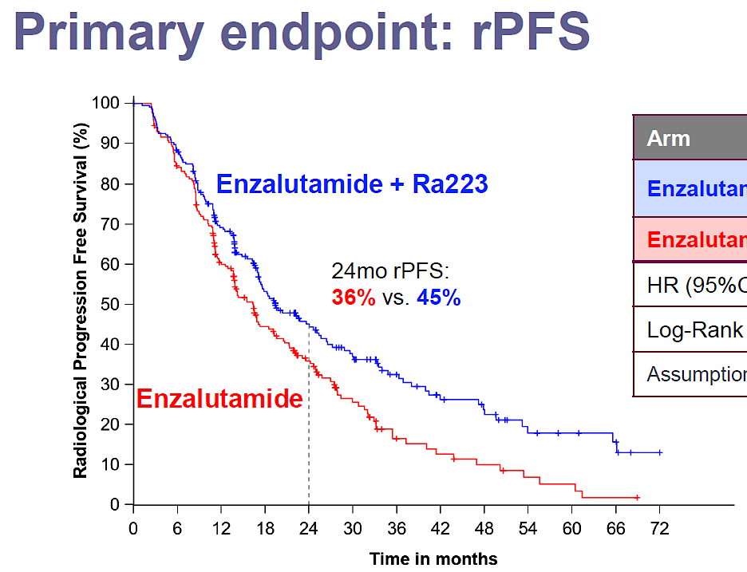
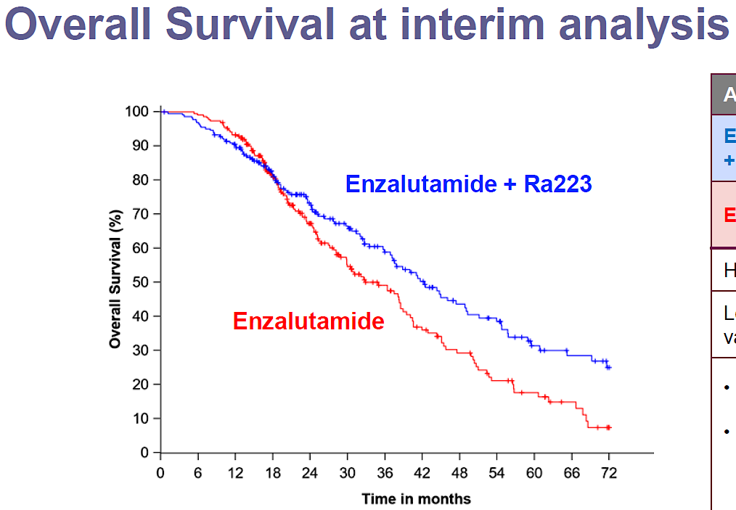
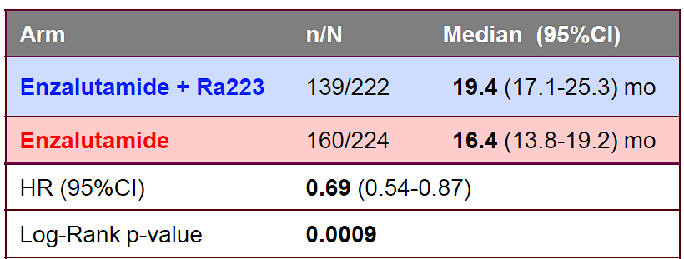
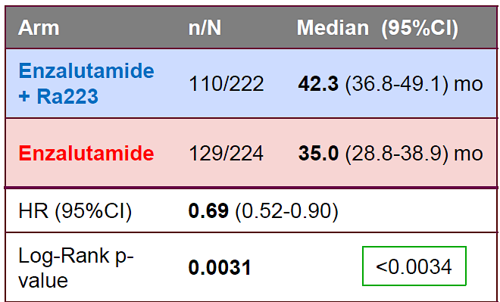
PEACE-3 trial: Enza +/- Radium²²³ in mCRPC
Gillessen S, et al. ESMO 2024; Abstract LBA1.

Slide 27
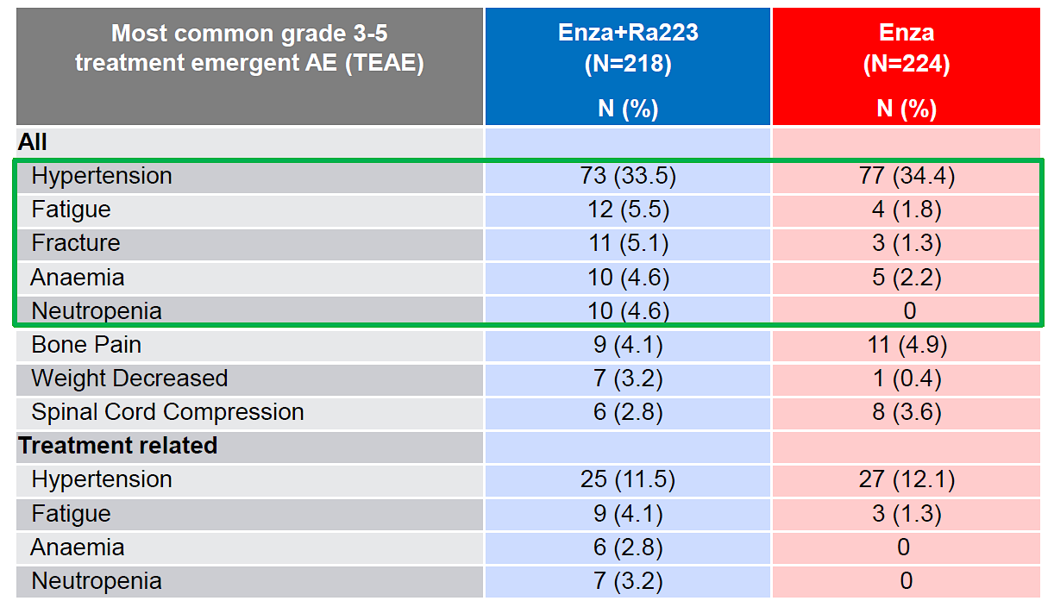
PEACE-3 trial: Adverse Events
Gillessen S, et al. ESMO 2024; Abstract LBA1.

Slide 28
Conclusions
PEACE-3 showed a statistically significant and clinically meaningful OS advantage with Enza/Rad²²³ vs. Enza alone
Conversely, there is no demonstrable OS benefit with use of ¹⁷⁷Lu-PSMA therapies in the pre-docetaxel mCRPC space
Safety of Enza/Rad²²³ seemed reasonable, with increased grade-3 fatigue, anemia, neutropenia, and weight loss
Enza + Rad²²³ (+ bone protection) may be a new standard for first-line bone-dominant mCRPC without prior ARPI treatment

Slide 29
Morris MJ et al. 177Lu-PSMA-617 versus a change of androgen receptor pathway inhibitor therapy for taxane-naive patients with progressive metastatic castration-resistant prostate cancer (PSMAfore): A phase 3, randomised, controlled trial. Lancet 2024; 404(10459):1227-39.

Slide 30
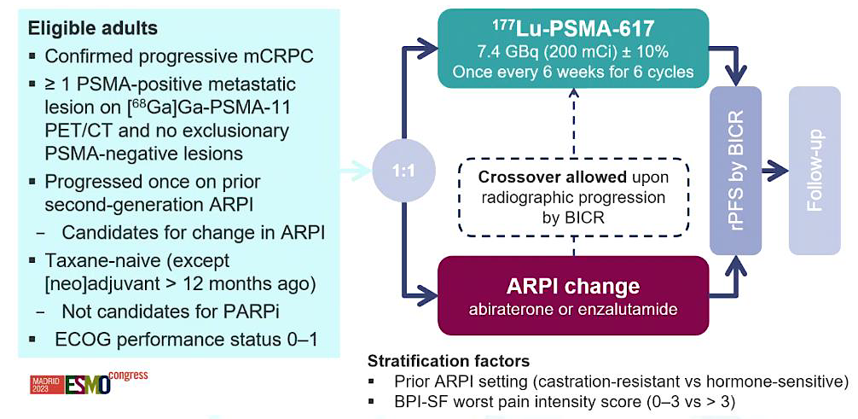
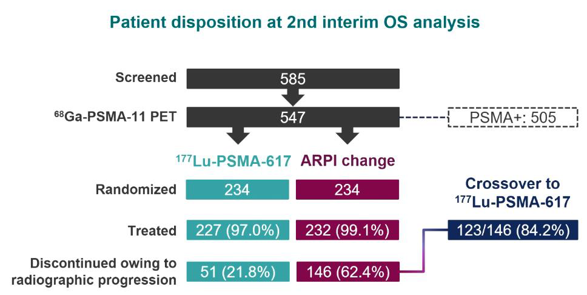
PSMAfore: ¹⁷⁷Lu-PSMA-617 in pre-taxane mCRPC
Morris MJ, et al. Lancet 2024; 404: 1227-39.

Slide 31
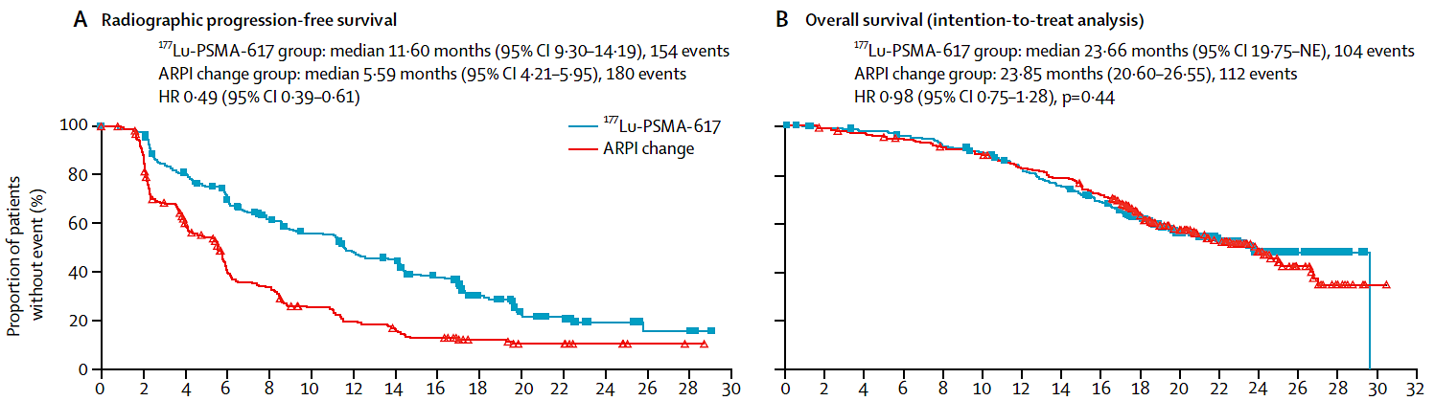
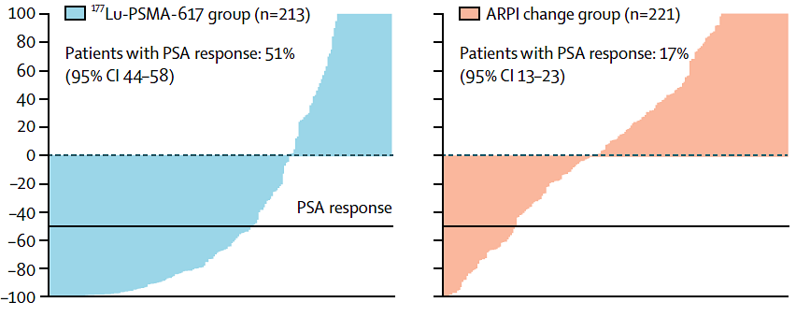

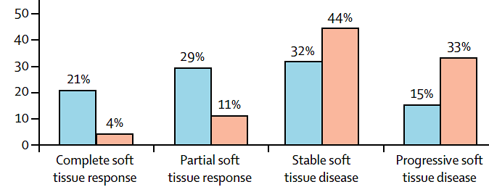
PSMAfore: ¹⁷⁷Lu-PSMA-617 vs. ARPI switch
Morris MJ, et al. Lancet 2024; 404: 1227-39.

Slide 32
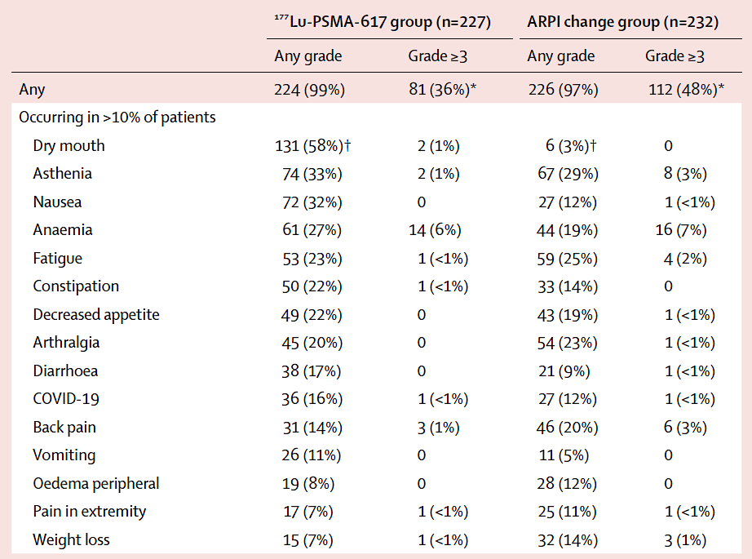
PSMAfore: Adverse Events
Morris MJ, et al. Lancet 2024; 404: 1227-39.

Slide 33
Conclusions
PSMAfore is the first randomized Phase 3 trial to assess
¹⁷⁷Lu-PSMA-617 in the pre-taxane mCRPC space
In this setting, ¹⁷⁷Lu-PSMA-617 improved rPFS (but not OS) when compared to ARPI switch in patients with one prior ARPI
The toxicity profile of ¹⁷⁷Lu-PSMA-617 is favorable, but includes dry mouth, nausea, diarrhea and anemia
On 3/28/2025, based on this trial, the FDA expanded the indication for ¹⁷⁷Lu-PSMA-617 into the pre-taxane mCRPC setting

Slide 34
Emmett L et al. Overall survival and quality of life with 177Lu-PSMA-617 plus enzalutamide vs enzalutamide alone in metastatic castration-resistant prostate cancer (ENZA-p): Secondary outcomes from a multicentre, open-label, randomised, phase 2 trial. Lancet Oncol 2025;26(3):291-9.

Slide 35
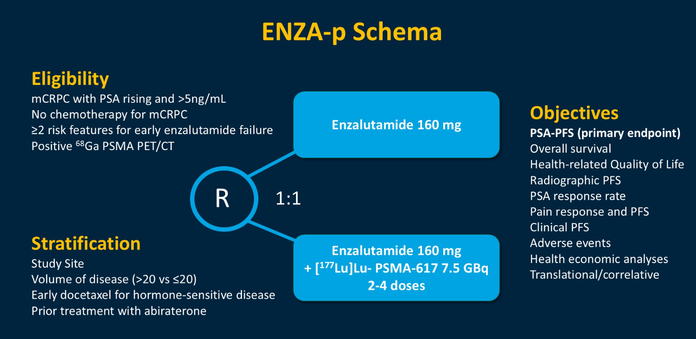
Enza-P trial: Enza +/- ¹⁷⁷Lu-PSMA-617 in mCRPC
Emmett L, et al. Lancet Oncol 2025; 26: 291-9.

Slide 36
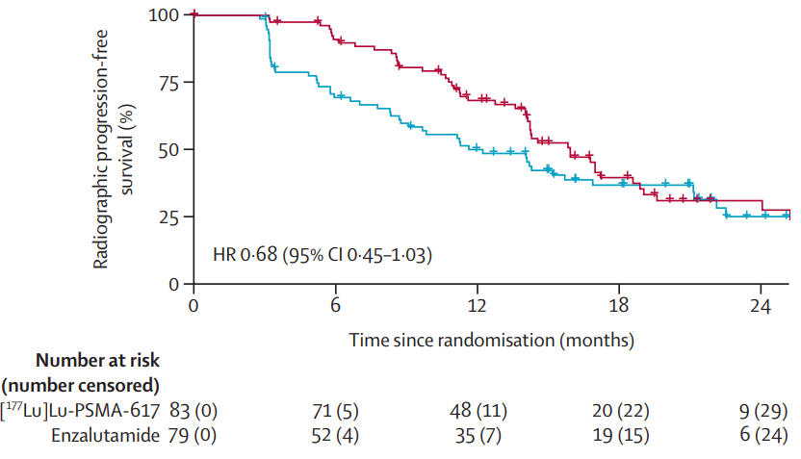
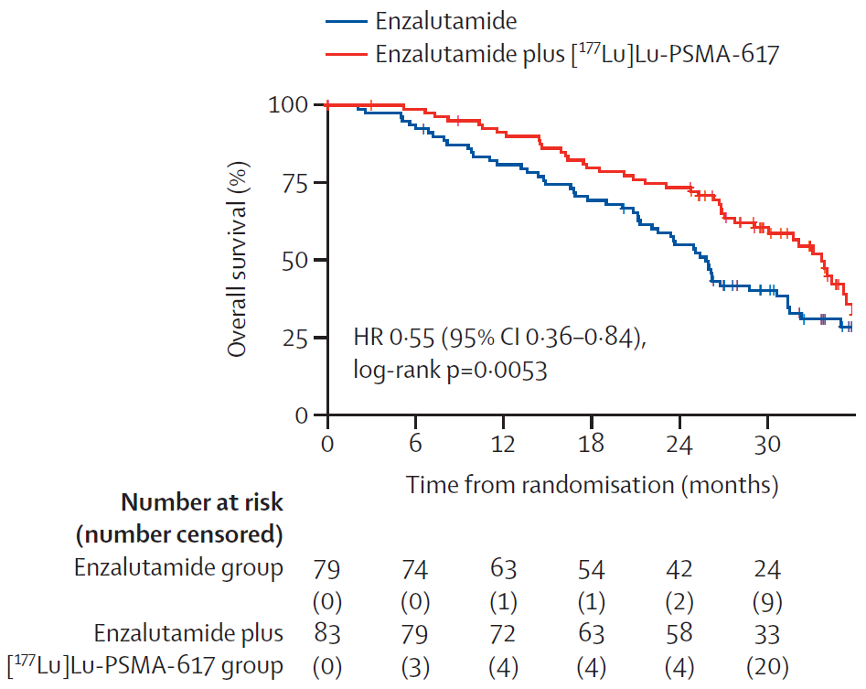
Enza-P trial: Enza +/- ¹⁷⁷Lu-PSMA-617 in mCRPC
rPFS
Survival
Emmett L, et al. Lancet Oncol 2025; 26: 291-9.

Slide 37
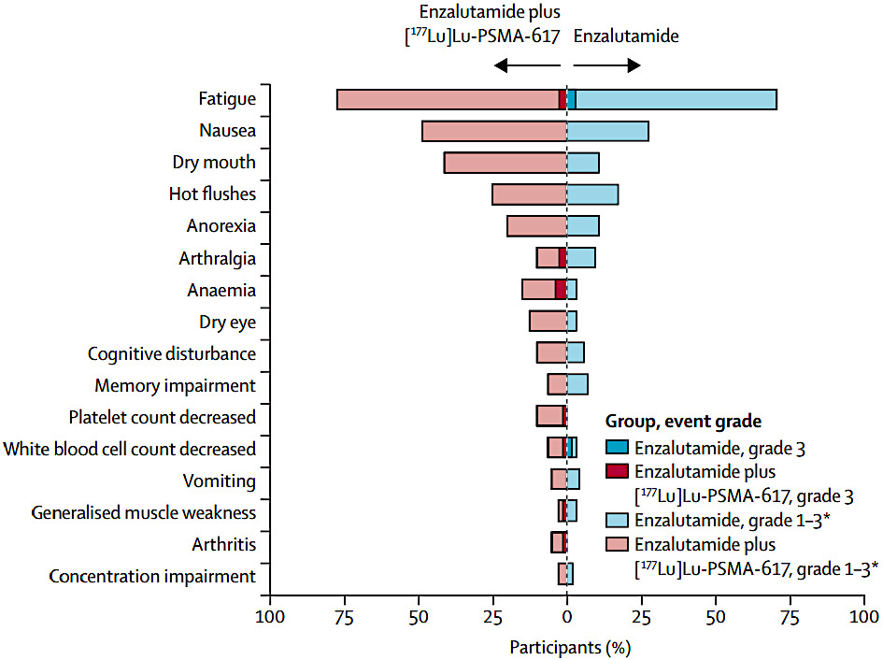
Enza-P trial: Enza +/- ¹⁷⁷Lu-PSMA-617 in mCRPC
Emmett L, et al. Lancet Oncol 2025; 26: 291-9.

Slide 38
Conclusions
Enza-P is the first study to show an OS advantage using ¹⁷⁷Lu-PSMA-617 (w/ Enza) in the pre-taxane mCRPC setting
Relative to Enza alone, ¹⁷⁷Lu-PSMA + Enza led to improved rPFS, improved deterioration-free survival, and improved pain/fatigue
Adverse events were dry mouth/eyes, nausea, cytopenias
The combination of Enza + ¹⁷⁷Lu-PSMA-617 is not currently FDA approved in the pre-taxane mCRPC setting
Phase 3 trials of this combination are needed

Slide 39
Sartor O et al. Efficacy of 177Lu-PNT2002 in PSMA-positive mCRPC following progression on an androgen-receptor pathway inhibitor (SPLASH). ESMO 2024; Abstract LBA65.

Slide 40
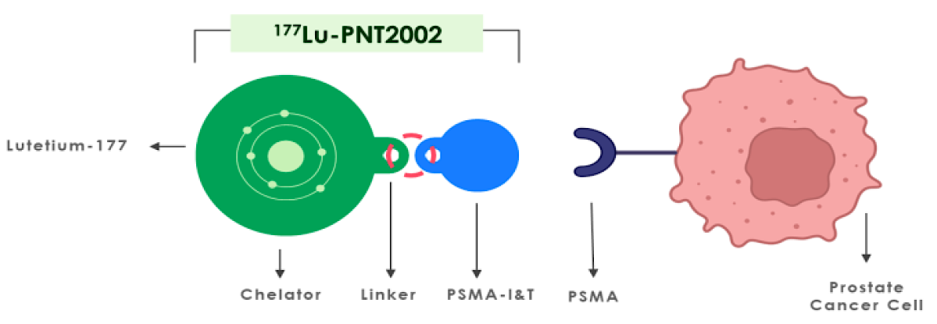
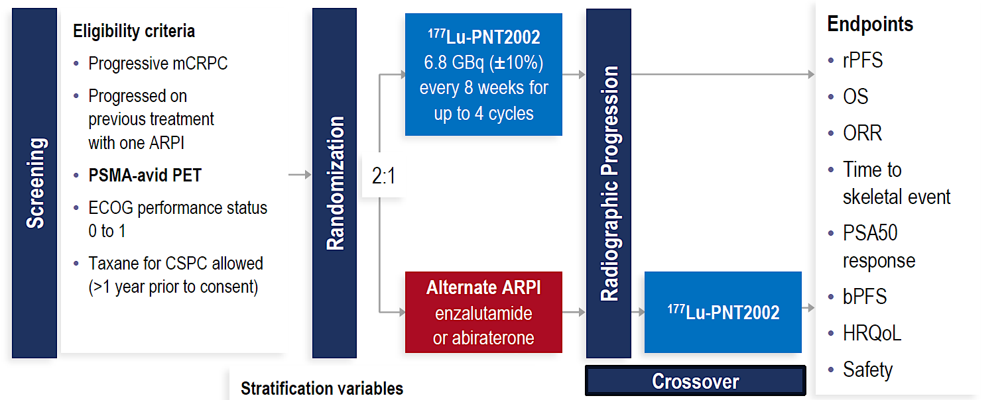
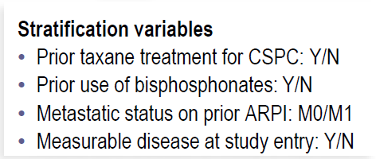
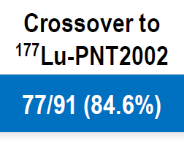
SPLASH: ¹⁷⁷Lu-PNT2002 vs. ARPI switch
Sartor O, et al. ESMO 2024; Abstract LBA65.

Slide 41
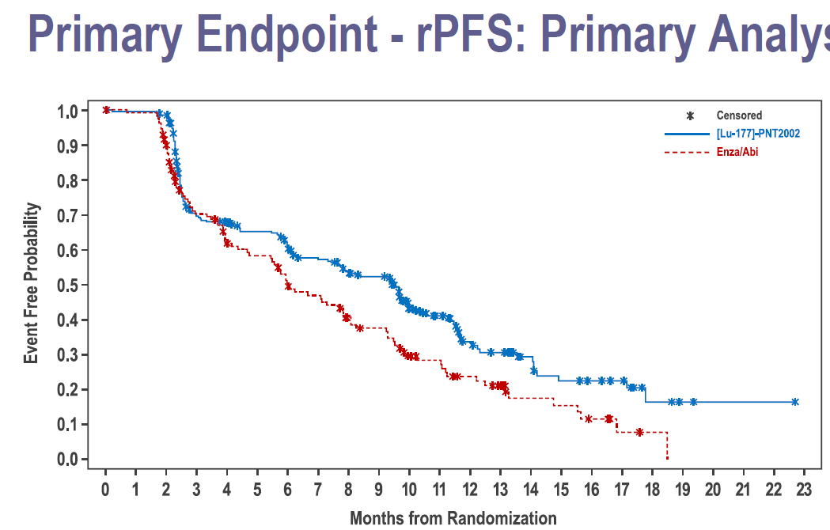

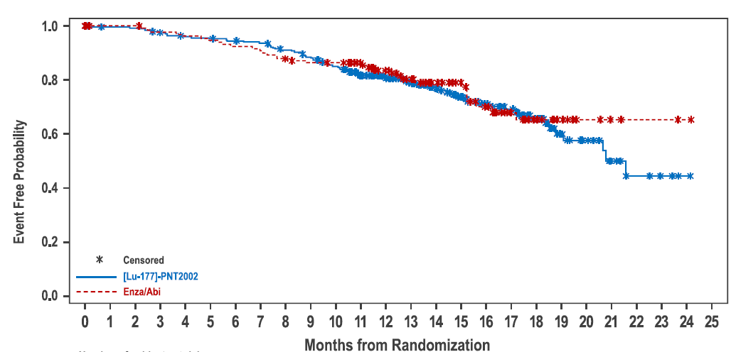
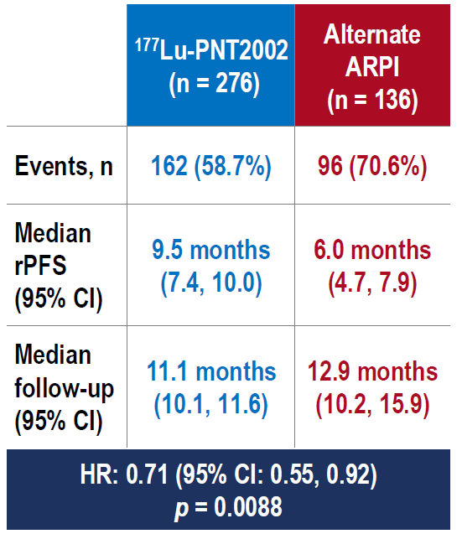
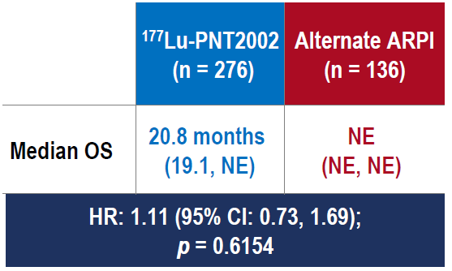
SPLASH: ¹⁷⁷Lu-PSMA-PNT2002 vs. ARPI switch
Sartor O, et al. ESMO 2024; Abstract LBA65.

Slide 42
Head-to-head comparison: SPLASH vs. PSMAfore
0.98
Sartor O, et al. ESMO 2024; Abstract LBA65. Morris MJ, et al. Lancet 2024; 404: 1227-39.

Slide 43
Conclusions
SPLASH (¹⁷⁷Lu-PNT2002) showed a more modest rPFS benefit vs. ARPI switch compared to PSMAfore (¹⁷⁷Lu-PSMA-617)
In SPLASH: ¹⁷⁷Lu-PSMA was given at 6.8 GBq (184 mCi) x 4
In PSMAfore: ¹⁷⁷Lu-PSMA was given at 7.4 GBq (184 mCi) x 6
Dose intensity was higher in PSMAfore, leading to better PFS?
Unclear if ¹⁷⁷Lu-PNT2002 will seek approval in 1st-L mCRPC
¹⁷⁷Lu-PNT2002 not currently FDA approved in any indication

Slide 44
Agarwal N et al. Cabozantinib (C) plus atezolizumab (A) versus 2nd novel hormonal therapy (NHT) in patients (Pts) with metastatic castration-resistant prostate cancer (mCRPC): Final overall survival (OS) results of the phase III, randomized, CONTACT-02 study. ESMO 2024; Abstract LBA67.

Slide 45
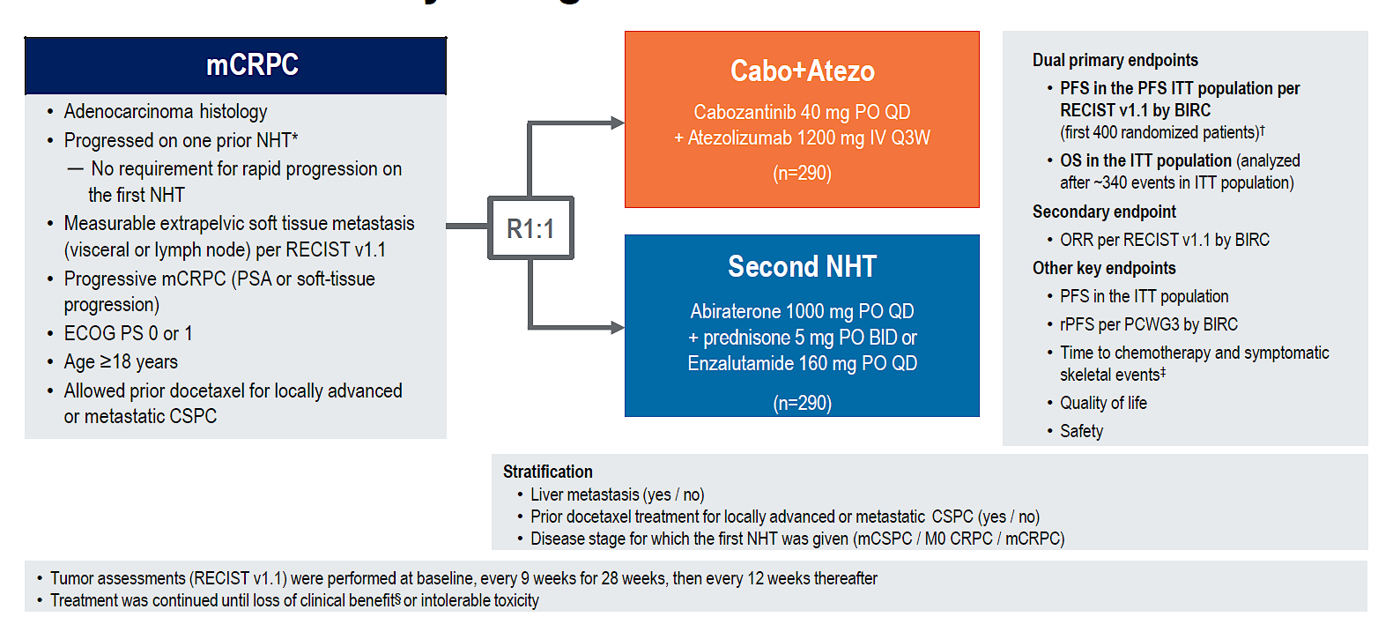
CONTACT-02 trial: Cabo/Atezo vs. ARPI switch
Agarwal N, et al. ESMO 2024; Abstract LBA67.

Slide 46
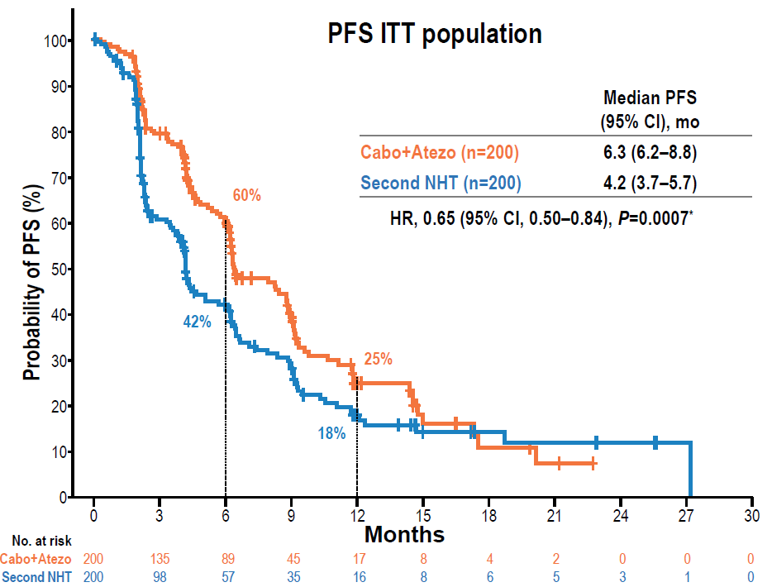
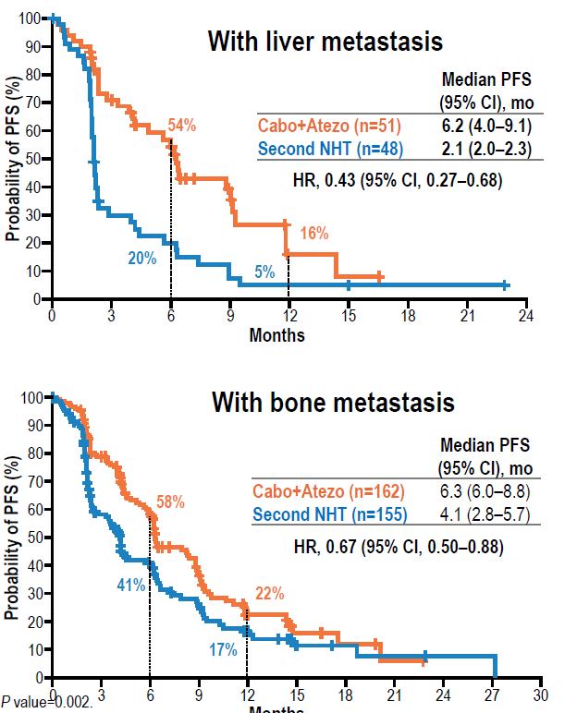
CONTACT-02: Overall PFS, and in Subgroups
Agarwal N, et al. ESMO 2024; Abstract LBA67.

Slide 47
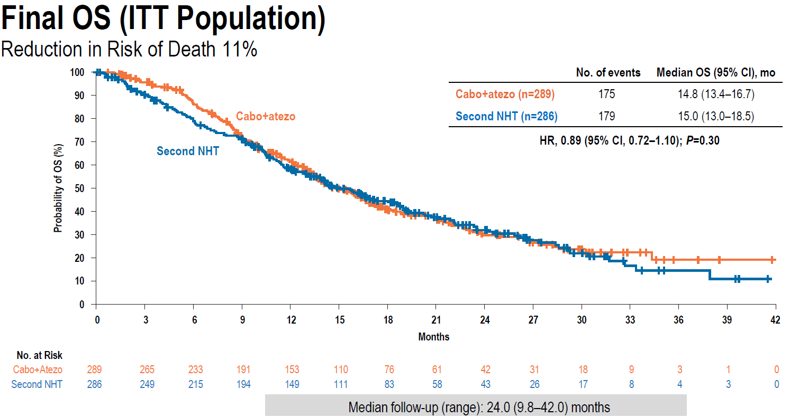
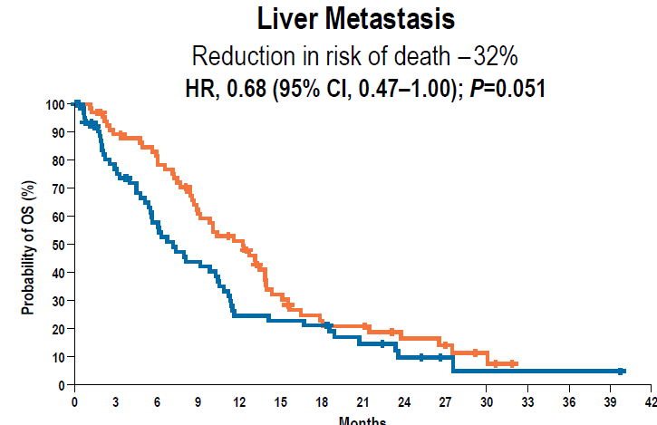
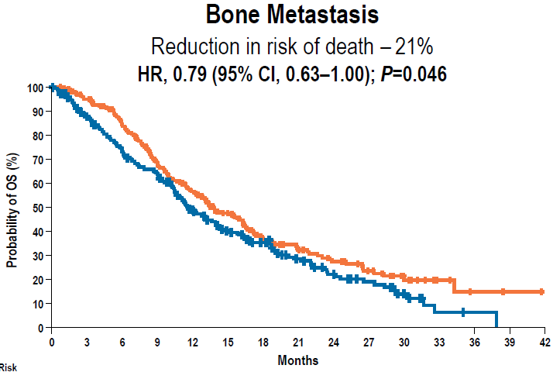
CONTACT-02: Overall OS, and in Subgroups
Months
Agarwal N, et al. ESMO 2024; Abstract LBA67.
Months

Slide 48
Conclusions
Contact-02 met its PFS co-primary endpoint (HR 0.65, P<0.01), but not its OS co-primary endpoint (HR 0.89, P=0.30)
PFS and OS trends were greatest in liver and bone met subsets
Adverse events of Cabo/Atezo: HTN, diarrhea, anemia, fatigue
Neither Cabo nor Atezo are currently FDA approved in mCRPC
Regulatory approval may be sought for liver mets subset
Open question: Does the Atezo add anything?

Slide 49
Schweizer MT et al. Mevrometostat (PF-06821497), an EZH2 inhibitor, in combination with enzalutamide in patients with metastatic castration-resistant prostate cancer (mCRPC): A randomized dose-expansion study. ASCO GU Symposium 2025; Abstract LBA138.

Slide 50
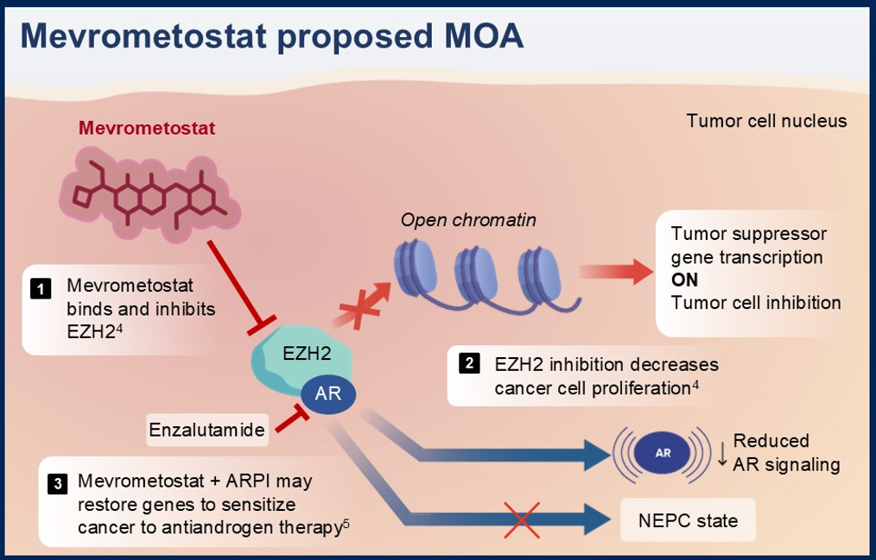
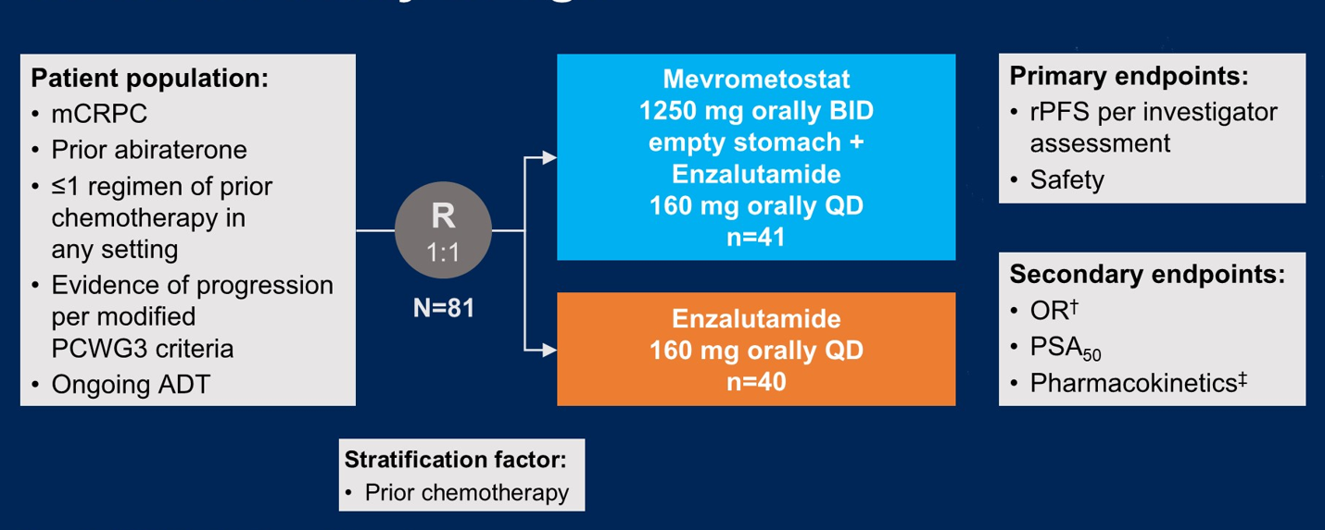
EZH2 Inhibitor: Mevrometostat
Schweizer MT , et al. ASCO GU Symposium 2025; Abstract LBA138.

Slide 51





Post-Abiraterone mCRPC: Enza +/- Mevro
Schweizer MT , et al. ASCO GU Symposium 2025; Abstract LBA138.

Slide 52


Adverse Events: Enza +/- Mevrometostat
Schweizer MT , et al. ASCO GU Symposium 2025; Abstract LBA138.

Slide 53
Conclusions
Mevrometostat is an oral EZH2 inhibitor that enhances efficacy of enzalutamide in post-abiraterone mCRPC pts (rPFS, HR 0.51)
Mevro 875 mg (with food) is the recommended Phase 3 dose
Adverse events: diarrhea, nausea, dysgeusia, anemia, alopecia
Phase 3 trials are in progress for mCRPC pts in the post-Abi space (MEVPRO-1) and the ARPI-naïve space (MEVPRO-2)

Slide 54
Gratzke CJ et al. Phase 3 OMAHA-004 study of CYP11A1 inhibitor opevesostat versus next-generation hormonal agent (NHA) switch in patients with metastatic castration-resistant prostate cancer (mCRPC) after 1 prior NHA. ASCO GU Symposium 2025;Abstract TPS301.
Yu EY et al. OMAHA-003: A phase 3 study of CYP11A1 inhibitor opevesostat versus next-generation hormonal agent (NHA) in metastatic castration-resistant prostate cancer (mCRPC) after NHA and taxane chemotherapy. ASCO GU Symposium 2025;Abstract TPS286.

Slide 55

ODM-208 → MK-5684 → Opevesostat

Slide 56


Opevesostat: Phase 2 CYPIDES trial
Fizazi K, et al. NEJM Evid. 2024;3:EVIDoa2300171; Fizazi K, et al. ASCO GU 2024; abstract 159.

Slide 57


OMAHA-004
(Pre-chemo mCRPC)
OMAHA-003
(Post-chemo mCRPC)
Gratzke CJ, et al. ASCO GU 2025; Abstract TPS301; Yu EY, et al. ASCO GU 2025; Abstract TPS286.

Slide 58
Conclusions
Opevesostat (MK-5684, formerly ODM-208) is an oral CYP11 inhibitor that suppresses production of all adrenal steroids
Has shown clinical activity in mCRPC post-ARPI in phase 2
Might show greater efficacy against AR-LBD+ mutations
OMAHA-004 and OMAHA-003 are phase 3 randomized trials of opevesostat vs. ARPI switch in pre- and post-chemo mCRPC
Opevesostat requires co-administration of glucocorticoid (dex) and mineralocorticoid (fludro) supplementation

Slide 59


THANK YOU !
Thank You !

