Slide 1
Prostate Cancer
Understanding the Current Paradigm and
New Approaches in the Care of Patients with Cancer
A Complimentary NCPD Hybrid Symposium Series Held During the 50th Annual ONS Congress
Thursday, April 10, 2025
12:15 PM – 1:45 PM
Faculty
Rahul Aggarwal, MD
Monica Averia, MSN, AOCNP, NP-C
Kathleen D Burns, RN, MSN, AGACNP‑BC, OCN
William K Oh, MD
Moderator
Neil Love, MD

Slide 2




Faculty
Monica Averia, MSN, AOCNP, NP-C
Oncology Nurse Practitioner
Clinical Instructor of Medicine
USC Norris Cancer Center
Los Angeles, California
Rahul Aggarwal, MD
Professor of Medicine and Thomas Perkins Distinguished Professor of Cancer Research
Director, Genitourinary Medical Oncology
University of California, San Francisco
Department of Medicine
Division of Hematology/Oncology
Associate Director for Clinical Research
UCSF Helen Diller Family Comprehensive Cancer Center
San Francisco, California
Kathleen D Burns, RN, MSN, AGACNP-BC, OCN
Genitourinary Medical Oncology
City of Hope Comprehensive Cancer Center
Duarte, California
William K Oh, MD
Director of Precision Medicine
Yale Cancer Center
Professor of Medicine
Division of Medical Oncology
Yale School of Medicine
Medical Director, Service Line
Smilow Cancer Hospital at Greenwich Hospital
New Haven, Connecticut

Slide 3
Dr Aggarwal — Disclosures
Advisory Committees | Novartis
Consulting Agreements | AbbVie Inc, AstraZeneca Pharmaceuticals LP, FibroGen Inc, Flare Therapeutics, Johnson & Johnson Pharmaceuticals, Merck, ORIC Pharmaceuticals, Pfizer Inc, Xencor
Contracted Research | Amgen Inc, AstraZeneca Pharmaceuticals LP, Johnson & Johnson Pharmaceuticals, Merck
Nonrelevant Financial Relationships | Prostate Cancer Clinical Trials Consortium

Slide 4
Ms Averia — Disclosures
No relevant conflicts of interest to disclose.

Slide 5
Ms Burns — Disclosures
Advisory Committees | Eisai Inc, Janssen Biotech Inc, Sumitomo Dainippon Pharma Oncology Inc
Speakers Bureaus | AstraZeneca Pharmaceuticals LP, Exelixis Inc, Pfizer Inc, Sumitomo Dainippon Pharma Oncology Inc

Slide 6
Dr Oh — Disclosures
Advisory Committees | Pfizer Inc
Consulting Agreements | Abbott Laboratories, AstraZeneca Pharmaceuticals LP, Cytogen Corporation, Nature's Toolbox Inc, Novartis, Sumitomo Dainippon Pharma Oncology Inc
Stock Options — Private Companies | Nature’s Toolbox Inc
Stock Options/Stock —Public Companies | GeneDx

Slide 7
Commercial Support
This activity is supported by educational grants from Astellas and Pfizer Inc, AstraZeneca Pharmaceuticals LP, Bayer HealthCare Pharmaceuticals, Janssen Biotech Inc, administered by Janssen Scientific Affairs LLC, Merck, and Novartis.
Research To Practice NCPD Planning Committee Members,
Staff and Reviewers
Planners, scientific staff and independent reviewers for Research To Practice have no relevant conflicts of interest to disclose.

Slide 8
This educational activity contains discussion of
non-FDA-approved uses of agents and regimens. Please refer to official prescribing information for each product for approved indications.

Slide 9
Agenda
Introduction: Overview of Prostate Cancer
Module 1: Recent Advances in the Treatment of Nonmetastatic Prostate Cancer
Module 2: Treatment Approaches for Metastatic Hormone-Sensitive Prostate Cancer
Module 3: Current Role of PARP Inhibitors in Metastatic Castration-Resistant Prostate Cancer (mCRPC)
Module 4: Current and Future Role of Radiopharmaceuticals in mCRPC

Slide 10
Agenda
Introduction: Overview of Prostate Cancer
Module 1: Recent Advances in the Treatment of Nonmetastatic Prostate Cancer
Module 2: Treatment Approaches for Metastatic Hormone-Sensitive Prostate Cancer
Module 3: Current Role of PARP Inhibitors in Metastatic Castration-Resistant Prostate Cancer (mCRPC)
Module 4: Current and Future Role of Radiopharmaceuticals in mCRPC

Slide 11
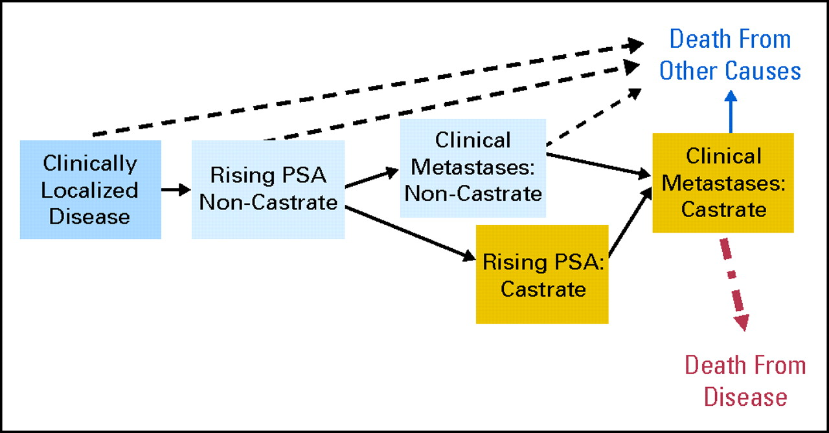
Clinical Disease States
Courtesy of Rahul Aggarwal, MD
Scher H, et al. J Clin Oncol 2008
Recent Advances in the Treatment of Nonmetastatic Prostate Cancer

Slide 12
Agenda
Introduction: Overview of Prostate Cancer
Module 1: Recent Advances in the Treatment of Nonmetastatic Prostate Cancer
Module 2: Treatment Approaches for Metastatic Hormone-Sensitive Prostate Cancer
Module 3: Current Role of PARP Inhibitors in Metastatic Castration-Resistant Prostate Cancer (mCRPC)
Module 4: Current and Future Role of Radiopharmaceuticals in mCRPC

Slide 13
Clinical Scenario
A patient with prostate cancer who has undergone prior local treatment now has a rising PSA and a rapid PSA doubling time but no evidence of metastatic disease and will be presented with the option of enzalutamide and androgen deprivation therapy or enzalutamide monotherapy

Slide 14


Recent Advances in the Treatment of Nonmetastatic Prostate Cancer
Rahul Aggarwal, MD
Professor of Medicine
University of California San Francisco

Slide 15
A 67 year old male who presented to my clinic…
Presented to PCP with obstructive urinary symptoms – dribbling, hesitancy, weak stream
PSA was 24 ng/mL (no prior screening PSA measurements)
TRUS biopsy with Gleason 4+4 prostate adenocarcinoma
MRI of the prostate with PI-RADS 4 lesion in the right base with likely extraprostatic extension, normal appearing seminal vesicles (cT3a)
PSMA PET without evidence of nodal or distant metastases

Slide 16
NCCN Risk Stratification and Staging
Low risk (Gleason ≤ 6, PSA < 10, T1/T2, < 33% cores positive)
Favorable intermediate risk (e.g. Gleason 3+4)
Unfavorable intermediate risk (e.g. Gleason 4+3)
High risk (any of Gleason ≥ 8, PSA > 20, T3/T4)
Very high risk localized
Node positive
Metastatic (M1a, M1b, M1c)
NCCN Guidelines version Jan 2025

Slide 17
Clinical Disease States
Scher H, et al. J Clin Oncol 2008
Recent Advances in the Treatment of Nonmetastatic Prostate Cancer

Slide 18
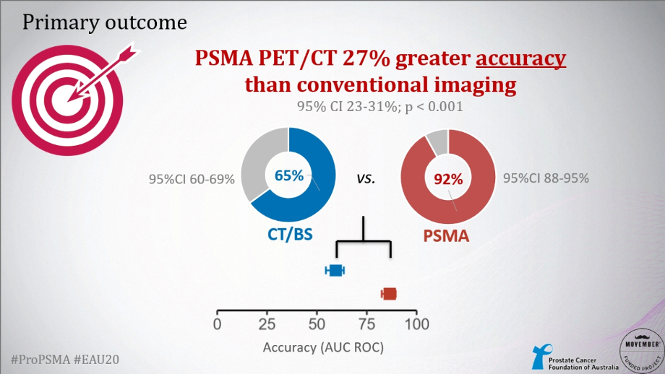
PSMA PET for Initial Staging of High Risk Prostate Cancer
Hofman M, et al. EAU 2020
Recent Advances in the Treatment of Nonmetastatic Prostate Cancer

Slide 19
Primary Therapy Options for Patients with Newly Diagnosed Localized Prostate Cancer
Is the patient appropriate for active surveillance?
Yes
No
Low or favorable intermediate risk:
Gleason group 1 or 2
PSA < 10
Low risk by genomic classifier
Radical
Prostatectomy
Radiation +/- ADT
Focal Tx
Recent Advances in the Treatment of Nonmetastatic Prostate Cancer

Slide 20
Back to our patient…
Patient opted for radical prostatectomy + pelvic lymph node dissection
  Pathology: Gleason 5+4 prostate adenocarcinoma, 0/13 nodes involved, + extracapsular extension, normal SV, negative margins (pT3aN0)
PSA was undetectable at first check 8 weeks post-op
14 months later, PSA became detectable and rose from:
  0.03 → 0.12 → 0.56
  PSA doubling time 2.4 months
Repeat PSMA PET negative for local, regional, or distant recurrence
Patient underwent salvage radiation to prostate bed + pelvis along with 6 months of androgen deprivation
  Side effects: Urinary frequency/urgency, hot flashes, mild fatigue, erectile dysfunction, mild mood changes
Recent Advances in the Treatment of Nonmetastatic Prostate Cancer

Slide 21
Our patient’s journey continued…
PSA rapidly became undetectable with salvage radiation + 6 months of ADT
Recovery of side effects was more variable
  Persistent urinary frequency and urge incontinence
  Intermittent hematuria → radiation cystitis on cystoscopy
2 years later…patient is now 71 years old, new co-morbidities of hypertension, CAD with stent placed 1 year prior
  PSA started to rise again, up to 0.73 with PSA doubling time of 2.4 months
PSMA PET with 3 new sites of metastasis (T5, L1, sternum)
Patient underwent targeted radiation (SBRT) to the PET-avid sites of disease with a decline in PSA level
Recent Advances in the Treatment of Nonmetastatic Prostate Cancer

Slide 22
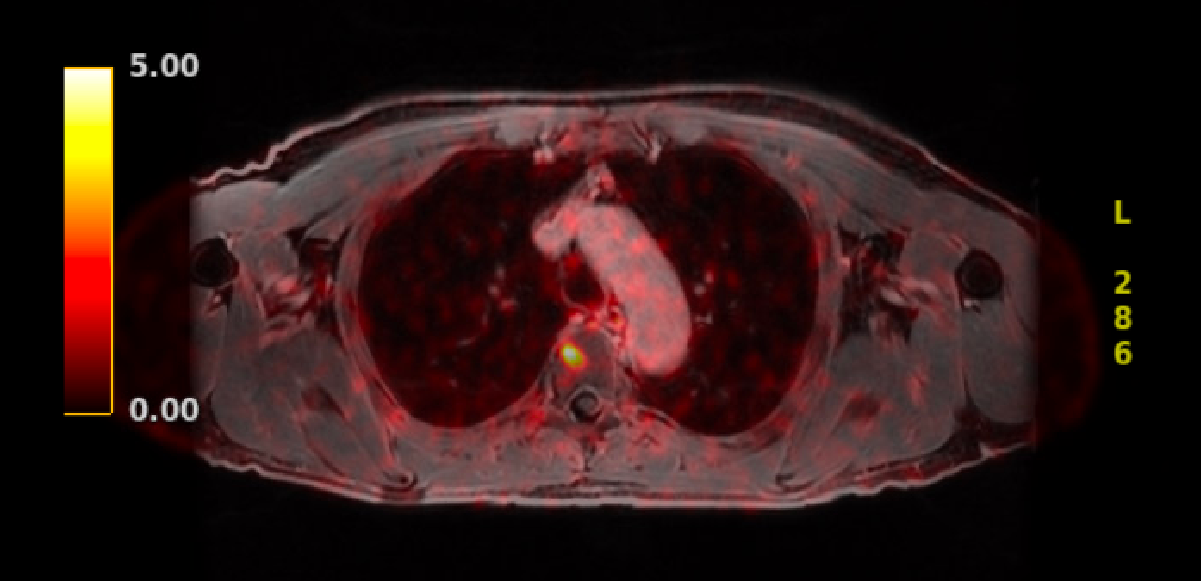
Our patient’s journey continued…
Recent Advances in the Treatment of Nonmetastatic Prostate Cancer

Slide 23
Back to our patient…
PSA dropped to a nadir of 0.3 ng/mL with targeted radiation, with PSA response lasting for 11 months
Subsequent rise as follows:
0.3 → 0.7 → 1.1, PSA doubling time of 3.1 months
Repeat PSMA PET without new PET-avid foci amenable to targeted radiation
What options to consider now?
  Surveillance
  ADT alone
  ADT + oral androgen pathway inhibitor
  Androgen pathway inhibitor alone
Chi K, et al. ASCO GU 2022
Recent Advances in the Treatment of Nonmetastatic Prostate Cancer

Slide 24
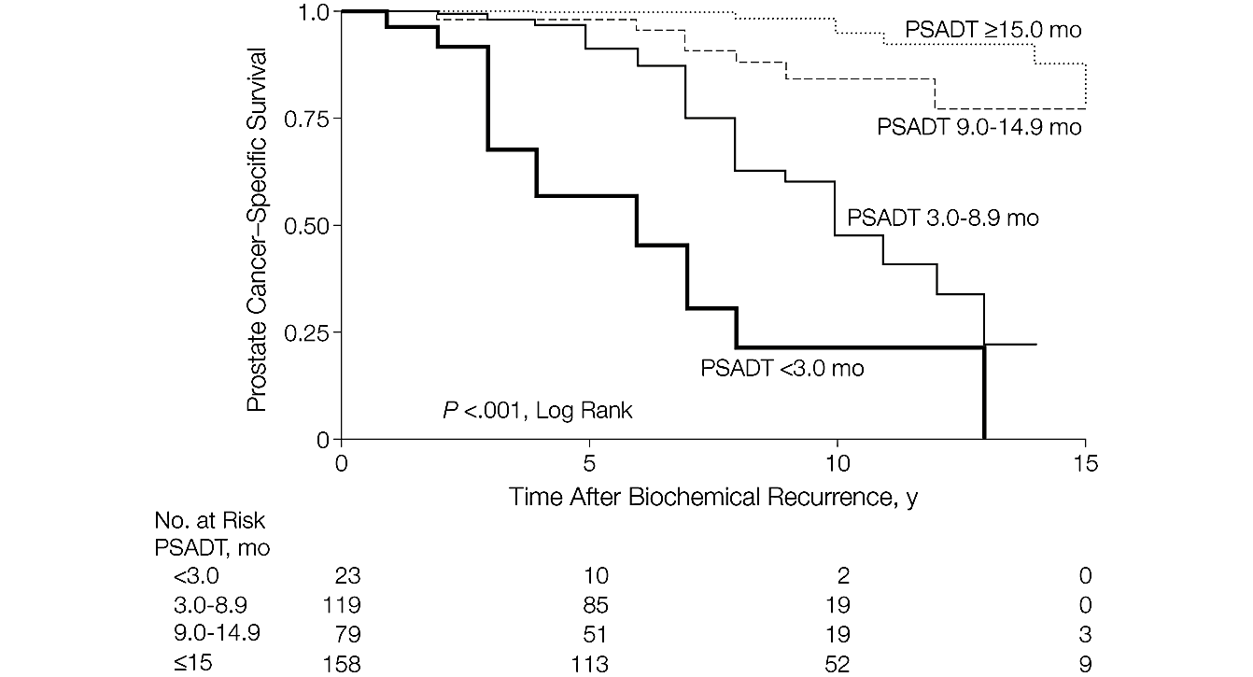
Patients with short PSA doubling time are at elevated risk of metastasis and prostate cancer related mortality
Freedland S, et al. JAMA 2005
Recent Advances in the Treatment of Nonmetastatic Prostate Cancer

Slide 25
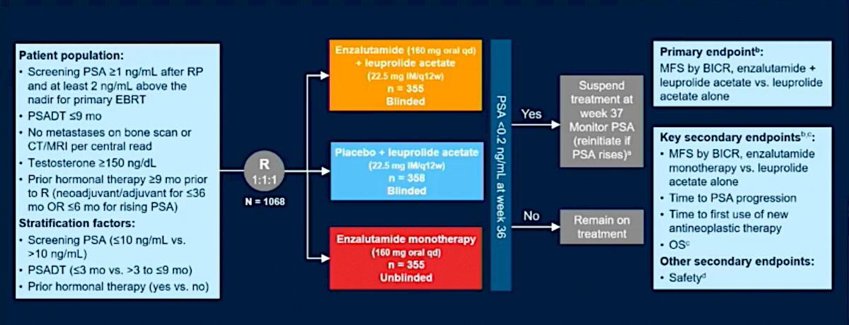
EMBARK: Use of enzalutamide alone or in combination with ADT in biochemically relapsed prostate cancer
Freedland S, et al. New Engl J Med 2023
Recent Advances in the Treatment of Nonmetastatic Prostate Cancer

Slide 26
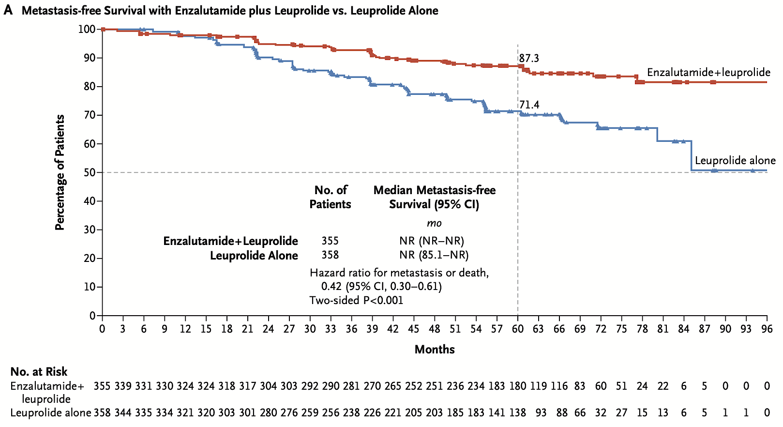
EMBARK: Enzalutamide plus Leuprolide – MFS
Freedland S, et al. New Engl J Med 2023
Recent Advances in the Treatment of Nonmetastatic Prostate Cancer

Slide 27
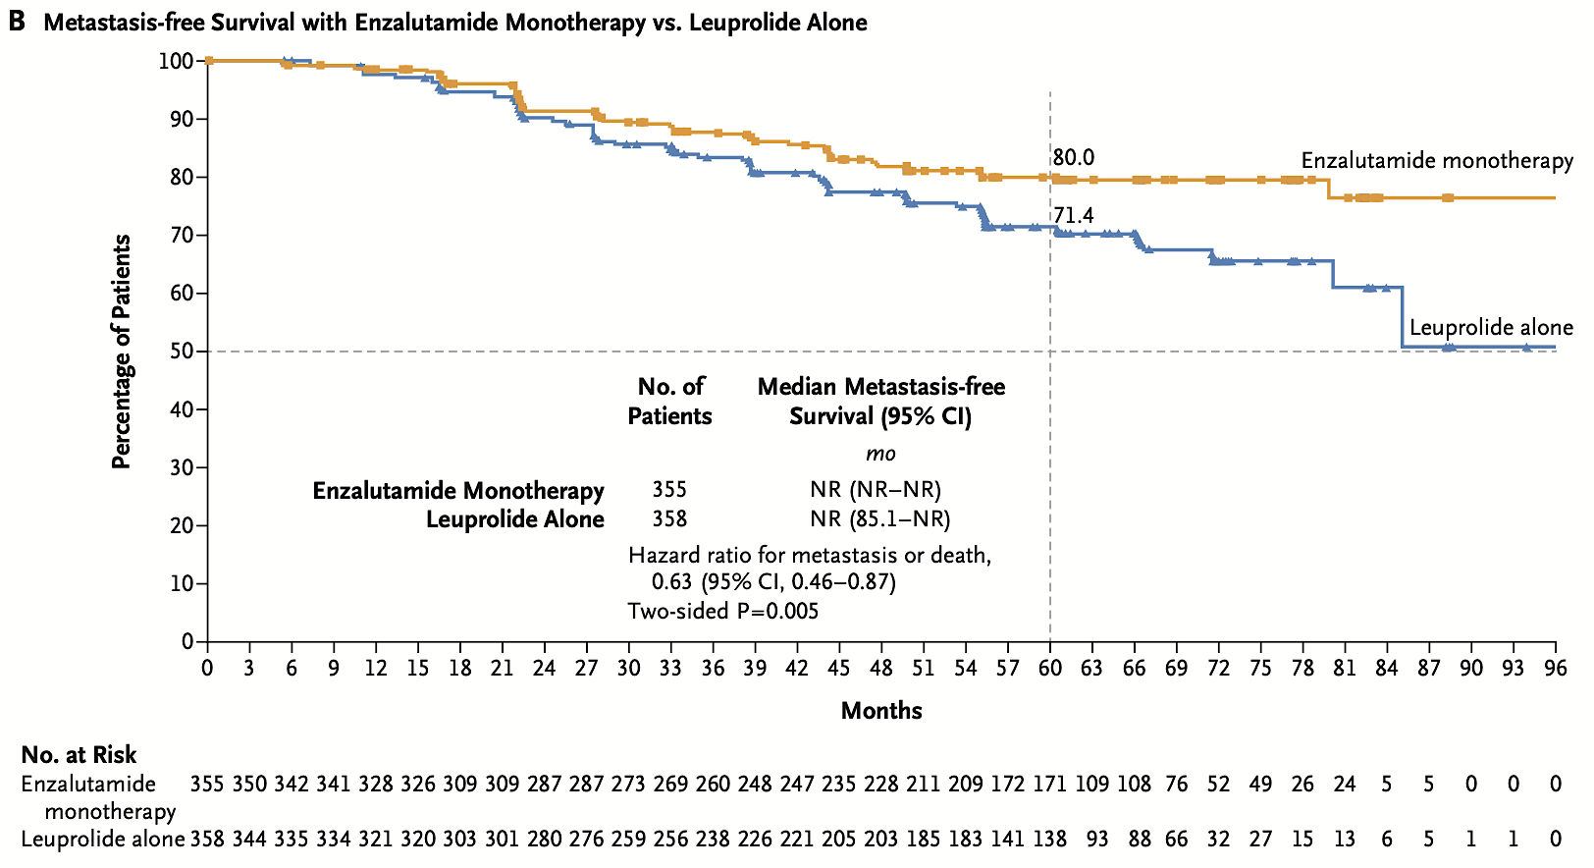
EMBARK: Enzalutamide Monotherapy – MFS
Freedland S, et al. New Engl J Med 2023
Recent Advances in the Treatment of Nonmetastatic Prostate Cancer

Slide 28
EMBARK: Take home points
ADT + enzalutamide improves metastasis-free and overall survival compared to ADT alone
Enzalutamide monotherapy also improves outcomes but magnitude of benefit smaller than with enzalutamide + ADT
Treatment break after 9 months of treatment in patients with optimal PSA response as part of intermittent treatment framework
Choosing between ADT + enzalutamide versus enzalutamide alone:
  Magnitude of benefit
  Toxicity profile: higher gynecomastia/breast pain; lower rates of fatigue, hot flashes, sexual side effects
  Anticipated off-treatment interval
Freedland S, et al. New Engl J Med 2023
Recent Advances in the Treatment of Nonmetastatic Prostate Cancer

Slide 29
Case conclusion
Patient opted for ADT + enzalutamide
Mild fatigue and hot flashes; no significant mood or cognitive side effects
Undetectable PSA nadir after 9 months of treatment
Currently on treatment break
Testosterone has recovered to 256 ng/dL
PSA remains less than 0.1 ng/mL
Recent Advances in the Treatment of Nonmetastatic Prostate Cancer

Slide 30
Roundtable Discussion

Slide 31
Nursing Considerations for Patients Receiving ADT
Monica Averia, MSN, AOCNP, NP-C

Slide 32
What do you tell your patients about to start treatment with ADT about how it works and why they are receiving it?
Androgen deprivation therapy (ADT) - cornerstone of prostate cancer therapy, but it has substantial side effects.
Goal: reduce the levels of male hormones in the body to slow down or stop the growth of prostate cancer cells that rely on androgens for survival.

Slide 33
Side Effects of Androgen Deprivation Therapy (ADT)
Discuss potential side effects with patient and their significant other before starting therapy:
Hot flashes
Bone density loss
Fatigue
Depression/emotional lability
Gynecomastia
Erectile dysfunction
Metabolic syndrome
Cognitive changes

Slide 34
How do you monitor for and manage common ADT-associated toxicities?
Hot flashes:
  medications such as venlafaxine or gabapentin, acupuncture has a role of relieving symptoms
Bone density loss:
  DEXA scan monitoring, weight bearing exercises, Calcium + Vitamin D, Osteoclast inhibitors have shown a role in preventing skeletal related events (zoledronic acid or denosumab).
Fatigue:
  Encourage regular exercise, maintain activity level
Depression/emotional lability:
  Monitor and explore during clinic visits. May benefit from counseling, medications SSRI.

Slide 35
How do you monitor for and manage common ADT-associated toxicities?
Gynecomastia:
  surgical and single-dose radiation to targeted breast area
Erectile dysfunction:
  ED and decreased libido is common with pts on ADT. Review role of PDE inhibitors (Sildenafil and Tadalafil). Refer to urology to help manage side effects of ADT, mechanical therapy, offer referral for sexual health support.
Metabolic syndrome:
  Weight gain, insulin resistance, dyslipidemia can occur. Encourage exercise. Diet modification.
Cognitive changes:
  Dementia- multiple studies have reported this issue, with mixed/conflicting findings. This remains an active area of research. Refer to neuro for further work-up if needed

Slide 36
How do you monitor for and manage common ADT-associated toxicities?
Does this differ based on patient age/performance status and medical history?
Individualized patient care. Consider treatment demand on patient:
  Baseline performance status
  Comorbidities
  Identify potential barriers:
    Financial- Copay, Access to patient assistance program
    Compliance issues
    Limitations: physical, mental, psychological, socioeconomic

Slide 37
Clinical examples/experiences from practice
75 y/o Asian male with cholangiocarcinoma + prostate adenocarcinoma.
Cholangiocarcinoma:
9/2023: presented to USC with cholangitis sp ERCP with biopsy: moderately differentiated adenocarcinoma
9/2023: Whipple resection: pT3N0M0 extrahepatic cholangiocarcinoma of the common bile duct. Margins were negative.
- 12/2023: Post op CT: showed no recurrence of cholangiocarcinoma.
- 02/2024 to 07/2024: Adjuvant capecitabine completed

Slide 38
Clinical examples/experiences from practice
Prostate cancer:
- 09/2023: PSA 31.10; Testosterone 511 (cholangio preop work-up)
- 10/18/23: Bx: GG 5 Gleason 4+5 Prostate Adenocarcinoma
- 11/2023: PSMA: metastases noted within the left pubic bone and the right acetabulum
- 12/15/23: ADT initiated
- 1/3/24 to 1/16/24: SBRT to the prostate
- 04/2024: PSA 0.02; Testosterone <12
- 12/2024: CT (cholangio ca): showed mild increase in a para-aortic node to 1.4 cm.
- 12/2024: PSA 1.83; Testosterone <12
- 02/2025: PSMA: negative for definitive area of active prostate cancer
- 02/2025: PET/CT: new hypermetabolic mediastinal, left hilar, left retroperitoneal LAD concerning metastases
- 3/3/25: PSA 4.72; Testosterone <12
- 3/24/25: Paraaortic LN Bx: Metastatic prostatic carcinoma
- 4/2/25: Enzalutamide added to treatment. Continue ADT
    Pt developed diabetes after Whipple procedure now on Metformin
- RTC 2 wks with labs: pending

Slide 39
Roundtable Discussion

Slide 40
Agenda
Introduction: Overview of Prostate Cancer
Module 1: Recent Advances in the Treatment of Nonmetastatic Prostate Cancer
Module 2: Treatment Approaches for Metastatic Hormone-Sensitive Prostate Cancer
Module 3: Current Role of PARP Inhibitors in Metastatic Castration-Resistant Prostate Cancer (mCRPC)
Module 4: Current and Future Role of Radiopharmaceuticals in mCRPC

Slide 41
Clinical Scenario
A patient with de novo mHSPC receives ADT in combination with an androgen receptor pathway inhibitor, and the option of docetaxel is also discussed

Slide 42
Metastatic HSPC
William K. Oh, MD
Director, Precision Medicine
Yale Cancer Center and Smilow Cancer Hospital
Service Line Medical Director
Smilow Cancer Hospital at Greenwich Hospital
Chair, National Prostate Cancer Roundtable
American Cancer Society

Slide 43
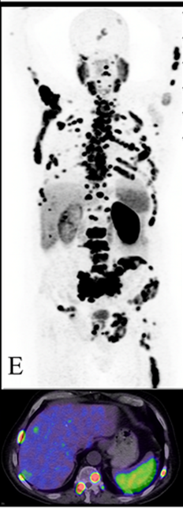
Case: A 60 year old Man with Liver Mets
A 60-year-old man presents with urinary retention, fatigue and poor appetite
Initial PSA 150 ng/mL (none prior)
TRUS biopsy: adenocarcinoma of the prostate, Gleason score 8
PSMA PET/CT shows multiple metastatic bone lesions in the pelvis, spine, ribs as well as diffuse liver lesions
No family history of prostate or other cancers
Germline and somatic genetic testing is negative
PMH: HTN

Slide 44
Clinical States of Prostate Cancer
Clinically
localized
Biochemical
Recurrence
Non-metastatic,
hormone-
sensitive
Non-metastatic
CRPC
Metastatic,
hormone-sensitive
Metastatic
CRPC
Death from prostate cancer
Death from other causes
10-15 years +
Notes:
44

Slide 45
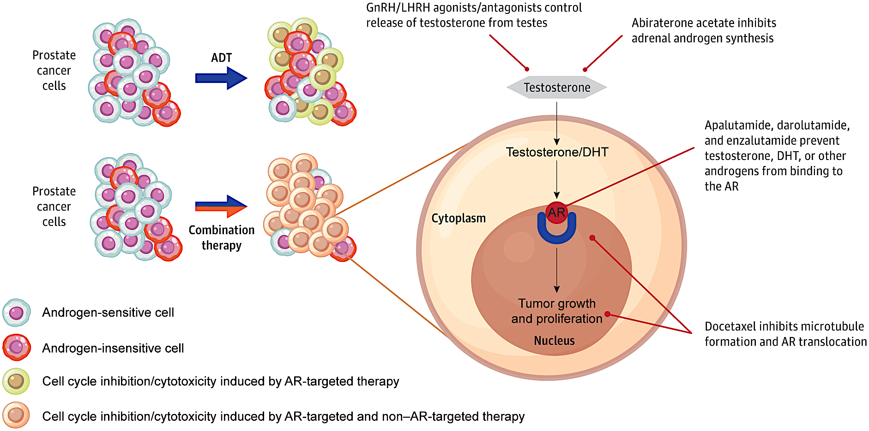
Combination Therapy Targets Tumor Heterogeneity in mHSPC
ARPI:
Abiraterone
ARPI:
Apalutamide Darolutamide
Enzalutamide
Chemo:
Docetaxel
Hussain. JAMA Onc 10:807, 2024

Slide 46
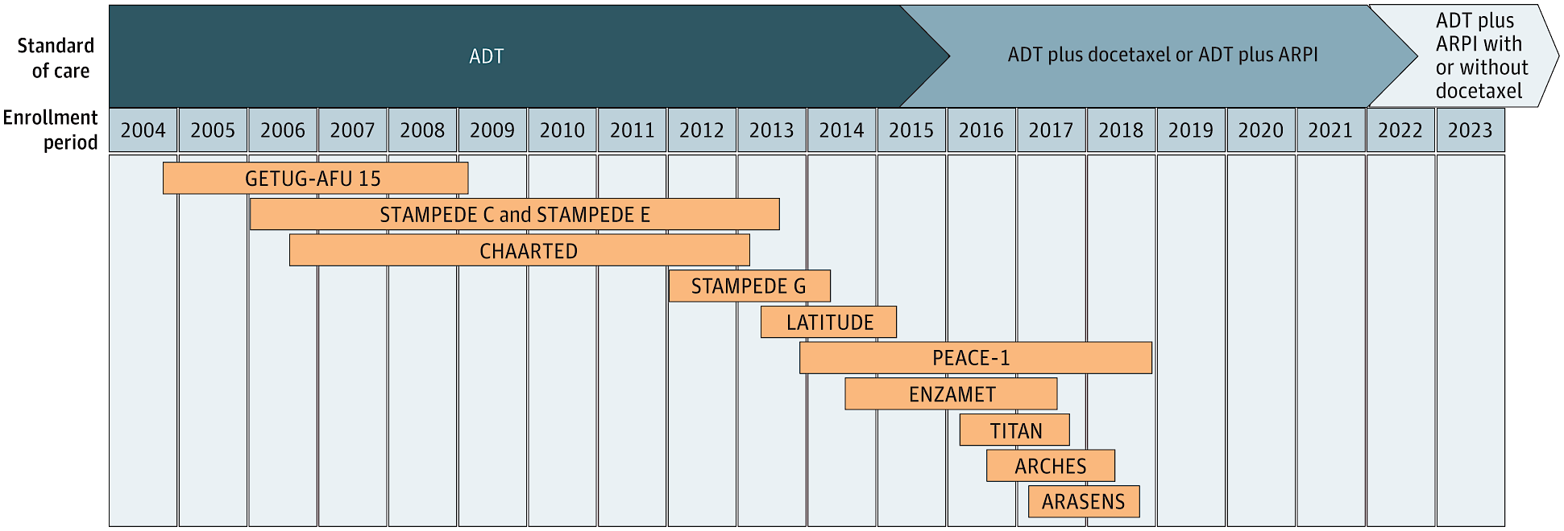
11 Prospective RCTs Demonstrate Significant Survival Benefit for Combination Therapy in mHSPC
ARANOTE
“Doublet” Therapies
[ADT] vs [ADT + ARPI]
HR for OS: 0.63-0.81
“Triplet” Therapies
[ADT + Doce] vs [ADT + Doce + ARPI]
HR for OS: 0.68-0.75
Hussain. JAMA Onc 10:807, 2024

Slide 47
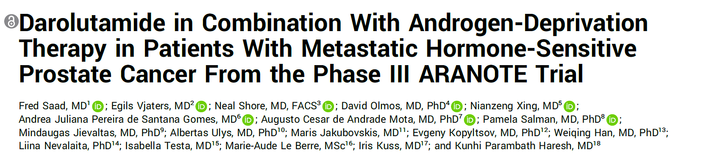
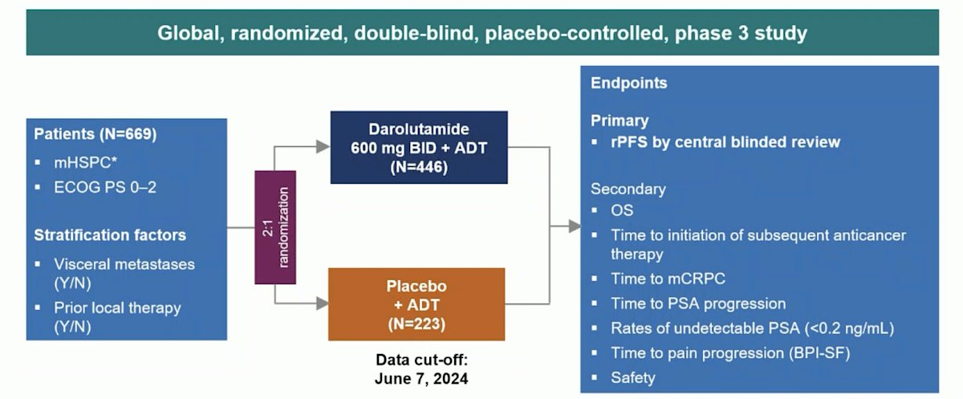

Slide 48
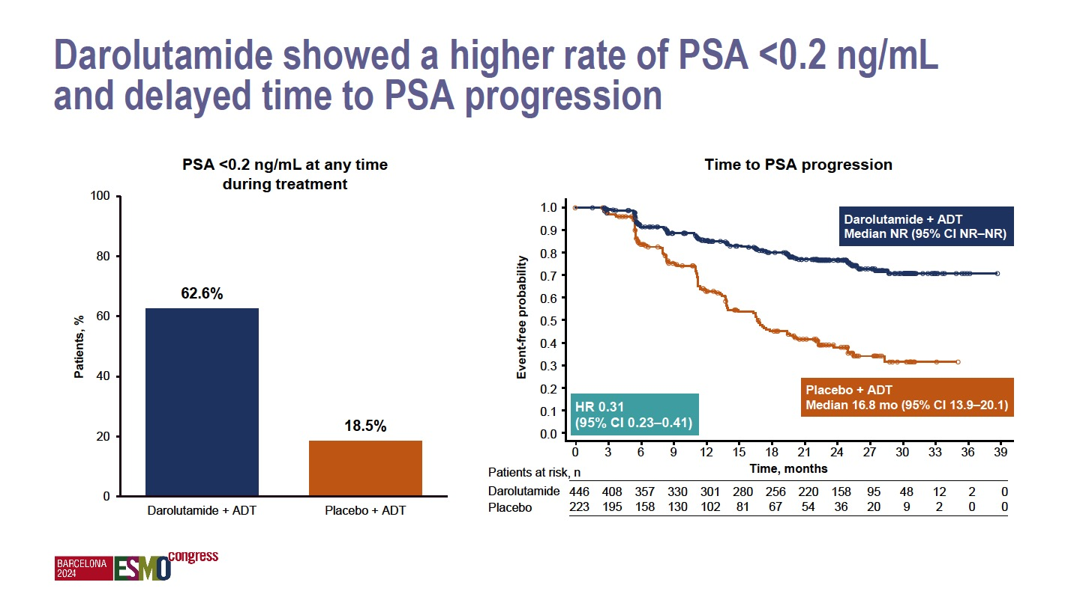
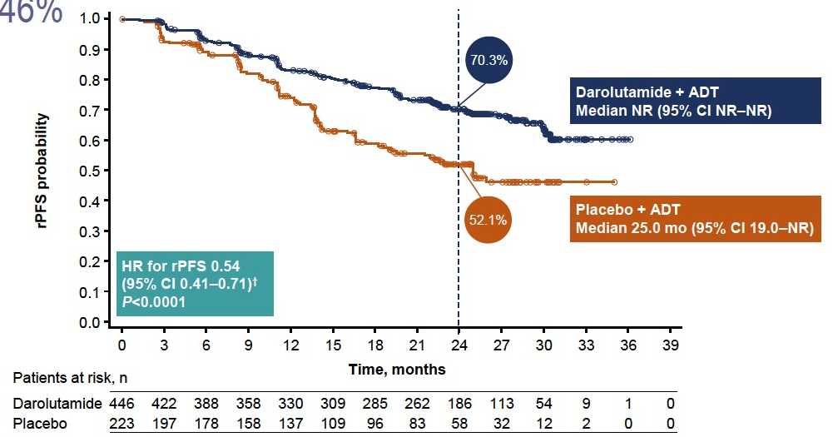
ARANOTE (Phase 3): Radiological PFS and PSA
Primary endpoint: Radiological PFS
PSA <0.2 ng/mL at any time during treatment
Time to PSA progression
Benefit of darolutamide was consistent across all subgroups
ADT, androgen-deprivation therapy.
Saad F, et al. ESMO 2024. Abstract LBA68

Slide 49
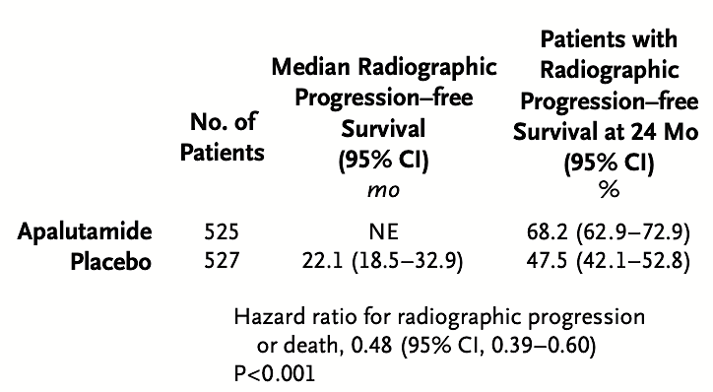
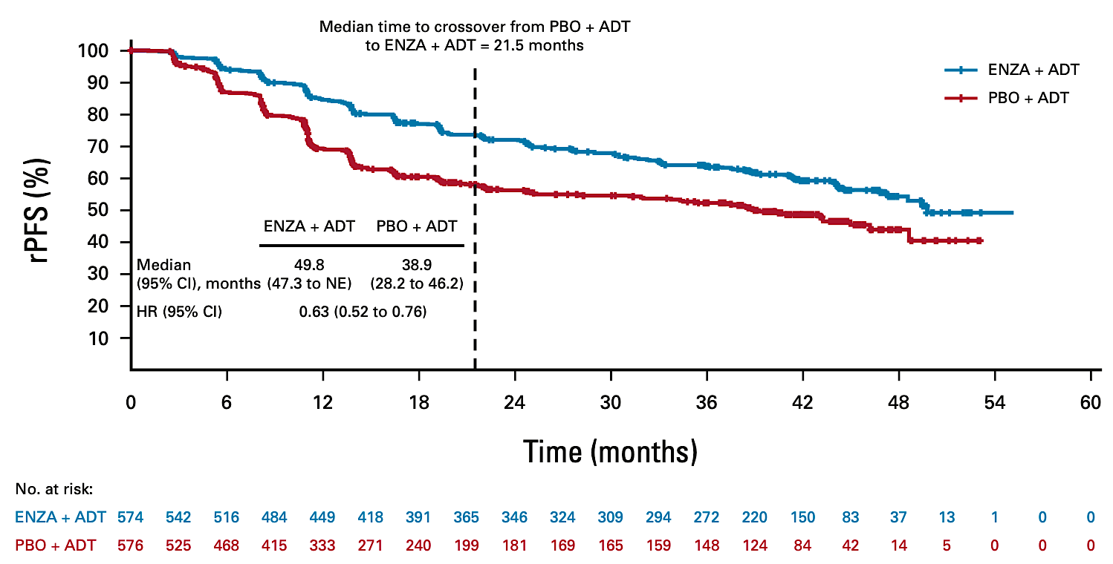
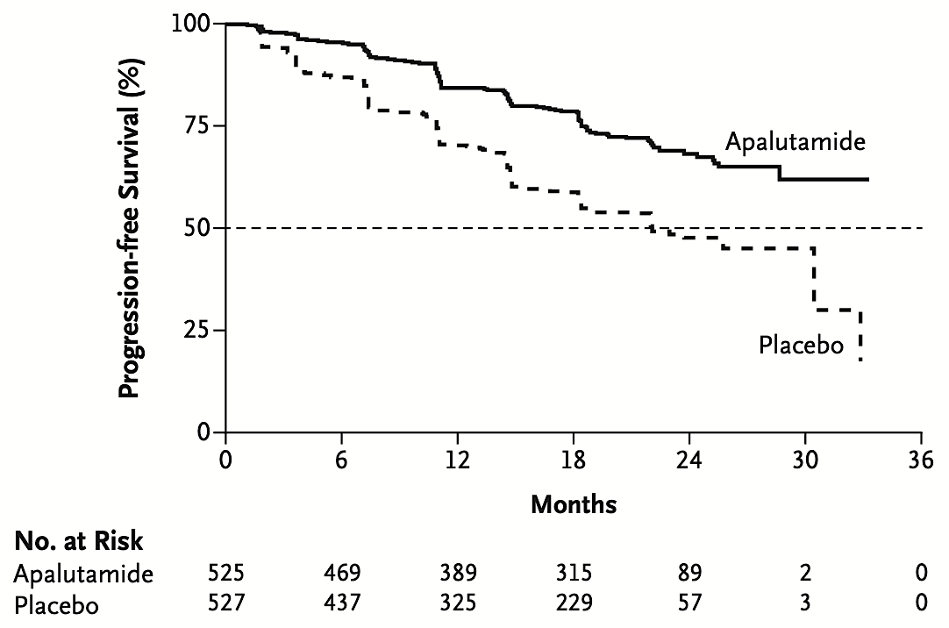
ARPI + ADT: Radiological PFS Analyses
TITAN - apalutamide
ARCHES - enzalutamide
Armstrong AJ, et al. J Clin Oncol. 2022;40(15):1616-1622.
Chi KN et al. N Engl J Med. 2019;381(1):13-24.

Slide 50
Fizazi K et al. Lancet Oncol. 2019 May;20(5):686-700.

Slide 51
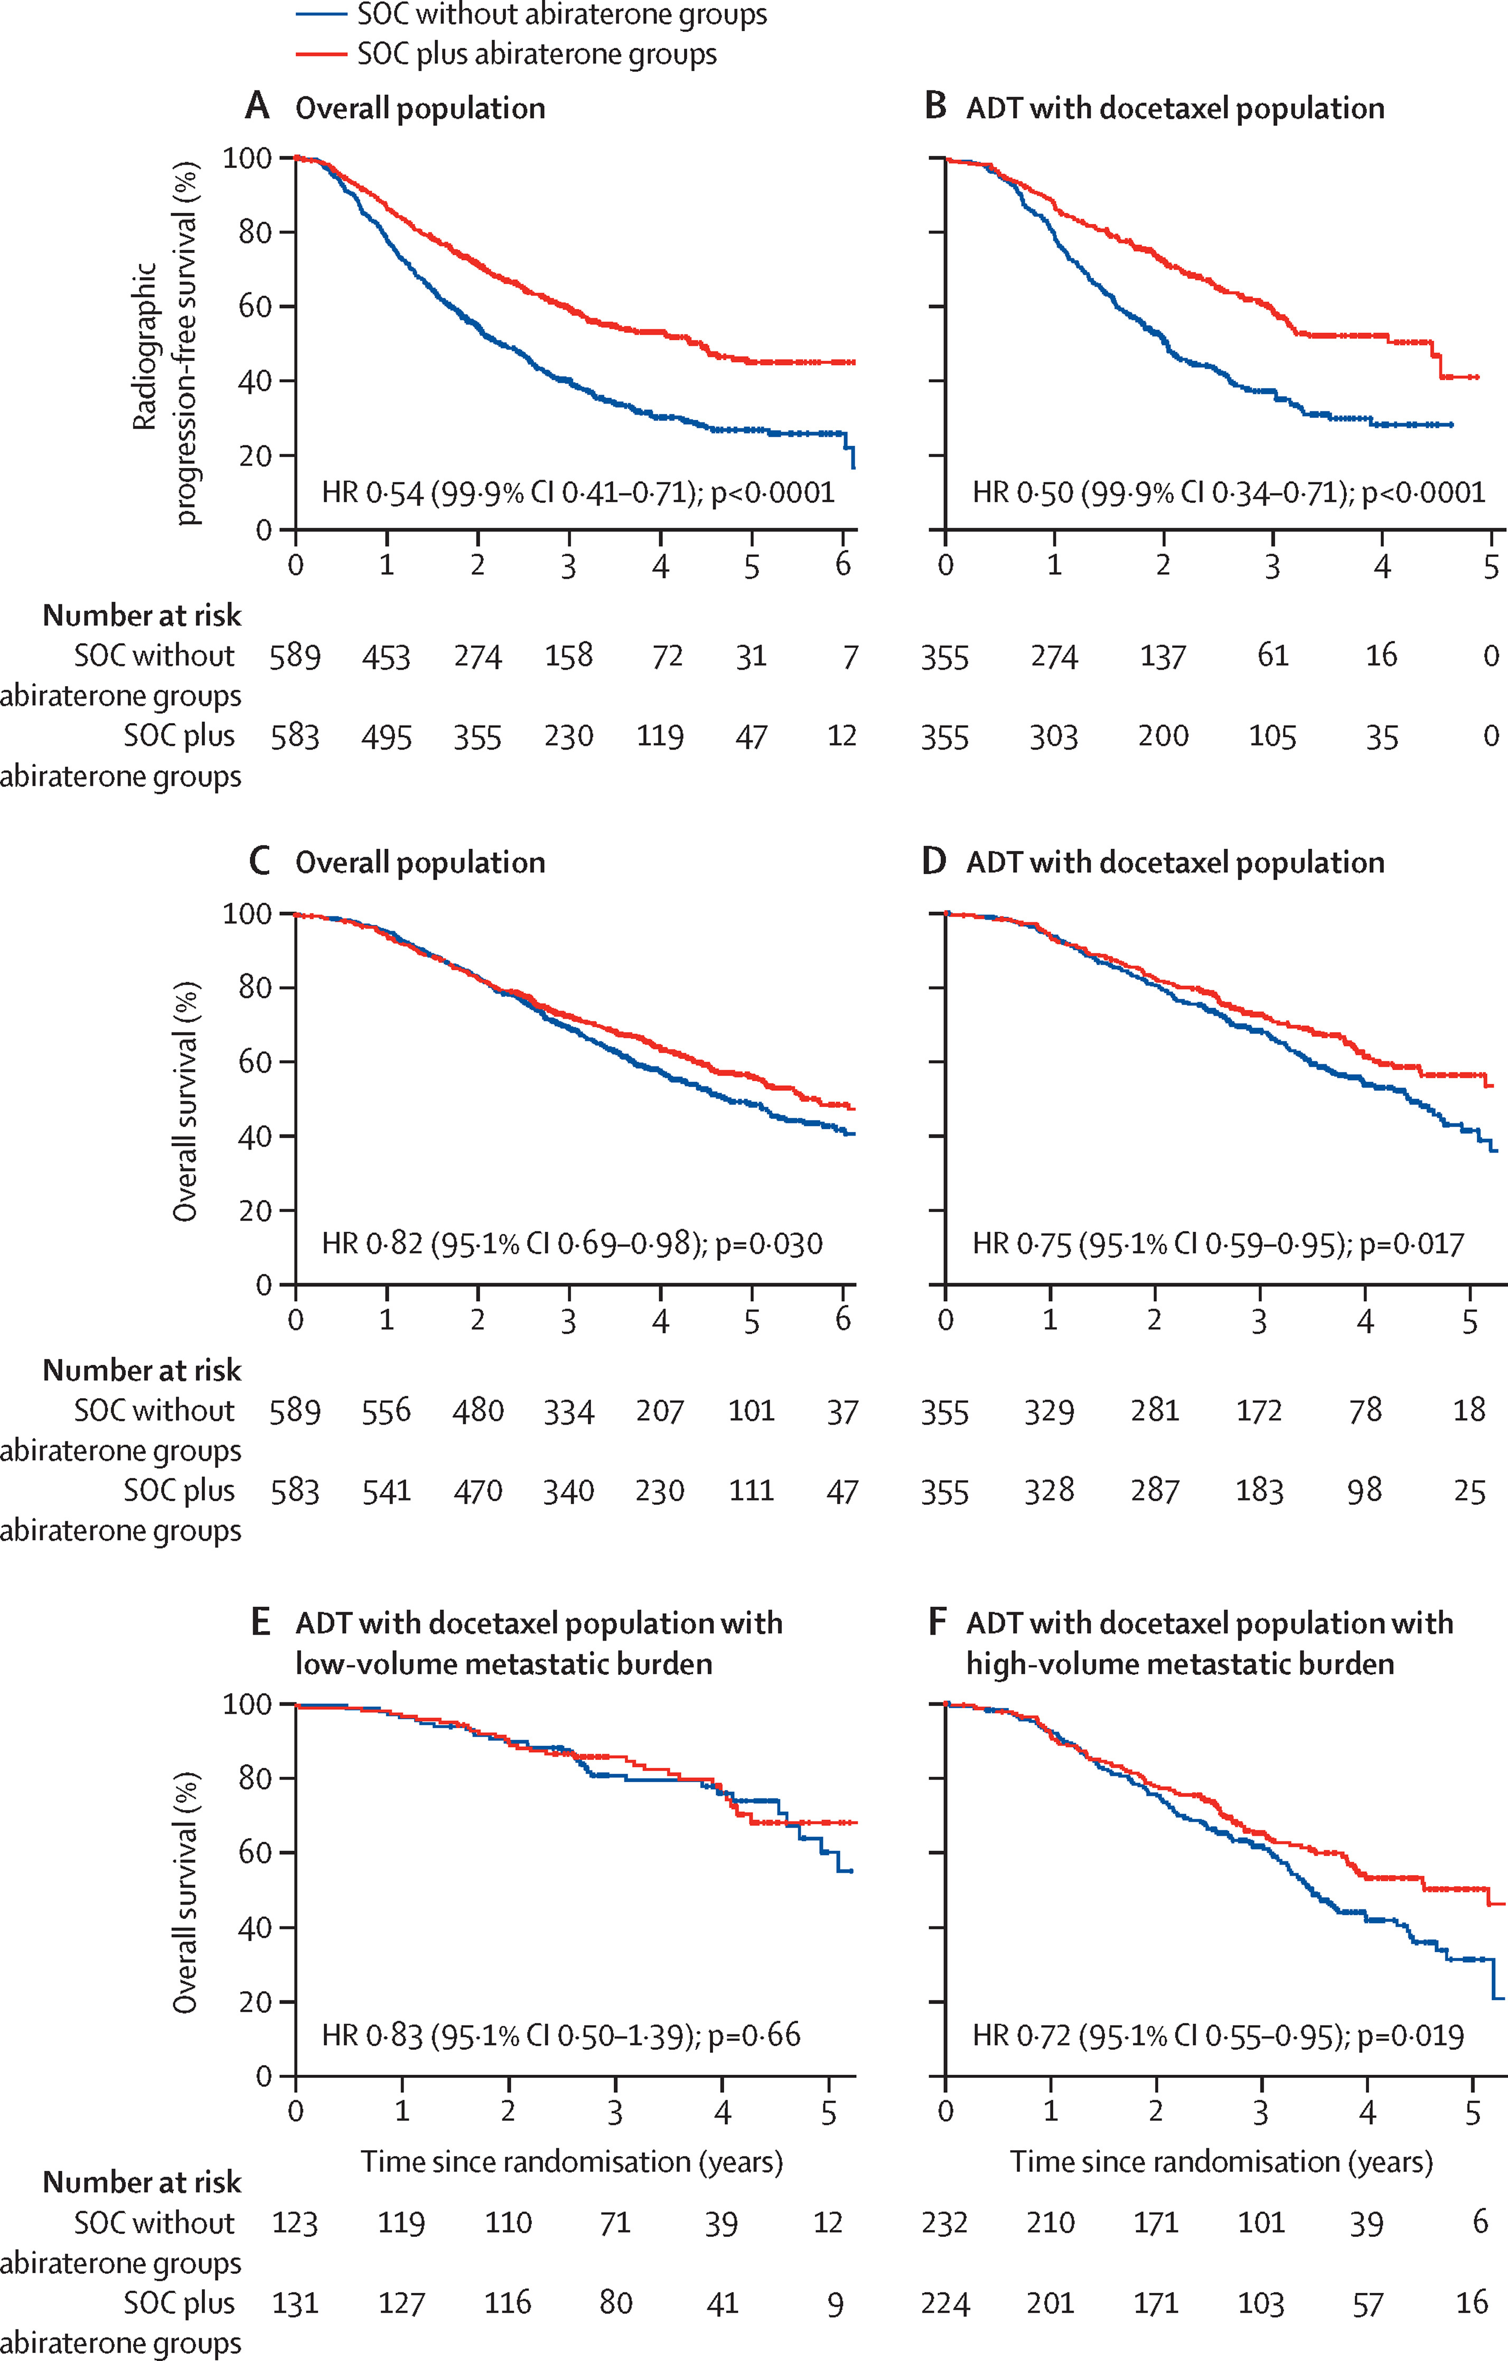
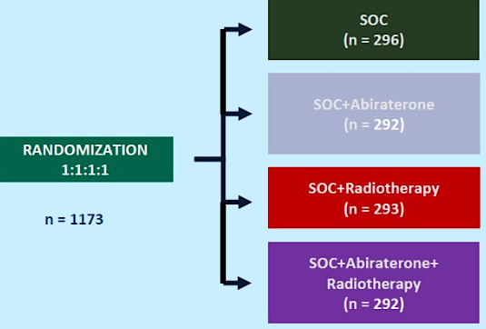
Phase 3 PEACE-1 Study (2x2):
Abiraterone + ADT + Docetaxel ± RT for mHSPC
Coprimary Endpoints (Overall Population)
Median follow-up: 4.4 y
SOC + Abi
4.5y
≥ 1 distant lesion on bone and/or CT scan), ECOG PS 0-2
SOC
2.2y
Median follow-up: 3.5y
SOC + Abi
5.7y
SOC
4.1y
Grade 3-5 AEs (>5%, ABI vs control):
neutropenic fever (5% vs 5%), neutropenia (10% vs 9%), liver toxicity (6% vs 1%) and HTN (21% vs 13%)
Fizazi K, et al. Lancet. 2022 Apr 30;399(10336):1695-1707.

Slide 52
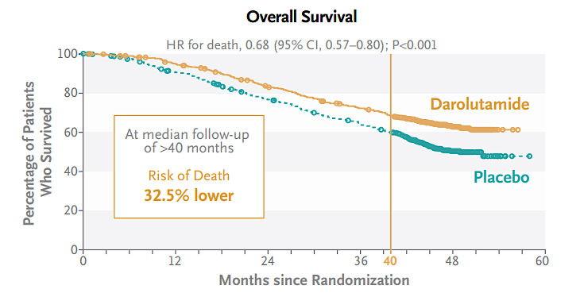
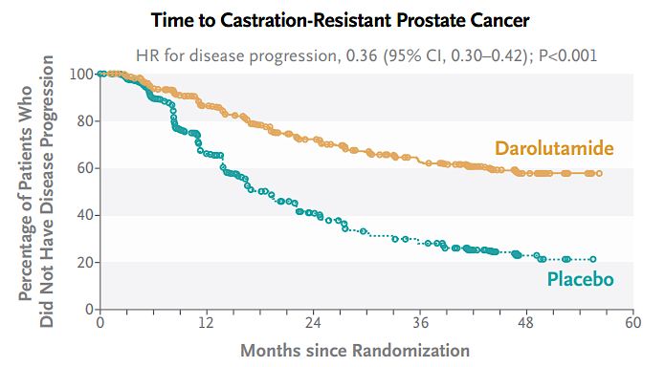
Phase 3 ARASENS Study of Darolutamide + ADT + Docetaxel for Advanced HSPC
N=1306
Primary Endpoint
mHSPC, ECOG PS 0-1, candidates for ADT and doecetaxel
Safety
AE incidence: similar in the 2 groups
Incidences of most common AEs (≥ 10%) highest during overlapping docetaxel treatment period in both groups
Grade 3/4 AEs: 66.1% (daro) vs 63.5% (pbo)
  Neutropenia: 33.7% vs 34.2%
Serious AEs: 45% vs 42%
Median OS: NR daro vs 48.9 mo PBO
Smith MR, et al. N Engl J Med. 2022;386:1132-1142.

Slide 53

Metastatic Hormone Sensitive Prostate Cancer
ADT + Docetaxel
ADT + ARPI
ADT + Docetaxel + Abiraterone
ADT + Docetaxel + Darolutamide
ADT alone

Slide 54
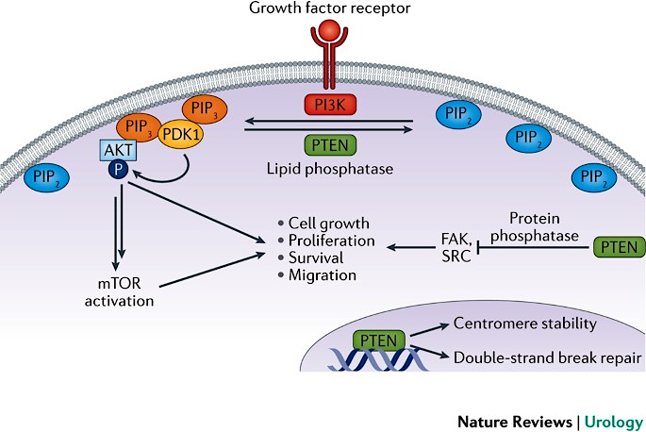

Slide 55
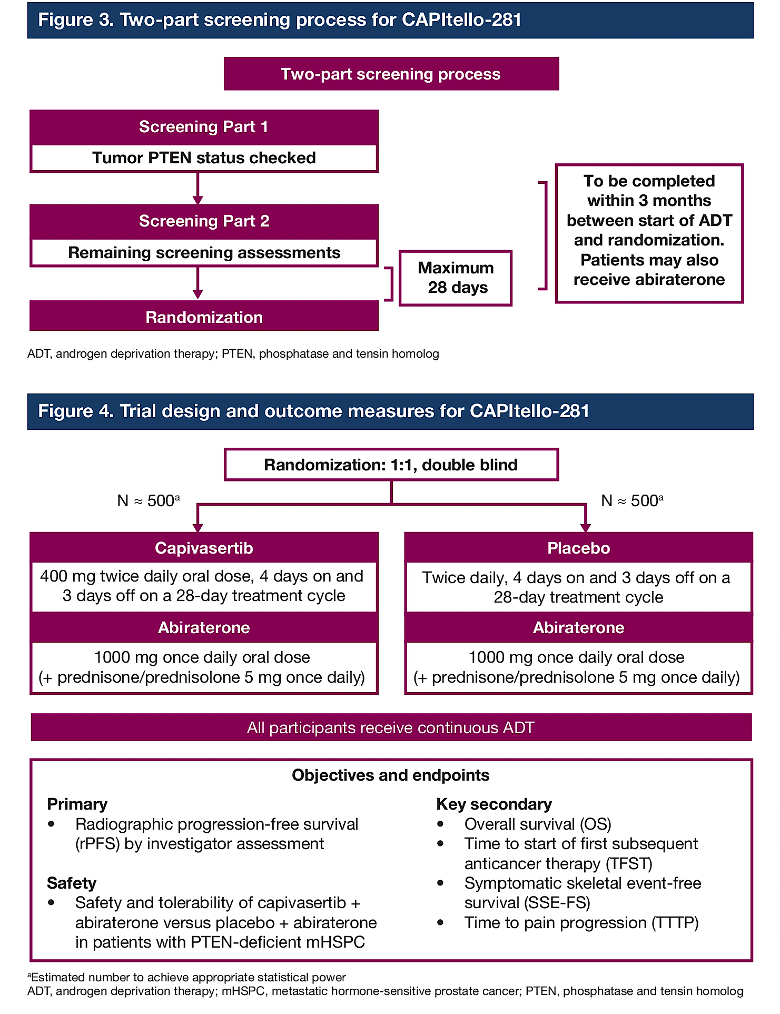
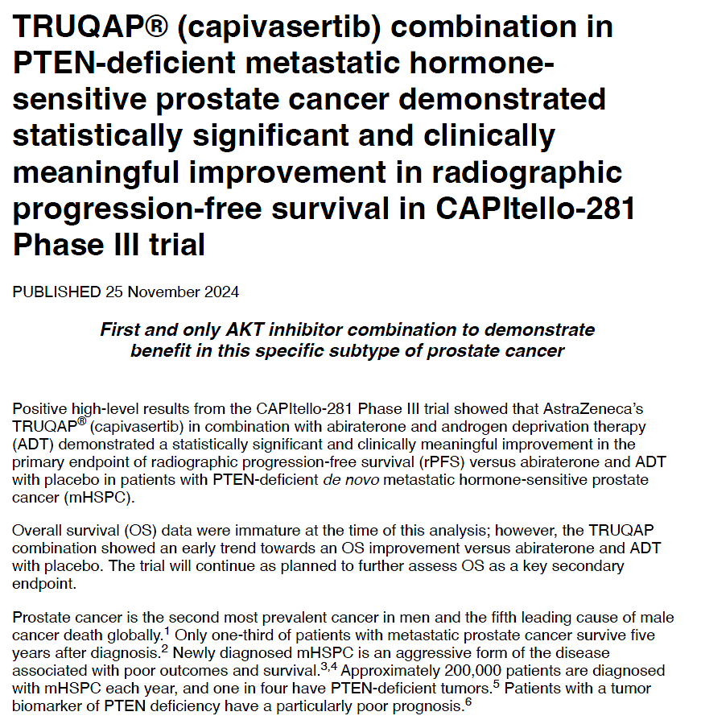
Capivasertib combination in
capivasertib
capivasertib

Slide 56
Treatment Landscape: 2025
Androgen Deprivation Therapy
Denosumab, Zoledronic Acid
Surgery / Radiation
PARP inhibitors (~23%)
Darolutamide
Apalutamide
Enzalutamide
Abiraterone
Radium-223
Lu-177 PSMA (~90%)
Androgen
Deprivation
Death
Local
Therapy
Therapies After
LHRH Agonists
and Antiandrogens
Docetaxel
Sipuleucel-T
Docetaxel
Cabazitaxel
Pembrolizumab (~3%)
Notes:
56

Slide 57
Patient Case Continued
Therapeutic options available were reviewed with the patient
ADT was started immediately with leuprolide
Darolutamide + docetaxel x 6 cycles was recommended given his young age and aggressive recurrence
Chemotherapy was complicated by fatigue, but he actually gained weight as his tumor regressed
His PSA responded, dropping to 0.4 after 6 months
He continues on leuprolide and darolutamide
PSA, labs and visits are conducted every 3 months

Slide 58
Roundtable Discussion

Slide 59

Kathleen Burns, Nurse Practitioner
GU Medical Oncology
City of Hope

Slide 60
Androgen Pathway Inhibitors
Also called ARPI, ARSI, ARTA
They intensify a single agent androgen deprivation therapy
Patient education
  Cost/insurance coverage/adherence
  Like any other targeted agents, they have unique side effects
    Enzalutamide – falls/fracture, fatigue, cognitive dysfunction, seizure
    Abiraterone – liver toxicity, cardiac risk, potassium changes, needs prednisone
    Darolutamide – bleeding, rash, hypertension, anemia
    Apalutamide – rash, falls/fracture, hypothyroidism, decreased appetite

Slide 61

Preparing for ARPIs
Baseline lipids
Calcium and vitamin D
Hypertension controlled
Exercise – cardio and resistance training
Nutrition counseling - reduce carbs

Slide 62

Case Study mHSPC
55 yr old man presented in 2/2024 – for a second opinion
9/28/23 - PSA found to be elevated to 97.3 on routine labs and referred to urology for evaluation
11/9/23 - TRUS biopsy with GS 4+3 or 3+4 disease in all cores
12/23/23 - PSMA with high level radiotracer activity involving most of the prostate with relative sparing of left anterior transition zone demonstrating SUV max of 17.9, consistent with primary prostatic malignancy. Intermediate level radiotracer uptake noted in the nonenlarged prominent lymph nodes in the right pelvis, retroperitoneum, mediastinum, left axilla and bilateral lower cervical regions, concerning for metastasis. Indeterminate low intermediate level focal radiotracer activity in the bones involving right posterior rib, right iliac bone and left posterior seventh rib with mild sclerosis
1/3/24 - Started on leuprolide and bicalutamide
1/30/24 - Saw a medical oncologist who recommended the addition of docetaxel to his leuprolide and bicalutamide. He disagreed and came to City of Hope for another opinion

Slide 63

Case study:
mHSPC, de novo, low-volume
We tried to sign him onto clinical trial tala/abi/ADT but insurance denied
We then recommended stopping the bicalutamide and starting doublet therapy with Leuprolide/abiraterone and he received radiation to the prostate
PSMA PET 10/24 showed resolution of disease
PSA has been undetectable indicating excellent response to treatment _________________________________________________________
Patient single, self employed pop-up caterer without significant comorbidities
Developed hypocalcemia from denosumab (after dental screening)– calcium supplementation needed adjusting
Developed transaminitis from the abi in the 2nd month – weekly labs, when resolved (4 weeks) restarted at ½ dose, never returned. Continues on therapy
Health maintenance (no primary care): colonoscopy, repeat DEXA every 1-2 years while on ADT, exercise and heart health counseling, not sexually active but interested in reconnecting with ED education. Monitor insulin resistance/blood glucose/lipids. Social work and support group referral for minimal social support and potential financial issues with insurance coverage

Slide 64

Triplet therapy
Darolutamide/ docetaxel/ ADT
mHSPC – higher risk or more symptomatic from PC
Prepare patients for changes in appearance
      Hair loss
      Potential refractory fluid retention
      Steroid side effects – thinning or bruising skin/ weight gain

Slide 65
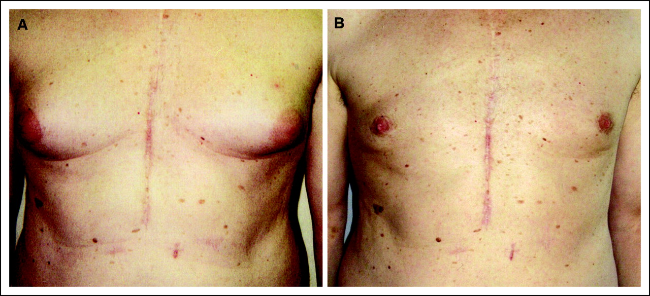
Enzalutamide monotherapy
Gynecomastia
Mastodynia
https://doi.org/10.1200/JCO.2005.03.8505

Slide 66
Roundtable Discussion

Slide 67
Agenda
Module 1: Recent Advances in the Treatment of Nonmetastatic Prostate Cancer
Module 2: Treatment Approaches for Metastatic Hormone-Sensitive Prostate Cancer
Module 3: Current Role of PARP Inhibitors in Metastatic Castration-Resistant Prostate Cancer (mCRPC)
Module 4: Current and Future Role of Radiopharmaceuticals in mCRPC

Slide 68
Clinical Scenario
A patient with mCRPC and a germline BRCA2 mutation is about to start treatment with a PARP inhibitor in combination with an AR pathway inhibitor

Slide 69
PARP inhibitors 2025
William K. Oh, MD
Director, Precision Medicine
Yale Cancer Center and Smilow Cancer Hospital
Service Line Medical Director
Smilow Cancer Hospital at Greenwich Hospital
Chair, National Prostate Cancer Roundtable
American Cancer Society

Slide 70
Patient Case: 74 yo M with Metastatic Prostate Cancer
FH: mother with breast cancer at 37 yrs
PSA 150, bone mets seen on bone scan
Treated with leuprolide, abiraterone/prednisone
PSA starts rising→docetaxel chemotherapy→progresses after 2 mo

Slide 71
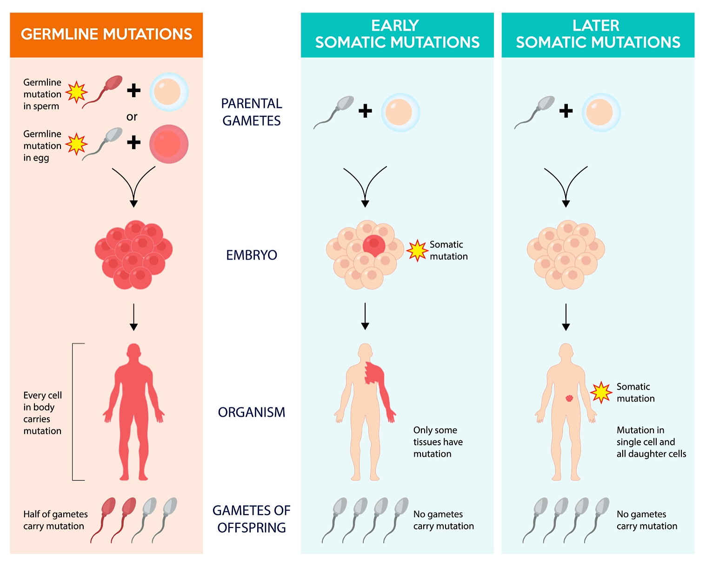
Somatic & Germline Variants in Cancer Care
Germline testing is used to determine the lifetime risk for developing cancer in a patient as well as identify risk in family members
Somatic tumor profiling can assess prognosis, determine individualized therapy options, and provide information about clinical trials

Slide 72
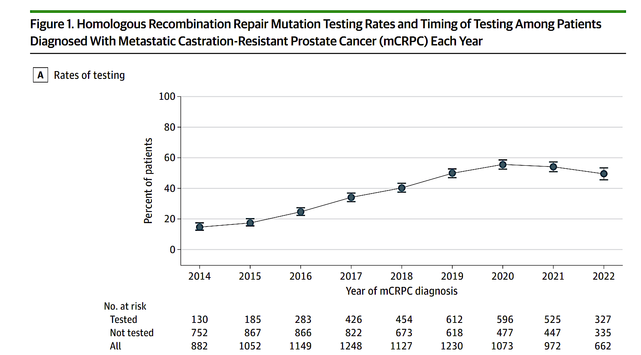
~60% of mCRPC Patients Do Not Get Tested!

Slide 73
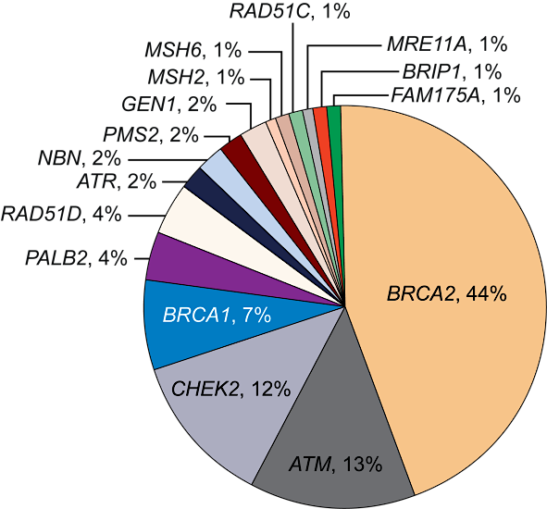
DNA Repair Gene Alterations Are Common in Metastatic Prostate Cancer^{1,2}
23% of mCRPCs harbor DNA damage repair (DDR) alterations
The frequency of DDR mutations increases with disease progression
About half of these (~12%) have germline alterations in DDR genes
Age and family history do not affect mutation frequency

Slide 74
PARP Inhibitor Combination Strategies for M1 CRPC
Notes:
Dr. Oh

Slide 75
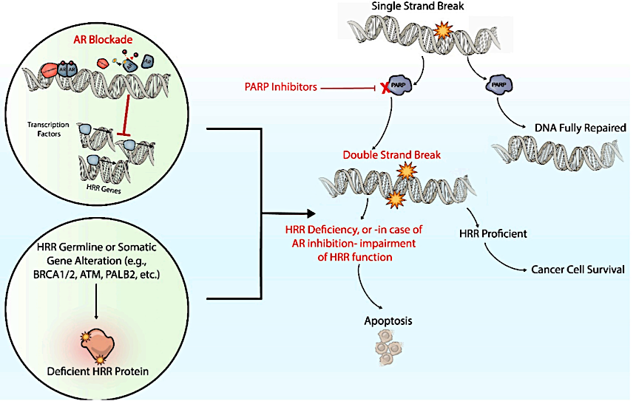
Synergy: PARPi + Androgen Receptor Signaling
PARP augments AR activity
Induces “BRCAness”
Induce a BRCA-loss like state that resembles HRR deficiency
Suppression of AR is associated with upregulated PARP activity
AR inhibition might provide a sensitivity that can be exploited by PARPi
PARPi may attenuate resistance to ARPIs
PARP indirectly augments AR-driven gene expression programs by binding to transcriptional coactivators
Loss of Rb1 is associated with disease progression & ARPI resistance, & can be accompanied by codeletion of BRCA2
Agarwal N, et al. Eur J Cancer 2023;192:113249

Slide 76
PROpel: Study Design
Phase 3, global, randomized, double-blind trial​
Key Eligibility Criteria
1L mCRPC
Docetaxel allowed at mHSPC stage
No prior abiraterone
Other NHAs allowed if stopped ≥12 months prior to enrollment
Ongoing ADT
ECOG 0‒1
Stratified by:
Site of distant metastases: bone only vs. visceral vs. other
Prior taxane at mHSPC: yes vs. no
Olaparib 300 mg bid
+
abiraterone 1000 mg qd*
n=399
Primary Endpoint:
Radiographic progression or death (rPFS) by investigator assessment
Key Secondary Endpoint:
Overall survival (alpha control)
Other Secondary Endpoints
Time to first subsequent therapy or death (TFST)
Time to second progression or death (PFS2)
Objective response rate (ORR)
HRRm† prevalence (retrospective testing)
Health-related quality of life
Safety and tolerability
R
Placebo
+
abiraterone 1000 mg qd*
n=397
(1:1)
Clarke NW. NEJM Evid 2022;1(9):EVIDoa2200043

Slide 77
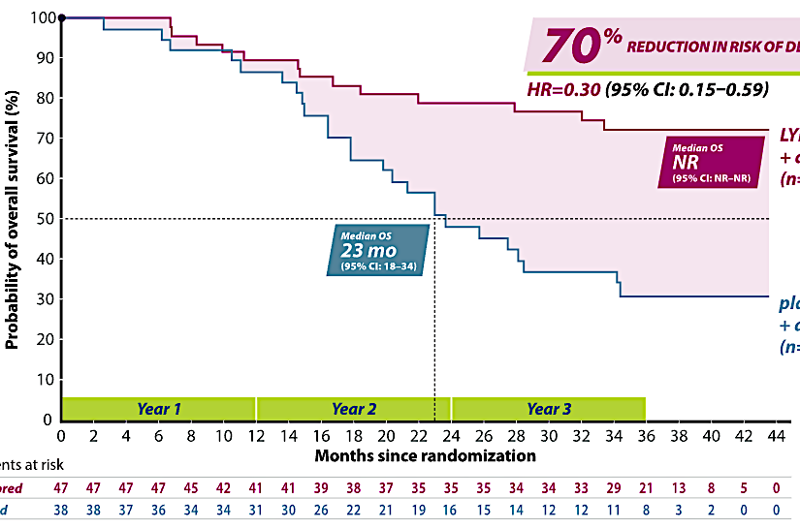
PROpel: Olaparib + Abiraterone for the 1L Treatment of Metastatic CRPC – OS in BRCAm
 | Abi + Ola (n=47) | Pbo + Abi (n=38)
Events, n (%) | 13 (28) | 25 (66)
Median (95% CI), months | NR (NR-NR) | 23 (18-34)
HR (95% CI) | 0.30 (0.15-0. 59)
Number of patients at risk
Abi + Ola
Abi + Pbo

Slide 78
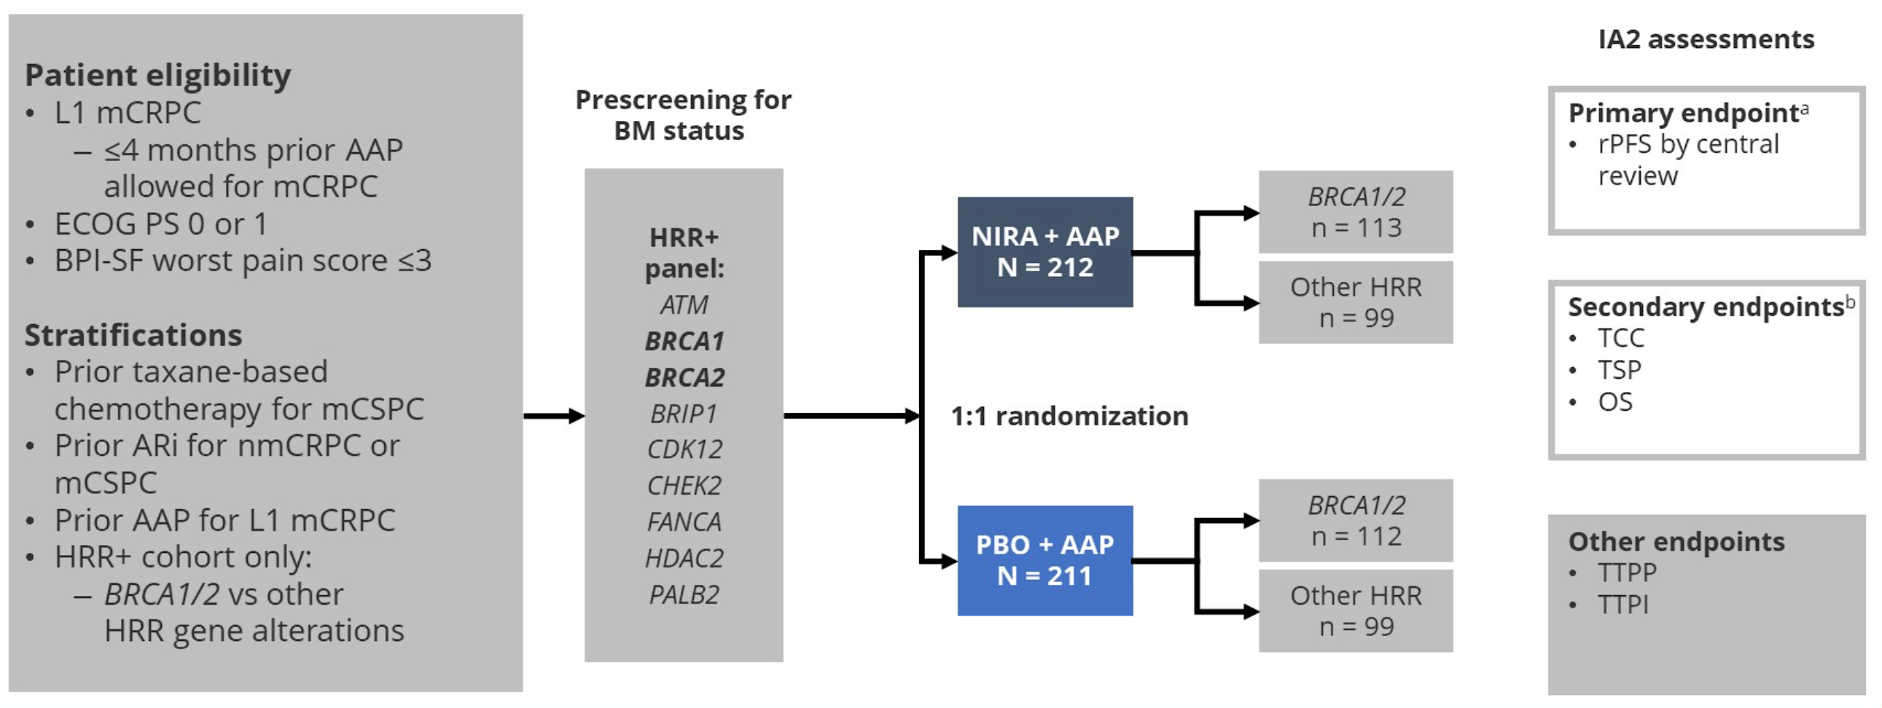
MAGNITUDE: Study Design
Efstathiou et al. ASCO GU 2023;Abstract 170.

Slide 79
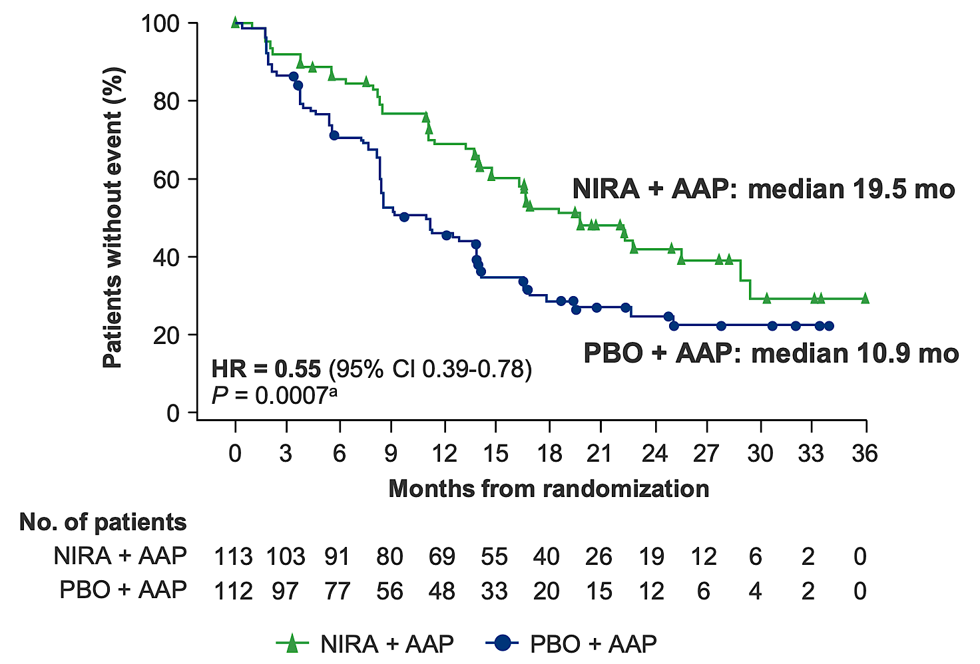
MAGNITUDE: rPFS in BRCA1/2 Subgroup
Efstathiou et al. ASCO GU 2023;Abstract 170.

Slide 80
TALAPRO-2: Study Design
Phase 3, randomized, double-blind, placebo-controlled trial​
Key Eligibility Criteria
First-line mCRPC
ECOG PS 0-1
Stratified by:
Prior abiraterone or docetaxel in castration-sensitive setting: Y vs. N
HRR gene alteration status: deficient vs. nondeficient vs. unknown
Talazoparib 0.5mg* + enzalutamide 160mg once daily
N=402
Primary Endpoint:
Radiographic progression-free survival (rPFS) by BICR
Key Secondary Endpoint:
Overall survival (alpha protected)
Other Secondary Endpoints
Time to cytotoxic chemotherapy
PFS2 by investigator assessment
ORR
Patient-reported outcomes
Safety
*0.35mg daily of moderate renal impairment
N=805
Placebo +
enzalutamide 160mg once daily N=403
R
1: 1
ECOG, Eastern Cooperative Oncology Group; BICR: Blinded Independent Central Review; ORR: Objective Response Rate
Agarwal N et al. Lancet 2023;402(10398):291-303.

Slide 81
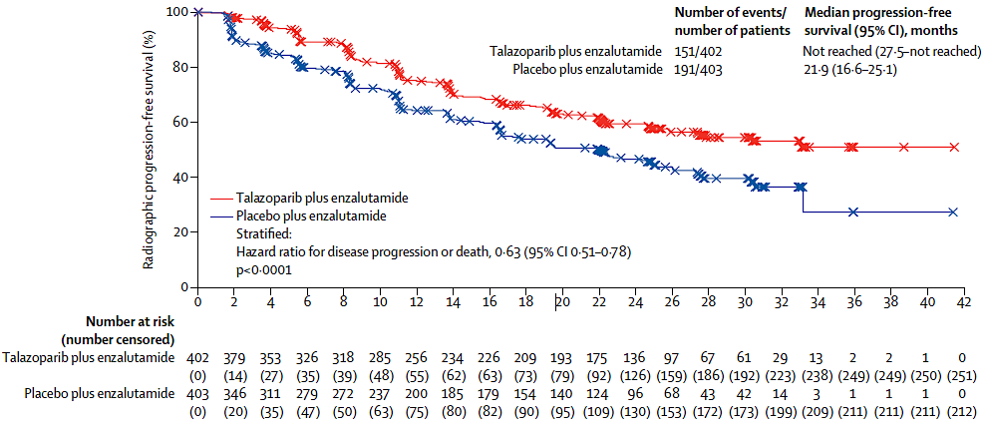
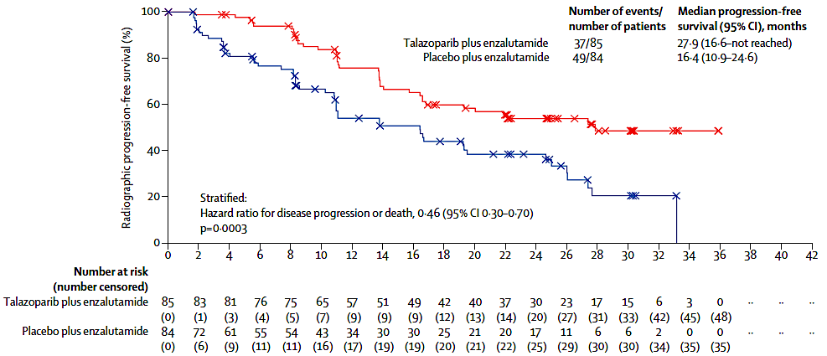
TALAPRO-2: rPFS by BICR
All Patients
HRR - deficient
Agarwal N et al. Lancet 2023;402(10398):291-303.

Slide 82
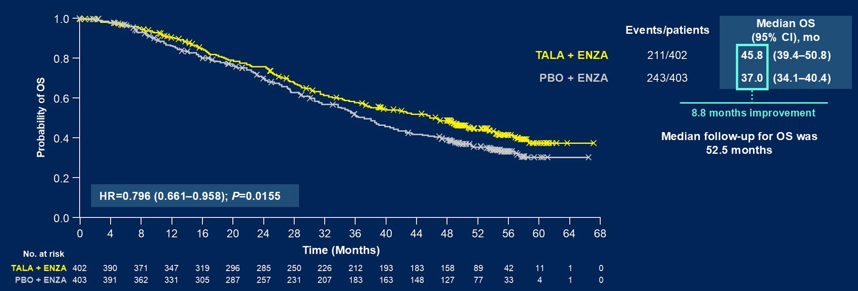
TALAPRO-2: OS Analysis
Agarwal et al. ASCO GU 2025;Abstract LBA18.

Slide 83
PARP Inhibitor Monotherapy
Strategies in M1 CRPC
Notes:
Dr. Abida

Slide 84
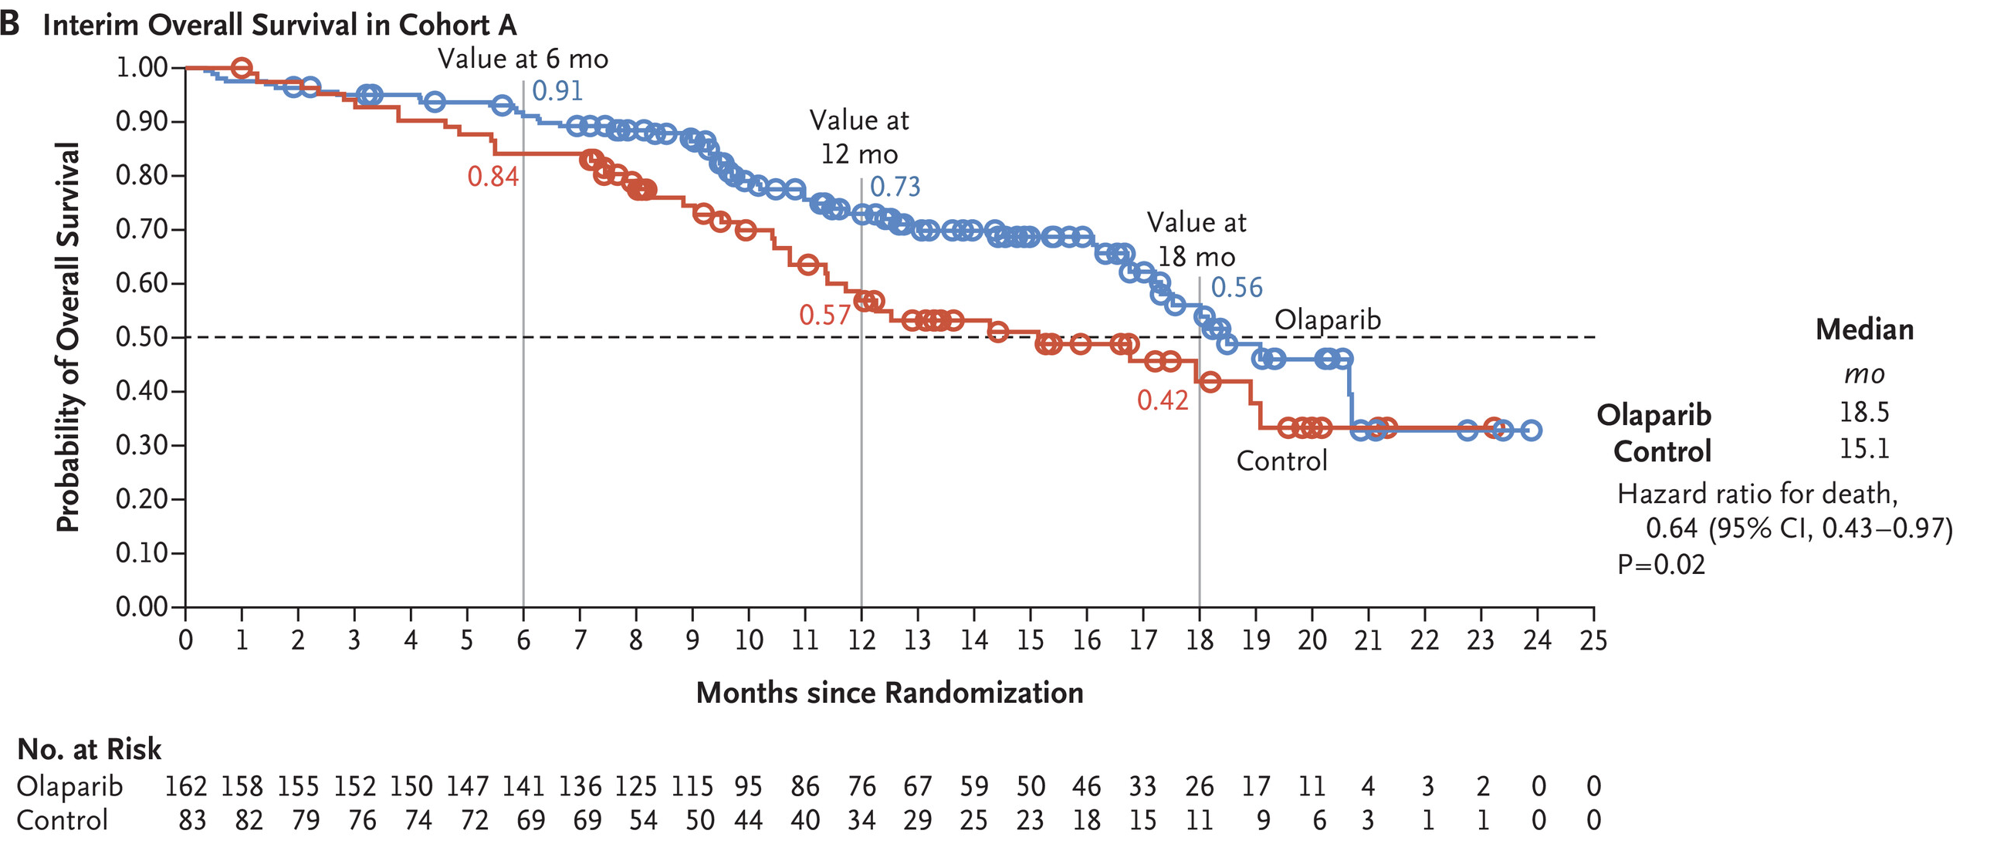
PROfound: OS in Cohort A (BRCA1, BRCA2, or ATM)
Mateo J, et al. N Engl Med 2020;382(22):2091-2102.

Slide 85
PARPi Adverse Events
 | Olaparib + AAP | Niraparib + AAP | Talazoparib + Enzalutamide | Olaparib | Rucaparib
 | PROpel¹ | MAGNITUDE² | TALAPRO-2³ | PROfound⁴ | TRITON3⁵
Anemia
Any Grade | 198 (50) | 105 (50) | 262 (66) | 119 (46) | 126 (47)
Grade ≥3 | 64 (16) | 64 (30) | 165 (46) | 55 (21) | 64 (24)
Fatigue or Asthenia
Any Grade | 153 (39) | 63 (30) | 134 (34) | 105 (41) | 165 (61)
Grade ≥3 | 10 (3) | 8 (4) | 16 (4) | 7 (3) | 19 (7)
Nausea
Any Grade | 122 (31) | 52 (25) | 82 (21) | 106 (41) | 134 (50)
Grade ≥3 | 1 (<1) | 1 (<1) | 2 (<1) | 7 (1) | 7 (3)
PE | 29 (7) | 4 (2) | 10 (3) | 11 (4) | 9 (3)
MDS / AML | MDS: 2 pts. | - | MDS: 1 pt AML: 1 pt | - | -
85
Represented as n,(%)
PE: Pulmonary ebmbolism; MDS: myelodysplastic syndrome; AML: acute myeloid leukemia
1. Saad F, et al. Lancet Oncol. 2023;24(10):1094-1108 2. Chi KN, et al. Ann Oncol. 2023;34(9):772-782. 3. Agarwal N et al. Lancet 2023;402(10398):291-303. 4. de Bono J, et al. N Engl Med 2020;382(22):2091-2102. 5. Fizazi K, et al. N Engl J Med. 2023;388(8):719-732.

Slide 86
Patient Case: 74 yo M with Metastatic Prostate Cancer
FH: mother with breast cancer at 37 yrs
PSA 150, bone mets seen on bone scan
Treated with leuprolide, abiraterone/prednisone
PSA starts rising→docetaxel chemotherapy→progresses after 2 mo
Genomic testing on tumor shows BRCA2 mutation and he starts on Olaparib
PSA declines by 90% and pain improves

Slide 87
Roundtable Discussion

Slide 88
Nursing Considerations for Patients Receiving PARP Inhibitors
Monica Averia, MSN, AOCNP, NP-C

Slide 89
Genetic counseling for patients with germline BRCA and other homologous recombination repair (HRR) abnormalities offers benefits for their children/grandchildren by:
Identifying At-Risk Family Members:
  Once a cancer-predisposing BRCA1 or BRCA2 germline variant is identified, testing at-risk relatives can identify those who also carry the familial variant.
Early Detection and Prevention:
  Allows for earlier and more targeted screening and preventive measures.
Personalized Treatment:
  Knowing about a BRCA mutation or other HRR abnormality can influence treatment decisions, as some therapies are more effective in individuals with these genetic changes.

Slide 90
Genetic counseling for patients with germline BRCA and other homologous recombination repair (HRR) abnormalities offers several benefits for their children/grandchildren:
Informed Decision-Making:
  Provides individuals with the knowledge and support they need to make informed decisions about their health and family planning.
Reducing Uncertainty:
  Help individuals and families understand the implications of genetic test results, potentially reducing anxiety and uncertainty.
Access to Resources and Support:
  Connect individuals and families with resources and support networks, including cancer support groups and other relevant organizations.

Slide 91
What do you tell your patients about to start treatment with a PARP inhibitor about how it works and why they are receiving it?
PARP inhibitors target DNA repair mechanisms.
A type of targeted therapy that interferes with a specific protein (PARP) that helps cancer cells repair DNA damage.
By blocking PARP, PARP inhibitors can cause cancer cells to die, especially those with certain DNA repair defects.

Slide 92
What do you tell your patients about to start treatment with a PARP inhibitor about how it works and why they are receiving it?
Olaparib + Abiraterone + Prednisone:
  Approved for patients with mCRPC who have deleterious or suspected deleterious mutations in the BRCA1 or BRCA2 genes.
Rucaparib:
  Approved for patients with mCRPC with BRCA1/2 mutations, after progression on prior androgen receptor-targeting agents and taxane-based chemotherapy.
Niraparib + Abiraterone + Prednisone:
  Approved for patients with mCRPC who have deleterious or suspected deleterious mutations in the BRCA1 or BRCA2 genes.
Talazoparib + Enzalutamide:
  Approved for patients with mCRPC with homologous recombination repair (HRR) gene alterations./

Slide 93
Dosing and Side Effects
Olaparib + Abiraterone + Prednisone:
Niraparib + Abiraterone + Prednisone:
Olaparib 300 mg po BID + Abiraterone
1000 mg po daily + Prednisone
Fatigue
GI: nausea, diarrhea, decreased appetite, abd pain
Cough
Anemia, Lymphopenia
Rare: Myelodysplastic syndrome, venous thrombolytic events, pneumonitis, embryo-fetal toxicity
Niraparib 200 mg po daily + Abiraterone 1000 mg po daily + Prednisone
Fatigue
GI: nausea, vomiting, decreased appetite
Anemia, Neutropenia, Thrombocytopenia
Rare: MDS, acute myeloid leukemia

Slide 94
Dosing and Side Effects
Talazoparib + Enzalutamide
Rucaparib
Talazoparib 0.5 mg po daily + Enzalutamide 160 mg po qd
Fatigue
GI: nausea, vomiting, diarrhea
Anemia, Neutropenia, Thrombocytopenia
Rare: Myelodysplastic syndrome (MDS) or acute myeloid leukemia (AML)
Rucaparib 600 mg po twice daily
Fatigue
GI: nausea, vomiting, diarrhea, constipation
Anemia, thrombocytopenia
Inc AST/ALT
Rash
Rare: MDS, venous thrombolytic events, pneumonitis, embryo-fetal toxicity

Slide 95
How do you monitor and manage common toxicities associated with PARP inhibitors?
Fatigue:
  Exercise, massage, cognitive behavioral therapy
  Evaluate for other potential causes: anemia, thyroid dysfunction, vitamin deficiencies
Nausea:
  Prophylactic antiemetics can be given about 30-60 minutes prior to each PARP inhibitor dose
  Olaparib interacts with CYP3A4, patients should not take aprepitant
  Recommend taking PARPI after meals to reduce risk of nausea
Vomiting:
  Identify food triggers, food diary.
  Do not take a second dose of medication if they vomit after the first one.

Slide 96
How do you monitor and manage common toxicities associated with PARP inhibitors?
Diarrhea/constipation: Loperamide and Laxatives, respectively.
Anemia, Thrombocytopenia, Neutropenia
Labs: initiation of treatment, q monthly CBC with differential
- Anemia:
  Evaluate for other causes of anemia
  Hold PARP inhibitor for grade ≥ 3 anemia
  Transfuse prbc
  Once Hgb returns to baseline and when symptoms resolve, restart PARP inhibitor at reduced dose
- Thrombocytopenia:
  Transfusion for thrombocytopenia is rare, but consider for patient with Plt <10K
*Fatigue, GI symptoms, cytopenia: the 3 most common toxicities of PARP inhibitors

Slide 97
How do you monitor and manage common toxicities associated with PARP inhibitors ?
Treatment: until disease progression or unacceptable toxicity
Manage PARP toxicities: with treatment hold, dose modification, supportive care
Patient on PARP inhibitors: concomitant GnRH or s/p bilateral orchiectomy.
Address side effects of ADT: sexual dysfunction, body changes, emotional lability, etc
Less common effects: headache, insomnia, dizziness, cough, cutaneous reactions (rucaparib), HTN
Assess therapeutic burden: Increased burden is associated with decreased QOL and well being.
Identify potential barriers: Financial, compliance, etc

Slide 98
Clinical examples/experiences from practice
- 74 yr old male
- 9/10/21: PSA of 5.9
- 11/8/21: Prostatectomy: GG5 (4+5) Adenocarcinoma of the Prostate. pT3bN0
- 12/17/21: PSA 0.47
- 12/29/21: PET fluciclovine F 18: showed s/p radical prostatectomy with nonspecific radiotracer uptake in the prostatectomy bed (SUV max 5.4)
-Treatment: 6 months of ADT + RT: prostate fossa and pelvic LNs (2/16/22 - 4/5/22)
- 4/25/22: PSA <0.03; Testosterone <12

Slide 99
Clinical examples/experiences from practice
5/2022 to 11/2023: PSA <0.02; Testosterone <12
02/09/24: PSA 0.02; Testosterone <12
05/10/24: PSA: 0.07; Testosterone <12
8/14/24: PSA: 0.36; Testosterone <12
9/11/24: PET piflufolastat F 18: Increased uptake in the left proximal femur
9/11/24: PSA: 1.72; Testosterone <12
- New c/o left leg discomfort, with/without activity. No pain med required

Slide 100
Clinical examples/experiences from practice
-10/2024: Tumor profiling: ATM mutation
- 10/2024: Olaparib + Abiraterone + Prednisone
- 11/11/24: PSA 0.72 (from 1.72); Testosterone <12
- 12/6/24: PSA 0.17; Testosterone <12
- 12/13/24 to 12/30/24: SBRT to Left Femur
- 01/17/25: PSA <0.02; Testosterone <12
- 4/2/25: PSA <0.02; Testosterone <12. Pt asymptomatic. Tolerating Olaparib + Abi + Pred
- SE: G1: fatigue, nausea controlled with prn antiemetics 1-2 per wk
- Continue q mnth follow-up with labs, cont ADT, Ca + Vit D
- Daughter x 1: Genetic testing: No actionable mutations

Slide 101
Roundtable Discussion

Slide 102
Agenda
Module 1: Recent Advances in the Treatment of Nonmetastatic Prostate Cancer
Module 2: Treatment Approaches for Metastatic Hormone-Sensitive Prostate Cancer
Module 3: Current Role of PARP Inhibitors in Metastatic Castration-Resistant Prostate Cancer (mCRPC)
Module 4: Current and Future Role of Radiopharmaceuticals in mCRPC

Slide 103
Clinical Scenario
A patient receives darolutamide/docetaxel/ADT for mHSPC but is then found to have new bone-only metastases on PSMA PET and receives radium-223

Slide 104
Current and Future Role of Radiopharmaceuticals in mCRPC
Rahul Aggarwal, MD
Professor of Medicine
University of California San Francisco

Slide 105
74 year old male who is a current patient of mine…
Presented to PCP with back pain, obstructive urinary symptoms in 2020
PSA was 124 ng/mL
TRUS biopsy with Gleason 4+4 prostate adenocarcinoma
Germline testing: negative for pathogenic mutations
Somatic testing: TMPRSS2-ERG fusion, PTEN deletion, TP53, MSS, TMB 1 mutation/MB
PSMA PET with multifocal osseous metastases + nodal metastases

Slide 106
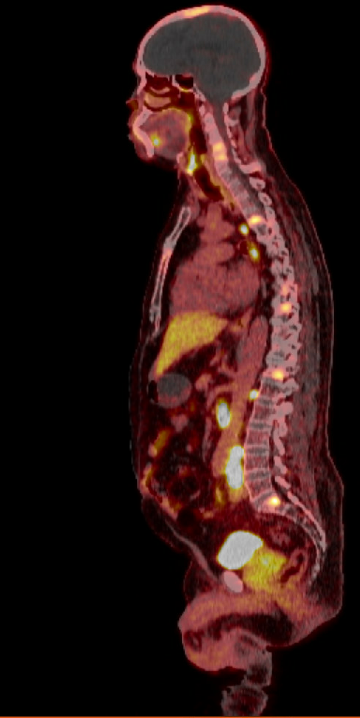
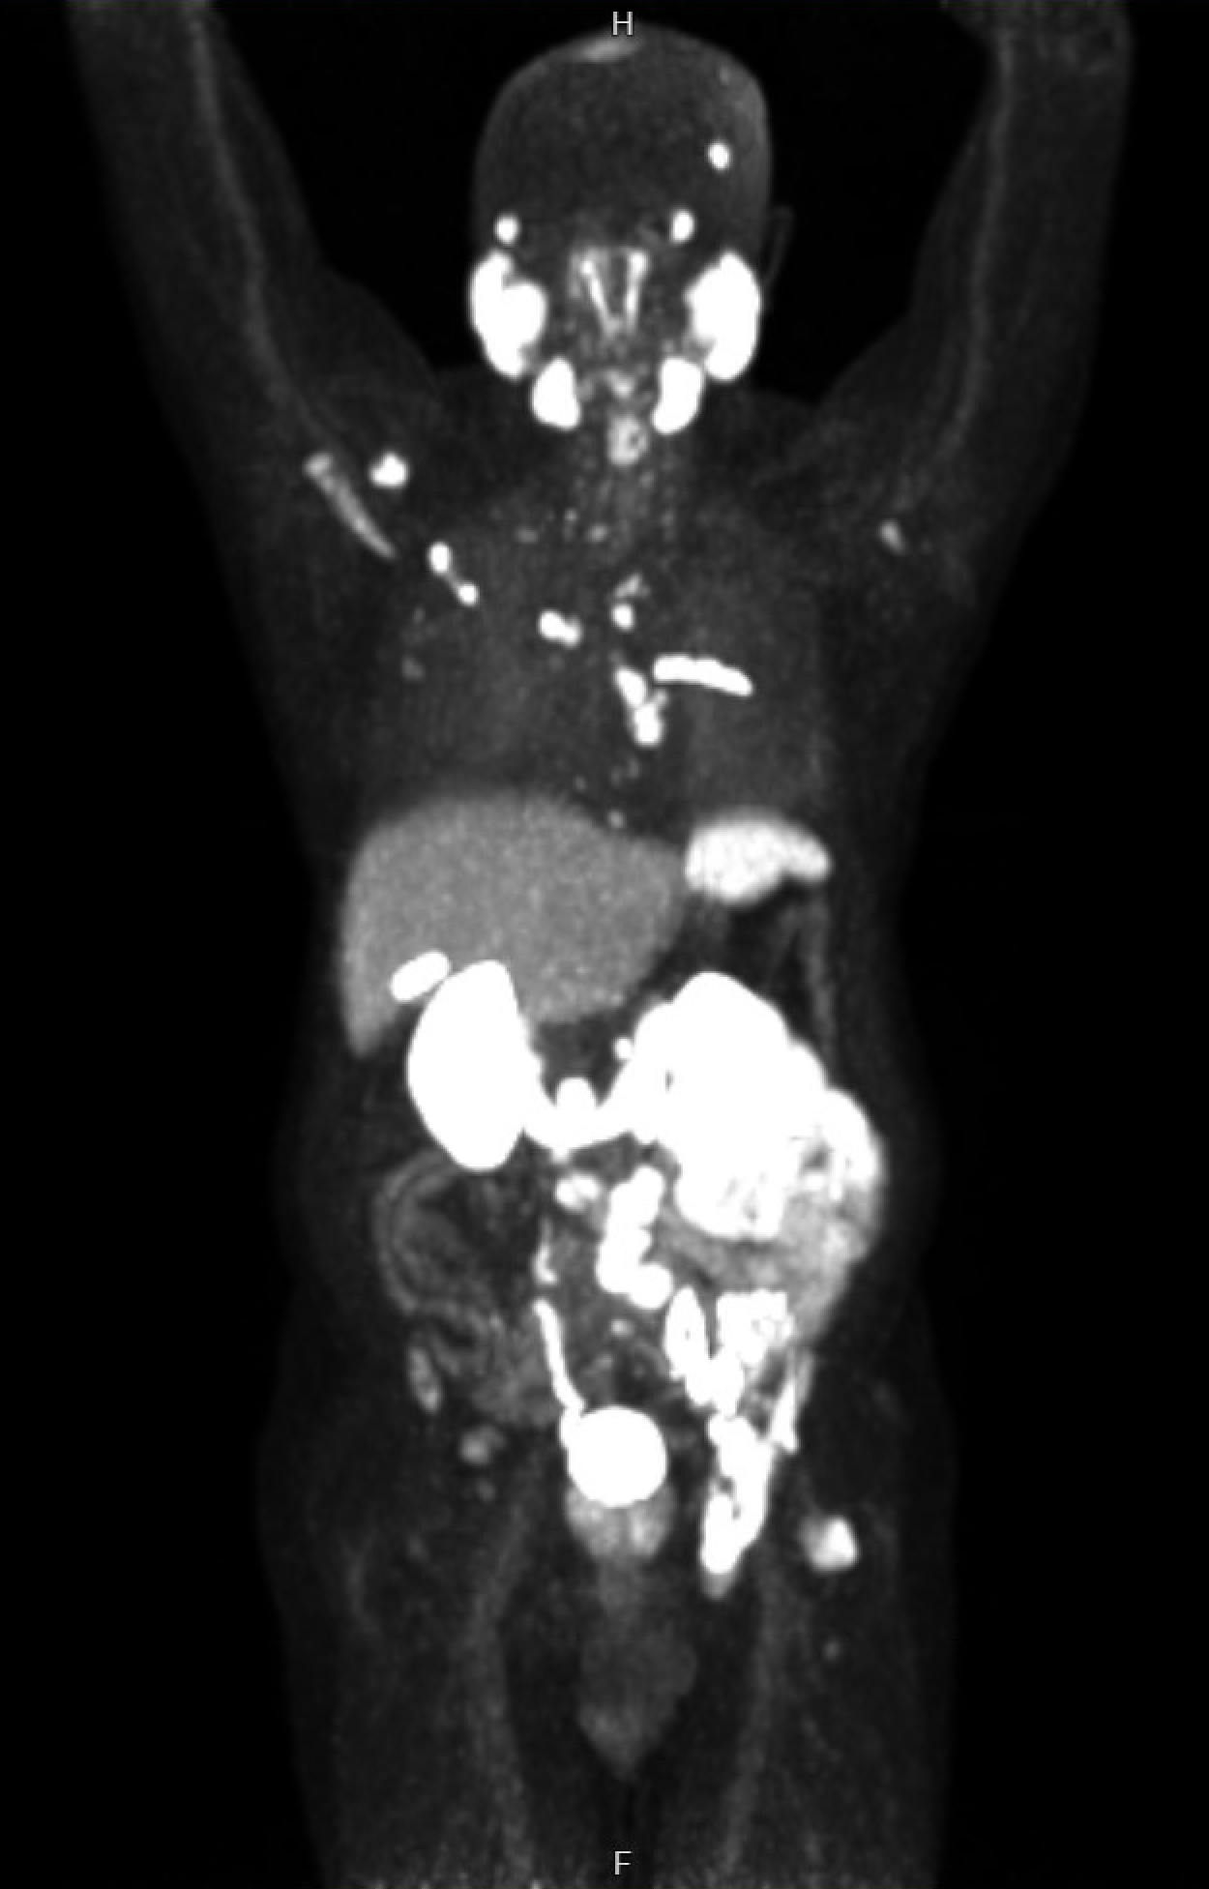
Staging PSMA PET

Slide 107
Case continued…
Patient treated with ‘triplet therapy’ – ADT + darolutamide + docetaxel chemotherapy x 6 cycles
Followed by continuation of ADT + darolutamide
Nadir PSA was 0.02 ng/mL at 12 months following start of treatment
Short time to castration resistance with subsequent rising PSA
  0.02 → 0.5 → 1.7 → 2.5 → 12.4
Unable to obtain insurance authorization for PSMA PET
Underwent conventional imaging (CT c/a/p + bone scan)

Slide 108
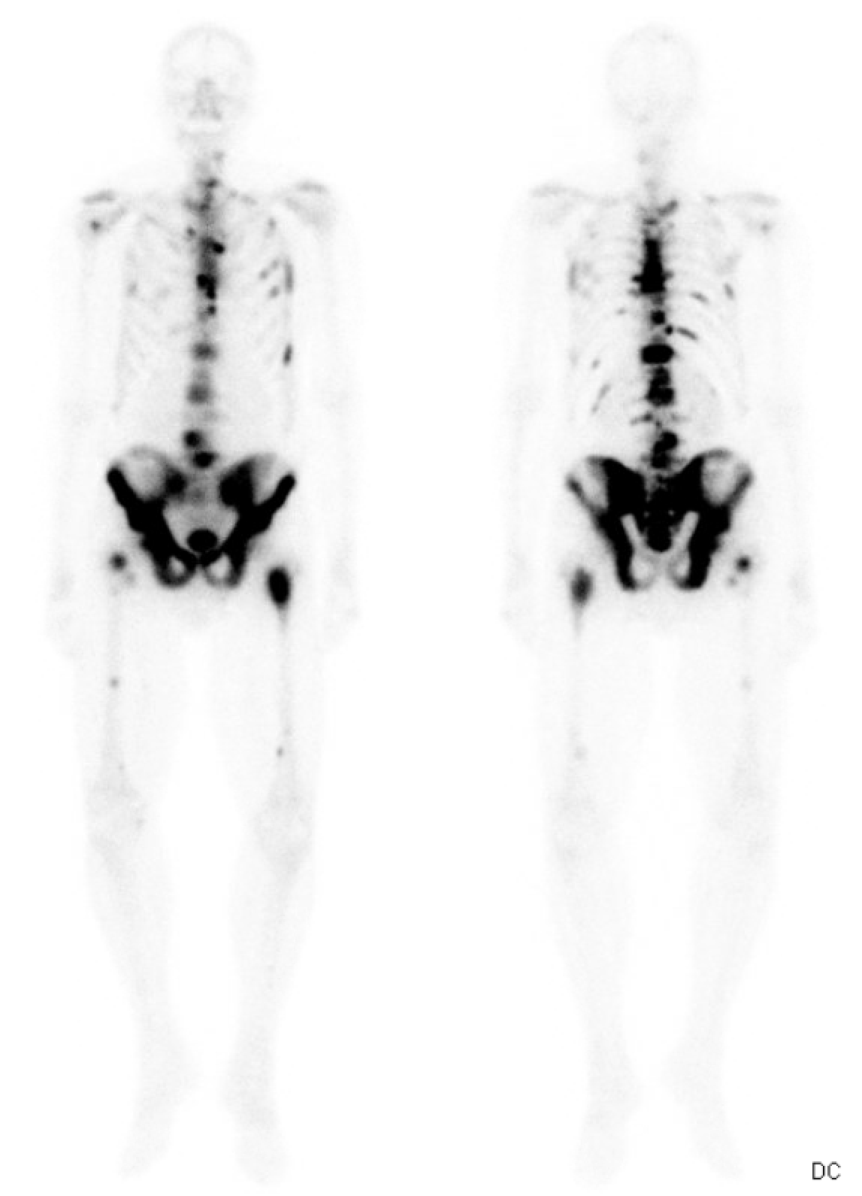
Conventional Imaging Results
Bone scan with widespread osseous metastases
CT c/a/p negative for enlarged nodes or visceral metastases
Increasing bone pain noted in multifocal regions including lumbar spine and bilateral posterior iliac region
Discussed options of docetaxel re-treatment, cabazitaxel +/- platinum, or radium-223
Current and Future Role of Radiopharmaceuticals in mCRPC

Slide 109
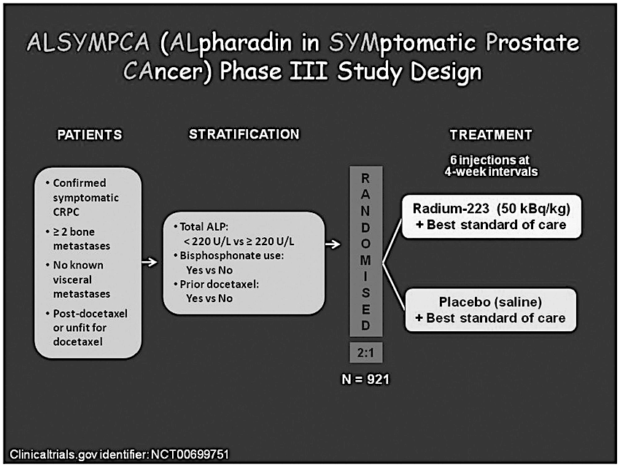
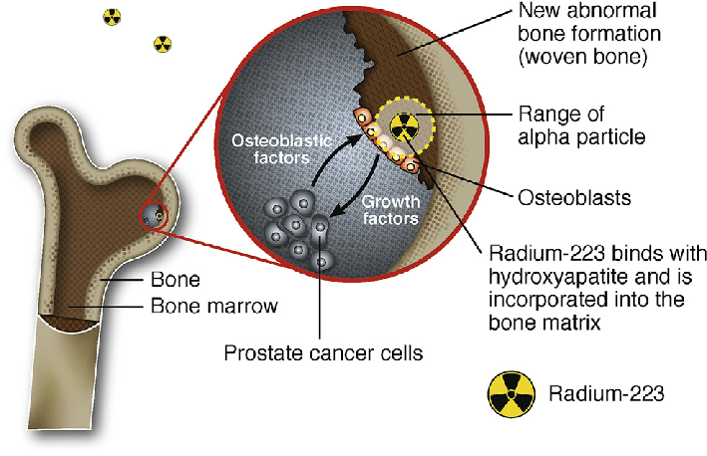
Radium-223 Improves Survival in Patients with Bone-Predominant Symptomatic mCRPC
Parker C, et al. New Engl J Med 2013
Current and Future Role of Radiopharmaceuticals in mCRPC

Slide 110
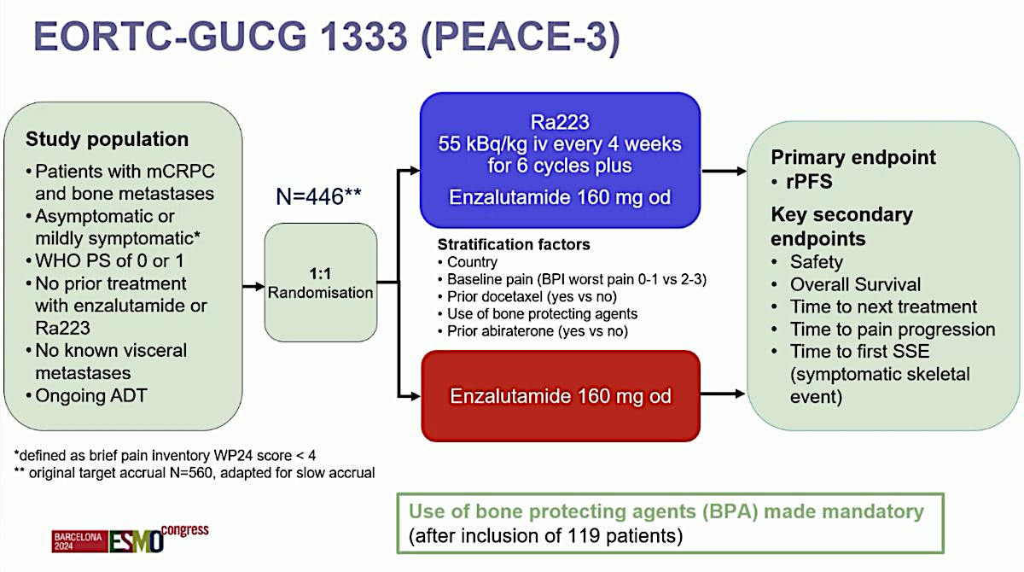
Radium-223 + Enzalutamide is a First-Line mCRPC Treatment Option for Some Patients
Radium-223 + enzalutamide improves PFS
  Unlike in ALSYMPCA, these were asymptomatic/minimally symptomatic patients
  Potential improvement in OS but longer follow up needed
Caveat: Majority of patients in this study had not received oral androgen pathway inhibitor
Gillessen S, et al. ESMO 2024
Current and Future Role of Radiopharmaceuticals in mCRPC

Slide 111
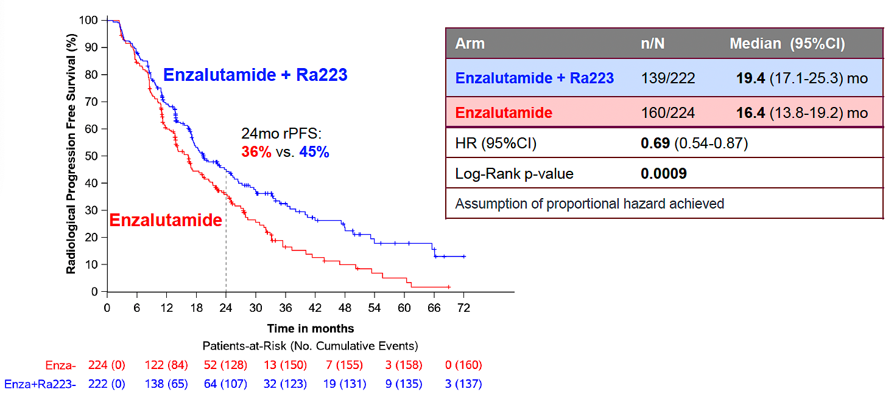
Radium-223 + Enzalutamide: rPFS Analysis
Gillessen S, et al. ESMO 2024
Current and Future Role of Radiopharmaceuticals in mCRPC

Slide 112
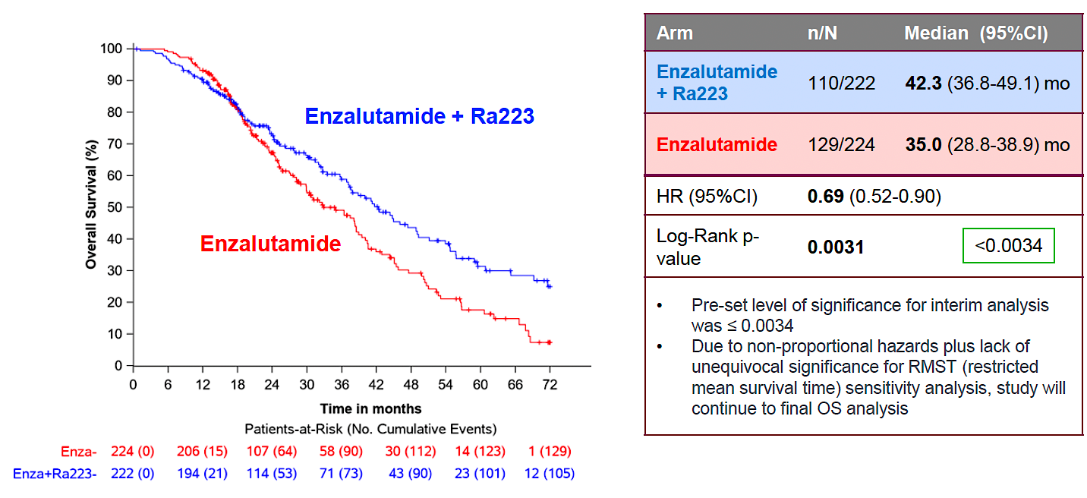
Radium-223 + Enzalutamide: Interim OS
Gillessen S, et al. ESMO 2024
Current and Future Role of Radiopharmaceuticals in mCRPC

Slide 113
Back to our patient…
Patient opted for radium-223 as next line of therapy
Received first three cycles of treatment given IV every 4 weeks
Improvement in bone pain and reduction in alkaline phosphatase
Serum PSA continued to rise but slower pace
Interim CT c/a/p after 3 cycles → no new soft tissue disease
Completed 3 additional cycles of radium-223 (total of 6 doses)
Toxicities: Mild flare in bone pain following dose #1, grade 1 anemia (Hgb from 12 to mid 10 range), intermittent mild fatigue and diarrhea
Following cycle #6, patient asked me what should I do now?
  Patient goals: Recently retired, wanted to travel and spend time with two grandchildren, wanted to avoid going back on chemotherapy if at all possible
Current and Future Role of Radiopharmaceuticals in mCRPC

Slide 114
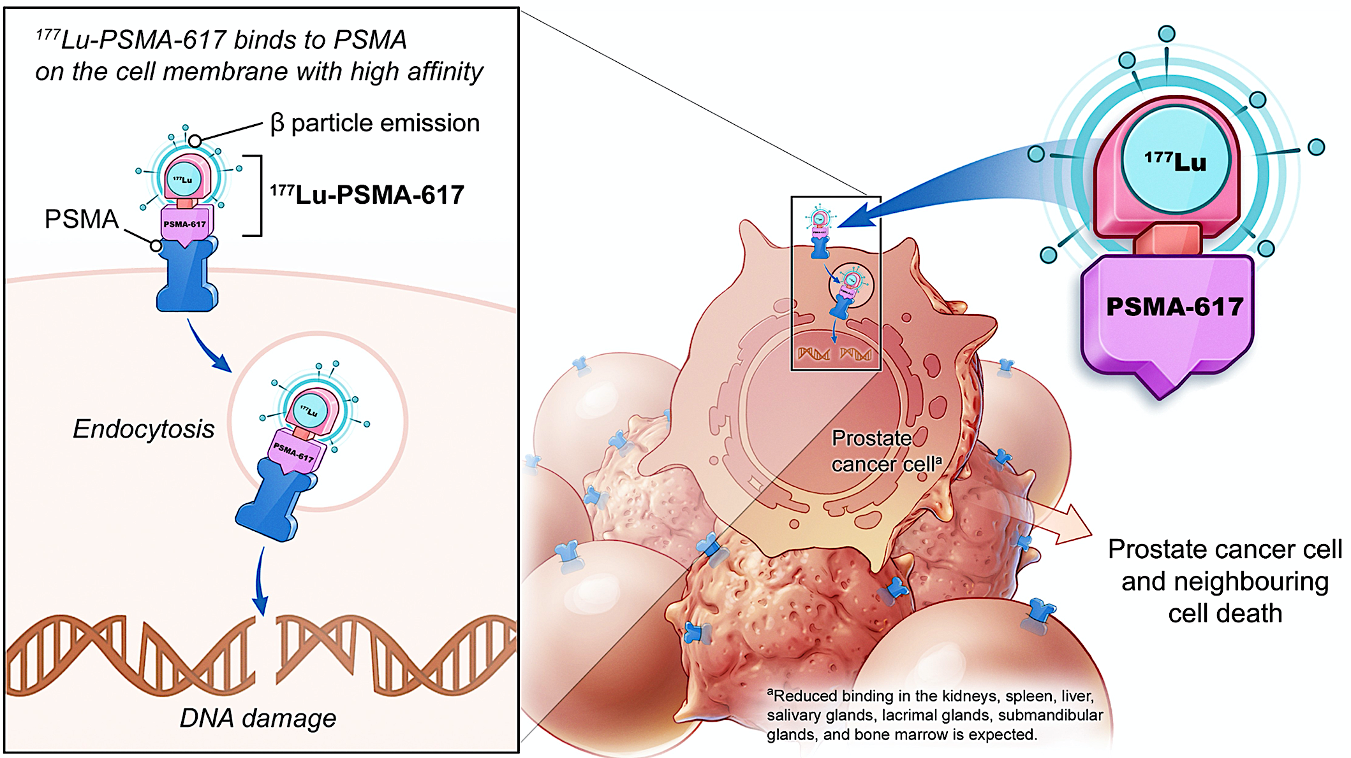
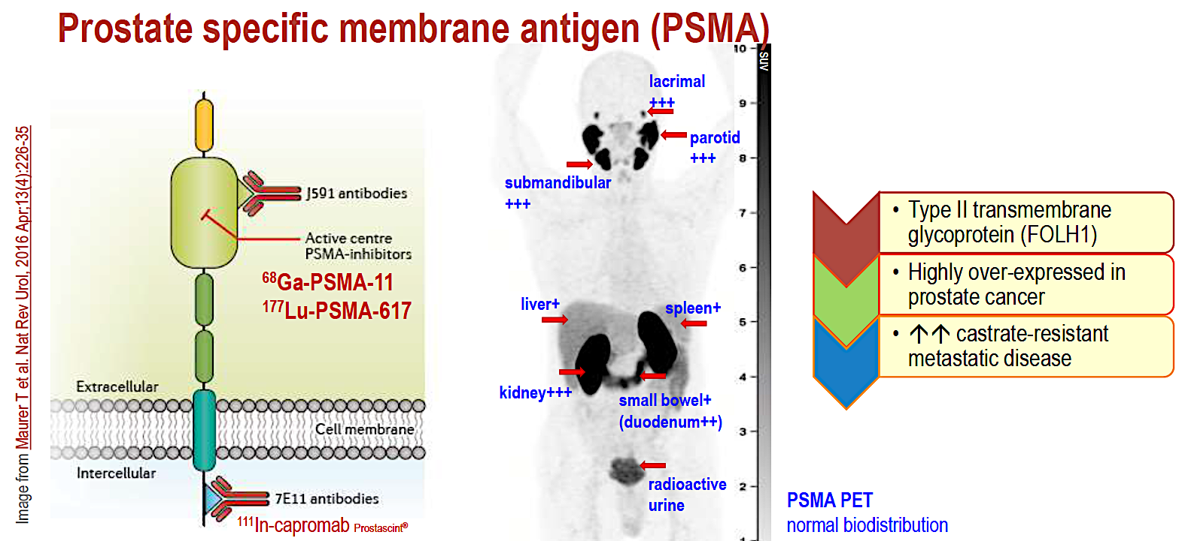
PSMA-Directed Radioligand Therapy
Selection criteria for Lu-PSMA treatment:
At least one PSMA positive lesion on PET imaging (uptake above background liver)
No soft tissue lesions that are PSMA PET negative
Approximately 85% of mCRPC patients will qualify
Recent Advances in the Treatment of Nonmetastatic Prostate Cancer

Slide 115
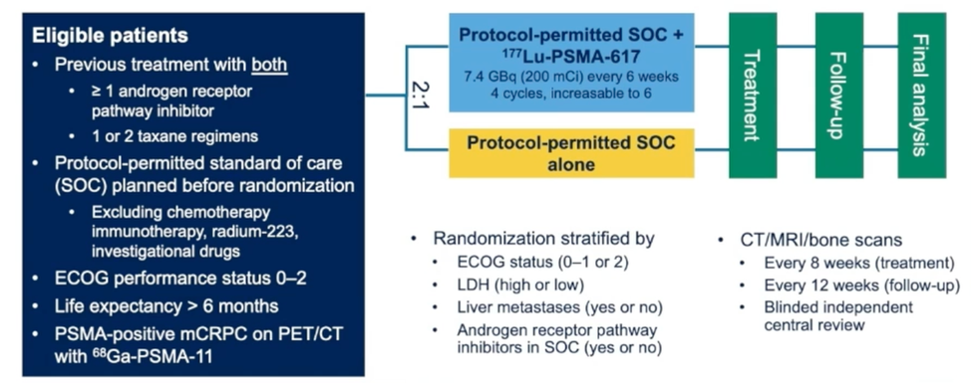
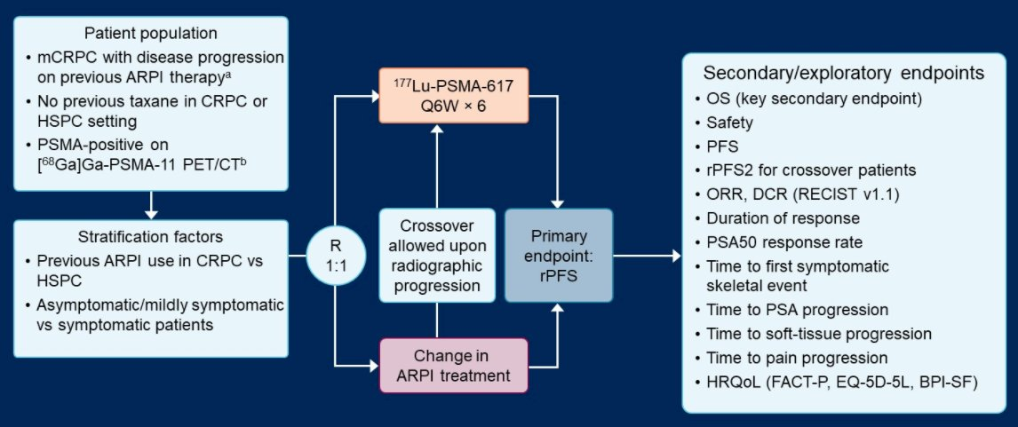
VISION and PSMAfore Establish ¹⁷⁷Lu-PSMA-617 as a Standard of Care in mCRPC
VISION: Post-taxane, post-ARPI
PSMAfore: Pre-taxane, post-ARPI
Both trials met primary endpoint of PFS
VISION demonstrated improvement in OS; PSMAfore – no difference in OS (follow up ongoing)
FDA approval post-taxane (March 23rd, 2022) and pre-taxane (March 28th, 2025)
Recent Advances in the Treatment of Nonmetastatic Prostate Cancer

Slide 116
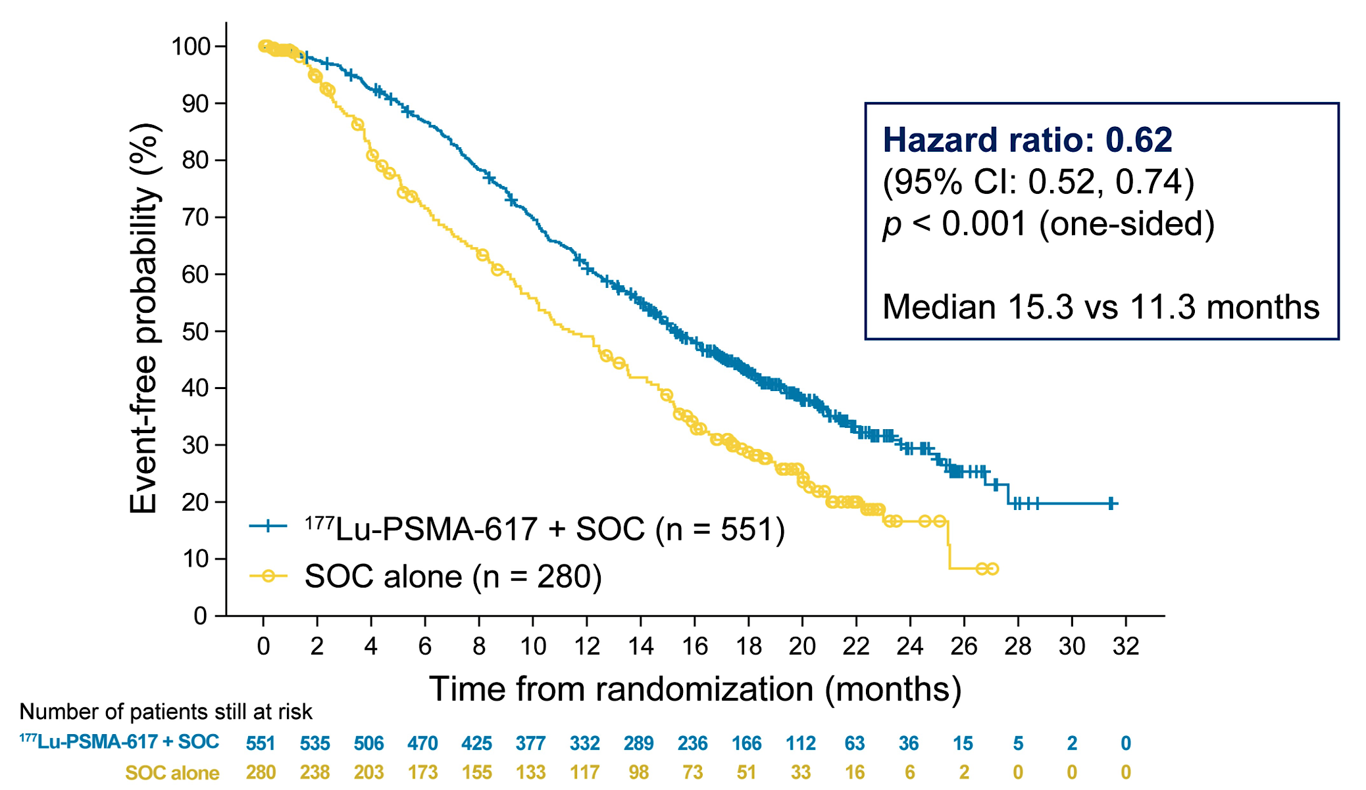
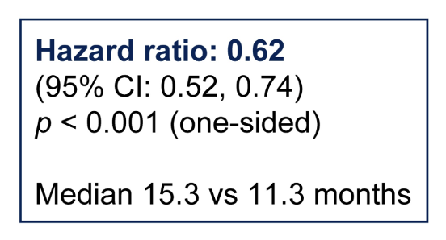

VISION and PSMAfore: OS Analyses
VISION: Post-taxane, post-ARPI
PSMAfore: Pre-taxane, post-ARPI
Recent Advances in the Treatment of Nonmetastatic Prostate Cancer
Morris et al. ASCO 2021;Abstract LBA4. Sartor et al. ESMO 2023;Abstract LBA13.

Slide 117
FDA Approves Lutetium Lu 177 Vipivotide Tetraxetan for Earlier Use
Before Chemotherapy for PSMA-Positive Metastatic CRPC
Press Release: March 28, 2025
“The US Food and Drug Administration (FDA) approved lutetium Lu 177 vipivotide tetraxetan for patients with prostate-specific membrane antigen (PSMA)-positive metastatic castration-resistant prostate cancer (mCRPC) who have been treated with an androgen receptor pathway inhibitor (ARPI) therapy and are considered appropriate to delay chemotherapy.
The expanded indication… is based on results of the Phase III PSMAfore trial. In the study, lutetium Lu 177 vipivotide tetraxetan reduced the risk of radiographic progression or death by 59% (HR = 0.41; 95% CI: 0.29, 0.56; p <0.0001) compared to a change in ARPI in patients with PSMA-positive mCRPC after treatment with ARPI therapy. At an updated exploratory analysis, lutetium Lu 177 vipivotide tetraxetan more than doubled median radiographic progression-free survival (11.6 months vs. 5.6 months).
In PSMAfore, the final overall survival (OS) analysis numerically favored lutetium Lu 177 vipivotide tetraxetan, with a hazard ratio of 0.91 (95% CI: 0.72, 1.14), but was not statistically significant. The OS analysis was confounded by the high rate of patients who crossed over from the control arm to lutetium Lu 177 vipivotide tetraxetan (60.3%). When adjusted for crossover, the OS hazard ratio was 0.59 (95% CI: 0.38, 0.91).”
https://www.novartis.com/news/media-releases/fda-approves-novartis-radioligand-therapy-pluvicto-earlier-use-chemotherapy-psma-positive-metastatic-castration-resistant-prostate-cancer

Slide 118
Our patient’s journey continued…
Patient opted for treatment break following completion of radium-223
Followed by PSA monthly and scans every 3 months
Was able to travel with minimal symptoms
Subsequent progression by PSA and scans
PSMA PET obtained demonstrating multifocal nodal and osseous metastases
Started 177Lu-PSMA-617 treatment with positive response by PSA and serial imaging
Toxicities:
  Chronic mild dry mouth, nausea for 3-4 days after each dose, low lymphocyte count, hemoglobin from 11 → mid 8 range
Recent Advances in the Treatment of Nonmetastatic Prostate Cancer

Slide 119


Serial SPECT Imaging
24 hours after dose #1 of Lu-PSMA-617
24 hours after dose #2 of Lu-PSMA-617
Recent Advances in the Treatment of Nonmetastatic Prostate Cancer

Slide 120
Back to our patient…
PSA dropped to a nadir of 6.1 ng/mL following dose #6 of Lu-PSMA-617
Remains on follow up
Persistent mild dry mouth, not impacting eating/drinking/swallowing
Persistent mild to moderate cytopenias
  Hgb 8-9 range
  Platelet count 60-75K
Renal function intact
Performance status good, bone pain minimal
Currently on surveillance
Future treatment options:
  Cabazitaxel, ? re-treatment with Lu-PSMA-617, clinical trial
Chi K, et al. ASCO GU 2022
Recent Advances in the Treatment of Nonmetastatic Prostate Cancer

Slide 121
Emerging Directions for Radiopharmaceutical Treatments in Advanced Prostate Cancer
Optimizing dosing schedule
  Adaptive dosing with treatment breaks in those with good response
  Dose escalation in those with high disease burden at baseline
Earlier disease settings
  Metastatic hormone sensitive
  Biochemical relapse
  Neoadjuvant prior to radical prostatectomy
New radio-isotopes
  Actinium-225, Lead-212, Terbium-161 → different energy, particle distance, decay patterns, half-lives
Combinations: AR pathway inhibitors, PARP inhibitors, immunotherapy, etc.
Recent Advances in the Treatment of Nonmetastatic Prostate Cancer

Slide 122
Roundtable Discussion

Slide 123
Kathleen Burns, Nurse Practitioner
GU Medical Oncology
City of Hope

Slide 124


Radio Ligand Therapy Theranostics
RADIOLIGAND
Lutetium Lu177 vipivotide tetraxetan
Radium-223

Slide 125

Radium-223
Indication: For the treatment of patients with castration-resistant prostate cancer, symptomatic bone metastases and no known visceral metastatic disease.
Side Effects (Alsympca trial)
    Bone marrow suppression
    Nausea/vomiting
    Diarrhea
    Peripheral edema
Patient Education
    No restrictions on personal contact
    Most of radioactivity is removed through the stool
    Until 1 week after dosing, radioactive body waste precautions
    Antiemetics and antidiarrheals available
    If adding enzalutamide (Peace-3), bone support

Slide 126

Radium case study
83 yr old male with mCRPC and diabetes mellitus with neuropathy.
Dx as mHSPC high risk and took abiraterone/pred for 2 yrs.
Radiographic progression, started sipuleucel-T.
After completion, his bone scan showed 3 bone mets with his only pain in the right shoulder – EBRT which initially helped his pain.
After developing more pain, his bone scan showed 1 more lesion.
He started Radium-233/enza per Peace-3. He’s completed 2 fractions with mild nausea not requiring medication.

Slide 127

Preparing patients for Lutetium-177
Given in Radiation Oncology or Nuclear Medicine
Family caregiver can play a big role – food/care while in isolation
Radiation safety card – can they fly/travel?
Specific instructions for radiation precautions
  Time- distance –shielding
  3 day rule
  Radioactive body fluids – urinary devices

Slide 128


Other considerations
~80% of men with PC express PSMA and qualify for treatment
If the PSMA targets are resolved, treatment may be held
Previously it was only indicated post chemo/ARPi
New indication March 2025
Post imaging – SPECT scans
Urinary devices
Family support – everyone needs to be educated – reporting symptoms

Slide 129

Managing Side Effects of Lu-177
Nausea (36% VISION -32% PSMAfore)
Kidney Injury (<10%)
Marrow Suppression (28-64V/30-67%F)
Dry Mouth (39V-61%F)
  Prevention
  Supportive Care
  Dental Care- fluoride trays
  We need more research
  This becomes more critical as the therapy moves earlier in treatment
Calais J, Morris MJ, Kendi AT, Kalebasty AR, Tutrone R, Anderson MJ, Sartor O. Best Patient Care Practices for Administering PSMA-Targeted Radiopharmaceutical Therapy.
J Nucl Med. 2024 Nov 1;65(11):1666-1671. doi: 10.2967/jnumed.124.268363. PMID: 39362764; PMCID: PMC11533911.

Slide 130

2 different Lutetium patients
64 yr old male with mHSPC started on triplet therapy
Progressed and went onto sipT, talazoparib/enza, XRT X2
Lutetium Lu 177 vipivotide tetraxetan 1/25 2 doses – psa from 20-87, pain increasing
SPECT imaging – tells us how the drug is disseminating
RLT conference and family mtg –pt wants to try one more then consider cabazitaxel or phase 1 clinical trial.
The role of nursing is critical: educate, goc, supportive med

Slide 131

2 very different Lutetium patients…
61 yr old s/p triplet therapy
Persistent PSMA+ bone mets
Received 4 cycles with response to PSA and PET scan
No dose limiting side effects
He started to take vacations in between- felt great
Transitioned to a clinical trial giving more than 6 cycles and has received 8 thus far
Notes:
Mammoth man

Slide 132

Collaboration for RLT management
Multidisciplinary conferences can be really helpful
  If you are familiar – reach out and teach
  If you have questions – ask
  Teaching others about what you contribute as nurses
    Supportive care
    Care coordination
    Patient education
    Symptom triage

