Slide 1
Year in Review: Management of Colorectal Cancer A CME/MOC-Accredited Live Webinar
Wednesday, February 19, 2025 5:00 PM – 6:00 PM ET
Faculty
Scott Kopetz, MD, PhD
Jeffrey Meyerhardt, MD, MPH
Moderator
Neil Love, MD

Slide 2
Faculty
Scott Kopetz, MD, PhD
Professor
Deputy Chair for Translational Research
Department of Gastrointestinal Medical Oncology
Associate Vice President
for Translational Integration
The University of Texas
MD Anderson Cancer Center
Houston, Texas
MODERATOR
Neil Love, MD Research To Practice
Miami, Florida
Jeffrey Meyerhardt, MD, MPH
Douglas Gray Woodruff Chair in Colorectal Cancer Research
Chief Clinical Research Officer
Dana-Farber Cancer Institute
Boston, Massachusetts

Slide 3
Commercial Support
This activity is supported by educational grants from GSK and Natera Inc.
Research To Practice CME Planning Committee Members, Staff and Reviewers
Planners, scientific staff and independent reviewers for Research To Practice have no relevant conflicts of interest to disclose.

Slide 4
Dr Kopetz — Disclosures
Consulting Agreements | Agenus Inc, Amgen Inc, AmMax Bio, Arcus Biosciences, AstraZeneca Pharmaceuticals LP, Aveo Pharmaceuticals, Bayer HealthCare Pharmaceuticals, BeiGene Ltd, Boehringer Ingelheim Pharmaceuticals Inc, Bristol Myers Squibb, Carina Biotech, Clasp Therapeutics, Cytovation ASA, Dewpoint Therapeutics, Frontier Medicines, Genentech, a member of the Roche Group, Harbinger Health, Ikena Oncology, Kestrel Therapeutics, Leap Therapeutics Inc, Marengo Therapeutics, Merck, Mirati Therapeutics Inc, Pfizer Inc, Replimune, Revolution Medicines, Roche Laboratories Inc, SageMedic Corporation, Servier Pharmaceuticals LLC, Sibylla Biotech, T-Cypher Bio, Tachyon Therapeutics, Tempus, Xaira Therapeutics, Zentalis Pharmaceuticals
Contracted Research | Amgen Inc, BioMed Valley Discoveries, Boehringer Ingelheim Pharmaceuticals Inc, BridgeBio, Bristol Myers Squibb, Cardiff Oncology, Daiichi Sankyo Inc, EMD Serono Inc, Frontier Medicines, Genentech, a member of the Roche Group, Guardant Health, Jazz Pharmaceuticals Inc, Johnson & Johnson Pharmaceuticals, Lilly, Pfizer Inc, Zentalis Pharmaceuticals

Slide 5
Dr Meyerhardt — Disclosures
No relevant conflicts of interest to disclose

Slide 6
This educational activity contains discussion of non-FDA-approved uses of agents and regimens. Please refer to official prescribing information for each product for approved indications.

Slide 8
Key Datasets
Jeffrey Meyerhardt, MD, MPH
Shah PK et al. Circulating tumor DNA for detection of molecular residual disease (MRD) in patients (pts) with stage II/III colorectal cancer (CRC): Final analysis of the BESPOKE CRC sub-cohort. Gastrointestinal Cancers Symposium 2025;Abstract 15.
Nakamura Y et al. ctDNA-based molecular residual disease and survival in resectable colorectal cancer. Nat Med 2024;30(11):3272-83.
Kataoka K et al. Survival benefit of adjuvant chemotherapy based on molecular residual disease detection in resected colorectal liver metastases: Subgroup analysis from CIRCULATE-Japan GALAXY. Ann Oncol 2024;35(11):1015-25.
Nowak JA et al. Prognostic and predictive role of circulating tumor DNA (ctDNA) in stage III colon cancer treated with celecoxib: Findings from CALGB (Alliance)/SWOG 80702. Gastrointestinal Cancers Symposium 2025;Abstract LBA14.
Tie J et al. Circulating tumor DNA analysis guiding adjuvant therapy in stage II colon cancer: Overall survival and updated 5-year results from the randomized DYNAMIC trial. ASCO 2024;Abstract 108.

Slide 9
Key Datasets
Jeffrey Meyerhardt, MD, MPH (Continued)
Lieu CH et al. NRG-GI008: Colon adjuvant chemotherapy based on evaluation of residual disease (CIRCULATE-NORTH AMERICA). ASCO 2024;Abstract TPS243.
Cercek A et al. Durable complete responses to PD-1 blockade alone in mismatch repair deficient locally advanced rectal cancer. ASCO 2024;Abstract LBA3512.
Chalabi M et al. Neoadjuvant immunotherapy in locally advanced mismatch repair-deficient colon cancer. N Engl J Med 2024;390(21):1949-58.
Chalabi M et al. Neoadjuvant immunotherapy in locally advanced MMR-deficient colon cancer: 3-year disease-free survival from NICHE-2. ESMO 2024;Abstract LBA24.
de Gooyer PG et al. Neoadjuvant nivolumab and relatlimab in locally advanced MMR-deficient colon cancer: A phase 2 trial. Nat Med 2024;30(11):3284-90.
Martling A et al. Low-dose aspirin reduces recurrence rate in colorectal cancer patients with PI3K pathway alterations: 3-year results from the ALASCCA trial. Gastrointestinal Cancers Symposium 2025;Abstract LBA125.

Slide 10
Key Datasets
Scott Kopetz, MD, PhD
Adam R et al. Liver transplantation plus chemotherapy versus chemotherapy alone in patients with permanently unresectable colorectal liver metastases (TransMet): Results from a multicentre, open-label, prospective, randomised controlled trial. Lancet 2024;404(10458):1107-18.
Lenz HJ et al. Nivolumab (NIVO) plus ipilimumab (IPI) vs chemotherapy (chemo) as first-line (1L) treatment for microsatellite instability-high/mismatch repair-deficient (MSI-H/dMMR) metastatic colorectal cancer (mCRC): Expanded efficacy analysis from CheckMate 8HW. ASCO 2024;Abstract 3503.
Andre T et al. Nivolumab plus ipilimumab versus nivolumab in microsatellite instability-high metastatic colorectal cancer (CheckMate 8HW): A randomised, open-label, phase 3 trial. Lancet 2025;405(10476):383-95.
Kopetz S et al. Molecular profiling of BRAF-V600E-mutant metastatic colorectal cancer in the phase 3 BEACON CRC trial. Nat Med 2024;30(11):3261-71.
Kopetz S et al. Encorafenib, cetuximab and chemotherapy in BRAF-mutant colorectal cancer: A randomized phase 3 trial. Nat Med 2025;[Online ahead of print].

Slide 11
Key Datasets
Scott Kopetz, MD, PhD (Continued)
Strickler JH et al. Final results of a phase 2 study of tucatinib and trastuzumab for HER2-positive mCRC (MOUNTAINEER). ASCO 2024;Abstract 3509.
Siena S et al. HER2-related biomarkers predict clinical outcomes with trastuzumab deruxtecan treatment in patients with HER2-expressing metastatic colorectal cancer: Biomarker analyses of DESTINY-CRC01. Nat Commun 2024;15(1):10213.
Raghav K et al. Trastuzumab deruxtecan in patients with HER2-positive advanced colorectal cancer (DESTINY-CRC02): Primary results from a multicentre, randomised, phase 2 trial. Lancet Oncol 2024;25(9):1147-62.
Fakih M et al. Overall survival (OS) of phase 3 CodeBreaK 300 study of sotorasib plus panitumumab (soto+pani) versus investigator’s choice of therapy for KRAS G12C-mutated metastatic colorectal cancer (mCRC). ASCO 2024;Abstract LBA3510.
Yaeger R et al. Adagrasib (ada) + cetuximab (cetux) for KRASG12C-mutated metastatic colorectal cancer (mCRC): Longer follow-up analysis from KRYSTAL-1. Gastrointestinal Cancers Symposium 2025;Abstract 131.

Slide 12
AGENDA Year in Review: Management of Colorectal Cancer (CRC)
MODULE 1: First-Line Treatment of BRAF V600E-Mutant Metastatic CRC (mCRC)
MODULE 2: Cell-Free DNA Molecular Residual Disease (MRD) Assays in Clinical Practice
MODULE 3: Immunotherapy for Localized and Metastatic MSI-High CRC
MODULE 4: Other Important Datasets
Hepatic transplant for liver-limited mCRC
HER2-positive CRC: Tucatinib, trastuzumab deruxtecan
KRAS G12C-mutant CRC: Adagrasib, sotorasib, EGFR inhibitors

Slide 13
AGENDA Year in Review: Management of Colorectal Cancer (CRC)
MODULE 1: First-Line Treatment of BRAF V600E-Mutant Metastatic CRC (mCRC)
MODULE 2: Cell-Free DNA Molecular Residual Disease (MRD) Assays in Clinical Practice
MODULE 3: Immunotherapy for Localized and Metastatic MSI-High CRC
MODULE 4: Other Important Datasets
Hepatic transplant for liver-limited mCRC
HER2-positive CRC: Tucatinib, trastuzumab deruxtecan
KRAS G12C-mutant CRC: Adagrasib, sotorasib, EGFR inhibitors

Slide 14
Discussion Question: First-Line Treatment of BRAF V600E-Mutant mCRC
Regulatory and reimbursement issues aside, what would be your most likely first-line treatment recommendation for a clinically stable 60-year-old patient with left-sided, pan-RAS wild-type, microsatellite stable (MSS), HER2-negative mCRC with a BRAF V600E mutation?

Slide 15
BREAKWATER: Study Design
BREAKWATER (NCT04607421) is an open-label, multicenter, phase 3 study in first line BRAF V600E-mutant mCRC
Inclusion criteria
Age ≥16 years (or ≥18 years based on country) No prior systemic treatment for metastatic disease Measurable disease (RECIST 1.1) BRAF V600E-mutant mCRC by local or central laboratory testing ECOG PS 0 or 1 Adequate bone marrow, hepatic, and renal function
EC (n=158)
Dual primary endpoints: PFS and ORR^{d} by BICR (EC + mFOLFOX6 vs SOC)
Key secondary endpoint: OS (EC + mFOLFOX6 vs SOC)
R
1:1:1^{a,b}
N=637
EC + mFOLFOX6 (n=236)
Exclusion criteria
Prior BRAF or EGFR inhibitors Symptomatic brain metastases MSI-H/dMMR tumors (unless patients were ineligible to receive immune checkpoint inhibitors due to a pre-existing medical condition) Presence of a RAS mutation
SOC (n=243)^{c}
Stratified by regions (US/Canada vs Europe vs Rest of World) and ECOG PS (0 vs 1)
Here we present the primary analysis of ORR by BICR (one of the dual primary endpoints), an interim analysis of OS, and safety in the EC + mFOLFOX6 and SOC arms
ªFollowing a protocol amendment, enrollment to the EC arm was stopped and patients were randomized 1:1 to the EC+mFOLFOX6 or SOC arms; data in the EC arm will be reported at a later date. ^{b}Patients were enrolled between November 16, 2021, and December 22, 2023. ^{c}mFOLFOX6/FOLFOXIRI/CAPOX ± bevacizumab. ^{d}In the first 110 patients in each of the EC+mFOLFOX6 and SOC arms.
CAPOX, capecitabine/oxaliplatin; BICR, blinded independent central review; dMMR, deficient mismatch repair; EC, encorafenib plus cetuximab; ECOG PS, Eastern Cooperative Oncology Group performance status; EGFR, epidermal growth factor receptor; mFOLFOX6, modified fluorouracil/leucovorin/oxaliplatin; FOLFOXIRI, fluorouracil/leucovorin/oxaliplatin/irinotecan; mCRC, metastatic colorectal cancer; MSI-H, microsatellite instability-high cancer; RECIST, Response Evaluation Criteria in Solid Tumors.

Slide 16
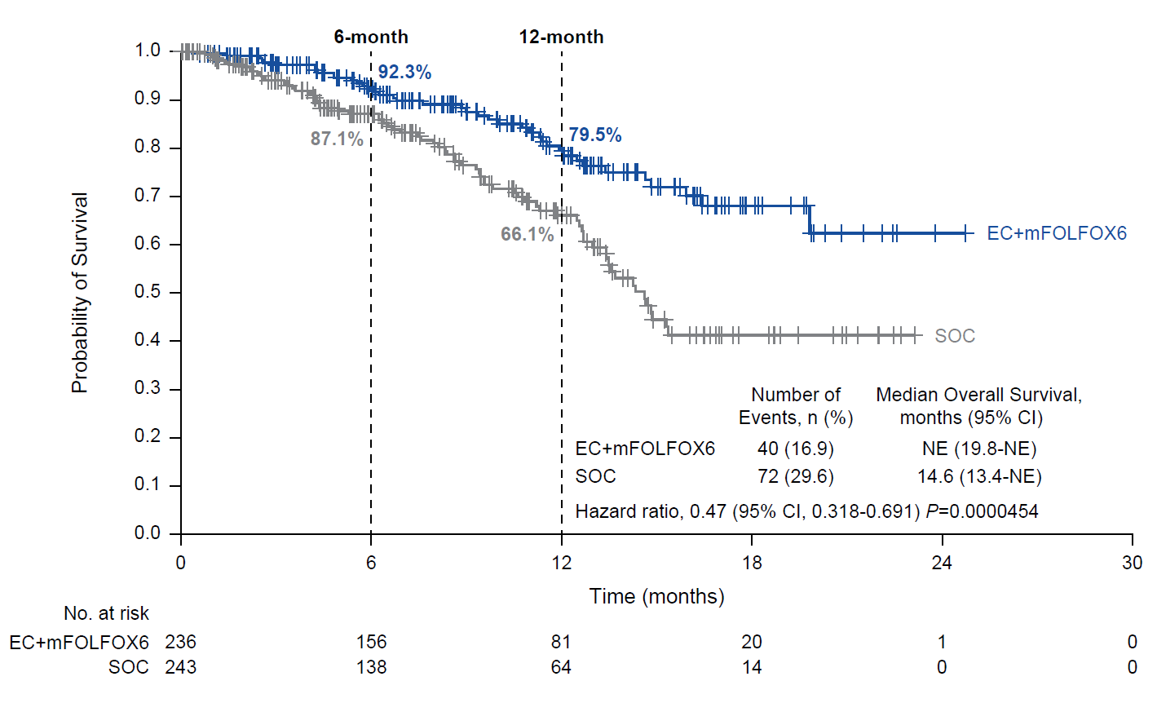
Interim Overall Survivalª
Data cutoff: December 22, 2023. ªOS was tested following the prespecified plan with one-sided alpha of 0.000000083, calculated as a portion of the nominal one-sided alpha of 0.001. Statistical significance was not achieved at this time.
EC, encorafenib plus cetuximab; mFOLFOX6, modified fluorouracil/leucovorin/oxaliplatin; NE, not estimable; SOC, standard of care.
Kopetz et al Nat Med ‘25
Notes:
Added P=0.0000454 after HR

Slide 17
Positive Topline Results Announced from Pivotal Phase III BREAKWATER Study Press Release: February 3, 2025
“Positive topline results [were announced] from the progression-free survival (PFS) analysis of the Phase 3 BREAKWATER study of encorafenib in combination with cetuximab and mFOLFOX6 (fluorouracil, leucovorin and oxaliplatin) in patients with metastatic colorectal cancer (mCRC) harboring a BRAF V600E mutation. The trial showed a statistically significant and clinically meaningful improvement in PFS, one of its dual primary endpoints, as assessed by blinded independent central review (BICR) compared to patients receiving chemotherapy with or without bevacizumab. Further, the encorafenib combination regimen demonstrated a statistically significant and clinically meaningful improvement in overall survival (OS), a key secondary endpoint in the trial.
‘We are extremely pleased with the clinically meaningful progression-free survival and overall survival results from the BREAKWATER study, which have the potential to be practice-changing for this patient population that has historically had limited treatment options and poor outcomes,’ said [the company’s chief oncology officer]. ‘The encorafenib regimen is emerging as a new standard of care as the first targeted therapy approved for use as early as first-line for patients with mCRC with a BRAF V600E mutation. We look forward to discussing these data with global health authorities to bring this treatment to more patients around the world, as soon as possible.’”
https://www.pfizer.com/news/press-release/press-release-detail/pfizers-braftovir-combination-regimen-significantly

Slide 18
EC+FOLFOX is the new standard of care for first-line BRAF^{V600E} CRC
Results appear synergistic and may follow improved understanding of tumor plasticity

Slide 19
AGENDA Year in Review: Management of Colorectal Cancer (CRC)
MODULE 1: First-Line Treatment of BRAF V600E-Mutant Metastatic CRC (mCRC)
MODULE 2: Cell-Free DNA Molecular Residual Disease (MRD) Assays in Clinical Practice
MODULE 3: Immunotherapy for Localized and Metastatic MSI-High CRC
MODULE 4: Other Important Datasets
Hepatic transplant for liver-limited mCRC
HER2-positive CRC: Tucatinib, trastuzumab deruxtecan
KRAS G12C-mutant CRC: Adagrasib, sotorasib, EGFR inhibitors

Slide 20
Discussion Questions: Cell-Free DNA MRD Assays in Clinical Practice
How would you capsulize the current available data with cell-free DNA in the adjuvant setting? If cell-free DNA is evaluated, when should the assay be ordered? What is your global conclusion on the clinical relevance? (Other issues: CALGB/SWOG-80702 trial – celecoxib and ctDNA)

Slide 21
2025
Abstract LBA14

Slide 22
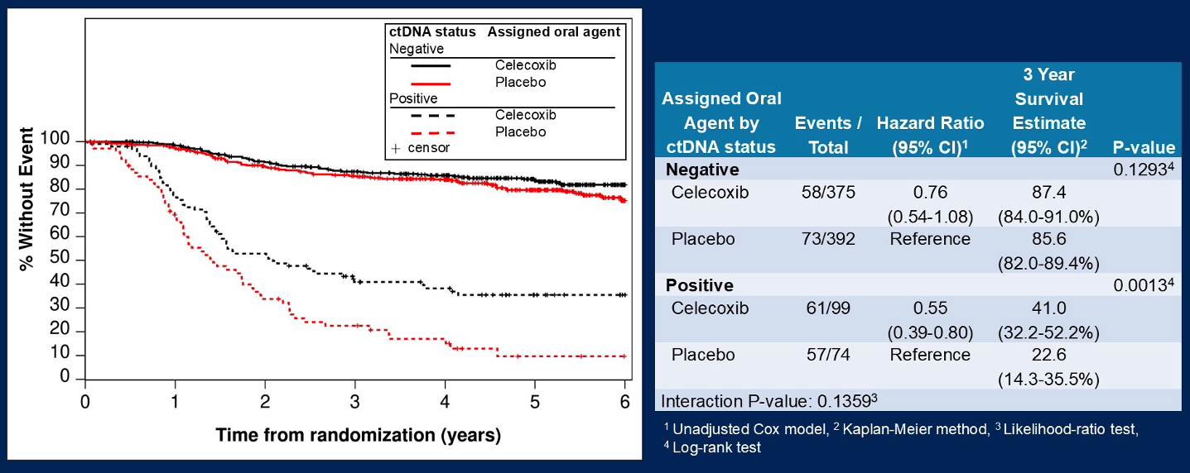
CALGB/SWOG-80702 Trial: Disease-Free Survival by ctDNA Status and Celecoxib Use
Nowak JA et al. Gastrointesinal Cancers Symposium 2025;Abstract LBA14.

Slide 23
CALGB/SWOG-80702: Overall Survival by ctDNA Status and Celecoxib Use
Nowak JA et al. Gastrointesinal Cancers Symposium 2025;Abstract LBA14.

Slide 24
CALGB/SWOG-80702: Celecoxib and ctDNA
ctDNA is highly prognostic
Celecoxib seemed to benefit patients with ctDNA-positive status, but the interaction p-value was not significant
Benefit was observed for patients with PIK3CA wild-type and mutated tumors
Data are suggestive but not definitive for using celecoxib when ctDNA-positive

Slide 25
Discussion Questions: Cell-Free DNA MRD Assays in Clinical Practice
Should all patients with localized CRC undergo cell-free DNA testing?
How, if at all, do you currently use this strategy in the adjuvant setting outside of a clinical trial protocol? Treatment escalation and/or de-escalation? If you opt to not order a cell-free DNA assay but another clinician does, do you consider the results when deciding on treatment?

Slide 26
Stage II/III BESPOKE CRC Study
ctDNA positivity is highly predictive of outcome – both immediately after surgery (MRD) and during surveillance
ctDNA MRD influences 16.3% of decisions on adjuvant therapy – 60% de-escalated and 36% escalated
ctDNA clearance is associated with improved outcomes (HR 0.43)
ctDNA MRD (+) had superior DFS (HR 0.48) with adjuvant therapy compared to observation; ctDNA MRD (-) did not have significant benefit (HR 0.93) for adjuvant therapy compared to observation
This is an observational study – not randomized and decision for therapy not controlled and likely confounded

Slide 27
DYNAMIC Trial: Stage II Colon Cancer
Noninferiority of standard (non-ctDNA approach) to ctDNA-guided management can be interpreted either as checking MRD does not change outcome or as checking MRD reduces the use of chemotherapy among patients with Stage II disease
Fewer patients on ctDNA-guided management received chemotherapy (15% vs 28%), but more received oxaliplatin (9.5% vs 2.7%)
Median time from surgery to start of therapy increased by 30 days with ctDNA-guided management (53 vs 83 days)

Slide 28
Discussion Questions: Cell-Free DNA MRD Assays in Clinical Practice
Beyond localized disease, in what clinical settings do you currently order a cell-free DNA assay? Surgically resectable liver metastases? Other sites of metastatic disease? Determining duration of immunotherapy for MSI-high CRC?
Which ongoing trials will be most helpful in further delineating the clinical application of cell-free DNA assays (eg, NRG-GI008/CIRCULATE-North America)?

Slide 29
Gastrointestinal Cancers Symposium 2024;Abstract TPS243.

Slide 30
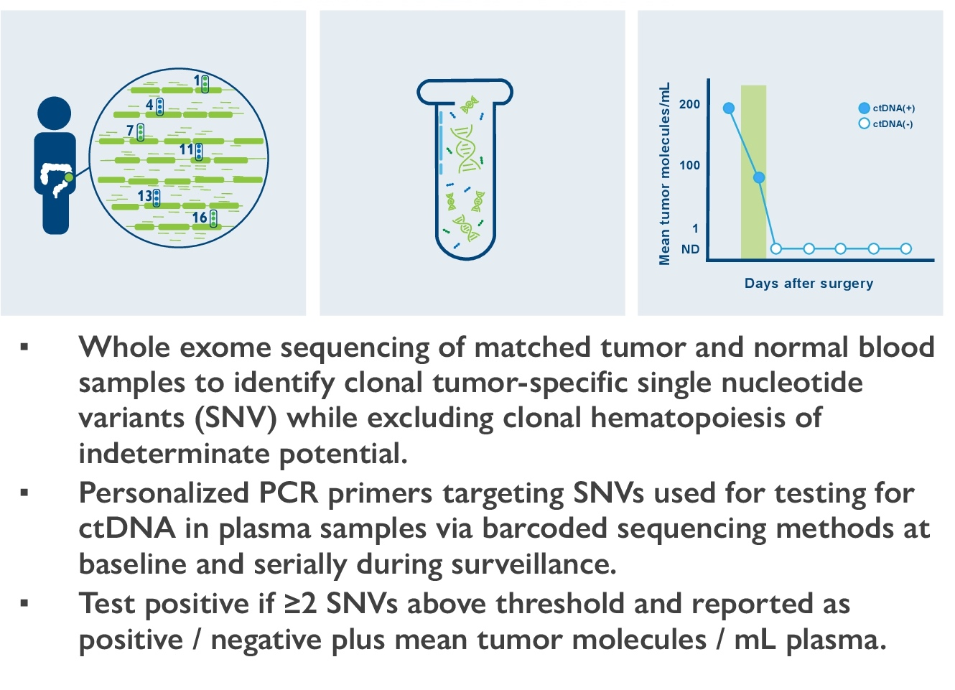
Phase II/III NRG-GI008 Study Design and ctDNA Testing
Primary endpoints (cohort A, ctDNA-):
Time to ctDNA-positive status (Phase II)
Disease-free survival (Phase III)
Primary endpoint (cohort B, ctDNA+):
Disease-free survival (Phase II/III)
Lieu CH et al. Gastrointestinal Cancers Symposium 2024;Abstract TPS243.

Slide 31
Phase II/III NRG-GI008 — CIRCULATE-North America
As of February 2025, ∼1/3 accrued
Stage IIB, IIC and III, microsatellite stable, colon only
Several questions are addressed in this trial:
To compare disease-free survival (DFS) in the ctDNA(-) cohort after resection of colon cancer treated with immediate versus delayed chemotherapy (based on serial ctDNA surveillance)
To compare DFS in the ctDNA(+) cohort after resection of colon cancer treated with FOLFOX versus FOLFIRINOX

Slide 32
CIRCULATE-Japan GALAXY CRC Study
In this expanded cohort of 2,240 patients with Stage I to IV colorectal cancer, a majority of the cohort did not receive chemotherapy
ctDNA MRD highly prognostic of outcome
Clearance also prognostic – 181 ctDNA(+) received adjuvant therapy – 38% sustained clearance, 31% transient clearance, 31% no clearance
Observational study – decision on who received chemotherapy and who did not likely confounded by other factors

Slide 33
CIRCULATE-Japan GALAXY Resected Liver Met Subset
190 patients with surgically resected colorectal liver metastases without any preoperative chemotherapy were included
32% MRD-positive; only 25% received adjuvant chemotherapy
MRD-negative not statistically different between chemotherapy and observation but absolute 10% difference at 2 years
Observational and small numbers

Slide 34
Discussion Question: Cell-Free DNA MRD Assays in Clinical Practice
What is the future clinical relevance of the INTERCEPT basket trial evaluating cell-free DNA-positive CRC (personalized mRNA vaccines, immunotherapy, BRAF V600E mutation-positive disease, etc)?

Slide 35
INTERCEPT Study: Positive ctDNA-based Minimal Residual Disease Assays During Surveillance Are Associated with High Rates of Undiagnosed Concomitant Radiographic Recurrences in Colorectal Cancer (CRC)
Stage II CRC
Surgery + / - Neoadjuvant Therapy
Adjuvant Therapy
Surveillance
ctDNA Positive
Radiographic Recurrence
Stage III CRC
No Radiographic Recurrence (MRD)
Resectable Stage IV CRC
All therapies and surveillance per routine care
Tissue informed (Signatera) ctDNA assay post-op & with each surveillance visit
MRD Clinical Trials
1,115 patients stages II-IV
Signatera, Natera, Inc (tumor informed) assay used
Dasari et al, ASCO 2023

Slide 36
Clinical Utility: Radiographic Findings of Patients ctDNA+ During Surveillance, n = 184
ctDNA positive before adjuvant therapy
39%; n=119
Adjuvant therapy
Future report
Radiologic evidence of metastatic disease
49% n=90
ctDNA positive during surveillance
61%; n=184
Radiologic evaluation
No radiologic evidence of disease (MRD)
51% n=94
Dasari et al, ASCO 2023
Radiographic Recurrence
Without Radiographic Recurrence
i.e. true MRD
n = 184
*including on adjuvant therapy

Slide 37
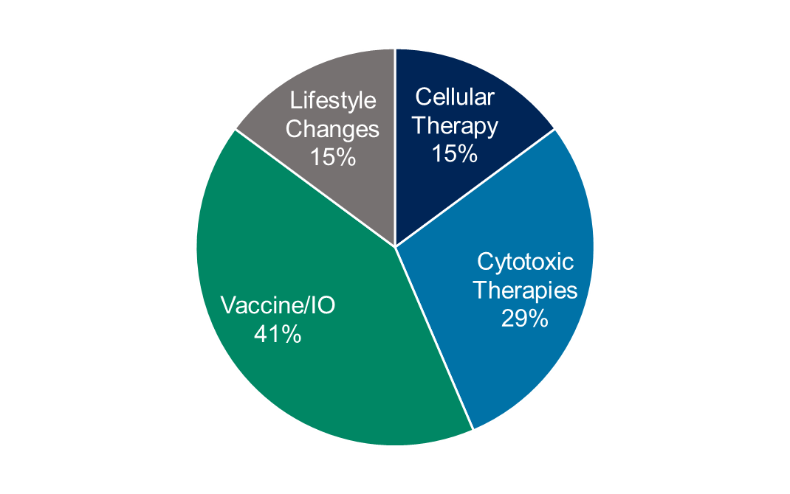
Clinical Utility: Enrollment onto MRD Trials
Future report on recurrence patterns & outcomes
Radiologic evidence of metastatic disease
49% n=90
ctDNA positive during surveillance
61%; n=184
No radiologic evidence of disease (MRD)
51% n=94
Enrolled into clinical trials of MRD
59% N=55
Dasari et al, ASCO 2023
Radiographic Recurrence
Without Radiographic Recurrence
i.e. true MRD
n = 184
*including on adjuvant therapy

Slide 38
AGENDA Year in Review: Management of Colorectal Cancer (CRC)
MODULE 1: First-Line Treatment of BRAF V600E-Mutant Metastatic CRC (mCRC)
MODULE 2: Cell-Free DNA Molecular Residual Disease (MRD) Assays in Clinical Practice
MODULE 3: Immunotherapy for Localized and Metastatic MSI-High CRC
MODULE 4: Other Important Datasets
Hepatic transplant for liver-limited mCRC
HER2-positive CRC: Tucatinib, trastuzumab deruxtecan
KRAS G12C-mutant CRC: Adagrasib, sotorasib, EGFR inhibitors

Slide 39
Discussion Questions: Immunotherapy for Localized and Metastatic MSI-High CRC
What are the pitfalls, if any, in MSI testing? How frequently do false-positive results occur and what is the cause of these results?
In what clinical situations should immunotherapy be administered as initial treatment for patients with localized MSI-high CRC? Which immunotherapy should be used and for how long in this setting? When should patients undergo surgery and/or other local therapy relative to receiving immunotherapy?

Slide 40
Discussion Question: Immunotherapy for Localized and Metastatic MSI-High CRC
Based on the data from the NICHE-1 and NICHE-2 studies in addition to the results with dostarlimab as neoadjuvant treatment for rectal cancer, should MSI testing be conducted for all patients with localized CRC prior to initiating treatment?

Slide 41
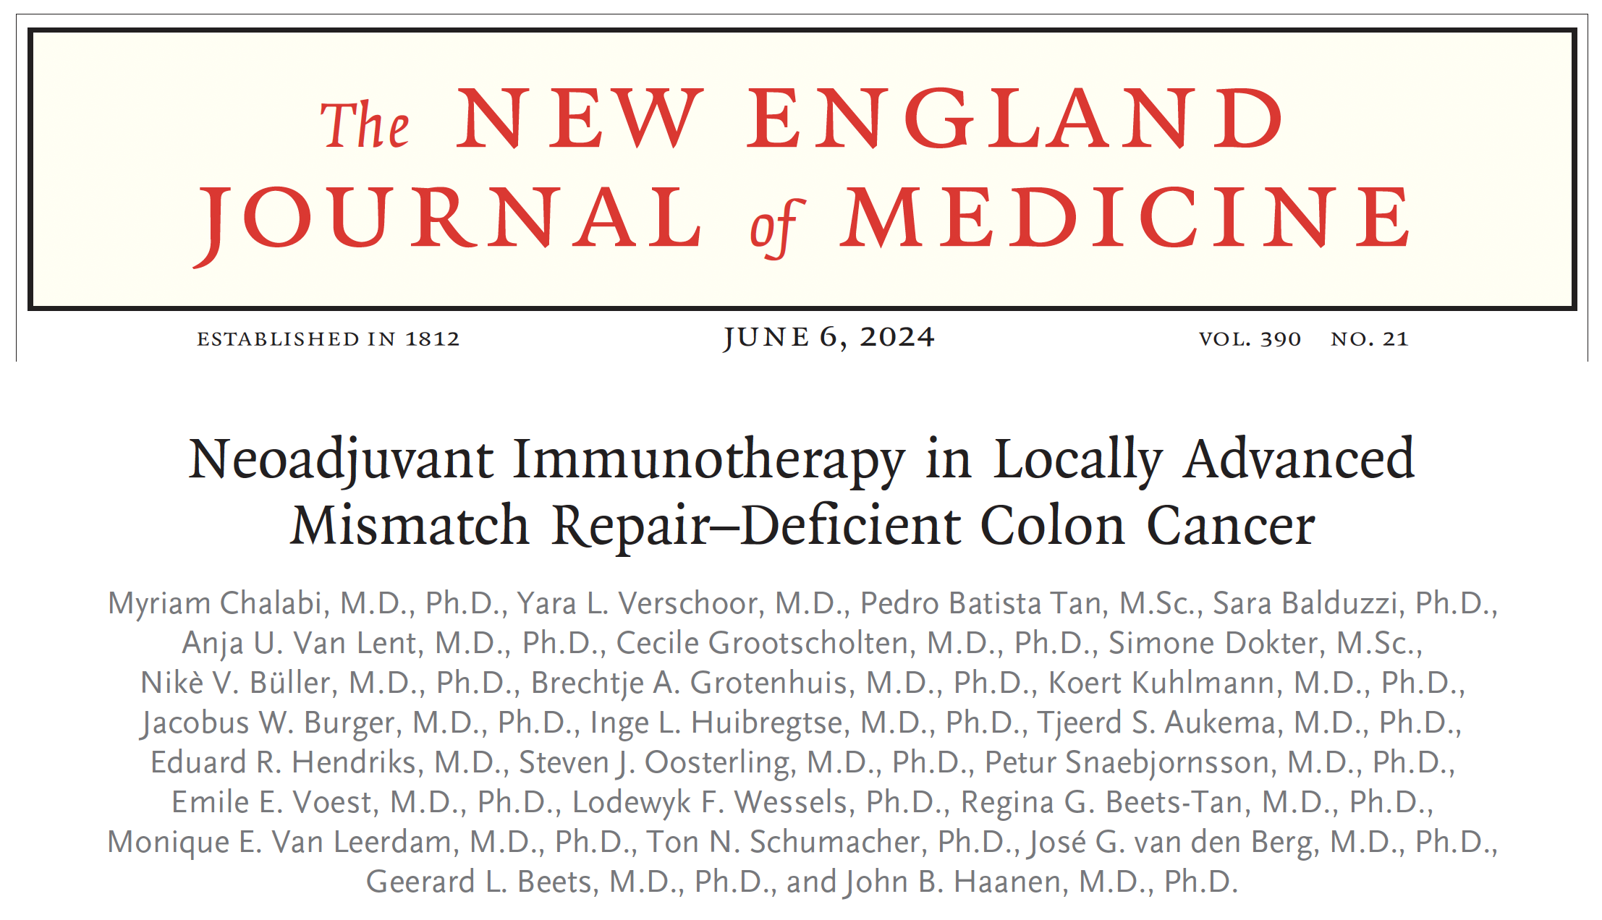
Abstract LBA24

Slide 42
NICHE-2 Trial: Pathologic Response
Chalabi M et al. N Engl J Med 2024 June 6;390(21):1949-58; ESMO 2024;Abstract LBA24.

Slide 43
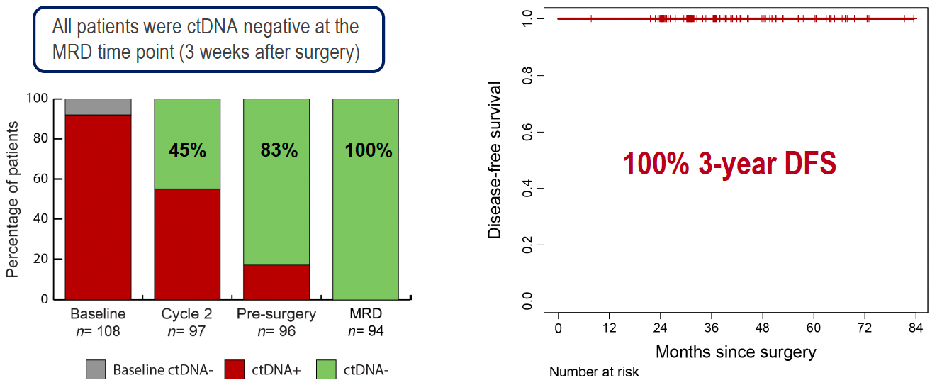
NICHE-2: Minimal Residual Disease (MRD)
Chalabi M et al. ESMO 2024;Abstract LBA24.

Slide 44
NICHE-2: Author Conclusions and Future Perspectives
dMMR = mismatch repair deficient; pCR = pathologic complete response
Chalabi M et al. ESMO 2024;Abstract LBA24.

Slide 45
NICHE-1 and NICHE-2 Studies in Colon Cancer
Patients received 2 doses of nivolumab and 1 dose of ipilimumab
Only 2.7% received chemotherapy after surgery (3/14 with positive nodes – 1 had 60% residual tumor in specimen)
Very few patients had delay of surgery beyond 6 weeks from study enrollment
Radiographic response only seen in 2 of 75 with pCR
Identifying the patients (both stages – NICHE-2 was limited to clinical Stage II and III) and MMR status is the challenge to implementation
Difference in response and duration of response for localized disease compared to metastatic disease (71% PFS at 2 years with combination in mCRC)

Slide 46
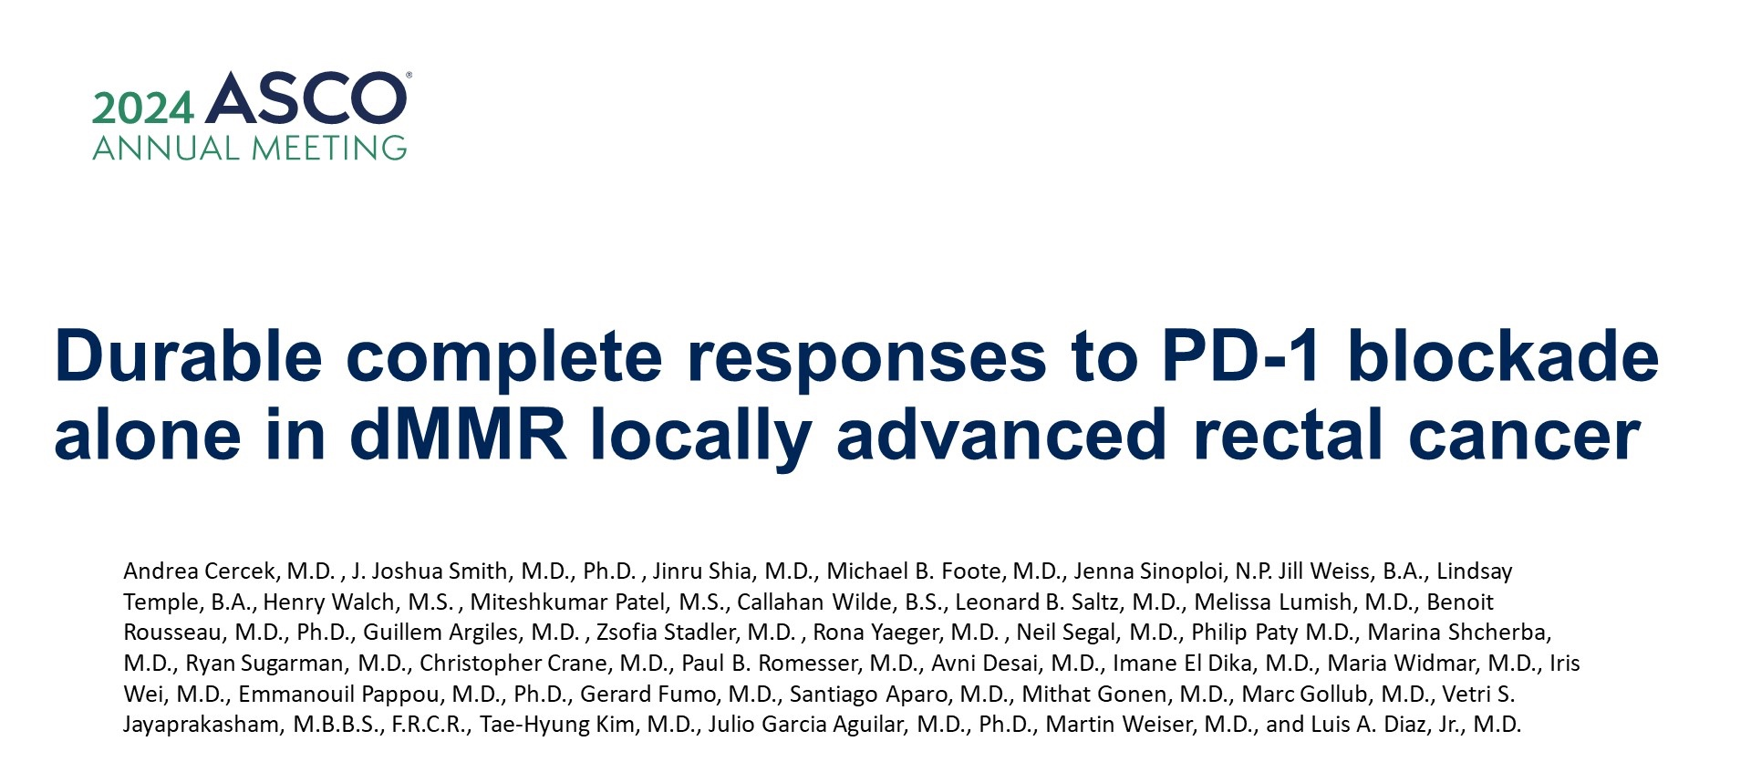
Abstract LBA3512

Slide 47
Neoadjuvant PD-1 blockade in dMMR locally advanced rectal cancer
PD-1 alone or in
Cercek A et al. ASCO 2024;Abstract LBA3512.

Slide 48
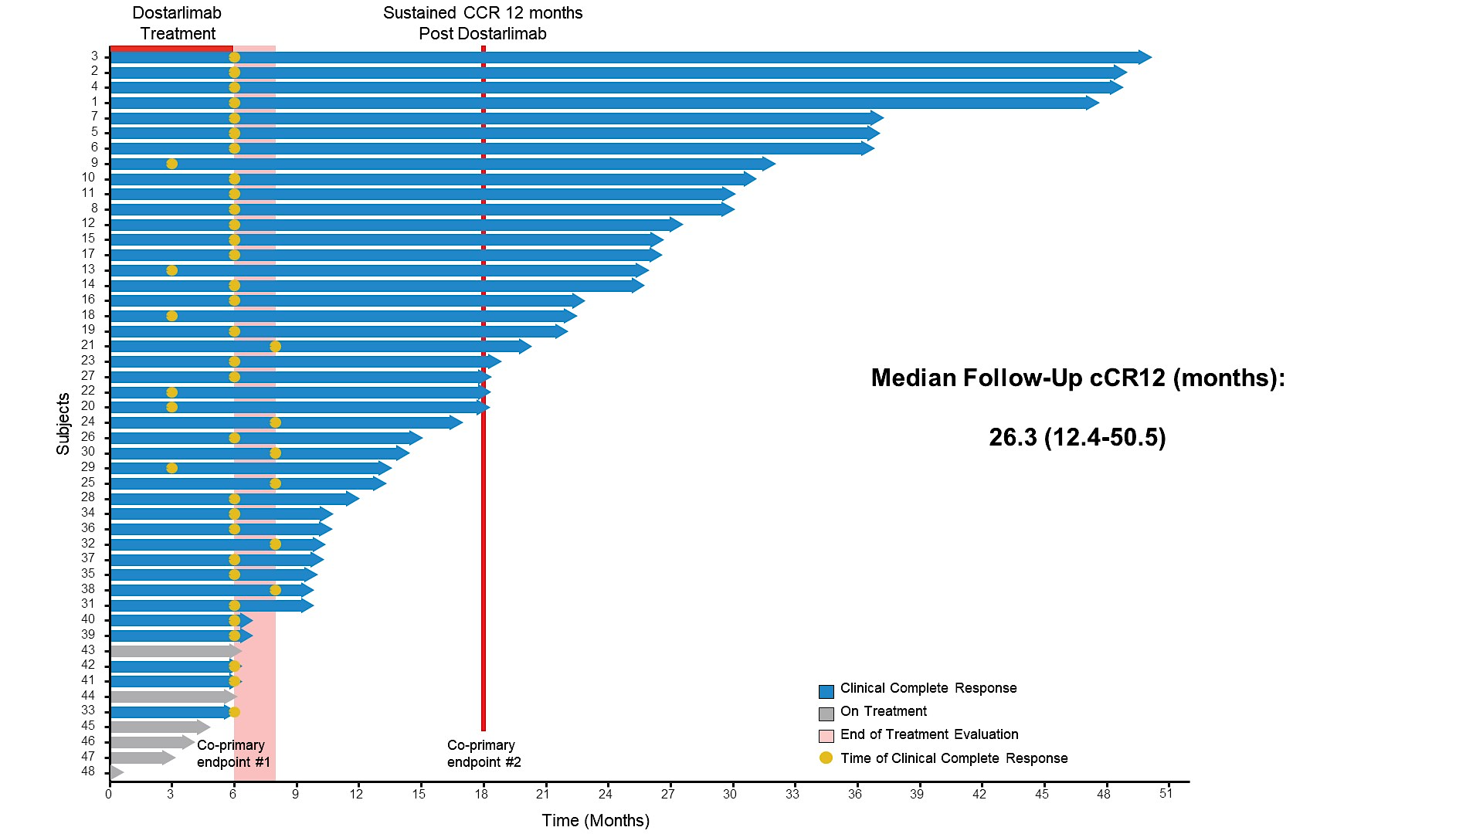
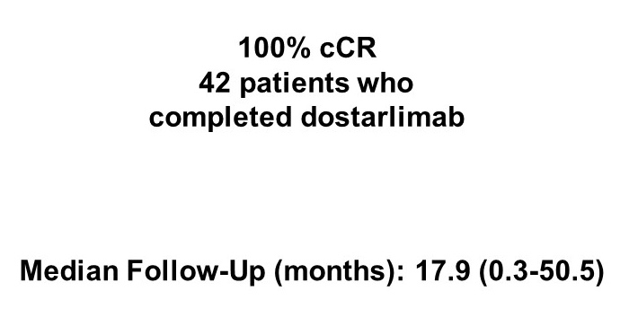
Dostarlimab: Clinical Complete Response (cCR) Rates After PD-1 Blockade
Sustained cCR 12 months Post Dostarlimab
Cercek A et al. ASCO 2024;Abstract LBA3512.

Slide 49
Neoadjuvant Therapy for MSI-H Rectal Cancer
5% to 10% of rectal cancers are microsatellite instability high (MSI-H)
To date, no patient has received standard chemotherapy, radiation or surgery
Sample size is still modest, but it is continuing to hold up
Is this applicable to all checkpoint inhibitors? How many doses are needed? Will there be late recurrences?

Slide 50
Key Ongoing Studies of (Neo)Adjuvant Dostarlimab for Patients with Resectable MSI-H/dMMR CRC
Study | N | Phase | Eligibility | Randomization | Estimated primary completion
China AZUR-1 (NCT06640049) | 23 | II | Stage II-III dMMR rectal adenocarcinoma | Dostarlimab | December 2028
AZUR-2 (NCT05855200) | 711 | III | T4N0 or Stage III dMMR colon adenocarcinoma | Dostarlimab Standard of care – CAPOX or FOLFOX | December 2028
AZUR-4 (NCT06567782) | 120 | II | T4N0 or Stage III dMMR colon adenocarcinoma | Dostarlimab CAPOX | September 2028
NAIO (NCT05239546) | 25 | II | Stage II-III dMMR CRC | Dostarlimab | April 2026
www.clinicaltrials.gov. Accessed February 2025.15

Slide 51
Discussion Questions: Immunotherapy for Localized and Metastatic MSI-High CRC
What is the optimal first-line treatment for metastatic MSI-high CRC? What is the ideal duration of immunotherapy in this setting? For which patients should dual immunotherapy be considered (eg, as in the CheckMate 8HW trial)?

Slide 52
CheckMate 8HW study design
16% of pts not MSI-H confirmed
Courtesy of Scott Kopetz, MD, PhD
Lenz et al. ASCO 2024; Andre et al. GI ASCO 2024

Slide 53
Progression-free survival
CheckMate 8HW: Progression-Free Survival with Nivo/Ipi versus Chemotherapy
Myocarditis and pneumonitis
Andre T et al. N Engl J Med 2024 Nov 28;391(21):2014-2026; Lenz et al. ASCO 2024.
Courtesy of Scott Kopetz, MD, PhD

Slide 54
CheckMate 8HW study design
Courtesy of Scott Kopetz, MD, PhD
Andre et al. GI ASCO 2024

Slide 55
Progression-free survival
CheckMate 8HW: Progression-Free Survival with Nivo/Ipi versus Nivo
100
Centrally confirmed MSI-H/dMMR | NIVO + IPI (n = 296) | NIVO (n = 286)
Median PFS,ª mo | NR | 39.3
95% CI | 53.8–NE | 22.1-NE
HR (95% CI) | 0.62 (0.48-0.81)
P value^{b} | 0.0003
90
12-mo rate
24-mo rate
36-mo rate
80
76%
71%
70
68%
60
NIVO + IPI
63%
Progression-free survival (%)
50
56%
51%
40
NIVO
30
20
10
0
0
3
6
9
12
15
18
21
24
27
30
33
36
39
42
45
48
51
54
57
60
No. at risk
Months
NIVO + IPI | 296 | 248 | 234 | 225 | 214 | 207 | 200 | 180 | 164 | 146 | 136 | 134 | 121 | 102 | 100 | 61 | 54 | 29 | 23 | 0 | 0
NIVO | 286 | 210 | 191 | 179 | 169 | 164 | 158 | 141 | 124 | 109 | 98 | 95 | 81 | 72 | 69 | 39 | 31 | 15 | 12 | 1 | 0
NIVO + IPI demonstrated statistically significant and clinically meaningful PFS benefit vs NIVO in patients with centrally confirmed MSI-H/dMMR mCRC across all lines of therapy
PFS benefit with NIVO + IPI vs NIVO was consistent in all randomized patients (median PFS: 54.1 vs 18.4 months; HR, 0.64 [95% CI, 0.52–0.79])
Courtesy of Scott Kopetz, MD, PhD
ªPer BICR. ^{b}Boundary for statistical significance, p < 0.0095.
Andre T et al. Lancet 2025;405:383–95.
Notes:
55

Slide 56
PD-1 + CTLA-4 is the new standard of care for first-line MSI-H CRC
This is likely improving CURE rates for this population

Slide 57
AGENDA Year in Review: Management of Colorectal Cancer (CRC)
MODULE 1: First-Line Treatment of BRAF V600E-Mutant Metastatic CRC (mCRC)
MODULE 2: Cell-Free DNA Molecular Residual Disease (MRD) Assays in Clinical Practice
MODULE 3: Immunotherapy for Localized and Metastatic MSI-High CRC
MODULE 4: Other Important Datasets
Hepatic transplant for liver-limited mCRC
HER2-positive CRC: Tucatinib, trastuzumab deruxtecan
KRAS G12C-mutant CRC: Adagrasib, sotorasib, EGFR inhibitors

Slide 58
Discussion Question: Hepatic Transplant for Liver-Limited mCRC
What, if any, is the current clinical role of hepatic transplant for liver-limited mCRC?

Slide 59
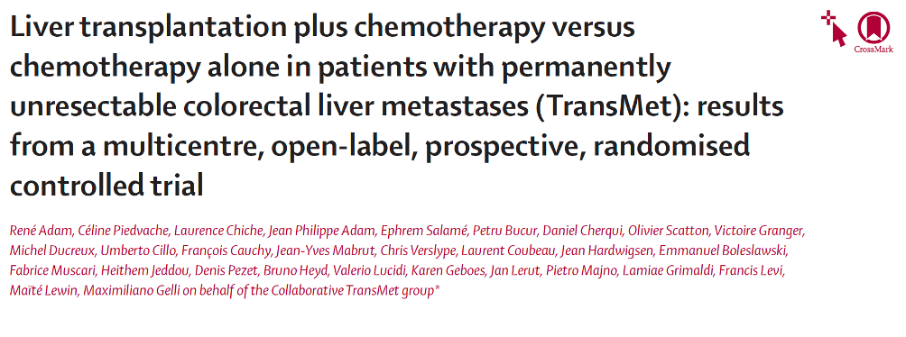
Lancet 2024 Sep 21;404(10458):1107-18
Abstract 3500

Slide 60
Slide 13

Slide 61
Impressive results for liver transplant in selected patients
But required high priority for livers on the donor list, which is currently not feasible in the US
Access to living related donor may improve feasibility in US in the future

Slide 62
Discussion Question: HER2-Positive mCRC
What is your current approach to sequencing tucatinib/trastuzumab and trastuzumab deruxtecan for patients with HER2-positive mCRC?

Slide 63
Trastuzumab and Tucatinib remains a standard of care for 2L+ RAS/BRAF^{wt} HER2^{amp}

Slide 64
Trastuzumab deruxtecan remains a standard of care for 2L+ HER2^{amp} without regard for RAS/BRAF
Resistance is NOT through loss of HER2^{amp} or acquired RAS mutations, so no concerns about sequencing T+T vs T-DXd

Slide 65
Discussion Question: KRAS G12C-Mutant mCRC
What is the practical application of the data evaluating the combinations of adagrasib/cetuximab and sotorasib/panitumumab for patients with KRAS G12C-mutant CRC?

Slide 66
Both Adagrasib + Cetuximab and Sotorasib + Panitumumab are standard of care options for KRAS^{G12C} tumors
But efficacy may differ between KRAS^{G12C} inhibitors

