Slide 1
Year in Review –
Advances in the Management of Metastatic CRC (mCRC)
S. Kopetz

Slide 2
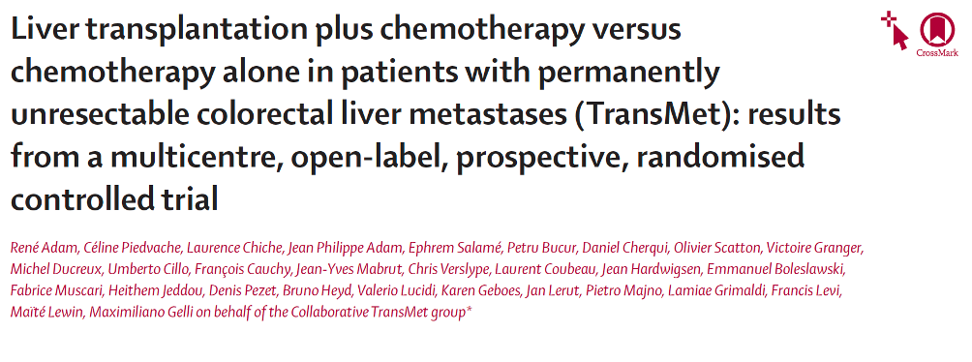
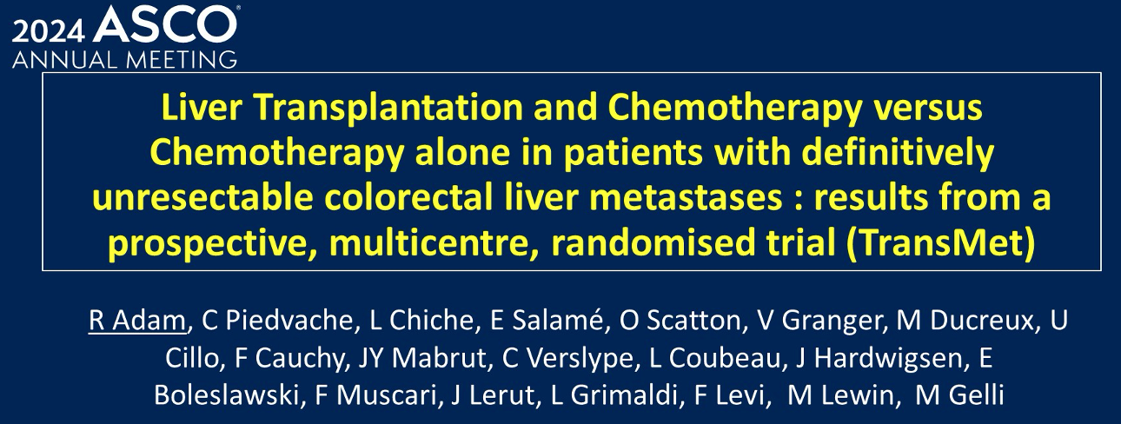
Lancet 2024 Sep 21;404(10458):1107-18
Abstract 3500

Slide 3
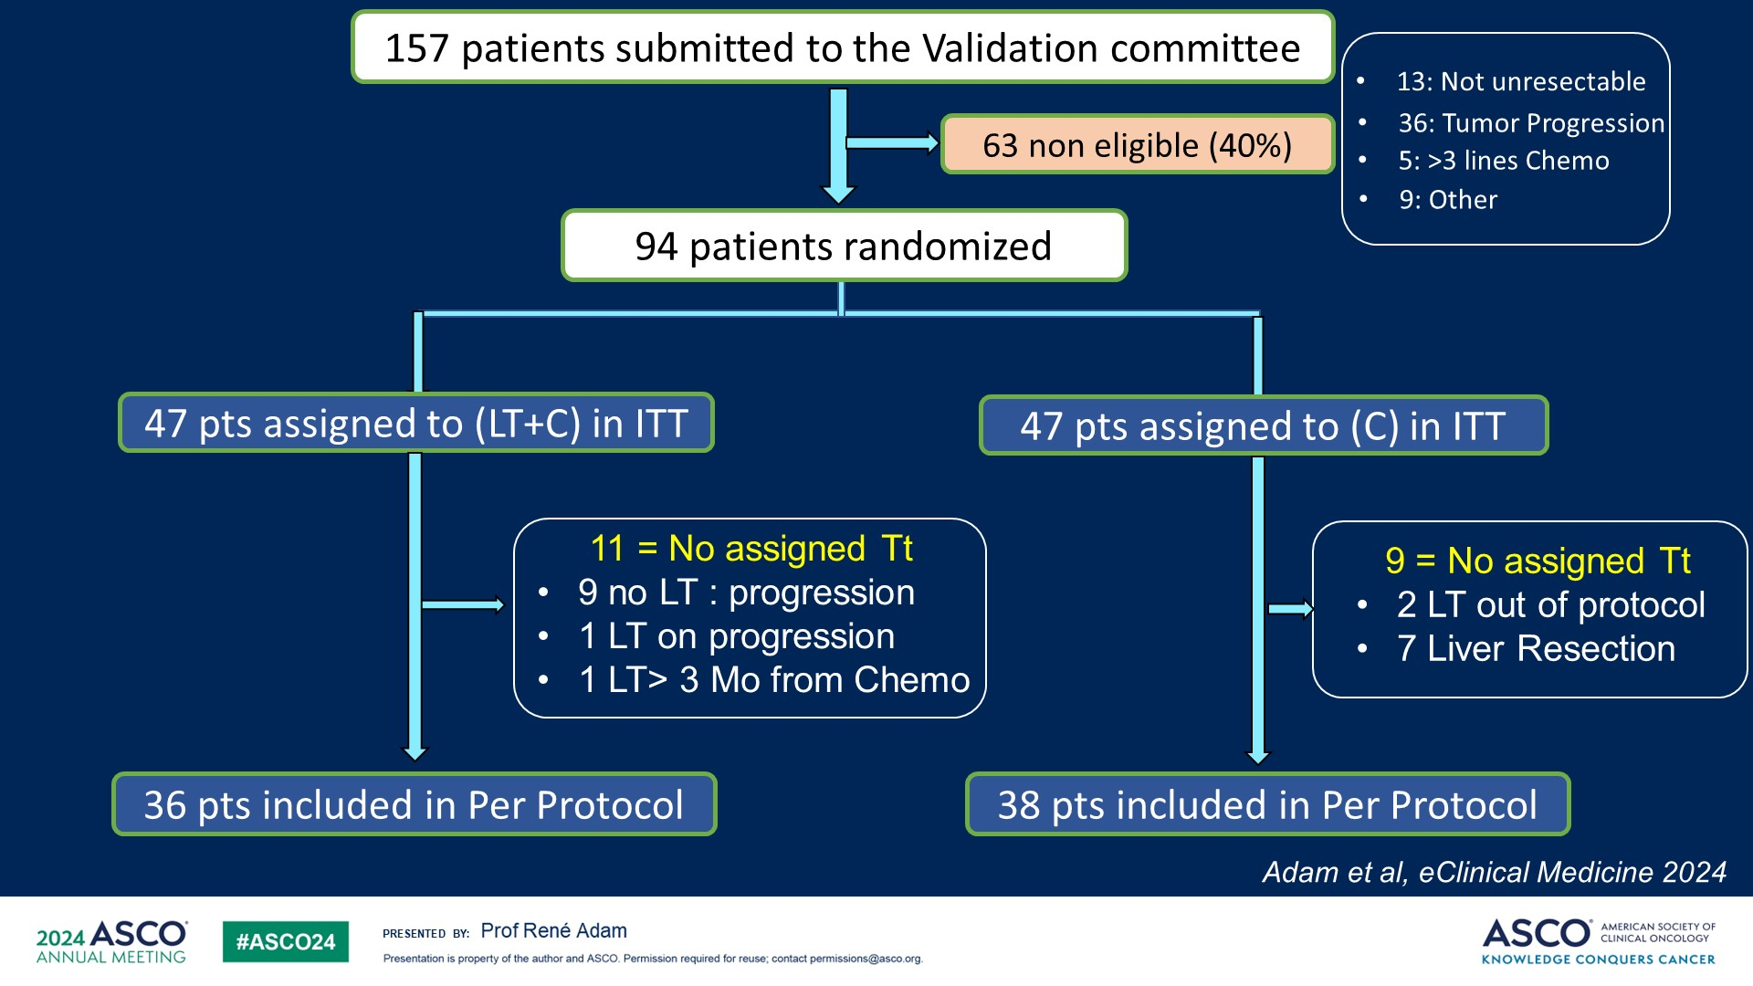
Slide 12

Slide 4
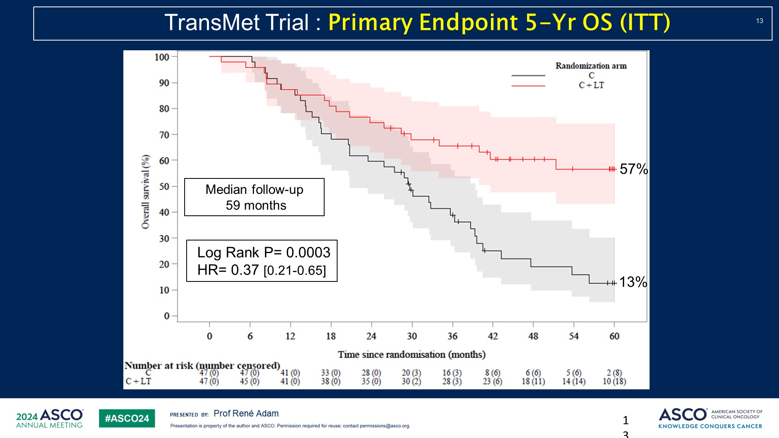
Slide 13

Slide 5
Impressive results for liver transplant in selected patients
But required high priority for livers on the donor list, which is currently not feasible in the US
Access to living related donor may improve feasibility in US in the future

Slide 6
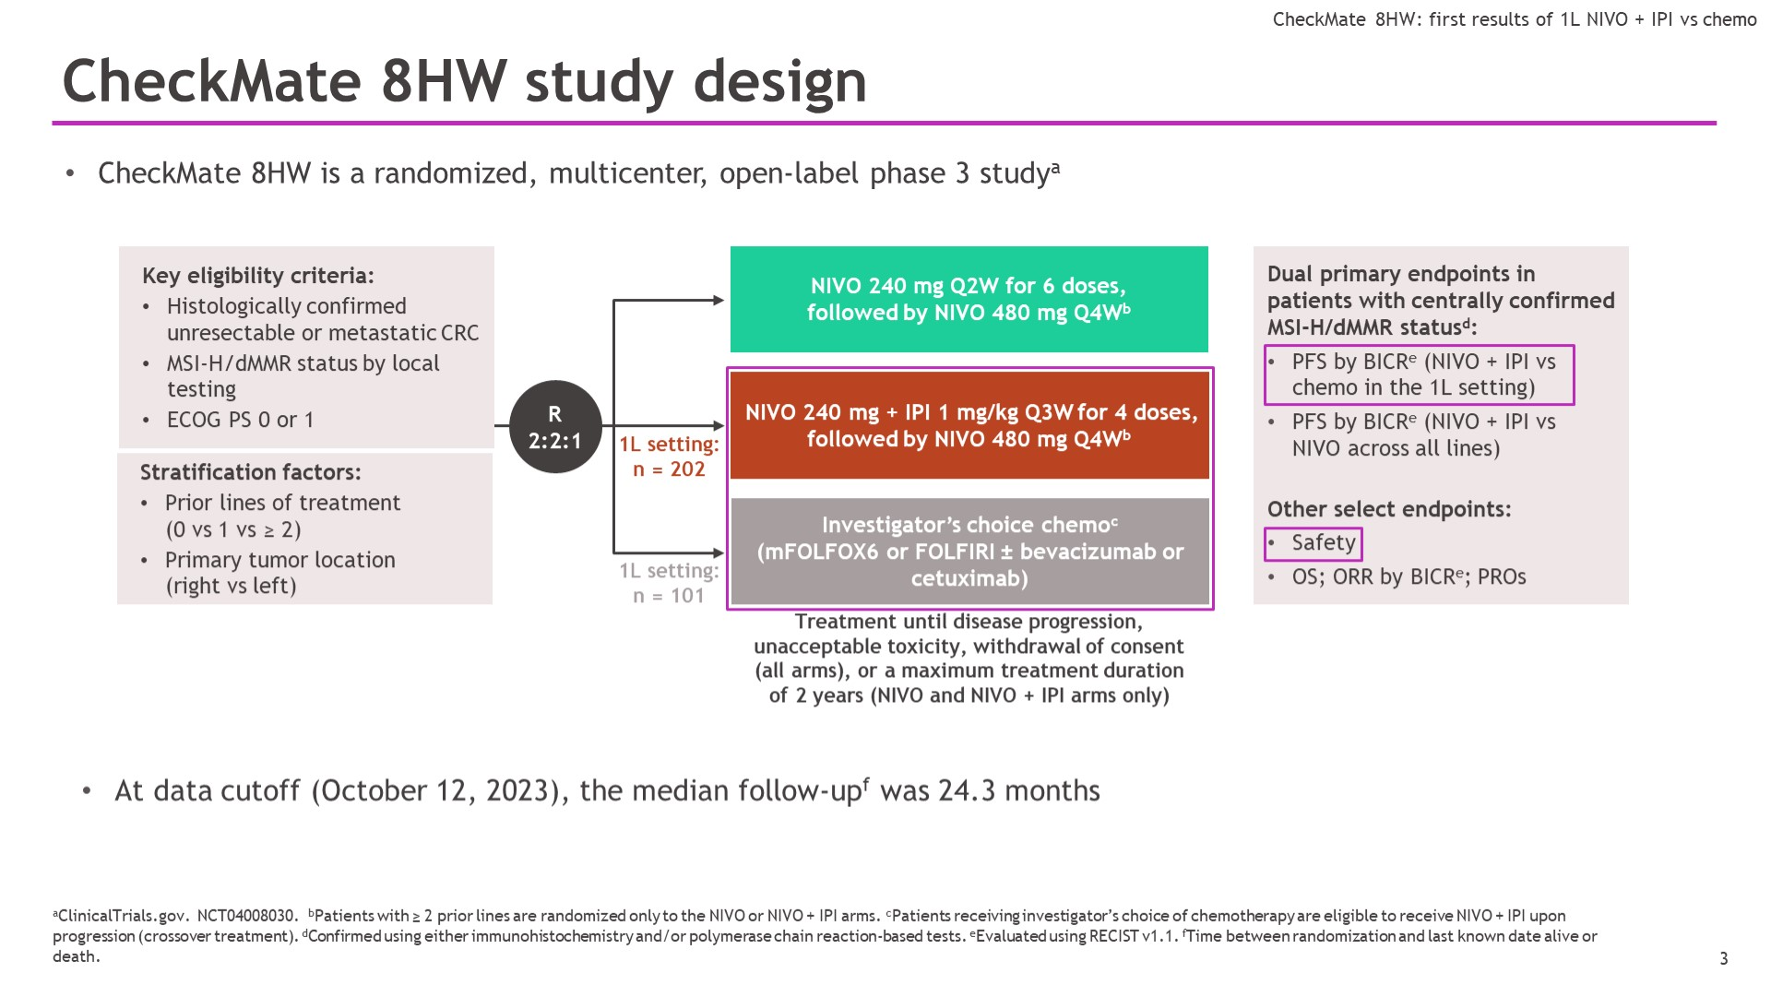
CheckMate 8HW study design
16% of pts not MSI-H confirmed
Lenz et al. ASCO 2024; Andre et al. GI ASCO 2024

Slide 7
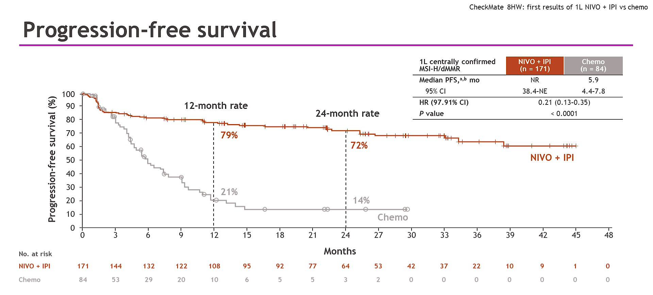
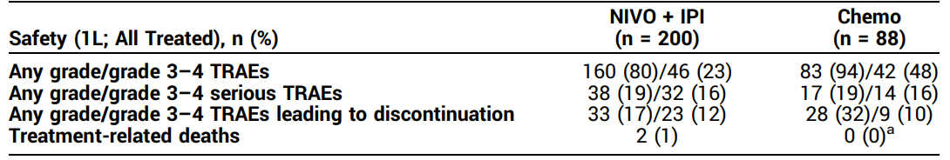
Progression-free survival
Andre T et al. N Engl J Med 2024 Nov 28;391(21):2014-2026; Lenz et al. ASCO 2024.
Myocarditis and pneumonitis

Slide 8
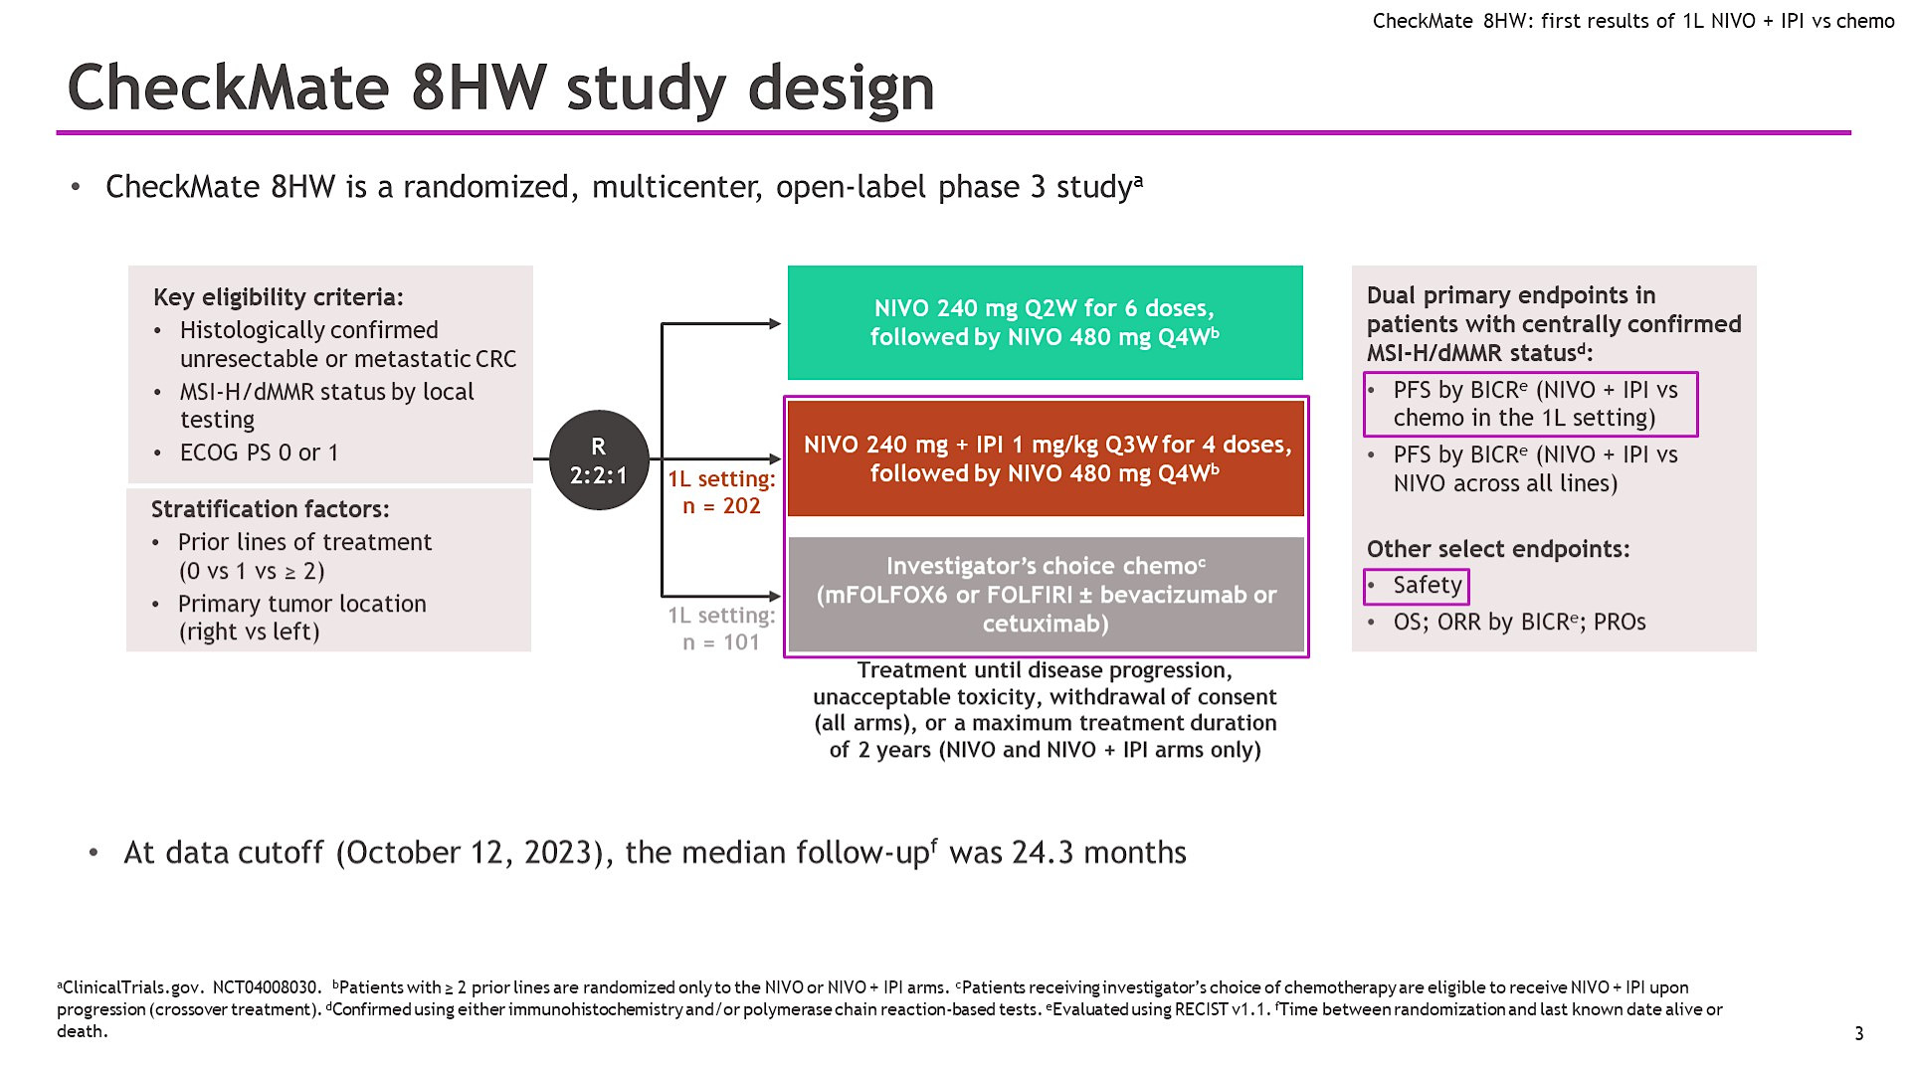
CheckMate 8HW study design
Andre et al. GI ASCO 2024

Slide 9
Progression-free survival
100
Centrally confirmed MSI-H/dMMR | NIVO + IPI (n = 296) | NIVO (n = 286)
Median PFS,ª mo | NR | 39.3
95% CI | 53.8–NE | 22.1-NE
HR (95% CI) | 0.62 (0.48-0.81)
P value^{b} | 0.0003
90
12-mo rate
24-mo rate
36-mo rate
80
76%
71%
70
68%
60
NIVO + IPI
63%
Progression-free survival (%)
50
56%
51%
40
NIVO
30
20
10
0
0
3
6
9
12
15
18
21
24
27
30
33
36
39
42
45
48
51
54
57
60
No. at risk
Months
NIVO + IPI | 296 | 248 | 234 | 225 | 214 | 207 | 200 | 180 | 164 | 146 | 136 | 134 | 121 | 102 | 100 | 61 | 54 | 29 | 23 | 0 | 0
NIVO | 286 | 210 | 191 | 179 | 169 | 164 | 158 | 141 | 124 | 109 | 98 | 95 | 81 | 72 | 69 | 39 | 31 | 15 | 12 | 1 | 0
NIVO + IPI demonstrated statistically significant and clinically meaningful PFS benefit vs NIVO in patients with centrally confirmed MSI-H/dMMR mCRC across all lines of therapy
    PFS benefit with NIVO + IPI vs NIVO was consistent in all randomized patients (median PFS: 54.1 vs 18.4 months; HR, 0.64 [95% CI, 0.52–0.79])
ªPer BICR. ^{b}Boundary for statistical significance, p < 0.0095.
Andre T et al. Lancet 2025;405:383–95.
Notes:
9

Slide 10
PD-1 + CTLA-4 is the new standard of care
for first-line MSI-H CRC
This is likely improving CURE rates for this population

Slide 11
BEACON Study: Encorafenib + Cetuximab in 2nd/3rd line mCRC
Patients with BRAF^{V600E} mCRC with disease progression after 1 or 2 prior regimens; ECOG PS of 0 or 1;
and no prior treatment with any RAF inhibitor, MEK inhibitor, or EGFR inhibitor
Phase 3
Primary
Endpoints*:
Triplet therapy
ENCO + BINI + CETUX
n = 205
OS
R
1:1:1
Doublet therapy
ENCO + CETUX
n = 205
Overall
Survival
ORR
(Blinded Central Review)
Control arm
FOLFIRI + CETUX, or
irinotecan + CETUX
n = 205
Secondary Endpoints: Doublet vs Control OS & ORR, PFS, Safety
*Triplet vs Control. Randomization was stratified by ECOG PS (0 vs. 1), prior use of irinotecan (yes vs. no), and cetuximab source (US-licensed vs. EU-approved).

Slide 12
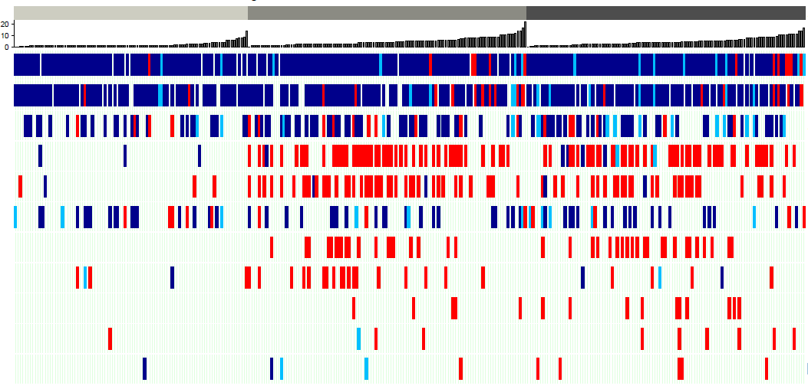

Encorafenib + Cetuximab : Key Genomic Alterations at Progression
Triplet
Doublet
Control
20
0
100
200
300
10
PFS
0
BRAF mut
TP53 mut
APC mut
KRAS mut
NRAS mut
PIK3CA mut
Change of Status Arm
MET amp
Acquired
Maintained
MAP2K1 mut
Lost
KRAS amp
BRAF amp
IGF1R amp
The key acquired resistance alterations were mutations in KRAS, NRAS, and MAP2K1, and amplification of MET
Kopetz et al Nat Med ‘24
Notes:
The most prevalent gene alterations found in BEACON patients—BRAF, TP53, APC, and PIK3CA—were primarily maintained
There was a low frequency of KRAS mutations in baseline ctDNA samples, and these were largely maintained

Slide 13
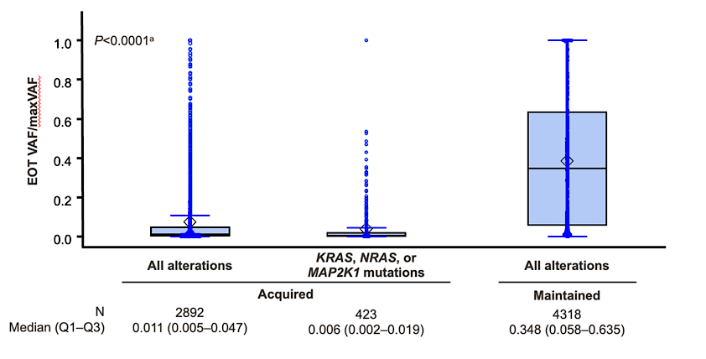
Acquired Alterations are Commonly Subclonal after E+C
Suggests less than 1/100 cells carry the resistant clone at the time of clinical progression.
Are other mechanisms co-occurring and driving resistance?
Kopetz et al Nat Med ‘24
ªP value for comparing between acquired (all) vs maintained (all) is based on the Wilcoxon rank-sum test (2-sided).

Slide 14
Secondary acquired mutations are common after BRAF/EGFR targeted therapy (when given alone), similar to EGFR and KRAS/EGFR results
But these resistant clones are very rare and may not be driving resistance?

Slide 15
BREAKWATER: Study Design
BREAKWATER (NCT04607421) is an open-label, multicenter, phase 3 study in first line BRAF V600E-mutant mCRC
Inclusion criteria
Age ≥16 years (or ≥18 years based on country) No prior systemic treatment for metastatic disease Measurable disease (RECIST 1.1) BRAF V600E-mutant mCRC by local or central laboratory testing ECOG PS 0 or 1 Adequate bone marrow, hepatic, and renal function
EC (n=158)
Dual primary endpoints: PFS and ORR^{d} by BICR (EC + mFOLFOX6 vs SOC)
Key secondary endpoint: OS (EC + mFOLFOX6 vs SOC)
R
1:1:1^{a,b}
N=637
EC + mFOLFOX6 (n=236)
Exclusion criteria
Prior BRAF or EGFR inhibitors Symptomatic brain metastases MSI-H/dMMR tumors (unless patients were ineligible to receive immune checkpoint inhibitors due to a pre-existing medical condition) Presence of a RAS mutation
SOC (n=243)^{c}
Stratified by regions (US/Canada vs Europe
vs Rest of World) and ECOG PS (0 vs 1)
Here we present the primary analysis of ORR by BICR (one of the dual primary endpoints), an interim analysis of OS, and safety in the EC + mFOLFOX6 and SOC arms
ªFollowing a protocol amendment, enrollment to the EC arm was stopped and patients were randomized 1:1 to the EC+mFOLFOX6 or SOC arms; data in the EC arm will be reported at a later date. ^{b}Patients were enrolled between November 16, 2021, and December 22, 2023. ^{c}mFOLFOX6/FOLFOXIRI/CAPOX ± bevacizumab. ^{d}In the first 110 patients in each of the EC+mFOLFOX6 and SOC arms.
CAPOX, capecitabine/oxaliplatin; BICR, blinded independent central review; dMMR, deficient mismatch repair; EC, encorafenib plus cetuximab; ECOG PS, Eastern Cooperative Oncology Group performance status; EGFR, epidermal growth factor receptor; mFOLFOX6, modified fluorouracil/leucovorin/oxaliplatin; FOLFOXIRI, fluorouracil/leucovorin/oxaliplatin/irinotecan; mCRC, metastatic colorectal cancer; MSI-H, microsatellite instability-high cancer; RECIST, Response Evaluation Criteria in Solid Tumors.

Slide 16
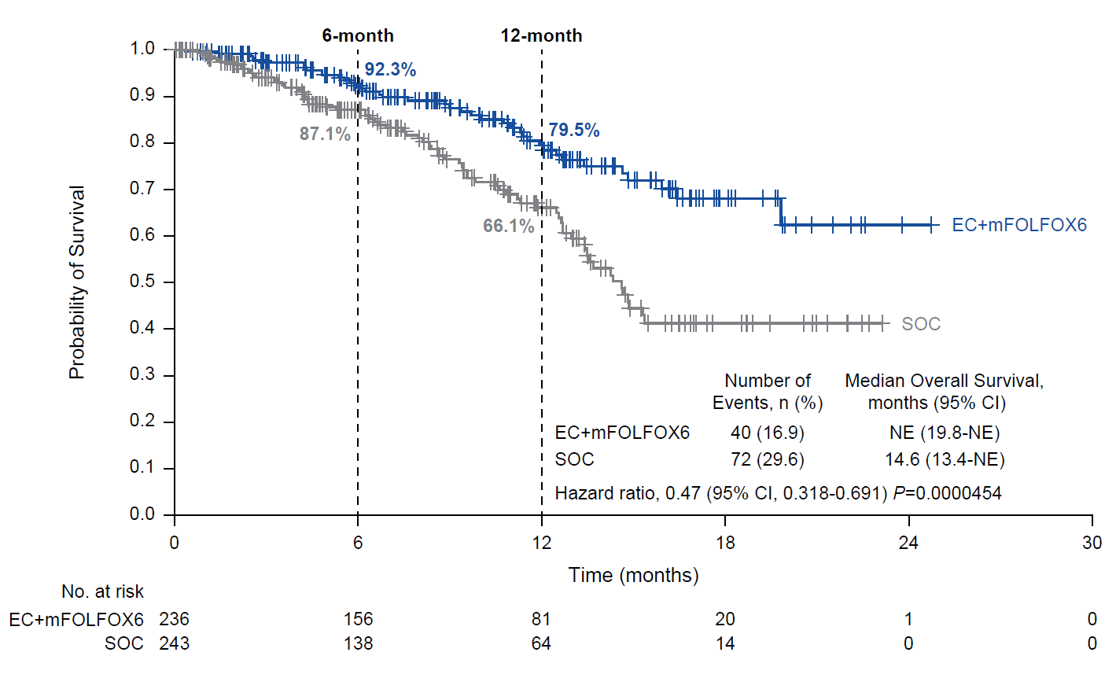
Interim Overall Survivalª
Data cutoff: December 22, 2023.
ªOS was tested following the prespecified plan with one-sided alpha of 0.000000083, calculated as a portion of the nominal one-sided alpha of 0.001. Statistical significance was not achieved at this time.
EC, encorafenib plus cetuximab; mFOLFOX6, modified fluorouracil/leucovorin/oxaliplatin; NE, not estimable; SOC, standard of care.
Kopetz et al Nat Med ‘25
Notes:
Added P=0.0000454 after HR

Slide 17
EC+FOLFOX is the new standard of care for first-line BRAF^{V600E} CRC
Results appear synergistic and may follow improved understanding of tumor plasticity

Slide 18
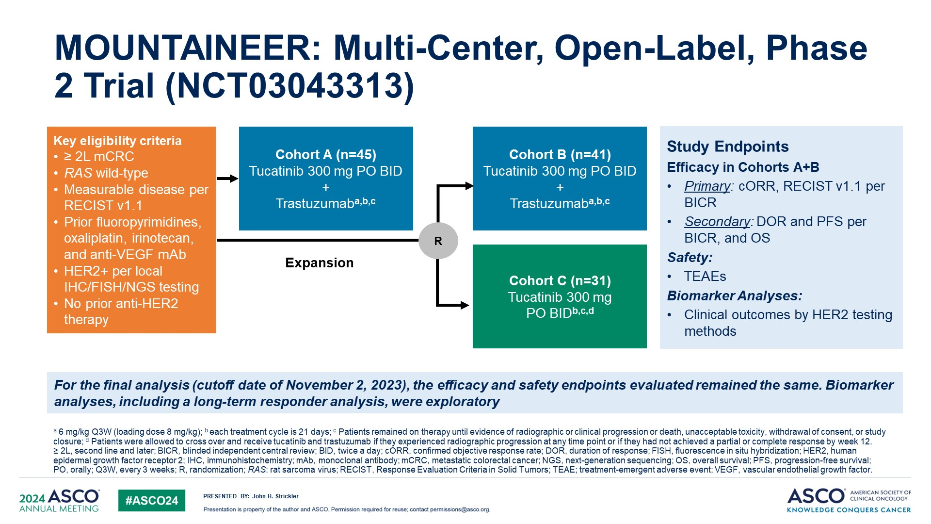
MOUNTAINEER: Multi-Center, Open-Label, Phase 2 Trial (NCT03043313)
Strickler JH et al. ASCO 2024;Abstract 3509.

Slide 19
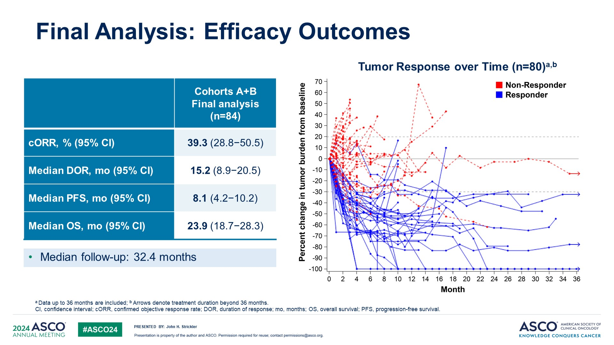
Final Analysis: Efficacy Outcomes
Strickler JH et al. ASCO 2024;Abstract 3509.

Slide 20
Trastuzumab and Tucatinib remains a standard of care for 2L+ RAS/BRAF^{wt} HER2^{amp}

Slide 21
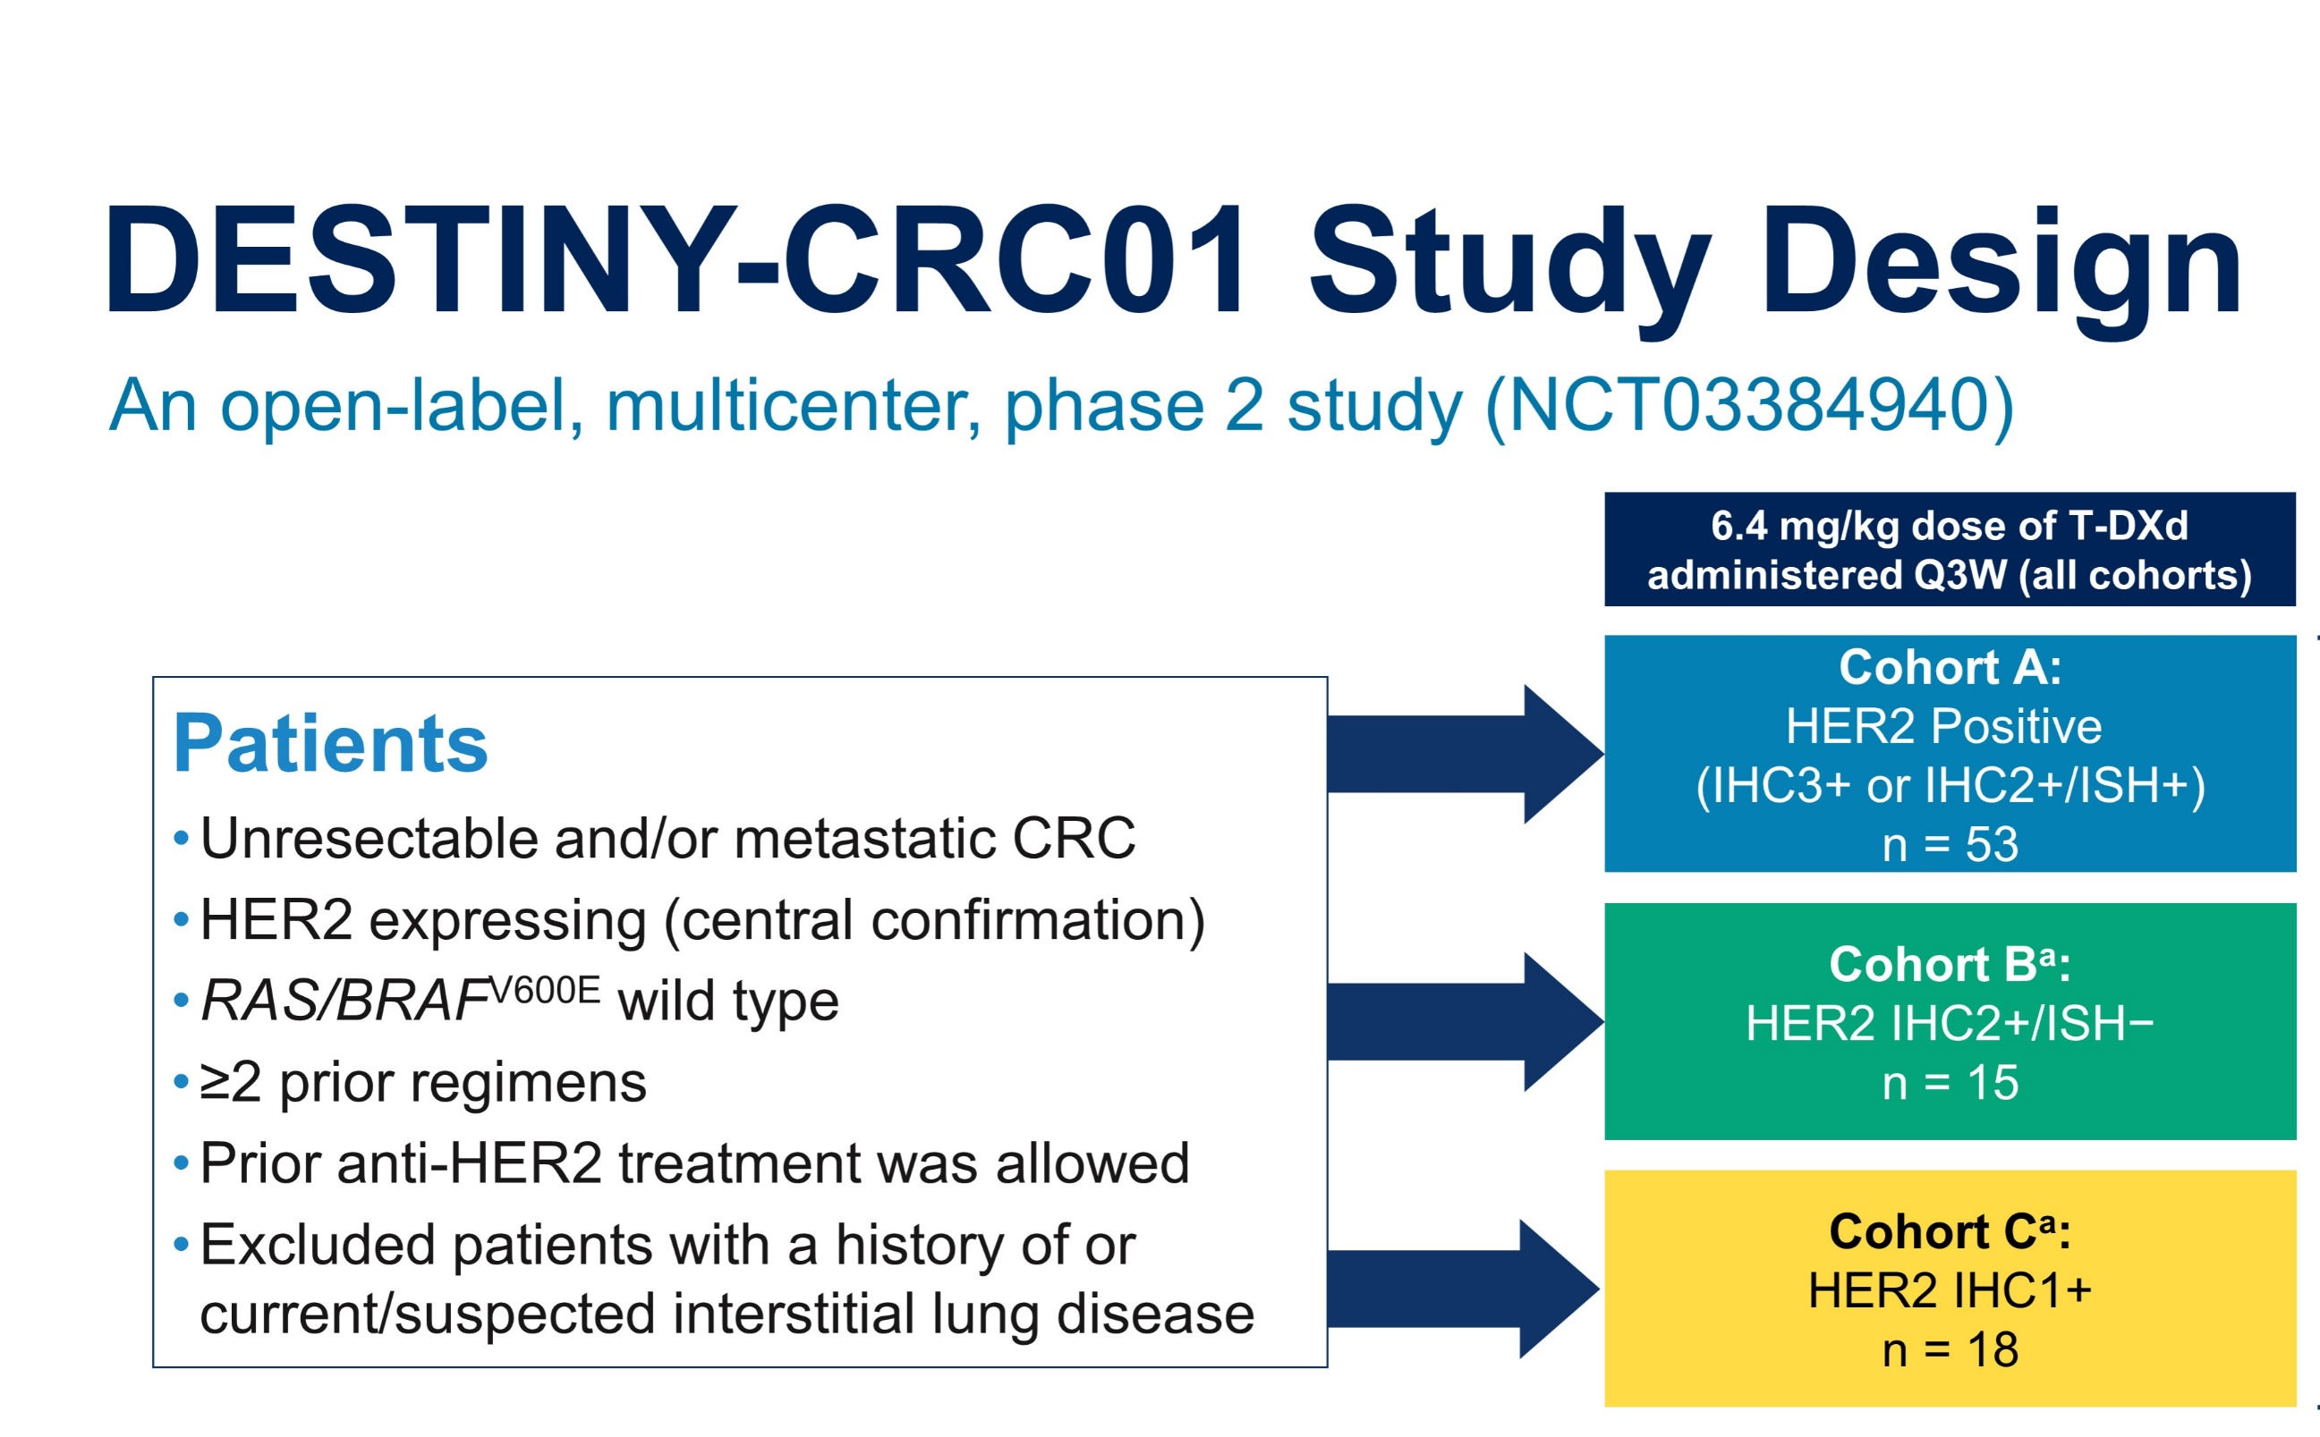
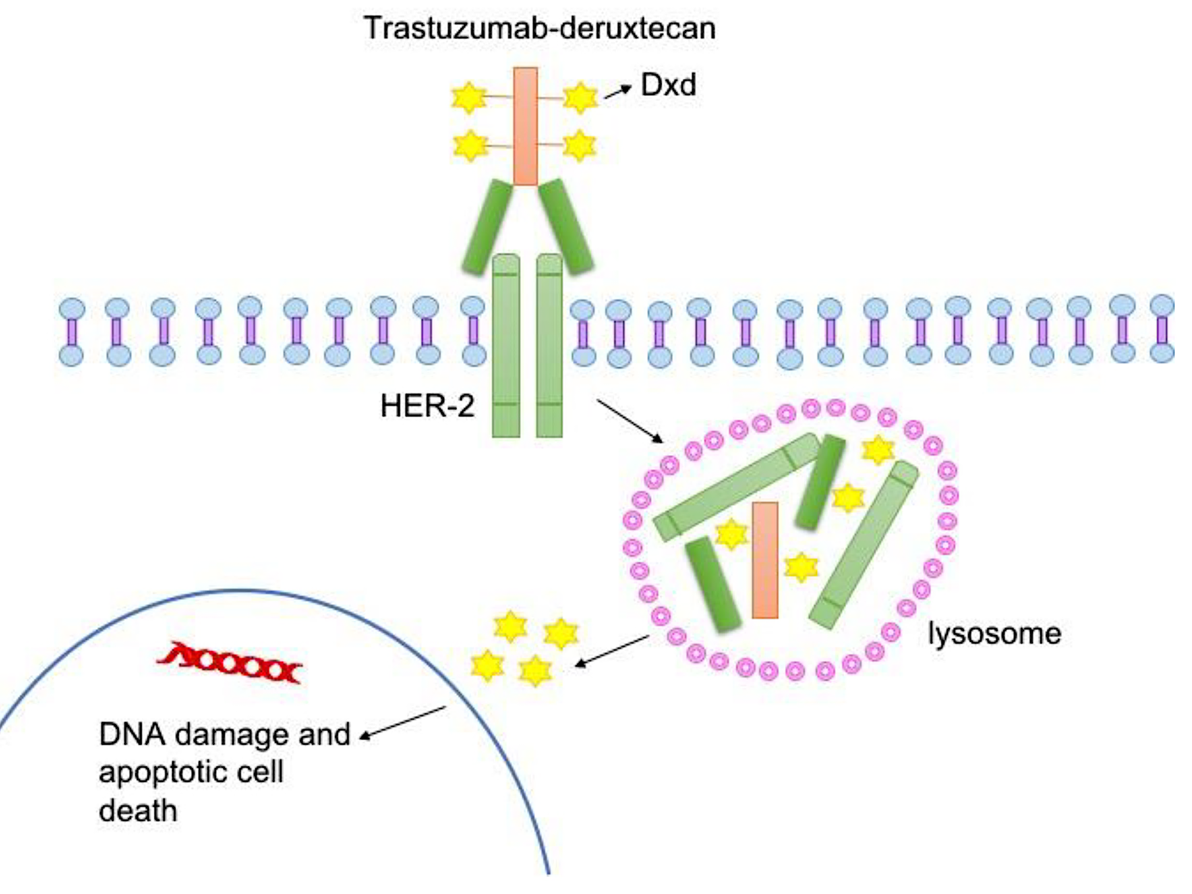
DESTINY-CRC01 Study Design
Trastuzumab deruxtecan (T-DXd): Topoisomerase payload with HER2 antibody
DXd
Yoshino et al Lancet Oncology ‘21

Slide 22
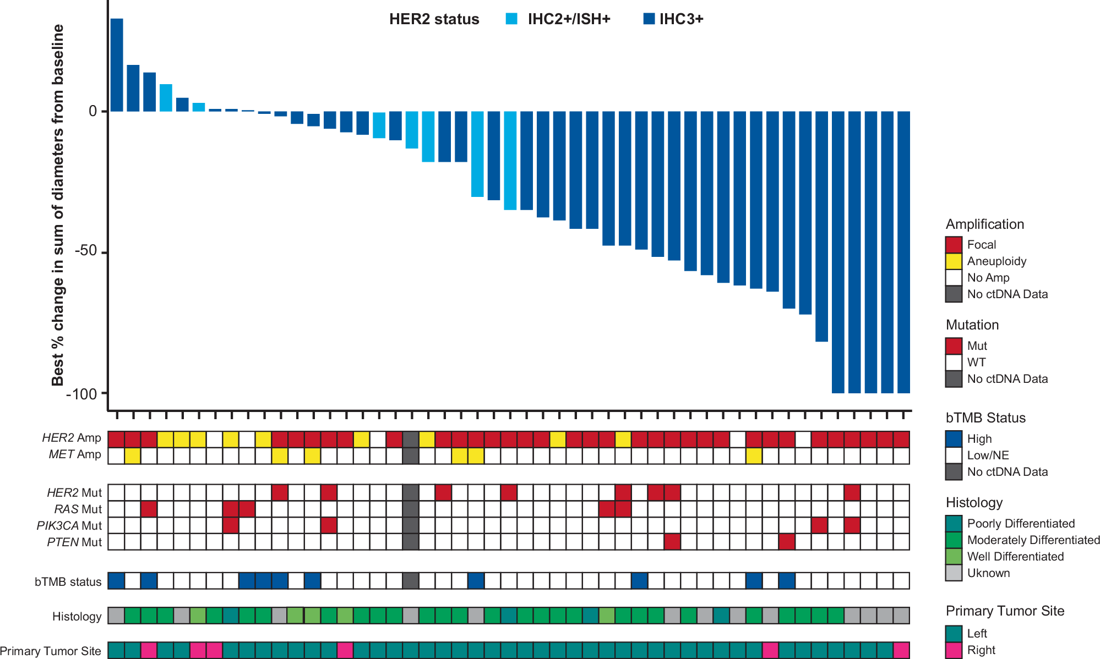
DESTINY-CRC01: Responses Seen in RAS mut and wt
Siena et al Nat Comm ‘24

Slide 23
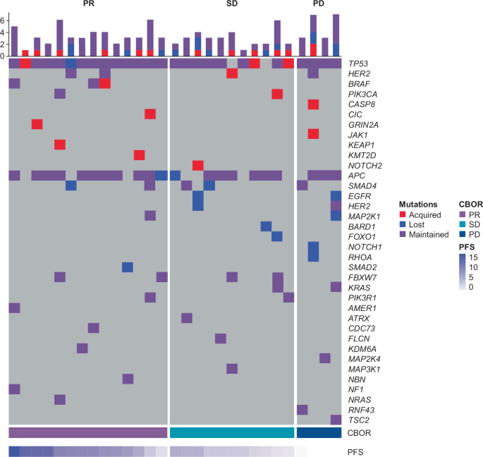
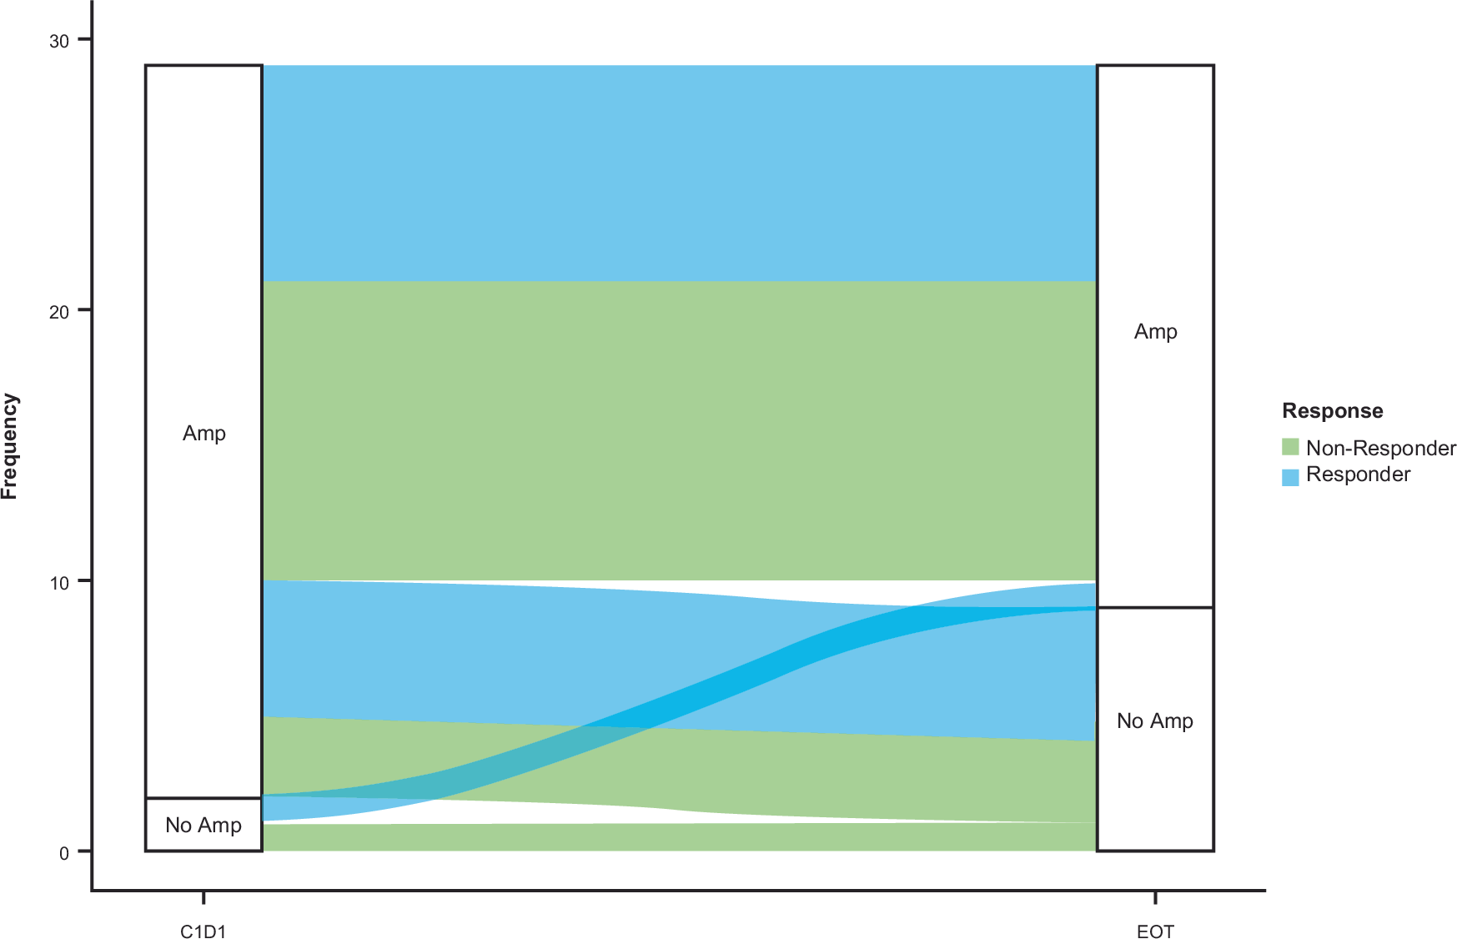
DESTINY-CRC01: No Acquired MAPK alterations or loss of HER2^{amp}
Siena et al Nat Comm ‘24

Slide 24
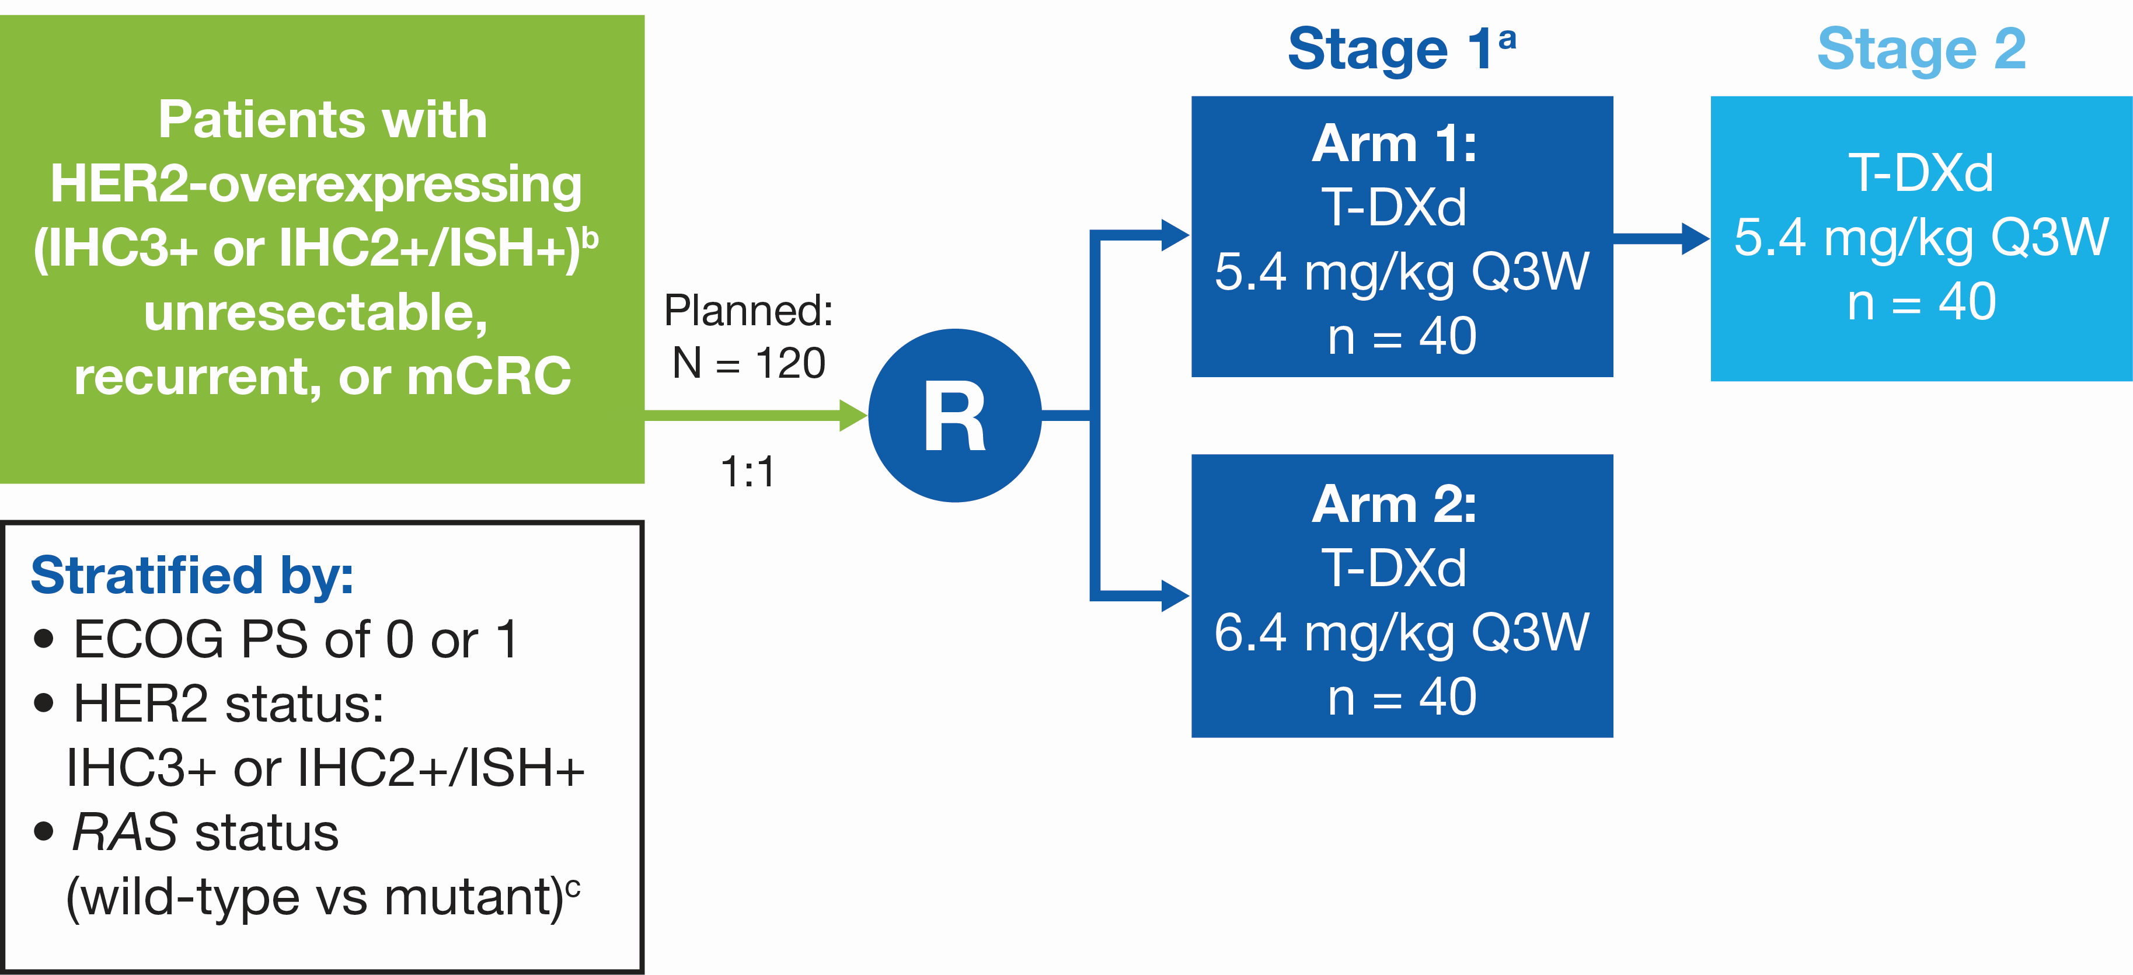
DESTINY-CRC02 Study
Trastuzumab Deruxtecan in Patients with HER2-Overexpressing Locally Advanced, Unresectable, or Metastatic Colorectal Cancer (mCRC): A Randomized, Multicenter, Phase 2 Study (DESTINY-CRC02)

Slide 25
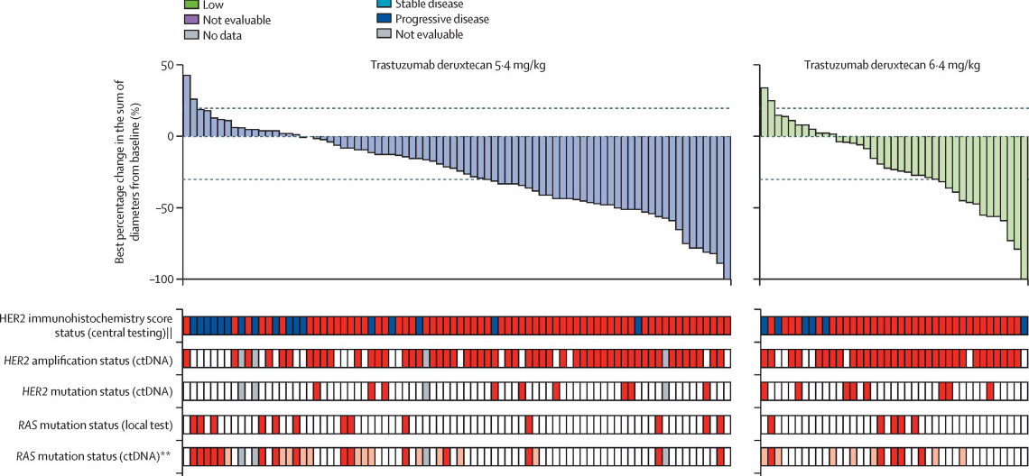
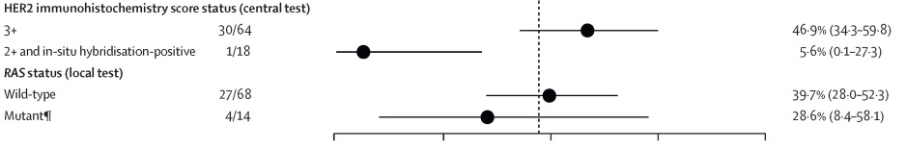
DESTINY-CRC02 Study
37.8%
27.5%
Raghav et al Lancet Onc ‘24

Slide 26
Trastuzumab deruxtecan remains a standard of care for 2L+ HER2^{amp} without regard for RAS/BRAF
Resistance is NOT through loss of HER2^{amp} or acquired RAS mutations, so no concerns about sequencing T+T vs T-DXd

Slide 27
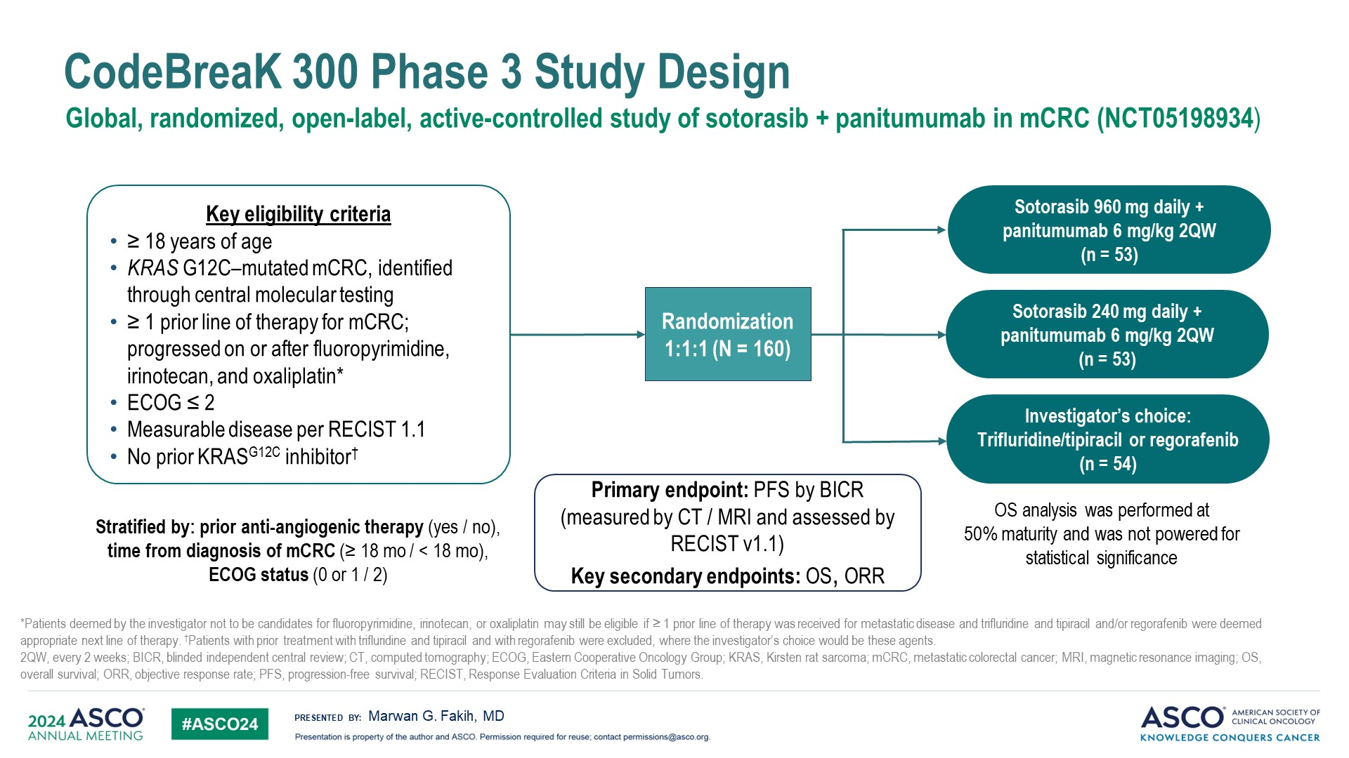
Slide 5
Abstract LBA3510
PFS was previously presented, favoring the Sotorasib 960mg + Pmab arm

Slide 28
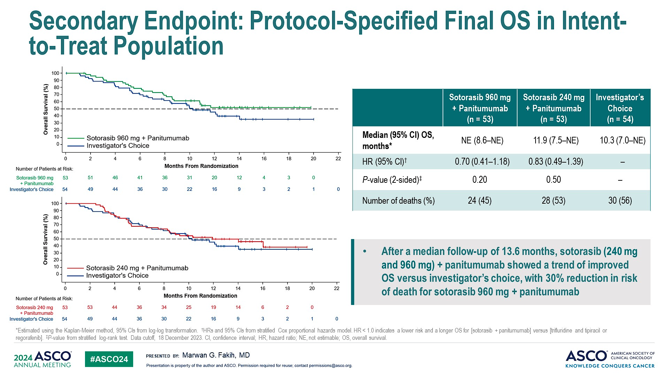
Secondary Endpoint: Protocol-Specified Final OS in Intent-to-Treat Population
2L+
2L+
Abstract LBA3510
31% cross-over in the control arm to other KRAS inhibitors

Slide 29
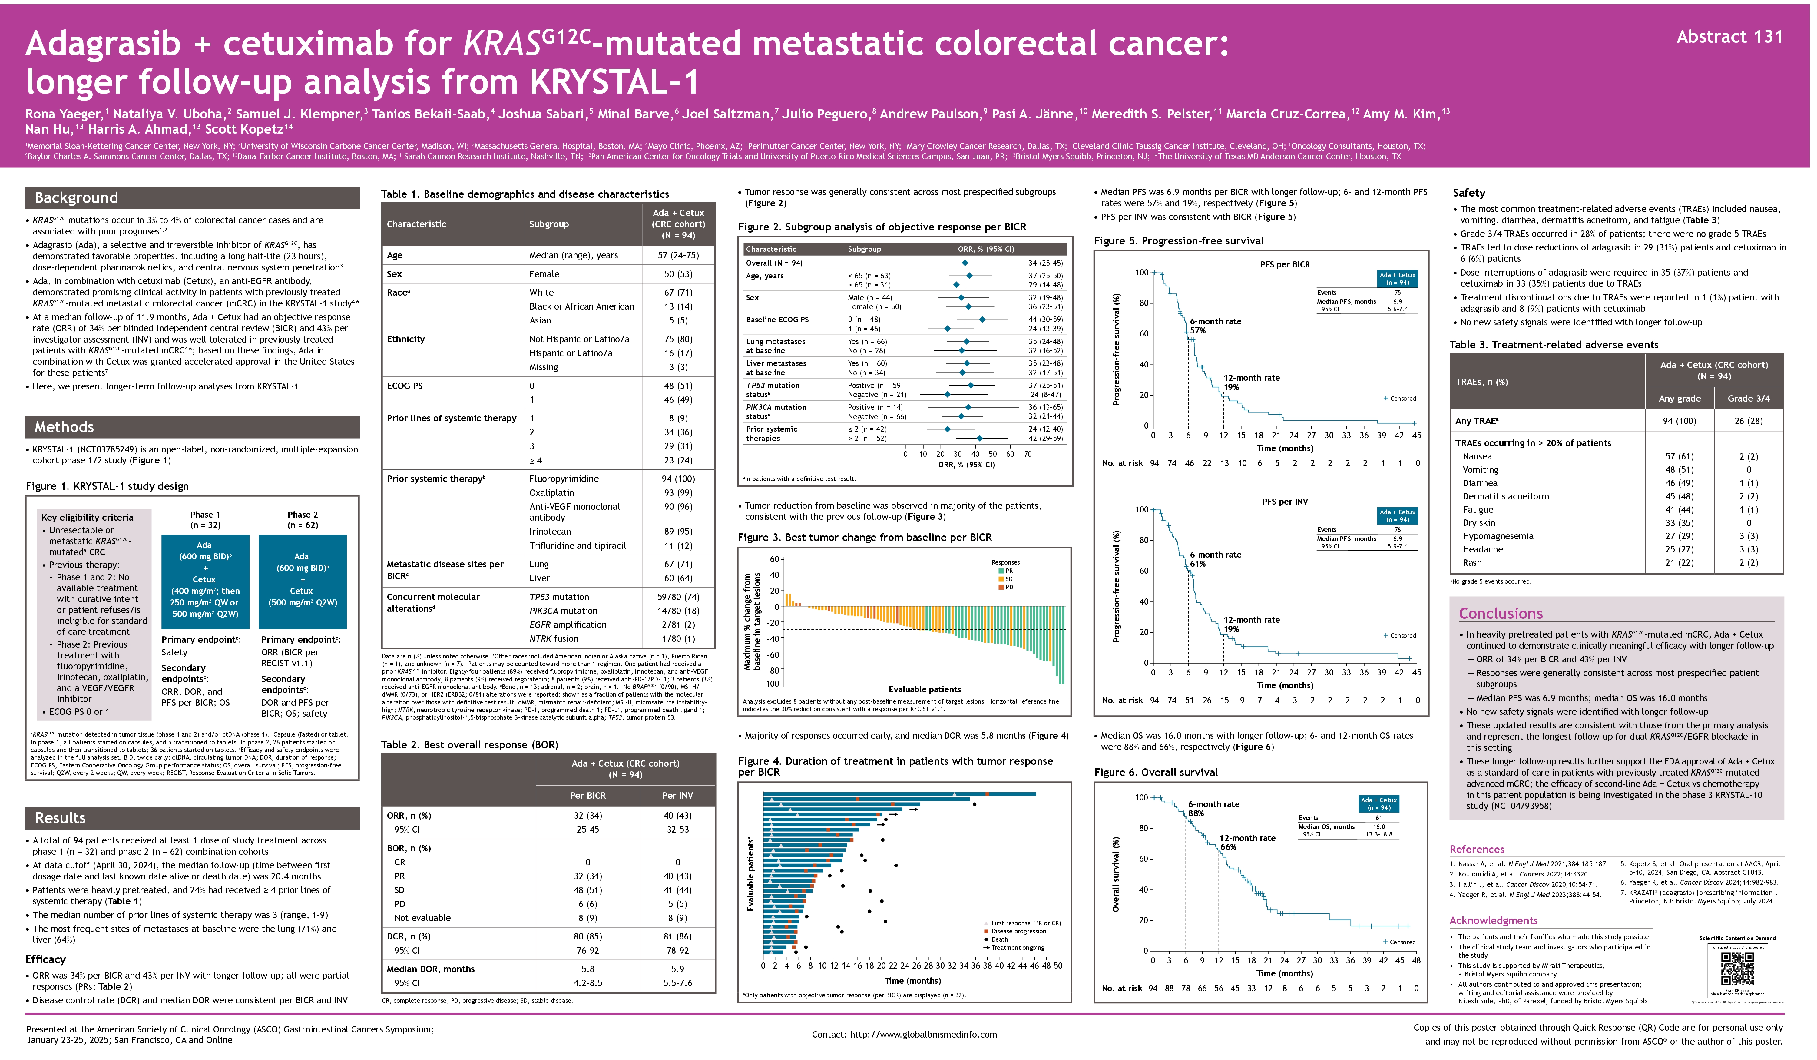

Slide 30
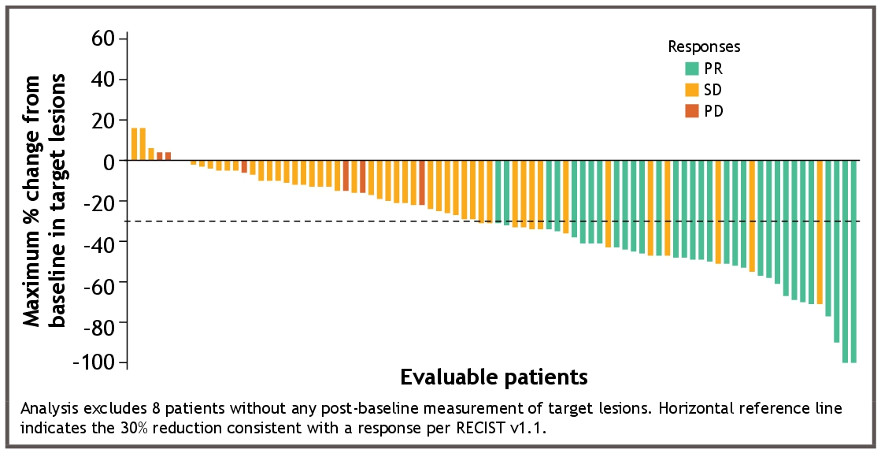
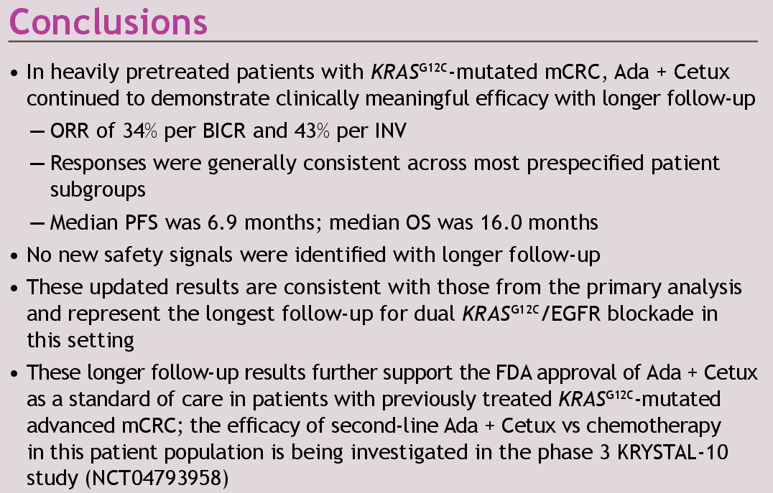

Slide 31
Both Adagrasib + Cetuximab and Sotorasib + Panitumumab are standard of care options for KRAS^{G12C} tumors
But efficacy may differ between KRAS^{G12C} inhibitors

