Slide 1
Expert Second Opinion: Optimizing the Use of Immunotherapy, MRD Assessment and Other Novel Approaches for Patients with Localized Colorectal Cancer
A CME Symposium Held Adjunct to the 2026 ASCO® Gastrointestinal Cancers Symposium
Thursday, January 8, 2026
7:15 PM – 8:45 PM PT
Faculty
Stacey A Cohen, MD
Jenny Seligmann, MBChB, PhD
Moderator
Christopher Lieu, MD

Slide 2



Faculty
Moderator Christopher Lieu, MD
Professor of Medicine
Associate Director for Clinical Research
Director, GI Medical Oncology
University of Colorado Cancer Center
Aurora, Colorado
Stacey A Cohen, MD
Professor
Fred Hutchinson Cancer Center
University of Washington
Seattle, Washington
Jenny Seligmann, MBChB, PhD
Professor of Gastrointestinal Cancer
University of Leeds
Leeds, United Kingdom

Slide 3
Dr Cohen — Disclosures Faculty
Advisory Committees | AbbVie Inc, Agenus Inc, Caris Life Sciences, DoMore Diagnostics, Exact Sciences Corporation, Guardant Health, Incyte Corporation, Janssen Biotech Inc, Merck, Pfizer Inc, Roche Laboratories Inc
Data and Safety Monitoring Boards/Committees | GSK

Slide 4
Dr Seligmann — Disclosures Faculty
No relevant conflicts of interest to disclose.

Slide 5
Dr Lieu — Disclosures Moderator
Consulting Agreements (to Institution) | Pfizer Inc
Contracted Research (All to Institution) | Genentech, a member of the Roche Group, Janssen Biotech Inc, Sanofi

Slide 6
Commercial Support
This activity is supported by educational grants from Genentech, a member of the Roche Group, GSK, and Natera Inc.
Research To Practice CME Planning Committee Members, Staff and Reviewers
Planners, scientific staff and independent reviewers for Research To Practice have no relevant conflicts of interest to disclose.

Slide 7
This educational activity contains discussion of non-FDA-approved uses of agents and regimens. Please refer to official prescribing information for each product for approved indications.

Slide 8
Agenda
Module 1: Neoadjuvant Treatment for Localized Colorectal Cancer (CRC) — Dr Seligmann
Module 2: Emerging Novel Approaches to Adjuvant Treatment for Localized CRC — Dr Lieu
Module 3: Role of Circulating Tumor DNA (ctDNA) Testing in Localized CRC — Dr Cohen

Slide 9
Survey of 50 Community-Based General Medical Oncologists
December 22, 2025 – January 7, 2026

Slide 10
Agenda
Module 1: Neoadjuvant Treatment for Localized Colorectal Cancer (CRC) — Dr Seligmann
Module 2: Emerging Novel Approaches to Adjuvant Treatment for Localized CRC — Dr Lieu
Module 3: Role of Circulating Tumor DNA (ctDNA) Testing in Localized CRC — Dr Cohen

Slide 11


Neoadjuvant treatments for localised CRC: Opportunities for Progress
Jenny Seligmann
Professor of Gastrointestinal Oncology and Honorary Medical Oncologist
University of Leeds, UK

Slide 12
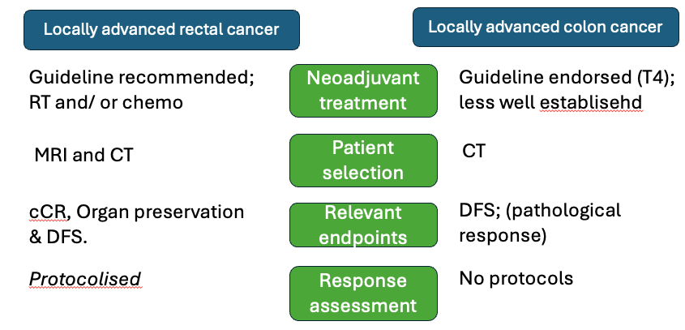


Locally advanced colorectal cancer
A tale of 2 tumor sites…..
A tale of 2 biomarker groups…..
MSI-H/ dMMR
5% LARC
15-20% LACC
less well established
MSS/ pMMR
95% LARC
80-85% LACC

Slide 13
Potential advantages & disadvantages of a neoadjuvant therapy in localised CRC
Positive experience in other cancers
Early treatment of micro-metastases
Downstaging for complete surgical resection
Potential for organ preservation
Preclinical studies show a stronger and deeper immune response with IO when primary tumor is in situ
Tumor microenvironment intact and tumor antigen heterogeneity may be minimal
Will patients not proceed to surgical resection?
PD in neoadjuvant window
Toxicity from neoadjuvant treatment
Will NAC lead to an increase in peri-operative complications?
Can we select appropriate patients using radiological staging assessment?
Battaglin F. Clin Adv Hematol Oncol. 2018; Sciafani F et al. Cancers (Basel). 2021; Smith HG et al. BJS Open. 2024

Slide 14
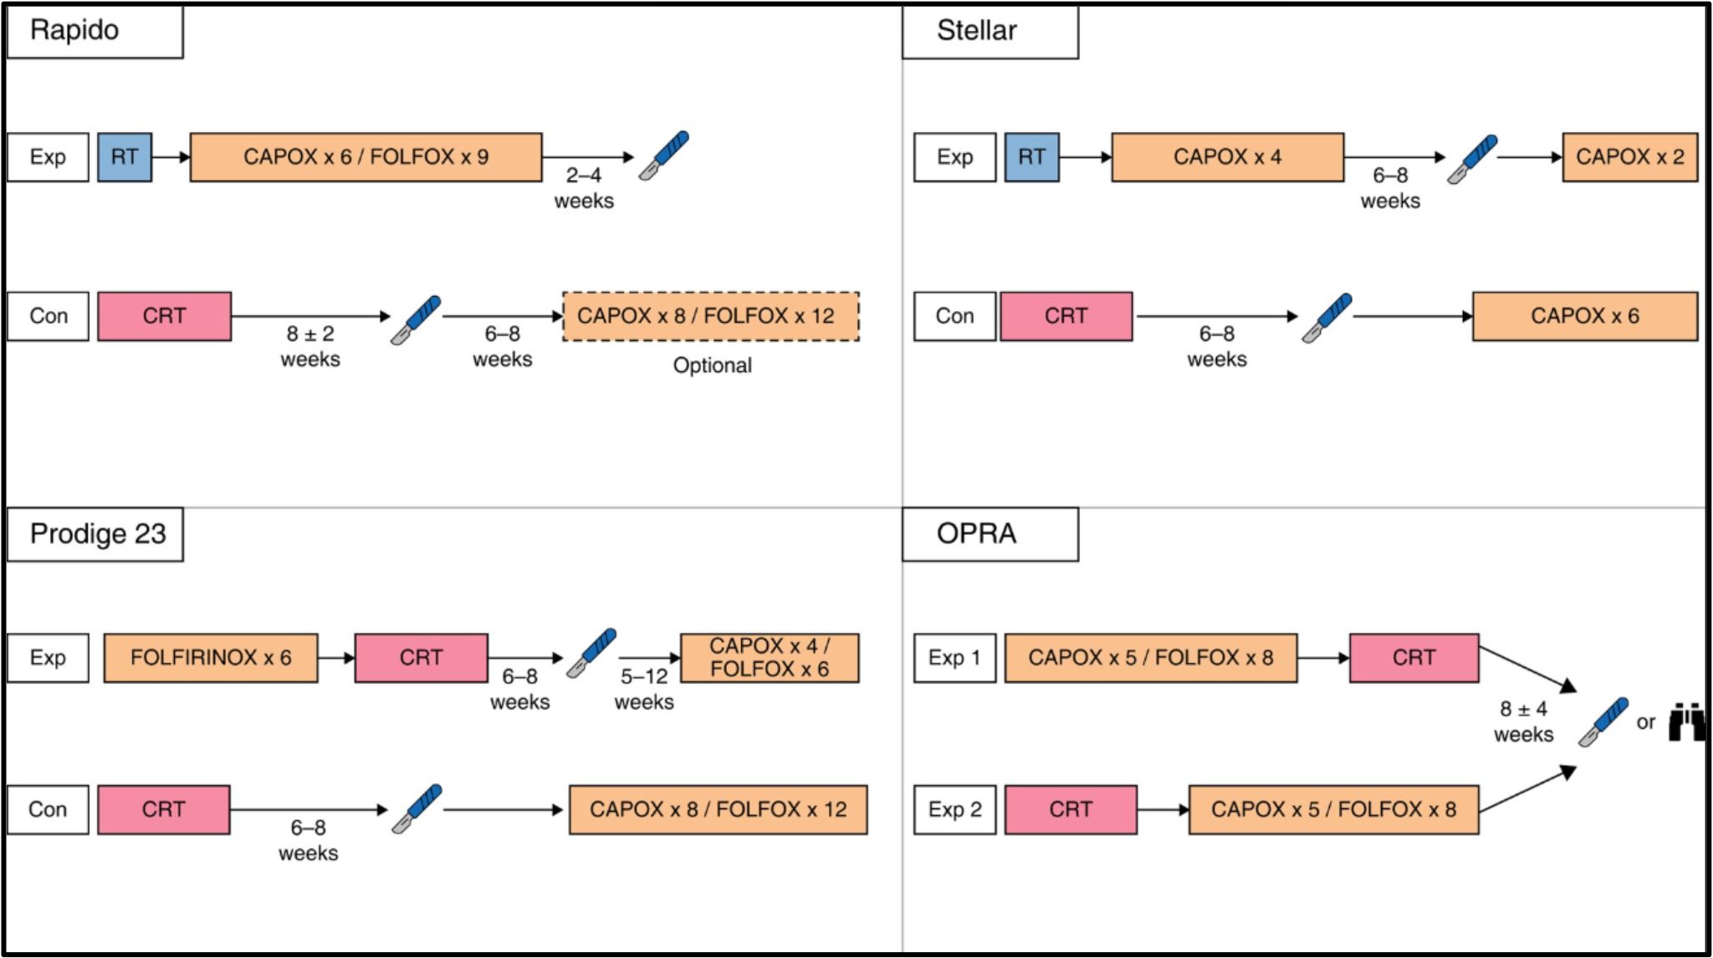
Locally advanced rectal cancer (LARC)
Total neoadjuvant treatment with chemotherapy and radiotherapy (TNT) is international standard of care to reduce local and distant recurrences
Multi-modal treatment is life-changing with risk of bladder, sexual, and bowel dysfunction, and risk of permanent stoma
If complete clinical response (cCR) is achieved, OPRA showed organ preservation is a viable option
No detriment in DFS c/w TME
Upfront CRT then consolidation chemo led to higher 3 year TME-free rates
Loco-regional failure – 11.7%
pCR rate = 28%
DFS = 76%
pCR rate = 17%
DFS = 65%
pCR rate = 28%
DFS = 76%
pCR rate = N/A
DFS = 76%
Loco-regional failure – 4%
Bahadoer, Lancet Oncol, 2021; Dijkstra, Ann Surg, 2023; Conroy, Lancet Oncol, 2021; Jin, J Clin Oncol, 2022; Garcia-Aguilar et al, JCO 2022

Slide 15
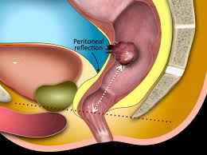
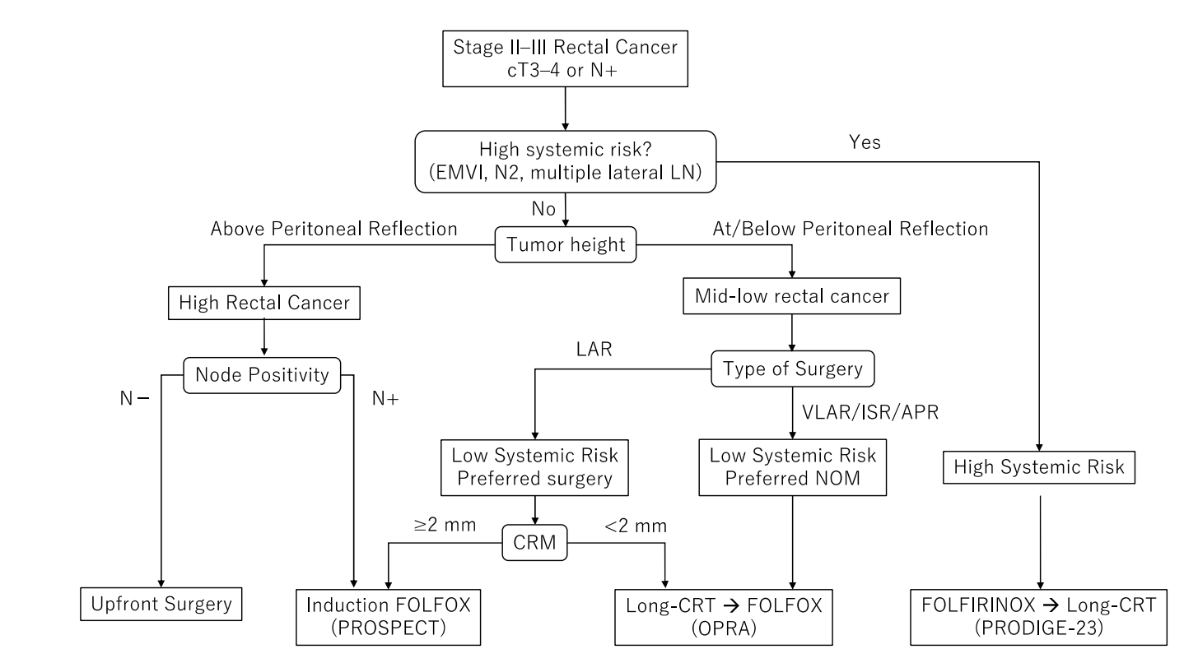
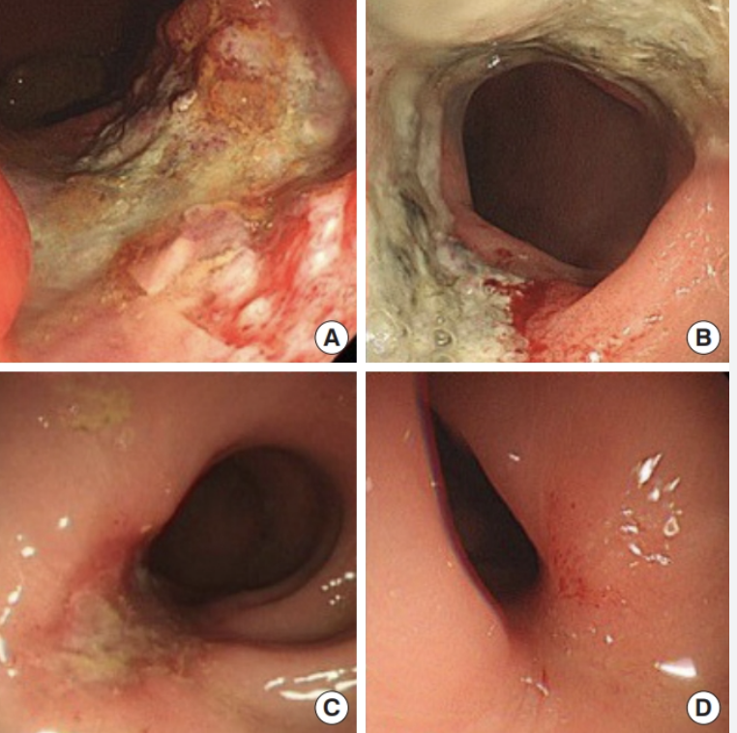

How do you select TNT strategy?
Anatomy
Treatment Intent
Biology/ local vs systemic risk
Ochiai, Cancers, 2024

Slide 16
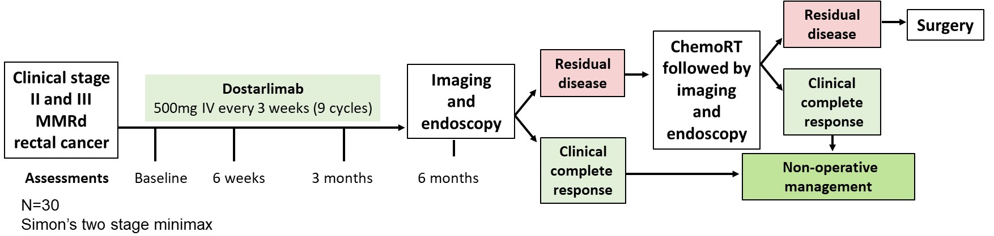
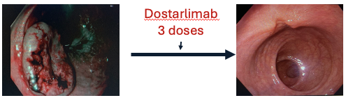
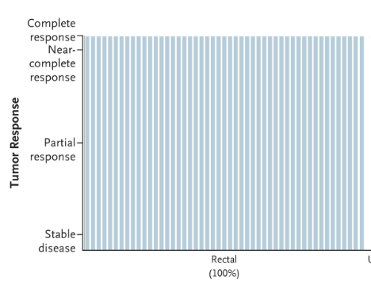

MSI-H Locally advanced rectal cancer: dostarlimab definitive treatment
49 dMMR rectal cancer
20% T4
49 cCR & proceeded to non-operative management
Median follow up for recurrence 30 months
RFS 92%
ctDNA became undetectable during neoadjuvant treatment in complete responders
Cercek et al. NEJM 2022; Cercek, NEJM, 2025

Slide 17
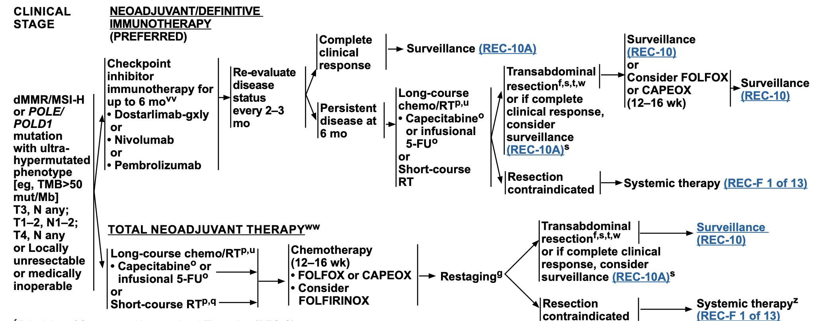
Does this data merit practice change?
49 patients
Single centre with world-leading expertise
Generalisability of patients?
BUT – rare population
Ethics of randomizing to SOC based upon current data
NCCN Rectal Cancer Guidelines, V0.2.2025

Slide 18
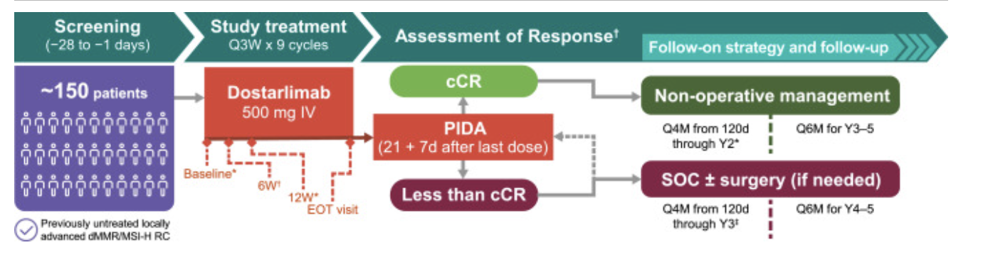
AZUR 1 – Global, single arm phase II registrational study
Cercek, Clin Colorectal Cancer, 2025

Slide 19
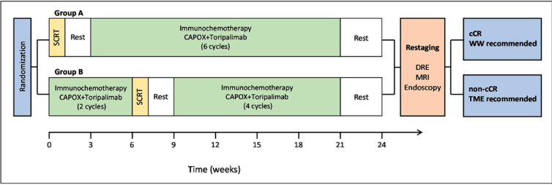
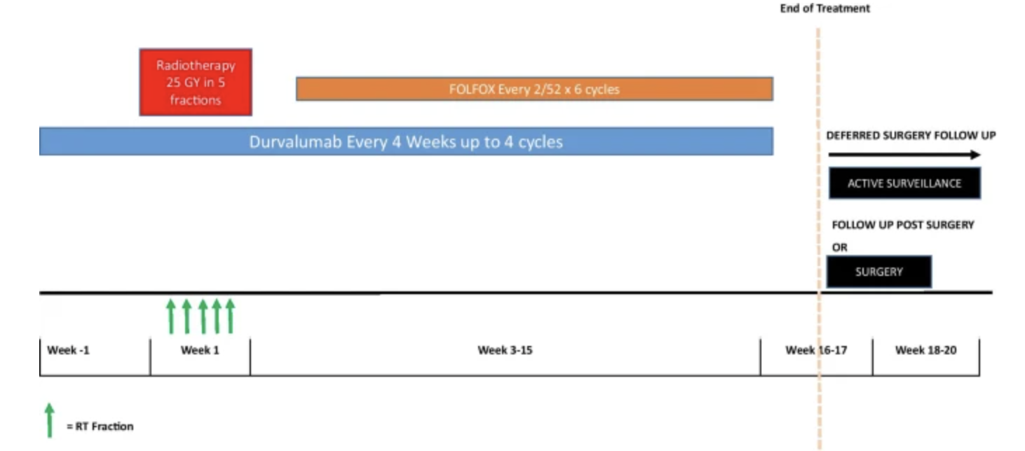
Neoadjuvant IO in MSS LARC
Historical control cCR rate of 25%
TORCH
121 MSS LARC patients
CR rate 56.5% in Arm A
CR rate 54.2% Arm B
15 pts in each group W & W strategy & remained disease free
PRIME-RT
46 MSS LARC patients
CR rate of 62% with SCRT
Xia, JCO, 2024; Roxburgh, ESTRO Meeting, 2025; Bach, ESTRO Meeting, 2025

Slide 20
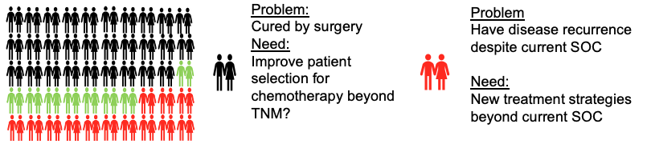
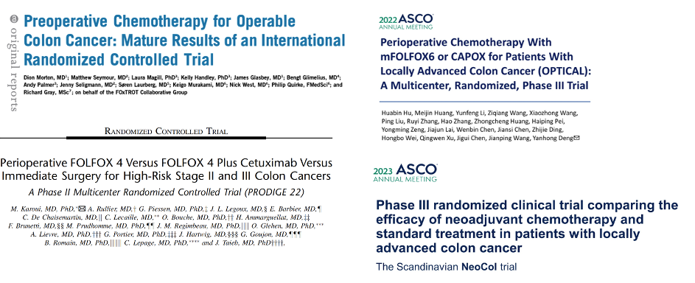
Neoadjuvant chemotherapy (NAC) for LACC
Design
Colon cancer
CT predicted T3-4, N0-2, M0
Fit for surgery and chemo
Not obstructed
Postop Pre&postop
Surgery
6 wks
OxFP
24 wks
OxFP
Surgery
18 wks
OxFP
Morton, J Clin Oncol, 2023

Slide 21
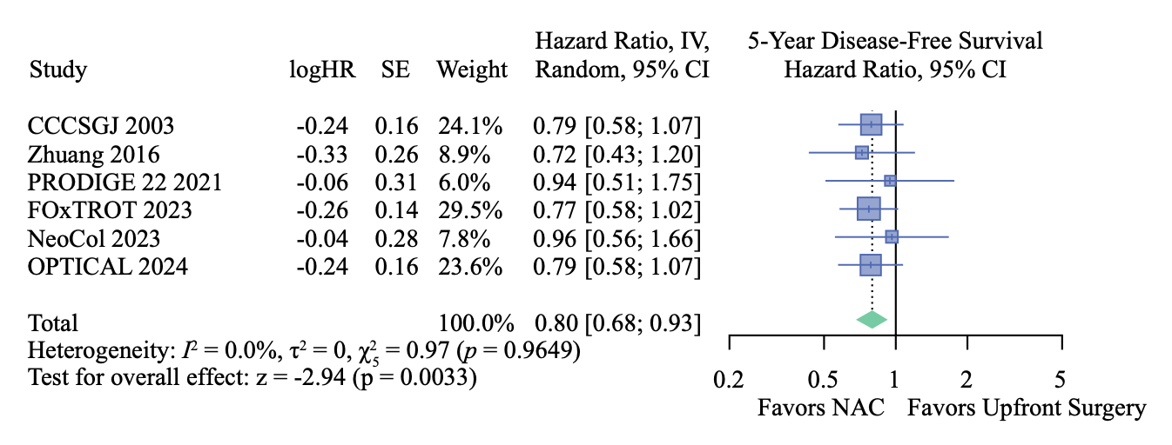
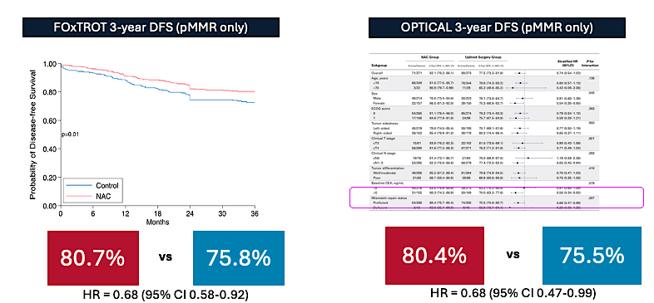
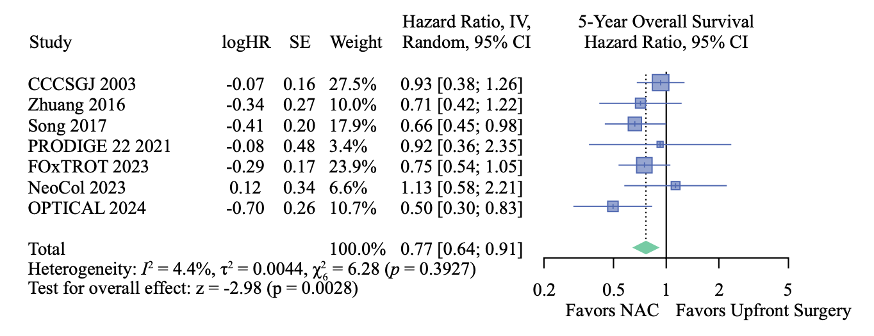
Meta-analysis of NAC in LACC
3038 patients included from 8 studies
Compared with upfront surgery, NAC:
Significant improvement in 5-year DFS (HR 0.80) and OS (HR 0.77)
Reduction in positive surgical margin (4.1% vs 6.3%, p<0.001)
Safety (during NAC & peri-operative) consistent amongst studies
Reduction in anastomotic leak (4.4% vs 5.7%, p=0.09)
20% reduction in recurrence
23% reduction in death
Jenny Seligmann
Sassun, Annals of Surgical Oncology, 2025

Slide 22
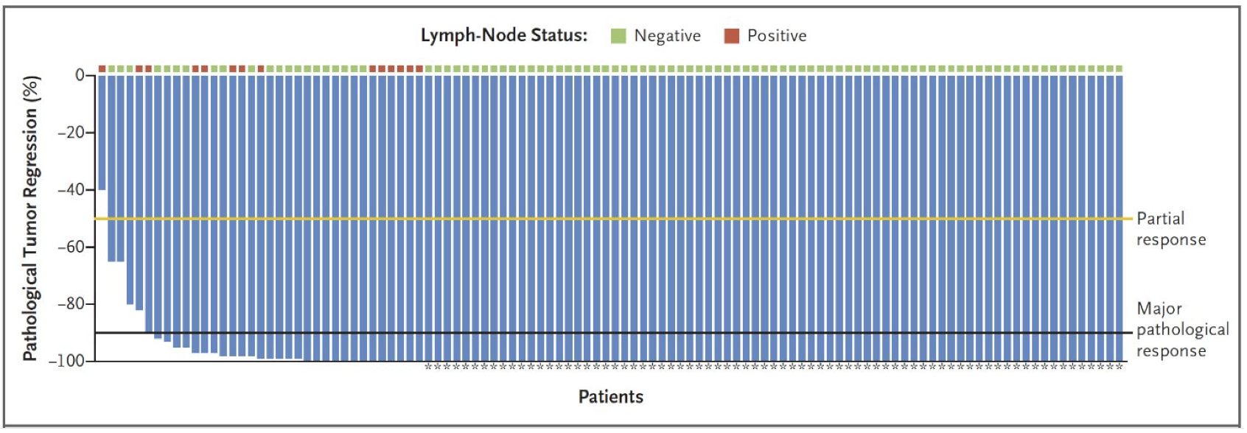
Neoadjuvant IO in MSI-H LACC
Study | Design | pCR rate
PICC (34) | Toripalimab +/- celecoxib (12 weeks) | 76.5%
Ludford (27) | Pembrolizumab (24 weeks) | 79%
NEOPRISM (32) | Pembrolizumab (9 weeks) | 53%
IMHOTEP | Pembrolizumab (6 weeks) | 46.0%
IMHOTEP | Pembrolizumab (12 weeks) | 68.2%
Xu et al | Sintilimab (4 weeks) | 47.7%
NICHE 2 (107) | Nivolimab + ipilimumab (4 weeks) | 68.0%
NICHE 3 (59) | Nivolumab +. Retalimab (4 weeks) | 68.0%
Xu et al | IBI310 + Sintilimab (4 weeks) | 80%
Kasi et al (4) | Botensilimab + balstilimab (4 weeks) | 100%
Safety and deliverability demonstrated
Consistent impressive efficacy
Over shorter treatment duration combination appears superior
Lesser difference in pCR if longer duration of anti-PD1 delivered
Heterogeneity in study designs limit definitive conclusions on optimal regimen
Xu, ASCO Meeting 2024; Shiu, ASCO Meeting 2024; Ludford, JCO, 2023; Hu, Lancet Gastro Hep, 2022; Cercek, ASCO Meeting 2024, Kasi, ASCO GI Meeting, 2024

Slide 23
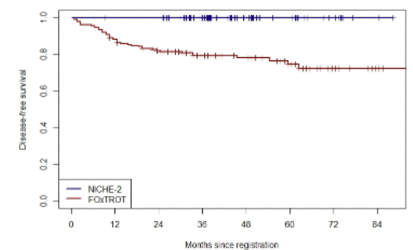
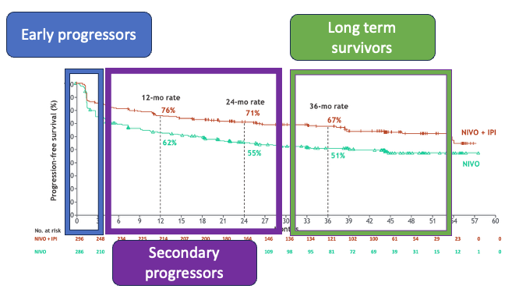
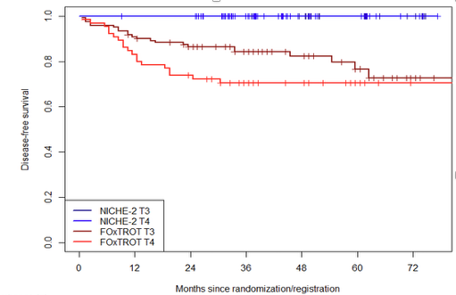
Do MSI-H LACC patients really need this approach?
Combined DFS analysis of NICHE-2 and FOxTROT dMMR patients
Heterogenous outcomes of treatment of metastatic MSI-H CRC
NICHE-2 vs FOxTROT DFS = 100% vs 80%, p<0.001%
DFS by T-stage:
T4 DFS = 100% vs 70%, p<0.001%
Jenny Seligmann
Seligmann, ESMO Congress, 2025; Andre, Lancet, 2025

Slide 24
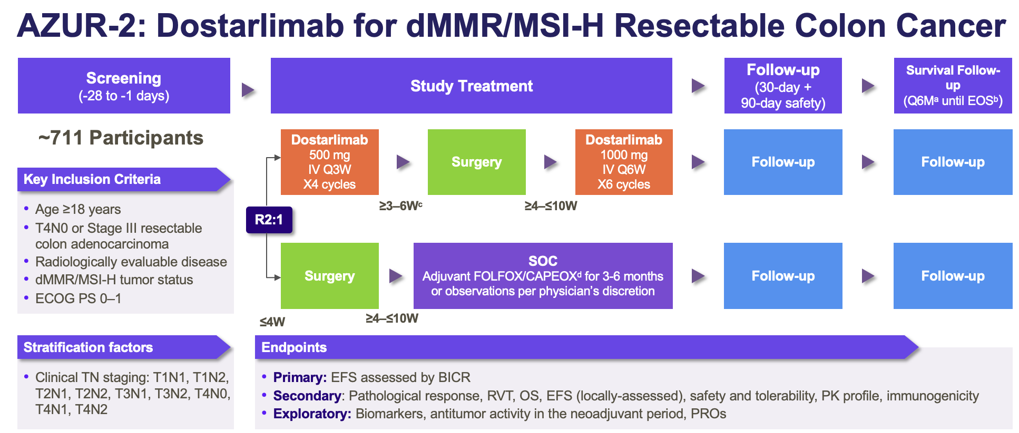
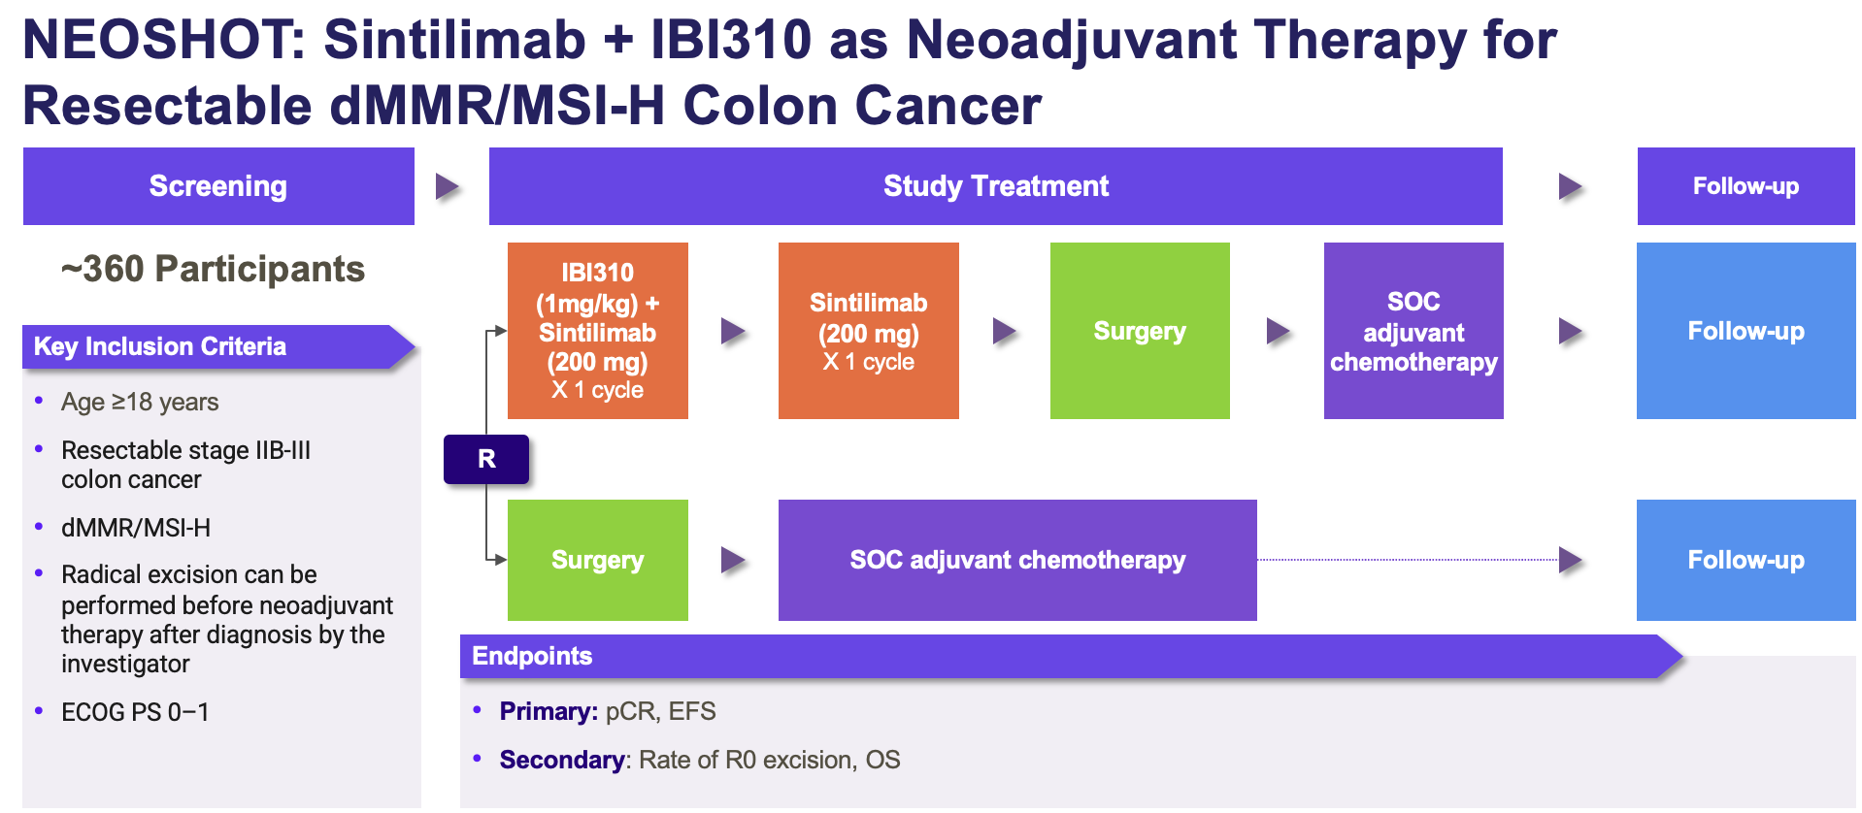
Has ATOMIC blasted out neoadjuvant IO in MSI-H ?
cT4 tumors
T3/ T4a tumors
What is needed for regulators?
High risk
Difficult to achieve R0 resection without multivisceral resection
What is the benefit compared with ATOMIC or observation?
Should be considered for neoadjuvant IO

Slide 25
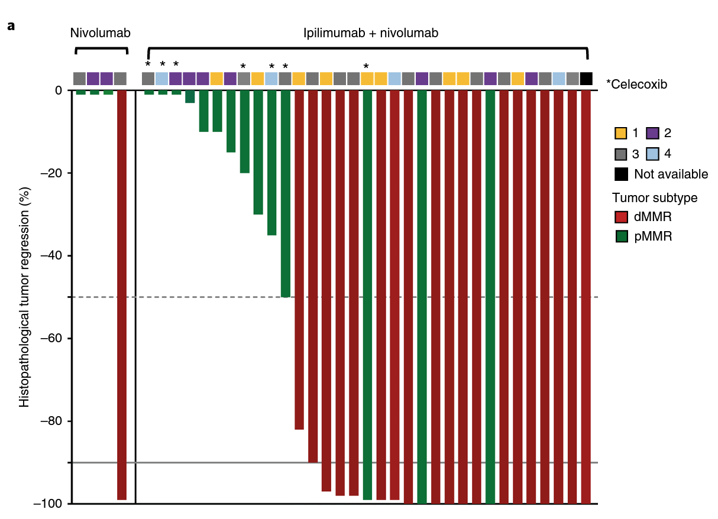
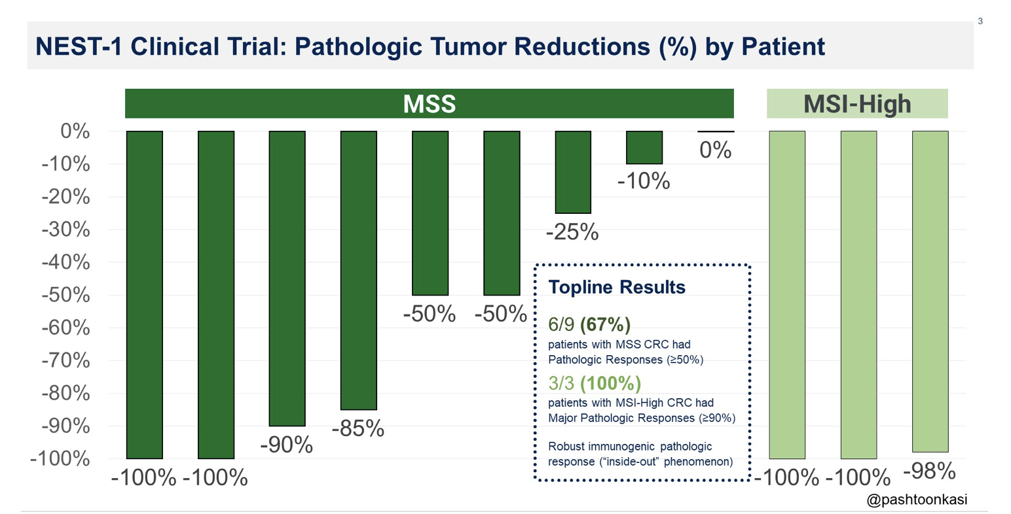
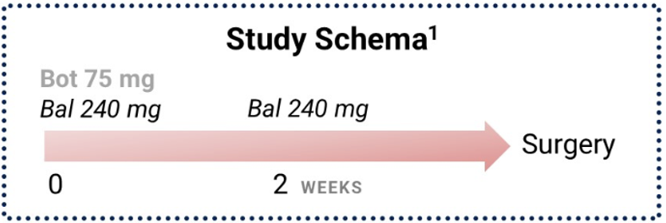
Neoadjuvant immunotherapy in MSS LACC
Initial data from 20 pMMR tumors in NICHE 1
4/15 pMMR tumors (27%) had path responses (3 MPRs, 1 PR, 0 CR)
NEST-1: Neoadjuvant Botensilimab and Balstilimab in LACC
Chalabi et al, Nature Medicine, 2020, Kasi, GI ASCO, 2024

Slide 26
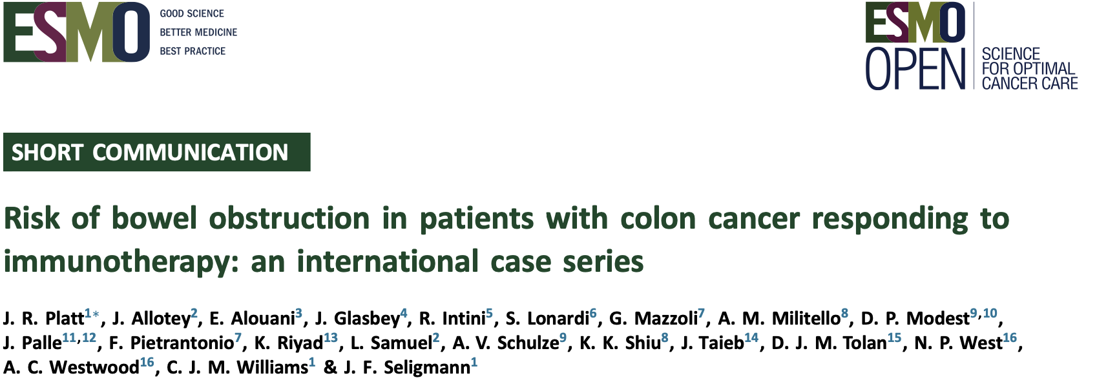
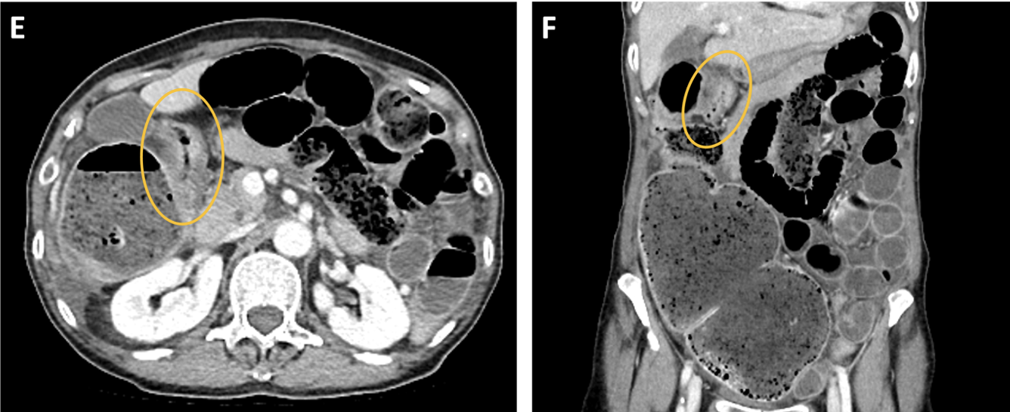
What is the magnitude of risk for emerging safety concerns for IO for locally advanced CRC?
Risk of grade 5 IO toxicity small but important risk.
Caution with baseline patient frailty
Risk of tumor related complications which are associated with good responses
Low grade endocrinopathies can mean life-long treatment
However, overall good tolerability & completion rates
De la Fouchardiere, ESMO Meeting 2024; Gooyer, ESMO Meeting 2024; Chalabi, ESMO Meeting 2024, Platt, ESMO Open 2024

Slide 27
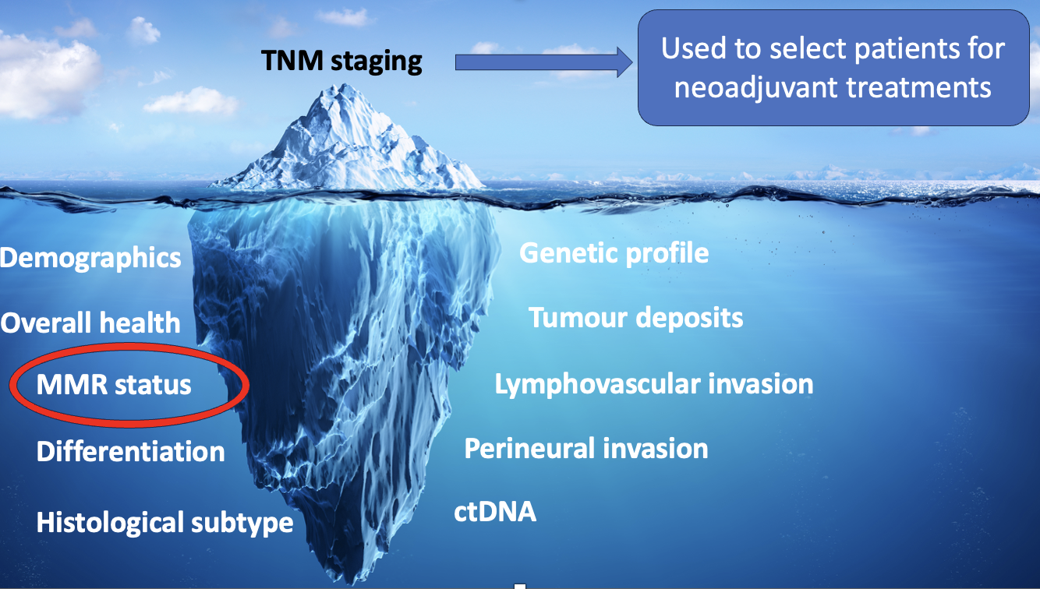
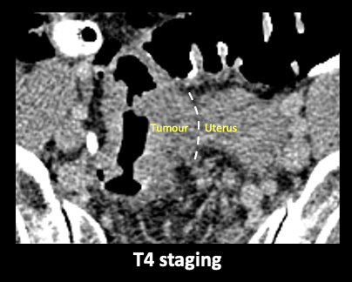
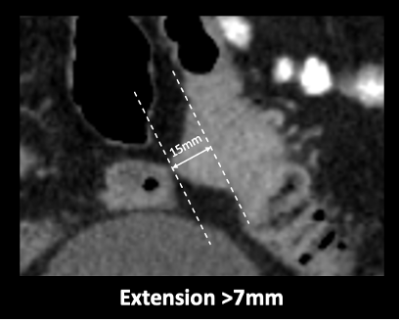
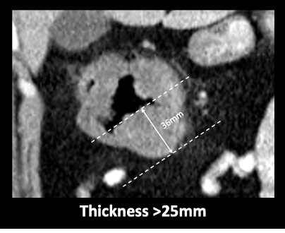
Patient selection & changing patient pathways
Patient selection for neoadjuvant treatments for both LACC and LARC could be improved
For colon cancer CT staging is possible
Radiological/ pathological correlation worse in dMMR than pMMR tumors
CT features identify high risk tumors at baseline, regardless of pathology
MSI/MMR testing pre-surgery is guideline endorsed
ctDNA may add to identification of the high risk patient at baseline
Radiology/ surgical engagement critical
Platt, ESMO Congress, 2024

Slide 28
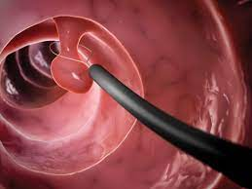

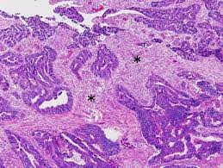

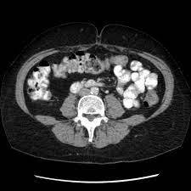
Decision points in the Treatment pathway
Pathway coordination
1
2
PATIENT CHOICE
MDT review of diagnosis & staging
MDT review of post-operative histology +/- MSI/MMR status
Assessment of post-rx response
Surgical resection
Adjuvant chemo
Follow up
Upfront MMR/MSI
Ability to review & treat rapidly
Informed & supportive surgical colleague
Radiology call on T & N stage

Slide 29
Conclusions
For locally advanced CRC knowledge of MSI/MMR status at baseline is important
Use of neoadjuvant IO can be transformative in MSI-H LARC; work on implementation required
Use of neoadjuvant IO should be recommended in the most advanced MSI-H LACC
Further evidence generation shall establish role compared with current SOC; long term data and biology supportive of neoadjuvant approach
Greatest future opportunity for neoadjuvant IO is with both MSS LARC and LACC
Neoadjuvant chemotherapy offers well evidenced improvements in long term outcomes compared with current SOC
Further development urgently required to identify the high risk patient at baseline and response assessment
The opportunity to cure more LACC patients requires implementation of new patient pathways and MDT collaborative working

Slide 30
Questions from General Medical Oncologists — Neoadjuvant Treatment for Localized Rectal Cancer
54 y/o man, Rectal adenocarcinoma, cT3N1, MSI-high/dMMR Comorbidities: Obesity, obstructive sleep apnea disease. Surgical team considering total neoadjuvant therapy; oncology considering neoadjuvant PD-1 inhibitor instead of chemoradiation. In locally advanced MSI-high CRC, when should neoadjuvant checkpoint inhibition replace chemotherapy or chemoradiation?

Slide 31
Questions from General Medical Oncologists — Neoadjuvant Treatment for Localized Rectal Cancer
A 62-year-old man with rectal bleeding and tenesmus. Colonoscopy reveals a low rectal mass 6 cm from the anal verge. Biopsy confirms adenocarcinoma. MRI pelvis: cT3N1 rectal cancer, threatening the mesorectal fascia. CT chest/abdomen: no distant metastases. Molecular testing: MSI-high/dMMR (loss of MLH1 and PMS2). Multidisciplinary team recommends neoadjuvant immune checkpoint inhibition. Duration of treatment? Dostarlimab administered every 3 weeks for 6 months? Any role for combo IO/IO? Monitoring (MRI and colonoscopy): What is the role of ctDNA and if negative, how frequently should it be reordered?

Slide 32
Questions from General Medical Oncologists — Neoadjuvant Treatment for Localized Rectal Cancer
53 y/o M with MSI-H rectal adenocarcinoma, clinical complete response to neoadjuvant dostarlimab. Surgery vs observation, what is the protocol to manage patients without surgery?
55 y/o man with no comorbidities with Stage IIIA rectal cancer, was given 12 weeks of neoadjuvant dostarlimab, achieved clinical CR. Would you recommend additional chemo/RT or only surgery?

Slide 33
Questions from General Medical Oncologists — Neoadjuvant Treatment for Localized Rectal Cancer
36 y/o M with Lynch syndrome and Crohn’s disease that is clinically quiescent, newly diagnosed Stage III rectal cancer. Is dostarlimab an option for a patient with Crohn’s disease that is not active?
55 y/o M with Stage 3 rectal cancer, found to be MSI-H. Has hx of RA with moderate control on biologic therapy. Would experts consider single-agent IO vs doublet? What are situations where singlet may be preferred?

Slide 34
Questions from General Medical Oncologists — Neoadjuvant Treatment for Localized Colon Cancer
44 yr old male with newly dx clinical Stage II MSI-high colon cancer is curious to see if he can get ICI alone and avoid surgery similar to rectal cancer. He is open to close monitoring with surveillance scopes, ctDNA and scans. Any data to show patients with MSI-high colon cancer can avoid chemotherapy? Role of ctDNA?
50 y/o, T4 Nx MSI-high colon cancer. Are CPI ready for prime time for neoadjuvant therapy for MSI-high locally advanced colon cancer? Role of ctDNA?

Slide 35
Questions from General Medical Oncologists — Neoadjuvant Treatment for Localized Colon Cancer
24 y/o F with T3N1 distal colon adenocarcinoma, MSI-H, with plan for neoadjuvant therapy followed by surgery. What immunotherapy combination (single vs dual agent) would you recommend?
A 39 y/o male with Stage IIIA, dMMR, RAS- right sided colon cancer, and pt strongly desired neoadjuvant tx approach after being told by surgeon that neoadjuvant tx can help out with surgery later on. Should I give nivo or pembro + FOLFOX, or should I advise dual ICI like nivo + ipi as neoadjuvant tx regimen?
62 y/o female with MSI-high right-sided large colon cancer causing near obstruction. Is neoadjuvant FOLFOX/nivolumab a good option?

Slide 36
Questions from General Medical Oncologists — Neoadjuvant Treatment for Localized Colon Cancer
85 y/o M (ECOG 1) with DM w/neuropathy, diabetic retinopathy, HTN, CKD, and T4N0 distal colon adenocarcinoma, MSI-H, with plan for neoadjuvant therapy followed by surgery. What immunotherapy combination (single vs dual agent) would you recommend given patient’s age and comorbidities?
85 yr old male with underlying controlled ulcerative colitis diagnosed with low sigmoid colon cancer and borderline surgical candidate. Would you treat a patient like this with IO with curative intent and try avoiding surgery?

Slide 37
Questions from General Medical Oncologists — Neoadjuvant Treatment for Localized Colon Cancer
56 yr old male with CRC, Lynch syndrome with 2 isolated liver mets. Any data for ICI such as atezo alone or with chemo prior to resection of oligo met? Any data to suggest chemo/IO is better than IO alone?

Slide 38
Agenda
Module 1: Neoadjuvant Treatment for Localized Colorectal Cancer (CRC) — Dr Seligmann
Module 2: Emerging Novel Approaches to Adjuvant Treatment for Localized CRC — Dr Lieu
Module 3: Role of Circulating Tumor DNA (ctDNA) Testing in Localized CRC — Dr Cohen

Slide 39



Emerging Novel Approaches to Adjuvant Treatment for Localized CRC
Christopher Lieu, MD Director, GI Medical Oncology
Associate Director for Clinical Research
University of Colorado

Slide 40
Topics for Discussion
Historical outcomes achieved with standard adjuvant chemotherapy for patients with localized CRC, including for those with MSI-H/dMMR disease
Addition of atezolizumab to FOLFOX chemotherapy for patients with Stage III CRC and dMMR tumors
Other ongoing trials evaluating immune checkpoint inhibitors as a component of adjuvant therapy for localized CRC

Slide 41
20+ FDA-Approved Regimens for Metastatic Colorectal Cancer
“Cytotoxics” Mechanism
1. 5-Fluorouracil (5-FU) -> pyrimidine analog
2. Capecitabine -> oral 5-FU pro-drug
3. TAS-102 -> 5-FU drug with metabolism inhibitor
4. Irinotecan -> topoisomerase I inhibitor
5. Oxaliplatin -> third-generation platinum
“Biologics/Targeted” Mechanism
1. Cetuximab -> antibody against EGFR
2. Panitumumab -> antibody against EGFR
3. Bevacizumab -> antibody against VEGF
4. Ziv-aflibercept -> VEGF trap
5. Ramucirumab -> antibody against VEGFR2
6. Ipilimumab -> antibody against CTLA-4 (MSI-high only)
7/8. Regorafenib/fruquintinib -> multi-tyrosine kinase inhibitors
9/10/11. Pembro/nivo/dostarlimab -> antibody against PD-1 (MSI-high only)
12. Encorafenib + cetuximab -> tyrosine kinase inhibitor against BRAF V600E
13. Tucatinib + trastuzumab -> HER2 tyrosine kinase inhibitor and antibody
14. Trastuzumab deruxtecan -> HER2 antibody-drug conjugate
15. Adagrasib + cetuximab -> KRAS G12C inhibitor
16. Sotorasib + cetuximab -> KRAS G12C inhibitor
EGFR, epidermal growth factor receptor; VEGF, vascular endothelial growth factor.

Slide 42
Only 3 FDA-Approved Drugs for Adjuvant Colorectal Cancer
“Cytotoxics” Mechanism
1. 5-Fluorouracil (5-FU) -> pyrimidine analog
2. capecitabine -> oral 5-FU pro-drug
3. TAS-102 -> 5-FU drug with metabolism inhibitor
4. irinotecan -> topoisomerase I inhibitor
5. oxaliplatin -> 3rd generation platinum
“Biologics/Targeted” Mechanism
1. cetuximab -> antibody against EGFR
2. panitumumab -> antibody against EGFR
3. bevacizumab -> antibody against VEGF
4. ziv-aflibercept -> VEGF trap
5. ramucirumab -> antibody against VEGFR2
6. regorafenib -> multi-tyrosine kinase inhibitor
7. ramucirumab -> antibody against VEGFR2
8/9. pembrolizumab/nivolumab -> antibody against PD-1 (MSI-high only)
10. ipilimumab -> antibody against CTLA-4 (MSI-high only)
11. encorafenib + cetuximab -> tyrosine kinase inhibitor against BRAF V600E

Slide 43
Adjuvant Therapy for Resected Primary
“MOSAIC” Trial
“LV5FU2” x 12
(infusional 5-FU/LV)
n = 2,246
Stage II/III colon CA
Primary endpoint:
3-yr disease free
survival (DFS)
“FOLFOX4” x 12
(infusional 5-FU/LV
with oxaliplatin)
Andre, NEJM 2004; Andre, JCO 2009

Slide 44
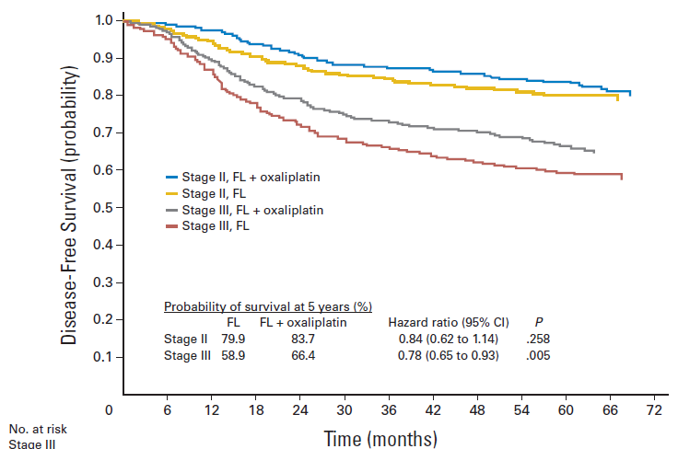
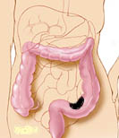
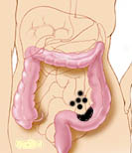
MOSAIC Trial: Disease-Free Survival
Stage II
Stage III
Andre, JCO 2009

Slide 45
MOSAIC:
Stage III Adjuvant FOLFOX
Study presented with > 5 years follow-up
6.6% DFS benefit maintained HR = 0.8, p = 0.003
Overall Survival 6 years | 5-FU | FOLFOX | p
Overall | 76% | 78.6% | 0.057
Stage II | 86.8% | 86.9% | 0.996
Stage III | 68.6% | 73% | 0.029
4.4% OS benefit in stage III

Slide 46
MSI-H in Colon Cancer: Prevalence and Prognosis
Stage | Prevalence | Prognosis Compared to MSS
II | 15%-20% | excellent
III | 8%-10% | same
IV | 4%-5% | same or worse
Hypermutated cancers too “deranged” to metastasize
Immune system can prevent spread
But once a metastatic clone has been selected, same or worse prognosis than microsatellite stable CRC
MSI-H, high levels of microsatellite instability; MSS, microsatellite stability.
The Cancer Genome Atlas, 2012.

Slide 47
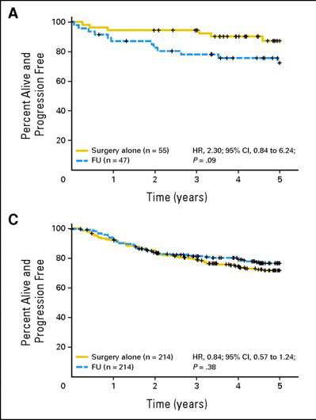
MSI-H (dMMR) and 5-FU in stage II colon cancer
Disease-free survival in patients with stage II disease and defective DNA mismatch repair (dMMR)
Patients did worse with chemo!
Disease-free survival in patients with stage II disease and proficient mismatch repair (pMMR)
No identifiable benefit with chemo and stage II disease
Sargent et al. J Clin Oncol 2010;28(20): 3219-3226.

Slide 48
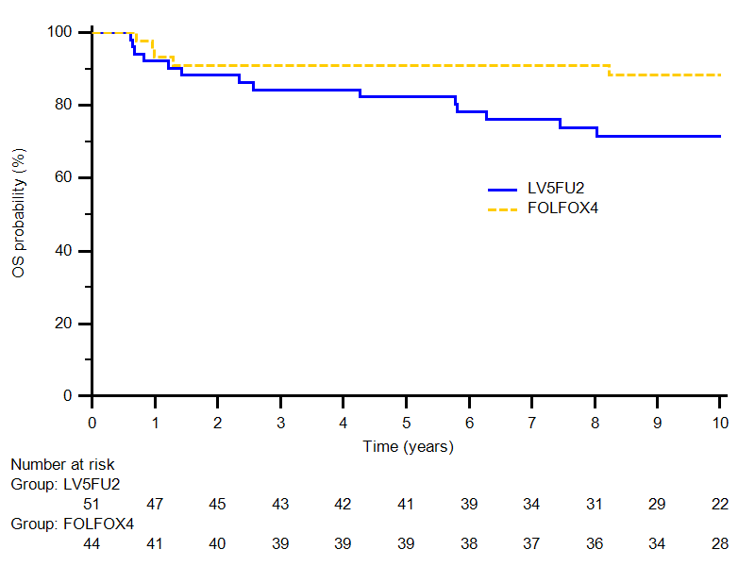
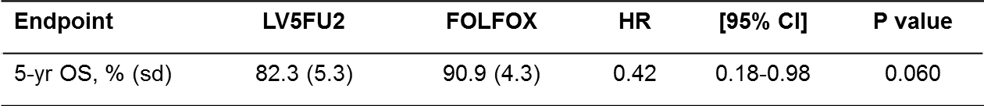
What about dMMR and FOLFOX for stage III CRC?
Although n < 100, data appear reassuring that patients with dMMR/MSI-H stage III derive the same benefit from the addition of oxaliplatin
(HR=0.42, p=.06)
Flejou et al. J Clin Oncol 31, 3524(2013

Slide 49
Exercise and Aspirin Making something old – new again!
What’s New in Adjuvant Colon Cancer?

Slide 50
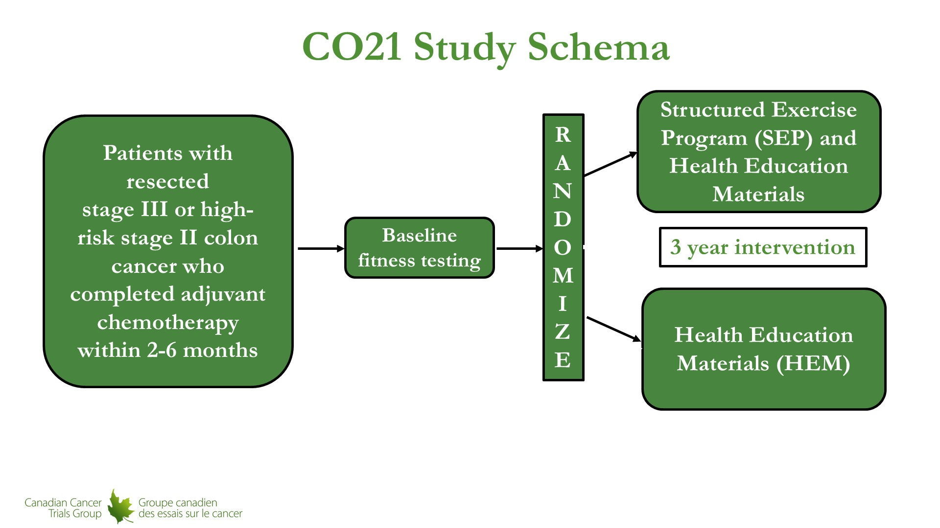
CO21 Study Schema
Courneya et al. N Engl J Med 2025;393:13-25

Slide 51
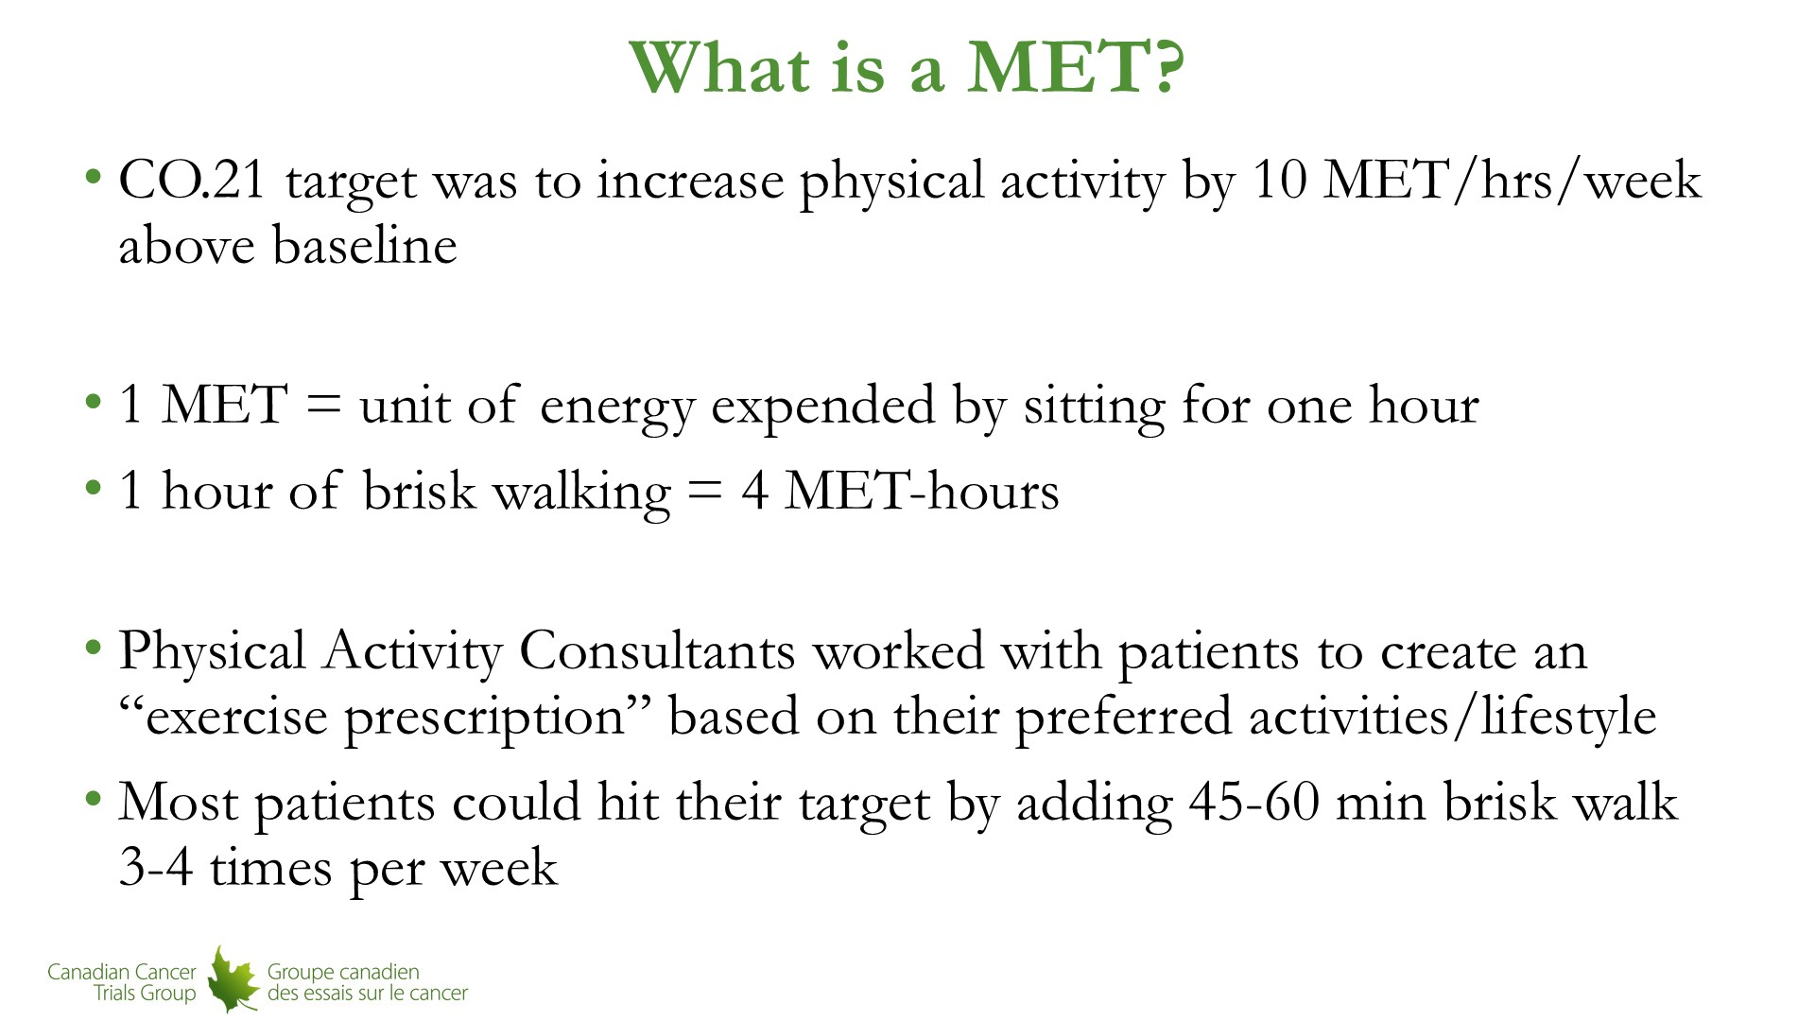
What is a MET?
Courneya et al. N Engl J Med 2025;393:13-25

Slide 52
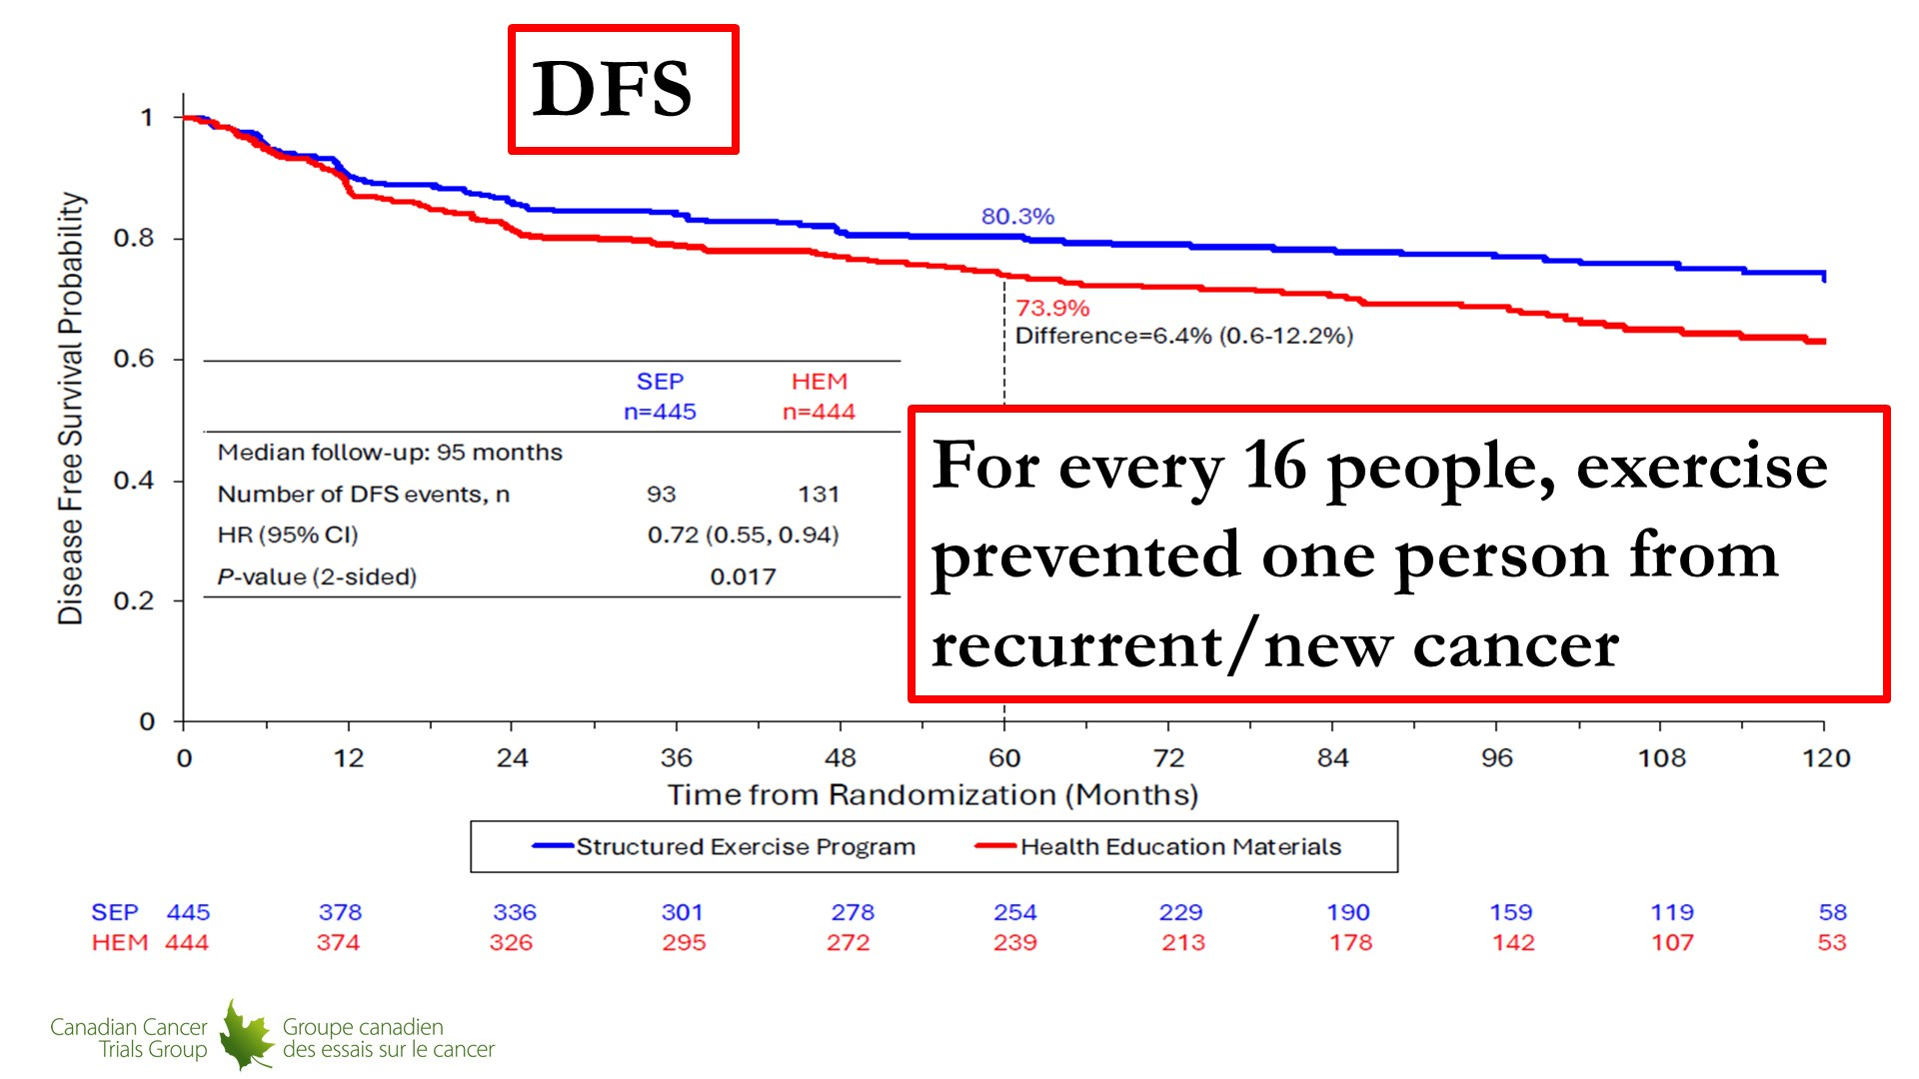
Slide 12
Courneya et al. N Engl J Med 2025;393:13-25

Slide 53
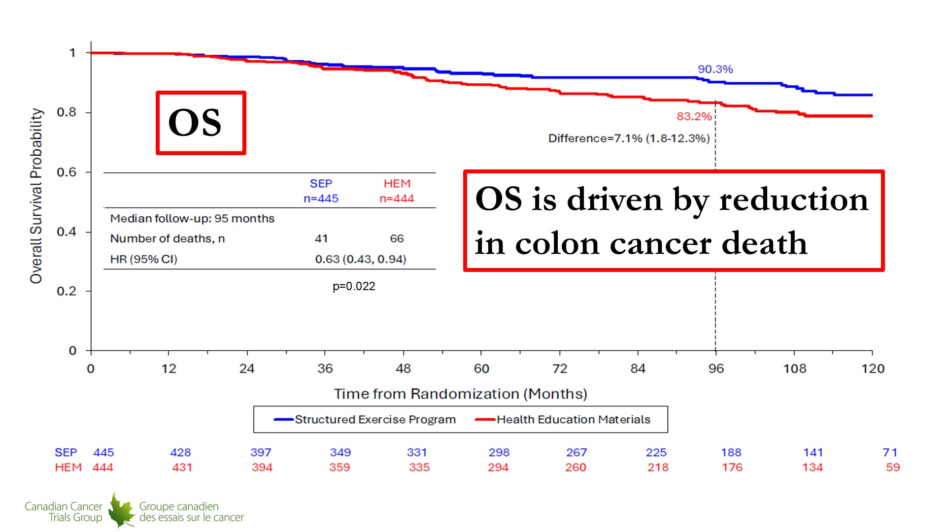
Slide 17
Courneya et al. N Engl J Med 2025;393:13-25

Slide 54
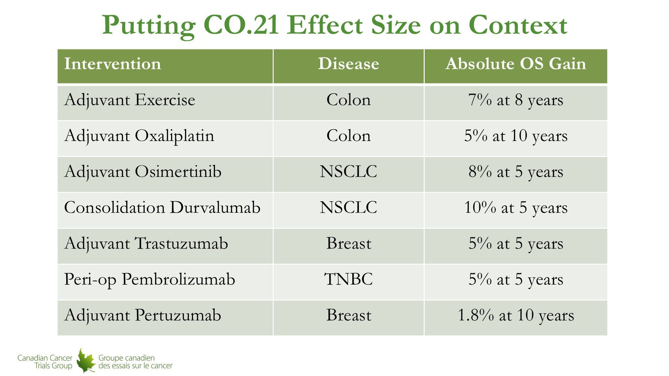
Putting CO.21 Effect Size on Context
Putting CO.21 Effect Size in Context
Courneya et al. N Engl J Med 2025;393:13-25

Slide 55
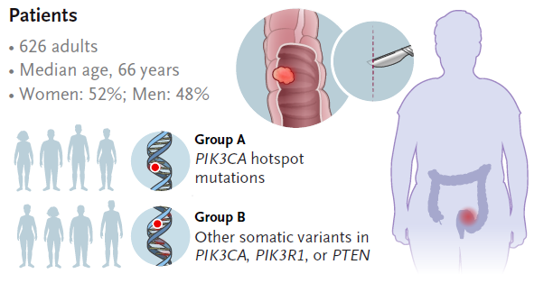
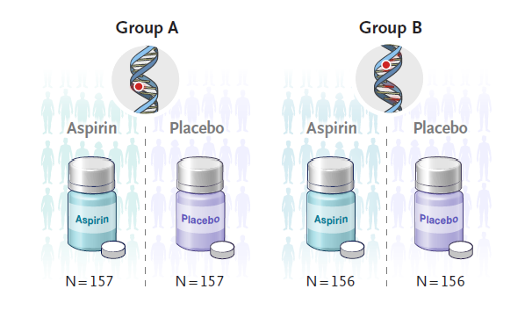
Aspirin and Colon Cancer Recurrence ALASSCA Study
Martling et al. N Engl J Med 2025;393:1051-1064

Slide 56
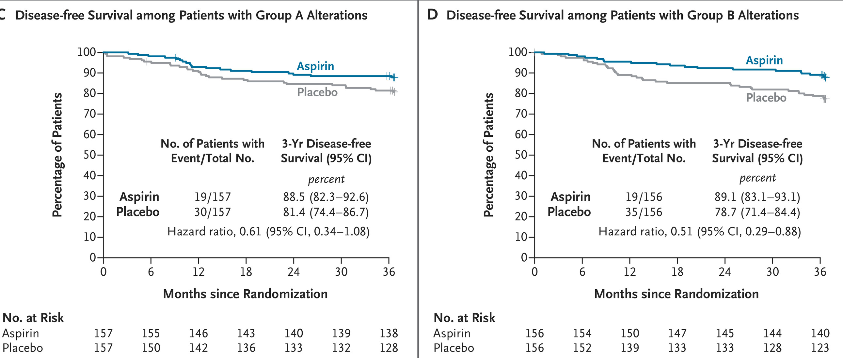
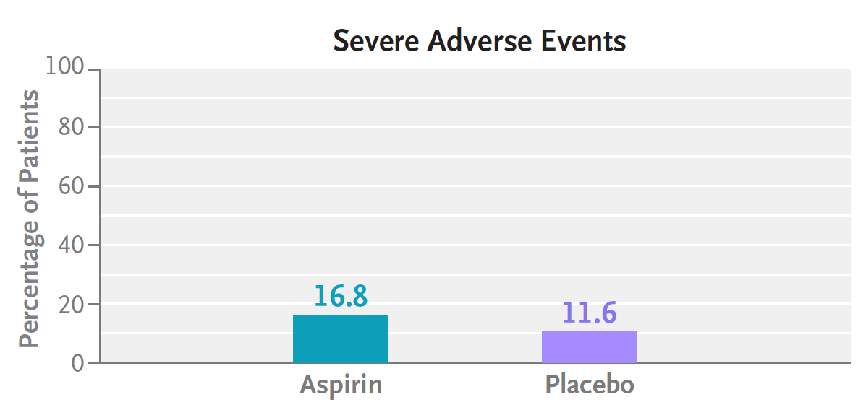
ALASSCA Study
Martling et al. N Engl J Med 2025;393:1051-1064

Slide 57

Take Home Points:
Exercise!
Aspirin should be given to patients with a PIK3CA mutation
QUESTIONS:
Should we be hiring more personal trainers and giving less oxaliplatin?
How many providers are testing for PIK3CA in early-stage CRC?
What is the optimal dose and duration of aspirin?
NCCN Colon Cancer Guidelines. Version 4.2025

Slide 58
Adjuvant Atezolizumab for dMMR/MSI-H
What’s New in Adjuvant Colon Cancer?

Slide 59

ATOMIC: addition of atezolizumab to standard chemotherapy for dMMR/MSI-H colon cancer
NCT02912559
Sinicrope et al. J Clin Oncol 43, 2025 (suppl 17; abstr LBA1)

Slide 60

Sinicrope et al. J Clin Oncol 43, 2025 (suppl 17; abstr LBA1)

Slide 61

Sinicrope et al. J Clin Oncol 43, 2025 (suppl 17; abstr LBA1)

Slide 62

DFS by Subgroups
Sinicrope et al. J Clin Oncol 43, 2025 (suppl 17; abstr LBA1)

Slide 63

Sinicrope et al. J Clin Oncol 43, 2025 (suppl 17; abstr LBA1)

Slide 64

Patient Safety
Sinicrope et al. J Clin Oncol 43, 2025 (suppl 17; abstr LBA1)

Slide 65

Immune-Related AEs
Sinicrope et al. J Clin Oncol 43, 2025 (suppl 17; abstr LBA1)

Slide 66

Take Home Points:
Neoadjuvant immune checkpoint inhibition should be considered for high-risk disease (T4b/bulky nodal disease) colon cancer
FOLFOX/atezolizumab is the new standard in patients not receiving neoadjuvant therapy
QUESTIONS:
Should we consider non-operative management for MSI-H/dMMR colon cancer?
Are serial colonoscopies better or worse than a hemicolectomy?
What is the best duration of immunotherapy after resection?
Is there a role for immunotherapy in pMMR/MSS colon cancer?
NCCN Colon Cancer Guidelines. Version 4.2025

Slide 67
Ongoing immunotherapy trials
What’s New in Adjuvant Colon Cancer?

Slide 68

AZUR-4: randomized study of neoadjuvant dostarlimab plus CAPEOX vs CAPEOX in untreated T4N0 or stage III in pMMR/MSS colon cancer
Primary Endpoints:
Major pathological response (≤ 10% residual viable tumor)
Safety
Secondary Endpoints:
Primary tumor resection exclusion
Pathological response
Rasschaert et al. 2025 ASCO Annual Meeting

Slide 69


A Phase II Clinical Trial Comparing the Efficacy of RO7198457 Versus Watchful Waiting in Patients With ctDNA‑positive, Resected Stage II (High Risk) and Stage III Colorectal Cancer RO7198457 (BNT122) = Personalized mRNA Cancer Vaccine
Key Eligibility Criteria:
Stage II/Stage III rectal cancer or Stage II (high risk)/Stage III colon cancer
Patients must have detectable ctDNA prior to start of adjuvant chemotherapy
Primary Endpoint: Disease Free Survival
Estimated enrollment = 327
CRCMRD.COM
https://crcmrd.com/?avada_portfolio=biontech

Slide 70
Questions from General Medical Oncologists — Adjuvant Treatment for Localized CRC
58-year-old male. Resected colon adenocarcinoma, Stage IIIA. MSI-H, BRAFV600E. Type 2 DM, peripheral neuropathy. Given CAPEOX and atezo. Which clinicopathologic features (ex: T stage, nodal burden, LVI, BRAF status) most strongly influence your recommendation for adjuvant treatment in MSI-high disease?
66 y/o M with Stage IIIb colon ca, MSI-high, ctDNA negative. What is the optimal adjuvant chemo? FOLFOX + nivolumab? Role of ctDNA?

Slide 71
Questions from General Medical Oncologists — Adjuvant Treatment for Localized CRC
71 yr old female with uncontrolled diabetes mellitus and grade 2 neuropathy at baseline has Stage III sigmoid cancer with 6 positive nodes. Tumor is MSI-H. One month post-op ctDNA is negative. Are there any situations where you would completely skip adjuvant chemotherapy and give only immunotherapy? If ctDNA is positive in this patient but tumor is MSI-high, would you still feel comfortable in proceeding with immunotherapy only?

Slide 72
Questions from General Medical Oncologists — Adjuvant Treatment for Localized CRC
82 y/o with DM, CAD, asthma with Stage III MSI-H colon cancer. Post op ctDNA negative. I do not offer patients with Stage III MSI-H colon cancer adjuvant therapy if ctDNA is negative, especially if older than 70. I do not think it is beneficial. I wait for them to have metastatic disease and treat with ICI. Curiously, in the 6 years since I’ve been doing this, none has had disease progression. Is this a reasonable practice?

Slide 73
Questions from General Medical Oncologists — Adjuvant Treatment for Localized CRC
Has any other ICI other than atezo been studied in combination with chemotherapy in colon cancer in adjuvant setting?
Management of 55 yo man with POLE mutation and oligometastatic disease to the lung, s/p resection? Management of localized and metastatic POLE mutant disease?

Slide 74
Questions from General Medical Oncologists — Adjuvant Treatment for Localized CRC
92 yr old female with Stage IIIc colon cancer status post surgery with 15 positive LN and positive ctDNA. Would you treat with single agent IO due to advanced age and if so for how long?
83 yo female stage 3 MSI-high CRC. Would you offer CPI to an 83-year-old?

Slide 75
Questions from General Medical Oncologists — Adjuvant Treatment for Localized CRC
55 yr old male with end stage renal disease in dialysis diagnosed with Stage IIIb colon cancer and baseline grade 2 peripheral neuropathy. Would you treat this patient with 5-FU and IO without oxaliplatin?
77 y/o with COPD, oxygen-dependent, diagnosed with Stage III colon cancer, post-op ctDNA negative. Is there a rationale for treating MSI-H colon cancer with adjuvant fluoropyrimidines (since it is inherently resistant)?

Slide 76
Questions from General Medical Oncologists — Adjuvant Treatment for Localized CRC
37 yr old male with newly diagnosed Stage III colon cancer, wants to be aggressive with treatment and is interested in considering immunotherapy. He asks if we can skip chemotherapy if his ctDNA remains negative. He does want benefit of immunotherapy maintenance. Based on the ATOMIC trial, for a young patient who wants to be aggressive would you give atezo with chemo? If ctDNA remains negative in the post op period at 1 mo and 3 mo, would you skip additional chemotherapy and continue only with immunotherapy?

Slide 77
Questions from General Medical Oncologists — Adjuvant Treatment for Localized CRC
Age/Sex: 62/M Diagnosis/stage: Colon adenocarcinoma, Stage III (pT3N2a), dMMR/MSI-H, BRAF WT. Comorbidities: Rheumatoid arthritis on low-dose prednisone + methotrexate (immune-toxicity risk), obesity. Post-op discussion: standard FOLFOX/CAPOX recommended; patient is very hesitant about neuropathy and asks about “immunotherapy instead.” For MSI-H Stage III, what is the current best practice: standard adjuvant oxaliplatin-based chemo, clinical trials of PD-1, or ctDNA-guided escalation/ de-escalation — how do you counsel?

Slide 78
Questions from General Medical Oncologists — Adjuvant Treatment for Localized CRC
53 yr old man with Stage II T4N0, contemplating adjuvant therapy. Any role for IO therapy in Stage II high-risk? ctDNA role here?
A 43 y/o female with Stage IIc, dMMR and positive liquid Bx, ctDNA+ after surgery; pt desired no chemo regimen be given adjuvantly. In this unique case, can I give nivo or pembro alone as adjuvant tx regimen? If so, for how long?
I have a 51 yo man with comorbidities of HTN and Stage IIA MSI-H colon cancer, s/p hemicolectomy, ctDNA negative. Would you offer adjuvant immunotherapy?

Slide 79
Questions from General Medical Oncologists — Adjuvant Treatment for Localized CRC
72 yo F, resected colon adenocarcinoma Stage II (T4aN0). MSI-H, BRAF wt, CAD. CKD stage 3. Observation. If adjuvant chemotherapy is chosen, do you modify regimen selection or duration (ex: 3 vs 6 months) specifically for MSI-high tumors?
56 yo F with right side pT4N0 colon cancer, MSI-high, ctDNA positive. What would be a good adjuvant regimen? Adjuvant therapy is usually not indicated for right-sided MSI-high Stage II colon cancer, but pT4 carries higher risks of occult peritoneal disease, and ctDNA is positive.

Slide 80
Agenda
Module 1: Neoadjuvant Treatment for Localized Colorectal Cancer (CRC) — Dr Seligmann
Module 2: Emerging Novel Approaches to Adjuvant Treatment for Localized CRC — Dr Lieu
Module 3: Role of Circulating Tumor DNA (ctDNA) Testing in Localized CRC — Dr Cohen

Slide 81
MODULE 3: Role of Circulating Tumor DNA (ctDNA) Testing in Localized CRC
Stacey A. Cohen, MD
Professor, Fred Hutchinson Cancer Center &
University of Washington

Slide 82
State of the data on ctDNA in colorectal cancer
ctDNA as a biomarker
Improved technology
Retrospective studies
Large observational cohorts
Prospective trials

Slide 83

Defining circulating tumor DNA (ctDNA)
ctDNA is a putative biomarker for disease activity
Low levels of cell-free DNA (cfDNA) can be detected even in the plasma of healthy individuals (1-10 ng/ml)
ctDNA = detecting mutations in cfDNA that are highly specific for cancer
Differences in genetic, epigenetic alterations
Different fragment sizes
Half-life: <2 hours
May fluctuate after trauma (surgery), chemotherapy
Gianni, Int J Mol Sci 2022

Slide 84

Tumor-informed vs tumor agnostic
Tumor-informed vs. tumor-uninformed (a.k.a. tumor-naïve, plasma only)
Blood results typically return in 7-14 days
Tumor-informed approaches may be more sensitive for MRD
Longer turnaround time for initial test result (~4-6 weeks)
Rolfo, Nat Rev Clin Oncol 2020

Slide 85
Longitudinal collection may overcome assay limitations
Repeat testing can increase sensitivity
Detection is cancer tumor burden dependent
Longitudinal testing can overcome extremely low-level disease
Rate of increase (e.g., doubling time) can be informative
Cohen, Nature 2023

Slide 86
Minimal/molecular residual disease (MRD)
MRD = small volume disease not appreciated radiographically or with other clinical measures
Hypothesis: ctDNA can pick up recurrences faster than would be detected radiographically or by other blood-based assays (ex. CEA)
Analyses have largely been retrospective and observational, but with emerging prospective data

Slide 87
State of the data on ctDNA in colorectal cancer
ctDNA
Improved technology
Retrospective studies
Large observational cohorts
GALAXY
BESPOKE
INTERCEPT
Prospective trials

Slide 88

CIRCULATE-Japan: GALAXY sub-study
n=6061 → 2240 with stage 2/3
Kotani, GI ASCO 2022; Nakamura Nat Med 2024

Slide 89

BESPOKE
n=1780 → 1166 with stage 2/3
Shah, ASCO GI 2025

Slide 90

ctDNA is a strong prognostic risk factor
Emerging data with both tumor-informed (LEFT) and tumor-agnostic (RIGHT) platforms
RFS by ctDNA status after surgery
ctDNA negative
ctDNA negative
HR 12.1
HR 11.2
ctDNA positive
ctDNA positive
15% ctDNA+; recurrence 60 vs. 7%
18% ctDNA+; recurrence 100 vs. 24%
Kasi, GI ASCO 2024; Parikh, Clin Can Res 2021

Slide 91


Longitudinal ctDNA clearance patterns are prognostic
GALAXY (Japan) and BESPOKE (USA) studies
Nakamura, Nat Med 2024; Kasi, GI ASCO 2024

Slide 92



ctDNA+ as a real-time predictor of metastasis
MDACC INTERCEPT study: n=1115 stage 2-4 with ctDNA evaluation after surgery
184 ctDNA+ during surveillance
Median lead time: 3 mo
Excluding concomitant relapse: 5.6 mo
Dasari, ASCO 2023; Maddalena, GI ASCO 2024

Slide 93
State of the data on ctDNA in colorectal cancer
ctDNA
Improved technology
Retrospective studies
Large observational cohorts
Prospective trials
Adjuvant: DYNAMIC, COBRA, DYNAMIC-III
Post-adjuvant: ALTAIR

Slide 94

DYNAMIC study
Prospective study randomizing resected stage II colon cancer 2:1 to ctDNA-guided management
40% were clinical high risk
20% were MSI-H
Primary endpoint:
2-year RFS
Tie, ASCO 2024; Tie, New Engl J Med 2022

Slide 95



DYNAMIC: recurrence-free survival
Non-inferior outcomes, despite differences in chemotherapy receipt
Recurrence-free survival
Chemo does not always “fix” ctDNA+
Tie, ASCO 2024; New Engl J Med 2022

Slide 96


COBRA
Stage IIA (T3N0) colon cancer
Using a (now older) tumor-naïve assay
6% ctDNA positive
43% spontaneously cleared in the observation arm (perhaps below the limit of the assay??)
11% cleared in the chemotherapy arm
Trial stopped early for futility (due to assay issues??)
Morris, GI ASCO 2024

Slide 97

DYNAMIC-III study
Prospective study randomizing resected stage III colon cancer 2:1 to ctDNA-guided management
Tie, ASCO 2025; Tie, Nat Med 2025

Slide 98


DYNAMIC-III: Recurrence-free survival
Improved outcomes with standard management
RFS: ctDNA-negative
RFS: ctDNA-positive
….Is it the assay? Cohort heterogeneity? Specific regimen?
Tie, Nat Med 2025

Slide 99

CIRCULATE-North America
Dasari et al. ASCO 2025;Abstract TPS3644.

Slide 100


ALTAIR
Post-adjuvant study
N=243, stage 2-4
36% had neoadjuvant chemo, 46% had adjuvant
Early data suggests a negative study
Bando, GI ASCO 2025

Slide 101
State of the data on ctDNA in colorectal cancer
ctDNA
Improved technology
Retrospective analyses
Survivorship: ALASCCA, 80702
Large observational cohorts
Prospective trials

Slide 102


ALASCCA
Prospective study of adjuvant 160mg aspirin vs placebo x 3 years for localized PI3Kmut CRC
Fuchs, J Clin Oncol 2013; Martling, New Engl J Med 2025

Slide 103


CALGB/SWOG 80702
Post-hoc analysis of this stage 3 adjuvant 3 vs 6 mo chemotherapy trial
Patients were additionally randomized to 3 years of celecoxib or placebo
ctDNA remains associated with poor prognosis
Benefit of celecoxib seems to be in the ctDNA+ patients, even when restricting to PIK3CA-mut (22%)
Nowak, GI ASCO 2025; Zhang, JAMA Oncol 2025

Slide 104
State of the data on ctDNA in colorectal cancer
ctDNA
Improved technology
Genetic changes
Epigenetics
Fragmentomics
Retrospective studies
Large observational cohorts
Prospective trials

Slide 105
ctDNA is not static, it is a technology
Ongoing and future developments
Discrete number of variants per patient (e.g., 16) → increased panel sizes
Depth and breadth of sequencing (Whole exome → whole genome)
Inclusion/improvement of epigenetics
Especially relevant for tumor-agnostic assays
Better cancellation of background “noise” (e.g., CHiP)
Binary reporting (positive/negative) → quantitative trending → evaluations of fold differences as a biomarker

Slide 106

Is ctDNA the future? Most likely in some capacity
Dasari, Nat Rev Clin Oncol 2020; Cohen, Nature 2023

Slide 107
Questions from General Medical Oncologists — Role of ctDNA Testing in Localized CRC
65 y/o with Stage II colon cancer – how comfortable are we in recommending chemo for Stage II colon cancer if MRD positive?
Stage IIb CRC adjuvant: preferred choice between available ctDNA testing platforms? Practicality of waiting for testing results?

Slide 108
Questions from General Medical Oncologists — Role of ctDNA Testing in Localized CRC
A 58-year-old man undergoes right hemicolectomy for colon cancer. Pathology: pT3N0 (Stage II) adenocarcinoma, moderately differentiated, no LVI. Adequate nodal sampling (18 nodes). MMR proficient (MSS). Traditional risk assessment: Clinically low–intermediate risk. Adjuvant chemotherapy would typically be optional or omitted. ctDNA performed 4 weeks post-op and was MRD-positive. Clinical dilemma: Standard clinicopathologic features suggest observation, MRD positivity implies high risk of recurrence. How do you approach low clinical risk patients, do you check ctDNA on everyone?

Slide 109
Questions from General Medical Oncologists — Role of ctDNA Testing in Localized CRC
72 yr old female with standard risk Stage IIIb colon cancer and ctDNA negative. If a patient would prefer not to receive chemotherapy do you think it’s a reasonable option to omit chemo if MRD tests are negative?
55 y/o female pt with Stage IIIA left-sided colon cancer, with only 1/16 LNs +, pt strongly wants MRD testing to decide adjuvant chemotherapy. Is it okay to go by ctDNA test result to guide FOLFOX adjuvant chemo in this pt’s case?

Slide 110
Questions from General Medical Oncologists — Role of ctDNA Testing in Localized CRC
58 y/o F with DM neuropathy and Stage II colon cancer with high Oncotype DX® Recurrence Score®, ctDNA for MRD is negative. Is it safe to omit adjuvant therapy in this pt?
68 y/o M with L-sided colon cancer s/p hemicolectomy, about to start adjuvant FOLFOX and initial ctDNA testing positive. Should positive ctDNA test at initiation of adjuvant therapy affect aggressiveness or duration of therapy?

Slide 111
Questions from General Medical Oncologists — Role of ctDNA Testing in Localized CRC
82F with hypothyroidism, DM, HTN, CAD, and T3N2 colon cancer s/p surgery, recommendation is for adjuvant chemotherapy. Patient is worried about chemo toxicities and functional decline. Would MRD assay results help you with treatment duration decision-making?

Slide 112
Questions from General Medical Oncologists — Role of ctDNA Testing in Localized CRC
68 y/o with Stage III MSI-H rectal cancer treated with 6 months of dostarlimab and achieves clinical CR on images and sigmoidoscopy but ctDNA positive. How many negative ctDNA tests are sufficient to stop testing? How often do you test?
66 y/o man with osteoarthritis Stage IIIA rectal cancer s/p TNT and surgery, had pCR, but ctDNA+. Would you recommend additional therapy?

Slide 113
Questions from General Medical Oncologists — Role of ctDNA Testing in Localized CRC
48-year-old man with Stage IIIB colorectal cancer s/p hemicolectomy s/p FOLFOX x 12C with +ctDNA. What to do with patients who have completed a full course of adjuvant therapy who have +ctDNA?
65 y/o F with L-sided colon ca s/p hemicolectomy and adjuvant FOLFOX. ctDNA testing negative for 1 year then returns low positive. Would experts start systemic therapy for a new positive ctDNA test after previous negativity?

Slide 114
Questions from General Medical Oncologists — Role of ctDNA Testing in Localized CRC
52 y/o female. Stage III colon cancer. ctDNA was positive. After 3 months of adjuvant FOLFOX, ctDNA was zero. But it turned positive at 6 months. Now CT showed upper abdominal LN. FOLFIRI and Bev started. When imaging shows evidence of recurrence, and ctDNA is positive, is a biopsy still needed to confirm the recurrence?

