Slide 1




2026
Future Directions in the Use of Oral SERDs for HR-Positive, HER2-Negative Breast Cancer
Erica L. Mayer MD, MPH
Division of Breast Oncology
Dana-Farber Cancer Institute
Boston, MA

Slide 2
Baird RD et al. Camizestrant in Combination with Three Globally Approved CDK4/6 Inhibitors in Women with ER+, HER2- Advanced Breast Cancer: Results from SERENA-1. Clin Cancer Res 2025;31(20):4244-54.
Bidard FC et al. Updated results and an exploratory analysis of ESR1m circulating tumor DNA (ctDNA) dynamics from SERENA-6, a phase 3 trial of camizestrant (CAMI) + CDK4/6 inhibitor (CDK4/6i) for emergent ESR1 mutations (ESR1m) during first-line (1L) endocrine-based therapy and ahead of disease progression in patients (pts) with HR+/HER2- advanced breast cancer (ABC). San Antonio Breast Cancer Symposium 2025;Abstract RF7-03.
Mayer E et al. Giredestrant (GIRE), an oral selective oestrogen receptor (ER) antagonist and degrader, + everolimus (E) in patients (pts) with ER-positive, HER2-negative advanced breast cancer (ER+, HER2– aBC) previously treated with a CDK4/6 inhibitor (i): Primary results of the phase III evERA BC trial. ESMO 2025;Abstract LBA16.
Rugo HS et al. Clinical and biomarker subgroup analysis of evERA Breast Cancer: A Phase III trial of giredestrant plus everolimus in patients with estrogen receptor-positive, HER2-negative advanced breast cancer previously treated with a CDK4/6 inhibitor. San Antonio Breast Cancer Symposium 2025;Abstract GS3-09.
Rugo H et al. Elacestrant in combination with everolimus or abemaciclib in patients with ER+/HER2- locally advanced or metastatic breast cancer (mBC): Phase 2 results from ELEVATE, an open-label, umbrella study. San Antonio Breast Cancer Symposium 2025;Abstract RF7-01.
Vidal M et al. Elacestrant in Women with Estrogen Receptor-Positive and HER2-Negative Early Breast Cancer: Results from the Preoperative Window-of-Opportunity ELIPSE Trial. Clin Cancer Res 2025;31(7):1223-32.
Robertson JFR et al. Pharmacodynamics of Camizestrant Treatment in Postmenopausal Women With Estrogen Receptor-Positive, Human Epidermal Growth Factor Receptor 2-Negative Primary Breast Cancer: Results From the Randomized, Presurgical SERENA-3 Study. J Clin Oncol 2026;[Online ahead of print].
Llomart-Cussac et al. Preoperative window-of-opportunity study with giredestrant or tamoxifen in premenopausal women with estrogen receptor-positive/human epidermal growth factor receptor 2-negative and Ki67≥10% early breast cancer: the EMPRESS study . ESMO 2025
Bardia A et al. Giredestrant vs standard-of-care endocrine therapy as adjuvant treatment for patients with estrogen receptor-positive, HER2-negative early breast cancer: Results from the global Phase III lidERA Breast Cancer trial. San Antonio Breast Cancer Symposium 2025;Abstract GS1-10.

Slide 3
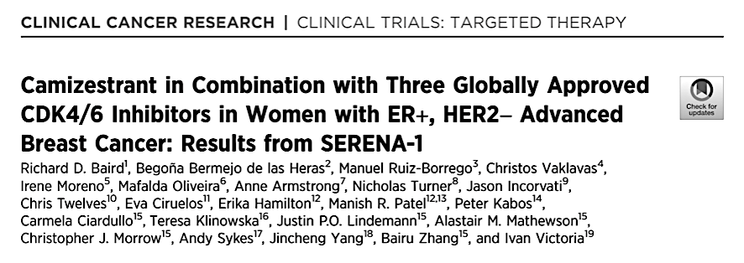
Phase I study in HR+/HER2- MBC
Camizestrant dose escalation with
Abemaciclib (n=53)
Palbociclib (n=78)
Ribociclib (n=60)
Baird et al, CCR 2025

Slide 4
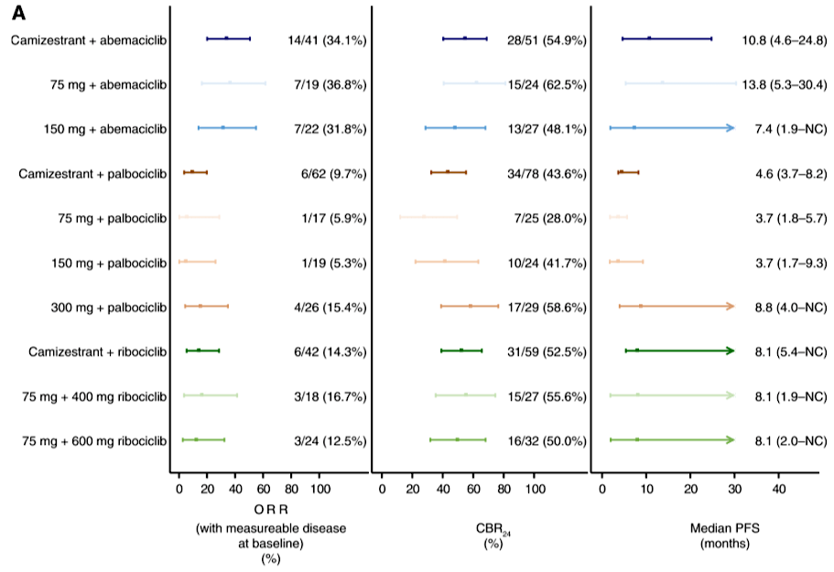
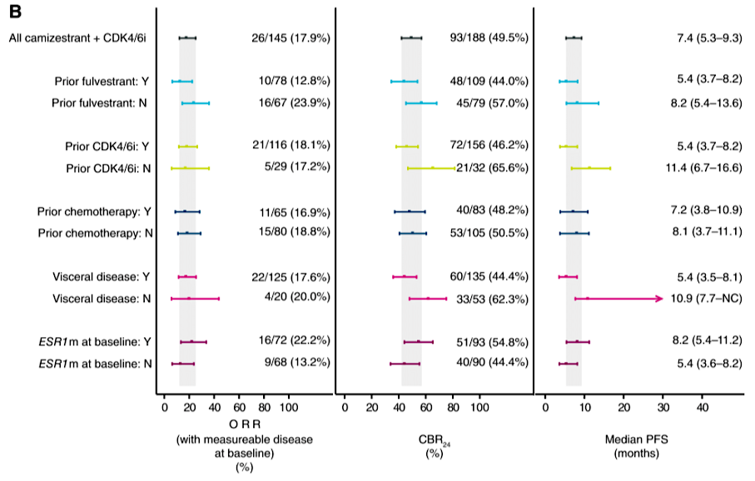
SERENA-1: Efficacy
Evidence of activity with camizestrant 75mg combined with all 3 CDK4/6i was observed, including in patients with:
prior fulvestrant
prior CDK4/6i
with or without ESR1m
with visceral disease

Slide 5
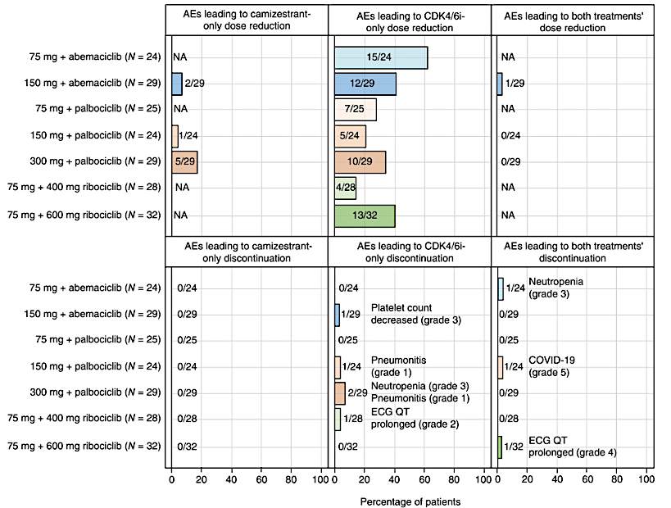
SERENA-1: Toxicity
Camizestrant safety profile consistent with monotherapy profile
Grade 1 photopsia (28%)
Almost all bradycardia events were grade 1
Combination of camizestrant with CDK4/6i does not appear to contribute additive toxicity, consistent with known safety profile of CDK4/6i and endocrine therapy.

Slide 6
SERENA-1: Discussion
Camizestrant well tolerated and active in combination with all CDK4/6 inhibitors.
Trial has established camizestrant 75mg as dose for combinations.
Photopsia is a unique oral SERD toxicity notable in early camizestrant trials. Despite prevalence, is typically brief, without impact on patient daily activities, and no impact on visual acuity.
Provides the safety data to support subsequent camizestrant and CDK4/6i studies
SERENA-6
SERENA-4
CAMBRIA-2

Slide 7

Updated results and an exploratory analysis of ESR1m circulating tumor DNA dynamics from SERENA-6, a phase 3 trial of camizestrant + CDK4/6 inhibitor for emergent ESR1m during first-line endocrine-based therapy and ahead of disease progression in patients with HR+/HER2– advanced breast cancer
François-Clément Bidard,¹ Erica L. Mayer,² Yeon Hee Park,³ Wolfgang Janni,⁴ Cynthia Ma,⁵ Massimo Cristofanilli,⁶ Giampaolo Bianchini,⁷ Kevin Kalinsky,⁸ Hiroji Iwata,⁹ Stephen Chia,¹⁰ Adam Brufsky,¹¹ Peter Fasching,¹² Zbigniew Nowecki,¹³ Javier Pascual,¹⁴ Einav Gal-Yam,¹⁵ Wei-Pang Chung,¹⁶ Seock-Ah Im,¹⁷ Alberto Zambelli,¹⁸ Florence Dalenc,¹⁹ Mafalda Oliveira,²⁰ Steven Fox,²¹ Manuel Selvi Miralles,²¹ Christopher Morrow,²² Cynthia Huang Bartlett,²³ and Nicholas C Turner²⁴
¹Institut Curie, Paris, France; ²Dana-Farber Cancer Institute, Boston, MA, USA; ³Samsung Medical Center, Sungkyunkwan University School of Medicine, Seoul, Republic of Korea; ⁴Universitätsklinikum Ulm, Ulm, Germany; ⁵Washington University School of Medicine, Saint Louis, MO, USA; ⁶Weill-Cornell Medicine/ New York-Presbyterian Hospital, New York, NY, USA; ⁷IRCCS Ospedale San Raffaele, Milan, Italy; ⁸Winship Cancer Institute, Atlanta, GA, USA; ⁹Nagoya City University, Nagoya, Japan; ¹⁰BC Cancer Agency, Vancouver, BC, Canada; ¹¹UMPC Magee-Womens Hospital, Pittsburgh, PA, USA; ¹²University Hospital Erlangen, Comprehensive Cancer Center Erlangen-EMN, Erlangen, Germany; ¹³Narodowy Instytut Onkologii im. Marii Skłodowskiej-Curie, Warsaw, Poland; ¹⁴Medical Oncology Department, Hospital Universitario Virgen de la Victoria. IBIMA. Málaga, Spain; ¹⁵Sheba Medical Center, Tel-Hashomer, Israel; ¹⁶National Cheng-Kung University Hospital, Tainan, Taiwan; ¹⁷Cancer Research Institute, Seoul National University College of Medicine, Seoul, Republic of Korea; ¹⁸IRCCS Istituto Clinico Humanitas, Milan, Italy; ¹⁹Institut Claudius Regaud, IUCT-Oncopole, Toulouse, France; ²⁰Medical Oncology Department, Vall d’Hebron University Hospital, Barcelona, Spain; ²¹Late Development, Oncology R&D, AstraZeneca, Cambridge, UK; ²²Research and Early Development, Oncology R&D, AstraZeneca, Cambridge, UK; ²³Late Development, Oncology R&D, AstraZeneca, Gaithersburg, MD, USA; ²⁴Royal Marsden Hospital, London, UK
This presentation is the intellectual property of the authors. Contact them at francois-clement.bidard@curie.fr for permission to reprint and/or distribute

Slide 8
SERENA-6 Study design
Adult patients with ER+/HER2– ABC
All patients that have received AI + CDK4/6i (palbociclib, ribociclib, or abemaciclib) as initial endocrine-based therapy for ABC for at least 6 months
ESR1m detected in circulating tumor DNA with no evidence of disease progression
Camizestrant (75 mg QD) + continuing CDK4/6i + placebo for AI (n=157)*
Treatment continued until disease progression, unacceptable toxicity, patient withdrawal, or death
R 1:1
N=315
Continuing AI + CDK4/6i + placebo for camizestrant (n=158)*
8 weeks
PD or death
Second PD or death
Randomization
Tumor assessments
ctDNA
Every 8 weeks for 18 months and then every 12 weeks until PD
D1 of alternating cycles and at end of treatment
C1D1†
C1D15
C2D1
C3D1
Reported in this presentation
D, Day; C, Cycle; ER+, estrogen receptor-positive; IHC, immunohistochemical; PD, progressive disease; QD, once daily; R, randomized. *Pre- or perimenopausal women and men received a luteinizing hormone-releasing hormone agonist per clinical guidelines. †Prior to receiving study treatments. ctDNA from patient blood samples were tested for ESR1m using Guardant360CDx (Guardant Health).

Slide 9
Switching to camizestrant + CDK4/6i prolongs time to progression and time to first subsequent therapy
Updated PFS*
 | CAMI + CDK4/6i | AI + CDK4/6i
Events | 90/157 | 115/158
mPFS (95% CI); mo | 16.6 (14.7–19.4) | 9.2 (7.2–9.7)
Hazard ratio (95% CI): 0.46 (0.34–0.62); P<0.00001
Switching to camizestrant + CDK4/6i treatment led to a clinically meaningful improvement in PFS compared with continuing AI + CDK4/6i
100
90
80
70
60
50
Δ mPFS: 7.4 months
The time to first subsequent therapy (defined as the time from randomization to receiving a first subsequent therapy, or death) also favored the camizestrant + CDK4/6i arm compared with the AI + CDK4/6i arm; hazard ratio (95% CI): 0.47 (0.35–0.62)
The magnitude of benefit in time to first subsequent therapy was consistent with PFS
PFS (%)
40
30
20
10
0
 | 0 | 3 | 6 | 9 | 12 | 15 | 18 | 21 | 24 | 27 | 30 | 33 | 36 | 39 | 42
Patients at risk | Time from randomization (months)
CAMI + CDK4/6i | 157 | 143 | 125 | 109 | 82 | 62 | 39 | 26 | 18 | 11 | 7 | 5 | 5 | 0
AI + CDK4/6i | 158 | 127 | 90 | 72 | 42 | 28 | 17 | 9 | 4 | 1 | 1 | 0 | 0 | 0
CAMI, camizestrant; mo, months; CI, confidence interval; DCO2, data cutoff 2; mPFS, median PFS; TFST, time to first subsequent therapy; RECIST, Response Evaluation Criteria in Solid Tumors. *Second pre-specified data cut DCO2: June 30, 2025. At DCO2, 58 patients in the camizestrant + CDK4/6i arm and 23 patients in the AI + CDK4/6i arm were still receiving study treatments. There were 88/157 TFST events in the camizestrant + CDK4/6i arm and 117/158 in the AI + CDK4/6i arm. PFS was defined per RECIST v1.1. The PFS and TFST hazard ratio and 95% CI are estimated using a Cox proportional hazards model stratified by disease site, ESR1m status detectable at first versus subsequent ctDNA tests, and time from initiation of AI + CDK4/6i to randomization.

Slide 10
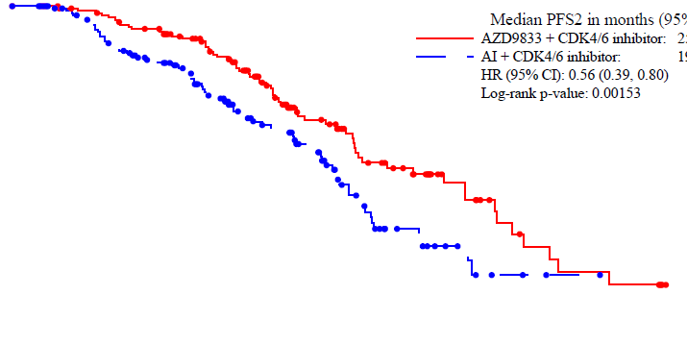
Switching to camizestrant + CDK4/6i prolongs time to second progression and time to second subsequent therapy
Updated PFS2*
 | CAMI + CDK4/6i | AI + CDK4/6i
Events | 62/157 | 71/158
mPFS2 (95% CI); mo | 25.7 (20.3–28.9) | 19.4 (17.8–21.4)
Hazard ratio (95% CI): 0.56 (0.39–0.80); P=0.00153 (Threshold for significance P=0.0001) Information fraction: 84%†
Switching to camizestrant + CDK4/6i treatment led to a clinically meaningful prolongation in PFS2 compared with continuing AI + CDK4/6i, demonstrating that the PFS gain is maintained in the subsequent line of therapy
100
90
80
70
60
50
The time to second subsequent therapy (defined as the time from randomization to receiving a second subsequent therapy, or death) also favored the camizestrant + CDK4/6i arm compared with the AI + CDK4/6i arm; hazard ratio (95% CI): 0.57 (0.40–0.81)
The magnitude of benefit in time to second subsequent therapy was consistent with PFS2
PFS2 (%)
40
30
20
10
0
 | 0 | 3 | 6 | 9 | 12 | 15 | 18 | 21 | 24 | 27 | 30 | 33 | 36 | 39 | 42
Patients at risk | Time from randomization (months)
CAMI + CDK4/6i | 157 | 149 | 143 | 134 | 113 | 86 | 56 | 38 | 28 | 17 | 10 | 6 | 5 | 0
AI + CDK4/6i | 158 | 149 | 127 | 114 | 85 | 62 | 49 | 25 | 14 | 7 | 3 | 1 | 0 | 0
(m)PFS2, (median) PFS2; TSST, time to second subsequent therapy. *Second pre-specified data cut DCO2: June 30, 2025. †Information fraction: the number of PFS2 events at this interim analysis divided by the number of PFS2 events expected at final analysis, multiplied by 100. There were 60/157 TSST events in the camizestrant + CDK4/6i arm and 77/158 in the AI + CDK4/6i arm. The PFS2 and TSST hazard ratio and 95% CI are estimated using a stratified Cox proportional hazards model stratified by ESR1m detectable at first versus subsequent ctDNA tests and time from initiation of AI + CDK4/6i to randomization.

Slide 11
Camizestrant + CDK4/6i profoundly reduces ESR1m ctDNA vs AI + CDK4/6i
In the AI + CDK4/6i arm, ESR1m allele frequency increased >500% from baseline in 24.4% of patients vs 0.8% of patients in the camizestrant + CDK4/6i arm
Camizestrant +
CDK4/6i (n=126)
AI +
CDK4/6i (n=123)
ESR1m allele frequency was profoundly reduced in the camizestrant + CDK4/6i arm vs the AI + CDK4/6i arm (Wilcoxon nominal P<0.00001)
10000
Log scale
1000
100
100
ESR1m sVAF % change from baseline (%)
50
Median change from baseline at C3D1 (8 weeks):
+66.7% (IQR: −67.9 to +465.0)
Median change from baseline at C3D1 (8 weeks):
−100% (IQR: −100 to −100)
Linear scale
0
-50
-100
Baseline VAF were balanced across arms. IQR, interquartile range; (s)VAF, (summed) variant allele fraction. Second pre-specified data cut DCO2: June 30, 2025.

Slide 12
SERENA-6 Discussion
Updated results from SERENA-6, with greater maturity, continue to support that changing to camizestrant at time of emergence of ESR1 mutation significantly prolongs PFS, favorably prolongs PFS2, and prolongs time to second therapy.
Reduced ESR1m levels with exposure to oral SERD support pharmacodynamic activity of camizestrant and molecular benefit.
Await mature PFS2 and OS data, as well as possible drug approval, to understand if SERENA-6 approach will become a new standard of care.

Slide 13
Giredestrant (GIRE), an oral selective oestrogen receptor (ER) antagonist and degrader, + everolimus (E) in patients (pts) with ER-positive, HER2-negative advanced breast cancer (ER+, HER2– aBC) previously treated with a CDK4/6 inhibitor (i): Primary results of the Phase III evERA BC trial
Erica L. Mayer, Sara M. Tolaney, Miguel Martin, Gregory A. Vidal, Luca Moscetti, Komal L. Jhaveri, Adam Brufsky, William J. Gradishar, Andreas Schneeweiss, Naoki Niikura, Anne Favret, Margarita Alfie, Keun Seok Lee, Sarah Khan, Merilin B. Feldman, Bann-mo Day, Lisa Lam, Walter C. Darbonne, Pablo Perez-Moreno, Hope S. Rugo
Presenting author: Erica L. Mayer, MD, MPH
Dana-Farber Cancer Institute, Boston, MA, USA

Slide 14
evERA
evERA: Study design
A global, randomised, open-label, Phase III trial
Breast Cancer
Key eligibility criteria*
ER+, HER2– aBC (1–3L of therapy)
≤ 2 prior lines of ET in the aBC setting
PD or relapse during/post-CDK4/6i + ET†
No prior chemotherapy in the aBC setting
Measurable disease per RECIST v1.1 or evaluable bone metastases
Enrolment period: August 2022 to October 2024
N = 373*
Giredestrant (30 mg) + everolimus (10 mg)†
Until PD or unacceptable toxicity
R 1:1
SOC ET‡ + everolimus (10 mg)† ‡Exemestane/fulvestrant/tamoxifen
† Dexamethasone mouthwash prophylaxis and treatment was strongly recommended per SWISH trial protocol¹
* Trial was enriched to 55% of patients with ESR1m at baseline (centrally tested via circulating tumor DNA)
† Patients had to receive ≥ 6 months of CDK4/6i + ET in the aBC setting to be eligible for enrollment; prior fulvestrant was allowed
Co-primary endpoints (RECIST v1.1)
INV-PFS in patients whose tumors had an ESR1m
INV-PFS in the ITT population
Key secondary endpoints
OS
INV-ORR, DoR
Stratification factors
Prior treatment with fulvestrant (yes vs no)
ESR1m (yes vs no/indeterminate)
Site of disease (visceral [lung and/or liver involvement] vs non-visceral)
ClinicalTrials.gov number, NCT05306340. Adapted from Mayer EL, et al. SABCS 2022 (poster OT2-01-07) with permission.
1–3L, first to third line; aBC, advanced breast cancer; CDK4/6i, cyclin-dependent kinase 4/6 inhibitor; DoR, duration of response; ER+, oestrogen receptor-positive; ESR1m, ESR1 mutation; ET, endocrine therapy; HER2–, HER2-negative; INV, investigator-assessed; ITT, intention to treat; ORR, objective response rate; OS, overall survival; PD, progressive disease; PFS, progression-free survival; R, randomisation; RECIST, Response Evaluation Criteria in Solid Tumours; SOC ET, standard of care endocrine therapy. 1. Rugo HS, et al. Lancet Oncology 2017; 18:654–662.
Presented by: Erica L. Mayer, MD, MPH.

Slide 15
Co-primary endpoints – INV-PFS in the ESR1m and ITT populations
ESR1m
ITT
Giredestrant + everolimus
n = 102
SOC ET + everolimus
n = 105
Giredestrant + everolimus
n = 183
SOC ET + everolimus
n = 190
 | Giredestrant + everolimus (n = 102) | SOC ET + everolimus (n = 105)
Events, n (%) | 63 (61.8) | 89 (84.8)
Median, mo (95% CI) | 9.99 (8.08, 12.94) | 5.45 (3.75, 5.62)
Stratified HR (95% CI) | 0.38 (0.27, 0.54); p < 0.0001
 | Giredestrant + everolimus (n = 102) | SOC ET + everolimus (n = 105)
Events, n (%) | 126 (68.9) | 163 (85.8)
Median, mo (95% CI) | 8.77 (6.60, 9.59) | 5.49 (4.01, 5.59)
Stratified HR (95% CI) | 0.56 (0.44, 0.71); p < 0.0001
100
100
80
80
66.1%
57.4%
60
60
INV-PFS (%)
INV-PFS (%)
38.1%
40.5%
39.6%
34.1%
40
40
15.2%
18.1%
20
20
0
0
0
3
6
9
12
15
18
21
24
27
30
0
3
6
9
12
15
18
21
24
27
30
Time (mo)
Time (mo)
No. at risk
No. at risk
Giredestrant + everolimus
SOC ET + everolimus
102
105
85
67
61
35
52
25
28
10
13
2
6
1
2
1
2
1
Giredestrant + everolimus
SOC ET + everolimus
183
190
149
131
95
68
70
50
47
27
29
14
14
7
3
3
3
3
1
1
Presented by: Hope S. Rugo, MD.

Slide 17
INV-PFS by duration of prior CDK4/6i (ESR1m population)
< 12 mo*
≥ 12 mo*
Giredestrant + everolimus
n = 80
SOC ET + everolimus
n = 86
Giredestrant + everolimus
n = 20
SOC ET + everolimus
n = 18
 | Giredestrant + everolimus (n = 102) | SOC ET + everolimus (n = 105)
Events, n (%) | 16 (80.0) | 16 (88.9)
Median, mo (95% CI) | 7.49 (3.65, 10.55) | 3.17 (1.87, 5.36)
HR (95% CI) | 0.33 (0.16, 0.70)
 | Giredestrant + everolimus (n = 102) | SOC ET + everolimus (n = 105)
Events, n (%) | 47 (58.8) | 73 (84.9)
Median, mo (95% CI) | 10.32 (8.08, 14.82) | 5.55 (3.91, 6.67)
HR (95% CI) | 0.42 (0.29, 0.61)
100
100
80
80
60
60
INV-PFS (%)
INV-PFS (%)
40
40
20
20
0
0
0
3
6
9
12
15
18
21
24
27
30
0
3
6
9
12
15
18
21
24
27
30
Time (mo)
Time (mo)
No. at risk
No. at risk
Giredestrant + everolimus
SOC ET + everolimus
20
18
16
8
11
3
9
1
3
2
Giredestrant + everolimus
SOC ET + everolimus
80
86
67
58
48
31
41
23
23
9
10
2
5
1
2
1
2
1
Presented by: Hope S. Rugo, MD.

Slide 18
INV-PFS by duration of prior CDK4/6i (ITT population)
< 12 mo*
≥ 12 mo*
Giredestrant + everolimus
n = 136
SOC ET + everolimus
n = 135
Giredestrant + everolimus
n = 44
SOC ET + everolimus
n = 50
 | Giredestrant + everolimus (n = 102) | SOC ET + everolimus (n = 105)
Events, n (%) | 88 (64.7) | 115 (85.2)
Median, mo (95% CI) | 9.23 (7.33, 11.24) | 5.55 (5.36, 6.51)
HR (95% CI) | 0.57 (0.43, 0.76)
 | Giredestrant + everolimus (n = 102) | SOC ET + everolimus (n = 105)
Events, n (%) | 37 (84.1) | 45 (90.0)
Median, mo (95% CI) | 5.55 (5.32, 7.43) | 3.81 (3.61, 5.36)
HR (95% CI) | 0.60 (0.38, 0.93)
100
100
80
80
60
60
INV-PFS (%)
INV-PFS (%)
40
40
20
20
0
0
0
3
6
9
12
15
18
21
24
27
30
0
3
6
9
12
15
18
21
24
27
30
Time (mo)
Time (mo)
No. at risk
No. at risk
Giredestrant + everolimus
SOC ET + everolimus
44
50
34
33
18
12
12
7
6
3
5
2
1
1
1
1
Giredestrant + everolimus
SOC ET + everolimus
136
135
113
95
75
54
65
41
39
22
23
12
12
7
2
3
2
3
1
Presented by: Hope S. Rugo, MD.

Slide 19
evERA Discussion
In the evERA trial, the combination of giredestrant and everolimus prolongs PFS in both ITT and ESR1m populations.
First trial to compare an oral SERD combination to a standard-of-care combination, rather than a monotherapy arm.
Benefit was observed in prespecified subgroups, including PIK3CA mutated (co-mutations ESR1 and PIK3CA) and regardless of duration of prior CDK4/6 inhibitor therapy. Benefit not pronounced in ESR1m not detected population.
Await potential regulatory approval.

Slide 20
Elacestrant in combination with everolimus or abemaciclib in patients with ER+/HER2- locally advanced or metastatic breast cancer: phase 2 results from ELEVATE, an open-label umbrella trial
Hope S. Rugo,¹ Sara M. Tolaney,² Nancy Chan,³ Giuliano Borges,⁴ Rinat Yerushalmi,⁵ Marina N. Sharifi,⁶ Wassim McHayleh,⁷ Thaddeus Beck,⁸ Neelima Vidula,⁹ Erika Hamilton,¹⁰ Kristine J. Rinn,¹¹ Joyce O’Shaughnessy,¹² Giuseppe Curigliano,¹³ Javier Cortés,¹⁴ Paula Muñoz Romero,¹⁵ Giulia Tonini,¹⁵ Alessandro Paoli,¹⁵ Li Cheng,¹⁶ Jennifer A. Crozier,¹⁶ Tomer Wasserman,¹⁶ Virginia Kaklamani¹⁷
1. City of Hope Cancer Center, Duarte, CA, USA; 2. Dana-Farber Cancer Institute, Boston, MA, USA; 3. NYU Langone Health, New York, NY, USA; 4. Catarina Pesquisa Clínica, Santa Catarina, Brazil; 5. Rabin Medical Center, Petah Tikva, Israel; 6. University of Wisconsin, Madison, WI, USA; 7. AdventHealth Cancer Institute, Orlando, FL, USA; 8. Highlands Oncology, Springdale, AR, USA; 9. Massachusetts General Hospital, Harvard Medical School, Boston, MA, USA; 10. Sarah Cannon Research Institute, Nashville, TN, USA; 11. Cancer Care Northwest, Spokane, WA, USA; 12. Baylor University Medical Center, Texas Oncology, US Oncology, Dallas, TX, USA; 13. Istituto Europeo di Oncologia, IRCCS, and University of Milano, Milano, Italy; 14. International Breast Cancer Center (IBCC), Quironsalud Group, Barcelona, Spain; 15. Menarini Group, Florence, Italy; 16. Menarini Group, New York, NY, USA; 17. University of Texas Health Sciences Center San Antonio, San Antonio, TX, USA

Slide 21
ELEVATE Trial Design
KEY ELIGIBILITY
ELEVATE PHASE 1b (n=90)
ELEVATE PHASE 2
Elacestrant 345 mg + Everolimus 7.5 mg
(n=50)
Elacestrant 86-345 mg* combined with either:
Alpelisib 150-250 mg^{a,b,c}
Everolimus 5-10 mg^{d,e,f,g}
Palbociclib 100-125 mg^{h,i,j}
Ribociclib 400-600 mg^{k,l,m,n,o}
Capivasertib 320-400 mg^{p,q,r}
Elacestrant 345 mg + Everolimus 7.5 mg
(n=50)
Women (pre-, peri-, or postmenopausal) or men
ER+, HER2- a/mBC
1-2 lines of prior ET +/- CDK4/6i
Prior fulvestrant allowed
Primary endocrine resistance allowed
No prior chemotherapy in the a/mBC setting
≥1 measurable lesion as per RECIST v1.1 or a mainly lytic bone lesion
Elacestrant 345 mg + Abemaciclib 150 mg (n=60)
RP2D
Elacestrant 345 mg + Ribociclib 400 mg
(n=30)
ELECTRA PHASE 1b (n=27)
Elacestrant 258-345 mg* combined with Abemaciclib 100-150 mg^{s,t,i}
Elacestrant 345 mg + Capivasertib 320 mg
(n=60)
Phase 2
Objectives
Primary: PFS (RECIST v1.1)
Elacestrant and everolimus dose are administered QD.
Abemaciclib is administered BID.
Secondary: ORR, DoR, CBR, PFS, OS, and safety
*Elacestrant 86 mg is equivalent to 100 mg elacestrant hydrochloride; elacestrant 172 mg is equivalent to 200 mg elacestrant hydrochloride; elacestrant 258 mg is equivalent to 300 mg elacestrant hydrochloride; elacestrant 345 mg is equivalent to 400 mg elacestrant hydrochloride. ªElacestrant 258 mg* + alpelisib 250 mg (cohort 1); ^{b}Elacestrant 258 mg* + alpelisib 200 mg (cohort -1); ^{c}Elacestrant 258 mg* + alpelisib 150 mg (cohort -2); ^{d}Elacestrant 258 mg* + everolimus 5 mg (cohort 1); ^{e}Elacestrant 345 mg* + everolimus 5 mg (cohort 2); ^{f}Elacestrant 345 mg* + everolimus 10 mg (cohort 3); ^{g}Elacestrant 345 mg* + everolimus 7.5 mg (cohort 4); ^{h}Elacestrant 258 mg* + palbociclib 100 mg (cohort 1); ^{i}Elacestrant 345 mg* + palbociclib 100 mg (cohort 2); ^{j}Elacestrant 345 mg* + palbociclib 125 mg (cohort 3); ^{k}Elacestrant 86 mg* + ribociclib 400 mg (cohort 1); ^{l}Elacestrant 172 mg* + ribociclib 400 mg (cohort 2); ^{m}Elacestrant 258 mg* + ribociclib 400 mg (cohort 3); ^{n}Elacestrant 172 mg* + ribociclib 600 mg (cohort 4); ºElacestrant 345 mg* + ribociclib 400 mg (cohort 5); ^{p}Elacestrant 258 mg* + capivasertib 320 mg (cohort 1); ^{q}Elacestrant 345 mg* + capivasertib 320 mg (cohort 2); ^{r}Elacestrant 345 mg* + capivasertib 400 mg (cohort 3); ^{S}Elacestrant 258 mg* + abemaciclib 100 mg (cohort 1); ^{t}Elacestrant 345 mg* + abemaciclib 100 mg (cohort 2); ^{i}Elacestrant 345 mg* + abemaciclib 150 mg (cohort 3). a/mBC, advanced or metastatic breast cancer; CBR, clinical benefit rate; CDK4/6i, cyclin-dependent kinase 4/6 inhibitor; DoR, duration of response; ER, estrogen receptor; ET, endocrine therapy; HER2, human epidermal growth factor receptor 2; n, number; ORR, objective response rate; OS, overall survival; PFS, progression-free survival; RECIST, Response Evaluation Criteria in Solid Tumors; RP2D, recommended phase 2 dose; v, version. References: 1. Open-Label Umbrella Trial to Evaluate Safety and Efficacy of Elacestrant in Various Combination in Patients With Metastatic Breast Cancer (ELEVATE). ClinicalTrials.gov. May 20, 2024. Accessed August 26, 2024. https://clinicaltrials.gov/trial/NCT05563220. 2. A Phase 1b/2, Open-Label Umbrella Trial to Evaluate Safety and Efficacy of Elacestrant in Various Combinations in Patients with Metastatic Breast Cancer (ELEVATE). STML-ELA-0222. Updated December 22, 2023.

Slide 22
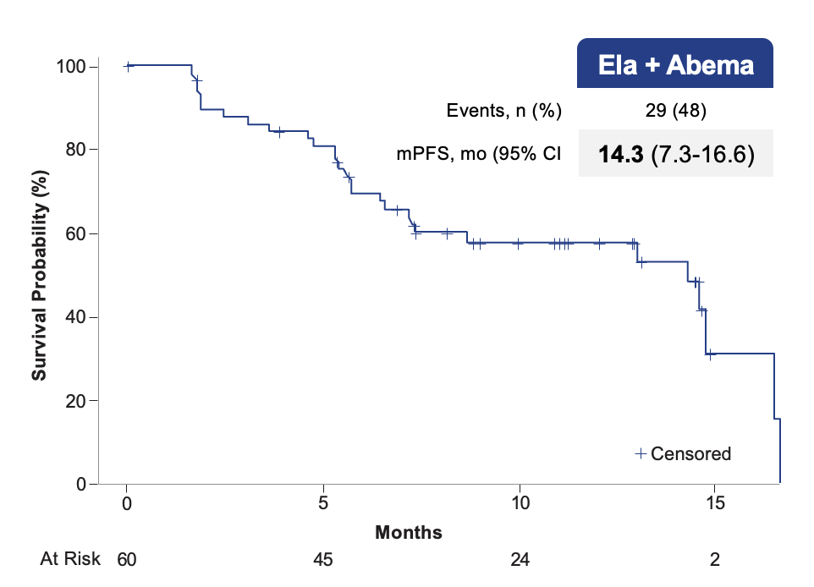
ELEVATE: PFS elacestrant + everolimus or elacestrant + abemaciclib
100
 | Ela + Eve
Events, n (%) | 29 (58)
mPFS, mo (95% CI | 8.3 (4.0-10.2)
Survival Probability (%)
80
60
40
20
Prior CDK4/6i 100%, Visceral metastases 72%, primary ET resistance 20%, ESR1m 42%, PIK3CAm 50%, Prior fulvestrant 50%
Visceral metastases 92%, primary ET resistance 15%, ESR1m 33%, PIK3CAm 27%, Prior CDK4/6i 50%, Prior fulvestrant 30%
Censored
0
0.0
2.5
5.0
7.5
10.0
12.5
15.0
Months
Ela + Eve showed 82.9% DCR, 19.5% ORR, 8.54 mo mDOR
Ela + Abema showed 91.2% DCR, 24.6% ORR, 14.75 mo mDOR
At Risk
50
37
24
20
13
10
0
Elacestrant + everolimus or elacestrant + abemaciclib combinations showed a consistent PFS benefit across all subgroups
Data cut-off: Sept 15, 2025. CDK4/6i, cyclin-dependent kinase 4/6 inhibitor; CI, confidence interval; Ela, elacestrant; ESR1m, estrogen receptor 1 mutation; ET, endocrine therapy; Eve, everolimus; mo, months; mPFS, median progression-free survival; n, number; NR, not reached; PIK3CAm, phosphatidylinositol-4,5-bisphosphate 3-kinase catalytic subunit alpha mutation; PFS, progression-free survival; wt, wild-type. DCR Disease Control Rate, ORR Overall Response Rate, mDOR Median Duration of Response

Slide 23
ELEVATE Discussion
Elacestrant combinations are active and tolerable.
Ribociclib combination already reported (PFS 7.8 mo, Rugo et al, ASCO 2025); capivasertib cohort ongoing.
In contrast to other oral SERD combination trials (EMBER-3, evERA, SERENA-6), lack of randomization limits interpretation.
Cannot compare to PFS in other trials due to difference in degree of patient pre-treatment.
Oral SERD combinations are the way forward, as PFS consistently >6 months with little additional toxicity from the endocrine agent.

Slide 24
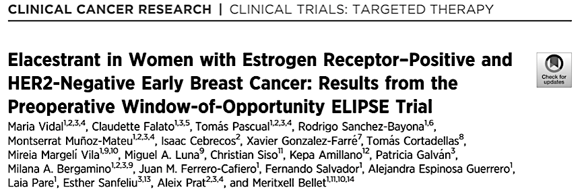
Preoperative window of opportunity study with elacestrant
Postmenopausal women (N=22), T1c-T2 N0 ER+ HER2- eBC with Ki67 >10%
Received 4 weeks elacestrant prior to surgery
Primary endpoint: complete cell cycle arrest (Ki67 <2.7%) at day 28
Vidal et al. CCR 2025

Slide 25
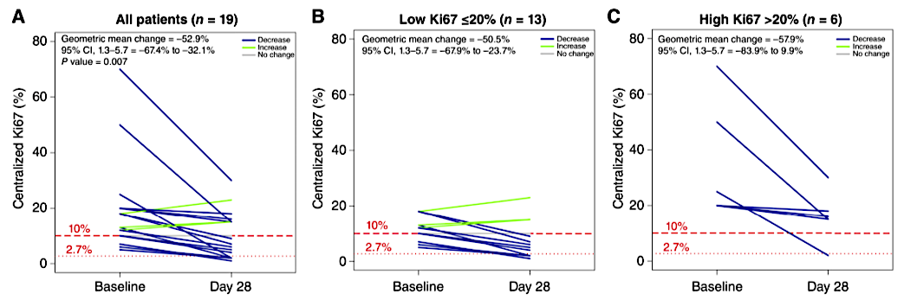
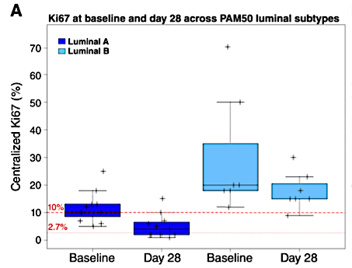
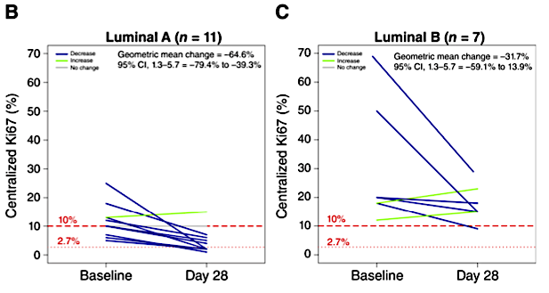
SOLTI-ELIPSE: Change in Ki-67
Ki67 variation between BL and day 28 from paired samples
Mean decrease in Ki67 was 8.4%
27.3% achieved a completed cell cycle arrest
42% in lumA tumors, 0% in lumB tumors
30.8% in low Ki-67%
16.7% in high Ki-67%

Slide 26
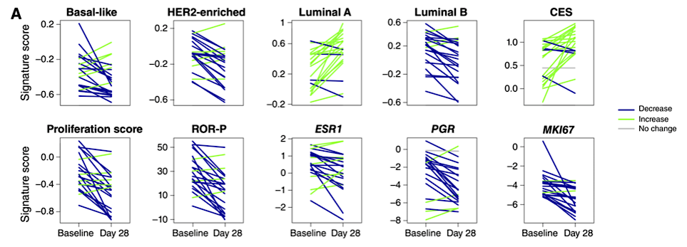
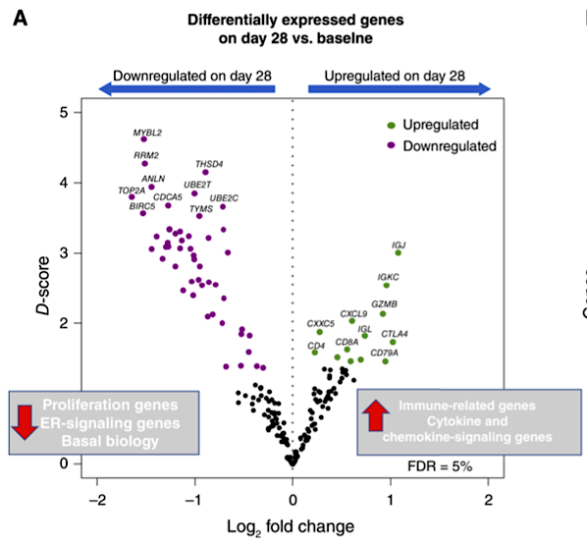
SOLTI-ELIPSE: Effect of Elacestrant Exposure
Change in expression of PAM50 signatures and selected genes suggests elacestrant exposure induces an endocrine sensitive phenotype
Increased CES (chemo-endocrine score) and luminal A signature
Decreased ESR1 and PGR
PAM50 proliferation signatures decreased (basal-like, HER2-enriched, ROR-signature P)
Increased immune-related genes

Slide 27
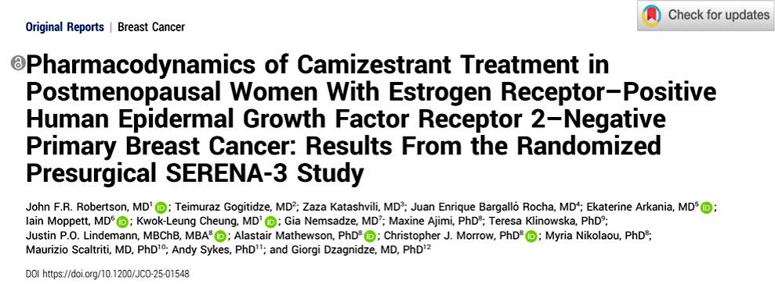
Preoperative window of opportunity study with camizestrant
Randomized 132 postmenopausal women with T>1cm to camizestrant dose levels
Patients received 5-7 days of camizestrant 75 mg, 150 mg, or 300 mg, or 75 mg, 150 mg for 12-15 days
Primary endpoint: change in ER; Secondary endpoints: change in PR expression, Ki67
Robertson et al. JCO 2026

Slide 28
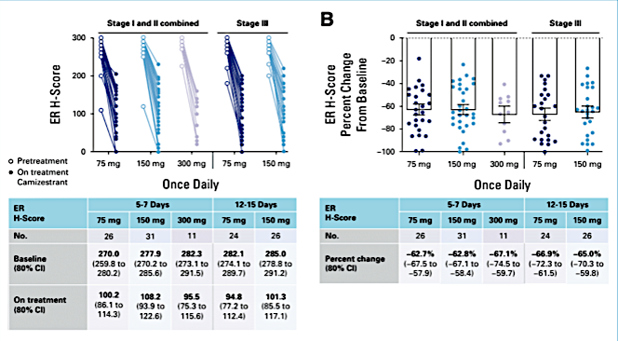
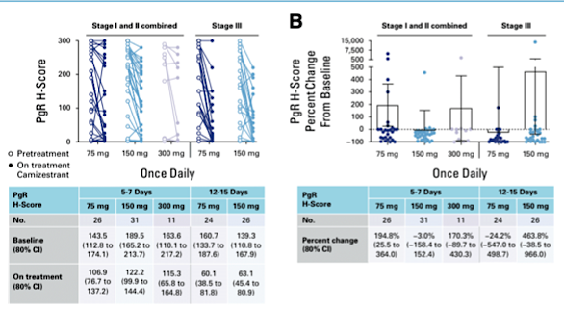
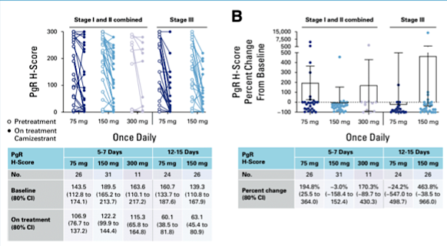
SERENA-3: Biomarker changes
ER
PR
Ki67
Reduction in ER/PR expression happened quickly, by days 5-7
Reduction in Ki67 was maximal at days 12-15
WOO trial confirmed camizestrant 75mg as dose for adjuvant trials
Dose also confirmed by SERENA-2 MBC monotherapy trial

Slide 29
Preoperative window-of-opportunity study with giredestrant or tamoxifen in premenopausal women with estrogen receptor-positive/human epidermal growth factor receptor 2-negative and Ki67≥10% early breast cancer: the EMPRESS study
Antonio Llombart-Cussac, Giuseppe Viale, Manuel Ruiz-Borrego, Vicente Carañana, Elena López-Miranda, María Isabel Blancas, Laia Garrigós, María Gión, Mariana Lopez, Ángel Guerrero, Cristina Saavedra, Juan Miguel Cejalvo, Juan de la Haba, Cinta Albacar, Meritxell Aguiló, José Antonio Guerrero, Pari Skamnioti, Jacques Medioni, José Manuel Pérez-García, Javier Cortés
October, 2025

Slide 30
EMPRESS: Background & Study design
Giredestrant is a potent, nonsteroidal, next generation oral selective ER degrader (SERD) and full antagonist with antitumor activity in patients with ER[+]/HER2[-] early and advanced breast cancer.
In pre- and perimenopausal women, it is administered in combination with gonadotropin-releasing hormone (GnRH) analogs.
EMPRESS (NCT05659563) evaluated if short-term preoperative giredestrant, without GnRH analogs, is superior to tamoxifen in reducing Ki67 in premenopausal ER[+]/HER2[−] early breast cancer patients.
Exclusively premenopausal population
No use of LHRH agonist with oral SERD
Patients with ER[+]/HER2[-] early breast carcinoma
Premenopausal women ≥ 18 years of age with previously untreated disease.
Histologically local confirmation of ER[+]/ HER2[-] invasive breast carcinoma.
Locally analyzed and centrally confirmed Ki67 ≥ 10%.
Tumor size ≥ 1.0 cm (ultrasound).
ECOG PS 0-1.
Adequate organ function.
Primary endpoint
Changes in tumor cell proliferation as measured by Ki67 expression between baseline and post-treatment tumor biopsy samples by central assessment in patients with centrally confirmed Ki67 ≥ 10% (Arm A vs Arm B).
Secondary endpoints
Cell cycle arrest rate (Ki67 ≤2.7%) in both arms.
Changes in ER and PgR protein levels and molecular profiling using HTG (PAM-like molecular test).
Incidence and severity of adverse events according to NCI-CTCAE v.5.0.
Arm A
Giredestrant 30mg PO QD
D1-D15
R
1:1
End of Study Visit (28d±3d after last dose)
End of Treatment Day 15 (+1d)
Tumor biopsy & blood samples
N=92
Arm B
Tamoxifen 20mg PO QD
D1-D15
Baseline and end of treatment tumor biopsy and blood sample.
Plasma endocrine panel performed pre- and post-therapy.
Abbreviations: d: days; ER: Estrogen receptor; PgR: Progesterone receptor; PO: orally; QD: daily
Antonio Llombart-Cussac​, MD, PhD

Slide 31
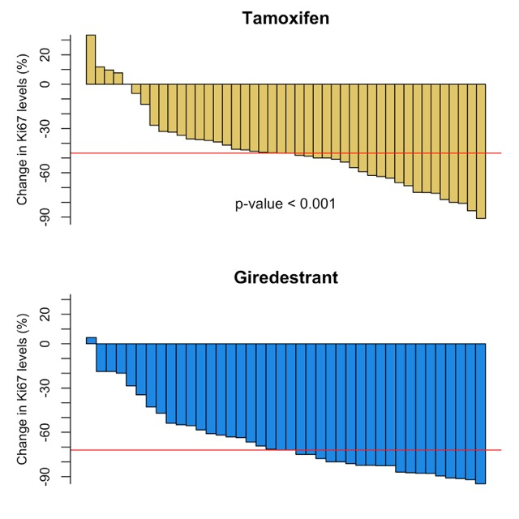
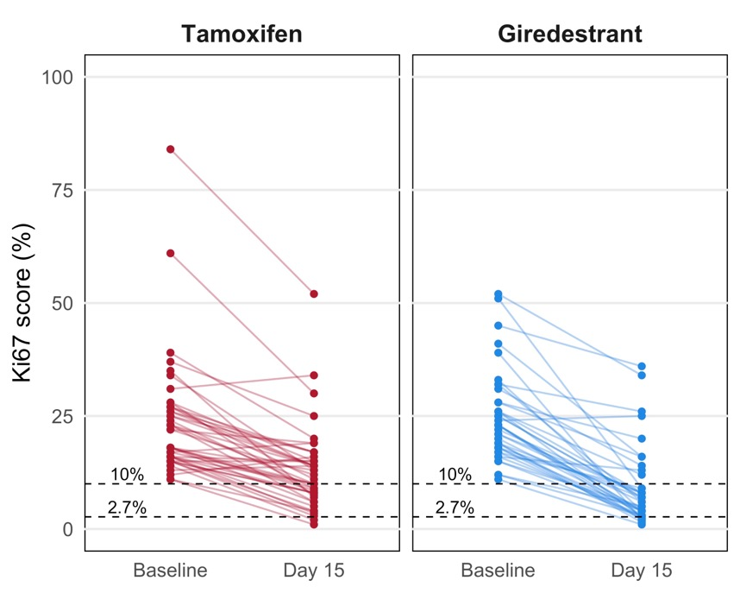
EMPRESS: Efficacy Results: Primary Endpoint
Relative change in Ki67 levels
Change in Ki67 levels between baseline and post-treatment
 | Tamoxifen | Giredestrant
Relative reduction % (95% CI) | -51 (-59; -43) | -73 (-78; -66) | <0.001
Greater reduction in proliferation with giredestrant over tamoxifen
No arm with SERD and OFS; unknown if OFS is needed in this setting
Antonio Llombart-Cussac​, MD, PhD
*Efficacy analyses are performed in the modified ITT population, including 44 in the tamoxifen group and 40 patients in the giredestrant group.

Slide 32
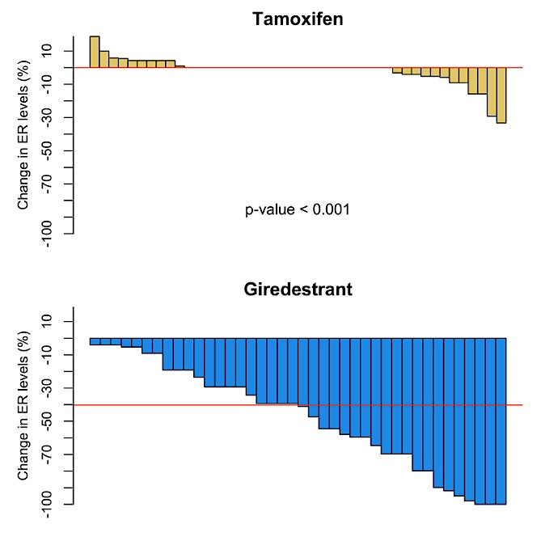
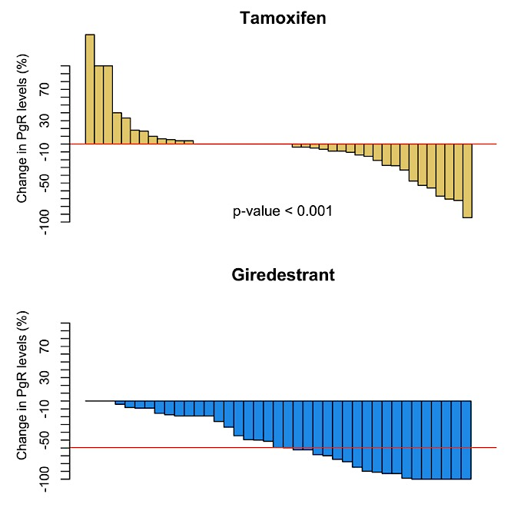
EMPRESS: Efficacy Results: Secondary Endpoints
Complete cell cycle arrest (CCCA): Ki67 ≤2.7%
Relative change in ER levels
Relative change in PgR levels
Preoperative giredestrant for 15 days showed greater antiproliferative activity than tamoxifen, similar to that seen in Coopera trial, without use of LHRH agonists.
Antonio Llombart-Cussac​, MD, PhD
*Efficacy analyses are performed in the modified ITT population, including 44 in the tamoxifen group and 40 patients in the giredestrant group.
Notes:
Pharmacodynamic effect

Slide 33
Preoperative SERD Window Trials: Discussion
SOLTI-ELIPSE
Short exposure to elacestrant in postmenopausal patients leads to 27% CCCA rate, induces a more endocrine-sensitive, less proliferative tumor phenotype
SERENA-3
Short exposure to camizestrant 75 mg in postmenopausal patients leads to suppression in ER, PR, Ki67
EMPRESS
Short exposure to giredestrant in premenopausal patients leads to substantial decrease in Ki67, ER/PR levels versus tamoxifen, without GNRH agonist
Question of premenopausal patients: is GNRH agonist needed or can SERD function in presence of high estrogen levels? Is there toxicity in young patients? Await randomized trials.
SOLTI-PREMIERE (elacestrant, NCT05982093)
Pre-EMBER (imlunestrant, NCT07287098)
Evidence of molecular response supports exploration in early breast cancer setting
WOO studies offer ability to evaluate activity, safety, and dosing in curative population, preparing for larger adjuvant trials.

Slide 34
Giredestrant vs standard-of-care endocrine therapy as adjuvant treatment for patients with estrogen receptor-positive, HER2-negative early breast cancer: Results from the global Phase III lidERA Breast Cancer trial
Presenting author: Aditya L. Bardia, MD
University of California, Los Angeles, Los Angeles, CA, USA
Aditya L. Bardia,* Peter Schmid,* Miguel Martín, Sara A. Hurvitz, Kyung Hae Jung, Mothaffar F. Rimawi, Shigehira Saji, Gustavo Werutsky, Nadia Harbeck, Sherene Loi, Akiko Ogiya, Manuel Ruiz-Borrego, Ahmet Alacacıoğlu, Jiong Wu, Chenglin Ye, Mario Liste-Hermoso, Nimali P. Withana, Tanja Badovinac Crnjevic, Mona D. Shah, Pablo Pérez-Moreno, Charles E. Geyer, Jr.*
* Equal contributions

Slide 35
lidERA Breast Cancer study design A global, randomized, open-label, multicenter Phase III trial
Key eligibility criteria
Participants with ER+, HER2-negative early breast cancer
Stage I–III disease (anatomical)
pN0 and pT > 1 cm with Grade 3, or Ki67 ≥ 20%, or high score on genomic assay,* or pT4N0
Node-positive
Pre- or post-menopausal†
Breast cancer surgery within 12 months
(Neo)adjuvant chemotherapy if indicated
At least 5-year treatment duration
5-year follow-up
N = 4170
Giredestrant (30 mg PO QD)
Long-term follow-up
R 1:1
SOC ET Tamoxifen/anastrozole/letrozole/exemestane
Stratification factors
Risk: Medium-‡ vs high-risk§ Stage I–III breast cancer
Region: USA/Canada/Western Europe vs Asia–Pacific vs RoW
Previous chemotherapy: No vs yes
Menopausal status: Pre-menopausal vs post-menopausal
Primary endpoint
IDFS (excluding second primary non-breast cancer)
Key secondary endpoints
DFS, DRFI, IDFS (including second primary non-breast invasive cancer with exception of non-melanoma skin cancers and in situ carcinomas of any site), LRRFI, OS, safety
Giredestrant is currently also being investigated in combination with abemaciclib in the adjuvant setting (lidERA Breast Cancer substudy 1)
Enrollment: August 2021 to September 2023. Up to 12 weeks of ET ± CDK4/6i were allowed. ER+ was defined as ≥ 1% positive cells by immunohistochemistry. * OncotypeDx ≥ 26 or high-risk Mammaprint. † Pre-menopausal patients on aromatase inhibitors or giredestrant had to receive ovarian function suppression with an approved luteinizing hormone-releasing hormone agonist. ‡ Medium risk: pN0 and primary tumor > 1 cm with high-risk biologic features (Grade 3, or Ki67 ≥ 20%, or high score on genomic assay [if available]) and pN1 with low-risk biologic features (Grade 1/2 and Ki67 < 20% and tumor ≤ 5 cm and low score on genomic assay [if available]). § High risk: pT4, or pN2, or pN3 and pN1 with high-risk biologic features (Grade 3, or Ki67 ≥ 20%, or tumor > 5 cm, or high score on genomic assay [if available]). CDK4/6i, cyclin-dependent kinase 4/6 inhibitor; DFS, disease-free survival; DRFI, distant recurrence-free interval; ER+, estrogen receptor-positive; ET, endocrine therapy; IDFS, invasive disease-free survival; LRRFI, locoregional recurrence-free interval; OS, overall survival; PO, orally; QD, once daily; R, randomization; RoW, rest of the world; SOC, standard-of-care. ClinicalTrials.gov number, NCT04961996. Adapted from Geyer CE, et al. ASCO 2023 (TPS616), with permission.
Presented by: Aditya L. Bardia, MD.

Slide 36

Primary endpoint: IDFS
 | Giredestrant + everolimus (n = 102) | SOC ET + everolimus (n = 105)
Events, n (%) | 140 (6.7) | 196 (9.4)
Stratified HR (95% CI) | 0.70 (0.57, 0.87); p = 0.0014*
100
97.7%
94.6%
96.9%
92.4%
IDFS (%)
92.3%
89.6%
80
70
0
6
12
18
24
30
36
42
0
6
12
18
24
30
36
42
Time (months)
No. at risk
Giredestrant
SOC ET
2084
2086
2021
2016
1969
1958
1932
1898
1716
1683
1088
1048
345
325
26
25
Presented by: Aditya L. Bardia, MD.

Slide 37
lidERA AE Overview
Common TEAEs (≥ 7.5% of patients in either arm at any grade)
Selected AEs
Giredestrant n = 2060
SOC ET n = 2074
 | Giredestrant n = 2060 | SOC ET n = 2074
Patients, n (%) with treatment discontinuations due to AEs
Musculoskeletal disorders | 38 (1.8) | 92 (4.4)
Arthralgias (PT) | 32 (1.6) | 76 (3.7)
Vasomotor disorders | 2 (< 0.1) | 18 (0.9)
Hot flush (PT) | 1 (< 0.1) | 16 (0.8)
Arthralgia
Hot flush
Headache
Fatigue
Insomnia
Nausea
COVID-19
Asthenia
Back pain
Radiation skin injury
Hypertension
Urinary tract infection
Cough
Diarrhea
Pain in extremity
Constipation
1.5 / 46.5
45.3 / 1.8
0.3 / 27.1
28.5 / 0.3
0.1 / 15.2
13.1 / 0.1
 | Giredestrant n = 2060 |  |  | SOC ET n = 2074
Patients, n (%) with selected AEs by medical concept*
 | G1 | G2 | G3–4 | G1 | G2 | G3–4
Bradycardia† | 217 (10.5) | 15 (0.7) | 0 | 64 (3.1) | 2 (< 0.1) | 0
Venous thromboembolic events | 4 (0.2) | 12 (0.6) | 2 (< 0.1)‡ | 3 (0.1) | 7 (0.3) | 7 (0.3)
Giredestrant
SOC ET
G1–2
G3–4
Patients (%)
Data cutoff: August 8, 2025. * Assessed as medical concepts using grouped terms; all other AEs by medical concept were comparable between arms, including four patients per arm (0.2%) who experienced photopsia. † G2 events occurred in 17 patients; 13 resolved, four patients discontinued treatment and the events resolved. ‡ G3 only. AE, adverse event; ET, endocrine therapy; G, grade; PT, preferred term; SOC, standard-of-care; TEAE, treatment-emergent adverse event.
Presented by: Aditya L. Bardia, MD.

Slide 38
lidERA in Context of Other Adjuvant Advances
 | absolute △ | HR
lidERA (2.75y) | 2.8% | 0.70
ATAC (3y) | 2.0% | 0.83
MonarchE (2y) | 2.8% | 0.75
MonarchE (4y) | 6.4% | 0.66
MonarchE (7y) | 6.5% | 0.73
NATALEE (3y) | 2.7% | 0.75
NATALEE (4y) | 4.4% | 0.72
NATALEE (5y) | 4.5% | 0.72
Highly similar HR and absolute iDFS benefit for adjuvant CDK4/6i trials and lidERA at same timepoint: Are these agents interchangeable?
Bardia A, SABCS2025; ATAC Trialists, Lancet 2005; Johnston S, JCO2020; Lancet Oncol 2023; ESMO2025; Hortobagyi G, Ann Oncol2025; Fasching PA, JAMA Oncol 2025; Crown J, ESMO2025
Presented by: Lisa A Carey, MD, ScM.

Slide 39
Adjuvant Trial Inclusion Criteria by Stage
Anatomic Stage (AJCC 8) | TNM Stage | LidERA BC | NATALEE | MonarchE
IA | T1 N0 M0 | Tumor larger than 1 cm and at least one high risk feature: Grade 3, or Ki67 ≥20%, or Oncotype DX ≥ 26 or High-Risk MammaPrint | X | X
IB | T0 N1mi M0 | ✓ | X | N1 with one high risk feature
 | T1 N1mi M0 | ✓ | X | N1 with one high risk feature
IIA | T0 N1 M0 | ✓ | ✓ | N1 with one high risk feature
 | T1 N1 M0 | ✓ | ✓ | N1 with one high risk feature
 | T2 N0 M0 | One high risk feature: Grade 3, or Ki67 ≥20%, or Oncotype DX ≥ 26 or High-Risk MammaPrint | Grade 3 or high risk Grade 2: Ki67 >20% or high genomic risk | X
IIB | T2 N1 M0 | ✓ | ✓ | ✓
 | T3 N0 M0 | One high risk feature: Grade 3, or Ki67 ≥20%, or Oncotype DX ≥ 26 or High-Risk MammaPrint | ✓ | X
IIIA | T0 N2 M0 | ✓ | ✓ | ✓
 | T1 N2 M0 | ✓ | ✓ | ✓
 | T2 N2 M0 | ✓ | ✓ | ✓
 | T3 N1 M0 | ✓ | ✓ | ✓
 | T3 N2 M0 | ✓ | ✓ | ✓
IIIB | T4 N0 M0 | ✓ | ✓ | X
 | T4 N1 M0 | ✓ | ✓ | ✓
 | T4 N2 M0 | ✓ | ✓ | ✓
IIIC | Any T N3 M0 | ✓ | ✓ | ✓
Notes:
Dr Mayer
These three trials are evaluating different types of agents, ET and CDK4/6, but reflect fairly modern definitions of risk, and increasingly may be what we are using in clinic to define risk. We can see that LidERA incorporates the broadest spectrum of patients, with every stage of breast cancer represented, and only the lowest risk disease excluded.

Slide 40
lidERA Discussion
Early readout – will benefits persist over time? Early events vs late events? Time-dependent effects on luminal B vs luminal A disease?
Few events in Stage I or medium-risk subgroups at early readout, need more maturity
No concurrent or sequential CDK4/6i used in the trial; unclear if combined SERD and CDK4/6i treatment would be additive or not.
Heterogenous treatment in premenopausal patients, comprising 40% of population.
Likely low percentage ESR1m positive tumors; how to explain activity of SERD over AI monotherapy in absence of mutation? Are there any biomarkers to predict benefit?
Financial costs should giredestrant be approved

Slide 41
Selection of Adjuvant Systemic Therapy for HR+ HER2- eBC
Stage | CDK4/6i yes/no | Oral SERD yes/no
I (higher risk) | N | Select cases
IIA | Consider | Consider
IIB | Y | After CDK?
III | Y | After CDK?
* If contraindication for CDK4/6i or deciding not to give, then more strongly consider giredestrant
Await results of CAMBRIA1/2, EMBER-4, ELEGANT

Slide 42








THANK YOU
Presentation is not for distribution without permission
For the 25th consecutive year, Dana-Farber Brigham Cancer Center has been recognized as a Best Hospital for cancer care by U.S. News & World Report

