Slide 1


Year in Review: Appropriate Identification of Candidates for and Practical Implementation of Oral Selective Estrogen Receptor Degraders (SERDs) for Progressive HR-Positive, HER2-Negative Metastatic Breast Cancer (mBC)
Aditya Bardia, MD, MPH, FASCO
Director, Breast Oncology Program,
Assistant Chief (Translational Research), Hem-Onc
Director of Translational Research Integration,
UCLA Health Jonsson Comprehensive Cancer Center
@DrAdityaBardia

Slide 2
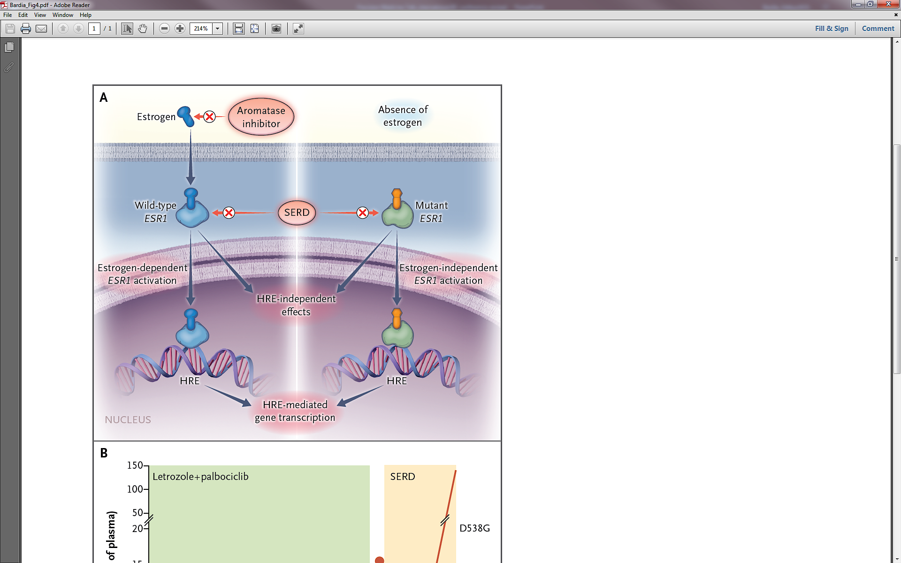
ESR1 (Acquired) Mutations: Resistance to AI
Bardia A, et al. N Engl J Med. 2018

Slide 3
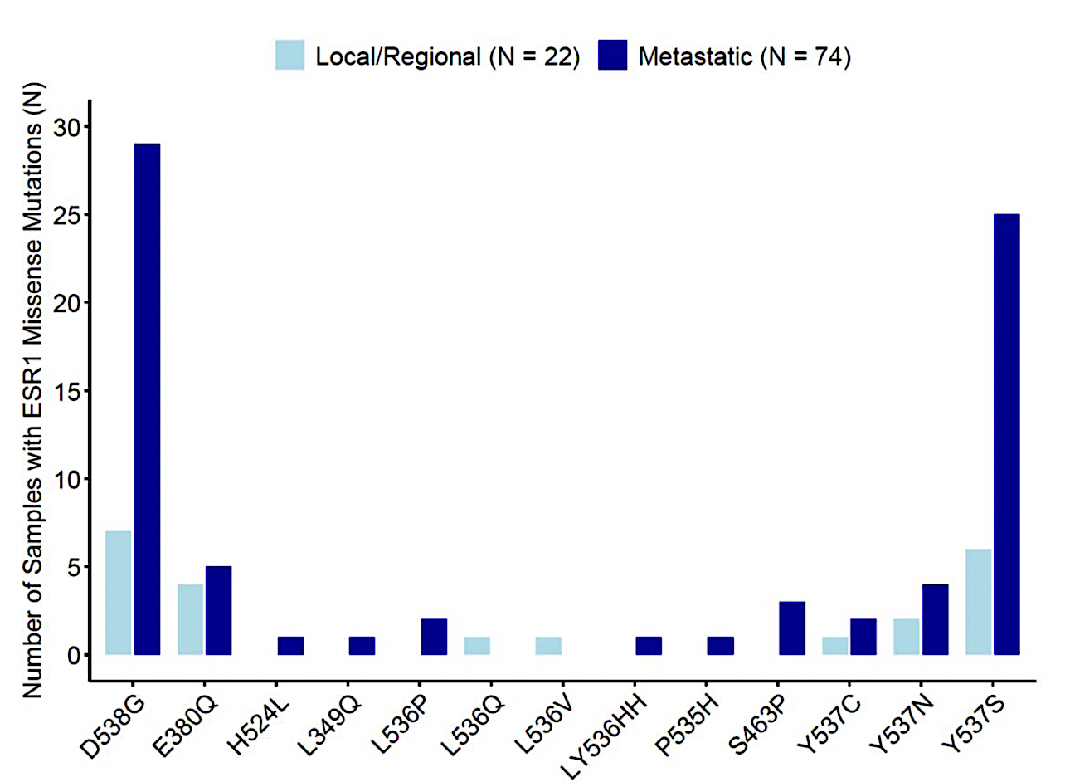
ESR1 (Acquired) Mutations:
Detection in Metastatic Setting
Basu et al. Breast Cancer Research 2026

Slide 4
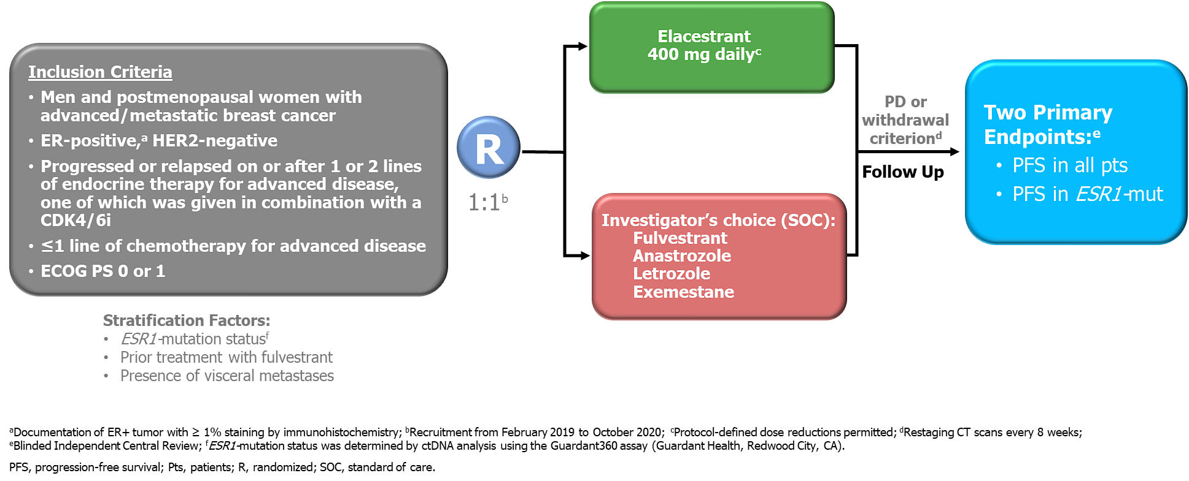
Phase 3 EMERALD: Study Design
A multicenter, international, randomized, open-label, active-controlled phase 3 trial for postmenopausal patients with ER+/HER2- MBC
Bardia A et al, SABCS 2022: Abstract GS-301.

Slide 5
Initial Phase 3 Trials with Oral SERDs: Differences in prior CDK 4/6i and primary outcomes
 | EMERALD¹ | AMEERA-3^{4,5} | acelERA^{6,7}
Treatment | Elacestrant | Amcenestrant | Giredestrant
Control arm | Fulvestrant / AIs | Fulvestrant / AIs / tamoxifen | Fulvestrant / AIs
Phase (N) | Ph 3 (478) | Ph 3 (367) | Ph 2/3 (303)
Patient population | Men or postmenopausal women | Men or women (any menopausal status) | Men or women (any menopausal status)
% ESR1m | 48% | 46.4% | 39%
Prior CDK4/6i | Required (100%) | Permitted (80%) | Permitted (42%)
Allowed prior fulvestrant | YES | YES | YES
Primary Endpoint | Dual (All and ESR1m) | Single (All) | Single (All)
Data readout | Positive | Negative | Negative
1. Bidard FC et al. J Clin Oncol. 2022;40(28):3246-3256. 2. Oliveira M et al. Lancet Oncol. 2024;25(11):1424-1439. 3. EMBER-3. NCT04975308. Updated Oct 18, 2024. Accessed Oct 22, 2024. https://clinicaltrials.gov/ct2/show/NCT04975308. 4. Tolaney SM et al. J Clin Oncol. 2023;41(24):4014-4024. 5. Sanofi Press Release. https://www.sanofi.com/en/media-room/press-releases/2022/2022-08-17-05-30-00-2499668. August 17, 2022. Accessed Oct 22, 2024. 6. Martin M et al. ASCO 2021. Abstract TPS1100. 7. Jimenez MM et al. J Clin Oncol. 2024;42(18):2149-2160.

Slide 6
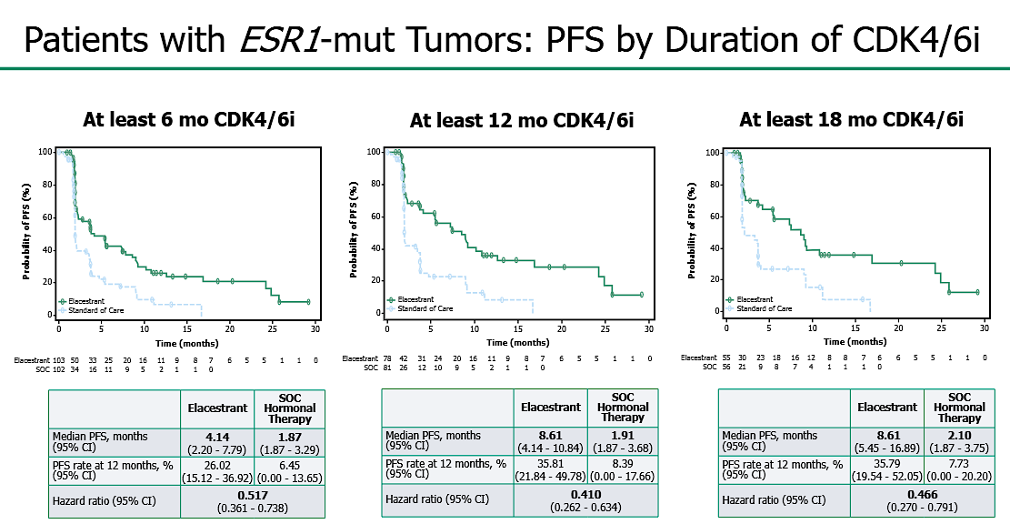
EMERALD: PFS by Duration of CDK 4/6i (ESR1m)
Bardia A, et al. Cancer Res. 2024.

Slide 7
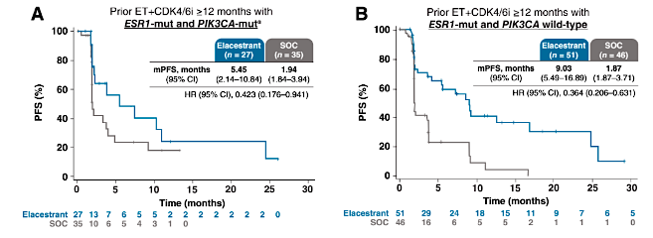
EMERALD: ≥ 12m on prior CDK 4/6i and mESR1 and mPIK3CA Group
Bardia A, et al. Cancer Res. 2024.

Slide 8
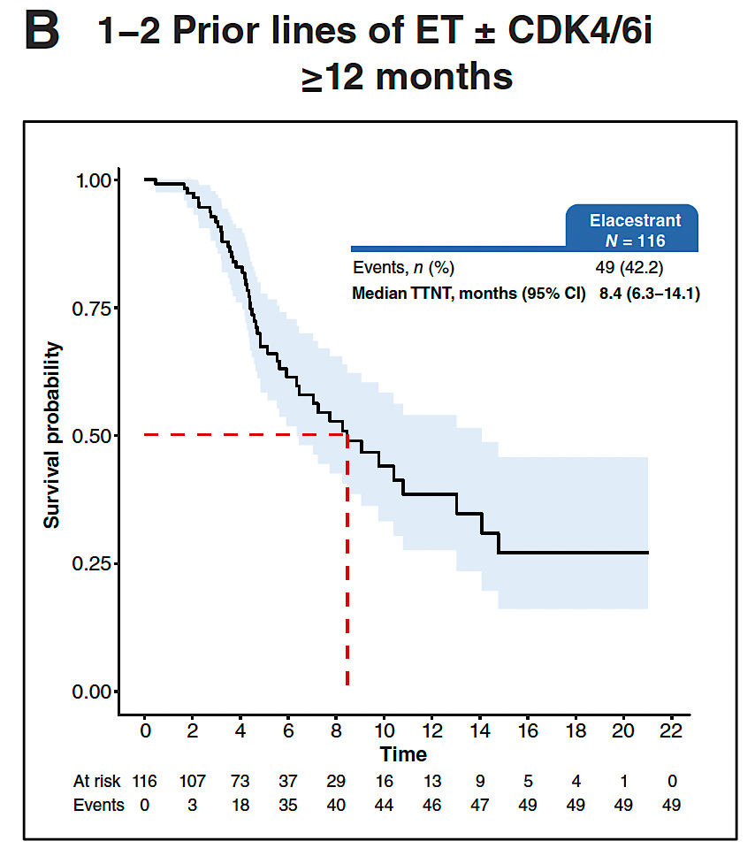
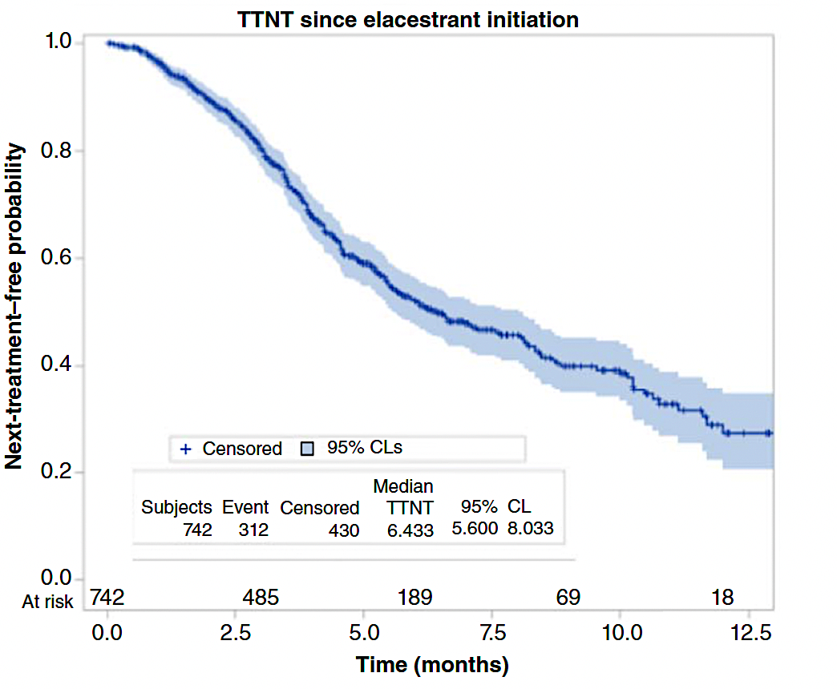
ELACESTRANT:
Real World Setting
Lloyd et al. Clin Cancer Res 2026
Rugo et al. Clin Cancer Res 2026

Slide 9
Elacestrant: Adverse Affects
AEs Occurring in ≥ 10% of Patients in Any Arm
AE, by Preferred Term | ELA (n = 237), No. (%) |  | SoC, No. (%)
 |  |  | Total (n = 229) |  | FUL (n = 161) |  | Al (n = 68)
 | All Grades | Grade 3/4 | All Grades | Grade 3/4 | All Grades | Grade 3/4 | All Grades | Grade 3/4
Nausea | 83 (35.0) | 6 (2.5) | 43 (18.8) | 2 (0.9) | 26 (16.1) |  | 17 (25.0) | 2 (2.9)
Fatigue | 45 (19.0) | 2 (0.8) | 43 (18.8) | 2 (0.9) | 35 (21.7) | 1 (0.6) | 8 (11.8) | 1 (1.5)
Vomiting | 45 (19.0) | 2 (0.8) | 19 (8.3) |  | 12 (7.5) |  | 7 (10.3)
Decreased appetite | 35 (14.8) | 2 (0.8) | 21 (9.2) | 1 (0.4) | 12 (7.5) |  | 9 (13.2) | 1 (1.5)
Arthralgia | 34 (14.3) | 2 (0.8) | 37 (16.2) |  | 28 (17.4) |  | 9 (13.2)
Diarrhea | 33 (13.9) | -- | 23 (10.0) | 2 (0.9) | 14 (8.7) | 1 (0.6) | 9 (13.2) | 1 (1.5)
Back pain | 33 (13.9) | 6 (2.5) | 22 (9.6) | 1 (0.4) | 16 (9.9) | 1 (0.6) | 6 (8.8)
AST increased | 31 (13.1) | 4 (1.7) | 28 (12.2) | 2 (0.9) | 20 (12.4) | 2 (1.2) | 8 (11.8)
Headache | 29 (12.2) | 4 (1.7) | 26 (11.4) |  | 18 (11.2) |  | 8 (11.8)
Constipation | 29 (12.2) |  | 15 (6.6) |  | 10 (6.2) |  | 5 (7.4)
Hot flush | 27 (11.4) |  | 19 (8.3) |  | 15 (9.3) |  | 4 (5.9)
Dyspepsia | 24 (10.1) |  | 6 (2.6) |  | 4 (2.5) |  | 2 (2.9)
ALT increased | 22 (9.3) | 5 (2.1) | 23 (10.0) | 1 (0.4) | 17 (10.6) |  | 6 (8.8) | 1 (1.5)
AE, adverse event; ALT, alanine aminotransferase; AST, aspartate aminotransferase.
Bidard FC, et al. J Clin Oncol. 2022

Slide 10
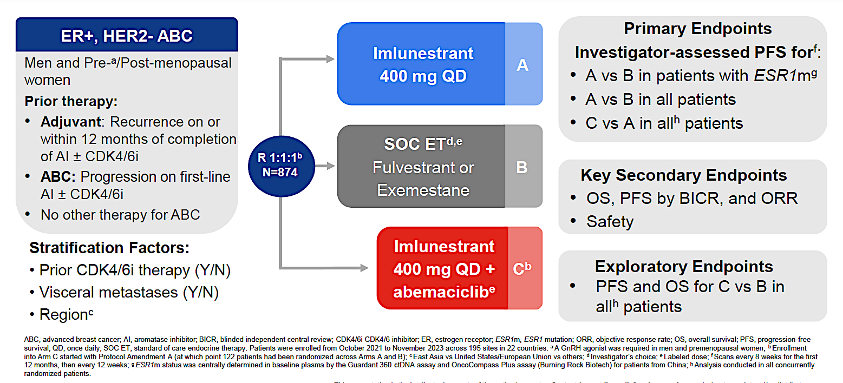
EMBER-3 Imlunestrant (+/- Abema) vs ET
Jhaveri KL, et al. NEJM. December 11, 2024. DOI: 10.1056/NEJMoa2410858; Jhaveri KL, et al. NEJM. Presented at 2024 SABCS. December 11-13, 2024. San Antonio, Texas. Abstract GS1-01.

Slide 11
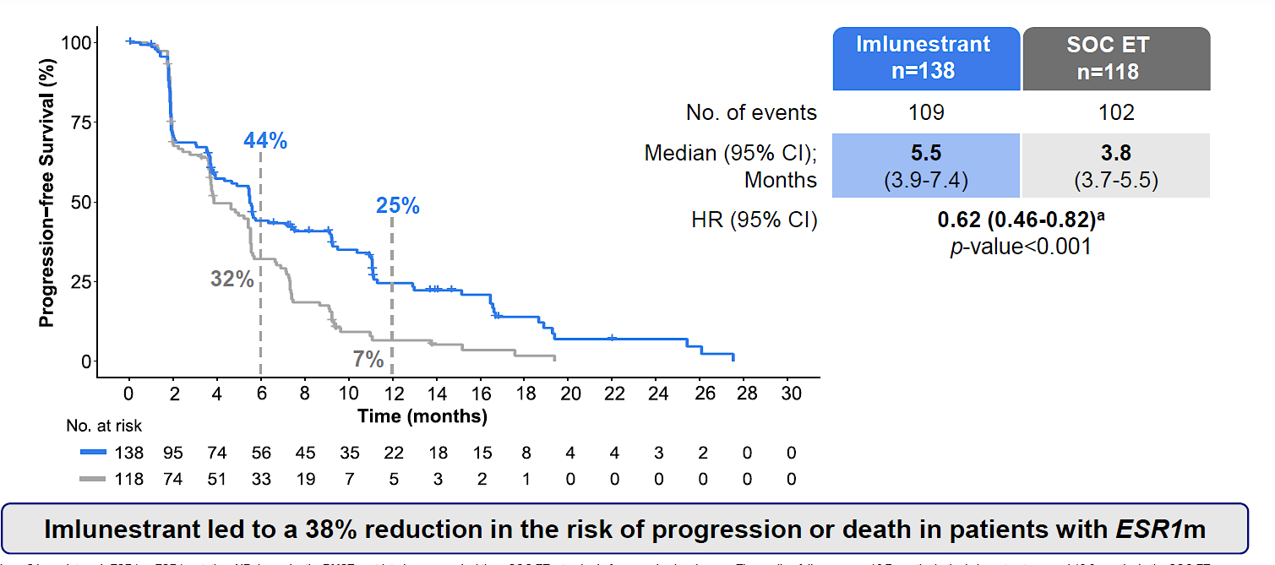
EMBER-3: PFS in ESR1m (Imlunestrant vs ET)
Investigator-assessed PFS in Patients with ESR1m
Jhaveri KL, et al. NEJM. 2024.

Slide 12
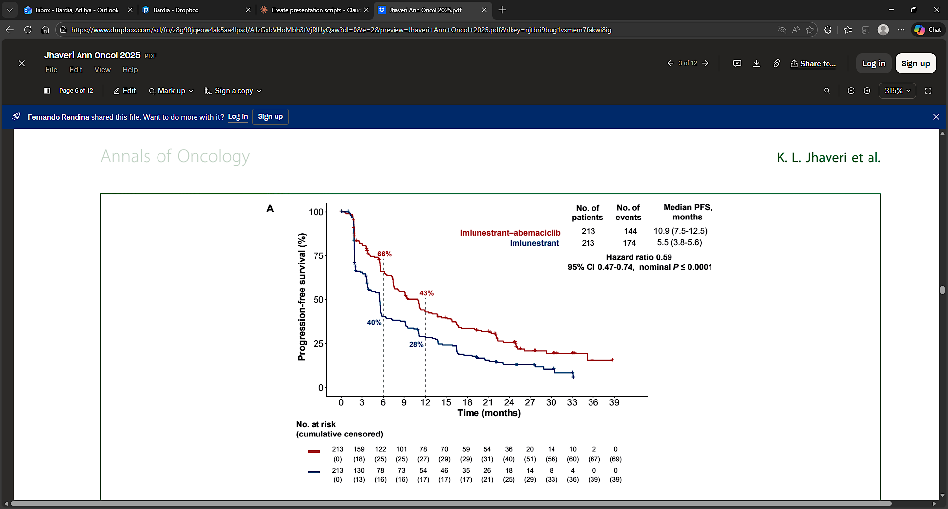
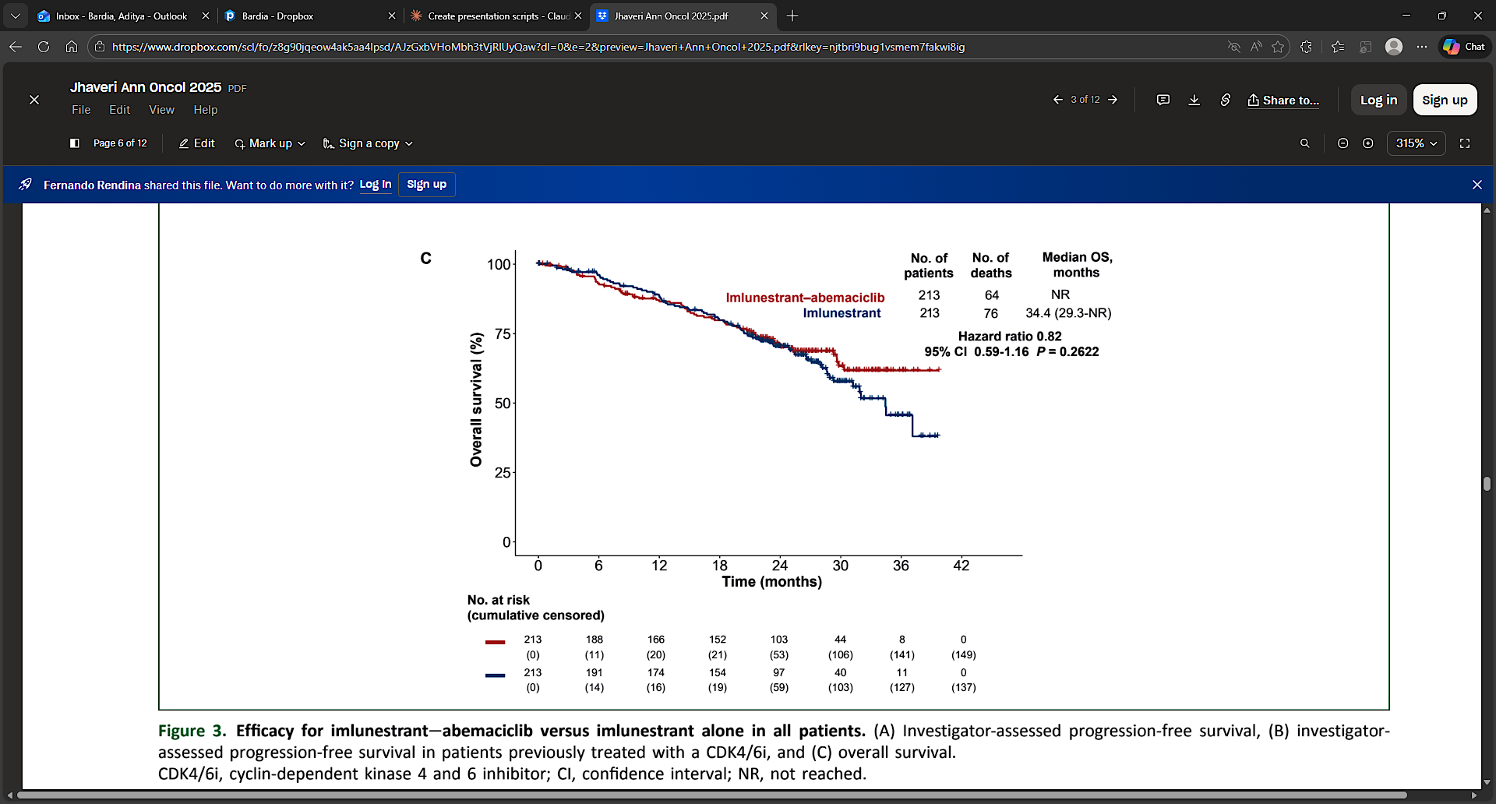
EMBER-3 PFS: Imlunestrant + Abema vs Imlunestrant
Jhaveri KL, et al. Ann Oncol 2025

Slide 13
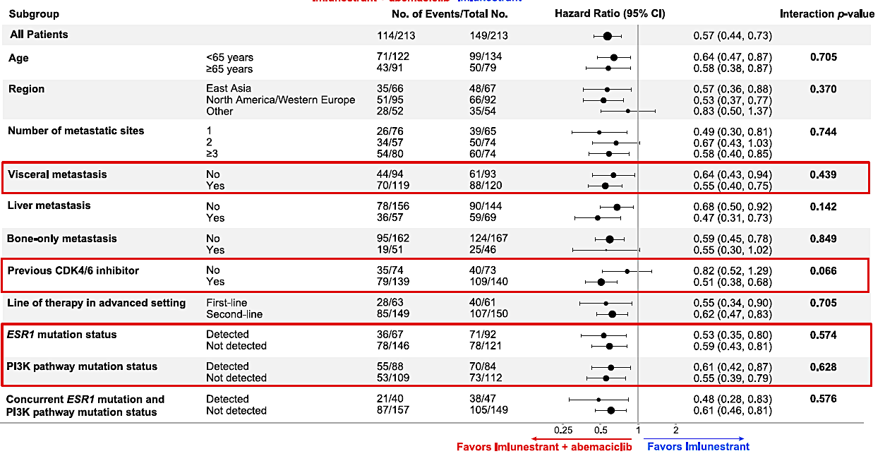
EMBER-3 PFS in Subgroups: Imlunestrant + Abema vs Imlunestrant
Jhaveri KL, et al. NEJM. 2024.

Slide 14
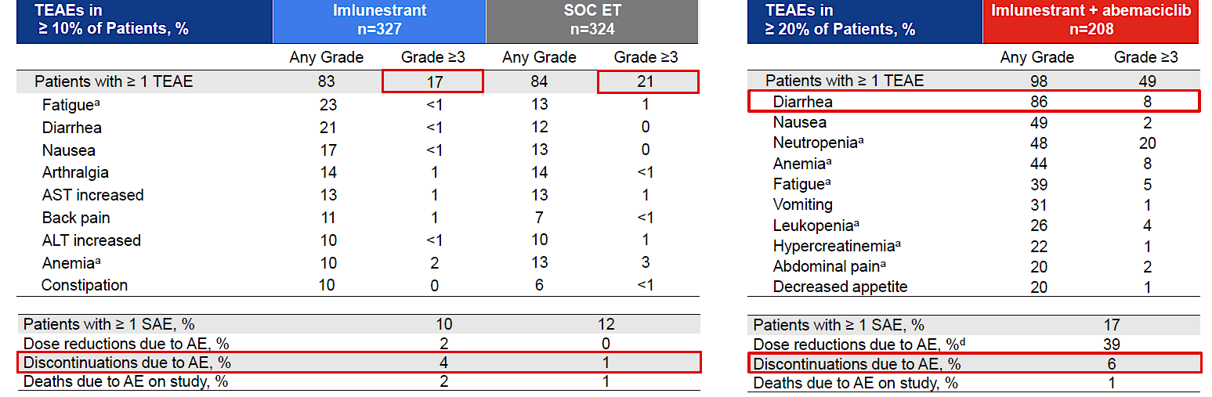
EMBER-3 Safety and Tolerability
Jhaveri KL, et al. NEJM. 2024.

Slide 15
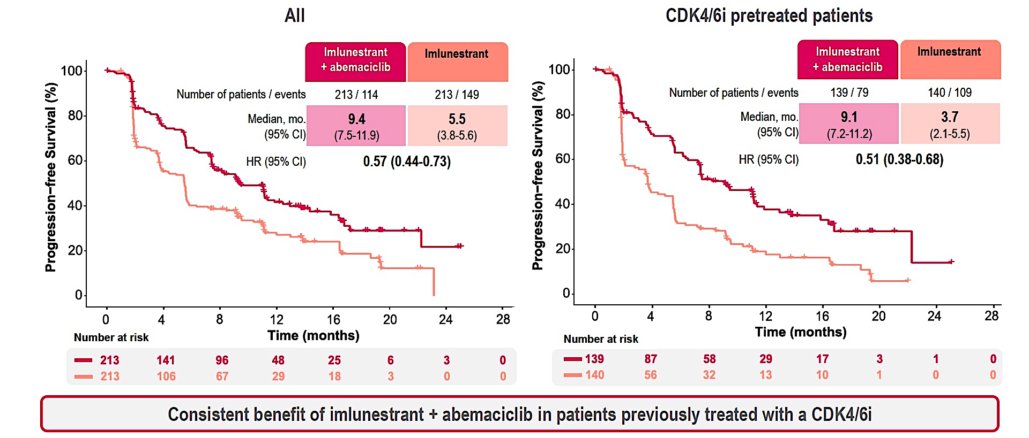
EMBER-3: PFS in All Pts, CDK4/6i Pretreated Pts
Manich CS et al. ESMO Breast 2025;Abstract 297O.

Slide 16
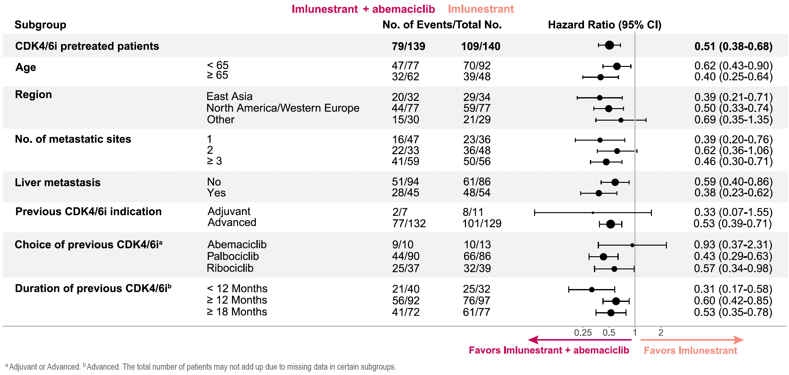
EMBER-3: Benefit Across Subgroups in CDK4/6i Pretreated Patients
Manich CS et al. ESMO Breast 2025;Abstract 297O.

Slide 17
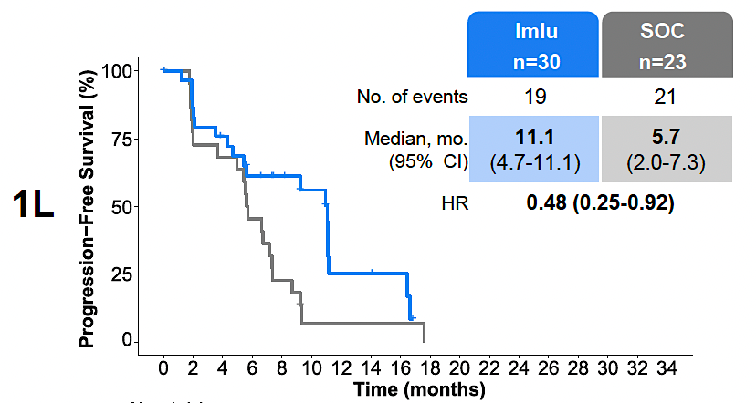
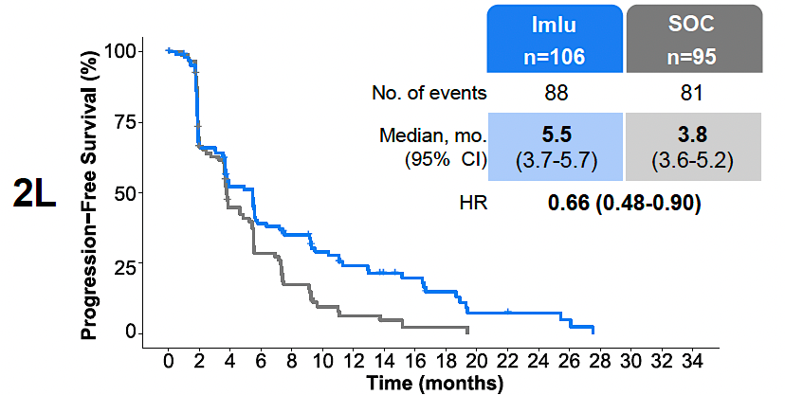
Phase III EMBER-3: Efficacy by Line of Therapy (ESR1m)
Neven P et al. ESMO Breast 2025;Abstract 306P.

Slide 18
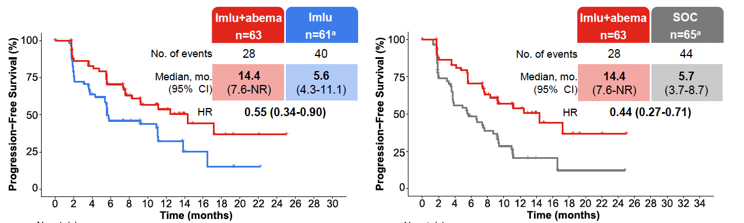
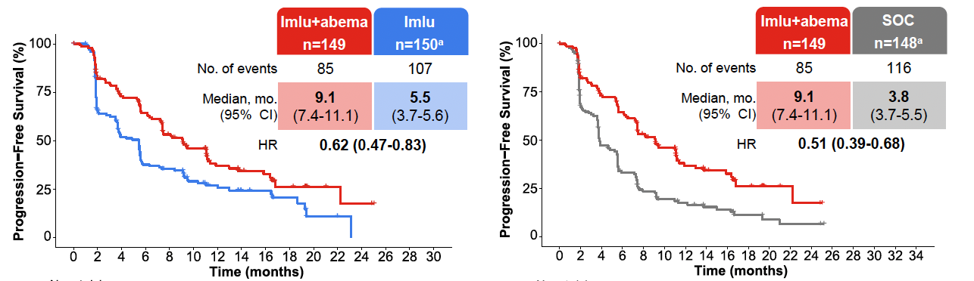
Phase III EMBER-3: Exploratory Analysis of Efficacy by Line of Therapy in Advanced Breast Cancer
Neven P et al. ESMO Breast 2025;Abstract 306P.

Slide 19
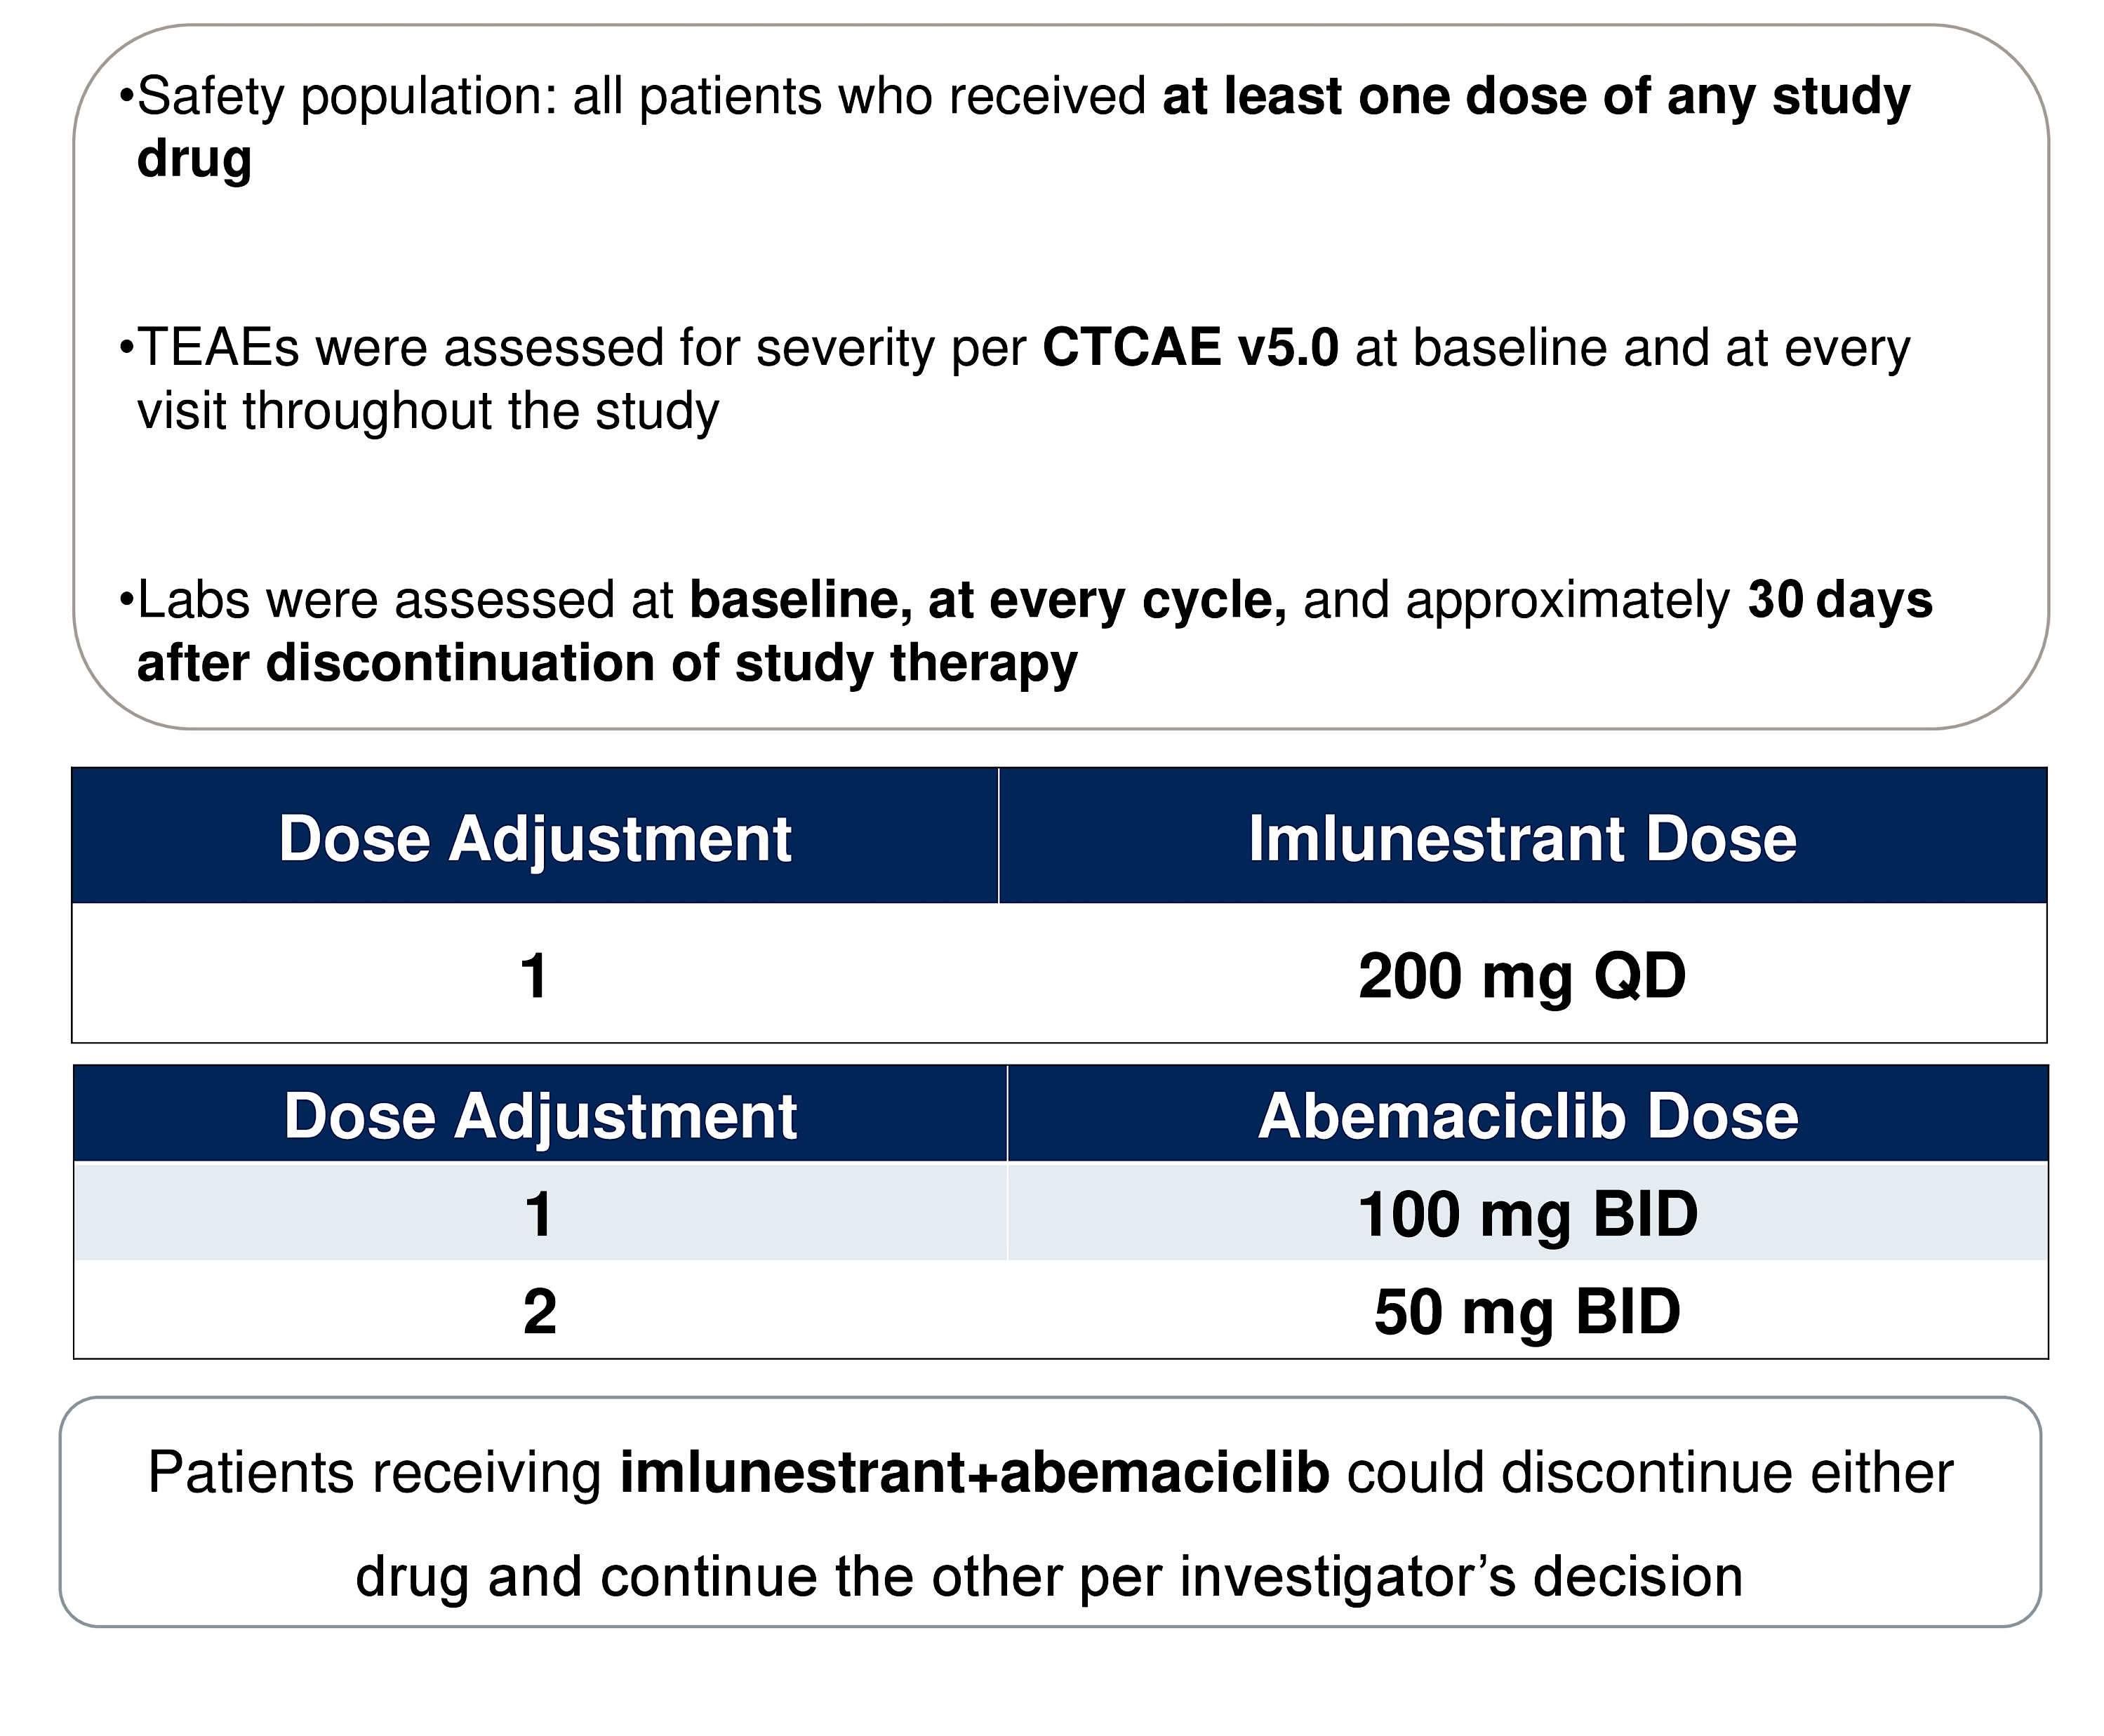
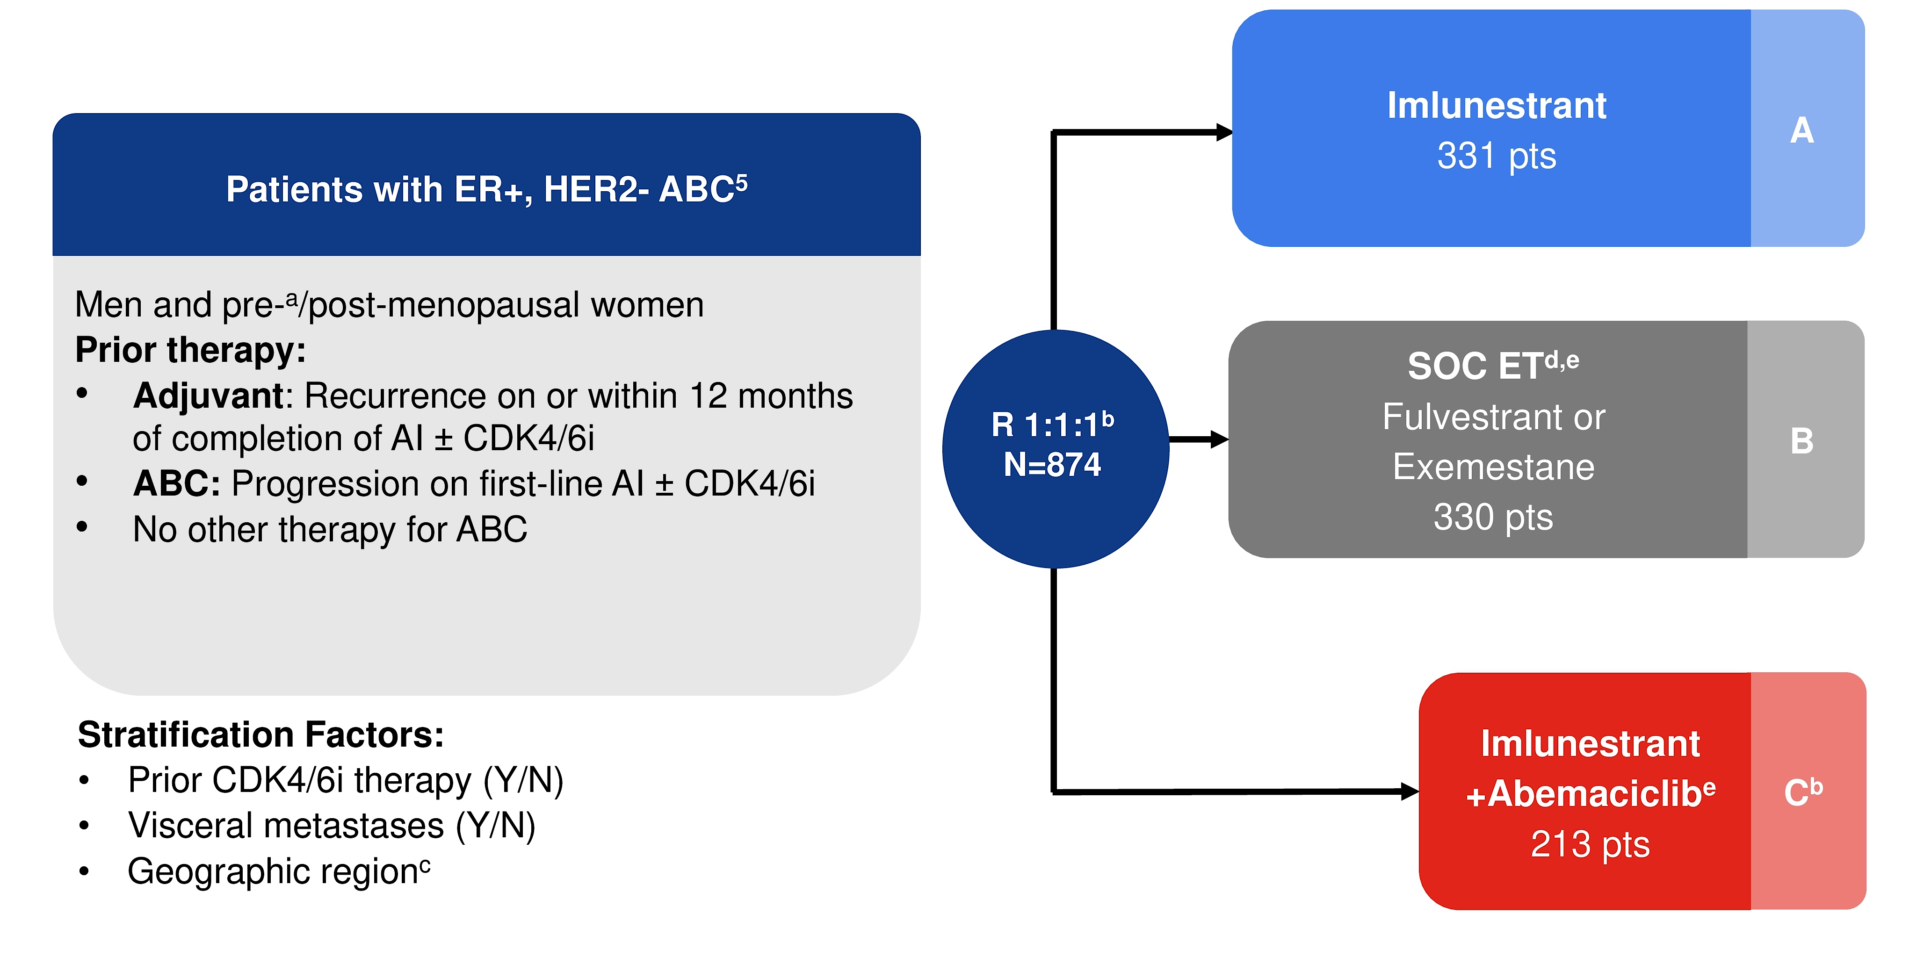
Phase III EMBER-3: Safety Analyses
O'Shaughnessy J et al. ASCO 2025;Abstract 1060.

Slide 20
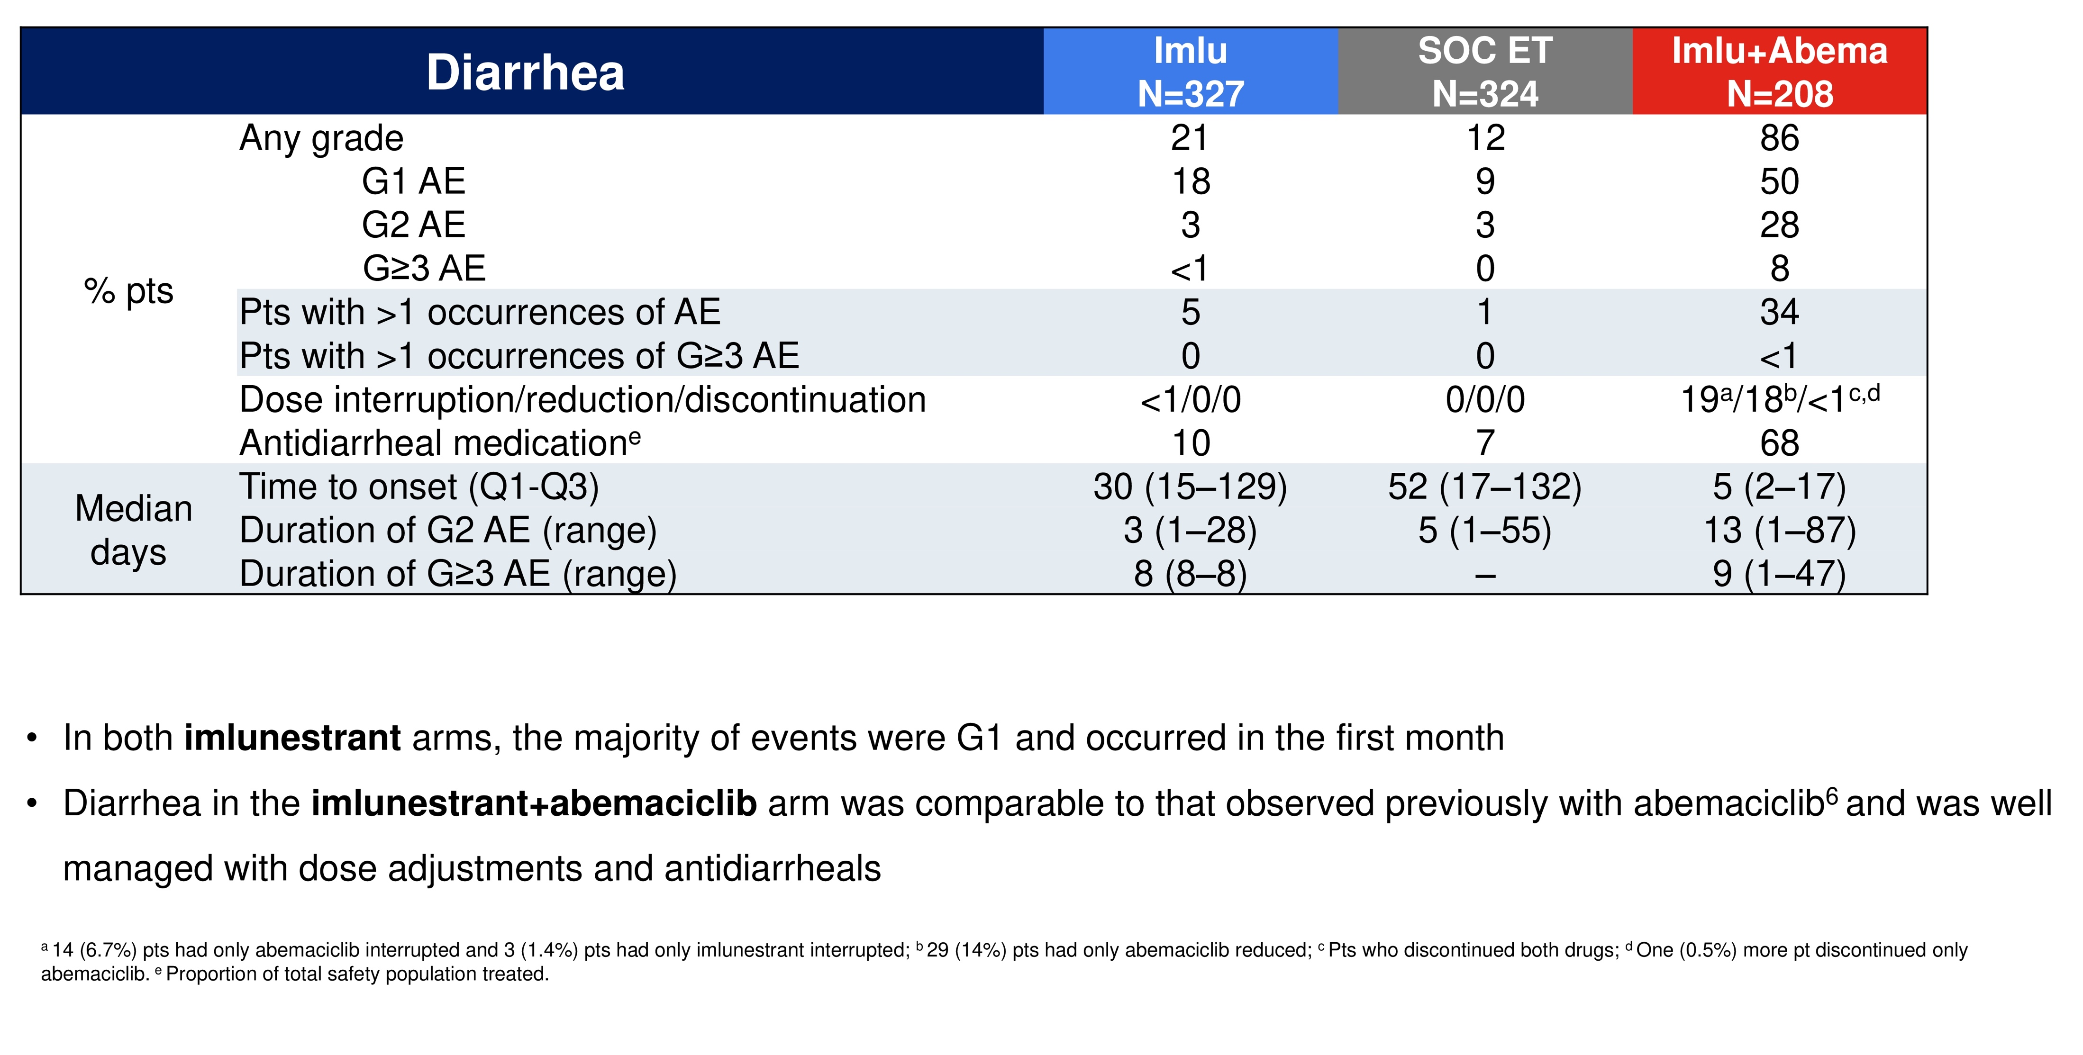
Phase III EMBER-3 (Safety Analysis): Diarrhea Summary
O'Shaughnessy J et al. ASCO 2025;Abstract 1060.

Slide 21
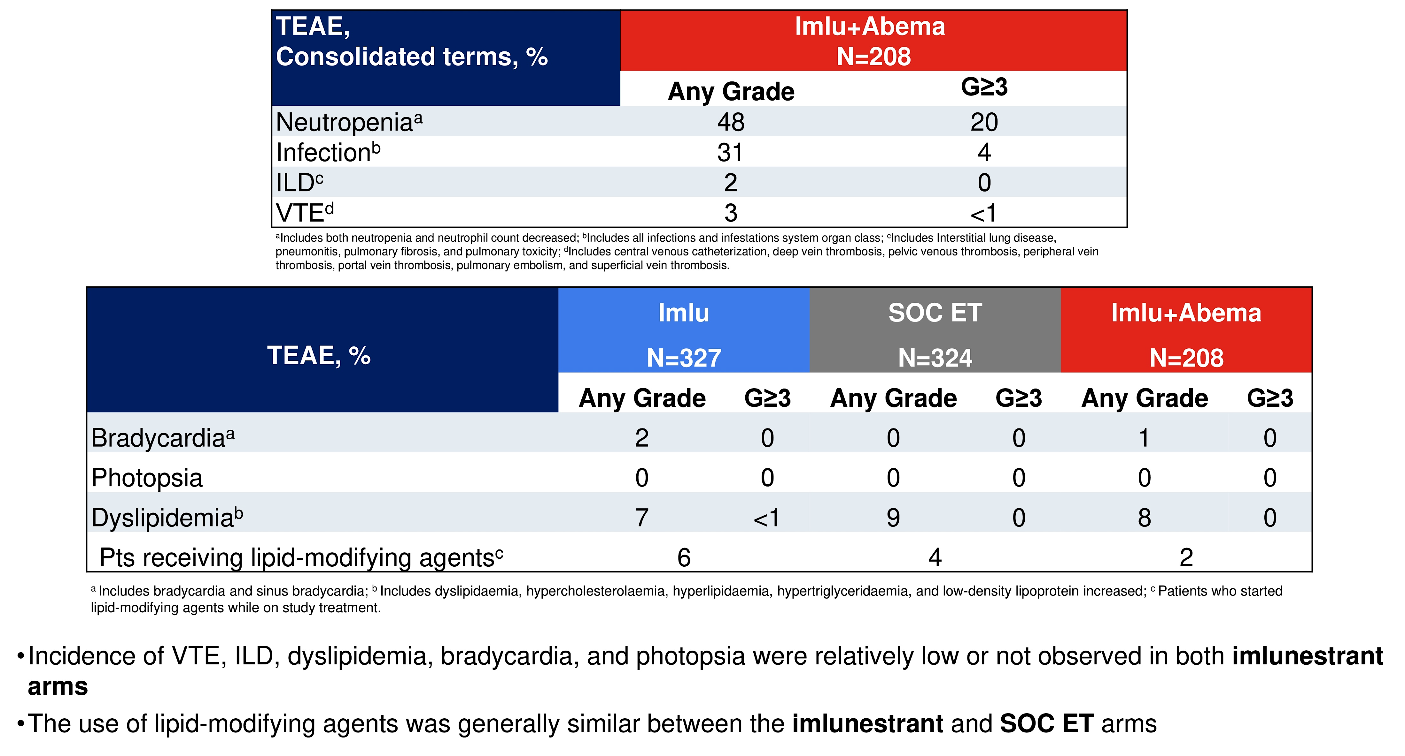
Phase III EMBER-3 (Safety Analysis): TEAEs of Interest
O'Shaughnessy J et al. ASCO 2025;Abstract 1060.

Slide 22
VERITAC-2: Vepdegestrant (ARV-471) Vs ET
Vepdegestrant (n=313)
200 mg PO qd
Primary endpoint: PFS by BICR in ITT and ESR1mut population Secondary endpoints: OS, CBR and ORR by BICR, AEs
ER+, HER2– ABC or MBC:
1 prior line of CDK4/6i + ET and ≤1 additional ET
Most recent ET for ≥6 months
No prior Chemo
R
1:1
Fulvestrant (n=311)
500 mg IM on D1, D15 of C1; D1 of C2+
Stratification factors: ESR1 mutation assessed by ctDNA, visceral disease
ª ESR1mut status was assessed in pretreatment ctDNA. ^{b} Disease progression during or within ≤12 months from the end of adjuvant therapy was counted as a line of therapy in ABC/MBC. ^{c} One additional patient in the vepdegestrant group and 3 additional patients in the fulvestrant group received 3 prior lines of therapy. ^{d} Other CDK4/6i included birociclib, dalpiciclib, and lerociclib.
Hamilton EP, et al. ASCO 2025. Abstract LBA1000.

Slide 23
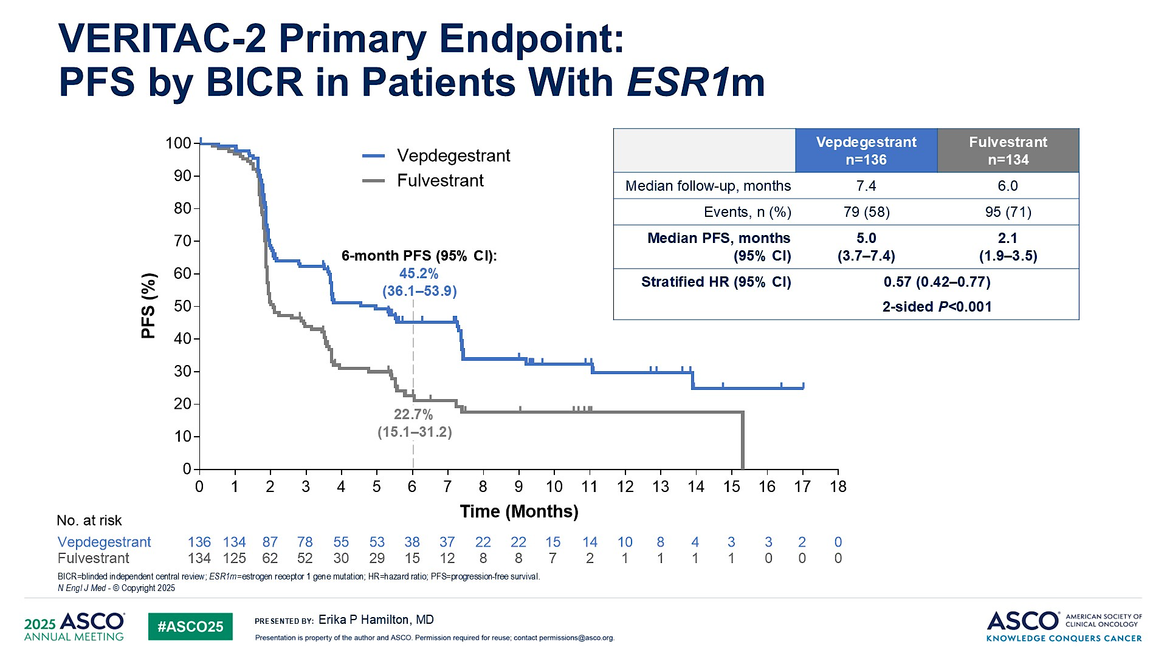
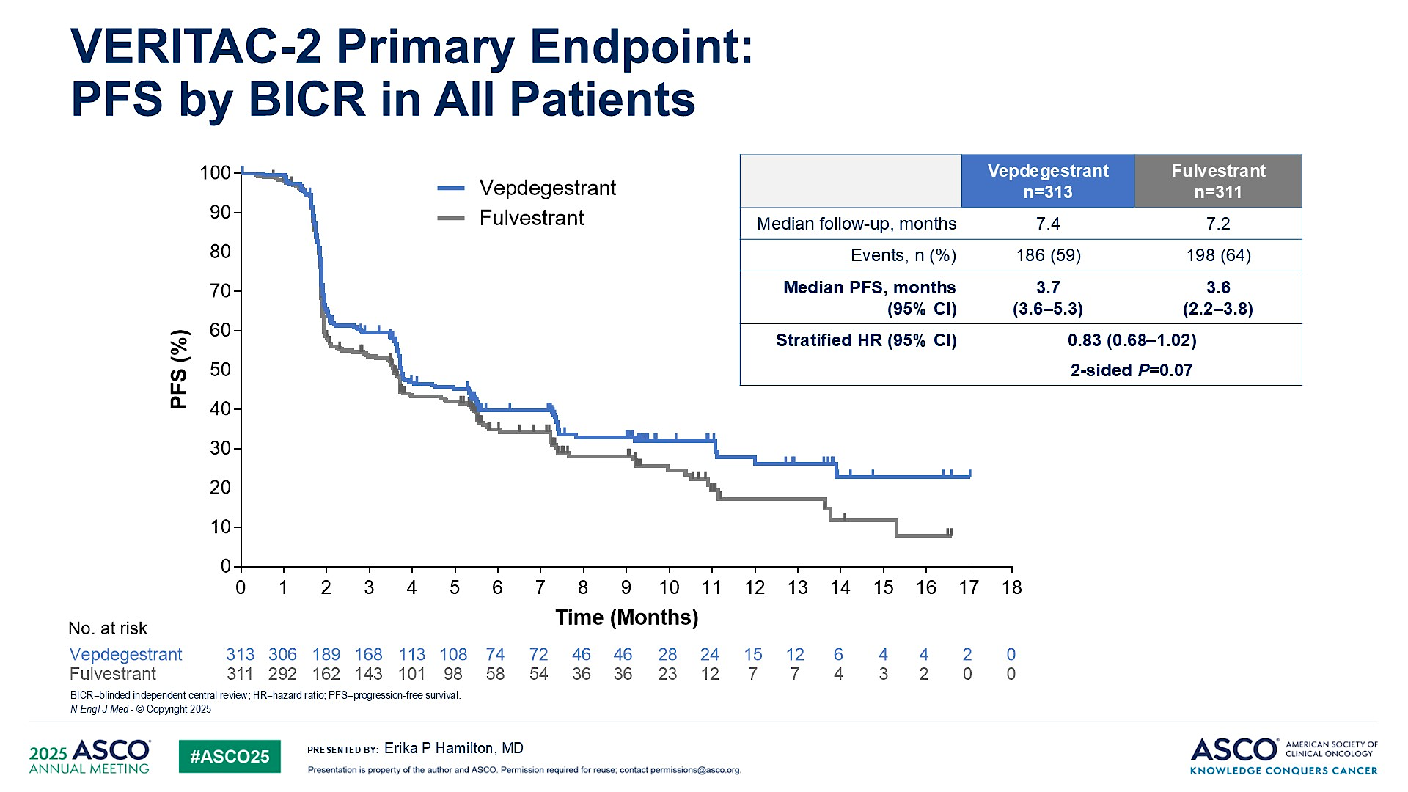
VERITAC-2: Study Results
Patients With ESR1mut
All Patients
PFS by BICR in ESR1mut | Vepdegestrant (n=136) | Fulvestrant (n=134)
Median follow-up, mo | 7.4 | 6.0
Events, n (%) | 79 (58) | 95 (71)
Median PFS, mo (95% CI) | 5.0 (3.7-7.4) | 2.1 (1.9-3.5)
Stratified HR (95% CI) | 0.57 (0.42-0.77); 2-sided P<0.001
PFS by BICR in ITT | Vepdegestrant (n=313) | Fulvestrant (n=311)
Median follow-up, mo | 7.4 | 7.2
Events, n (%) | 186 (59) | 198 (64)
Median PFS, mo (95% CI) | 3.7 (3.6-5.3) | 3.6 (2.2-3.8)
Stratified HR (95% CI) | 0.83 (0.68-1.02); 2-sided P=0.07
Hamilton EP, et al. ASCO 2025. Abstract LBA1000.

Slide 24
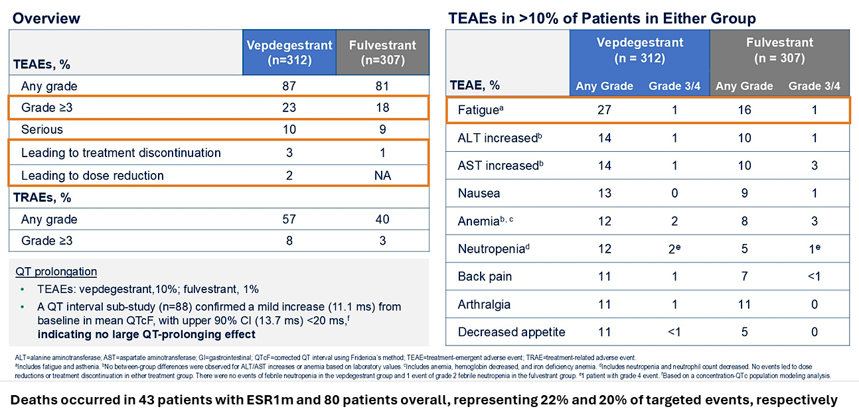
VERITAC-2: Safety and Tolerability

Slide 25
Phase 3 Trials with Oral SERDs: Differences in prior CDK 4/6i and primary outcomes
 | EMERALD¹ | AMEERA-3^{4,5} | acelERA^{6,7}
Treatment | Elacestrant | Amcenestrant | Giredestrant
Control arm | Fulvestrant / AIs | Fulvestrant / AIs / tamoxifen | Fulvestrant / AIs
Sample Size | 478 | 367 | 303
% ESR1m | 48% | 46.4% | 39%
Prior CDK4/6i | Required | Permitted | Permitted
Primary Endpoint | Dual (All and ESR1m) | Single (All) | Single (All)
Data readout | Positive | Negative | Negative
Adverse Effect | Nausea | GI | Bradycardia
EMBER-3
Imlunestrant (+/- Abema)
Fulvestrant / AIs
874
29.2%
Permitted
Dual (All and ESR1m)
Positive
Diarrhea
VERITAC-2
Vepdegestrant
Fulvestrant
624
43.2%
Required
Dual (All and ESR1m)
Positive
Anemia, Neutropenia

Slide 26
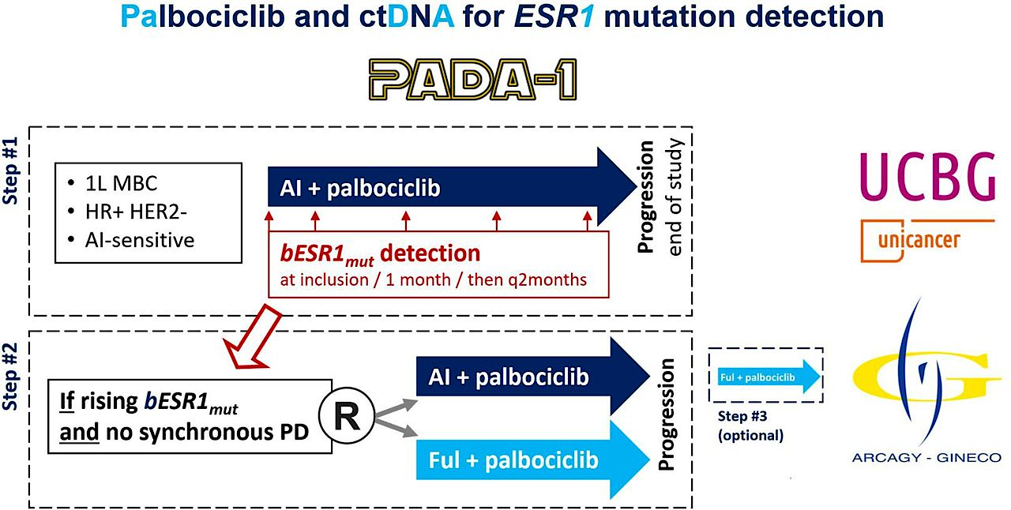
Phase III PADA-1: Study Design
bESR1 =Blood ESR1
Berger F et al. BMJ Open 2022 March 3;12(3):e055821.

Slide 27
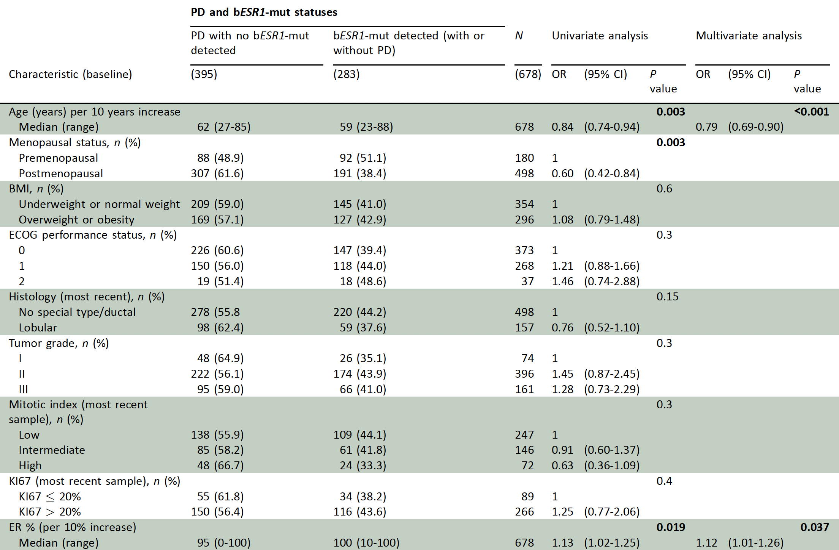
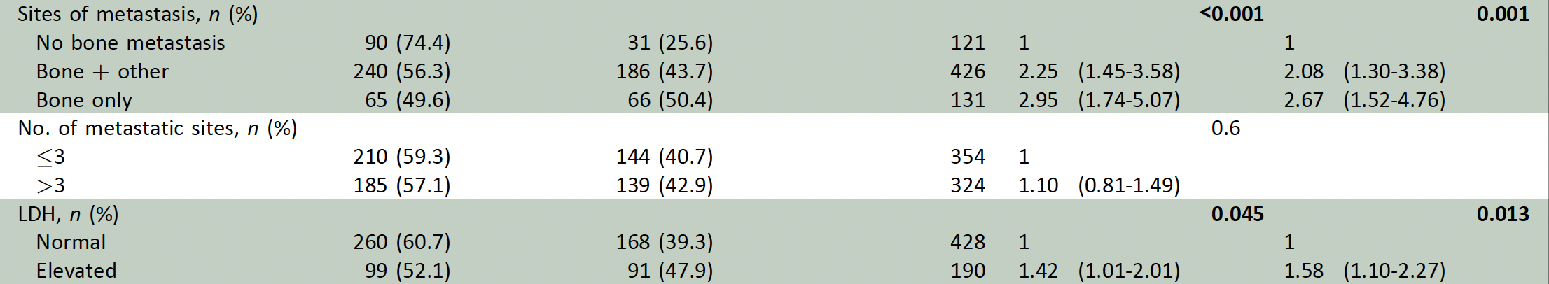
PADA-1: Factors Associated with Rising bESR1 Mutation Detection Under Treatment with AI and Palbociclib
Cabel L et al. Ann Oncol 2026;37(3):329-40.

Slide 28
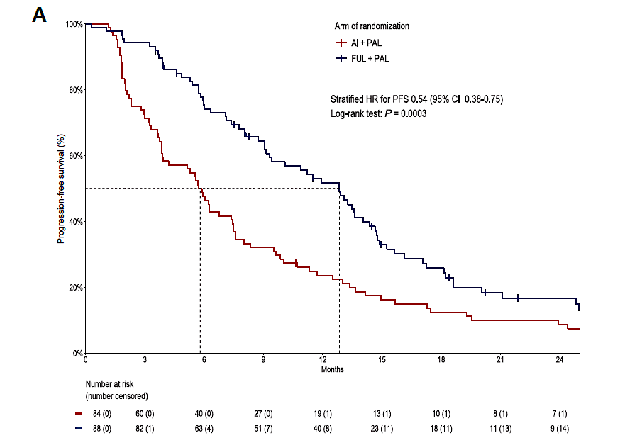
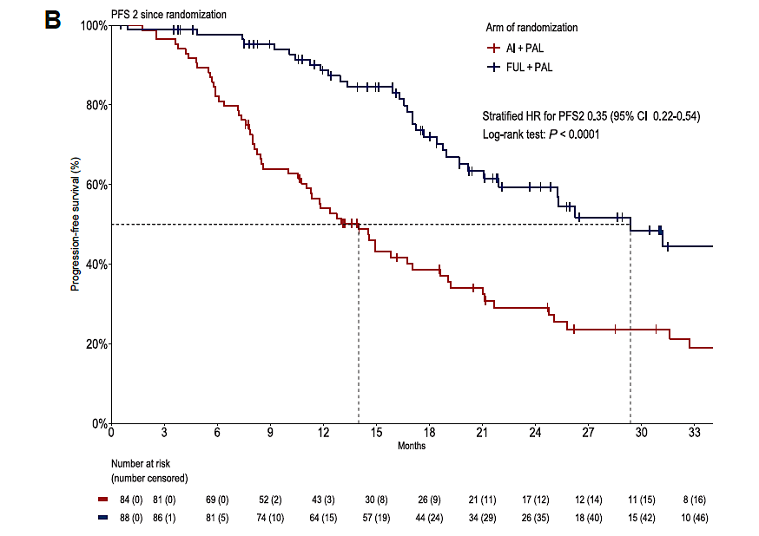
PADA-1: PFS, PFS2 in the Second Step
Cabel L et al. Ann Oncol 2026;37(3):329-40.

Slide 29
SERENA-6: Camizestrant + CDK4/6i vs ET + CDK 4/6i
Key Eligibility Criteria
ER+/HER2– ABCª
On 1L AI + CDK4/6i for ≥6 months
ESR1mut detected in ctDNA with no evidence of disease progression
Screening (N=3325)
ESR1mut surveillance (n=3256): Testing every 2-3 months
Patients with ESR1mut detected^{b} (n=548)
1:1 randomization (n=315)
Experimental Arm (n=157)
Camizestrant 75 mg PO qd +
continue same CDK4/6i +
Pbo for AI
Comparator Arm (n=158)
Continue AI (anastrozole/letrozole) + continue same CDK4/6i + Pbo for camizestrant
ª Pre- or perimenopausal women, and men received an LHRH agonist per clinical guidelines. ^{b} 51% tested positive on first test, 38% after 2-5 tests, and 11% after >5 tests. ^{c} Stratification factors.
Turner NC, et al. ASCO 2025. Abstract LBA4.

Slide 30
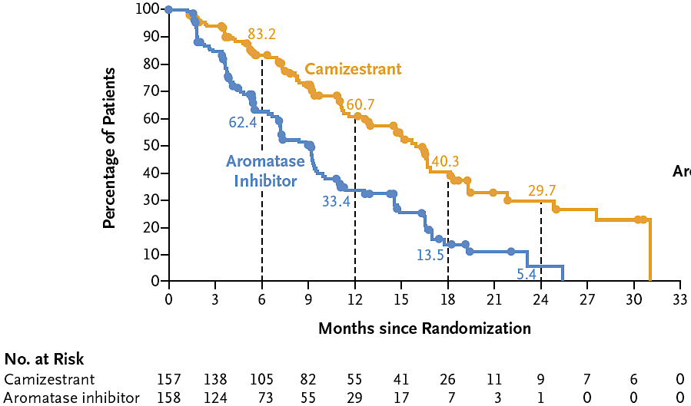
SERENA-6: Camizestrant + CDK4/6i Results
Investigator-Assessed PFS | Camizestrant + CDK4/6i (n=157) | AI + CDK4/6i (n=158)
PFS events, n | 71 | 100
mPFS, mo (95% CI) | 16.0 (12.7-18.2) | 9.2 (7.2-9.5)
Adjusted HR (95% CI) | 0.44 (0.31-0.60); P<0.00001
Investigator-Assessed PFS
PFS (%)
Time From Randomization (months)
PFS2ª | Camizestrant + CDK4/6i (n=157) | AI + CDK4/6i (n=158)
PFS2 events, n | 38 | 47
12-mo PFS2 rate, % | 85.4 | 74.4
Adjusted HR (95% CI) | 0.52 (0.33-0.81); P=0.0038 [interim analysis threshold P=0.0001]
Median follow-up: 12.6 mo
PFS benefit was consistent across the CDK4/6i and clinically relevant subgroups
ª Information fraction: 54%. Final PFS2 analysis will occur at 158 PFS2 events.
Turner NC, et al. ASCO 2025. Abstract LBA4.

Slide 31
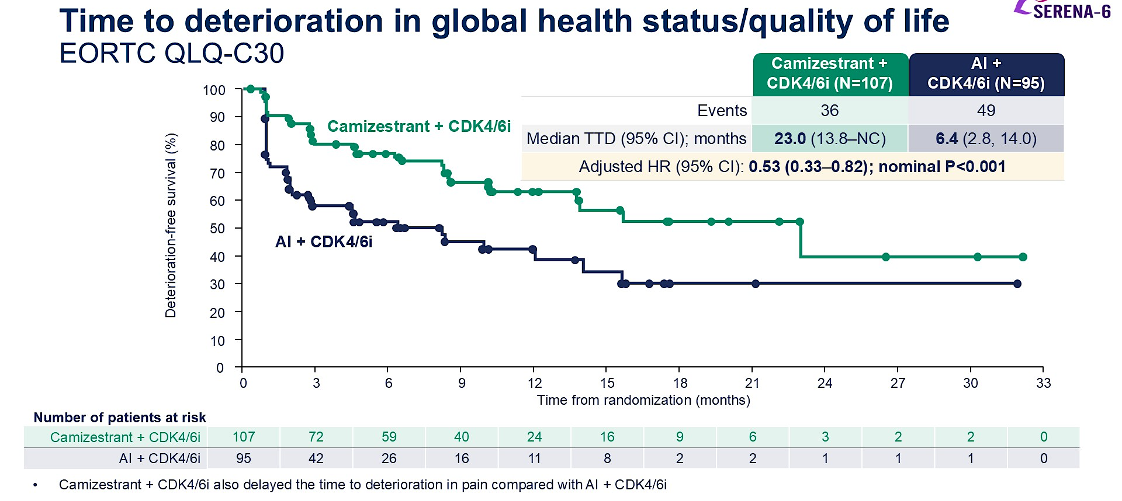
SERENA-6: QOL Results
Turner ASCO 2025; Bidard et al. N Engl J Med. 2025 Online ahead of print.

Slide 32
How about combination Therapy with other SERDs?

Slide 33
Giredestrant + Everolimus vs ET + Everolimus: EVERA Study Design
Study design
A global, randomised, open-label, Phase III trial
Key eligibility criteria*
ER+, HER2– aBC (1–3L of therapy)
≤ 2 prior lines of ET in the aBC setting
PD or relapse during/post-CDK4/6i + ET
No prior chemotherapy in the aBC setting
Measurable disease per RECIST v1.1 or evaluable bone metastases
Enrolment period: August 2022 to October 2024
N = 373*
Giredestrant (30 mg) + everolimus (10 mg)†
Until PD or unacceptable toxicity
R 1:1
SOC ET‡ + everolimus (10 mg)† ‡Exemestane/fulvestrant/tamoxifen
† Dexamethasone mouthwash prophylaxis and treatment was strongly recommended per SWISH trial protocol¹
* Trial was enriched to 55% of patients with ESR1m at baseline (centrally tested via circulating tumour DNA)
Stratification factors
Prior treatment with fulvestrant (yes vs no)
ESR1m (yes vs no/indeterminate)
Site of disease (visceral [lung and/or liver involvement] vs non-visceral)
Coprimary endpoints (RECIST v1.1)
INV-PFS in patients whose tumours had ESR1m
INV-PFS in the ITT population
Key secondary endpoints
OS
INV-assessed ORR, DoR
Presented by: Erica L. Mayer, MD, MPH.
ClinicalTrials.gov number, NCT05306340. Adapted from Mayer EL, et al. SABCS 2022 (poster OT2-01-07) with permission.
1–3L, first to third line; aBC, advanced breast cancer; CDK4/6i, cyclin-dependent kinase 4/6 inhibitor; DoR, duration of response; ER+, oestrogen receptor-positive; ESR1m, ESR1 mutation; ET, endocrine therapy; HER2–, HER2-negative; INV, investigator-assessed; ITT, intention to treat; ORR, objective response rate; OS, overall survival; PD, progressive disease; PFS, progression-free survival; R, randomisation; RECIST, Response Evaluation Criteria in Solid Tumours; SOC ET, standard of care endocrine therapy. 1. Rugo HS, et al. Lancet Oncology 2017; 18:654–662.

Slide 34
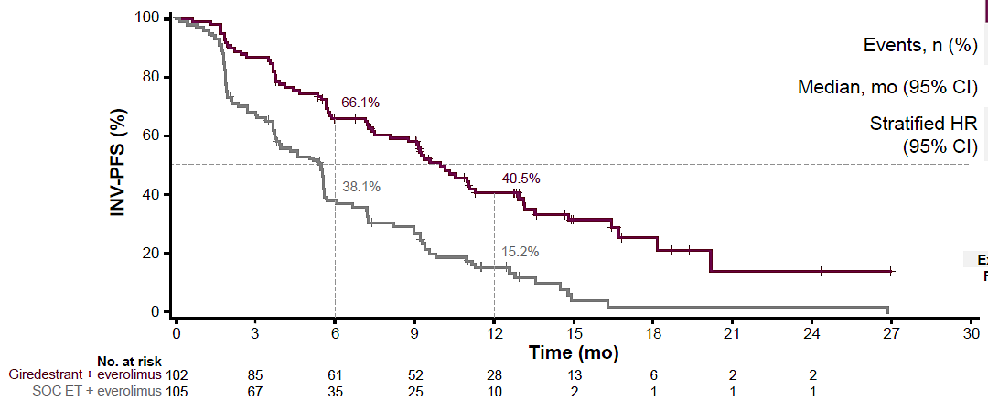
Giredestrant + Everolimus vs ET + Everolimus: PFS in ESR1 mutant setting (EVERA)
PFS in ESR1mut | Giredestrant + Everolimus (n=102) | SOC ET + Everolimus (n=105)
Events, n (%) | 63 (61.8) | 89 (84.8)
Median, mo (95% CI) | 9.99 (8.1-12.9) | 5.45 (3.8-5.6)
Stratified HR (95% CI) | 0.38 (0.27-0.54); P<0.0001
66.1%
38.1%
40.5%
15.2%
INV-PFS in ESR1mut Population
Mayer E, et al. ESMO 2025. Abstract LBA16.
PFS benefit was consistent across key subgroups and regardless of SOC ET

Slide 35
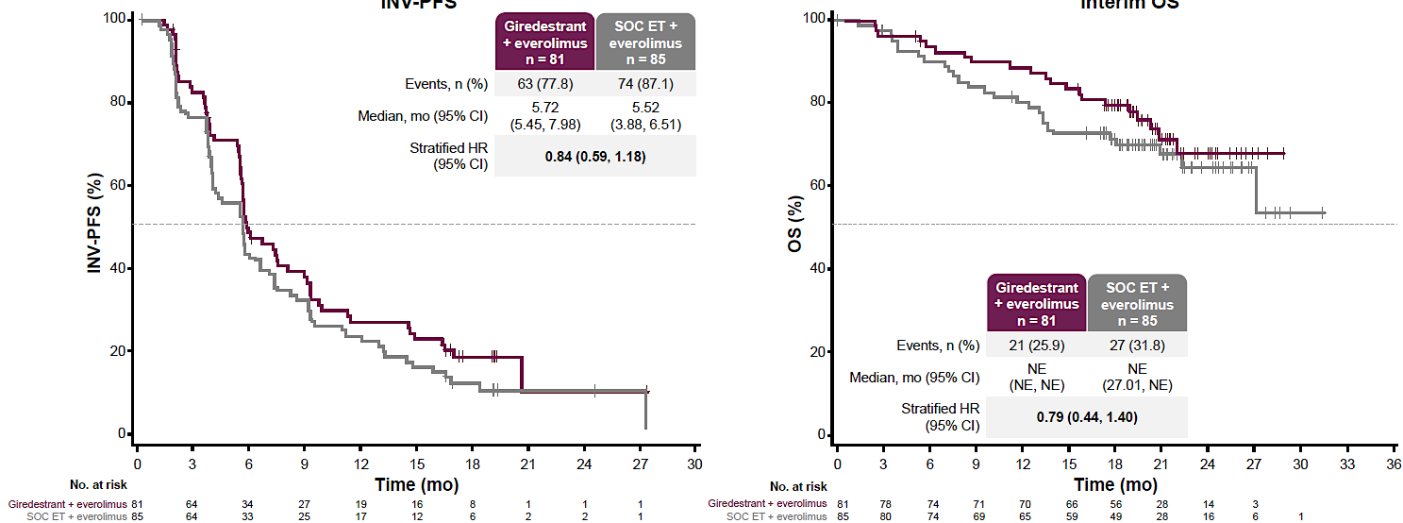
Giredestrant + Everolimus vs ET + Everolimus: PFS in non-ESR1 mutant setting (EVERA)
Mayer E, et al. ESMO 2025. Abstract LBA16.
INV-PFS in Non-ESR1mut Population

Slide 36
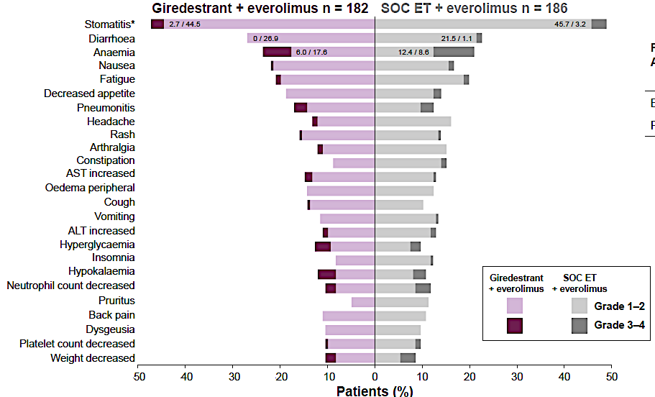
Giredestrant + Everolimus vs ET + Everolimus: Treatment Related Adverse Events (EVERA)
TEAEs in ≥10% of Patients
Mayer E, et al. ESMO 2025. Abstract LBA16.

Slide 37
ELEVATE Study Design
How about Elacestrant based combos? (ELEVATE)
Phase 1b (n=90)
Phase 2
Phase 1B objective
Elacestrant 258 mg* combined with either:
Arm A (n=50)
Elacestrant + Alpelisib
Alpelisib 150–250 mg^{a,b}
Everolimus 5 mg
Palbociclib 100 mg
Ribociclib 400 mg^{c}
Capivasertib 320 mg
Primary: Determine RP2D of elacestrant in combination with each of the other study drugs
Cohort 1
Arm B (n=50)
Elacestrant + Everolimus
Prior CDK4/6i
required
Elacestrant 345 mg* combined with either:
Arm C (n=60)
Elacestrant + Abemaciclib^{i}
Elacestrant + Ribociclib
Phase 2 objectives
Alpelisib 250 mg
Everolimus 5 mg
Palbociclib 100 mg
Ribociclib 400 mg^{d}
Capivasertib 320 mg
RP2D of various combinations
N=310
Primary: Evaluate the PFS of elacestrant in combination with each of the other study drugs
Secondary: Evaluate efficacy and safety of elacestrant in combination with each of the other study drugs
Cohort 2
Arm D (n=90)
Elacestrant + Palbociclib
Elacestrant + Abemaciclib^{i}
Elacestrant + Ribociclib
No prior
CDK4/6i
Elacestrant 345 mg* combined with either:
Alpelisib 300 mg
Everolimus 7.5–10 mg^{e}
Palbociclib 125 mg
Ribociclib 400–600 mg^{f,g,h}
Capivasertib 400 mg
Cohort 3+
Arm E (n=60)
Elacestrant + Capivasertib
Prior CDK4/6i
allowed
*Elacestrant 86 mg is equivalent to 100 mg elacestrant hydrochloride; elacestrant 172 mg is equivalent to 200 mg elacestrant hydrochloride; elacestrant 258 mg is equivalent to 300 mg elacestrant hydrochloride; and elacestrant 345 mg is equivalent to 400 mg elacestrant hydrochloride; ªElacestrant 258 mg* + alpelisib 200 mg (cohort -1); ^{b}Elacestrant 258 mg* + alpelisib 150 mg (cohort -2); ^{c}Elacestrant 86 mg* + ribociclib (cohort 1); ^{d}Elacestrant 172 mg* + ribociclib (cohort 2); ^{e}Elacestrant 345 mg* + everolimus 7.5 mg (cohort 4); ^{f}Elacestrant 258 mg* + ribociclib 400 mg (cohort 3); ^{g}Elacestrant 172 mg* + ribociclib 600 mg (cohort 4); ^{h}Elacestrant 345 mg + ribociclib 400 mg (cohort 5); ^{i}The RP2D for the combination of elacestrant and abemaciclib was determined in the ongoing ELECTRA trial (NCT05386108). +, additional Cohorts; CDK4/6i, cyclin-dependent kinase 4/6 inhibitor; PFS, progression-free survival; RP2D, recommended phase 2 dose.
NCT05563220
Chan N, et al ASCO 2025: Abstract #1079
Combination of oral SERD with other targeted therapies

Slide 38
Elacestrant Based Combos:
mPFS*
Elacestrant + Everolimus
n=23
Elacestrant + Ribociclib
n=33
100
100
80
mPFS 8.3 months
95% CI: 3.9-NR
80
mPFS 7.8 months
95% CI: 5.6-NR
PFS (%)
60
PFS (%)
60
40
40
20
20
0
Censored
0
Censored
0
5
10
15
20
0
5
10
15
20
Months
Months
At Risk
23
12
8
4
1
At Risk
33
15
4
2
0
Median follow-up time of 5.5 months at data cut-off
Median follow-up time of 4.8 months at data cut-off
Clinical characteristics: visceral metastases 61%, prior fulvestrant 48%, 2 prior lines of ET for adv/mBC 35%, primary endocrine resistance 17%, ESR1-mutated tumors 44% (10/23), and PIK3CA-mutated tumors 26% (6/23).
Clinical characteristics: visceral metastases 67%, prior fulvestrant 55%, 2 prior lines of ET for adv/mBC 21%, primary endocrine resistance 9%, ESR1-mutated tumors 39% (13/33), and PIK3CA-mutated tumors 30% (10/33).
Data cut-off: 12 MAR 2025. mPFS, median progression-free survival
Rugo HS, et al ASCO 2025: Abstract #1070

Slide 39
How about early breast cancer?

Slide 40
Adjuvant Studies: Upfront Vs Switch Strategy
lidERA and CAMBRIA-2 study design
EMBER-4, CAMBRIA-1 and ELEGANT study design
ER+, HER2– medium/high-risk stage I–III eBC
Prior surgery with curative intent
Completed (neo)adjuvant chemotherapy (if administered) and/or surgery <12 mo prior to enrolment; ≤4 weeks of prior ET
Oral SERD
ER+, HER2– high-risk eBC
2–5 years of prior adjuvant ET for ER+, HER2– eBC (completed or discontinued ≤6 mo prior to screening)
Oral SERD
5-YEAR FOLLOW-UP
R 1:1
FOLLOW-UP
R 1:1
Endocrine monotherapy
Endocrine monotherapy
Primary endpoint: IDFS (excluding second primary non-BC)
Key secondary endpoints: OS, IDFS (including second primary non-BC), DFS, distant and locoregional RFI, safety, pharmacokinetics, PROs
Primary endpoint: IDFS (excluding second primary non-BC)
Key secondary endpoints: OS, DRFS, safety, pharmacokinetics, PROs

Slide 41

Primary endpoint: IDFS
 | Giredestrant + everolimus (n = 102) | SOC ET + everolimus (n = 105)
Events, n (%) | 140 (6.7) | 196 (9.4)
Stratified HR (95% CI) | 0.70 (0.57, 0.87); p = 0.0014*
100
97.7%
96.9%
94.6%
92.4%
IDFS (%)
92.3%
89.6%
80
70
0
6
12
18
24
30
36
42
0
6
12
18
24
30
36
42
No. at risk
Time (months)
Giredestrant
SOC ET
2084
2086
2021
2016
1969
1958
1932
1898
1716
1683
1088
1048
345
325
26
25

Slide 42
IDFS in key subgroups
Giredestrant vs ET in Early Breast Cancer: iDFS (Lidera)
 |  | Patients, n
 | Total, n | Giredestrant | SOC ET |  | HR (95% CI)
All patients | 4170 | 2084 | 2086 |  | 0.70 (0.57, 0.87)
Age group, years
≤ 45 | 906 | 472 | 434 |  | 0.81 (0.50, 1.33)
> 45 to ≤ 55 | 1355 | 660 | 695 |  | 0.54 (0.36, 0.80)
> 55 to ≤ 65 | 1118 | 567 | 551 |  | 0.77 (0.53, 1.13)
> 65 | 791 | 385 | 406 |  | 0.82 (0.49, 1.36)
Region
Asia–Pacific | 1088 | 544 | 544 |  | 0.70 (0.44, 1.12)
Latin America/Africa/Eastern Europe | 1317 | 680 | 637 |  | 0.68 (0.51, 0.92)
USA/Canada/Western Europe | 1765 | 860 | 905 |  | 0.68 (0.44, 1.04)
Menopausal status
Pre-menopausal | 1680 | 841 | 839 |  | 0.65 (0.44, 0.95)
Post-menopausal | 2490 | 1243 | 1247 |  | 0.73 (0.56, 0.95)
AJCC stage at surgery*
I | 537 | 254 | 283 |  | 0.89 (0.42, 1.90)
II | 1963 | 1013 | 950 |  | 0.58 (0.39, 0.85)
III | 1643 | 799 | 844 |  | 0.74 (0.56, 0.98)
Risk
High | 2895 | 1448 | 1447 |  | 0.69 (0.55, 0.88)
Medium | 1275 | 636 | 639 |  | 0.74 (0.42, 1.31)
Previous chemotherapy
No | 787 | 392 | 395 |  | 0.63 (0.33, 1.21)
Yes | 3383 | 1692 | 1691 |  | 0.71 (0.57, 0.90)
Giredestrant better
SOC ET better
IDFS benefit was consistent across key prespecified subgroups
Presented by: Aditya L. Bardia, MD.SABCS 2025

Slide 43
AE overview (safety-evaluable population)
Giredestrant vs ET in Early Breast Cancer: Adverse Events (Lidera)
Common TEAEs (≥ 7.5% of patients in either arm at any grade)
Selected AEs
Giredestrant n = 2060
SOC ET n = 2074
 | Giredestrant n = 2060 | SOC ET n = 2074
Patients, n (%) with treatment discontinuations due to AEs
Musculoskeletal disorders | 38 (1.8) | 92 (4.4)
Arthralgias (PT) | 32 (1.6) | 76 (3.7)
Vasomotor disorders | 2 (< 0.1) | 18 (0.9)
Hot flush (PT) | 1 (< 0.1) | 16 (0.8)
Arthralgia
Hot flush
Headache
Fatigue
Insomnia
Nausea
COVID-19
Asthenia
Back pain
Radiation skin injury
Hypertension
Urinary tract infection
Cough
Diarrhea
Pain in extremity
Constipation
1.5 / 46.5
45.3 / 1.8
0.3 / 27.1
28.5 / 0.3
0.1 / 15.2
13.1 / 0.1
 | Giredestrant n = 2060 |  |  | SOC ET n = 2074
Patients, n (%) with selected AEs by medical concept*
 | G1 | G2 | G3–4 | G1 | G2 | G3–4
Bradycardia† | 217 (10.5) | 15 (0.7) | 0 | 64 (3.1) | 2 (< 0.1) | 0
Venous thromboembolic events | 4 (0.2) | 12 (0.6) | 2 (< 0.1)‡ | 3 (0.1) | 7 (0.3) | 7 (0.3)
Giredestrant
SOC ET
G1–2
G3–4
Patients (%)
Presented by: Aditya L. Bardia, MD.SABCS 2025

Slide 44
Summary
Endocrine therapy is the mainstay of management of patients with HR+ MBC.
Elacestrant, an oral SERD, has demonstrated superiority over standard endocrine therapy in 2nd-3rd line setting, and was approved by FDA for ESR1 mutant MBC. Similarly, Imlunestrant (+/- abema) for ESR1 mutant MBC.
Giredestrant demonstrated superiority over standard endocrine therapy in localized HR+ breast cancer.
Several oral SERDs are in clinical development for HR+ breast cancer, alone and in combination therapy with other targeted therapies, including CDK 4/6, PI3K, and AKT inhibitors, which would further change the therapeutic landscape for HR+ breast cancer.

Slide 45
Management of HR+/HER2- MBC:
Treatment Algorithm
First line therapy
ET+ CDK 4/6i
Genotyping (plasma preferred)
ESR1m
PIK3CAm
AKT Pathway
gBRCAm
WT
2nd line (plus) therapy
Ful + Alpelisib
Ful + Capivasertib
Fulvestrant +/-
CDK 4/6i, mTORi
Elacestrant
Imlunestrant (+/- abema)
? Giredestrant + Everolimus
? Vepdegestrant
PARP Inh
Notes:
https://www.esmo.org/living-guidelines/esmo-metastatic-breast-cancer-living-guidelines/triple-negative-breast-cancer

Slide 46

Thank you for your attention
@DrAdityaBardia

