Slide 1
Year in Review:
Management of Breast Cancer
A CME/MOC-Accredited Live Webinar
Wednesday, March 26, 2025
5:00 PM – 6:00 PM ET
Faculty
Rebecca A Dent, MD, MSc
Nancy U Lin, MD
Moderator
Neil Love, MD

Slide 2



Faculty
Rebecca A Dent, MD, MSc
Senior Consultant
Deputy Chief Executive Officer (Clinical)
National Cancer Centre Singapore
Singapore
MODERATOR
Neil Love, MD
Research To Practice
Miami, Florida
Nancy U Lin, MD
Associate Chief, Division of Breast Oncology
Dana-Farber Cancer Institute
Professor of Medicine
Harvard Medical School
Boston, Massachusetts

Slide 3
Commercial Support
This activity is supported by educational grants from AstraZeneca Pharmaceuticals LP, Daiichi Sankyo Inc, Genentech, a member of the
Roche Group, Lilly, Novartis, and Puma Biotechnology Inc.
Research To Practice CME Planning Committee Members,
Staff and Reviewers
Planners, scientific staff and independent reviewers for Research To Practice have no relevant conflicts of interest to disclose.

Slide 4
Prof Dent — Disclosures
No relevant conflicts of interest to disclose.

Slide 5
Dr Lin — Disclosures
Consulting Agreements | Artera, AstraZeneca Pharmaceuticals LP, Blueprint Medicines, Daiichi Sankyo Inc, Eisai Inc, Janssen Biotech Inc, Menarini Group, Olema Oncology, Seagen Inc, Shorla Oncology, Stemline Therapeutics Inc
Contracted Research | AstraZeneca Pharmaceuticals LP, Genentech, a member of the Roche Group, Merck, Olema Oncology, Pfizer Inc, Seagen Inc, Zion Pharma
Travel Support | AstraZeneca Pharmaceuticals LP, Olema Oncology

Slide 6
This educational activity contains discussion of
non-FDA-approved uses of agents and regimens. Please refer to official prescribing information for each product for approved indications.

Slide 7
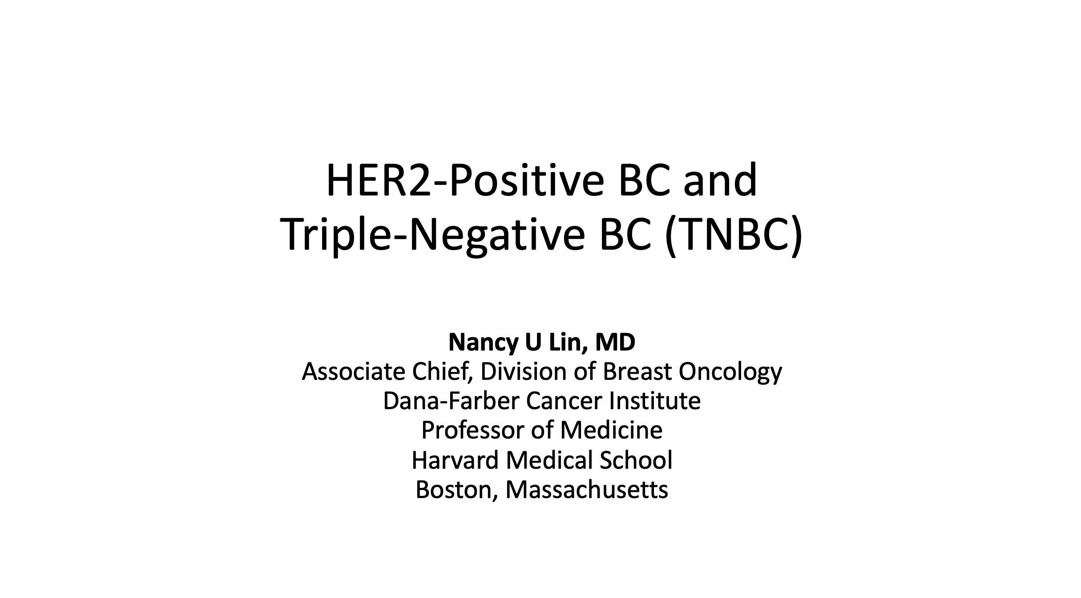


Slide 8
Key Datasets
Rebecca A Dent, MD, MSc
Rastogi P et al. Adjuvant abemaciclib plus endocrine therapy for hormone receptor-positive, human epidermal growth factor receptor 2-negative, high-risk early breast cancer: Results from a preplanned monarchE overall survival interim analysis, including 5-year efficacy outcomes. J Clin Oncol 2024;42(9):987-93.
Hortobagyi GN et al. A phase III trial of adjuvant ribociclib plus endocrine therapy versus endocrine therapy alone in patients with HR-positive/HER2-negative early breast cancer: Final invasive disease-free survival results from the NATALEE trial. Ann Oncol 2025;36(2):149-57.
Lu YS et al. Final results of RIGHT Choice: Ribociclib plus endocrine therapy versus combination chemotherapy in premenopausal women with clinically aggressive hormone receptor-positive/human epidermal growth factor receptor 2-negative advanced breast cancer. J Clin Oncol 2024;42(23):2812-21.
Kalinsky K et al. Abemaciclib plus fulvestrant vs fulvestrant alone for HR+, HER2- advanced breast cancer following progression on a prior CDK4/6 inhibitor plus endocrine therapy: Primary outcome of the phase 3 postMONARCH trial. ASCO 2024;Abstract LBA1001.
Metzger O et al. AFT-38 PATINA: A randomized, open label, Phase III trial to evaluate the efficacy and safety of palbociclib + anti-HER2 therapy + endocrine therapy vs anti-HER2 therapy + endocrine therapy after induction treatment for hormone receptor-positive (HR+)/HER-positive metastatic breast cancer. San Antonio Breast Cancer Symposium 2024;Abstract GS2-12.
Turner NC et al. Inavolisib-based therapy in PIK3CA-mutated advanced breast cancer. N Engl J Med 2024;391(17):1584-96.
Jhaveri K et al. Imlunestrant, an oral selective estrogen receptor degrader (SERD), as monotherapy & combined with abemaciclib, for patients with ER+, HER2- advanced breast cancer (ABC), pretreated with endocrine therapy (ET): Results of the Phase 3 EMBER-3 trial. San Antonio Breast Cancer Symposium 2024;Abstract GS1-01.

Slide 9
Key Datasets
Rebecca A Dent, MD, MSc (continued)
Oliveira M et al. Camizestrant, a next-generation oral SERD, versus fulvestrant in post-menopausal women with oestrogen receptor-positive, HER2-negative advanced breast cancer (SERENA-2): A multi-dose, open-label, randomised, phase 2 trial. Lancet Oncol 2024;25(11):1424-39.
Camizestrant demonstrated highly statistically significant and clinically meaningful improvement in progression-free survival in 1st-line advanced HR-positive breast cancer with an emergent ESR1 tumour mutation in SERENA-6 phase III trial [press release]. February 26, 2025. https://www.astrazeneca.com/media-centre/press-releases/2025/camizestrant-improved-pfs-in-1l-hr-breast-cancer.html.
Oliveira M et al. Capivasertib and fulvestrant for patients with hormone receptor-positive, HER2-negative advanced breast cancer (CAPItello-291): Patient-reported outcomes from a phase 3, randomised, double-blind, placebo-controlled trial. Lancet Oncol 2024;25(9):1231-44.
Bardia A et al. Datopotamab deruxtecan versus chemotherapy in previously treated inoperable/metastatic hormone receptor-positive human epidermal growth factor receptor 2-negative breast cancer: Primary results from TROPION-Breast01. J Clin Oncol 2025;43(3):285-96.
Pistilli B et al. Datopotamab deruxtecan (Dato-DXd) vs chemotherapy (CT) in previously-treated inoperable or metastatic hormone receptor-positive, HER2-negative (HR+/HER2–) breast cancer (BC): Final overall survival (OS) from the phase III TROPION-Breast01 trial. ESMO Virtual Plenary 2025;Abstract VP1-2025.
Bardia A et al. Trastuzumab deruxtecan after endocrine therapy in metastatic breast cancer. N Engl J Med 2024;391(22):2110-22.
Pistilli B et al. Efficacy, safety and biomarker analysis of ICARUS-BREAST01: A phase II study of patritumab deruxtecan (HER3-DXd) in patients (pts) with HR+/HER2- advanced breast cancer (ABC). ESMO 2024;Abstract 340O.

Slide 10
Key Datasets
Nancy U Lin, MD
Geyer CE Jr et al. Survival with trastuzumab emtansine in residual HER2-positive breast cancer. N Engl J Med 2025;392(3):249-57.
Tarantino P et al. Adjuvant trastuzumab emtansine versus paclitaxel plus trastuzumab for stage I human epidermal growth factor receptor 2-positive breast cancer: 5-year results and correlative analyses from ATEMPT. J Clin Oncol 2024;
42(31):3652-65.
Saura C et al. Trastuzumab deruxtecan in previously treated patients with HER2-positive metastatic breast cancer: Updated survival results from a phase II trial (DESTINY-Breast01). Ann Oncol 2024;35(3):302-7.
Fehm T et al. Trastuzumab deruxtecan versus treatment of physician's choice in patients with HER2-positive metastatic breast cancer (DESTINY-Breast02): Patient-reported outcomes from a randomised, open-label, multicentre, phase 3 trial. Lancet Oncol 2024;25(5):614-25.
Cortés J et al. Trastuzumab deruxtecan versus trastuzumab emtansine in HER2-positive metastatic breast cancer: Long-term survival analysis of the DESTINY-Breast03 trial. Nat Med 2024;30(8):2208-15.
Harbeck N et al. Trastuzumab deruxtecan in HER2-positive advanced breast cancer with or without brain metastases: A phase 3b/4 trial. Nat Med 2024;30(12):3717-27.
Freedman RA et al. Neratinib and ado-trastuzumab emtansine for pretreated and untreated human epidermal growth factor receptor 2 (HER2)-positive breast cancer brain metastases: Translational Breast Cancer Research Consortium trial 022. Ann Oncol 2024;35(11):993-1002.

Slide 11
Key Datasets
Nancy U Lin, MD (continued)
Jhaveri K et al. Efficacy and genomic analysis of HER2-mutant, metastatic triple-negative breast cancer treated with neratinib alone or in combination with trastuzumab in the phase 2 SUMMIT basket trial. ASCO 2024;Abstract 1094.
Schmid P et al. Neoadjuvant pembrolizumab or placebo plus chemotherapy followed by adjuvant pembrolizumab or placebo for high-risk early-stage TNBC: Overall survival results from the phase III KEYNOTE-522 study. ESMO 2024;Abstract LBA4.
Garber J et al. OlympiA: A phase 3, multicenter, randomized, placebo-controlled trial of adjuvant olaparib after (neo)adjuvant chemotherapy in patients w/ germline BRCA1 & BRCA2 pathogenic variants & highrisk HER2-negative primary breast cancer. San Antonio Breast Cancer Symposium 2024;Abstract GS1-09.
Tung NM et al. TBCRC 048 (olaparib expanded) expansion cohorts: Phase 2 study of olaparib monotherapy in patients (pts) with metastatic breast cancer (MBC) with germline (g) mutations in PALB2 or somatic (s) mutations in BRCA1 or BRCA2. ASCO 2024;Abstract 1021.
Xu B et al. Sacituzumab tirumotecan (SKB264/MK-2870) in patients (pts) with previously treated locally recurrent or metastatic triple-negative breast cancer (TNBC): Results from the phase III OptiTROP-Breast01 study. ASCO 2024;Abstract 104.
Bardia A et al. Datopotamab deruxtecan in advanced or metastatic HR+/HER2- and triple-negative breast cancer: Results from the Phase I TROPION-PanTumor01 study. J Clin Oncol 2024;42(19):2281-94.

Slide 12
AGENDA
Year in Review: Management of Breast Cancer
INTRODUCTION: A New Paradigm for Triple-Positive Breast Cancer?
MODULE 1: CDK4/6 Inhibitors for HR-Positive, HER2-Negative Breast Cancer
MODULE 2: Oral Selective Estrogen Receptor Degraders for HR-Positive, HER2-Negative Breast Cancer
MODULE 3: Treatment of PIK3CA/PTEN/AKT-Mutated Breast Cancer
MODULE 4: Antibody-Drug Conjugates (ADCs) for HR-Positive, HER2-Negative Breast Cancer
MODULE 5: ADCs for HER2-Positive Breast Cancer
MODULE 6: HER2-Targeting Tyrosine Kinase Inhibitors for HER2-Positive Breast Cancer
MODULE 7: Treatment of Localized Triple-Negative Breast Cancer (TNBC)
MODULE 8: ADCs for Advanced TNBC

Slide 13
AGENDA
Year in Review: Management of Breast Cancer
INTRODUCTION: A New Paradigm for Triple-Positive Breast Cancer?
MODULE 1: CDK4/6 Inhibitors for HR-Positive, HER2-Negative Breast Cancer
MODULE 2: Oral Selective Estrogen Receptor Degraders for HR-Positive, HER2-Negative Breast Cancer
MODULE 3: Treatment of PIK3CA/PTEN/AKT-Mutated Breast Cancer
MODULE 4: Antibody-Drug Conjugates (ADCs) for HR-Positive, HER2-Negative Breast Cancer
MODULE 5: ADCs for HER2-Positive Breast Cancer
MODULE 6: HER2-Targeting Tyrosine Kinase Inhibitors for HER2-Positive Breast Cancer
MODULE 7: Treatment of Localized Triple-Negative Breast Cancer (TNBC)
MODULE 8: ADCs for Advanced TNBC

Slide 14




Slide 15
HER2-Positive Breast Cancer: Key Recent Highlights
June 2005: Adjuvant trastuzumab data presented
December 2011: CLEOPATRA data presented
December 2018: KATHERINE data presented
December 2019: DESTINY-Breast01 data presented – trastuzumab deruxtecan approved
December 2019: HER2CLIMB data presented – tucatinib approved April 2020
June 2022: DESTINY-Breast04 data presented
December 2024: PATINA data presented

Slide 16
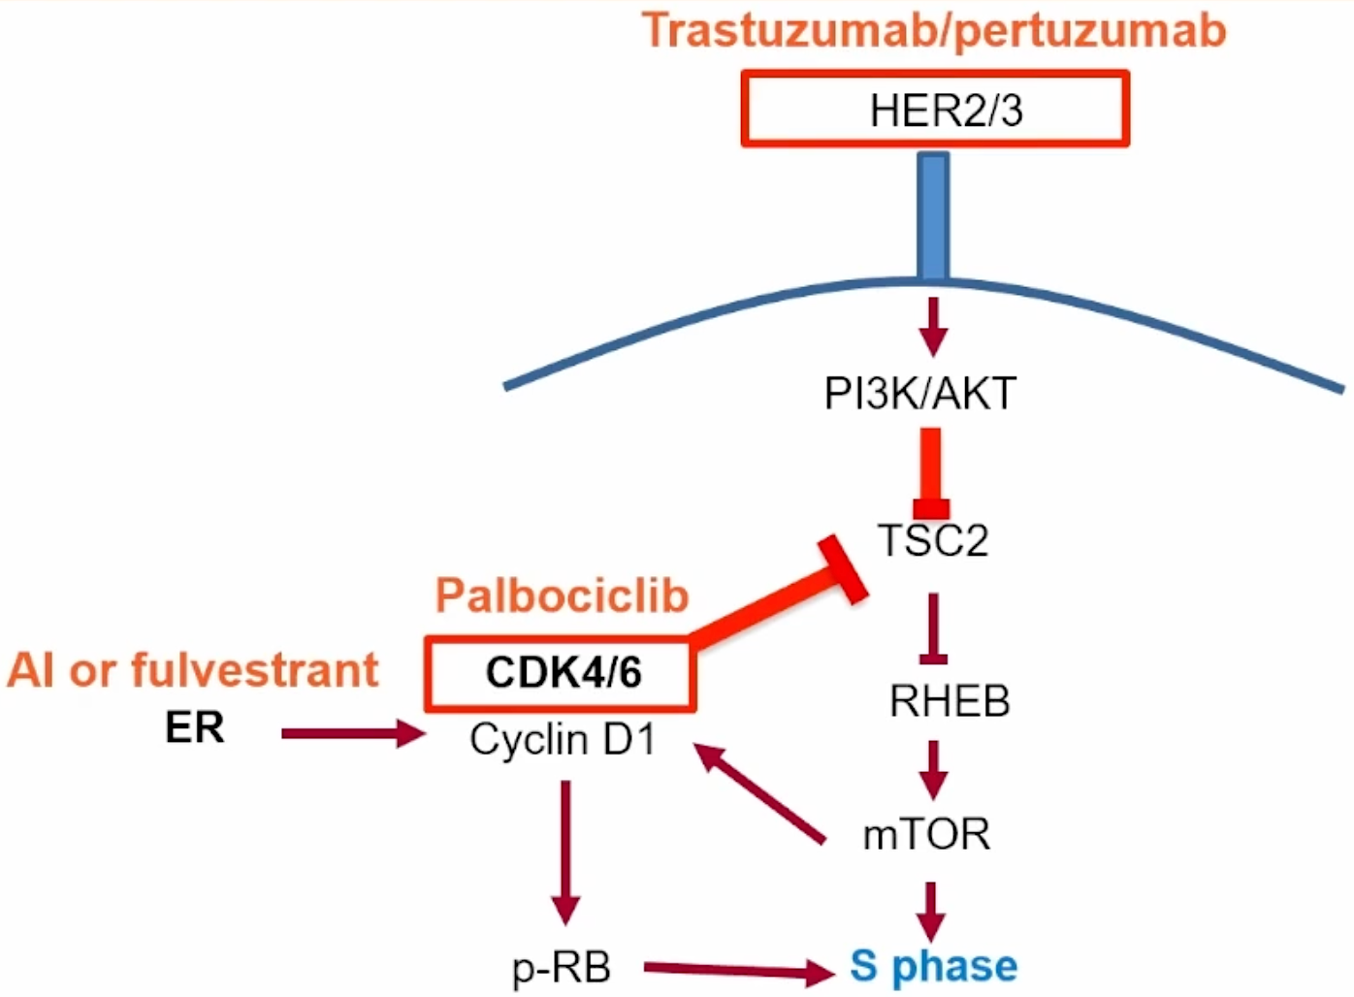
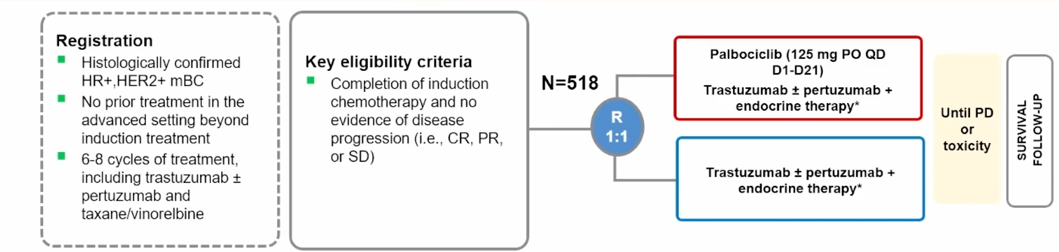
Triple-positive; PATINA
Metzger O, et al. SABCS 2024. Abstract GS02-12
Courtesy of Rebecca A Dent, MD, MSc

Slide 17
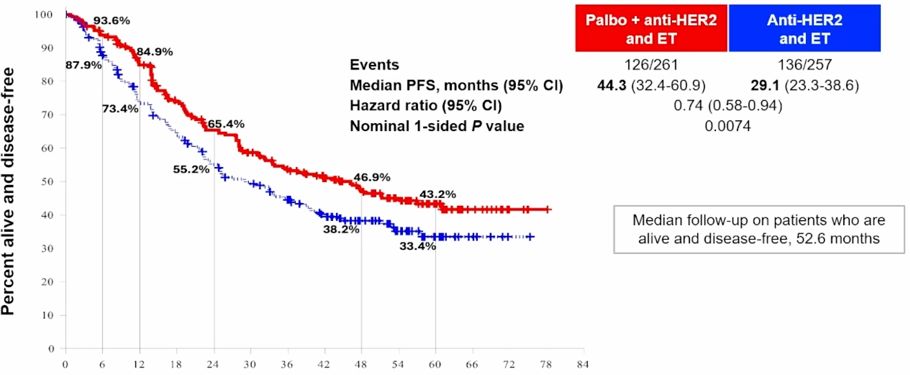
Triple-positive; PATINA
~ 4 years!
Oral + sc anti-Her2 = OPD
Metzger O, et al. SABCS 2024. Abstract GS02-12
Courtesy of Rebecca A Dent, MD, MSc

Slide 18
PATINA (Phase 3): Efficacy of palbociclib + anti-HER2 therapy + ET, treatment response and OS
Confirmed ORRª
Secondary endpoint: OS (interim analysis)
P=0.046
ORR (%)
100
90
80
n=257
n=261
70
Anti-HER2 + ET
Palbociclib + anti-HER2 + ET
60
 | Palbo + anti-HER2 + ET | Anti-HER2 + ET
Events, n/N | 58/261 | 61/257
Median OS, months (95% CI) | NE (71.6, NE) | 77 (72, NE)
3-year OS, % (95% CI) | 87.0 (82.8, 91.2) | 84.7 (80, 89.3)
5-year OS, % (95% CI) | 74.3 (67.7, 80.9) | 69.8 (62.4, 77.2)
HR (95% CI) | 0.86 (0.6, 1.24)
OS (%)
50
Clinical benefit rate^{b}
P=0.01
40
30
20
CBR (%)
10
0
0
6
12
18
24
30
36
42
48
54
60
66
72
78
84
n=257
n=261
Time (months)
Anti-HER2 + ET
Palbociclib + anti-HER2 + ET
Metzger O, et al. SABCS 2024. Abstract GS02-12
Courtesy of Rebecca A Dent, MD, MSc

Slide 19
AGENDA
Year in Review: Management of Breast Cancer
INTRODUCTION: A New Paradigm for Triple-Positive Breast Cancer?
MODULE 1: CDK4/6 Inhibitors for HR-Positive, HER2-Negative Breast Cancer
MODULE 2: Oral Selective Estrogen Receptor Degraders for HR-Positive, HER2-Negative Breast Cancer
MODULE 3: Treatment of PIK3CA/PTEN/AKT-Mutated Breast Cancer
MODULE 4: Antibody-Drug Conjugates (ADCs) for HR-Positive, HER2-Negative Breast Cancer
MODULE 5: ADCs for HER2-Positive Breast Cancer
MODULE 6: HER2-Targeting Tyrosine Kinase Inhibitors for HER2-Positive Breast Cancer
MODULE 7: Treatment of Localized Triple-Negative Breast Cancer (TNBC)
MODULE 8: ADCs for Advanced TNBC

Slide 20
Key Datasets
Rastogi P et al. Adjuvant abemaciclib plus endocrine therapy for hormone receptor-positive, human epidermal growth factor receptor 2-negative, high-risk early breast cancer: Results from a preplanned monarchE overall survival interim analysis, including 5-year efficacy outcomes. J Clin Oncol 2024;42(9):987-93.
Hortobagyi GN et al. A phase III trial of adjuvant ribociclib plus endocrine therapy versus endocrine therapy alone in patients with HR-positive/HER2-negative early breast cancer: Final invasive disease-free survival results from the NATALEE trial. Ann Oncol 2025;36(2):149-57.
Lu YS et al. Final results of RIGHT Choice: Ribociclib plus endocrine therapy versus combination chemotherapy in premenopausal women with clinically aggressive hormone receptor-positive/human epidermal growth factor receptor 2-negative advanced breast cancer. J Clin Oncol 2024;42(23):2812-21.
Kalinsky K et al. Abemaciclib plus fulvestrant vs fulvestrant alone for HR+, HER2- advanced breast cancer following progression on a prior CDK4/6 inhibitor plus endocrine therapy: Primary outcome of the phase 3 postMONARCH trial. ASCO 2024;Abstract LBA1001.
Metzger O et al. AFT-38 PATINA: A randomized, open label, Phase III trial to evaluate the efficacy and safety of palbociclib + anti-HER2 therapy + endocrine therapy vs anti-HER2 therapy + endocrine therapy after induction treatment for hormone receptor-positive (HR+)/HER-positive metastatic breast cancer. San Antonio Breast Cancer Symposium 2024;Abstract GS2-12.

Slide 21
monarchE: Adjuvant Abemaciclib + ET in High-Risk, Node-Positive HR+/HER2- EBC
International, randomized, open-label phase III trial
Stratified by prior CT,
menopausal status, region
ITT Population (Cohorts 1 + 2)
Patients with high-risk, node-positive, HR+/HER2- EBC; prior (neo)adjuvant CT permitted;
pre- or postmenopausal;
no distant metastasis;
≤16 mo from surgery to randomization; ≤12 wk of ET
after last non-ET
(N = 5637)
Cohort 1 (91% of patients)
≥4 positive ALNs or 1-3 positive ALNs plus histologic grade 3 and/or tumor ≥5 cm
Abemaciclib 150 mg BID up to 2 yr +
ET per standard of care of physician’s choice for 5-10 yr as clinically indicated
(n = 2808)
Cohort 2 (9% of patients)
1-3 positive ALNs, Ki-67 ≥20% per central testing, grade 1/2, tumor size <5 cm
ET per standard of care of physician’s choice for 5-10 yr as clinically indicated
(n = 2829)
Primary endpoint: iDFS
Key secondary endpoints: iDFS in Ki-67 high (≥20%) population, DRFS, OS, safety, PROs
Courtesy of Rebecca A Dent, MD, MSc
Rastogi. J Clin Oncol. 2024;42:987. Johnston. JCO. 2020;38:3987.
Notes:
ALN, axillary lymph node; CT, chemotherapy; DRFS, distant relapse–free survival; EBC, early breast cancer; ET, endocrine therapy; HR, hormone receptor; iDFS, invasive disease–free survival; ITT, intention-to-treat; OS, overall survival; PRO, patient-reported outcome.

Slide 22
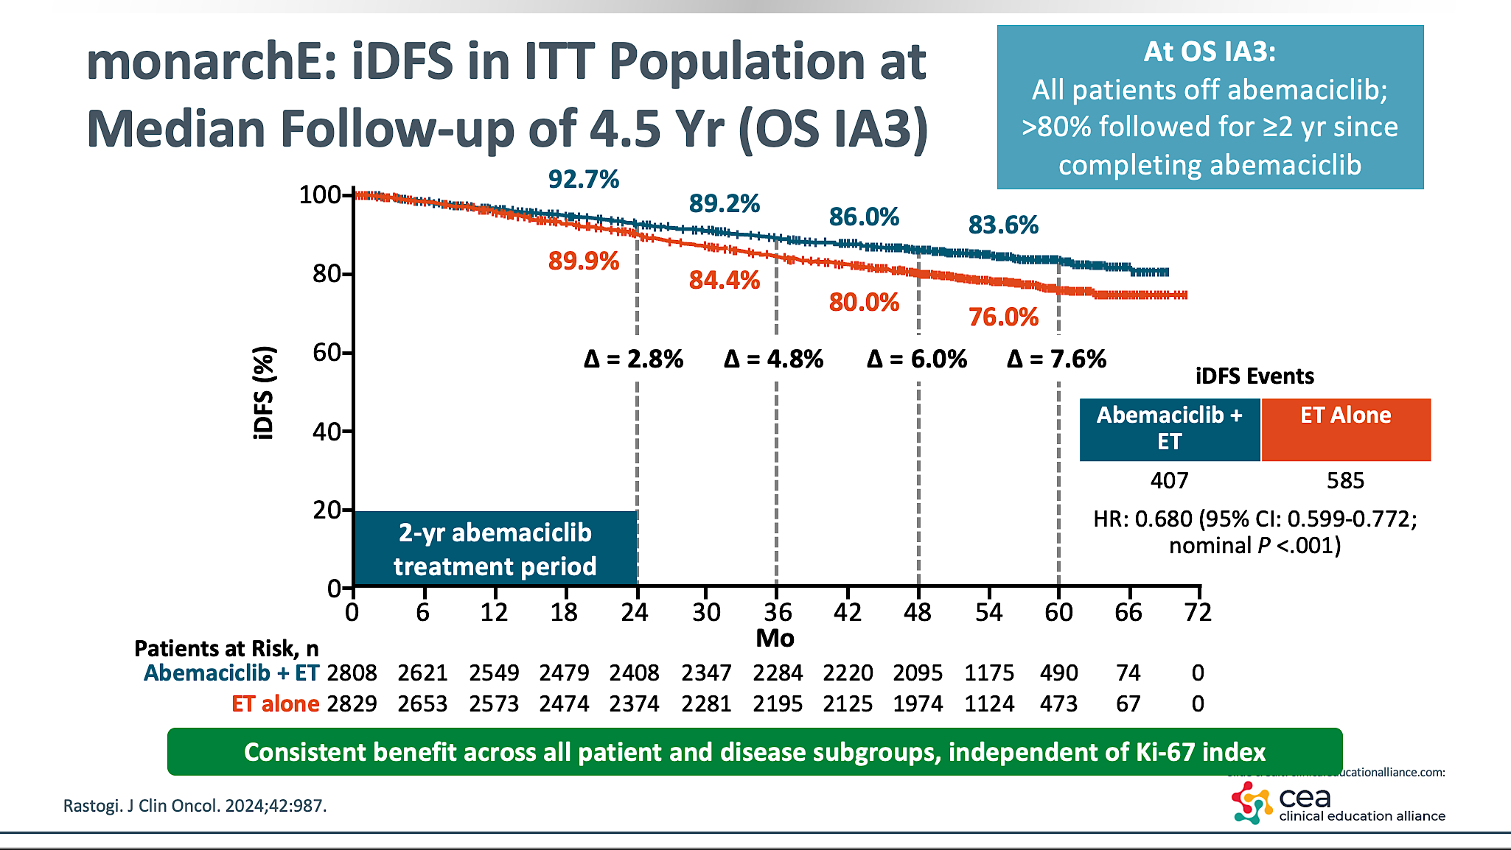
monarchE; iDFS
Courtesy of Rebecca A Dent, MD, MSc

Slide 23
monarchE: Subgroup Analysis of Benefit by Age
Outcome | iDFS |  |  | DRFS
Parameter, % | ITT | Age <65 Yr | Age ≥65 Yr | ITT | Age <65 Yr | Age ≥65 Yr
Events, n/N Abemaciclib + ET ET alone | 336/2808 499/2829 | 270/2371 414/2416 | 66/437 85/413 | 281/2808 421/2829 | 230/2371 353/2416 | 51/437 68/413
HR (95% CI) | 0.664 (0.578-0.762) | 0.646 (0.554-0.753)* | 0.767 (0.556-1.059)* | 0.659 (0.567-0.767) | 0.647 (0.548-0.764)† | 0.748 (0.520-1.077)†
4-yr rate, % Abemaciclib + ET ET alone | 85.8 79.4 | 86.5 79.8 | 82.0 76.8 | 88.4 82.5 | 88.8 82.6 | 86.1 81.5
Absolute benefit in 4-yr rate, % | 6.4 | 6.7 | 5.2 | 5.9 | 6.2 | 4.6
iDFS and DRFS benefits with abemaciclib are similar for older vs younger patients
Patients aged ≥75 yr more frequently had grade 3 diarrhea, grade 2/3 fatigue, and more discontinuations due to AEs
Courtesy of Rebecca A Dent, MD, MSc
Hamilton. ASCO 2023. Abstr 501.
Notes:
DRFS, distant relapse–free survival; ET, endocrine therapy; iDFS, invasive disease–free survival; ITT, intention-to-treat.

Slide 24
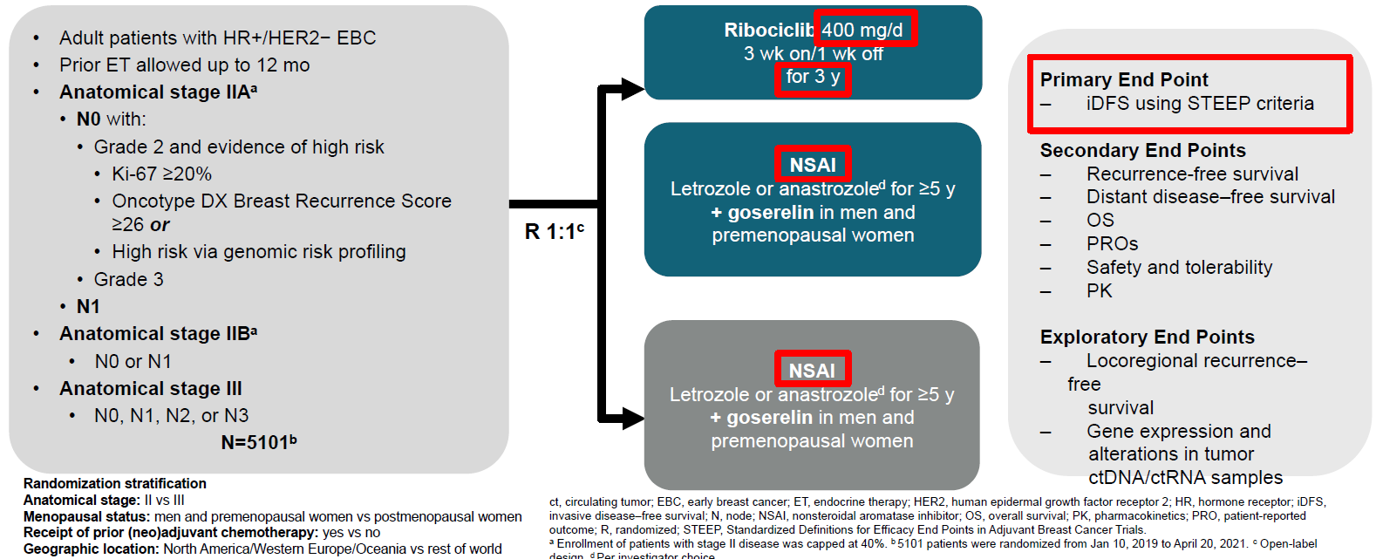
NATALEE: Adjuvant ribociclib+NSAI for HR+/HER2- EBC
Courtesy of Rebecca A Dent, MD, MSc
Hortobagyi G, et al. Annals of Oncology 2025

Slide 25
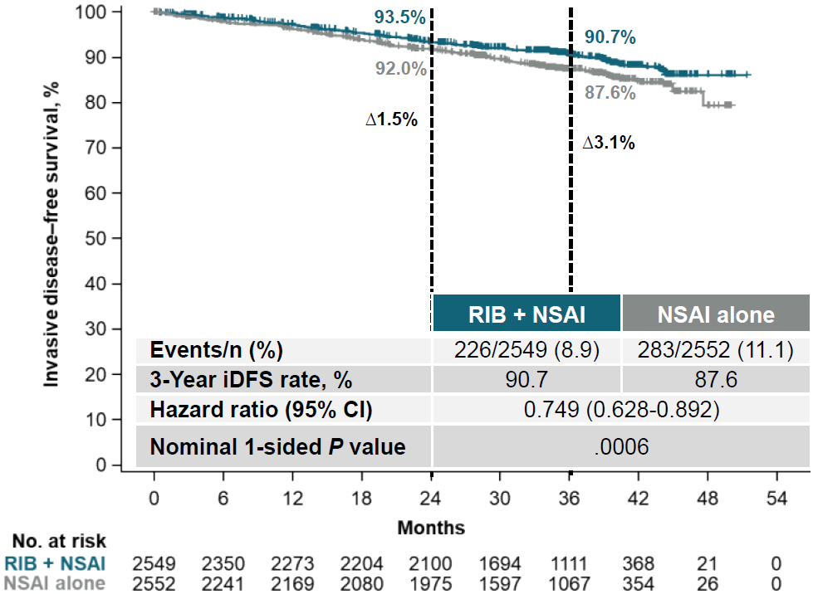
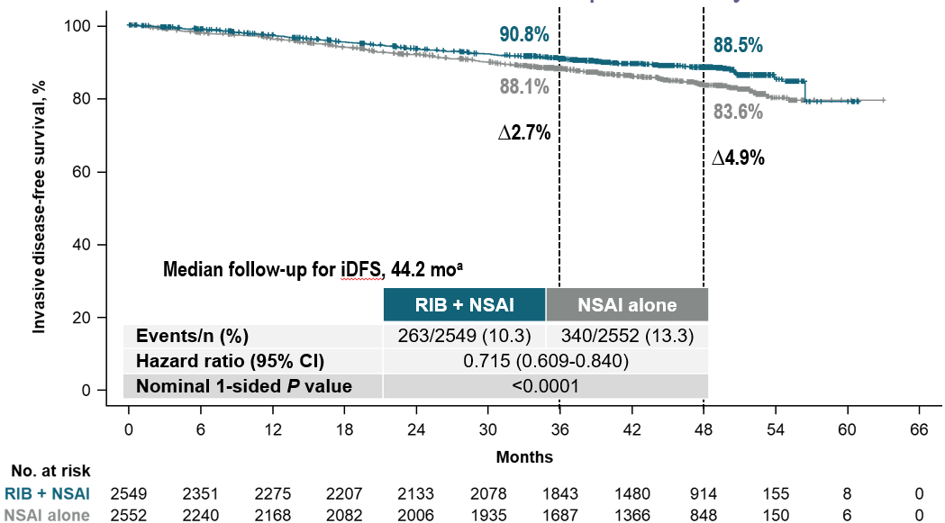
NATALEE: iDFS – primary endpoint
Median follow-up 33.3 months
78.3% of pts off ribociclib treatment
Median follow-up 44.2 months
100% of pts off ribociclib treatment
Δ1.5%
Δ3.1%
Δ 2.7%
Δ 4.9%
Risk of invasive disease was reduced by 28.5% with ribociclib plus NSAI vs NSAI alone
Courtesy of Rebecca A Dent, MD, MSc
Hortobagyi G, et al. Annals of Oncology 2025
Notes:
Clinical threshold of 5% where clinicians feel that we should discuss with patients

Slide 26
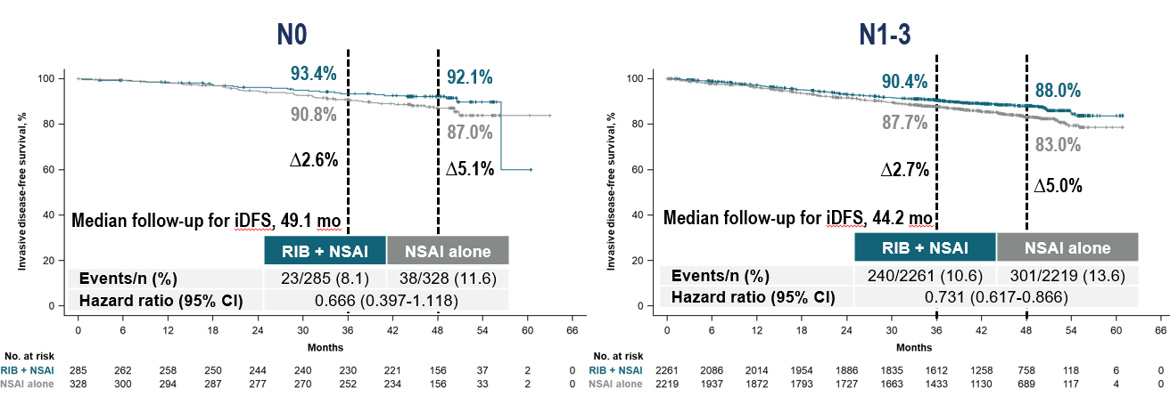
NATALEE: iDFS by nodal status
Median follow-up 44.2 months
100% of pts off ribociclib treatment
Ribociclib + NSAI showed an increasing magnitude of iDFS benefit over time for patients with N0 or N1-3 disease
Courtesy of Rebecca A Dent, MD, MSc
Hortobagyi G, et al. Annals of Oncology 2025

Slide 27
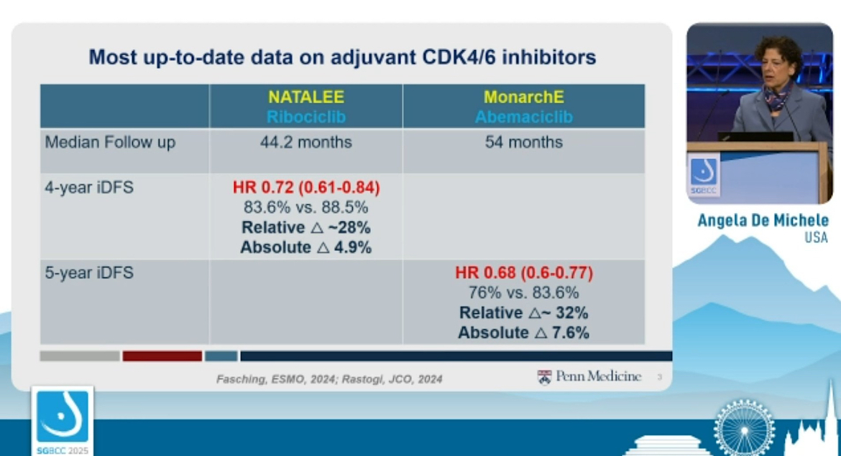
monarchE
Abemaciclib
No overall survival benefit for either agent
at this time
Courtesy of Rebecca A Dent, MD, MSc
Notes:
In high risk node neg, node +
IDFS and no OS benefit, may be hard to show OS give long term survival and heterogeneity of disease and treatment

Slide 28
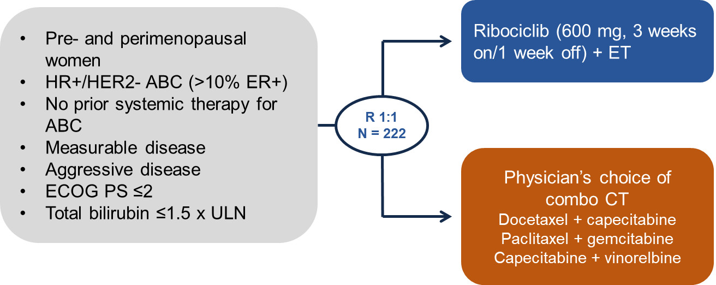
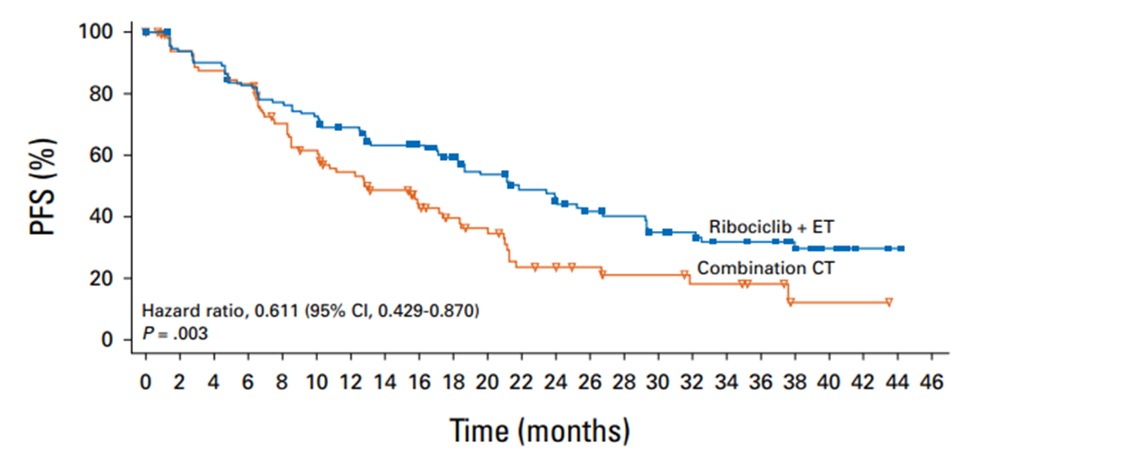
RIGHT Choice: 1L ribociclib + ET vs CT for high-risk HR+/HER2- MBC
Patient population
ER-positivity ≥50%: 86.0%
de novo metastatic: 64.4%
Rapid progression: 18.5%
Visceral crisis: 47.7%
Doublet chemotherapy
Primary Endpoint: PFS in Arm A vs Arm B
OS data is immature
Patients on the ribociclib + ET arm had lower symptomatic AE rates, and fewer discontinuations
Δ9.0 months
Ribociclib + ET resulted in a significant improvement in mPFS in premenopausal women with clinically aggressive HR+/HER2- MBC compared to combination CT
Courtesy of Rebecca A Dent, MD, MSc
Saghir et al., ASCO 2023 Abstract 1063; Lu YS et al. J Clin Oncol 2024;42:2812.

Slide 29
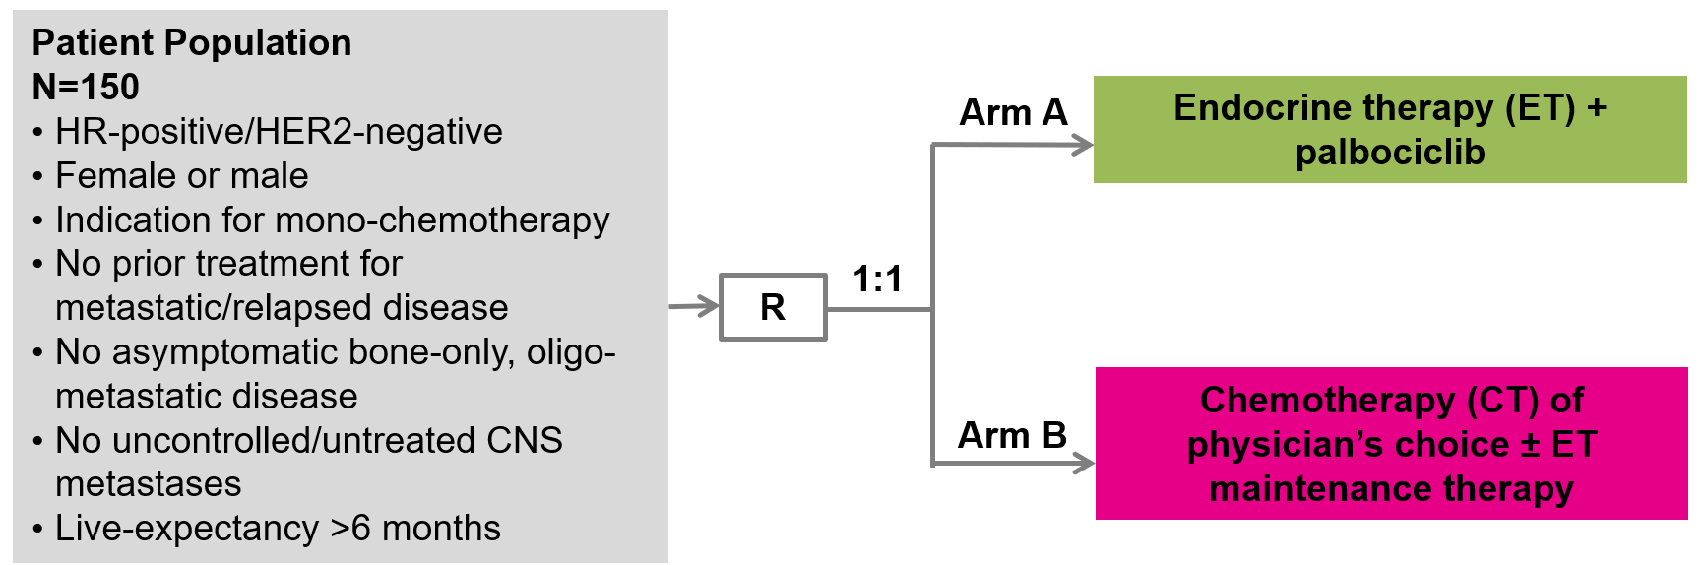
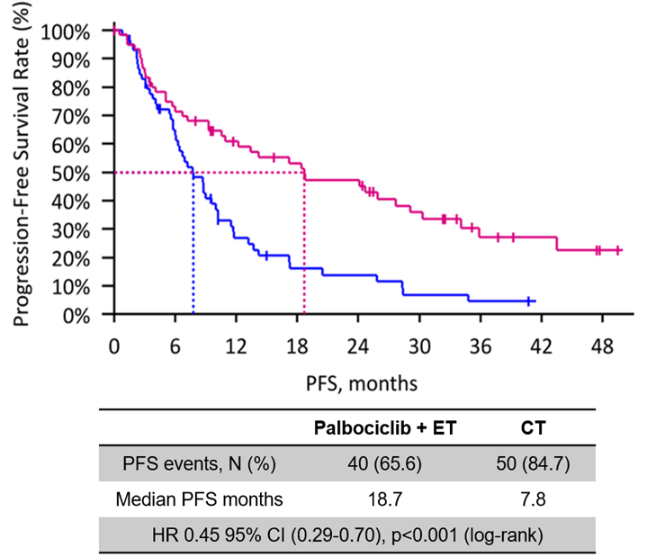
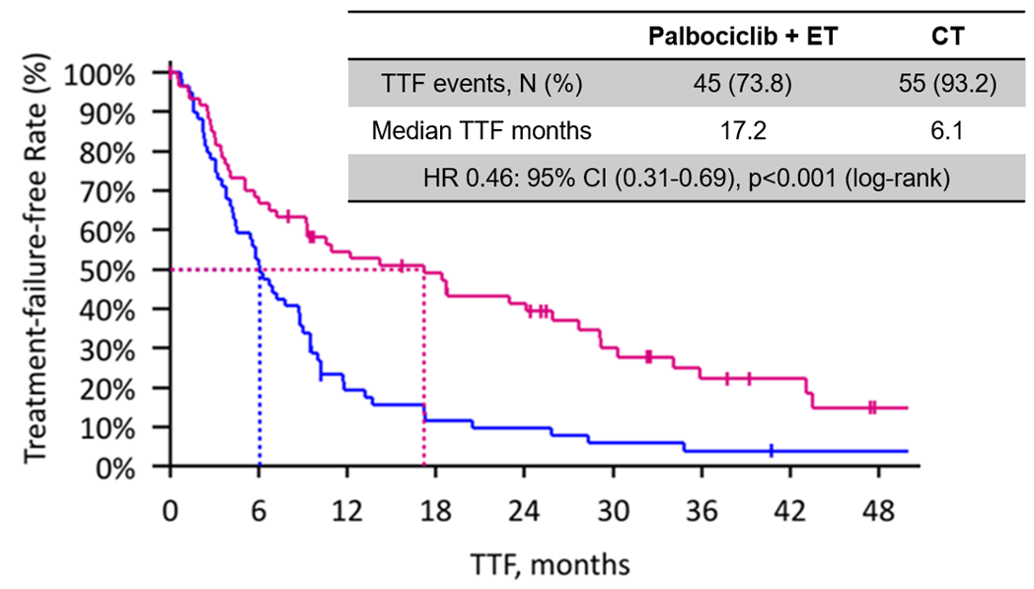
PADMA: 1L palbociclib + ET vs CT for high-risk HR+/HER2- MBC
Patient population
Endocrine resistant: ~32%
de novo metastatic: ~37%
HER2-low: ~66%
PIK3CA mutations: 22.5%
BRCA mutations: 5.8%
ESR1 mutations: 1.7%
Primary Endpoint: Time to treatment failure in Arm A vs Arm B
Secondary Endpoint: PFS in Arm A vs Arm B
Median follow-up was 36.8 months (range 0-74.4)
Significant improvement in TTF and PFS for palbociclib + ET vs mono-CT as 1L therapy for HR+/HER2- MBC
Courtesy of Rebecca A Dent, MD, MSc
Loibl S et al., SABCS 2024 LB1-03
Notes:
Unless visceral disease endo and CDKi

Slide 30
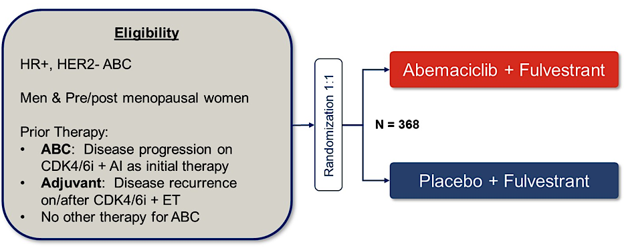
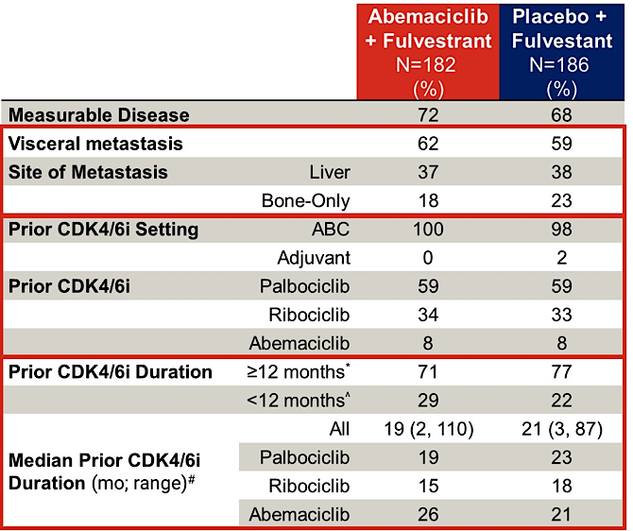
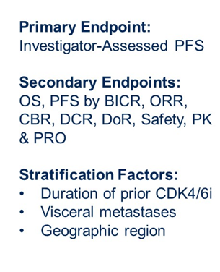
postMONARCH: CDK 4/6i after PD on CDK 4/6i+ET
Is continued CDK4/6 blockade after progression on CDK4/6i with an ET switch effective?
Study Schema
Patient population
Courtesy of Rebecca A Dent, MD, MSc
Kalinsky K et al. ASCO 2024 LBA1001; Kalinsky K et al. JCO 2024.

Slide 31
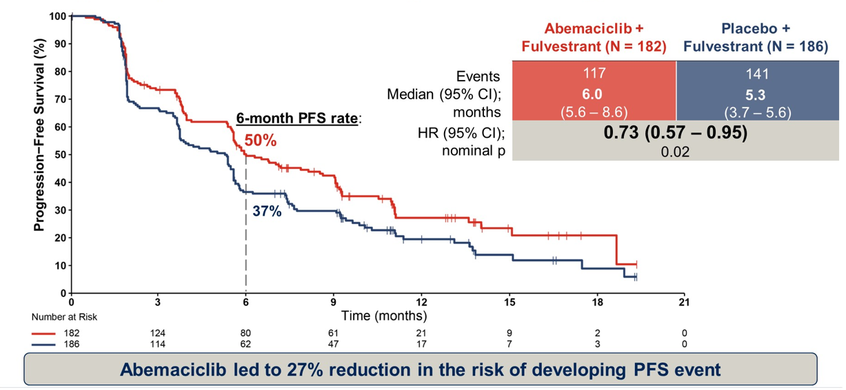
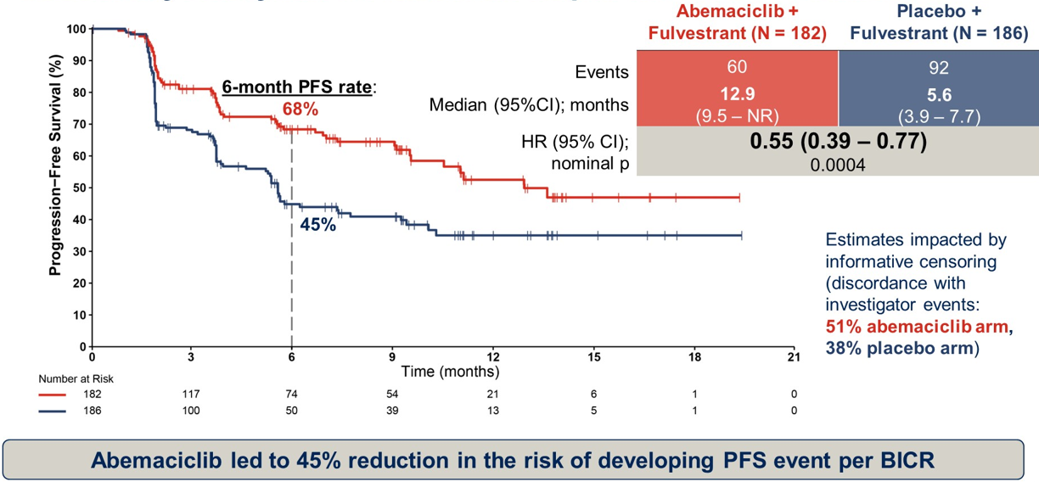
postMONARCH: Efficacy endpoints
Primary EP: Investigator assessed PFS
Secondary EP: BICR - assessed PFS
Courtesy of Rebecca A Dent, MD, MSc
Kalinsky K et al. ASCO 2024 LBA1001; Kalinsky K et al. JCO 2024.

Slide 32






postMONARCH (Phase 3): Subgroup analysis of investigator- assessed PFS by prior CDK4/6i duration and visceral metastasis
PFS by prior CDK4/6i duration: <12 months
PFS among patients without visceral metastases
100
 | Abemaciclib + fulvestrant (n=53) | Placebo + fulvestrant (n=40)
Events | 38 | 31
Median (95% CI); months | 5.5 (2.4, 9.1) | 3.0 (1.9, 4.2)
HR (95% Cl) | 0.80 (0.50, 1.29)
100
 | Abemaciclib + fulvestrant (n=70) | Placebo + fulvestrant (n=77)
Events | 32 | 53
Median (95% CI); months | 11.1 (6.3, NR) | 5.6 (5.3, 9.2)
HR (95% Cl) | 0.53 (0.34, 0.83)
90
90
80
80
70
70
60
60
50
50
PFS (%)
PFS (%)
40
40
30
30
20
20
10
10
0
0
0
3
6
9
12
15
18
21
0
3
6
9
12
15
18
21
Time (months)
Time (months)
PFS by prior CDK4/6i duration: ≥12 months
PFS among patients with visceral metastases
 | Abemaciclib + fulvestrant (n=129) | Placebo + fulvestrant (n=144)
Events | 79 | 109
Median (95% CI); months | 7.0 (5.6, 9.0) | 5.4 (4.0, 5.7)
HR (95% Cl) | 0.70 (0.52, 0.94)
100
 | Abemaciclib + fulvestrant (n=112) | Placebo + fulvestrant (n=109)
Events | 85 | 88
Median (95% CI); months | 5.4 (3.7, 5.9) | 3.7 (2.0, 5.4)
HR (95% Cl) | 0.87 (0.64, 1.17)
100
90
90
80
80
70
70
60
60
50
50
PFS (%)
PFS (%)
40
40
30
30
20
20
10
10
0
0
0
3
6
9
12
15
18
21
0
3
6
9
12
15
18
21
Time (months)
Time (months)
Courtesy of Rebecca A Dent, MD, MSc
Kalinsky K et al. ASCO 2024 LBA1001; Kalinsky K et al. JCO 2024.

Slide 33
AGENDA
Year in Review: Management of Breast Cancer
INTRODUCTION: A New Paradigm for Triple-Positive Breast Cancer?
MODULE 1: CDK4/6 Inhibitors for HR-Positive, HER2-Negative Breast Cancer
MODULE 2: Oral Selective Estrogen Receptor Degraders for HR-Positive, HER2-Negative Breast Cancer
MODULE 3: Treatment of PIK3CA/PTEN/AKT-Mutated Breast Cancer
MODULE 4: Antibody-Drug Conjugates (ADCs) for HR-Positive, HER2-Negative Breast Cancer
MODULE 5: ADCs for HER2-Positive Breast Cancer
MODULE 6: HER2-Targeting Tyrosine Kinase Inhibitors for HER2-Positive Breast Cancer
MODULE 7: Treatment of Localized Triple-Negative Breast Cancer (TNBC)
MODULE 8: ADCs for Advanced TNBC

Slide 34
Key Datasets
Jhaveri K et al. Imlunestrant, an oral selective estrogen receptor degrader (SERD), as monotherapy & combined with abemaciclib, for patients with ER+, HER2- advanced breast cancer (ABC), pretreated with endocrine therapy (ET): Results of the Phase 3 EMBER-3 trial. San Antonio Breast Cancer Symposium 2024;Abstract GS1-01.
Oliveira M et al. Camizestrant, a next-generation oral SERD, versus fulvestrant in post-menopausal women with oestrogen receptor-positive, HER2-negative advanced breast cancer (SERENA-2): A multi-dose, open-label, randomised, phase 2 trial. Lancet Oncol 2024;25(11):1424-39.
Camizestrant demonstrated highly statistically significant and clinically meaningful improvement in progression-free survival in 1st-line advanced HR-positive breast cancer with an emergent ESR1 tumour mutation in SERENA-6 phase III trial [press release]. February 26, 2025. https://www.astrazeneca.com/media-centre/press-releases/2025/camizestrant-improved-pfs-in-1l-hr-breast-cancer.html.

Slide 35
SERENA-2: Camizestrant vs Fulvestrant (oral vs IM SERD) Postmenopausal Patients With ER+/HER2- Advanced BC
Multicenter, open-label, parallel-group, randomized phase II study
Prior CDK4/6i, lung/liver metastases
Camizestrant 300 mg PO QD
(n = 20) (stopped early*)
Postmenopausal women with ER+/HER2- advanced BC; evidence of progression on/after last systemic therapy; at least 1 lesion measuring ≥10 mm in longest diameter; ECOG/WHO PS 0-1; ≤1 line of ET or chemotherapy in advanced setting; without prior fulvestrant or oral SERD
(N = 240)
Camizestrant 75 mg PO QD
(n = 74)
Camizestrant 150 mg PO QD
(n = 73)
Fulvestrant 500 mg IM Q28†
(n = 73)
*CSP v5 amendment: 16Dec20. †In cycle 1, fulvestrant given on D1, 15, 29, then Q28 for additional cycles.
Primary endpoint: investigator-assessed PFS
Key secondary endpoints: CBR24, ORR, OS, safety
Courtesy of Rebecca A Dent, MD, MSc
M Oliveira et al. Lancet Oncology 2024

Slide 36
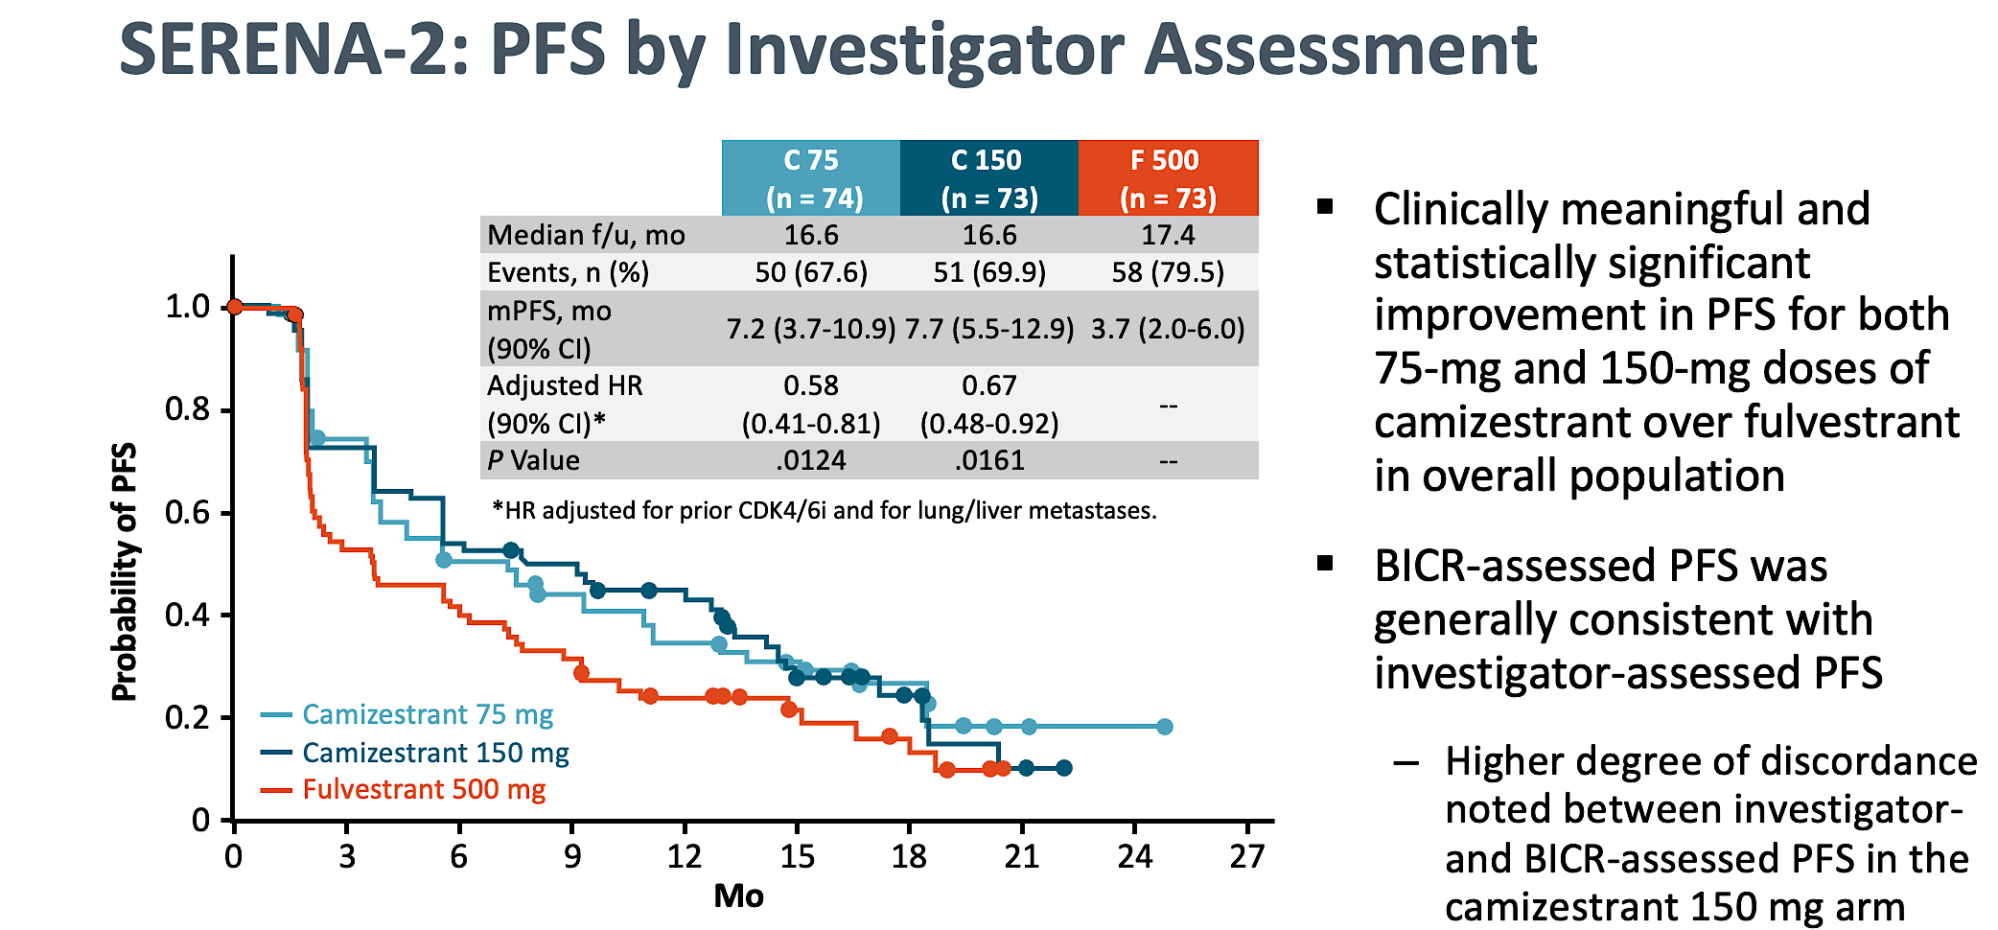
Courtesy of Rebecca A Dent, MD, MSc
M Oliveira et al. Lancet Oncology 2024

Slide 37
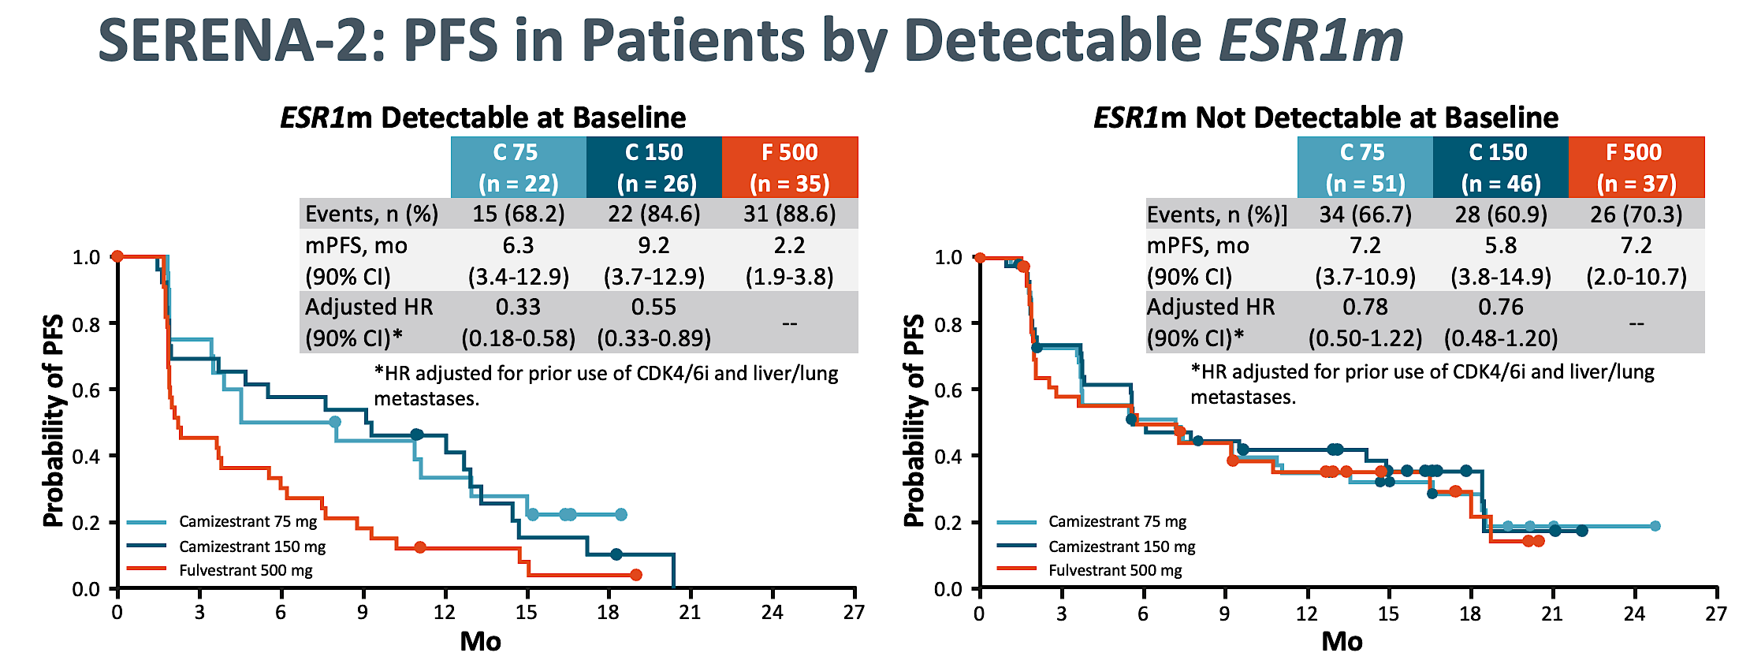
Camizestrant results in a clinically meaningful improvement in PFS vs fulvestrant in patients with ESR1m
Courtesy of Rebecca A Dent, MD, MSc
M Oliveira et al. Lancet Oncology 2024

Slide 38
    For 1L mBC patients who develop an ESR1m during AI + CDK4/6i treatment, SERENA-6 aims to get ahead of clinical progression to extend the benefit of 1L ET
PIK3CA/AKT1/PTEN alterations
BRCAm/PALB2m
ESR1m
SERENA-6 (Phase III)
1L switch to camizestrant + CDK4/6i on emergence of ESR1m
Step 1: ESR1m detection
HR-positive,
HER2-negative
locally advanced (inoperable) or mBC^{1,2}
Currently receiving AI (anastrozole or letrozole) + CDK4/6i (palbociclib, abemaciclib or ribociclib) ± LHRH as 1L treatment for ≥6 months with no evidence of PD^{1,2*}
Continue 1L treatment with AI (anastrozole or letrozole)
+ CDK4/6i (palbociclib, abemaciclib or ribociclib) ± LHRH
Primary endpoint²
PFS*
Key secondary endpoints²
PFS2, ORR, CBR₂₄, OS, PROs (TTD), time to ChT
ESR1m screening in plasma ctDNA (every 2–3 treatment cycles) and tumour imaging as per SoC
ESR1m positive ctDNA detected and no evidence
of PD†
ESR1m negative tumour
and no evidence of PD
Step 2: Randomised treatment (N=300)²
Switch to camizestrant (75 mg QD)
+ maintain same CDK4/6i + placebo for AI
R
Continue on AI + maintain same CDK4/6i
+ placebo for camizestrant
1:1
Courtesy of Rebecca A Dent, MD, MSc
This is an investigational regimen, not licenced or reimbursed by any regulatory health or payer body globally.
*By investigator assessment; †Inclusion criteria for Step 2 include evaluable disease as per RECIST v1.1.²
1L=first-line; AI=aromatase inhibitor; CBR₂₄=clinical benefit rate at 24 weeks; CDK4/6i=cyclin-dependent kinase 4/6 inhibitor; ChT=chemotherapy; CI=confidence interval; ctDNA=circulating tumour DNA; ESR1m=oestrogen receptor alpha mutation; ET=endocrine therapy; HER2=human epidermal growth factor receptor 2; HR=hormone receptor; LHRH=luteinising hormone-releasing hormone; mBC=metastatic breast cancer; ngSERD=next-generation selective oestrogen receptor degrader; ORR=objective response rate; OS=overall survival; PD=disease progression; PFS=progression-free survival; PRO=patient reported outcome; QD=once daily; R=randomisation; RECIST=response evaluation criteria in solid tumors; SoC=standard of care; TTD=time to deterioration.
1. NIH. SERENA-6. Available at: https://www.clinicaltrials.gov/study/NCT04964934 (Accessed November 2024); 2. Bidard F-C, et al. Presented at SABCS Annual Meeting 2021, December 7–10. San Antonio, Tx. Abstract #OT2-11-05.

Slide 39
SERENA-6: First-Line Camizestrant Demonstrated Improvement in Progression-Free Survival for Advanced HR-Positive Breast Cancer with an Emergent ESR1 Tumor Mutation
Press Release: February 26, 2025
“Positive high-level results from a planned interim analysis of the SERENA-6 Phase III trial showed that camizestrant in combination with a cyclin-dependent kinase (CDK) 4/6 inhibitor (palbociclib, ribociclib or abemaciclib) demonstrated a highly statistically significant and clinically meaningful improvement in the primary endpoint of progression-free survival (PFS). The trial evaluated switching to the camizestrant combination versus continuing standard-of-care treatment with an aromatase inhibitor (AI) (anastrozole or letrozole) in combination with a CDK4/6 inhibitor in the 1st-line treatment of patients with hormone receptor (HR)-positive, HER2-negative advanced breast cancer whose tumors have an emergent ESR1 mutation.
The key secondary endpoints of time to second disease progression (PFS2) and overall survival (OS) were immature at the time of this interim analysis. However, the camizestrant combination demonstrated a trend toward improvement in PFS2. The trial will continue as planned to further assess key secondary endpoints.”
https://www.astrazeneca.com/media-centre/press-releases/2025/camizestrant-improved-pfs-in-1l-hr-breast-cancer.html

Slide 40
EMBER-3 (Phase 3): Imlunestrant ± abemaciclib for ER+, HER2− advanced breast cancer pretreated with ET
Key eligibility
ER+, HER2– advanced breast cancer
Men and pre-ª/postmenopausal women
Prior therapy:
Adjuvant: Recurrence on or within 12 months of completion of AI ± CDK4/6i
Advanced breast cancer: Progression on first-line AI ± CDK4/6i
No other therapy for advanced disease
A: Imlunestrant 400 mg QD (n=331)
Primary endpoints
  Investigator-assessed PFS for^{c}:
    A vs B in patients with ESR1m^{d}
    A vs B in all patients
    C vs A in all^{e} patients
Key secondary endpoints
  OS, PFS by BICR, and ORR
  Safety
  Exploratory endpoints
  PFS and OS for C vs B in all^{e} patients
R
1:1:1
B: SOC ET
Fulvestrant or exemestane
(n=330)
N=874
C:^{b} Imlunestrant 400 mg QD + abemaciclib
(n=213)
Stratification factors
The primary reason for study treatment discontinuation was progressive disease in all arms
Prior CDK4/6i therapy (yes vs no)
Visceral metastases (yes vs no)
Region (East Asia, US/EU vs others)
Jhaveri K, et al. SABCS 2024. Abstract GS1-01.
Courtesy of Rebecca A Dent, MD, MSc

Slide 41
EMBER-3 (Phase 3): Investigator-assessed PFS by subgroup, imlunestrant + abemaciclib vs imlunestrant
PFS: Patients with ESR1 mutation
PFS: Patients without ESR1 mutation
 | Imlunestrant + abemaciclib | Imlunestrant
Events, n/N | 36/67 | 71/92
Median PFS, months (95% CI) | 11.1 (7.4, 13.7) | 5.5 (3.8, 7.2)
HR (95% CI) | 0.53 (0.35, 0.80)
 | Imlunestrant + abemaciclib | Imlunestrant
Events, n/N | 78/146 | 78/121
Median PFS, months (95% CI) | 9.1 (7.4, 14.4) | 5.5 (3.6, 5.8)
HR (95% CI) | 0.59 (0.43, 0.81)
100
100
75
75
PFS (%)
Treatment response (95% CI):
Patients with ESR1 mutation
  Imlunestrant + abemaciclib, n=54: 35% (22, 48)
  Imlunestrant [n=74]: 15% (7, 23)
  SOC ET, n=58: 3% (0, 8)
Patients without ESR1 mutation
  Imlunestrant + abemaciclib, n=113: 23% (15, 31)
  Imlunestrant, n=95: 10% (4, 15)
  SOC ET, n=104: 6% (1, 10)
50
50
PFS (%)
25
25
0
0
0
2
4
6
8
10
12
14
16
18
20
22
24
26
28
30
0
2
4
6
8
10
12
14
16
18
20
22
24
26
28
30
Time (months)
No. at risk
Time (months)
No. at risk
67
54
47
39
33
22
14
7
6
3
1
1
0
0
0
0
146
111
94
83
63
50
34
22
19
10
5
4
3
0
0
0
92
62
50
35
28
20
12
9
7
3
0
0
0
0
0
0
121
78
56
42
39
28
17
11
11
7
3
2
0
0
0
0
PFS: Patients with prior CDK4/6i treatment
PFS: Patients with PI3K pathway mutation
 | Imlunestrant + abemaciclib | Imlunestrant
Events, n/N | 79/139 | 109/140
Median PFS, months (95% CI) | 9.1 (7.2, 11.2) | 3.7 (2.1, 5.5)
HR (95% CI) | 0.51 (0.38, 0.68)
 | Imlunestrant + abemaciclib | Imlunestrant
Events, n/N | 55/88 | 70/84
Median PFS, months (95% CI) | 7.6 (5.6, 11.0) | 3.8 (3.1, 5.5)
HR (95% CI) | 0.61 (0.42, 0.87)
100
100
75
75
50
50
PFS (%)
PFS (%)
25
25
0
0
0
2
4
6
8
10
12
14
16
18
20
22
24
26
28
30
0
2
4
6
8
10
12
14
16
18
20
22
24
26
28
Time (months)
Time (months)
No. at risk
139
105
87
76
58
43
29
19
17
8
3
2
1
0
0
0
No. at risk
88
62
51
41
32
19
11
8
5
2
1
1
0
0
0
140
79
56
39
32
21
13
11
10
6
1
0
0
0
0
0
84
53
35
23
20
15
7
5
4
2
0
0
0
0
0
Jhaveri K, et al. SABCS 2024. Abstract GS1-01
Courtesy of Rebecca A Dent, MD, MSc

Slide 42
EMBER-3 (Phase 3): Interim OS, imlunestrant vs SOC ET
Patients with ESR1 mutation
(31% maturity)
All patients
(23% maturity)
100
100
75
75
OS (%)
OS (%)
50
50
25
 | Imlunestrant | SOC ET
Events n/N | 32/138 | 48/118
HR (95% CI) | 0.55 (0.35, 0.86); P=0.008ª
25
 | Imlunestrant | SOC ET
Events n /N | 62/331 | 90/330
HR (95% CI) | 0.69 (0.50, 0.96)^{b}
0
0
0
2
4
6
8
10
12
14
16
18
20
22
24
26
28
30
32
34
0
2
4
6
8
10
12
14
16
18
20
22
24
26
28
30
32
34
In patients without ESR1 mutation: maturity 18% (HR=0.87; 95% CI: 0.54, 1.40)^{c}
In all patients within the combination therapy comparison: maturity 15% (HR=1.34; 95% CI: 0.81, 2.21)^{c}
This important trial showed that imlunestrant improved PFS compared with SOC ET in patients with ESR1 mutations
The addition of abemaciclib further improved PFS compared with imlunestrant alone in all patients, but it was not compared with SOC ET plus abemaciclib which makes assessment of components more difficult in the ESR1 wildtype population. However, these data demonstrate efficacy of abemaciclib plus ET after progression on prior CDK4/6i therapy with either palbociclib or ribociclib
Imlunestrant was well tolerated alone and in combination with abemaciclib
Jhaveri K, et al. SABCS 2024. Abstract GS1-01.
Courtesy of Rebecca A Dent, MD, MSc

Slide 43
AGENDA
Year in Review: Management of Breast Cancer
INTRODUCTION: A New Paradigm for Triple-Positive Breast Cancer?
MODULE 1: CDK4/6 Inhibitors for HR-Positive, HER2-Negative Breast Cancer
MODULE 2: Oral Selective Estrogen Receptor Degraders for HR-Positive, HER2-Negative Breast Cancer
MODULE 3: Treatment of PIK3CA/PTEN/AKT-Mutated Breast Cancer
MODULE 4: Antibody-Drug Conjugates (ADCs) for HR-Positive, HER2-Negative Breast Cancer
MODULE 5: ADCs for HER2-Positive Breast Cancer
MODULE 6: HER2-Targeting Tyrosine Kinase Inhibitors for HER2-Positive Breast Cancer
MODULE 7: Treatment of Localized Triple-Negative Breast Cancer (TNBC)
MODULE 8: ADCs for Advanced TNBC

Slide 44
Key Datasets
Turner NC et al. Inavolisib-based therapy in PIK3CA-mutated advanced breast cancer. N Engl J Med 2024;391(17):1584-96.
Oliveira M et al. Capivasertib and fulvestrant for patients with hormone receptor-positive, HER2-negative advanced breast cancer (CAPItello-291): Patient-reported outcomes from a phase 3, randomised, double-blind, placebo-controlled trial. Lancet Oncol 2024;25(9):1231-44.

Slide 45
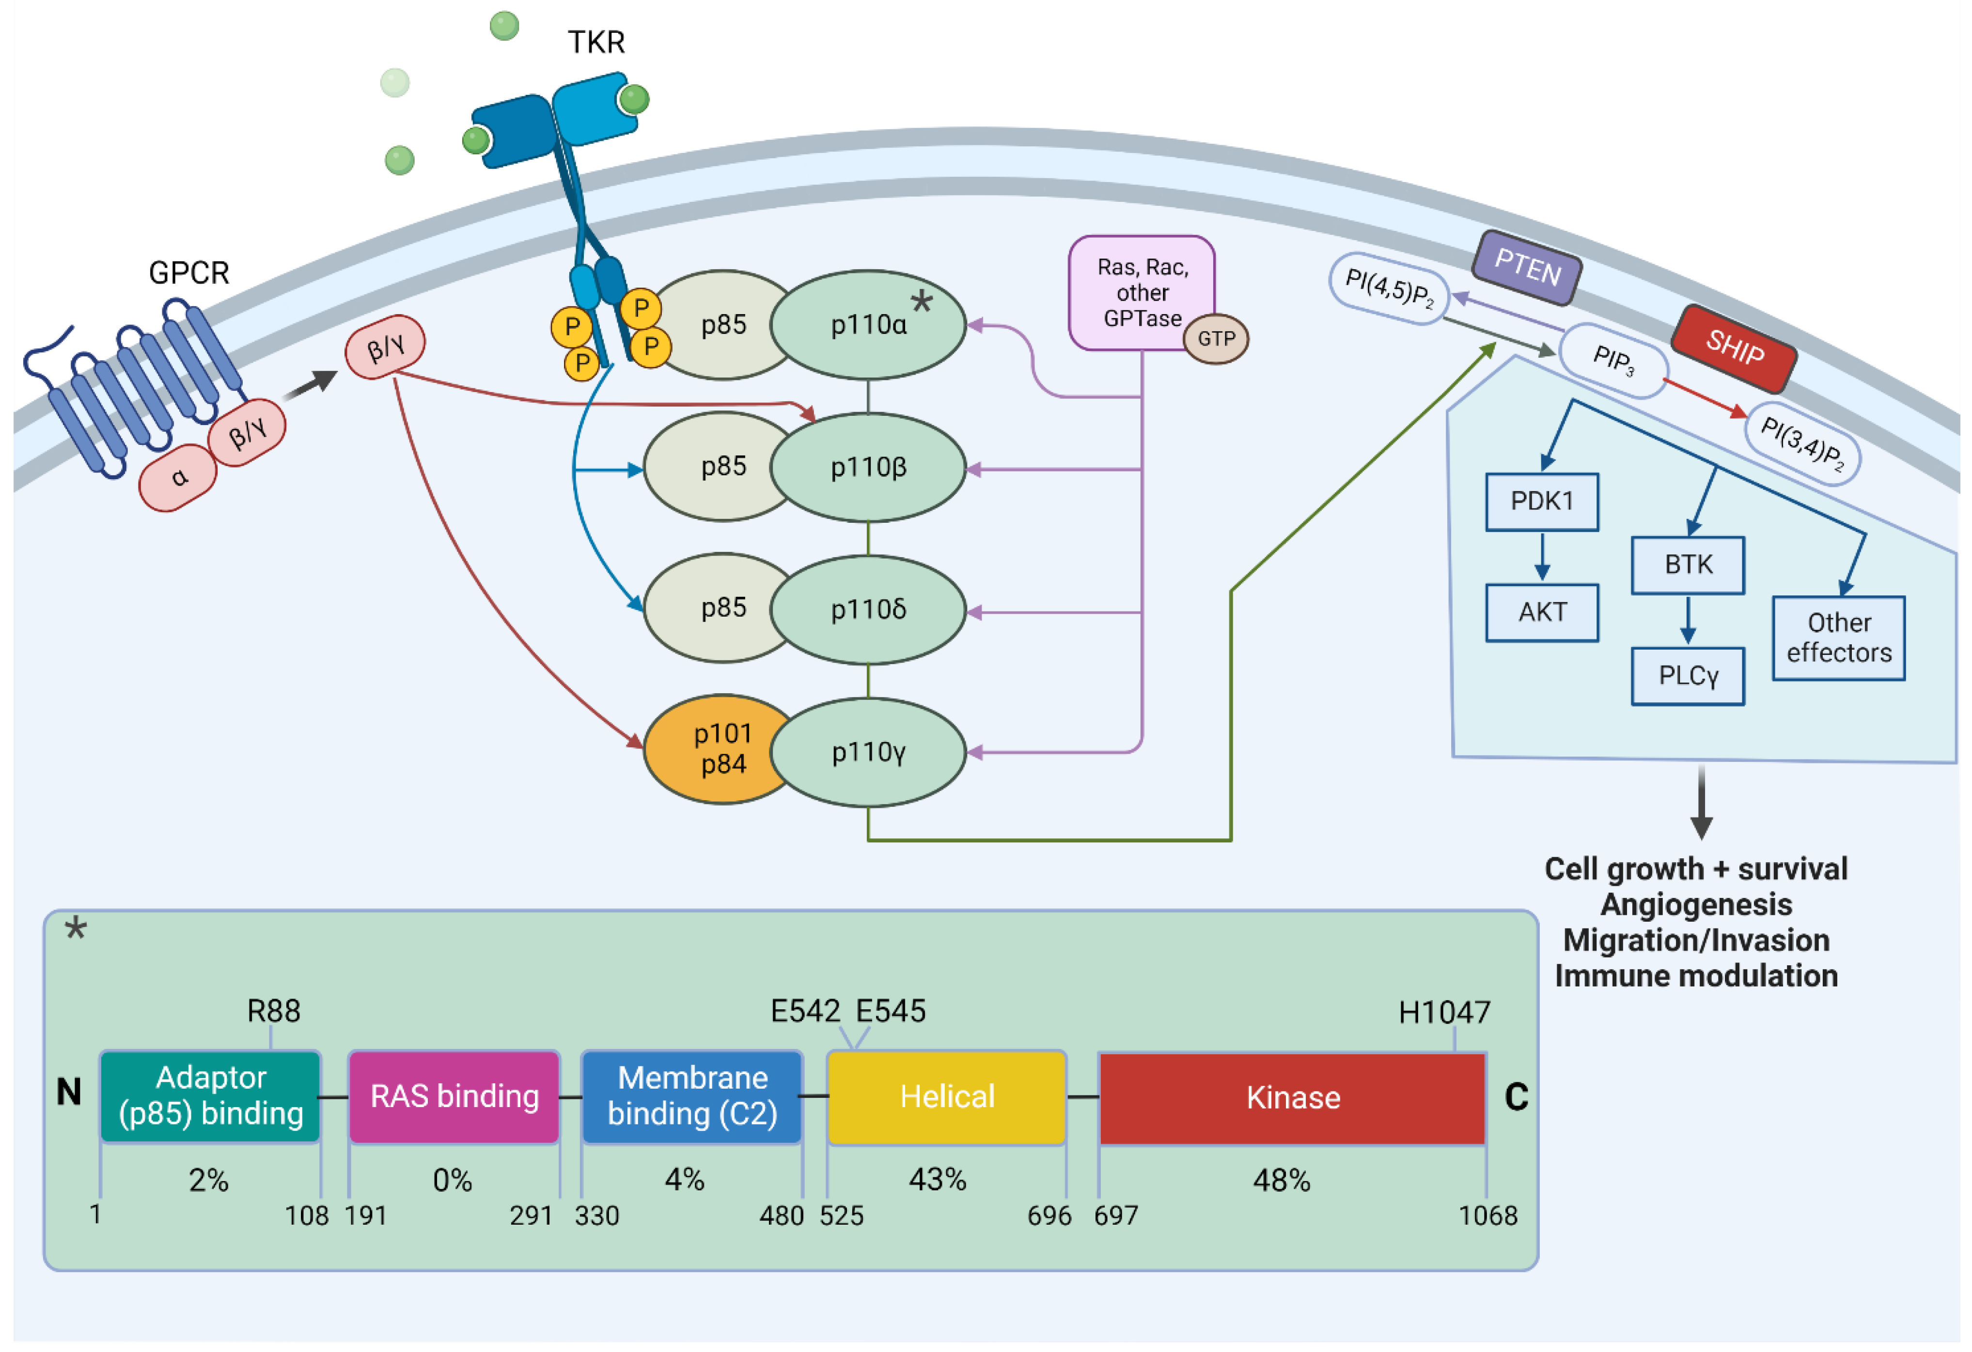
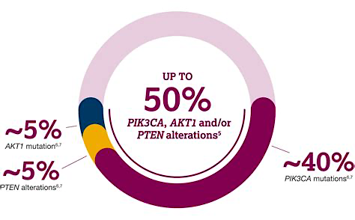
PIK3CA/PTEN/AKT
Biology
Courtesy of Rebecca A Dent, MD, MSc

Slide 46
CAPItello-291 showed a PFS benefit with the addition of capivasertib to fulvestrant vs. fulvestrant in both ITT and PI3K/AKT pathway-altered populations
CAPItello-291 (Phase III)
2L+ capivasertib + fulvestrant vs. fulvestrant
Post-CDK4/6i: 70%
AEs occurring in >15% of patients in either treatment arm in the ITT population, %¹ | Capivasertib + fulvestrant (n=355) |  | Placebo + fulvestrant (n=350)
 | All Grade | Grade ≥3 | All Grade | Grade ≥3
Diarrhoea | 72.4 | 9.3 | 20.0 | 0.3
Rash† | 38.0 | 12.1 | 7.1 | 0.3
Nausea | 34.6 | 0.8 | 15.4 | 0.6
Fatigue | 20.8 | 0.6 | 12.9 | 0.6
Vomiting | 20.6 | 1.7 | 4.9 | 0.6
Headache | 16.9 | 0.3 | 12.3 | 0.6
Decreased appetite | 16.6 | 0.3 | 6.3 | 0.6
Hyperglycaemia | 16.3 | 2.0 | 3.7 | 0.3
Dual primary endpoint:
PFS in PI3K/AKT pathway-altered cohort^{1*}
 | Capivasertib + fulvestrant (n=155) | Placebo + fulvestrant (n=134)
PFS events | 121 | 115
Median PFS (95% CI); months | 7.3 (5.5–9.0) | 3.1 (2.0–3.7)
Adjusted hazard ratio (95% CI) | 0.50 (0.38–0.65); two-sided p-value <0.001
100
80
60
PFS (%)
40
20
Diarrhoea, rash, and hyperglycaemia occurred shortly after starting capivasertib + fulvestrant [median days to onset (IQR) of any grade: 8 (2–22), 12 (10–15), and 15 (1–51), respectively]²
0
0
1
2
3
4
5
6
7
8
9
10
11
12
13
14
15
16
17
18
19
20
21
22
23
24
25
26
Time from randomisation (months)
Courtesy of Rebecca A Dent, MD, MSc
N Turner et al., ESMO Breast 2023 Abstract 187O

Slide 47
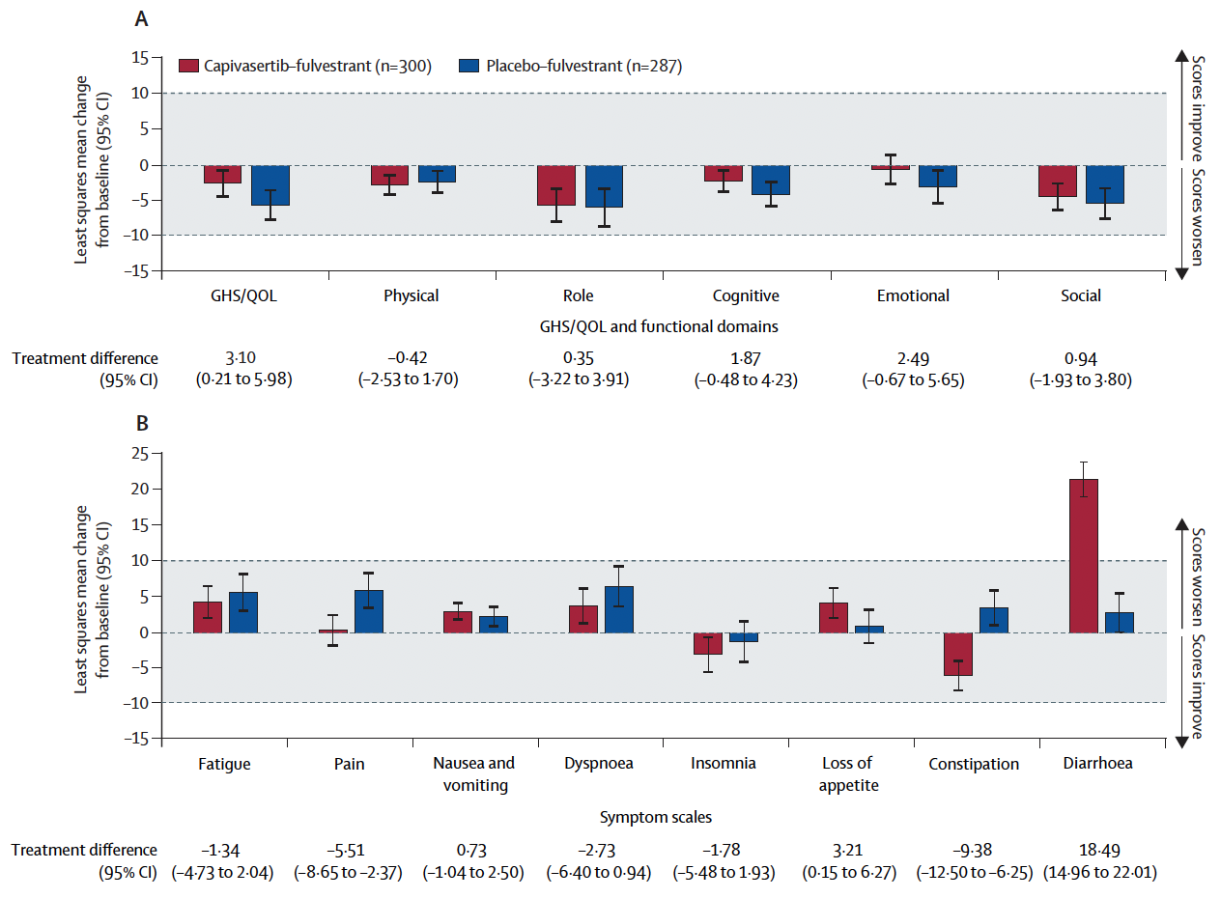
CAPItello-291: Mean Change from Baseline with Capivasertib and Fulvestrant in EORTC QLQ-C30 Global Health Status/Quality of Life, Functional Domains and Symptom Scales
Oliveira M et al. Lancet Oncol 2024;25(9):1231.

Slide 48
INAVO120 (Phase 3): Inavolisib + palbociclib + fulvestrant in patients with PIK3CA-mutated, HR+, HER2− locally advanced/metastatic breast cancer
Inavolisib is a selective inhibitor of the catalytic alpha isoform subunit
(p110α encoded by PIK3CA) of the P13K complex
Key eligibility
Enrichment of patients with poor prognosis:
PIK3CA-mutated, HR+, HER2– LA/mBC
by central ctDNA or local tissue/ctDNA test
Measurable disease
Progression during/ within 12 months of adjuvant ET completion
Inavolisib 9 mg QD PO + palbociclib 125 mg QD PO D1–D21 + fulvestrant 500 mg C1D1/15 and Q4W
Efficacy endpoints
PFS by investigator
OS
ORR, BOR, CBR, DOR
Time from randomization to end or discontinuation of next-line treatment, or death from any cause (proxy for PFS2)
Time from randomization to first
subsequent chemotherapy after
treatment discontinuation
R
1:1
N=325
Placebo PO QD +
palbociclib 125 mg PO QD
D1–D21 + fulvestrant 500 mg C1D1/15 and Q4W
Safety endpoints
Key selected AEs (hyperglycemia, diarrhea, rash, and
stomatitis/mucosal inflammation)
Jhaveri K et al. SABCS 2023; Turner N, et al. NEJM 2024; Juric D, et al. ASCO 2024
Courtesy of Rebecca A Dent, MD, MSc

Slide 49
INAVO120 (Phase 3): Efficacy
Primary endpoint: PFS (previously reported)
  Median PFS: 15 months vs 7.3 months; HR: 0.43 (95% CI: 0.32, 0.59); P<0.0001
Additional analyses (data cutoff: Sep 29, 2023), median follow-up: 21.3 months (prespecified boundary of significance for OS was not met, analyses are descriptive)
Time to discontinuation of next-line treatment, or death (proxy for PFS2)
Time to first subsequent chemo after treatment discontinuation
 | Inavo+Palbo+Fulv (n=161) | Pbo+Palbo+Fulv (n=164)
No. of events, n (%) | 59 (36.6) | 80 (48.4)
Median (95% CI), months | 24.0 (18.6, NE) | 15.1 (13.5, 22.3)
Stratified HR (95% CI) | 0.54 (0.38, 0.77)
 | Inavo+Palbo+Fulv (n=161) | Pbo+Palbo+Fulv (n=164)
No. of events, n (%) | 48 (29.28) | 68 (41.5)
Median (95% CI), months | NE (24.8, NE) | 15.0 (10.6, 24.8)
Unstratified HR (95% CI) | 0.54 (0.37, 0.78)
100
100
75
75
Event-free (%)
Event-free (%)
50
50
25
Δ 8.9 months
25
Inavo+Palbo+Fulv
Inavo+Palbo+Fulv
Pbo+Palbo+Fulv
Pbo+Palbo+Fulv
0
Censored
0
Censored
0
3
6
9
12
15
18
21
24
27
30
33
36
39
0
3
6
9
12
15
18
21
24
27
30
33
36
39
Time (months)
Time (months)
Jhaveri K et al. SABCS 2023; Turner N, et al. NEJM 2024; Juric D, et al. ASCO 2024
Courtesy of Rebecca A Dent, MD, MSc

Slide 50
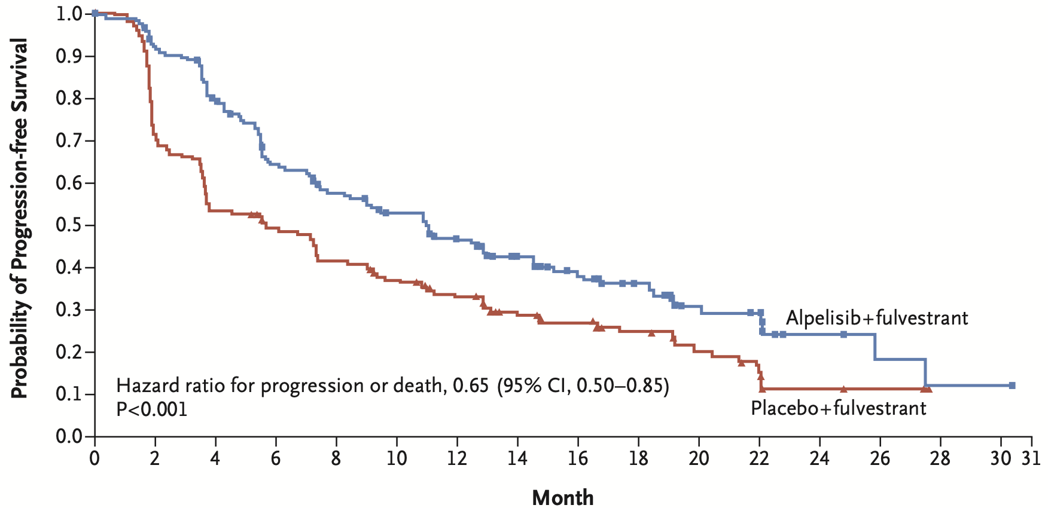
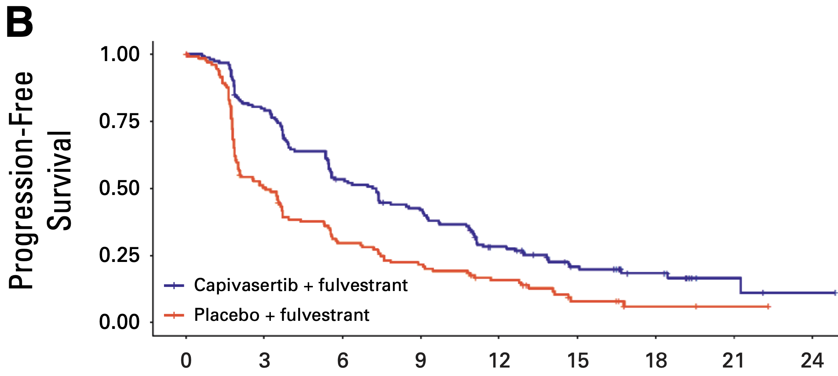
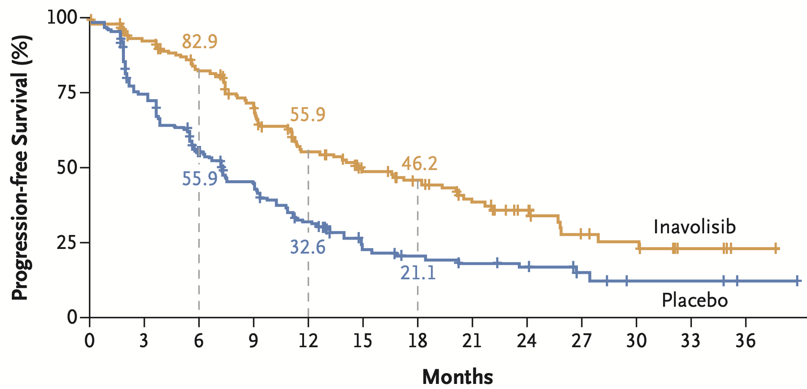
PIK3CA/PTEN/AKT Trials
Alpelisib
PI3Kα-specific
Capivasertib
AKT1, AKT2, and AKT3
HR, 0.5 [95% CI, 0.37-0.68]
Inavolisib PIK3CAi
0.43 (95% CI, 0.32–0.59)
P<0.001
Toxicities
neutropenia, hyperglycemia, stomatitis, diarrhea, rash
F Andre et al. NEJM 2019; M Oliveira et al. Lancet Oncology 2024; N Turner et al. NEJM 2024
Courtesy of Rebecca A Dent, MD, MSc

Slide 51
AGENDA
Year in Review: Management of Breast Cancer
INTRODUCTION: A New Paradigm for Triple-Positive Breast Cancer?
MODULE 1: CDK4/6 Inhibitors for HR-Positive, HER2-Negative Breast Cancer
MODULE 2: Oral Selective Estrogen Receptor Degraders for HR-Positive, HER2-Negative Breast Cancer
MODULE 3: Treatment of PIK3CA/PTEN/AKT-Mutated Breast Cancer
MODULE 4: Antibody-Drug Conjugates (ADCs) for HR-Positive, HER2-Negative Breast Cancer
MODULE 5: ADCs for HER2-Positive Breast Cancer
MODULE 6: HER2-Targeting Tyrosine Kinase Inhibitors for HER2-Positive Breast Cancer
MODULE 7: Treatment of Localized Triple-Negative Breast Cancer (TNBC)
MODULE 8: ADCs for Advanced TNBC

Slide 52
Key Datasets
Bardia A et al. Datopotamab deruxtecan versus chemotherapy in previously treated inoperable/metastatic hormone receptor-positive human epidermal growth factor receptor 2-negative breast cancer: Primary results from TROPION-Breast01. J Clin Oncol 2025;43(3):285-96.
Pistilli B et al. Datopotamab deruxtecan (Dato-DXd) vs chemotherapy (CT) in previously-treated inoperable or metastatic hormone receptor-positive, HER2-negative (HR+/HER2–) breast cancer (BC): Final overall survival (OS) from the phase III TROPION-Breast01 trial. ESMO Virtual Plenary 2025;Abstract VP1-2025.
Bardia A et al. Trastuzumab deruxtecan after endocrine therapy in metastatic breast cancer. N Engl J Med 2024;391(22):2110-22.
Pistilli B et al. Efficacy, safety and biomarker analysis of ICARUS-BREAST01: A phase II study of patritumab deruxtecan (HER3-DXd) in patients (pts) with HR+/HER2- advanced breast cancer (ABC). ESMO 2024;Abstract 340O.

Slide 53
DESTINY-Breast06 (Phase 3): Trastuzumab deruxtecan vs chemotherapy for HR+, HER2-low or HER2-ultralow metastatic breast cancer with prior ET
Open-label, randomized, multicenter study
Key eligibility
HR+ metastatic breast cancer
HER2-low (IHC 1+ or IHC 2+/ISH−) or HER2-ultralow (IHC 0 with membrane staining)
Chemotherapy naïve in the mBC setting
Prior lines of therapy
≥2 lines of ET ± targeted therapy for mBC OR 1 line for mBC AND
Progression ≤6 months of starting first-line ET + CDK4/6i OR Recurrence ≤24 months of starting adjuvant ET
Endpoints
Primary
PFS (BICR) in HER2-low
Key secondary
PFS (BICR) in ITT (HER2-low + ultralow)
OS in HER2-low
OS in ITT (HER2-low + ultralow)
T-DXd
5.4 mg/kg Q3W
(n=436)
R
1:1
HER2-low = 713
HER2-ultralow = 153
N=866
TPC
(n=430)
Other secondary
PFS (INV) in HER2-low
ORR (BICR/INV) and DOR (BICR/INV) in HER2-low and ITT (HER2-low + ultralow)
Safety and tolerability
Patient-reported outcomes
Stratification factors
Options:
capecitabine,
nab-paclitaxel,
paclitaxel
Prior CDK4/6i use (yes vs no)
HER2 expression (IHC 1+ vs IHC 2+/ISH− vs IHC 0 with membrane staining)
Prior taxane in the non-metastatic setting (yes vs no)
Curigliano G, et al. ASCO 2024. Abstract LBA1000.
Courtesy of Rebecca A Dent, MD, MSc

Slide 54
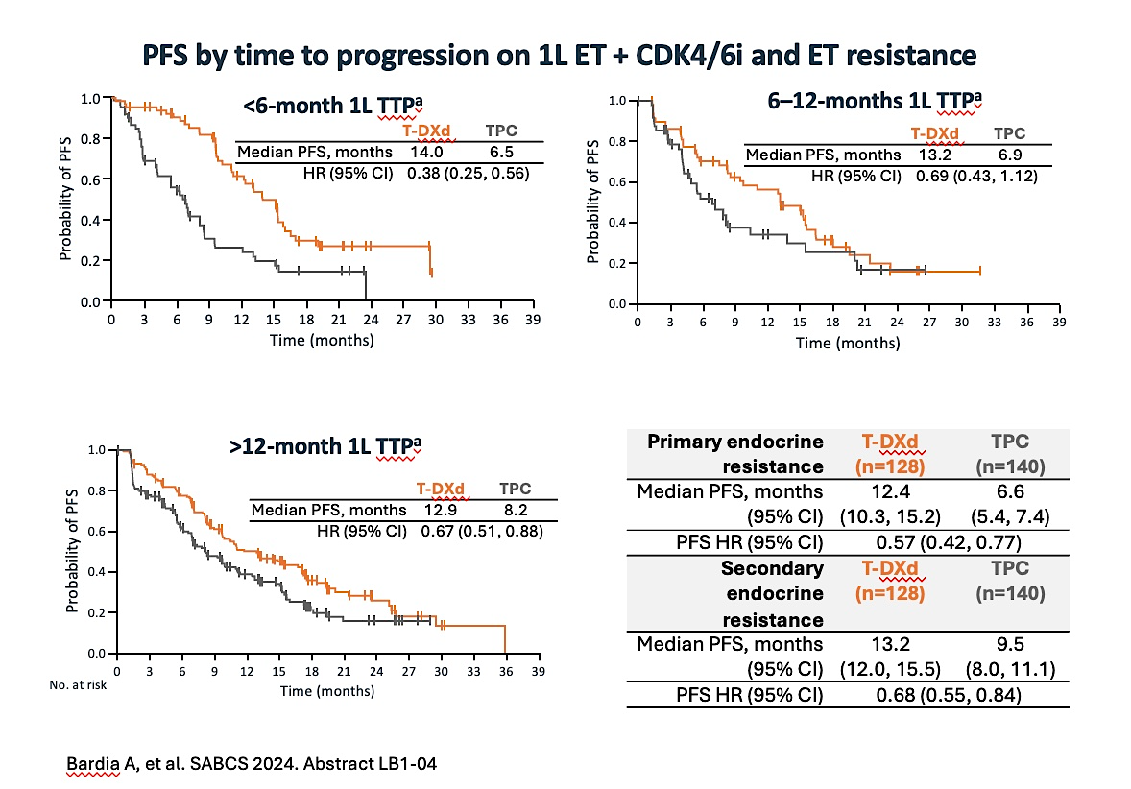
DESTINY-Breast06 (Phase 3): T-DXd efficacy by time to progression on 1L ET + CDK4/6i and ET resistance
6–12-month 1L TTPª
Courtesy of Rebecca A Dent, MD, MSc

Slide 55
DESTINY-Breast06 (Phase 3): PFS2 in the overall ITT population and TTP subgroups
PFS2 (ITT population)ª
1.0
 | T-DXd | TPC
Median PFS2, months | 20.3 | 14.7
HR (95% CI) | 0.62 (0.52, 0.74); P<0.0001
0.8
0.6
Probability of EFS
0.4
Δ 5.6 months
0.2
0.0
0
3
6
9
12
15
18
21
24
27
30
33
35
39
42
No. at risk
Time (months)
T-DXd
TPC
436
430
431
399
396
365
365
311
322
244
268
183
176
109
115
69
78
48
43
26
23
12
11
6
4
2
1
0
0
0
 | <6-month 1L TTP |  | 6–12-month 1L TTP |  | >12-month 1L TTP
 | T-DXd (n=65) | TPC (n=59) | T-DXd (n=60) | TPC (n=52) | T-DXd (n=168) | TPC (n=166)
Median PFS2, months (95% CI) | 18.9 (14.4, 24.0) | 15.2 (10.9, 17.5) | 17.1 (13.9, 31.8) | 13.7 (10.3, 17.1) | 20.0 (18.6, 25.3) | 14.3 (12.6, 15.9)
PFS2 HR (95% CI) | 0.73 (0.46, 1.14) |  | 0.59 (0.37, 0.94) |  | 0.57 (0.43, 0.75)
This subset analysis of DESTINY-Breast06 provides important information about which patients are most likely to benefit from 1L
T-DXd compared with standard chemotherapy, which for the majority of patients was capecitabine
In particular, patients with a short TTP on first line ET, or those with primary endocrine resistance had markedly improved PFS with T-DXd
Bardia A, et al. SABCS 2024. Abstract LB1-04
Courtesy of Rebecca A Dent, MD, MSc

Slide 56
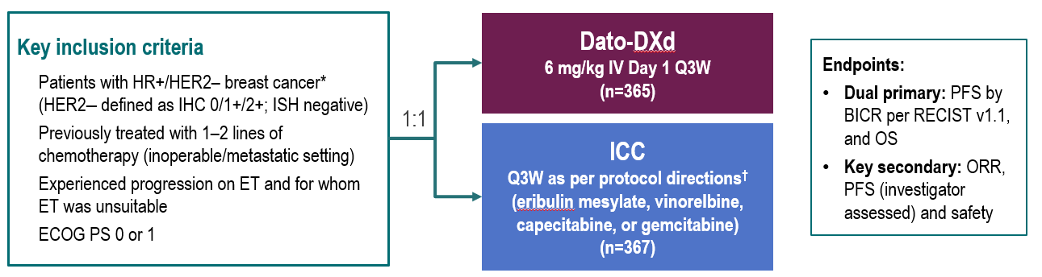
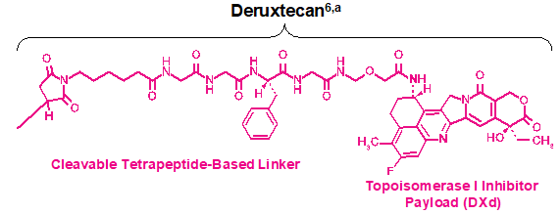
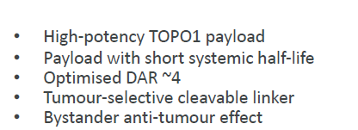
TROPION-Breast01: Ph 3 trial of Dato-DXd in HR+/HER2- MBC
Dato-DXd: Humanised anti-TROP2
monoclonal antibody
TROPION-Breast01 Schema
Courtesy of Rebecca A Dent, MD, MSc
Bardia A et al. ESMO 2023, LBA11

Slide 57
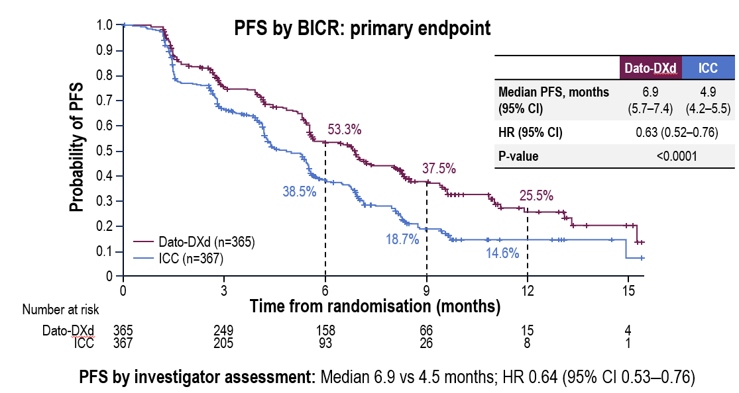
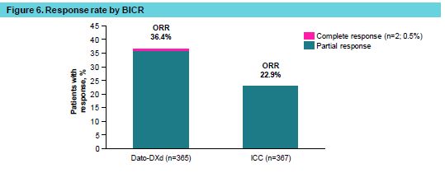
TROPION-Breast01: Efficacy outcomes
Primary EP: PFS by BICR
Response rate by BICR
Overall survival (dual primary endpoint)
OS data were not mature (information fraction 39%): median follow-up 9.7 months.
A trend favoring Dato-DXd was observed: HR 0.84 (95% CI 0.62–1.14).
Courtesy of Rebecca A Dent, MD, MSc
Bardia A et al. ESMO 2023, LBA11; Rugo HS et al. MBCC 2024

Slide 58
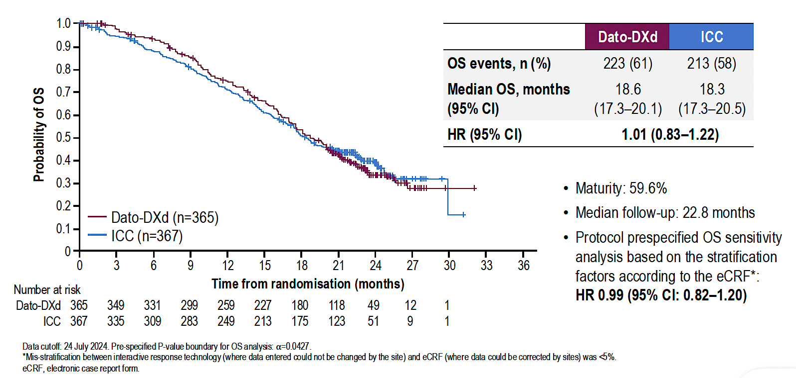
TROPION-Breast01: Final Overall Survival Analysis with Datopotamab Deruxtecan (Dato-DXd) for Previously Treated HR-Positive mBC
Pistilli B et al. ESMO 2024;Abstract VP1-2025.

Slide 59
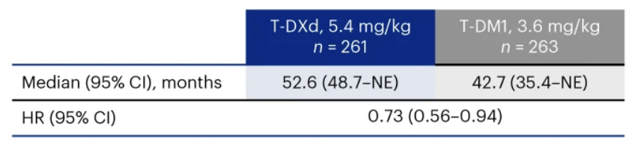
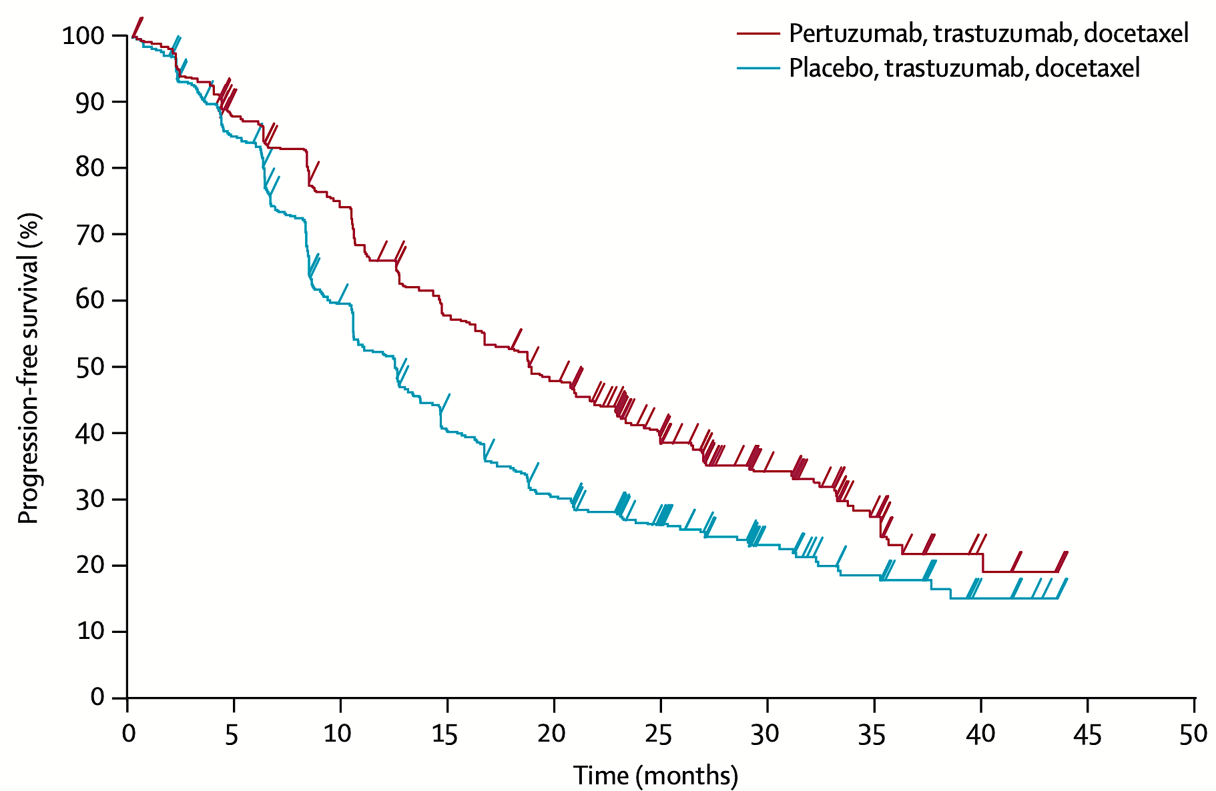
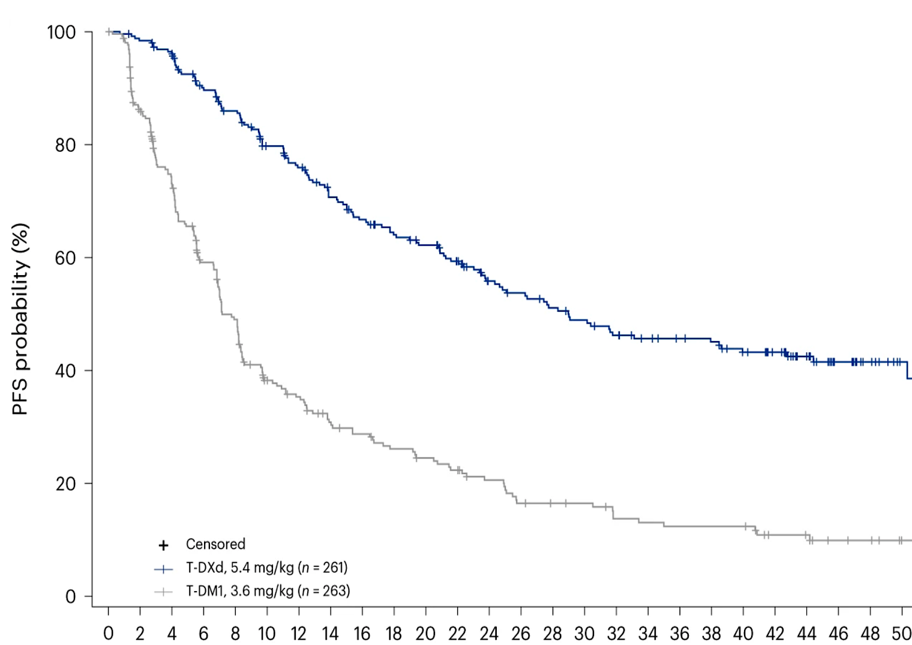
HER2-Positive MBC (HR all comers)
CLEOPATRA; 1st line
DESTINY-Breast; 2nd line
18.7 vs 12.4 mo
58
Courtesy of Rebecca A Dent, MD, MSc

Slide 60
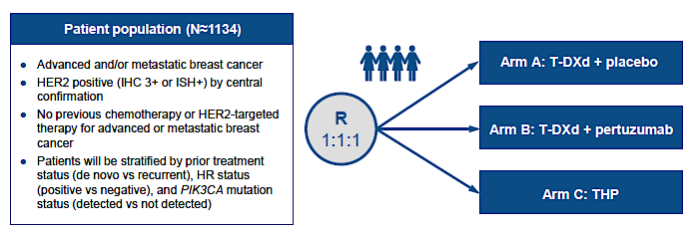
DESTINY-Breast09 Phase III Trial Design
Tolaney SM et al. San Antonio Breast Cancer Symposium 2021;Abstract OT1-14-02.

Slide 61
AGENDA
Year in Review: Management of Breast Cancer
INTRODUCTION: A New Paradigm for Triple-Positive Breast Cancer?
MODULE 1: CDK4/6 Inhibitors for HR-Positive, HER2-Negative Breast Cancer
MODULE 2: Oral Selective Estrogen Receptor Degraders for HR-Positive, HER2-Negative Breast Cancer
MODULE 3: Treatment of PIK3CA/PTEN/AKT-Mutated Breast Cancer
MODULE 4: Antibody-Drug Conjugates (ADCs) for HR-Positive, HER2-Negative Breast Cancer
MODULE 5: ADCs for HER2-Positive Breast Cancer
MODULE 6: HER2-Targeting Tyrosine Kinase Inhibitors for HER2-Positive Breast Cancer
MODULE 7: Treatment of Localized Triple-Negative Breast Cancer (TNBC)
MODULE 8: ADCs for Advanced TNBC

Slide 62
Key Datasets
Geyer CE Jr et al. Survival with trastuzumab emtansine in residual HER2-positive breast cancer. N Engl J Med 2025;392(3):249-57.
Tarantino P et al. Adjuvant trastuzumab emtansine versus paclitaxel plus trastuzumab for stage I human epidermal growth factor receptor 2-positive breast cancer: 5-year results and correlative analyses from ATEMPT. J Clin Oncol 2024;42(31):3652-65.
Saura C et al. Trastuzumab deruxtecan in previously treated patients with HER2-positive metastatic breast cancer: Updated survival results from a phase II trial (DESTINY-Breast01). Ann Oncol 2024;35(3):302-7.
Fehm T et al. Trastuzumab deruxtecan versus treatment of physician's choice in patients with HER2-positive metastatic breast cancer (DESTINY-Breast02): Patient-reported outcomes from a randomised, open-label, multicentre, phase 3 trial. Lancet Oncol 2024;25(5):614-25.
Cortés J et al. Trastuzumab deruxtecan versus trastuzumab emtansine in HER2-positive metastatic breast cancer: Long-term survival analysis of the DESTINY-Breast03 trial. Nat Med 2024;30(8):2208-15.
Harbeck N et al. Trastuzumab deruxtecan in HER2-positive advanced breast cancer with or without brain metastases: A phase 3b/4 trial. Nat Med 2024;30(12):3717-27.

Slide 63
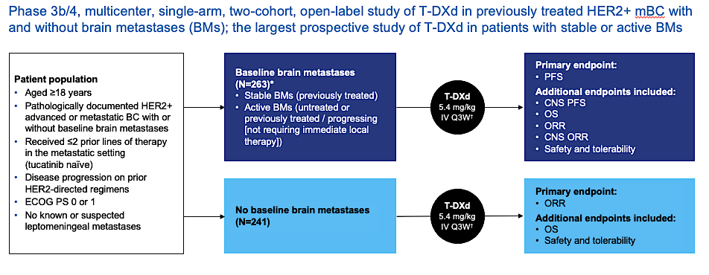
DESTINY-Breast12: T-DXd for HER2+ Brain Mets
Harbeck N et al. Nat Med 2024;30(12):3717-27.
Courtesy of Nancy U Lin, MD

Slide 64
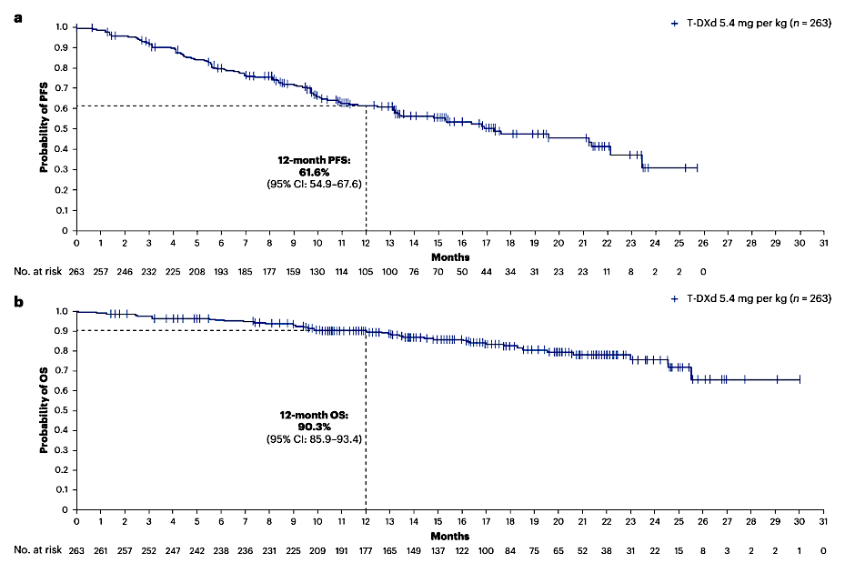
DESTINY-Breast12: T-DXd for HER2+ Brain Mets
Brain Metastases Cohort (n=263)
Median PFS 17.3 months
12 month PFS 61.6%
12 month CNS PFS 58.9%
12 month OS 90.3%
Overall ORR 51.7% (64.1% in those
with measurable dx at BL)
CNS ORR 71.7%
Prior lines: 0 prior (7.6%), 1 prior (50.2%), 2 prior (41.4%)
Harbeck N et al. Nat Med 2024;30(12):3717-27.
Courtesy of Nancy U Lin, MD

Slide 65
Baseline BMs: CNS ORR
100
Patients with measurable CNS disease at baseline (post-hoc analysis)
n=138
80
60
40
20
Best percentage change in target CNS lesion size from baseline
0
−20
−40
−60
−80
−100
 |  |  |  | Active BM subgroups
Measurable CNS disease at baseline | All patients (n=138) | Stable BMs (n=77) | Active BMs (n=61) | Untreated (n=23) Post-hoc analysis | Previously treated / progressing (n=38) Post-hoc analysis
Confirmed CNS ORR, % (95% CI) | 71.7 (64.2, 79.3) | 79.2 (70.2, 88.3) | 62.3 (50.1, 74.5) | 82.6 (67.1, 98.1) | 50.0 (34.1, 65.9)
T-DXd showed substantial CNS responses in the overall BMs population, including patients with stable and active BMs
Dashed line indicates a 30% decrease in target tumor size (PR)
*Imputed values: a value of +20% was imputed if best percentage change could not be calculated because of missing data if: a patient had a new lesion or progression of non-target lesions or target lesions, or had withdrawn because of PD and had no evaluable target lesion data before or at PD
BM, brain metastasis; CI, confidence interval; CNS, central nervous system; ORR, objective response rate; PD, progressive disease; PR, partial response; T-DXd, trastuzumab deruxtecan
Lin et al, ESMO 2024
Harbeck N et al. Nat Med 2024;30(12):3717-27.
Courtesy of Nancy U Lin, MD

Slide 66
DESTINY-Breast12: Conclusions and Thoughts
Robust and durable intracranial activity of T-DXd in HER2+ MBC
  Favorable results seen in patients with both stable and active brain mets
Increases confidence in the use of T-DXd in the 2L setting even in patients with active brain metastases
Another systemic option for patients with active BM – to be weighed against local therapy
ILD remains an issue
  9 grade 5 events: 4/9 co-occurring with opportunistic infection (none received PJP prophylaxis)
  Investigator-reported ILD rates may overestimate compared to centrally adjudicated rates
  Several cases of confirmed opportunistic lung infections – careful attention to PJP prophylaxis in the BM population on chronic steroids is important
Harbeck N et al. Nat Med 2024;30(12):3717-27.
Courtesy of Nancy U Lin, MD

Slide 67
AGENDA
Year in Review: Management of Breast Cancer
INTRODUCTION: A New Paradigm for Triple-Positive Breast Cancer?
MODULE 1: CDK4/6 Inhibitors for HR-Positive, HER2-Negative Breast Cancer
MODULE 2: Oral Selective Estrogen Receptor Degraders for HR-Positive, HER2-Negative Breast Cancer
MODULE 3: Treatment of PIK3CA/PTEN/AKT-Mutated Breast Cancer
MODULE 4: Antibody-Drug Conjugates (ADCs) for HR-Positive, HER2-Negative Breast Cancer
MODULE 5: ADCs for HER2-Positive Breast Cancer
MODULE 6: HER2-Targeting Tyrosine Kinase Inhibitors for HER2-Positive Breast Cancer
MODULE 7: Treatment of Localized Triple-Negative Breast Cancer (TNBC)
MODULE 8: ADCs for Advanced TNBC

Slide 68
Key Datasets
Freedman RA et al. Neratinib and ado-trastuzumab emtansine for pretreated and untreated human epidermal growth factor receptor 2 (HER2)-positive breast cancer brain metastases: Translational Breast Cancer Research Consortium trial 022. Ann Oncol 2024;35(11):993-1002.
Jhaveri K et al. Efficacy and genomic analysis of HER2-mutant, metastatic triple-negative breast cancer treated with neratinib alone or in combination with trastuzumab in the phase 2 SUMMIT basket trial. ASCO 2024;Abstract 1094.

Slide 69
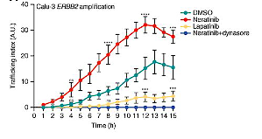
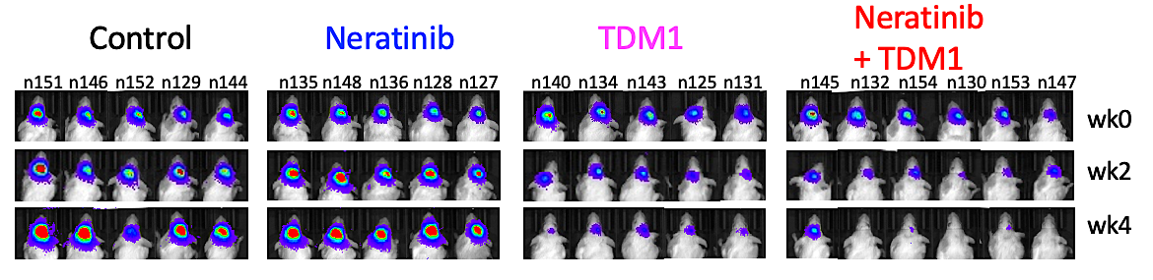
TBCRC 022: T-DM1 + Neratinib for HER+ Brain Mets
Rationale for the Combination
Neratinib
+ T-DM1
T-DM1
PDX model of HER2+ breast cancer brain mets
Deeper and more durable responses with the combination
Neratinib increases HER2 trafficking
and may overcome T-DM1 resistance
Freedman RA et al. Ann Oncol 2024;35(11):993-1002.
Li et al, Cancer Discov 2020
Courtesy of Nancy U Lin, MD

Slide 70
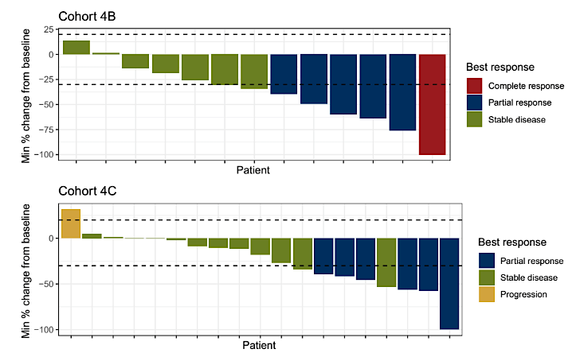
TBCRC 022: T-DM1 + neratinib for HER+ Brain Mets
Progressing after prior local tx
No prior T-DM1
CNS ORR 35.3%
Median PFS 4.1 mo
Median OS 23.3 mo
12 mo OS 87%
Progressing after prior local tx
Prior T-DM1 exposure
CNS ORR 28.6%
Median PFS 4.1 mo
Median OS 20.9 mo
12 mo OS 80%
Freedman RA et al. Ann Oncol 2024;35(11):993-1002.
Courtesy of Nancy U Lin, MD

Slide 71
TBCRC 022: Conclusions and Thoughts
Even with the advent of T-DXd and tucatinib, there is a substantial need for multiple lines of systemic therapy for patients with active brain metastases
CNS ORR to T-DM1 + neratinib exceeds that of neratinib monotherapy (CNS ORR 8%)
CNS responses are seen in about 1/3 of patients with prior T-DM1 exposure
Limitations: no patients had received prior tucatinib, and only a few had prior T-DXd
Await more granular CNS data from HER2CLIMB-02
Provides another systemic option for patients with HER2+ BM
Courtesy of Nancy U Lin, MD

Slide 72
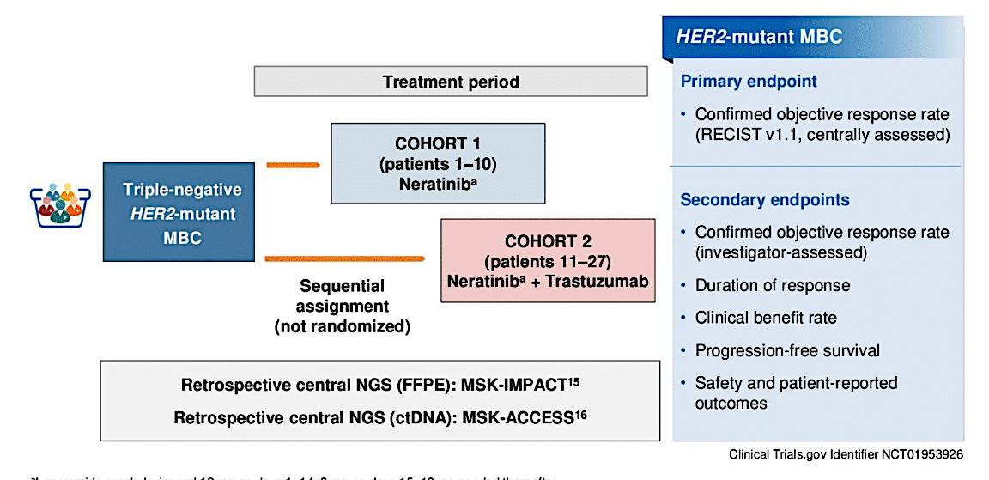
SUMMIT Trial: HER2-mutant TNBC treated with Neratinib or Neratinib + Trastuzumab
Cohort 1
Neratinib
N=10
Median 2.5 prior lines
Cohort 2
Neratinib + trastuzumab
N=17
Median 2 prior lines
Courtesy of Nancy U Lin, MD
Jhaveri K et al. ASCO 2024;Abstract 1094.

Slide 73
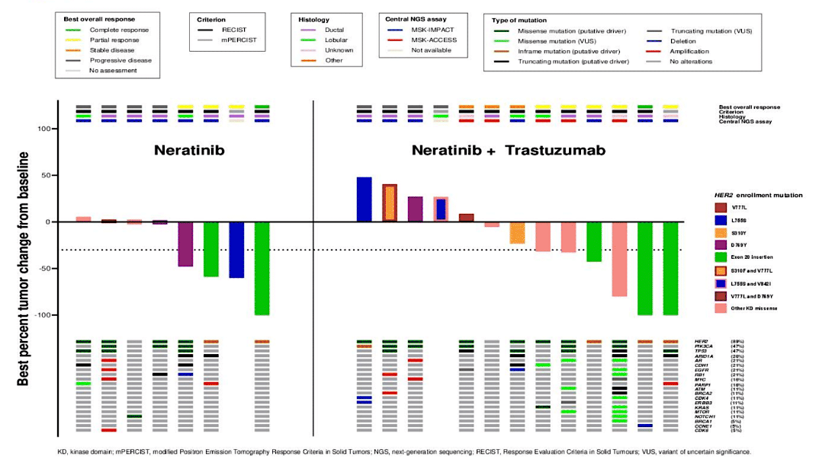
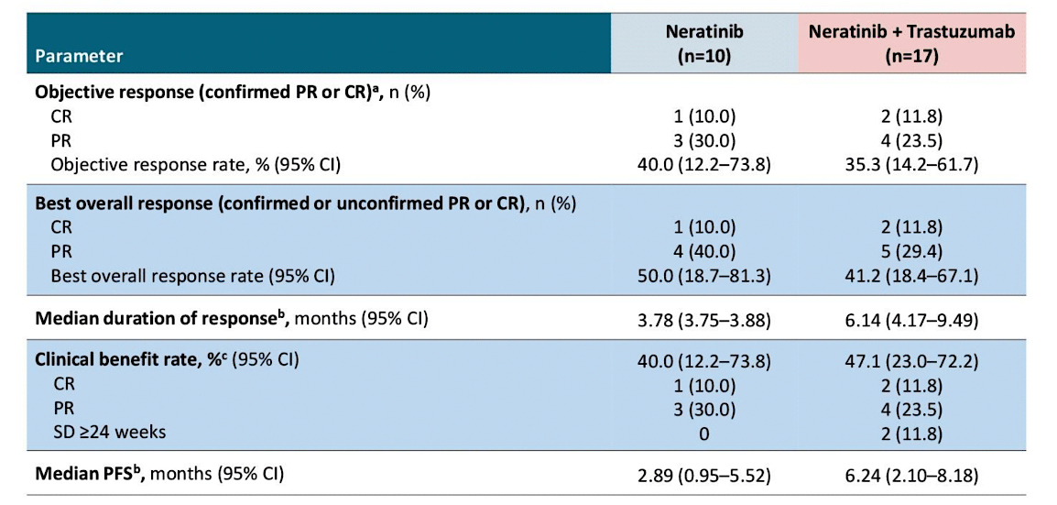
SUMMIT Trial: HER2-mutant TNBC treated with Neratinib or Neratinib + Trastuzumab
Confirmed ORR 40% (N), 35.3% (N+T)
Median PFS 2.89 mo (N), 6.24 mo (N+T)
Deepest responses in those with Exon 20 insertions
Jhaveri K et al. ASCO 2024;Abstract 1094.
Courtesy of Nancy U Lin, MD

Slide 74
SUMMIT Trial TNBC basket:
Conclusions and Thoughts
Impressive response rates (40%) in pre-treated HER2-mut TNBC
Longer DoR and PFS with the doublet of N+T
Small numbers but compares favorably to “nth-line” chemo in TNBC
Previously published data in HR+/HER2-mut MBC
  ORR 38.6%, median PFS 8.3 months with neratinib + fulvestrant + trastuzumab
New data for tucatinib + trastuzumab in HER2-mut MBC
  Confirmed ORR 41.9%; median PFS 9.5 months
  Pts with HR+ disease also received fulvestrant
  Only 4 pts with TNBC included
Jhaveri K et al. ASCO 2024;Abstract 1094.
Jhaveri et al, Ann Oncol 2023
Okines et al, Nat Med 2025
Courtesy of Nancy U Lin, MD

Slide 75
AGENDA
Year in Review: Management of Breast Cancer
INTRODUCTION: A New Paradigm for Triple-Positive Breast Cancer?
MODULE 1: CDK4/6 Inhibitors for HR-Positive, HER2-Negative Breast Cancer
MODULE 2: Oral Selective Estrogen Receptor Degraders for HR-Positive, HER2-Negative Breast Cancer
MODULE 3: Treatment of PIK3CA/PTEN/AKT-Mutated Breast Cancer
MODULE 4: Antibody-Drug Conjugates (ADCs) for HR-Positive, HER2-Negative Breast Cancer
MODULE 5: ADCs for HER2-Positive Breast Cancer
MODULE 6: HER2-Targeting Tyrosine Kinase Inhibitors for HER2-Positive Breast Cancer
MODULE 7: Treatment of Localized Triple-Negative Breast Cancer (TNBC)
MODULE 8: ADCs for Advanced TNBC

Slide 76
Key Datasets
Schmid P et al. Neoadjuvant pembrolizumab or placebo plus chemotherapy followed by adjuvant pembrolizumab or placebo for high-risk early-stage TNBC: Overall survival results from the phase III KEYNOTE-522 study. ESMO 2024;Abstract LBA4.
Garber J et al. OlympiA: A phase 3, multicenter, randomized, placebo-controlled trial of adjuvant olaparib after (neo)adjuvant chemotherapy in patients w/ germline BRCA1 & BRCA2 pathogenic variants & highrisk HER2-negative primary breast cancer. San Antonio Breast Cancer Symposium 2024;Abstract GS1-09.
Tung NM et al. TBCRC 048 (olaparib expanded) expansion cohorts: Phase 2 study of olaparib monotherapy in patients (pts) with metastatic breast cancer (MBC) with germline (g) mutations in PALB2 or somatic (s) mutations in BRCA1 or BRCA2. ASCO 2024;Abstract 1021.

Slide 77
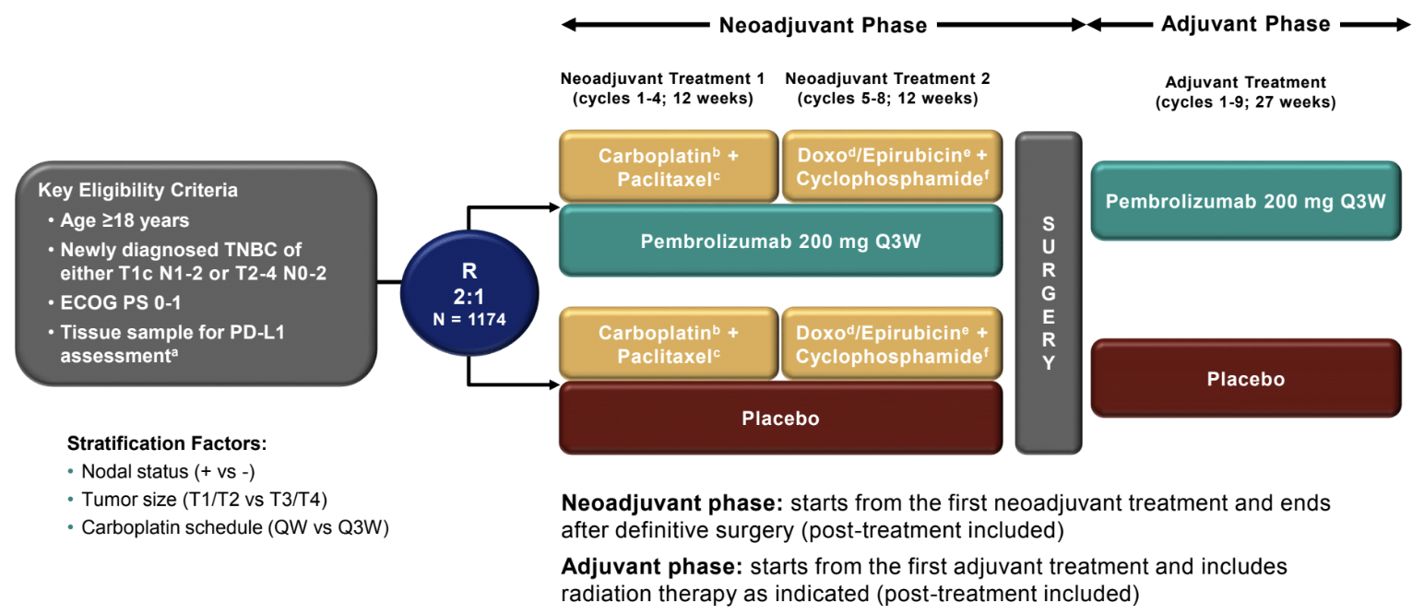
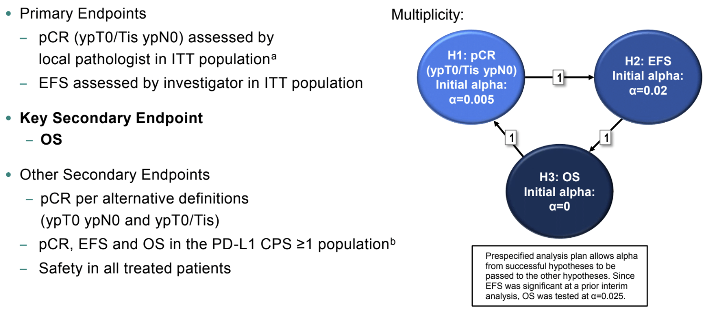
KEYNOTE-522: Neoadjuvant pembro for TNBC
Notes:
~1/2 node positive
Median age 48-49
Only 132 pts (84 pembro)
age 65+
Courtesy of Nancy U Lin, MD
Schmid P et al. ESMO 2024;Abstract LBA4.

Slide 78
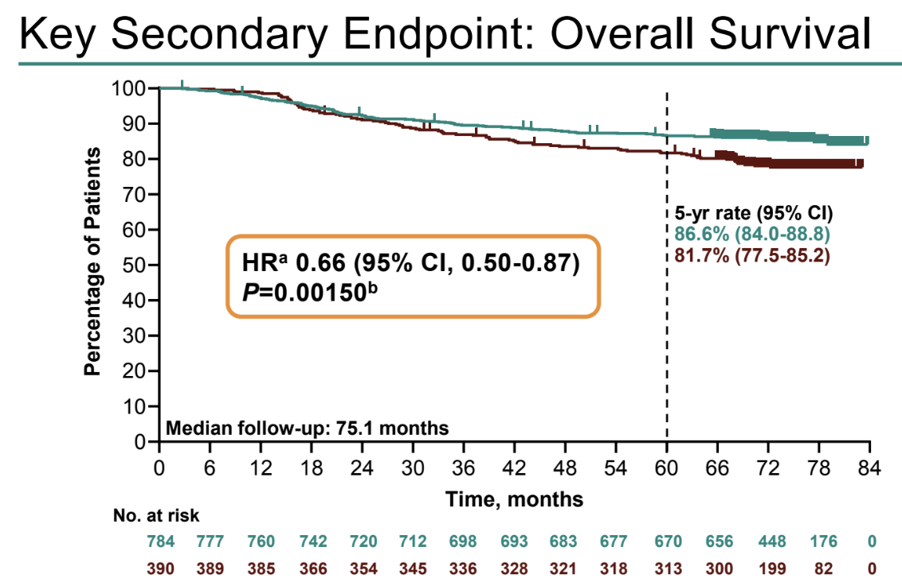

KEYNOTE-522: Improvement in OS with Pembro
Schmid P et al. ESMO 2024;Abstract LBA4.
Schmid P et al, N Engl J Med 2024
Courtesy of Nancy U Lin, MD

Slide 79

KEYNOTE-522: OS by Pathologic Response
Schmid P et al. ESMO 2024;Abstract LBA4.
Schmid P et al, N Engl J Med 2024
Courtesy of Nancy U Lin, MD

Slide 80
KEYNOTE-522: Conclusions and Thoughts
At a median f/u of 75.1 mo, a 5% gain in 5 year OS (81.7% vs 86.6%) with pembrolizumab
Similar hazard ratio for benefit in N+ and N-
Benefits seen regardless of PD-L1 status
Supports the use of KN522 as standard of care for pts with T2N0 or node positive TNBC
Questions:
  Is adjuvant pembro required in those with pCR (to be tested in OptimICE-pCR)?
  In whom can we de-escalate the anthracycline a la NeoPACT – carbo/docetaxel/pembro x 6 cycles – (few pts age 65+ treated on KN522)?
  Who can do well with chemotherapy alone (without IO)?
  How can we improve outcomes in patients with residual disease, where 5 yr OS is still only 71.8%?
Courtesy of Nancy U Lin, MD

Slide 81


Slide 82



Slide 83

OlympiA: Adjuvant Olaparib in gBRCA1/2 carriers
>70% enrolled pts were gBRCA1
>80% had TNBC
~50% adjuvant
~50% post neoadjuvant
Third pre-specified analysis at 10 years from first patient in
Median follow up of 6.1 years (additional 2.6 y f/u since previous)
Garber J et al. SABCS 2024;Abstract GS1-09.
Courtesy of Nancy U Lin, MD

Slide 84


OlympiA: iDFS
ITT Population
Similar magnitude of benefit for DDFS
Similar rates of MDS/AML (4 events (0.4%) for Olaparib; 6 events (0.7%) in placebo arm)
Numerically fewer CNS events as 1st iDFS event (2.8% vs 4.4%)
Fewer new primary cancers with olaparib (contralateral breast cancer, new primary ovarian/fallopian tube cancer)
Garber J et al. SABCS 2024;Abstract GS1-09.
Courtesy of Nancy U Lin, MD

Slide 85


OlympiA: OS
ITT Population
Garber J et al. SABCS 2024;Abstract GS1-09.
Courtesy of Nancy U Lin, MD

Slide 86
OlympiA: Conclusions and Thoughts
Significant benefit in iDFS (HR 0.65), DDFS, and OS (HR 0.72) with adjuvant Olaparib
Effect seen in both HR+ and TN patients and in BRCA1 or BRCA2 carriers
No signal of increase in MDS/AML at 6.1 y median f/u
All patients who meet anatomic eligibility criteria for Olaparib (with drug access) should be offered germline genetic testing
TNBC: Cape vs Olaparib post NAC?
  No direct comparison
  CREATE-X OS HR 0.52, 8% absolute gain
  GEICAM (adjuvant cape) suggested more benefit of capecitabine in non-basal subtypes
  OlympiAD – Olaparib outperformed chemo of provider choice (~1/2 capecitabine) in MBC setting
ER+: Abema or Ribo vs Olaparib?
  No direct comparison
  MONARCHE @ 54 mo median f/u, HR 0.68 for iDFS (7.6% absolute gain); no statistically significant OS benefit
  NATALEE @ 34 mo median f/u, HR 0.75 for iDFS (3% gain at 3y); no difference yet in OS
  For 4+ positive nodes, generally prefer Olaparib (or a sequence of ola -> CDK4/6i in very high-risk patients)
  For 1-3 positive nodes (OlympiA did not include if adjuvant only), could consider CDK4/6i but lean towards olaparib: shorter duration of therapy and OS benefit already demonstrated
  For node negative disease, olaparib has not been studied, and would consider ribo in carefully selected patients who would have met eligibility for NATALEE
Courtesy of Nancy U Lin, MD

Slide 87

TBCRC 048: Olaparib Expanded Initial Cohort
Gene | ORR (90% CI)
gPALB2 (n=11) | 82% (48-98%)
sBRCA (n=16) | 50% (25-75%)
ATM, CHEK2 (n=18) | 0%
Tung NM et al. J Clin Oncol 2020
Courtesy of Nancy U Lin, MD

Slide 88


TBCRC 048: Olaparib Expanded Expansion Cohorts
Median PFS 9.6 months
Median PFS 7.2 months
Key Eligibility: 0-2 prior chemo for MBC
Key exclusion: prior PARP, progression on platinum
Tung NM et al. ASCO 2024;Abstract 1021.
Courtesy of Nancy U Lin, MD

Slide 89

TBCRC 048: Olaparib Expanded Expansion Cohorts
Tung NM et al. ASCO 2024;Abstract 1021.
Courtesy of Nancy U Lin, MD

Slide 90
TBCRC 048: Conclusions and Thoughts
Confirms very high response rates and durability of benefit in gPALB2 carriers
Activity in sBRCA numerically less than in initial cohort but still respectable (37%, median PFS 7.2 mo)
Estimates of frequency of sBRCA in primary tumors ~3-4%
Frequency in MBC esp in later lines is not well-described
Sufficient activity to consider on a routine basis and to justify:
  Routine germline testing in MBC patients
  NGS testing to identify somatic alterations
Courtesy of Nancy U Lin, MD

Slide 91

AGENDA
Year in Review: Management of Breast Cancer
INTRODUCTION: A New Paradigm for Triple-Positive Breast Cancer?
MODULE 1: CDK4/6 Inhibitors for HR-Positive, HER2-Negative Breast Cancer
MODULE 2: Oral Selective Estrogen Receptor Degraders for HR-Positive, HER2-Negative Breast Cancer
MODULE 3: Treatment of PIK3CA/PTEN/AKT-Mutated Breast Cancer
MODULE 4: Antibody-Drug Conjugates (ADCs) for HR-Positive, HER2-Negative Breast Cancer
MODULE 5: ADCs for HER2-Positive Breast Cancer
MODULE 6: HER2-Targeting Tyrosine Kinase Inhibitors for HER2-Positive Breast Cancer
MODULE 7: Treatment of Localized Triple-Negative Breast Cancer (TNBC)
MODULE 8: ADCs for Advanced TNBC

Slide 92
Key Datasets
Xu B et al. Sacituzumab tirumotecan (SKB264/MK-2870) in patients (pts) with previously treated locally recurrent or metastatic triple-negative breast cancer (TNBC): Results from the phase III OptiTROP-Breast01 study. ASCO 2024;Abstract 104.
Bardia A et al. Datopotamab deruxtecan in advanced or metastatic HR+/HER2- and triple-negative breast cancer: Results from the Phase I TROPION-PanTumor01 study. J Clin Oncol 2024;42(19):2281-94.

Slide 93


TROPION-PanTumor01: Phase 1 Dato-DXd for HR+ or TN MBC
Courtesy of Nancy U Lin, MD
Bardia A et al. J Clin Oncol 2024;42(19):2281-94.

Slide 94

TROPION-PanTumor01: Phase 1 Dato-DXd for HR+ or TN MBC
Bardia A et al. J Clin Oncol 2024;42(19):2281-94.
Courtesy of Nancy U Lin, MD

Slide 95
TROPION-PanTumor01: Where does Dato-DXd fit in?
 | HR+/HER2- MBC
 | DESTINY-Breast06 | DESTINY-Breast04 | TROPION-PanTumor01 | TROPION-Breast01 | TROPiCS-02
Treatment arms | T-DXd vs TPC | T-DXd vs TPC | Dato-DXd | Dato-DXd vs TPC | SG vs TPC
HER2 status | Low or ultralow | Low (1+, 2+/ISH-) | Any HER2-neg | Any HER2-neg | Any HER2-neg
Prior chemo for MBC | 0 | 1-2 | No upper limit* | 1-2 | 2-4
Median PFS HR (95% CI) | 13.2 vs 8.1 mo HR 0.63 (0.53-0.75) | 9.6 vs 4.2 mo HR 0.37 (0.30-0.56) | 8.3 mo | 6.9 vs 4.9 mo HR 0.63 (0.52-0.76) | 5.5 vs 4.9 mo HR 0.65 (0.53-0.81)
Median OS HR (95% CI) | N/A HR 0.81 (0.65-1.00) | 23.9 vs 17.6 mo HR 0.69 (0.55-0.87) | NE | N/A HR 0.84 (0.62-1.14) | 14.5 vs 11.2 mo HR 0.79 (0.65-0.95)
ORR | 57.3% vs 31.2% | 52.6% vs 16.3% | 26.8% | 36.4% vs 22.9% | 21% vs 14%
*median of 5 prior lines for MBC
Slide adapted from Ana Garrido-Castro MD
Courtesy of Nancy U Lin, MD

Slide 96
TROPION-PanTumor01: Where does Dato-DXd fit in?
 | Triple-Negative MBC
 | DESTINY-Breast04 | TROPION-PanTumor01 | TROPION-Breast02 | ASCENT | OptiTROP-Breast01
Treatment arms | T-DXd vs TPC | Dato-DXd | Dato-DXd vs TPC | SG vs TPC | Sac-TMT vs TPC
HER2 status | Low (1+, 2+/ISH-) | Any HER2-neg | Any HER2-neg; Not a candidate for PD1/PDL1 inhibitor | Any HER2-neg | Any HER2-neg
Prior chemo for MBC | 1-2 | No upper limit* | 0 | >1 | >2
Median PFS HR (95% CI) | 6.3 vs 2.9 mo HR 0.29 (0.15-0.57) | 4.4 mo (all) 7.3 mo (topo1-naïve) | ?? | 5.6 vs 1.7 mo HR 0.41 (0.32-0.52) | 6.7 vs 2.5 mo HR 0.32 (0.22-0.44)
Median OS HR (95% CI) | 17.1 vs 8.3 mo HR 0.58 (0.31-1.08) | 13.5 mo (all) 14.3 mo (topo1-naïve) | ?? | 12.1 vs 6.7 mo HR 0.48 (0.38-0.59) | NR vs 9.4 mo HR 0.53 (0.36-0.78)
ORR | 50.0% vs 16.7% | 31.8% (all) 40.0% (topo1-naïve) | ?? | 35% vs 5% | 45.4% vs 12.0%
*median of 3 prior lines for MBC
Courtesy of Nancy U Lin, MD

