Slide 1
Optimal Management of Brain Metastases in Patients with HER2-Positive Breast Cancer
Sarah Sammons MD
Senior Physician; Dana Farber Cancer Institute
Assistant Professor; Harvard Medical School
Notes:
Please prepare a 20 to 25-minute PowerPoint presentation (approximately 25 data slides) to be discussed in a 1-on-1 call with Dr Love, after which Dr Love will discuss select content with you in a conversational manner.
Please provide at your earliest convenience or by Friday, July 11, 2025.
Oncology Today: Optimal Management of Brain Metastases in Patients with HER2-Positive Breast Cancer — Dr Sammons
Incidence of CNS metastases in patients with HER2-positive mBC and effect on overall prognosis
Comparative levels of CNS permeability of approved agents for HER2-positive mBC
Intracranial efficacy documented with trastuzumab deruxtecan (T-DXd) in published research efforts (eg, DESTINY-Breast01, 02 and 03, DEBBRAH, TUXEDO-1)
Proportion of patients with brain metastases enrolled on the noncomparative Phase IIIb/IV DESTINY-Breast12 study of T-DXd; CNS and other outcomes documented in this cohort
CNS activity observed with tucatinib-based therapy in HER2CLIMB and HER2CLIMB-02
Available clinical trial findings and/or retrospective data with the use of tucatinib/trastuzumab/capecitabine and T-DXd in patients with HER2-positive mBC and leptomeningeal disease
Ongoing clinical trials of established and investigational HER2-directed approaches for patients with CNS metastases
Cases: Two patients from your practice relevant to the topics above (please include one who fared well on T-DXd if possible)

Slide 2
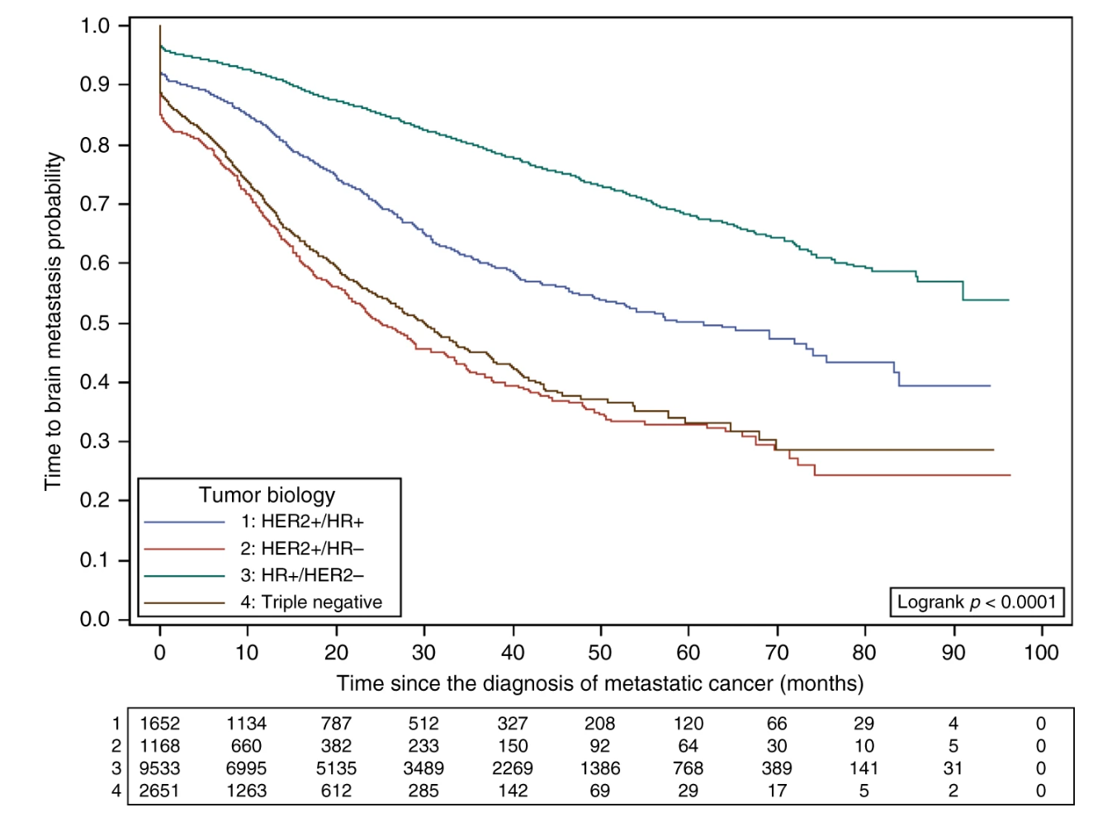

Incidence of Brain Metastases Among Patients with Metastatic Breast Cancer (MBC)
Time to brain metastases by MBC subtype
Based on a large French database enrolling >12,000 patients with MBC from 2008 to 2014:
Two-year cumulative incidence of brain metastases:
mTNBC: 45%
HR+/HER2- MBC: 14%
HER2+ MBC: 29-49%
Brain metastases associated with significant morbidity and mortality
Darlix et. al. Br J Cancer 2019
Sammons | 2024

Slide 3
HER2+ BrMs Incidence Increase by Line of Therapy
The cohort (N=16063) included those with BM at index date (N=947)
A total of 1955 patients with incident BM were recorded during the follow-up
Excluding patients with brain metastases at diagnosis (6.1%), cumulative incidence of BM at 60 months was
23% in HR+/HER2+
34% in HR-/HER2+: Early Event
Prevalence of BM per line of therapy,% | HR+, HER2+ (1L N=3062) | HR-, HER2+ (1L N=902)
1 | 6.3 | 11.2
2 | 17.6 | 31.2
3 | 21.5 | 36.3
4 | 26.1 | 37.1
5+ | 26.5 | 36.9
Sammons, JNCCN 2025

Slide 4
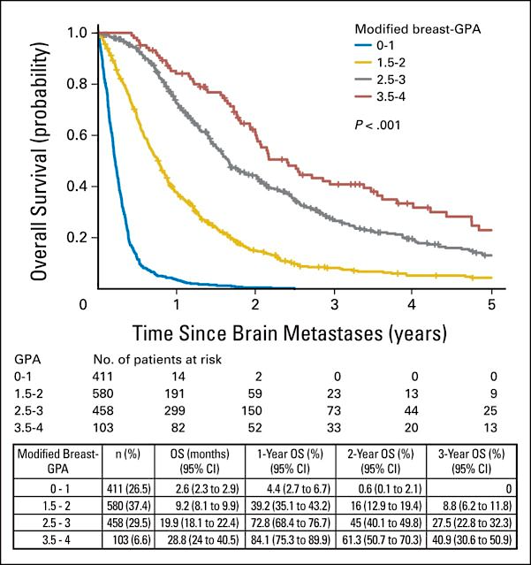
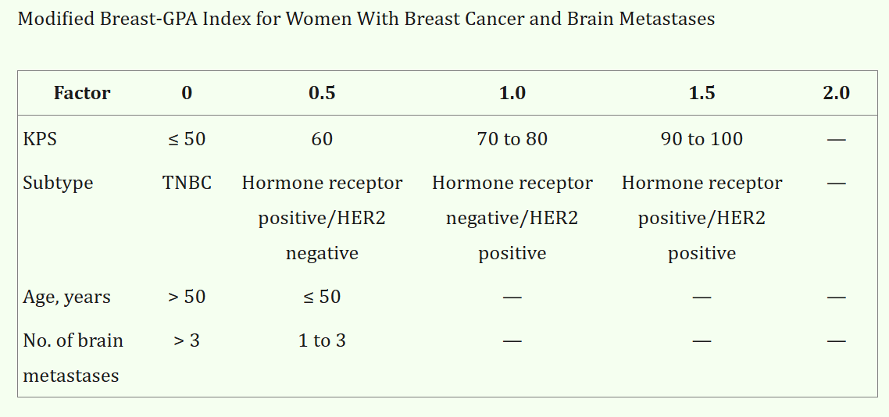
Prognostic Factors in Patients with BCBM; Higher the Better
Modified Breast Graded Prognostic Assessment
1) Age >50
2) TNBC and HER2 Negative
3) Poor Performance Status
4) >3 Brain Metastases
Sperduto P, Int J of Rad Onc Biol and Physics, 2012: Subbiah, JCO 2015
Sammons | 2024
Notes:
A multi-institutional retrospective database of 400 breast cancer patients treated for newly diagnosed brain metastases was generated. Prognostic factors significant for survival were analyzed by multivariate Cox regression and recursive partitioning analysis (RPA). Factors were weighted by the magnitude of their regression coefficients to define the GPA index. 3.4 (n = 23), 7.7 (n = 104), 15.1 (n = 140), and 25.3 (n = 133) months.

Slide 5
Who is at Risk of Dying from their Brain Metastases?
1218 patients with newly diagnosed BrM BWH/DFCI from 2008–2015
Neurologic death: radiographic intracranial progression with accompanying neurologic symptomatology in the absence of systemic disease progression of a life-threatening nature. Defined by 2 radoncs independently.
Factors predictive of neurologic death were assessed via univariable and multivariable Fine and Gray competing risks regression.
Reese, World Neurosurg 2022.
Sammons | 2024

Slide 6
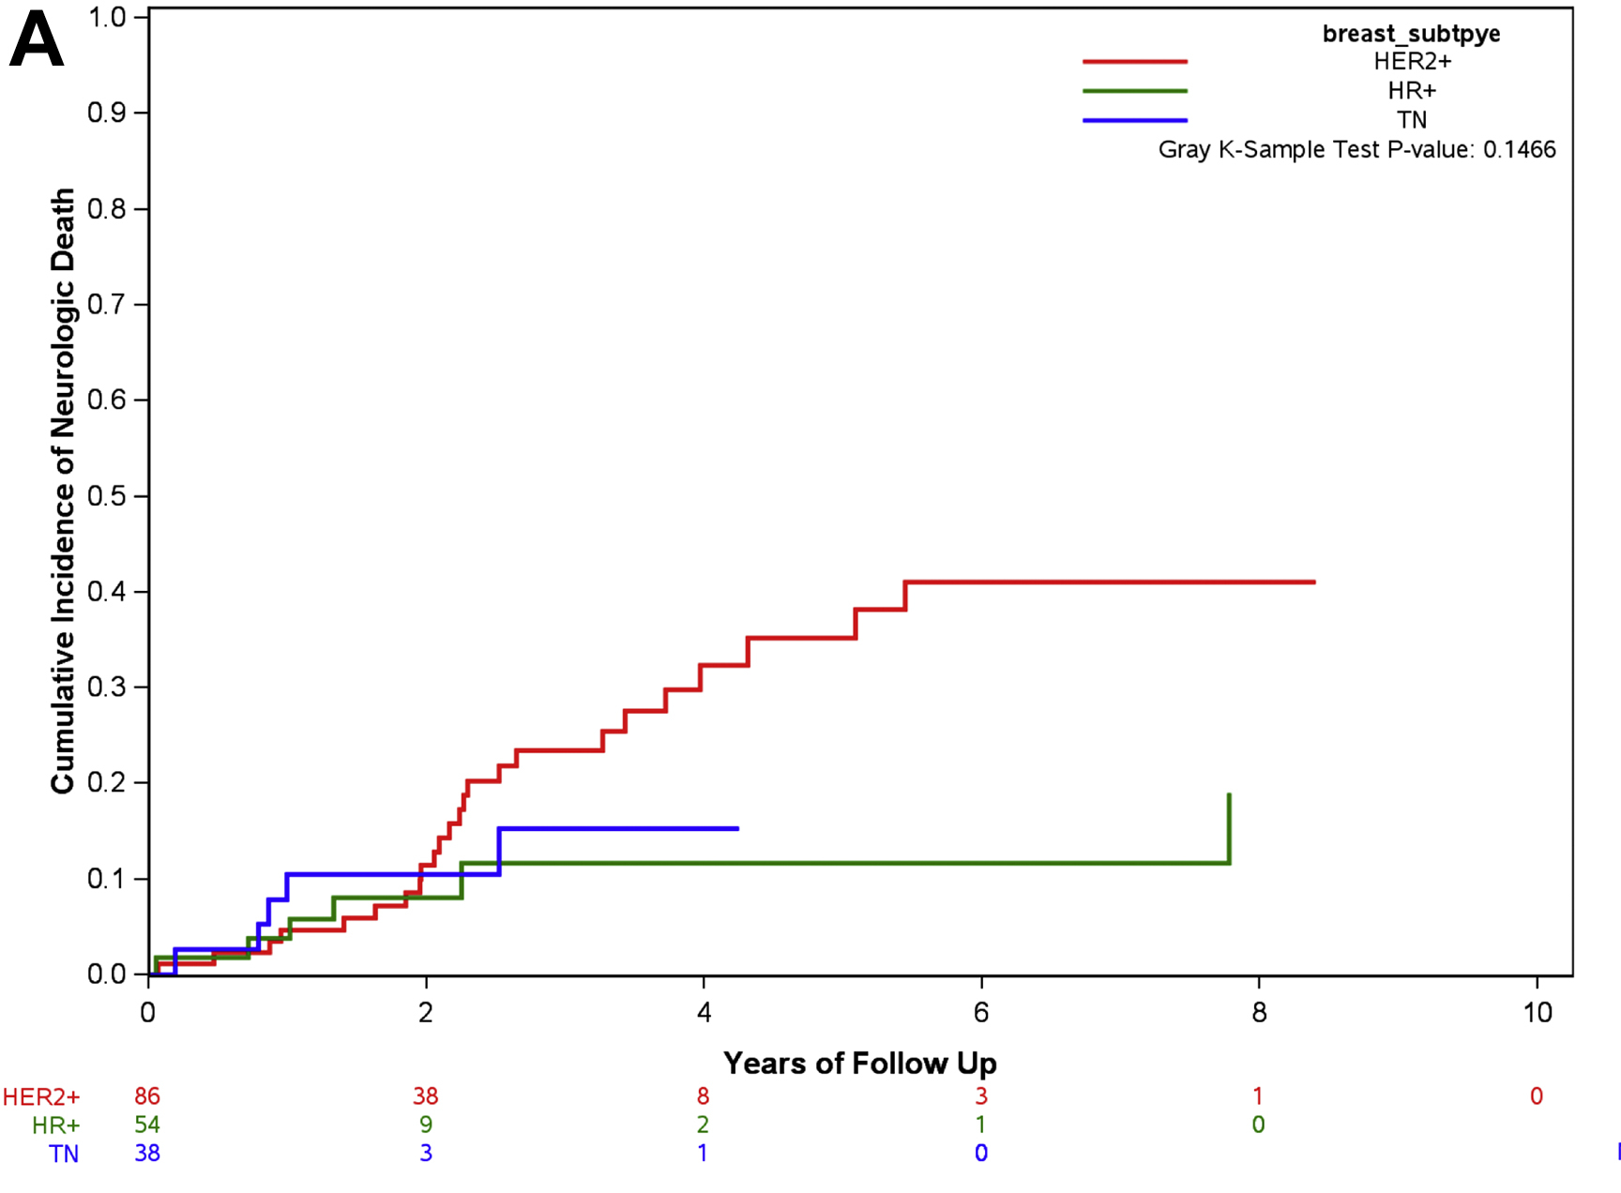
HER2+ BrM Highest Neurologic Death Risk
HER2+ disease displayed increased neurologic death (univariable analysis only: HR 2.41, P = 0.05).
# brain metastases (HR 1.01 per additional metastasis, 95% CI 1.01–1.02, P < 0.001)
Upfront administration of WBRT (HR 2.19, 95% CI 1.60–3.00, P < 0.001).
Conversely, high KPS and progressive extracranial disease (HR 0.50, 95% CI 0.38–0.67, P < 0.001) were associated with a reduced risk of neurologic death
Limitations: Prior to tucatinib and T-DXd.
Reese, World Neurosurg 2022.
Sammons | 2024
Notes:
1218 patients newly diagnosed BrM BWH/DFCI from 2008–2015.
Neurologic death: radiographic intracranial progression with accompanying neurologic symptomatology in the absence of systemic disease progression of a life-threatening nature. Defined by 2 radoncs independently.
Factors predictive of neurologic death were assessed via univariable and multivariable Fine and Gray competing risks regression.

Slide 7
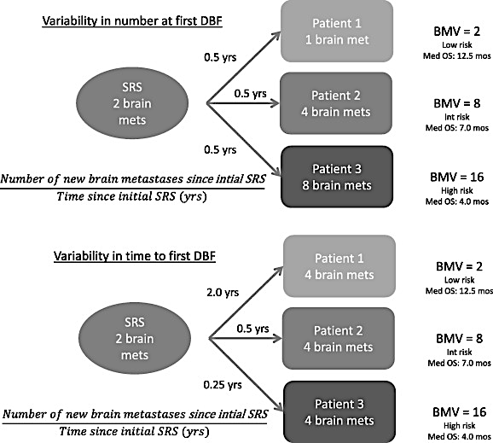
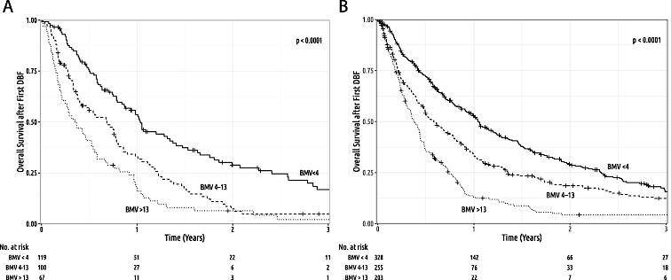
High Brain Metastases Velocity in Prognostic
# New brain metastases since initial SRS/ Time Since Initial SRS
Quickly recurrent or high # of Brain Metastases Concerning
McTyre, Radiotherapy and Oncol 2020.
Sammons | 2024

Slide 8
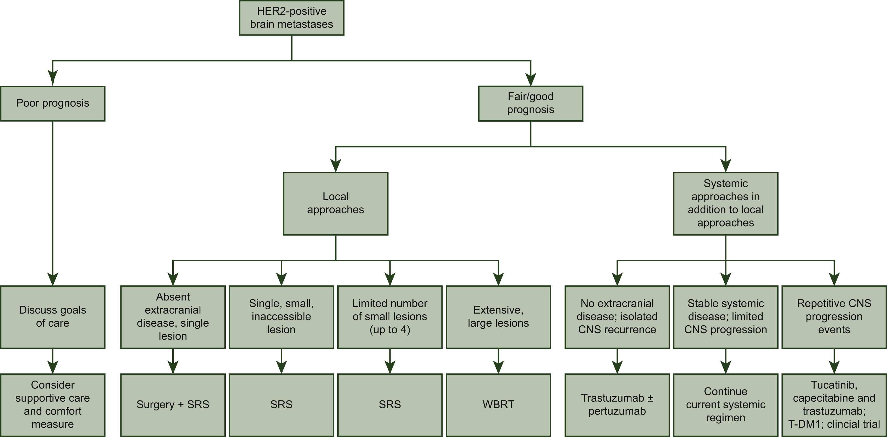
Local Therapy Recommendations for HER2+ BrMs
Tucatinib regimen, T-DXd, or clinical trial
ESMO Open 2021 6DOI: (10.1016/j.esmoop.2021.100256)
Treating up to 20 BrMs with SRS supported
Notes:
So, let’s switch gears a bit here and review our current algorithm for local therapy for brain metastases. For patients with a solitary lesion, consideration of resection followed by SRS is standard, both from a diagnostic and treatment perspective. For patients with a limited number of lesions, Radiosurgery remains our mainstay. Finally, for patients who present with multiple lesions, or diffuse dural based disease, WBRT is considered standard. Given the longer term neurocognitive sequelae of WBRT, techniques such as hippocampal sparing and/or use of memantine can be considered.

Slide 9
Deferral of Local Therapy in HER2+ BrMs
Deferral of local therapy for systemic therapy could be considered between MDC team and patient if all are true:
favorable prognosis
asymptomatic single lesion < 2cm, multiple or diffuse brain metastasis < 2 cm
no symptomatic mass effect
option to proceed and previously untreated with HER2-directed therapy with known Active CNS activity (IE HER2CLIMB, T-DXd etc)
ASCO 2022 HER2+ Brain Metastases Guidelines (Ramakrishna, JCO 2022)

Slide 10
HER2 Directed Therapies, Highest iORR for Active CNS BrMs
 | iORR (CR + PR)
T-DXd | 71%
Pyrotinib/capecitabine (ex-US) | 74.6%
Tucatinib/trastuzumab /capecitabine (US) | 47.3%
Neratinib plus capecitabine after previous lapatinib | 33%
Neratinib plus capecitabine without previous lapatinib | 49%
T-DM1 | 21–44%
iORRs post-TDXd and Tucatinib are Unknown, suspected to be lower
Bartsch et al, Nat Med 2022; Vaz Batista et al, Neuro Oncol 2023; Montemurro, ESMO 2022; Hurvitz, ESMO 2023; Curigliano Ann Onc 2022; Freedman et al, J Clin Oncol 2019; Yan Lancet Oncol 2022.
Notes:
Worth pointing out on the slide somewhere that the pyrotinib data were generated in much less heavily pretreated pts

Slide 11
CNS-PFS and OS HER2+ BrMs
Therapy | Population | Comparator | PFS BrM (RECIST) | CNS-PFS | OS BrMs Population
T-DM1 | Prior tras | Lapatinib/Cape | 5.5m | Unknown | Improved
T-DXd (Pooled Analysis) | Prior tras | T-DM1 | 15m | Stable: 12.3m* Active: 18.5m | Improved
Tucatinib/Tras/Cape | Prior tras/pertuz/T-DM1 | Tras/Cape | 7.6m | Stable: 13.9m* Active: 9.6m | Improved
Neratinib/Cape | Prior tras | Lap/Cape | 8.8m | NA | Not improved
Pyrotinib/Cape | Prior tras | Lap/Cape | NA | No Prior RT: 11.3m Prior RT: 5.6m | Improved
Montemurro, ESMO 2022; Hurvitz, ESMO 2023; Curigliano Ann Onc 2022; Freedman et al, J Clin Oncol 2019; Yan Lancet Oncol 2022.

Slide 12
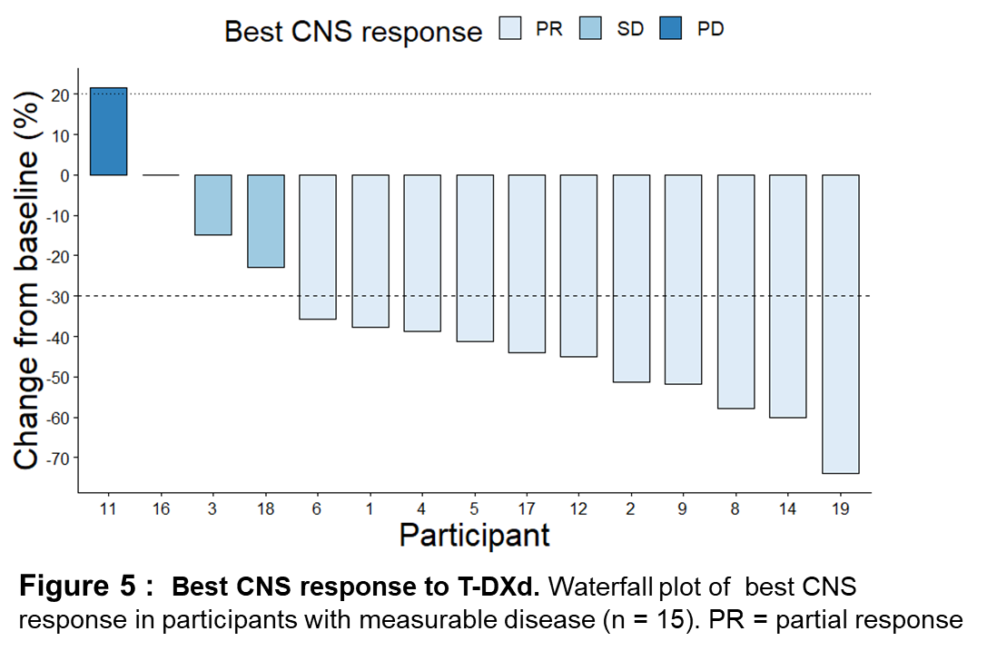
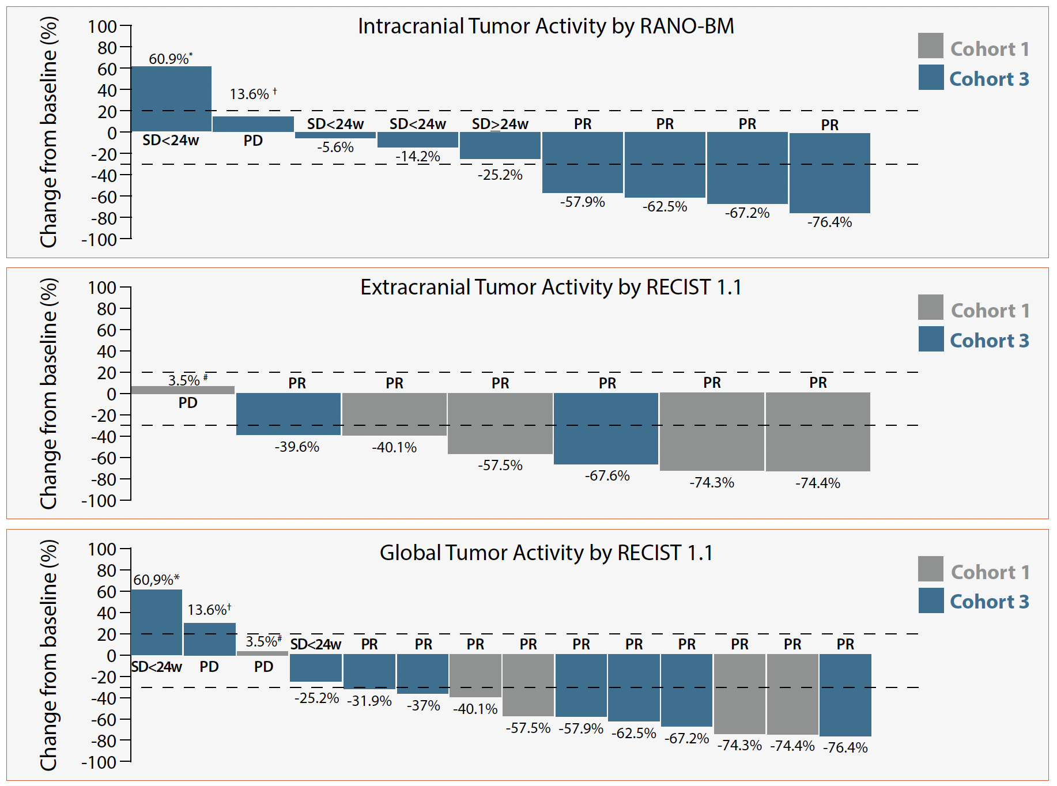
T-DXd in Active HER2+ BCBrMs
Best CNS response
TUXEDO-1 trial
Bartsch et al, Nat Med 2022
DEBBRAH trial
Vaz Batista et al, Neuro Oncol 2023
DFCI/Duke/MDACCC series
Kabraji et al, Clin Ca Res 2022
ORR-IC = 73% in pts with
active BM
ORR-IC =44% in pts with
Active BM
ORR-IC =73%
(70% in pts with active BM)
Sammons | 2024

Slide 13
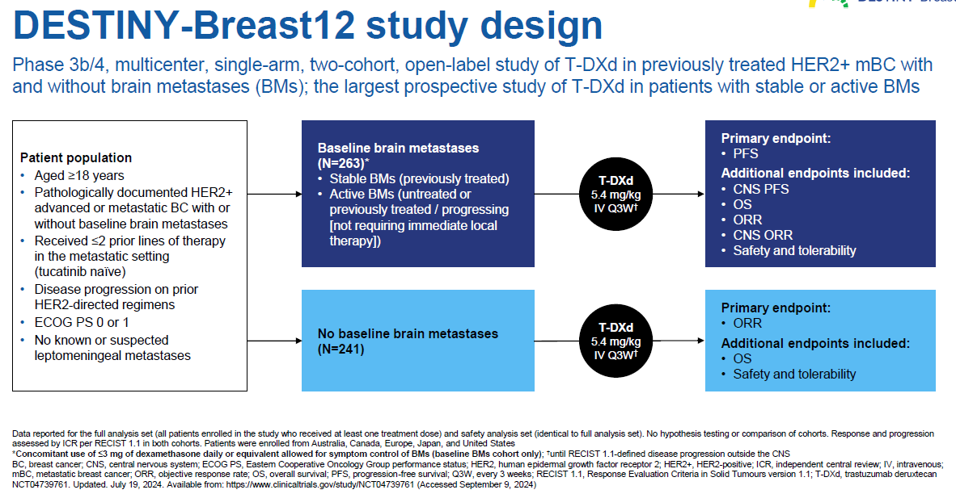
Lin N et al. ESMO, 2024.
Sammons | 2024
Notes:
Largest prospective study of TDxD in setting of metastatic HER2+ BC +/- BrM; not sample size; all Tucatinib Naïve

Slide 14
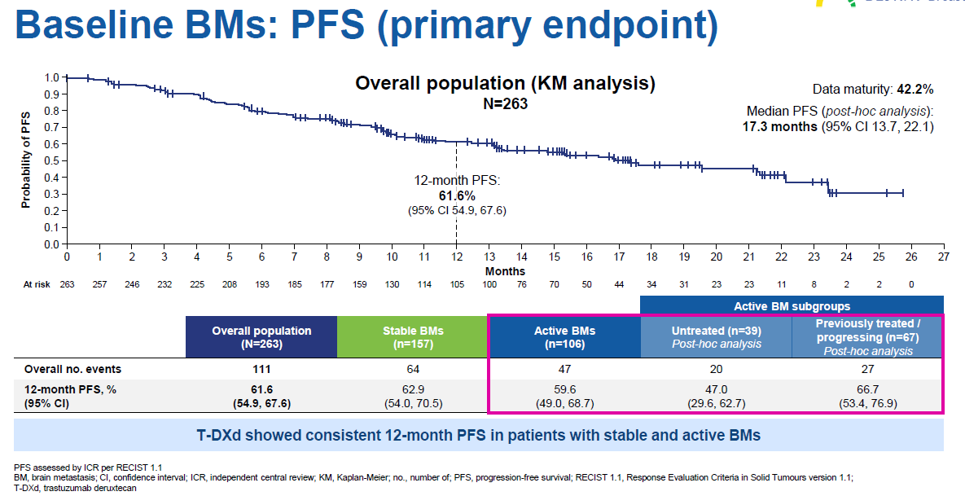
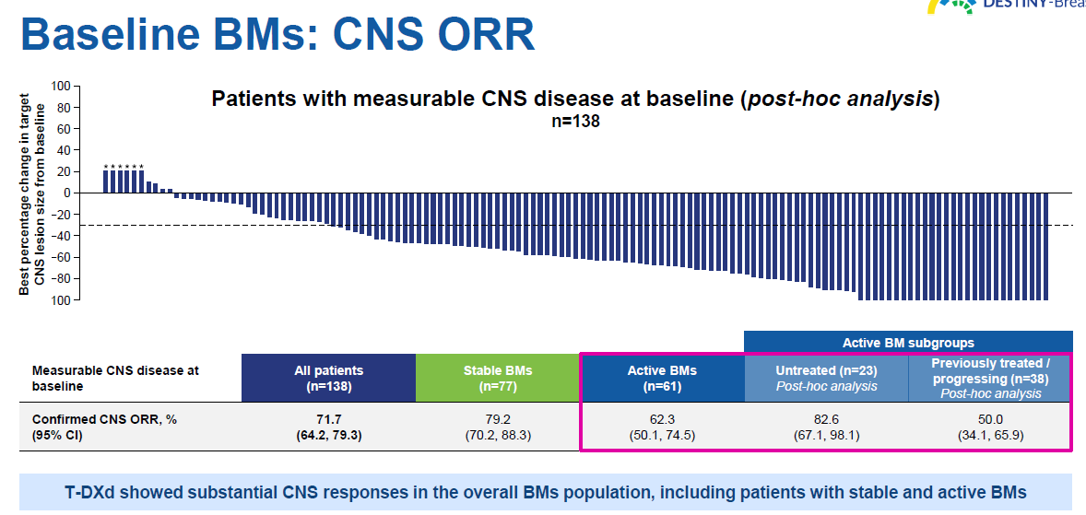
Outcomes for CNS and non-CNS disease similar:
PFS at 12 months = 61.6%
CNS PFS at 12 months = 58.9%
ORR (all) = 64.1%
CNS ORR = 71.7%
12 Month Overall Survival Rates Similar:
With Brain Metastases = 90.3%
Without Brain Metastases = 90.6%
Lin N et al. ESMO, 2024.
Sammons | 2024

Slide 15
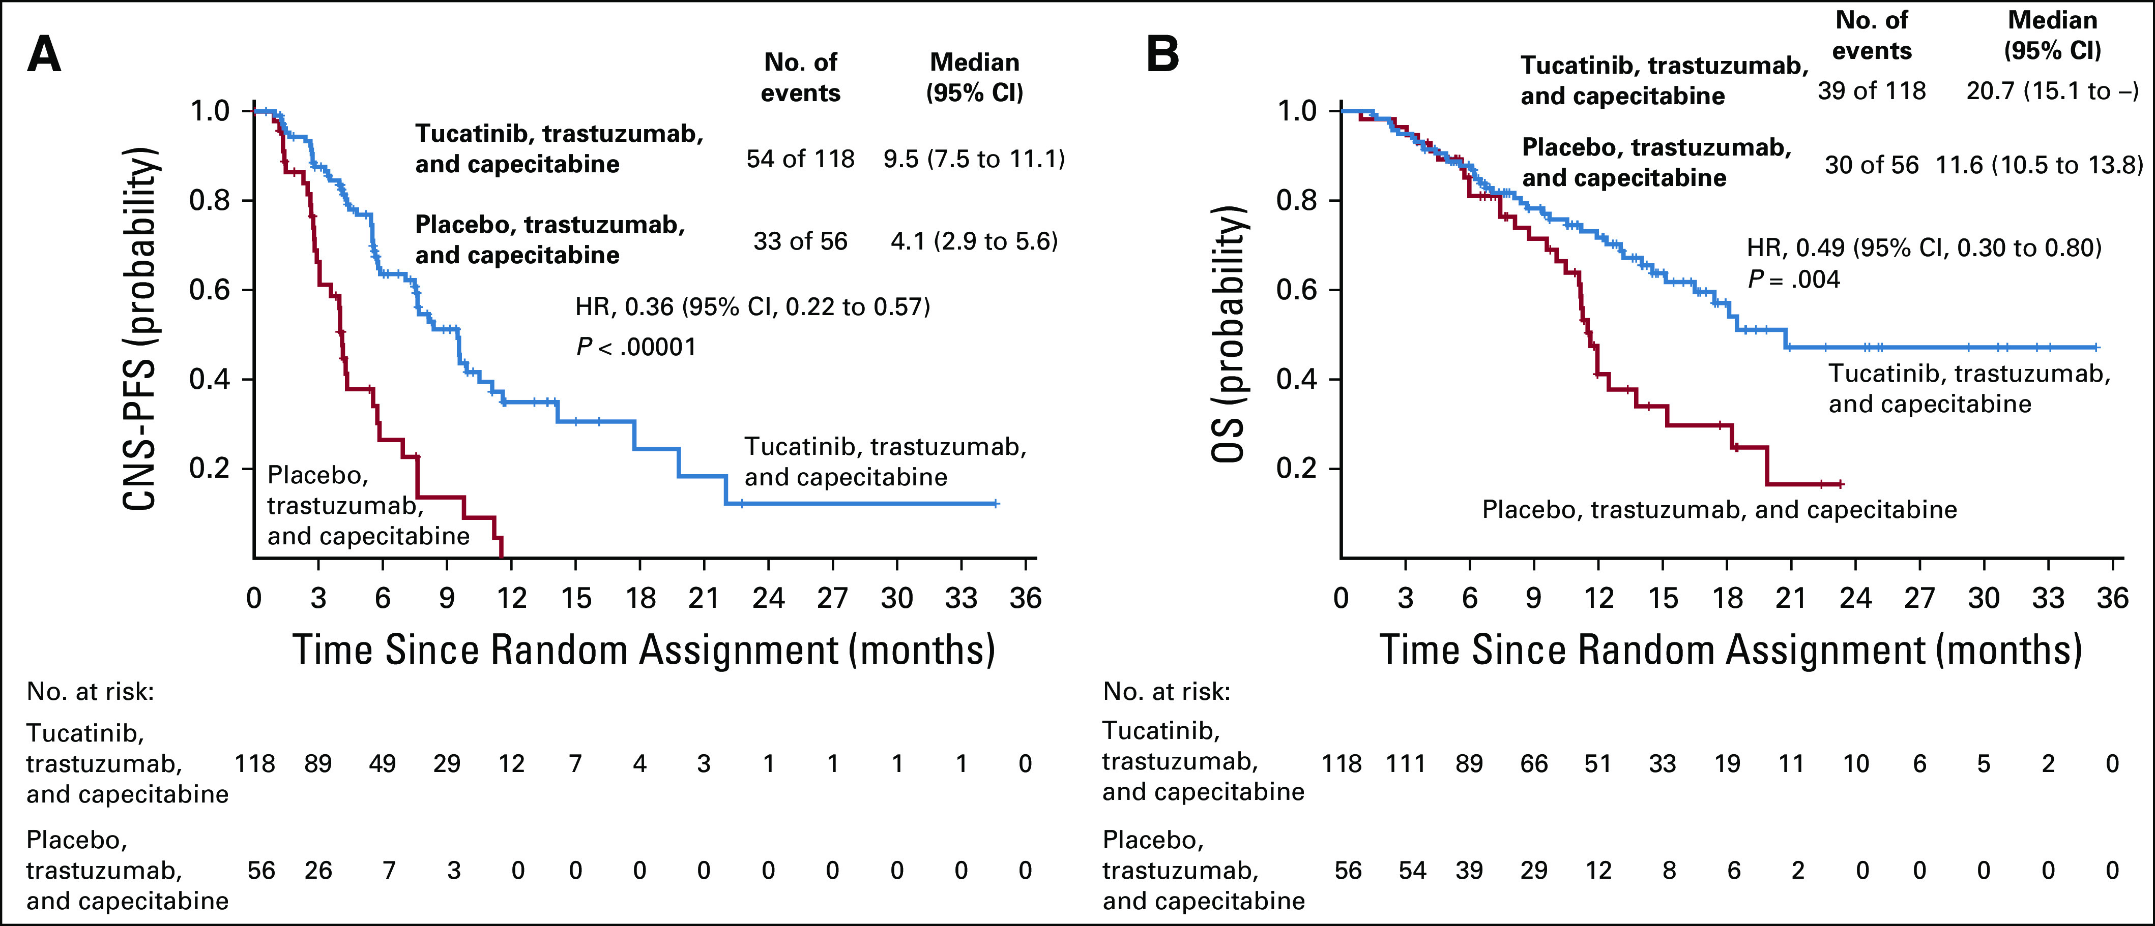
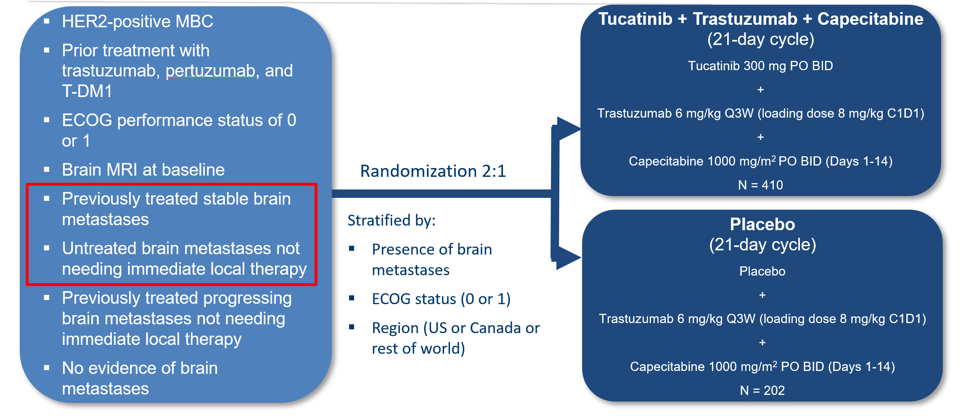
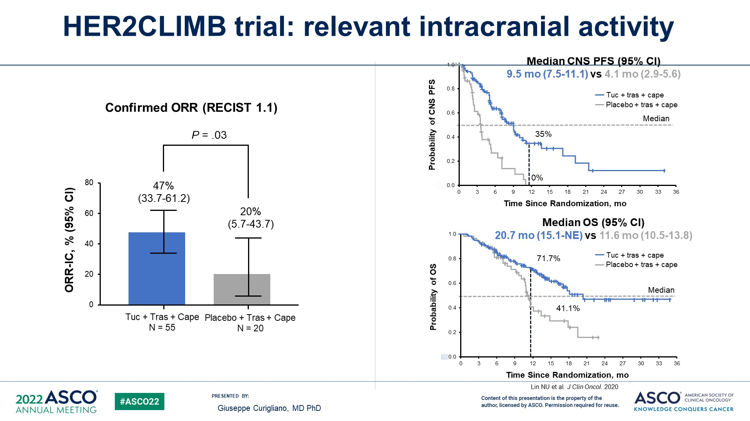
Tucatinib, Trastuzumab, Capecitabine in BrM
Improves iORR, CNS-PFS,
PFS, OS in BrM
Curigliano Ann Onc 2022 33:321; Presented at ASCO Annual Meeting 2022
Lin NU et al. J Clin Oncol 2020

Slide 16
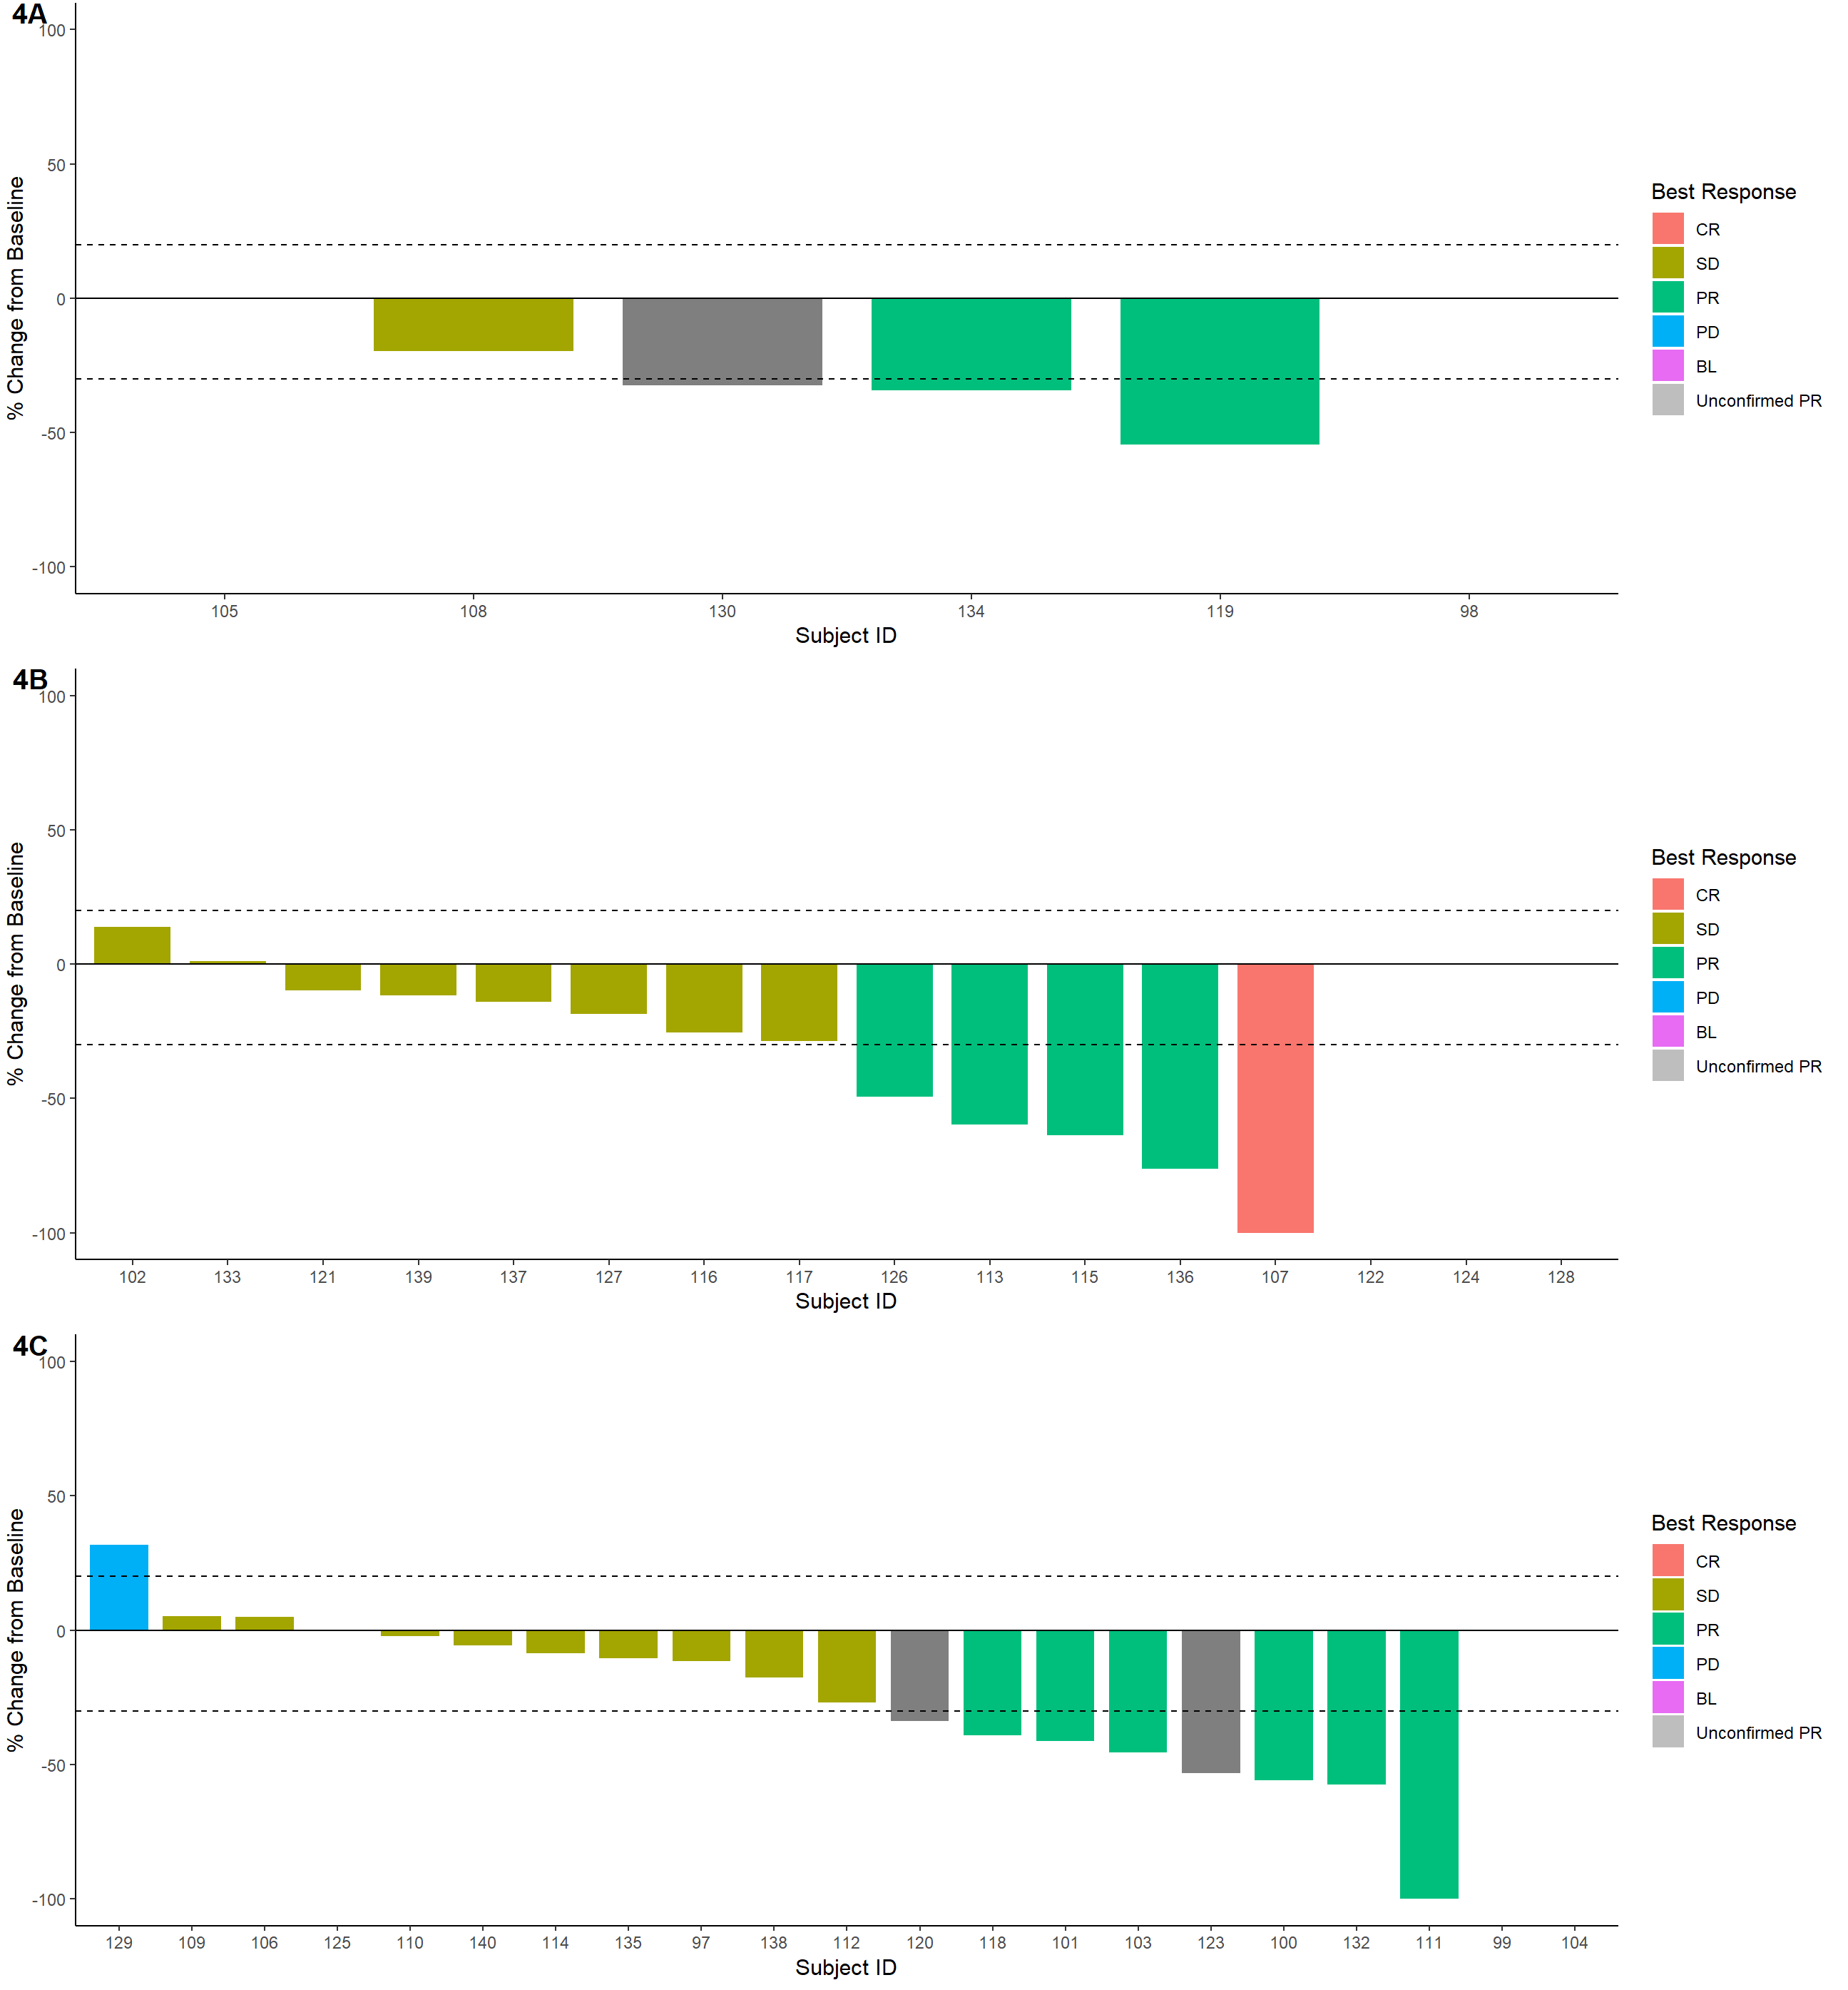
Neratinib + TDM1 in Active HER2+ BrMs
Response | Cohort 4A | Cohort 4B | Cohort 4C
 | Prev untx’d | Prev tx’d, no prior TDM1 | Prev tx’d, +Prior TDM1
CR | 0 (0) | 1 (5.9) | 0 (0)
PR | 2 (33.3) | 4 (23.5) | 6 (28.6)
Unconfirmed PR | 1 (16.7) | 0 (0) | 2 (9.5)
SD | 2 (33.3) | 8 (47.1) | 10 (47.6)
PD | 0 (0) | 0 (0) | 1 (4.8)
Unavailable (off tx before imaging) | 1 (16.7) | 3 (17.6) | 2 (9.5)
CNS ORR | 33.3% (4.3-77.7%) | 29.4% (10.3-56.0%) | 28.6% (11.3-52.2%)
CNS CR + PR + SD ≥6 mos | 50% (11.8-88.2%) | 35.3% (14.2-61.7%) | 33.3 (14.6-57.0%)
Current Choice in CNS Predominant Disease After T-DXd and Tucatinib
Freedman, SABCS 2022
Sammons | 2024

Slide 17

Systemic Therapies for HER2+ BC LMD
Preferred Options:
Tucatinib, capecitabine, trastuzumab- (10 month OS)
Trastuzumab Deruxtecan
(13 month OS)
Alternative Options:
Neratinib, capecitabine
(10 month OS)
Intrathecal trastuzumab
(8-13 month OS)
O’brien ASCO 2024, Vaz Batista, SABCS 2023, Freedman et al, JCO 2017
Pellerino et al, Cancers (Basel) 2022
Sammons | 2024

Slide 18
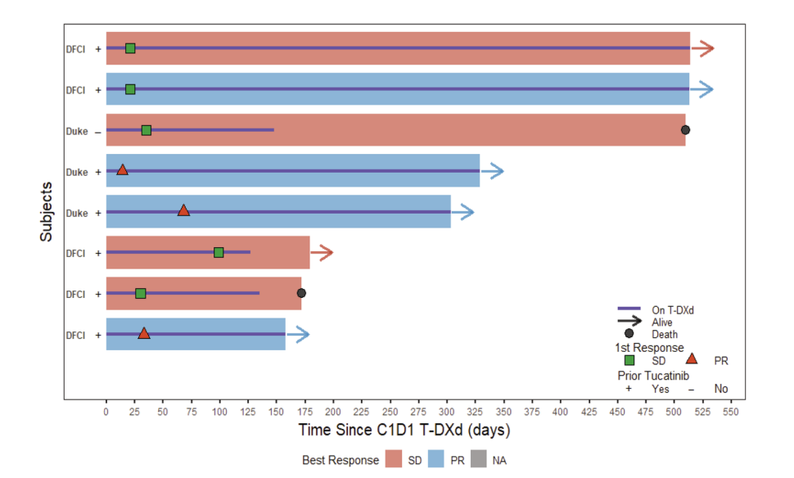
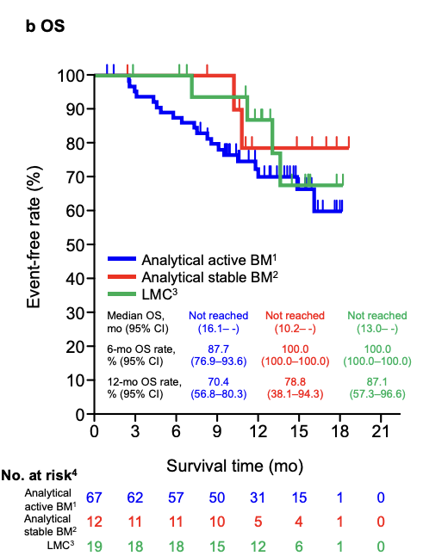
Trastuzumab deruxtecan in HER2+ BC LMD
Two cohort studies and small prospective study in HER2+ LMD
Alder…Sammons, NPJ Breast Cancer, 2023
8 pts with active LMD
Niikura et al, NPJ Breast Cancer 2023
19 pts with active LMD
Overall Survival
Partial response rate on RANO-LM= 50%
Median OS = 10.4 months ( 158 – 626 days)
Short Follow-up Period
IC-ORR =77.8% (7/9 patients)
12 months PFS = 60.7% (95% CI, 34.5–79.1%)
12 months OS = 87.1% (95% CI, 57.3–96.6%)
Sammons | 2024
Notes:
Trastuzumab-deruxtecan has also produced very interesting results in two American and Japanese cohorts.
In the Dana Farber and Duke cohort of 8 patients, 50% achieved a partial response, and median OS was 10.4 months.
In the Japanese cohort of 19 patients, 7 out of 9 achieved a response, and PFS and OS at 12 months were 60% and 87% respectively.

Slide 19
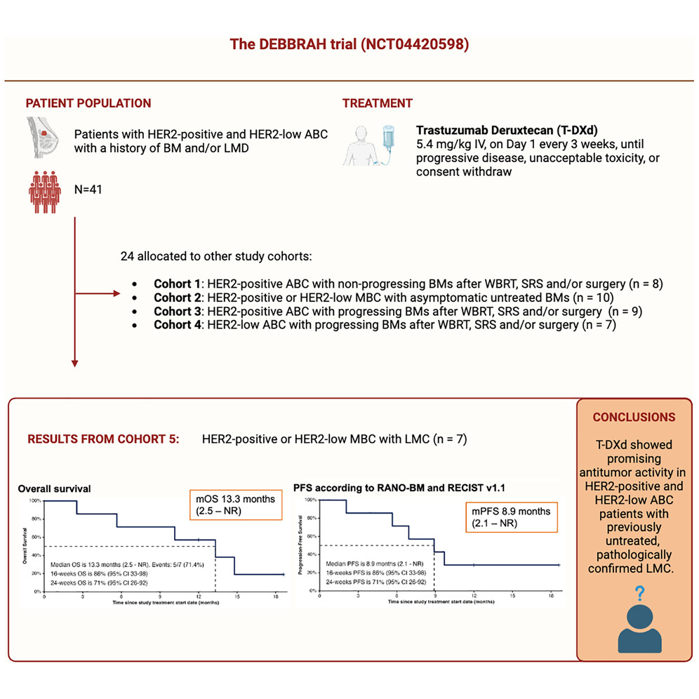
DEBBRAH: Trastuzumab deruxtecan in HER2+ or Low BC LMD
N=7 patients. The median age was 55 years. Synchronous extracranial metastases 85.7%
3 HER2+; 4 HER2-low
Median OS of 13.3 months and a median PFS of 8.9 months
Intracranial and extracranial activity with a CBR of 71.4%
Vaz Batista, SABCS 2023
Sammons | 2024

Slide 20
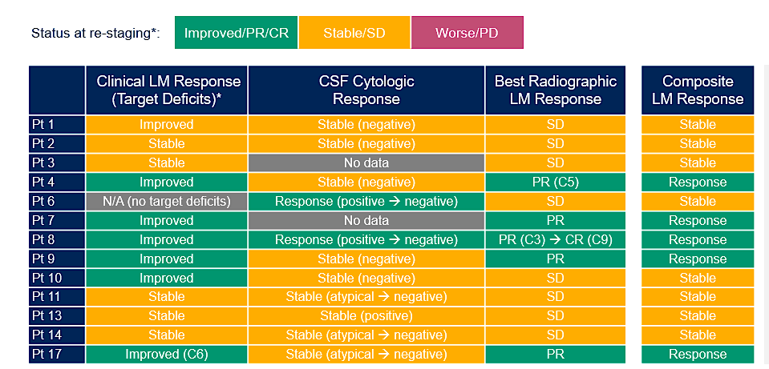
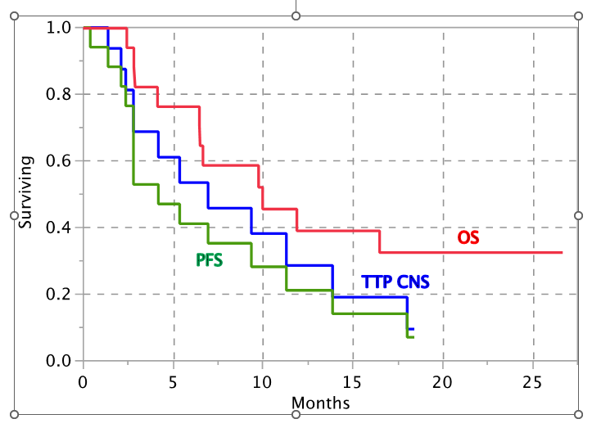
Tucatinib + Capecitabine + Trastuzumab for HER2+ LMD
TBCRC049 Study (NCT03501979)
Investigator-initiated phase 2 study evaluating the tucatinib regimen in HER2+ breast cancer LM
Previously Reported
ENROLLMENT: 17 patients enrolled
CSF: Therapeutic levels of tucatinib and ONT-993²
SAFETY: Consistent with prior tucatinib studies
MEDIAN OVERALL SURVIVAL: 10 months (95% CI: 4.1, not reached)³
MEDIAN TIME TO CNS PROGRESSION: 6.9 months (95% CI: 2.3, 13.8)³
13 response-eligible patients
100% achieved clinical benefit
10 month OS
38% LM objective response per composite
Stringer-Reasor, ASCO 2021, Murthy et al, SABCS 2021, O’Brien ASCO 2024
Sammons | 2024
Notes:
Also with Tucatinib
In the TBCRC 49 trial, 17 HER2+ MBC with newly diagnosed LMD patients received tucatinib plus capecitabine plus trastuzumab.
The concentration of tucatinib between CSF and plasma was approximately equivalent.
Time to CNS progression was 6.9 months and median OS 10 months.

Slide 21
Ongoing HER2+ CNS Compounds in Development
IAM1363- brain penetrant HER2 TKI
ZN-A-1041- brain penetrant HER2 TKI
NVL-330
TAS2940
ARX-788
Disitamab vedotin (RC48)
Zanidatamab zovodotin (ZW49)
BNT-327 (VEGF/PD-1 bispecific)

Slide 22

65-year-old female with de novo ER-, HER2+ MBC on trastuzumab, pertuzumab for 4-years develops new 6mm single brain metastases s/p SRS with controlled extracranial disease.
Continue HP
2 small brain metastases 4 months later s/p SRS
Prefers oral therapy, transition to tucatinib, trastuzumab, capecitabine
Sammons | 2024
Notes:
65-year-old female with de novo ER-, HER2+ MBC on trastuzumab, pertuzumab for 4 years develops new single brain metastases s/p SRS with controlled extracranial disease.
Radiate, continue HP and offer Bridget Trial to add tucatinib. Hold off on more toxic agents until next progression.
39-year-old female with history of T2N1 ER-, HER2+ breast cancer s/p curative treatment with pCR and one year of HP presents with 7 new brain metastases with no extracranial disease. She receives SRS to all 7 lesions continues HP, develops 2 more brain metastases 6 months later s/p SRS
High-risk patient for neurologic death, High Brain metastases Velocity
Transition to T-DXd or HER2CLIMB

Slide 23
39-year-old female develops 7 new brain metastases 6 months into treatment with taxane, trastuzumab, pertuzumab with new liver metastases concurrently. Brain MRI shows all lesions are < 2cm, no mass effect and since starting steroids the patient is asymptomatic.
Treat with T-DXd, defer radiation with MRI at 6 weeks.
Intracranial partial response with 45% reduction in sum of all lesions.
CT CAP at 12 weeks with PR.
Continues on T-DXd at this time.

Slide 24

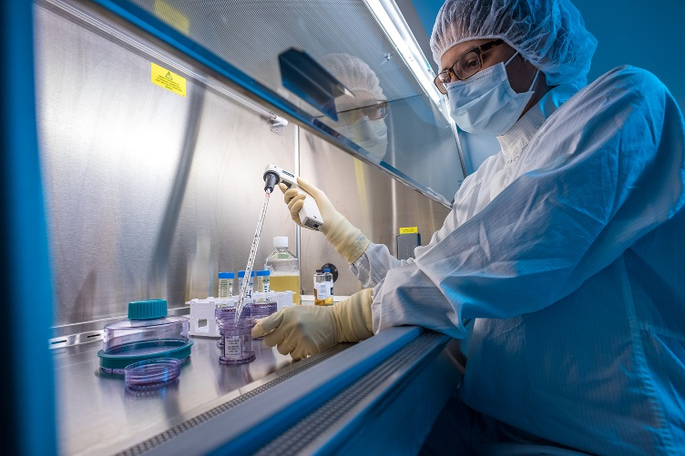





THANK YOU
For the 23rd consecutive year, Dana-Farber Brigham Cancer Center has been recognized as a Best Hospital for cancer care by U.S. News & World Report

