Slide 1
5-MINUTE JOURNAL CLUB Reviewing the Role of Oral SERDs in the Management of ER-Positive Metastatic Breast Cancer Issue 7
Rinath M Jeselsohn, MD
Moderated by Neil Love, MD

Slide 2

Rinath M Jeselsohn, MD
Assistant Professor of Medicine
Harvard Medical School
Director for ER+ Translational Discovery Research
Dana-Farber Cancer Institute
Boston, Massachusetts

Slide 3
Papers Discussed in This Issue
Jhaveri KL et al. Imlunestrant with or without abemaciclib in advanced breast cancer. N Engl J Med. December 11, 2024;[Online ahead of print]
Jhaveri KL et al. Imlunestrant, an oral selective estrogen receptor degrader (SERD), as monotherapy & combined with abemaciclib, for patients with ER+, HER2- advanced breast cancer (ABC), pretreated with endocrine therapy (ET): Results of the phase 3 EMBER-3 trial. San Antonio Breast Cancer Symposium 2024;Abstract GS1-01.
Bhave MA et al. Comprehensive genomic profiling of ESR1, PIK3CA, AKT1, and PTEN in HR(+)HER2(-) metastatic breast cancer: Prevalence along treatment course and predictive value for endocrine therapy resistance in real-world practice. Breast Cancer Res Treat 2024;[Online ahead of print].

Slide 4
Papers Discussed in This Issue
Oliveira M et al. Camizestrant, a next-generation oral SERD, versus fulvestrant in post-menopausal women with oestrogen receptor-positive, HER2-negative advanced breast cancer (SERENA-2): A multi-dose, open-label, randomised, phase 2 trial. Lancet Oncol 2024;25(11):1424-39.
Jeselsohn R. Latest on selective estrogen receptor degraders (SERDs). San Antonio Breast Cancer Symposium 2024;Education Session 5.

Slide 5
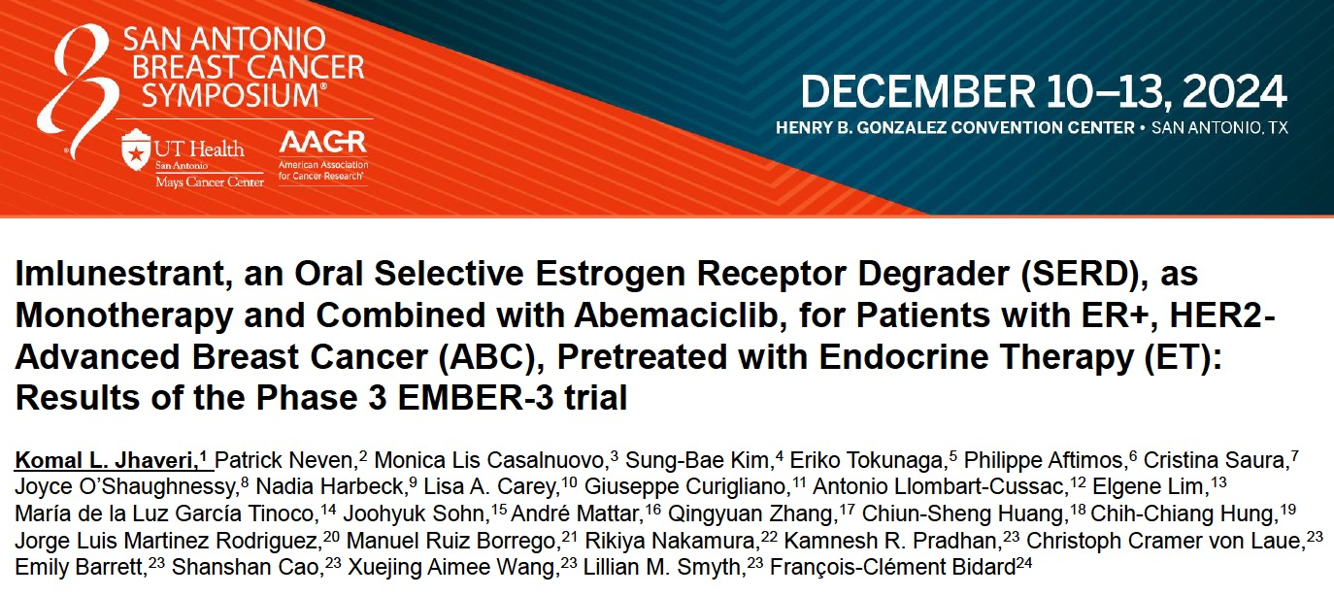
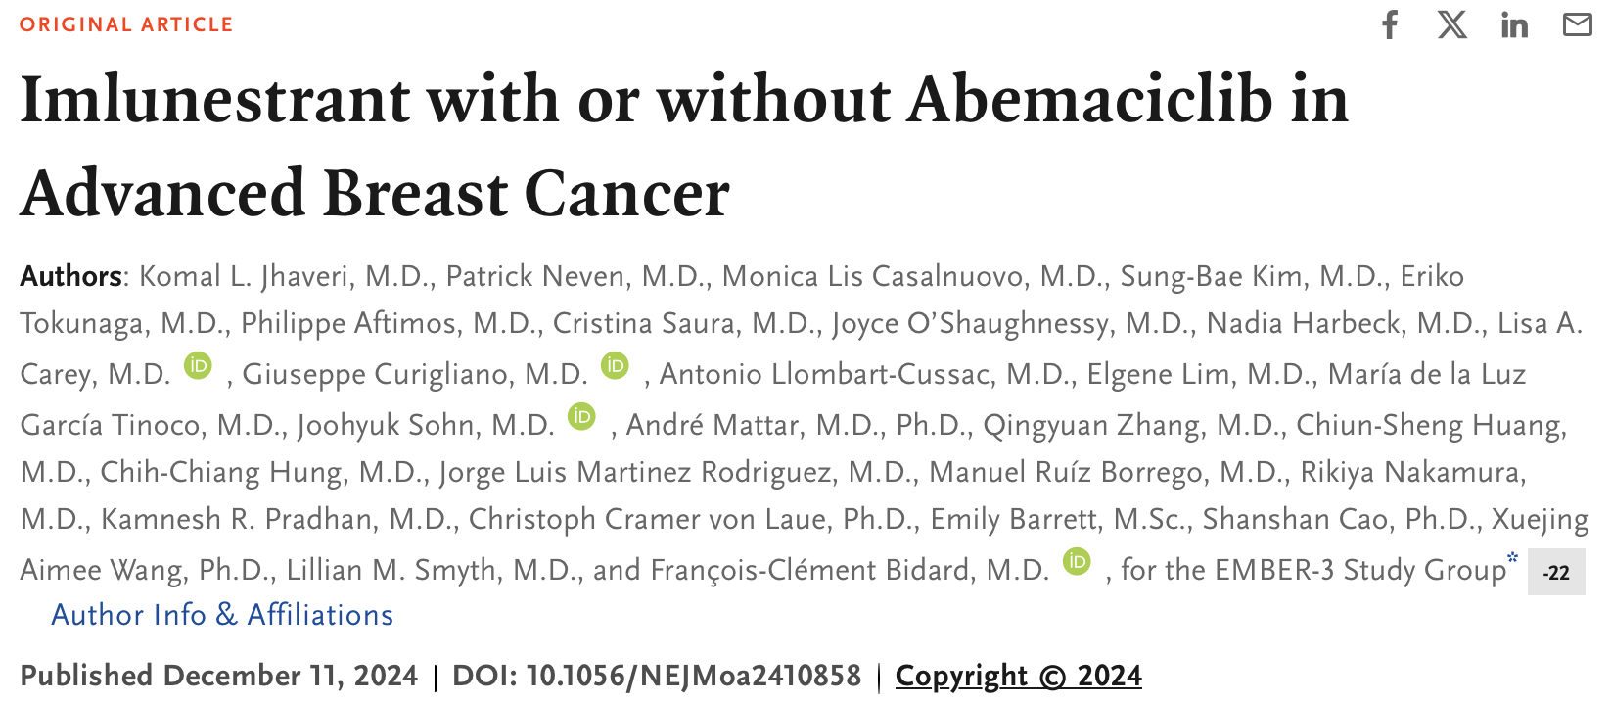
Abstract GS1-01

Slide 6
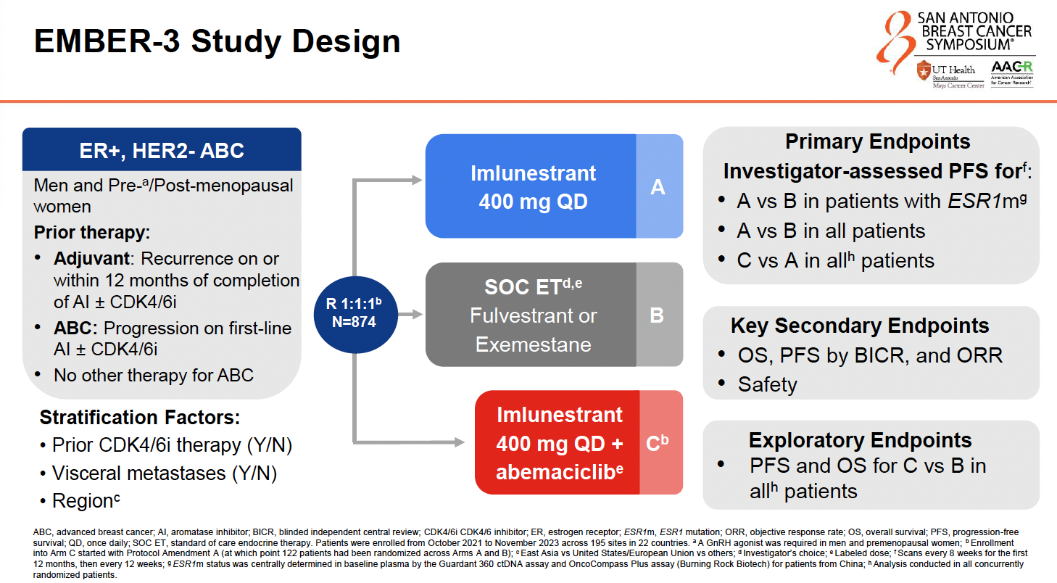
Jhaveri KL et al. San Antonio Breast Cancer Symposium 2024;Abstract GS1-01.

Slide 7
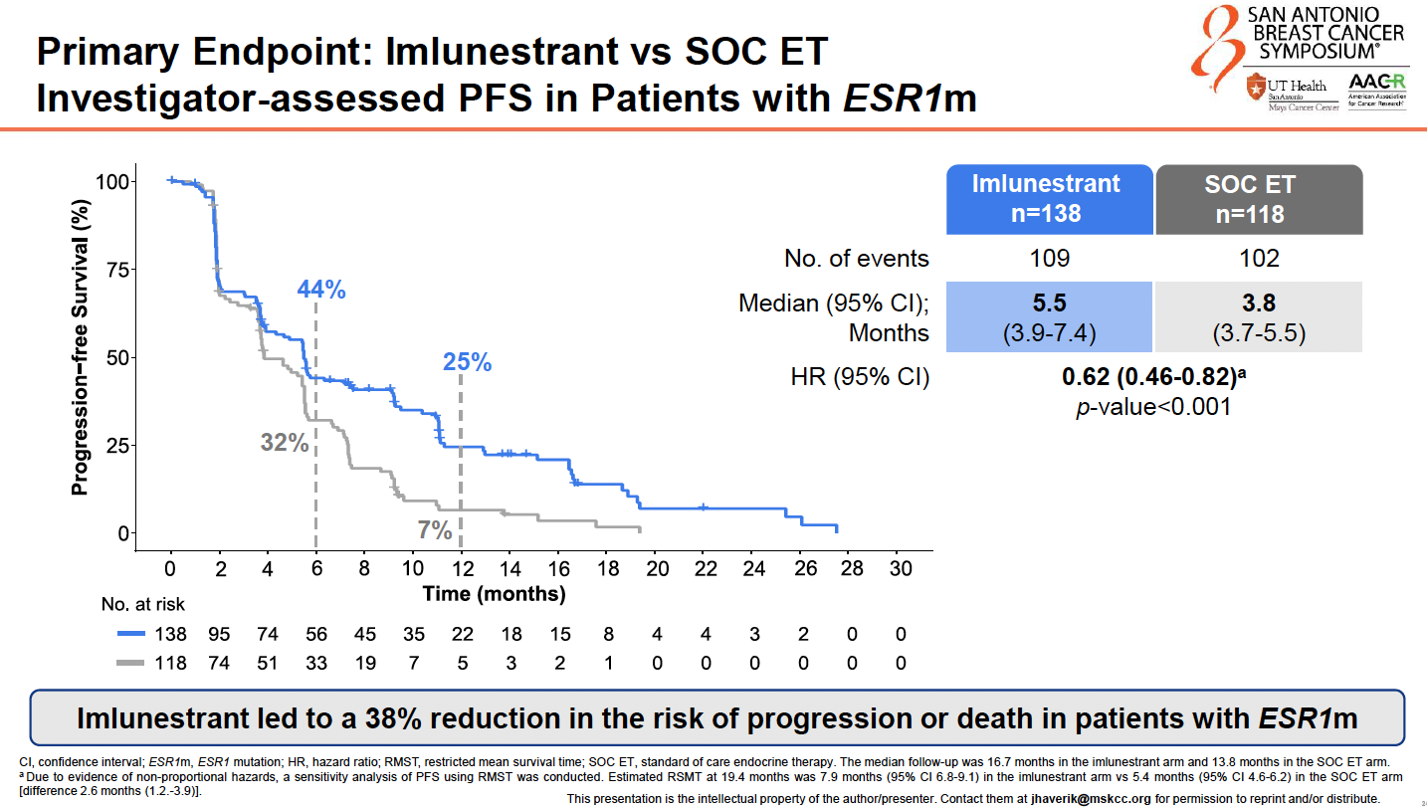
Jhaveri KL et al. San Antonio Breast Cancer Symposium 2024;Abstract GS1-01.

Slide 8
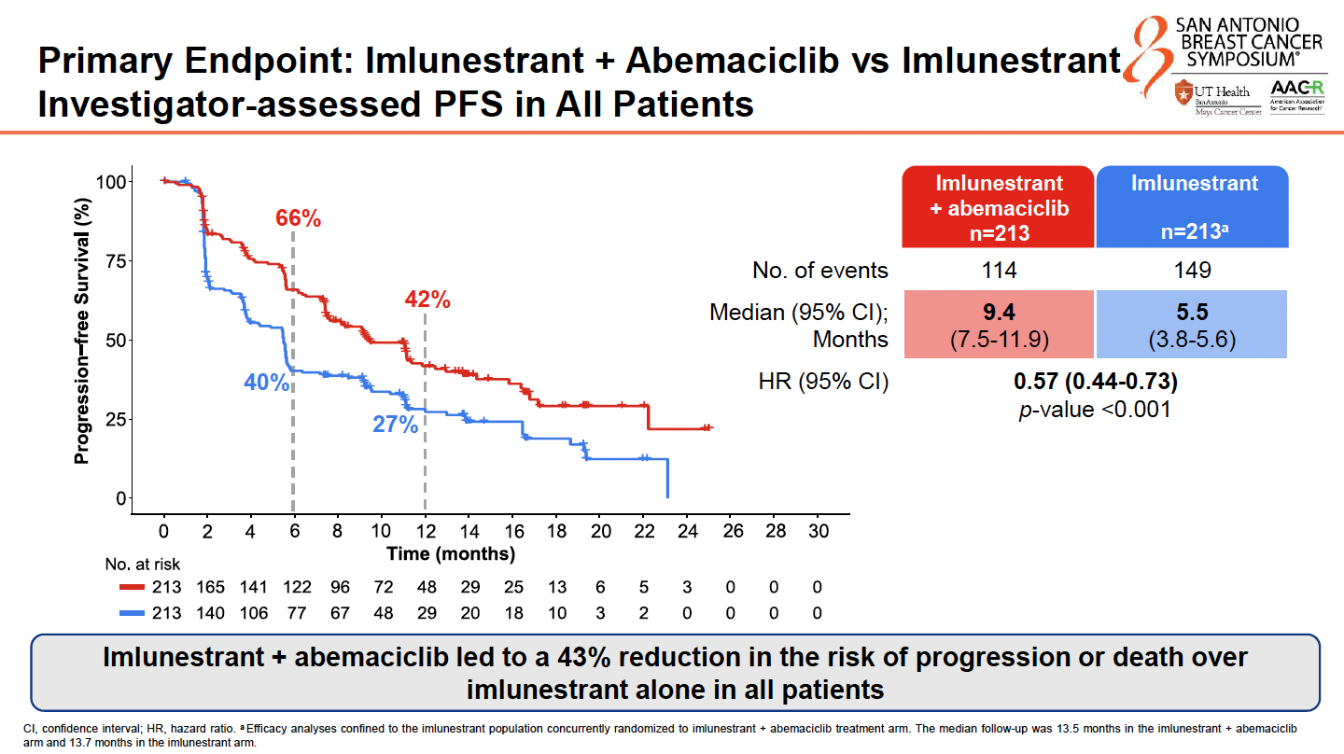
Jhaveri KL et al. San Antonio Breast Cancer Symposium 2024;Abstract GS1-01.

Slide 9
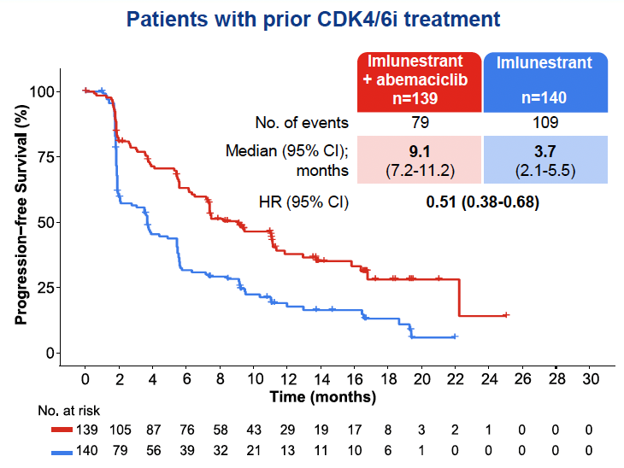
Jhaveri KL et al. San Antonio Breast Cancer Symposium 2024;Abstract GS1-01.

Slide 10
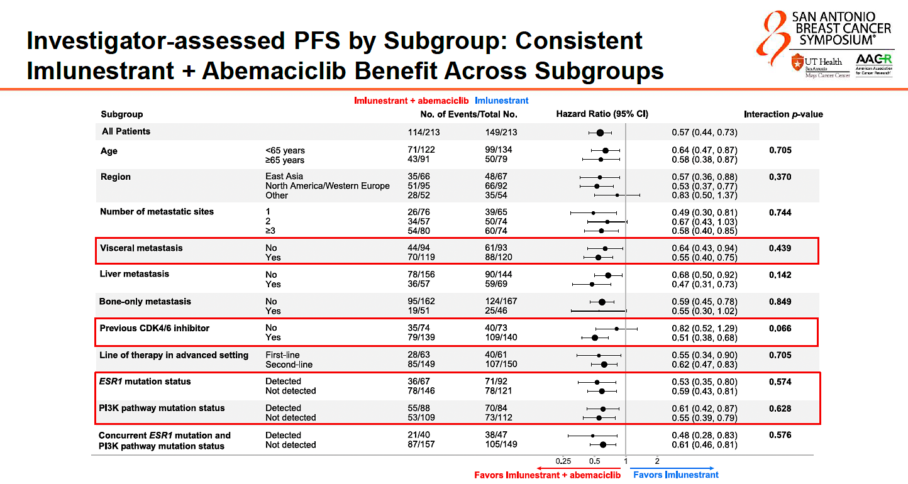
Jhaveri KL et al. San Antonio Breast Cancer Symposium 2024;Abstract GS1-01.

Slide 11
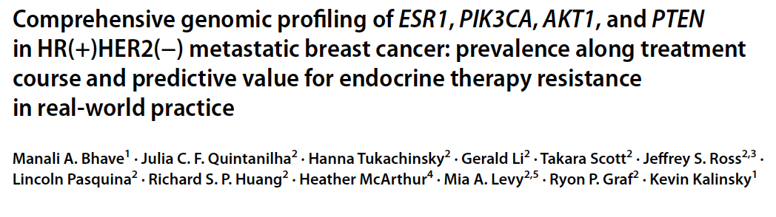
Breast Cancer Res Treat 2024;[Online ahead of print].

Slide 12
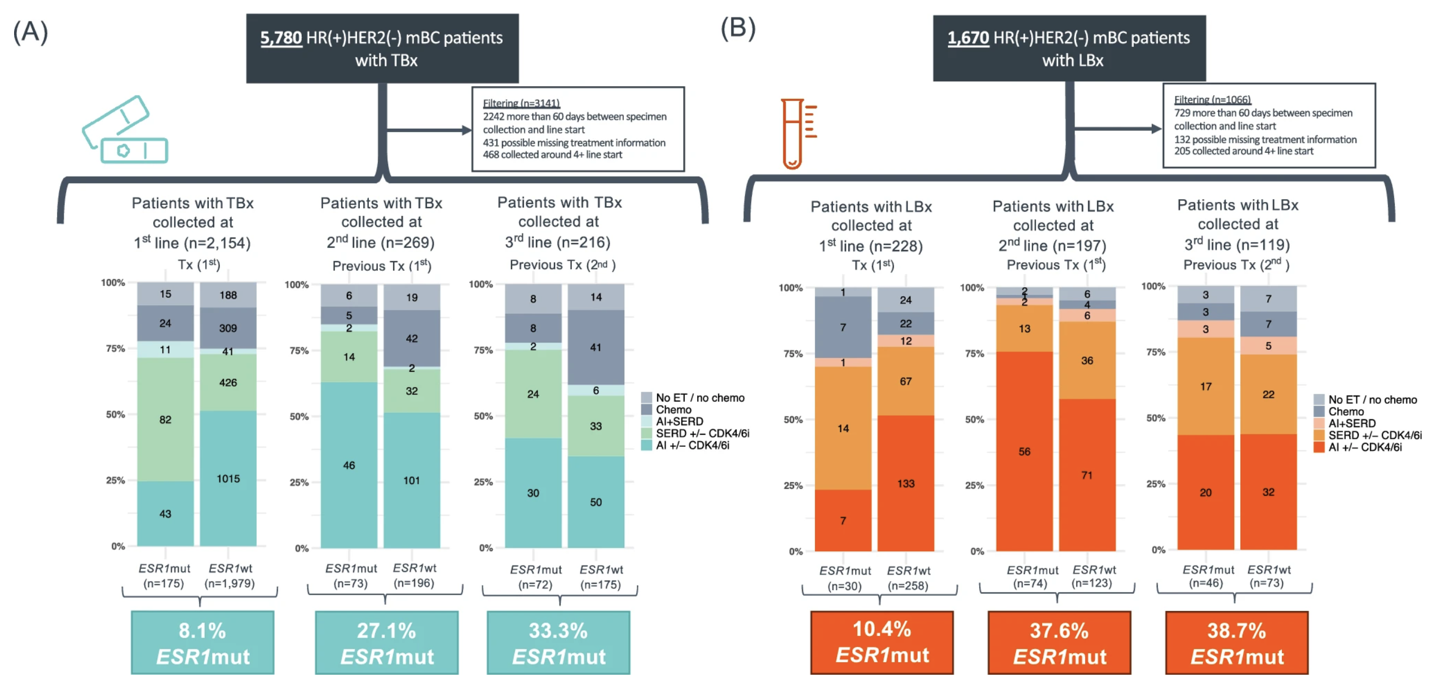
Bhave MA et al. Breast Cancer Res Treat 2024;[Online ahead of print].

Slide 13
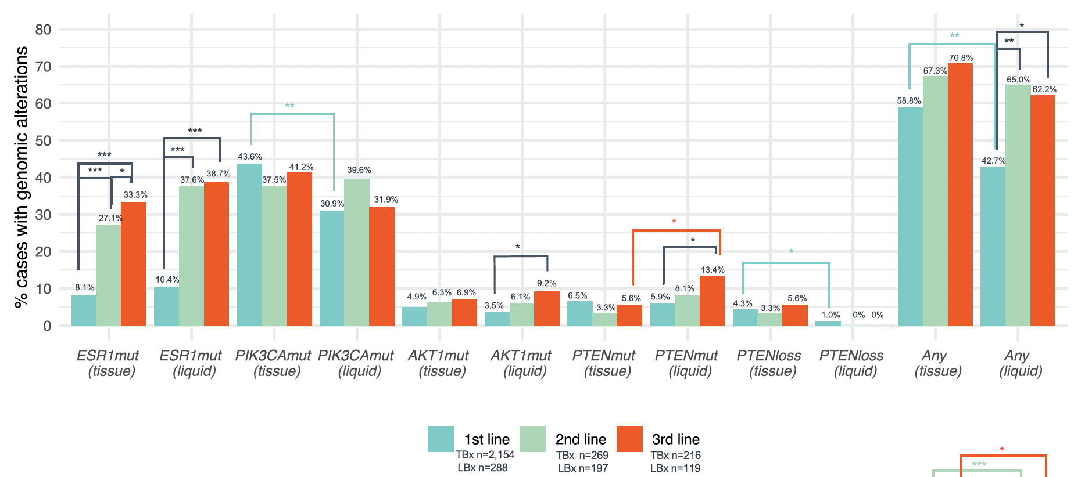
Bhave MA et al. Breast Cancer Res Treat 2024;[Online ahead of print].

Slide 14
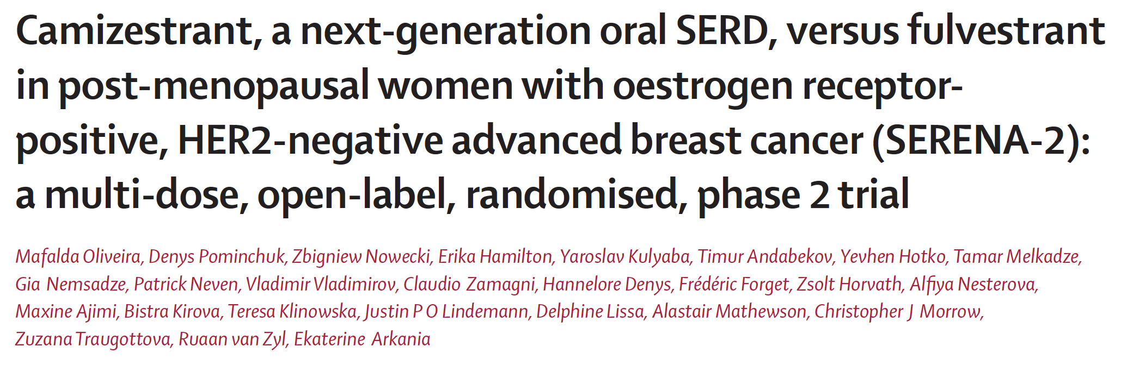
Lancet Oncol 2024;25(11):1424-39.

Slide 15
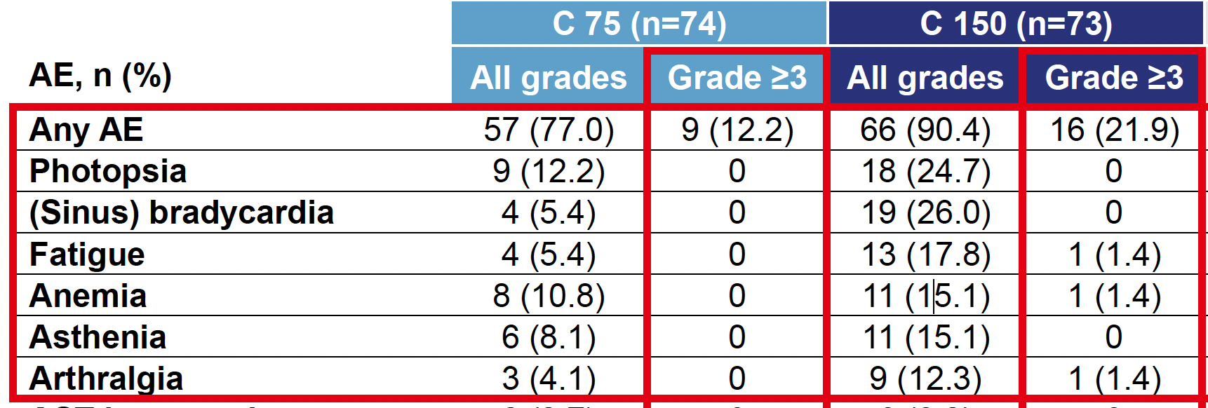
Oliveira M et al. Lancet Oncol 2024;25(11):1424-39. Oliveira M et al. San Antonio Breast Cancer Symposium 2022;Abstract GS3-02.

Slide 16
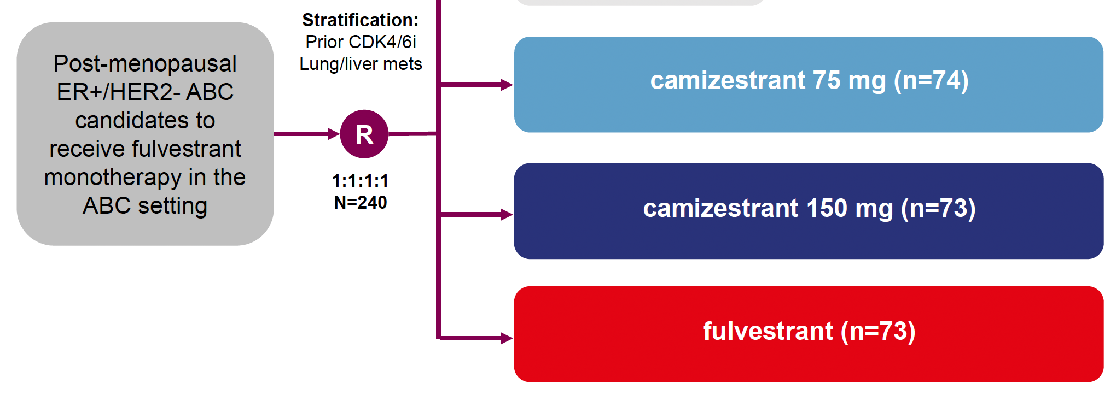
Oliveira M et al. Lancet Oncol 2024;25(11):1424-39. Oliveira M et al. San Antonio Breast Cancer Symposium 2022;Abstract GS3-02.

Slide 17
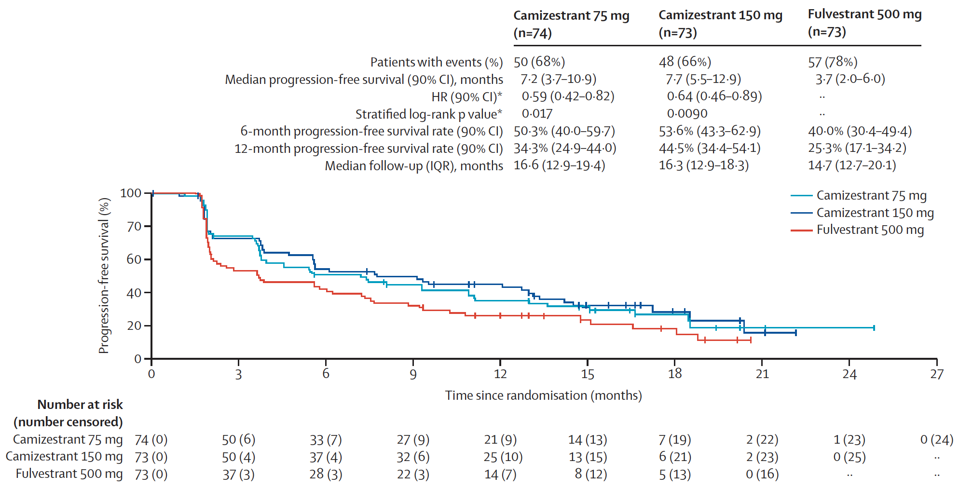
Oliveira M et al. Lancet Oncol 2024;25(11):1424-39.

Slide 18
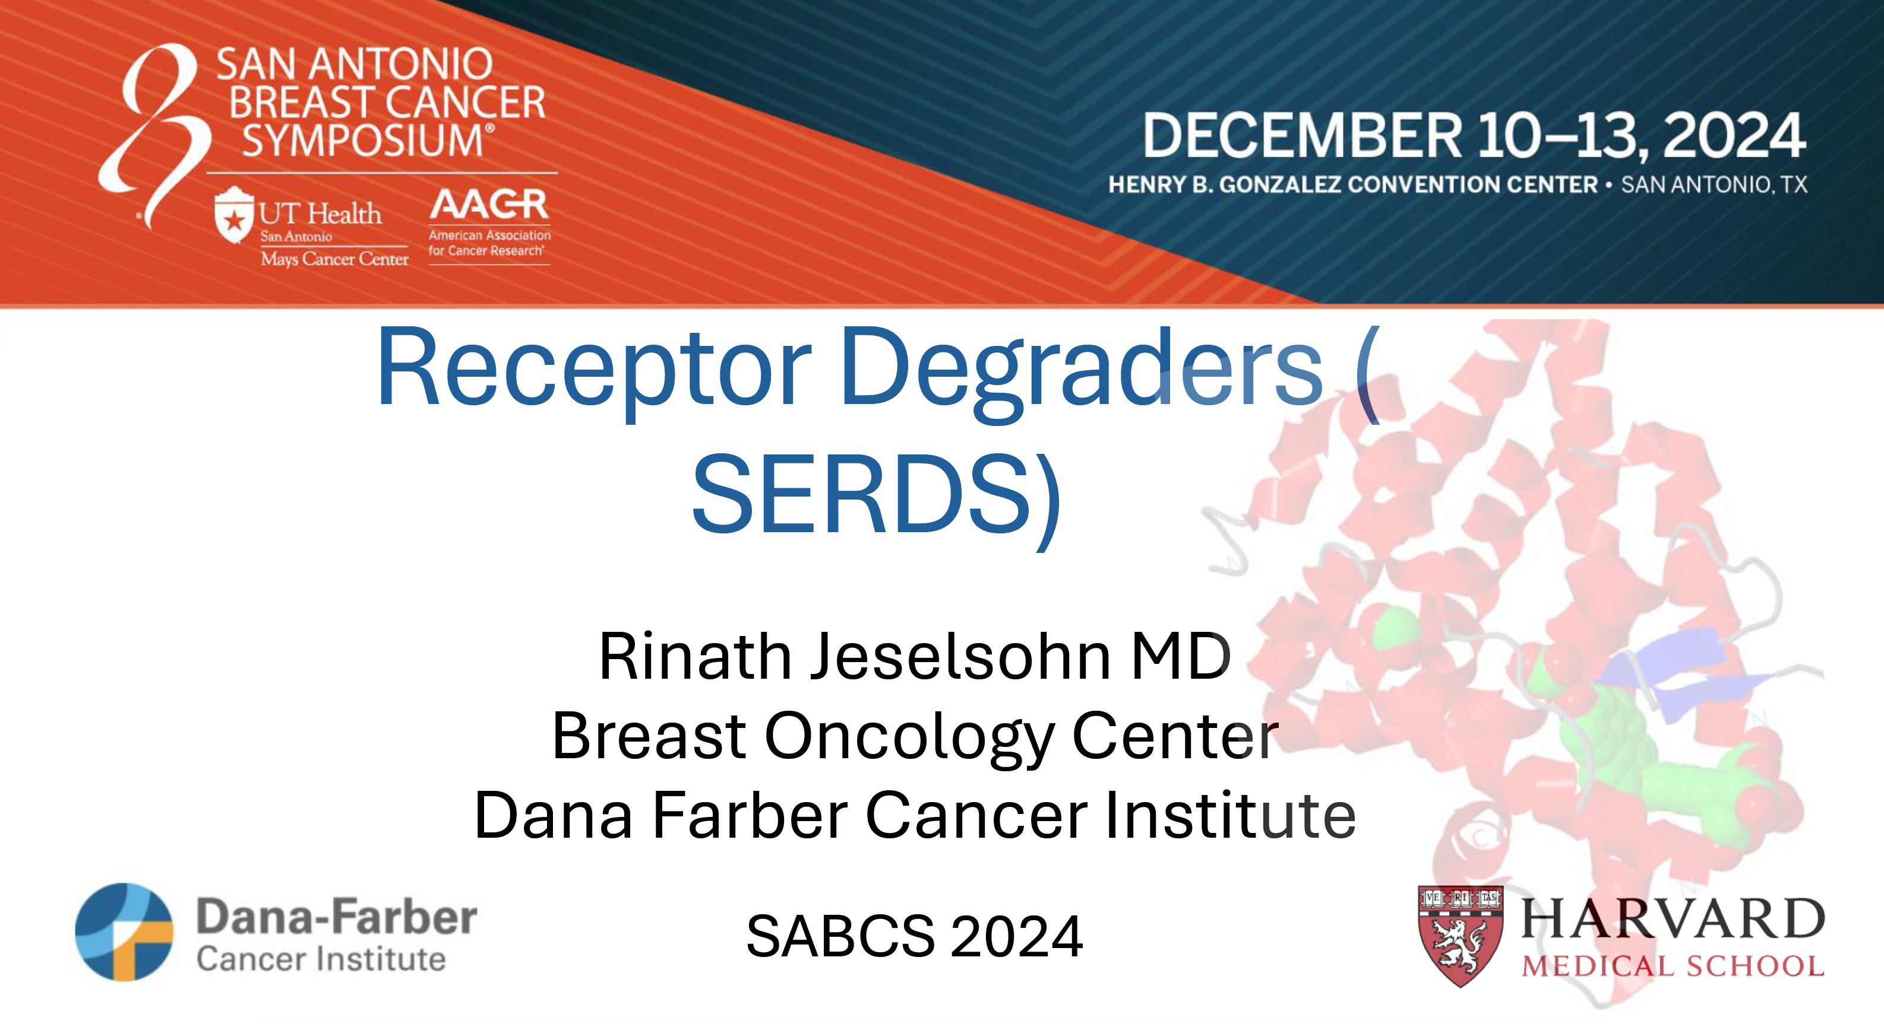
(SERDS)

Slide 19
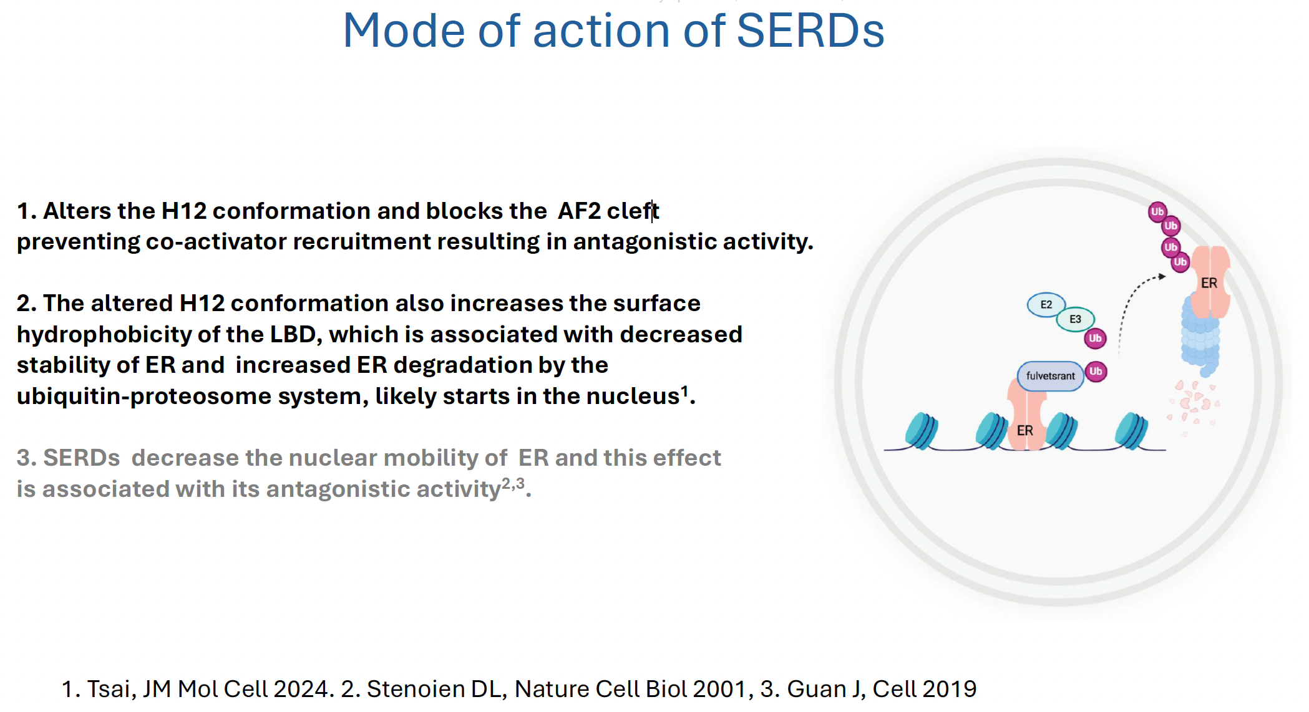
Jeselsohn R. San Antonio Breast Cancer Symposium 2024;Education Session 5.

Slide 20
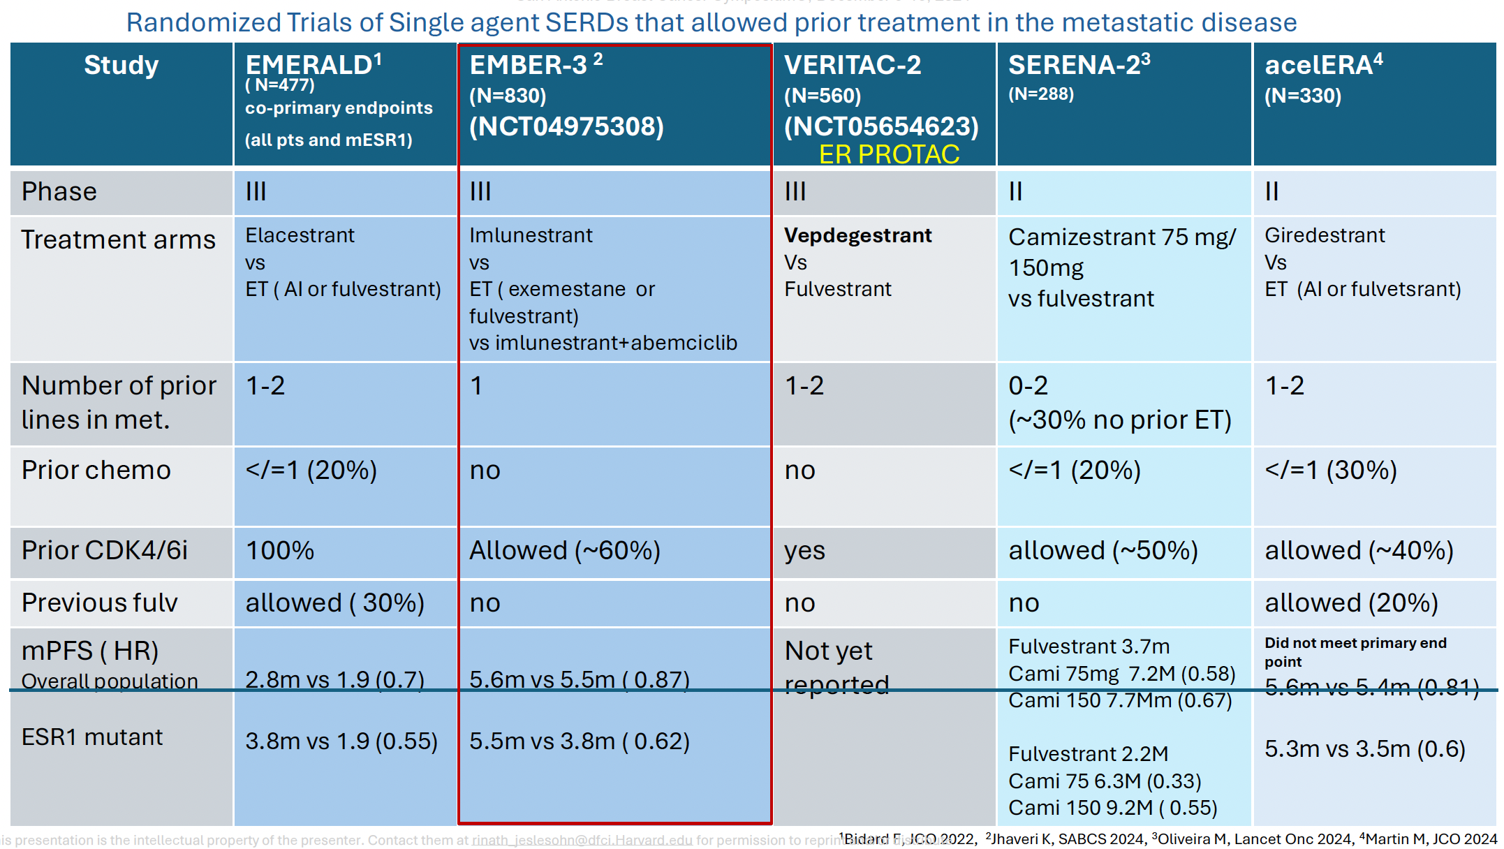
Jeselsohn R. San Antonio Breast Cancer Symposium 2024;Education Session 5.

