Slide 1
Head and Neck Cancer Friday, April 26, 2024 6:00 AM – 7:30 AM
What I Tell My Patients: Integrating New Research Information into Current Clinical Care
A Complimentary NCPD Hybrid Symposium Series Held During the 49th Annual ONS Congress
Faculty
Meetal Dharia, NP-C, AOCNP
Robert L Ferris, MD, PhD
Robert Haddad, MD
Lynsey P Teulings, APRN
Moderator
Neil Love, MD

Slide 2
Faculty
Meetal Dharia, NP-C, AOCNP
Division of Hematology/Oncology
UCLA Health
Los Angeles, California
Lynsey P Teulings, APRN
Nurse Practitioner
Head and Neck Medical Oncology
Smilow Cancer Hospital
at Yale New Haven Health
New Haven, Connecticut
Robert L Ferris, MD, PhD
Director, UPMC Hillman Cancer Center
Hillman Professor of Oncology
UPMC Senior Vice President for Oncology Programs
Associate Senior Vice Chancellor for Cancer Research
University of Pittsburgh School of Medicine
Pittsburgh, Pennsylvania
Moderator Neil Love, MD Research To Practice Miami, Florida
Robert Haddad, MD
Chief, Division of Head and Neck Oncology
McGraw Chair in Head and Neck Oncology
Institute Physician
Dana-Farber Cancer Institute
Professor of Medicine
Harvard Medical School
Boston, Massachusetts

Slide 3
Ms Dharia — Disclosures
No relevant conflicts of interest to disclose

Slide 4
Dr Ferris — Disclosures
Advisory Boards | Adaptimmune, Bristol Myers Squibb, Coherus BioSciences, CureVac, CytoAgents, Eisai Inc, Genmab US Inc, Hookipa Pharma Inc, Instil Bio, Lifescience Dynamics, MacroGenics Inc, MeiraGTx, Merck, Merus, Numab Therapeutics AG, Oncocyte, Pfizer Inc, Rakuten Medical Inc, Regeneron Pharmaceuticals Inc, Seagen Inc, SIRPant Immunotherapeutics Inc, Vir Biotechnology Inc
Clinical Trial, Research Funding | Bristol Myers Squibb

Slide 5
Dr Haddad — Disclosures
No relevant conflicts of interest to disclose

Slide 6
Ms Teulings — Disclosures
Advisory Committee | EMD Serono Inc

Slide 7
Commercial Support
This activity is supported by educational grants from Coherus BioSciences and EMD Serono Inc.
Research To Practice NCPD Planning Committee Members, Staff and Reviewers
Planners, scientific staff and independent reviewers for Research To Practice have no relevant conflicts of interest to disclose.

Slide 8
This educational activity contains discussion of non-FDA-approved uses of agents and regimens. Please refer to official prescribing information for each product for approved indications.

Slide 9
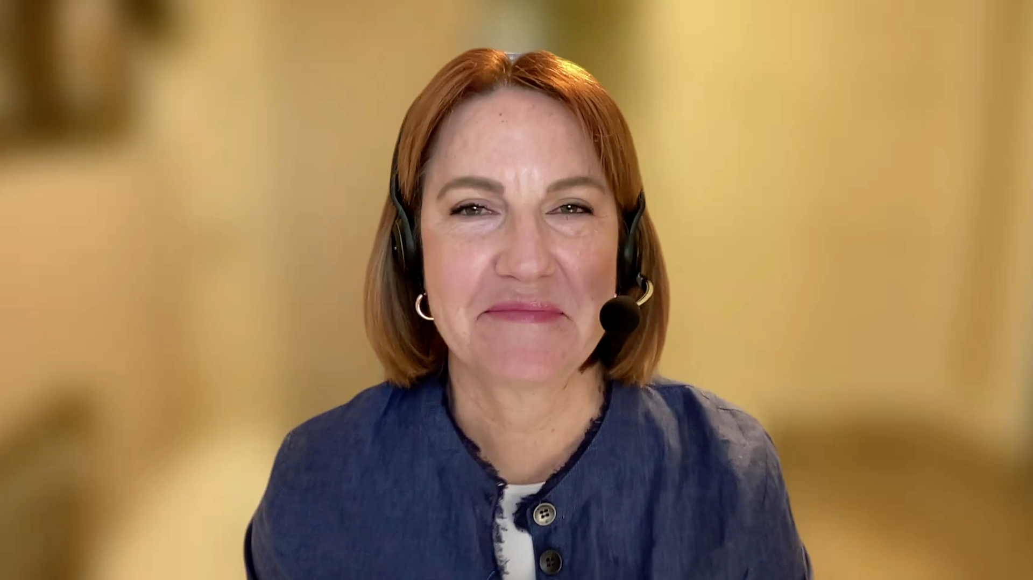
Consulting Nurse Faculty
Jacqueline Broadway-Duren, PhD, DNP, APRN, FNP-BC
The University of Texas MD Anderson Cancer Center
Houston, Texas
Jessica Mitchell, APRN, CNP, MPH
Mayo Clinic College of Medicine and Science
Rochester, Minnesota
Kathleen D Burns, RN, MSN, AGACNP-BC, OCN
City of Hope Comprehensive Cancer Center
Duarte, California
Tiffany A Richards, PhD, ANP-BC, AOCNP
The University of Texas MD Anderson Cancer Center
Houston, Texas
Sonia Glennie, ARNP, MSN, OCN
Swedish Cancer Institute Center for Blood Disorders
Seattle, Washington
Kimberly A Spickes, MNSc, RN, APRN, OCN, ACNP-BC
University of Arkansas for Medical Sciences
Little Rock, Arkansas
Amy Goodrich, CRNP
The Sidney Kimmel Comprehensive Cancer Center
Baltimore, Maryland
Ronald Stein, JD, MSN, NP-C, AOCNP
USC Norris Comprehensive Cancer Center
Los Angeles, California
https://www.ResearchToPractice.com/ONS2024Clips

Slide 10
Head and Neck Cancer Friday, April 26, 2024 6:00 AM – 7:30 AM
What I Tell My Patients: Integrating New Research Information into Current Clinical Care
A Complimentary NCPD Hybrid Symposium Series Held During the 49th Annual ONS Congress
Faculty
Meetal Dharia, NP-C, AOCNP
Robert L Ferris, MD, PhD
Robert Haddad, MD
Lynsey P Teulings, APRN
Moderator
Neil Love, MD

Slide 11
Agenda
Introduction
Module 1: Biology of and Multidisciplinary Treatment Approach to Head and Neck Cancer
Module 2: Local Treatment for Head and Neck Cancer
Module 3: Emerging Treatment Strategies for Head and Neck Cancer
Module 4: Immunotherapy for Head and Neck Cancer

Slide 12
Agenda
Introduction
Module 1: Biology of and Multidisciplinary Treatment Approach to Head and Neck Cancer
Module 2: Local Treatment for Head and Neck Cancer
Module 3: Emerging Treatment Strategies for Head and Neck Cancer
Module 4: Immunotherapy for Head and Neck Cancer

Slide 13
Consulting Nursing Faculty Comments
Assessing the family/friend support system
Tiffany A Richards, PhD, ANP-BC, AOCNP

Slide 14
Agenda
Introduction
Module 1: Biology of and Multidisciplinary Treatment Approach to Head and Neck Cancer
Module 2: Local Treatment for Head and Neck Cancer
Module 3: Emerging Treatment Strategies for Head and Neck Cancer
Module 4: Immunotherapy for Head and Neck Cancer

Slide 15
The Biology of Head and Neck Cancer
Dr Ferris
Pittsburgh, PA
Dr Haddad
Boston, MA
Anatomic locations in which head and neck cancer can occur (eg, larynx/hypopharynx, nasal cavity/paranasal sinus, nasopharynx, oral cavity/oropharynx, salivary gland); implications of primary tumor location for treatment planning
Staging of head and neck cancer; significance of disease stage for prognosis and treatment
Role of certain viruses, such as the human papillomavirus (HPV) and the Epstein-Barr virus, in head and neck cancer pathogenesis; ramifications of HPV status, if any, for patient outcomes and therapeutic decision-making
Other risk factors for the development of head and neck cancer, such as tobacco use, heavy alcohol consumption, environmental or occupational inhalants and radiation exposure

Slide 16
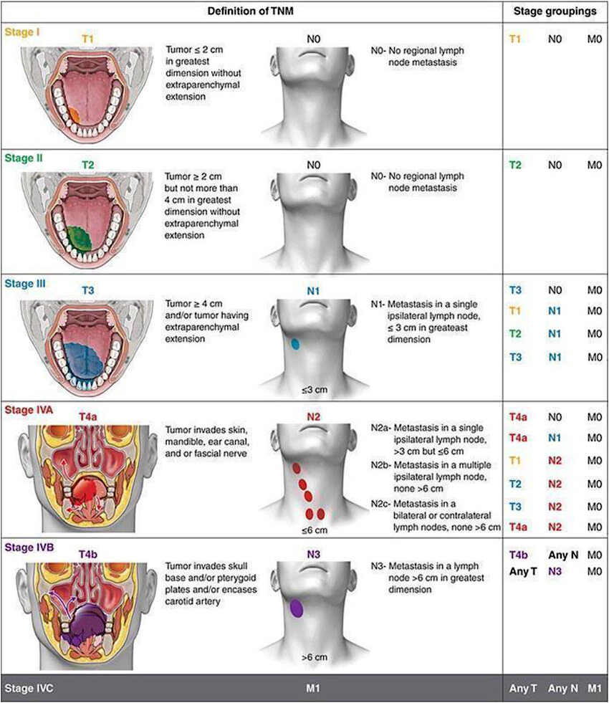
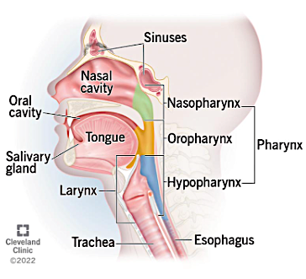
Head and Neck Cancer Regions and Staging
https://www.cancer.gov/types/head-and-neck/head-neck-fact-sheet; https://my.clevelandclinic.org/health/diseases/14458-head-and-neck-cancer;
Khan SR et al. Heliyon 2023 May;9(5):e15894.

Slide 17
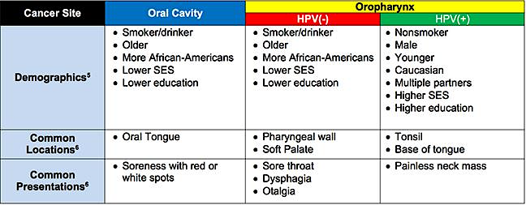
Head and Neck Cancers: Common Demographics and Clinical Characteristics
https://www.headandneck.org/hpvthroatcancerstaging/

Slide 18
Lynsey P Teulings, APRN
What I tell my patients who are experiencing guilt/stigma about a diagnosis of head and neck cancer associated with HPV, tobacco use or alcohol consumption

Slide 19
The Multidisciplinary Treatment of Head and Neck Cancer
Dr Ferris
Pittsburgh, PA
Dr Haddad
Boston, MA
Importance of interdisciplinary coordination in formulating a treatment plan for patients with head and neck cancer
Role of various specialists, such as surgeons, radiation oncologists, medical oncologists, nurses, dentists, speech therapists and nutritionists, in the care of patients with head and neck cancer
Indications for surgery in head and neck cancer; types of surgical procedures employed for various disease subtypes
Rationale for the use of radiation therapy and/or chemotherapy as adjuvant or neoadjuvant treatment for head and neck cancer in patients undergoing surgery or as primary therapy for those with potentially curable disease who are not surgical candidates

Slide 20
Agenda
Introduction
Module 1: Biology of and Multidisciplinary Treatment Approach to Head and Neck Cancer
Module 2: Local Treatment for Head and Neck Cancer
Module 3: Emerging Treatment Strategies for Head and Neck Cancer
Module 4: Immunotherapy for Head and Neck Cancer

Slide 21
The Potential Short- and Long-Term Effects of Surgery for Head and Neck Cancer
Dr Ferris
Pittsburgh, PA
Dr Haddad
Boston, MA
Educating patients regarding wound care, potential need for feeding or tracheostomy tubes and, if applicable, tracheostomy care
Potential for xerostomia, trismus, dysphagia, cranial nerve dysfunction, dental problems and other long-term effects in patients undergoing head and neck cancer surgery; appropriate interventions for each
Likelihood of altered dietary intake among patients with head and neck cancer; strategies to address weight loss, dehydration and nutritional deficiencies
Counseling patients who are struggling with the cosmetic outcomes of head and neck cancer surgery; role of and coordination with cosmetic surgeons and mental healthcare professionals

Slide 22
Meetal Dharia, NP-C, AOCNP
What I tell my patients with head and neck cancer about strategies to maintain adequate nutrition

Slide 23
Radiation Therapy and Chemotherapy Side Effects
Dr Ferris
Pittsburgh, PA
Dr Haddad
Boston, MA
Spectrum of adverse effects associated with radiation therapy (eg, fatigue, hearing loss, dysphagia, xerostomia, carotid stenosis, hypothyroidism, strictures, fistula formation, osteoradionecrosis)
Potential for common and serious side effects with chemotherapy; appropriate monitoring strategies and patient education regarding when to contact the care team
Relative timing of radiation therapy- and chemotherapy-associated toxicities
Available supportive management strategies for side effects associated with radiation therapy and chemotherapy

Slide 24
Lynsey P Teulings, APRN
What I tell my patients who are about to receive adjuvant chemotherapy with or without radiation therapy for head and neck cancer

Slide 25
Consulting Nursing Faculty Comments
Listening to patients
Jacqueline Broadway-Duren, PhD, DNP, APRN, FNP-BC

Slide 26
Agenda
Introduction
Module 1: Biology of and Multidisciplinary Treatment Approach to Head and Neck Cancer
Module 2: Local Treatment for Head and Neck Cancer
Module 3: Emerging Treatment Strategies for Head and Neck Cancer
Module 4: Immunotherapy for Head and Neck Cancer

Slide 27
Emerging Treatment Strategies Aimed at Improving Outcomes Associated with Localized or Locally Advanced Head and Neck Cancer
Dr Ferris
Pittsburgh, PA
Dr Haddad
Boston, MA
Long-term outcomes observed with the traditional treatment paradigm for localized or locally advanced head and neck cancer; proportion of patients with locally advanced disease who develop locoregional recurrence or distant metastases
Educating patients regarding the potential advantages of participating in a clinical research study of a novel investigational strategy
Scientific justification for targeting inhibitors of apoptosis proteins for locally advanced SCCHN; mechanism of action of xevinapant

Slide 28
Emerging Treatment Strategies Aimed at Improving Outcomes Associated with Localized or Locally Advanced Head and Neck Cancer
Dr Ferris
Pittsburgh, PA
Dr Haddad
Boston, MA
Reductions in the risk of locoregional recurrence, disease progression and death observed with the addition of xevinapant to chemoradiation therapy among patients with locally advanced SCCHN in early clinical trials
Ongoing and planned Phase III studies of xevinapant for locally advanced SCCHN; estimated completion dates

Slide 29
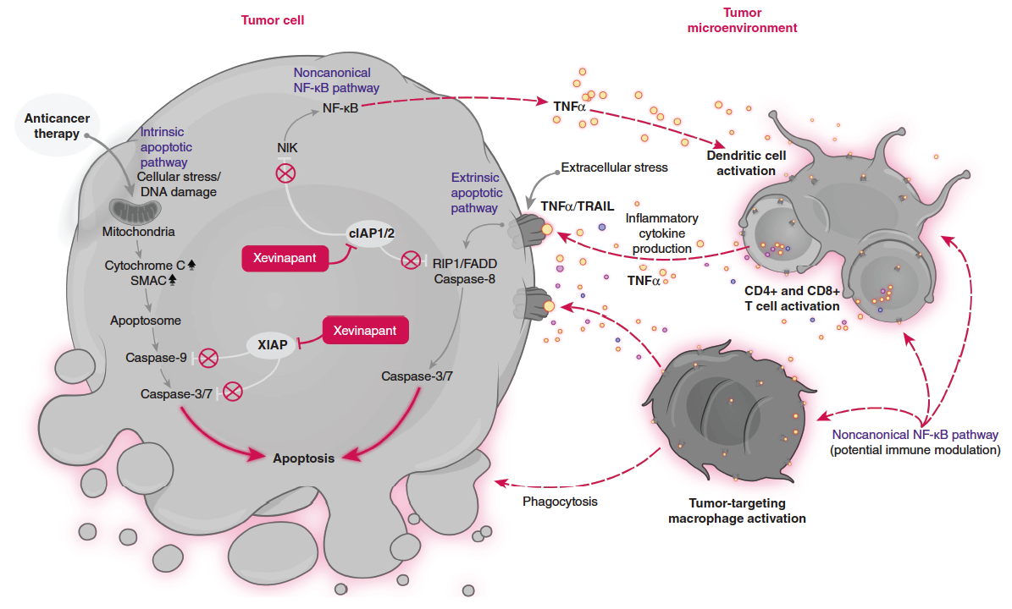
Xevinapant: Proposed Mechanism of Action
Xevinapant is thought to:
Restore apoptosis in cancer cells by blocking XIAP and cIAP1/2, leading to activation of caspases downstream of the intrinsic mitochondrial and extrinsic TNF receptor signaling pathways
Enhance the inflammatory antitumor response in immune cells of the tumor microenvironment by activating noncanonical NF-κB signaling through blocking of cIAP1/2 downstream of the TNF receptor
Ferris RL et al. Future Oncol 2024 April;20(12):739-48.

Slide 30
Xevinapant
Mechanism of action
First-in-class oral IAP (inhibitor of apoptosis protein) blocker
Indication
Investigational
Key clinical trial
Phase III XRAY VISION trial evaluating xevinapant versus placebo added to radiation therapy for high-risk patients with resected locally advanced SCCHN who are ineligible to receive cisplatin-based chemoradiation concurrently
www.clinicaltrials.gov. NCT05386550. Accessed April 2024.
Notes:
Phase II

Slide 31
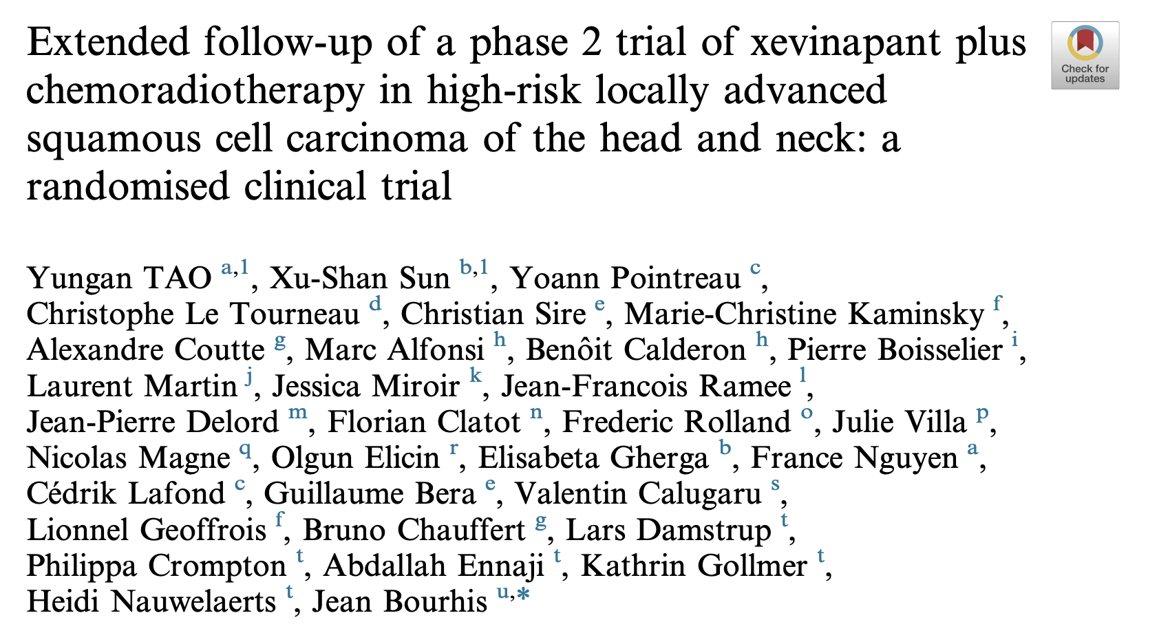
Eur J Cancer 2023;183:24-37.
Notes:
Phase II

Slide 32
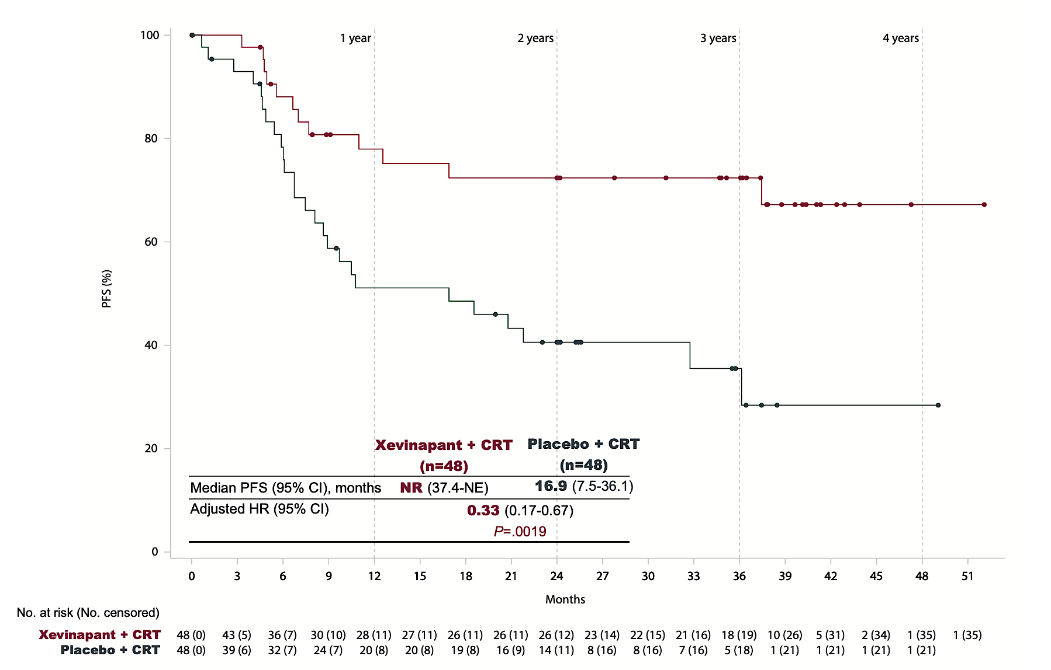
Results of a Phase II Trial of Xevinapant with Chemoradiation Therapy for High-Risk Locally Advanced SCCHN: Progression-Free Survival (PFS)
NR = not reached
Tao Y et al. Eur J Cancer 2023;183:24-37.
Notes:
Phase II

Slide 33
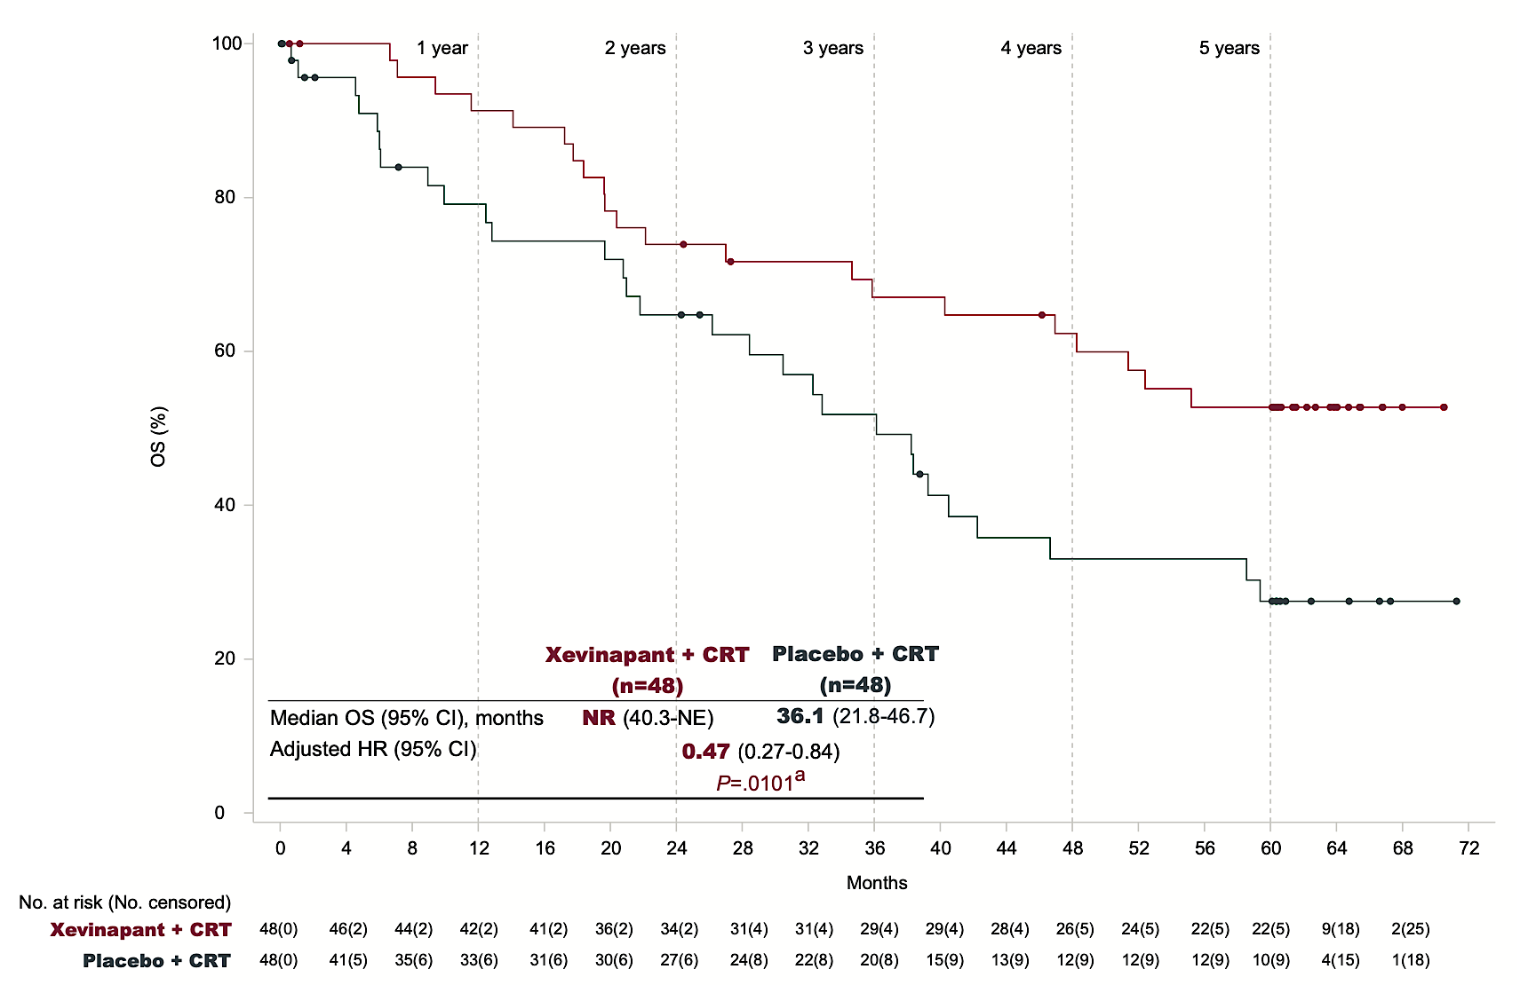
Results of a Phase II Trial of Xevinapant with Chemoradiation Therapy for High-Risk Locally Advanced SCCHN: Overall Survival (OS)
Tao Y et al. Eur J Cancer 2023;183:24-37.
Notes:
Phase II

Slide 34
Tolerability Considerations with Xevinapant
Dr Ferris
Pittsburgh, PA
Dr Haddad
Boston, MA
Common patient misperceptions regarding the safety of clinical trial participation and strategies to dispel these concerns
Preparing interested patients with head and neck cancer for trial participation; instructions regarding adherence, monitoring requirements, adverse event (AE) reporting, et cetera
Proportion of patients experiencing late-onset toxicities with xevinapant in combination with chemoradiation therapy versus chemoradiation therapy alone in published clinical trials
Most common late-onset toxicities, such as dry mouth, dysgeusia, dysphagia and fibrosis, reported with xevinapant in combination with chemoradiation therapy

Slide 35
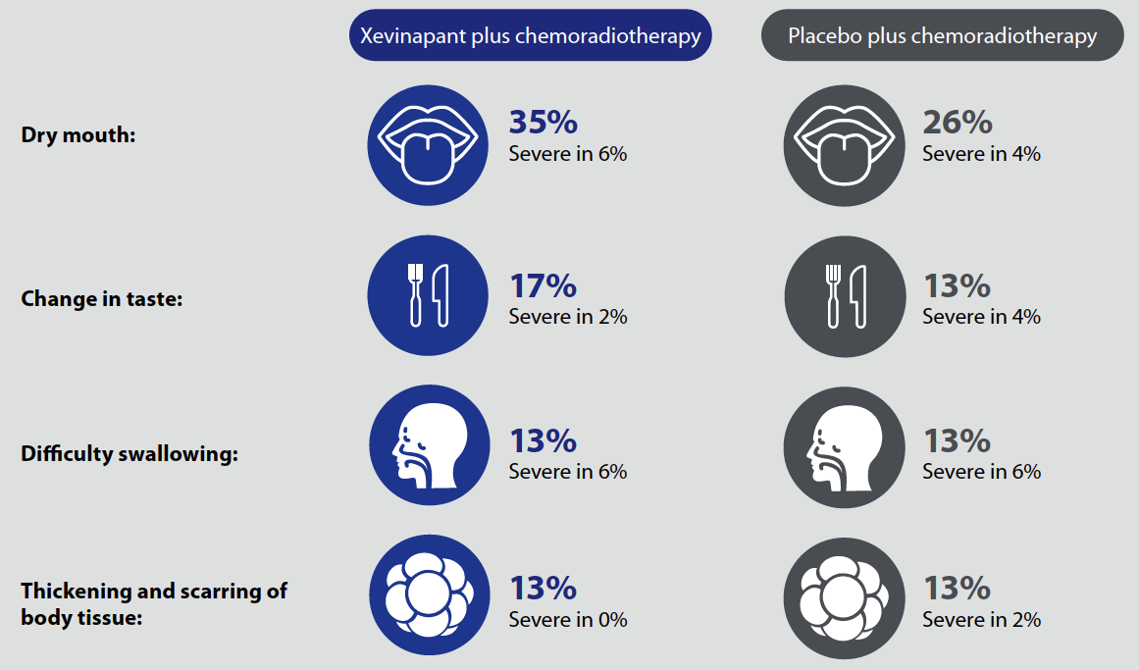
Results of a Phase II Trial of Xevinapant with Chemoradiation Therapy for High-Risk Locally Advanced SCCHN: Common Side Effects
Tao Y et al. Future Oncol 2023 August;19(26):1769-76.
Notes:
Phase II

Slide 36
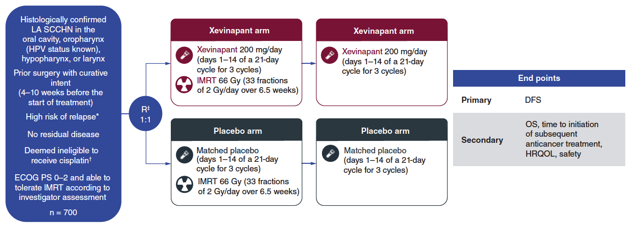
XRAY VISION: Phase III Study Design
LA = locally advanced; SCCHN = squamous cell carcinoma of head and neck; HPV = human papillomavirus; IMRT = intensity-modulated radiation therapy; DFS = disease-free survival; OS = overall survival; HRQOL = health-related quality of life
Ferris RL et al. Future Oncol 2024 April;20(12):739-48.

Slide 37
Meetal Dharia, NP-C, AOCNP
What I tell my patients about the logistics and potential benefits of enrolling on a clinical trial

Slide 38
Lynsey P Teulings, APRN
What I tell my patients about the role of palliative/end-of-life care

Slide 39
Agenda
Introduction
Module 1: Biology of and Multidisciplinary Treatment Approach to Head and Neck Cancer
Module 2: Local Treatment for Head and Neck Cancer
Module 3: Emerging Treatment Strategies for Head and Neck Cancer
Module 4: Immunotherapy for Head and Neck Cancer

Slide 40
The Established Role of Anti-PD-1/PD-L1 Antibodies in Therapy for Advanced Head and Neck Cancer
Dr Ferris
Pittsburgh, PA
Dr Haddad
Boston, MA
Rationale for the activity of immune checkpoint inhibitors in head and neck cancer
Principal findings with pembrolizumab as monotherapy or in combination with platinum/5-FU as first-line treatment for recurrent or metastatic SCCHN
Indications for pembrolizumab monotherapy and pembrolizumab/chemotherapy for recurrent or metastatic SCCHN; impact of PD-L1 status and other factors on patient selection for these regimens
Clinical trial database supporting the use of pembrolizumab and nivolumab for patients with relapsed metastatic SCCHN

Slide 41
Nivolumab
Mechanism of action
Anti-PD-1 monoclonal antibody
Indication as single agent
For patients with recurrent or metastatic SCCHN with disease progression on or after a platinum-based therapy
Recommended dose as single agent
240 mg every 2 weeks or 480 mg every 4 weeks
Nivolumab package insert, 3/2024.

Slide 42
Pembrolizumab
Mechanism of action
Anti-PD-1 monoclonal antibody
Indications
In combination with FU as first-line therapy for metastatic or unresectable recurrent SCCHN As a single agent as first-line therapy for metastatic or unresectable recurrent SCCHN with PD-L1 CPS ≥1
As a single agent for recurrent or metastatic SCCHN with disease progression on or after platinum-containing chemotherapy
Recommended dose as single agent
200 mg every 3 weeks or 400 mg every 6 weeks
Pembrolizumab package insert, 3/2024.

Slide 43
Newly Approved Immunotherapeutic Strategies for Nasopharyngeal Carcinoma
Dr Ferris
Pittsburgh, PA
Dr Haddad
Boston, MA
Unique histopathology, etiology, clinical behavior and natural history of nasopharyngeal carcinoma relative to other squamous cell carcinomas of the head and neck
Similarities and differences between toripalimab and other anti-PD-1/PD-L1 antibodies
Efficacy and safety findings reported with toripalimab in combination with platinum-based chemotherapy as first-line treatment for recurrent or metastatic nasopharyngeal carcinoma
Key outcomes documented with toripalimab as monotherapy in the second-line setting and beyond
Recent FDA approval of toripalimab for nasopharyngeal carcinoma and current clinical role

Slide 44
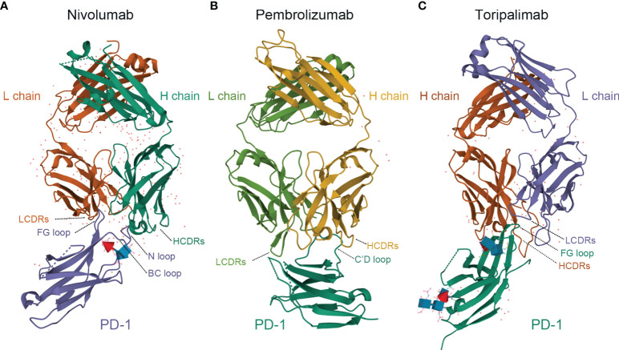
Comparison of Structures of PD-1 in Complex with Nivolumab, Pembrolizumab and Toripalimab
Toripalimab is able to bind to PD-1, efficiently blocking the interaction with its ligands; the blockade is mainly attributed to the stereospecific hindrance of the heavy chain.
The interaction of toripalimab with PD-1 is mainly attributed to the complementarity-determining regions of the heavy chain of the former and the FG loop of the latter; the light chain complementarity- determining regions of toripalimab participate mainly in recognizing the epitopes on PD-1.
Comparatively, nivolumab mainly binds to the N-terminal loop of PD-1, while the binding of pembrolizumab primarily involves the C’D loop.
Zhang L et al. Front Immunol 2022 January 12;12:730666.

Slide 45
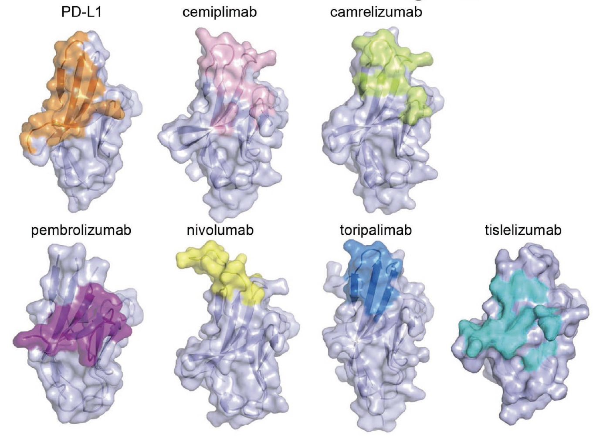
Each PD-1 Inhibitor Has a Different Binding Site to PD-1
Lu D et al. Front Immunol 2022;13:826045.

Slide 46
Toripalimab
Mechanism of action
Anti-PD-1 monoclonal antibody
Indications
In combination with cisplatin and gemcitabine as first-line therapy for patients with metastatic or with recurrent locally advanced nasopharyngeal carcinoma (NPC)
As a single agent for patients with recurrent unresectable or metastatic NPC with disease progression on or after a platinum-containing chemotherapy
Recommended dose
First-line NPC with chemotherapy: 240 mg IV every 3 weeks
Recurrent NPC as monotherapy: 3 mg/kg IV every 2 weeks
Toripalimab package insert, 10/2023.

Slide 47
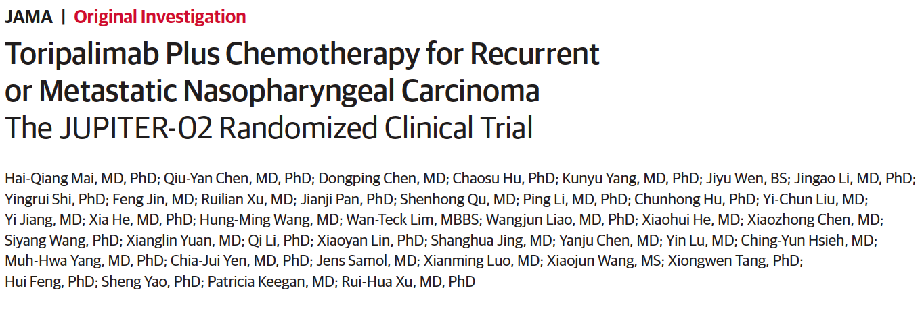
2023 November 28;330(20):1961-70

Slide 48
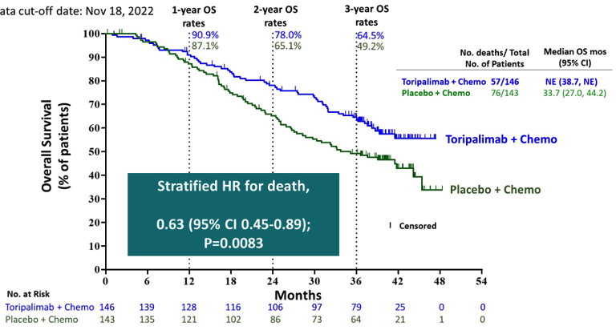
JUPITER-02: Final Overall Survival in the ITT Population
ITT = intent-to-treat
Mai H-Q et al. ASCO 2023;Abstract 6009.
Data cutoff: November 18, 2022

Slide 49
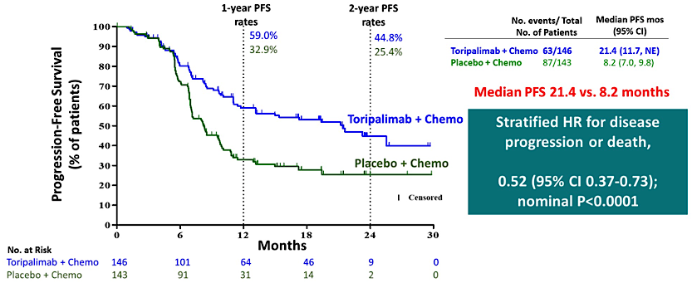
JUPITER-02: Final Progression-Free Survival in the ITT Population
Mai H-Q et al. ASCO 2023;Abstract 6009.
Data cutoff: June 8, 2021

Slide 50
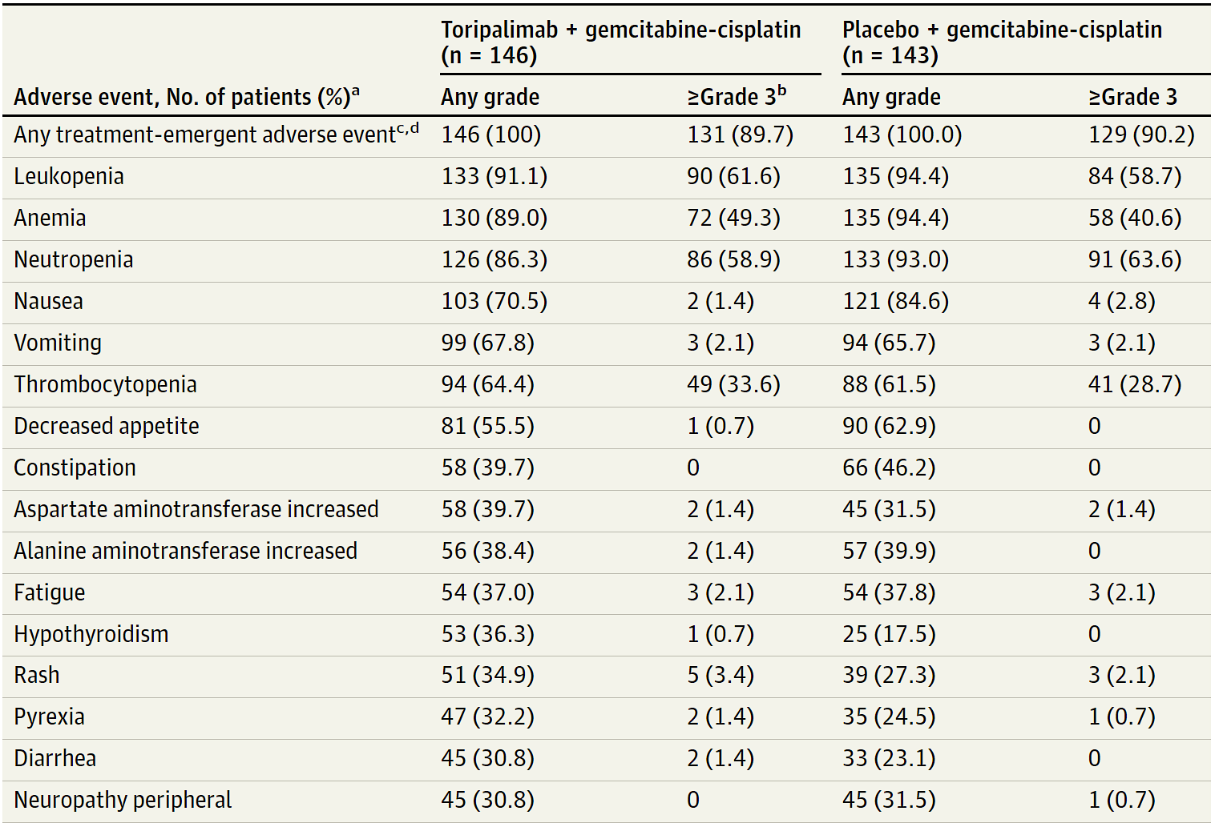
JUPITER-02: Select Treatment-Emergent Adverse Events
Mai H-Q et al. JAMA 2023 November 28;330(20):1961-70.

Slide 51
FDA Approves Toripalimab-tpzi for Nasopharyngeal Carcinoma Press Release – October 27, 2023
“The Food and Drug Administration approved toripalimab-tpzi with cisplatin and gemcitabine for the first-line treatment of adults with metastatic or recurrent, locally advanced nasopharyngeal carcinoma (NPC). FDA also approved toripalimab-tpzi as a single agent for adults with recurrent unresectable or metastatic NPC with disease progression on or after a platinum-containing chemotherapy.
Efficacy of toripalimab-tpzi with cisplatin and gemcitabine was evaluated in JUPITER-02 (NCT03581786), a randomized, multicenter, single region, double-blind, placebo-controlled trial in 289 patients with metastatic or recurrent, locally advanced NPC who had not received previous systemic chemotherapy for recurrent or metastatic disease.
Efficacy of toripalimab-tpzi as a single agent was evaluated in POLARIS-02 (NCT02915432), an open-label, multicenter, single country, multicohort trial in 172 patients with unresectable or metastatic NPC who had received prior platinum-based chemotherapy or had disease progression within 6 months of completion of platinum-based chemotherapy administered as neoadjuvant, adjuvant, or definitive chemoradiation treatment for locally advanced disease.”
https://www.fda.gov/drugs/resources-information-approved-drugs/fda-approves-toripalimab-tpzi-nasopharyngeal-carcinoma

Slide 52
The Tolerability of Immune Checkpoint Inhibitors
Dr Ferris
Pittsburgh, PA
Dr Haddad
Boston, MA
Pathophysiology, incidence and spectrum of immune-mediated and other AEs observed with anti-PD-1/PD-L1 antibodies
Impact on the tolerability of anti-PD-1/PD-L1 antibodies when administered in combination with chemotherapy
Optimal monitoring and management of immune-related and other AEs with anti- PD-1/PD-L1 antibodies
Relative and absolute contraindications to the use of immune checkpoint inhibitor therapy; role, if any, for patients with preexisting autoimmune complications

Slide 53
Meetal Dharia, NP-C, AOCNP
What I tell my patients about to begin treatment with an anti-PD-1/PD-L1 antibody

