Slide 1
Optimal Implementation of Antibody-Drug Conjugates Thursday, April 25, 2024 12:15 PM – 1:45 PM
What I Tell My Patients: Integrating New Research Information into Current Clinical Care
A Complimentary NCPD Hybrid Symposium Series Held During the 49th Annual ONS Congress
Faculty
Jamie Carroll, APRN, MSN, CNP
Kelly EH Goodwin, MSN, RN, ANP-BC
Erika Hamilton, MD
Hope S Rugo, MD
Moderator
Neil Love, MD

Slide 2
Faculty
Jamie Carroll, APRN, MSN, CNP
Assistant Professor, Oncology
Mayo Clinic
Rochester, Minnesota
Hope S Rugo, MD
Professor of Medicine
Winterhof Family Professor of Breast Cancer
Director, Breast Oncology and Clinical Trials Education
Medical Director, Cancer Infusion Services
University of California, San Francisco
Helen Diller Family Comprehensive Cancer Center
San Francisco, California
Kelly EH Goodwin, MSN, RN, ANP-BC
Thoracic Cancer Center
Massachusetts General Hospital
Boston, Massachusetts
Moderator Neil Love, MD Research To Practice Miami, Florida
Erika Hamilton, MD
Director, Breast Cancer Research Program
Sarah Cannon Research Institute
Nashville, Tennessee

Slide 3
Ms Carroll — Disclosures
Speakers Bureaus | AstraZeneca Pharmaceuticals LP, Lilly, Novartis

Slide 4
Ms Goodwin — Disclosures
No relevant conflicts of interest to disclose

Slide 5
Dr Hamilton — Disclosures
Consulting Agreements — Payment Made to Institution | Accutar Biotechnology Inc, AstraZeneca Pharmaceuticals LP, Daiichi Sankyo Inc, Ellipses Pharma, Entos Pharmaceuticals, Fosun Pharma, Genentech, a member of the Roche Group, Gilead Sciences Inc, Greenwich LifeSciences Inc, Jazz Pharmaceuticals Inc, Lilly, Mersana Therapeutics Inc, MphaR, Novartis, Olema Oncology, Orum Therapeutics, Pfizer Inc, Stemline Therapeutics Inc, Theratechnologies, Tubulis, Zentalis Pharmaceuticals
Contracted Research —Payment Made to Institution | AbbVie Inc, Accutar Biotechnology Inc, Acerta Pharma — A member of the AstraZeneca Group, ADC Therapeutics, Akesobio Australia Pty Ltd, Amgen Inc, Aravive Inc, ArQule Inc, Artios, Arvinas, AstraZeneca Pharmaceuticals LP, AtlasMedx Inc, BeiGene Ltd, Black Diamond Therapeutics Inc, Bliss Biopharmaceutical, Boehringer Ingelheim Pharmaceuticals Inc, Clovis Oncology, Compugen, Context Therapeutics, Cullinan Oncology, Curis Inc, CytomX Therapeutics, Daiichi Sankyo Inc, Dantari, Deciphera Pharmaceuticals Inc, Duality Biologics, eFFECTOR Therapeutics Inc, Ellipses Pharma, Elucida Oncology Inc, EMD Serono Inc, FUJIFILM Pharmaceuticals USA Inc, G1 Therapeutics Inc, Genentech, a member of the Roche Group, Gilead Sciences Inc, H3 Biomedicine, Harpoon Therapeutics, Hutchison MediPharma, ImmunoGen Inc, Incyte Corporation, Infinity Pharmaceuticals Inc, Inspirna, InventisBio, Jacobio Pharmaceuticals Group Co Ltd, Karyopharm Therapeutics, K-Group Beta, Kind Pharmaceuticals LLC, Leap Therapeutics Inc, Lilly, Loxo Oncology Inc, a wholly owned subsidiary of Eli Lilly & Company, Lycera, MacroGenics Inc, Marker Therapeutics Inc, Mersana Therapeutics Inc, Merus, Molecular Templates, Myriad Genetic Laboratories Inc, Novartis, NuCana, Olema Oncology, OncoMed Pharmaceuticals Inc, Onconova Therapeutics Inc, Oncothyreon, ORIC Pharmaceuticals, Orinove Inc, Orum Therapeutics, Pfizer Inc, PharmaMar, Pieris Pharmaceuticals Inc, Pionyr Immunotherapeutics, Plexxikon Inc, Prelude Therapeutics, ProfoundBio, Radius Health Inc, Regeneron Pharmaceuticals Inc, Relay Therapeutics, Repertoire Immune Medicines, Seagen Inc, Sermonix Pharmaceuticals, Shattuck Labs, Stemcentrx, Sutro Biopharma, Syndax Pharmaceuticals, Syros Pharmaceuticals Inc, Taiho Oncology Inc, Takeda Pharmaceuticals USA Inc, Tesaro, A GSK Company, Tolmar, Transcenta, Treadwell Therapeutics, Verastem Inc, Zenith Epigenetics, Zymeworks Inc
Nonrelevant Financial Relationship | Verascity Science

Slide 6
Dr Rugo — Disclosures
Consulting Agreements | Daiichi Sankyo Inc, Eisai Inc, Napo Pharmaceuticals Inc, Viatris
Contracted Research | Ambrx, AstraZeneca Pharmaceuticals LP, Daiichi Sankyo Inc, F Hoffmann-La Roche Ltd, Genentech, a member of the Roche Group, Gilead Sciences Inc, Lilly, Merck, Novartis, OBI Pharma Inc, Pfizer Inc, Stemline Therapeutics Inc

Slide 7
Commercial Support
This activity is supported by educational grants from AstraZeneca Pharmaceuticals LP and Daiichi Sankyo Inc.
Research To Practice NCPD Planning Committee Members, Staff and Reviewers
Planners, scientific staff and independent reviewers for Research To Practice have no relevant conflicts of interest to disclose.

Slide 8
This educational activity contains discussion of non-FDA-approved uses of agents and regimens. Please refer to official prescribing information for each product for approved indications.

Slide 9
How was it different to take care of this patient versus another patient in the same oncologic setting?
What unique biopsychosocial factors (eg, attitude, comorbidities, social support) were considered in the overall management of this case?

Slide 10
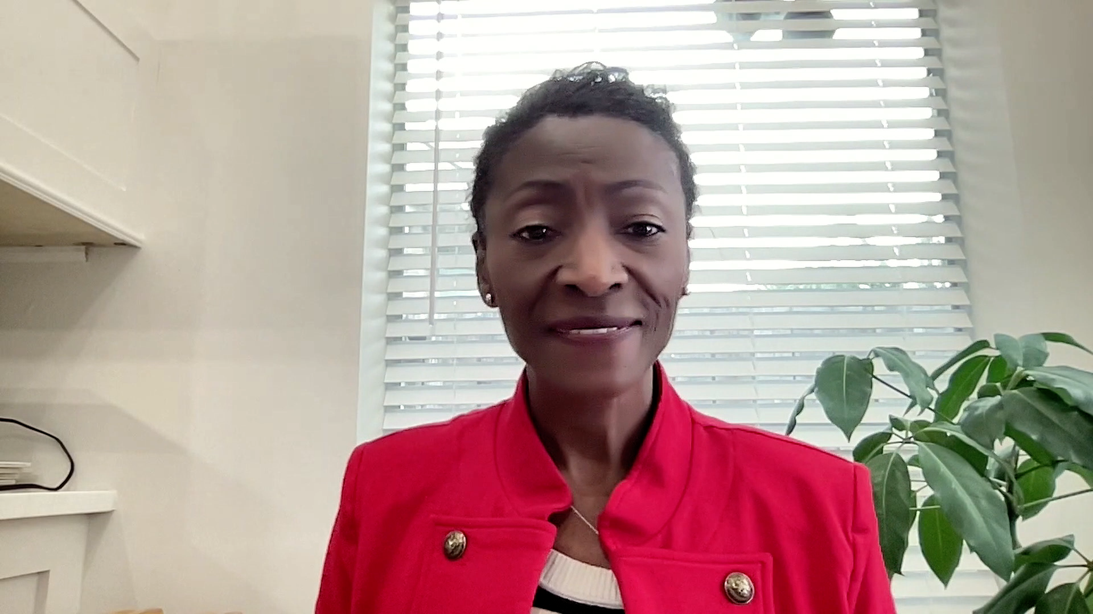
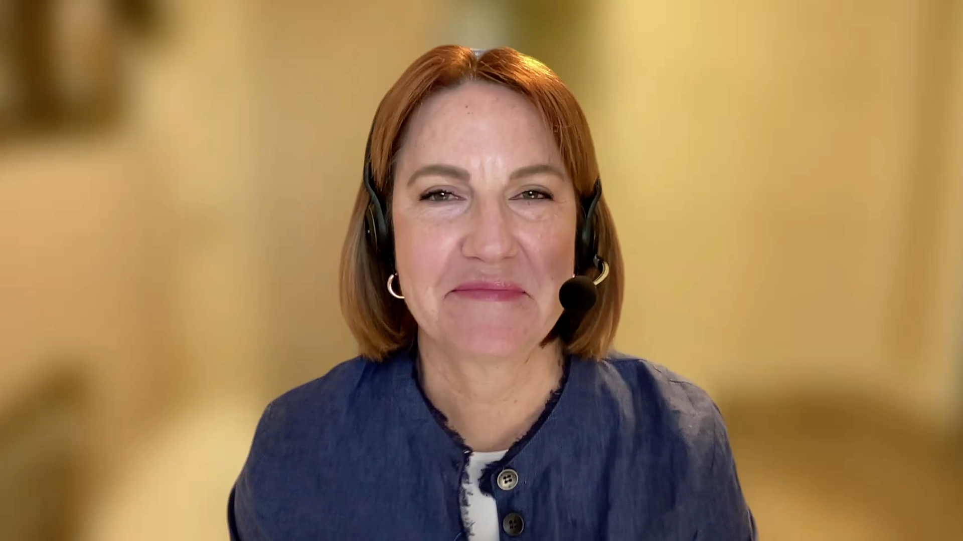
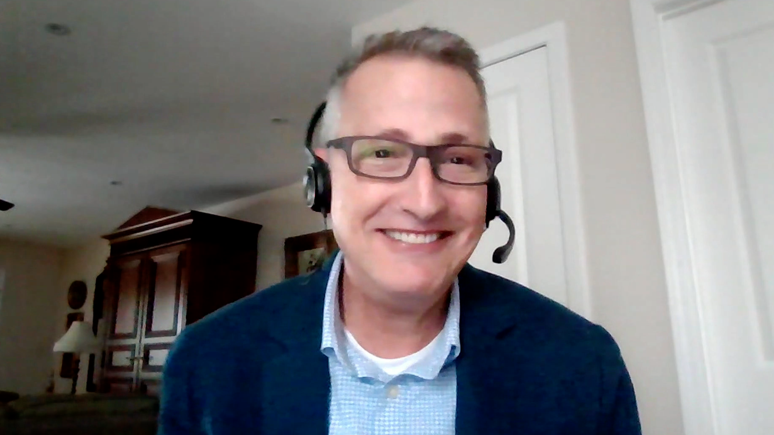
Consulting Nurse Faculty
Jacqueline Broadway-Duren, PhD, DNP, APRN, FNP-BC
The University of Texas MD Anderson Cancer Center
Houston, Texas
Jessica Mitchell, APRN, CNP, MPH
Mayo Clinic College of Medicine and Science
Rochester, Minnesota
Kathleen D Burns, RN, MSN, AGACNP-BC, OCN
City of Hope Comprehensive Cancer Center
Duarte, California
Tiffany A Richards, PhD, ANP-BC, AOCNP
The University of Texas MD Anderson Cancer Center
Houston, Texas
Sonia Glennie, ARNP, MSN, OCN
Swedish Cancer Institute Center for Blood Disorders
Seattle, Washington
Kimberly A Spickes, MNSc, RN, APRN, OCN, ACNP-BC
University of Arkansas for Medical Sciences
Little Rock, Arkansas
Amy Goodrich, CRNP
The Sidney Kimmel Comprehensive Cancer Center
Baltimore, Maryland
Ronald Stein, JD, MSN, NP-C, AOCNP
USC Norris Comprehensive Cancer Center
Los Angeles, California
https://www.ResearchToPractice.com/ONS2024Clips

Slide 11
Agenda
Introduction
Module 1: Overview of Antibody-Drug Conjugates (ADCs); HER2-Targeted ADCs for Breast Cancer — T-DM1, Trastuzumab Deruxtecan
Module 2: The Incidence and Management of Interstitial Lung Disease (ILD) with ADCs
Module 3: ADCs Targeting Other Signaling Pathways in Breast Cancer — Sacituzumab Govitecan, Datopotamab Deruxtecan, Patritumab Deruxtecan
Module 4: ADCs for Other Tumor Types and Toxicities Associated with ADCs

Slide 12
Agenda
Introduction
Module 1: Overview of Antibody-Drug Conjugates (ADCs); HER2-Targeted ADCs for Breast Cancer — T-DM1, Trastuzumab Deruxtecan
Module 2: The Incidence and Management of Interstitial Lung Disease (ILD) with ADCs
Module 3: ADCs Targeting Other Signaling Pathways in Breast Cancer — Sacituzumab Govitecan, Datopotamab Deruxtecan, Patritumab Deruxtecan
Module 4: ADCs for Other Tumor Types and Toxicities Associated with ADCs

Slide 13
Consulting Nursing Faculty Comments
Listening versus talking
Jessica Mitchell, APRN, CNP, MPH

Slide 14
Agenda
Introduction
Module 1: Overview of Antibody-Drug Conjugates (ADCs); HER2-Targeted ADCs for Breast Cancer — T-DM1, Trastuzumab Deruxtecan
Module 2: The Incidence and Management of Interstitial Lung Disease (ILD) with ADCs
Module 3: ADCs Targeting Other Signaling Pathways in Breast Cancer — Sacituzumab Govitecan, Datopotamab Deruxtecan, Patritumab Deruxtecan
Module 4: ADCs for Other Tumor Types and Toxicities Associated with ADCs

Slide 15
The Current and Future Role of ADCs in Cancer Therapy
Panel Discussion
FDA-approved indications for ADCs for various tumor types
Other promising ADCs in clinical development as anticancer therapy
Counseling patients regarding reasonable expectations about ADC efficacy and tolerability; customizing communication strategies based on individual preferences, educational background, cultural and linguistic background, et cetera
Suitability of ADCs for various patient populations, including those who are older or frail and those with preexisting comorbidities

Slide 16
FDA Grants Accelerated Approval to Fam-Trastuzumab-Deruxtecan-Nxki for Unresectable or Metastatic HER2-Positive Solid Tumors Press Release – April 5, 2024
“…the Food and Drug Administration granted accelerated approval to fam-trastuzumab deruxtecan-nxki for adult patients with unresectable or metastatic HER2-positive (IHC3+) solid tumors who have received prior systemic treatment and have no satisfactory alternative treatment options.
Efficacy was evaluated in 192 adult patients with previously treated unresectable or metastatic HER2-positive (IHC 3+) solid tumors who were enrolled in one of three multicenter trials: DESTINY-PanTumor02 (NCT04482309), DESTINY-Lung01 (NCT03505710), and DESTINY-CRC02 (NCT04744831).”
“The major efficacy outcome measure in all three trials was confirmed objective response rate (ORR), and an additional efficacy outcome was duration of response (DOR). All outcomes were assessed by independent central review (ICR) based on RECIST v1.1. In DESTINY-PanTumor02, ORR was 51.4% (95% CI: 41.7, 61.0) and median DOR was 19.4 months (range 1.3, 27.9+). In DESTINY-Lung01, ORR was 52.9% (95% CI: 27.8, 77.0) and median DOR was 6.9 months (range 4.0, 11.7+). In DESTINY-CRC02, ORR was 46.9% (95% CI: 34.3, 59.8), and DOR was 5.5 months (range 1.3+, 9.7+).”
https://www.fda.gov/drugs/resources-information-approved-drugs/fda-grants-accelerated-approval-fam-trastuzumab-deruxtecan-nxki-unresectable-or-metastatic-her2

Slide 17
HER2-Targeting Antibody-Drug Conjugates (ADCs)
mAb targets tumour-specific antigens
ADC Attributes | T-DM1 | T-DXd
Payload MoA | Antimicrotubule | Topoisomerase I inhibitor
Drug-to-antibody ratio | ~3.5:1 | ~8:1
Tumor-selective cleavable linker? | No | Yes
Evidence of bystander antitumor effect? | No | Yes
Tumour antigen internalised upon ADC binding
Potent
cytotoxic payload
Stable linker releases payload only in target cell
Bystander effect due to
payload release before internalisation or membrane permeability
Schmid P et al. San Antonio Breast Cancer Symposium 2021.

Slide 18
Trastuzumab Deruxtecan
Mechanism of action
Antibody-drug conjugate directed against HER2
Indications in other tumor types
For patients with unresectable or metastatic non-small cell lung cancer (NSCLC) whose tumors have activating HER2 (ERBB2) mutations, as detected by an FDA-approved test, and who have received a prior systemic therapy
For patients with locally advanced or metastatic HER2-positive (IHC 3+ or IHC 2+/ISH positive) gastric or gastroesophageal junction adenocarcinoma who have received a prior trastuzumab-based regimen.
For patients with unresectable or metastatic HER2-positive (IHC 3+) solid tumors who have received prior systemic therapy and have no satisfactory alternative therapeutic options
Recommended dose
5.4 mg/kg IV infusion q3wk until disease progression or unacceptable toxicity
6.4 mg/kg IV infusion q3wk until disease progression or unacceptable toxicity (gastric cancer)
Trastuzumab deruxtecan package insert, April 2024.

Slide 19
FDA-Approved Indications for Select ADCs for Solid Tumors
Agent | Initial indication | Approval date
Enfortumab vedotin (monotherapy) | Patients with locally advanced or metastatic urothelial cancer who have previously received a programmed death receptor-1 (PD-1) or programmed death-ligand (PD-L1) inhibitor and platinum-containing chemotherapy, or are ineligible for cisplatin-containing chemotherapy and have previously received one or more prior lines of therapy | Accelerated: 12/18/2019 Traditional: 7/9/2021
Enfortumab vedotin (plus pembrolizumab) | In combination with pembrolizumab for the treatment of adult patients with locally advanced or metastatic urothelial cancer | Accelerated: 4/3/2023 Traditional: 12/15/2023
Mirvetuximab soravtansine | Patients with folate receptor alpha (FRα)-positive, platinum-resistant epithelial ovarian, fallopian tube, or primary peritoneal cancer, who have received 1 to 3 prior systemic therapy regimens | Accelerated: 11/14/2022 Traditional: 3/22/2024
Tisotumab vedotin | Patients with recurrent or metastatic cervical cancer with disease progression on or after chemotherapy | Accelerated: 9/20/2021
https://www.fda.gov/drugs/resources-information-approved-drugs/oncology-cancer-hematologic-malignancies-approval-notifications

Slide 20
FDA-Approved Indications for Select ADCs for Heme Malignancies
Agent | Initial indication | Approval date
Gemtuzumab ozogamicin | Newly-diagnosed CD33-positive acute myeloid leukemia (AML) in adults and pediatric patients 1 month and older and in relapsed or refractory CD33-positive AML in adults and pediatric patients 2 years and older | Accelerated: 5/17/2000 Traditional: 9/1/2017
Brentuximab vedotin | Patients with Hodgkin lymphoma after failure of autologous stem cell transplant (ASCT) or after failure of at least two prior multi-agent chemotherapy regimens in patients who are not ASCT candidates | Accelerated: 8/19/2011 Traditional: 8/18/2015
Inotuzumab ozogamicin | Adult patients with relapsed or refractory CD22-positive B-cell precursor acute lymphoblastic leukemia (ALL) | Traditional: 8/17/2017
Polatuzumab vedotin | In combination with bendamustine and a rituximab product for the treatment of adult patients with relapsed or refractory DLBCL, NOS, after at least two prior therapies | Accelerated: 6/10/2019 Traditional: 4/19/2023
Loncastuximab tesirine | Patients with relapsed or refractory large B-cell lymphoma after 2 or more lines of systemic therapy, including diffuse large B-cell lymphoma (DLBCL) not otherwise specified, DLBCL arising from low-grade lymphoma, and high-grade B-cell lymphoma | Accelerated: 4/23/2021
https://www.fda.gov/drugs/resources-information-approved-drugs/oncology-cancer-hematologic-malignancies-approval-notifications

Slide 21
Antibody-Drug Conjugates (ADCs) as Cancer Treatment; Overview of HER2-Targeted ADCs for Breast Cancer — T-DM1, Trastuzumab Deruxtecan
Dr Hamilton
Nashville, Tennessee
Dr Rugo
San Francisco, California
Specificity of monoclonal antibodies and ability to target cancer while avoiding normal tissues
Rationale for conjugating monoclonal antibodies with cytotoxic drugs; theoretical improvement of chemotherapy efficacy while reducing systemic exposure and toxicity
Structural components of commercially available and investigational ADCs
Direct mechanism of antitumor activity of ADCs
Other means by which ADCs can elicit an antitumor effect, such as bystander killing, antibody-dependent cellular toxicity and complement-dependent cytotoxicity
Optimal timing for approved ADCs or consideration of a clinical trial with one of these agents
Mode of administration, dose and schedule of various ADCs
Recommended premedications for patients about to begin therapy with an ADC
Known drug-drug interactions between ADCs and other classes of agents

Slide 22
Ado-Trastuzumab Emtansine (T-DM1)
Mechanism of action
Antibody-drug conjugate directed against HER2
Indication in breast cancer
For patients with HER2-positive, metastatic breast cancer who previously received trastuzumab and a taxane, separately or in combination. Patients should have either received prior therapy for metastatic disease or experienced disease recurrence during or within 6 months of completing adjuvant therapy
For patients with HER2-positive localized breast cancer who have residual invasive disease after receiving neoadjuvant taxane and trastuzumab-based therapy
Recommended dose for breast cancer
3.6 mg/kg IV infusion q3wk (21-day cycle) until disease progression or unacceptable toxicity, or a total of 14 cycles for patients with localized breast cancer
Ado-trastuzumab emtansine package insert, February 2022.

Slide 23
Trastuzumab Deruxtecan (T-DXd)
Mechanism of action
Antibody-drug conjugate directed against HER2
Indication in breast cancer
For patients with unresectable or metastatic HER2-positive (IHC 3+ or ISH positive) breast cancer who have received a prior anti-HER2-based regimen either in the metastatic setting or in the (neo)adjuvant setting and have experienced disease recurrence during or within 6 months of completing therapy
For patients with unresectable or metastatic HER2-low (IHC 1+ or IHC 2+/ISH negative) breast cancer who have received a prior chemotherapy in the metastatic setting or have experienced disease recurrence during or within 6 months of completing adjuvant chemotherapy
Recommended dose for breast cancer
5.4 mg/kg IV infusion q3wk until disease progression or unacceptable toxicity
Trastuzumab deruxtecan package insert, April 2024.

Slide 24
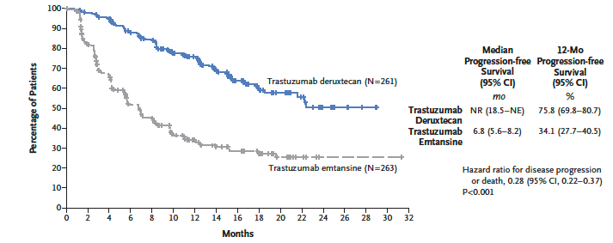
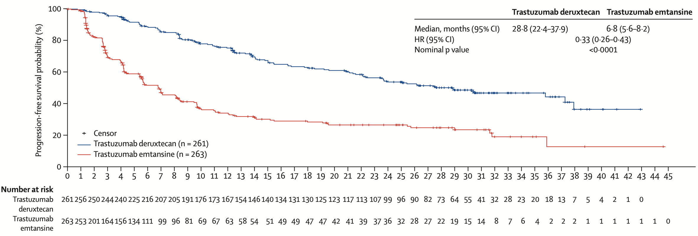
DESTINY-Breast03: Progression-Free Survival by BICR
First Interim Analysis
Updated Results
Cortes J et al. N Engl J Med 2022;386:1143-54; Hurvitz SA et al. Lancet 2023;401:105-17.
BICR = blinded independent central review

Slide 25
T-DXd Mechanism of Action, Bystander Effect and Rationale for Targeting HER2-Low Breast Cancer
ORR = objective response rate
Modi S et al. ASCO 2022;Abstract LBA3. Modi S et al. N Engl J Med 2022;387(1):9-20.

Slide 26
Jamie Carroll, APRN, MSN, CNP
What I tell my patients with HER2-positive and HER2-low breast cancer about the mechanism of action of and acute side effects associated with trastuzumab deruxtecan

Slide 27
Kelly EH Goodwin, MSN, RN, ANP-BC
What I tell my patients with lung cancer and HER2 mutations about the mechanism of action of and acute side effects associated with trastuzumab deruxtecan

Slide 28
Agenda
Introduction
Module 1: Overview of Antibody-Drug Conjugates (ADCs); HER2-Targeted ADCs for Breast Cancer — T-DM1, Trastuzumab Deruxtecan
Module 2: The Incidence and Management of Interstitial Lung Disease (ILD) with ADCs
Module 3: ADCs Targeting Other Signaling Pathways in Breast Cancer — Sacituzumab Govitecan, Datopotamab Deruxtecan, Patritumab Deruxtecan
Module 4: ADCs for Other Tumor Types and Toxicities Associated with ADCs

Slide 29
The Incidence and Management of Interstitial Lung Disease (ILD) with ADCs
Dr Hamilton
Nashville, Tennessee
Dr Rugo
San Francisco, California
Pathophysiology of ILD associated with ADCs; baseline risk factors for the development of ILD
Rates, severity and timing of ILD in clinical trials of various ADCs
Appropriate workup for patients suspected of experiencing therapy-related ILD; strategies to distinguish drug-related pulmonary toxicity from other potential causes
Guidelines for treatment modifications and discontinuation for patients experiencing complications from ILD; indications for restarting ADC therapy after resolution of symptoms
Utility of other supportive care measures for patients experiencing ILD, such as corticosteroids and oxygen supplementation

Slide 30
DESTINY-Breast02: Adjudicated Drug-Related ILD/Pneumonitis
 | Adjudicated as drug-related ILD
 | Grade 1 | Grade 2 | Grade 3 | Grade 4 | Grade 5 | Any grade
T-DXd (n = 404) | 11 (2.7) | 26 (6.4) | 3 (0.7) | 0 | 2 (0.5) | 42 (10.4)
TPC (n = 195) | 0 | 0 | 1 (0.5) | 0 | 0 | 1 (0.5)
Median time to onset of adjudicated drug-related ILD was 209.5 days (41-628 days) with T-DXd
Left ventricular (LV) dysfunction
T-DXd arm, 18 (4.5%) patients experienced an LV dysfunction event
2 (0.5%) patients had a Grade ≥3 event
TPC arm, 3 (1.5%) patients experienced an LV dysfunction event
1 (0.5%) patient had a Grade ≥3 event
Andre F et al. Lancet 2023;401(10390):1773-85; Krop I et al. San Antonio Breast Cancer Symposium 2022;Abstract GS2-01.

Slide 31
JCO Oncol Pract 2023;19:539-46.
JCO Oncol Pract 2023;19:526-27.

Slide 32
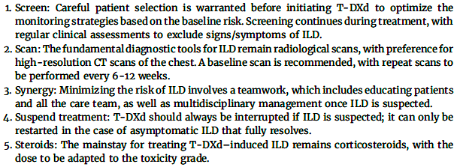
The Five “S” Rules: Strategies to Minimize the Risk and Impact of ILD
Tarantino P and SM Tolaney. JCO Oncol Pract 2023;19:526-27.

Slide 33
Jamie Carroll, APRN, MSN, CNP
What I tell my patients with breast cancer about to begin therapy with trastuzumab deruxtecan about screening for and management of ILD

Slide 34
Kelly EH Goodwin, MSN, RN, ANP-BC
What I tell my patients with lung cancer about to begin therapy with trastuzumab deruxtecan about screening for and management of ILD

Slide 35
Agenda
Introduction
Module 1: Overview of Antibody-Drug Conjugates (ADCs); HER2-Targeted ADCs for Breast Cancer — T-DM1, Trastuzumab Deruxtecan
Module 2: The Incidence and Management of Interstitial Lung Disease (ILD) with ADCs
Module 3: ADCs Targeting Other Signaling Pathways in Breast Cancer — Sacituzumab Govitecan, Datopotamab Deruxtecan, Patritumab Deruxtecan
Module 4: ADCs for Other Tumor Types and Toxicities Associated with ADCs

Slide 36
Other ADCs for Breast Cancer; Sacituzumab Govitecan, Datopotamab Deruxtecan, Patritumab Deruxtecan
Dr Hamilton
Nashville, Tennessee
Dr Rugo
San Francisco, California
Optimal timing for initiation of approved ADCs or consideration of a clinical trial evaluating one of these agents
Mode of administration, dose and schedule of various ADCs
Recommended premedications for patients about to begin therapy with an ADC
Known drug-drug interactions between ADCs and other classes of agents
Sequencing of ADCs for patients with HER2-low and HER2-negative breast cancer

Slide 37
Sacituzumab Govitecan
Mechanism of action
Antibody-drug conjugate directed against TROP2
Indication in breast cancer
For patients with unresectable locally advanced or metastatic triple-negative breast cancer (mTNBC) who have received 2 or more prior systemic therapies, at least 1 of them for metastatic disease
For patients with unresectable locally advanced or metastatic hormone receptor (HR)-positive, HER2-negative (IHC 0, IHC 1+ or IHC 2+/ISH negative) breast cancer who have received endocrine-based therapy and at least 2 additional systemic therapies in the metastatic setting
Recommended dose for breast cancer
10 mg/kg IV infusion once weekly on days 1 and 8 of continuous 21-day treatment cycles until disease progression or unacceptable toxicity
Sacituzumab govitecan package insert, February 2023.

Slide 38
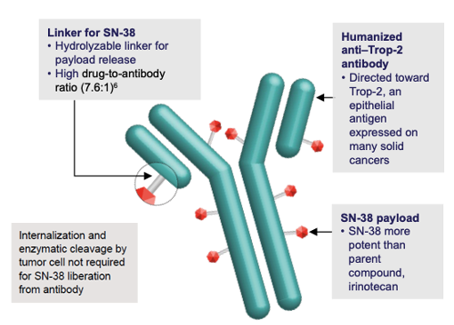
Sacituzumab Govitecan
Courtesy of Hope S Rugo, MD.

Slide 39
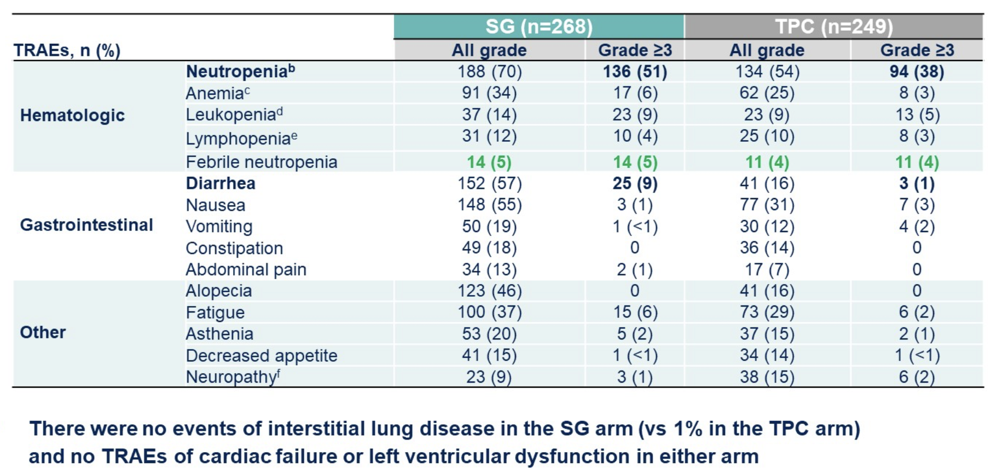
Sacituzumab Govitecan: Safety Profile in the TROPiCS-02 Trial
SG = sacituzumab govitecan; TPC = treatment of physician's choice; TRAEs = treatment-related adverse events
Rugo HS et al. Lancet 2023;402(10411):1423-33. Rugo HS et al. ASCO 2022;Abstract LBA1001.

Slide 40
Datopotamab Deruxtecan (Dato-DXd)
Mechanism of action
Antibody-drug conjugate directed against TROP2
Indication
Investigational
Key clinical trial in breast cancer
Phase III TROPION-Breast01 trial of datopotamab deruxtecan versus investigator’s choice of chemotherapy for patients with inoperable or metastatic HR-positive, HER2-negative breast cancer who have received 1 or 2 prior lines of systemic chemotherapy
Bardia A et al. San Antonio Breast Cancer Symposium 2023;Abstract GS02-01.

Slide 41
Datopotamab Deruxtecan (Dato-DXd)
Bardia A et al. ESMO 2023;Abstract LBA11.

Slide 42
TROPION-Breast01: Adverse Events of Clinical Interest
Bardia A et al. San Antonio Breast Cancer Symposium 2023;Abstract GS02-01.

Slide 43
Datopotamab Deruxtecan Biologics License Application Accepted in the US for Patients with Previously Treated Metastatic HR-Positive, HER2-Negative Breast Cancer Press Release – April 2, 2024
“…the Biologics License Application (BLA) for datopotamab deruxtecan (Dato-DXd) has been accepted in the US for the treatment of adult patients with unresectable or metastatic hormone receptor (HR)-positive, HER2-negative (IHC 0, IHC 1+ or IHC 2+/ISH-) breast cancer who have received prior systemic therapy for unresectable or metastatic disease. The Prescription Drug User Fee Act date, the US Food and Drug Administration (FDA) action date for its regulatory decision, is during the first quarter of 2025.
The BLA is based on results from the pivotal TROPION-Breast01 Phase III trial in which datopotamab deruxtecan demonstrated a statistically significant and clinically meaningful improvement for the dual primary endpoint of progression-free survival (PFS) compared to investigator’s choice of chemotherapy in patients with unresectable or metastatic HR-positive, HER2-negative breast cancer previously treated with endocrine-based therapy and at least one systemic therapy. For the dual primary endpoint of overall survival (OS), interim results numerically favoured datopotamab deruxtecan over chemotherapy but were not mature at the time of data cut-off. The trial is ongoing and OS will be assessed at future analyses.”
https://www.astrazeneca.com/media-centre/press-releases/2024/fda-accepts-dato-dxd-bla-for-breast-cancer.html

Slide 44
Patritumab Deruxtecan (HER3-DXd)
Mechanism of action
Antibody-drug conjugate directed against HER3
Indication
Investigational (breast cancer, lung cancer)
Key clinical trials
Phase I/II multicenter trial of patritumab deruxtecan for previously treated HER3-expressing metastatic breast cancer
Multiple ongoing Phase II studies to evaluate patritumab deruxtecan in the metastatic setting (ICARUS-BREAST01, BRE 354)
Ongoing studies to evaluate patritumab deruxtecan as neoadjuvant therapy (TOT-HER3, VALENTINE)
Phase II HERTHENA-Lung01 study demonstrating efficacy for EGFR-mutated NSCLC
Ongoing Phase III HERTHENA-Lung02 study for EGFR-mutated NSCLC after a third-generation EGFR tyrosine kinase inhibitor
Krop IE et al. J Clin Oncol 2023;41:5550-60.

Slide 45
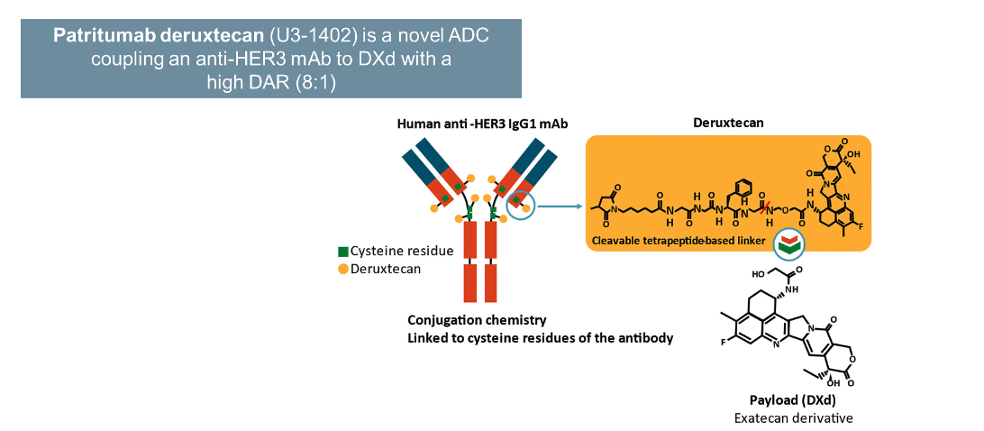
Patritumab Deruxtecan (HER3-DXd)
Krop IE et al. ASCO 2022;Abstract 1002.

Slide 46
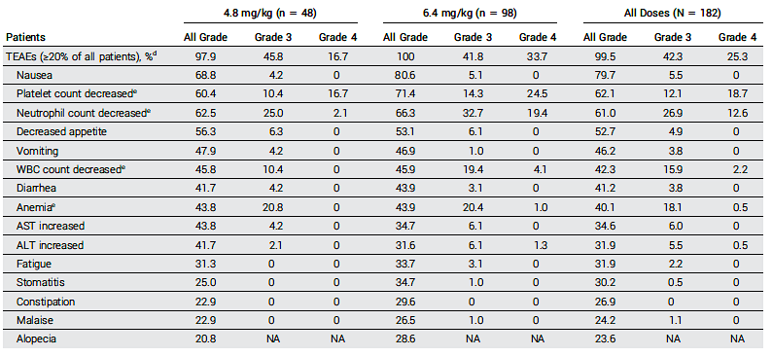
Adverse Events in a Phase I/II Study of Patritumab Deruxtecan for Previously Treated HER3-Positive Metastatic Breast Cancer
Krop IE et al. J Clin Oncol 2023;41:5550-60.

Slide 47
Treatment-Related ILD in a Phase I/II Study of Patritumab Deruxtecan for Previously Treated HER3-Positive Metastatic Breast Cancer
Krop IE et al. J Clin Oncol 2023;41:5550-60.

Slide 48
Jamie Carroll, APRN, MSN, CNP
What I tell my patients with breast cancer about the mechanism of action of and side effects associated with sacituzumab govitecan

Slide 49
Kelly EH Goodwin, MSN, RN, ANP-BC
What I tell my patients with lung cancer about the mechanisms of action of and side effects associated with datopotamab deruxtecan and patritumab deruxtecan

Slide 50
Agenda
Introduction
Module 1: Overview of Antibody-Drug Conjugates (ADCs); HER2-Targeted ADCs for Breast Cancer — T-DM1, Trastuzumab Deruxtecan
Module 2: The Incidence and Management of Interstitial Lung Disease (ILD) with ADCs
Module 3: ADCs Targeting Other Signaling Pathways in Breast Cancer — Sacituzumab Govitecan, Datopotamab Deruxtecan, Patritumab Deruxtecan
Module 4: ADCs for Other Tumor Types and Toxicities Associated with ADCs

Slide 51
Cytopenias Associated with ADCs
Dr Hamilton
Nashville, Tennessee
Dr Rugo
San Francisco, California
Educating patients regarding the capacity of ADCs to cause acute chemotherapy-like side effects
Incidence and severity of neutropenia, thrombocytopenia and anemia with approved and investigational ADCs
Appropriate monitoring of complete blood counts during therapy
Thresholds for dose modification, treatment interruption or treatment discontinuation for patients experiencing cytopenias

Slide 52
Mucositis/Stomatitis Associated with Certain ADCs
Dr Hamilton
Nashville, Tennessee
Dr Rugo
San Francisco, California
Incidence and severity of mucositis/stomatitis with various approved and investigational ADCs
Educating patients about the importance of oral hygiene during treatment with ADCs known to cause mucositis/stomatitis
Role of prescription steroid mouthwash or homemade mouth rinses, prophylactic antibiotics/antifungals and pain medications for patients at risk for or experiencing mucositis/stomatitis
Dietary recommendations for patients experiencing mucositis/stomatitis; utility of meal replacement shakes or protein powders for those not receiving adequate nutrition

Slide 53
Rare Cardiac Toxicities with HER2-Targeted ADCs
Dr Hamilton
Nashville, Tennessee
Dr Rugo
San Francisco, California
Pathophysiology of the cardiotoxicity associated with anti-HER2 therapies, including ADCs
Incidence of left ventricular dysfunction noted with HER2-targeted ADCs in clinical trial experiences
Appropriate monitoring of left ventricular ejection fraction (LVEF) at baseline and during treatment with HER2-targeted ADCs
Threshold for treatment interruption for patients experiencing LVEF decrease; indications for restarting HER2-targeted ADC therapy after recovery
Role of interdisciplinary coordination with cardiologists when monitoring for and managing cardiac toxicities associated with HER2-targeted ADCs

Slide 54
Ocular Toxicities of ADCs
Dr Hamilton
Nashville, Tennessee
Dr Rugo
San Francisco, California
Pathophysiology of ocular adverse events associated with certain ADCs; spectrum, incidence and severity of ocular toxicities with different agents
Optimal patient counseling and education regarding signs of ocular toxicity and the importance of early reporting of symptoms
Guidelines for treatment modification for patients experiencing ocular complications of ADCs
Utility of other prophylactic and supportive care measures to mitigate and/or manage ocular toxicities
Importance of interdisciplinary coordination with eye-care professionals in the identification and management of treatment-related ocular events

Slide 55
Gastrointestinal and Other Side Effects of ADCs
Dr Hamilton
Nashville, Tennessee
Dr Rugo
San Francisco, California
Rates of various gastrointestinal issues, such as nausea/vomiting, diarrhea, decreased appetite and constipation, among patients receiving ADC therapy
Role of prophylactic antiemetics and/or antidiarrheals for patients about to begin treatment with an ADC
Educating patients regarding strategies to maintain proper nutrition during treatment
Role of complementary therapies such as acupuncture in managing gastrointestinal side effects of ADCs
Incidence and management of peripheral neuropathy associated with various ADCs
Strategies to mitigate the potential psychosocial ramifications of visible side effects of ADC treatment, such as alopecia
Spectrum of other toxicities associated with 1 or more ADCs used in the treatment of cancer, such as fatigue, cutaneous reactions, hemorrhage, effusion/edema and hyperglycemia
Collaborative role of oncology nurses in comprehensive biopsychosocial care for patients with cancer; capacity to optimize clinical and quality-of-life outcomes with anticancer therapies, including ADCs

Slide 56
Patritumab Deruxtecan (HER3-DXd) Targeting HER3 May Address Multiple EGFR TKI Resistance Mechanisms in NSCLC
HER3-DXd is an antibody-drug conjugate with 3 components:
A fully human anti-HER3 IgG1 mAb (patritumab), covalently linked to:
A topoisomerase I inhibitor payload, an exatecan derivative, via
A tetrapeptide-based cleaver linker
TKI = tyrosine kinase inhibitor
Janne PA et al. ASCO 2021;Abstract 9007.

Slide 57
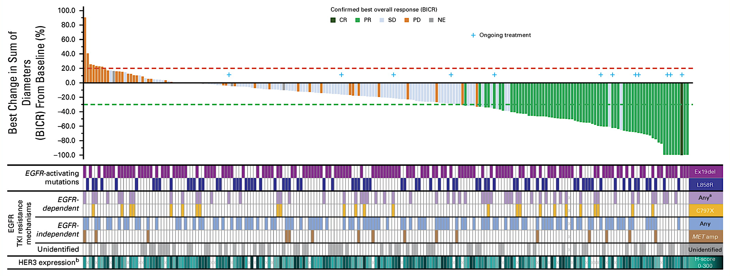
Patritumab Deruxtecan Demonstrated Efficacy for NSCLC with EGFR Mutations in the Phase II HERTHENA-Lung01 Study
CR = complete response; PR = partial response; SD = stable disease; PD = progressive disease; NE = not evaluated
Yu HA et al. J Clin Oncol 2023;41(35):5363-75.

Slide 58
Ifinatamab Deruxtecan (I-DXd)
Patel MR et al. ESMO 2023;Abstract 690P.

Slide 59
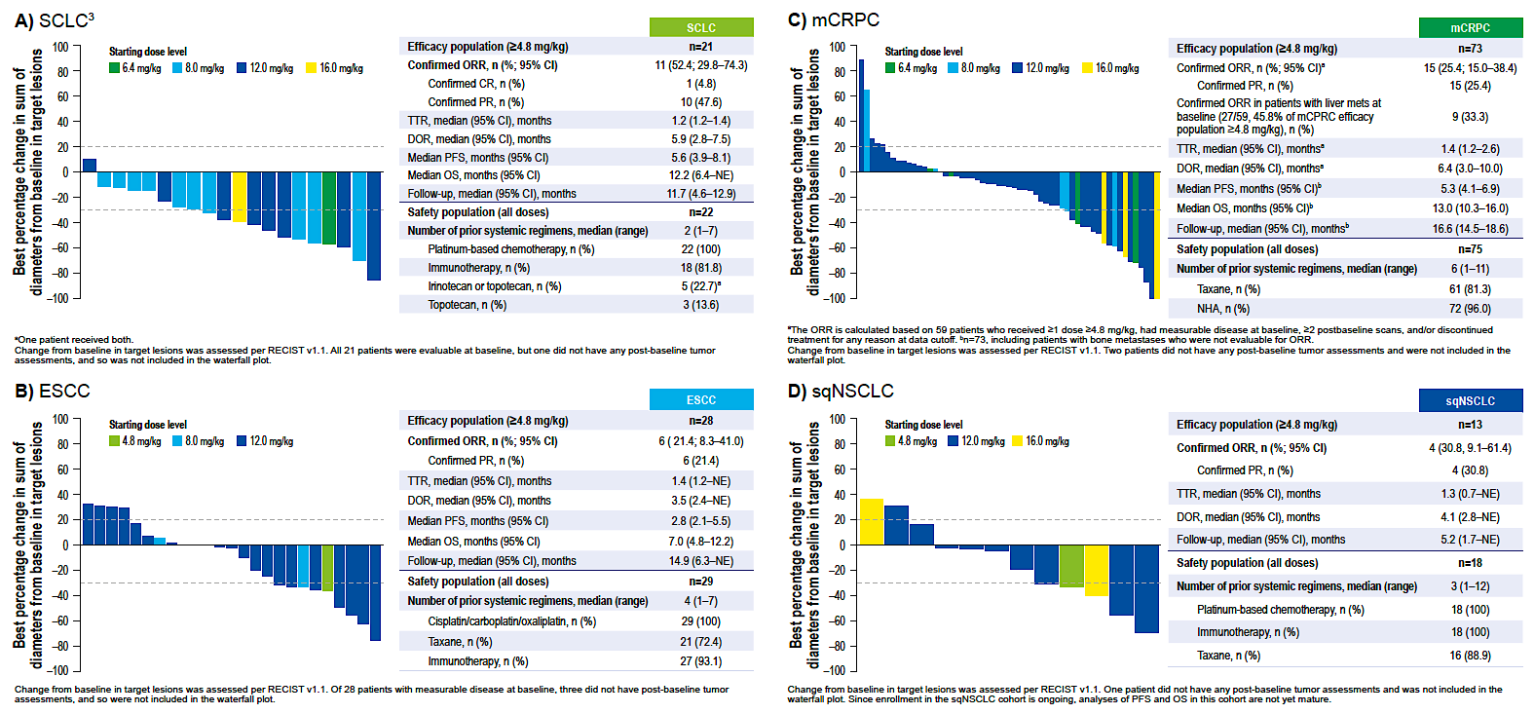
Phase I/II Study of Ifinatamab Deruxtecan for Advanced Solid Tumors
Patel MR et al. ESMO 2023;Abstract 690P.

Slide 60
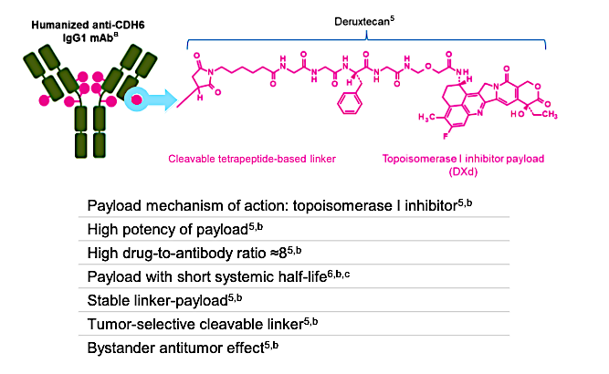
Raludotatug Deruxtecan (R-DXd)
Moore K et al. ESMO 2023;Abstract 745MO.

Slide 61
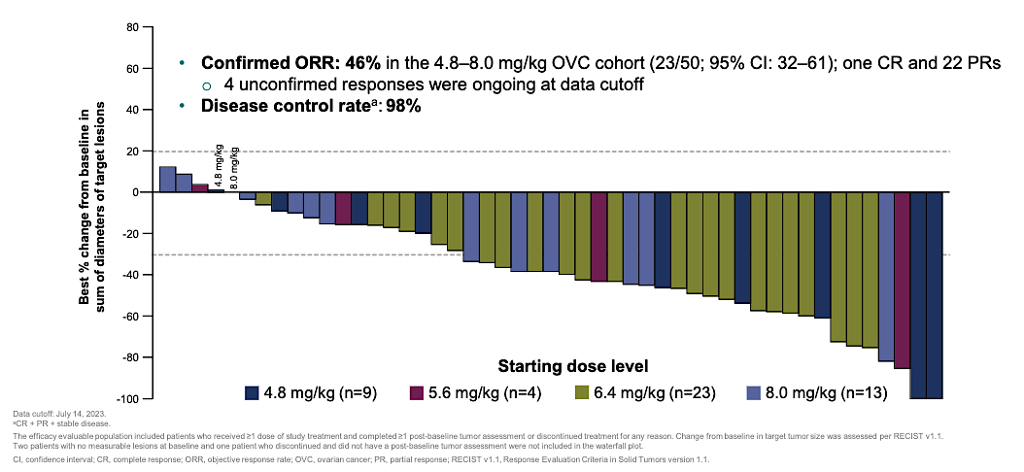
Phase I Study of Raludotatug Deruxtecan for Pretreated Ovarian Cancer
Moore K et al. ESMO 2023;Abstract 745MO.

Slide 62
Consulting Nursing Faculty Comments
Importance of mentorship and giving back
Ronald Stein, JD, MSN, NP-C, AOCNP

Slide 63
Consulting Nursing Faculty Comments
Humor in oncology
Kathleen D Burns, RN, MSN, AGACNP-BC, OCN

