Slide 1
The Implications of Recent Datasets for the Current and Future Management of Non-Small Cell Lung Cancer with Actionable Targets Beyond EGFR A CME/MOC-Accredited Live Webinar in Conjunction with the IASLC 2024 World Conference on Lung Cancer
Wednesday, September 11, 2024 5:00 PM – 6:00 PM ET
Faculty
Ibiayi Dagogo-Jack, MD
Corey J Langer, MD
Moderator
Neil Love, MD

Slide 2

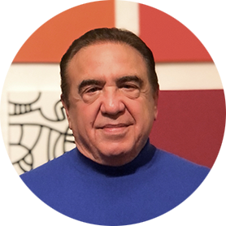

Faculty
Ibiayi Dagogo-Jack, MD
Assistant Professor of Medicine
Harvard Medical School
Massachusetts General Hospital
Boston, Massachusetts
MODERATOR
Neil Love, MD Research To Practice Miami, Florida
Corey J Langer, MD
Director of Thoracic Oncology
Abramson Cancer Center
Professor of Medicine
Perelman School of Medicine
University of Pennsylvania
Philadelphia, Pennsylvania

Slide 3
Dr Dagogo-Jack — Disclosures
Consulting Agreements | AstraZeneca Pharmaceuticals LP, Bayer HealthCare Pharmaceuticals, BostonGene, Bristol Myers Squibb, EpiQ, Foundation Medicine, Genentech, a member of the Roche Group, Lilly, Merus, Novocure Inc, Pfizer Inc, Roche Laboratories Inc, Sanofi, Thermo Fisher Scientific

Slide 4
Dr Langer — Disclosures
Consulting/Advisory | AbbVie Inc, Amgen Inc, AstraZeneca Pharmaceuticals LP, Boehringer Ingelheim Pharmaceuticals Inc, Daiichi Sankyo Inc, Genentech, a member of the Roche Group, Gilead Sciences Inc, GSK, Jazz Pharmaceuticals Inc, Merck, Mirati Therapeutics Inc, Novocure Inc, Pfizer Inc, Regeneron Pharmaceuticals Inc, Sanofi, Takeda Pharmaceuticals USA Inc
Contracted Research | Amgen Inc, AstraZeneca Pharmaceuticals LP, Daiichi Sankyo Inc, FUJIFILM Pharmaceuticals USA Inc, Incyte Corporation, Inovio Pharmaceuticals Inc, Janssen Biotech Inc, Lilly, Merck, Navire Pharma, Takeda Pharmaceuticals USA Inc, Trizell
Data and Safety Monitoring Boards/Committees | Incyte Corporation, Mirati Therapeutics Inc, Oncocyte, Razor Genomics, Summit Therapeutics
Medical Writing Support | Novartis
Nonrelevant Financial Relationships | Medscape, OncLive, Projects in Knowledge, RTOG Foundation, VA (VALOR)

Slide 5
Dr Love — Disclosures
Dr Love is president and CEO of Research To Practice. Research To Practice receives funds in the form of educational grants to develop CME activities from the following companies: AbbVie Inc, Adaptive Biotechnologies Corporation, ADC Therapeutics, Agios Pharmaceuticals Inc, Alexion Pharmaceuticals, Amgen Inc, Array BioPharma Inc, a subsidiary of Pfizer Inc, Astellas, AstraZeneca Pharmaceuticals LP, Aveo Pharmaceuticals, Bayer HealthCare Pharmaceuticals, BeiGene Ltd, BeyondSpring Pharmaceuticals Inc, Black Diamond Therapeutics Inc, Blueprint Medicines, Boehringer Ingelheim Pharmaceuticals Inc, Bristol Myers Squibb, Celgene Corporation, Clovis Oncology, Coherus BioSciences, CTI BioPharma, a Sobi Company, Daiichi Sankyo Inc, Eisai Inc, Elevation Oncology Inc, EMD Serono Inc, Epizyme Inc, Exact Sciences Corporation, Exelixis Inc, Five Prime Therapeutics Inc, Foundation Medicine, G1 Therapeutics Inc, Genentech, a member of the Roche Group, Genmab US Inc, Geron Corporation, Gilead Sciences Inc, Grail Inc, GSK, Halozyme Inc, Helsinn Healthcare SA, Hologic Inc, ImmunoGen Inc, Incyte Corporation, Ipsen Biopharmaceuticals Inc, Janssen Biotech Inc, administered by Janssen Scientific Affairs LLC, Jazz Pharmaceuticals Inc, Karyopharm Therapeutics, Kite, A Gilead Company, Kronos Bio Inc, Legend Biotech, Lilly, Loxo Oncology Inc, a wholly owned subsidiary of Eli Lilly & Company, MEI Pharma Inc, Merck, Mersana Therapeutics Inc, Mirati Therapeutics Inc, Mural Oncology Inc, Natera Inc, Novartis, Novartis Pharmaceuticals Corporation on behalf of Advanced Accelerator Applications, Novocure Inc, Oncopeptides, Pfizer Inc, Pharmacyclics LLC, an AbbVie Company, Puma Biotechnology Inc, Regeneron Pharmaceuticals Inc, R-Pharm US, Sanofi, Seagen Inc, Servier Pharmaceuticals LLC, SpringWorks Therapeutics Inc, Stemline Therapeutics Inc, Sumitomo Dainippon Pharma Oncology Inc, Syndax Pharmaceuticals, Taiho Oncology Inc, Takeda Pharmaceuticals USA Inc, TerSera Therapeutics LLC, Tesaro, A GSK Company, TG Therapeutics Inc, Turning Point Therapeutics Inc, Verastem Inc, and Zymeworks Inc.

Slide 6
Commercial Support
This activity is supported by educational grants from Bristol Myers Squibb, Genentech, a member of the Roche Group, and Lilly.
Research To Practice CME Planning Committee Members, Staff and Reviewers
Planners, scientific staff and independent reviewers for Research To Practice have no relevant conflicts of interest to disclose.

Slide 7
This educational activity contains discussion of non-FDA-approved uses of agents and regimens. Please refer to official prescribing information for each product for approved indications.

Slide 8
Agenda
Introduction: A Model for Targeted Treatment in Non-Small Cell Lung Cancer (NSCLC)
Module 1: NSCLC with ALK, ROS1 and NTRK Rearrangements — Dr Langer
Module 2: Current and Future Treatment of Metastatic NSCLC with RET, MET, HER2 and KRAS Alterations — Dr Dagogo-Jack

Slide 9
Agenda
Introduction: A Model for Targeted Treatment in Non-Small Cell Lung Cancer (NSCLC)
Module 1: NSCLC with ALK, ROS1 and NTRK Rearrangements — Dr Langer
Module 2: Current and Future Treatment of Metastatic NSCLC with RET, MET, HER2 and KRAS Alterations — Dr Dagogo-Jack

Slide 10
General Issues Related to the Management of NSCLC
Where do ROS1-, NTRK-, RET-, MET-, BRAF-, KRAS- and HER2-targeted treatments fit in?
Adjuvant therapy
Stage III resectable disease
First-line treatment of metastatic disease
Brain metastases (without radiation therapy)
Role of immunotherapy, if any

Slide 11
Agenda
Introduction: A Model for Targeted Treatment in Non-Small Cell Lung Cancer (NSCLC)
Module 1: NSCLC with ALK, ROS1 and NTRK Rearrangements — Dr Langer
Module 2: Current and Future Treatment of Metastatic NSCLC with RET, MET, HER2 and KRAS Alterations — Dr Dagogo-Jack

Slide 12
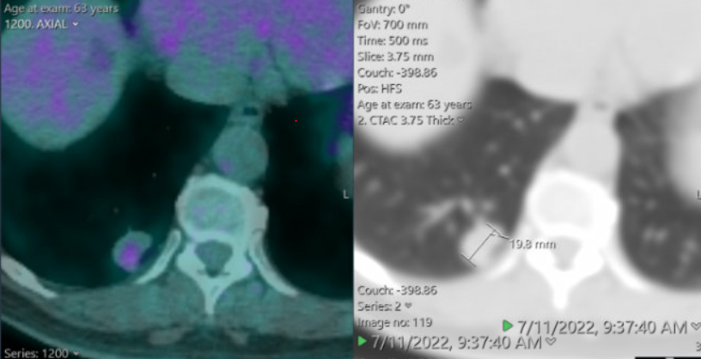
Case Presentation – Dr Langer: ALK (+) Adjuvant
57 yo WM never smoker, after a long motorcycle trip across several states, developed pain c/w L renal colic, presented to a local ED in NYS where CT A/P demonstrated a non-obstructing L renal stone and "incidental" 2-3 cm RLL nodule c/w malignancy
Discharged home w/ pain meds
Passed the stone spontaneously in < 1 wk
Subsequently seen by Penn pulmonologist
PET/CT demonstrated a 2.8 cm RLL nodule w/ SUV 3, no other suspicious uptake.
Clinical stage: Stage IA3 (cT1c, cN0, cM0)
07/22/22: Robotic R upper lobectomy w/ LN dissection. Path c/w moderately differentiated adenocarcinoma w/ + Levels 7, 11, 12, 4 nodes (none seen pre-op on CT or PET)
08/03/22: MRI Brain unremarkable
Final pathologic stage: IIIA - (pT1c, pN2, cM0) - 2.8 cm, 6/18 nodes
PD-L1: 1%. Fusion panel (+) EML4ALK. NGS otherwise (-)
What’s the next step?

Slide 13
Case Presentation – Dr Langer: ALK (+) Adjuvant (Continued)
57 yo WM never smoker, after a long motorcycle trip across several states, developed pain c/w L renal colic, presented to a local ED in NYS where CT A/P demonstrated a non-obstructing L renal stone and "incidental" 2-3 cm RLL nodule c/w malignancy
Discharged home w/ pain meds
Passed the stone spontaneously in < 1 wk
Subsequently seen by Penn pulmonologist
PET/CT demonstrated a 2.8 cm RLL nodule w/ SUV 3, no other suspicious uptake.
Clinical stage: Stage IA3 (cT1c, cN0, cM0)
07/22/22: Robotic R upper lobectomy w/ LN dissection. Path c/w moderately differentiated adenocarcinoma w/ + Levels 7, 11, 12, 4 nodes (none seen pre-op on CT or PET)
08/03/22: MRI Brain unremarkable
Final pathologic stage: IIIA - (pT1c, pN2, cM0) - 2.8 cm, 6/18 nodes
PD-L1: 1%. Fusion panel (+) EML4ALK. NGS otherwise (-)
What’s the next step?
Pt received DDP-Pem x 3 cycles with 4th cycle changed to Carbo/Pem b/o cumulative GI toxicity and vertigo
Long discussion re: utility of alectinib (preceded unveiling of ALINA data).
After consultation with various ALK experts, went ahead with full dose: 600 mg BID

Slide 14
Contemporary Care for Pts with NSCLC and ALK, ROS1 and NTRK State-of-the-Art – post ASCO and WCLC 2024
Division of Hematology & Oncology
Corey J. Langer, MD, FACP
Director of Thoracic Oncology
Abramson Cancer Center
Professor of Medicine
Perelman School of Medicine
University of Pennsylvania
Philadelphia, PA 19104
Corey.langer@uphs.upenn.edu
CP: 215-806-6152

Slide 15
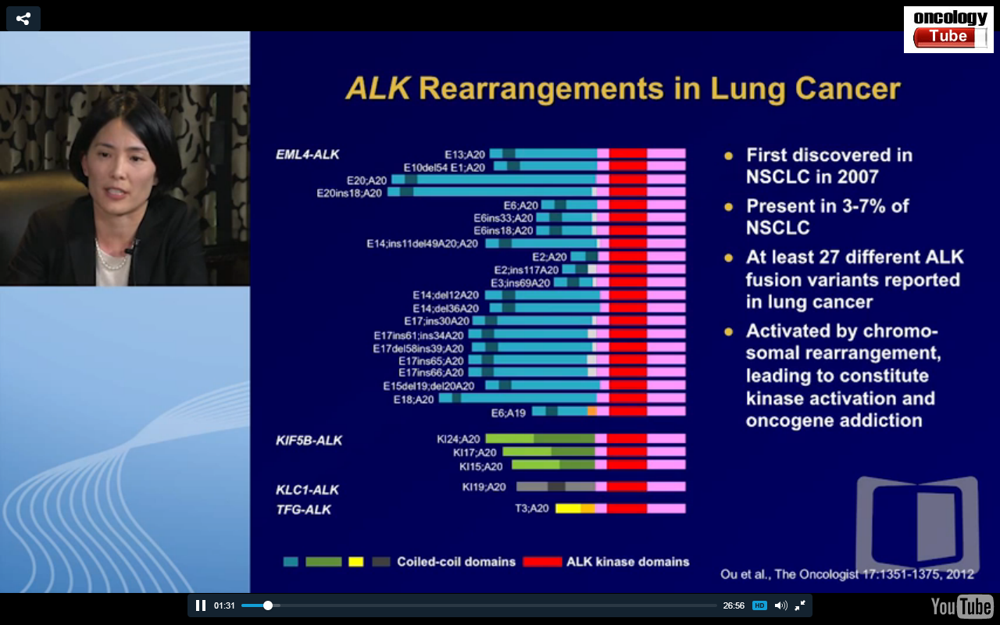
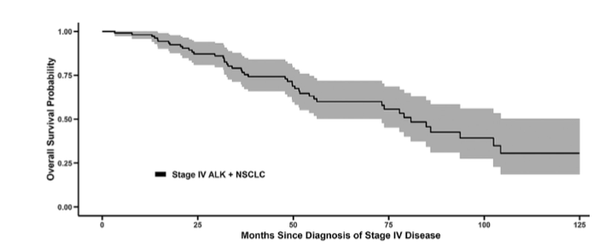
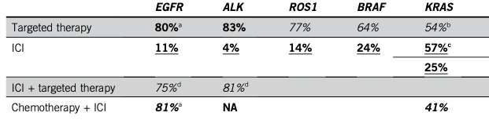
ALK+ NSCLC in brief
1. Incidence of ALK rearrangements: 5-7% of all NSCLC*
2. Testing for ALK rearrangements is mandatory
* Over 50.000 new cases/year worldwide
3. ALK-Is are extending survival in ALK+ NSCLC
4. No role for IT as single agent or in combination with ALK-Is
OS time 81 months (6.8 years)
Pacheco JM, JTO 2018
Calles A, et al. ASCO EDBK 2020

Slide 16
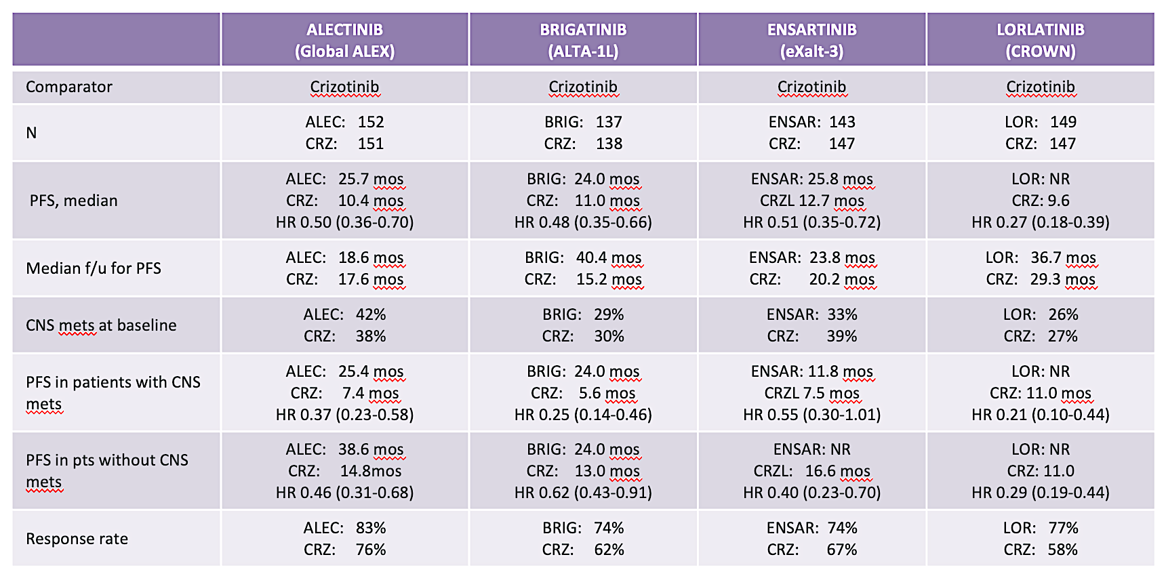
Is There a BEST First-line Option?
ENSARTINIB
eXalt3
CRZ:
CRZ:
CRZ:
Peters S, et al. N Engl J Med. 2017;377(9):829-838. Mok T, et al. Ann Oncol. 2020;31(8):1056-1064. Camidge DR, et al. N Engl J Med. 2018;379(21):2027-2039. Camidge DR et al. J Thorac Oncol. 2021;16(12):2091-2108. Horn L, et al. JAMA Oncol. 2021;7(11):1617-1625. Solomon BJ, et al. J Clin Oncol. 2022;40(31):3593-3602.

Slide 17
NCCN Preferred Regimens 1L in ALK+ NSCLC
FIRST-LINE THERAPY
Preferred
Alectinib (category 1)
Brigatinib (category 1)
Lorlatinib (category 1)
Other Recommended
Ceritinib (category 1)
Useful in certain circumstances
Crizotinib (category 1)
ALK rearrangement discovered prior to first-line systemic therapy
ALK
rearrangement
ALK rearrangement discovered during first-line systemic therapy
Complete planned systemic therapy, including maintenance therapy, or interrupt, followed by alectinib (preferred) or brigatinib (preferred) or loratinib (preferred) or ceritinib or crizotinib
Current Treatment Paradigm
Second-generation TKI (alectinib or brigatinib)
Third-gen TKI
Chemotherapy or clinical trials
Third-gen TKI (Lorlatinib)
Chemotherapy or clinical trials

Slide 18
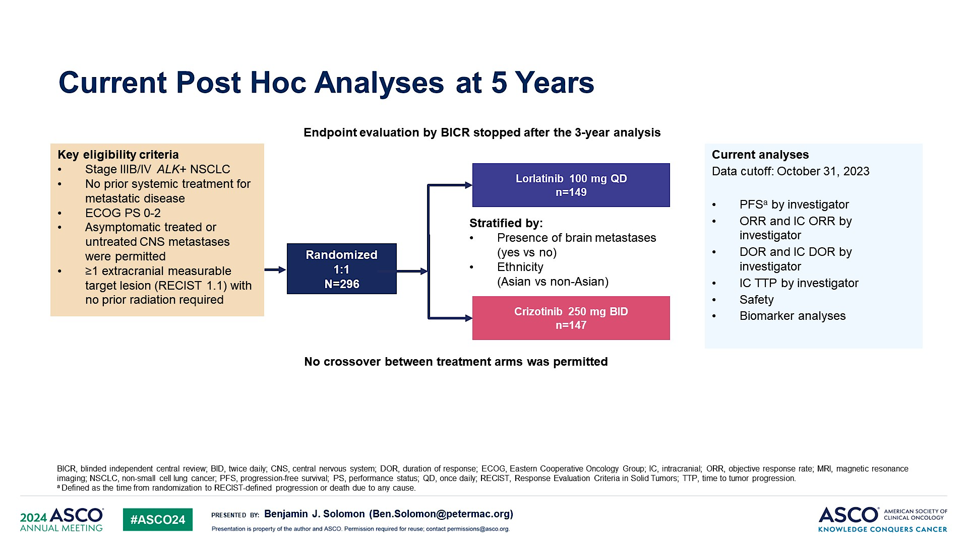
Current Post Hoc Analyses at 5 Years
CROWN Trial

Slide 19
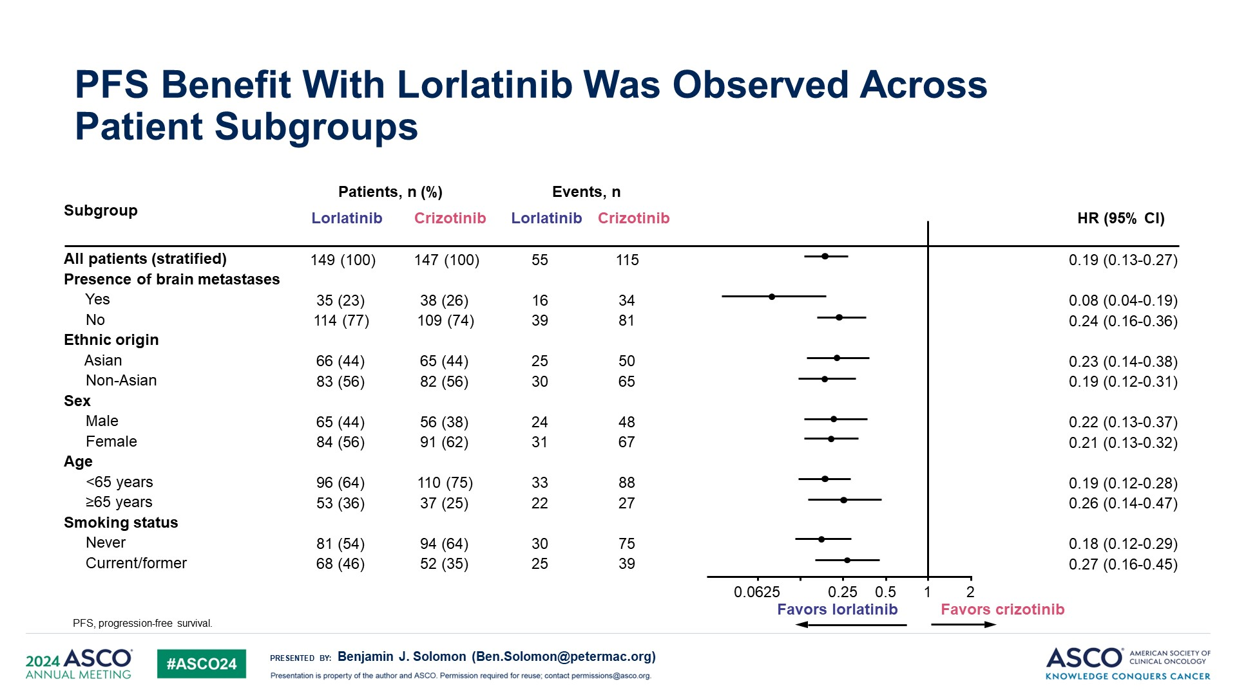
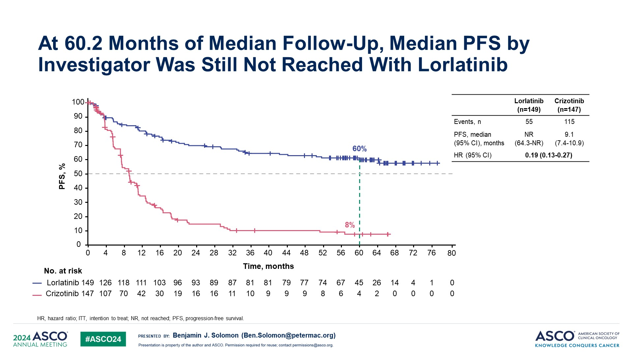

Slide 20
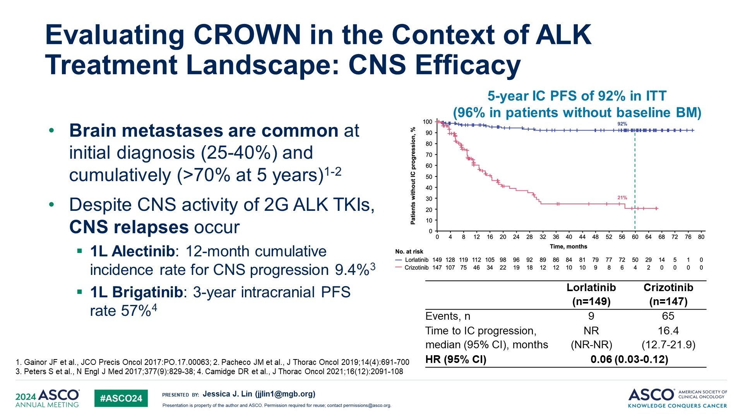
Evaluating CROWN in the Context of ALK Treatment Landscape: CNS Efficacy

Slide 21
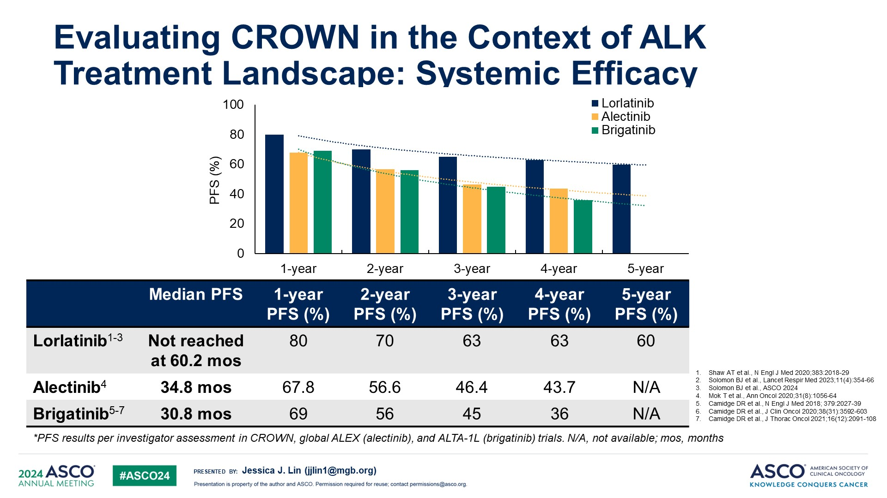
Evaluating CROWN in the Context of ALK Treatment Landscape: Systemic Efficacy

Slide 22
Evaluating CROWN in the Context of ALK Treatment Landscape: Systemic Efficacy
Beware: Cross Trial Comparisons – NOT statistically valid
and Toxicity is a major concern

Slide 23
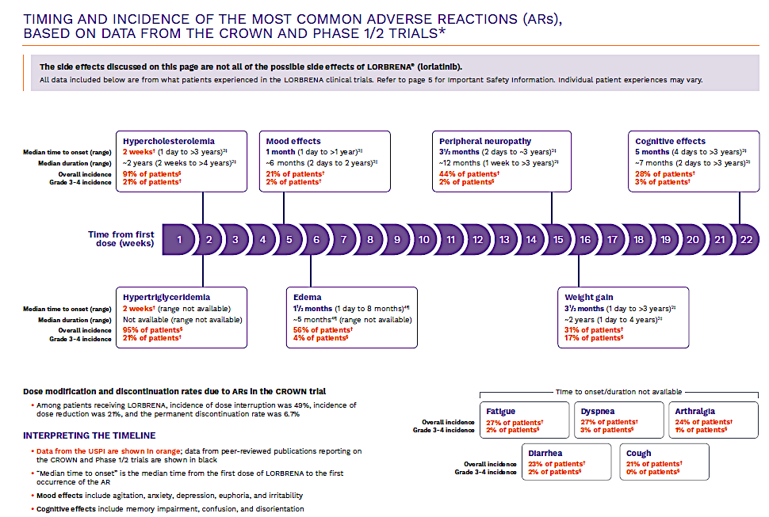
Timing and Incidence of Most Common Adverse Reactions Based on Data from the CROWN and Phase I/2 Trials
Among patients receiving lorlatinib, incidence of dose interruption was 49%, incidence of
lorlatinib to the first

Slide 24
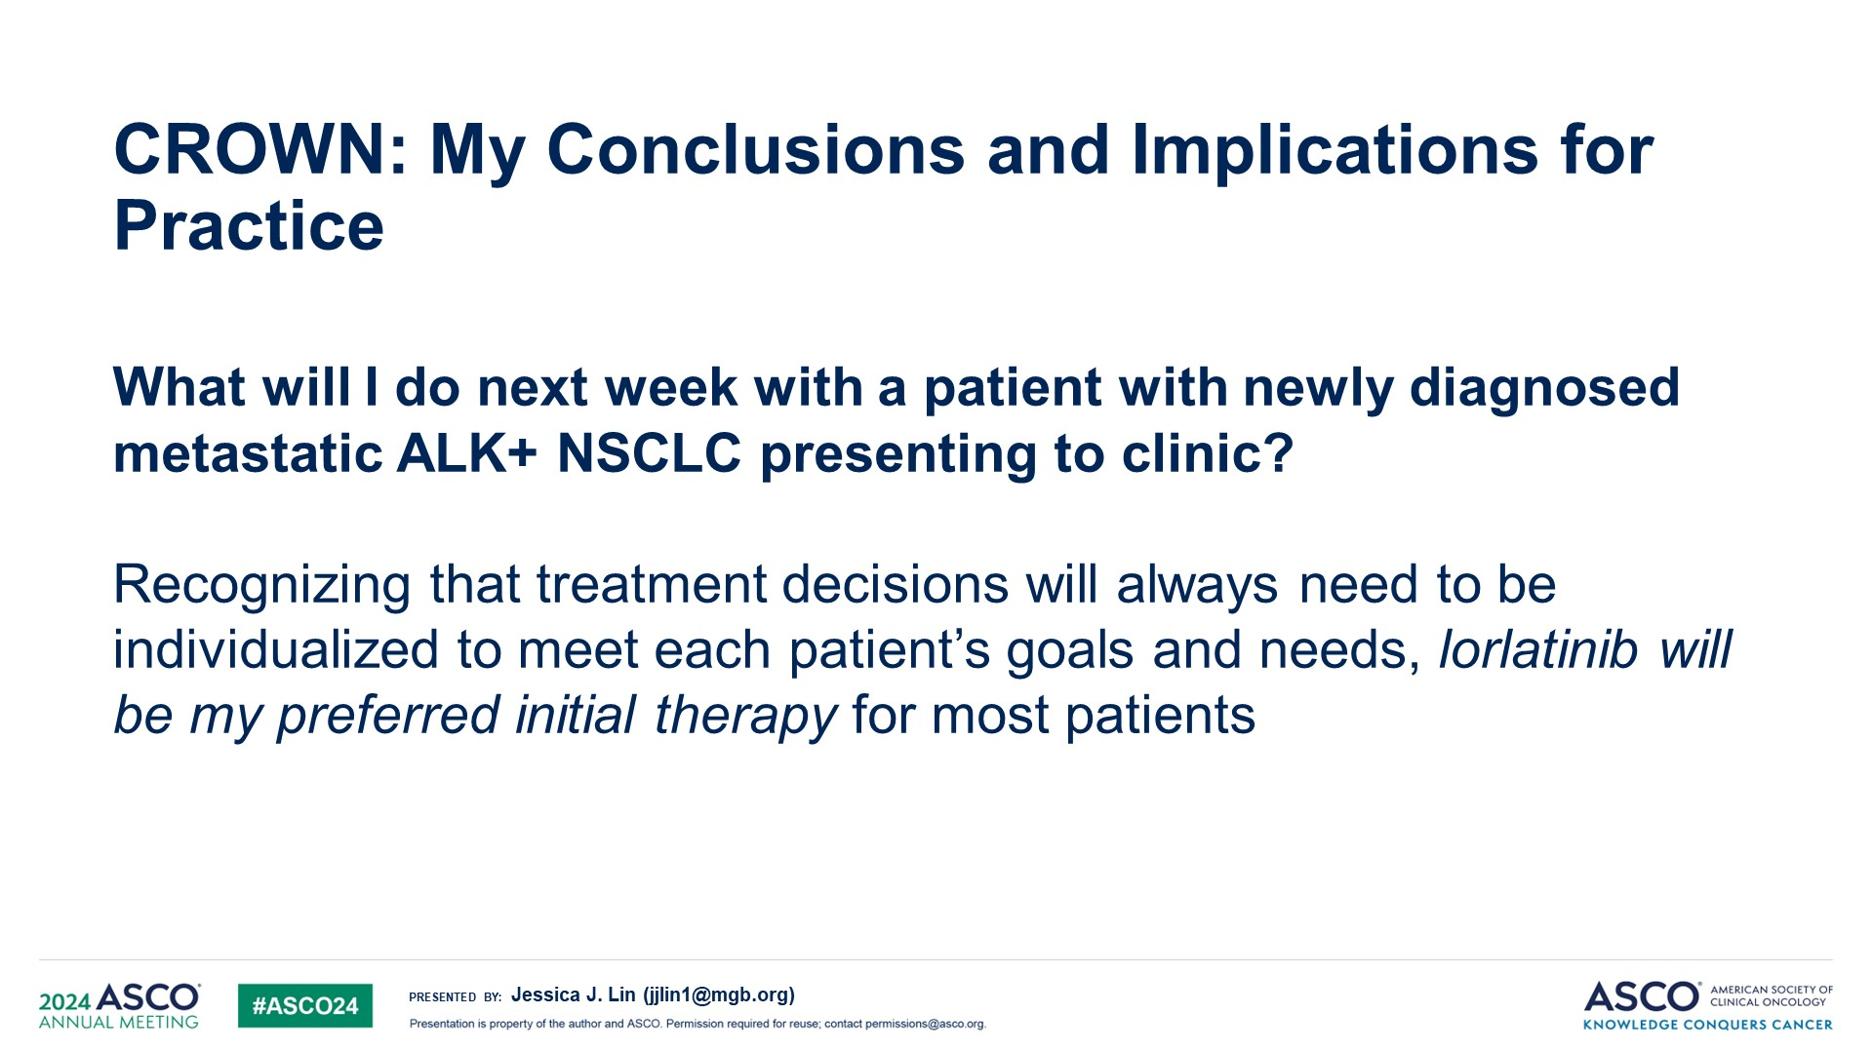
CROWN: My Conclusions and Implications for Practice
CROWN: Jessica Lin’s Commentary
L

Slide 25
CROWN: My Conclusions and Implications for Practice
CROWN: Langer’s Commentary
L
Langer’s Pragmatic Approach:
Lorlatinib for younger pts, with limited or no co-morbidities, aggressive tumor +/- CNS involvement
Alectinib (or brigatinib) for older pts, limited tumor burden, absence of CNS invasion
I’d personally favor a randomized trial with OS as primary endpoint along with Quality-Adjusted Survival

Slide 26
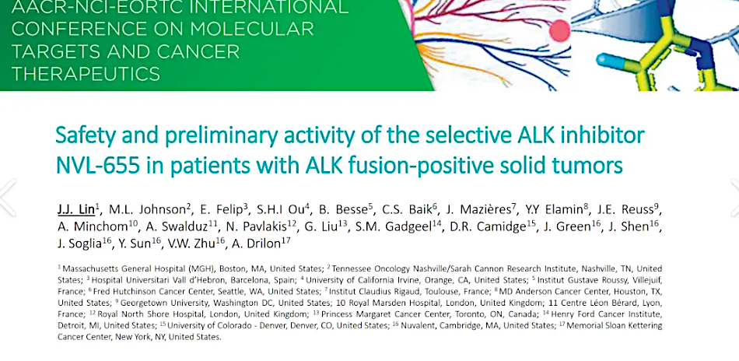
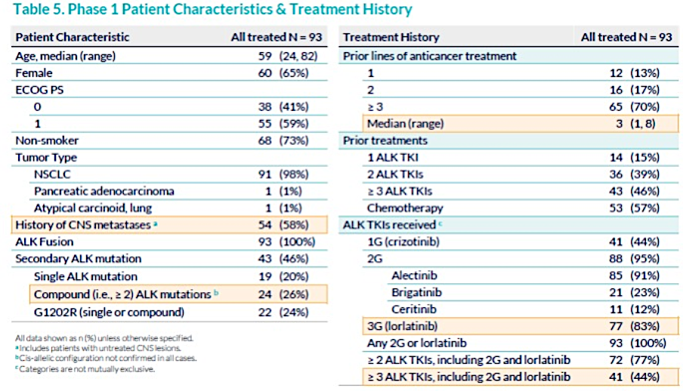
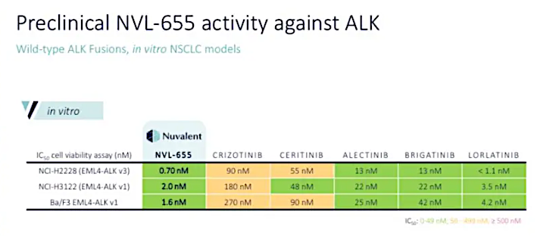
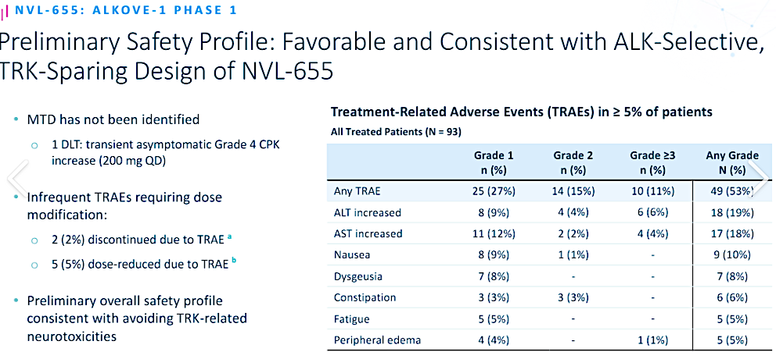
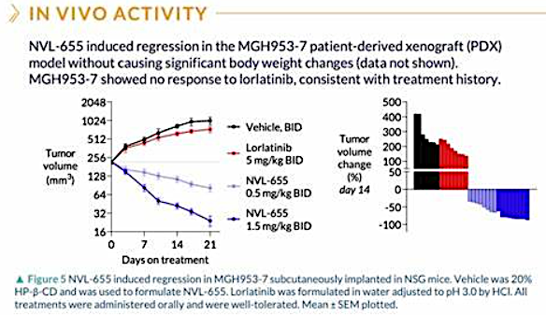
Lin JJ et al. AACR-EORTC-NCI International Conference on Molecular Targets and Cancer. October, 2023; Abstract B154.

Slide 27
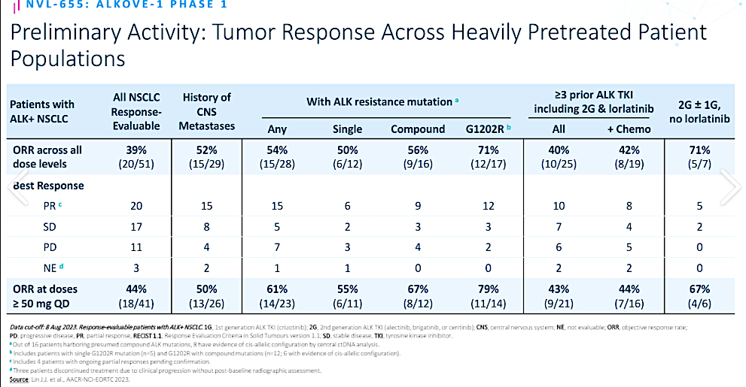
Lin JJ et al. AACR-EORTC-NCI International Conference on Molecular Targets and Cancer. October, 2023; Abstract B154.

Slide 28
ALINA: efficacy and safety of adjuvant alectinib versus chemotherapy in patients with early-stage ALK+ NSCLC
Benjamin J. Solomon¹, Jin Seok Ahn², Rafal Dziadziuszko³, Fabrice Barlesi⁴, Makoto Nishio⁵, Dae Ho Lee⁶, Jong-Seok Lee⁷, Wenzhao Zhong⁸, Hidehito Horinouchi⁹, Weimin Mao¹⁰, Maximilian Hochmair¹¹, Filippo de Marinis¹², Maria Rita Migliorino¹³, Igor Bondarenko¹⁴, Tania Ochi Lohmann¹⁵, Tingting Xu¹⁶, Andres Cardona¹⁷, Walter Bordogna¹⁸, Thorsten Ruf¹⁹, Yi-Long Wu⁸
¹Peter MacCallum Cancer Centre, Melbourne, Australia; ²Samsung Medical Center, Seoul, Republic of Korea; ³Medical University of Gdansk, Gdańsk, Poland; ⁴International Center for Thoracic Cancers (CICT), France; Paris Saclay University, Faculty of Medicine, France; ⁵Cancer Institute Hospital, Japanese Foundation for Cancer Research, Koto, Tokyo, Japan; ⁶Asan Medical Center, Seoul, Republic of Korea; ⁷Division of Hematology and Medical Oncology, Department of Internal Medicine, Seoul National University Bundang Hospital, Seongnam, Republic of Korea; ⁸Guangdong Lung Cancer Institute, Guangdong Provincial People’s Hospital, Guangdong, China; ⁹Department of Thoracic Oncology, National Cancer Center Hospital, Chuo City, Tokyo, Japan; ¹⁰Institute of Basic Medicine and Cancer, Chinese Academy of Sciences, Zhejiang, China; ¹¹Department of Respiratory & Critical Care Medicine, Karl-Landsteiner-Institute of Lung Research & Pulmonary Oncology, Clinic Floridsdorf; ¹²Thoracic Oncology Division, European Institute of Oncology, Via Giuseppe Ripamonti, Milan, Italy; ¹³Pneumo-Oncology Unit, San Camillo Forlanini Hospital, Rome, Italy; ¹⁴Dnipropetrovsk Medical Academy, Dnipro, Ukraine; ¹⁵PD Oncology, F. Hoffmann-La Roche Ltd, Basel, Switzerland; ¹⁶Department of Clinical Science, Roche (China) Shanghai, China; ¹⁷Data and Statistical Sciences, F. Hoffmann-La Roche Ltd, Switzerland; ¹⁸Product Development Medical Affairs, F. Hoffmann-La Roche Ltd, Basel, Switzerland; ¹⁹PD Safety Risk Management, F. Hoffmann-La Roche Ltd, Basel, Switzerland

Slide 29
ALINA study design*
Resected Stage IB (≥4cm)–IIIA ALK+ NSCLC
per UICC/AJCC 7th edition
Other key eligibility criteria:
ECOG PS 0–1
Eligible to receive platinum-based chemotherapy
Adequate end-organ function
No prior systemic cancer therapy
Stratification factors:
Stage: IB (≥ 4cm) vs II vs IIIA
Race: Asian vs non-Asian
Alectinib 600 mg BID
2 years
Recurrence
Further treatments at investigator’s choice and survival follow-up
R 1:1
Platinum-based chemotherapy†
Q3W; 4 cycles
Recurrence
N=257
Primary endpoint
DFS per investigator,‡ tested hierarchically:
Stage II–IIIA → ITT (Stage IB–IIIA)
Other endpoints
CNS disease-free survival
OS
Safety
Disease assessments (including brain MRI)§ were conducted: at baseline, every 12 weeks for year 1–2, every 24 weeks for year 3–5, then annually
Data cut-off: 26 June 2023; CNS, central nervous system; DFS, disease-free survival; ITT, intention to treat *Superiority trial; †Cisplatin + pemetrexed, cisplatin + vinorelbine or cisplatin + gemcitabine; cisplatin could be switched to carboplatin in case of intolerability; ‡DFS defined as the time from randomisation to the first documented recurrence of disease or new primary NSCLC as determined by the investigator, or death from any cause, whichever occurs first; §Assessment by CT scan where MRI not available; NCT03456076
Wu YL et al. N Engl J Med. 2024;390(14):1265-1276.

Slide 30
Disease-free survival: ITT (stage IB–IIIA)*
100
93.6%
 | Alectinib (N=130) | Chemotherapy (N=127)
Patients with event Death Recurrence | 15 (12%) 0 15 | 50 (39%) 1 49
Median DFS, months (95% CI) | Not reached | 41.3 (28.5, NE)
DFS HR (95% CI) | 0.24 (0.13, 0.43) p†<0.0001
88.7%
80
Alectinib
63.7%
60
54.0%
Disease-free survival (%)
Chemotherapy
40
20
0
At the data cutoff date, OS data were immature with only 6 (2.3%) OS events reported‡
0
6
12
18
24
30
36
42
48
54
Time (months)
No. at risk
Alectinib
130
123
123
118
74
55
39
22
10
3
Chemo
127
112
98
89
55
41
27
18
11
2
Median survival follow up: alectinib, 27.8 months; chemotherapy, 28.4 months
Data cut-off: 26 June 2023; Time from last patient in to data cut off was ~18 months *Per UICC/AJCC 7th edition; †Stratified log rank; ‡2 events in the alectinib arm, 4 events in the chemo arm; one additional patient in the chemo arm died but was censored due to incomplete date of death recorded. DFS defined as the time from randomisation to the first documented recurrence of disease or new primary NSCLC as determined by the investigator, or death from any cause, whichever occurs first
Wu YL et al. N Engl J Med. 2024;390(14):1265-1276.

Slide 31
Disease-free survival subgroup analysis (ITT)
Subgroup
No. of events / patients
DFS HR (95% CI)
All patients
65 / 257
0.24 (0.14–0.43)
Age
<65
≥65
43 / 196
22 / 61
0.26 (0.13–0.52)
0.24 (0.08–0.71)
Sex
Male
Female
35 / 123
30 / 134
0.26 (0.11–0.60)
0.22 (0.10–0.50)
Race
Asian
Non-Asian
31 / 143
34 / 114
0.36 (0.17–0.79)
0.16 (0.06–0.38)
ECOG PS at baseline
0
1
32 / 137
33 / 120
0.20 (0.09–0.46)
0.31 (0.14–0.69)
Tobacco use history
Never
Current
Previous
37 / 154
0 / 8
28 / 95
0.27 (0.13–0.55)
NE
0.22 (0.08–0.57)
Stage*
Stage IB
Stage II
Stage IIIA
6 / 26
22 / 92
37 / 139
0.21 (0.02–1.84)
0.24 (0.09–0.65)
0.25 (0.12–0.53)
Regional lymph node status
N0
N1
N2
11 / 39
20 / 88
34 / 130
0.19 (0.04–0.88)
0.34 (0.13–0.89)
0.21 (0.09–0.47)
0.1
0.3
1.0
3.0
Alectinib better
Chemotherapy better
Data cut-off: 26 June 2023 Arrows indicate lower bound of the CI<0.1; *Per UICC/AJCC 7th edition
Wu YL et al. N Engl J Med. 2024;390(14):1265-1276.

Slide 32
CNS disease-free survival in the ITT population
98.4%
95.5%
 | Alectinib (N=130) | Chemotherapy (N=127)
Patients with event Death Brain recurrence | 5 1 4 | 18 4 14
CNS-DFS HR* (95% CI) | 0.22 (0.08, 0.58)
100
Alectinib
80
85.8%
Chemotherapy
79.7%
60
CNS disease-free survival (%)
40
20
0
0
6
12
18
24
30
36
42
48
54
Time (months)
No. at risk
Alectinib
130
124
124
118
74
55
39
22
10
3
Chemo
127
113
98
90
57
43
27
18
11
2
Median survival follow up: alectinib, 27.8 months; chemotherapy, 28.4 months
Data cut-off: 26 June 2023 *Stratified analysis with race and stage as stratification factors CNS-DFS defined as time from randomisation to the first documented recurrence of disease in the CNS or death from any cause
Wu YL et al. N Engl J Med. 2024;390(14):1265-1276.

Slide 33
Questions?

Slide 34
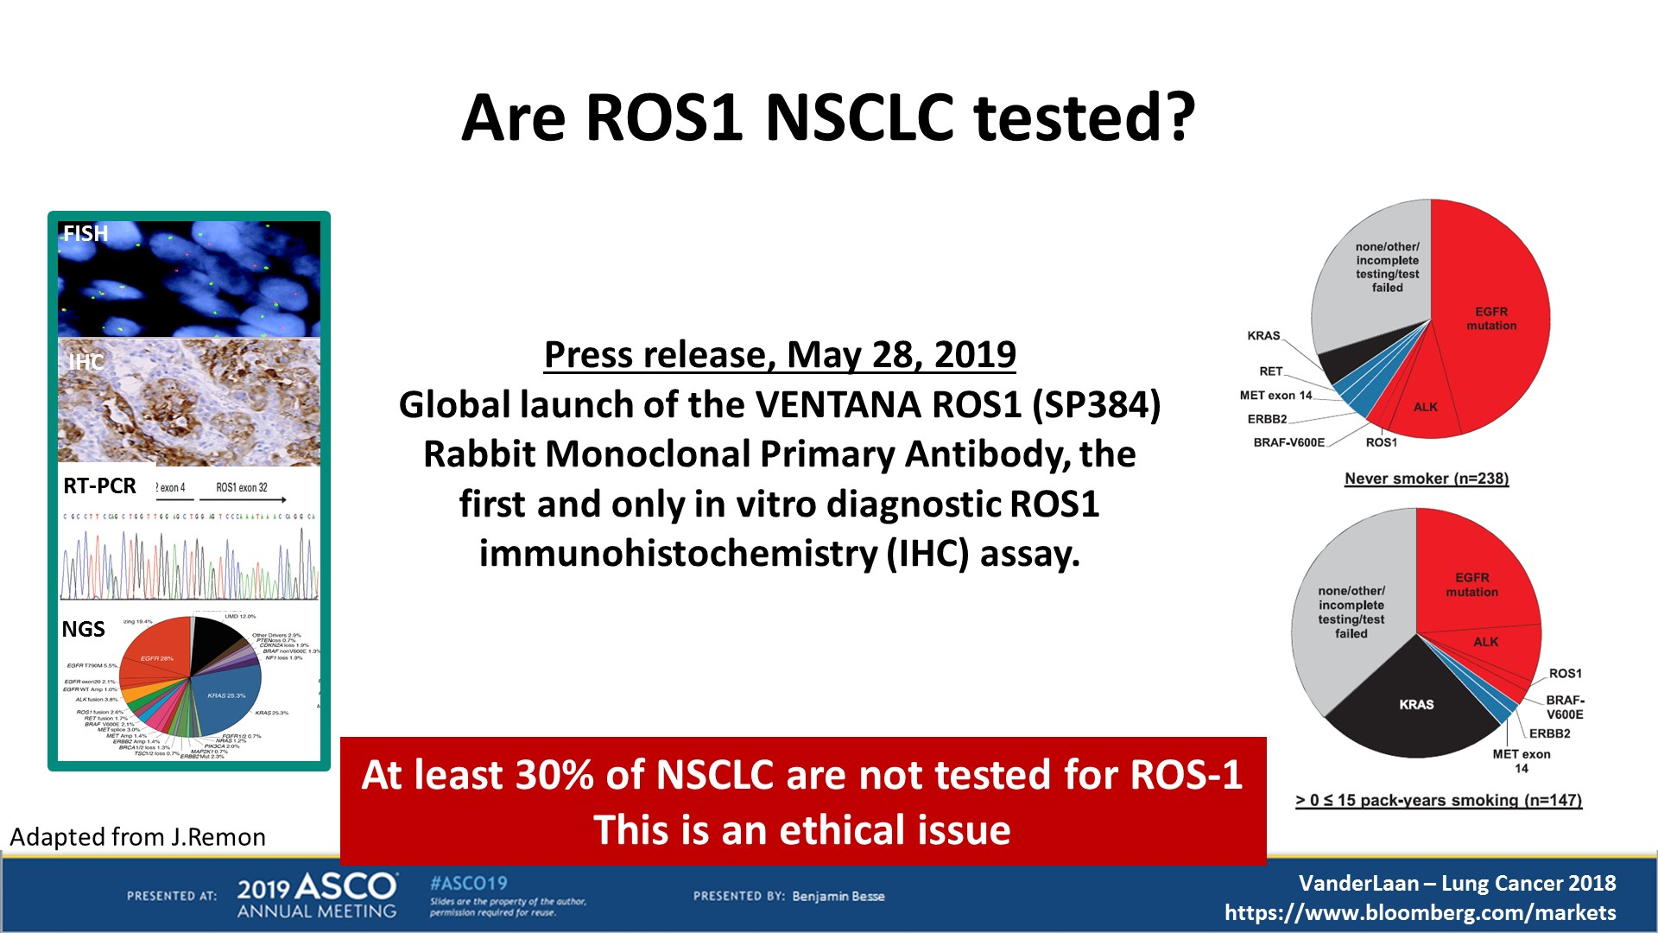
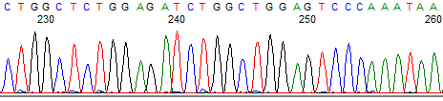
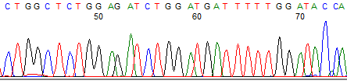
ROS1 rearrangements in NSCLC
Patients with ROS1 rearrangements share many features in common with ALK+ patients (adenocarcinoma histology, younger age at diagnosis, never or light smokers)
Rare event occurring in 1-2 % of NSCLC and mutually exclusive with EGFR, HER2, KRAS, BRAF mutations and with ALK rearrangements
According to current guidelines, ROS1 testing should be performed on all adenocarcinoma patients irrespective of clinical characteristics (and I’d add all never smokers or remote former smokers regardless of histology)
Screening test: IHC → positive results confirmed by FISH or other cytogenetic method
Indicated agents: crizotinib, entrectinib, repotrectinib
SDC4 exon 2
ROS1 exon 32
SDC4 exon 2
ROS1 exon 34
Bergethon K, et al. J Clin Oncol 2012; Davies KD, et al. Clin Cancer Res 2012; Kalemkerian GP, et al. JCO 2018

Slide 35

ROS1 Agents with Activity in ROS1 rearrangements^{1,2}
Therapy | Trial(s) | Efficacy |  | CNS Penetration
 |  | ORR | PFS (mo) | IC-ORR | IC-PFS (mo)
Crizotinib | PROFILE 1001 (NCT00585195) ^{3,4} | 72%† | 19.3† | — | —
Entrectinib^{‡5} | ALKA STARTRK-1 (NCT02097810) STARTRK-2 (NCT02568267) | 77%† | 19.0† | 55% | 13.6§
Repotrectinib | TRIDENT-1 (NCT03093116)⁶ | 79% | 35.7
Tyrosine kinase inhibitors
Crizotinib
Entrectinib
Repotrectinib
Lorlatinib
Ceritinib*
P
P
P
P
P
P
P
P
Downstream signaling
Approved therapy MOA: Tyrosine kinase inhibitors; limits downstream signaling
mNSCLC therapy setting:
First line: crizotinib, entrectinib, and repotrectinib preferred, ceritinib and lorlatinib also yield responses
Subsequent therapy: depends on extent of progression and prior therapy
Entrectinib was recommended as first-line or subsequent therapy for patients with CNS metastasis
Repotrectinib has displaced both entrectinib and crizotinib as 1st line drug of choice
*Not approved for this indication. †Assessed by independent review. ‡Pooled analysis.. §Assessed by investigator. Abbreviations: CNS, central nervous system; IC, intracranial; mNSCLC, metastatic non-small cell lung cancer; MOA, mechanism of action; ORR, objective response rate; PFS, progression-free survival; ROS1, proto-oncogene tyrosine-protein kinase. 1. NCCN Clinical Practice Guidelines in Oncology (NCCN Guidelines®) for Non-Small Cell Lung Cancer V.2.2024. © National Comprehensive Cancer Network, Inc. 2024. All rights reserved. Accessed February 23, 2024. To view the most recent and complete version of the guideline, go online to NCCN.org. 2. Pal P, et al ROS-1. J Clin Pathol. 2017;1:1-9. 3. Shaw At, et al. N Engl J Med. 2014;371(21):1963-71. 4. Shaw AT, et al. Ann Oncol. 2019;30(7):1121-1126. 5. Drilon A, et al. Lancet Oncol. 2020;21(2):261-270. 6. Drilon A, et al. N Engl J Med. 2024;390(2):118-131.

Slide 36
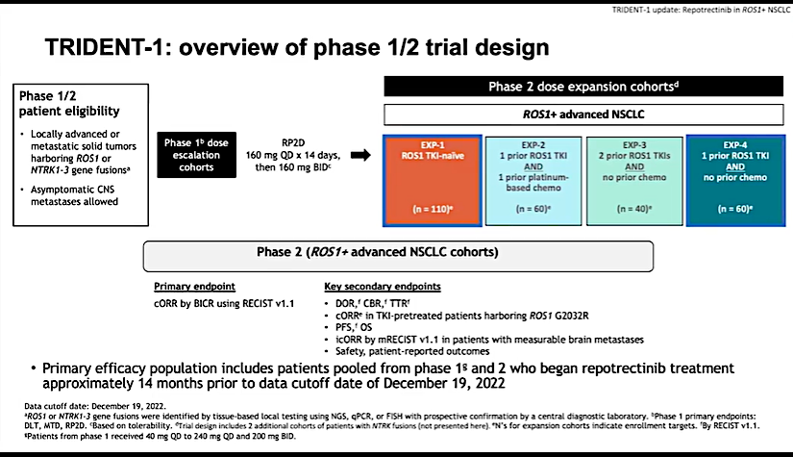
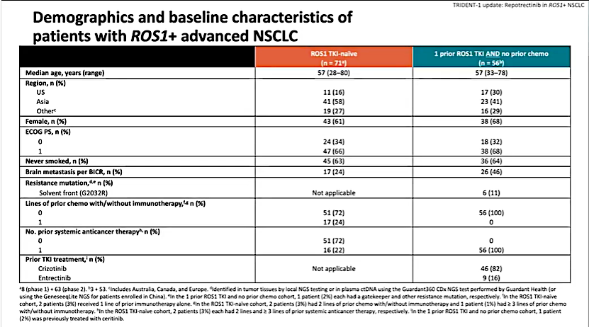
Repotrectinib in ROS1 (+) mNSCLC
Drilon A, Camidge DR, Lin JJ, et al. N Engl J Med. 2024;390(2):118-131.

Slide 37
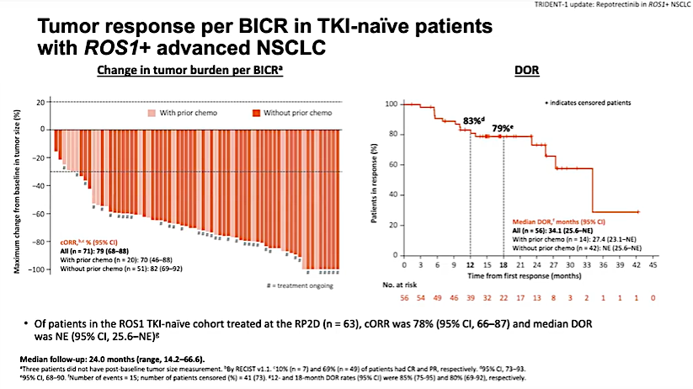
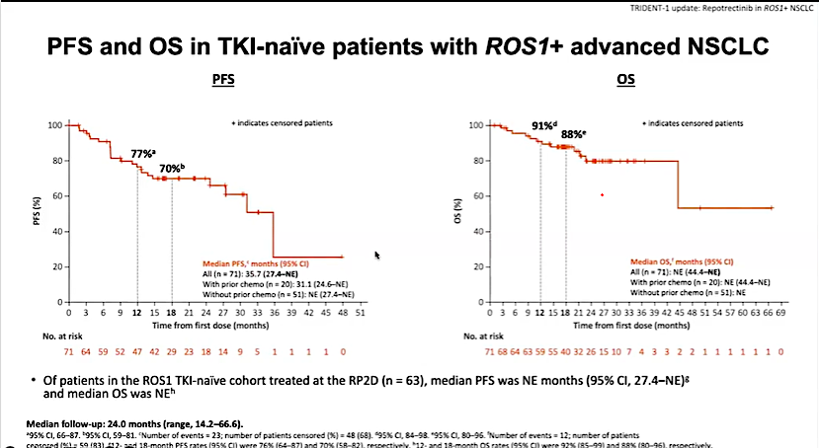
Repotrectinib in Tx-naïve 1L ROS1 (+) mNSCLC
Drilon A, Camidge DR, Lin JJ, et al. N Engl J Med. 2024;390(2):118-131.

Slide 38
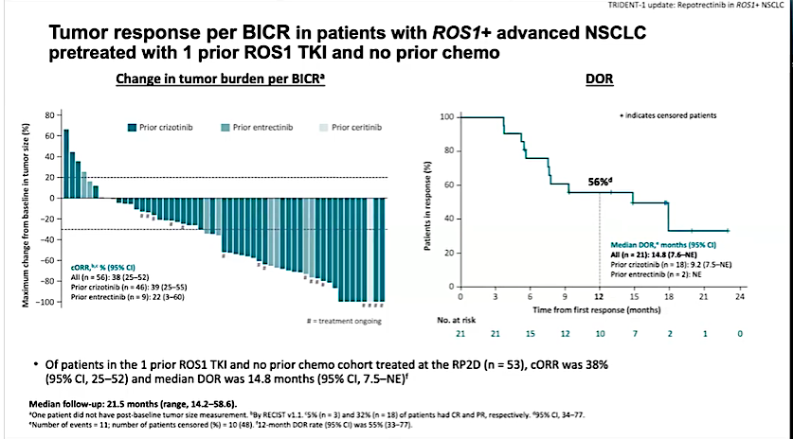
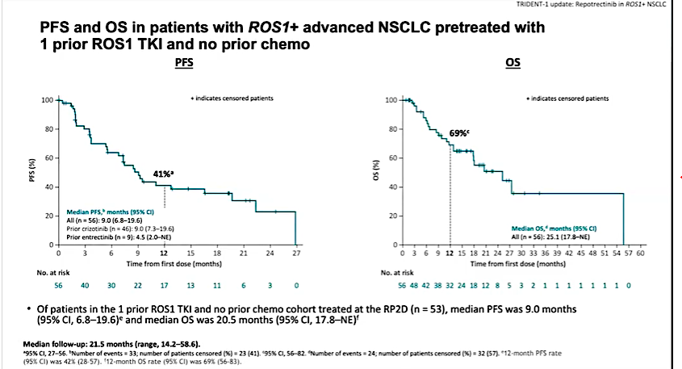
Repotrectinib in 2L ROS1 (+) mNSCLC
Drilon A, Camidge DR, Lin JJ, et al. N Engl J Med. 2024;390(2):118-131.

Slide 39
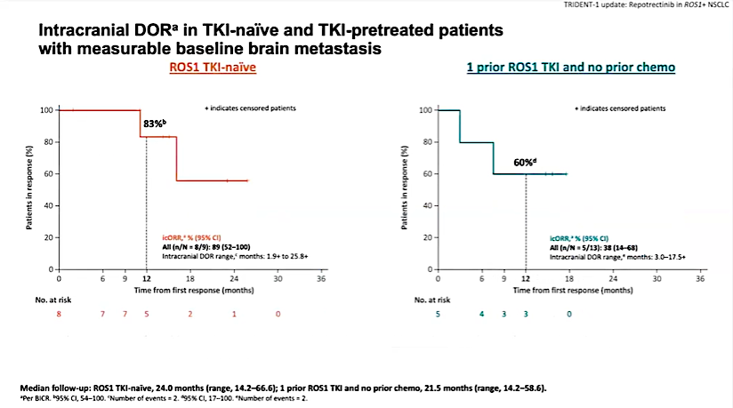
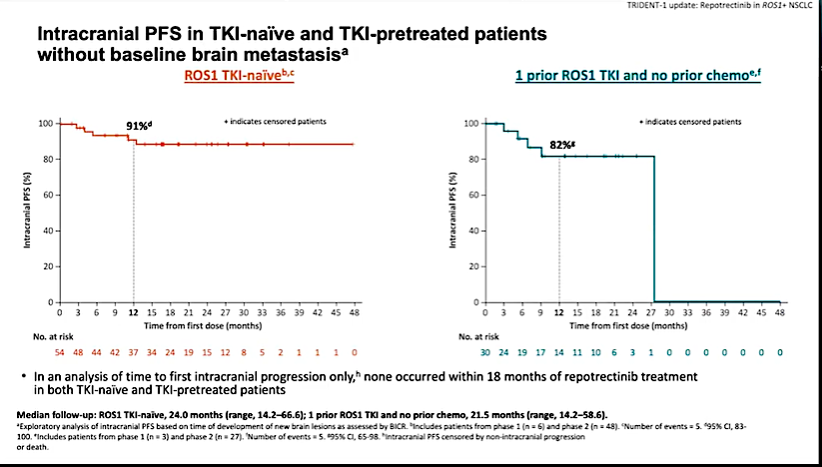
Repotrectinib: CNS Activity
Drilon A, Camidge DR, Lin JJ, et al. N Engl J Med. 2024;390(2):118-131.

Slide 40
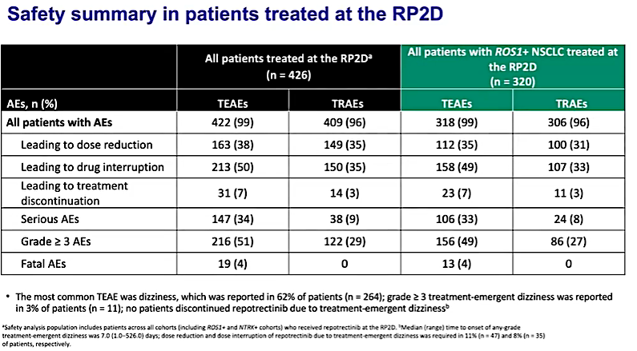
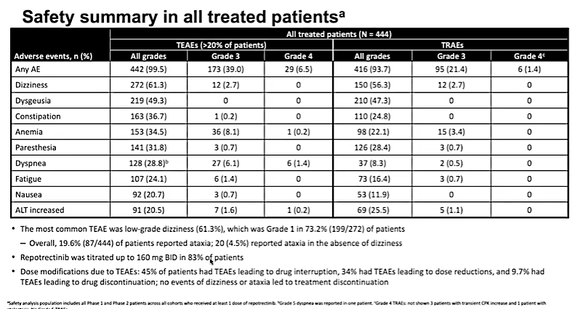
Repotrectinib: Toxicity
of patients
Solomon BJ et al. ESMO 2023; Abstract 1372P. Cho BC, Lin JJ, Camidge DR, et al. EORTC-NCI-AACR Molecular Targets and Cancer Therapeutics Symposium 2022; Abstract 2LBA.

Slide 41
TRUST-II (NCT04919811): Phase 2 Trial of Taletrectinib in ROS1+ NSCLCª
Key Eligibility Criteria
Cohort 1: ROS1 TKI naive
Taletrectinib 600 mg QD
Endpoints
Inclusion Criteria:
Locally advanced or metastatic NSCLC
Age ≥18 years^{b}
ECOG PS 0–1
Evidence of ROS1 fusion
Primary:
IRC-assessed cORR per RECIST v1.1
Secondary:
DOR
IC-ORR
Cohort 2: 1 Prior ROS1 TKI
Taletrectinib 600 mg QD
BOR
DCR
TTR
PFS
Safety^{c}
Category | TKI Naive (n=55)ª | TKI Pretreated (n=50)ª | Overall (N=159)^{c}
Median age, years (range) | 57.0 (27–82) | 55.0 (27–79) | 57.0 (27–83)
Female, n (%) | 31 (56.4) | 27 (54.0) | 89 (56.0)
Never smoker, n (%) | 28 (50.9) | 30 (60.0) | 90 (56.6)
Region, Asia/Non-Asia, n (%) | 34 (61.8)/21 (38.2) | 22 (44.0)/28 (56.0) | 74 (46.5)/85 (53.5)
ECOG PS 0/1, n (%) | 22 (40.0)/33 (60.0) | 24 (48.0)/26 (52.0) | 66 (41.5)/93 (58.5)
Stage IV disease, n (%) | 49 (89.1) | 49 (98.0) | 151 (95.0)
Prior anticancer chemotherapy, n (%) | 11 (20.0) | 19 (38.0) | 64 (40.3)
Brain metastasis, n (%) | 19 (34.5) | 28 (56.0) | 72 (45.3)
Prior crizotinib/entrectinib, n (%) | – | 40 (80.0)/10 (20.0) | 82 (51.6)/27 (17.0)
Data cutoff: June 7, 2024. ªRegistrational cohorts are shown. ^{b}Or ≥20 years, as required by local regulations. ^{c}Safety population includes all patients who received ≥1 dose of taletrectinib 600 mg. BOR, best overall response; cORR, confirmed objective response rate; DCR, disease control rate; DOR, duration of response; ECOG PS, Eastern Cooperative Oncology Group performance status; IC, intracranial; IRC, independent review committee; NSCLC, non–small cell lung cancer; PFS, progression-free survival; QD, every day; RECIST, Response Evaluation Criteria in Solid Tumors; TKI, tyrosine kinase inhibitor; TTR, time to response.
Liu G et al. WCLC 2024; Abstract MA06.03.

Slide 42
Taletrectinib Responses in TKI-Naive ROS1+ NSCLC^{a,b}
 | TKI Naive (n=54)
cORR, % (95% CI) | 85.2 (72.88, 93.38)
Asia ORR (n=33) | 87.9 (71.80, 96.60)
Non-Asia ORR (n=21) | 81.0 (58.09, 94.55)
Measurable baseline brain metastases | TKI Naive (n=9)
IC-ORR, % (95% CI) | 66.7 (29.93, 92.51)
CR, n (%) | 2 (22.2)
PR, n (%) | 4 (44.4)
CR
PR
SD
PD
CR
PR
SD
PD
*
Best Percent Change in Sum of Diameters From Baseline (%)
Best Percent Change in Sum of Diameters From Baseline (%)
Brain metastasis
Prior chemo
Median follow-up: 15.8 mo (range: 3.6–29.8)
Data cutoff: June 7, 2024. ªResponse evaluable population (patients with ≥1 measurable lesion at baseline who received ≥1 dose of taletrectinib). ^{b}Patients with confirmed BOR as not evaluable are not displayed in the waterfall plots. *One patient had a best percent change of 0%. BOR, best overall response; CI, confidence interval; cORR, confirmed objective response rate; CR, complete response; IC, intracranial; DOR, duration of response; NR, not reached; PD, progressive disease; PFS, progression-free survival; PR, partial response; SD, stable disease; TKI, tyrosine kinase inhibitor.
Liu G et al. WCLC 2024; Abstract MA06.03.

Slide 43
Taletrectinib Responses in TKI-Pretreated ROS1+ NSCLC^{a,b}
 | TKI Pretreated (n=47)
cORR, % (95% CI) | 61.7 (46.38, 75.49)
Asia ORR (n=21) | 57.1 (34.02, 78.18)
Non-Asia ORR (n=26) | 65.4 (44.33, 82.79)
Measurable baseline brain metastases | TKI Pretreated (n=16)
IC-ORR, % (95% CI) | 56.3 (29.88, 80.25)
CR, n (%) | 1 (6.3)
PR, n (%) | 8 (50.0)
CR
PR
SD
PD
CR
PR
SD
PD
*
Best Percent Change in Sum of Diameters From Baseline (%)
Best Percent Change in Sum of Diameters From Baseline (%)
Brain metastasis
Prior TKI
Prior chemo
C
C
C
E
E
C
C
C
C
C
E
C
C
E
C
C
Prior TKI
C
E
C
C
C
C
C
C
C
C
C
C
E
C
C
C
C
C
E
C
C
C
E
E
E
C
E
C
C
E
C
C
E
C
C
C
C
C
C
C
C
C
C
E
C
C
C
Median follow-up: 15.7 mo (range: 3.9–29.8)
Data cutoff: June 7, 2024. ªResponse evaluable population (patients with ≥1 measurable lesion at baseline who received ≥1 dose of taletrectinib). ^{b}Patients with confirmed BOR as not evaluable are not displayed in the waterfall plots. *One patient had a best percent change of 0%. C, crizotinib; CI, confidence interval; cORR, confirmed objective response rate; CR, complete response; E, entrectinib; IC, intracranial; DOR, duration of response; NR, not reached; PD, progressive disease; PFS, progression-free survival; PR, partial response; SD, stable disease; TKI, tyrosine kinase inhibitor.
Liu G et al. WCLC 2024; Abstract MA06.03.

Slide 44
Taletrectinib Safety: TEAEs in ≥15% of Patients (N=159)
 | Any grade, n (%) | Grade ≥3, n (%)
Increased ALT | 108 (67.9) | 24 (15.1)
Increased AST | 107 (67.3) | 11 (6.9)
Diarrhea | 90 (56.6) | 1 (0.6)
Nausea | 82 (51.6) | 3 (1.9)
Vomiting | 53 (33.3) | 2 (1.3)
Constipation | 40 (25.2) | 0 (0)
Anemia | 32 (20.1) | 7 (4.4)
Dysgeusia | 31 (19.5) | 0 (0)
Increased blood CPK | 29 (18.2) | 6 (3.8)
Dizziness | 27 (17.0) | 0 (0)
Prolonged QT | 24 (15.1) | 5 (3.1)
Median exposure of taletrectinib was 8.4 months (range: 0.1–28.9)
37.1% of patients had a TEAE leading to a dose reduction
The most common events leading to dose reduction were elevated liver enzymes (16.4%)
7.5% of patients had a TEAE leading to treatment discontinuation; 1.3% were treatment-related
Rates of neurologic TEAEs were low (dysgeusia: 19.5%; dizziness: 17.0%); none were grade ≥3
No treatment-related AE led to death
Data cutoff: June 7, 2024. AE, adverse event; ALP, alkaline phosphatase; ALT, alanine aminotransferase; AST, aspartate aminotransferase; CPK, creatinine phosphokinase; TEAE, treatment-emergent adverse event.
Liu G et al. WCLC 2024; Abstract MA06.03.

Slide 45
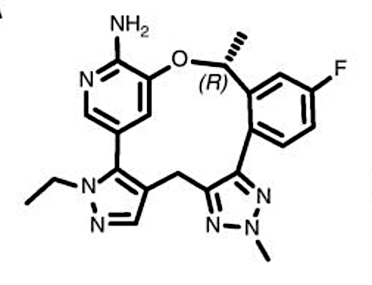
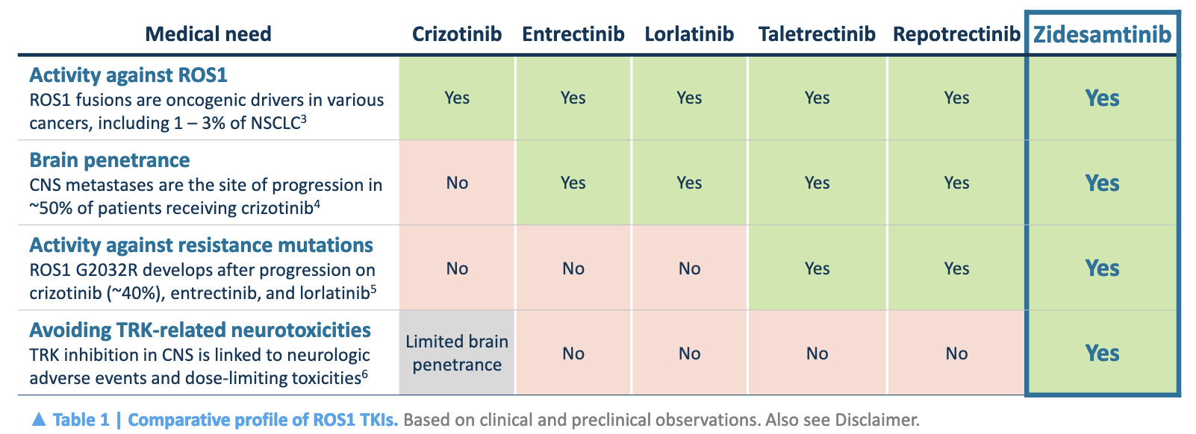
Zidesamtinib (NVL-520)
Zidesamtinib
Disclaimer: As of March 2024, crizotinib, entrectinib, and repotrectinib have been approved by the FDA for the treatment of patients with ROS1+ metastatic NSCLC. Zidesamtinib is being investigated in a Phase 1/2 trial for patients with advanced ROS1+ NSCLC and other solid tumors (ARROS1, NCT05118789). No head-to-head clinical studies have been conducted for approved or investigational therapies versus zidesamtinib. Preclinical experiments are not powered to determine the statistical significance of differences in measurements between any of the inhibitors tested.
Drilon A, Horan JC, Tangpeerachaikul A, et al. Cancer Discov. 2023;13(3):598-615. Tangpeerachaikul A et al. AACR 2024; Abstract LB182.

Slide 46
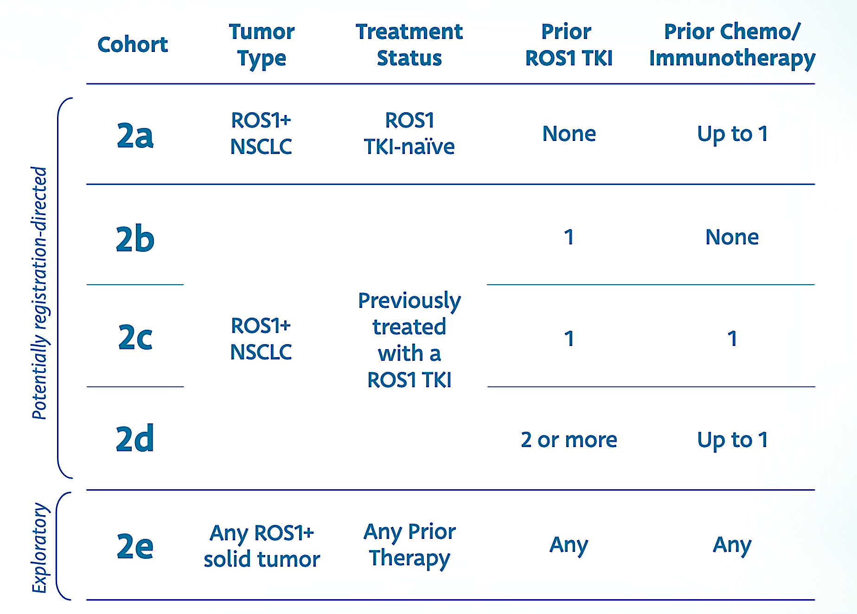
ARROS-1: A Phase 1/2 Study of NVL-520 in Patients With Advanced
NSCLC and Other Solid Tumors Harboring ROS1 Rearrangements
Key Inclusion Criteria
Age ≥ 12 years (Patients aged 12 to 17 will only be enrolled in countries and sites where regulations allow)
Advanced non-small cell lung cancer (NSCLC) or other solid tumor
Histologically or cytologically confirmed metastatic solid tumor with documented ROS1 rearrangement
Measurable disease according to RECIST 1.1
Adequate baseline organ function and bone marrow reserve
Key Exclusion Criteria
Patient’s cancer has a known oncogenic driver alteration other than ROS1
Major surgery within 4 weeks of study entry
Actively receiving systemic treatment or direct medical intervention on another therapeutic clinical study
https://clinicaltrials.gov/study/NCT05118789; Manufacturer’s website.

Slide 47
Questions?

Slide 48
NTRK 1/2/3 Fusions
Protein function: Receptor tyrosine kinase
Actionable driver: 3’ sequence of the NTRK gene fuses to the 5’ sequence of a partner gene, resulting in a TRK fusion protein
P
P
Incidence: VERY low, likely < 0.1% of all Non-sq NSCLC
Typical clinical characteristics: difficult to classify due to rarity of fusions and small sample size of previous studies
P
P
P
P
P
P
Tyrosine kinase inhibitors
Entrectinib
Larotrectinib
Downstream signaling
Therapy | Trial(s) | Efficacy |  | CNS Penetration
 |  | ORR | PFS (mo) | IC-ORR | IC-PFS (mo)
Entrectinib*^{†3} | ALKA STARTRK-1 (NCT02097810) STARTRK-2 (NCT02568267) | 64.5% | 20.8 | 60% | 8.9
Larotrectinib*^{‡4} | LOXO-TRK-14001 (NCT02122913) NAVIGATE (NCT02576431) | 73% | 35.4 | — | —
Approved therapy MOA: -- Entrectinib – pan-TRK–, ROS1-, and ALK-TKI; -- Larotrectinib – pan-TRK–TKI; blocks downstream signal
mNSCLC therapy setting:
First line: larotrectinib and entrectinib preferred
Subsequent therapy: depends on histology and prior therapy
*Pooled analysis. †Assessed by independent review. ‡Investigator assessed. Abbreviations: EGFR, epidermal growth factor receptor; mNSCLC, metastatic non-small cell lung cancer; MOA, mechanism of action; ORR, objective response rate; PFS, progression-free survival; TKI, tyrosine kinase inhibitor; TRK, tropomyosin receptor kinase. 1. NCCN Clinical Practice Guidelines in Oncology (NCCN Guidelines®) for Non-Small Cell Lung Cancer V.2.2024. © National Comprehensive Cancer Network, Inc. 2024. All rights reserved. Accessed February 23, 2024. To view the most recent and complete version of the guideline, go online to NCCN.org. 2. Liu F, et al. Front Oncol. 2022;12:864666. 3. Cho BC, et al. J Clin Oncol. 2023;41(suppl_16):9047..4. Drilon A, et al. JCO Precis Oncol. 2022;6:e2100418.

Slide 49
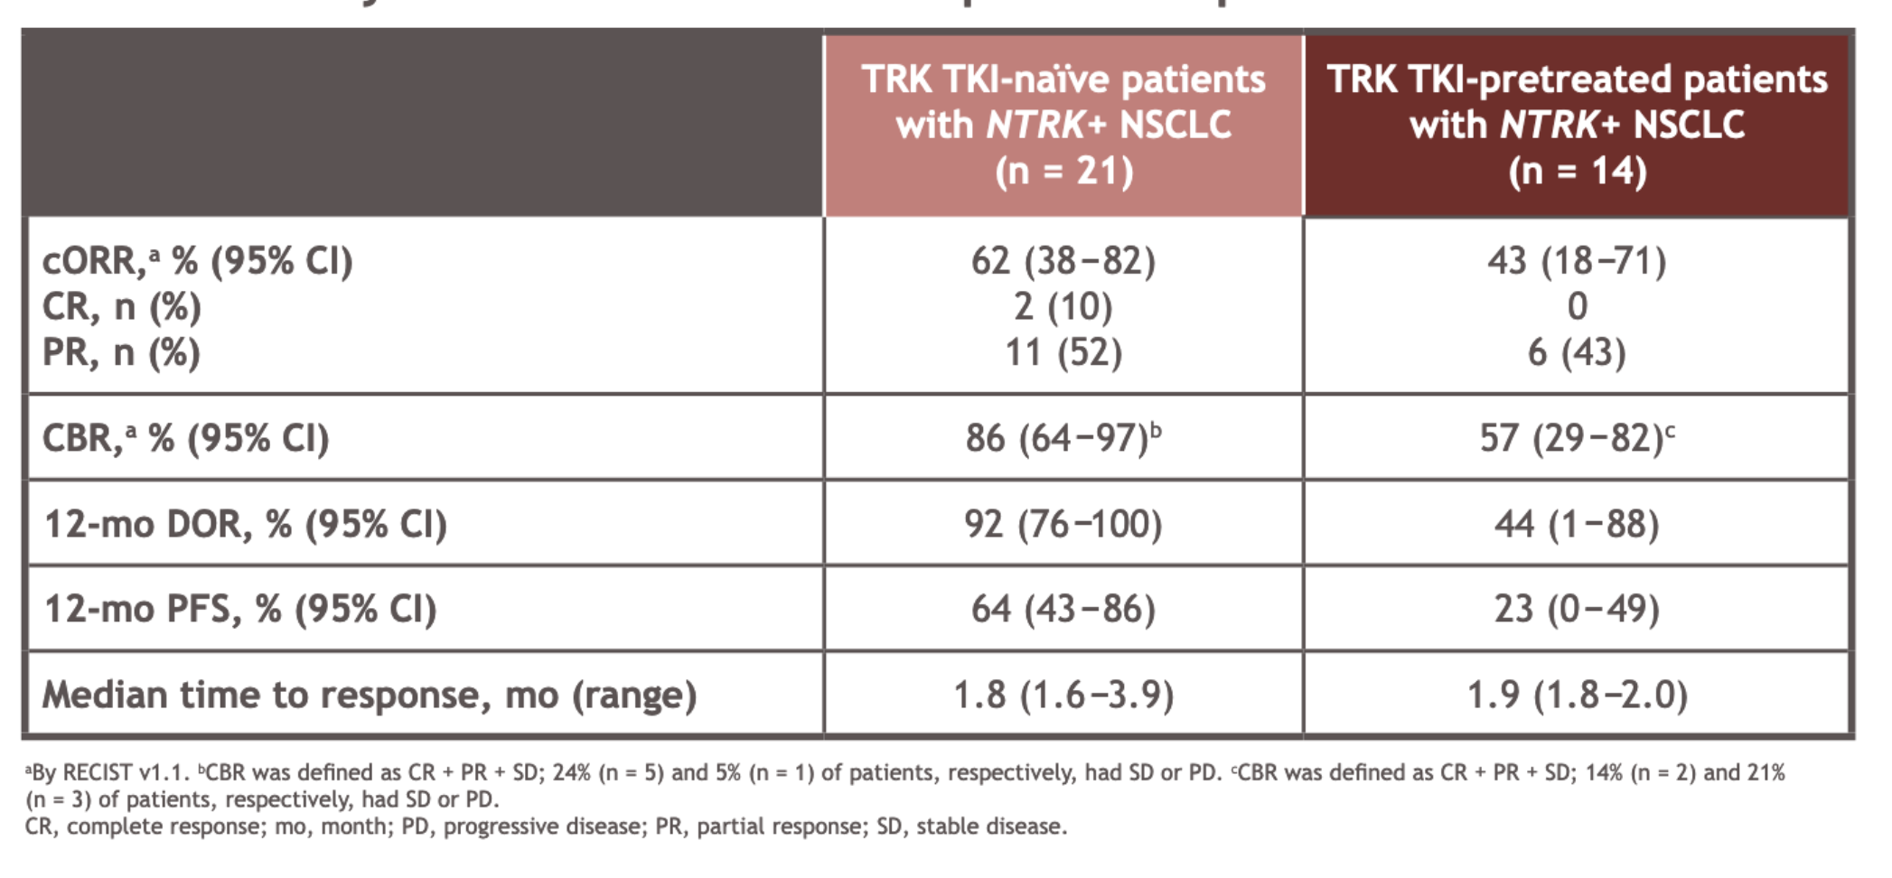
Repotrectinib in patients with NTRK fusion‑positive advanced solid tumors, including NSCLC: Phase 1/ 2 TRIDENT‑1 trial
On June 13, 2024, the FDA granted accelerated approval to repotrectinib for adult and pediatric patients 12 years and older with solid tumors that have a neurotrophic tyrosine receptor kinase gene fusion, are locally advanced or metastatic or where surgical resection is likely to result in severe morbidity, and that have progressed following treatment or have no satisfactory alternative therapy.
Solomon B et al. ESMO 2023; Abstract 1372P.

Slide 50
Case Presentation – Dr Langer: 52 yo WF - ROS1 (+) mNSCLC
HPI (12/27/16): 52 yo WF never smoker presented to OSH ER in 11/16 with 7 lb weight loss, increasing cough, DOE and LUQ pain --> ribs.
Sx prompted abdominal US, which showed a small L pl effusion; normal liver, bile duct, GB and pancreas.
CXR showed multiple pulmonary nodules suspicious for cancer, with large, semi-lucent LUL mass.
CT demonstrated a solid LUL mass measuring 56 x 46 mm with consolidation in the anterior lingula;
It also showed a discrete 28 mm mass in the LLL and 20 mm mass in anterior LLL, along with innumerable additional bilateral pulmonary nodules, as well as moderate L pleural effusion.
Additional findings:
13 x 13 mm infracarinal LN
Sclerotic lesions in the mid-sternum and T12
2.4 cm hypodense lesion in the posterior segment of the R hepatic lobe ; < 1 cm lesion in the L hepatic lobe.
Seen by Pulmonary who recommended a CT guided bx of the LUL, which was performed on 11/09/16
Pathology proved c/w adenocarcinoma of lung origin.
Additional testing included EGFR, ALK, ROS1 and PDL1 was initially deemed (-)
Ultimately, pt was recommended to consider systemic chemo, but has opted for naturopathic approaches
Over 6 wks on various vitamins and supplements, cough improved, but she continued to lose wt and noted progressive DOE.
PET imaging ordered

Slide 51
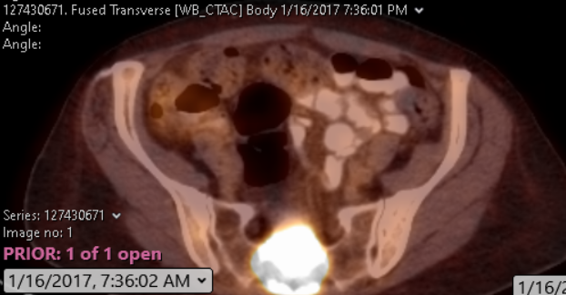
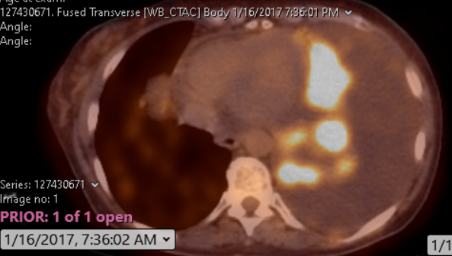
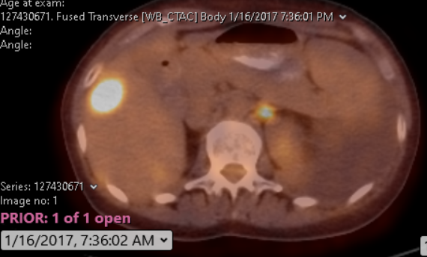
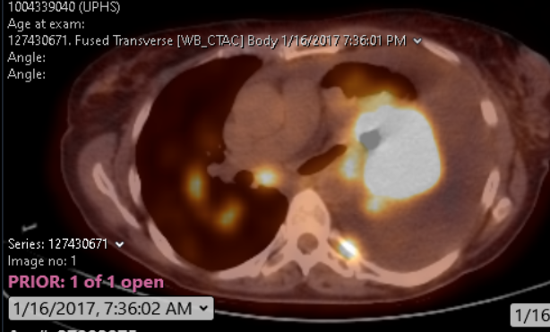
Case Presentation – Dr Langer: 52 yo WF - ROS1 (+) mNSCLC (Continued)

Slide 52
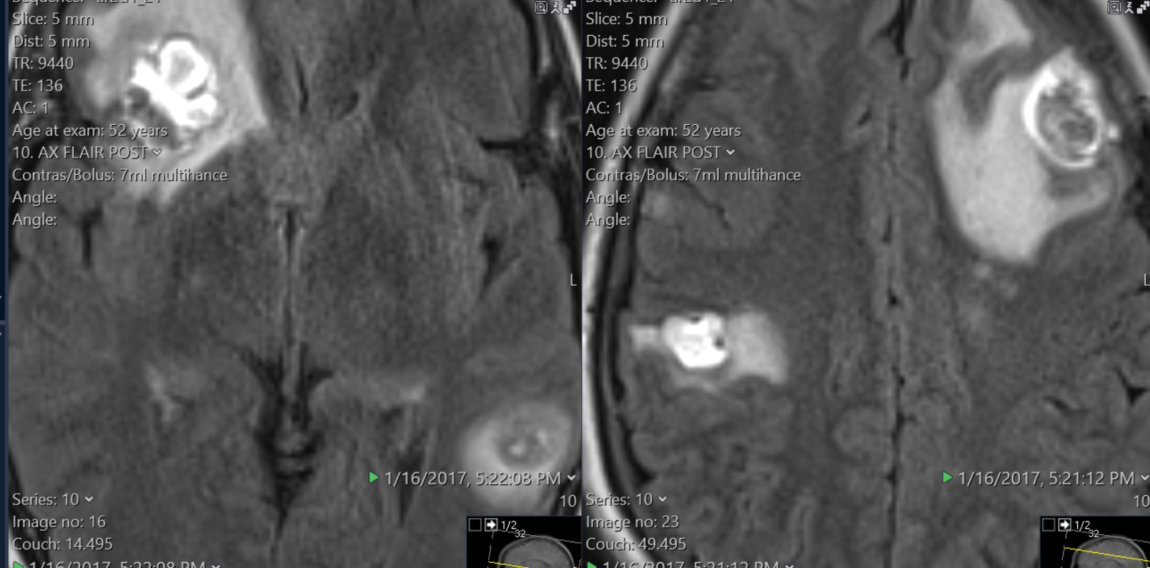
Case Presentation – Dr Langer: 52 yo WF - ROS1 (+) mNSCLC (Continued)
MRI: multiple CNS mets, TNTC
Stage: IV (bone, liver, lung, brain, nodal)
Repeated molecular markers:
EGFR (-)
KRAS (-)
ALK (-)
BRAF (-)
ROS1 (+): 16% of 200 nuclei had separation of the 3’ ROS1 and 5’ ROS1.Interval
01/19/17: pt was feeling worse with increasing DOE and declining appetite. No neurologic Sx, x for occasional HAs. Started crizotinib and began WBRT. Remained on assorted vitamin supplements, but began to question their utility. No other complaints.
Interval Hx 02/16/17: pt returned in follow-up for 2 week toxicity evaluation on crizotinib. S/p WBRT. Her energy and appetite were good with less insomnia. LUQ pain had resolved s/p thoracentesis x 2.
She noted mild bilateral LE edema, which started after initiating dexamethasone and crizotinib, prompting steroid taper.
Pt also noted brief visual disturbances (flashing lights), mostly at night. No lightheadedness, only mild DOE.

Slide 53
Case Presentation – Dr Langer: 52 yo WF - ROS1 (+) mNSCLC (Continued): Tx Course (1)
01/17: began Crizotinib, completed WBRT: Major response in all sites
SRS 11/09/18 with repeat GK SRS 01/11/19 to 5 separate Asx’ic sites, all < 10 mm:.
05/26/22: Smoldering PD - LUL and L hilar LN, all other sites resolved/improved
09/01/22: Increasing pace of PD - oligo PD in LUL, new CNS lesions, each 1-3 mm; other sites stable
11/22: GK for 15 lesions. Crizotinib continued
03/02/23: Continued PD - LUL with increasing L pleural effusion; stable bone mets
04/10/23 - 04/13/23: Lorlatinib initiated at 50% dose, but c/b intractable dizziness, fatigue, anxiety and insomnia. Pt paused lorlatinib, then resumed after 4 wks, but dev’d similar Sx at 25% dose
06/08/23: PD - LUL, pleura, pulmonary nodules, bones (sacrum, spine); new onset LBP
07/23: Palliative XRT to sacral bone mets
07/23: Entrectinib started at 1/3 dose; stopped by 09/23, c/b profound fatigue and anorexia
07/23 – 01/24: Off Tx, diminishing PS, new sites of bone pain. Needed L pleurex catheter. Declined chemo

Slide 54
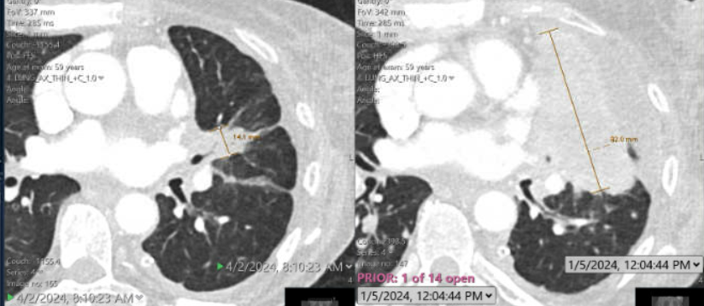
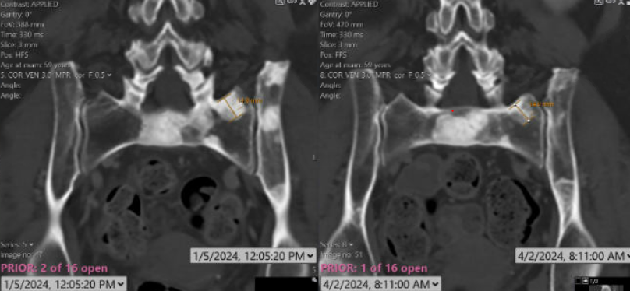
Case Presentation – Dr Langer: 52 yo WF - ROS1 (+) mNSCLC (Continued): Tx Course (1)
Palliative XRT to T10, finished 01/31/24 01/09/24: Started repotrectinib, after multiple delays:
By 1/30/24 - 50% dose due to toxicity, but felt better by 2/19/24, prompting dose increase to 80mg BID
04/02/24 - 07/16/24: Profound PR
Has required periodic SRS for growing CNS lesions in interim
09/09/24: Current side effects: grade 1-2 peripheral edema, fatigue, and constipation

Slide 55
Agenda
Introduction: A Model for Targeted Treatment in Non-Small Cell Lung Cancer (NSCLC)
Module 1: NSCLC with ALK, ROS1 and NTRK Rearrangements — Dr Langer
Module 2: Current and Future Treatment of Metastatic NSCLC with RET, MET, HER2 and KRAS Alterations — Dr Dagogo-Jack

Slide 56
Case Presentation – Dr Dagogo-Jack: Stage IV RET-Rearranged NSCLC
A 69-year-old with a remote 12 pack year smoking history presented with cervical radiculopathy prompting a CXR and neck x-ray which demonstrated a RML opacity.
CT chest confirmed a 2.7 cm RML nodule without associated lymphadenopathy. Brain MRI and PET did not demonstrate metastases.
Bronchoscopy/EBUS confirmed a diagnosis of NSCLC without nodal involvement. He subsequently underwent right middle lobe wedge resection with pathology consistent with lung adenocarcinoma—stage IA (pT1cN0M0).
No adjuvant therapy was advised.
1 year later, he developed an enlarging subcutaneous nodule. Biopsy confirmed metastatic lung cancer. Restaging studies, including brain MRI and PET, demonstrated a solitary 1 cm frontal metastasis, findings concerning for suture line recurrence, and multifocal osseous uptake.
RNA NGS identified a KIF5B-RET rearrangement.
He commenced treatment with Selpercatinib. He tolerated the medication with side effects of hypertension and dry mouth.
3 years into treatment, he developed progression of the frontal (CNS) metastasis prompting craniotomy and resection. Molecular testing demonstrated a G810S solvent front mutation.
He continued on Selpercatinib until 9 months later when he developed symptomatic leptomeningeal disease and transitioned to hospice.

Slide 57
World Lung Targeted Lung Webinar September 2024
Ibiayi Dagogo-Jack, MD
Assistant Professor of Medicine
Massachusetts General Hospital Cancer Center
Harvard Medical School

Slide 58
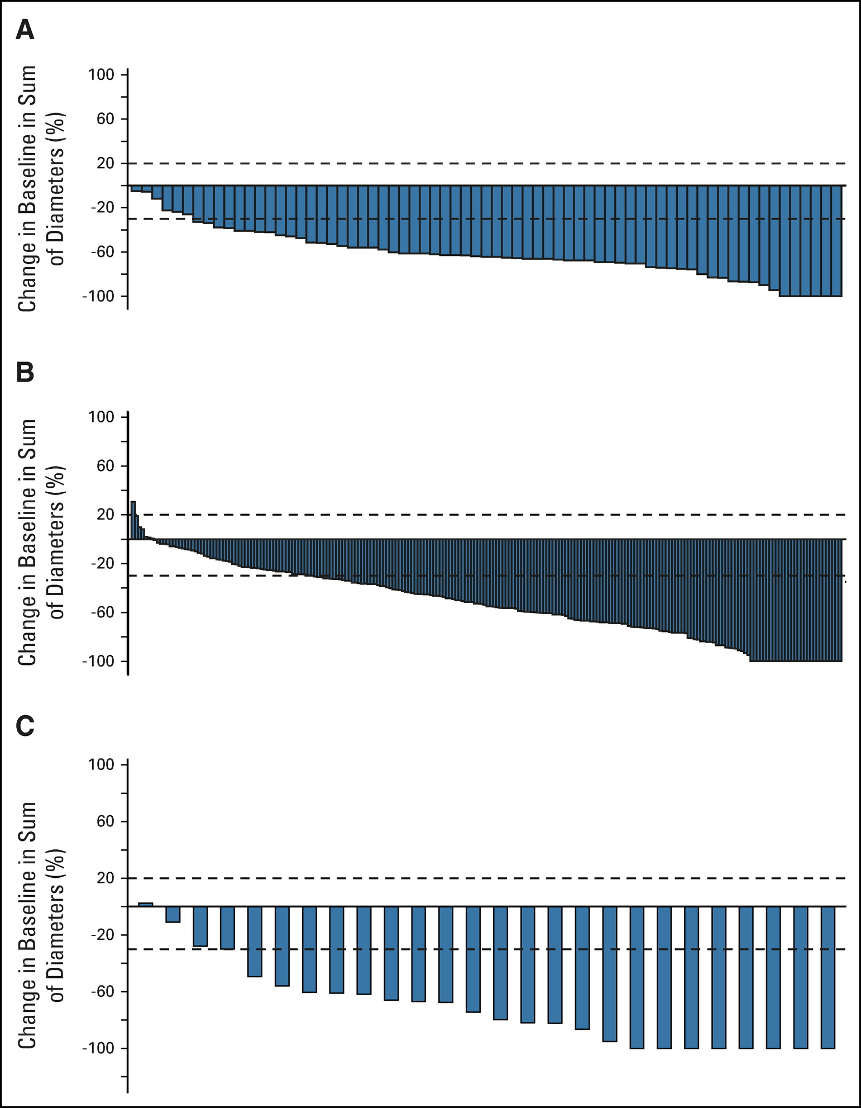
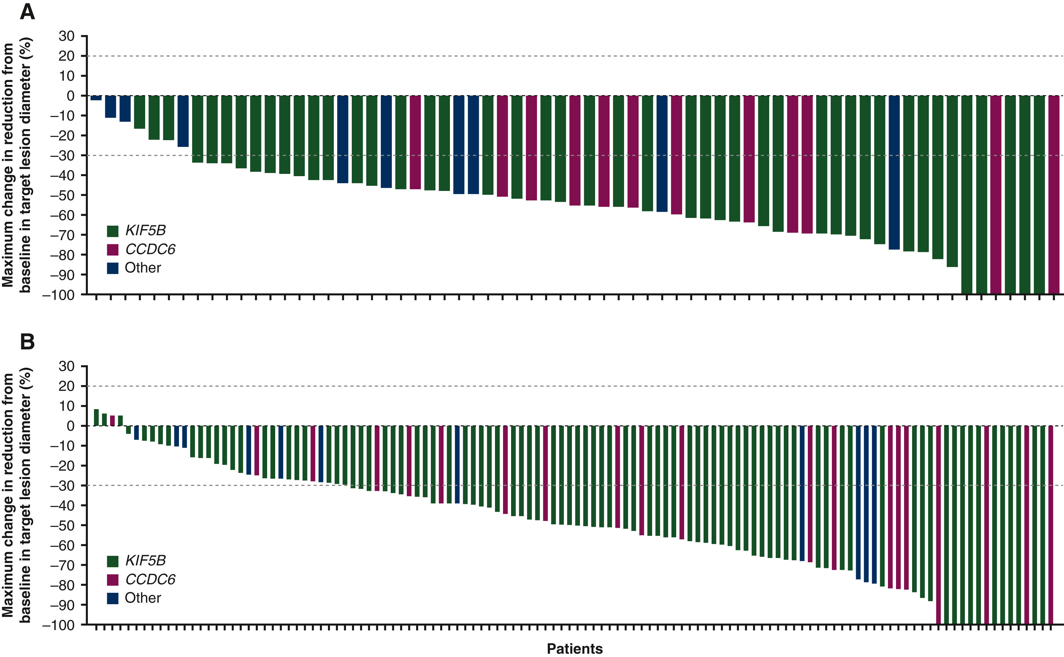
RET-Rearranged NSCLC: Current Management
Selpercatinib and Pralsetinib are both FDA-approved for treatment of RET-rearranged NSCLC
Selpercatinib
Pralsetinib
Treatment Naive
Treatment Naive
ORR: 81%,
Median PFS 22 months
ORR: 79%
Median PFS: NR
Prior Platinum-Based Chemo
Prior Platinum-Based Chemo
ORR: 61%
Median PFS 24.9 months
ORR: 59%, DCR 90%
Median PFS: 16.5 months
Drilon JCO 2023, Greisinger Annals of Oncology 2022

Slide 59
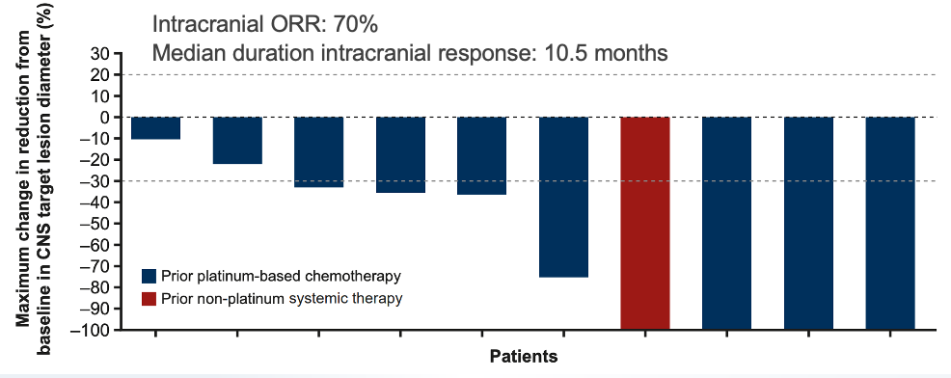
Intracranial Activity of Selpercatinib and Pralsetinib
Selpercatinib
Pralsetinib
CNS ORR 85%
CNS ORR 70%
Drilon JCO 2023, Greisinger Annals of Oncology 2022

Slide 60
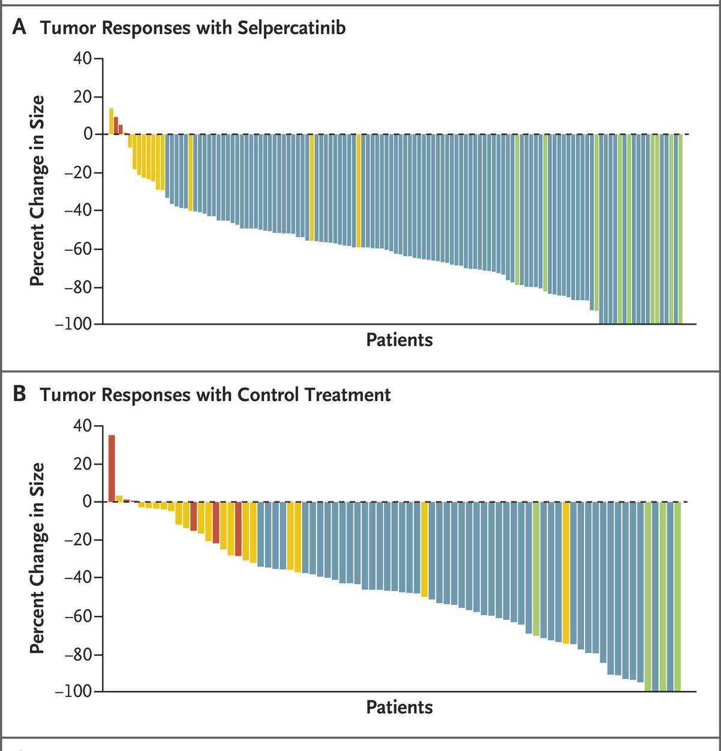
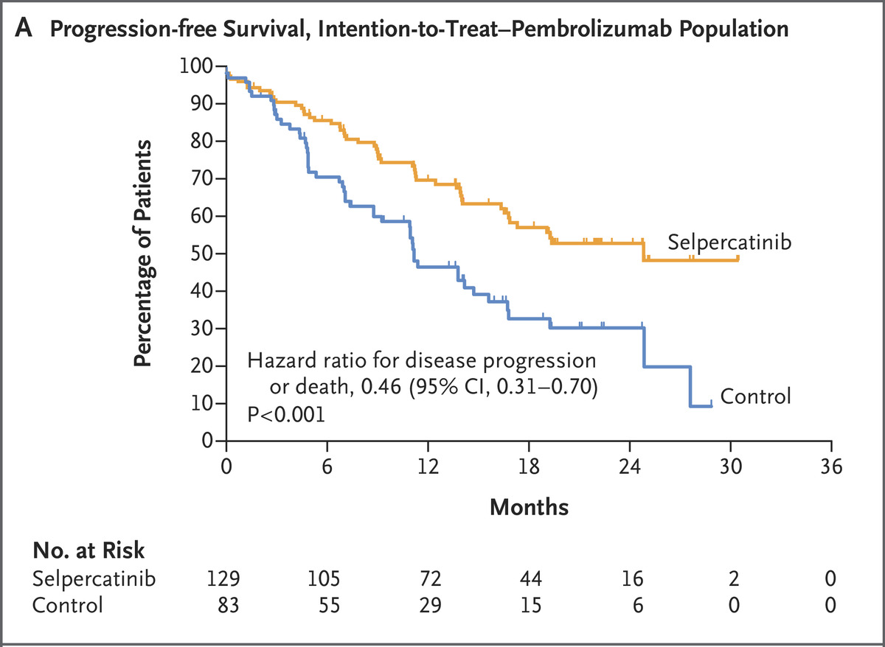
1st Line Selpercatinib: LIBRETTO-431
Global randomized phase III study comparing Selpercatinib to chemo +/- immunotherapy in 1st line
Initially 1:1 randomization, ultimately 2:1 (overall 1.6:1).
Crossover occurred in 60% of pts in control arm + additional 15% of pts received a RET TKI outside of study
Median PFS: 24.8 mos vs 11.2 mos
ORR 84%
Selpercatinib
CNS ORR
82%
ORR 65%
ChemoIO
CNS ORR
58%
Zhou NEJM 2023

Slide 61
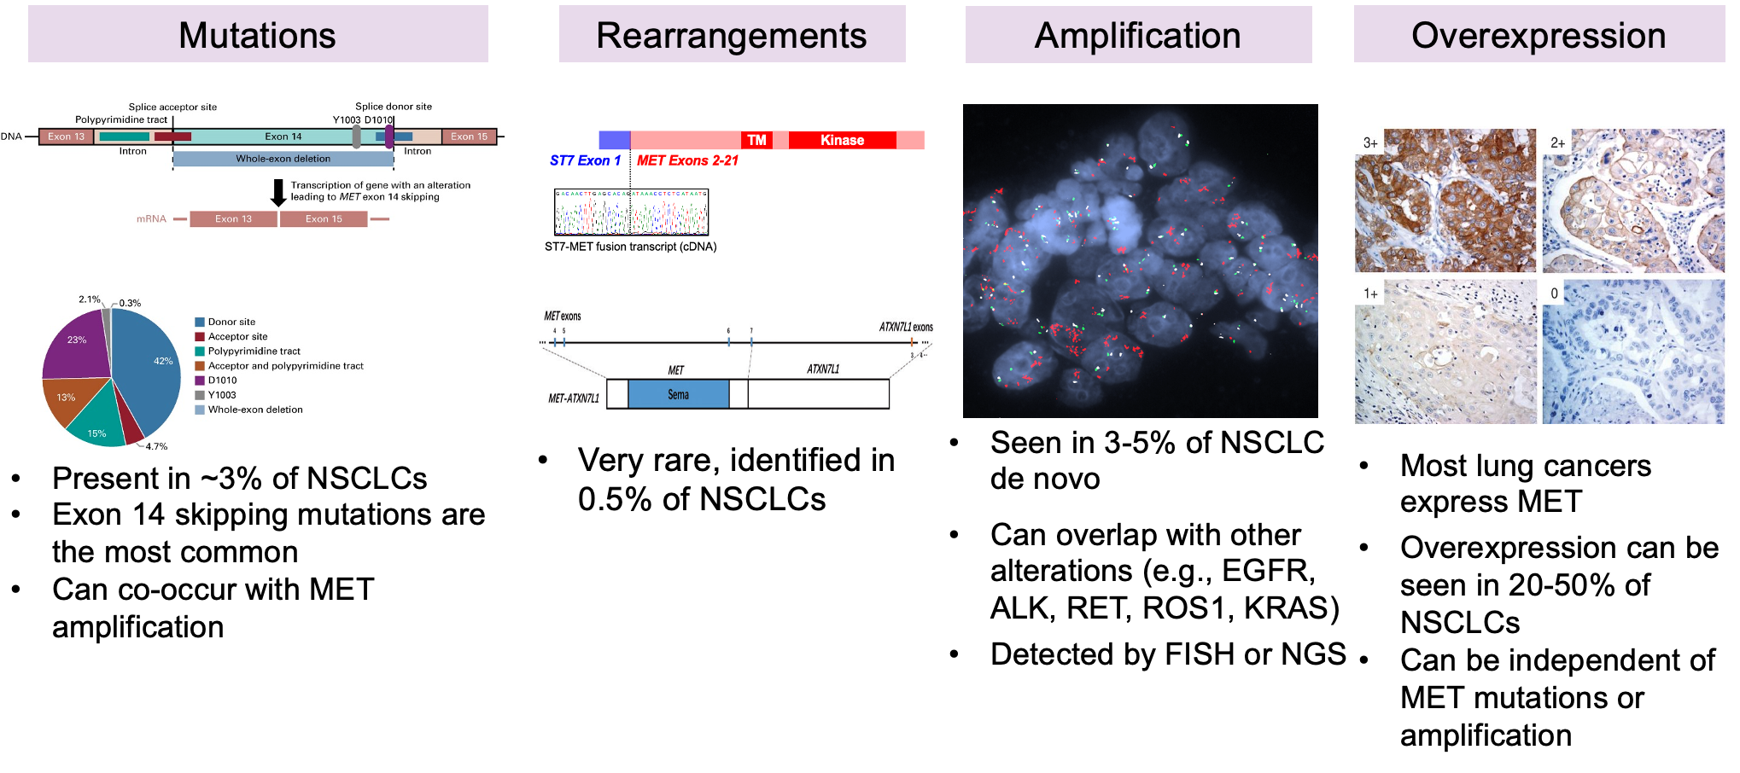
Diverse MET Alterations in NSCLC
Socinski MA JCO Precis Oncology, Zhu Annals of Oncology 2018, Dagogo-Jack Clin Cancer Res 2022

Slide 62
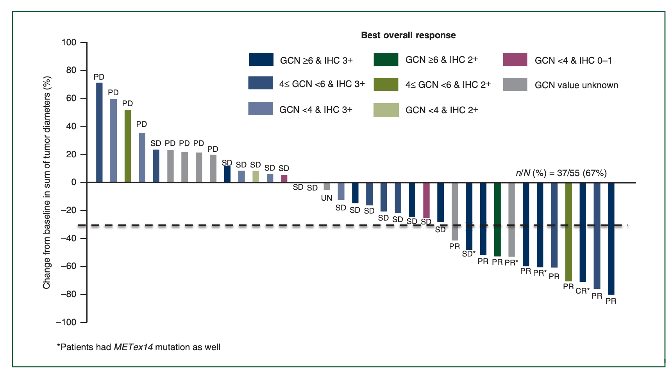
Capmatinib in NSCLC with MET Overexpression
Genomic alterations (MET amplification and exon 14 skipping) predict sensitivity to capmatinib better than MET overexpression
Objective Response Rate:
MET IHC 3+ (n = 37) = 24%
MET GCN ≥ 6 (n = 15) = 47%
Schuler Annals Oncology 2020

Slide 63

Telisotuzumab Vedotin (Teliso-V), an anti-cMET ADC
Dosed at 1.9 mg/kg IV Q2Weeks
MMAE: monomethyl auristatin E = microtubule polymerization inhibitor
LUMINOSITY study: Phase 2 non-randomized multicenter study for patients with c-MET overexpressing metastatic NSCLC after ≤2 lines of therapy
Primary Endpoint: ORR by independent central review per RECIST v1.1
Camidge ASCO 2024

Slide 64

LUMINOSITY Phase 2: Teliso-V in MET Overexpressing EGFR^{wt} Non-Squamous NSCLC
c-MET overexpression definition (Ventana SP44 antibody):
(1) High: ≥50% of tumor cells with 3+ staining (2) Intermediate: 25-49% of tumor cells with 3+ staining
Objective Response Rate
Overall: 28.6%
c-MET High: 34.6%
c-MET Intermediate: 22.9%
Median PFS:
c-MET High: 5.5 months
c-MET Intermediate: 6.0 months
Median Duration of Response:
c-MET High: 9.0 months
c-MET Intermediate: 7.2 months
Median OS:
c-MET High: 14.6 months
c-MET Intermediate: 14.2 months
Disease Control Rate
Overall 59%
Camidge JCO 2024

Slide 65
LUMINOSITY: Safety of Teliso-V in MET Overexpressing EGFR^{wt} Non-Squamous NSCLC
TRAEs Occurring in > 5% of Pts | NSQ EGFR^{wt} NSCLC (N = 172)
 | Any Grade | Grade ≥3
Treatment-emergent AE | 167 (97.1) | 97 (56.4)
TRAE | 140 (81.4) | 48 (27.9)
Peripheral sensory neuropathy | 52 (30.2) | 12 (7.0)
Peripheral edema | 28 (16.3) | 3 (1.7)
Fatigue | 24 (14.0) | 4 (2.3)
Decreased appetite | 20 (11.6) | 1 (0.6)
Increased ALT | 19 (11.0) | 6 (3.5)
Pneumonitis | 18 (10.5) | 5 (2.9)
Hypoalbuminemia | 18 (10.5) | 0
Nausea | 17 (9.9) | 0
Vision blurred | 16 (9.3) | 2 (1.2)
Increased AST | 16 (9.3) | 0
Asthenia | 13 (7.6) | 1 (0.6)
Anemia | 10 (5.8) | 1 (0.6)
Increased γ-glutamyltransferase | 10 (5.8) | 1 (0.6)
Keratitis | 10 (5.8) | 0
Peripheral neuropathy | 9 (5.2) | 1 (0.6)
Decreased weight | 9 (5.2) | 0
Payload Toxicity
MET Class Toxicity
Pneumonitis
2 patients (1.2%) with grade 5 TRAEs of ILD and respiratory failure
Peripheral neuropathy was cumulative and was grade ≥3 in 9.3% of pts
Drug-related ILD seen in 9.9% of pts, with 5.2% grade ≥3 and 1.7% grade 5
21.5% of patents discontinued treatment due to TRAEs
ILD/Pneumonitis (8.7%)
Peripheral neuropathy (10.5%)
Camidge JCO 2024

Slide 66
Questions?

Slide 67
Trastuzumab Deruxtecan in HER2-Mutant NSCLC: DESTINY-Lung02
Trastuzumab deruxtecan is approved for NSCLC with a HER2 mutation
Randomized two cohort noncomparative phase 2 to optimize safety (i.e., ILD risk)
FDA-approved dose is 5.4 mg/kg.
DESTINY-Lung02
Response Assessment | Not Powered to Compare the 2 Arms
Response Assessment by BICR | T-DXd 5.4 mg/kg n = 102 | T-DXd 6.4 mg/kg n = 50
Confirmed Objective Response Rate, n (%) | 50 (49.0) | 28 (56.0)
Best overall response, n (%) Complete Response Partial Response Stable Disease Progressive Disease | 1 (1.0) 49 (48.0) 45 (44.1) 4 (3.9) | 2 (4.0) 26 (52.0) 148 (36.0) 2 (4.0)
Disease Control Rate, n (%) | 95 (93.1) | 46 (92.0)
Median PFS, Months | 9.9 | 15.4
Median OS, Months | 19.5 | NR
Interstitial Lung Disease (Prior ICI/No Prior ICI), % | 12.9 (14.9/7.4) | 28.0 (28.2/27.3)
Dose Reduction/Drug Discontinuation, % | 16.8/13.9 | 32/20
Should We Use T-DXd in the 1st Line?
DESTINY-Lung04
Median Onset of ILD
88 days
CNS ORR and DOR
50% with 5.4 mg/kg
9.5 months with 5.4 mg/kg
Goto JCO 2023

Slide 68

Trastuzumab Deruxtecan in HER2 Expressing NSCLC: DESTINY-Lung01 (5.4 mg/kg)
On April 5, 2024, FDA granted accelerated approval to T-DXd for pts with metastatic HER2-positive (IHC 3+) solid tumors following progression on standard therapy
HER2 “overexpression” is observed in ~10-23 % of NSCLC
Approval in lung cancer based on DESTINY-Lung01 where 3+ constituted strong expression in ≥10% of individual cells or in a tumor cell cluster
ORR: 52.9%
Median DOR: 6.9 months
Median PFS: 6.7 months (2+ and 3+))
Median OS: 11.2 months (2+ and 3+)
ILD occurred in 3 (7%) pts in the overall cohort; two cases were fatal
Smit Lancet 2024

Slide 69

DESTINY-Lung03: Phase IB Dose-Escalation Study of Trastuzumab Deruxtecan for HER2-Overexpressing (HER2-OE) NSCLC
ORR = objective response rate; DOR = duration of response; DCR = disease control rate; PFS = progression-free survival; OS = overall survival; TKI = tyrosine kinase inhibitor
Yang WCLC 2024

Slide 70

Trastuzumab Deruxtecan for HER2-OE NSCLC: DESTINY-Lung03
ORR: 44.4%
Median DOR: 11.0 months
Median PFS: 8.2 months
Median OS: 17.1 months
Results from DESTINY-Lung03 Part 1 confirm the clinical benefit of T-DXd monotherapy (5.4 mg/kg; arm 1D) for pretreated HER2-overexpressing (IHC 3+/2+) metastatic NSCLC, building on DESTINY-Lung01 cohort 1a results
Yang WCLC 2024

Slide 71
WCLC HER2 Tyrosine Kinase Inhibitor Updates
SOHO-01 (BAY 2927088) oral HER2 TKI (n=44 pts)
Presented by Dr. Xuining Le
ORR 72.1%, DCR 83.7%, median PFS 7.5 months
Among YVMA mutations (71% of pts): ORR 90%, DCR 97%, PFS 9.9 months
Safety: 87% with diarrhea; 32% dose reduction; 7% dose discontinuation
BEAMION Lung-01 (Zongertinib), oral HER2 TKI (n=132 pts)
Presented by Dr. Gerrina Ruiter
ORR 67%, DCR >94% across 2 doses: 120 mg and 240 mg
CNS ORR 33-40%
Diarrhea 48%; 3% treatment discontinuation; 11% dose reduction

Slide 72

2 FDA-Approved KRAS G12C Inhibitors
Approved 5/2021
Approved 12/2022

Slide 73

CodeBreak 200: Open-Label Phase 3 Study of Sotorasib vs Docetaxel (1:1 Randomization)
Primary Endpoint: PFS by BICR
ORR: 28.1% vs 13.2%
Median DOR: 8.6 vs 6.8 mo
Median OS: 10.6 vs 11.3 mo
(study not powered for OS)
(33% with subsequent G12Ci)
deLangen Lancet 2024

Slide 74
CodeBreak 200: Sotorasib vs Docetaxel Safety Profiles
Adverse Event | Sotorasib All | Grade ≥3 | Docetaxel All | Grade ≥3
Diarrhea | 34%| 12% | 12%| 1%
Fatigue | 7%| 1% | 25%| 6%
Alopecia | 1%| 0% | 21%| 0%
Nausea | 14%|1% | 20%| 1%
Anemia | 3%| 1% | 18%| 3%
Decreased Appetite | 11%|2% | 14%| 0%
Stomatitis | 1%|0% | 11%| 1%
Constipation | 3%|0% | 11%|0%
Asthenia | 4%|1% | 11%|3%
AST Increase | 10%|8% | 0%|0%
ALT Increase | 10%|5% | 0%|0%
Peripheral Neuropathy | 0%|0% | 10%|1%
Dose Reduction | 15% | 27%
Discontinuation | 10% | 11%
deLangen Lancet 2024

Slide 75

KRYSTAL-12: Open-Label Phase 3 Study of Adagrasib vs Docetaxel (2:1 Randomization)
Primary Endpoint: PFS by BICR; Hierarchical (PFS→ORR→OS); OS immature
ORR: 32% vs 9%
Median DOR: 8.3 vs 5.4 mo
CNS ORR: 24% vs 11%
Median OS: 10.6 vs 11.3 mo
(29% crossover)
Mok ASCO 2024

Slide 76

KRYSTAL-12: Open-Label Phase 3 Study of Adagrasib vs Docetaxel (Safety Findings)
ADA
DOC
Grade ≥3 TRAEs: 47% vs 46%
Dose Reduction: 48% vs 24%
Dose Interrupted: 59% vs 19%
Discontinuation: 8% vs 14%
Mok ASCO 2024

Slide 77

KRYSTAL-12: Impact on QOL (>85% Completion Rate)
Felip WCLC 2024

Slide 78

KRYSTAL-12: Impact on QOL
Felip WCLC 2024

Slide 79

KRYSTAL-12: Impact on QOL
Felip WCLC 2024

Slide 80
Questions?

Slide 81
Efficacy of Investigational KRAS G12C Inhibitors
Drug | ORR | DCR | Median PFS
Divarasib (n=44) | 59% | — | 15.3 months
Olomorasib | 35% (all solid tumors) 41% (NSCLC post-G12Ci) | 89% | 8.1 months
Garsorasib (n=74) | 52% | 89% | 9.1 months
Glecirasib (n=119) | 48% | 86% | 8.2 months
IBI351 (n=116) | 49% | 91% | 9.7 months
Sacher WCLC 2024, Heist ASCO 2024, Li WCLC 2024, Li ASCO 2022, Zhou WCLC 2024

Slide 82
Case Presentation – Dr Dagogo-Jack: Stage IV KRAS^{G12C} NSCLC
A 52-year-old male with an active smoking history was taken to the emergency room after losing consciousness while driving. Brain MRI demonstrated a 5 cm R frontal mass with extensive edema, as well as several smaller brain metastases. PET + CT chest, abdomen, pelvis revealed a 1.2 cm right middle lobe nodule without lymphadenopathy or abdominopelvic abnormalities.
He underwent R frontal craniotomy with pathology consistent with a PD-L1 negative metastatic lung adenocarcinoma harboring KRAS G12C in addition to STK11 and KEAP1 mutations.
Stereotactic radiosurgery was performed on four separate sub-centimeter brain metastases. He also received fractionated radiation to the resection cavity.
He was subsequently treated with carboplatin + pemetrexed + pembrolizumab.
After 4 cycles, scans demonstrated progression of CNS disease and an unchanged lung nodule.
He underwent whole brain radiation therapy.
Six months later in the setting of further progression in the CNS despite whole brain radiation, he initiated Adagrasib. He required a dose reduction after 6 weeks due to intractable nausea/vomiting.
Repeat imaging on Adagrasib demonstrated progression of 1 brain metastasis with slight decrease in size of the remaining metastases. He underwent SRS and remained on Adagrasib for 5 months before it was discontinued in setting of poor tolerance and further CNS progression.

