Slide 1
Non-Small Cell Lung Cancer with an EGFR Mutation
Friday, April 26, 2024
12:15 PM – 1:45 PM
What I Tell My Patients:
Integrating New Research Information
into Current Clinical Care
A Complimentary NCPD Hybrid Symposium Series Held During the 49th Annual ONS Congress
Faculty
Marianne J Davies, DNP, ACNP, AOCNP, FAAN
Alexander I Spira, MD, PhD
Jillian Thompson, MSN, ANP-BC, AOCNP
Helena Yu, MD
Moderator
Neil Love, MD

Slide 2





Faculty
Marianne J Davies, DNP, ACNP, AOCNP, FAAN
Program Manager, Care Signature
Oncology Service Line, Yale New Haven Health
Oncology Nurse Practitioner-Senior APP II
Yale Cancer Center
Smilow Cancer Hospital at Yale New Haven
Associate Professor
Yale University School of Nursing
New Haven, Connecticut
Helena Yu, MD
Medical Oncologist
Associate Attending
Memorial Sloan Kettering Cancer Center
New York, New York
Moderator
Neil Love, MD
Research To Practice
Miami, Florida
Alexander I Spira, MD, PhD
CEO and Clinical Director, NEXT Virginia
Director, Virginia Cancer Specialists Research Program
Fairfax, Virginia
Jillian Thompson, MSN, ANP-BC, AOCNP
Nurse Practitioner
MedStar Georgetown University Hospital
Lombardi Comprehensive Cancer Center
Washington, DC

Slide 3
Ms Davies — Disclosures
No relevant conflicts of interest to disclose

Slide 4
Dr Spira — Disclosures
Advisory Committees | Amgen Inc, Array BioPharma Inc, a subsidiary of Pfizer Inc, AstraZeneca Pharmaceuticals LP, Black Diamond Therapeutics Inc, Blueprint Medicines, Bristol Myers Squibb, Daiichi Sankyo Inc, Gritstone bio, Incyte Corporation, Janssen Biotech Inc, Jazz Pharmaceuticals Inc, Lilly, Merck, Mersana Therapeutics Inc, Mirati Therapeutics Inc, Novartis, Regeneron Pharmaceuticals Inc, Sanofi, Takeda Pharmaceuticals USA Inc
Contracted Research | AbbVie Inc, ADC Therapeutics, AI Therapeutics, Alkermes, Amgen Inc, Arch Therapeutics Inc, ArriVent Biopharma, Astellas, Astex Pharmaceuticals, AstraZeneca Pharmaceuticals LP, Black Diamond Therapeutics Inc, Blueprint Medicines, BluPrint Oncology, Boehringer Ingelheim Pharmaceuticals Inc, Bristol Myers Squibb, CytomX Therapeutics, Daiichi Sankyo Inc, Gritstone bio, Ignyta Inc, Incyte Corporation, Janssen Biotech Inc, Loxo Oncology Inc, a wholly owned subsidiary of Eli Lilly & Company, MacroGenics Inc, Medikine, Mersana Therapeutics Inc, Mirati Therapeutics Inc, Nalo Therapeutics, Novartis, Plexxikon Inc, Regeneron Pharmaceuticals Inc, Revolution Medicines, Roche Laboratories Inc, Rubius Therapeutics, Scorpion Therapeutics, Synthekine, Takeda Pharmaceuticals USA Inc

Slide 5
Ms Thompson — Disclosures
Advisory Committees | Janssen Biotech Inc, Mirati Therapeutics Inc
Nonrelevant Financial Relationship | Targeted Oncology

Slide 6
Dr Yu — Disclosures
Consulting Agreements | AbbVie Inc, AstraZeneca Pharmaceuticals LP, Black Diamond Therapeutics Inc, Blueprint Medicines, C4 Therapeutics, Cullinan Oncology, Daiichi Sankyo Inc, Ipsen Biopharmaceuticals Inc, Janssen Biotech Inc, Taiho Oncology Inc, Takeda Pharmaceuticals USA Inc
Data and Safety Monitoring Board/ Committee | Janssen Biotech Inc
Research Funding to My Institution | AstraZeneca Pharmaceuticals LP, Black Diamond Therapeutics Inc, Blueprint Medicines, Cullinan Oncology, Daiichi Sankyo Inc, Erasca, Janssen Biotech Inc, Novartis, Pfizer Inc

Slide 7
Commercial Support
This activity is supported by educational grants from AstraZeneca Pharmaceuticals LP and Janssen Biotech Inc, administered by Janssen Scientific Affairs LLC.
Research To Practice NCPD Planning Committee Members,
Staff and Reviewers
Planners, scientific staff and independent reviewers for Research To Practice have no relevant conflicts of interest to disclose.

Slide 8
This educational activity contains discussion of
non-FDA-approved uses of agents and regimens. Please refer to official prescribing information for each product for approved indications.

Slide 9


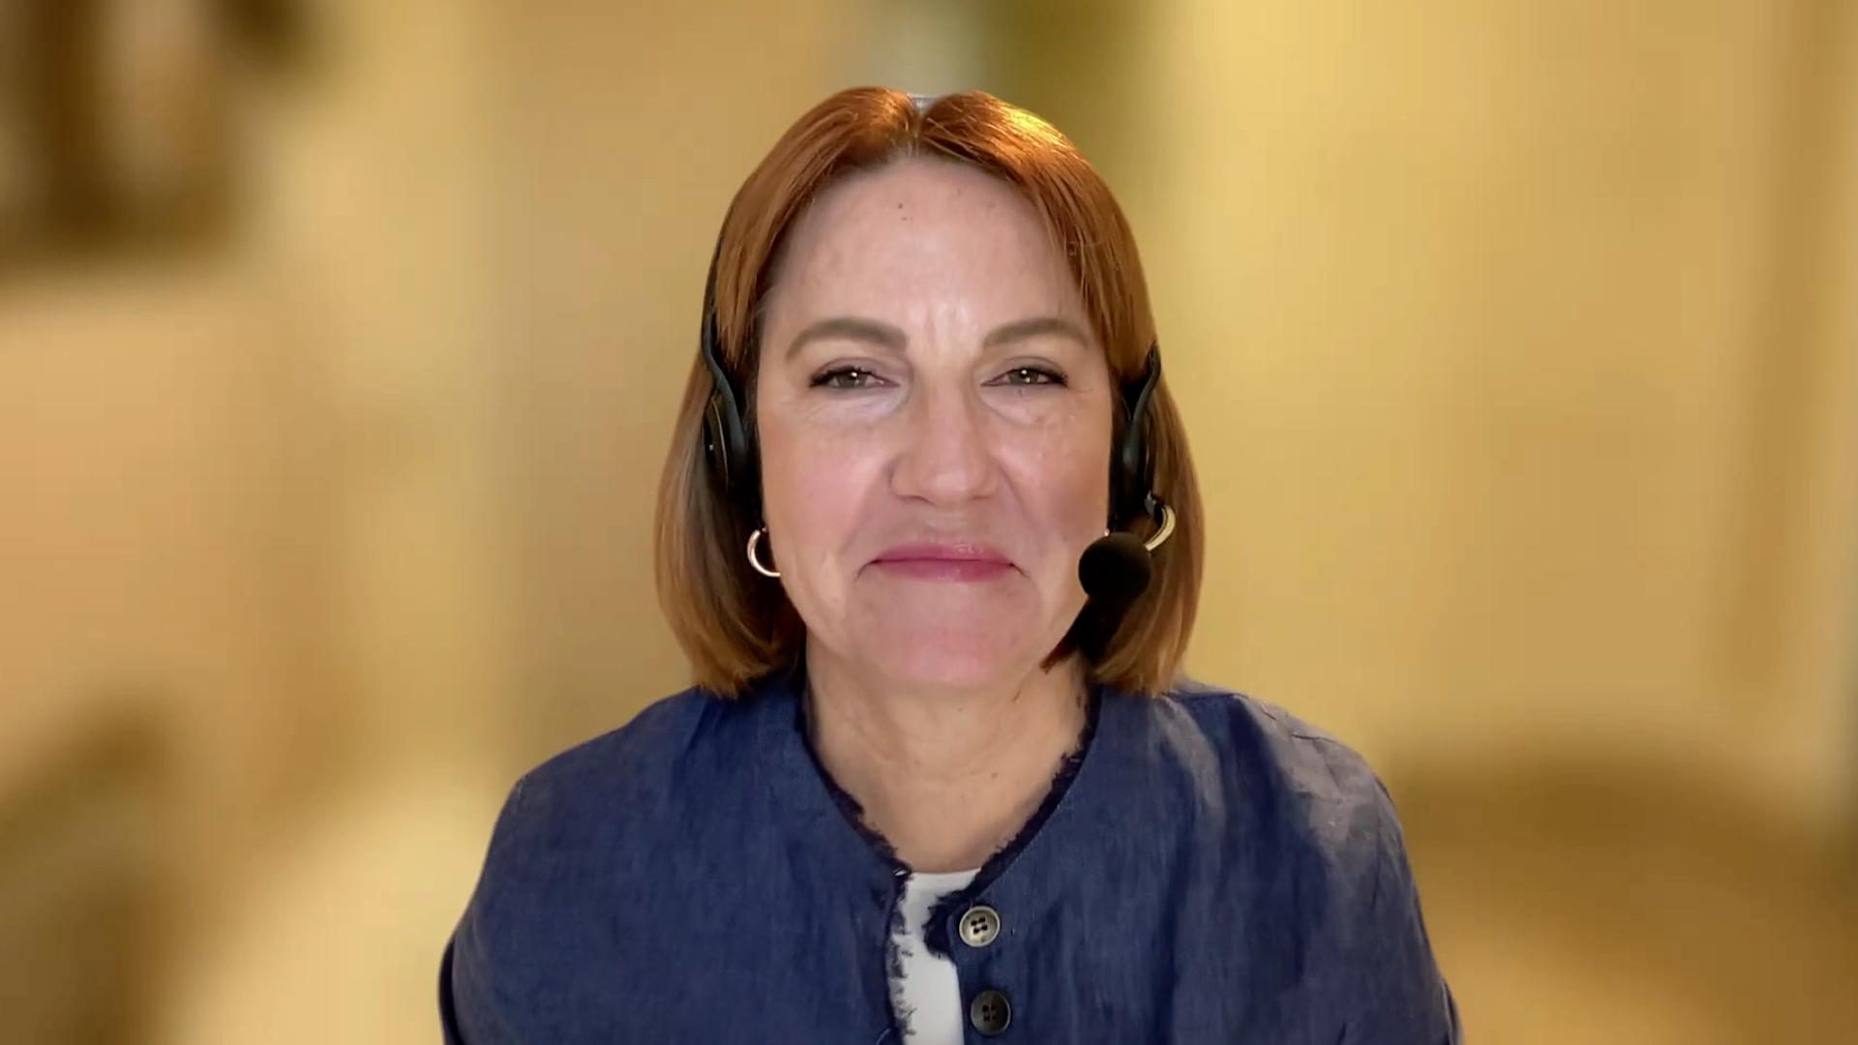





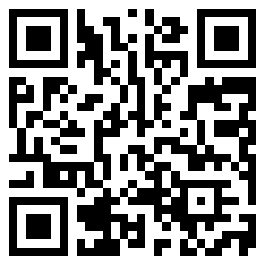
Consulting Nurse Faculty
Jacqueline Broadway-Duren, PhD, DNP, APRN, FNP-BC
The University of Texas
MD Anderson Cancer Center
Houston, Texas
Jessica Mitchell, APRN, CNP, MPH
Mayo Clinic College of Medicine and Science
Rochester, Minnesota
Kathleen D Burns, RN, MSN, AGACNP-BC, OCN
City of Hope Comprehensive
Cancer Center
Duarte, California
Tiffany A Richards, PhD, ANP-BC, AOCNP
The University of Texas
MD Anderson Cancer Center
Houston, Texas
Sonia Glennie, ARNP, MSN, OCN
Swedish Cancer Institute Center
for Blood Disorders
Seattle, Washington
Kimberly A Spickes, MNSc, RN, APRN, OCN, ACNP-BC
University of Arkansas for Medical Sciences
Little Rock, Arkansas
Amy Goodrich, CRNP
The Sidney Kimmel Comprehensive Cancer Center
Baltimore, Maryland
Ronald Stein, JD, MSN, NP-C, AOCNP
USC Norris Comprehensive Cancer Center
Los Angeles, California
https://www.ResearchToPractice.com/ONS2024Clips

Slide 10
Agenda
Introduction
Module 1: Localized Non-Small Cell Lung Cancer (NSCLC) with an EGFR Mutation
Module 2: First-Line Therapy for Patients with Metastatic NSCLC and EGFR Mutations
Module 3: Management of Progressive EGFR-Mutated NSCLC
Module 4: Targeting EGFR Exon 20 Insertion Mutations

Slide 11
Agenda
Introduction
Module 1: Localized Non-Small Cell Lung Cancer (NSCLC) with an EGFR Mutation
Module 2: First-Line Therapy for Patients with Metastatic NSCLC and EGFR Mutations
Module 3: Management of Progressive EGFR-Mutated NSCLC
Module 4: Targeting EGFR Exon 20 Insertion Mutations

Slide 12
Consulting Nursing Faculty Comments
Patient education about clinical trial participation
Amy Goodrich, CRNP

Slide 13
Agenda
Introduction
Module 1: Localized Non-Small Cell Lung Cancer (NSCLC) with an EGFR Mutation
Module 2: First-Line Therapy for Patients with Metastatic NSCLC and EGFR Mutations
Module 3: Management of Progressive EGFR-Mutated NSCLC
Module 4: Targeting EGFR Exon 20 Insertion Mutations

Slide 14
EGFR Testing in Non-Small Cell Lung Cancer (NSCLC)
Dr Spira
Fairfax, Virginia
Dr Yu
New York, New York
Spectrum of EGFR mutations found in NSCLC; clinical relevance of and similarities and differences among various detectable EGFR mutations
Incidence of targetable EGFR mutations in localized and metastatic disease; optimal timing of EGFR testing
Available platforms to identify EGFR mutations in patients with NSCLC; advantages and limitations of next-generation sequencing versus one-off testing
Reliability of plasma-based assays to document the presence of actionable EGFR mutations; current clinical utility
Role of repeat biomarker testing in the care of patients with progressive NSCLC with an EGFR mutation

Slide 15
Targetable Oncogenic Drivers
EGFR sensitizing
Gefitinib⁴
Erlotinib⁴
Afatinib⁴
Osimertinib⁴
Necitumumab⁴
Rociletinib³
ALK
Crizotinib⁴
Alectinib⁴
Ceritinib⁴
Lorlatinib²
Brigatinib²
MET
Crizotinib²
Cabozantinib²
HER2
Trastuzumab emtansine²
Afatinib²
Dacomitinib²
ROS1
Crizotinib⁴
Cabozantinib²
Ceritinib²
Lorlatinib²
DS-6051b¹
BRAF
Vemurafenib²
Dabrafenib²
RET
Cabozantinib²
Alectinib²
Apatinib²
Vandetanib²
Ponatinib²
Lenvatinib²
KEY
1 - Phase I
2 - Phase II
3 - Phase III
4 - Approved
NTRK1
Entrectinib²
LOXO-101²
Cabozantinib²
DS-6051b¹
MEK1
Trametinib²
Selumetinib³
Cobimetinib¹
PIK3CA
LY3023414²
PQR 309¹
Presented by Frances Shepherd at 2019 ASCO Annual Meeting.

Slide 16
Marianne J Davies, DNP, ACNP, AOCNP, FAAN
What I tell my patients who are never-smokers and are diagnosed with lung cancer and how I explain the significance of EGFR mutations

Slide 17
Osimertinib for Localized and Locally Advanced NSCLC with an EGFR Mutation
Dr Spira
Fairfax, Virginia
Dr Yu
New York, New York
Long-term findings, including overall survival outcomes, with adjuvant osimertinib for Stage IB to Stage IIIA NSCLC with an EGFR mutation after complete tumor resection
Protection against central nervous system (CNS) disease recurrence observed with adjuvant osimertinib
Patient selection for and appropriate incorporation of adjuvant osimertinib into routine practice

Slide 18
Osimertinib for Localized and Locally Advanced NSCLC with an EGFR Mutation
Dr Spira
Fairfax, Virginia
Dr Yu
New York, New York
Choosing between osimertinib and immune checkpoint inhibition for patients eligible for both treatments
Tolerability of osimertinib in the adjuvant setting; appropriate threshold for dose reduction, dose delays or treatment discontinuation for patients with NSCLC receiving adjuvant osimertinib
Ongoing efforts seeking to further define the role of osimertinib in the management of nonmetastatic NSCLC with an EGFR mutation

Slide 19
Osimertinib
Mechanism of action
EGFR tyrosine kinase inhibitor
Indication in the adjuvant setting
After tumor resection for patients with NSCLC whose tumors have EGFR exon 19 deletions or exon 21 L858R mutations, as detected by an FDA-approved test
Recommended dose
80 mg PO once daily, with or without food, until disease recurrence, or unacceptable toxicity, or for up to 3 years
Osimertinib package insert, 2/2024.

Slide 20
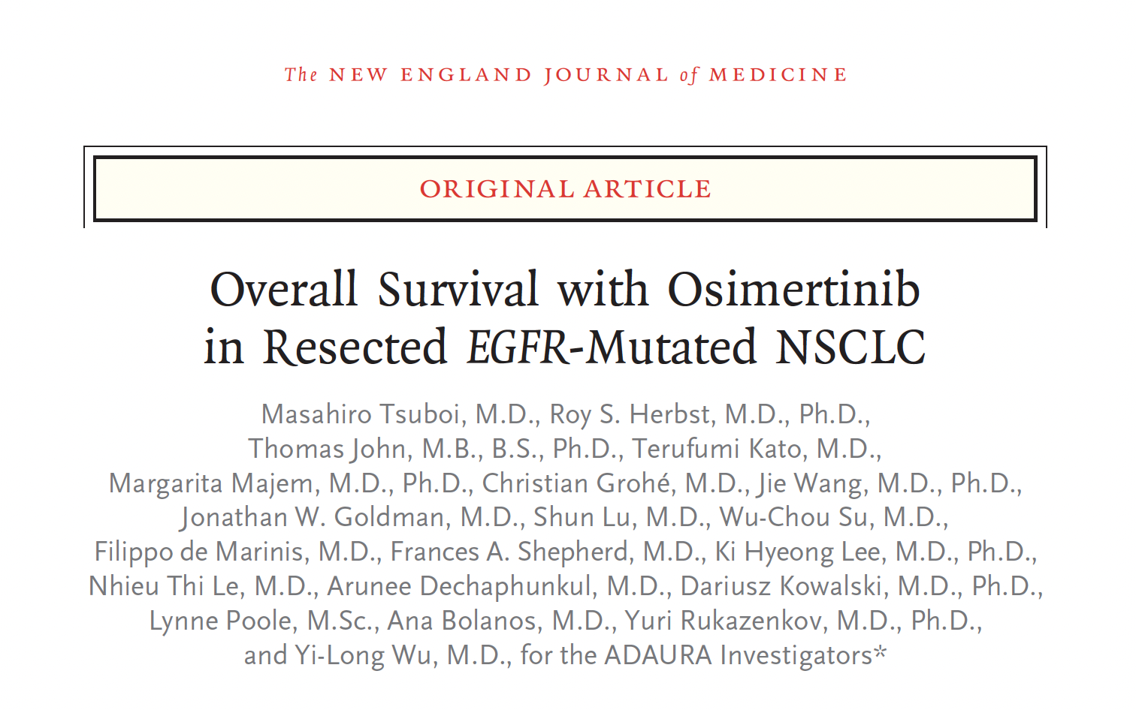
2023;389(2):137-47

Slide 21
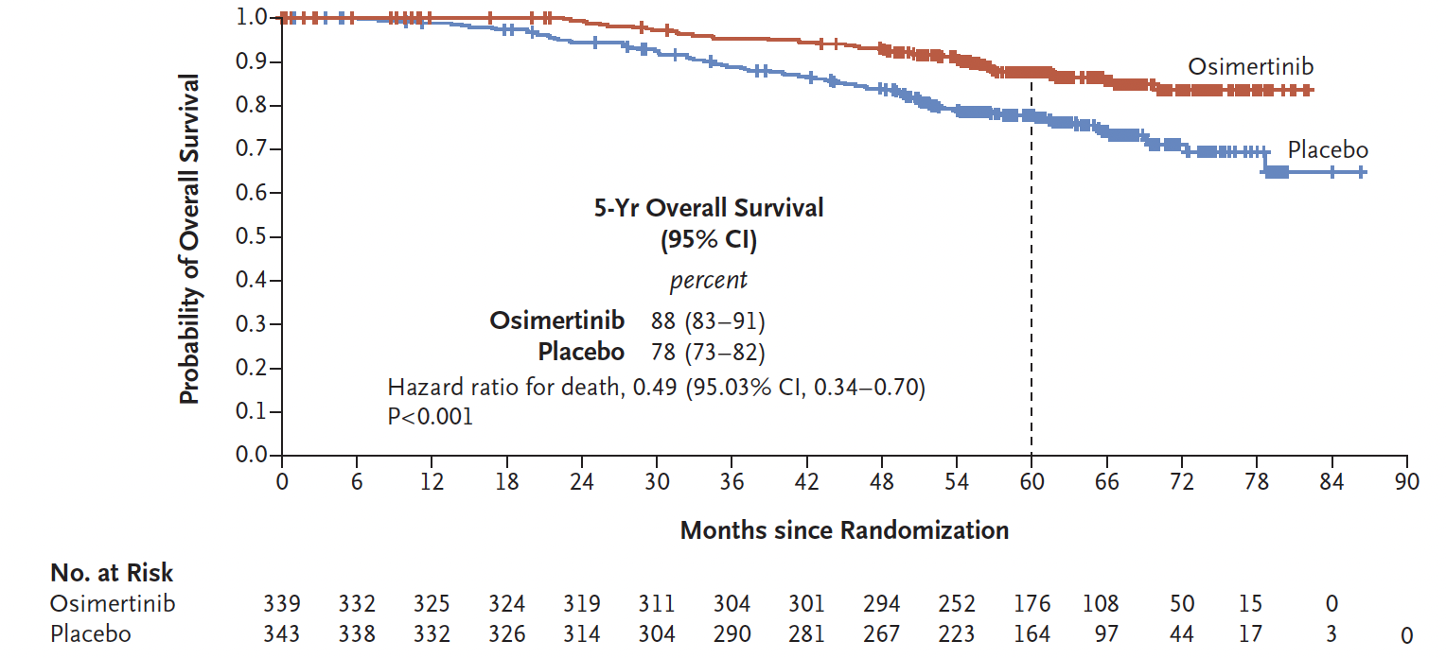
ADAURA: Overall Survival in Stage IB-IIIA Disease
Tsuboi M et al. N Engl J Med 2023;389(2):137-47.

Slide 22
Osimertinib After Chemoradiation Therapy Demonstrated an Efficacy Benefit for Unresectable Stage III NSCLC with an EGFR Mutation in the Phase III LAURA Trial
Press Release – Febuary 19, 2024
“Positive high-level results from the LAURA Phase III trial showed osimertinib demonstrated a statistically significant and highly clinically meaningful improvement in progression-free survival (PFS) for patients with unresectable, Stage III epidermal growth factor receptor-mutated (EGFRm) non-small cell lung cancer (NSCLC) after chemoradiotherapy (CRT) compared to placebo after CRT.
LAURA is a randomised, double-blind, placebo-controlled, multi-centre, global Phase III trial in patients with unresectable, Stage III EGFRm NSCLC whose disease has not progressed following definitive platinum‑based CRT.
Overall survival (OS) data showed a favourable trend for osimertinib, although data were not mature at the time of this analysis. The trial will continue to assess OS as a secondary endpoint.”
https://www.astrazeneca.com/media-centre/press-releases/2024/tagrisso-improved-pfs-in-stage-iii-lung-cancer.html

Slide 23
Jillian Thompson, MSN, ANP-BC, AOCNP
What I tell my patients who are about to begin osimertinib for localized or locally advanced EGFR-mutant NSCLC; goals of adjuvant therapy

Slide 24
Agenda
Introduction
Module 1: Localized Non-Small Cell Lung Cancer (NSCLC) with an EGFR Mutation
Module 2: First-Line Therapy for Patients with Metastatic NSCLC and EGFR Mutations
Module 3: Management of Progressive EGFR-Mutated NSCLC
Module 4: Targeting EGFR Exon 20 Insertion Mutations

Slide 25
Established First-Line Therapy for Metastatic NSCLC with an EGFR Mutation
Dr Spira
Fairfax, Virginia
Dr Yu
New York, New York
Long-term benefit observed with up-front osimertinib monotherapy for patients with metastatic NSCLC with an EGFR mutation
Intracranial response rates and rates of CNS progression documented with up-front osimertinib
Sequencing of osimertinib relative to local therapies, such as stereotactic radiosurgery and whole-brain radiation therapy, for patients with NSCLC with an EGFR mutation and brain metastases
Utility of rechallenge with osimertinib for patients who receive the drug in the adjuvant setting and experience subsequent disease progression
Strategies to prevent and/or ameliorate gastrointestinal, dermatologic and other adverse events (AEs) with osimertinib

Slide 26
Osimertinib
Mechanism of action
EGFR tyrosine kinase inhibitor
Indication in the first-line metastatic setting
For patients with metastatic NSCLC whose tumors have EGFR exon 19 deletions or exon 21 L858R mutations, as detected by an FDA-approved test
In combination with pemetrexed and platinum-based chemotherapy, for patients with locally advanced or metastatic NSCLC whose tumors have EGFR exon 19 deletions or exon 21 L858R mutations, as detected by an FDA-approved test
Recommended dose
Metastatic NSCLC: 80 mg PO once daily, with or without food, until disease recurrence, or unacceptable toxicity
Locally advanced or metastatic NSCLC: 80 mg PO once daily administered in combination with pemetrexed and platinum-based chemotherapy, with or without food, until disease progression or unacceptable toxicity due to osimertinib
Osimertinib package insert, 2/2024.

Slide 27
Marianne J Davies, DNP, ACNP, AOCNP, FAAN
What I tell my patients with EGFR-mutant metastatic NSCLC who are about to begin first-line treatment with osimertinib with or without chemotherapy

Slide 28
Newly Approved and Promising Investigational Approaches to First-Line Therapy for Metastatic NSCLC with an EGFR Mutation
Dr Spira
Fairfax, Virginia
Dr Yu
New York, New York
Rationale for the evaluation of osimertinib in combination with chemotherapy as first-line treatment for patients with NSCLC with an EGFR mutation
Progression-free survival (PFS) and other key efficacy and safety outcomes observed with first-line osimertinib/chemotherapy compared to osimertinib alone
Recent FDA approval of first-line osimertinib/chemotherapy and selection of optimal candidates for this strategy

Slide 29
Newly Approved and Promising Investigational Approaches to First-Line Therapy for Metastatic NSCLC with an EGFR Mutation
Dr Spira
Fairfax, Virginia
Dr Yu
New York, New York
Mechanistic similarities and differences between the bispecific antibody amivantamab and EGFR TKIs; rationale for the selection of lazertinib as a therapeutic partner for amivantamab in clinical trials
PFS and other efficacy outcomes observed with first-line amivantamab in combination with lazertinib compared to osimertinib for patients with NSCLC and an EGFR mutation
Potential clinical role of first-line amivantamab/lazertinib

Slide 30
FDA Approves Osimertinib with Chemotherapy for NSCLC with an EGFR Mutation
Press Release – Febuary 16, 2024
“The Food and Drug Administration approved osimertinib with platinum-based chemotherapy for patients with locally advanced or metastatic non-small cell lung cancer (la/mNSCLC) whose tumors have EGFR exon 19 deletions or exon 21 L858R mutations, as detected by an FDA-approved test.
Efficacy was evaluated in FLAURA 2 (NCT04035486), an open-label, randomized trial of 557 patients with EGFR exon 19 deletion or exon 21 L858R mutation-positive la/mNSCLC and no prior systemic therapy for advanced disease. Patients were randomized 1:1 to receive either osimertinib with platinum-based chemotherapy or osimertinib monotherapy.
The major efficacy outcome measure was progression free survival (PFS), as assessed by investigator, with overall survival (OS) as a key secondary outcome measure.”
https://www.fda.gov/drugs/resources-information-approved-drugs/fda-approves-osimertinib-chemotherapy-egfr-mutated-non-small-cell-lung-cancer

Slide 31
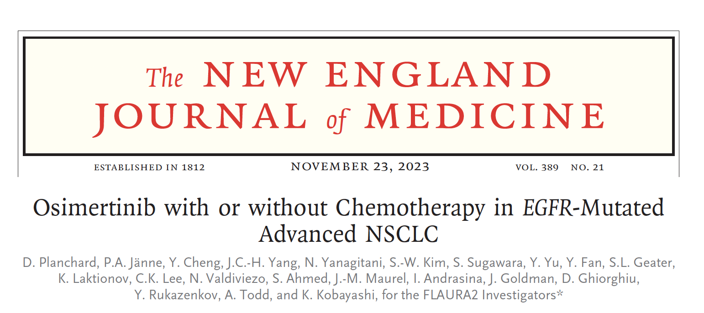
1935-48

Slide 32
Amivantamab
Mechanism of action
Bispecific EGFR-directed and MET receptor-directed antibody
Indication in the recurrent setting
As a single agent for adult patients with locally advanced or metastatic NSCLC with EGFR exon 20 insertion mutations whose disease has progressed on or after platinum-based chemotherapy
Recommended dose as a single agent
Administered weekly for 4 weeks, with the initial dose as a split infusion in week 1 on day 1 and day 2, then administer every 2 weeks thereafter, starting at week 5, until disease progression or unacceptable toxicity
Body weight less than 80 kg = 1,050 mg
Body weight greater than or equal to 80 kg = 1,400 mg
Amivantamab package insert, 3/2024.

Slide 33
Lazertinib
Mechanism of action
Oral third-generation, irreversible EGFR TKI
Indication
Investigational
Pivotal clinical data
Phase III MARIPOSA trial of lazertinib and amivantamab combination therapy versus osimertinib versus lazertinib as first-line therapy for patients with locally advanced or metastatic NSCLC with an EGFR mutation
Phase III MARIPOSA-2 trial of amivantamab and chemotherapy with and without lazertinib for advanced NSCLC with an EGFR mutation after disease progression on osimertinib
Cho BC et al. ESMO 2023;Abstract LBA14. Passaro A et al. Ann Oncol 2024;35(1):77-90.

Slide 34
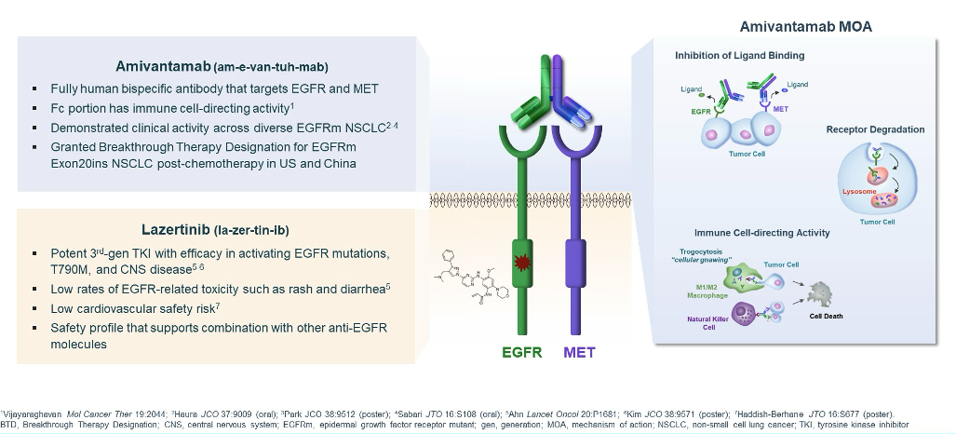
Amivantamab and Lazertinib
Bauml JM et al. ASCO 2021;Abstract 9006.

Slide 35
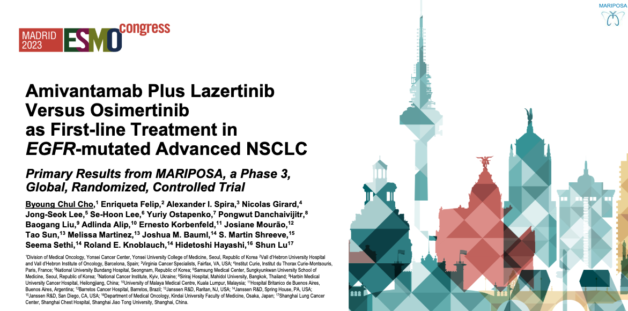
Abstract LBA14

Slide 36
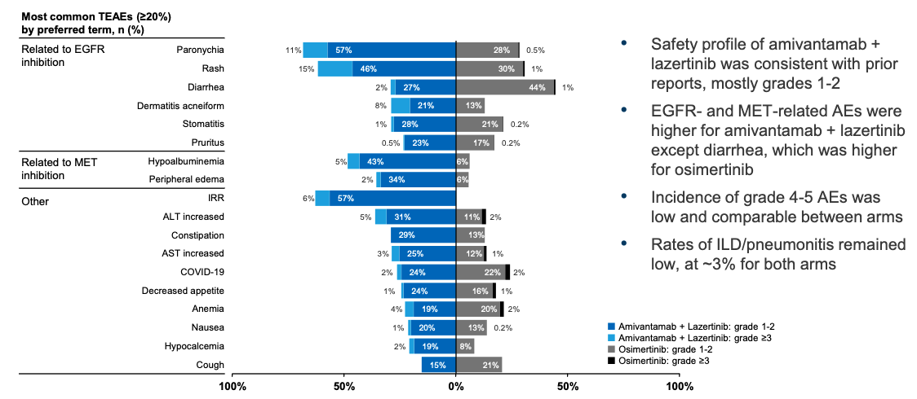
MARIPOSA: Safety Profile of Amivantamab with Lazertinib
Cho BC et al. ESMO 2023;Abstract LBA14.

Slide 37
Common Toxicities Associated with Amivantamab
Dr Spira
Fairfax, Virginia
Dr Yu
New York, New York
Spectrum, frequency and severity of common toxicities with amivantamab, such as dermatologic AEs, fatigue, musculoskeletal pain and stomatitis
Incidence and timing of infusion-related reactions with amivantamab; appropriate premedication and infusion modification strategies
Pathophysiology of ocular toxicities associated with amivantamab, such as keratitis, dry eye, conjunctival redness, blurred vision and uveitis; importance of consultation with ophthalmology for patients experiencing symptoms

Slide 38
Common Toxicities Associated with Amivantamab
Dr Spira
Fairfax, Virginia
Dr Yu
New York, New York
Other, less frequently occurring side effects with amivantamab, such as interstitial lung disease (ILD)/pneumonitis; recommended approaches for monitoring and management
Effect on the tolerability of amivantamab when administered in combination with other systemic therapies, such as lazertinib and/or chemotherapy

Slide 39
Jillian Thompson, MSN, ANP-BC, AOCNP
What I tell my patients who are being considered for or enrolling on a clinical trial with amivantamab/lazertinib

Slide 40
Consulting Nursing Faculty Comments
Experiencing grief as an oncology provider
Sonia Glennie, ARNP, MSN, OCN

Slide 41
Agenda
Introduction
Module 1: Localized Non-Small Cell Lung Cancer (NSCLC) with an EGFR Mutation
Module 2: First-Line Therapy for Patients with Metastatic NSCLC and EGFR Mutations
Module 3: Management of Progressive EGFR-Mutated NSCLC
Module 4: Targeting EGFR Exon 20 Insertion Mutations

Slide 42
The Current and Future Management of Progressive NSCLC with an EGFR Mutation
Dr Spira
Fairfax, Virginia
Dr Yu
New York, New York
Published findings with and ongoing evaluation of osimertinib combined with other agents, such as savolitinib and tepotinib, to overcome common mechanisms of resistance
Recently presented data with amivantamab in combination with chemotherapy with and without lazertinib for patients with NSCLC with an EGFR mutation who experience disease progression on osimertinib
Rationale for targeting HER3 in patients with NSCLC with an EGFR mutation; structural components and mechanism of action of patritumab deruxtecan (HER3-DXd)

Slide 43
The Current and Future Management of Progressive NSCLC with an
EGFR Mutation (Continued)
Dr Spira
Fairfax, Virginia
Dr Yu
New York, New York
Published efficacy and safety findings with HER3-DXd for NSCLC with an EGFR mutation after progression on EGFR TKI therapy and platinum-based chemotherapy
Potential clinical roles of amivantamab/chemotherapy with or without lazertinib and HER3-DXd for progressive NSCLC with an EGFR mutation

Slide 44
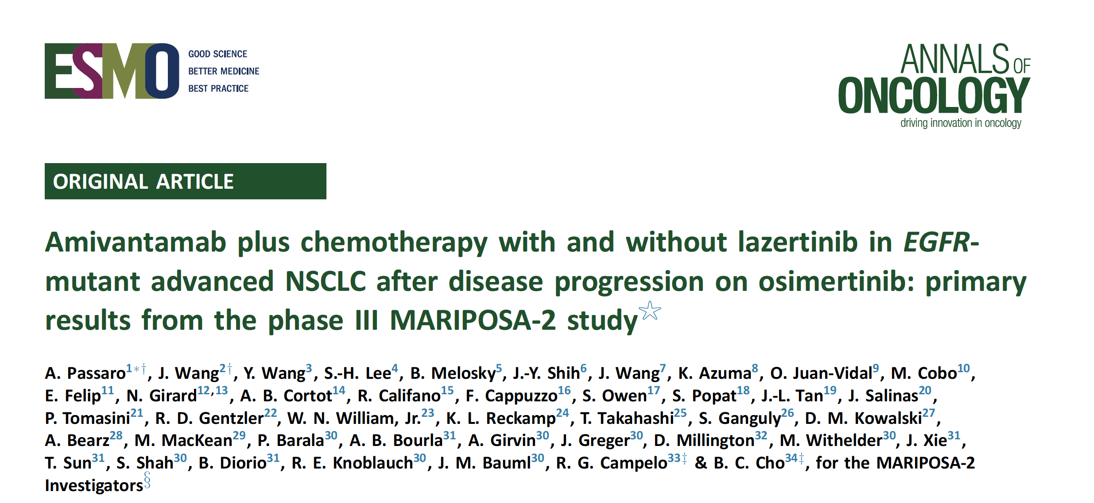
2024;35(1):77-90

Slide 45
Patritumab Deruxtecan (HER3-DXd)
Mechanism of action
Antibody-drug conjugate directed against HER3
Indication
Investigational
Key clinical trial
HERTHENA-Lung02 Phase III trial of patritumab deruxtecan versus platinum-based chemotherapy in metastatic or locally advanced NSCLC with an EGFR mutation after progression on third-generation EGFR TKI therapy
Mok T et al. Future Oncol 2024;20(15):969-80.

Slide 46
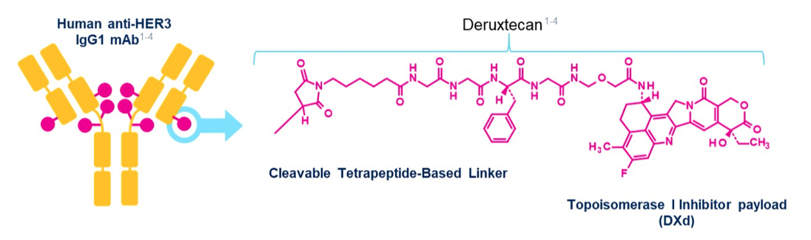
HER3-DXd Targeting HER3 May Address Multiple EGFR TKI Resistance Mechanisms
HER3-DXd is an antibody-drug conjugate with 3 components:
A fully human anti-HER3 IgG1 mAb (patritumab), covalently linked to:
A topoisomerase I inhibitor payload, an exatecan derivative, via
A tetrapeptide-based cleaver linker
Janne PA et al. ASCO 2021;Abstract 9007.

Slide 47
Tolerability and Other Practical Considerations with HER3-DXd
Dr Spira
Fairfax, Virginia
Dr Yu
New York, New York
Frequency of dose interruptions, dose reductions and treatment discontinuation with HER3-DXd in published clinical trials
Rates of Grade ≥3 cytopenias reported among patients receiving HER3-DXd; optimal monitoring of complete blood counts
Other commonly reported treatment-related AEs observed with HER3-DXd, such as gastrointestinal issues and fatigue
Incidence and severity of ILD reported with HER3-DXd; appropriate monitoring and management

Slide 48
Marianne J Davies, DNP, ACNP, AOCNP, FAAN
What I tell my patients who are being considered for or are about to enroll on a clinical trial with patritumab deruxtecan

Slide 49
Jillian Thompson, MSN, ANP-BC, AOCNP
What I tell my patients with metastatic lung cancer about the importance of clinical trial participation

Slide 50
Agenda
Introduction
Module 1: Localized Non-Small Cell Lung Cancer (NSCLC) with an EGFR Mutation
Module 2: First-Line Therapy for Patients with Metastatic NSCLC and EGFR Mutations
Module 3: Management of Progressive EGFR-Mutated NSCLC
Module 4: Targeting EGFR Exon 20 Insertion Mutations

Slide 51
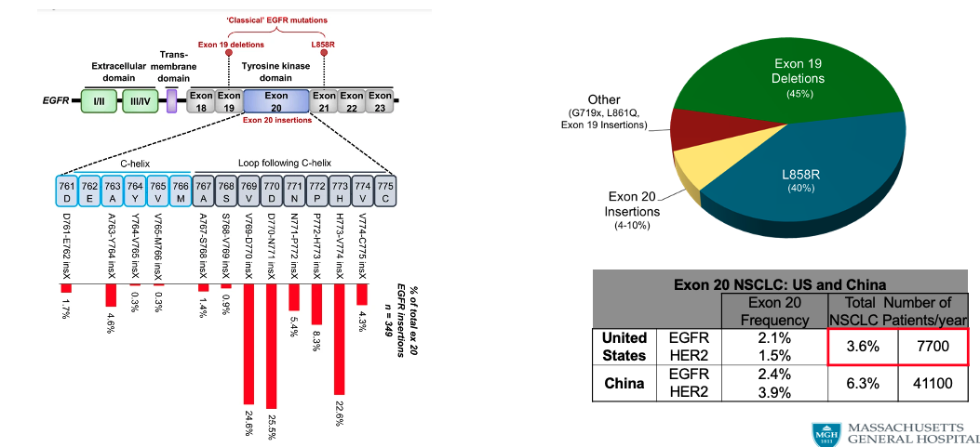
Frequency of EGFR Exon 20 Mutations
Courtesy of Zofia Piotrowska, MD, MHS

Slide 52
Treatment for Metastatic NSCLC with EGFR Exon 20 Insertion Mutations
Dr Spira
Fairfax, Virginia
Dr Yu
New York, New York
Rationale for the lack of activity with traditional EGFR TKIs in this patient subset; biological basis for the activity of amivantamab
Long-term efficacy and safety data with amivantamab for patients with metastatic NSCLC and EGFR exon 20 insertion mutations who experience progression on or after platinum-based chemotherapy
Key findings with the combination of amivantamab and platinum-based chemotherapy for newly diagnosed advanced NSCLC with EGFR exon 20 insertion mutations

Slide 53
Treatment for Metastatic NSCLC with EGFR Exon 20 Insertion Mutations (Continued)
Dr Spira
Fairfax, Virginia
Dr Yu
New York, New York
Recent FDA approval of amivantamab in combination with chemotherapy as first-line treatment for NSCLC with EGFR exon 20 insertion mutations; implications for therapeutic sequencing
Rationale for the recent voluntary withdrawal of mobocertinib for NSCLC with EGFR exon 20 insertion mutations

Slide 54
Amivantamab
Mechanism of action
Bispecific EGFR-directed and MET receptor-directed antibody
Indication in the first-line setting
In combination with carboplatin and pemetrexed for patients with locally advanced or metastatic NSCLC with EGFR exon 20 insertion mutations, as detected by an FDA-approved test
Recommended dose
Initial week 1 dose is a split infusion given on day 1 and day 2
Body weight <80 kg: 1,400 mg IV infusion weekly with chemotherapy on weeks 1-4, then 1,750 mg IV infusion q3wk beginning week 7 until progression/toxicity
Body weight ≥80 kg: 1,750 mg IV infusion weekly with chemotherapy on weeks 1-4, then 2,100 mg IV infusion q3wk beginning week 7 until progression/toxicity
Amivantamab package insert, 3/2024.

Slide 55
FDA Approves Amivantamab for NSCLC with EGFR Exon 20 Insertion Mutations
Press Release – March 1, 2024
“The Food and Drug Administration approved amivantamab-vmjw with carboplatin and pemetrexed for the first-line treatment of locally advanced or metastatic non-small cell lung cancer (NSCLC) with epidermal growth factor receptor (EGFR) exon 20 insertion mutations, as detected by an FDA-approved test.
The FDA also granted traditional approval to amivantamab-vmjw for adult patients with locally advanced or metastatic NSCLC with EGFR exon 20 insertion mutations, as detected by an FDA-approved test, whose disease has progressed on or after platinum-based chemotherapy. FDA previously granted accelerated approval for this indication.
Efficacy was evaluated in PAPILLON (NCT04538664), a randomized, open-label multicenter trial of 308 patients with EGFR exon 20 insertion mutations. Patients were randomized 1:1 to receive amivantamab-vmjw with carboplatin and pemetrexed or carboplatin and pemetrexed.”
https://www.fda.gov/drugs/resources-information-approved-drugs/fda-approves-amivantamab-vmjw-egfr-exon-20-insertion-mutated-non-small-cell-lung-cancer-indications

Slide 56
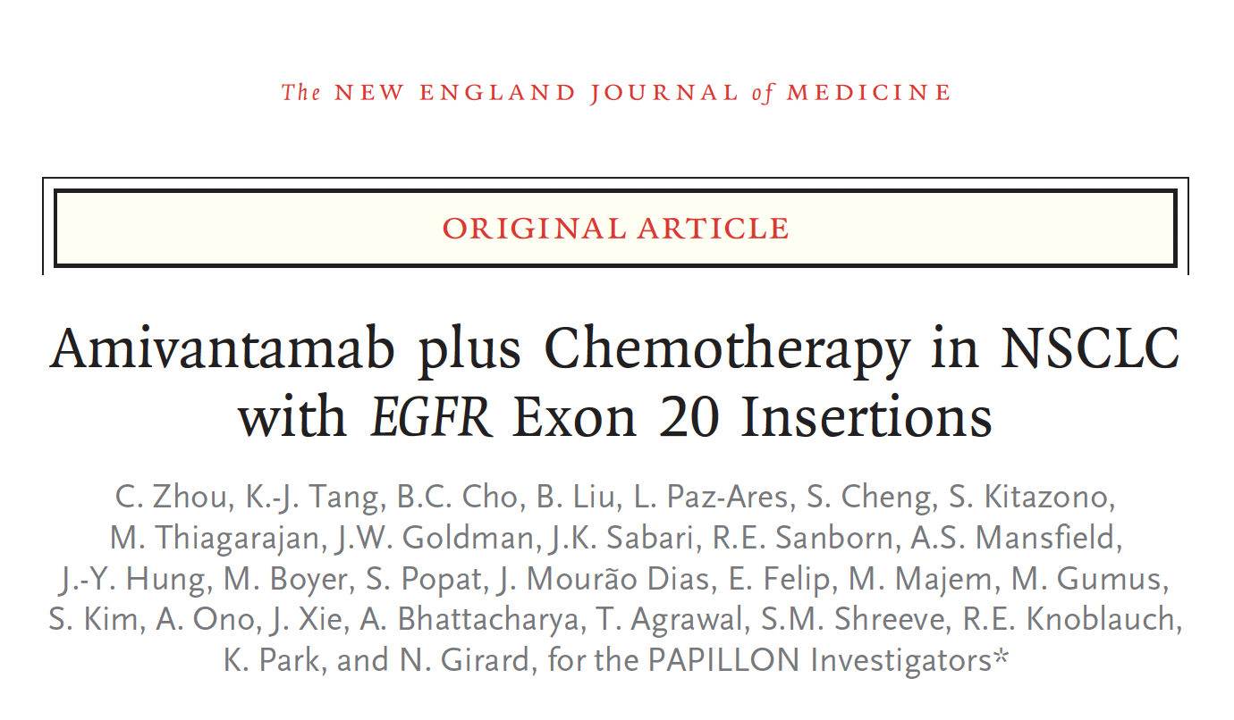
2023;389:2039-51

Slide 57
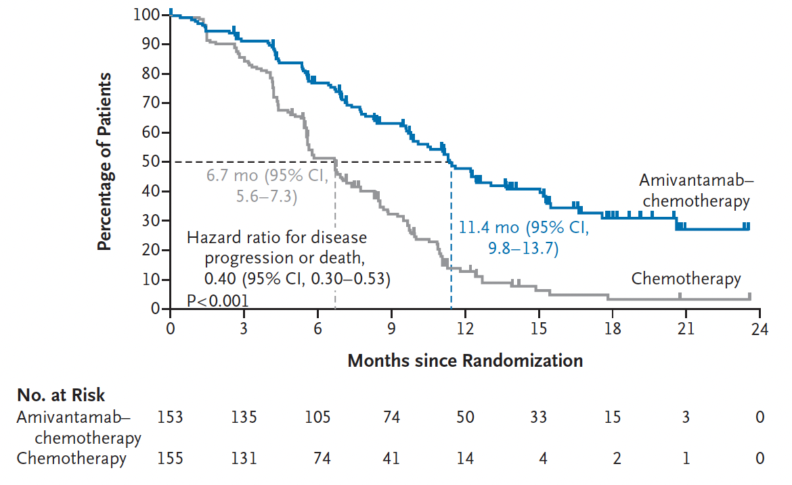
PAPILLON Trial Primary Endpoint: PFS by Blinded Independent Central Review
Zhou C et al. N Engl J Med 2023;389:2039-51.

Slide 58
PAPILLON: Select Adverse Events
Adverse event | Amivantamab-chemotherapy (n = 151) |  | Chemotherapy (N = 155)
 | All grades | Grade ≥3 | All grades | Grade ≥3
Neutropenia | 59% | 33% | 45% | 23%
Anemia | 50% | 11% | 55% | 12%
Leukopenia | 38% | 11% | 32% | 3%
Rash | 54% | 11% | 8% | 0
Thrombocytopenia | 36% | 10% | 30% | 10%
7% of patients discontinued amivantamab due to drug-related adverse reactions
Zhou C et al. N Engl J Med 2023;389:2039-51.

