Slide 1
Year in Review: Multiple Myeloma Edition
Jesús G. Berdeja, M.D.
Director of Multiple Myeloma Research

Slide 2
KarMMa-3: Phase III Trial of Ide-Cel vs SoC in R/R MM
International, open-label, randomized phase III trial
Stratified by age (<65 vs ≥65), prior therapies
(2 lines vs 3-4 lines), and high-risk cytogenetics
(present or absent)
Lymphodepletion
CAR T-Cell Infusion (Day 0)
Cyclophosphamide 300 mg/m² +
Fludarabine 30 mg/m²
Idecabtagene Vicleucel
150-450 x 10⁶ CAR T-cells
(n = 254)
Patients with R/R MM after 2-4 prior
lines of therapy; including a PI, an IMiD, and daratumumab; disease progression in ≤60 days after last therapy
ECOG PS ≤1
(N = 386)
N = 254
2:1
N = 74
Investigators’ Choice SoC*
(n = 132)
PD or unacceptable toxicity
Crossover allowed after PD
N = 132
Primary endpoint: PFS
Key secondary endpoints: ORR, OS, DoR, MRD detection, safety
*SoC choices: dara/pom/dex (n = 43); daraVd (n = 7); ixa/len/dex (n = 22); Kd (n = 30);
elo/pom/dex (n = 30).
Rodriguez-Otero. NEJM. 2023;388:1002.
Notes:
DoR, duration of response; dara, daratumumab; dex, dexamethasone; ECOG, Eastern Cooperative Oncology Group; elo, elotuzumab; ide-cel, idecabtagene vicleucel; IMiD, immunomodulatory drug; ixa, ixazomib; Kd, carfilzomib/dexamethasone; len, lenalidomide; MM, multiple myeloma; MRD, measurable residual disease; OS, overall survival; PD, progressive disease; PFS, progression-free survival; PI, proteasome inhibitor; pom, pomalidomide; PS, performance status; R/R, relapsed/refractory; SoC, standard of care; Vd, bortezomib/dexamethasone.

Slide 3
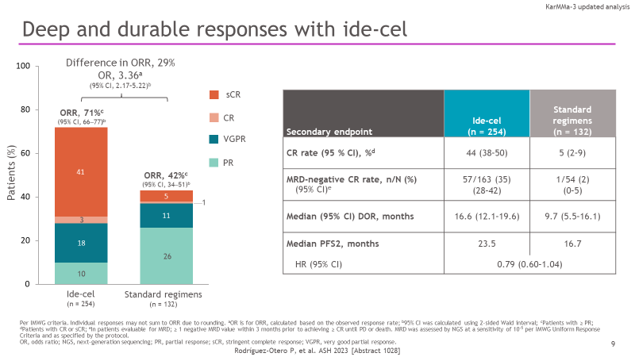
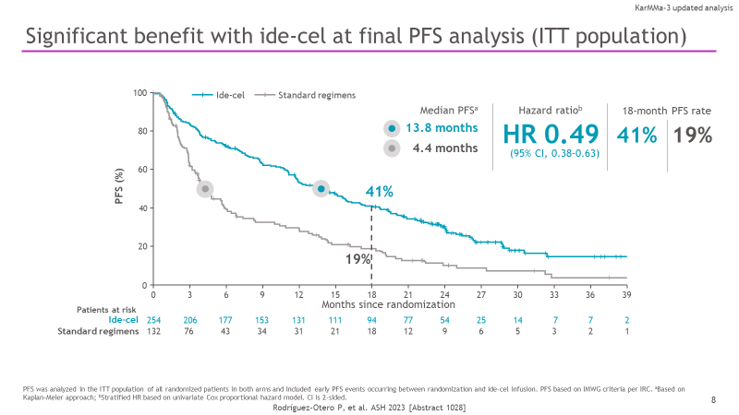
Efficacy Results
PFS ITT population
42% crossover rate confounds OS analysis
Rodriguez-Otero. NEJM. 2023;388:1002. Rodriguez-Otero. ASH 2023, Abs 1028

Slide 4
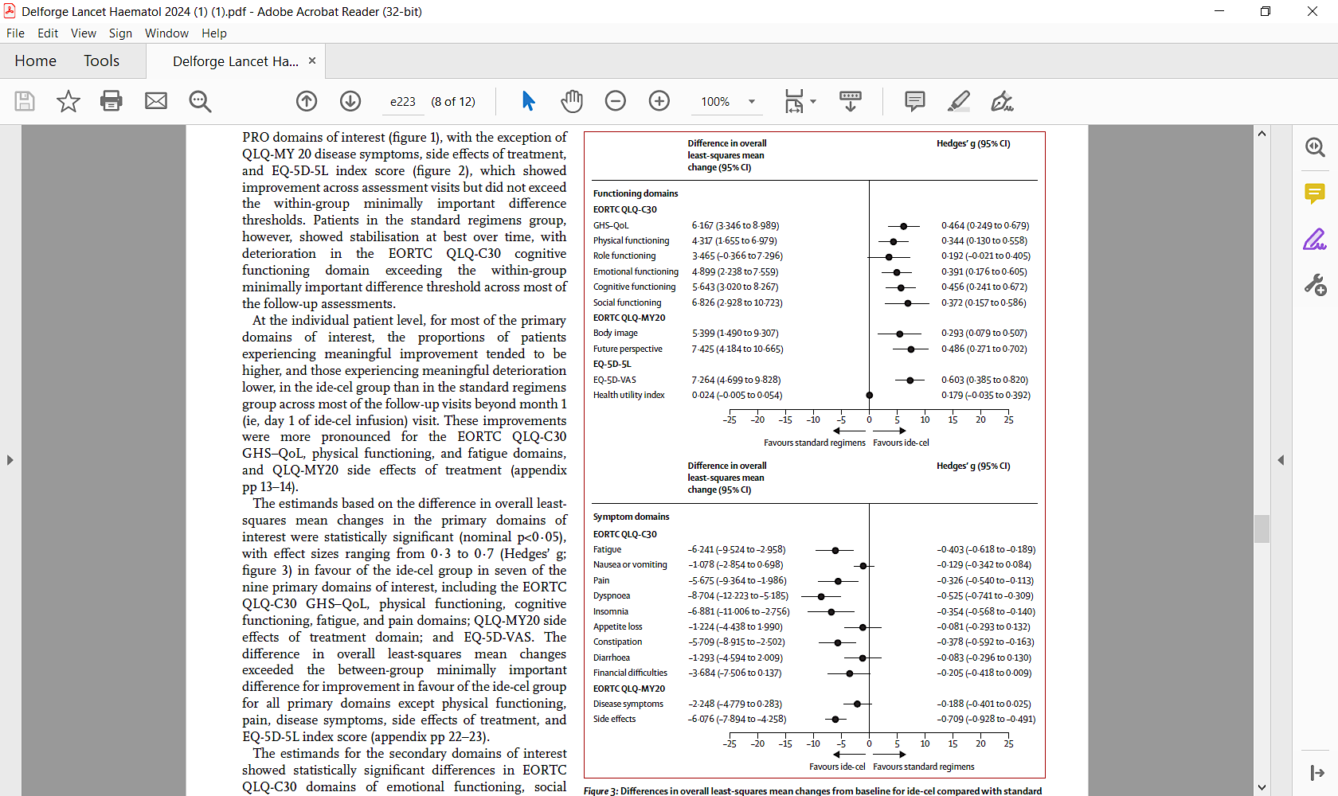
Delforge: KarMMa-3 QOL
Results from the Functional domains EORTC QLQ-C30, EORTC QLQ-MY20 and EQ-5D-5L
  A positive change denotes improvement in function
Results from the Symptom domains EORTC QLQ-C30, EORTC QLQ-MY20
  A negative change denotes improvement in symptoms
Delforge et al. Lancet Haematol 2024;11(e216-27).

Slide 5
Conclusions on KarMMa-3
Previous FDA indication following pivotal KarMMa study
  Adults with R/R multiple myeloma after ≥4 prior lines of therapy, including an immunomodulatory agent, a proteasome inhibitor, and an anti-CD38 monoclonal Ab
New FDA indication following KarMMa-3 results
  Adults with R/R multiple myeloma after ≥2 prior lines of therapy, including an immunomodulatory agent, a proteasome inhibitor, and an anti-CD38 monoclonal Ab
No new safety signals in an earlier line population

Slide 6
CARTITUDE-4: Phase III Trial of Cilta-Cel vs SoC in Lenalidomide-Refractory MM
Randomized, open-label phase III trial
Stratified by choice of SoC (PVd/DPd), ISS stage, number previous lines of therapy
Bridging Therapy*
≥1 cycle
(n_{ITT} = 208)
D1
Cilta-Cel Infusion
Target: 0.75 x 10⁶ CAR+ T-cells/kg
(n = 176†)
D1-112
Collect safety, efficacy, PK/PD data Q28D
Adults with MM;
1-3 prior lines of therapy (including PI + IMiD); lenalidomide refractory;
ECOG PS 0-1; no prior CAR T-cell or BCMA-targeted therapy
(N = 419)
Follow-up
Standard of Care Therapy
Physician’s choice of PVd or DPd until PD
(n = 208)
*Physician’s choice of PVd or DPd. †As-treated population (n = 176): 32 patients did not receive cilta-cel as part of study due to PD (n = 30) or death (n = 2) during bridging therapy/lymphodepletion.
Primary endpoint: PFS
Secondary endpoints: ≥ CR, ORR, MRD negativity, OS, safety, PROs
Analysis after 15.9 mo median follow-up (range: 0.1-27 mo)
San-Miguel. NEJM. 2023;389(4):335-347
Notes:
Cilta-cel, ciltacabtagene autoleucel; CR, complete response; DPd, daratumumab/pomalidomide/dexamethasone; ECOG, Eastern Cooperative Oncology Group; IMiD, immunomodulatory drug; ISS, International Staging System; ITT, intention-to-treat; MM, multiple myeloma; MRD, measurable residual disease; ORR, overall response rate; OS, overall survival; PD, progressive disease; PFS, progression-free survival; PI, proteasome inhibitor; PK/PD, pharmacokinetics/pharmacodynamics; PRO, patient-reported outcome; PS, performance status; PVd, pomalidomide/bortezomib/dexamethasone.

Slide 7
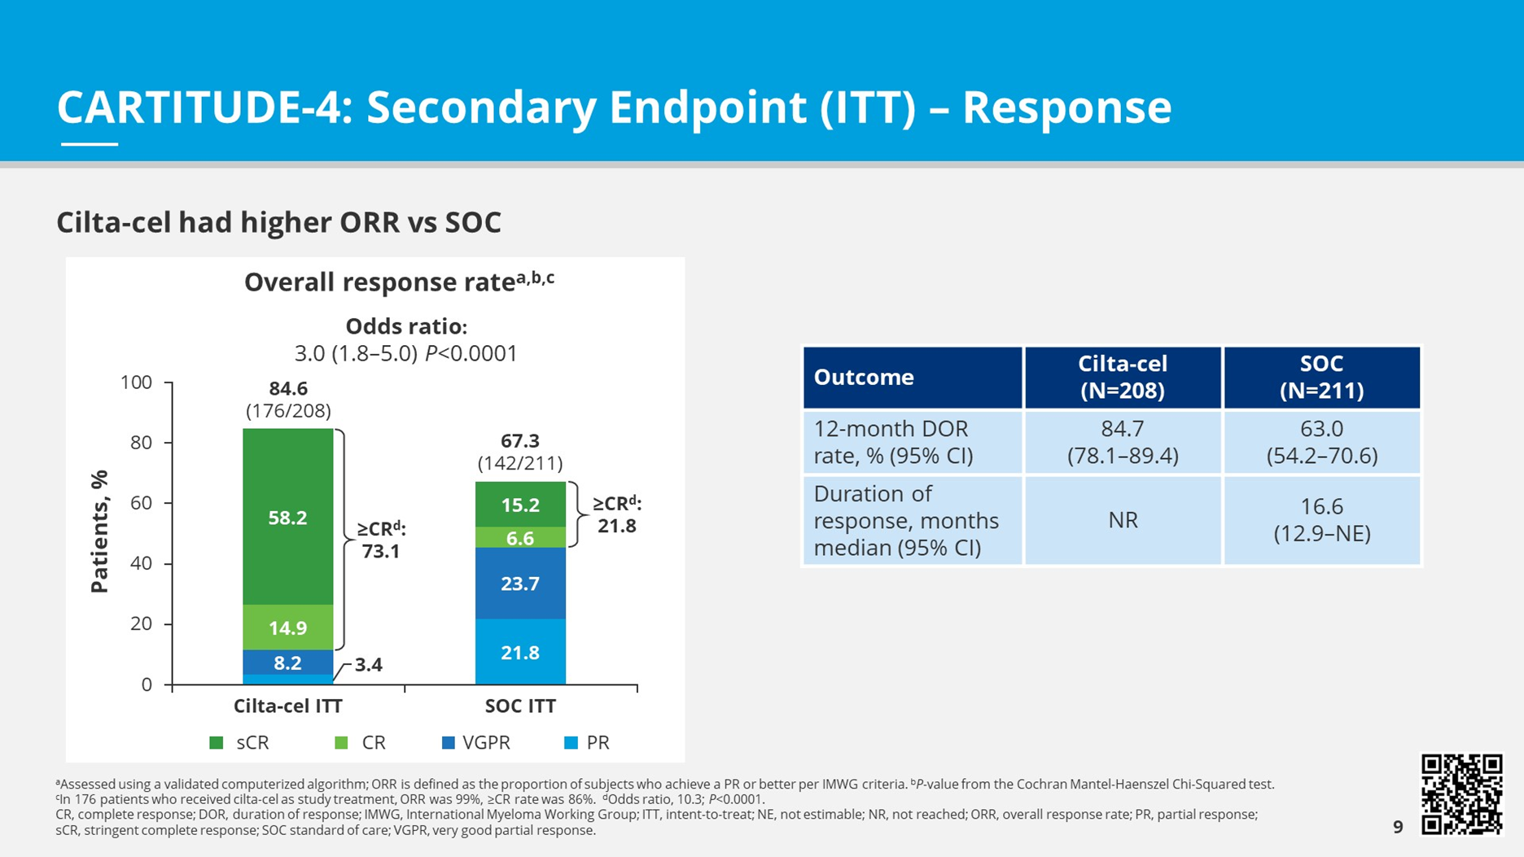
CARTITUDE-4: PFS and ORR
 | Cilta-Cel (n = 208) | SoC (n = 211) | SoC (n = 211)
mPFS, mo (95% CI) | NR (22.8-NE) | 11.8 (9.7-13.8) | 11.8 (9.7-13.8)
 | HR: 0.26 (95% CI: 0.18-0.38; P <.0001)
12-mo PFS, % | 76 | 49
Progression-free Survival
100
80
Cilta-cel group
60
Progression-free Survival (%)
40
20
Wk 8 End of Bridging Phase
Standard-care group
0
0
3
6
9
12
15
18
21
24
27
30
Mo
San-Miguel. NEJM 2023;389(4):335-347.
Notes:
Cilta-cel, ciltacabtagene autoleucel; ITT, intention-to-treat; m, median; NE, not estimable; NR, not reached; PFS, progression-free survival; SoC, standard of care.

Slide 8
Conclusions on CARTITUDE-4
Previous FDA indication following pivotal CARTITUDE-1 study
  Adults with R/R multiple myeloma after ≥4 prior lines of therapy, including an immunomodulatory agent, a proteasome inhibitor, and an anti-CD38 monoclonal Ab
New FDA indication following CARTITUDE-4 results
  Adults with R/R multiple myeloma after ≥1 prior line of therapy, including an immunomodulatory agent, a proteasome inhibitor, and refractory to lenalidomide
Incidence of delayed MNTs was much less c/w CARTITUDE-1
  Perhaps due to better bridging therapy – less disease burden
Incidence of secondary malignancies less c/w CARTITUDE-1
  Signal for secondary heme malignancies still exists

Slide 9
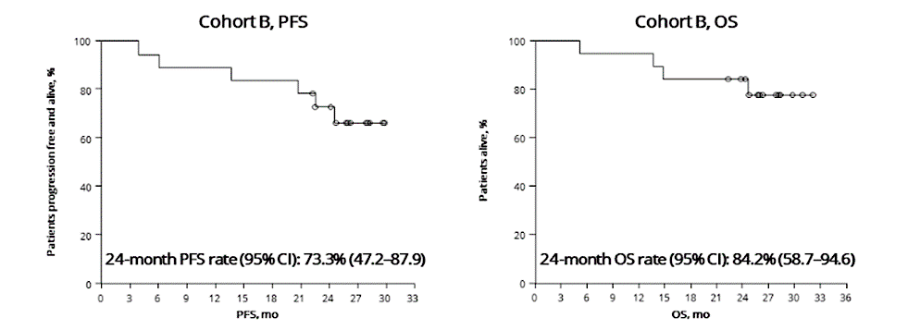
CARTITUDE-2 Cohort B
Response
Eligibility
  1 prior LOT
  PD ≤ 12 mos after ASCT or start of anti-myeloma therapy
Primary endpoint: MRD negativity (10⁻⁵ threshold)
Secondary/Exploratory endpoints: ORR, DOR, AEs, PFS, OS
19 patients treated – all functionally HR by definition
≥ CR 89.5%
Primary endpoint: sustained MRD negativity 10⁻⁵
93.3% MRD-
76.9% sustained MRD- ≥ 6 mos
61.5% sustained MRD- ≥ 12 mos
Hillengass et al. ASH 2023, Abs 1021.

Slide 10
KarMMa-2 Cohort 2b
Response
Eligibility
  PD <18 mos from front-line w/o ASCT
Primary endpoint: CRR
Secondary/Exploratory endpoints: ORR, DOR, TTR, PFS, OS
31 patients treated – all functionally HR by definition
≥ CR 71%
Leleu et al. EHA 2024; Abs S208

Slide 11
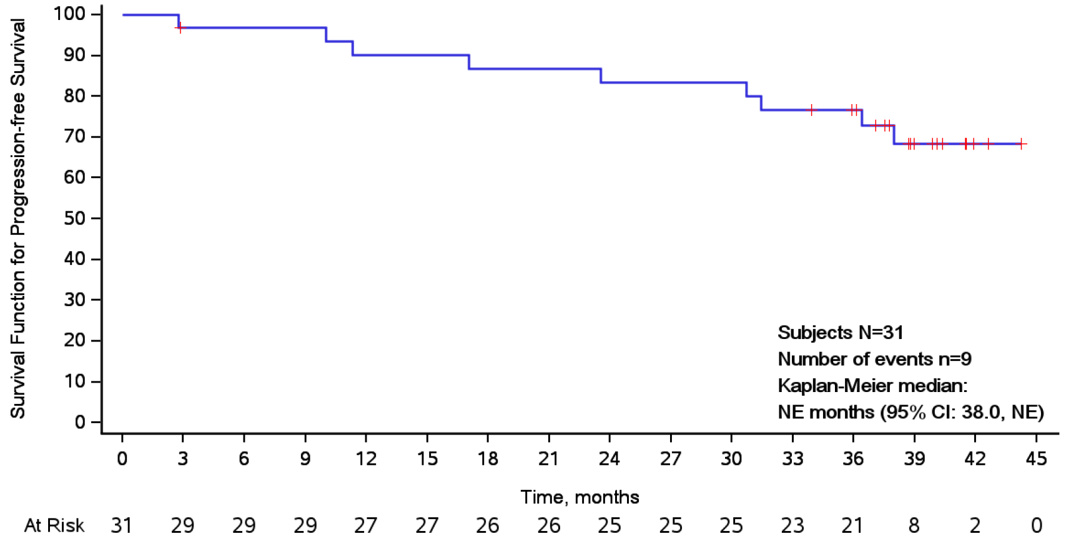
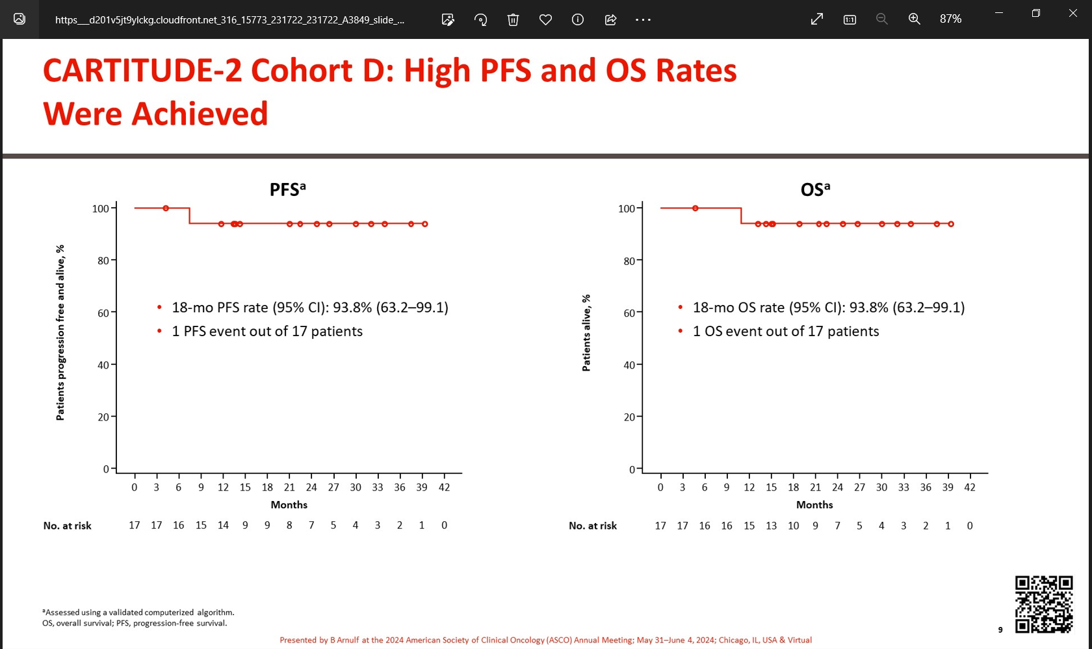
CAR-T Cells in Frontline in Patients with Suboptimal Response to ASCT
¹KarMMa-2 Cohort 2c (ide-cel for <VGPR post ASCT)
  N=32, 8 pts received optional len maint
  ORR 87% (≥CR 77%), CRS 58% (all gr1,2)
²CARTITUDE-2 Cohort D (Cilta-cel for <CR Post ASCT)
  N=17, 12 pts received len maint
  ORR 94% (≥CR 94%)
  CRS 82% (all gr1,2), ICANS in 1, no MNT
BMT CTN 1902 Ph-2 Study
KarMMa-9 Ph-3 Study
<CR p ASCT
Ide-Cel
Len x1 year
36 mos PFS 77%
Ide-Cel
Len until PD
<CR p ASCT
R
Len until PD
18 mos PFS 94%
¹Dhodapkar et al: ASH 2023, Abs 2101. ²Arnulf et al: ASCO 2024, Abs 7505.

Slide 12
Moving CAR T-Cells to Frontline Treatment
CARTITUDE-5
Phase 3 Randomized Trial
apheresis
Induction
VRD x 6c
Consolidation
VRD x 2c (bridging)
Cilta-Cel
Consolidation
VRD x 2c
Rd maintenance to PD
NDMM
(No intent to transplant)
R
N = 650
CARTITUDE-6
Phase 3 Randomized Trial
apheresis
ND TEMM
D-VRD x 6c
Cilta-Cel
D-VRD x 4c
ASCT
Len x 2 yrs*
R
D-VRD x 2c
Len x 2 yrs*
N = 750
apheresis

Slide 13
Moving CAR T towards the frontline
Small cohorts with both ide-cel and cilta-cel show that CAR T-cells are feasible as early as consolidation in first line
CAR T-cells are effective for patients with functional HR MM (relapse within 2 yrs of frontline Tx)
CAR T-cells expand well even in very low burden of disease (post ASCT)
As seen with KarMMa-3 and CARTITUDE-4, cytopenias, CRS and neurotoxicity may be less in less heavily pretreated patients and in setting of low burden of disease
This data supports planned frontline trials with both ide-cel and cilta-cel

Slide 14
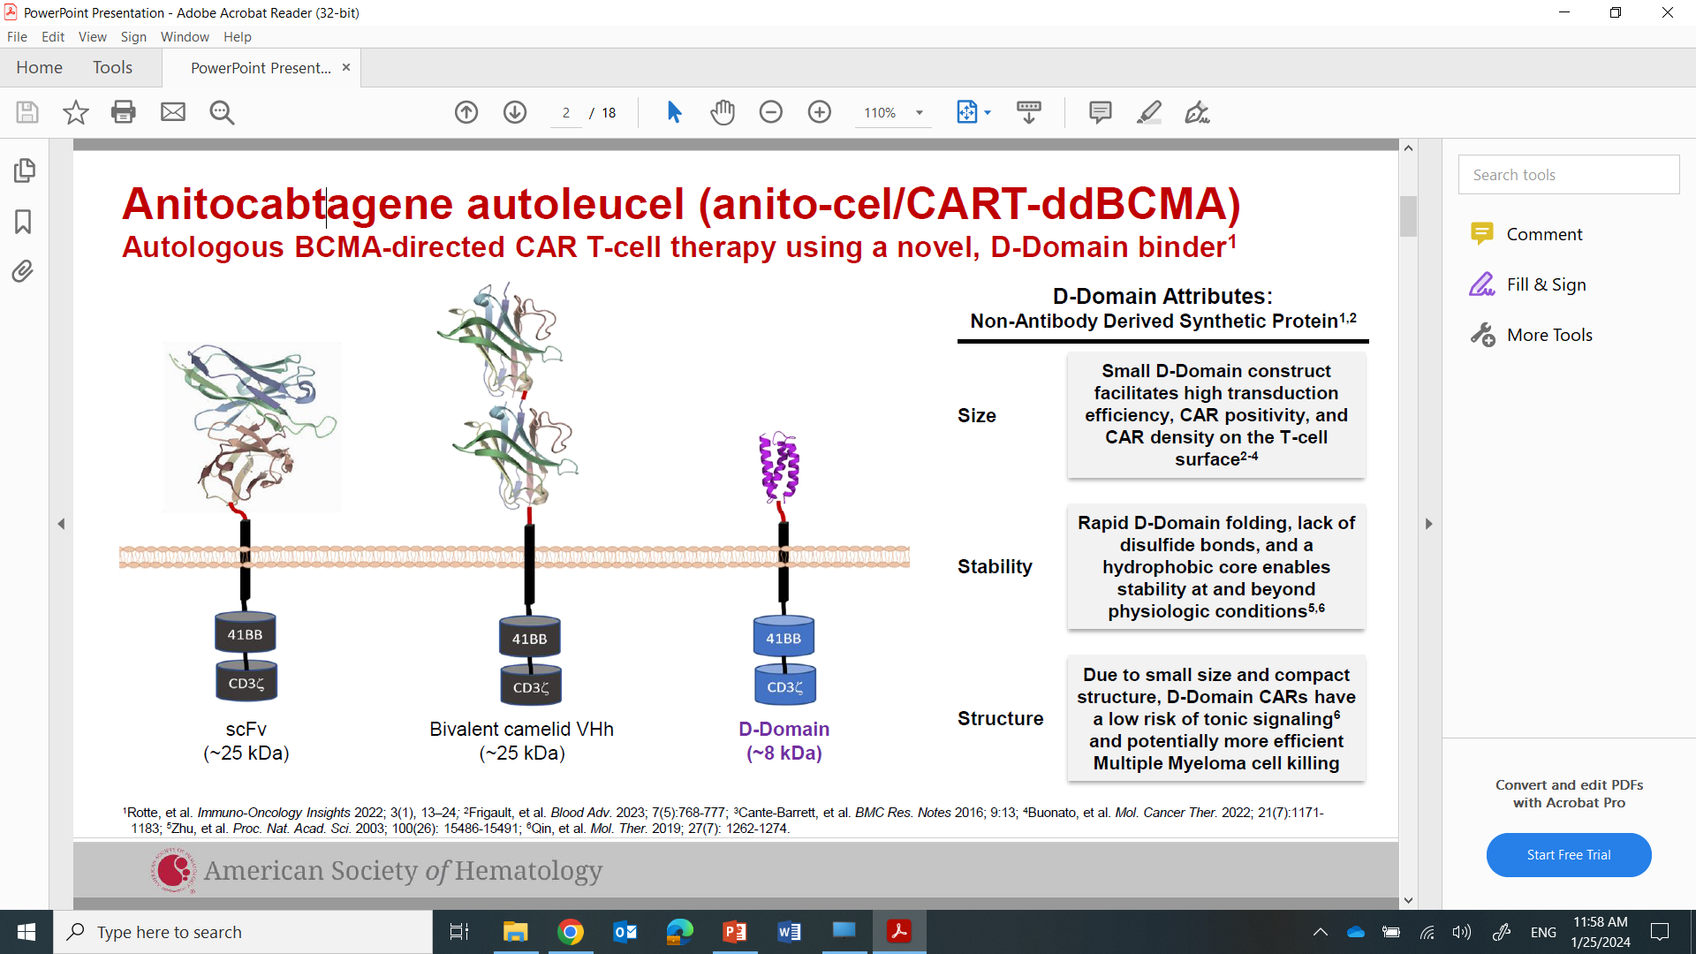
Anitocabtagene autoleucel (anito-cel/CART-ddbcma)

Slide 15
Phase I Anito-Cel: Summary of Results
38 pts tx @ 2 dose levels 100 million and 300 million CAR T cells
  100 million dose expanded
Salient patient characteristics
  100% triple refractory
  Median 4 LOT
  34% EMD
AE Any grade (grade ≥3)
  CRS @100 million – 94% (0), Med onset 2 ds
  ICANS – 16% (3%), Median onset 4 ds
  No delayed non ICANS neurotoxicity reported
ORR 100%
All Pts
EMD Pts
Median f/u 26.5 mos, med PFS NR
  All pts 24 mos PFS 56%
  EMD pts 24 mos PFS 57.5%
Dhakal et al. EHA 2024, Abstract S207

Slide 16
Conclusions on Anito-cel
Novel synthetic construct may allow for higher CAR expression, low tonic signaling, improved activity
Impressive 100% ORR
Impressive responses in EMD – a difficult to treat population
Durability of response in all, but especially EMD patients is of great interest
Toxicity profile seems reasonable with no delayed neurotoxicity
Pivotal trials ongoing

Slide 17


CC‑95266‑MM‑001: phase 1 study of BMS-986393: a GPRC5D autologous CAR T-cell therapy
CAR T-cell
manufacturing
Apheresis
Bridging therapy (optional)
Flu/Cy LYMPHODEPLETION
One-time infusion
GPRC5D CAR T cells
Post-treatment
Follow-up 24 months
Treatment-free interval
Key eligibility criteria
RRMM
ECOG PS 0–1
≥ 3 prior regimens, including ASCT,ª a PI, an IMiD, and an
anti-CD38 antibody
Progressed < 12 months of last regimen^{b}
Prior BCMA-directed therapies allowed, including CAR T cells
Part A: dose escalation (n = 36)^{c,d}
Part B: dose expansion (n = 48)^{c}
450 × 10⁶ CAR T cells
n = 3
450 × 10⁶ CAR T cells
n = 8
300 × 10⁶ CAR T cells
n = 6
300 × 10⁶ CAR T cells
n = 11
150 × 10⁶ CAR T cells
n = 12
Recommended phase 2 dose
150 × 10⁶ CAR T cells
n = 14
75 × 10⁶ CAR T cells
n = 9
75 × 10⁶ CAR T cells
n = 15
25 × 10⁶ CAR T cells
n = 6
Primary objective: safety and tolerability, MTD/RP2D
Secondary objectives: PK, antitumor activity
ªUnless ineligible. ^{b}Unless last therapy was CAR T-cell therapy, which can be ≥ 12 months prior. ^{c}28-day evaluation period followed by 24 months of follow-up. ^{d}Modified toxicity probability interval (mTPI-2) design with ≥ 3 patients per dose level.
ASCT, autologous stem cell transplant; Cy, cyclophosphamide; ECOG PS, Eastern Cooperative Oncology Group performance status; Flu, fludarabine; MTD, maximum tolerated dose;
PK, pharmacokinetics.
Bal S, et al. ASH 2023, Abstract 219.

Slide 18
Figure 2. CC‑95266‑MM‑001 (NCT04674813): first-in-human phase 1 study
One-time infusion
GPRC5D CAR T cells
CAR T-cell
manufacturing
Apheresis
Bridging therapy (optional)
Post-treatment
follow-up 24 months
Treatment-free interval
LYMPHODEPLETION
Lymphodepletion (days −5, −4, −3 from BMS-986393 infusion) with daily
fludarabine 30 mg/m² + cyclophosphamide 300 mg/m²
BMS-986393
RP2D
(150 × 10⁶ CAR T cells)
Part B Dose Expansion
Cohort C
Key eligibility criteria
RRMM
Disease progressed ≤ 12 months of most recent regimen per IMWG criteriaª
ECOG PS 0–1
1–3 prior antimyeloma regimens including a PI and an IMiD®, and ASCT^{b}
Prior BCMA-directed therapies allowed, including CAR T cell therapies
Primary objective: safety at the RP2D
Secondary objectives: PK, antitumor activity
ªUnless most recent therapy was CAR T-cell therapy, which could be ≥ 12 months prior. ^{b}Unless ineligible. Figure is adapted from Bal S, et al. Oral presentation at American Society of Hematology (ASH) Annual Meeting; December 9–12, 2023; San Diego, CA. Presentation 219.
Nadeem et al. EHA 2024, P951

Slide 19
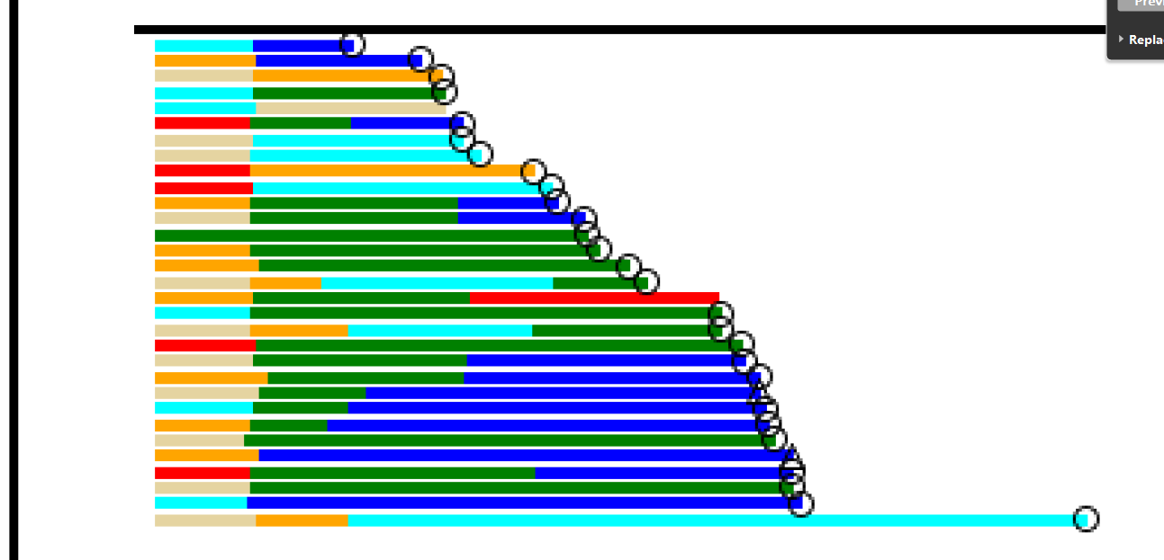
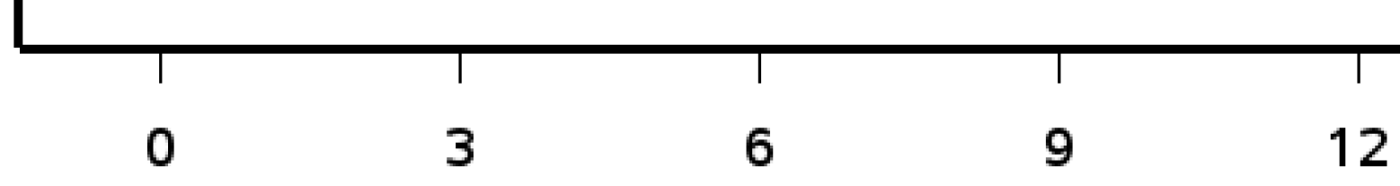
Figure 3. Responses in patients treatedª with BMS-986393
A) Overall response rate and (B) Responses over time
A
ORR
96%
B
CRR
42%
Response rate (%)
Response evaluable patients
Response
evaluable patients
(n = 24)
0
0
3
6
9
12
Time on study (month)
Data cutoff: March 18, 2024. ªThe efficacy-evaluable analysis set includes all patients who received conforming BMS-986393 cell product, had measurable disease at the most recent disease assessment prior to BMS-986393 infusion, and had ≥ 1 post-infusion disease response assessment. Responses were assessed per IMWG criteria.
CR, complete response; CRR, complete response rate; IMWG, International Myeloma Working Group; MR, minimal response; NA, not available; ORR, overall response rate; PD, progressive disease; PR, partial response; sCR, stringent complete response; SD, stable disease; VGPR, very good partial response.
Nadeem et al. EHA 2024, P951

Slide 20
Table 3. Treatment-related adverse events (TRAEs) of interest
TRAE of interest, n (%) | All treated patients (N = 31)
 | Any grade | Grade 3/4
CRS | 25(81) | 0
ICANS-type neurotoxicityª | 3 (10) | 0
Non-ICANS-type neurotoxicity^{b} | 3 (10) | 0
Select on-target/off-tumor adverse events of skin, nails, mouth
Dysgeusia | 9 (29) | 0
Nails^{c} | 8 (26) | 0
Skin^{d} | 3 (10) | 0
Dysphagia | 2 (6) | 0
Other adverse events suspected related to BMS-986393
Weight loss | 1 (3) | 0
Data cutoff: March 18, 2024. ªICANS frequency considers TEAEs (not TRAEs), and multiple events occurring within 7 days from each other as a single episode. ^{b}Non-ICANS-neurotoxicity events include the following preferred terms: dizziness, ataxia, neurotoxicity, dysarthria and nystagmus. ^{c}Nails includes preferred terms of nail bed disorder and nail disorder. ^{d}Skin includes preferred terms of pruritis, maculo-papular rash, pain of skin, erythema, and vesicular rash.
AE, adverse event; CRS, cytokine release syndrome; ICANS, immune effector cell-associated neurotoxicity syndrome; TEAE, treatment-emergent adverse event; TRAE, treatment-related adverse event.
Nadeem et al. EHA 2024, P951

Slide 21
Conclusions on BMS-986393
GPRC5D-directed CAR T-Cells are effective
Efficacy seen in patients with prior BCMA-directed therapies, implications for sequencing?
Some toxicity similar to BCMA-directed CARTs (cytopenias, CRS)
Some toxicity are target specific – GPRC5D
  Cerebellar neurotox - dose related, reversible?
    Seen less in cohort C – pts with 1-3 prior LOT
  On-target, off-tumor tox appears less than same target with bispecifics
    Less incidence and shorter duration: dysgeusia, nail changes, rash

Slide 22
MajesTEC-1: Study Design
Phase 1/2, dose escalation study to evaluate teclistamab in patients with RRMM
≥3 prior lines of therapy
No prior BCMA-targeted therapy
  Primary endpoint: Phase 1 - safety and determine RP2D. Phase 2 - ORR
  Key secondary endpoints: DOR, ≥VGPR, ≥ CR, sCR, TTR, MRD status, PFS, OS, safety,
  pharmacokinetics, immunogenicity, PRO
Dosing Overview
Teclistamab Dosing
Premedication
Limited to step-up and first full dose
No steroid requirement after 1st full dose
Step-up doses 0.06 and 0.3 mg/kg within 1 wk of 1st full dose
Initial Q2wk IV dose changed to IV or SC Qwk
IV Dosing
0.3-720 mcg/kg
SC Dosing
80-3000mcg/kg
RP2D 1500 mcg/kg SC qWk
Moreau et al. NEJM 2022, 387(6):495-505.
Presented at the 63rd American Society of Hematology (ASH) Annual Meeting & Exposition; December 11-14, 2021; Atlanta, GA/Virtual.

Slide 23
MajesTEC-1: Long-Term Follow-Up mFU: 30.4 months
ORR
Overall
≥CR
≥VGPR
DOR
ORR^{a,b}:
63.0
(104/165)
 | Median, mo (95% CI) | 30-mo DOR rate (95% CI)
Overall | 24.0 (17.0-NE) | 45.0% (34.8-54.7)
≥CR | NR (26.7-NE) | 60.8% (48.7-71.0)
≥VGPR | 25.6 (18.1-NE) | 48.7% (38.3-58.3)
≥CR^{b}:
46.1
≥VGPR:
59.4
PFS
Best response:
 | Median, mo (95% CI) | 30-mo PFS rate (95% CI)
Overall | 11.4 (8.8-16.4) | 30.1% (22.9-37.7)
≥CR | NR (26.9-NE) | 61.0% (48.9-71.1)
≥VGPR | 26.7 (19.4-NE) | 48.8% (38.5-58.4)
sCR
CR
VGPR
PR
ªResponse assessed by independent review committee. ^{b}At 30-month mFU of the phase 2 efficacy population (patients enrolled in Cohort A on or before March 18, 2021; n=110 patients supporting the USPI¹): ORR, 61.8; ≥CR, 46.4% (n=51)
Garfall et. al., ASCO 2024. poster 7540.

Slide 24
Conclusions on MajesTEC-1
First BCMA:CD3 bispecific approved for MM
  Indication: Adults with R/R multiple myeloma after ≥4 prior lines of therapy, including an immunomodulatory agent, a proteasome inhibitor, and an anti-CD38 monoclonal Ab
Long-term f/u data >30 mos continue to support excellent dz control
  Patients in CR have not reached median PFS, DOR @ 30 mos
No new toxicity signals
  Question if decreased infections with adequate prophy/IVIG replacement and decreased frequency of dosing

Slide 25
MagnetisMM-3: Phase II Trial Design and Primary Endpoint
Inclusion:
age >18 with RRMM
previously treated with PI, IMiD, and CD38mAb
ECOG <2
Screened (n = 237)
Not enrolled (n = 50)
Screen failure (n = 45)
Not screening failure but not enrolled (n = 5)
Enrolled (n = 187)
Prior BCMA-directed therapy
(n = 64)
ORR, 61%
(95% CI; 51.8-69.6)
No prior BCMA-directed therapy
(n = 123)
Received elranatamab (n = 123)
Patients (%)
≥CR: 37.4%
Ongoing elranatamab treatment (n = 41)
Discontinued treatment (n = 82)
Disease progression (n = 48)
AE (n = 17)
Death (n = 9)
Patient request (n = 4)
Lack of efficacy (n = 3)
Global deterioration of health status (n=1)
Primary Endpoint: ORR by BICR
Secondary Endpoints: ORR by baseline extramedullary disease status, ORR by investigator, CR rate, TTR< DOR, DOCR, MRD, PFS< OS safety
≥VGPR: 56.1%
Ongoing follow-up (n = 63)
Discontinued follow-up (n = 60)
Death (n = 52)
Patient request (n = 7)
Lost to follow-up (n = 1)
Lesokhin et al. Nat Med 29, 2259–2267 (2023). Mohty et al. EHA 2024, Abs 932.

Slide 26
MagnetisMM-3: Secondary Endpoints
Duration of Response
Progression-free Survival
Overall Survival
24-month rate for patients with ≥CR (95% CI): 87.9% (73.1-94.8)
Median OS, 24.6 months
(95% CI, 13.4-NE)
24-month rate for patients with ≥CR (95% CI): 90.6% (76.9-96.4)
24-month rate for patients with OR (95% CI): 66.9% (54.4-76.7)
Median DOR, months (95% CI)
Median PFS, months (95% CI)
All responders NR (NE-NE)
Overall 17.2 (9.8-NE)
Patients with ≥CR NR (NE-NE)
Patients with ≥CR NR (NE-NE)
No. at Risk
All responders | 75 | 70 | 65 | 57 | 50 | 45 | 41 | 38 | 35 | 18 | 3 | 1 | 0
Patients with ≥CR | 46 | 46 | 46 | 43 | 40 | 36 | 35 | 34 | 31 | 18 | 3 | 1 | 0
No. at Risk
Overall | 123 | 78 | 67 | 63 | 54 | 48 | 44 | 42 | 39 | 32 | 7 | 1 | 0
Patients with ≥CR | 46 | 46 | 46 | 44 | 42 | 38 | 36 | 35 | 35 | 28 | 7 | 1 | 0
No. at Risk | 123 | 106 | 92 | 84 | 74 | 67 | 61 | 60 | 56 | 47 | 13 | 3 | 2 | 0
Mohty et. al., EHA 2024. Poster 932.

Slide 27
Conclusions MagnetisMM-3
2nd BCMA:CD3 bispecific approved for MM
  Indication: Adults with R/R multiple myeloma after ≥4 prior lines of therapy, including an immunomodulatory agent, a proteasome inhibitor, and an anti-CD38 monoclonal Ab
Updated data with excellent DOR and PFS
  Med PFS 17.2 mos
No new toxicity signals
  Similar to teclistamab

Slide 28
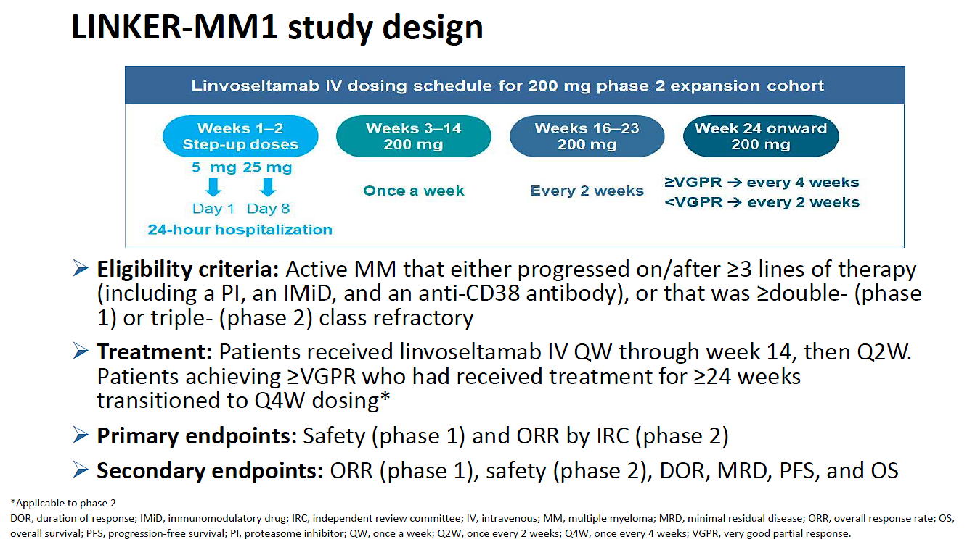
Linvoseltamab - LINKER-MM1 Study Update
Lentzsch et al. EHA 2024, Abs S212.

Slide 29
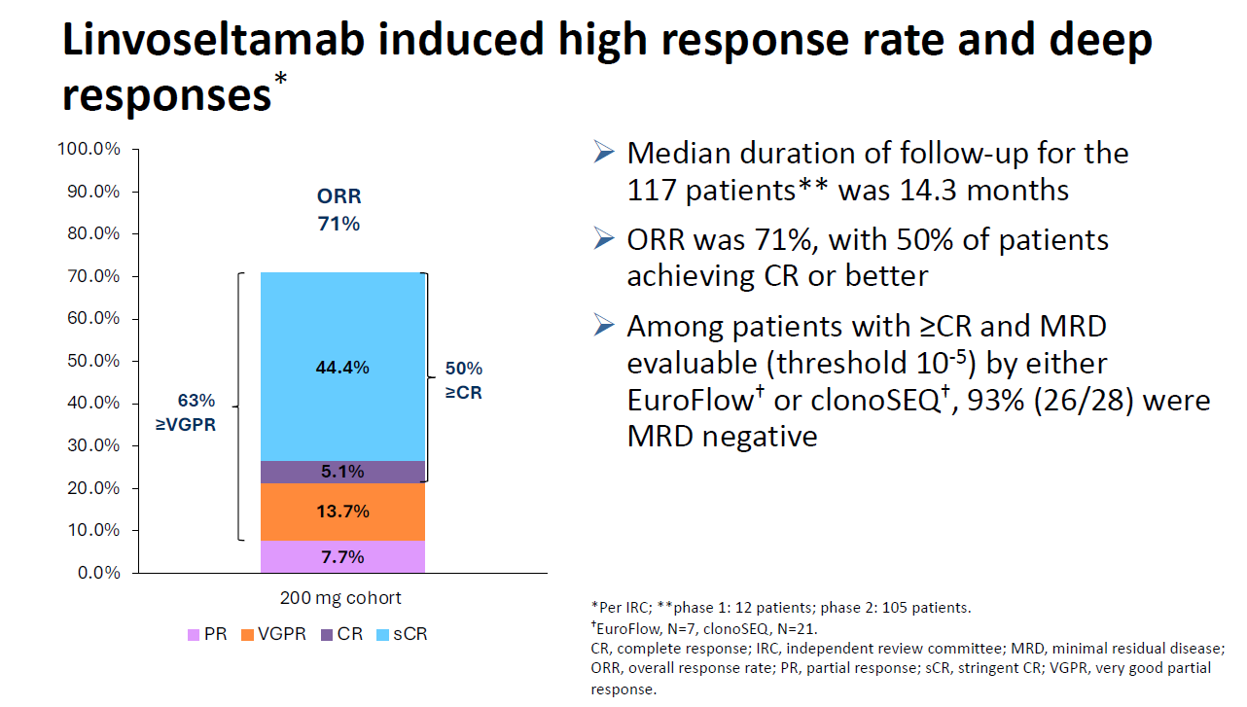
Linvoseltamab - LINKER-MM1 Responses
Lentzsch et al. EHA 2024, Abs S212.

Slide 30
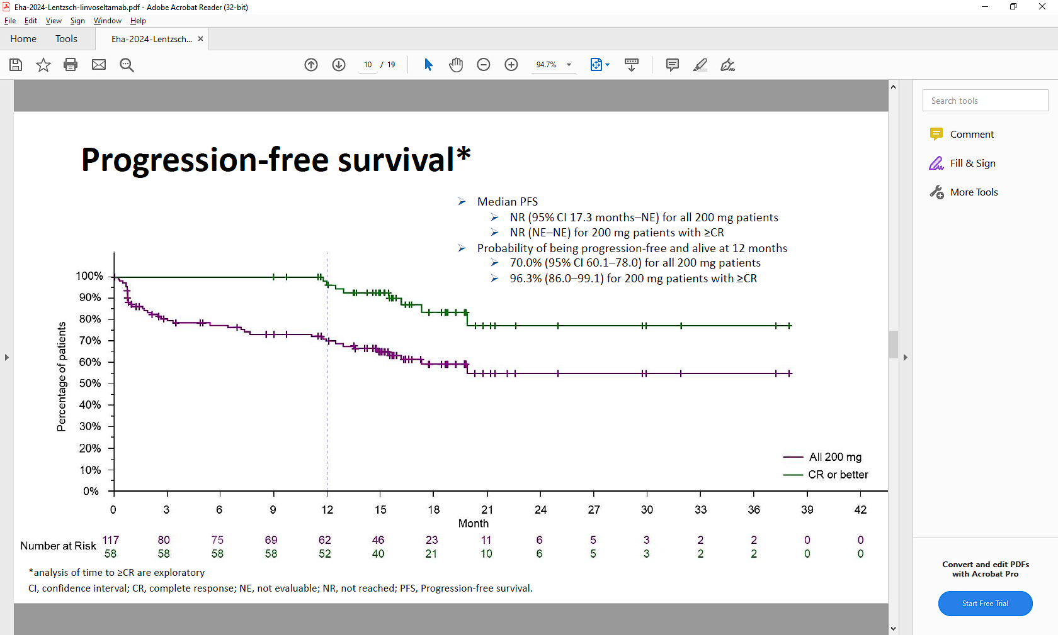
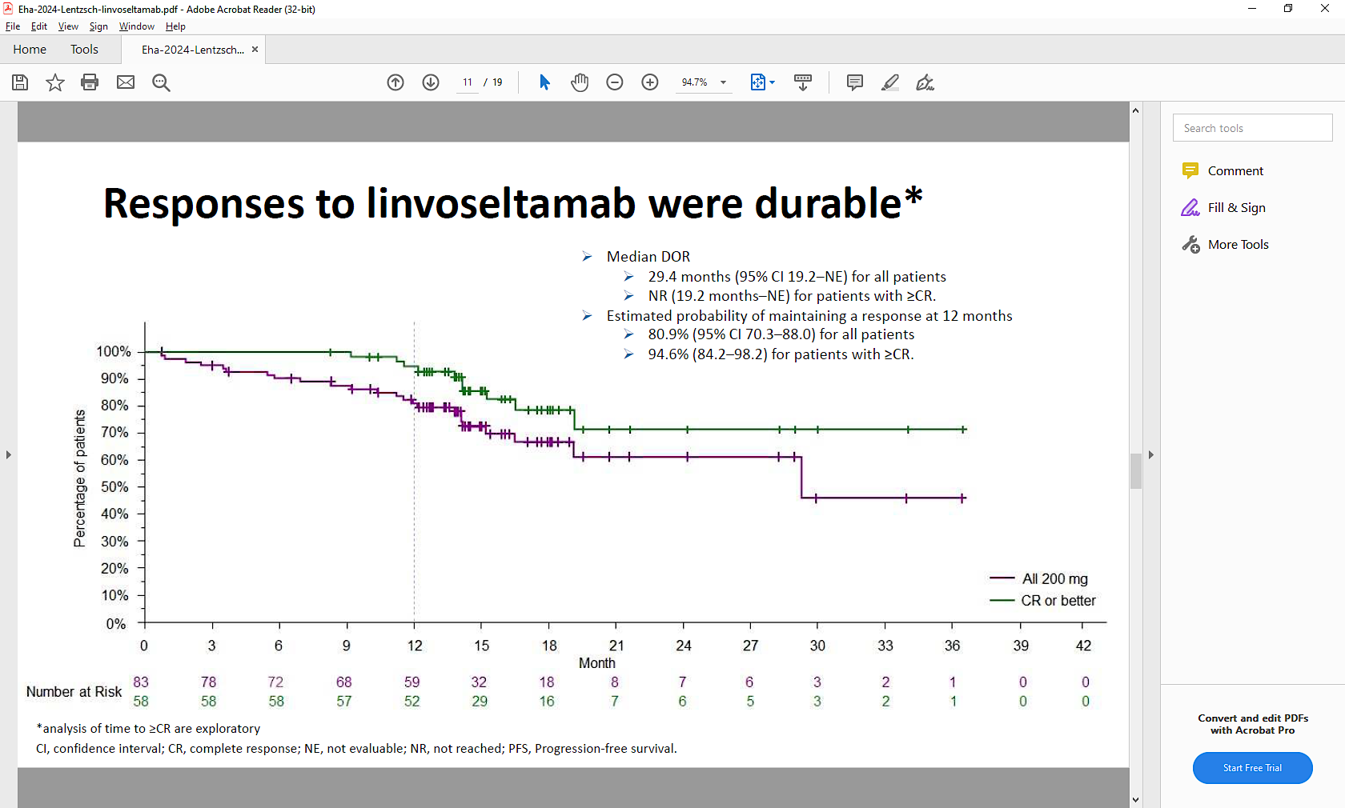
Linvoseltamab - LINKER-MM1 Survival Curves
Median f/u 14.3 mos
Duration of Response
Lentzsch et al. EHA 2024, Abs S212.

Slide 31
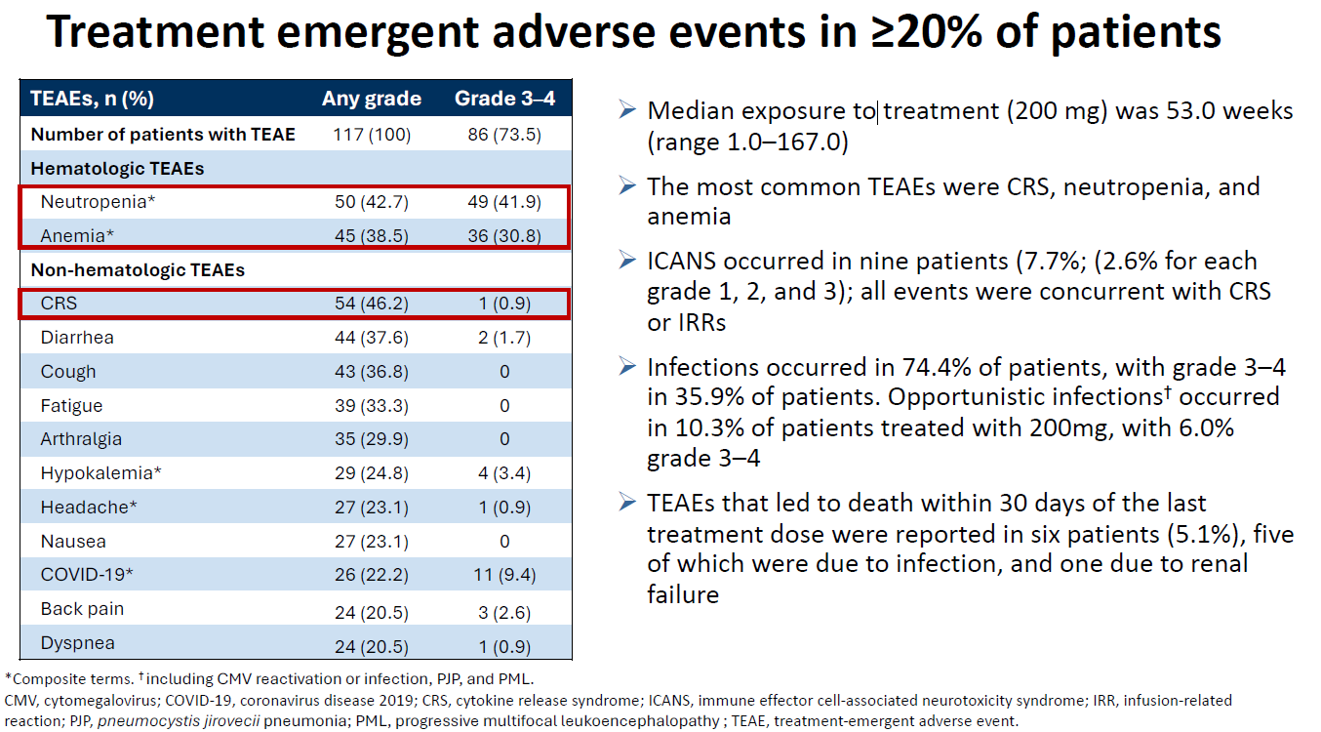
Linvoseltamab - LINKER-MM1 Safety
Lentzsch et al. EHA 2024, Abs S212.

Slide 32
Conclusions LINKER-MM1
FDA Review expected this summer - 3rd BCMA:CD3 bispecific?
Efficacy similar to teclistamab, elranatamab
Differences:
  IV vs SQ
  2 1-day hospitalization vs 3-6 days for other products
Toxicity similar
  Infections continue to be high as with other BCMA products
  Decrease with time on therapy, question if true difference or due to less frequent dosing/implementation of better prophy, IVIG use

Slide 33
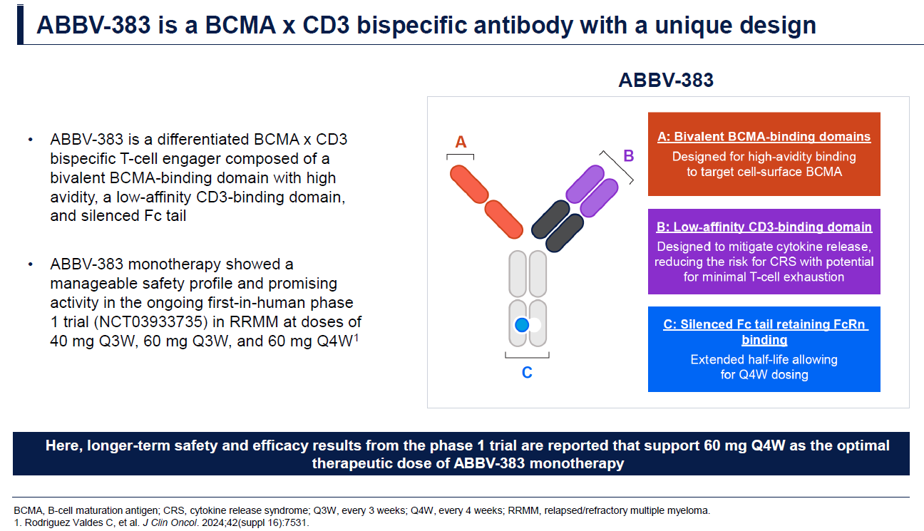
ABBV-383 Phase I Trial Update – Report of 3 highest dose levels
Weisel et al. EHA 2024, Abs S211.

Slide 34
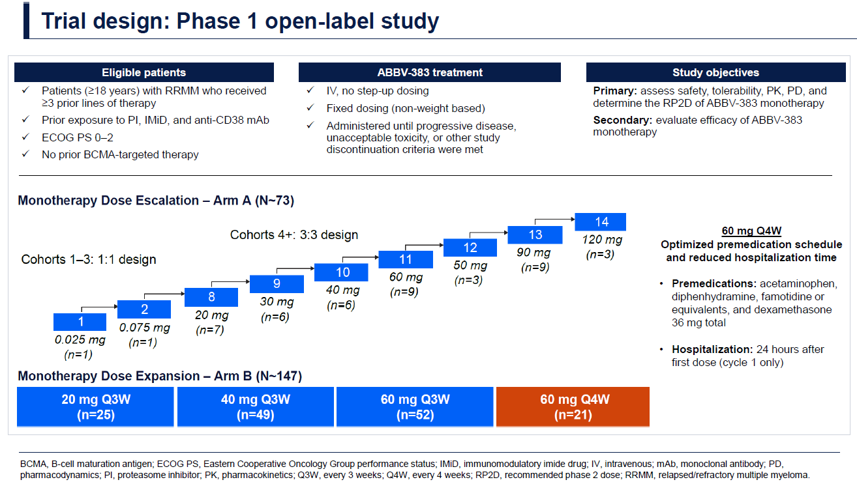
ABBV-383 Trial Design
Weisel et al. EHA 2024, Abs S211.

Slide 35
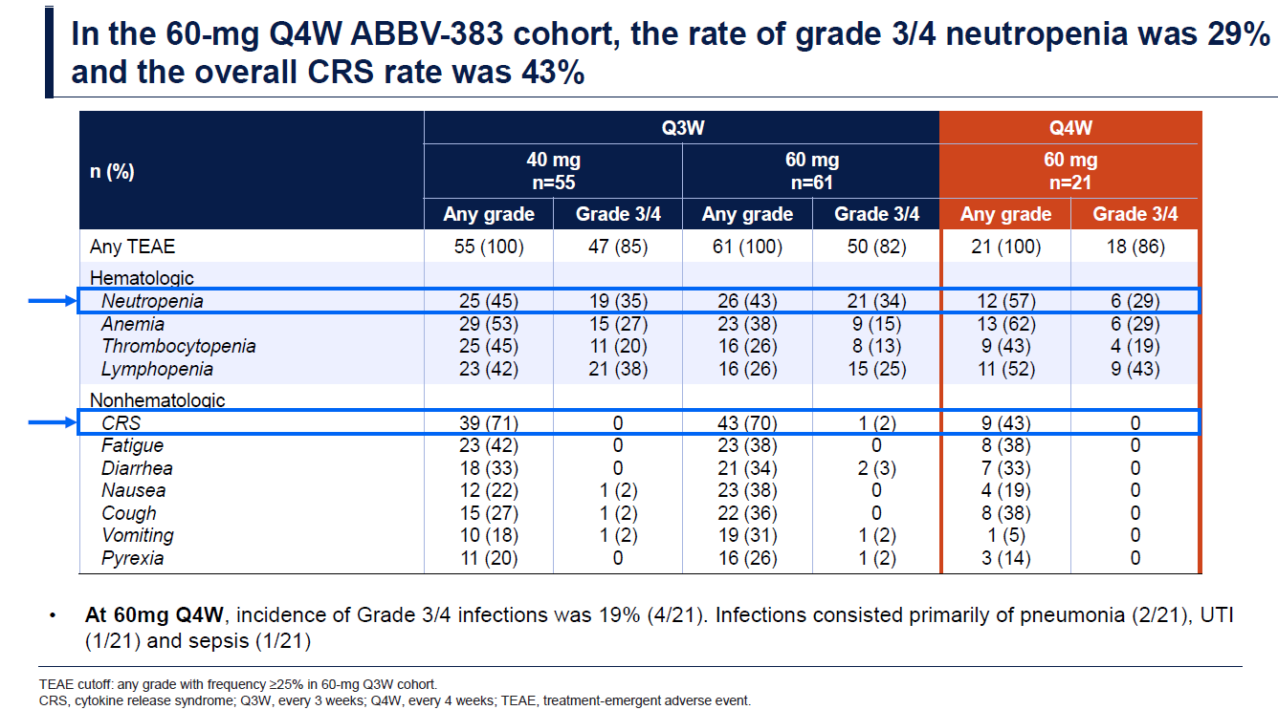
ABBV-383 Safety
Weisel et al. EHA 2024, Abs S211.

Slide 36
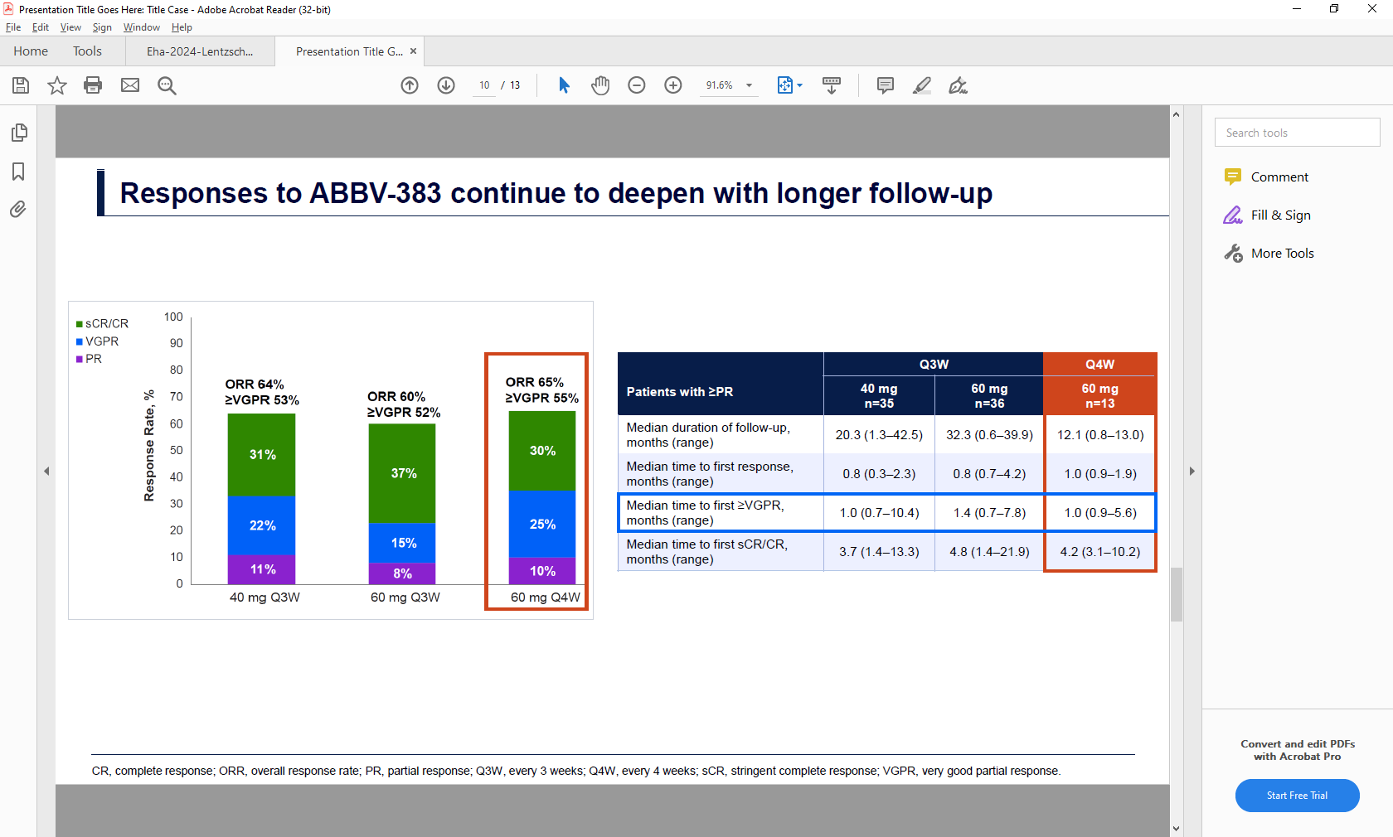
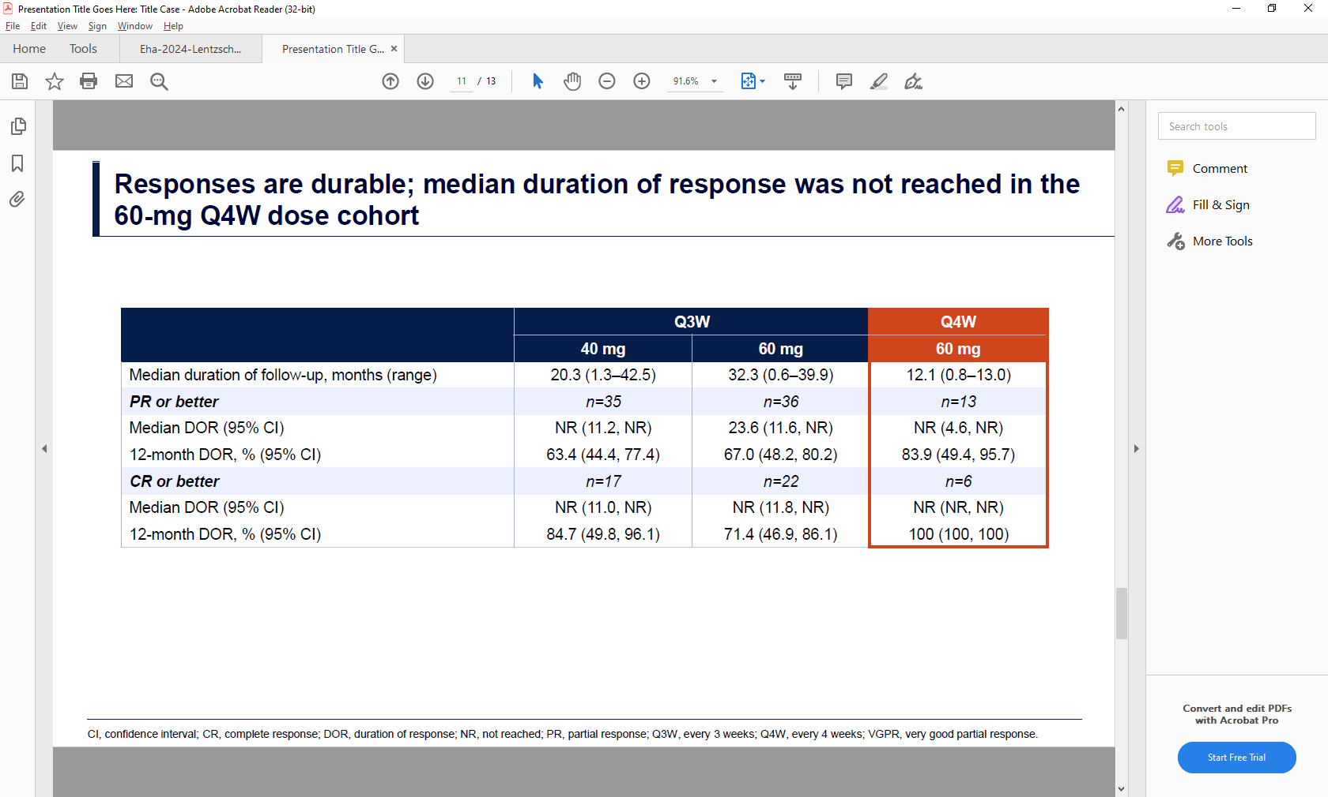
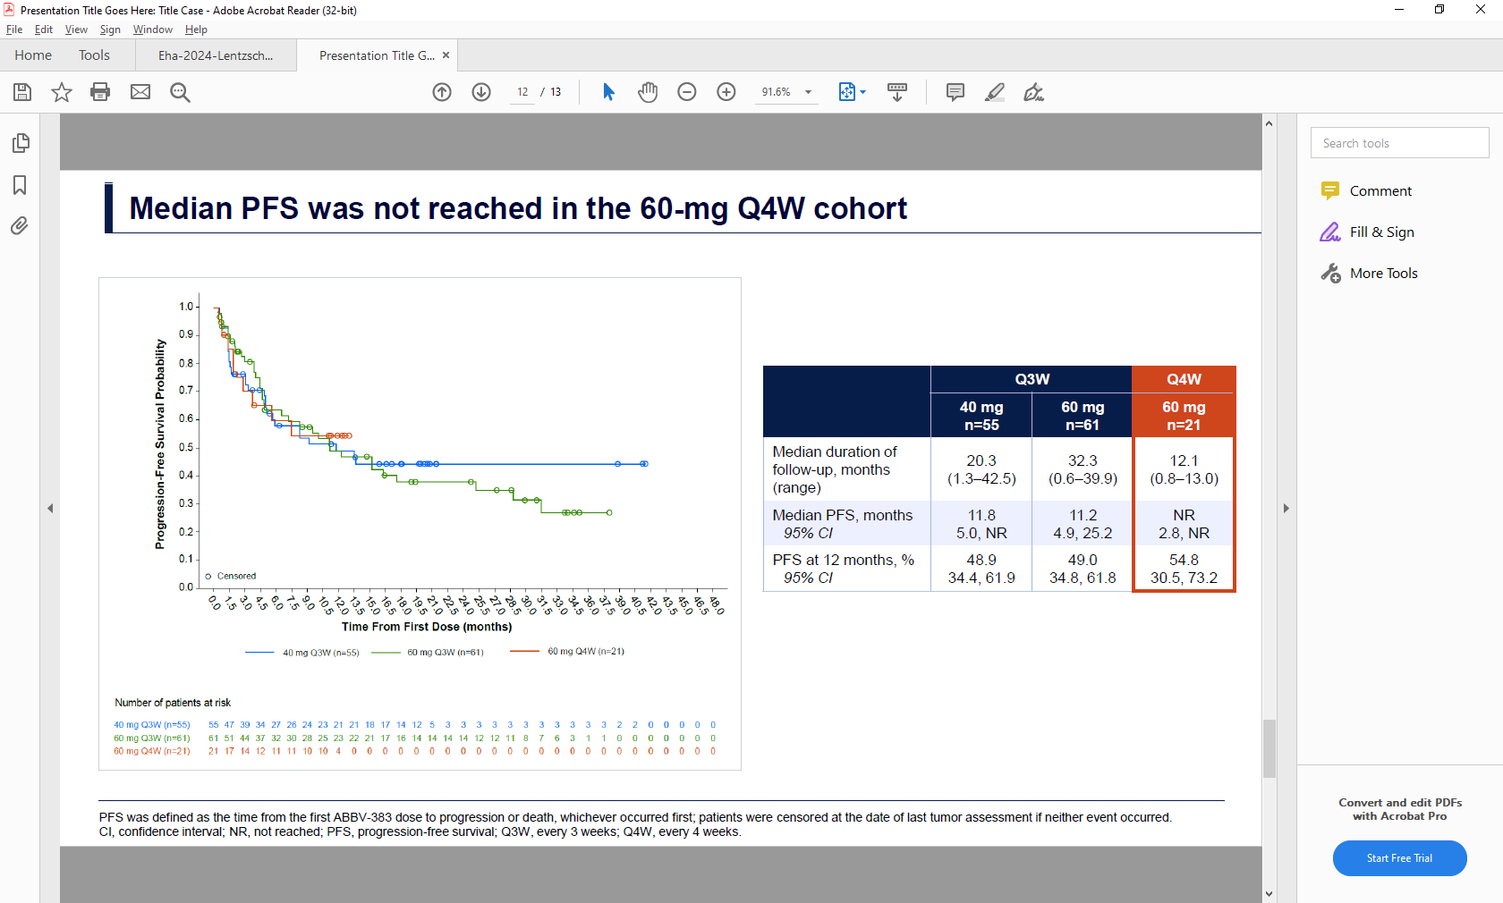
ABBV-383 Response
PFS
Weisel et al. EHA 2024, Abs S211.

Slide 37
Conclusions on ABBV-383
Another very active BCMA:CD3 bispecific
Construct differences
  Allows for q4wk dosing
  Less CRS?
  Fewer infections?
Registrational phase 3 trial: CERVINO trial at 60mg Q4wks is ongoing

Slide 38
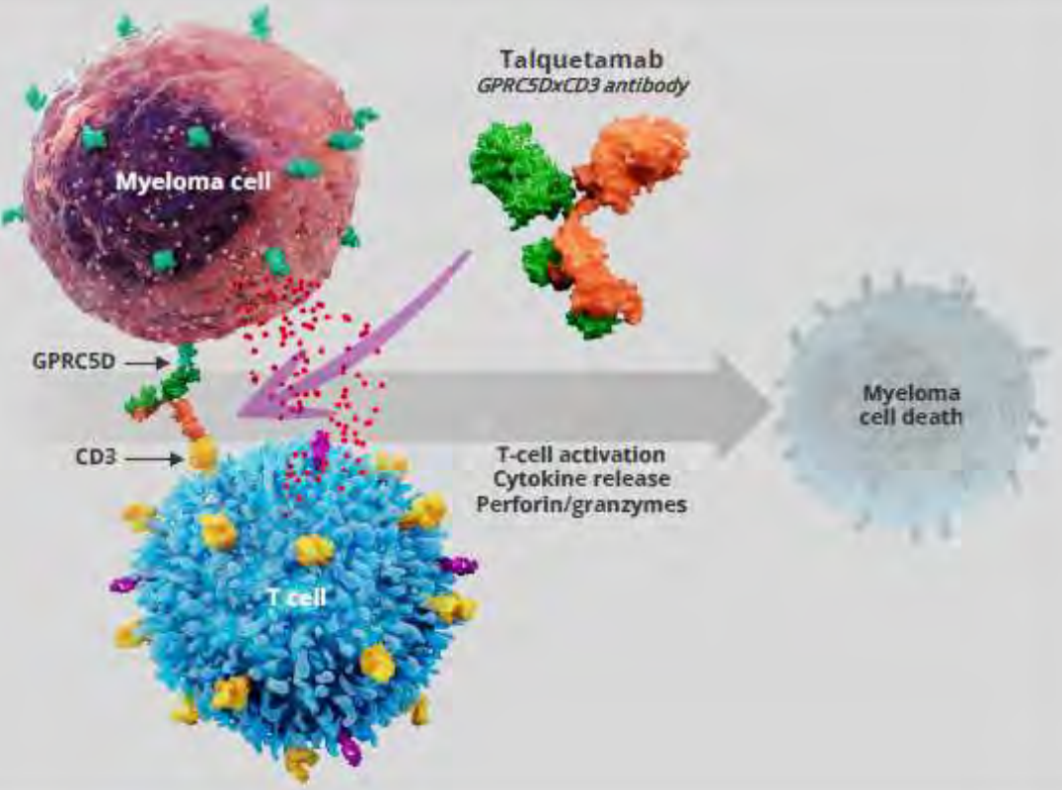
Talquetamab – MonumenTAL-1
Talquetamab is a novel first-in-class, off-the-shelf, T-cell redirecting bispecific antibody directed against a new antigen target called GPRC5D
GPRC5D is a novel antigen target in myeloma that is highly expressed on malignant plasma cells with limited expression in normal human tissues, including hematopoietic stem cells
Pivotal phase 2 data showed > 70% ORR in heavily pretreated pts with RRMM.
High response rates were also seen in pts with prior T-cell redirection therapy.
The safety profile was clinically manageable with low rates of high-grade infections and discontinuations.
Talquetamab
GPRC5DxCD3 antibody
Myeloma cell
GPRC5D →
Myeloma
cell death
CD3 →
T-cell activation
Cytokine release
Perforin/granzymes
T cell
Phase 1 experience – 232 pt, 70% ORR and 10.2m median PFS
Schinke et.al. ASH 2023. Abstract 8036.

Slide 39
MonumenTAL-1: Key Efficacy Outcomes
Outcomes | Tal 0.4 mg/kg QW (n=143)ª | Tal 0.8 mg/kg Q2W (n=154)ª | Prior TCR (n=78)
Median follow-up, months | 29.8 | 23.4 | 20.5
ORR, n (%) | 106 (74.1) | 107 (69.5) | 52 (66.7)
≥VGPR, n(%) | 85 (59.4) | 91 (59.1) | 43 (55.1)
≥CR, n(%) | 47 (32.9) | 62 (40.3) | 33 (42.3)
Median DOR, months | 9.5 | 17.5 | N/A^{b}
(95% CI) | (6.7-13.4) | (12.5-NR)
12-month DOR rate, % | 43.8 | 60.6 | 55.8
(95% CI) | (34.1-53.1) | (50.4-69.4) | (40.8-68.4)
Median PFS, months | 7.5 | 11.2 | 7.7
(95% CI) | (5.7-9.4) | (8.4-14.6) | (4.1-14.5)
12-month PFS rate, % | 34.9 | 46.8 | 44.7
(95% CI) | (27.0-42.9) | (38.5-54.8) | (33.1-55.7)
Rasche et al. EHA 2024, Abs P915.

Slide 40
MonumenTAL-1: Adverse Effects
AEs (≥20% of any RP2D cohort) | 0.4 mg/kg SC QW (n=143) Median Follow-up, 11.0 months | 405 µg/kg SC QWª n=30 | 0.8 mg/kg SC Q2W (n=145) Median Follow-up, 5.1 months
 | Any Grade n (%) | Grade 3/4 (%) | Any Grade (%) | Grade 3/4 (%)
CRS | 113 (79.0) | 3 (2.1) | 105 (72.4) | 1 (0.7)
Anemia | 64 (44.8) | 45 (31.5) | 57 (39.3) | 36 (24.8)
Neutropenia | 49 (34.3) | 44 (30.8) | 41 (28.3) | 32 (22.1)
Lymphopenia | 40 (28.0) | 37 (25.9) | 38 (26.2) | 37 (25.5)
Thrombocytopenia | 39 (27.3) | 29 (20.3) | 39 (26.9) | 24 (16.6)
Skin-related AEs^{d} | 80 (55.9) | 0 | 98 (67.6) | 1 (0.7)
Nail-related AEs^{e} | 74 (51.7) | 0 | 63 (43.4) | 0
Dysgeusia^{f} | 69 (48.3) | NA | 67 (46.2) | NA
Rash-related AEs^{g} | 56 (39.2) | 2 (1.4) | 39 (26.9) | 8 (5.5)
Weight decreased | 57 (39.9) | 3 (2.1) | 47 (32.4) | 2 (1.4)
Pyrexia | 53 (37.1) | 4 (2.8) | 35 (24.1) | 1 (0.7)
Asthenia | 37 (25.9) | 3 (2.1) | 13 (9.0) | 2 (1.4)
Dry mouth | 36 (25.2) | 0 | 53 (36.6) | 0
Diarrhea | 34 (23.8) | 3 (2.1) | 32 (22.1) | 0
Dysphagia | 34 (23.8) | 0 | 33 (22.8) | 3 (2.1)
Fatigue | 32 (22.4) | 5 (3.5) | 29 (20.0) | 1 (0.7)
Decreased appetite | 25 (17.5) | 2 (1.4) | 29 (20.0) | 2 (1.4)
Most high-grade AEs were cytopenias
Infections
0.4 mg/kg QW
Any grade: 57.3%
Grade 3/4: 16.8%
Opportunistic infection: 3.5%
COVID-19: 9.1%
  Grade 3/4: 0.7%
Infections
0.8 mg/kg Q2W
Any grade: 50.3%
Grade 3/4: 11.7%
Opportunistic infection: 2.8%
COVID-19: 11.0%
  Grade 3/4: 2.1%
Chari et al., ASH 2022

Slide 41
Conclusions on MonumenTAL-1
First GPRC5D:CD3 bispecific approved for MM
  Indication: Adults with R/R multiple myeloma after ≥4 prior lines of therapy, including an immunomodulatory agent, a proteasome inhibitor, and an anti-CD38 monoclonal Ab
Longer-term f/u continues to show durable responses
  Q2wk dosing appears more durable
  Excellent responses in patients with prior T-cell redirecting Tx, mostly BCMA-directed
Toxicity
  Plus – infections though common, appear less frequent/lower grade than BCMA –directed bispecifics
  Minus – Off tumor, on target effects: dysgeusia, nail dysmorphia, rash, weight loss can be difficult for patient

Slide 42
DREAMM-7: study design
Recruitment period
~13 months from FPI (May 7, 2020) to LPI (June 28, 2021)
Treatment period
Until end of study, withdrawal of consent, PD, death, or
unacceptable toxicity
Follow-up period
Cycles 1-8
Cycle 9+
Eligibility criteria
Adults with MM
≥1 prior line of MM therapy and documented PD during or after most recent therapy
No prior treatment with anti-BCMA
Not refractory to or intolerant of daratumumab or bortezomib
1:1 Randomization
Arm A (BVd)
Belamaf
2.5 mg/kg IV q3w
+
Belamaf monotherapy
2.5 mg/kg IV q3w
End-of-treatment visit
Follow-up for
PFS q3w
(for patients who discontinue due to reasons other than PD)
Disease assessments q3w
Follow-up for
OS q12w
(for patients who discontinue due to PD or other reasons)
bortezomib 1.3 mg/m² SC on days 1, 4, 8, and 11 of cycles 1-8 (21-day cycles)
+
dexamethasone 20 mg day of and day after bortezomib
Daratumumab monotherapy
16 mg/kg IV q4w in cycle 9+
Arm B (DVd)
Daratumumab
16 mg/kg IV qw in cycles 1-3; and q3w in cycles 4-8 +
bortezomib 1.3 mg/m² SC on days 1, 4, 8, and 11 of cycles 1-8 (21-day cycles)
+
dexamethasone 20 mg on day of and day after bortezomib
Median follow-up (ITT)
28.2 months (range, 0.1-40.0 months)
Stratification:
Prior lines of treatment (1 vs 2 or 3 vs ≥4)
R-ISS stage (I vs II/III)
Prior bortezomib (yes vs no)
Primary endpoint:
PFS (IRC assessed)
Key secondary endpoints:
OS, DOR, and MRD
Additional secondary endpoints:
CRR, ORR, CBR, TTR, TTP, PFS2, AEs, ocular findings, and QOL
Hungria et. al. NEJM 2024;[Online ahead of print]

Slide 43
DREAMM-7: PFS and OS in the ITT
BVd
DVd
PFS
OS
18 months
18 months
84%
69%
Median 36.6
months
73%
Median 13.4 months
43%
No. at risk
PFSª | BVd (N=243) | DVd (N=251)
Events, n(%) | 91 (37) | 158 (63)
PFS, median (95% CI), mo^{b} | 36.6 (28.4-NR) | 13.4 (11.1-17.5)
HR (95% CI)^{c} | 0.41 (0.31-0.53)
P value^{d} | <.00001
OSª | BVd (N=243) | DVd (N=251)
Events, n(%) | 54 (22) | 87 (35)
OS, median (95% CI), mo^{b} | NR | NR
HR (95% CI)^{c} | 0.57 (0.4-0.8)
P value^{d} | .00049e
Hungria et. al. NEJM 2024;[Online ahead of print]

Slide 44
DREAMM-8: Study Design
Recruitment period
October 2020 to December 2022
Treatment period
Until PD, death, unacceptable toxicity, end of study,
or withdrawal of consent
Eligibility criteria
Adults with MM
≥1 prior line of MM therapy including LEN
Documented PD during or after their most recent therapy
No prior treatment with anti-BCMA or pomalidomide; not refractory/ intolerant to bortezomib
N=302
BPd (Q4W)
Belantamab mafodotin
2.5 mg/kg IV (cycle 1) then 1.9 mg/kg IV Q4W from cycle 2 onward
+
Pomalidomide 4 mg orally on days 1-21 (28-day cycles)
+
Dexamethasone 40 mg on days 1, 8, 15, and 22
End-of-treatment visit
Primary endpoint:
PFS (IRC assessed per IMWG)
Key secondary endpoints:
OS, MRD negativity, DOR
Additional secondary endpoints include:
ORR, CRR, ≥VGPR, TTBR, TTR, TTP, PFS2, AEs, ocular findings, HRQOL, and PROs
1:1 Randomization
PVd (Q3W)
Bortezomib
1.3 mg/m² SC on days 1, 4, 8, and 11 of cycles 1-8 then days 1 and 8
(21-day cycles)
+
Pomalidomide 4 mg orally on days 1-14 (21-day cycles)
+
Dexamethasone 20 mgª on the day of and day after bortezomib
Stratification^{b}:
Prior lines of treatment (1 vs 2 or 3 vs ≥4)
Prior bortezomib (yes vs no)
Prior anti-CD38 therapy (yes vs no)
Dimopoulos et. al. NEJM 2024;[Online ahead of print]

Slide 45
DREAMM-8: Efficacy
BPd
PVd
PFS
Positive OS Trend Favoring BPd vs PVd
12 months
12 months
83%
71%
76%
51%
No. at risk
No. at risk
PFSª | BPd (N=155) | PVd (N=147)
Events, n(%) | 62 (40) | 80 (54)
Median PFS (95% CI), months | NR (20.6-NR) | 12.7 (9.1-18.5)
HR (95% CI); P value | 0.52 (0.37-0.73); <.001
Interim OS | BPd (N=155) | PVd (N=147)
Events, n(%)ª | 49 (32) | 56 (38)
Median OS (95% CI), months | NR (33.0-NR) | NR (25.2-NR)
HR (95% CI)^{b} | 0.77 (0.53-1.14)
Dimopoulos et. al. NEJM 2024;[Online ahead of print]

Slide 46
Conclusions on DREAMM-7 and DREAMM-8
Belantamab mafodotin was the first FDA-approved ADC in MM based on the DREAMM-2 study
Withdrawn after the negative confirmatory DREAMM-3
The impressive results of both the DREAMM-7 and DREAMM-8 studies should get this drug approved in combination
  DREAMM-7 first trial to beat a dara-based triplet combination
Ocular toxicity remains an issue but appears improved with less frequent dosing in combination
If approved as early as 2nd line, it will make sequencing of BCMA-directed drugs much more complicated

