Slide 1
Myelofibrosis
Saturday, April 27, 2024
12:15 PM – 1:45 PM
What I Tell My Patients:
Integrating New Research Information
into Current Clinical Care
A Complimentary NCPD Hybrid Symposium Series Held During the 49th Annual ONS Congress
Faculty
Ilene Galinsky, NP
Andrew T Kuykendall, MD
Sara M Tinsley-Vance, PhD, APRN, AOCN
Abdulraheem Yacoub, MD
Moderator
Neil Love, MD

Slide 2





Faculty
Ilene Galinsky, NP
Senior Adult Leukemia Program
Research Nurse Practitioner
Dana-Farber Cancer Institute
Boston, Massachusetts
Abdulraheem Yacoub, MD
Professor of Medicine
Division of Hematologic Malignancies
and Cellular Therapeutics (HMCT)
Department of Internal Medicine
The University of Kansas Cancer Center
Westwood, Kansas
Andrew T Kuykendall, MD
Associate Member, Department of Malignant Hematology
Moffitt Cancer Center
Assistant Professor, Department of Oncologic Sciences
University of South Florida
Tampa, Florida
Moderator
Neil Love, MD
Research To Practice
Miami, Florida
Sara M Tinsley-Vance, PhD, APRN, AOCN
Nurse Practitioner and Researcher
Malignant Hematology
Moffitt Cancer Center
Courtesy Assistant Professor
University of South Florida College of Nursing
Tampa, Florida

Slide 3
Ms Galinsky — Disclosures
Advisory Committees | AbbVie Inc, Astellas, CTI Biopharma, a Sobi company, Novartis, Takeda Pharmaceuticals USA Inc
Consulting Agreements | AbbVie Inc, CTI Biopharma, a Sobi company, Novartis

Slide 4
Dr Kuykendall — Disclosures
Advisory Committees | AbbVie Inc, Blueprint Medicines, Bristol Myers Squibb, Cogent Biosciences, CTI Biopharma, a Sobi company, Incyte Corporation, Karyopharm Therapeutics, PharmaEssentia
Consulting Agreements | AbbVie Inc, Karyopharm Therapeutics, MorphoSys
Contracted Research | Blueprint Medicines, Bristol Myers Squibb, Geron, Janssen Biotech Inc, Protagonist Therapeutics, MorphoSys
Data and Safety Monitoring Board/Committee | Geron

Slide 5
Dr Tinsley-Vance — Disclosures
Advisory Committees | AbbVie Inc, CTI Biopharma, a Sobi company, Incyte Corporation, Pfizer Inc
Consulting Agreements | CTI Biopharma, a Sobi company, Incyte Corporation, Novartis
Speakers Bureaus | Astellas, Bristol Myers Squibb, CTI Biopharma, a Sobi company, Incyte Corporation, Jazz Pharmaceuticals Inc
Nonrelevant Financial Relationships (Contracted Research) | Gulf Coast Community Foundation, National Institutes of Health, Patient-Centered Outcomes Research Institute

Slide 6
Dr Yacoub — Disclosures
Consulting Agreements | AbbVie Inc, Acceleron Pharma, Apellis, CTI Biopharma, a Sobi company, Gilead Sciences Inc, Incyte Corporation, Karyopharm Therapeutics, Notable Labs, Novartis, Pfizer Inc, PharmaEssentia, Protagonist Therapeutics, Servier Pharmaceuticals LLC

Slide 7
Commercial Support
This activity is supported by educational grants from CTI Biopharma, a Sobi company, GSK, and Incyte Corporation.
Research To Practice NCPD Planning Committee Members,
Staff and Reviewers
Planners, scientific staff and independent reviewers for Research To Practice have no relevant conflicts of interest to disclose.

Slide 8
This educational activity contains discussion of
non-FDA-approved uses of agents and regimens. Please refer to official prescribing information for each product for approved indications.

Slide 9
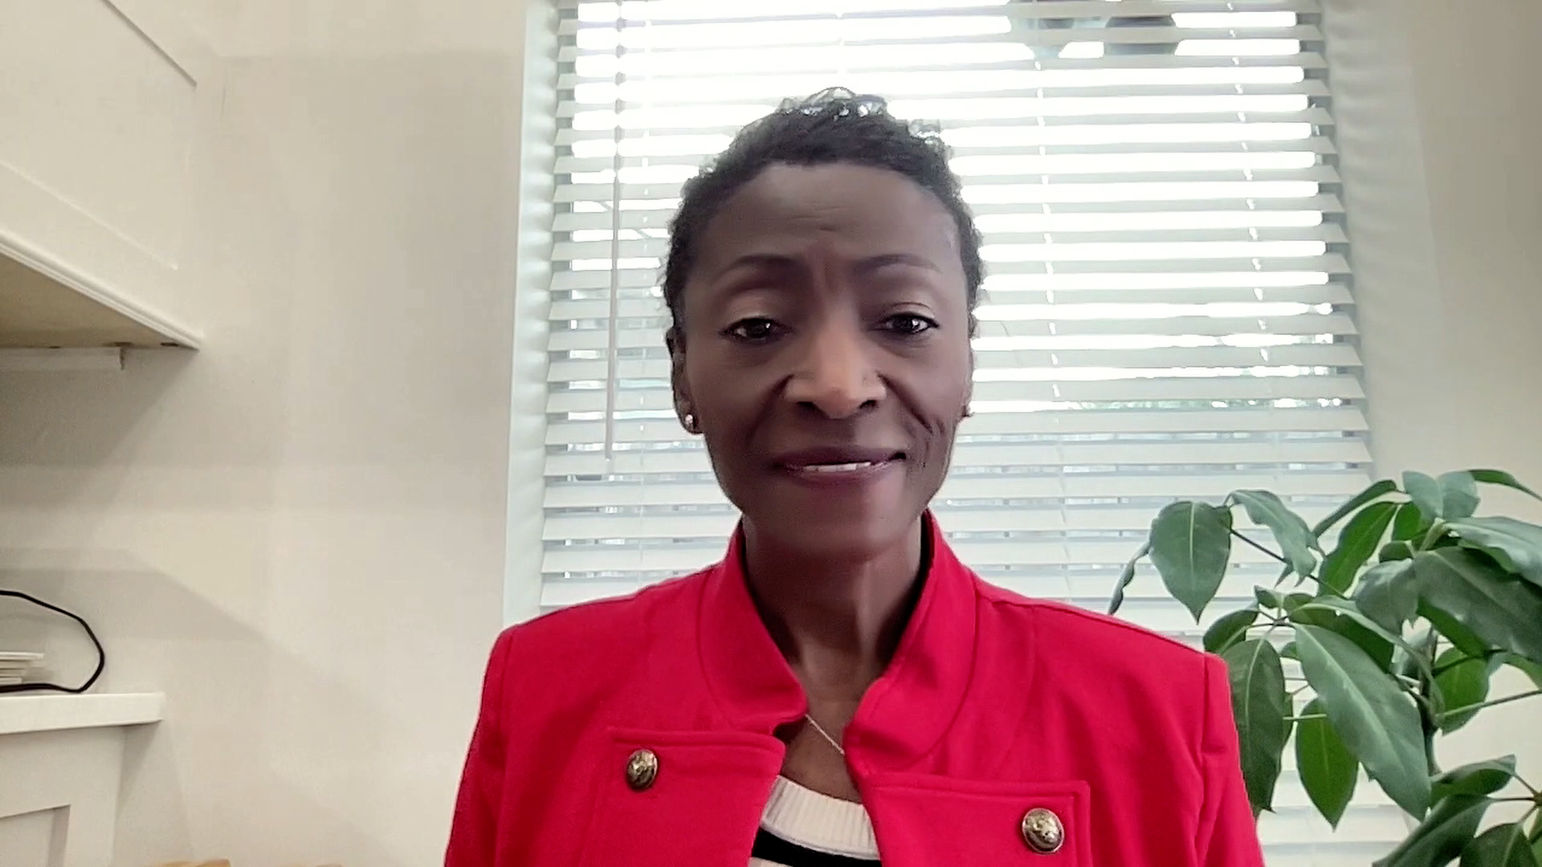

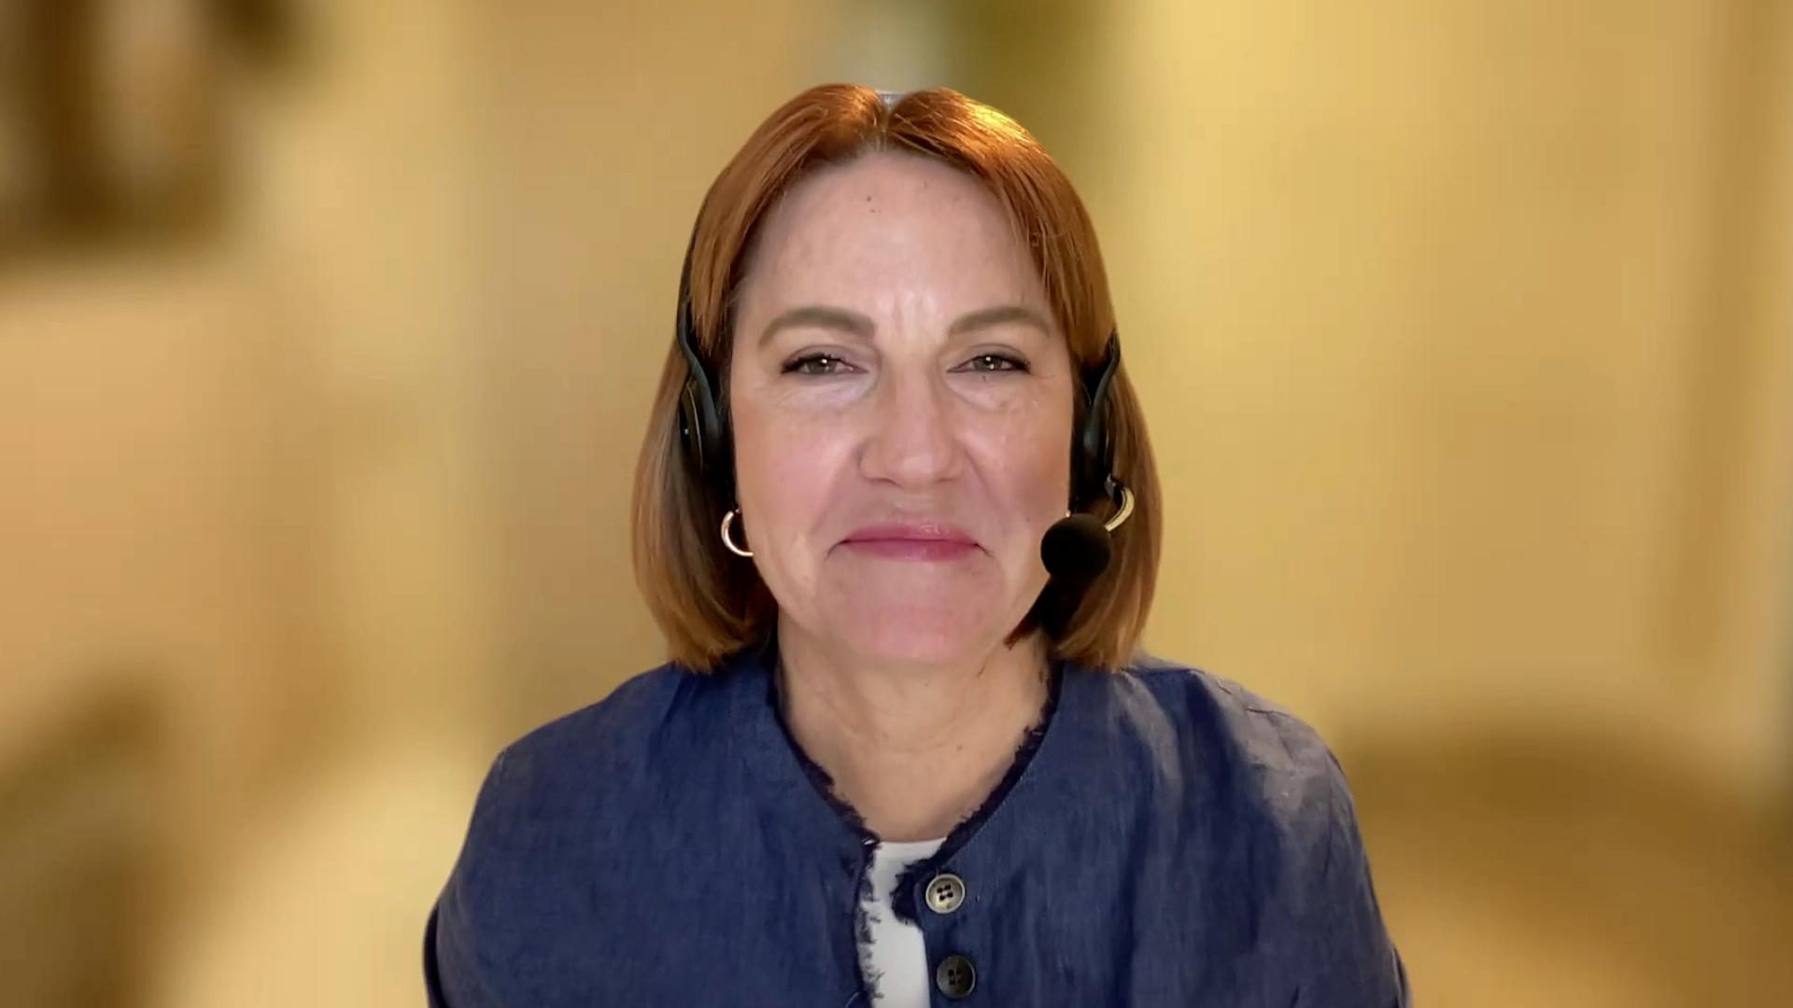






Consulting Nurse Faculty
Jacqueline Broadway-Duren, PhD, DNP, APRN, FNP-BC
The University of Texas
MD Anderson Cancer Center
Houston, Texas
Jessica Mitchell, APRN, CNP, MPH
Mayo Clinic College of Medicine and Science
Rochester, Minnesota
Kathleen D Burns, RN, MSN, AGACNP-BC, OCN
City of Hope Comprehensive
Cancer Center
Duarte, California
Tiffany A Richards, PhD, ANP-BC, AOCNP
The University of Texas
MD Anderson Cancer Center
Houston, Texas
Sonia Glennie, ARNP, MSN, OCN
Swedish Cancer Institute Center
for Blood Disorders
Seattle, Washington
Kimberly A Spickes, MNSc, RN, APRN, OCN, ACNP-BC
University of Arkansas for Medical Sciences
Little Rock, Arkansas
Amy Goodrich, CRNP
The Sidney Kimmel Comprehensive Cancer Center
Baltimore, Maryland
Ronald Stein, JD, MSN, NP-C, AOCNP
USC Norris Comprehensive Cancer Center
Los Angeles, California
https://www.ResearchToPractice.com/ONS2024Clips

Slide 10
Agenda
Introduction
Module 1: Biology of Myelofibrosis (MF)
Module 2: Role of Available and Investigational JAK inhibitors in the Management of MF
Module 3: Promising Agents and Strategies for Patients with MF

Slide 11
Agenda
Introduction
Module 1: Biology of Myelofibrosis (MF)
Module 2: Role of Available and Investigational JAK inhibitors in the Management of MF
Module 3: Promising Agents and Strategies for Patients with MF

Slide 12
Consulting Nursing Faculty Comments
Financial stressors on patients
Jacqueline Broadway-Duren, PhD, DNP, APRN, FNP-BC

Slide 13
Agenda
Introduction
Module 1: Biology of Myelofibrosis (MF)
Module 2: Role of Available and Investigational JAK inhibitors in the Management of MF
Module 3: Promising Agents and Strategies for Patients with MF

Slide 14
The Biology of MF
Dr Kuykendall
Tampa, Florida
Dr Yacoub
Westwood, Kansas
Typical presentation, symptoms and clinical course of MF; differences between primary and secondary disease
Clinical significance of the JAK-STAT pathway in MF development
Appropriate risk stratification for patients with MF; advantages and limitations of available scoring systems
Establishing goals of care; identification of patients who may be appropriate for allogeneic stem cell transplant
Effectiveness of various interventions, such as transfusions, erythropoiesis-stimulating agents, growth factors and splenectomy, in addressing common symptoms of MF

Slide 15
Overview of Myelofibrosis (MF)
Ph positive
BCR-ABL
Myeloproliferative Neoplasms¹
Ph negative
CML
PV
ET
Primary MF
Post-PV MF
Post-ET MF
Myelofibrosis
MF prevalence
Approximately 16,000 to 18,500 patients in the United States²
MF is characterized by
Bone marrow fibrosis, cytopenias, and constitutional symptoms³
Splenomegaly⁴
MF natural history
Time course of disease progression is highly variable but frequently characterized by a period of stable disease followed by a late stage with rapid clinical progression^{5,6}
MF, myelofibrosis
PV, polycythemia vera
ET, essential thrombocythemia
CML, chronic myeloid leukemia
¹Tefferi A, Vardiman JW. Leukemia. 2008;22:14-22; ²Data on file, Incyte Corporation; ³Verstovsek S. Clin Can Res. 2010;16:1988-1996;
⁴Mesa RA. Blood. 2009;113(22):5394-5400; ⁵Cervantes F, et al. Blood. 2009;113:2895-2901; ⁶Tam CS, et al. J Clin Oncol. 2009;27:5587-5593.
Courtesy of Rami Komrokji, MD
Notes:
Myelofibrosis (MF) is a Philadelphia chromosome-negative, or Ph(-), myeloproliferative neoplasm (MPN) distinct from Ph(+) MPNs such as chronic myelogenous leukemia (CML)
MF is either a primary event or evolves secondarily from polycythemia vera (post-PV MF) or essential thrombocythemia (post-ET MF)
MF is characterized by bone marrow fibrosis, cytopenias, splenomegaly, and other symptoms. The natural history is highly variable but is frequently characterized by a period of stable disease followed by a late stage with rapid clinical progression
There are about 16,000 to 18,500 patients with MF in the United States

Slide 16
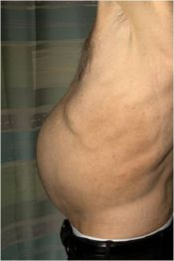
Myelofibrosis: Clinical Manifestations¹
Constitutional symptoms | Fatigue, weight loss, cachexia, pruritus, night sweats, bone/joint pain, low-grade fever, cough
Marked hepatosplenomegaly | Early satiety, abdominal discomfort, painful splenic infarcts, portal hypertension, cachexia
Nonhepatosplenic extramedullary hematopoiesis (rare) | Cord compression, ascites, pulmonary hypertension, pulmonary embolism, lymphadenopathy, skin tumors
Thrombohemorrhagic complications
Marked leukocytosis or thrombocytosis; severe anemia, thrombocytopenia, neutropenia; hyperuricemia
Increased risk of leukemic transformation
Splenomegaly²
1. Barbui T et al. J Clin Oncol. 2011;29:761-770. 2. Image provided courtesy of S. Verstovsek.
Courtesy of Rami Komrokji, MD

Slide 17
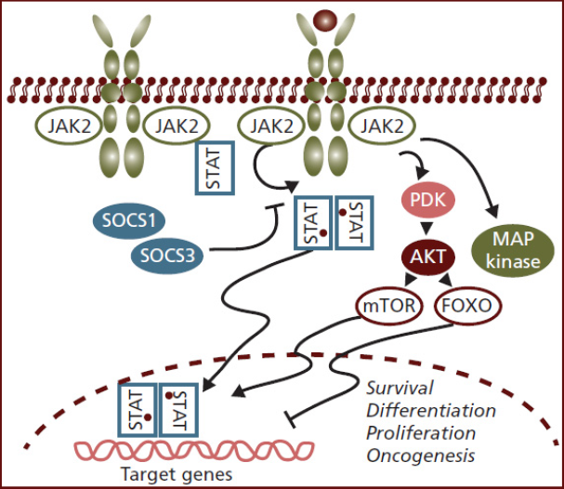
JAK-STAT Pathway Constitutively Activated in Myelofibrosis
JAK-STAT pathway implicated in normal hematopoiesis¹
An activating mutation in the pseudokinase domain of Janus kinase 2 (JAK2) was identified in approximately 50% of MF patients
Dysregulation of JAK-STAT, regardless of JAK mutation status, is a key pathologic feature of MF and other MPNs^{1,2}
1. Vannucchi AM et al. CA Cancer J Clin. 2009;59:171-191. 2. Anand S et al. Blood. 2011;118:1610-1621.
Courtesy of Rami Komrokji, MD

Slide 18
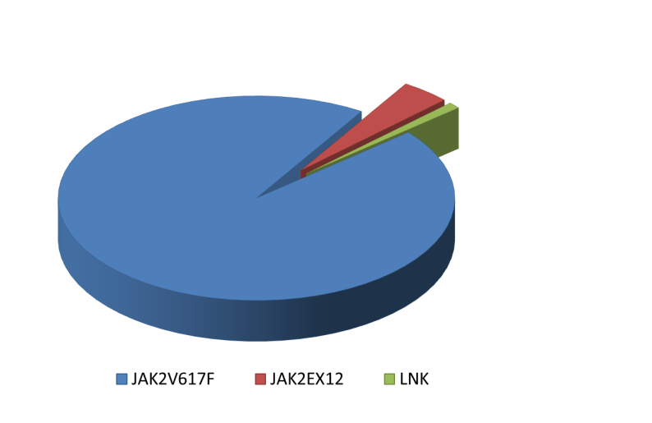
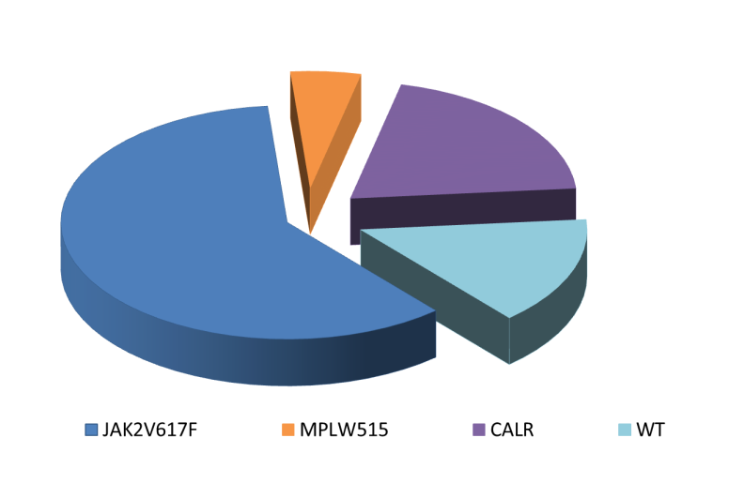
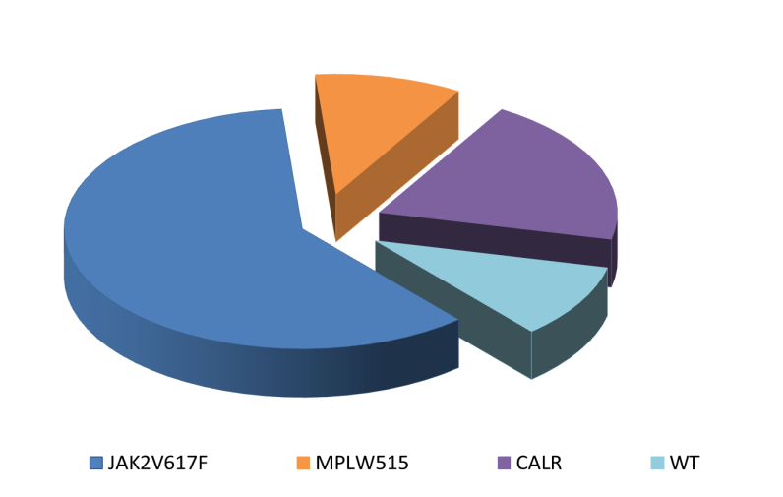
Phenotypic Driver Mutations
(they activate JAK-STAT pathway) in MPNs
PV
ET
MF
3%
3-5%
5-8%
20-25%
20-25%
1%
96%
60%
60%
10-15%
10-15%
JAK2 V617F
MPL (W515x)
Type1/Type1-like
JAK2 Exon12
CALR mut
Type2/Type2-like
Others (SH2B3)
Unknown (Triple Negative)
Klampfl T, et al. NEJM 2013;369(25):2379-90; Nangalia J, et al. NEJM 2013;369(25):2391-405.
Courtesy of Rami Komrokji, MD

Slide 19
Ilene Galinsky, NP
What I tell my patients with MF about myeloproliferative neoplasms – how they are defined and diagnosed and the goals of treatment, including allotransplant

Slide 20
Quality of Life in MPNs
Individualized based on your goals and values
Optimal symptom management
Shared decision-making
  Enhanced by understanding of MPN
Improved communication
Courtesy of Sara M Tinsley-Vance, PhD, APRN, AOCN

Slide 21
You are a key member of your healthcare team
Assist your healthcare team in recognition and evaluation of your symptoms
This tool can help you evaluate how symptoms change over time
Discuss your symptoms with your healthcare team and focus on how it affects your normal routine
Emanuel, R.M., Dueck, A.C., Geyer, H.L., Kiladjian, J.J., Slot,S., Zweegman, S., te Boekhorst, P.A., … Mesa. R.A. (2012).Myeloproliferative neoplasm (MPN) symptom assessment form total symptom score: prospective international assessment of an abbreviated symptom burden scoring system among patient with MPNs. Journal of Clinical Oncology, 30(33), 4098–4103.
Courtesy of Sara M Tinsley-Vance, PhD, APRN, AOCN

Slide 22
Identify Goals of Treatment
Individualized to what is most important to you
Improve symptoms and overall quality of life
  Fatigue
  Concentration Problems
  Early Satiety
  Inactivity
  Night Sweats
  Pruritus (Itching)
  Bone Pain
  Abdominal Discomfort
  Weight Loss
  Fever
Reduction in spleen size
Delay progression of MPN to later stages of disease and transformation to acute myelogenous leukemia
Sometimes cure is the goal through allogeneic transplant
Emanuel, R.M., Dueck, A.C., Geyer, H.L., Kiladjian, J.J., Slot,S., Zweegman, S., te Boekhorst, P.A., … Mesa. R.A. (2012). Myeloproliferative neoplasm (MPN) symptom assessment form total symptom score: prospective international assessment of an abbreviated symptom burden scoring system among patient with MPNs. Journal of Clinical Oncology, 30(33), 4098–4103. Mesa, R.A., Scherber, R.M., & Geyer, H.L. (2015). Reducing symptom burden in patients with myeloproliferative neoplasms in the era of Janus kinase inhibitors. Leukemia & Lymphoma, 56(7), 1989–1999.
Courtesy of Sara M Tinsley-Vance, PhD, APRN, AOCN

Slide 23
Anemia Management
Monitor complete blood count
Recognize symptoms of anemia (increasing fatigue, shortness of breath)
Communicate symptoms to healthcare team – could be related to anemia
Review medications at each visit
Consider other causes of anemia aside from myelofibrosis (bleeding, nutrition, worry)
Transfuse as needed to minimize impact of anemia on quality of life
Involve your support team in education
Fowkles , Sabrina et al. Myeloproliferative neoplasms (MPNs) – Part 2: A nursing guide to managing the symptom burden of MPNs. Canadian Oncology Nursing Journal / Revue canadienne de soins infirmiers en oncologie, [S.l.], v. 28, n. 4, p. 276-281, Oct. 2018. ISSN 2368-8076. Available at: <http://canadianoncologynursingjournal.com/index.php/conj/article/view/931>. Date accessed: 19 Mar. 2020.
Courtesy of Sara M Tinsley-Vance, PhD, APRN, AOCN

Slide 24
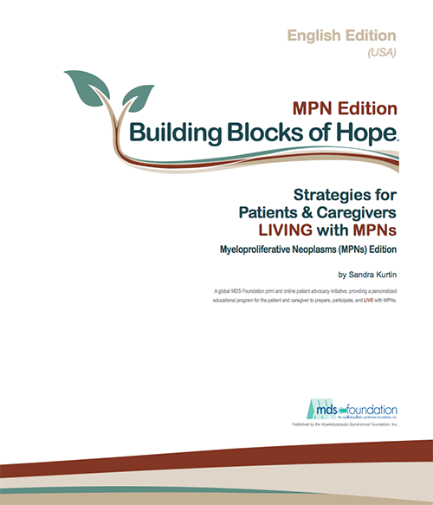
Strategies to Improve Understanding
Written communication reinforces verbal communication
  These are complicated diseases that are difficult to explain to others
Online Resources
  MDS Foundation Building Blocks of Hope MPN Edition
  Voices of MPN
  MPN Research
  Leukemia and Lymphoma Society -MPN
Courtesy of Sara M Tinsley-Vance, PhD, APRN, AOCN

Slide 25
Agenda
Introduction
Module 1: Biology of Myelofibrosis (MF)
Module 2: Role of Available and Investigational JAK inhibitors in the Management of MF
Module 3: Promising Agents and Strategies for Patients with MF

Slide 26
The Role of Ruxolitinib in Therapy for MF
Dr Kuykendall
Tampa, Florida
Dr Yacoub
Westwood, Kansas
Published research database with ruxolitinib for patients with intermediate- and high-risk MF; impact on symptom control and survival
Common side effects and toxicities associated with ruxolitinib, such as thrombocytopenia, anemia, neutropenia and infection; appropriate monitoring of blood counts
Initial dosing of ruxolitinib and dose-modification strategies for patients with treatment-related toxicity, preexisting thrombocytopenia or inadequate initial response
Importance of gradual tapering versus abrupt discontinuation of ruxolitinib

Slide 27
Ruxolitinib
Mechanism of action
Janus-associated kinase (JAK) 1/2 inhibitor
Indication in myelofibrosis
For the treatment of intermediate- or high-risk myelofibrosis, including primary myelofibrosis, post-polycythemia vera (PV) myelofibrosis and post-essential thrombocythemia (ET) myelofibrosis in adults
Recommended dosing for myelofibrosis
Starting dose based on patient’s baseline platelet count:
  Greater than 200 x 10⁹/L: 20 mg given orally twice daily
  100 x 10⁹/L to 200 x 10⁹/L: 15 mg given orally twice daily
  50 x 10⁹/L to less than 100 x 10⁹/L: 5 mg given orally twice daily
Monitor complete blood counts every 2 to 4 weeks until doses are stabilized, and then as clinically indicated. Modify or interrupt dosing for thrombocytopenia.
Ruxolitinib package insert, 1/2023.

Slide 28
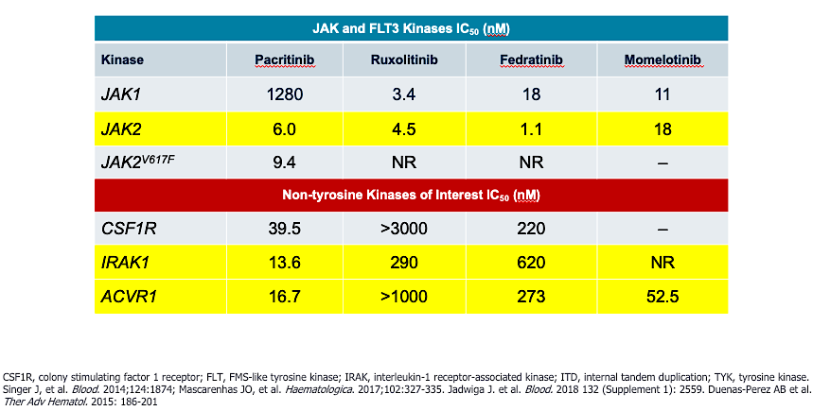
JAK Inhibitor Specificities
Courtesy of John O Mascarenhas, MD.

Slide 29
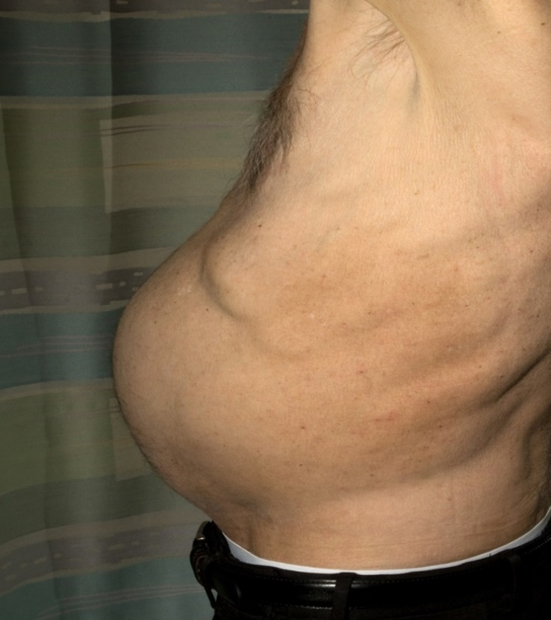
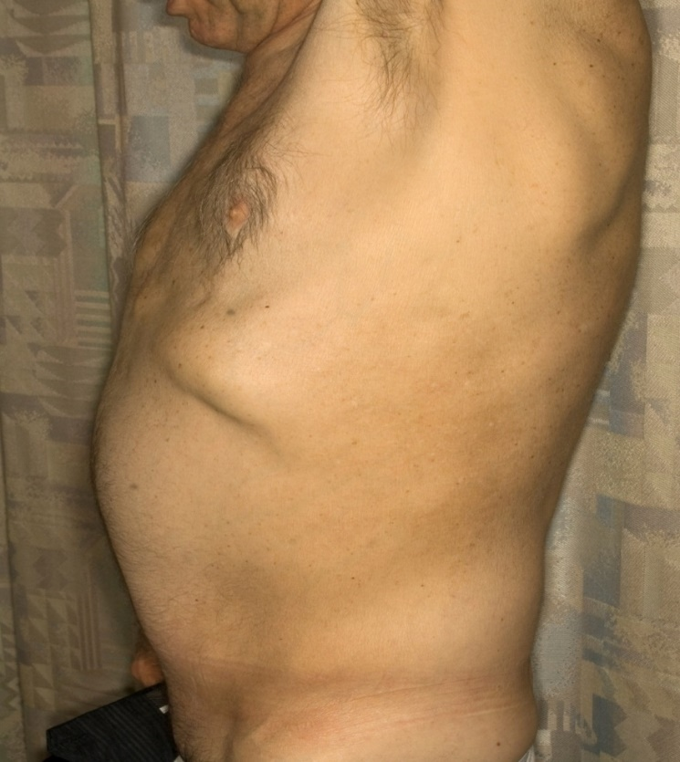
What Does Ruxolitinib Do?
Patient Before Ruxolitinib Therapy
After 2 Months of Therapy
It is good for spleen and symptoms
Courtesy of Rami Komrokji, MD

Slide 30
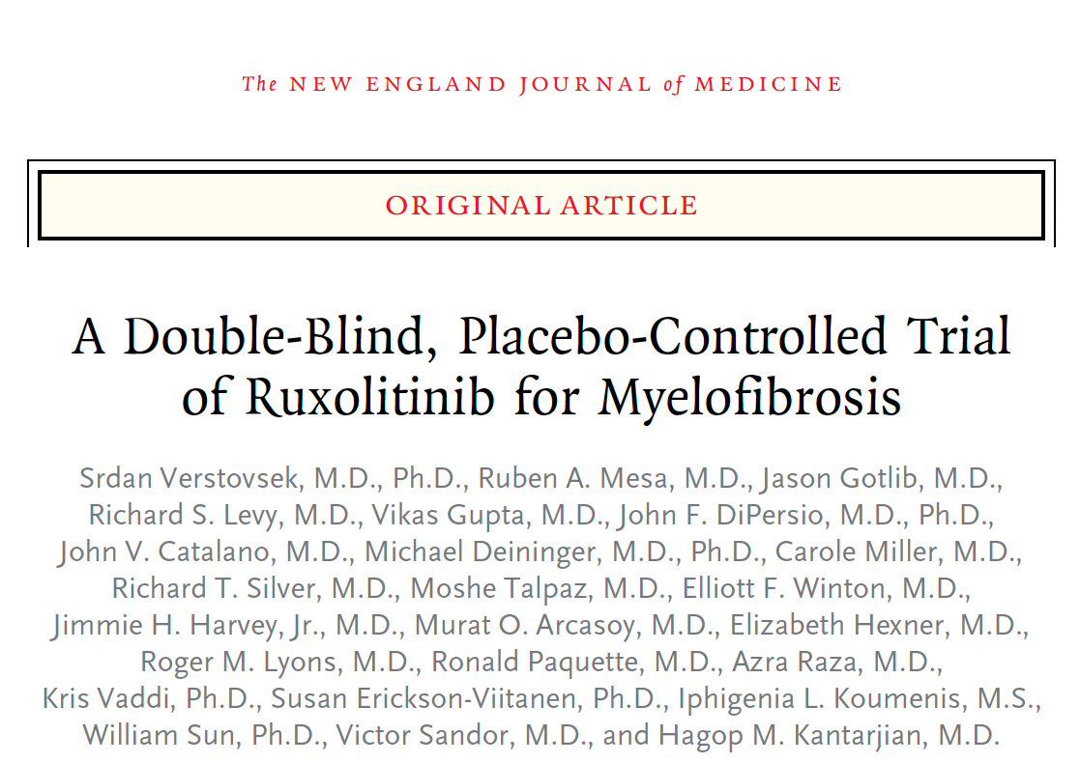
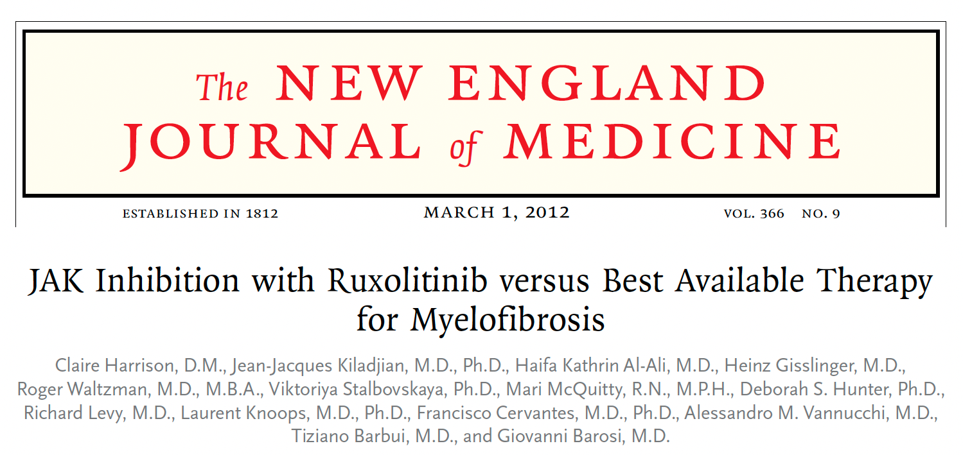
2012;366:799-807
COMFORT-I
COMFORT-II

Slide 31
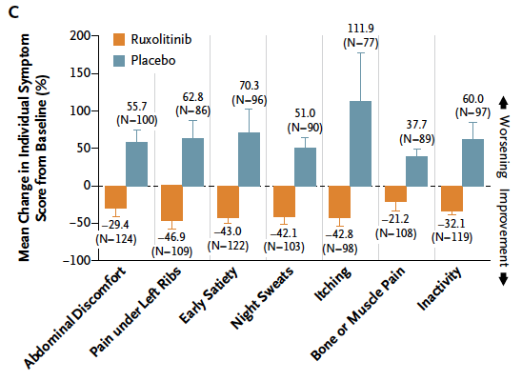
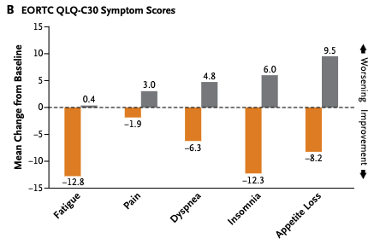
COMFORT-I and COMFORT-II: Symptom Responses with Ruxolitinib
COMFORT-I
COMFORT-II
Verstovsek S et al. New Engl J Med 2012;366:799. Harrison C et al. New Engl J Med 2012;366:787.

Slide 32
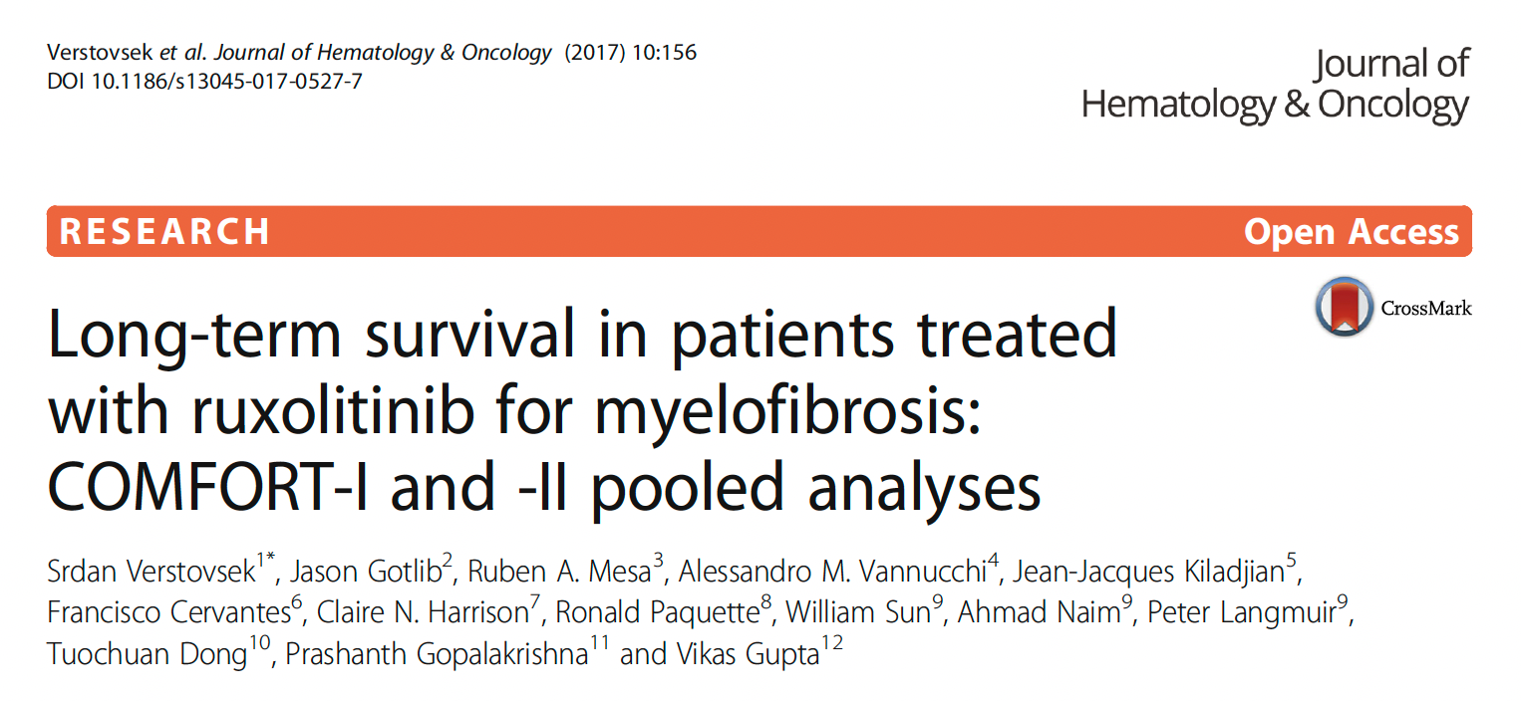

Slide 33
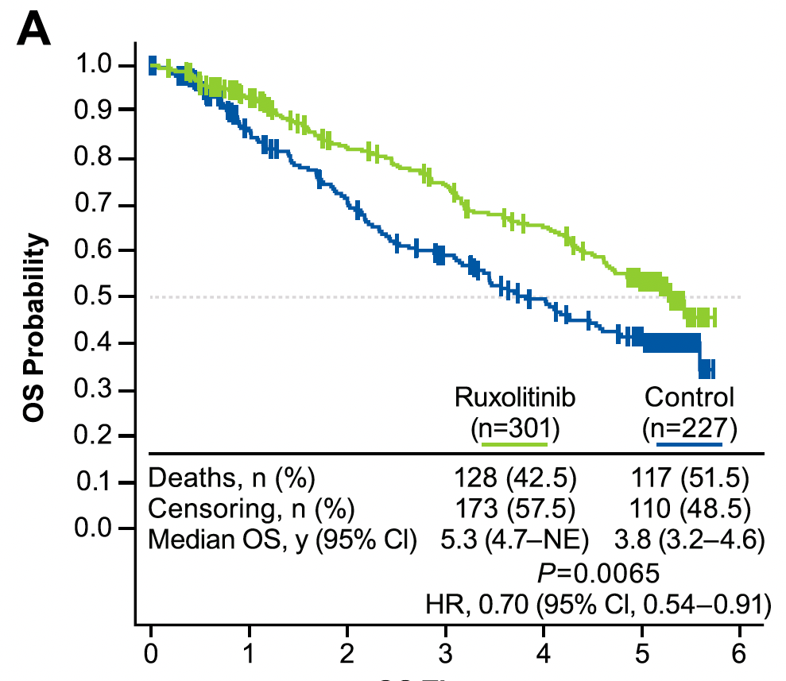
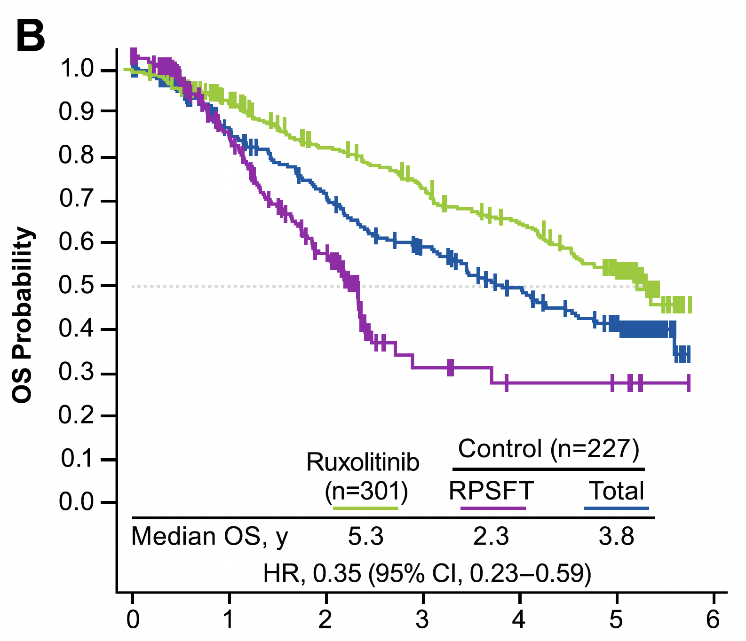
COMFORT-I and II Pooled Analyses: Long-Term Survival with Ruxolitinib
OS (5-year ITT population)
OS (corrected for crossover)
Ruxolitinib
Control
OS Time (years)
OS Time (years)
OS = overall survival; ITT = intention to treat
Verstovsek S et al. J Hematol Oncol 2017;10:156.

Slide 34
Sara M Tinsley-Vance, PhD, APRN, AOCN
What I tell my patients who are about to begin treatment with ruxolitinib

Slide 35
Fedratinib in the Management of MF
Dr Kuykendall
Tampa, Florida
Dr Yacoub
Westwood, Kansas
Mechanistic similarities and differences between fedratinib and ruxolitinib
Efficacy and safety outcomes reported in key studies of fedratinib for newly diagnosed or previously treated MF; selection of patients for fedratinib therapy
Incidence of encephalopathy with fedratinib; assessment of thiamine levels and thiamine supplementation for patients receiving this agent
Rates of gastrointestinal (GI) adverse events reported with fedratinib; early implementation of mitigation strategies to prevent GI toxicity
Spectrum, frequency and severity of other toxicities associated with fedratinib; optimal approach to monitoring and management

Slide 36
Fedratinib
Mechanism of action
JAK2 and FLT3 inhibitor
Indication
For patients with intermediate-2 or high-risk primary or secondary (post-PV or post-ET) MF
Recommended dosing
400 mg PO once daily with or without food for patients with a baseline platelet count greater than or equal to 50 x 10⁹/L
Reduce dose for patients taking strong CYP3A inhibitors or with severe renal impairment
Fedratinib package insert, 5/2023.

Slide 37
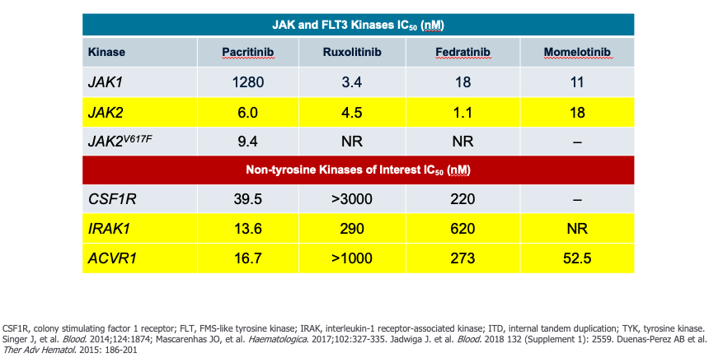
JAK Inhibitor Specificities
Courtesy of John O Mascarenhas, MD.

Slide 38
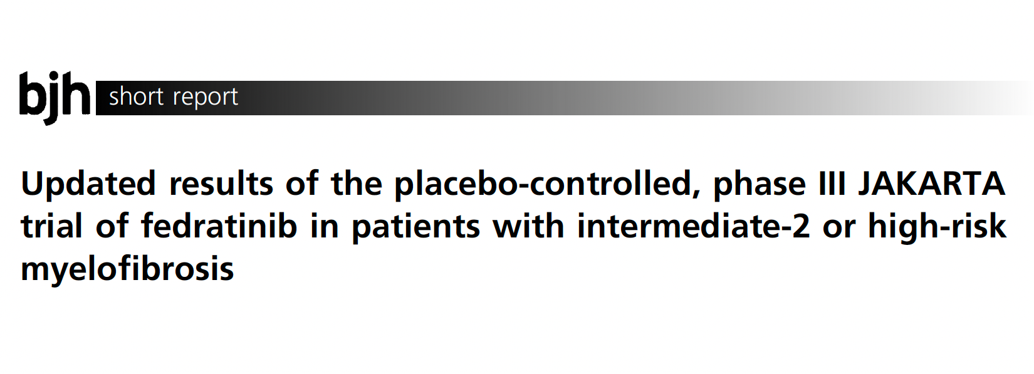
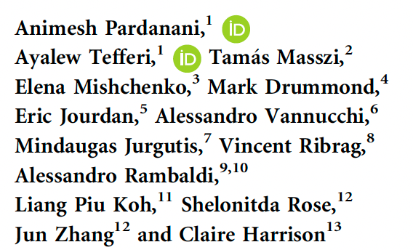
Br J Haematol 2021;195:244-8

Slide 39
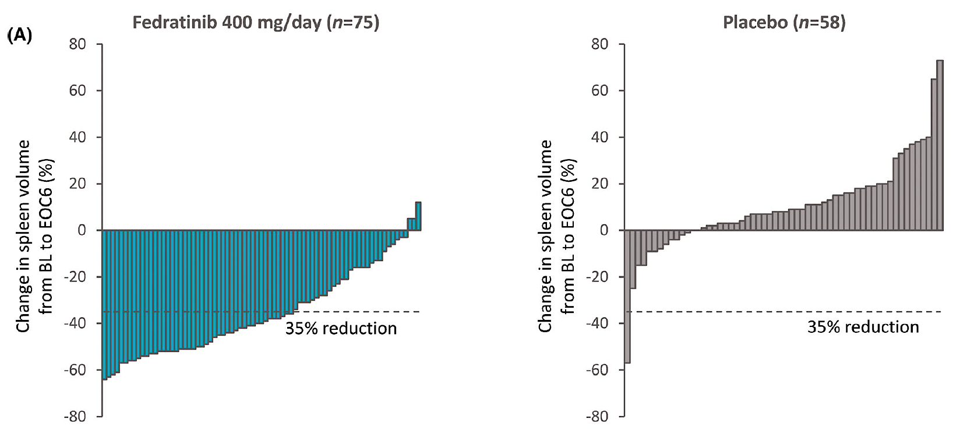
JAKARTA: Change in Spleen Volume from Baseline to End of Cycle 6
Pardanani A et al. Br J Haematol 2021;195:244-8.

Slide 40
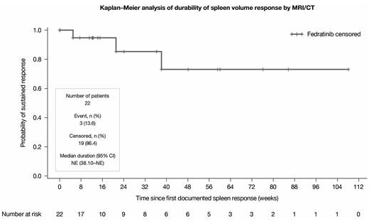
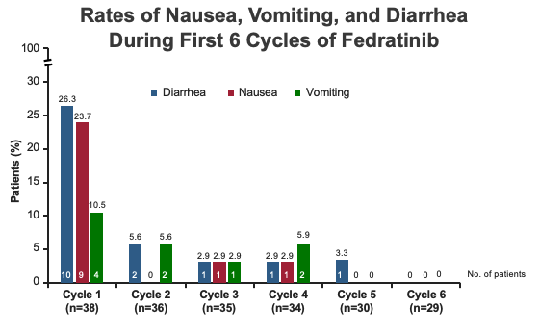
Phase IIIB FREEDOM Trial of Fedratinib for Patients with Primary, Post-PV or Post-ET Myelofibrosis Previously Treated with Ruxolitinib
FREEDOM included proactive strategies to mitigate GI adverse events, thiamine level decreases and potential encephalopathy
Clinically relevant and durable spleen responses were observed
Most GI AEs were Grade 1/2 and occurred during cycle 1, and decreased in subsequent cycles
6 patients with Grade 1/2 decreases in thiamine levels after initial tx were treated and deficiencies were resolved at next assessment; no patients required tx discontinuation due to low thiamine levels
Gupta V et al. ASH 2022;Abstract 1711.

Slide 41
JAKARTA: Selected Adverse Events
 | Fedratinib 400 mg (n = 96) |  | Placebo (n = 95)
Adverse events | All grades | Grade ≥3 | All grades | Grade ≥3
Diarrhea | 66% | 5% | 16% | 0
Nausea | 62% | 0 | 15% | 0
Anemia | 40% | 30% | 14% | 7%
Vomiting | 39% | 3.1% | 5% | 0
Fatigue | 19% | 5% | 16% | 1.1%
Laboratory parameters
Anemia | 74% | 34% | 32% | 10%
Thrombocytopenia | 47% | 12% | 26% | 10%
Neutropenia | 23% | 5% | 13% | 3.3%
Biochemistry
Lipase increased | 35% | 10% | 7% | 2.2%
No patient receiving fedratinib 400 mg/day experienced Wernicke encephalopathy
Pardanani A et al. Br J Haematol 2021;195:244-8.

Slide 42
Fedratinib Warning: Encephalopathy, Including Wernicke
Serious and fatal encephalopathy, including Wernicke’s, has occurred in patients treated with fedratinib. Wernicke’s encephalopathy is a neurologic emergency. Assess thiamine levels in all patients prior to starting fedratinib, periodically during treatment, and as clinically indicated. Do not start fedratinib in patients with thiamine deficiency; replete thiamine prior to treatment initiation. If encephalopathy is suspected, immediately discontinue fedratinib and initiate parenteral thiamine. Monitor until symptoms resolve or improve and thiamine levels normalize.
Fedratinib package insert, May 2023.

Slide 43
Ilene Galinsky, NP
What I tell my patients who are about to begin treatment with fedratinib

Slide 44
The Role of Pacritinib in MF Treatment
Dr Kuykendall
Tampa, Florida
Dr Yacoub
Westwood, Kansas
Implications of the mechanistic differences between pacritinib and other approved JAK inhibitors for its safety in cytopenic patients
Key efficacy and safety findings with pacritinib for MF, including for patients with baseline thrombocytopenia
FDA approval of pacritinib for patients with MF and severe thrombocytopenia; optimal use in clinical practice and ongoing investigations
Potential utility of pacritinib for patients with MF and severe anemia
Reported risk of hemorrhage and other adverse events with pacritinib; importance of holding therapy before planned surgical and invasive procedures

Slide 45
JAK Inhibitor Specificities
Courtesy of John O Mascarenhas, MD

Slide 46
Pacritinib
Mechanism of action
Oral inhibitor of JAK2, FLT3 and IRAK1 kinases
Indication
For patients with intermediate or high-risk primary or secondary (post-PV or post-ET) myelofibrosis with a platelet count below 50 x 10⁹/L
Recommended dosing
200 mg PO BID, with or without food
Pacritinib package insert, 8/2023.

Slide 47
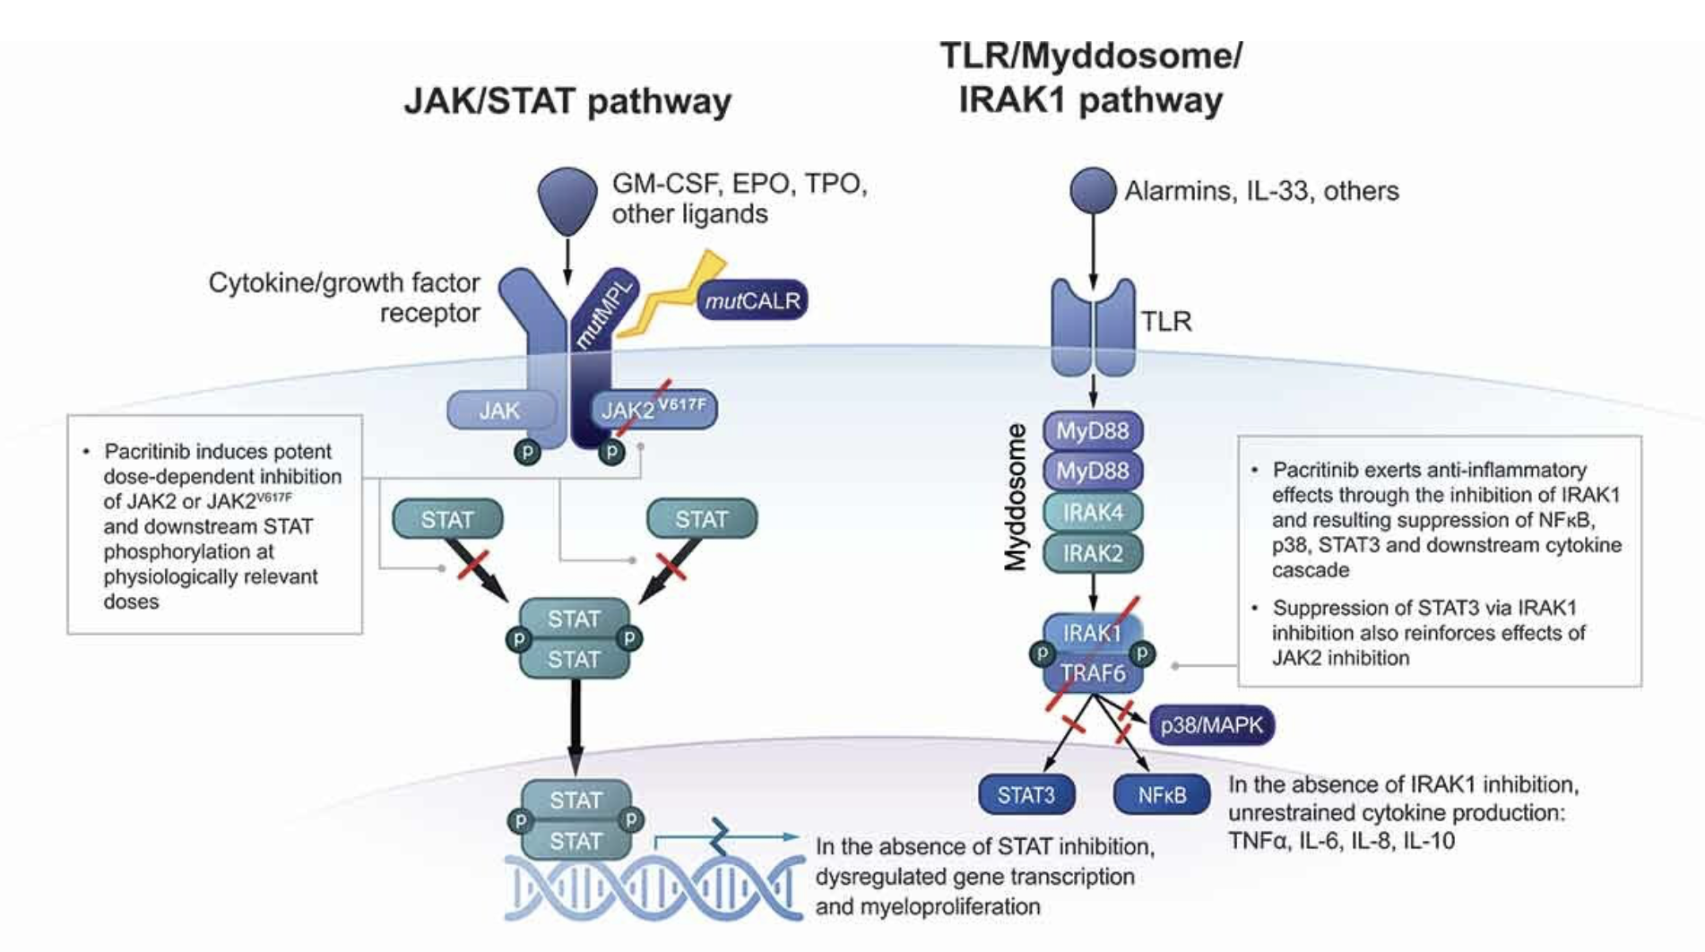
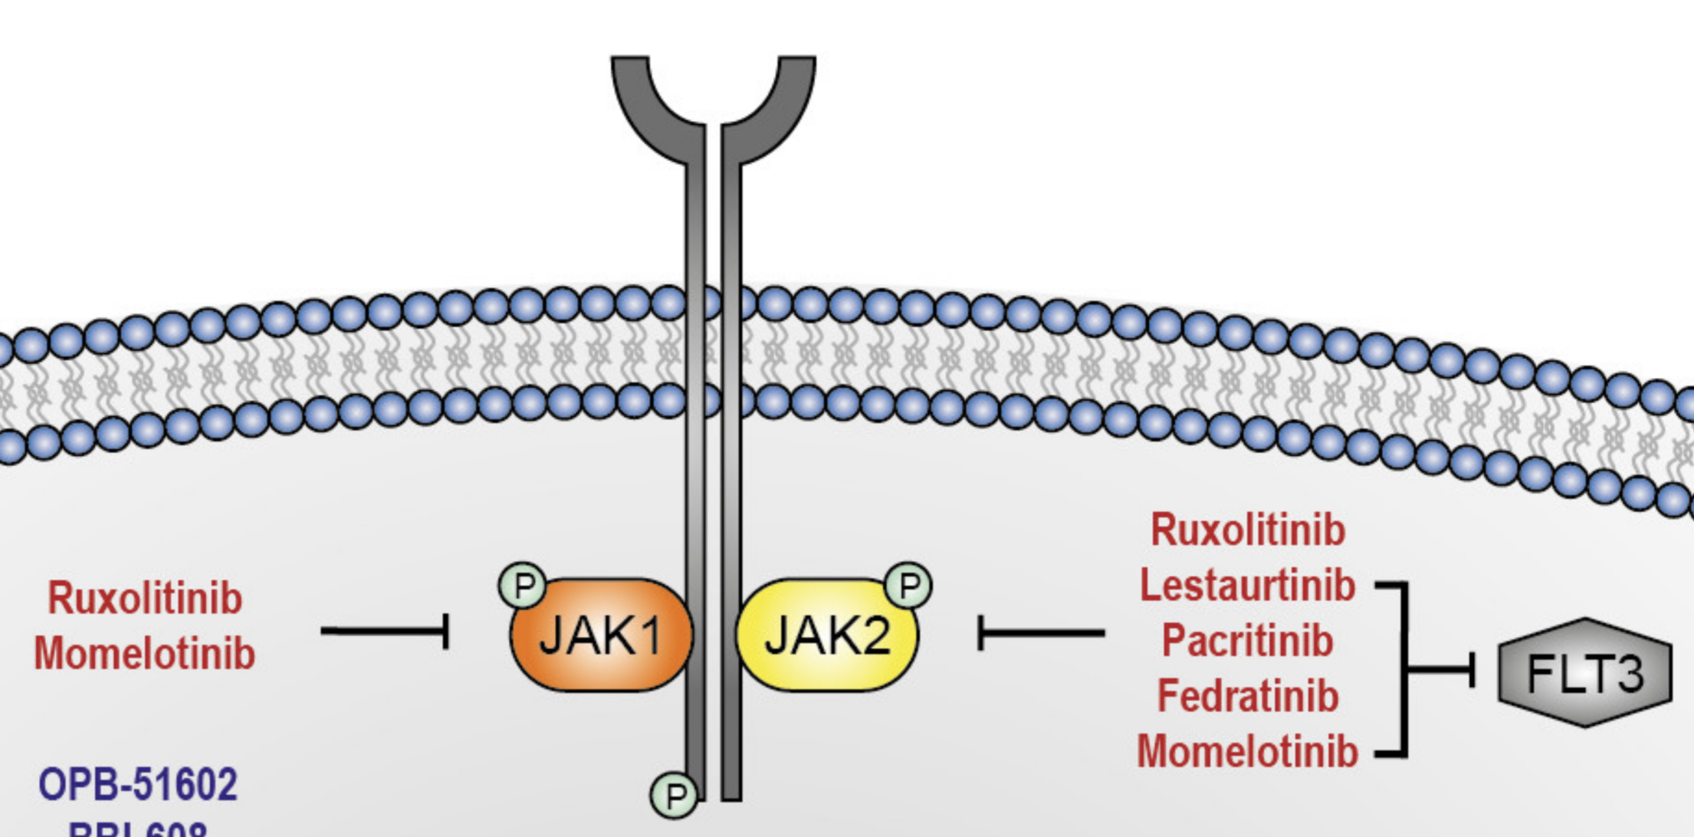
Pacritinib Mechanism of Action: JAK2/FLT3/IRAK1 Inhibitor
Mascarenhas J. Expert Rev Hematol 2022;15(8):671-84. Moser B et al. Biomedicines 2021;9(8):1051.

Slide 48
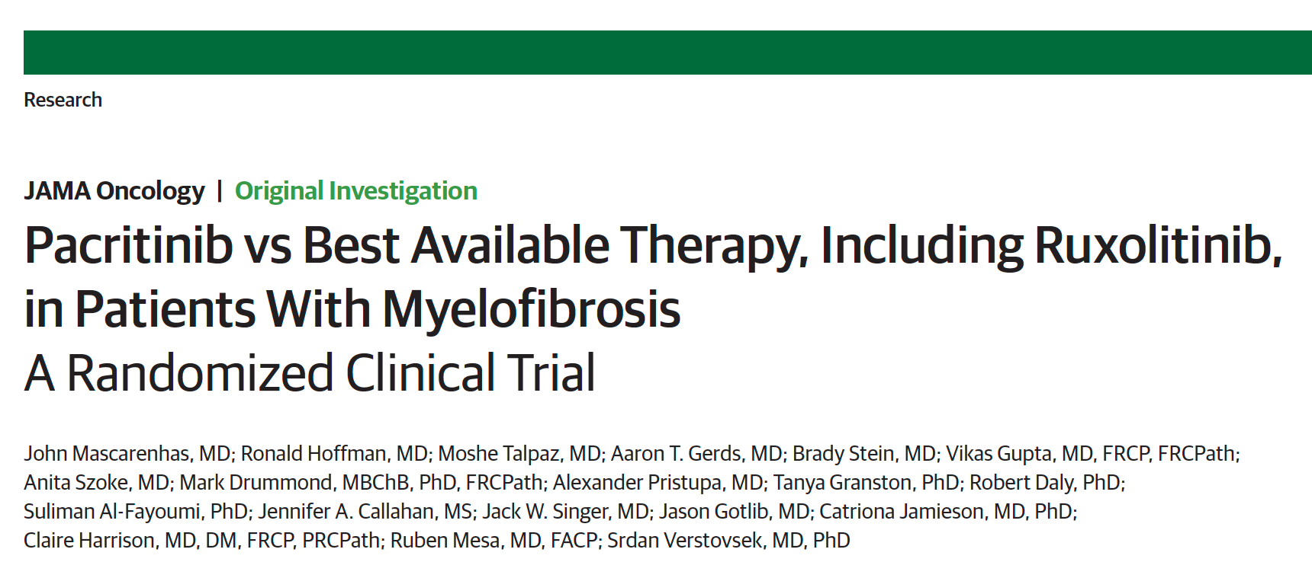
2018;4(5):652-9

Slide 49
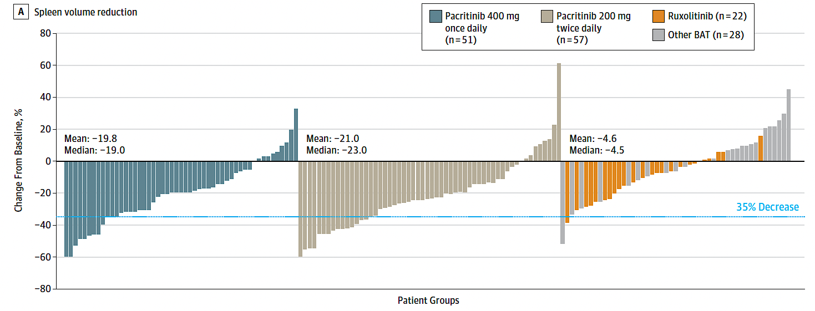
PERSIST-2 Trial: Spleen Volume Reduction (SVR)
Pts with ≥35% SVR: 15%
Pts with ≥35% SVR: 22%
Pts with ≥35% SVR: 3%
Mascarenhas J et al. JAMA Oncol 2018;4:652-9.

Slide 50
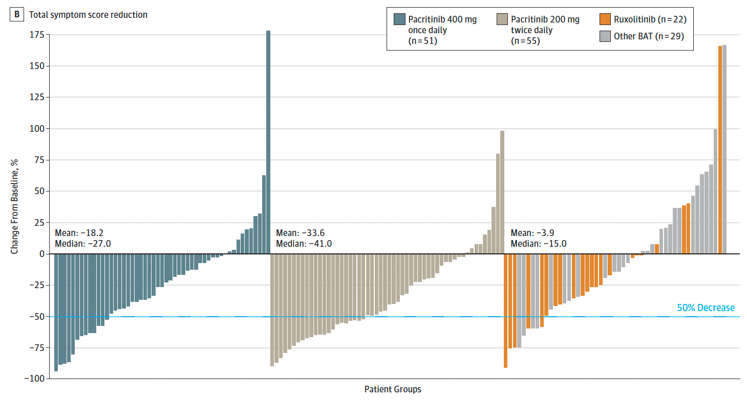
PERSIST-2: Reduction in Total Symptom Score (TSS)
Pts with ≥50% reduction
in TSS: 17%
Pts with ≥50% reduction
in TSS: 32%
Pts with ≥50% reduction
in TSS: 14%
Mascarenhas J et al. JAMA Oncol 2018;4:652-9.

Slide 51
PERSIST-2: Adverse Event Profile of Pacritinib
Adverse Reactions | PAC 200 mg BID (n = 106) | BAT (n = 98)
Any-grade AEs in >15% of patients in either arm, %
Diarrhea | 48 | 15
Thrombocytopenia | 34 | 24
Nausea | 32 | 11
Anemia | 24 | 15
Peripheral edema | 20 | 15
Vomiting | 19 | 5
Fatigue | 17 | 16
Grade ≥3 AEs in >5% of patients in either arm, %
Thrombocytopenia | 32 | 18
Anemia | 22 | 14
Neutropenia | 7 | 5
Pneumonia | 7 | 3
Serious AEs in >3% of patients in either arm, %
Anemia | 8 | 3
Thrombocytopenia | 6 | 2
Pneumonia | 6 | 4
Congestive heart failure | 4 | 2
Mascarenhas J et al. JAMA Oncol 2018;4:652-59.

Slide 52
Impact of Symptom Benefit and Transfusion Response on Survival in Myelofibrosis Patients Treated with Pacritinib: PERSIST-2 Landmark Survival Analysis
Ajufo H et al.
ASH 2023;Abstract 3207.

Slide 53
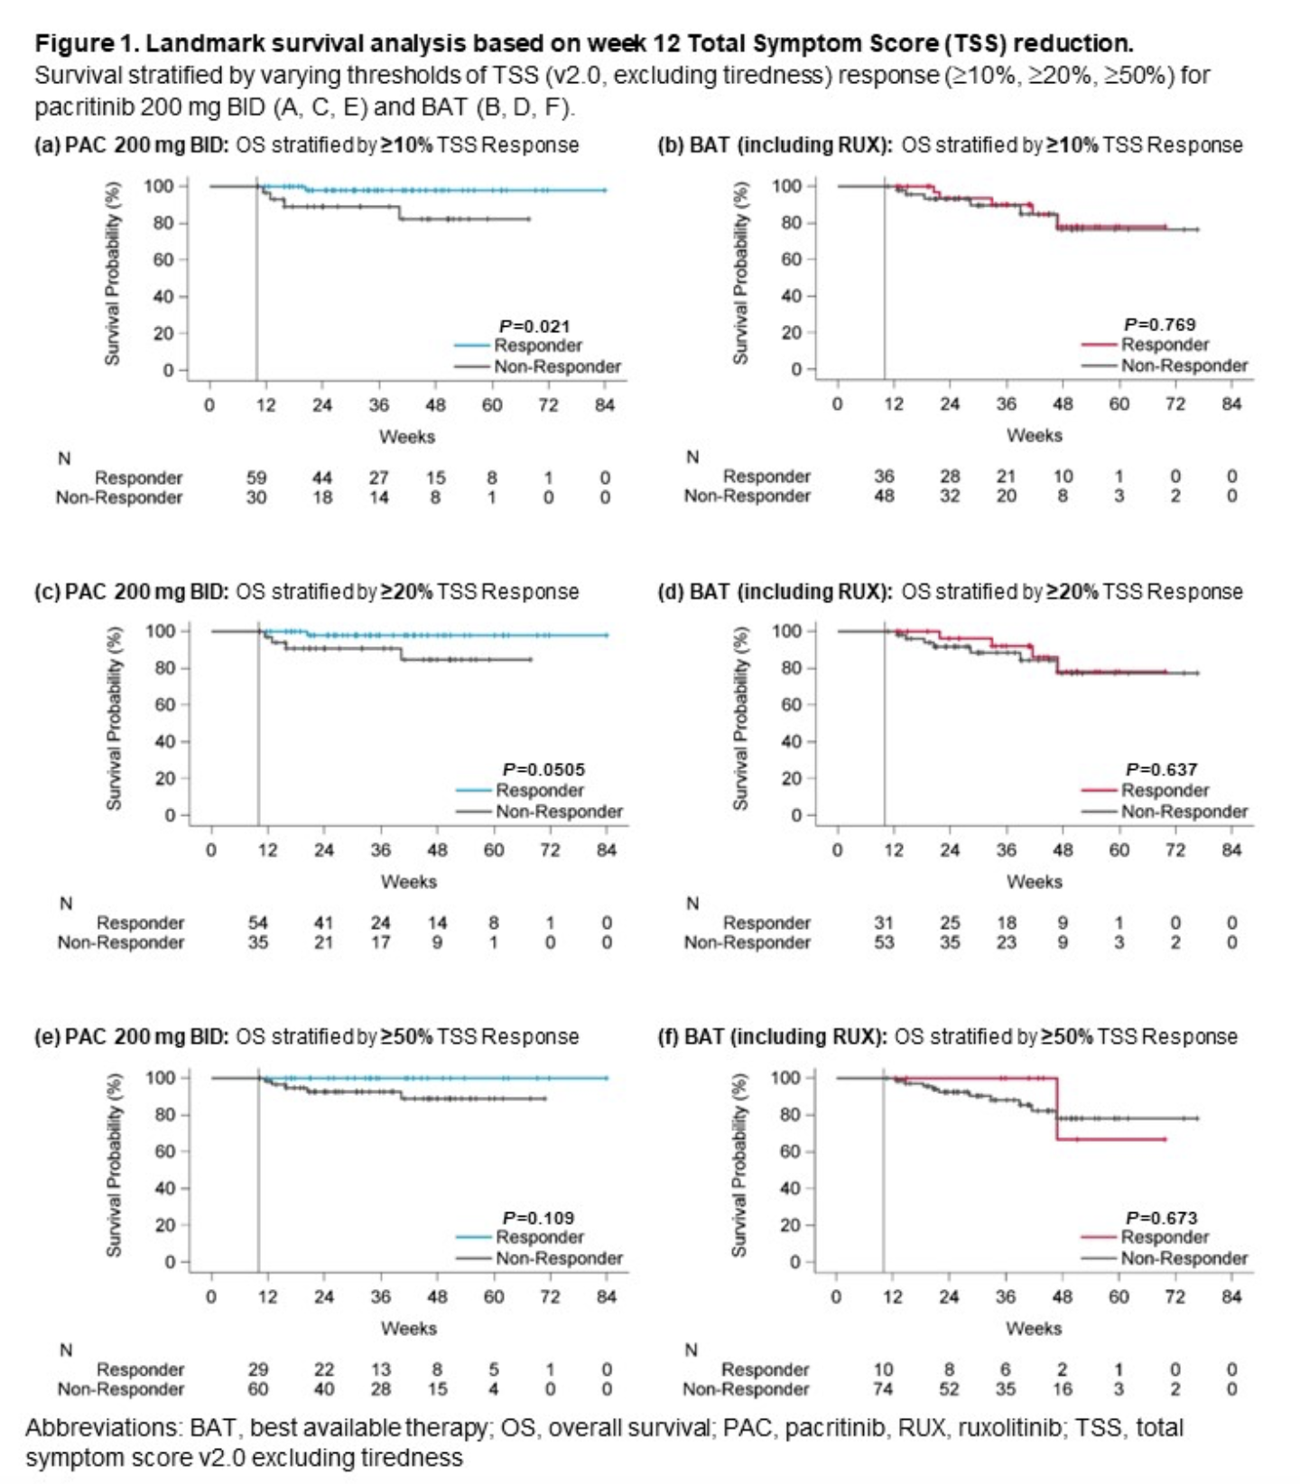
PERSIST-2: OS Stratified by TSS Response
Ajufo H et al. ASH 2023;Abstract 3207.

Slide 54
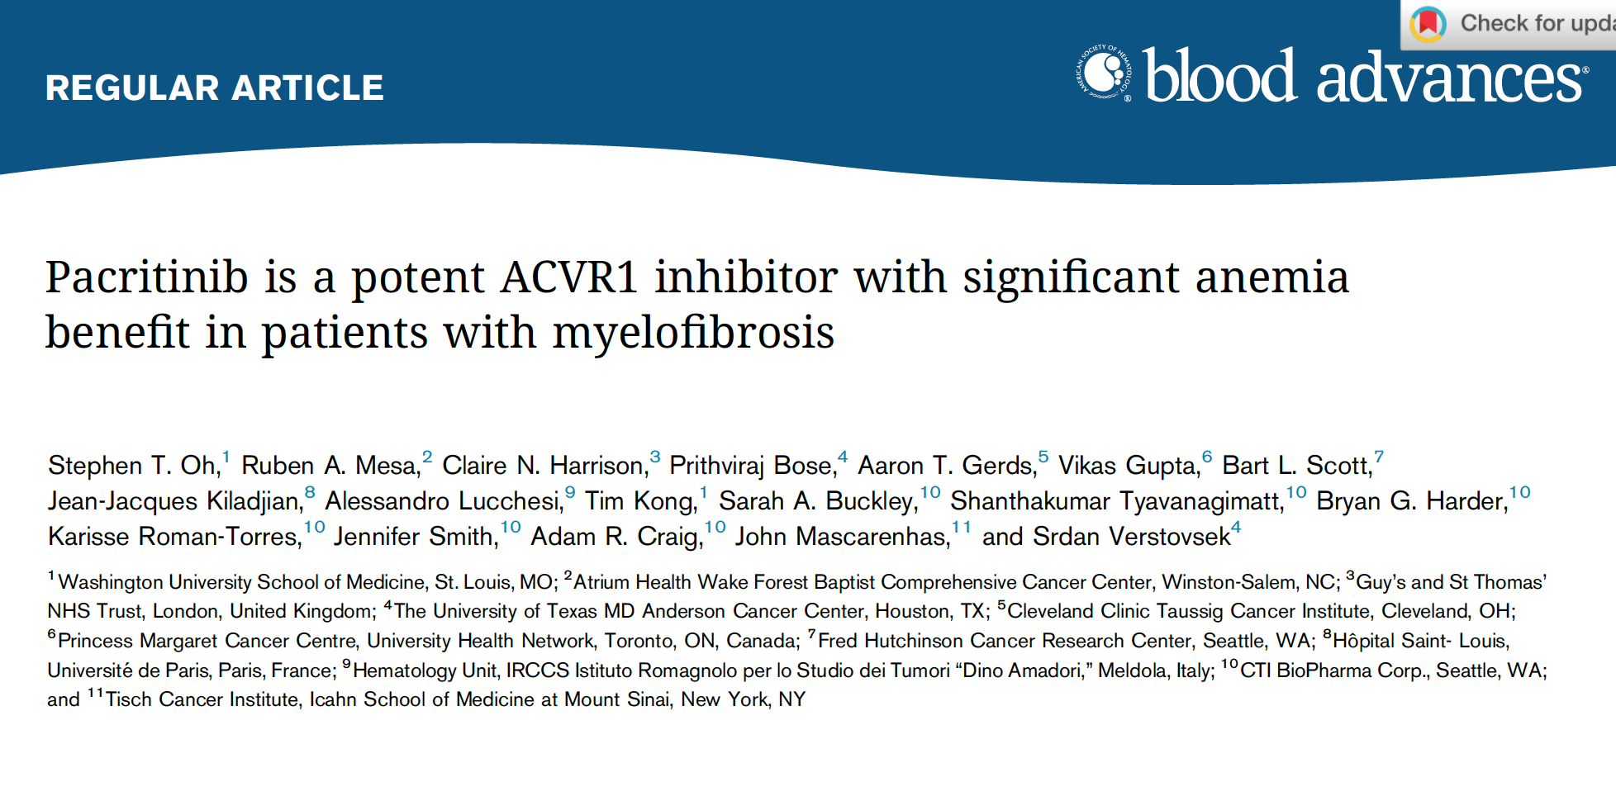
2023;7(19):5835-42

Slide 55
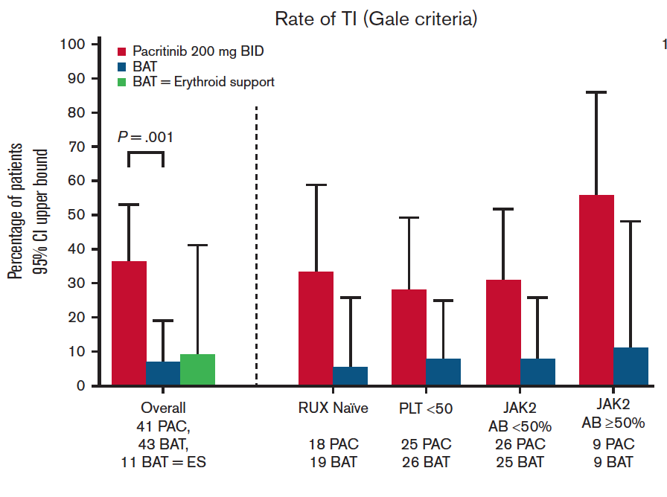
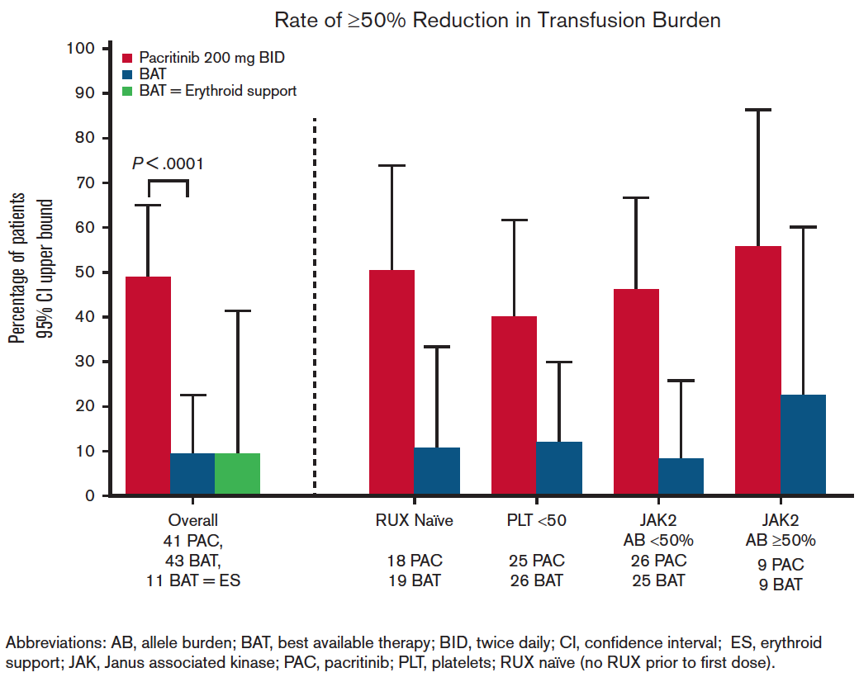
PERSIST-2: Transfusion Independence (TI) and Transfusion Reduction with Pacritinib
Oh ST et al. Blood Adv 2023;7(19):5835-42.

Slide 56
Sara M Tinsley-Vance, PhD, APRN, AOCN
What I tell my patients who are about to begin treatment with pacritinib

Slide 57
The Current Utility of Momelotinib in Therapy for MF
Dr Kuykendall
Tampa, Florida
Dr Yacoub
Westwood, Kansas
Rationale for the activity of momelotinib in patients with MF and anemia
Historical data sets with momelotinib for treatment-naïve and previously treated MF
Key clinical trial findings supporting the FDA approval of momelotinib for symptomatic, anemic patients with MF who have previously received a JAK inhibitor
Tolerability and toxicity profile of momelotinib; recognition and management of commonly occurring adverse events, such as anemia, thrombocytopenia, infections and peripheral neuropathy

Slide 58
JAK Inhibitor Specificities
Courtesy of John O Mascarenhas, MD

Slide 59
Momelotinib
Mechanism of action
Highly selective JAK1/2 and activin A receptor, Type 1 (ACVR1) inhibitor
Indication
For treatment of intermediate or high-risk myelofibrosis, including primary or secondary myelofibrosis (post-PV or post-ET), in adults with anemia
Recommended dosing
200 mg PO once daily, with or without food
Severe hepatic impairment (Child-Pugh class C): Reduce the starting dose to 150 mg PO once daily
Momelotinib package insert, 9/2023.

Slide 60
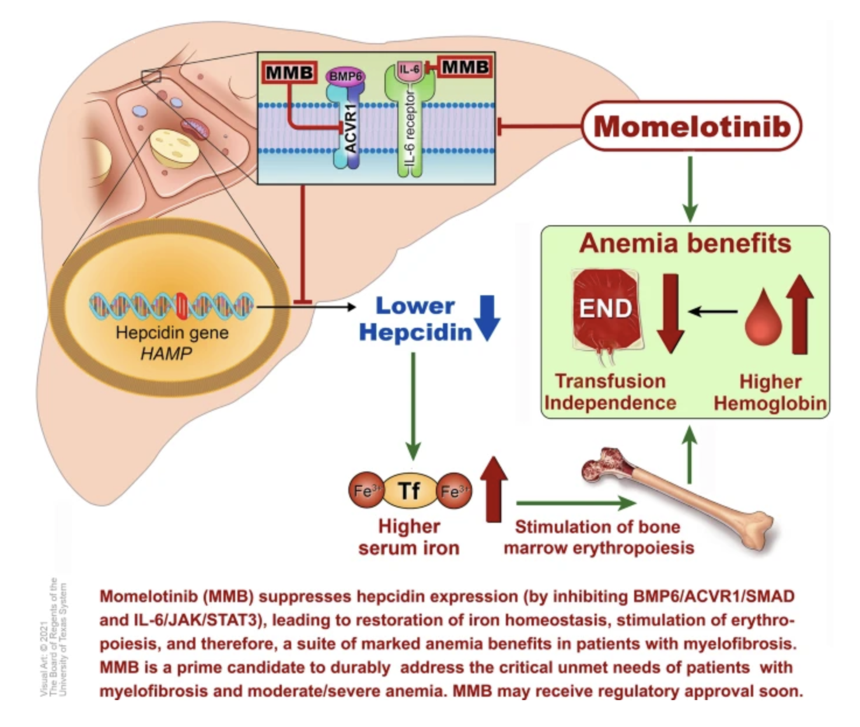
Proposed Mechanism of Momelotinib for MF with Anemia
Chifotides HT et al. J Hematol Oncol 2022;15(1):7.

Slide 61
Momelotinib Granted Approval for Myelofibrosis with Anemia
Press Release: September 15, 2023
“On September 15, 2023, the FDA approved momelotinib for the treatment of intermediate- or high-risk myelofibrosis, including primary myelofibrosis or secondary myelofibrosis (post–polycythemia vera and post–essential thrombocythemia), in adults with anemia.
The FDA approval of momelotinib is supported by data from the pivotal MOMENTUM study (NCT04173494) and a subpopulation of adults with anemia from the SIMPLIFY-1 phase III trial (NCT01969838).
MOMENTUM was designed to evaluate the safety and efficacy of momelotinib vs danazol for the treatment and reduction of key manifestations of myelofibrosis in an anemic, symptomatic, JAK inhibitor–experienced patient population. The MOMENTUM trial met all its primary and key secondary endpoints, demonstrating statistically significant response with respect to constitutional symptoms, splenic response, and transfusion independence in patients treated with momelotinib vs danazol.”
https://ascopost.com/news/september-2023/fda-approves-momelotinib-for-patients-with-myelofibrosis-and-anemia/

Slide 62
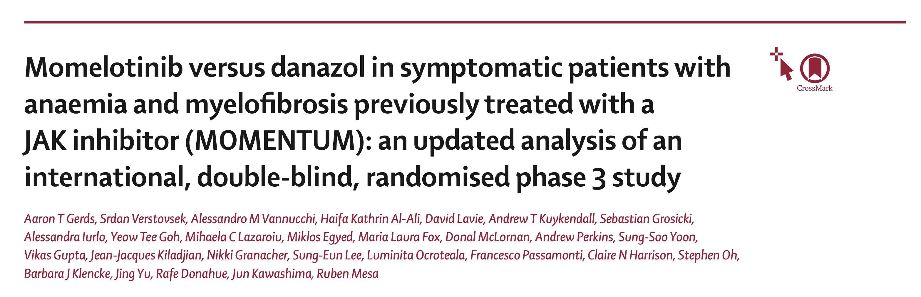
Lancet Haematol 2023;10(9):e735-46

Slide 63
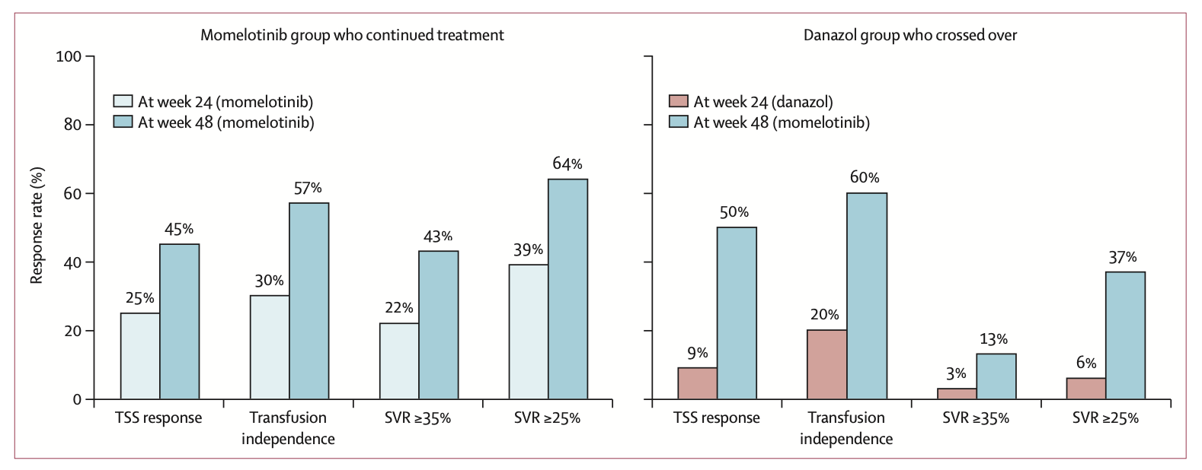
MOMENTUM: Summary of Response Rates at Weeks 24 and 48
Gerds AT et al. Lancet Haematol 2023;10(9):e735-46.

Slide 64
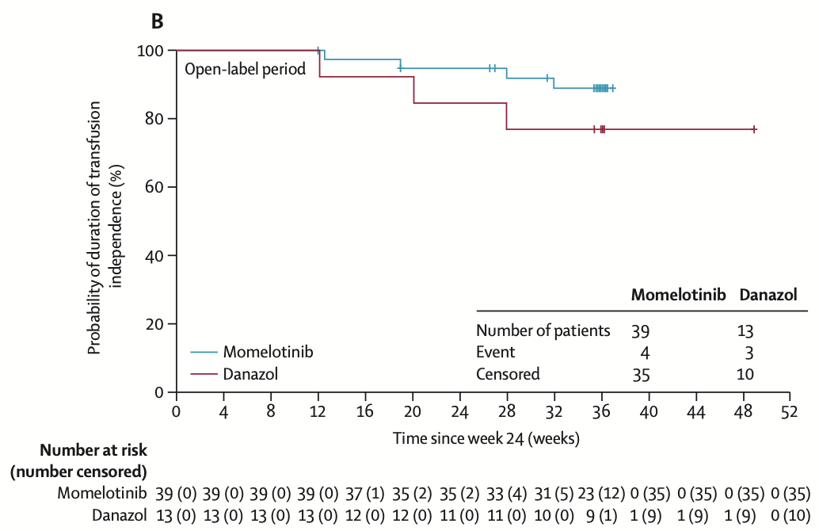
MOMENTUM: Duration of Transfusion Independence Response
Gerds AT et al. Lancet Haematol 2023;10(9):e735-46.

Slide 65
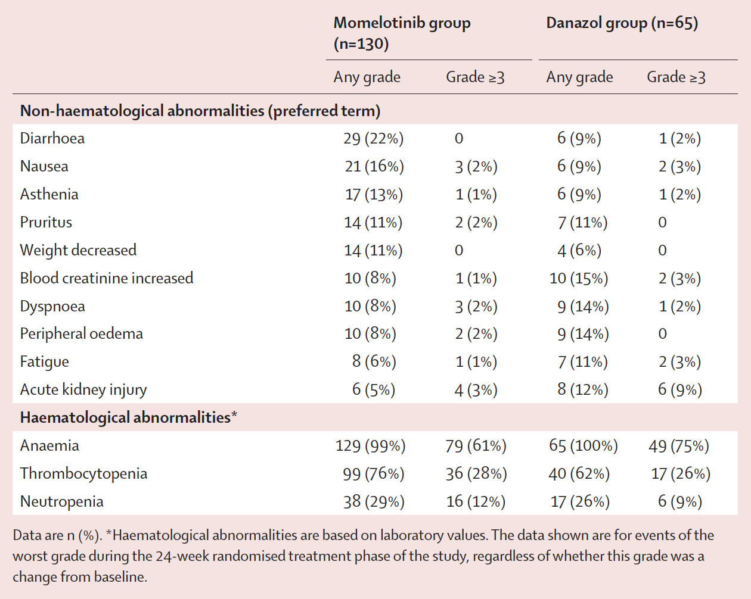
MOMENTUM: Treatment-Emergent Adverse Events
Verstovsek S et al. Lancet 2023;401:269-80.

Slide 66
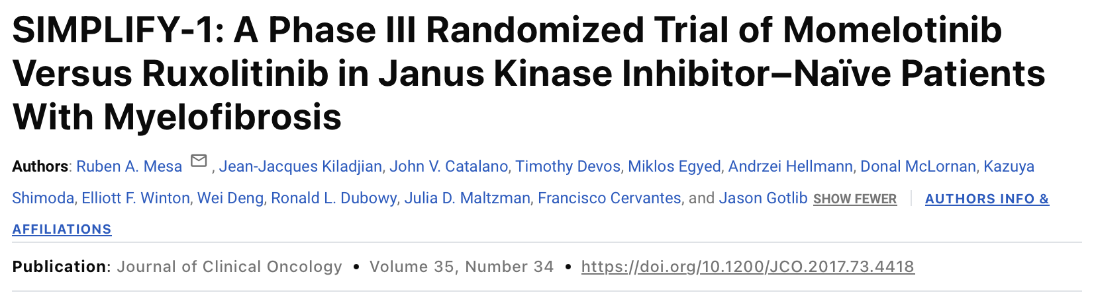
JCO 35, 3844-3850(2017)

Slide 67
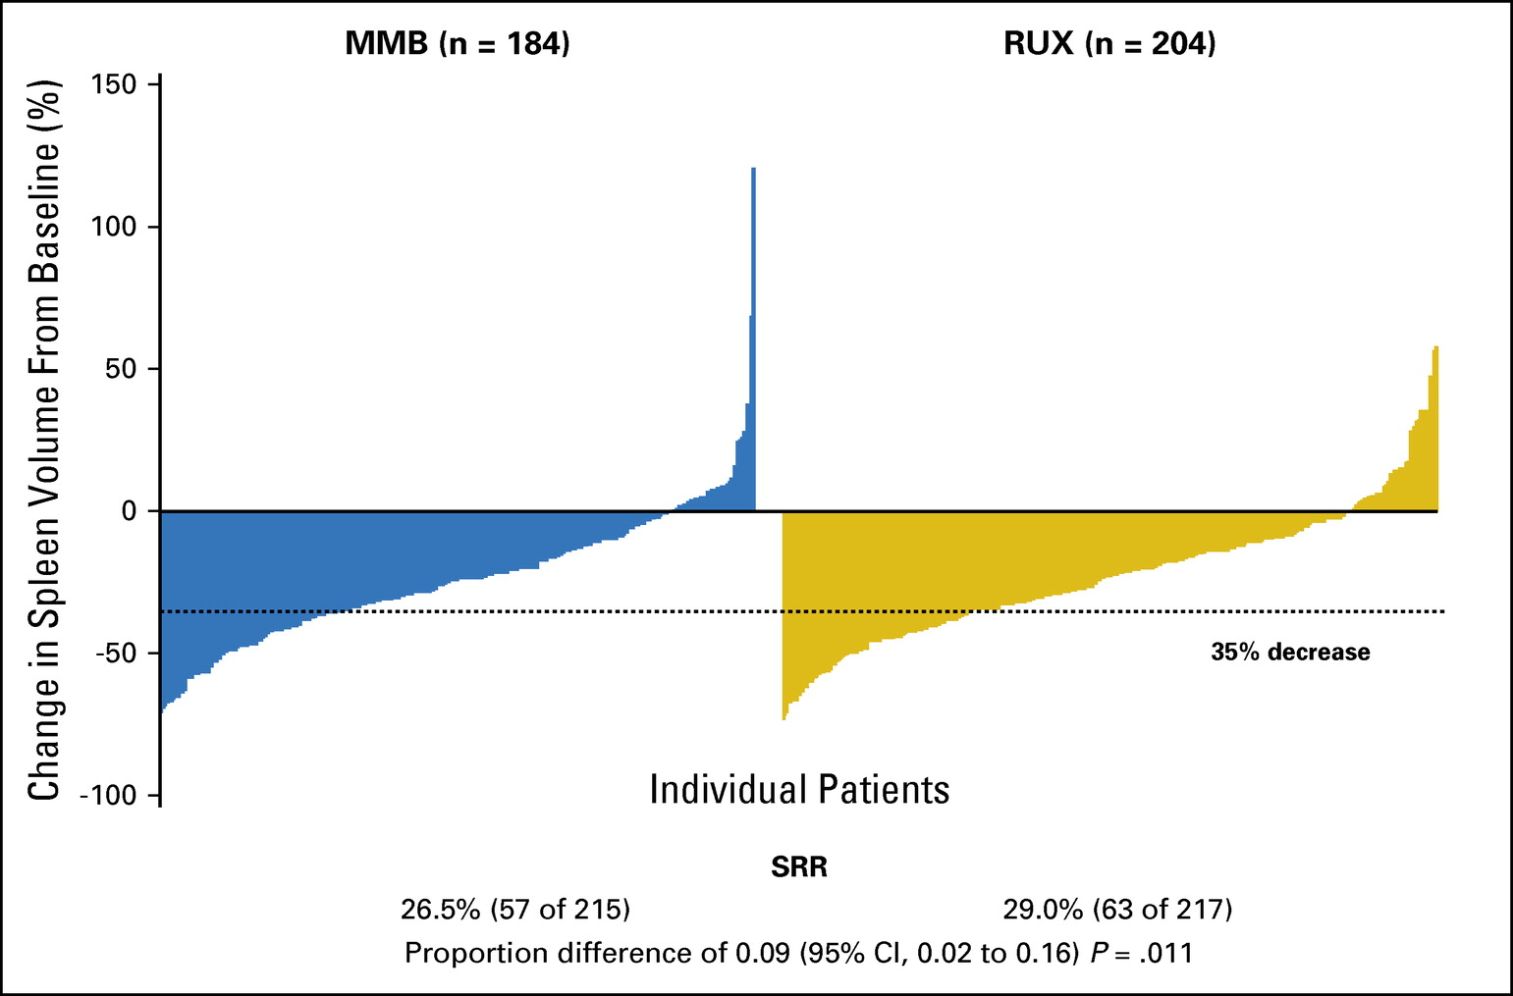
SIMPLIFY-1: Primary Endpoint (Change in Spleen Volume)
Mesa RA et al. JCO 35, 3844-3850(2017)

Slide 68
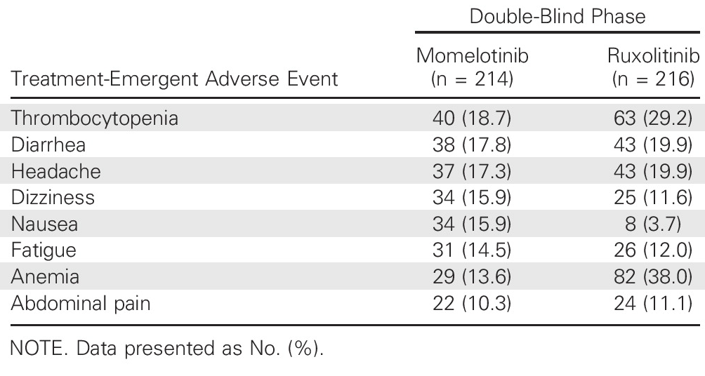
SIMPLIFY-1: Adverse Events
Mesa RA et al. JCO 35, 3844-3850(2017)

Slide 69
Ilene Galinsky, NP
What I tell my patients who are about to begin treatment with momelotinib

Slide 70
Agenda
Introduction
Module 1: Biology of Myelofibrosis (MF)
Module 2: Role of Available and Investigational JAK inhibitors in the Management of MF
Module 3: Promising Agents and Strategies for Patients with MF

Slide 71
Promising Agents and Strategies for Patients with MF
Dr Kuykendall
Tampa, Florida
Dr Yacoub
Westwood, Kansas
Educating patients on the potential advantages of participating in a clinical research study of a novel strategy
Mechanism of antitumor activity of navitoclax and biological rationale for its evaluation in patients with MF, including in tandem with JAK2 inhibition
Recently presented efficacy and safety findings with navitoclax in combination with ruxolitinib versus ruxolitinib alone for patients with previously untreated MF
Potential role of navitoclax in the up-front setting and ongoing evaluation for relapsed/refractory disease
Tolerability profile of navitoclax in published clinical investigations

Slide 72
Promising Agents and Strategies for Patients with MF (Continued)
Dr Kuykendall
Tampa, Florida
Dr Yacoub
Westwood, Kansas
Scientific justification for the inhibition of BET proteins for MF; mechanism of action of pelabresib
Recently presented findings with the combination of pelabresib and ruxolitinib for JAK inhibitor-naïve MF
Early results with and ongoing evaluations of other BET inhibitors, such as INCB057643 and BMS-986158, as monotherapy and in combination with JAK inhibitors
Available data with luspatercept as monotherapy or combined with a JAK2 inhibitor for patients with MF and anemia; current nonresearch role, if any

Slide 73
Promising Agents and Strategies for Patients with MF (Continued)
Dr Kuykendall
Tampa, Florida
Dr Yacoub
Westwood, Kansas
Potential role of ACVR1/ALK2 inhibition in alleviating anemia for patients with MF; mechanism of action of zilurgisertib
Preliminary data with and ongoing investigation of zilurgisertib as monotherapy and combined with ruxolitinib for patients with anemia due to MF
Early activity and safety data with and ongoing investigation of other novel agents and strategies for MF, such as imetelstat, navtemadlin, selinexor, bomedemstat and ropeginterferon alfa-2b

Slide 74
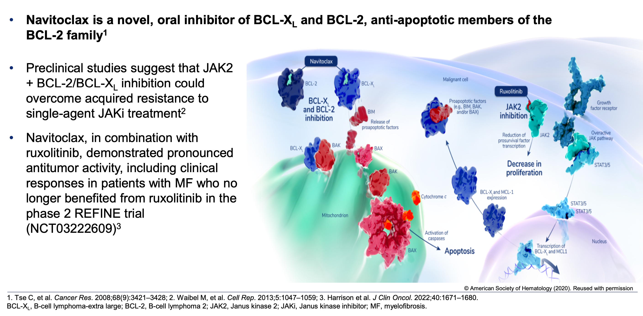
Navitoclax Mechanism of Action in Myelofibrosis
Pemmaraju N et al. ASH 2023;Abstract 620.

Slide 75
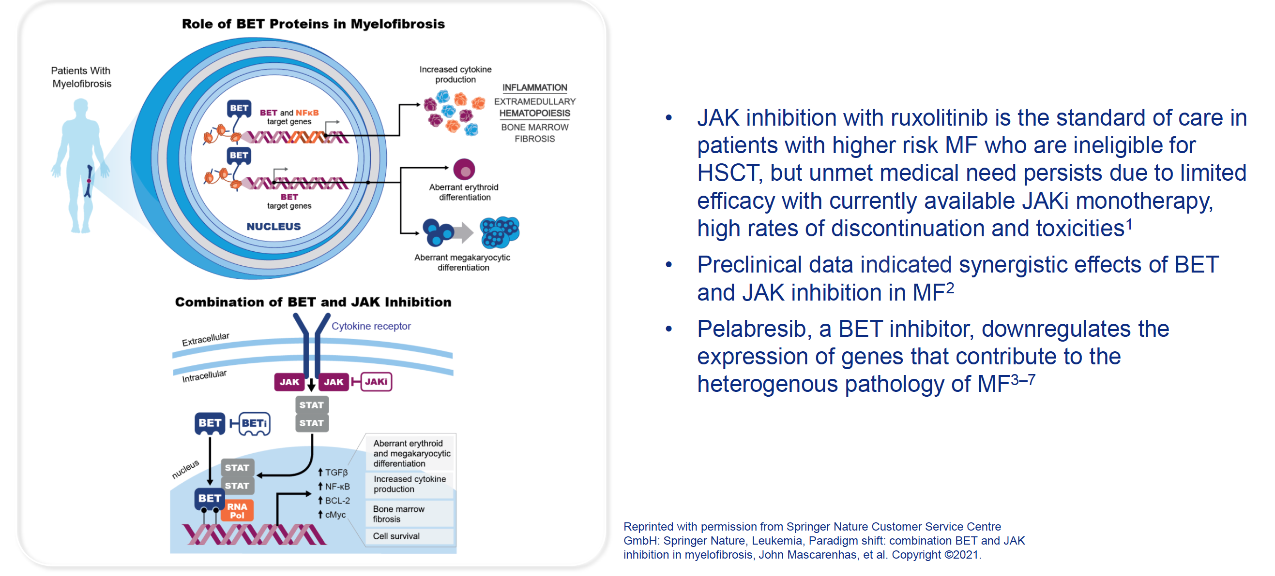
Simultaneous Inhibition of BET and JAK in Myelofibrosis
A Potential Therapeutic Approach to Address Heterogeneous Disease Pathology
Mascarenhas J et al. ASH 2022;Abstract 238.

Slide 76
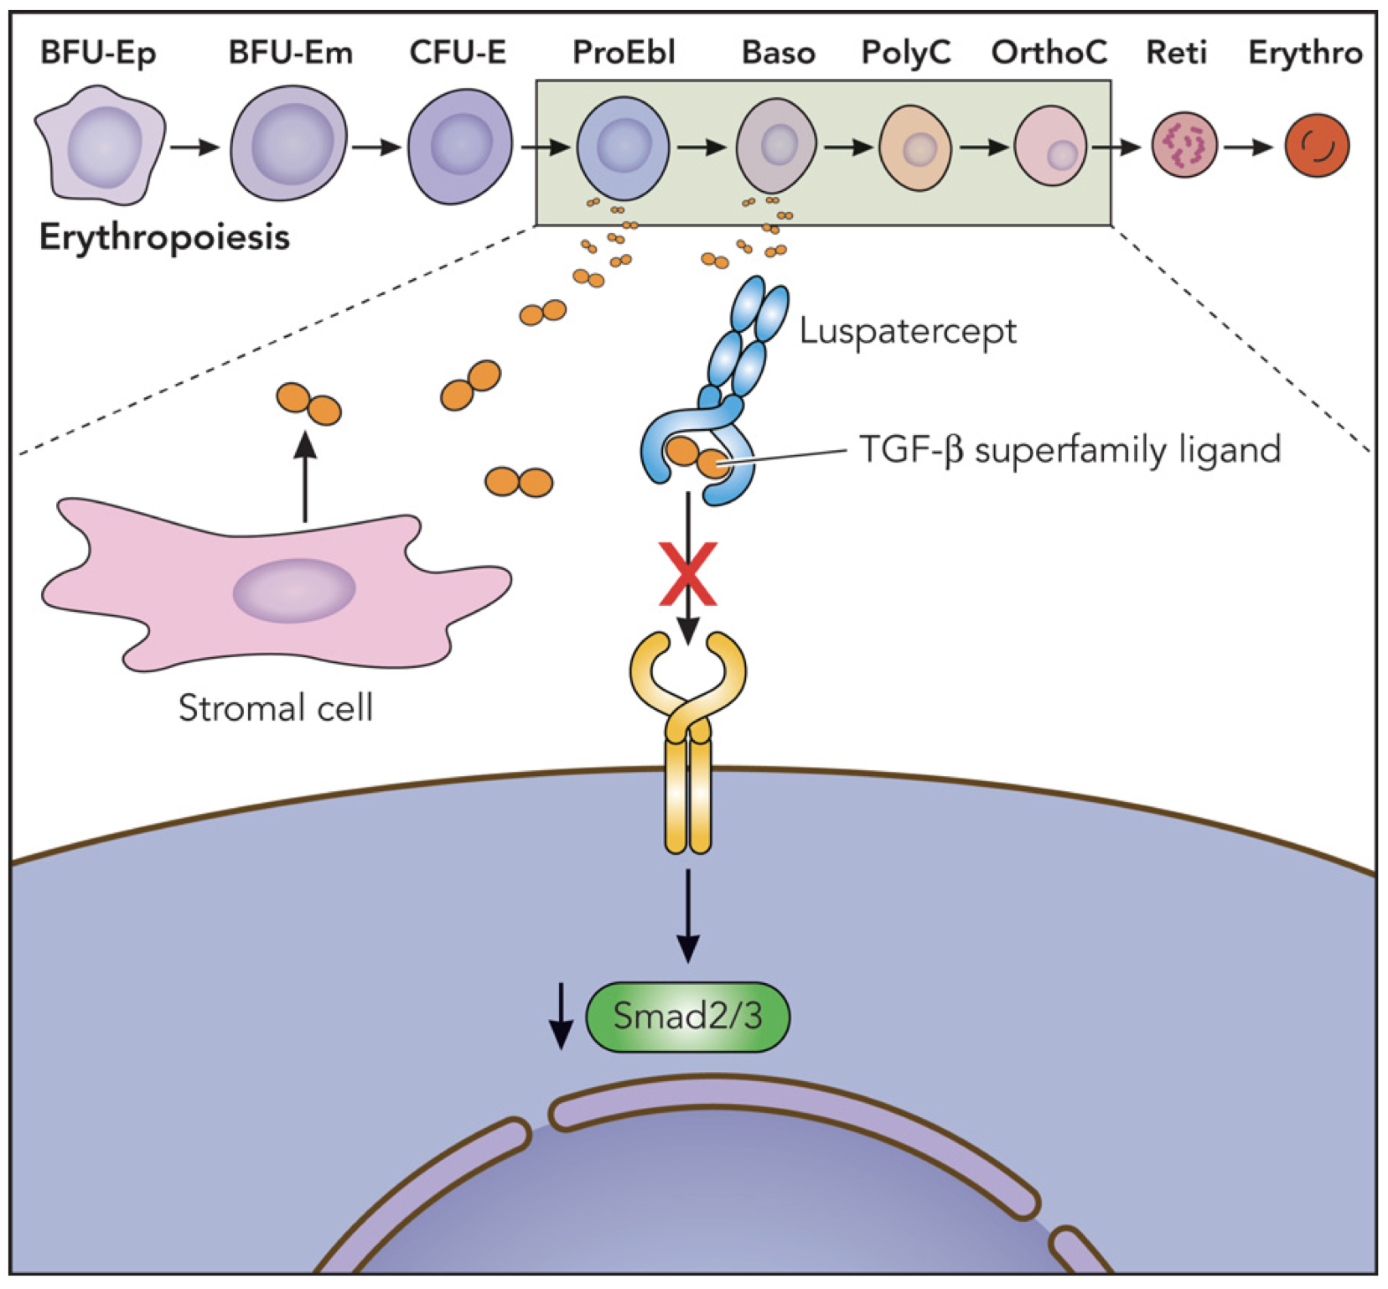
Luspatercept Mechanism of Action in Anemia
Kubasch AS et al. Blood Adv 2021;5(5):1565-75.

Slide 77
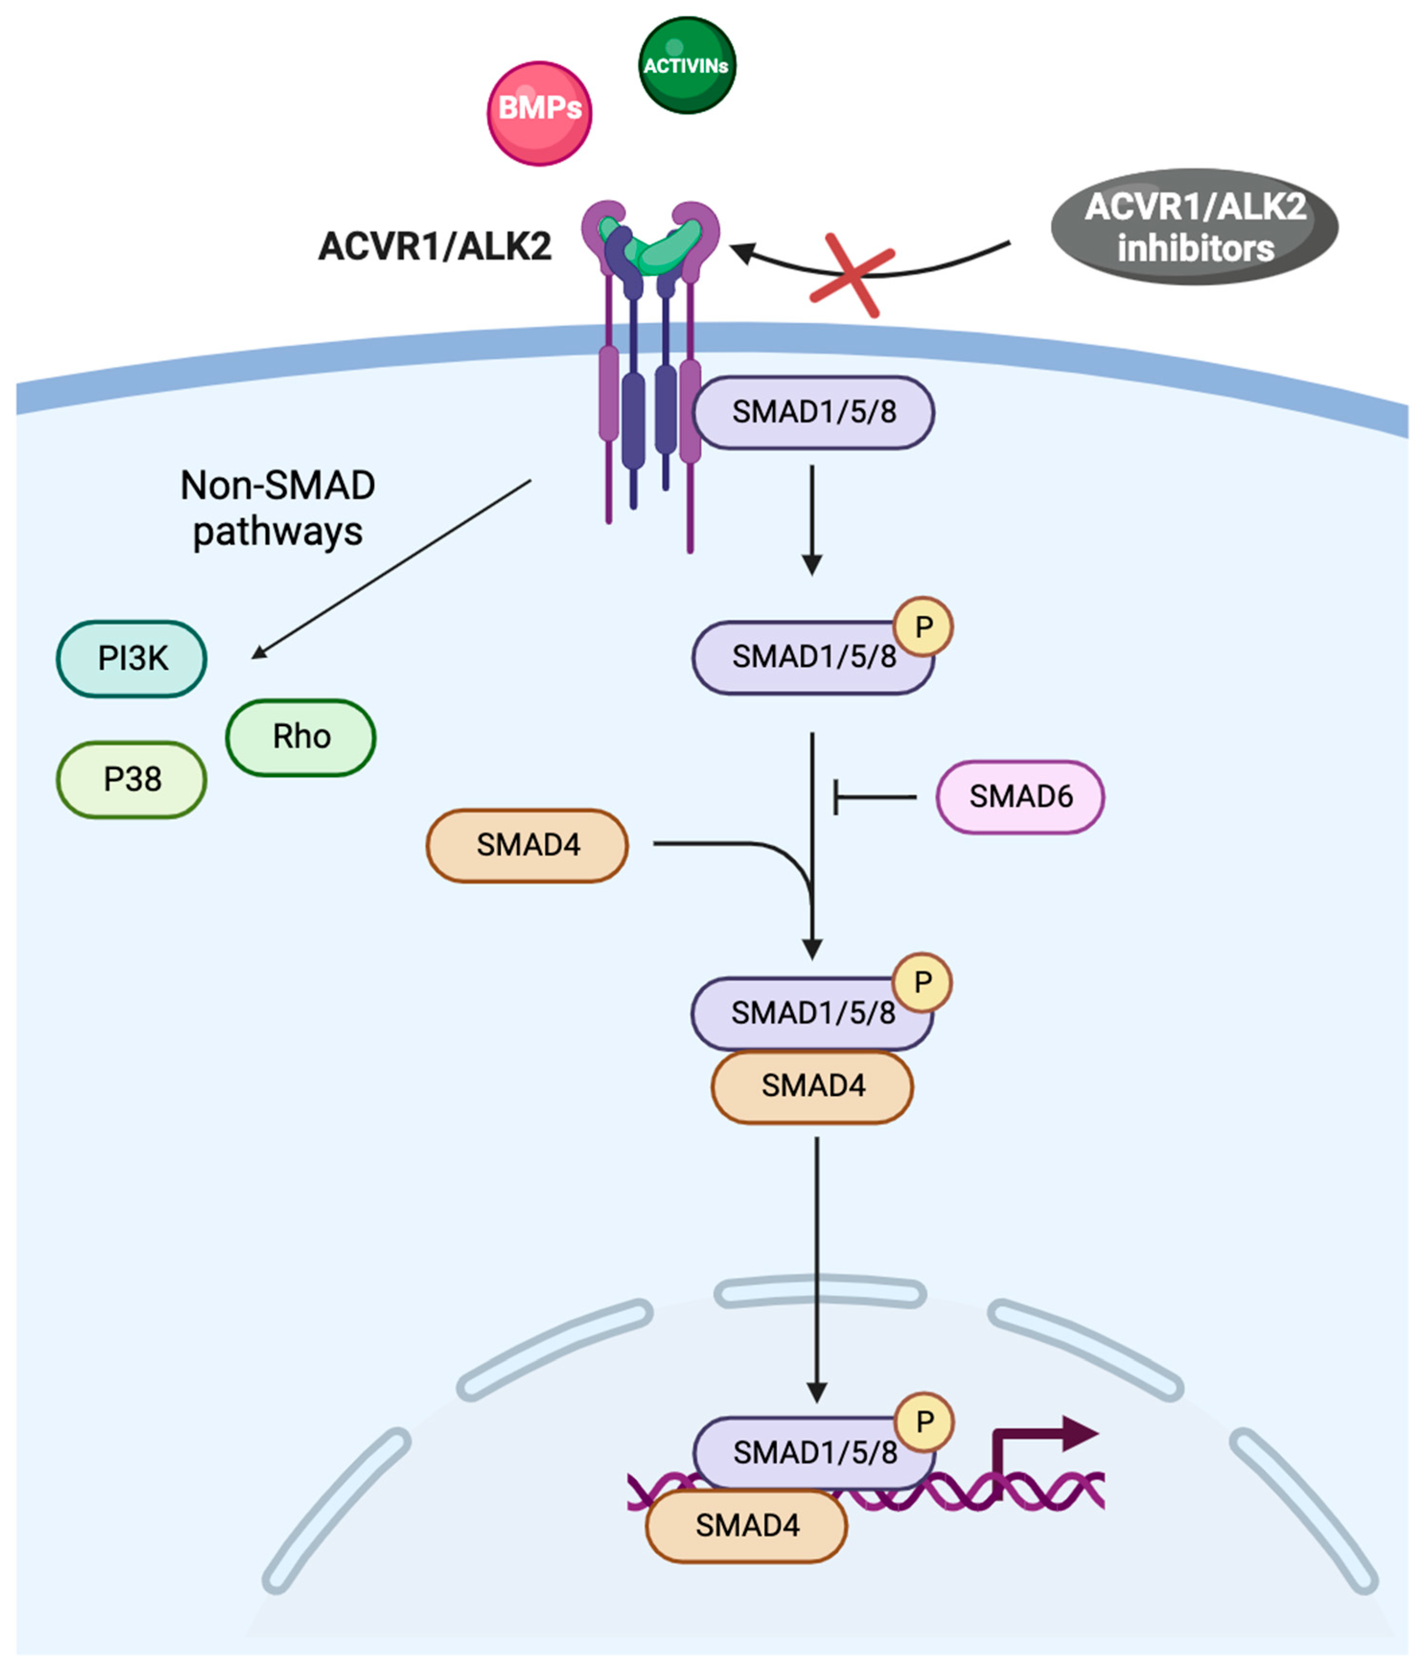
ACVR1 Is an Emerging Biomarker in MF and Anemia
Oh ST et al. Blood Adv 2023;7(19):5835-42; Duminuco A et al. Cancers 2024;16(1):154.

Slide 78
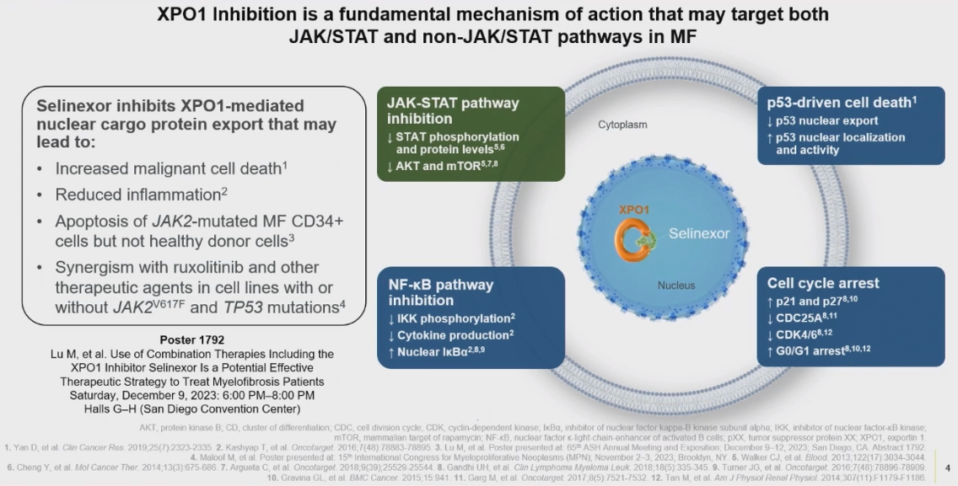
Selinexor Mechanism of Action in Myelofibrosis
Tantravahi S et al. ASH 2023;Abstract 622.

Slide 79
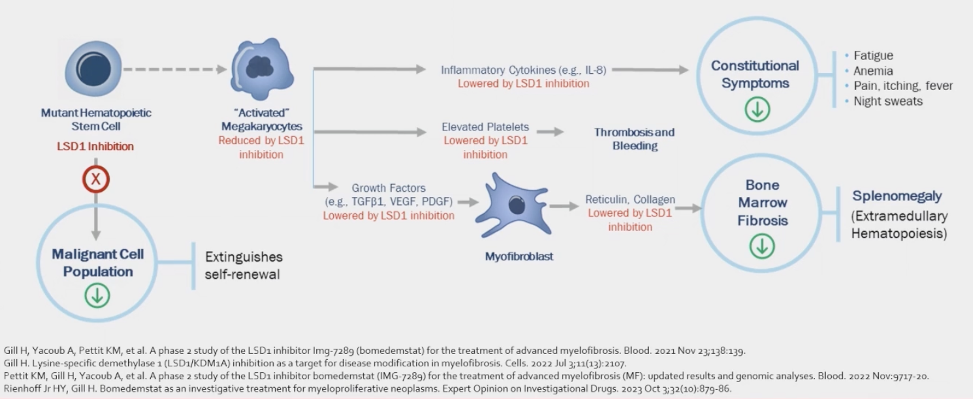
Bomedemstat Mechanism of Action
Gill H et al. ASH 2023;Abstract 621.

Slide 80
Sara M Tinsley-Vance, PhD, APRN, AOCN
What I tell my patients about the logistics and potential benefits of enrolling on a clinical trial

Slide 81
Consulting Nursing Faculty Comments
Trip to LEGOLAND
Amy Goodrich, CRNP

