Slide 1
Chronic Lymphocytic Leukemia and Bispecific Antibodies in the Management of Lymphoma
What I Tell My Patients: Integrating New Research Information into Current Clinical Care
A Complimentary NCPD Hybrid Symposium Series Held During the 49th Annual ONS Congress
Thursday, April 25, 2024 6:00 PM – 8:00 PM
Faculty
John N Allan, MD
Brad S Kahl, MD
Robin Klebig, MSN, APRN, CNP, AOCNP
Mollie Moran, APRN-CNP, AOCNP
Moderator
Neil Love, MD

Slide 2
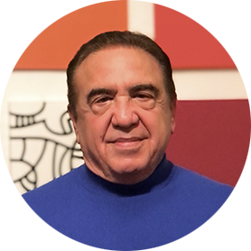
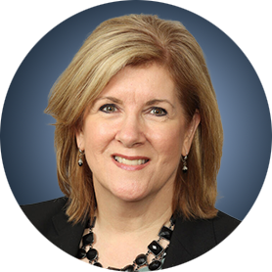
Faculty
John N Allan, MD
Associate Professor of Clinical Medicine
Weill Cornell Medicine
New York, New York
Mollie Moran, APRN-CNP, AOCNP
Nurse Practitioner
The James Cancer Hospital and Solove Research Institute
The Ohio State University
Columbus, Ohio
Brad S Kahl, MD
Professor of Medicine
Washington University School of Medicine
Director, Lymphoma Program
Siteman Cancer Center
St Louis, Missouri
Moderator Neil Love, MD Research To Practice Miami, Florida
Robin Klebig, MSN, APRN, CNP, AOCNP
Hematology Outpatient APP Supervisor
Assistant Professor of Medicine
Nurse Practitioner, Lymphoma Group
Division of Hematology
Mayo Clinic
Rochester, Minnesota

Slide 3
Dr Allan — Disclosures
Advisory Committee | NeoGenomics
Consulting Agreements | AbbVie Inc, Adaptive Biotechnologies Corporation, ADC Therapeutics, AstraZeneca Pharmaceuticals LP, BeiGene Ltd, Genentech, a member of the Roche Group, Janssen Biotech Inc, Lilly, Pharmacyclics LLC, an AbbVie Company
Contracted Research | BeiGene Ltd, Celgene Corporation, Genentech, a member of the Roche Group
Data and Safety Monitoring Board/Committee | Merck
Speakers Bureaus | AbbVie Inc, BeiGene Ltd, Janssen Biotech Inc, Pharmacyclics LLC, an AbbVie Company

Slide 4
Dr Kahl — Disclosures
Consulting Agreements | AbbVie Inc, Acerta Pharma — A member of the AstraZeneca Group, ADC Therapeutics, AstraZeneca Pharmaceuticals LP, BeiGene Ltd, Celgene Corporation, Genentech, a member of the Roche Group, Genmab US Inc, Janssen Biotech Inc, Kite, A Gilead Company, Lilly, Novartis, Roche Laboratories Inc

Slide 5
Ms Klebig — Disclosures
No relevant conflicts of interest to disclose

Slide 6
Ms Moran — Disclosures
No relevant conflicts of interest to disclose

Slide 7
Commercial Support
This activity is supported by educational grants from AbbVie Inc, Genentech, a member of the Roche Group, and Genmab US Inc and AbbVie Inc.
Research To Practice NCPD Planning Committee Members, Staff and Reviewers
Planners, scientific staff and independent reviewers for Research To Practice have no relevant conflicts of interest to disclose.

Slide 8
This educational activity contains discussion of non-FDA-approved uses of agents and regimens. Please refer to official prescribing information for each product for approved indications.

Slide 9
How was it different to take care of this patient versus another patient in the same oncologic setting?
What unique biopsychosocial factors (eg, attitude, comorbidities, social support) were considered in the overall management of this case?

Slide 10
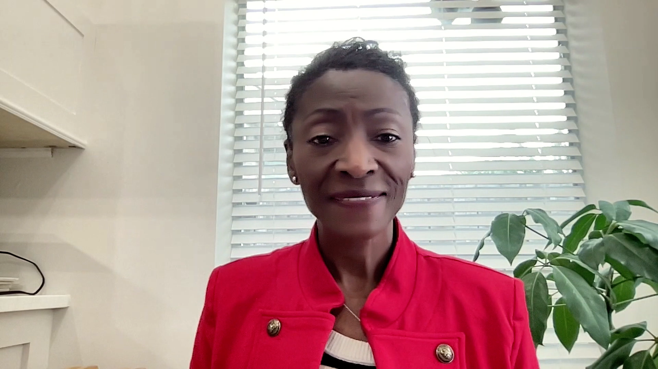
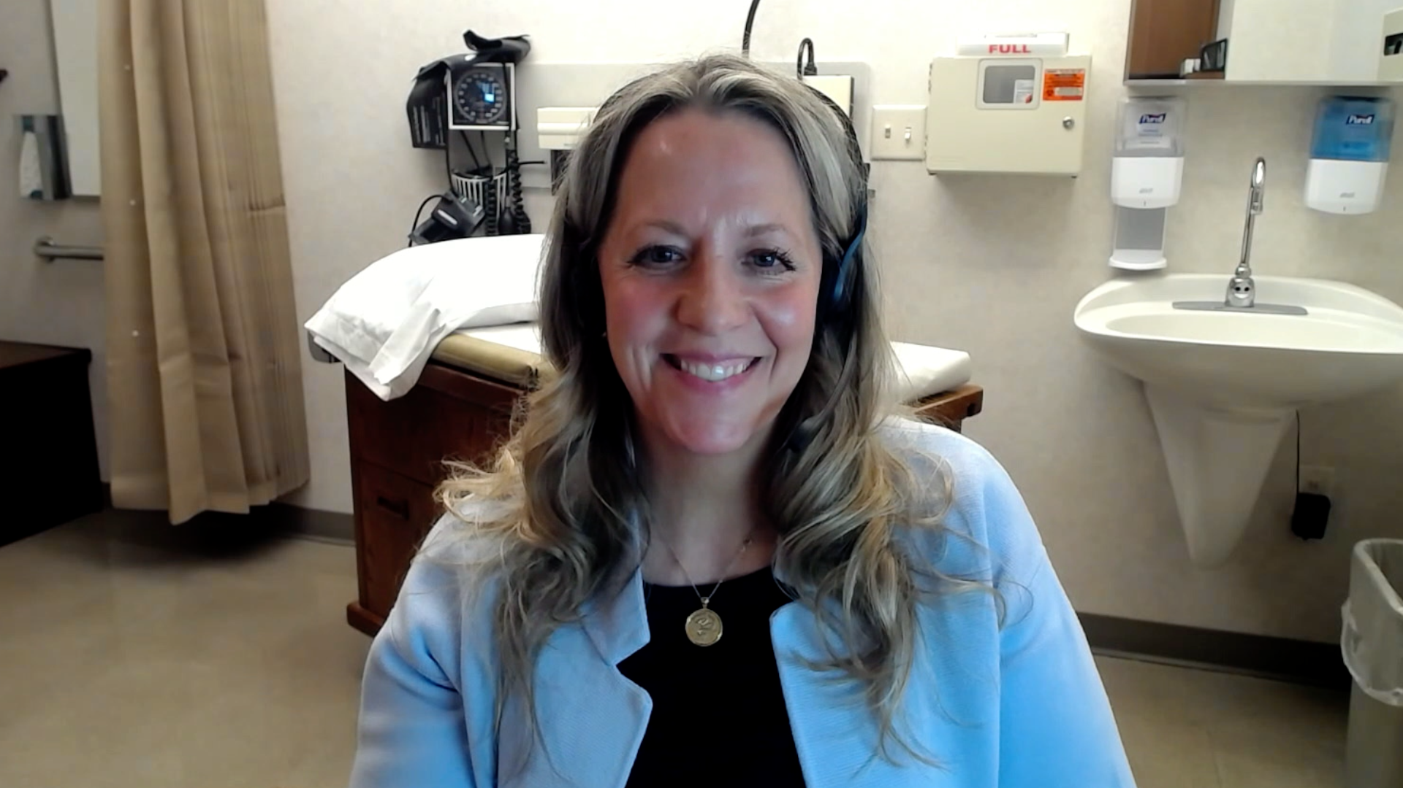
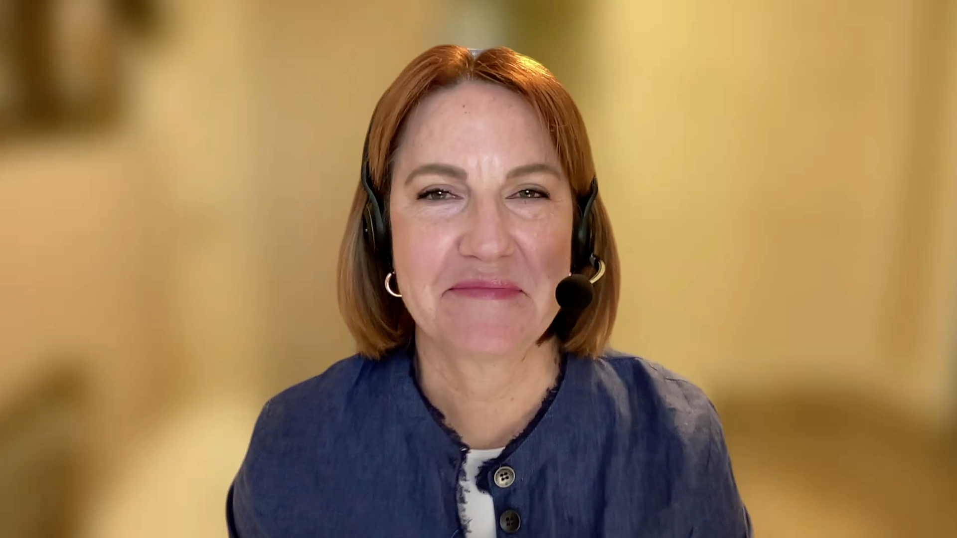
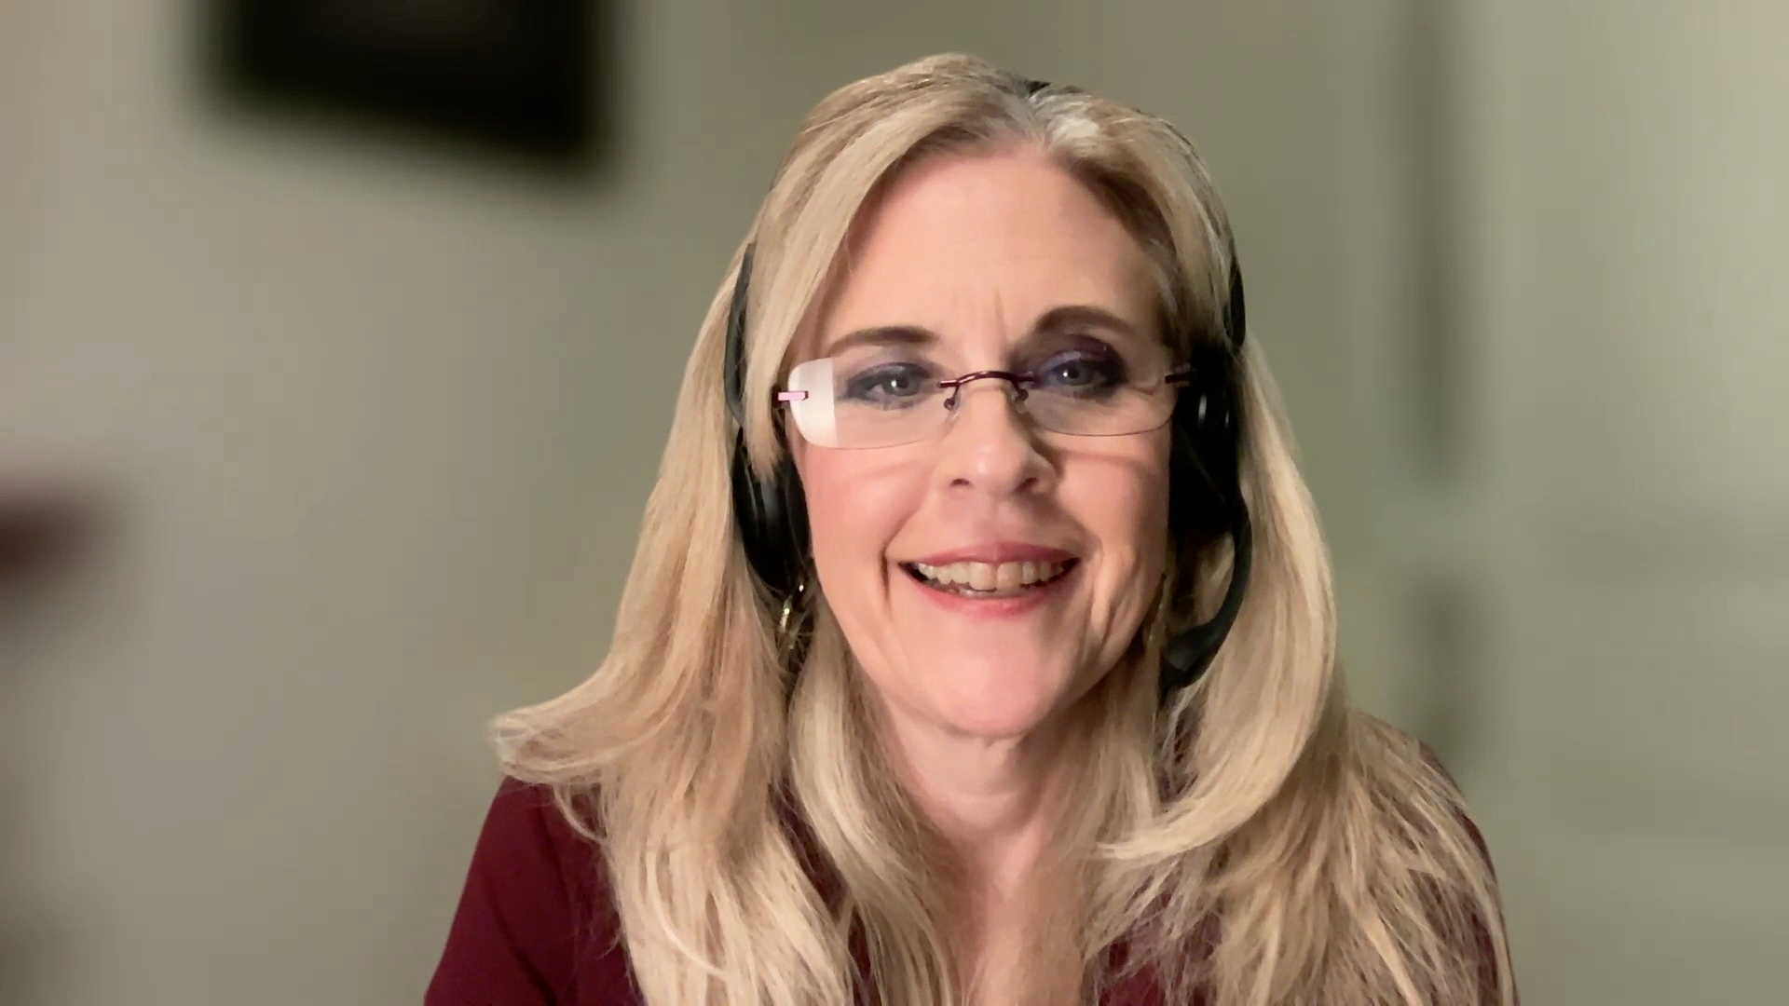
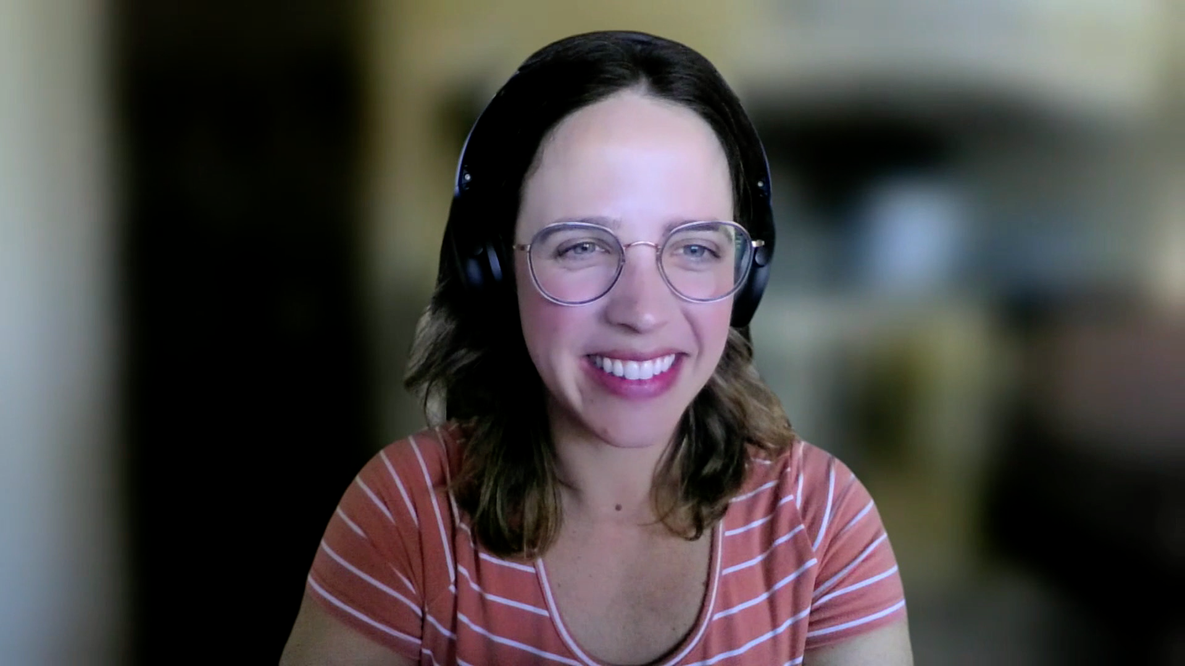
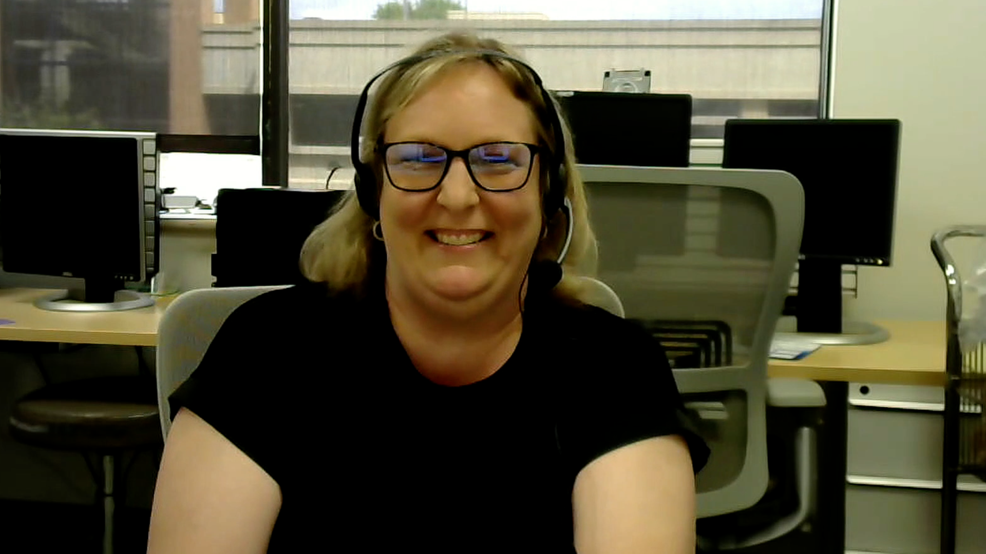
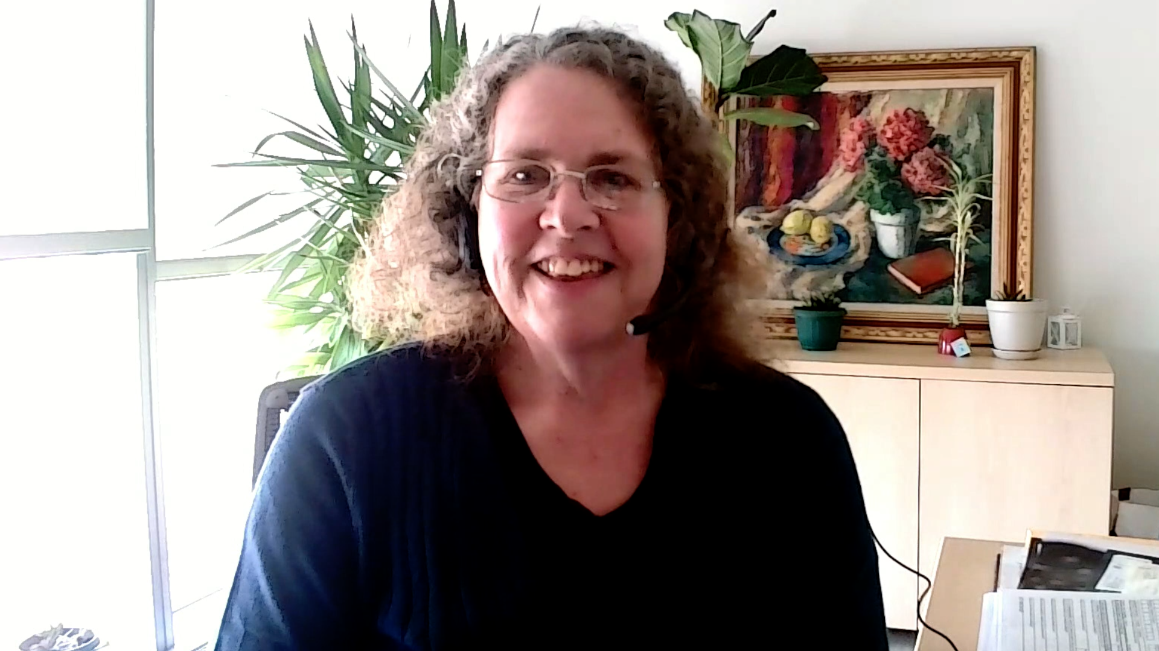
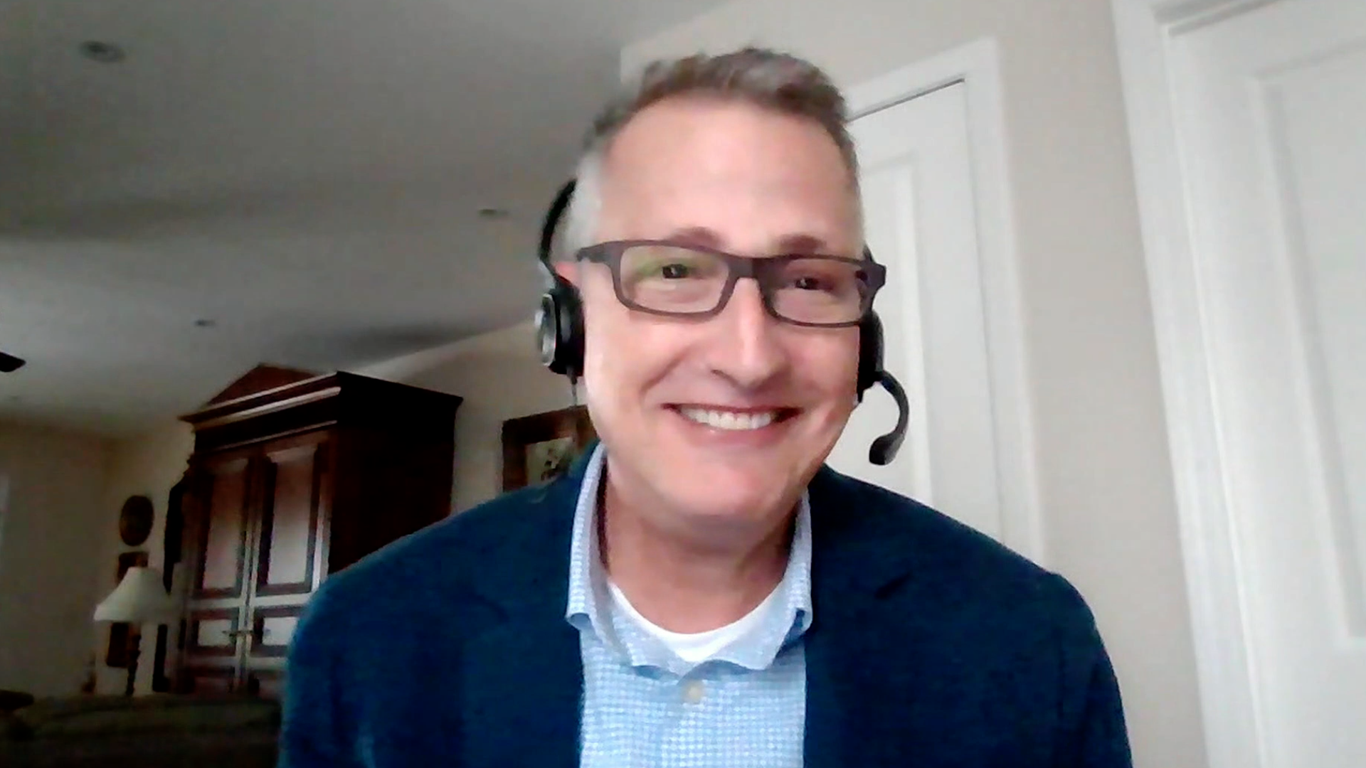
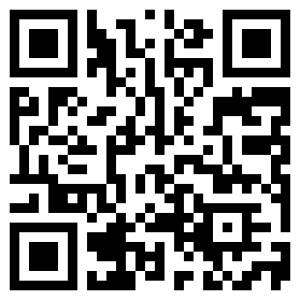
Consulting Nurse Faculty
Jacqueline Broadway-Duren, PhD, DNP, APRN, FNP-BC
The University of Texas MD Anderson Cancer Center
Houston, Texas
Jessica Mitchell, APRN, CNP, MPH
Mayo Clinic College of Medicine and Science
Rochester, Minnesota
Kathleen D Burns, RN, MSN, AGACNP-BC, OCN
City of Hope Comprehensive Cancer Center
Duarte, California
Tiffany A Richards, PhD, ANP-BC, AOCNP
The University of Texas MD Anderson Cancer Center
Houston, Texas
Sonia Glennie, ARNP, MSN, OCN
Swedish Cancer Institute Center for Blood Disorders
Seattle, Washington
Kimberly A Spickes, MNSc, RN, APRN, OCN, ACNP-BC
University of Arkansas for Medical Sciences
Little Rock, Arkansas
Amy Goodrich, CRNP
The Sidney Kimmel Comprehensive Cancer Center
Baltimore, Maryland
Ronald Stein, JD, MSN, NP-C, AOCNP
USC Norris Comprehensive Cancer Center
Los Angeles, California
https://www.ResearchToPractice.com/ONS2024Clips

Slide 11
Oncology clinical trial terminology
Waterfall plot
Kaplan-Meier curve
Overall survival
Progression-free survival
Disease-free survival
Objective response rate
Hazard ratio
Phase I/II/III
Minimal residual disease
Circulating tumor DNA
Notes:
11
11
11
11
11

Slide 12
Agenda
Introduction
Module 1: Biology of Chronic Lymphocytic Leukemia (CLL)
Module 2: Venetoclax-Based Up-Front Treatment for CLL
Module 3: BTK Inhibition Alone or in Combination with Venetoclax for CLL
Module 4: Bispecific Antibodies as a Treatment Option for Non-Hodgkin Lymphoma
Module 5: Bispecific Antibodies in the Management of Follicular Lymphoma
Module 6: Bispecific Antibodies for the Treatment of Diffuse Large B-Cell Lymphoma
Module 7: Practical Considerations and Tolerability of Bispecific Antibodies

Slide 13
Agenda
Introduction
Module 1: Biology of Chronic Lymphocytic Leukemia (CLL)
Module 2: Venetoclax-Based Up-Front Treatment for CLL
Module 3: BTK Inhibition Alone or in Combination with Venetoclax for CLL
Module 4: Bispecific Antibodies as a Treatment Option for Non-Hodgkin Lymphoma
Module 5: Bispecific Antibodies in the Management of Follicular Lymphoma
Module 6: Bispecific Antibodies for the Treatment of Diffuse Large B-Cell Lymphoma
Module 7: Practical Considerations and Tolerability of Bispecific Antibodies

Slide 14
Consulting Nursing Faculty Comments
Patient self-advocacy and treatment decision-making
Jacqueline Broadway-Duren, PhD, DNP, APRN, FNP-BC

Slide 15
Agenda
Introduction
Module 1: Biology of Chronic Lymphocytic Leukemia (CLL)
Module 2: Venetoclax-Based Up-Front Treatment for CLL
Module 3: BTK Inhibition Alone or in Combination with Venetoclax for CLL
Module 4: Bispecific Antibodies as a Treatment Option for Non-Hodgkin Lymphoma
Module 5: Bispecific Antibodies in the Management of Follicular Lymphoma
Module 6: Bispecific Antibodies for the Treatment of Diffuse Large B-Cell Lymphoma
Module 7: Practical Considerations and Tolerability of Bispecific Antibodies

Slide 16
Biology of CLL
Dr Allan
New York, New York
Dr Kahl
St Louis, Missouri
Implications of various biomarkers, such as IGHV mutation, deletion 17p and TP53 mutation, for prognosis and therapeutic selection
Indications for initiating active therapy for patients with previously untreated CLL
Relevant comorbidities, such as hypertension, preexisting cardiac arrhythmias and chronic kidney disease, that can influence clinical decision-making for patients with CLL
Risk of infection and timing of vaccinations for patients with CLL

Slide 17
Robin Klebig, MSN, APRN, CNP, AOCNP
What I tell my patients with newly diagnosed CLL who are going to be observed rather than starting active therapy

Slide 18
CLL Affects a Significant Number of Patients Worldwide, and Predominantly Older Patients
With an estimated 191,000 new cases globally, CLL represents 22% to 30% of all leukemia worldwide, being the most common leukemia in Western countries^{1,2}
Median age at diagnosis³:
Men are ~2X more likely to develop CLL⁵
72
~90% of patients diagnosed
with CLL are >55 years old⁴
1. Union for International Cancer Control. 2. Combest AJ, et al. J Hematol Oncol Pharm. 2016;6(2):54-56. 3. Eichhorst B, et al. Ann Oncol. 2015;26(suppl 5):v78-v84. 4. Lymphoma Coalition. 5. Scarfò L, et al. Crit Rev Oncol Hematol. 2016;104:169-182.
Courtesy of John M Pagel, MD, PhD
Notes:
Key Takeaway
Chronic lymphocytic leukemia (CLL) impacts a large number of patients globally, especially the elderly.
Speaker Notes
CLL is the most common form of leukemia in the Western world and accounts for about one-third of all new leukemia cases¹
CLL represents an estimated 22% to 30% of all leukemia cases worldwide²
CLL has a reduced frequency in Asian countries, including China, India, and Japan, where CLL represents 4% to 10% of all leukemias²
A CLL diagnosis is often based on results from blood tests ordered for routine care or an unrelated condition^{3,4}
The most common presentation is asymptomatic lymphocytosis¹
Up to 80% of patients show no symptoms at the time of diagnosis⁵
Some patients have indolent disease and never require therapy, whereas others may progress rapidly and require treatment¹
Patients are usually elderly at the time of CLL diagnosis and incidence increases with age⁶
Approximately 90% of all patients diagnosed with CLL are more than 55 years old, and the median age at CLL diagnosis is 72 years old⁶
Men have a higher frequency of CLL development than women, with a male-to-female ratio of 1.5-2.1³
References
Union for International Cancer Control. https://www.who.int/selection_medicines/committees/expert/20/applications/CLL.pdf. Accessed November 6, 2019.
Combest AJ, Danford RC, Andrews ER, Simmons A, McAtee P, Reitsma DJ. Overview of the recent developments in chronic lymphocytic leukemia, part 1. J Hematol Oncol Pharm. 2016;6(2):54-56.
Scarfò L, Ferreri AJ, Ghia P. Chronic lymphocytic leukaemia. Crit Rev Oncol Hematol. 2016;104:169-182.
American Cancer Society. Signs and Symptoms of Chronic Lymphocytic Leukemia. https://www.cancer.org/cancer/chronic-lymphocytic-leukemia/detection-diagnosis-staging/signs-symptoms.html. Accessed October 15, 2019.
Bell R. Developing a clinical program based on the needs of patients with chronic lymphocytic leukemia: preparing for illness episodes. J Adv Pract Oncol. 2017;8(5):462-473.
Eichhorst B, Robak T, Montserrat E, et al; ESMO Guidelines Committee. Ann Oncol. 2015;26(suppl 5):v78-v84.

Slide 19
Indications for treatment:
Disease-related symptoms
Fatigue can be tricky
Progressive bulky disease
Spleen > 6 cm below costal margin; LN > 10 cm
Progressive bone marrow failure, manifesting as anemia or thrombocytopenia
Autoimmune complications poorly responsive to steroids
Progressive lymphocytosis: Lymphocyte doubling time < 6 months, or increase in ≥ 50% in a two-month period
*Note: Absolute lymphocyte count alone not an indication for treatment
Courtesy of Brad S Kahl, MD

Slide 20
CLL special considerations
High frequency of AI complications
ITP, AIHA, neutropenia
High frequency of infections
Check Ig levels
Consider IVIg replacement therapy if recurrent infections and IgG < 300
High rate of skin cancer
Low threshold to send to Dermatology
Courtesy of Brad S Kahl, MD

Slide 21
Agenda
Introduction
Module 1: Biology of Chronic Lymphocytic Leukemia (CLL)
Module 2: Venetoclax-Based Up-Front Treatment for CLL
Module 3: BTK Inhibition Alone or in Combination with Venetoclax for CLL
Module 4: Bispecific Antibodies as a Treatment Option for Non-Hodgkin Lymphoma
Module 5: Bispecific Antibodies in the Management of Follicular Lymphoma
Module 6: Bispecific Antibodies for the Treatment of Diffuse Large B-Cell Lymphoma
Module 7: Practical Considerations and Tolerability of Bispecific Antibodies

Slide 22
Venetoclax-Based Up-Front Treatment
Dr Allan
New York, New York
Dr Kahl
St Louis, Missouri
Outcomes observed with venetoclax-based up-front treatment for patients with CLL
Key factors placing patients at risk for tumor lysis syndrome (TLS) with venetoclax; approaches to monitoring for and management of laboratory and clinical TLS
Spectrum, incidence, severity and management of other toxicities reported with venetoclax, such as neutropenia, infections and gastrointestinal disorders
Definition and clinical significance of minimal residual disease (MRD)
Current role, if any, of MRD assessment in the management of CLL; implications for the duration of venetoclax-based treatment

Slide 23
Mollie Moran, APRN-CNP, AOCNP
What I tell my patients about to begin treatment with venetoclax/obinutuzumab

Slide 24
Mechanism of Action of Venetoclax
Bcl-2 functions to prevent cell death by apoptosis
Venetoclax is specific for Bcl-2 and inhibits its function, thereby removing the block on apoptosis
Venetoclax
Bcl-2
Bcl-XL
Tumor cell
Platelet
Adapted from Davids MS, Letai A. Cancer Cell 2013;23(2):139-41.

Slide 25
Venetoclax
Mechanism of action
Bcl-2 inhibitor
Indication
For patients with CLL or SLL
Dosing
In combination with obinutuzumab: After ramp-up, continue venetoclax 400 mg once daily until the last day of cycle 12
In combination with rituximab: After ramp-up, continue venetoclax 400 mg once daily for 24 months
As monotherapy: After ramp-up, continue venetoclax 400 mg once daily until disease progression or unacceptable toxicity
Venetoclax package insert, 6/2022.

Slide 26
Patient Education: Venetoclax
Pharmacy consultation re potential drug interactions
CYP3A4 interactions – Avoid strong inhibitors and inducers
Azole antifungals, mycin antibiotics, protease inhibitors, etc
Moderate – Consider dose adjustment
Avoid grapefruit/juice, Seville oranges, and starfruit
Take with food and water, same time each day
Courtesy of Robin Klebig, MSN, APRN, CNP, AOCNP

Slide 27
Patient Education: Venetoclax (Continued)
Potential for tumor lysis syndrome (TLS)
5-week ramp-up to goal dose
Hospitalization for weekly ramp up (bulky)
TLS lab monitoring q8h x 24 hours
Allopurinol
Hydration
Nausea
Antiemetic as needed
Diarrhea
Loperamide as needed
Record # stools per day at baseline
Cytopenias
Neutropenia
Increased infection risk
Thrombocytopenia
Bleeding risk
Anemia
Typically not transfusion requiring
Courtesy of Robin Klebig, MSN, APRN, CNP, AOCNP

Slide 28
TLS Risk with Venetoclax Is a Continuum Based on Multiple Factors
Courtesy of Matthew S Davids, MD, MMSc

Slide 29
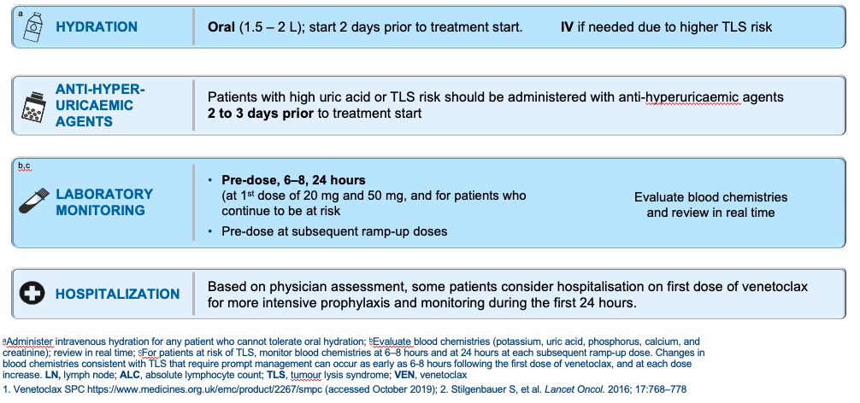
Venetoclax: TLS Prophylaxis and Monitoring
risk)
Courtesy of Matthew S Davids, MD, MMSc

Slide 30
Agenda
Introduction
Module 1: Biology of Chronic Lymphocytic Leukemia (CLL)
Module 2: Venetoclax-Based Up-Front Treatment for CLL
Module 3: BTK Inhibition Alone or in Combination with Venetoclax for CLL
Module 4: Bispecific Antibodies as a Treatment Option for Non-Hodgkin Lymphoma
Module 5: Bispecific Antibodies in the Management of Follicular Lymphoma
Module 6: Bispecific Antibodies for the Treatment of Diffuse Large B-Cell Lymphoma
Module 7: Practical Considerations and Tolerability of Bispecific Antibodies

Slide 31
Available Bruton Tyrosine Kinase (BTK) Inhibitors
Dr Allan
New York, New York
Dr Kahl
St Louis, Missouri
Long-term findings from Phase III studies assessing ibrutinib-, acalabrutinib- and zanubrutinib-based therapy for patients with treatment-naïve CLL
Incidence and severity of cardiac arrhythmias, including atrial fibrillation or flutter, documented with approved BTK inhibitors
Probability of other cardiovascular toxicities, such as stroke, hypertension and bruising or bleeding
Spectrum and frequency of clinically relevant noncardiovascular toxicities, including cytopenias, infections, headache, dermatologic symptoms, arthralgias or myalgia and gastrointestinal-related events
Appropriate monitoring for and management of treatment-related cardiovascular and noncardiovascular events in patients receiving BTK inhibitors

Slide 32
Robin Klebig, MSN, APRN, CNP, AOCNP
What I tell my patients about to begin treatment with a BTK inhibitor

Slide 33
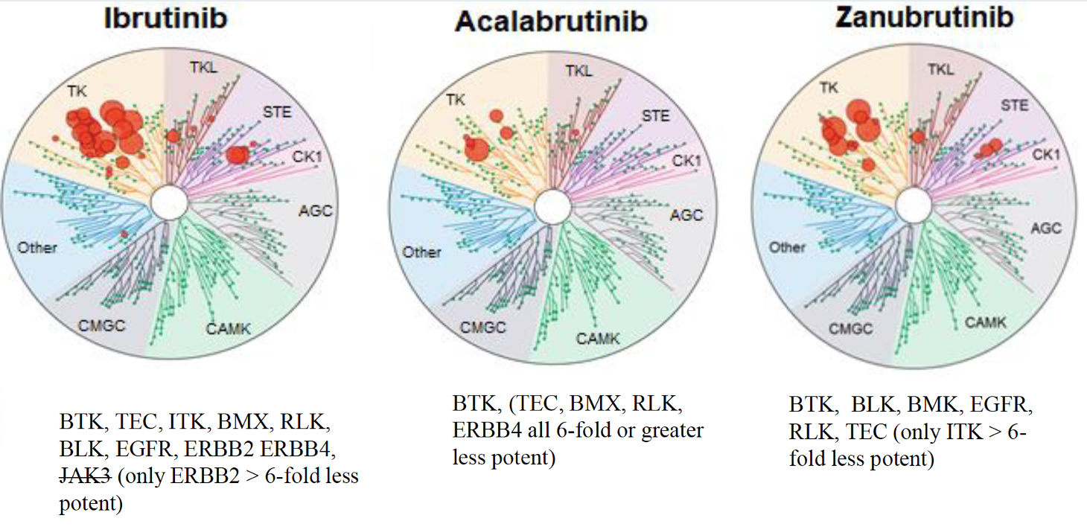
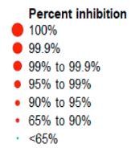
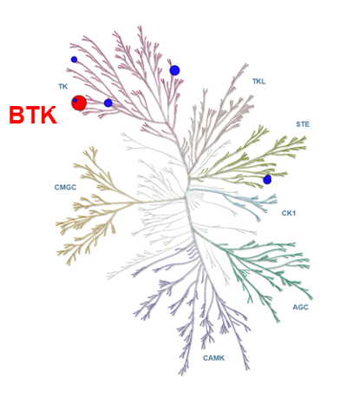
Irreversible and Reversible BTK Inhibitors for CLL
BTK inhibitor | Binding | T1/2 (hours) | IC50 (nM) | Dosing
Ibrutinib | Covalent irreversible C481 | 4-8 | 0.5 | 420 mg
Acalabrutinib | Covalent irreversible C481 | 0.9 | 5.1 | 100 mg BID
Zanubrutinib | Covalent irreversible C481 | 2-4 | 0.5 | 160 or 320 mg BID
Pirtobrutinib | Noncovalent reversible | Not available | 0.85 | 200 mg
Irreversible
Reversible
Pirtobrutinib (LOXO-305)
Robak T et al. Cancers 2022 February 2;14(3):771.

Slide 34
Ibrutinib
Mechanism of action
BTK inhibitor
Indication
For patients with CLL or small lymphocytic lymphoma (SLL)
Recommended dose
420 mg po qd swallowed whole with water
Key issues
Dose reduction guidelines
Ibrutinib package insert, 8/2022.

Slide 35
Acalabrutinib
Mechanism of action
BTK inhibitor
Indication
For patients with CLL or SLL
Recommended dose
100 mg po approximately every 12 hours swallowed whole with water, with or without food
Key issues
Dose reduction guidelines
Acalabrutinib package insert, 8/2022.

Slide 36
Zanubrutinib
Mechanism of action
BTK inhibitor
Indication
For patients with CLL or SLL
Recommended dose
160 mg po twice daily or 320 mg po once daily, swallowed whole with water, with or without food
Key issues
Dose reduction guidelines
Zanubrutinib package insert, 3/2024.

Slide 37
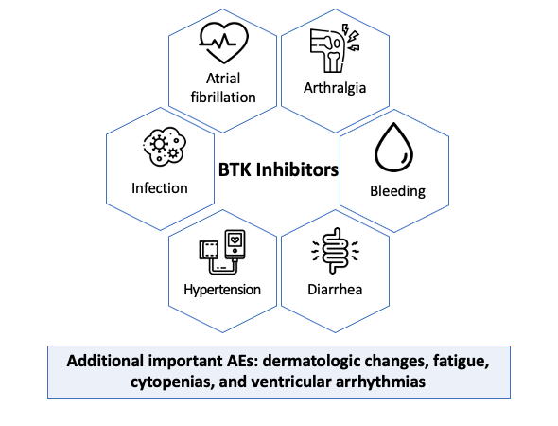
Summary of Adverse Events with BTK Inhibitors
Courtesy of Matthew S Davids, MD, MMSc

Slide 38
Potential Role of BTK Inhibitors with Venetoclax
Dr Allan
New York, New York
Dr Kahl
St Louis, Missouri
Mechanistic rationale for combining BTK inhibitors and venetoclax with and without CD20 antibodies for CLL
Published data sets evaluating ibrutinib/venetoclax for newly diagnosed and relapsed/refractory (R/R) CLL
Available data with acalabrutinib or zanubrutinib in combination with venetoclax with or without an anti-CD20 antibody
Ongoing Phase III studies assessing novel doublet and triplet combinations for previously untreated and R/R disease; potential clinical role of this strategy
Incidence and severity of clinically relevant toxicities encountered when combining BTK inhibitors and venetoclax

Slide 39
Mollie Moran, APRN-CNP, AOCNP
What I tell my patients about to begin treatment with a BTK inhibitor in combination with venetoclax

Slide 40
Selection and Sequencing of Therapies for R/R CLL
Dr Allan
New York, New York
Dr Kahl
St Louis, Missouri
Long-term follow-up from Phase III trials evaluating BTK inhibitors and venetoclax for R/R CLL
Role of rechallenging with agents used in a prior line of treatment
Antitumor activity documented with pirtobrutinib in patients with R/R CLL; current clinical role
Biological rationale for and available data with CD19-directed chimeric antigen receptor (CAR) T-cell therapy for CLL; recent FDA approval

Slide 41
Pirtobrutinib
Mechanism of action
BTK inhibitor
Indication
For patients with CLL or SLL who have received at least 2 prior lines of therapy, including a BTK inhibitor and a Bcl-2 inhibitor
Recommended dose
200 mg orally once daily; swallow whole with water, with or without food. Do not cut, crush or chew tablets
Key issues
Dose reduction guidelines
Pirtobrutinib package insert, 12/2023.

Slide 42
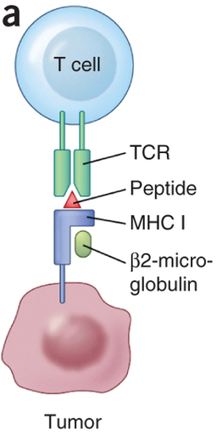
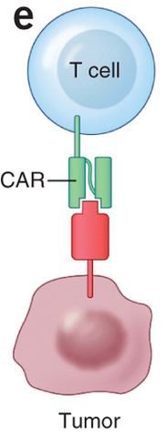
Chimeric Antigen Receptor (CAR) Modified T Cells
Normal T cell
CAR T cell
Genetically engineered T cells altered to express an artificial receptor, CAR
Signaling domain
Ag-recognition domain
Target antigen
Courtesy of Sattva S Neelapu, MD
Adapted from Hinrichs & Restifo. Nat Biotech 2013

Slide 43
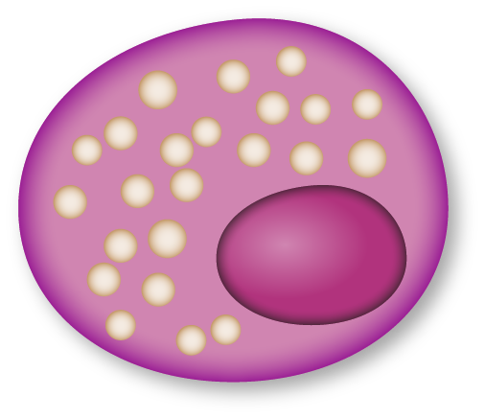
CAR T Cells: Mechanism of Action
T cell
Tumor cell
CAR enables T cell to recognize tumor cell antigen
Expression of CAR
Viral DNA Insertion
Antigen
CAR T cells multiply and release cytokines
Tumor cell apoptosis
Notes:
Slide created by E Squared Communications

Slide 44
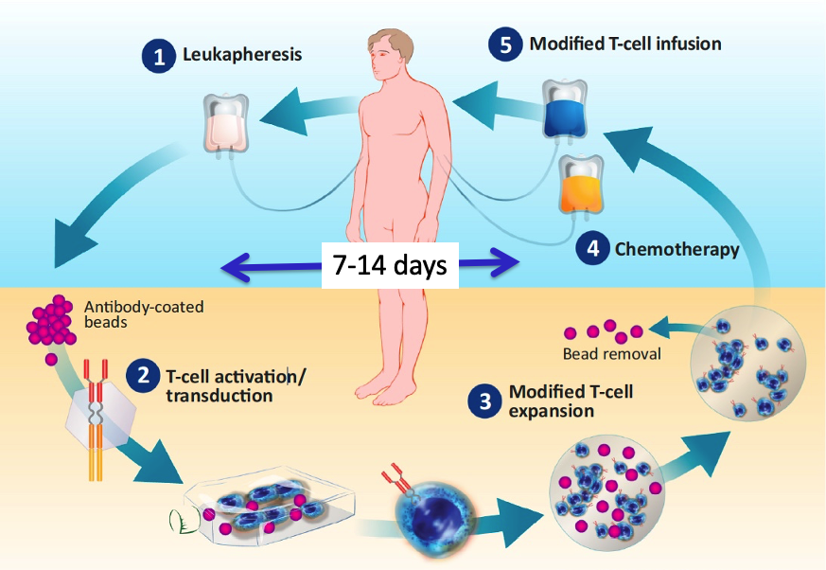
Overview of CAR T-Cell Therapy
Modification, Courtesy of David Porter, MD

Slide 45
U.S. FDA Approves Liso-Cel as the First and Only CAR T Cell Therapy for Adults with Relapsed or Refractory Chronic Lymphocytic Leukemia (CLL) or Small Lymphocytic Lymphoma (SLL) Press Release: March 14, 2024
“…the U.S. Food and Drug Administration (FDA) has granted accelerated approval of lisocabtagene maraleucel (liso-cel), a CD19-directed chimeric antigen receptor (CAR) T cell therapy, for the treatment of adult patients with relapsed or refractory chronic lymphocytic leukemia (CLL) or small lymphocytic lymphoma (SLL) who have received at least two prior lines of therapy, including a Bruton tyrosine kinase (BTK) inhibitor and a B-cell lymphoma 2 (BCL-2) inhibitor. This indication is approved under accelerated approval based on response rate and duration of response.
TRANSCEND CLL 004 (NCT03331198) is a Phase 1/2 open-label, single-arm, multicenter study evaluating liso-cel in patients with relapsed or refractory chronic lymphocytic leukemia or small lymphocytic lymphoma. The Phase 1 dose escalation portion of the study assessed the safety and recommended dose for the subsequent Phase 2 expansion cohort. The Phase 2 portion of the study is evaluating liso-cel at the recommended dose from the Phase 1 monotherapy arm. The primary endpoint of the Phase 2 portion of the study is complete response rate, including complete remission with incomplete bone marrow recovery, based on independent review committee according to the International Workshop on Chronic Lymphocytic Leukemia (iwCLL) 2018 guidelines..”
https://news.bms.com/news/corporate-financial/2024/U.S.-FDA-Approves-Bristol-Myers-Squibbs-Breyanzi--as-the-First-and-Only-CAR -T-Cell-Therapy-for-Adults-with-Relapsed-or-Refractory-Chronic-Lymphocytic-Leukemia-CLL-or-Small-Lymphocytic-Lymphoma-SLL/default.aspx

Slide 46
Approved CAR T Cell Therapies in Lymphoma
Agent | Approved Indications
Axicabtagene Ciloleucel | Large B-Cell Lymphoma refractory to 1L chemoimmunotherapy or relapsed within 12 months of 1L chemoimmunotherapy R/R Large B-Cell Lymphoma after 2+ lines of systemic therapy R/R FL after 2+ lines of systemic therapy
Brexucabtagene Autoleucel | R/R MCL after prior chemotherapy, anti-CD20 therapy, and a BTK inhibitor
Lisocabtagene Maraleucel | Large B-Cell Lymphoma refractory to 1L chemoimmunotherapy or relapsed within 12 months of 1L chemoimmunotherapy R/R Large B-Cell Lymphoma after 2+ lines of systemic therapy R/R CLL or SLL after 2+ lines of therapy, including a BTKi and a BCL-2 inhibitor
Tisagenlecleucel | R/R Large B-Cell Lymphoma after 2+ lines of systemic therapy R/R FL after 2+ lines of systemic therapy
Notes:
Highlight DAEPOCH-R

Slide 47
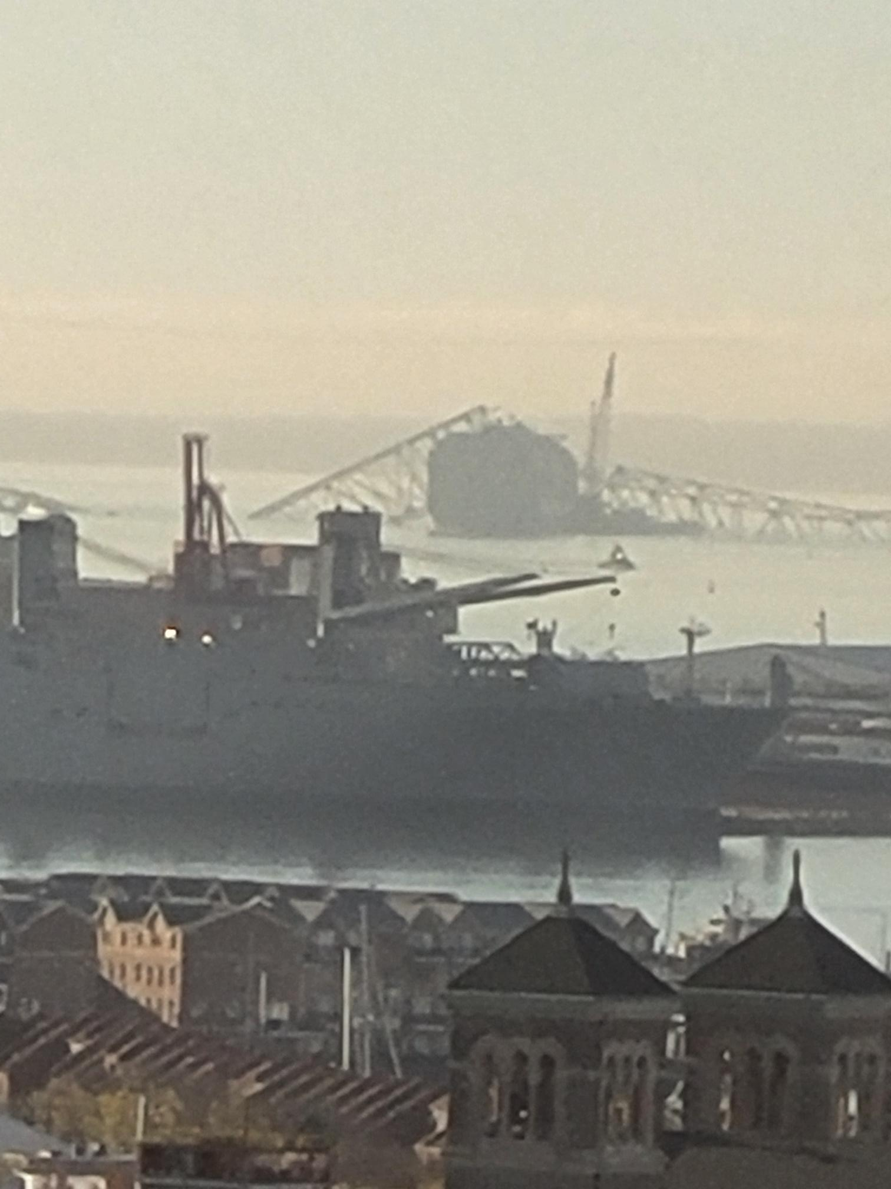
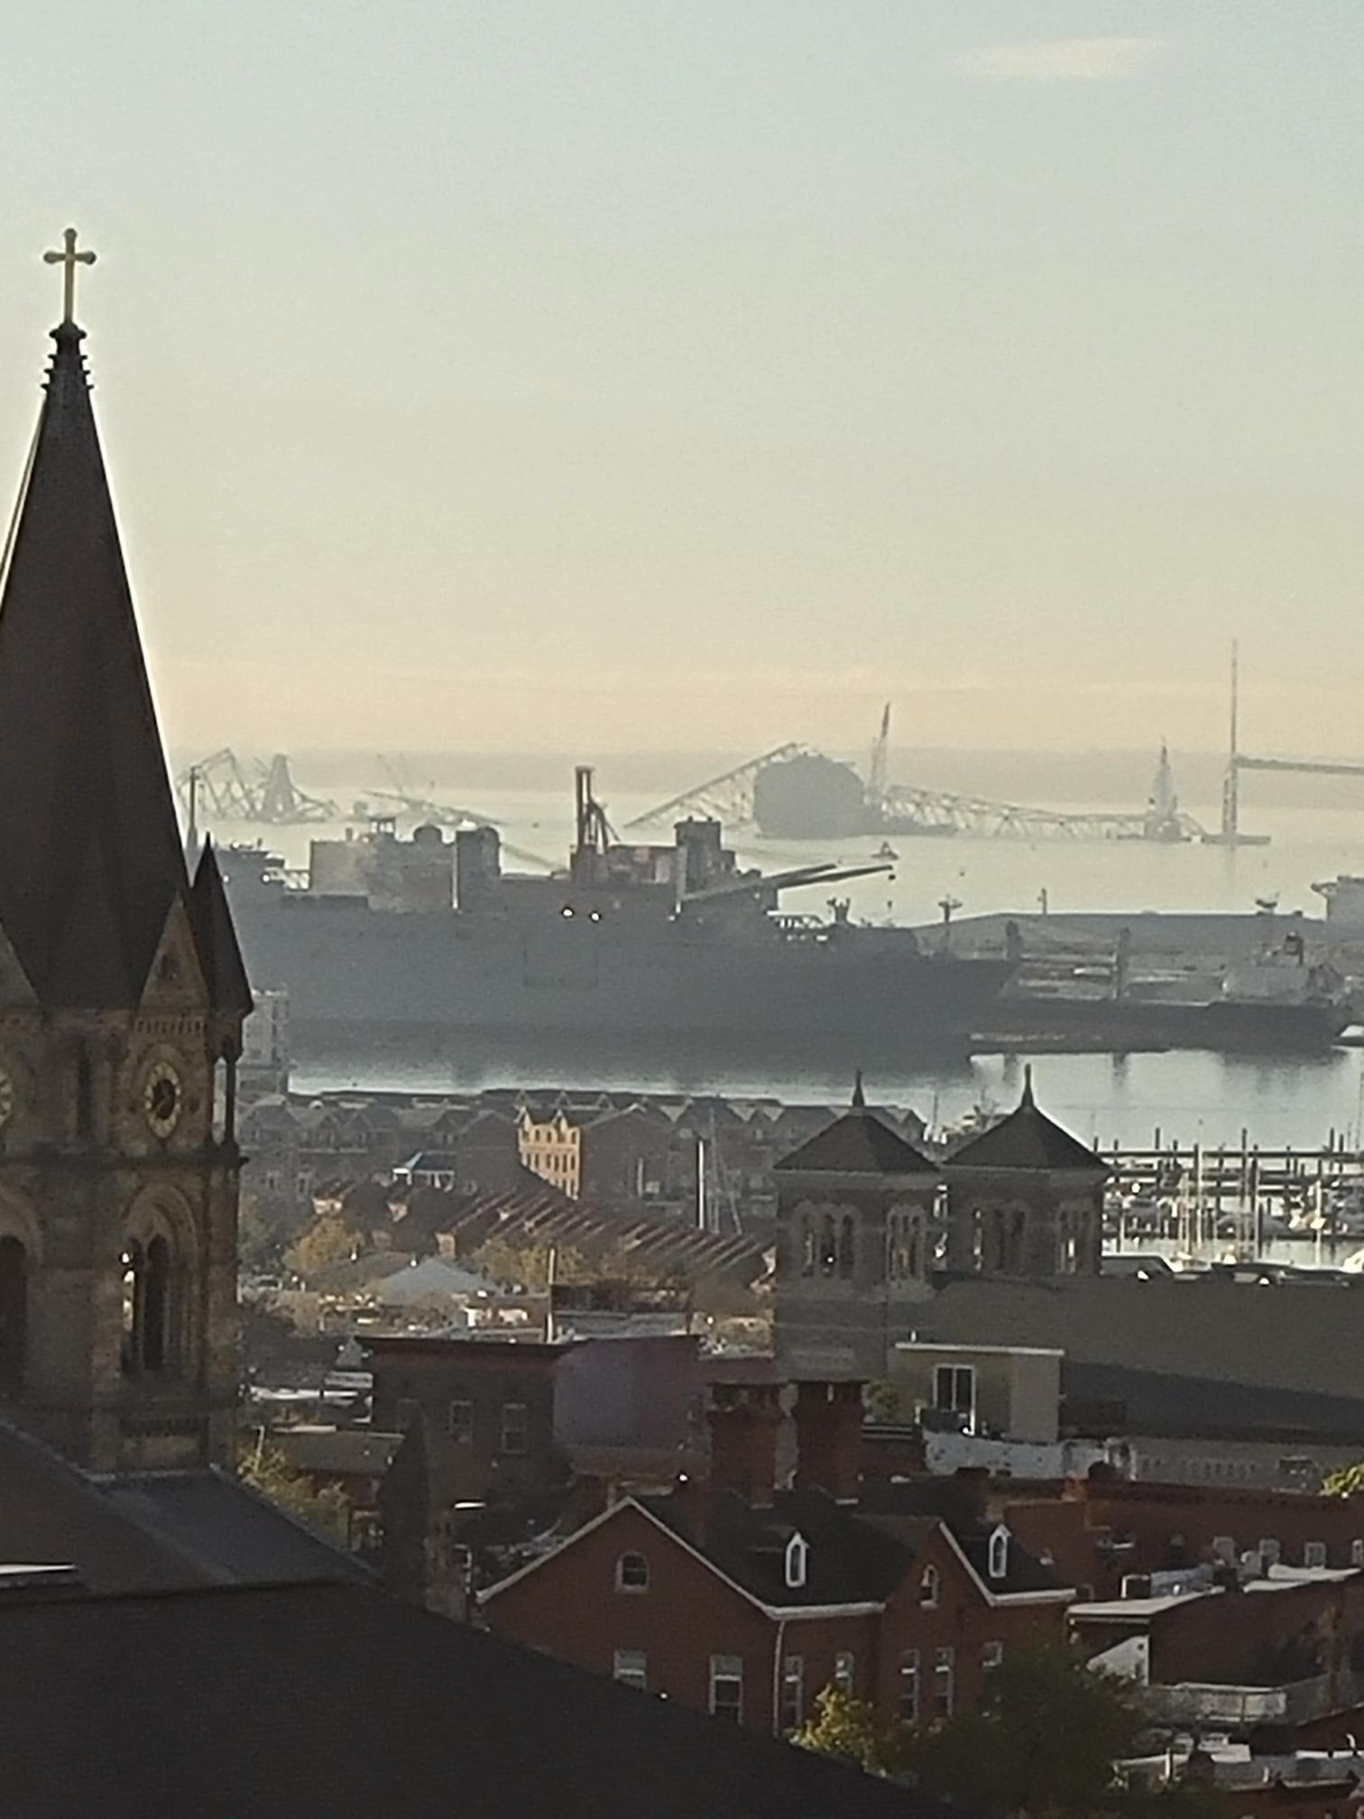

Slide 48
Consulting Nursing Faculty Comments
Interactions between community oncologists and tertiary care centers
Amy Goodrich, CRNP

Slide 49
Consulting Nursing Faculty Comments
Bispecific immunotherapy and risk for infection
Amy Goodrich, CRNP

Slide 50
Agenda
Introduction
Module 1: Biology of Chronic Lymphocytic Leukemia (CLL)
Module 2: Venetoclax-Based Up-Front Treatment for CLL
Module 3: BTK Inhibition Alone or in Combination with Venetoclax for CLL
Module 4: Bispecific Antibodies as a Treatment Option for Non-Hodgkin Lymphoma
Module 5: Bispecific Antibodies in the Management of Follicular Lymphoma
Module 6: Bispecific Antibodies for the Treatment of Diffuse Large B-Cell Lymphoma
Module 7: Practical Considerations and Tolerability of Bispecific Antibodies

Slide 51
Bispecific Antibodies as a Treatment Option for Non-Hodgkin Lymphoma (NHL)
Dr Allan
New York, New York
Dr Kahl
St Louis, Missouri
Potential therapeutic advantages over traditional monoclonal antibodies of using bispecific antibodies to engage 2 disease targets with 1 molecule
Scientific rationale for the selection of CD20 and CD3 as targets for bispecific antibodies in NHL
Mechanistic similarities and differences among the various approved and investigational CD20 x CD3 bispecific antibodies, such as epcoritamab, glofitamab, mosunetuzumab and odronextamab
Potential practical advantages of the “off-the-shelf” nature of bispecific antibodies relative to CAR T-cell therapy

Slide 52
Robin Klebig, MSN, APRN, CNP, AOCNP
What I tell my patients about what bispecific antibodies are and how they work

Slide 53
Approved and Investigational Bispecific Antibodies for NHL
Drug Name | Route of Administration | Investigational Status
Mosunetuzumab | Intravenous | Approved (R/R FL)
Glofitamab | Intravenous | Approved (R/R DLBCL)
Epcoritamab | Subcutaneous | Approved (R/R DLBCL)
Odronextamab | Intravenous | Investigational (R/R FL, DLBCL)* *03/2024: FDA issued CRLs
Radhakrishnan VS, Davies AJ. Front Immunol 2024 January 11:14:1295599.

Slide 54
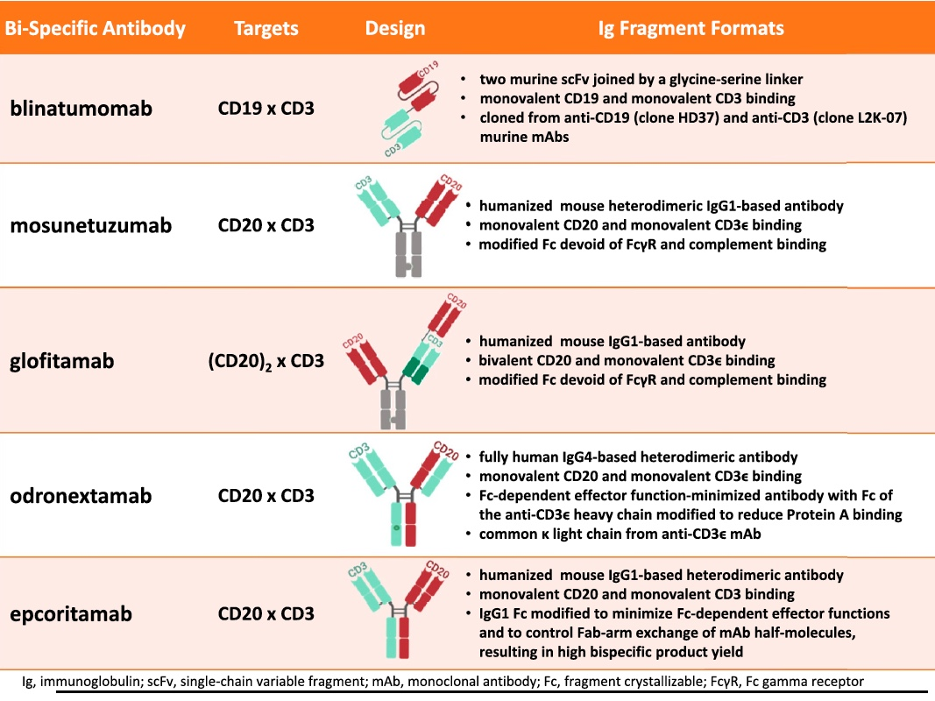
Structure of Select Bispecific Antibodies
Schuster SJ. Hematol Oncol 2021;39(S1):113-16.

Slide 55
Agenda
Introduction
Module 1: Biology of Chronic Lymphocytic Leukemia (CLL)
Module 2: Venetoclax-Based Up-Front Treatment for CLL
Module 3: BTK Inhibition Alone or in Combination with Venetoclax for CLL
Module 4: Bispecific Antibodies as a Treatment Option for Non-Hodgkin Lymphoma
Module 5: Bispecific Antibodies in the Management of Follicular Lymphoma
Module 6: Bispecific Antibodies for the Treatment of Diffuse Large B-Cell Lymphoma
Module 7: Practical Considerations and Tolerability of Bispecific Antibodies

Slide 56
Bispecific Antibodies in the Management of Follicular Lymphoma (FL)
Dr Allan
New York, New York
Dr Kahl
St Louis, Missouri
Frequency, depth and durability of responses to mosunetuzumab in patients with R/R FL
Recent FDA approval of mosunetuzumab for patients with FL after 2 or more lines of systemic therapy
Optimal integration of mosunetuzumab into FL treatment algorithms
Available data and ongoing research with other CD20 x CD3 bispecific antibodies for FL, such as epcoritamab, glofitamab and odronextamab

Slide 57
Mosunetuzumab
Mechanism of action
Bispecific CD20-directed CD3 T-cell engager
Indication
For patients with relapsed or refractory FL after 2 or more lines of systemic therapy
Recommended administration
Intravenous infusion
Key issues
Boxed warning for serious or life-threatening CRS; warnings and precautions include neurologic toxicity, infections, cytopenias and tumor flare
Mosunetuzumab package insert, 12/2022.

Slide 58
Mosunetuzumab: Mechanism of Action
Bartlett NL et al. ASH 2022;Abstract 610.

Slide 59
Agenda
Introduction
Module 1: Biology of Chronic Lymphocytic Leukemia (CLL)
Module 2: Venetoclax-Based Up-Front Treatment for CLL
Module 3: BTK Inhibition Alone or in Combination with Venetoclax for CLL
Module 4: Bispecific Antibodies as a Treatment Option for Non-Hodgkin Lymphoma
Module 5: Bispecific Antibodies in the Management of Follicular Lymphoma
Module 6: Bispecific Antibodies for the Treatment of Diffuse Large B-Cell Lymphoma
Module 7: Practical Considerations and Tolerability of Bispecific Antibodies

Slide 60
Bispecific Antibodies in the Management of Diffuse Large B-Cell Lymphoma (DLBCL)
Dr Allan
New York, New York
Dr Kahl
St Louis, Missouri
Pivotal clinical trial results with glofitamab and with epcoritamab for multiregimen-relapsed DLBCL
FDA-approved indications for glofitamab and epcoritamab in patients with DLBCL
Optimal sequencing of bispecific antibodies relative to other available therapies for DLBCL; patient and disease-related factors

Slide 61
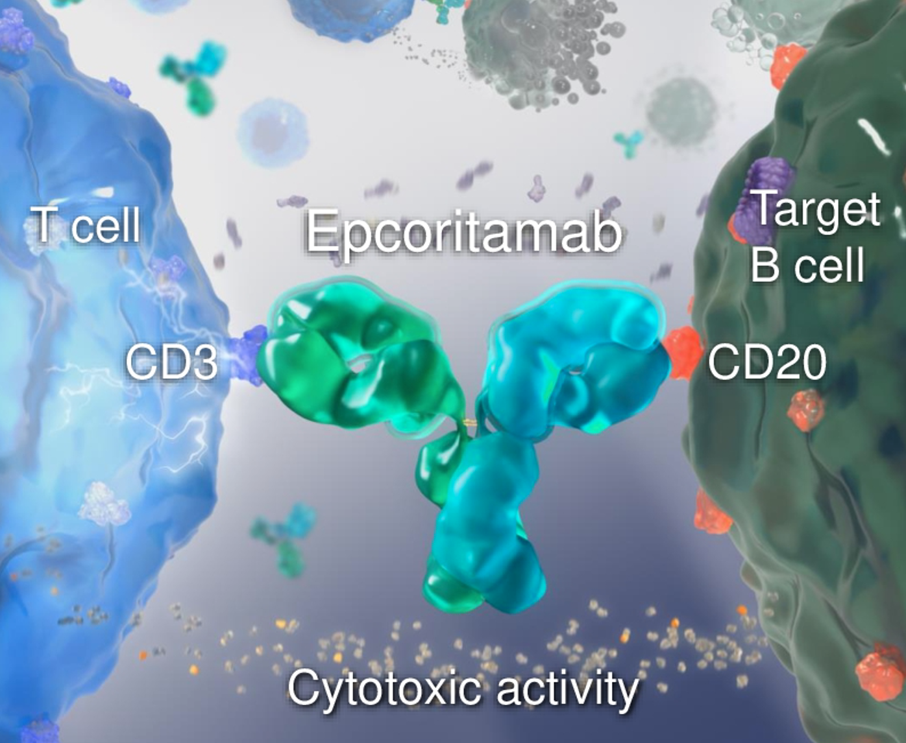
Epcoritamab: Mechanism of Action of Subcutaneous Bispecific Antibody
Falchi L et al. ASCO 2022;Abstract 7524.

Slide 62
Epcoritamab
Mechanism of action
Bispecific CD20-directed CD3 T-cell engager
Indication
For patients with relapsed or refractory DLBCL not otherwise specified, including DLBCL arising from indolent lymphoma, and high-grade B-cell lymphoma after 2 or more lines of systemic therapy
Recommended administration
Subcutaneous injection
Key issues
Boxed warning for serious or life-threatening CRS and ICANS (immune effector cell-associated neurotoxicity syndrome); warnings and precautions include infections, cytopenias and embryo-fetal toxicity
Epcoritamab package insert, 5/2023.

Slide 63
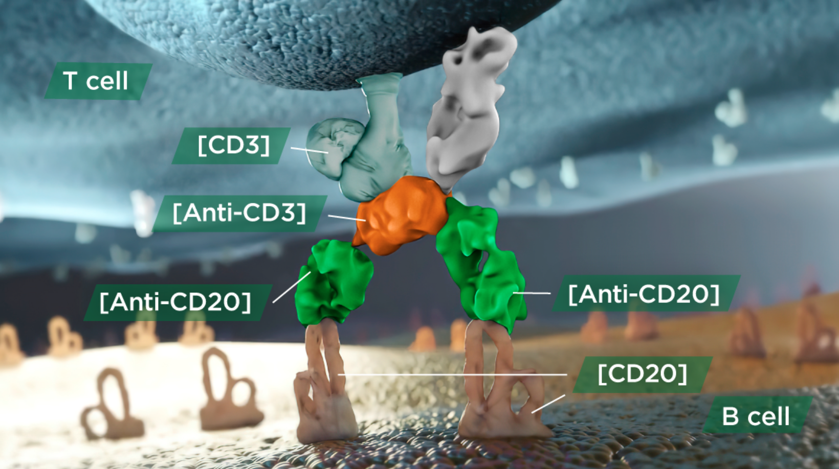
Glofitamab: Mechanism of Action
https://www.columvi-hcp.com/about/how-columvi-works.html.

Slide 64
Glofitamab
Mechanism of action
Bispecific CD20-directed CD3 T-cell engager
Indication
For patients with relapsed or refractory DLBCL not otherwise specified or large B-cell lymphoma arising from FL, after 2 or more lines of systemic therapy
Recommended administration
Intravenous infusion
Key issues
Boxed warning for serious or fatal CRS; warnings and precautions include neurologic toxicity, serious infections, tumor flare and embryo-fetal toxicity
Glofitamab package insert, 6/2023.

Slide 65
Glofitamab: Background and Mechanism of Action
Dickinson M et al. ASCO 2022;Abstract 7500; EHA 2022;Abstract S220.

Slide 66
Glofitamab Meets Primary Endpoint of Overall Survival for Relapsed or Refractory DLBCL in Phase III STARGLO Study Press Release: April 14, 2024
“The Phase III STARGLO study met its primary endpoint of overall survival.
The study demonstrated that people with relapsed or refractory (R/R) diffuse large B-cell lymphoma (DLBCL), who have received at least one prior line of therapy and are not candidates for autologous stem cell transplant, lived longer when treated with glofitamab-gxbm in combination with gemcitabine and oxaliplatin (GemOx) versus rituximab in combination with GemOx.
Safety of the combination appeared consistent with the known safety profiles of the individual medicines. The data will be submitted to health authorities and shared at an upcoming medical meeting.”
https://www.gene.com/media/press-releases/15021/2024-04-14/genentechs-columvi-meets-primary-endpoin

Slide 67
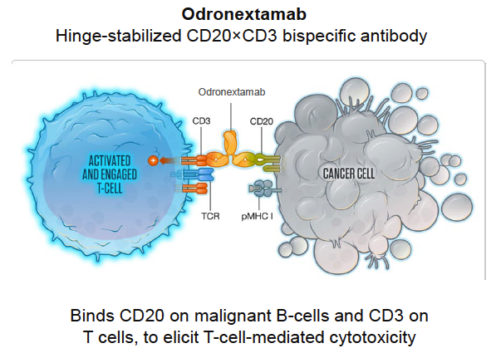
Odronextamab: Mechanism of Action
Kim TM et al. ASH 2022;Abstract 949.

Slide 68
Odronextamab
Mechanism of action
Bispecific antibody directed against CD20 on B cells and CD3 on T cells
Indication
Investigational
Key trial data
Phase II ELM-2 study evaluating odronextamab for patients with relapsed or refractory DLBCL
Kim WS et al. ASH 2022;Abstract 444.

Slide 69
FDA Issues Complete Response Letters for Odronextamab for R/R FL and R/R DLBCL Press Release: March 25, 2024
“The US Food and Drug Administration (FDA) has issued Complete Response Letters (CRLs) for the Biologics License Application (BLA) for odronextamab in relapsed/refractory (R/R) follicular lymphoma (FL) and in R/R diffuse large B-cell lymphoma (DLBCL), each after two or more lines of systemic therapy. The only approvability issue is related to the enrollment status of the confirmatory trials. The CRLs – one for R/R FL and one for R/R DLBCL – did not identify any approvability issues with the odronextamab clinical efficacy or safety, trial design, labeling or manufacturing.
[The manufacturer] has been actively enrolling patients in multiple Phase 3 trials for odronextamab as part of the OLYMPIA program – one of the largest clinical programs in lymphoma. As the OLYMPIA program is intended to change the treatment paradigm of several B-cell non-Hodgkin lymphoma subtypes – including in earlier lines of therapy – in agreeing to the program, the FDA required that the trials include both dose-finding and confirmatory portions. Enrollment in the dose-finding portion has begun, but the CRLs indicate that the confirmatory portions of these trials should be underway and that the timelines to completion be agreed prior to resubmission. [The company] is committed to working closely with the FDA and investigators to bring odronextamab to patients with R/R FL and R/R DLBCL as quickly as possible. [The company] plans on sharing updates on enrollment and regulatory timelines later this year.
Regulatory review of odronextamab remains ongoing by the European Medicines Agency (EMA) for the treatment of R/R DLBCL and R/R FL. In the European Union, odronextamab was granted Orphan Drug Designation in DLBCL and FL.”
https://investor.regeneron.com/news-releases/news-release-details/regeneron-provides-update-biologics-license-application

Slide 70
Agenda
Introduction
Module 1: Biology of Chronic Lymphocytic Leukemia (CLL)
Module 2: Venetoclax-Based Up-Front Treatment for CLL
Module 3: BTK Inhibition Alone or in Combination with Venetoclax for CLL
Module 4: Bispecific Antibodies as a Treatment Option for Non-Hodgkin Lymphoma
Module 5: Bispecific Antibodies in the Management of Follicular Lymphoma
Module 6: Bispecific Antibodies for the Treatment of Diffuse Large B-Cell Lymphoma
Module 7: Practical Considerations and Tolerability of Bispecific Antibodies

Slide 71
Practical Considerations with the Use of Bispecific Antibodies
Dr Allan
New York, New York
Dr Kahl
St Louis, Missouri
Routes of administration and step-up dosing schedules of various bispecific antibodies
Recommended premedication and prophylaxis for patients with NHL about to begin treatment with bispecific antibodies
Educating patients about the need for hospitalization with specific bispecific antibody therapies; timing and duration of hospitalization
Anticipated duration of treatment with bispecific antibody therapy

Slide 72
Cytokine Release Syndrome (CRS) and Neurotoxicity with Bispecific Antibodies
Dr Allan
New York, New York
Dr Kahl
St Louis, Missouri
Incidence and severity of CRS and neurotoxicity with bispecific antibody therapy in patients with NHL
Time course for and common signs and symptoms of CRS and neurotoxicity
Optimal monitoring of patients for early detection of CRS and neurotoxicity
Guideline-endorsed approaches to the mitigation and management of CRS and neurotoxicity

Slide 73
Other Tolerability and Toxicity Issues with Bispecific Antibody Therapy
Dr Allan
New York, New York
Dr Kahl
St Louis, Missouri
Incidence of cytopenias, infections and tumor flare with bispecific antibody therapy in pivotal clinical trials
Spectrum, frequency and severity of other common adverse events with bispecific antibodies among patients with NHL, such as fatigue, rash, musculoskeletal pain and laboratory anomalies
Counseling patients about the importance of monitoring for and reporting symptoms of common and less common adverse events with bispecific antibodies
Strategies to manage side effects of bispecific antibodies in routine practice; appropriate thresholds for dose modification and treatment discontinuation

Slide 74
Mollie Moran, APRN-CNP, AOCNP
What I tell my patients about logistical considerations with bispecific antibodies, such as premedications/prophylaxis, the need for hospitalization, step-up dosing and duration of treatment

Slide 75
Robin Klebig, MSN, APRN, CNP, AOCNP
What I tell my patients about CRS and neurotoxicity associated with bispecific antibodies

Slide 76
Mollie Moran, APRN-CNP, AOCNP
What I tell my patients about other toxicities associated with bispecific antibodies, such as cytopenias and infections, tumor flare, fatigue, rash, musculoskeletal pain and laboratory anomalies

Slide 77
Consulting Nursing Faculty Comments
Entering the oncology field and managing burnout
Sonia Glennie, ARNP, MSN, OCN

Slide 78
Consulting Nursing Faculty Comments
Choosing oncology work over other clinical roles
Sonia Glennie, ARNP, MSN, OCN

