Slide 1
Ovarian Cancer
Friday, April 26, 2024
6:00 PM – 7:30 PM
What I Tell My Patients:
Integrating New Research Information
into Current Clinical Care
A Complimentary NCPD Hybrid Symposium Series Held During the 49th Annual ONS Congress
Faculty
Courtney Arn, CNP
Floor J Backes, MD
Kathleen N Moore, MD, MS
Jaclyn Shaver, MS, APRN, CNP, WHNP
Moderator
Neil Love, MD

Slide 2





Faculty
Kathleen N Moore, MD, MS
Deputy Director
Associate Director, Clinical Research
Virginia Kerley Cade Chair
in Developmental Therapeutics
Co-Director, Cancer Therapeutics Program
OU Health Stephenson Cancer Center
Associate Director, GOG Partners
Board of Directors, GOG Foundation
Oklahoma City, Oklahoma
Courtney Arn, CNP
The James Cancer Hospital
and Solove Research Institute
The Ohio State University
Columbus, Ohio
Floor J Backes, MD
Professor
Fellowship Director
Division of Gynecologic Oncology
Department of Obstetrics and Gynecology
The Ohio State University College of Medicine
The James Cancer Hospital and Solove
Research Institute
Columbus, Ohio
Jaclyn Shaver, MS, APRN, CNP, WHNP
Section of Gynecologic Oncology
OU Health Stephenson Cancer Center
Oklahoma City, Oklahoma
Moderator
Neil Love, MD
Research To Practice
Miami, Florida

Slide 3
Ms Arn — Disclosures
Speakers Bureaus | AstraZeneca Pharmaceuticals LP, Eisai Inc, Genmab US Inc, ImmunoGen Inc, Merck, Seagen Inc

Slide 4
Dr Backes — Disclosures
Advisory Committees and Consulting Agreements | AstraZeneca Pharmaceuticals LP, BioNTech SE, Clovis Oncology, Daiichi Sankyo Inc, Eisai Inc, EMD Serono Inc, GSK, ImmunoGen Inc, Merck

Slide 5
Dr Moore — Disclosures
Advisory Committees | Aadi Bioscience, Aravive Inc, AstraZeneca Pharmaceuticals LP, Blueprint Medicines, Caris Life Sciences, Clovis Oncology, Duality Biologics, Eisai Inc, Genentech, a member of the Roche Group, GSK, ImmunoGen Inc, Janssen Biotech Inc, Lilly, Merck, Mersana Therapeutics Inc, Myriad Genetic Laboratories Inc, Panavance Therapeutics, Regeneron Pharmaceuticals Inc, VBL Therapeutics, Verastem Inc, Zentalis Pharmaceuticals
Consulting Agreements | Aadi Bioscience, Caris Life Sciences, Duality Biologics, Eisai Inc, Mersana Therapeutics Inc, Regeneron Pharmaceuticals Inc
Contracted Research | Genentech, a member of the Roche Group, GSK, Lilly, PTC Therapeutics

Slide 6
Ms Shaver — Disclosures
No relevant conflicts of interest to disclose

Slide 7
Commercial Support
This activity is supported by educational grants from AstraZeneca Pharmaceuticals LP, GSK, and Merck.
Research To Practice NCPD Planning Committee Members,
Staff and Reviewers
Planners, scientific staff and independent reviewers for Research To Practice have no relevant conflicts of interest to disclose.

Slide 8
This educational activity contains discussion of
non-FDA-approved uses of agents and regimens. Please refer to official prescribing information for each product for approved indications.

Slide 9
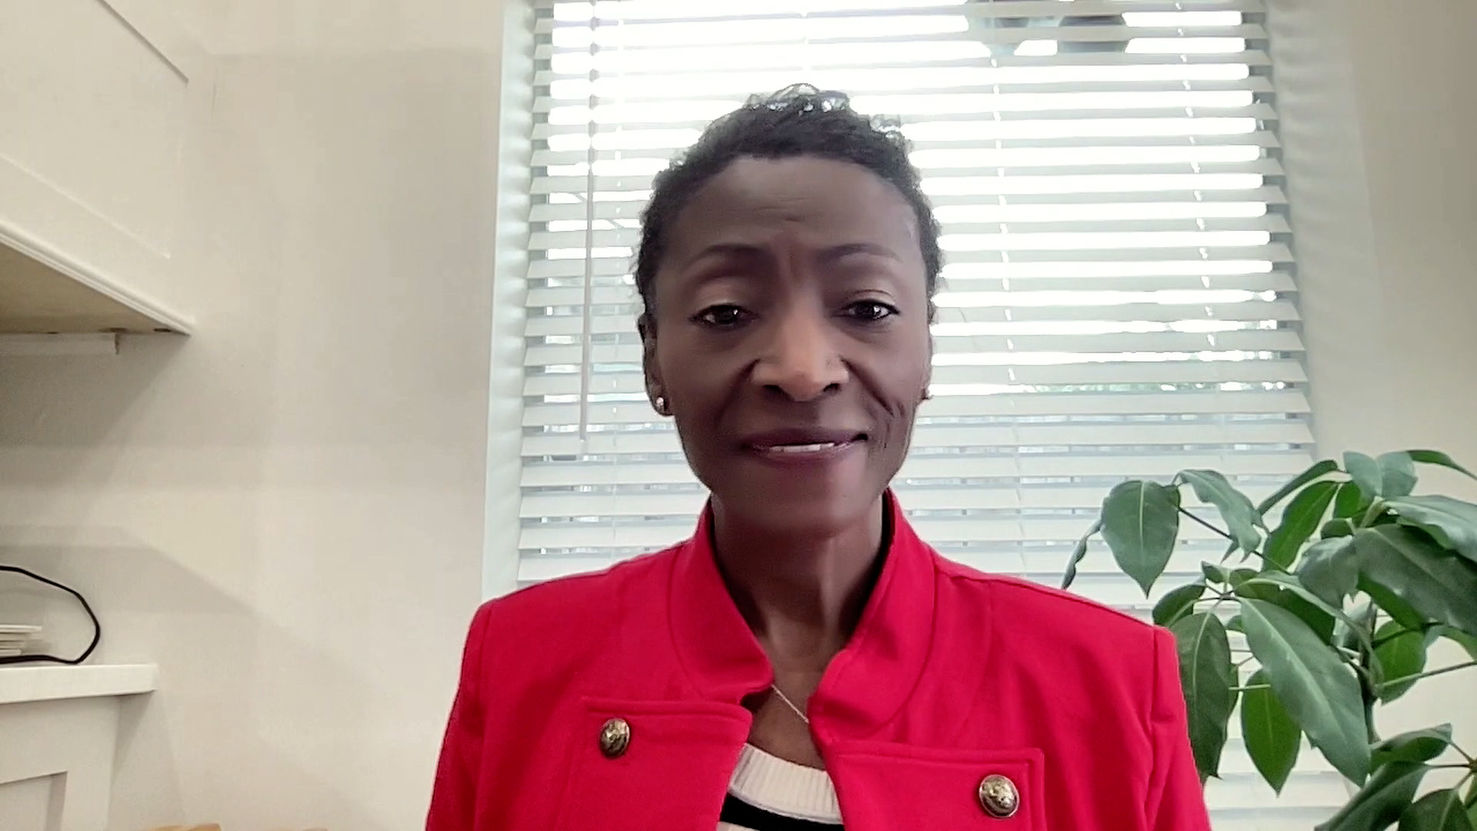

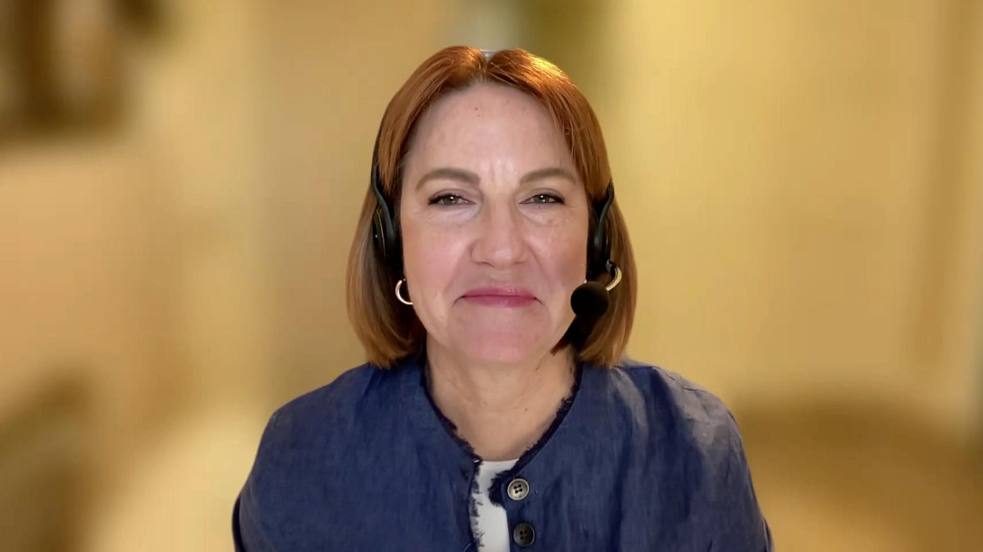






Consulting Nurse Faculty
Jacqueline Broadway-Duren, PhD, DNP, APRN, FNP-BC
The University of Texas
MD Anderson Cancer Center
Houston, Texas
Jessica Mitchell, APRN, CNP, MPH
Mayo Clinic College of Medicine and Science
Rochester, Minnesota
Kathleen D Burns, RN, MSN, AGACNP-BC, OCN
City of Hope Comprehensive
Cancer Center
Duarte, California
Tiffany A Richards, PhD, ANP-BC, AOCNP
The University of Texas
MD Anderson Cancer Center
Houston, Texas
Sonia Glennie, ARNP, MSN, OCN
Swedish Cancer Institute Center
for Blood Disorders
Seattle, Washington
Kimberly A Spickes, MNSc, RN, APRN, OCN, ACNP-BC
University of Arkansas for Medical Sciences
Little Rock, Arkansas
Amy Goodrich, CRNP
The Sidney Kimmel Comprehensive Cancer Center
Baltimore, Maryland
Ronald Stein, JD, MSN, NP-C, AOCNP
USC Norris Comprehensive Cancer Center
Los Angeles, California
https://www.ResearchToPractice.com/ONS2024Clips

Slide 10
Agenda
Module 1: Newly Diagnosed Advanced Ovarian Cancer
Module 2: Role of PARP Inhibitors in the Management of Relapsed/Refractory Ovarian Cancer
Module 3: Targeted Therapy for Patients with Advanced Ovarian Cancer

Slide 11
Agenda
Module 1: Newly Diagnosed Advanced Ovarian Cancer
Module 2: Role of PARP Inhibitors in the Management of Relapsed/Refractory Ovarian Cancer
Module 3: Targeted Therapy for Patients with Advanced Ovarian Cancer

Slide 12
The Incidence, Pathogenesis and Prognosis of Ovarian Cancer (OC); Genetic Testing in Newly Diagnosed Advanced OC
Dr Backes
Columbus, Ohio
Dr Moore
Oklahoma City, Oklahoma
Incidence of OC in the United States and the rest of the world
Various histologic subtypes of OC and implications for prognosis and treatment
Survival rates associated with various stages of OC
Rationale for stable OC incidence yet rising number of patients with the disease; contribution of the availability of novel therapies to this phenomenon
Similarities and differences between germline and somatic genetic mutations

Slide 13
The Incidence, Pathogenesis and Prognosis of Ovarian Cancer (OC); Genetic Testing in Newly Diagnosed Advanced OC
Dr Backes
Columbus, Ohio
Dr Moore
Oklahoma City, Oklahoma
Incidence and clinical significance of BRCA mutations and other germline or somatic alterations in OC, such as PALB2, ATM and RAD51C/D
Definition and frequency of homologous recombination deficiency (HRD) in OC; rationale for determining HRD status and available testing methodologies
Current roles of next-generation sequencing and germline sequencing in advanced OC; similarities and differences among available genetic testing platforms
Purpose and potential benefits of genetic counseling after a diagnosis of OC

Slide 14
The Typical Course of Advanced Ovarian Cancer
Patients for whom platinum is an option, formerly ‘Platinum-Sensitive’
Progression >6 months after completion
of platinum-based chemotherapy
Surgery (primary or IDS)
+ primary or adjuvant chemotherapy
+/- bevacizumab
Follow-up
Second
Response/
Disease Stabilisation
Relapse/
Progression
(100%)
First-Line
Treatment
Stage III, IV
First Response*
Relapse/
Progression
(70%-80%)
Patients for whom platinum is not an option, formerly ‘Platinum-Resistant’
Progression <6 months after completion of
platinum-based chemotherapy
*Around 5% of patients are primary treatment-refractory, meaning disease progressed during therapy or within 4 weeks after the last dose.
IDS=interval debulking surgery.
1. Ledermann JA et al. Ann Oncol. 2013;24(Suppl 6):vi24-vi32. 2. Giornelli GH. Springerplus. 2016;5(1):1197. 3. Pignata S et al. Ann Oncol. 2017;28(suppl_8):viii51-viii56. 4. du Bois A et al. Cancer. 2009;115(6):1234-1244. 5. Wilson MK et al. Ann Oncol. 2017;28(4):727-732.
Courtesy of Kathleen N Moore, MD, MS

Slide 15
Jaclyn Shaver, MS, APRN, CNP, WHNP
What I tell my patients with newly diagnosed advanced ovarian cancer about what to expect from initial treatment (surgery and/or chemotherapy) and the importance of genetic testing

Slide 16
The Role of PARP Inhibitor Maintenance in Newly Diagnosed Advanced OC
Dr Backes
Columbus, Ohio
Dr Moore
Oklahoma City, Oklahoma
Mechanism of antitumor activity of PARP inhibitors and rationale for their use as maintenance therapy for patients with OC
Similarities and differences between various PARP inhibitors approved in OC
Long-term findings from Phase III studies, such as SOLO-1, PAOLA-1, PRIMA and PRIME, supporting the use of olaparib, niraparib and olaparib/bevacizumab maintenance for patients with newly diagnosed OC
Clinical, biological and practical factors affecting the selection of up-front olaparib, niraparib or olaparib/bevacizumab maintenance
Early findings with niraparib/bevacizumab maintenance after front-line platinum-based chemotherapy/bevacizumab; ongoing evaluation and potential clinical role

Slide 17
Courtney Arn, CNP
What I tell my patients with advanced ovarian cancer who are about to begin maintenance treatment with a PARP inhibitor with or without bevacizumab

Slide 18


Pivotal Trials and Regulatory Milestones in First-Line Maintenance Therapy for Advanced Ovarian Cancer
PRIMA⁴
Niraparib
PAOLA-1⁵
Olaparib + bevacizumab
GOG-0218/ICON7^{1,2}
Bevacizumab
SOLO-1³
Olaparib
BRCAm
VELIA⁶
Veliparib + Pt-based chemotherapy
2011
2018
2019
2020
Regulatory
approvals:
Niraparib^{11,12}
Olaparib + bevacizumab^{13,14}
Bevacizumab⁷
Olaparib⁹
Olaparib¹⁰
Bevacizumab⁸
Dates shown indicate the year of the publication of the pivotal studies and regulatory approvals for these compounds.
1. Burger RA et al. N Engl J Med 2011;365:2473. 2. Perren TJ et al. N Engl J Med 2011;365:2484. 3. Moore K et al. N Engl J Med 2018;379:2495. 4. González-Martín A et al. N Engl J Med. 2019;381:239.
5. Ray-Coquard I et al. N Engl J Med 2019;381:2416. 6. Coleman RL et al. N Engl J Med 2019;381:2403. 7. European Medicines Agency. Published September 22, 2011. Accessed June 7, 2021.
8. F. Hoffmann-La Roche Ltd. Published June 13, 2018. Accessed June 7, 2021. 9. FDA. Published December 26, 2018. Accessed June 7, 2021. 10. EMA. Published April 26, 2019. Accessed June 7, 2021. 11. GSK. Published April 29, 2020. Accessed June 7, 2021. 12. GSK. Published October 29, 2020. Accessed June 7, 2021. 13. FDA. Published May 11, 2020. Accessed June 7, 2021. 14. EMA. Published September 17, 2020. Accessed June 7, 2021.
Content Courtesy of Kathleen N Moore, MD, MS
Notes:
Note for reviewers:
URL access dates have been updated- otherwise no changes to reference block
Note for reviewers: This is an approved slide from ESMO Fall 2021 (NX-GBL-NRP-PPTX-210002)
Slide content is unchanged from previous version
1. Burger 2011/
p2474/c1/¶4/L1-3; c2/¶1/L8-14
2. Perren 2011/
p2485/c1/¶3/L1-8
Bevacizumab (EU)
7. Avastin EMA CHMP 2011/p1/
¶1,2
Bevacizumab (US)
8. Roche Press Release 2018/p1/
Date; ¶1
Olaparib (US)
9. FDA Lynparza Press Release 2018/p1/¶1
Olaparib (EU)
10. Lynparza EMA CHMP 2019/p1/
¶1,2, Bullet 1
Niraparib (US/EU)
11. GSK FDA Approval Press Release 2020/p1/
Date; p2/¶1/L1-7
12. GSK EMA Approval Press Release 2020/p1/
Date; ¶1; p2/¶1
Olaparib + bev (US/EU)
13. FDA Olaparib + bev Approval Press Release 2020/p1/
¶1
14. Lynparza EMA CHMP 2020/p1/
¶1,2; Bullet 3

Slide 19
Select Phase III First-Line PARP Inhibitor Maintenance Trials
Study design | SOLO-1¹ (N = 391) | PAOLA-1² (N = 806) | PRIMA³ (N = 733) | PRIME⁴ (N = 384)
Treatment arms vs placebo | Olaparib | Bevacizumab ± olaparib | Niraparib | Niraparib
Patient population | BRCA mutation | All-comers | All-comers | All-comers
Treatment duration | 24 months | 15 months for bev 24 months for olaparib | 36 months or until PD | 36 months
Median PFS | 56 vs 13.8 months HR: 0.33 | 22.1 vs 16.6 months HR: 0.59 | 22.1 vs 10.9 months HR: 0.40 | 24.8 vs 8.3 months HR: 0.45
bev = bevacizumab; PD = disease progression; PFS = progression-free survival
¹ Banerjee S et al. Lancet Oncol 2021;22:1721-31. ² Ray-Coquard I et al. Ann Oncol 2023;34(8):681-92. ³ González-Martín A et al. Eur J Cancer 2023;189:112908. ⁴ Li N et al. JAMA Oncol. 2023;[Online ahead of print].

Slide 20
The Potential Role of PARP Inhibitors in Combination with Anti-PD-1/PD-L1 Antibodies in Advanced OC Management
Dr Backes
Columbus, Ohio
Dr Moore
Oklahoma City, Oklahoma
Historical data with immune checkpoint inhibitors for OC
Biological rationale for combining PARP inhibitors with anti-PD-1/PD-L1 antibodies for OC
Available early-phase research results with PARP inhibitors with anti-PD-1/PD-L1 antibodies with or without bevacizumab for advanced OC
Recent findings from the Phase III DUO-O trial evaluating up-front durvalumab with platinum-based chemotherapy/bevacizumab followed by durvalumab/bevacizumab/olaparib as maintenance therapy for advanced OC; clinical implications
Other ongoing Phase III research evaluating PARP inhibitors in combination with
anti-PD-1/PD-L1 antibodies for OC

Slide 21
Jaclyn Shaver, MS, APRN, CNP, WHNP
What I tell my patients with advanced ovarian cancer who are being considered for or enrolling on a clinical trial with a PARP inhibitor in combination with an anti-PD-1/PD-L1 antibody with or without bevacizumab

Slide 22
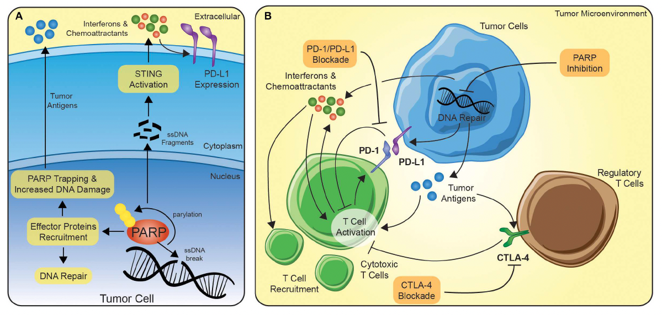
Potential Synergy Between PARP Inhibition and Immune Checkpoint Blockade
Vikas P et al. Front Oncol 2020;10:570.

Slide 23
Side Effects Associated with PARP Inhibitors
Dr Backes
Columbus, Ohio
Dr Moore
Oklahoma City, Oklahoma
Spectrum, incidence and severity of common class- and agent-specific toxicities associated with PARP inhibitors in patients with OC
Optimal monitoring and management paradigm for common PARP inhibitor-related toxicities
Long-term risk of acute myeloid leukemia/myelodysplastic syndromes with PARP inhibitor therapy
Role of switching to an alternative PARP inhibitor for patients who are experiencing unacceptable toxicity

Slide 24
Dosing, Adherence and Other Issues with PARP Inhibitors for OC
Dr Backes
Columbus, Ohio
Dr Moore
Oklahoma City, Oklahoma
Initial dosing and appropriate dose-modification strategies for approved PARP inhibitors
Optimal duration of PARP inhibitors in the maintenance setting
Importance of adherence for patients receiving long-term oral medications, including PARP inhibitors; strategies to encourage and assess adherence
Challenges of polypharmacy and the potential for drug-drug interactions between approved PARP inhibitors and other medications and supplements

Slide 25
Consulting Nursing Faculty Comments
Patient adherence to therapy; dose modifications
Kimberly A Spickes, MNSc, RN, APRN, OCN, ACNP-BC

Slide 26
Agenda
Module 1: Newly Diagnosed Advanced Ovarian Cancer
Module 2: Role of PARP Inhibitors in the Management of Relapsed/Refractory Ovarian Cancer
Module 3: Targeted Therapy for Patients with Advanced Ovarian Cancer

Slide 27
PARP Inhibitors for Relapsed/Refractory
(R/R) OC
Dr Backes
Columbus, Ohio
Dr Moore
Oklahoma City, Oklahoma
Defining “platinum-sensitive” and “platinum-resistant” in relapsed OC
Long-term follow-up from pivotal trials evaluating niraparib, olaparib and rucaparib for patients with platinum-sensitive and platinum-resistant recurrent OC
Rationale for recent withdrawals of various indications for olaparib, niraparib and rucaparib, and implications for current management of R/R disease
Key data documenting the clinical utility of rechallenge with a PARP inhibitor for patients who have experienced disease progression on or after prior PARP inhibitor therapy; current role in practice

Slide 28
Courtney Arn, CNP
What I tell my patients with relapsed/refractory ovarian cancer about goals of treatment

Slide 29
Voluntary Withdrawals of Late-Line Indications for PARP Inhibitors
Niraparib – September 14, 2022
The indication for niraparib has been voluntarily withdrawn for the treatment of advanced ovarian, fallopian tube or primary peritoneal cancer in adult patients who have received 3 or more prior chemotherapy regimens and whose cancer is associated with homologous recombination deficiency status. The decision was made in consultation with the US FDA and based on a totality of information from PARP inhibitors for ovarian cancer in the late line treatment setting.
Olaparib – August 26, 2022
The indication for olaparib has been voluntarily withdrawn for the treatment of deleterious or suspected deleterious gBRCAm advanced ovarian cancer in adult patients who have received 3 or more prior lines of chemotherapy. The decision was made in consultation with the US FDA after a recent subgroup analysis indicated a potential detrimental effect on overall survival for olaparib compared to the chemotherapy control arm in the subgroup of patients who had received 3 or more prior lines of chemotherapy in the randomized Phase III study SOLO-3.
Rucaparib – June 10, 2022
The indication for rucaparib has been voluntarily withdrawn for the treatment of BRCA-mutated ovarian cancer after 2 or more chemotherapies. The withdrawal is based on discussions with the US FDA following submission of overall survival data from the ARIEL4 trial, which demonstrated an increased risk of death in participants with BRCA-mutated ovarian cancer treated with rucaparib after 2 or more therapies.
https://www.federalregister.gov/d/2024-06299; https://medinfo.gsk.com/5f95dbd7-245e-4e65-9f36-1a99e28e5bba/57e2a3fa-7b9b-432f-a220-5976a509b534/57e2a3fa-7b9b-432f-a220-5976a509b534_viewable_rendition__v.pdf?medcommid=REF--ALL-004447; https://www.hayesinc.com/news/market-withdrawal-rubraca-for-third-line-ovarian-cancer-indication/

Slide 30
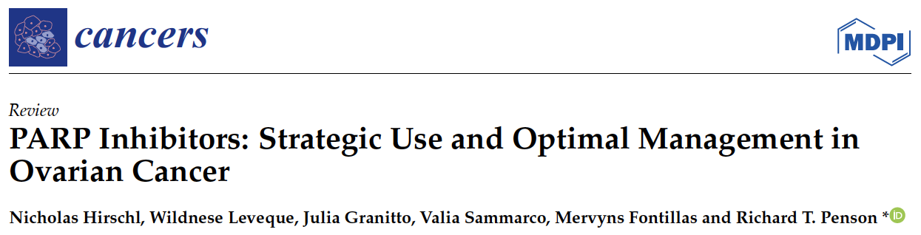
Cancers (Basel) 2024 February 25;16(5):932.

Slide 31
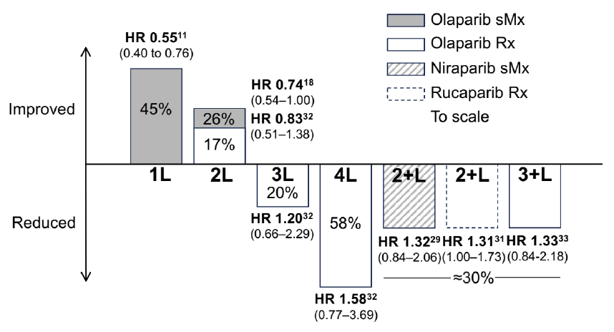
Overall Survival Impact of PARP Inhibition:
Hazard Ratios Translated into Percent Change in OS
HR = hazard ratio; sMx = switch maintenance; Rx = treatment; 1L = first line; 2L = second line; 3L = third line; 4L = fourth line; 2+L = two or more prior lines; 3+L = three or more prior lines
Hirschl N et al. Cancers (Basel) 2024 February 25;16(5):932.

Slide 32
Agenda
Module 1: Newly Diagnosed Advanced Ovarian Cancer
Module 2: Role of PARP Inhibitors in the Management of Relapsed/Refractory Ovarian Cancer
Module 3: Targeted Therapy for Patients with Advanced Ovarian Cancer

Slide 33
The Incidence and Management of HER2-Positive OC
Dr Backes
Columbus, Ohio
Dr Moore
Oklahoma City, Oklahoma
Frequency of HER2 expression and biological rationale for targeting HER2 in advanced OC
Structural components and mechanism of antitumor activity of trastuzumab deruxtecan (T-DXd)
Outcomes observed in the cohort of patients with OC in the Phase II DESTINY-PanTumor02 trial of T-DXd for pretreated HER2-expressing solid tumors
Current nonresearch role, if any, of T-DXd in treatment for patients with HER2-positive advanced OC
Recent tumor-agnostic approval of T-DXd for HER2-positive solid tumors

Slide 34
Jaclyn Shaver, MS, APRN, CNP, WHNP
What I tell my patients about HER2 testing and potential therapy with trastuzumab deruxtecan

Slide 35
FDA Grants Accelerated Approval to Trastuzumab Deruxtecan for Unresectable or Metastatic HER2-Positive Solid Tumors
Press Release: April 5, 2024
“On April 5, 2024, the Food and Drug Administration granted accelerated approval to fam-trastuzumab deruxtecan-nxki for adult patients with unresectable or metastatic HER2-positive (IHC3+) solid tumors who have received prior systemic treatment and have no satisfactory alternative treatment options. Efficacy was evaluated in 192 adult patients with previously treated unresectable or metastatic HER2-positive (IHC 3+) solid tumors who were enrolled in one of three multicenter trials: DESTINY-PanTumor02 (NCT04482309), DESTINY-Lung01 (NCT03505710), and DESTINY-CRC02 (NCT04744831). All three trials excluded patients with a history of interstitial lung disease (ILD)/pneumonitis requiring treatment with steroids or ILD/pneumonitis at screening and clinically significant cardiac disease. Patients were also excluded for active brain metastases or ECOG performance status >1. Treatment was administered until disease progression, death, withdrawal of consent, or unacceptable toxicity.
The recommended fam-trastuzumab deruxtecan-nxki dosage for this indication is 5.4 mg/kg given as an intravenous infusion once every 3 weeks (21-day cycle) until disease progression or unacceptable toxicity. This tumor agnostic indication is approved under accelerated approval based on objective response rate and duration of response. Continued approval for this indication may be contingent upon verification and description of clinical benefit in a confirmatory trial(s).”
https://www.fda.gov/drugs/resources-information-approved-drugs/fda-grants-accelerated-approval-fam-trastuzumab-deruxtecan-nxki-unresectable-or-metastatic-her2

Slide 36
The Current Role of Mirvetuximab Soravtansine for OC Treatment
Dr Backes
Columbus, Ohio
Dr Moore
Oklahoma City, Oklahoma
Frequency of and scientific rationale for targeting folate receptor alpha (FRα) in OC
Mechanism of action and structural components of mirvetuximab soravtansine
Published research findings, such as SORAYA and MIRASOL, with mirvetuximab soravtansine for patients with FRα-high platinum-resistant OC
Recent FDA approval of mirvetuximab soravtansine; implications for biomarker assessment and current OC management
Ongoing studies of mirvetuximab soravtansine for platinum-sensitive advanced OC

Slide 37
Toxicities with Mirvetuximab Soravtansine
Dr Backes
Columbus, Ohio
Dr Moore
Oklahoma City, Oklahoma
Pathophysiology and incidence of the ocular toxicities observed with mirvetuximab soravtansine
Monitoring and management techniques for mirvetuximab soravtansine-related ocular events
Importance of collaboration with eye care specialists for patients receiving mirvetuximab soravtansine
Spectrum, frequency, severity and timing of other common toxicities reported with mirvetuximab soravtansine; optimal management approaches

Slide 38
Courtney Arn, CNP
What I tell my patients about the mechanism of action and side effects of mirvetuximab soravtansine

Slide 39
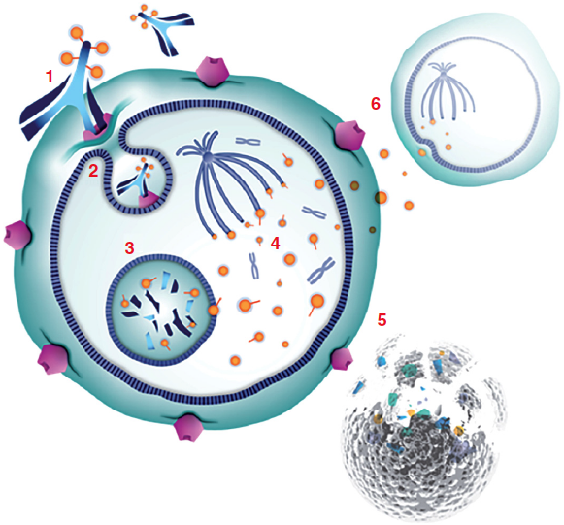
Mirvetuximab Soravtansine: Mechanism of Action
(1) Mirvetuximab soravtansine binds with high affinity to FRα expressed on the tumor cell surface
(2) The antibody-drug conjugate (ADC)/receptor complex becomes internalized via antigen-mediated endocytosis
(3) Lysosomal processing releases active DM4 catabolites from the ADC molecule
(4) These maytansinoid derivatives inhibit tubulin polymerization and microtubule assembly
(5) The potent antimitotic effects result in cell-cycle arrest and apoptosis
(6) Active metabolites can also diffuse into neighboring cells and induce further cell death — in other words, bystander killing
Moore K et al. Future Oncol 2018:14(2);123-36.

Slide 40
Mirvetuximab Soravtansine
Mechanism of action
Antibody-drug conjugate directed against folate receptor alpha (FRα)
Indication
For patients with FRα-positive, platinum-resistant epithelial ovarian, fallopian tube, or primary peritoneal cancer, who have received 1 to 3 prior systemic treatment regimens
Recommended dose
6 mg/kg adjusted ideal body weight administered as an IV infusion q3wk until disease progression or unacceptable toxicity
Key issues
Boxed warning for severe ocular toxicity
Mirvetuximab soravtansine package insert, 3/2024.

Slide 41
FDA Approves Mirvetuximab Soravtansine-Gynx for FRα-Positive, Platinum-Resistant Epithelial Ovarian, Fallopian Tube, or Primary Peritoneal Cancer
Press Release: March 22, 2024
“On March 22, 2024, the Food and Drug Administration approved mirvetuximab soravtansine-gynx for adult patients with FRα positive, platinum-resistant epithelial ovarian, fallopian tube, or primary peritoneal cancer, who have received one to three prior systemic treatment regimens.
Efficacy was evaluated in Study 0416 (MIRASOL, NCT04209855), a multicenter, open-label, active-controlled, randomized, two-arm trial in 453 patients with platinum-resistant epithelial ovarian, fallopian tube, or primary peritoneal cancer. Patients were permitted to receive up to three prior lines of systemic therapy. The trial enrolled patients whose tumors were positive for FRα expression as determined by the FOLR1 (FOLR1-2.1) RxDx Assay.
The major efficacy outcome measures were overall survival (OS), investigator-assessed progression-free survival (PFS) and confirmed overall response rate (ORR) per investigator assessment. PFS and ORR were evaluated according to RECIST, version 1.1.”
https://www.fda.gov/drugs/resources-information-approved-drugs/fda-approves-mirvetuximab-soravtansine-gynx-fra-positive-platinum-resistant-epithelial-ovarian

Slide 42
Consulting Nursing Faculty Comments
Spirituality and religion
Jessica Mitchell, APRN, CNP, MPH

Slide 43
Consulting Nursing Faculty Comments
Self-care and avoiding professional burnout
Kathleen D Burns, RN, MSN, AGACNP-BC, OCN

