Slide 1
Endometrial Cancer
Thursday, April 25, 2024
6:00 AM – 7:30 AM
What I Tell My Patients:
Integrating New Research Information
into Current Clinical Care
A Complimentary NCPD Hybrid Symposium Series Held During the 49th Annual ONS Congress
Faculty
Jennifer Filipi, MSN, NP
Kathryn M Lyle, MSN, WHNP-BC, AGNP-C
David M O’Malley, MD
Shannon N Westin, MD, MPH, FASCO, FACOG
Moderator
Neil Love, MD

Slide 2





Faculty
Jennifer Filipi, MSN, NP
Department of Gynecologic Oncology
Massachusetts General Hospital
Cancer Center
Boston, Massachusetts
Shannon N Westin, MD, MPH, FASCO, FACOG
Professor
Medical Director, Gynecologic Oncology Center
Director, Early Drug Development
Department of Gynecologic Oncology
and Reproductive Medicine
The University of Texas MD Anderson Cancer Center
Houston, Texas
Kathryn M Lyle, MSN, WHNP-BC, AGNP-C
Nurse Practitioner
Division of Gynecologic Oncology
The University of Alabama at Birmingham
Birmingham, Alabama
Moderator
Neil Love, MD
Research To Practice
Miami, Florida
David M O’Malley, MD
Director and Professor
Division of Gynecologic Oncology in Obstetrics
and Gynecology
John G Boutselis Chair in Gynecologic Oncology
The Ohio State University and The James Comprehensive Cancer Center
Columbus, Ohio

Slide 3
Ms Filipi — Disclosures
No relevant conflicts of interest to disclose

Slide 4
Ms Lyle— Disclosures
No relevant conflicts of interest to disclose

Slide 5
Dr O’Malley — Disclosures
Advisory Committees and Consulting Agreements (Personal Fees) | AbbVie Inc, Adaptimmune, Agenus Inc, Arcus Biosciences, Arquer Diagnostics, AstraZeneca Pharmaceuticals LP, Atossa Therapeutics, Cardiff Oncology, Celcuity, Clovis Oncology, Corcept Therapeutics, Duality Biologics, Eisai Inc, Elevar Therapeutics, Exelixis Inc, F Hoffmann-La Roche Ltd, Genelux Corporation, Genentech, a member of the Roche Group, GSK, ImmunoGen Inc, Imvax Inc, InterVenn Biosciences, InxMed, Iovance Biotherapeutics, Janssen Biotech Inc, Jazz Pharmaceuticals Inc, Laekna Therapeutics, Leap Therapeutics Inc, Luzsana Biotechnology, Merck, Mersana Therapeutics Inc, MSD, Myriad Genetic Laboratories Inc, Novartis, Novocure Inc, OncoC4, Onconova Therapeutics Inc, Regeneron Pharmaceuticals Inc, Replimune, Roche Diagnostics, R-Pharm US, Seagen Inc, Sorrento Therapeutics, Sumitomo Dainippon Pharma Oncology Inc, Sutro Biopharma, Tarveda Therapeutics, Toray Industries Inc, Trillium Therapeutics Inc, Umoja Biopharma, VBL Therapeutics, Verastem Inc, Vincerx Pharma, Xencor, Zentalis Pharmaceuticals
Contracted Research (Institution Received Funds) | AbbVie Inc, Advaxis Inc, Agenus Inc, Alkermes, Aravive Inc, Arcus Biosciences, AstraZeneca Pharmaceuticals LP, BeiGene Ltd, Bristol Myers Squibb, Clovis Oncology, Deciphera Pharmaceuticals Inc, Eisai Inc, EMD Serono Inc, Exelixis Inc, F Hoffmann-La Roche Ltd, Genentech, a member of the Roche Group, Genmab US Inc, GSK, ImmunoGen Inc, Incyte Corporation, Iovance Biotherapeutics, Karyopharm Therapeutics, Leap Therapeutics Inc, Merck, Mersana Therapeutics Inc, MSD, Novartis, Novocure Inc, OncoC4, OncoQuest Inc, Pfizer Inc, Predictive Oncology Inc, Prelude Therapeutics, Regeneron Pharmaceuticals Inc, Rubius Therapeutics, Seagen Inc, Sumitomo Dainippon Pharma Oncology Inc, Sutro Biopharma, Tesaro, A GSK Company, Verastem Inc
Nonrelevant Financial Relationships | GOG Foundation Inc, Ludwig Institute for Cancer Research Ltd, National Cancer Institute, NRG Oncology, RTOG, SWOG

Slide 6
Dr Westin — Disclosures
Consulting Agreements | AstraZeneca Pharmaceuticals LP, Caris Life Sciences, Clovis Oncology, Eisai Inc, EQRx, Genentech, a member of the Roche Group, Gilead Sciences Inc, GSK, Immunocore, ImmunoGen Inc, Lilly, Loxo Oncology Inc, a wholly owned subsidiary of Eli Lilly & Company, Merck, Mereo BioPharma, Mersana Therapeutics Inc, NGM Biopharmaceuticals, Nuvectis Pharma Inc, pharmaand GmbH, Seagen Inc, Verastem Inc, Vincerx Pharma, Zentalis Pharmaceuticals, ZielBio
Contracted Research | AstraZeneca Pharmaceuticals LP, Avenge Bio, Bayer HealthCare Pharmaceuticals, Bio-Path Holdings, Clovis Oncology, Genentech, a member of the Roche Group, GSK, Jazz Pharmaceuticals Inc, Mereo BioPharma, Novartis, Nuvectis Pharma Inc, pharmaand GmbH, Zentalis Pharmaceuticals

Slide 7
Commercial Support
This activity is supported by educational grants from Eisai Inc, GSK, and Merck.
Research To Practice NCPD Planning Committee Members,
Staff and Reviewers
Planners, scientific staff and independent reviewers for Research To Practice have no relevant conflicts of interest to disclose.

Slide 8
This educational activity contains discussion of
non-FDA-approved uses of agents and regimens. Please refer to official prescribing information for each product for approved indications.

Slide 9
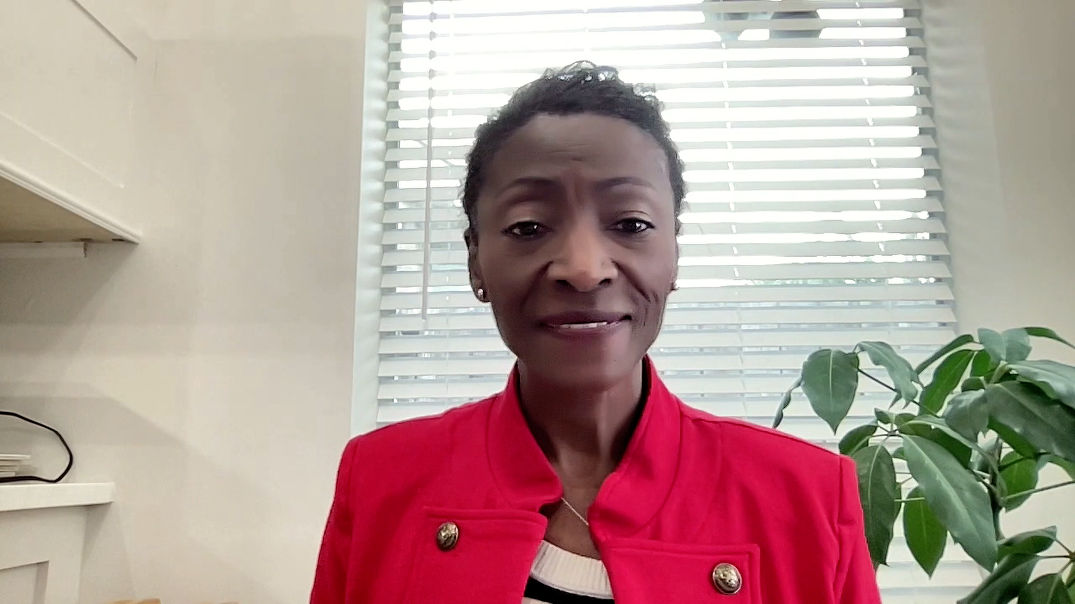

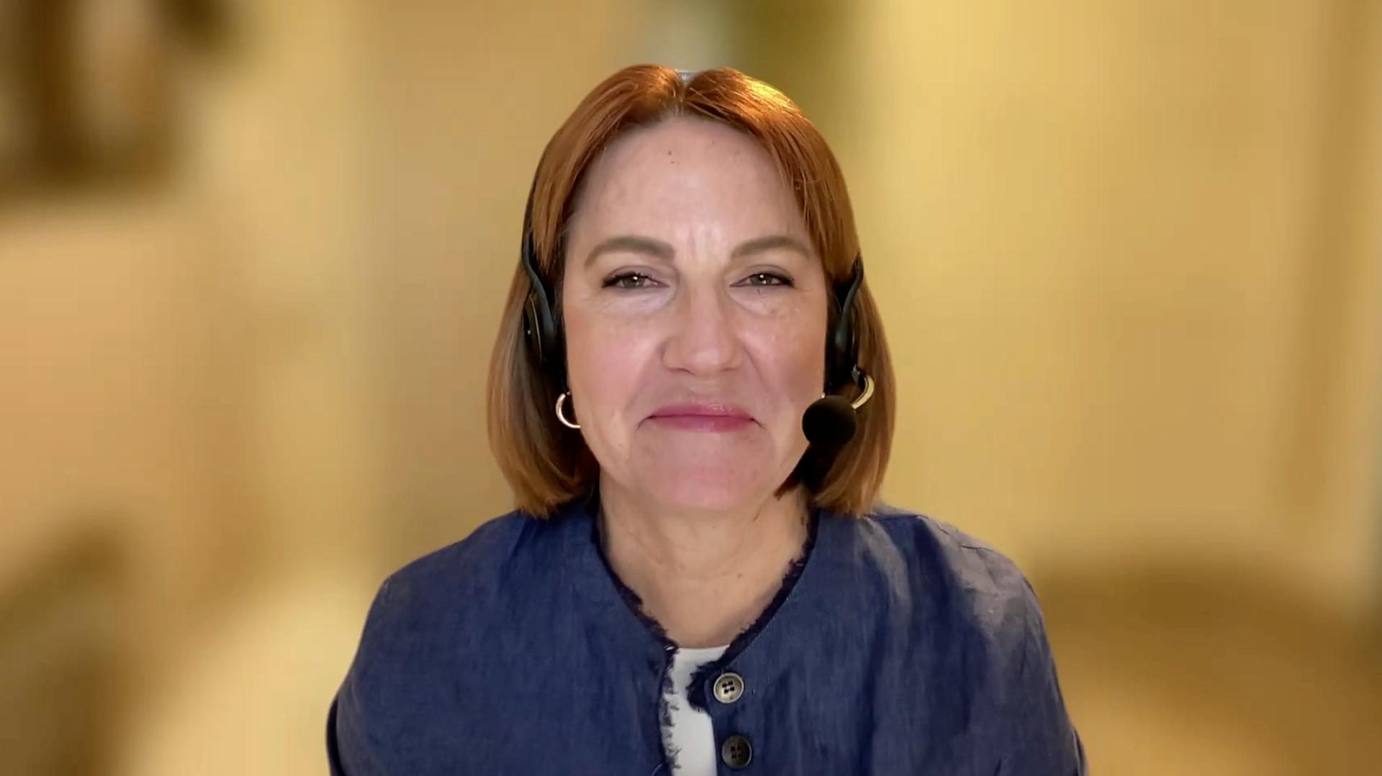






Consulting Nurse Faculty
Jacqueline Broadway-Duren, PhD, DNP, APRN, FNP-BC
The University of Texas
MD Anderson Cancer Center
Houston, Texas
Jessica Mitchell, APRN, CNP, MPH
Mayo Clinic College of Medicine and Science
Rochester, Minnesota
Kathleen D Burns, RN, MSN, AGACNP-BC, OCN
City of Hope Comprehensive
Cancer Center
Duarte, California
Tiffany A Richards, PhD, ANP-BC, AOCNP
The University of Texas
MD Anderson Cancer Center
Houston, Texas
Sonia Glennie, ARNP, MSN, OCN
Swedish Cancer Institute Center
for Blood Disorders
Seattle, Washington
Kimberly A Spickes, MNSc, RN, APRN, OCN, ACNP-BC
University of Arkansas for Medical Sciences
Little Rock, Arkansas
Amy Goodrich, CRNP
The Sidney Kimmel Comprehensive Cancer Center
Baltimore, Maryland
Ronald Stein, JD, MSN, NP-C, AOCNP
USC Norris Comprehensive Cancer Center
Los Angeles, California
https://www.ResearchToPractice.com/ONS2024Clips

Slide 10
Agenda
Introduction
Module 1: Incidence and Biology of Endometrial Cancer (EC)
Module 2: Use of Immune Checkpoint Inhibitors as Monotherapy for EC
Module 3: First-Line Therapy for Primary Advanced or Recurrent EC
Module 4: Lenvatinib/Pembrolizumab in the Management of Metastatic EC
Module 5: Potential Role of Selinexor in the Management of EC
Module 6: Incidence and Management of HER2-Positive EC

Slide 11
Agenda
Introduction
Module 1: Incidence and Biology of Endometrial Cancer (EC)
Module 2: Use of Immune Checkpoint Inhibitors as Monotherapy for EC
Module 3: First-Line Therapy for Primary Advanced or Recurrent EC
Module 4: Lenvatinib/Pembrolizumab in the Management of Metastatic EC
Module 5: Potential Role of Selinexor in the Management of EC
Module 6: Incidence and Management of HER2-Positive EC

Slide 12
Consulting Nursing Faculty Comments
People with newly diagnosed cancer
Kimberly A Spickes, MNSc, RN, APRN, OCN, ACNP-BC

Slide 13
Agenda
Introduction
Module 1: Incidence and Biology of Endometrial Cancer (EC)
Module 2: Use of Immune Checkpoint Inhibitors as Monotherapy for EC
Module 3: First-Line Therapy for Primary Advanced or Recurrent EC
Module 4: Lenvatinib/Pembrolizumab in the Management of Metastatic EC
Module 5: Potential Role of Selinexor in the Management of EC
Module 6: Incidence and Management of HER2-Positive EC

Slide 14
Incidence and Biology of
Endometrial Cancer (EC)
Dr O’Malley
Columbus, Ohio
Dr Westin
Houston, Texas
Incidence and prognosis of EC in the United States and the rest of the world
Appreciation of various molecular subtypes of EC and implications for prognosis and current management
Frequency of microsatellite instability (MSI)/mismatch repair (MMR) deficiency in patients with EC
Optimal timing of and approach to MSI/MMR assessment

Slide 15
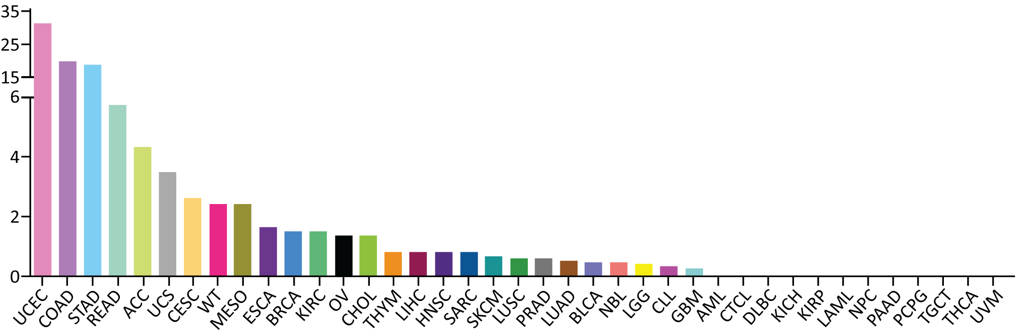
High MSI Across 39 Cancer Types
Whole-exome data from 11,139 tumor-normal pairs from The Cancer Genome Atlas and Therapeutically Applicable Research to Generate Effective Treatments projects
Endometrial cancer was recently shown to have
the highest prevalence of MSI across 39 human cancer types
~30% of primary endometrial cancers are MSI high
13% to 30% of recurrent endometrial cancers are MSI high or MMR deficient
Percent of MSI-high cases
Tumor type
UCEC = uterine corpus endometrial carcinoma
Bonneville R et al. JCO Precis Oncol 2017;1:1-15; Green AK et al. ASCO Educational Book 2020.

Slide 16
Agenda
Introduction
Module 1: Incidence and Biology of Endometrial Cancer (EC)
Module 2: Use of Immune Checkpoint Inhibitors as Monotherapy for EC
Module 3: First-Line Therapy for Primary Advanced or Recurrent EC
Module 4: Lenvatinib/Pembrolizumab in the Management of Metastatic EC
Module 5: Potential Role of Selinexor in the Management of EC
Module 6: Incidence and Management of HER2-Positive EC

Slide 17
Use of Immune Checkpoint Inhibitors for EC
Dr O’Malley
Columbus, Ohio
Dr Westin
Houston, Texas
Mechanism of action of anti-PD-1/PD-L1 antibodies
Similarities and differences among different currently available anti-PD-1/
PD-L1 antibodies
Published efficacy and safety data with anti-PD-1/PD-L1 antibody monotherapy for MSI-high (MSI-H)/MMR-deficient (dMMR) recurrent EC
Optimal integration of pembrolizumab and dostarlimab into the care of patients with recurrent MSI-H/dMMR EC

Slide 18
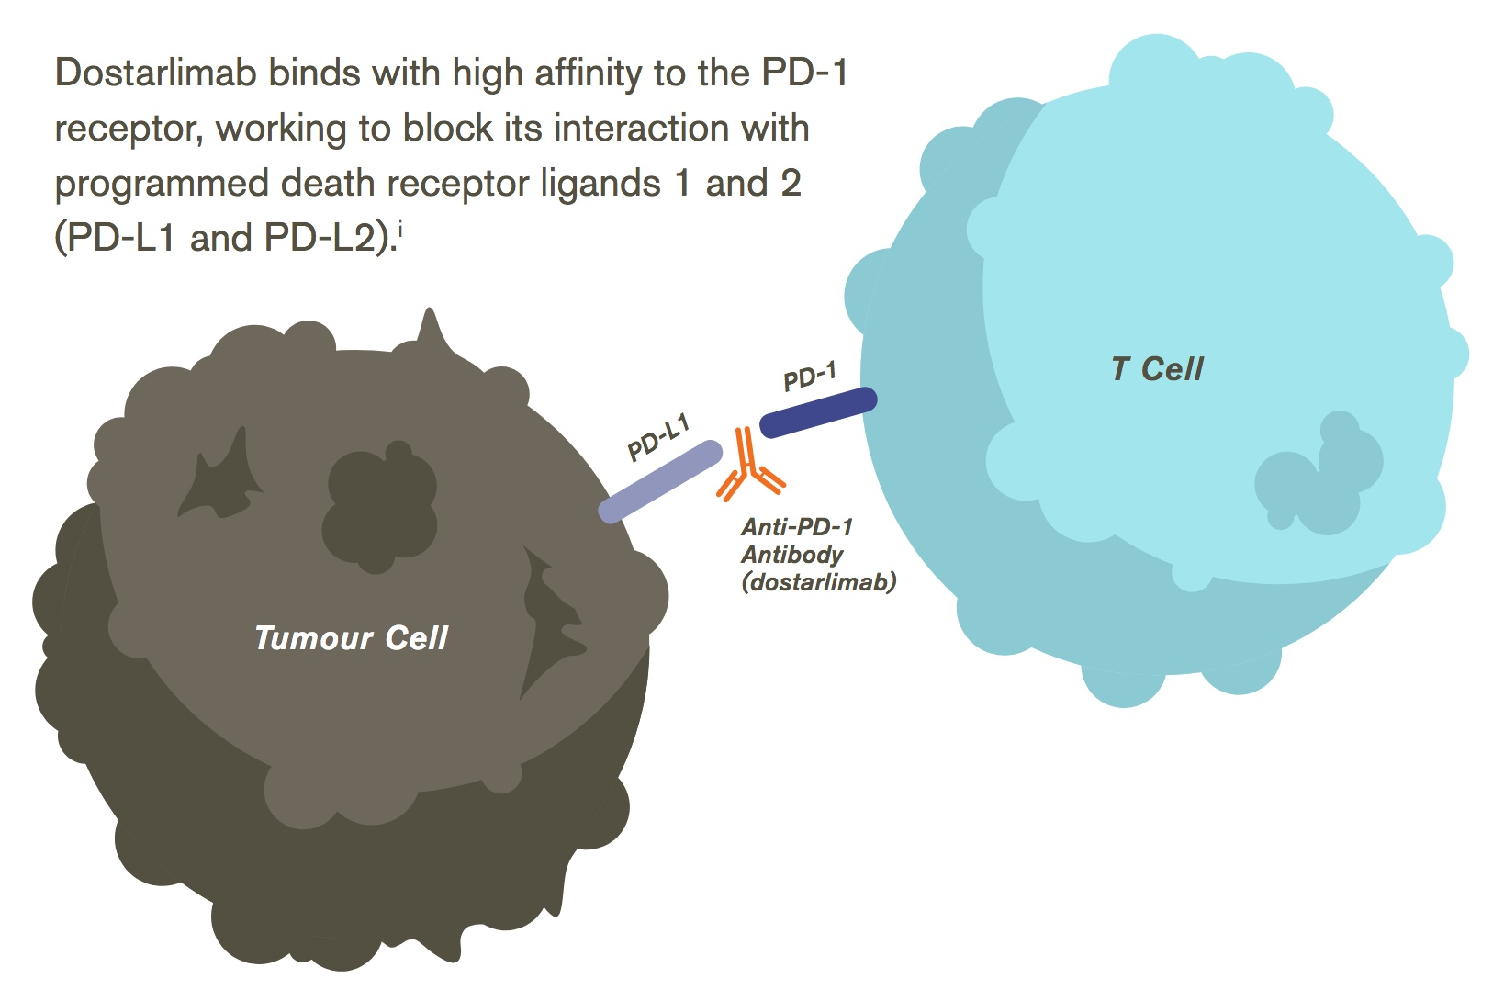
Dostarlimab Mechanism of Action
https://us.gsk.com/media/5875/dostarlimab-infographic_approved-0422.pdf

Slide 19
Dostarlimab
Mechanism of action
Anti-PD-1 monoclonal antibody
Indication as single agent
For patients with mismatch repair deficient (dMMR) recurrent or advanced endometrial cancer that has progressed during or after a prior platinum-containing regimen in any setting who are not candidates for curative surgery or radiation
Recommended dose as single agent
500 mg IV q3wk doses 1-4, then 1,000 mg IV q6wk
Dostarlimab package insert, 3/2024.

Slide 20
Pembrolizumab
Mechanism of action
Anti-PD-1 monoclonal antibody
Indication as single agent
For patients with advanced MSI-H or dMMR EC who have disease progression after prior systemic therapy in any setting and are not candidates for curative surgery or radiation
Recommended dose
200 mg IV every 3 weeks or 400 mg IV every 6 weeks
Pembrolizumab package insert, 3/2024.

Slide 21
Kathryn M Lyle, MSN, WHNP-BC, AGNP-C
What I tell my patients with MSI-H/dMMR EC about to begin treatment with an anti-PD-1/PD-L1 antibody

Slide 22
Agenda
Introduction
Module 1: Incidence and Biology of Endometrial Cancer (EC)
Module 2: Use of Immune Checkpoint Inhibitors as Monotherapy for EC
Module 3: First-Line Therapy for Primary Advanced or Recurrent EC
Module 4: Lenvatinib/Pembrolizumab in the Management of Metastatic EC
Module 5: Potential Role of Selinexor in the Management of EC
Module 6: Incidence and Management of HER2-Positive EC

Slide 23
First-Line Therapy for Primary Advanced or Recurrent EC
Dr O’Malley
Columbus, Ohio
Dr Westin
Houston, Texas
Historical role of and outcomes achieved with chemotherapy as first-line treatment for primary advanced or recurrent EC
Biological rationale for the evaluation of anti-PD-1/PD-L1 antibodies in combination with chemotherapy for patients with EC
Similarities and differences among the Phase III RUBY, NRG-GY018 and AtTEnd trials evaluating dostarlimab, pembrolizumab and atezolizumab, respectively, in combination with chemotherapy as first-line treatment for primary advanced or recurrent EC
Key efficacy findings from the RUBY, NRG-GY018 and AtTEnd trials; outcomes reported in the MSI-H/dMMR and microsatellite-stable (MSS)/MMR-proficient (pMMR) cohorts
Recent FDA approval of dostarlimab in combination with carboplatin and paclitaxel, followed by single-agent dostarlimab, for primary advanced or recurrent dMMR/MSI-H EC; optimal integration into current management

Slide 24
Dostarlimab
Mechanism of action
Anti-PD-1 monoclonal antibody
Indication as combination therapy
In combination with carboplatin and paclitaxel, followed by single-agent dostarlimab, for patients with primary advanced or recurrent endometrial cancer (EC) whose disease is mismatch repair deficient (dMMR) or microsatellite instability high (MSI-H).
Recommended dose as combination therapy
In combination with carboplatin/paclitaxel: 500 mg IV q3wk doses 1-6, then as monotherapy 1,000 mg IV q6wk
Dostarlimab package insert, 3/2024.

Slide 25
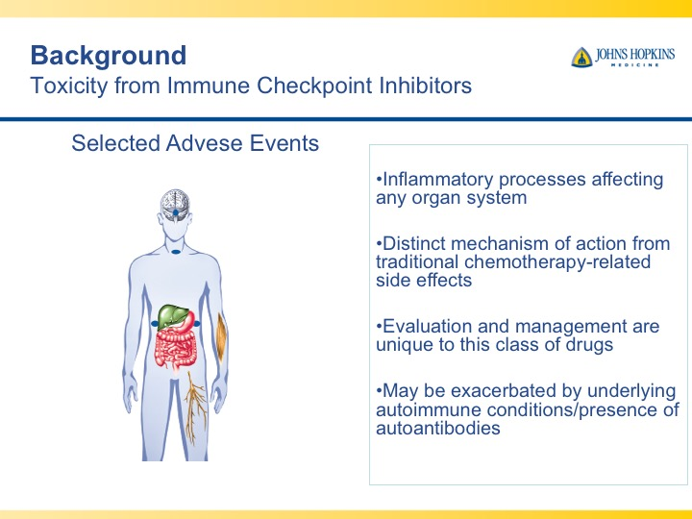
Symptoms of Immunotherapy Toxicity
Hypophysitis
(fatigue)
Thyroiditis
(over/underactive thyroid)
Adrenal Insufficiency (fatigue)
Diabetes Mellitus
(type I, II, fatigue, DKA)
Colitis
(diarrhea, abd pain)
Dermatitis
(rash, itch, blistering)
Pneumonitis
(dyspnea, cough)
Myocarditis
(chest pain, dyspnea)
Hepatitis
(abn LFTs, jaundice)
Pancreatitis
(abd pain)
Neurotoxicities
(MG, encephalitis)
Arthritis
(joint pain)

Slide 26
Jennifer Filipi, MSN, NP
What I tell my patients with EC about to begin treatment with an anti-PD-1/PD-L1 antibody in combination with chemotherapy

Slide 27
Consulting Nursing Faculty Comments
Patient self-advocacy and shared treatment decision-making
Tiffany A Richards, PhD, ANP-BC, AOCNP

Slide 28
PARP Inhibitors Combined with Immunotherapy for Advanced EC
Dr O’Malley
Columbus, Ohio
Dr Westin
Houston, Texas
Mechanism of antitumor activity of PARP inhibitors and biological rationale for their investigation for EC; potential therapeutic synergy between PARP inhibitors and immune checkpoint inhibitors (ICIs)
Key efficacy findings from the Phase III DUO-E trial evaluating first-line durvalumab in combination with chemotherapy followed by maintenance durvalumab with or without olaparib for newly diagnosed advanced or recurrent EC
Similarities and differences between the designs of the DUO-E trial and part 2 of the RUBY trial; recently presented data with maintenance dostarlimab/niraparib in RUBY part 2
Potential role of anti-PD-1/PD-L1 antibodies in combination with PARP inhibitors in the future care of patients with EC

Slide 29

Biological Rationale for Combining a PARP Inhibitor (PARPi) with an Immune Checkpoint Inhibitor
PARP inhibitors
DSB
processing
(EXO1, BLM1, etc)
DSB
checkpoint activation
(ATM, ATR, CHK1)
Preclinical models indicate synergy between PARPi and anti-PD-1 agents regardless of BRCA mutation status or PD-L1 status
Error-prone repair
Cytosolic DNA
ATM/ATR/CHK1 activation
Point mutations
STING pathway activation
STAT1/3 activation
IRF1 activation
Neoantigens
Type I IFN response
PD-L1 upregulation
Immune activating
Immune suppressing
Preclinical data demonstrate synergy with PARPi and anti-PD-1 combinations.
Konstantinopoulos P et al. ASCO 2018;Abstract 106.
Notes:
29

Slide 30
Practical Considerations with Anti-PD-1/
PD-L1 Antibodies Alone or in Combination with Chemotherapy or a PARP Inhibitor
Dr O’Malley
Columbus, Ohio
Dr Westin
Houston, Texas
Pathophysiology, incidence and spectrum of immune-mediated and other adverse events (AEs) observed with anti-PD-1/PD-L1 antibodies as monotherapy or in combination with chemotherapy or a PARP inhibitor
Recommended monitoring and management paradigms for immune-related and other AEs with ICIs for gynecologic cancers
Strategies to discern whether toxicities relate to chemotherapy, a PARP inhibitor, immune checkpoint inhibition or combinations of these agents
Role of rechallenge for patients for whom ICI therapy has been held due to immune-mediated toxicity
Relative and absolute contraindications to anti-PD-1/PD-L1 antibody therapy; role, if any, in therapy for patients with preexisting autoimmune conditions or a history of solid organ transplant

Slide 31
Kathryn M Lyle, MSN, WHNP-BC, AGNP-C
What I tell my patients with EC who are being considered for or are about to enroll on a clinical trial with a PARP inhibitor

Slide 32
Agenda
Introduction
Module 1: Incidence and Biology of Endometrial Cancer (EC)
Module 2: Use of Immune Checkpoint Inhibitors as Monotherapy for EC
Module 3: First-Line Therapy for Primary Advanced or Recurrent EC
Module 4: Lenvatinib/Pembrolizumab in the Management of Metastatic EC
Module 5: Potential Role of Selinexor in the Management of EC
Module 6: Incidence and Management of HER2-Positive EC

Slide 33
Lenvatinib/Pembrolizumab in the Management of Mismatch Repair Proficient (pMMR) Metastatic EC
Dr O’Malley
Columbus, Ohio
Dr Westin
Houston, Texas
Biological rationale for combining ICIs with agents targeting the VEGF pathway for EC
Major findings, including overall survival data, supporting the use of lenvatinib in combination with pembrolizumab for patients with advanced pMMR EC with disease progression after prior systemic therapy
Optimal integration of pembrolizumab/lenvatinib into current EC management algorithms
Recent announcement of failure of the Phase III LEAP-001 trial evaluating lenvatinib/pembrolizumab in the up-front setting; implications for current practice and future research

Slide 34
Mechanism of Action of Lenvatinib
VEGFR
FGFR
Lenvatinib
X
RAS
Orally available inhibitor of multiple tyrosine kinases including VEGF receptors, FGFR, RET, PDGFR and KIT
Demonstrated promising radiographic response rates and survival results in Phase II and III trials in hepatocellular carcinoma
PI3K
RAF
MEK
AKT
mTOR
T202/Y204
P
P
T389
ERK1/2
P
S6K
T421/S424
S235/S236
P
S6
Angiogenesis
Finn RS et al. Proc ASCO 2014;Abstract TPS4153; Stjepanovic N et al. Biologics 2014;8:129-39; Cheng AL et al. Proc ASCO 2017;Abstract 4001; Ikeda K et al. J Gastroenterol 2017;52(4):512-9.

Slide 35
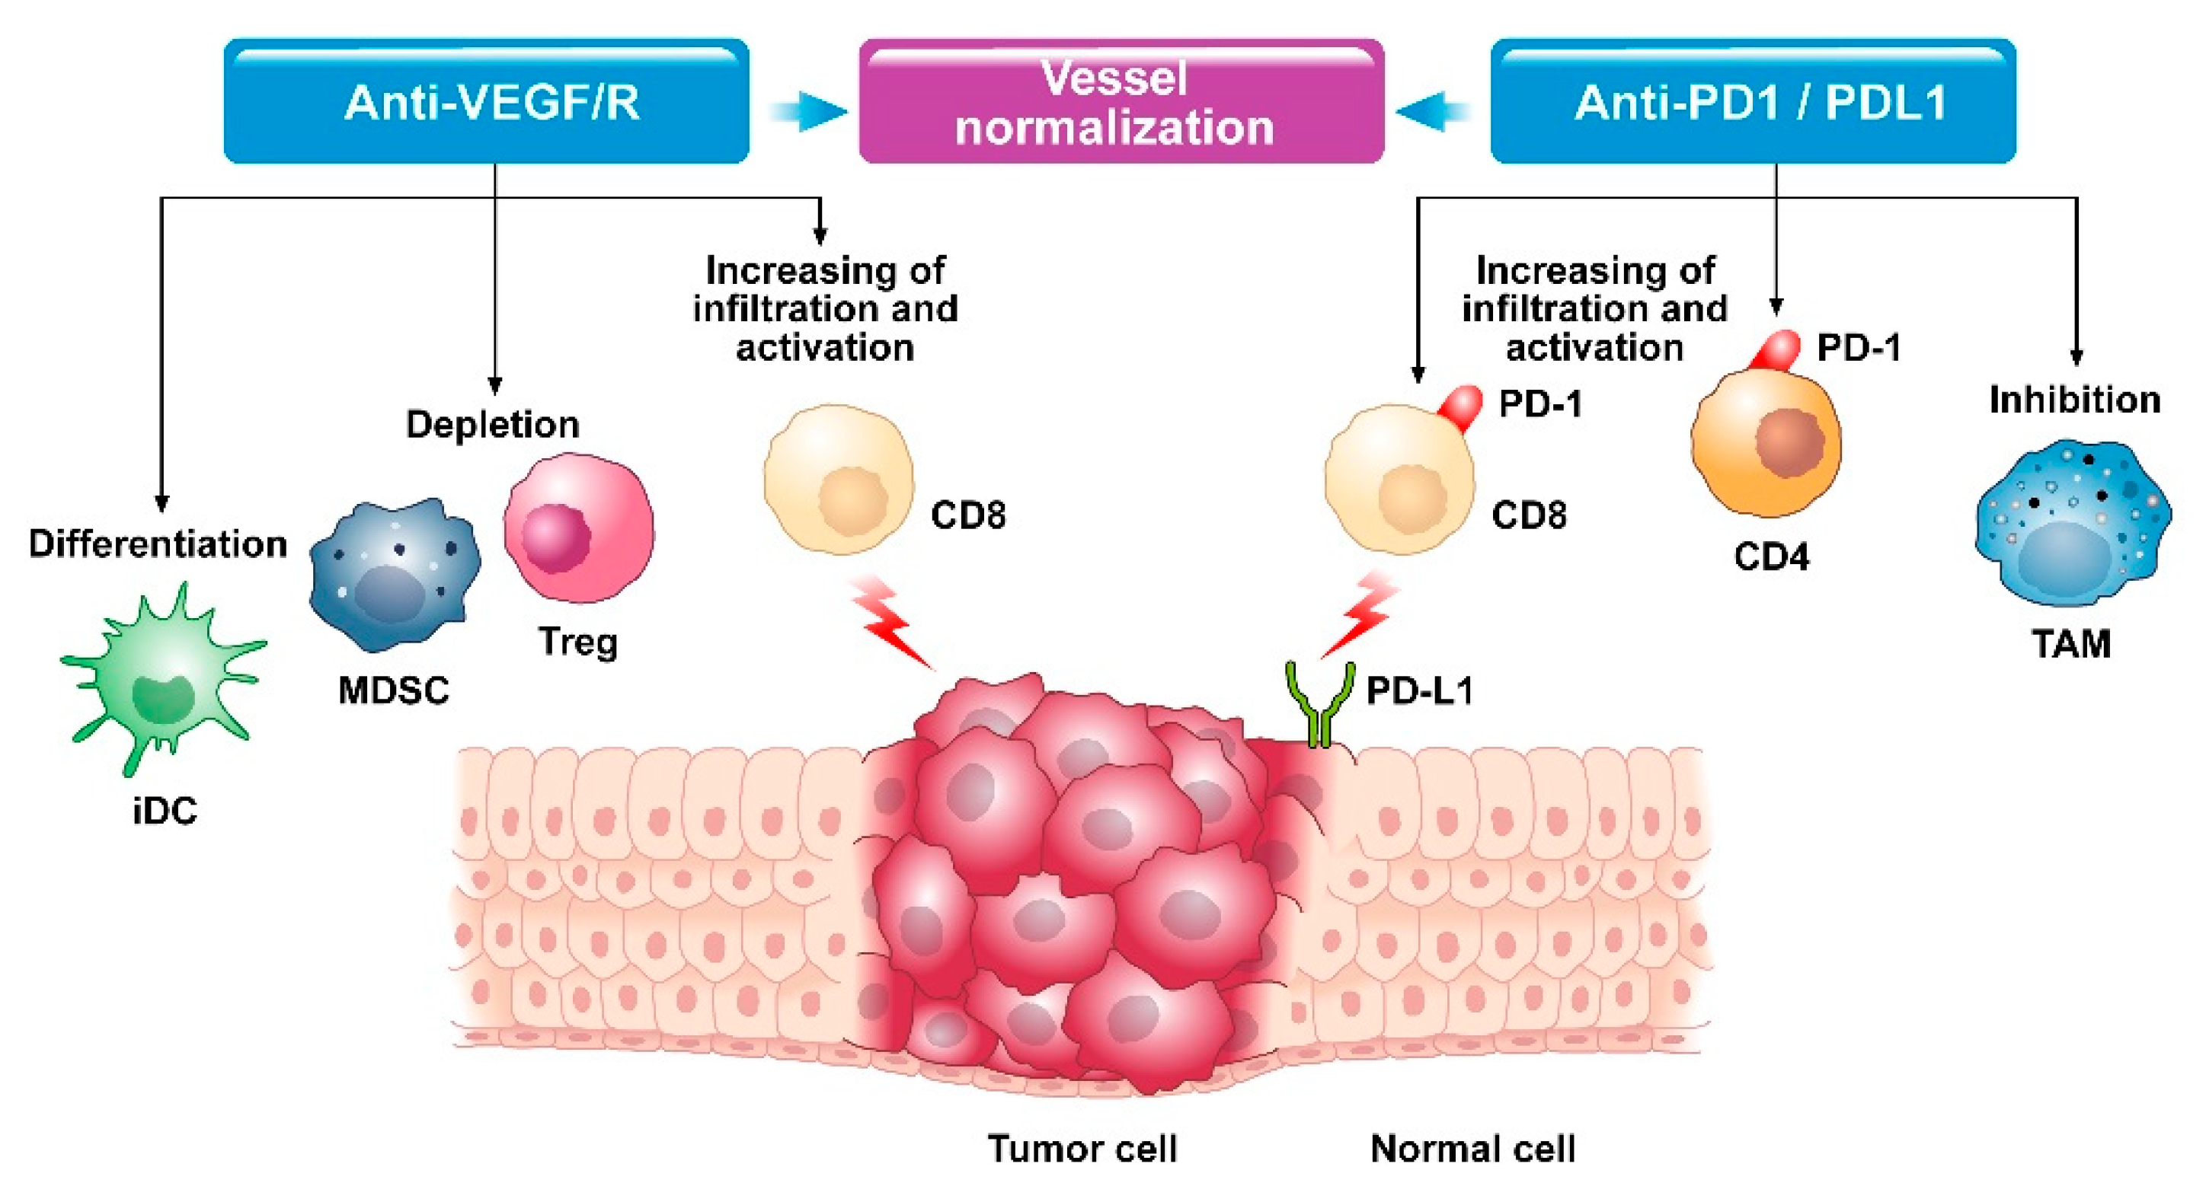
Biological Rationale for Combining Immune Checkpoint Inhibitors with VEGF Pathway Targeted Agents
Reduction in Treg activity
Reversal of immunosuppressive effects of VEGF
Improved T-cell trafficking and infiltration of CD8+ into the tumor bed
Oaknin A. ASCO 2022; Education Session.

Slide 36
Lenvatinib
Mechanism of action
Oral multikinase inhibitor
Indication in combination with pembrolizumab
For patients with advanced endometrial carcinoma that is pMMR or not MSI-H who have disease progression after prior systemic therapy in any setting and are not candidates for curative surgery or radiation
Recommended dose in combination with pembrolizumab
20 mg orally once daily
Lenvatinib package insert, 4/2024.

Slide 37
Pembrolizumab
Mechanism of action
Anti-PD-1 monoclonal antibody
Indication in combination with lenvatinib
For patients with for advanced EC that is pMMR or not MSI-H who have disease progression after prior systemic therapy in any setting and are not candidates for curative surgery or radiation
Recommended dose in combination with lenvatinib
200 mg IV every 3 weeks or 400 mg IV every 6 weeks
Pembrolizumab package insert, 3/2024.

Slide 38
Update on Phase III LEAP-001 Trial Evaluating Pembrolizumab Plus Lenvatinib as First-Line Treatment for Patients with Advanced or Recurrent Endometrial Carcinoma
Press Release – December 8, 2023
“…the Phase 3 LEAP-001 trial evaluating pembrolizumab plus lenvatinib did not meet its dual primary endpoints of overall survival (OS) and progression-free survival (PFS) for the first-line treatment of patients with advanced or recurrent endometrial carcinoma whose disease is mismatch repair proficient (pMMR)/not microsatellite instability-high (MSI-H) or mismatch repair deficient (dMMR)/MSI-H.
At the final analysis, pembrolizumab plus lenvatinib did not improve OS or PFS sufficiently to meet the study’s prespecified statistical criteria in the first-line treatment of certain patients with advanced or recurrent endometrial carcinoma versus a standard of care, platinum-based chemotherapy doublet (carboplatin plus paclitaxel). The safety profile of pembrolizumab plus lenvatinib was consistent with that observed in previously reported studies evaluating the combination. A full evaluation of the data from this study is ongoing.”
https://www.merck.com/news/merck-and-eisai-provide-update-on-phase-3-leap-001-trial-evaluating-pembrolizumab-plus-lenvima-lenvatinib-as-first-line-treatment-for-patients-with-advanced-or-recurrent-endometrial-carcinom/

Slide 39
Toxicities with Lenvatinib/Pembrolizumab
Dr O’Malley
Columbus, Ohio
Dr Westin
Houston, Texas
Incidence, severity, timing and management of AEs observed in patients with EC receiving lenvatinib/pembrolizumab, such as hypertension, gastrointestinal issues, weight loss and hand-foot syndrome
Approaches to encourage adequate nutrition among patients receiving the combination of lenvatinib and pembrolizumab
Initial dosing and dose-modification strategies for pembrolizumab/lenvatinib for EC; available data exploring the effect of lenvatinib dose reductions on antitumor activity
Strategies to determine the cause of toxicities that could stem from either lenvatinib or pembrolizumab

Slide 40
Jennifer Filipi, MSN, NP
What I tell my patients with EC about to begin treatment with lenvatinib/pembrolizumab

Slide 41
Agenda
Introduction
Module 1: Incidence and Biology of Endometrial Cancer (EC)
Module 2: Use of Immune Checkpoint Inhibitors as Monotherapy for EC
Module 3: First-Line Therapy for Primary Advanced or Recurrent EC
Module 4: Lenvatinib/Pembrolizumab in the Management of Metastatic EC
Module 5: Potential Role of Selinexor in the Management of EC
Module 6: Incidence and Management of HER2-Positive EC

Slide 42
Potential Role of Selinexor in the Management of EC
Dr O’Malley
Columbus, Ohio
Dr Westin
Houston, Texas
Mechanism of antitumor activity of selinexor and biological rationale for its investigation as maintenance therapy for EC
Progression-free survival advantage documented with selinexor as maintenance therapy after first-line chemotherapy in patients with advanced or recurrent EC in the SIENDO trial; outcomes achieved in the p53 wild-type subgroup
Design, eligibility criteria and key endpoints of the Phase III XPORT-EC-042 trial assessing selinexor maintenance after first-line chemotherapy for p53 wild-type advanced EC
Spectrum, frequency, severity and management of commonly encountered toxicities with selinexor for EC; lessons learned from the multiple myeloma experience

Slide 43
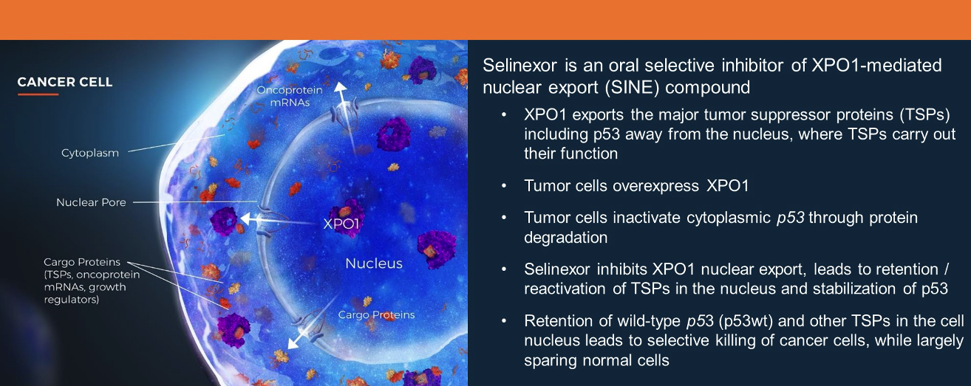
Mechanism of Action of Selinexor
Makker V et al. ASCO 2022;Abstract 5511.

Slide 44
Selinexor
Mechanism of action
Inhibitor of the nuclear exporter XPO1
Indication
Investigational in endometrial cancer
Key clinical trial
Phase III SIENDO trial evaluating selinexor as front-line maintenance therapy in advanced or recurrent endometrial cancer
Vergote I et al. J Clin Oncol 2023;41(35):5400-10.

Slide 45
Kathryn M Lyle, MSN, WHNP-BC, AGNP-C
What I tell my patients with EC who are being considered for or are about to enroll on a clinical trial with selinexor

Slide 46
Agenda
Introduction
Module 1: Incidence and Biology of Endometrial Cancer (EC)
Module 2: Use of Immune Checkpoint Inhibitors as Monotherapy for EC
Module 3: First-Line Therapy for Primary Advanced or Recurrent EC
Module 4: Lenvatinib/Pembrolizumab in the Management of Metastatic EC
Module 5: Potential Role of Selinexor in the Management of EC
Module 6: Incidence and Management of HER2-Positive EC

Slide 47
Incidence and Management of HER2-Positive EC
Dr O’Malley
Columbus, Ohio
Dr Westin
Houston, Texas
Frequency of HER2 expression in advanced EC; optimal timing of and approach to testing
Published clinical research studies supporting the use of trastuzumab as a component of therapy for HER2-positive uterine serous carcinoma and carcinosarcoma
Efficacy and safety outcomes achieved with T-DXd among patients with advanced EC in the DESTINY-PanTumor02 study
Potential implications of DESTINY-PanTumor02 for biomarker evaluation and clinical management for advanced EC

Slide 48
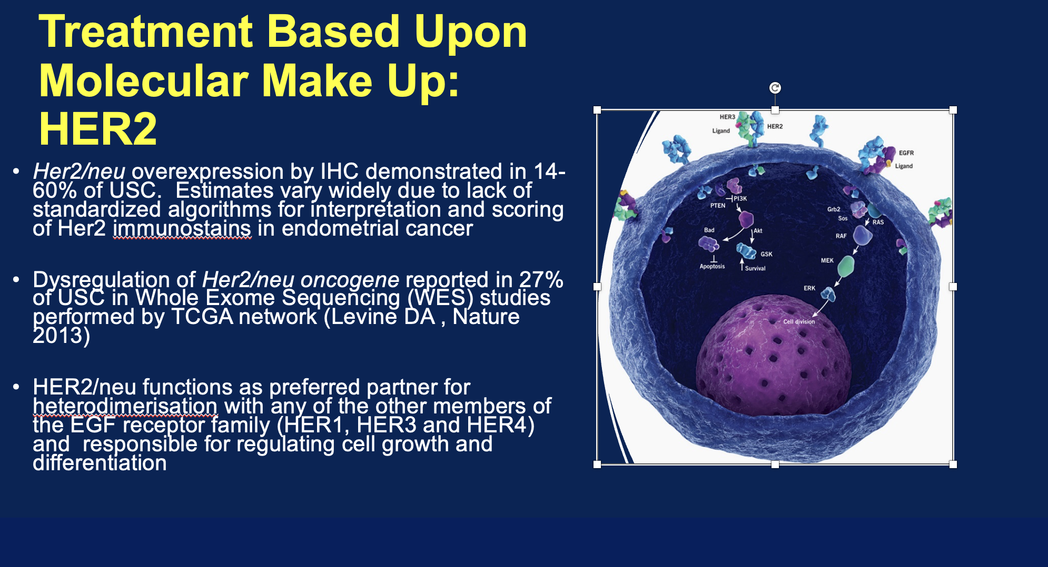
HER2/neu in Endometrial Cancer
USC = uterine serous carcinoma
Courtesy of Matthew A Powell, MD.

Slide 49
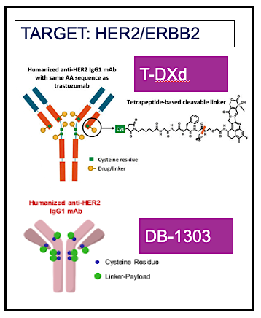
Trastuzumab Deruxtecan
Courtesy of Matthew A Powell, MD.

Slide 50
Trastuzumab Deruxtecan
Mechanism of action
Antibody-drug conjugate directed against HER2
Indication
Unresectable or metastatic HER2-positive (IHC 3+) solid tumors who have received prior systemic treatment and have no satisfactory alternative treatment options
Key clinical trial
Phase II DESTINY-PanTumor02 trial evaluating trastuzumab deruxtecan in patients with HER2-expressing solid tumors
Meric-Bernstam F et al. J Clin Oncol 2024;42(1):47-58.

Slide 51
Jennifer Filipi, MSN, NP
What I tell my patients with EC about being tested for HER2 and potentially enrolling on a trial of trastuzumab deruxtecan

