Slide 1
Optimizing the Role of Hormonal Therapy and Novel Therapeutic Strategies for Patients with Prostate Cancer
Maha Hussain, MD, FACP, FASCO
Genevieve Teuton Professor of Medicine
Division of Hematology/Oncology
Deputy Director
Robert H Lurie Comprehensive Cancer Center
Northwestern University Feinberg School of Medicine
Chicago, Illinois

Slide 2
Prostate Cancer Disease States
PROSPER
ARAMIS
Newly Diagnosed PC
PSA ↑↑
nmCRPC
Increasing PSA Levels
PSA ↑↑
Biochemically Recurrent PC
PEACE-1
HERO
TITAN
STAMPEDE
ARCHES
ENZAMET
ARASENS
CYCLONE 3
PRESTO
EMBARK
mCRPC
Newly Diagnosed Metastatic PC (mHSPC)
CYCLONE 1
Phase 1 Capivasertib + Abiraterone
PSA relapse post Localized Therapy (surgery/radiation)
Disease Monitoring
ADT + /-AR-I, ADT + Docetaxel +/-AR-I
Castration-Resistant Prostate Cancer
Scher HI et al. PLoS One 2015

Slide 3
Non-Metastatic Prostate Cancer with PSA Relapse

Slide 4
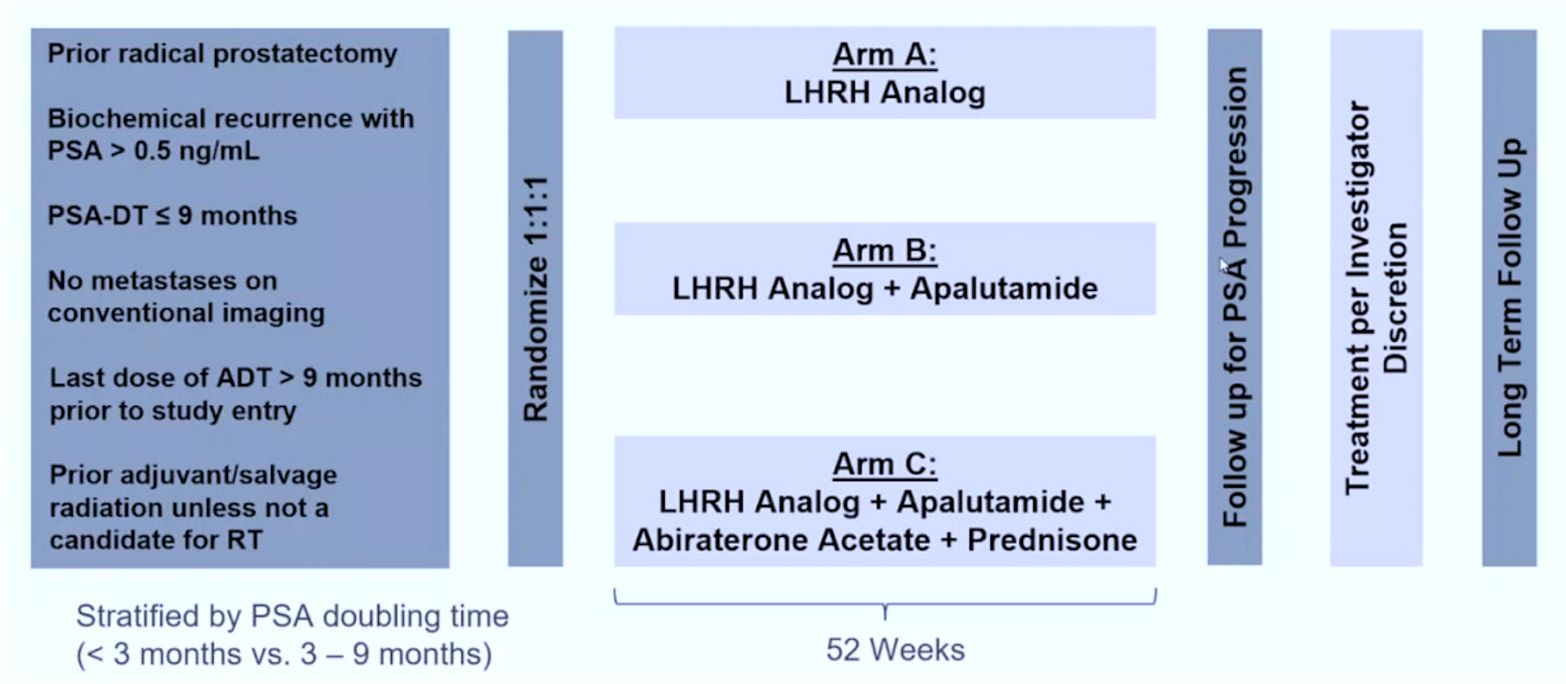
PRESTO: A Phase III Randomized Study of Androgen Annihilation for High-Risk Biochemically Relapsed Prostate Cancer
ADT = androgen deprivation therapy
https://www.urotoday.com/conference-highlights/esmo-2022/esmo-2022-prostate-cancer/139400-esmo-2022-discussion-of-presto-and-propel.html

Slide 5
PRESTO: Updated PFS
 | Apa + ADT vs ADT | Apa + AAP + ADT vs ADT | Apa + ADT vs Apa + AAP + ADT
PSA-PFS | 24.9 vs 20.3 months HR = 0.52 [95% CI, 0.35 to 0.77] | 26.0 vs 20.0 months HR = 0.48 [95% CI, 0.32 to 0.71] | 24.9 vs 26.0 months HR = 0.95 (95% CI: 0.62-1.45)
 | ADT | Apa + ADT | Apa + AAP + ADT
Median Time to Testosterone Recovery (months) | 3.9 | 3.8 | 4.7
AAP = abiraterone acetate with prednisone
In patients with high-risk BCR following radical prostatectomy, intensified ADT with addition of apalutamide or apalutamide plus abiraterone prolonged biochemical PFS without new safety concerns identified. Follow up is ongoing to determine the impact on longer term endpoints including MFS and time to castration resistance.
Aggarwal R et al. AUA 2023;Abstract LBA02-11.

Slide 6
EMBARK: A Phase III Randomized Study of Enzalutamide or Placebo with Leuprolide Acetate and Enzalutamide Monotherapy for High-Risk Biochemically Recurrent Prostate Cancer
Patient population
Screening PSA ≥1 ng/mL after RP and at least 2 ng/mL above nadir for primary EBRT
PSADT ≤9 mo
No metastases on bone scan or CT/MRI per central read
Testosterone ≥150 ng/dL
Prior hormonal therapy ≥9 mo prior to randomization (neoadjuvant/adjuvant for ≤36 mo OR ≤6 mo for rising PSA)
Stratification factors
Screening PSA (≤10 ng/mL vs >10 ng/mL)
PSADT (≤3 mo vs >3 to ≤9 mo)
Prior hormonal therapy (yes vs no)
Enzalutamide (160 mg oral qd) + leuprolide acetate
(22.5 mg IM/q12w)
n = 355
Blinded
Primary endpoint:
MFS by BICR, enzalutamide + leuprolide acetate vs leuprolide acetate alone
Suspend treatment at week 37
Monitor PSA
(reinitiate if PSA rises)
Yes
Key secondary endpoints:
MFS by BICR, enzalutamide monotherapy vs leuprolide acetate alone
Time to PSA progression
Time to first use of new antineoplastic therapy
OS
Other secondary endpoint:
Safety
Placebo + leuprolide acetate
(22.5 mg IM/q12w)
n = 358
Blinded
R
1:1:1
PSA <0.2 ng/mL at week 36
Enzalutamide monotherapy
(160 mg oral qd)
n = 355
Unblinded
No
Remain on treatment
RP = radical prostatectomy; EBRT = external beam radiation therapy; PSADT = PSA doubling time; MFS = metastasis-free survival

Slide 7
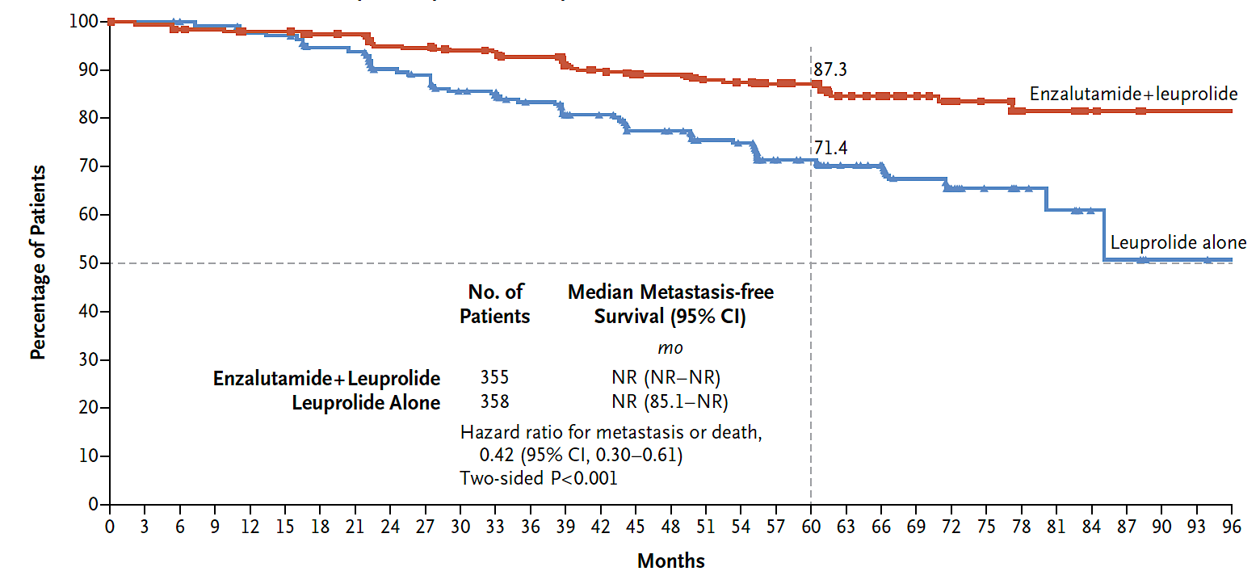
EMBARK: Metastasis-Free Survival with Enzalutamide and Leuprolide versus Leuprolide Alone
Freedland SJ et al. N Engl J Med 2023;389(16):1453-65.

Slide 8
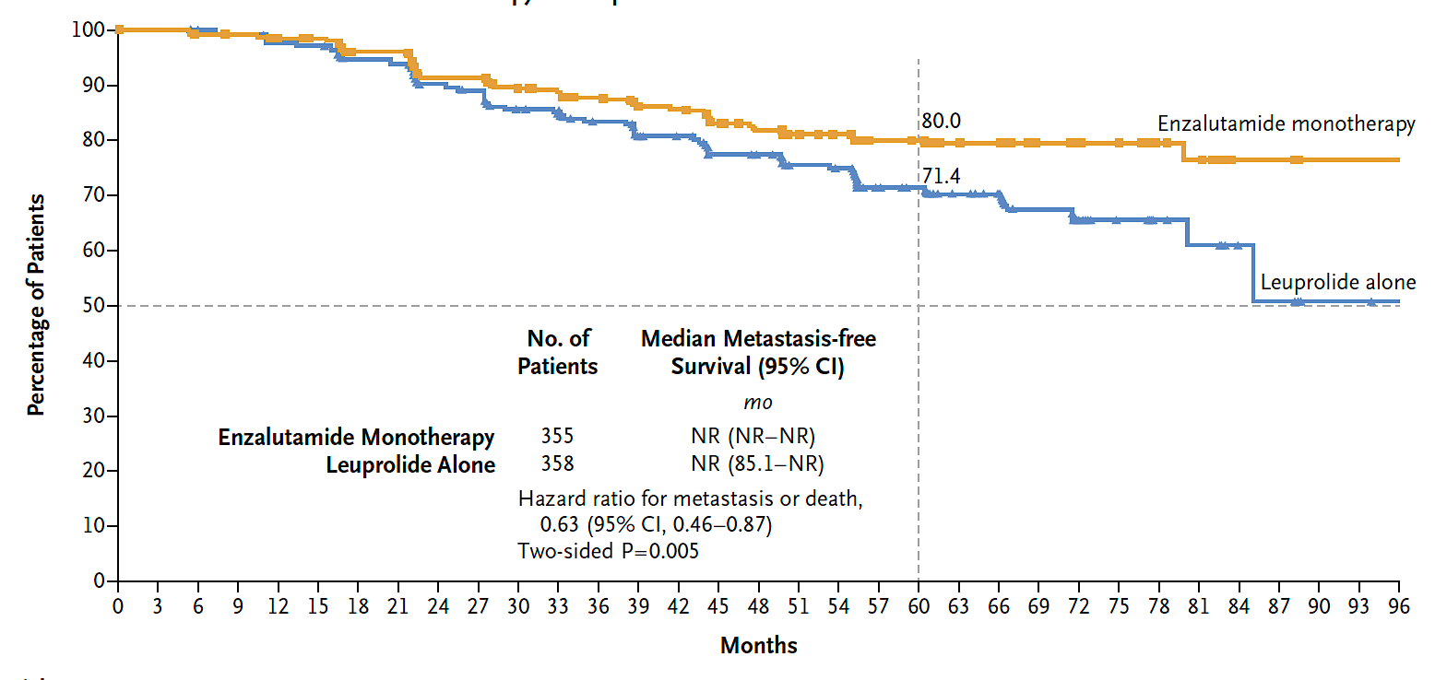
EMBARK: MFS with Enzalutamide Monotherapy versus Leuprolide Alone
Data on overall survival were immature at the time of publication.
The safety profile of enzalutamide was consistent with that shown in previous clinical studies, with no apparent detrimental effect on quality of life.
Freedland SJ et al. N Engl J Med 2023;389(16):1453-65.

Slide 9
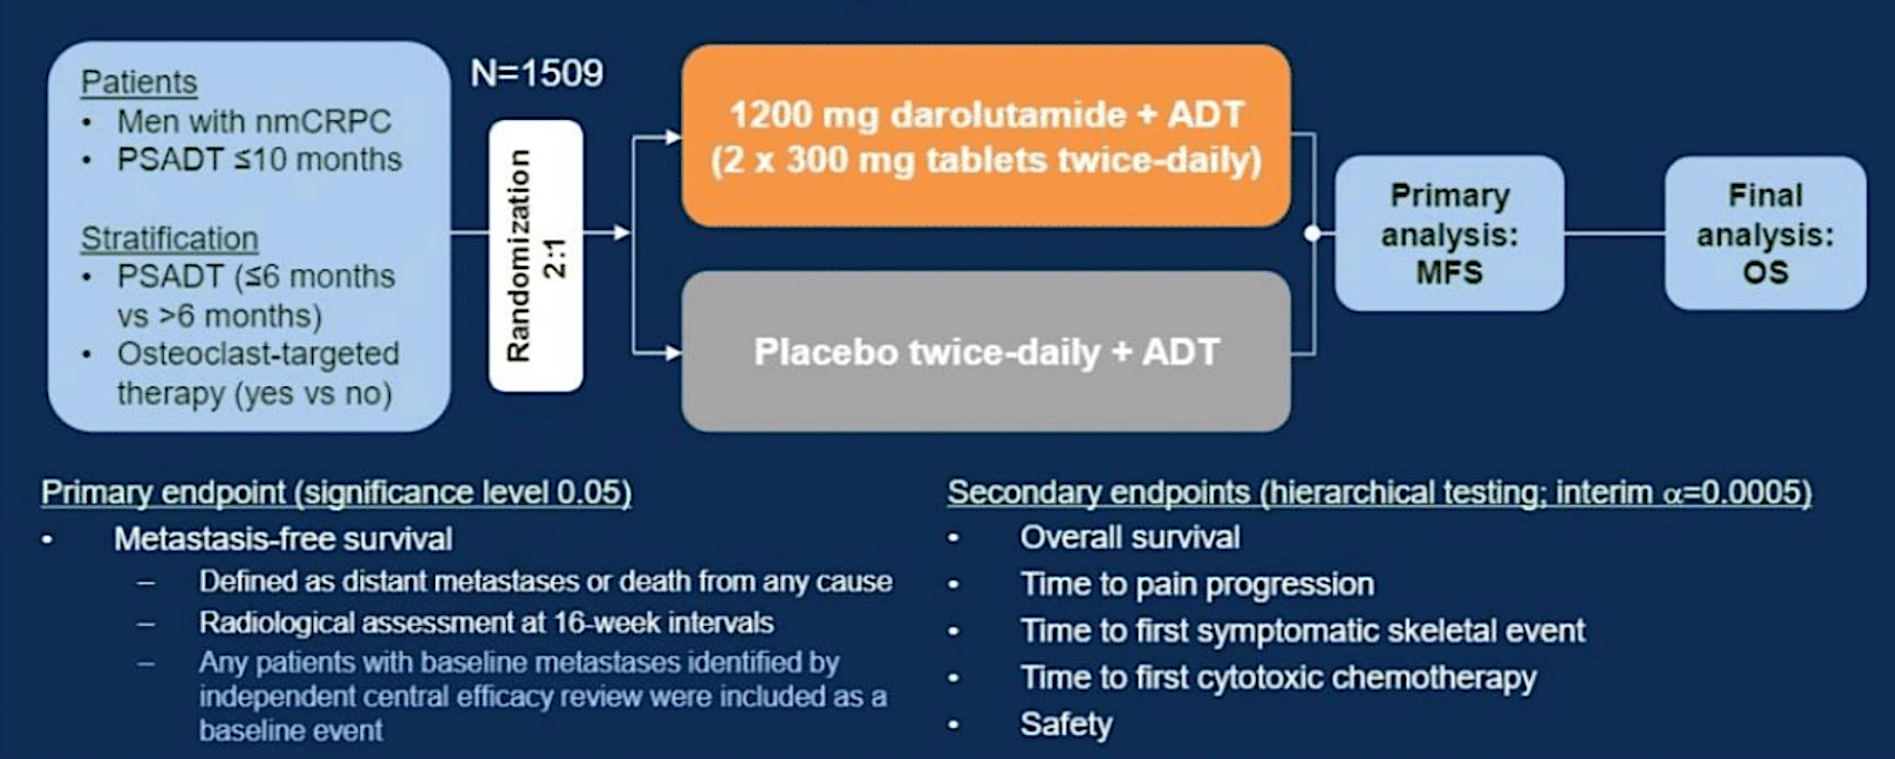
ARAMIS: Darolutamide for Nonmetastatic Castration-Resistant Prostate Cancer (nmCRPC) – Study Design
https://www.urotoday.com/conference-highlights/asco-gu-2019/asco-gu-2019-prostate-cancer/110279-sco-gu-2019-efficacy-and-safety-data-of-the-aramis-study-darolutamide-in-nonmetastatic-castration-resistant-prostate-cancer-patients.html

Slide 10
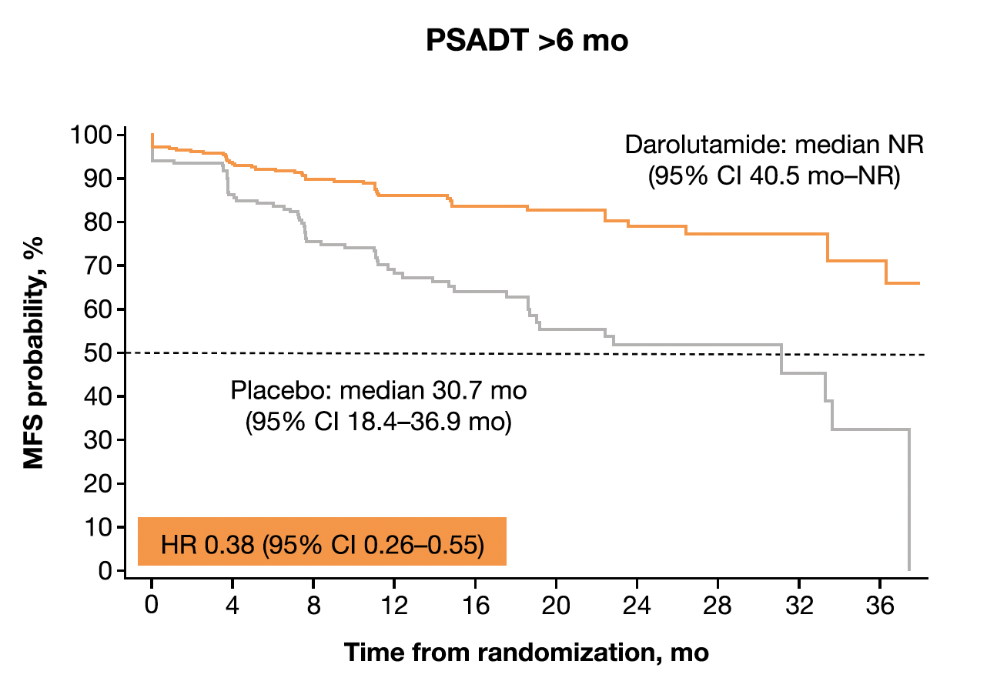
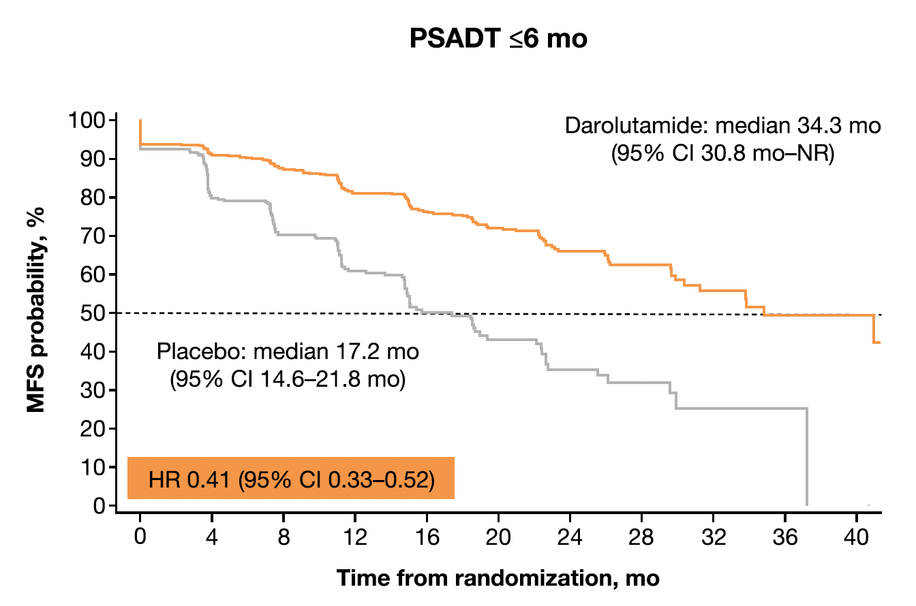
Efficacy and Safety of Darolutamide in Patients with nmCRPC Stratified by PSA Doubling Time: Planned Subgroup Analysis of the Phase III ARAMIS Trial
For patients with nmCRPC and PSADT ≤6 mo or >6 mo (maximum 10 mo), darolutamide provided a favorable benefit-risk ratio, characterized by significant improvements in MFS, OS, and other clinically relevant endpoints; maintenance of QoL; and favorable tolerability.
Bögemann M et al. [Published correction appears in Eur Urol 2023;83(2):e60]. Eur Urol 2023;83(3):212-21.

Slide 11
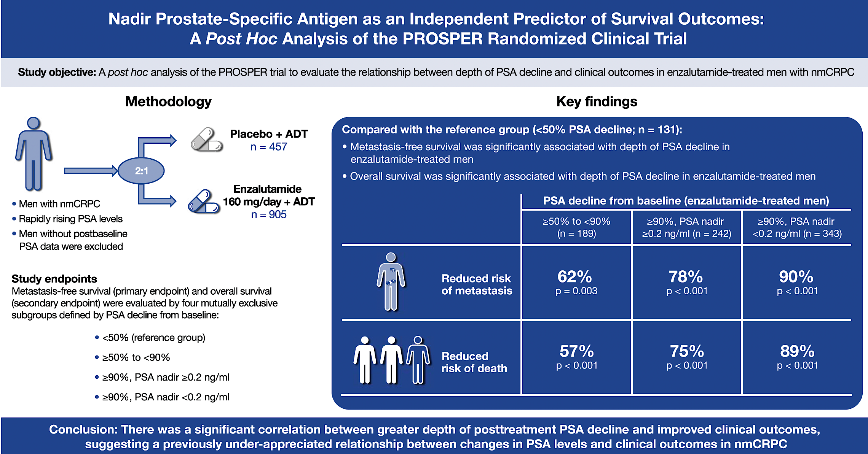
Hussain M et al. J Urol 2023;209(3):532-9.

Slide 12
Metastatic Hormone-Sensitive Prostate Cancer (mHSPC)

Slide 13
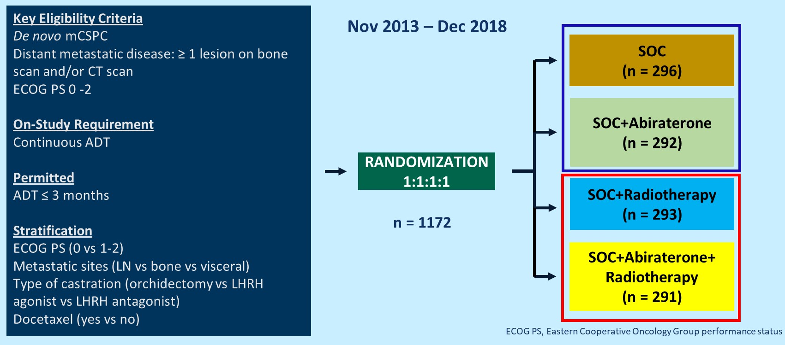
PEACE-1: Abiraterone with Prednisone Added to ADT and Docetaxel for De Novo mCSPC (mHSPC) – Study Design
Primary endpoints: rPFS (PCWG2 criteria; imaging at least q6m after PSA rise) and OS
SOC = standard of care (Investigator's choice of ADT or ADT with docetaxel)
Bossi A et al. ASCO 2023;Abstract LBA5000.

Slide 14
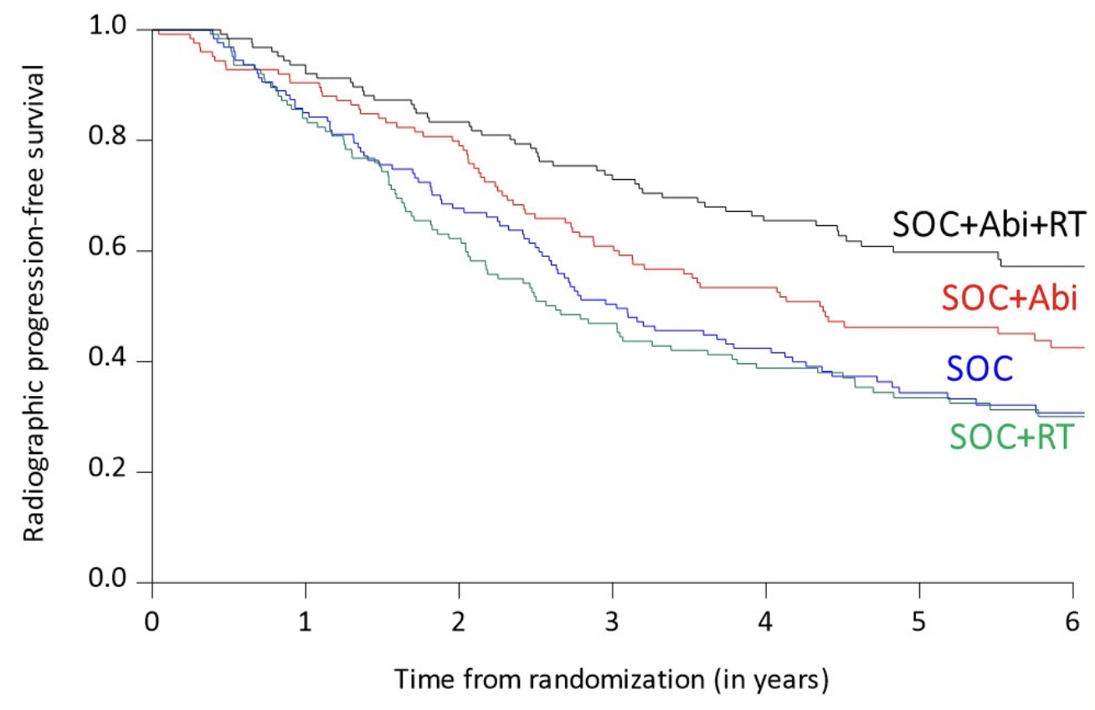
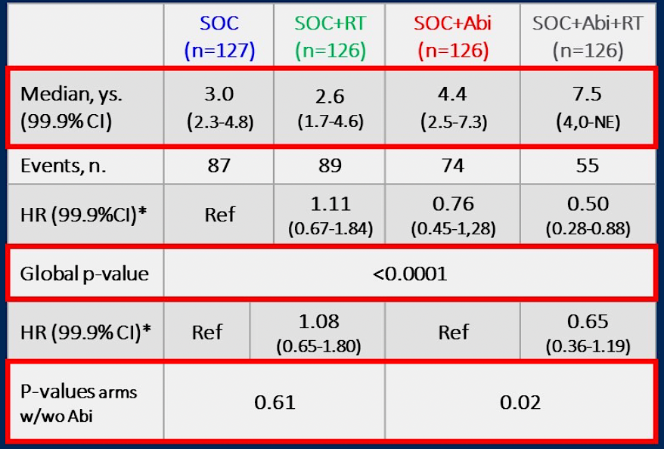
PEACE-1: Radiographic Progression-Free Survival in the Low-Volume Population
− Combining prostate RT with intensified systemic treatment improves rPFS and HRPC-free survival in men with low burden, de-novo mHSPC
Bossi A et al. ASCO 2023;Abstract LBA5000.

Slide 15
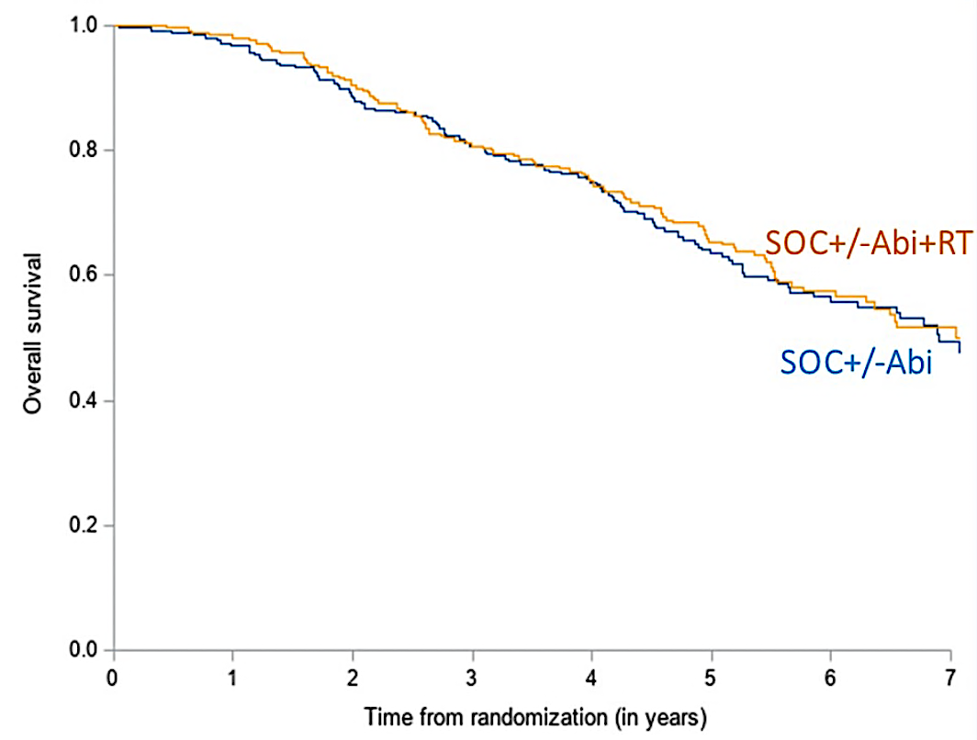
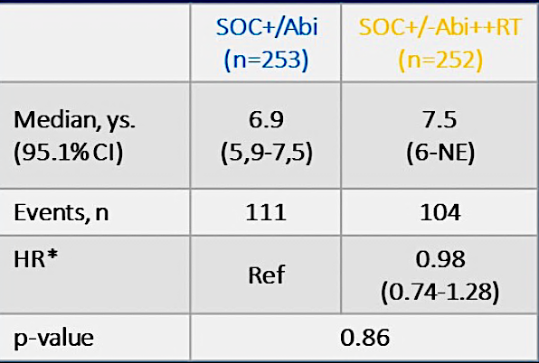
PEACE-1: Overall Survival in the Low-Volume Population
− There was no detectable impact of prostate RT on OS
Bossi A et al. ASCO 2023;Abstract LBA5000.

Slide 16
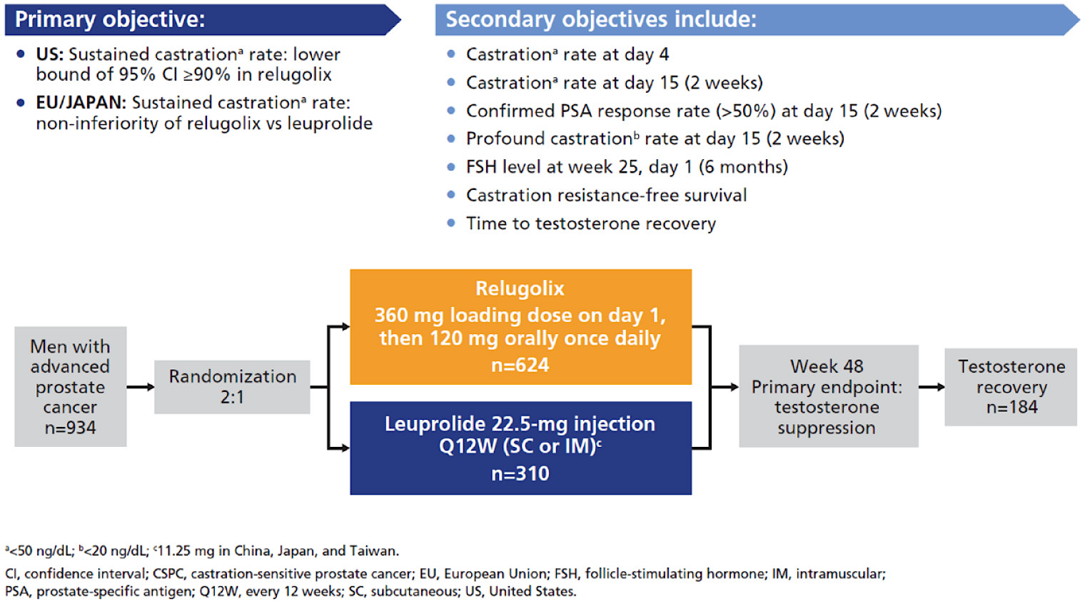
HERO: A Randomized Phase III Study Evaluating Relugolix versus Leuprolide for Advanced Prostate Cancer
– Relugolix is an oral gonadotropin-releasing hormone antagonist (GnRHa)
− The trial enrolled PCa patients who either relapsed (biochemical or clinical) after curative intent local treatment
(n = 467) or had incurable locally advanced disease (n = 252) or newly diagnosed with hormone-sensitive metastatic disease (n = 211).
Saad F et al. Ther Adv Med Oncol 2021;13:1-12.

Slide 17
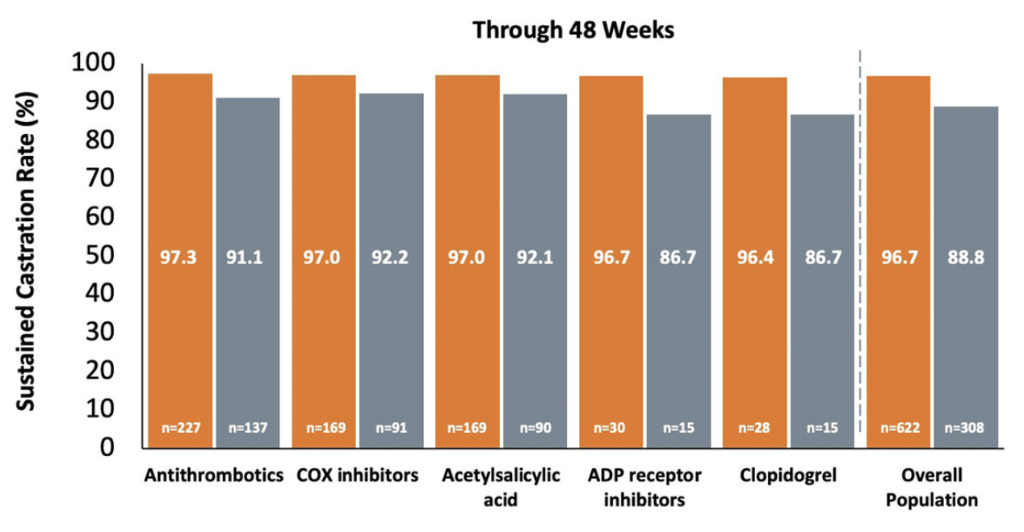
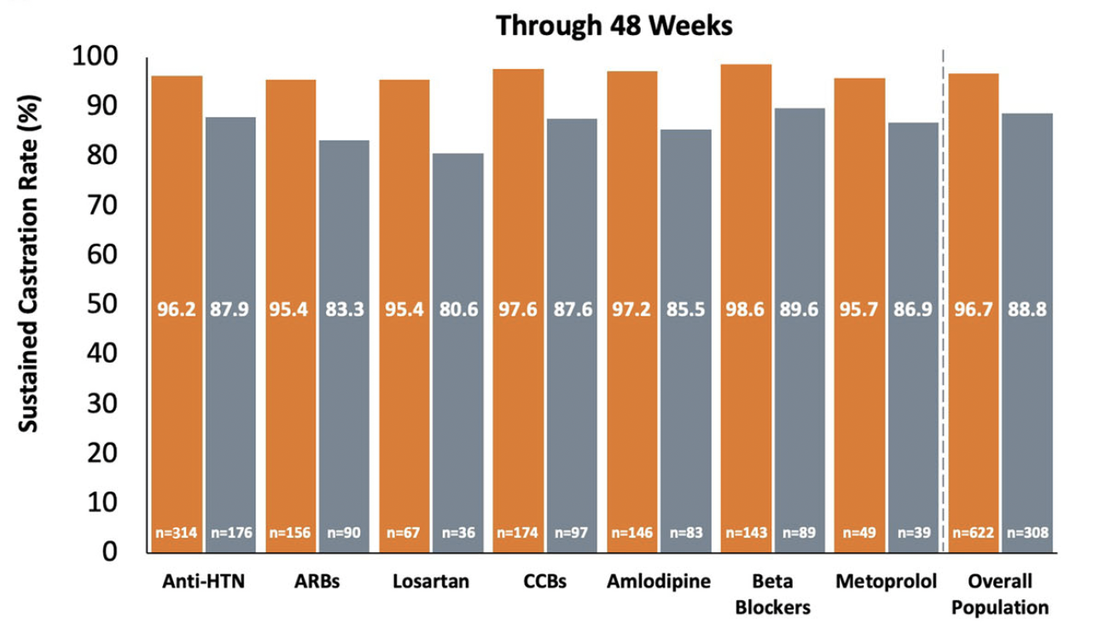
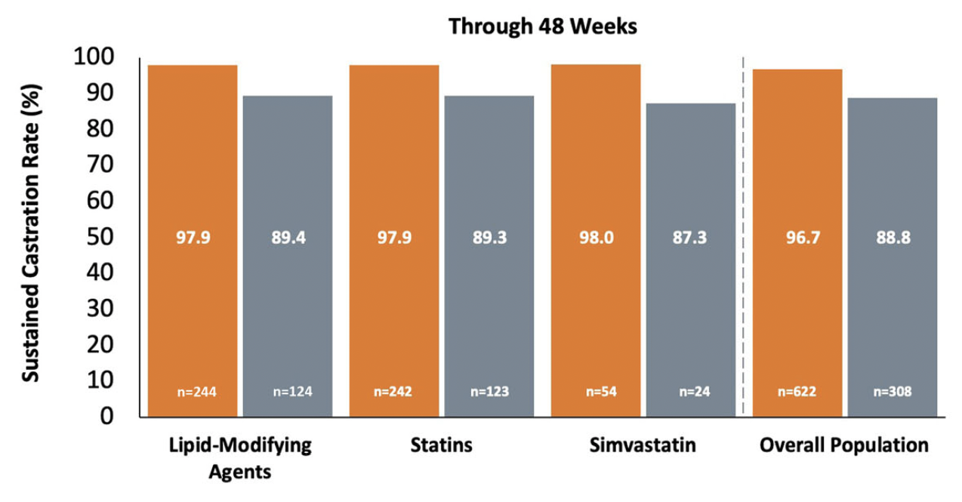
HERO: Sustained Castration Rates from Day 29 Through Week 48 for Concomitant Cardiovascular Therapies
Antithrombotics
Antihypertensives
Relugolix
Leuprolide
Lipid modifying agents
CV-related medications do not appear to impact Relugolix efficacy and are generally well tolerated in patients with advanced PC.
Shore ND et al. Adv Ther 2023;40(11):4919-27.

Slide 18
TITAN Study Design
Key eligibility criteria
Castration sensitive
Distant metastatic disease by ≥1 lesion on bone scan
ECOG PS 0 or 1
On-study requirement
Continuous ADT
Permitted
Prior docetaxel
ADT ≤6 mo for mCSPC or
≤ 3 y for local disease
Local treatment completed ≥1 y prior
Stratifications
Gleason score at diagnosis (≤7 vs >7)
Region (NA and EU vs all other countries)
Prior docetaxel (yes vs no)
APA 240 mg qd + ADT
(n = 525)
Second Rx at clinician’s discretion
PFS2
OS
rPFS
R
1:1
PBO + ADT
(n = 527)
Dual primary endpoints
rPFS
OS
Secondary endpoints
(by hierarchical testing order of analysis)
Time to cytotoxic chemotherapy
Time to pain progression
Time to chronic opioid use
Time to skeletal-related event
Other clinically relevant endpoints
Time to symptomatic local progression
Time to PSA progression
PFS2
Time to castration resistance
mCSPC = metastatic castration-sensitive prostate cancer; rPFS = radiographic progression-free survival; PFS2 = time to second progression or death

Slide 19
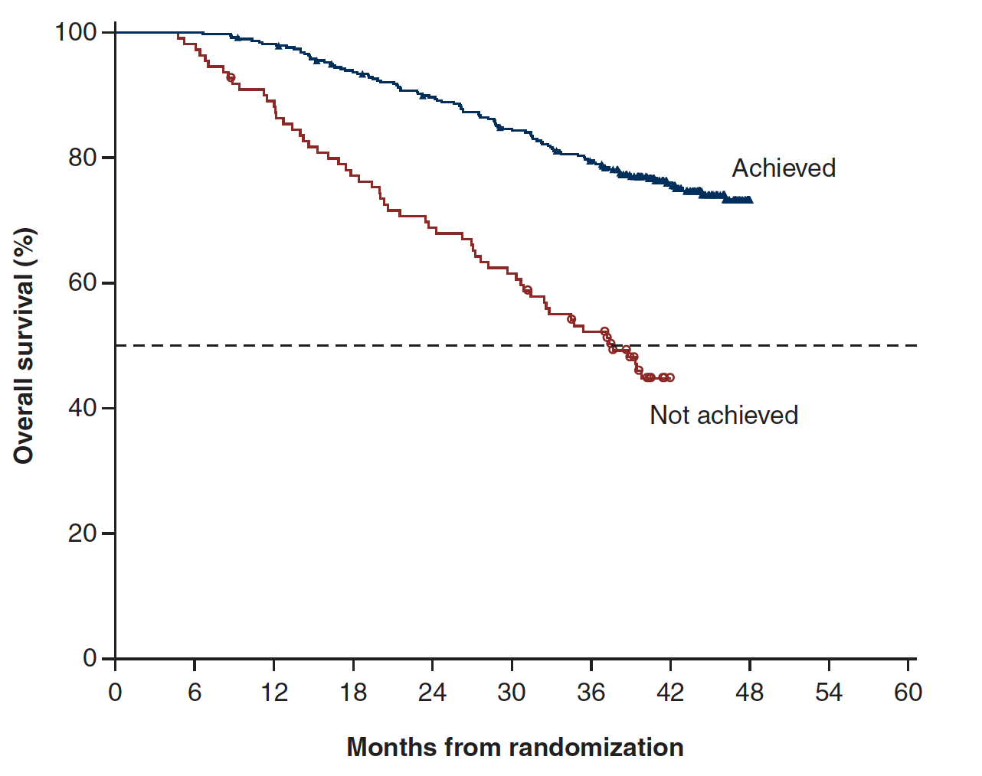
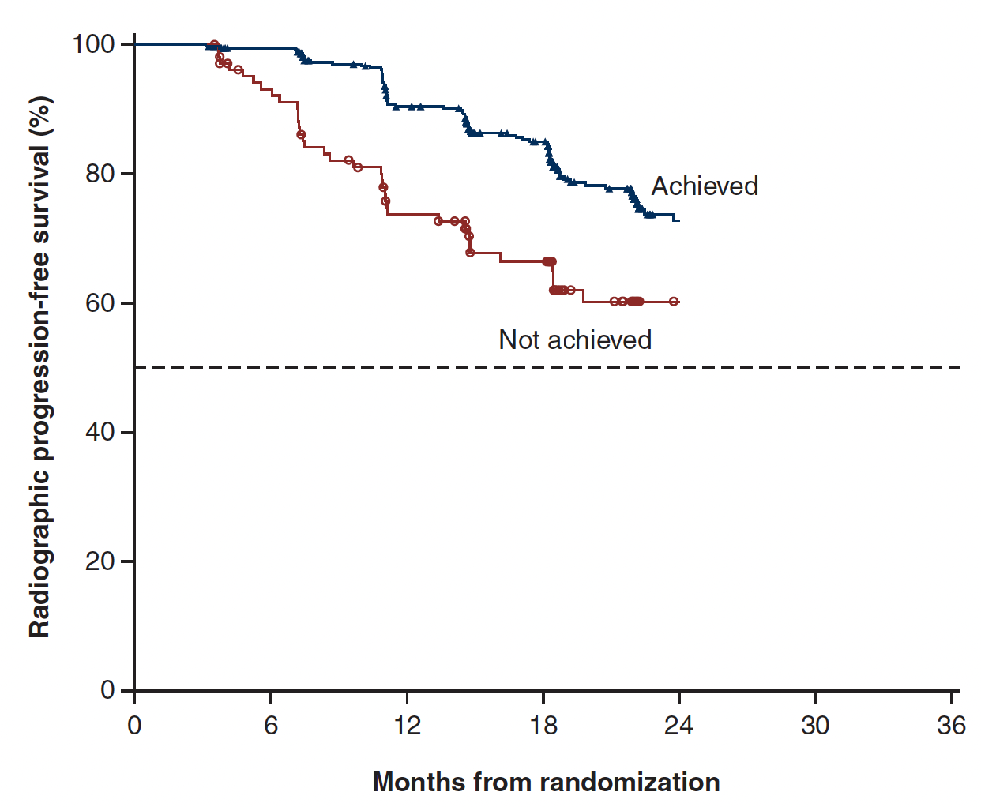
TITAN: Outcomes by Achievement of Deep PSA Decline (≥90% PSA Decline or PSA ≤0.2 ng/ml) at 3 Months of Apalutamide Treatment
OS
PFS
Apalutamide plus ADT demonstrated a robust (rapid, deep, and durable) PSA decline that was associated
with improved clinical outcomes, including long-term survival.
Chowdhury S et al. Ann Oncol 2023;34(5):477-85.

Slide 20
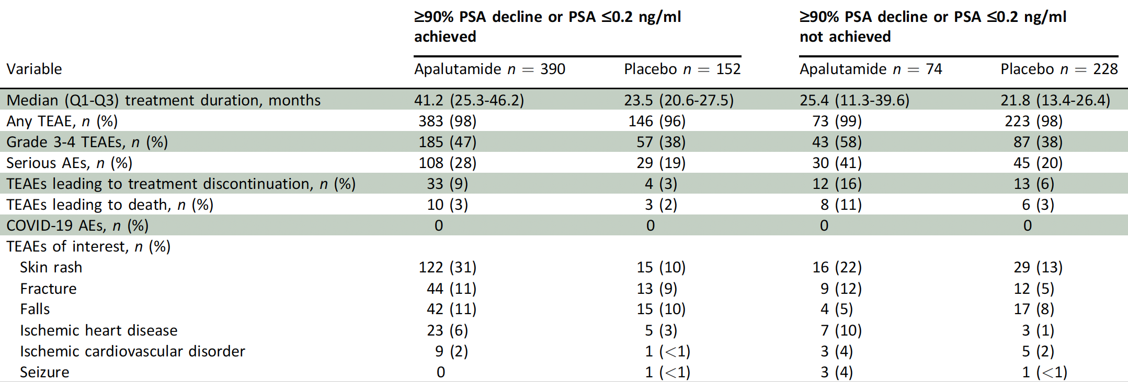
TITAN: Treatment-Emergent Adverse Events at 6 Months of Study Treatment
Treatment-emergent adverse events at 6 months of apalutamide treatment were assessed in patients with or without a deep PSA decline. The overall safety profile was similar to that described previously for the overall intent-to-treat TITAN population.
Chowdhury S et al. Ann Oncol 2023;34(5):477-85.

Slide 21
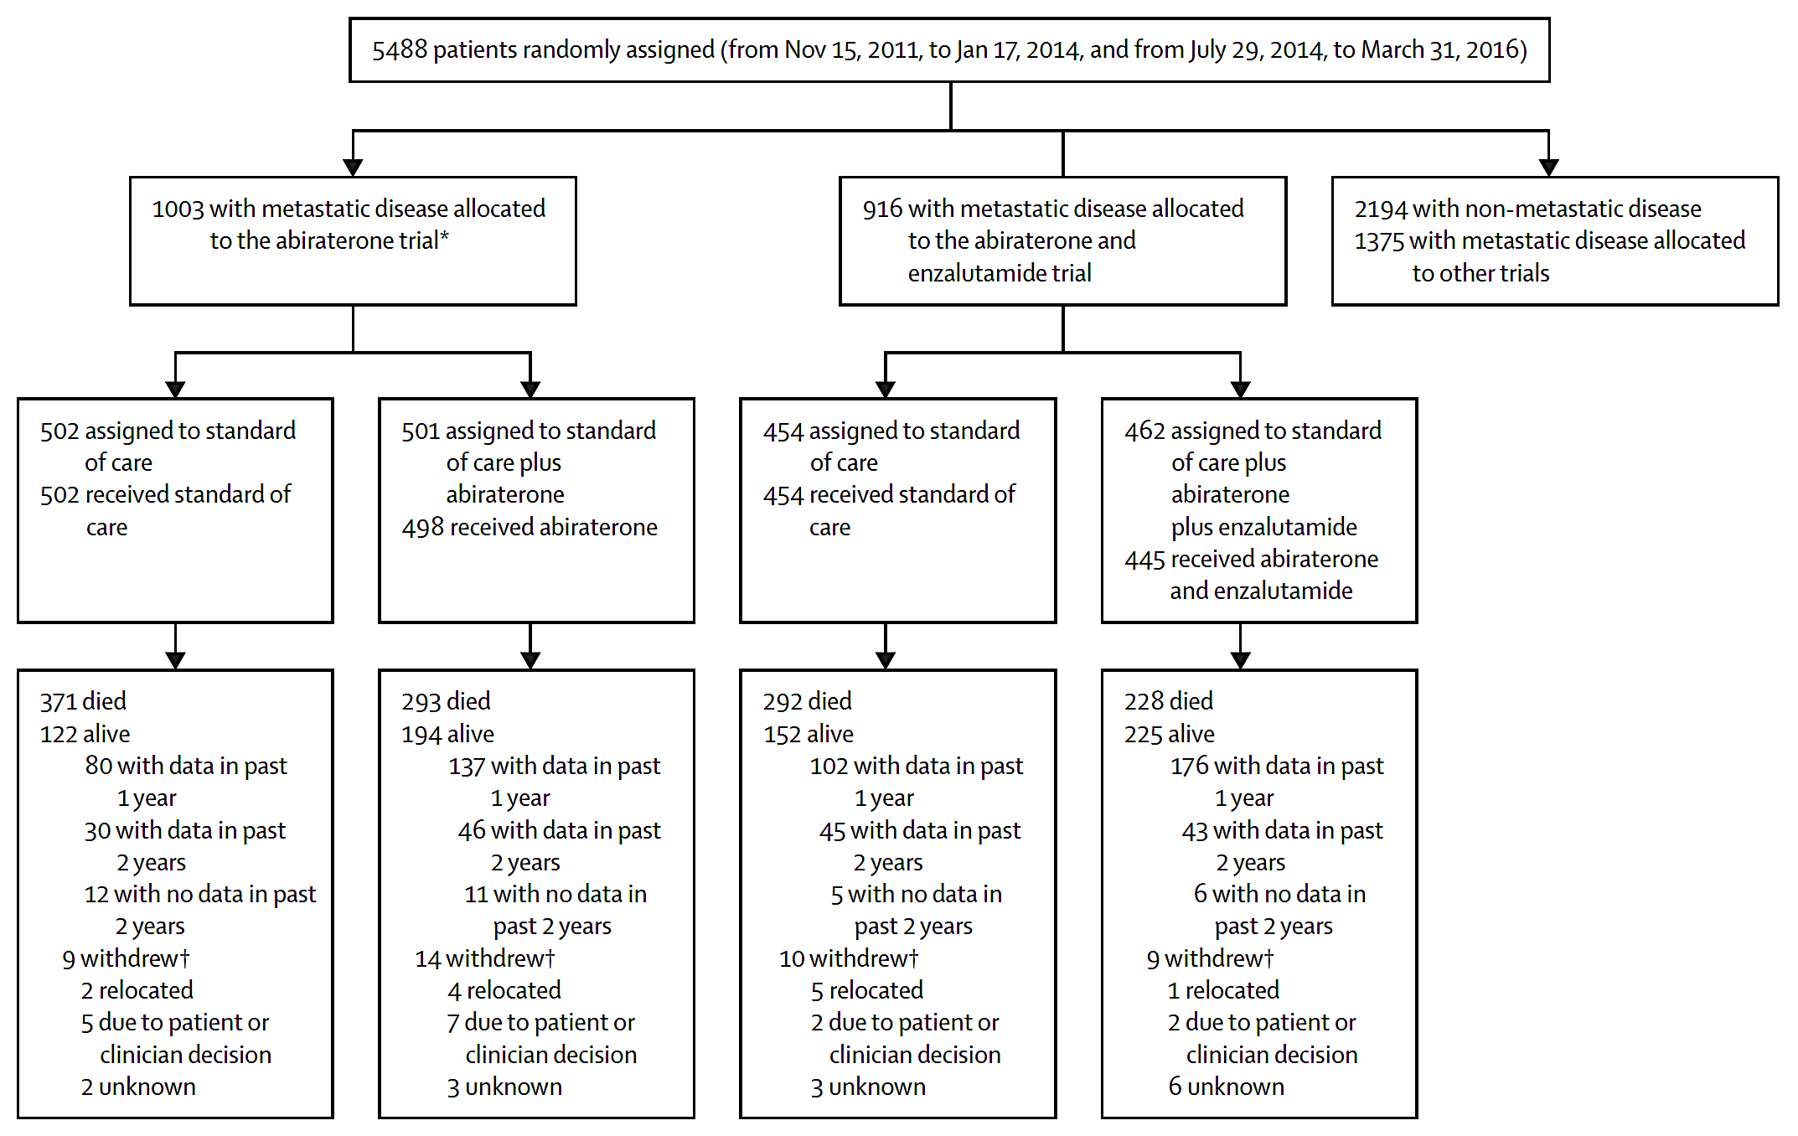
Final Results from 2 Randomized Phase III Trials of the STAMPEDE Platform Protocol
− A multigroup, multistage trial aimed to evaluate long-term outcomes and test whether combining enzalutamide with abiraterone and androgen deprivation therapy improves survival.
Attard G et al. Lancet Oncol 2023;24(5):443-56.

Slide 22
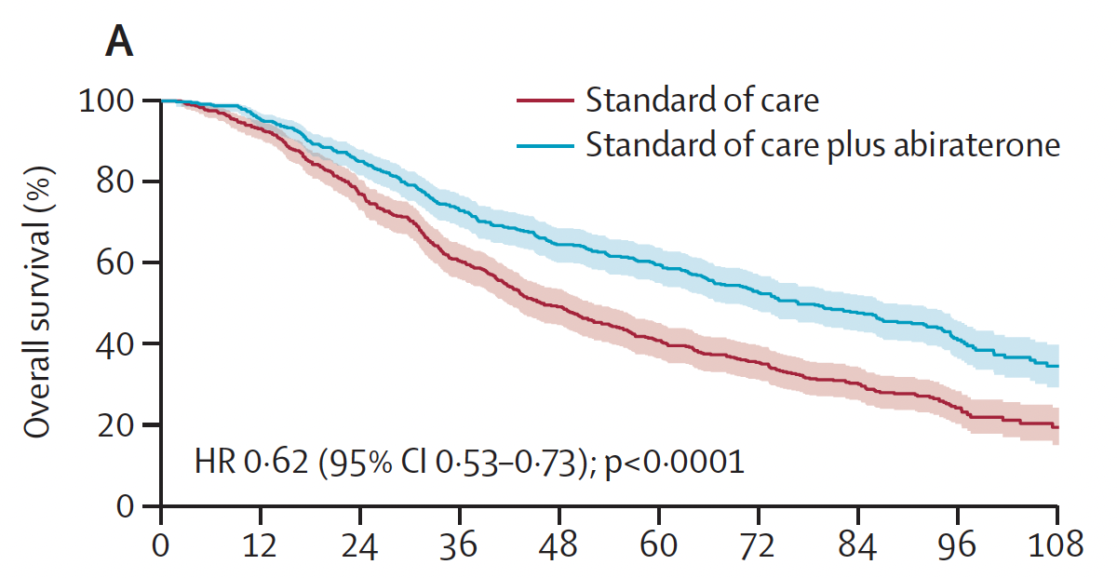
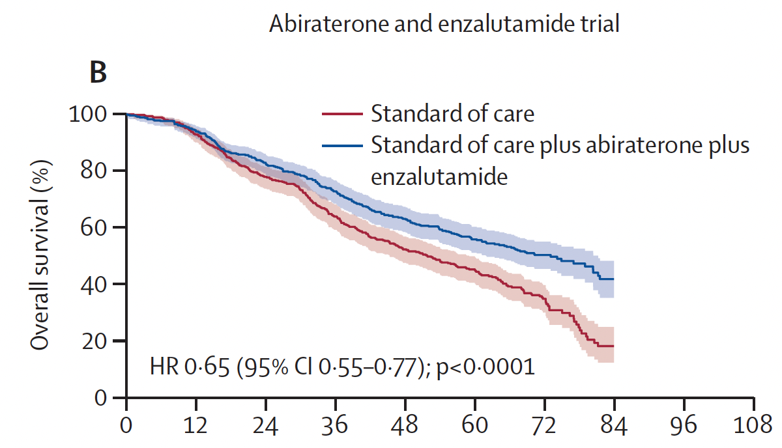
Final Results from 2 Randomized Phase III Trials of the STAMPEDE Platform Protocol (continued)
ADT
ADT + abiraterone acetate + prednisolone (AAP)
ADT
ADT + AAP + enzalutamide
Time since randomization (months)
– Enzalutamide and abiraterone should not be combined for patients with prostate cancer starting long-term androgen deprivation therapy.
- Clinically important improvements in survival from addition of abiraterone to androgen deprivation therapy are maintained for longer than 7 years.
Attard G et al. Lancet Oncol 2023;24(5):443-56.

Slide 23
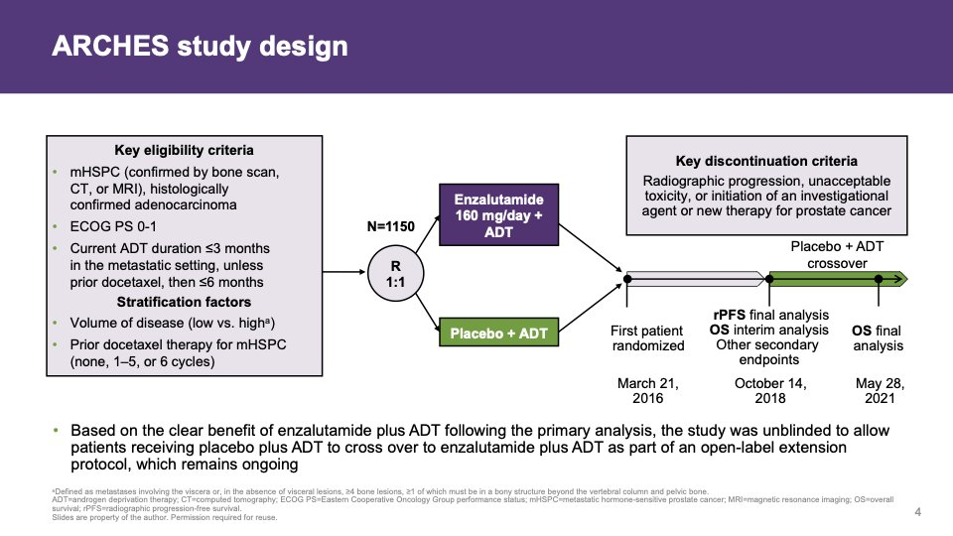
ARCHES Study Design
Armstrong AJ et al. Eur Urol 2023;84(2):229-41.

Slide 24
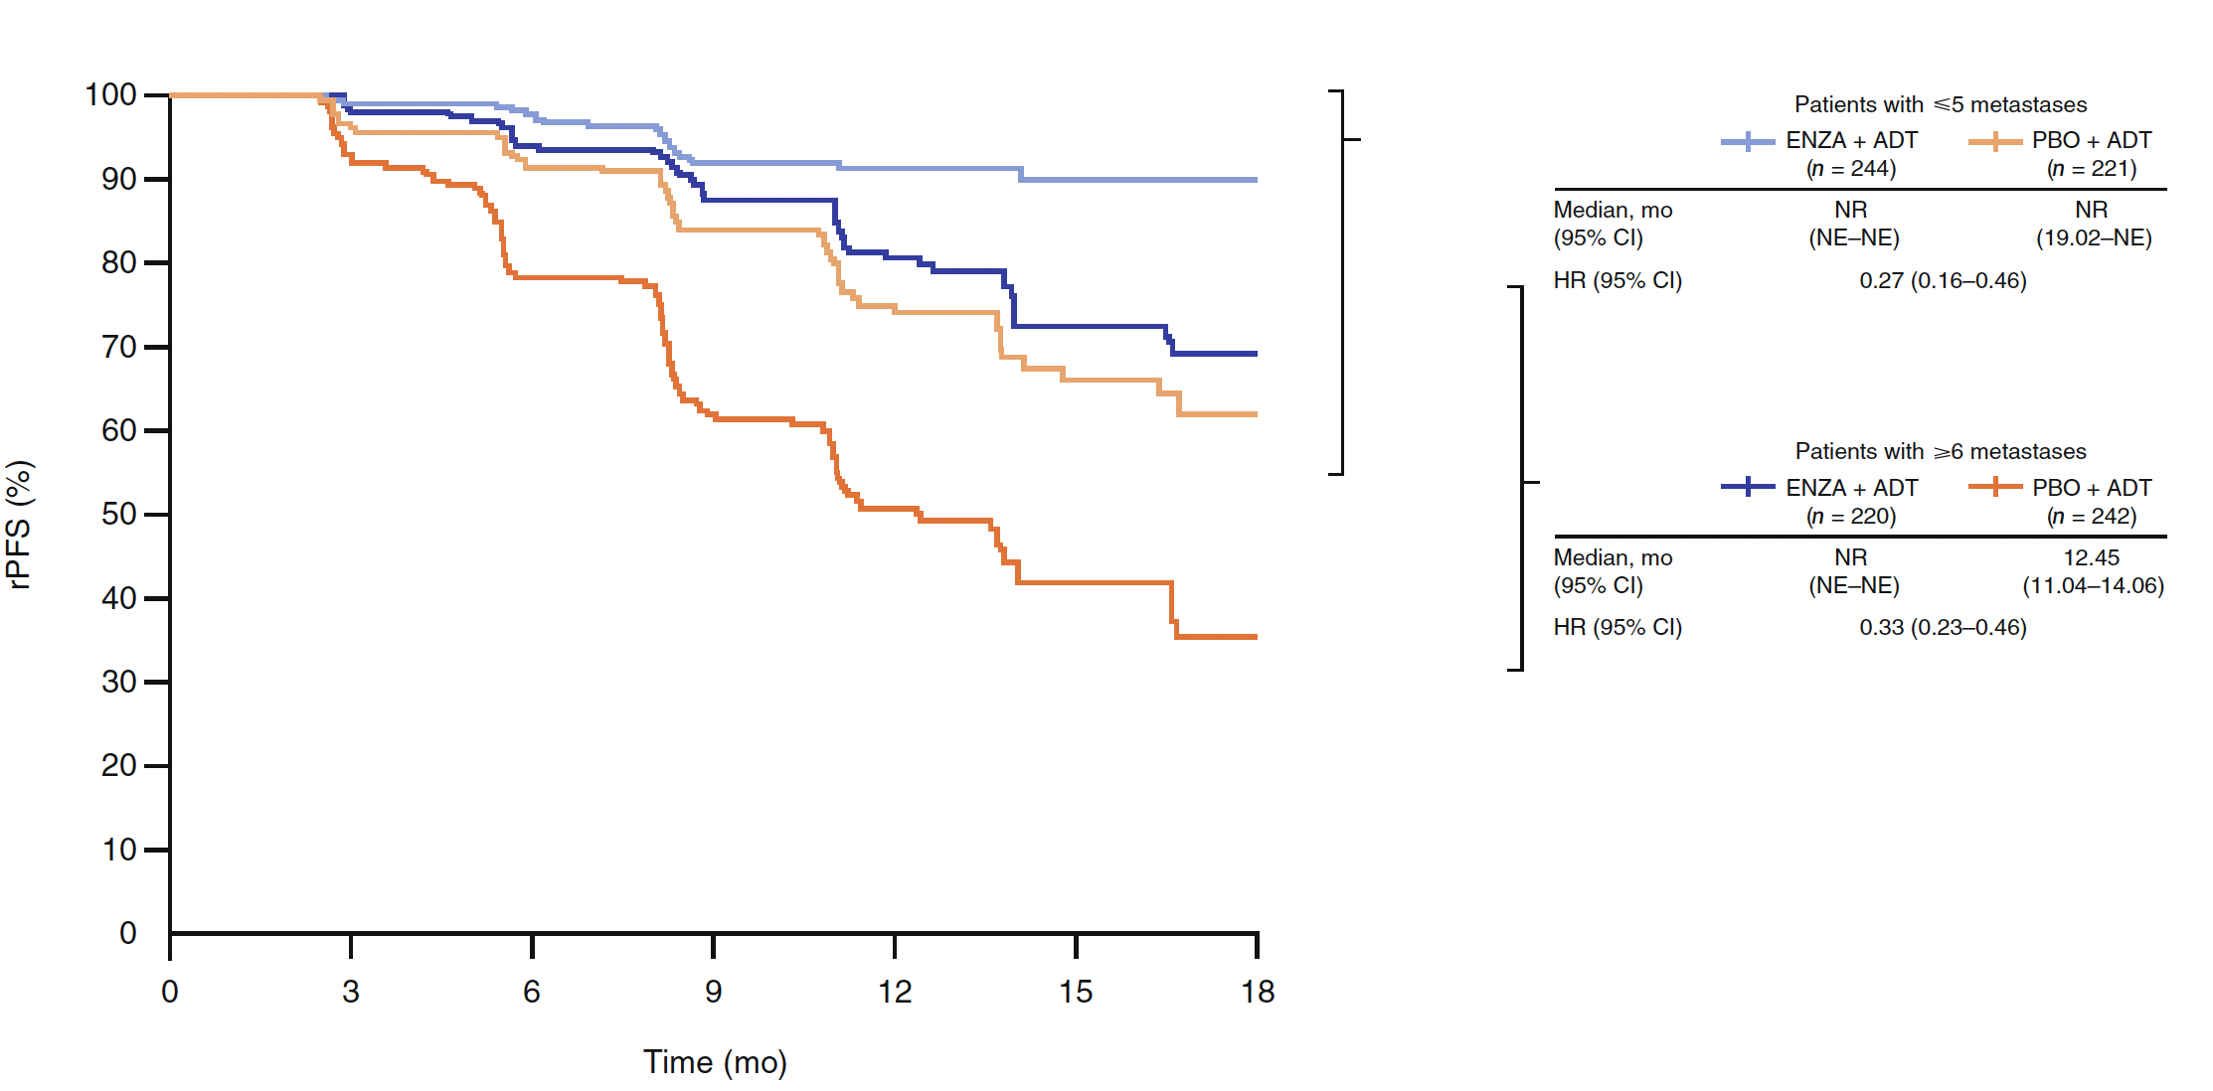
Post-Hoc Analysis of ARCHES: rPFS by Oligometastatic and Polymetastatic Disease
Oligometastatic: Patients with 1-5 metastases
Polymetastatic: Patients with ≥6 metastases
− Enzalutamide + ADT delayed radiographic progression and improved survival in patients with oligometastatic or polymetastatic HSPC.
- Patients with oligometastatic HSPC who received enzalutamide + ADT had better clinical outcomes than those with polymetastatic disease, with all subgroups benefiting over ADT alone, suggesting that earlier treatment intensification with systemic potent AR inhibition is advantageous.
Armstrong AJ et al. Eur Urol 2023;84(2):229-41.

Slide 25
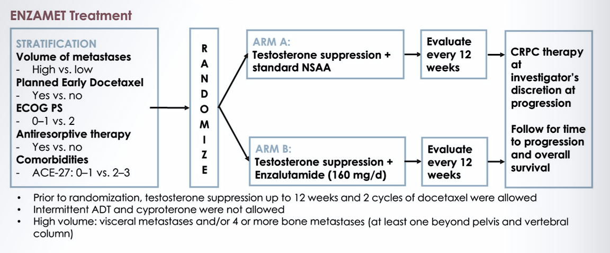
ENZAMET Study Design

Slide 26
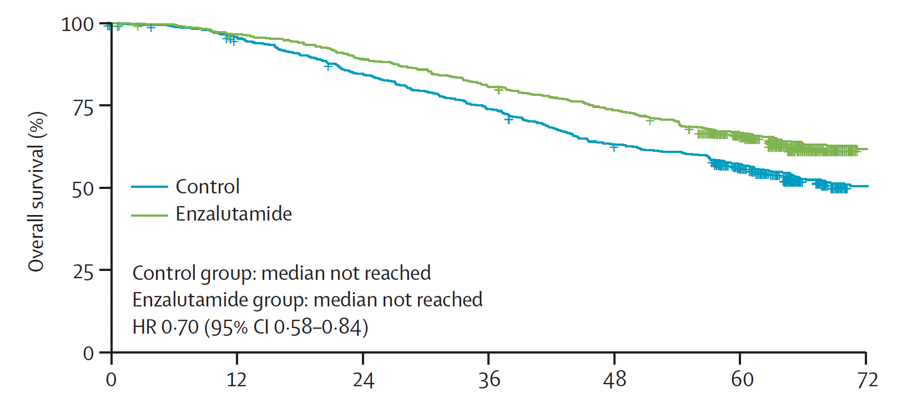
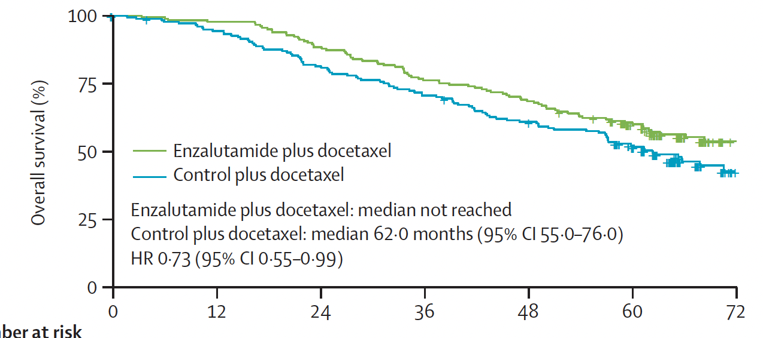
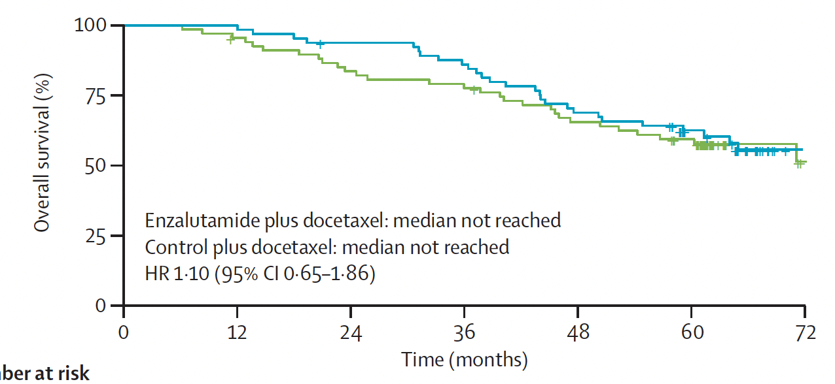
ENZAMET: Overall Survival
Synchronous metastatic disease
Enzalutamide + docetaxel
Control + docetaxel
Control
Enzalutamide
Overall Survival (%)
Control group: median 22·0 months (95% CI 20·0–25·0)
Enzalutamide group: median 68·0 months (95% CI 59·0–81·0)
HR 0·44 (95% CI 0·38–0·52)
Overall Survival (%)
Control group: median not reached
Enzalutamide group: median not reached
HR 0.70 (95% CI 0.58-0.84)
Metachronous metastatic disease
Time since randomization (months)
– The addition of enzalutamide to standard of care showed sustained improvement in overall survival for patients with mHSPC and should be considered as a treatment option for eligible patients.
Overall Survival (%)
Control group: median 25·0 months (95% CI 22·0–30·0)
Enzalutamide group: median 81·0 months (95% CI 64·0–NA)
HR 0·45 (95% CI 0·39–0·53)
Sweeney CJ et al. Lancet Oncol 2023;24(4):323-34.

Slide 27
ARASENS: A Randomized Phase III Trial of Darolutamide versus Placebo for Metastatic Hormone-Sensitive Prostate Cancer (mHSPC) – Study Design
Smith MR et al. Genitourinary Cancers Symposium 2022;Abstract 13.

Slide 28
Definition of Disease Volume and Risk Subgroups
High-Volume Disease: CHAARTED Criteria¹ | High-Risk Disease: LATITUDE Criteria²
Visceral metastases ≥4 bone metastases with ≥1 beyond the vertebral column/pelvisª | ≥2 risk factors: Gleason score ≥8 ≥3 bone metastasesª Visceral metastases
1. Sweeney CJ, et al. N Engl J Med. 2015; 373:737-746; 2. Fizazi K, et al. N Engl J Med. 2017;377:352-360; 3. Manohar PR, et al. World J Nucl Med. 2017;16:39-44.

Slide 29
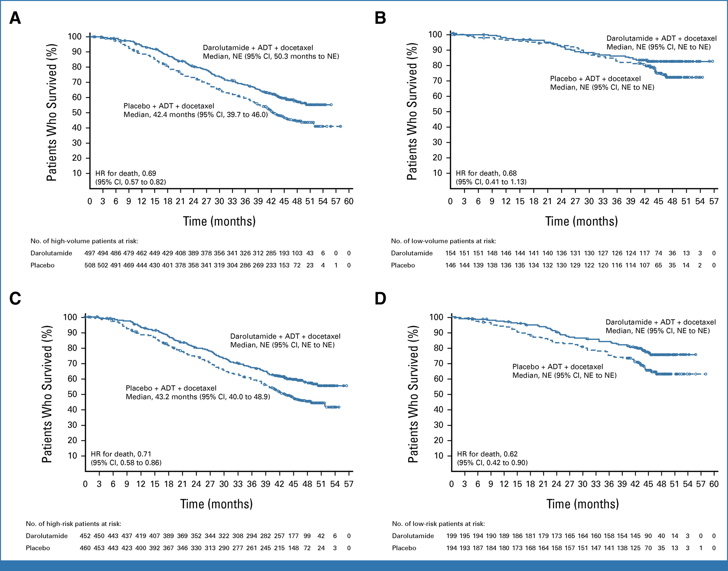
Phase III ARASENS Trial: Overall Survival by Subgroup (Disease Volume)
High-volume disease
Low-volume disease
Darolutamide + ADT + docetaxel
Median, NE (95% CI, NE to NE)
Darolutamide + ADT + docetaxel
Median, NE (95% CI, 50.3 months to NE)
Placebo + ADT + docetaxel
Median, NE (95% CI, NE to NE)
Placebo + ADT + docetaxel
Median, 42.4 months (95% CI, 39.7 to 46.0)
HR for death, 0.69
(95% CI, 0.57 to 0.82)
HR for death, 0.68
(95% CI, 0.41 to 1.13)
Hussain M et al. J Clin Oncol 2023;41(20):3595-607.

Slide 30
Phase III ARASENS Trial: Overall Survival by Subgroup (Disease Risk)
High-risk disease
Low-risk disease
Darolutamide + ADT + docetaxel
Median, NE (95% CI, NE to NE)
Darolutamide + ADT + docetaxel
Median, NE (95% CI, NE to NE)
Placebo + ADT + docetaxel
Median, NE (95% CI, NE to NE)
Placebo + ADT + docetaxel
Median, 43.2 months (95% CI, 40.0 to 48.9)
HR for death, 0.71
(95% CI, 0.58 0.86)
HR for death, 0.62
(95% CI, 0.42 to 0.90)
High-risk disease was defined as two of the following risk factors associated with poor prognosis: Gleason score ≥8, three or more bone metastases, and presence of measurable visceral metastasis. Low risk disease was defined as not meeting the high-risk criteria.
Hussain M et al. J Clin Oncol 2023;41(20):3595-607.

Slide 31
Novel Management Approaches for Patients with Advanced PC

Slide 32
Rationale to Study Abemaciclib in Metastatic Prostate Cancer
1
2
3
The Androgen Receptor (AR) signaling pathway plays a pivotal role in normal prostate gland development as well as prostate carcinogenesis (4).
Preclinical and human models suggest a relationship between the cellular AR level in both primary and metastatic disease and disease progression to castration resistant PCa (CRPC) (5-7).
The transition from clinically localized prostate cancer to castration resistance (CRPC) involves a complex interplay of molecules and is attributed to aberrant AR signaling (4).
Abemaciclib is a potent and selective oral inhibitor of CDK4&6 that is approved for the treatment of early and advanced/metastatic HR+/HER2- breast cancer (1).
As with estrogen receptor signaling pathway in breast cancer, evidence exists that the AR signaling pathway activates the CDK4/6 – cyclin D1 axis to sustain prostate cancer cell proliferation and survival (2,3).
In both hormone sensitive and castration resistance prostate cancer cell models, Abemaciclib demonstrated in vitro activity, as single agent and in combination with AR blocker agents, limiting cellular proliferation.
HYPOTHESIS: dual inhibition of the AR axis and cell cycle entry with the coadministration of abiraterone and Abemaciclib may inhibit the proliferation of prostate cancer cells and delay progression of anti-androgen resistant disease.
References: 1. Abemaciclib package insert, 2021; 2. Knudsen et al. 1998; 3. Xu et al. 2006; 4. Lonergan et al. 2011; 5, Hershall et al. 2001; 6. Ricciardelli et. al, 2005; 7. Chen CD et. al. 2004

Slide 33
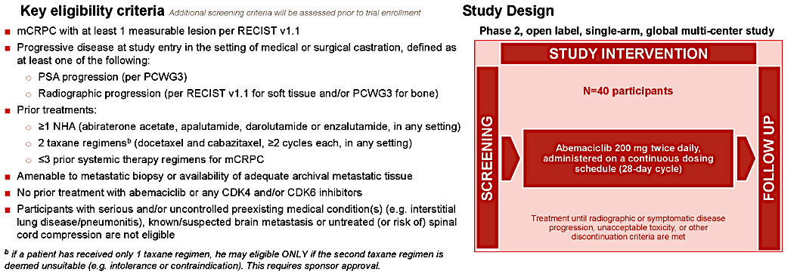
CYCLONE 1 Study Design
Agarwal N et al. ASCO 2021;Abstract TPS5086.

Slide 34
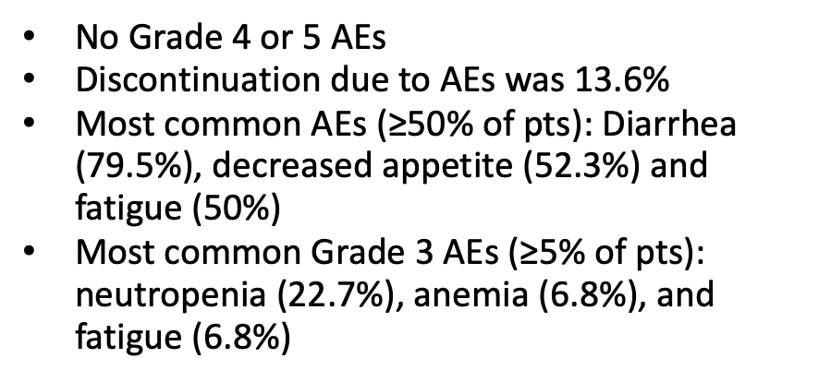
CYCLONE 1: Results
Metric | No. patients
ORR | 3 (6.8%)
Stable disease | 17 (38.6%)
Stable disease lasting ≥6 months | 6 (13.6%)
DCR | 45.5%
Median PFS | 2.7 months (95% CI 1.9, 3.7)
6-month rPFS | 24.9% (95% CI 12.4, 39.5)
Median OS | 7.6 months (CI 5.6, NE)
No Grade 4 or 5 AEs
Discontinuation due to AEs was 13.6%
Most common AEs (≥50% of pts): Diarrhea (79.5%), decreased appetite (52.3%) and fatigue (50%)
Most common Grade 3 AEs ($\text{≥}$5% of pts): neutropenia (22.7%), anemia (6.8%), and fatigue (6.8%)
Abemaciclib demonstrated modest but objective single-agent clinical activity in patients with very heavily pretreated progressive mCRPC.
ORR = objective response rate; DCR = disease control rate
Agarwal N et al. AACR 2023;Abstract CT159.

Slide 35
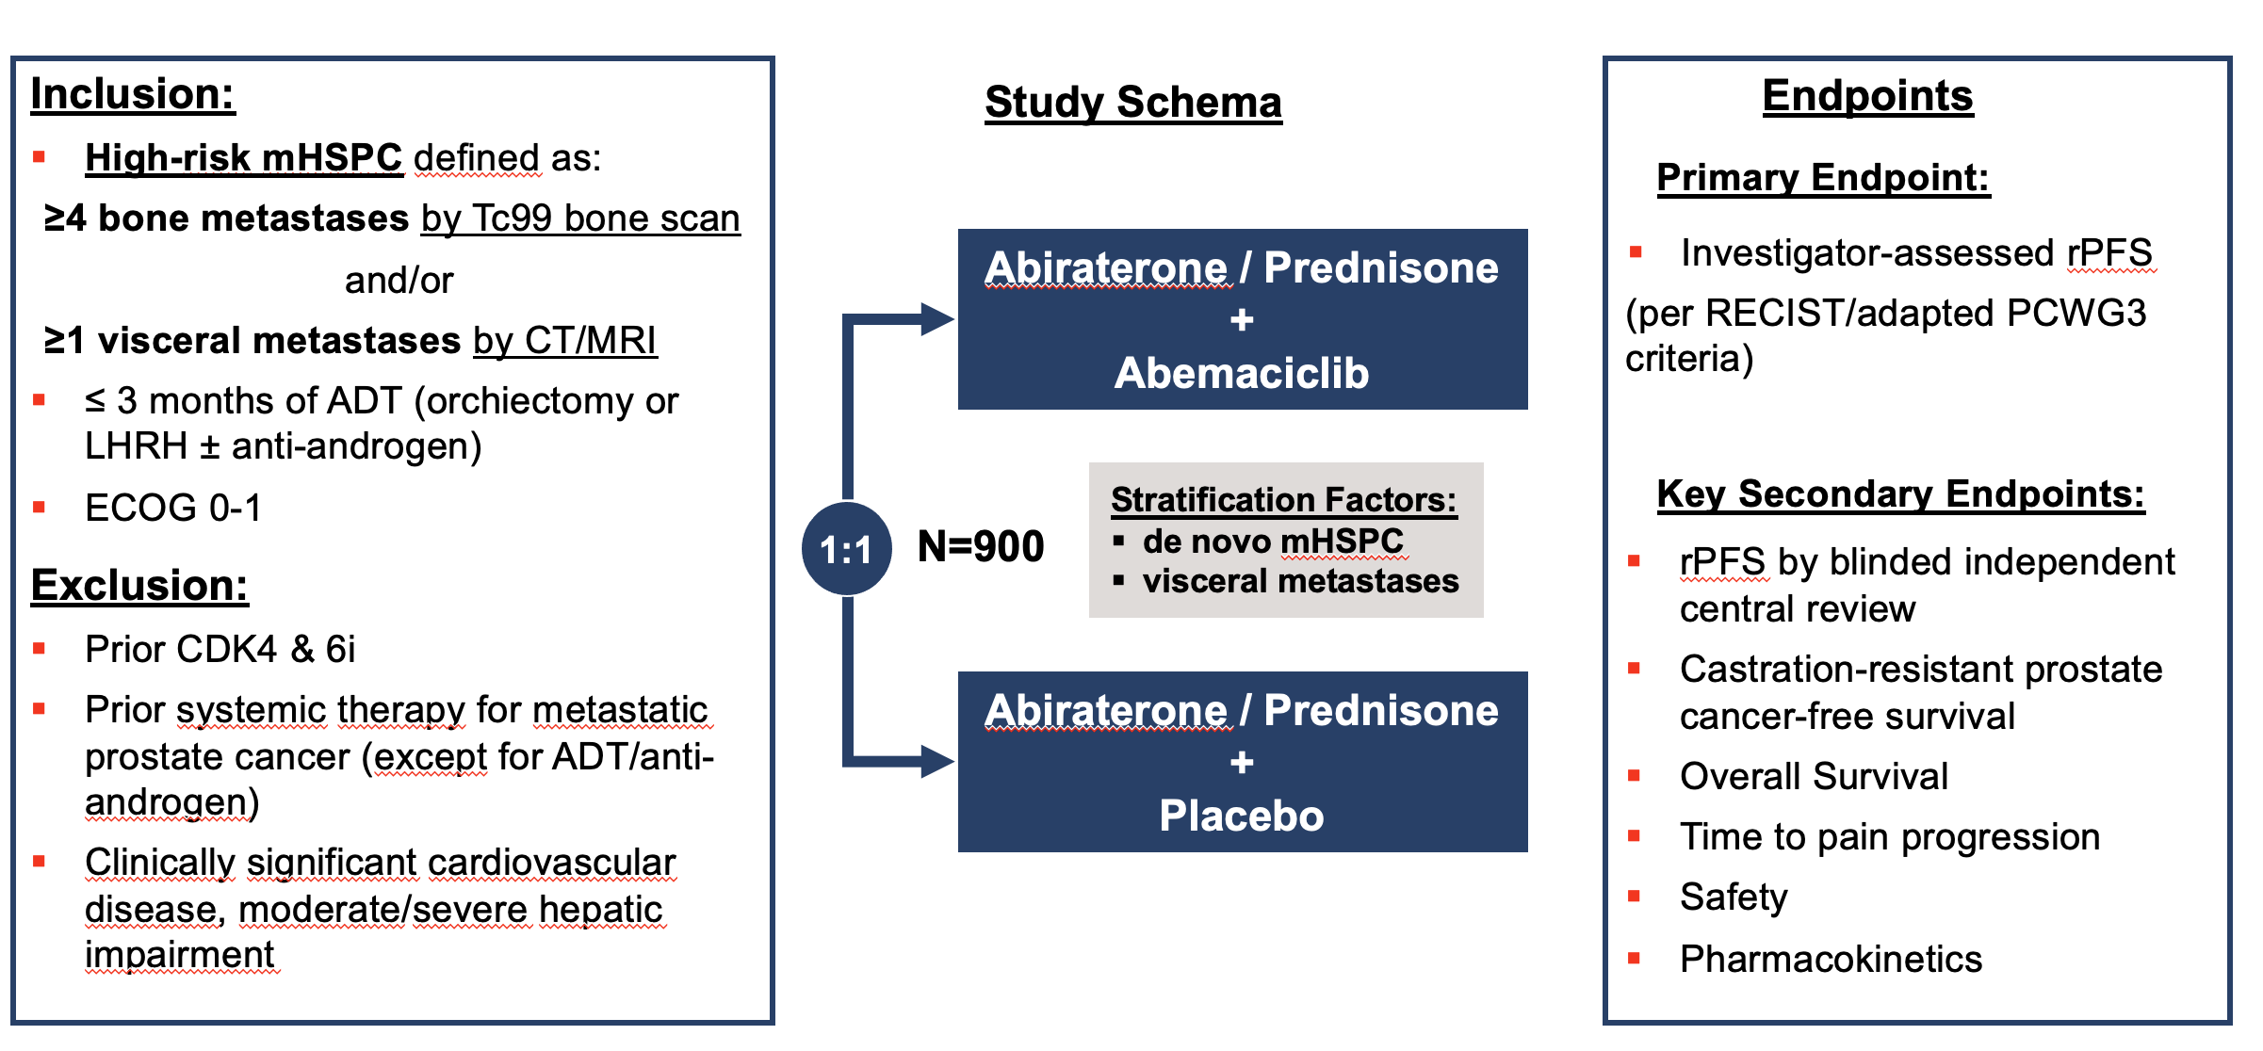
CYCLONE 3: A Phase III, Randomized, Double-Blind, Placebo-Controlled Study of Abemaciclib in Combination with Abiraterone for High Risk mHSPC
Smith MR et al. Genitourinary Cancers Symposium 2023;Abstract TPS289. Matsubara N et al. ESMO Asia 2023;Abstract 284TiP.

Slide 36
“Phase 3 CYCLONE-2 results [demonstrated that] abemaciclib added to abiraterone did not meet the primary endpoint of improved radiographic progression-free survival in men with metastatic castration-resistant prostate cancer (mCRPC); the overall safety and tolerability profile was consistent with the known profiles of the medicines.”
https://investor.lilly.com/news-releases/news-release-details/lilly-reports-strong-fourth-quarter-2023-financial-results-and

Slide 37
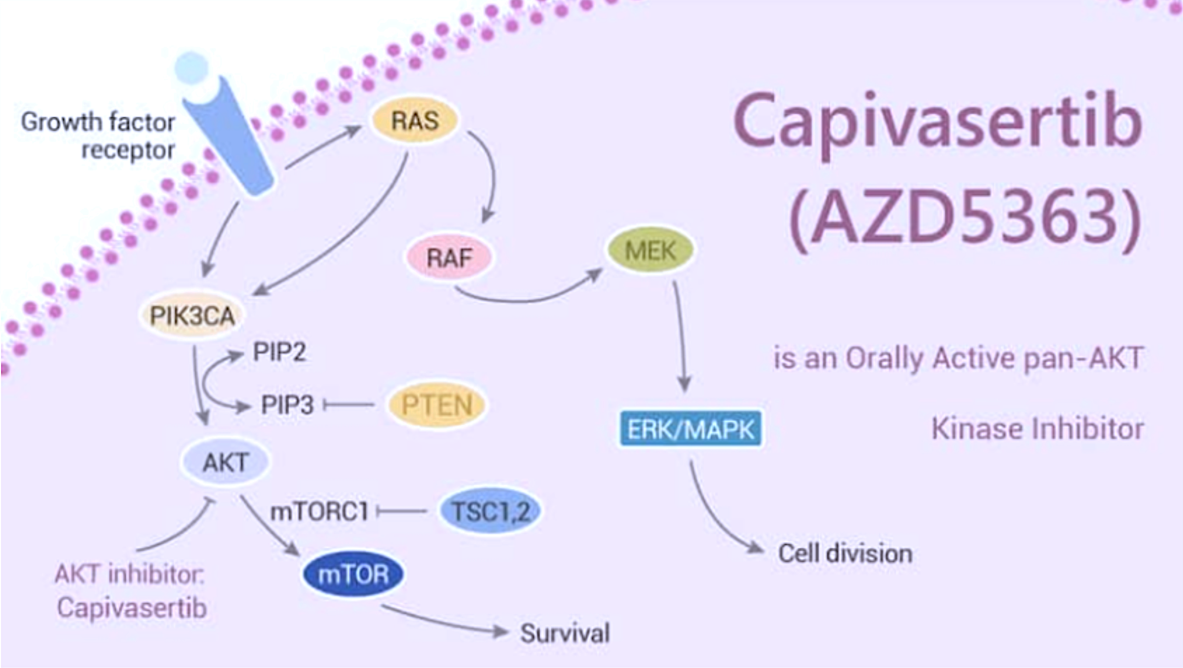
Rationale to Study Capivasertib (Pan-AKT Inhibitor) in mHRPC
Patients with metastatic prostate cancer can develop PI3K/AKT/PTEN pathway-associated resistance to andro-gen receptor-targeted therapy.
In an open-label phase Ib study, 27 patients received abiraterone acetate + capivasertib, a potent, selective pan-AKT inhibitor.
The combination demonstrated acceptable tolerability with no dose-limiting toxicity and pharmacokinetics consistent with monotherapy dosing. These data support further clinical evaluation in this patient population.
Shore N et al. Clin Genitourin Cancer 2023;21(2):278-85. Kyinno Biotechnology November 11, 2023.

Slide 38
Phase I Trial of Capivasertib with Abiraterone Acetate for Patients with mCRPC: Study Design
Key inclusion criteria
Asymptomatic or mildly symptomatic histologically confirmed de novo hormone-sensitive prostate adenocarcinoma
PTEN IHC result indicating PTEN deficiency
Metastatic disease by clear evidence of
≥1 bone lesion and/or ≥1 soft tissue lesion
Eligibility for abiraterone and steroid therapy
Ongoing ADT with GnRH analog, or LHRH agonists or antagonist, or bilateral orchiectomy (regardless of method) from 0 days to a maximum of 93 days prior to randomization
ECOG performance status 0 to 1
Primary Endpoint
Radiographic PFS
Secondary Endpoints
OS
TFST
SSE-FS
TTPP
Time to PSA progression
TTCR
PFS2
QoL Outcomes
AEs
Capivasertib 400 mg BID + abiraterone acetate
R
1:1
Placebo + abiraterone acetate
– Nine participants (33%) showed a 20% or greater decrease in PSA during study treatment.
– The combination of capivasertib/abiraterone had an acceptable tolerability profile consistent with the known profile of each agent.
– These data support further evaluation of capivasertib and abiraterone acetate in patients with advanced prostate cancer.
Shore N et al. Clin Genitourin Cancer 2023;21(2):278-85.

Slide 39
Prostate Cancer Disease States
PROSPER
ARAMIS
Newly Diagnosed PC
PSA ↑↑
nmCRPC
Increasing PSA Levels
PSA ↑↑
Biochemically Recurrent PC
PEACE-1
HERO
TITAN
STAMPEDE
ARCHES
ENZAMET
ARASENS
CYCLONE 3
PRESTO
EMBARK
mCRPC
Newly Diagnosed Metastatic PC (mHSPC)
CYCLONE 1
CYCLONE 2
Phase 1 Capivasertib + Abiraterone
PSA relapse post Localized Therapy (surgery/radiation)
Disease Monitoring
ADT + /-AR-I, ADT + Docetaxel +/-AR-I
Castration-Resistant Prostate Cancers
Scher HI et al. PLoS One 2015.
Notes:
Green – Positive for at least one primary endpoint
Red – Negative for the analysis within in this presentation
Orange – Requires additional evaluation/TiP

Slide 40
Appendix

Slide 41
Conclusions
Positive data sets | Negative data sets | Additional evaluation needed
Extended follow-up from PRESTO: Positive biochemical PFS; MFS and TTCR evaluation is ongoing | STAMPEDE: No OS benefit from adding enzalutamide to AAP/(long-term)ADT | PEACE-1: Positive for PFS, no OS benefit at this time
EMBARK: MFS improved for enzalutamide + leuprolide and enzalutamide monotherapy | CYCLONE 2: No PFS benefit | CYCLONE 1: Modest but objective single-agent activity
Post-hoc analysis of PROSPER: Prognostic value of PSA dynamics |  | Phase I Capi + AA: Early efficacy signal
Subgroup analysis of ARAMIS: Improved MFS & OS
Subgroup analysis of HERO: CV-related medications are safe to use with relugolix
PSA kinetics from TITAN: PSA decline associated with improved clinical outcomes
Post-hoc analysis of ARCHES: Positive PFS and OS
ENZAMET: Positive OS
Subgroup analysis of ARASENS: Positive OS

