Slide 1
Wednesday, May 1, 2024
7:00 PM – 8:00 PM ET
What I Tell My Patients:
Integrating New Research Information
into Current Clinical Care
Prostate Cancer
A Complimentary NCPD Webinar in Partnership with the Oncology Nursing Society
Faculty
Andrew J Armstrong, MD, ScM
Brenda Martone, MSN, NP-BC, AOCNP
Moderator
Neil Love, MD

Slide 2



Faculty
Andrew J Armstrong, MD, ScM
Professor of Medicine, Surgery
Pharmacology and Cancer Biology
Director of Research
Duke Cancer Institute Center for Prostate
and Urologic Cancers
Divisions of Medical Oncology and Urology
Duke University
Durham, North Carolina
MODERATOR
Neil Love, MD
Research To Practice
Miami, Florida
Brenda Martone, MSN, NP-BC, AOCNP
Northwestern Medicine
Northwestern Memorial Hospital
Chicago, Illinois

Slide 3









Consulting Nurse Faculty
Jacqueline Broadway-Duren, PhD, DNP, APRN, FNP-BC
The University of Texas
MD Anderson Cancer Center
Houston, Texas
Jessica Mitchell, APRN, CNP, MPH
Mayo Clinic College of Medicine and Science
Rochester, Minnesota
Kathleen D Burns, RN, MSN, AGACNP-BC, OCN
City of Hope Comprehensive
Cancer Center
Duarte, California
Tiffany A Richards, PhD, ANP-BC, AOCNP
The University of Texas
MD Anderson Cancer Center
Houston, Texas
Sonia Glennie, ARNP, MSN, OCN
Swedish Cancer Institute Center
for Blood Disorders
Seattle, Washington
Kimberly A Spickes, MNSc, RN, APRN, OCN, ACNP-BC
University of Arkansas for Medical Sciences
Little Rock, Arkansas
Amy Goodrich, CRNP
The Sidney Kimmel Comprehensive Cancer Center
Baltimore, Maryland
Ronald Stein, JD, MSN, NP-C, AOCNP
USC Norris Comprehensive Cancer Center
Los Angeles, California
https://www.ResearchToPractice.com/ONS2024Clips

Slide 4
How was it different to take care of this patient
versus another patient in the same oncologic setting?
What unique biopsychosocial factors (eg, attitude, comorbidities, social support) were considered
in the overall management of this case?

Slide 5
Dr Armstrong — Disclosures
Advisory Committees | AstraZeneca Pharmaceuticals LP, Bayer HealthCare Pharmaceuticals, Bristol Myers Squibb, Clovis Oncology, Exelixis Inc, GoodRx, Merck, Myovant Sciences, Novartis, Pfizer Inc, Z-Alpha
Consulting Agreements | Astellas, AstraZeneca Pharmaceuticals LP, Bayer HealthCare Pharmaceuticals, Bristol Myers Squibb, Celgene Corporation, Clovis Oncology, Dendreon Pharmaceuticals Inc, Epic Sciences, Exact Sciences Corporation, Exelixis Inc, Forma Therapeutics, GoodRx, Janssen Biotech Inc, Merck, Myovant Sciences, Novartis, Pfizer Inc, Z-Alpha
Contracted Research | Amgen Inc, Astellas, AstraZeneca Pharmaceuticals LP, Bayer HealthCare Pharmaceuticals, Bristol Myers Squibb, Celgene Corporation, Dendreon Pharmaceuticals Inc, Forma Therapeutics, Janssen Biotech Inc, Merck, Novartis, Pfizer Inc
Nonrelevant Financial Relationships | National Cancer Institute, National Institutes of Health, Prostate Cancer Foundation/Movember, US Department of Defense

Slide 6
Ms Martone — Disclosures
No relevant conflicts of interest to disclose

Slide 7
Commercial Support
This activity is supported by an educational grant from Novartis.
Research To Practice NCPD Planning Committee Members,
Staff and Reviewers
Planners, scientific staff and independent reviewers for Research To Practice have no relevant conflicts of interest to disclose.

Slide 8
This educational activity contains discussion of
non-FDA-approved uses of agents and regimens. Please refer to official prescribing information for each product for approved indications.

Slide 9
Agenda
INTRODUCTION: Overview of Prostate Cancer; Hormonal Therapy
MODULE 1: Radiopharmaceuticals for the Management of Metastatic Castration-Resistant Prostate Cancer (mCRPC)
MODULE 2: Biomarker Testing for mCRPC; PARP Inhibitors for mCRPC

Slide 10
Agenda
INTRODUCTION: Overview of Prostate Cancer; Hormonal Therapy
MODULE 1: Radiopharmaceuticals for the Management of Metastatic Castration-Resistant Prostate Cancer (mCRPC)
MODULE 2: Biomarker Testing for mCRPC; PARP Inhibitors for mCRPC

Slide 11
Clinical Disease States Model of Prostate Cancer
Death from
other causes
Noncastrate prostate cancer
Castrate prostate cancer
Clinical Metastases
Clinically
localized disease
Rising PSA:
noncastrate
Clinical metastases:
noncastrate
Clinical metastases:
castrate
Rising PSA:
castrate
Death from
disease
Two defining criteria
Rising PSA in the setting of castrate testosterone levels (<50 ng/dL)
No radiographically identifiable metastasis

Slide 12
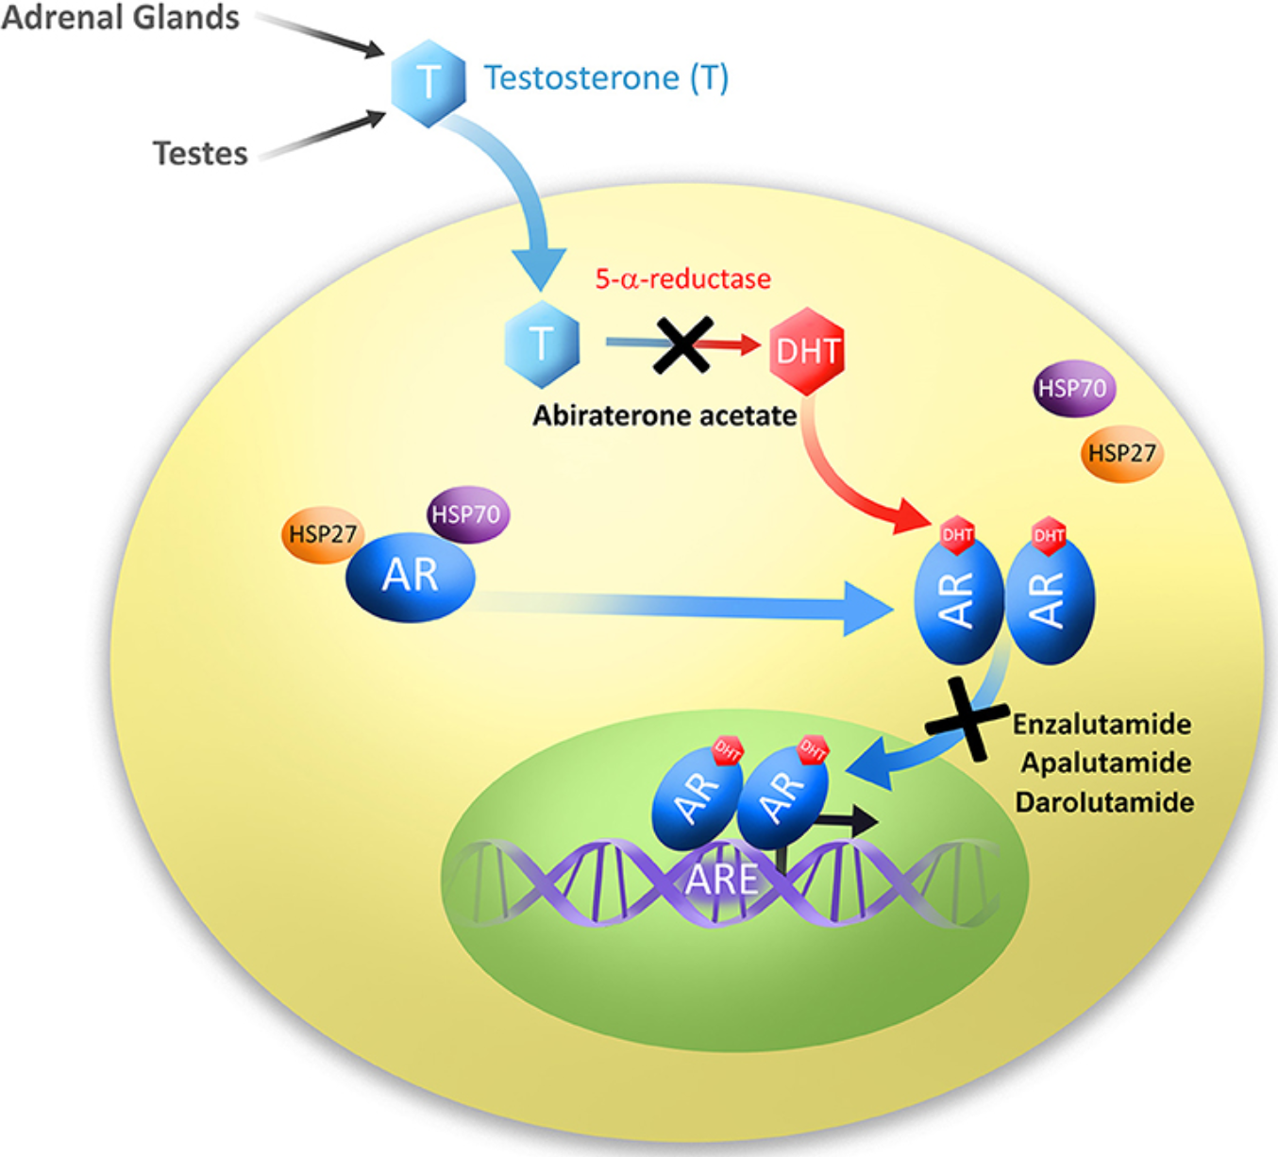
Diagram of Androgen Production and Its Targeted Inhibition
Rice MA et al. Front Oncol 2019;9:801.

Slide 13
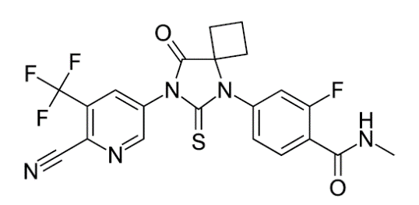
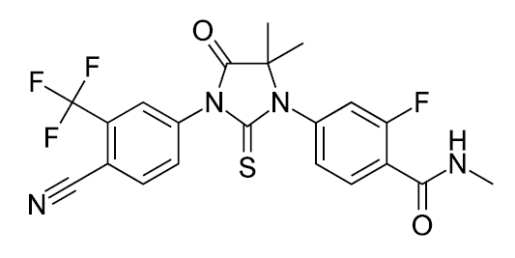
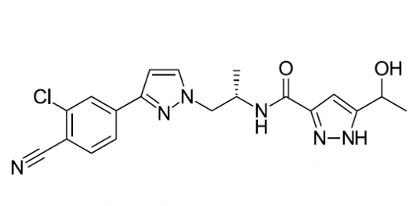
Next-Generation Androgen Receptor
Pathway Inhibitors (ARPIs)^{1,2}
Apalutamide
Enzalutamide
Darolutamide
Apalutamide and enzalutamide have similar structures
Darolutamide is structurally distinct from apalutamide and enzalutamide, characterized by low blood–brain barrier penetration^{1,2} and may have improved tolerability

Slide 14
Key secondary endpoint — Time to PSA progression for enzalutamide combination vs. leuprolide acetate
100
 | Enzalutamide combination (n = 355) | Leuprolide acetate (n = 358)
Events, n (%) | 8 (2) | 93 (26)
Median time to PSA progression (95% CI), mo | NR (NR) | NR (NR)
80
Enzalutamide combination
Leuprolide acetate
60
PSA progression free (%)
HR (95% CI):
0.07 (0.03–0.14); P<0.0001ª
40
20
0
0
6
12
18
24
30
36
42
48
54
60
66
72
78
84
90
Time to PSA progression (mo)
355 | 337 | 326 | 319 | 302 | 286 | 270 | 260 | 247 | 230 | 175 | 119 | 75 | 37 | 12 | 0
358 | 341 | 314 | 293 | 268 | 253 | 223 | 201 | 182 | 168 | 128 | 83 | 42 | 20 | 7 | 3
Patients at risk
Enzalutamide combination
Leuprolide acetate
Data cutoff: January 31, 2023. Symbols indicate censored data. ªThe HR was based on a Cox regression model with treatment as the only covariate stratified by screening PSA, PSADT, and prior hormonal therapy as reported in the IWRS; relative to leuprolide acetate <1 favoring enzalutamide combination; the two-sided P-value is based on a stratified log-rank test.
Shore N et al. AUA 2023;Abstract LBA02-09.
Notes:
EMBARK TLF/p141A
EMBARK TLF/p141B

Slide 15

Key secondary endpoint — Time to PSA progression for enzalutamide combination vs. leuprolide acetate
100
 | Enzalutamide combination (n = 355) | Leuprolide acetate (n = 358)
Events, n (%) | 8 (2) | 93 (26)
Median time to PSA progression (95% CI), mo | NR (NR) | NR (NR)
80
Enzalutamide combination
Leuprolide acetate
60
PSA progression free (%)
HR (95% CI):
0.07 (0.03–0.14); P<0.0001ª
40
20
0
0
6
12
18
24
30
36
42
48
54
60
66
72
78
84
90
Time to PSA progression (mo)
355 | 337 | 326 | 319 | 302 | 286 | 270 | 260 | 247 | 230 | 175 | 119 | 75 | 37 | 12 | 0
358 | 341 | 314 | 293 | 268 | 253 | 223 | 201 | 182 | 168 | 128 | 83 | 42 | 20 | 7 | 3
Patients at risk
Enzalutamide combination
Leuprolide acetate
Data cutoff: January 31, 2023. Symbols indicate censored data. ªThe HR was based on a Cox regression model with treatment as the only covariate stratified by screening PSA, PSADT, and prior hormonal therapy as reported in the IWRS; relative to leuprolide acetate <1 favoring enzalutamide combination; the two-sided P-value is based on a stratified log-rank test.
Shore N et al. AUA 2023;Abstract LBA02-09.
Notes:
EMBARK TLF/p141A
EMBARK TLF/p141B

Slide 16
Consulting Nursing Faculty Comments
Androgen deprivation therapy for prostate cancer
Kathleen D Burns, RN, MSN, AGACNP-BC, OCN

Slide 17
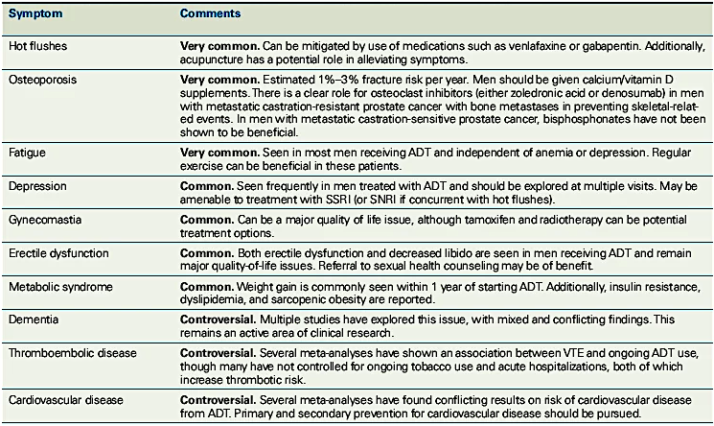
Major side effects associated with ADT
Courtesy of Laurence Klotz, CM, MD

Slide 18
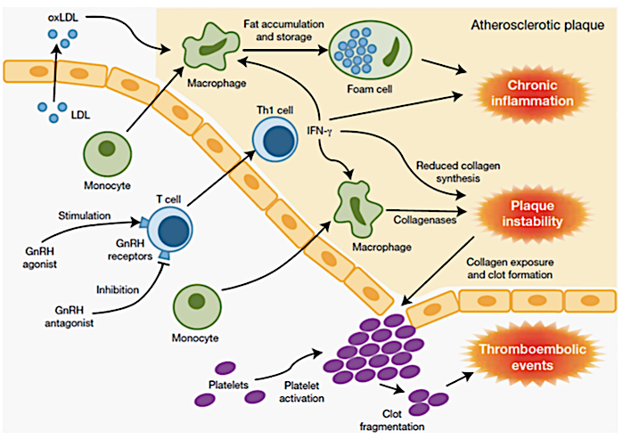
Stimulation of immunocytes by LHRH may destabilize vascular plaques
Courtesy of Laurence Klotz, CM, MD
Tivesten Å et al. Urol Oncol 2015;33(11):464-75.

Slide 19
Unanswered questions:
Timing of ADT in PSA only recurrence
Are oligomets on PSMA only = pre-PSMA PSA only recurrence or to N/M positive disease on conventional imaging.
Can the EMBARK data be extrapolated to the other ARPIs?
When and how to use intensified AR targeted therapy intermittently? What is the induction period and optimal threshold for re-treatment?
Once intensified, always intensified?
Role of ARPI monotherapy—should it be more widely used?
What about lower risk PSA only recurrence—also a role forADT + ARPI combination?
Will biomarkers allow for personalized approach (HRR/PARPs, etc.)
Courtesy of Laurence Klotz, CM, MD

Slide 20


Slide 21
Agenda
INTRODUCTION: Overview of Prostate Cancer; Hormonal Therapy
MODULE 1: Radiopharmaceuticals for the Management of Metastatic Castration-Resistant Prostate Cancer (mCRPC)
MODULE 2: Biomarker Testing for mCRPC; PARP Inhibitors for mCRPC

Slide 22
Lutetium Lu 177 Vipivotide Tetraxetan for mCRPC
Dr Armstrong
Durham, North Carolina
Mechanism of action of lutetium Lu 177 vipivotide tetraxetan
Published Phase III data sets with lutetium Lu 177 vipivotide tetraxetan for patients with PSMA-positive mCRPC
Implications of recently presented data for the sequencing of lutetium Lu 177 vipivotide tetraxetan; optimal integration into current mCRPC treatment algorithms
Early data with and ongoing evaluation of lutetium Lu 177 vipivotide tetraxetan in combination with other systemic therapies (eg, pembrolizumab, olaparib) or in earlier settings

Slide 23
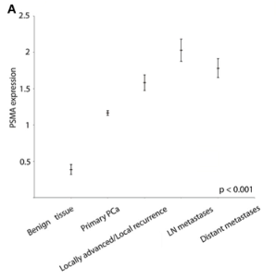
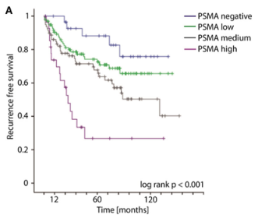
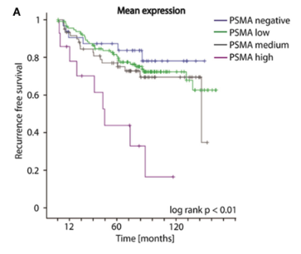
Prostate-Specific Membrane Antigen (PSMA)
PSMA expression increases during prostate cancer progression
High PSMA expression on both biopsy and radical prostatectomy (RPE) specimens significantly associates with a higher risk of disease recurrence following curative surgery
RFS following RPE stratified by PSMA expression on biopsies
RFS following RPE stratified by PSMA expression on RPE specimens
Hupe MC et al. Front Oncol 2018;8:263.

Slide 24
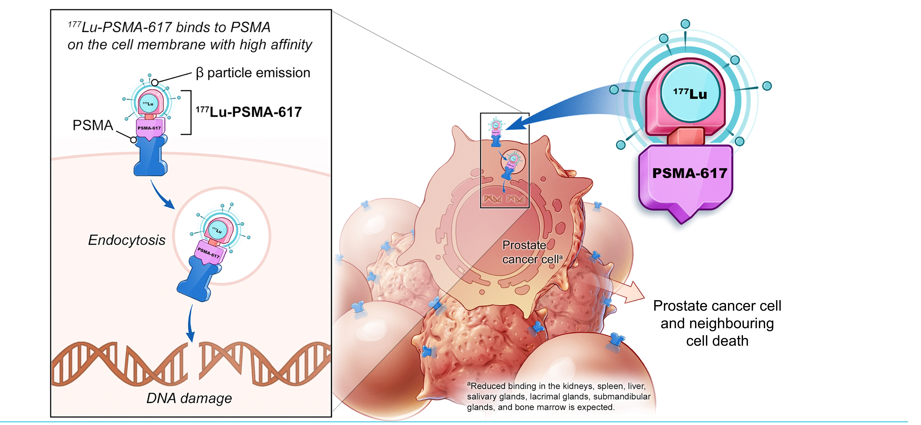
177Lu-PSMA-617 targeted radioligand therapy<br />
Lutetium Lu 177 Vipivotide Tetraxetan (Formerly ¹⁷⁷Lu-PSMA-617): Mechanism of Action
TARGETED TO PSMA
Morris MJ et al. ASCO 2021;Abstract LBA4.

Slide 25
Lutetium Lu 177 Vipivotide Tetraxetan
Mechanism of action
Targeted radioligand
Indication
For adult patients with prostate-specific membrane antigen (PSMA)-positive metastatic castration-resistant prostate cancer (mCRPC) who have received androgen receptor (AR) pathway inhibition and taxane-based chemotherapy
Recommended dose
7.4 GBq (200 mCi) every 6 weeks for up to 6 doses
Lutetium Lu 177 vipivotide tetraxetan package insert, 10/2022.

Slide 26
Brenda Martone, MSN, NP-BC, AOCNP
What I tell my patients with PSMA-positive mCRPC who are about to begin treatment with lutetium Lu 177 vipivotide tetraxetan about how it works and what to expect

Slide 27
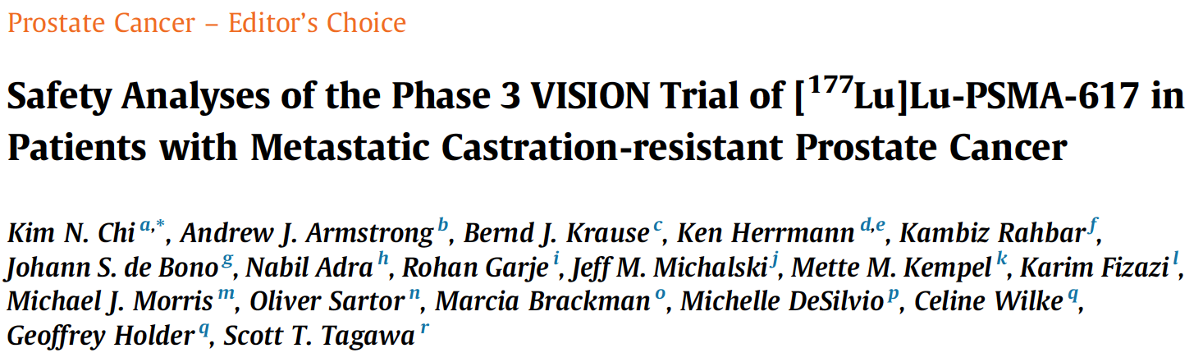
Eur Urol 2024 April;85(4):382-91
Author Conclusions: Overall, these safety analyses support a favorable benefit risk profile of up to 6 cycles of ¹⁷⁷Lu-PSMA-617 plus SoC in heavily pretreated patients with PSMA-positive mCRPC. The results provide important information for health care providers supporting the use of a further 2 cycles of ¹⁷⁷Lu-PSMA-617 in patients who are clinically benefiting and tolerating the therapy after 4 cycles. The analyses also emphasize that differences in treatment exposure and safety observation time between treatment groups are an important consideration when evaluating safety data in clinical studies. Ongoing phase 3 trials are investigating whether radioligand therapy with ¹⁷⁷Lu-PSMA-617 has a good safety profile and therapeutic benefit earlier in the treatment sequence for mCRPC.

Slide 28
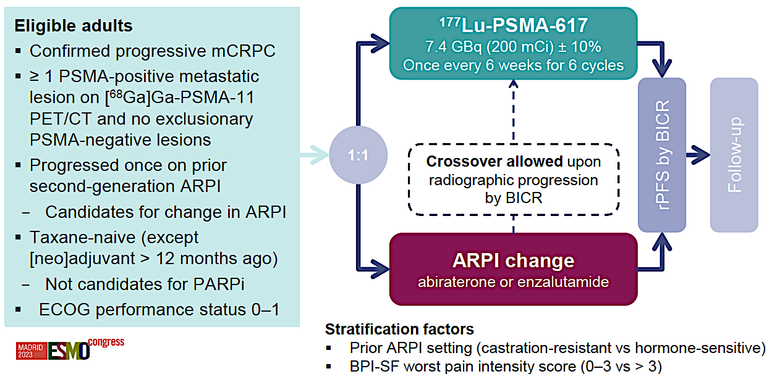
PSMAfore Trial: Phase III Study Design
ARPI = androgen receptor pathway inhibitor
Sartor O et al. ESMO 2023;Abstract LBA13.

Slide 29
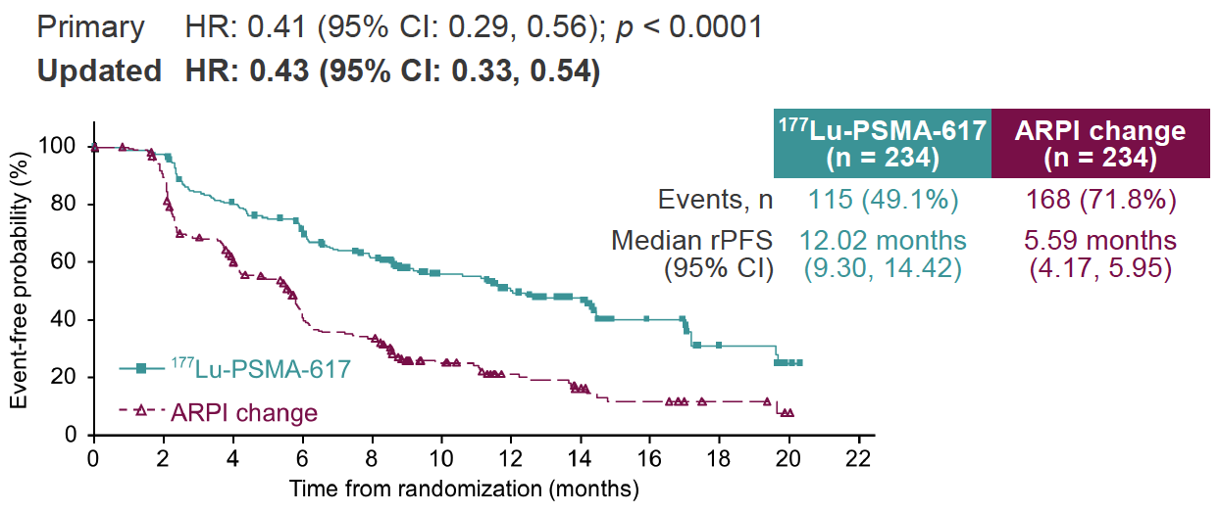
PSMAfore: Primary Endpoint Radiographic Progression-Free
Survival (rPFS)
Sartor O et al. ESMO 2023;Abstract LBA13.

Slide 30
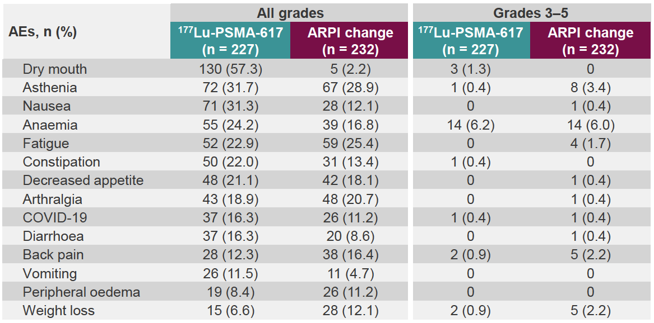
PSMAfore: Treatment-Emergent Adverse Events
AEs = adverse events
Sartor O et al. ESMO 2023;Abstract LBA13.

Slide 31
PRINCE: A Phase Ib Study of Pembrolizumab with Lutetium Lu 177 Vipivotide Tetraxetan for mCRPC
Sandhu S et al. ESMO 2021;Abstract 577O.

Slide 32
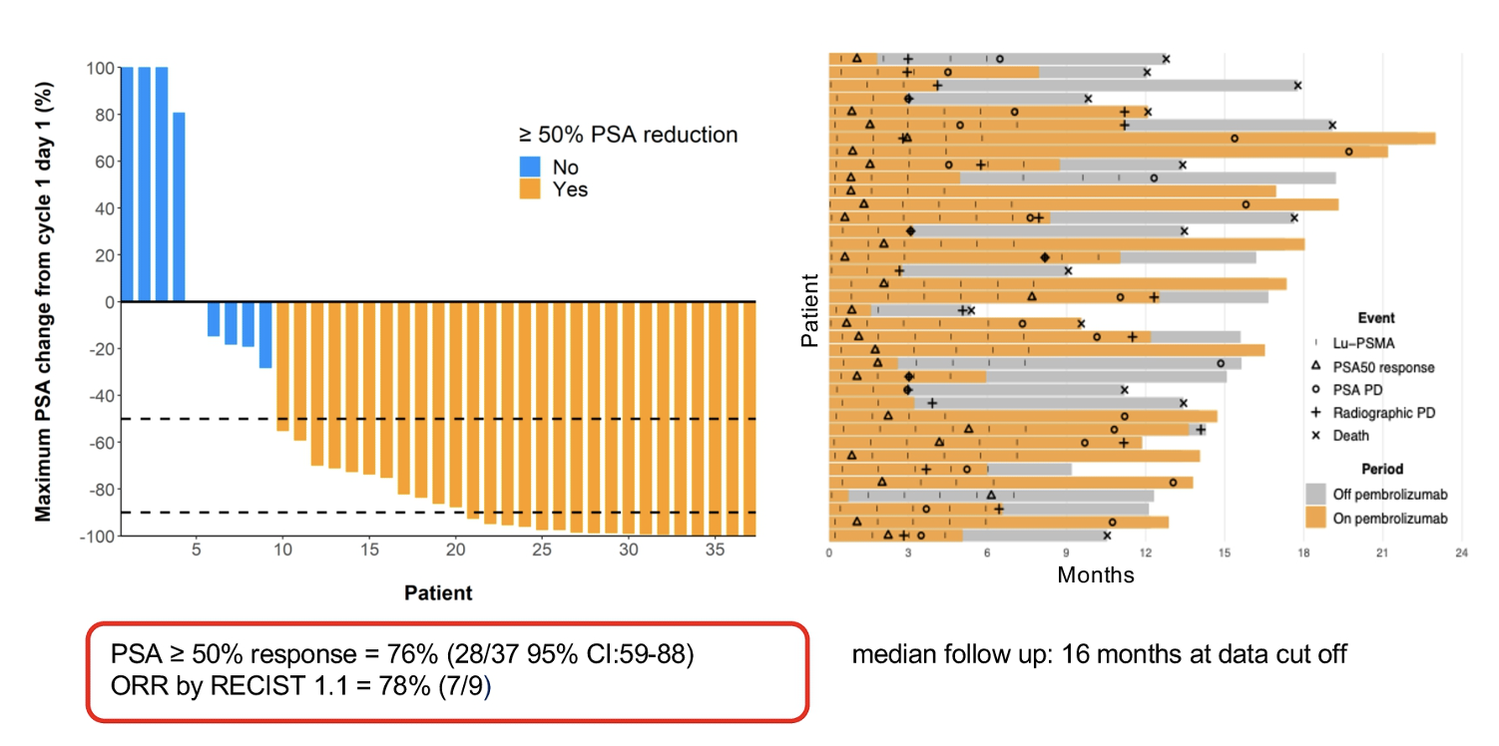
PRINCE Primary Endpoint: PSA Response Rate
Sandhu S et al. ASCO 2022;Abstract 5017.

Slide 33
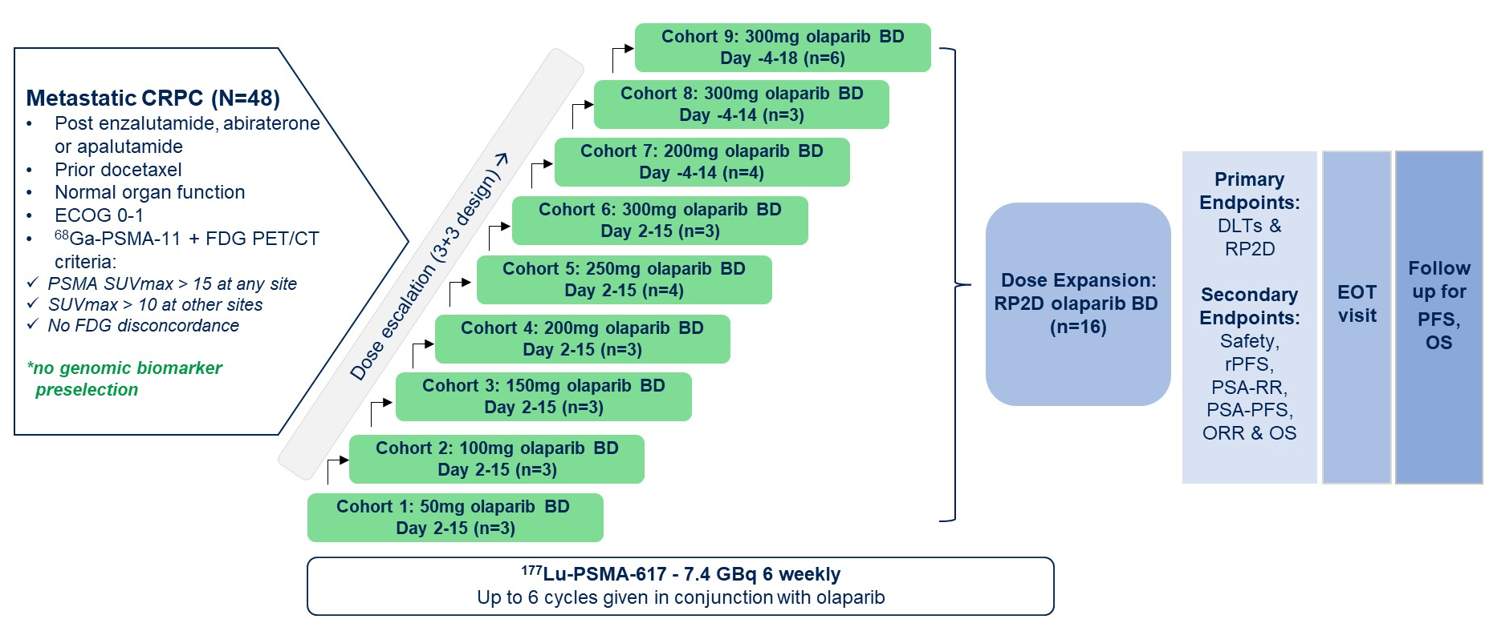
LuPARP: A Phase I Trial of Olaparib with Lutetium Lu 177
Vipivotide Tetraxetan for mCRPC
Sandhu S et al. ASCO 2023;Abstract 5005.

Slide 34
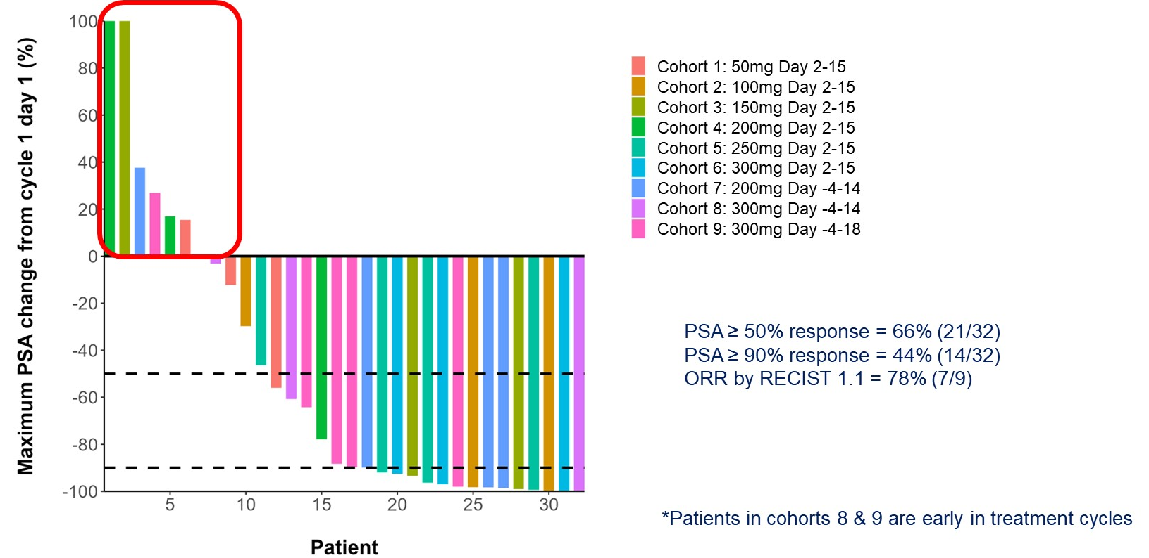
LuPARP: PSA Responses
Sandhu S et al. ASCO 2023;Abstract 5005.

Slide 35
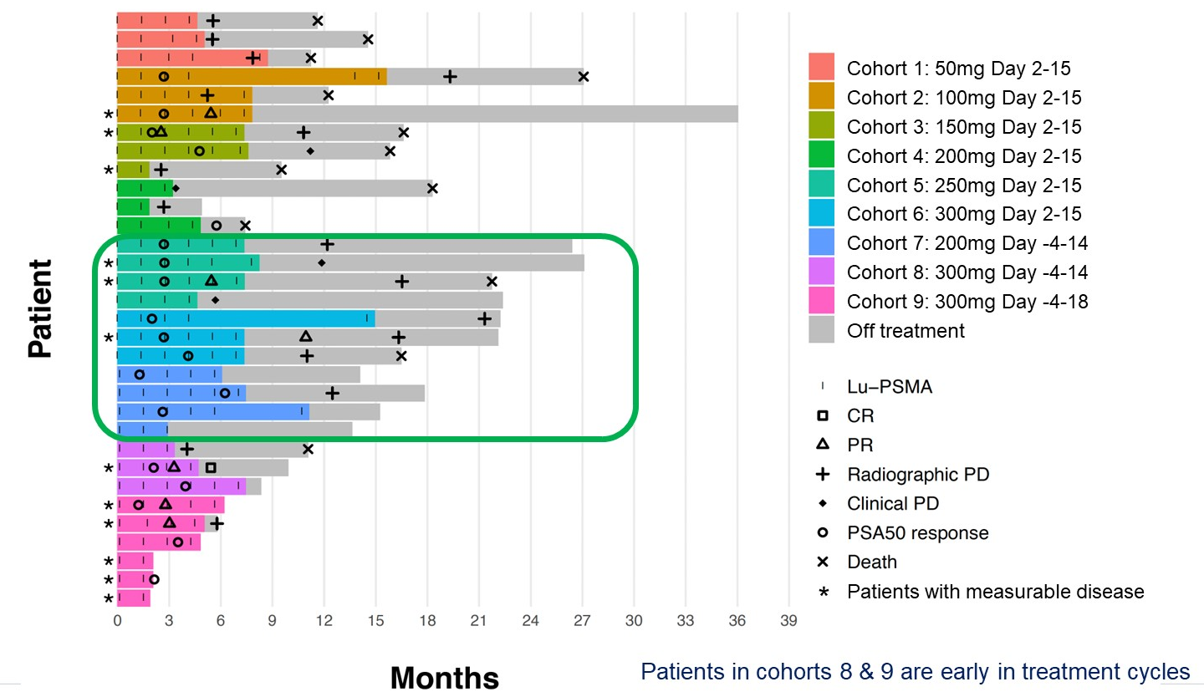
LuPARP: Swimmer Plots
Sandhu S et al. ASCO 2023;Abstract 5005.

Slide 36
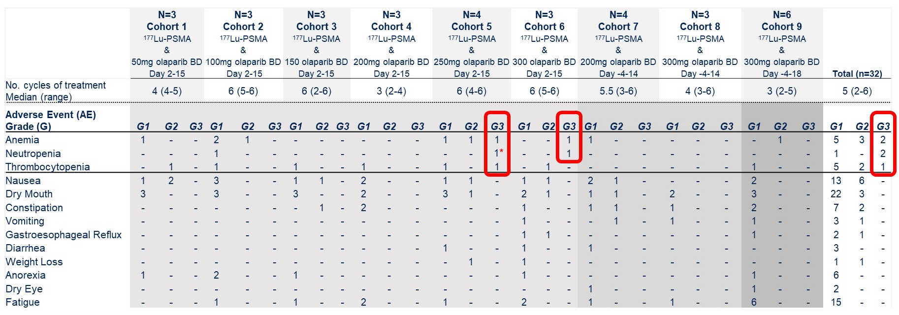
LuPARP: Common Adverse Events in ≥5%
Sandhu S et al. ASCO 2023;Abstract 5005.

Slide 37
Radium-223 for mCRPC
Dr Armstrong
Durham, North Carolina
Mechanism of antitumor activity of radium-223
Rationale for the activity of radium-223 in bone metastases but not in other organs
Available data with and ongoing research studies of radium-223 for mCRPC
Patient selection for and optimal integration of radium-223 into current mCRPC treatment algorithms

Slide 38
Radium-223 Chloride
Mechanism of action
Alpha particle-emitting radioactive therapeutic agent
Indication
For patients with castration-resistant prostate cancer, symptomatic bone metastases and no known visceral metastatic disease
Recommended dose
55 kBq (1.49 microcurie) per kg of body weight, administered at 4-week intervals for 6 injections
Radium-223 package insert, 12/2019.

Slide 39
Brenda Martone, MSN, NP-BC, AOCNP
What I tell my patients with mCRPC about to receive radium-223 about how it works and what to expect from treatment, and educating patients regarding appropriate precautions when receiving a radiopharmaceutical

Slide 40
Practical Considerations with the Use of Novel Radiopharmaceuticals for Prostate Cancer
Dr Armstrong
Durham, North Carolina
Appropriate monitoring of complete blood counts, kidney function and other laboratory values during treatment with lutetium Lu 177 vipivotide tetraxetan
Recommended algorithms for the management of common AEs observed in patients receiving lutetium Lu 177 vipivotide tetraxetan (eg, fatigue, dry mouth, gastrointestinal toxicity, cytopenias)
Incidence, severity and management of commonly occurring AEs with
radium-223 (eg, cytopenias, gastrointestinal toxicity, peripheral edema)
Educating patients receiving lutetium Lu 177 vipivotide tetraxetan and radium-223 regarding appropriate radiation protection precautions

Slide 41
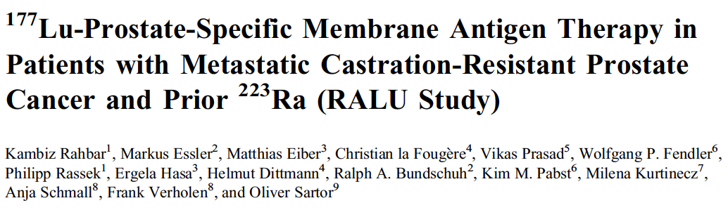
J Nucl Med 2023 December 1;64(12):1925-31

Slide 42
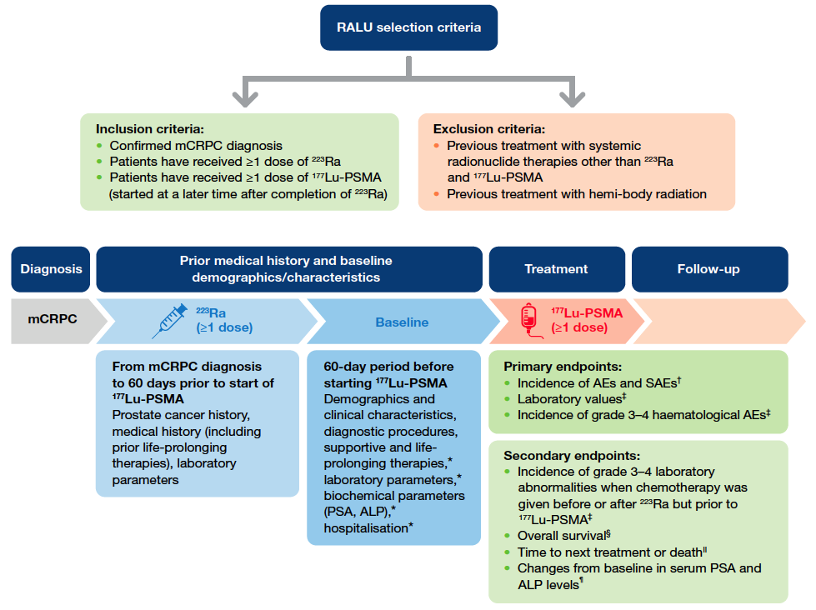
RALU Study: Retrospective Analysis Selection Criteria
Rahbar K et al. J Nucl Med 2023 December 1;64(12):1925-31.

Slide 43
RALU: Key Points
QUESTION
Can ¹⁷⁷Lu-PSMA be safely given to patients with mCRPC if they have previously received radium-223, and is safety impacted depending on where radium-223 is positioned in the treatment sequence?
PERTINENT FINDINGS
In this real-world setting, ¹⁷⁷Lu-PSMA had an acceptable safety profile for patients who had previously received radium-223, with low rates of hematologic and overall adverse events.
Median OS from the first dose of ¹⁷⁷Lu-PSMA was 13.2 months and was similar irrespective of whether patients had received taxane-based chemotherapy before or after radium-223 or if the time between radium-223 and ¹⁷⁷Lu-PSMA was less than 6 months versus 6 months or more.
IMPLICATIONS FOR PATIENT CARE
For patients with mCRPC and prior radium-223 therapy, ¹⁷⁷Lu-PSMA had an acceptable safety profile and an effectiveness comparable to that seen in the VISION trial, irrespective of when patients had received prior radium-223.
Rahbar K et al. J Nucl Med 2023 December 1;64(12):1925-31.

Slide 44
Consulting Nursing Faculty Comments
Listening to patients and involving them in their medical care
Jacqueline Broadway-Duren, PhD, DNP, APRN, FNP-BC
Ronald Stein, JD, MSN, NP-C, AOCNP

Slide 45
Agenda
INTRODUCTION: Overview of Prostate Cancer; Hormonal Therapy
MODULE 1: Radiopharmaceuticals for the Management of Metastatic Castration-Resistant Prostate Cancer (mCRPC)
MODULE 2: Biomarker Testing for mCRPC; PARP Inhibitors for mCRPC

Slide 46
Biomarker Testing in Metastatic Castration-Resistant Prostate Cancer (mCRPC)
Dr Armstrong
Durham, North Carolina
Spectrum and frequency of BRCA1/2 and other homologous recombination repair (HRR) abnormalities in prostate cancer
Indications for, optimal timing of and practical implementation of genetic testing
Clinical relevance of PSMA expression in prostate cancer; indications for, timing of, and practical implementation of PSMA detection
Clinical and biological factors in the selection and sequencing of therapy for patients with mCRPC without an HRR abnormality; implications of prior therapeutic exposure

Slide 47
HRR Genes and Metastatic Prostate Cancer
Courtesy of Emmanuel S Antonarakis, MD

Slide 48
What are the relevant HRR Genes?
“First Tier” | “Second Tier” | “Third Tier”
BRCA2 (6–8%) | CDK12 (5–7%) | ATM (5–7%)
BRCA1 (1–2%) | BARD1 (1%) | CHEK2 (2–3%)
PALB2 (1–2%) | BRIP1 (1–2%) | CHEK1 (1%)
RAD51B (1%) | RAD51C (1%) | FANCL (1–2%)
RAD54L (1%) | RAD51D (1%)
Courtesy of Emmanuel S Antonarakis, MD

Slide 49
NCCN Guidelines: Testing Criteria for Prostate Cancer Susceptibility Genes (Specifically ATM, BRCA1, BRCA2, CHEK2 and HOXB13)
Germline testing
Somatic tumor testing
Personal history of prostate cancer with specific features:
By tumor characteristics (any age)
  Metastatic
  Histology
    high- or very-high-risk group
By family history and ancestry
  ≥1 close blood relative with:
    breast cancer at age ≤50 y
    triple-negative breast cancer at any age
    male breast cancer at any age
    ovarian cancer at any age
    pancreatic cancer at any age
    metastatic, high-, or very-high-risk group at any age
  ≥3 close blood relatives with prostate cancer (any grade) and/or breast cancer on the same side of the family including the patient with prostate cancer
  Ashkenazi Jewish ancestry
Somatic testing for alterations in DNA damage response:
Multigene tumor testing for alterations in HRR genes, including but not limited to BRCA1, BRCA2, ATM, PALB2, FANCA, RAD51D, CHEK2, and CDK12, is recommended in patients with metastatic prostate cancer. This testing can be considered in patients with regional prostate cancer
Tumor testing for MSI-H or dMMR is recommended in patients with mCRPC and may be considered in patients with regional or castration-sensitive metastatic prostate cancer
TMB testing may be considered in patients with mCRPC
Family history of cancer
An affected (not meeting testing criteria listed above) or unaffected individual with a first-degree blood relative meeting any of the criteria listed above (except unaffected individuals whose relatives meet criteria only for systemic therapy decision-making)
Testing may be considered in the following scenario:
Personal history of prostate cancer with intermediate-risk prostate cancer with intraductal/cribriform histology at any age
MSI-H = high miscrosatellite instability; dMMR = mismatch repair deficient; TMB = tumor mutational burden
National Comprehensive Cancer Network (NCCN®). NCCN clinical practice guidelines in oncology. Prostate cancer — Version 3.2024.
NCCN clinical practice guidelines in oncology. Genetic/familiar high-risk assessment: Breast, ovarian, and pancreatic cancer — Version 3.2024.

Slide 50
PARP Inhibitors for mCRPC
Dr Armstrong
Durham, North Carolina
Published findings with olaparib/abiraterone, niraparib/abiraterone and talazoparib/enzalutamide as first-line therapy for patients with mCRPC; outcomes observed in patients with and without HRR gene mutations
FDA-approved indications for olaparib/abiraterone, niraparib/abiraterone and talazoparib/enzalutamide for mCRPC; optimal patient selection for these approaches
Long-term findings with and indications for PARP inhibitor monotherapy for patients with mCRPC
Incidence, timing and severity of common class- and agent-specific toxicities associated with PARP inhibitors alone and in combination with hormonal therapy

Slide 51
Brenda Martone, MSN, NP-BC, AOCNP
What I tell my patients with mCRPC who are about to begin treatment with a PARP inhibitor alone or in combination with hormonal therapy about the importance of BRCA/HRR testing

Slide 52
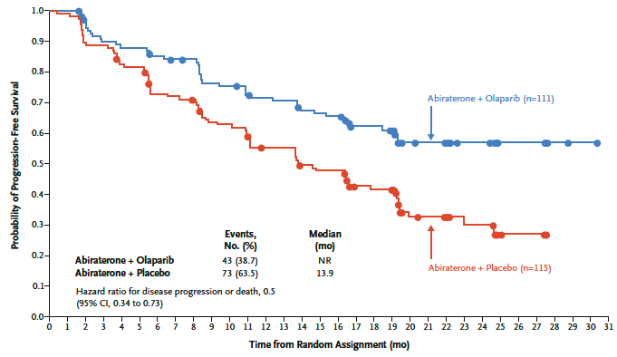
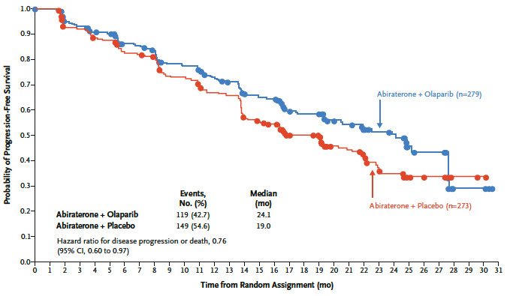
PROpel: Primary Radiographic Progression-Free Survival
HRRm subgroup
Non-HRRm subgroup
Abiraterone + Olaparib
Abiraterone + Olaparib
Abiraterone + Placebo
Abiraterone + Placebo
Clarke NW et al. NEJM Evid 2022;1(9):EVIDoa2200043.

Slide 53
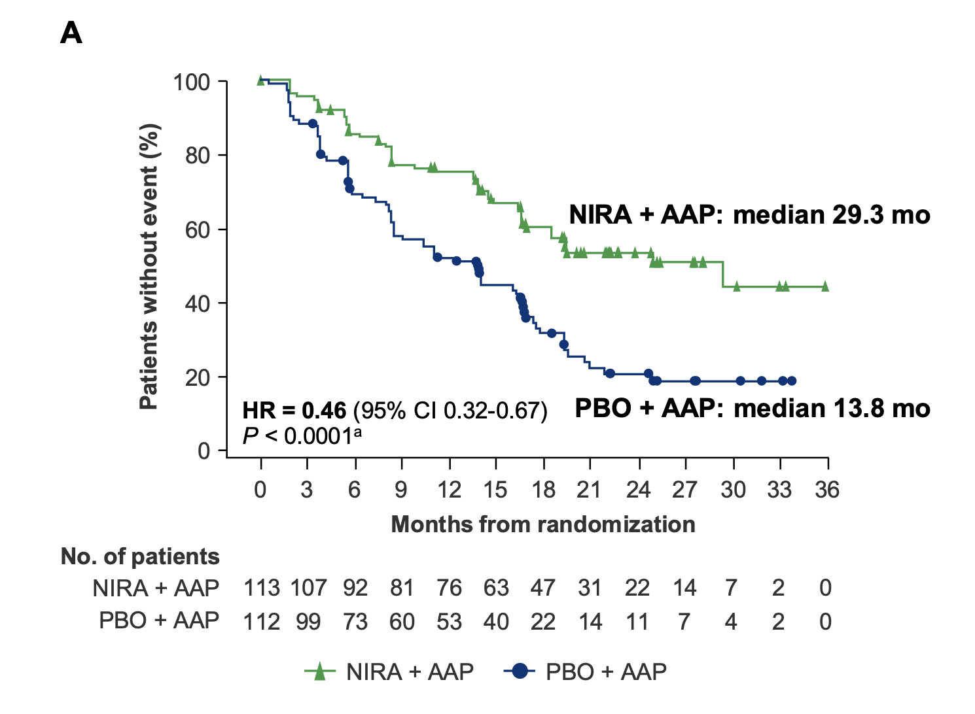
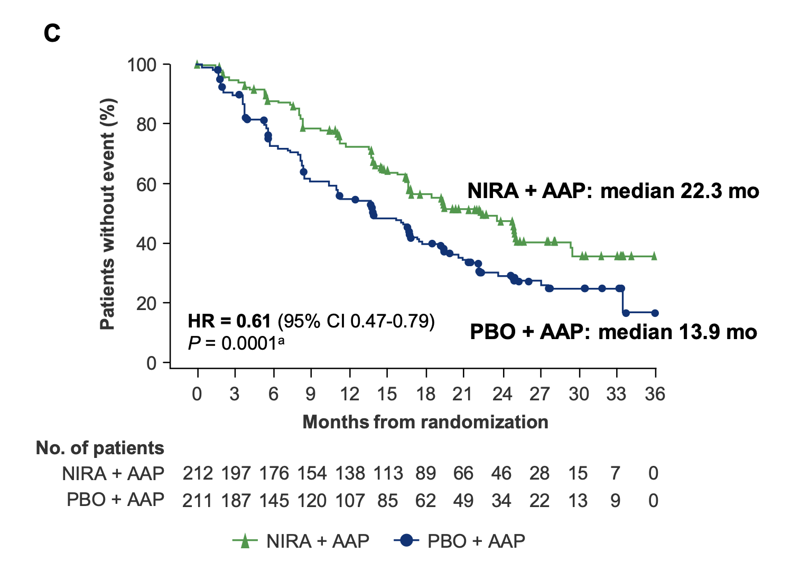
MAGNITUDE Trial: Radiographic Progression-Free Survival at Second Interim Analysis
BRCA1/2 subgroup
HRR mutation subgroup
Chi KN et al. Ann Oncol 2023;34(9):772-82.

Slide 54
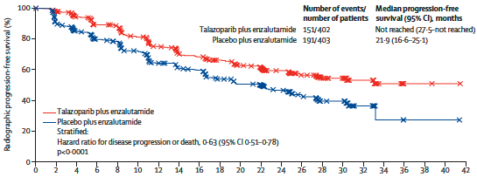
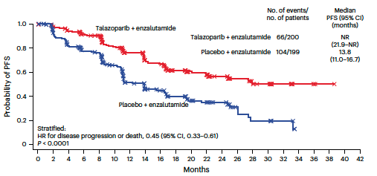
TALAPRO-2 Trial: Radiographic Progression-Free Survival
All patients
HRR-deficient subgroup
Agarwal N et al. Lancet Oncol 2023;402(10398):291-303. Fizazi K et al. Nature Med 2024;30(1):257-64.

Slide 55
Appendix

Slide 56
FDA Approves Lutetium Lu 177 Vipivotide Tetraxetan for the Treatment of mHRPC
Press Release: March 23, 2022
“On March 23, 2022, the Food and Drug Administration approved [the radioligand therapy
lutetium Lu 177 vipivotide tetraxetan] for the treatment of adult patients with prostate-specific membrane antigen (PSMA)-positive metastatic castration-resistant prostate cancer (mCRPC) who have been treated with androgen receptor (AR) pathway inhibition and taxane-based chemotherapy.
On the same day, the FDA approved gallium Ga 68 gozetotide, a radioactive diagnostic agent for positron emission tomography (PET) of PSMA-positive lesions, including selection of patients with metastatic prostate cancer for whom lutetium Lu 177 vipivotide tetraxetan PSMA-directed therapy is indicated. Gallium Ga 68 gozetotide is the first radioactive diagnostic agent approved for patient selection in the use of a radioligand therapeutic agent.
Efficacy was evaluated in [the Phase III VISION trial, which] demonstrated a statistically significant improvement in the primary endpoints OS and rPFS. Hazard ratio (HR) for OS was 0.62 (95% CI: 0.52, 0.74; p < 0.001) for the comparison of lutetium Lu 177 vipivotide tetraxetan plus BSoC versus BSoC. Median OS was 15.3 months (95% CI: 14.2, 16.9) in the lutetium Lu 177 vipivotide tetraxetan plus BSoC arm and 11.3 months (95% CI: 9.8, 13.5) in the BSoC arm, respectively.”
https://www.fda.gov/drugs/resources-information-approved-drugs/fda-approves-pluvicto-metastatic-castration-resistant-prostate-cancer

Slide 57
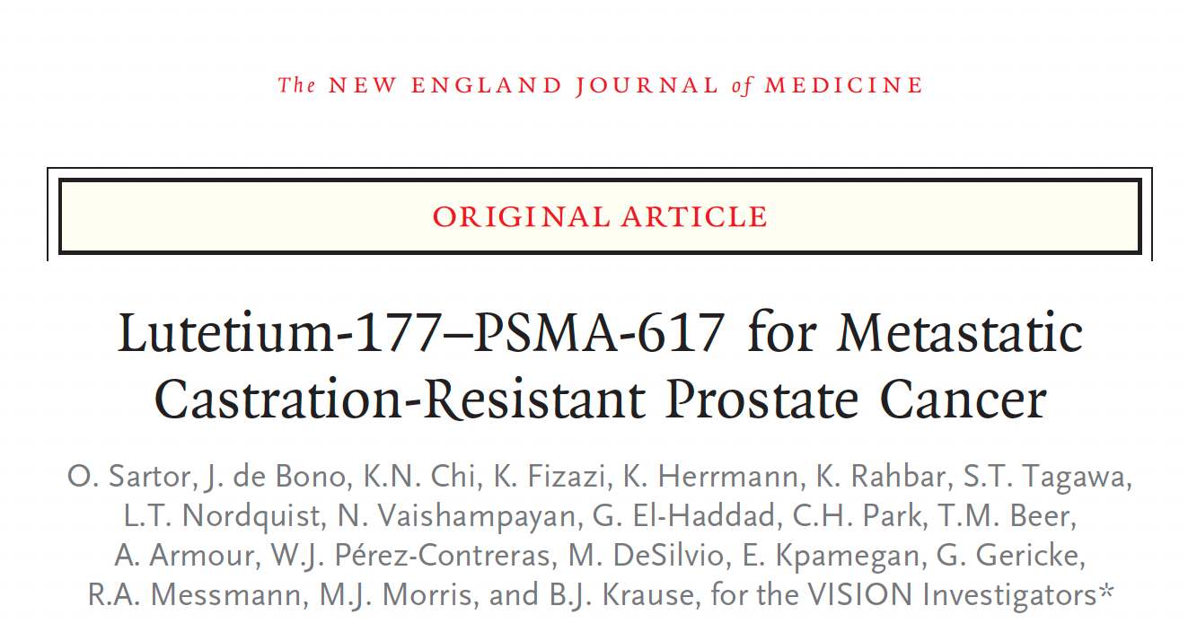
2021;385(12):1091-103

Slide 58
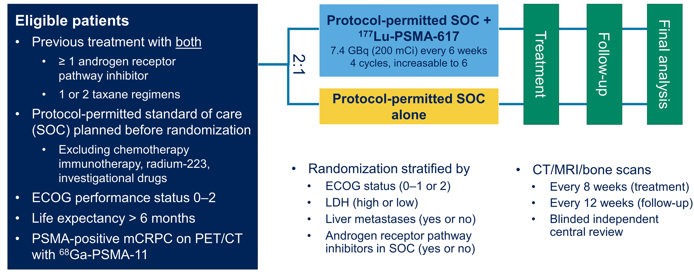
VISION: A Pivotal Phase III Trial of Lutetium Lu 177 Vipivotide Tetraxetan for mHRPC
Morris MJ et al. ASCO 2021;Abstract LBA4. Sartor O et al. N Engl J Med 2021;385(12):1091-103.

Slide 59
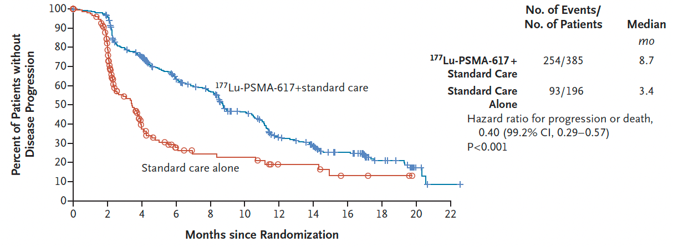
VISION: Imaging-Based Progression-Free Survival by Independent Central Review
Median OS (lutetium Lu 177 vipivotide tetraxetan versus standard therapy): 15.3 months versus 11.3 months (HR 0.62, p < 0.001)
Time to first symptomatic skeletal event or death (lutetium Lu 177 vipivotide tetraxetan versus standard therapy): 11.5 months versus 6.8 months (HR 0.50, p < 0.001)
Sartor O et al. N Engl J Med 2021;385(12):1091-103.

Slide 60
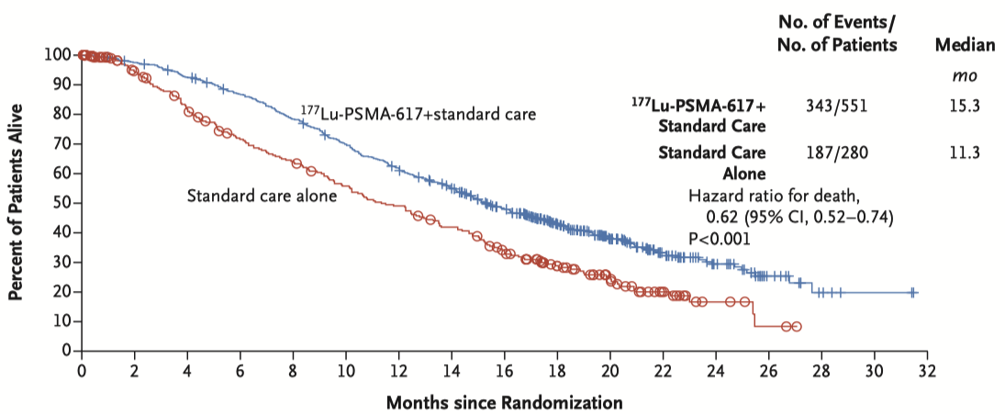
VISION: Overall Survival
Sartor O et al. N Engl J Med 2021;385(12):1091-103.

Slide 61
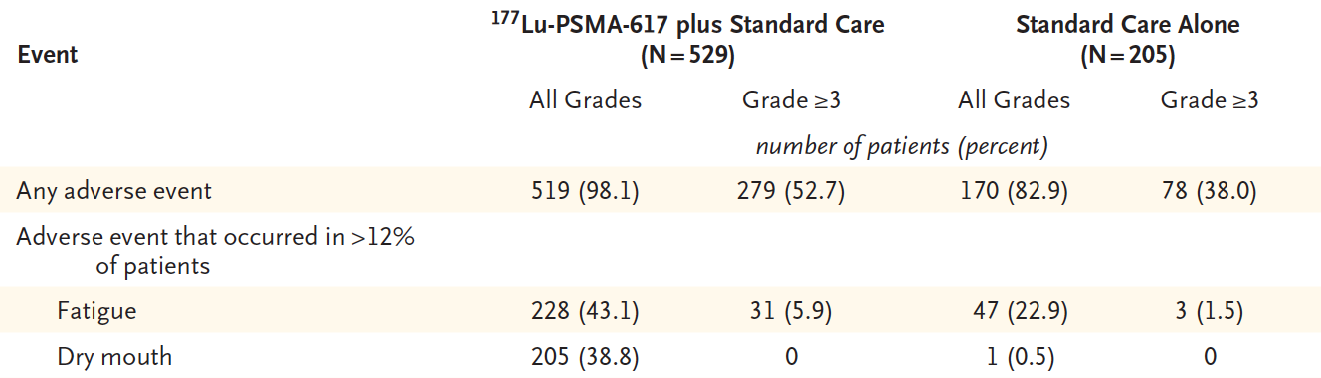
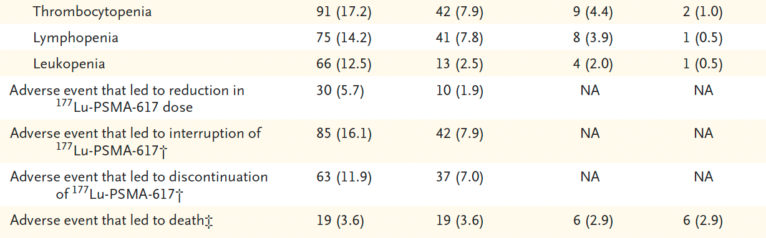
VISION: Selected Adverse Events
Sartor O et al. N Engl J Med 2021;385(12):1091-103.

Slide 62
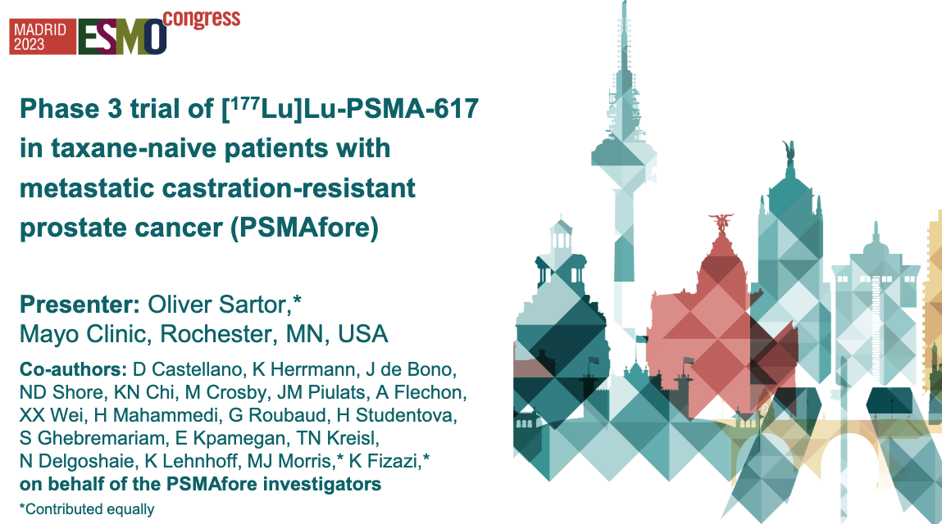
Abstract LBA13

Slide 63
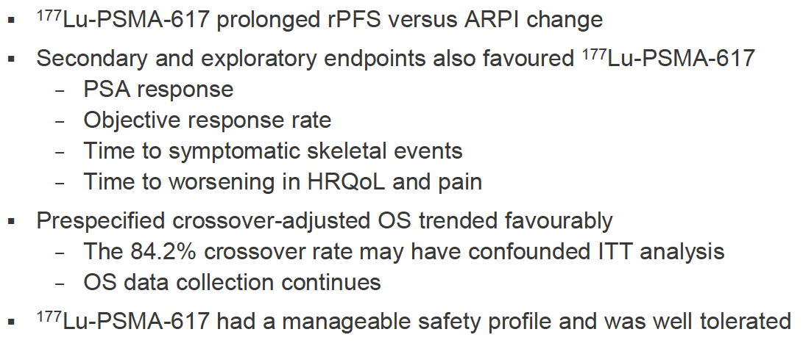
PSMAfore: Author Conclusions
HRQoL = health-related quality of life
Sartor O et al. ESMO 2023;Abstract LBA13.

Slide 64
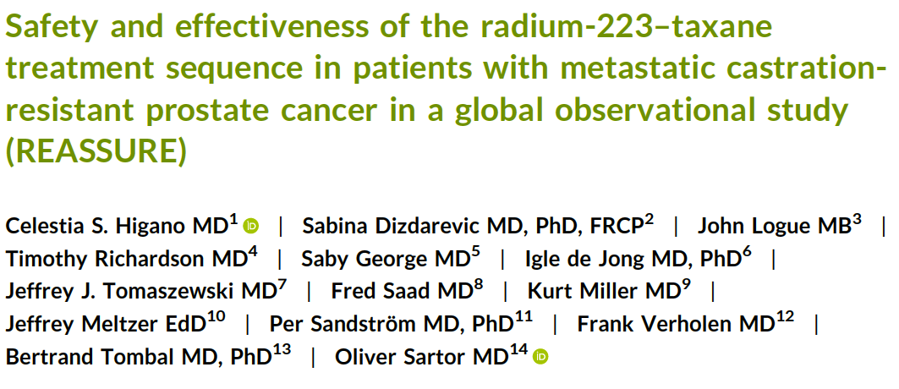
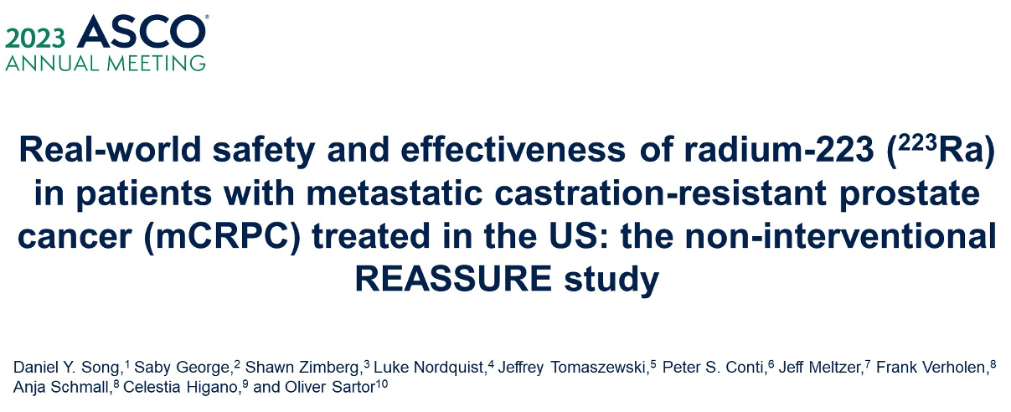
Abstract 5050
Cancer 2024 February 10;[Online ahead of print]

Slide 65
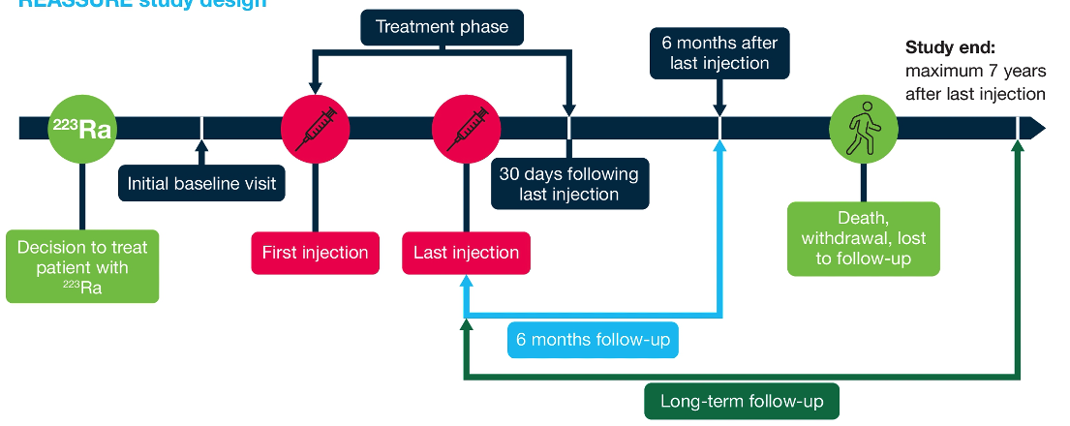
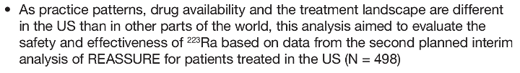
REASSURE: Study Design and Objective
Higano CS et al. Cancer 2024 February 10;[Online ahead of print]; Song DY et al. ASCO 2023;Abstract 5050.

Slide 66
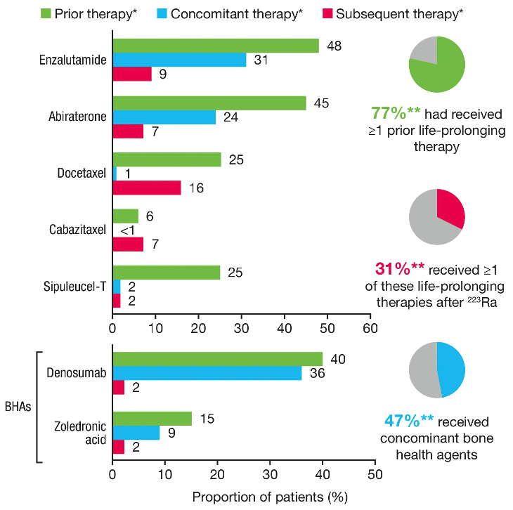
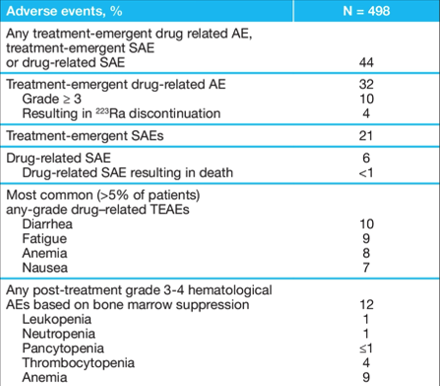
REASSURE: Life-Prolonging Therapies, Bone Health Agents (BHAs) and Safety
SAE = serious adverse event
Song DY et al. ASCO 2023;Abstract 5050.

Slide 67
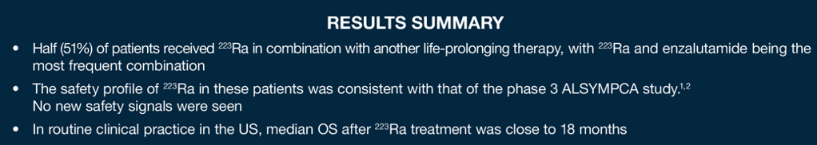
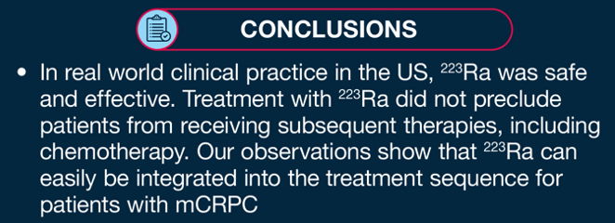
REASSURE: Author Conclusions and Summary
Song DY et al. ASCO 2023;Abstract 5050.

Slide 68
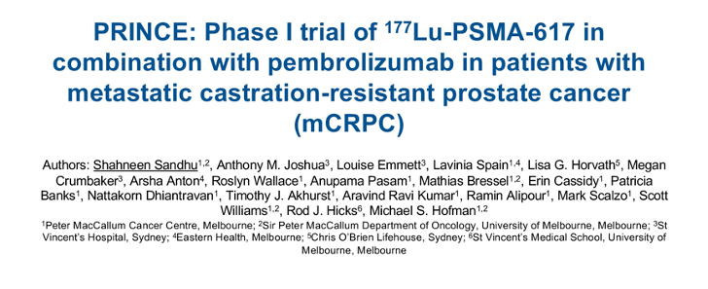
ASCO 2022;Abstract 5017

Slide 69
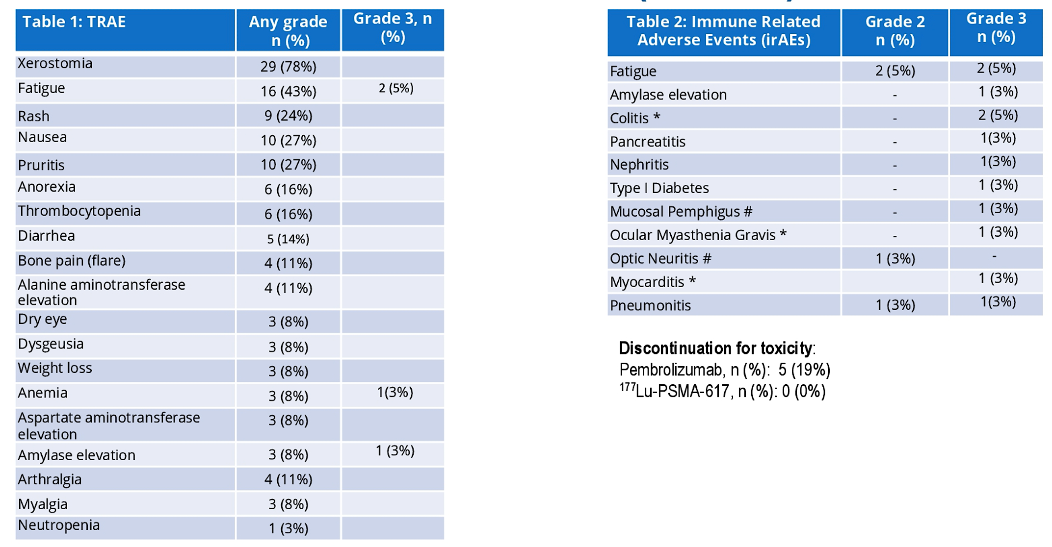
PRINCE: Treatment-Related Adverse Events (TRAEs)
Sandhu S et al. ASCO 2022;Abstract 5017.

Slide 70
Positive Top-Line Results Announced from the Pivotal Phase III SPLASH Trial of ¹⁷⁷Lu-PNT2002 for mCRPC
Press Release – December 18, 2023
“[The manufacturers] today announced statistically significant topline results from the pivotal phase 3 SPLASH study evaluating the efficacy and safety of ¹⁷⁷Lu-PNT2002, a prostate-specific membrane antigen (PSMA)-targeted radioligand therapy (RLT), in patients with metastatic castration-resistant prostate cancer (mCRPC) after progression on an androgen receptor pathway inhibitor (ARPI).
The SPLASH trial met its primary endpoint, demonstrating a median radiographic progression-free survival (rPFS) per blinded independent central review of 9.5 months for patients treated with ¹⁷⁷Lu-PNT2002, compared to 6.0 months for patients treated with ARPI in the control arm, a statistically significant 29% reduction in the risk of radiographic progression or death (hazard ratio [HR] 0.71; p = 0.0088). At the time of the analysis, interim overall survival (OS) results were immature (46% of protocol-specified target OS events reached), the HR was 1.11. The companies expect additional, follow-up data in 2024 prior to the potential submission of a New Drug Application (NDA).”
https://www.globenewswire.com/news-release/2023/12/18/2797730/0/en/Lantheus-and-POINT-Biopharma-Announce-Positive-Topline-Results-from-Pivotal-SPLASH-Trial-in-Metastatic-Castration-Resistant-Prostate-Cancer.html

Slide 71
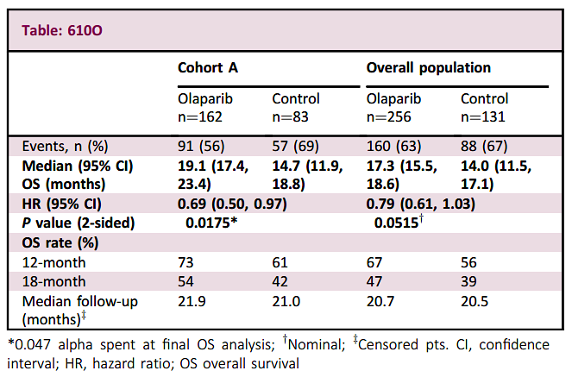
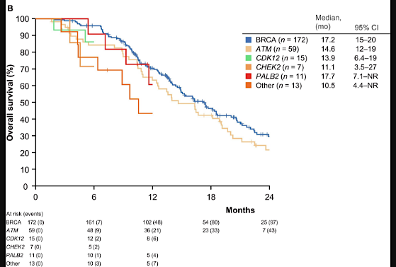
PARP Monotherapy
Overall survival
PROFOUND: Olaparib post ARPi, versus ARPi
Cohort A: BRCA1, BRCA2, or ATM
Triton 2: Rucaparib post ARPi and Docetaxel
OS by gene
Courtesy of Alan H Bryce, MD.

Slide 72
FDA Approves Olaparib with Abiraterone and Prednisone (or Prednisolone) for mCRPC with a BRCA Mutation
Press Release – May 31, 2023
“… the Food and Drug Administration approved olaparib with abiraterone and prednisone (or prednisolone) for adult patients with deleterious or suspected deleterious BRCA-mutated (BRCAm) metastatic castration-resistant prostate cancer (mCRPC), as determined by an FDA-approved companion diagnostic test.
Efficacy was evaluated in the PROpel trial (NCT03732820) that enrolled 796 patients with mCRPC, Patients were randomized (1:1) to receive either olaparib with abiraterone or placebo with abiraterone and also received prednisone or prednisolone. The major efficacy outcome measure was investigator-assessed radiological progression-free survival (rPFS) per RECIST version 1.1 for soft tissue and Prostate Cancer Working Group criteria for bone lesions. Overall survival (OS) was an additional endpoint.
The recommended olaparib dose is 300 mg taken orally twice daily with or without food. The recommended abiraterone dose is 1000 mg taken orally once daily. Abiraterone should be administered with prednisone or prednisolone 5 mg orally twice daily. Patients should also receive a GnRH analog concurrently or should have had a prior bilateral orchiectomy.”
https://www.fda.gov/drugs/drug-approvals-and-databases/fda-approves-olaparib-abiraterone-and-prednisone-or-prednisolone-brca-mutated-metastatic-castration

Slide 73
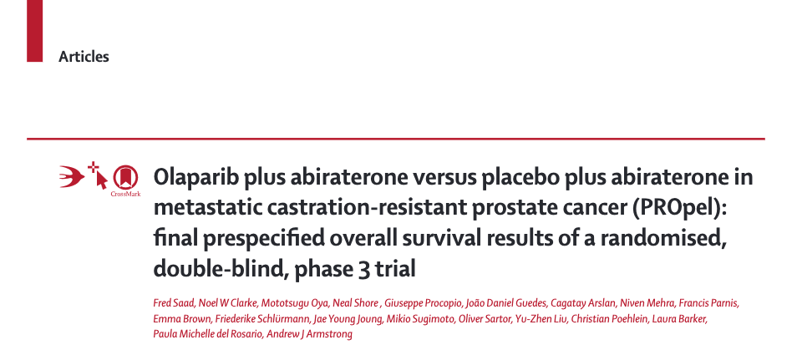
Lancet Oncol 2023;24(10):1094-108

Slide 74
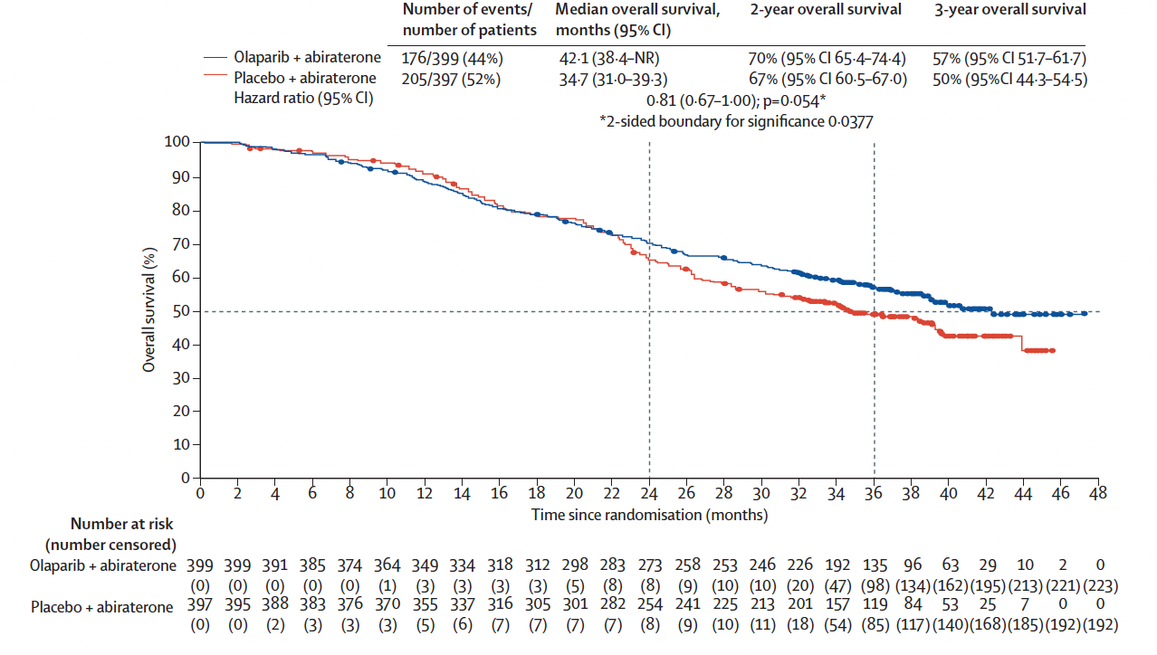
PROpel Trial: Final Prespecified Overall Survival Results in
Intent-to-Treat Population
Saad F et al. Lancet Oncol 2023;24(10):1094-108.

Slide 75
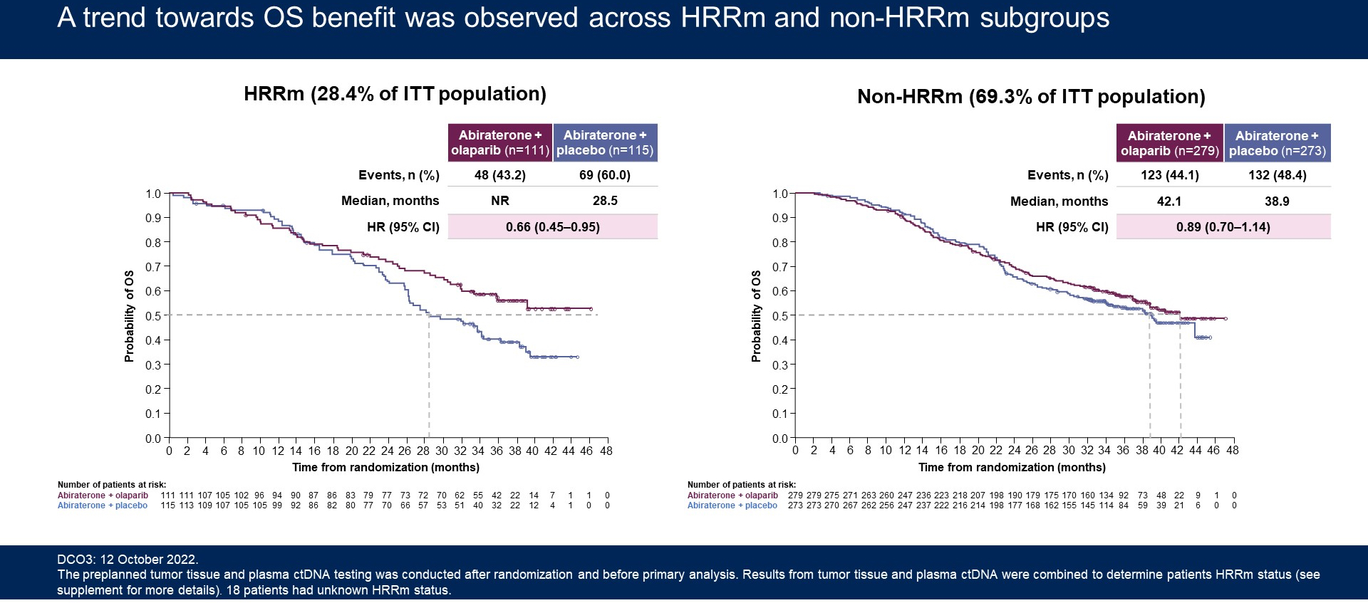
PROpel: Overall Survival (OS) in HRRm and Non-HRRm Subgroups (DCO3)
HRRm = homologous recombination repair mutation
Clarke N et al. Genitourinary Cancers Symposium 2023;Abstract LBA16.

Slide 76
FDA Approves Niraparib and Abiraterone Acetate with Prednisone for mCRPC with a BRCA Mutation
Press Release – August 11, 2023
“... the Food and Drug Administration approved the fixed dose combination of niraparib and abiraterone acetate, with prednisone, for adult patients with deleterious or suspected deleterious BRCA-mutated castration-resistant prostate cancer (mCRPC), as determined by an FDA-approved test.
Efficacy was evaluated in Cohort 1 of MAGNITUDE (NCT03748641), a randomized, double-blind, placebo-controlled trial enrolling 423 patients with homologous recombination repair (HRR) gene-mutated mCRPC. Patients were randomized (1:1) to receive niraparib 200 mg and abiraterone acetate 1,000 mg plus prednisone 10 mg daily or placebo and abiraterone acetate plus prednisone daily. The major efficacy outcome measure was radiographic progression-free survival (rPFS) per RECIST version 1.1 for soft tissue and Prostate Cancer Working Group 3 criteria for bone, assessed by blinded independent central review. Overall survival (OS) was an additional endpoint.
The recommended dose is 200 mg niraparib and 1,000 mg abiraterone acetate taken orally once daily in combination with 10 mg of prednisone daily until disease progression or unacceptable toxicity. Patients receiving niraparib and abiraterone acetate plus prednisone should also receive a GnRH analog concurrently or should have had bilateral orchiectomy.”
https://www.fda.gov/drugs/resources-information-approved-drugs/fda-approves-niraparib-and-abiraterone-acetate-plus-prednisone-brca-mutated-metastatic-castration

Slide 77

2023;34(9):772-82

Slide 78
FDA Approves Talazoparib with Enzalutamide for mCRPC with an HRR Gene Mutation
Press Release – June 20, 2023
“… the Food and Drug Administration approved talazoparib with enzalutamide for homologous recombination repair (HRR) gene-mutated metastatic castration-resistant prostate cancer (mCRPC).
Efficacy was evaluated in TALAPRO-2 (NCT03395197), a randomized, double-blind, placebo-controlled, multi-cohort trial enrolling 399 patients with HRR gene-mutated mCRPC. Patients were randomized (1:1) to receive enzalutamide 160 mg daily plus either talazoparib 0.5 mg or placebo daily. The major efficacy outcome measure was radiographic progression-free survival (rPFS) per RECIST version 1.1 for soft tissue and Prostate Cancer Working Group 3 criteria for bone, assessed by blinded independent central review.
The recommended talazoparib dose is 0.5 mg taken orally once daily in combination with enzalutamide until disease progression or unacceptable toxicity. The recommended enzalutamide dose is 160 mg taken orally once daily. Patients receiving talazoparib and enzalutamide should also receive a GnRH analog concurrently or should have had bilateral orchiectomy.”
https://www.fda.gov/drugs/drug-approvals-and-databases/fda-approves-talazoparib-enzalutamide-hrr-gene-mutated-metastatic-castration-resistant-prostate

Slide 79


Lancet Oncol 2023;402(10398):291-303
2024;30(1):257-64

Slide 80
Safety Summary
 | PROPEL Olaparib + Abiraterone | MAGNITUDE Niraparib + Abiraterone | TALAPRO-2 Talazoparib + Enzaluatmide
Select G3-4 Toxicities % (all grades %)
Anemia ---Transfusion Rate | 16.3 (50) 18% | 30.1 (50.0) 27.4% | 46 (66) 39%
Fatigue | 2.5 (39.0) | 3.3 (29.7) | 4 (34)
Nausea | 0.3 (31.0) | 0.5 (24.5) | <1 (21)
Hypertension | 3.8 (15.0) | 33 (15.6) | 5 (14)
Pulmonary Embolism | 7.3% | 1.9% | 2.5%
Outcomes
PARP interruption | 49% | 49.1% | 62.0%
PARP dose reduction | 22.6% | 20.3% | 53.0%
PARP discontinuation | 17.3% | 15.1% | 19.0%
Toxicities are largely a class effect of PARPi’s. Myelosuppression and GI toxicity are most prominent.
AE’s of special interest include MDS/AML and PE.
Courtesy of Alan H Bryce, MD.
Clarke. NEJM Evid. 2022;1. Chi. J Clin Oncol. 2023; JCO2201649. Fizazi. Lancet. 2023;402

