Slide 1
Consensus or Controversy? Clinical Investigators Provide Perspectives on the Current and Future Management of Urothelial Bladder Cancer
Part 2 of a 2-Part CME Symposium Series Held in Conjunction with the 2024 ASCO Genitourinary Cancers Symposium
Friday, January 26, 2024
7:00 PM – 9:00 PM PT (10:00 PM – 12:00 AM ET)
Faculty
Matthew Milowsky, MD, FASCO
Peter H O'Donnell, MD
Jonathan E Rosenberg, MD
Arlene Siefker-Radtke, MD
Moderator
Evan Y Yu, MD

Slide 2
Faculty
Matthew Milowsky, MD, FASCO
George Gabriel and Frances Gable Villere Distinguished Professor
Vice Chief for Research and Education
Section Chief, Genitourinary Oncology
UNC Division of Oncology
Co-Lead, Clinical and Translational Research
Co-Director, Urologic Oncology Program
UNC Lineberger Comprehensive Cancer Center
Chapel Hill, North Carolina
Arlene Siefker-Radtke, MD
Professor
Department of Genitourinary Medical Oncology
Division of Cancer Medicine
The University of Texas
MD Anderson Cancer Center
Houston, Texas
Moderator Evan Y Yu, MD
Section Head, Medical Oncology, Clinical Research Division
Fred Hutchinson Cancer Center
Medical Director, Clinical Research Support
Fred Hutchinson Cancer Research Consortium
Professor of Medicine
Division of Hematology and Oncology, Department of Medicine
University of Washington School of Medicine
Seattle, Washington
Peter H O'Donnell, MD
Associate Professor of Medicine
Department of Medicine
The University of Chicago
Chicago, Illinois
Jonathan E Rosenberg, MD
Chief, Genitourinary Medical Oncology Service
Division of Solid Tumor Oncology
Enno W Ercklentz Chair
Memorial Sloan Kettering Cancer Center
New York, New York

Slide 3
Dr Milowsky — Disclosures Faculty
Contracted Research | Accuray, Acrivon Therapeutics, ALX Oncology, Amgen Inc, Arvinas, Astellas, AstraZeneca Pharmaceuticals LP, Bayer HealthCare Pharmaceuticals, Boehringer Ingelheim Pharmaceuticals Inc, Bristol Myers Squibb, Clovis Oncology, G1 Therapeutics Inc, Genentech, a member of the Roche Group, Incyte Corporation, Loxo Oncology Inc, a wholly owned subsidiary of Eli Lilly & Company, Merck, Mirati Therapeutics Inc, MorphoSys, Novartis, Seagen Inc
Nonrelevant Financial Relationships | Alliance for Clinical Trials in Oncology, Alliance Foundation Trials LLC, Elsevier (Co-Editor-in-Chief, Clinical Genitourinary Cancer), Hoosier Cancer Research Network Inc, Medscape, The Prostate Cancer Clinical Trials Consortium

Slide 4
Dr O'Donnell — Disclosures Faculty
Advisory Committees | Merck, Seagen Inc
Consulting Agreements | Adept Field Solutions, AmerisourceBergen, Astellas, Axiom Healthcare Strategies, Curio Science, Custom Learning Designs (CLD), EMD Serono Inc, Health Advances, Merck, Pfizer Inc, Seagen Inc, Vaniam Group, Vida Ventures LLC
Contracted Research (to Institution) | Acerta Pharma — A member of the AstraZeneca Group, Astellas, AstraZeneca Pharmaceuticals LP, Boehringer Ingelheim Pharmaceuticals Inc, Bristol Myers Squibb, Genentech, a member of the Roche Group, Janssen Biotech Inc, Merck, Seagen Inc
Data and Safety Monitoring Boards/Committees | Dragonfly Therapeutics, G1 Therapeutics Inc, Janssen Biotech Inc, Nektar
Sponsored Travel | Astellas, Curio Science, Seagen Inc
Nonrelevant Financial Relationships | Advarra, FirstWord Pharma, Great Debates &Updates, Hart Wagner LLP, IntrinsiQ Specialy Solutions, ISMIE, Med Learning Group, MJH Life Sciences, NAMCP, O’Brien & Ryan, LLP, Parexel, PeerView, PharmaVision UK, PRIME Education LLC, The Institute for Enquiring Minds

Slide 5
Dr Rosenberg — Disclosures Faculty
Advisory Committees | Astellas, Seagen Inc, Tyra Biosciences
Consulting Agreements | Aadi Bioscience, Alligator Bioscience, Astellas, AstraZeneca Pharmaceuticals LP, Boehringer Ingelheim Pharmaceuticals Inc, Bristol Myers Squibb, EMD Serono Inc, Emergence Therapeutics, Genentech, a member of the Roche Group, Gilead Sciences Inc, Imvax Inc, Infinity Pharmaceuticals Inc, Jiangsu Hengrui Medicine Co Ltd, Lilly, Merck, Mirati Therapeutics Inc, Pfizer Inc, QED Therapeutics, Seagen Inc, Tyra Biosciences
Contracted Research | Astellas, AstraZeneca Pharmaceuticals LP, Bayer HealthCare Pharmaceuticals, Seagen Inc
Speakers Bureaus | EMD Serono Inc, Pfizer Inc
Nonrelevant Financial Relationships | Clinical Care Options, Medscape, MJH Life Sciences

Slide 6
Dr Siefker-Radtke — Disclosures Faculty
No relevant conflicts of interest to disclose.

Slide 7
Dr Yu — Disclosures Moderator
Consulting Agreements | Aadi Bioscience, Advanced Accelerator Applications, Bayer HealthCare Pharmaceuticals, Janssen Biotech Inc, Merck, Oncternal Therapeutics
Contracted Research | Bayer HealthCare Pharmaceuticals, Blue Earth Diagnostics, Daiichi Sankyo Inc, Dendreon Pharmaceuticals Inc, Lantheus, Merck, Seagen Inc, Surface Oncology, Taiho Oncology Inc, Tyra Biosciences

Slide 8
Dr Friedlander — Disclosures Survey Participant
Advisory Committees | Aadi Bioscience, Astellas, Seagen Inc
Consulting Agreement | Merck
Contracted Research | Bristol Myers Squibb, Roche Laboratories Inc, Seagen Inc, Trishula Therapeutics Inc
Data and Safety Monitoring Board/Committee | AstraZeneca Pharmaceuticals LP

Slide 9
Dr Plimack — Disclosures Survey Participant
Advisory Committees and Consulting Agreements | Astellas, AstraZeneca Pharmaceuticals LP, Eisai Inc, EMD Serono Inc, IMV Inc, Merck, Pfizer Inc, Seagen Inc, Synthekine
Contracted Research | Merck

Slide 10
Dr Sharma — Disclosures Video Participant
Consulting Agreements | AstraZeneca Pharmaceuticals LP, Genzyme Corporation, Gilead Sciences Inc, GSK, Merck, Novartis, Pfizer Inc, Sanofi
Contracted Research | Gilead Sciences Inc, Merck, Novartis
Stock Options/Stock ― Public Company | Amgen Inc, Janssen Biotech Inc, Johnson & Johnson Pharmaceuticals, Sanofi

Slide 11
Commercial Support
This activity is supported by educational grants from AstraZeneca Pharmaceuticals LP, Bristol Myers Squibb, Daiichi Sankyo Inc, and Janssen Biotech Inc, administered by Janssen Scientific Affairs LLC.
Research To Practice CME Planning Committee Members, Staff and Reviewers
Planners, scientific staff and independent reviewers for Research To Practice have no relevant conflicts of interest to disclose.

Slide 12
This educational activity contains discussion of published and/or investigational uses of agents that are not indicated by the Food and Drug Administration. Research To Practice does not recommend the use of any agent outside of the labeled indications. Please refer to the official prescribing information for each product for discussion of approved indications, contraindications and warnings. The opinions expressed are those of the presenters and are not to be construed as those of the publisher or grantors.

Slide 13
Agenda
Module 1: Role of Anti-PD-1/PD-L1 Antibodies in Therapy for Nonmetastatic Urothelial Bladder Cancer (UBC) — Dr Milowsky
Module 2: Other Novel Strategies Under Investigation for Nonmetastatic UBC — Dr O’Donnell
Module 3: Front-Line Treatment for Metastatic UBC (mUBC) — Dr Rosenberg
Module 4: Emerging Role of HER2-Targeted Therapy for mUBC — Dr Yu
Module 5: Selection and Sequencing of Therapy for Relapsed/Refractory mUBC — Dr Siefker-Radtke

Slide 14
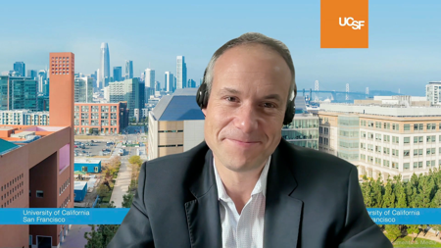
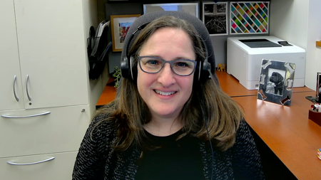
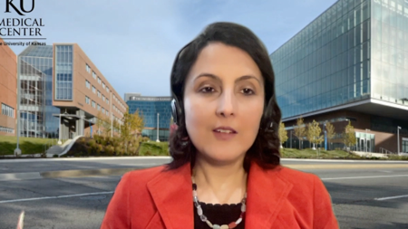
Consulting Faculty
Terence Friedlander, MD
Professor of Medicine and Robert and Virginia O’Reilly Family Endowed Chair
Chief, Division of Hematology/Oncology
Zuckerberg San Francisco General Hospital
Helen Diller Family Comprehensive Cancer Center
University of California, San Francisco
San Francisco, California
Elizabeth R Plimack, MD, MS
Professor, Medical Oncology
Deputy Director, Fox Chase Cancer Center
Temple Health
Philadelphia, Pennsylvania
Priyanka Sharma, MD
Frank B Tyler Professor in Cancer Research
Division of Medical Oncology, Department of Internal Medicine
Co-Program Leader
Drug Discovery, Delivery and Experimental Therapeutics Program
The University of Kansas Cancer Center
Westwood, Kansas

Slide 15
MODULE 1: Role of Anti-PD-1/PD-L1 Antibodies in Therapy for Nonmetastatic Urothelial Bladder Cancer (UBC) – Dr Milowsky

Slide 16
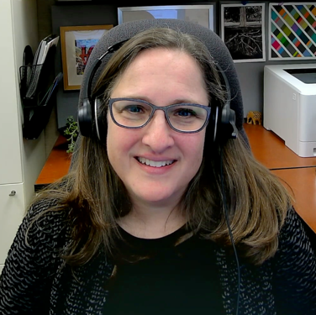
Consulting Faculty Questions
Adjuvant nivolumab after neoadjuvant chemoradiation and surgery for muscle-invasive bladder cancer (MIBC); discussing with patients
Neil Love, MD
Elizabeth R Plimack, MD, MS

Slide 17
QUESTIONS FOR THE FACULTY
How do you discuss the benefits and risks of using adjuvant nivolumab with patients receiving neoadjuvant chemoradiation therapy?
Do you use adjuvant nivolumab for patients with upper tract urothelial cancer?
What are your thoughts on the emerging results of the Phase III AMBASSADOR trial of adjuvant pembrolizumab and the potential choice of IO in this setting?
Elizabeth R Plimack, MD, MS

Slide 18
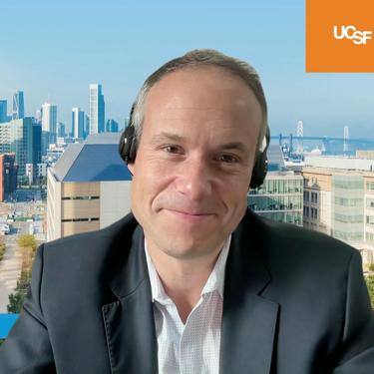
Consulting Faculty Questions
Ongoing evaluation of the role of cell-free DNA assays to enhance adjuvant treatment strategies
Neil Love, MD
Terence Friedlander, MD

Slide 19
QUESTIONS FOR THE FACULTY
Do you anticipate that subcutaneous immune checkpoint inhibitors will soon be available? What impact do you see this having on the patient experience and flow in the oncology clinic?
How do you think through the risk-benefit ratio surrounding the use of adjuvant nivolumab? Do you anticipate that ctDNA will eventually be used in UBC, and what are your thoughts about the design of ongoing trials evaluating this strategy?
Terence Friedlander, MD

Slide 20
For a 65-year-old patient who receives neoadjuvant chemotherapy for MIBC and undergoes cystectomy, in general how do presence or absence of residual disease and PD-L1 status affect your decision whether the patient should receive postoperative adjuvant immunotherapy and which immunotherapy to administer? For how long do you generally administer adjuvant nivolumab?
Presence or absence of residual disease (pCR or not)
PD-L1 status
Treatment duration
Use eligibility from study –
≥ypT2
Do not routinely check
1 year
Residual pT2 disease or greater
Typically no but will order if “on the fence”
1 year
Presence of invasive disease is key
No effect
1 year
More likely to consider it for ≥T3b or nodes
Not done
1 year
Residual pT2 disease or greater
No effect
1 year
Very important – if T3+ then we offer adjuvant nivolumab
Less important, not a major driver of decision
1 year
Don’t offer adjuvant Tx to patient with pCR; nivolumab
Little to no effect
1 year
pCR = pathologic complete response

Slide 21
Please describe the last patient in your practice diagnosed with muscle-invasive bladder cancer (MIBC) who received adjuvant nivolumab after neoadjuvant therapy and surgery.
Age
PD-L1 status
One year of adjuvant nivolumab completed?
IO tolerability issues
74 years
Unknown
Yes
No irAEs
65 years
Unknown
3 weeks in
None
80 years
Negative
Yes
None
65 years
Unknown
Still on Tx
—
67 years
Unknown
4 months in
No significant IO-related, mild rash
75 years
Negative
4 months in
Infusion reaction
43 years
Unknown
Ongoing
No irAEs
IO = immunotherapy; irAEs = immune-related adverse events

Slide 22
Role of Anti-PD-1/PD-L1 Antibodies in Nonmetastatic Urothelial Bladder Cancer
Matthew Milowsky, MD
George George Gabriel and Frances Gable Villere Distinguished Professor
Section Chief, Genitourinary Oncology

Slide 23
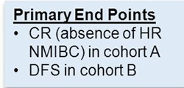
KEYNOTE-057: Single-Arm, Open-Label Phase 2 Study (NCT02625961)
Necchi A et al. Genitourinary Cancers Symposium 2023;Abstract LBA442.

Slide 24
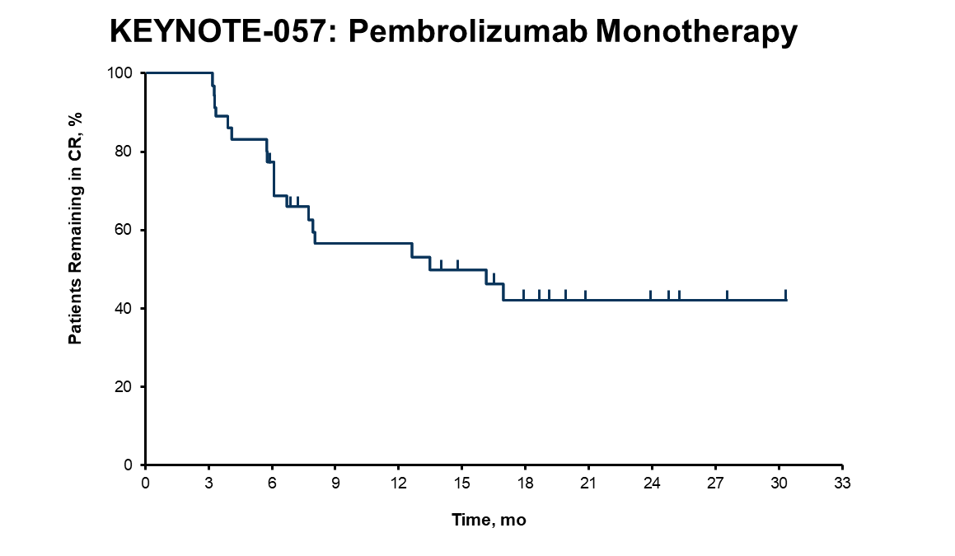
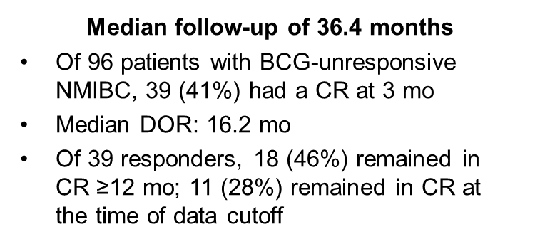
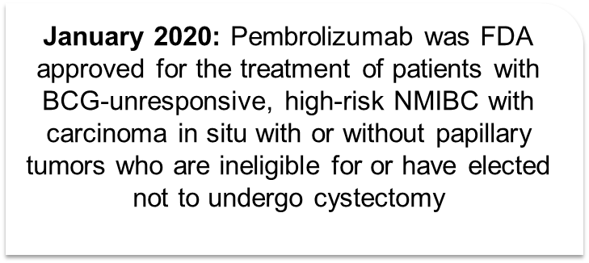
KEYNOTE-057 Cohort A & B Results
COHORT A COHORT B
Balar AV et al. Lancet Oncol 2021;22:919-930
Necchi A et al. Genitourinary Cancers Symposium 2023;Abstract LBA442.

Slide 25
Ongoing phase III trials of anti-PD-(L)1 plus BCG in BCG-naïve NMIBC
Bedke et al. Urologic Oncology. 2023;41:461-75.

Slide 26
POTOMAC: Phase III Study of Durvalumab with BCG versus BCG Alone for High-Risk, BCG-Naïve NMIBC
De Santis M et al. Genitourinary Cancers Symposium 2019;Abstract TPS500.

Slide 27
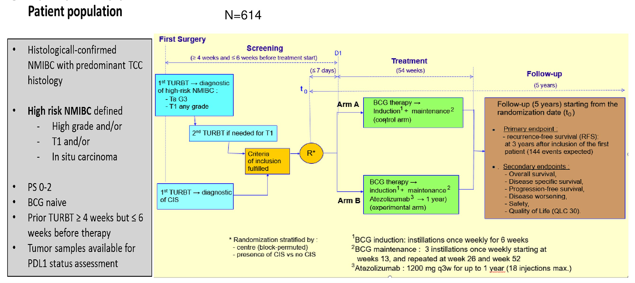
ALBAN: Phase III Trial of Atezolizumab with BCG versus BCG Alone for BCG-Naïve, High-Risk NMIBC
Roupret M et al. ASCO 2019;Abstract TPS4589.

Slide 28
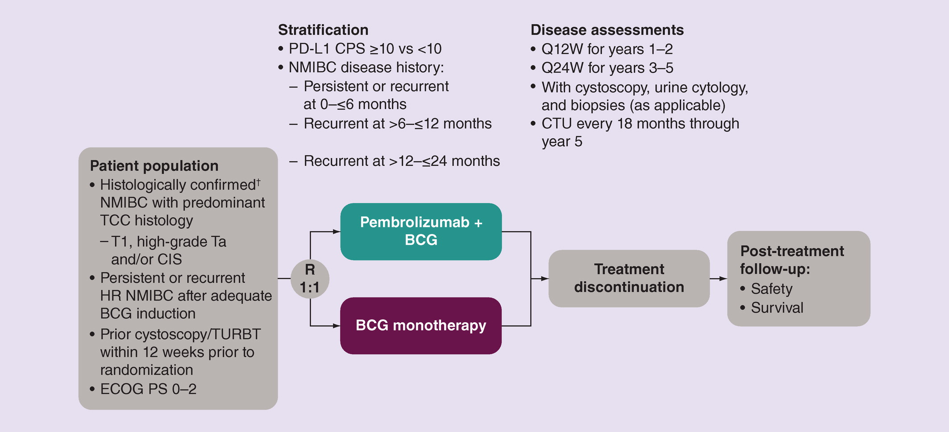
KEYNOTE-676 – Phase III trial of pembrolizumab plus BCG versus BCG monotherapy in patients with persistent/recurrent high-risk NMIBC after BCG induction
Primary Endpoint: CR rate in patients with CIS
Secondary Endpoints: EFS, 12-month EFS rate
RFS, OS, DSS, time to cystectomy, DOR, 12-mo DOR rate, HRQoL
Kamat et al. Future Oncology. 2020;16.

Slide 29
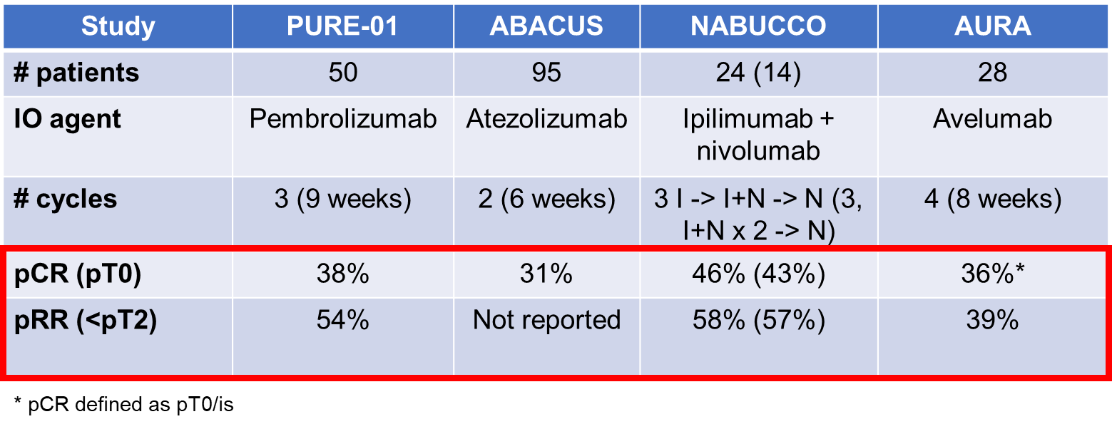
Neoadjuvant ICI in patients with MIBC
Necchi et al, JCO 2018, Powles et al, Nat Med 2019, Kaimakliotis et al, ASCO Annual Mtg 2020;abstr 5019, van Dorp et al, ESMO 2021;abstr 5132,
Van Dijk et al, ASCO Annual Mtg 2020;abstr 5020, Milowsky ASCO Annual Meeting 2022.

Slide 30
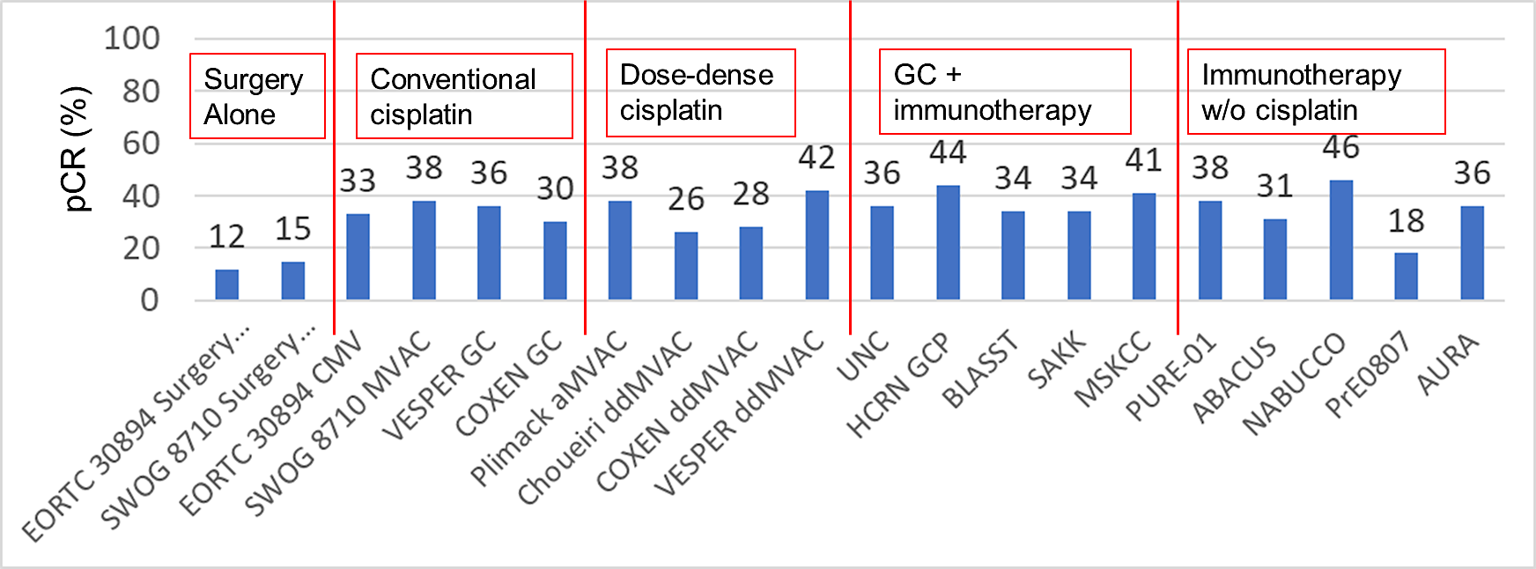
Grossman et al, NEJM 2003 EORTC 30894, JCO 2011 Pfister et al, Euro Urol 2021
Flaig et al, CCR 2021 Rose et al, GU ASCO 2021, abstr 396 Hoimes et al, ESMO 2018, abstr 5681
Gupta et al, JCO 38,6_supp (Feb 2020) Cathomas et al, GU ASCO 2021, abstr 430 Funt et al, ASCO Annual Mtg 2021, abstr 4517
Necchi et al, JCO 2018 Powles et al, Nat Med 2019 Van Dijk et al, ASCO Annual Mtg 2020, abstr 5020
Grivas et al, ASCO Annual Mtg 2021, abstr 4518 Kaimakliotis et al, ASCO Annual Mtg 2020, abstr 5019 Milowsky ASCO Annual Mtg 2022

Slide 31
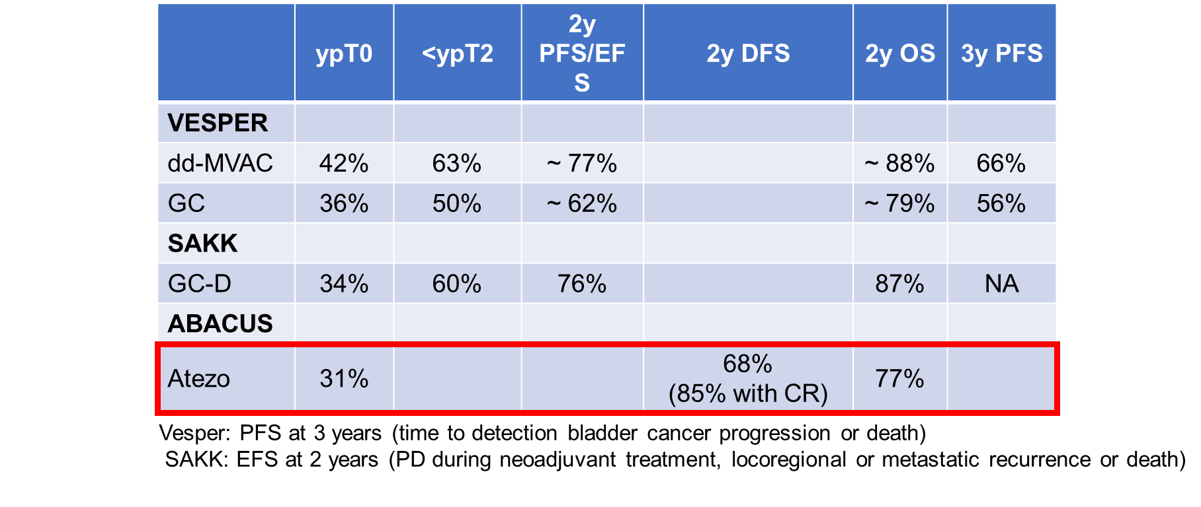
2y PFS/EFS
VESPER:
Pfister et al. J Clin Oncol. 2022, Szabados et al. Eur Urol. 2022,
Milowsky ASCO Annual Meeting 2022.

Slide 32
Ongoing Phase III studies – ICI + chemo
KEYNOTE-866

Slide 33
ICI plus EV

Slide 34
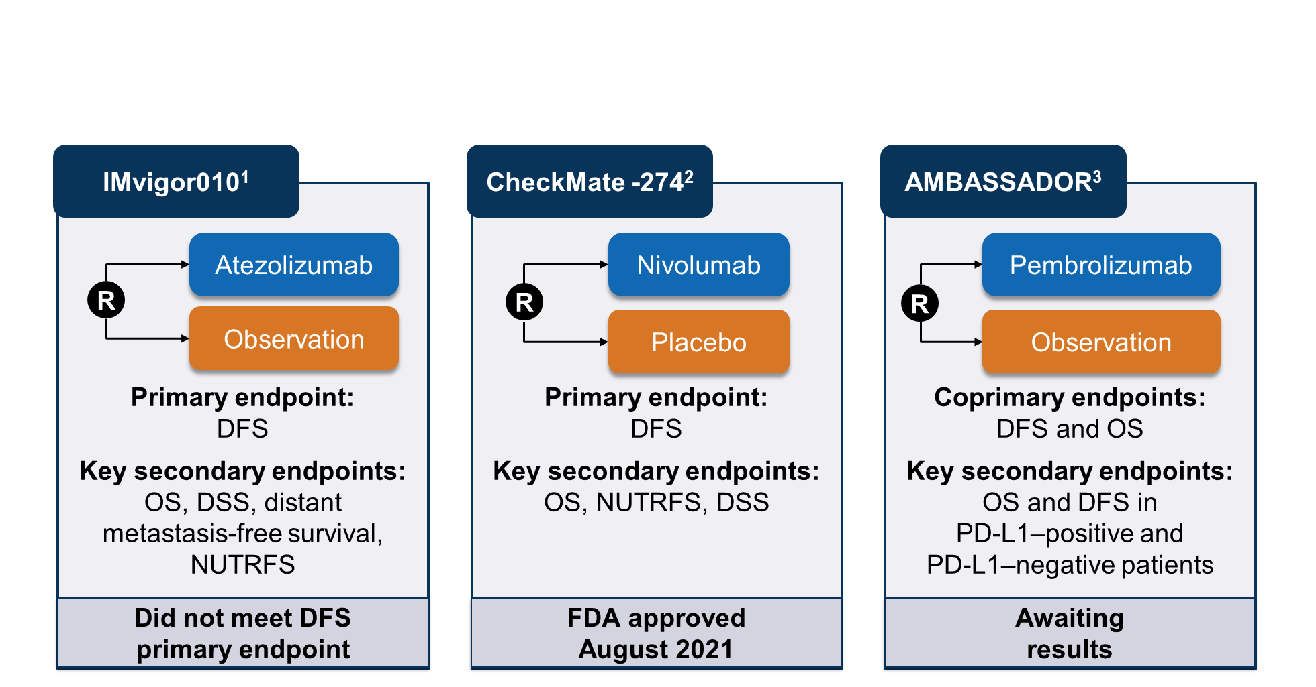
Adjuvant trials with PD-1/L1 inhibitors
CheckMate 274
LBA 531
https://clinicaltrials.gov/ct2/show/NCT02450331.
https://clinicaltrials.gov/ct2/show/NCT02632409.
https://clinicaltrials.gov/ct2/show/NCT03244384.

Slide 35
CheckMate 274
Milowsky, AUA Annual Meeting 2023.

Slide 36
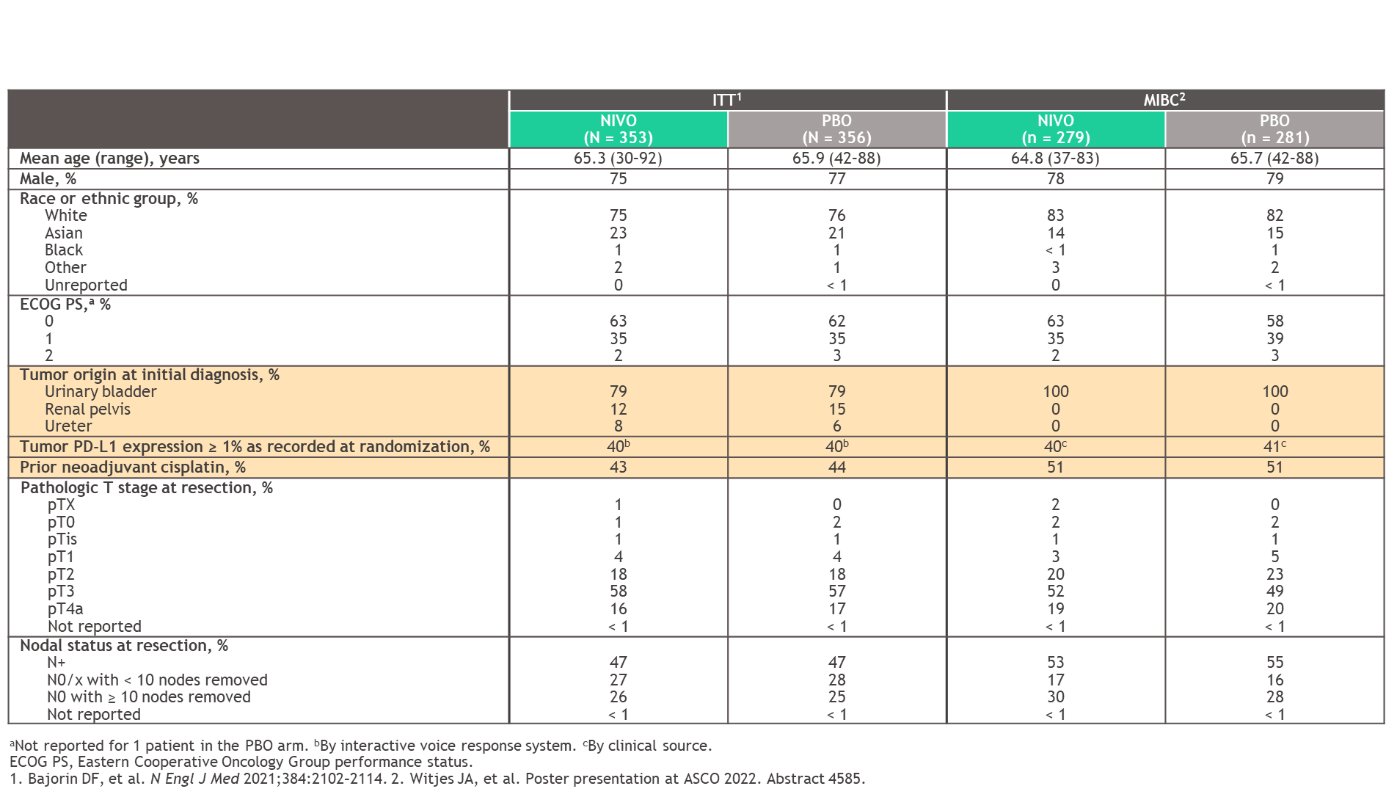
Baseline characteristics
Milowsky, AUA Annual Meeting 2023.

Slide 37
Disease-free survival
Milowsky, AUA Annual Meeting 2023.

Slide 38
Disease-free survival
Milowsky, AUA Annual Meeting 2023.

Slide 39
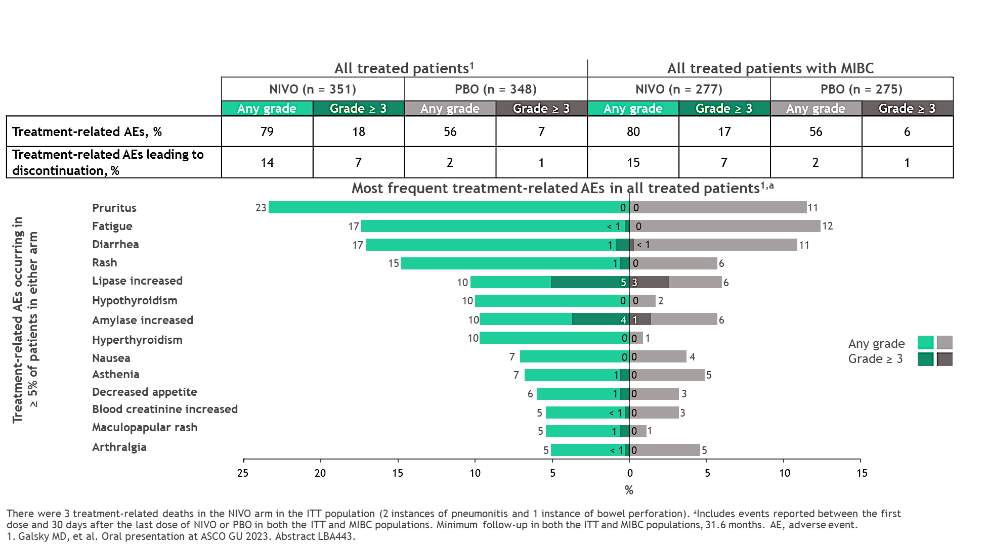
Safety
Milowsky, AUA Annual Meeting 2023.

Slide 40
A031501 AMBASSADOR: Study Design
Phase 3 randomized, open label, multicenter study of adjuvant pembrolizumab vs observation in patients with high-risk muscle-invasive urothelial carcinoma (MIUC)
NCT03244384
Key Eligibility
Muscle-invasive urothelial carcinoma: bladder, urethra, renal pelvis, ureter
Post-radical surgery (cystectomy, nephrectomy, nephroureterectomy, or ureterectomy) ≥ 4 but ≤ 16 weeks
Post-neoadjuvant chemotherapy and ≥ pT2 and/or N+/+margins
OR
cisplatin-ineligible or refusing and ≥ pT3 or pN+/+margins
Dual Primary Endpoints
Disease-free survival
Overall survival
Stratify
PD-L1 status*
Neoadjuvant
chemotherapy yes/no
Pathologic stage:
pT2/3/4aN0
pT4aN0
pT4bNx/N1-3
+surgical margins
Pembrolizumab
200 mg q3W
1 year (18 cycles)
N=739
R
1:1
Observation
Key Secondary Endpoints
DFS/OS PD-L1 +/-
Safety
Correlative Endpoints
DFS/OS ctDNA +/-
DFS/OS immune gene signatures
DFS/OS tumor molecular subtype
DFS/OS TCR clonality
QOL
*PD-L1 status was tested centrally and defined using the combined positive score: percentage of PD-L1-positive tumor cells and infiltrating immune cells relative to the total number of tumor cells. PD-L1 positive = CPS ≥ 10%, Dako PD-L1 immunohistochemistry 22C3 pharmDx assay. DFS: disease-free survival (defined as new MIUC, metastatic disease, or death without recurrence); OS: overall survival

Slide 41
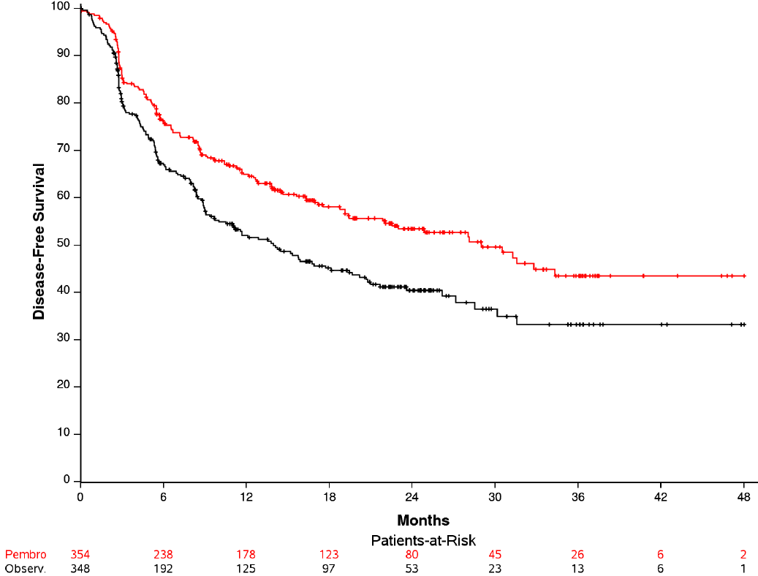
A031501 AMBASSADOR: Disease-Free Survival
 | No. of events/total | Median (95% CI), months
PEMBROLIZUMAB | 147/354 | 29.0 (21.8-NR)
OBSERVATION | 172/348 | 14.0 (9.7–20.2)
HR (95% CI) 0.69 (0.54–0.87) P = 0.001
(%)
Pembro
Observ.
Data Lock 3/10/2022
CI confidence interval; NE, not estimable; NR not reached.
Median follow-up (range) 22.3 months (0.03-48.9)
(Time from Randomization)

Slide 42
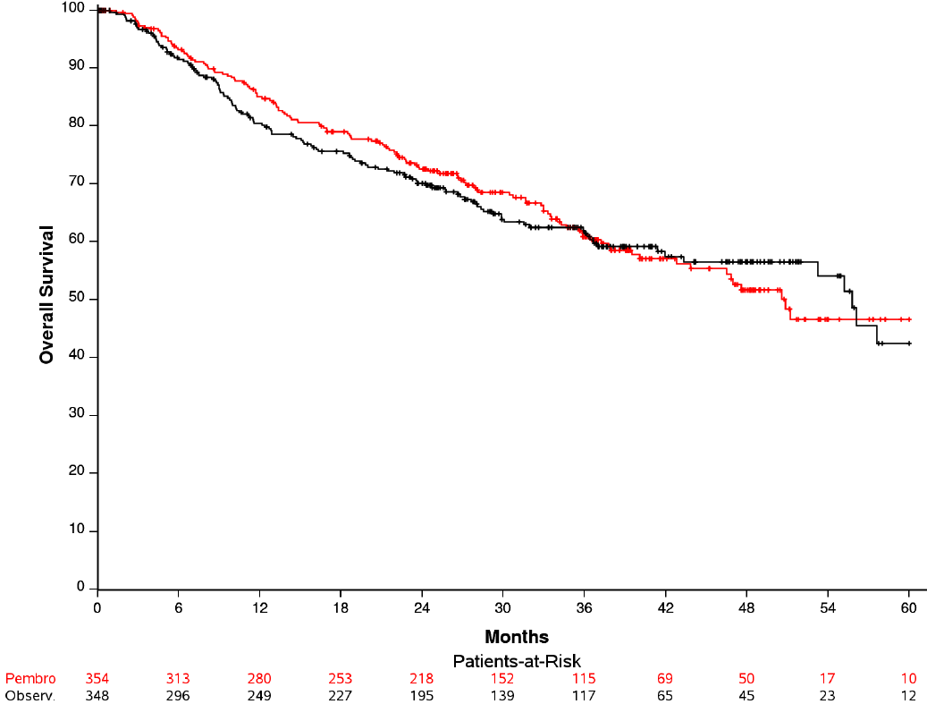
A031501 AMBASSADOR: Overall Survival (interim)
(%)
Pembro
 | No. of events/total | Median (95% CI), months
PEMBROLIZUMAB | 131/354 | 50.9 (43.8-NR)
OBSERVATION | 126/348 | 55.8 (53.3–NR)
HR (95% CI) 0.98 (0.76–1.26) P = 0.884
Observ.
Data Lock 7/13/2023
CI confidence interval; NE, not estimable; NR not reached.
Median follow-up (range) 36.9 months (0-63.9)
(Time from Randomization)

Slide 43
A031501 AMBASSADOR: Safety Summary
All AEs (regardless of attribution) | Pembrolizumab N=345 | Observation N=343
Adverse Events (any) | N (%) | N (%)
Grade 3 | 133 (38.6%) | 80 (23.3%)
Grade 4 | 17 (4.9%) | 13 (3.8%)
Grade 5 | 17 (4.9%) | 16 (4.7%)
Hematologic Adverse Events
Grade 3 | 19 (5.5%) | 9 (2.6%)
Grade 4 | 3 (0.9%) | 0 (0.0%)
Grade 5 | 0 (0.0%) | 0 (0.0%)
Non-Hematologic Adverse Events
Grade 3 | 130 (37.7%) | 78 (22.7%)
Grade 4 | 16 (4.6%) | 13 (3.8%)
Grade 5 | 17 (4.9%) | 16 (4.7%)
Grade >3
167 (48.4)
Grade >3
109 (31.8)

Slide 44
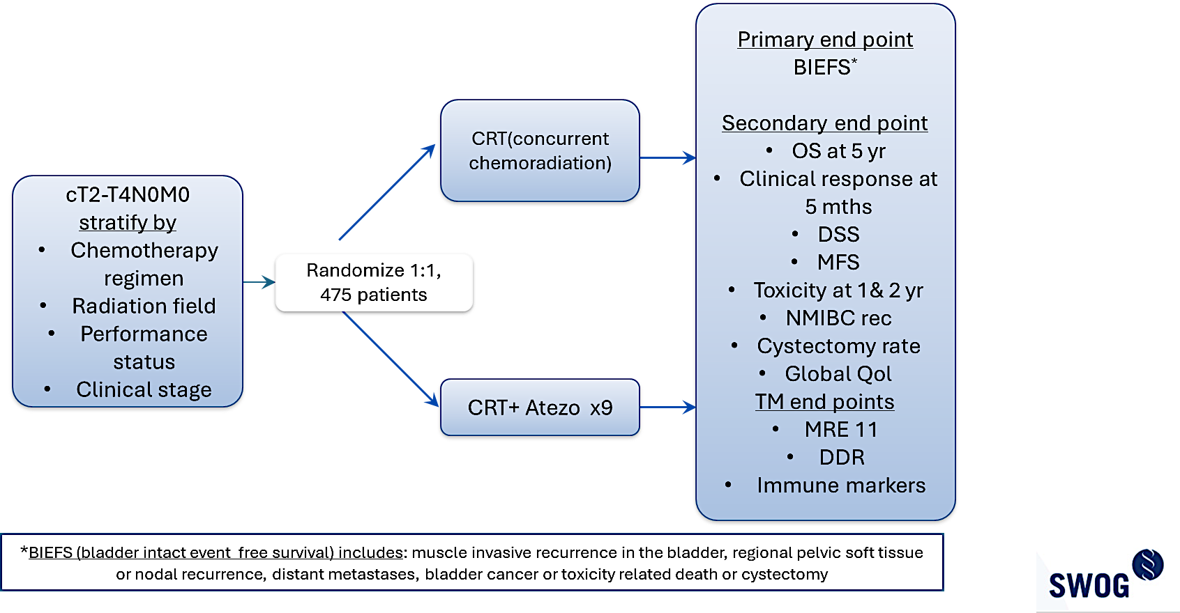
Phase III trial of concurrent chemoradiation with or without atezolizumab for localized MIBC: SWOG/NRG Intergroup Trial (S1806) (NCT03775265)
CRT (concurrent chemoradiation)
CRT + Atezo x9
c/o Himanshu Nagar

Slide 45
Conclusion
Pembrolizumab monotherapy is a treatment option for patients with high-risk BCG-unresponsive NMIBC
Additional studies are needed prior to the incorporation of ICIs into neoadjuvant treatment of patients with MIBC
Adjuvant ICI is a standard of care in patients with high-risk MIBC
Ongoing phase 3 clinical trials with ICI in combination with chemotherapy, immunotherapy, and chemoradiation may change the treatment landscape for patients with nonmetastatic UC

Slide 46
MODULE 2: Other Novel Strategies Under Investigation for Nonmetastatic UBC – Dr O’Donnell

Slide 47
Consulting Faculty Questions
Perspectives on bladder preservation and the evolution of systemic therapies for patients with MIBC
Neil Love, MD
Elizabeth R Plimack, MD, MS

Slide 48
QUESTIONS FOR THE FACULTY
What novel approaches to neoadjuvant therapy do you find particularly promising?
As neoadjuvant systemic therapy improves, can we identify more patients who can avoid cystectomy? What is your experience with bladder-sparing strategies in MIBC?
Elizabeth R Plimack, MD, MS

Slide 49
Consulting Faculty Questions
Pembrolizumab as treatment for BCG-unresponsive, high-risk NMIBC; intravesical drug delivery systems for MIBC
Neil Love, MD
Terence Friedlander, MD

Slide 50
QUESTIONS FOR THE FACULTY
What are the unique challenges associated with cystectomy in elderly patients with comorbidities?
Do you believe novel intravesical approaches such as TAR-200 and TAR-210 will provide meaningful improvements in outcomes over current standard therapies for patients with NMIBC and MIBC?
How are these strategies tolerated, and how do you anticipate they will be used in the future?
Terence Friedlander, MD

Slide 51
Please describe the last patient in your practice with localized UBC (muscle invasive or not muscle invasive) who was enrolled on a clinical trial.
Age
Clinical trial
Assigned Tx arm (if applicable)
Response
Tolerability
78 years
Alliance A031803
N/A
Pending
Probable IO-related arthritis
71 years
KN-905/EV-303
Awaiting assignment
Pending
Pending
77 years
EV monotherapy for upper tract tumors
N/A
Pending
Similar to expected
65 years
Neoadjuvant chemo with IO
IO
Still free of disease
—
69 years
Neoadjuvant variant trial with MVAC/pembro
N/A
Tx ongoing
Tx ongoing
65 years
EV-304/B15
EV + pembro
Pending
Pending
70 years
RETAIN-2
N/A
Tx ongoing
Tx ongoing
EV = enfortumab vedotin; MVAC = methotrexate/vinblastine/doxorubicin/cisplatin; pembro = pembrolizumab

Slide 52
Based on your personal clinical experience and/or knowledge of available data, what is your global perspective on the overall efficacy and tolerability of the TAR-200 delivery system?
Exciting approach to intravesical therapy with activity in BCG-unresponsive disease and more limited but provocative data in the neoadjuvant MIBC setting
No personal experience yet but looks very favorable based on the literature
Seems quite active but not sure how effective it will be controlling invasive disease to prevent metastasis (it’s not systemic therapy, which is a real issue for MIBC)
Very promising options under development!
It looks promising — I have not used it myself yet
Very encouraging – effective and fairly well tolerated therapy for some patients with an MIBC; Mechanistically it makes sense to expose the tumor to longer durations of chemotherapy.
Very tolerable, seems effective, long-term outcomes not disclosed yet and will be key

Slide 53
Other Novel Strategies Under Investigation for Nonmetastatic Urothelial Bladder Cancer (UBC)
Peter H. O’Donnell, M.D.
Section of Hematology/Oncology
Genitourinary Oncology Program
Committee on Clinical Pharmacology
and Pharmacogenomics
The University of Chicago

Slide 54
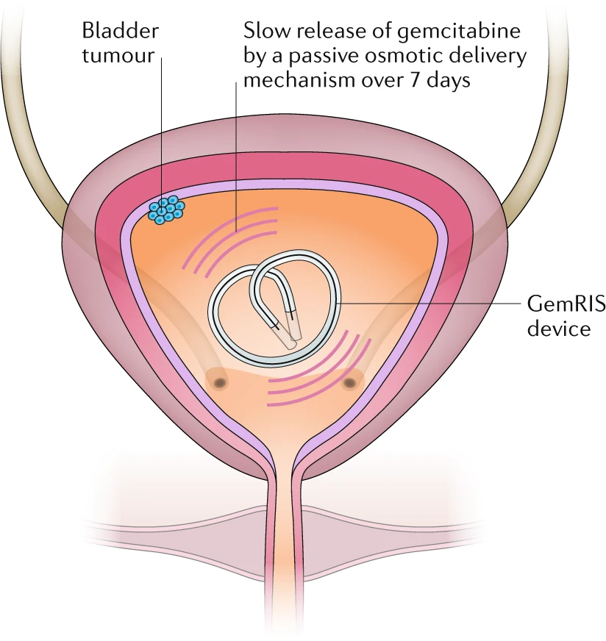
Intravesical Depot Delivery System
“TAR-200”
Plasma gem levels undetectable
Most common treatment-emergent AEs: frequent urination (22%); dysuria (20%); urgency (18%); incontinence (9%); almost all grade 1/2
Tan and Kelly, Nat Rev Urol (2018)
Daneshmand et al., Urol Oncol (2022)
Necchi et al., ESMO Abstract LBA105 (2023)

Slide 55
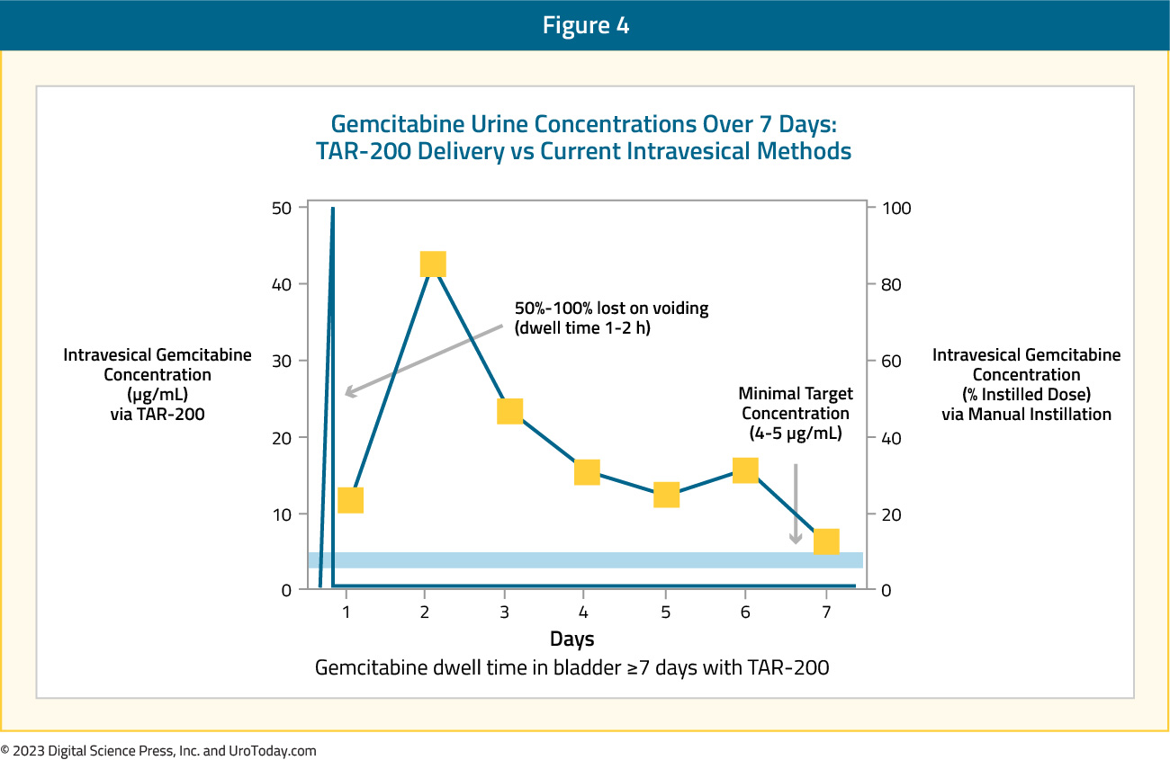
Intravesical Drug Levels
water
Daneshmand et al., AUA Abstract LBA02-03 (2023)
Sayyid and Klaassen, UroToday (2023)

Slide 56
SunRISe-1: TAR-200 in NMIBC
Historical benchmarks for 12-month CR rates:
Pembrolizumab (19%)
Atezolizumab (15%)
Nadofaragene firadenovec (23%)

Slide 57
TAR-200 Intravesical Results
cystoscopy/biopsy/cytology/imaging assessed at 24 and 48 weeks
Necchi et al., ESMO Abstract LBA105 (2023)

Slide 58
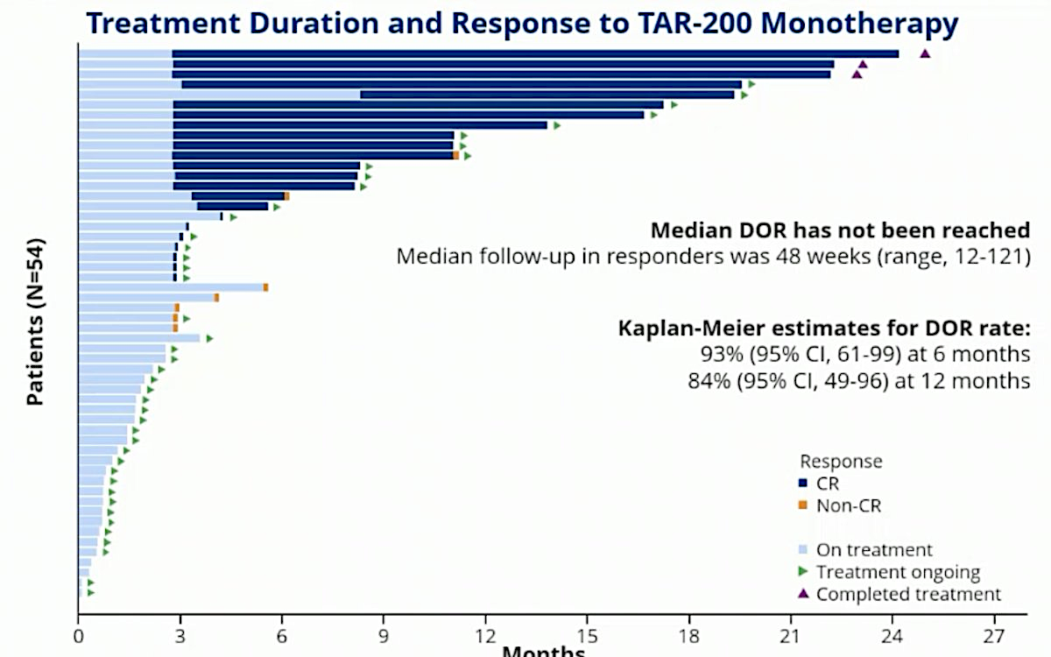
Duration of Response – TAR-200
Months
Necchi et al., ESMO Abstract LBA105 (2023)

Slide 59
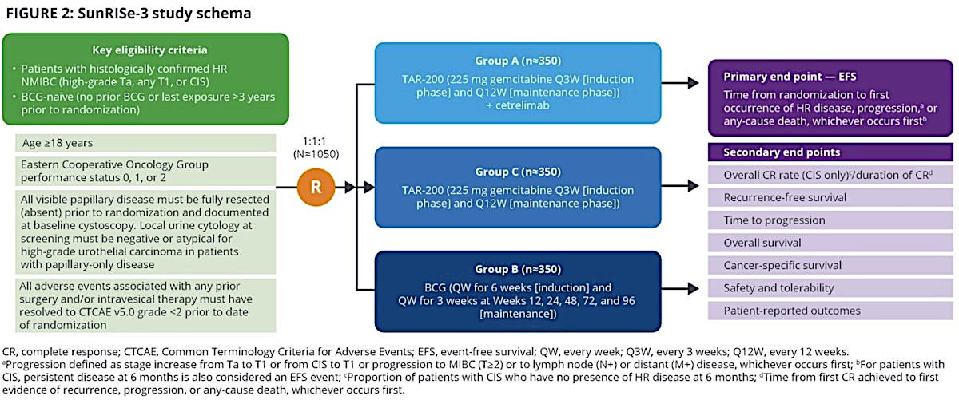
SunRISe-3: TAR-200 +/- Cetrelimab vs BCG
Necchi et al., ESMO Abstract 2407TiP (2023)

Slide 60
TAR-200 + Cetrelimab vs Cetrelimab Alone as Neoadjuvant Therapy in MIBC
Psutka et al., GU ASCO Abstract TPS584 (2023)

Slide 61
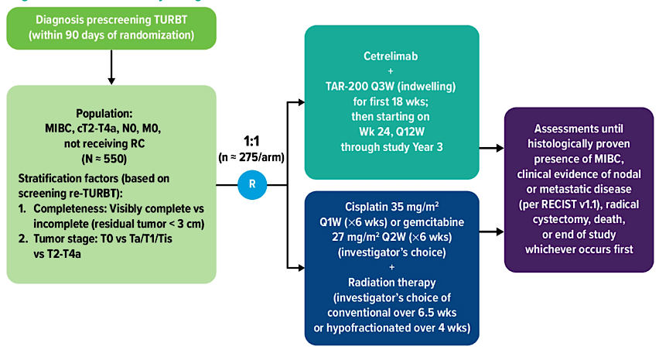
TAR-200 + Cetrelimab vs ChemoRT in MIBC
Williams et al., ASCO Abstract TPS4586 (2021)

Slide 62
TAR-210: Erdafitinib Intravesical Delivery System in FGFR-Altered NMIBC
Vilaseca et al., ESMO Abstract LBA104 (2023)

Slide 63
TAR-210: Erdafitinib-RIS Results (NMIBC)
Vilaseca et al., ESMO Abstract LBA104 (2023)

Slide 64
Sustained Urinary Erdafitinib Release Over 90 Days, with Low Systemic Exposure
>50 x lower mean [plasma] than oral erdafitinib 9mg daily
No hyperphosphatemia
Vilaseca et al., ESMO Abstract LBA104 (2023)

Slide 65
Intravesical Enfortumab Vedotin
Kamat et al., GU ASCO Abstract TPS582 (2023)

Slide 66
Select Ongoing Trials Evaluating Other Novel Therapies for Patients with High-Risk NMIBC
Trial | Phase | n | Population | Intervention
NCT05704244 | III | 24 | BCG unresponsive | Nadofaragene firadenovec
CREST NCT04165317 | III | 1,070 | BCG naïve, BCG unresponsive | Sasanlimab Sasanlimab + BCG BCG
QUILT-3.032 NCT03022825 | II/III | 190 | BCG unresponsive | N-803 (interleukin-15 superagonist complex ) + BCG N-803
TRUCE-04 NCT05495724 | II | 176 | HER2 overexpressing | Tislelizumab + disitamab vedotin
ADAPT-BLADDER NCT03317158 | I/II | 55 | BCG unresponsive, BCG relapsing, BCG naïve | Durvalumab Durvalumab + BCG or radiation therapy or gemcitabine or tremelimumab
NCT04706598 | I/II | 56 | BCG unresponsive | Camrelizumab
NCT05843448 | I | 30 | BCG unresponsive/intolerant | PD‐L1/IDO peptide vaccine + pembrolizumab IV
BCG = Bacillus Calmette-Guérin
Hannouneh ZA et al. Cancer Med 2023;12(24):21944-68.

Slide 67
Summary
Novel delivery systems and intravesical use of traditionally-systemic agents show promise in early-stage bladder cancer
TAR-200 granted FDA breakthrough therapy designation in BCG-unresponsive high-risk NMIBC (Dec 2023)
Combination strategies being explored
Delay progression / need for cystectomy?

Slide 68
MODULE 3: Front-Line Treatment for Metastatic UBC (mUBC) – Dr Rosenberg

Slide 69
Consulting Faculty Questions
Enfortumab vedotin (EV) with pembrolizumab as first-line treatment for metastatic urothelial bladder cancer (UBC); management of rash and neuropathy associated with EV
Neil Love, MD
Elizabeth R Plimack, MD, MS
Terence Friedlander, MD

Slide 70
QUESTIONS FOR THE FACULTY
Are you using enfortumab vedotin/pembrolizumab as first-line therapy for mUBC regardless of platinum eligibility?
Elizabeth R Plimack, MD, MS
What has been your experience with the tolerability of enfortumab vedotin/pembrolizumab?
How do you manage common side effects (eg, rash, peripheral neuropathy) with this combination?
Terence Friedlander, MD

Slide 71
Consulting Faculty Questions
Autoimmune contraindications to immunotherapy
Neil Love, MD
Terence Friedlander, MD

Slide 72
QUESTIONS FOR THE FACULTY
Which autoimmune conditions do you believe constitute an absolute contraindication to treatment with an immune checkpoint inhibitor?
How do you think through the use of these agents in patients with autoimmune diseases or those who have undergone solid organ transplant?
Terence Friedlander, MD

Slide 73
Please describe the last patient in your practice who received enfortumab vedotin/pembrolizumab as first-line treatment for metastatic UBC.
Age
PD-L1 status
Benefit derived
Side effects
73 years
Unknown
Some
Rash, Grade 1 neuropathy
65 years
Unknown
Too early to determine
Faring well
65 years
Unknown
A great deal
Neuropathy, fatigue, dysgeusia
65 years
Unknown
A great deal
Neuropathy
72 years
Unknown
A great deal
Peripheral neuropathy, dry skin
72 years
Positive
A great deal
Neuropathy, colitis
86 years
Unknown
A great deal
Pruritus/dry skin, fatigue

Slide 74
In general, what is your preferred first-line treatment regimen for an 80-year-old patient with metastatic UBC who has received no prior systemic therapy and is not a candidate for cisplatin? Does PD-L1 level affect your decision-making?
Preferred first-line regimen
PD-L1 affect decision-making?
Enfortumab vedotin/pembrolizumab
No
Enfortumab vedotin/pembrolizumab
No
Enfortumab vedotin/pembrolizumab
No
Enfortumab vedotin/pembrolizumab
No
Enfortumab vedotin/pembrolizumab
No
Enfortumab vedotin/pembrolizumab
No
Enfortumab vedotin/pembrolizumab
No

Slide 75
In general, what is your preferred first-line treatment regimen for an 80-year-old patient with metastatic UBC who has received no prior systemic therapy and is not a candidate for cisplatin or carboplatin? Does PD-L1 level affect your decision-making?
Preferred first-line regimen
PD-L1 affect decision-making?
Enfortumab vedotin/pembrolizumab
No
Pembrolizumab
Yes
Pembrolizumab
Yes
Enfortumab vedotin/pembrolizumab
No
Enfortumab vedotin/pembrolizumab
No
Pembrolizumab
Yes, slightly
Atezolizumab
No

Slide 76
First-line and maintenance therapy for metastatic urothelial cancer
Jonathan Rosenberg, MD
Chief, Genitourinary Oncology Service
Enno Ercklentz Chair
Department of Medicine
Memorial Sloan Kettering Cancer Center
Professor of Medicine
Weill Cornell Medical College

Slide 77
Treatment Landscape of metastatic UC
Enfortumab vedotin and pembrolizumab approved for metastatic UC
Platinum based chemotherapy is no longer the default option for metastatic UC patients
Role of avelumab maintenance is reduced in this new paradigm
Patients who are not felt to be candidates for cytotoxic agents may receive pembrolizumab monotherapy

Slide 78
JAVELIN Bladder100 trial: Longer term follow-up (≥ 2 years) confirms initial data
OS
PFS
Powles, et al. J Clin Oncol 40, 2022 (suppl 6; abstr 487)

Slide 79
JAVELIN Bladder100 trial: Overall, outcomes favor avelumab no matter prior chemo response
Sridhar et al. ASCO 2022

Slide 80
Metastatic UC: ADC Therapy with enfortumab vedotin
Targets Nectin-4 which is highly
expressed in urothelial cancers

Slide 81
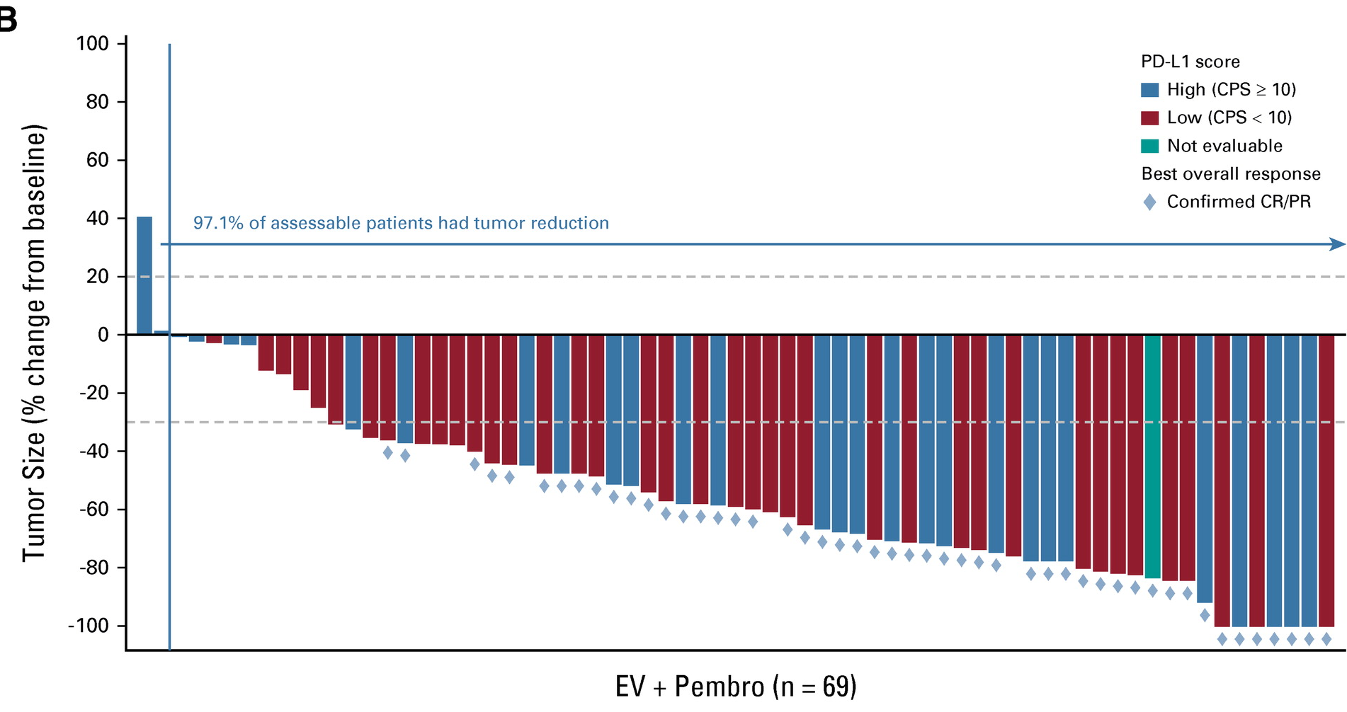
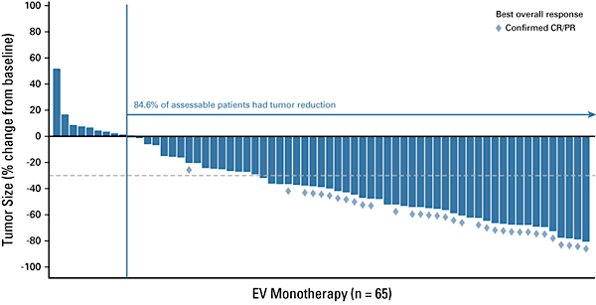
EV-103 Cohort K: EV +/- pembrolizumab
 | EV+Pembro (N=76) | EV Monotherapy (N=73)
Confirmed ORR (95% CI) | 64.5% (52.7-75.1) | 45.2% (33.5-57.3)
Complete response | 10.5% | 4.1%
Partial Response | 53.9% | 41.1%
Progressive Disease | 7.9% | 9.6%
Not evaluable or no assessment | 5.3% | 10.9%
EV/Pembro activity independent of PD-L1 status
27/44 (61.4%) cORR in CPS<10
21/31 (67.7%) cORR in CPS≥10
O’Donnell et al. JCO 2023 41(25):4107-4117.

Slide 82
EV-302/KEYNOTE-A39 (NCT04223856)
Patient population
Previously untreated la/mUC
Eligible for platinum, EV, and P
PD-(L)1 inhibitor naive
GFR ≥30 mL/minª
ECOG PS ≤2^{b}
EV + Pembrolizumab
No maximum treatment cycles for EV, maximum 35 cycles for P
Dual primary endpoints:
PFS by BICR
OS
Select secondary endpoints:
ORR per RECIST v1.1 by BICR and investigator assessment
Safety
N=886
R
1:1
Treatment until disease progression per BICR, clinical progression, unacceptable toxicity, or completion of maximum cycles
Chemotherapy^{c}
(Cisplatin or carboplatin + gemcitabine)
Maximum 6 cycles
Stratification factors: cisplatin eligibility (eligible/ineligible), PD-L1 expression (high/low), liver metastases (present/absent)
Cisplatin eligibility and assignment/dosing of cisplatin vs carboplatin were protocol-defined; patients received 3-week cycles of EV (1.25 mg/kg; IV) on Days 1 and 8 and P (200 mg; IV) on Day 1
Statistical plan for analysis: the first planned analysis was performed after approximately 526 PFS (final) and 356 OS events (interim); if OS was positive at interim, the OS interim analysis was considered final
Adapted from Powles et al. ESMO 2023 LBA6

Slide 83
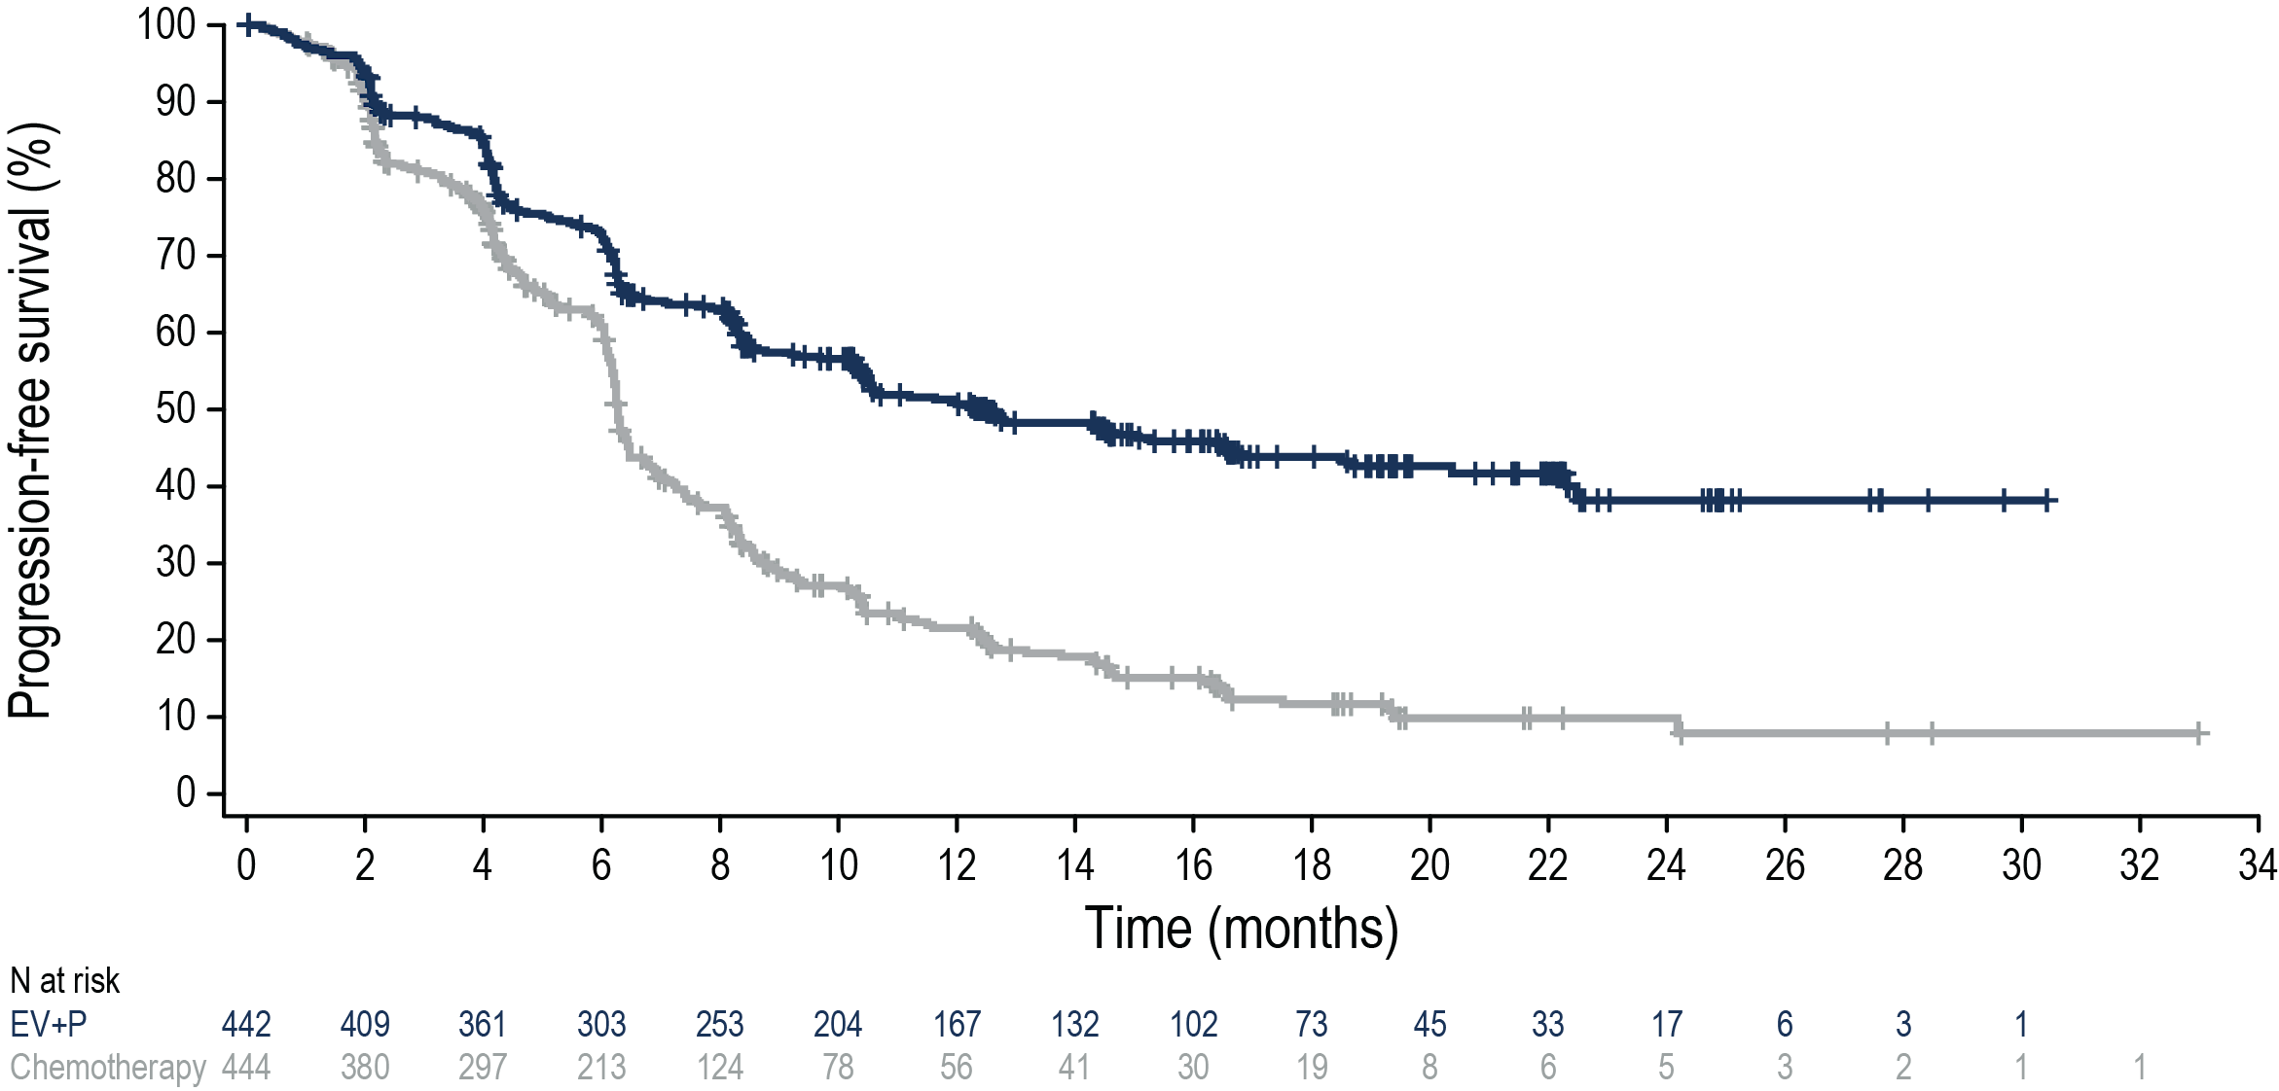
EV-302: Progression-Free Survival per BICR
Risk of progression or death was reduced by 55% in patients who received EV+P
 | N | Events (%) | HRª (95% CI) | 2-sided P value | mPFS (95% CI), months
EV+P | 442 | 223 (50.5) | 0.45 (0.38-0.54) | <0.00001 | 12.5 (10.4-16.6)
Chemotherapy | 444 | 307 (69.1) |  |  | 6.3 (6.2-6.5)
50.7%
43.9%
21.6%
11.7%
Adapted from Powles et al. ESMO 2023 LBA6

Slide 84
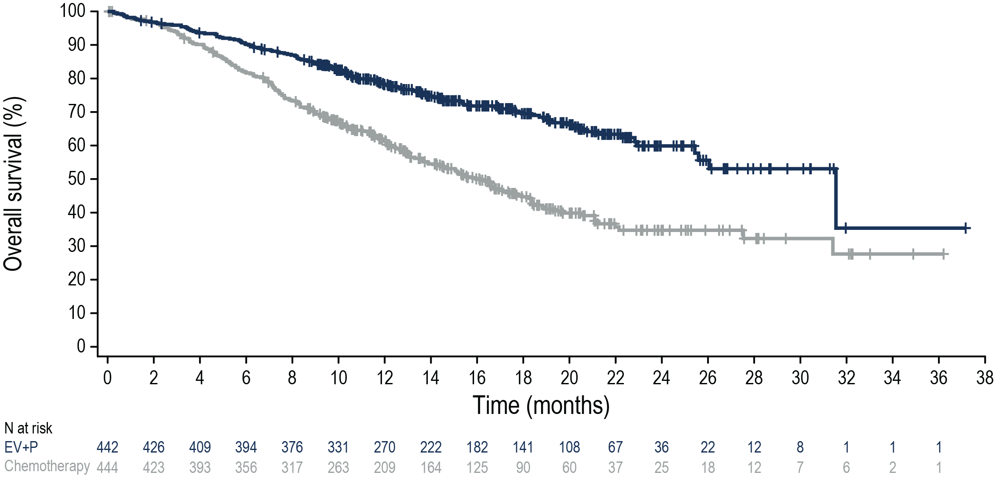
EV-302: Overall Survival
Risk of death was reduced by 53% in patients who received EV+P
 | N | Events (%) | HRª (95% CI) | 2-sided P value | mOS (95% CI), months
EV+P | 442 | 133 (30.1) | 0.47 (0.38-0.58) | <0.00001 | 31.5 (25.4-NR)
Chemotherapy | 444 | 226 (50.9) |  |  | 16.1 (13.9-18.3)
78.2%
Median survival follow-up: 17.2 months
69.5%
61.4%
44.7%
Adapted from Powles et al. ESMO 2023 LBA6

Slide 85
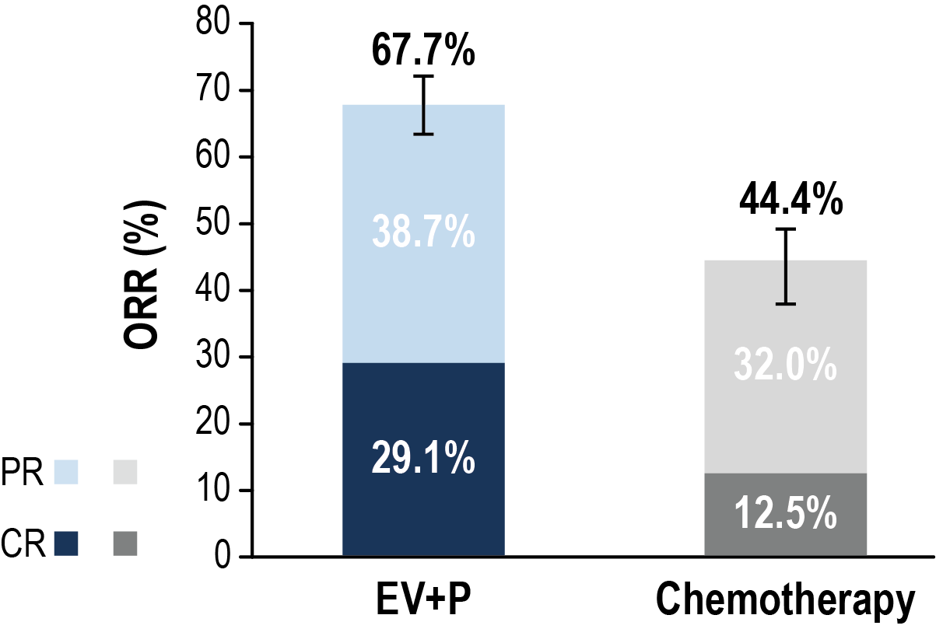
EV-302: Confirmed Overall Response per BICR
Significant improvement in objective response rate was observed with EV+P
 | EV+P (N=437) | Chemotherapy (N=441)
Confirmed ORR, n (%) (95% CI) | 296 (67.7) (63.1-72.1) | 196 (44.4) (39.7-49.2)
2-sided P value | <0.00001
Best overall responseª, n (%)
Complete response | 127 (29.1) | 55 (12.5)
Partial response | 169 (38.7) | 141 (32.0)
Stable disease | 82 (18.8) | 149 (33.8)
Progressive disease | 38 (8.7) | 60 (13.6)
Not evaluable/No assessment^{b} | 21 (4.8) | 36 (8.2)
Median DOR (95% CI) | NR (20.2, NR) | 7.0 (6.2, 10.2)
EV+P ORR is remarkably consistent across studies
Adapted from Powles et al. ESMO 2023 LBA6

Slide 86
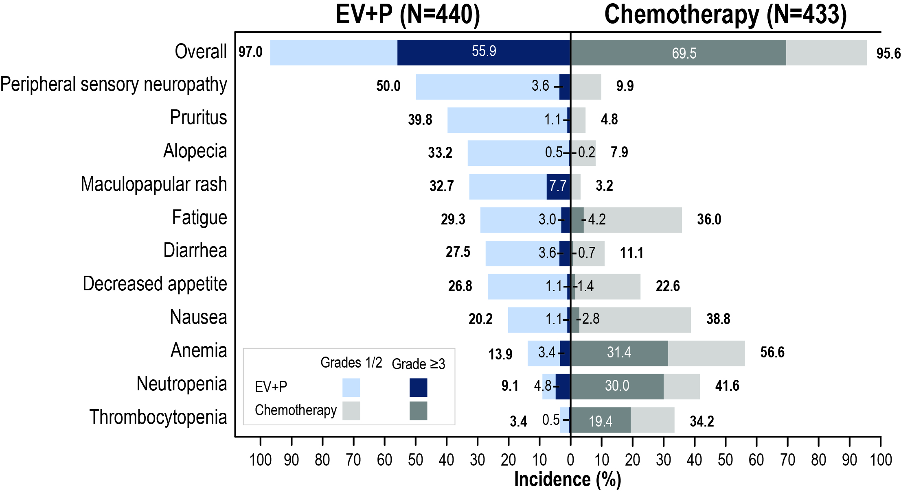
EV-302: Treatment-Related Adverse Events
Grade ≥3 events were 56% in EV+P and 70% in chemotherapy
Serious TRAEs:
122 (27.7%) EV+P
85 (19.6%) chemotherapy
TRAEs leading to death (per investigator):
EV+P: 4 (0.9%)
Asthenia
Diarrhea
Immune-mediated lung disease
Multiple organ dysfunction syndrome
Chemotherapy: 4 (0.9%)
Febrile neutropenia
Myocardial infarction
Neutropenic sepsis
Sepsis
c/o Powles et al.
Median number of cycles (range): 12.0 (1,46) for EV+P; 6.0 (1,6) for chemotherapy
Adapted from Powles et al. ESMO 2023 LBA6

Slide 87
EV-302: Conclusions
Risk of progression or death reduced by 55% with EV+P
Risk of death reduced by 53% with EV+P
Median OS 31.5 months with EV+P
All patient subsets seemed to benefit
Confirmed ORR was 67.7% and 44.4% in the EV+P and chemo arms, respectively
Transformative data
Will replace chemotherapy for most patients with mUC
Availability will be limited for some time in certain regions

Slide 88
CheckMate901: two phase 3 trials of immune checkpoint blockade
Press release: negative for OS in PDL1 high
Data not presented yet
Arm A: Nivolumab 1 mg/kg +
Ipilimumab 3 mg/kg
Q3W up to 4 doses
Nivolumab 480 mg Q4W
until PD, unacceptable
toxicity, or up to 24 mo
Cisplatin eligible or ineligible
Arm B: Gemcitabine + Cisplatin or Carboplatin
Q3W up to 6 cycles
First line la/mUC
Arm C: Nivolumab 360 mg +
Gemcitabine + Cisplatin
Q3W up to 6 cycles
Nivolumab 480 mg Q4W
until PD, unacceptable
toxicity, or up to 24 mo
Cisplatin eligible only
Arm D: Gemcitabine + Cisplatin
Q3W up to 6 cycles
Positive for PFS and OS
Galsky. ASCO 2018. Abstr TPS539. NCT03036098.

Slide 89
CheckMate 901: Study design
Does Nivolumab improve outcomes when added to gemcitabine-cisplatin?
Stratification factors:
Tumor PD-L1 expression (≥ 1% vs < 1%)
Liver metastases (yes vs no)
Combination phase
Monotherapy phase
Key inclusion criteria
Age ≥ 18 years
Previously untreated unresectable or mUC involving the renal pelvis, ureter, bladder, or urethra
Cisplatin eligible
ECOG PS of 0-1
NIVO 360 mg on D1 + Gemcitabine 1000 mg/m² on D1/D8 + Cisplatin 70 mg/m² on D1 Q3W (up to 6 cycles)^{b}
NIVO 480 mg Q4W
(until progression, unacceptable toxicity, withdrawal, or up to 24 months^{c})
N = 304
3 weeks
R
Gemcitabine 1000 mg/m² on D1/D8 + Cisplatin 70 mg/m² on D1 Q3W (up to 6 cycles)^{b}
N = 304
Median (range) study follow-up, 33.6 (7.4–62.4) months
Primary endpoints: OS, PFS per BICR
Key secondary endpoints: OS and PFS by PD-L1 ≥ 1%,^{d} HRQoL
Key exploratory endpoints: ORR per BICR, safety
Adapted from M van der Heijden; ESMO LBA7 2023

Slide 90
CheckMate 901: OS (primary endpoint)
100
90
Treatment | Events/patients | Median OS (95% CI), months
NIVO+GC | 172/304 | 21.7 (18.6-26.4)
GC | 193/304 | 18.9 (14.7–22.4)
HR (95% CI), 0.78 (0.63–0.96) P = 0.0171
12-month rate:
80
70
70.2%
60
24-month rate:
Overall survival (%)
46.9%
50
62.7%
40
30
40.7%
NIVO+GC
20
10
GC
0
0
6
12
18
24
30
36
42
48
54
60
66
Months
No. at risk
NIVO+GC
304
264
196
142
97
69
48
25
15
7
2
0
GC
304
242
166
122
82
49
33
17
13
4
1
0
Adapted from M van der Heijden; ESMO LBA7 2023

Slide 91
CheckMate 901: PFS per BICR (primary endpoint)
100
90
Treatment | Events/patients | Median PFS (95% CI), months
NIVO+GC | 211/304 | 7.9 (7.6-9.5)
GC | 191/304 | 7.6 (6.1–7.8)
HR (95% CI), 0.72 (0.59–0.88) P = 0.0012
80
70
60
Progression-free survival (%)
12-month rate:
50
40
34.2%
24-month rate:
30
23.5%
20
NIVO+GC
10
21.8%
9.6%
GC
0
0
6
12
18
24
30
36
42
48
54
60
Months
No. at risk
NIVO+GC
304
179
82
57
41
31
19
11
6
1
0
GC
304
119
35
17
10
8
5
1
0
0
0
Adapted from M van der Heijden; ESMO LBA7 2023

Slide 92
CheckMate 901: Objective response outcomes
ORR (95% CI) and BOR per BICRª
Time to and duration of responses
57.6% (51.8-63.2)
CR
Any objective response^{c} | NIVO+GC (n = 175) | GC (n = 131)
Median TTR (Q1-Q3), months | 2.1 (2.0–2.3) | 2.1 (2.0–2.2)
Median DoR (95% CI), months | 9.5 (7.6–15.1) | 7.3 (5.7–8.9)
PR
43.1% (37.5-48.9)
21.7%
Patients (%)
11.8%
Complete response^{d} | NIVO+GC (n = 66) | GC (n = 36)
Median TTCR (Q1-Q3), months | 2.1 (1.9-2.2) | 2.1 (1.9-2.2)
Median DoCR (95% CI), months | 37.1 (18.1-NE) | 13.2 (7.3-18.4)
35.9%
31.3%
SD | 25.3% |  | 28.3%
PD | 9.5% |  | 12.8%
UE^{b} | 7.6% |  | 15.8%
NIVO+GC
(N = 304)
GC
(N = 304)
Nivolumab associated with higher ORR, CR rate, and longer DOR
Adapted from M van der Heijden; ESMO LBA 2023

Slide 93
CheckMate 901: Treatment-related AEs in all treated patients
NIVO+GC (n = 304)
GC (n = 288)
Treatment-related AE, %ª | Any grade | Grade ≥ 3^{b} | Any grade | Grade ≥ 3^{b}
Any | 97 | 62 | 93 | 52
Leading to discontinuation | 21 | 11 | 17 | 8
Anemia
57
22
18
48
Nausea
47
< 1
1
48
Neutropenia
31
19
15
30
Decreased neutrophil count
25
14
11
21
Fatigue
24
2
1
24
Decreased appetite
22
1
< 1
16
Decreased platelet count
22
8
5
15
Decreased white blood cell count
21
10
4
14
Vomiting
18
1
2
17
Asthenia
15
1
2
16
Thrombocytopenia
15
7
5
12
Pruritus
14
1
0
3
Grade 1–2
Constipation
14
0
< 1
14
Rash
13
1
< 1
3
Diarrhea
13
1
0
9
Grade ≥ 3
Hypothyroidism
13
0
0
Increased blood creatinine
13
< 1
0
12
Leukopenia
13
2
2
11
60
40
20
0
20
40
60
Incidence, %
Adapted from M van der Heijden; ESMO LBA 2023
Modest increase in grade ≥3 toxicity

Slide 94
CheckMate 901: Nivolumab + GC
Higher ORR, DOR and CR rate with addition of nivolumab compared to gem/cis
Significantly longer PFS and OS
First study where chemotherapy + checkpoint inhibitor improved outcomes in mUC
Cisplatin and immunotherapy may have advantages over carboplatin-based combinations
Is this better than avelumab maintenance strategy?
All patients get a checkpoint inhibitor, rather than only those who benefit

Slide 95
NORSE Phase 2 Study Design: 1st line cisplatin ineligible mUC with FGFR3 alterations
Key eligibility criteria
Age ≥18 years
mUC diagnosis
Ineligible for cisplatin^{b}
Select FGFR alterations (mutation/fusion)^{c}
Measurable disease
No prior systemic therapy for mUC
Erdafitinib (n=44) Once-daily erdafitinib 8 mg with pharmacodynamically guided uptitration to 9 mg
Primary end points
ORR
Safety
1:1
N=89
R
Erdafitinib + cetrelimab (n=45)
Once-daily erdafitinib 8 mg + cetrelimab
Secondary end points
DCR
DOR
Time to response
PFS
OS
Patients with any PD-L1 status could be enrolled
Molecular eligibility was determined by central or local testing; a total of 1430 patients underwent central molecular screening^{c}
Non-comparative phase II study
2/3 were CPS <10
Siefker-Radtke et al. J Clin Oncol 41, 2023 (suppl 16; abstr 4504)

Slide 96
NORSE: ORR of 44% and 55% Was Observed With Erdafitinib and Erdafitinib Plus Cetrelimab, Respectively
ORR with erdafitinib monotherapy was consistent with previous results in FGFR-altered mUC, and responses were durable
ORR >50% was observed with combination therapy, with a durable DOR
For patients with a CR in the combination arm (n=6), median DOR was not reached
In patients with a CPS <10, ORR was 46.4% in monotherapy and 50.0% in the combination arm
Data are limited in patients with PD-L1 high status (CPS ≥10)
ORR, 54.5% (95% CI, 38.8-69.6)
ORR, 44.2% (95% CI, 29.1-60.1)
Confirmed
CR (n=6)
Confirmed
CR (n=1)
Confirmed PR
(n=18)
Confirmed PR
(n=18)
 | Erdafitinib (N=43) | Erdafitinib + Cetrelimab (N=44)
DCR, median (95% CI), % | 88.4 (74.9-96.1) | 79.5 (64.7-90.2)
DOR, median (95% CI), months | 9.72 (4.6-NE) | 11.10 (8.8-NE)
Erdafitinib (N=43)ª
Erdafitinib + Cetrelimab (N=44)ª
Responses are investigator assessed.
Siefker-Radtke et al. J Clin Oncol 41, 2023 (suppl 16; abstr 4504)
Notes:
ORR from prior analysis (ESMO 2021):
Erda, 33%
Erda + CET, 68%
Median follow-up at prior analysis (ESMO 2021):
All patients, 6.7 months

Slide 97
NORSE: Longer PFS and OS provocative with combination therapy
Progression-free Survival
Overall Survival
100
Erdafitinib + cetrelimab
100
Erdafitinib + cetrelimab
Erdafitinib
Erdafitinib
80
80
60
Median PFS:
11.0 months (95% CI, 5.5-13.6)
5.6 months (95% CI, 4.3-7.4)
60
Median OS:
20.8 months (95% CI, 12.0-NE)
16.2 months (95% CI, 8.3-NE)
PFS Probability, %
OS Probability, %
40
40
20
20
12-month OS rate:
68% (95% CI, 50-81)
56% (95% CI, 40-70)
0
0
0
3
6
9
12
15
18
21
24
27
30
33
36
0
3
6
9
12
15
18
21
24
27
30
33
36
Months
Months
Patients at risk
Erdafitinib + cetrelimab | 44 | 32 | 25 | 21 | 11 | 6 | 5 | 3 | 3 | 1 | 0 | 0 | 0
Erdafitinib | 43 | 32 | 17 | 10 | 8 | 5 | 4 | 3 | 2 | 1 | 0 | 0 | 0
Patients at risk
Erdafitinib + cetrelimab | 44 | 36 | 35 | 27 | 19 | 11 | 8 | 5 | 3 | 1 | 1 | 1 | 0
Erdafitinib | 43 | 40 | 30 | 21 | 17 | 12 | 7 | 5 | 3 | 2 | 1 | 0 | 0
Siefker-Radtke et al. J Clin Oncol 41, 2023 (suppl 16; abstr 4504)

Slide 98
First-line therapy for la/mUC is changing finally!
EV/pembro is now standard for metastatic UC patients in US
EV-302 comparing to platinum-based chemotherapy is positive for PFS/OS (OS EV/P 31.5mo vs GP 16.1mo)
Addition of nivolumab to gem/cis improves PFS and OS (OS NGC 21.7mo vs GC 18.9mo)
GC+N will be a first-line option for patients and likely used more frequently outside US where EV/P is not as readily available
Pembrolizumab monotherapy for frail patients
Avelumab maintenance checkpoint blockade following response to initial platinum-based chemotherapy remains a standard of care today
As landscape evolves and CPI is started at initial therapy for metastatic disease, its role will diminish
Combinations of IO+FGFR3i remain investigational
Key unanswered question: what is the best treatment for recurrences after adjuvant CPI?

Slide 99
MODULE 4: Emerging Role of HER2-Targeted Therapy for mUBC – Dr Yu

Slide 100
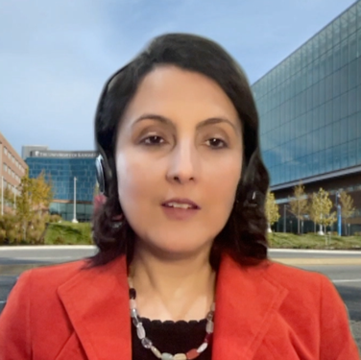
Consulting Faculty Questions
Perspectives from the breast cancer experience: HER2 testing and durability of responses with trastuzumab deruxtecan (T-DXd)
Neil Love, MD
Priyanka Sharma, MD

Slide 101
QUESTIONS FOR THE FACULTY
What is your approach to HER2 testing in mUBC?
What is the appropriate threshold for the use of HER2-targeted therapy?
Assuming you could access both T-DXd and disitamab vedotin, how would you integrate these agents into the treatment algorithm for mUBC?
Priyanka Sharma, MD

Slide 102
Consulting Faculty Questions
Perspectives from the breast cancer experience: Identification and management of T-DXd-associated side effects
Neil Love, MD
Priyanka Sharma, MD

Slide 103
QUESTIONS FOR THE FACULTY
What is your approach to the prevention and management of T-DXd-associated nausea and vomiting?
How do you screen for ILD in patients receiving T-DXd?
What is your experience with T-DXd and disitamab vedotin, and have you observed clinically meaningful responses to these agents?
Priyanka Sharma, MD

Slide 104
Please describe a patient in your practice with HER2-positive metastatic UBC who received trastuzumab deruxtecan (T-DXd).
Age
Tx received
Benefit derived
Side effects
N/A
N/A
N/A
N/A
65 years
T-DXd
Not much
Well tolerated
78 years
T-DXd
A great deal
Mild fatigue
65 years
T-DXd
A great deal
Don’t know — treated in Phase I
58 years
T-DXd + nivolumab
Some
None
68 years
T-DXd
Not much
Fatigue, asthenia, alopecia, lower blood counts, mild nausea
No personal experience

Slide 105
Have you offered or would you offer HER2-targeted therapy to your patients with HER2-positive metastatic UBC outside of a protocol setting?
I have, trastuzumab deruxtecan
I have, trastuzumab deruxtecan
I have, trastuzumab deruxtecan
I have not but would for the right patient
I have, trastuzumab deruxtecan (FDA approved in other diseases and accessible off label); disitamab vedotin (wish list)
I have, trastuzumab deruxtecan
I have not and would not

Slide 106
Should HER2 testing be ordered for patients with metastatic UBC?
Yes
Yes
Yes
Yes
Yes
Yes
Yes

Slide 107
Regulatory and reimbursement issues aside, in which line of therapy would you generally offer targeted treatment to a patient with HER2-positive metastatic UBC?
Third line and beyond
Beyond third line
Third line
Third line
Beyond third line
Third line
Third line and beyond

Slide 108
Based on your personal clinical experience and/or knowledge of available data, for each of the following agents please estimate the chance that a patient will experience toxicity during treatment that will require withholding administration. What is the primary toxicity patients experience that leads to withholding this drug?
Trastuzumab deruxtecan
Disitamab vedotin
Chance of withholding
Primary toxicity
Chance of withholding
Primary toxicity
30%-40%
Pneumonitis/ neutropenia
40%-50%
Neuropathy
30%
GI issues
80%
Neuropathy
20%
Fatigue
40%
Fatigue
—
—
100%
Neuropathy
Low
Pneumonitis
Medium
Fatigue
50%
Myelosuppression
70%
Neuropathy
No personal experience

Slide 109
FRED HUTCH / UNIVERSITY OF WASHINGTON / SEATTLE CHILDREN’S
CANCER CONSORTIUM
Emerging Role of HER2-Targeted Therapy in Metastatic Urothelial Bladder Cancer
2024 ASCO GU: Urothelial Bladder Cancer Symposium
January 26, 2024
Evan Y. Yu, M.D.
Section Head, Medical Oncology, Clinical Research Division
Medical Director, Clinical Research Support
Fred Hutchinson Cancer Center
Professor of Medicine, Division of Hematology & Oncology
University of Washington, Seattle, WA

Slide 110
Discussion Topics
HER2 expression in urothelial bladder cancer
Antibody drug conjugates (ADCs) e.g. trastuzumab deruxtecan and disitamab vedotin
Monotherapy
Combination therapy with ADCs and checkpoint inhibitors

Slide 111
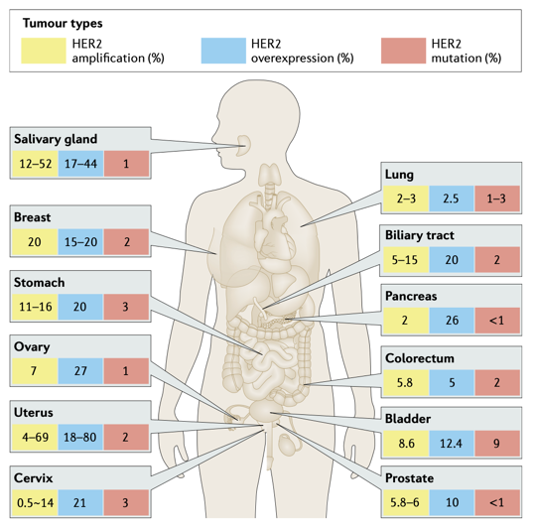
HER2 as a Cancer Specific Target
Oh DY, Bang YJ. Nat Rev Clin Oncol 2020; 17:33-48.

Slide 112
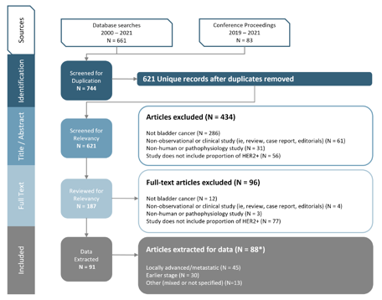
HER2 Expression in Locally Advanced/Metastatic Urothelial Bladder Cancer (LA/mUC)
HER2 IHC not typically assessed as part of standard clinical care
No standardized criteria for defining HER2 expression
Systemic Literature Review of reported HER2 status in LA/mUC
A significant proportion of patients with LA/mUC have tumors with HER2 expression based on pre-defined criteria
HER2+ (IHC 3+ OR IHC 2+ / ISH+): 12.3% weighted avg (6 studies, N=971 pts)
HER2 low (IHC 2+/ISH- OR IHC 1+): 47.9% weighted avg (4 studies, N=275 pts)
Data on slide courtesy of Vadim Koshkin from:
Scherrer E, et al. Front Oncol 2022.

Slide 113
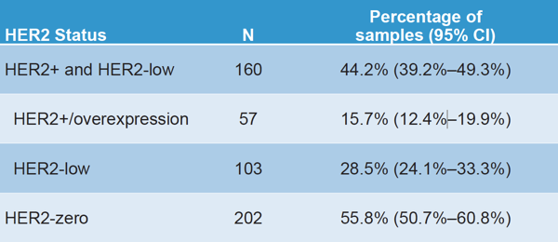
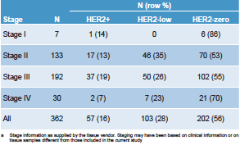
HER2 Expression in Primary Urothelial Bladder Cancer Resection Samples Using Standardized Laboratory Methods
HER2 expression in n=362 surgical UC samples using a standardized protocol
Samples were commercially sourced, paraffin-embedded primary UC resections evaluated by trained readers for HER2 expression
Methods:
HER2/neu (4B5) Rabbit Monoclonal Primary Antibody IHC assay used
For HER2 gene amplification, used HER2 Dual ISH DNA Probe Cocktail that detects both ERBB2 and its residing chromosome (17). HER2 gene amplification defined by HER2/Chr17 ratio ≥2.0
HER2 IHC staining scored based on an established algorithm for gastric cancer
Koshkin VS, et al. J Clin Oncol 41, 2023 (suppl 6; abstr 556).

Slide 114
Disappointing Early Results with HER2 Targeted Therapy in Urothelial Bladder Cancer
Other HER2 targeted drugs tested in bladder cancer³
DN24-02
Lapatinib
Afatinib
2 ADC basket trials with Ado-trastuzumab emtansine (T-DM1) and bladder cancer cohorts
KAMELEON (NCT02999672) – HER2 overexpression
MSKCCC (NCT02675829) – HER amplified or mutated
Her2/neu overexpression selected by IHC, gene amplification or elevated serum levels
31/44 (70%) ORR¹
22.7% with grade 1-3 cardiotoxicity
3/9 (33%) ORR with HER2 amplified urothelial carcinoma in a trastuzumab/pertuzumab basket trial²
Hussain MH, et al. J Clin Oncol 2007; 25:2218-24.
Bryce AH, et al. J Clin Oncol 35, 2017 (suppl 6S; abstr 348)
Koshkin V, et al. Bladder Cancer 2019; 5:1-12

Slide 115
General Design Elements for an Antibody Drug Conjugate (ADC)
Chau CH, et al. Lancet 2019; 394:793-804

Slide 116
ADC Mechanism of Action
Chau CH, et al. Lancet 2019; 394:793-804

Slide 117
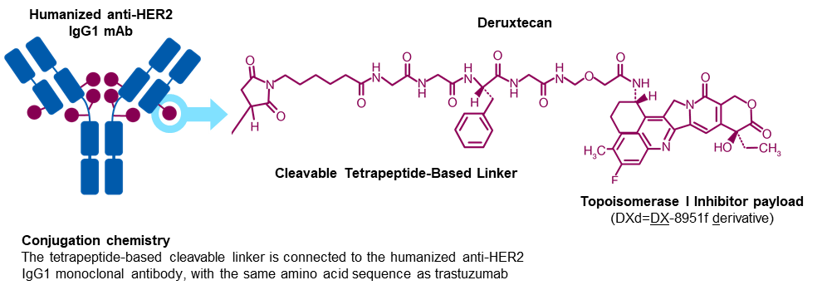
Trastuzumab Deruxtecan and Disitamab Vedotin
Trastuzumab Deruxtecan
Humanized anti-HER2 IgG1 mAb
Protease-cleavable vc maleimidocaproyl linker
Microtubule-disrupting agent, (MMAE/vedotin)
Disitamab
Disitamab vedotin

Slide 118
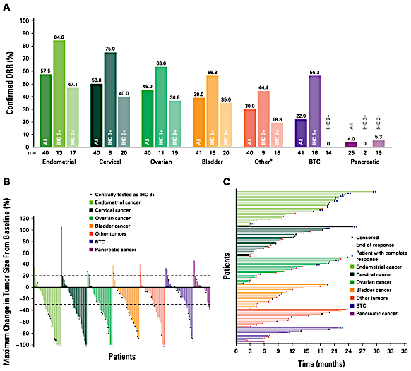
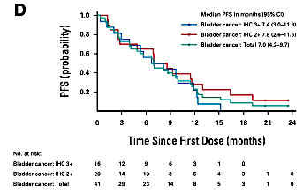
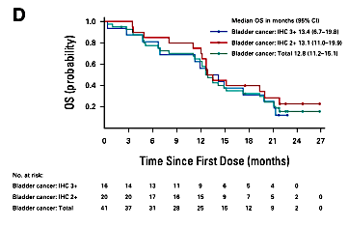
Trastuzumab Deruxtecan Monotherapy from DESTINY-PanTumor02 Phase 2 trial
Median PFS in months (95% CI)
Bladder cancer: IHC3+ 7.4 (3.0–11.9)
Bladder cancer: IHC 2+ 7.8 (2.6–11.6)
Bladder cancer: Total 7.9 (4.2–9.7)
56.3
39.0
PFS
35.0
All
IHC2+
IHC3+
Median OS in months (95% CI)
Bladder cancer: IHC3+ 13.4 (6.7–19.8)
Bladder cancer: IHC 2+ 13.1 (11.0–19.9)
Bladder cancer: Total 12.8 (11.2–15.1)
OS
Meric-Bernstam F, et al. J Clin Oncol 2024; 42:47-58.

Slide 119
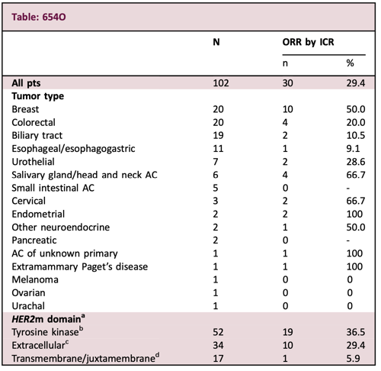
Trastuzumab Deruxtecan Monotherapy from DESTINY-PanTumor01 Phase 2 trial – Focus on mUC Patients with HER2 Mutations
Patients with advanced solid tumors harboring prespecified HER2 mutations
Progressed on previous systemic therapy
Trastuzumab Deruxtecan 5.4 mg/kg q3w
Li BT, et al. Ann Oncol 2023; 34 (suppl 2):S459-S460.

Slide 120
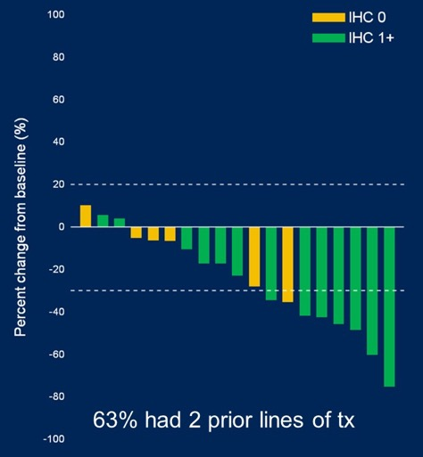
Disitamab Vedotin (RC48) Monotherapy
Activity in HER2 2-3+
Activity in HER2 1+
ORR=26.3% (5/19)
IHC 0=0% (0/6)
IHC 1+=38.5% (5/13)
ORR
IHC2+FISH+ or IHC3+ (n=45) = 62.2%
IHC2+FISH- (n=53) = 39.6%
Sheng X, et al. J Clin Oncol 40, no. 16_suppl (June 1, 2022) 4518-4518.
Sheng X, et al. J Clin Oncol; epub November 21, 2023.
Xu H, et al. J Clin Oncol 40, no. 16_suppl (June 1, 2022) 4519-4519.

Slide 121
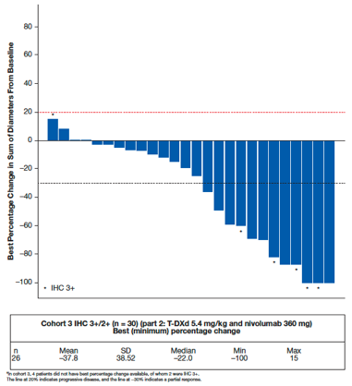
Trastuzumab Deruxtecan Combination with Nivolumab Trial Schema
Key Eligibility Criteria
Advanced/metastatic HER2-expressing breast or urothelial cancer
ECOG 0-1
≥1 measurable lesion per RECIST 1.1
No prior T-DXd or Nivo
Meets criteria for 1 of the 4 cohorts in part 2
Part 1: Dose Escalation
3+3+3 design
Part 2: Dose Expansion
ORR 36.7%
T-DXd 3.2 mg/kg q3w
+
Nivo 360 mg q3w
(n=4)ª
Cohort 1: HER2-positive (IHC 3+ or IHC 2+/ISH+) BC post–T-DM1
n=29
Cohort 2: HER2-low (IHC 1+ or IHC 2+/ISH−) BC post standard treatment
n=16
T-DXd 5.4 mg/kg q3w
+
Nivo 360 mg q3w
(n=3)^{b}
RDE
Cohort 3: HER2-high expressing (IHC 2+/3+) urothelial cancer post Ctx and IO naive
n≈30 (planned)
Cohort 4: HER2-low (IHC 1+) urothelial cancer post Ctx and IO treatment naive
n≈15 (planned)
ªThree patients were HER2-positive, 1 was HER2-low. ^{b}All patients were HER2-positive.
BC, breast cancer; Ctx, chemotherapy; HER2, human epidermal growth factor receptor 2; IHC, immunohistochemistry; IO, immuno-oncologic; ISH, in situ hybridization; Nivo, nivolumab; q3w, every 3 weeks; RDE, recommended dose for expansion; T-DM1, trastuzumab emtansine; T-DXd, trastuzumab deruxtecan; UC, urothelial carcinoma.
Galsky MD, et al. J Clin Oncol 40, no.6_suppl (Feb 20, 2022) 438-438.

Slide 122
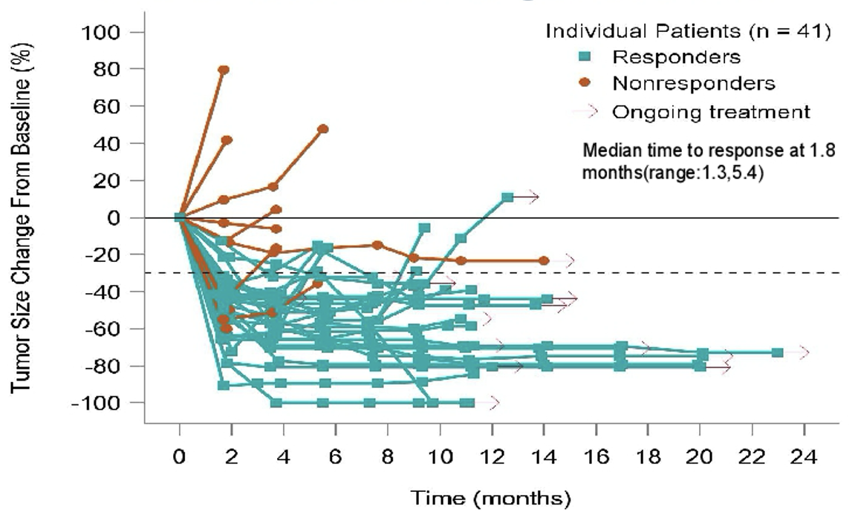
Disitamab Vedotin and Toripalimab
Confirmed ORR: 73.2%
4 CRs, 26 PRs
Sheng X et al. ASCO 2023;Abstract 4566.

Slide 123
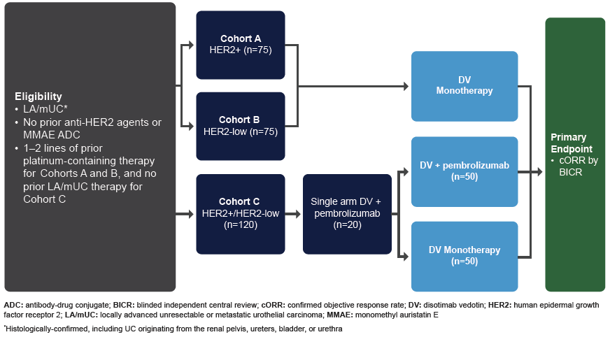
Disitamab Vedotin Bladder Cancer Phase 2 Trial Design
disitamab vedotin; HER2: human epidermal growth

Slide 124
Disitamab Vedotin Bladder Cancer Randomized Phase 3 Trial Design
An Open-label, Randomized, Controlled Phase 3 Study of Disitamab Vedotin in Combination with Pembrolizumab Versus Chemotherapy in Subjects with Previously Untreated Locally Advanced or Metastatic Urothelial Carcinoma that Expresses HER2 (IHC 1+ and Greater)
DV + Pembrolizumab
*Treatment until progression
* DV 1.5 mg/kg Q2W until disease progression and pembrolizumab 400 mg Q6W for up to 18 cycles
Eligibility:
LA/mUC
Previously untreated
Eligible for platinum
Central lab HER2 status ≥ IHC 1+
(n=700)
Stratification Factors:
Cisplatin eligibility
Presence of liver metastasis
HER2 status
Intent of avelumab maintenance use
Dual-Primary Endpoints
PFS by BICR
OS
R
1:1
Cisplatin/Carboplatin + Gemcitabine
X 4-6 cycles, maintenance therapy as clinically appropriate
Maintenance therapy in the 1L setting as clinically appropriate and locally approved is allowed.
Avelumab will not be provided by sponsor.
289 sites in 30 countries globally
US, Canada, LATAM, EU, Israel, Turkey, APAC
Competitive enrollment – No site/country cap
Estimated enrollment start & end date
FPI: Q3 2023
LPI: Q1 2026
NCT05911295

Slide 125
Take Home Points
HER2 expression is not uncommon for urothelial bladder cancer
Antibody drug conjugates offer an exciting technology that recently has shown clinical efficacy in many cancers, including bladder cancer
HER2 is being revisited as a promising drug target for patients with urothelial bladder cancer
A couple examples of promising ADCs for bladder cancer that target HER2 include trastuzumab deruxtecan and disitamab vedotin, both as monotherapy and in combination with checkpoint inhibitors

Slide 126
FDA Grants Accelerated Approval to Trastuzumab Deruxtecan for Unresectable or Metastatic HER2-Positive Solid Tumors Press Release: April 5, 2024
On April 5, 2024, US FDA granted accelerated approval to trastuzumab deruxtecan (T-DXd) for adult patients with unresectable or metastatic HER2-positive (IHC3+) solid tumors who have received prior systemic treatment and have no satisfactory alternative treatment options. Efficacy was evaluated in 192 adult patients with previously treated unresectable or metastatic HER2-positive (IHC 3+) solid tumors who were enrolled in one of three multicenter trials: DESTINY-PanTumor02 (NCT04482309), DESTINY-Lung01 (NCT03505710), and DESTINY-CRC02 (NCT04744831). All three trials excluded patients with a history of interstitial lung disease (ILD)/pneumonitis requiring treatment with steroids or ILD/pneumonitis at screening and clinically significant cardiac disease. Patients were also excluded for active brain metastases or ECOG performance status >1. Treatment was administered until disease progression, death, withdrawal of consent, or unacceptable toxicity.
The recommended –DXd dosage for this indication is 5.4 mg/kg given as an intravenous infusion once every 3 weeks (21-day cycle) until disease progression or unacceptable toxicity. This tumor agnostic indication is approved under accelerated approval based on objective response rate and duration of response. Continued approval for this indication may be contingent upon verification and description of clinical benefit in a confirmatory trial(s).
https://www.fda.gov/drugs/resources-information-approved-drugs/fda-grants-accelerated-approval-fam-trastuzumab-deruxtecan-nxki-unresectable-or-metastatic-her2

Slide 127
MODULE 5: Selection and Sequencing of Therapy for Relapsed/Refractory mUBC – Dr Siefker-Radtke

Slide 128
Consulting Faculty Questions
Selection and sequencing of therapies for relapsed/refractory metastatic UBC; potential integration of erdafitinib for patients with metastatic UBC and FGFR alterations
Neil Love, MD
Elizabeth R Plimack, MD, MS

Slide 129
QUESTIONS FOR THE FACULTY
How do you generally sequence enfortumab vedotin, erdafitinib and sacituzumab govitecan for patients who are eligible to receive all 3 agents?
How do you generally screen for ocular toxicities in patients with mUBC receiving erdafitinib? How often do you recommend consultation with an ophthalmologist? How do you approach the management of ocular AEs?
Elizabeth R Plimack, MD, MS

Slide 130
Consulting Faculty Questions
Efficacy and tolerability of erdafitinib
Neil Love, MD
Terence Friedlander, MD

Slide 131
QUESTIONS FOR THE FACULTY
What other common toxicities (eg, rash, nail changes, hand-foot syndrome, stomatitis) have been reported with erdafitinib, and how do you manage each of these?
How much of an advantage is the oral route of administration of erdafitinib for patients in your practice?
Terence Friedlander, MD

Slide 132
Please describe the last patient in your practice who received erdafitinib for metastatic UBC. What side effects, if any, did the patient experience? How much benefit, if any, did the patient derive from treatment?
Age
Side effects
Benefit derived
77 years
PPE, nail disorders, diarrhea, stomatitis, decreased appetite, weight loss
A great deal
60 years
Mouth sores, skin toxicity, nail disorders, failure to thrive
None
72 years
Dysgeusia, paronychia, nail loss, rash, mucositis
A great deal
83 years
None so far
A great deal
58 years
Fatigue, hand-foot syndrome, nail dystrophy
Not much
71 years
Hand-foot syndrome, asthenia/fatigue, CSR
Some
72 years
CSR, paronychia, fatigue, cytopenias
Not much
PPE = Palmar-plantar erythrodysesthesia; CSR = central serous retinopathy

Slide 133
What would you generally recommend as third-line therapy for a 65-year-old patient with FGFR-mutated metastatic UBC whose disease had progressed on first-line pembrolizumab and second-line enfortumab vedotin?
Erdafitinib
Erdafitinib
Erdafitinib
Erdafitinib
Erdafitinib
Erdafitinib
Erdafitinib

Slide 134
Is it reasonable to refer patients about to receive enfortumab vedotin or erdafitinib to an optometrist rather than an ophthalmologist prior to commencing therapy?
Yes
No
I’m not sure
No
I’m not sure
Yes
Yes

Slide 135
How would you generally sequence erdafitinib, enfortumab vedotin and sacituzumab govitecan for a patient with metastatic UBC who is eligible to receive all 3?
Enfortumab vedotin → erdafitinib → sacituzumab govitecan
Enfortumab vedotin → sacituzumab govitecan → erdafitinib
Enfortumab vedotin → erdafitinib → sacituzumab govitecan
Enfortumab vedotin → erdafitinib → sacituzumab govitecan
Enfortumab vedotin → erdafitinib → sacituzumab govitecan
Enfortumab vedotin → erdafitinib → sacituzumab govitecan
Enfortumab vedotin → erdafitinib → sacituzumab govitecan

Slide 136
In general, when you administer erdafitinib, do you preemptively prescribe a steroid mouthwash for the prevention of treatment-related stomatitis?
No
No
No
No
No
Yes
No

Slide 137
Selection and Sequencing: Optimizing Therapy for Relapsed/Refractory Metastatic Urothelial Cancer
Arlene Siefker-Radtke, MD
Professor
Department of Genitourinary Medical Oncology

Slide 138
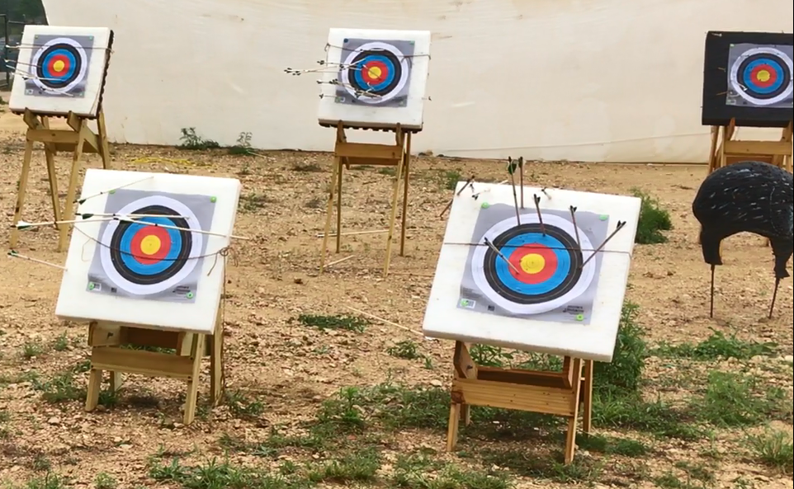
Choosing a good Target
Trop-2
PD-L1
Her-2
p53
Nectin-4
FGFR3
Easily reproducible
Anyone can do it
CLIA certification
Not open to interpretation/everyone agrees
Does not fluctuate or change
Predicts response or benefit!

Slide 139
Front-line Treatment Metastatic Urothelial Cancer
Cisplatin eligible
Enfortumab Vedotin + Pembrolizumab (category 1, new 2023)
DDMVAC/GC (category 1)
Gemcitabine and cisplatin + Nivolumab (category 1, new 2023)
Cisplatin ineligible
Enfortumab Vedotin + Pembrolizumab (category 1, new 2023)
Gemcitabine and carboplatin
Atezolizumab or pembrolizumab
Those not eligible for any chemotherapy regardless of PDL1 expression
Maintenance (in first response to platinum)
Avelumab
Consider maintenance avelumab for patients with CR/PR, or SD with platinum-based chemotherapy (category 1)

Slide 140
Previously Treated,
Metastatic Urothelial Cancer

Slide 141
Previously Treated/mUC: Basic Concepts
Includes those who progress within 12 months of neoadjuvant or adjuvant chemotherapy
If you’ve given it before, don’t give it again
No data on the role of additional immunotherapy (for or against)
Look for mutations
Limited information on sequencing
Erdafitinib
Decisions often based upon toxicity

Slide 142
Enfortumab Vedotin:
The First Antibody Drug Conjugate in mUC

Slide 143
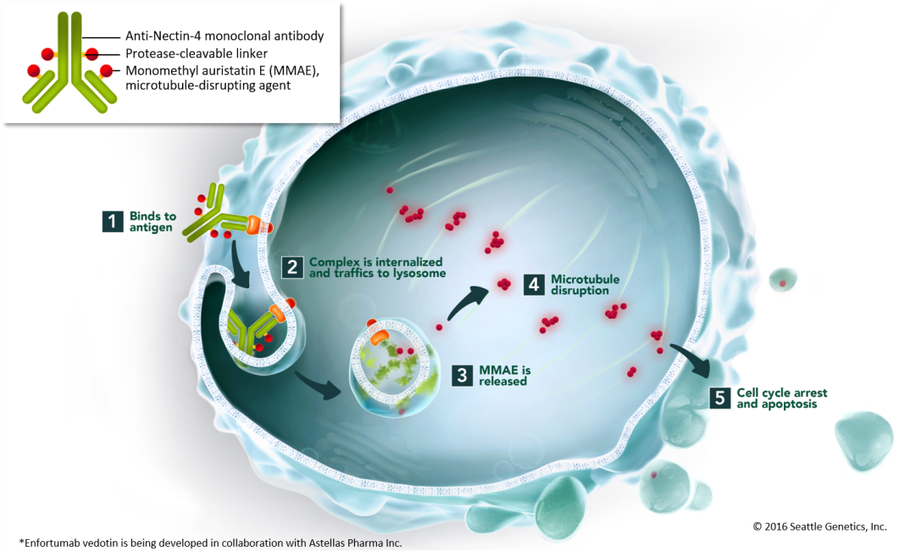
Enfortumab Vedotin
Fully humanized monoclonal antibody targeting Nectin-4
Nectin-4
A transmembrane cell adhesion molecule
Expressed in 83% of mUC patient samples
“Payload” is auristatin-E, a microtubule disrupting agent
Antibody is conjugated by a protease cleavable linker

Slide 144
EV-301 Open-Label Phase 3 Trial Design
Abstract 393
Enfortumab vedotin
(N=301)
1.25 mg/kg
on Days 1, 8, and 15
of each 28-day cycle
Key eligibility criteria:
Histologically/cytologically confirmed UC, including with squamous differentiation or mixed cell types
Radiographic progression or relapse during or after PD-1/L1 treatment for advanced UC
Prior platinum-containing regimen for advanced UC^{b}
ECOG PS 0 or 1
Primary endpoint: Overall survival
Secondary endpoints:
Progression-free survival
Disease control rate
Overall response rate
Safety
1:1 randomization
with stratificationª
Preselected Chemotherapy
(N=307)^{c}
Docetaxel 75 mg/m² or
Paclitaxel 175 mg/m² or
Vinflunine^{d} 320 mg/m²
on Day 1 of each
21-day cycle
Investigator-assessed per RECIST v1.1
ªStratification variables were ECOG performance status (0 or 1), regions of the world (United States, western Europe, or rest of world), liver metastasis (yes or no).
^{b}If used in the adjuvant/neoadjuvant setting, progression must be within 12 months of completion.
^{c}Investigator selected prior to randomization.
^{d}In countries where approved; overall proportion of patients receiving vinflunine capped at 35%.
Abbreviations: ECOG PS, Eastern Cooperative Oncology Group performance status; PD-1/L1, programmed cell death protein-1/programmed death-ligand 1; RECIST, Response Evaluation Criteria in Solid Tumors; UC, advanced urothelial carcinoma.

Slide 145
Similar outcomes as reported previously!

Slide 147
WARNING: SERIOUS SKIN REACTIONS
See full prescribing information for complete boxed warning.
Enfortumab vedotin can cause severe and fatal cutaneous adverse reactions, including Stevens-Johnson syndrome (SJS) and Toxic Epidermal Necrolysis (TEN).
Immediately withhold enfortumab vedotin and consider referral for specialized care for suspected SJS or TEN or severe skin reactions.
Permanently discontinue enfortumab vedotin in patients with confirmed SJS or TEN; or Grade 4 or recurrent Grade 3 skin reactions. (2.2), (5.1) (6.1)

Slide 148
Metabolism of Enfortumab Vedotin
Metabolite MMAE
17% recovered in feces over 1 week period
6% recovered in urine over 1 week period
Dose reduction
Renal impairment: No differences in AUC for mild-moderate-severe
No significant dose reductions
Effect on end-stage renal disease/dialysis is unknown
Liver impairment: Mild hepatic impairment 48% AUC increase in MMAE
Mild hepatic impairment: bilirubin 1-1.5 x ULN with NL AST and ALT or bilirubin ≤ ULN and AST > ULN
Frequency of ≥ Grade 3 adverse reactions and deaths in moderate (Child-Pugh B) or severe (Child-Pugh C)
AVOID use in moderate-severe hepatic impairment
FDA package insert 12/2023

Slide 149
Monitoring Caveats
Grade 3-4 hyperglycemia increase in greater BMI and higher HgbA1C
HgbA1C ≥ 8 excluded
HOLD for:
Glucose > 250 mg/dL
Could be a sign of impaired clearance of MMAE
Mechanism unknown
Personal hypothesis: impaired glycogen storage as a sign of saturation of liver metabolism
New Hypothesis: potent tubule stabilization resulting in decreased glucose transport and muscle weakness resulting in decreased glucose utilization and even rhabdomyolysis
Peeling skin or bullous skin lesions
May have more diffuse rash preceding this
Grade 3 diarrhea
FDA package insert 12/2023

Slide 150
Sacituzumab Govitecan:
The Second Antibody Drug Conjugate in mUC

Slide 151
Sacituzumab Govitecan (SG)
Humanized monoclonal antibody targeting Trop-2 expression
Trop-2
Epithelial antigen expressed on many solid cancers
Expressed in ~ 83% of mUC patient samples; testing for expression not necessary
“Payload” is SN-38, the active metabolite of irinotecan, inhibiting topoisomerase 1
Payload is conjugated by a hydrolyzable linker

Slide 152
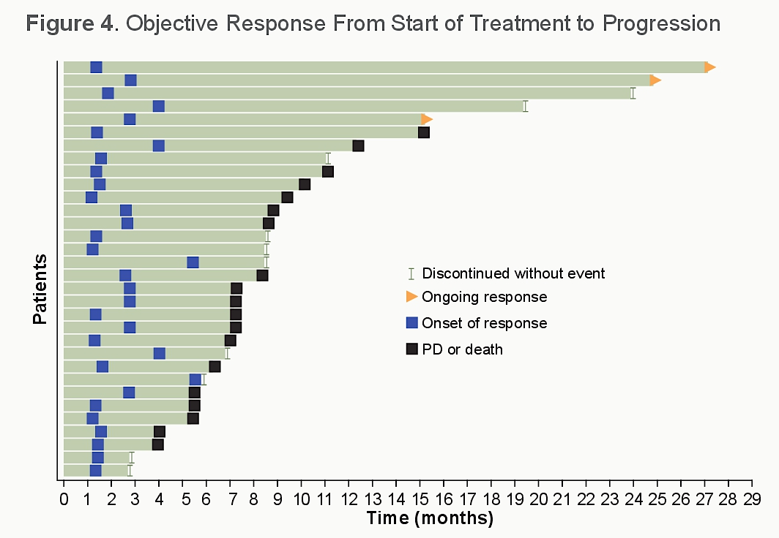
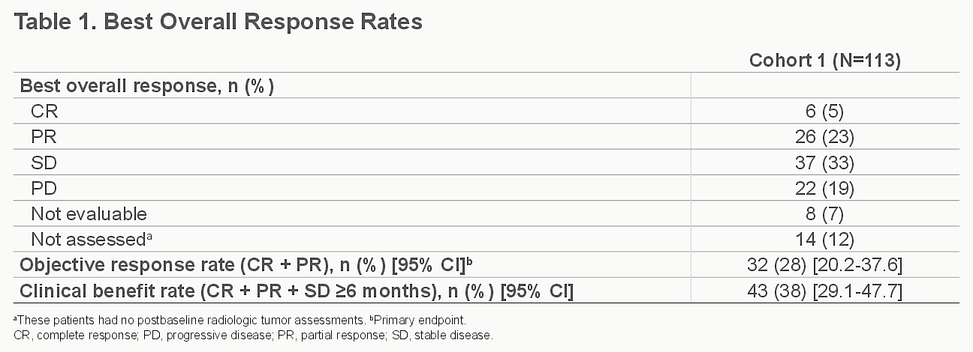
TROPHY-U-01 Cohort 1: Phase II Study of Sacituzumab Govitecan for mUC That Progressed After Platinum Chemotherapy and a Checkpoint Inhibitor
Tagawa ST et al. Genitourinary Cancers Symposium 2023;Abstract 526.

Slide 153
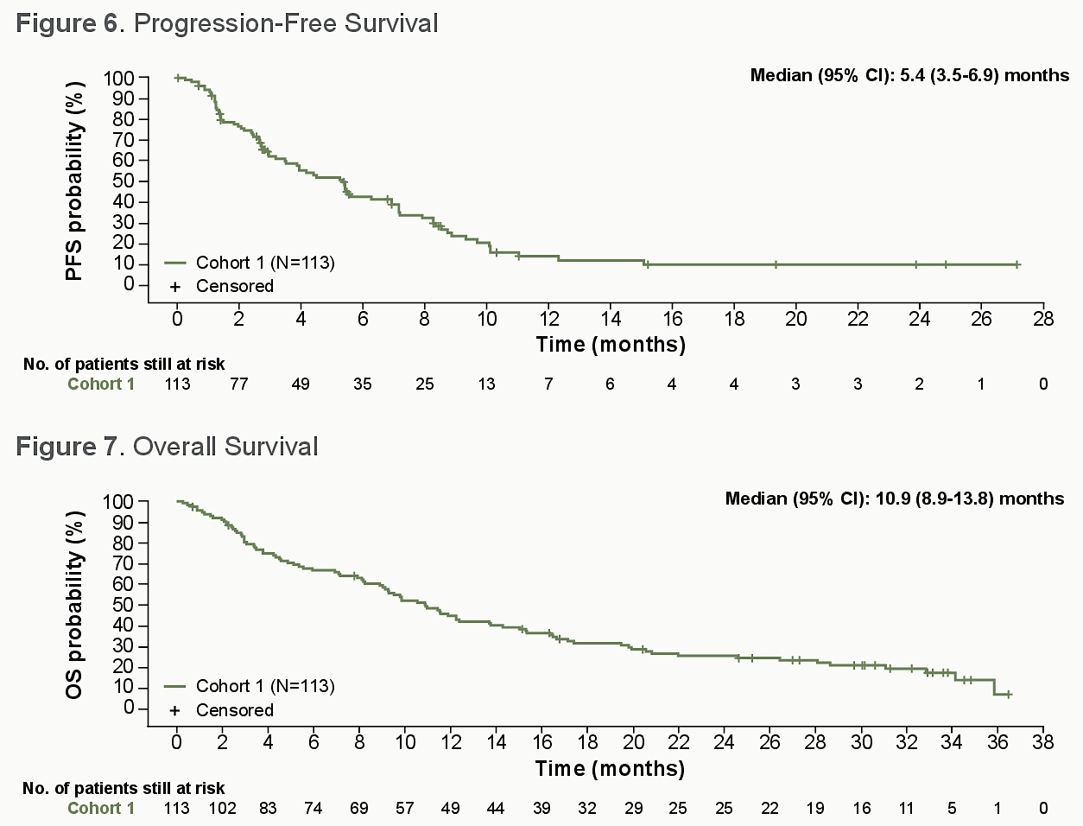
TROPHY-U-01 Cohort 1: Phase II Study of Sacituzumab Govitecan for mUC That Progressed After Platinum Chemotherapy and a Checkpoint Inhibitor (cont.)
Tagawa ST et al. Genitourinary Cancers Symposium 2023;Abstract 526.

Slide 154
TROPHY-U-01 Cohort 1: Phase II Study of Sacituzumab Govitecan for mUC That Progressed After Platinum Chemotherapy and a Checkpoint Inhibitor (cont.)
Tagawa ST et al. Genitourinary Cancers Symposium 2023;Abstract 526.

Slide 155
Erdafitinib:
The First Biomarker Targeted Therapy in mUC

Slide 156
Phase 3 THOR Study: Erdafitinib Versus Chemotherapy of Choice in Patients With Advanced Urothelial Cancer and Select FGFR Aberrations
Cohort 1
Key eligibility criteria
Age ≥18 years
Metastatic or unresectable UC
Confirmed disease progression
Prior tx with anti–PD-(L)1
1-2 lines of systemic tx
Select FGFR3/2alt (mutation/fusion)ª
ECOG PS 0-2
Erdafitinib (n=136)
Once-daily erdafitinib 8 mg with pharmacodynamically guided uptitration to 9 mg
Primary end point:
OS
1:1
N=266^{b}
R
Chemotherapy of Choice (n=130)
docetaxel or vinflunine once every 3 weeks
Key secondary end points:
PFS
ORR
Safety
Stratification factors: region (North America vs European Union vs rest of world), ECOG PS (0 or 1 vs 2), and disease distribution (presence vs absence of visceral [lung, liver, or bone] metastases)
NCT03390504
Loriot Y et al. ASCO 2023; Abstract LBA4619.

Slide 157
Overall Survival.
Y Loriot et al. N Engl J Med 2023. DOI: 10.1056/NEJMoa2308849
Notes:
Figure 2. Overall Survival. Shown are Kaplan–Meier estimates of overall survival. Circles and squares indicate censored data in the erdafitinib group and chemotherapy group, respectively. Results for overall survival in key subgroups are provided in Figure S3.

Slide 158
The Safety Profiles Were Consistent With the Known Profiles of Erdafitinib and Chemotherapy (2/2)
Patients with AEs of interest, n (%) | Erdafitinib (n=135) |  | Chemotherapy (n=112)
 | Any grade | Grade 3-4 | Any grade | Grade 3-4
Nail disordersª | 90 (66.7) | 15 (11.1) | 6 (5.4) | 0
Skin disorders^{b} | 74 (54.8) | 16 (11.9) | 14 (12.5) | 0
Eye disorders (excluding central serous retinopathy)^{c} | 57 (42.2) | 3 (2.2) | 6 (5.4) | 0
Central serous retinopathy^{d} | 23 (17.0) | 3 (2.2) | 0 | 0
Loriot Y et al. ASCO 2023; Abstract LBA4619.

Slide 159
Erdafitinib:
Sequencing in mUC

Slide 160
Phase 3 THOR Study: Erdafitinib Versus Pembrolizumab in Patients With Metastatic Urothelial Carcinoma and Select FGFR Alterations
Cohort 2
Key eligibility criteria
Age ≥18 years
Metastatic or unresectable UC
Confirmed disease progression on 1 prior tx
Naive to anti–PD-(L)1 tx
Select FGFR3/2alt (mutation/fusion)ª
ECOG PS 0-2
Erdafitinib (n=175) Once-daily erdafitinib 8 mg with pharmacodynamically guided uptitration to 9 mg
Primary end point
OS
1:1
N=351^{b}
R
Secondary end points
PFS
ORR
Safety
Pembrolizumab (n=176)
200 mg once every 3 weeks
Stratification factors: region (North America vs European Union vs rest of world), ECOG PS (0 or 1 vs 2), and disease distribution (presence vs absence of visceral [lung, liver, or bone] metastases)
NCT03390504
Siefker-Radtke AO et al. Ann Oncol 2024;35(1):107-117.

Slide 161
ORR: 40.0% With Erdafitinib and 21.6% With Pembrolizumab
ORR was 40.0% (95% CI, 32.7-47.7) for erdafitinib and 21.6% (95% CI,15.8-28.4) for pembrolizumab
Median DOR was 4.3 months (95% CI, 3.7-6.9) for erdafitinib and 14.4 months (95% CI, 7.4-27.8) for pembrolizumab
ORR 40.0%
Relative risk, 1.85 (95% CI, 1.32-2.59;
P < 0.001ª)^{b}
Patients, %
CR 6.3%
(n=11)
ORR 21.6%
PR 33.7%
(n=59)
CR 4.5% (n=8)
PR 17.0%
(n=30)
Erdafitinib (n=175)
Pembrolizumab (n=176)
Siefker-Radtke AO et al. Ann Oncol 2024;35(1):107-117.

Slide 162
No Significant Difference Was Found in Overall Survival Between Erdafitinib and Pembrolizumab
100
The primary end point was not met
Median OS was 10.9 months (95% CI, 9.2-12.6) for erdafitinib and 11.1 months (95% CI, 9.7-13.6) for pembrolizumab
HR, 1.18 (95% CI, 0.9-1.5; P = 0.18)
Erdafitinib
Median OS:
10.9 months (95% CI, 9.2-12.6)
11.1 months (95% CI, 9.7-13.6)
80
60
OS, %
Pembrolizumab
40
20
0
0
3
6
9
12
15
18
21
24
27
30
33
36
39
42
45
48
51
54
57
Months Since Randomization
No. at risk
Erdafitinib
175
160
131
100
78
60
52
41
30
28
23
21
13
9
7
2
1
1
1
0
Pembrolizumab
176
148
119
103
84
72
60
52
43
34
29
23
19
11
8
8
1
1
0
0
Siefker-Radtke AO et al. Ann Oncol 2024;35(1):107-117.

Slide 163
Previously Treated/mUC: Options
Checkpoint inhibitors
Pembrolizumab, Avelumab, or Nivolumab (pick-one!)
Antibody-Drug Conjugates
Enfortumab Vedotin
Sacituzumab Govitecan
Mutation driven
Erdafitinib
After immunotherapy, unless need for cytoreductive therapy: visceral crisis

Slide 164
Previously Treated/mUC: Options
Checkpoint inhibitors
Pembrolizumab, Avelumab, or Nivolumab (pick-one!)
Antibody-Drug Conjugates
Enfortumab Vedotin
Sacituzumab Govitecan
Mutation driven
Erdafitinib
Do we need to give platinum???

