Slide 1
Consensus or Controversy? Clinical Investigators
Provide Perspectives on the Current and Future
Management of Prostate Cancer
Part 1 of a 2-Part CME Symposium Series Held in Conjunction
with the 2024 ASCO Genitourinary Cancers Symposium
Thursday, January 25, 2024
6:15 PM – 8:15 PM PT (9:15 PM – 11:15 PM ET)
Faculty
Rahul Aggarwal, MD
Emmanuel S Antonarakis, MD
Elisabeth I Heath, MD
A Oliver Sartor, MD
Moderator
Alan H Bryce, MD

Slide 2





Faculty
Rahul Aggarwal, MD
Professor of Medicine
Director, Genitourinary Medical Oncology
University of California, San Francisco
Department of Medicine
Division of Hematology/Oncology
Associate Director for Clinical Research
UCSF Helen Diller Family
Comprehensive Cancer Center
San Francisco, California
Elisabeth I Heath, MD
Associate Center Director, Translational Sciences
Chair, Genitourinary Oncology Multidisciplinary Team
Professor of Oncology and Medicine
Hartmann Endowed Chair for Prostate Cancer Research
Director, Prostate Cancer Research
Karmanos Cancer Institute
Wayne State University School of Medicine
Detroit, Michigan
A Oliver Sartor, MD
Chief, Genitourinary Cancers Disease Group
Director of Radiopharmaceutical Clinical Trials
Mayo Clinic
Rochester, Minnesota
Emmanuel S Antonarakis, MD
Clark Endowed Professor of Medicine
Division of Hematology, Oncology
and Transplantation
University of Minnesota
Minneapolis, Minnesota
Moderator
Alan H Bryce, MD
Chief Clinical Officer
Professor of Medical Oncology and Therapeutics Research
Professor of Molecular Medicine, TGen
City of Hope
Phoenix, Arizona

Slide 3
Dr Aggarwal — Disclosures
Faculty
No relevant conflicts of interest to disclose.

Slide 4
Dr Antonarakis — Disclosures
Faculty
Advisory Committees | Aadi Bioscience, Amgen Inc, AstraZeneca Pharmaceuticals LP, Bayer HealthCare Pharmaceuticals, Blue Earth Diagnostics, Janssen Biotech Inc, Merck, Pfizer Inc, Sanofi, Tango Therapeutics, Tempus
Consulting Agreements | AIkido Pharma Inc, Corcept Therapeutics, Foundation Medicine, HOOKIPA Pharma Inc, KeyQuest Health, Lilly, Menarini Silicon Biosystems, Z-Alpha
Contracted Research | Astellas, Bayer HealthCare Pharmaceuticals, Bristol Myers Squibb, MacroGenics Inc, Merck, Orion Corporation
Patent Holder | QIAGEN

Slide 5
Dr Heath — Disclosures
Faculty
Advisory Committees | Astellas, AstraZeneca Pharmaceuticals LP, Bayer HealthCare Pharmaceuticals, Sanofi
Consulting Agreements | Astellas, AstraZeneca Pharmaceuticals LP, Bayer HealthCare Pharmaceuticals, Janssen Biotech Inc, Sanofi
Contracted Research | Arvinas, Astellas, AstraZeneca Pharmaceuticals LP, Bayer HealthCare Pharmaceuticals, BioXcel Therapeutics Inc, Bristol Myers Squibb, Calithera Biosciences, Caris Life Sciences, Corcept Therapeutics, Corvus Pharmaceuticals, Daiichi Sankyo Inc, Eisai Inc, Exelixis Inc, F Hoffmann-La Roche Ltd, Five Prime Therapeutics Inc, Fortis Therapeutics, Gilead Sciences Inc, GSK, Harpoon Therapeutics, Infinity Pharmaceuticals Inc, iTeosTherapeutics, Janssen Biotech Inc, Merck, Mirati Therapeutics Inc, Modra Pharmaceuticals, MSD, Novartis, Oncolys BioPharma, Peloton Therapeutics Inc, a wholly-owned subsidiary of Merck & Co Inc, Pfizer Inc, Pharmacyclics LLC, an AbbVie Company, POINT Biopharma, Seagen Inc
Honoraria/Paid Travel | Astellas, Bayer HealthCare Pharmaceuticals, Caris Life Sciences, Sanofi, Seagen Inc
Speakers Bureau | Sanofi
Nonrelevant Financial Relationship | Calibr

Slide 6
Dr Sartor — Disclosures
Faculty
Consulting Agreements | Fusion Pharmaceuticals, ITM Isotopen Technologien München AG, Janssen Biotech Inc, NorthStar Rx LLC, Novartis, Pfizer Inc, POINT Biopharma, Sanofi, Telix Pharmaceuticals Limited, TeneoBio
Consulting or Advisory Roles | Advanced Accelerator Applications, AstraZeneca Pharmaceuticals LP, Bayer HealthCare Pharmaceuticals, Clarity Pharmaceuticals, Fusion Pharmaceuticals, ITM Isotopen Technologien München AG, Janssen Biotech Inc, NorthStar Rx LLC, Novartis, Pfizer Inc, POINT Biopharma, Sanofi, Telix Pharmaceuticals Limited, TeneoBio
Data and Safety Monitoring Boards/Committees | AstraZeneca Pharmaceuticals LP, Merck, Pfizer Inc
Research Funding to Institution | Advanced Accelerator Applications, Amgen Inc, AstraZeneca Pharmaceuticals LP, Bayer HealthCare Pharmaceuticals, Invitae, Janssen Biotech Inc, Lantheus, Merck, Novartis, Progenics Pharmaceuticals Inc, TeneoBio
Stock Options/Ownership — Public Companies | Abbott Laboratories, AbbVie Inc, Fusion Pharmaceuticals, Johnson & Johnson Pharmaceuticals, Lantheus, Lilly, Pfizer Inc, Telix Pharmaceuticals Limited
Nonrelevant Financial Relationships | ARTBIO, Convergent Therapeutics Inc, Curadh, Ratio Therapeutics

Slide 7
Dr Bryce — Disclosures
Moderator
Advisory Committees | AstraZeneca Pharmaceuticals LP, Bayer HealthCare Pharmaceuticals, Gilead Sciences Inc, Lantheus, Merck, Myovant Sciences, Novartis, Pfizer Inc
Consulting Agreement | MOMA therapeutics
Contracted Research | Astellas, Janssen Biotech Inc
Data and Safety Monitoring Board/Committee | Lantheus

Slide 8
Dr Armstrong — Disclosures
Survey Participant
Advisory Committees | AstraZeneca Pharmaceuticals LP, Bayer HealthCare Pharmaceuticals, Bristol Myers Squibb, Clovis Oncology, Exelixis Inc, GoodRx, Merck, Myovant Sciences, Novartis, Pfizer Inc, Z-Alpha
Consulting Agreements | Astellas, AstraZeneca Pharmaceuticals LP, Bayer HealthCare Pharmaceuticals, Bristol Myers Squibb, Celgene Corporation, Clovis Oncology, Dendreon Pharmaceuticals Inc, Epic Sciences, Exact Sciences Corporation, Exelixis Inc, Forma Therapeutics, GoodRx, Janssen Biotech Inc, Merck, Myovant Sciences, Novartis, Pfizer Inc, Z-Alpha
Contracted Research | Amgen Inc, Astellas, AstraZeneca Pharmaceuticals LP, Bayer HealthCare Pharmaceuticals, Bristol Myers Squibb, Celgene Corporation, Dendreon Pharmaceuticals Inc, Forma Therapeutics, Janssen Biotech Inc, Merck, Novartis, Pfizer Inc
Nonrelevant Financial Relationships | National Cancer Institute, National Institutes of Health, Prostate Cancer Foundation/Movember, US Department of Defense

Slide 9
Dr McKay — Disclosures
Survey Participant
Consulting Agreements | AstraZeneca Pharmaceuticals LP, Aveo Pharmaceuticals, Bayer HealthCare Pharmaceuticals, Blue Earth Diagnostics, Bristol Myers Squibb, Calithera Biosciences, Caris Life Sciences, Dendreon Pharmaceuticals Inc, Eisai Inc, Exelixis Inc, Johnson & Johnson Pharmaceuticals, Lilly, Merck, Myovant Sciences, Novartis, Pfizer Inc, Sanofi, Seagen Inc, Sorrento Therapeutics, Telix Pharmaceuticals Limited, Tempus
Contracted Research | AstraZeneca Pharmaceuticals LP, ArteraAI, Bayer HealthCare Pharmaceuticals, Bristol Myers Squibb, Exelixis Inc, Oncternal Therapeutics

Slide 10
Commercial Support
This activity is supported by educational grants from AstraZeneca Pharmaceuticals LP, Bayer HealthCare Pharmaceuticals, Exelixis Inc, Janssen Biotech Inc, administered by Janssen Scientific Affairs LLC, Lilly, Merck, and Novartis.
Research To Practice CME Planning Committee Members,
Staff and Reviewers
Planners, scientific staff and independent reviewers for Research To Practice have no relevant conflicts of interest to disclose.

Slide 11
This educational activity contains discussion of published and/or investigational uses of agents that are not indicated by the Food and Drug Administration. Research To Practice does not recommend the use of any agent outside of the labeled indications. Please refer to the official prescribing information for each product for discussion of approved indications, contraindications and warnings. The opinions expressed are those of the presenters and are not to be construed
as those of the publisher or grantors.

Slide 12
Agenda
Module 1: Optimizing the Management of Nonmetastatic Prostate Cancer — Dr Aggarwal
Module 2: Evidence-Based Selection of Treatment for Metastatic Hormone-Sensitive Prostate Cancer — Dr Antonarakis
Module 3: New Considerations with PARP Inhibitors for Metastatic
Castration-Resistant Prostate Cancer (mCRPC) — Dr Bryce
Module 4: Role of Novel Radiopharmaceuticals in Therapy for mCRPC
— Dr Sartor
Module 5: Promising Investigational Approaches for Patients with
Prostate Cancer — Dr Heath

Slide 13
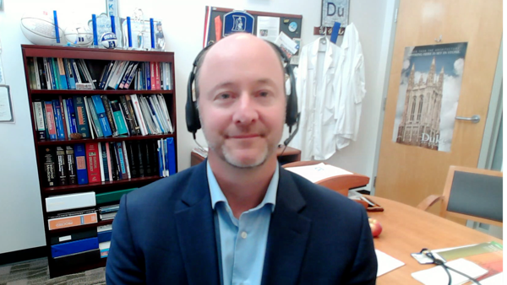

Consulting Faculty
Andrew J Armstrong, MD, ScM
Professor of Medicine, Surgery, Pharmacology and Cancer Biology
Director of Research
Duke Cancer Institute Center for Prostate and Urologic Cancers
Divisions of Medical Oncology and Urology
Duke University
Durham, North Carolina
Rana R McKay, MD
Associate Professor of Medicine and Urology
Associate Director, Translational Sciences
Interim Associate Director, Clinical Sciences
Co-Lead, Genitourinary Oncology Program
University of California San Diego
Moores Cancer Center
La Jolla, California

Slide 14
MODULE 1: Optimizing the Management of Nonmetastatic Prostate Cancer – Dr Aggarwal

Slide 15

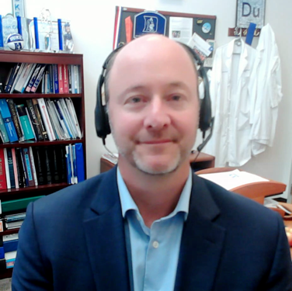
Consulting Faculty Questions
Androgen receptor (AR) inhibitors in the localized (M0) setting
Neil Love, MD
Andrew J Armstrong, MD, ScM

Slide 16

QUESTIONS FOR THE FACULTY
Would you extrapolate from the STAMPEDE data and substitute another AR pathway inhibitor (ie, apalutamide, darolutamide or enzalutamide) for abiraterone for a patient with high-risk localized prostate cancer?
What are your thoughts about ongoing trials evaluating AR pathway inhibitors for high-risk localized disease? Are you already employing any of these strategies in clinical practice while awaiting the results?
Andrew J Armstrong, MD, ScM

Slide 17
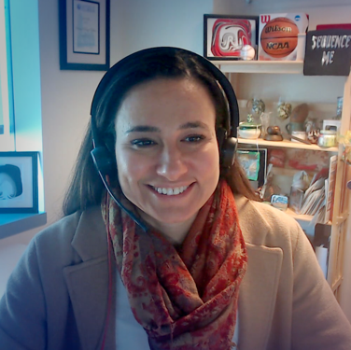
Consulting Faculty Questions
Management of biochemically recurrent prostate cancer;
EMBARK data and integration of intermittent hormonal therapy
Neil Love, MD
Rana R McKay, MD
Andrew J Armstrong, MD, ScM

Slide 18

QUESTIONS FOR THE FACULTY
What would you recommend for a highly functional
90-year-old man with biochemical (M0) recurrence after radical prostatectomy and salvage radiation therapy
(PSA 11-13 ng/mL, PSA doubling time 6 months)?
In which situations are you considering enzalutamide and ADT for patients with biochemical recurrence after definitive local therapy? What about enzalutamide monotherapy? Intermittent versus continuous?
What is your opinion about prophylactic breast radiation for patients receiving enzalutamide monotherapy?
Rana R McKay, MD
Andrew J Armstrong, MD, ScM

Slide 19
How would you approach the management of high-risk localized prostate cancer in a patient with negative CT imaging but PSMA PET suggesting metastatic disease?
Systemic therapy with ADT + AR signaling inhibitor; treat primary tumor with radiation; MDT to PET-avid sites of disease if oligometastatic in select cases
If oligometastatic, treat mets with MDT RT, add 12-24 months of ADT +
AR signaling inhibitor, consider RT to the primary prostate gland
Add radiation to metastatic sites
PSMA PET-positive data must be considered in the treatment plan; if possible,
a tissue biopsy may be indicated to confirm metastatic disease
Treat with SBRT and add abi for the duration of the ADT (typically 2 y)
Treat as metastatic low-volume mHSPC, still treat primary with RT,
routine use of ADT/AR signaling inhibitors
If amenable to MDT then definitive radiation and ADT + abi with MDT;
if not amenable to MDT, then definitive radiation and ADT + abi
MDT = metastasis-directed therapy; SBRT = stereotactic body radiation therapy; AR = androgen receptor; abi = abiraterone

Slide 20
What was the age of the last patient in your practice with locally advanced prostate cancer? What was their PSA level?
Age
PSA
70 years
45 ng/mL
58 years
19 ng/mL
74 years
8.9 ng/mL
62 years
23 ng/mL
72 years
8 ng/mL
68 years
5 ng/mL
70 years
15 ng/mL

Slide 21
For the patient in the previous scenario with locally advanced prostate cancer, what were their tumor characteristics? What specific treatment did the patient receive?
Tumor characteristics
Treatment
Gleason 4 + 5
ADT + abiraterone x 24 mo,
RT to prostate + pelvis
Gleason 5 + 4 = 9, cT3b, node-negative,
PSMA PET-negative
ADT + abiraterone x 24 mo,
primary prostatic RT
Gleason 4 + 5
RT, ADT + abiraterone x 2 years
Gleason 8 (4 + 4), cT3b
RT, leuprolide, abiraterone
Gleason 4 + 5 = 9, T3b
ADT + abiraterone and XRT
GG5 (Gleason 10) cT1c but PSMA PET
with possible ECE/EVI, N0
ADT + abiraterone, RT to prostate
and pelvic nodes
Gleason 4 + 5, cT3a
Abiraterone, ADT + EBRT to
prostate and pelvic nodes
XRT = radiation therapy; EBRT = external beam radiation therapy

Slide 22
What was the age of the last patient in your practice who received systemic therapy for biochemical recurrence after local therapy for prostate cancer? What was their PSA level and PSA doubling time?
Age
PSA
PSA doubling time
65 years
0.6 ng/mL
3.4 months
62 years
1.8 ng/mL
5.5 months
68 years
3.5 ng/mL
7 months
70 years
4.8 ng/mL
8 months
75 years
0.3 ng/mL
9 months
73 years
6 ng/mL
4 months
65 years
1.21 ng/mL
3 months

Slide 23
For the patient in the previous scenario who received systemic therapy for biochemical recurrence after local therapy for prostate cancer, what specific treatment did the patient receive? Did the patient receive intermittent or continuous therapy?
Treatment
Intermittent or continuous
MDT RT to PET-avid sites coupled
with ADT x 3 mo
Intermittent
Leuprolide + enza 160 mg (plan for
12 mo if complete PSA response)
Intermittent
ADT
Intermittent
Leuprolide
Intermittent
PSMA PET-directed SBRT with 6 mo
of abiraterone monotherapy
—
ADT + enzalutamide
Intermittent
Relugolix + enzalutamide
Intermittent
MDT = metastasis-directed therapy

Slide 24
Outside of a clinical trial, are you offering enzalutamide monotherapy without ADT as an option to your patients with biochemical recurrence after definitive therapy for prostate cancer?
No
Yes, if patient asks
No
Yes, if patient wants faster recovery from sexual dysfunction
No (may discuss but not using yet)
Yes, but only for patients unable to tolerate ADT + enzalutamide
Yes, if patient prefers to avoid castration therapy

Slide 25
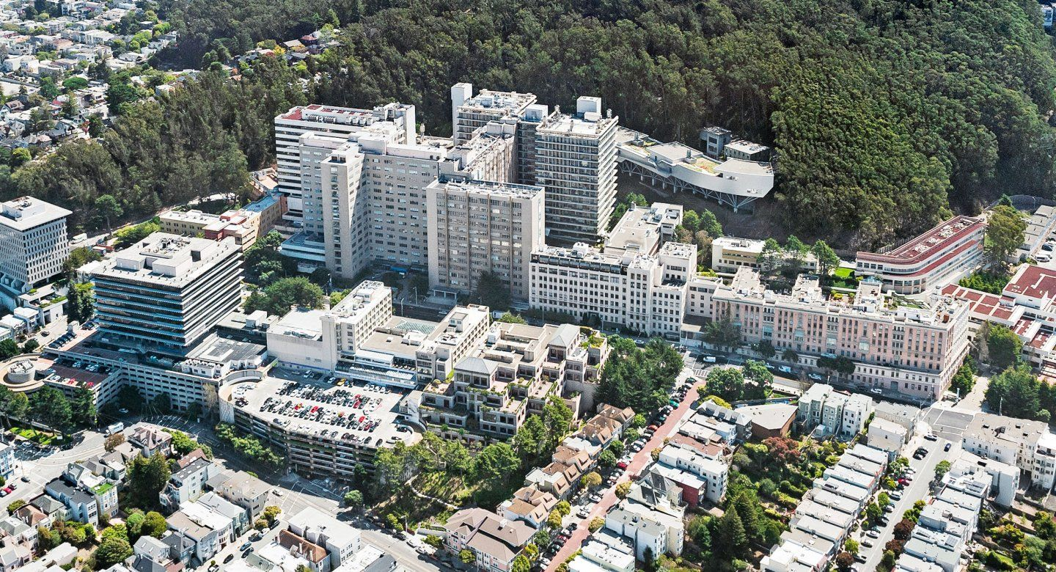

Optimizing the Management of Nonmetastatic Prostate Cancer
Rahul Aggarwal MD
Professor of Medicine
University of California San Francisco

Slide 26
Outline
Risk stratification and staging of patients with newly diagnosed prostate cancer
  Molecular testing
  Imaging
High-risk nonmetastatic prostate cancer
Biochemically recurrent castration-sensitive prostate cancer
Nonmetastatic CRPC

Slide 27
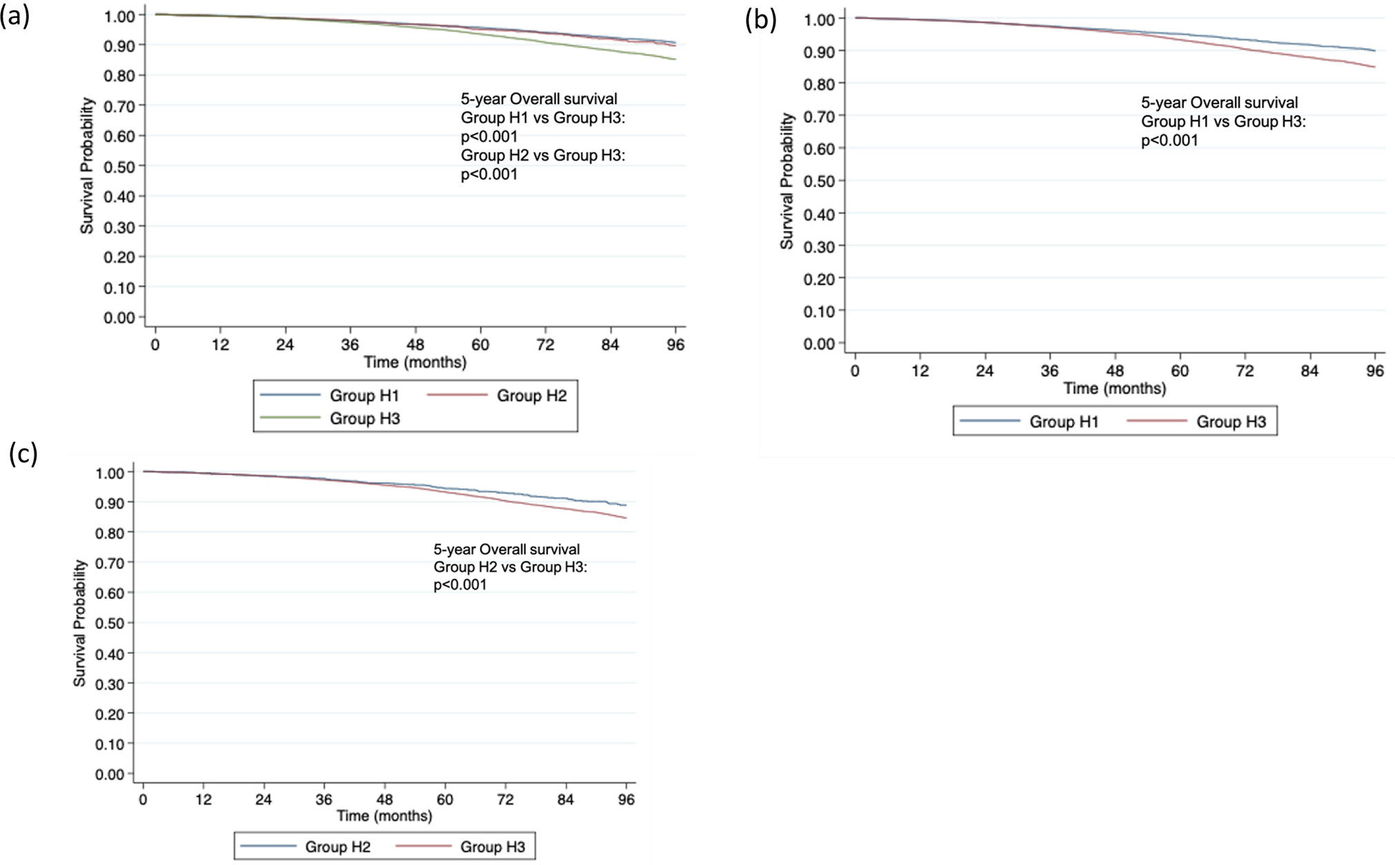
Risk Stratification of Newly Diagnosed Prostate Cancer
Outcomes by High Risk Criterion
NCCN criteria
  Low
  Favorable/unfavorable intermediate
  High
  Very high
Garg H et al. Prostate Cancer Prostatic Disease 2023

Slide 28
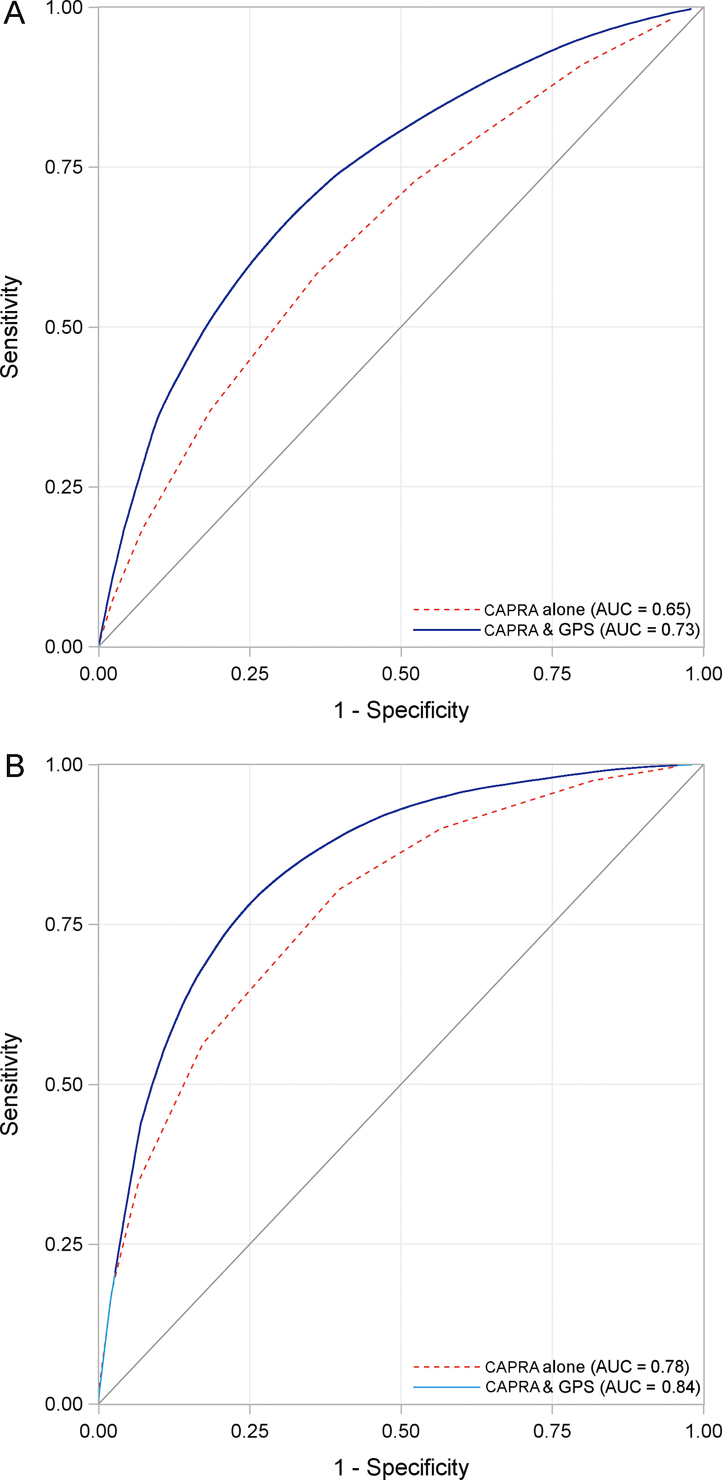
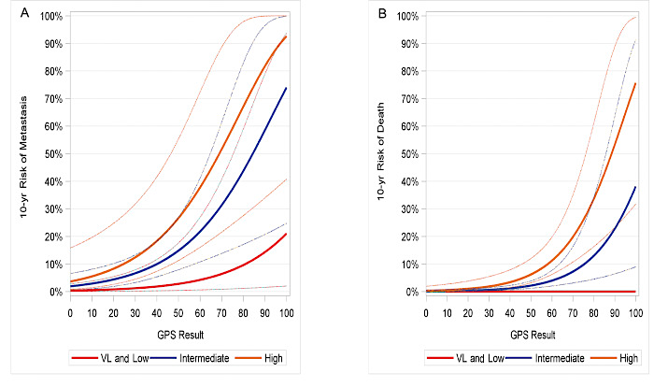
Molecularly Guided Risk Stratification
Van Den Eeden SK et al. European Urology 2018

Slide 29
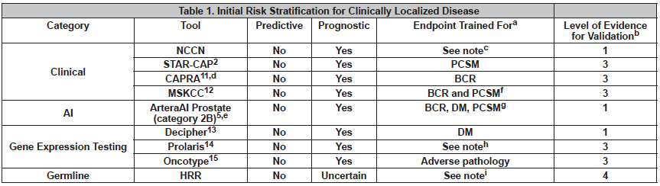
Molecularly Guided Risk Stratification
NCCN Guidelines Prostate Cancer version 4.2023

Slide 30
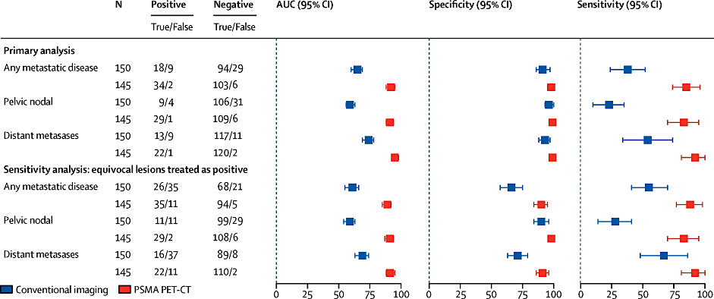
PSMA PET increases the accuracy of staging in high risk prostate cancer
Distant metastases
Distant metastases
Hofman MS et al. Lancet Oncol 2020

Slide 31
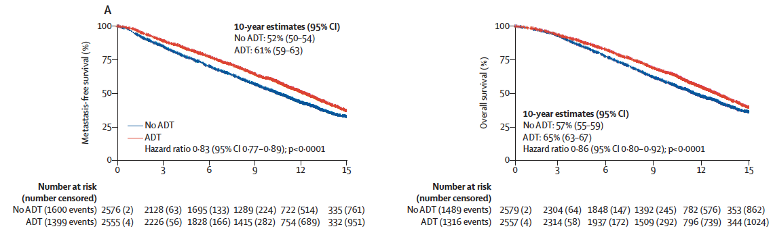
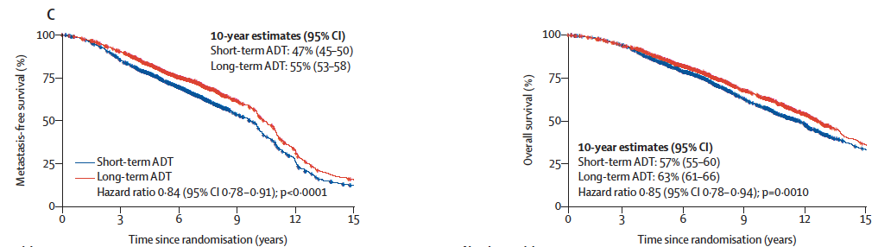
Outcomes with ADT plus radiation: an individualized patient data meta-analysis
ADT versus no ADT
Short versus long term ADT
Kishan, AU et al. Lancet Oncol 2022

Slide 32
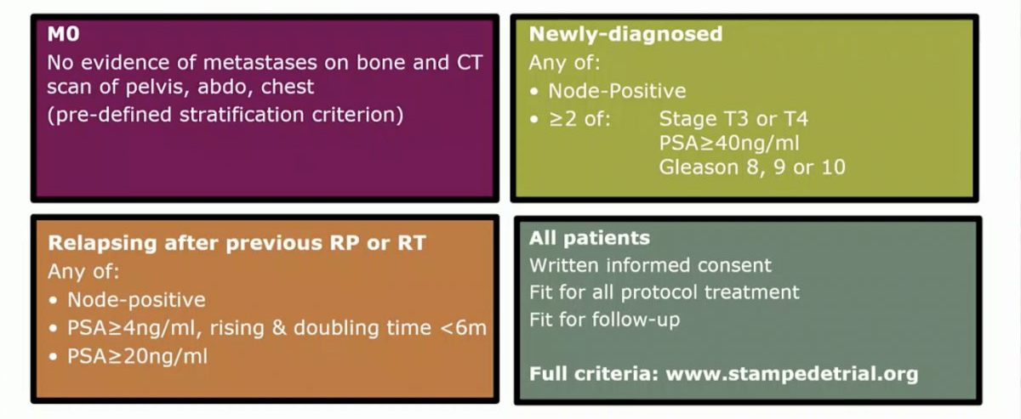
ADT intensification in very high risk non-metastatic prostate cancer: STAMPEDE
Very high risk (higher than NCCN)
Attard G et al. Lancet 2022

Slide 33
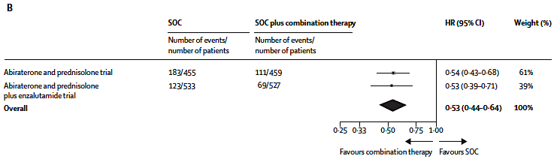
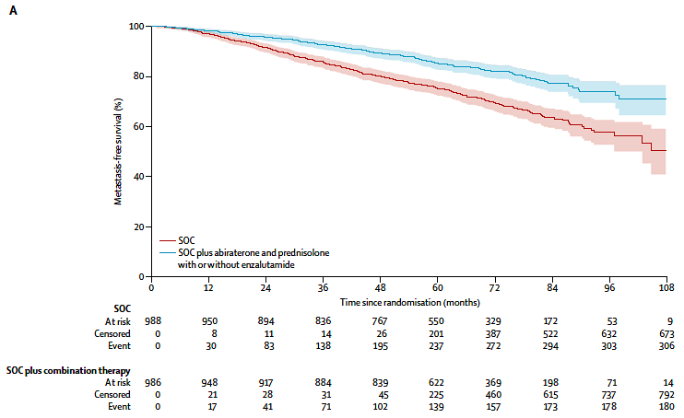
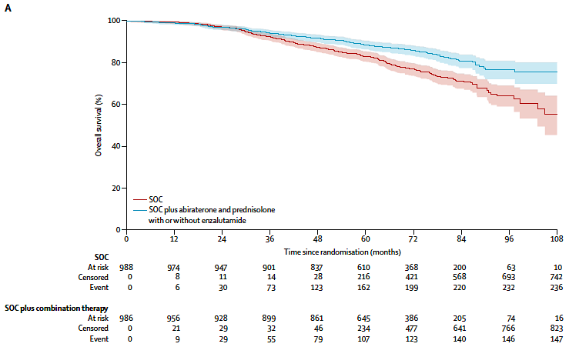
ADT intensification with abiraterone improves survival outcomes in newly diagnosed high risk non-metastatic prostate cancer
Attard G et al. Lancet 2022

Slide 34
Outline
Risk stratification and staging of patients with newly diagnosed prostate cancer
  Molecular testing
  Imaging
High-risk nonmetastatic prostate cancer
Biochemically recurrent castration-sensitive prostate cancer
Nonmetastatic CRPC

Slide 35
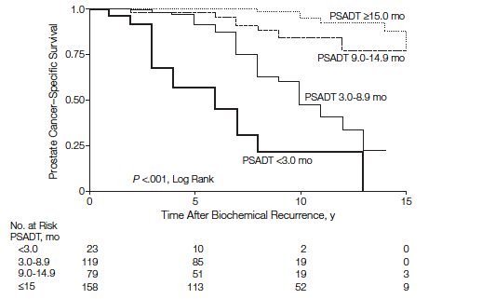
Risk stratification for non-metastatic biochemically recurrent CSPC
PSA doubling time
Gleason grade
Time interval from definitive local tx to relapse
Emerging factors
  PSMA PET
  Molecular features (PTEN loss)
Freedland SJ, et al. JAMA 2005

Slide 36
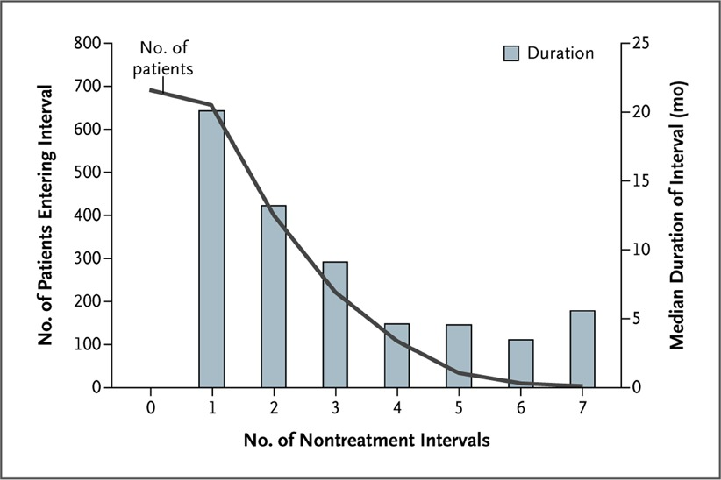
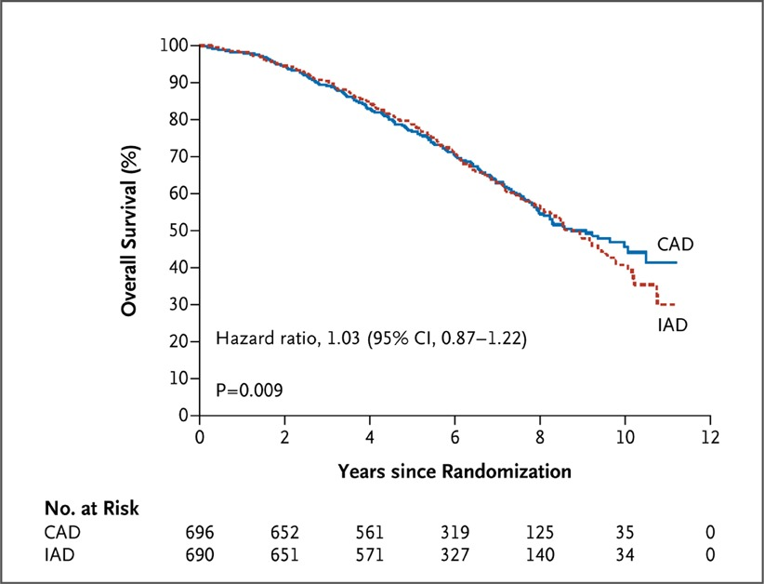
Intermittent ADT as a framework for the management of nmCSPC
Crook JM, et al. New Engl J Med 2012

Slide 37
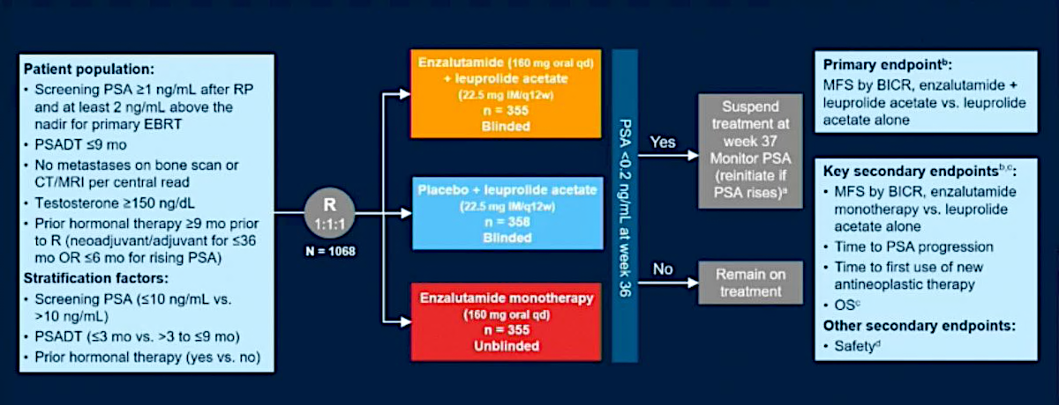
EMBARK Phase 3 Study

Slide 38
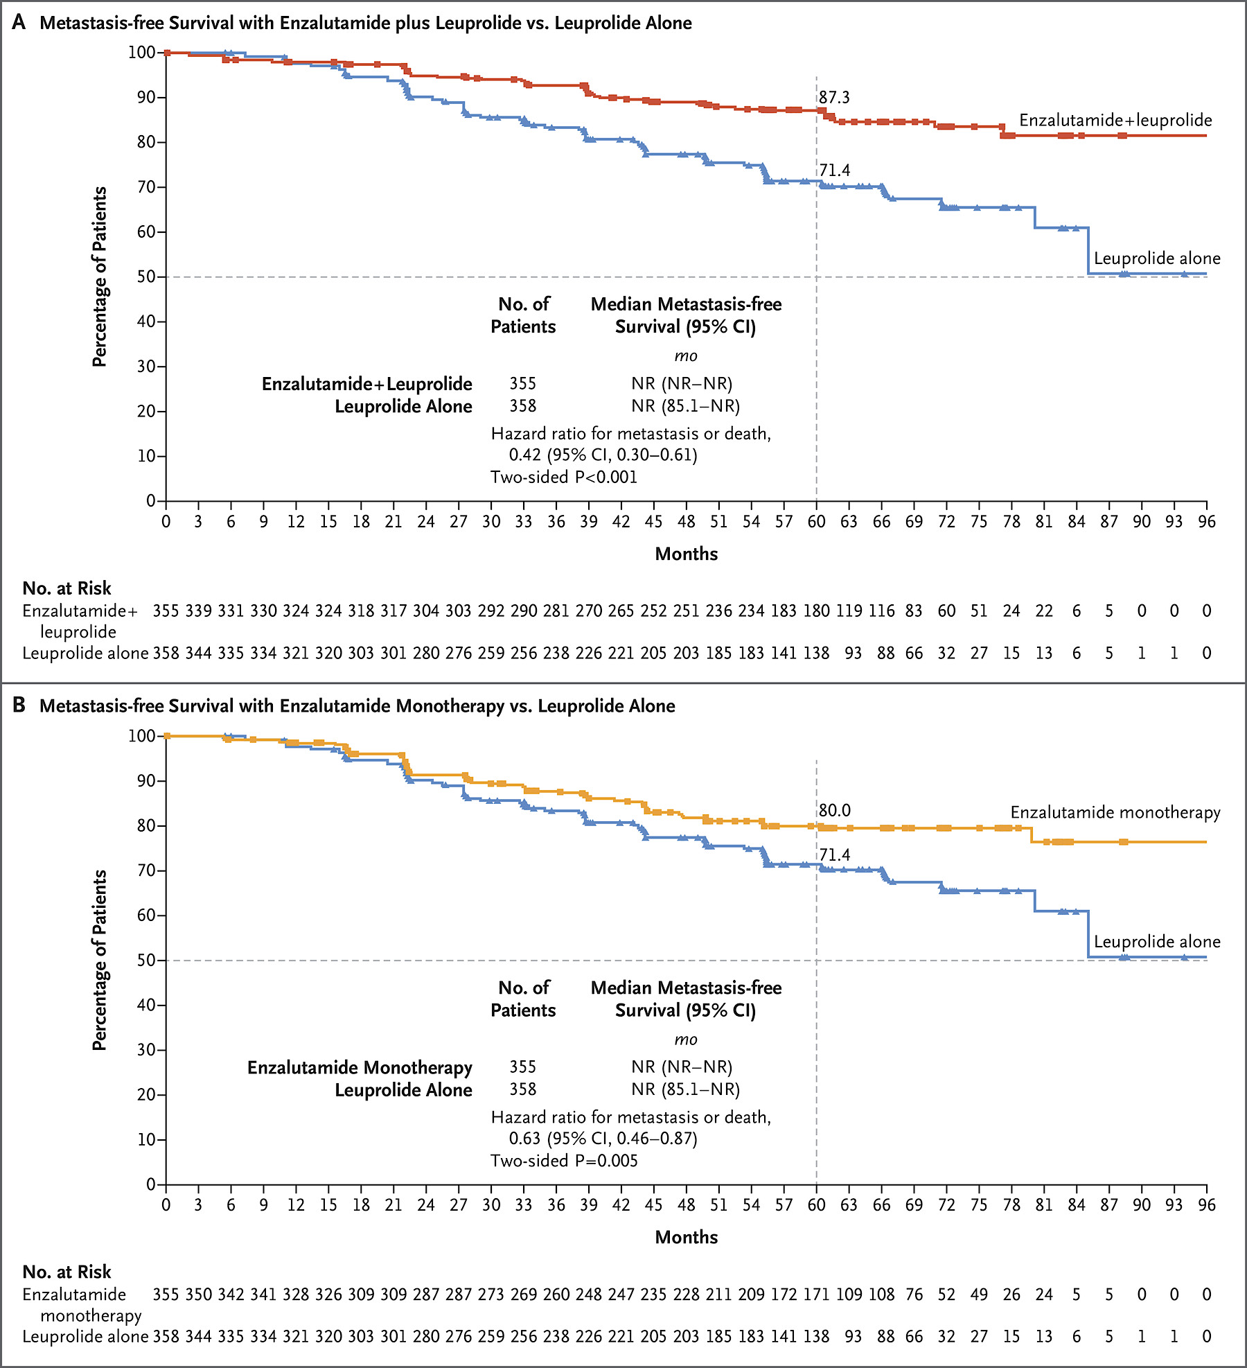
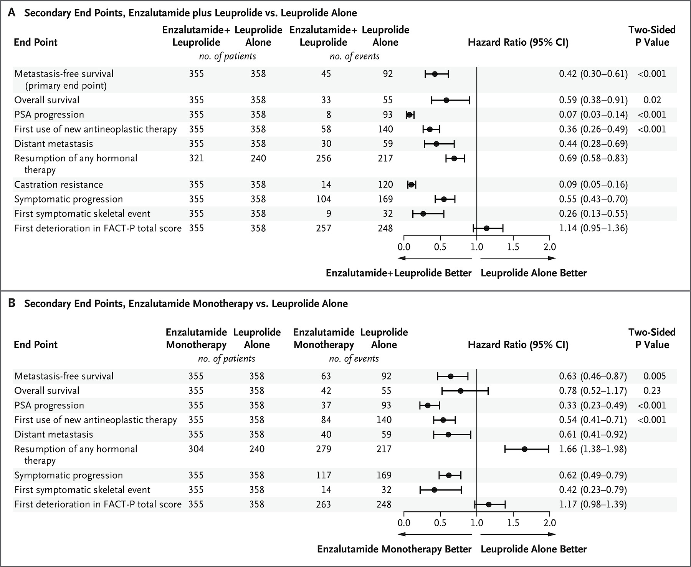
EMBARK: Metastasis-free survival prolonged with inclusion of enzalutamide
Freedland SJ, et al. New Engl J Med 2023

Slide 39
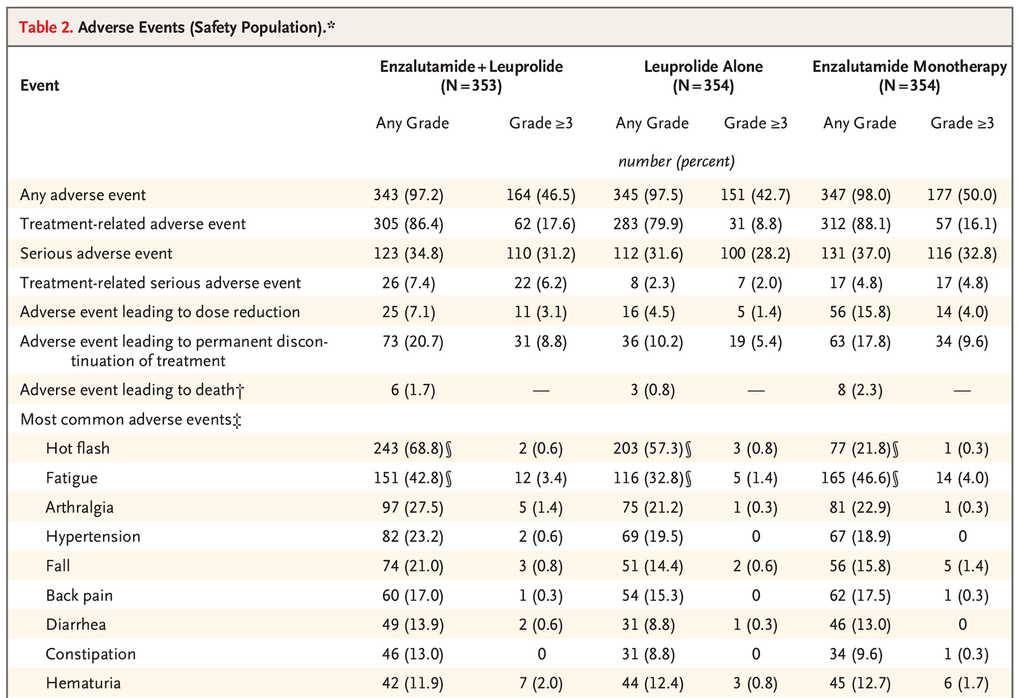
EMBARK: Safety of Enzalutamide + Leuprolide
Freedland SJ et al. N Engl J Med 2023;389(16):1453-65.

Slide 40
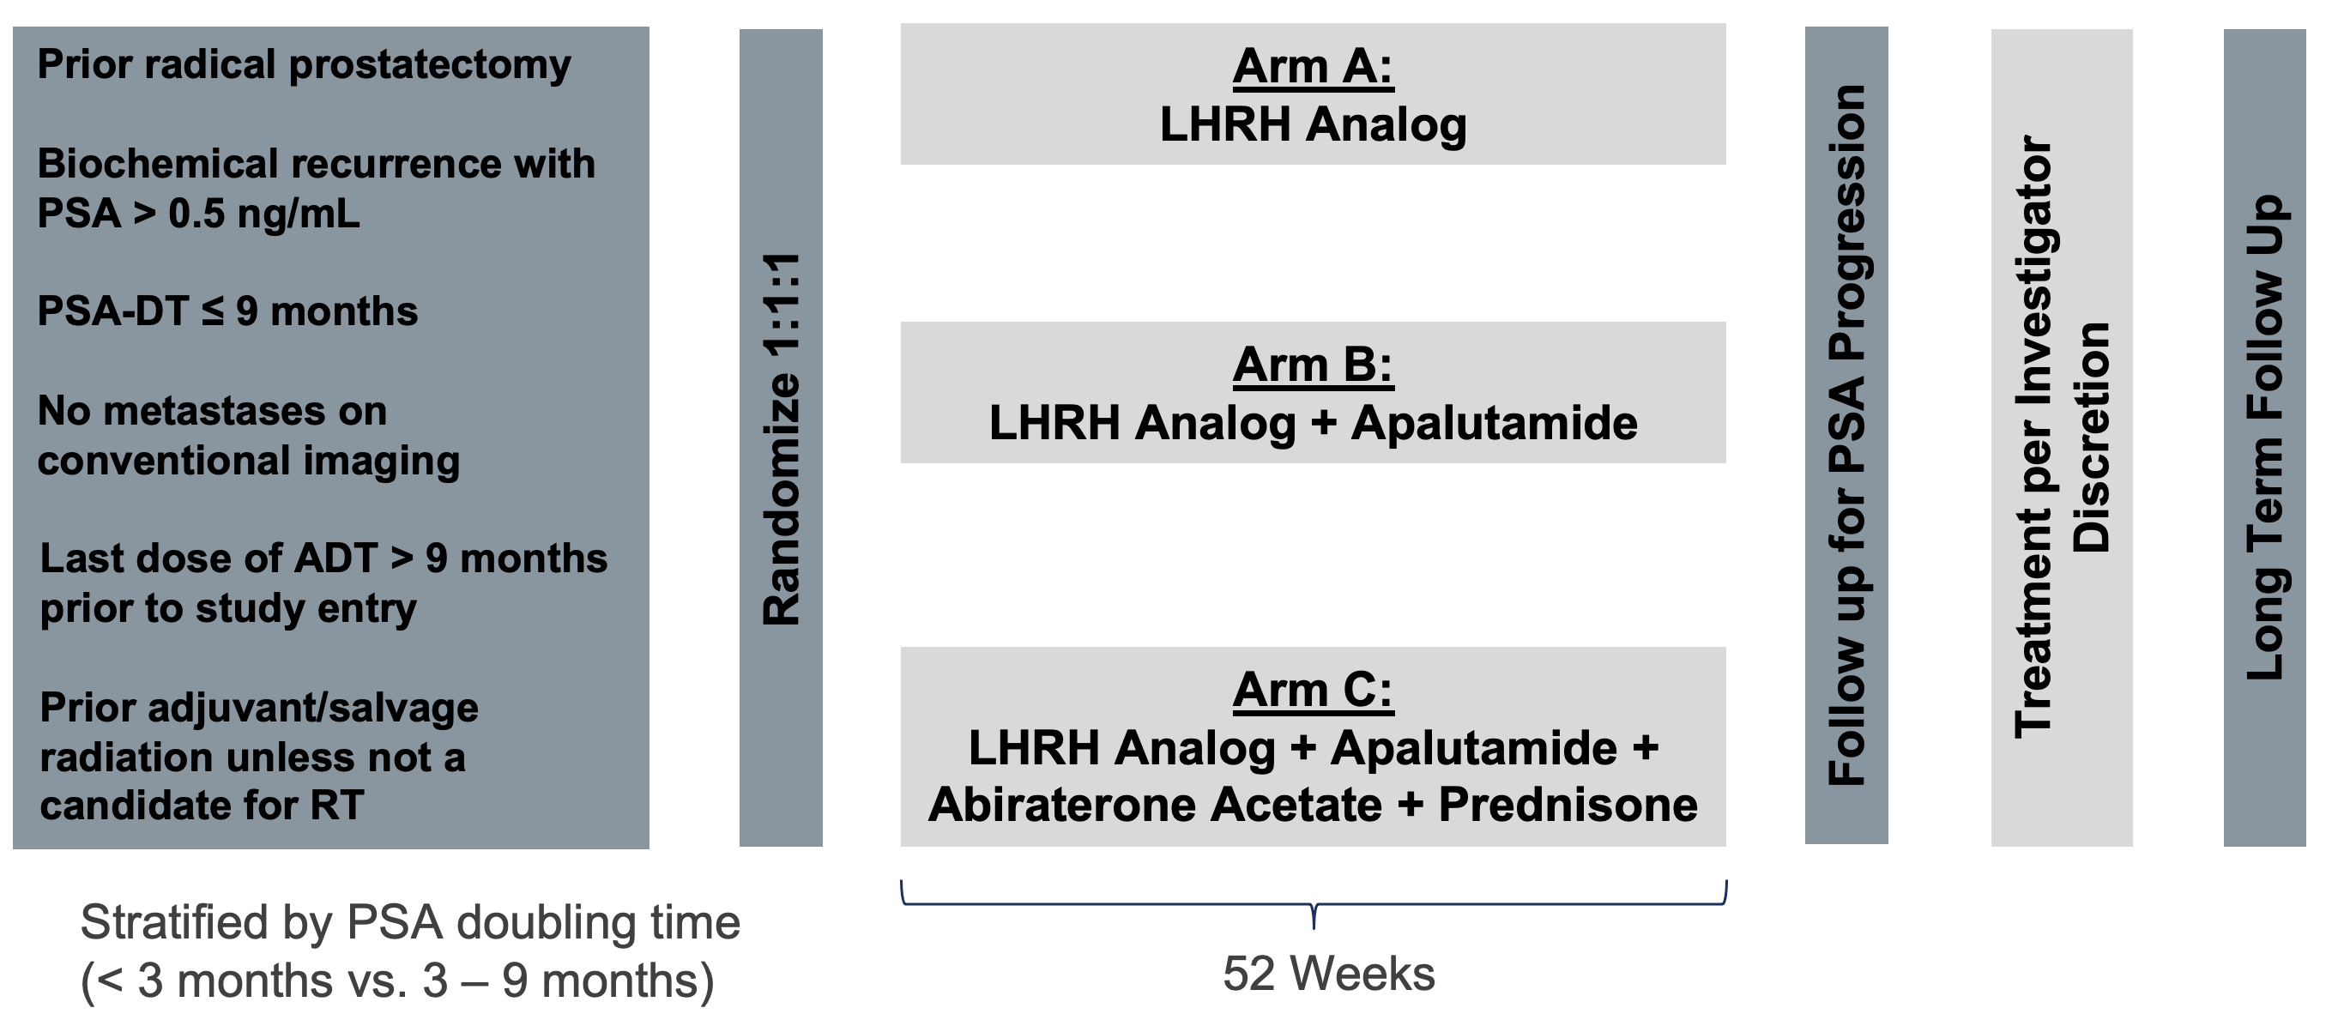
PRESTO Phase 3 Study
Aggarwal R et al. ESMO 2022

Slide 41
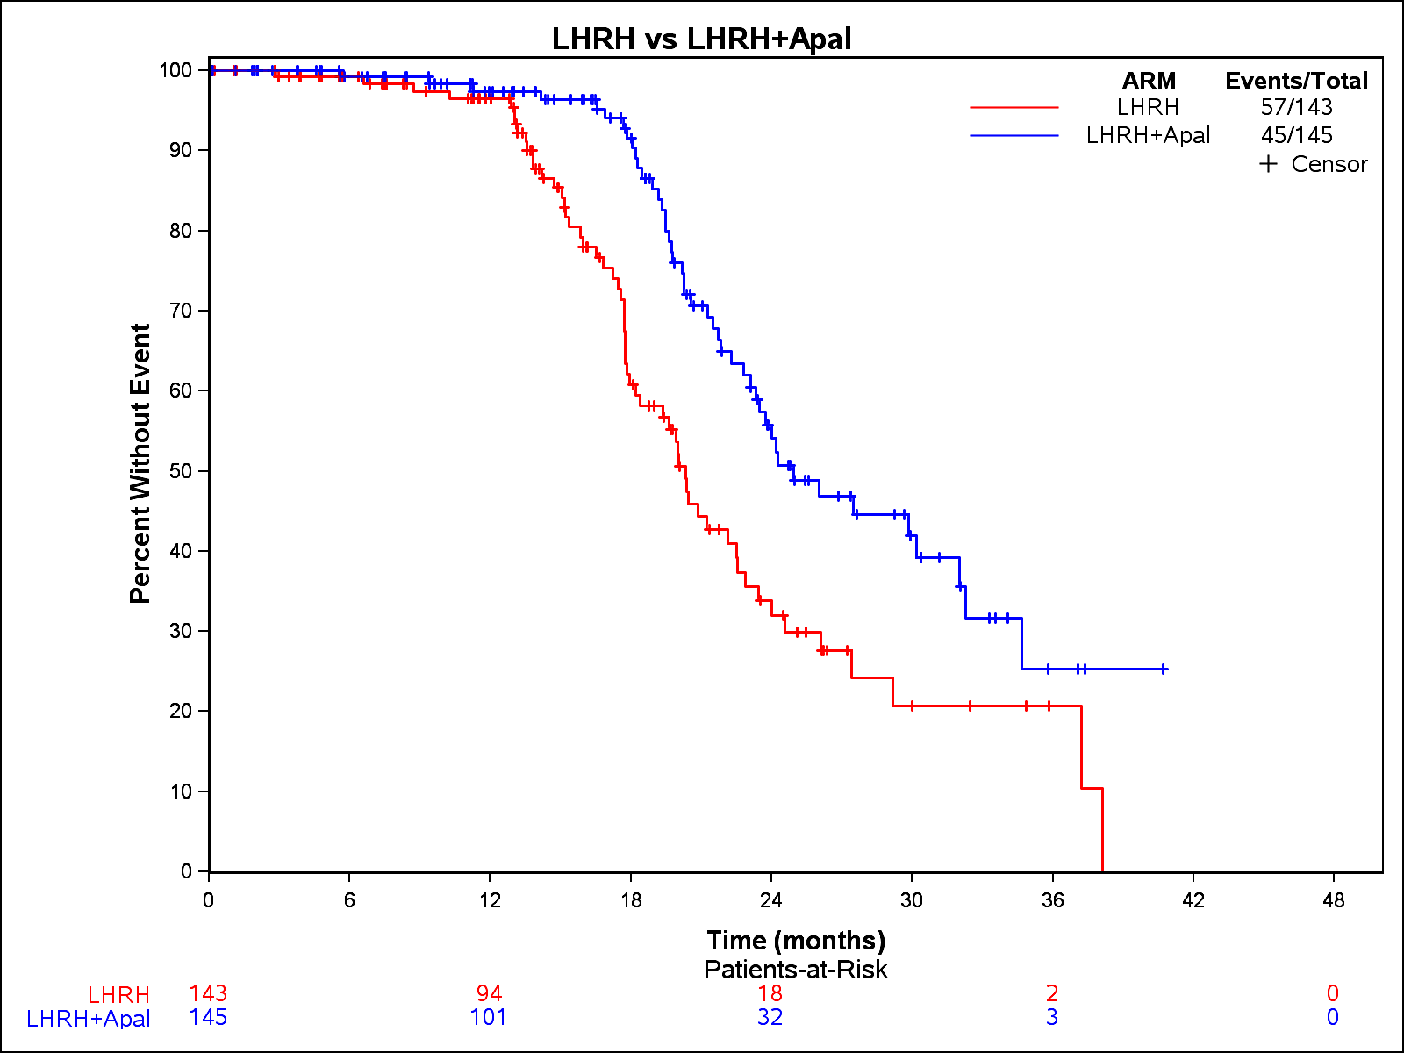
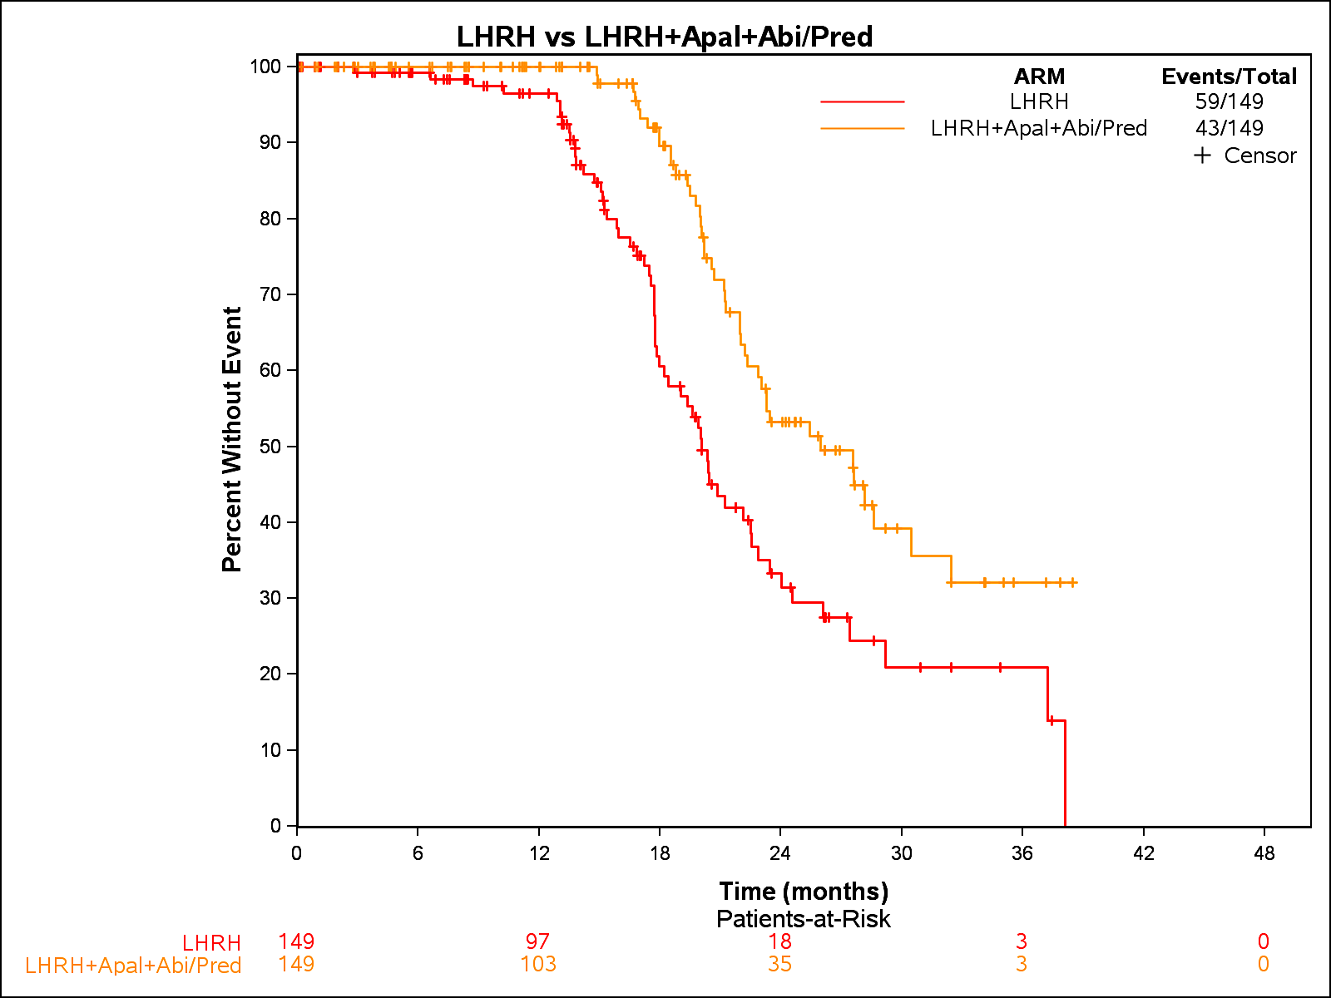
PRESTO: ADT intensification prolongs PSA progression-free survival
ADT + Apalutamide vs. ADT
ADT + Apa + AAP vs. ADT
Aggarwal R et al. ESMO 2022

Slide 42
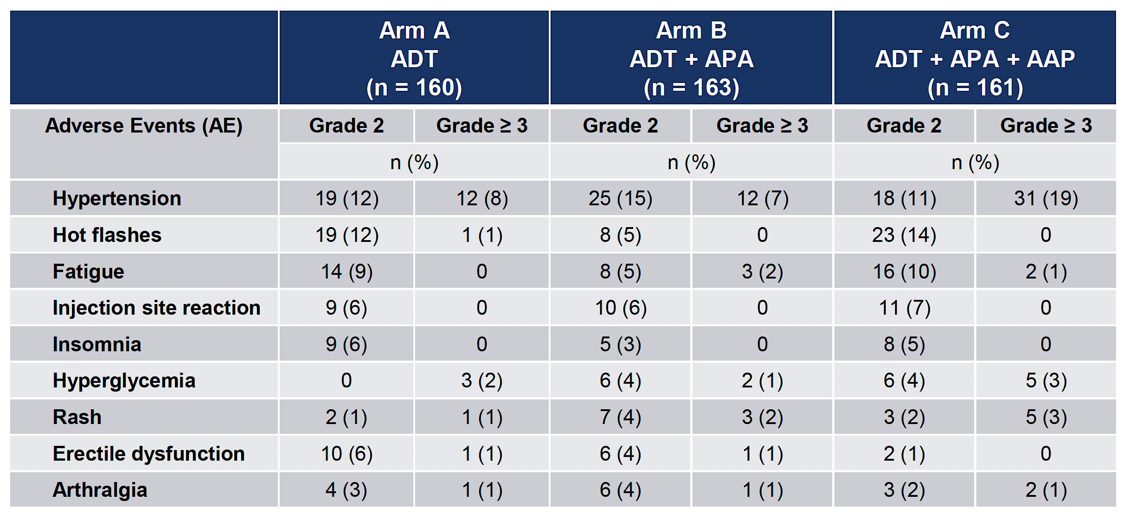
PRESTO: Safety of ADT ± Apalutamide ± Abiraterone/Prednisone
Aggarwal R et al. ESMO 2022;Abstract LBA63.

Slide 43
Current/Future Directions in nmCSPC
Other secondary hormonal therapies for management of nmCSPC
Role of metastasis-directed radiation based upon metabolic imaging
Non-hormonal therapies (e.g. targeted radioligand therapy)
Evolution of the MFS endpoint to incorporate metabolic imaging
Molecularly defined risk stratification

Slide 44
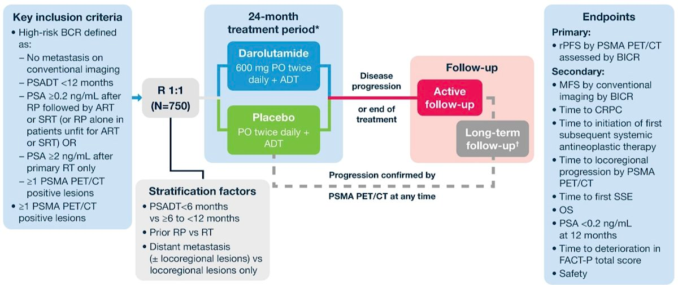
ARASTEP: Phase 3 Trial of Darolutamide in nmCSPC

Slide 45
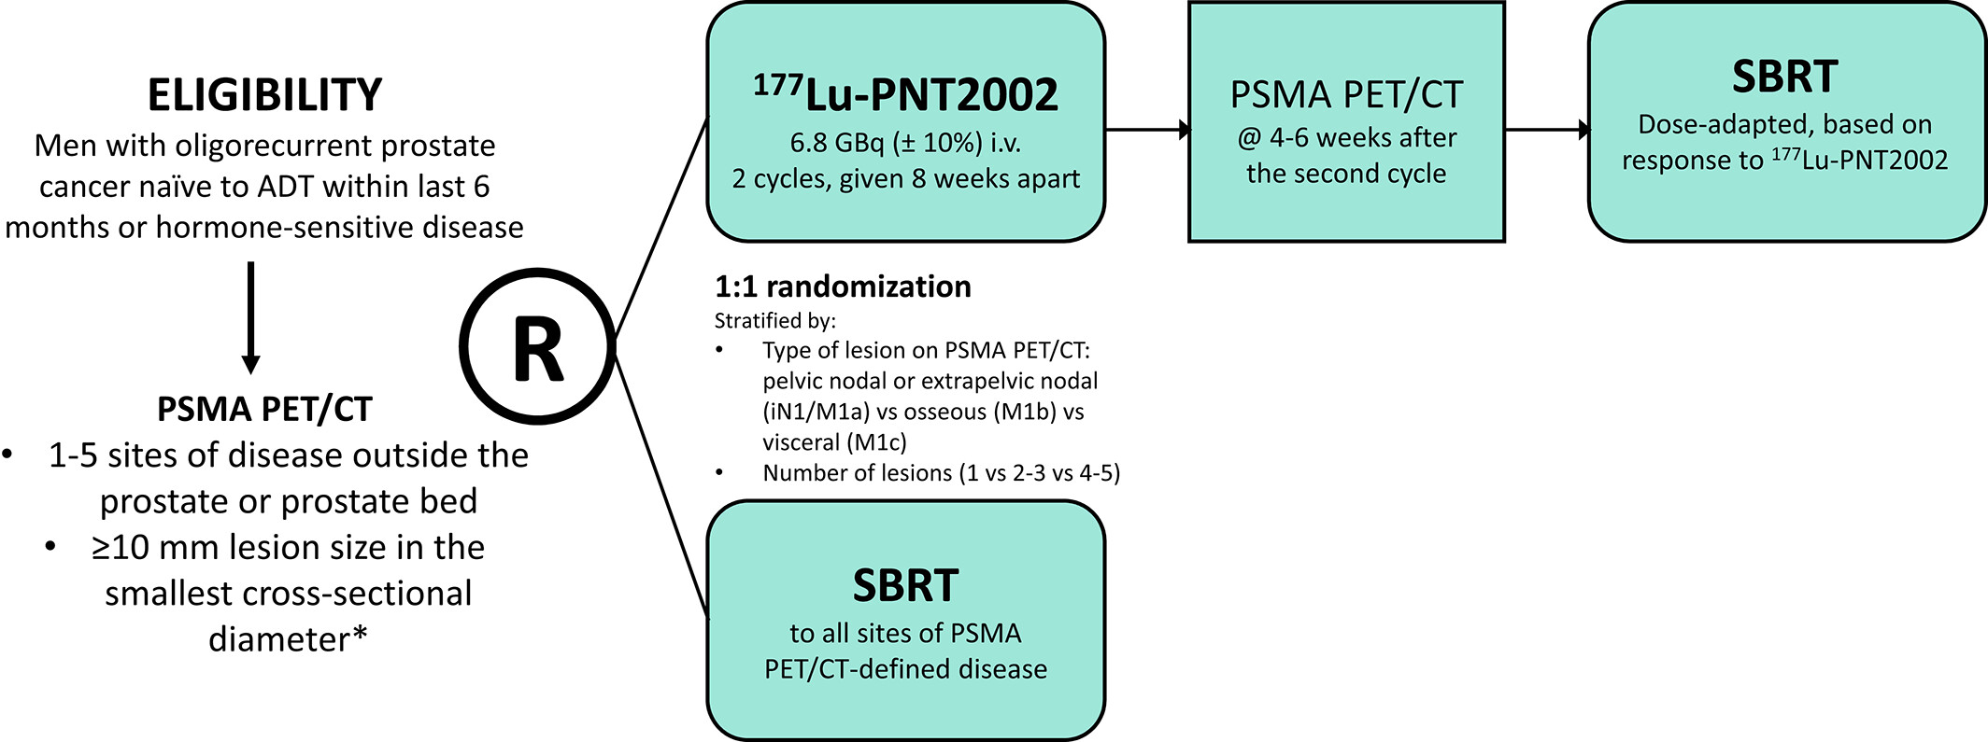
ADT-free treatment approach: Metastasis-directed radiation +/- radioligand therapy

Slide 46
Outline
Risk stratification and staging of patients with newly diagnosed prostate cancer
  Molecular testing
  Imaging
High-risk nonmetastatic prostate cancer
Biochemically recurrent castration-sensitive prostate cancer
Nonmetastatic CRPC

Slide 47
ADT intensification in nmCRPC
 | PROSPER | SPARTAN | ARAMIS
Agents | Placebo vs. enzalutamide | Placebo vs. apalutamide | Placebo vs. darolutamide
Entry criteria | nmCRPC, N0, PSA-DT < 10 months, PSA > 2 ng/ml | nmCRPC, N0/N1, PSA-DT < 10 months, PSA > 2 ng/ml | nmCRPC, N0/N1, PSA-DT < 10 months, PSA > 2 ng/ml
Sample size | 1401 (468/933) | 1207 (401/806) | 1509 (554/955)
Metastasis-free survival | 14.7 (14.2–15.0) vs. 36.6 months (33.1–NR); HR: 0.29, CI: 0.24–0.35 | 16.2 vs. 40.5 months; HR: 0.30, CI: 0.24–0.36 | 18.4 (15.5–22.3) vs. 40.4 (34.3–NR);HR: 0.41, CI: 0.34–0.50
Overall survival | 56.3 (54.5–63.0) vs. 67.0 (64.0–NR); HR: 0.73, CI: 0.61–0.89 | 59.9 (52.8–NR) vs. 73.9 months (61.2–NR); HR: 0.79, CI: 0.65–0.96 | NR vs. NR; HR: 0.69, CI: 0.53–0.88
Grade ≥ 3 adverse event | 27.0 vs. 48.0% | 36.5 vs. 59.0% | 25.1 vs. 30.3%
Wenzel M et al. Prostate Cancer Prostatic Diseases 2022

Slide 48
Current/future directions in nmCRPC and oligometastatic CRPC
What is the optimal definition of oligometastatic/oligorecurrent disease by metabolic imaging?
What is role of metastasis-directed treatment in CRPC?
Is there a subset of patients for whom switch in ARSI is reasonable (e.g. low volume of disease by PET)?
Molecular features to guide treatment sequencing/selection?
Combination versus sequential treatment?
  E.g. ARSI + PARPi phase 3 trial data

Slide 49
Take Home Points
ADT intensification improves long term outcomes in high risk early stage prostate cancer
  Very high risk localized newly diagnosed prostate cancer
  High risk non-metastatic biochemically recurrent disease
Risk stratification is critical to select patients appropriate for treatment intensification
  Validation of predictive biomarkers is critical
ADT-free treatment approaches including metastasis-directed radiation offer promise but require rigorous prospective validation

Slide 50
MODULE 2: Evidence-Based Selection of Treatment for Metastatic Hormone-Sensitive Prostate Cancer (mHSPC) – Dr Antonarakis

Slide 51
Consulting Faculty Questions
Current approaches to the treatment of mHSPC; PSMA-PET imaging as part of the armamentarium
Neil Love, MD
Rana R McKay, MD

Slide 52

QUESTIONS FOR THE FACULTY
Is ADT intensification with an AR pathway inhibitor now standard of care? When combining an AR pathway inhibitor with ADT for a patient with mHSPC, do you have a preference for a specific agent?
In what situations do you utilize the ARASENS regimen of ADT/docetaxel/darolutamide?
How would you approach a patient with negative conventional imaging but a PSMA-PET suggestive of metastatic disease?
Rana R McKay, MD

Slide 53
Consulting Faculty Questions
Real-world experience with side effects associated
with AR inhibitors
Neil Love, MD
Andrew J Armstrong, MD, ScM

Slide 54
QUESTIONS FOR THE FACULTY
What has been your experience with the toxicities associated with AR pathway inhibitors (eg, cognitive effects with enzalutamide, rash with apalutamide, cardiovascular/hepatotoxicity and steroid toxicity with abiraterone)?
How do patient age and comorbidities affect your choice among these agents?
Andrew J Armstrong, MD, ScM

Slide 55
What are your usual criteria for using ADT with docetaxel and darolutamide for patients with mHSPC?
Liver mets or other aggressive variant, clinical and/or genomic features,
de novo metastatic disease, younger patient, good PS
High-volume mets, symptomatic mets, visceral mets, de novo, mutation in TP53/RB1
Never for metachronous low volume, occasionally for metachronous high volume, occasionally for de novo low volume, usually for de novo high volume
De novo presentation, high volume (visceral mets,
>4 bone mets with >1 beyond vertebra/pelvis)
High-volume disease and liver mets especially
High-volume disease by CHAARTED criteria, not solely based
on PSMA PET (BS, CT/MRI), candidate for docetaxel
High volume, visceral mets, low PSA to tumor burden,
TSG alterations
TSG = tumor suppressor gene

Slide 56
Outside of a clinical trial, have you recommended ADT and darolutamide without docetaxel for a patient with mHSPC?
Yes
Yes
Yes
No
Yes
Yes
Yes

Slide 57
Globally, which comorbidities are likely to steer you away from choosing ADT and abiraterone?
Poorly controlled diabetes or CHF
Severe heart failure, severe diabetes,
more than 2+ peripheral edema
Diabetes
Brittle diabetes, history of ulcer
Liver dysfunction
Diabetes, steroid intolerance, severe obesity, CHF, severe HTN uncontrolled, cardiac arrhythmias, hypokalemia
CHF, HTN, liver dysfunction
CHF = congestive heart failure; HTN = hypertension

Slide 58
Globally, which comorbidities are likely to steer you away from choosing ADT and apalutamide?
History of seizure or multiple falls/gait instability
Skin conditions (rash), ataxia/imbalance
CNS disease, history of CVA
Uncontrolled hypertension
Rash
Drug-drug interactions
Arrhythmias, falls

Slide 59
Globally, which comorbidities are likely to steer you away from choosing ADT and enzalutamide?
History of seizure or multiple falls/gait instability, baseline cognitive
dysfunction or situations where patient requires high cognitive function
Seizure disorder, severe fatigue, severe diarrhea, ataxia/imbalance
CNS disease, history of CVA
History of seizure
Age, cognitive concerns, fatigue, fall risk
Drug-drug interactions, age >75 or severe frailty,
cognitive concerns/memory loss
Falls, seizure, drug-drug interaction

Slide 60
Globally, which comorbidities are likely to steer you away from choosing ADT and darolutamide?
None
None
None
None
None
None
None

Slide 61
Evidenced-Based Treatment for Metastatic Hormone-Sensitive Prostate Cancer (mHSPC)
Research To Practice
January 25, 2024
Emmanuel S. Antonarakis, M.D.
Clark Endowed Professor of Medicine
Division of Hematology/Oncology & Transplantation, University of Minnesota
Associate Director of Translation, Masonic Cancer Center

Slide 62

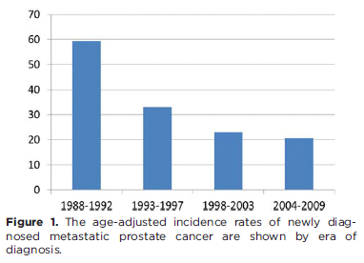
Incidence of de novo mHSPC around the globe
5-30%
5%
60%
Wu JN, Cancer 2014; 120: 818-823.

Slide 63
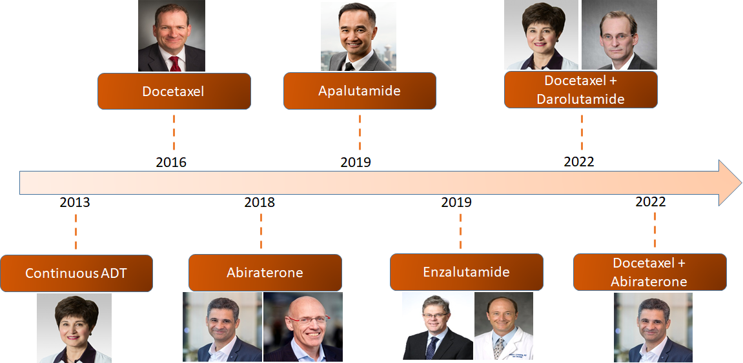
Evolving Paradigm of mHSPC Management
Hussein M. et al. NEJM 2013; Fizazi K et al. NEJM 2017; James N.D. et al. NEJM 2017; Davis I.D. et al. NEJM 2017; Armstrong A. et al. JCO 2019; Chi K.N. et al. NEJM 2019; Smith MR. et al NEJM 2022; Fizazi K. et al Lancet 2022.
Courtesy of Neeraj Agarwal

Slide 64
Metastatic HSPC: Overview of Treatment Options
Androgen-deprivation therapy is the mainstay of managing mHSPC
Intensifying therapy beyond ADT alone is associated with improved OS
  Doublet therapy: ADT + ARPI (abiraterone/prednisone, apalutamide, enzalutamide)
    NOTE: Doublet of ADT + docetaxel is no longer recommended!
  Triplet therapy: ADT + chemotherapy (docetaxel) + ARPI (abiraterone/pred, darolutamide, enzalutamide?)
  Radiation therapy to the prostate in the setting of low-volume disease
NCCN. Prostate cancer. v 4.2023.

Slide 65
Historical data: CHAARTED, ADT ± Docetaxel in mHSPC: High-volume vs Low-volume
Adding docetaxel to ADT showed greater benefit in high- (vs. low-) volume disease
High-Volume Disease **
Low-Volume Disease
100
Median OS, Mo
ADT + docetaxel 51.2
ADT alone 34.4
HR: 0.63 (95% CI: 0.50-0.79; P <.001)
100
Median OS, Mo
ADT + docetaxel 63.5
ADT alone NR
HR: 1.04 (95% CI: 0.70-1.55; P = .86)
80
80
60
60
OS (%)
OS (%)
40
40
20
20
0
0
0
12
24
36
48
60
72
84
96
108
0
12
24
36
48
60
72
84
96
108
Mo
Mo
Kyriakopoulos CE, JCO 2018; 36: 1080-87.

Slide 66
Role of Prostate XRT: STAMPEDE – H
Low burden
High burden
SOC+RT
SOC
SOC
SOC+RT
HR: 0.68 (95% CI 0.52-0.90); p=0.007
3 year OS (%):
SOC = 73%
SOC+RT = 81%
HR: 1.07 (95% CI 0.90-1.28); p=0.420
3 year OS (%):
SOC = 54%
SOC+RT = 53%
Parker C, Lancet 2018

Slide 67
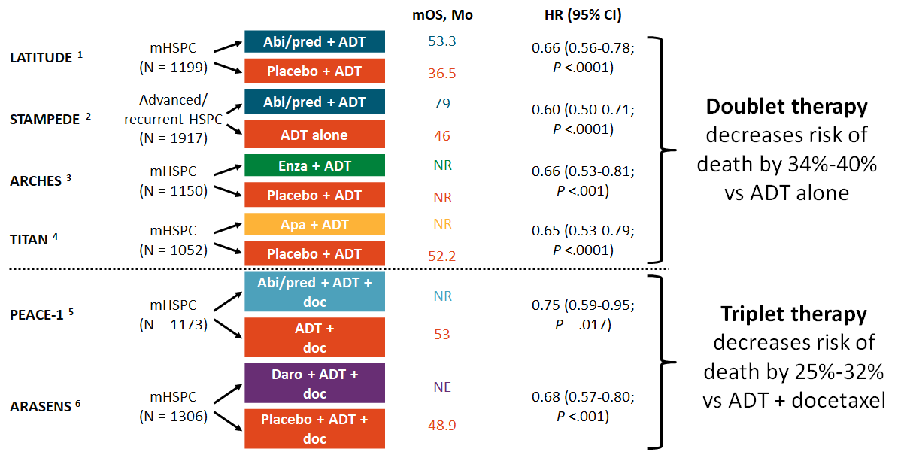
OS with Doublet and Triplet Therapy in mHSPC
1. Fizazi. Lancet Oncol. 2019;20:686. 2. James. Int J Cancer. 2022;151:422. 3. Armstrong. JCO. 2022;40:1616. 4. Chi. JCO. 2021;39:2294. 5. Fizazi. Lancet. 2022;399:1695. 6. Smith. NEJM. 2022;386:1132.

Slide 68
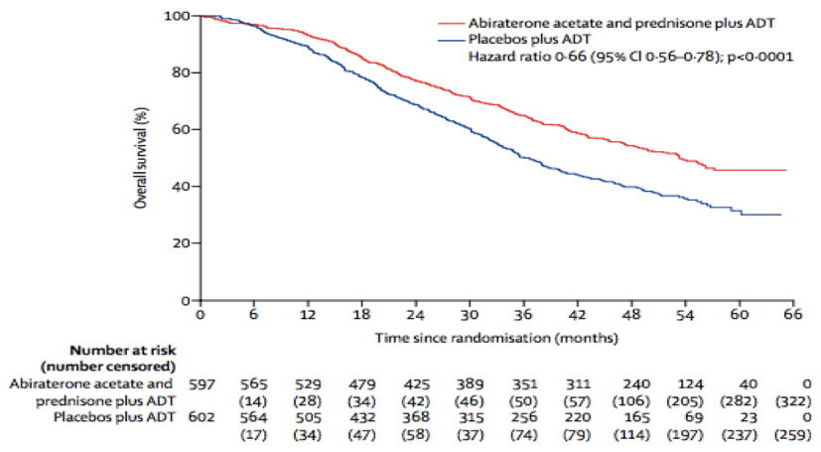
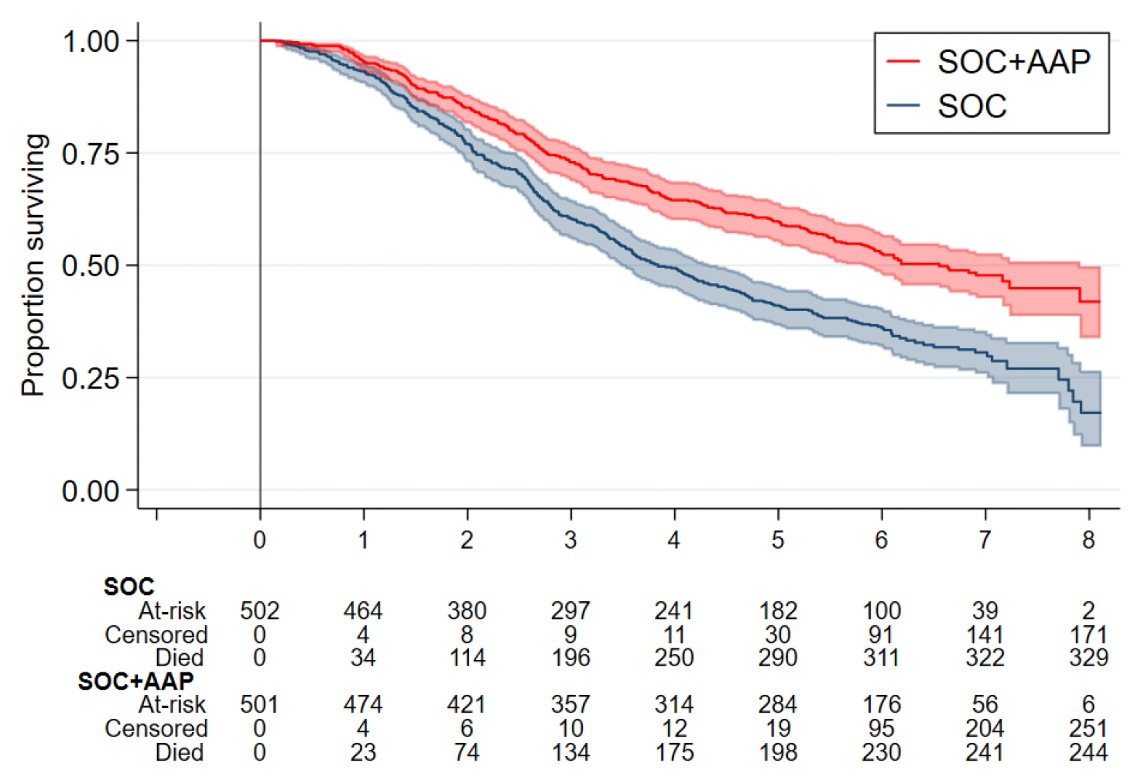
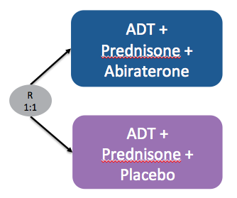
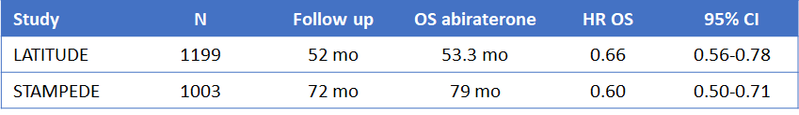
ADT + Abiraterone > ADT alone in mHSPC
LATITUDE
STAMPEDE – G
Fizazi K, N Engl J Med 2017; 377: 352-60. James ND, N Engl J Med 2017; 377: 338-51. Fizazi K, et al. Lancet Oncol 2019; 20: 686-700. James ND, et al. Ann Oncol 2020; 31: S507-S549. Attard G et al. Lancet Oncol. 2023;24(5):443-456.

Slide 69
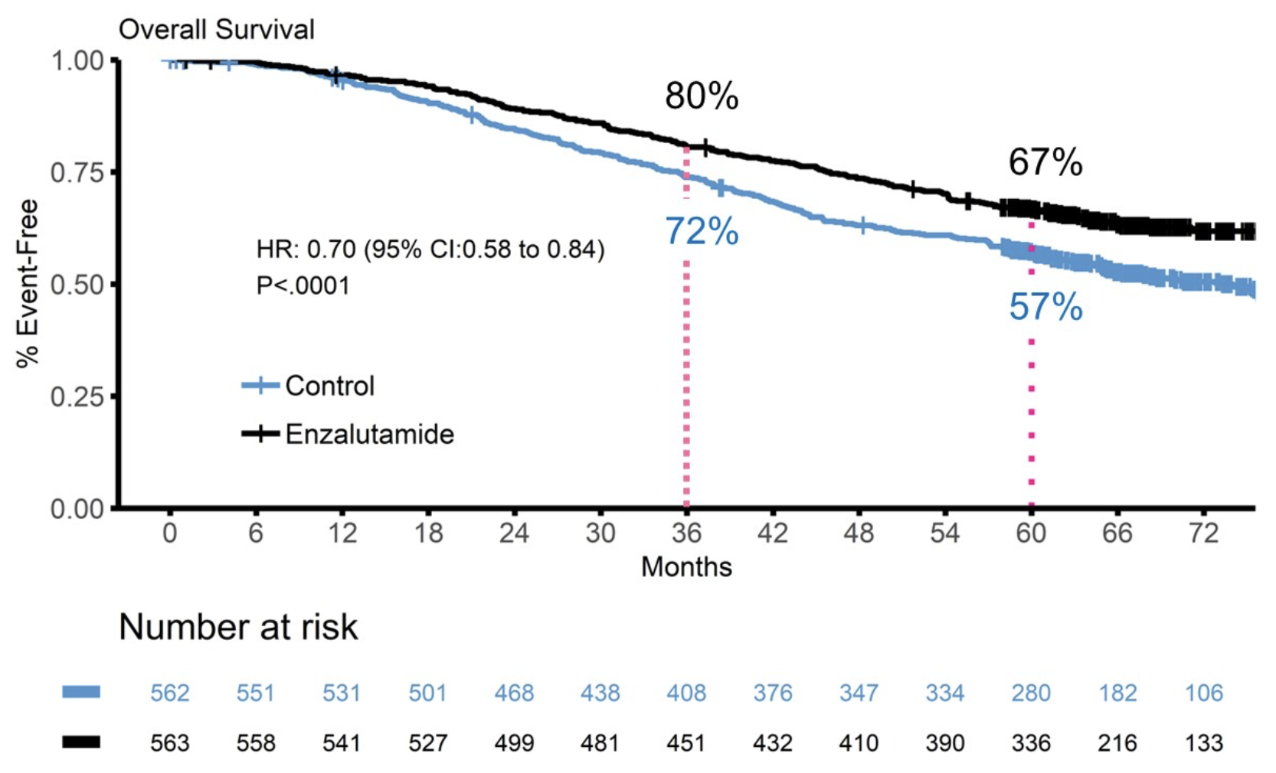
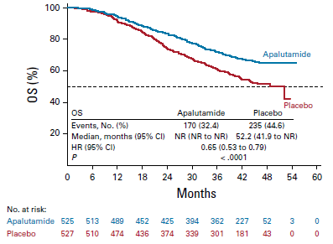
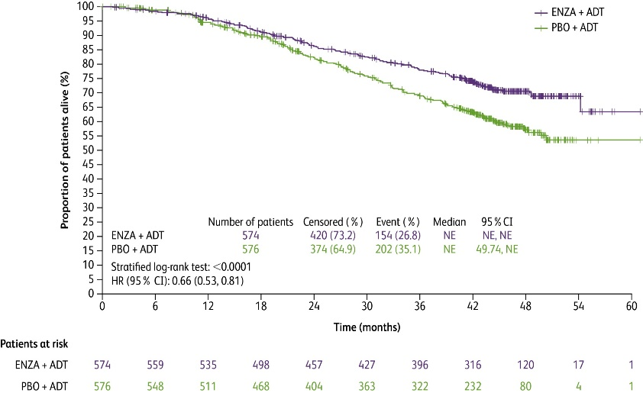
ADT + ARPI > ADT alone in mHSPC
ENZAMET (Enzalutamide)
ARCHES (Enzalutamide)
TITAN (Apalutamide)
Davis I et al. NEJM 2019;381:121-31.
Davis I et al. ASCO 2022; Abstract LBA5004.
Armstrong A et al. ESMO 2021; Abstract LBA25.
Armstrong A et al. J Clin Oncol 2022;40(15):1616-22.
Chi K et al. J Clin Oncol 2021;39(20):2294-303

Slide 70
Triplet Therapy: ARASENS trial (ADT/ doce/ daro)
Key Eligibility Criteria
mHSPC
ECOG 0 or 1
Candidates for ADT + docetaxel
Stratification Factors
Extent of disease (M1a vs 1b vs 1c)
ALP level (< vs > ULN)
N=1,305
ADT + docetaxel x 6 cycles
+ darolutamide 600 mg BID
R
ADT + docetaxel x 6 cycles
+ placebo by mouth BID
1:1
Primary endpoint: OS
Key secondary endpoints: time to mCRPC, time to initiation of subsequent anticancer therapy, time to SSE-free survival, time to first SSE, time initiation of subsequent RX, time to pain progression
Smith MR, et al. N Engl J Med. 2022 Mar 24;386(12):1132-1142.

Slide 71
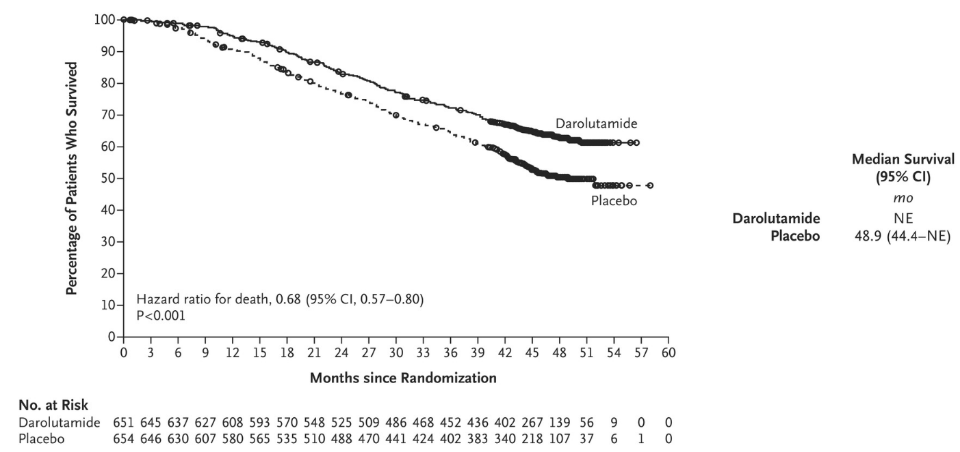
ARASENS trial (ADT/ doce ± darolutamide)
Overall Survival
32% improvement in OS with the Triplet Regimen
Smith MR, et al. NEJM 2022;386:1132-42.

Slide 72

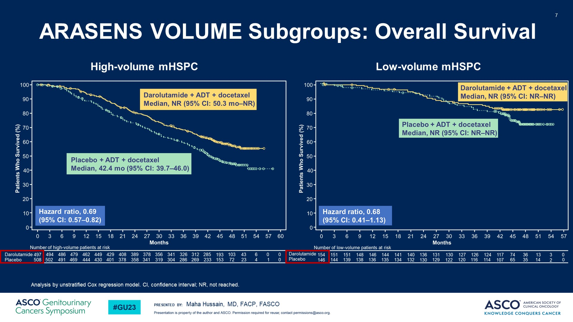
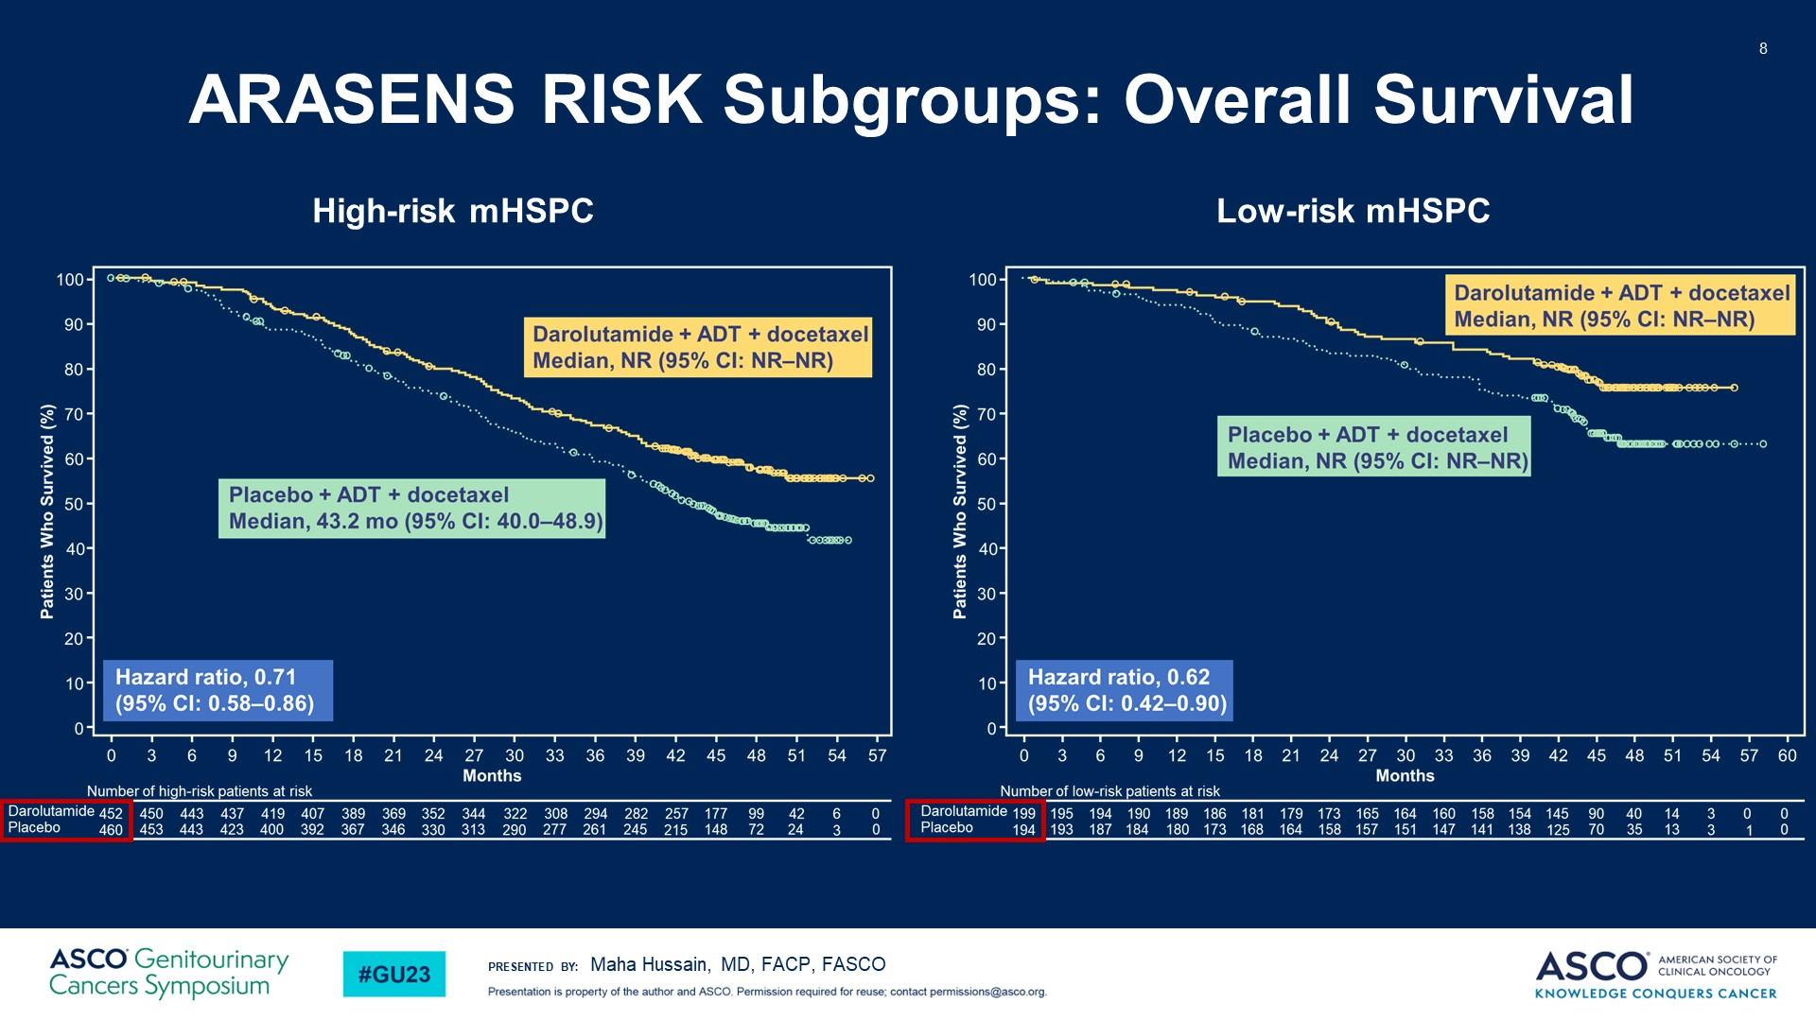
ARASENS trial: Two important subsets
Hussain M, et al. ASCO GU. 2023. Hussain M et al. J Clin Oncol 2023;41(20):3595-3607.

Slide 73
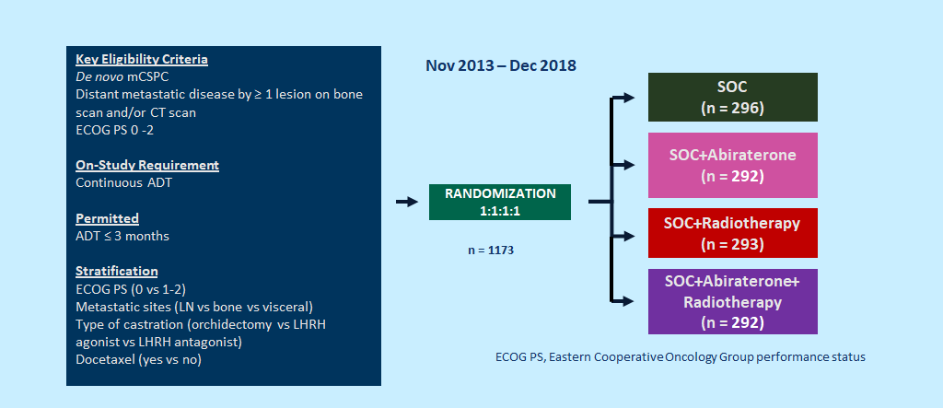

Triplet Therapy: Design of PEACE-1 (2x2)
Bossi A, ASCO Annual 2023

Slide 74
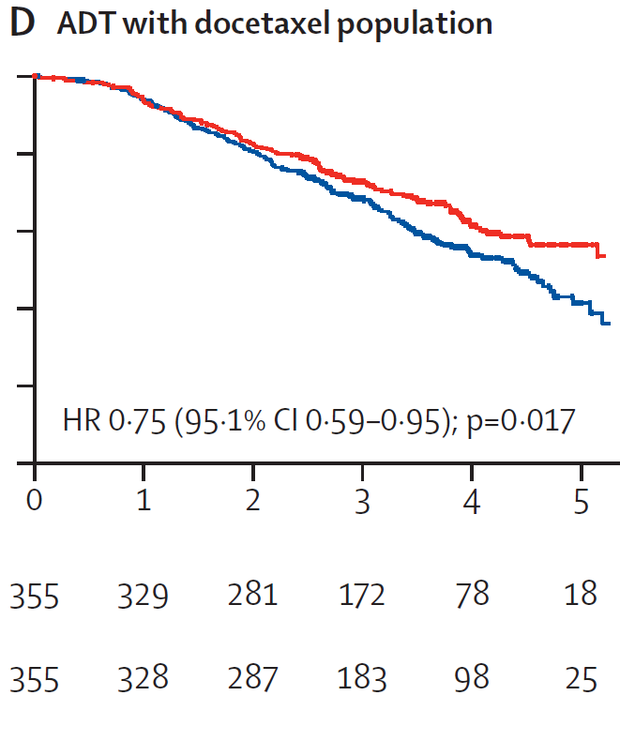
PEACE-1: ADT/doce + Abiraterone > ADT/doce
Median rPFS = 2.03 vs 4.46 yr
Median OS = 4.43 yr vs NR
Fizazi K, Lancet 2022

Slide 75
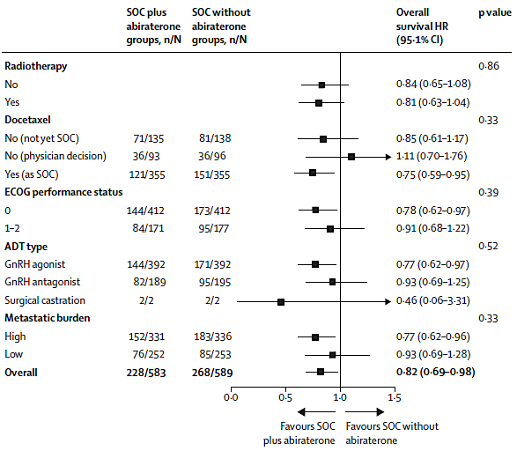
PEACE-1 (Abiraterone): OS Subsets
Fizazi K, Lancet 2022

Slide 76
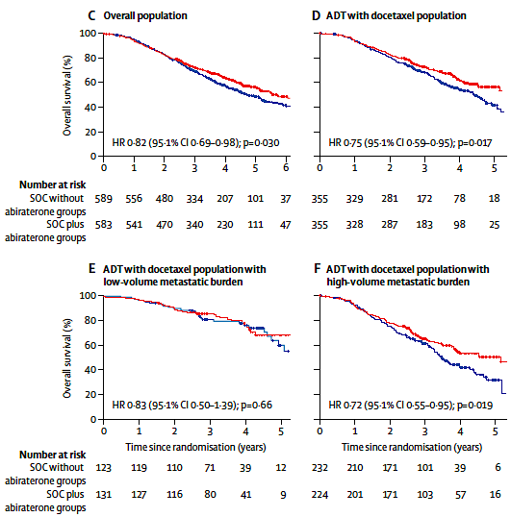
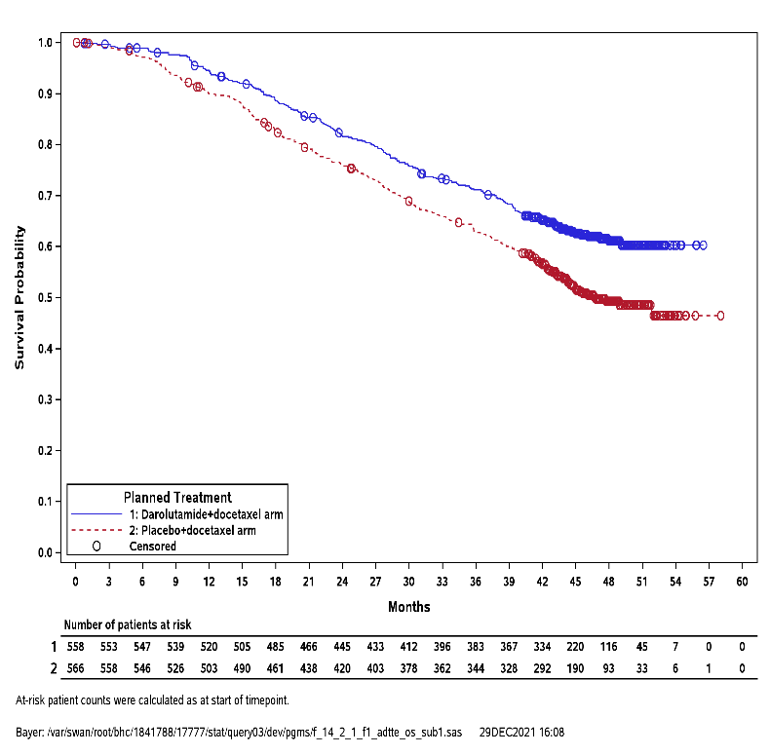
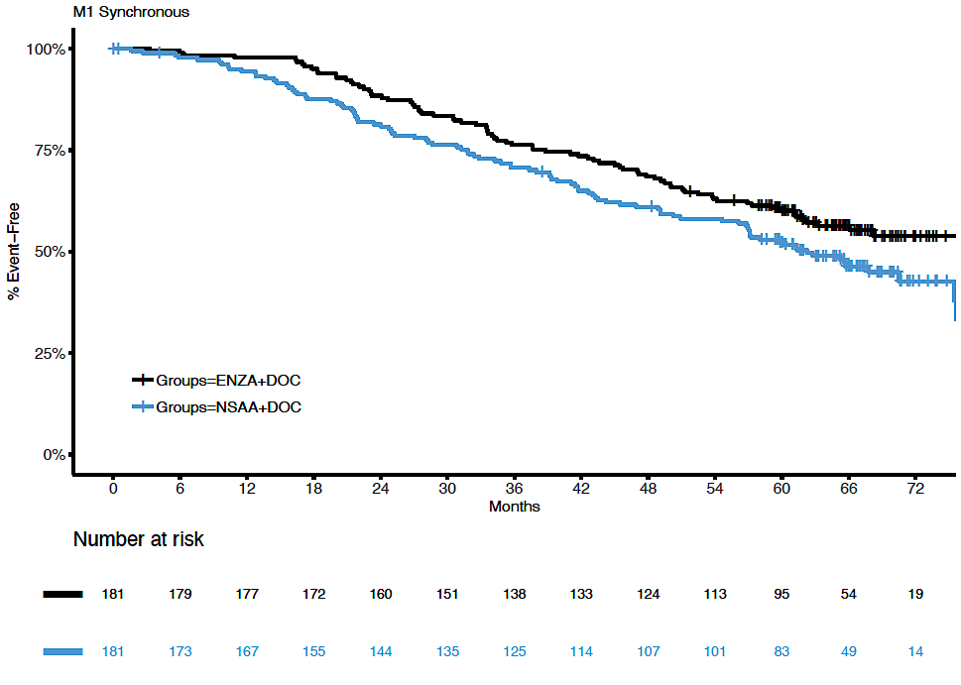
Triplet: Consistent benefit in de novo mHSPC
ADT + Doc + Abi > ADT + Doc
PEACE-1 (all De novo)
ADT + Doc + Daro > ADT + Doc
ARASENS (De novo subset)
ADT + Doc + Enza > ADT + Doc
ENZAMET (De novo subset)
HR: 0.71
(95% CI: 0.59–0.85)
HR: 0.73
(95% CI: 0.59–0.99)
Fizazi K Lancet 2022; Smith M NEJM 2022; Davis I ASCO 2022

Slide 77
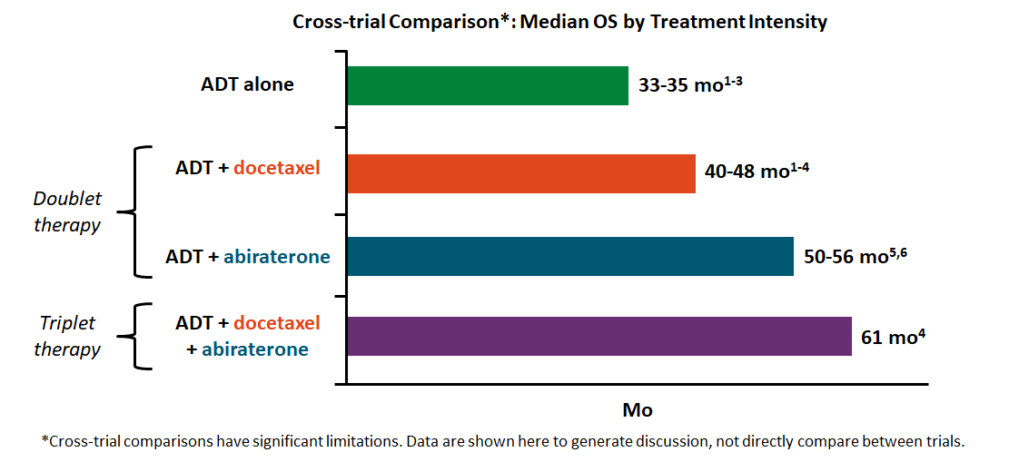
Median OS with Treatment Intensification in de novo High-Volume mHSPC
1. Kyriakopoulos. JCO. 2018;36:1080. 2. Gravis. Eur Urol. 2018;73:847. 3. Clarke. Ann Oncol. 2019;30:1992.
4. Fizazi. Lancet. 2022;399:1695. 5. Fizazi. Lancet Oncol. 2019;20:686. 6. James. Int J Cancer. 2022;151:422.

Slide 78
Role of Prostatic XRT: PEACE-1 (2x2)
Bossi A, ASCO Annual 2023

Slide 79
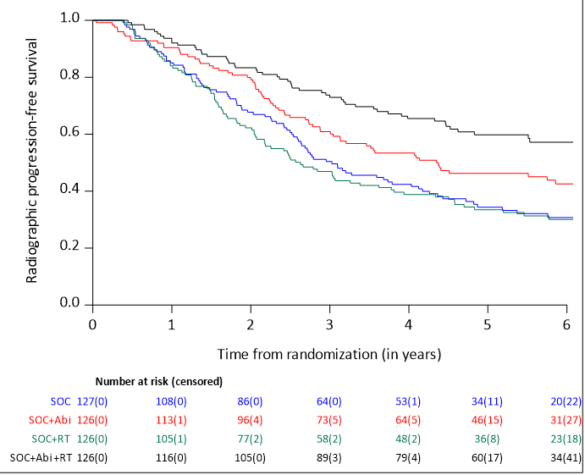
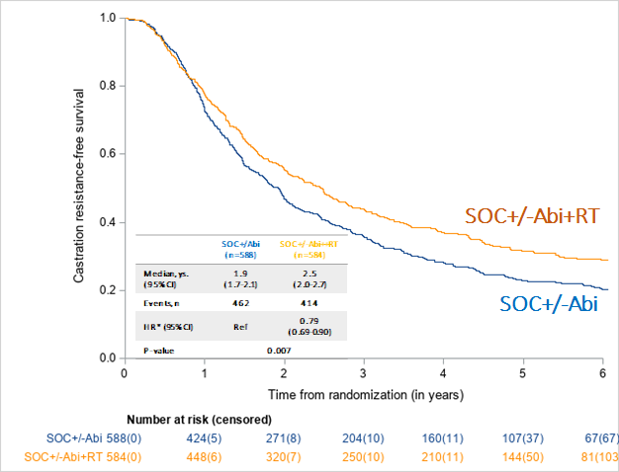

Role of Prostate XRT: Efficacy outcomes
rPFS
Time to CRPC
SOC + Abi + RT
SOC + Abi
SOC
SOC + RT
SOC+/-Abi
(n=588)
Bossi A, ASCO Annual 2023

Slide 80



Role of Prostate XRT: OS, and GU events
OS (low-volume pts)
Time to serious GU event
SOC+/-Abi
(n=253)
Bossi A, ASCO Annual 2023

Slide 81

Factors Contributing to Treatment Choice
Morgans AK, J Clin Oncol 2022; 40: 818-824.

Slide 82
Selected Ongoing Phase III Trials in mHSPC
Trial | Regimens | Population
ARANOTE (NCT04736199) | ADT ± darolutamide (without docetaxel) | mHSPC, unselected (N = 662)
KEYNOTE-991 (NCT04191096) | ADT + enzalutamide ± pembrolizumab | mHSPC, unselected (N = 1,232)
CAPItello-281 (NCT04493853) | ADT + abiraterone acetate ± capivasertib | De novo mHSPC, PTEN loss on IHC (N = 1000)
CYCLONE 03 (NCT05288166) | ADT + abemaciclib + abiraterone/prednisone | High-risk mHSPC, unselected (N = 900)
TALAPRO-3 (NCT04821622) | Enzalutamide ± talazoparib | mHSPC, HRR gene mutation (N = 550)
AMPLITUDE (NCT04497844) | Abiraterone/prednisone ± niraparib | mHSPC, HRR gene mutation (N = 788)
PSMAddition (NCT04720157) | AR-directed tx + ADT ± ¹⁷⁷Lu-PSMA-617 | mHSPC, PSMA-PET positive (N = 1,126)

Slide 83

The future of mHSPC treatment
Hamid A, et al. Am Soc Clin Oncol Educ Book, 2023, e390166.

Slide 84
Treatment of mHSPC: Conclusions
Almost no role for ADT alone (except in exceptional cases e.g. life expectancy < 2 yrs)
Doublets of ADT + ARPI are applicable to most (except those with visceral metastasis or other high-risk genomic or clinical features)
No role of ADT + docetaxel doublet (given superiority of ADT+ doce + ARPI triplets). Triplets have replaced ADT+ docetaxel
Clearest benefit of triplet: De novo high-volume mHSPC
Prostate XRT may improve OS, delay GU events in low-volume HSPC
Biomarkers may guide treatment decisions in the near future

Slide 85
MODULE 3: New Considerations with PARP Inhibitors for
Metastatic Castration-Resistant Prostate Cancer (mCRPC) – Dr Bryce

Slide 86
Consulting Faculty Questions
Selection of optimal PARP inhibitor for mCRPC;
use of PARP inhibitors for patients with non-BRCA mutations
Neil Love, MD
Andrew J Armstrong, MD, ScM
Rana R McKay, MD

Slide 87
QUESTIONS FOR THE FACULTY
For a patient with BRCA-mutated mCRPC, how do you choose among the 3 approved PARP inhibitor-based combinations?
In which situations would you offer one of these combinations to a patient with mCRPC and an HRR mutation other than BRCA? What about patients without a documented HRR gene mutation?
Andrew J Armstrong, MD, ScM
Rana R McKay, MD

Slide 88
Consulting Faculty Questions
PARP inhibitor-associated side effects; risk of second cancer
with prolonged exposure to PARP inhibitors
Neil Love, MD
Rana R McKay, MD

Slide 89
QUESTIONS FOR THE FACULTY
How do you typically manage the fatigue and anemia associated with PARP inhibitors? What is your threshold for dose reduction?
How do you integrate the increased risk of AML/MDS in clinical decision-making?
Rana R McKay, MD

Slide 90
What is your usual approach to mutation testing for possible use of a PARP inhibitor for a patient with mCRPC?
Multigene germline and somatic/NGS
Multigene germline and somatic/NGS
Multigene germline and somatic/NGS
Multigene germline and somatic/NGS
Multigene germline and somatic/NGS
Multigene germline and somatic/NGS
Multigene germline and somatic/NGS
NGS = next-generation sequencing

Slide 91
In addition to BRCA1/2, what other homologous recombination repair (HRR) mutations will lead you to attempt to use a PARP inhibitor for mCRPC? What about LOH?
PALB2, RAD51
PALB2, RAD51B/C/D, RAD54L; perhaps CDK12 or really high gLOH (eg, >20%)
PALB2, FANCA
CHEK2, CDK12, BARD1, BRIP1, PALB2, RAD51b, RAD51c, RAD51d
PALB2, RAD54L, RAD51 family members
ATM, CDK12, CHEK2, PALB2, RAD51 family members
PALB2

Slide 92
What was the age of the last patient in your practice with mCRPC who received a PARP inhibitor in combination with ADT and a secondary hormonal agent? What HRR gene mutation did the patient have? Which specific regimen did the patient receive?
Age
HRR gene mutation
Treatment
73 years
gBRCA2
Talazoparib + enzalutamide
62 years
BRCA2 (somatic)
Talazoparib + enzalutamide
No patient
Not applicable
Not applicable
74 years
BRCA2
Talazoparib + enzalutamide
59 years
BRCA2
Olaparib + abiraterone
63 years
BRCA2 (somatic)
Olaparib + abiraterone
65 years
PALB2
Talazoparib + enzalutamide

Slide 93
A 65-year-old man with a germline BRCA2 mutation presents with HSPC metastatic to the bone and receives docetaxel and ADT, experiencing response then progression (PSMA-positive). Regulatory and reimbursement issues aside, what systemic treatment would you most likely recommend?
Olaparib + abiraterone
Olaparib + abiraterone
Talazoparib + enzalutamide
Lutetium Lu 177 vipivotide tetraxetan
Olaparib + abiraterone
Olaparib + abiraterone
Talazoparib + enzalutamide

Slide 94
A 65-year-old man with a germline BRCA2 mutation presents with HSPC metastatic to the bone and receives enzalutamide and ADT, experiencing response then progression (PSMA-positive). Regulatory and reimbursement issues aside, what systemic treatment would you most likely recommend?
Olaparib
Olaparib
Olaparib
Lutetium Lu 177 vipivotide tetraxetan
Olaparib + abiraterone
Olaparib
Olaparib

Slide 95
New Considerations with the Use of PARP Inhibitors for Metastatic CRPC (mCRPC)
Research to Practice Prostate Cancer Symposium
GU ASCO 2024
Alan H. Bryce, M.D.
Chief Clinical Officer, City of Hope Cancer Center, Phoenix
Clinical Professor, Department of Medical Oncology and Therapeutics Research
Professor of Molecular Medicine, TGen Research Institute
@AlanBryce9

Slide 96
Inherited DNA-repair gene mutations in men with metastatic prostate cancer
Case series of men with metastatic prostate cancer, unselected for family history of cancer or age at diagnosis​
Case Series​ | Description​ | Patients, n​ | Patients With ​ Mutations, n (%)​
1​ | Stand Up to Cancer: Prostate Cancer Foundation discovery series​ | 150​ | 15 (10.0)​
2​ | Stand Up to Cancer: Foundation validation series​ | 84​ | 9 (10.7)​
3​ | Royal Marsden Hospital​ | 131​ | 16 (12.2)​
4​ | University of Washington​ | 91​ | 8 (8.8)​
5​ | Weill Cornell Medical College​ | 69​ | 7 (10.1)​
6​ | University of Michigan​ | 43​ | 4 (9.3)​
7​ | Memorial Sloan Kettering Cancer Center​ | 124​ | 23 (18.5)​
Total​ | ​ | 692​ | 82 (11.8)​
RAD51C, 1%
MSH6, 1%
MRE11A, 1%
MSH2, 1%
BRIP1, 1%
GEN1, 2%
FAM175A, 1%
PMS2, 2%
NBN, 2%
ATR, 2%
RAD51D, 4%
PALB2, 4%
BRCA1, 7%
BRCA2, 44%
CHEK2, 12%
ATM, 13%
Pritchard. NEJM. 2016;375:443.

Slide 97

Cancer Evolution
Mutational Landscape By Disease State
Locoregional
mHSPC
mCRPC
Genomic progression from localized disease to mCRPC
BRCA1: 1% to 2%
BRCA2: 6% to 10%
FANCA: 1% to 7%
Cumulative incidence of pathogenic DDR variants (excluding ATM) ~25%
10-15% germline
10-15% somatic
Abida. JCO Precision Oncol. 2017;PO.17.00029.

Slide 98


PARP Monotherapy
Overall survival
PROFOUND: Olaparib post ARPi, versus ARPi
Cohort A: BRCA1, BRCA2, or ATM
Triton 2: Rucaparib post ARPi and Docetaxel
OS by gene

Slide 99
Select studies combining PARP Inhibitors with other agents in mCRPC
AR Therapy
Immunotherapy
Cotargeting Other Pathways
Ph III PROpel
Approved
Ph III KEYLYNK-010
Negative results
Ph II
NCT03810105
Ph I/II COMRADE*
NCT03317392
Ph I LuPARP*
NCT03874884
Ph II NCT02893917
Olaparib
Abiraterone
Pembrolizumab
Durvalumab
Radium-223
¹⁷⁷Lu-PSMA-617
Cediranib (VEGFRi)
Ph III TALAPRO-2
Approved
Ph II†
NCT04824937
Ph I*
NCT04846478
Ph I*
NCT04703920
Talazoparib
Enzalutamide
Telaglenastat (GLSi)
Tazemetostat (EZH2i)
Belinostat (HDACi)
Ph III CASPAR*
NCT04455750
Ph II CheckMate 9KD
NCT03338790
Ph II PLATI-PARP
NCT03442556
Phase I/II
NCT04253262
Rucaparib
Enzalutamide
Nivolumab
Chemotherapy
Copanlisib (PI3Ki)
Ph III MAGNITUDE
Approved
Ph I/II QUEST
NCT03431350
Ph I NiraRad
NCT03076203
Niraparib
Phase III
Abiraterone
Cetrelimab
Radium-223
Early phase
Trials active as of January 2024. *Recruiting. †Not yet recruiting.

Slide 100
Rationale for Cotargeting AR Signaling and PARP
PARP Inhibitor Synergizes With Castration in
Mouse Xenograft Models of Prostate Cancer
Preclinical evidence for potential synthetic lethality
PARP-1 interacts with androgen signaling
Castration-resistant tumor cells exhibit increased PARP-1 activity
Preclinically, PARP-1–inhibition synergizes with AR-targeted therapy
NHAs inhibit transcription of several HRR genes, inducing HRR deficiency and increasing sensitivity to PARP inhibition
100
AR+
HT-sensitive prostate cancer
80
60
Tumors Doubling (%)
Control
Castration
PARP inhibitor
Castration + PARP inhibitor
40
20
0
0
20
40
60
Days After Start of Treatment
Polkinghorn. Cancer Discov. 2013;3:1245. Schiewer. Cancer Discov. 2012;2:1134.
Asim. Nat Commun. 2017;29:374. Li. Sci Signal. 2017;10:eaam7479. Schiewer. Cancer Discov. 2012;2:1134.

Slide 101
TALAPRO-2
First-Line Enzalutamide ± Talazoparib for mCRPC
Randomized, double-blind, placebo-controlled phase III trial
Stratification by prior abiraterone or docetaxel for CSPC (yes vs no), HRR gene status (deficient vs nondeficient or unknown)
Talazoparib 0.5 mg QD* +
Enzalutamide 160 mg QD
(n = 402)
Patients with newly diagnosed mCRPC;
ECOG PS 0-1; samples prospectively assessed for HRR gene alterations
(N = 805)
Placebo +
Enzalutamide 160 mg QD
(n = 403)
HRR gene alterations: BRCA1, BRCA2, PALB2, ATM, ATR, CHECK2, FANCA, RAD51C, NBN, MLH1, MRE11A, CDK12
*0.35 mg if moderate renal impairment.
Primary endpoint: rPFS by BICR
Key secondary endpoint: OS
Other secondary endpoints: time to cytotoxic chemotherapy, PFS2 (by investigator), ORR, PROs, safety
Agarwal. ASCO GU 2023. Abstr LBA17.

Slide 102
TALAPRO-2
rPFS by BICR
rPFS
1.0
 | Talazoparib + Enzalutamide (n = 402) | Placebo + Enzalutamide (n = 403)
Events, n | 151 | 191
Median rPFS, mo | NR (27.5-NR) | 21.9 (16.6-25.1)
Median f/u, mo | 24.9 | 24.6
0.8
0.6
Talazoparib + Enzalutamide
Probability of rPFS
0.4
0.2
Placebo + Enzalutamide
HR: 0.63 (95% CI: 0.51-0.78) P < .0001
0.0
0
2
4
6
8
10
12
14
16
18
20
22
24
26
28
30
32
34
36
38
40
42
Months
No. at risk
TALA + ENZA | 402 | 379 | 353 | 326 | 318 | 285 | 256 | 234 | 226 | 209 | 193 | 175 | 136 | 97 | 67 | 61 | 29 | 13 | 2 | 2 | 1 | 0
PBO + ENZA | 403 | 346 | 311 | 279 | 272 | 237 | 200 | 185 | 179 | 154 | 140 | 124 | 96 | 68 | 43 | 42 | 14 | 3 | 1 | 1 | 1 | 0
Investigator assessed rPFS HR: 0.64 (95% CI: 0.50-0.91) P < .001
Agarwal. ASCO GU 2023. Abstr LBA17.

Slide 103
TALAPRO-2
Overall survival in HRR MUT+ subgroup
OS
1.0
Talazoparib + Enzalutamide
 | Talazoparib + Enzalutamide (n = 200) | Placebo + Enzalutamide (n = 199)
Events, n | 43 | 53
Median OS, mo | NR(36.4-NR) | 33.7 (27.6-NR)
0.8
0.6
Probability of OS
0.4
Placebo + Enzalutamide
0.2
0.0
HR: 0.69 (95% CI: 0.46-1.03) P = .068
0
2
4
6
8
10
12
14
16
18
20
22
24
26
28
30
32
34
36
38
40
42
Months
No. at risk
TALA + ENZA | 402 | 398 | 388 | 377 | 368 | 360 | 344 | 331 | 313 | 298 | 288 | 277 | 223 | 167 | 136 | 104 | 59 | 26 | 10 | 2 | 1 | 0
PBO + ENZA | 403 | 399 | 387 | 376 | 360 | 344 | 326 | 315 | 301 | 290 | 280 | 260 | 200 | 146 | 117 | 86 | 42 | 16 | 6 | 3 | 1 | 0
OS data at 24% mature; additional follow-up is needed
Agarwal N et al. The Lancet. 2023. doi.org/10.1016/S0140-6736(23)01055-3

Slide 104
TALAPRO-2
Safety
TEAEs of Special Interest
MDS: 1 patient receiving talazoparib during safety reporting period
AML: 1 patient receiving talazoparib during follow-up period
Pulmonary embolism: 10 (3.0%) patients with talazoparib + enzalutamide and 3 (0.7%) patients with placebo + enzalutamide
TEAE, n (%) | Talazoparib + Enzalutamide (n = 398) | Placebo + Enzalutamide (n = 401)
Any TEAE Treatment related | 392 (98.0) 357 (90.0) | 379 (95.0) 279 (70.0)
Serious AE Treatment related | 157 (39.0) 78 (20.0) | 107 (27.0) 11 (3.0)
Any grade 3-4 TEAE | 299 (75.0) | 181 (45)
Any grade 5 TEAE Treatment related | 13 (3.3) 0 | 18 (4.5) 2 (0.5)
Dose interruption of talazoparib or placebo due to AE | 247 (62.0) | 84 (21.0)
Dose reduction of talazoparib or placebo due to AE | 210 (53.0) | 27 (7.0)
Discontinuation of talazoparib or placebo due to AE | 75 (19.0) | 49 (12.0)
Median relative dose intensity remained >83.5% in dose-reduced patients
Most common TEAEs leading to dose reduction: anemia (43.0%), neutropenia (15. 0%), thrombocytopenia (6.0%)
Agarwal. ASCO GU 2023. Abstr LBA17.

Slide 105

TALAPRO-2 HRR-Deficient: rPFS by BICR by Selected Gene Subgroups
Reproduced with Permission
Content of this presentation is the property of the author, licensed by ASCO. Permission required for reuse.

Slide 106
PROpel
First-line Abiraterone/Prednisone ± Olaparib in mCRPC
International, randomized, double-blind phase III study
Stratified by metastatic disease sites (bone only vs visceral vs other); taxane for mHSPC (yes vs no)
Patients with mCRPC
  No prior tx for mCRPC
  Ongoing ADT
  Docetaxel for mHSPC allowed
  No prior abiraterone
  ECOG PS 0/1
  No screening for HRR mutations required, but optional biopsies and blood collected for NGS testing
  (N = 796)
Olaparib 300 mg BID +
Abiraterone 1000 mg QD +
Prednisone/Prednisolone 5 mg BID
(n = 399)
Until radiographic progression or unacceptable toxicity
Crossover from placebo to
olaparib not permitted
Placebo +
Abiraterone 1000 mg QD +
Prednisone/Prednisolone 5 mg BID
(n = 397)
Primary endpoint: rPFS by investigator
Key secondary endpoints: OS, time to subsequent therapy or death, PFS2, ORR, HRRm prevalence (retrospectively assessed), HRQoL, safety
Clarke. NEJM Evid. 2022;1. Saad. ASCO GU 2022. Abstr 11. Clarke. ASCO GU 2023. Abstr LBA16.

Slide 107


PROpel rPFS by HRR status
 | Abi + Ola (n = 111) | Abi + Placebo (n = 115)
Events, n (%) | 43 (38.7) | 73 (63.5)
Median rPFS, mo | NR | 13.9
 | HR: 0.5 (95% CI: 0.34-0.73)
 | Abi + Ola (n = 279) | Abi + Placebo (n = 273)
Events, n (%) | 119 (42.7) | 149 (54.6)
Median rPFS, mo | 24.1 | 19.0
HR: 0.76 (95% CI: 0.60-0.97) | HR 0.61 (0.49-0.74); nominal P < .0001
1.0
1.0
Non HRRm
HRRm
0.8
0.8
Abiraterone + Olaparib
Abiraterone + Olaparib
0.6
0.6
Probability
Probability
0.4
0.4
0.2
0.2
Abiraterone + Placebo
Abiraterone + Placebo
0
0
0
4
8
12
16
20
24
28
32
36
40
44
48
0
4
8
12
16
20
24
28
32
36
40
44
Mo
Mo
Clarke. NEJM Evid. 2022;1.
Clarke. NEJM Evid. 2022;1.

Slide 108
PROpel
OS by HRR status
 | Abi + Ola (n = 111) | Abi + Placebo (n = 115)
Median OS, mo | NR | 28.5
 | HR: 0.66 (95% CI: 0.45-0.95)
 | Abi + Ola (n = 279) | Abi + Placebo (n = 273)
Median OS, mo | 42.1 | 38.9
HR: 0.89 (95% CI: 0.70-1.14) | HR 0.61 (0.49-0.74); nominal P < .0001
1.0
1.0
0.8
0.8
0.6
0.6
Probability
Probability
0.4
0.4
Not HRR Mutated
(69.3% of ITT population)
HRR Mutated
(28.4% of ITT population)
0.2
0.2
0
0
0
4
8
12
16
20
24
28
32
36
40
44
48
0
4
8
12
16
20
24
28
32
36
40
44
Mo
Mo
Clarke. ASCO GU 2023. Abstr LBA16.

Slide 109
PROpel
Safety
AE, n (%) | Abiraterone + Olaparib (n = 398) | Abiraterone + Placebo (n = 396)
Any AE | 389 (97.7) | 380 (96.0)
Any AE grade ≥3 | 222 (55.8) | 171 (43.2)
Death due to AE | 26 (6.5) | 20 (5.1)
Any AE leading to: Dose interruption of olaparib or placebo Dose reduction of olaparib or placebo Discontinuation of olaparib or placebo Discontinuation of abiraterone | 195 (49.0) 90 (22.6) 69 (17.3) 45 (11.3) | 112 (28.3) 24 (6.1) 34 (8.6) 37 (9.3)
2 cases of MDS/AML in abiraterone + olaparib arm
Incidence of new primary malignancies, pneumonitis balanced between treatment arms
HRQoL assessed by FACT-P was similar between treatment arms
Clarke. ASCO GU 2023. Abstr LBA16.

Slide 110
MAGNITUDE
First-line Abiraterone/Prednisone ± Niraparib in mCRPC
International, randomized, double-blind phase III trial
Patients with mCRPC
  No prior systemic tx for mCRPC, no prior PARPi
  Prior AAP permitted for mCRPC if ≤4 mo
  BPI-SF worst pain score ≤3
  No uncontrolled HTN, severe/unstable angina, MI, or ischemia
  ECOG PS 0/1
(N = 670)
Niraparib 200 mg PO QD + AAP†
HRRmut+
(n = 423)
Placebo PO QD + AAP †
Until PD, unacceptable toxicity, death, or end of study (total study duration ~66 mo)
Prescreened for HRR Biomarker Status*
Niraparib 200 mg PO QD + AAP †
HRRmut-
(n = 247)
Placebo PO QD + AAP †
*HRRmut+ per tissue and/or plasma assays for ATM, BRCA1, BRCA2, BRIP1, CDK12, CHEK2, FANCA, HDAC2, PALB2.
†AAP: abiraterone acetate 1000 mg PO QD + prednisone 10 mg PO QD.
Primary endpoint: radiographic PFS by central review
Secondary endpoints: OS, time to symptomatic progression, time to cytotoxic chemotherapy
Chi. ASCO GU 2022. Abstr 12. Chi. J Clin Oncol. 2023; JCO2201649.

Slide 111
MAGNITUDE Primary Endpoint rPFS by Central Review
HRRmut+ Cohort
Median follow-up: 26.8 mo
BRCA1/2-Mutated Cohort
Median follow-up: 24.8 mo
100
100
80
80
Niraparib + AAP: 19.5 mo
60
Niraparib + AAP: 16.7 mo
60
Patients Without Events (%)
Patients Without Events (%)
40
40
20
Placebo + AAP: 13.7 mo
20
Placebo + AAP: 10.9 mo
HR: 0.76 (95% CI: 0.60-0.97; P = .0280)
HR: 0.55 (95% CI: 0.39-0.78; P = .0007)
0
0
0
3
6
9
12
15
18
21
24
27
30
0
3
6
9
12
15
18
21
24
27
30
Patients at Risk, n
Mo From Randomization
Patients at Risk, n
Mo From Randomization
Nira + AAP
Pbo + AAP
212
211
192
182
167
149
129
102
96
78
64
53
45
35
21
15
10
9
2
2
0
0
Nira + AAP
Pbo + AAP
113
112
103
97
90
77
65
43
45
28
31
20
18
11
9
5
4
2
1
0
0
0
Chi. J Clin Oncol. 2023; JCO2201649. Chi. ASCO GU 2022. Abstr 12.

Slide 112
MAGNITUDE
TEAEs in HRR MUT+ Cohort
Safety Outcome, n (%) | Niraparib + AAP (n = 212) | Placebo + AAP (n = 211)
All TEAEs Drug related | 211 (99.5) 165 (77.8) | 203 (96.2) 121 (57.3)
Grade 3/4 TEAEs | 153 (72.1) | 104 (49.2)
Serious AEs Drug related | 93 (43.9) 24 (11.3) | 61 (28.9) 6 (2.8)
Dose reduction due to AE | 42 (20.3) | 7 (3.8)
Discontinuation of niraparib/placebo due to AE | 23 (15.1) | 10 (5.7)
All deaths within 30 d of last dose Death due to prostate cancer AE | 29 (13.7) 10 (4.7) 19 (9.0) | 23 (10.9) 14 (6.6) 9(4.3)
AEs most frequently leading to dose reduction in niraparib arm:
Anemia, 50%
Thrombocytopenia, 23.1%
Median relative dose intensity in niraparib arm: 99%
Chi. J Clin Oncol. 2023; JCO2201649. Chi. ASCO GU 2022. Abstr 12.

Slide 113
MAGNITUDE: Common TEAEs of Clinical Interest in HRR MUT+ Cohort
TEAEs Occurring in >10% of Niraparib Arm or of Clinical Interest, n (%) | Niraparib + AAP (n = 212) |  | Placebo + AAP (n = 211)
 | All Grades | Grade ≥3 | All Grades | Grade ≥3
Hematologic Anemia Thrombocytopenia Neutropenia AML/MDS | 106 (50.0) 49 (23.1) 32 (15.1) 0 | 64 (30.1) 16 (2.4) 14 (6.6) 0 | 48 (22.7) 20 (9.5) 15 (7.1) 1 (0.5) | 18 (8.5) 5 (2.4) 5 (2.3) 1 (0.5)
Cardiovascular Hypertension Arrhythmia Cardiac failure Ischemic heart disease | 70 (33.0) 27 (12.7) 4 (1.9) 4 (1.9) | 33 (15.6) 6 (2.8)* 3 (1.4)* 4 (1.9) | 47 (22.3) 12 (5.7) 4 (1.9) 8 (3.8) | 26 (12.3) 3 (1.4) 1 (0.5) 6 (2.8)†
General disorders Fatigue | 63 (29.7) | 8 (3.7) | 40 (19.0) | 11(2.5)
Gastrointestinal Constipation Nausea | 70 (33.0) 52 (24.5) | 1(0.5) 1 (0.5) | 33 (15.6) 31 (14.7) | -- 0
Hepatotoxicity | 25 (11.8) | 4 (1.9) | 26 (12.3) | 10 (4.7)
Cerebrovascular disorders | 6 (2.8) | 2 (0.9) | 2 (0.9) | 1 (0.5)*
Chi. J Clin Oncol. 2023; JCO2201649. Chi. ASCO GU 2022. Abstr 12.

Slide 114
Summary of Completed Trials with PARP Inhibitors and AR Signaling Inhibitors
 | PROpel | MAGNITUDE | TALAPRO-2
Radiographic PFS
All-comers, ITT population | 24.8 vs 16.6 mo HR 0.66, 95% CI 0.54–0.81 | Not assessed | NR vs 21.9 mo HR 0.63, 95% CI 0.51–0.78
HRR gene aberration present | NR vs 13.9 mo HR 0.50, 95% CI 0.34–0.73 | HR 0.76, 95% CI 0.60–0.97 | HR 0.46, 95% CI 0.30–0.70
HRR gene aberration absent/unknown | 24.1 vs 19.0 mo HR 0.76, 95% CI 0.60–0.97 | HR 1.09, 95% CI 0.75–1.57 | HR 0.70, 95% CI 0.54–0.89
BRCA1/2 gene aberration | NR | HR 0.55, 95% CI 0.39–0.78 | NR
Overall survival
ITT population | 47.9% at maturity 42.1 vs 34.7 mo HR 0.81, 95% CI 0.67–1.00 | Not assessed | 31% at maturity HR 0.89, 95% CI 0.69–1.14
HRR gene aberration present | NR vs 28.5 mo HR 0.66, 95% CI 0.45–0.95 | 27% at maturity HR 1.01, 95% CI 0.75–1.36 | NR
HRR gene aberration absent | 42.1 vs 38.9 mo HR 0.89, 95% CI 0.70–1.14 | NR | NR
BRCA1/2 gene aberration | NR vs 23 mo HR 0.29, 95% CI 0.14–0.56 | 29.3 VS 28.6 mo HR 0.88, 95% CI 0.58-1.34 | NR
Beije. Eur Urol. 2023;S0302-2838(23)02716-1.

Slide 115
Safety Summary
 | PROPEL Olaparib + Abiraterone | MAGNITUDE Niraparib + Abiraterone | TALAPRO-2 Talazoparib + Enzaluatmide
Select G3-4 Toxicities % (all grades %)
Anemia ---Transfusion Rate | 16.3 (50) 18% | 30.1 (50.0) 27.4% | 46 (66) 39%
Fatigue | 2.5 (39.0) | 3.3 (29.7) | 4 (34)
Nausea | 0.3 (31.0) | 0.5 (24.5) | <1 (21)
Hypertension | 3.8 (15.0) | 33 (15.6) | 5 (14)
Pulmonary Embolism | 7.3% | 1.9% | 2.5%
Outcomes
PARP interruption | 49% | 49.1% | 62.0%
PARP dose reduction | 22.6% | 20.3% | 53.0%
PARP discontinuation | 17.3% | 15.1% | 19.0%
Toxicities are largely a class effect of PARPi’s. Myelosuppression and GI toxicity are most prominent.
AE’s of special interest include MDS/AML and PE.
Clarke. NEJM Evid. 2022;1. Chi. J Clin Oncol. 2023; JCO2201649. Fizazi. Lancet. 2023;402

Slide 116
Ongoing Ph3 studies of PARPi in mHSPC
Trial | Design | Treatment | Control | Setting | Primary endpoint | Estimated/actual enrollment
AMPLITUDE NCT04497844 | Phase-III randomized controlled trial | Niraparib + Abiraterone Acetate + Prednisone | Abiraterone Acetate + Prednisone | mHSPC Deleterious germline or somatic homologous recombination repair gene mutations Previous docetaxel in mHSPC allowed | rPFS | 778
TALAPRO-3 NCT04821622 | Phase-III randomized controlled trial | Talazoparib + Enzalutamide | Enzalutamide | mHSPC Deleterious germline or somatic homologous recombination repair gene mutations Previous docetaxel in mHSPC not allowed | rPFS | 550
AMPLITUDE
TALAPRO-3
Niraparib + AAP
Talazoparib + enzalutamide
DDR gene mutated mHSPC
778
1:1
Primary endpoint
rPFS
DDR gene mutated mHSPC
550
1:1
Primary endpoint
rPFS
AAP
Enzalutamide
Stratification factors
Type of HRR alteration
Volume of disease
Prior docetaxel treatment
Stratification factors
BRCA vs. non-BRCA
Volume of disease
Timing of metastases
Rathkopf DE, ASCO GU 2021. Agarwal N, ASCO GU 2022

Slide 117
EvoPAR-PR01: Phase III Study of AZD5305 vs Placebo in mHSPC Receiving Physician's Choice of New Hormonal Agents
Trial Identifier: NCT06120491
AZD5305 + Abiraterone/Darolutamide/Enzalutamide
Key inclusion criteria
mHSPC (≥1 bone lesion and/or ≥1 soft tissue lesion)
ECOG PS 0-1
Receiving ADT with GnRH analogue or bilateral orchiectomy
N = 1800
550 HRRm
1250 non-HRRm
(1:1)
Placebo + Abiraterone/Darolutamide/Enzalutamide
Key exclusion criteria
Any prior prostate cancer pharmacotherapy or surgery
History of arrythmia and cardiovascular disease
History of MDS/AML
Any predisposition to bleeding
Outcomes
  Primary Endpoint: rPFS [up to 50 months]
  Key Secondary Endpoints: OS, time to first subsequent therapy or death (TFST), symptomatic skeletal event-free survival (SSE-FS) [up to 90 months]
mHSPC = metastatic hormone-sensitive prostate cancer; ADT = androgen deprivation therapy; GnRH = gonadotropin releasing hormone; ECOG PS = Eastern Cooperative Oncology Group Performance Status; HRRm = homologous recombination repair mutated; MDS = myelodysplastic syndrome; AML = acute myeloid leukemia; rPFS = radiographic progression-free survival OS = overall survival
www.clinicaltrials.gov; Accessed January 2024.

Slide 118
Summary
PARP inhibitors continue to prove effective in patients with metastatic PC harboring HRR mutations
Combinations with ARPi’s are manageable and effective
Toxicities vary across the different combinations and require careful management
Data in earlier lines of therapy are expected in the near future

Slide 119
MODULE 4: Role of Novel Radiopharmaceuticals in Therapy for mCRPC – Dr Sartor

Slide 120
Consulting Faculty Questions
Optimal candidates for lutetium Lu 177 vipivotide
tetraxetan (¹⁷⁷Lu-PSMA-617); monitoring disease
and treatment options after ¹⁷⁷Lu-PSMA-617
Neil Love, MD
Andrew J Armstrong, MD, ScM
Rana R McKay, MD

Slide 121
QUESTIONS FOR THE FACULTY
Do you use PSMA-PET characteristics to identify patients who may fare better with lutetium Lu 177 vipivotide tetraxetan than with cabazitaxel?
How do you approach follow-up imaging for patients receiving PSMA radioligand therapy? Do you follow with PSMA-PET or conventional imaging?
Is there any role for re-treatment with lutetium Lu 177 vipivotide tetraxetan? What about the combination of lutetium Lu 177 vipivotide tetraxetan with other systemic therapies?
Andrew J Armstrong, MD, ScM
Rana R McKay, MD

Slide 122
Consulting Faculty Questions
Prevention and management of side effects associated
with lutetium Lu 177 vipivotide tetraxetan
Neil Love, MD
Rana R McKay, MD
Andrew J Armstrong, MD, ScM

Slide 123
QUESTIONS FOR THE FACULTY
How do you approach radiation protection precautions for patients with external urine collection devices who are receiving lutetium Lu 177 vipivotide tetraxetan?
Andrew J Armstrong, MD, ScM
What strategies do you use to prevent and manage the xerostomia and dry eye associated with lutetium Lu 177 vipivotide tetraxetan?
Rana R McKay, MD

Slide 124
Consulting Faculty Questions
Sequencing lutetium Lu 177 vipivotide tetraxetan
and radium Ra 223 dichloride
Neil Love, MD
Andrew J Armstrong, MD, ScM
Rana R McKay, MD

Slide 125
QUESTIONS FOR THE FACULTY
In which clinical situations are you currently prioritizing radium-223 for patients with mCRPC?
Do you generally use lutetium Lu 177 vipivotide tetraxetan or radium-223 first for patients with PSMA-positive mCRPC and bone-only metastases?
What investigational radioligand therapies with targets beyond PSMA seem most promising?
Andrew J Armstrong, MD, ScM
Rana R McKay, MD

Slide 126
What was the age of the last patient in your practice with mCRPC who received lutetium Lu 177 vipivotide tetraxetan? What prior treatment or treatments did the patient receive?
Age
Prior treatment
72 years
Abiraterone, docetaxel
78 years
ADT, abi, docetaxel, daro
78 years
ADT, abi, docetaxel
72 years
Enzalutamide, docetaxel
62 years
ADT/abi/enza/docetaxel
66 years
Abi, enza, docetaxel, sip-T
83 years
Docetaxel
Daro = darolutamide; sip-T = sipuleucel-T

Slide 127
A 65-year-old man receiving ADT and abiraterone/prednisone for mHSPC develops new bone metastases (PSMA-positive). Genetic testing is negative for HRR mutations. Regulatory and reimbursement issues aside, what systemic treatment would you most likely recommend?
Docetaxel
Docetaxel
Docetaxel
Lutetium Lu 177 vipivotide tetraxetan
Lutetium Lu 177 vipivotide tetraxetan
Docetaxel or radium-223
Docetaxel

Slide 128
Regulatory and reimbursement issues aside, what would you generally recommend first for a patient with PSMA-positive mCRPC (chemotherapy or ¹⁷⁷Lu-PSMA-617)?
Chemotherapy
Lutetium Lu 177 vipivotide tetraxetan
Lutetium Lu 177 vipivotide tetraxetan
Lutetium Lu 177 vipivotide tetraxetan
Lutetium Lu 177 vipivotide tetraxetan
Lutetium Lu 177 vipivotide tetraxetan
Chemotherapy

Slide 129
Regulatory and reimbursement issues aside, what would you generally prefer for a patient with PSMA-positive mCRPC and bone-only metastases
(radium-223 or ¹⁷⁷Lu-PSMA-617)?
Lutetium Lu 177 vipivotide tetraxetan
Lutetium Lu 177 vipivotide tetraxetan
Lutetium Lu 177 vipivotide tetraxetan
Lutetium Lu 177 vipivotide tetraxetan
Lutetium Lu 177 vipivotide tetraxetan
Lutetium Lu 177 vipivotide tetraxetan
Lutetium Lu 177 vipivotide tetraxetan

Slide 130
Based on current clinical trial data and your personal experience, to what extent do you believe the xerostomia associated with lutetium Lu 177 vipivotide tetraxetan is problematic for patients?
Not very problematic
Somewhat problematic
Not very problematic
Not very problematic
Not very problematic
Somewhat problematic
Not very problematic

Slide 131
What strategies do you use to prevent and manage the xerostomia associated with lutetium Lu 177 vipivotide tetraxetan?
Mouth rinse 3 to 4 times per day
Saliva supplements, mouth rinse
Hydration
Hydration, OTC medications for dry mouth
Water and mints
Ice packs to salivary glands (preventive), hydration pre- and
post-therapy and long term, chewing gum
Hydration, mouth rinse

Slide 132
Role of novel radiopharmaceuticals in prostate cancer
Oliver Sartor, MD
Chief, GU Cancers Disease Group
Director, Radiopharmaceutical Trials
Mayo Clinic

Slide 133

Theranostics:
See it…. Treat it…..Love it!
Cell surface target, a ligand, a linker, and an isotope

Slide 134
VISION: ¹⁷⁷Lu-PSMA-617 Phase III trial
Study Design
Population
Alternate Primary Endpoints
¹⁷⁷Lu-PSMA-617
(IV 7.4 GBq
Q6W up to 6 cycles)
+ SoC
n=551
Progressive mCRPC
PSMA-positive with ⁶⁸Ga-PSMA-11 PET/CT scan (uptake more than liver)
Previous taxane (≤2 regimens) therapy and previous abiraterone/ enzalutamideª (≥1 regimen)
ECOG PS 0–2
Life expectancy >6 months
rPFS (per PCWG3)
OS
SoC Selection
R 2:1
n=831
Key Secondary Endpoints
(with α control)
SoC alone
n=280
RECIST v1.1 response: ORR
Time to first SSE
Stratification Factors
Serum LDH (≤ 260 IU/L vs >260 IU/L)
Presence of liver metastases (yes vs no)
ECOG PS (0–1 vs 2)
Inclusion of ARPI in SoC (yes vs no) at time of randomisation

Slide 135
VISION: ¹⁷⁷Lu-PSMA-617 Phase III trial
VISION met both primary endpoints of OS and rPFS
Sartor et al NEJM 2021
OS: HR 0.62 (95% CI 0.52-0.74)
rPFS: HR 0.40 (95% CI 0.29-57)
 | ¹⁷⁷Lu-PSMA-617 + SoC (n=551) | SoC alone (n=280)
Median OS, months | 15.3 | 11.3
HR (95% CI) | 0.62 (0.52–0.74)
P value, one-sided | <0.001
 | ¹⁷⁷Lu-PSMA-617 + SoC (n=385) | SoC alone (n=186)
Median rPFS, months | 8.7 | 3.4
HR (95% CI) | 0.40 (0.29–0.57)
P value, one-sided | <0.001
100
100
90
80
90
70
80
60
70
Event-free probability (%)
50
60
40
Event-free probability (%)
50
30
40
20
10
¹⁷⁷Lu-PSMA-617 + SoC (n/N=343/551)
30
0
SoC alone (n/N=187/280)
20
0
2
4
6
8
10
12
14
16
18
20
22
24
26
28
30
32
10
¹⁷⁷Lu-PSMA-617 + SoC (n/N=254/385)
Number still at risk
Time from randomisation (months)
SoC alone(n/N=93/196)
¹⁷⁷Lu-PSMA-617
+ SoC
551
535
506
470
425
377
332
289
236
166
112
63
36
15
5
2
0
0
0
1
2
3
4
5
6
7
8
9
10
11
12
13
14
15
16
17
18
19
20
21
22
23
SoC alone
280
238
203
173
155
133
117
98
73
51
33
16
6
2
0
0
0
Time from randomisation (months)
Number still at risk
¹⁷⁷Lu-PSMA-617
+ SoC
385
373
362
292
272
235
215
194
182
146
137
121
88
83
71
51
49
37
21
18
6
1
1
0
SoC alone
196
146
119
58
36
26
19
14
14
13
13
11
7
7
7
4
3
3
2
2
0
0
0
0

Slide 136

SUV^{mean} on baseline PSMA PET predicts rPFS and OS
Kuo et al. EANM 2023

Slide 137

Overall Survival Nomogram from VISION
Herrmann et al. ASCO 2023

Slide 138

PSMAfore: phase 3, randomized, study of ¹⁷⁷Lu-PSMA-617 versus ARPI change in taxane-naive patients with PSMA-positive mCRPC
Eligible patients
Adults with confirmed progressive mCRPC
≥ 1 PSMA-positive metastatic lesion on [⁶⁸Ga]Ga‑PSMA-11 PET/CT and no PSMA-negative lesions that meet specific size exclusion criteria
Progressed once on prior second-generation ARPI
              Candidates for change in ARPI
Taxane-naive (except adjuvant/neoadjuvant
> 12 months ago)
  No prior treatment with immunotherapy (except sipuleucel-T) or systemic radiotherapy (within 6 months)
  Not candidates for PARP inhibition
ECOG performance status 0–1
¹⁷⁷Lu-PSMA-617
7.4 GBq (200 mCi) ± 10%
Once every 6 weeks for 6 cycles
1:1
Long-term follow-up
Crossover allowed upon centrally confirmed radiographic progression
BICR rPFS
Androgen receptor pathway inhibitor (ARPI) change –
abiraterone or enzalutamide
Randomization stratification factors
Prior ARPI setting (castration-resistant vs hormone-sensitive prostate cancer)
BPI-SF worst pain intensity score (0–3 vs > 3)

Slide 139


Updated rPFS analysis for PSMAfore
Sartor et al. ESMO 2023
Median, months (95% CI):
12.02 (9.30, 14.42) vs 5.59 (4.17, 5.95)
HR: 0.43 (95% CI: 0.33,-0.54)

Slide 140

Intent-to-treat analysis OS for PSMAfore
Sartor et al. ESMO 2023
HR: 1.16 (95% CI: 0.83, 1.64)
 | ¹⁷⁷Lu-PSMA-617 (n = 234) | ARPI change (n = 234)
Median follow-up | 12.72 months | 13.08 months
Events, n | 69 (29.5%)ª | 65 (27.8%)
Median OS (95% CI) | 19.25 months (16.95, NE) | 19.71 months (17.81, NE)
Crossover: 123/146 (84.2%)
patients who discontinued with radiographic progression

Slide 141
¹⁷⁷Lu-PNT2002 Demonstrates Initial Safety and Efficacy for mCRPC
Press Release: December 18, 2023
“Topline results from the phase 3 SPLASH trial (NCT04647526) show initial safety and efficacy of
¹⁷⁷Lu-PNT2002, an investigational prostate-specific membrane antigen (PSMA)-targeted radioligand therapy, in patients with metastatic castration-resistant prostate cancer (mCRPC) who have progressed following treatment with androgen receptor pathway inhibitor (ARPI).
The trial met its primary end point of radiographic progression-free survival (rPFS) per blinded independent central review and demonstrated a favorable safety profile in this patient population.
Overall, ¹⁷⁷Lu-PNT2002 demonstrated a median rPFS of 9.5 months, compared with 6.0 months among patients in the control arm, who were treated with an ARPI. This translates to a
29% reduction in the risk of radiographic progression or death with ¹⁷⁷Lu-PNT2002 (HR, 0.71;
P = 0.0088).”
https://www.urologytimes.com/view/177lu-pnt2002-shows-initial-safety-and-efficacy-in-mcrpc

Slide 142
ENZA-p randomized phase II in mCRPC
Emmett et al, ESMO 2023
Eligibility
mCRPC with PSA rising and >5ng/mL
No chemotherapy for mCRPC
≥2 high risk features for early Enza failure
Positive ⁶⁸Ga PSMA PET/CT
Enzalutamide 160 mg
Objectives
PSA-PFS (primary)
Radiographic PFS
PSA response rate
Pain response and PFS
Clinical PFS
HRQOL
Adverse events
Overall survival
Health economics
Translational/correlative
R
1:1
Stratification
Study Site
Volume of disease (>20 vs ≤20)
Early docetaxel for hormone-sensitive disease
Prior treatment with abiraterone
Enzalutamide 160 mg
+ Lu-PSMA 7.5 GBq
2-4 doses

Slide 143


ENZA-p PSA Response Rates
Emmett et al. ESMO 2023
PSA 50% RR
PSA 90% RR
Enzalutamide
Enzalutamide + Lu-PSMA
Enzalutamide
Enzalutamide + Lu-PSMA
68%
93%
37%
78%

Slide 144
PSMAddition: Design for Metastatic Castrate-Sensitive Prostate Cancer
Screening
Treatment
Posttreatment
FU
Survival
FU
Patient population
Untreated or minimally treated^{b}
mHSPC
Appropriate SOC (ADT and ARPI)
PSMA-positive on
[⁶⁸Ga]Ga-PSMA-11 PET/CT
SOC +
¹⁷⁷Lu-PSMA-617
Q6W × 6
Safety FU (up to
30 days) ±
long-term safety
FU (12 months)
+
Efficacy FU
(if end of
treatment was
any reason
other than
documented PD
by BICR
OS
Safety FU
every 90 days
Primary
endpoint:
radiographic
PFS by BICR
Crossover
allowed upon
radiographic
progression
Stratification factors
Disease volume
Age
Previous or planned treatment of
primary tumor
R
1:1
SOC
SOC =ADT and ARPI of choice (abiraterone or enzalutamide or apalutamide)

Slide 145
A Phase III Open-label Study Comparing Lutetium (177Lu) Vipivotide Tetraxetan Versus Observation in PSMA Positive Oligometastatic Prostate Cancer (PSMA-DC)
Eligible patients
Adults with progressive castrate-sensitive prostate cancer
1-5 PSMA-positive M1 lesion on PSMA PET and negative conventional imaging
All metastatic lesions amenable to SBRT
PSADT <10 months
Prior treatment of the prostate by RP or XRT
Non-castrate T at baseline
Prior adjuvant ADT allowed if >12 months in past
ECOG performance status 0–1
¹⁷⁷Lu-PSMA-617
7.4 GBq (200 mCi)
+ SBRT
1:1
Long-term
follow-up
MFS
SBRT

Slide 146

Targeting DNA damage repair pathways in combination with radionuclides
O’Connor, Molecular Cell 60, November 19, 2015

Slide 147

Phase I LuPARP study:
¹⁷⁷Lu-PSMA-617 and olaparib
Sandhu et al. ASCO 2023
PSA 90=44%

Slide 148

Antigen release from radiated tumor: Synergy with immunotherapies?
Kamrava et al., Molecular Biosystems: 5:1249–1372, 2009

Slide 149


Lancet Oncol 2023; 24: 1266–76

Slide 150
Alpha Particles
(Ra-223, Ac-225, Pb-212, At-211)

Slide 151
Critical differences in α and β Particles: Short range, high LET and lethal!
Two protons
Two neutrons
One electron
Alpha Beta
 | α | β
Relative particle mass | 7300 | 1
Speed of light | 6% | 98%
Initial energy (MeV) per particle | 3–8 | 0.01–2.5
Range in tissue (μm) | 40–100 | 50–5000
* LET (KeV/μm) | 60–230 | 0.015–0.4
DNA hits to kill cells | 1–10 | 100–1000
*LET, linear energy transfer adapted from Henriksen G, et al. J Nucl Med. 2003;44(2):252-9

Slide 152

Radium-223 targets osteoblastic bone lesions

Slide 153
EORTC GUCG 1333 (PEACE III)
Study population
Patients with bone-predominant mCRPC (≥2 bone metastases)
Asymptomatic or mildly symptomatic
WHO PS of 0 or 1
No prior treatment with, cyp17 inhibitors, enzalutamide, Ra233, other radionucleotides, hemibody radiotherapy
No known brain or visceral metastases
Primary endpoint
rPFS
Secondary endpoints
OS
DSS
SSE
Time to initiation of next systemic anti-neoplastic therapy
PFS2
Brief Pain Inventory (BPI),
(EQ-5D-5L)
Enzalutamide 160 mg qd
Radium-223
55 kBq/kg IV every 4 weeks for 6 cycles
Target Accrual
N=560
1:1
Randomisation,
Stratification factors
Country
Baseline pain (BPI worst pain 0-1 vs 2-3)
Prior docetaxel (yes vs no)
Use of bone health agents*
Enzalutamide 160 mg qd
PFS2

Slide 154

Phase III Trial of Docetaxel vs. Docetaxel and Radium-223 for Metastatic Castration-Resistant Prostate Cancer

Slide 155
AlphaBet:
Combination of Radium-223 and
¹⁷⁷Lu-PSMA-I&T in men with metastatic castration-resistant prostate cancer
Kostos et al. Front Med https://doi.org/10.3389/fmed.2022.1059122
NCT05383079

Slide 156
BAT-RAD
Bipolar Androgen Therapy (BAT) and Radium-223 (RAD) in Metastatic Castration-resistant Prostate Cancer (mCRPC)
NCT04704505

Slide 157

Metastatic Hormone-Sensitive Prostate Cancer with ²²⁵Ac-PSMA-617 and No Hormones
Sathegke et al. EJNMMI 2023 https://doi.org/10.1007/s00259-023-06165-9
Just so you know

Slide 158
Challenges: Metastatic prostate cancer is a genetically heterogeneous group of diseases but radiation can kill them all!
Robinson et al. Cell 161:1215, 2015

Slide 159
MODULE 5: Promising Investigational Approaches for Patients with Prostate Cancer – Dr Heath

Slide 160
Consulting Faculty Questions
Promising treatment strategies under investigation — immunotherapy, cabozantinib, abemaciclib and others
Neil Love, MD
Rana R McKay, MD

Slide 161
QUESTIONS FOR THE FACULTY
What novel investigational strategies are you most excited about for patients with metastatic prostate cancer? What drug classes do you believe are most likely to be approved in the near future?
What are your thoughts about recent data on the combination of nivolumab and cabozantinib and on the use of CDK4/6 inhibitors (abemaciclib)?
Rana R McKay, MD

Slide 162
Consulting Faculty Questions
Approach to endocrine therapy for patients
with disease progression on prior AR inhibitor;
potential role of targeted therapies
Neil Love, MD
Andrew J Armstrong, MD, ScM

Slide 163
QUESTIONS FOR THE FACULTY
Do you routinely offer a second AR pathway inhibitor after disease progression on one of these agents?
Does a change in AR pathway inhibitor after prior treatment with one of these drugs represent a reasonable control arm for future clinical trials?
Do you order AR-V7 testing for your patients experiencing disease progression on secondary hormonal therapy?
What are your thoughts about the future role of oral targeted agents such as capivasertib and cabozantinib in this disease?
Andrew J Armstrong, MD, ScM

Slide 164
What was the age of the last patient in your practice with metastatic prostate cancer who was enrolled on a clinical trial? On which clinical trial was the patient enrolled and what treatment did they receive?
Age
Clinical trial treatment
68 years
Lu-PSMA + pembrolizumab
75 years
PSMA x CD3 + bispecific antibody
64 years
Trial of PT-112
66 years
Darolutamide + AZD5305 on
PETRANHA study
72 years
About to enroll on trial
of ²²⁵Ac-PSMA-617
56 years
Ph II CHAMP trial of cabazitaxel, carboplatin, nivolumab and ipilimumab
63 years
Ph II single-arm trial of nivolumab + cabozantinib

Slide 165
Based on emerging positive findings from the Phase III CONTACT-02 study, in which situations, if any, would you use the combination of cabozantinib and atezolizumab?
Need to see OS data first
Not yet, I would wait for more mature OS data
To be determined
In non-HRR mutated mCRPC
Need to see data
None
After AR signaling inhibitor, after PSMA therapy
OS = overall survival

Slide 166
Do you believe one or more CDK4/6 inhibitors (eg, abemaciclib) will someday be endorsed for use in metastatic prostate cancer?
No
Yes
Yes
No
No
No
Yes

Slide 167
What type(s) of tolerability issues would you anticipate with CDK4/6 inhibitors in metastatic prostate cancer?
Neutropenia, GI toxicities
Myelosuppression, LFT abnormalities, small but scary risk of ILD
Myelosuppression, GI toxicity
Neutropenia, anemia, fatigue, diarrhea
GI side effects and low blood counts
Diarrhea and some marrow suppressive effects, nausea, fatigue
Diarrhea
ILD = interstitial lung disease

Slide 168
Which investigational approaches do you believe hold the most therapeutic promise in metastatic prostate cancer?
Bispecific T-cell engagers (eg, xaluritamig [AMG 509]),
emerging ADCs (B7-H3, ARX517)
STEAP1-directed engagers (xaluritamig),
alpha particle radioligands, B7-H3 targeting drugs
BiTEs and RLT
Bicyclic peptides, PROTACs, BET inhibitors
Targeted alpha particle therapies (both Ac-225 and Pb-212), novel ADCs
(PSMA and beyond), STEAP1-targeted BiTEs, selected AR degraders
BiTEs, CAR T combinations, ADCs, alpha particle therapies, AR degraders, CBP/p300 inhibitors, EZH2 inhibitor combinations, combinations with dual checkpoint blockade
PSMA ADC, B7-H3 ADC, AR degraders, alternate radioligand

Slide 169

Prostate Cancer Treatment Updates
Elisabeth I. Heath, MD FACP
Professor of Oncology
Associate Center Director, Translational Sciences
Chair, Genitourinary Oncology Multidisciplinary Team
Detroit, MI

Slide 170
CONTACT-02: Scientific Rationale
Prostate cancer associated with immune-suppressive tumor microenvironment (TME)
  Tregs and immunosuppressive M2 macrophages recruited to TME, limited CD8+ T cells, and correlated with worse prognosis
  Promotion of immune-permissive TME is potential therapeutic strategy
Immune checkpoint inhibitors (ICI) alone has limited activity in prostate cancer
ICI in combination with receptor tyrosine kinase (RTK) inhibitors against Tyro3, Axl, and Mer (TAM) kinases has increased efficacy in preclinical studies
Cabozantinib, RTK inhibitor against TAM promotes an immune-permissive environment that consists of decreased Tregs and increased cytokines
ICI in combination with RTK inhibitor effective in other cancers such as renal cell carcinoma
Lundholm M et al. Sci. Rep. 5, 15651(2015). Kiniwa Y et al. Clin Cancer Res. 13(23),6947-6958 (2007). Hansen AR et al. Ann. Oncol. 29(8), 1807-1813(2018). Davidsen K et al. Cancer Res. 78(suppl.13), abstract 3774(2018). Axelrod HD et al. Mol. Cancer Res. 17(2), 356-369(2019). Choueri TK et al. N. Engl. J. Med. 373(19), 1814-1823 (2015).

Slide 171
CONTACT-02: Clinical Background Data
COMET-1
  Phase III randomized, double-blind study of cabozantinib versus prednisone
  No OS improvement in overall population (11 vs 9.8 months, HR=0.9, p=0.213)
  Higher OS rate with cabozantinib with visceral metastasis
COSMIC-021
  Phase Ib open-label study of cabozantinib and atezolizumab in multiple solid tumors including renal and prostate cancer
  Cohort 6 in mCRPC with prior NHT
    44 patients with ORR 32%, 2 patients (CR), 12 patients (PR), 50% with PSA decrease
    36 patients with visceral or extrapelvic lymph node metastasis, ORR 33%
Smith MR et al. J. Clin.Oncol. 34(25), 3005-2013 (2016). Paul SK et al. J. Clin. Oncol. 39(33), 3725-3736 (2021). Agarwal N et al. J. Clin. Oncol.8(suppl.15), abstract 5564 (2020).

Slide 172


Slide 173
CONTACT-02 Study Design
mCRPC
Adenocarcinoma histology Progressed on one prior NHT* No requirement for rapid progression on the first NHT Measurable extrapelvic soft tissue metastasis (visceral or lymph node) per RECIST v1.1 Progressive mCRPC (PSA or soft-tissue progression) ECOG PS 0 or 1 Age ≥18 years Allowed prior docetaxel for locally advanced or metastatic CSPC
Cabo+Atezo
Cabo 40 mg PO QD
+ Atezo 1200 mg IV Q3W
Dual primary endpoints
PFS in the PFS ITT population per RECIST v1.1 by BIRC (first 400 randomized patients)†
OS in the ITT population
Secondary endpoint
ORR per RECIST v1.1 by BIRC
Other key endpoints
PFS in the ITT population
rPFS per PCWG3 by BIRC
PSA response rate
Time to PSA progression, symptomatic skeletal event‡, chemotherapy, pain progression
Safety
R1:1
Second NHT
Abiraterone 1000 mg PO QD
+ prednisone 5 mg PO BID
or
Enzalutamide 160 mg PO QD
Stratification
Liver metastasis (yes / no)
Prior docetaxel treatment for locally advanced or metastatic CSPC (yes / no)
Disease stage for which the first NHT was given (mCSPC / M0 CRPC / mCRPC)
Tumor assessments (RECIST v1.1) were performed at baseline, every 9 weeks for 28 weeks, then every 12 weeks thereafter
Treatment was continued until loss of clinical benefit§ or intolerable toxicity
BID, twice daily; BIRC, Blinded Independent Radiology Committee; CSPC, castration-sensitive prostate cancer; ECOG PS, Eastern Cooperative Oncology Group performance status; ITT, intention-to-treat; IV, intravenous; M0 CRPC, non-metastatic CRPC; mCSPC, metastatic CSPC; ORR, objective response rate; OS, overall survival; PFS, progression-free survival; PO, orally; PSA, prostate specific antigen; QD, once daily; Q3W, every 3 weeks; PCWG3, Prostate Cancer Working Group 3; RECIST, Response Evaluation Criteria in Solid Tumors.
*NHT for the treatment of mCSPC, M0 CRPC, or mCRPC. †Bone scan assessment not included in analysis. ‡Time to symptomatic skeletal event is defined as time from randomization to earliest of any of the following: radiation therapy to bone, surgery to bone, spinal cord compression, or symptomatic fracture. §Patients may be treated beyond progression if there is clinical benefit in the opinion of the investigator.

Slide 174

PFS per BIRC* (PFS ITT Population†)
Cabo+Atezo Reduced the Risk of Progression or Death by 35% vs Second NHT
100
 | No. of Events | Median (95% Cl), months
Cabo+Atezo (n=200) | 117 | 6.3 (6.2–8.8)
Second NHT (n=200) | 135 | 4.2 (3.7–5.7)
Stratified HR 0.65 (95% CI, 0.50–0.84); P=0.0007†
90
80
70
60%
60
Probability of PFS (%)
50
40
42%
30
25%
20
18%
10
0
0
3
6
9
12
15
18
21
24
27
30
No. at Risk
Cabo+Atezo | 200 | 135 | 89 | 45 | 17 | 8 | 4 | 2 | 0 | 0 | 0
Second NHT | 200 | 98 | 57 | 35 | 16 | 8 | 6 | 5 | 3 | 1 | 0
Months
Median PFS per BIRC (ITT): 6.3 vs 4.2 mo (HR 0.64 [95% CI, 0.50–0.81]; P=0.0002)
Median rPFS per PCWG3 in PFS ITT population: 6.3 vs 4.1 mo (HR, 0.62 [95% CI, 0.48–0.81])
CI, confidence interval; HR, hazard ratio. *PFS per RECIST v1.1 by BIRC or death. †Critical P value=0.002. †First 400 randomized patients.

Slide 175

Interim OS (ITT Population)
49% of Target Number of Events
 | No. of Events | Median (95% Cl), months
Cabo+Atezo (n=253) | 77 | 16.7 (15.1–20.9)
Second NHT (n=254) | 89 | 14.6 (11.6–22.1)
Hazard ratio 0.79 (95% CI, 0.58–1.07); P=0.13
100
90
87%
80
79%
70
62%
60
Probability of OS (%)
57%
50
40
30
20
10
0
0
3
6
9
12
15
18
21
24
27
30
Months
No. at Risk
Cabo+Atezo | 253 | 204 | 155 | 104 | 68 | 48 | 20 | 10 | 5 | 1 | 0
Second NHT | 254 | 198 | 141 | 107 | 66 | 43 | 28 | 15 | 9 | 3 | 0
Critical P value for OS is 0.002675 at this interim analysis using a prespecified Lan-DeMets O’Brien-Fleming (LD-OF) alpha-spending function.

Slide 176
CYCLONE-1: Scientific Rationale
Cyclin-dependent Kinases 4 and 6 (CDK4 and CDK6) are enzymes that primarily function in the transition from the G1 phase to the S phase of the cell cycle
Kinases are activated when they bind to specific regulatory proteins called cyclins, particularly Cyclin D1
Once activated, CDK4 and CDK6 phosphorylate the retinoblastoma protein (Rb)
Phosphorylated Rb releases transcription factor E2F, activating genes necessary for DNA synthesis and progression into S phase
Targeting CDK4 and CDK6 can prevent uncontrolled proliferation of cancer cells
Three FDA approved CDK4/6 inhibitors for metastatic breast cancer
  Palbociclib
  Ribociclib
  Abemaciclib
Comstock CES et al. Oncogene (2013) 32, 5481-5491. Kase AM et al. Onco Targets Ther 2020;13:10499-10513.

Slide 177
CYCLONE-1: Scientific Rationale
AR acts as a master regulator of G1-S phase progression in prostate cancer
AR activates CDK4 and CDK6
CDK4 and CDK6 are direct transcriptional targets of c-Myc which is upregulated in mCRPC
Resistance to AR signaling inhibitors have been associated with CDK6 and MYC amplifications and cyclin D1 upregulation
Abemaciclib is oral selective inhibitor of CDK4 and CDK6
Balk SP et al. Nucl Recept Signal 2008 Feb 1;6: e001. Cho H et al. Cancer Discov 2014;4:318-33. Quigley DA et al. Cell 2018;174:758-69. Han GC et al. JCO Preci Oncol 2017;1-11. Pal SK et al. Cancer 2018:124:1216-24.

Slide 178
CYCLONE-1: Study Design
Treatment
Abemaciclib 200 mg PO BID
Cycle = 28 days
Planned 40 patients
Patient Population
mCRPC
ECOG 0-1
Progressed after >1 NHA
Progressed after 2 taxanes
Treatment until
unacceptable adverse
events or disease
progression
Endpoints and Assessments
Primary Objective: ORR
Secondary Objectives: safety, rPFS, OS, PSA response, Ki-67 expression
Agarwal N et al. 2021 ASCO Annual Meeting. TPS5086.

Slide 179
CYCLONE-1: Results
44 patients enrolled, median age 68, PS=1, at least 3 metastatic sites, 47% with visceral metastasis, 28% liver metastasis
Primary endpoint of ORR NOT met (6.8% compared to target ORR of 12.5%)
Disease control rate 45% with 38% of patients with stable disease
Median rPFS 2.7 months, median OS 7.6 months
Grade 3 treatment related AEs: neutropenia, anemia, fatigue, diarrhea
Conclusion: Abemaciclib demonstrated modest but objective single agent activity in heavily pretreated mCRPC
Agarwal N et al. Cancer Res 2023 (83) 8-supplement):CT159.

Slide 180

CYCLONE-2: Study Design (mCRPC)
DOI: 10.1200/JCO.2022.40.6_suppl.TPS198 Journal of Clinical Oncology 40, no. 6_suppl.

Slide 181

CYCLONE-3: Study Design (mHSPC)
McKay R et al. 2022 ESMO Annual Meeting.

Slide 182


Study Design
CYCLONE-2 (mCRPC)
No prior NHA, chemotherapy, radiopharmaceuticals
Primary Objective: rPFS
Secondary Objectives: safety, ORR, OS
CYCLONE-3 (mHSPC)
No prior ADT, NHA, chemotherapy
Primary Objective: rPFS
Secondary Objectives: safety, castration-resistant prostate cancer-free survival, OS

Slide 183
Additional Clinical Trials
A Phase 1b Study of Abemaciclib Plus Darolutamide in Men With Metastatic Castration-Resistant Prostate Cancer (NCT05999968)
Phase II Abemaciclib With or Without Atezolizumab for mCRPC (NCT04751929)
Phase II Abemaciclib in Combination With Androgen Deprivation Therapy for Locally Advanced Prostate Cancer (RAD 1805) (NCT04298983)
Phase I/II Neo-DAB: Darolutamide and Abemaciclib in Prostate Cancer (NCT05617885)
Phase II Palbociclib in Patients With Metastatic Castration-Resistant Prostate Cancer (NCT02905318)
Phase I/II Enzalutamide With and Without Ribociclib for Metastatic, Castrate-Resistant, Chemotherapy-Naive Prostate Cancer That Retains RB Expression (NCT02555189)

Slide 184

Capivasertib: Scientific Rationale
AKT protein (protein kinase B, PKB) plays an important part in the PI3K/AKT/mTOR signaling pathway in prostate cancer
Pathway becomes dysregulated leading to prostate cancer progression
AKT plays a role in inhibiting apoptosis and overactivation of AKT has been linked to hormone resistance
Shorning BY et al. Int. J.Mol.Sci.2020,21,4507. Edlind MP et al. Asian J Androl. 2014:16(3):378-386.

Slide 185
ProCAID: Results
Capivasertib is a potent selective inhibitor of all three AKT isoforms (AKT1/2/3)
Phase II, randomized, double-blind, placebo-controlled trial in mCRPC patients
Eligibility: no restrictions on prior NHA but previous chemotherapy not allowed
All patients received docetaxel and prednisolone
Patients also received capivasertib 320 mg PO BID or matched placebo PO BID on a 4 days on/3 days off schedule
Dose was determined based on Phase Ib portion of ProCAID
Primary outcome: investigator-assessed composite PFS
Crabb SJ et al. Journal of Clinical Oncology 39, no. 3 (January 20, 2021) 190-201. Crabb SJ et al. Invest New Drugs 35:599-607, 2017.

Slide 186

ProCAID: Results
150 patients enrolled
Median cPFS 7.03 months versus 6.7 months
Addition of capivasertib to chemotherapy did not meet primary endpoint
Crabb SJ et al. Journal of Clinical Oncology 39, no. 3 (January 20, 2021) 190-201.

Slide 187


ProCAID: Results
Updated OS analysis shows that adding capivasertib to docetaxel in mCRPC improves survival (25.3 mos vs 20.3 mos)
OS benefit seen in patients who received ARTA ( 25.3 mos vs. 17.6 mos)
Prior data showed that there was no relationship between OS and biomarker status for PI3K/AKT/PTEN pathway activation
Crabb SJ et al. Eur Urol. 2022 Nov;82(5):512-515. doi: 10.1016/j.eururo.2022.05.019. Epub 2022 Jun 7. Crabb et al. J Clin Oncol, 39(2021),pp190-201.

Slide 188
Additional Clinical Trials
Phase III Study of Capivasertib + Docetaxel vs Placebo + Docetaxel as Treatment for Metastatic Castration Resistant Prostate Cancer (mCRPC) (CAPItello-280) (NCT05348577)
Phase III Study Capivasertib + Abiraterone as Treatment for Patients With Metastatic Hormone-sensitive Prostate Cancer and PTEN Deficiency (CAPItello-281) (NCT04493853)
A Single-Arm Phase II Study of Neoadjuvant Intensified Androgen Deprivation (Leuprolide and Abiraterone Acetate) in Combination With AKT Inhibition (Capivasertib) for High-Risk Localized Prostate Cancer With PTEN Loss (SNARE) (NCT05593497)

Slide 189
Novel Targets in Clinical Trials
Chimeric antigen receptor (CAR) T cells, based on genetic engineering of the patient’s own T cells for targeted tumor cell lysis
Bromodomain (BET) inhibitors
Androgen Receptor (AR) degraders (PROTAC)
Bicyclic peptides or drug conjugates (synthetic short peptides that are chemically bonded to form a two-loop structure, resembling a bicycle)
877 interventional and accruing clinical trials for patients with prostate cancer
Clinicaltrials.gov accessed 01/03/2024

