Slide 1
What Clinicians Want to Know:
Addressing Current Questions and Controversies in the Management of Prostate Cancer
Saturday, June 1, 2024
7:00 PM – 9:00 PM CT (8:00 PM – 10:00 PM ET)
Faculty
Neeraj Agarwal, MD, FASCO
Emmanuel S Antonarakis, MD
Tanya B Dorff, MD
Matthew R Smith, MD, PhD
Moderator
Andrew J Armstrong, MD, ScM

Slide 2





Faculty
Neeraj Agarwal, MD, FASCO
Professor of Medicine
Senior Director for Clinical Research
Huntsman Cancer Institute Presidential Endowed Chair
of Cancer Research
Director, Center of Investigational Therapeutics
Director, Genitourinary Oncology Program
Huntsman Cancer Institute, University of Utah (NCI-CCC)
Salt Lake City, Utah
Matthew R Smith, MD, PhD
Claire and John Bertucci Endowed Chair
in Genitourinary Cancers
Professor of Medicine
Harvard Medical School
Director, Genitourinary Malignancies Program
Massachusetts General Hospital Cancer Center
Boston, Massachusetts
Emmanuel S Antonarakis, MD
Clark Endowed Professor of Medicine
Division of Hematology, Oncology and Transplantation
University of Minnesota
Minneapolis, Minnesota
Moderator
Andrew J Armstrong, MD, ScM
Professor of Medicine, Surgery, Pharmacology
and Cancer Biology
Director of Research
Duke Cancer Institute Center for Prostate
and Urologic Cancers
Divisions of Medical Oncology and Urology
Duke University
Durham, North Carolina
Tanya B Dorff, MD
Professor of Medicine
Vice Chair for Clinical Affairs
Department of Medical Oncology and
Therapeutics Research
Section Chief, Genitourinary Cancer Program
City of Hope National Medical Center
Los Angeles, California

Slide 3
Dr Agarwal — Disclosures
Faculty
No relevant conflicts of interest to disclose.

Slide 4
Dr Antonarakis — Disclosures
Faculty
Advisory Committees | Aadi Bioscience, Amgen Inc, AstraZeneca Pharmaceuticals LP, Bayer HealthCare Pharmaceuticals, Blue Earth Diagnostics, Curium, Janssen Biotech Inc, Merck, Pfizer Inc, Sanofi, Tango Therapeutics, Tempus
Consulting Agreements | EcoR1 Capital LLC, Hookipa Pharma Inc, Lilly, Menarini Silicon Biosystems, Z-Alpha
Contracted Research | Astellas, Bayer HealthCare Pharmaceuticals, Bristol Myers Squibb, Clovis Oncology, MacroGenics Inc, Merck, Novartis, Orion Corporation, Seagen Inc
Patent Holder | QIAGEN

Slide 5
Dr Dorff — Disclosures
Faculty
Advisory Committees | Astellas, AstraZeneca Pharmaceuticals LP, Janssen Biotech Inc, Sanofi
Consulting Agreement | Bayer HealthCare Pharmaceuticals

Slide 6
Dr Smith — Disclosures
Faculty
Advisory Committees | Bayer HealthCare Pharmaceuticals, Janssen Biotech Inc, Lilly, Pfizer Inc
Consulting Agreements | Ambrx, Bayer HealthCare Pharmaceuticals, Janssen Biotech Inc, Lilly, Pfizer Inc
Contracted Research (to Institution) | Bayer HealthCare Pharmaceuticals, Janssen Biotech Inc, Lilly, Pfizer Inc
Stock Options/Ownership— Public Company | Ambrx

Slide 7
Dr Armstrong — Disclosures
Moderator
Advisory Committees | AstraZeneca Pharmaceuticals LP, Bayer HealthCare Pharmaceuticals, Bristol Myers Squibb, Clovis Oncology, Exelixis Inc, GoodRx, Merck, Myovant Sciences, Novartis, Pfizer Inc, Z-Alpha
Consulting Agreements | Astellas, AstraZeneca Pharmaceuticals LP, Bayer HealthCare Pharmaceuticals, Bristol Myers Squibb, Celgene Corporation, Clovis Oncology, Dendreon Pharmaceuticals Inc, Epic Sciences, Exact Sciences Corporation, Exelixis Inc, Forma Therapeutics, GoodRx, Janssen Biotech Inc, Merck, Myovant Sciences, Novartis, Pfizer Inc, Z-Alpha
Contracted Research | Amgen Inc, Astellas, AstraZeneca Pharmaceuticals LP, Bayer HealthCare Pharmaceuticals, Bristol Myers Squibb, Celgene Corporation, Dendreon Pharmaceuticals Inc, Forma Therapeutics, Janssen Biotech Inc, Merck, Novartis, Pfizer Inc
Nonrelevant Financial Relationships | National Cancer Institute, National Institutes of Health, Prostate Cancer Foundation/Movember, US Department of Defense

Slide 8
Neil Love, MD — Disclosures
Dr Love is president and CEO of Research To Practice. Research To Practice receives funds in the form of educational grants to develop CME activities from the following companies: AbbVie Inc, Adaptive Biotechnologies Corporation, ADC Therapeutics, Agios Pharmaceuticals Inc, Alexion Pharmaceuticals, Amgen Inc, Array BioPharma Inc, a subsidiary of Pfizer Inc, Astellas, AstraZeneca Pharmaceuticals LP, Aveo Pharmaceuticals, Bayer HealthCare Pharmaceuticals, BeiGene Ltd, BeyondSpring Pharmaceuticals Inc, Blueprint Medicines, Boehringer Ingelheim Pharmaceuticals Inc, Bristol Myers Squibb, Celgene Corporation, Clovis Oncology, Coherus BioSciences, CTI Biopharma, a Sobi company, Daiichi Sankyo Inc, Eisai Inc, Elevation Oncology Inc, EMD Serono Inc, Epizyme Inc, Exact Sciences Corporation, Exelixis Inc, Five Prime Therapeutics Inc, Foundation Medicine, G1 Therapeutics Inc, Genentech, a member of the Roche Group, Genmab US Inc, Gilead Sciences Inc, Grail Inc, GSK, Halozyme Inc, Helsinn Healthcare SA, ImmunoGen Inc, Incyte Corporation, Ipsen Biopharmaceuticals Inc, Janssen Biotech Inc, administered by Janssen Scientific Affairs LLC, Jazz Pharmaceuticals Inc, Karyopharm Therapeutics, Kite, A Gilead Company, Kronos Bio Inc, Legend Biotech, Lilly, Loxo Oncology Inc, a wholly owned subsidiary of Eli Lilly & Company, MEI Pharma Inc, Merck, Mersana Therapeutics Inc, Mirati Therapeutics Inc, Mural Oncology Inc, Natera Inc, Novartis, Novartis Pharmaceuticals Corporation on behalf of Advanced Accelerator Applications, Novocure Inc, Oncopeptides, Pfizer Inc, Pharmacyclics LLC, an AbbVie Company, Puma Biotechnology Inc, Regeneron Pharmaceuticals Inc, R-Pharm US, Sanofi, Seagen Inc, Servier Pharmaceuticals LLC, SpringWorks Therapeutics Inc, Stemline Therapeutics Inc, Sumitomo Dainippon Pharma Oncology Inc, Syndax Pharmaceuticals, Taiho Oncology Inc, Takeda Pharmaceuticals USA Inc, TerSera Therapeutics LLC, Tesaro, A GSK Company, TG Therapeutics Inc, Turning Point Therapeutics Inc, Verastem Inc, and Zymeworks Inc.

Slide 9
Commercial Support
This activity is supported by educational grants from AstraZeneca Pharmaceuticals LP, Bayer HealthCare Pharmaceuticals, Janssen Biotech Inc, administered by Janssen Scientific Affairs LLC, and Merck.
Research To Practice CME Planning Committee Members,
Staff and Reviewers
Planners, scientific staff and independent reviewers for Research To Practice have no relevant conflicts of interest to disclose.

Slide 10
This educational activity contains discussion of
non-FDA-approved uses of agents and regimens. Please refer to official prescribing information for each product for approved indications.

Slide 11
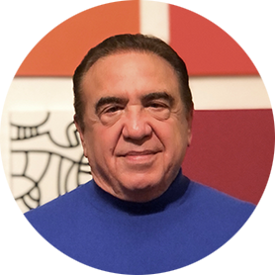


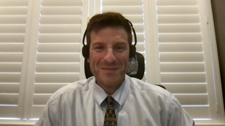
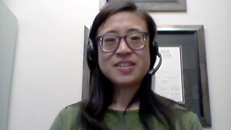
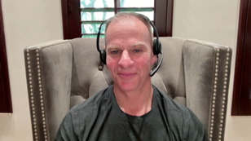
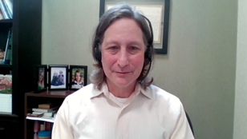
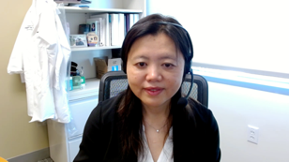
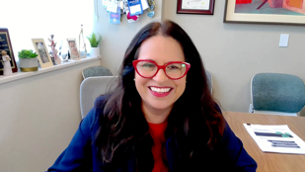


Consulting Oncologists
Neil Love, MD
Research To Practice
Miami, Florida
Laila Agrawal, MD
Norton Cancer Institute
Louisville, Kentucky
Shaachi Gupta, MD, MPH
Florida Cancer Specialists
& Research Institute
Lake Worth, Florida
Spencer H Bachow, MD
Lynn Cancer Institute
Boca Raton, Florida
Kimberly Ku, MD
Bloomington, Illinois
Warren S Brenner, MD
Lynn Cancer Institute
Boca Raton, Florida
Neil Morganstein, MD
Atlantic Health System
Summit, New Jersey
Gigi Chen, MD
John Muir Health
Pleasant Hill, California
Estelamari Rodriguez, MD, MPH
Sylvester Comprehensive Cancer Center
Miami, Florida
Sunil Gandhi, MD
Florida Cancer Specialists
& Research Institute
Lecanto, Florida
Erik Rupard, MD
Intermountain Health
St George, Utah

Slide 12
Agenda
Module 1: Optimizing the Management of Nonmetastatic Prostate Cancer — Dr Dorff
Module 2: Evidence-Based Selection of Treatment for Metastatic Hormone-Sensitive Prostate Cancer — Dr Smith
Module 3: New Considerations with the Use of PARP Inhibitors for Metastatic Castration-Resistant Prostate Cancer (mCRPC) — Dr Agarwal
Module 4: Role of Novel Radiopharmaceuticals for mCRPC —
Dr Armstrong
Module 5: Promising Investigational Approaches for Patients with Prostate Cancer — Dr Antonarakis

Slide 13
Agenda
Module 1: Optimizing the Management of Nonmetastatic Prostate Cancer — Dr Dorff
Module 2: Evidence-Based Selection of Treatment for Metastatic Hormone-Sensitive Prostate Cancer — Dr Smith
Module 3: New Considerations with the Use of PARP Inhibitors for Metastatic Castration-Resistant Prostate Cancer (mCRPC) — Dr Agarwal
Module 4: Role of Novel Radiopharmaceuticals for mCRPC —
Dr Armstrong
Module 5: Promising Investigational Approaches for Patients with Prostate Cancer — Dr Antonarakis

Slide 14
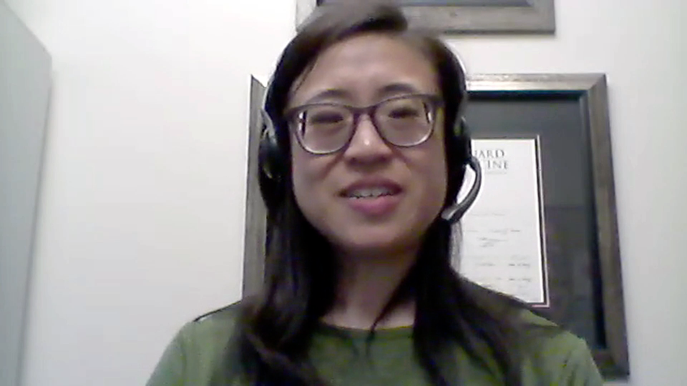
Consulting Faculty Comments
Management of very high-risk localized prostate cancer
Dr Kimberly Ku (Bloomington, Illinois)

Slide 15
QUESTIONS FOR THE FACULTY
In what situations are you considering treatment intensification for patients with newly diagnosed high-risk nonmetastatic hormone-sensitive prostate cancer?
How do you define high risk?
Are you always using abiraterone in this situation, or will you consider other AR pathway inhibitors?

Slide 16
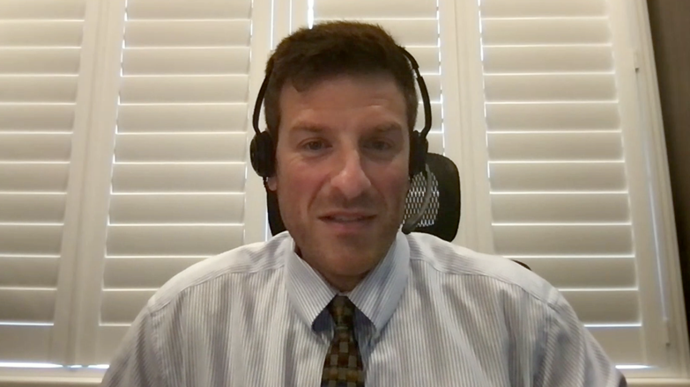

Consulting Faculty Comments
Androgen receptor (AR) inhibitors in the localized (M0) setting
Dr Spencer Bachow
(Boca Raton, Florida)
Dr Kimberly Ku
(Bloomington, Illinois)

Slide 17
QUESTIONS FOR THE FACULTY
How have findings from the EMBARK trial changed your practice?
For which patients with biochemical recurrence are you now offering androgen deprivation therapy (ADT) with enzalutamide?

Slide 18
QUESTIONS FOR THE FACULTY
How do you view findings from the PRESTO trial?
Would you find clinical equipoise in employing apalutamide instead of enzalutamide for a patient with biochemical recurrence for whom you wished to intensify treatment using an AR pathway inhibitor?

Slide 19
Non-metastatic (BCR) prostate cancer
Tanya Dorff, MD
Professor of Medicine
Section Chief, Genitourinary Cancer Program

Slide 20
Biochemical Recurrence of Prostate Cancer: New Data
EMBARK
  Data: Doublet (ADT + Enza) moves to high risk BCR
  Novel: Enzalutamide monotherapy
  Controversies: PET imaging and recategorization
PRESTO
  Data: Doublet (ADT + Apa) may be useful in BCR
  Confirms: AR antag + CYP17 inhib not beneficial
  Controversies: time to PSA rise as meaningful endpoint
nmCRPC: long term data from SPARTAN, ARAMIS and PROSPER
Ongoing trials
  ARASTEP

Slide 21
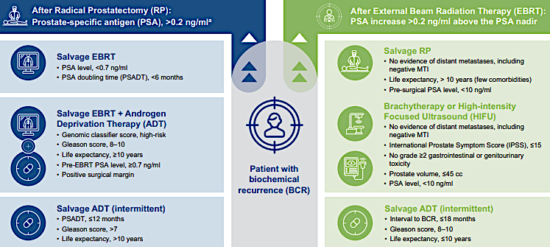
Taking a step back… BCR patients need to be contextualized
Initial disease characteristics and PSA DT are strong predictors
Newer technologies:
Decipher
ArteraAI
Shore ND et al. Prost Ca Prost Dis 2024; 27:192-201

Slide 22
EMBARK and PRESTO at a glance
 | EMBARK (n=1068) | PRESTO (n=503)
Inclusion | PSA DT ≤9 mo PSA ≥2 post RT or ≥1 post RRP | PSA DT ≤9 months PSA >0.5
Arms | A) Leuprolide B) Leuprolide + Enzalutamide C) Enzalutamide | A) Degarelix (or LHRH agonist) B) Degarelix + Apalutamide C) Degarelix + Apalutamide + Abiraterone
Treatmt duration | 36 weeks (stop if PSA <0.2) | 1 year
Baseline PSA | Median 5-5.5 (1-308) 50% had RRP + salvage RT 30% had prior ADT | Median 1.8 (1-3.6) 100% had RRP, 85% salvage RT 42% had prior ADT
Primary Endpt result | 5 year MFS (A vs B) 87.3% vs 71.4% HR 0.42 (0.30-0.61) | PSA PFS (incr by 25%, >2 ng/dL) A vs B 24.9 mo vs 20.3 HR 0.52 (0.35-0.77)

Slide 23
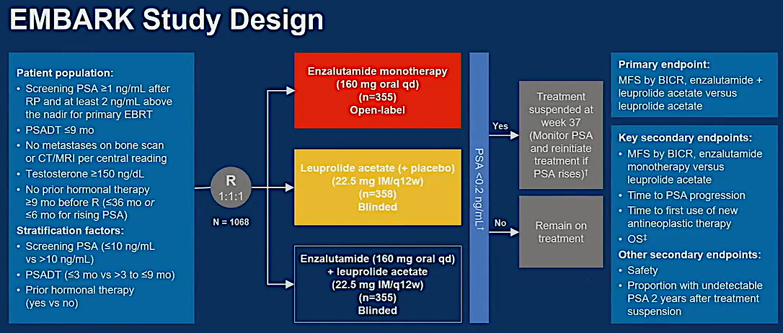
Shore ND et al. ASCO GU 2024;Abstract 15.

Slide 24
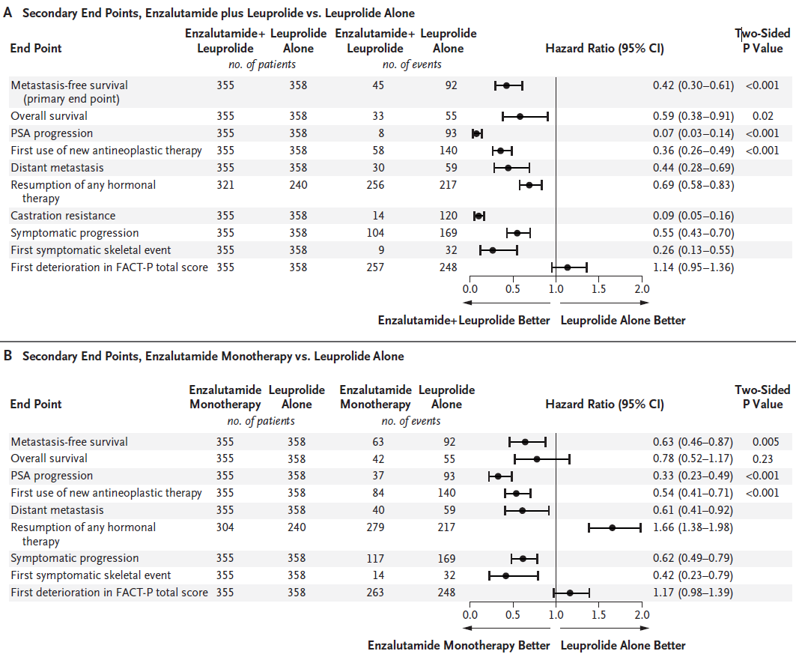
EMBARK
Doublet superior to LHRH agonist except for
- Deterioration in FACT-P
Enza monotherapy superior to LHRH agonist except for
time off treatment
Deterioration in FACT-P
91% on doublet got treatment break
68% on LHRH agonist
86% on Enza monotx
Freedland SJ et al. N Engl J Med. 2023;389(16):1453-1465.

Slide 25
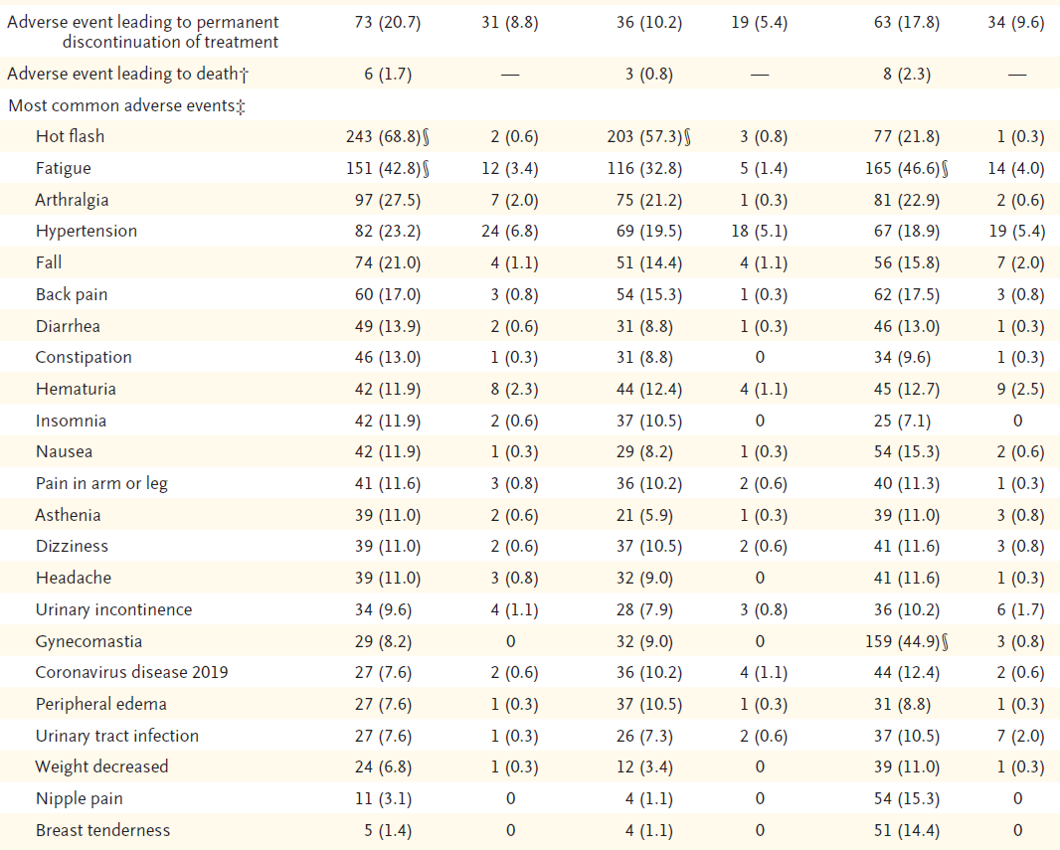
EMBARK
Adverse events
Freedland SJ et al. N Engl J Med. 2023;389(16):1453-1465.

Slide 26
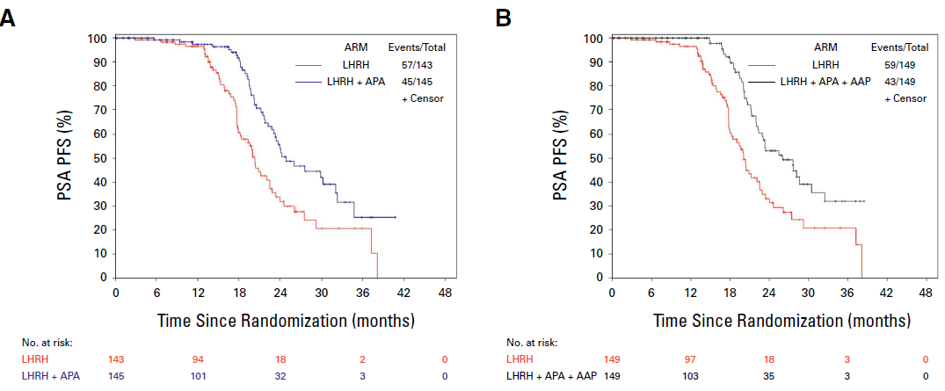
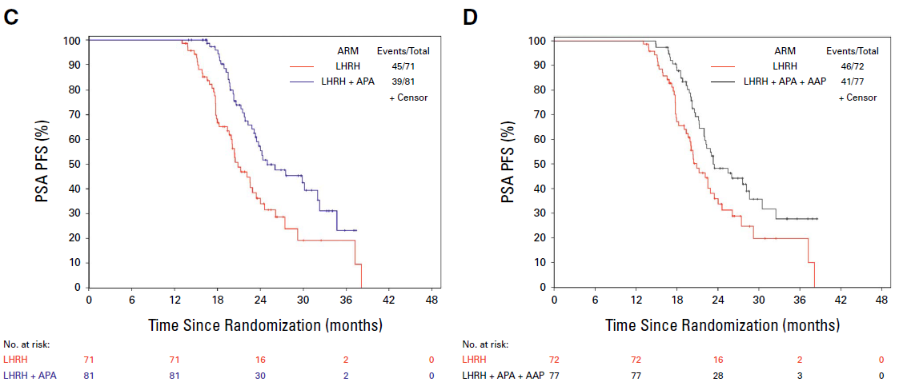
PRESTO primary endpoint
PSA PFS for ADT + Apa vs ADT (A) and triplet vs ADT (B)
Time to testosterone recovery >150
ADT + Apa (5.7 mo) vs ADT (5.1 months)
Longer with triplet (6.9 months)
Aggarwal R et al. J Clin Onc 2024; 42:1114-23

Slide 27
Treatment options in m0 CRPC
Study Name Agent | SPARTAN Apalutamide 240 mg daily | PROSPER Enzalutamide 160 mg daily | ARAMIS Darolutamide 600 mg BID
Design | 2:1 apa/placebo | 2:1 enza/placebo | 2:1 daro/placebo
Number of pts | 1207 | 1401 | 1509
Inclusion: | PSA DT <10 mo Pelvic LN <2 cm OK | PSA DT <10 mo -- bPSA >2 | PSA DT <10 mo Pelvic LN <2cm OK bPSA >2
Met Free Surv | 40.5 mo vs 16.2 placebo (HR 0.28) | 36.6 mo vs 14.7 placebo (HR 0.29) | 40.4 mo vs 18.4 placebo (HR 0.41)
Discontinuation | 10.6% apa, 7.0% placebo | 9% enza, 6% placebo | 8.9% daro, 8.7% placebo
Smith MR et al. NEJM 2018; 378:1408-1418
Hussain M et al. NEJM 2018; 378:2465-74
Fizazi K et al. NEJM 2019; 380:1235-46

Slide 28

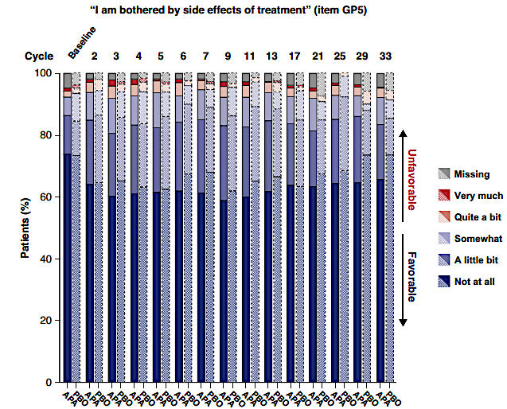
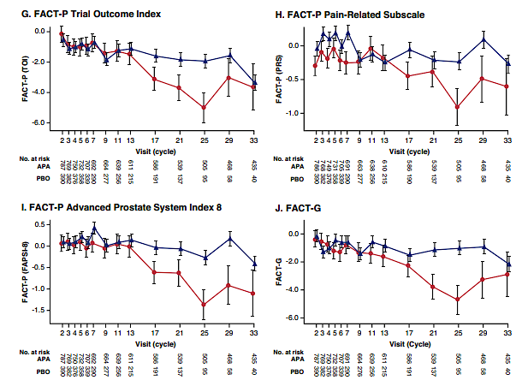
Long-term results from nmCRPC trials: SPARTAN (apalutamide)
Oudard S et al. Eur Urol Focus 2022; 8:958-67

Slide 29
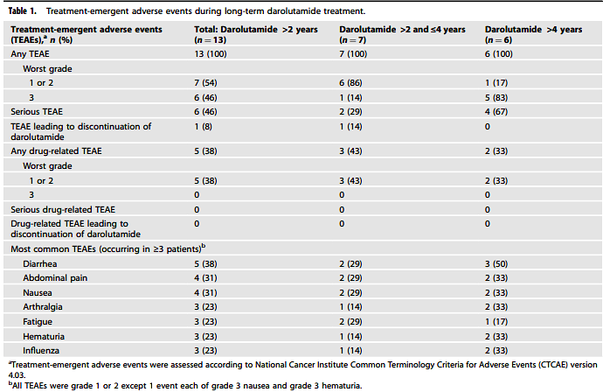
Long-term safety and tolerability of darolutamide: ARAMIS
Very small subset of patients
No new safety signals emerged
No DEXA data
Jones RH et al. Prost Ca Prost Dis 2023; 1-4

Slide 30
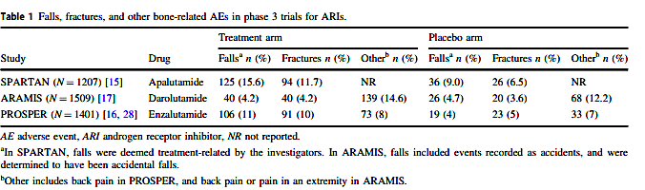
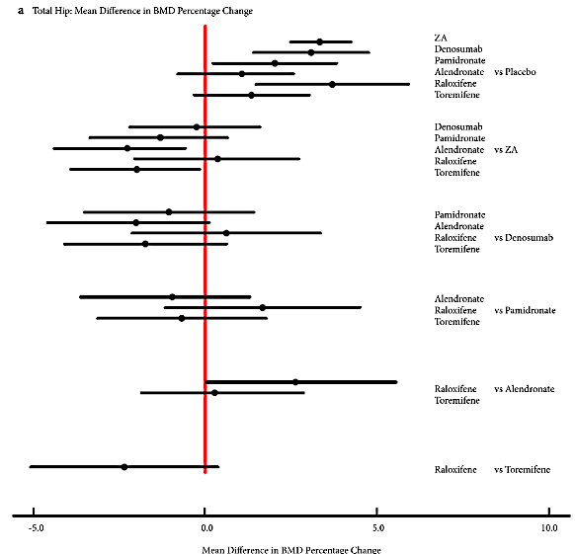
Bone health in nmCRPC
Management strategies:
Vitamin D +/- Calcium
Exercise
Regular screening by DEXA
Bone support agents
Hussain A et al. PCAN 2021; 24:290-300
Poon Y et al. BJUI 2018; 121:17-28

Slide 31
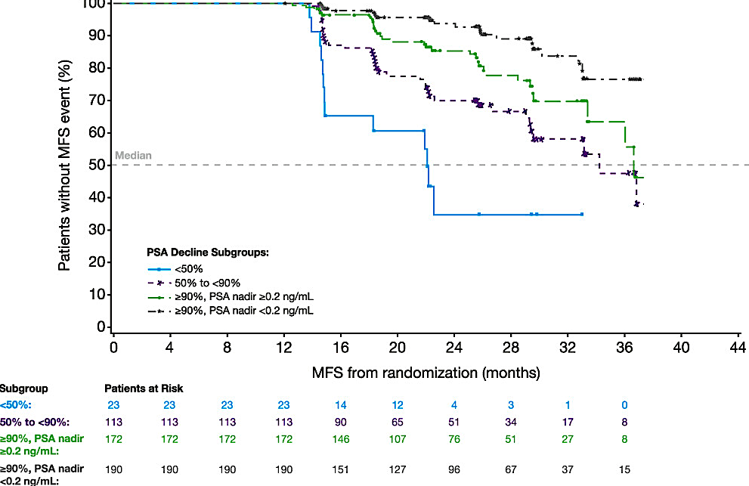
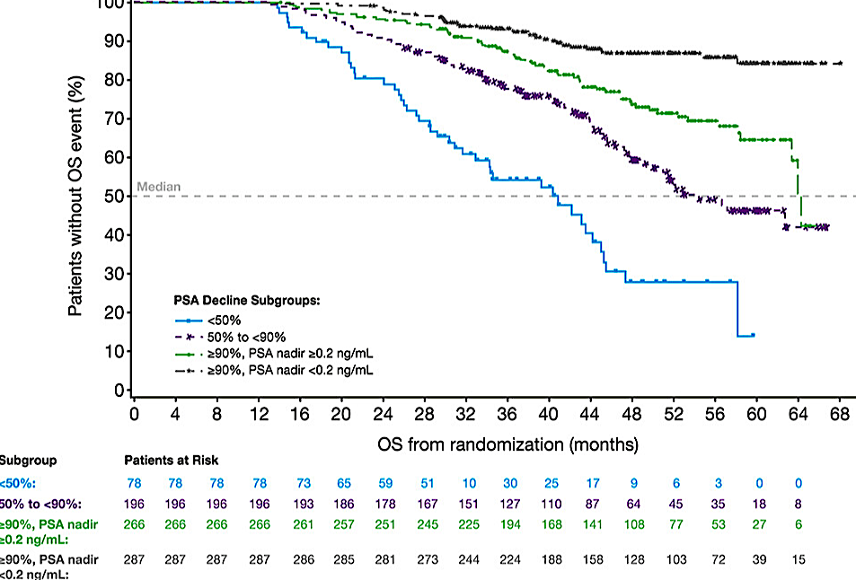
Long-term analysis from PROSPER: PSA nadir associated with benefit
Other nmCRPC trials have also shown this
No known intervention for those with inadequate PSA nadir
Hussain M et al. J Urol 2023; 209:532-9

Slide 32
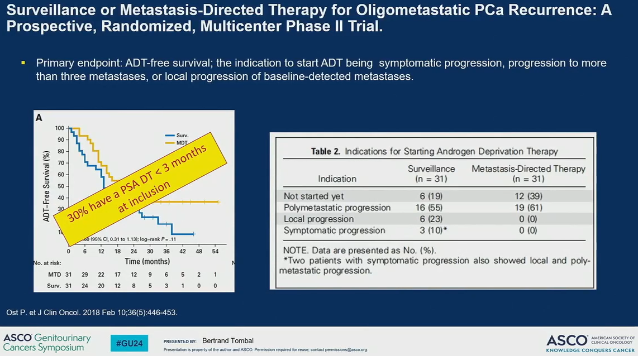
Alternative approaches to systemic management: use PSMA PET → MDT
No OS benefit
For some men delaying ADT is a goal

Slide 33
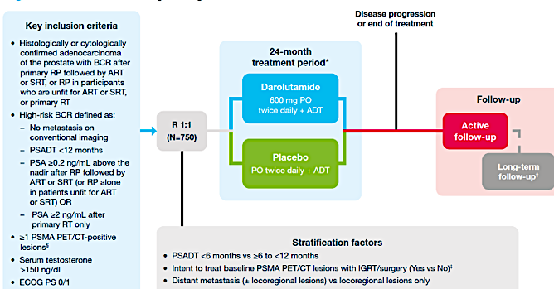
Ongoing phase 3 trials: ARASTEP
Addresses the unmet need of PSMA PET+
TiP poster ASCO 2024
Chehrazi-Raffle et al

Slide 34
Ongoing trials in the BCR space
NCT05478239 | N=30 | ArtemiCoffee in patients with rising PSA | PSA 50% decline in 24 weeks | Kentucky
NCT03753334 | N=40 | EPA (LCn3 supp) | Change in PSA DT | Quebec
NCT04519879 | N=66 | White button mushroom supplement | Change in PSA during 48 weeks | COH (S. Calif)
NCT04114825 | N=180 | RV001V (BRaVac) | Time to PSA progression | Completed accrual, awaiting results

Slide 35
Agenda
Module 1: Optimizing the Management of Nonmetastatic Prostate Cancer — Dr Dorff
Module 2: Evidence-Based Selection of Treatment for Metastatic Hormone-Sensitive Prostate Cancer — Dr Smith
Module 3: New Considerations with the Use of PARP Inhibitors for Metastatic Castration-Resistant Prostate Cancer (mCRPC) — Dr Agarwal
Module 4: Role of Novel Radiopharmaceuticals for mCRPC —
Dr Armstrong
Module 5: Promising Investigational Approaches for Patients with Prostate Cancer — Dr Antonarakis

Slide 36

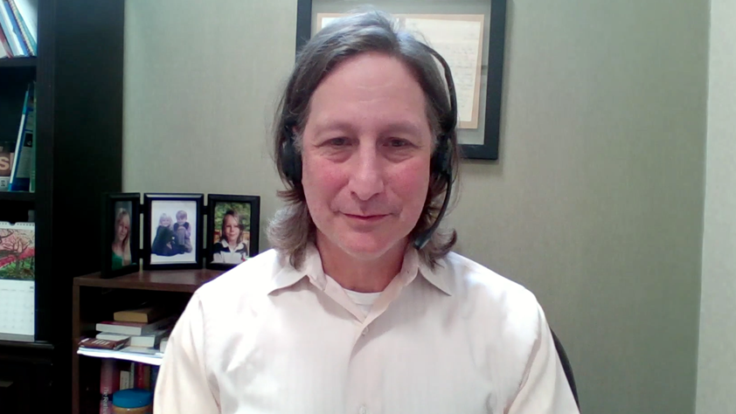

Consulting Faculty Comments
Optimal selection of initial therapy for patients with
metastatic hormone-sensitive prostate cancer
and integration of triplet therapy
Dr Shaachi Gupta
(Lake Worth, Florida)
Dr Neil Morganstein
(Summit, New Jersey)
Dr Gigi Chen
(Pleasant Hill, California)

Slide 37
QUESTIONS FOR THE FACULTY
Given they have never been evaluated head to head, is there any evidence that ADT/docetaxel/darolutamide is superior to ADT with an AR pathway inhibitor alone?
For which types of patients are you prioritizing the triplet of ADT/docetaxel/darolutamide over other available options?

Slide 38
QUESTIONS FOR THE FACULTY
When using ADT in combination with an AR pathway inhibitor in the hormone-sensitive metastatic setting, which agent are you most frequently utilizing?
Are you comfortable using ADT/darolutamide without docetaxel?

Slide 39

Consulting Faculty Comments
Initial treatment options for older patients; durability of
responses observed with AR inhibitors and with relugolix
Dr Erik Rupard (St George, Utah)

Slide 40
Cancer care in the Amish community
Dr Erik Rupard (St George, Utah)
To view, visit https://www.ResearchToPractice.com/ASCO24Clip

Slide 41
QUESTIONS FOR THE FACULTY
Do you approach patients who present de novo with metastatic disease any differently than those who experience relapse after localized therapy?
How important is volume of disease in making these decisions?

Slide 42



Evidence-Based Selection of Treatment for Metastatic Castration-Sensitive Prostate Cancer (mCSPC)
Matthew R. Smith, M.D.,Ph.D.
Professor of Medicine, Harvard Medical School
Director, MGH Genitourinary Malignancies Program
Notes:
42

Slide 43
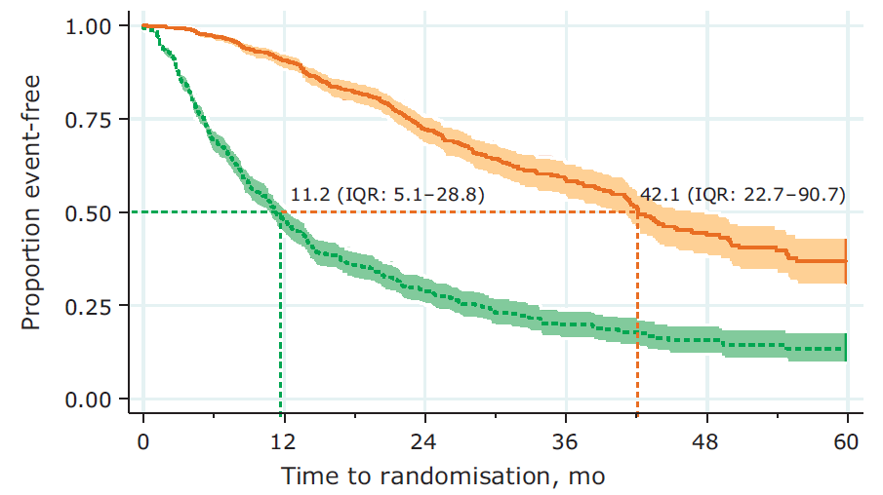
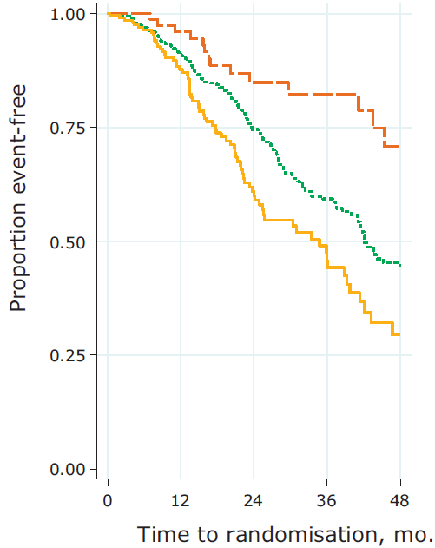
Clinical Outcomes in Metastatic Prostate Cancer:
STAMPEDE Experience with ADT
Death
Soft tissue only
Bone only
Bone and soft tissue
Failure event
(PSA progression, local progression, distant metastases, or death)
STAMPEDE Control Arm
Metastatic disease
Accrued 10/2005-1/2014
N=917
James ND et al (2015) Eur Urol 67: 1028-1038

Slide 44
Level 1 Evidence for Improved Overall Survival in mCSPC
Studies | Intervention | Control | Comments
GETUG-AFU 15 CHAARTED STAMPEDE-C | Docetaxel + ADT | ADT | Benefit in high-volume subgroup
LATITUDE STAMPEDE-G | Abiraterone + ADT | ADT | Similar benefits by risk group
ARCHES ENZAMET | Enzalutamide + ADT | ADT | Similar benefits by risk group
TITAN | Apalutamide + ADT | ADT | Similar benefits by risk group
ARASENS | Darolutamide + ADT + docetaxel | ADT + docetaxel | Similar benefits for recurrent and de novo metastatic disease
PEACE-1 | Abiraterone +ADT + docetaxel (+/- prostate radiation) | ADT + docetaxel (+/- prostate radiation) | Subgroup analysis
Gravis et al Lancet Oncol 2013; Sweeney et al NEJM 2015; James N et al Lancet 2015; Attard G et al Lancet Oncol 2023; Fizazi K et al NEJM 2017; James et al NEJM 2017; Armstrong et al JCO 2021; Davis et al NEJM 2019; Chi KN et al NEJM 2019; Smith MR et al NEJM 2022; Fizazi K et al Lancet 2022

Slide 45
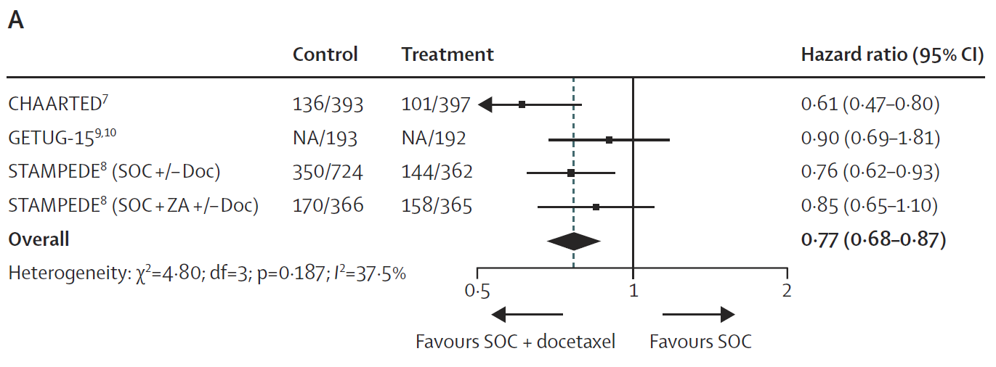
Meta-Analysis of RCTs of Docetaxel in mCSPC
Overall Survival
GETUG-AFU 15^{9,10}
Results based on 2993 men/2198 events
9% absolute improvement in survival at 4 years
Vale et al. Lancet Oncol 2016; 17(2):243-56

Slide 46
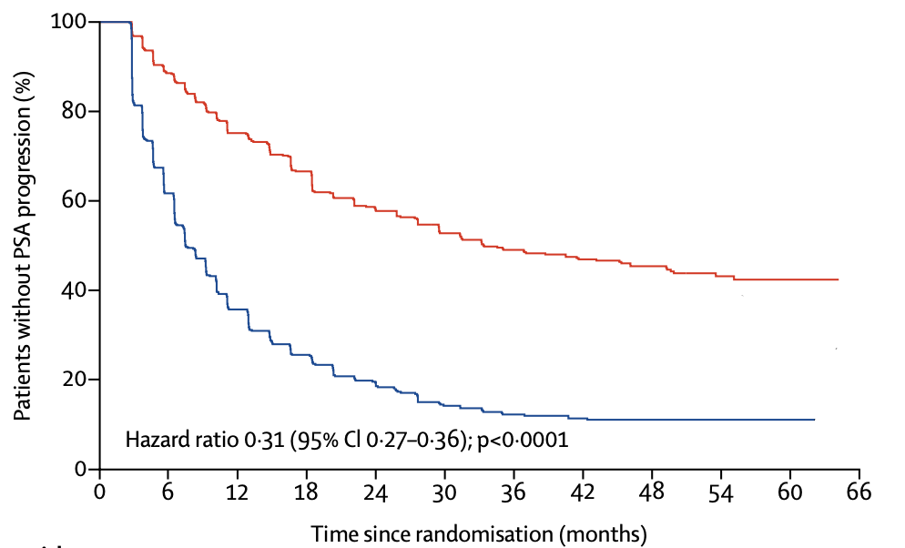
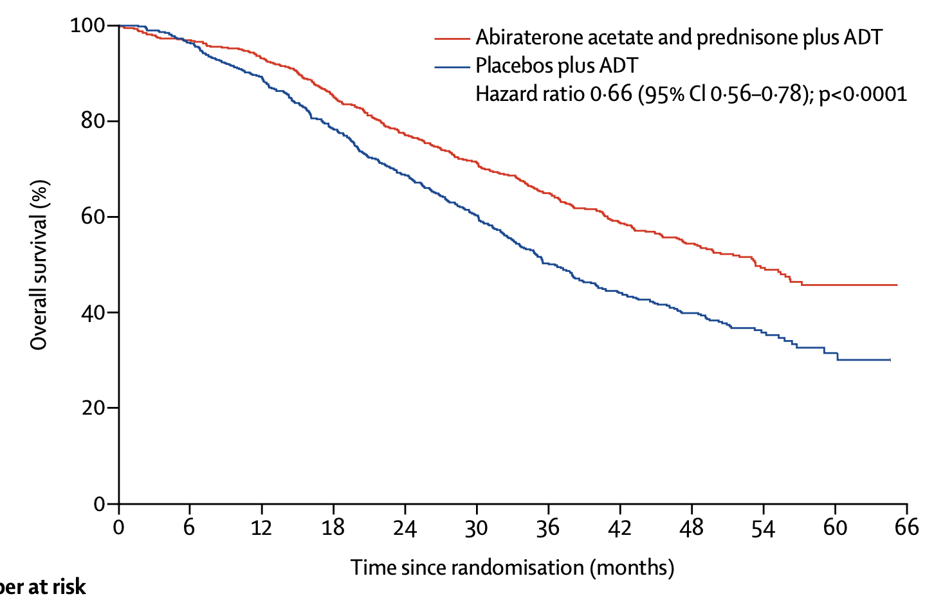
LATITUDE: Abiraterone Acetate for mCSPC
SPARTAN ─ Overall Study Design
Phase 3 Placebo-Controlled, Randomized International Study
Radiographic Progression-Free Survival Overall Survival
Fizazi K et al. Lancet Oncol 2019; 20: 686–700

Slide 47
STAMPEDE: Docetaxel vs Abiraterone Comparison
SPARTAN ─ Overall Study Design
Phase 3 Placebo-Controlled, Randomized International Study
Sydes et al (2018) Annals of Oncology 29:1235-1248

Slide 48
STAMPEDE: Docetaxel vs Abiraterone Comparison
SPARTAN ─ Overall Study Design
Phase 3 Placebo-Controlled, Randomized International Study
Overall Survival
Overall Survival
Sydes et al (2018) Annals of Oncology 29:1235-1248

Slide 49
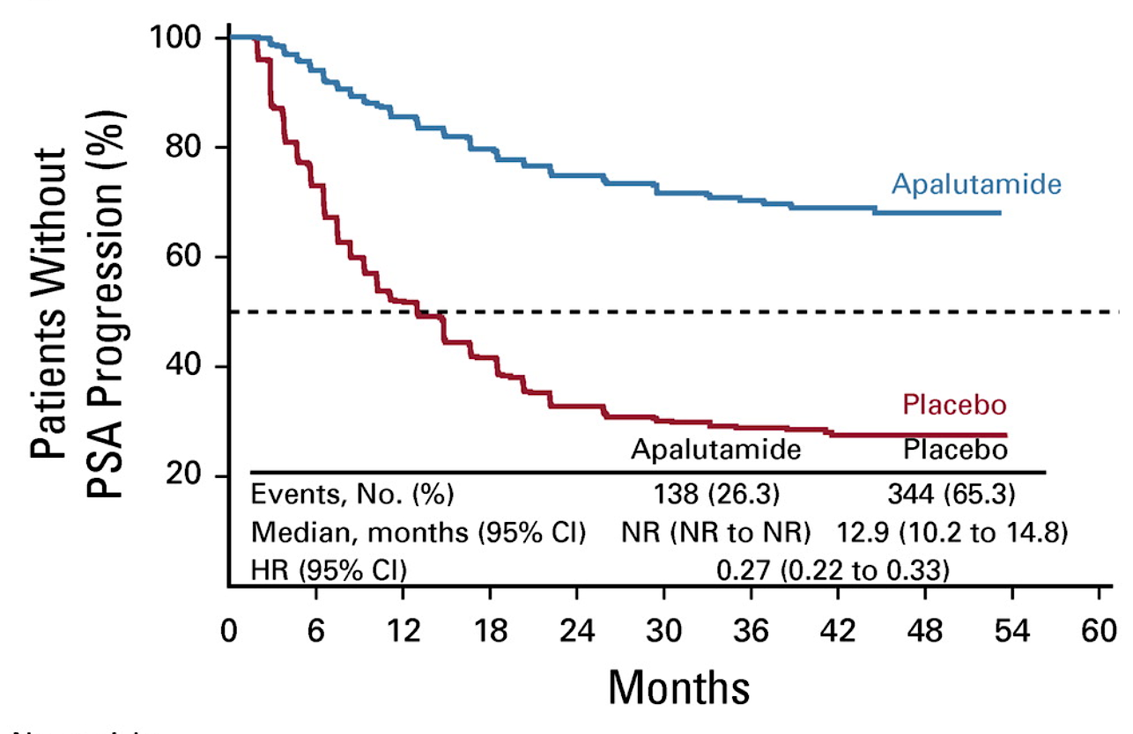
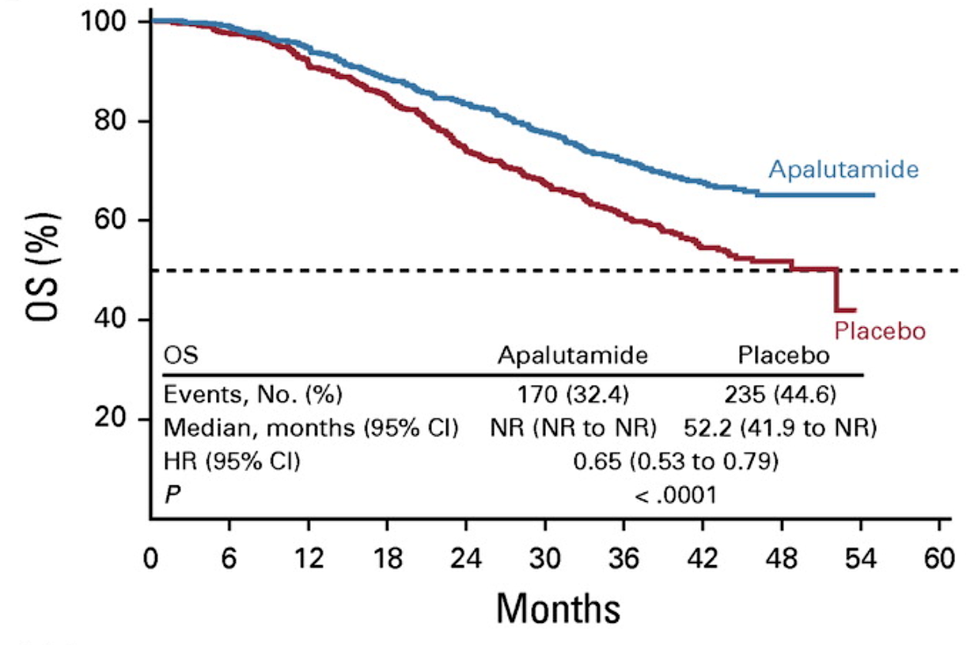
TITAN: Apalutamide for mCSPC
SPARTAN ─ Overall Study Design
Phase 3 Placebo-Controlled, Randomized International Study
Radiographic Progression-Free Survival Overall Survival
Chi KN, Chowdhury S, Bjartell A, et al. J Clin Oncol. 2021;39(20):2294-2303.

Slide 50
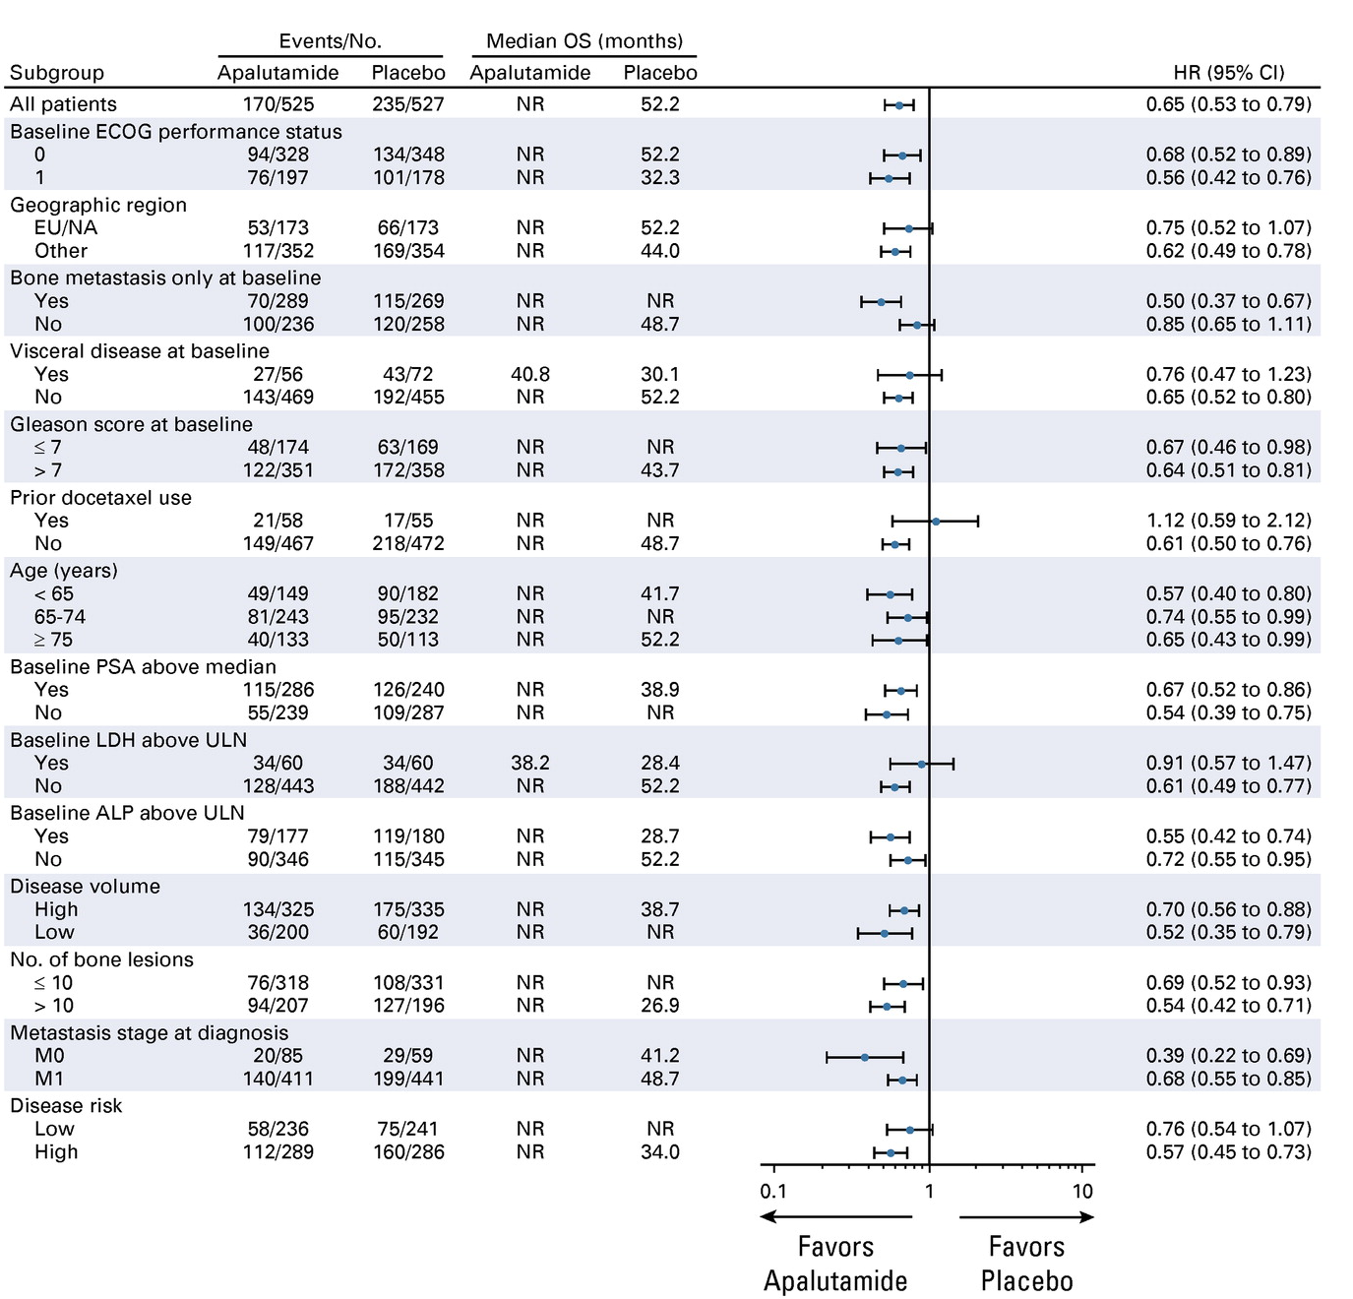
Overall Survival
TITAN Subgroup Analyses
SPARTAN ─ Overall Study Design
Phase 3 Placebo-Controlled, Randomized International Study
Chi KN, Chowdhury S, Bjartell A, et al. J Clin Oncol. 2021;39(20):2294-2303.

Slide 51
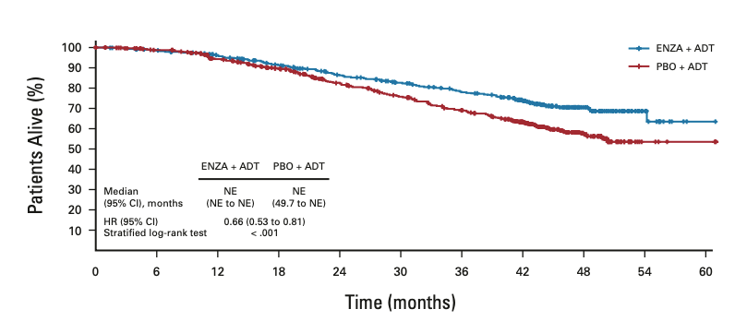
ARCHES: Enzalutamide for mCSPC
SPARTAN ─ Overall Study Design
Phase 3 Placebo-Controlled, Randomized International Study
rPFS
OS
Armstrong et al (2019) J Clin Oncol 37: 2974-2986; Armstrong et al (2022) J Clin Oncol DOI: 10.1200/JCO.22.00193

Slide 52
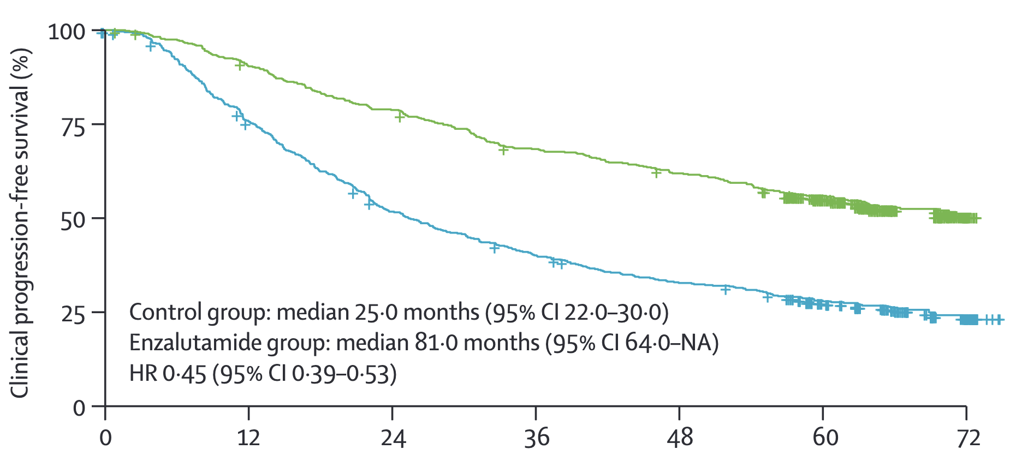
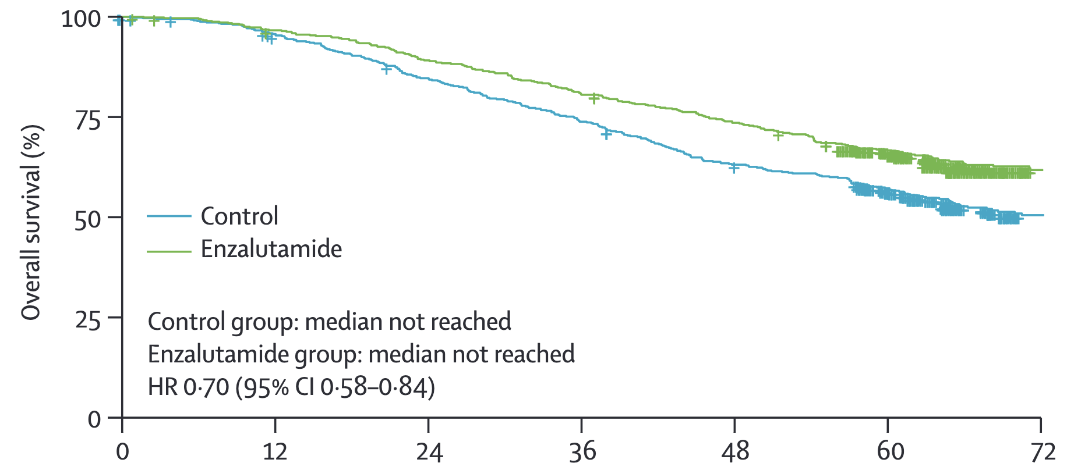
ENZAMET: Enzalutamide for mCSPC
SPARTAN ─ Overall Study Design
Phase 3 Placebo-Controlled, Randomized International Study
Clinical Progression-Free Survival Overall Survival
Time since randomization (months)
Time since randomization (months)
Sweeney CJ, Martin AJ, Stockler MR, et al. Lancet Oncol. 2023;24(4):323-334

Slide 53
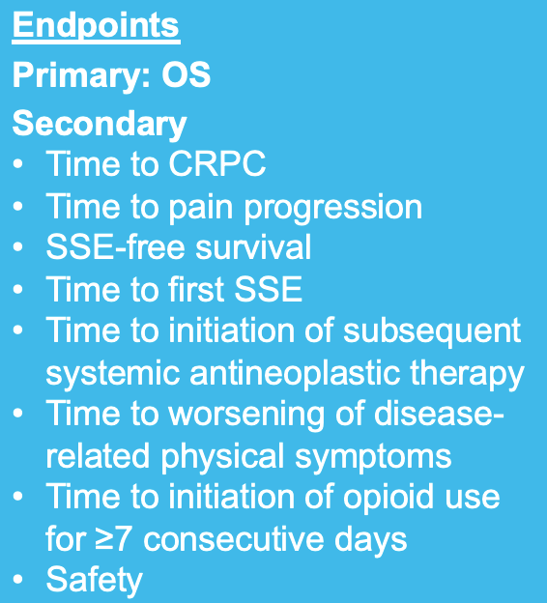
53
ARASENS Study Design
Global, randomized, double-blind, placebo-controlled phase III study (NCT02799602)
Docetaxel × 6
Endpoints
Primary: OS
Secondary
Time to CRPC
Time to pain progression
SSE-free survival
Time to first SSE
Time to initiation of subsequent systemic antineoplastic therapy
Time to worsening of disease-related physical symptoms
Time to initiation of opioid use for ≥7 consecutive days
Safety
Patients (N=1306)
mHSPC
ECOG PS 0 or 1
Candidates for ADT and docetaxel
Stratification
Extent of disease: M1a vs M1b vs M1c
ALP < vs ≥ ULN
Darolutamide 600 mg twice daily + ADT
1:1
randomization
(N=1305*)
Primary analysis
Placebo twice daily + ADT
Docetaxel × 6
FPFV: Nov 2016
LPFV: June 2018
Data cut-off
Oct 25, 2021
The primary analysis was planned to occur after ~509 deaths
Secondary efficacy endpoints were tested hierarchically
*One enrolled patient was excluded from all analysis sets because of Good Clinical Practice violations. ALP, alkaline phosphatase; CRPC, castration-resistant prostate cancer; ECOG PS, Eastern Cooperative Oncology Group performance status; FPFV, first patient first visit; LPFV, last patient first visit; M1a, nonregional lymph node metastases only; M1b, bone metastases ± lymph node metastases; M1c, visceral metastases ± lymph node or bone metastases; Q3W, every 3 weeks; SSE, symptomatic skeletal event; ULN, upper limit of normal.
Smith et al (2022) N Engl J Med DOI: 10.1056/NEJMoa2119115

Slide 54
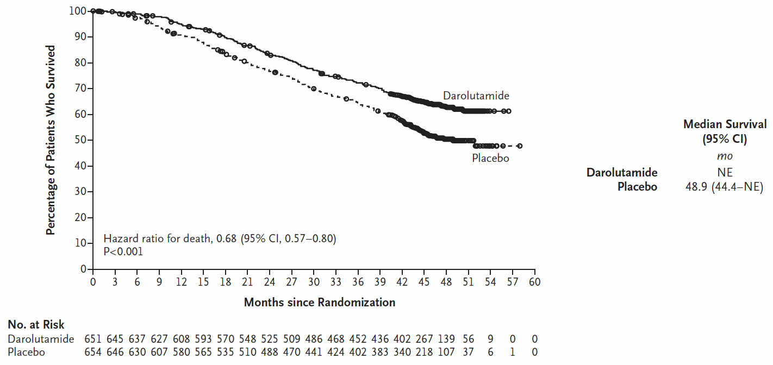
ARASENS Primary Endpoint: Overall Survival
Smith et al (2022) N Engl J Med DOI: 10.1056/NEJMoa2119115

Slide 55
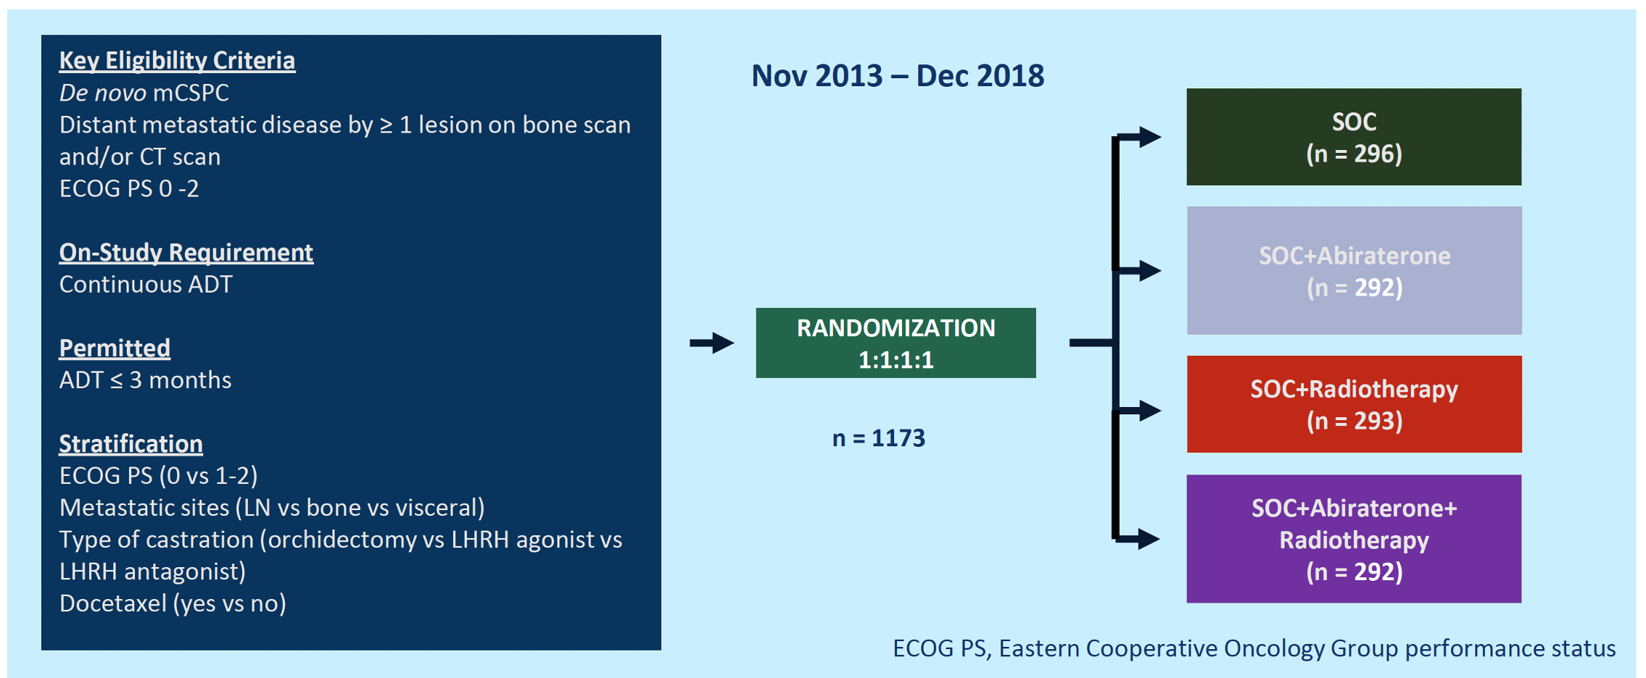

PEACE-1 Study Design

Slide 56
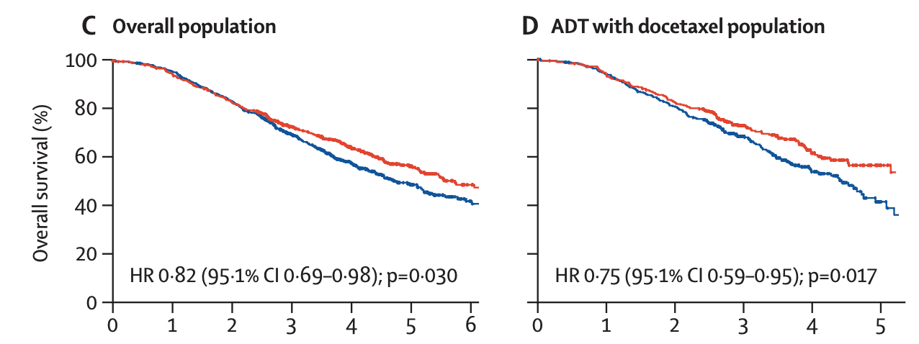
PEACE-1: Overall Survival
Fizazi et al (2022) Lancet https://doi.org/10.1016/ S0140-6736(22)00367-1

Slide 57
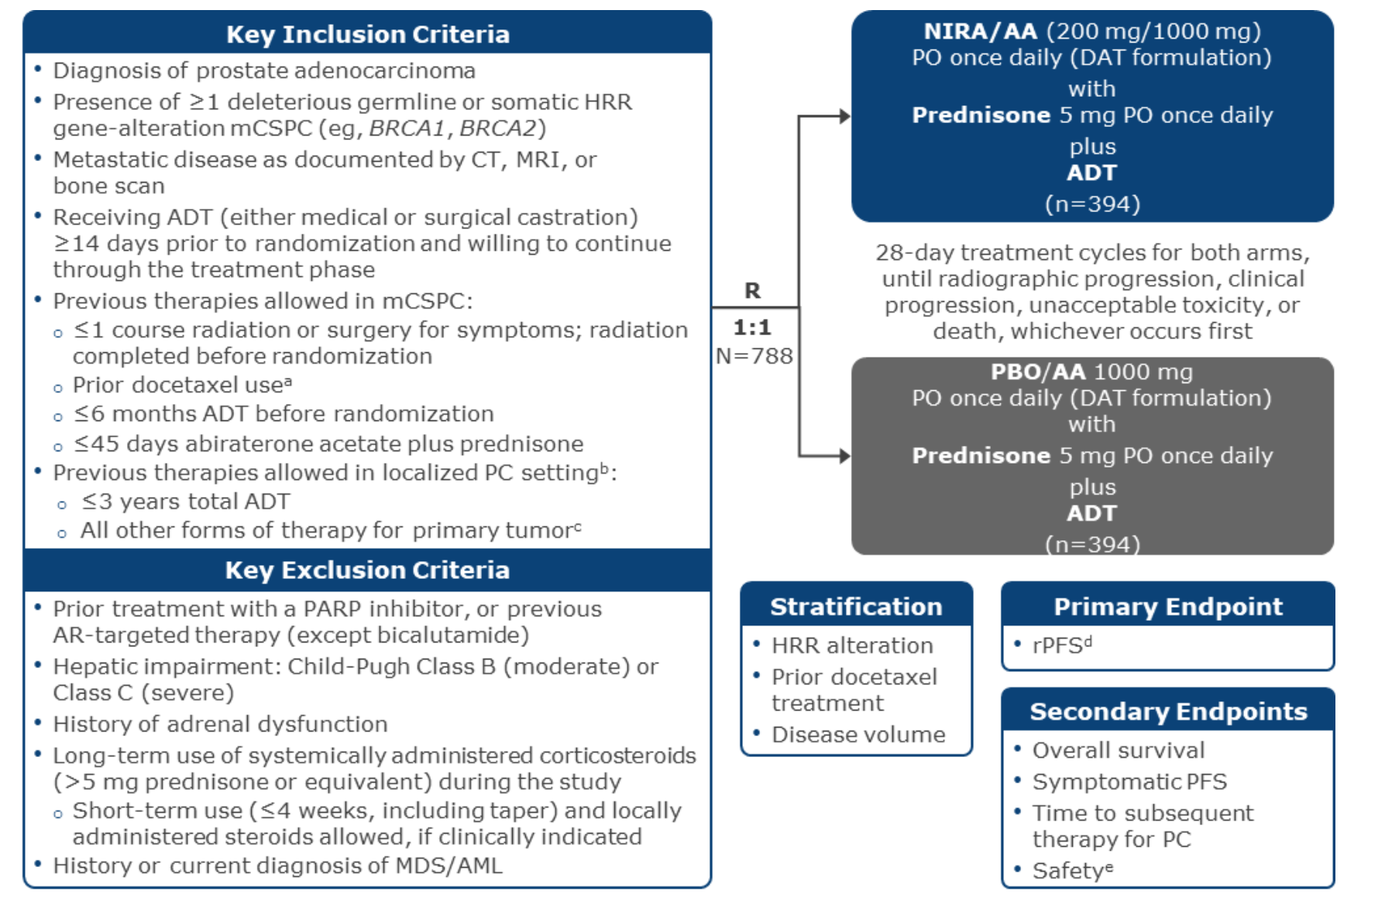
AMPLITUDE Study Design
ClinicalTrials.gov NCT04497844

Slide 58
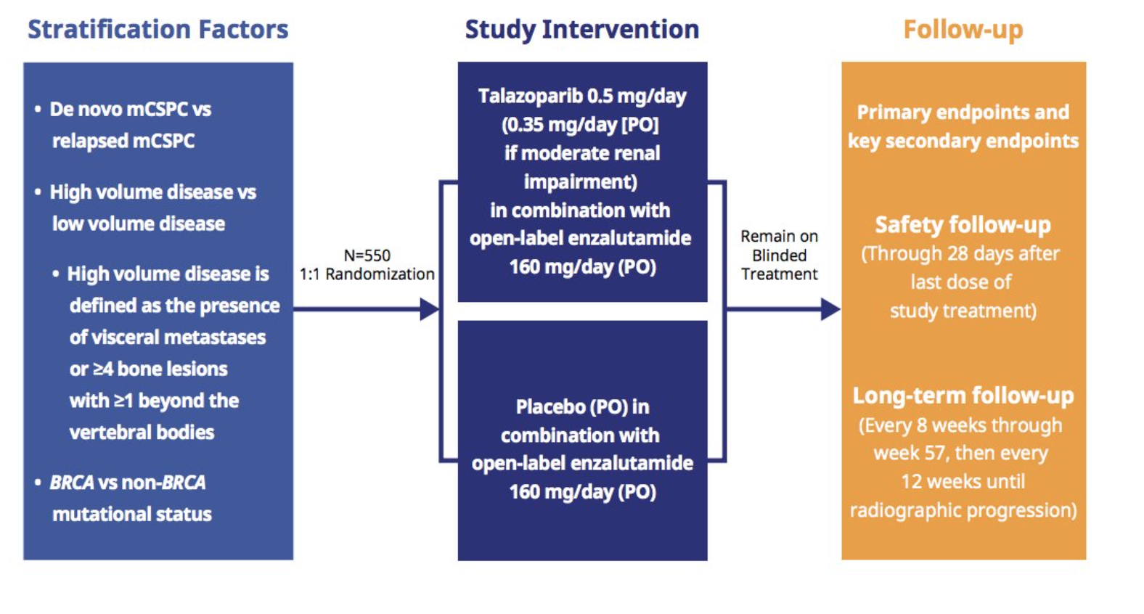
TALAPRO-3 Study Design
ClinicalTrials.gov NCT04821622

Slide 59
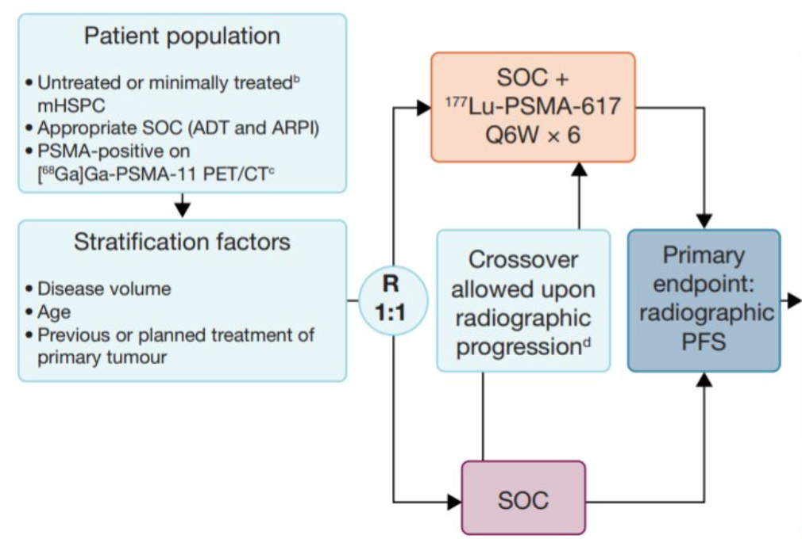
PSMAddition: Phase 3 Trial of ¹⁷⁷Lu-PSMA-617 in mCSPC
ClinicalTrials.gov NCT04720157

Slide 60
Conclusions
ADT alone is not a standard of care for most patients with mCSPC
Treatment intensification improves overall survival in mCSPC
  ADT + docetaxel > ADT alone
  ADT + ARPI >ADT alone
  ADT + docetaxel + darolutamide > ADT + docetaxel
  ADT + docetaxel + abiraterone > ADT + docetaxel
Most/all patients with mCSPC should receive an ARPI:
  ADT +ARPI
  ADT + docetaxel + ARPI (darolutamide or abiraterone)
Ongoing phase 3 clinical trials will evaluate the role of PARPi and
PSMA RLT in mCSPC

Slide 61
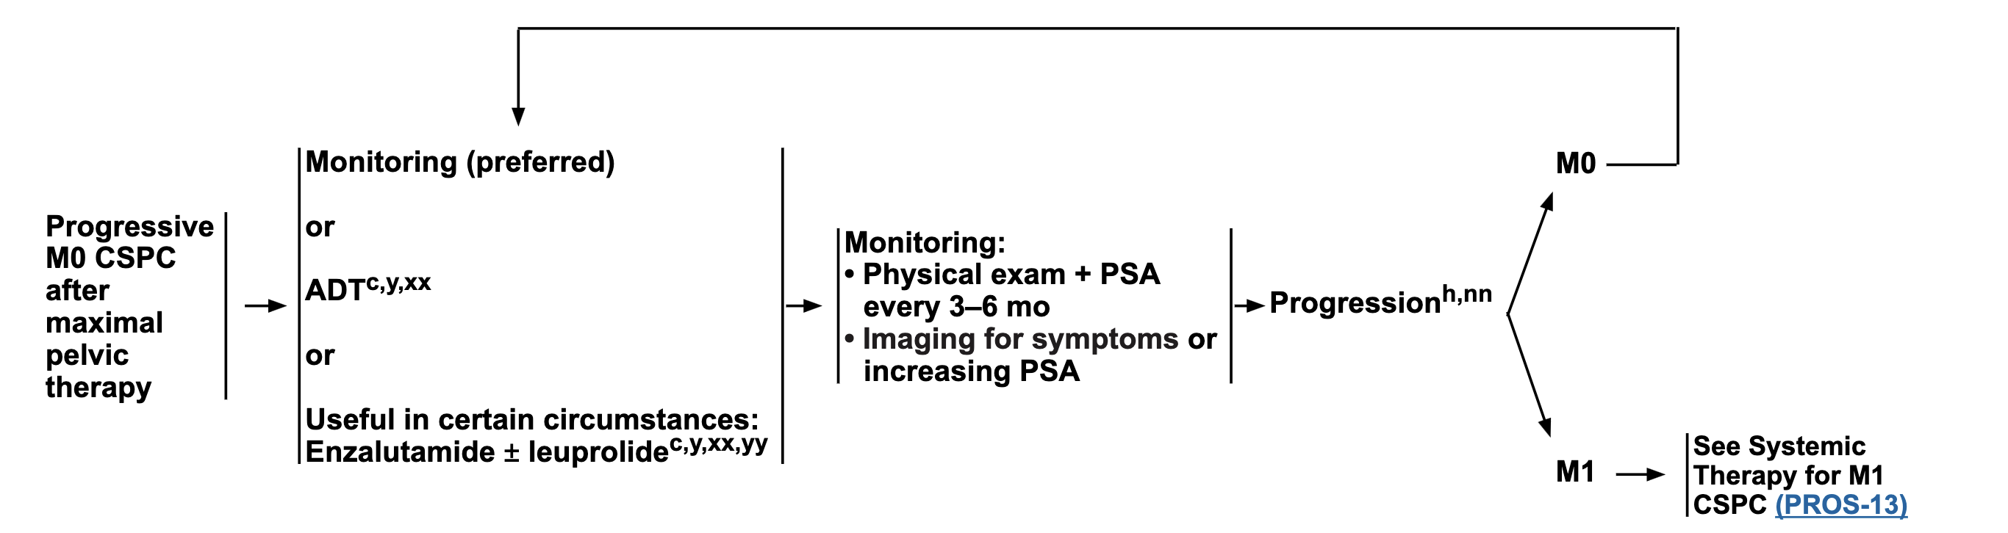
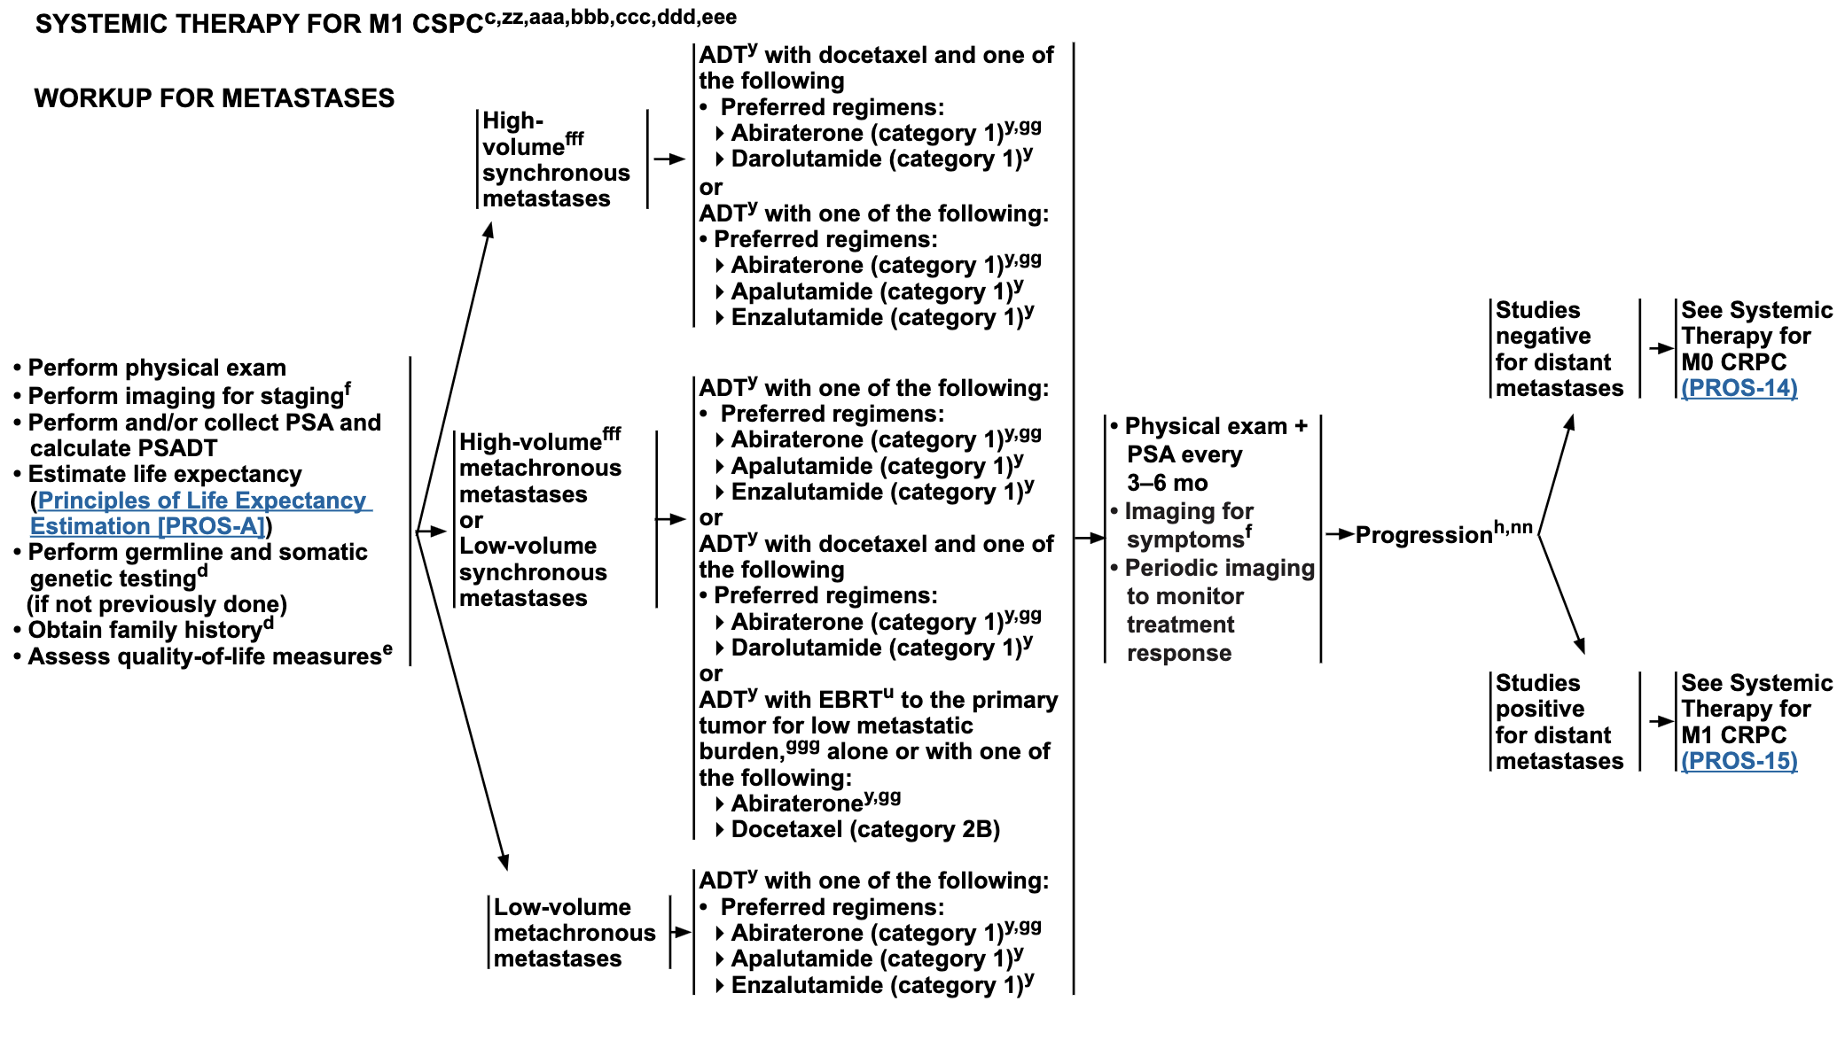
Accessed May 2024.

Slide 62
Agenda
Module 1: Optimizing the Management of Nonmetastatic Prostate Cancer — Dr Dorff
Module 2: Evidence-Based Selection of Treatment for Metastatic Hormone-Sensitive Prostate Cancer — Dr Smith
Module 3: New Considerations with the Use of PARP Inhibitors for Metastatic Castration-Resistant Prostate Cancer (mCRPC) — Dr Agarwal
Module 4: Role of Novel Radiopharmaceuticals for mCRPC —
Dr Armstrong
Module 5: Promising Investigational Approaches for Patients with Prostate Cancer — Dr Antonarakis

Slide 63



Consulting Faculty Comments
Role of liquid biopsies; selection of PARP inhibitor for patients with mCRPC and risk of myelodysplasia with these agents
Dr Neil Morganstein
(Summit, New Jersey)
Dr Kimberly Ku
(Bloomington, Illinois)
Dr Sunil Gandhi
(Lecanto, Florida)

Slide 64
QUESTIONS FOR THE FACULTY
Do you believe there is therapeutic synergy between PARP inhibitors and AR pathway inhibitors?
Is combination therapy really better than sequential single agents in this case?

Slide 65
QUESTIONS FOR THE FACULTY
When combining a PARP inhibitor with an AR pathway inhibitor, do you have a preference for abiraterone or enzalutamide, and if so, why?

Slide 66
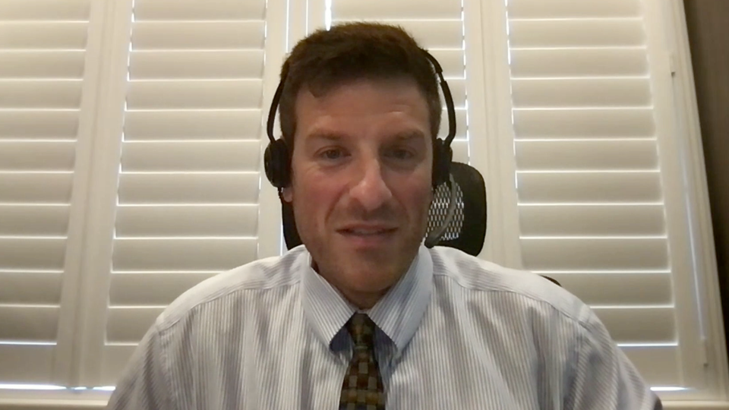
Consulting Faculty Comments
Use of PARP inhibitors in combination with ADT and AR inhibitors for patients with mCRPC; PARP inhibitor combination therapy for patients without BRCA or HRR gene mutations
Dr Kimberly Ku
(Bloomington, Illinois)
Dr Spencer Bachow
(Boca Raton, Florida)

Slide 67
QUESTIONS FOR THE FACULTY
Do you make a clinical distinction among the various HRD pathway abnormalities? Do you view certain alterations as truly sensitive to PARP inhibition and others as only marginal in terms of their relevance?

Slide 68
QUESTIONS FOR THE FACULTY
For a patient who has received an AR pathway inhibitor in an earlier disease setting, do you generally favor PARP-inhibitor monotherapy or will you combine the PARP inhibitor with an alternate AR pathway inhibitor?

Slide 69
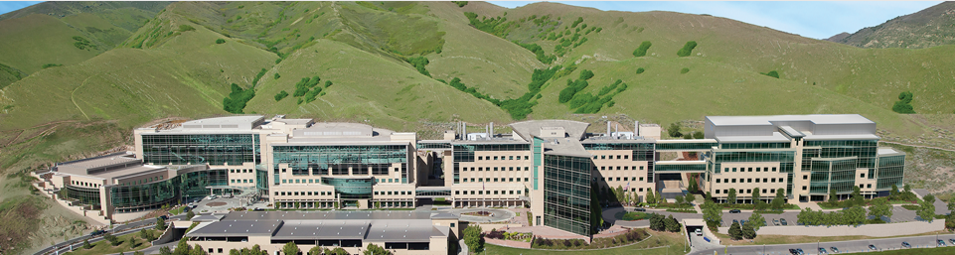
New Considerations with the Use of PARP Inhibitors for mCRPC
Neeraj Agarwal, MD, FASCO
Professor of Medicine (Medical Oncology)
Senior Director for Clinical Translation, Huntsman Cancer Institute (HCI)
HCI Presidential Endowed Chair of Cancer Research
Director, Center of Investigational Therapeutics
Director, Genitourinary Oncology Program
Huntsman Cancer Institute, University of Utah (NCI-CCC)

Slide 70
Learning Objectives
Incidence of BRCA1/2 and other HRR abnormalities in patients with prostate cancer
Long-term data with PARPi monotherapy in patients with mCRPC
Biologic rationale for combining PARP inhibitors with ARPIs in patients with prostate cancer
Key efficacy and safety results from phase 3 studies combining PARPi with ARPIs

Slide 71
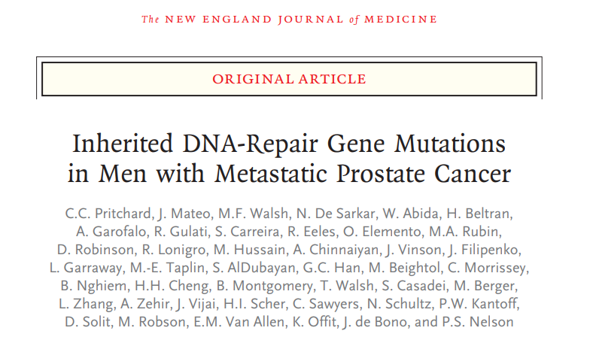
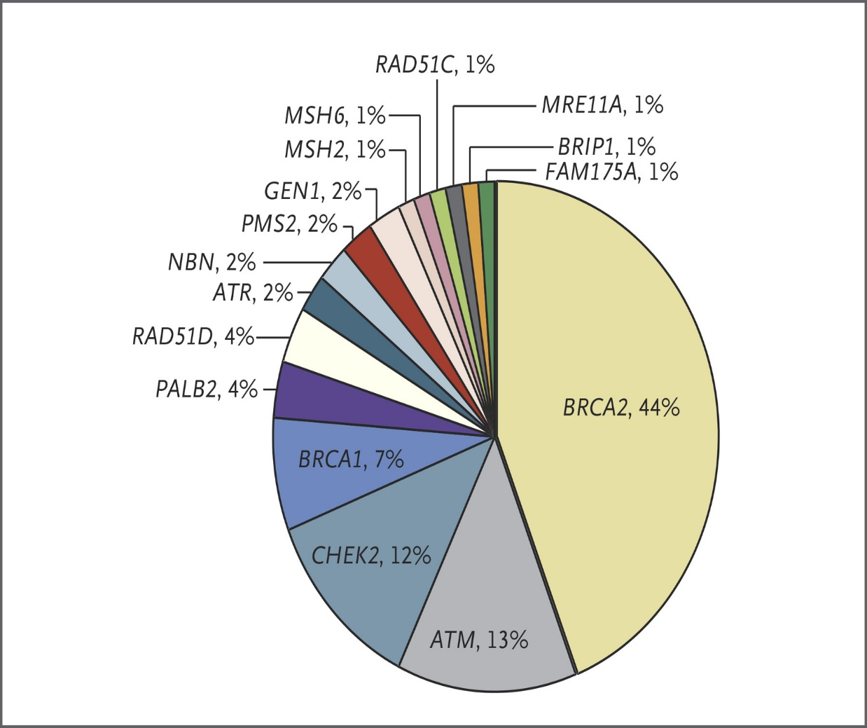
Germline HRR Mutations in Metastatic Prostate Cancer
Germline mutations in DNA repair genes: 11.8%
Pritchard et al. NEJM 2016

Slide 72
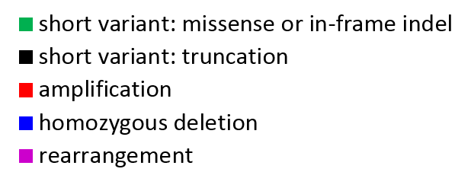



Genomic Landscape in Advanced Prostate Cancer (Tissue DNA)
n=3476 (Primary site: 1660; Metastatic site: 1816)
HRR pathway alterations: 23.4%.
Other DNA repair pathway alterations (FA/ICL): 4.8%,
CDK12 (5.6%),
Chung JH, …, Agarwal N. JCO Precision Oncology 2019
Notes:
The histogram above shows the frequency and type of GAs with the most frequent ones in <CLICK> TP53, PTEN, AR, MYC, and BRCA2. Many of the alterations detected are targetable with drugs already available in the clinic. Fanconi anemia/interstrand crosslink repair (FA/ICL). Homologous recombination repair (HRR)–related pathway alterations were observed in 23.4% of cases (Fig 1B), and other DNA repair pathway alterations included Fanconi anemia/interstrand crosslink repair (FA/ICL) genes (4.8%), CDK12 (5.6%), mismatch repair (MMR) genes (4.3%), and the DNA polymerase gene POLE (0.1%; Fig 1B).

Slide 73
Learning Objectives
Incidence of BRCA1/2 and other HRR abnormalities in patients with prostate cancer
Long-term data with PARPi monotherapy in patients with mCRPC
Biologic rationale for combining PARP inhibitors with ARPIs in patients with prostate cancer
Key efficacy and safety results from phase 3 studies combining PARPi with ARPIs

Slide 74

Efficacy of PARPi Monotherapy in mCRPC
ratio
Agarwal N. Fizazi K. European Journal of Cancer, 2023.

Slide 75

PROfound Trial: Phase 3 Trial Design
Olaparib 300 mg bid
n = 162
Primary endpoint:
rPFS by BICR in Cohort A
(alpha=0.05)
Key eligibility criteria
mCRPC
Disease progression on prior NHA, eg enzalutamide and/ or abiraterone treatment
Alterations in ≥1 of any qualifying gene with a direct or indirect role in HRR*
Cohort A:
BRCA1, BRCA2 or ATM
N=245
Physician's choice of enza or abi†
n = 83
Confirmed ORR by BICR in Cohort A
(alpha=0.05)
2:1 randomization
Open-label
Upon BICR progression, Physician's choice patients were eligible for crossover to olaparib
rPFS by BICR in Cohorts A+B
(alpha=0.05)
Olaparib 300 mg bid
n = 94
Time to pain progression
in Cohort A
(alpha=0.05)
Cohort B:
Other HRR alterations
N=142
Stratification Factors
Previous taxane
Measurable disease
Physician's choice of enza or abi†
n = 48
OS in Cohort A → Interim
(alpha=0.01)
OS in Cohort A → Final
(alpha=0.047)
Statistical assumption for primary endpoint: Target hazard ratio = 0.53 (assumed 9.5 vs 5 months), 95% power, 2-sided 5% alpha (60% maturity, 143 events)
*BRCA1, BRCA2, ATM, BARD1, BRIP1, CDK12, CHEK1, CHEK2, FANC, PALB2, PPP2R2A, RAD51B, RAD51C, RAD51D RAD54L; †Physician choice of either enzalutamide (160 mg qd) or abiraterone (1000 mg qd plus prednisone [5 mg bid]); BICR, blinded independent central review; bid, twice daily; ORR, objective response rate; OS, overall survival; rPFS, radiographic progression free survival.
1. de Bono J et al. N Engl J Med 2020;382:2091–102

Slide 76


Post-hoc Analysis of PROfound Trial: Olaparib Efficacy in Patients with BRCA Alterations
 | Olaparib (N=102) | Control (N=58)
Events (%) | 62 (61) | 51 (88)
Median rPFS | 9.8 mo | 3.0 mo
HR (95% CI) | 0.22 (0.15 – 0.32)
 | Olaparib (N=102) | Control (N=58)
Events (%) | 53 | 41
Median OS | 20.1 mo | 14.4 mo
HR (95% CI) | 0.63 (0.42 ‒ 0.95)
olaparib
olaparib
control
control
rPFS
OS
Data cutoff date: March 2020
Median follow-up 21.9 mo (olaparib group) and 21.0 mo (control group)
Mateo et al., JCO, 2023

Slide 77

Post-hoc Analysis of PROfound Trial: Olaparib Safety in Patients with BRCA Alterations
AEs in patients with BRCA alterations
Data cutoff date: March 2020
Median follow-up 21.9 mo (olaparib group) and 21.0 mo (control group)
Mateo et al., JCO, 2023

Slide 78


Long-term Data with Rucaparib (TRITON2): Efficacy
rPFS
OS
Median follow-up 23.7 mo (BRCA group) and 25.8 mo (non-BRCA group)
Abida et al, EU, 2023

Slide 79

Long-term Data with Rucaparib (TRITON2): Safety
Median follow-up 23.7 mo (BRCA group) and 25.8 mo (non-BRCA group)
Abida et al., EU, 2023

Slide 80



Long-term Data with Talazoparib (TALAPRO-1): Safety
Data cutoff date: September 2020
Median follow-up: 16.1 mo
Mehra et al, The Oncologist, 2022

Slide 81
Learning Objectives
Incidence of BRCA1/2 and other HRR abnormalities in patients with prostate cancer
Long-term data with PARPi monotherapy in patients with mCRPC
Biologic rationale for combining PARP inhibitors with ARPIs in patients with prostate cancer
Key efficacy and safety results from phase 3 studies combining PARPi with ARPIs

Slide 82

The rationale for combining PARPi with ARPI
ARPIs induce a phenotype resembling HRR deficiency
Suppressed AR function causes an upregulation of PARP
ARPIs prime tumor cells
for PARP inhibition
PARP augments AR activity
PARP inhibitors may attenuate resistance to ARPIs
PARP inhibitors extend the benefits of ARPIs
Adapted from Bin Gui et al. PNAS 2019 June, DOI https://doi.org/10.1073/pnas.1908547116
Agarwal N et al. European Journal of Cancer 2023.

Slide 83
Learning Objectives
Incidence of BRCA1/2 and other HRR abnormalities in patients with prostate cancer
Long-term data with PARPi monotherapy in patients with mCRPC
Biologic rationale for combining PARP inhibitors with ARPIs in patients with prostate cancer
Key efficacy and safety results from phase 3 studies combining PARPi with ARPIs

Slide 84


Phase 3 trials of PARPi + AR pathway inhibitor in 1st line mCRPC setting
PROpel: Abiraterone + Olaparib ¹
Published
MAGNITUDE: Abiraterone + Niraparib ²
Published
TALAPRO-2: Enzalutamide + Talazoparib³
Published
CASPAR: Enzalutamide + Rucaparib Terminated
1- Clarke NW et al., NEJM Evidence. 2022 Aug 23
2- Chi KN et al., JCO. 2022 Feb 20;40(6_suppl):12–12. Kim Chi, (2022 Genitourinary Cancers Symposium (ASCO GU). Abstract #12)
3- Agarwal N et al., The Lancet. 2023 June 4
This Photo by Unknown Author is licensed under CC BY-SA

Slide 85



Phase 3 PARPi + ARPI Trials Design
Clarke, NW. et al. NEJM Evidence, 2022
Double-Blind,
Chi, KN. et al. JCO, 2022
85
Agarwal, N. et al. Lancet, 2023

Slide 86
Phase 3 combination trials of PARP inhibitors with an ARPI
 | PROpel (N = 796) | MAGNITUDE (N = 423) | TALAPRO-2 (Cohort 1: N = 805) | TALAPRO-2 (Cohort 2: N = 399)
Trial population mCRPC 1st line | Docetaxel / ARSI in mCSPC setting allowed (ARSI without progression and > 12 months ago) | Docetaxel / ARSI in mCSPC setting allowed ; Abiraterone in mCRPC allowed if given < 4 months | Docetaxel / Abiraterone in mCSPC setting allowed | Yes (abiraterone only)
Design and randomization | 1 : 1 randomization Abiraterone + olaparib (n = 399) vs abiraterone + placebo (n = 397) | Cohort 1: HRR cohort 1 : 1 randomization abiraterone + niraparib (n = 212) vs abiraterone + placebo (n = 211) Cohort 2: non-HRR cohort (closed prematurely because of futility) | All-comer population 1 : 1 randomization Enzalutamide + talazoparib (n = 402) vs enzalutamide + placebo (n = 403) | HRR cohort 1 : 1 randomization Enzalutamide + talazoparib (n = 200) vs enzalutamide + placebo (n = 199)
HRR analysis | Tissue or ctDNA / retrospective | 100% tissue / prospective | 100% tissue / prospective | 99.5% tissue / prospective 0.5% ctDNA or unspecified tissue source / prospective
Primary endpoint | rPFS (investigator review) | rPFS (central review) | rPFS (central review) | rPFS (central review)
rPFS, HR (95% CI)
All comers | HR 0.66 (0.54-0.81) | NR | HR 0.63 (0.51-0.78) | Not included
HRR -ve | HR 0.76 (0.6-0.97) | HR 1.09 (0.75-1.57) | HR 0.70 (0.54-0.89) | Not included
HRR +ve | HR 0.50 (0.34-0.73) | HR 0.76 (0.60-0.97) | HR 0.46 (0.30-0.70) | HR 0.45 (0.33-0.61)
BRCA+ | HR 0.23 (0.12-0.43) | HR 0.55 (0.39-0.78) | HR 0.23 (0.10-0.53) | HR 0.20 (0.11-0.36)
ORR (all comers) | 58% vs 48% | 60% vs 28% (only HRR+ pts) | 61.7% vs 43.9% | 67% vs 40%
OS (all comers) | HR 0.81 (0.67-1) | HR 0.82 (0.60-1.10) (only for HRR+ pts) | Immature HR 0.89 (0.69-1.14) | Immature HR 0.69 (0.46-1.03)
FDA approval; EMA approval | mCRPC with BRCA1/2 mutations; mCRPC when chemotherapy is not indicated | mCRPC with BRCA1/2 mutations | mCRPC with any HRR mutations; mCRPC when chemotherapy is not clinically indicated
Publication | Clarke N….Saad F. NEJM Evidence, 2022 | Chi K….Sandhu S. JCO, 2023….Chi K Annals Oncol, 2023 | Agarwal N….Fizazi K. Lancet, 2023 | Fizazi K….Agarwal N. Nature Medicine, 2023

Slide 87

Abstract # 19<br />BRCAAway: A Randomized Phase 2 Trial of Abiraterone, Olaparib, or Abiraterone + Olaparib in Patients with Metastatic Castration-Resistant Prostate Cancer (mCRPC) bearing Homologous Recombination-Repair Mutations (HRRm)

Slide 88

Baseline Characteristics
61 pts with qualifying alteration(s)
were randomized to Arms I-III.
previous treatment frequencies may not add up to the

Slide 89

Efficacy Summary

Slide 90
Median PFS from Randomization to End of Crossover Treatment
Arm 1: Abiraterone → Olaparib
16 mo
Arm 2: Olaparib → Abiraterone
16 mo
Arm 3: Abiraterone + Olaparib
39 mo
Time Since Randomization, Months
Hussain M., ASCO GU 2024

Slide 91
My take on PARPi plus ARPI in mCRPC
In 2023, only ~34% of patients with new mCRPC had prior exposure to ARPI (Swami, 2024 AUA, Abs:24-7158)
How I select a given combination:
  For new mCRPC with BRCA1/2 mutations, I use the PARPi combinations based on my selection of the partner ARPI;
  For new mCRPC with non-BRCA1/2 HRRm, I use enzalutamide plus talazoparib
Based on the results of the BRCAAway trial, the upfront combination of an ARPI+PARPi seems more efficacious than the sequencing of ARPI followed by a PARPi
All patients with advanced prostate cancer should undergo tumor genomic profiling and germline testing
Next steps:
  Elucidation of the mechanism of response in HRRm-negative patients, and
  Mechanism of resistance to PARPi
Notes:
(Swami, AUA, 2024, Abs#24-7158)
How I select a given combination: 1) For new mCRPC with BRCA1/2 mutations, I use the PARPi combinations based on my selection of the partner ARPI; 2) For new mCRPC with non-BRCA1/2 HRRm, I use enzalutamide plus talazoparib

Slide 92
Agenda
Module 1: Optimizing the Management of Nonmetastatic Prostate Cancer — Dr Dorff
Module 2: Evidence-Based Selection of Treatment for Metastatic Hormone-Sensitive Prostate Cancer — Dr Smith
Module 3: New Considerations with the Use of PARP Inhibitors for Metastatic Castration-Resistant Prostate Cancer (mCRPC) — Dr Agarwal
Module 4: Role of Novel Radiopharmaceuticals for mCRPC —
Dr Armstrong
Module 5: Promising Investigational Approaches for Patients with Prostate Cancer — Dr Antonarakis

Slide 93

Consulting Faculty Comments
Integrating radiopharmaceutical agents alone
or in combination with other treatment modalities
Dr Gigi Chen
(Pleasant Hill, California)
Dr Kimberly Ku
(Bloomington, Illinois)
Dr Spencer Bachow
(Boca Raton, Florida)

Slide 94
QUESTIONS FOR THE FACULTY
When might we see some new data with Radium 223, and why haven’t we seen more?

Slide 95
QUESTIONS FOR THE FACULTY
Where in your therapeutic algorithm have you typically been employing lutetium Lu 177 vipivotide tetraxetan, and do you generally recommend this approach first before docetaxel-based chemotherapy?

Slide 96
QUESTIONS FOR THE FACULTY
For patients eligible for both lutetium Lu 177 vipivotide tetraxetan and radium-223, do you have a preference for one over the other?
Do any available data suggest that the sequence of these agents matters?

Slide 97
QUESTIONS FOR THE FACULTY
Do you find any of the emerging radiopharmaceuticals to be particularly exciting in that they might replace or unseat lutetium Lu 177 vipivotide tetraxetan in your therapeutic algorithm?

Slide 98

Radiopharmaceuticals in
Men with mCRPC
ASCO 2024 Updates
Andrew J Armstrong MD ScM FACP
Professor of Medicine, Surgery, Pharmacology and Cancer Biology
Duke Cancer Institute Center for Prostate and Urologic Cancers

Slide 99


ALSYMPCA: ɑ-Emitter Radium 223 and Survival in mCRPC
Parker C, et al. N Engl J Med. 2013;369:213-223.

Slide 100


ALSYMPCA: Safety
AEs that occurred in ≥ 5% of patients in the safety population
AE, adverse event.
Parker C, et al. N Engl J Med. 2013;369:213-223.

Slide 101
ERA-223: Abi + Prednisone or Prednisolone ± Radium 223
Patient population
Different from ALSYMPCA
  Asymptomatic
  Chemo naive
Radium 223
Combined with Abi plus prednisone or prednisolone
Locations
Conducted in North America, Europe, Asia, Australia, Brazil, and Israel at 168 sites
Eligible Patients:
Asymptomatic or mildly symptomatic
Chemo-naive BM patients with CRPC
No known brain or visceral metastasis
ECOG PS 0 or 1
Stratification:
Geographic region
Concurrent use of bisphosphonate vs denosumab vs none
Total ALP > 90 U/L vs ≤ 90 U/L
Radium 223
55 kBq/kg every 4 wk × 6 IV + Abi + prednisone or prednisolone
SSE-free survival
Active follow-up in clinic (clinic visit every 3 mo until SSE or death or inability to travel)
R
Matching placebo + Abi + prednisone or prednisolone
Long-term follow-up
Phone call every 6 mo until 7 y after the last dose of radium 223 or death
OS, long-term safety
Imaging with CT and bone scan
BM, bone metastasis; IV, intravenous; SSE, symptomatic skeletal events.
Smith MR, et al. Lancet Oncol. 2019;20:408-419.

Slide 102


ERA-223 Stopped Early by IDMC for Adverse Findings: Fracture
Smith MR, et al. Lancet Oncol. 2019;20:408-419.
KM Curve of Time to First Fracture
KM Estimates of OS in ITT Population
% of patients free from fractures or SSEs
IDMC, independent data monitoring committee; KM, Kaplan-Meier; SSE, symptomatic skeletal events
EMA. March 13, 2018. Accessed November 7, 2022. https://www.ema.europa.eu/en/documents/referral/xofigo-article-20-procedure-assessment-report-provisional-measures_en.pdf

Slide 103
PEACE III: Phase 3 Trial to Assess Whether Upfront Enzalutamide and Radium 223 Improves rPFS1 vs Enzalutamide Alone in Patients With CRPC Metastatic to Bone
Radium 223 (55 kBq/kg standard dose monthly for 6 mo) + enzalutamide 160 mg daily
Eligibility Criteria:
Histologically confirmed diagnosis of prostate adenocarcinoma
Progressive CRPC
Asymptomatic or mildly symptomatic
Metastatic to bone with ≥ 4 bone mets ± additional lymph node mets
WHO PS 0-1
Patients with visceral mets not allowed
Patients with multifocal bone lesions allowed, whereas patients with diffuse confluent bone lesions not allowed
Enzalutamide
160 mg daily
Primary outcomes: rPFS1, event of progression (objective progression of disease, appearance of ≥ 2 new bone lesions and for the first follow-up assessment only)
Secondary outcomes: OS, prostate cancer-specific survival, first SSE, time and incidence of first skeletal PFS, time from entry to initiation of next systemic antineoplastic therapy, treatments elected after first disease progression, second PFS in sequential regimen, patient self-rating scale assessing pain associated with cancer, time to pain progression, occurrence of AEs, time to opiate use, QoL, rate of skeletal fractures
QoL, quality of life; rPFS1, radiological progression-free survival;
WHO, World Health Organization.
ClinicalTrials.gov. Accessed November 28, 2022. https://clinicaltrials.gov/ct2/show/NCT02194842

Slide 104

PEACE III: Updated Analysis
Decreased fracture rate by mandating BPAs in the EORTC 1333/PEACE III trial combining radium 223 and Enza vs Enza alone: an updated safety analysis
Bone Fractures and Cumulative Incidence: Safety Population
BPA, bone-protecting agent; Cum, cumulative; Enza, enzalutamide; EORTC, European Organisation for Research and Treatment of Cancer; Rad, radium.
Gillessen S, et al. J Clin Oncol. 2021;39(suppl 15):5002.

Slide 105

DORA Phase 3 Trial Schema
Primary endpoint: OS
Stratify: visceral metastases, prior docetaxel for mHSPC
*Dexamethasone will be given per institutional practice. Growth factor support may be used per ASCO
guidelines, but use as primary prophylaxis should be avoided. Pegfilgrastim, if given, should be given 24 hours
after the last study drug(s) are given.
Morris MJ et al. ASCO 2021;Abstract TPS5091.

Slide 106


PSMA: Transmembrane Protein
Schematic Representation of PSMA/GCPII Transmembrane Protein
PSMA: Gene Expression High in the Prostate^{[b]}
[a]
a. Evans JC, et al. Br J Pharmacol. 2016;173:3041-3079; b. O'Keefe DS, et al. Prostate. 2004;58:200-210.

Slide 107
PSMA Binding Ligands Can Be Linked to Therapeutic Agents via a Chelator
Chatalic K, et al. Theranostics. 2016;6:849-861.

Slide 108
Phase 3 VISION Trial: Study Design
  Patients selected based on PSMA-PET and CT scan
Eligibility Criteria
Progressive mCRPC
PSMA positive with gallium 68-PSMA-11 PET/CT scan (per predefined criteria)
Previous taxane (≤ 2 regimens) therapy and previous Abi/Enza (≥ 1 regimen)
ECOG PS 0-2
Life expectancy > 6 mo
Lutetium 177-PSMA-617 + SOC (n = 551)
Trial fully enrolled
(N = 831)
R
2:1
SOC alone (n = 280)
Primary endpoints: OS, imaging-based PFS
Secondary endpoints: ORR and DCR per RECIST response, time to SSE, safety
Results published: 6/23/21
FDA approved: 3/23/22
Supply chain problems: 5/5/22
DCR, disease control rate; FDA, Food and Drug Administration; ORR, objective response rate; RECIST, Response Evaluation Criteria in Solid Tumors.
Sartor O, et al. N Engl J Med. 2021;385:1091-1103.

Slide 109


Phase 3 VISION Trial: Primary Endpoints OS and rPFS Were Met
rPFS: HR 0.40 (99.2% CI, 0.29, 0.57)
OS: HR 0.62 (95% CI, 0.52, 0.74)
Note: OS positive (HR 0.63) in rPFS subset and rPFS positive (HR 0.43) in OS subset
FDA Approved March 23, 2022!
Sartor O, et al. N Engl J Med. 2021;385:1091-1103.

Slide 110


PSMA-Lu177 vs Cabazitaxel: TheraP Trial
37%
66%
47%
91%
Hofman MS et al Lancet 2021
Burton JP et al Lancet Oncol 2022
PSMA SUVmean<10: PSA50 32% vs 52% still favored PSMA-Lu177

Slide 111


Lu177-PSMA-617 Updates: TheraP
Hofman MS et al Lancet Oncol 2024
HR 0.62
HR 0.56
Conclusion: SUVmean >10 is prognostic for survival with both cabazitaxel and 177-PSMA-617 therapy but not predictive (similar for FDG PET and adverse prognosis)
High SUV OS HR 0.96 vs 1.07 for low SUV mCRPC patients
P(interaction)=0.70 not significant

Slide 112

Overall Survival by whole-body SUV_{mean} quartiles
Higher whole-body SUV_{mean} was associated with improved OS
SUV_{mean} quartile | Median OS (months)
≥ 9.9 (highest) | 21.4
≥ 7.5, < 9.9 | 14.6
≥ 5.7, < 7.5 | 12.6
< 5.7 (lowest) | 14.5
All SUV subgroups had better rPFS and OS than a second/third ARSI thus prognostic but NOT predictive!
SUV_{mean} | OS
 | HR [95% CI], p value
Univariate analysis | 0.92 [0.89, 0.95], < 0.001
Multivariate analysis | 0.88 [0.84, 0.91], < 0.001
CI, confidence interval; HR, hazard ratio; FAS, full-analysis set; OS, overall survival; SUV, standardized uptake value
Abstract 5002
Dr Andrew J Armstrong

Slide 113


PSA decline is associated with improved overall and progression-free survival with PSMA-Lu177
Armstrong et al ESMO 2022;Abstract 1372P

Slide 114



Lu177-PSMA-617 Updates: VISION and QOL
Fizazi K Lancet Oncol 2023

Slide 115


PSMAfore: Ph 3 evaluating ¹⁷⁷Lu-PSMA-617 vs change in NHA in chemo-naïve, NHA-exposed mCRPC
Baseline characteristics were as expected for a chemo-naïve mCRPC patient population
Note that 505/547 (92%) of patients meet
⁶⁸Ga-PSMA-11 screening criteria (see below)
⁶⁸Ga PSMA +ve based on whether soft tissue or bone only disease: centrally determined visually based on a lesion showing greater intensity compared to background liver;
  soft tissue disease (with or without bone disease), all of the following 5 requirements must be met for eligibility [68Ga]Ga-PSMA-11 PET positivity in:
    ≥1 lesion (osseous or extraosseous) irrespective of size;
    all lymph nodes that measure ≥25 mm in short axis;
    all bone metastases with a soft tissue component ≥10 mm in the longest diameter (PSMA-negative bone metastases without a soft tissue component do not exclude pts);
    all solid organ metastases ≥10 mm in the longest diameter;
    all intraprostatic lesions regardless of size.
  bone-only disease: ≥1 site of bone involvement must be [68Ga]Ga-PSMA-11 PET positive.
Sartor O, et al. Abstract presented at: ESMO Congress 2023; October 20-24, 2023; Madrid, Spain, Abstract LBA13
Notes:
ARPI, androgen receptor pathway inhibitor; BICR, blinded independent central review; BPI-SF, Brief Pain Inventory - Short Form; CT, computed tomography; ECOG, Eastern Cooperative Oncology Group; Ga, gallium; GBq, gigabecquerel;; IV, intravenous; Lu, lutetium; mCi, millicurie; mCRPC, metastatic castration-resistant prostate cancer; NHA, novel hormonal agent; PARPi, poly ADP-ribose polymerase inhibitor; PET, positron emission tomography; Q6W, every 6 weeks; rPFS, radiographic progression-free survival; PSA, prostate specific antigen; PSMA, prostate-specific membrane antigen.
Sartor O, et al. Abstract presented at: ESMO Congress 2023; October 20-24, 2023; Madrid, Spain, Abstract LBA13.

Slide 116
PSMAfore study met primary endpoint of rPFS
Primary endpoint was met:
  At the time of primary analysis (DCO October 2, 2022): HR was 0.41 (95% CI: 0.29, 0.56); P < .0001
  At the time of second interim OS analysis (DCO June 21, 2023): HR was 0.43 (95% CI: 0.33, 0.54)
rPFS (at the time of second interim OS analysis)
 | ¹⁷⁷Lu-PSMA-617 (N=234) | Change of ARPI (N=234)
Events, n (%) | 115 (49) | 168 (72%)
Median rPFS , months (95% CI) | 12.0 (9.30, 14.42) | 5.6 (4.2, 5.9)
HR (95% CI) P-value | 0.41 (0.29-0.56) < 0.0001
100
¹⁷⁷Lu-PSMA-617
Change of ARPI
Event-free probability, %
80
60
40
20
0
0
2
4
6
8
10 12 14
16 18
20
22
Patients at risk Time from randomization (months)
¹⁷⁷Lu-PSMA-617 | 234 | 216 | 174 | 150 | 125 | 82 | 64 | 45 | 20 | 10 | 2 | 0
Change of ARPI | 234 | 197 | 126 | 79 | 65 | 36 | 21 | 12 | 8 | 4 | 1 | 0
6
Sartor O, et al. Abstract presented at: ESMO Congress 2023; October 20-24, 2023; Madrid, Spain, Abstract LBA13

Slide 117

PSMAfore did not show an OS advantage at IA2
100
OS (intent-to-treat analysis)
ITT analysis
Event-free probability, %
 | ¹⁷⁷Lu-PSMA-617 (N=234) | Change of ARPI (N=234)
Events, n (%) | 69 (29)ª | 65 (28)
Median OS , months (95% CI) | 19.2 (16.9-NE) | 19.7 (17.8-NE)
HR (95% CI) P-value | 1.16 (0.83-1.64) --
80
60
40
20
¹⁷⁷Lu-PSMA-617
Change of ARPI
0
0
6
12 18
Time from randomization (months)
24
30
Crossover: 123/146 (84%)
patients with radiographic progression crossed over
OS (prespecified crossover-adjusted analysis)
 | ¹⁷⁷Lu-PSMA-617 (N=234) | Change of ARPI (N=234)
Median OS , months (95% CI) | 19.2 (16.9-NE) | 19.5 (14.9-NE)
HR (95% CI) | 0.80 (0.48-1.33)
ªThree patients died before receiving ¹⁷⁷Lu-PSMA-617.
9
Sartor O, et al. Abstract presented at: ESMO Congress 2023; October 20-24, 2023; Madrid, Spain, Abstract LBA13

Slide 118
¹⁷⁷Lu–PSMA–I&T: The ECLIPSE Ph3 Trial
Primary endpoint
rPFS
Patient population
mCRPC with progression per PCWG3 guidelines Only one prior ARAT (abiraterone, enzalutamide, darolutamide, apalutamide) No prior chemo treatment No prior radioligands ECOG PS 0–2 Positive PSMA-PET scan
¹⁷⁷Lu-PSMA-I&T 200 mCi every 6 weeks x 6
(n=266)
Key secondary endpoints
OS Overall PFS PFS-2 (second PFS) PSA response rate Time to first SSE QOL (EORTC QLQ-C30)
R
2:1
Alternative ARAT
(n=133)
Key correlative endpoint
Dosimetry PKs (pharmacokinetics)
Enrollment completed
ClinicalTrials.gov Identifier: NCT05204927

Slide 119


Phase 3 SPLASH study of 177Lu-PNT2002 demonstrated statistically significant improvement in radiographic progression-free survival (rPFS)
The SPLASH trial met its primary endpoint, improved rPFS per BICR of 9.5 mo for patients treated with ¹⁷⁷Lu-PNT2002, compared to 6.0 months for patients treated with ARPI in the control arm, a statistically significant 29% reduction in the risk of radiographic progression or death (hazard ratio [HR] 0.71; p=0.0088).
At the time of the analysis, interim overall survival (OS) results were immature (46% of protocol-specified target OS events reached), the HR was 1.11.
84.6% cross-over at progression on control (does not count commercial cross-over)

Slide 120

PSMAddition: Benefits of PSMA RLT in the mHSPC Setting
N=1144
NCT04720157
Enrollment completed
Tagawa ST et al. ASCO 2023;Abstract TPS5116.

Slide 121





177Lu-PSMA-617 Combination Therapy: LuPARP
Sandhu GU 2023 abstract 5005
No DLTs, RP2D is olaparib 300 mg BID days -4 to +18 of each 6-weekly cycle
PSA50 66%
ORR 78%
47% cleared all CTCs; 87% cleared all PSMA+ CTCs

Slide 122



ENZA-p: Synergy with ARSI Therapy?
Patient population:
11-14% prior abiraterone
52-58% de novo M1
53-56% prior docetaxel for mHSPC
2-4 doses given adaptively based on PSMA PET response, with further dosing only for those with PSMA-avid persistent disease
SUVmax>15 at one site, >10 at all sites PLUS 2 adverse prognostic factors
Emmett L et al ESMO 2023 LBA84

Slide 123

ENZA-p Results
PSA50 93% (combo) vs 68% (enza alone)
Similar adverse event profile except slightly more dry mouth (40% vs 10%) and anemia (14% vs 3%)

Slide 124
Radio-conjugates: PSMA targeted alpha emitters (Actinium-225) as 9th line treatment
Kratochwil et a. J Nuc Med 57: 1-4, 2016

Slide 125
Current CRPC Alpha Programs
Antibodies
  J591-single dose phase I complete and “underway”
  PSMA TTC antibody-Th-227 complete
  Anti-HK2-Ac-225 Phase I underway
  IGF1R-Ac-225 Phase I underway
  J592 PSMA (Cu-64 imaging lead in)
  PSMA TTC Antibody-Ac-225 close
Small molecules
  PSMA-617-Ac-225 underway
  “PSMA I&T”-Ac-225 Phase I underway
  “PSMA albumin binder”-Ac-225 underway
  PNT2001 PSMA-Ac-225 close
  “PSMA albumin binder”-Ac-225 close
  PSMA NRG-001-Pb-212 close
  ADVC001-Pb-212 close
  PMI21-At-211 close

Slide 126

Radionuclide | Chelate | Half life | Total alpha | “Long lived” Intermediate | Final
Terbium-149 | DOTA | 4.1 hours | 1 alpha |  | Nd-145
Astatine-211 | Halogen chemistry | 7.2 hours | 1 alpha |  | Pb-207
Bismuth-212 | C-DEPA/ DTPA/DOTA | 61 minutes | 1 alpha 1 beta |  | Pb-208
Lead-212 | TCMC and more | 10.6 hours | 1 alpha 2 beta |  | Pb-208
Bismuth-213 | C-DEPA/ DTPA/DOTA | 46 minutes | 1 alpha 2 beta |  | Bi-209
Radium-224 | None | 3.6 days | 4 alpha | Lead-212 | Pb-208
Actinium-225 | DOTA and macropa, more | 10.0 days | 4 alpha 2 beta | Bismuth-213 | Bi-209
Radium-223 | None | 11.4 days | 4 alpha 2 beta |  | Pb-207
Thorium-227 | DOTA | 18.7 days | 5 alpha | Radium-223 | Pb-207

Slide 127







GPC3 as a novel target in NEPC
2024 PCF Challenge: Develop α-RLT vs GPC3 for NEPC!

Slide 128
Agenda
Module 1: Optimizing the Management of Nonmetastatic Prostate Cancer — Dr Dorff
Module 2: Evidence-Based Selection of Treatment for Metastatic Hormone-Sensitive Prostate Cancer — Dr Smith
Module 3: New Considerations with the Use of PARP Inhibitors for Metastatic Castration-Resistant Prostate Cancer (mCRPC) — Dr Agarwal
Module 4: Role of Novel Radiopharmaceuticals for mCRPC —
Dr Armstrong
Module 5: Promising Investigational Approaches for Patients with Prostate Cancer — Dr Antonarakis

Slide 129
Consulting Faculty Comments
Use of novel hormonal agents with ADT or as monotherapy
Dr Spencer Bachow (Boca Raton, Florida)

Slide 130
QUESTIONS FOR THE FACULTY
What other novel therapies under development for metastatic prostate cancer do you believe hold the most therapeutic promise?

Slide 131
QUESTIONS FOR THE FACULTY
To what degree are you optimistic that immune checkpoint inhibition will play a role in the care of patients with metastatic prostate cancer beyond the small population with microsatellite instability-high disease?
Do you think the atezolizumab/cabozantinib regimen will be the one to cross the finish line?

Slide 132
QUESTIONS FOR THE FACULTY
Based on what we know from previous research efforts, do you believe capivasertib will eventually enter the treatment armamentarium for metastatic prostate cancer?
If so, do you anticipate that this agent will ultimately prove to be effective exclusively in patients with PTEN deficiency, or do you believe it will more likely demonstrate antitumor
activity in a broader patient population?

Slide 133
Promising Investigational Agents for Patients with Advanced Prostate Cancer
Research To Practice
June 1, 2024
Emmanuel S. Antonarakis, M.D.
Clark Endowed Professor of Medicine
Division of Hematology/Oncology & Transplantation, University of Minnesota
Associate Director of Translation, Masonic Cancer Center

Slide 134
Outline
PI3K-AKT-mTOR pathway: Ipatasertib and capivasertib
TKI/IO combinations: Cabozantinib plus atezolizumab
CYP11 inhibition: Opevesostat
AR-targeting PROTACs: Bavdegalutamide, ARV-766, BMS-986365
Antibody-drug conjugates (ADCs): Vobramitamab duocarmazine
Bispecific immune engagers: Xaluritamig

Slide 135
PI3K-AKT-mTOR pathway:
Ipatasertib and capivasertib

Slide 136

Reciprocal pathways: AR and PI3K

Slide 137


Ph-3 IPATential150 trial: Abi +/- Ipatasertib
PFS – Intention to Treat
PFS – PIK3CA/AKT/PTEN altered
100
Progression-free survival (%)
Sweeney C, et al. Lancet 2021; 398:131-142.

Slide 138



Ph3 CAPItello-281: Abi +/- Capivasertib (mHSPC)
Fizazi K, et al. ASCO GU 2021; abstract TPS178.

Slide 139



Ph-2 ProCAID trial: Doce +/- Capivasertib
OS – ITT
OS – Prior ARPI
OS – No prior ARPI
Time since randomisation (mo)
Time since randomisation (mo)
Time since randomisation (mo)
Crabb SJ, et al. European Urology 2022; 82: 512-515.

Slide 140



Ph3 CAPItello-280: Doce ± Capivasertib (mCRPC)
Crabb SJ, et al. ASCO GU 2023; abstract TPS287.

Slide 141
TKI/IO combinations:
Cabozantinib plus atezolizumab

Slide 142
Cabozantinib + Atezo: Rationale
Agarwal N, et al. ASCO GU 2021; Abstract TPS190.

Slide 143
COSMIC-021: ORR and PSA response
ORR
PSA₅₀ Response
Agarwal N, et al. ESMO 2021; Abstract LBA24; Agarwal N, et al. Lancet Oncol 2022;23:899-909.

Slide 144
CONTACT-02: Phase III Trial Schema
Primary Endpoints:
• PFS per RECIST v1.1 by BIRC
• OS
Secondary Endpoint:
• ORR per RECIST v1.1 by BIRC
Agarwal N, et al. ASCO GU Symposium 2021; Abstract TPS190.

Slide 145



CONTACT-02: PFS Results (OS immature)
Agarwal N, et al. ASCO GU Symposium 2024; Abstract 18.

Slide 146
CYP11 inhibition: Opevesostat

Slide 147

ODM-208 → MK-5684 → Opevesostat

Slide 148


Opevesostat: Phase 2 CYPIDES trial
Fizazi K, et al. NEJM Evid. 2024;3:EVIDoa2300171; Fizazi K, et al. ASCO GU 2024; abstract 159.

Slide 149

Opevesostat (MK-5684): Phase 3 trial
Yu EY, et al. ASCO 2024; abstract TPS5113.

Slide 150
AR-targeting PROTACs: Bavdegalutamide, ARV-766, BMS-986365

Slide 151

ARV-110: AR-directed PROTAC
(Bavdegalutamide)
Gao X, et al. ASCO GU 2022; Abstract 17.

Slide 152


Phase 1 trial Phase 2 trial
Gao X, et al. ASCO GU 2022; Abstract 17.

Slide 153


ARV-766: Phase 2 trial
Endpoint
Petrylak D, et al. ASCO 2023, abstract TPS290; Petrylak D, et al. ASCO 2024, abstract 5011.

Slide 154



BMS-986365: Phase 1 trial
Rathkopf D, et al. ASCO GU 2024, abstract 134.

Slide 155
Antibody-drug conjugates (ADCs): e.g. Vobramitamab duocarmazine

Slide 156

B7-H3: Member of B7 family of checkpoints
Expressed by 85-90% of prostate cancers (higher expression in mCRPC than in localized PCa).
Pardoll D, et al. Nature 2012.

Slide 157

MGC018 is a B7-H3–directed ADC
Vobramitamab duocarmazine
Jang S, et al. J Clin Oncol 39; 2021 (ASCO abstract 2631).

Slide 158


MGC018 clinical trial: Phase 2a Expansion
Shenderov E, et al. ESMO 2021 (abstract #620P).

Slide 159
TAMARACK trial: Vobramitamab duocarmazine
CP-MGC018-03: Phase 2, Randomized, Open-Label Study of Two Dose Levels of Vobramitamab Duocarmazine in Men with Metastatic Castration-Resistant Prostate Cancer
Key Eligibility Criteria
Note: Open-label study. No blinding of staff or participants.
mCRPC
One prior ARAT
Up to 1 prior chemo
≤ 3 prior lines of therapy
for mCRPC
N=100
Randomized 1:1
Vobra duo - 2.0 mg/kg IV Q4W
Vobra duo - 2.7 mg/kg IV Q4W
Stratification Factors
Visceral disease
Prior chemo
Region (USA vs Other)
Primary Endpoint:
rPFS
Secondary Endpoints:
AEs, PSA₅₀, ORR, DOR, SSEs, PK, ADA
De Bono JS, et al. ESMO 2023 (abstract 1842TiP).

Slide 160
Bispecific immune engagers: e.g. Xaluritamig

Slide 161


STEAP1 membrane expression in mCRPC
Mhawech-Fauceglia P, et al. Histopathology; 2017; 50: 472-483.

Slide 162

Xaluritamig (AMG 509)

Slide 163

Xaluritamig: Clinical activity (Phase I trial)
% Change from baseline in PSA
Kelly WK, et al. Cancer Discovery; 2024; 14: 76-89.

Slide 164

Xaluritamig: Clinical activity (Phase I trial)
Kelly WK, et al. Cancer Discovery; 2024; 14: 76-89.

Slide 165
Summary
PI3K-AKT-mTOR pathway: Ipatasertib and capivasertib
TKI/IO combinations: Cabozantinib plus atezolizumab
CYP11 inhibition: Opevesostat
AR-targeting PROTACs: Bavdegalutamide, ARV-766, BMS-986365
Antibody-drug conjugates (ADCs): Vobramitamab duocarmazine
Bispecific immune engagers: Xaluritamig

