Slide 1
Other Considerations in the
Management of CRC
Arvind Dasari, MD, MS
Associate Professor
Department of Gastrointestinal Medical Oncology
The University of Texas
MD Anderson Cancer Center
Houston, Texas

Slide 2
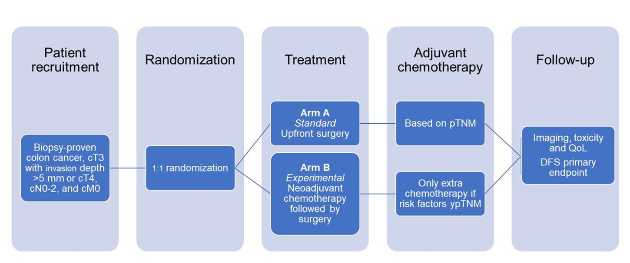
NeoCol: Phase III Trial Comparing Neoadjuvant vs Upfront Surgery in Locally Advanced Colon Cancer
Primary Endpoint:
Disease Free Survival
Secondary Endpoints: Adjuvant Therapy
Overall Survival
Toxicity
QoL
N = 248
10/2013 to 11/2021
CAPOX x 3c or FOLFOX x 4c
Jensen et al, ASCO 2023

Slide 3
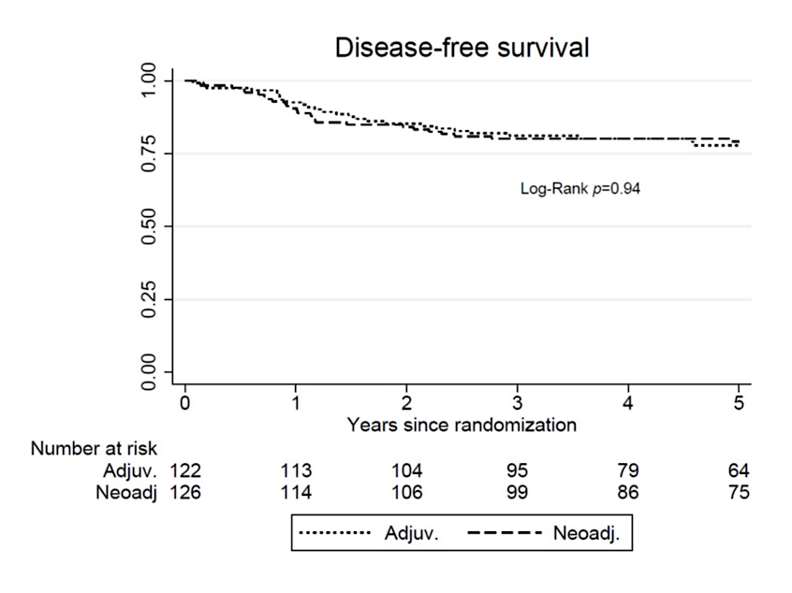
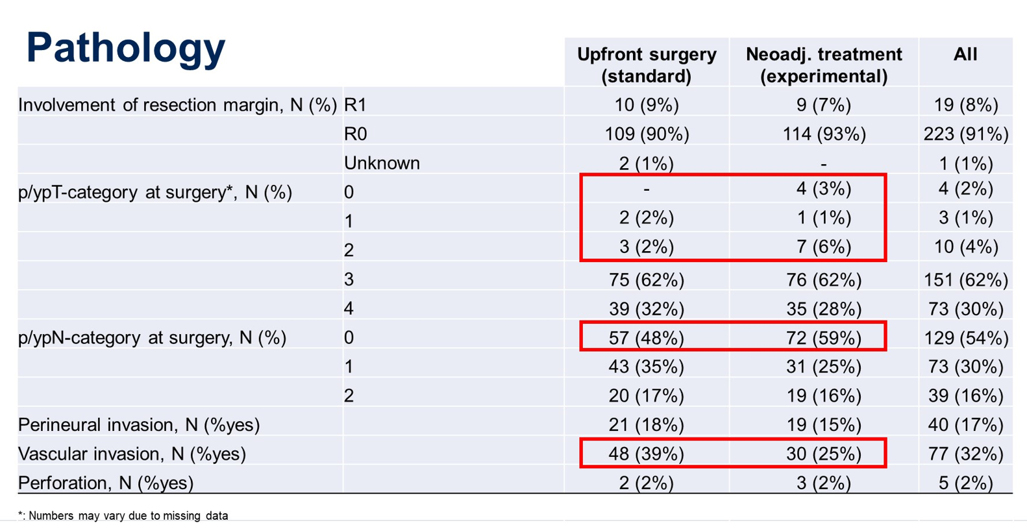
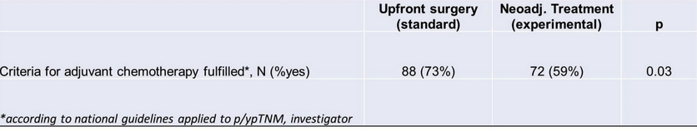
NeoCol: Results
No improvement in DFS
Is CT staging accurate?
Upfront surgery (clinical vs path staging):
T1-2 : 0 vs 4%
T3 : 74 vs 62%
T4 : 31 vs 32%
Downstaging with neoadjuvant therapy
Jensen et al, ASCO 2023

Slide 4
NeoCol: Conclusions & Takeaways
Neoadjuvant chemotherapy is not superior to standard upfront surgery with regards to survival
CT scans may not provide accurate staging
MSI and ctDNA testing not done in the study
Await QoL data
Takeaway:
Neoadjuvant chemotherapy is safe when needed in patients with very locally advanced disease to downstage but no clear benefit to recommend routine use over upfront surgery in colon cancer patients
Jensen et al, ASCO 2023

Slide 5
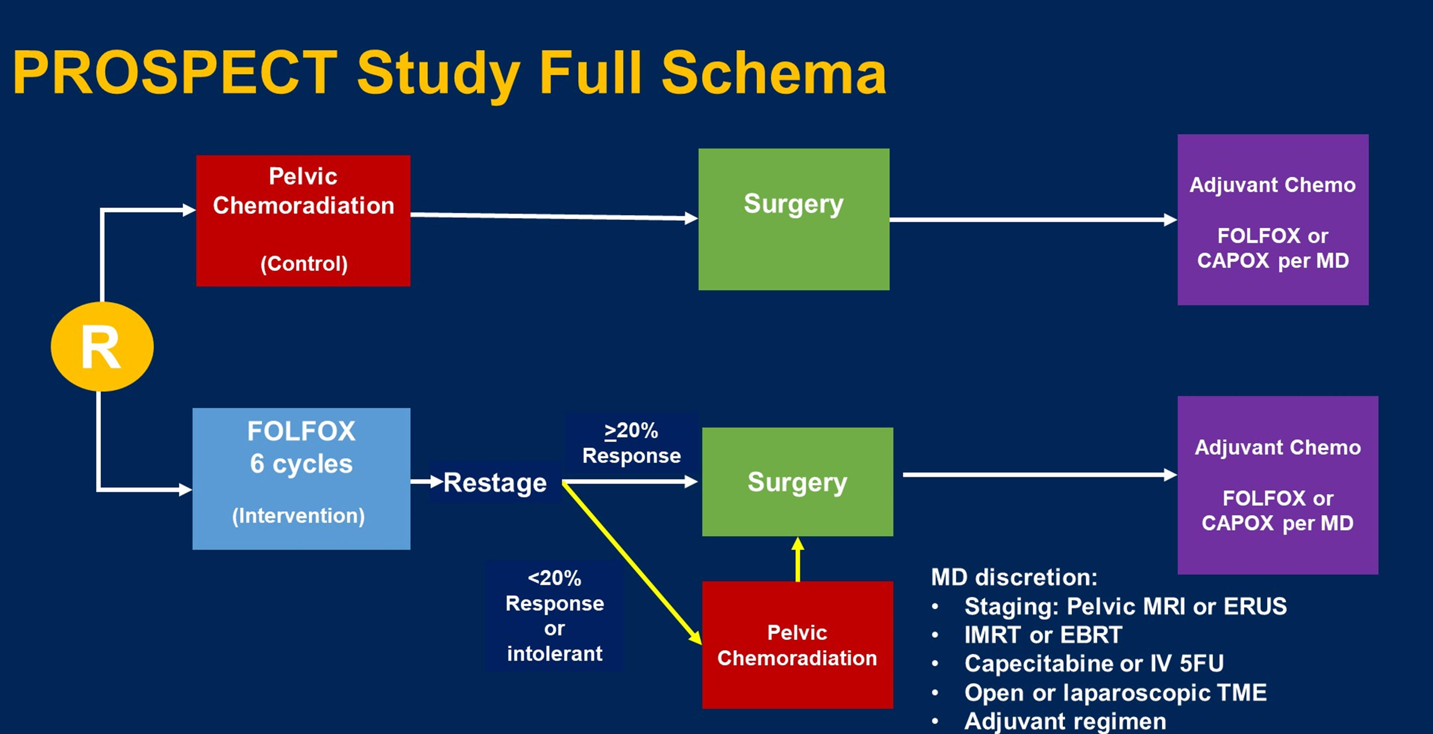
PROSPECT Trial: Preoperative Chemo with Selective CRT vs CRT for Locally Advanced Rectal Cancer
Primary Endpoint:
Disease Free Survival
Secondary Endpoints: Local recurrence
Overall Survival
R0 resection
pCR
AEs
QoL
N = 1,128
Statistics:
- Non-inferiority design
HR interval ≤ 1.29 corresponding
to 5-year DFS < 5%
Key Inclusion Criteria:
- Clinical stage T2N+, T3N-, T3N+
- Candidate for sphincter sparing surgery
- ≤ 4 pelvic LN ≤ 1 cm in short axis
Key Exclusion Criteria:
- Clinical stage T4 tumor
- Tumor requiring APR
- ≥ 4 pelvic LN ≥ 1 cm in short axis
Schrag et al, ASCO 2023

Slide 6
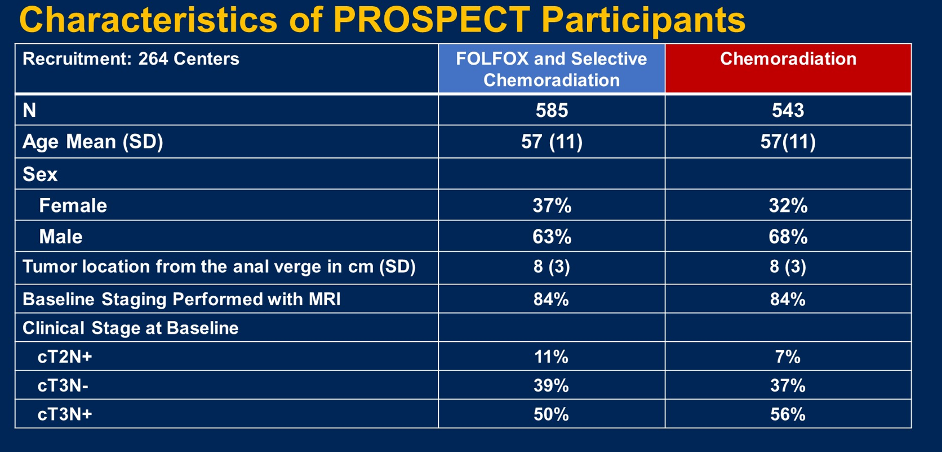
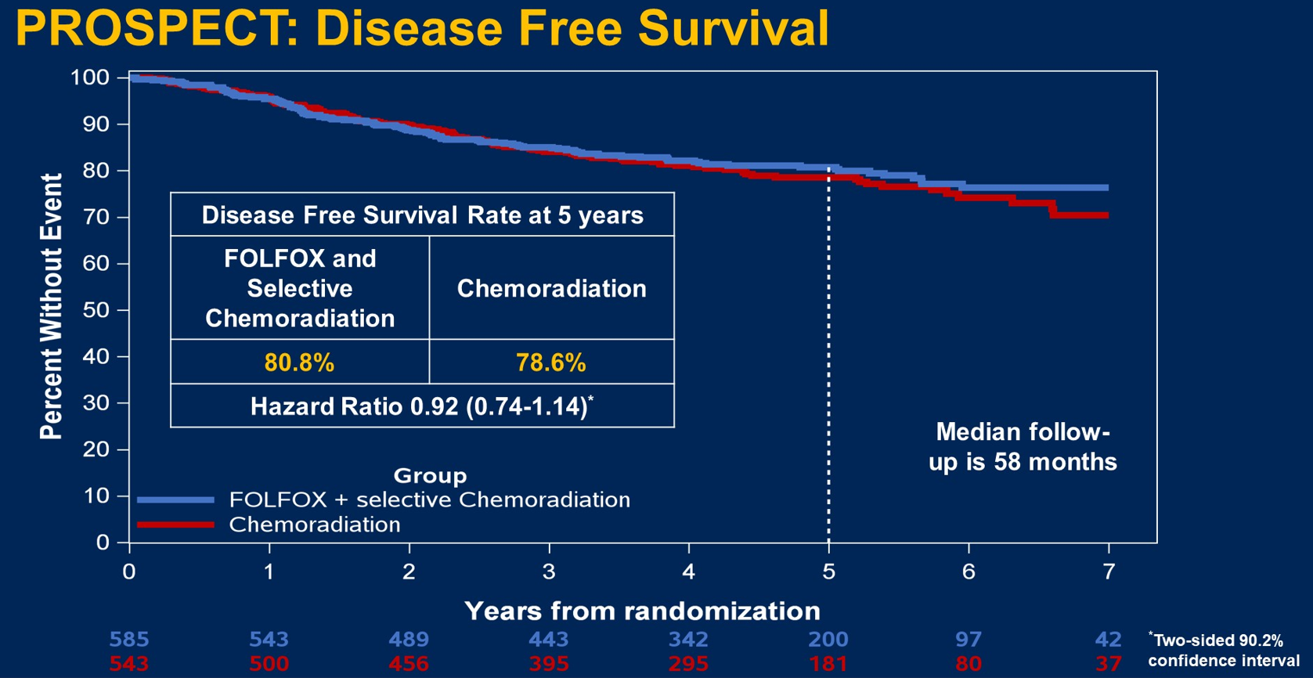
PROSPECT: Results
9% of patients with FOLFOX and selective CRT received CRT
N = 1,128
Outcome | FOLFOX & Selective Pelvic CRT# | Pelvic CRT | Hazard Ratio (95% CI)
Local Recurrence Free Rate | 98.2% | 98.4% | 1.18 (0.44-3.16)
OS | 89.5% | 90.2% | 1.04 (0.74-1.44)
pCR | 22% | 24%
Schrag et al, ASCO 2023; Schrag et al, NEJM 2023

Slide 7
PROSPECT: Conclusions & Takeaways
In patients with mid and upper rectal tumors with cT2-3 and without extensive LN involvement, upfront FOLFOX may be done to omit radiation
Takeaways
Current approach to locally advanced rectal adenocarcinoma:
Accurate staging with pelvic MRI and / or EUS & microsatellite testing
Stage, MSI Status | Location | Treatment Approach
MSI-H | Any | Immunotherapy
cT2-3N0 | Upper | Upfront surgery vs CRT
cT2N1, CT3N0-1 | Upper, mid | Chemotherapy and selective radiotherapy
cT4 or N2 or other high-risk features (EMVI,LPLN low lying, +CRM) | Any, especially low | Total neoadjuvant therapy; consider w&w for cCR for low lying tumors
EMVI = Extramural vascular invasion
LPLN = Lateral pelvic lymph nodes
CRM = Circumferential radial margin
w&w = watch and wait
cCR = complete clinical response

Slide 8
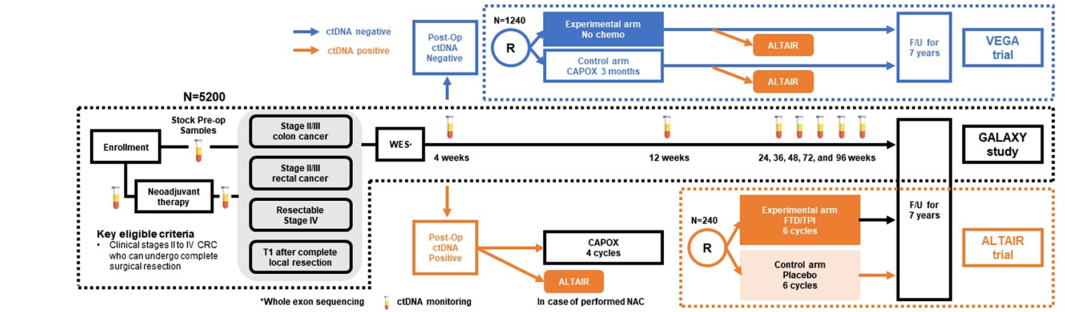
CIRCULATE-JAPAN ctDNA Dynamics in CRC Patients: Updated Results
2,998 patients stages I-IV
Median Follow-up: 16.14 months
Signatera, Natera, Inc (tumor informed) assay used
Yukami et al, ASCO 2024

Slide 9
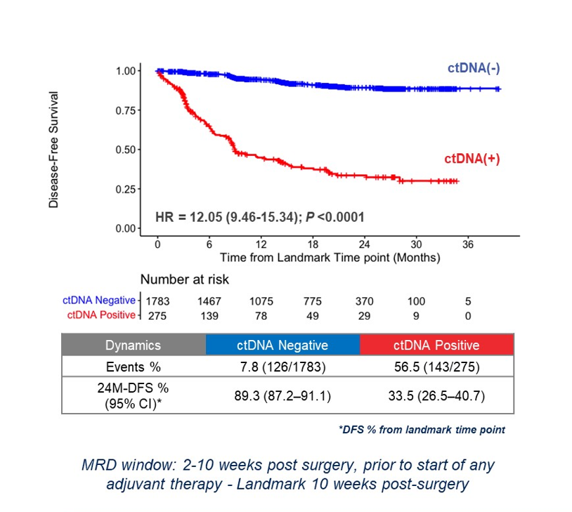
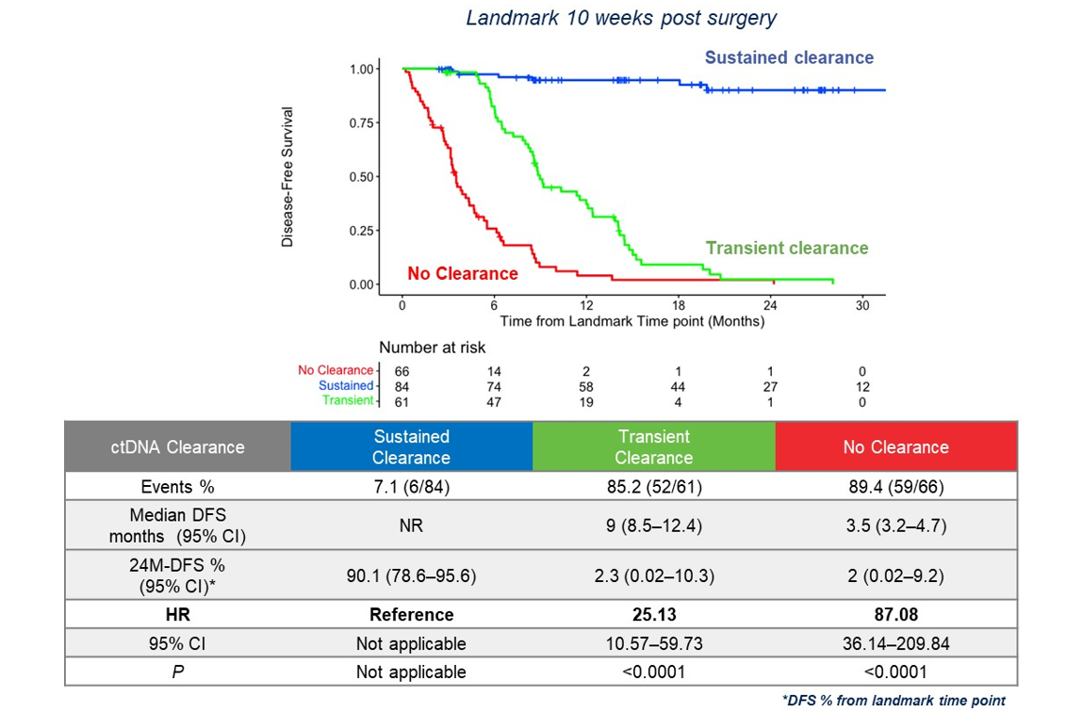
CIRCULATE-JAPAN ctDNA Dynamics in CRC Patients: Updated Results
ctDNA-positive after surgery associated with worse DFS
Sustained clearance associated with superior DFS
Yukami et al, ASCO 2024

Slide 10
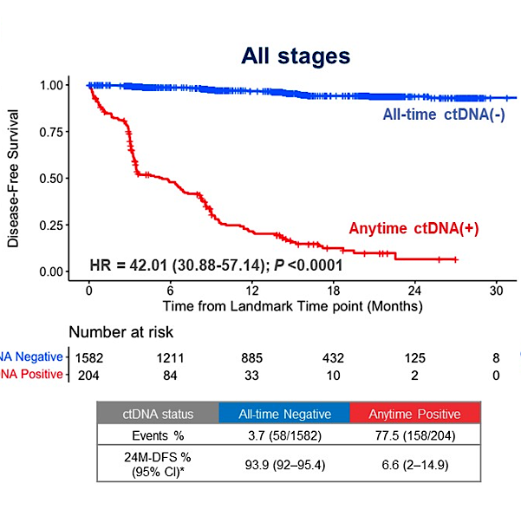
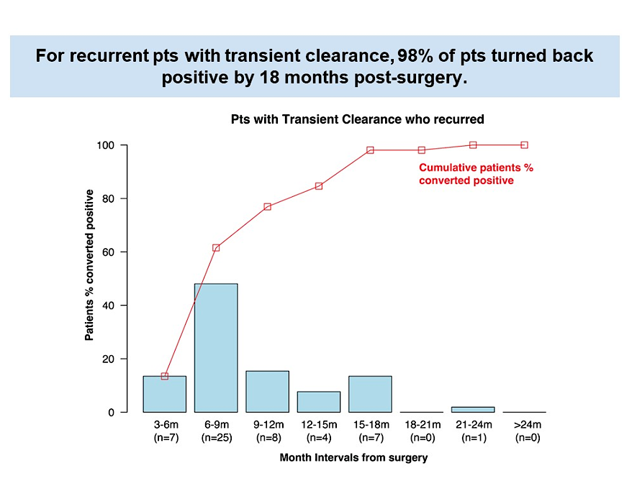
CIRCULATE-JAPAN ctDNA Dynamics in CRC Patients: Updated Results
ctDNA Negative
ctDNA Positive
ctDNA-positive in surveillance window is associated with inferior DFS
Yukami et al, ASCO 2024

Slide 11
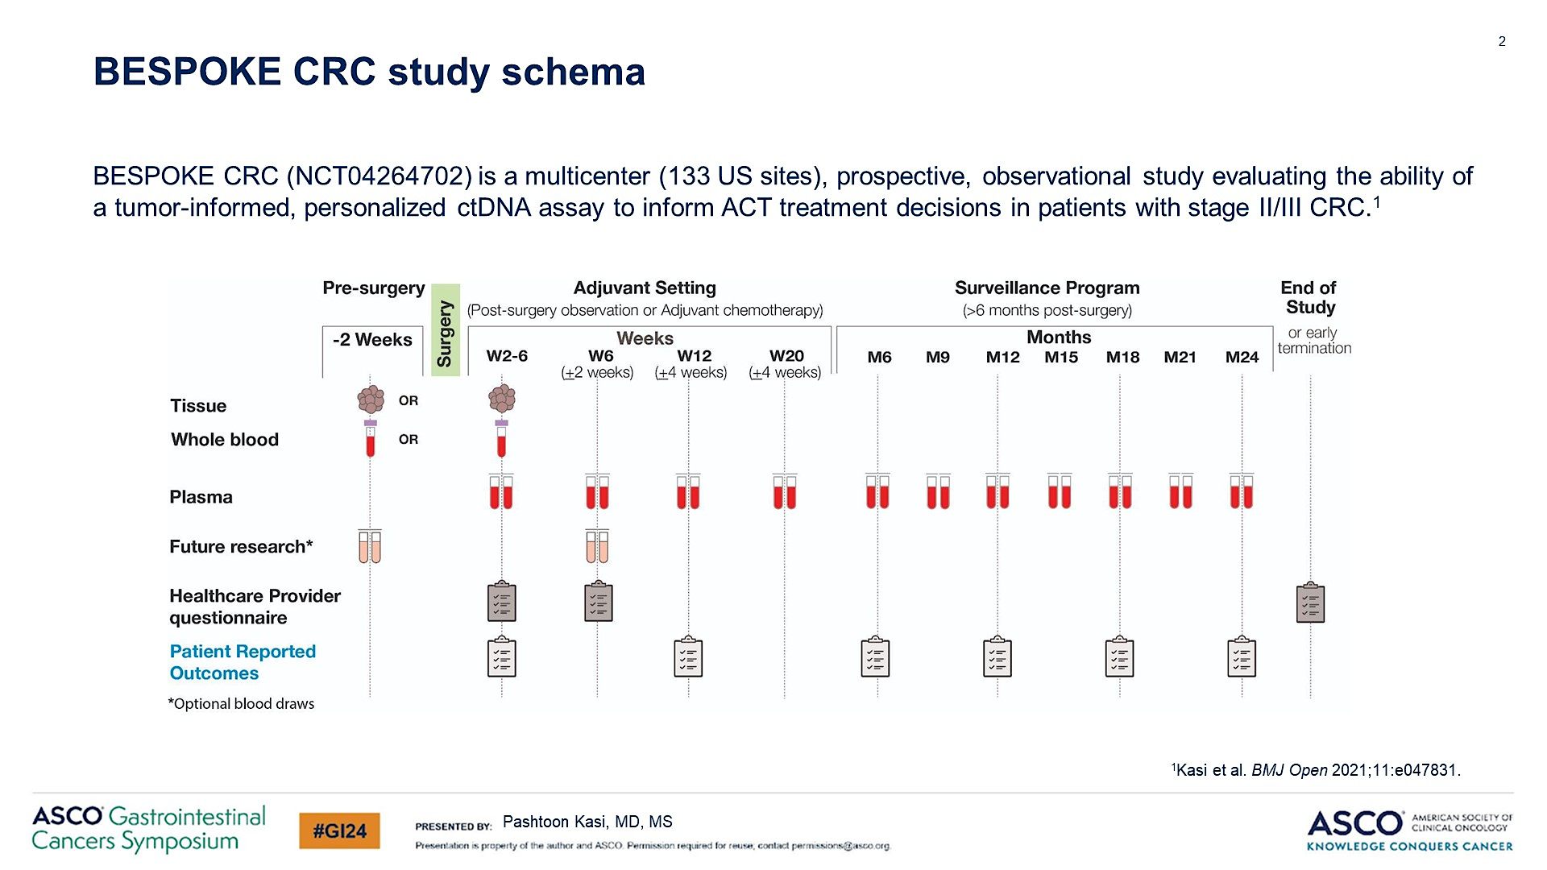
BESPOKE CRC Study: ctDNA in Stage II/III Colorectal Cancer
655 patients
Signatera, Natera, Inc (tumor informed) assay used
Kasi et al, ASCO GI 2024

Slide 12
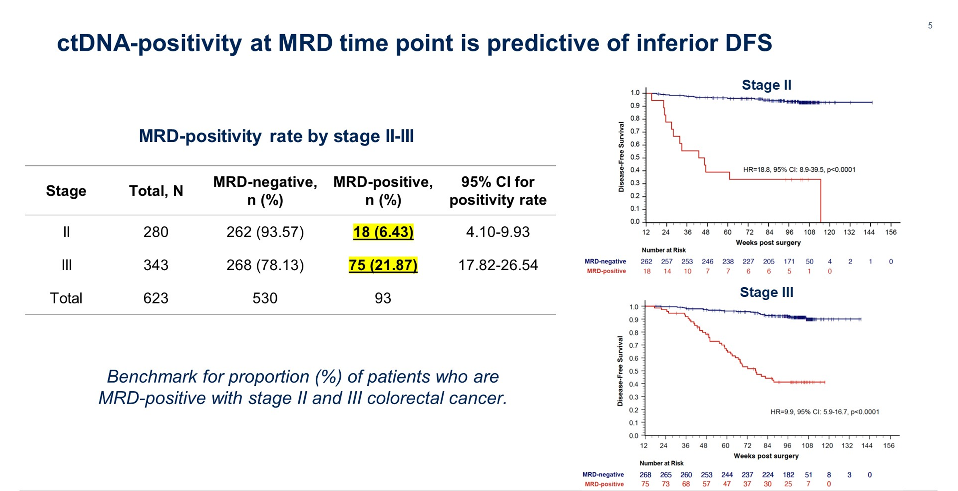
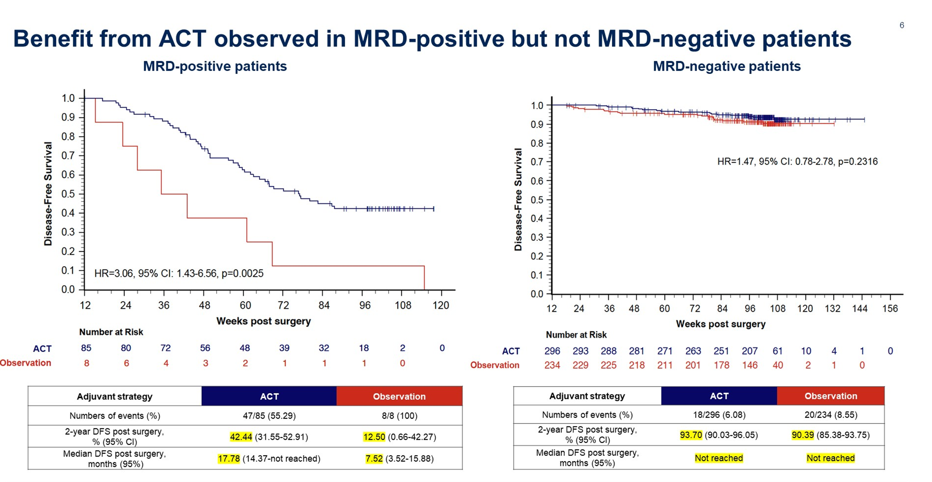
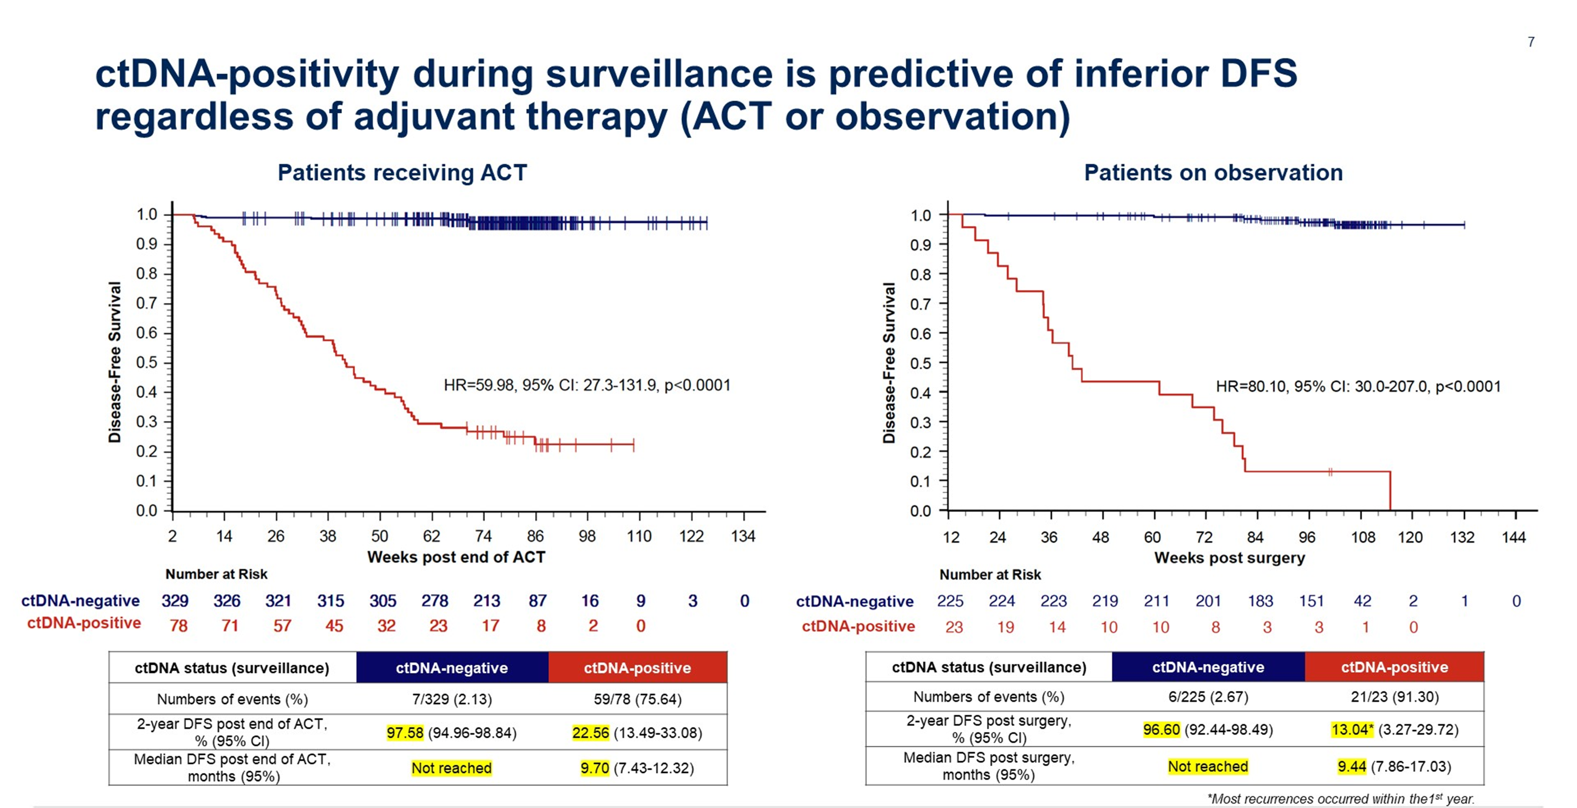
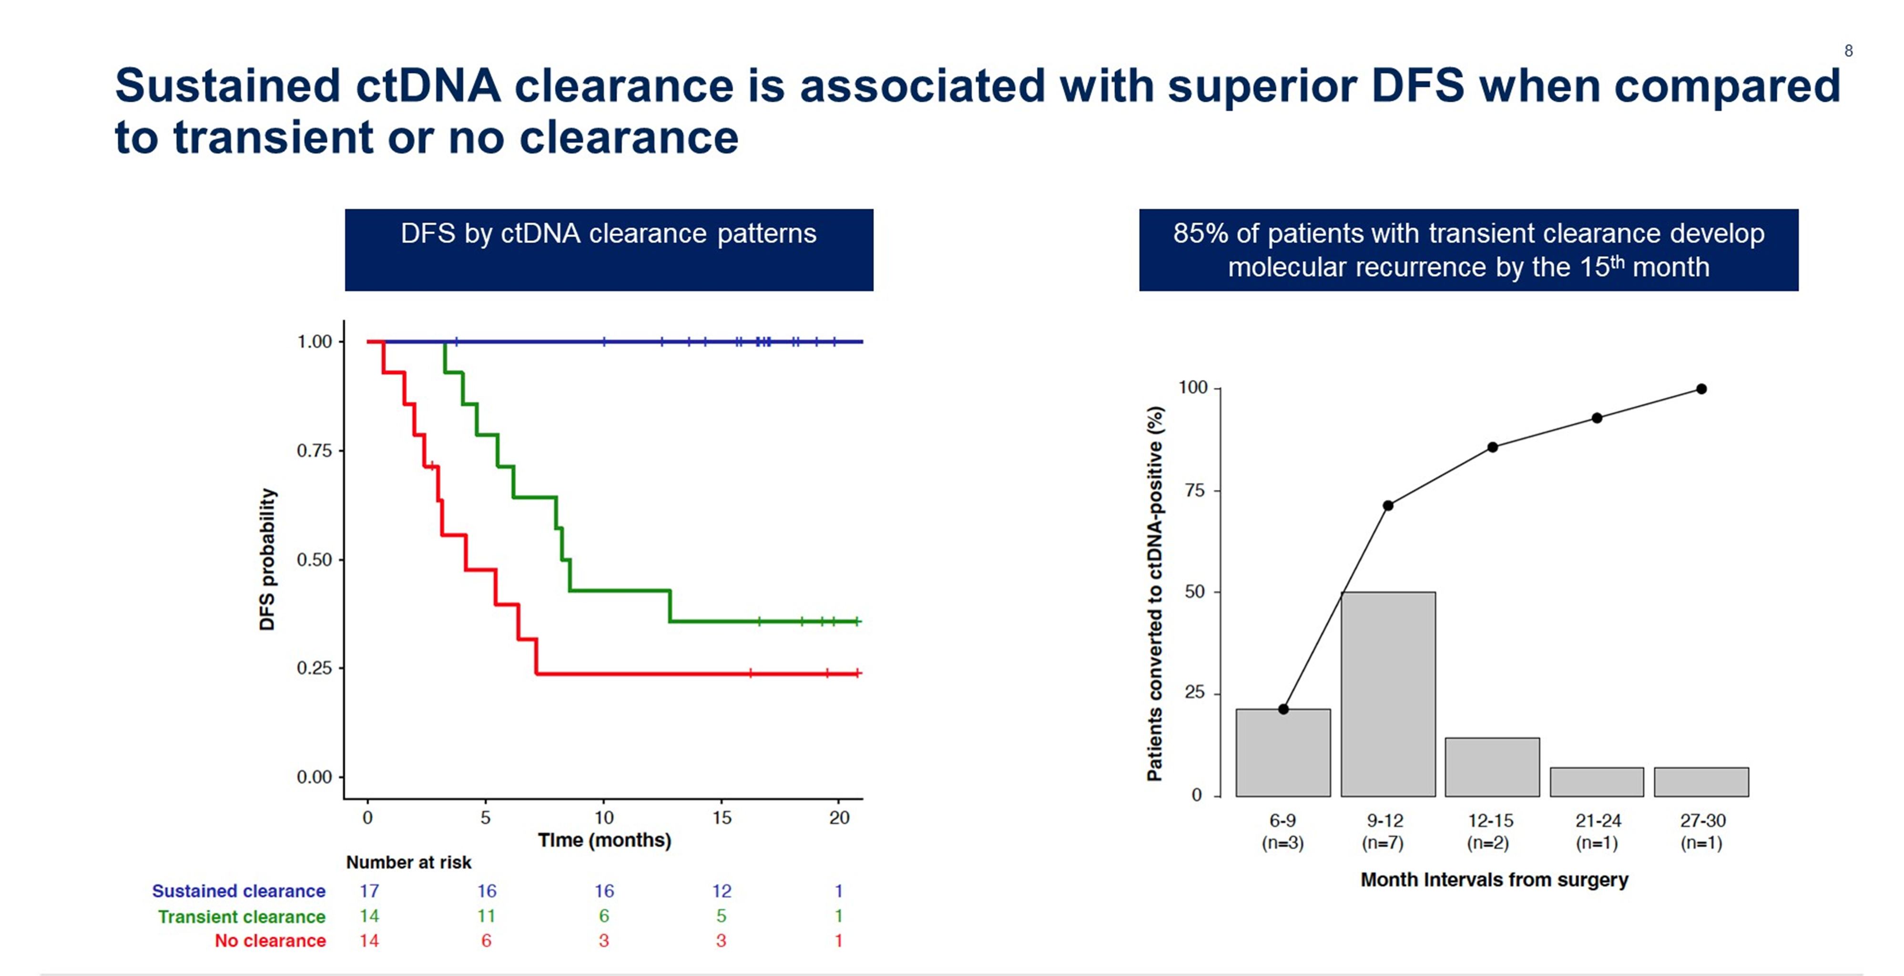
BESPOKE: Results
Kasi et al, ASCO GI 2024

Slide 13
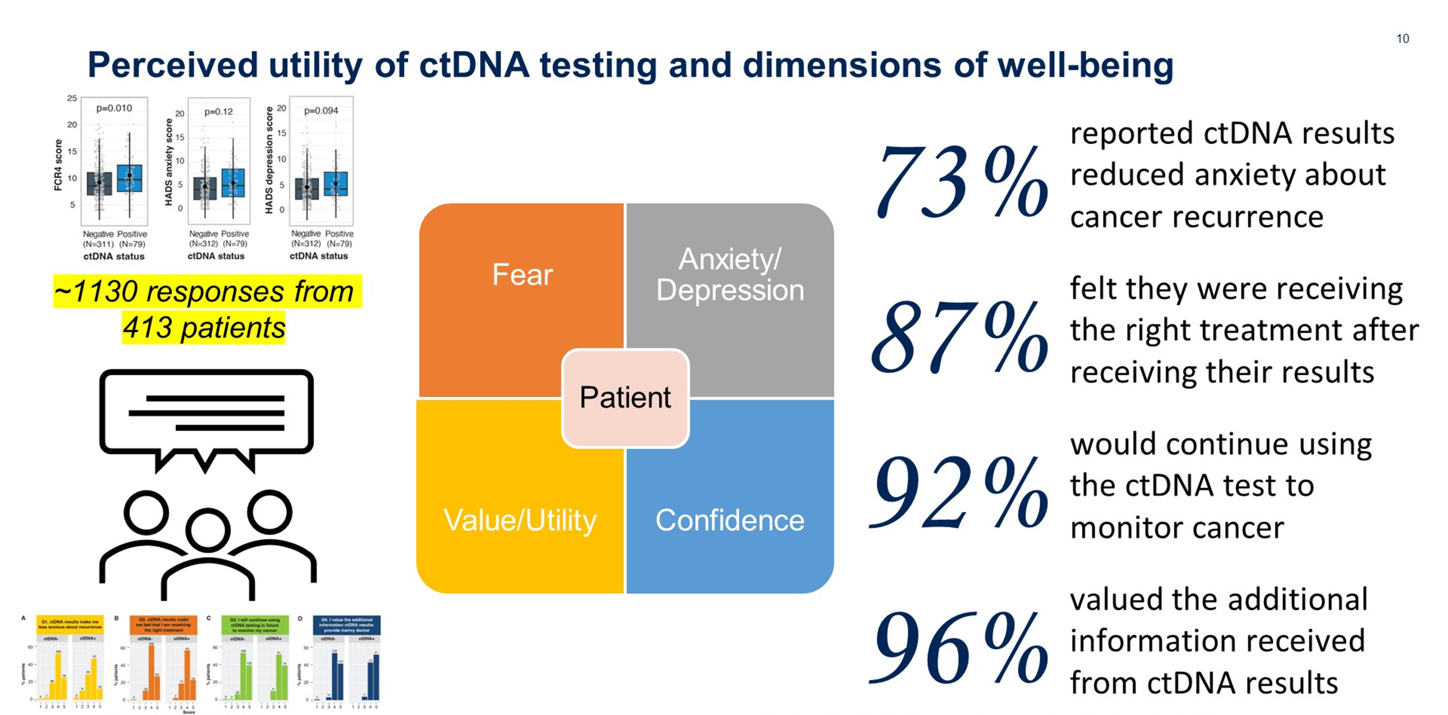
BESPOKE: Results
Kasi et al, ASCO GI 2024

Slide 14
CIRCULATE-JAPAN & BESPOKE: Conclusions & Takeaways
Confirms the known prognostic effects of ctDNA positivity in post-operative and surveillance settings
Sustained ctDNA clearance post-adjuvant therapy is significantly associated with > 90% DFS
Transient ctDNA clearance on adjuvant therapy correlated with improved median DFS compared to non-cleared patients but prognosis remains poor
Patients value and would like to use ctDNA testing
Takeaway:
ctDNA is a very strong prognostic marker but need to await results of interventional trials to establish clinical utility
NCCN Guidelines (v1.2024): Circulating tumor (ctDNA) is emerging as a prognostic marker; however, there is currently insufficient evidence to recommend routine use of ctDNA assays outside of a clinical trial. Participation in clinical trials is encouraged.

Slide 15





Stage IIB, IIC or III Resected Colon Cancer
Circulating tumor DNA (ctDNA) results within 6-8 weeks of surgery
No ctDNA detected
ctDNA is detected
R
Joint analysis with CIRCULATE-Japan
CAPOX or FOLFOX*
Surveillance with
Serial ctDNA
ctDNA is detected
No ctDNA detected
R
CAPOX or
FOLFOX#
FOLFOXIRI #
*: Duration and regimen per physician discretion
#: 6 months duration
NRG-GI008

Slide 16

INTERCEPT Study: Positive ctDNA-based Minimal Residual Disease Assays During Surveillance Are Associated with High Rates of Undiagnosed Concomitant Radiographic Recurrences in Colorectal Cancer (CRC)
Stage II CRC
Surgery + / - Neoadjuvant Therapy
Adjuvant Therapy
Surveillance
ctDNA Positive
Radiographic Recurrence
Stage III CRC
No Radiographic Recurrence (MRD)
Resectable Stage IV CRC
All therapies and surveillance per routine care
Tissue informed (Signatera) ctDNA assay post-op & with each surveillance visit
MRD Clinical Trials
1,115 patients stages II-IV
Signatera, Natera, Inc (tumor informed) assay used
Dasari et al, ASCO 2023

Slide 17
Clinical Utility: Radiographic Findings of Patients ctDNA+ During Surveillance, n = 184
ctDNA positive before adjuvant therapy
39%; n=119
Adjuvant therapy
Future report
Radiologic evidence of metastatic disease
49% n=90
ctDNA positive during surveillance
61%; n=184
Radiologic evaluation
No radiologic evidence of disease (MRD)
51% n=94
Dasari et al, ASCO 2023
Radiographic Recurrence
Without Radiographic Recurrence
i.e. true MRD
n = 184
*including on adjuvant therapy

Slide 18
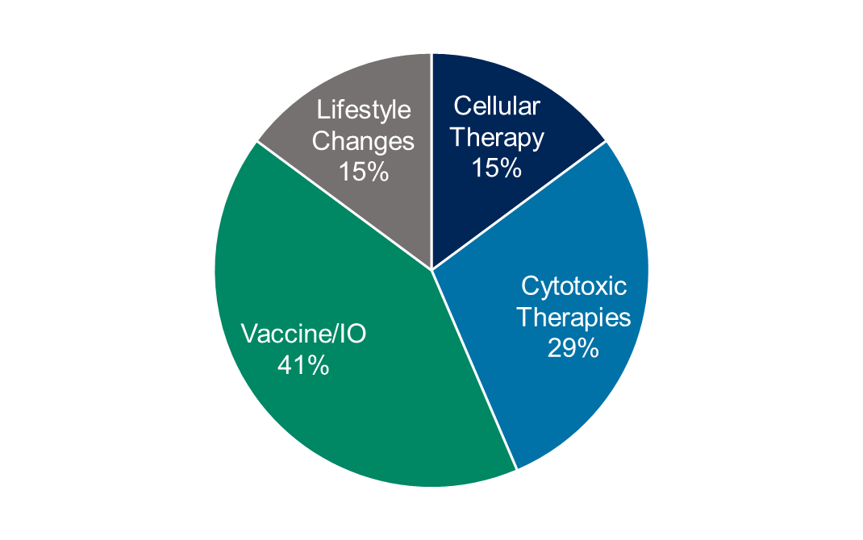
Clinical Utility: Enrollment onto MRD Trials
Future report on recurrence patterns & outcomes
Radiologic evidence of metastatic disease
49% n=90
ctDNA positive during surveillance
61%; n=184
No radiologic evidence of disease (MRD)
51% n=94
Enrolled into clinical trials of MRD
59% N=55
Dasari et al, ASCO 2023
Radiographic Recurrence
Without Radiographic Recurrence
i.e. true MRD
n = 184
*including on adjuvant therapy

Slide 19
INTERCEPT: Conclusions & Takeaways
When ctDNA+, important to do scans to look for any overt metastatic disease
Unclear if ctDNA surveillance picks up oligometastatic spread amenable to locoregional therapies
Patients who are truly MRD+ should be encouraged to enroll onto clinical trials given lack of data on how to manage these patients
Takeaway:
Need more sensitive assays and data on how to manage these patients

Slide 20
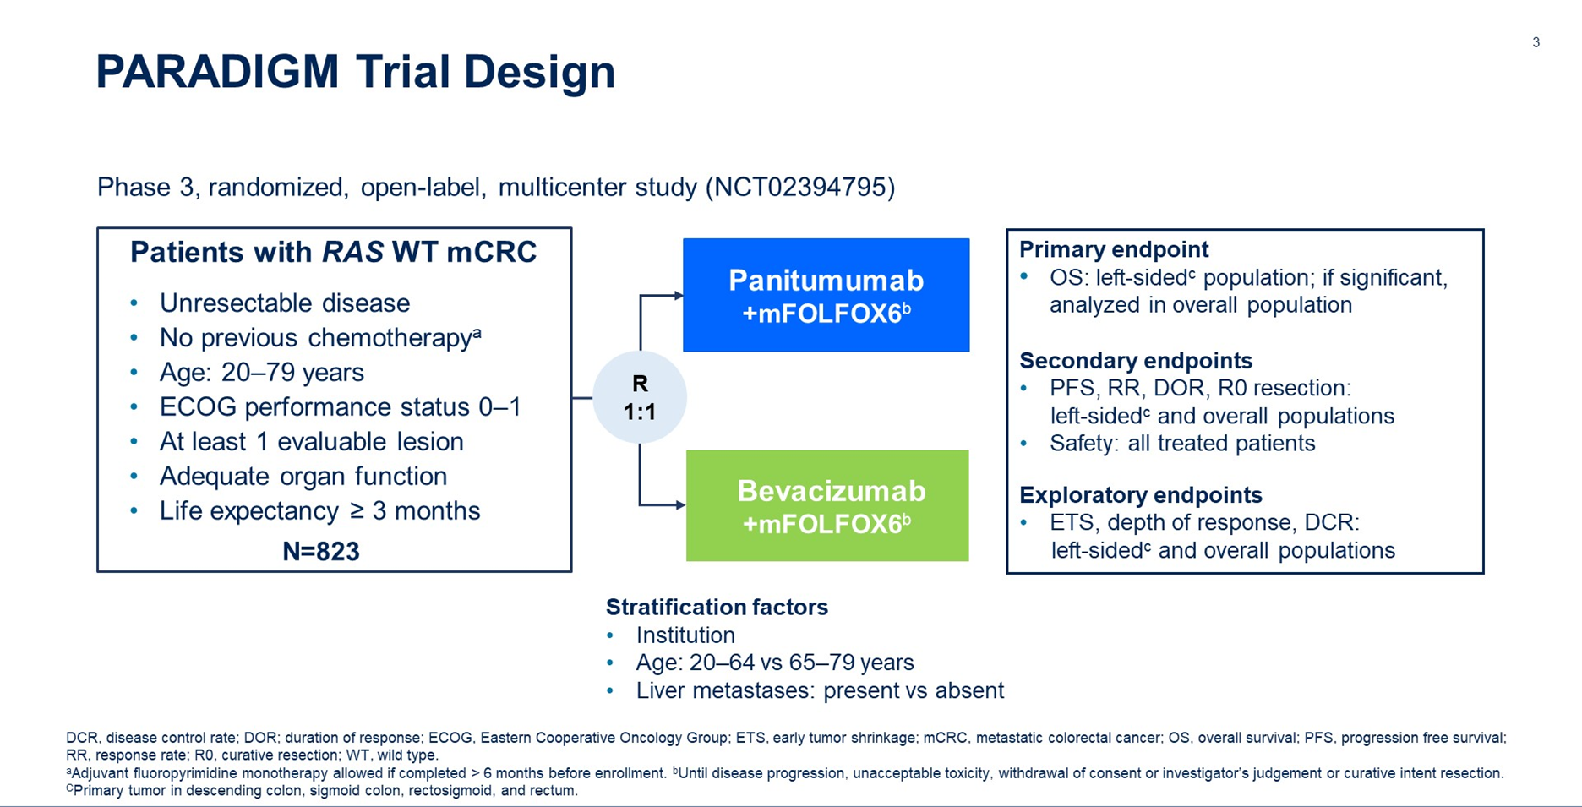
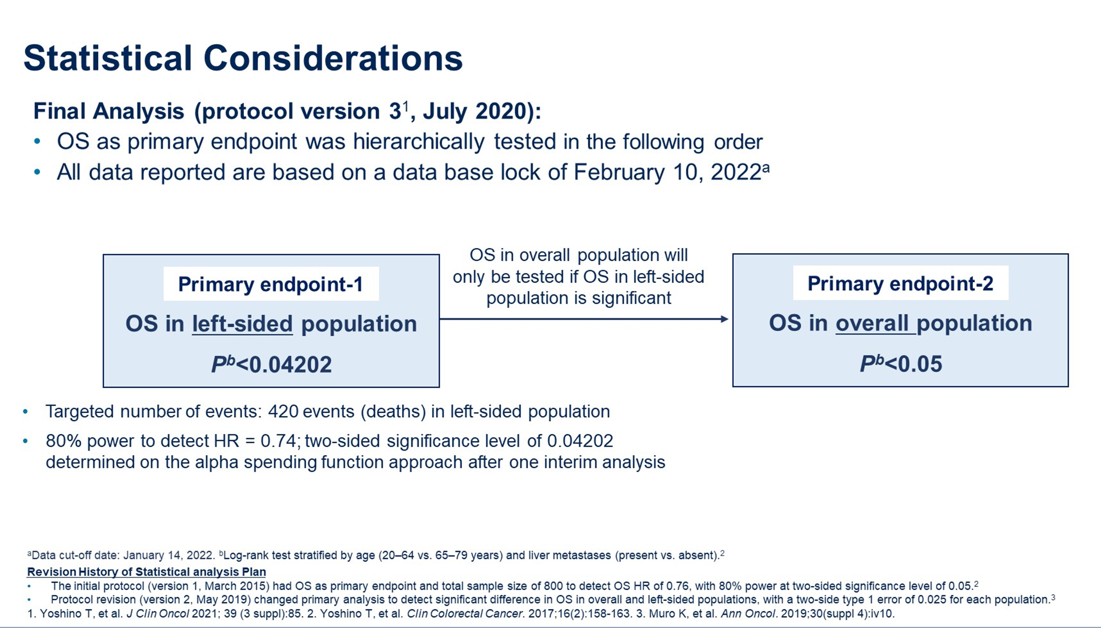
PARADIGM Trial: 1st Line mFOLFOX6 with Panitumumab or Bevacizumab in RAS WT mCRC
In the overall population, ~ 75% were L sided
Yamakazi et al, ASCO 2023

Slide 21
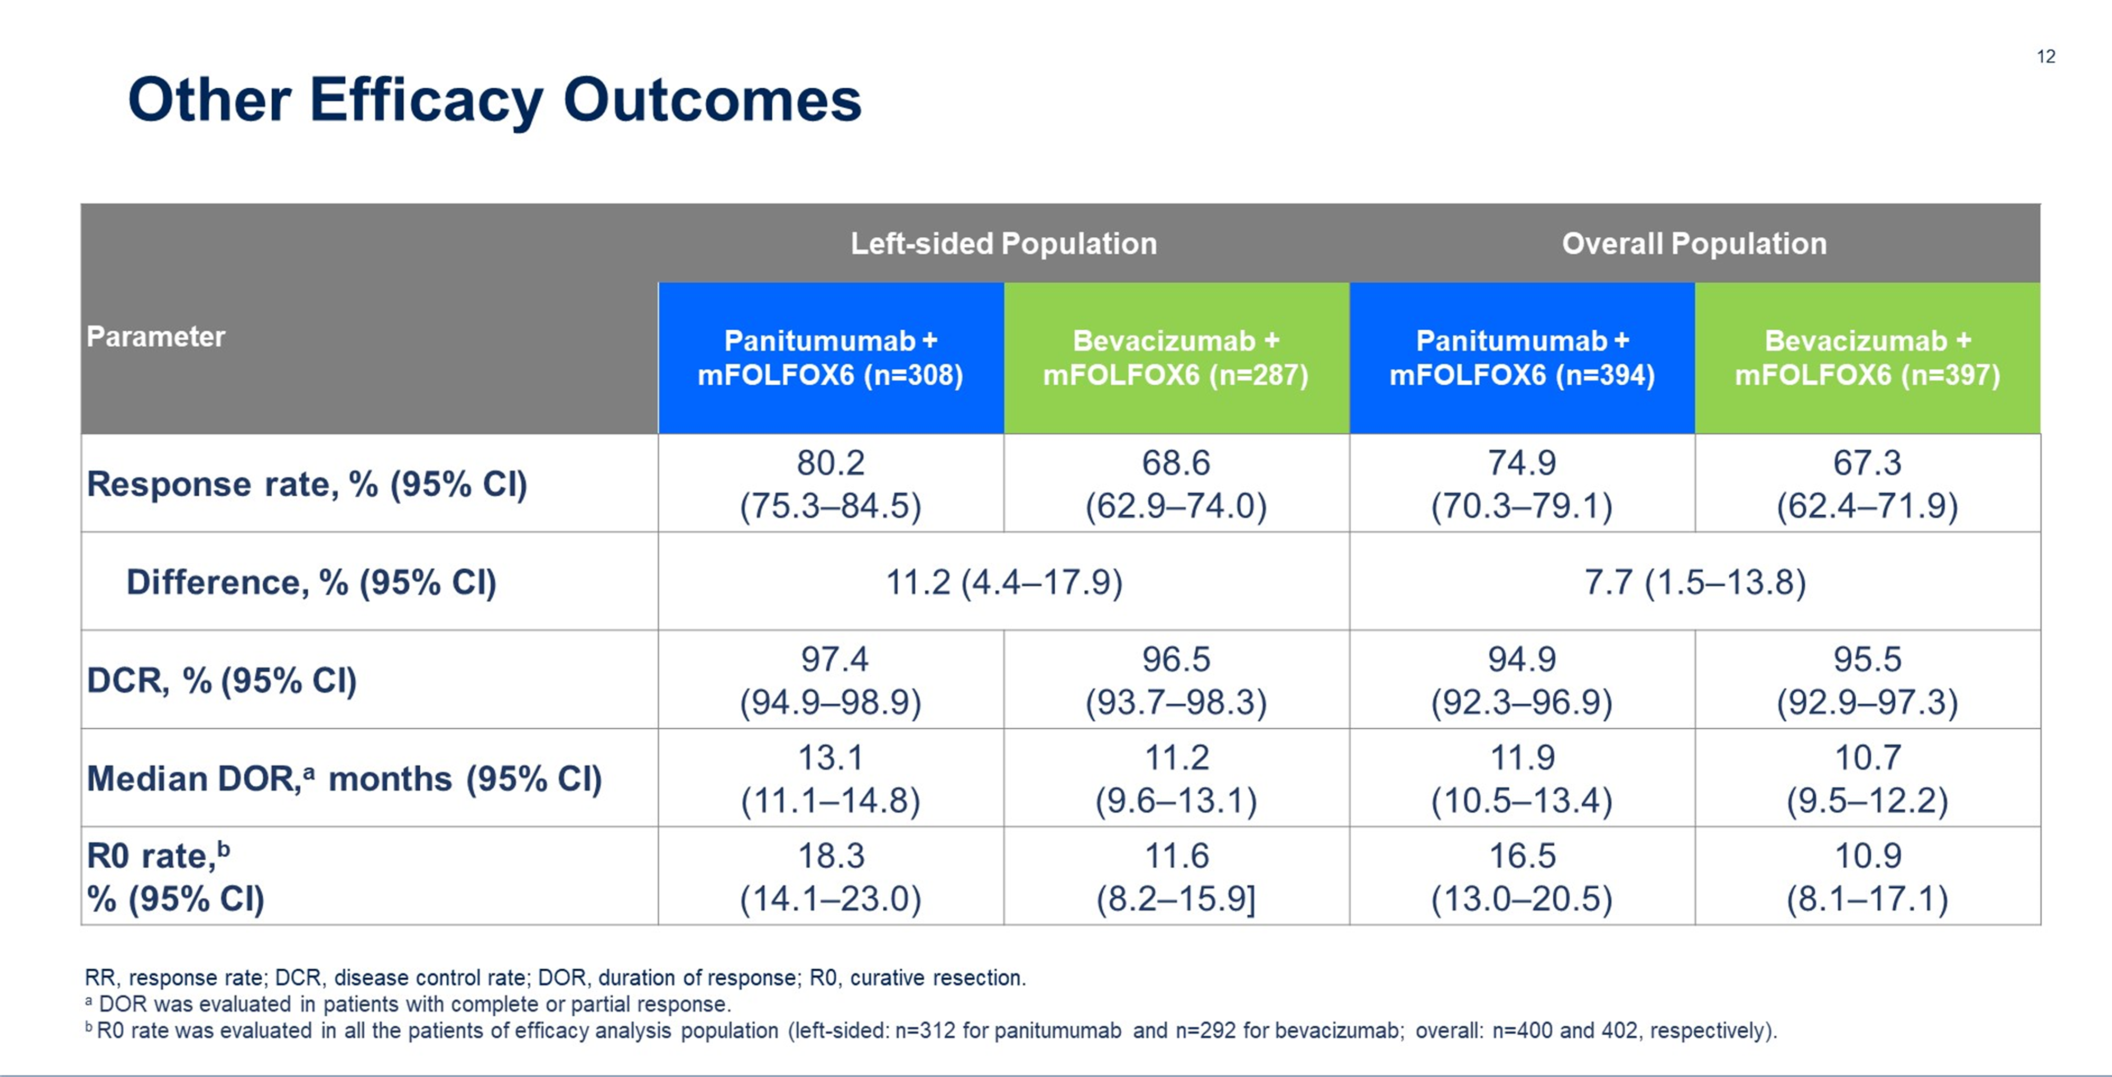
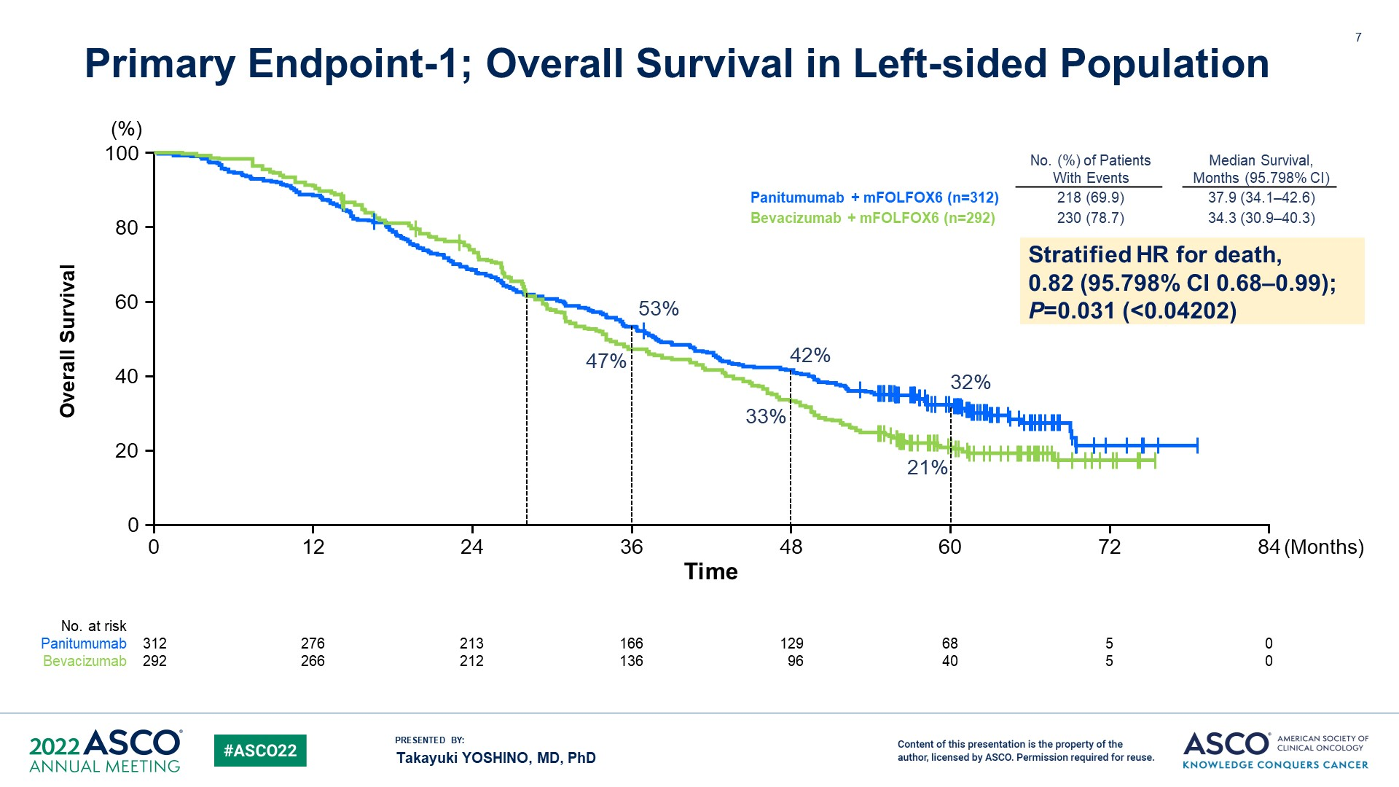
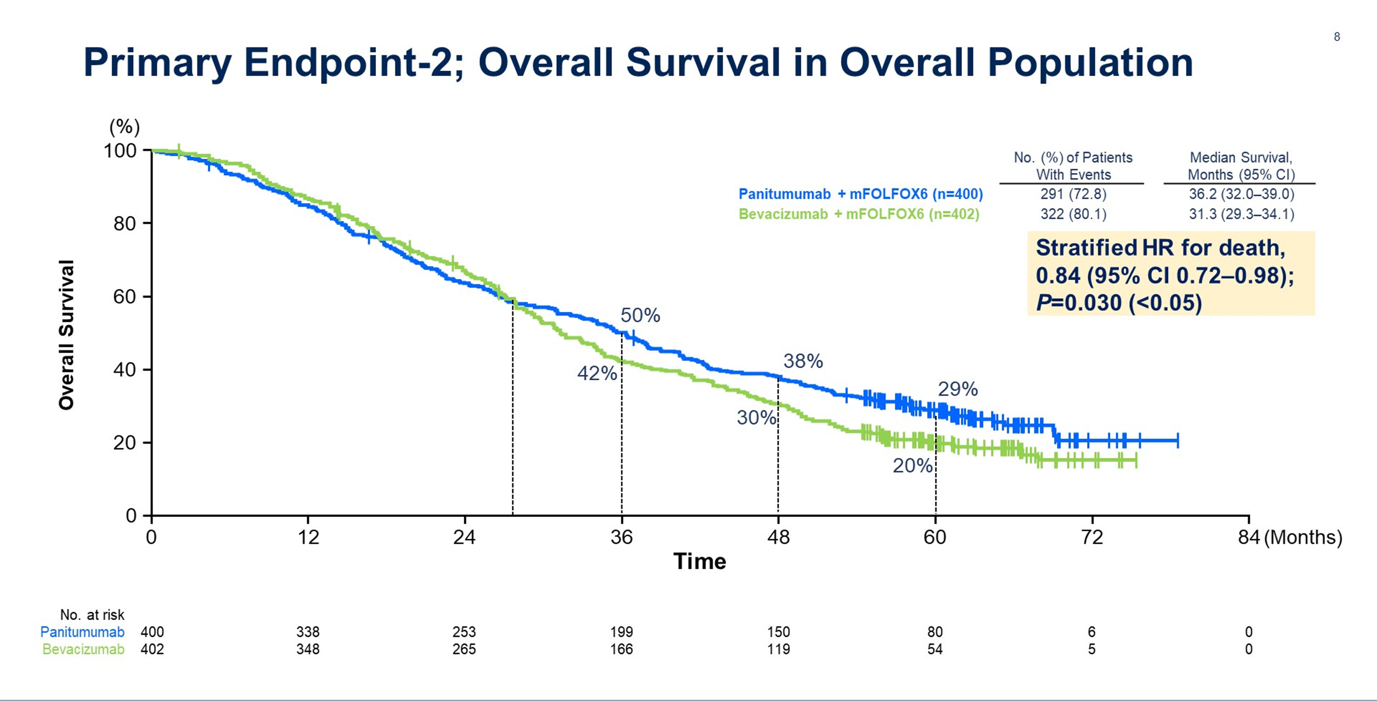
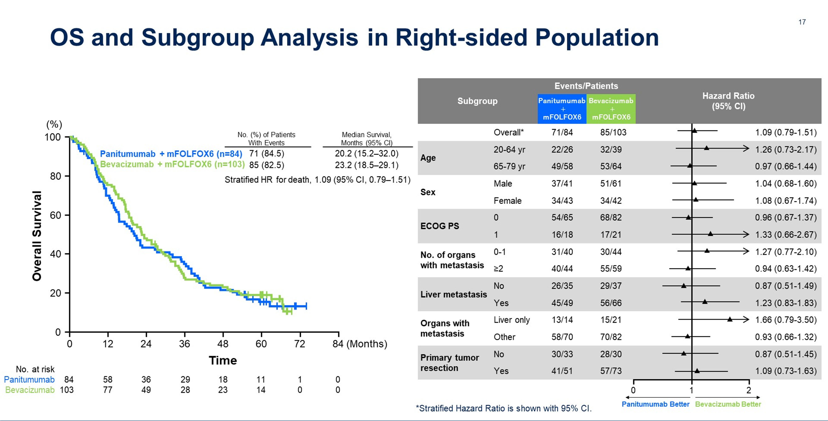
OS improved in L sided and overall population
ORR, R0 resection improved (L sided & overall population)
No benefit in R sided population
Yamakazi et al, ASCO 2023; Watanabe et al, JAMA 2023

Slide 22
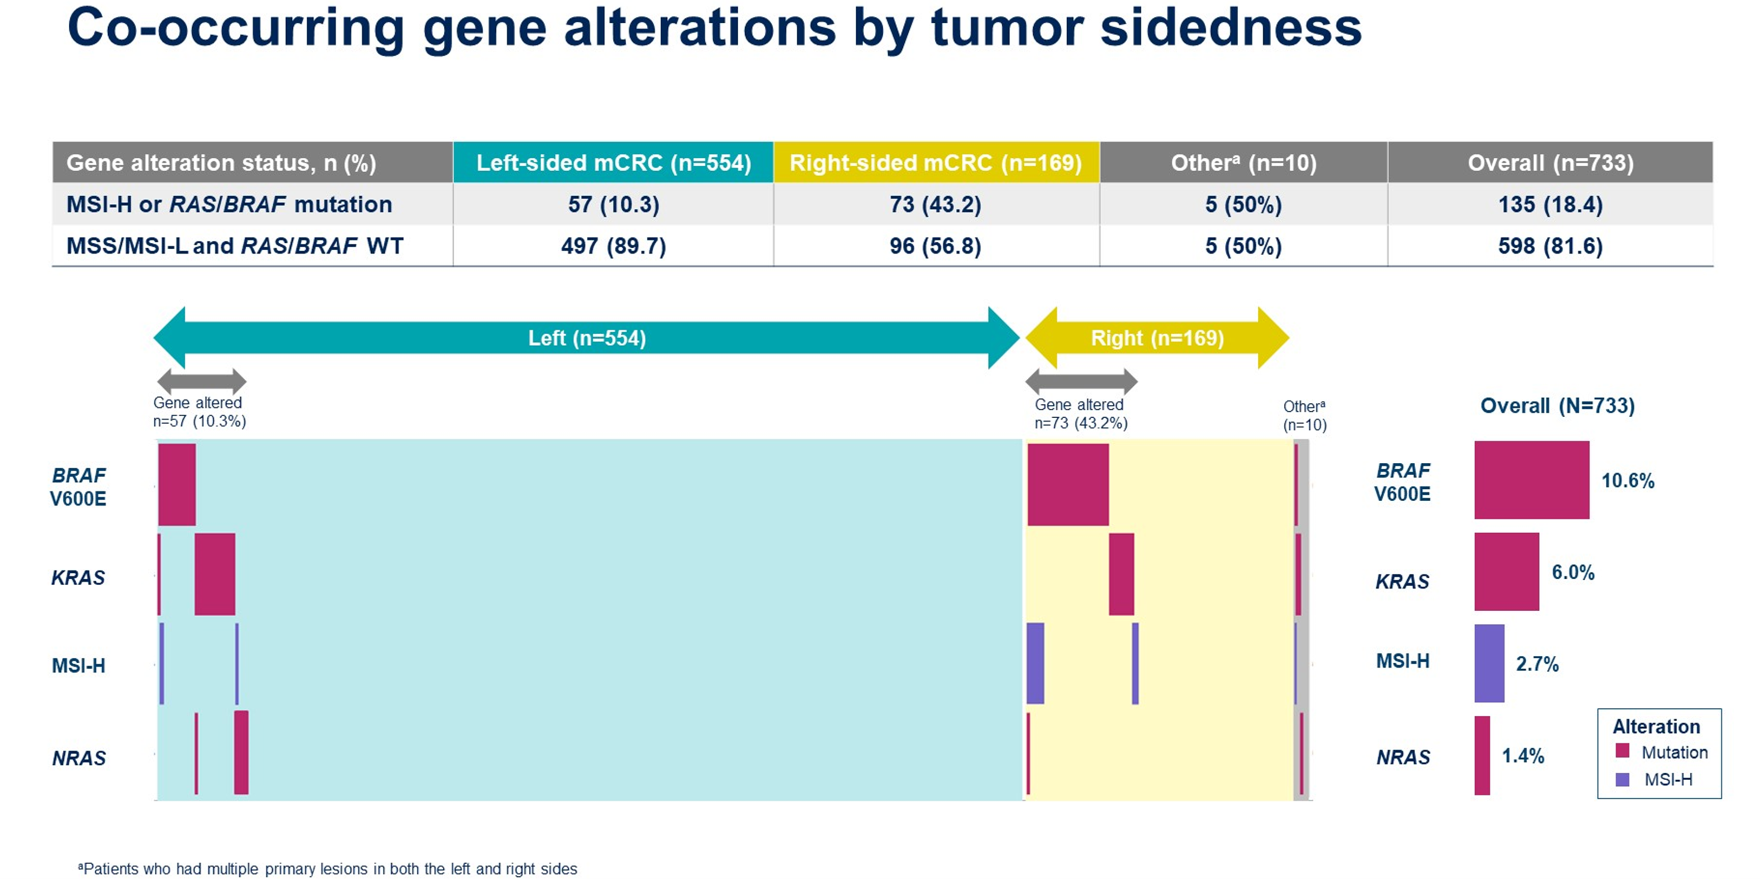
PARADIGM Trial: ctDNA Biomarker Study
N = 733
Yamakazi et al, ASCO 2023

Slide 23
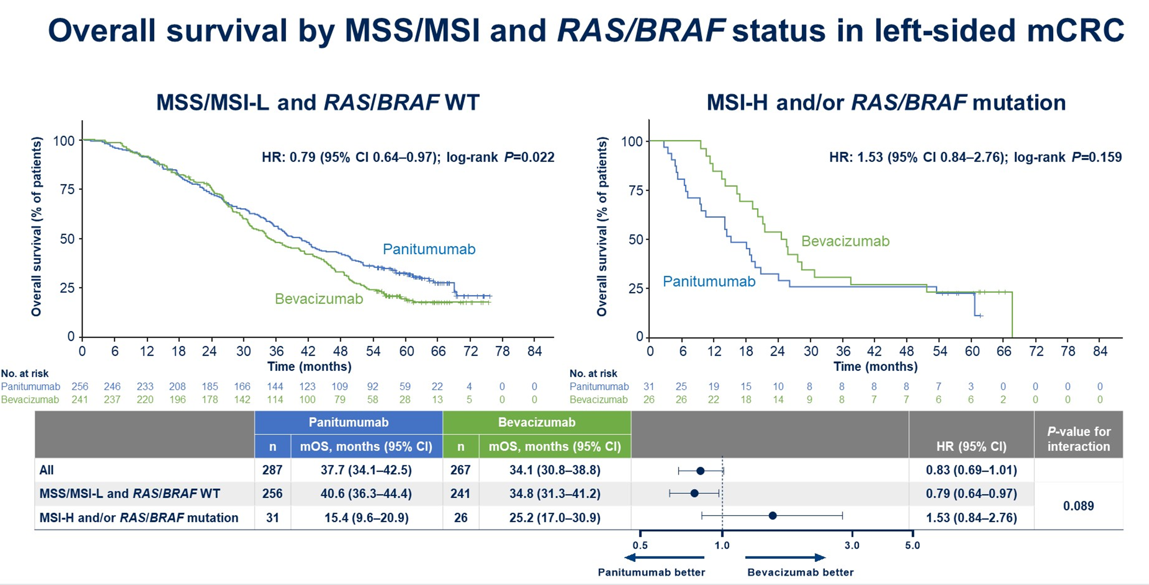
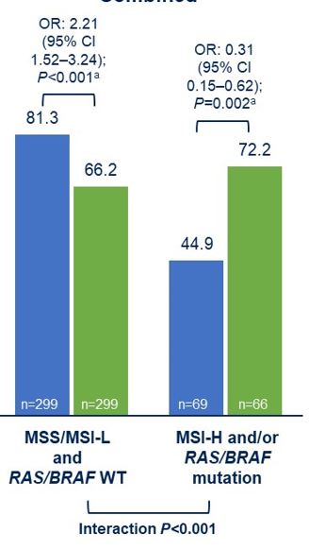
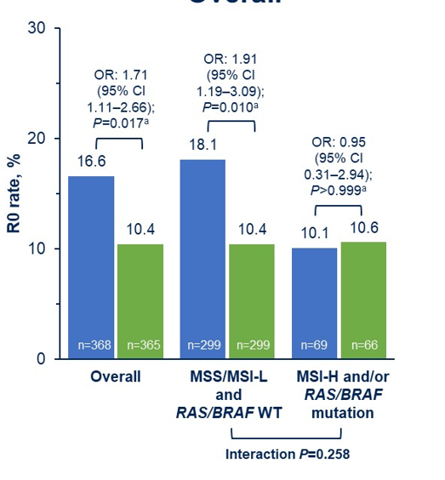
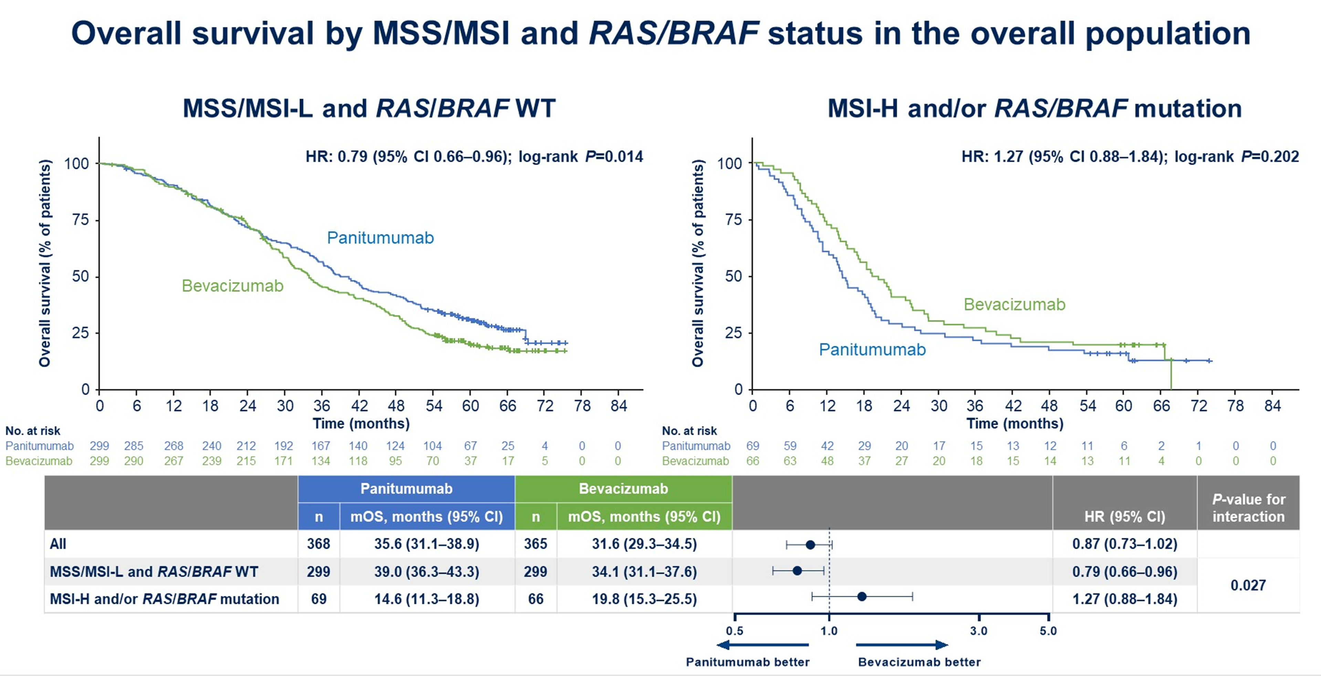
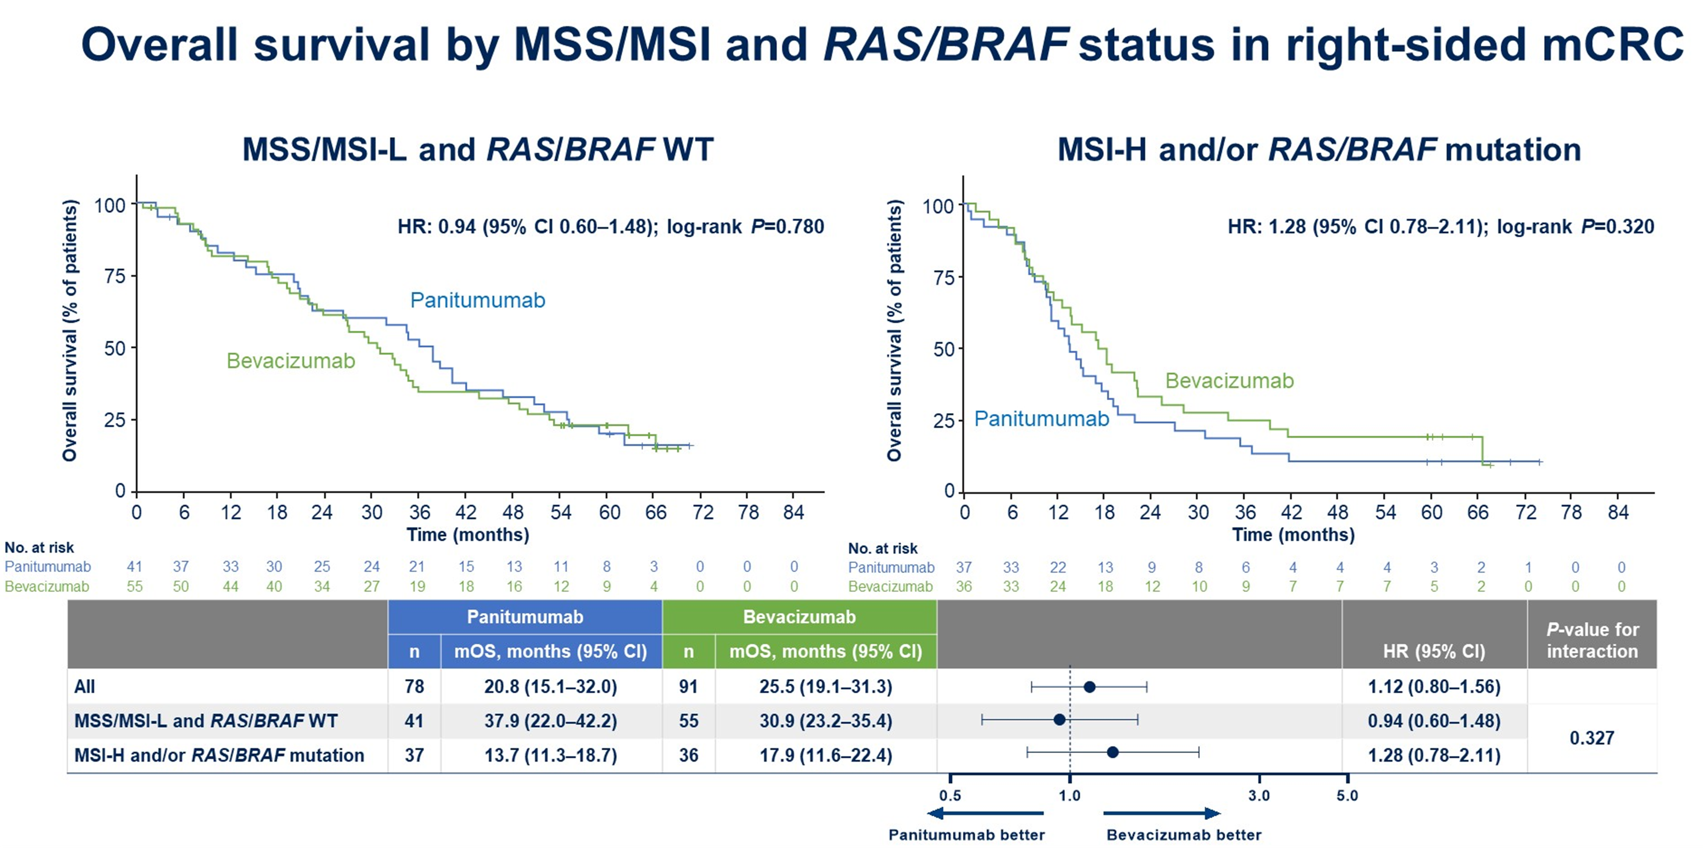
PARADIGM Trial: ctDNA Biomarker Study
ORR, R0 resection improved only in MSS/MSI-L, RAS/BRAF WT
OS improved only in MSS/MSI-L, RAS/BRAF WT
No benefit in R sided tumors
Yamakazi et al, ASCO 2023

Slide 24
PARADIGM: Conclusions & Takeaways
1st line therapy with EGFR moab in mCRC patients with L sided RAS/RAF WT tumors is associated with improved ORR, R0 resection rates and OS
Takeaway:
Consider 1st line therapy with EGFR moab in mCRC patients with L sided RAS/RAF WT tumors (also Her2neu non-amplified)

Slide 25
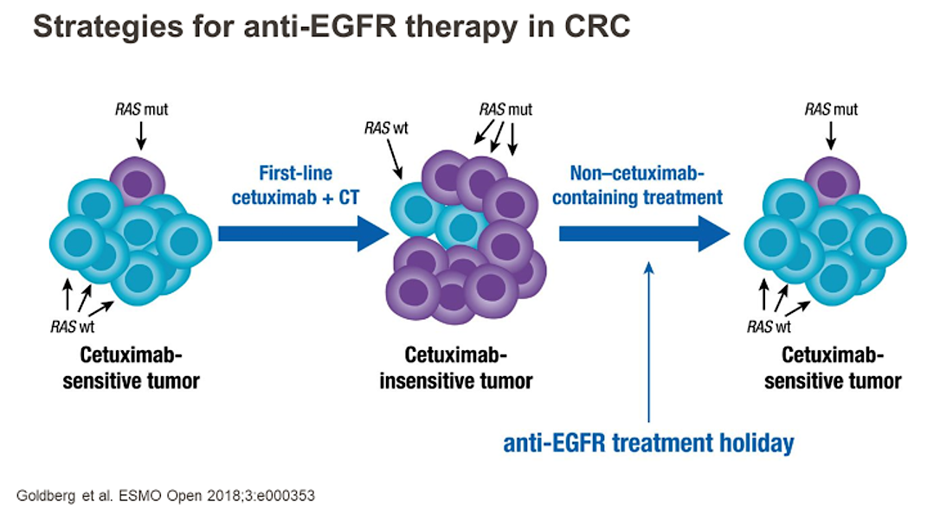
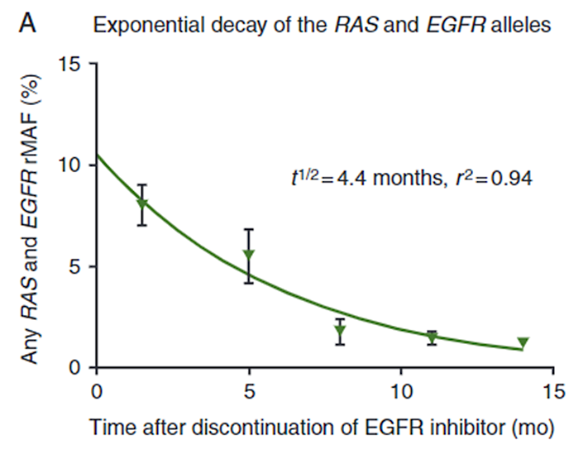
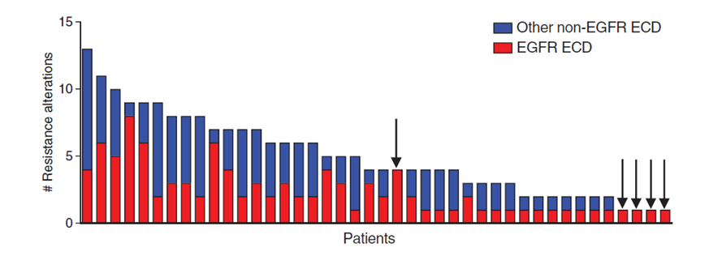
EGFR Therapy Resistance in Later Lines
Exponential Decay of Alterations
Co-occurrence of Alterations
Median # of MT: 4
Parseghian et al, 2019; Strickler et al, 2018; Goldberg et al, 2018

Slide 26
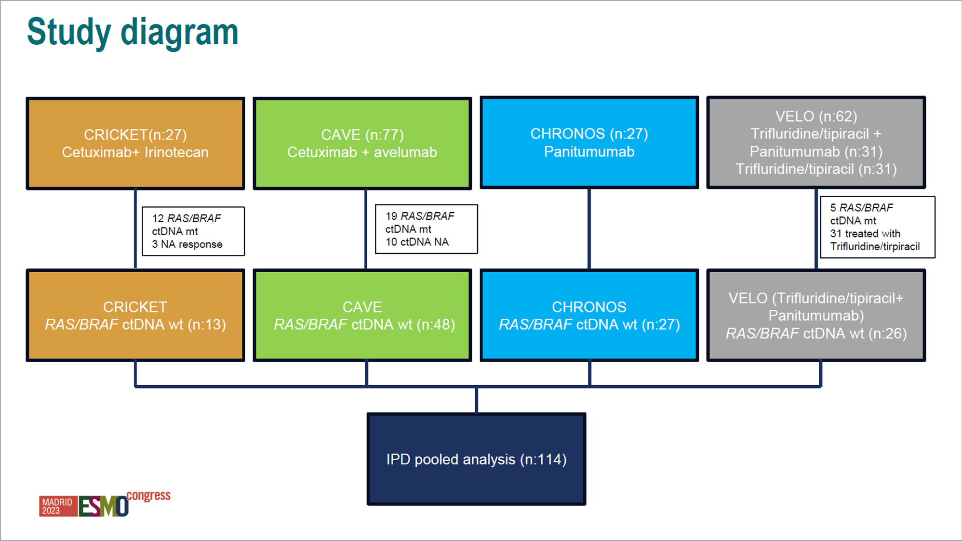
Rechallenge with EGFR antibodies: Pooled Analysis of 4 phase II trials
Trifluridine/tipiracil (n:31)
N = 114
Trifluridine/tipiracil
Ciardiello et al, ESMO 2023

Slide 27
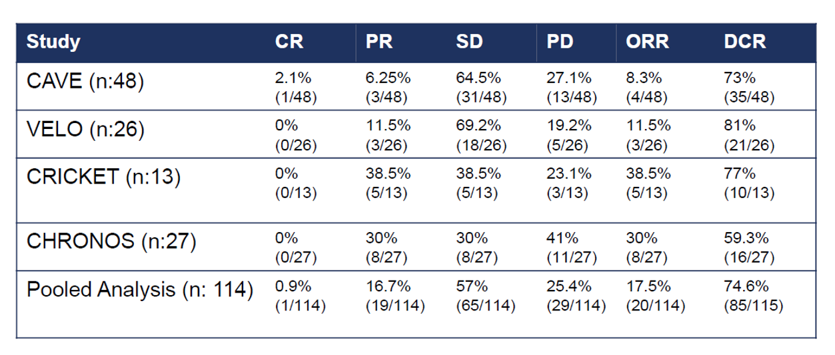
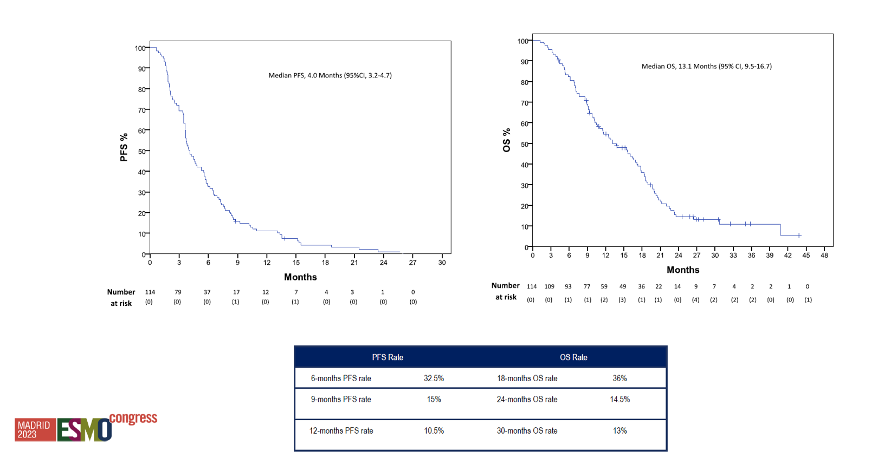
Rechallenge with EGFR antibodies: Results
Median PFS = 4 mos
Median OS = 13.1 mos
Takeaway:
EGFR rechallenge is a reasonable option after checking ctDNA for resolution of resistance mechanisms
Ciardiello et al, ESMO 2023

Slide 28
Acquired Genomic Alterations on
First-Line Chemotherapy With Cetuximab in
Advanced Colorectal Cancer: Circulating Tumor
DNA Analysis of the CALGB/SWOG-80405
Trial (Alliance)
N = 1,128
Kanwal Raghav, MD¹; Fang-Shu Ou, PhD²; Alan P. Venook, MD³; Federico Innocenti, MD, PhD⁴; Ryan Sun, PhD¹; Heinz-Josef Lenz, MD⁵; and Scott Kopetz, MD, PhD¹
¹The University of Texas MD Anderson Cancer Center, Houston, TX
²Alliance Statistics and Data Management Center, Mayo Clinic, Rochester, MN
³UCSF Helen Diller Family Comprehensive Cancer, San Francisco, CA
⁴AbbVie Inc, North Chicago, IL
⁵USC Norris Comprehensive Cancer Center, University of Southern California, Los Angeles, CA
J Clin Oncol 41:472-478.

Slide 29

CALGB/SWOG 80405:
FINAL DESIGN
mCRC
1st-line
KRAS wild type
(codons 12,13)
STRATA:
FOLFOX/FOLFIRI
Prior adjuvant
Prior XRT
FOLFIRI
or
FOLFOX
MD choice
Chemo + Cetuximab
Chemo + Bevacizumab
N = 1140
1° Endpoint: Overall Survival
2°Endpoints: PFS, chemo / biologic agent interaction

Slide 30
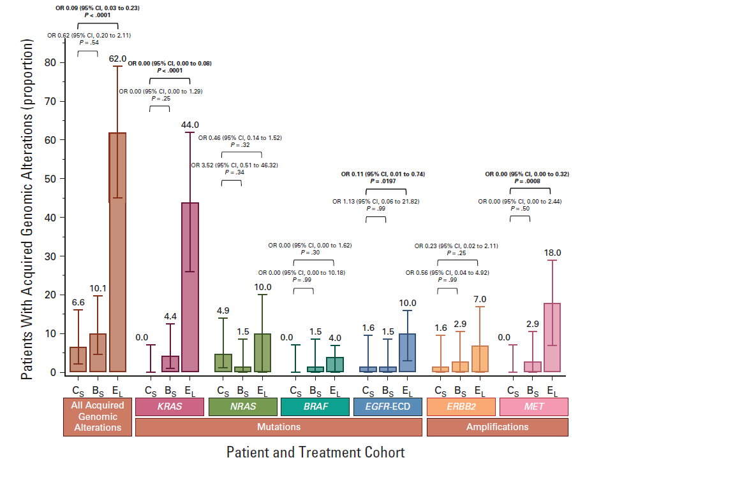
N = 130
Later lines of therapy
Takeaway:
Hypothesis generating study
Alterations, classically associated with anti-EGFR-antibody resistance in later lines rare with up-front use of anti-EGFR-chemotherapy indicating divergent resistance mechanisms.
N = 1,128
Cetux
Bev
Raghav et al, J Clin Oncol 41:472-478.

Slide 31
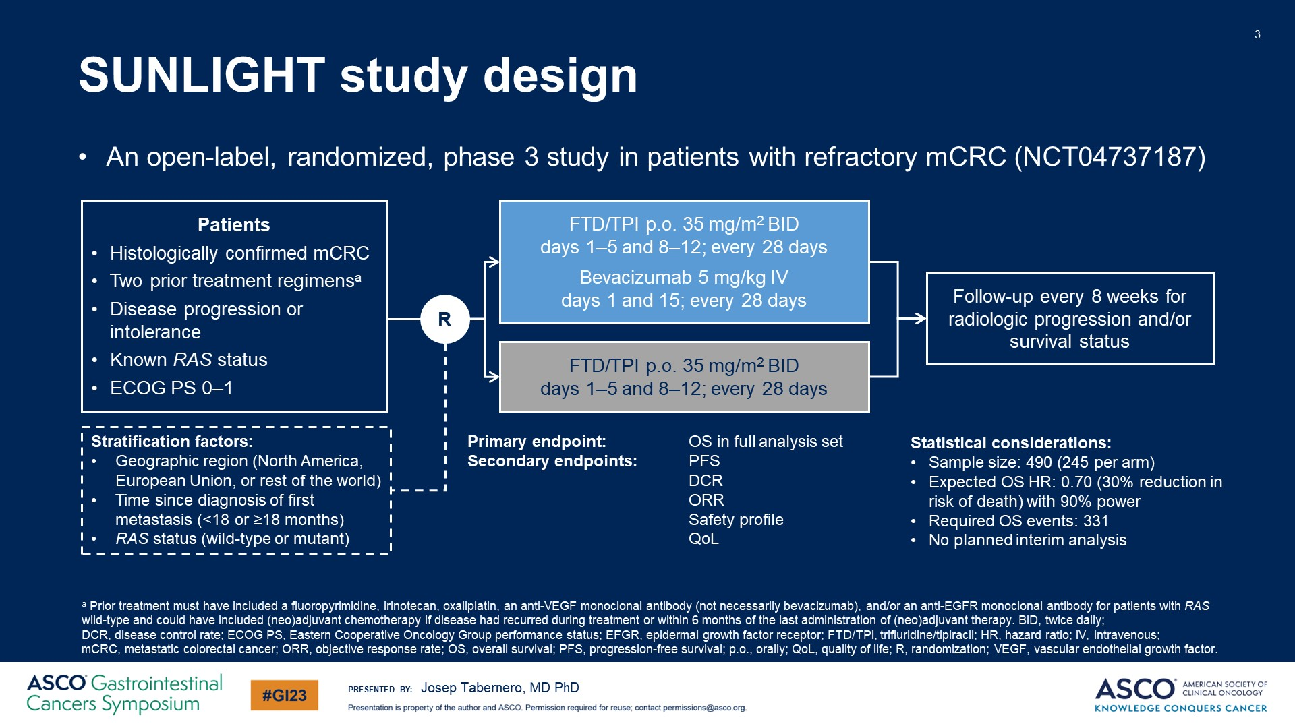
SUNLIGHT study design
SUNLIGHT Trial: Phase III TAS-102 + / - bev in 3rd Line mCRC
Prior treatment with anti-VEGF ab: 75%
Prior treatment with anti-VEGF ab in 2 lines: 25%
Tabanero et al. ASCO GI 2023

Slide 32
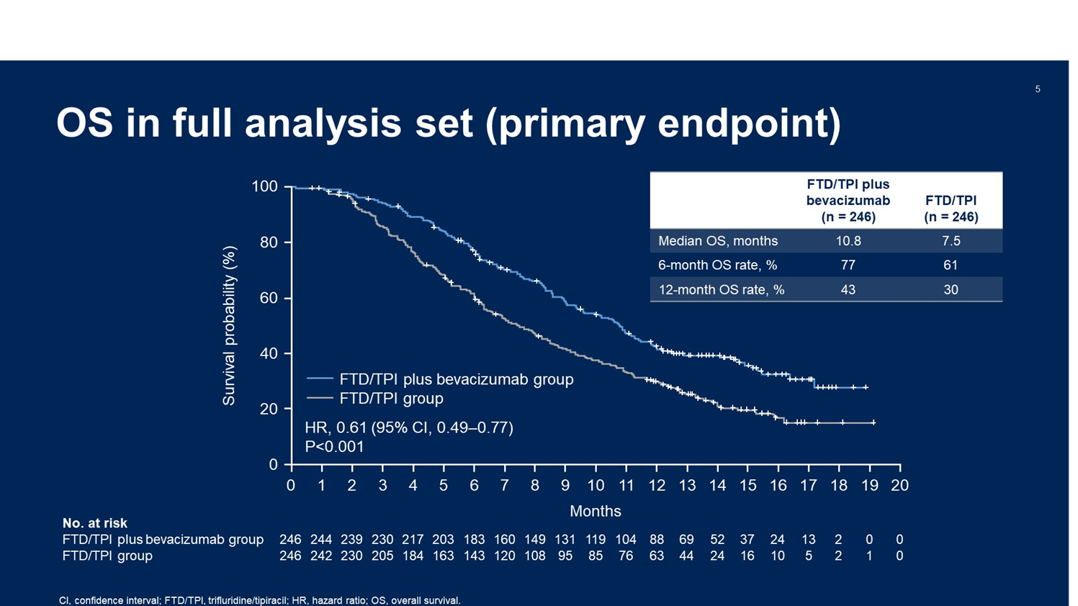
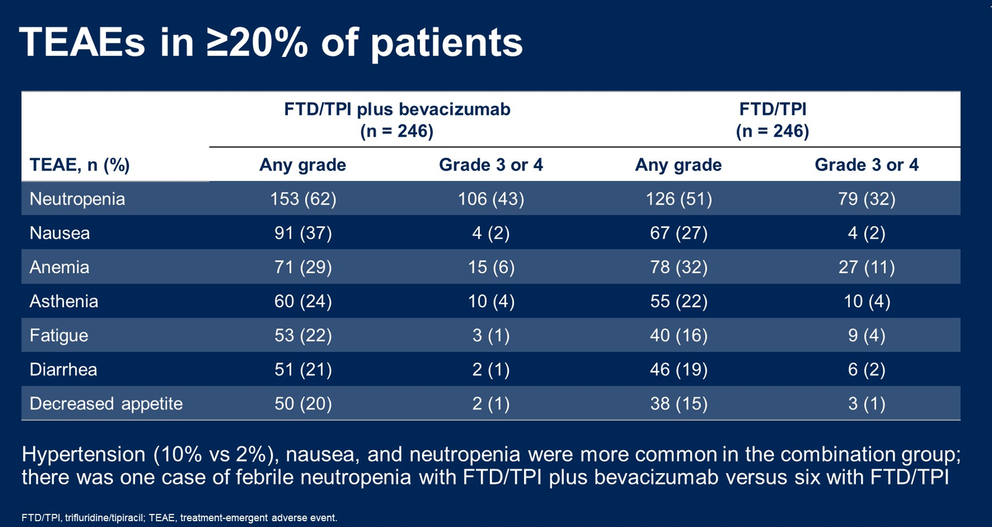
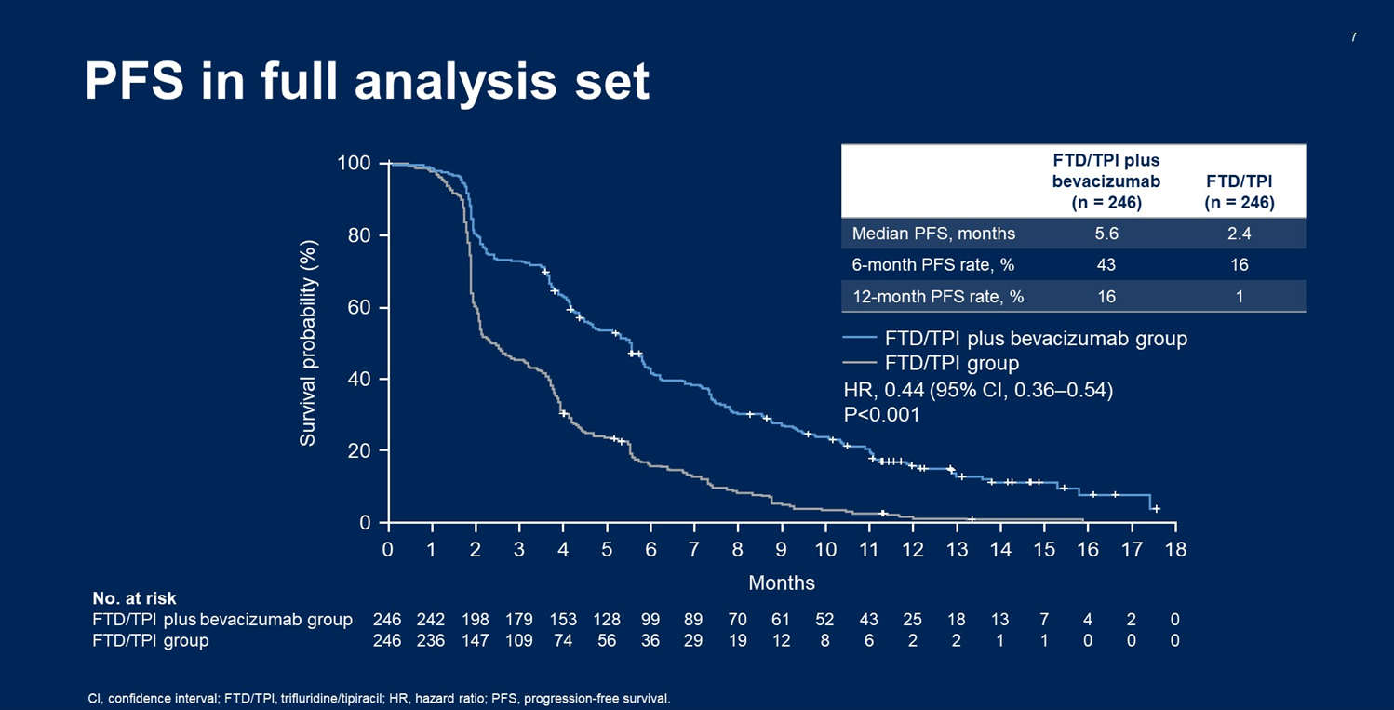
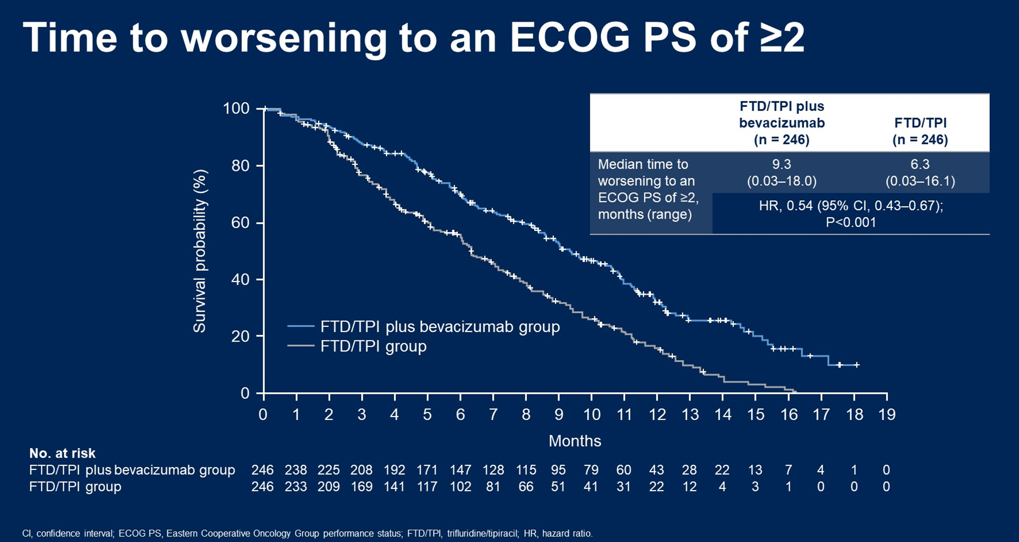
SUNLIGHT Trial: Results
Tabanero et al. ASCO GI 2023; Prager et al. NEJM 2023

Slide 33
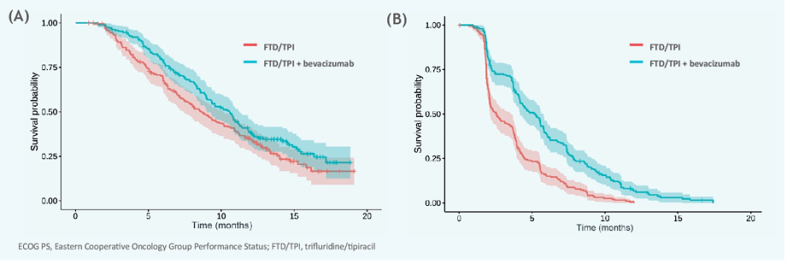
SUNLIGHT Trial: PFS and OS in ECOG PS 0-1
OS
10.58 vs 8.71 months
HR, 0.78 (95%CI, 0.61 to 0.99)
- 91% of patients at discontinuation had PS 0-1
- Both PFS and OS were better in these patients
- Allows for subsequent therapies
PFS
5.22 vs vs 2.55 months
HR, 0.49 (95%CI, 0.4 to 0.61)
Taieb et al. ASCO 2023

Slide 34
SUNLIGHT: Conclusions & Takeaways
TAS-102 + bevacizumab significantly improved OS and PFS compared to TAS-102 alone in 3rd line
Toxicities consistent with prior experience with these agents
Takeaway:
TAS-102 + bev FDA approved for 3rd line mCRC and should be chosen over TAS-102 unless contraindications for anti-VEGF therapy

Slide 35
FRESCO-2 Study Design
FRESCO-2 Trial: Fruquintinib vs placebo in refractory mCRC
Patient Eligibility
Prior treatment with fluoropyrimidine-, oxaliplatin- and irinotecan-based chemotherapy, an anti-VEGF biological therapy, and, if RAS wild type, an anti-EGFR therapy
Progression on, or intolerance to, TAS-102 and/or regorafenib
Prior treatment with an immune checkpoint inhibitor or BRAF inhibitor if indicated
Fruquintinib 5 mg PO, QD (3 weeks on, 1 week off)
+
BSC
(N=458)
R
2:1
Treatment until progression or unacceptable toxicity
Placebo 5 mg PO, QD
(3 weeks on, 1 week off)
+
BSC
(N=229)
N=687
Stratification Factors
Prior therapy (TAS-102 vs regorafenib vs TAS-102 and regorafenib)
RAS mutational status (wild-type vs mutant)
Duration of metastatic disease (≤18 months vs >18 months)
Note: To ensure the patient population is reflective of clinical practice, the number of patients treated with prior regorafenib was limited to 344 patients (50%)
BSC, best supportive care.
NCT04322539.
Prior lines of therapy: 4 (median)
Prior treatment with anti-VEGF ab: 96%
Prior TAS-102 52%; prior rego 10%; both 39%
Dasari A et al. ESMO 2022, Presentation LBA25
Notes:
Eligible patients were required to have prior treatment with all standard cytotoxic chemotherapy agents, an anti-VEGF antibody and targeted therapies as appropriate. They were also required to have prior TAS-102 and / or regorafenib. Pts were randomized 2:1 to fruquintib vs placebo dosed at 5 mg po qd 3 w on 1 w off and also received BSC in both arms. Stratification factors include prior therapy (TAS-102 vs regorafenib vs both), RAS mutation status and duration of metastatic disease. For alignment with ongoing clinical practice, proportion of pts with prior regorafenib was capped at 50%

Slide 36
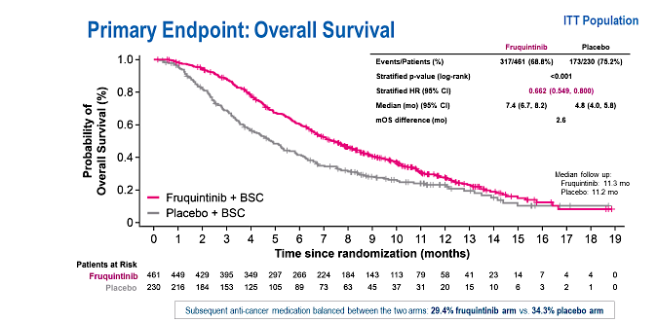
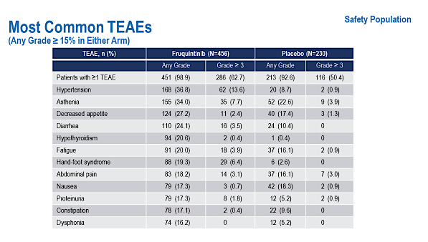
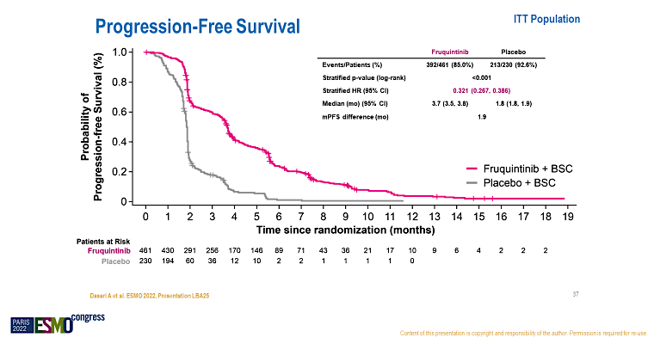
FRESCO-2 Trial: Results
Dasari A et al. ESMO 2022, Presentation LBA25
Dasari A et al. Lancet 2023
Notes:
Eligible patients were required to have prior treatment with all standard cytotoxic chemotherapy agents, an anti-VEGF antibody and targeted therapies as appropriate. They were also required to have prior TAS-102 and / or regorafenib. Pts were randomized 2:1 to fruquintib vs placebo dosed at 5 mg po qd 3 w on 1 w off and also received BSC in both arms. Stratification factors include prior therapy (TAS-102 vs regorafenib vs both), RAS mutation status and duration of metastatic disease. For alignment with ongoing clinical practice, proportion of pts with prior regorafenib was capped at 50%

Slide 37
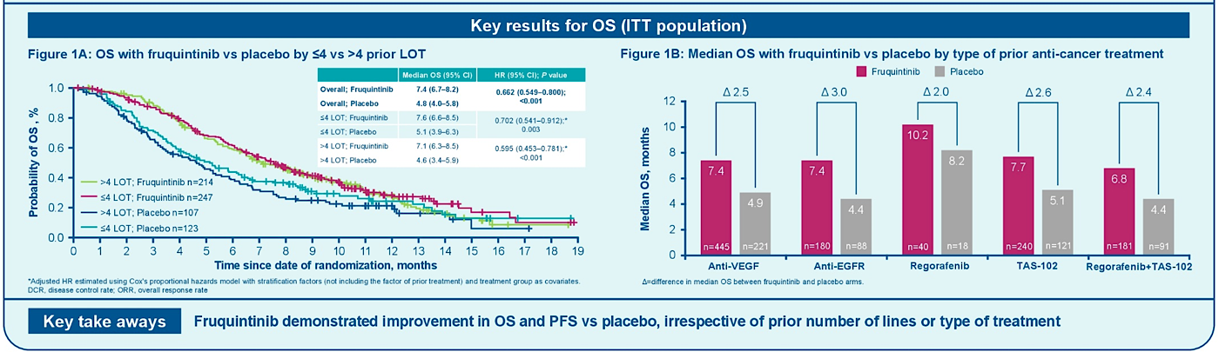
FRESCO-2 Trial: Subgroup Analysis by Prior Therapy
Dasari et al. ASCO 2023
Notes:
Most common AEs grade 3 or higher were HTN in 14%, asthenia in 8% and decreased appetite in 2%. Of note, grade 3 or higher HFS, proteinuria and LFT changes were all 6% or lower

Slide 38
FRESCO-2: Conclusions & Takeaways
Fruquintinib improved OS and PFS in patients with refractory mCRC
Toxicities consistent with prior experience and overall appears to be well tolerated
Takeaway:
Fruquintinib approved for 3rd and 4th line mCRC and should be considered for eligible patients

