Slide 1
Gastroesophageal and Colorectal Cancers Saturday, April 27, 2024 6:00 PM – 8:00 PM
What I Tell My Patients: Integrating New Research Information into Current Clinical Care
A Complimentary NCPD Hybrid Symposium Series Held During the 49th Annual ONS Congress
Faculty
Deanna A Griffie, MSN, AGNP-C
Caroline Kuhlman, MSN, APRN-BC
Manish A Shah, MD
John Strickler, MD
Moderator
Neil Love, MD

Slide 2
Faculty
Deanna A Griffie, MSN, AGNP-C
Nurse Practitioner
GI Medical Oncology
Duke Cancer Institute
Durham, North Carolina
John Strickler, MD
Associate Professor
Associate Director, Clinical Research – GI
Duke University
Durham, North Carolina
Caroline Kuhlman, MSN, APRN-BC
Nurse Practitioner
Tucker Gosnell Center for Gastrointestinal Cancers
Massachusetts General Hospital
Boston, Massachusetts
Moderator Neil Love, MD Research To Practice Miami, Florida
Manish A Shah, MD
Chief, Solid Tumor Oncology Service
Director, Gastrointestinal Oncology Program
Co-Director, Center for Advanced Digestive Care
Bartlett Family Professor
of Gastrointestinal Oncology
Weill Cornell Medicine/NewYork-Presbyterian Hospital
New York, New York

Slide 3
Ms Griffie — Disclosures
No relevant conflicts of interest to disclose

Slide 4
Ms Kuhlman — Disclosures
No relevant conflicts of interest to disclose

Slide 5
Dr Shah — Disclosures
Contracted Research | Bristol Myers Squibb, Merck, Oncolys BioPharma

Slide 6
Dr Strickler — Disclosures
Advisory Committees | AbbVie Inc, Agenus Inc, Astellas, AstraZeneca Pharmaceuticals LP, Bayer HealthCare Pharmaceuticals, BeiGene Ltd, Daiichi Sankyo Inc, Genentech, a member of the Roche Group, GSK, Jazz Pharmaceuticals Inc, Johnson & Johnson Pharmaceuticals, Lilly, Merck, Natera Inc, Pfizer Inc, Regeneron Pharmaceuticals Inc, Sanofi, Taiho Oncology Inc, Takeda Pharmaceuticals USA Inc, Xilio Therapeutics
Contracted Research | AbbVie Inc, Amgen Inc, A*STAR D3, Bayer HealthCare Pharmaceuticals, BeiGene Ltd, Curegenix, Daiichi Sankyo Inc, Erasca, Genentech, a member of the Roche Group, GSK, Leap Therapeutics Inc, Lilly, Novartis, Pfizer Inc, Revolution Medicines
Data and Safety Monitoring Boards/Committees | AbbVie Inc, BeiGene Ltd, GSK, Pfizer Inc
Stock Options — Private Company | Triumvira Immunologics

Slide 7
Commercial Support
This activity is supported by educational grants from Astellas, AstraZeneca Pharmaceuticals LP, Bristol Myers Squibb, and Taiho Oncology Inc.
Research To Practice NCPD Planning Committee Members, Staff and Reviewers
Planners, scientific staff and independent reviewers for Research To Practice have no relevant conflicts of interest to disclose.

Slide 8
This educational activity contains discussion of non-FDA-approved uses of agents and regimens. Please refer to official prescribing information for each product for approved indications.

Slide 9
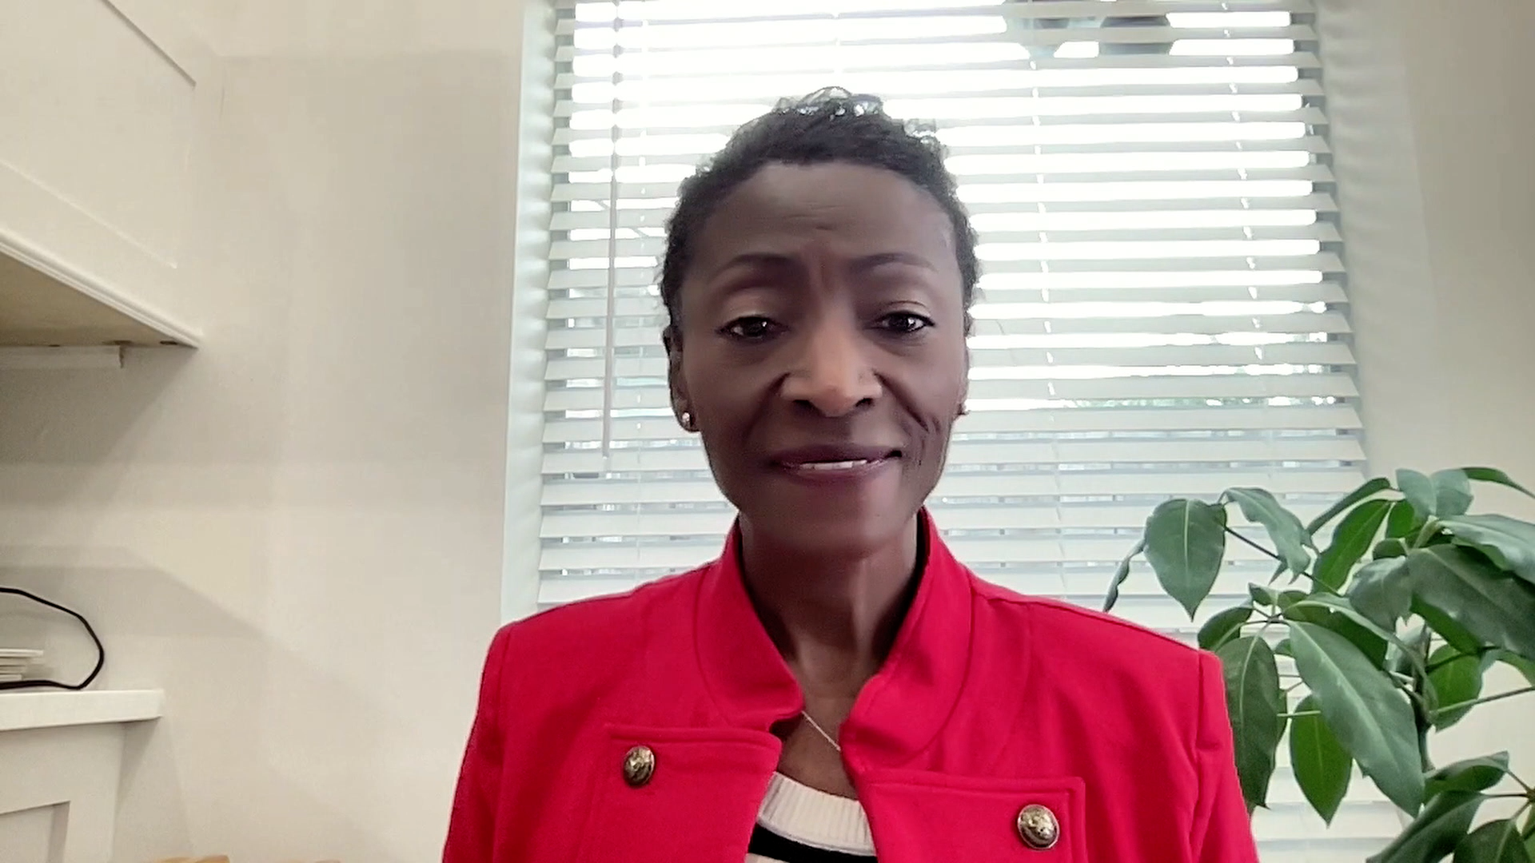
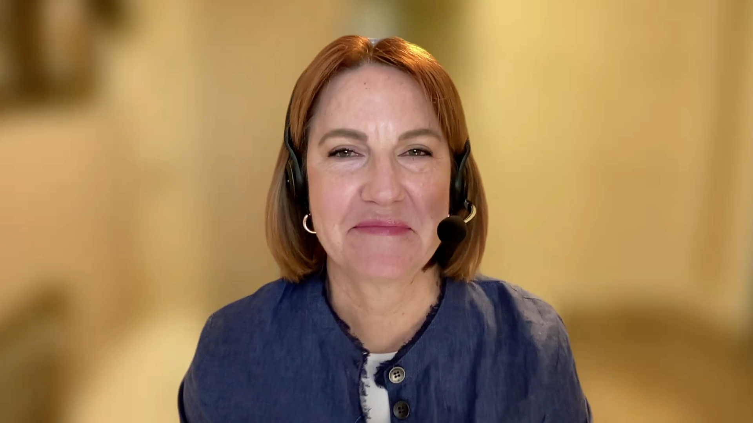
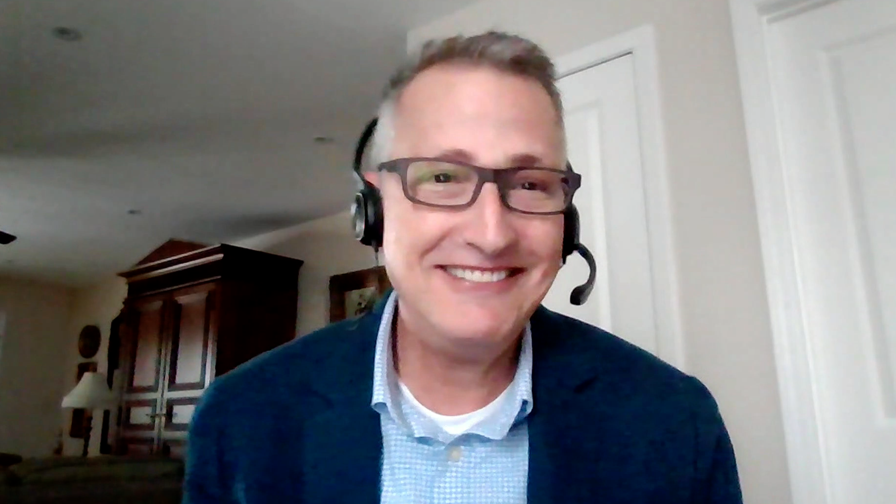
Consulting Nurse Faculty
Jacqueline Broadway-Duren, PhD, DNP, APRN, FNP-BC
The University of Texas MD Anderson Cancer Center
Houston, Texas
Jessica Mitchell, APRN, CNP, MPH
Mayo Clinic College of Medicine and Science
Rochester, Minnesota
Kathleen D Burns, RN, MSN, AGACNP-BC, OCN
City of Hope Comprehensive Cancer Center
Duarte, California
Tiffany A Richards, PhD, ANP-BC, AOCNP
The University of Texas MD Anderson Cancer Center
Houston, Texas
Sonia Glennie, ARNP, MSN, OCN
Swedish Cancer Institute Center for Blood Disorders
Seattle, Washington
Kimberly A Spickes, MNSc, RN, APRN, OCN, ACNP-BC
University of Arkansas for Medical Sciences
Little Rock, Arkansas
Amy Goodrich, CRNP
The Sidney Kimmel Comprehensive Cancer Center
Baltimore, Maryland
Ronald Stein, JD, MSN, NP-C, AOCNP
USC Norris Comprehensive Cancer Center
Los Angeles, California
https://www.ResearchToPractice.com/ONS2024Clips

Slide 10
Agenda
Introduction
Part 1: Gastroesophageal Cancer
Part 2: Colorectal Cancer

Slide 11
Agenda
Introduction
Part 1: Gastroesophageal Cancer
Part 2: Colorectal Cancer

Slide 12
Consulting Nursing Faculty Comments
Assessing the patient with newly diagnosed cancer
Kathleen D Burns, RN, MSN, AGACNP-BC, OCN

Slide 13
Agenda
Introduction
Part 1: Gastroesophageal Cancer
Module 1: Immune Checkpoint Inhibitors in the Management of Nonmetastatic Gastroesophageal Cancers
Module 2: First-Line Therapy for Metastatic Gastroesophageal Cancers
Module 3: Current and Future Role of Targeted Therapy in the Management of Gastroesophageal Cancers
Part 2: Colorectal Cancer

Slide 14
Agenda
Introduction
Part 1: Gastroesophageal Cancer
Module 1: Immune Checkpoint Inhibitors in the Management of Nonmetastatic Gastroesophageal Cancers
Module 2: First-Line Therapy for Metastatic Gastroesophageal Cancers
Module 3: Current and Future Role of Targeted Therapy in the Management of Gastroesophageal Cancers
Part 2: Colorectal Cancer

Slide 15
The Current Role of Anti-PD-1/PD-L1 Antibodies in the Management of Nonmetastatic Gastroesophageal Cancers
Dr Shah
New York, New York
Dr Strickler
Durham, North Carolina
Long-term outcomes achieved with historical treatment approaches for patients with localized/locally advanced gastroesophageal tumors
Key efficacy and safety findings with adjuvant nivolumab for patients with resected esophageal or gastroesophageal junction (GEJ) cancer
Appropriate selection of candidates for treatment with adjuvant nivolumab

Slide 16
Adjuvant Nivolumab
Mechanism of action
Anti-PD-1 antibody
Indication
For the adjuvant treatment of completely resected esophageal or GEJ cancer with residual pathologic disease in patients who have received neoadjuvant chemoradiation therapy
Recommended dose
240 mg IV infusion every 2 weeks or 480 mg IV infusion every 4 weeks for total treatment duration of 1 year
Nivolumab package insert, 3/2024.

Slide 18
The Potential Role of Immune Checkpoint Inhibitors as Neoadjuvant Therapy for Patients with Gastric/GEJ Cancer
Dr Shah
New York, New York
Dr Strickler
Durham, North Carolina
Early data with immune checkpoint inhibitors as neoadjuvant therapy for resectable microsatellite instability-high (MSI-H)/mismatch repair-deficient (dMMR) gastric/GEJ adenocarcinoma
Improvement in pathologic complete response rate with the addition of durvalumab to neoadjuvant FLOT (fluorouracil/leucovorin/oxaliplatin/docetaxel) for patients with resectable gastric/GEJ cancer in the Phase III MATTERHORN trial
Ongoing evaluation of perioperative durvalumab in the MATTERHORN study and potential clinical role of this strategy

Slide 19
Durvalumab
Mechanism of action
Anti-PD-L1 antibody
Indication for gastric/GEJ cancer
Investigational
Pivotal clinical trial
Phase III MATTERHORN trial of neoadjuvant-adjuvant durvalumab and FLOT chemotherapy for resectable gastric and GEJ cancer
Al-Batran S-E et al. ESMO 2023;Abstract 129O.

Slide 20
Abstract 129O

Slide 21
MATTERHORN Trial Design
Al-Batran S-E et al. ESMO 2023;Abstract 129O.

Slide 22
Caroline Kuhlman, MSN, APRN-BC
What I tell my patients about (neo)adjuvant systemic therapy for localized/locally advanced gastroesophageal cancer

Slide 23
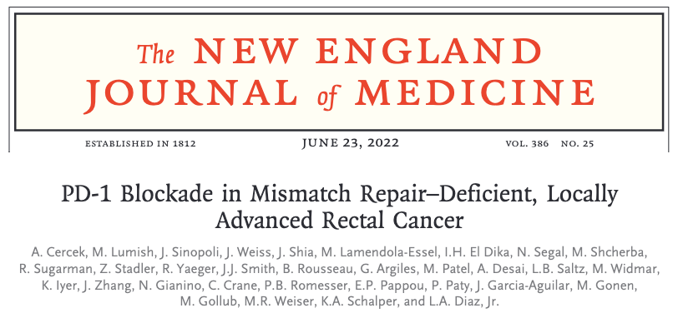

Slide 24
Agenda
Introduction
Part 1: Gastroesophageal Cancer
Module 1: Immune Checkpoint Inhibitors in the Management of Nonmetastatic Gastroesophageal Cancers
Module 2: First-Line Therapy for Metastatic Gastroesophageal Cancers
Module 3: Current and Future Role of Targeted Therapy in the Management of Gastroesophageal Cancers
Part 2: Colorectal Cancer

Slide 25
First-Line Therapy for Metastatic Gastroesophageal Cancers
Dr Shah
New York, New York
Dr Strickler
Durham, North Carolina
Biological similarities and differences between gastric, GEJ and esophageal cancers; effect of tumor location and histology on management approach
Influence of PD-L1 status on the selection of first-line treatment; appropriate timing of and optimal approaches to PD-L1 assessment
Published data sets demonstrating the efficacy of first-line nivolumab- and pembrolizumab-containing regimens for advanced gastric, GEJ and esophageal cancer
Evidence-based selection of chemotherapy alone versus combined chemoimmunotherapy versus dual immune checkpoint inhibition for patients with newly diagnosed gastroesophageal tumors

Slide 26
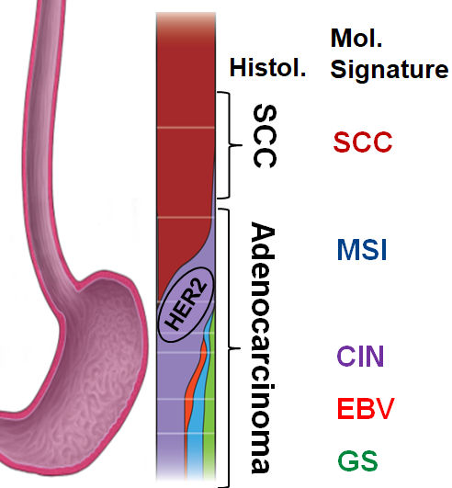
2024 Simplified landscape of first-line therapy for fit patient with gastroesophageal cancer (NCCN Category 1 or 2A)
Any PD-L1 status
Nivo + oxaliplatin/FP
Nivo + IPI
PD-L1 CPS ≥ 10
Pembro + oxaliplatin/FP
Pembro +/- chemo
Nivo + FOLFOX
Nivo + IPI
Dostarlimab
PD-L1 CPS ≥ 5-10 (CPS ≥ 1 ?)
Nivo or pembro + platin/FP
CPS, Combined positive score; FP, fluoropyrimidine; nivo, nivolumab; pembro, pembrolizumab; ICI, immune checkpoint inhibition; IPI, ipilimumab
Courtesy of Harry Y Yoon, MD, MHS

Slide 27
Select Phase III Trials Evaluating Nivolumab or Nivolumab/Ipilimumab as First-Line Treatment of Gastroesophageal Cancers
Trial name | Histology | Study arms | Key endpoints
CheckMate 649 | GEJ adenocarcinoma; HER2-negative | Nivo + FP vs FP | CPS ≥5 OS HR: 0.70 All patients OS HR: 0.79
 |  | Nivo 1 mg/kg + Ipi 3 mg/kg vs FP | CPS ≥5 OS HR: 0.89 All patients OS HR: 0.91
CheckMate 648 | Esophageal SCC | Nivo 3 mg/kg + Ipi 1mg/kg vs FP | PD-L1 ≥1% OS HR: 0.62 All patients OS HR: 0.77
 |  | Nivo + FP vs FP | PD-L1 ≥1% OS HR: 0.59 All patients OS HR: 0.78
ATTRACTION-4 | Gastric or GEJ cancer | Nivo + FP vs FP | All patients OS HR: 0.9
GEJ = gastroesophageal junction; FP = fluoropyrimidine + platinum agent; CPS = combined positive score for PD-L1; OS = overall survival; HR = hazard ratio; SCC = squamous cell carcinoma
Adapted from Karim F et al. Cancers (Basel) 2023;15(16):4099; Janjigian YY et al. J Clin Oncol 2024; February 21 [Online ahead of print].; Kato K et al. Gastrointestinal Cancers Symposium 2023;Abstract 290. Shitara K et al. Nature 2022;603:942-8. Kang Y-K et al; Lancet Oncol 2022;23(2):234-47.

Slide 28
Select Phase III Trials Evaluating Pembrolizumab as First-Line Treatment of Gastroesophageal Cancers
Trial name | Histology | Study arms | Key endpoints
KEYNOTE-590 | Esophageal or GEJ SCC | Pembro + FP vs Placebo + FP | All patients | OS HR: 0.72 PD-L1 CPS ≥10 OS HR: 0.64
 |  |  | Esophageal SCC | OS HR: 0.71 PD-L1 CPS ≥10 OS HR: 0.60
KEYNOTE-062 | Gastric or GEJ adenocarcinoma | Pembro alone vs Placebo + FP | CPS ≥1 OS HR: 0.91 CPS ≥10 OS HR: 0.69
 |  | Pembro + FP vs Placebo + FP | CPS ≥1 OS HR: 0.85 CPS ≥10 OS HR: 0.85
KEYNOTE-859 | Gastric or GEJ adenocarcinoma | Pembro + FP vs Placebo + FP | CPS ≥1 OS HR: 0.74 CPS ≥10 OS HR: 0.65
GEJ = gastroesophageal junction; SCC = squamous cell carcinoma; FP = fluoropyrimidine + platinum agent; OS = overall survival; HR = hazard ratio; CPS = combined positive score
Adapted from Karim F et al. Cancers (Basel) 2023;15(16):4099; Shah MA Gastrointestinal Cancers Symposium 2024;Abstract 250; Rha SY et al. Lancet Oncol 2023;24(11):1181-95. Shitara K et al. JAMA Oncol 2020;6(10):1571-80.

Slide 29
Deanna A Griffie, MSN, AGNP-C
What I tell my patients who are about to start first-line chemoimmunotherapy for metastatic gastroesophageal cancer

Slide 30
Agenda
Introduction
Part 1: Gastroesophageal Cancer
Module 1: Immune Checkpoint Inhibitors in the Management of Nonmetastatic Gastroesophageal Cancers
Module 2: First-Line Therapy for Metastatic Gastroesophageal Cancers
Module 3: Current and Future Role of Targeted Therapy in the Management of Gastroesophageal Cancers
Part 2: Colorectal Cancer

Slide 31
The Potential Role of Therapy Targeting Claudin 18.2 (CLDN18.2) for Gastroesophageal Cancers
Dr Shah
New York, New York
Dr Strickler
Durham, North Carolina
Biological rationale for targeting CLDN18.2 in gastric/GEJ cancers; mechanism of antitumor activity of zolbetuximab
Published efficacy and safety findings with zolbetuximab in combination with chemotherapy as first-line therapy for patients with advanced CLDN18.2-positive gastric/GEJ cancer
Potential clinical role of up-front zolbetuximab/chemotherapy and implications for biomarker assessment
Incidence, severity and timing of nausea and vomiting observed with zolbetuximab for patients with and without prior gastrectomy
Role of antiemetics and other supportive care measures for patients receiving zolbetuximab
Spectrum, frequency and management of other toxicities reported with zolbetuximab

Slide 32
Zolbetuximab
Mechanism of action
Anti-CLDN18.2 antibody
Indication
Investigational
Pivotal clinical data
Phase III SPOTLIGHT¹ and GLOW² trials evaluating zolbetuximab in combination with either FOLFOX or CAPOX as first-line treatment for patients with HER2-negative locally advanced unresectable or metastatic gastric or GEJ cancers
1. Shitara K et al. Lancet 2023;401:1655-68.
2. Shah MA et al. Nat Med 2023;29(8):2133-41.

Slide 33
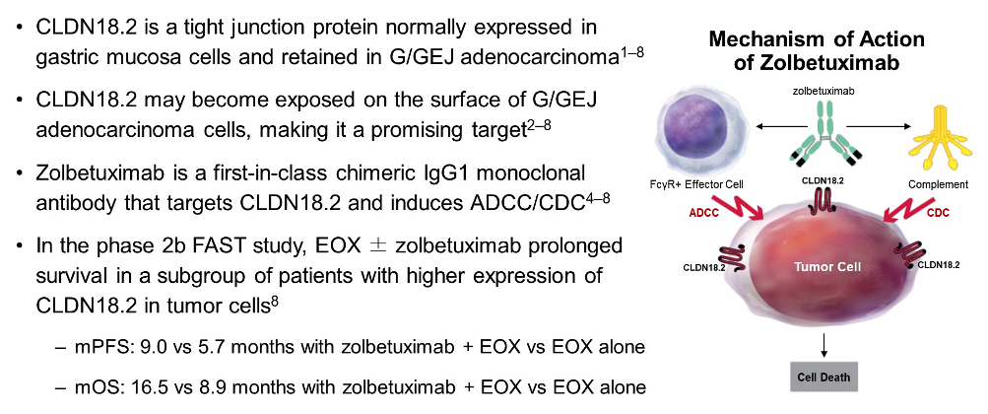
Mechanism of Action of Zolbetuximab
Shitara K et al. Gastrointestinal Cancers Symposium 2023;Abstract LBA292.

Slide 34
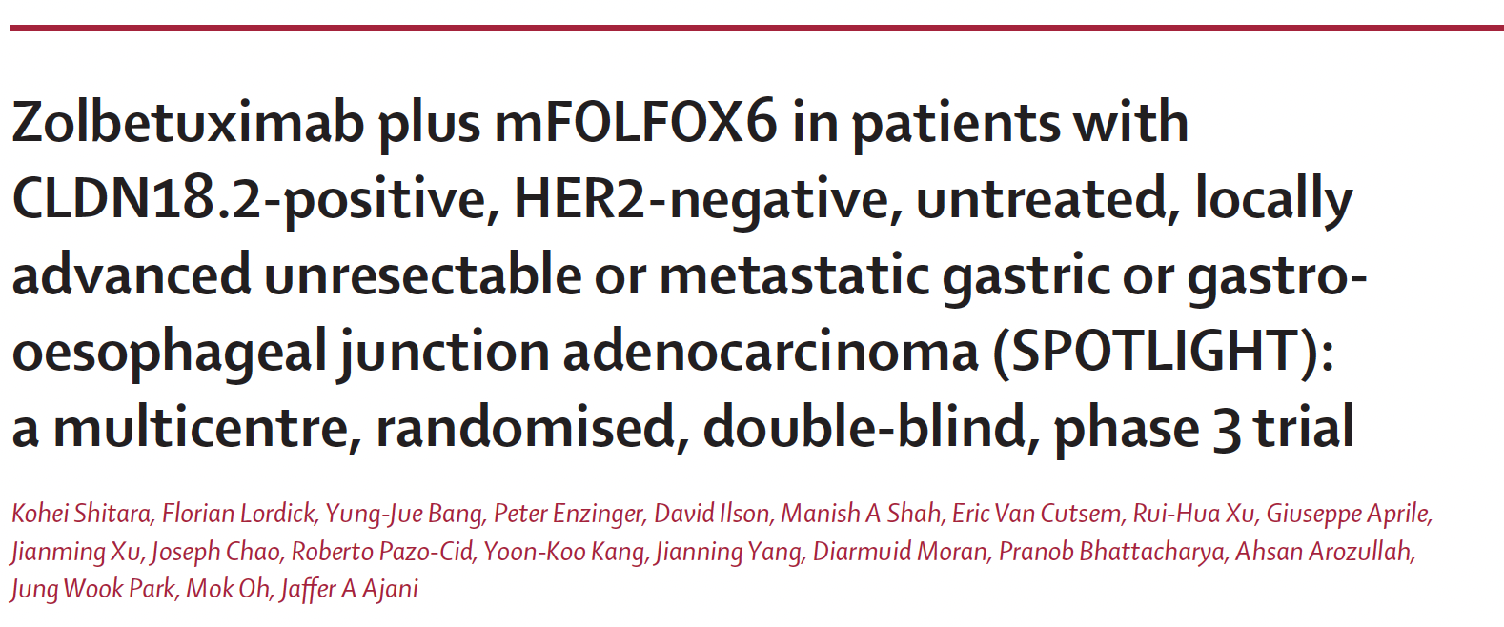
Lancet 2023;401:1655-68.

Slide 35
SPOTLIGHT: Progression-Free Survival (Primary Endpoint)
Shitara K et al. Gastrointestinal Cancers Symposium 2023;Abstract LBA292. Shitara K et al. Lancet 2023;401:1655-68.

Slide 36
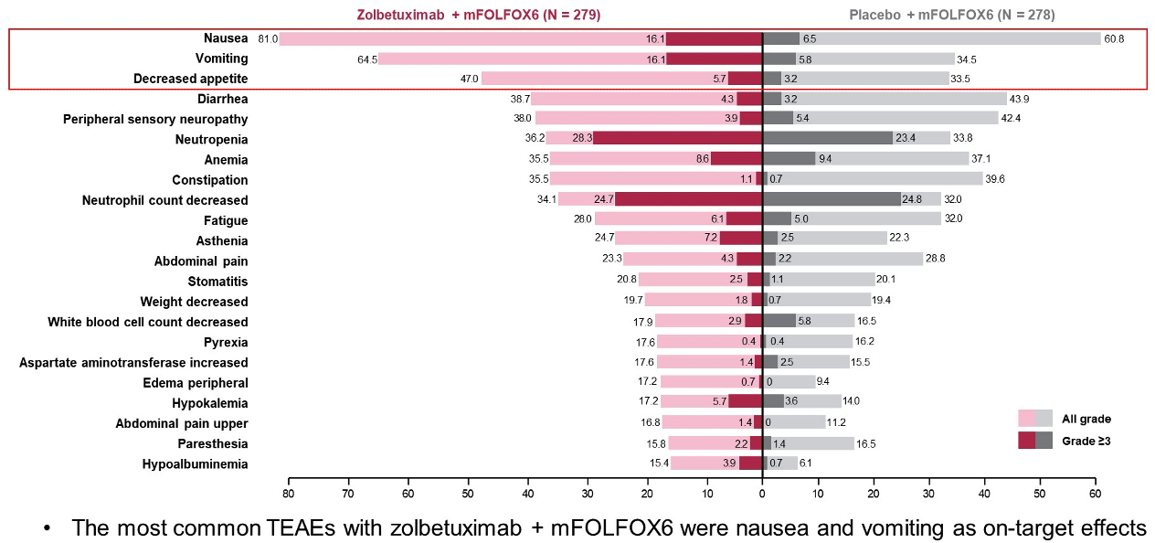
SPOTLIGHT: TEAEs Occurring in ≥15% of Patients
TEAEs = treatment-emergent adverse events
Shitara K et al. Gastrointestinal Cancers Symposium 2023;Abstract LBA292. Shitara K et al. Lancet 2023;401:1655-68.

Slide 37
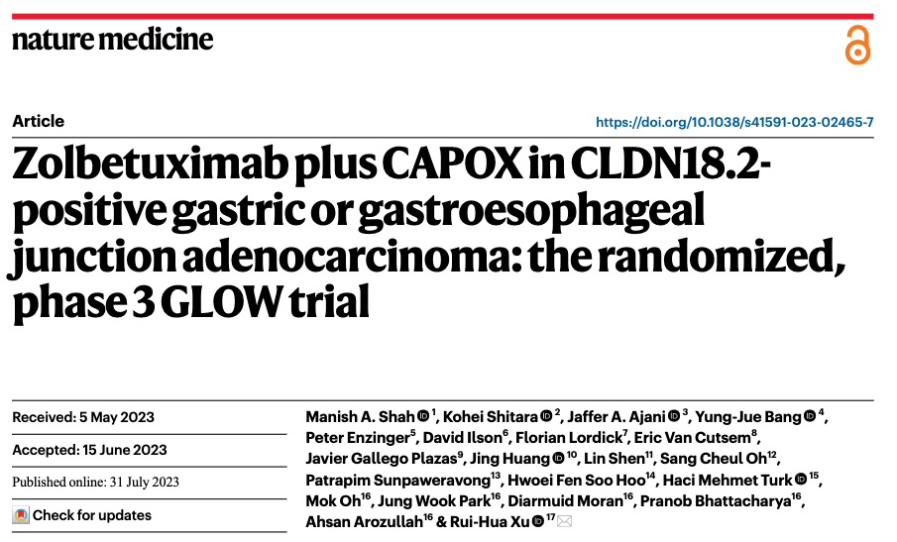
2023;29(8):2133-41.

Slide 38
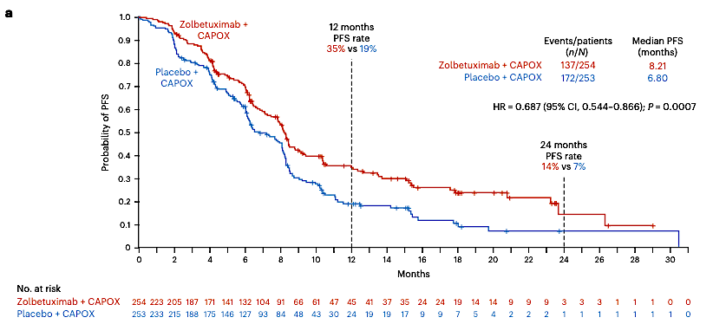
GLOW: Progression-Free Survival (PFS) by Independent Review Committee (Primary Endpoint)
Shah MA et al. Nat Med 2023;29(8):2133-41.

Slide 39
Caroline Kuhlman, MSN, APRN-BC
What I tell my patients with gastric/GEJ cancers who are about to begin therapy with zolbetuximab

Slide 40
Targeted Therapies for HER2-Positive Gastroesophageal Cancers
Dr Shah
New York, New York
Dr Strickler
Durham, North Carolina
Principal outcomes supporting the addition of pembrolizumab to chemotherapy/trastuzumab for previously untreated HER2-positive advanced gastric/GEJ adenocarcinoma; effect of PD-L1 status on eligibility for this approach
Published data with trastuzumab deruxtecan (T-DXd) for patients with progressive HER2-positive gastric/GEJ cancer
Spectrum, frequency and management of toxicities associated with T-DXd

Slide 41
FDA Amends Gastric Cancer Indication for Pembrolizumab Press Release – November 7, 2023
“… the Food and Drug Administration revised the existing indication of pembrolizumab with trastuzumab, fluoropyrimidine, and platinum-containing chemotherapy for the first-line treatment of patients with locally advanced unresectable or metastatic HER2-positive gastric or gastroesophageal junction (GEJ) adenocarcinoma. This updated indication, which remains approved under accelerated approval regulations, restricts its use to patients whose tumors express PD-L1 (CPS ≥1) as determined by an FDA-approved test.
The FDA also approved ... PD-L1 IHC 22C3 pharmDx as a companion diagnostic device to select patients with gastric or GEJ adenocarcinoma whose tumors express PD-L1 (CPS ≥1).
Efficacy was evaluated in KEYNOTE-811 (NCT03615326), a multicenter, randomized, double-blind, placebo-controlled trial in patients with HER2-positive locally advanced or metastatic gastric or GEJ adenocarcinoma who have not previously received systemic therapy for metastatic disease. ... In a recent, prespecified interim analysis of the fully enrolled trial (N = 698), in a subgroup analysis conducted in patients with PD-L1 CPS <1 (N = 104), the hazard ratio (HR) for OS and PFS were 1.41 (95% CI 0.90, 2.20) and 1.03 (95% CI 0.65, 1.64), respectively.”
https://www.fda.gov/drugs/resources-information-approved-drugs/fda-amends-pembrolizumabs-gastric-cancer-indication

Slide 42
Trastuzumab Deruxtecan: Gastric and Gastroesophageal Cancers
Mechanism of action
Antibody-drug conjugate directed against HER2
Indication
For patients with locally advanced or metastatic HER2-positive (IHC 3+ or IHC 2+/ISH-positive) gastric or gastroesophageal junction adenocarcinoma who have received a prior trastuzumab-based regimen
Recommended dosing
6.4 mg/kg given IV every 3 weeks (21-day cycle) until disease progression or unacceptable toxicity
Trastuzumab deruxtecan prescribing information, 4/2024.

Slide 43
Trastuzumab Deruxtecan
Courtesy of Markus Moehler, MD.

Slide 44
Lancet Oncol 2023;24:744-56.

Slide 45
DESTINY-Gastric02: Overall Safety Summary and ILD/Pneumonitis
Ku G et al. ESMO 2022;Abstract 1205MO; Van Cutsem E et al. Lancet Oncol 2023;24:744-56.

Slide 46
The Integration of Therapies Targeting HER2 into the Management of mCRC
Dr Shah
New York, New York
Dr Strickler
Durham, North Carolina
Incidence of HER2 amplification/overexpression in patients with mCRC; recommended timing of and appropriate platforms for HER2 testing
Pivotal data with tucatinib/trastuzumab for previously treated HER2-positive mCRC
FDA approval and current clinical role of tucatinib/trastuzumab
Available efficacy and safety findings with T-DXd in HER2-expressing mCRC
Current and future nonresearch role of T-DXd

Slide 47
HER2 as an Emerging Precision Cancer Medicine Target in Metastatic CRC
Actionable targets in metastatic CRC
Usually left sided
Not mutually exclusive with RAS or BRAF mutations
Associated with lung and brain metastases
May predict resistance to EGFR antibodies
Courtesy of John H Strickler, MD

Slide 48
Tucatinib: Colorectal Cancer
Mechanism of action
HER2 tyrosine kinase inhibitor
Indication
In combination with trastuzumab for patients with RAS wild-type HER2-positive unresectable or metastatic colorectal cancer that has progressed after fluoropyrimidine-, oxaliplatin- and irinotecan-based chemotherapy
Tucatinib recommended dose
300 mg orally twice daily with or without food
Tucatinib prescribing information, 1/2023.

Slide 49
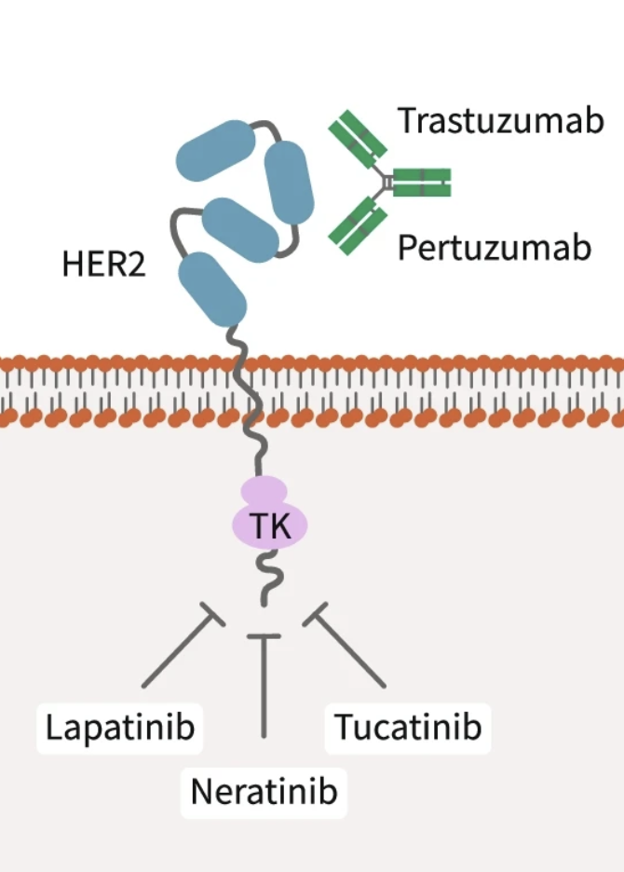
Tucatinib Mechanism of Action
Wynn CS et al. Cancer Metastasis Rev 2022;41(1):193-209.

Slide 50
Trastuzumab Deruxtecan: HER2-Positive Solid Tumors
Mechanism of action
Antibody-drug conjugate directed against HER2
Indication
For patients with unresectable or metastatic HER2-positive (IHC 3+) solid tumors who have received prior systemic treatment and have no satisfactory alternative treatment options
Recommended dosing
5.4 mg/kg IV infusion once every 3 weeks (21-day cycle) until disease progression or unacceptable toxicity
Trastuzumab deruxtecan prescribing information, 4/2024.

Slide 51
FDA Grants Accelerated Approval to Trastuzumab-Deruxtecan for Unresectable or Metastatic HER2-Positive Solid Tumors Press Release – April 5, 2024
“…the Food and Drug Administration granted accelerated approval to fam-trastuzumab deruxtecan-nxki for adult patients with unresectable or metastatic HER2-positive (IHC3+) solid tumors who have received prior systemic treatment and have no satisfactory alternative treatment options.
Efficacy was evaluated in 192 adult patients with previously treated unresectable or metastatic HER2-positive (IHC 3+) solid tumors who were enrolled in one of three multicenter trials: DESTINY-PanTumor02 (NCT04482309), DESTINY-Lung01 (NCT03505710), and DESTINY-CRC02 (NCT04744831).
“The major efficacy outcome measure in all three trials was confirmed objective response rate (ORR), and an additional efficacy outcome was duration of response (DOR). All outcomes were assessed by independent central review (ICR) based on RECIST v1.1. In DESTINY-PanTumor02, ORR was 51.4% (95% CI: 41.7, 61.0) and median DOR was 19.4 months (range 1.3, 27.9+). In DESTINY-Lung01, ORR was 52.9% (95% CI: 27.8, 77.0) and median DOR was 6.9 months (range 4.0, 11.7+). In DESTINY-CRC02, ORR was 46.9% (95% CI: 34.3, 59.8), and DOR was 5.5 months (range 1.3+, 9.7+).”
https://www.fda.gov/drugs/resources-information-approved-drugs/fda-grants-accelerated-approval-fam-trastuzumab-deruxtecan-nxki-unresectable-or-metastatic-her2

Slide 52
Abstract 3501

Slide 53
Deanna A Griffie, MSN, AGNP-C
What I tell my patients about to begin therapy with trastuzumab deruxtecan

Slide 55
Consulting Nursing Faculty Comments
Support avenues for younger patients with cancer
Jessica Mitchell, APRN, CNP, MPH

Slide 56
Agenda
Introduction
Part 1: Gastroesophageal Cancer
Part 2: Colorectal Cancer (CRC)
Module 4: Adjuvant Therapy in the Management of Localized CRC
Module 5: Immunotherapy in the Management of Metastatic CRC (mCRC)
Module 6: Management Approaches for Patients with Relapsed/Refractory (R/R) mCRC
Module 7: Use of Novel Targeted Therapy in the Management of mCRC

Slide 57
Agenda
Introduction
Part 1: Gastroesophageal Cancer
Part 2: Colorectal Cancer (CRC)
Module 4: Adjuvant Therapy in the Management of Localized CRC
Module 5: Immunotherapy in the Management of Metastatic CRC (mCRC)
Module 6: Management Approaches for Patients with Relapsed/Refractory (R/R) mCRC
Module 7: Use of Novel Targeted Therapy in the Management of mCRC

Slide 58
Use of Adjuvant Therapy in the Management of Localized CRC
Dr Shah
New York, New York
Dr Strickler
Durham, North Carolina
Factors guiding the use of adjuvant chemotherapy for patients with Stage II and Stage III CRC
Rationale for the assessment of molecular residual disease (MRD) using circulating tumor DNA (ctDNA) to help inform treatment decision-making for patients with localized CRC
Published research data with ctDNA testing to identify patients at increased risk for recurrence who are likely to benefit from adjuvant chemotherapy
Active studies examining the clinical utility of ctDNA-based MRD testing for guiding treatment decisions and monitoring recurrence in CRC; current and future clinical role

Slide 59
Rationale for ctDNA-Based MRD Monitoring in Localized CRC
Malla M et al. J Clin Oncol 2022;40(24):2846-57.
Courtesy of Christopher Lieu, MD

Slide 60
Tumor Tissue vs. Blood NGS Testing
Delayed results
Quick results
Larger panel
Limitations: Accessibility, quality, and quantity
Reduced logistics
Smaller biomarker panel
*Excellent concordance previously demonstrated
Courtesy of Cathy Eng, MD, FACP, FASCO
Acknowledgement: Jeanne Tie, ASCO 2022; Bardelli et al: Cell Press, 2022

Slide 61
Caroline Kuhlman, MSN, APRN-BC
What I tell my patients being considered for adjuvant chemotherapy after surgery for localized CRC about the role of ctDNA

Slide 62
Agenda
Introduction
Part 1: Gastroesophageal Cancer
Part 2: Colorectal Cancer (CRC)
Module 4: Adjuvant Therapy in the Management of Localized CRC
Module 5: Immunotherapy in the Management of Metastatic CRC (mCRC)
Module 6: Management Approaches for Patients with Relapsed/Refractory (R/R) mCRC
Module 7: Use of Novel Targeted Therapy in the Management of mCRC

Slide 63
The Current Role of Immune Checkpoint Inhibitors (ICIs) in the Treatment of Metastatic CRC (mCRC)
Dr Shah
New York, New York
Dr Strickler
Durham, North Carolina
Incidence of MSI-H/dMMR mCRC; rationale for the activity of ICIs in MSI-H/dMMR tumors
Long-term outcomes with front-line pembrolizumab for MSI-H/dMMR mCRC
Recently presented findings indicating improved progression-free survival with first-line nivolumab/ipilimumab compared to chemotherapy for patients with MSI-H/dMMR mCRC; potential role of this strategy
Rational incorporation of pembrolizumab, nivolumab and nivolumab/ipilimumab into treatment for patients with progressive MSI-H/dMMR mCRC

Slide 64
Tolerability and Other Practical Considerations with ICIs
Dr Shah
New York, New York
Dr Strickler
Durham, North Carolina
Pathophysiology, spectrum, frequency, severity and timing of immune-mediated and other adverse events (AEs) observed with anti-PD-1/PD-L1 antibodies
Effect on the tolerability of anti-PD-1/PD-L1 antibodies when administered in combination with other systemic therapies such as chemotherapy and anti-CTLA-4 antibodies
Optimal approaches to monitoring and management for immune-related and other AEs with ICIs; differences in approach, if any, for patients with localized versus metastatic disease
Optimal duration of immune checkpoint inhibition

Slide 65
High MSI Across 39 Cancer Types Whole-exome data from 11,139 tumor-normal pairs from The Cancer Genome Atlas and Therapeutically Applicable Research to Generate Effective Treatments projects
Colon adenocarcinoma had a high-MSI prevalence of 19.7%
Percent of MSI-high cases
Tumor type
COAD = colon adenocarcinoma
Bonneville R et al. JCO Precis Oncol 2017;1:1-15; Green AK et al. ASCO Educational Book 2020.

Slide 66
Shiu K et al. ESMO 2023;Abstract LBA32.

Slide 67
Nivolumab plus ipilimumab vs chemotherapy as <br />first-line treatment for microsatellite instability-high/<br />mismatch repair-deficient metastatic colorectal cancer: first results of the CheckMate 8HW study

Slide 68
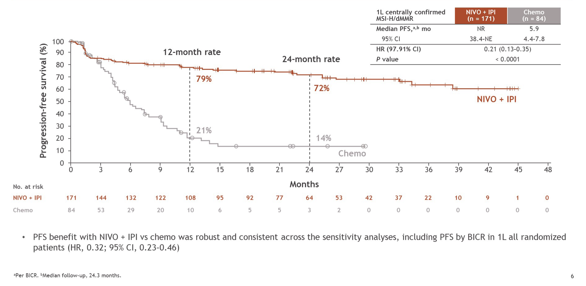
CheckMate 8HW: Progression-Free Survival
Andre T et al. Gastrointestinal Cancers Symposium 2024;Abstract LBA768.

Slide 69
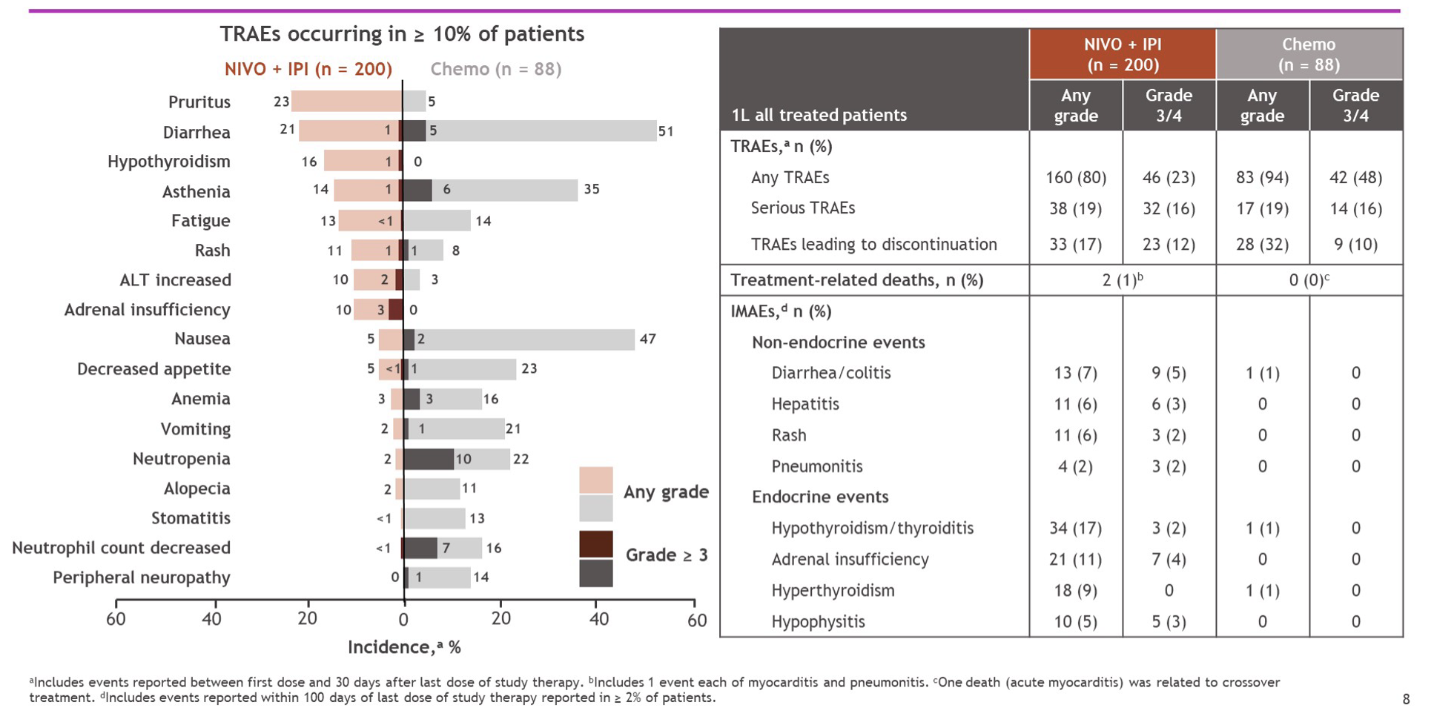
CheckMate 8HW: Treatment-Related Adverse Events (TRAEs)
1L = first line; IMAEs = immune-mediated adverse events
Andre T et al. Gastrointestinal Cancers Symposium 2024;Abstract LBA768.

Slide 70
Symptoms of Immunotherapy Toxicity
Hypophysitis (fatigue)
Thyroiditis
(over/underactive thyroid)
Adrenal Insufficiency (fatigue)
Diabetes Mellitus
(type I, II, fatigue, DKA)
Colitis
(diarrhea, abd pain)
Dermatitis
(rash, itch, blistering)
Pneumonitis
(dyspnea, cough)
Myocarditis
(chest pain, dyspnea)
Hepatitis
(abn LFTs, jaundice)
Pancreatitis
(abd pain)
Neurotoxicities
(MG, encephalitis)
Arthritis (joint pain)

Slide 71
Deanna A Griffie, MSN, AGNP-C
What I tell my patients with metastatic CRC who are about to begin therapy with an immune checkpoint inhibitor

Slide 72
Agenda
Introduction
Part 1: Gastroesophageal Cancer
Part 2: Colorectal Cancer
Module 4: Adjuvant Therapy in the Management of Localized CRC
Module 5: Immunotherapy in the Management of Metastatic CRC (mCRC)
Module 6: Management Approaches for Patients with Relapsed/Refractory (R/R) mCRC
Module 7: Use of Novel Targeted Therapy in the Management of mCRC

Slide 73
The Role of TAS-102/Bevacizumab in the Management of Relapsed/Refractory (R/R) mCRC
Dr Shah
New York, New York
Dr Strickler
Durham, North Carolina
Long-term findings with TAS-102 monotherapy for patients with multiregimen-relapsed mCRC
Published efficacy and safety data with TAS-102 in combination with bevacizumab for patients with R/R mCRC
Recent FDA approval of TAS-102/bevacizumab and current clinical role
Factors influencing the sequencing of TAS-102 with or without bevacizumab vis-à-vis other available therapies for progressive mCRC, such as regorafenib, EGFR antibodies and fruquintinib
Spectrum and frequency of toxicities reported with TAS-102 with or without bevacizumab; recommended monitoring and management protocols

Slide 74
Select Later-Line Options for Metastatic Colorectal Cancer
Agent | Indications
Regorafenib | mCRC previously treated with fluoropyrimidine-, oxaliplatin- and irinotecan-based chemotherapy, anti-VEGF therapy and, if RAS wild-type, anti-EGFR therapy
TAS-102 | As a single agent or in combination with bevacizumab for mCRC previously treated with fluoropyrimidine-, oxaliplatin- and irinotecan-based chemotherapy, anti-VEGF therapy and, if RAS wild-type, anti-EGFR therapy
Fruquintinib | mCRC previously treated with fluoropyrimidine-, oxaliplatin- and irinotecan-based chemotherapy, anti-VEGF therapy and, if RAS wild-type and medically appropriate, anti-EGFR therapy

Slide 75
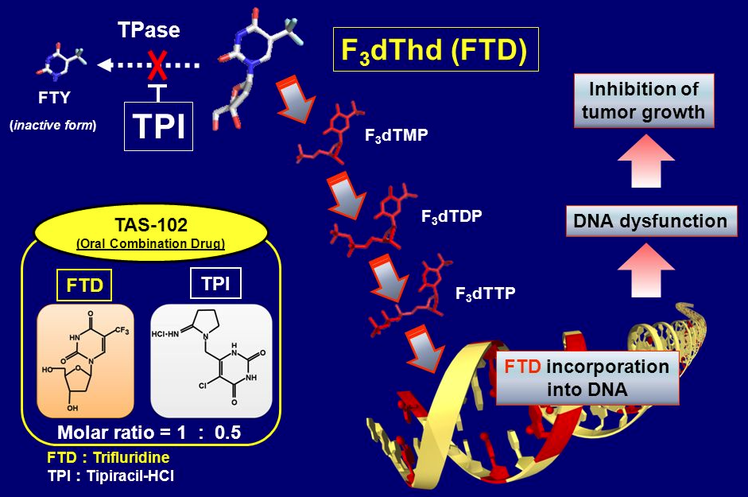
TAS-102: Mechanism of Action
Yoshino T et al. ESMO 2014;Abstract O-0022.

Slide 76
Trifluridine and Tipiracil (TAS-102)
Mechanism of action
Combination of trifluridine, a nucleoside metabolic inhibitor, and tipiracil, a thymidine phosphorylase inhibitor
Indication
As a single agent or in combination with bevacizumab for patients with mCRC who have previously received fluoropyrimidine-, oxaliplatin- and irinotecan-based chemotherapy, an anti-VEGF biological therapy and, if RAS wild type, an anti-EGFR therapy
Recommended dose
35 mg/m² (maximum 80 mg based on trifluridine) orally twice daily with food on days 1 through 5 and days 8 through 12 of each 28-day cycle until disease progression or unacceptable toxicity
TAS-102 (trifluridine and tipiracil) package insert, 8/2023.

Slide 77
FDA Approves Trifluridine and Tipiracil with Bevacizumab for Previously Treated Metastatic Colorectal Cancer Press Release – August 2, 2023
“On August 2, 2023, the Food and Drug Administration approved trifluridine and tipiracil with bevacizumab, for metastatic colorectal cancer (mCRC) previously treated with fluoropyrimidine-, oxaliplatin- and irinotecan-based chemotherapy, an anti-VEGF biological therapy, and if RAS wild-type, an anti-EGFR therapy. FDA had previously approved single-agent trifluridine and tipiracil for this indication in September 2015.
Safety and efficacy were evaluated in SUNLIGHT (NCT04737187), a randomized, open-label, multicenter, global trial of trifluridine and tipiracil with bevacizumab compared to single-agent trifluridine and tipiracil in 492 patients with mCRC who received a maximum of two prior chemotherapy regimens and demonstrated progressive disease or intolerance to the last regimen.
The recommended trifluridine and tipiracil dose is 35 mg/m² orally twice daily with food on days 1 through 5 and days 8 through 12 of each 28-day cycle”
https://www.fda.gov/drugs/drug-approvals-and-databases/fda-approves-trifluridine-and-tipiracil-bevacizumab-previously-treated-metastatic-colorectal-cancer

Slide 78
TAS-102/Bevacizumab: Common Side Effects
The most common side effects of TAS-102 when used alone include
Low blood counts
Tiredness and weakness
Nausea
Decreased appetite
Diarrhea
Vomiting
Abdominal pain
Fever
The most common side effects of TAS-102 when used in combination with bevacizumab include
Low blood counts
Tiredness and weakness
Nausea
Certain abnormal liver function blood tests
Decreased sodium in blood
Diarrhea
Abdominal pain
Decreased appetite
TAS-102 (trifluridine and tipiracil) patient information, 8/2023

Slide 79
Caroline Kuhlman, MSN, APRN-BC
What I tell my patients with mCRC who are about to begin therapy with TAS-102/bevacizumab

Slide 80
Agenda
Introduction
Part 1: Gastroesophageal Cancer
Part 2: Colorectal Cancer (CRC)
Module 4: Adjuvant Therapy in the Management of Localized CRC
Module 5: Immunotherapy in the Management of Metastatic CRC (mCRC)
Module 6: Management Approaches for Patients with Relapsed/Refractory (R/R) mCRC
Module 7: Use of Novel Targeted Therapy in the Management of mCRC

Slide 81
The Potential Role of KRAS-Targeted Therapy in the Management of mCRC
Dr Shah
New York, New York
Dr Strickler
Durham, North Carolina
Incidence of KRAS G12C mutations in mCRC; mechanism of action of sotorasib and adagrasib
Available efficacy and safety data with sotorasib and adagrasib monotherapy for patients with mCRC and KRAS G12C mutations
Rationale for combining KRAS-targeted agents with anti-EGFR therapy for mCRC
Recently presented findings with sotorasib and panitumumab for patients with chemorefractory mCRC with a KRAS G12C mutation; potential clinical role of this strategy

Slide 82
KRAS: An Important Target for GI Cancers
N= 148,268 patients (tumors with KRAS mutation prevalence > 10% listed)
GI Cancer
Non-GI Cancer
Accessed from GENIE Cohort v13.0-public (https://genie.cbioportal.org/). AACR Project GENIE Consortium. AACR Project GENIE:
powering precision medicine through an international consortium. Cancer Discov 2017; 7: 818-31.
Courtesy of John H Strickler, MD

Slide 83
Adagrasib and Sotorasib: Colorectal Cancer
Mechanism of action
RAS GTPase inhibitors
Indication
Investigational for CRC
Pivotal clinical data
Phase I/II KRYSTAL-1 study of adagrasib with or without cetuximab for patients with previously treated KRAS G12C-mutated metastatic CRC
Phase II CodeBreaK 100 study of sotorasib for advanced solid tumors harboring a KRAS G12C mutation
Phase III CodeBreaK 300 trial of sotorasib and panitumumab for chemorefractory metastatic CRC with a KRAS G12C mutation
Yaeger R et al. N Engl J Med 2023;388:44-54; Yaeger R et al. Cancer Discov 2024;April 8:OF1-OF12.
Fakih MG et al. Lancet Oncol 2022;23:115-24; Fakih MG et al. N Engl J Med 2023;389(23):2125-39.

Slide 84
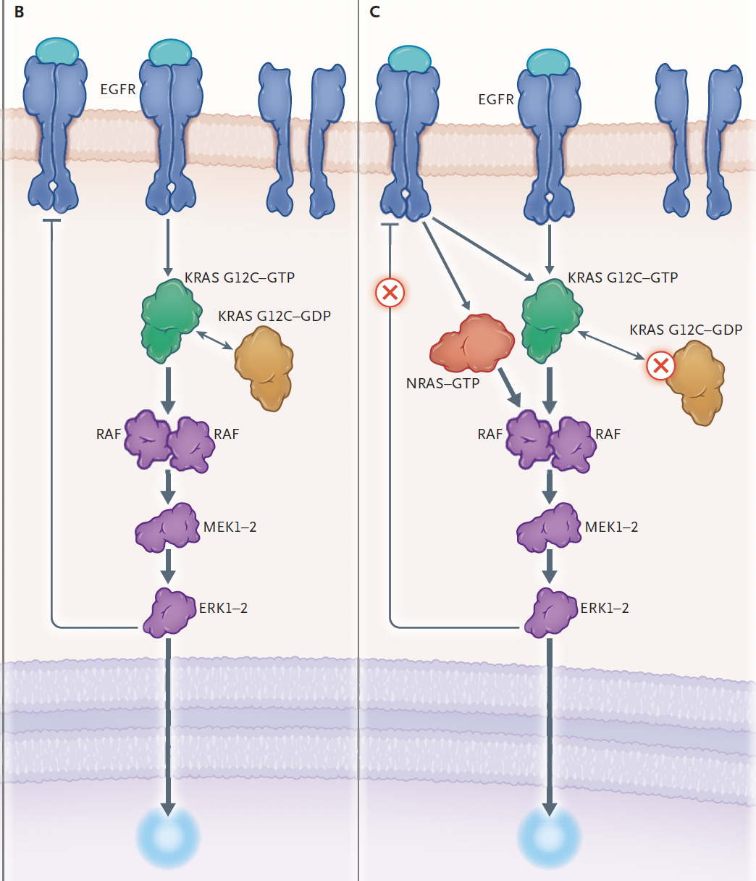
Rationale for KRAS-Targeted and Anti-EGFR Combination Therapy in mCRC
Panel C shows the effects of KRAS G12C mutation selective inhibition wherein ERK inhibition by drug releases the negative feedback loops, leading to activation of RTK and downstream signaling and ultimately resulting in a rebound in ERK signaling.
The high level of RTKs seen with colorectal cancer effectively raises the threshold needed to sufficiently inhibit the ERK pathway to elicit tumor regression.
The EGFR inhibitor in this
combination treatment serves to inhibit the feedback
reactivation.
Panel B shows signaling in receptor tyrosine kinase (RTK)–rich tissue, such as that of the colorectum, where negative feedback loops resulting from activated extracellular signal-related kinase (ERK) largely suppress signaling from RTKs such as EGFR.
Arrow thickness indicates the relative strength of signal.
Yaeger R. N Engl J Med 2023;389(23):2197-99.

Slide 85
Deanna A Griffie, MSN, AGNP-C
What I tell my patients with mCRC and a KRAS G12C mutation who are about to begin therapy with a KRAS inhibitor

Slide 86
Consulting Nursing Faculty Comments
Isn’t oncology depressing?
Tiffany A Richards, PhD, ANP-BC, AOCNP

Slide 87
Consulting Nursing Faculty Comments
Advice to someone entering the oncology nursing field
Tiffany A Richards, PhD, ANP-BC, AOCNP

