Slide 1
Investigator Perspectives on Available Research and Challenging Questions in Melanoma and Nonmelanoma Skin Cancers: A Post-ASCO 2024 Annual Review
Tuesday, June 11, 2024 5:00 PM – 6:00 PM ET
Faculty
Nikhil I Khushalani, MD
Jason J Luke, MD
Moderator
Neil Love, MD

Slide 2
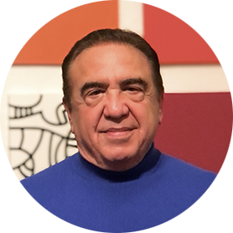
Faculty
Nikhil I Khushalani, MD
Senior Member and Vice Chair
Department of Cutaneous Oncology
Moffitt Cancer Center
Tampa, Florida
MODERATOR
Neil Love, MD Research To Practice Miami, Florida
Jason J Luke, MD
Associate Director for Clinical Research
Director, Immunotherapy and Drug Development Center
Associate Professor of Medicine
UPMC Hillman Cancer Center and University of Pittsburgh
Pittsburgh, Pennsylvania

Slide 3
Dr Khushalani — Disclosures Faculty
Advisory Committees and Consulting Agreements | Bristol Myers Squibb, Castle Biosciences Incorporated, Genzyme Corporation, Instil Bio, Iovance Biotherapeutics, Jounce Therapeutics, Merck, Nektar Therapeutics, Novartis, Regeneron Pharmaceuticals Inc
Contracted Research (All to Institution) | Bristol Myers Squibb, Celgene Corporation, GSK, HUYA Bioscience International, Merck, Modulation Therapeutics, Novartis, Regeneron Pharmaceuticals Inc, Replimune
Data and Safety Monitoring Boards/Committees | AstraZeneca Pharmaceuticals LP, Incyte Corporation
Stock Options/Ownership — Public Companies | Amarin Corporation, Asensus Surgical, Bellicum Pharmaceuticals Inc

Slide 4
Dr Luke — Disclosures Faculty
Consultancy with Compensation | AbbVie Inc, Agenus Inc, Alnylam, AskGene Pharma, Atomwise, Bayer HealthCare Pharmaceuticals, Bristol Myers Squibb, Castle Biosciences Incorporated, Codiak BioSciences, Crown, Cugene, Curadev, Day One Biopharmaceuticals, Eisai Inc, EMD Serono Inc, Endeavor BioMedicines, Flame Biosciences, G1 Therapeutics Inc, Genentech, a member of the Roche Group, Geneos Therapeutics, Gilead Sciences Inc, Glenmark Pharmaceuticals, HotSpot Therapeutics, Ikena Oncology, Immatics, Immunocore, Incyte Corporation, Instil Bio, Inzen Therapeutics, IO Biotech, Janssen Biotech Inc, KoBioLabs, Krystal Biotech Inc, KSQ Therapeutics, LegoChem Biosciences, Lyvgen Biopharma, MacroGenics Inc, Merck, Mersana Therapeutics Inc, Nektar Therapeutics, Novartis, Partner Therapeutics, Pfizer Inc, Pioneering Medicines, PsiOxus Therapeutics, Regeneron Pharmaceuticals Inc, Replimune, Ribon Therapeutics, Roivant, Sanofi, Servier Pharmaceuticals LLC, Stingthera, STORM Therapeutics Ltd, Sumitomo Dainippon Pharma Oncology Inc, Synlogic, Synthekine, Teva Oncology
Data and Safety Monitoring Boards/Committees | AbbVie Inc, Agenus Inc, Evaxion Biotech A/S, Immutep, Shionogi Inc
Research Support (All to Institution) | AbbVie Inc, Astellas, AstraZeneca Pharmaceuticals LP, Bristol Myers Squibb, Corvus Pharmaceuticals, Day One Biopharmaceuticals, EMD Serono Inc, F-star Therapeutics Inc, Genmab US Inc, HotSpot Therapeutics, Ikena Oncology, Immatics, Imugene, Incyte Corporation, Janux Therapeutics, KAHR, MacroGenics Inc, Merck, Moderna, Nektar Therapeutics, NextCure, Novartis, Numab Therapeutics AG, Palleon Pharmaceuticals, Pfizer Inc, Replimune, Rubius Therapeutics, Sanofi, Servier Pharmaceuticals LLC, Scholar Rock, Synlogic, Takeda Pharmaceuticals USA Inc, Tizona Therapeutics Inc, Trishula Therapeutics Inc, TScan Therapeutics, Werewolf Therapeutics, Xencor
Scientific Advisory Boards (No Stock) | 7 Hills Pharma Inc, Affivant, BioCytics, Bright Peak Therapeutics, Exo Therapeutics Inc, F-star Therapeutics Inc, Inzen Therapeutics, RefleXion, Xilio Therapeutics
Scientific Advisory Boards (Stock) | Actym Therapeutics, Alphamab Oncology, Arch Oncology, Duke Street Bio, Elpiscience, Kanaph Therapeutics, NeoTX, Onc.AI, OncoNano Medicine, physIQ, Pyxis Oncology, Saros Therapeutics, STipe Therapeutics, Tempest Therapeutics

Slide 5
Dr Love — Disclosures
Dr Love is president and CEO of Research To Practice. Research To Practice receives funds in the form of educational grants to develop CME activities from the following companies: AbbVie Inc, Adaptive Biotechnologies Corporation, ADC Therapeutics, Agios Pharmaceuticals Inc, Alexion Pharmaceuticals, Amgen Inc, Array BioPharma Inc, a subsidiary of Pfizer Inc, Astellas, AstraZeneca Pharmaceuticals LP, Aveo Pharmaceuticals, Bayer HealthCare Pharmaceuticals, BeiGene Ltd, BeyondSpring Pharmaceuticals Inc, Blueprint Medicines, Boehringer Ingelheim Pharmaceuticals Inc, Bristol Myers Squibb, Celgene Corporation, Clovis Oncology, Coherus BioSciences, CTI BioPharma, a Sobi Company, Daiichi Sankyo Inc, Eisai Inc, Elevation Oncology Inc, EMD Serono Inc, Epizyme Inc, Exact Sciences Corporation, Exelixis Inc, Five Prime Therapeutics Inc, Foundation Medicine, G1 Therapeutics Inc, Genentech, a member of the Roche Group, Genmab US Inc, Gilead Sciences Inc, Grail Inc, GSK, Halozyme Inc, Helsinn Healthcare SA, ImmunoGen Inc, Incyte Corporation, Ipsen Biopharmaceuticals Inc, Janssen Biotech Inc, administered by Janssen Scientific Affairs LLC, Jazz Pharmaceuticals Inc, Karyopharm Therapeutics, Kite, A Gilead Company, Kronos Bio Inc, Legend Biotech, Lilly, Loxo Oncology Inc, a wholly owned subsidiary of Eli Lilly & Company, MEI Pharma Inc, Merck, Mersana Therapeutics Inc, Mirati Therapeutics Inc, Mural Oncology Inc, Natera Inc, Novartis, Novartis Pharmaceuticals Corporation on behalf of Advanced Accelerator Applications, Novocure Inc, Oncopeptides, Pfizer Inc, Pharmacyclics LLC, an AbbVie Company, Puma Biotechnology Inc, Regeneron Pharmaceuticals Inc, R-Pharm US, Sanofi, Seagen Inc, Servier Pharmaceuticals LLC, SpringWorks Therapeutics Inc, Stemline Therapeutics Inc, Sumitomo Dainippon Pharma Oncology Inc, Syndax Pharmaceuticals, Taiho Oncology Inc, Takeda Pharmaceuticals USA Inc, TerSera Therapeutics LLC, Tesaro, A GSK Company, TG Therapeutics Inc, Turning Point Therapeutics Inc, Verastem Inc, and Zymeworks Inc.

Slide 6
Commercial Support
This activity is supported by an educational grant from Merck.
Research To Practice CME Planning Committee Members, Staff and Reviewers
Planners, scientific staff and independent reviewers for Research To Practice have no relevant conflicts of interest to disclose.

Slide 7
This educational activity contains discussion of non-FDA-approved uses of agents and regimens. Please refer to official prescribing information for each product for approved indications.

Slide 8
Agenda
Introduction
Module 1: Evidence-Based Treatment of Nonmetastatic and Metastatic Melanoma — Dr Luke
Module 2: Optimizing the Management of Nonmelanoma Skin Cancers — Dr Khushalani

Slide 9
Agenda
Introduction
Module 1: Evidence-Based Treatment of Nonmetastatic and Metastatic Melanoma — Dr Luke
Module 2: Optimizing the Management of Nonmelanoma Skin Cancers — Dr Khushalani

Slide 10
Key ASCO 2024 Data Sets
Blank CU et al. Neoadjuvant nivolumab plus ipilimumab versus adjuvant nivolumab in macroscopic, resectable stage III melanoma: The phase 3 NADINA trial. Abstract LBA2.
Hauschild A et al. Long-term follow up for adjuvant dabrafenib plus trametinib in stage III BRAF-mutated melanoma: Final results of the COMBI-AD study. Abstract 9500.
Weber JS et al. Individualized neoantigen therapy mRNA-4157 (V940) plus pembrolizumab in resected melanoma: 3-year update from the mRNA-4157-P201 (KEYNOTE-942) trial. Abstract LBA9512.
Tawbi HA et al. Nivolumab plus relatlimab vs nivolumab in previously untreated metastatic or unresectable melanoma (RELATIVITY-047): Overall survival and melanoma-specific survival outcomes at 3 years. Abstract 9524.
Thomas SS et al. Efficacy and safety of lifileucel, an autologous tumor-infiltrating lymphocyte cell therapy, and pembrolizumab in patients with immune checkpoint inhibitor-naive unresectable or metastatic melanoma: Updated results from IOV-COM-202 cohort 1A. Abstract 9505.

Slide 11
Key ASCO 2024 Data Sets
Muñoz-Cousleo E et al. Pembrolizumab for locally advanced or recurrent/metastatic cutaneous squamous cell carcinoma: Long-term results of the Phase 2 KEYNOTE-629 Study. Abstract 9554.
Ladwa R et al. Using serial ¹⁸F-FDG PET/CT PERCIST response to predict long-term efficacy to immune checkpoint inhibitors in patients with advanced cutaneous squamous cell carcinoma. Abstract 9548.
Amatore F et al. Neoadjuvant pembrolizumab produces high pathologic response rates in locally advanced (LA) resectable cutaneous squamous cell carcinoma (cSCC): Final results. Abstract 9591.
Ladwa R et al. A phase 2 study of de-escalation in resectable, locally advanced cutaneous squamous cell carcinoma (cSCC) with the use of neoadjuvant pembrolizumab: De-Squamate. Abstract 9514.

Slide 12
Agenda
Introduction
Module 1: Evidence-Based Treatment of Nonmetastatic and Metastatic Melanoma — Dr Luke
Module 2: Optimizing the Management of Nonmelanoma Skin Cancers — Dr Khushalani

Slide 13
Where Are We Now with the Management of Melanoma?
Neoadjuvant
Adjuvant
Metastatic
BRAF mutated
BRAF wild-type

Slide 14
Evidence-Based Treatment of Nonmetastatic and Metastatic Melanoma Jason J Luke, MD Director of the Cancer Immunotherapeutics Center UPMC Hillman Cancer Center Associate Professor of Medicine University of Pittsburgh Pittsburgh, Pennsylvania

Slide 15
Abstract LBA2

Slide 16
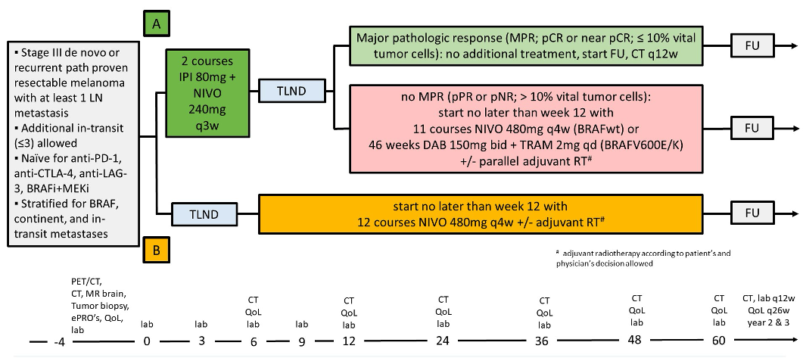
NADINA Trial Design
TLND = therapeutic lymph node dissection
Blank CU et al. ASCO 2024;Abstract LBA2.

Slide 17
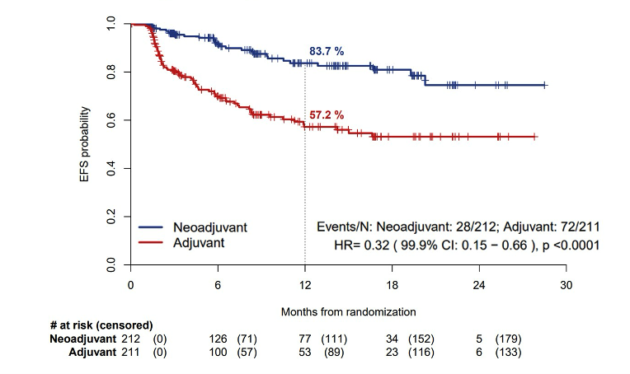
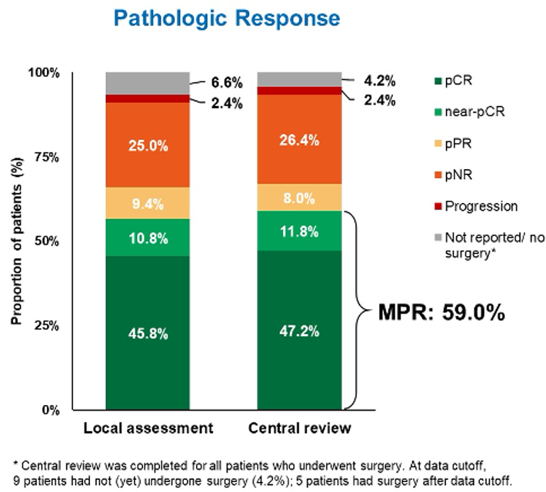
NADINA Event-Free Survival (EFS) and Pathologic Response
pCR = pathologic complete response; pPR = pathologic partial response; pNR = pathologic nonresponse
All key subgroups had an EFS benefit with neoadjuvant ipilimumab/nivolumab
Blank CU et al. ASCO 2024;Abstract LBA2.

Slide 18
FDA-Approved Adjuvant Immunotherapy Options for Melanoma
Monotherapy | FDA approval | Pivotal study | Stage | HR RFS | HR OS
Nivolumab | 10/13/23 | CheckMate 76K | IIB, IIC | 0.42 | NA
Pembrolizumab | 12/3/21 | KEYNOTE-716 | AJCC 8th IIB, IIC | 0.62 | NA
Pembrolizumab | 2/15/19 | KEYNOTE-054 | AJCC 7th IIIA, IIIB, IIIC | 0.61 | NA
Nivolumab | 12/20/17 | CheckMate 238 | AJCC 7th IIIB, IIIC, IV | 0.72 | 0.86
Ipilimumab | 10/28/15 | EORTC-18071 | AJCC 7th IIIA, IIIB, IIIC | 0.75 | 0.73
HR = hazard ratio; RFS = relapse- or recurrence-free survival; OS = overall survival; NA = not available
Kirkwood JM et al. Nat Med 2023;29:2835-43; Luke JJ et al. J Clin Oncol 2024;42:1619-24; Eggermont AMM et al. NEJM Evid 2022; 1(11):EVIDoa2200214; Larkin J et al. Clin Cancer Res 2023;29:3352-61; Eggermont AMM et al. Eur J Cancer 2019;119;1-10.

Slide 19
Abstract 9500

Slide 20
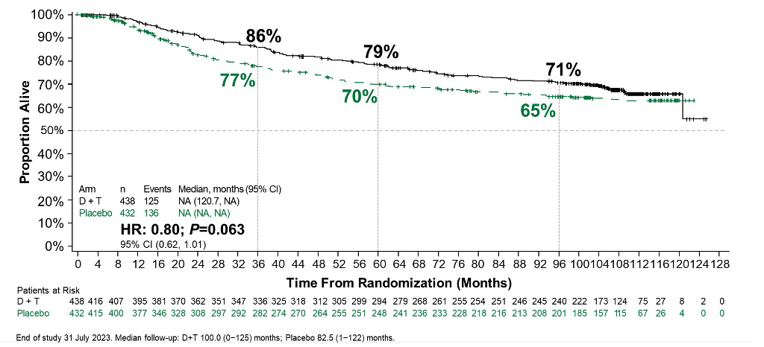
Final Analysis of COMBI-AD: Overall Survival (ITT Population)
ITT = intent to treat
Hauschild A et al. ASCO 2024;Abstract 9500.

Slide 21
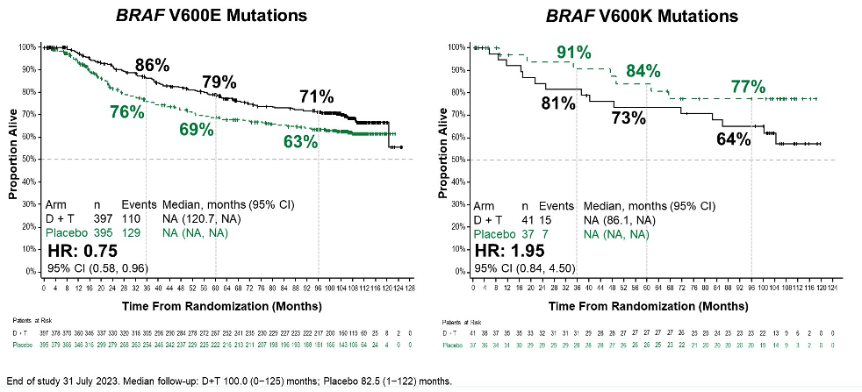
Subgroup Analysis of COMBI-AD: Effect of Treatment on Overall Survival by BRAF V600 Mutations (ITT Population)
Hauschild A et al. ASCO 2024;Abstract 9500.

Slide 22
Questions?

Slide 23
Abstract LBA9512

Slide 24
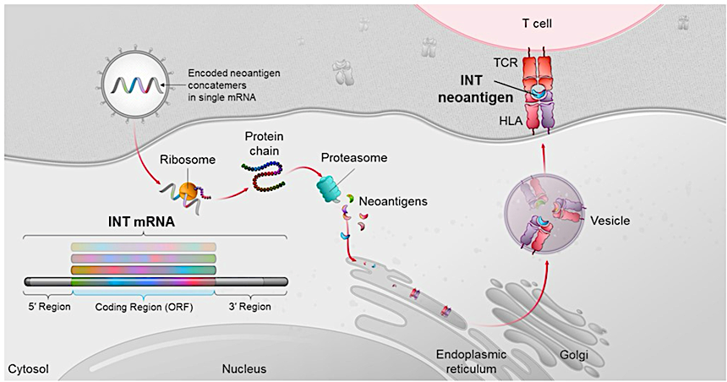
KEYNOTE-942 Trial Design: Pembrolizumab with or without Individualized Neoantigen Therapy (INT)
Weber JS et al. ASCO 2024;Abstract LBA9512.

Slide 25
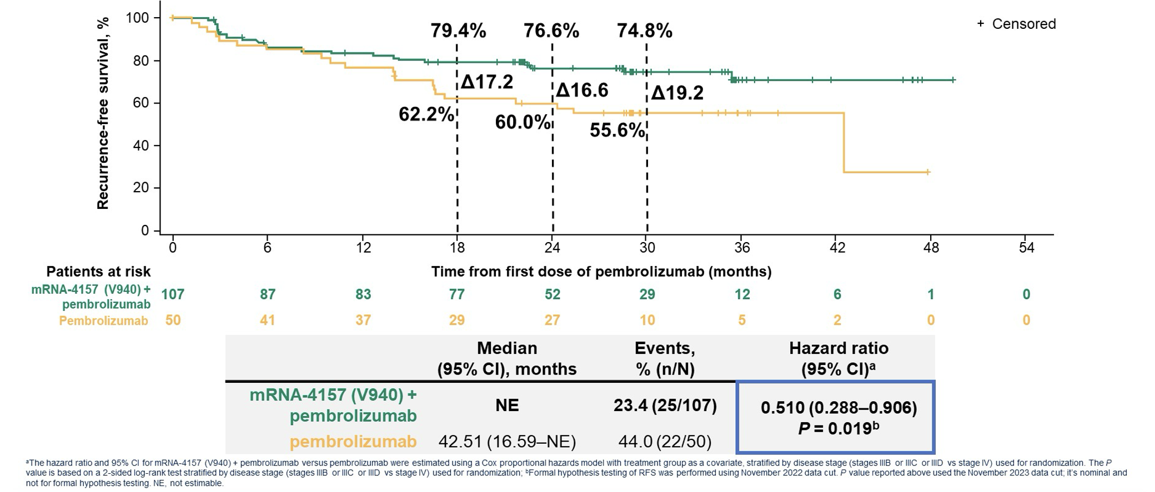
KEYNOTE-942 Primary Endpoint: Recurrence-Free Survival
Translational analyses suggest mRNA-4157 (V940) + pembrolizumab may benefit a broad patient population irrespective of the status of PD-L1, tumor mutational burden, ctDNA and HLA heterozygosity
Weber JS et al. ASCO 2024;Abstract LBA9512.

Slide 26
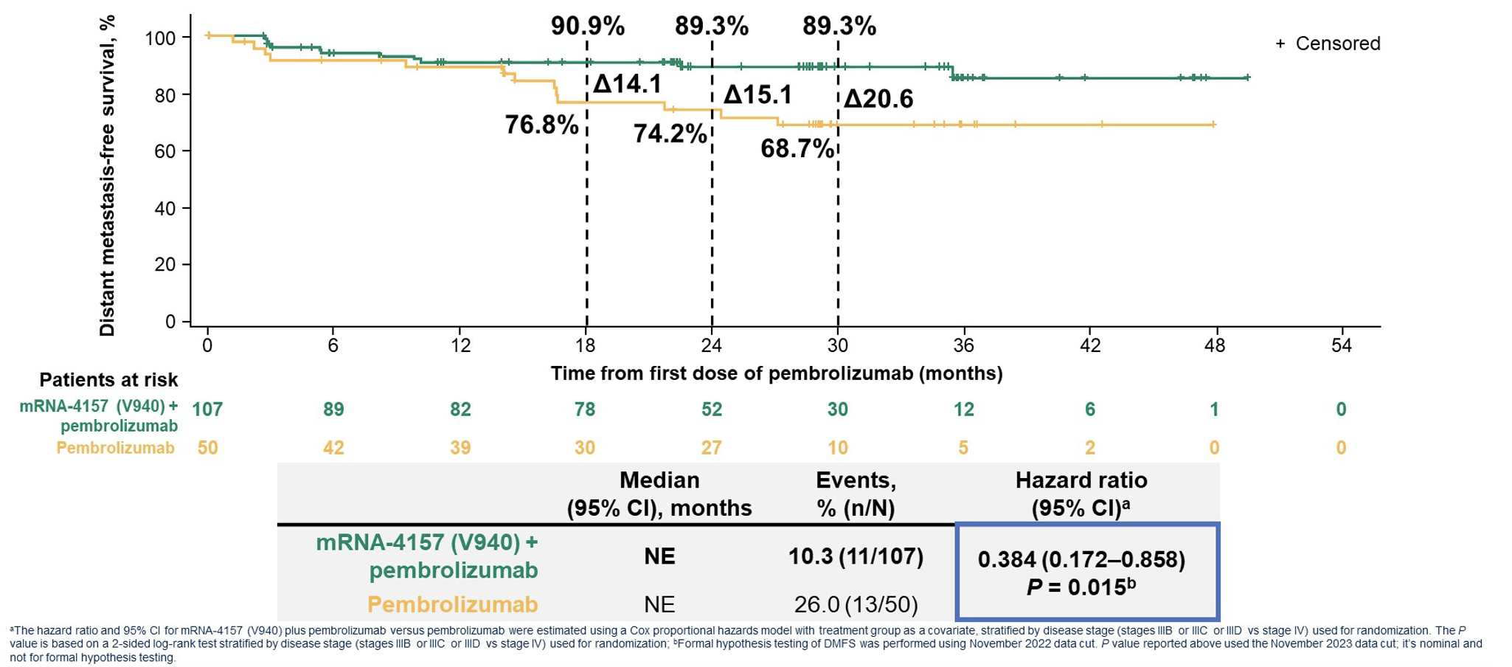
KEYNOTE-942: Distant Metastasis-Free Survival
Weber JS et al. ASCO 2024;Abstract LBA9512.

Slide 27
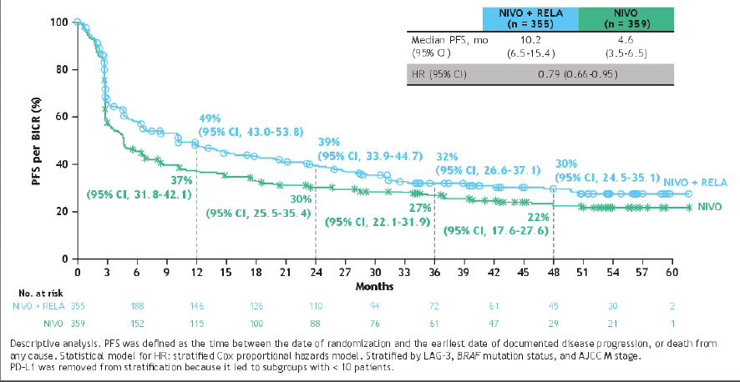
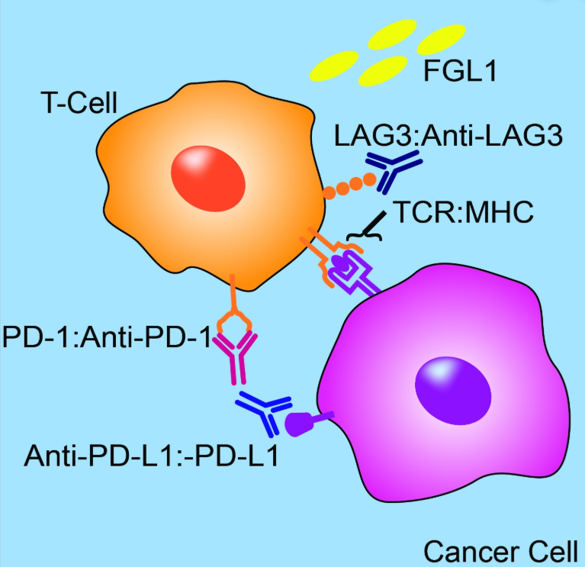
RELATIVITY-047 Trial: Nivolumab (Anti-PD-1) and Relatlimab (Anti-LAG-3)
Median overall survival: 51.0 vs 33.2 months (HR 0.80)
Objective response rate: 44% vs 34%
Tawbi HA et al. ASCO 2024;Abstract 9524.

Slide 28
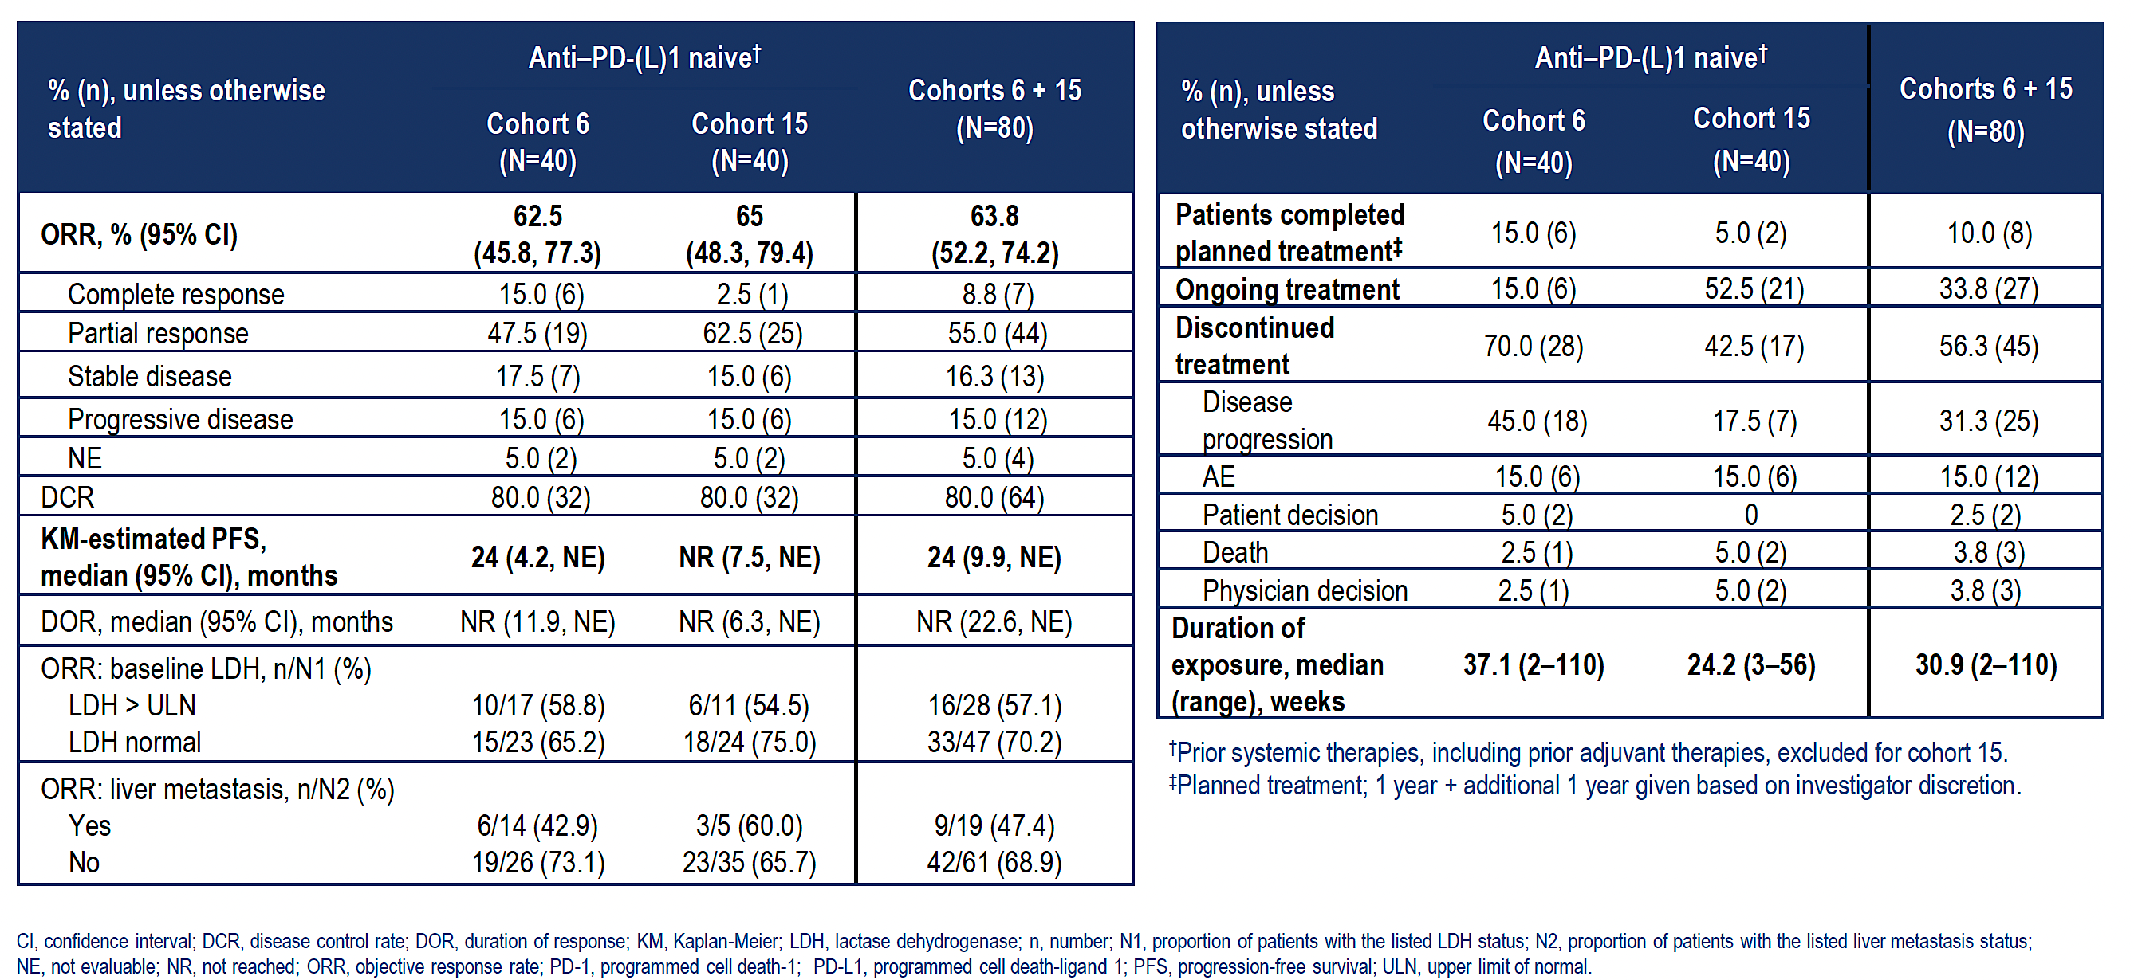
Phase I Expansion Cohort of Fianlimab and Cemiplimab for Patients with Advanced Melanoma: Anti-PD-1/PD-L1 Naïve Group
Hamid O et al. ESMO 2022;Abstract 790MO.

Slide 29
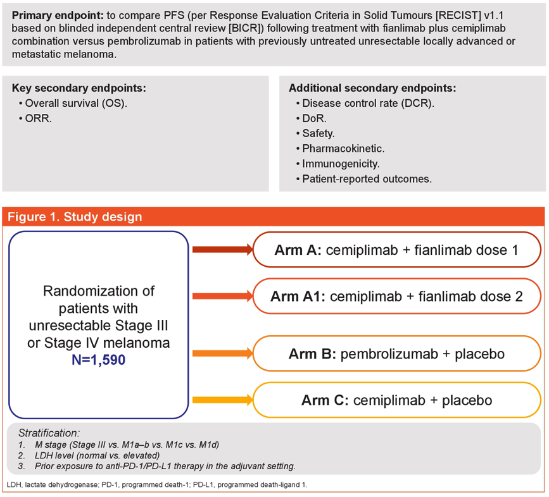
Phase III Trial of Fianlimab/Cemiplimab versus Pembrolizumab for Patients with Previously Untreated Unresectable Locally Advanced or Metastatic Melanoma
Baramidze A et al. ASCO 2023;Abstract TPS9602.
PFS = progression-free survival; ORR = objective response rate

Slide 30
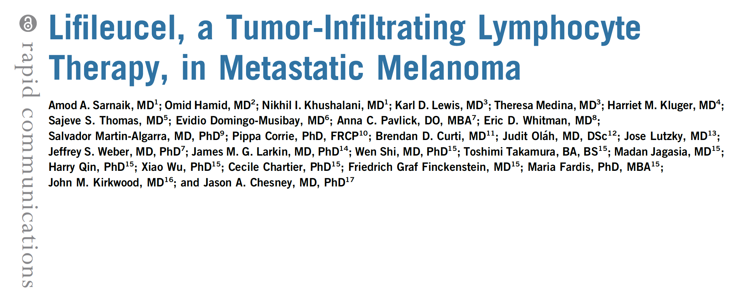
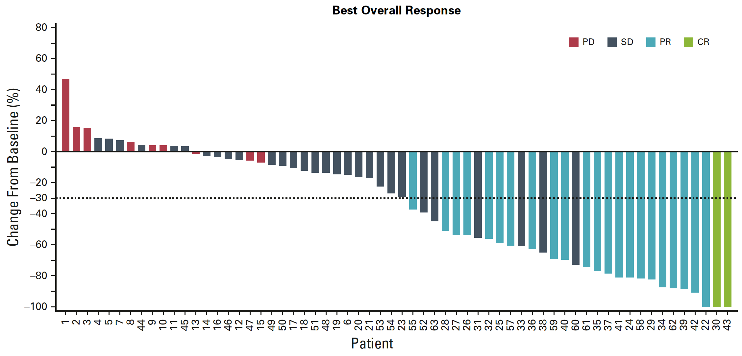
FDA Grants Accelerated Approval to Lifileucel for Unresectable or Metastatic Melanoma Press Release: February 16, 2024
J Clin Oncol 2021;39:2656-66.

Slide 31
Abstract 9505

Slide 32
IOV-COM-202 Cohort 1A: Response Summary
Thomas S et al. ASCO 2024;Abstract 9505.

Slide 33
TILVANCE-301: An Ongoing Phase III Confirmatory Trial
Thomas S et al. ASCO 2024;Abstract 9505.

Slide 34
Agenda
Introduction
Module 1: Evidence-Based Treatment of Nonmetastatic and Metastatic Melanoma — Dr Luke
Module 2: Optimizing the Management of Nonmelanoma Skin Cancers — Dr Khushalani

Slide 35
Where Are We Now with the Management of Nonmelanoma Skin Cancers?
Cutaneous squamous cell carcinoma
Neoadjuvant
Adjuvant
Metastatic/recurrent
Basal cell carcinoma

Slide 36
Optimizing the Management of Non-Melanoma Skin Cancer: Updates from ASCO 2024
Nikhil I. Khushalani, MD
Assistant Center Director, Clinical Research Review and Partnerships
Vice-Chair and Senior Member, Cutaneous Oncology
Moffitt Cancer Center, Tampa, FL

Slide 37
Long Term Data for Anti-PD1 Therapy for Advanced Cutaneous Squamous Cell Carcinoma

Slide 38
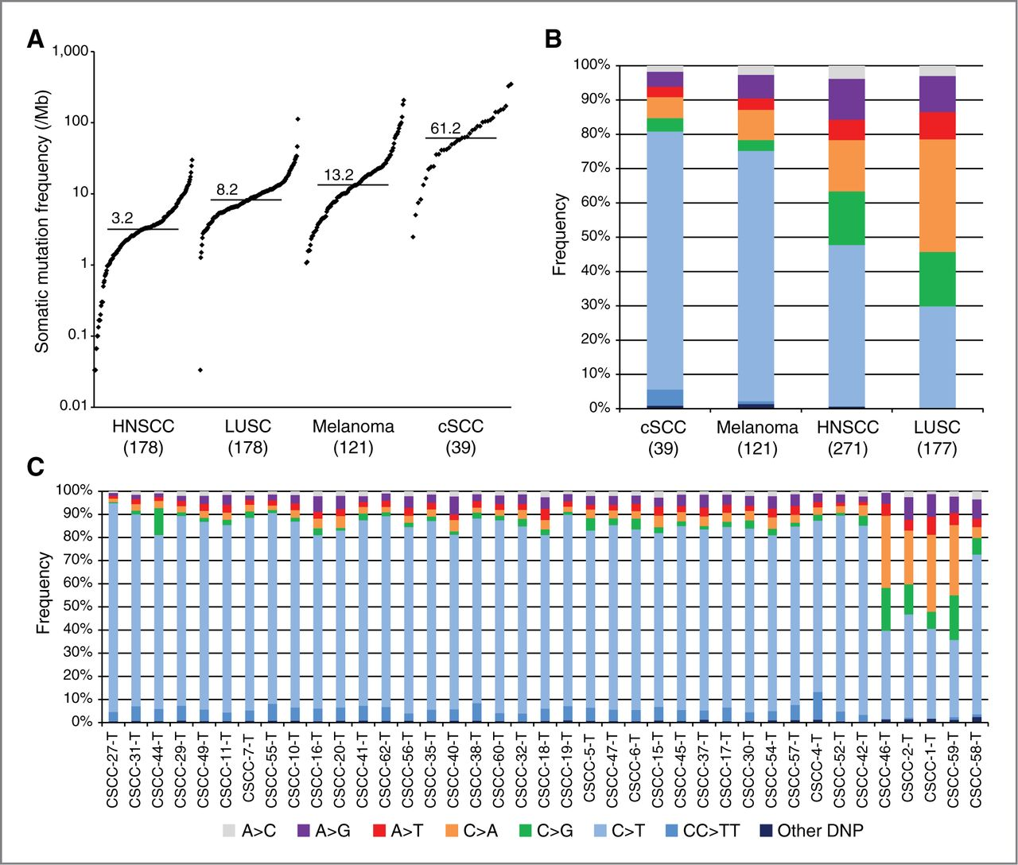
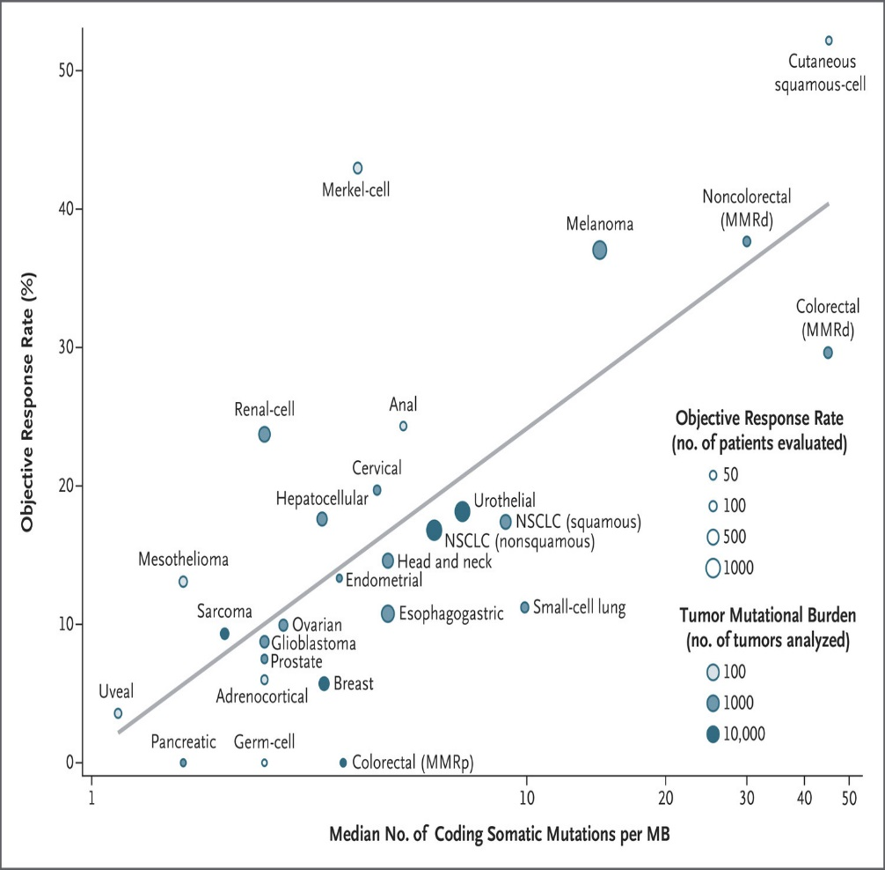
TMB and Response to Anti-PD1 Therapy
Pickering CR. Clin Cancer Res. 2014;20:6582; Yarchoan M. N Engl J Med. 2017;377:2500.

Slide 39
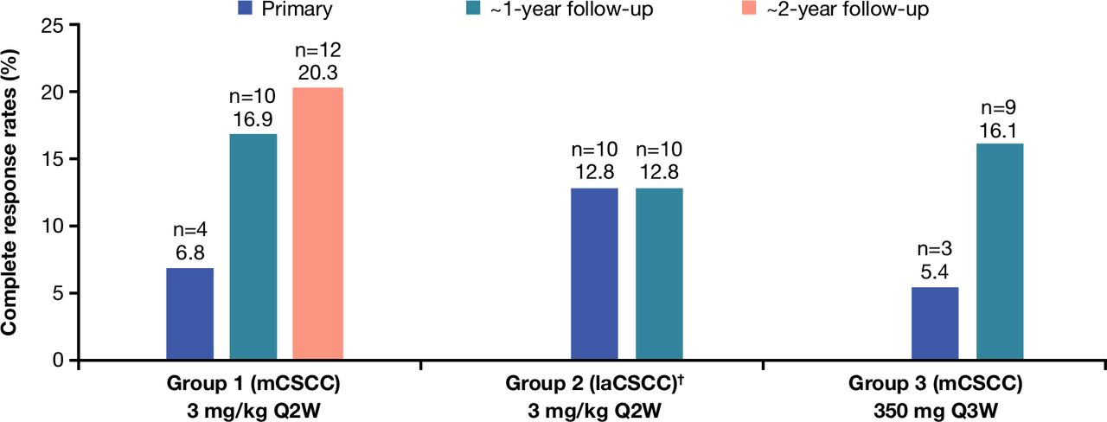
EMPOWER-CSCC 1: Cemiplimab in Advanced CSCC
N=193 | Cohort 1 | Cohort 2 | Cohort 3
Dose | 3mg/kg q2w | 3mg/kg q2w | 350mg q3w
ORR (%) | 50.8 | 44.9 | 42.9
CR (%) | 20.3 | 12.8 | 16.1
mPFS | 18.1 months (95% CI, 10.3-24.3)
Rischin D, Khushalani NI, et al. J Immunother Cancer 2021;e002757

Slide 40
KEYNOTE-629 Pembrolizumab in Advanced CSCC
N=159 | Locally Advanced (54) | Recurrent/Metastatic (105)
ORR % | 50 | 35.2
CR % | 16.7 | 10.5
DCR % | 64.8 | 52.4
Median PFS (m) | NR (95% CI, 5.5-NR) | 5.7 (95% CI, 3.1-8.5)
ASCO 2024 UPDATE (Median Follow-Up 63.1 months) | Locally Advanced (54) | Recurrent/Metastatic (105)
ORR % | 51.9 | 35.2
CR % | 22.2 | 12.4
Median PFS (m) | 14.4 (95% CI, 5.5-43.6) | 5.7 (95% CI, 3.1-8.5)
Median OS (m) | NR (95% CI, 33.3-NR) | 23.8 (95% CI, 13.4-30.9)
8.8% discontinued therapy due to TRAE
Hughes BGM, Munoz-Couselo E, et al. Ann Oncol 2021;32:P1276; Munoz-Couselo E, et al. ASCO 2024, Abstract 9554

Slide 41
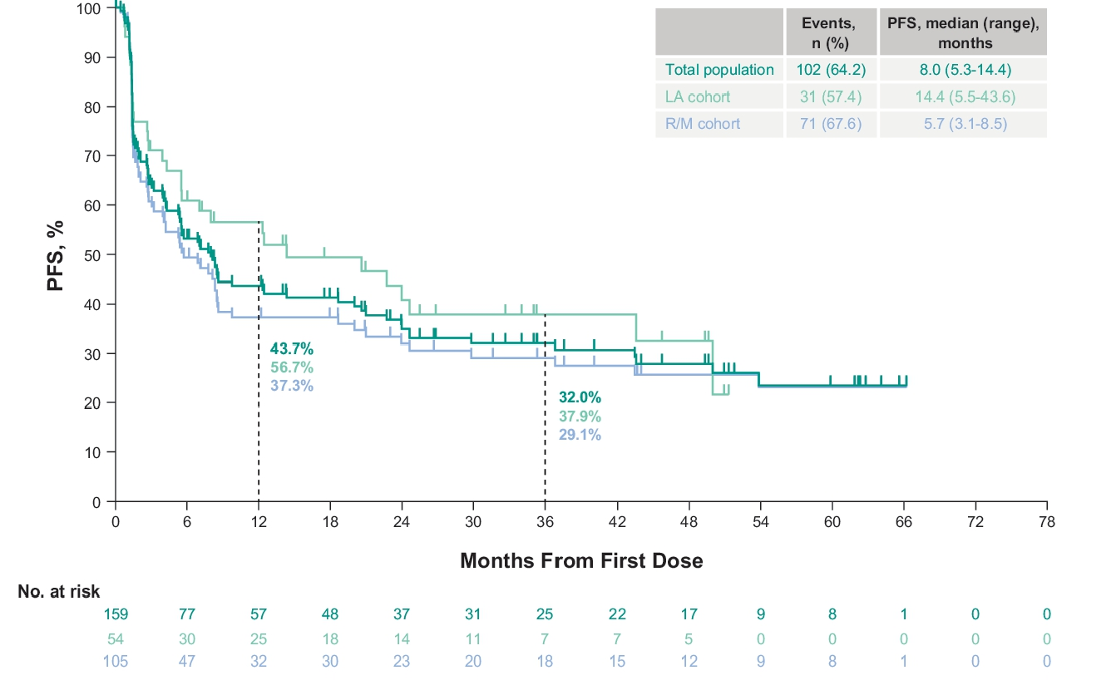
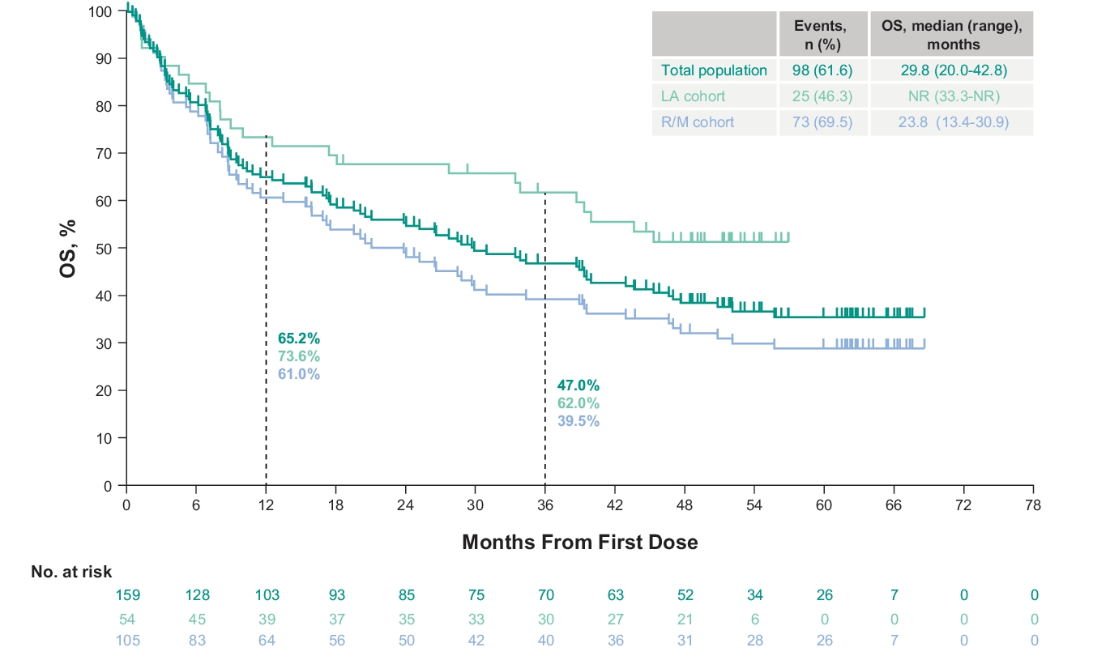
Survival on KEYNOTE-629
PFS
OS
Munoz-Couselo E, et al. ASCO 2024, Abstract 9554

Slide 42
KEYNOTE-629 Safety
Grade 3-5 treatment related AEs: 11.3%
TRAE leading to treatment discontinuation: 8.8%
Immune related AEs requiring steroids: 11.3%
No new safety signals with longer follow-up
Munoz-Couselo E, et al. ASCO 2024, Abstract 9554

Slide 43
Conclusion: Anti-PD1 monotherapy with cemiplimab or pembrolizumab can provide deep and durable responses in advanced, unresectable CSCC Unanswered Questions: 1. Do we need to explore combination IO therapy? 2. Biomarkers of response needed

Slide 44
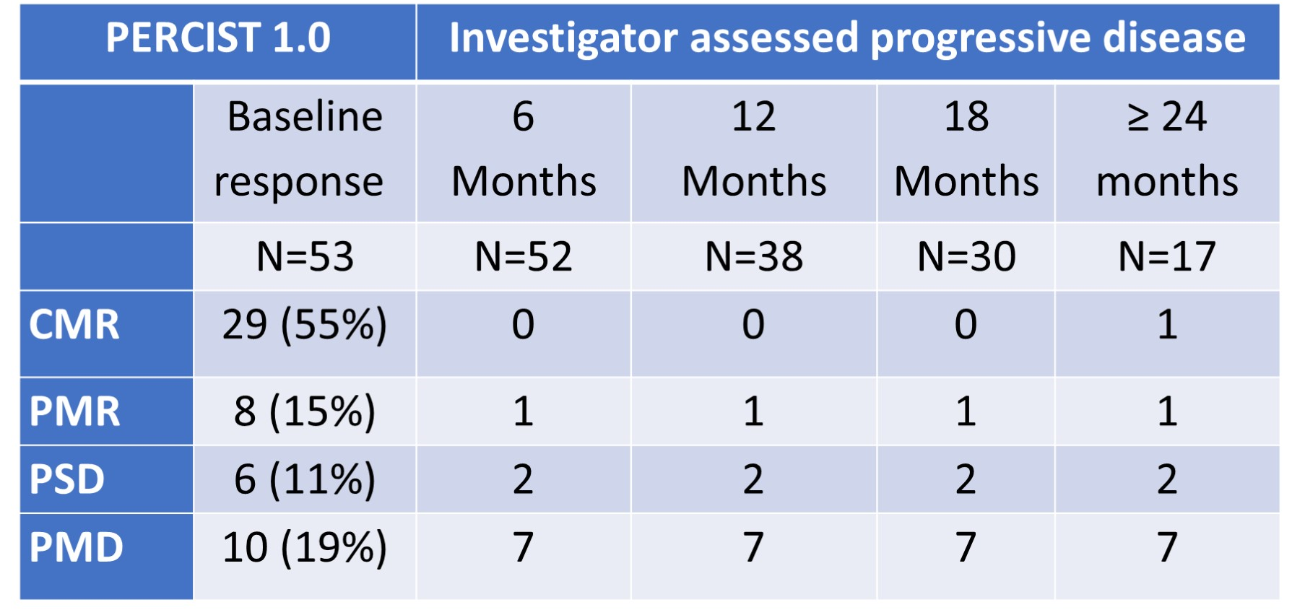
PET-CT as a Prognostic Biomarker
Retrospective study (n=53)
Baseline + at least 1 PET-CT < 4m from starting IO
Estimated 12m PFS was 100% for CMR versus 30% in PMD
Ladwa R, et al. ASCO 2024, Abstract 9548

Slide 45
Questions?

Slide 46
Neoadjuvant Therapy for Resectable High-Risk Cutaneous Squamous Cell Carcinoma

Slide 47
Neoadjuvant Cemiplimab in Resectable CSCC
Stage II*–IV resectable CSCC
Neoadjuvant cemiplimab × 4 doses (imaging after 2 doses)
Part 1
Curative-intent surgery
Part 2
Adjuvant radiotherapy at investigator discretion
Gross ND, Miller D, Khushalani NI, et al. N Engl J Med 2022;387:1557.

Slide 48
Neoadjuvant Cemiplimab
Primary End Point: Pathologic Complete Response (pCR) Rate
Pathologic Response | Independent Review | Radiographic Response
pCR | 50.6% | ORR: 68.4% CR: 6.3%
MPR | 12.7%
Non-pCR/MPR | 25.3%
Not evaluable | 11.4%
Gross ND, Miller D, Khushalani NI, et al. N Engl J Med 2022;387:1557.

Slide 49
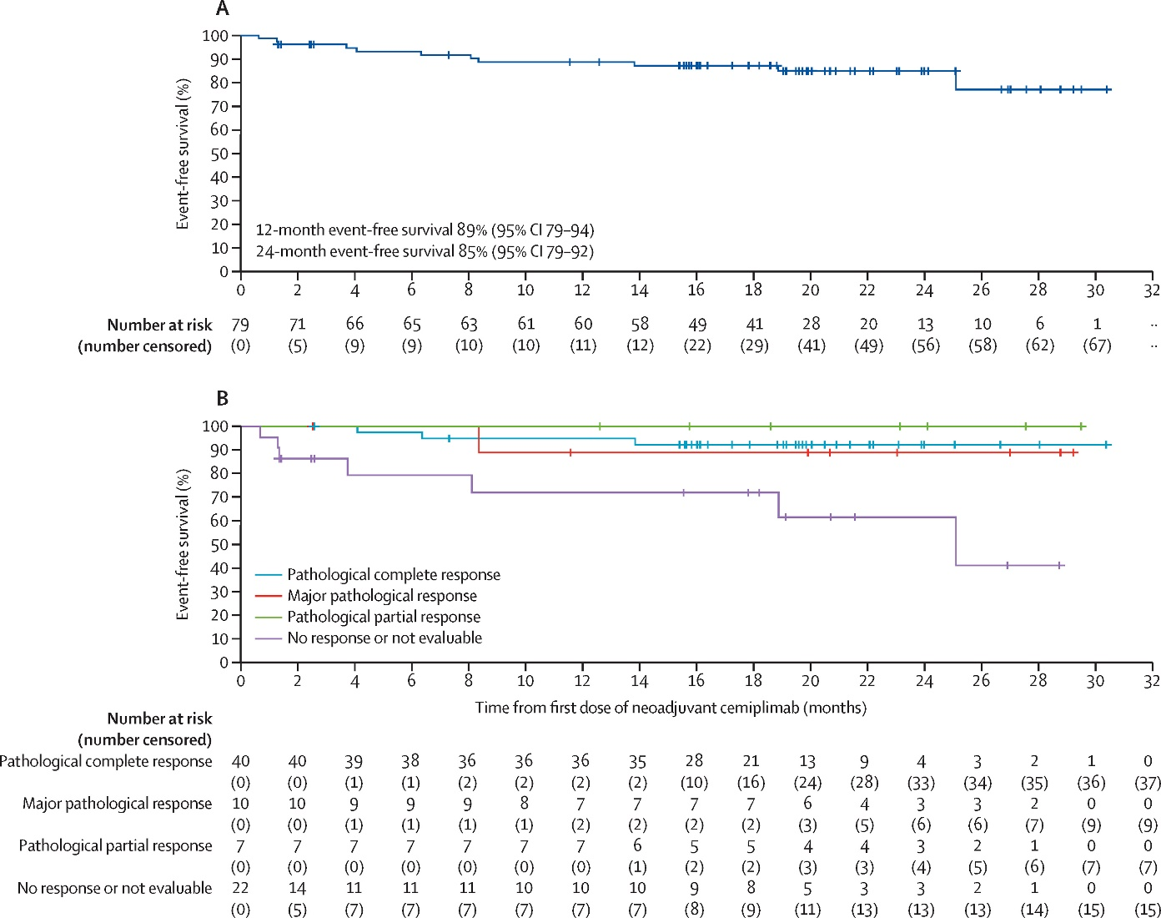
Event-free Survival with Neoadjuvant Cemiplimab
24m EFS: 85%
Gross ND, Miller DM, Khushalani NI, et al. Lancet Oncol 2023;24:1196.

Slide 50
Neoadjuvant Pembrolizumab in CSCC
N=30; single arm study
2 cycles of pembrolizumab → surgery → 15 cycles of pembrolizumab
Median age 77 years (55-89)
pCR rate: 59%
Amatore F, et al. ASCO 2024, Abstract 9591

Slide 51
DESQUAMATE Study
N=27
Aimed to de-escalate from planned surgery +/- post-operative radiotherapy (PORT) following 4 cycles of neoadjuvant pembrolizumab in resectable high-risk stage II-IV CSCC
If complete clinical + radiographic (PET-CT) response + mapping biopsy negative, then NO surgery/RT
If non-complete clinical response, then surgery + risk adaptive post-operative therapy based on pathologic response
If pCR/MPR – only pembro post-op
If > 10% viable tumor – PORT + pembro post-op
Ladwa R, et al. ASCO 2024, Abstract 9514

Slide 52
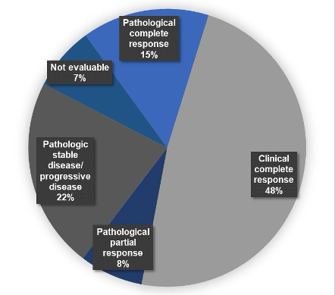
DESQUAMATE Results
De-escalation in 63%
Pts with CCR, PCR or PPR with 100% RFS at 12 months
Both surgery and PORT eliminated in 48%
PORT only in 15%
All recurrences (n=3) in pts with > 50% viable tumor at surgery
Ladwa R, et al. ASCO 2024, Abstract 9514

Slide 53
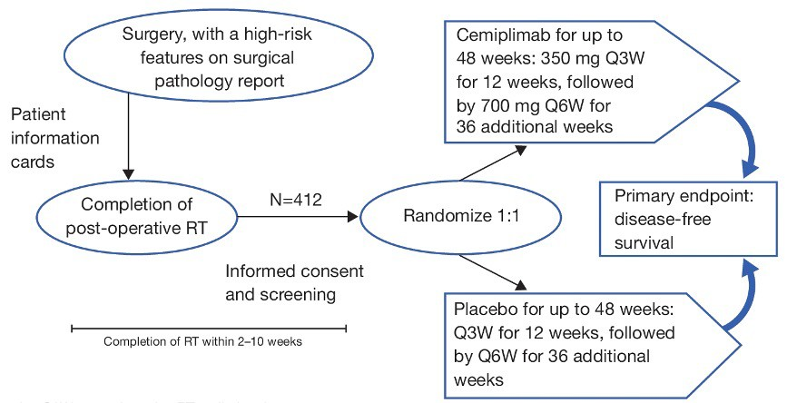
Adjuvant Trials in High-Risk CSCC
KEYNOTE-630
KEYNOTE-630: accrual completed
C-POST: recruiting
C-POST
Schenker M et al. AACR-AHNS 2023; Abstract PO-009; Rischin D et al. ASCO 2022;Abstract TPS9592.

Slide 54
Hedgehog Inhibitors in BCC
VISMODEGIB
ERIVANCE BCC Trial
N=104
ORR: 60.3% (LA), 48.5% (Metastatic, M)
Median DOR: 26.2m (LA), 14.8m (M)
Median PFS: 12.9m (LA), 9.3m (M)
Median OS: NE (LA), 33.4m (M)
SONIDEGIB
BOLT Trial
N=230
48-month final analysis
ORR (200mg cohort): 56% (LA), 8% (M)
Median DOR: 26.1m (LA), 24.0m (M)
Median PFS: 22.1m (LA), 13.1m (M)
Sekulic A et al. BMC Cancer 2017;332:s12885; Dummer et al, Br J Dermatol 2020;182:1369.

Slide 55
Real World Data in BCC: HHI Discontinuation Is Common
Cumulative Risk of first HhI discontinuation
Months
Ge W, et al. Future Oncol. 2022 Jul;18(23):2561-2572.

Slide 56
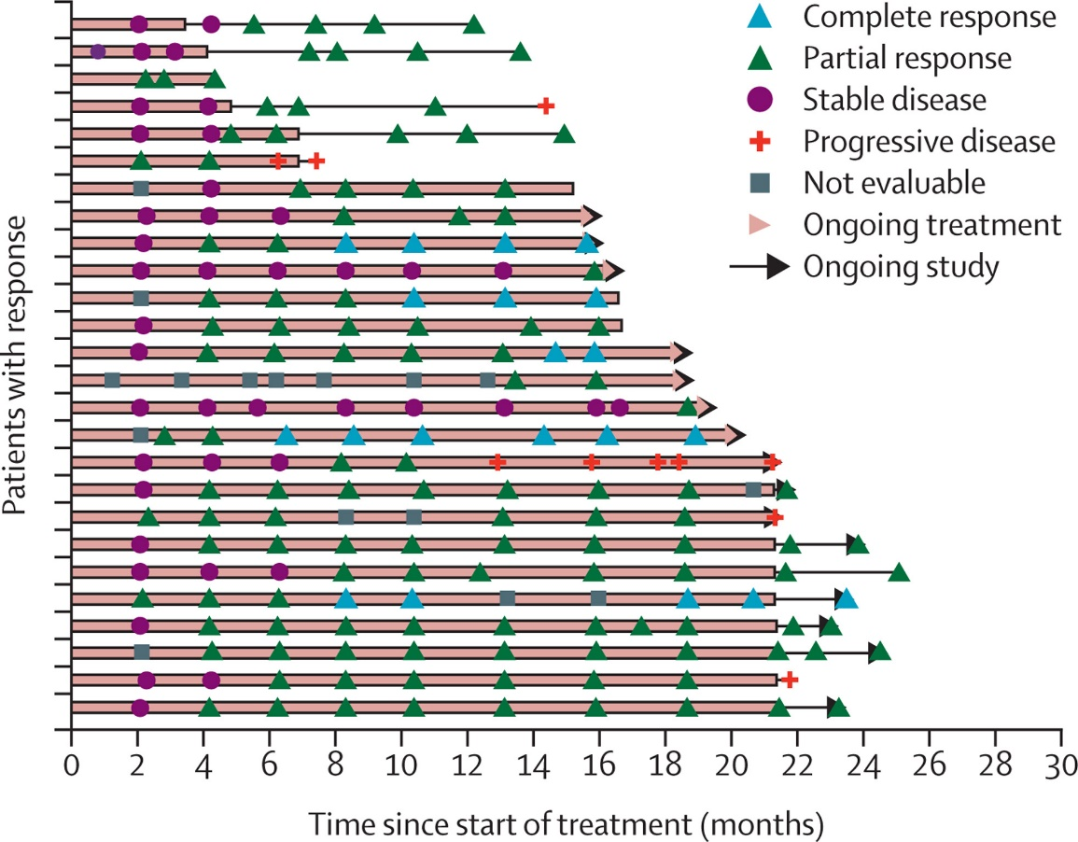
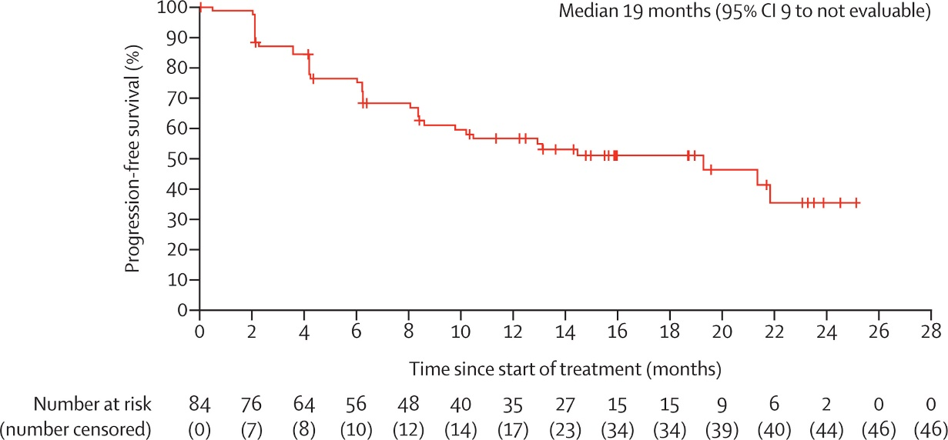
Cemiplimab in Basal Cell Carcinoma
Locally advanced BCC; intolerant or PD on HHI, or SD X 9 months
ORR 32.1% (7.1% CR)
DCR 79.8%
Stratigos AJ, Sekulic A, et al. Lancet Oncol 2021;22:848
Stratigos AJ, Sekulic A, et al. J Am Acad Dermatol 2024;90:414

Slide 57
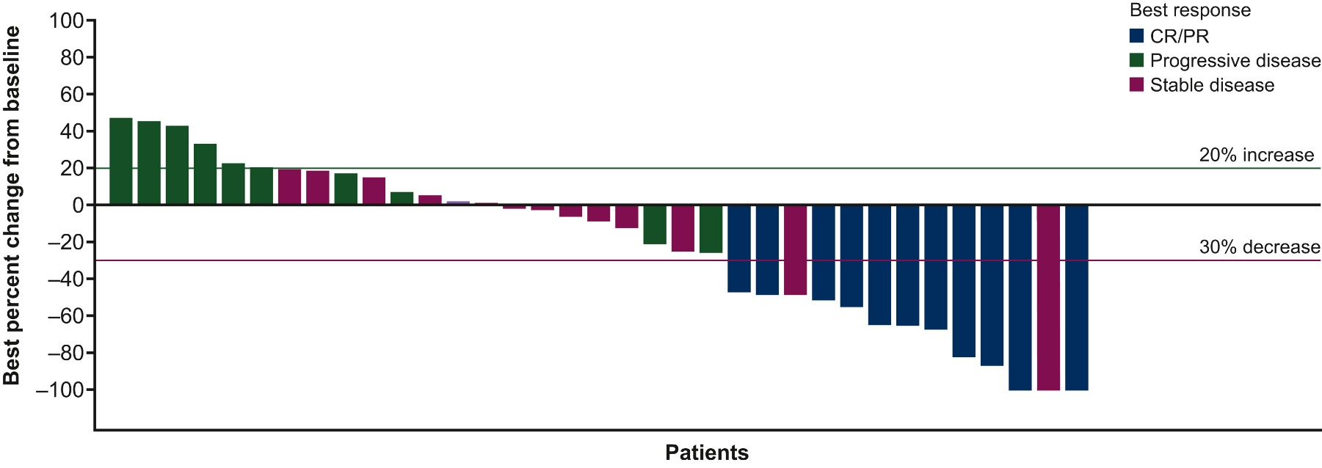
Cemiplimab For Metastatic BCC After HHI
ORR: 22%; CR: 4%
mPFS: 10 months (95% CI, 4-16)
Lewis KD, Peris K, et al. Ann Oncol 2024;35(2):221-28

Slide 58
Nivolumab + Relatlimab in Advanced BCC
N=19
13 (NIVO alone); ORR 46%
9 HHI naïve (5/9: ORR 56%)
5 (NIVO + RELA)
ORR 20% (1/5); SD 60% (3/5)
1 (NIVO + IPI)
No response
Schenk et al. ESMO 2022; Poster 820P

Slide 59
Therapies of Interest in NMSC
Intralesional
RP1 (CERPASS, ARTACUS): CSCC
Daromun (L19IL2 + L19TNF): BCC
IFX-Hu2.0: Merkel cell carcinoma (MCC)
Systemic
Neoadjuvant nivolumab plus relatlimab: MCC

Slide 60
Conclusions
Anti-PD1-based therapy is SOC front-line treatment for advanced CSCC
Neoadjuvant anti-PD1 therapy is effective with high pCR rate in CSCC
Early promise of IT in HHI-refractory BCC is encouraging and warrants investigation as front-line therapy

