Slide 1
Year in Review: Clinical Investigator Perspectives on the Most Relevant New Data Sets and Advances in Oncology Hormone Receptor-Positive Breast Cancer
A Multitumor CME/MOC-Accredited Live Webinar Series
Thursday, January 11, 2024 5:00 PM – 6:00 PM ET
Faculty
Stephanie L Graff, MD, FACP
Erica Mayer, MD, MPH, FASCO
Moderator
Neil Love, MD

Slide 2



Faculty
Stephanie L Graff, MD, FACP
Associate Professor of Medicine
Warren Alpert Medical School of Brown University
Director of Breast Oncology, Lifespan Cancer Institute
Co-Lead, Breast Cancer Translational Disease Research Group
Legorreta Cancer Center at Brown University
Medical Advisor, Dr Susan Love Foundation for Breast Cancer Research
Providence, Rhode Island
MODERATOR
Neil Love, MD Research To Practice
Miami, Florida
Erica Mayer, MD, MPH, FASCO Director of Breast Cancer Clinical Research Breast Oncology Center Dana-Farber Cancer Institute Associate Professor of Medicine Harvard Medical School Boston, Massachusetts

Slide 3
Commercial Support
This activity is supported by educational grants from AstraZeneca Pharmaceuticals LP, Daiichi Sankyo Inc, Lilly, and Stemline Therapeutics Inc.
Research To Practice CME Planning Committee Members, Staff and Reviewers
Planners, scientific staff and independent reviewers for Research To Practice have no relevant conflicts of interest to disclose.

Slide 4
Dr Graff — Disclosures
Advisory Boards (All Relationships Ended, Self) | AstraZeneca Pharmaceuticals LP, Daiichi Sankyo Inc, Genentech, a member of the Roche Group, Gilead Sciences Inc, Loxo Oncology Inc, a wholly owned subsidiary of Eli Lilly & Company, Menarini Group, Novartis, Pfizer Inc, Seagen Inc, Stemline Therapeutics Inc
Research Funding (All Funds to Institution) | AstraZeneca Pharmaceuticals LP, Daiichi Sankyo Inc, Novartis
Nonrelevant Financial Relationship | HCA Healthcare (stock ownership)

Slide 5
Dr Mayer — Disclosures
Consulting Agreements | AstraZeneca Pharmaceuticals LP, Lilly, Novartis

Slide 6
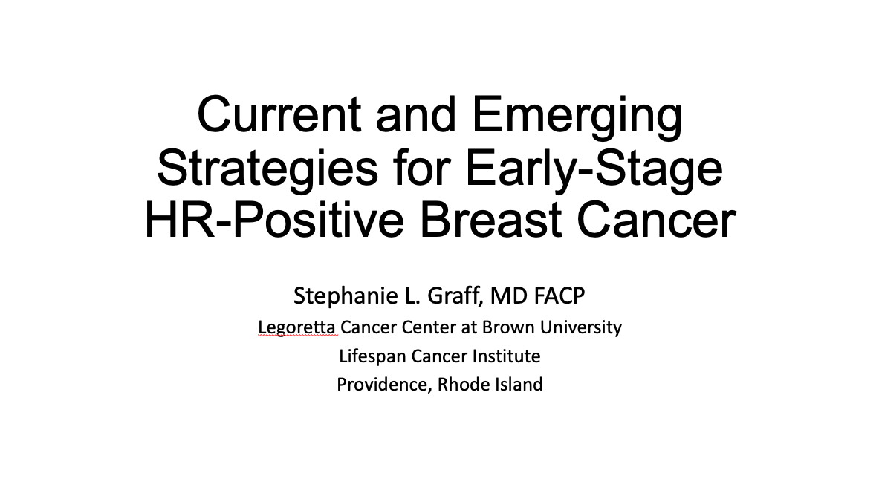


Slide 7
Key Data Sets
Stephanie L Graff, MD, FACP
Taylor C et al. Using Oncotype DX breast Recurrence Score® assay to define the role of neoadjuvant endocrine therapy in early-stage hormone receptor-positive breast cancer. Breast Cancer Res Treat 2023;199(1):91-8.
Trapani D et al. Identifying patterns and barriers in Oncotype DX Recurrence Score testing in older patients with early-stage, estrogen receptor-positive breast cancer: Implications for guidance and reimbursement. JCO Oncol Pract 2023;19(8):560-70.
Loi S et al. A randomized, double-blind trial of nivolumab (NIVO) vs placebo (PBO) with neoadjuvant chemotherapy (NACT) followed by adjuvant endocrine therapy (ET) ± NIVO in patients (pts) with high-risk, ER+ HER2− primary breast cancer (BC). ESMO 2023;Abstract LBA20.
Cardoso F et al. KEYNOTE-756: Phase III study of neoadjuvant pembrolizumab (pembro) or placebo (pbo) + chemotherapy (chemo), followed by adjuvant pembro or pbo + endocrine therapy (ET) for early-stage high-risk ER+/HER2– breast cancer. ESMO 2023;Abstract LBA21.

Slide 8
Key Data Sets
Stephanie L Graff, MD, FACP (continued)
Hortobagyi G et al. Ribociclib (RIB) + nonsteroidal aromatase inhibitor (NSAI) as adjuvant treatment in patients with HR+/HER2− early breast cancer: Final invasive disease–free survival (iDFS) analysis from the NATALEE trial. San Antonio Breast Cancer Symposium 2023;Abstract GS03-03.
Johnston SRD et al. Abemaciclib plus endocrine therapy for hormone receptor-positive, HER2-negative, node-positive, high-risk early breast cancer (monarchE): Results from a preplanned interim analysis of a randomised, open-label, phase 3 trial. Lancet Oncol 2023;24(1):77-90.
Harbeck N et al. Adjuvant abemaciclib plus endocrine therapy for HR+, HER2-, high-risk early breast cancer: Results from a preplanned monarchE overall survival interim analysis, including 5-year efficacy outcomes. ESMO 2023;Abstract LBA17.
Pagani O et al. Adjuvant exemestane with ovarian suppression in premenopausal breast cancer: Long-term follow-up of the combined TEXT and SOFT trials. J Clin Oncol 2023;41(7):1376-82.

Slide 9
Key Data Sets
Stephanie L Graff, MD, FACP (continued)
Gray RG et al. Effects of ovarian ablation or suppression on breast cancer recurrence and survival: Patient-level meta-analysis of 14,993 pre-menopausal women in 25 randomized trials. ASCO 2023;Abstract 503.
Partridge AH et al. Interrupting endocrine therapy to attempt pregnancy after breast cancer. N Engl J Med 2023;388(18):1645-56.
Robertson J et al. SERENA-3: A randomized pre-surgical window of opportunity study assessing dose and duration of camizestrant treatment in post-menopausal women with ER-positive, HER2-negative primary breast cancer. San Antonio Breast Cancer Symposium 2023;Abstract RF01-01.

Slide 10
Key Data Sets
Erica Mayer, MD, MPH, FASCO
Jhaveri K et al. Phase III study of inavolisib or placebo in combination with palbociclib and fulvestrant in patients with PIK3CA-mutant, hormone receptor-positive, HER2-negative locally advanced or metastatic breast cancer: INAVO120 primary analysis. San Antonio Breast Cancer Symposium 2023;Abstract GS03-13.
Goetz M et al. MONARCH 3: Final overall survival results of abemaciclib plus a nonsteroidal aromatase inhibitor as first-line therapy for HR+, HER2- advanced breast cancer. San Antonio Breast Cancer Symposium 2023;Abstract GS01-12.
Turner NC et al. Capivasertib in hormone receptor-positive advanced breast cancer. N Engl J Med 2023;388(22):2058-70.
Howell S et al. Capivasertib and fulvestrant for patients with aromatase inhibitor-resistant HR positive/HER2-negative advanced breast cancer: Exploratory analysis of PFS by AKT pathway gene from the Phase 3 CAPItello-291 trial. San Antonio Breast Cancer Symposium 2023;Abstract PS17-03.
Lu J et al. Elacestrant vs standard-of-care in ER+/HER2- advanced or metastatic breast cancer (mBC) with ESR1 mutation: Key biomarkers and clinical subgroup analyses from the phase 3 EMERALD trial. San Antonio Breast Cancer Symposium 2023;Abstract PS17-02.

Slide 11
Key Data Sets
Erica Mayer, MD, MPH, FASCO (continued)
Burstein HJ et al. Testing for ESR1 mutations to guide therapy for hormone receptor-positive, human epidermal growth factor receptor 2-negative metastatic breast cancer: ASCO guideline Rapid Recommendation Update. J Clin Oncol 2023;41(18):3423-5.
Oliveira M et al. Clinical activity of camizestrant, a next-generation SERD, versus fulvestrant in patients with a detectable ESR1 mutation: Exploratory analysis of the SERENA-2 phase 2 trial. ASCO 2023;Abstract 1066.
Jhaveri K et al. Imlunestrant monotherapy and in combination with abemaciclib, with or without an aromatase inhibitor, in estrogen receptor-positive (ER+), HER2-negative (HER2-) advanced breast cancer (aBC): Updated results from the EMBER study. San Antonio Breast Cancer Symposium 2023;Abstract PS15-09.
Tolaney SM et al. Final overall survival (OS) analysis from the phase 3 TROPiCS-02 study of sacituzumab govitecan (SG) in patients (pts) with hormone receptor–positive/HER2-negative (HR+/HER2–) metastatic breast cancer (mBC). ASCO 2023;Abstract 1003.

Slide 12
Key Data Sets
Erica Mayer, MD, MPH, FASCO (continued)
Bardia A et al. Randomized phase 3 study of datopotamab deruxtecan vs chemotherapy for patients with previously-treated inoperable or metastatic hormone receptor-positive, HER2-negative breast cancer: Results from TROPION-Breast01. San Antonio Breast Cancer Symposium 2023;Abstract GS02-01.
Modi S et al. Trastuzumab deruxtecan (T-DXd) versus treatment of physician’s choice (TPC) in patients (pts) with HER2-low unresectable and/or metastatic breast cancer (mBC): Updated survival results of the randomized, phase III DESTINY-Breast04 study. ESMO 2023;Abstract 376O.
Modi S et al. Trastuzumab deruxtecan (T-DXd) vs treatment of physician’s choice (TPC) in patients (pts) with HER2-low, hormone receptor-positive (HR+) unresectable and/or metastatic breast cancer (mBC): Exploratory biomarker analysis of DESTINY-Breast04. ASCO 2023;Abstract 1020.
Hamilton EP et al. A phase 2 study of HER3-DXd in patients (pts) with metastatic breast cancer (MBC). ASCO 2023;Abstract 1004.
Krop IE et al. Patritumab deruxtecan (HER3-DXd), a human epidermal growth factor receptor 3-directed antibody-drug conjugate, in patients with previously treated human epidermal growth factor receptor 3-expressing metastatic breast cancer: A multicenter, Phase I/II trial. J Clin Oncol 2023;41(36):5550-60.

Slide 13
Agenda
INTRODUCTION: Endocrinology and Pharmacology of Hormonal Therapy for Breast Cancer
MODULE 1: Current and Emerging Strategies for Localized Hormonal Receptor (HR)-Positive Breast Cancer — Dr Graff
MODULE 2: Advances in the Care of Patients with HR-Positive Metastatic Breast Cancer — Dr Mayer

Slide 14
Agenda
INTRODUCTION: Endocrinology and Pharmacology of Hormonal Therapy for Breast Cancer
MODULE 1: Current and Emerging Strategies for Localized Hormonal Receptor (HR)-Positive Breast Cancer — Dr Graff
MODULE 2: Advances in the Care of Patients with HR-Positive Metastatic Breast Cancer — Dr Mayer

Slide 15
2023: What a year!
Mirroring the rest of oncology, breast cancer remains an incredibly fast paced field with multiple new agents and evolving data
New drug approvals and new results continue to modify treatment paradigms
Toxicity and tolerability are key and may be differentiators
New findings hopefully result in better and longer outcomes for our patients
Courtesy of Erica Mayer, MD, MPH, FASCO

Slide 16
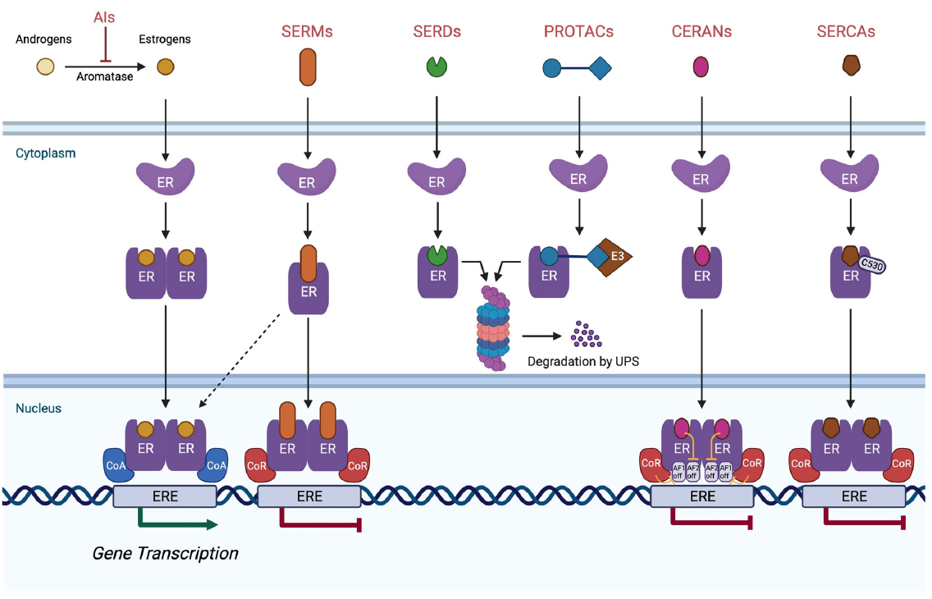
Mechanisms of Action of Antiestrogen Therapies
AI = aromatase inhibitor; SERM = selective estrogen receptor modulator; SERD = selective estrogen receptor downregulator; PROTAC = proteolysis-targeting chimera; CERAN = complete estrogen receptor antagonist; SERCA = selective estrogen receptor covalent antagonist; ERE = estrogen-responsive element
Patel R et al. NPJ Breast Cancer 2023 April 5;9(1):20.

Slide 17
For patients who experience disease progression on a CDK4/6 inhibitor with endocrine therapy for ER-positive metastatic breast cancer, testing is indicated for alterations in which of the following?
PIK3CA
ESR1
AKT/PTEN
All of the above
PIK3CA and ESR1 only
PIK3CA and AKT/PTEN only
ESR1 and AKT/PTEN only
I’m not sure

Slide 18
Beyond the Guidelines: Clinical Investigator Perspectives on the Management of ER-Positive Metastatic Breast Cancer
Part 1 of a 3-Part CME Satellite Symposium Series in Partnership with
the 2023 San Antonio Breast Cancer Symposium®
Tuesday, December 5, 2023
7:15 PM – 9:15 PM CT (8:15 PM – 10:15 PM ET)
Faculty
Francois-Clement Bidard, MD, PhD
Erika Hamilton, MD
Komal Jhaveri, MD, FACP
Virginia Kaklamani, MD, DSc
Hope S Rugo, MD
Moderator
Neil Love, MD

Slide 19







Slide 20
INAVO120: Phase III study of inavolisib (GDC-0077) or placebo in combination with palbociclib and fulvestrant in PIK3CA-mutant, HR+/HER2- MBC: Study Design
San Antonio Breast Cancer Symposium®, December 5–9, 2023
Key eligibility criteria
Enrichment of patients with poor prognosis:
PIK3CA-mutated, HR+, HER2- ABC by central ctDNA* or local tissue/ctDNA test
Measurable disease
Progression during/within 12 months of adjuvant ET completion
No prior therapy for ABC
Fasting glucose <126 mg/dL and HbA_{1C} <6.0%
Enrolment period: December 2019-September 2023
N=325
Inavolisib (9 mg QD PO)
+ palbociclib (125 mg PO QD D1-D21) + fulvestrant (500 mg C1D1/15 and Q4W)**
Until PD or toxicity
R
1:1
SURVIVAL FOLLOW-UP
Placebo (PO QD)
+ palbociclib (125 mg PO QD D1-D21) + fulvestrant (500 mg C1D1/15 and Q4W)**
Stratification factors:
Visceral Disease (Yes vs. No)
Endocrine Resistance (Primary vs. Secondary)†
Region (North America/Western Europe; Asia; Other)
Endpoints
Primary: PFS by Investigator
Secondary: OS‡, ORR, BOR, CBR, DOR, PROs
* Central testing for PIK3CA mutations was done on ctDNA using FoundationOne®Liquid (Foundation Medicine). In China, the central ctDNA test was the PredicineCARE NGS assay (Huidu). † Defined per 4th European School of Oncology (ESO)–European Society for Medical Oncology (ESMO) International Consensus Guidelines for Advanced Breast Cancer.¹ Primary: relapse while on the first 2 years of adjuvant ET; Secondary: relapse while on adjuvant ET after at least 2 years or relapse within 12 months of completing adjuvant ET. ‡ OS testing only if PFS is positive; interim OS analysis at primary PFS analysis; **Pre-menopausal women received ovarian suppression. ctDNA, circulating tumor DNA; R, randomized. 1. Cardoso F, et al. Ann Oncol 2018;29:1634–1657.
Courtesy of Erica Mayer, MD, MPH, FASCO

Slide 21
INAVO120: Primary endpoint: PFS (investigator assessed)
San Antonio Breast Cancer Symposium®, December 5–9, 2023
6-month
12-month
18-month
 | Inavo+Palbo+Fulv (n=161) | Pbo+Palbo+Fulv (n=164)
No. of events, n (%) | 82 (50.9) | 113 (68.9)
Median (95% CI), mo | 15.0 (11.3, 20.5) | 7.3 (5.6, 9.3)
Stratified hazard ratio (95% CI) | 0.43 (0.32, 0.59) p<0.0001
100
82.9%
75
55.9%
55.9%
PFS (%)
46.2%
50
32.6%
Inavo+Palbo+Fulv
21.1%
25
Pbo+Palbo+Fulv
Censored
0
0
3
6
9
12
15
18
21
24
27
30
33
36
Time (mo)
Patients at risk:
Inavo+Palbo+Fulv | 161 | 134 | 111 | 92 | 66 | 48 | 41 | 31 | 22 | 13 | 11 | 5 | 1
Pbo+Palbo+Fulv | 164 | 113 | 77 | 59 | 40 | 23 | 19 | 16 | 12 | 6 | 3 | 3 | 1
Median follow-up: 21.3 months
CCOD: 29th September 2023 CI, confidence interval; Fulv, fulvestrant; Inavo, inavolisib; mo, months; Palbo, palbociclib; Pbo, placebo; PFS, progression-free survival.
Courtesy of Erica Mayer, MD, MPH, FASCO

Slide 22
INAVO120: Adverse events with any grade AEs ≥20% incidence in either treatment group
San Antonio Breast Cancer Symposium®, December 5–9, 2023
Adverse Events | Inavo+Palbo+Fulv (N=162) |  | Pbo+Palbo+Fulv (N=162)
 | All Grades | Grade 3-4 | All Grades | Grade 3-4
Neutropenia | 144 (88.9%) | 130 (80.2%) | 147 (90.7%) | 127 (78.4%)
Thrombocytopenia | 78 (48.1%) | 23 (14.2%) | 73 (45.1%) | 7 (4.3%)
Stomatitis/Mucosal inflammation | 83 (51.2%) | 9 (5.6%) | 43 (26.5%) | 0
Anemia | 60 (37.0%) | 10 (6.2%) | 59 (36.4%) | 3 (1.9%)
Hyperglycemia | 95 (58.6%) | 9 (5.6%) | 14 (8.6%) | 0
Diarrhea | 78 (48.1%) | 6 (3.7%) | 26 (16.0%) | 0
Nausea | 45 (27.8%) | 1 (0.6%) | 27 (16.7%) | 0
Rash | 41 (25.3%) | 0 | 28 (17.3%) | 0
Decreased Appetite | 38 (23.5%) | <2% | 14 (8.6%) | <2%
Fatigue | 38 (23.5%) | <2% | 21 (13.0%) | <2%
COVID-19 | 37 (22.8%) | <2% | 17 (10.5%) | <2%
Headache | 34 (21.0%) | <2% | 22 (13.6%) | <2%
Leukopenia | 28 (17.3%) | 11 (6.8%) | 40 (24.7%) | 17 (10.5%)
Ocular Toxicities | 36 (22.2%) | 0 | 21 (13.0%) | 0
Key AEs are shown in bold. AES were assessed per CTCAE V5. Neutropenia, thrombocytopenia, stomatitis/mucosal inflammation, anemia, hyperglycemia, diarrhea, nausea and rash were assessed as medical concepts using grouped terms AE, adverse event; ALT, alanine aminotransferase; AST, aspartate aminotransferase; Fulv, fulvestrant; Inavo, inavolisib; Palbo, palbociclib; Pbo, placebo.
No toxicity prophylaxis used in this trial
Courtesy of Erica Mayer, MD, MPH, FASCO

Slide 23
INAVO120: Inavolisib
Reassuring to see improved outcomes in a very high-risk cohort of patients with HR+ MBC.
Supports need to know PIK3CA mutation status from time of diagnosis of MBC, in 1L setting.
Palbociclib remains a CDK4/6i option for MBC; may be best tolerated of the agents and easiest to combine in a triplet.
Population had low BMI and was not diverse; toxicity profile including hyperglycemia and mucositis, may be different in a more “real world” group of patients.
Next generation mutant specific PIK3CA inhibitors may offer efficacy with minimal hyperglycemia
Courtesy of Erica Mayer, MD, MPH, FASCO

Slide 24
Agenda
INTRODUCTION: Endocrinology and Pharmacology of Hormonal Therapy for Breast Cancer
MODULE 1: Current and Emerging Strategies for Localized Hormonal Receptor (HR)-Positive Breast Cancer — Dr Graff
MODULE 2: Advances in the Care of Patients with HR-Positive Metastatic Breast Cancer — Dr Mayer

Slide 25
Neoadjuvant Immunotherapy
Loi S et al. A randomized, double-blind trial of nivolumab (NIVO) vs placebo (PBO) with neoadjuvant chemotherapy (NACT) followed by adjuvant endocrine therapy (ET) ± NIVO in patients (pts) with high-risk, ER+ HER2− primary breast cancer (BC). ESMO 2023;Abstract LBA20.
Cardoso F et al. KEYNOTE-756: Phase III study of neoadjuvant pembrolizumab (pembro) or placebo (pbo) + chemotherapy (chemo), followed by adjuvant pembro or pbo + endocrine therapy (ET) for early-stage high-risk ER+/HER2– breast cancer. ESMO 2023;Abstract LBA21.

Slide 26
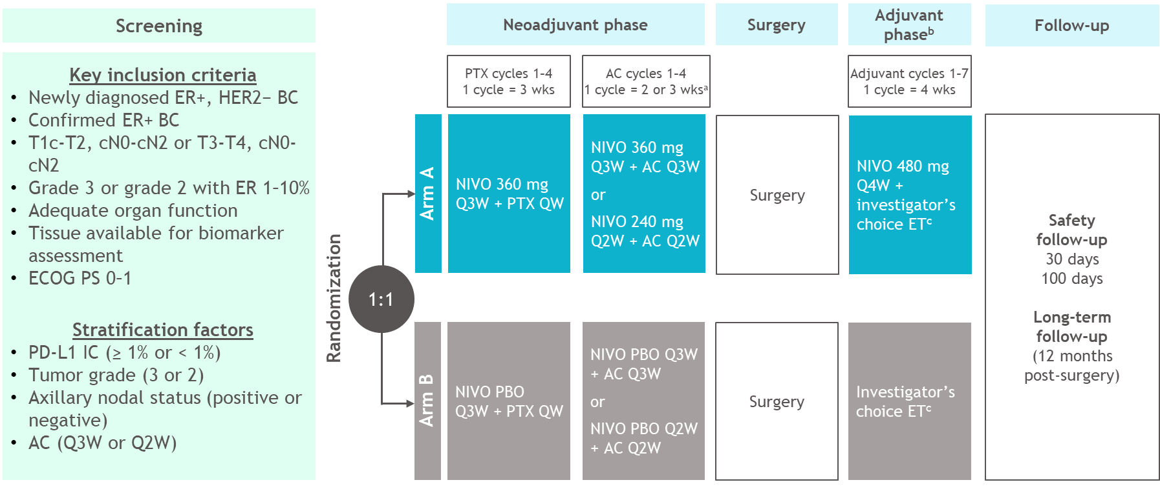
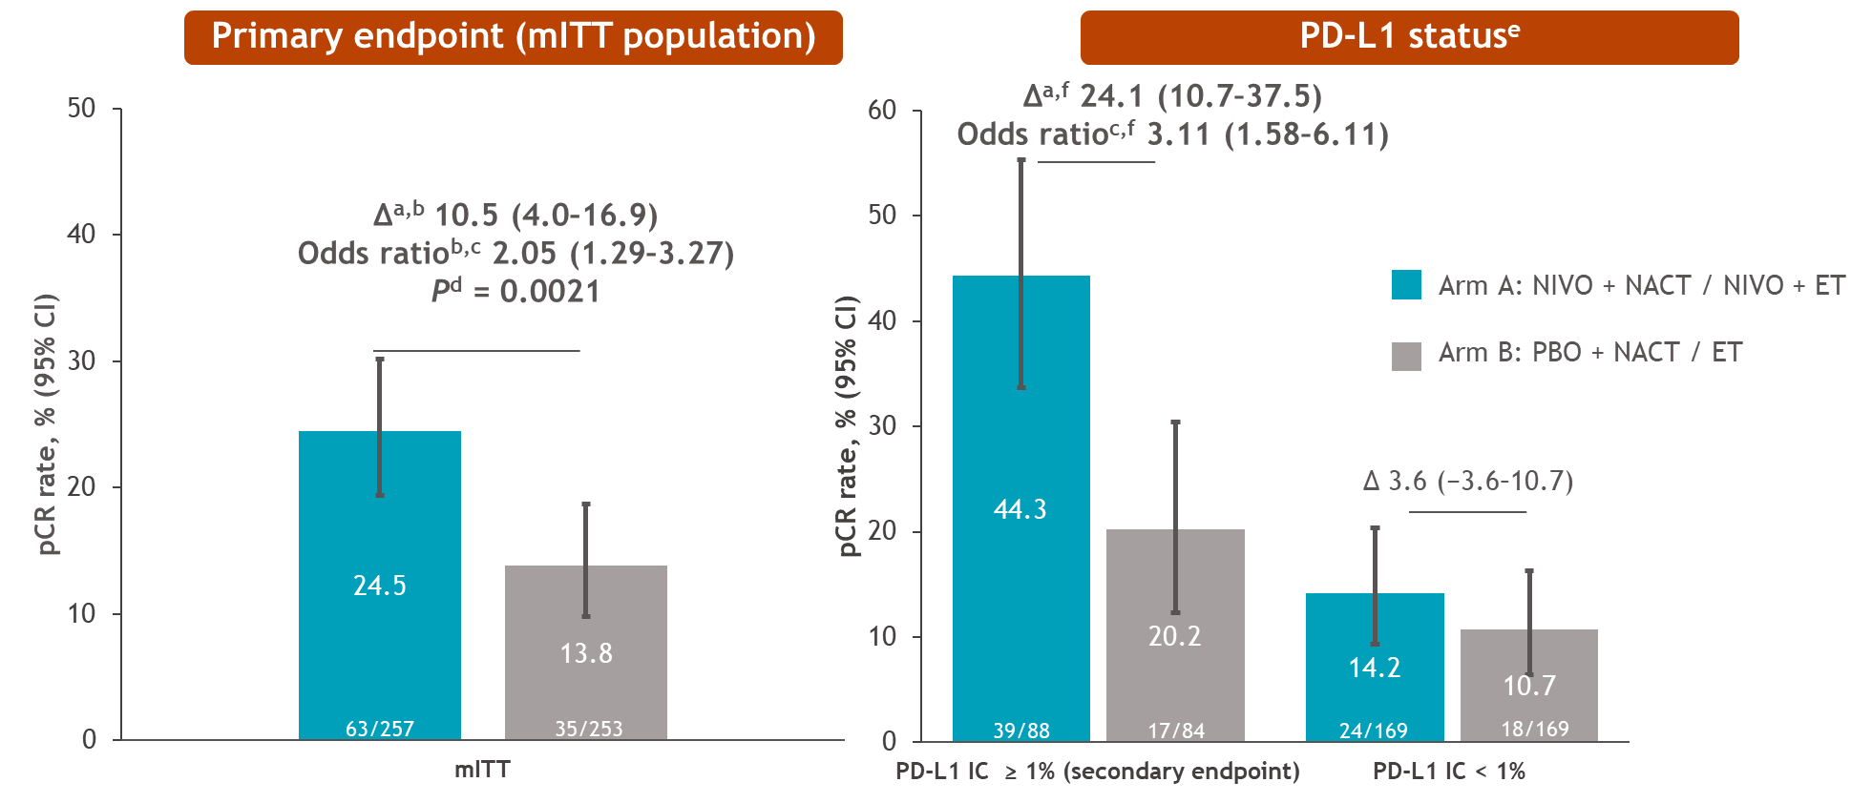
CheckMate 7FL: A randomized, double-blind trial of nivolumab vs placebo with neoadjuvant chemotherapy followed by adjuvant endocrine therapy ± NIVO in patients with high-risk, ER+ HER2− primary breast cancer
Study population: median age 50, 98% G3, ~45% Stage III, AC dosing 50/50 Q3 vs DD
The addition of NIVO to NACT/ET increased pCR by 10.5% (24.5% in arm A and 13.8% in arm B)
The benefit from NIVO was more pronounced in patients with PD-L1 IC ≥ 1% (SP142)
∆ pCR of 24.1% (44.3% in arm A and 20.2% in arm B)
∆ RCB 0-1 of 28.5% (54.5% in arm A and 26.2% in arm B)
Loi S et al. A randomized, double-blind trial of nivolumab (NIVO) vs placebo (PBO) with neoadjuvant chemotherapy (NACT) followed by adjuvant endocrine therapy (ET) ± NIVO in patients (pts) with high-risk, ER+ HER2− primary breast cancer (BC). ESMO 2023;Abstract LBA20.
Courtesy of Stephanie L Graff, MD, FACP

Slide 27
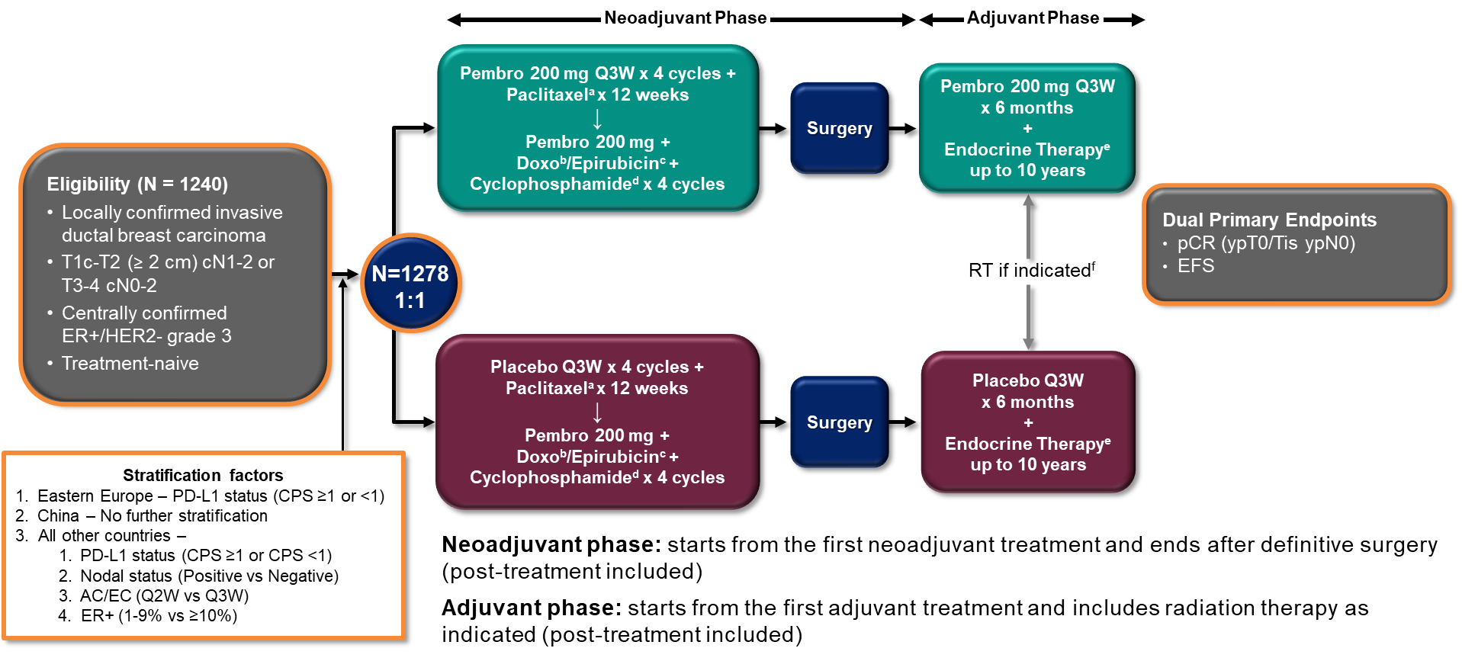
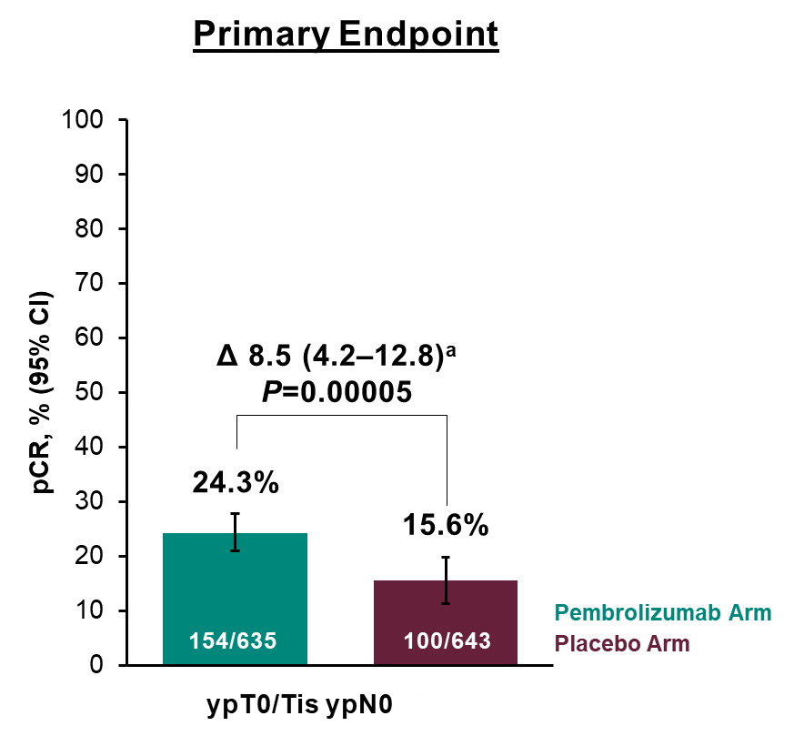
KEYNOTE-756: Phase 3 Study of Neoadjuvant Pembrolizumab or Placebo + Chemotherapy Followed by Adjuvant Pembrolizumab or Placebo + Endocrine Therapy for Early-Stage High-Risk ER+/HER2– Breast Cancer
Study population: median age 49, 100% G3, 90% node positive, 35% T3/T4, AC dosing ~65 Q3 weeks
The addition of PEMBRO to NACT/ET increased pCR by 8.5%
Presenter's conclusion: Pembro benefit was “regardless of PD-L1 status”; but magnitude of benefit smaller in PD-L1 negative population (∆ 4.5% vs 9.8%)
Rate of Grade 3-5 TRAE ∆ 6.1%, and serious TRAE ∆ 8.2% in pembro arm
Will await Event Free Survival before KEYNOTE-756 informs practice
Cardoso F et al. KEYNOTE-756: Phase III study of neoadjuvant pembrolizumab (pembro) or placebo (pbo) + chemotherapy (chemo), followed by adjuvant pembro or pbo + endocrine therapy (ET) for early-stage high-risk ER+/HER2– breast cancer. ESMO 2023;Abstract LBA21.
Courtesy of Stephanie L Graff, MD, FACP

Slide 28
Use of Oncotype DX® to Define the Role of Neoadjuvant Therapy
Taylor C et al. Using Oncotype DX breast Recurrence Score® assay to define the role of neoadjuvant endocrine therapy in early-stage hormone receptor-positive breast cancer. Breast Cancer Res Treat 2023;199(1):91-8.
Trapani D et al. Identifying patterns and barriers in Oncotype DX Recurrence Score testing in older patients with early-stage, estrogen receptor-positive breast cancer: Implications for guidance and reimbursement. JCO Oncol Pract 2023;19(8):560-70.

Slide 29
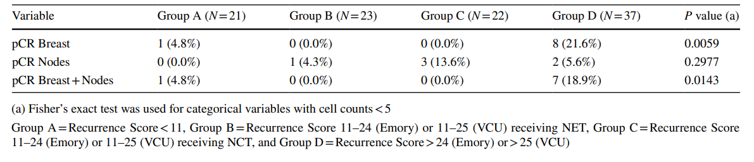
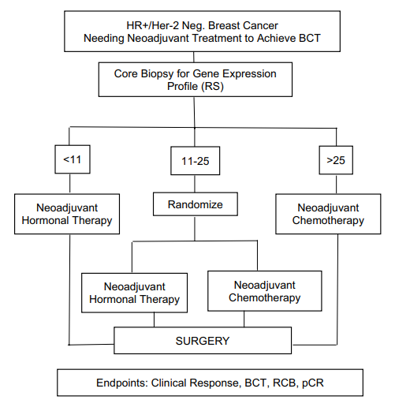
Using Oncotype DX breast Recurrence Score® assay to define the role of neoadjuvant endocrine therapy in early‑stage hormone receptor‑positive breast cancer
Further supports TAILORx and RxPONDER
Two cohorts received significantly different lengths of neoadjuvant endocrine therapy (median 10 months versus 5.5), with no significant differences in pCR across RS result groups between the two institutions
Taylor C et al. Using Oncotype DX breast Recurrence Score® assay to define the role of neoadjuvant endocrine therapy in early-stage hormone receptor-positive breast cancer. Breast Cancer Res Treat 2023;199(1):91-8.
Courtesy of Stephanie L Graff, MD, FACP

Slide 30
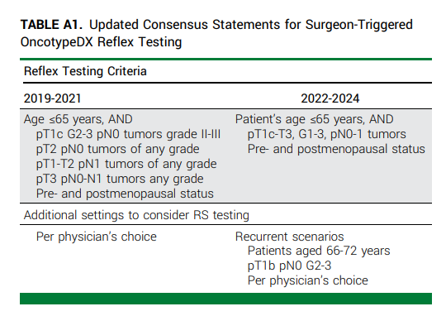
Identifying Patterns & Barriers in Oncotype DX Recurrence Score Testing in Older Patients With Early-Stage, Estrogen Receptor–Positive Breast Cancer: Implications for Guidance, Reimbursement, Trapani JCO-OP
 | Cohort A (Reflex) n=1087 (64.4%) | Cohort B (Case-by-Case) n=600 (35.6%) | Cohort B + Age>65 n=279 (46.5% of Cohort B)
RS Range | 0-74 (median 16) | 0-62 (median 17) | NR
Low | 205 (18.9%) | 130 (21.7%) | 70 (25.1%)
Intermediate | 711 (67.5%) | 357 (59.7%) | 156 (55.9%)
High | 167 (15.4%) | 111 (18.6%) | 52 (18.6%)
Received Chemotherapy | 20.5% | 21.8% | 15.4%
Authors created cohort of patients >65 years who did not have RS testing for comparison
Were older (median age 73 v 69 years)
More likely G1 tumors (43.9% v 15.1%)
More likely to have not undergone SLNB/ALND (48% v 9.3%)
Trapani D et al. Identifying patterns and barriers in OncotypeDX Recurrence Score testing in older patients with early-stage, estrogen receptor-positive breast cancer: Implications for guidance and reimbursement. JCO Oncol Pract 2023;19(8):560-70.
Courtesy of Stephanie L Graff, MD

Slide 31
Adjuvant CDK4/6 Inhibition
Hortobagyi G et al. Ribociclib (RIB) + nonsteroidal aromatase inhibitor (NSAI) as adjuvant treatment in patients with HR+/HER2− early breast cancer: Final invasive disease–free survival (iDFS) analysis from the NATALEE trial. San Antonio Breast Cancer Symposium 2023;Abstract GS03-03.
Johnston SRD et al. Abemaciclib plus endocrine therapy for hormone receptor-positive, HER2-negative, node-positive, high-risk early breast cancer (monarchE): Results from a preplanned interim analysis of a randomised, open-label, phase 3 trial. Lancet Oncol 2023;24(1):77-90.
Harbeck N et al. Adjuvant abemaciclib plus endocrine therapy for HR+, HER2-, high-risk early breast cancer: Results from a preplanned monarchE overall survival interim analysis, including 5-year efficacy outcomes. ESMO 2023;Abstract LBA17.
Robertson J et al. SERENA-3: A randomized pre-surgical window of opportunity study assessing dose and duration of camizestrant treatment in post-menopausal women with ER-positive, HER2-negative primary breast cancer. San Antonio Breast Cancer Symposium 2023;Abstract RF01-01.

Slide 32
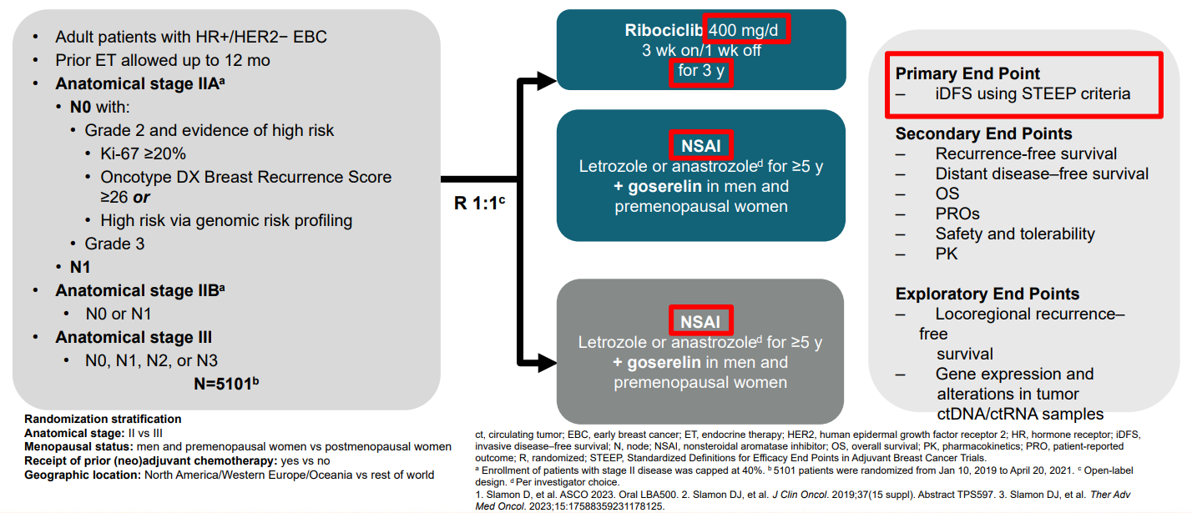
Ribociclib + Nonsteroidal Aromatase Inhibitor as Adjuvant Treatment in Patients With HR+/HER2− Early Breast Cancer: Final Invasive Disease–Free Survival Analysis From the NATALEE Trial
Second IE Analysis 1/11/23 = 426 iDFS events, 54% stopped Ribo including 20% completing 3 years and 33% stopping early vs Final IDFS Analysis 7/21/23 = 509 iDFS events, 78.3% stopped Ribo including 42.8% completing 3 years and 35.5% stopping early
Median follow-up for IDFS was 33.3 mos (max 51 mos)—5.6 mos more than second IE analysis
Hortobagyi G et al. Ribociclib (RIB) + nonsteroidal aromatase inhibitor (NSAI) as adjuvant treatment in patients with HR+/HER2− early breast cancer: Final invasive disease–free survival (iDFS) analysis from the NATALEE trial. San Antonio Breast Cancer Symposium 2023;Abstract GS03-03.
Courtesy of Stephanie L Graff, MD, FACP

Slide 33
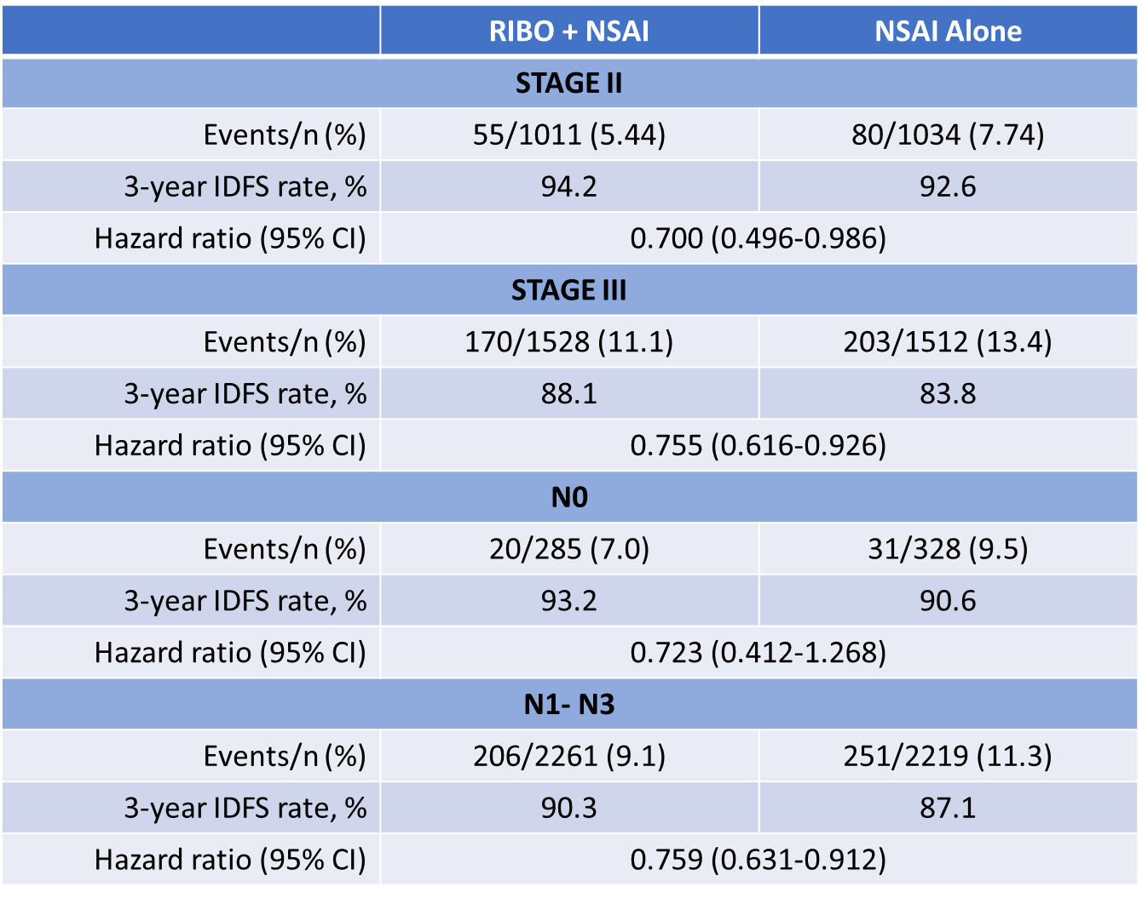
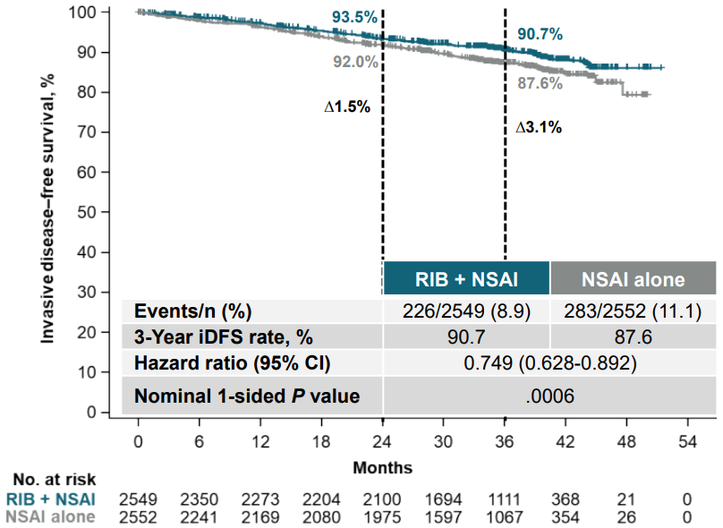
Ribociclib + Nonsteroidal Aromatase Inhibitor as Adjuvant Treatment in Patients With HR+/HER2− Early Breast Cancer: Final Invasive Disease–Free Survival Analysis From the NATALEE Trial
Invasive Disease-Free Survival
Absolute iDFS benefit with Ribo plus NSAI was 3.1% at 3 years, a 25.1% relative risk reduction
iDFS benefit consistent across prespecified subgroups, including patients with stage II, III, node-negative, and node-positive disease
Hortobagyi G et al. Ribociclib (RIB) + nonsteroidal aromatase inhibitor (NSAI) as adjuvant treatment in patients with HR+/HER2− early breast cancer: Final invasive disease–free survival (iDFS) analysis from the NATALEE trial. San Antonio Breast Cancer Symposium 2023;Abstract GS03-03.
Courtesy of Stephanie L Graff, MD, FACP

Slide 34
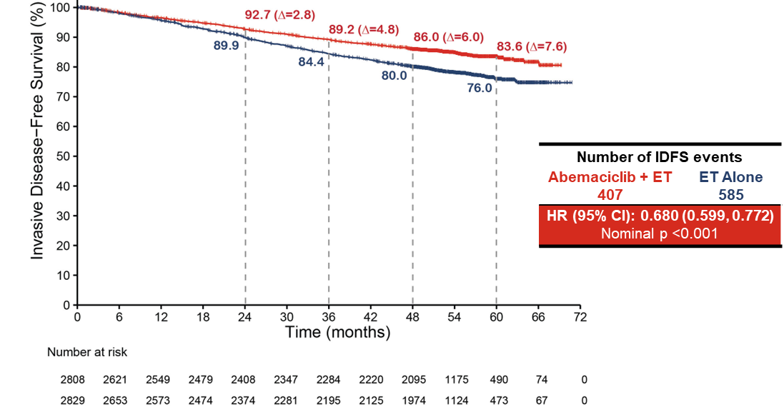
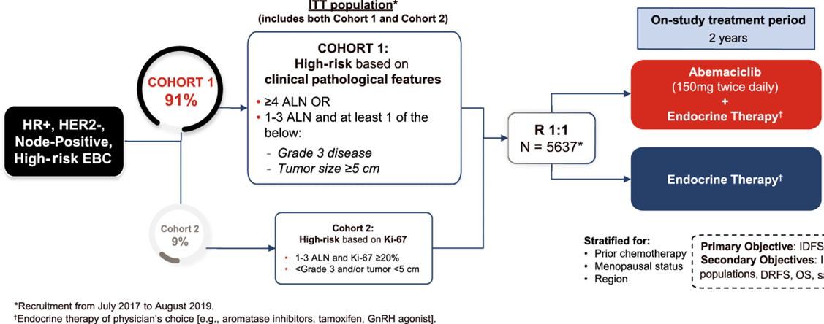
Adjuvant abemaciclib plus endocrine therapy for HR+, HER2-, high-risk early breast cancer: results from a preplanned monarchE overall survival interim analysis, including 5-year efficacy outcomes
Overall Survival Interim Analysis 3 (OS IA3) 7/3/2023= Median follow up 4.5 years (54 mos); all patients completed abemaciclib, with 80% followed 2 years since completion
32% risk reduction in IDFS, absolute difference of 7.6% at 5 years
48 mos (Lancet, Jan 2023): 4-year IDFS rate abema + ET 85.8% (95% CI 84.2–87.3) vs. ET alone 79.4% (77.5–81.1), absolute ∆ 6.4%
32.5% risk reduction in DRFS, absolute difference of 6.7% at 5 years (not shown)
Johnston SRD et al. Abemaciclib plus endocrine therapy for hormone receptor-positive, HER2-negative, node-positive, high-risk early breast cancer (monarchE): Results from a preplanned interim analysis of a randomised, open-label, phase 3 trial. Lancet Oncol 2023;24(1):77-90.
Harbeck N et al. Adjuvant abemaciclib plus endocrine therapy for HR+, HER2-, high-risk early breast cancer: Results from a preplanned monarchE overall survival interim analysis, including 5-year efficacy outcomes. ESMO 2023;Abstract LBA17.
Courtesy of Stephanie L Graff, MD, FACP

Slide 35
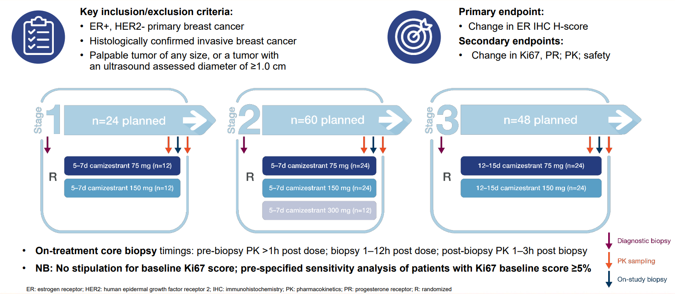
SERENA-3: A randomized pre-surgical window of opportunity study assessing dose and duration of camizestrant treatment in post-menopausal women with ER-positive, HER2-negative primary breast cancer
Enrolled
92.6% Ductal
Stage I (34.8%) or Stage II (57.8%)
Mostly G2 (66.7%)
N0 (69.6%) or N1 (26.7%)
Robertson J et al. SERENA-3: A randomized pre-surgical window of opportunity study assessing dose and duration of camizestrant treatment in post-menopausal women with ER-positive, HER2-negative primary breast cancer. San Antonio Breast Cancer Symposium 2023;Abstract RF01-01.
Courtesy of Stephanie L Graff, MD, FACP

Slide 36
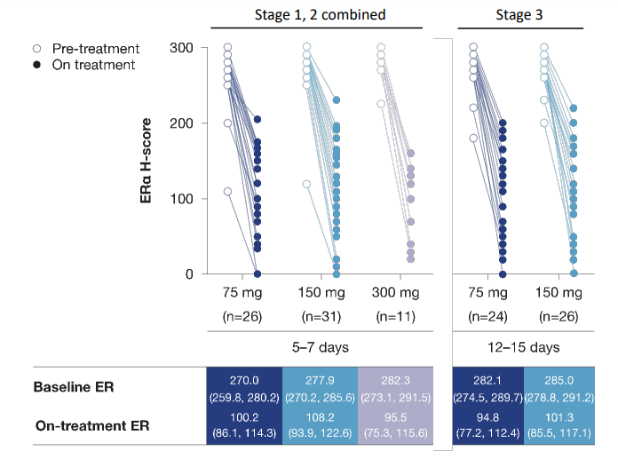
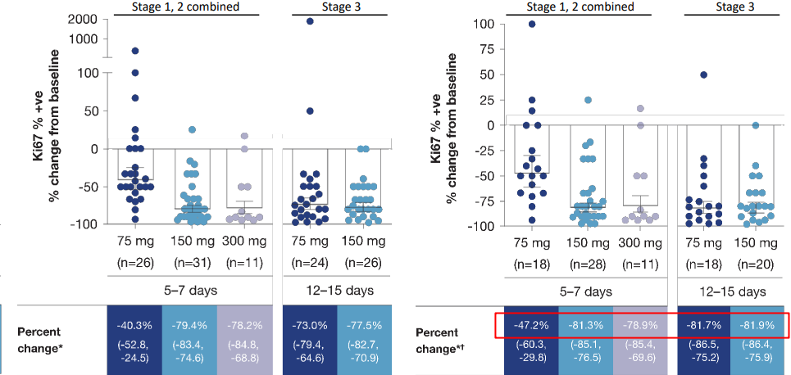
SERENA-3: A randomized pre-surgical window of opportunity study assessing dose and duration of camizestrant treatment in post-menopausal women with ER-positive, HER2-negative primary breast cancer
Camizestrant effectively degrades ERα on treatment across stages, treatment doses & duration of exposure
After 5-7 days of exposure, ki-67 is reduced; more effectively at 150 and 300 mg than at 75 mg. After 12-15 days of exposure, ki-67 reduced ~82% for both 75 and 150 mg doses
Robertson J et al. SERENA-3: A randomized pre-surgical window of opportunity study assessing dose and duration of camizestrant treatment in post-menopausal women with ER-positive, HER2-negative primary breast cancer. San Antonio Breast Cancer Symposium 2023;Abstract RF01-01.
Courtesy of Stephanie L Graff, MD, FACP

Slide 37
Agenda
INTRODUCTION: Endocrinology and Pharmacology of Hormonal Therapy for Breast Cancer
MODULE 1: Current and Emerging Strategies for Localized Hormonal Receptor (HR)-Positive Breast Cancer — Dr Graff
MODULE 2: Advances in the Care of Patients with HR-Positive Metastatic Breast Cancer — Dr Mayer

Slide 38
Choice of First-Line CDK4/6 Inhibitor
Goetz M et al. MONARCH 3: Final overall survival results of abemaciclib plus a nonsteroidal aromatase inhibitor as first-line therapy for HR+, HER2- advanced breast cancer. San Antonio Breast Cancer Symposium 2023;Abstract GS01-12.

Slide 39
MONARCH 3 Study Design
N = 493
Eligibility Criteria:
HR+, HER2- ABC
Postmenopausal
Metastatic or locoregionally recurrent disease with no prior systemic therapy in this setting
If (neo)adjuvant ET administered, a disease-free interval of >12 months since completion of ET
ECOG PS ≤1
abemaciclib 150 mg PO BID +
anastrozole 1 mg or
letrozole 2.5 mg PO QD until PD ª
Primary Endpoint⁵
Investigator-assessed PFS
Key Secondary Endpoints
Overall survival, response rates, safety
Exploratory Endpoint Chemotherapy-free survival
Stratification Factors
Metastatic site (visceral, bone only, or other)
Prior ET (AI, no ET, or other)
Randomization 2:1
placebo PO BID +
anastrozole 1 mg or letrozole 2.5 mg QD until PDª
MONARCH 3 enrolled from November 2014 to November 2015 in 158 centers from 22 countries
ª per physician’s choice: 79.1 % received letrozole, 19.9 % received anastrozole
⁵Goetz MP, et al. J Clin Oncol. 2017;35(32):3638-3646
Courtesy of Erica Mayer, MD, MPH, FASCO

Slide 40
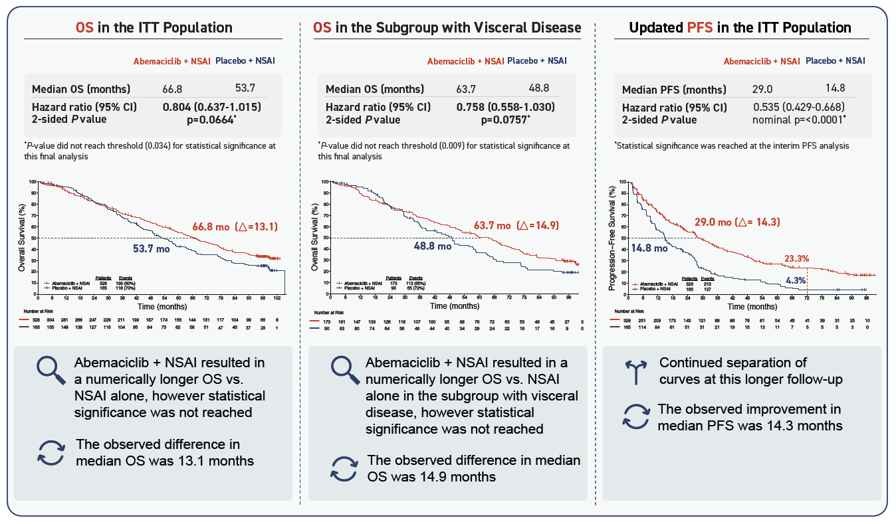
MONARCH 3 Final OS results of abemaciclib plus AI as first-line therapy for HR+, HER2- advanced breast cancer
Courtesy of Erica Mayer, MD, MPH, FASCO

Slide 41
Overall Survival in Patients Treated with CDK4/6i for Metastatic Disease
 | Treatment Arm: OS, Median, Mo | Placebo Arm: OS, Median, Mo | Hazard Ratio | Hazard Ratio (95% CI) | P Value | Significance reached vs placeboª
PALOMA-2¹ Palbociclib + letrozole | 53.9 | 51.2 |  | 0.956 (0.777-1.177) | 0.3378 | ✗
PALOMA-3² Palbociclib + fulvestrant | 34.9 | 28.0 |  | 0.81 (0.64-1.03) | .09 | ✗
MONARCH 2³ Abemaciclib + fulvestrant | 46.7 | 37.3 |  | 0.76 (0.61-0.95) | .01 | ✓
MONARCH 3 Abemaciclib + NSAI | 66.8 | 53.7 |  | 0.804 (0.637-1.015) | .0664 | ✗
MONALEESA-2^{4,5} Ribociclib + letrozole | 63.9 | 51.4 |  | 0.76 (0.63-0.93) | .004 | ✓
MONALEESA-7⁶ Ribociclib + goserelin + tamoxifen/NSAI | NR | 40.9 |  | 0.71 (0.54-0.95) | .00973 | ✓
MONALEESA-3⁷ Ribociclib + fulvestrant | NR | 40.0 |  | 0.72 (0.57-0.92) | .00455 | ✓
PAL
ABE
RIBO
PARSIFAL-LONG: mOS 65 months
0.4
0.6
0.8
1.0
1.2
Favors CDK4/6i
Favors PBO
ª The red × denotes trials that did not report significant median OS compared with placebo. ABC, advanced breast cancer; ABE, abemaciclib; NR, not reached; NSAI, non-steroidal aromatase inhibitor; OS, overall survival; RIBO, ribociclib; PAL, palbociclib. 1. Finn RS, et al. J Clin Oncol. 2022; 40 (suppl 17; abstr LBA1003). 2. Turner NC, et al. N Engl J Med. 2018;379:1926-1936. 3. Sledge GW, et al. JAMA Oncol. 2020;6:116-124. 4. Hortobagyi GN, et al. N Engl J Med. 2022;386:942-950. 5. Hortobagyi GN, et al. ESMO 2021. Oral LBA17_PR. 6. Im SA, et al. N Engl J Med. 2019;381:307-316. 7. Slamon DJ, et al. N Engl J Med. 2020;382:514-524.
Courtesy of Erica Mayer, MD, MPH, FASCO
41

Slide 42
MONARCH 3 OS
Smaller trial than other 1L CDK4/6i trials: 2:1 randomization and split alpha create statistical challenges versus the other larger trials
OS benefits are somewhat washed out with subsequent therapies
1 in 5 patients without progression at 8 years
PARSIFAL-LONG – 65-month median OS for palbociclib, may revive interest in the agent
For now, tend to select ribociclib, but abemaciclib is a reasonable alternative, especially if ribociclib not feasible
Courtesy of Erica Mayer, MD, MPH, FASCO

Slide 43
Capivasertib
Turner NC et al. Capivasertib in hormone receptor-positive advanced breast cancer. N Engl J Med 2023;388(22):2058-70.
Howell S et al. Capivasertib and fulvestrant for patients with aromatase inhibitor-resistant HR positive/HER2-negative advanced breast cancer: Exploratory analysis of PFS by AKT pathway gene from the Phase 3 CAPItello-291 trial. San Antonio Breast Cancer Symposium 2023;Abstract PS17-03.

Slide 44
CAPItello-291: Study overview
Phase III, randomized, double-blind, placebo-controlled study (NCT04305496)
Capivasertib
Patients with HR+/HER2– ABC
400 mg twice daily,
4 days on, 3 days off
Dual primary endpoints
Fulvestrant
PFS by investigator assessment
Overall
AKT pathway–altered s (≥1 qualifying PIK3CA, AKT1, or PTEN alteration)
Men and pre-/post-menopausal women
Recurrence or progression while on or <12 months from end of adjuvant AI, or progression while on prior AI for ABC
≤2 lines of prior endocrine therapy for ABC
≤1 line of chemotherapy for ABC
Prior CDK4/6 inhibitors allowed (at least 51% required)
No prior SERD, mTOR inhibitor, PI3K inhibitor, or AKT inhibitor
HbA1c <8.0% (63.9 mmol/mol) and diabetes not requiring insulin allowed
FFPE sample from the primary/recurrent cancer available for retrospective central molecular testing
500 mg: cycle 1, days 1 & 15; then every 4 weeks
R1:1 (N=708)
Stratification factors:
Liver metastases (yes/no)
Prior CDK4/6 inhibitor (yes/no)
Region*
Placebo
Key secondary endpoints
Overall survival
Overall
AKT pathway–altered s
Objective response rate
Overall
AKT pathway–altered s
Twice daily,
4 days on, 3 days off
Fulvestrant
500 mg: cycle 1, days 1 & 15; then every 4 weeks
.
HER2– was defined as IHC 0 or 1+, or IHC 2+/ISH–. *Region 1: United States, Canada, Western Europe, Australia, and Israel, Region 2: Latin America, Eastern Europe and Russia vs Region 3: Asia.
ABC, advanced (locally advanced [inoperable] or metastatic) breast cancer.
Pre- or peri-menopausal women also received a luteinizing hormone-releasing hormone agonist for the duration of the study treatment
Turner NC, et al. SABCS 2022. Abstract GS3-04.
Courtesy of Erica Mayer, MD, MPH, FASCO

Slide 45
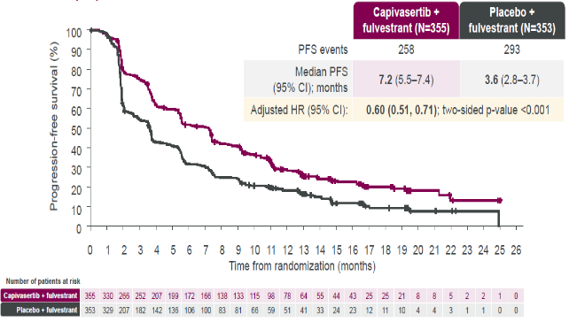
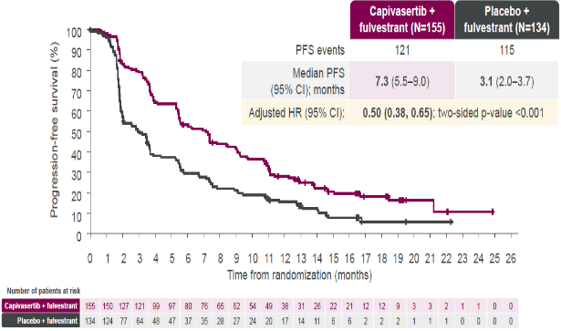
CAPItello-291 Dual Primary Endpoints: PFS in Overall and AKT Pathway-altered Populations
Capivasertib plus fulvestrant provides a statistically significant and clinically meaningful improvement in PFS in the overall and the AKT pathway-altered populations
PFS in Overall: 7.2 vs 3.6 HR: 0.60
PFS in AKT Altered: 7.3 vs 3.1 HR: 0.50
+ indicates a censored observation. HR was estimated using the Cox proportional hazard model stratified by the presence of liver metastases, prior use of CDK4/6 inhibitor, and geographic region. Turner NC, et al. SABCS 2022. Abstract GS3-04.
45
Courtesy of Erica Mayer, MD, MPH, FASCO

Slide 46
CAPItello-291 Adverse Event Profile
AEs (>10% of patients) – overall population
Capivasertib + fulvestrant (N=355)
Placebo + fulvestrant (N=350)
Total (%)/Grade 3 (%)
Grade 1
Grade 2
Grade 3*
Grade 3*
Grade 2
Grade 1
Total (%)/Grade 3 (%)
Diarrhea
Rash†
Nausea
Fatigue
Vomiting
Headache
Decreased appetite Hyperglycemia
Stomatitis
Asthenia
Pruritus
Anemia
Urinary tract infection
72.4/
9.3
20.0
/0.3
38.0/
12.1
7.1/
0.3
Capivasertib/ placebo action | Capivasertib + fulvestrant (N=355) | Placebo + fulvestrant (N=350)
Dose hold | 124 (34.9) | 36 (10.3)
Dose reduction | 70 (19.7) | 6 (1.7)
Discontinuation for AE | 46 (13.0) | 8 (2.3)
34.6/
0.8
15.4
/0.6
20.8/
0.6
12.9
/0.6
20.6/
1.7
4.9/
0.6
16.9/
0.3
12.3
/0.6
16.6/0.3
6.3/
0.6
16.3/2.0
3.7/
0.3
14.6/2.0
4.9
/0.0
13.2/1.1
10.3
/0.6
12.4/0.6
6.6
/0.0
10.4/
2.0
4.9/1.1
10.1/
1.4
6.6/0.0
= Key AEs
100 80 60 40 20 0 0 20 40 60 80 100
Percentage of patients (%)
*All events shown were Grade 3 except 1 case of Grade 4 hyperglycemia in the capivasertib + fulvestrant arm.
†The collective term rash includes the preferred terms of rash, rash macular, maculopapular rash, rash papular, and rash pruritic.
Turner NC, et al. N Engl J Med. 2023;388(22):2058-2070.
Courtesy of Erica Mayer, MD, MPH, FASCO

Slide 47
CAPItello-291 - capivasertib
The combination of capivasertib and fulvestrant is now an approved therapy for pretreated HR+/HER2- MBC with a PIK3CA/AKT1/PTEN-alteration.
Supports need for tumor genomic profiling; ctDNA may be preferred
Toxicity profile may be a differentiator:
Notable for diarrhea and rash; nausea and fatigue also observed.
Less hyperglycemia than seen with alpelisib in a population including diabetics, although glucose monitoring is necessary.
Consider prophylactic antihistamine for rash; educate patients about antidiarrheal use.
May be a preferred choice compared to alpelisib, especially if concerned about hyperglycemia.
Courtesy of Erica Mayer, MD, MPH, FASCO

Slide 48
Oral SERDs
Lu J et al. Elacestrant vs standard-of-care in ER+/HER2- advanced or metastatic breast cancer (mBC) with ESR1 mutation: Key biomarkers and clinical subgroup analyses from the phase 3 EMERALD trial. San Antonio Breast Cancer Symposium 2023;Abstract PS17-02.
Burstein HJ et al. Testing for ESR1 mutations to guide therapy for hormone receptor-positive, human epidermal growth factor receptor 2-negative metastatic breast cancer: ASCO guideline Rapid Recommendation Update. J Clin Oncol 2023;41(18):3423-5.
Oliveira M et al. Clinical activity of camizestrant, a next-generation SERD, versus fulvestrant in patients with a detectable ESR1 mutation: Exploratory analysis of the SERENA-2 phase 2 trial. ASCO 2023;Abstract 1066.
Jhaveri K et al. Imlunestrant monotherapy and in combination with abemaciclib, with or without an aromatase inhibitor, in estrogen receptor-positive (ER+), HER2-negative (HER2-) advanced breast cancer (aBC): Updated results from the EMBER study. San Antonio Breast Cancer Symposium 2023;Abstract PS15-09.

Slide 49
EMERALD Phase 3 Trial of Elacestrant vs SOC in ER+/HER2–MBC: Study Design and Patients^{1,2}
Key Eligibility Criteria
ER+/HER2– MBC
1-2 prior lines of ET, one of which in combination with CDK4/6i
≤1 line of chemotherapy for advanced disease
ECOG PS 0-1
Patient Characteristics, n (%) |  | Elacestrant | C 150 mg (n=73) | SOC | Total (N=240)
 |  | All (n=239) | ESR1mut (n=115) | All (n=239) | ESR1mut (n=115)
Median age (range), years |  | 63 (24-89) | 64 (28-89) | 63 (32-83) | 63 (32-83)
ECOG PS | 0 | 143 (59.8) | 67 (58.3) | 135 (56.5) | 61 (54.9)
 | 1 | 96 (40.2) | 48 (41.7) | 103 (43.1) | 51 (45.1)
Visceral metastasis, % |  | 163 (68.2) | 81 (70.4) | 170 (71.1) | 84 (74.3)
Prior CDK4/6i |  | 239 (100) | 115 (100) | 239 (100) | 113 (100)
Prior lines of ET | 1 | 129 (54.0) | 73 (63.5) | 142 (59.4) | 69 (61.1)
 | 2 | 110 (46.0) | 42 (36.5) | 97 (40.6) | 44 (38.9)
Type of prior ET | Fulvestrant | 70 (29.3) | 27 (23.5) | 75 (31.4) | 28 (24.8)
 | AI | 193 (80.8) | 101 (87.8) | 194 (81.2) | 96 (85.0)
 | Tamoxifen | 19 (7.9) | 9 (7.8) | 15 (6.3) | 9 (8.0)
Prior lines of Chemo | 0 | 191 (79.9) | 89 (77.4) | 180 (75.3) | 81 (71.7)
 | 1 | 48 (20.1) | 26 (22.6) | 59 (24.7) | 32 (28.3)
R
A
N
D
O
M
I
Z
E
D
Elacestrant
400 mgª
PD or withdrawal criterion^{b}
1:1
Investigator’s choice (SOC)
Fulvestrant
Anastrozole
Letrozole
Exemestane
Primary endpoints^{c}: PFS in all, PFS in ESR1mut patients
Secondary endpoints: OS, safety
ª Protocol-defined dose reductions permitted. ^{b} Restaging CT scans every 8 weeks. ^{c} By BICR.
1. Bidard F, et al. J Clin Oncol. 2022;40(28):3246-3256. 2. Bardia A, et al. SABCS 2022. Abstract GS3-01.
Courtesy of Erica Mayer, MD, MPH, FASCO

Slide 50
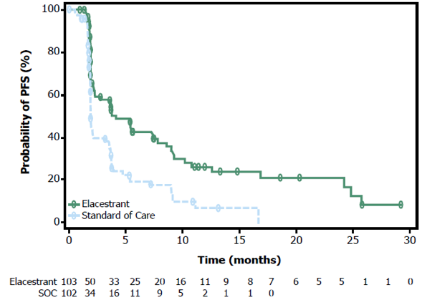
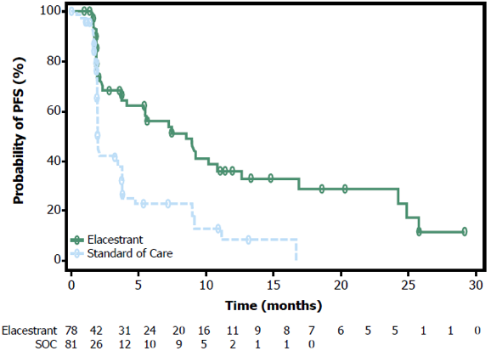
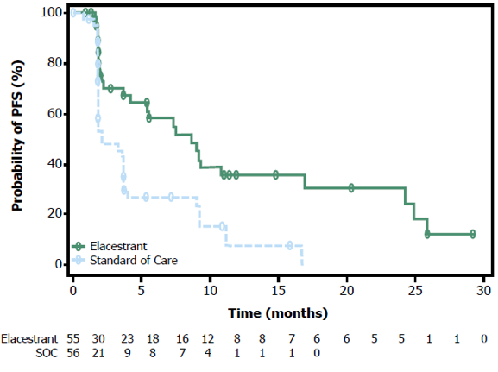
EMERALD: PFS in ESR1mut Population by Duration of Prior CDK4/6i
PFS by Duration of CDK4/6i in Patients With ESR1mut Tumors
≥6 mo CDK4/6i
≥12 mo CDK4/6i
≥18 mo CDK4/6i
PFS by Duration of CDK4/6i | ≥6 Months |  | ≥12 Months |  | ≥18 Months
 | Elacestrant (n=103) | SOC (n=102) | Elacestrant (n=78) | SOC (n=81) | Elacestrant (n=55) | SOC (n=56)
mPFS, mo (95% CI) | 4.14 (2.20-7.79) | 1.87 (1.87-3.29) | 8.61 (4.14-10.84) | 1.91 (1.87-3.68) | 8.61 (5.45-16.89) | 2.10 (1.87-3.75)
12-mo PFS rate, % (95% CI) | 26.02 (15.12-36.92) | 6.45 (0.00-13.65) | 35.81 (21.84-49.78) | 8.39 (0.00-17.66) | 35.79 (19.54-52.05) | 7.73 (0.00-20.20)
HR (95% CI) | 0.517 (0.361-0.738) |  | 0.410 (0.262-0.634) |  | 0.466 (0.270-0.791)
Bardia A, et al. SABCS 2022. Abstract GS3-01
Courtesy of Erica Mayer, MD, MPH, FASCO

Slide 51
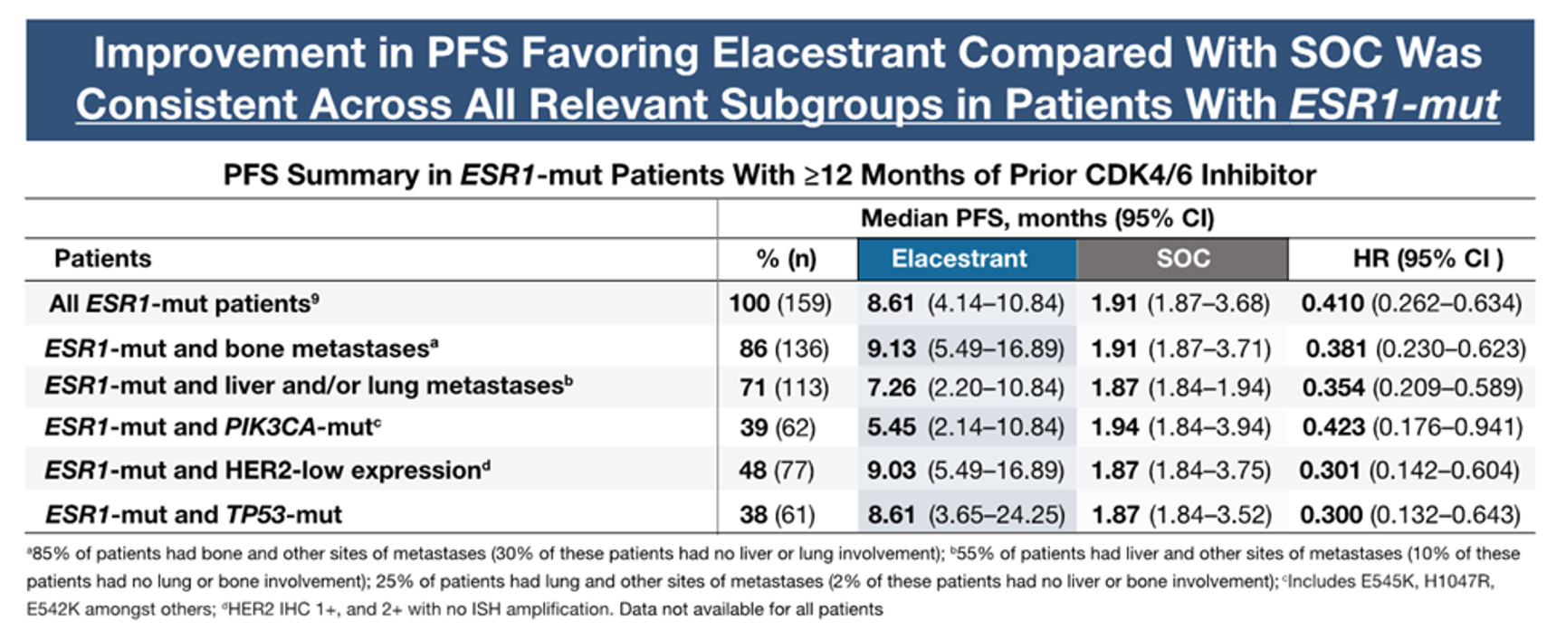
Phase 3 EMERALD Biomarker & Subgroup Analysis
Subgroup analysis (by sites of metastases, common coexisting mutations [PIK3CA, TP53], and HER2-low status) of patients with endocrine sensitive (CDK4/6i for ≥12 mos) HR+ MBC with ESR1 mutations, revealed clinically meaningful improvement in PFS favoring elacestrant vs SOC was consistent across all relevant subgroups
Lu et al. SABCS 2023. Abstract PS-17-02.
Courtesy of Erica Mayer, MD, MPH, FASCO

Slide 52
EMERALD Subgroup Analysis
Elacestrant monotherapy is an option in MBC with ESR1 mutation and retained endocrine sensitivity (eg, prior CDK4/6 inhibitor duration ≥12 months)
In that situation, the ER pathway could be the main driver of disease, regardless of the metastatic site or coexistence of PIK3CA-mut, TP53-mut, or HER2-low expression.
If there are both ESR1 and PIK3CA mutations or HER2-low, could prioritize elacestrant as a well tolerated option before moving to capivasertib, alpelisib, or T-DXd.
Await results of studies of elacestrant combinations.
ESR1 is a kinetic mutation that develops over time; supports need to check ESR1 status at time of PD.
Courtesy of Erica Mayer, MD, MPH, FASCO

Slide 53
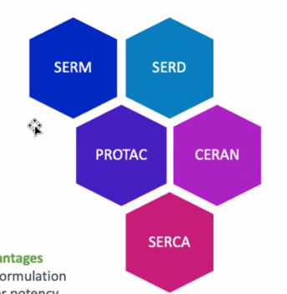
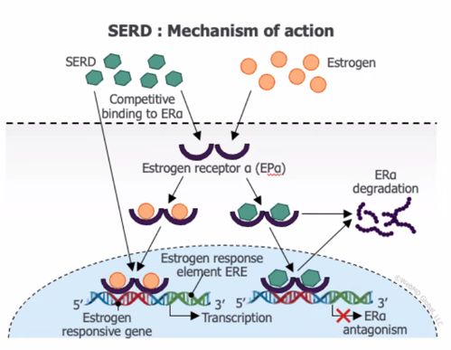
Novel Endocrine Therapies May Address Endocrine Resistance in MBC
Key Advantages
Oral formulation
Higher potency
Activity in ESR1mut MBC
Activity in post-ET and CDK4/6i treated pts
Can be well tolerated
Hernando et al. Int J Mol Sci. 2021; slide adapted from Erika Hamilton.
Courtesy of Erica Mayer, MD, MPH, FASCO

Slide 54
SERENA-2: Phase 2 Trial of Camizestrant vs Fulvestrant in ER+/HER2– MBC: Study Design and Patients
Key Eligibility Criteria
Recurrence or progression on ≥1 line of ET
No prior fulvestrant or oral SERD in ABC
≤1 line of ET in ABC setting
≤1 line chemotherapy in ABC setting
Measurable and nonmeasurable disease
Patient Characteristics, % |  | C75 (n=74) | C150 (n=73) | F (n=73)
Median age (range), years |  | 61 (37-79) | 60 (42-84) | 60 (35-84)
ER+ |  | 100 | 100 | 100
ECOG PS 0 |  | 62.2 | 57.5 | 58.9
Lung/liver metastasis |  | 58.1 | 58.9 | 58.9
Liver metastasis |  | 31.1 | 41.1 | 47.9
ESR1mut detectable^{c} |  | 29.7 | 35.6 | 47.9
Chemotherapy in ABC |  | 21.6 | 12.3 | 26.0
ET adjuvant | AI | 40.5 | 35.6 | 31.5
 | SERM | 32.4 | 45.2 | 43.8
ET in ABC | 0 lines | 37.8 | 28.8 | 26.0
 | 1 line | 62.2 | 71.2 | 74.0
 | AI | 55.4 | 67.1 | 67.1
 | SERM | 6.8 | 2.7 | 6.8
Prior CDK4/6i^{d} |  | 51.4 | 50.7 | 50.7
Palbociclib |  | 21.6 | 31.5 | 30.1
Ribociclib |  | 23.0 | 19.2 | 16.4
Abemaciclib |  | 5.4 | 1.4 | 4.1
R
A
N
D
O
M
I
Z
E
D
Camizestrant 300 mgª (n=20)
Postmenopausal ER+/HER2– ABC
C75: Camizestrant 75 mg (n=74)
C150: Camizestrant 150 mg (n=73)
F: Fulvestrant (n=73)
1:1:1:1 N=240
Primary endpoint: PFS by investigator^{b}
Secondary endpoints: CBR24, ORR, OS, safety
Translational endpoints: Serial CTC and ctDNA (ESR1mut) analyses
ª CSP v5 amendment: December 16, 2020. ^{b} Disease progression defined using RECIST v1.1. ^{c} ESR1mut assessed in plasma samples at screening and C1D1; ESR1mut defined as E380Q, V422del, S463P, L536H/P/R, Y537C/D/N/S, D538G, individual mutations present in >2% total cases reported. ^{d} Missing or not specified in 3 patients.
Oliveira M et al. SABCS 2022. Abstract GS3-02.
Courtesy of Erica Mayer, MD, MPH, FASCO

Slide 55
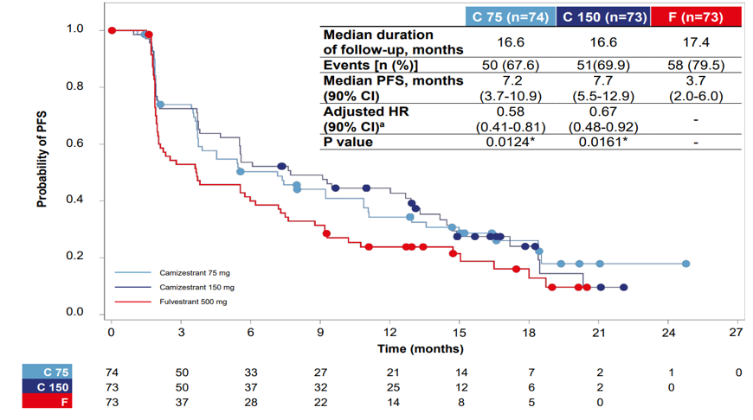
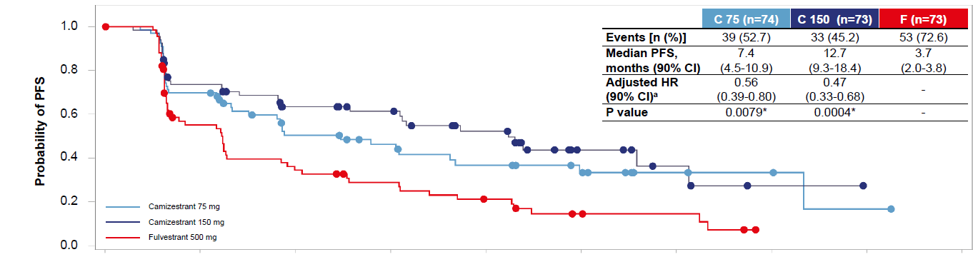
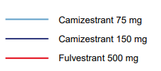
SERENA-2: PFS in ITT
Primary Endpoint: PFS by Investigator Assessment
PFS by BICR
 | C75 (n=74) | C150 (n=73) | F (n=73)
Median follow-up, mo | 16.6 | 16.6 | 17.4
Events, n (%) | 50 (67.6) | 51 (69.9) | 58 (79.5)
mPFS, mo (90% CI) | 7.2 (3.7-10.9) | 7.7 (5.5-12.9) | 3.7 (2.0-6.0)
Adjusted HRª (90% CI) | 0.58 (0.41-0.81) | 0.67 (0.48-0.92) | -
P value | 0.0124^{b} | 0.0161^{b} | -
 | C75 (n=74) | C150 (n=73) | F (n=73)
Events, n (%) | 39 (52.7) | 33 (45.2) | 53 (72.6)
mPFS, mo (90% CI) | 7.4 (4.5-10.9) | 12.7 (9.3-18.4) | 3.7 (2.0-3.8)
Adjusted HRª (90% CI) | 0.56 (0.39-0.80) | 0.47 (0.33-0.68) | -
P value | 0.0079^{b} | 0.0004^{b} | -
ª HR adjusted for prior use of CDK4/6i and liver/lung metastases. ^{b} Statistically significant.
Oliveira M et al. SABCS 2022. Abstract GS3-02.
Courtesy of Erica Mayer, MD, MPH, FASCO

Slide 56
SERENA-2: Exploratory Analysis
Camizestrant monotherapy has shown promising data over fulvestrant in patients with HR+/HER2- MBC and an ESR1 mutation
The agent retains activity regardless of number or type of ESR1 mutations
Ongoing studies are looking at:
Camizestrant combinations
Other oral SERDs in combinations: giredestrant, imlunestrant
ARV-471 (vepdegestrant, PROTAC), OP-1250 (CERAN)
Likely will be a rapidly expanding space in the next 1-2 years
Courtesy of Erica Mayer, MD, MPH, FASCO

Slide 57
Novel Oral Endocrine Therapies: SERD, CERAN, PROTAC
Agent | Disease setting | Select ongoing trials
ORAL SERDs
Elacestrant (RAD1901) | Advanced/Metastatic | EMERALD, ELEVATE
Giredestrant (GDC-9545) | Advanced/Metastatic | persevERA, acelERA, evERA. pionERA
 | Neoadjuvant | coopERA
 | Adjuvant | lidERA
Camizestrant (AZD9833) | Advanced/Metastatic | SERENA-1,-2,-4, -6
 | Neoadjuvant | SERENA-3
 | Adjuvant | CAMBRIA, CAMBRIA-2
Imlunestrant (LY3484356) | Advanced/Metastatic | EMBER
 | Neoadjuvant | EMBER-2
 | Adjuvant | EMBER-4
Other novel agents
ARV-471 | Advanced/Metastatic | NCT04072952
OP-1250 | Advanced/Metastatic | NCT04505826
Courtesy of Erica Mayer, MD, MPH, FASCO

Slide 58
EMBER: Phase 1a/b Study of Imlunestrant With Abemaciclib ± AI in ER+ ABC: Study Design
Key Eligibility Criteria
ER+/HER2– ABC
≤1 line of prior therapy of ABC
No prior CDK4/6i
Demonstrated prior sensitivity to ET or have untreated de novo ABC
Imlunestrant + abemaciclib
Primary Endpoint
Determine RP2D
Secondary Endpoints
Safety
PK
Antitumor activity (ORR, CBR, TTR, PFS)
R
1:1
Imlunestrant +
abemaciclib +
AIª
N=85
Imlunestrant PO qd with abemaciclib (150 mg bid) ± AI in 28-day cycles
Men and premenopausal women received concomitant GnRH agonist
Cutoff date Oct 6, 2022
RP2D imlunestrant combination
with abemaciclib:
imlunestrant 400 mg qd
(same as monotherapy)
Stratification Factors
Menopausal status
Visceral metastases
ª AI was physician’s choice of anastrozole, letrozole, or exemestane at standard doses. Jhaveri KL, et al SABCS 2023. Abstract PS15-09.
Courtesy of Erica Mayer, MD, MPH, FASCO

Slide 59
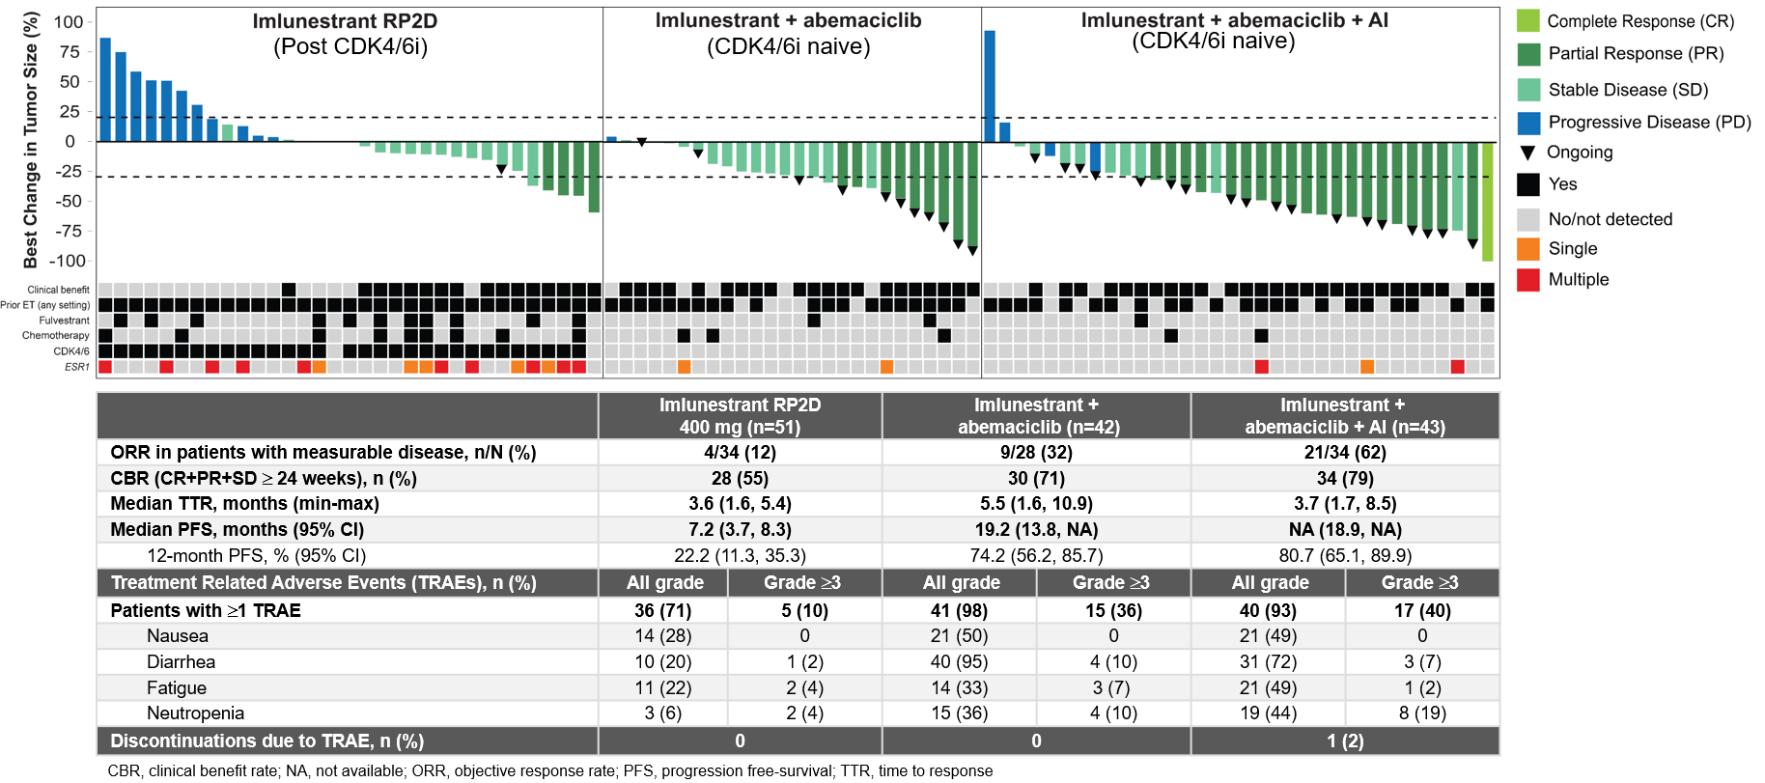
EMBER: Imlunestrant With Abemaciclib ± AI: Efficacy & Safety Summary
Jhaveri KL, et al SABCS 2023. Abstract PS15-09
Courtesy of Erica Mayer, MD, MPH, FASCO

Slide 60
EMBER: Imlunestrant With Abemaciclib ± AI: Summary
Imlunestrant monotherapy was well tolerated; no new safety signals observed
RP2D was determined as 400mg QD
Combination with abemaciclib ± AI revealed no new safety signals and no drug-drug interactions
Clinical activity is encouraging with imlunestrant monotherapy, especially at the RP2D and particularly in the 2L post-CDK4/6i setting. Robust efficacy is observed with imlunestrant in combination with abemaciclib ± AI
Pivotal Phase 3, randomized, open-label registration trials of imlunestrant are ongoing:
EMBER-3 (NCT04975308): Imlunestrant, investigator’s choice ET (fulvestrant or AI), and imlunestrant + abemaciclib in ER+/HER2- ABC previously treated with ET
EMBER-4 (NCT05514054): Adjuvant imlunestrant vs. adjuvant ET in patients who have previously received 2 to 5 years of adjuvant ET for ER+/HER2- early BC with an increased risk of recurrence
Jhaveri KL, et al SABCS 2023. Abstract PS15-09
Courtesy of Erica Mayer, MD, MPH, FASCO

Slide 61
Antibody-Drug Conjugates
Modi S et al. Trastuzumab deruxtecan (T-DXd) versus treatment of physician’s choice (TPC) in patients (pts) with HER2-low unresectable and/or metastatic breast cancer (mBC): Updated survival results of the randomized, phase III DESTINY-Breast04 study. ESMO 2023;Abstract 376O.
Bardia A et al. Randomized phase 3 study of datopotamab deruxtecan vs chemotherapy for patients with previously-treated inoperable or metastatic hormone receptor-positive, HER2-negative breast cancer: Results from TROPION-Breast01. San Antonio Breast Cancer Symposium 2023;Abstract GS02-01.
Hamilton EP et al. A phase 2 study of HER3-DXd in patients (pts) with metastatic breast cancer (MBC). ASCO 2023;Abstract 1004.
Krop IE et al. Patritumab deruxtecan (HER3-DXd), a human epidermal growth factor receptor 3-directed antibody-drug conjugate, in patients with previously treated human epidermal growth factor receptor 3-expressing metastatic breast cancer: A multicenter, Phase I/II trial. J Clin Oncol 2023;41(36):5550-60.

Slide 62
Antibody-drug conjugates in breast cancer
Datopotamab
Courtesy of Erica Mayer, MD, MPH, FASCO

Slide 63
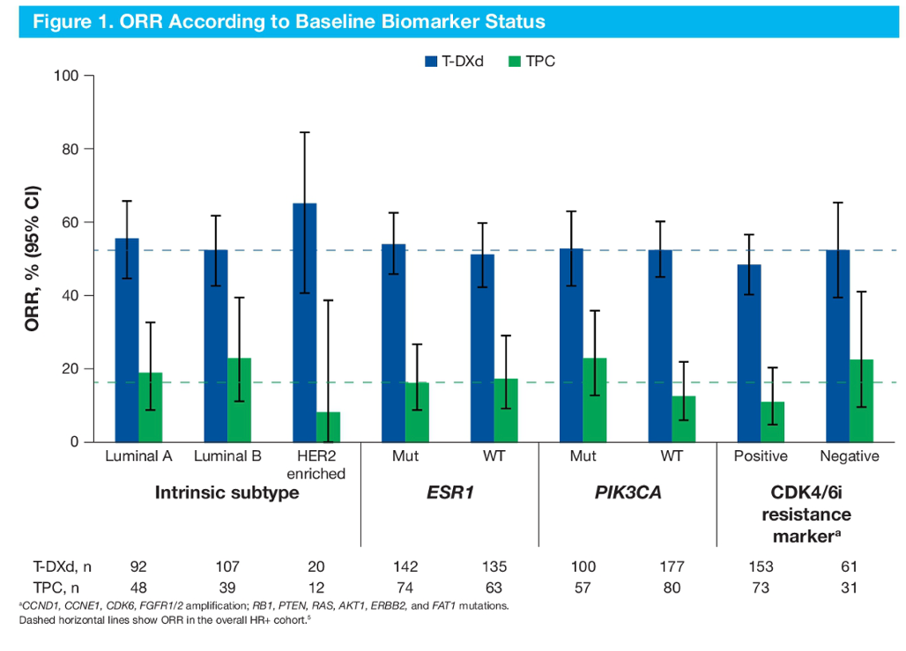
T-DXd versus TPC in HER2-low MBC: Updated survival results of the Phase III DESTINY-Breast04 study.
Preserved clinical benefit for T-DXd over TPC therapy was observed regardless of biomarker status including intrinsic subtype, ESR1 mutation, PIK3CA mutation, or CDK4/6i resistance marker status
PFS according to baseline biomarker status
Biomarker | Status | Median PFS (95% CI) |  | HR (95% CI)
Biomarker | Status | T-DXd | TPC | HR (95% CI)
PIK3CA | WT | 10.0 (8.5–12.2) n=177 | 4.8 (2.9–8.3) n=80 | 0.50 (0.35–0.70)
 | Mut | 9.7 (7.5–12.3) n=100 | 6.2 (5.3–7.8) n=57 | 0.60 (0.40–0.91)
ESR1 | WT | 10.0 (8.3–12.6) n=135 | 5.3 (4.0–7.8) n=63 | 0.43 (0.29–0.62)
 | Mut | 9.8 (8.2–12.0) n=142 | 6.9 (4.3–10.7) n=74 | 0.67 (0.47–0.97)
Intrinsic subtype | HER2 | 11.0 (6.6–NA) n=20 | 2.7 (1.4–5.9) n=12 | 0.15 (0.05–0.40)
 | Luminal A | 13.0 (10.1–16.4) n=92 | 7.8 (5.4–12.4) n=48 | 0.57 (0.36–0.89)
 | Luminal B | 8.7 (6.9–11.1) n=107 | 4.8 (2.7–8.3) n=39 | 0.60 (0.40–0.92)
Modi S et al. ESMO 2023;Abstract 376O
Courtesy of Erica Mayer, MD, MPH, FASCO

Slide 64
TROPION-Breast01 Study Design¹
Randomized, phase 3, open-label, global study (NCT05104866)
Key inclusion criteria:
Patients with HR+/HER2– breast cancer* (HER2‒ defined as IHC 0/1+/2+; ISH negative)
Previously treated with 1–2 lines of chemotherapy (inoperable/metastatic setting)
Experienced progression on ET and for whom ET was unsuitable
ECOG PS 0 or 1
Dato-DXd
6 mg/kg IV Day 1 Q3W
(n=365)
Endpoints:
Dual primary: PFS by BICR per RECIST v1.1, and OS
Secondary endpoints included: ORR, PFS (investigator assessed), TFST, safety, PROs
1:1
Investigator’s choice of chemotherapy (ICC)
as per protocol directions†
(eribulin mesylate D1,8 Q3W; vinorelbine D1,8 Q3W; gemcitabine D1,8 Q3W; capecitabine D1–14 Q3W)
(n=367)
Randomization stratified by:
Lines of chemotherapy in unresectable/metastatic setting (1 vs 2)
Geographic location (US/Canada/Europe vs ROW)
Previous CDK4/6 inhibitor (yes vs no)
Treatment continued until PD, unacceptable tolerability, or other discontinuation criteria
Detailed description of the statistical methods published previously.¹ *Per American Society of Clinical Oncology/College of American Pathologists (ASCO/CAP) guidelines. †ICC was administered as follows: eribulin mesylate, 1.4 mg/m² IV on Days 1 and 8, Q3W; vinorelbine, 25 mg/m² IV on Days 1 and 8, Q3W; or gemcitabine, 1000 mg/m² IV on Days 1 and 8, Q3W; capecitabine, 1000 or 1250 mg/m² orally twice daily on Days 1 to 14, Q3W (dose per standard institutional practice). CDK4/6, cyclin-dependent kinase 4/6; D, day; ECOG PS, Eastern Cooperative Oncology Group performance status; ET, endocrine therapy; IHC, immunohistochemistry; ISH, in-situ hybridization; IV, intravenous; PD, progressive disease; PROs, patient-reported outcomes; Q3W, every 3 weeks; RECIST, Response Evaluation Criteria in Solid Tumors; ROW, rest of world; TFST, time to first subsequent therapy.
1. Bardia A, et al. Future Oncol 2023; doi: 10.2217/fon-2023-0188.
San Antonio Breast Cancer Symposium® | @SABCSSanAntonio
Courtesy of Erica Mayer, MD, MPH, FASCO

Slide 65
TROPION-Breast01: Progression-Free Survival
PFS by investigator assessment
1.0
0.8
 | Dato-DXd | ICC
Median PFS, months (95% CI) | 6.9 (5.9–7.1) | 4.5 (4.2–5.5)
HR (95% CI) | 0.64 (0.53–0.76)
0.6
55.2%
Probability of PFS
0.4
34.7%
Dato-DXd (n=365)
36.9%
ICC (n=367)
21.7%
0.2
20.9%
9.9%
0.0
0
3
6
9
12
15
18
Number at risk
Time from randomization (months)
Dato-DXd
365
272
185
74
19
4
0
ICC
367
216
110
43
11
2
0
PFS by BICR (primary endpoint)¹: Median 6.9 vs 4.9 months; HR 0.63 (95% CI 0.52‒0.76); P<0.0001
1. Bardia A, et al. Oral Presentation at ESMO 2023; Abstract LBA11.
Data cut-off: 17 July 2023.
San Antonio Breast Cancer Symposium® | @SABCSSanAntonio
Courtesy of Erica Mayer, MD, MPH, FASCO

Slide 66
TROPION-Breast01: Adverse Events of Clinical Interest
Neutropenia* | Dato-DXd (n=360) | ICC (n=351)
Treatment-related neutropenia*, n (%)
Any grade | 39 (11) | 149 (42)
Grade ≥3 | 4 (1) | 108 (31)
Leading to dose interruption | 0 | 60 (17)
Leading to dose reduction | 1 (0.3) | 45 (13)
Leading to dose discontinuation | 0 | 1 (0.3)
G-CSF usage, n (%)
On treatment | 10 (3) | 81 (22)
Post-treatment† | 1 (0.3) | 30 (8)
Stomatitis‡ | Dato-DXd (n=360) | ICC (n=351)
Treatment-related stomatitis‡, n (%)
Any grade | 180 (50) | 46 (13)
Grade 3 | 23 (6) | 9 (3)
Leading to dose interruption | 5 (1) | 3 (1)
Leading to dose reduction | 44 (12) | 5 (1)
Leading to dose discontinuation | 1 (0.3) | 0
*Neutropenia includes the preferred terms neutropenia and neutrophil count decreased. Treatment-related febrile neutropenia occurred in 0 patients in the Dato-DXd arm and 8 patients (2.3%; all grade ≥3) in the ICC arm.
†Administered after discontinuation of study treatment. ‡As part of the Oral Care Protocol specified in the study protocol, daily use of prophylaxis with a steroid-containing mouthwash (e.g., dexamethasone oral solution or a similar mouthwash regimen using an alternative steroid advocated by institutional/local guidelines) was highly recommended.
G-CSF, granulocyte colony stimulating factor.
San Antonio Breast Cancer Symposium® | @SABCSSanAntonio
Courtesy of Erica Mayer, MD, MPH, FASCO

Slide 67
Phase 2 trial of HER3-DXd in patients with metastatic breast cancer
Key inclusion criteria
ECOG 0/1
Locally advanced/mBC with ≥1 measurable lesion
HER2− per ASCO-CAP guidelines by IHC (includes 0 and low expression)
HR+ or HR−
HR+: Unlimited lines of ET; prior CDK4/6 inhibitor required; ≤2 prior CT lines in metastatic setting
HR– TNBC: 1–3 prior CT lines in metastatic setting
No prior treatment with any HER3-targeting agent or any ADC that contains an exatecan derivative
Part A (presented here, N=60)
Part B (currently expanding, N=20–40)
Expansion in ≤3 populations based on:
HER3 expression 25–74% and/or ≥75%
ER expression: TNBC, low (1–10%), high (>10%)
HER2– mBC
Patritumab deruxtecan 5.6 mg/kg IV Q3W
Patritumab deruxtecan 5.6 mg/kg IV Q3W
Part A efficacy analysis Activity and HER3 expression
Part B efficacy analysis Response rate and 6-mo PFS
Primary objectives:
ORR and 6-month PFS
Secondary objectives:
Safety and tolerability
DoR
PFS
CBR
Part Z (currently enrolling, N=21)
HER2+ mBC Post T-DXd
Patritumab deruxtecan 5.6 mg/kg IV Q3W
HER3 is expressed in 30%-75% of breast cancers; overexpression is associated with poor prognosis
Patritumab deruxtecan: novel ADC targeting HER3 with topoisomerase I inhibitor payload capable of bystander antitumor effects
Part Z efficacy analysis Response rate and 6-mo PFS
CBR, clinical benefit rate Hamilton EP, et al. ASCO 2023. Abstract 1004
Courtesy of Erica Mayer, MD, MPH, FASCO

Slide 68
Phase 2 trial of HER3-DXd: Efficacy
Duration on study treatment by HER3 membrane expression
Best percentage change in sum of diameters from baseline in target lesions
Response legend
CR
PR
PD
Death
Treatment Ongoing
>75% HER3 expression
25–74% HER3 expression
<25% HER3 expression
TNBC
60
HER3 unknown
ER+
≥75%
40
20
0
Best change in sum of diameters from baseline (%)
-20
Level of HER3 expression
25-74%
-40
-60
<25%
-80
Unknown
-100
Tumor type legend
ER+
TNBC
0
1
2
3
4
5
6
7
8
9
10
11
12
13
14
15
Treatment duration (months)
Hamilton EP, et al. ASCO 2023. Abstract 1004
Courtesy of Erica Mayer, MD, MPH, FASCO

Slide 69
Phase 2 trial of HER3-DXd: Safety and Conclusions
Safety summary
TRAEs occurring in ≥10% of patients by highest reported gradeª | Any grade (N=60) | Grade 3/4 (N=60)
Any AE | 56 (93.3) | 19 (31.7)
Nausea | 30 (50.0) | 2 (3.3)
Fatigue | 27 (45.0) | 4 (6.7)
Diarrhea | 22 (36.7) | 3 (5.0)
Vomiting | 19 (31.7) | 1 (1.7)
Anemia | 18 (30.0) | 0
Alopecia | 17 (28.3) | N/A
Hypokalemia | 9 (15.0) | 1 (1.7)
Decreased appetite | 8 (13.3) | 0
Neutrophil count decreased | 7 (11.7) | 3 (5.0)
WBC count decreased | 7 (11.7) | 1 (1.7)
Treatment-related SAEs | N=60
Interstitial lung disease | 1 (1.7)
Nausea/vomiting | 1 (1.7)
Pneumonitis | 1 (1.7)
Thrombocytopenia | 1 (1.7)
Unrelated SAEs
Dyspnea | 1 (1.7)
Pneumocystis jirovecii pneumonia | 1 (1.7)
Pneumothorax | 1 (1.7)
Patritumab is active, regardless of level of HER3 expression in HER2-non-amplified MBC, more so in HR+ than in TNBC pts
Responses are durable in most patients. Safety is also reasonable with nausea, diarrhea, and fatigue the main toxicities and very little ILD to date
Unclear how patients will respond to patritumab following treatment and progression on T-DXd with shared payload
Should patritumab be developed to follow T-DXd, or in patients with HER2 ultralow or 0 IHC pts, instead of T-DXd?
ªNo Grade 5 AEs recorded prior to data cutoff Hamilton EP, et al. ASCO 2023. Abstract 1004
Courtesy of Erica Mayer, MD, MPH, FASCO

