Slide 1
Year in Review: Clinical Investigator
Perspectives on the Most Relevant New Data Sets and Advances in Oncology
A Multitumor CME/MOC-Accredited Live Webinar Series
HER2-Positive and Triple-Negative Breast Cancer
Tuesday, January 30, 2024
5:00 PM – 6:00 PM ET
Faculty
Ian E Krop, MD, PhD
Priyanka Sharma, MD
Moderator
Neil Love, MD

Slide 2



Faculty
Ian E Krop, MD, PhD
Associate Cancer Center Director for Clinical Research
Director, Clinical Trials Office
Yale Cancer Center
New Haven, Connecticut
MODERATOR
Neil Love, MD
Research To Practice
Miami, Florida
Priyanka Sharma, MD
Frank B Tyler Professor in Cancer Research
Division of Medical Oncology, Department of Internal Medicine
Co-Program Leader
Drug Discovery, Delivery and Experimental Therapeutics Program
The University of Kansas Cancer Center
Westwood, Kansas

Slide 3
Commercial Support
This activity is supported by educational grants from AstraZeneca Pharmaceuticals LP, Daiichi Sankyo Inc, and Puma Biotechnology Inc.
Research To Practice CME Planning Committee Members,
Staff and Reviewers
Planners, scientific staff and independent reviewers for Research To Practice have no relevant conflicts of interest to disclose.

Slide 4
Dr Krop — Disclosures
Advisory Committees | AstraZeneca Pharmaceuticals LP, Daiichi Sankyo Inc, Novartis, Seagen Inc
Consulting Agreements | AstraZeneca Pharmaceuticals LP, Daiichi Sankyo Inc, Genentech, a member of the Roche Group
Contracted Research | MacroGenics Inc, Pfizer Inc
Data and Safety MonitoringBoards/Committees | Merck, Novartis, Seagen Inc

Slide 5
Dr Sharma — Disclosures
Consulting Agreements | AstraZeneca Pharmaceuticals LP, Genzyme Corporation, Gilead Sciences Inc, GSK, Merck, Novartis, Pfizer Inc, Sanofi
Contracted Research | Gilead Sciences Inc, Merck, Novartis
Stock Options/Stock ― Public Company | Amgen Inc, Janssen Biotech Inc, Johnson & Johnson Pharmaceuticals, Sanofi

Slide 6
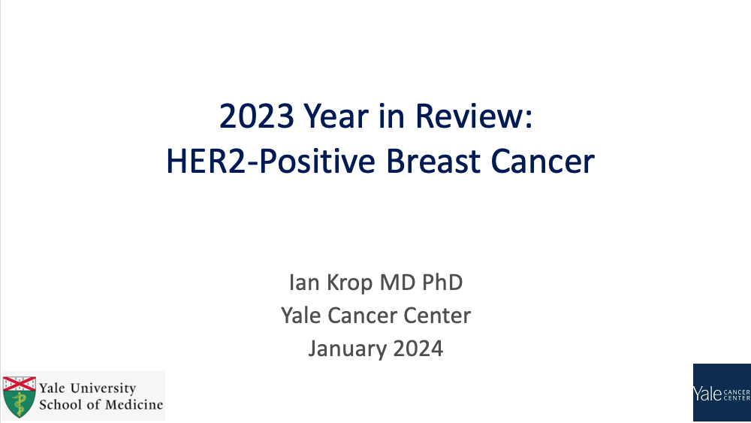


Slide 7
Key Data Sets
Ian E Krop, MD, PhD
Tolaney SM et al. Adjuvant paclitaxel and trastuzumab for node-negative, HER2-positive breast cancer: Final 10-year analysis of the open-label, single-arm, phase 2 APT trial. Lancet Oncol 2023;24(3):273-85.
Cortes J et al. 3-year invasive disease-free survival (iDFS) of the strategy-based, randomized phase II PHERGain trial evaluating chemotherapy (CT) de-escalation in human epidermal growth factor receptor 2-positive (HER2[+]) early breast cancer (EBC). ASCO 2023;Abstract LBA506.
Holmes FA et al. Overall survival with neratinib after trastuzumab-based adjuvant therapy in HER2-positive breast cancer (ExteNET): A randomised, double-blind, placebo-controlled, phase 3 trial. Eur J Cancer 2023;184:48-59.
Chan A et al. Final findings from the CONTROL trial: Strategies to reduce the incidence and severity of neratinib-associated diarrhea in patients with HER2-positive early-stage breast cancer. Breast 2023:67:94-101.

Slide 8
Key Data Sets
Ian E Krop, MD, PhD (continued)
Jhaveri K et al. Neratinib + fulvestrant + trastuzumab for HR-positive, HER2-negative, HER2-mutant metastatic breast cancer: Outcomes and biomarker analysis from the SUMMIT trial. Ann Oncol 2023;34(10):885-98.
André F et al. Trastuzumab deruxtecan versus treatment of physician's choice in patients with HER2-positive metastatic breast cancer (DESTINY-Breast02): A randomised, open-label, multicentre, phase 3 trial. Lancet 2023;401(10390):1773-85.
Hurvitz SA et al. Trastuzumab deruxtecan versus trastuzumab emtansine in patients with HER2-positive metastatic breast cancer: Updated results from DESTINY-Breast03, a randomised, open-label, phase 3 trial. Lancet 2023;401(10371):105-17.
Krop IE et al. An age-specific pooled analysis of trastuzumab deruxtecan (T‑DXd) in patients (pts) with HER2-positive (HER2+) metastatic breast cancer (mBC) from DESTINY-Breast01, -02, and -03. ASCO 2023;Abstract 1006.

Slide 9
Key Data Sets
Ian E Krop, MD, PhD (continued)
Hurvitz SA et al. A pooled analysis of trastuzumab deruxtecan (T-DXd) in patients (pts) with HER2-positive (HER2+) metastatic breast cancer (mBC) with brain metastases (BMs) from DESTINY-Breast (DB) -01, -02, and -03. ESMO 2023;Abstract 377O.
Pérez-García JM et al. Trastuzumab deruxtecan in patients with central nervous system involvement from HER2-positive breast cancer: The DEBBRAH trial. Neuro Oncol 2023;25(1):157-66.
Lin NU et al. Tucatinib vs placebo, both in combination with trastuzumab and capecitabine, for previously treated ERBB2 (HER2)-positive metastatic breast cancer in patients with brain metastases: Updated exploratory analysis of the HER2CLIMB randomized clinical trial. JAMA Oncol 2023;9(2):197-205.
Hurvitz S et al. HER2CLIMB-02: Randomized, double-blind phase 3 trial of tucatinib and trastuzumab emtansine for previously treated HER2-positive metastatic breast cancer. SABCS 2023;Abstract GS01-10.

Slide 10
Key Data Sets
Priyanka Sharma, MD
Schmid P et al. Pembrolizumab or placebo plus chemotherapy followed by pembrolizumab or placebo for early-stage TNBC: Updated EFS results from the phase III KEYNOTE-522 study. ESMO 2023;Abstract LBA18.
Gianni L et al. Event-free survival (EFS) analysis of neoadjuvant taxane/carboplatin with or without atezolizumab followed by an adjuvant anthracycline regimen in high-risk triple negative breast cancer (TNBC): NeoTRIP Michelangelo randomized study. ESMO 2023;Abstract LBA19.
Ignatiadis M et al. Adding atezolizumab to adjuvant chemotherapy for stage II and III triple-negative breast cancer is unlikely to improve efficacy: Interim analysis of the ALEXANDRA/IMpassion030 phase 3 trial. SABCS 2023;Abstract GS01-03.
Rugo HS et al. KEYNOTE-355: Outcomes in patients who discontinued chemotherapy before pembrolizumaband in patients with immune-mediated AEs. ESMO Breast 2023;Abstract 191M0.
Jiang Z et al. TORCHLIGHT: A randomized, double-blind, phase III trial of toripalimab versus placebo, in combination with nab-paclitaxel (nab-P) for patients with metastatic or recurrent triple-negative breast cancer (TNBC). ASCO 2023;Abstract LBA1013.

Slide 11
Key Data Sets
Priyanka Sharma, MD (continued)
Loibl S et al. Health-related quality of life in the phase III ASCENT trial of sacituzumab govitecan versus standard chemotherapy in metastatic triple-negative breast cancer. Eur J Cancer 2023;178:23-33.
Bar Y et al. Dynamic HER2-low status among patients with triple negative breast cancer (TNBC): The impact of repeat biopsies. ASCO 2023;Abstract 1005.
Modi S et al. Trastuzumab deruxtecan (T-DXd) versus treatment of physician’s choice (TPC) in patients (pts) with HER2-low unresectable and/or metastatic breast cancer (mBC): Updated survival results of the randomized, phase III DESTINY-Breast04 study. ESMO 2023;Abstract 376O.
Robson ME et al. OlympiAD extended follow-up for overall survival and safety: Olaparib versus chemotherapy treatment of physician’s choice in patients with a germline BRCA mutation and HER2-negative metastatic breast cancer. Eur J Cancer 2023;184:39-47.

Slide 12
Key Data Sets
Priyanka Sharma, MD (continued)
Khan QJ et al. Randomized trial of fixed dose capecitabine compared to standard dose capecitabine in metastatic breast cancer: The X-7/7 trial. ASCO 2023;Abstract 1007.
Schmid P et al. Datopotamab deruxtecan (Dato-DXd) + durvalumab (D) as first-line (1L) treatment for unresectable locally advanced/metastatic triple-negative breast cancer (a/mTNBC): Updated results from BEGONIA, a phase Ib/II study. ESMO 2023;Abstract 379MO.
Krop IE et al. Patritumab deruxtecan (HER3-DXd), a human epidermal growth factor receptor 3-directed antibody-drug conjugate, in patients with previously treated human epidermal growth factor receptor 3-expressing metastatic breast cancer: A multicenter, phase I/II trial.
J Clin Oncol 2023;41(36):5550-60.
Zhang J et al. First-in-human/phase I trial of HS-20089, a B7-H4 ADC, in patients with advanced solid tumors. ESMO 2023;Abstract 381O.

Slide 13
Agenda
INTRODUCTION: Educating Non-Breast Cancer Specialty Oncologists About HER2-Targeted Therapies – ASCO Genitourinary Cancers Symposium 2024
MODULE 1: HER2-Positive Breast Cancer — Dr Krop
MODULE 2: Triple-Negative Breast Cancer — Dr Sharma

Slide 14
Agenda
INTRODUCTION: Educating Non-Breast Cancer Specialty Oncologists About HER2-Targeted Therapies – ASCO Genitourinary Cancers Symposium 2024
MODULE 1: HER2-Positive Breast Cancer — Dr Krop
MODULE 2: Triple-Negative Breast Cancer — Dr Sharma

Slide 15
Consensus or Controversy? Clinical Investigators
Provide Perspectives on the Current and Future
Management of Urothelial Bladder Cancer
Part 2 of a 2-Part CME Symposium Series Held in Conjunction
with the 2024 ASCO Genitourinary Cancers Symposium
Friday, January 26, 2024
7:00 PM – 9:00 PM PT (10:00 PM – 12:00 AM ET)
Faculty
Matthew Milowsky, MD, FASCO
Peter H O'Donnell, MD
Jonathan E Rosenberg, MD
Arlene Siefker-Radtke, MD
Moderator
Evan Y Yu, MD

Slide 16
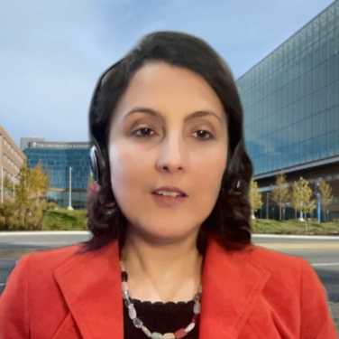

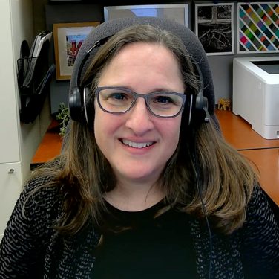
Consulting Faculty Questions
Perspectives from the breast cancer experience: Identification
and management of T-DXd-associated side effects
Neil Love, MD
Priyanka Sharma, MD

Slide 17
Agenda
INTRODUCTION: Educating Non-Breast Cancer Specialty Oncologists About HER2-Targeted Therapies – ASCO Genitourinary Cancers Symposium 2024
MODULE 1: HER2-Positive Breast Cancer — Dr Krop
MODULE 2: Triple-Negative Breast Cancer — Dr Sharma

Slide 18
De-escalation of Perioperative Treatment
HER2-Positive Breast Cancer
Tolaney SM et al. Adjuvant paclitaxel and trastuzumab for node-negative, HER2-positive breast cancer: Final 10-year analysis of the open-label, single-arm, phase 2 APT trial. Lancet Oncol 2023;24(3):273-85.
Cortes J et al. 3-year invasive disease-free survival (iDFS) of the strategy-based, randomized phase II PHERGain trial evaluating chemotherapy (CT) de-escalation in human epidermal growth factor receptor 2-positive (HER2[+]) early breast cancer (EBC). ASCO 2023;Abstract LBA506.

Slide 19
Third Annual National General Medical Oncology Summit
Friday, March 22, 2024 — 7:00 PM – 9:00 PM
Keynote Session Special Feature: Clinicians with Cancer
What adjuvant treatment do you think a medical oncologist would prefer to receive for a subcentimeter, node-negative, HER2-positive breast cancer?

Slide 20
The era of personalized medicine in HER2+ EBC
The favorable outcomes of HER2+ breast cancers provide opportunity to:
  De-escalate therapy for lower risk patients to reduce the toxicities of treatment
  Escalate therapy for minority of patients who are risk for recurrence despite maximal current management
Courtesy of Ian E Krop, MD, PhD

Slide 21
APT: Conclusions
Paclitaxel and trastuzumab (TH) is associated with excellent outcomes and is a standard of care for patients with stage I HER2+ breast cancer
  Favorable outcomes for both ER+ and ER- HER2+ cancers and for T1C cancers
  Not all patients require adjuvant trastuzumab-based chemotherapy (particularly T1aN0)
Is there a role for T-DM1 in stage I pts?
Courtesy of Ian E Krop, MD, PhD

Slide 22

PHERGain: Can PET response be used to guide therapy
de-escalation in HER2+ EBC?
AFTER CYCLE 2 (6 weeks)
AFTER CYCLE 6 or 8
BASAL: PET Scan (Total Body)
Breast MRI / Biopsy
GROUP A
TCHP
x2
TCHP
x4
PH (ETx)
x12
Key Eligibility Criteria
Centrally confirmed HER2[+] stage I-IIIA EBC.
Tumor diameter ≥ 1.5 cm by MRI or ultrasound.
Presence of a breast PET-evaluable lesion.
N=71
R
1:4
N=356
pCR
PH (ETx)
x10
Response
PH (ETx) x6
PET (Total Body) Scan
SURGERY
First Primary Endpoint
pCR in PET Responders (Arm B)
Second Primary Endpoint
3-year iDFS rate in Arm B
Stratification factors
Hormonal receptor status (+/-)
Non-pCR
TCHP x6 –
PH (ETx) x4
PH (ETx)^{ⱡ} x2
FOLLOW UP
GROUP B
No Response
TCHP
x6
N=285
PH (ETx)
x10
Tissue/blood samples
Tissue/blood samples
Tissue/blood samples
If subclinical PET M1
TCHP
x6
Surgery (Y/N)
PH (ETx)
x12
GROUP C
C: Carboplatin; D: Docetaxel; EBC: Early breast cancer; ETx: Endocrine therapy (letrozole post-menopausal/tamoxifen pre-menopausal), Adjuvant ETx up to 3 years from surgery; PET: ¹⁸F-fluorodeoxyglucose positron emission tomography/computed tomography; H: Trastuzumab SC; HER2: Human Epidermal Growth Factor Receptor 2; iDFS: Invasive disease-free survival; MRI: Magnetic resonance Imaging; P: Pertuzumab IV; R: Randomization; TCHP: Trastuzumab, pertuzumab, docetaxel, and carboplatin. ^{ⱡ} All hormonal receptor-positive patients received ETx concomitantly with PH (except on chemotherapy).
PET RESPONDERS: RECIST responders after cycle 2 with SUV_{max} reduction ≥40%.
pCR, Pathological complete response (ypT0/isN0)
Dr. JAVIER CORTÉS MD PhD
Courtesy of Ian E Krop, MD, PhD

Slide 23
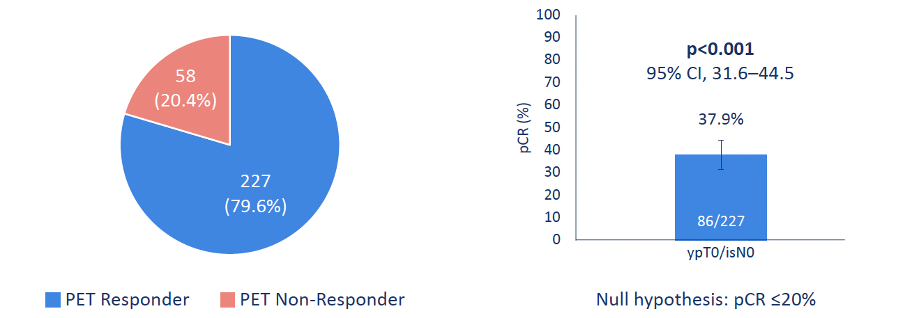
23
PHERGain Primary Endpoint: pCR in ¹⁸F-FDG-PET responders in group B
PET Responders and Non-Responders
pCR rate
pCR was observed in patients with both HER2++ and HER2+++, pts with stage II and stage III, and pts ER+ and ER-.
Pérez-García, JM, et al. (2021). Lancet Oncol, 22(6), 858-871.
CI: Confidence interval; PET: ¹⁸F-fluorodeoxyglucose positron emission tomography/computed tomography; pCR: Pathological complete response (ypT0/isN0).
Dr. JAVIER CORTÉS MD PhD
Courtesy of Ian E Krop, MD, PhD

Slide 24
PHERGain Conclusions
PET-guided de-escalation approach yields generally favorable overall outcome: 3-year iDFS of 95.4%
  Allows 30% of pts to omit chemotherapy
  Note relatively short-term follow-up
How does this compare to short course of neoadj chemo (eg THP) with pCR rate of ≈55% and presumably no need for additional chemotherapy (eg COMPASS pCR trial)?
Can we use upfront biomarker selection to enrich these types of approaches with patients most likely to do well with de-escalation approach?
Courtesy of Ian E Krop, MD, PhD

Slide 25
Neratinib in the Post-Adjuvant and Metastatic Settings
HER2-Positive Breast Cancer
Holmes FA et al. Overall survival with neratinib after trastuzumab-based adjuvant therapy in HER2-positive breast cancer (ExteNET): A randomised, double-blind, placebo-controlled, phase 3 trial. Eur J Cancer 2023;184:48-59.
Chan A et al. Final findings from the CONTROL trial: Strategies to reduce the incidence and severity of neratinib-associated diarrhea in patients with HER2-positive early-stage breast cancer. Breast 2023:67:94-101.
Jhaveri K et al. Neratinib + fulvestrant + trastuzumab for HR-positive, HER2-negative, HER2-mutant metastatic breast cancer: Outcomes and biomarker analysis from the SUMMIT trial. Ann Oncol 2023;34(10):885-98.

Slide 26
Third Annual National General Medical Oncology Summit
Friday, March 22, 2024 — 7:00 PM – 9:00 PM
Keynote Session Special Feature: Clinicians with Cancer
How do you think a medical oncologist who had recently completed adjuvant therapy for HER2-positive breast cancer would think through the decision to receive postadjuvant neratinib?

Slide 27
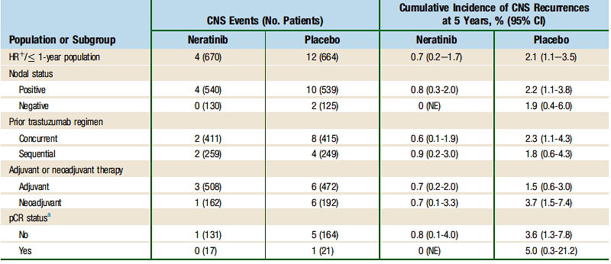
ExteNET: Cumulative incidence of CNS disease as 1st site of recurrence
Courtesy of Ian E Krop, MD, PhD
Chan et al Clin Breast Cancer 2021 Feb;21(1):80-91.e7.

Slide 28
Who Should Receive Neratinib?
Neratinib benefit (relative and absolute) in ER+HER2+ high risk patients
  Must be balanced against toxicity risk
No data giving neratinib after pertuzumab or T-DM1
  All patients at sufficiently high risk to receive neratinib will have received pertuzumab and T-DM1
So who should receive it?
  Unclear, but my opinion is that it is reasonable option to consider in ER+ patients with positive nodes after neoadjuvant therapy
Courtesy of Ian E Krop, MD, PhD

Slide 29
How to mitigate neratinib induced diarrhea?
Neratinib dose escalation, along with loperamide, is associated with relatively low rates of gr3 diarrhea
Most pts who get through 1st cycle have low rate of drug discontinuation due to diarrhea
  Patient education is key
Courtesy of Ian E Krop, MD, PhD

Slide 30
SUMMIT: Does neratinib have activity in breast cancers with somatic HER2 mutations?
Somatic HER2 mutations seen in 3-5% of HR+ HER2 non-amplified cancers
  More common in lobular cancers (5-8%)
  May be acquired with endocrine resistance
SUMMIT trial is basket study evaluating neratinib alone and in combination in patients with HER2 mutant breast cancer
  Initial results showed single agent activity: 17% ORR in HR+ HER2mutant MBC
  Combination of neratinib and fulvestrant: 30% ORR
  ctDNA data suggested secondary HER2 mutations or HER2 amplification as mechanism of resistance
Data led to cohort of neratinib + fulvestrant + trastuzumab (NFT) performed (n=71) in pts previously treated with CDK4/6 inhibitor
  Randomized subset: F vs FT vs NFT (n=21)
Courtesy of Ian E Krop, MD, PhD
Jhaveri et al, Annals of Oncology 34:885 2023

Slide 31
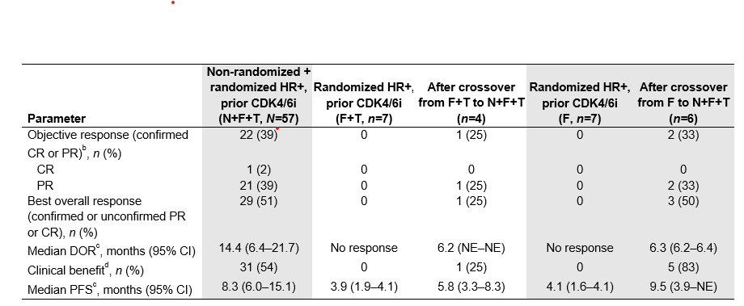
SUMMIT: Does neratinib have activity in breast cancers with somatic HER2 mutations?
ORR: 63% V777L 24% L755S 80% dual mutation
HER2 expression level or FISH amplification were not assoc with ORR
Grade 3 diarrhea was 53% with triplet despite loperamide prophylaxis
Courtesy of Ian E Krop, MD, PhD
Jhaveri et al, Annals of Oncology 34:885 2023

Slide 32
SUMMIT: Conclusion
Neratinib + fulvestrant has clinically meaningful activity in patients with ER+HER2mutant MBC
  Addition of trastuzumab may further increase benefit
  Substantial Gr3 diarrhea – consider neratinib dose escalation
Neratinib based therapy can be considered an effective treatment option for ER+HER2mutant MBC
  Included in NCCN guidelines
These data provide additional support for obtaining somatic tumor sequencing (tissue or ctDNA) in the MBC setting
Courtesy of Ian E Krop, MD, PhD

Slide 33
Sequencing of Therapy for HER2-Positive mBC
HER2-Positive Breast Cancer
Hurvitz SA et al. Trastuzumab deruxtecan versus trastuzumab emtansine in patients with HER2-positive metastatic breast cancer: Updated results from DESTINY-Breast03, a randomised, open-label, phase 3 trial. Lancet 2023;401(10371):105-17.
André F et al. Trastuzumab deruxtecan versus treatment of physician's choice in patients with HER2-positive metastatic breast cancer (DESTINY-Breast02): A randomised, open-label, multicentre, phase 3 trial. Lancet 2023;401(10390):1773-85.
Krop IE et al. An age-specific pooled analysis of trastuzumab deruxtecan (T‑DXd) in patients (pts) with HER2-positive (HER2+) metastatic breast cancer (mBC) from DESTINY-Breast01, -02, and -03. ASCO 2023;Abstract 1006.

Slide 34
DESTINY-Breast03: Adjudicated Drug-Related Interstitial Lung Disease/Pneumonitis
 | Grade 1 | Grade 2 | Grade 3 | Grade 4 | Grade 5 | Any grade
T-DXd (n = 257) | 11 (4.3) | 26 (10.1) | 2 (0.8) | 0 | 0 | 39 (15.2)
T-DM1 (n = 261) | 4 (1.5) | 3 (1.1) | 1 (0.4) | 0 | 0 | 8 (3.1)
Adjudicated drug-related ILD/pneumonitis rates were similar to other mBC trials with T-DXd^{1,2}
With longer treatment exposure and follow-up, the ILD/pneumonitis rate increased from 10.5% in the PFS interim analysis³ to 15.2%
  There were 4 additional grade 1, 8 additional grade 2, and no additional grade 3 events
The overall incidence of grade 3 events (0.8%) was the same as in the PFS interim analysis³
There were no adjudicated drug-related grade 4 or 5 events
ILD, interstitial lung disease; mBC, metastatic breast cancer; T-DM1, trastuzumab emtansine; T-DXd, trastuzumab deruxtecan.
1. Modi S et al. N Engl J Med 2020; 382(7): 610-21. 2. Powell CA et al. ESMO Open 2022; 7(4): 100554. 3. Cortes J et al. N Engl J Med. 2022;386:1143-1154.
Courtesy of Ian E Krop, MD, PhD
Hurvitz SA et al. Lancet 2023;401:105

Slide 35
DB-03 Conclusions
Establishes T-DXd role as preferred 2nd line SOC for most patients
  Unprecedented levels of activity and reassuring ILD data
Should there be a different SOC for pts with active CNS metastases?
Courtesy of Ian E Krop, MD, PhD

Slide 36
Adverse Events of Special Interest: ILD and LV Dysfunction
Adjudicated as Drug-related ILDª
n (%) | Grade 1 | Grade 2 | Grade 3 | Grade 4 | Grade 5 | Any Grade
T-DXd (n = 404) | 11 (2.7) | 26 (6.4) | 3 (0.7) | 0 | 2 (0.5) | 42 (10.4)
TPC (n = 195) | 0 | 0 | 1 (0.5) | 0 | 0 | 1 (0.5)
Median time to onset of adjudicated drug-related ILD was 209.5 days (range, 41-638 days)
with T‑DXd
In the T-DXd arm, 18 (4.5%) patients experienced an LV dysfunction event^{c}
  2 (0.5%) patients had a grade ≥3 event
In the TPC arm, 3 (1.5%) patients experienced an LV dysfunction^{d}
  1 (0.5%) patient had a grade ≥3 event
LV dysfunction^{b}
ILD, interstitial lung disease; LV, left ventricular; T-DXd, trastuzumab deruxtecan; TPC, treatment of physician’s choice.
ªThe safety analysis set includes all randomly assigned patients who received at least 1 dose of study treatment. ^{b}Left ventricular dysfunction included preferred terms of acute left ventricular failure, acute right ventricular failure, cardiac failure, cardiac failure acute, cardiac failure chronic, cardiac failure congestive, chronic left ventricular failure, chronic right ventricular failure, ejection fraction decreased, left ventricular failure, right ventricular failure, ventricular failure, and left ventricular dysfunction. ^{c}17 ejection fraction decreased (2 grade ≥3), 1 LV dysfunction (grade 1). ^{d}1 ejection fraction decreased (grade 1), 2 cardiac failure (1 grade ≥3).
Courtesy of Ian E Krop, MD, PhD
André F et al. Lancet 2023;401:1773

Slide 37
DB-02 Conclusions
Provides first randomized data demonstrating benefit of one ADC after cancer has progressed on a different ADC
  Provides support for paradigm of treating pts with HER2+ breast cancer with sequential ADCs with different payloads
Courtesy of Ian E Krop, MD, PhD

Slide 38
Does age impact efficacy or tolerability of T-DXd?
Older patients experience higher rates of toxicity from chemotherapy
To determine if this effect is observed with T-DXd, an analysis of pts <65yo vs ≥65 was conducted in pooled data from DB-01, -02, 03
Courtesy of Ian E Krop, MD, PhD

Slide 39
Descriptive Efficacy According to Age for T-DXdª
Median Overall Survival
 | DESTINY-Breast01 |  | DESTINY-Breast02 |  | DESTINY-Breast03
 | <65 (n = 140) | ≥65 (n = 44) | <65 (n = 321) | ≥65 (n = 85) | <65 (n = 212) | ≥65 (n = 49)
mOS, months (95% CI) | 28.1 (23.3-36.1) | 30.9 (21.9-NE) | NR (35.5-NE) | 30.2 (22.3-39.2) | NR (40.5-NE) | NR (26.3-NE)
Efficacy in patients aged <65 and ≥65 years treated with T-DXd was generally similar; however no formal comparison was made
ªEfficacy data was not pooled due to bias induced by the heterogeneity of the study population. Trial data cutoffs; DESTINY-Breast01: March 26, 2021; DESTINY-Breast02: June 30, 2022; DESTINY-Breast03: July 25, 2022.
mOS, median overall survival; NE, not estimable; NR, not reached; T-DXd, trastuzumab deruxtecan.
Ian Krop, MD, PhD
Courtesy of Ian E Krop, MD, PhD

Slide 40
Relative Dose Intensity
TPC (DB-02)
Relative dose intensity was similar between <65 and ≥65 age groups, regardless of treatment received
ªRelative dose intensity (%) = (dose intensity/planned dose intensity) ×100.
DB, DESTINY-Breast; T-DM1, trastuzumab emtansine; T-DXd, trastuzumab deruxtecan; TPC, treatment of physician’s choice.
Ian Krop, MD, PhD
Courtesy of Ian E Krop, MD, PhD

Slide 41
Most Common Grade ≥3 Drug-related TEAEs in ≥5% of Patients
 | T-DXd Pool | Full analysis set |  | TPC (DB-02) | Full analysis set |  | T-DM1 (DB-03) | Full analysis set
 | <65 (n = 668) | ≥65 (n = 177) | ≥75 (n = 33) | <65 (n = 157) | ≥65 (n = 38) | ≥75 (n = 8) | <65 (n = 204) | ≥65 (n = 57) | ≥75 (n = 8)
Grade ≥3ª drug-related TEAEs, n (%) | 291 (43.6) | 96 (54.2) | 13 (39.4) | 48 (30.6) | 12 (31.6) | 5 (62.5) | 82 (40.2) | 28 (49.1) | 3 (37.5)
Neutropenia^{b} | 117 (17.5) | 41 (23.2) | 4 (12.1) | 5 (3.2) | 1 (2.6) | 1 (12.5) | 6 (2.9) | 3 (5.3) | 0
Fatigue^{c} | 52 (7.8) | 20 (11.3) | 5 (15.2) | 1 (0.6) | 1 (2.6) | 1 (12.5) | 2 (1.0) | 0 | 0
Nausea | 43 (6.4) | 15 (8.5) | 4 (12.1) | 3 (1.9) | 0 | 0 | 0 | 1 (1.8) | 0
Anemia^{d} | 42 (6.3) | 20 (11.3) | 3 (9.1) | 1 (0.6) | 0 | 0 | 6 (2.9) | 6 (10.5) | 1 (12.5)
Leukopenia^{e} | 42 (6.3) | 15 (8.5) | 2 (6.1) | 0 | 0 | 0 | 3 (1.5) | 0 | 0
Lymphopenia^{f} | 28 (4.2) | 11 (6.2) | 1 (3.0) | 2 (1.3) | 0 | 0 | 2 (1.0) | 1 (1.8) | 0
Thrombocytopenia^{g} | 28 (4.2) | 9 (5.1) | 0 | 2 (1.3) | 0 | 0 | 47 (23.0) | 19 (33.3) | 2 (25.0)
Transaminases increased^{h} | 18 (2.7) | 1 (0.6) | 0 | 1 (0.6) | 1 (2.6) | 0 | 16 (7.8) | 4 (7.0) | 0
Diarrhea | 9 (1.3) | 4 (2.3) | 0 | 10 (6.4) | 2 (5.3) | 1 (12.5) | 2 (1.0) | 0 | 0
Patients ≥65 years of age experienced more grade ≥3 TEAEs across all trials
ªGrade ≥3 drug-related TEAEs present in ≥5% of patients, sorted in descending order of frequency in the T-DXd pooled arm for the <65 years age group. Grade ≥3 drug-related TEAEs calculated in all patients in the analysis set. ^{b}Neutropenia includes the preferred terms neutrophil count decreased and neutropenia. ^{c}Fatigue includes the preferred terms fatigue, asthenia, malaise, and lethargy. ^{d}Anemia includes the preferred terms hemoglobin decreased, red blood cell count decreased, anemia, and hematocrit decreased. ^{e}Leukopenia includes the preferred terms white blood cell count decrease and leukopenia. ^{f}Lymphopenia includes the preferred terms lymphocute count decreased and lymphopenia. ^{g}Thrombocytopenia includes the preferred terms platelet count decreased and thrombocytopenia. ^{h}Transaminases increased includes the preferred terms transaminases increased, aspartate aminotransferase increased, alanine aminotransferase increased, gamma-glutamyltransferase increased, liver function test abnormal, hepatic function abnormal, and liver function test increased.
T-DM1, trastuzumab emtansine; T-DXd, trastuzumab deruxtecan; TEAE, treatment emergent adverse event; TPC, treatment of physician’s choice.
Ian Krop, MD, PhD
Courtesy of Ian E Krop, MD, PhD

Slide 42
Adjudicated Drug-related ILD/Pneumonitisª
 | T-DXd Pool | Full analysis set |  | TPC (DB-02) | Full analysis set |  | T-DM1 (DB-03) | Full analysis set
 | <65 (n = 668) | ≥65 (n = 177) | ≥75 (n = 33) | <65 (n = 157) | ≥65 (n = 38) | ≥75 (n = 8) | <65 (n = 204) | ≥65 (n = 57) | ≥75 (n = 8)
Any grade, n (%) | 79 (11.8) | 31 (17.5) | 5 (15.2) | 0 | 1 (2.6) | 0 | 6 (2.9) | 2 (3.5) | 1 (12.5)
1 | 21 (3.1) | 7 (4.0) | 0 | 0 | 0 | 0 | 3 (1.5) | 1 (1.8) | 0
2 | 48 (7.2) | 20 (11.3) | 5 (15.2) | 0 | 0 | 0 | 2 (1.0) | 1 (1.8) | 1 (12.5)
3 | 4 (0.6) | 3 (1.7) | 0 | 0 | 1 (2.6) | 0 | 1 (0.5) | 0 | 0
4 | 0 | 0 | 0 | 0 | 0 | 0 | 0 | 0 | 0
5 | 6 (0.9) | 1 (0.6) | 0 | 0 | 0 | 0 | 0 | 0 | 0
Rates of adjudicated ILD/pneumonitis were generally higher in patients ≥65 years of age across all trials compared to patients <65 years of age
Most drug-related ILD/pneumonitis cases were of low grade
ªNo ILD/pneumonitis cases were pending adjudication at the respective data cutoff dates (DESTINY-Breast01: March 26, 2021; DESTINY-Breast02: June 30, 2022; DESTINY-Breast03: July 25, 2022).
ILD, interstitial lung disease; T-DM1, trastuzumab emtansine; T-DXd, trastuzumab deruxtecan; TPC, treatment of physician’s choice.
Ian Krop, MD, PhD
Courtesy of Ian E Krop, MD, PhD

Slide 43
Conclusion
Results of this pooled analysis indicate that T-DXd remains an effective treatment option for patients ≥65 years of age
  mPFS and confirmed ORR by BICR were similar with T-DXd in patients <65 and ≥65 years of age within each trial
The safety profile of T-DXd was acceptable across all age subgroups
  Patients ≥65 years of age experienced more grade ≥3 TEAEs across all trials
Further research/real-world evidence studies for older patients, also addressing aspects of comorbidities and frailty, would be informative
T-DXd may be considered as an effective option for patients
across all age subgroups with an acceptable safety profile
BICR, blinded independent central review; HER2, human epidermal growth factor receptor 2; mBC, metastatic breast cancer; mPFS, median progression free survival; ORR, objective response rate; T-DXd, trastuzumab deruxtecan; TEAE, treatment emergent adverse event.
Ian Krop, MD, PhD
Courtesy of Ian E Krop, MD, PhD

Slide 44
HER2-Positive Brain Metastases
HER2-Positive Breast Cancer
Hurvitz S et al. HER2CLIMB-02: Randomized, double-blind phase 3 trial of tucatinib and trastuzumab emtansine for previously treated HER2-positive metastatic breast cancer. SABCS 2023;Abstract GS01-10.
Hurvitz SA et al. A pooled analysis of trastuzumab deruxtecan (T-DXd) in patients (pts) with HER2-positive (HER2+) metastatic breast cancer (mBC) with brain metastases (BMs) from DESTINY-Breast (DB) -01, -02, and -03. ESMO 2023;Abstract 377O.
Pérez-García JM et al. Trastuzumab deruxtecan in patients with central nervous system involvement from HER2-positive breast cancer: The DEBBRAH trial. Neuro Oncol 2023;25(1):157-66.

Slide 45
HER2CLIMB-02 Study Design
San Antonio Breast Cancer Symposium®, December 5-9, 2023
HER2+ LA/MBC
with progression after trastuzumab and taxane in any settingª
ECOG PS ≤1
Previously treated stable, progressing, or untreated brain metastases not requiring immediate local therapy
T-DM1 + Tucatinib
T-DM1 3.6 mg/kg IV and Tucatinib 300 mg PO BID
Outcomes
Primary
PFS by investigator assessment per RECIST v1.1
Key Secondary (hierarchical)
OS
PFS in patients with brain metastases
cORR per RECIST v1.1
OS in patients with brain metastases
N≈460
R 1:1
Stratification factors:
T-DM1 + Placebo
T-DM1 3.6 mg/kg IV and Placebo PO BID
Line of treatment for metastatic disease (1L vs other)
Hormone receptor status (positive vs negative)
Presence or history of brain metastases (yes vs no)
ECOG PS (0 vs 1)
The primary analysis for PFS was planned after ≈331 PFS events to provide 90% power for hazard ratio of 0.7 at two-sided alpha level of 0.05.
The first of two interim analyses for OS was planned at the time of the primary PFS analysis, if the PFS result was significantly positive^{b}.
No prior HER2 TKI or T-DXd
NCT03975647. https://www.clinicaltrials.gov/study/NCT03975647. Accessed Oct 5, 2023.
a Patients who received prior tucatinib, afatinib, T-DXd, or any investigational anti-HER2, anti-EGFR, or HER2 TKIs were not eligible. Patients who received lapatinib and neratinib were not eligible if the drugs were received within 12 months of starting study treatment, and patients who received pyrotinib for recurrent or metastatic breast cancer were not eligible. These patients were eligible if the drugs were given for ≤21 days and were discontinued for reasons other than disease progression or severe toxicity. b Subsequent OS analyses are planned upon 80% and 100% of required events for the final OS analysis.
1L, first-line; BID, twice daily; cORR, confirmed objective response rate; ECOG PS, Eastern Cooperative Oncology Group performance status; IV, intravenously; LA/MBC, locally advanced or metastatic breast cancer; OS, overall survival; PFS, progression-free survival; PO, orally; R, randomization; RECIST, Response Evaluation Criteria in Solid Tumors; T-DM1, trastuzumab emtansine; T-DXd, trastuzumab deruxtecan; TKIs, tyrosine kinase inhibitors.
Date of data cutoff: Jun 29, 2023. Patients were enrolled from Oct 8, 2019, to Jun 16, 2022.
Courtesy of Ian E Krop, MD, PhD

Slide 46
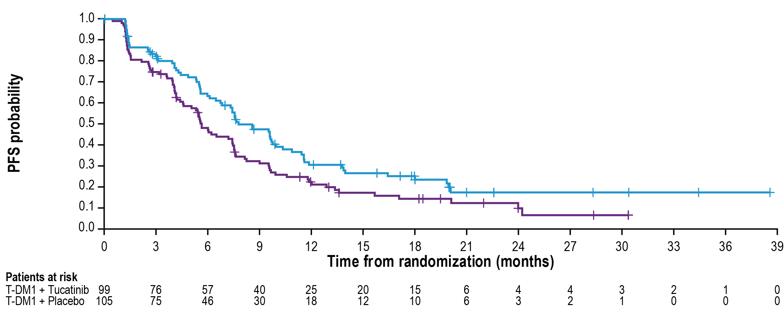
HER2CLIMB-02: PFS in Patients with Brain Metastases
San Antonio Breast Cancer Symposium®, December 5-9, 2023
 | T-DM1 + Tucatinib (N=99) | T-DM1 + Placebo (N=105)
# of events | 70 | 85
Median PFS (95% CI) | 7.8 months (6.7, 10.0) | 5.7 months (4.6, 7.5)
 | HR (95% CI)ª: 0.64 (0.46, 0.89)
a The outcome was not formally tested.
HR, hazard ratio; PFS, progression-free survival; T-DM1, trastuzumab emtansine. Date of data cutoff: Jun 29, 2023.
Courtesy of Ian E Krop, MD, PhD

Slide 47
HER2CLIMB-02: Conclusion
Addition of tucatinib to T-DM1 modestly improves PFS
  Relative benefit larger in patients with CNS disease
  No OS benefit, but data immature
  Increased toxicity appears manageable, but ≈20% drug discontinuation
  Caveat: data are in T-DXd naïve patients
Unclear whether tucatinib should be used with T-DM1 or trastuzumab/capecitabine
  Is there a role for using it in both combinations sequentially?
Courtesy of Ian E Krop, MD, PhD

Slide 48
Are there other options for active brain mets besides TKIs?
Does trastuzumab deruxtecan have activity in HER2+ brain metastases?
Dogma had been that large biologics like ADCs cannot cross the blood brain barrier
Courtesy of Ian E Krop, MD, PhD

Slide 49
Retrospective Exploratory Pooled Analysis Plan¹⁻³
DESTINY-Breast01 (N = 253)^{a,b}
Phase II study
Patients previously treated with T-DM1
Patients with asymptomatic and previously locally treated BM eligible
Prior BM therapy within 60 days prohibited
T-DXd^{e}
(Total n = 184)
(With BM n = 19)
T-DXd pool (N = 851)
T-DXd BM pool (n = 148)
T-DXd non-BM pool (n = 703)
T-DXd^{e}
(Total n = 406)
(With BM n = 83)
Endpoints:
IC-ORR (CR+PR in brain) per BICR per RECIST v1.1
IC-DoR per BICR
CNS-PFS per BICR
Safety and tolerability
DESTINY-Breast02 (N = 608)^{a,c}
Phase III study
Patients previously treated with T-DM1
Patients with asymptomatic and previously treated/untreated BM eligible
Prior BM therapy within 14 days of randomization prohibited
R
2:1
TPC per label
Trastuzumab/Capecitabine
or
Lapatinib/Capecitabine
(Total n = 202)
(With BM n = 41)
2:1
Comparator pool (N = 465)
Comparator BM pool (n = 83)
Comparator non-BM pool (n = 382)
DESTINY-Breast03 (N = 524)^{a,d}
Phase III study
Patients previously treated with trastuzumab and a taxane in metastatic or (neo)adjuvant setting with recurrence within 6 months of therapy
Patients with asymptomatic and previously treated/untreated BM eligible
Prior BM therapy within 14 days of randomization prohibited
T-DXd^{e}
(Total n = 261)
(With BM n = 46)
R
1:1
T-DM1^{f}
(Total n = 263)
(With BM n = 42)
The BM and non-BM pools were determined by BICR at baseline among all patients based on mandatory brain CT/MRI screening
BICR, blinded independent central response; BM, brain metastasis; CNS, central nervous system; CR, complete response; CT, computed tomography; DB, DESTINY-Breast; DoR, duration of response; HER2, human epidermal growth factor receptor 2; IC, intracranial; mBC, metastatic breast cancer; MRI, magnetic resonance imaging; ORR, objective response rate; PFS, progression-free survival; PR, partial response; R, randomization; RECIST v1.1, Response Evaluation Criteria in Solid Tumors version 1.1; T-DM1, trastuzumab emtansine; T-DXd, trastuzumab deruxtecan; TPC, treatment of physician’s choice (trastuzumab/capecitabine or lapatinib/capecitabine).
Data for patients in the 5.4 mg/kg T-DXd arms were pooled from the DB-01, DB-02, and DB-03 trials. Comparator data were pooled from the DB-02 and DB-03 trials. All three studies were conducted in unresectable/mBC; HER2 status was confirmed centrally; and a documented radiographic progression after most recent treatment was required.
ªThe presence of BMs was not a stratification factor. ^{b}Data Cutoff: March 26, 2021. ^{c}Data Cutoff: June 30, 2022. ^{d}Data Cutoff: May 21, 2021. ^{e}5.4 mg/kg Q3W. ^{f}3.6 mg/kg Q3W.
1. Modi S et al. N Engl J Med. 2020; 382:610-621 [article and supplementary appendix]. 2. André F et al. The Lancet. 2023. https://doi.org/10.1016/S0140-6736(23)00725-0 [article and supplementary appendix]. 3. Cortes J et al. N Engl J Med. 2022; 368(12):1143-1154 [article and supplementary appendix].
Sara A. Hurvitz, MD
Courtesy of Ian E Krop, MD, PhD

Slide 50
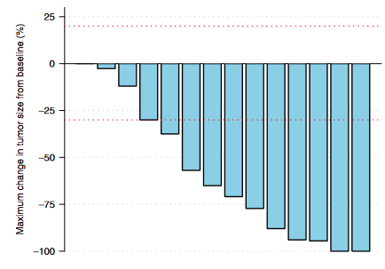
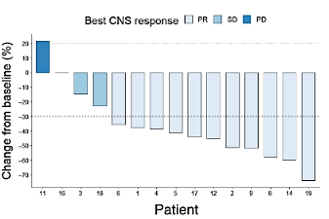
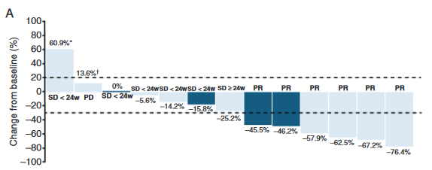
Small studies of T-DXd in patients with HER2+ progressive brain metastases
TUXEDO-1
DFCI/MDACC/Duke case series
DEBBRAH trial
Intracranial RR: 73%
n=15
Intracranial RR: 73%
n=15
Intracranial RR: 50% (untreated/asymptomatic)
Intracranial RR: 44% (progressing)
n=4/9
Bartsch R, et al. Nat Med. 28:1840. 2022
Kabraji S, et al. Clin Cancer Res. 29:174. 2023
Pérez-García et al. Neuro-Oncology 25:157. 2023
Courtesy of Ian E Krop, MD, PhD

Slide 51
T-DXd CNS Studies Conclusions
Pooled analysis of DB-01,-02,-03 show strong evidence of activity of T-DXd in patients with both stable and active brain mets
  Most pts had previously untreated and asymptomatic brain mets
Several additional studies (all small) of T-DXd also demonstrate intracranial activity of T-DXd in patients with progressive brain mets
Together, these studies provide compelling evidence of intracranial activity of T-DXd
Courtesy of Ian E Krop, MD, PhD

Slide 52
Approach to Therapy for Metastatic HER2+ Disease
Current Approach for Metastatic HER2+ Breast Cancer
1st Line
Taxane + trastuzumab + pertuzumab
Active CNS
CNS dominant disease
Active CNS
Extracranial dominant
No or stable CNS disease
2nd Line
Trastuzumab deruxtecan
Tucatinib
Tras/cape
Trastuzumab deruxtecan
3rd Line
Tucatinib
T-DM1
Trastuzumab deruxtecan
Tucatinib
T-DM1
4th Line
Trastuzumab+ chemotherapy
T-DM1
Trastuzumab+ chemotherapy
5th Line+
Trastuzumab+ chemotherapy (or endrocrine therapy if HR+)
Margetuximab+ chemotherapy (if low affinity FcR genotype)
Courtesy of Ian E Krop, MD, PhD

Slide 53
Agenda
INTRODUCTION: Educating Non-Breast Cancer Specialty Oncologists About HER2-Targeted Therapies – ASCO Genitourinary Cancers Symposium 2024
MODULE 1: HER2-Positive Breast Cancer — Dr Krop
MODULE 2: Triple-Negative Breast Cancer — Dr Sharma

Slide 54
Neoadjuvant Chemoimmunotherapy
Triple-Negative Breast Cancer
Schmid P et al. Pembrolizumab or placebo plus chemotherapy followed by pembrolizumab or placebo for early-stage TNBC: Updated EFS results from the phase III KEYNOTE-522 study. ESMO 2023;Abstract LBA18.
Gianni L et al. Event-free survival (EFS) analysis of neoadjuvant taxane/carboplatin with or without atezolizumab followed by an adjuvant anthracycline regimen in high-risk triple negative breast cancer (TNBC): NeoTRIP Michelangelo randomized study. ESMO 2023;Abstract LBA19.
Ignatiadis M et al. Adding atezolizumab to adjuvant chemotherapy for stage II and III triple-negative breast cancer is unlikely to improve efficacy: Interim analysis of the ALEXANDRA/IMpassion030 phase 3 trial. SABCS 2023;Abstract GS01-03.

Slide 55
Third Annual National General Medical Oncology Summit
Friday, March 22, 2024 — 7:00 PM – 9:00 PM
Keynote Session Special Feature: Clinicians with Cancer
How do you think a medical oncologist with localized TNBC would think through the choice and duration of chemotherapy to receive in combination with neoadjuvant pembrolizumab? How would they approach adjuvant therapy?

Slide 56
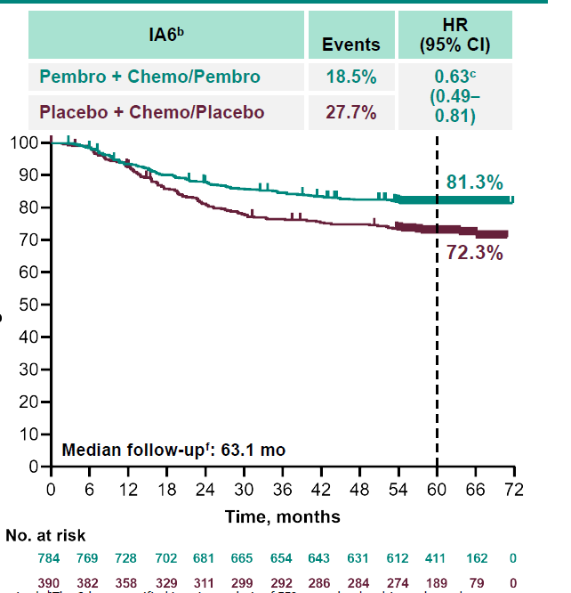
KEYNOTE-522: IA6
EFS by pCR
Δ=4%
92.2%
pCR Yes
HR (95% CI)
0.65 (0.39-1.08)
88.2%
Δ=9%
62.6%
Δ=10.3%
pCR No
HR (95% CI)
0.72 (0.54-0.96)
52.3%
38% of patients with RD with EFS event despite pembrolizumab
Need better therapies
108/201
Schmid et al ESMO 2023
Courtesy of Priyanka Sharma, MD
Data cutoff date: March 23, 2023.

Slide 57
KN-522: IA6 summary
  After a median follow-up of >5 years, neoadjuvant pembro + chemo followed by adjuvant pembrolizumab continues to show a clinically meaningful improvement in EFS compared with neoadjuvant chemo alone
  The EFS benefit was generally consistent in subgroups based on TNM stage (II/III) and nodal status (+/-)
  Follow-up for OS is ongoing
  EFS improvement in pembrolizumab group was observed regardless of pCR outcome
    ? Driven primarily by neoadjuvant pembrolizumab. ? What is the relative contribution of adjuvant pembrolizumab
  pCR/RD: locally assessed. ? Reliability of local assessment of pCR in an international trial
Courtesy of Priyanka Sharma, MD

Slide 58
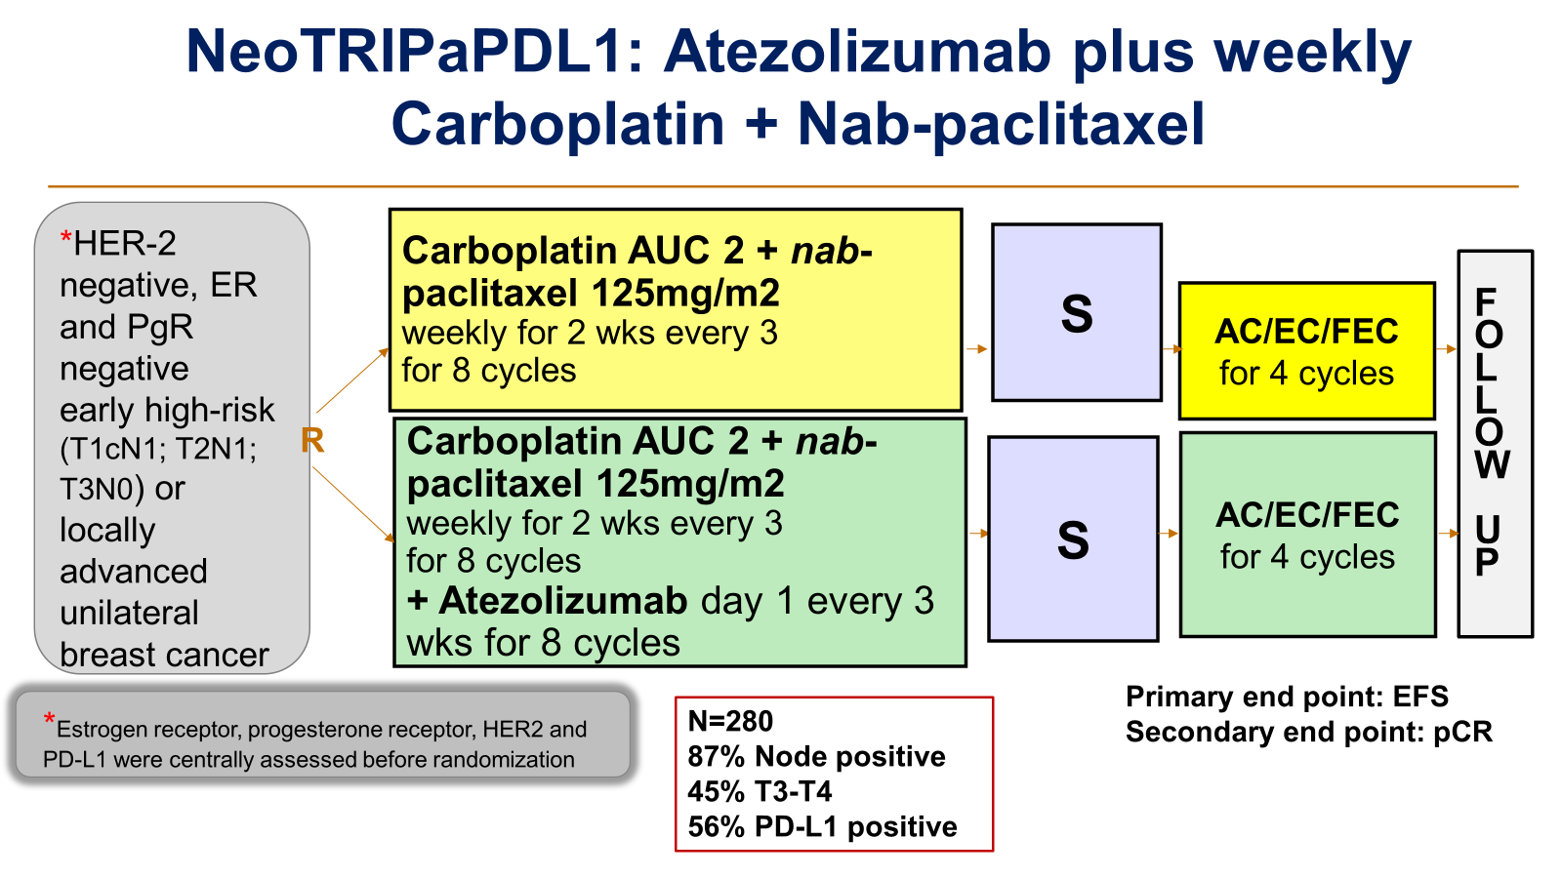
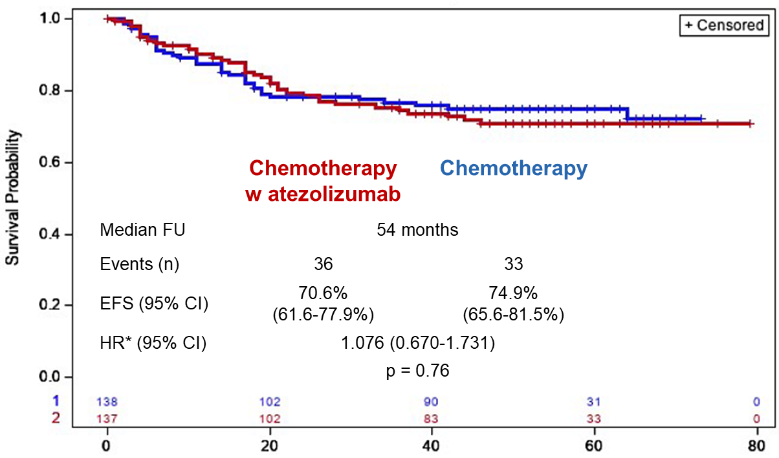
NeoTRIPaPDL1: Atezolizumab plus weekly Carboplatin + Nab-paclitaxel
EFS
No adjuvant ICB
PD-L1 status and pCR
pCR, positive PD-L1, earlier stage
as well as higher sTILs
were all prognostic and linked to better EFS, but they were not predictive of atezolizumab benefit
Courtesy of Priyanka Sharma, MD
Gianni et al Annal Oncol 2022, Gianni et al ESMO 2023

Slide 59
Why no pCR or EFS Benefit in NeoTRIPaPDL1?
  PDL-1 vs PD-1 inhibitor
    IMpassion031: pCR better, EFS numerically better with atezolizumab
    mTNBC: Atezo plus taxane not statistically superior to taxane (IMpassion130, 131)
  Chemotherapy backbone: no anthracycline
  Anatomic risk of enrolled population:
    90% with node positive disease (compared to 30% in IMpassion031)
    With high anatomical risk would efficacy be more in line with what is observed in mTNBC?
  Differences in tumour biology: Higher TILs in chemo alone arm giving the control arm inherent better prognosis compared to IO arm
  Chance
Courtesy of Priyanka Sharma, MD

Slide 60
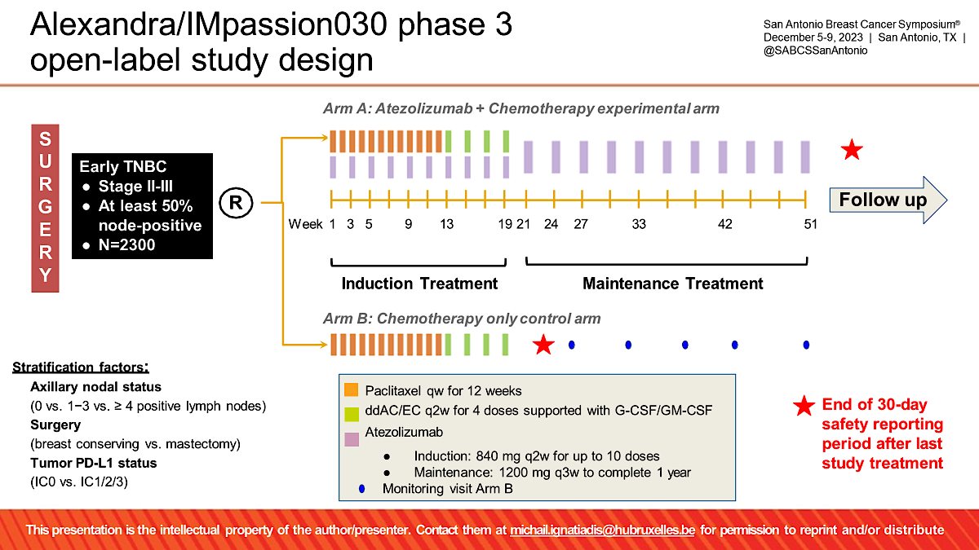
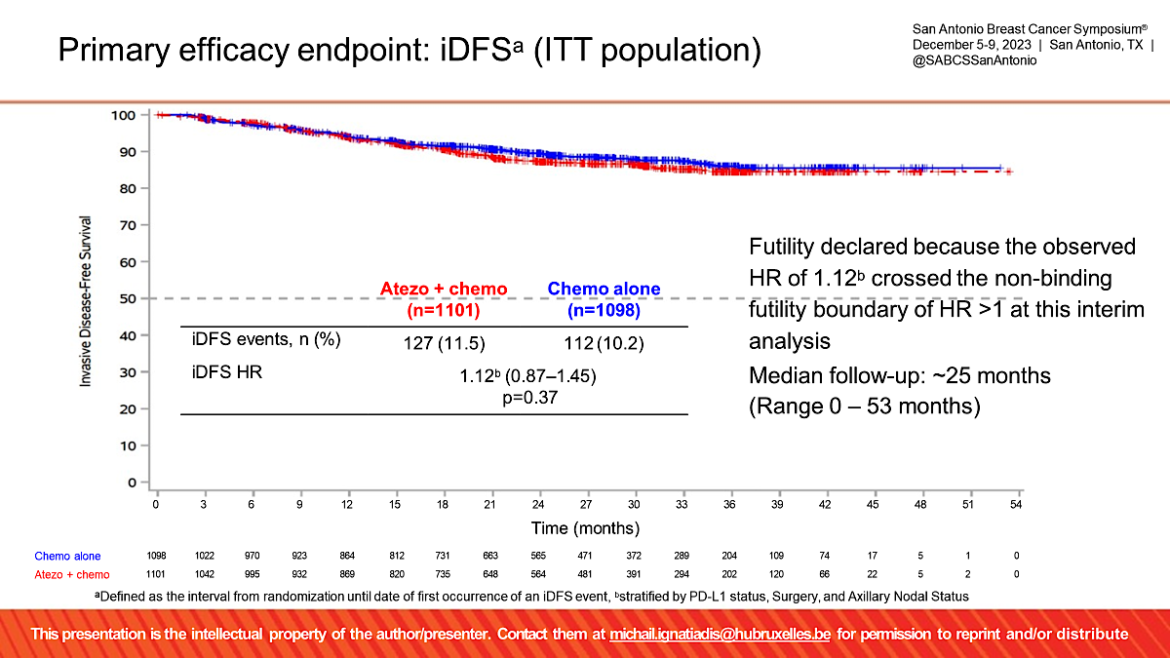
ALEXANDRA/IMpassion030 phase 3 trial : Adjuvant IO (without neoadjuvant component)
iDFS: Primary End Point
Timing of IO matters: Neoadjuvant more effective than adjuvant IO
Previous Animal data consistent with clinical findings (Liu et al Cancer Discover 2015)
Similar observations in other cancer like Melanoma
Ignatiadis SABCS 2023
Courtesy of Priyanka Sharma, MD

Slide 61
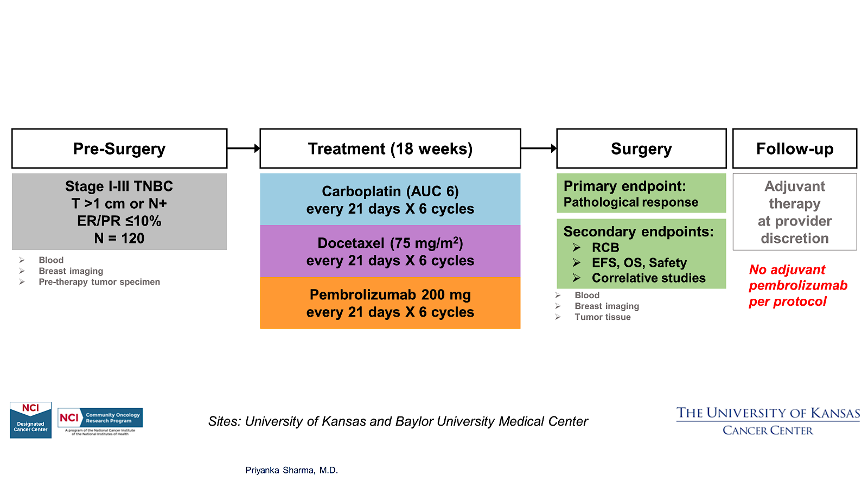
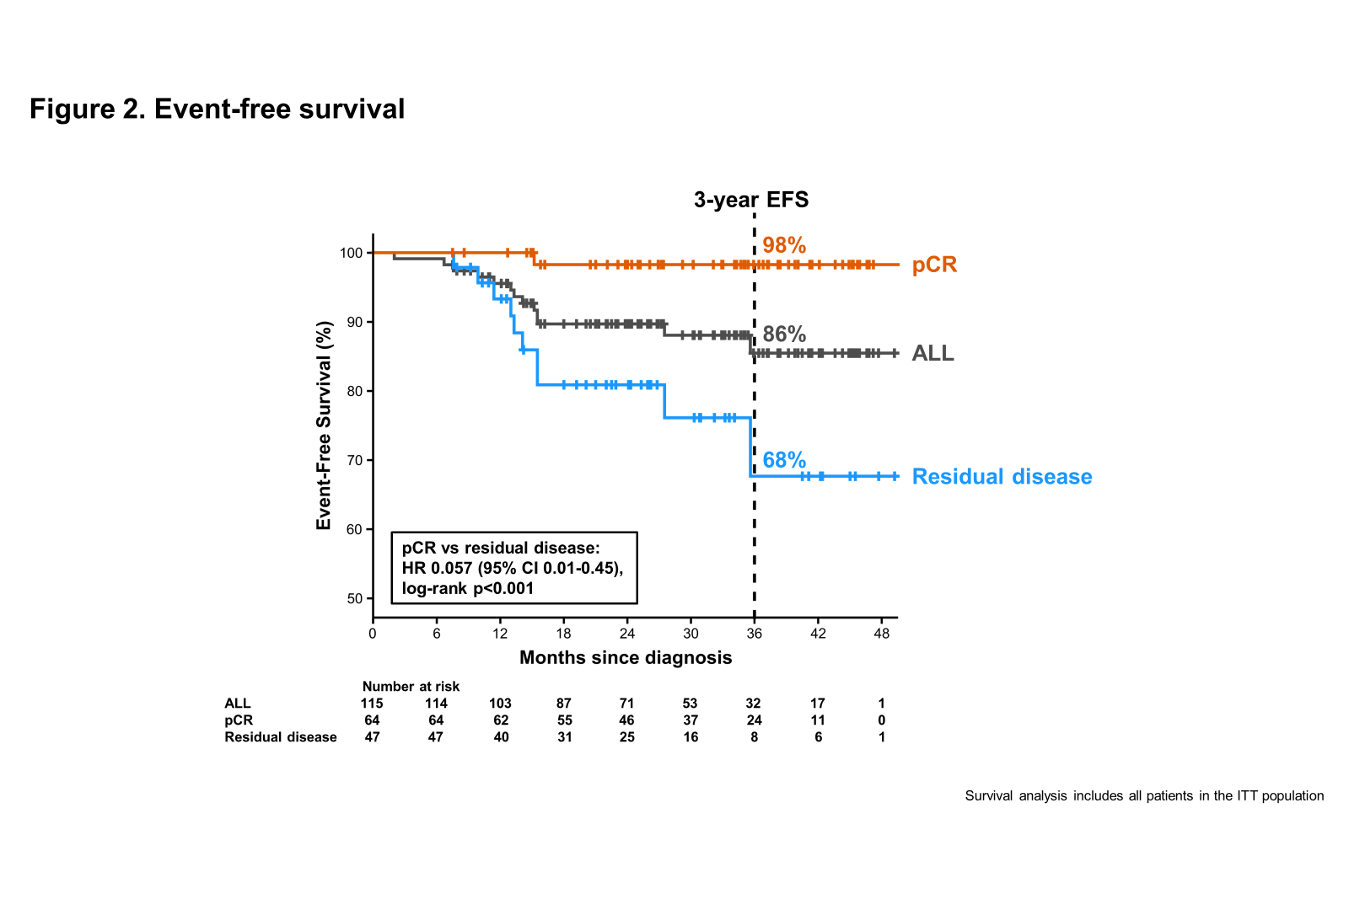
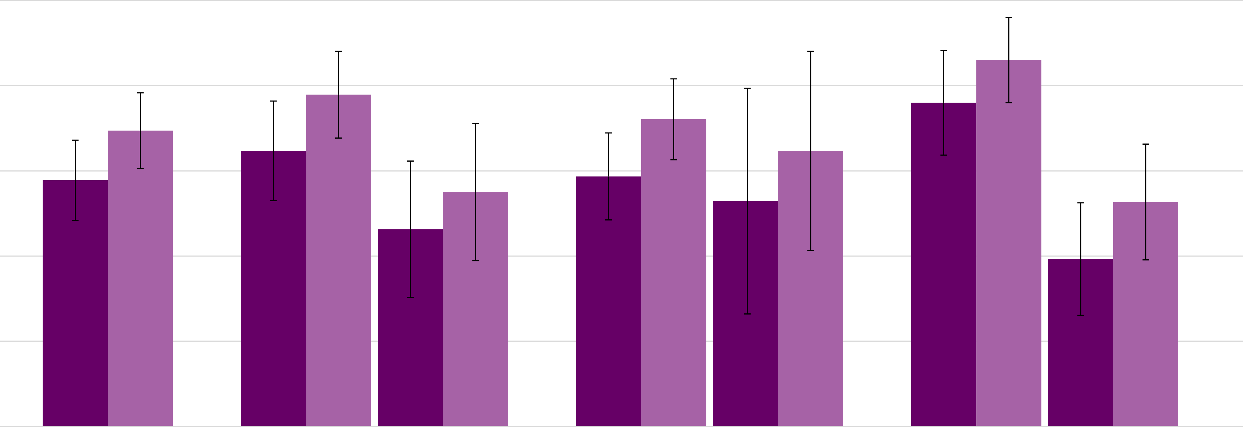
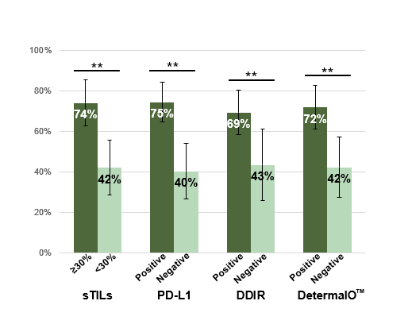
NeoPACT: Carboplatin + Docetaxel+ Pembrolizumab
100%
RCB 0+1
86%
80%
78%
pCR
72%
76%
60%
Provide data on an alternative anthracycline-free chemoimmunotherapy regimen for patients who are not eligible/wish to avoid anthracycline-based regimens and support further evaluation of this regimen as a chemotherapy de-escalation strategy in randomized studies (On going SWOG 2212 trial)
69%
58%
53%
40%
46%
39%
20%
0%
N=111
Immune enrichment assessed by sTILs, PD-L1 or IO response signature was noted in almost 50% of patients and was associated with high pCR rates exceeding 70%.
Sharma et al JAMA Oncology 2023
Courtesy of Priyanka Sharma, MD

Slide 62

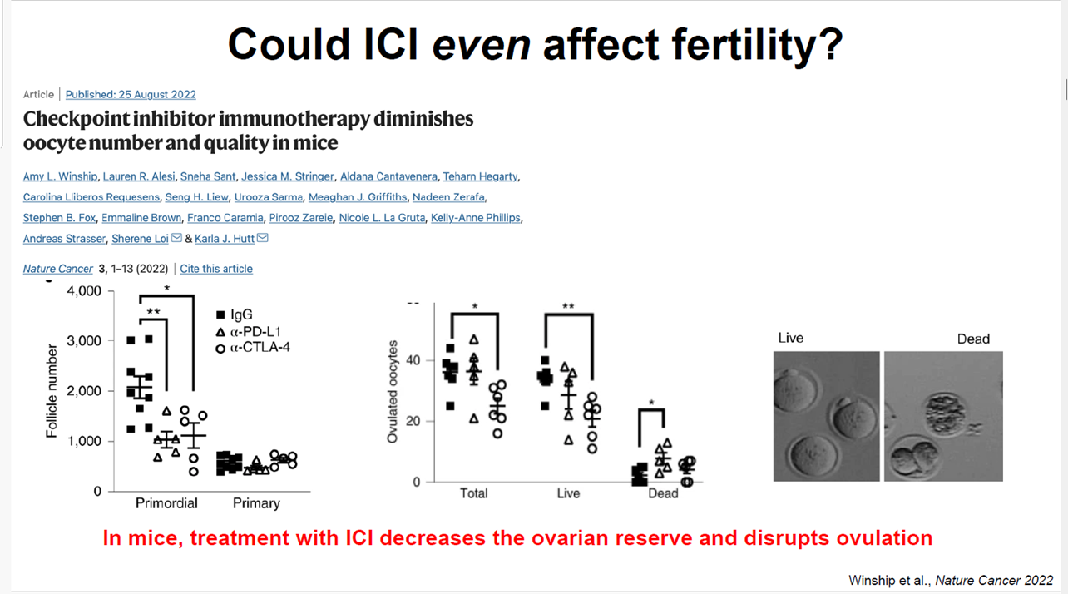
irAE: KN-522 real world toxicity
Real World data
N=577 (17 sites), 18.2% Blacks
Delayed toxicity
N=320, Patients with BC undergoing ICI at UCSF
25% had Delayed toxicities : > 90d after ICI START
  Median time to onset 6 months (range 91-1800days )
7.5% had Post-treatment toxicities >60d after STOPPING ICI
  Median time to onset 4 months (range 69-1100d)
Most common delayed & post-treatment irAEs were hypothyroidism, colitis, rash ,adrenal insufficiency and hepatitis
Adverse drug events(ADE) causing dose reduction | 37.6%
ADE leading to early discontinuation | 39.5%
irAE, all grades | 71%
irAE > 3 | 33.5%
More than what meets the eye
 | Blacks | Whites | p
pCR | 52.3% | 55.9% | 0.6
> 3 irAE | 20.9% | 33.8% | 0.011
Hospitalization rate | 39% | 36% | 0.5
Hofherr et al SABCS 2023, Jacob et al SABCS 2023
Courtesy of Priyanka Sharma, MD

Slide 63
Chemoimmunotherapy for mTNBC
Triple-Negative Breast Cancer
Rugo HS et al. KEYNOTE-355: Outcomes in patients who discontinued chemotherapy before pembrolizumaband in patients with immune-mediated AEs. ESMO Breast 2023;Abstract 191M0.
Jiang Z et al. TORCHLIGHT: A randomized, double-blind, phase III trial of toripalimab versus placebo, in combination with nab-paclitaxel (nab-P) for patients with metastatic or recurrent triple-negative breast cancer (TNBC). ASCO 2023;Abstract LBA1013.

Slide 64
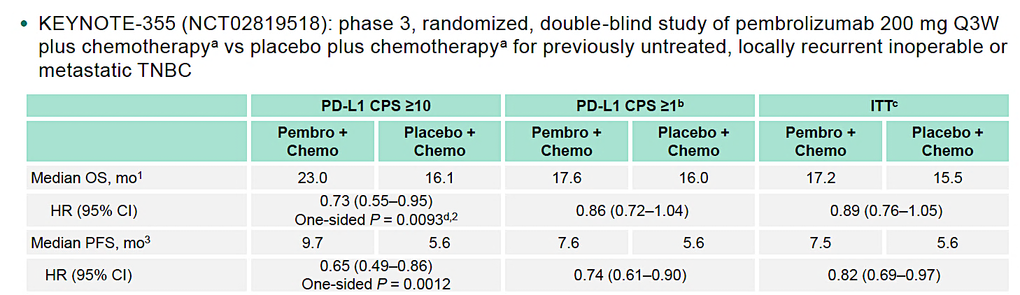
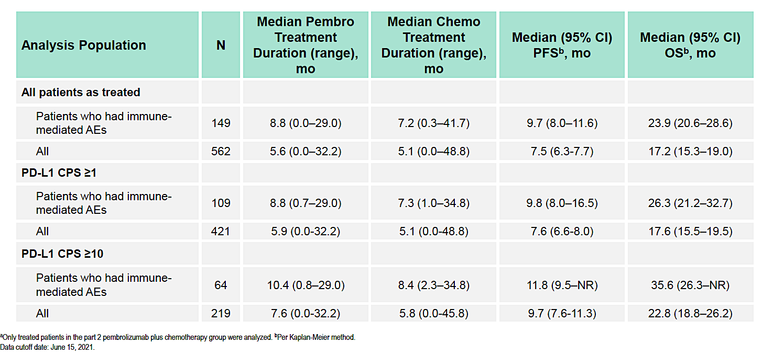
KEYNOTE-355: Outcomes in Patients Who Discontinued Chemotherapy Before Pembrolizumab and in Patients With Immune Mediated AEs
PFS and OS in Patients treated with pembro+ chemo with or without irAE
30% of patients with irAE
Exploratory analyses to evaluate efficacy in patients who:
–Had disease control and discontinued chemotherapy
before pembrolizumab
–Experienced immune-mediated AEs
Rugo et al ESMO 2023
Courtesy of Priyanka Sharma, MD

Slide 65
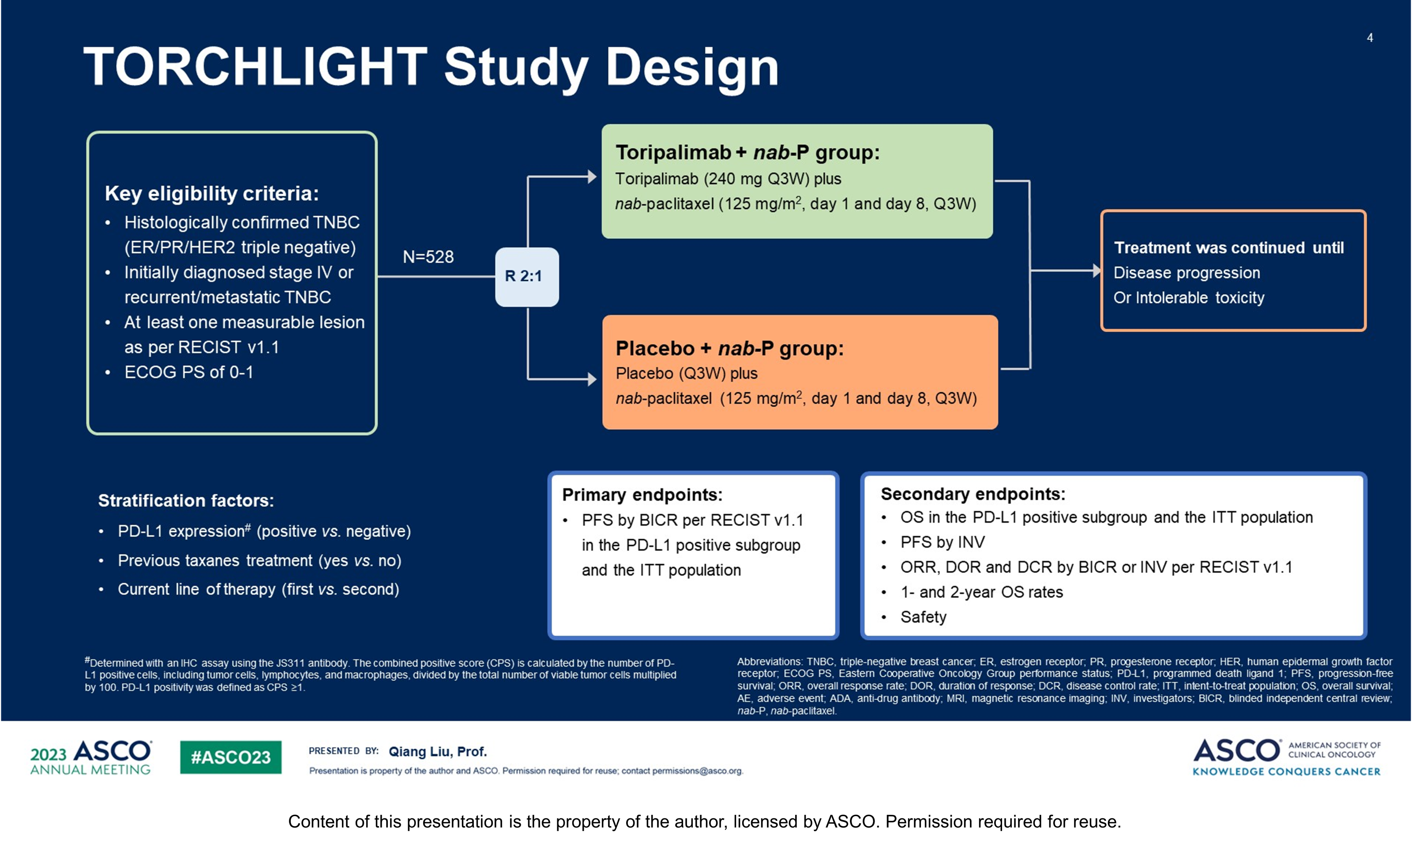
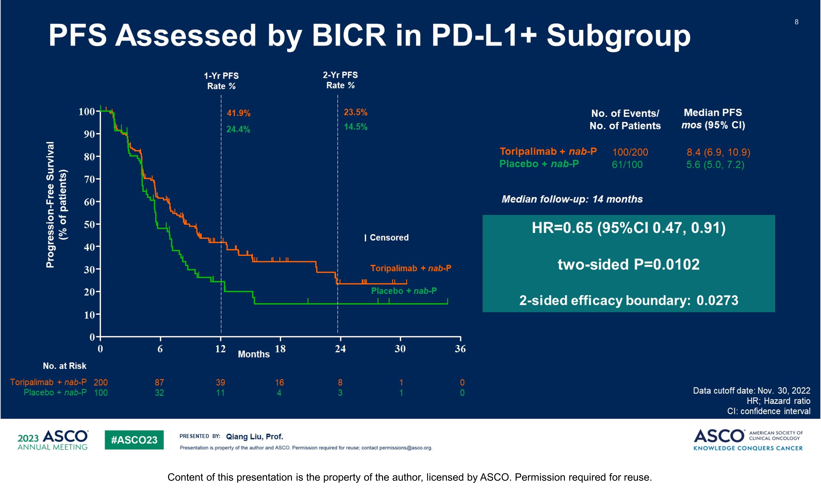
TORCHLIGHT: A randomized, double-blind, phase III trial of toripalimab versus placebo, in combination with nab-paclitaxel (nab-P) for patients with metastatic or recurrent triple-negative breast cancer (TNBC). ASCO 2023;Abstract LBA1013
N=531, Toripalimab:PD1 antibody
-PDL1 assay (CPS, JS311 antibody): CPS > 1 considered PDL1+ve, 56% PDL1+ve
-Data presented: prespecified IA of PFS in PDL1+ population and ITT
-93% first line, 28-31% de-novo metastatic, Prior taxane in only 15%
Median PFS 8.4 vs 5.6 months, HR 0.65
Liu et al ASCO 2023
Courtesy of Priyanka Sharma, MD

Slide 66
TORCHLIGHT: Summary
At IA 1 PFS prolonged with addition of toripalimab to nab-paclitaxel in PDL1+ population
  HR and Median PFS very similar to KN355
PFS in ITT did not meet the prespecified hierarchal testing boundary at IA 1
OS data is immature, Follow up ongoing
PDL1 testing by yet another assay and threshold
Enrollment only in China: ? approval path for other countries/regions
Limited toxicity data provided
Courtesy of Priyanka Sharma, MD

Slide 67
PARP Inhibitors
Triple-Negative Breast Cancer
Robson ME et al. OlympiAD extended follow-up for overall survival and safety: Olaparib versus chemotherapy treatment of physician’s choice in patients with a germline BRCA mutation and HER2-negative metastatic breast cancer. Eur J Cancer 2023;184:39-47.

Slide 68
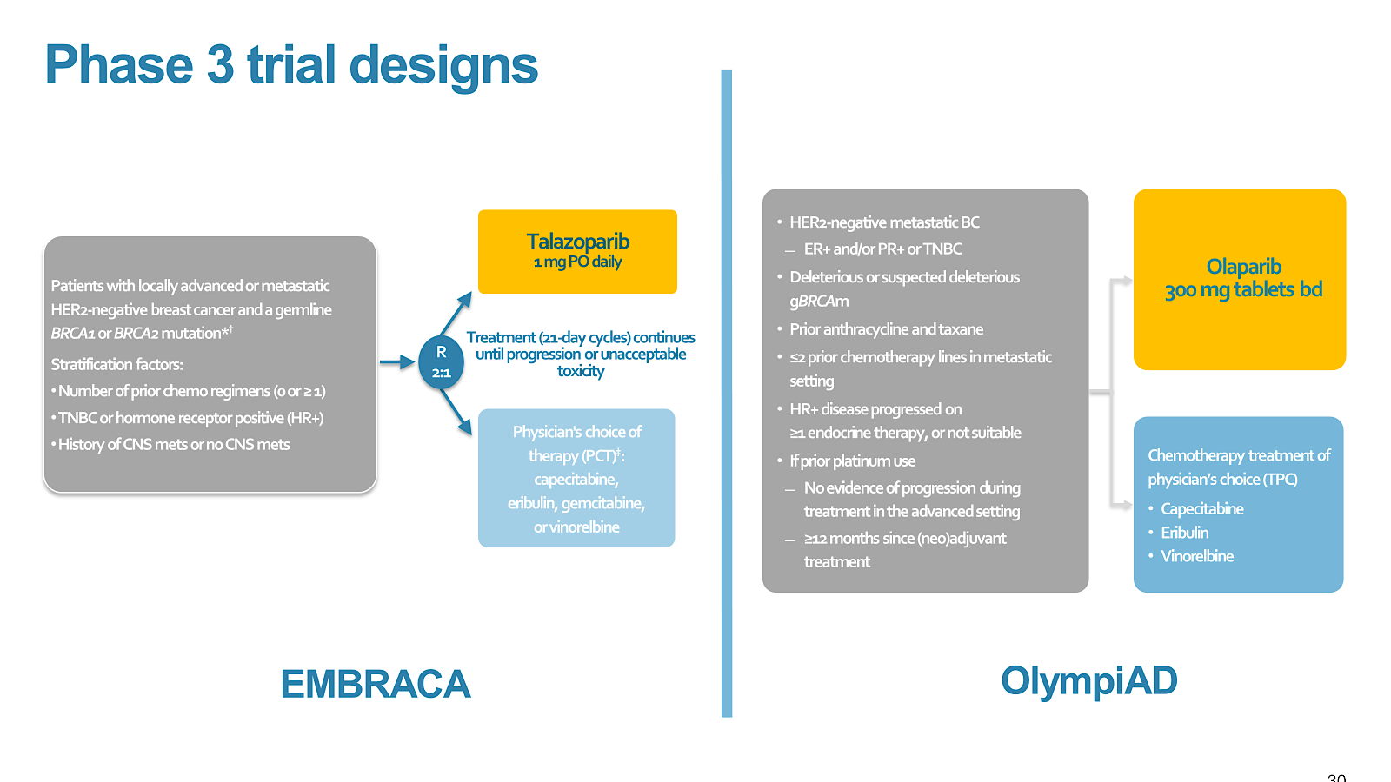
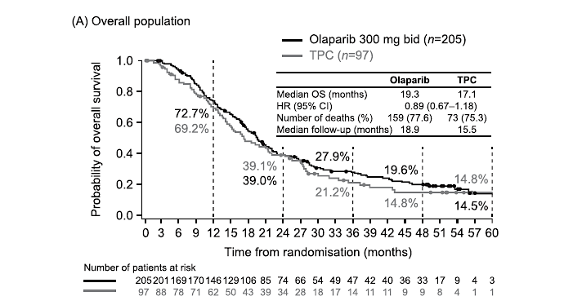
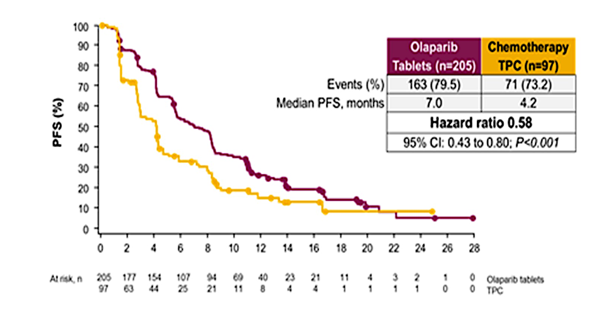
OlympiAD: Extended follow-up for overall survival and safety
Median follow-up: 25.7 months longer than that previously reported for OS and safety
Median OS: Olaparib (19.3 months) vs TPC (17.1 months) HR 0.90 (0.66 1.23)
Courtesy of Priyanka Sharma, MD
Robson et al European Journal of Cancer 184 (2023) 39e47

Slide 69
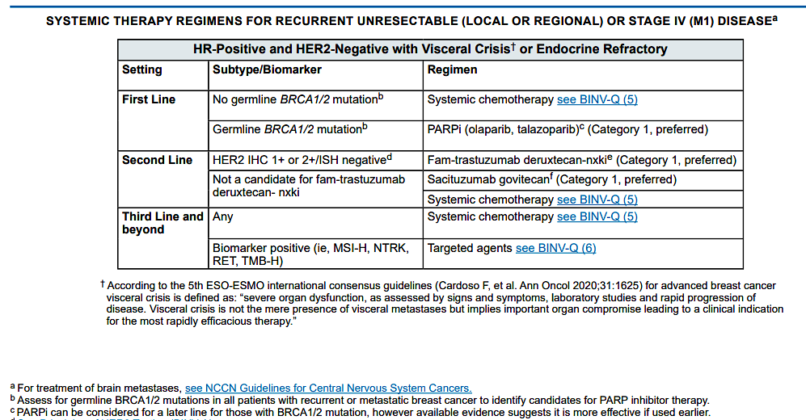
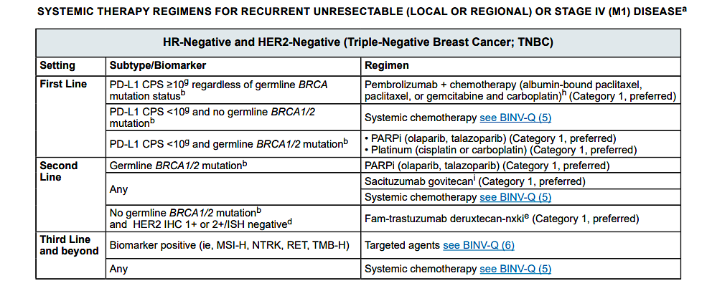
PARPi for MBC
Courtesy of Priyanka Sharma, MD

Slide 70
Antibody-Drug Conjugates – Part 1
Triple-Negative Breast Cancer
Bar Y et al. Dynamic HER2-low status among patients with triple negative breast cancer (TNBC): The impact of repeat biopsies. ASCO 2023;Abstract 1005.
Modi S et al. Trastuzumab deruxtecan (T-DXd) versus treatment of physician’s choice (TPC) in patients (pts) with HER2-low unresectable and/or metastatic breast cancer (mBC): Updated survival results of the randomized, phase III DESTINY-Breast04 study. ESMO 2023;Abstract 376O.
Loibl S et al. Health-related quality of life in the phase III ASCENT trial of sacituzumab govitecan versus standard chemotherapy in metastatic triple-negative breast cancer. Eur J Cancer 2023;178:23-33.

Slide 71
Third Annual National General Medical Oncology Summit
Friday, March 22, 2024 — 7:00 PM – 9:00 PM
Keynote Session Special Feature: Clinicians with Cancer
How do you think a medical oncologist with metastatic breast cancer would feel about enrolling on a clinical trial of a novel agent or strategy, such as an antibody-drug conjugate, after exhausting all available treatment options?

Slide 72
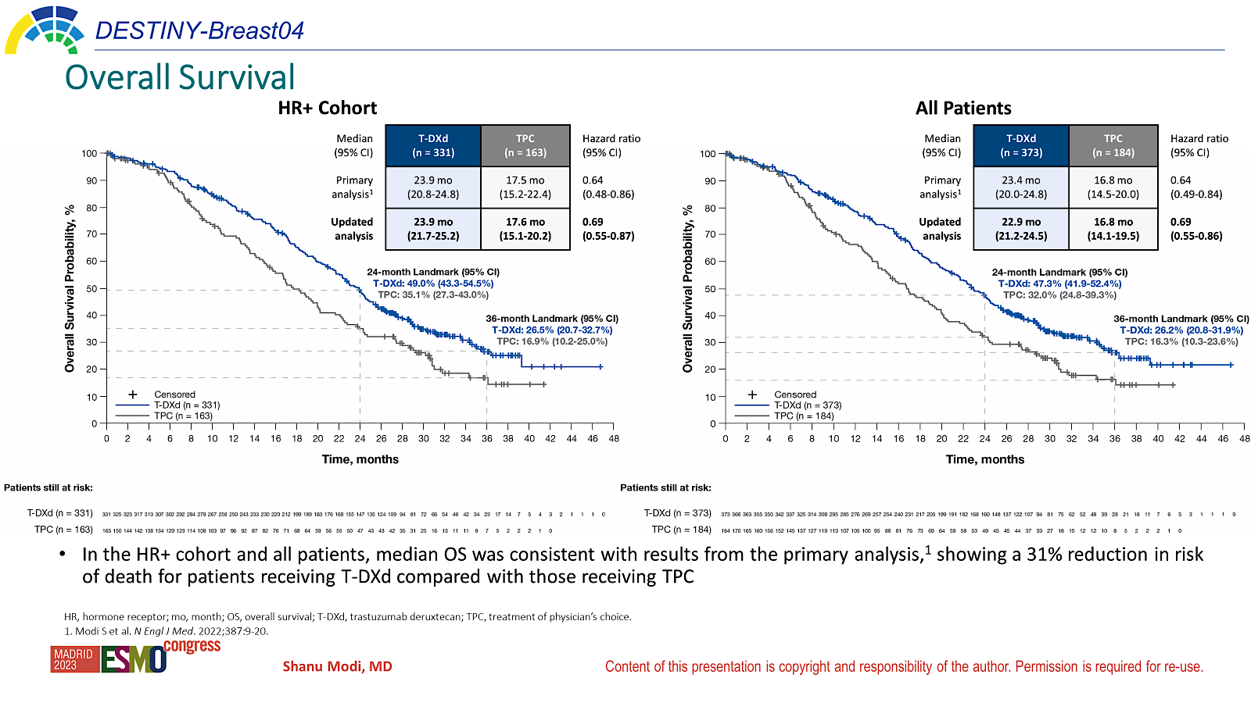
DB-04: Updated OS and safety
The median follow-up was 18.4 months at initial reporting
There were no new cases of ILD/pneumonitis since the primary analysis (data cutoff, January 11, 2022)
In the HR+ cohort and all patients, median OS was consistent with results from the primary analysis, showing a 31% reduction in risk of death for patients receiving T-DXd compared with those receiving TPC
Modi et ESMO 2023
Courtesy of Priyanka Sharma, MD

Slide 73
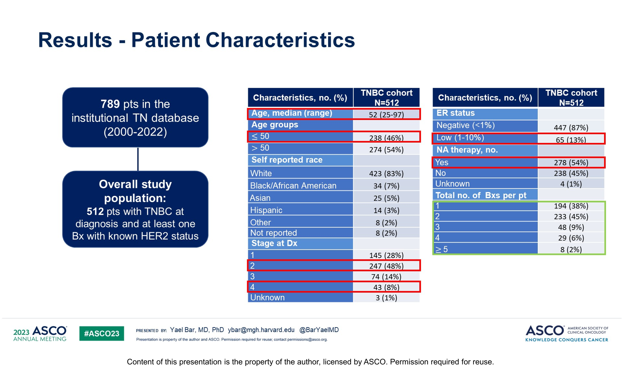
Impact of repeat biopsies on HER2-low status among patients with TNBC
Retrospective study
Bar Y et al ASCO 2023, Abstract # 1005
Courtesy of Priyanka Sharma, MD

Slide 74
Health-related quality of life in the phase III ASCENT trial of sacituzumab govitecan versus TPC in metastatic TNBC
HRQoL was assessed on day 1 of each treatment cycle using the EORTC QLQ-C30. Score changes from baseline were analysed using linear mixed-effect models for repeated measures. Stratified Cox regressions evaluated time to first clinically meaningful change of HRQoL.
  Data collected up to C6D1
  The analysis population comprised 236 patients randomized to SG and 183 to TPC.
SG > TPS: global health status (GHS)/QoL, physical functioning, fatigue, and pain
TPC> SG : nausea/vomiting and diarrhea
SG arm had a significantly better QLQ-C30 summary score Least-Square (LS) mean change from baseline than TPC arm.
Median TTW of GHS/QoL was similar in both treatment arms (14.1 weeks for SG and 15.1 weeks for TPC; HR Z 0.87, 95% CI 0.70 to 1.07; P Z 0.18)
Median time to first clinically meaningful worsening was longer for SG than for TPC for physical functioning (22.1 versus 12.1 weeks, P < 0.001), role functioning (11.4 versus 7.1 weeks, P < 0.001), fatigue (7.7 versus 6.0 weeks, P < 0.05), and pain (21.6 versus 9.9 weeks, P < 0.001).
SG prolongs progression-free survival and overall survival in patients with refractory/relapsed metastatic TNBC.
  SG generally associated with greater improvements and delayed worsening of HRQoL scores compared with TPC supporting its use for patients with mTNBC over TPC
Loibl et al Eur J of Cancer 2023
Courtesy of Priyanka Sharma, MD

Slide 75
Antibody-Drug Conjugates – Part 2
Triple-Negative Breast Cancer
Schmid P et al. Datopotamab deruxtecan (Dato-DXd) + durvalumab (D) as first-line (1L) treatment for unresectable locally advanced/metastatic triple-negative breast cancer (a/mTNBC): Updated results from BEGONIA, a phase Ib/II study. ESMO 2023;Abstract 379MO.
Krop IE et al. Patritumab deruxtecan (HER3-DXd), a human epidermal growth factor receptor 3-directed antibody-drug conjugate, in patients with previously treated human epidermal growth factor receptor 3-expressing metastatic breast cancer: A multicenter, phase I/II trial.
J Clin Oncol 2023;41(36):5550-60.
Zhang J et al. First-in-human/phase I trial of HS-20089, a B7-H4 ADC, in patients
with advanced solid tumors. ESMO 2023;Abstract 381O.

Slide 76
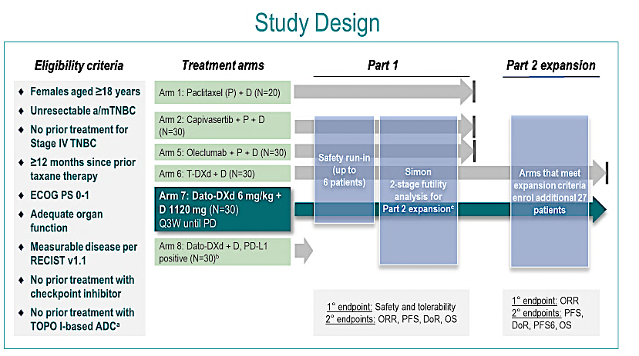
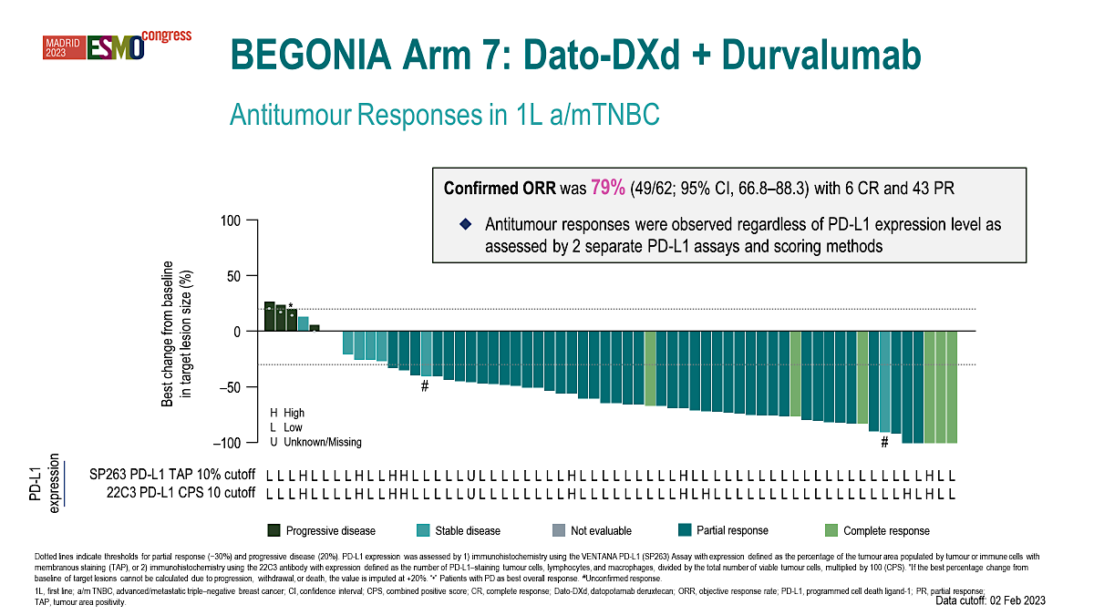
Datopotamab deruxtecan (Dato-DXd) + durvalumab as first-line treatment for unresectable locally advanced/metastatic TNBC: Updated Arm 7 results from phase Ib/II BEGONIA study
1° endpoints: Safety and tolerability
2° endpoints: ORR, PFS, DoR, OS
Characteristic | Dato-DXd + D N=62
Age, median (range), years | 53 (31–74)
No prior treatment, n (%) | 26 (42)
Prior treatments for early-stage disease, n (%)
Radiotherapy | 30 (48)
Cytotoxic chemotherapy | 33 (53)
Taxane | 26 (42)
Anthracycline | 29 (47)
Platinum compound | 9 (15)
Hormonal therapy | 10 (16)
Targeted therapy | 1 (2)
Visceral metastases,^{c} n (%) | 37 (60)
Lymph node metastases, n (%) | 42 (68)
PD-L1 expression,^{d} n (%)
High (TAP ≥10%) | 7 (11)
Low (TAP <10%) | 54 (87)
Unknown/Missing | 1 (2)
Courtesy of Priyanka Sharma, MD
Schmid P et al ESMO 2023, Abstract # 379MO

Slide 77
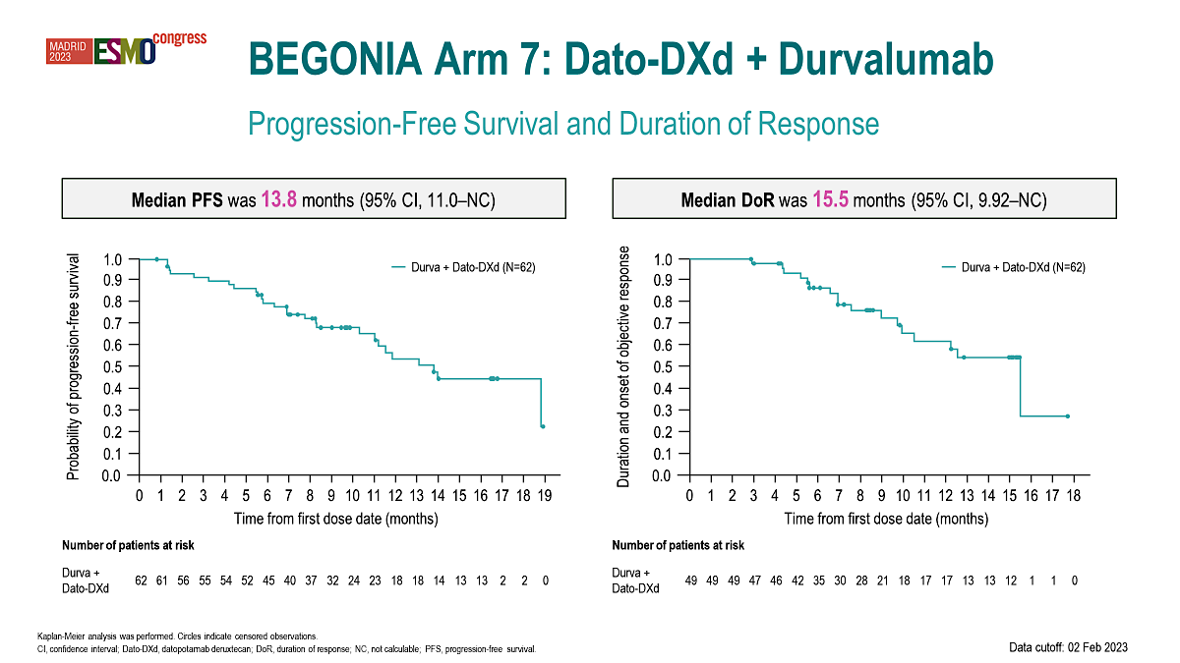
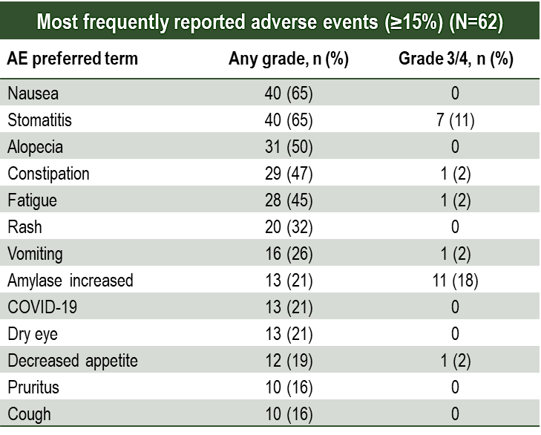
BEGONIA: Durvalumab plus Dato-DXd
Safety
Patients, n (%) | Dato-DXd + D N=62
Any AEs | 62 (100)
Grade 3/4 | 35 (57)
Any treatment-related AEsª | 62 (100)
Grade 3/4 | 27 (44)
Any serious AEs | 14 (23)
Treatment-related | 6 (10)
AEs leading to discontinuation of any treatments | 10 (16)
AEs leading to death^{b} | 1 (2)
Dose adjustments
Dato-DXd dose reduction | 18 (29)
Dato-DXd dose delay | 28 (45)
Durvalumab dose delay | 31 (50)
  The most common AEs were gastrointestinal
  Stomatitis was the most common AE leading to Dato-DXd dose reduction (11 patients)
  There were 3 (5%) adjudicated treatment-related ILD/pneumonitis events (2 grade=2, 1 grade=1)
  The most frequent AESIs were for stomatitis (65%), rash (32%), dry eye (21%), hypothyroidism (14.5%), and keratitis (14.5%)
Courtesy of Priyanka Sharma, MD

Slide 78
ADC plus IO combination in TNBC
Combination of Dato-DXd plus Durva yielded robust activity in first line setting
  Only 50% had prior chemotherapy for early-stage disease
  Single arm design prohibits assessment of combination vs Dato-DXd monotherapy efficacy
    Data-DXd monotherapy ORR in much heavily pre-treated patient population (TROPION-PanTumor01, Median of 3 prior lines of therapy): 33%
Ocular toxicity: pretreatment ophthalmology evaluation required
Stomatitis: Prophylactic management with steroid mouth wash
On-going Phase III trials of ADC plus IO in TNBC
TROPION-Breast02 (recruiting): 1st line trial comparing Dato-DXd to investigator's choice chemotherapy in patients with mTNBC who are not candidates for PD-1/PD-L1 Inhibitor therapy (NCT05374512)
TROPION-Breast03 (recruiting): Dato-DXd with or without Durvalumab Versus Investigator's Choice of Therapy in Patients With Stage I-III TNBC with residual disease Following Neoadjuvant Therapy (NCT05629585)
TROPION-Breast04 (recruiting): Randomized Study of Neoadjuvant Dato-DXd Plus durvalumab followed by adjuvant durvalumab Versus neoadjuvant pembrolizumab plus chemotherapy followed by adjuvant pembrolizumab for Triple-Negative or Hormone Receptor-low/HER2-negative Breast Cancer (NCT06112379)
ASCENT-04 (recruiting): Sacituzumab Govitecan and Pembrolizumab Versus TPC and Pembrolizumab in Previously Untreated, Locally Advanced Inoperable or Metastatic TNBC (PD-L1+) (NCT05382286)
ASCENT-05 (recruiting): Sacituzumab Govitecan and Pembrolizumab Versus Treatment of Physician's Choice TNBC with Residual Invasive Disease after neoadjuvant Therapy and Surgery (NCT05633654)
Courtesy of Priyanka Sharma, MD

Slide 79
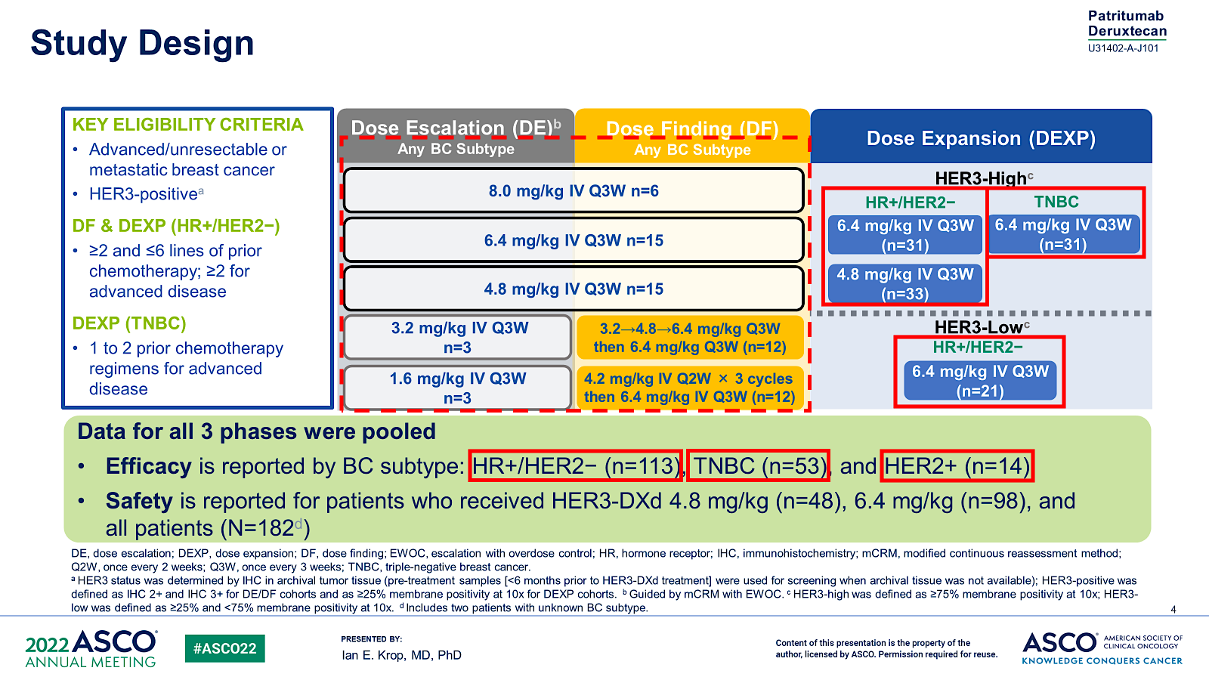
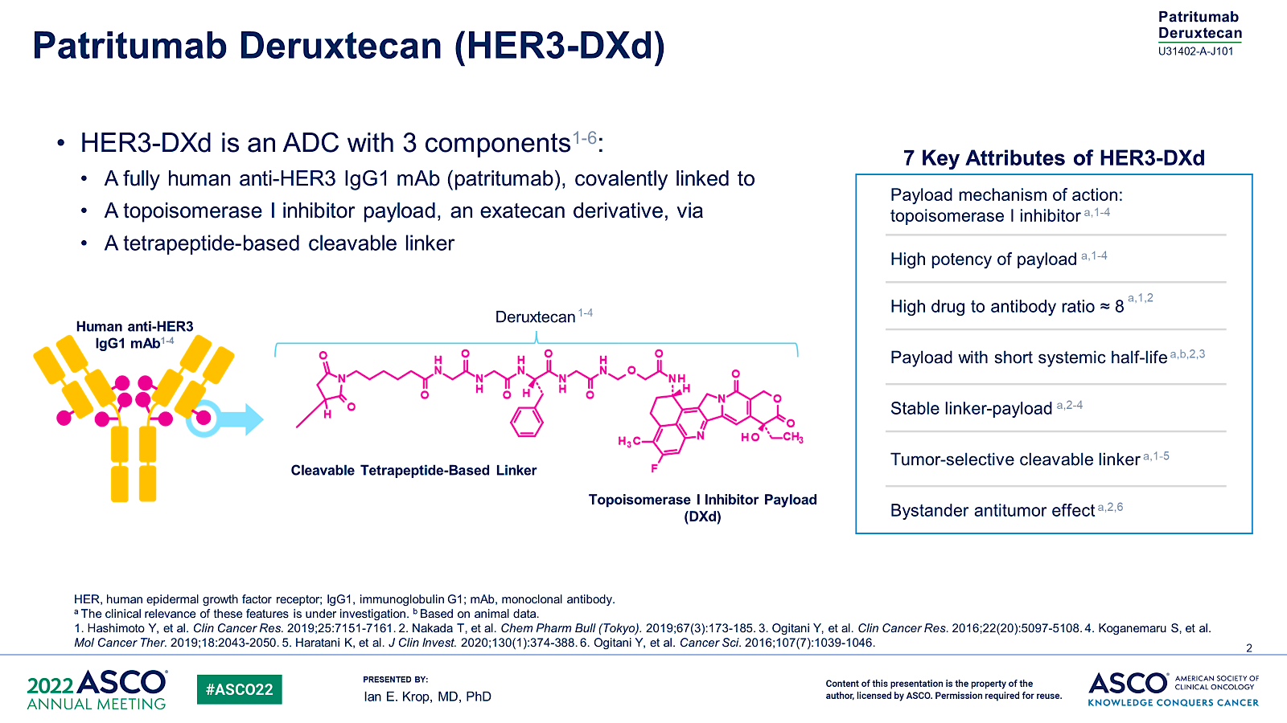
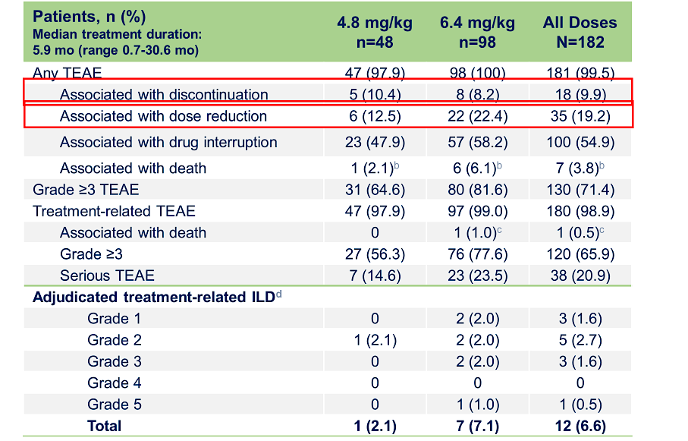
Patritumab deruxtecan (HER3-DXd) in previously treated HER3-expressing metastatic breast cancer: Phase I/II trial
HER3 was determined by IHC in archival tumor tissue (pre-treatment samples [<6 months prior to HER3-DXd treatment])
-HER3-positive was defined as IHC 2+ and IHC 3+ for DE/DF cohorts and as ≥25% membrane positivity at 10x for DEXP cohorts.
-HER3-high was defined as ≥75% membrane positivity at 10x
-HER3-low was defined as ≥25% and <75% membrane positivity at 10x
GI and hematologic toxicity were the most common TEAEs
The rate of adjudicated treatment-related ILD was 7%; most cases were grade 1 and 2
Krop IE et al JCO 2023;41(36):5550-60.
Courtesy of Priyanka Sharma, MD

Slide 80
Clinical Activity of HER3-DXd Across BC Subtypes
Outcomes (BICR per RECIST 1.1) | HR+/HER2− (n=113) | TNBC (n=53) | HER2+ (n=14)
 | HER3-High and -Low | HER3-High | HER3-High
Confirmed ORR, % (95% CI​ª) | 30.1 (21.8-39.4) | 22.6 (12.3-36.2) | 42.9 (17.7-71.1)
Best overall response, %^{b}
PR | 30.1 | 22.6 | 42.9
SD | 50.4 | 56.6 | 50.0
PD | 11.5 | 17.0 | 7.1
NE | 8.0 | 3.8 | 0.0
DOR, median (95% CI), mo | 7.2 (5.3-NE) | 5.9 (3.0-8.4) | 8.3 (2.8-26.4)
PFS, median (95% CI), mo | 7.4 (4.7-8.4) | 5.5 (3.9-6.8) | 11.0 (4.4-16.4)
6-month PFS rate, % (95% CI) | 53.5 (43.4-62.6) | 38.2 (24.2-52.0) | 51.6 (22.1-74.8)
OS, median (95% CI), mo | 14.6 (11.3-19.5) | 14.6 (11.2-17.2) | 19.5 (12.2-NE)
HER3-DXd demonstrated antitumor activity across BC subtypes
Antitumor activity was also demonstrated across the range of HER3 expression
As a similar safety profile was seen with 4.8 mg/kg and 6.4 mg/kg
5.6 mg/kg dose is being evaluated in BC in many ongoing trials
Courtesy of Priyanka Sharma, MD
Krop IE et al Clin Oncol 2023;41(36):5550-60.

Slide 81
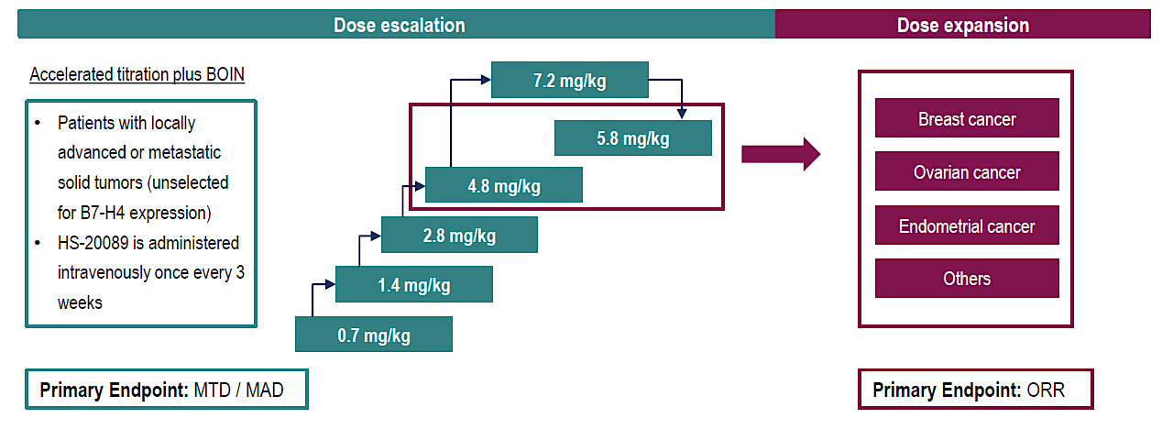
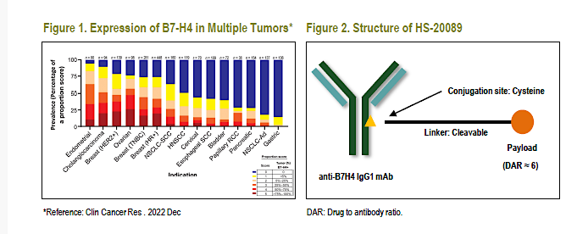
First-in-human/phase I trial of HS-20089, a B7-H4 ADC, in patients with advanced solid tumors.
B7 homolog 4 protein (B7-H4), a transmembrane glycoprotein in the B7 superfamily, is highly expressed in various types of solid tumors with low expression in normal tissues
HS-20089 is a novel B7-H4 targeted ADC
  Target; B7-H4, Toxin: topoisomerase I inhibitor (DAR:6)
  protease-cleavable linker
N=52 patients treated at 6 dose levels
Mean of 3.7 prior therapy lines:
N=48 with breast cancer (n=32 TNBC)
MTD: 5.8 mg/kg.
Most common Gr 3 TRAEs were hematological toxicity. Grade 1-2 N/V and LFT increase noted in >20% of patients
There was no adverse event leading to death. No interstitial pneumonia or infusion reactions reported.
Zhang J et al. ESMO 2023;Abstract 381O.
Courtesy of Priyanka Sharma, MD

Slide 82
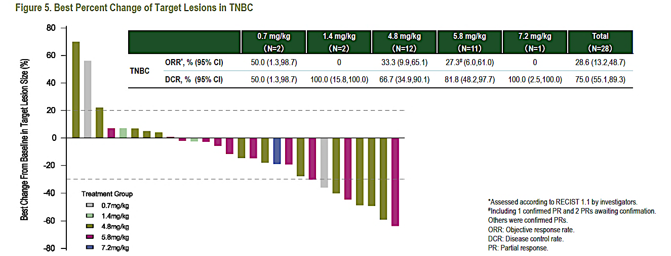
B7-H4 ADC, in patients with advanced solid tumors: Efficacy in TNBC
At potential target therapeutic doses of 4.8 and 5.8 mg/kg, the ORRs were 33.3% and 27.3%, respectively.
ORR in patients treated with prior IO (n=7): 42%
? ORR in patients treated with prior ADC
PFS and median duration of response not reported
Expansion is ongoing
Zhang J et al. ESMO 2023;Abstract 381O.
Courtesy of Priyanka Sharma, MD

Slide 83

ADCs in TNBC: present and future
? ADC with non-Topo 1 payload
Very little is known about mechanisms of resistance:
  ? Target, ? Payload, ? Both ? others
? ADC after ADC efficacy:
  Optimal sequence for mTNBC?: Should level of target expression guide decisions? current methods of target level expression (IHC based) are not optimal to guide selection of therapy
    Need quantitative assays
  Will be an important question to answer if ADCs move in curative setting (Residual disease and Neoadjuvant trials are ongoing)
TROP-2 ADCs with Topo-1 payload: SG approved regardless of HER2 low/zero (>1 Line)
  Dato-DXd, SKB264 (MK-2870)
HER2 ADC: T-DXd (Topo-1 payload) Approved for HER2 low mTNBC (> 1L)
HER3 ADC: HER3-DXd (Topo 1 payload): In trials
B7-H4 ADC: HS-20089 (Topo 1 payload): In trials
Bispecific antibodies: In trials
Courtesy of Priyanka Sharma, MD

