Slide 1


Triple Negative Breast Cancer
Priyanka Sharma, MD
Professor of Medicine
University of Kansas Medical Center

Slide 2
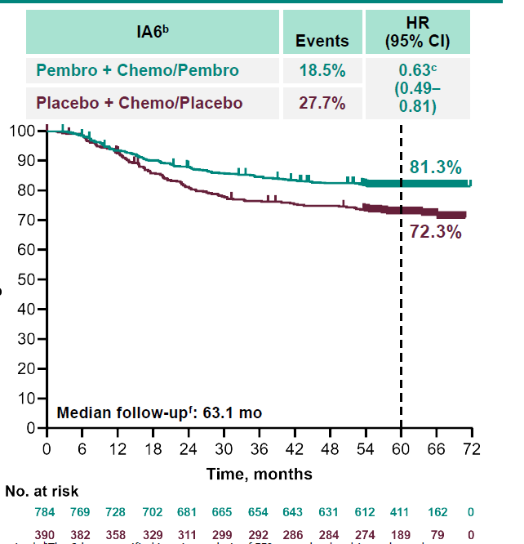
KEYNOTE-522: IA6
EFS by pCR
Δ=4%
92.2%
pCR Yes
HR (95% CI)
0.65 (0.39-1.08)
88.2%
Δ=9%
62.6%
Δ=10.3%
pCR No
HR (95% CI)
0.72 (0.54-0.96)
52.3%
38% of patients with RD with EFS event despite pembrolizumab
Need better therapies
108/201
Data cutoff date: March 23, 2023.
Schmid et al ESMO 2023
Notes:
At median follow up of a little over 5 years 81% in patients on pembro arm and 72% in those in chemo arm, a delta of 9%. When looking at EFS by pCR

Slide 3
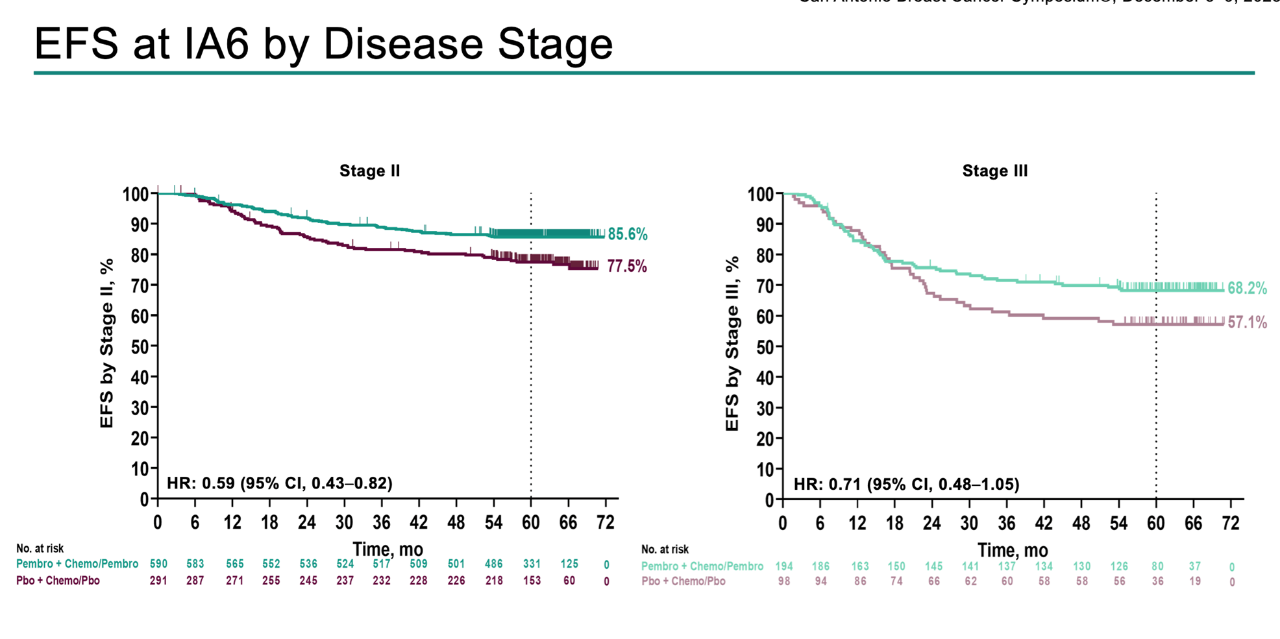
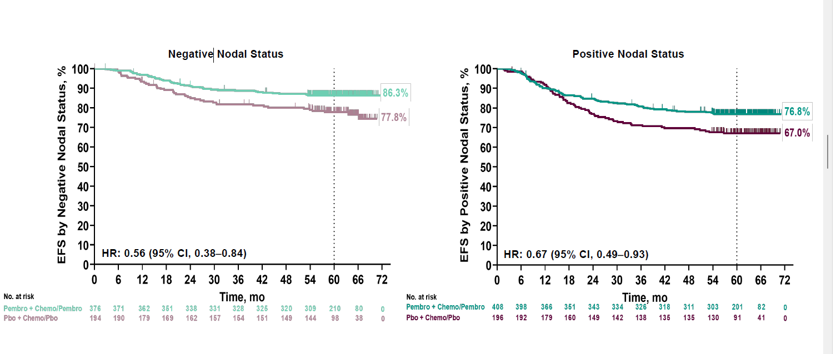
KEYNOTE-522: subgroup analysis
32% of patients with EFS event despite pembrolizumab
Need better therapies
77% of patients with N-ve disease without EFS event with chemotherapy alone
Not all patients may need treatment escalation beyond chemotherapy
Schmid et al SABCS 2023

Slide 4
KN-522: IA6 summary
  After a median follow-up of >5 years, neoadjuvant pembro + chemo followed by adjuvant pembrolizumab continues to show a clinically meaningful improvement in EFS compared with neoadjuvant chemo alone
  The EFS benefit was generally consistent in subgroups based on TNM stage (II/III) and nodal status (+/-)
  Follow-up for OS is ongoing
  EFS improvement in pembrolizumab group was observed regardless of pCR outcome
    ? Driven primarily by neoadjuvant pembrolizumab. ? What is the relative contribution of adjuvant pembrolizumab
  pCR/RD: locally assessed. ? Reliability of local assessment of pCR in an international trial
Notes:
A word of caution about outcomes based on pCR or not. pCR was locally assessed in the trial and Local pCR assessment in an international trial may not be consistent and as accurate as we would like

Slide 5
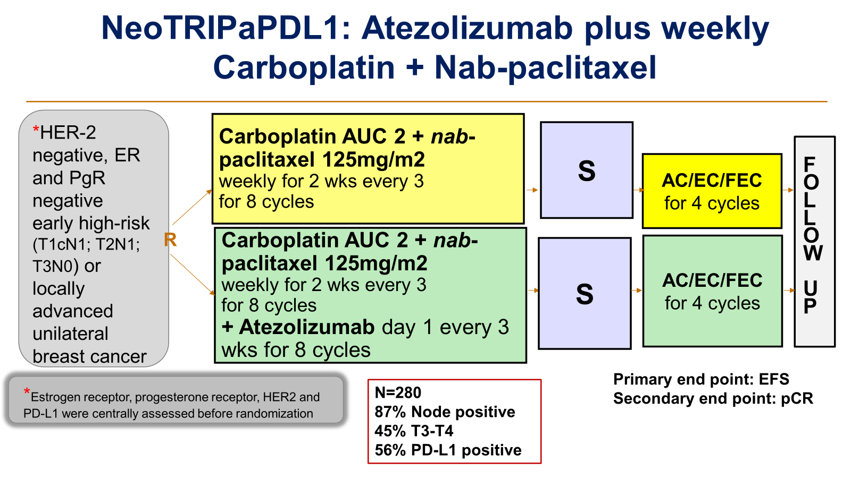
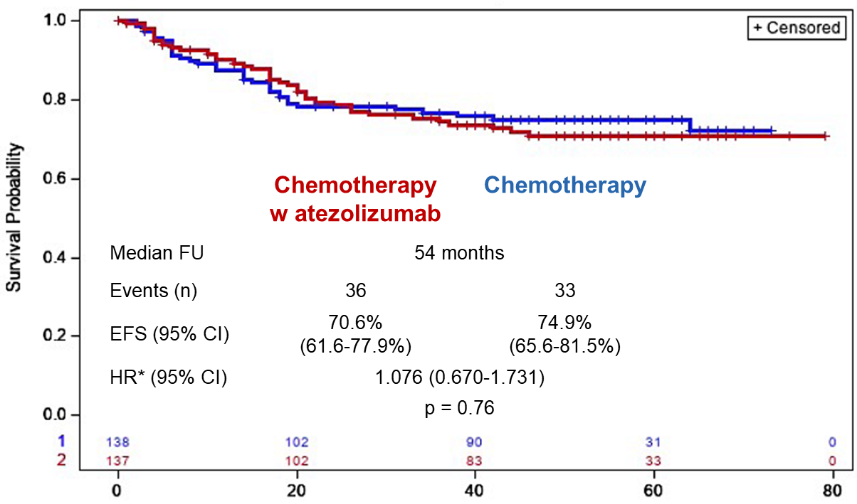
NeoTRIPaPDL1: Atezolizumab plus weekly Carboplatin + Nab-paclitaxel
EFS
No adjuvant ICB
PD-L1 status and pCR
pCR, positive PD-L1, earlier stage
as well as higher sTILs
were all prognostic and linked to better EFS, but they were not predictive of atezolizumab benefit
Gianni et al Annal Oncol 2022, Gianni et al ESMO 2023

Slide 6
Why no pCR or EFS Benefit in NeoTRIPaPDL1?
  PDL-1 vs PD-1 inhibitor
    IMpassion031: pCR better, EFS numerically better with atezolizumab
    mTNBC: Atezo plus taxane not statistically superior to taxane (IMpassion130, 131)
  Chemotherapy backbone: no anthracycline
  Anatomic risk of enrolled population:
    90% with node positive disease (compared to 30% in IMpassion031)
    With high anatomical risk would efficacy be more in line with what is observed in mTNBC?
  Differences in tumour biology: Higher TILs in chemo alone arm giving the control arm inherent better prognosis compared to IO arm
  Chance
Notes:
Compared to other breast cancer subtypes

Slide 7
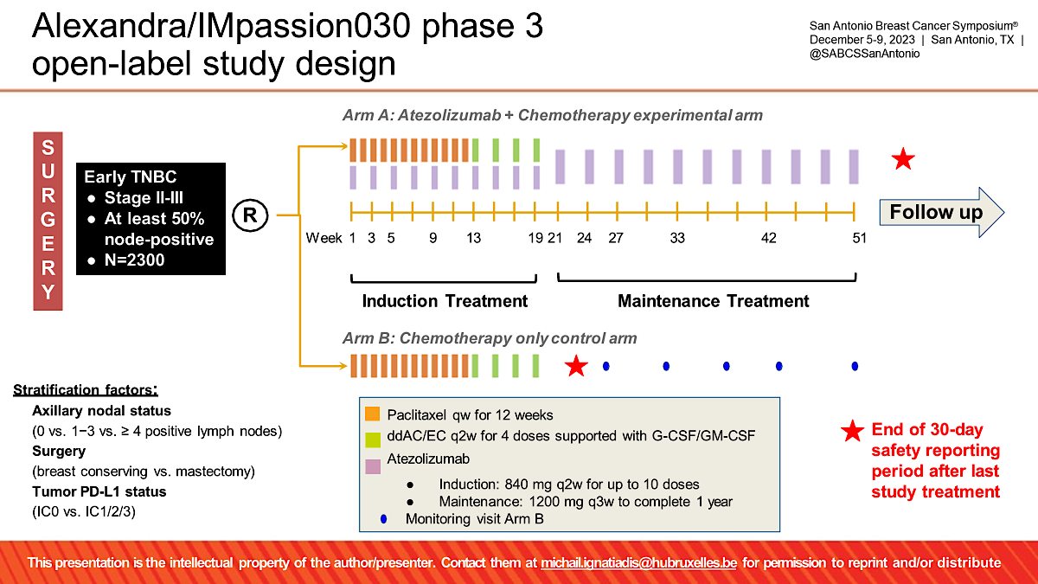
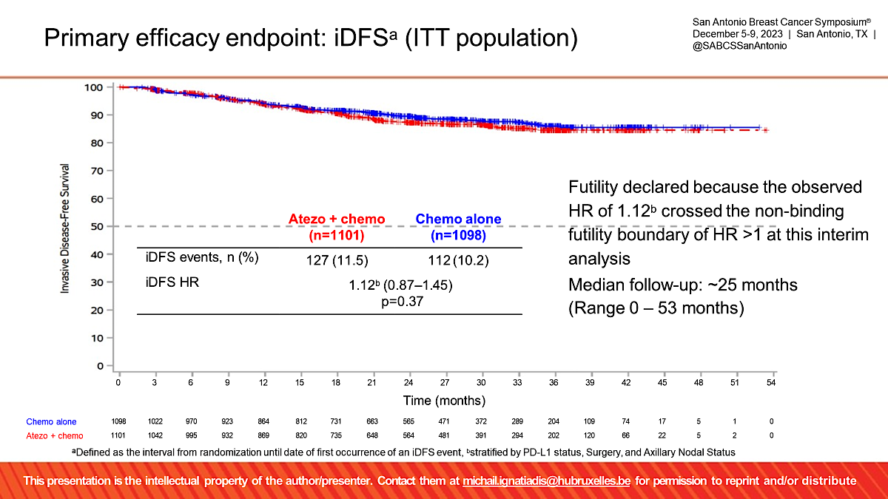
ALEXANDRA/IMpassion030 phase 3 trial : Adjuvant IO (without neoadjuvant component)
iDFS: Primary End Point
Timing of IO matters: Neoadjuvant more effective than adjuvant IO
Previous Animal data consistent with clinical findings (Liu et al Cancer Discover 2015)
Similar observations in other cancer like Melanoma
Ignatiadis SABCS 2023

Slide 8
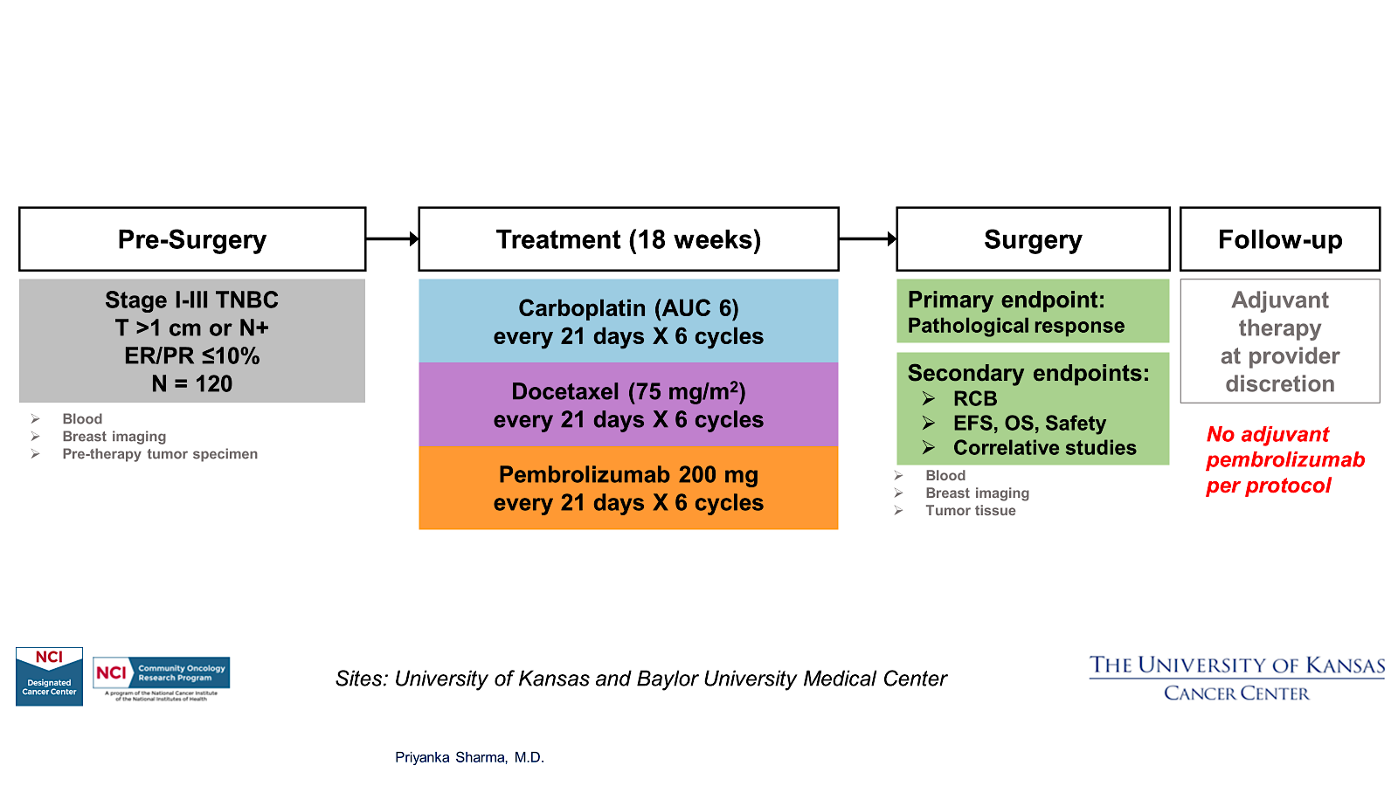
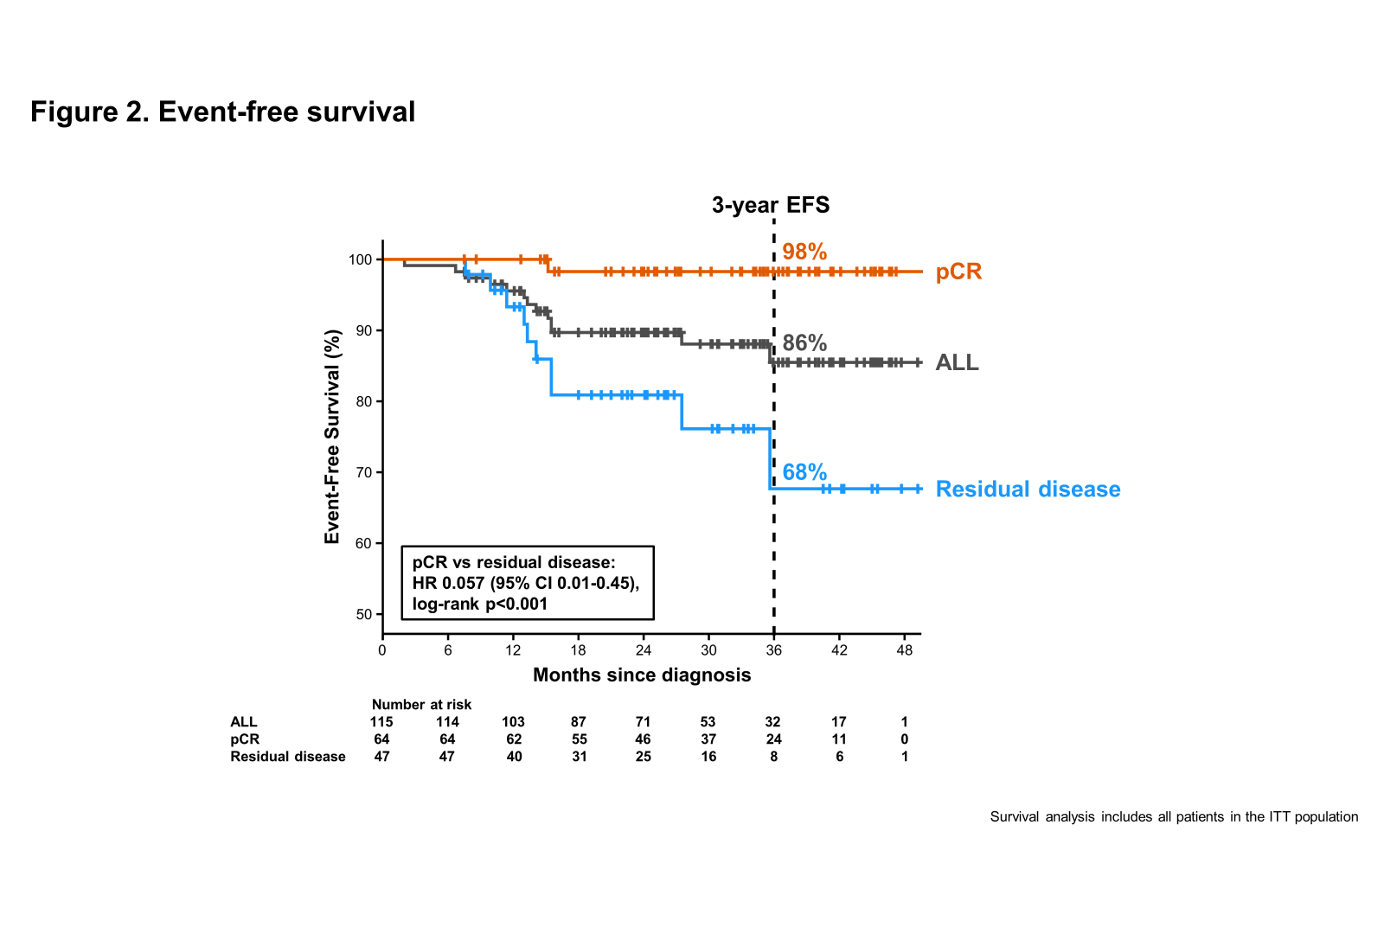
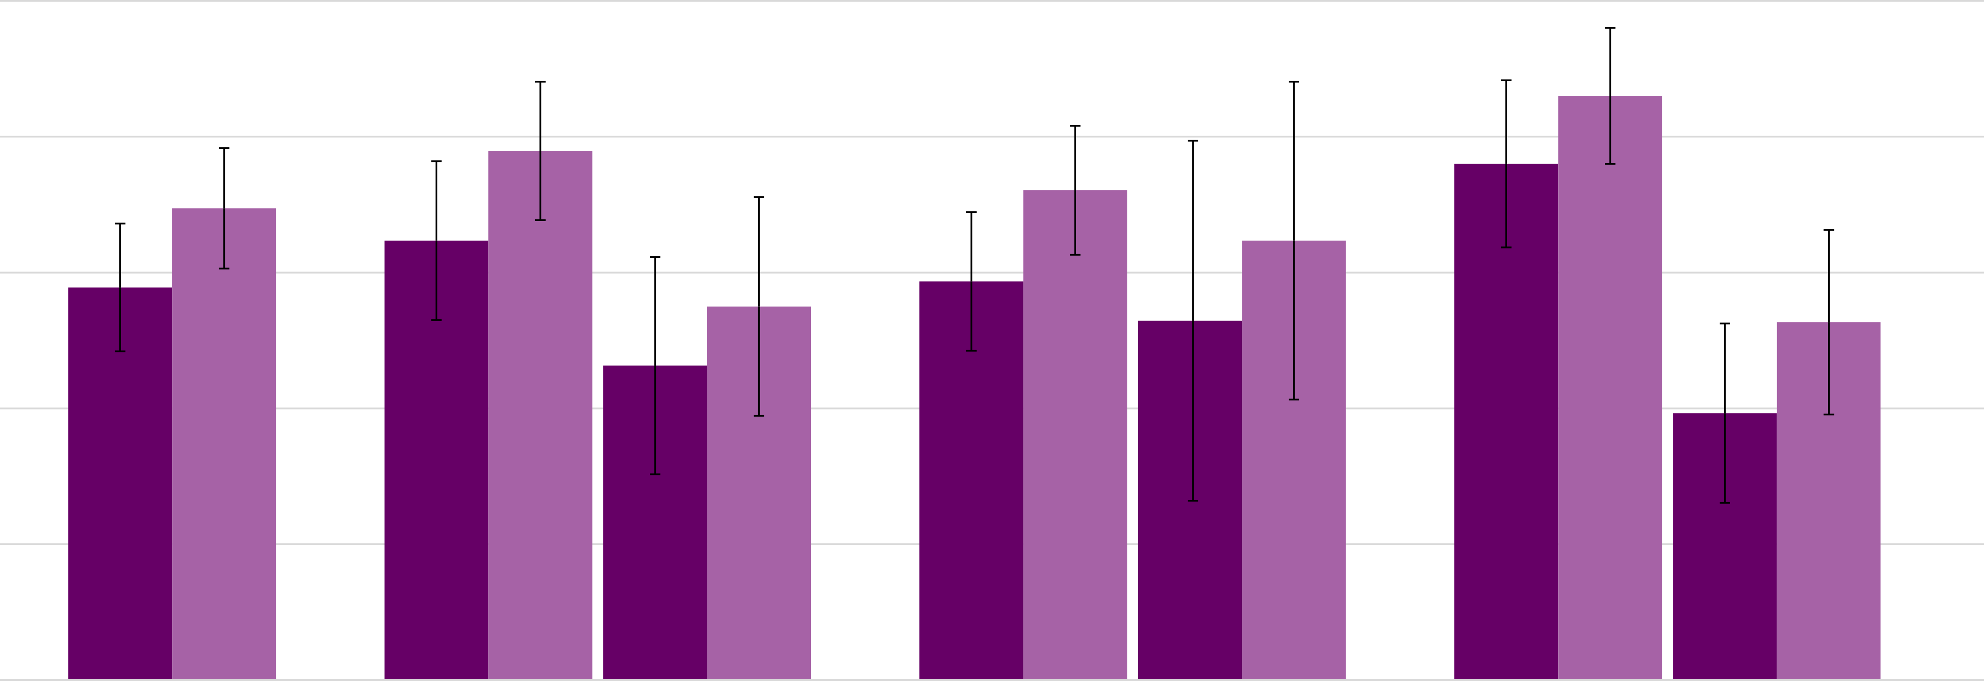
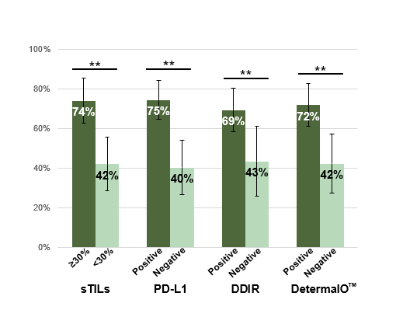
NeoPACT: Carboplatin + Docetaxel+ Pembrolizumab
100%
RCB 0+1
86%
80%
78%
pCR
72%
76%
60%
Provide data on an alternative anthracycline-free chemoimmunotherapy regimen for patients who are not eligible/wish to avoid anthracycline-based regimens and support further evaluation of this regimen as a chemotherapy de-escalation strategy in randomized studies (On going SWOG 2212 trial)
69%
58%
53%
40%
46%
39%
20%
0%
N=111
Immune enrichment assessed by sTILs, PD-L1 or IO response signature was noted in almost 50% of patients and was associated with high pCR rates exceeding 70%.
Sharma et al JAMA Oncology 2023

Slide 9

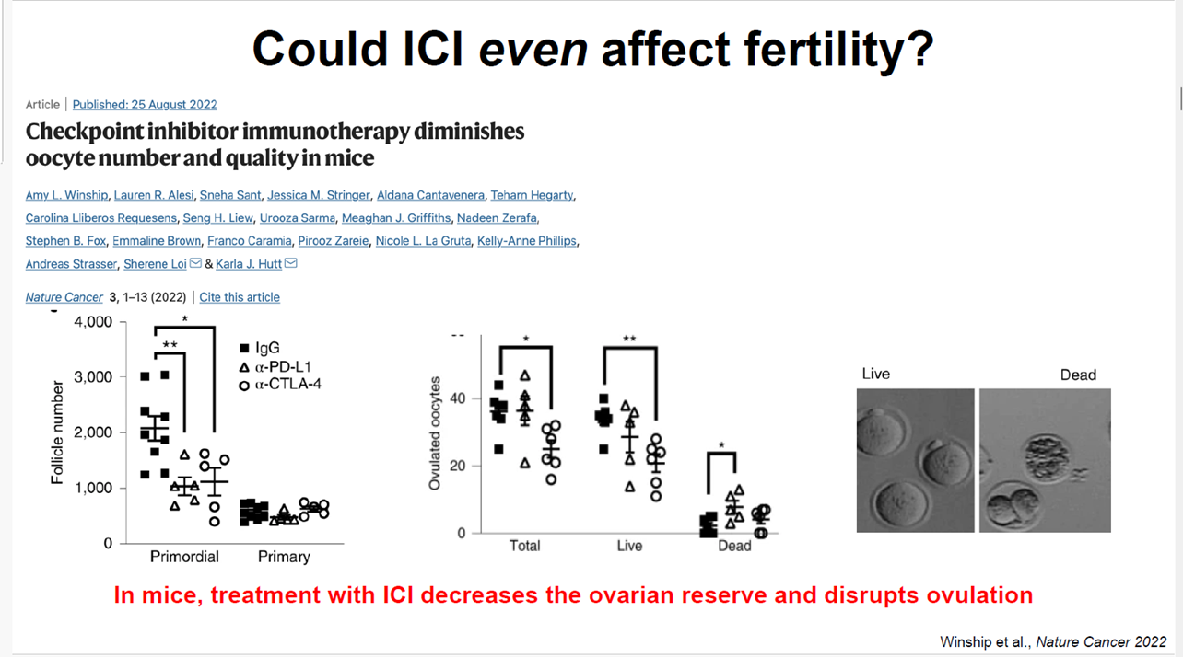
irAE: KN-522 real world toxicity
Real World data
N=577 (17 sites), 18.2% Blacks
Delayed toxicity
N=320, Patients with BC undergoing ICI at UCSF
25% had Delayed toxicities : > 90d after ICI START
  Median time to onset 6 months (range 91-1800days )
7.5% had Post-treatment toxicities >60d after STOPPING ICI
  Median time to onset 4 months (range 69-1100d)
Most common delayed & post-treatment irAEs were hypothyroidism, colitis, rash ,adrenal insufficiency and hepatitis
Adverse drug events(ADE) causing dose reduction | 37.6%
ADE leading to early discontinuation | 39.5%
irAE, all grades | 71%
irAE > 3 | 33.5%
More than what meets the eye
 | Blacks | Whites | p
pCR | 52.3% | 55.9% | 0.6
> 3 irAE | 20.9% | 33.8% | 0.011
Hospitalization rate | 39% | 36% | 0.5
Hofherr et al SABCS 2023, Jacob et al SABCS 2023

Slide 10
Metastatic TNBC
First line Chemo plus IO
  KN355 additional analysis
  TORCHLIGHT study
Approved ADC updates
  DB-04 Updated OS analysis, ASCENT QOL
ADC + IO: BEGONIA updated analysis
Novel ADCs: Patritumab deruxtecan (HER3 ADC), HS 20089 (B7 H4 ADC)
Optimal Capecitabine dosing
PARPi: OlympiAD OS and safety update

Slide 11
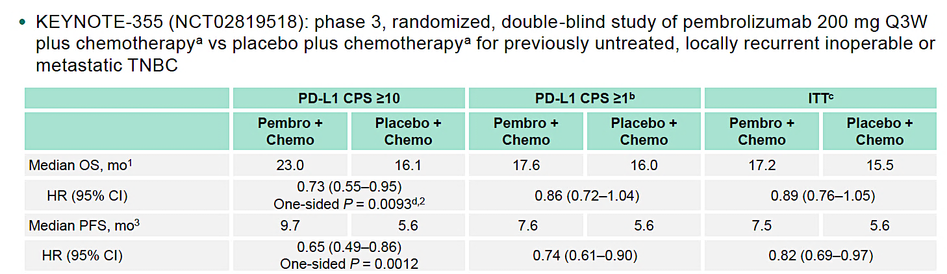
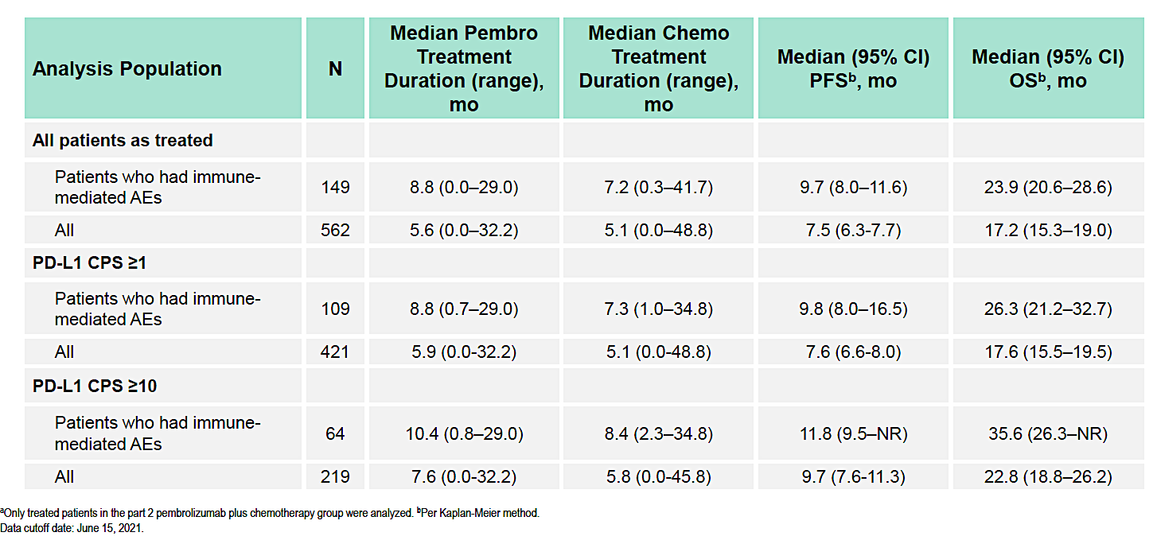
KEYNOTE-355: Outcomes in Patients Who Discontinued Chemotherapy Before Pembrolizumab and in Patients With Immune Mediated AEs
PFS and OS in Patients treated with pembro+ chemo with or without irAE
30% of patients with irAE
Exploratory analyses to evaluate efficacy in patients who:
–Had disease control and discontinued chemotherapy
before pembrolizumab
–Experienced immune-mediated AEs
Rugo et al ESMO 2023
Notes:
847 were randomly assigned to treatment, with 566 patients in the pembrolizumab–chemotherapy group and 281 patients in the placebo–chemotherapy group.
CPS > 10: 220 vs 103
ORR: 52% in CPS > 10 with chemo plus pembro.

Slide 12
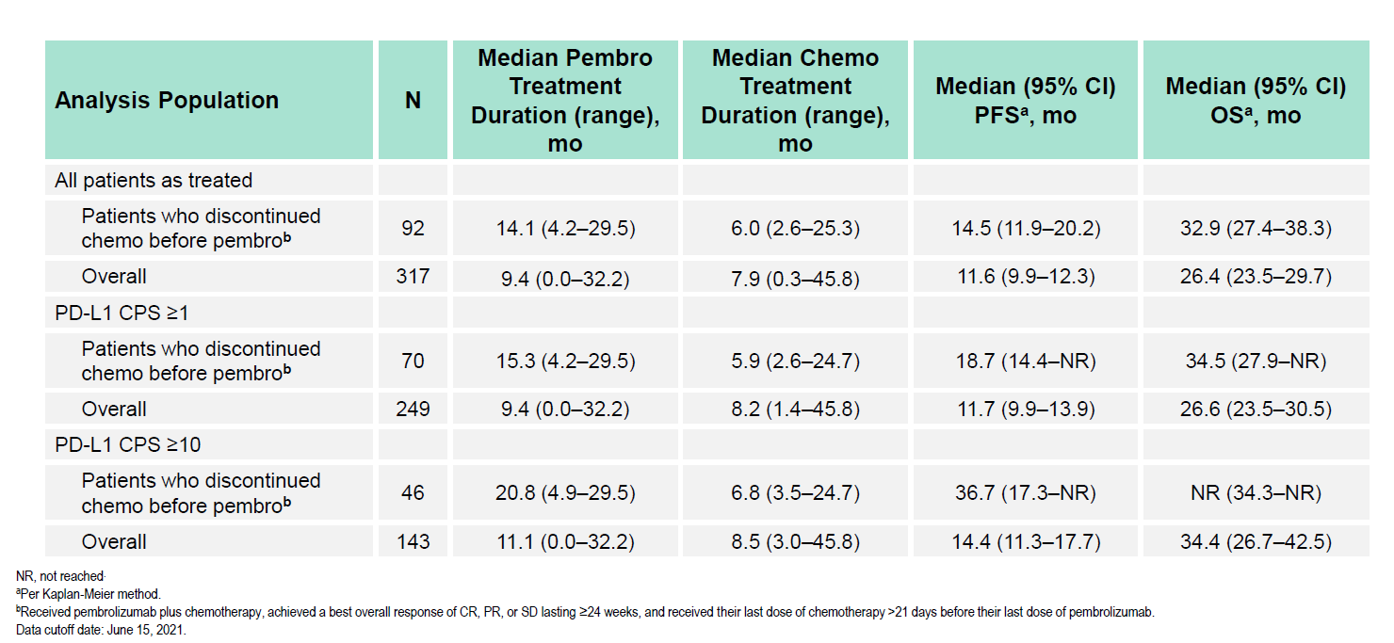
KEYNOTE-355: Outcomes in Patients Who Discontinued Chemotherapy Before Pembrolizumab and in Patients With Immune Mediated AEs
PFS and OS in Patients Treated With Pembro+
Chemo Who Had CR, PR, or SD ≥24 Weeks
24% of patients with CR/PR/SD (clinical benefit) stopped chemo prior to stopping pembrolizumab
There was no evidence of detrimental effect on PFS or OS among patients with clinical benefit who discontinued chemotherapy and continued pembrolizumab monotherapy
  Numerically better PFS and OS
Reassuring data for patients who get initial benefit from the chemo-pembro combination
  Chemotherapy can safely be stopped after 6-8 cycles for side effects (neuropathy, fatigue, QOL)
Patients with irAEs derived similar benefit from pembrolizumab as the overall CPS > 10 population
24% of patients with CR/PR/SD
Notes:
847 were randomly assigned to treatment, with 566 patients in the pembrolizumab–chemotherapy group and 281 patients in the placebo–chemotherapy group.
CPS > 10: 220 vs 103
ORR: 52% in CPS > 10 with chemo plus pembro.

Slide 13
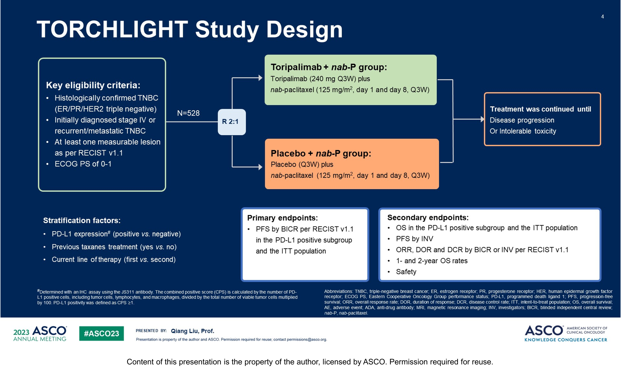
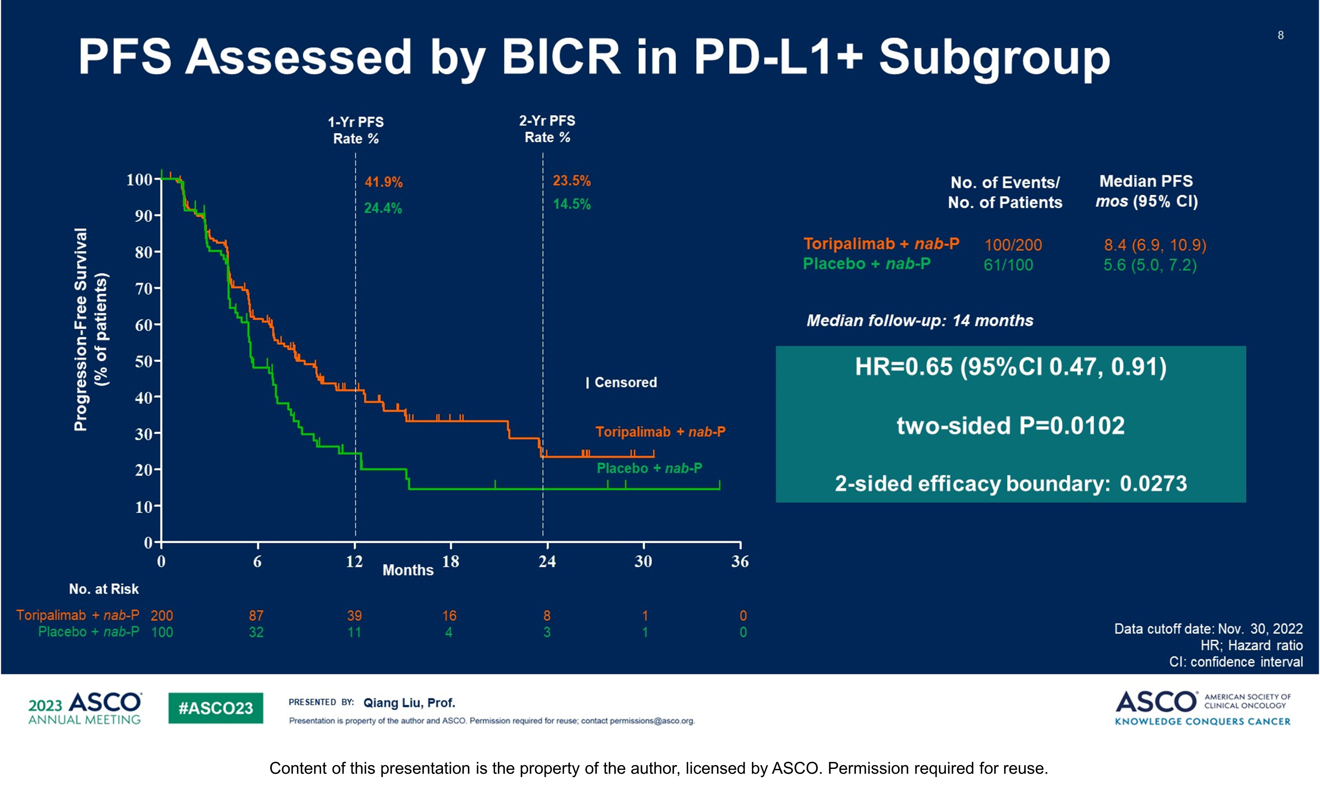
TORCHLIGHT: A randomized, double-blind, phase III trial of toripalimab versus placebo, in combination with nab-paclitaxel (nab-P) for patients with metastatic or recurrent triple-negative breast cancer (TNBC). ASCO 2023;Abstract LBA1013
N=531, Toripalimab:PD1 antibody
-PDL1 assay (CPS, JS311 antibody): CPS > 1 considered PDL1+ve, 56% PDL1+ve
-Data presented: prespecified IA of PFS in PDL1+ population and ITT
-93% first line, 28-31% de-novo metastatic, Prior taxane in only 15%
Median PFS 8.4 vs 5.6 months, HR 0.65
Liu et al ASCO 2023

Slide 14
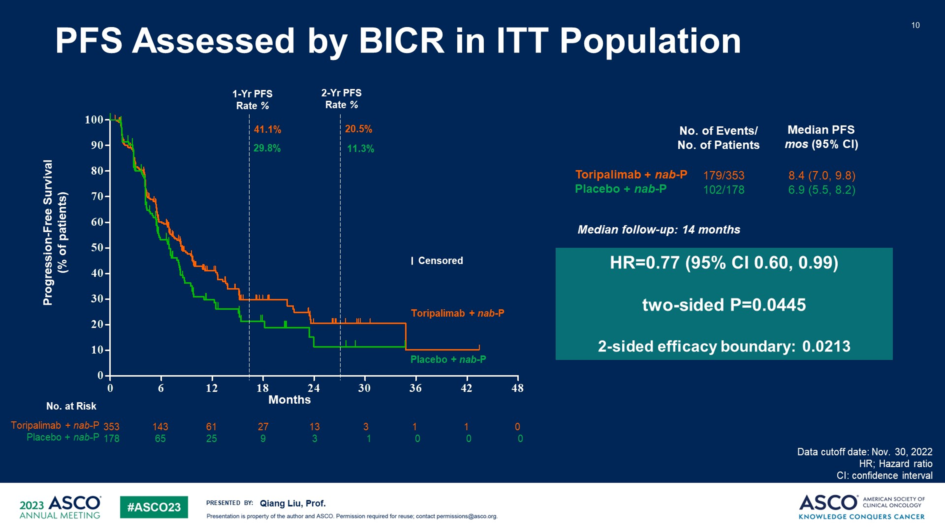
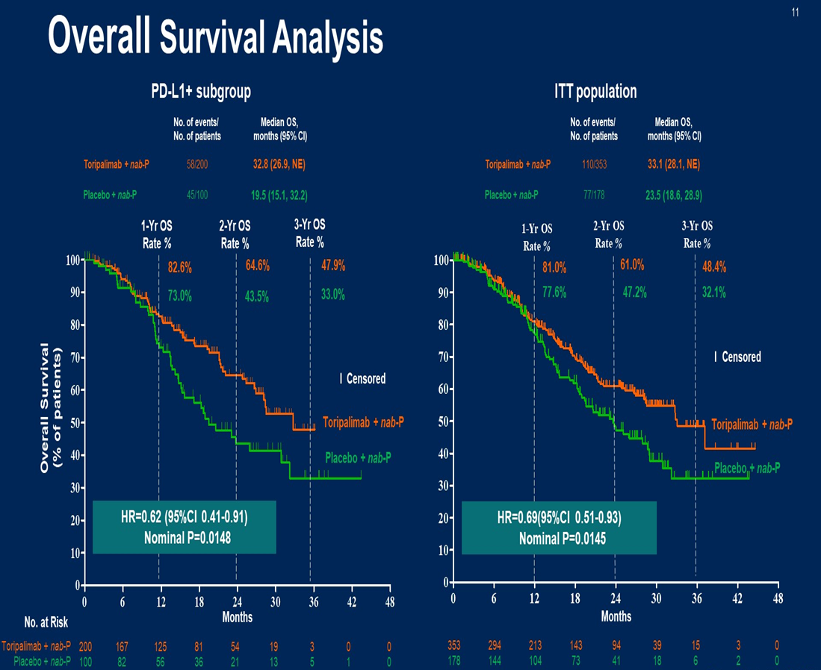
TORCHLIGHT
Hierarchal testing: PFS in PDL1+→PFS in ITT→OS in PDL1+
Median OS in PDL1+: 19.5 vs 32.8 months
Median PFS in ITT: 8.4 vs 6.9 months, HR 0.77
Toxicity: Details of % of irAEs or irAEs of all types not provided
“No new safety signals” per authors
Liu et al ASCO 2023

Slide 15
TORCHLIGHT: Summary
At IA 1 PFS prolonged with addition of toripalimab to nab-paclitaxel in PDL1+ population
  HR and Median PFS very similar to KN355
PFS in ITT did not meet the prespecified hierarchal testing boundary at IA 1
OS data is immature, Follow up ongoing
PDL1 testing by yet another assay and threshold
Enrollment only in China: ? approval path for other countries/regions
Limited toxicity data provided
Notes:
We hope to see more details on toxicity in future presentations.

Slide 16
Health-related quality of life in the phase III ASCENT trial of sacituzumab govitecan versus TPC in metastatic TNBC
HRQoL was assessed on day 1 of each treatment cycle using the EORTC QLQ-C30. Score changes from baseline were analysed using linear mixed-effect models for repeated measures. Stratified Cox regressions evaluated time to first clinically meaningful change of HRQoL.
  Data collected up to C6D1
  The analysis population comprised 236 patients randomized to SG and 183 to TPC.
SG > TPS: global health status (GHS)/QoL, physical functioning, fatigue, and pain
TPC> SG : nausea/vomiting and diarrhea
SG arm had a significantly better QLQ-C30 summary score Least-Square (LS) mean change from baseline than TPC arm.
Median TTW of GHS/QoL was similar in both treatment arms (14.1 weeks for SG and 15.1 weeks for TPC; HR Z 0.87, 95% CI 0.70 to 1.07; P Z 0.18)
Median time to first clinically meaningful worsening was longer for SG than for TPC for physical functioning (22.1 versus 12.1 weeks, P < 0.001), role functioning (11.4 versus 7.1 weeks, P < 0.001), fatigue (7.7 versus 6.0 weeks, P < 0.05), and pain (21.6 versus 9.9 weeks, P < 0.001).
SG prolongs progression-free survival and overall survival in patients with refractory/relapsed metastatic TNBC.
  SG generally associated with greater improvements and delayed worsening of HRQoL scores compared with TPC supporting its use for patients with mTNBC over TPC
Loibl et al Eur J of Cancer 2023

Slide 17
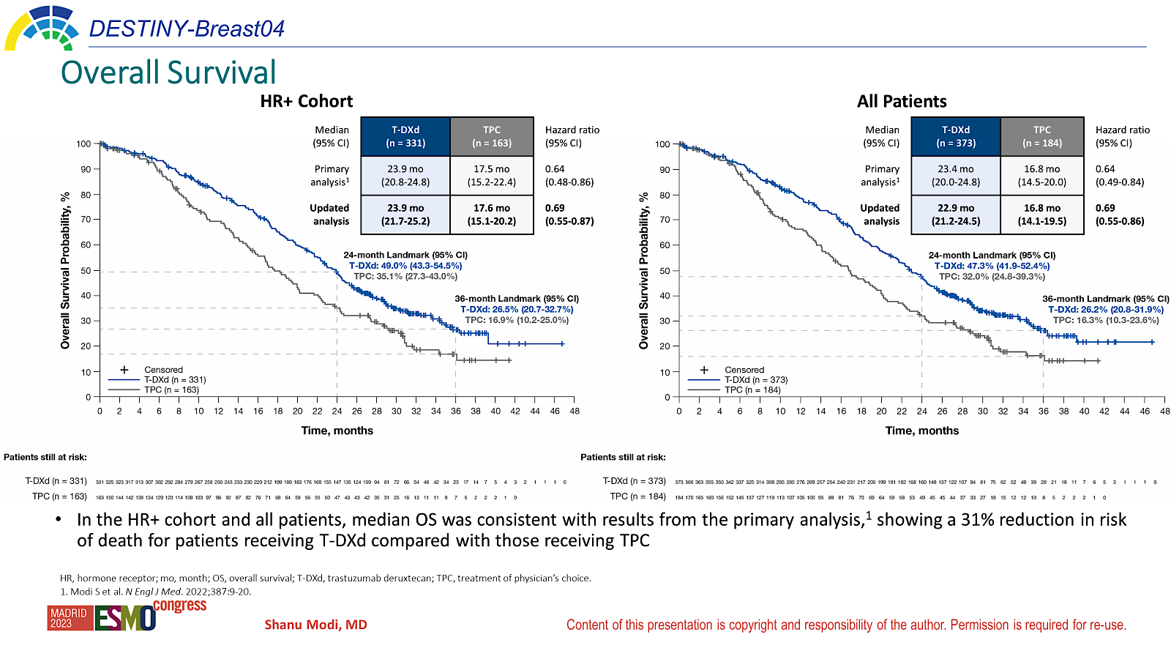
DB-04: Updated OS and safety
The median follow-up was 18.4 months at initial reporting
There were no new cases of ILD/pneumonitis since the primary analysis (data cutoff, January 11, 2022)
In the HR+ cohort and all patients, median OS was consistent with results from the primary analysis, showing a 31% reduction in risk of death for patients receiving T-DXd compared with those receiving TPC
Modi et ESMO 2023

Slide 18
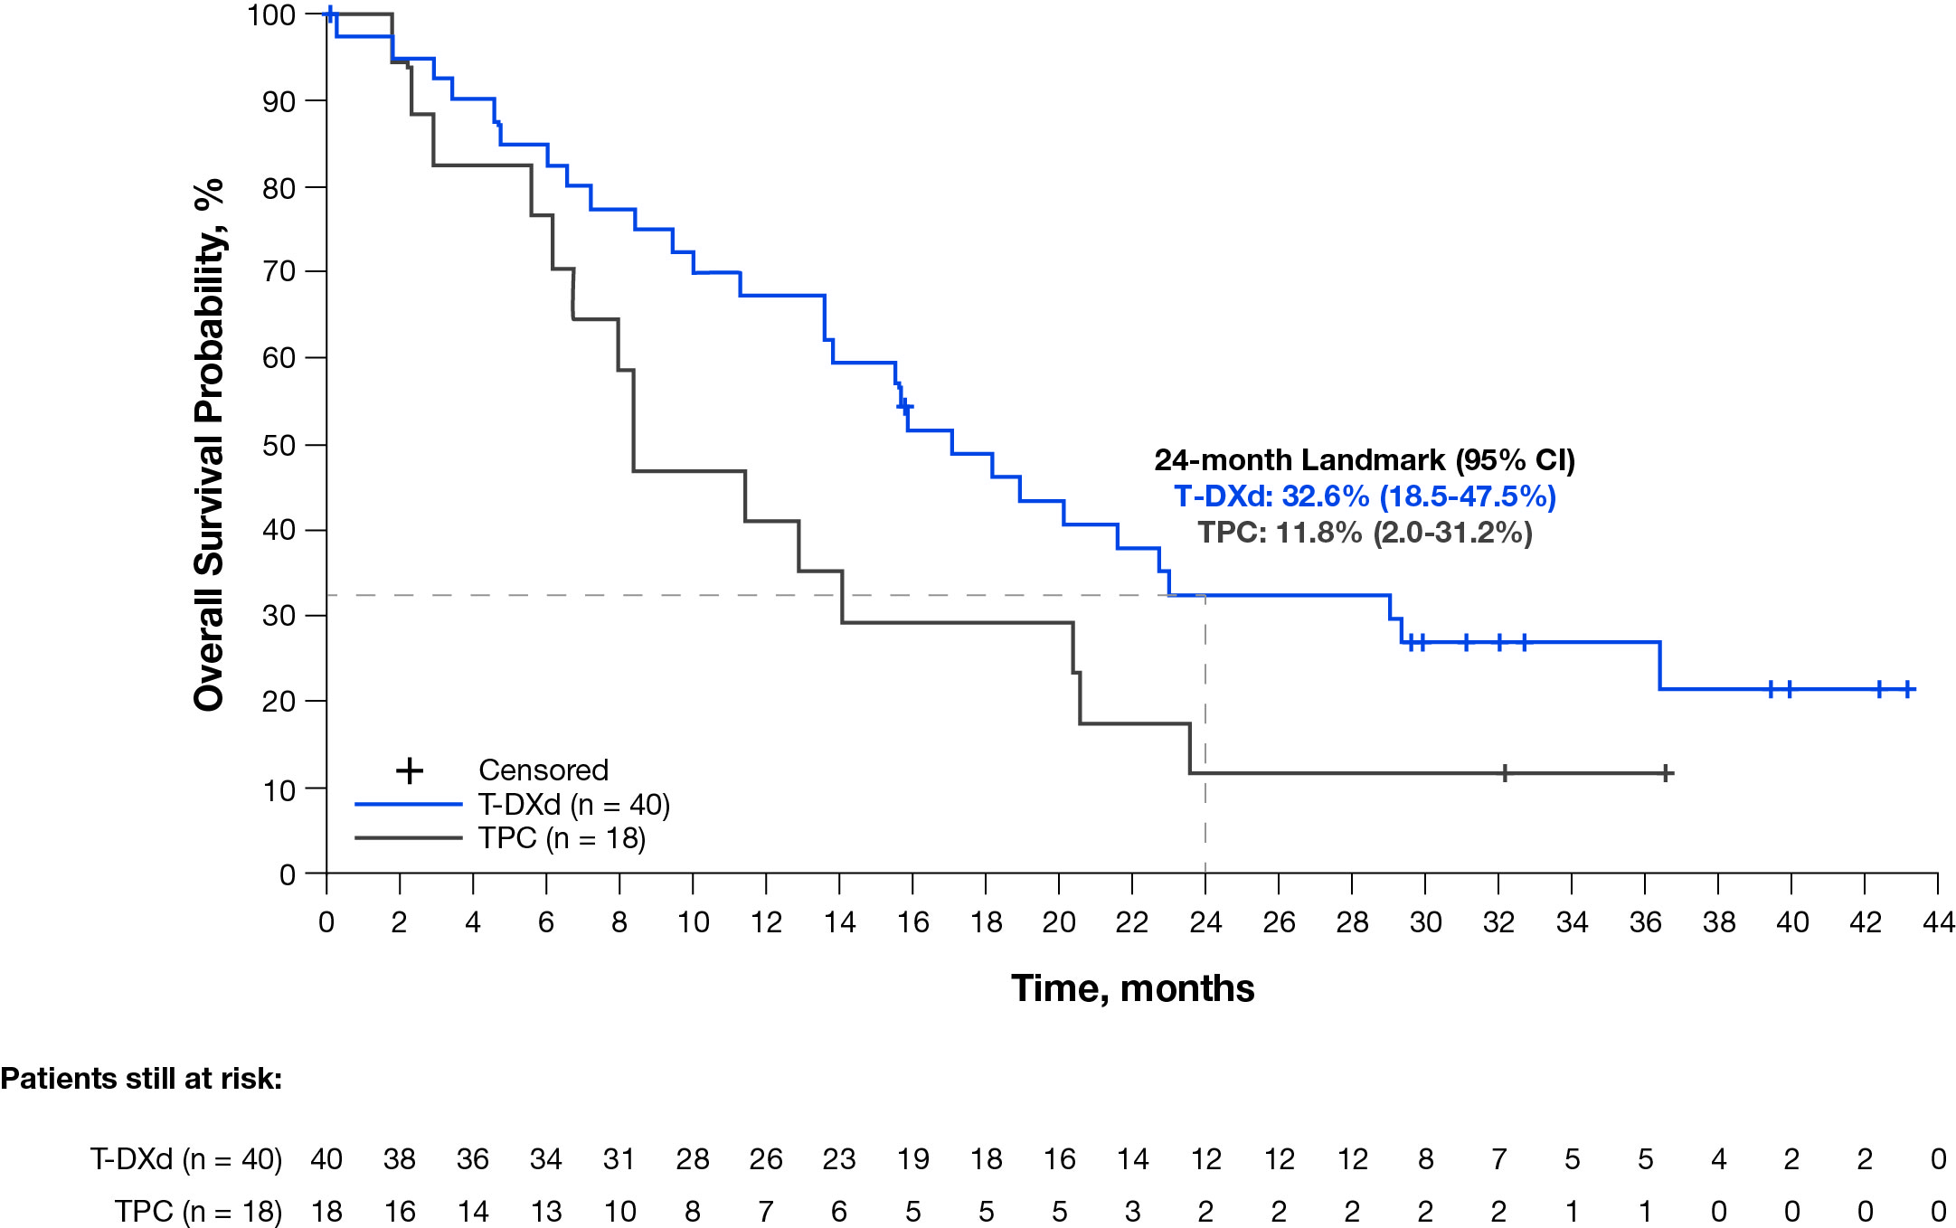
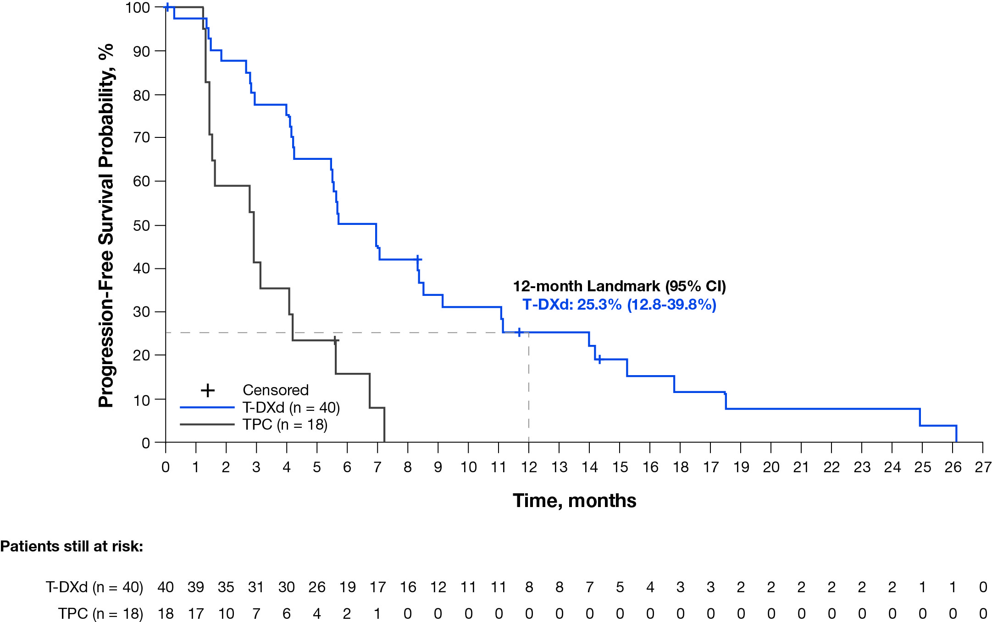
DB-04 Updated OS: Efficacy in the HR− Cohort (Exploratory Analyses)
Overall Survival
Progression-Free Survival (by Investigator)
Median (95% CI) | T-DXd (n = 40) | TPC (n = 18) | Hazard ratio (95% CI)
Primary analysis¹ | 18.2 mo (13.6-NE) | 8.3 mo (5.6-20.6) | 0.48 (0.24-0.95)
Updated analysis | 17.1 mo (13.6-23.0) | 8.3 mo (5.6-20.4) | 0.58 (0.31-1.08)
Median (95% CI) | T-DXd (n = 40) | TPC (n = 18) | Hazard ratio (95% CI)
Primary analysis (by BICRª)¹ | 8.5 mo (4.3-11.7) | 2.9 mo (1.4-5.1) | 0.46 (0.24-0.89)
Updated analysis (by investigator) | 6.3 mo (4.2-8.5) | 2.9 mo (1.4-4.2) | 0.29 (0.15-0.57)
ªPFS by investigator was not analyzed for the HR− cohort at the time of the primary analysis.
There was a 42% reduction in risk of death and 71% reduction in risk of disease progression or death for HR− patients receiving T-DXd compared with TPC
Modi et ESMO 2023

Slide 19
DB-04: Updated OS and safety
Results from the 32-month median follow-up for DB-04 confirm the sustained improvement in PFS and OS for T-DXd over TPC in HER2-low (IHC 1+, IHC 2+/ISH−) mBC
  Some drop in median PFS and OS in the T-DXd arm in the HR− Cohort (Exploratory Analyses) but HR continues to be similar to the initial analysis
With longer treatment duration, the overall safety profile of T-DXd was consistent with the primary analysis
  Rates of ILD/pneumonitis remained unchanged with longer follow-up

Slide 20
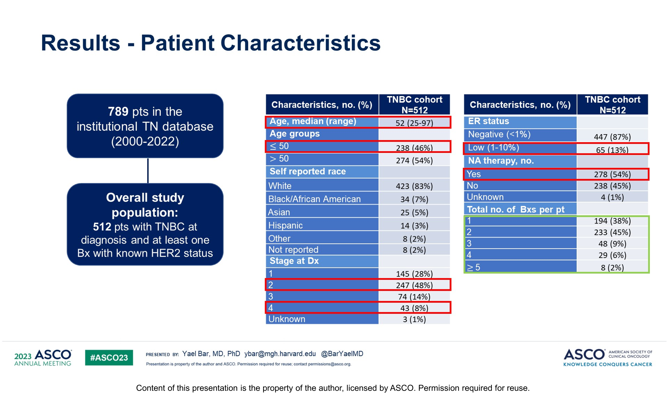
Impact of repeat biopsies on HER2-low status among patients with TNBC
Retrospective study
Bar Y et al ASCO 2023, Abstract # 1005

Slide 21
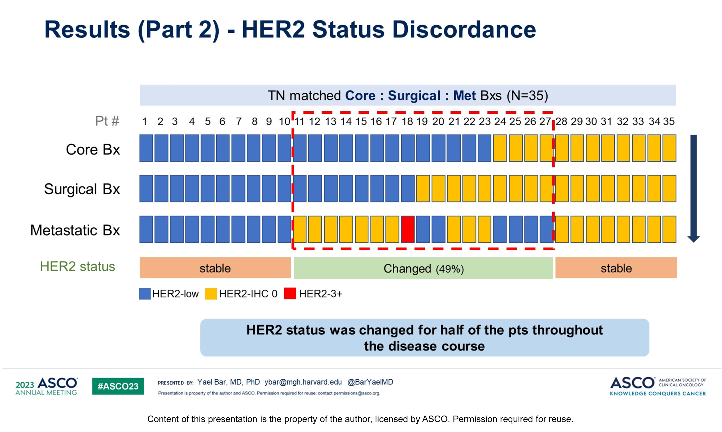
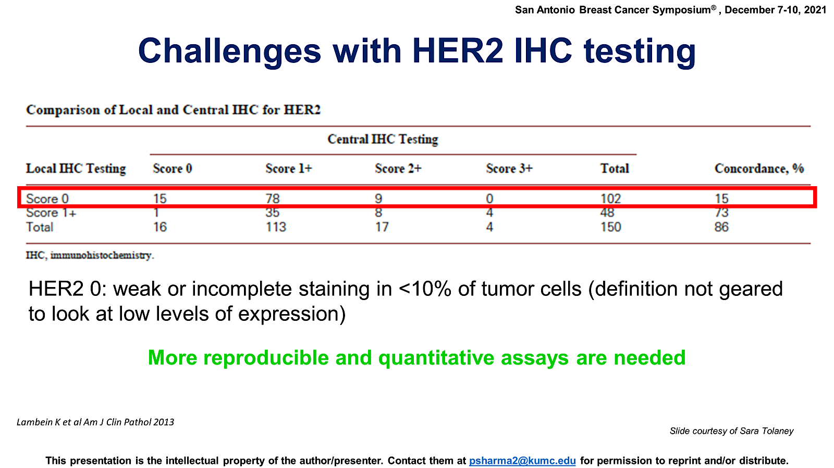
Impact of repeat biopsies on HER2-low status among patients with TNBC
True change or known technical problems with the assay?
In DB-04 HER2 low status (centrally confirmed) on either primary or metastatic tissue allowed for eligibility
Current clinical practice is to use any HER2 low result for T-DXd recommendations
Discordance between Core→Surgical and Surgical→MetBx
HER2 Status changed in both directions
Bar Y et al ASCO 2023, Abstract # 1005

Slide 22
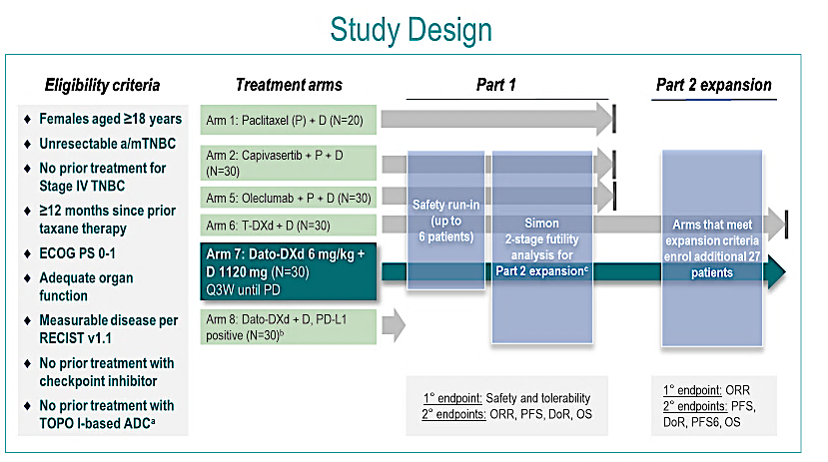
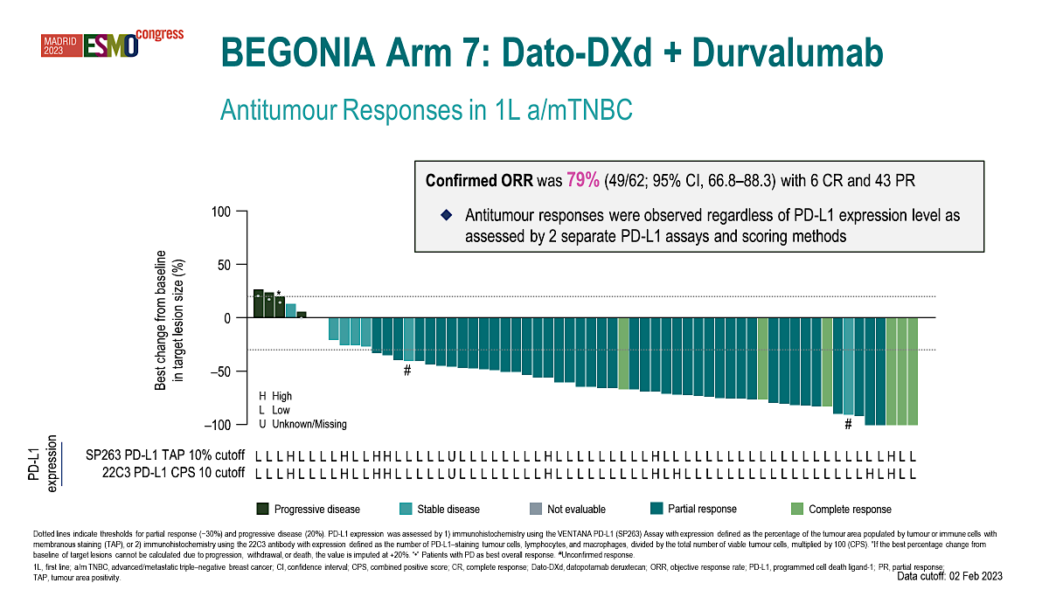
Datopotamab deruxtecan (Dato-DXd) + durvalumab as first-line treatment for unresectable locally advanced/metastatic TNBC: Updated Arm 7 results from phase Ib/II BEGONIA study
1° endpoints: Safety and tolerability
2° endpoints: ORR, PFS, DoR, OS
Characteristic | Dato-DXd + D N=62
Age, median (range), years | 53 (31–74)
No prior treatment, n (%) | 26 (42)
Prior treatments for early-stage disease, n (%)
Radiotherapy | 30 (48)
Cytotoxic chemotherapy | 33 (53)
Taxane | 26 (42)
Anthracycline | 29 (47)
Platinum compound | 9 (15)
Hormonal therapy | 10 (16)
Targeted therapy | 1 (2)
Visceral metastases,^{c} n (%) | 37 (60)
Lymph node metastases, n (%) | 42 (68)
PD-L1 expression,^{d} n (%)
High (TAP ≥10%) | 7 (11)
Low (TAP <10%) | 54 (87)
Unknown/Missing | 1 (2)
Schmid P et al ESMO 2023, Abstract # 379MO

Slide 23
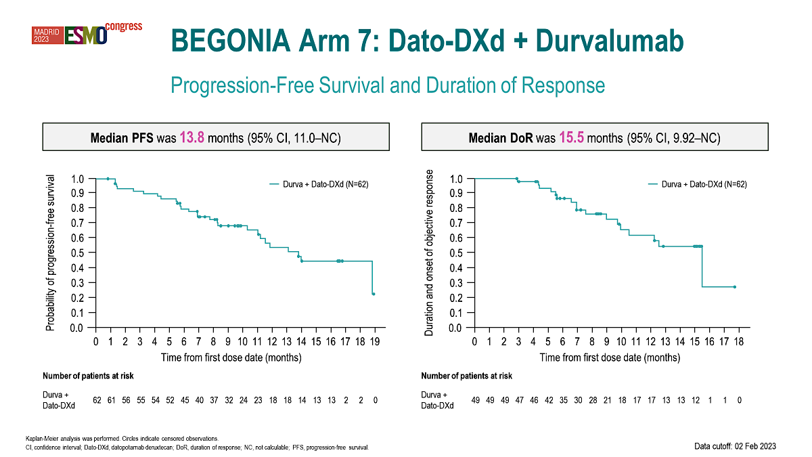
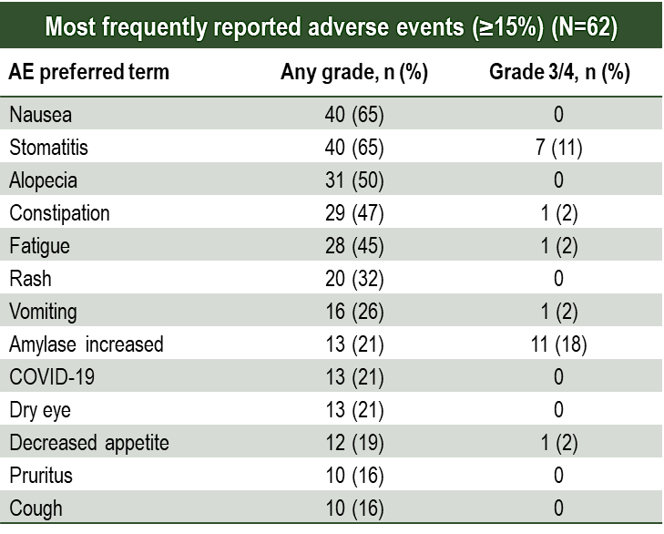
BEGONIA: Durvalumab plus Dato-DXd
Safety
Patients, n (%) | Dato-DXd + D N=62
Any AEs | 62 (100)
Grade 3/4 | 35 (57)
Any treatment-related AEsª | 62 (100)
Grade 3/4 | 27 (44)
Any serious AEs | 14 (23)
Treatment-related | 6 (10)
AEs leading to discontinuation of any treatments | 10 (16)
AEs leading to death^{b} | 1 (2)
Dose adjustments
Dato-DXd dose reduction | 18 (29)
Dato-DXd dose delay | 28 (45)
Durvalumab dose delay | 31 (50)
  The most common AEs were gastrointestinal
  Stomatitis was the most common AE leading to Dato-DXd dose reduction (11 patients)
  There were 3 (5%) adjudicated treatment-related ILD/pneumonitis events (2 grade=2, 1 grade=1)
  The most frequent AESIs were for stomatitis (65%), rash (32%), dry eye (21%), hypothyroidism (14.5%), and keratitis (14.5%)

Slide 24
ADC plus IO combination in TNBC
Combination of Dato-DXd plus Durva yielded robust activity in first line setting
  Only 50% had prior chemotherapy for early-stage disease
  Single arm design prohibits assessment of combination vs Dato-DXd monotherapy efficacy
    Data-DXd monotherapy ORR in much heavily pre-treated patient population (TROPION-PanTumor01, Median of 3 prior lines of therapy): 33%
Ocular toxicity: pretreatment ophthalmology evaluation required
Stomatitis: Prophylactic management with steroid mouth wash
On-going Phase III trials of ADC plus IO in TNBC
TROPION-Breast02 (recruiting): 1st line trial comparing Dato-DXd to investigator's choice chemotherapy in patients with mTNBC who are not candidates for PD-1/PD-L1 Inhibitor therapy (NCT05374512)
TROPION-Breast03 (recruiting): Dato-DXd with or without Durvalumab Versus Investigator's Choice of Therapy in Patients With Stage I-III TNBC with residual disease Following Neoadjuvant Therapy (NCT05629585)
TROPION-Breast04 (recruiting): Randomized Study of Neoadjuvant Dato-DXd Plus durvalumab followed by adjuvant durvalumab Versus neoadjuvant pembrolizumab plus chemotherapy followed by adjuvant pembrolizumab for Triple-Negative or Hormone Receptor-low/HER2-negative Breast Cancer (NCT06112379)
ASCENT-04 (recruiting): Sacituzumab Govitecan and Pembrolizumab Versus TPC and Pembrolizumab in Previously Untreated, Locally Advanced Inoperable or Metastatic TNBC (PD-L1+) (NCT05382286)
ASCENT-05 (recruiting): Sacituzumab Govitecan and Pembrolizumab Versus Treatment of Physician's Choice TNBC with Residual Invasive Disease after neoadjuvant Therapy and Surgery (NCT05633654)

Slide 25
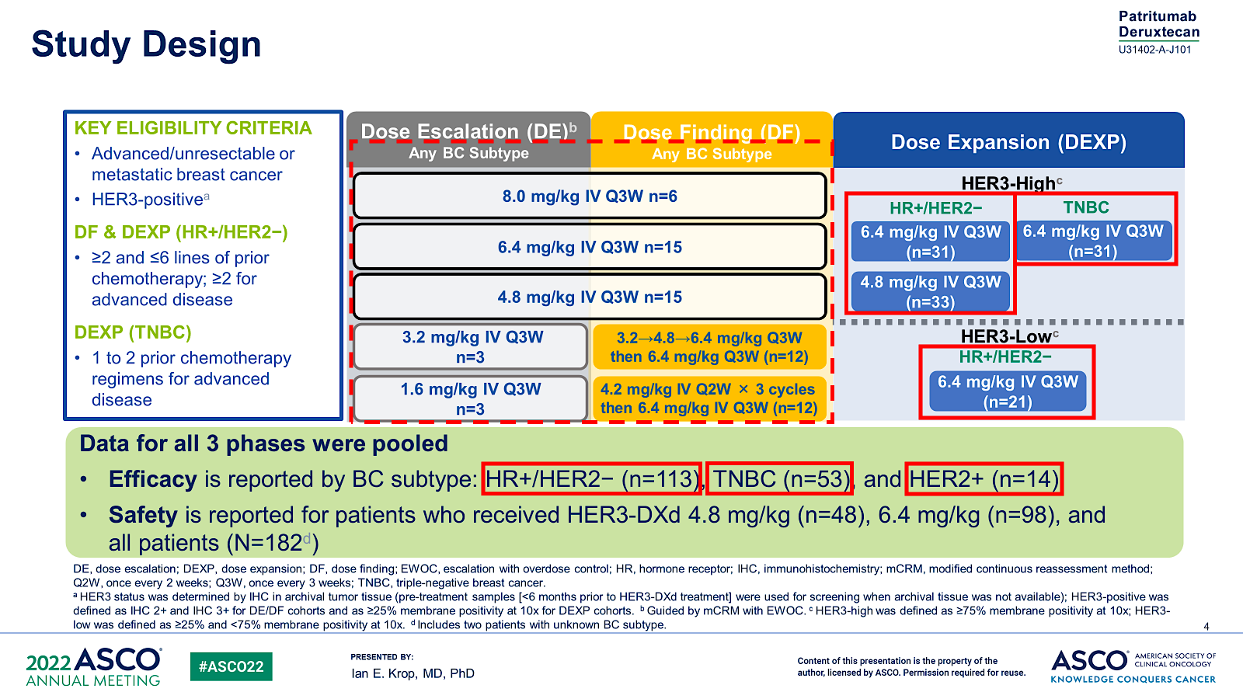
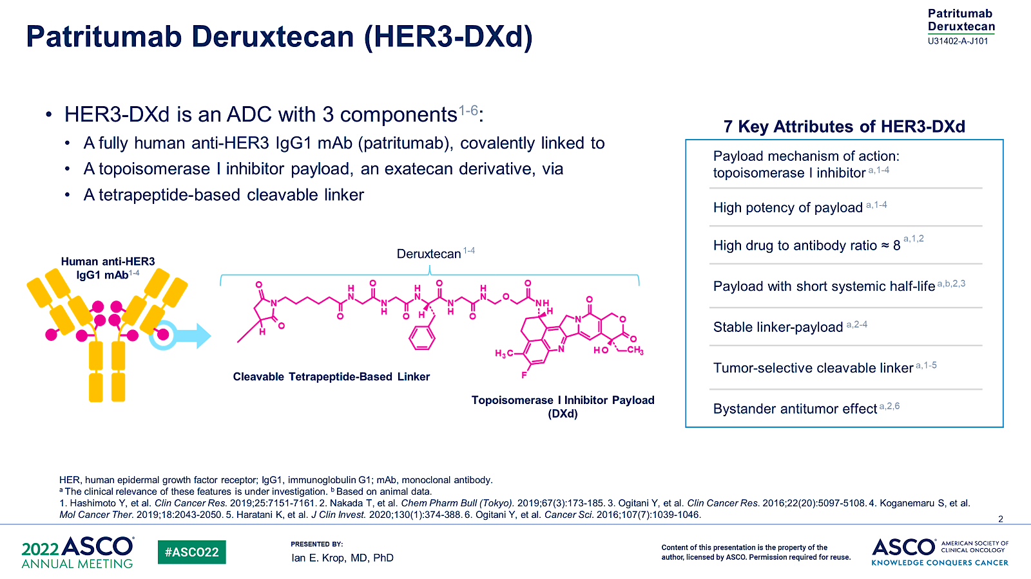
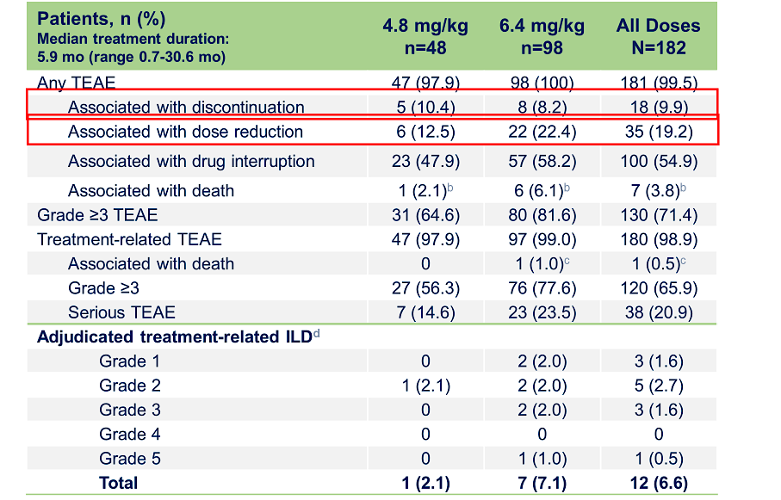
Patritumab deruxtecan (HER3-DXd) in previously treated HER3-expressing metastatic breast cancer: Phase I/II trial
HER3 was determined by IHC in archival tumor tissue (pre-treatment samples [<6 months prior to HER3-DXd treatment])
-HER3-positive was defined as IHC 2+ and IHC 3+ for DE/DF cohorts and as ≥25% membrane positivity at 10x for DEXP cohorts.
-HER3-high was defined as ≥75% membrane positivity at 10x
-HER3-low was defined as ≥25% and <75% membrane positivity at 10x
GI and hematologic toxicity were the most common TEAEs
The rate of adjudicated treatment-related ILD was 7%; most cases were grade 1 and 2
Krop IE et al JCO 2023;41(36):5550-60.

Slide 26
Clinical Activity of HER3-DXd Across BC Subtypes
Outcomes (BICR per RECIST 1.1) | HR+/HER2− (n=113) | TNBC (n=53) | HER2+ (n=14)
 | HER3-High and -Low | HER3-High | HER3-High
Confirmed ORR, % (95% CI​ª) | 30.1 (21.8-39.4) | 22.6 (12.3-36.2) | 42.9 (17.7-71.1)
Best overall response, %^{b}
PR | 30.1 | 22.6 | 42.9
SD | 50.4 | 56.6 | 50.0
PD | 11.5 | 17.0 | 7.1
NE | 8.0 | 3.8 | 0.0
DOR, median (95% CI), mo | 7.2 (5.3-NE) | 5.9 (3.0-8.4) | 8.3 (2.8-26.4)
PFS, median (95% CI), mo | 7.4 (4.7-8.4) | 5.5 (3.9-6.8) | 11.0 (4.4-16.4)
6-month PFS rate, % (95% CI) | 53.5 (43.4-62.6) | 38.2 (24.2-52.0) | 51.6 (22.1-74.8)
OS, median (95% CI), mo | 14.6 (11.3-19.5) | 14.6 (11.2-17.2) | 19.5 (12.2-NE)
HER3-DXd demonstrated antitumor activity across BC subtypes
Antitumor activity was also demonstrated across the range of HER3 expression
As a similar safety profile was seen with 4.8 mg/kg and 6.4 mg/kg
5.6 mg/kg dose is being evaluated in BC in many ongoing trials
Krop IE et al Clin Oncol 2023;41(36):5550-60.

Slide 27
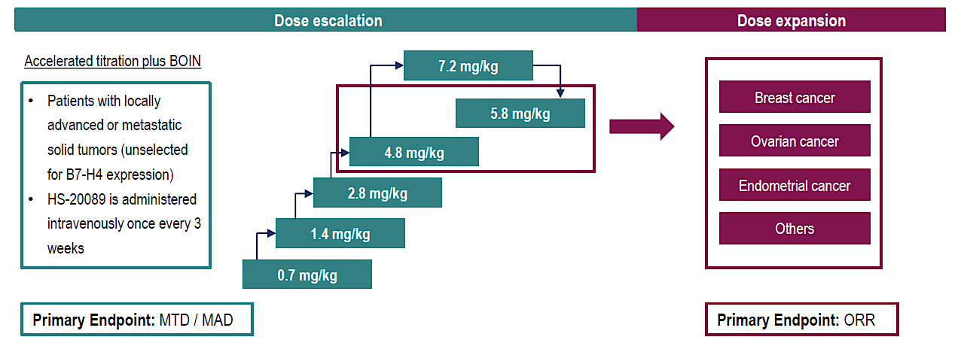
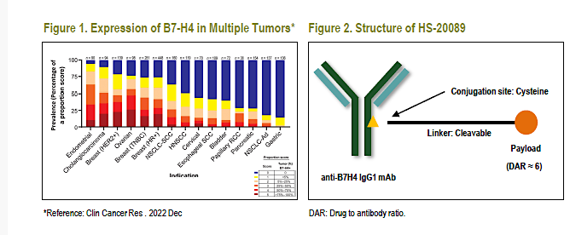
First-in-human/phase I trial of HS-20089, a B7-H4 ADC, in patients with advanced solid tumors.
B7 homolog 4 protein (B7-H4), a transmembrane glycoprotein in the B7 superfamily, is highly expressed in various types of solid tumors with low expression in normal tissues
HS-20089 is a novel B7-H4 targeted ADC
  Target; B7-H4, Toxin: topoisomerase I inhibitor (DAR:6)
  protease-cleavable linker
N=52 patients treated at 6 dose levels
Mean of 3.7 prior therapy lines:
N=48 with breast cancer (n=32 TNBC)
MTD: 5.8 mg/kg.
Most common Gr 3 TRAEs were hematological toxicity. Grade 1-2 N/V and LFT increase noted in >20% of patients
There was no adverse event leading to death. No interstitial pneumonia or infusion reactions reported.
Zhang J et al. ESMO 2023;Abstract 381O.

Slide 28
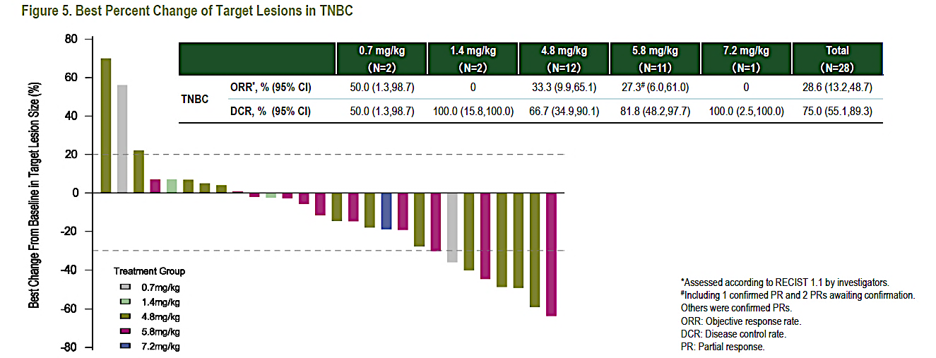
B7-H4 ADC, in patients with advanced solid tumors: Efficacy in TNBC
At potential target therapeutic doses of 4.8 and 5.8 mg/kg, the ORRs were 33.3% and 27.3%, respectively.
ORR in patients treated with prior IO (n=7): 42%
? ORR in patients treated with prior ADC
PFS and median duration of response not reported
Expansion is ongoing
Zhang J et al. ESMO 2023;Abstract 381O.

Slide 29

ADCs in TNBC: present and future
? ADC with non-Topo 1 payload
Very little is known about mechanisms of resistance:
  ? Target, ? Payload, ? Both ? others
? ADC after ADC efficacy:
  Optimal sequence for mTNBC?: Should level of target expression guide decisions? current methods of target level expression (IHC based) are not optimal to guide selection of therapy
    Need quantitative assays
  Will be an important question to answer if ADCs move in curative setting (Residual disease and Neoadjuvant trials are ongoing)
TROP-2 ADCs with Topo-1 payload: SG approved regardless of HER2 low/zero (>1 Line)
  Dato-DXd, SKB264 (MK-2870)
HER2 ADC: T-DXd (Topo-1 payload) Approved for HER2 low mTNBC (> 1L)
HER3 ADC: HER3-DXd (Topo 1 payload): In trials
B7-H4 ADC: HS-20089 (Topo 1 payload): In trials
Bispecific antibodies: In trials

Slide 30
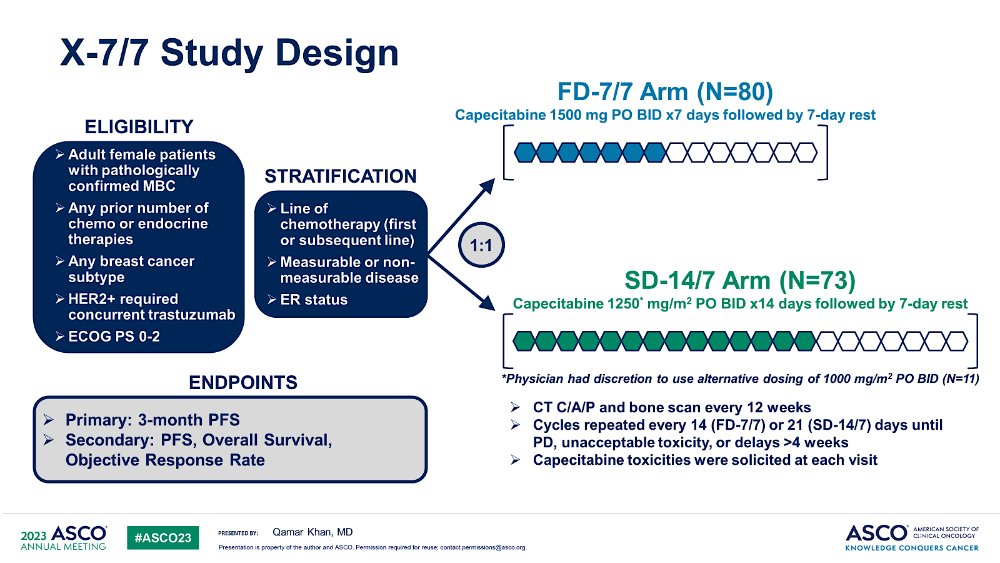
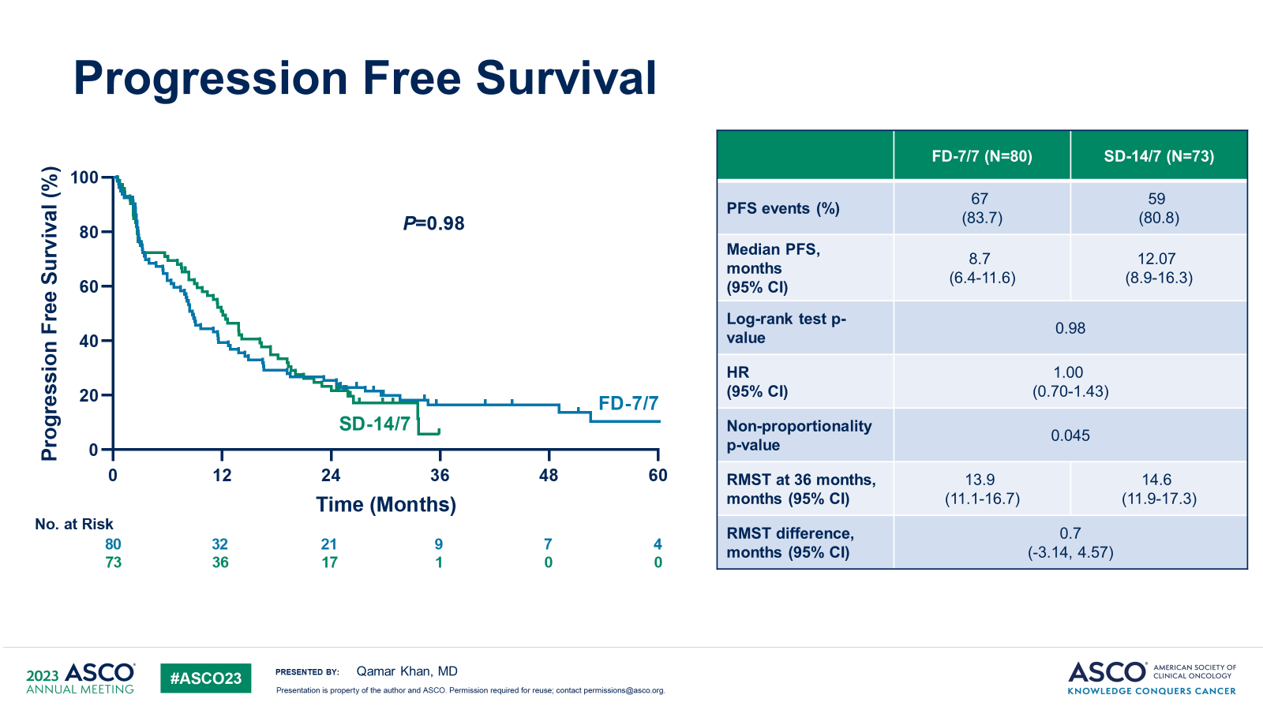
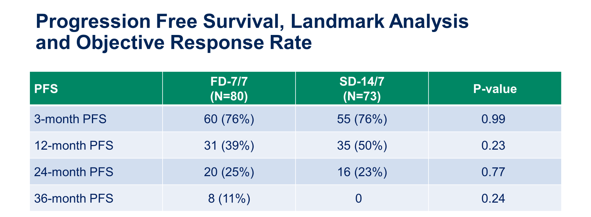
Randomized Trial of Fixed Dose Capecitabine Compared to Standard Dose Capecitabine in Metastatic Breast Cancer: X-7/7 trial
N=153
79% HR+ , 11% TNBC
58-70% 1L therapy
Khan et al ASCO 2023

Slide 31
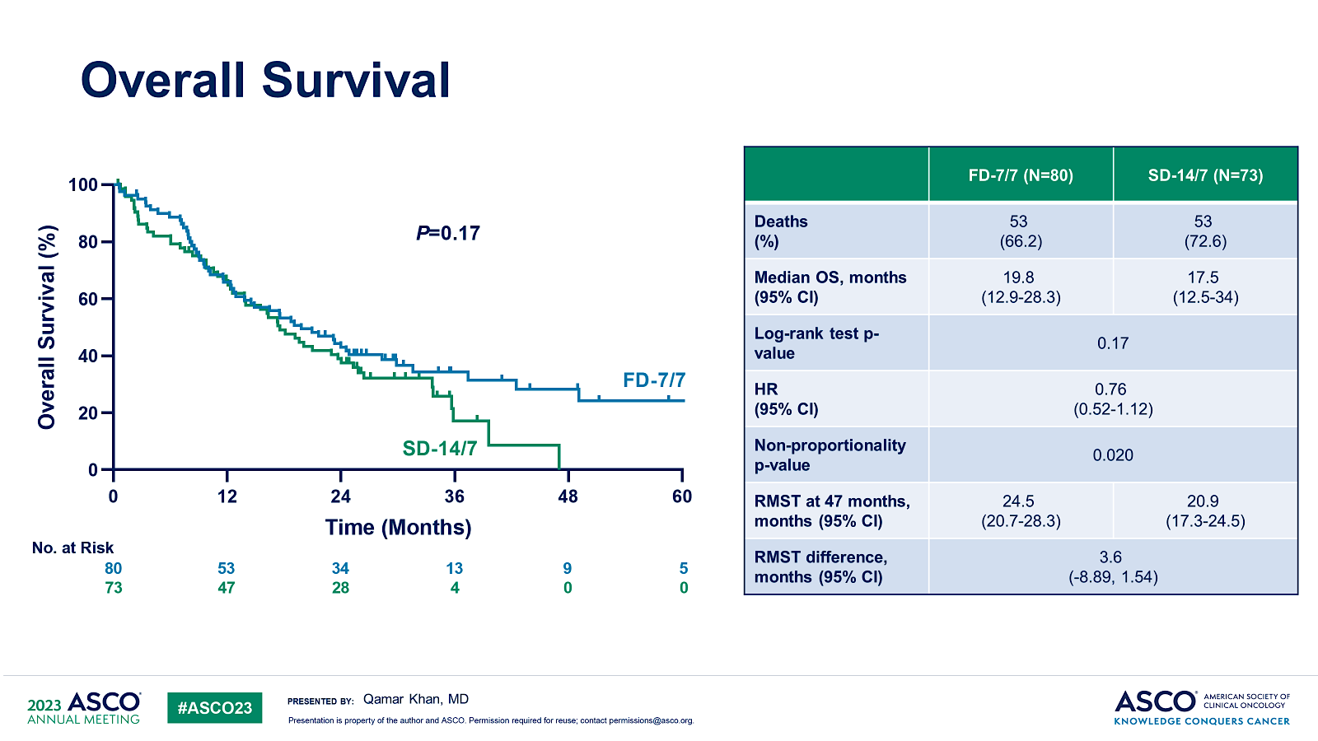
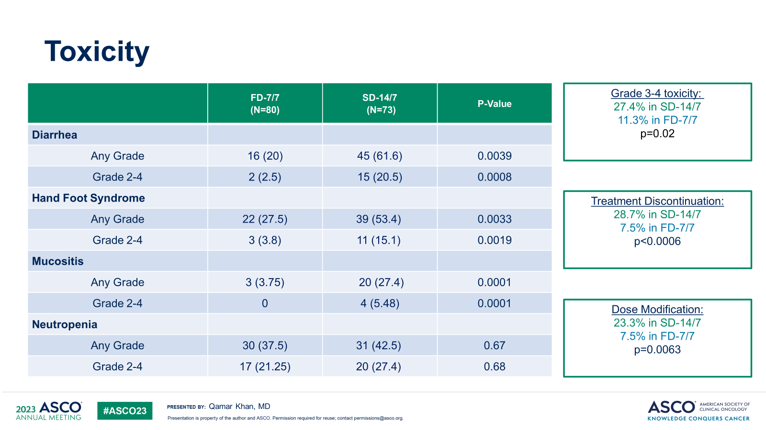
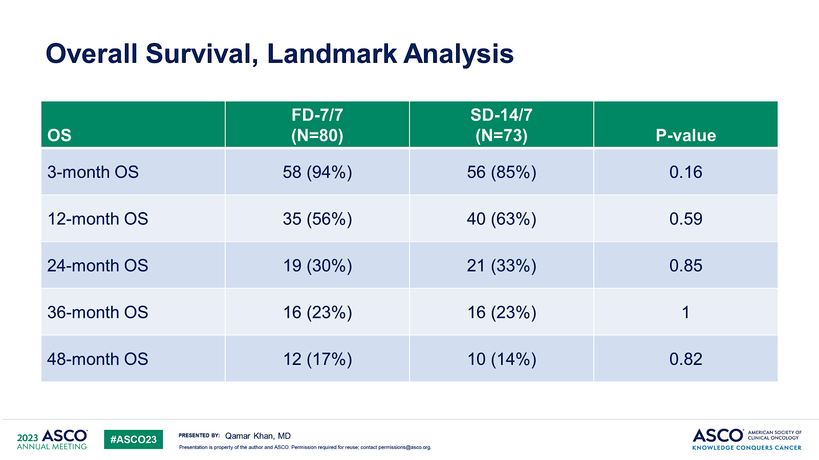
X-7/7 trial
Toxicity
Fixed-dose capecitabine (1500 mg twice daily) on a 7/7 schedule when compared to BSA-based dose on a 14/7 schedule showed
  Similar efficacy
  Lower toxicity
  Fewer treatment discontinuations and dose modifications
Provides an alternative capecitabine schedule for patients with mBC
  Few patients with TNBC and HER2+ BC
Implications for adjuvant Capecitabine in TNBC residual disease
Khan et al ASCO 2023

Slide 32
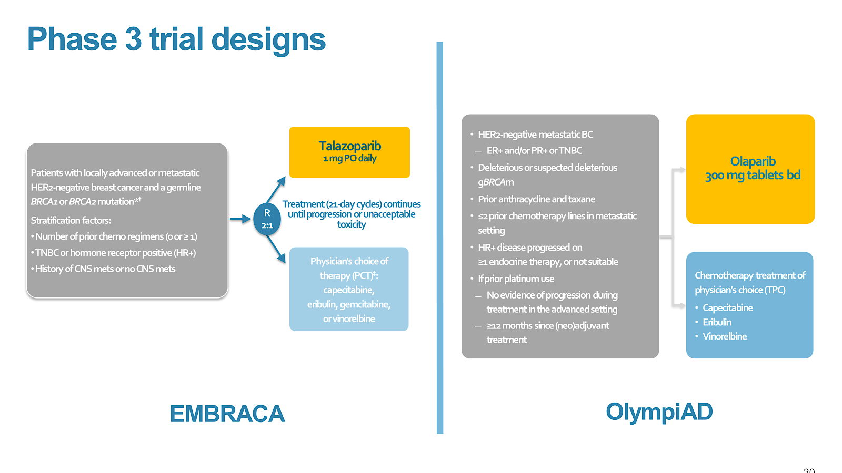
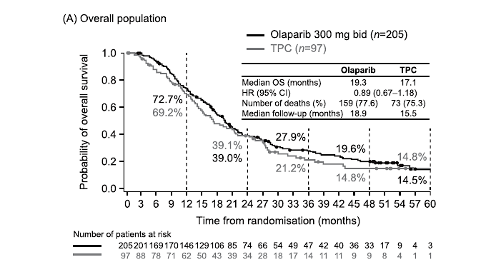
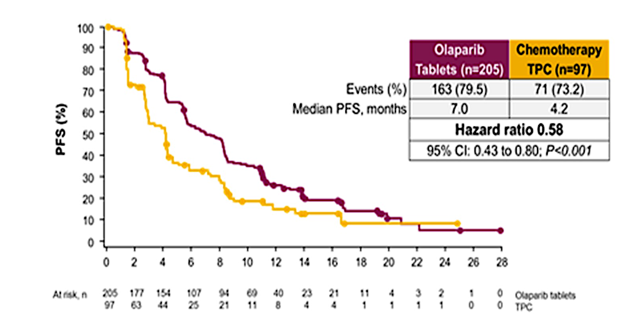
OlympiAD extended follow-up for overall survival and safety
Median follow-up: 25.7 months longer than that previously reported for OS and safety
Median OS: Olaparib (19.3 months) vs TPC (17.1 months) HR 0.90 (0.66 1.23)
Robson et al European Journal of Cancer 184 (2023) 39e47
Notes:
At the time of the final pre-specified overall survival (OS) analysis (25th September 2017), median follow up for OS in censored patients was 25.3 months and 26.3 months in the olaparib and TPC groups,
respectively (18.9 versus 15.5 months overall, respectively).
At this data-cut, 192 of the 302 patients randomised
had died (64% data maturity), and there was no
statistically significant difference in median OS between
olaparib (19.3 months) and TPC (17.1 months)

Slide 33
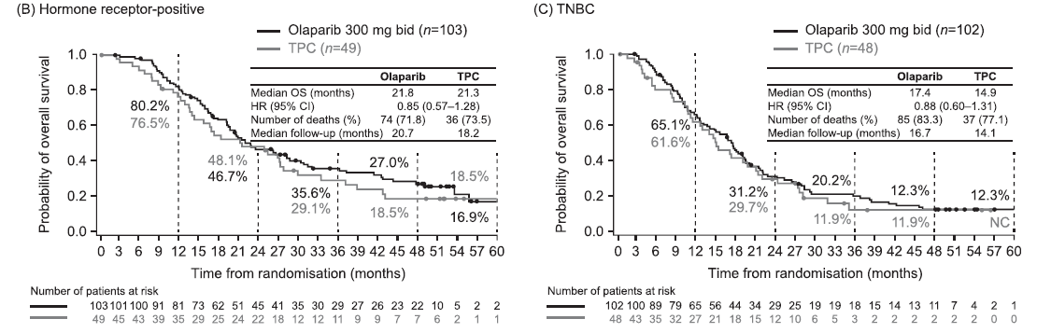
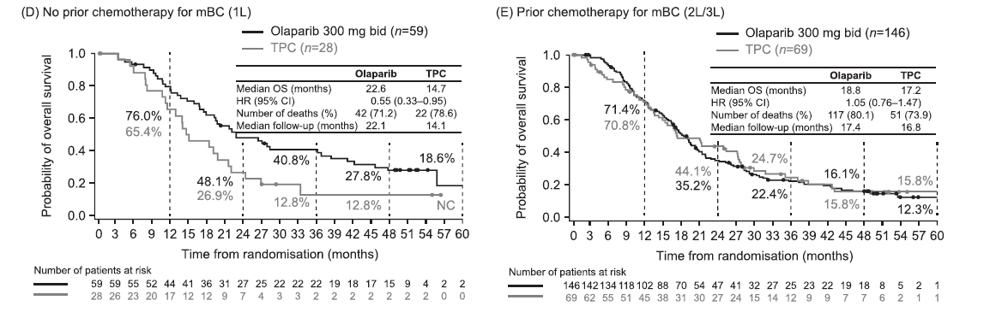
OlympiAD extended follow-up: overall survival and safety
-No new SAEs related to olaparib were reported during the extended follow-up period.
-No cases of myelodysplastic
syndrome, acute myeloid leukemia or pneumonitis were reported throughout the study
Robson et al European Journal of Cancer 184 (2023) 39e47

Slide 34
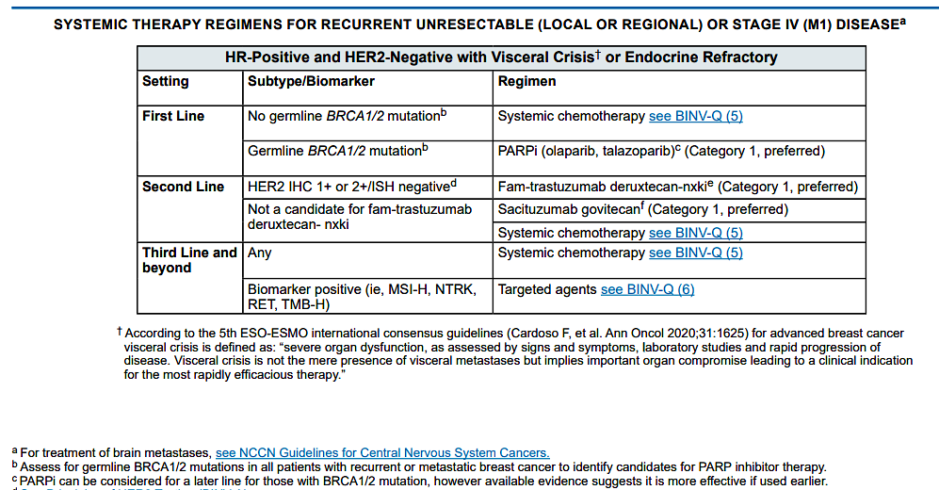
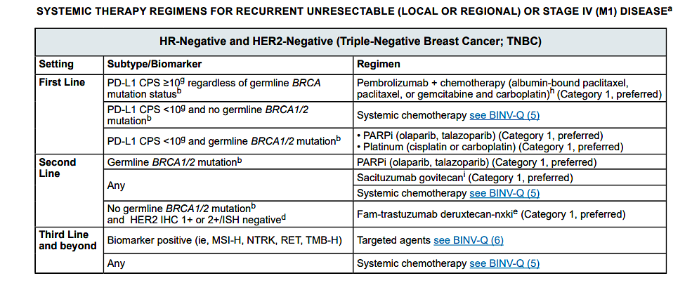
PARPi for MBC

