Slide 1
Oncology Q&A: Addressing Common Questions Posed by Patients with Metastatic Triple-Negative Breast Cancer A Live Webinar for Patients, Developed in Partnership with the Triple Negative Breast Cancer Foundation
Wednesday, November 13, 2024 6:00 PM – 7:00 PM ET
Faculty
Lisa A Carey, MD, ScM, FASCO
Rita Nanda, MD
Moderator
Neil Love, MD

Slide 2
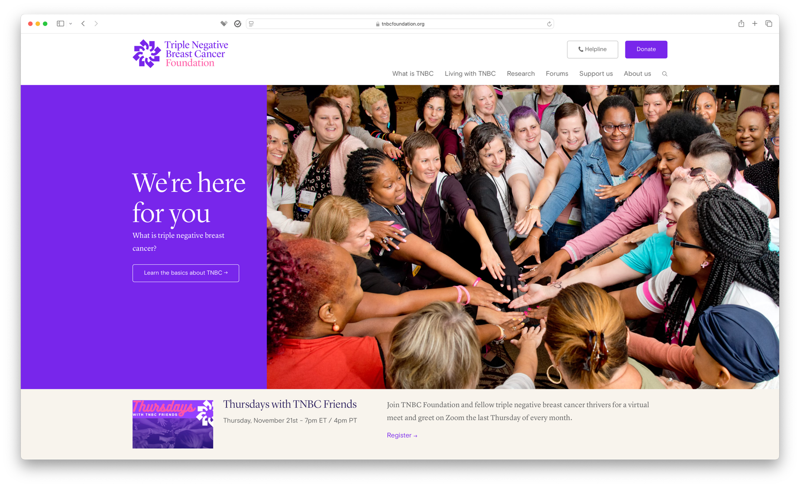

Slide 3
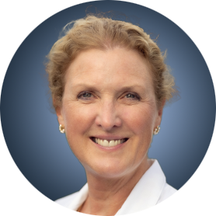
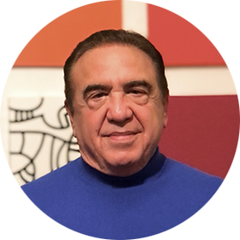
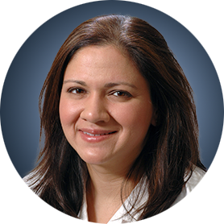
Faculty
Lisa A Carey, MD, ScM, FASCO
L Richardson and Marilyn Jacobs Preyer
Distinguished Professor for
Breast Cancer Research
Deputy Director for Clinical Sciences
Lineberger Comprehensive Cancer Center
University of North Carolina
Chapel Hill, North Carolina
MODERATOR
Neil Love, MD Research To Practice Miami, Florida
Rita Nanda, MD
Director, Breast Oncology
Associate Professor of Medicine
Section of Hematology/Oncology
The University of Chicago
Chicago, Illinois

Slide 4
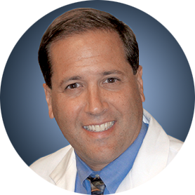
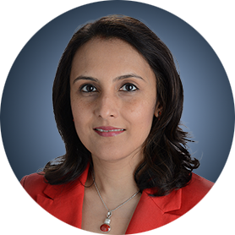
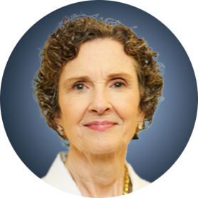
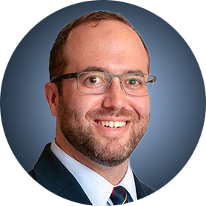
Survey Participants
Adam M Brufsky, MD, PhD
Professor of Medicine
UPMC Hillman Cancer Center
Department of Medicine
University of Pittsburgh
Pittsburgh, Pennsylvania
Priyanka Sharma, MD
Frank B Tyler Professor in Cancer Research
Division of Medical Oncology, Department of Internal Medicine
Co-Program Leader
Drug Discovery, Delivery and Experimental Therapeutics Program
The University of Kansas Cancer Center
Westwood, Kansas
Joyce O’Shaughnessy, MD
Celebrating Women Chair in Breast Cancer Research
Baylor University Medical Center
Chair, Breast Disease Committee
Sarah Cannon Research Institute
Dallas, Texas
Seth Wander, MD, PhD
Assistant Professor of Medicine
Harvard Medical School
Attending Physician
Massachusetts General Hospital
Boston, Massachusetts

Slide 5
Dr Carey — Disclosures
No relevant conflicts of interest to disclose.

Slide 6
Dr Nanda — Disclosures
Advisory Committees | AstraZeneca Pharmaceuticals LP, Daiichi Sankyo Inc, Exact Sciences Corporation, GE Healthcare, Gilead Sciences Inc, Guardant Health, Merck, Moderna, Novartis, OBI Pharma Inc, Pfizer Inc, Sanofi, Seagen Inc, Stemline Therapeutics Inc, Summit Therapeutics
Contracted Research | Arvinas, AstraZeneca Pharmaceuticals LP, Bristol Myers Squibb, Corcept Therapeutics, Genentech, a member of the Roche Group, Gilead Sciences Inc, GSK, Merck, Novartis, OBI Pharma Inc, Pfizer Inc, Relay Therapeutics, Seagen Inc, Sun Pharmaceutical Industries Ltd, Taiho Oncology Inc

Slide 7
Dr Love — Disclosures
Dr Love is president and CEO of Research To Practice. Research To Practice receives funds in the form of educational grants to develop CME activities from the following companies: AbbVie Inc, Adaptive Biotechnologies Corporation, ADC Therapeutics, Agios Pharmaceuticals Inc, Alexion Pharmaceuticals, Amgen Inc, Array BioPharma Inc, a subsidiary of Pfizer Inc, Arvinas, Astellas, AstraZeneca Pharmaceuticals LP, Aveo Pharmaceuticals, Bayer HealthCare Pharmaceuticals, BeiGene Ltd, BeyondSpring Pharmaceuticals Inc, Black Diamond Therapeutics Inc, Blueprint Medicines, Boehringer Ingelheim Pharmaceuticals Inc, Bristol Myers Squibb, Celgene Corporation, Clovis Oncology, Coherus BioSciences, CTI BioPharma, a Sobi Company, Daiichi Sankyo Inc, Eisai Inc, Elevation Oncology Inc, EMD Serono Inc, Epizyme Inc, Exact Sciences Corporation, Exelixis Inc, Five Prime Therapeutics Inc, Foundation Medicine, G1 Therapeutics Inc, Genentech, a member of the Roche Group, Genmab US Inc, Geron Corporation, Gilead Sciences Inc, Grail Inc, GSK, Halozyme Inc, Helsinn Healthcare SA, Hologic Inc, ImmunoGen Inc, Incyte Corporation, Ipsen Biopharmaceuticals Inc, Janssen Biotech Inc, administered by Janssen Scientific Affairs LLC, Jazz Pharmaceuticals Inc, Karyopharm Therapeutics, Kite, A Gilead Company, Kronos Bio Inc, Legend Biotech, Lilly, Loxo Oncology Inc, a wholly owned subsidiary of Eli Lilly & Company, MEI Pharma Inc, Merck, Mersana Therapeutics Inc, Mirati Therapeutics Inc, Mural Oncology Inc, Natera Inc, Novartis, Novartis Pharmaceuticals Corporation on behalf of Advanced Accelerator Applications, Novocure Inc, Nuvalent, Oncopeptides, Pfizer Inc, Pharmacyclics LLC, an AbbVie Company, Puma Biotechnology Inc, Regeneron Pharmaceuticals Inc, R-Pharm US, Sanofi, Seagen Inc, Servier Pharmaceuticals LLC, SpringWorks Therapeutics Inc, Stemline Therapeutics Inc, Sumitomo Dainippon Pharma Oncology Inc, Syndax Pharmaceuticals, Taiho Oncology Inc, Takeda Pharmaceuticals USA Inc, TerSera Therapeutics LLC, Tesaro, A GSK Company, TG Therapeutics Inc, Turning Point Therapeutics Inc, Verastem Inc, and Zymeworks Inc.

Slide 8
Commercial Support
This activity is supported by an educational grant from Gilead Sciences Inc.
Research To Practice CME Planning Committee Members, Staff and Reviewers
Planners, scientific staff and independent reviewers for Research To Practice have no relevant conflicts of interest to disclose.

Slide 9
This educational activity contains discussion of non-FDA-approved uses of agents and regimens. Please refer to official prescribing information for each product for approved indications.

Slide 10
Agenda: Oncology Q&A Metastatic Triple-Negative Breast Cancer (TNBC)
Stages of TNBC; Recurrence After Adjuvant Treatment
Long-Term Outcomes with Metastatic TNBC
Side Effects and Complications of Treatment
Dose Reduction
Working While Receiving Treatment
Support for Minor Children and Grandchildren
Second Opinions and Self Advocacy
Recording Clinic Visits; Complementary Therapies; Nutrition
Living Wills and Advanced Directives

Slide 12
Agenda: Oncology Q&A Metastatic Triple-Negative Breast Cancer (TNBC)
Stages of TNBC; Recurrence After Adjuvant Treatment
Long-Term Outcomes with Metastatic TNBC
Side Effects and Complications of Treatment
Dose Reduction
Working While Receiving Treatment
Support for Minor Children and Grandchildren
Second Opinions and Self Advocacy
Recording Clinic Visits; Complementary Therapies; Nutrition
Living Wills and Advanced Directives

Slide 13
Stages of TNBC; Recurrence After Adjuvant Treatment

Slide 14
Agenda: Oncology Q & A Metastatic Triple-Negative Breast Cancer (TNBC)
Stages of TNBC; Recurrence After Adjuvant Treatment
Long-Term Outcomes with Metastatic TNBC
Side Effects and Complications of Treatment
Dose Reduction
Working While Receiving Treatment
Support for Minor Children and Grandchildren
Second Opinions and Self Advocacy
Recording Clinic Visits; Complementary Therapies; Nutrition
Living Wills and Advanced Directives

Slide 15
Long-Term Outcomes with Metastatic TNBC

Slide 16
Common Systemic Treatments for Metastatic TNBC
Chemotherapy Anthracyclines Taxanes Immunotherapy Pembrolizumab (Keytruda®) Atezolizumab (Tecentriq®) | Antibody-drug conjugates Sacituzumab govitecan (Trodelvy®) Trastuzumab deruxtecan (Enhertu®) (HER2 low) PARP inhibitors (for TNBC with BRCA mutations) Olaparib (Lynparza®) Talazoparib (Talzenna®)

Slide 17
A 65-year-old woman in good health (PS 0) with no other major medical conditions is about to begin treatment for metastatic triple-negative breast cancer (TNBC). The patient is asymptomatic. How would you respond if the patient asked, What are the 3 most common side effects or clinical complications with this treatment?
Sacituzumab govitecan
Trastuzumab deruxtecan (T-DXd)
PARP inhibitor
Neutropenia, diarrhea, fatigue
Nausea, fatigue, alopecia
Nausea, fatigue, anemia
Neutropenia, diarrhea, nausea
Nausea/vomiting, fatigue, neutropenia
Nausea, fatigue, anemia
Diarrhea, neutropenia, fatigue
Nausea, ILD, thrombocytopenia
Anemia, nausea, fatigue
Diarrhea, neutropenia, fatigue
Fatigue, alopecia, ILD
Nausea, fatigue, anemia
Low white blood cell count, diarrhea, fatigue
Nausea/vomiting, fatigue, pneumonitis
Nausea, low hemoglobin, fatigue
Fatigue, nausea/diarrhea, blood count changes
Fatigue, nausea/loose stool, pneumonitis (rare)
Fatigue, blood count changes, nausea
ILD = interstitial lung disease

Slide 18
A 65-year-old woman in good health (PS 0) with no other major medical conditions is about to begin treatment for metastatic TNBC. The patient is asymptomatic. How would you respond if the patient asked, What is the percent chance that side effects/toxicity will lead to the treatment being stopped temporarily?
Sacituzumab govitecan
T-DXd
PARP inhibitor
40%
30%
20%
50%
25%
25%
20%
20%
20%
33%
33%
25%
25%
20%
10%
20%
20%
10%

Slide 19
A 65-year-old woman in good health (PS 0) with no other major medical conditions is about to begin treatment for metastatic TNBC. The patient is asymptomatic. How would you respond if the patient asked, If the dose of the treatment is reduced, will it be less effective?
Sacituzumab govitecan
T-DXd
PARP inhibitor
No
No
No
No
No
No
No
No
No
No
Likely not
Likely not
No
No
No
No
No
No

Slide 20
A 65-year-old woman in good health (PS 0) with no other major medical conditions is about to begin treatment for metastatic TNBC. The patient is asymptomatic. How would you respond if the patient asked, What is the percent chance that side effects/toxicity will lead to the treatment being permanently discontinued?
Sacituzumab govitecan
T-DXd
PARP inhibitor
10%
15%
5%
<5%
15%
<5%
5%
15%
5%
10%
15%
10%
5%-6%
13%-15%
5%-6%
5%-10%
5%-10%
<5%

Slide 21
A 65-year-old woman in good health (PS 0) with no other major medical conditions is about to begin treatment for metastatic TNBC. The patient is asymptomatic. How would you respond if the patient asked, What is the percent chance that the treatment will be stopped at some point because the cancer is getting worse and another treatment will be needed?
Sacituzumab govitecan
T-DXd
PARP inhibitor
90%
85%
95%
100%
100%
100%
90%
90%
90%
100%
90%
85%
100%
100%
100%
100%
100%
100%

Slide 22
A 65-year-old woman in good health (PS 0) with no other major medical conditions is about to begin treatment for metastatic TNBC. The patient is asymptomatic. How would you respond if the patient asked, In general, for approximately how long do patients with metastatic TNBC receive this treatment?
Sacituzumab govitecan
T-DXd
PARP inhibitor
4-5 months
4-5 months
6-7 months
6 months
10 months
8 months
10 months
10 months
10 months
6 months
8 months
6 months
5-6 months
6 months
6-7 months
~4-8+ months
6-12+ months
~4-8+ months

Slide 23
Do you use preemptive growth factors for patients with TNBC receiving sacituzumab govitecan?
No, but have a low threshold
No
Yes, pegfilgrastim (or biosimilar) on day 9
No (I start at a reduced dose of sacituzumab govitecan unless patient is young and very healthy)
Yes, pegfilgrastim on day 9
No

Slide 24
Approximately what proportion of patients with metastatic TNBC are eligible to receive trastuzumab deruxtecan (T-DXd) for HER2-low disease?
50%
35%
30%
30%
30%
60%

Slide 25
Do you use preemptive growth factors for patients with TNBC receiving T-DXd?
No
No
No
No
No
No

Slide 26
For patients with metastatic TNBC who are eligible to receive both sacituzumab govitecan and T-DXd, which agent do you generally use first?
Sacituzumab govitecan
Sacituzumab govitecan
Sacituzumab govitecan
Sacituzumab govitecan
Sacituzumab govitecan
Sacituzumab govitecan

Slide 27
Agenda: Oncology Q & A Metastatic Triple-Negative Breast Cancer (TNBC)
Stages of TNBC; Recurrence After Adjuvant Treatment
Long-Term Outcomes with Metastatic TNBC
Side Effects and Complications of Treatment
Dose Reduction
Working While Receiving Treatment
Support for Minor Children and Grandchildren
Second Opinions and Self Advocacy
Recording Clinic Visits; Complementary Therapies; Nutrition
Living Wills and Advanced Directives

Slide 28
Side Effects and Complications of Treatment

Slide 29
Agenda: Oncology Q & A Metastatic Triple-Negative Breast Cancer (TNBC)
Stages of TNBC; Recurrence After Adjuvant Treatment
Long-Term Outcomes with Metastatic TNBC
Side Effects and Complications of Treatment
Dose Reduction
Working While Receiving Treatment
Support for Minor Children and Grandchildren
Second Opinions and Self Advocacy
Recording Clinic Visits; Complementary Therapies; Nutrition
Living Wills and Advanced Directives

Slide 30
Dose Reduction

Slide 31
Agenda: Oncology Q & A Metastatic Triple-Negative Breast Cancer (TNBC)
Stages of TNBC; Recurrence After Adjuvant Treatment
Long-Term Outcomes with Metastatic TNBC
Side Effects and Complications of Treatment
Dose Reduction
Working While Receiving Treatment
Support for Minor Children and Grandchildren
Second Opinions and Self Advocacy
Recording Clinic Visits; Complementary Therapies; Nutrition
Living Wills and Advanced Directives

Slide 32
Working While Receiving Treatment

Slide 33
Agenda: Oncology Q & A Metastatic Triple-Negative Breast Cancer (TNBC)
Stages of TNBC; Recurrence After Adjuvant Treatment
Long-Term Outcomes with Metastatic TNBC
Side Effects and Complications of Treatment
Dose Reduction
Working While Receiving Treatment
Support for Minor Children and Grandchildren
Second Opinions and Self Advocacy
Recording Clinic Visits; Complementary Therapies; Nutrition
Living Wills and Advanced Directives

Slide 34
Support for Minor Children and Grandchildren

Slide 35
Agenda: Oncology Q & A Metastatic Triple-Negative Breast Cancer (TNBC)
Stages of TNBC; Recurrence After Adjuvant Treatment
Long-Term Outcomes with Metastatic TNBC
Side Effects and Complications of Treatment
Dose Reduction
Working While Receiving Treatment
Support for Minor Children and Grandchildren
Second Opinions and Self Advocacy
Recording Clinic Visits; Complementary Therapies; Nutrition
Living Wills and Advanced Directives

Slide 36
Second Opinions and Self Advocacy

Slide 37
Agenda: Oncology Q & A Metastatic Triple-Negative Breast Cancer (TNBC)
Stages of TNBC; Recurrence After Adjuvant Treatment
Long-Term Outcomes with Metastatic TNBC
Side Effects and Complications of Treatment
Dose Reduction
Working While Receiving Treatment
Support for Minor Children and Grandchildren
Second Opinions and Self Advocacy
Recording Clinic Visits; Complementary Therapies; Nutrition
Living Wills and Advanced Directives

Slide 38
Recording Clinic Visits; Complementary Therapies; Nutrition

Slide 39
Agenda: Oncology Q & A Metastatic Triple-Negative Breast Cancer (TNBC)
Stages of TNBC; Recurrence After Adjuvant Treatment
Long-Term Outcomes with Metastatic TNBC
Side Effects and Complications of Treatment
Dose Reduction
Working While Receiving Treatment
Support for Minor Children and Grandchildren
Second Opinions and Self Advocacy
Recording Clinic Visits; Complementary Therapies; Nutrition
Living Wills and Advanced Directives

Slide 40
Living Wills and Advanced Directives

Slide 41
Thank you

