Slide 1
Striving for Consensus:
Exploring the Current Role of Ovarian Suppression in the Management of Breast Cancer
Thursday, April 18, 2024
12:30 PM – 2:40 PM ET
Faculty
William J Gradishar, MD
Virginia Kaklamani, MD, DSc
Erica Mayer, MD, MPH, FASCO
Seth Wander, MD, PhD
Moderator
Neil Love, MD

Slide 2





Faculty
William J Gradishar, MD
Betsy Bramsen Professor of Breast Oncology
Professor of Medicine
Chief, Division of Hematology/Oncology
Northwestern Medicine Feinberg School of Medicine
Northwestern University
Chicago, Illinois
Seth Wander, MD, PhD
Assistant Professor of Medicine
Harvard Medical School
Attending Physician
Massachusetts General Hospital
Boston, Massachusetts
Virginia Kaklamani, MD, DSc
Professor of Medicine
Ruth McLean Bowman Bowers Chair in Breast Cancer Research and Treatment
AB Alexander Distinguished Chair in Oncology
Leader, Breast Oncology Program
UT Health San Antonio MD Anderson Cancer Center
San Antonio, Texas
MODERATOR
Neil Love, MD
Research To Practice
Miami, Florida
Erica Mayer, MD, MPH, FASCO
Director of Breast Cancer Clinical Research
Breast Oncology Center
Dana-Farber Cancer Institute
Associate Professor of Medicine
Harvard Medical School
Boston, Massachusetts

Slide 3
Agenda
Introduction
Module 1: Addition of Ovarian Function Suppression (OFS) to Adjuvant Endocrine Therapy for Premenopausal Patients with Hormone Receptor (HR)-Positive Breast Cancer — Dr Gradishar
Module 2: Role of OFS in Preserving Fertility and/or Ovarian Function in Premenopausal Patients — Dr Mayer
Module 3: Tolerability/Toxicity of OFS — Dr Kaklamani
Module 4: Other Practical Considerations in the Application of OFS — Dr Wander

Slide 4
Agenda
Introduction
Module 1: Addition of Ovarian Function Suppression (OFS) to Adjuvant Endocrine Therapy for Premenopausal Patients with Hormone Receptor (HR)-Positive Breast Cancer — Dr Gradishar
Module 2: Role of OFS in Preserving Fertility and/or Ovarian Function in Premenopausal Patients — Dr Mayer
Module 3: Tolerability/Toxicity of OFS — Dr Kaklamani
Module 4: Other Practical Considerations in the Application of OFS — Dr Wander

Slide 5
Common Questions from Community-Based Physicians
Who should receive adjuvant ovarian function suppression (OFS)/ablation versus tamoxifen alone?
In what situations do you prefer oophorectomy to OFS?
When using OFS, what is your usual duration and dosing interval?
Does HER2 status affect your approach to endocrine therapy?
How do you approach OFS during chemotherapy for fertility preservation versus ovarian function preservation?
What is the optimal approach for interrupting endocrine therapy to allow for pregnancy?
How do you approach the management of side effects associated with OFS (hot flashes, vaginal dryness, etc)?

Slide 6
Approximately how many women with breast cancer in your practice are currently…
Patients with mBC
with minor children
Younger than age 30
25
5
20
30
3
6
20
3
24
2
40
3
mBC = metastatic breast cancer

Slide 7
Agenda
Introduction
Module 1: Addition of Ovarian Function Suppression (OFS) to Adjuvant Endocrine Therapy for Premenopausal Patients with Hormone Receptor (HR)-Positive Breast Cancer — Dr Gradishar
Module 2: Role of OFS in Preserving Fertility and/or Ovarian Function in Premenopausal Patients — Dr Mayer
Module 3: Tolerability/Toxicity of OFS — Dr Kaklamani
Module 4: Other Practical Considerations in the Application of OFS — Dr Wander

Slide 8
Which adjuvant treatment would you most likely recommend for a
30-year-old premenopausal woman with 0.5-cm ER-positive, HER2-negative, node-negative localized breast cancer and the Recurrence Score® (RS) below?
RS = 8
Endocrine Tx
RS = 20
Endocrine Tx
Tamoxifen*
Tamoxifen*
Tamoxifen
–
Tamoxifen
OFS/ablation and tamoxifen
Tamoxifen
Discuss tamoxifen vs
OFS plus tamoxifen
–
–
Tamoxifen
Tamoxifen
*Low risk – T1 tumor, not grade 3

Slide 9
Which adjuvant treatment would you most likely recommend for a
30-year-old premenopausal woman with 1-cm ER-positive, HER2-negative, node-negative localized breast cancer and the Recurrence Score® (RS) below?
RS = 8
Endocrine Tx
RS = 20
Endocrine Tx
OFS/ablation
OFS/ablation
Tamoxifen
OFS/ablation and letrozole
Tamoxifen
OFS/ablation and tamoxifen
Tamoxifen
–
Tamoxifen
OFS/ablation and exemestane
Tamoxifen
OFS/ablation and letrozole

Slide 10
Which adjuvant treatment would you most likely recommend for a
30-year-old premenopausal woman with 1.5-cm ER-positive, HER2-negative, node-negative localized breast cancer and the RS below?
RS = 8
Endocrine Tx
RS = 20
Endocrine Tx
OFS/ablation
OFS/ablation
Tamoxifen
OFS/ablation and letrozole
Tamoxifen
OFS/ablation and tamoxifen
Tamoxifen
Discuss OFS with tamoxifen/AI
Tamoxifen
OFS/ablation and exemestane
Tamoxifen
OFS/ablation and exemestane

Slide 11
Which adjuvant treatment would you most likely recommend for a
30-year-old premenopausal woman with 2-cm ER-positive, HER2-negative, node-negative localized breast cancer and the RS below?
RS = 8
Endocrine Tx
RS = 20
Endocrine Tx
OFS/ablation
OFS/ablation
OFS/ablation and letrozole
OFS/ablation and letrozole
OFS/ablation and tamoxifen
OFS/ablation and tamoxifen
Tamoxifen
Discuss OFS with tamoxifen/AI
Tamoxifen
OFS/ablation and exemestane
Tamoxifen
OFS/ablation and letrozole

Slide 12
Which adjuvant treatment would you most likely recommend for a
30-year-old premenopausal woman with 2.5-cm ER-positive, HER2-negative, node-negative localized breast cancer and the RS below?
RS = 8
Endocrine Tx
RS = 20
Endocrine Tx
OFS/ablation
OFS/ablation
OFS/ablation and letrozole
OFS/ablation and letrozole
OFS/ablation and tamoxifen
OFS/ablation and tamoxifen
Discuss OFS with tamoxifen/AI
OFS/ablation and AI
Tamoxifen
OFS/ablation and exemestane
Tamoxifen
OFS/ablation and letrozole

Slide 13
Which adjuvant endocrine therapy would you most likely recommend for a 45-year-old premenopausal woman with ER-positive, HER2-negative localized breast cancer with 1 positive node and the RS below?
RS = 8
Endocrine Tx
RS = 20
Endocrine Tx
OFS/ablation + anastrozole
OFS/ablation + anastrozole
OFS/ablation + letrozole
OFS/ablation + letrozole
OFS/ablation + anastrozole
OFS/ablation + anastrozole
OFS/ablation + tamoxifen
or letrozole
OFS/ablation + tamoxifen
or letrozole
OFS/ablation + exemestane
OFS/ablation + exemestane
OFS/ablation + letrozole
OFS/ablation + letrozole

Slide 14
Addition of Ovarian Function Suppression (OFS) to Adjuvant Endocrine Therapy for Premenopausal Patients with Hormone Receptor (HR)-Positive Breast Cancer (BC)
William J Gradishar, MD
Northwestern University
Chicago, Illinois

Slide 15
Adjuvant ovarian function suppression
  OFS vs No OFS
  AI + OFS vs TAM + OFS

Slide 16

Premenopausal Women: Adjuvant CMF Chemotherapy
CMF chemotherapy produced high rates of amenorrhoea
the possibility that in an unknown fraction of pre-menopausal women CMF could also be acting through hormonal mechanisms would not per se diminish the usefulness of
adjuvant chemotherapy nor its potential for cure.
.
Bonadonna, et al. Cancer. 1977.

Slide 17
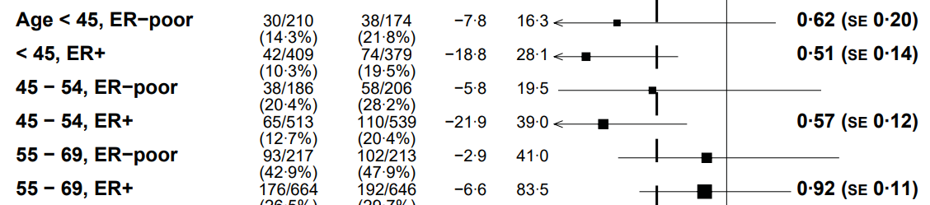
EBCTCG Trials CMF vs No Chemo: Breast Cancer Mortality
CMF Effective in Premenopausal ER+
CMF, cyclophosphamide methotrexate fluorouracil; EBCTCG, Early Breast Cancer Trialists' Collaborative Group; ER, estrogen receptor; SE, standard error.
EBCTCG, Lancet 2012.

Slide 18
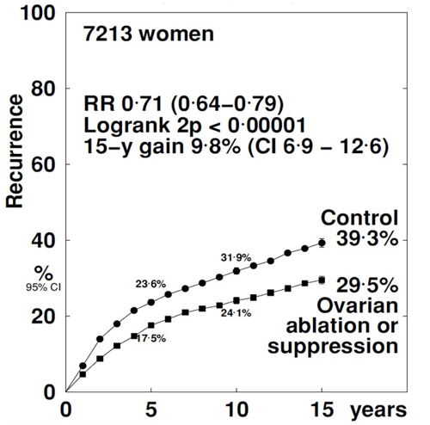
EBCTCG meta-analysis of 14,999 patients from 25 randomized trials: effects of ovarian ablation/suppression on breast cancer recurrence and survival
OFS
vs
No OFS
patients
Recurrence Risk
No chemotherapy or Remained premenopausal after chemotherapy
No OFS
Abs Diff: ~10%
OFS
Richard Gray. ASCO 2023

Slide 19
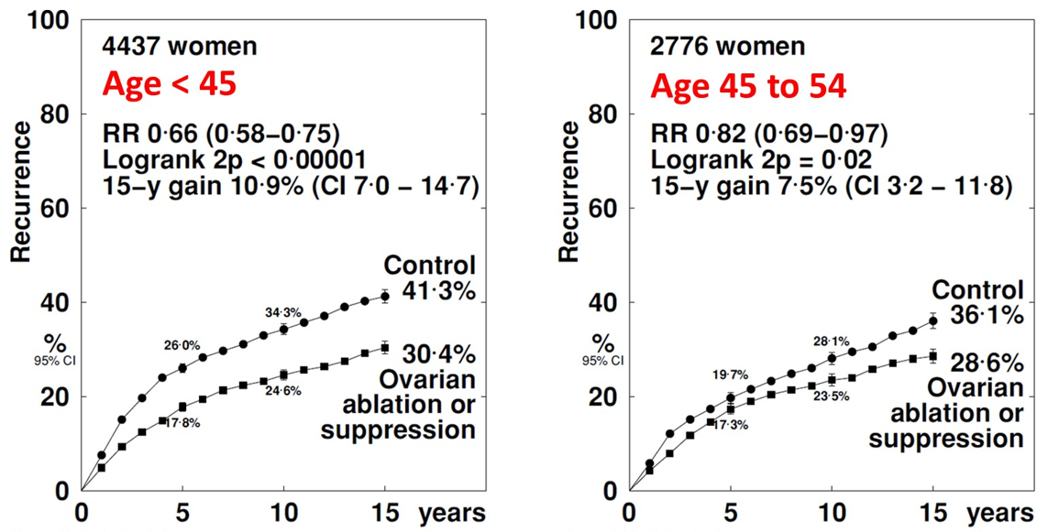
Recurrence Risk per age
No chemotherapy or premenopausal after chemotherapy
patients
patients
No OFS
No OFS
OFS
OFS
Abs Diff: ~11%
Abs Diff: 7.5%
Richard Gray. ASCO 2023

Slide 20
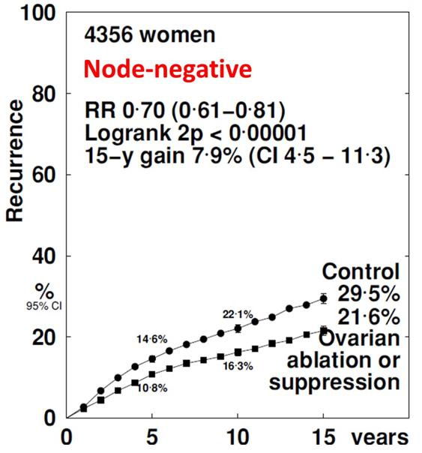
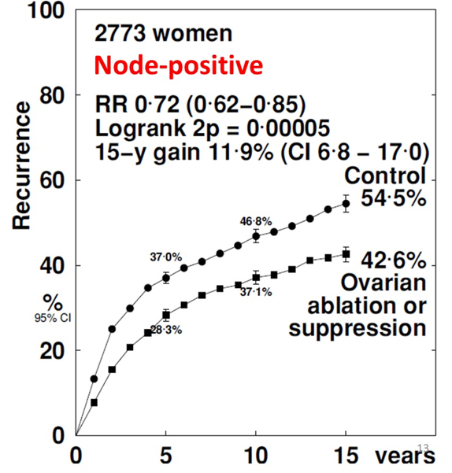
Recurrence Risk per Node Status
No chemotherapy or premenopausal after chemotherapy
patients
patients
No OFS
No OFS
OFS
OFS
Abs Diff: ~8%
Abs Diff: 12%
Richard Gray. ASCO 2023

Slide 21
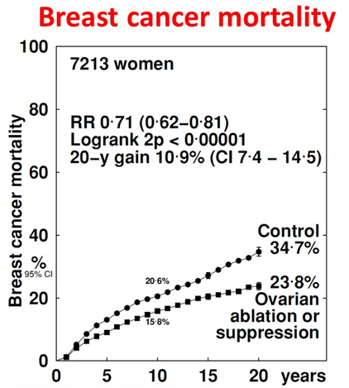
patients
OFS
  Decrease recurrence risk
  Improves OS
  Benefit regardless LN status,
  More significant benefit if LN+, age < 45 years old
No OFS
5 yrs OFS is not easy.
Adherence can be challenge
OFS
Abs Diff: ~11%
Richard Gray. ASCO 2023

Slide 22
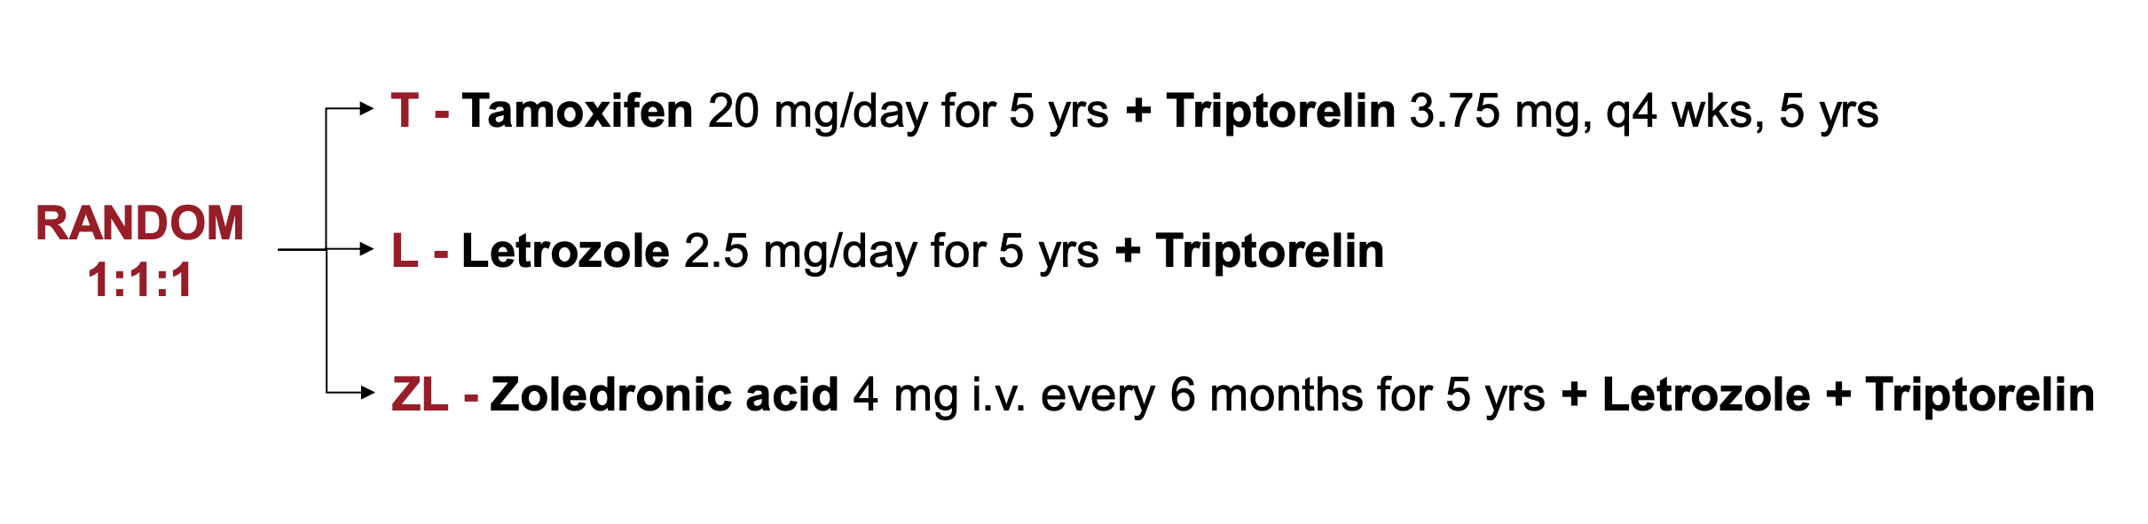
Length of GnRHa Therapy: HOBOE Trial
Phase 3 trial
1065 premenopausal patients with HR+ early breast cancer
Median follow-up of 64 months: DFS at 5 years was 85.4%, 93.2% and 93.3% with tamoxifen, letrozole and zoledronic acid + letrozole, respectively (p = 0.008)
Perrone F et al. Eur J Cancer 2019;118:178-186.

Slide 23
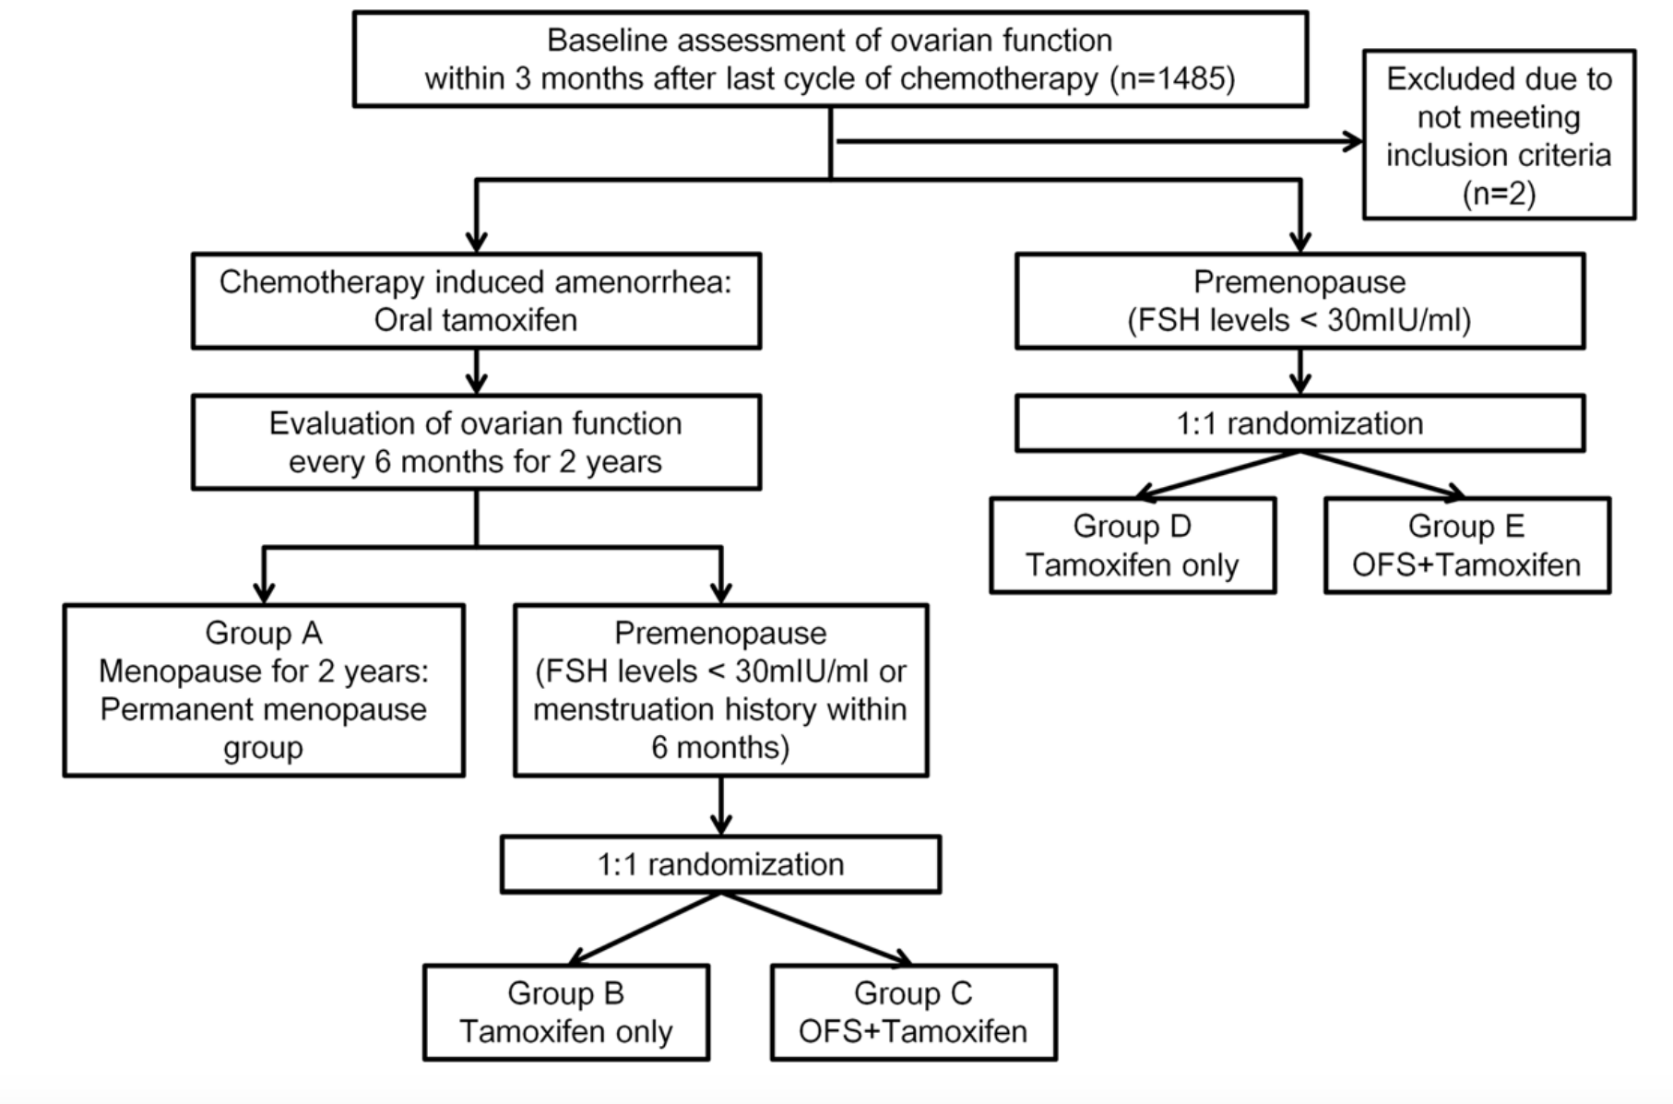
Data to Support at Least 2 Years of GnRHa: ASTRRA Trial
Phase III prospective, randomized
1,483 pre-menopausal women age < 45 years with ER-positive breast cancer who received chemotherapy
Ovarian function assessment: FSH and menses
Goserelin for 2 years plus 5 years of tamoxifen compared with 5 years of tamoxifen alone

Slide 24
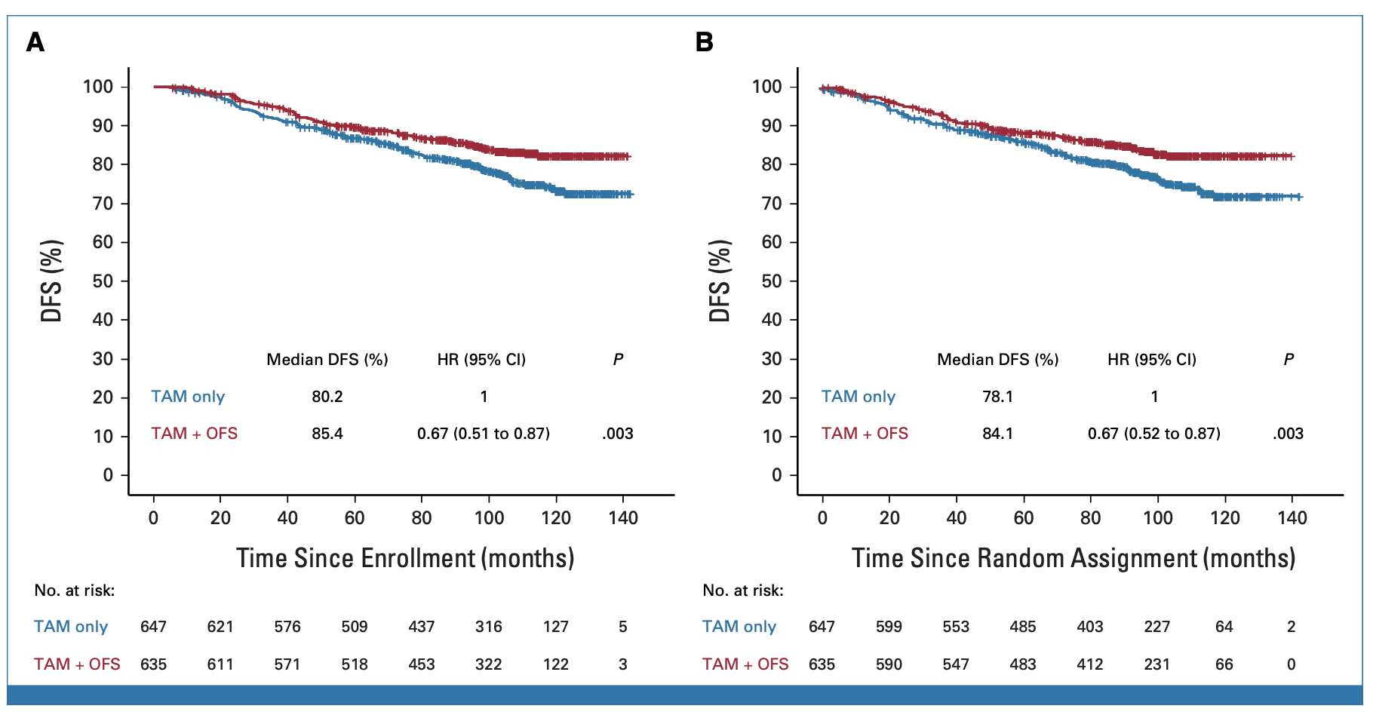
Data to Support at Least 2 Years of OFS: ASTRRA Trial
8-year DFS: 85.4% vs 80.2% (HR=0.67; 95% CI, 0.51 to 0.87)
Kaplan-Meier estimates of DFS: (A) from the time of enrollment and (B) from the time of random assignment to the time of the first event.

Slide 25



TEXT
Tamoxifen and
EXemestane Trial
R
Premenopausal
≤12 wks after surgery
Planned OFS
No planned chemo
OR planned chemo
A
N
Tamoxifen+OFS x 5y
Exemestane+OFS x 5y
D
O
M
I
Joint Analysis (N=4690)
Z
E
SOFT
Premenopausal
≤12 wks after surgery
No chemo
OR
Remain premenopausal
≤ 8 mos after chemo
Suppression of Ovarian Function Trial
Tamoxifen+OFS x 5y
Exemestane+OFS x 5y
R
A
N
Tamoxifen x 5y
Tamoxifen+OFS x 5y Exemestane+OFS x 5y
D
O
M
I
Z
E
OFS=ovarian function suppression

Slide 26
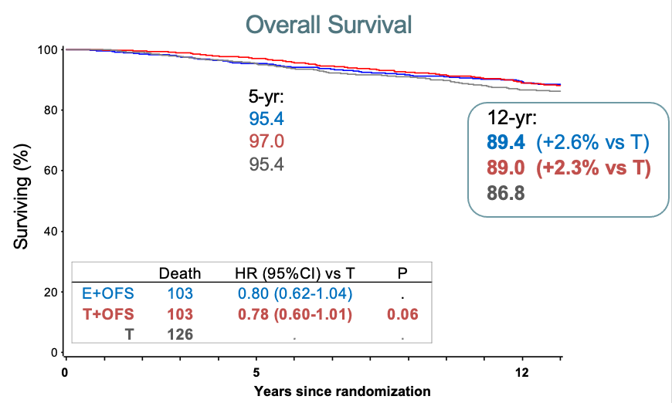
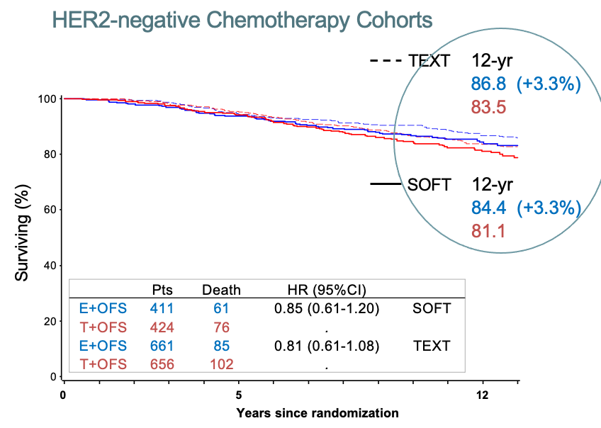
Update on SOFT and TEXT Trials: What is the role of OFS?
SOFT: Overall survival
OFS adds to either tam (2.3%) or exe (2.6%)
Benefit limited to high risk/prior chemo
More substantial benefit (~10%) for those at higher clinical risk
Study design: Trials launched in 2003 to evaluate:
  Is there a benefit of adding OFS to tamoxifen, in particular for pre-menopausal women (SOFT)
  When OFS is given, is there a benefit of aromatase inhibitor vs. tamoxifen (SOFT and TEXT)
Previous results at 5 and 8 yrs median FU:
  Addition of OFS to tamoxifen reduces recurrence and death
  Further reduction of distant recurrence, but not death, with exemestane + OFS vs. tamoxifen + OFS
  Absolute benefit varies depending on underlying risk of recurrence; Tamoxifen alone sufficient for low risk
SABCS 2022: Planned update focusing on DR and OS
  Median FU of SOFT and TEXT was 12 and 13 years
  76% patients alive & in FU
SOFT + TEXT: OS in chemo cohort
E + OFS survival benefit (3.3%) over T+OFS
Regan et al SABCS 2021

Slide 27
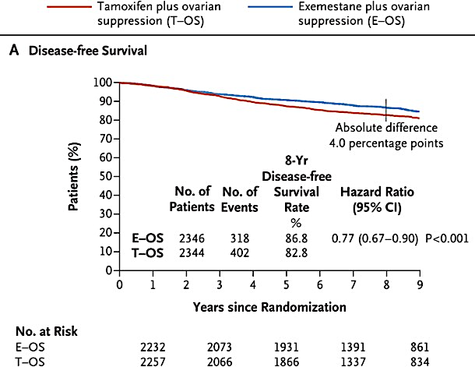
Pagani O et al,
NEJM 2018;379:122-37

Slide 28
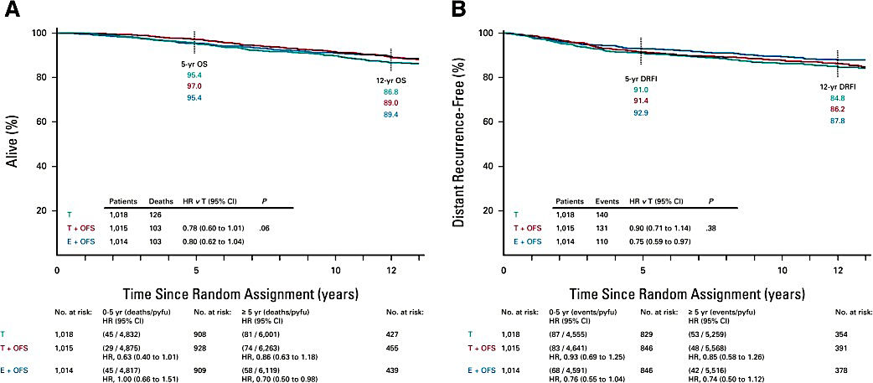
SOFT: Outcomes after median follow-up of 12 years
OS
DRFI
Francis PA et al, J Clin Oncol
41:1370-1375

Slide 29
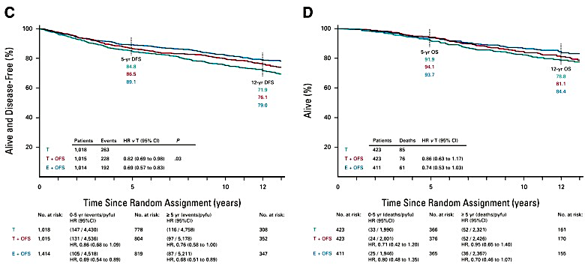
SOFT: Outcomes after median follow-up of 12 years
DFS
with 5- and 12-year event-free percentages according to treatment in the ITT population
OS
in patients with HER2- negative tumors who received prior chemotherapy
Francis PA et al, J Clin Oncol
41:1370-1375

Slide 30
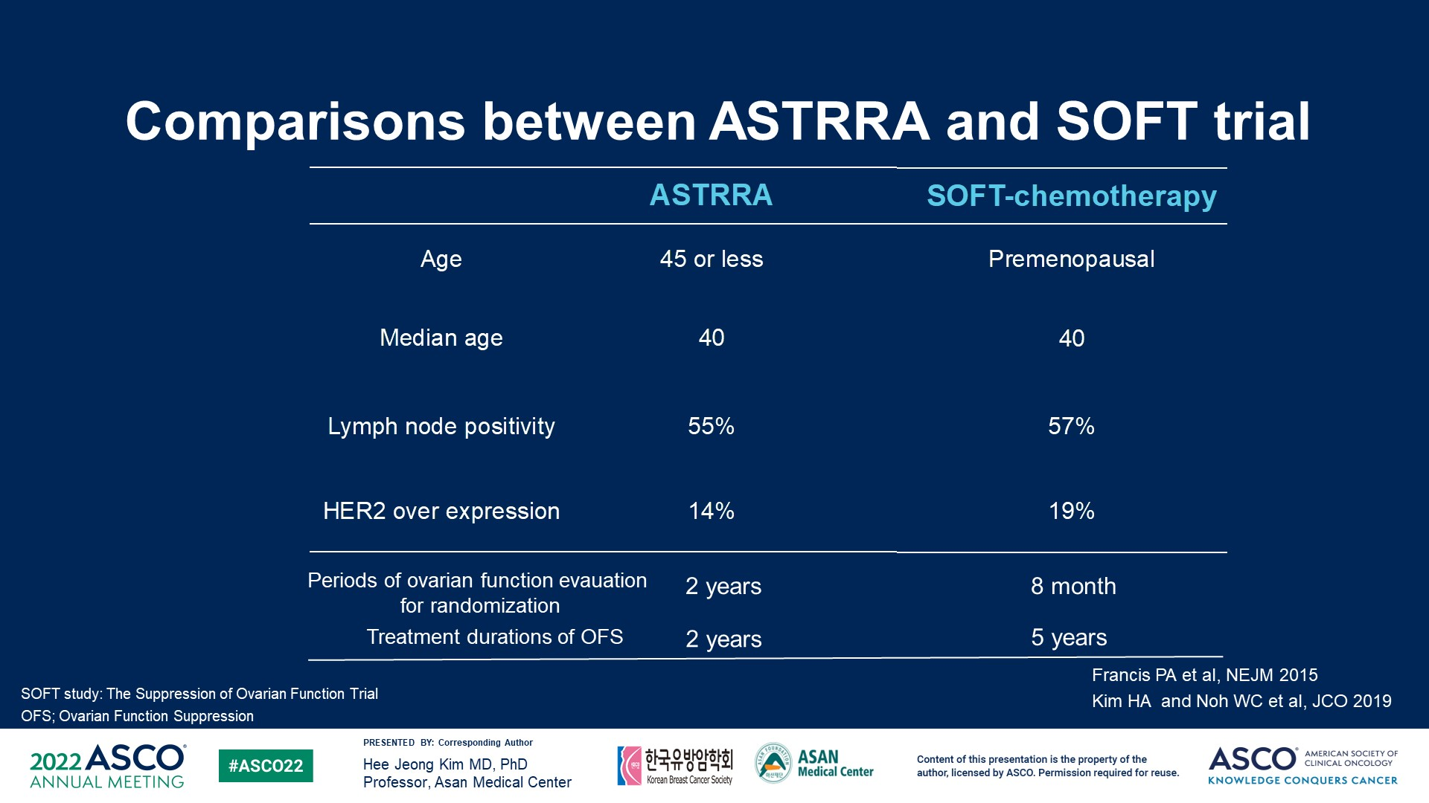
Comparisons between ASTRRA and SOFT trial

Slide 31
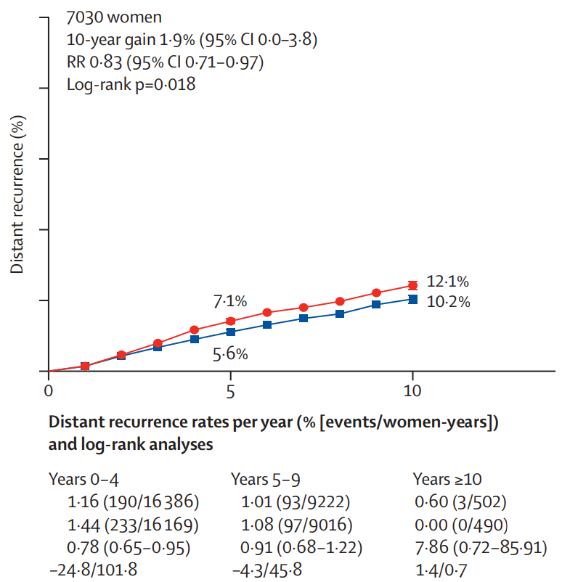
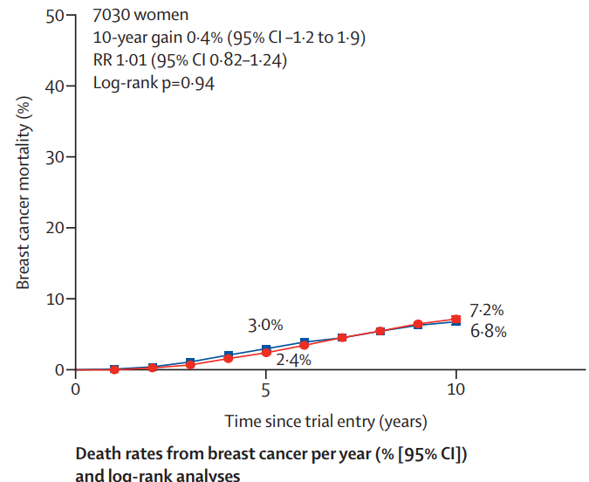

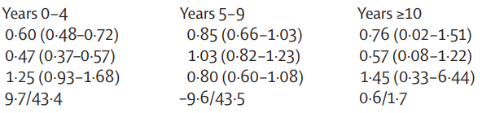
EBCTCG meta-analysis of 7030 patients from four randomized trials: AI + OFS versus TAM + OFS in premenopausal patients with ER+ early-stage breast cancer
AI +OFS
vs
TAM + OFS
Four Clinical Trials:
ABCSG:
NEJM 2009
Ann Oncol 2015
TEXT:
NEJM 2014
NEJM 2018
SOFT:
NEJM. 2014
NEJM 2018
HOBOE
Eur J Cancer. 2019
dRFS
OS
AI+OFS vs TAM+ OFS: improves dRFS (mainly during the year 0-4) but not OS
Early Breast Cancer Trialists’ Collaborative Group; Lancet Oncol. 2022

Slide 32
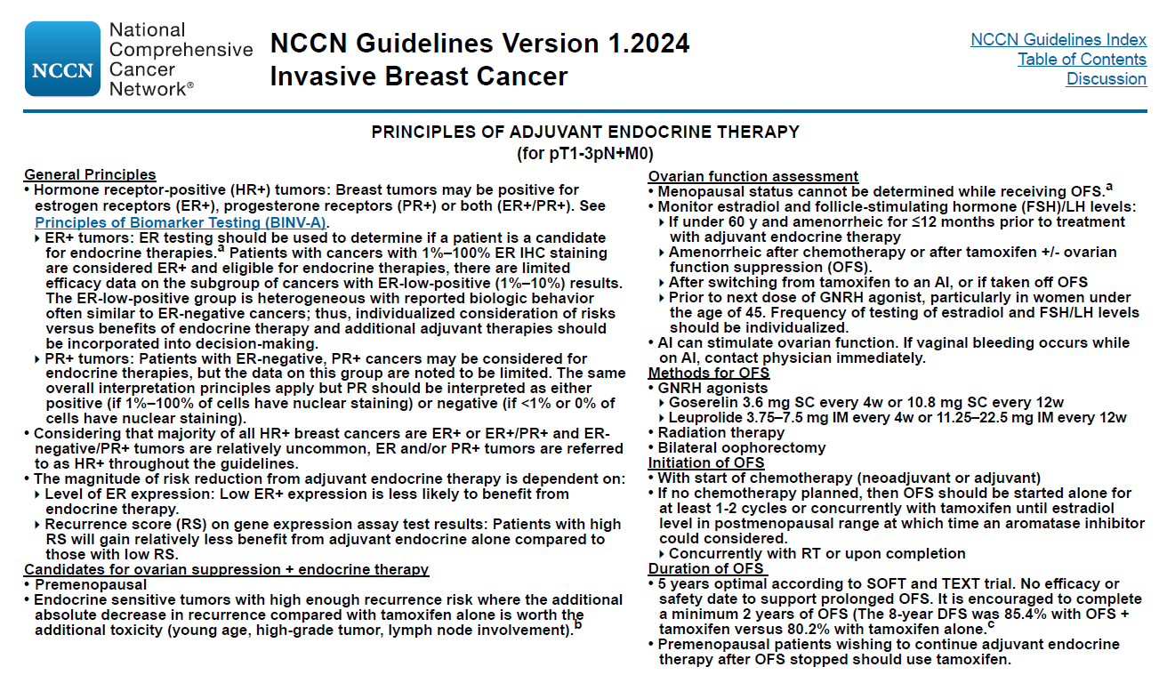
BINV-K, 1 of 2. © 2024 National Comprehensive Cancer Network, Inc. All rights reserved. NCCN Guidelines® and this illustration may not be reproduced in any form without the express written permission of NCCN. Available at: NCCN.org.

Slide 33
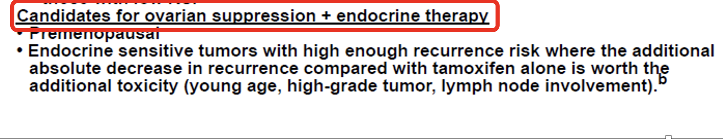
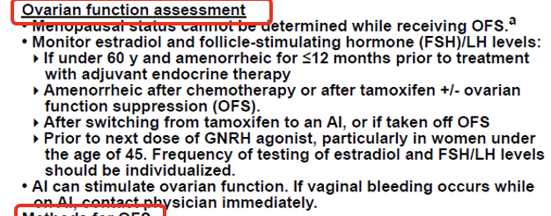

Slide 34
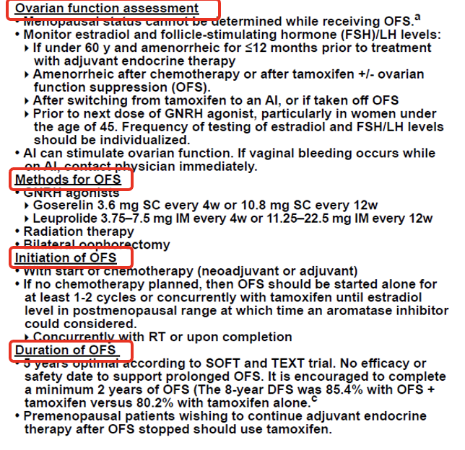

Slide 35
Dose Interval of GnRHa: What Do the Guidelines Say?
ASCO guidelines¹:
  Monthly administration of GnRH agonist therapy is preferred.
  However, as randomized trials have shown equivalent physiological and clinical outcomes using either monthly or every 3 months GnRH administration in patients with premenopausal breast cancer, the Panel considered every 3 months therapy as a reasonable alternative.
ESMO guidelines²:
  Current guidelines support monthly use to optimize ovarian function suppression, particularly in very young women (<35 years of age) and in those receiving an AI.
  3-6 monthly use may be considered on a case-by-case basis with very close monitoring of ovarian function, when monthly use is not feasible or accepted by the patient.
.

Slide 36

Length of GnRHa Therapy: What Do the Guidelines Say?
ESMO guidelines: “GnRHa in combination with tamoxifen or an AI should be prescribed for 5 years based on the SOFT/TEXT data.”

Slide 37
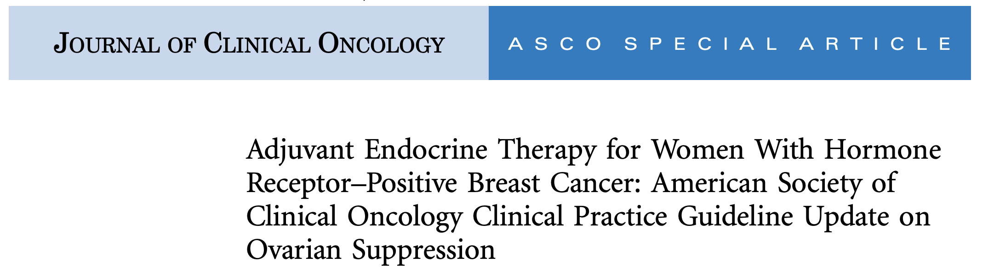
Length of GnRHa Therapy: What Do the Guidelines Say?
ASCO guidelines: “The standard duration of ovarian suppression in the included trials was 5 years. With no comparative data available on alternative durations, the panel supports ovarian suppression for 5 years.”

Slide 38
Premenopausal Women
Adjuvant Endocrine Therapy Strategies for Clinic
Tamoxifen 5 years
(EBCTCG data)
Tamoxifen 10 years (still premenopausal)
(ATLAS Trial)
Tamoxifen → AI 5 years (become postmenopausal)
(MA.17 trial)
Tamoxifen + Ovarian Function Suppression
(SOFT, ASTRRA trials)
AI + Ovarian Function Suppression 5 y *
(SOFT, TEXT, HOBOE trials)
* monarchE, NATALEE
Lower risk
Lower risk
Higher risk
.

Slide 39
Selection of Adjuvant Endocrine Therapy in Premenopausal
HR+ HER2- Breast Cancer
Composite risk of recurrence derived from combination of clinical-pathologic factors may assist decision-making:
  Age
  Nodal status
  Tumor size
  Tumor grade
  ER %
  PgR %
  Ki67 %
.
Regan et al, J Clin Oncol 2016

Slide 40
Composite Risk App:
Tailoring Premenopausal Adjuvant Endocrine Therapy
https://rconnect.dfci.harvard.edu/CompositeRiskSTEPP/
Composite Risk Application - Harvard University
Tailoring Adjuvant Endocrine Therapy for Premenopausal Women - Absolute Improvements in Freedom from Distant Recurrence With Adjuvant Endocrine Therapies for Premenopausal Women With HR+/HER2- Breast Cancer, as Investigated in the TEXT and SOFT Clinical Trials, According to Composite Risk
Meredith Regan
Pagani, et al. J Cin Oncol. 2019. https://rconnect.dfci.harvard.edu/CompositeRiskSTEPP/

Slide 41
NCCN Guidelines
Menopause | ODX RS | Recommendations
Pos – M (N0-N1) | <26 | ET
 | ≥26 | ChemoET
Pre – M(N0) | <16 | ET
 | 16-25 | Consider ChemoET Or OFS + ET
 | ≥26 | ChemoET
Pre - M (N1) | <26 | Consider chemoET Or OFS + ET
 | ≥26 | ChemoET
Unclear if chemotherapy benefit was due to the OFS effects promoted by chemotherapy
OFSET Study
designed to answer these questions
NCCN Guidelines® for Breast Cancer (Version 1.2024).

Slide 42
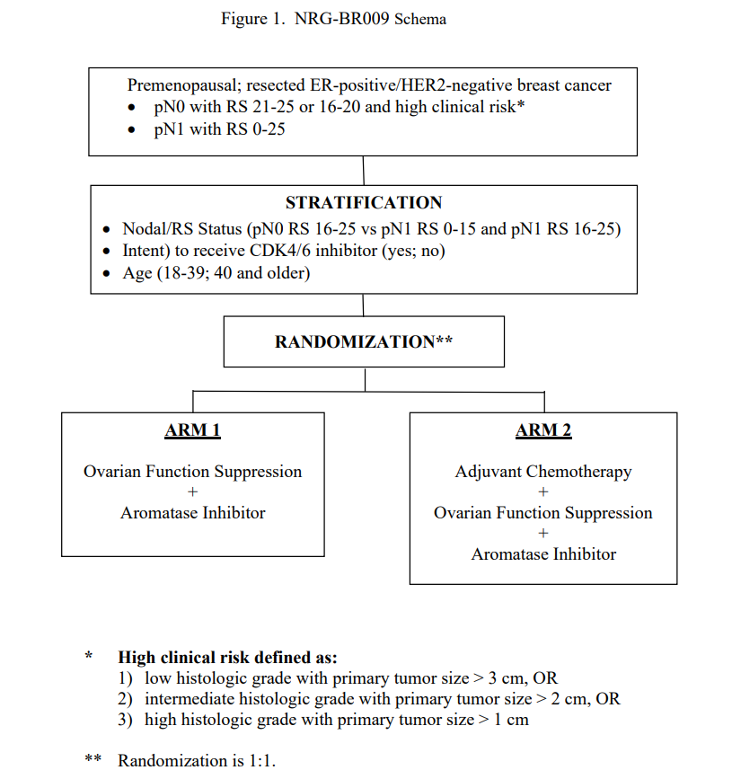
NRG-BR009 (OFSET)
  Pre-Menopausal
  pT1-T3, pN0-1
  ER+/HER2-
  RS≤25
  It’s Active

Slide 43
Dr Gradishar – Case 1: 25-year-old woman
25-year-old female (lawyer), daughter of 2 physicians, self-detected left breast mass confirmed by mother. Underwent imaging confirming ~2 cm mass, no suspicious nodes. PE revealed mass in left breast without any axillary adenopathy. Core biopsy c/w infiltrating ductal carcinoma, ER+, PR+ and HER2+; Germline testing was negative. Underwent bilateral nipple sparing mastectomy and found to have on the Left: 2.2. cm IDC with 1/16 nodes positive. She received ACT chemo with concurrent trastuzumab and pertuzumab.

Slide 44
Dr Gradishar – Case 2: 38-year-old woman
38-year-old, premenopausal. Hispanic female self-identified large mass in right breast; confirmed by mammogram as ~4-5 cm mass with no axillary nodes visualized. Menstrual periods are regular; germline testing is negative. Biopsy was ER+/PR+ and HER2– IDC. S 0/5 nodes. She underwent skin sparing mastectomy and sentinel lymph node biopsy; path 5.1 cm tumor with 0/5 nodes. The patient received postoperative ACT followed by chest wall radiation therapy. Started tamoxifen. Question of ovarian suppression.

Slide 45
Agenda
Introduction
Module 1: Addition of Ovarian Function Suppression (OFS) to Adjuvant Endocrine Therapy for Premenopausal Patients with Hormone Receptor (HR)-Positive Breast Cancer — Dr Gradishar
Module 2: Role of OFS in Preserving Fertility and/or Ovarian Function in Premenopausal Patients — Dr Mayer
Module 3: Tolerability/Toxicity of OFS — Dr Kaklamani
Module 4: Other Practical Considerations in the Application of OFS — Dr Wander

Slide 46
Have you offered or would you offer the opportunity to discontinue hormonal therapy to a premenopausal patient with low-risk (node-negative) localized breast cancer who is receiving a GnRHa in combination with adjuvant endocrine treatment and wishes to become pregnant?
I have
I have
I have
–
I have
I have

Slide 47
In general, for a premenopausal patient with low-risk (node-negative) localized breast cancer who is receiving a GnRHa in combination with adjuvant endocrine treatment and wishes to become pregnant, what is the minimum duration of hormonal therapy that you would recommend before you would be comfortable discontinuing treatment?
I have proceeded to pregnancy with delayed hormone
therapy in 2 patients
5 years
2 years
2 years
1 year
2 years

Slide 48
In general, for a premenopausal patient with low-risk (node-negative) localized breast cancer who is receiving a GnRHa in combination with adjuvant endocrine treatment and wishes to become pregnant, how long would you feel comfortable allowing her to remain off hormonal therapy?
2 years
2 years
2 years
2 years
3 years
2 years

Slide 49
Have you offered or would you offer the opportunity to discontinue hormonal therapy to a premenopausal patient with high-risk (multiple positive nodes) localized breast cancer who is receiving a GnRHa in combination with adjuvant endocrine treatment and wishes to become pregnant?
I have
I have
I have not but would for the right patient
I have not but would for the right patient
I have
I have not but would for the right patient

Slide 50
In general, for a premenopausal patient with high-risk (multiple positive nodes) localized breast cancer who is receiving a GnRHa in combination with adjuvant endocrine treatment and wishes to become pregnant, what is the minimum duration of hormonal therapy that you would recommend before you would be comfortable discontinuing treatment?
2 years
5 years
2 years
5 years
2 years
3-4 years

Slide 51
In general, for a premenopausal patient with high-risk (multiple positive nodes) localized breast cancer who is receiving a GnRHa in combination with adjuvant endocrine treatment and wishes to become pregnant, how long would you feel comfortable allowing her to remain off hormonal therapy?
2 years
2 years
–
2 years
2 years
1 year

Slide 52
The Role of Ovarian Suppression in Preserving Ovarian Function in Premenopausal Patients with Early Breast Cancer
Erica L. Mayer MD MPH
Dana-Farber Cancer Institute
Boston, MA

Slide 53
Outline:
Potential risk of infertility with cytotoxic therapy in premenopausal patients with breast cancer
Role of ovarian suppression during chemotherapy in preventing chemotherapy-induced amenorrhea in premenopausal patients with early breast cancer
Safety of pregnancy after a breast cancer diagnosis

Slide 54
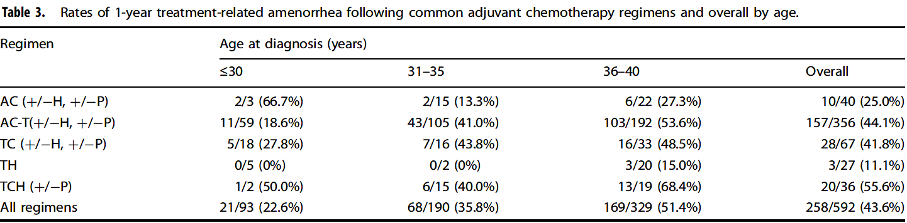
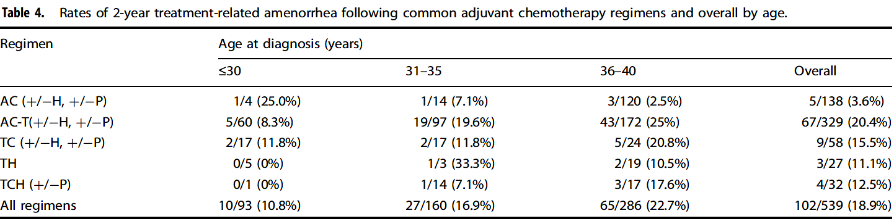
Risk of Treatment-Related Amenorrhea with Breast Cancer Therapy
Amenorrhea at 1 year is often used as proxy for fertility
Rates of amenorrhea increase with increasing age and vary by chemotherapy regimen
Poorvu et al, NPJ Breast, 2021

Slide 55
Chemotherapy-related Amenorrhea: Menses Recovery
By Age Group
60%
Cohort study of 1636 premenopausal women
Amenorrhea was more frequent among older women and those receiving adjuvant tamoxifen
Amenorrhea was significantly associated with worse insomnia, systemic therapy–related adverse effects, and sexual dysfunction
50%
40%
30%
Participants, %
20%
10%
0%
18 – 34
35 – 39
40 – 44
≥45
Age, y
Menses recovery
Early (at 1 y)
Late (at 1 – 2 y)
Very late (2 – 4 y)
Menses Recovery Rate by Age Group Among 729 Women With Menses Status Available at All Time Points
Overall, 313 patients (42.9%) reported menses recovery
Notes:
The older the patient, the higher the risk of ovarian insufficiency

Slide 56
Impact of Chemotherapy on Fertility
More women are delaying pregnancy in the modern era; a breast cancer diagnosis can complicate fertility and family planning
The impact of chemotherapy on ovarian function should be discussed with patients in the first visit with the oncologist: impact on fertility and menopausal symptoms
Young Women’s Breast Cancer Study (YWS) prospective cohort of 620 patients with age ≤ 40 years with a diagnosis of breast cancer:¹
  37% reported that before their breast cancer diagnosis, they had wished to have future biologic children
  51% were concerned about becoming infertile post-treatment
Patients who are interested in fertility preservation should be offered a referral to a reproductive specialist²

Slide 57
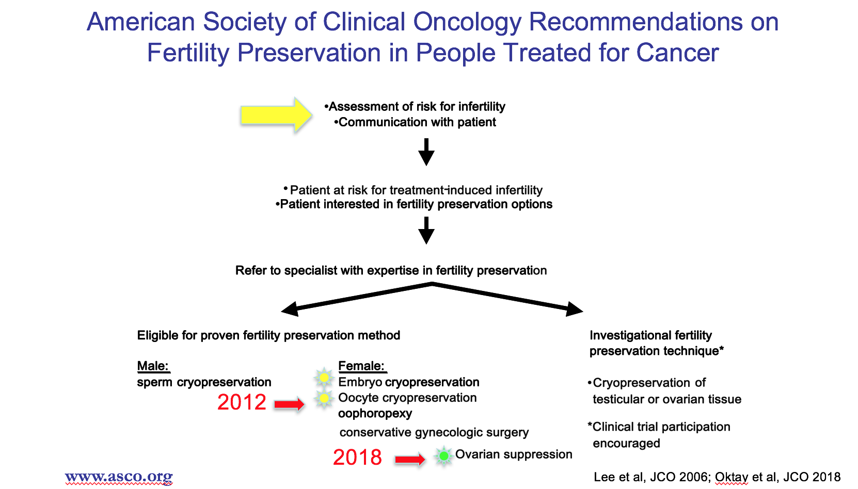

Slide 58
What can we do? Fertility Preservation with GnRHa Ovarian Suppression during Chemotherapy
INDIRECT EFFECT
GnRHa
DIRECT EFFECT
Temporary OS with GnRHa during chemotherapy in premenopausal patients with breast cancer may decrease the risk of premature ovarian insufficiency
Protective gonadal effect of GnRHa during chemotherapy: mechanism of action is not fully known
Majority of clinical trials used amenorrhea to define premature ovarian insufficiency
GnRHa should not replace cryopreservation!
Hypothalamus
GnRH
Pituitary
FSH
Ovary
Ovary
⬊ Growth factor secretion
⬊ Follicular recruitment
(burn-out)
⬊ Vascularization
⬊ Apoptosis
⬉ Germ cells
GnRH receptor
Hypothesized indirect and direct mechanisms of action for the protective gonadal effect of temporary ovarian suppression with GnRHa during chemotherapy. Abbreviations: GnRH, gonadotropin-releasing hormone; FSH, follicle-stimulating hormone; GnRHa, gonadotropin-releasing hormone agonist.

Slide 59
How it works: Timing of GnRHa Therapy in Relation to Chemotherapy
Study | N | GnRHa | Start | Interval | End
PROMISE-GIM6¹ | 281 | Triptorelin | At least 1 week prior to chemotherapy | Every 4 weeks | Last dose before the last cycle of chemotherapy
POEMS/S0230² | 218 | Goserelin | At least 1 week prior to chemotherapy | Every 4 weeks | Last dose within 2 weeks before or after final chemotherapy dose
Anglo Celtic Group OPTION³ | 221 | Goserelin | At least 1 week prior to chemotherapy (preferably 2 weeks) | Every 3-4 weeks | Until the end of chemotherapy
GBG 37 ZORO⁴ | 60 | Goserelin | At least 2 weeks prior to chemotherapy | Every 4 weeks | Until the end of chemotherapy
Munster PN et al⁵ | 49 | Triptorelin | 1-4 weeks prior to chemotherapy | Every 4 weeks | Until the end of chemotherapy
Elgindy EA et al⁶ | 50 | Triptorelin | At least 10 days prior to chemotherapy | Every 4 weeks | Until the end of chemotherapy
Meta-analysis, N=873 patients
GnRHa, gonadotropin releasing hormone agonist
1. Del Mastro L et al. JAMA 2011. Moore HCF et al. N Eng J Med 2015. 3. Leonard RCF et al. Ann Oncol 2017. 4. Gerber B et al. J Clin Oncol 2011. 5. Munster PN et al. J Clin Oncol 2012. 6. Elgindy EA et al. Obstet Gynecol 2013.

Slide 60
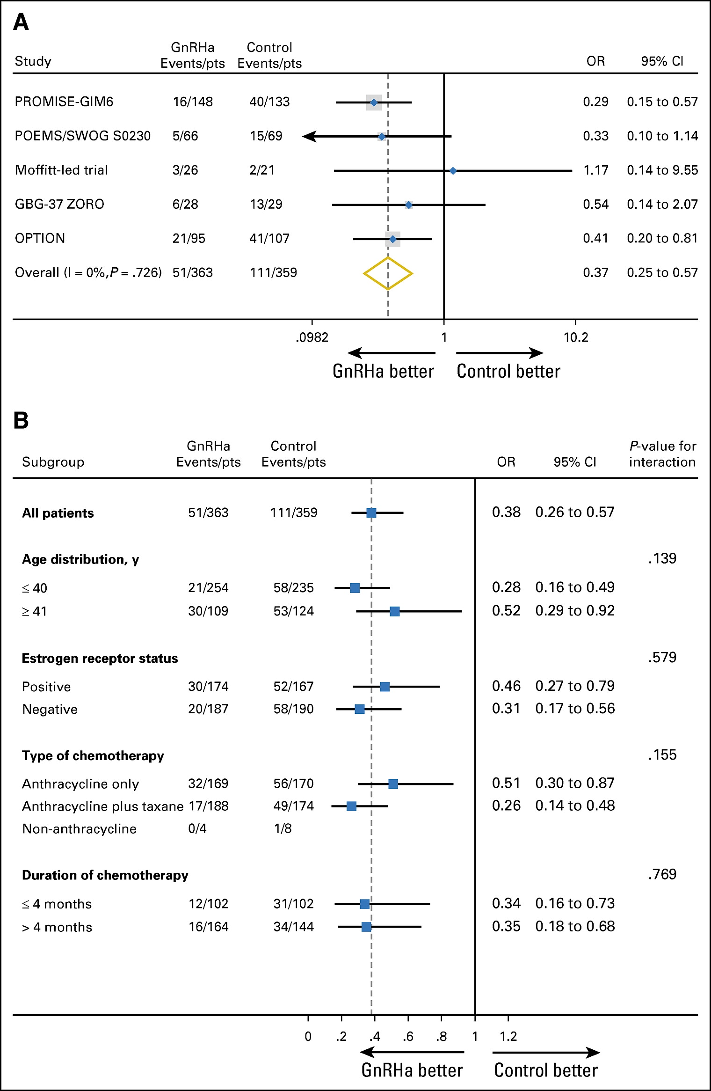
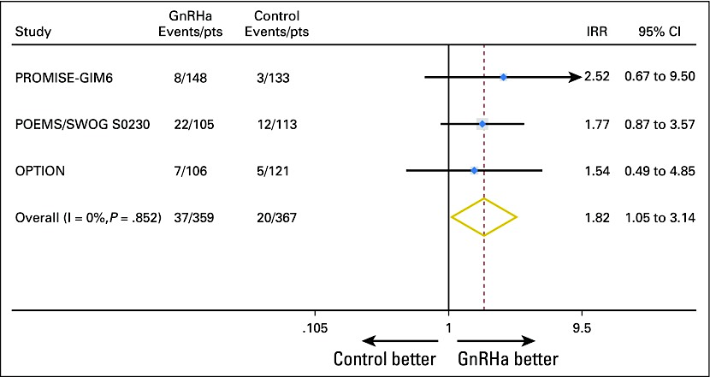
Premature ovarian insufficiency and pregnancy outcomes
GnRHa reduced risk of chemotherapy-induced premature ovarian insufficiency, 14.1% vs 30.9%, OR 0.38 (95% CI 0.26-0.57, p<0.001)
Effect was consistent across all patient subgroups
Pregnancy rate 10.3% with GnRHa vs 5.5% with control, all in patients <40 years
Lambertini et al, JCO, 2018

Slide 61
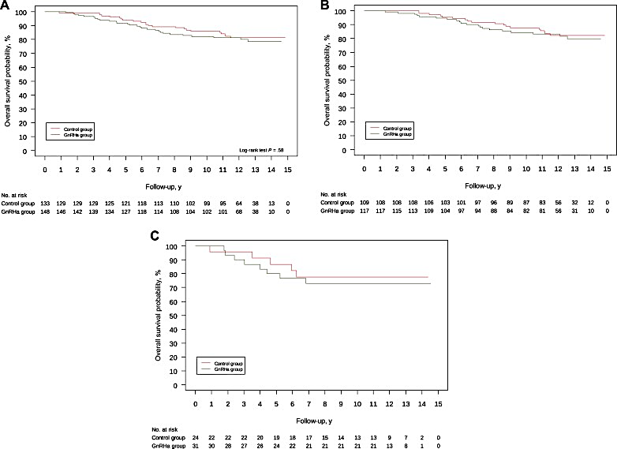
PROMISE GIM-6: 12 year Survival Outcomes of GNRHa to Preserve Ovarian Function
OS All patients
OS HR+
OS HR-
Lambertini et al, JNCI, 2022

Slide 62
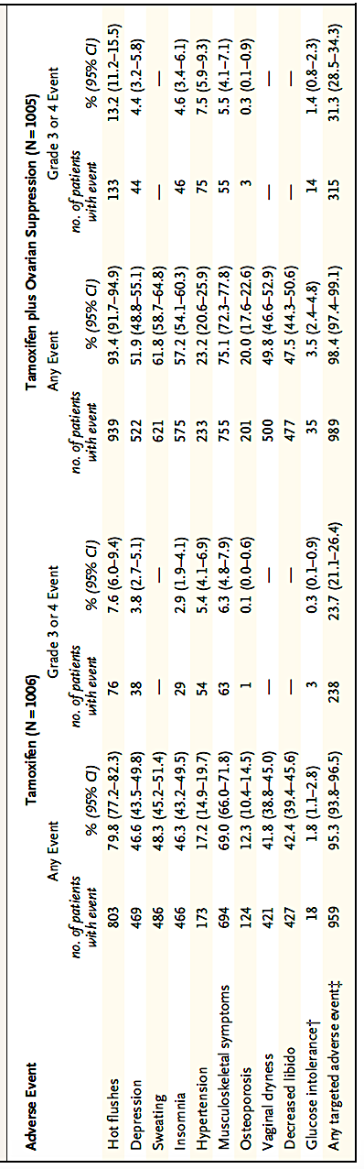
SOFT (Tamoxifen vs. Tamoxifen + OFS) Side Effects
Francis et al, NEJM, 2014

Slide 63
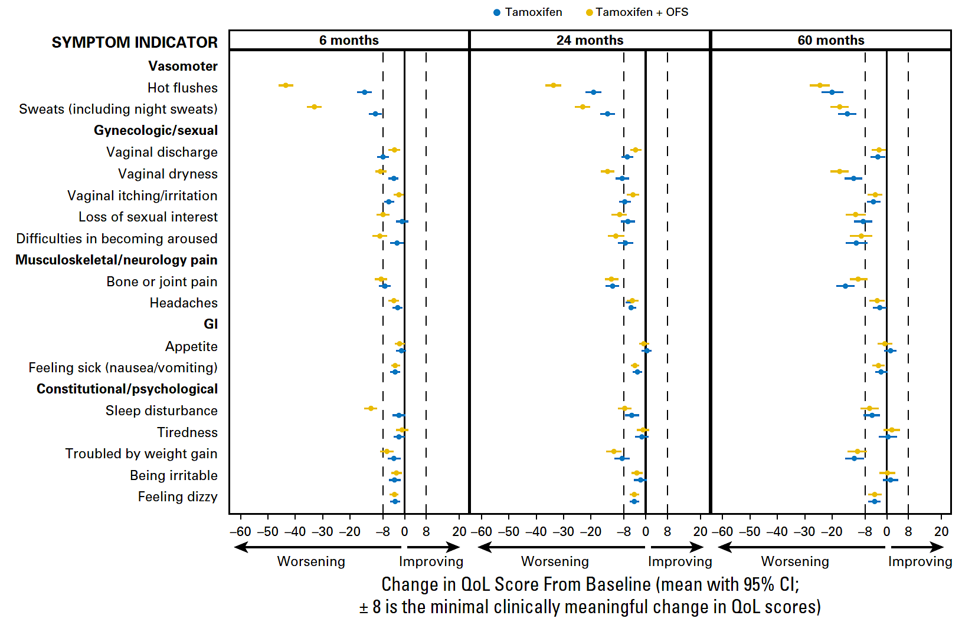
SOFT (Tamoxifen vs. Tamoxifen + OFS) Patient-Reported Outcomes
Ribi et al, JCO, 2016

Slide 64
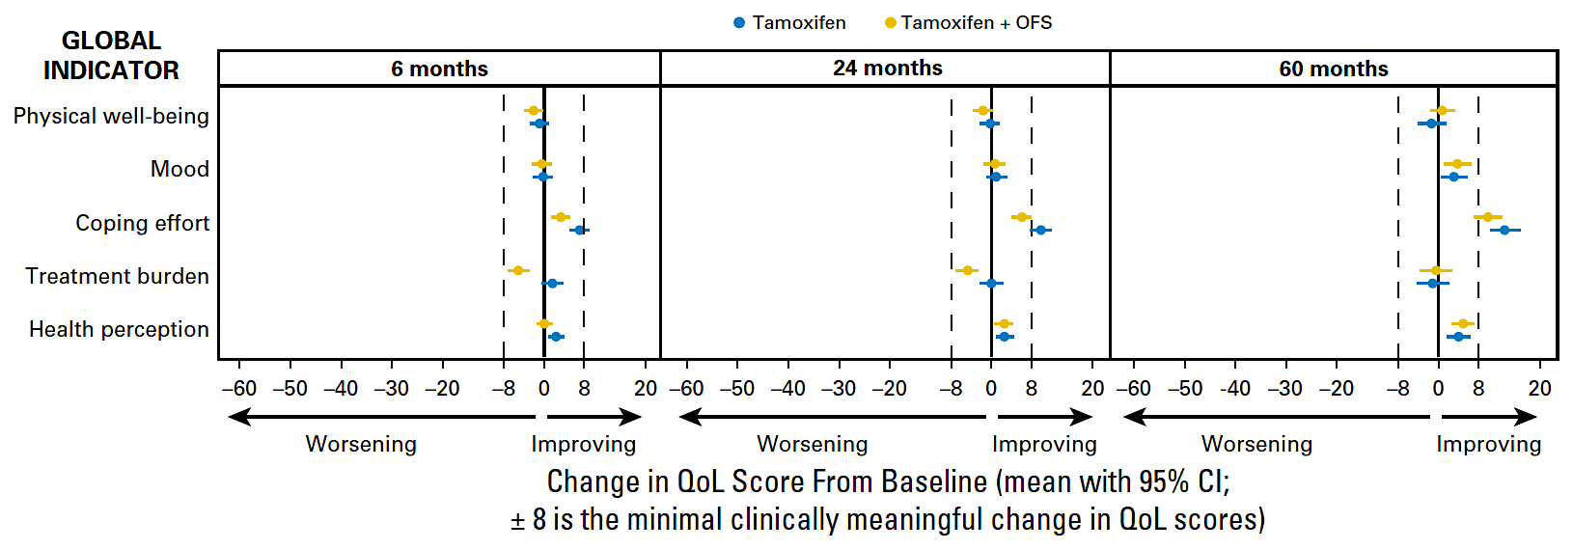
SOFT Quality of Life
Ribi et al, JCO, 2016

Slide 65
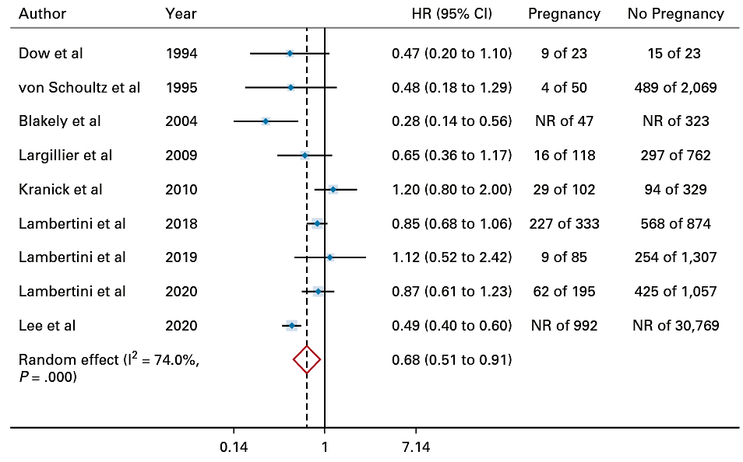
Is it safe to get pregnant after a breast cancer diagnosis?
Lambertini et al, JCO, 2022

Slide 66
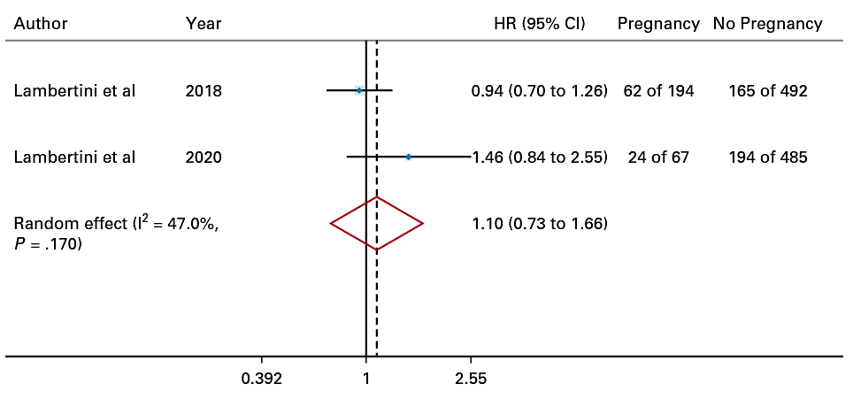
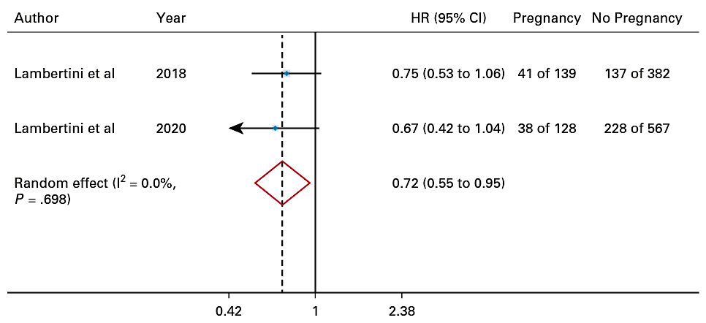
Disease-Free Survival After Pregnancy vs No Pregnancy
HR+ Breast Cancer
HR- Breast Cancer
Lambertini et al, JCO, 2022

Slide 67
The POSITIVE Trial: ELIGIBILITY
Premenopausal women wishing to become pregnant
Age ≤42 years at study entry
At least 18 months and no more than 30 months of prior adjuvant ET
for stage I-III HR+ BC
  Prior neo/adjuvant chemotherapy ± fertility preservation allowed
  No clinical evidence of recurrence
Partridge et al, SABCS, 2022
Partridge AH, et al. SABCS 2022; NEJM 2023
4

Slide 68
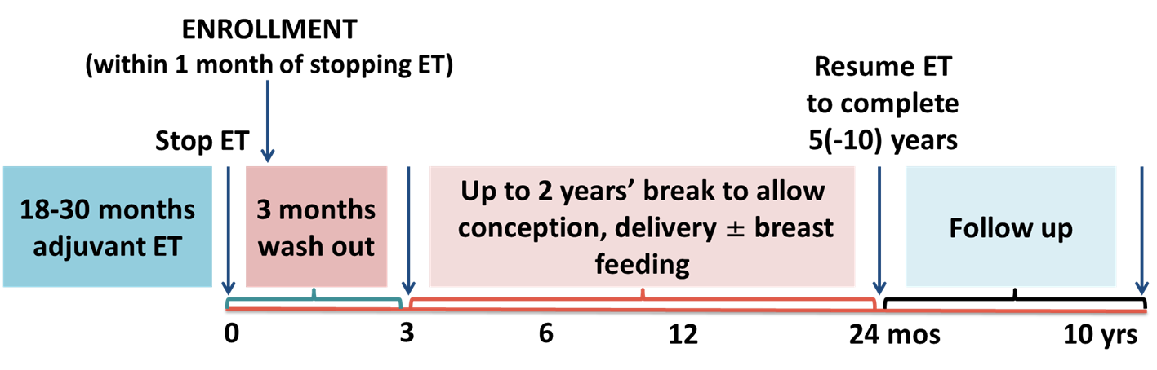
POSITIVE TRIAL PROCEDURES
Planned ET interruption (within 1 month of trial enrollment):
Up to 2 years to attempt pregnancy, conceive, deliver, and breastfeed, including
3-months washout period
  If no pregnancy by 1 year, fertility assessment strongly recommended
  ET resumption strongly recommended after pregnancy to complete planned 5-10 yrs
  Long-term follow-up
Partridge et al, SABCS, 2022
Partridge AH, et al. SABCS 2022; NEJM 2023
5

Slide 69
POSITIVE: PREGNANCY OUTCOMES
 | N | % of 497 | % of 368
Secondary endpoint population | 497 | 100%
At least one on trial pregnancy | 368 | 74% | 100%
At least one live birth (full-term or preterm) | 317 | 64% | 86%
At least one miscarriage | 93 | 19% | 25%
At least one elective abortion | 16 | 3% | 4%
At least one stillbirth/neonatal death | 1/1 | 0.2% / 0.2% | 0.3% / 0.3%
Note: 110 women had more than one pregnancy, and may contribute information to more than one row
Partridge AH, et al. SABCS 2022; NEJM 2023
15

Slide 70
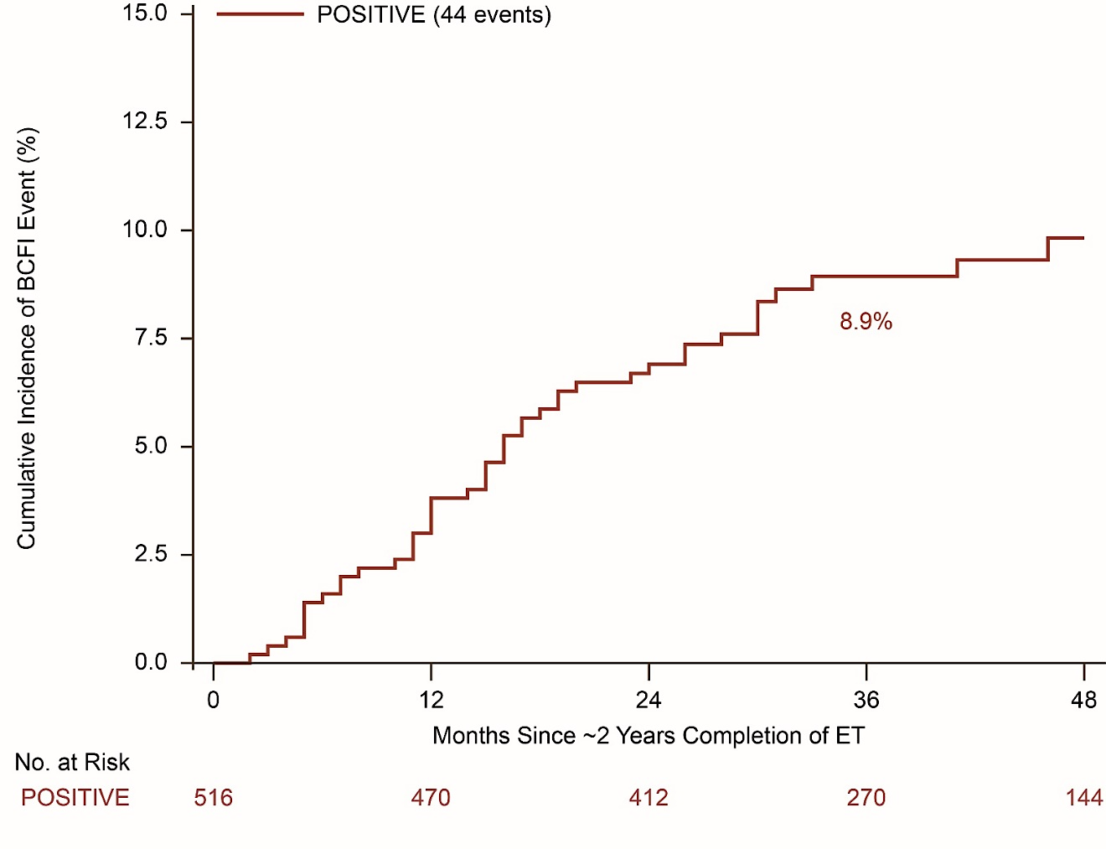
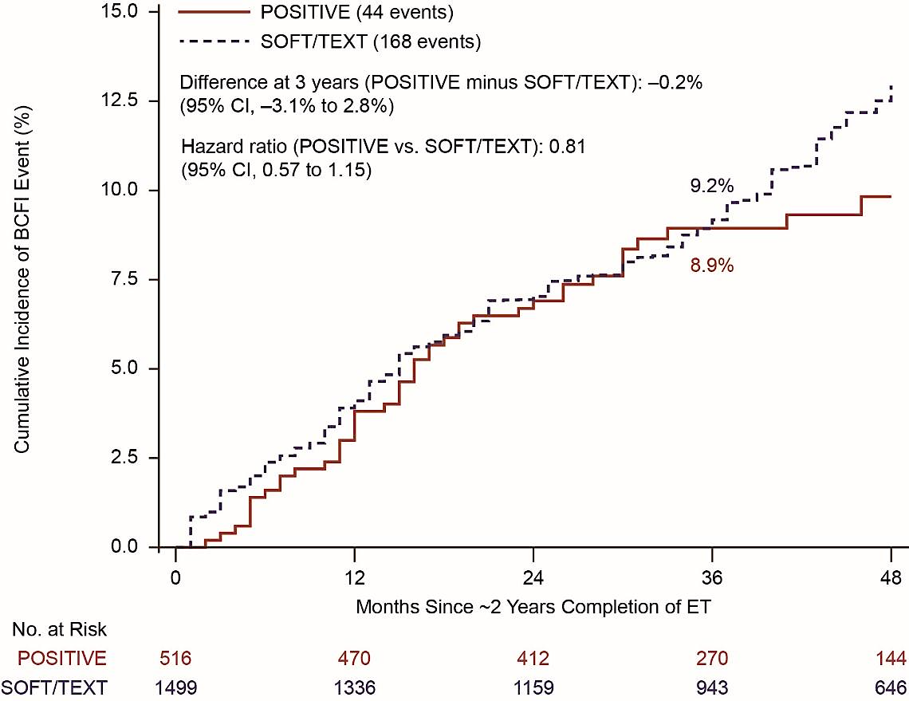
POSITIVE Trial Breast Cancer Outcomes
BCFI- POSITIVE only
BCFI- SOFT and TEXT matching analyses
Time
Partridge AH, et al. SABCS 2022; NEJM 2023

Slide 71
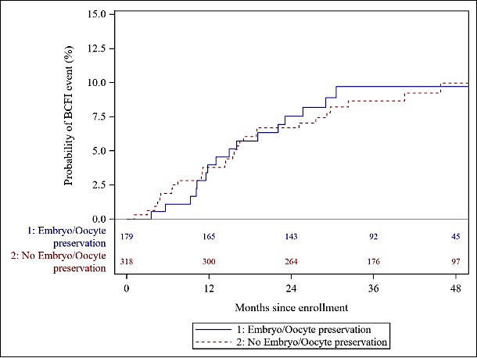
POSITIVE: Ovarian stimulation & breast cancer outcome
1) As part of embryo/oocyte cryopreservation - at breast cancer diagnosis
At 3-years, BCFI-events cumulative
incidence
9.7% (95% CI: 6.0% to 15.4%) for the 179
patients who underwent ovarian stimulation
8.7% (95% CI: 6.0% to 12.5%) for the 318
patients who did not
Embryo/oocyte cryopreservation at diagnosis followed by embryo transfer after ET interruption had higher pregnancy rates and was not associated with worse prognosis
Azim et al, SABCS 2023

Slide 72
Dr Mayer – Case 1: 33-year-old woman
A 33 year old woman presented with a right breast mass; on imaging, a 4 cm mass and at least 2 abnormal axillary nodes were appreciated.
Breast and axillary biopsy showed invasive breast cancer, grade 3, ER+/PR+/HER2 3+.
MRI confirmed at least 4.7 cm of disease with multiple abnormal right axillary nodes.
Preoperative TCHP x 6 chemotherapy is planned.
She is newly engaged, and has postponed her wedding due to this diagnosis.
In your first visit, she tells you the most important thing for her right now is fertility preservation.

Slide 73
Dr Mayer – Case 1: 33-year-old woman (cont)
You plan to offer GnRHa concurrent with chemotherapy. When should this be started?
  One month before chemotherapy start
  1-2 weeks before chemotherapy start
  1 month into chemotherapy
  Once chemotherapy is completed
  After oncofertility consultation is completed

Slide 74
Dr Mayer – Case 1: 33-year-old woman (cont)
You plan to offer GnRHa concurrent with chemotherapy. When should this be started?
  One month before chemotherapy start
  1-2 weeks before chemotherapy start
  1 month into chemotherapy
  Once chemotherapy is completed
  After oncofertility consultation is completed

Slide 75
Dr Mayer – Case 2: 35-year-old woman
This patient originally presented at age 35 with T2N0 grade 3 ER+/HER2- breast cancer while pregnant, with primary tumor measuring 4.7 cm on imaging.
She received preoperative AC + T, then had surgery showing a pCR.
Delivered a healthy baby boy.
Initiated OS and AI.
After two years of adjuvant endocrine therapy, she comes to clinic and is asking about safety of pregnancy.

Slide 76
Dr Mayer – Case 2: 35-year-old woman (cont)
You advise her:
  It’s OK to attempt pregnancy now, once endocrine therapy is stopped.
  It’s OK to get pregnant after a 1 month washout from endocrine therapy.
  It’s OK to get pregnant, but she should not use any assisted reproductive technologies.
  It’s OK to get pregnant after a 3 month washout from endocrine therapy.
  It’s not OK to get pregnant; she should continue on adjuvant endocrine therapy and look into adoption.

Slide 77
Dr Mayer – Case 2: 35-year-old woman (cont)
You advise her:
  It’s OK to attempt pregnancy now, once endocrine therapy is stopped.
  It’s OK to get pregnant after a 1 month washout from endocrine therapy.
  It’s OK to get pregnant, but she should not use any assisted reproductive technologies.
  It’s OK to get pregnant after a 3 month washout from endocrine therapy.
  It’s not OK to get pregnant; she should continue on adjuvant endocrine therapy and look into adoption.

Slide 78
Agenda
Introduction
Module 1: Addition of Ovarian Function Suppression (OFS) to Adjuvant Endocrine Therapy for Premenopausal Patients with Hormone Receptor (HR)-Positive Breast Cancer — Dr Gradishar
Module 2: Role of OFS in Preserving Fertility and/or Ovarian Function in Premenopausal Patients — Dr Mayer
Module 3: Tolerability/Toxicity of OFS — Dr Kaklamani
Module 4: Other Practical Considerations in the Application of OFS — Dr Wander

Slide 79
What is your typical strategy to ameliorate vaginal dryness/dyspareunia associated with OFS?
Vaginal lubricants and moisturizers, vaginal estrogen, topical pain relievers, pelvic floor therapy
Vaginal lubricants and moisturizers, vaginal estrogens
Vaginal lubricants and moisturizers
Vaginal lubricants and moisturizers, vaginal estrogen, pelvic floor therapy, CO2 laser treatment
Vaginal lubricants and moisturizers, topical pain relievers, pelvic floor therapy, CO2 laser treatment
Vaginal lubricants and moisturizers

Slide 80
Are there situations in which you recommend hormone replacement therapy to ameliorate side effects associated with OFS?
Yes — severe depression, suicidal, unresponsive
to therapy
No
Yes – only in BRCA carrier previvors
No
No
No

Slide 81
Do you or your practice employ any alternative approaches to manage symptoms associated with OFS (eg, exercise, complementary strategies)?
Yes — exercise, breathing exercises, SSRIs
Yes – exercise, acupuncture, gabapentin
Yes – exercise, CBT for menopausal symptoms
Yes
Yes – exercise, acupuncture
Yes – exercise, acupuncture
SSRIs = selective serotonin reuptake inhibitors

Slide 82
Tolerability/Toxicity of OFS
Virginia Kaklamani, MD DSc
Professor of Medicine
Leader, Breast Oncology Program

Slide 83
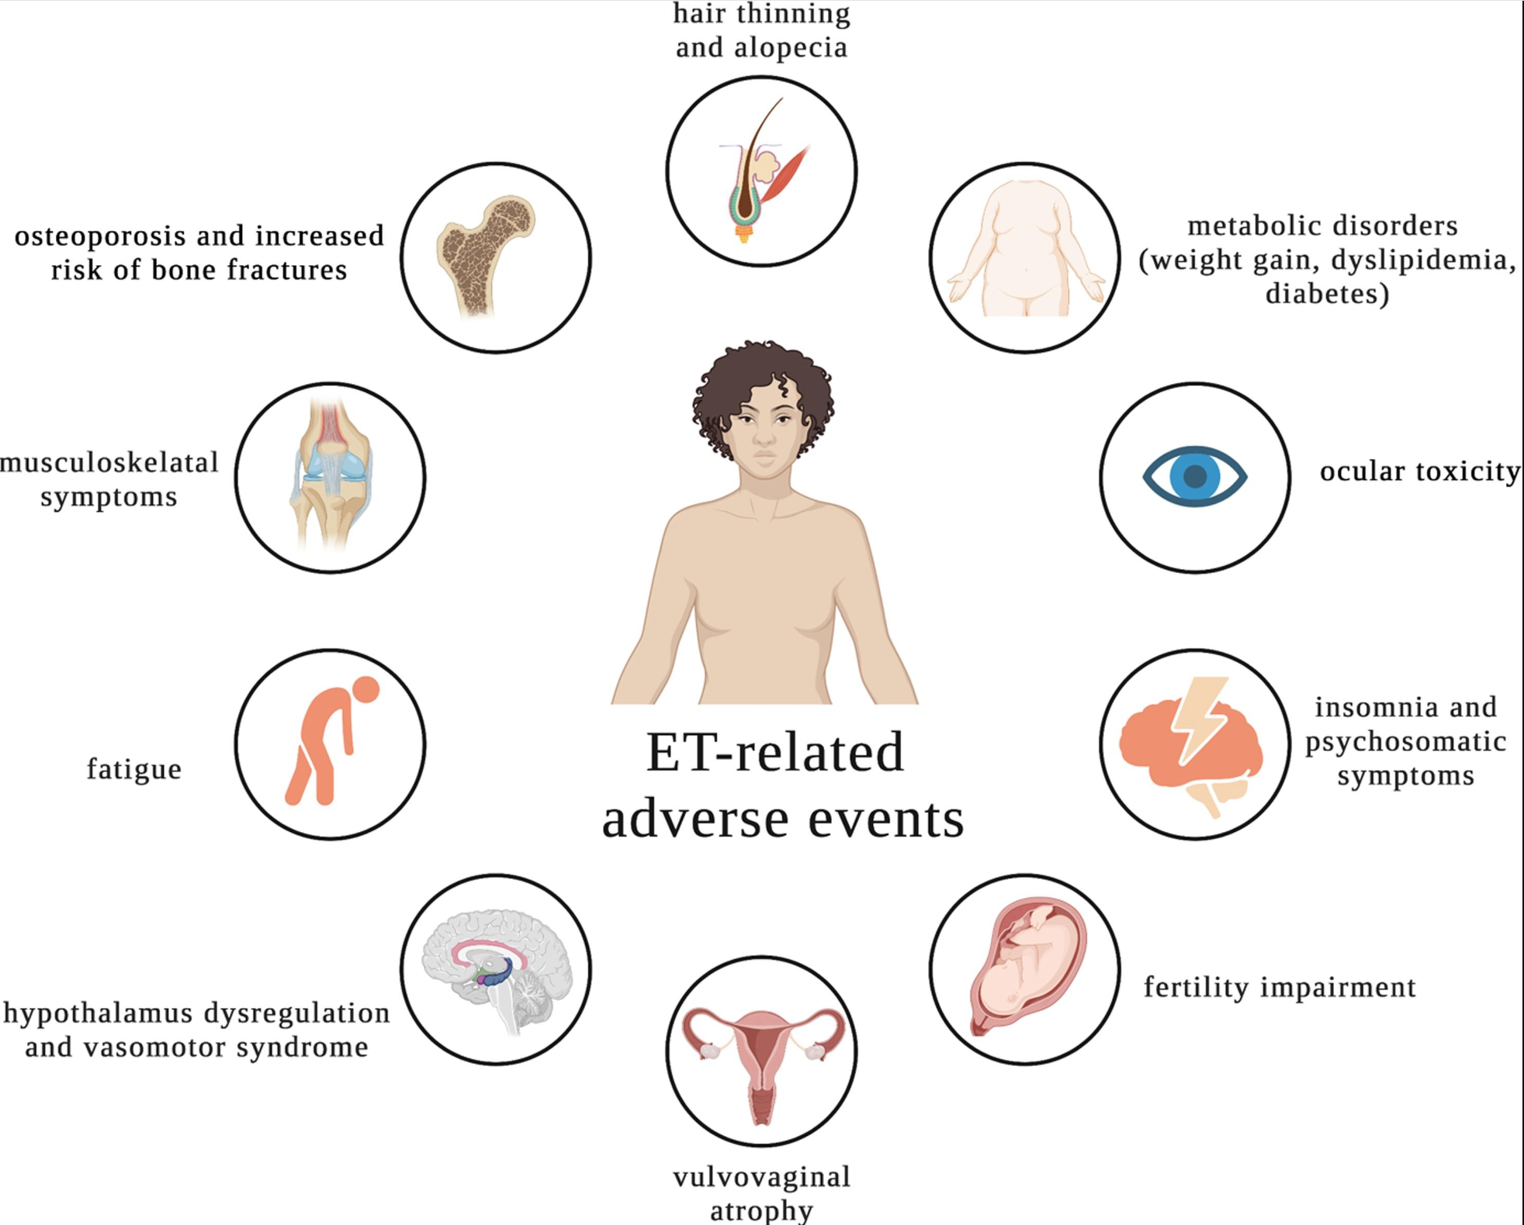
Side effects related to OFS

Slide 84
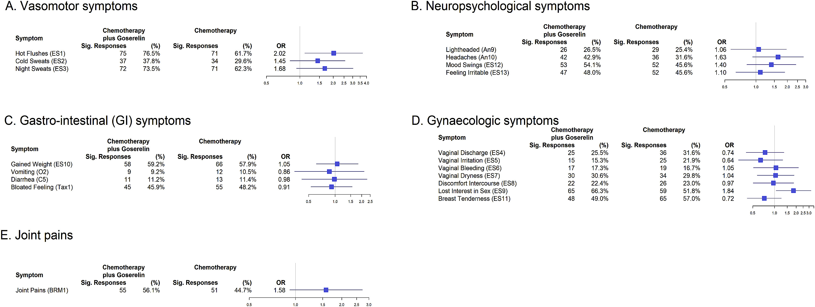
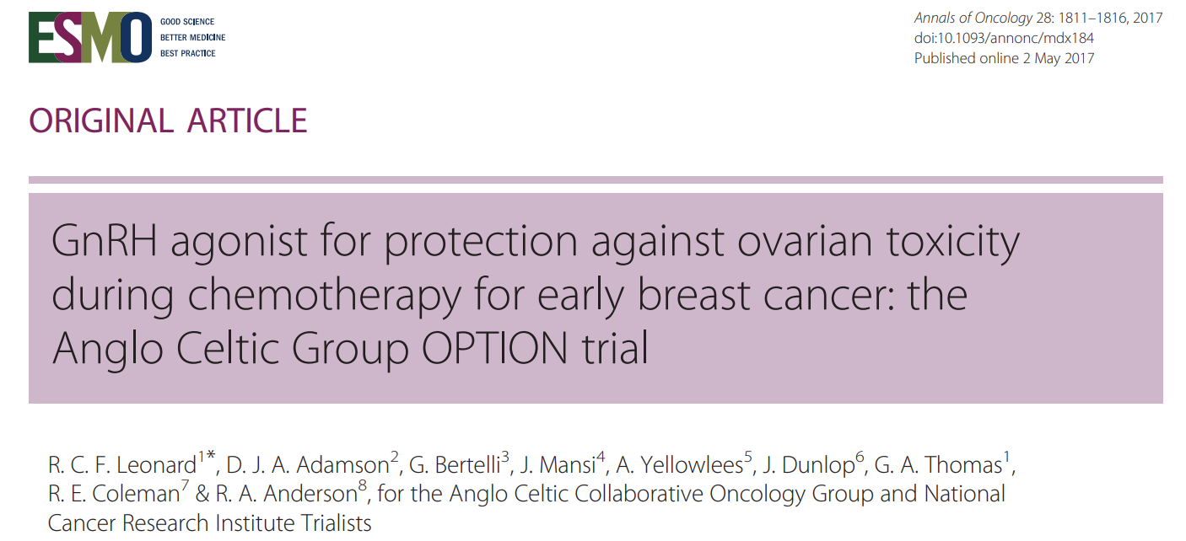
OPTION Trial QoL Data
50
40
30
Recurrence (%)
20
10
9.0%
0
0
5
10
Yr

Slide 85
Summary of AEs on SOFT+TEXT
 | Tamoxifen (%) | OFS+ Tam (%) | OFS+ Exe (%)
Hot Flashes | 80.4 | 93.5 | 92.4
Insomnia | 46.8 | 59.5 | 59.3
Musculoskeletal | 70 | 77.8 | 89.9
Osteoporosis | 13.7 | 27.9 | 42.2
Decreased Libido | 43.2 | 42.2 | 45.6
Vaginal Dryness | 42.4 | 49.2 | 53.7
Francis PA et al. N Engl J Med. 2018;379(2):122-137.

Slide 86
Rates of Discontinuation on SOFT
 | Tamoxifen | Tamoxifen + OFS | Exemestane + OFS
ET | 22.5 | 18.5 | 27.8
GnRH |  | 22.0 | 20.4
Francis PA et al. N Engl J Med. 2018;379(2):122-137.

Slide 87
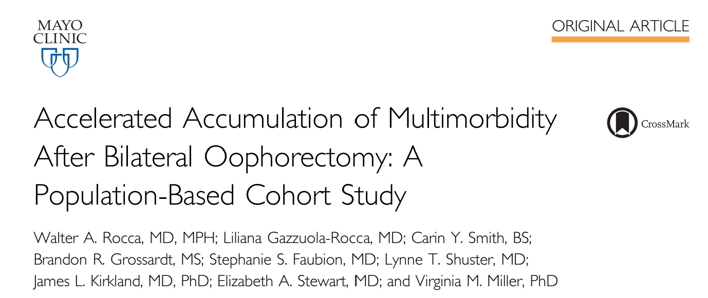
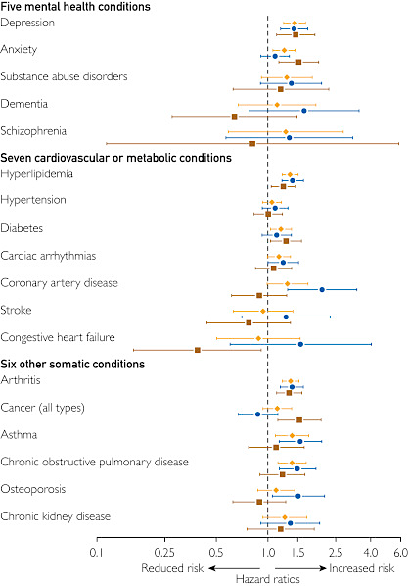
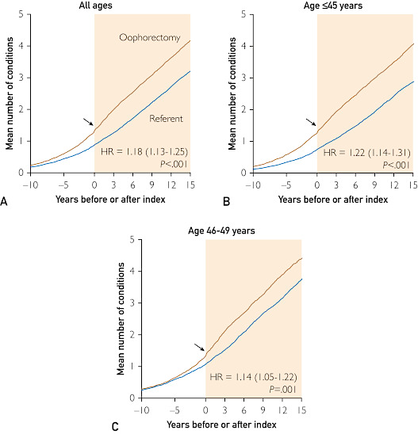
Figure 2

Slide 88
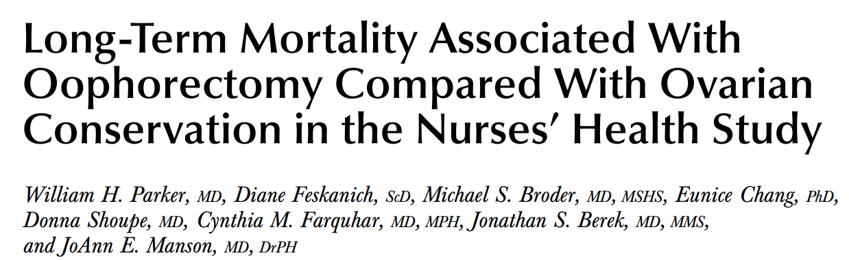
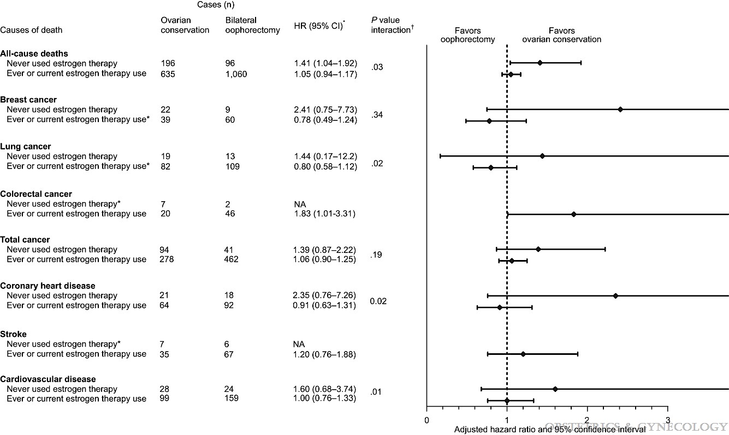
In women under the age of 50 BSO was associated with higher all cause mortality and higher mortality from cardiovascular disease.

Slide 89
Overcoming Vasomotor symptoms
Behavioral modifications
Acupuncture
Physical Activity
SSRIs: Venlafaxine
Clonidine
Gabapentin
Oxybutynin
Fezolinetant (selective neurokinin-3 receptor antagonist)

Slide 90
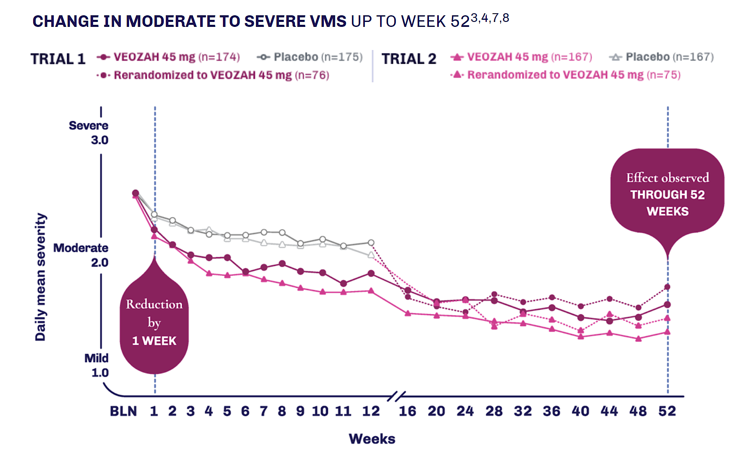
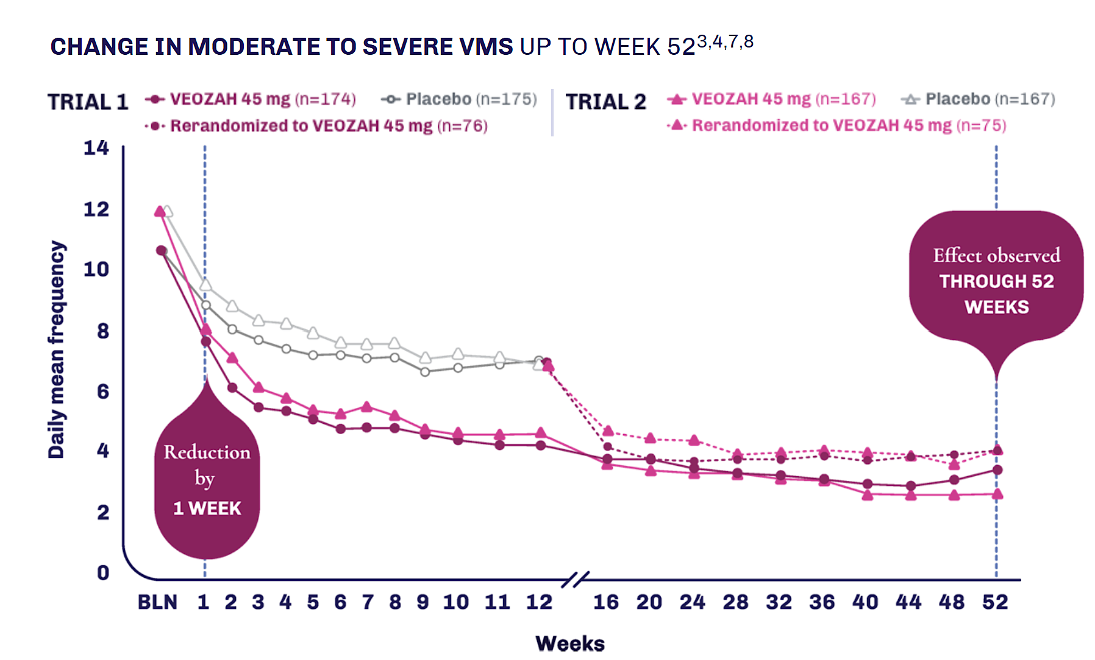
Efficacy of Fezolinetant
Fezolinetant 45 mg (n=174) Placebo (n=175)
Rerandomized to fezolinetant 45 mg (n=76)
Fezolinetant 45 mg (n=167) Placebo (n=167)
Rerandomized to fezolinetant 45 mg (n=75)
Fezolinetant 45 mg (n=174) Placebo (n=175)
Rerandomized to fezolinetant 45 mg (n=76)
Fezolinetant 45 mg (n=167) Placebo (n=167)
Rerandomized to fezolinetant 45 mg (n=75)

Slide 91


Slide 92

Vulvovaginal atrophy
Lambertini et al. ASCO Educational Book 2023.

Slide 93

Bone Health
Monitor BMD by DXA scan every 2 years
Regular monitoring of side effects and treatment compliance^{f}

Slide 94
Dr Kaklamani – Case 1: 35-year-old woman
35 yo woman with L 2cm ER+ HER2- breast cancer 1+LN after lumpectomy. She undergoes chemotherapy with ACT. She does not want any more children. Genetic testing negative.
She becomes amenorrheic after chemotherapy but we start tamoxifen and abemaciclib.
After 6 mo of therapy she starts menstruating again.

Slide 95
Dr Kaklamani – Case 2: 48-year-old woman
48 yo woman premenopausal. R side 3.6cm tumor LN- s/p lumpectomy. Oncotype DX® score is 26.
She receives chemotherapy with TC and becomes amenorrheic.
What treatment should we recommend now?

Slide 96
Agenda
Introduction
Module 1: Addition of Ovarian Function Suppression (OFS) to Adjuvant Endocrine Therapy for Premenopausal Patients with Hormone Receptor (HR)-Positive Breast Cancer — Dr Gradishar
Module 2: Role of OFS in Preserving Fertility and/or Ovarian Function in Premenopausal Patients — Dr Mayer
Module 3: Tolerability/Toxicity of OFS — Dr Kaklamani
Module 4: Other Practical Considerations in the Application of OFS — Dr Wander

Slide 97
In general, in addition to monitoring amenorrhea, what laboratory parameters, if any, do you routinely assess to determine menopausal status in a patient with ER-positive localized breast cancer who is receiving a GnRHa in combination with adjuvant endocrine therapy and was premenopausal at the time of initial diagnosis?
FSH, estradiol*
FSH, estradiol
FSH, estradiol
Estradiol
AMH**, estradiol
FSH, estradiol
FSH = follicle-stimulating hormone
* Will check these several times immediately prior to next dose in those changing to depot every 3-month formulation
**Haven’t done, but considering

Slide 98
For premenopausal patients with ER-positive localized breast cancer who wish to maintain fertility and to whom you are going to administer a GnRHa, when do you typically start it relative to chemotherapy?
Sequentially
Concurrently
Sequentially
Concurrently
Concurrently
Concurrently

Slide 99
When administering a GnRHa in combination with adjuvant endocrine therapy for a 35-year-old woman with ER-positive localized breast cancer, what is your typical planned duration of ovarian function suppression (OFS)?
5 years
5 years
5 years
5 years
5 years
5 years

Slide 100
A 28-year-old premenopausal woman with a 2.8-cm, ER/PR-positive, HER2-positive IDC who is interested in preserving fertility is going to receive neoadjuvant paclitaxel/trastuzumab/pertuzumab. When, if at all, would you initiate a GnRHa? Would your approach to the use of a GnRHa change if the patient experienced a pathologic complete response to neoadjuvant treatment?
Prior to neoadjuvant treatment; No
Concurrently with neoadjuvant treatment; Yes
Prior to neoadjuvant treatment; No
Prior to neoadjuvant treatment; No
Concurrently with neoadjuvant treatment; No
Concurrently with neoadjuvant treatment; No
IDC = invasive ductal carcinoma

Slide 101
Ovarian Suppression in the Management of Patients with Breast Cancer:
Other Practical Considerations in the Application of OFS
Research To Practice Virtual Think Tank
April 18th, 2024
Seth A. Wander, MD, PhD
Assistant Professor of Medicine
Harvard Medical School
Massachusetts General Hospital
swander@mgh.harvard.edu

Slide 102
Ovarian Suppression, Practical Considerations
Defining and assessing menopausal status in patients with breast cancer.
Optimal timing of ovarian suppression initiation (and fertility preservation).
Appropriate duration of ovarian suppression treatment.
Long- vs short-acting GnRH formulations.

Slide 103
Ovarian Suppression, Practical Considerations
Defining and assessing menopausal status in patients with breast cancer.
Optimal timing of ovarian suppression initiation (and fertility preservation).
Appropriate duration of ovarian suppression treatment.
Long- vs short-acting GnRH formulations.

Slide 104
Methods to Assess Menopausal Status
Per NCCN Guidelines:
Prior bilateral oophorectomy.
Age ≥60 years.
Age <60 with amenorrhea for ≥12m in the absence of prior chemotherapy, tamoxifen, toremifene, or ovarian suppression, and estradiol and follicle-stimulating hormone (FSH) in the postmenopausal range.
Age <60 years: chemotherapy-induced amenorrhea for ≥12 months and estradiol and FSH in the postmenopausal range on serial measurements.
McCann KE et al NPJ Breast Ca 2024
NCCN Clinical Practice Guidelines in Oncology: Breast cancer. Version 4.2023

Slide 105
Methods to Assess Menopausal Status
Consensus Statement on Reproductive Aging: Harlow SD et al J Clin Endo Metab 2012

Slide 106
Ovarian Suppression, Practical Considerations
Defining and assessing menopausal status in patients with breast cancer.
Optimal timing of ovarian suppression initiation (and fertility preservation).
Appropriate duration of ovarian suppression treatment.
Long- vs short-acting GnRH formulations.

Slide 107
GnRH Initiation Timing and Fertility
GnRH agonists have been used DURING chemo to improve fertility, though data is mixed
N=218, HR-, premenopausal
Standard chemo +/- goserelin
Primary endpoint: rate of ovarian failure at 2y (menstrual history + FSH level)
Secondary endpoints: pregnancy rates, DFS, OS
Moore HCF et al. NEJM 2015;372(10):923-932. Moore HCF et al. J Natl Cancer Inst 2019;111(2):210-213.

Slide 108
GnRH Initiation Timing and Fertility
Potential concerns:
No insights related to reproductive endocrinology
Higher numbers of patients attempted pregnancy in the goserelin group
Preclinical data suggests that chemo impacts ovarian follicles regardless of GnRH
Moore HCF et al. NEJM 2015;372(10):923-932. Moore HCF et al. J Natl Cancer Inst 2019;111(2):210-213.

Slide 109
GnRH Initiation Timing: Clinical Approach
Key Questions for Clinical Decision-Making:
What is the goal for GnRH use? Fertility preservation or cancer-risk reduction
What is the patient’s current menopausal status at diagnosis? Is chemotherapy likely to induce menopause?
What are the disease characteristics? Higher risk (eg node positive) vs lower risk
Should GnRH initiation precede antiestrogen treatment (eg to begin during XRT)? Is there value in initiating treatment with tamoxifen and transitioning to AI for younger patients?

Slide 110
Ovarian Suppression, Practical Considerations
Defining and assessing menopausal status in patients with breast cancer.
Optimal timing of ovarian suppression initiation (and fertility preservation).
Appropriate duration of ovarian suppression treatment.
Long- vs short-acting GnRH formulations.

Slide 111
GnRH Therapy Duration
Open-label, randomized pilot study
N=222
>60% Stage I; >90% Stage I-II
Leuprorelin q3m x2y vs 3-5y
With Tamoxifen
Primary end-point: DFS and Safety
Shiba E et al. Breast Cancer 2016;23(3):499-509.

Slide 112
GnRH Therapy Duration
DFS Rates (3-5y vs 2y):
@Year 5: 94.1 vs 91.8%
@Year 7: 90.8 vs 90.4%
OS Rates: 100% @ Years 3-5 (both groups)
Shiba E et al. Breast Cancer 2016;23(3):499-509.

Slide 113
GnRH Therapy Duration
Shiba E et al. Breast Cancer 2016;23(3):499-509.

Slide 114
GnRH Therapy Duration – ASTRRA Trial
Randomized phase III
N=1483
Premenopausal, <45y
Stage I-III, +chemo
Tamoxifen x5y
1:1 +/- OFS (goserelin) x2y
Primary endpoint: DFS
Secondary endpoint: OS
Baek SY et al. J Clin Oncol 2023;41(31):4864-4871.

Slide 115
GnRH Therapy Duration – ASTRRA Trial
Baek SY et al. J Clin Oncol 2023;41(31):4864-4871.

Slide 116
Dr Wander – Case #1:
Considering GnRH Initiation/Resumption
A 50 yo woman was diagnosed with R breast cancer.
Perimenopausal at the time of diagnosis with irregular cycles.
MRI with 1.0cm lesion in the R breast at 0900, no abnormal adenopathy.
Core biopsy with grade 2 invasive lobular carcinoma. ER/PR+ (>90%, strong), HER2 IHC 2+ FISH negative.
R breast excision: pathology with invasive lobular carcinoma, diameter 1.1cm, grade 2, no lymphovascular invasion. 1/2 sentinel lymph nodes with macrometastatic disease (5mm). pT1cN1
Discussions related to Oncotype DX use in peri-/pre-menopausal patients pursued, patient reluctant to consider chemotherapy. Oncotype DX 15; chemotherapy declined.
Adjuvant XRT completed.
Adjuvant leuprolide initiated (monthly), followed by letrozole…

Slide 117
Dr Wander – Case #1: Continued
One year after initiating Leuprolide + Letrozole…
The patient expressed a preference to hold Leuprolide (now age 52y).
No menstrual cycles or spotting occurred during or after Leuprolide hold.
Estradiol/FSH/LH checked every 3-4m after stopping…
 | Leuprolide Held +3m | Leuprolide Held +6m | Leuprolide Held +8m | Leuprolide Held +12m
Estradiol (pg/mL)pg/mL | <5 | 41 | <5 | <5
FSH IU/L | 107.4 | 87.7 | 126.0 | 142.7
LH IU/L | 57.5 | 54.4 | 65.3 | 64.5
Key Questions/Considerations:
Best approach to ovarian suppression in this age group? 1m vs 3m dosing? Duration before discontinuation?
Response to transient increase in estradiol without any menstrual spotting or symptoms? Optimal approach to monitoring with laboratory studies?

Slide 118
Ovarian Suppression, Practical Considerations
Defining and assessing menopausal status in patients with breast cancer.
Optimal timing of ovarian suppression initiation (and fertility preservation).
Appropriate duration of ovarian suppression treatment.
Long- vs short-acting GnRH formulations.

Slide 119
Long vs Short-Acting GnRH
Multicenter, open-label, randomized group study (Japan)
Premenopausal HR+ early breast cancer
N=170
1:1, goserelin 10.8mg (3m) vs 3.6mg (monthly)
Primary endpoint: non-inferiority of E2 AUC over 24 weeks
Secondary endpoints: E2, FSH, menstrual cycle pattern, safety
Masuda N et al BCRT 2011

Slide 120
Long vs Short-Acting GnRH
Masuda N et al BCRT 2011

Slide 121
Long vs Short-Acting GnRH
Multicenter, open-label, randomized phase 3
Premenopausal HR+ advanced breast cancer
N=222, all received Tamoxifen
1:1, goserelin 10.8mg (3m) vs 3.6mg (monthly)
Primary endpoint: PFS at 24 weeks (non-inferiority)
Secondary endpoints: ORR, E2 level, safety
Noguchi S et al. Breast Cancer 2016;23(5):771-779.

Slide 122
Long vs Short-Acting GnRH
Noguchi S et al. Breast Cancer 2016;23(5):771-779.

Slide 123
Long vs Short-Acting GnRH
Noguchi S et al. Breast Cancer 2016;23(5):771-779.

Slide 124
Dr Wander – Case #2:
Longer-Term GnRH Use in High Risk
A 40 yo woman was diagnosed with L breast cancer.
Premenopausal at the time of diagnosis with regular cycles; G2P2; prior use of OCPs (x10-15y), none currently. No future interest in fertility.
Diagnostic breast imaging with 5.0cm lesion in the L breast at 0600, +abnormal adenopathy. Staging scans negative. Germline testing negative for pathogenic variants (including BRCA1/2).
Core biopsy with grade 3 invasive ductal carcinoma. ER/PR+ (>90%, strong), HER2 IHC 1+ FISH negative.
Pre-operative chemotherapy with dose-dense Doxorubicin, Cyclophosphamide, Paclitaxel.
Bilateral mastectomy: pathology with residual invasive ductal carcinoma; diameter 3.5cm, 30% cellularity, grade 3. 5/10 regional lymph nodes positive, again with treatment effect. ypT2N2, RCB-III.
Adjuvant XRT initiated; monthly Leuprolide initiated during XRT.
Letrozole initiated after completing XRT; monthly Leuprolide continued x6m.
Adjuvant Abemaciclib initiated after ~2m on adjuvant AI once tolerance stable.
Zoledronic acid initiated for bone health and breast cancer risk reduction…

Slide 125
Dr Wander – Case #2: Continued
The patient was stable with mild toxicity (rare hot flashes, mild arthralgia, self-limited loose stool) on: monthly Leuprolide, Letrozole 2.5mg QD, Abemaciclib 150mg BID and Zoledronic acid q6m.
Per preference, after 6 months of therapy, she opted to transition to 3m Leuprolide dosing (with q6w visits and lab checks on Abemaciclib).
After 12-18 months of adjuvant therapy, she opted for elective bilateral salpingo-oophorectomy.
Letrozole continued (plan 7-10y), Abemaciclib therapy completed (24 months total).
Key Questions/Considerations:
Best approach to ovarian suppression in this age group? 1m vs 3m dose? Duration before pursuing BSO?
Practical approach to initiating complex regimen (OS, AI, CDKi, etc)? Approach to bone health management in young patients with early integration of OS/AI?

Slide 126
Ovarian Suppression, Practical Considerations
Defining and assessing menopausal status in patients with breast cancer.
  Based on a combination of clinical features (age, duration of amenorrhea) and laboratory assessments (E2, FSH, LH).
Optimal timing of ovarian suppression initiation (and fertility preservation).
  Considerations include current menopausal status/age, goals of treatment, clinical risk features. Data related to ovarian suppression and fertility preservation is controversial.
Appropriate duration of ovarian suppression treatment.
  Optimal approach to discontinuation in perimenopausal patients is personalized, with careful clinical and laboratory monitoring.
Long- vs short-acting GnRH formulations.
  Data suggests similar impact in early- and later-stage disease. Dependent upon patient age/preference, planned duration of ovarian suppression.

Slide 127
Administration of Goserelin at Alternative Anatomical
Sites in Premenopausal Breast Cancer
Sheen M et al.
NCCN National Conference 2024;Abstract CLO24-065.

