Slide 1

Understanding the Current and Future Role of Oral Selective Estrogen Receptor Degraders (SERDs) in the Management of Estrogen Receptor-Positive Metastatic Breast Cancer
Komal Jhaveri, MD, FACP
Patricia and James Cayne Chair for Junior Faculty
Associate Attending, Breast Medicine and Early Drug Development Service
Section Head, Endocrine Therapy Research Program
Clinical Director, Early Drug Development Service
Memorial Sloan Kettering Cancer Center
Associate Professor
Weill Cornell Medical College
New York, New York
@jhaveri_komal

Slide 2
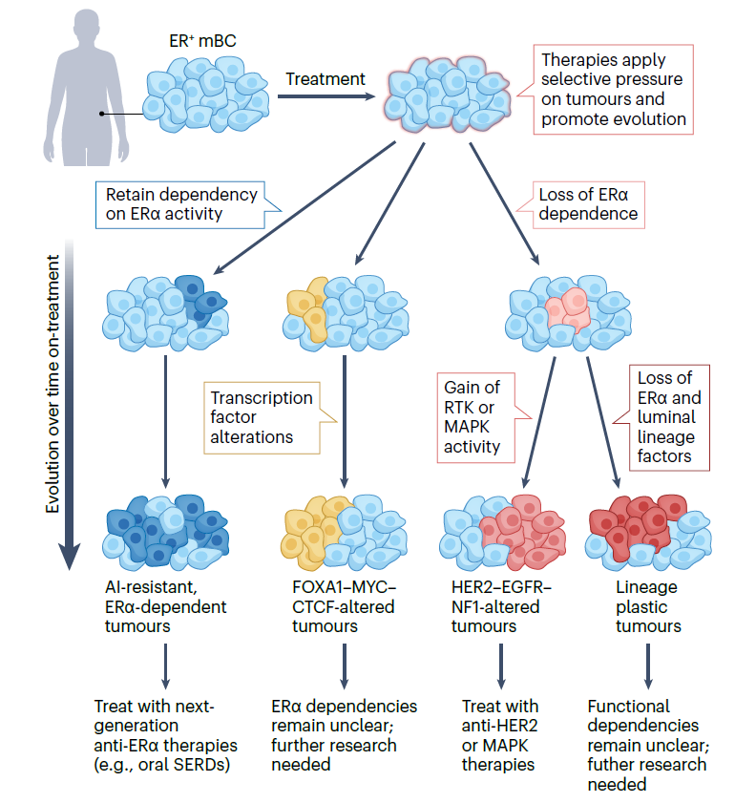
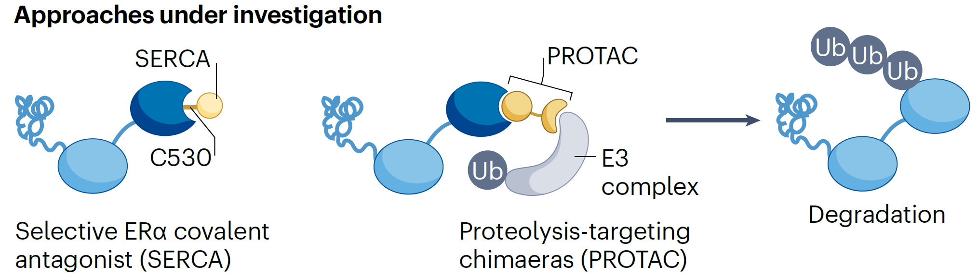
Limitations with current approved ET and implications of tumor evolution
AI, Tamoxifen, Fulvestrant:
  Toxicity challenges
  Non-Adherence is an issue in early stage due to
  toxicity: 49% fully adherent with 5 years of ET
Tamoxifen: Weaker ER suppression
Fulvestrant:
  Poor PK, dose,
  dependent efficacy,
  Modest efficacy post CDK4/6i
  Activity limited in ESR1 Y537S
Notes:
Tumour experiencing the pressure of endocrine therapies can evolve via distinct paths and can be categorized by their dependency on oestrogen receptor-α (ER) signalling (described from left to right below). Dark blue: a subset of cancers retain dependency on ER signalling but acquire features that render them resistant to first-line therapies such as aromatase inhibitors (AIs). The acquisition of ESR1 mutations exemplifies this evolution route, allowing tumours to progress in an ER-dependent but oestrogen-independent or other ligand-independent manner. These ER-dependent tumours are responsive to next-generation ER therapeutics, such as oral selective ER downregulators (SERDs). Yellow: tumours can also acquire alterations in other key transcription factors, such as FOXA1 or MYC. It remains unclear whether transcription factor-altered tumours retain ER dependency, thus further study is required to assess whether they might respond to next-generation ER-targeted therapies or require alternative treatments. Pink and red: other cancers lose dependency on ER altogether. Pink: of these, some become driven by orthogonal signalling pathways, such as HER2 or mitogen-activated protein kinases (MAPKs), and may benefit from the corresponding targeted therapies (for example, anti-HER2 therapies). Red: others lose ER expression altogether and show some evidence of undergoing lineage alterations. These tumours are reminiscent of lineage-plastic prostate cancers, which lose androgen receptor expression, although much less is known regarding lineage plasticity in breast cancer. Further investigation is required to devise treatment strategies for this subset. mBC, metastatic breast cancer; RTK, receptor tyrosine kinase.

Slide 3
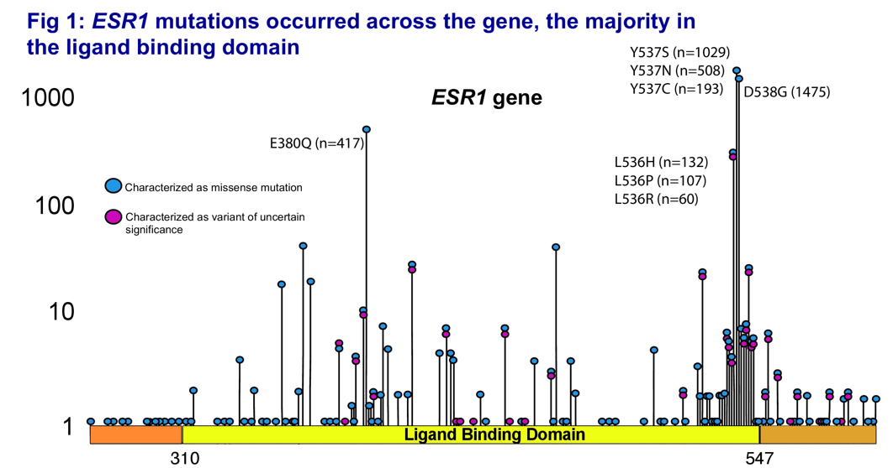
ESR1 Mutations in Advanced Breast Cancer
Major acquired mutation of metastatic ER+ BC
Acquired through prior AI therapy
Ligand independence
Rare in primary tumors (<1%), but highly enriched in MBC
Trial | Study Population | ER+ MBC Patient Population | ESR1 Mut, %
MONALEESA-2 | Letrozole ± ribociclib | 1st line | 4.0
BOLERO-2 | Exemestane ± everolimus | After PD on ET | 28.8
FERGI | Fulvestrant ± pictilisib | After PD on ET | ~40.0
PALOMA-3 | Fulvestrant ± palbociclib | After PD on ET | 25.3
SoFEA | Fulvestrant ± anastrozole | After PD on ET | 39.1
Toy W et al. Nat Genet. 2013;45(12)1439-1445. Robinson DR et al. Nat Genet. 2013;45(12):1446-1451. Ma CX et al. Nat Rev Cancer. 2015;15(5):261-275.
Medford AJ et al. ASCO 2023. Abstract 1074. Hortobagyi GN et al. Ann Oncol. 2018;29(7):1541-7. Chandarlapaty S et al. JAMA Oncol. 2016;2(10):1310-5.
Spoerke JM et al. Nat Commun. 2016;7:11579. Cristofanilli M et al. Lancet Oncol. 2016:17(4):425-39. Fribbens C et al. J Clin Oncol. 2016;34(25):29618.

Slide 4
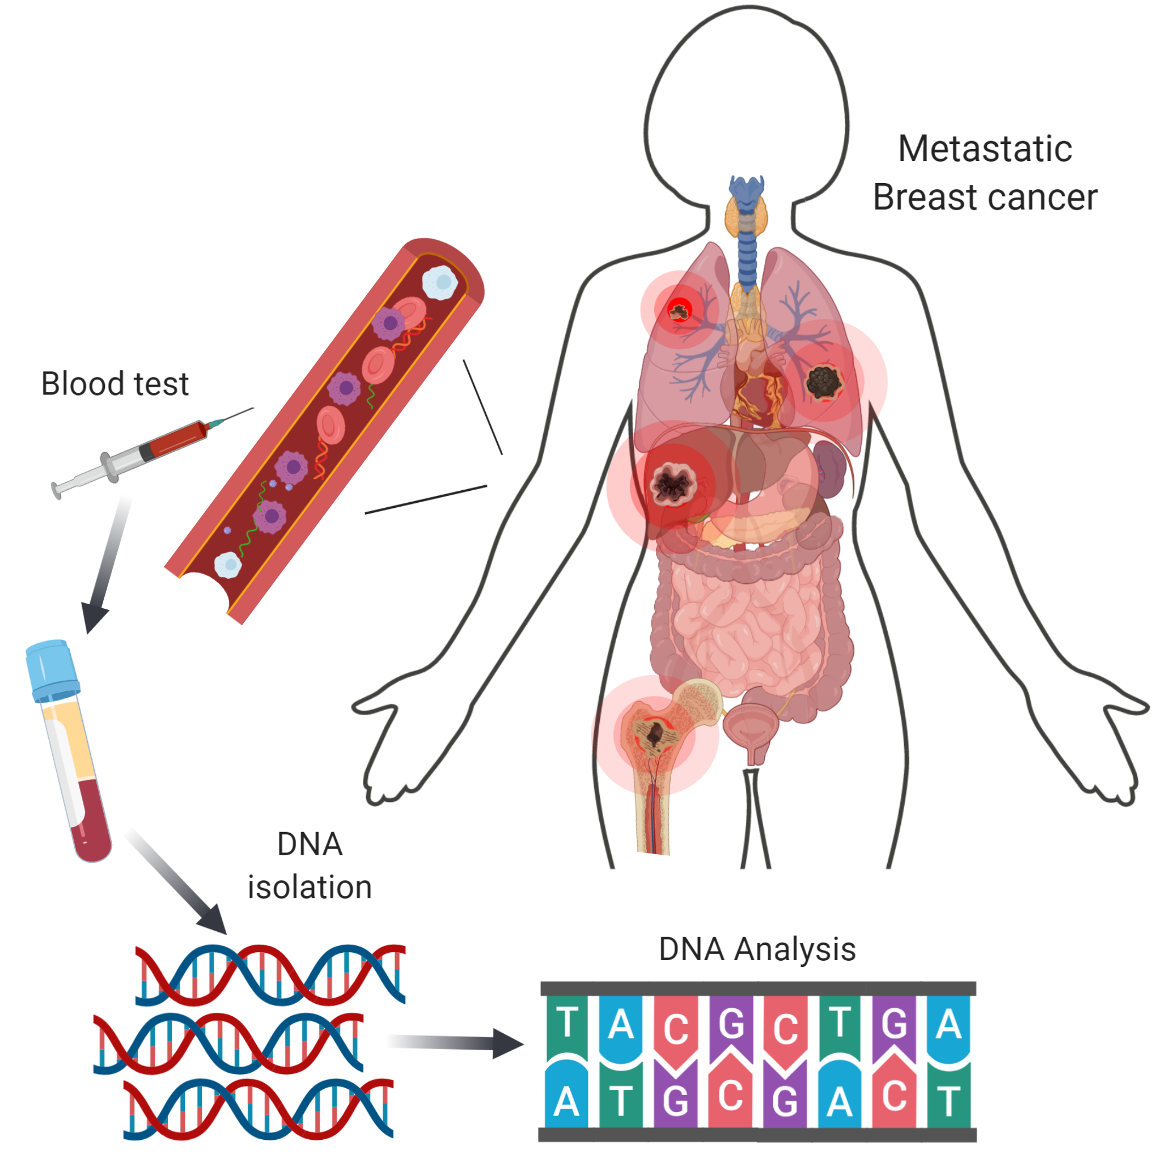
ESR1 Mutations Often Subclinical: Liquid Biopsy Testing Is the Standard
ctDNA testing identified more ESR1 mutations than contemporaneous biopsy
Different metastases may develop different resistance mutations
Turner NC et al. Lancet Oncol. 2020;21(10):1296-1308.

Slide 5
ESR1 Mutations: SoFEA and EFFECT Combined Analysis
ESR1-mutant breast cancer has poor outcome if treated with further AI
ESR1 mutations detected in 30% (151/383) baseline samples
Turner NC et al. Clin Cancer Res. 2022;26(19):5172-5177.

Slide 6
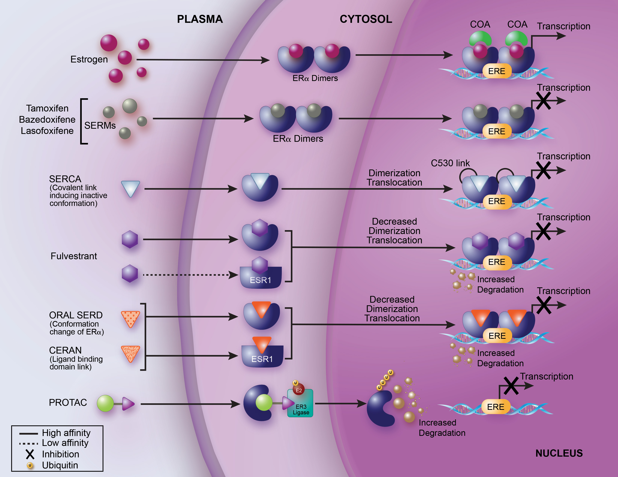
Several Novel Endocrine Agents In Development
Ultimate Goal: Downregulate ERα with an agent that has an optimal Therapeutic Index and improved efficacy
Fulvestrant
Raloxifene
Lasofoxifene
Fulvestrant
Elacestrant
Giredestrant
Amcenestrant
Camizestrant
Imlunestrant
Rintodestrant
D-0502
Zb-716
ZN-c5
SHR9549
LSZ102
GDC0810
GDC0927
AZD9496
ARV-471 (PROTAC)
OP-1250 (CERAN)
Bazedoxifene
Tamoxifen
Toremifene
H3B-6545 (SERCA)
Oral SERDs
Green: Approved for distinct indications
Blue: Currently in clinical development
Black: Clinical Development discontinued
SERCA: Serum ER Covalent Antagonist; CERAN: Complete ER Antagonist; PROTAC: Proteolysis Targeting Chimera
Adapted from McDonnell et al JCO 2021; Ferraro…Jhaveri Cancer Treatment Reviews 2022

Slide 7
NCCN Guidelines® Update: HR+/HER2– MBC
HR+/HER2– MBC and Postmenopausal or Premenopausal Receiving Ovarian Ablation or Suppression
Setting | Preferred Regimens | Other Recommended Regimens (First and Subsequent Lines)
First line | Aromatase inhibitor + CDK4/6 inhibitor Aromatase inhibitor + ribociclib (Category 1) Aromatase inhibitor + abemaciclib Aromatase inhibitor + palbociclib | Selective ER downregulator Fulvestrant Elacestrant for ESR1-mutated tumors Selective ER downregulator (fulvestrant, Category 1) + nonsteroidal aromatase inhibitor (anastrozole, letrozole) (Category 1) Nonsteroidal aromatase inhibitor Anastrozole Letrozole Selective ER modulator Tamoxifen Steroidal aromatase inactivator Exemestane
 | Fulvestrant + CDK4/6 inhibitor Fulvestrant + ribociclib (Category 1) Fulvestrant + abemaciclib (Category 1) Fulvestrant + palbociclib
Second line | Fulvestrant + CDK4/6 inhibitor, if CDK4/6 inhibitor not previously used (Category 1)
 | Alpelisib + fulvestrant, for PIK3CA-mutated tumors (Category 1)
 | Everolimus + endocrine therapy (exemestane, fulvestrant, tamoxifen)
HR+/HER2– MBC With Visceral Crisis or Endocrine Refractory
Setting | Subtype/Biomarker | Regimen
First line | No germline BRCA1/2 mutation | Systemic chemotherapy
 | Germline BRCA1/2 mutation | PARPi (olaparib, talazoparib) (Category 1, preferred)
Second line | HER2 IHC1+ or 2+/ISH negative | T-DXd (Category 1, preferred)
 | Not a candidate for T-DXd | Sacituzumab govitecan (Category 1, preferred)
 |  | Systemic chemotherapy
Third line and beyond | Any | Systemic chemotherapy
 | Biomarker positive (ie, MSI-H, NTRK, RET, TMB-H) | Targeted agents
NCCN Clinical Practice Guidelines in Oncology (NCCN Guidelines®) for Breast Cancer. V.4.2023. Accessed July 19, 2023.

Slide 8
EMERALD Phase 3 Trial of Elacestrant vs SOC in ER+/HER2– MBC: Study Design and Patients^{1,2}
Key Eligibility Criteria
ER+/HER2– MBC
1-2 prior lines of ET, one of which in combination with CDK4/6i
≤1 line of chemotherapy for advanced disease
ECOG PS 0-1
Patient Characteristics, ^{d} n (%) |  | Elacestrant | C 150 mg (n=73) | SOC | Total (N=240)
 |  | All (n=239) | ESR1mut (n=115) | All (n=239) | ESR1mut (n=115)
Median age (range), years |  | 63 (24-89) | 64 (28-89) | 63 (32-83) | 63 (32-83)
Female |  | 233 (97.5) | 115 (100) | 238 (99.6) | 113 (100)
ECOG PS | 0 | 143 (59.8) | 67 (58.3) | 135 (56.5) | 61 (54.9)
 | 1 | 96 (40.2) | 48 (41.7) | 103 (43.1) | 51 (45.1)
Visceral metastasis, % |  | 163 (68.2) | 81 (70.4) | 170 (71.1) | 84 (74.3)
Prior CDK4/6i |  | 239 (100) | 115 (100) | 239 (100) | 113 (100)
Prior lines of ET | 1 | 129 (54.0) | 73 (63.5) | 142 (59.4) | 69 (61.1)
 | 2 | 110 (46.0) | 42 (36.5) | 97 (40.6) | 44 (38.9)
Type of prior ET | Fulvestrant | 70 (29.3) | 27 (23.5) | 75 (31.4) | 28 (24.8)
 | AI | 193 (80.8) | 101 (87.8) | 194 (81.2) | 96 (85.0)
 | Tamoxifen | 19 (7.9) | 9 (7.8) | 15 (6.3) | 9 (8.0)
Prior lines of CT | 0 | 191 (79.9) | 89 (77.4) | 180 (75.3) | 81 (71.7)
 | 1 | 48 (20.1) | 26 (22.6) | 59 (24.7) | 32 (28.3)
R
A
N
D
O
M
I
Z
E
D
Elacestrant
400 mgª
PD or withdrawal criterion^{b}
1:1
Investigator’s choice (SOC)
Fulvestrant
Anastrozole
Letrozole
Exemestane
Primary endpoints^{c}: PFS in all, PFS in ESR1mut
Secondary endpoints: OS, safety
ª Protocol-defined dose reductions permitted. ^{b} Restaging CT scans every 8 weeks. ^{c} By BICR. ^{d} Patient characteristics are updated from 2022 SGO presentation.
1. Bidard F, et al. J Clin Oncol. 2022;40(28):3246-3256. 2. Bardia A, et al. SABCS 2022. Abstract GS3-01.

Slide 9
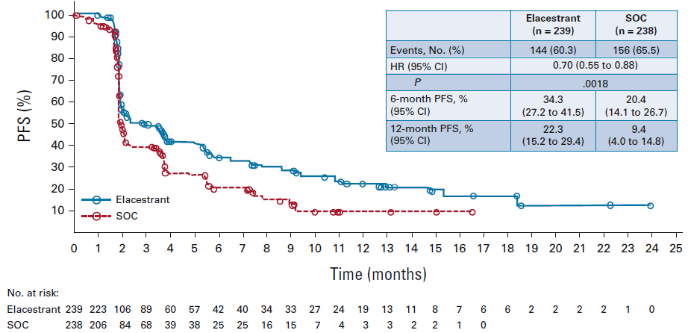
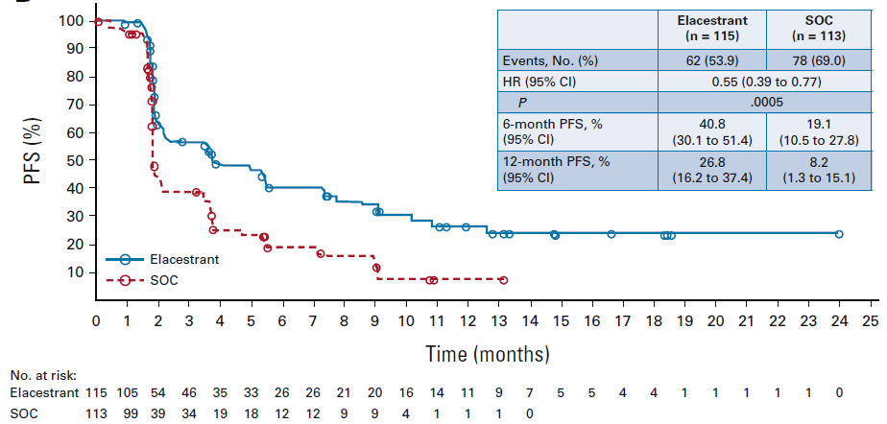
EMERALD: PFS With Elacestrant vs SOC in ITT and
ESR1mut Populations
PFS in All Patients
PFS in Patients With ESR1mut Tumors
 | Elacestrant (n=239) | SOC (n=238)
Event, n (%) | 144 (60.3) | 156 (65.5)
HR (95% CI) | 0.70 (0.55-0.88)
P value | 0.0018
6-month PFS, % (95% CI) | 34.3 (27.2-41.5) | 20.4 (14.1-26.7)
12-month PFS, % (95% CI) | 22.3 (15.2-29.4) | 9.4 (4.0-14.8)
 | Elacestrant (n=115) | SOC (n=113)
Event, n (%) | 62 (53.9) | 78 (69.0)
HR (95% CI) | 0.55 (0.39-0.77)
P value | 0.0005
6-month PFS, % (95% CI) | 40.8 (30.1-51.4) | 19.1 (10.5-27.8)
12-month PFS, % (95% CI) | 26.8 (16.2-37.4) | 8.2 (1.3-15.1)
Bidard F, et al. J Clin Oncol. 2022;40(28):3246-3256.

Slide 10
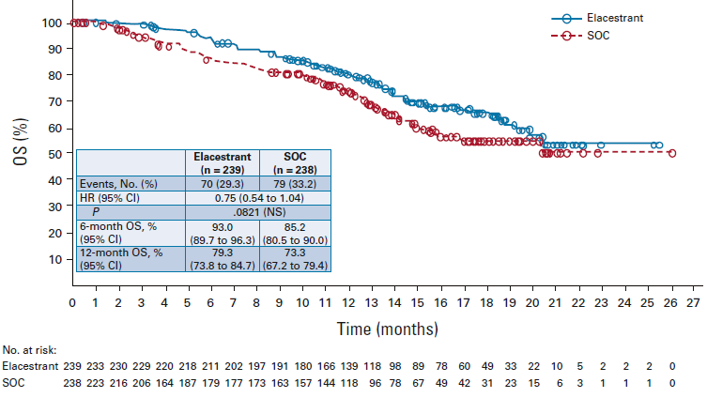
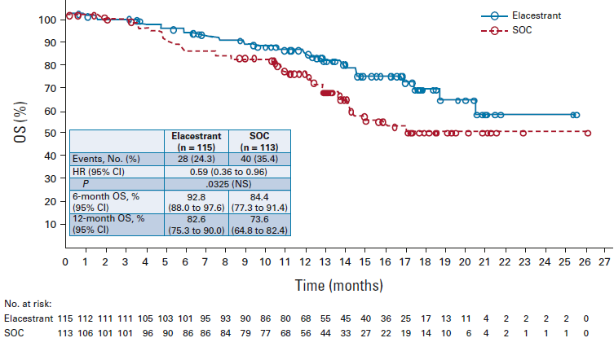
EMERALD: OS With Elacestrant vs SOC in ITT and
ESR1mut Populations
OS in All Patients
OS in Patients With ESR1mut Tumors
 | Elacestrant (n=239) | SOC (n=238)
Event, n (%) | 70 (29.3) | 79 (33.2)
HR (95% CI) | 0.75 (0.54-1.04) | 1.91
P value | 0.0821 (NS)
6-mo OS, % (95% CI) | 93.0 (89.7-96.3) | 85.2 (80.5-90.0)
12-mo OS, % (95% CI) | 79.3 (73.8-84.7) | 73.3 (67.2-79.4)
 | Elacestrant (n=115) | SOC (n=113)
Event, n (%) | 28 (24.3) | 40 (35.4)
HR (95% CI) | 0.59 (0.36-0.96) | 1.91
P value | 0.0325 (NS)
6-mo OS, % (95% CI) | 92.8 (88.0-97.6) | 84.4 (77.3-91.4)
12-mo OS, % (95% CI) | 82.6 (75.3-90.0) | 73.6 (64.8-82.4)
Bidard F, et al. J Clin Oncol. 2022;40(28):3246-3256.

Slide 11
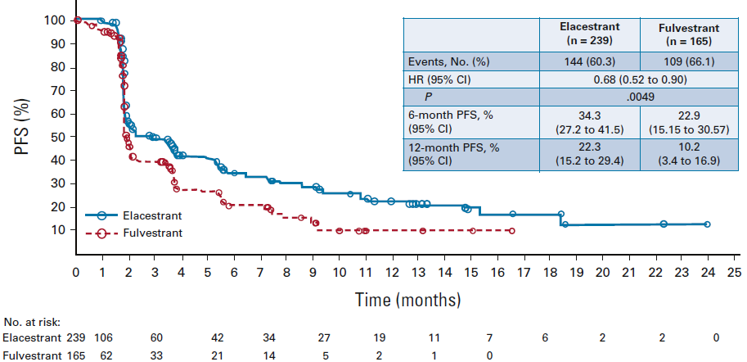
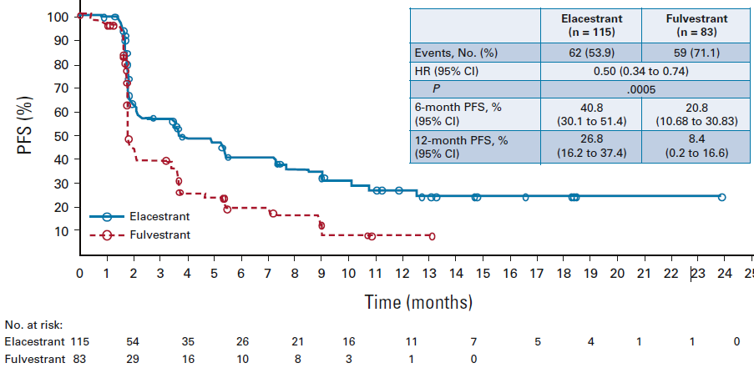
EMERALD: PFS With Elacestrant vs Fulvestrant in ITT and ESR1mut Populations
PFS in All Patients
PFS in Patients With ESR1mut Tumors
 | Elacestrant (n=239) | Fulvestrant (n=165)
Event, n (%) | 144 (60.3) | 156 (65.5)
HR (95% CI) | 0.68 (0.52-0.90) | 1.91
P value | 0.0049
6-mo PFS, % (95% CI) | 34.3 (27.2-41.5) | 22.9 (15.15-30.57)
12-mo PFS, % (95% CI) | 22.3 (15.2-29.4) | 10.2 (3.4-16.9)
 | Elacestrant (n=115) | Fulvestrant (n=83)
Event, n (%) | 62 (53.9) | 59 (71.1)
HR (95% CI) | 0.50 (0.34-0.74) | 1.91
P value | 0.0005
6-mo PFS, % (95% CI) | 40.8 (30.1-51.4) | 20.8 (0.7-30.8)
12-mo PFS, % (95% CI) | 26.8 (16.2-37.4) | 8.4 (0.2-16.6)
Bidard F, et al. J Clin Oncol. 2022;40(28):3246-3256.

Slide 12
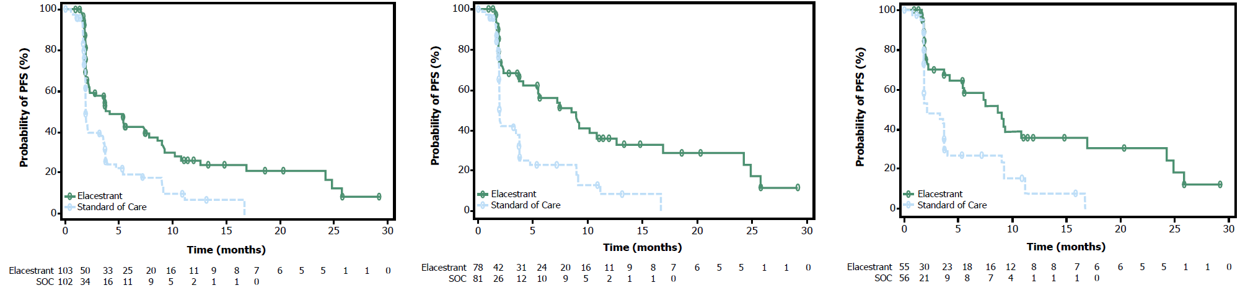
EMERALD: PFS in ESR1mut by Duration of Prior CDK4/6i
PFS by Duration of CDK4/6i in Patients With ESR1mut Tumors
≥6 mo CDK4/6i
≥12 mo CDK4/6i
≥18 mo CDK4/6i
PFS by Duration of CDK4/6i | ≥6 Months |  | ≥12 Months |  | ≥18 Months
 | Elacestrant (n=103) | SOC (n=102) | Elacestrant (n=78) | SOC (n=81) | Elacestrant (n=55) | SOC (n=56)
mPFS, mo (95% CI) | 4.14 (2.20-7.79) | 1.87 (1.87-3.29) | 8.61 (4.14-10.84) | 1.91 (1.87-3.68) | 8.61 (5.45-16.89) | 2.10 (1.87-3.75)
12-mo PFS rate, % (95% CI) | 26.02 (15.12-36.92) | 6.45 (0.00-13.65) | 35.81 (21.84-49.78) | 8.39 (0.00-17.66) | 35.79 (19.54-52.05) | 7.73 (0.00-20.20)
HR (95% CI) | 0.517 (0.361-0.738) |  | 0.410 (0.262-0.634) |  | 0.466 (0.270-0.791)
Bardia A, et al. SABCS 2022. Abstract GS3-01.

Slide 13
EMERALD: Safety and Summary
Safety Summary
Most AEs, including nausea, were grade 1-2
No grade 4 TRAEs were reported
Discontinuations of therapy due to TRAEs:
  Elacestrant arm: 3.4%
  SOC arm: 0.9%
No hematologic safety signal was observed
None of the patients in either treatment arm experienced sinus bradycardia
Authors’ Conclusions
Survival benefits were observed with elacestrant
vs SOC and vs fulvestrant in both ITT and
ESR1mut populations
The duration of prior CDK4/6i therapy was associated with PFS:
  PFS was longer with a longer duration of CDK4/6i
  This effect was more pronounced in patients with ESR1mut tumors
The safety profile of elacestrant was consistent with previous reports:
  Low-grade nausea was common in both treatment arms, but required low usage of antiemetic drugs
These results demonstrate PFS benefit for elacestrant vs SOC with a low rate of AEs and suggest elacestrant monotherapy could become a viable 2L/3L treatment option for patients with ER+/HER2– MBC
Nausea Summary | Elacestrant (n=237) | SOC (n=230)
Grade 3 nausea, n (%) | 6 (2.5) | 2 (0.9)
Dose reduction rate due to nausea, n (%) | 3 (1.3) | N/A
Discontinuation rate due to nausea, n (%) | 3 (1.3) | 0
Antiemetic use, % | 8 | 10.3 (AI) 1.3 (fulvestrant)
Bardia A, et al. SABCS 2022. Abstract GS3-01.

Slide 14
SERENA-2 Phase 2 Trial of Camizestrant vs Fulvestrant in ER+/HER2– MBC: Study Design and Patients
Key Eligibility Criteria
Recurrence or progression on ≥1 line of ET
No prior fulvestrant or oral SERD in ABC
≤1 line of ET in ABC setting
≤1 line chemotherapy in ABC setting
Measurable and nonmeasurable disease
Patient Characteristics, % |  | C75 (n=74) | C150 (n=73) | F (n=73)
Median age (range), years |  | 61 (37-79) | 60 (42-84) | 60 (35-84)
ER+ |  | 100 | 100 | 100
ECOG PS 0 |  | 62.2 | 57.5 | 58.9
Lung/liver metastasis |  | 58.1 | 58.9 | 58.9
Liver metastasis |  | 31.1 | 41.1 | 47.9
ESR1mut detectable^{c} |  | 29.7 | 35.6 | 47.9
Chemotherapy in ABC |  | 21.6 | 12.3 | 26.0
ET adjuvant | AI | 40.5 | 35.6 | 31.5
 | SERM | 32.4 | 45.2 | 43.8
ET in ABC | 0 lines | 37.8 | 28.8 | 26.0
 | 1 line | 62.2 | 71.2 | 74.0
 | AI | 55.4 | 67.1 | 67.1
 | SERM | 6.8 | 2.7 | 6.8
Prior CDK4/6i^{d} |  | 51.4 | 50.7 | 50.7
Palbociclib |  | 21.6 | 31.5 | 30.1
Ribociclib |  | 23.0 | 19.2 | 16.4
Abemaciclib |  | 5.4 | 1.4 | 4.1
R
A
N
D
O
M
I
Z
E
D
Camizestrant 300 mgª (n=20)
Postmenopausal ER+/HER2– ABC
C75: Camizestrant 75 mg (n=74)
C150: Camizestrant 150 mg (n=73)
F: Fulvestrant (n=73)
1:1:1:1
N=240
Primary endpoint: PFS by investigator^{b}
Secondary endpoints: CBR24, ORR, OS, safety
Translational endpoints: Serial CTC and ctDNA (ESR1mut) analyses
ª CSP v5 amendment: December 16, 2020. ^{b} Disease progression defined using RECIST v1.1. ^{c} ESR1mut assessed in plasma samples at screening and C1D1 ESR1mut defined as E380Q, V422del, S463P, L536H/P/R, Y537C/D/N/S, D538G, individual mutations present in >2% total cases reported. ^{d} Missing or not specified in 3 patients.
Oliveira M, et al. SABCS 2022. Abstract GS3-02.

Slide 15
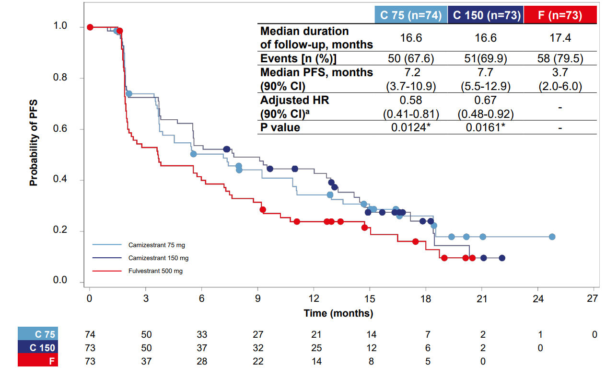
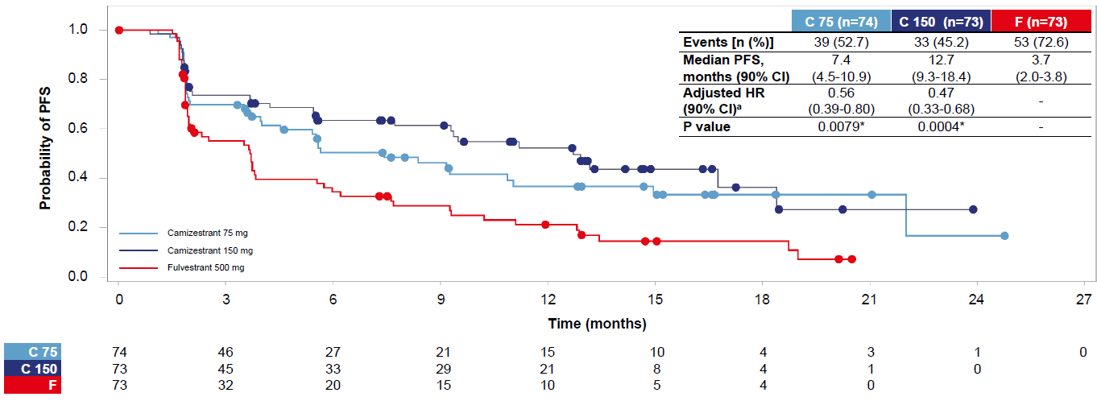
SERENA-2: PFS in ITT
Primary Endpoint: PFS by Investigator Assessment
PFS by BICR
 | C75 (n=74) | C150 (n=73) | F (n=73)
Median follow-up, mo | 16.6 | 16.6 | 17.4
Events, n (%) | 50 (67.6) | 51 (69.9) | 58 (79.5)
mPFS, mo (90% CI) | 7.2 (3.7-10.9) | 7.7 (5.5-12.9) | 3.7 (2.0-6.0)
Adjusted HRª (90% CI) | 0.58 (0.41-0.81) | 0.67 (0.48-0.92) | -
P value | 0.0124^{b} | 0.0161^{b} | -
 | C75 (n=74) | C150 (n=73) | F (n=73)
Events, n (%) | 39 (52.7) | 33 (45.2) | 53 (72.6)
mPFS, mo (90% CI) | 7.4 (4.5-10.9) | 12.7 (9.3-18.4) | 3.7 (2.0-3.8)
Adjusted HRª (90% CI) | 0.56 (0.39-0.80) | 0.47 (0.33-0.68) | -
P value | 0.0079^{b} | 0.0004^{b} | -
ª HR adjusted for prior use of CDK4/6i and liver/lung metastases. ^{b} Statistically significant.
Oliveira M, et al. SABCS 2022. Abstract GS3-02.

Slide 16
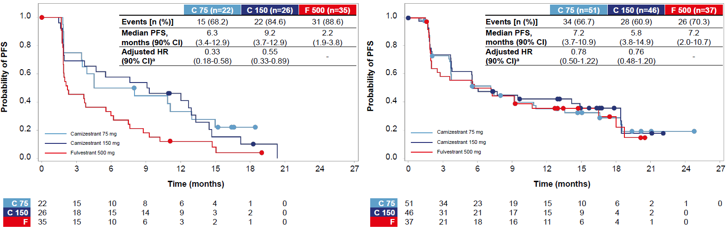
SERENA-2: PFS in Patients by Detectable ESR1mut
PFS in Patients With ESR1mut Detectable at Baseline
PFS in Patients With ESR1mut Not Detectable at Baseline
 | C75 (n=22) | C150 (n=26) | F (n=35)
mPFS, mo (90% CI) | 6.3 (3.4-12.9) | 9.2 (3.7-12.9) | 2.2 (1.9-3.8)
Adjusted HRª (90% CI) | 0.33 (0.18-0.58) | 0.55 (0.33-0.89) | -
 | C75 (n=51) | C150 (n=46) | F (n=37)
mPFS, mo (90% CI) | 7.2 (3.7-10.9) | 5.8 (3.8-14.9) | 7.2 (2.0-10.7)
Adjusted HRª (90% CI) | 0.78 (0.50-1.22) | 0.76 (0.48-1.20) | -
Camizestrant was associated with improvements in PFS over fulvestrant at both doses studied in the subgroups of patients with detectable ESR1mut, patients previously treated with CDK4/6i + ET, patients with lung and/or liver metastases, and patients with evidence of ER-driven disease
ª HR adjusted for prior use of CDK4/6i and liver/lung metastases.
Oliveira M, et al. SABCS 2022. Abstract GS3-02.

Slide 17
SERENA-2: Safety and Summary
Safety Summary, n (%) | C75 (n=74) | C150 (n=73) | C300 (n=20) | F (n=73)
Mean total duration, mo (SD) | 8.27 (6.59) | 8.91 (6.78) | 9.26 (8.19) | 7.34 (6.09)
Any TEAE | 57 (77.0) | 66 (90.4) | 19 (95.0) | 50 (68.5)
Any TRAE | 39 (52.7) | 49 (67.1) | 14 (70.0) | 13 (17.8)
CTCAE grade ≥3 | 1 (1.4) | 2 (2.7) | 1 (5.0) | 1 (1.4)
Serious | 3 (4.1) | 2 (2.7) | 1 (5.0) | 0
Fatal | 0 | 0 | 0 | 0
Leading to discontinuation | 2 (2.7) | 0 | 0 | 0
TEAE leading to dose reduction | 1 (1.4) | 9 (12.3) | 4 (20.0) | 0
TEAE leading to dose interruption | 11 (14.9) | 16 (21.9) | 4 (20.0) | 3 (4.1)
TRAE leading to dose interruption | 7 (9.5) | 8 (11.0) | 3 (15.0) | 0
Median duration of dose interruption, days | 7.0 | 7.5 | 7.0 | -
Safety Summary, n (%) | C75 mg (n=74) | C150 mg (n=73) | C300 mg (n=20) | F (n=73)
Any TEAE | 57 (77.0) | 66 (90.4) | 19 (95.0) | 50 (68.5)
All grade photopsia | 9 (12.2) | 18 (24.7) | 7 (35.0) | 0
Grade ≥3 | 0 | 0 | 0 | 0
All grade bradycardia | 4 (5.4) | 19 (26.0) | 8 (40.0) | 0
Grade ≥3 | 0 | 0 | 0 | 0
All grade fatigue | 4 (5.4) | 13 (17.8) | 4 (20.0) | 3 (4.1)
Grade ≥3 | 0 | 1 (1.4) | 0 | 0
All grade anemia | 8 (10.8) | 11 (15.1) | 1 (5.0) | 5 (6.8)
Grade ≥3 | 0 | 1 (1.4) | 0 | 2 (2.7)
All grade asthenia | 6 (8.1) | 11 (15.1) | 2 (10.0) | 4 (5.5)
Grade ≥3 | 0 | 0 | 0 | 0
All grade arthralgia | 3 (4.1) | 9 (12.3) | 2 (10.0) | 2 (2.7)
Grade ≥3 | 0 | 1 (1.4) | 0 | 0
Authors’ Conclusions
Camizestrant at both 75 and 150 mg doses improved PFS versus fulvestrant in postmenopausal patients with ER+/HER2– ABC
Both doses were well tolerated, with infrequent grade ≥3 TRAEs, dose reduction, and discontinuations
Oliveira M, et al. SABCS 2022. Abstract GS3-02.

Slide 18
Activity of other oral SERDS as monotherapy post CDK4/6i progression
 | SERENA-2 (NCT04214288) | EMBER (NCT04188548)
SERD | Camizestrant | Imlunestrant
Phase | 2 | 1
N | 288 | 114
Patient population | ER+/HER2- MBC | ER+/HER2-MBC
Number of prior Therapies | 0-2 | 0-8; median 2
Prior Chemotherapy | 19% | 25%
Prior Fulvestrant | Not allowed | 52%
Prior CDK4/6i | 51% | 93%
Treatment arms | Camizestrant (various doses) vs Fulvestrant | Imlunestrant (200mg-800mg)
ESR1 mutations | 37% | 49%
Primary endpoint | PFS | Safety, RP2D
Results | phase 3 dose: 75mg QD PFS 5.5 vs 2.1 months HR 0.49 (prior CDK 4/6i) PFS 6.6 vs 2.2 (ESR1m) HR 0.33 | RP2D: 400mg QD ORR 8%, CBR 42%; at 400g dose CBR 55%; PFS in 2L post CDK4/6i 6.5 months
Oliveira et al SABCS 2022; Jhaveri ESMO 2023

Slide 19
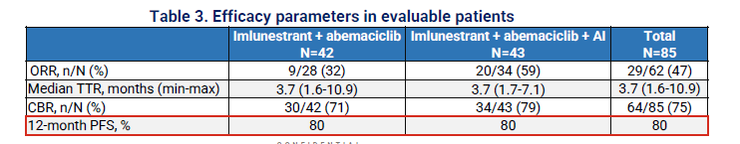
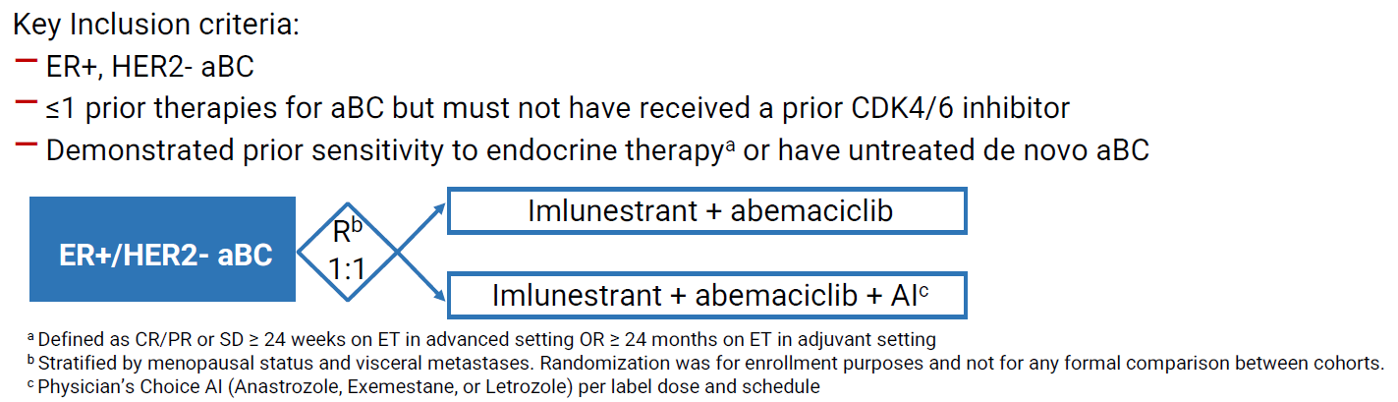
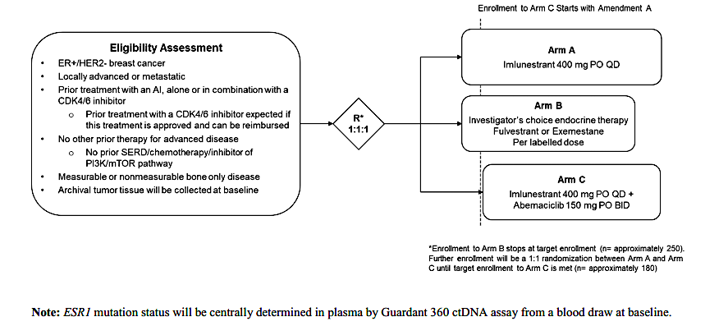
Imlunestrant in combination with Abemaciclib: EMBER Phase 1
Imlunestrant + Abemaciclib +/- AI: N = 85 (Jhaveri SABCS 2022)
Safety profile (diarrhea, nausea, fatigue, neutropenia) compared favorably to fulvestrant + Abemaciclib in MONARCH 2
No drug-drug PK interactions
EMBER-3 (NCT04975308)

Slide 20
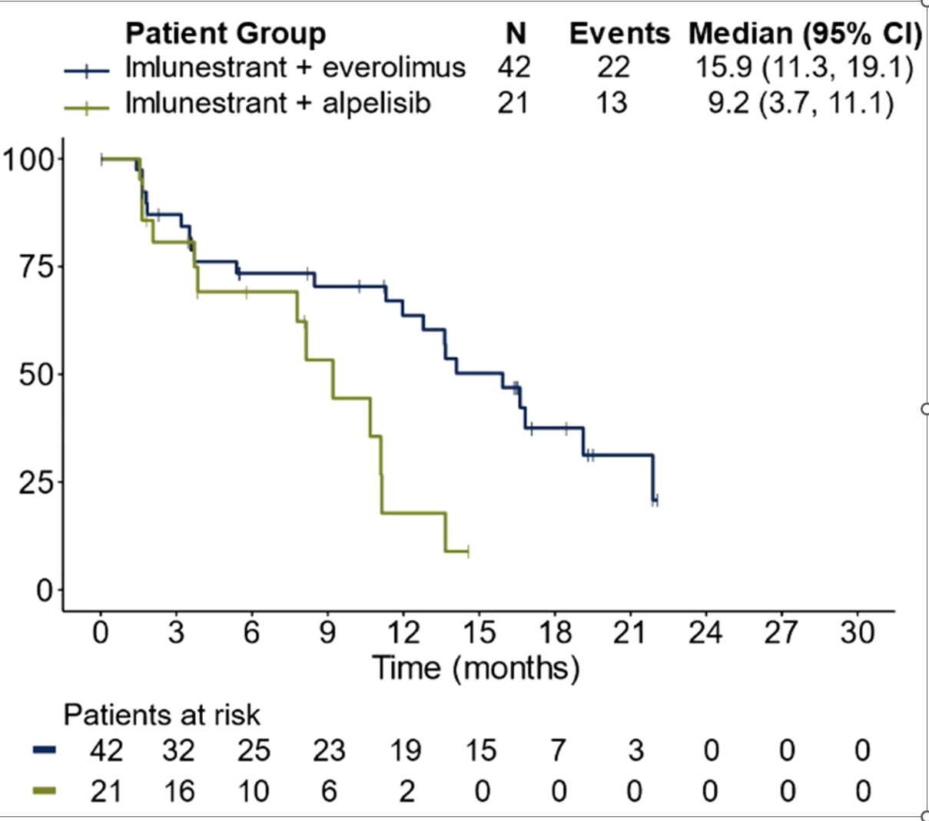
EMBER (Phase 1a/b): Efficacy – PFS for Imlunestrant + Everolimus / Alpelisib
Median 1 prior line of therapy
Everolimus cohort: 48% ESR1m; 17% PIK3CAm
Alpelisib cohort: : 47% ESR1m; 84% PIK3CAm (central)
Jhaveri K, et al. ESMO 2023. Abstract 383MO

Slide 21
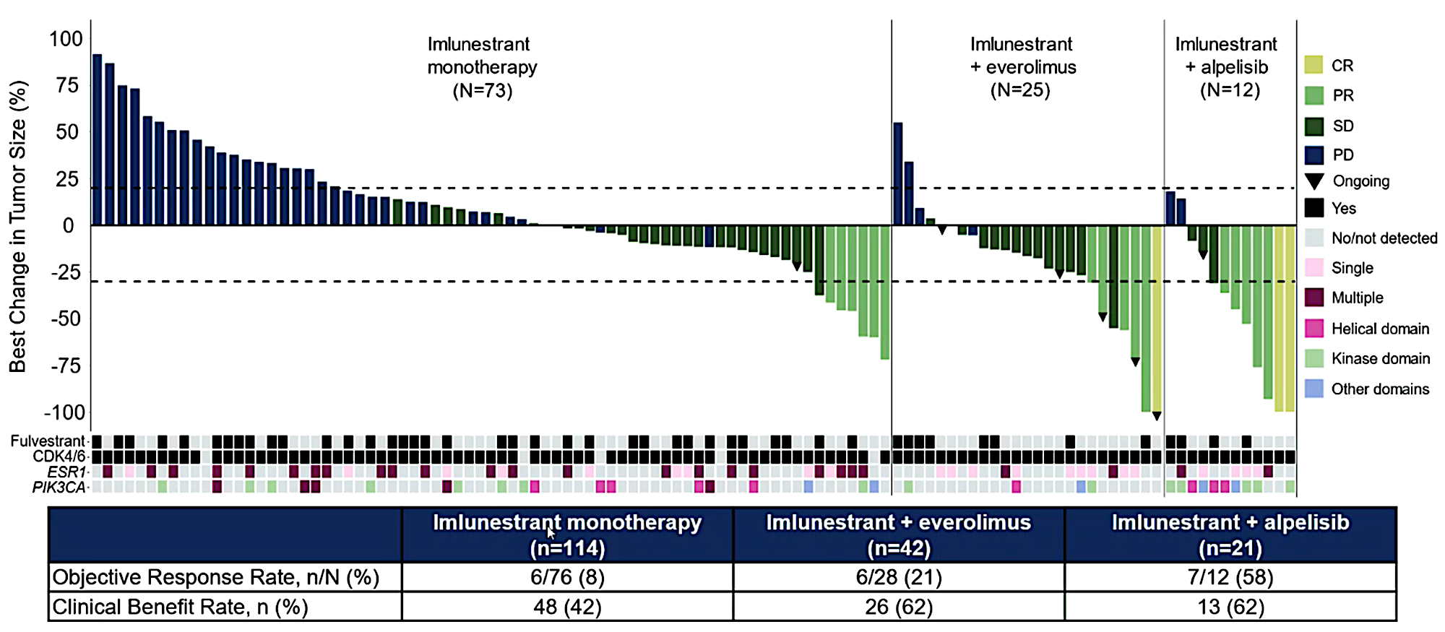
EMBER (Phase 1a/b): Efficacy – tumor response in patients with measurable disease
Jhaveri K, et al. ESMO 2023. Abstract 383MO

Slide 22
Selected Ongoing Clinical Trials of SERDs + Targeted Agents in HR+/HER2- ABC
Trial (NCT Identifier) | Intervention | Study Population | Primary Endpoint(s) | Secondary Endpoint(s) | Enrollment (Estimated) | Recruiting (Yes/No)*
ELEVATE (NCT05563220) | Elacestrant + Abemaciclib Ribociclib Palbociclib Alpelisib Everolimus | < 2 ET, one of which is in combination with CDK4/6i | RP2D of elacestrant in combination with each of the other study drugs | Safety, PK, Efficacy (ORR, CBR, PFS, OS) | 322 | Yes
pionERA Breast Cancer (NCT06065748) | Giredestrant + CDK4/6i vs. Fulvestrant + CDK4/6i | Resistance to prior adjuvant ET; prior use of neo/adjuvant CDK4/6i allowed | PFS in ESR1m subgroup and full analysis set | PFS in the ESR1nmd subgroup, OS, cORR, DoR, CBR, time to chemotherapy, TTCD in PROs, AEs, vital sign and clinical laboratory test abnormalities | 1050 | Not yet recruiting
evERA Breast Cancer (NCT05306340) | Giredestrant + Everolimus vs. Physician's choice of ET + Everolimus | Prior ET in combination with CDK4/6i (metastatic or adjuvant setting) | PFS in ESR1m subgroup and ITT population | OS, ORR, DoR, CBR, TTCD pain severity, presence, and interference, TTCD in PROs, AEs, vital sign and clinical laboratory test abnormalities, plasma concentration of giredestrant | 320 | Yes

Slide 23
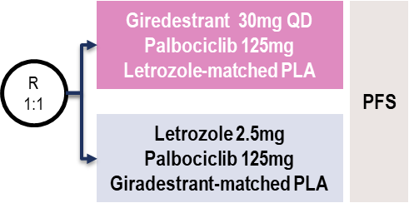
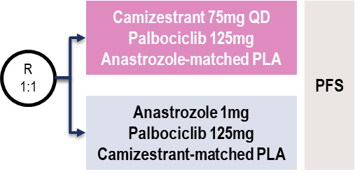
Ongoing Trials of Oral SERDs in Combination with
CDK4/6i in the 1st-L Metastatic Setting
persevERA
(NCT04546009)
N = 978
ER+/HER2- LA/ABC
No prior systemic tx for ABC
SERENA-4
(NCT04711252)
N = 1342
ER+/HER2- LA/ABC
No prior systemic tx for ABC

Slide 24
SERENA-6: ctDNA ESR1 mutation-guided therapy^{1,2}
1L SoC (AI* + CDK4/6i†)‡
Randomisation to switch ET or continue 1L treatment‡
1st screening
ESR1 surveillance
2nd screening
Study treatment
Evaluable disease (RECIST v1.1)
No evidence of PD (investigator-assessed)
N = 300
Camizestrant 75 mg PO qd + CDK4/6i§
HR+, HER2– mBC
Currently on 1L AI
+ CDK4/6i for ≥6 months with no evidence of PD
ECOG PS 0–1
Tumour imaging per SoC
ctDNA centrally tested for ESR1 mutations every
2–3 treatment cycles
ESR1 mutations
R
1:1
FOLLOW-UP
AI¶ + CDK4/6i§
No ESR1 mutations
Primary endpoint: PFS (investigator-assessed)
Secondary endpoints: PFS2, OS, chemotherapy-free survival, ORR, CBR₂₄, PROs, safety
Discontinue upon PD
The SERENA-6 trial is currently recruiting
Letrozole or anastrozole. † Palbociclib or abemaciclib. ‡ Pre-/peri-menopausal women and men receive LHRH agonist as applicable. § Maintain same CDK4/6i as 1L treatment; ¶ Maintain same AI as 1L treatment.
1L, first line; AI, aromatase inhibitor; CBR₂₄, clinical benefit rate at 24 weeks; CDK4/6i, cyclin-dependent kinase 4/6 inhibitor; ctDNA, circulating tumour DNA; ET, endocrine therapy; HR, hormone receptor; LHRH, luteinising hormone-releasing hormone; mBC, metastatic breast cancer; ORR, objective response rate; OS, overall survival; PD, disease progression; PFS, progression-free survival; PFS2, time to second progression or death; PO, orally; PRO, patient-reported outcome; qd, once daily; RECIST, Response Evaluation Criteria in Solid Tumors.
1. Bidard FC et al. SABCS 2021 (Abstract OT2-11-05; poster presentation); 2. https://clinicaltrials.gov/ct2/show/NCT04964934 (accessed August 2023).

Slide 25
Key Messages and Remaining Questions
Approved endocrine agents (tamoxifen, AIs, fulvestrant) have their limitations
-Pharmacologic, toxicity, efficacy post CDK4/6i, resistance mechanisms
Goal: Develop novel endocrine agents that cause complete ER inhibition and have an optimal therapeutic index
    -Elacestrant is the first approved oral SERD for ESR1 mutant cancer
Other SERDs are in development both as single agents and in combinations with other targeted agents
Will there be benefit with novel ET + targeted agents regardless of ESR1 mutation?
Can we optimally sequence these agents to improve outcomes in metastatic setting?
Adjuvant trials with oral SERDs are underway
Mechanisms of resistance?

Slide 26
Case 1
56-year-old presented with de novo ER+/HER2 – (IHC 1+) metastatic breast cancer to the bones (biopsy proven) in 2018
She was started on Letrozole plus Palbociclib and after 5 years progressed in the bones and liver. NGS panel showed ESR1D538G mutation
What is the next best treatment option?
  Trastuzumab Deruxtecan
  Capecitabine
  Alpelisib + Fulvestrant
  Elacestrant
Correct Answer: D

Slide 27
Case 2
49-year-old woman
PMH: anxiety and insomnia (on Effexor and Ambien)
2011: IDC of the left breast dx in Taiwan ER+/PR-/HER-2 (2+) FISH not amplified, s/p lumpectomy w/ SLNbx, s/p radiation
2011-2015: Tamoxifen daily
2015: R breast DCIS s/p lumpectomy s/p radiation
2015-2018: Raloxifene daily
Seen at MSKCC 11/15/2017 (was 43 years at that time): US guided core biopsy of left breast at 11:00 axis 4cm from the nipple; atypical papillary lesion.
01/02/2018: left breast excision at 11:00 axis surgical pathology shows moderately differentiated IDC; greatest dimension 0.32cm; DCIS, clear surgical margins; ER 95%, PR 98%, HER2 neg (1+) FISH not amplified; Ki-67 5-10%, clear surgical margins, LVI negative. pT1a pNX.

Slide 28
Case 2 (Continued)
01/24/2018: PET/CT imaging shows 2.0cm lesion in the left hepatic lobe SUV max 5.5; 3.6 cm mass posterior uterine wall SUV max 9.7 with Pelvic US recommended; 4 cm area of soft tissue density in UIQ of left breast SUV max 2.7 consistent with post-surgical changes; 5mm nodule in the left lower pulmonary lobe, non-specific inflammatory or metastatic.
02/01/2018: endocervical biopsy of polyp with benign findings with acute and chronic inflammation and squamous metaplasia.
2/27/18 PET + CT CAP:
1. FDG avid left breast lesion, suspicious for breast cancer, unless attributable to recent surgical procedure.
2. FDG avid liver lesion, suspicious for hepatic metastasis.
3. FDG avid lesion in the posterior uterus. Uterine leiomyomata may be FDG avid, however a more clinically significant lesion cannot be excluded.
Consider pelvic ultrasound for correlation.

Slide 29
Case 2 (Continued)
3/8/18 TVUS/US pelvis: 1. Leiomyomatous uterus with posterior fibroid. 2. No ovarian mass.
3/12/18 Liver biopsy: Adenocarcinoma, moderately differentiated, morphologically compatible with breast primary ER+ 99%, PR+10%, HER2 neg (1+), AR+ (99%)
3/18- 10/2020: Letrozole plus Palbociclib, POD in liver
11/2020: Liver Biopsy: NGS: ( MSK IMPACT)
1. ATM (NM_000051) exon56 p.Q2729R (c.8186A>G)
2. GATA3 (NM_002051) exon6 p.S404Pfs*93
(c.1210_1238delAGCCACATCTCGCCCTTCAGCCACTCCAG)
3. TBX3 (NM_016569) exon7 p.E388Dfs*12 (c.1164_1183delGGCCTGCGACGCGGCCAAGA)
Genetic testing: No mutations
MSK ACCESS ( plasma NGS): no mutations
Enrolled on EMBER trial: received Imlunestrant monotherapy 11/1/2020-12/1/2022 with POD in liver
Had grade 1 nausea and diarrhea while on therapy

Slide 30
Case 3
60-year-old woman with the following oncologic history:
Age 40 DCIS treated with lumpectomy and radiation
3/14/17 Bilateral mastectomy and R SLNB
R: 11 mm mod-diff IDC, no LVI, ER 50% PR 30% HER2 1+ FISH negative, 0/3 SLN, Oncotype RS 6
4/2017 - 1/2020 Tamoxifen
1/2020 - 6/2020 Exemestane, she did not tolerate due to arthralgias
6/2020 Tamoxifen
She palpated a R breast mass, ultrasound revealed a 1.2 x 0.5 x 2.0 cm complex solid and cystic mass
2/11/21 R breast core bx: grade 2 IDC ER 100% PR 80% HER2 2+ FISH negative
2/24/21 Breast MRI: 2 x 0.6 cm mass in R breast, indeterminate liver lesions
2/26/21 PET/CT: hypermetabolic liver lesions, periportal nodes, lytic bone metastases
MRI Brain: negative
Palliative RT to R hip
3/24/21 Bone bx: metastatic ductal carcinoma, ER 80% PR <1% HER2 2+ FISH negative
4/8/21 C1D1, 1L treatment: oral SERD (Imlunestrant) and abemaciclib
Remains on treatment: last seen 1/23
Grade 1 diarrhea
Grade 1 fatigue

Slide 31

Acknowledgements
Patients and their families who inspire us everyday
Questions?
@jhaveri_komal

Slide 32



In general, which CDK4/6 inhibitor are you most likely to recommend in combination with endocrine therapy for a postmenopausal patient with ER-positive, HER2-negative metastatic breast cancer?
17
Ribociclib
Palbociclib
2
Abemaciclib
1

